Slide 1



Industrial wood construction
Teaching materials for industrial wood construction education
2022

Slide 2
Origin of the materials
Use of the materials
These learning materials for industrial wood construction have been prepared in a project led by Puuinfo Oy in 2021–2022. Also involved in the project were
Lappia Vocational College,
TTS-Työtehoseura ry
South-Eastern Finland University of Applied Sciences,
Metropolia University of Applied Sciences,
Jyväskylä University of Applied Sciences,
University of Tampere, and
Federation of the Finnish Woodworking Industries Puutuoteteollisuus ry
The project was funded by the Ministry of the Environment.
The materials are intended to be used as extensively as possible in industrial wood construction education and studies.
The materials are released under the Creative Commons licence Attribution-ShareAlike (CC BY-SA), which requires that the author be properly credited when the materials are used and that derivative works may only be distributed under the same licence as the original work.
The original materials and any updates to them by Puuinfo will be published on the Library of Open Educational Resources website (aoe.fi) and the Puuinfo.fi website.

Slide 3
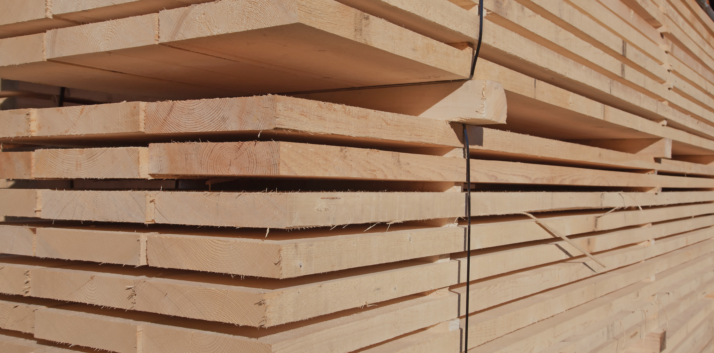
Standards and product approval of construction products

Slide 4
Authors
Tomi Toratti, Federation of the Finnish Woodworking Industries Puutuoteteollisuus ry
Release date: 11/05/2022

Slide 5
Table of Contents
Commonly used abbreviations in standardisation
Definition of a standard
Structural design standards
Execution standard
Product standards
Phases for preparing EN standards
Product approval – European and Finnish procedures

Slide 6
Commonly used abbreviations in standardisation
CPR Construction Products Regulation
CEN European Committee for Standardisation), member states: EU and EFTA member states
SFS Finnish Standards Association
EN CEN European standard
hEN Harmonised EN standard, leads to products’ CE marking
BWR Basic Work Requirements
DoP Declaration of Performance
prEN European draft standard
FV Formal vote
Enq Enquiry
NA National annex

Slide 7
Definition of a standard 1/2
What is a standard? Standards are a set of documents that compile commonly agreed-upon requirements, recommendations, or properties of products, their manufacturing, testing, systems, or services. Without these common rules, our daily life would not be as easy and safe.
Why do standards exist and what are their benefits? Standards increase the quality, safety, and compatibility of products and services. According to studies, they foster the activities of all sizes of businesses and increase customers’ trust. Small and big companies and organisations in Finland and worldwide use standards. Legislation and building regulations often refer to standards as well.

Slide 8
Definition of a standard 2/2
SFS marking on a standard’s label indicates that the standard has been approved in Finland. In case of a standard approved in Germany, the label would indicate DIN, and in Sweden, it would be SS, instead of SFS. SFS standards define the activities, product quality, and market in Finland.
EN marking on a standard's label indicates that the standard is an approved European standard. The following abbreviation is important for Finns: like other European countries, Finland also must approve all EN standards, as we are a member of the European Committee for Standardisation (CEN). EN standards define activities within Europe and the European internal market. Conflicts with SFS standards are not permitted and SFS standards have to adapt to EN standards within a certain timeframe.
ISO marking indicates that a standard has been internationally approved. ISO standards regulate worldwide activities and properties. They are often developed based on EN standards, which other countries may adapt.
If a standard’s label include multiple abbreviations, it means that the standard is approved in all those regions. If a standard’s label only includes, for example, the abbreviation SFS, it is a national standard approved only in Finland. Example: SFS-EN ISO 128-1:2020 (standard's label, number, part, and publication year)

Slide 9
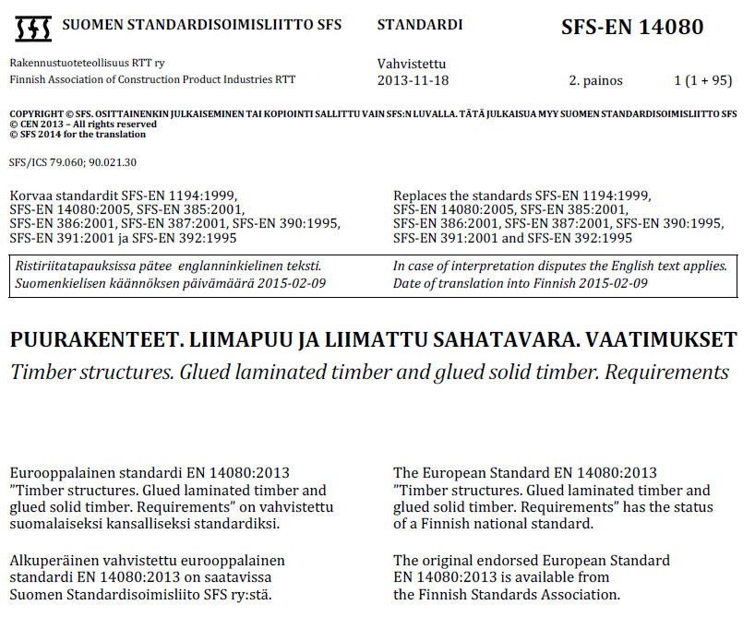
Example of the cover page of a standard for glued laminated timber:
National foreword
This European standard includes a harmonised part based on the construction products directive, which permits the use of a CE marking in the construction product after the date of introduction defined by the European Commission.
The informative annex ZA, which indicates, for instance, the harmonised part of the standard, must be followed by manufacturers when applying a CE marking to their product..

Slide 10
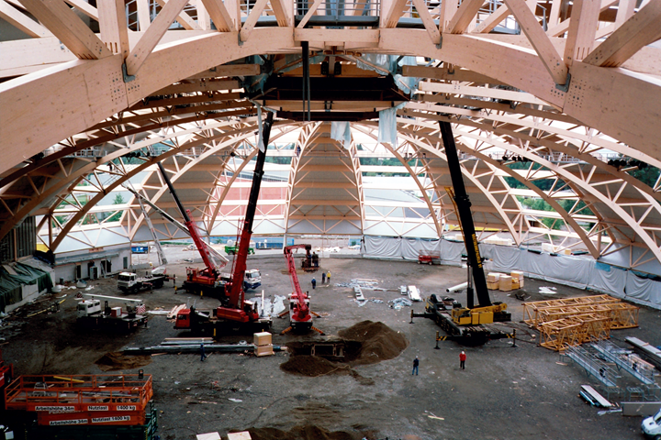
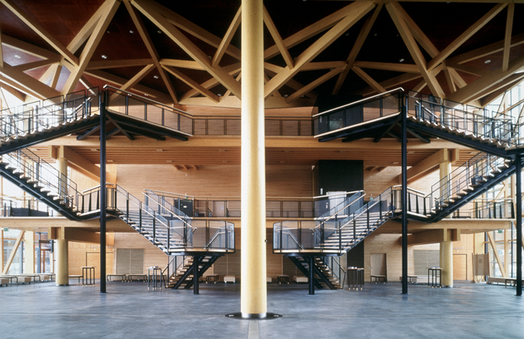
Standards guide the quality of construction
Process quality
Standards define the planning and execution
Planning and construction processes
Collaboration and communication between parties involved
Quality control in implementation
Product quality
Defined by product standards
Quality is related to various properties of a product, including technical, visual, ecological, health, and longevity factors.
Quality control in production

Slide 11
Main standard types
Product standards – include, for example, product descriptions, intended use, minimum values for properties, and quality control procedures
Harmonised product standards – additionally to the previous, it includes a reference to the Construction Products Regulation and registering procedures regarding compliance evaluation and a CE marking/declaration of performance(DoP)
Classification standards – describe the classification of products or their properties, for example: Sawn timber strength classification SFS-EN 338
Testing standards – describe testing procedures and the presentation of test results
Execution standards – describe the execution of the construction site and its quality control, for example: SFS 5978 Execution of timber structures. Rules regarding the load-bearing structural parts of buildings
Structural design standards - Eurocodes

Slide 12
Structural design standards

Slide 13
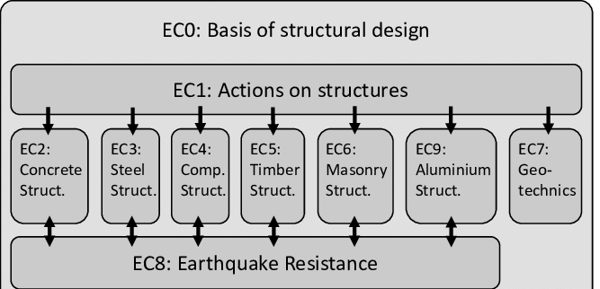
Eurocode parts
RIL 205-1-2017 handbook: Design of timber structures

Slide 14
Eurocode 5: Design of timber structures
SFS-EN 1995-1-1 Design of timber structures – general structural design
SFS-EN 1995-1-2 Fire design of timber structures – structural design for fire safety
SFS-EN 1995-2 Timber bridges – structural design of timber bridges
When using Eurocodes, national added instructions, termed national annexes, are also used to complement the Eurocode.

Slide 15
Execution standards

Slide 16
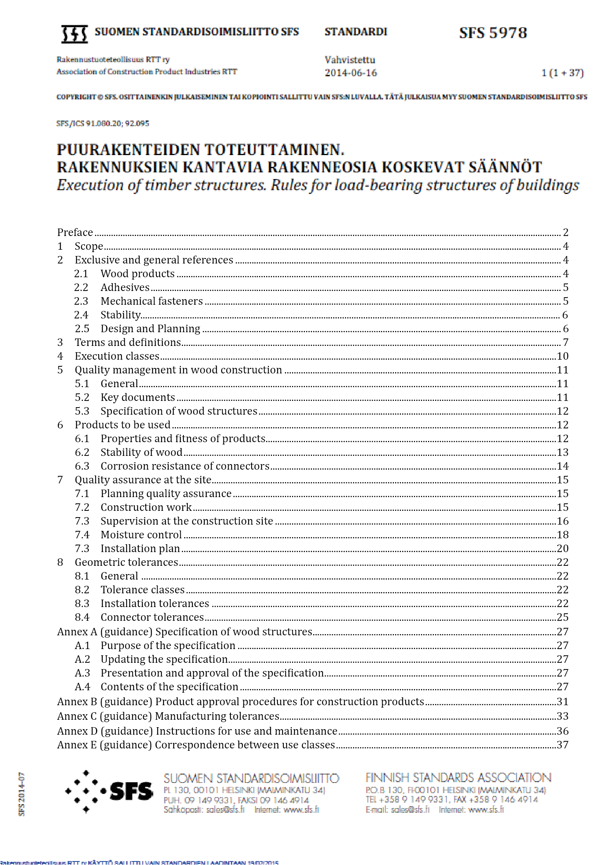

Slide 17
Execution standards have three goals
To transfer the requirements presented during the design phase to the executors. In other words, serve as a link between the design and execution phases.
To define the main documents for the execution phase that describe the technical requirements or requirement classes for execution
To serve as a check-list for the designer so they can ensure that they provide the executors with all necessary technical information for executing the structure
In order to achieve these goals, the designers must produce documents and drawings that feature all necessary information to execute the work according to the design.

Slide 18
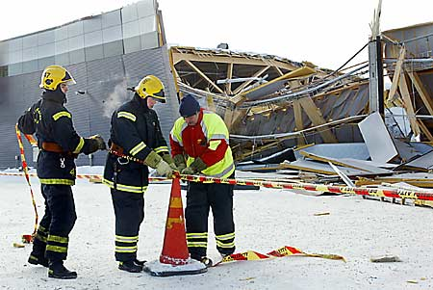
Report TVBK-3053
ISSN 0349:4969
ISNR:LUTVDG/TVBK-3053-SE (228)
Design of safe timber structures –
How can we learn from structural failures in concrete,
steel and timber?
Eva Frühwald Erik Serrano
Tomi Toratti Arne Emilsson
Sven Thelandersson
Result: 50 % of cases relate to bad design 25 % of cases relate to human factors on the site Conclusion: Human factors in the building process are dominant

Slide 19
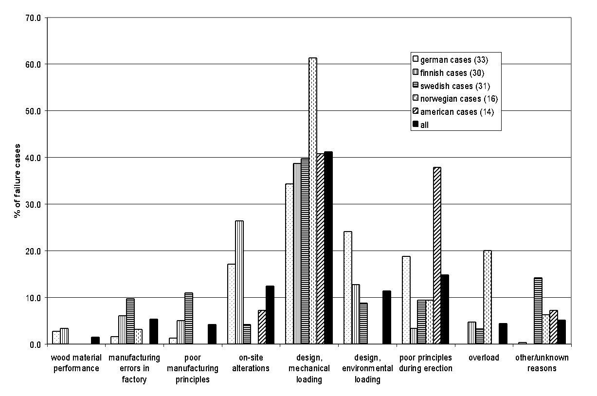
Design errors
Overload
Material defect
Human errors

Slide 20
Product standards

Slide 21
Contents of product standards
Which product is the standard designed for, and what is the scope of the product
Definable product properties - mechanical properties - properties regarding building physics - dangerous emissions, such as formaldehyde - dimensional tolerances etc.
Reference standards, for example, classification and testing standards
Factory’s quality control procedures
Product marking: Contents of the CE marking and declaration of performance (hEN in cases of a harmonised EN standard)

Slide 22
Harmonised product standards for timber products
Approved hEN product standards:
EN 13986 Wood-based panels for use in construction
EN 14250 Structural members assembled with punched metal plate fasteners
EN 14374 Structural LVL
EN 14342 Wood flooring
EN 14080 Glued laminated timber
EN 14081 Strength graded structural timber
EN 14915 Solid wood panelling and cladding
EN 14545 Timber structures. Connectors
EN 14592 Timber structures. Dowel-type fasteners
EN 14229 Wood poles for overhead lines
EN 15497 Structural finger jointed solid timber
Under drafting:
EN 14732 Prefabricated timber wall, floor and roof elements
EN 16351 CLT – Cross laminated timber

Slide 23
Code | Product | Scope of harmonised product standards
EN 13986:2004 | Wood-based panels | Wood-based panels in construction use Includes the use of glue laminated timber panels, plywood, LVL (as panels), OSB, chipboard or cement-bonded particleboard, wet method fibreboards (hard, semi-hard, and porous fibreboards), and dry method boards (MDF) for construction. May include chemical substances that improve their fire resistance and biological durability.
EN 14250:2010 | Nail plate structures | For prefabricated structural elements used in buildings (e.g. roof, wall, and floor trusses, and framed designs and composite beams)that are made of structural construction timber according to the standard EN 14081-1 or structural finger jointed solid timber (according to the standards EN 15497) and that have been assembled with punched metal plate fasteners. This includes potential wood preservation but not fire proofing.
EN 14374:2004 | Structural LVL | Structural untreated LVL (laminated veneer lumber), (fire proofing and wood preservation treatment are not included)
EN 14342:2005 +A1:2008 | Wood flooring | For indoor wooden flooring and parquet, including covered public spaces. Potential fire proofing is also included
EN 14080:2005 | Glued laminated timber | Glued laminated timber, including that treated with wood preservatives. A minimum of 4 horizontally glued lamellae (the upcoming draft standard: a minimum of 2 lamellae of 6–45 mm (glued laminated timber) or a minimum of 2 pieces of sawn timber of 45–85 mm (glued sawn timber))
EN 14081-1: +A1:2011 | Timber strength classes | Mechanically or visually strength-sorted timber – sawn rectangle-shaped timber. This includes potential wood preservation but not fire proofing nor finger jointed sawn timber.
EN 14915:2006 +AC:2007 | Solid wood panelling and cladding | For solid wood panelling and cladding (incl. wall cladding) indoors and outdoors. Potential wood preservation treatment is also included.
EN 14545:2008 | Timber structures. Connectors | Metal connectors for timber structures, e.g., shear plates, split ring connectors, tooth plate connectors, and nailing plates
EN 14592:2008 | Dowel-type fasteners | Dowel-type metal fasteners for timber structures, e.g., nails, screws, dowels, and bolts
EN 14229:2010 | Wood poles for overhead lines | Wood poles for overhead lines, both treated with preservatives and untreated

Slide 24
Phases for preparing EN standards

Slide 25
The objective of CEN is to develop EN standards mainly within 36 months, including the following stages:
drawing up the first draft (6 months) – at the Technical Committee (TC) on a member state's initiative
drawing up a draft for enquiry (6 months) – member states’ follow-up groups may provide comments
handling and translation (2.5 months) – translated into the 3 main European languages
enquiry (5 months)
drawing up a formal vote draft (8 months) – comments given during the enquiry are considered in TCs.
handling and translation (3.5 months)
formal vote (2 months) – member states’ follow-up groups vote
handling, translation, ratification, and publication (3 months)
36 months in total. In practise, the process often takes double the allotted time
After the publication, standards are implemented nationally, which takes 6 months with reference standards and 9 months with harmonised product standards. Additionally, a transitional period of 12 months is followed in member states after the implementation of harmonised product standards.

Slide 26
Product approval

Slide 27
General information on product approval
The conformity of construction products must be demonstrated when they are introduced to the market
Manufacturers must provide information about the properties of their products (quality control)
Developers are always responsible for ensuring the conformity
of the used construction products
must demonstrate compliance with regulations and requirements
In practise, designers select products and solutions that comply with building regulations

Slide 28
Basic work requirements for construction products
1. Strength and stability
2. Fire safety
3. Hygiene, health, and environment
4. User safety
5. Noise abatement and noise conditions
6. Energy efficiency
7. Sustainable development

Slide 29
Demonstrating the fitness of construction products
When a harmonised product standard (hEN) exists for a product group, the products must be approved in accordance with that standard. Product approval procedures apply throughout the entire European Economic Region. There are 11 harmonised product standards for timber products.
If harmonised product standard (hEN) for a construction material does not exist, the manufacturer can demonstrate the fitness of the product for construction in Finland in one of the following ways:
Obtain a voluntary European Technical Assessment (ETA) -> CE marking
Obtain a voluntary national product approval: verification certificate
Demonstrate the fitness of a construction product with a verification on the construction site

Slide 30
National product approval procedures
EU level product approval procedures
LAND USE AND BUILDING ACT ACT ON THE TYPE APPROVAL OF CERTAIN CONSTRUCTION PRODUCTS + DECREE
CONSTRUCTION PRODUCTS REGULATION
Harmonised product standard SFS-EN (hEN)
ETA approval (European Technical Assessment)
Verification certificate
Type approval (discontinuing)
Manufacturer's quality control (rare)
CE marking
Verification on the construction site

Slide 31
EU level product approval procedures
CONSTRUCTION PRODUCTS REGULATION
Harmonised product standard SFS-EN (hEN)
ETA approval (European Technical Assessment)
CE marking

Slide 32
Concepts 1/2
A harmonised product standard (hEN) is a standard developed by the European Committee for Standardization for specific product groups. References to these standards are published in the Official Journal of the European Union. These standards define the properties for specific product groups, requirements for production and quality control, and information included in the CE marking.
European Technical Assessment (ETA) can be applied to construction products lacking a harmonised product standard. ETA is a voluntary technical assessment that offers a route to CE marking, particularly designed for new and innovative products. In Finland, European Technical Assessments are issued by Eurofins Expert Services Oy, but manufacturers can apply for an ETA through similar institutions in other member states.
Notified bodies are institutions that members states have qualified and authorised to carry out third-party testing and quality assessment for manufacturing, which is necessary for obtaining a CE marking.

Slide 33
Concepts 2/2
Declaration of Performance (DoP) is an obligatory standard document for all construction products with CE marking. DoP includes information about a specific product property values and classes, based on the relevant standard or technical assessment. Manufacturers draw up declarations of performance and are responsible for the accuracy of this information. Information that must be included in the DoP is outlined in the Annex III of the EU’s Construction Products Regulation.
AVCP system is a procedure used to specify the assessment and verification criteria for the consistency and performance of each product group. There are five systems in total (4, 3, 2+, 1, and 1+), and they define the extent to which a notified body participates in the verification of product properties or manufacturing quality control during the manufacturing of the product.
The Construction Products Regulation is an EU regulation that governs the use of CE marking in construction products, among other things. As of 2013, the regulation repealed the former EU Construction Products Directive.

Slide 34
Construction Products Regulation (CPR)
The Construction Products Regulation No 305/2011 was published in the Official Journal of the European Union on 4 April 2011. It entered into force partly on 24 April 2011 and repealed the Construction Products Directive completely on 1 July 2013
The Regulation is integrated into the national legislation of all member states, leading to the repeal of any conflicting national laws
As of 1 July 2013, CE marking became mandatory in Finland for construction products introduced to the market that have a harmonised product standard (hEN) and have passed their transitional period
Applies to approximately 80% of the construction products used in Finland (in terms of volume)
The amount grows as new hENs are published and their CE marking's transitional period passes
CE marking enables a common product approval and promotes seamless internal market in the EU/European Economic Area

Slide 35
CE documents for Construction Products Regulation
Declaration of Performance (DoP)
Can be made available on the manufacturer’s website, emailed to the customer, or sent as a printed version upon request (can also be delivered together with the product)
Indicates the notified properties of the product (performance), including their values and classes
CE marking
Delivered with the product (in the product, packaging, or delivery document)
Usually includes the address to the manufacturer’s website, where the DoP can be found
Certificate from a notified body (a third-party entity for CE marking)
Required for construction products that are critical from the safety and health perspective
The manufacturer obtains the certificate from a notified body after the initial factory quality control inspection
Manufacturer must deliver the certificate to the customer or authority upon request
DoP and the certificate from a notified body must be delivered in the language of the member state in which it is introduced to the market: in Finland, in Finnish or Swedish.

Slide 36
Example of a Declaration of Performance
7. Declared performance:
The performance of the product identified above is in conformity with the set of declared performance/s. This declaration of performance is issued, in accordance with the EU Regulation No. 305/2011, under the sole responsibility of the manufacturer identified above.
Signed for and on behalf of the manufacturer by:
Place and date: 15 June 2020 Name: xxx
Essential properties | Performance | Harmonised technical specification
Mechanical strength in ultimate limit state and long-term bending in service limit state | Glued laminated timber strength class GL 30c, Species: Spruce (Picea abies) | EN 14080:2013
Gluing strength | Gluing quality I, according to the EN 301
Fire resistance | Fire resistance class according to the EN 1995-1-2 and the Finnish national annex
Reaction to fire | D-s2,d0
Release of dangerous substances | Formaldehyde class E1
Long-term durability | Durability class 4, according to the EN 350
DECLARATION OF PERFORMANCE
No. 001ABC15062014
1. Unique identifier for a product type: ABC glued laminated timber GL 30h, width 90–250 mm, height 180–1,215 mm, length 5–25 m
2nd Intended use: Load-bearing structure
3rd Manufacturer: Company ABC Street 1, 00110 Helsinki
Email: companyabc@abc.fi
5. AVCP system: AVCP 1
6a. Harmonised standard: EN 14080:2013
Notified body: No. 2345CPR
Certificate from a notified body: No.2345CPR5678 ¹
¹ good to include
Note: Provide a link to the Safety Data Sheet etc. if necessary

Slide 37

Example of a CE marking for glued laminated timber
14 NB: 2345CPR |  | CE symbol The last two digits of the marking's issuance year Identifier of a notified body
Company ABC, Street 1, FI-00110, Helsinki DoP: 001ABC |  | Manufacturer's contact information DoP number
EN 14080 Glued laminated timber GL 30c Width 160 mm, height 1,215 mm, length 20 m Intended use: Load-bearing structure Gluing quality: I Reaction to fire: D-s2,d0 Other information: www.companyabc.fi/DoP |  | Identifier of a harmonised product standard (hEN) Product identifier Intended use Some of the declared properties of the product (can be indicated with codes, if they are presented in the hEN) Address to the manufacturer's website, where the DoP is presented

Slide 38
CE marking
What is CE marking?
What CE marking is not?
With CE marking, the manufacturer demonstrates and guarantees that the essential product properties have been inspected according to the harmonised product standard.
CE marking identifies a product for the buyer, indicates the product properties in a harmonised manner, and makes it easier to compare products.
CE marking enables products’ introduction to the European internal market, replacing national product approvals and thus increasing harmonisation.
The properties for construction products are demonstrated with declarations of performance (DoPs).
The CE marking alone does not guarantee the suitability of a product for specific construction projects or within a particular country.
National regulations continue to govern the design, use of construction products, and construction project.
CE marking does not guarantee adherence to the national building regulations.

Slide 39
National product approval procedures
LAND USE AND BUILDING ACT ACT ON THE TYPE APPROVAL OF CERTAIN CONSTRUCTION PRODUCTS + DECREE
Verification certificate
type approval
manufacturer's quality control
Verification on the construction site

Slide 40
Type approval
Eurofinns and partially Kiwa Inspecta have issued type approvals for product groups regulated by decrees on type approval
For the product groups intended to receive type approvals in the future, the Ministry of Environment must establish decrees for the requirements for specific product groups and update the decrees on type approval
For now, the requirements for specific product groups and the updated decrees on type approval (regarding construction materials) apply only to reinforcing steels

Slide 41
Verification certificate
At the moment, it is possible to obtain a verification certificate for the following wood construction product groups, for which the Ministry of Environment has approved an evaluation criterion:
Prefabricated timber walls, base floors, intermediate floors, and attic floors
Tensile strained and glued steel bar and screw connectors for wooden structures
Shear stressed fasteners and connectors for wooden structures
Prefabricated stairs
Wood and steel composite beams (e.g., Posi joist beams)
Load-bearing wood-framed assemblies made with mechanical jointing (nail plate structures that cannot have CE marking. In such cases, glued laminated timber or LVL products are used in grids, for example)

Slide 42
Verification on the construction site
When a construction product does not have a CE marking nor national product approval, its fitness for construction is demonstrated with a verification on the construction site.
In such cases, the party implementing the project must ensure that the construction product meets the specific project's essential technical requirements.
Additionally, the building supervision authority may, at its discretion, require the party implementing the project to demonstrate that the construction product fulfils the essential technical requirements set for it if there are grounds to suspect non-compliance.
The following aspects are considered essential for the verification on the construction site:
A) Does the construction product meet the essential technical requirements specified in the Land Use and Building Act or stipulated by it, and can it be used for the intended project based on its properties.
B) Does the manufacturer of a prefabricated product have valid third-party quality control and is it sufficient.
C) Annexes (such as research reports and product descriptions) with dates on which the verification is based and other prerequisites for meeting the requirements.
Additionally to the verification on the construction site, the fitness of a construction product in a specific building can also be demonstrated, for example, by a voluntary product certificate, issued by an entity that the building supervision authority has approved, that includes the above information or by a third-party inspection, if necessary.

