Slide 1



Industrial wood construction
Teaching materials for industrial wood construction education
2022

Slide 2
Origin of the materials
Use of the materials
These learning materials for industrial wood construction have been prepared in a project led by Puuinfo Oy in 2021–2022. Also involved in the project were
Lappia Vocational College,
TTS-Työtehoseura ry
South-Eastern Finland University of Applied Sciences,
Metropolia University of Applied Sciences,
Jyväskylä University of Applied Sciences,
University of Tampere, and
Federation of the Finnish Woodworking Industries Puutuoteteollisuus ry
The project was funded by the Ministry of the Environment.
The materials are intended to be used as extensively as possible in industrial wood construction education and studies.
The materials are released under the Creative Commons licence Attribution-ShareAlike (CC BY-SA), which requires that the author be properly credited when the materials are used and that derivative works may only be distributed under the same licence as the original work.
The original materials and any updates to them by Puuinfo will be published on the Library of Open Educational Resources website (aoe.fi) and the Puuinfo.fi website.

Slide 3
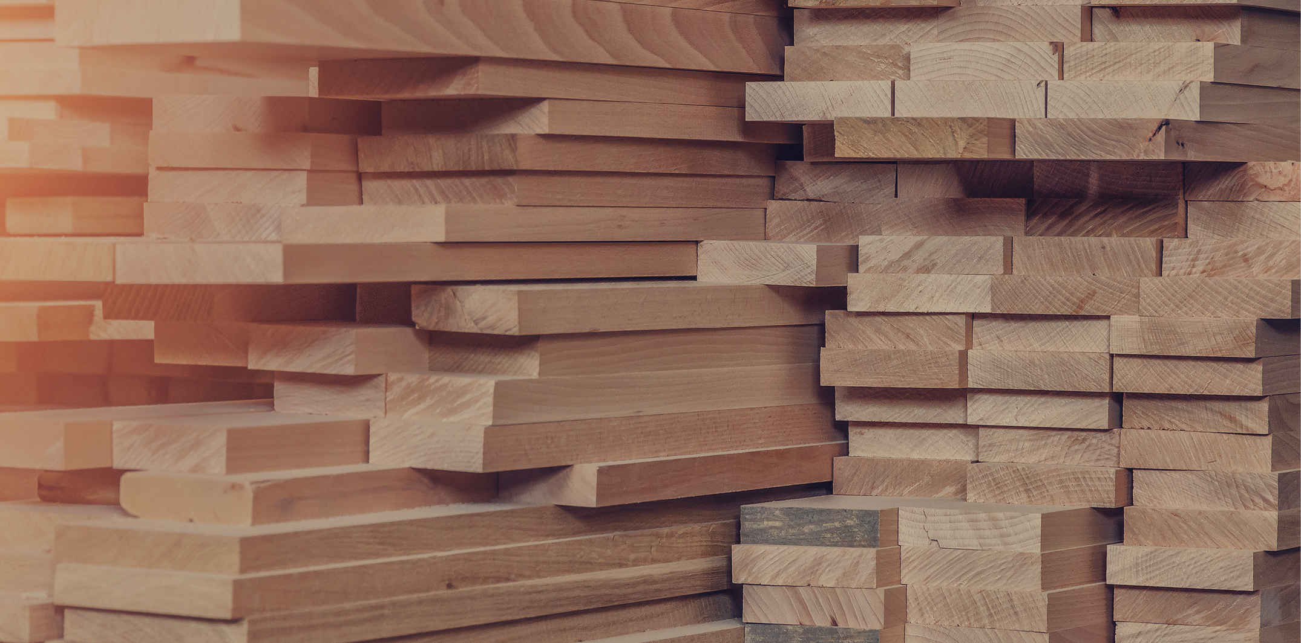
Surface treatment of wood

Slide 4
Authors
Martti Mylly, Lappia Vocational College
Release date: 10/06/2022

Slide 5
Surface treatment of wooden buildings

Slide 6
Interior surface treatment
Indoor wooden surfaces can be surface-treated either to protect the wood or for decorative purposes.
The wooden surface is protected against UV radiation, dirt, wear, and moisture.
Wood floors can be painted, varnished, oiled, or waxed. Treatment agents have different properties and should be selected according to the surface.
Parquet, board, and plank floors are varnished to showcase the wooden surface.
Oil treatment impregnates the superficial cells of the wood, preventing it from absorbing dirt or moisture.
Wax is a lightweight treatment agent that, when uncoloured, alters the natural tone and feel of the wood relatively little.

Slide 7
Interior surface treatments
In wetrooms, wooden surfaces are protected against moisture with oil or varnish products.
Sauna wood preservatives can be used in saunas, and they can be tinted to the hues of the varnish colour map.
In translucent treatments, the surface of the wood is tinted but the pattern remains visible.
Translucent treatments can be done with varnish, oil, or wax products, wood preservatives, or glazing paint.
In staining, wood is tinted with water-thinnable or soluble dyes.
When selecting a surface treatment agent, the sheen level should also be taken into consideration; the glossier the agent, the clearer the differences in hues.

Slide 8
Exterior surface treatment
Paint protects wooden surfaces from the weather and reduces the impact of moisture content changes in the wood, thus prolonging the life cycle of the wooden structure.
Painted wooden houses are very time and weather-resistant.
Properly applied high-quality paint is dirt-resistant, keeps its colour, and helps maintain a tidy exterior.
Relative humidity also affects the moisture content of the wood.
Depending on the surrounding conditions, wood either absorbs or exudes moisture.
Wooden surfaces require water vapour permeability from the surface treatment agent.

Slide 9
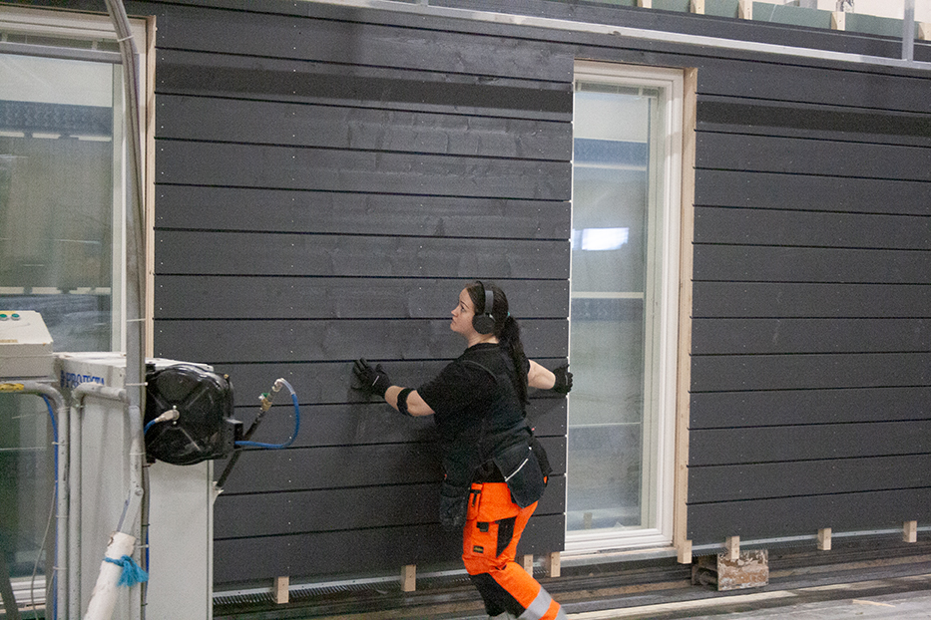
Exterior surface treatment
When surface-treating pressure impregnated timber, attention must be paid to ensuring that the wood is sufficiently dry.
Heat-treated wood surfaces should be surface-treated immediately upon installation.
Special attention should be paid to the surface treatment of cut surfaces, as the wood naturally absorbs the most moisture from the longitudinal ends of the piece.
If the products are treated before installation, the mounting points must be treated separately with a surface treatment agent after installation.
Prefabricated wall panel surface-treated, photo: Jukkatalo Oy

Slide 10
Fire protection of wooden structures
Fire-protected wood products have an impact on the fire resistance of residential blocks of flats, public buildings, and various facilities, as well as their fulfilment of fire safety requirements
There are various methods for fireproofing wood products.
Requirements that are one main class lower may be permitted for surfaces if, considering the use of the fire compartment, the hazard of ignition or spread of fire is smaller than normal.
The fire behaviour of wood is well known. Wood combusts at 250 to 300 °C.
A layer of char is formed on the surface of burning wood, which slows down the burning.

Slide 11
Fire protection of wooden structures
The wooden structure can be structurally designed to be protected throughout the required fire resistance time.
If a wood product is treated with a fire retardant using a certified method, its fire class can be up to B-s1,d0.
The use of industrially fire-protected ready-to-install wood products and structures is part of the fire engineering design of the building.
Fire retardants have traditionally contained substances that are harmful to humans and the environment, such as boric acid, boron, bromides, formaldehyde, phosphorus, and ammonia.
The new environmentally friendly fire retardants are water-based solutions that contain e.g. food-grade salts and polymers.

Slide 12
Wetroom treatments

Slide 13
Wetroom treatments
When choosing the waterproofing material, particular attention should be paid to its long-term durability.
The moisture performance of wetrooms can be enhanced with good ventilation, underfloor heating, proper sloping, and stone background walls.
In industrial wood construction, wetrooms are mainly completed in prefabricated box unit systems.
The bathrooms of detached houses often have water damage that is due to defective structures or construction defects.
Water damage most commonly occurs in non-waterproof floors and lightweight walls.

Slide 14
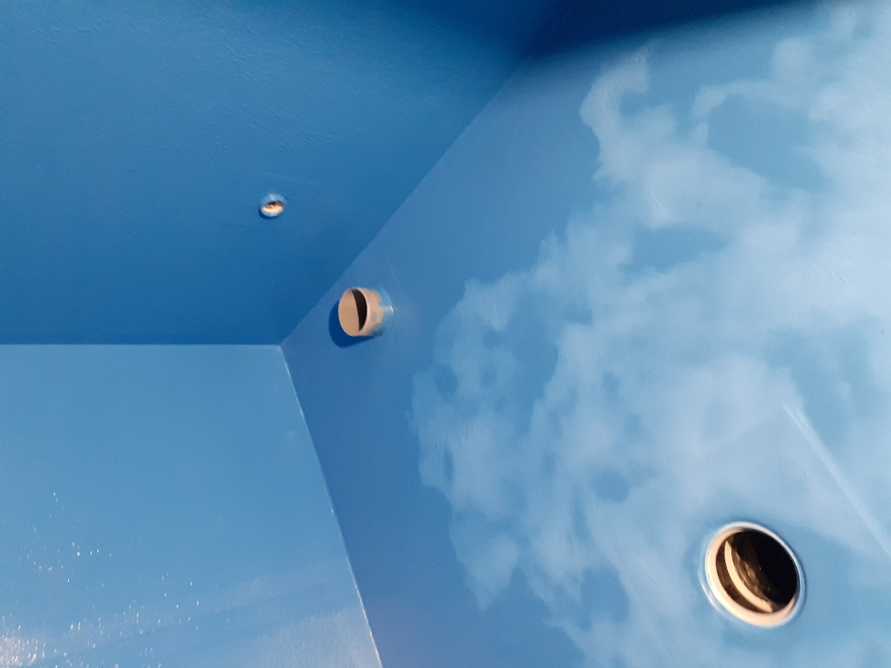
Wetroom treatments
When choosing the waterproofing material, particular attention should be paid to long-term durability.
The moisture performance of wetrooms can be enhanced with good ventilation, underfloor heating, proper slopes, and background walls of stone.
Water damage most commonly occurs in non-waterproof floors and lightweight walls.

Slide 15
Wood surface treatment agents

Slide 16
Water-thinnable paints and varnishes
Water-thinnable paints and varnishes are suitable for house-painting and indoor use (walls and ceilings).
Paint protects the wooden surface from the weather and reduces the impact of moisture content changes in the wood, thus prolonging the life cycle of the wooden structure.
Properly applied high-quality paint is dirt-resistant, keeps its colour, and helps maintain a tidy exterior.
Today, acrylate paints are the most commonly used finishing paints.
Modern acrylate paints are water vapour-permeable due to their microporous properties.

Slide 17
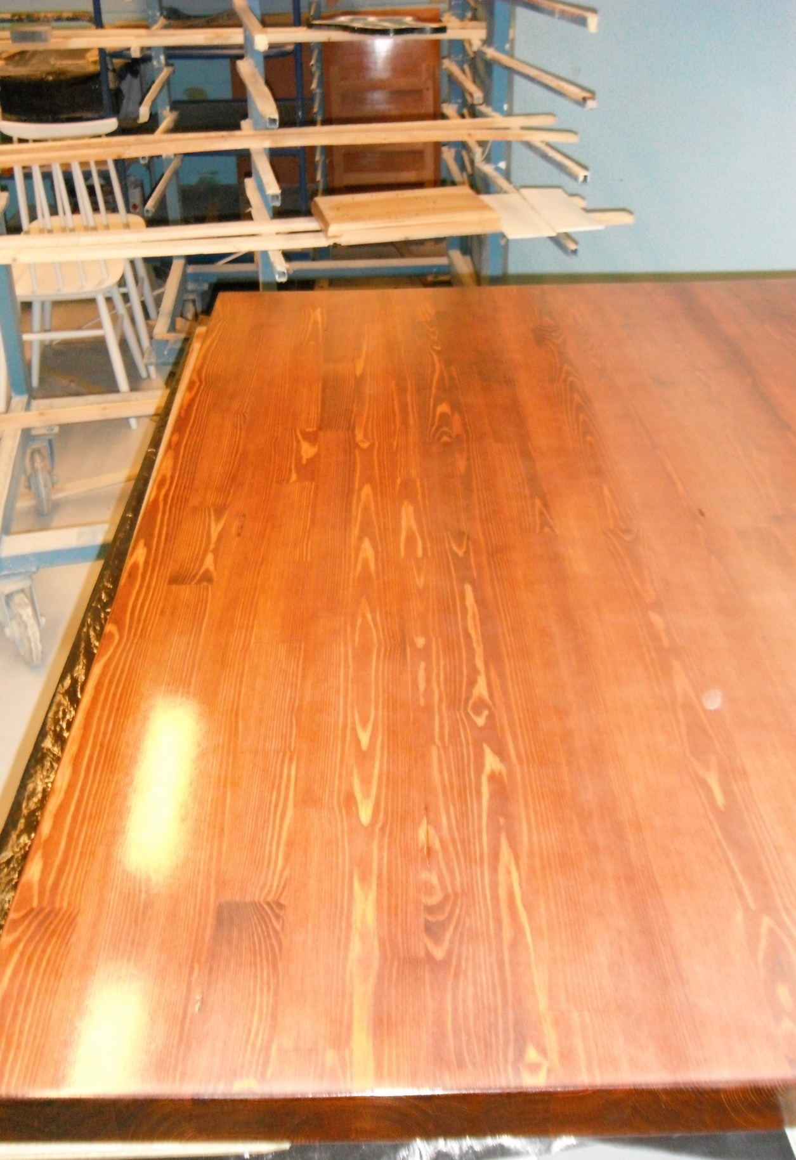
Varnishes
Varnishes are surface treatment agents that form an adhesive transparent film when applied.
Varnish categories can be differentiated by the prefix denoting the binding agent.
Alkyd varnishes are used indoors and for varnishing different types of wooden surfaces.
They come in various sheen levels: matte, semi-dull, semi-gloss and gloss.
Alkyd varnishes can be applied with a brush, roller, or sprayer.

Slide 18
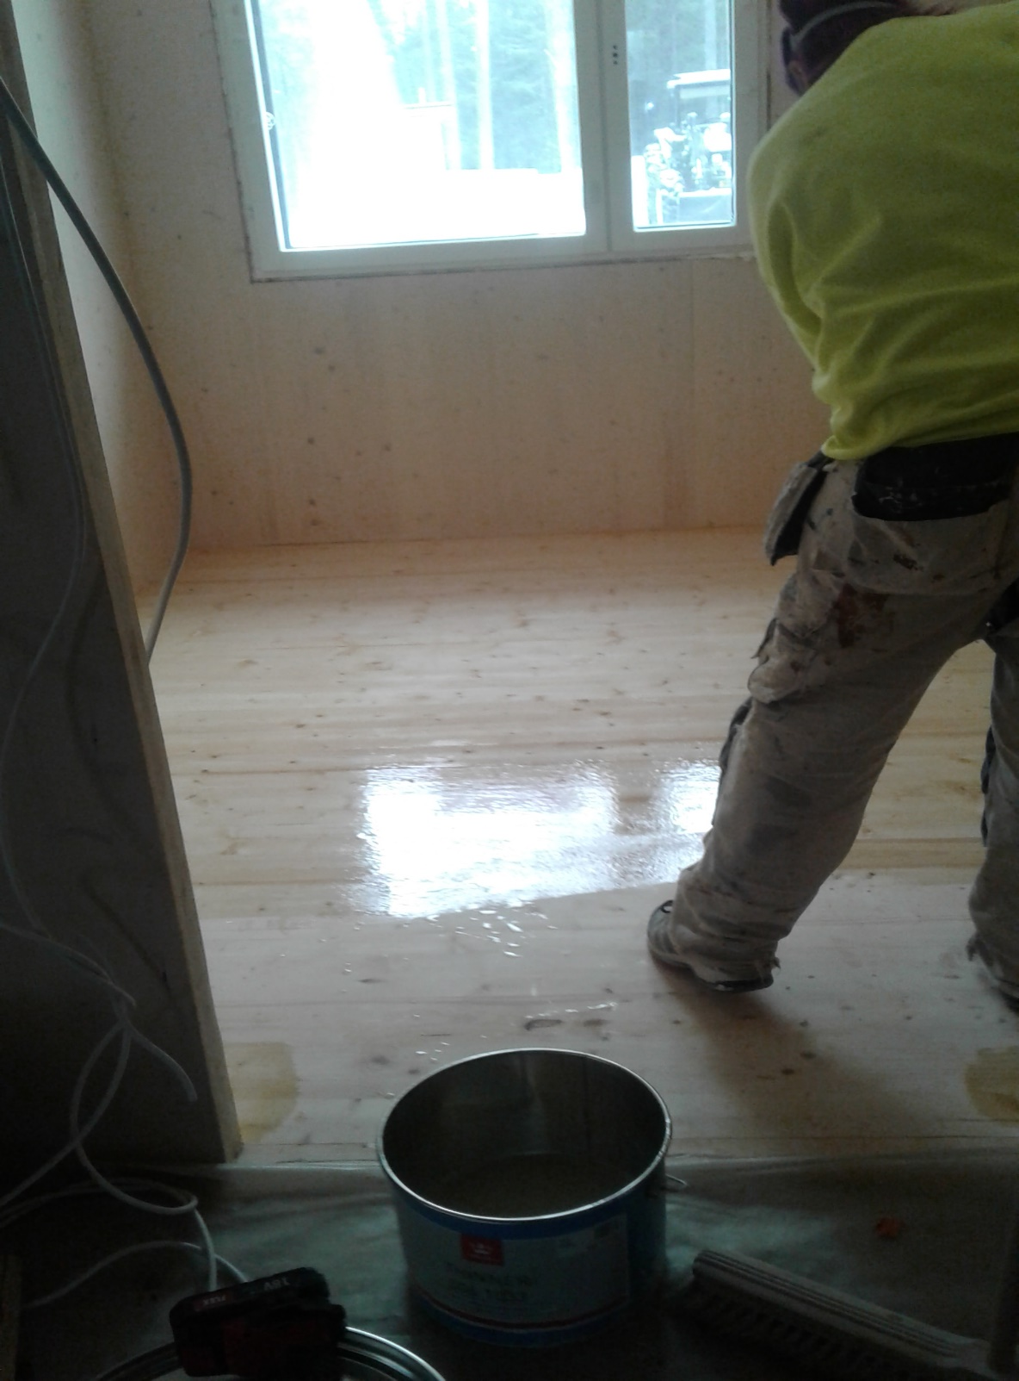
Reaction varnishes (epoxy)
Reaction varnishes are either single-component or two-component varnishes.
They come in various sheen levels: matte, semi-gloss and gloss.
In industrial wood construction, they are used for e.g. parquets and wood floors.

Slide 19
Translucent wood stains
In treating log surfaces, translucent or opaque wood stains are preferred over house paint.
The reason is both visual and structural.
The moisture content of solid timber varies considerably more than that of wood panelling, so a thinner protective treatment that permeates water vapour is preferred.
In addition, the colour protects the wood from the greying impact of the sun.
Translucent wood stains are easy to maintain, and they are well-suited for log surfaces.

Slide 20
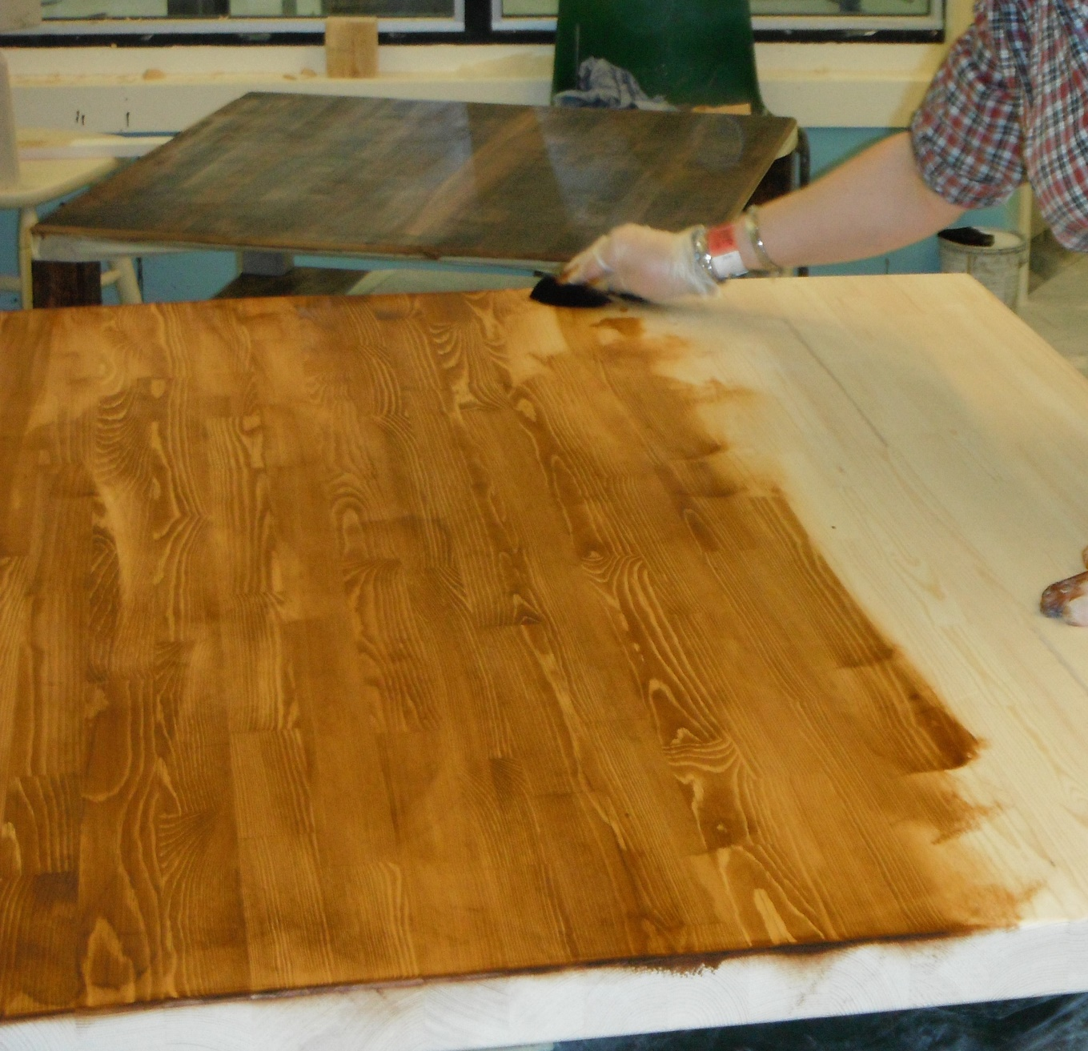
Stains
Staining means dyeing wood while leaving the grains visible.
Stains do not contain binding agents, hence they do not protect the wood, they just tint it.
Stain does not stick to e.g. glue or grease.
Stain can be applied with a brush, roller, or sprayer.
Stains are suitable for indoor wooden surfaces, such as panellings.

Slide 21
Wood preservatives
In oil-based substances, pigments also provide protection against the yellowing effect of the sun.
Colourless or soft white surface treatment preserves the natural appearance of the wood, but provides minimal protection against UV radiation.
Wood preservatives and wood oils contain vegetable-based oils that mould fungi and dry rot gladly feed on.
Mould fungi and dry rot feed on the mixture of water and vegetable oil used to treat wood.
That is why fungicides must be added to these substances to prevent the wood from moulding, decaying, or becoming blue-stained.

Slide 22
Preparations for the treatment of wooden surfaces

Slide 23
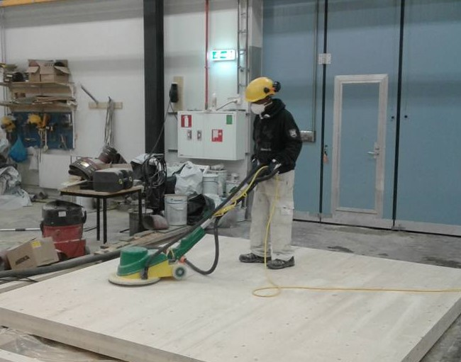
Sanding
Wood surfaces are always sanded in favour of the grain. The sanding should be even throughout, and no stop marks should be left on the surface.
The wood is not dampened, and abrasive dust is not removed with water.
Dust is cleaned up with a brush or an industrial vacuum cleaner.
Massive wood is hard to sand through, but with plywood or parquet, remember to check the sanding allowance.

Slide 24
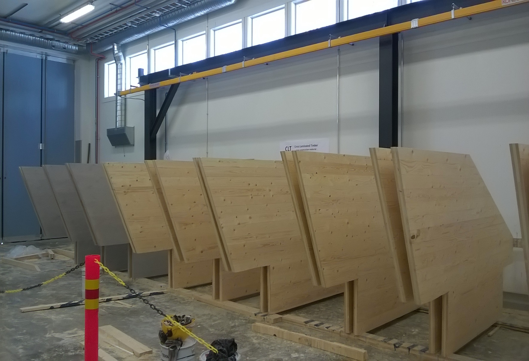
Priming
Careful priming improves the adhesion and durability of the top coat.
Priming should be done as early as possible.
Priming prevents the absorption of water and prepares the surface for painting.
Most primers also include anti-mould agents, so no separate mould treatment is needed.
The final surface treatment of the wood should be performed as soon as possible.

Slide 25
Treatment agent application methods

Slide 26
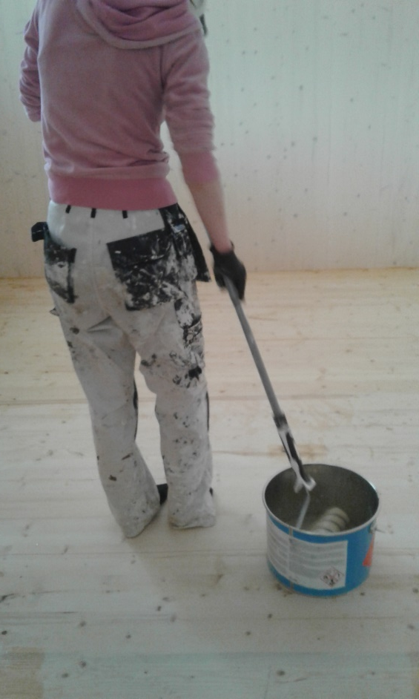
Roller and brush application
Roller or brush application is the best painting method in certain cases.
Rollers and brushes make it easier to reach the points that cannot be painted with sprayers.
Rollers and brushes often complement spray painting; they are used e.g. for painting edges, narrow gaps, inner corners, and hollows.
The paint can be applied into the pores of the surface.
There is also smaller need to protect the parts that are to be left unpainted.

Slide 27
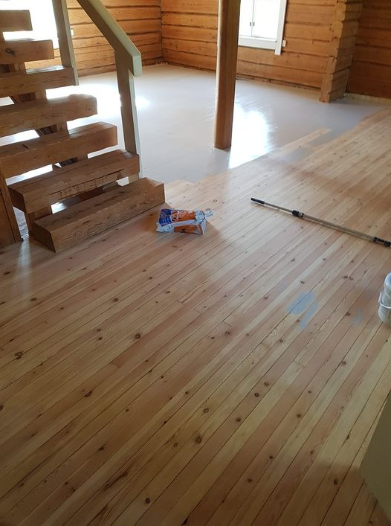
Roller and brush application
Roller application is faster than brush application.
In roller application, coating thickness will depend on nap length; longer nap will produce thick but uneven films of paint.
Rollers may leave so-called "crows' feet" marks in the paint if the coating is too thick or the nap too long.
Roller-applied paint must have good levelling properties.
Paints that dry and set quickly are not suitable.
Slow-drying paints, such as alkyd paints, are suitable.

Slide 28
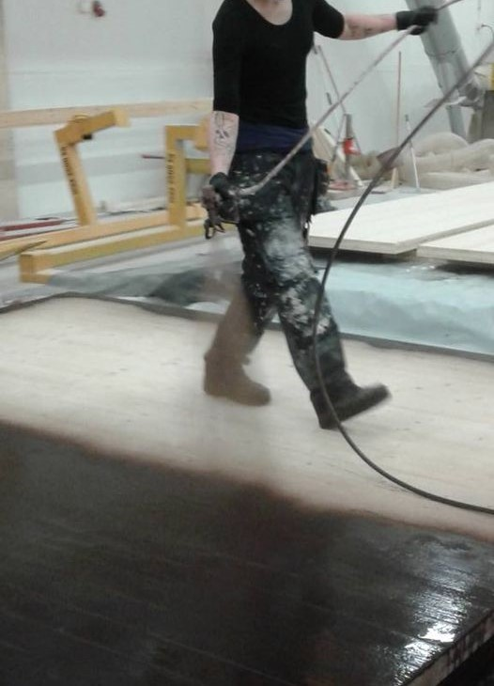
Spray painting
Spray painting is gaining popularity in the painting of both façades and interior surfaces.
The primary advantage of spray painting is its speed as compared to more traditional rolling and brushing techniques.
As a technique, spray painting is significantly more demanding than brush and roller painting.
Incorrect technique will easily make the surface uneven and patchy or leave visible sags.

