Slide 1



Industrial wood construction
Teaching materials for industrial wood construction education
2022

Slide 2
Origin of the materials
Use of the materials
These learning materials for industrial wood construction have been prepared in a project led by Puuinfo Oy in 2021–2022. Also involved in the project were
Lappia Vocational College,
TTS-Työtehoseura ry
South-Eastern Finland University of Applied Sciences,
Metropolia University of Applied Sciences,
Jyväskylä University of Applied Sciences,
University of Tampere, and
Federation of the Finnish Woodworking Industries Puutuoteteollisuus ry
The project was funded by the Ministry of the Environment.
The materials are intended to be used as extensively as possible in industrial wood construction education and studies.
The materials are released under the Creative Commons licence Attribution-ShareAlike (CC BY-SA), which requires that the author be properly credited when the materials are used and that derivative works may only be distributed under the same licence as the original work.
The original materials and any updates to them by Puuinfo will be published on the Library of Open Educational Resources website (aoe.fi) and the Puuinfo.fi website.

Slide 3
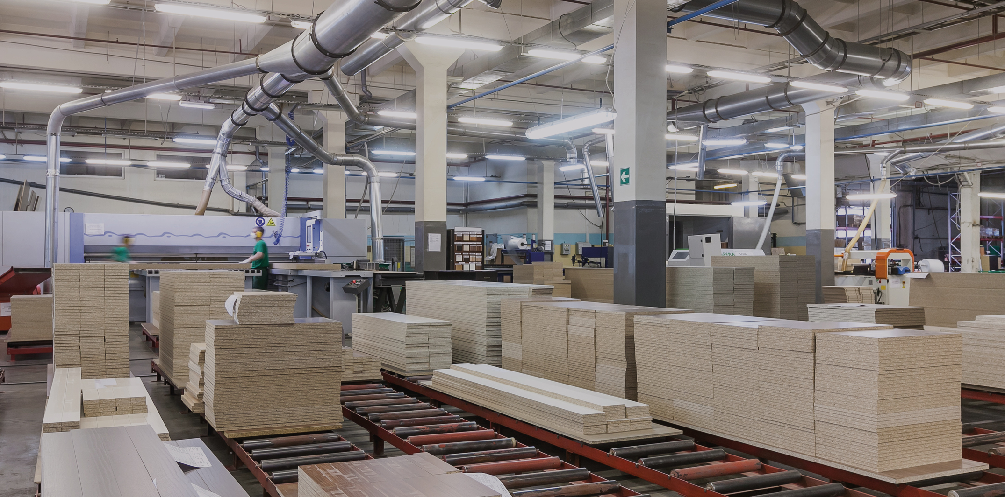
Industrial prefabrication and CAM manufacturing

Slide 4
Authors
Martti Mylly, Lappia Vocational College
Release date: 10/06/2022

Slide 5
Toolpaths and codes

Slide 6
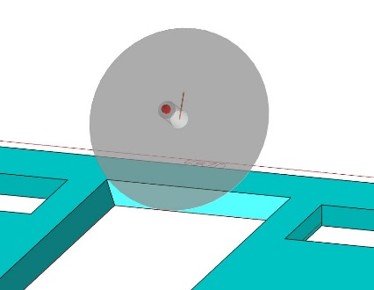
Toolpath creation
Once a model to be machined is finished, the first step is creating toolpaths for it.
At this point, the work methods used for machining are selected (sawing, drilling and grinding) and the blades for these operations are selected.
CAM software is used to create toolpaths.
Once the toolpaths have been completed, they can be simulated to check that they are correct.

Slide 7
Machining codes
The last step in programming is converting the file produced by the CAM software into a format that the machine tool can read.
This stage is called post processing. The post processed file contains text in ASCII code that is imported into the machine.
CAM (Computer Aided Manufacturing) is a widely used term that has different meanings in industry.
It is in many contexts defined as computer controlled automated manufacturing systems.
In practice, this means importing the geometry data of CAD models needed for machining pieces into the CNC centre.

Slide 8

Post-processors
Almost every machine type has its own post-processor.
Before the created toolpaths can be run, the code produced by CAM software must be translated into a format that a CNC grinder can understand.
Different CAM systems mainly produce similar code, but the writing formats of special commands, in particular, differ.
The codes are either NC codes, G codes or machine specific codes.
CAM software
Post processor
Machine tool

Slide 9
Post-processors
Simply put, a post processor is a type of translator that converts the CL file (Cutter Location File) containing the machining operations generated by the CAM software (paths, tools, machining speeds etc.) into a machining code which the machine tool will run.
Most types of CAM software produce one or several types of files containing so-called neutral language for a CNC machine.
They come either in binary format known as CLDATA or in ASCII format tailored based on APT (Automatically Programmed Tools) language.
Any text editor can read files in ASCII format, but binary data cannot be read without understanding its structure.

Slide 10
NC code
Simply put, CNC machines mainly understand commands that represent sections of a line or a circle.
More complicated shapes are produced as their combinations, divided into small steps.
Especially controlling five axes simultaneously requires an advanced machine tool control system. Initially, CNC machines were controlled by manually entered G codes, on which the control of modern machines is also based.
E.g. a linear movement is realised with code G1, whereas for clockwise and anti-clockwise curves, codes G2/G3 are used.
Manual codes have been used less as CAM software and machine user interfaces process the NC code for the machine automatically.

Slide 11
NC code
Understanding the code used to control a CNC machine is useful in case of a fault or when coding that differs from the usual is needed.
One line of an NC code is known as an NC phrase, which the machine’s control system interprets as a command for one of the machine axes to move.
The machining directions of a CNC machine are usually identified as the main axes X, Y and Z. X axis is, when seen from the front of the machine, the one parallel with the left and right side.
The X axis usually denotes the axis that controls the longest possible machining dimension.
The Y axis denotes backwards and forwards in the depth direction of the machine and the second longest dimension.
The Z axis is the vertical axis in the direction of the machine spindle, usually the shortest machining dimension.
The machine may additionally have other axes, including A , B and C, which represent rotary axes of the main axes.
The most common one is a rotary axis in the direction of the Z axis, also known as C axis.

Slide 12
G code
G code is an open source code.
It is independent of the CAD/CAM system used.
G code is a low-level command language. Coding complicated movements directly in G is labour-intensive.
If the tool model changes, the G code must be rewritten.
However, minor changes to tool lengths can be managed by correcting dimensions and blades.

Slide 13
G code
The writing of G code can be entrusted to the CAM software based on the CAD model of the piece to be manufactured and the dimensions of the available tool.
In G code, each line (known as a block) is regarded as a command. Each line of G code contains several codes consisting of letters and numbers, where the letters correspond to different types of commands.
For example, "G" is used in most movement commands, and "M" in various commands; x, y and z are used to define locations in a three-dimensional space.

Slide 14
Machine-specific codes
Machine tools for wood also use machine specific command languages.
For this, a CAD software that supports the tool in question is required.
When the 3D model is finished, the designer translates (converts) the model into the code language used by the machining program.
The machining file is imported to the machine control panel, which guides the manufacture of the building elements to be machined.
The converted file usually contains data in ASCII format, which includes the toolpaths of the building elements to be manufactured and the tool to be used.

Slide 15
Machine-specific codes
The actual control of the machine tool takes place using a built-in programming language, to which the operator need not pay attention.
This can be called a closed source code which, however, must be opened in order to import the CAD program into the machine tool in question and to convert it.

Slide 16
CNC machining
Companies acquire the CNC machines best suited for their purposes, or the machines are purchased for the manufacture of certain types of products.
A large selection of blades used in the machines is available.
The blades are mainly made from hard metal, while those put under the highest strain are diamond blades.
CNC technology is becoming more widespread, and ordinary machine types are developed into machines and applications suited for different functions.
Operating and programming a CNC machine require different knowledge and skills than conventional building work.

Slide 17
CNC machining
However, the operator must have a comprehensive understanding of the manufacture of structures and the principles of machining technology.
It is part of the operator's professional skills to know how wood behaves and how durable structures can be produced.
To obtain tidy machining results, the blades must be selected correctly.
The machine is only a production tool; incorrectly set machining values and directions and wrong blades result in faulty pieces and damage to the machine.
Simulation before machining is always advisable.

Slide 18
Production design of structural elements to be manufactured

Slide 19
Stages of production design
Production design consists of the design and factory processes.
The design processes are divided into architectural and structural design.
Factory processes consist of manufacture of structural elements, unit assembly, complementary work stages (electricity, HVAC, surface treatment etc.) and logistics.
The production processes are usually factory specific, depending on the frame system and unit prefabrication degree.

Slide 20
Design processes
At the core of the design process is a 3D structural model which, in a more advanced form, is a data model.
A data model is a simplified 3D model which contains data on the material, strength and other technical properties of structural components, their surface treatment and other matters that are essential for their manufacture.
The design work can also take place in 2D software, but in this case the data cannot be transmitted to the next step, and in practice, you have to start from the beginning.

Slide 21
Design processes
At best, the same native format is used in the design process from architectural design to the creation of the tooling geometry.
In practice, however, the precondition for this is that the architect, structural designer and persons creating the tooling geometry use the same design software.
If this is not possible, a file format is needed between the different types of software that can be used to convert the data from one to the other.
For this, IFC file format has been developed, which is a common standard for data models.
Even if the same software is used in building and structural design, an IFC model of the designs must in any case be created if, for example, you want to incorporate electrical and HVAC designs in the same model.

Slide 22
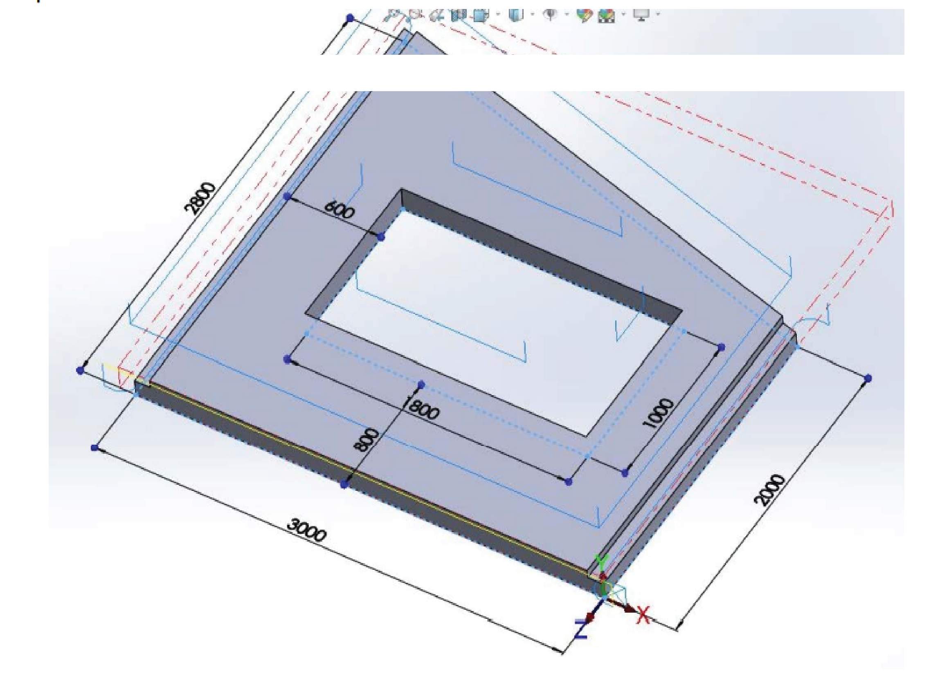
Design processes
A workable file format for transmitting the solid model between programs can usually be found
Key designs from manufacturing point of view include component and assembly drawings with their details for the units and building components to be produced.
Having access to installation drawings and details in the manufacturing stage is also advisable as, if necessary, they can be used to check such issues as how the units are joined to other structural components.
Master plans are usually not needed in the manufacturing and installation stages.

Slide 23
Cost estimates and schedule
Many building design programs are already so advanced that they automatically produce comprehensive input data for quantity surveillance.
Off-the-shelf programs are available for cost calculations. If you wish to have a tailored template for cost calculations, creating it in a spreadsheet program is relatively easy.
Key points in the schedule are the time required for the manufacturing process, completion date of designs and the agreed delivery dates.
These aspects must be coordinated to be able to keep to the schedule in production operations.

Slide 24
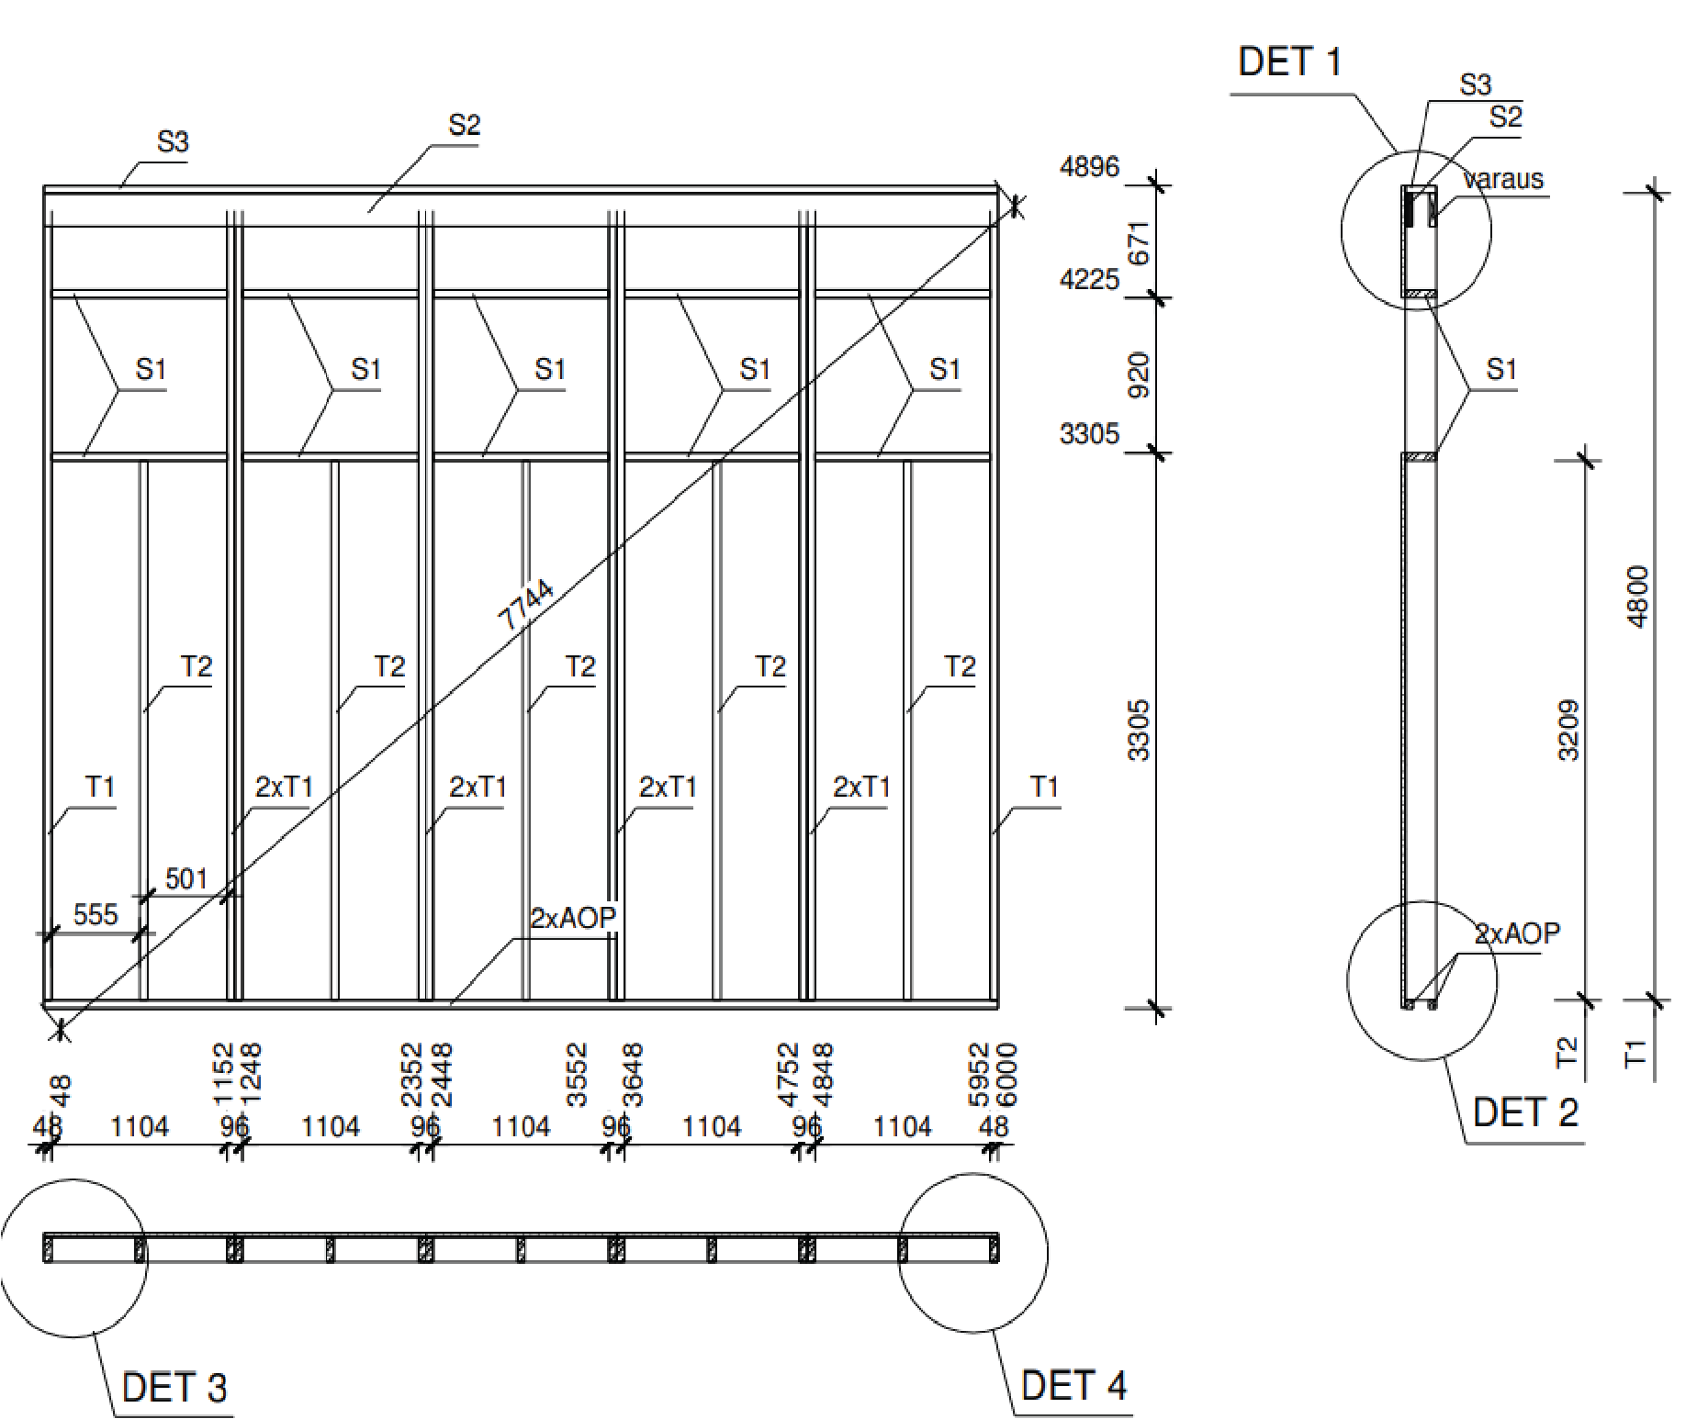
Importing design files into production
_{Wall element SE1,4 pieces}
The files, drawings and other documents needed in production depend on the factory process the plant is using.
For example, at a unit factory which manufactures components using a traditional production line where the units are assembled using manual tools and the unit moves from one work stage to the next on a roller bed, the manufacturing takes place following drawings.

Slide 25
Importing design files into production
If the manufacturing process is fully automated, 3D modelling is used in computer-controlled manufacturing.
At most production plants manufacturing timber structures, some functions have been automated and others are completed based on drawings.

Slide 26
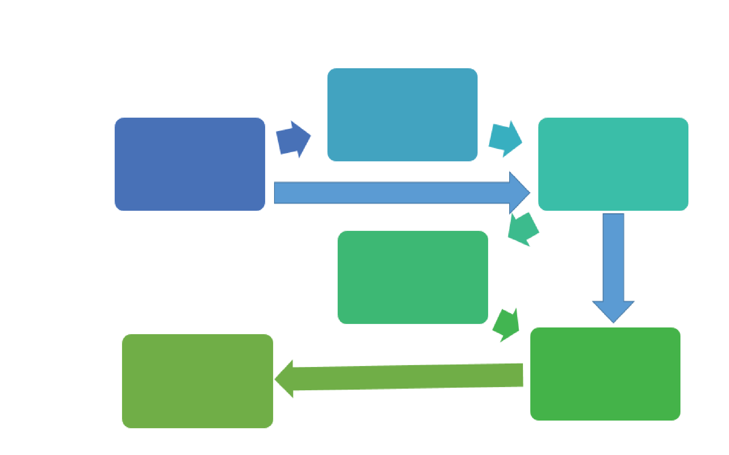
Importing design files into production
Information flow from design to production
When different programs are used in design work, file format conversion is needed when the file is imported into production. If designs were produced in the same software, no conversion is needed. This speeds up the design work. It should also be noted that all properties are not necessarily imported from one file format to another.
File format conversion
ARK
RAK
File format conversion
CNV
CAM

Slide 27
Quality assurance
Quality assurance is part of each manufacturing stage.
In case of units, at least the main dimensions and locations of openings are checked. For building elements, all main dimensions are also checked, as well as other dimensions critical for installation.
Building elements are also inspected visually to ensure that the product is as designed and that its quality is good enough for the intended use.
In case of load-bearing structural components, their correspondence to the design strength grade and the use of design dimensions in manufacturing must also be verified.

Slide 28
Logistics
Once the building elements and units have been completed, they are loaded for transport to site.
The units and other elements are packaged and protected against soiling and damage in transport.
They are loaded following a loading diagram, which is in most cases drawn up by the unit designer.
The basic principle in loading units is that they can be unloaded at site in the order of installation without intermediate storage.
Consequently, the transport vehicles to be used must be already known in the design stage.

Slide 29
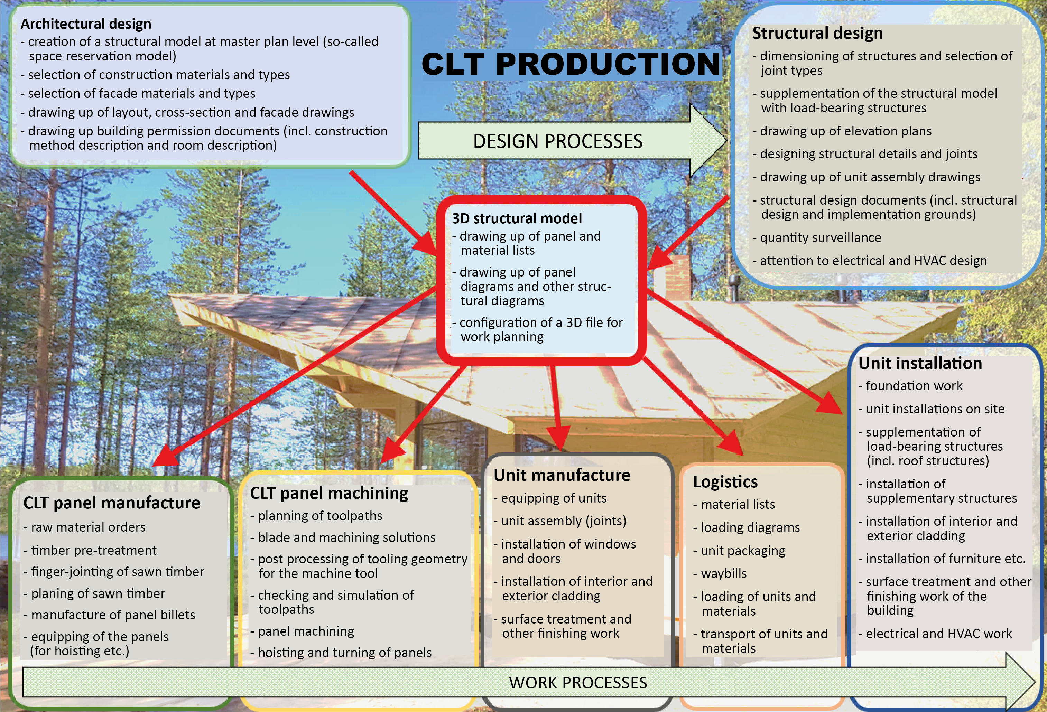

Slide 30
Use of automated production lines in industrial wood construction

Slide 31
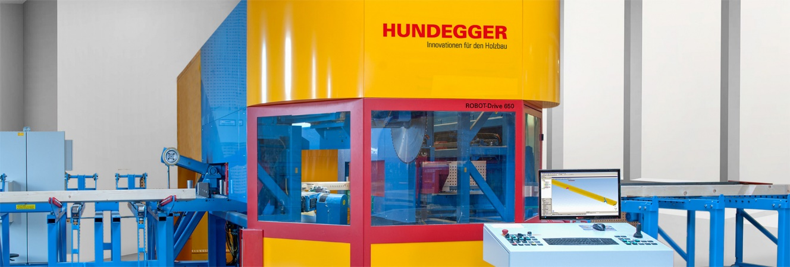
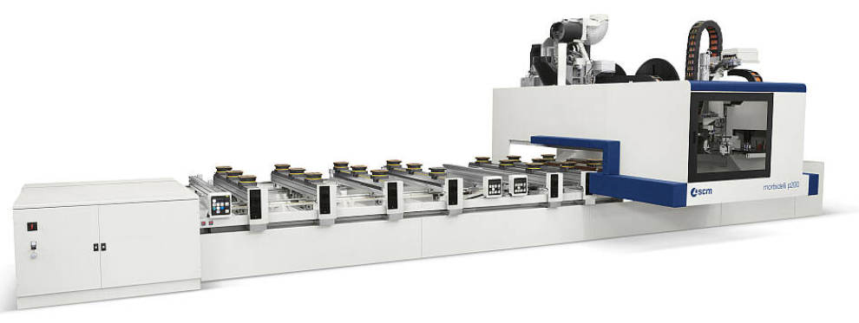
Production technology
From production technology point of view, structural elements are manufactured in factory conditions either with manually controlled machine tools, including a band saw, radial cross-cut saw or ripper, or on automated machining lines.
Automated machining lines today play an increasingly large role in the manufacture of such elements.
A precondition for this is 3D modelling of the pieces to be machined already in the design stage of the structures.

Slide 32
Production technology
Column-and-beam type timber structures are actually a very old method of wood construction. As timber houses with framed structure and, in particular, unit structures became more widespread, this method fell out of use.
As automated production lines have become more common, column-and-beam construction has been growing.
In column-and-beam construction, the demanding machining accuracy of joint structures causes problems.

Slide 33
Production technology
Efficient work methods for manufacturing these joints could not previously be found in industrial wood construction.
The strengths of many wood joint types have also not been officially defined. This is why designers and building supervision authorities cannot accurately assess their durability.
Requirements of construction physics also cause problems, especially solutions for heat and moisture.

Slide 34
Production technology
Thanks to advanced modern work methods and the impressive look of structures of this type, buildings with column-and-beam structure have again attracted interest.
Traditional wood construction has made a comeback as old methods have been combined with machine tools equipped with modern technology.
For joining components that were laboursome to cut in the olden days, 3D models can now be produced in CAD software, and the geometry created by it can be imported directly into the machine tool.

Slide 35
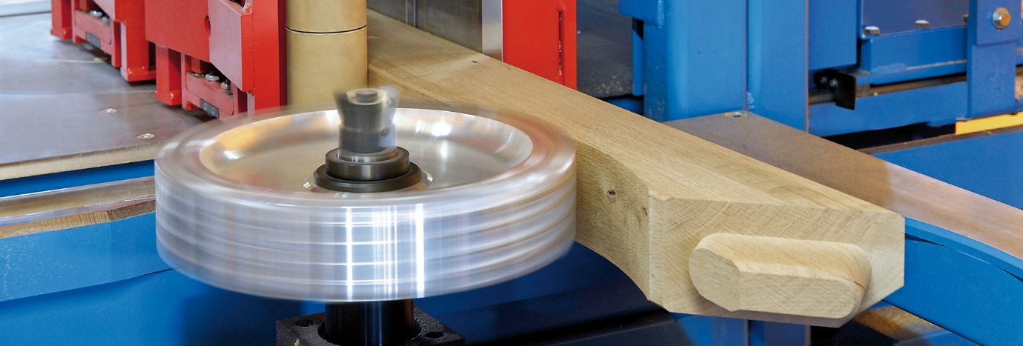
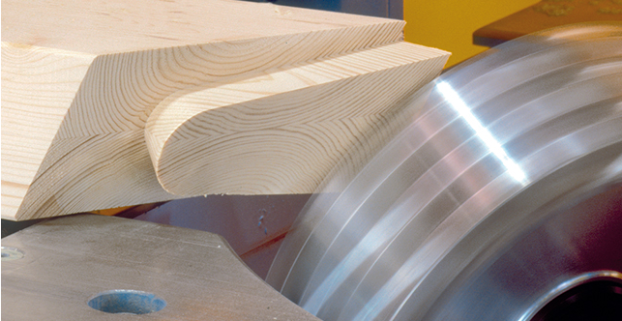
Production technology
The capacity of a comb joint with bevelled corners has been found great, and its stiffness is almost as good as that of a dowel joint.
The capacity depends on the angle between the top and bottom chord, the slope of the notched surface, depth of the notch and the cross-sectional length of the joint.
The capacity of a dovetail joint has been found smaller, but the joint is relatively tough.
The capacity depends on the angle between the bottom and top chord, the area of the compression surface below and above the dovetail, the slope of the dovetail and the length of the rafter section below the joint.

Slide 36
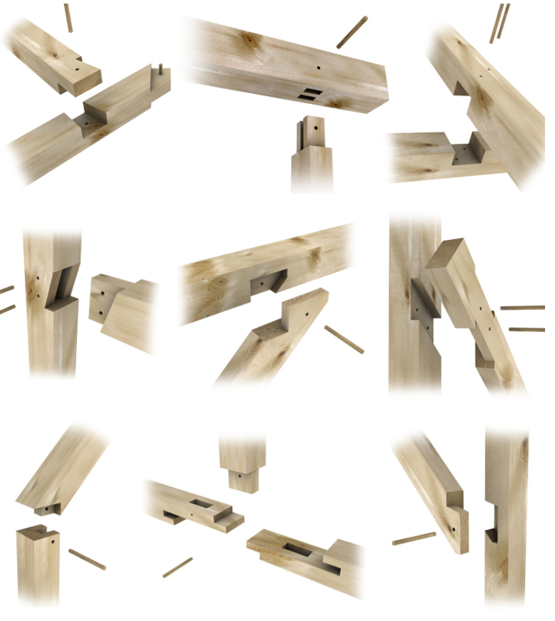
Machining technique
The material costs of contact joints are usually affordable, as large metal joiners that impair the fireproofing of a timber structure are usually the costliest part of the structure.
Contact joints are very little used in Finland today, but in Central Europe, several traditional joint types are still in use, which have been found the easiest and most secure way of joining wooden building elements.
The preconditions for an impeccably functioning contact joint are contact surfaces that fit together well, dimensional accuracy of the pieces to be joined, and stable moisture ratio at equilibrium in the used timber.

Slide 37
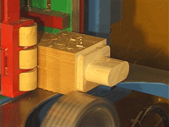
Machining technique
Another significant use is machining massive timber structures.
Even large units can be manufactured using modern, 5-axis CNC grinders.
The units can be 16 metres in length and 3.4 metres in width. A solid timber unit may be up to 400 mm in thickness.
Openings for windows and doors, edge joints, HVAC penetrations etc. can be machined in the elements. However, a precondition for this is that the entire process is run using 3D modelling, CAM toolpaths and CNC manufacturing technology.

Slide 38
Manufacturing wood structures with CNC machining techniques

Slide 39
CNC blade technique
Wood is a natural material that is never completely consistent in quality.
The tooling properties of wood also depend on the direction in which it is machined.
To achieve tidy and fault-free results, the correct blades and tooling values must be selected for the material and task.
This is an important part of a CNC machinist’s professional skill.
Many types of blades are used for manufacturing wood structures.
They can be divided into saw blades, planing blades, mill grinders, drills, chain saws and various special blades.
A machinist must be able to recognise all blades and know how to use them appropriately.

Slide 40
CNC blade technique
The most commonly used blade of a CNC centre is a circular saw for cutting wood in different directions.
The machining direction affects the blade angles, and traditionally, different types of blades exist for splitting and cutting wood.
The circular saw of a CNC centre is a generic circular blade used in all cutting directions. The circular saw has a thin, multi-teeth blade in which the cutting blade is on the circumference.
The number of teeth varies depending on the blade size (12 – 144).
The blade arbor thickness (2 mm – 10 mm) and diameter (150 – 1200 mm) vary depending on the blade size. The blades for industrial use normally have hard metal teeth.

Slide 41
CNC blade technique
Blades with diamond teeth are also available.
The angle of chip flow in commonly used rip blades usually is approx. 20 degrees.
The shape of the tooth, which also varies depending on the manufacturer, can be seen when looking at the tooth from the front. Different solutions are used to dampen the operating noise of circular saw blades.
Sometimes the blade arbor has a side-cutting hard metal part that prevents the timber under stress from being stuck in the arbor.

Slide 42
CNC blade technique
Planing machine type cutters and router bits are used to smooth the wood surface or, for example, to produce a wave-like pattern on the billet surface.
Cutters are planing blades with several replacement blades.
The blade sizes vary 100 … 250 mm.
The blade material usually is high-speed steel or hard metal.
Different manufacturers have plenty of blade models.

Slide 43
CNC blade technique
Routers are planing blades with two or more fixed cutting blades.
A router bit can usually be operated at higher feed speeds than cutters, removing more material at once.
Due to their massive structure, router bits are more expensive to produce than cutters.
Cutters and router bits have multiple cutting blades.
Blades can also be placed on the arbor in a spiral shape, in which case chips come off and are expelled from the blade efficiently.
Blades of this type do not always produce a tidy surface, which is why the surface needs to be finished.

Slide 44
CNC blade technique
Mill grinders are used for shaping the wood, machining joints and other tooling.
Grinder blades come in many types and sizes.
Shaft mounted end mills are generally used in CNC centres, especially for machining shapes.
Grinding and finishing blades are available for end mills.
End mills usually have a threaded blade to obtain sharper and tidier results.
The upwards thread removes the material to be cut during machining.

Slide 45
CNC blade technique
End mills are usually fully or partly made of hard metal.
Some end mills have replaceable bits.
All blade models do not perform the cutting at the tip of the blade, in which case they are not suitable for machining that starts in the middle of the piece.
Replacement blades come in all shapes.
A diamond-tipped grinder has a steel arbor and thin diamond pieces in the tips of the blades.
Diamond blades are many times more durable than hard metal blades.

Slide 46
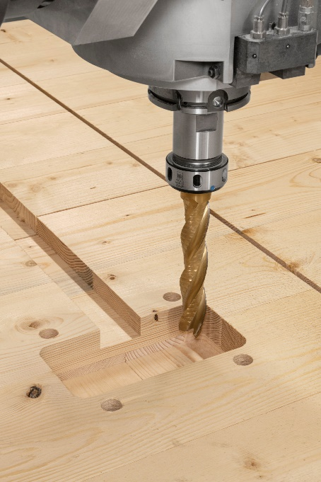
CNC blade technique
Wood drill bits used in the wood industry are usually made from hard metal or high-speed steel and have a point at the end.
The high-speed steel bit is the most suitable one for drilling solid wood as it produces a tidy end result.
Drills with a pulling middle point are mainly used for manual drilling and they are ill suited for CNC machines, as in these applications, the bit tends to pull itself towards the wood.
This is why, if used in a CNC centre, the piece to be drilled may come off the table and cause a hazard. When drilling particularly long holes, the suitability of the bit for CNC centre use should be checked.
The machining values (movement speed, rotations, chip removals) must be calculated for each bit and material when drilling long holes.

Slide 47
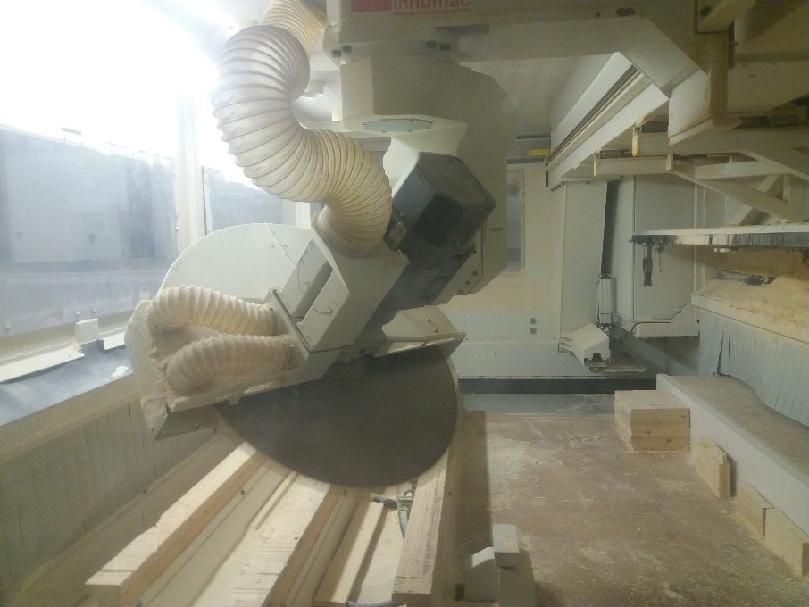
Blade angles
The blade has different angles that are highly significant for the machining process and the quality of the end result, or the smoothness of the wood surface to be machined.
Collectively, the angles are also known as blade geometry.
The sum of the angle of taper, angle of sharpening and angle of chip flow usually is 90 degrees. The angle of taper is needed to prevent the flank of the blade from rubbing against the wood.
The angle of taper should be around 15 degrees.
The angle of sharpening depends on the materials to be machined, and with wood, also the direction.

Slide 48
Blade angles
In blades used purely for cutting, the angle of chip flow can be negative, which means that the chip flow surface is inclined towards the machining direction.
Cutting hard metal blades are always wider than the actual arbor.
Blade durability can be adjusted by the blade angles, but this may impair the machining results, and probably increases the force needed for cutting.
Blade angles optimal for the machining process are aimed for.
Blade materials in use are unalloyed steel, high-speed steel, stellite (the basic material of which is cobolt), hard metal and diamond.
High-speed and hard metal blades are mainly used for solid timber products.

Slide 49
Preliminary preparations for CNC machining
For positioning the piece in a CNC controlled machine, e.g. pneumatically controlled positioning pins, laser positioning, mechanical grippers or measurement coordinates are used.
The key is knowing where the zero point of the piece is located in terms of the coordinates used by the machine.
There are several methods for holding the piece in place; the most common one for small pieces is likely to be a vacuum pump.
For large pieces, mechanical grippers are used, or the piece is held in place by its own weight, such as large CLT panel billets.
Before starting, it is advisable to simulate the machining program of the piece, which helps to avoid e.g. collision movements of the machine, or loose pieces falling in between the bars.

Slide 50
CNC machining
Operating a CNC machine requires different knowledge and skills than conventional manufacture of construction products.
Increasing automation speeds up the changes of programs, settings and blades. However, the operator should be well familiar with the machine’s control system to know what to do in case of a fault.
After simulation, the actual machining is a highly automated phase, in which the operator at most adjusts the feeding speed and, of course, corrects any faults.

Slide 51
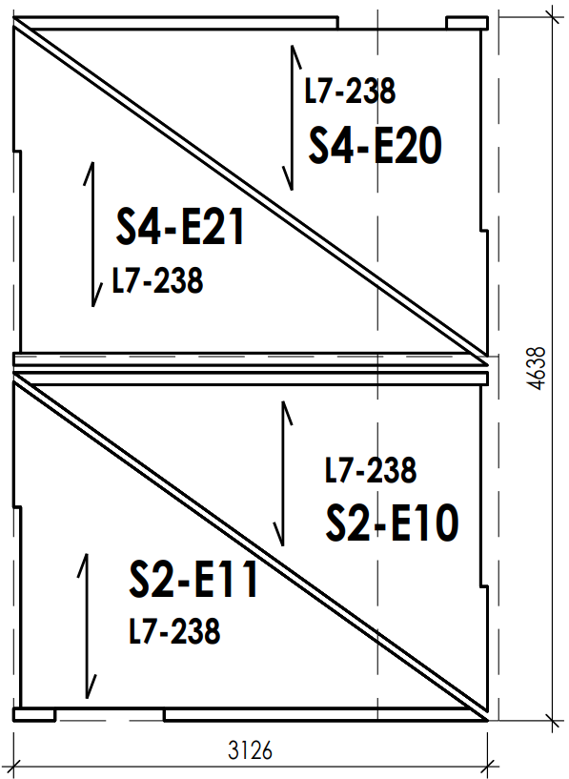
Scrap-free blanking
Scrap-free blanking means placing the pieces to be machined out of a panel so that as little waste is produced as possible.
This can take place in two ways, in principle: automatically with a CAM programme or manually.
Scrap-free blanking is particularly useful when the production volumes are high.
In this case, automated scrap-free blanking is the most suitable method.
Scrap-free blanking of CLT panels. The arrows point to the direction of surface lamellae. The CLT panels were designed by data modelling, which means that the dimensions of individual components need not be given. Image Lappia Vocational College

Slide 52
Scrap-free blanking
For large components with small production volumes, manual scrap-free blanking can also be used.
Several different production batches can be combined, maximising the benefits for the entire production.
The same product often contains several different timber thicknesses and even wood from different tree species, in which case combining production batches is useful.
If the pieces are small and there is a risk of them moving during machining, the blade should be lifted up by 3 to 5 mm to prevent the component from being detached from the panel.
The piece is later detached using hand tools.
This way, damage to pieces and blades can be avoided, and loose pieces can be prevented from flying off and causing an occupational safety hazard.

