Slide 1



Industrial wood construction
Teaching materials for industrial wood construction education
2022

Slide 2
Origin of the materials
Use of the materials
These learning materials for industrial wood construction have been prepared in a project led by Puuinfo Oy in 2021–2022. Also involved in the project were
Lappia Vocational College,
TTS-Työtehoseura ry
South-Eastern Finland University of Applied Sciences,
Metropolia University of Applied Sciences,
Jyväskylä University of Applied Sciences,
University of Tampere, and
Federation of the Finnish Woodworking Industries Puutuoteteollisuus ry
The project was funded by the Ministry of the Environment.
The materials are intended to be used as extensively as possible in industrial wood construction education and studies.
The materials are released under the Creative Commons licence Attribution-ShareAlike (CC BY-SA), which requires that the author be properly credited when the materials are used and that derivative works may only be distributed under the same licence as the original work.
The original materials and any updates to them by Puuinfo will be published on the Library of Open Educational Resources website (aoe.fi) and the Puuinfo.fi website.

Slide 3
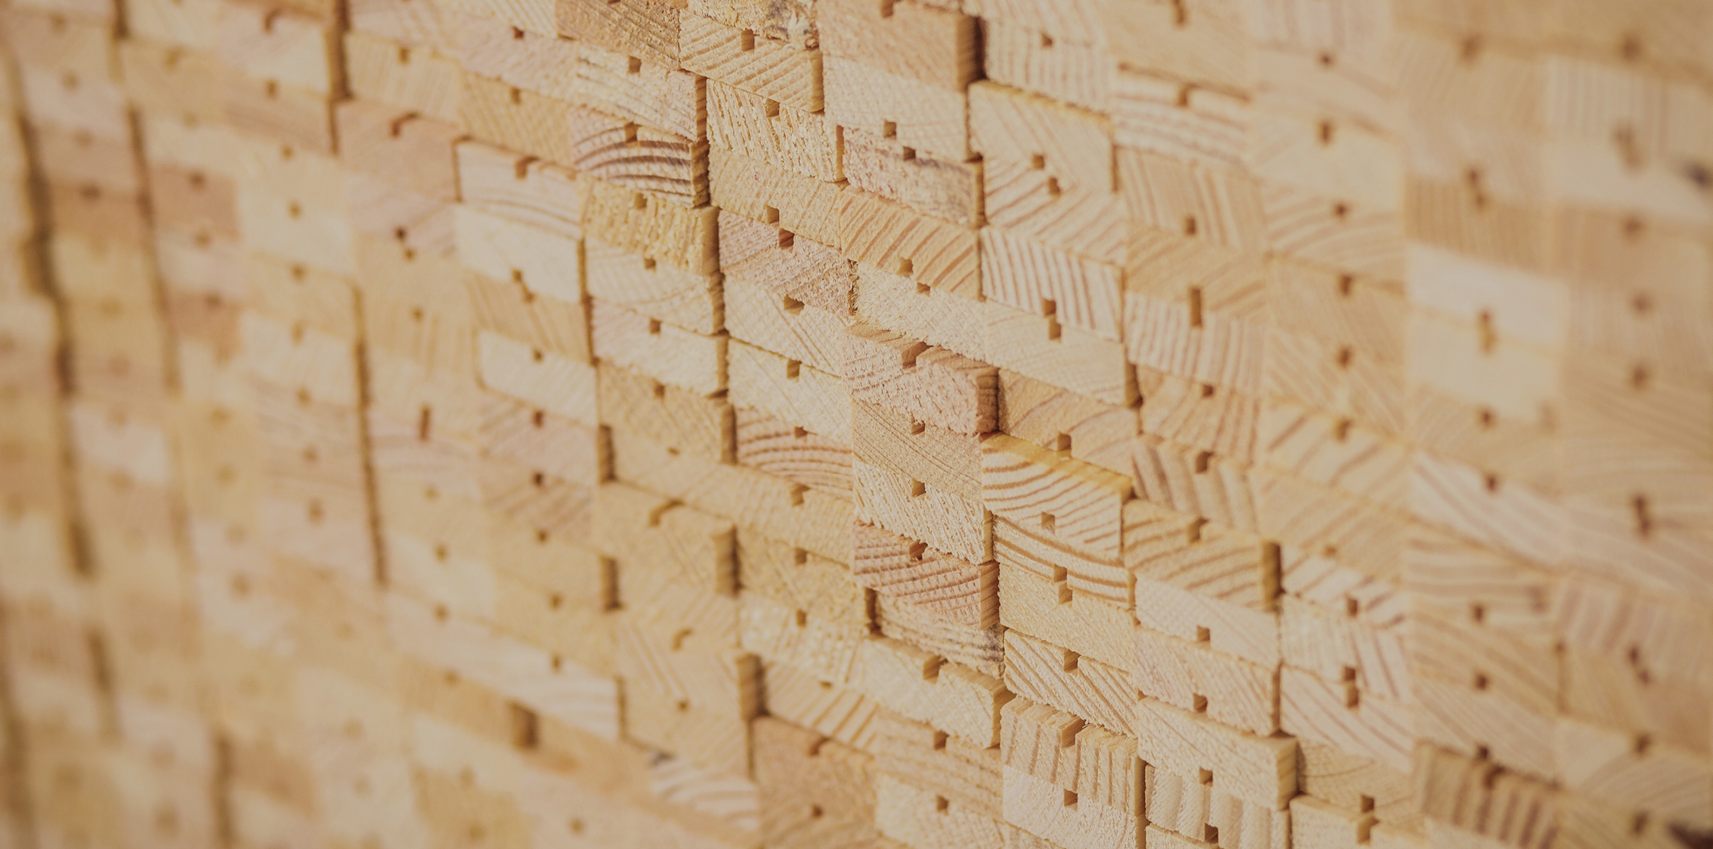
Manufacture of nail plate structures

Slide 4
Authors
Martti Mylly, Lappia Vocational College
Release date: 10/06/2022

Slide 5
Features of nail plate structures

Slide 6
Nail plate structure / NR structure
Nail plate structures are industrially manufactured and structurally dimensioned wood-framed assemblies formed by mechanically jointing nail plates with stress-graded sawn timber cut to size.
The structure specifically refers to roof framework, i.e. trusses, frames, and built-up beams, that have nail plate joints on both sides.
Nail plate structures are typically used as load-bearing timber structures.
Nail plate structures are manufactured in specialised factories under external quality control.

Slide 7
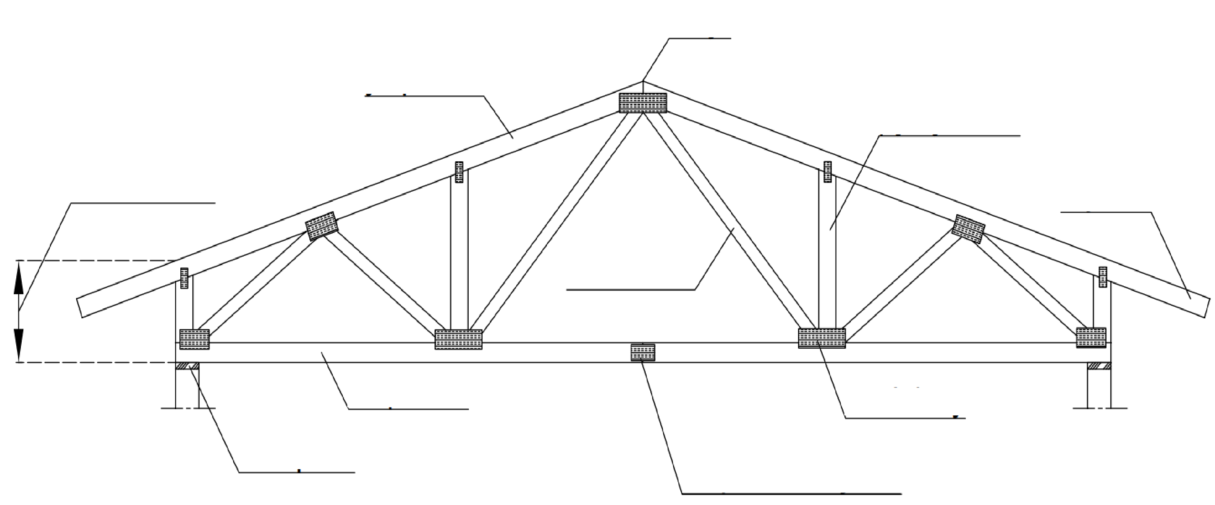
Truss parts
apex (peak)
top chord
web
support height
overhang
web
bottom chord
nail plate
bearing
splice

Slide 8
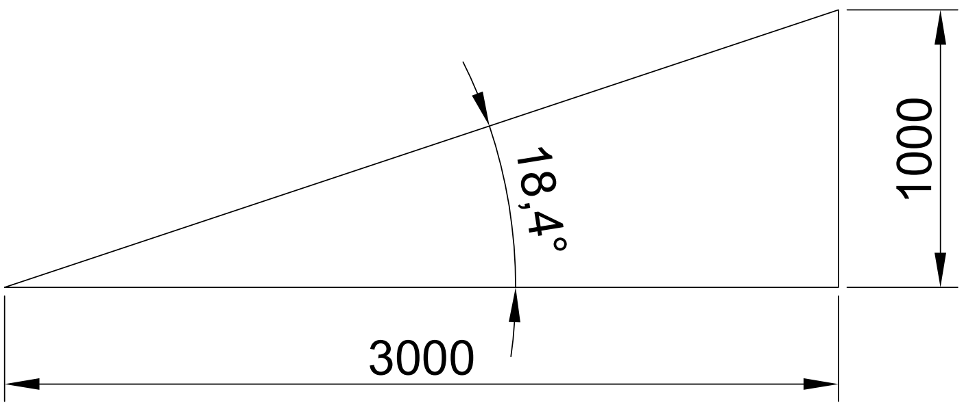
Roof slope
Roof slope is often expressed in ratios, e.g. 1:3 (18.43 degrees) or 1:2.5 (21.8 degrees). For example, a 1:3 slope means a vertical rise of 1 metre on a horizontal run of 3 metres.
The slope is selected according to the roof slope in the building permit images. The slope can also be expressed in degrees or by using the main dimensions.

Slide 9
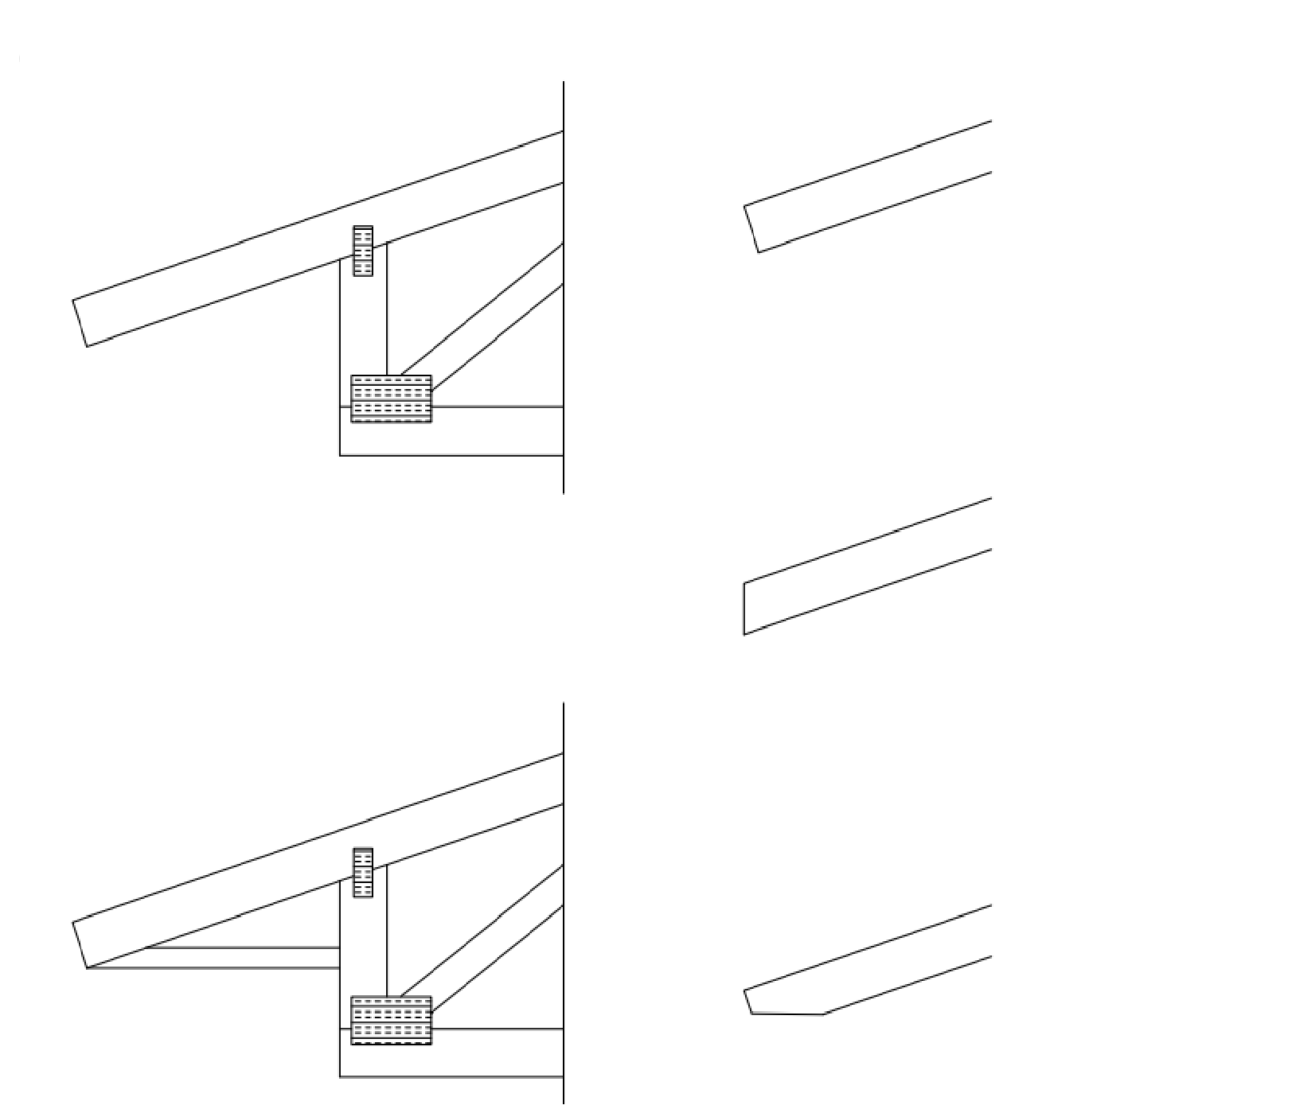
Overhang shapes
open overhang
square cut
There are two types of overhangs: open overhangs and boxed overhangs.
The end of the overhang can be cut either rectangularly or vertically.
The end may also be double cut.
plumb cut
boxed overhang
double cut

Slide 10
Designing nail plate structures

Slide 11
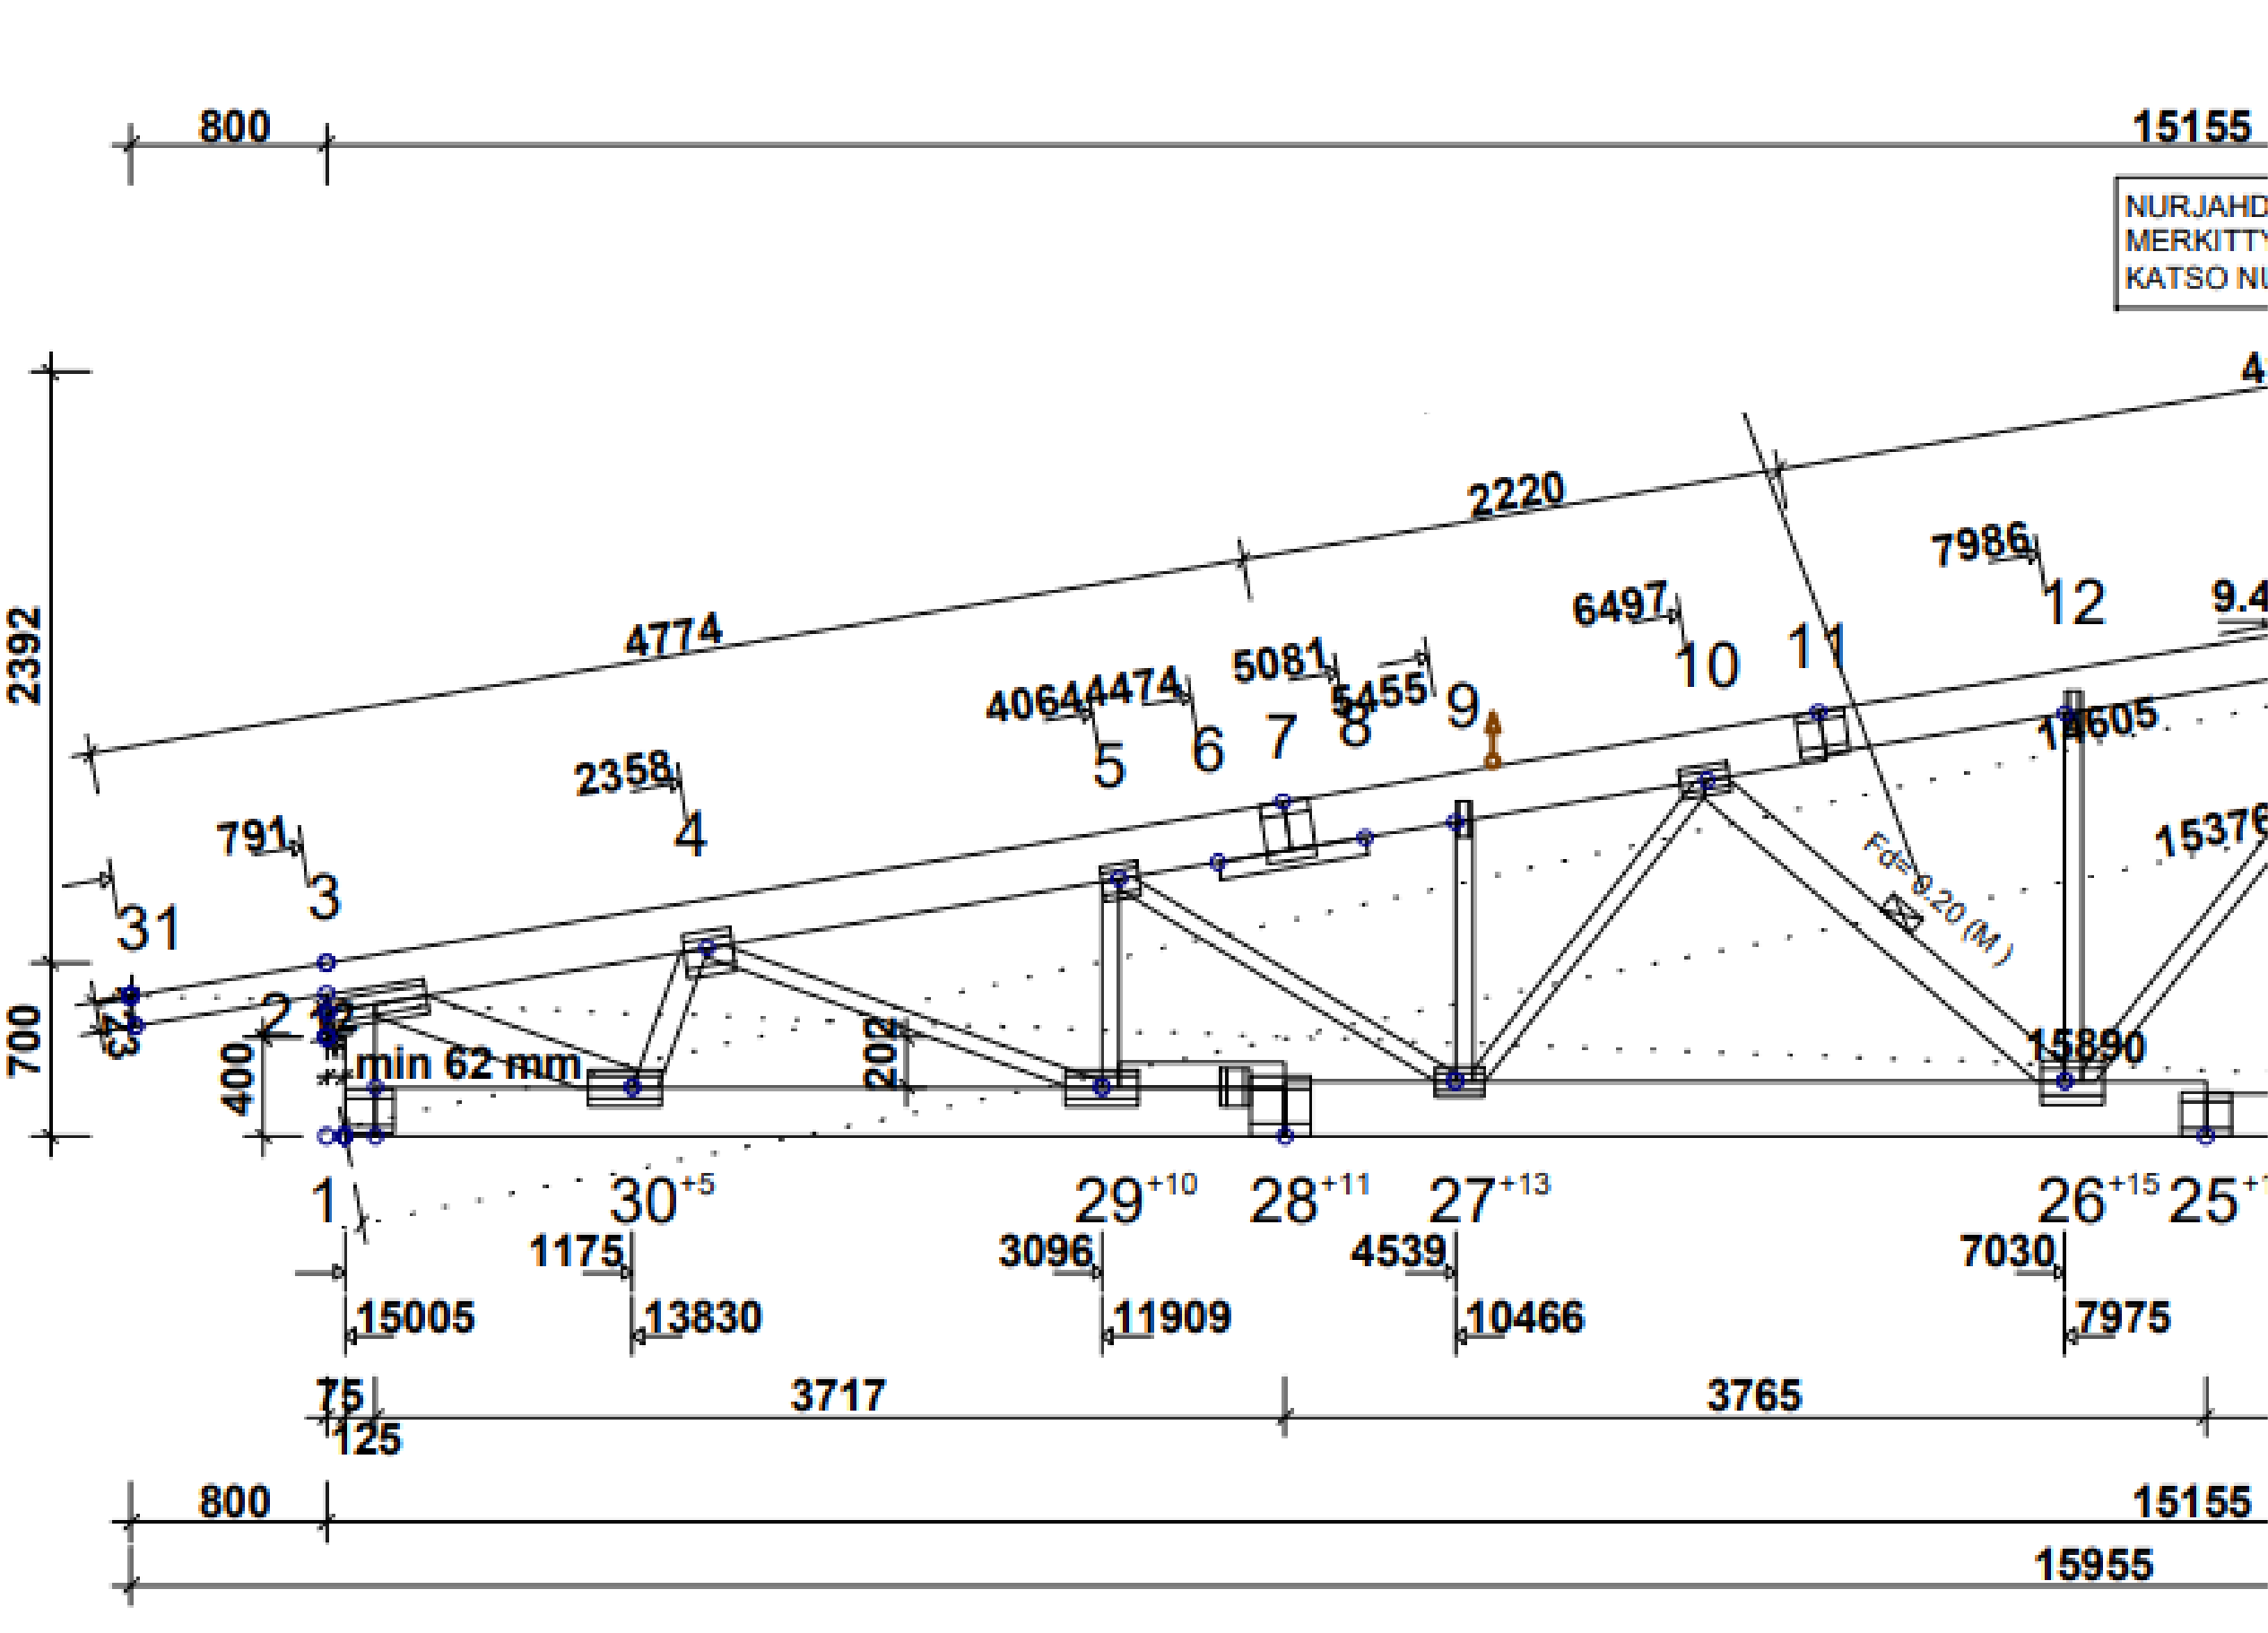
Truss plan
BUCKLING SUPPORT POINTS MARKED WITH RED PAINT SEE BUCKLING SUPPORT INSTRUCTIONS DET1!

Slide 12
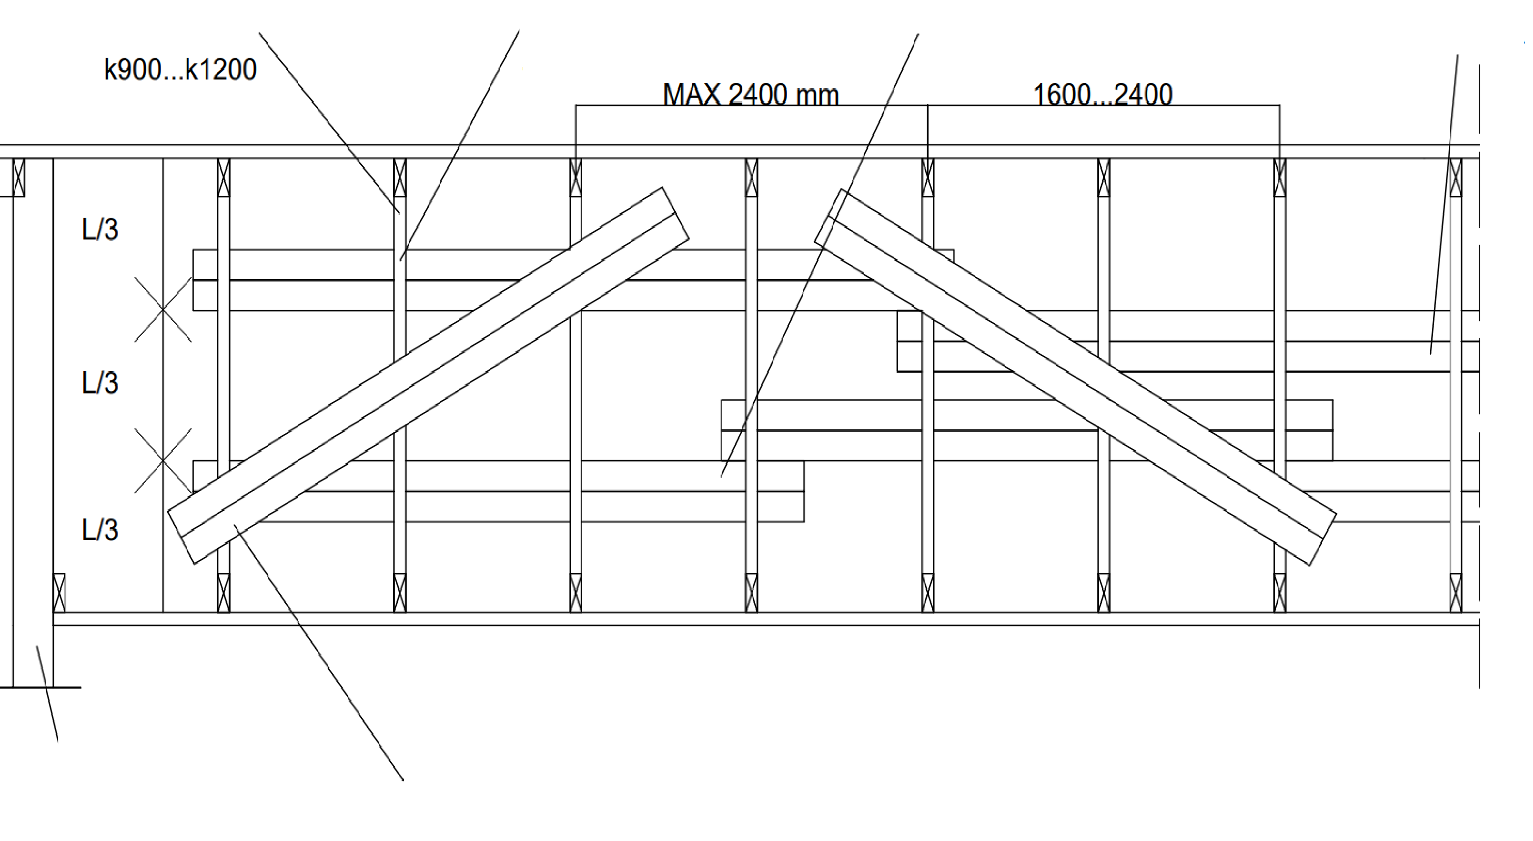
Lateral support of a nail plate structure
NAIL PLATE STRUCTURES
BOARD 2x22x100 OR 22x150 + 5N 2.8x75/WEB
BUCKLING-SUPPORTED
WEB
END FRAME
DIAGONAL BRACES 2x22x100 OR 22x150 ALTERNATING DIRECTION + 9N 2.8x75/WEB

Slide 13
Nail plate truss types

Slide 14
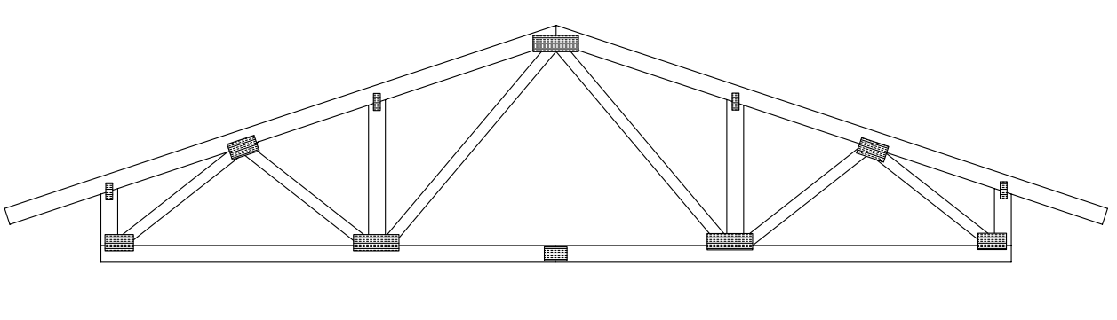
Ridge truss
The ridge truss is the most common truss type for all building types. The ridge truss is also the best alternative for long spans, up to 25 m. In residential buildings, a 900 mm spacing on centres is recommended. A ridge truss also enables the construction of an attic space for storage. In storage attic frame trusses, the shape of the attic is formed around the webs of the truss.

Slide 15
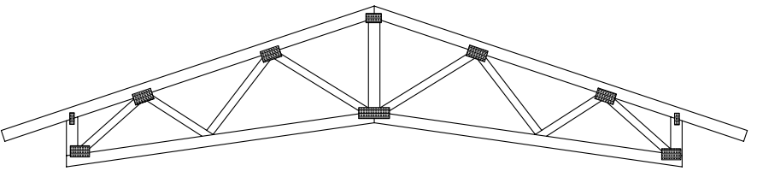
Scissors truss
The scissors truss is widely used in single-family houses and production facilities when a higher than normal floor-to-ceiling height is needed.
The scissors truss requires a higher structural support height than the ridge truss. The bottom chord may be comprise of 2 or 3 pieces.
Usually, the inclination of the bottom chord is smaller than the inclination of the top chord.

Slide 16
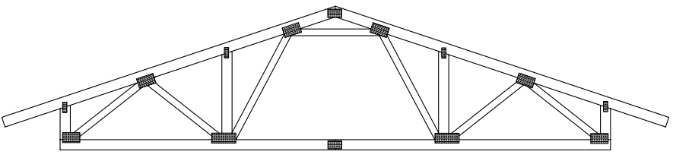
Attic frame truss (for storage)
The attic frame truss enables the use of the attic space for storage.
The width of the storage attic will be approximately 1/3 of the length of the bottom chord, and the loading capacity will be 200 kg/m2.
The space cannot be converted into living space. Attic frame trusses are available with both inclined and straight walls.

Slide 17
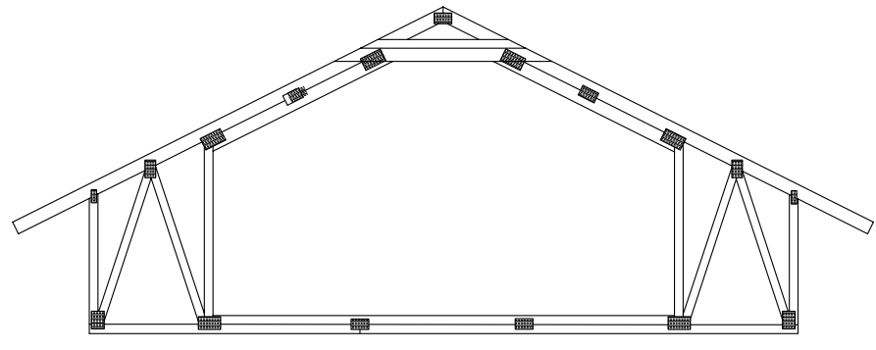
Attic frame truss
The attic frame truss is used in 1.5-storey residential buildings.
The recommended spacing is 900 mm on centres.
The feasibility of the dimensions of the frame depend on several factors, such as inclination, the height of the frame, and loads.
Main dimensions must be determined on a case-by-case basis.
In attic frame trusses, the bottom chord serves as a floor joist for the top floor.

Slide 18
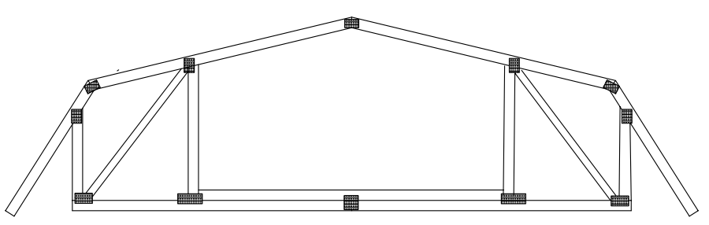
Mansard truss
Mansard roofs have two slopes on both sides, and often windows in the lower section with the steeper slope.
The inhabitable floor under the roof is also called mansard or mansard floor.
A mansard structure usually provides one extra floor to the building, but steep and long mansard roofs can create several floors.

Slide 19
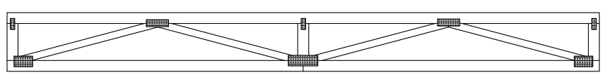
Beam truss
The beam truss is a webbed truss of uniform height used in residential and commercial buildings.
The beam truss can also be used as a wind truss between the actual roof trusses.

Slide 20
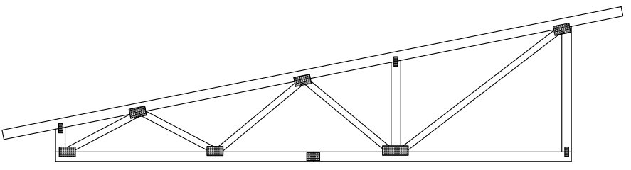
Single-pitch truss
The single-pitch truss is used when the roof is designed to slope on one side only.
The single-pitch trusses are also often used in wide-span buildings with a load-bearing line in the middle.
This also makes the handling and installing of the truss easier compared to one very long truss.
Single-pitch trusses can also be used when the tops of the slopes are at different levels.

Slide 21
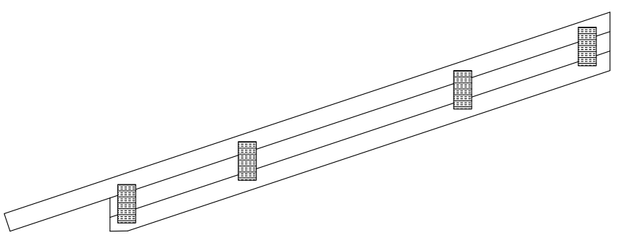
Built-up beam
Built-up beams are manufactured by fastening 2 to 3 wide pieces of timber together with nail plates.
Built-up beams are often used when the aim is to utilise the entire width of the upper floor.
Built-up beams can also be used for sloping ceilings.
Built-up beams are often used in horizontal structures as joists to achieve slightly longer spans than normal.

Slide 22
Joist
Joists are used to form the intermediate floor, or they may serve as part of the intermediate floor with the bottom chords of the attic frame.
The spacing is typically 400 or 600 mm on centres. Joists are typically made of 42 mm thick and 198 mm or 223 mm high timber.
Other dimensions may be used in certain scenarios. The joist requires at least three support points with normal frame widths (exterior walls + intermediate support).

Slide 23
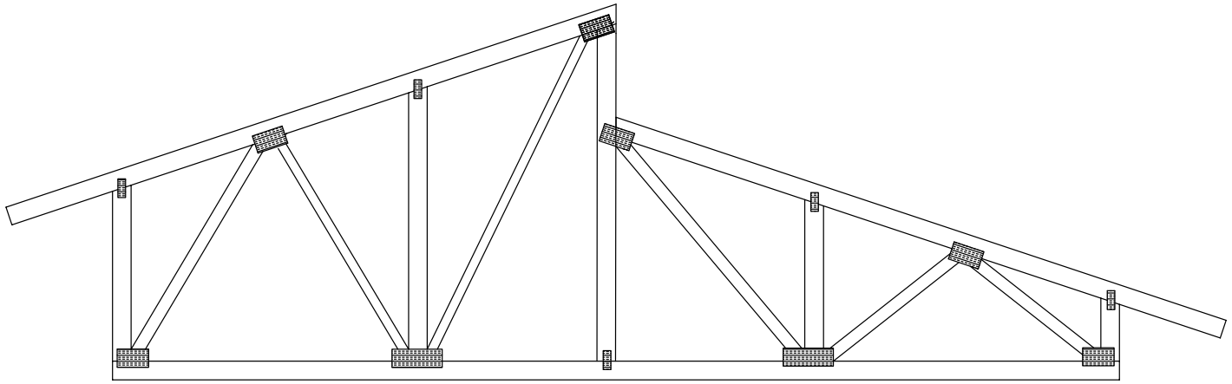
Dual-shed roof trusses
A dual-shed roof refers to a roof shape in which the tops of the roof slopes are at different levels.
A dual-shed roof can be implemented either with one solid truss or with two single-pitch trusses.
Two single-pitch trusses are usually used for longer spans.

Slide 24
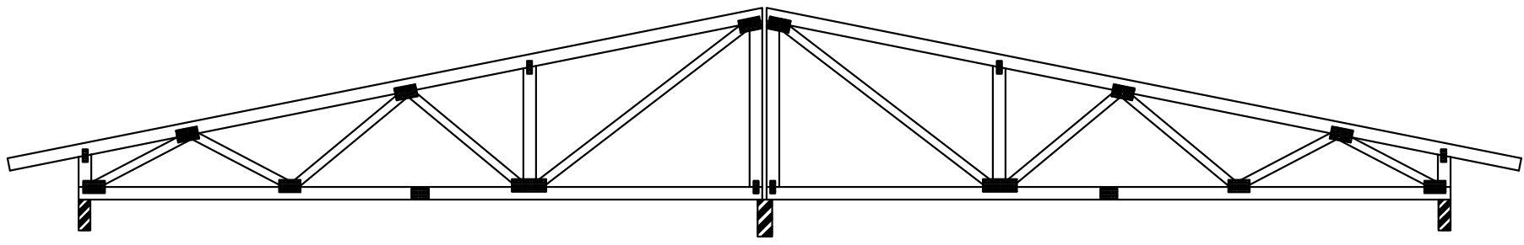
Two-span truss
A two-span truss is a roof structure made of two separate single-pitch trusses.
This structure is used with wide-span spaces when it is possible to utilise an intermediate support.
The intermediate support can be a beam or a wall.
The truss frame can also be made of several trusses that are supported on load-bearing lines.

Slide 25
Fire-safe truss
The applications of the fire-safe truss include all roof structures with R30 fire resistance rating requirement.
The fire-safe truss consists of three interconnected nail plate trusses in which the chimney effect forming between the trusses in the event of a fire is effectively eliminated.
The three trusses are jointed at the truss factory, which helps ensure that all the actions required by the fire statement will be carried out.
Normal truss diagrams with fire resistance rating requirements are required as input data.
Information on the fire-protected parts of the truss is also required.
Usually, the top chord is protected by roof battens from above, and the bottom chord is protected by e.g. sheathing and non-combustible thermal insulation from below.

Slide 26
Manufacture of nail plate structures

Slide 27
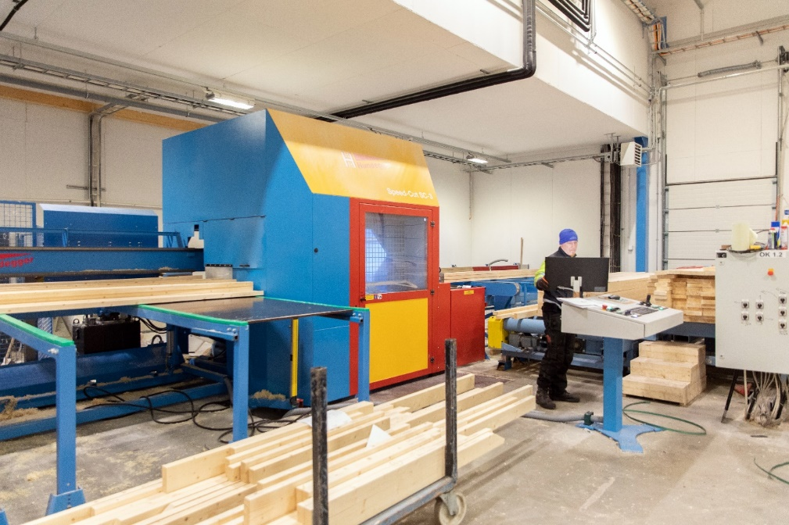
Manufacture of a nail plate structure
The most important documents for production are the drawings made for the nail plate structures.
Each nail plate structure manufacturer has their own manufacturing processes.
The production roughly proceeds as follows: the parts of the nail plate structure are first manufactured and then the structure is assembled using nail plates.
The designs present all the necessary structural parts with dimensions.
Manufacture of truss webs on a computer-controlled line,
photo: Keminmaan Puurakenne Oy

Slide 28
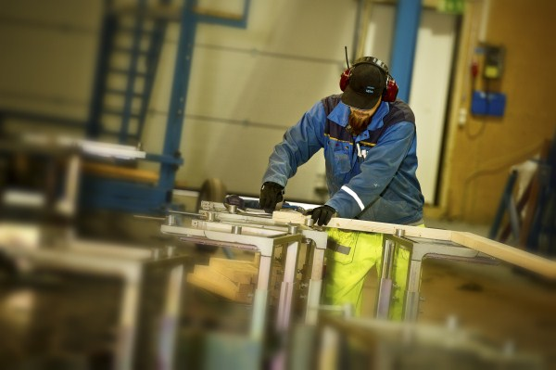
Manufacture of a nail plate structure
The assembly typically takes place on a magnetic assembly table.
In order to align the truss components, the assembly pattern will first be constructed on the table.
The construction time for the pattern will vary depending on the truss type and span.
Nail plate press, photo: Keminmaan Puurakenne Oy

Slide 29
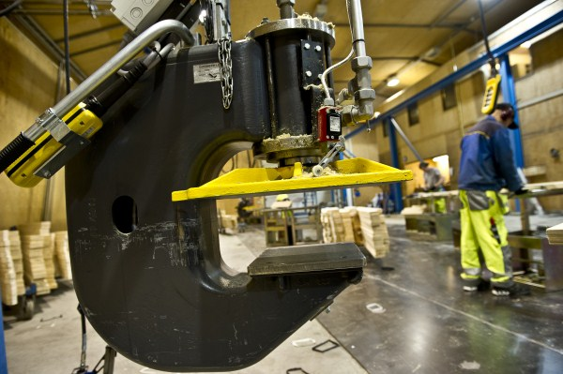
Manufacture of a nail plate structure
The same production line is usually used to make the same type of truss, which enables changing the truss type with minor adjustments to the pattern.
'Same type of truss' refers to trusses with the same bottom chord length, support height, and top chord slope, or at least one of these characteristics.
The installation tolerance of the webs in nail plate trusses is ±10 mm.
Nail plate press, photo: Keminmaan Puurakenne Oy

Slide 30
Transportation and storage of nail plate structures

Slide 31
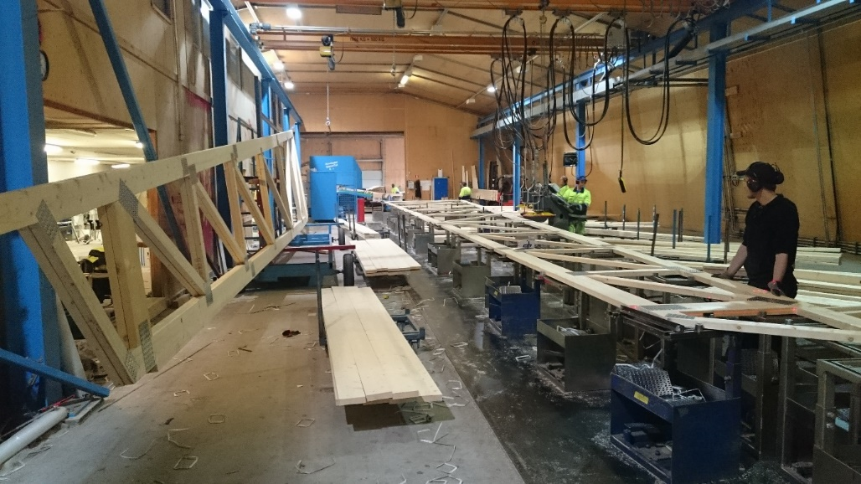
Transportation and storage of nail plate structures
The structural parts assembled with nail plates are protected against moisture, dirt, damage, and scratches.
The structural parts assembled with nail plates are always stored on a dry, stable, and level surface.
Nail plate structures are stored on site on a vertical or horizontal platform to prevent permanent deflection.
Assembled trusses, photo: Keminmaan Puurakenne Oy

Slide 32
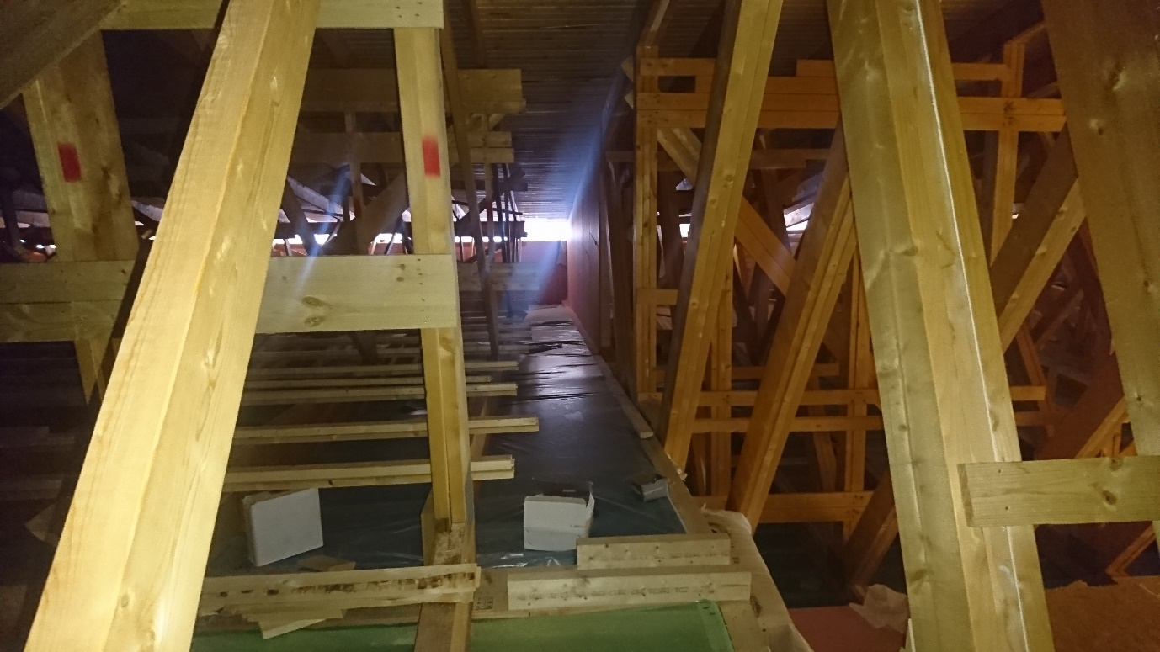
Transportation and storage of nail plate structures
The supporting timber must stand high enough, so that no parts of the nail plate structures are in contact with the ground or exposed to snow, and sufficient ventilation cavity must be left under the protective covers.
The manufacturer's product-specific instructions must be followed when moving, lifting, and storing structural parts assembled with nail plates.
The bundles are supported by the actual support points of the part, and in such a way that the bundles cannot tip over.
Ventilation of the structural components must be ensured during storage.
Attic floor constructed with a roof truss, photo: Keminmaan Puurakenne Oy

