Slide 1



Industrial wood construction
Teaching materials for industrial wood construction education
2022

Slide 2
Origin of the materials
Use of the materials
These learning materials for industrial wood construction have been prepared in a project led by Puuinfo Oy in 2021–2022. Also involved in the project were
Lappia Vocational College,
TTS-Työtehoseura ry
South-Eastern Finland University of Applied Sciences,
Metropolia University of Applied Sciences,
Jyväskylä University of Applied Sciences,
University of Tampere, and
Federation of the Finnish Woodworking Industries Puutuoteteollisuus ry
The project was funded by the Ministry of the Environment.
The materials are intended to be used as extensively as possible in industrial wood construction education and studies.
The materials are released under the Creative Commons licence Attribution-ShareAlike (CC BY-SA), which requires that the author be properly credited when the materials are used and that derivative works may only be distributed under the same licence as the original work.
The original materials and any updates to them by Puuinfo will be published on the Library of Open Educational Resources website (aoe.fi) and the Puuinfo.fi website.

Slide 3
Manufacture of LVL panels

Slide 4
Authors
Martti Mylly, Lappia Vocational College
Release date: 27/03/2022

Slide 5
LVL panel properties

Slide 6
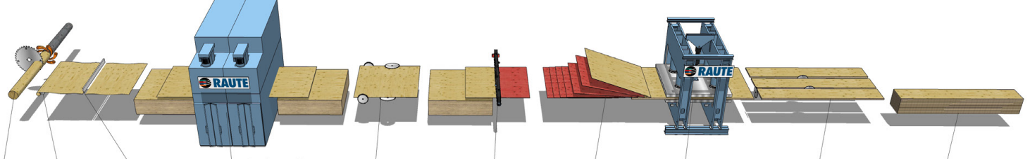
LVL manufacturing flowchart
① ② ③ ④ ⑤ ⑥ ⑦ ⑧ ⑨ ⑩
Steps in the LVL manufacturing process:
Log conditioning and debarking ② Peeling ③ Clipping ④ Drying and grading
Pre-pressing ⑥ Gluing ⑦ Lay-up ⑧ Hot pressing
⑨ Cut to size ⑩ Packing and delivery

Slide 7
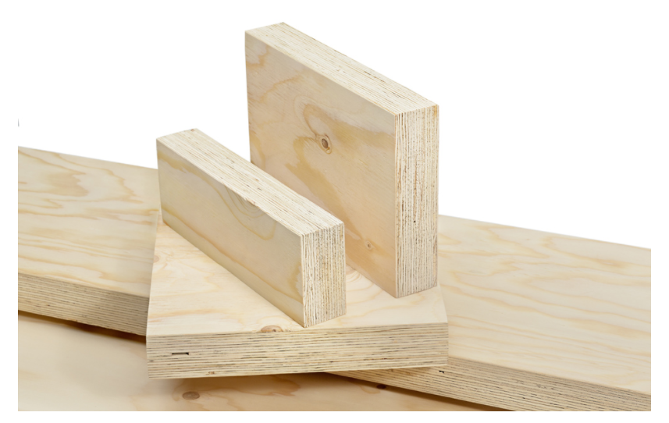
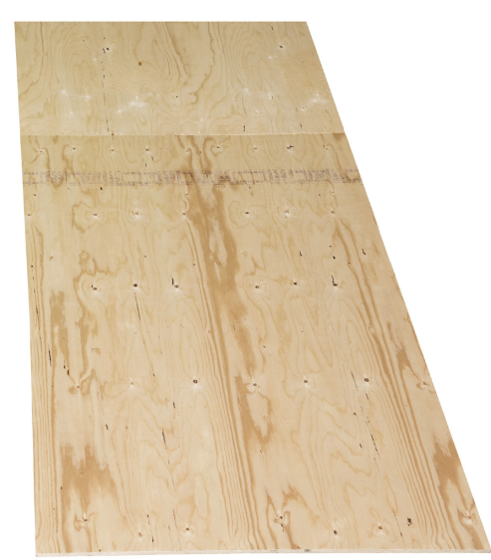
Beam structures with veneers in parallel
Beams where the veneers have all been laid up in in parallel are used as load-bearing beams and columns.
Their load-bearing capacity in the vertical direction of the structure is very good.
The beams are weak in the direction perpendicular to the veneer, which is why the structure must be stiffened in this direction.
As a result, the beams are stiffened to withstand horizontal forces, or at the very least they must be checked for buckling caused by the load.

Slide 8
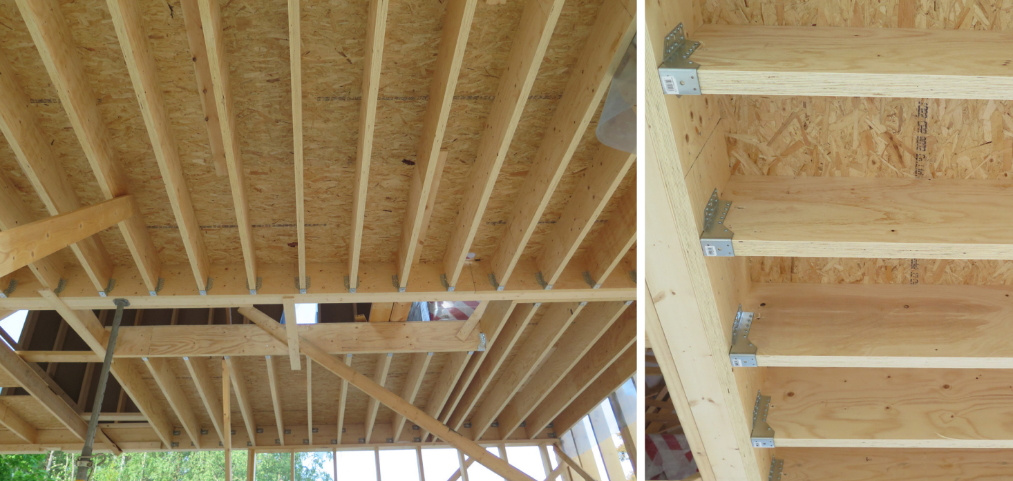
Beam structures with veneers in parallel
The most common heights are 200, 260, 300, 360 and 400 mm, and widths 45 and 51 mm.
When used as a partition wall stud, typical dimensions for LVL are 39x66 and 39x92.
When a large beam is needed, 75x400 is also common.
Standard lengths are 6,000 and 12,000 mm.
For partition wall studs, the standard lengths are 2,550 mm, 3,000 mm, 4,000 mm and 6,000 mm.
LVL structures, photos: LVL-Handbook

Slide 9
Beam structures with cross-bonded veneers
Panel structures with cross-bonded veneers are used as building boards in the base floors, intermediate floors and attic floors.
They can be used as both panels and beams.
Some of the veneers (approximately 20%) are laid crosswise, which increases the transverse strength and rigidity of the piece.
Large penetrations for building services can be made into the structures without significantly impacting their load-bearing capacity.
Thicker 75 mm panels can be used in residential buildings, even wooden blocks of flats.
The most common widths are 900, 1,200, 1,800 and 2,500 mm.
The thickness of the panels varies between 27 and 75 mm in 6 mm increments.
The length of the panel is 2,000–25,000 mm.

Slide 10
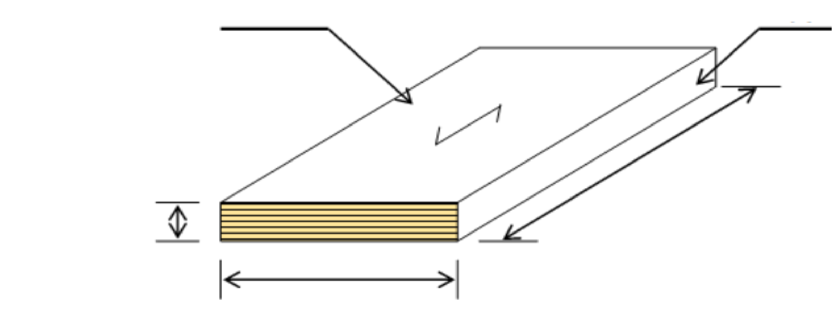
Massive LVL panels
LVL panels are also manufactured for unit prefabrication. LVL panels that are 84–350 mm thick, 100–2,400 mm wide and 6,000–19,900 mm long can be manufactured for use in horizontal structures (base, intermediate, and attic floors).
For wall structures, panels come in the following dimensions: thickness 75–350 mm; length 6,000–19,900 mm; width 2,550, 2,800, 3,000 or 3,150 mm.
Face
Edge
Length
Thickness
21–75 mm
Width ≤ 2,500 mm

Slide 11
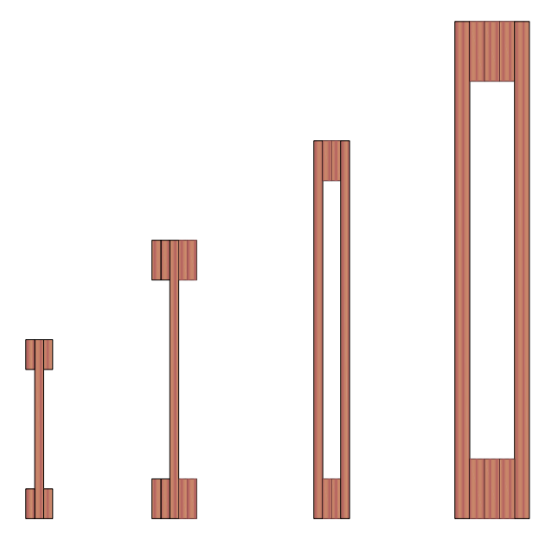
LVL building elements
LVL products are used for all construction purposes: from new construction to renovation and industrial use.
Examples of applications include beams, columns, trusses, frames, and window and door components.

Slide 12
Prefabricated roof, floor, and wall units
LVL is an excellent material for prefabricated units.
Prefabricated wood units speed up the assembly and reduce project costs.
The load-bearing structure of the units typically consists of fixed sections that allow spans of up to nine metres in roofs and floors.
LVL is a light, robust, and durable solution for load-bearing structures that also enables long spans.

Slide 13
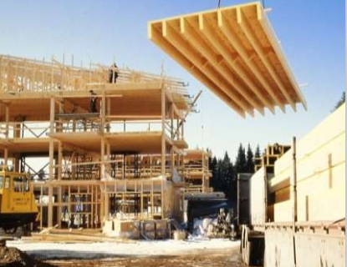
Rib panels
Rib panels are best suited for short-span floors, lean-tos, and uninsulated roofs.
Rib panels consist of a uniform, LVL panel with cross-bonded veneers and structurally bonded LVL ribs with parallel veneers.
The units can be supplied pre-equipped with factory-fitted PVC or underfelt.
Rib panels can also be implemented as inverted structures on intermediate floors or as roof panels in prefabricated box units.
Rib panel installation

Slide 14
Semi-open rib panel
The semi-open rib panel is best suited for the base and attic floors of residential buildings, schools, day-care centres, and offices.
The panel is rigid but has a low structural height, which enables the cost-effective implementation of the vibration design of the floors.
Carefully designed joint details speed up the installation and simplify the construction of wall structures while ensuring a tight and non-settling end result.

Slide 15
Closed rib panel
With a maximum length of 24 m, closed rib panels can be used as long-span attic floor components.
Cross-bonded LVL panels form a diaphragm that can also be used to stiffen the framework.
Thermal insulation and waterproof roof are installed at the factory, and all work performed during the installation phase can be done from the roof side.
This secures the thermal and moisture performance of the structure.

Slide 16
Manufacture of LVL panels

Slide 17
Log conditioning and debarking
The logs delivered at the factory are measured, debarked, conditioned in warm water, and cut to the correct length for the veneer-peeling machine.
The logs are conditioned in water or steamed in order to soften the wood before veneer-peeling or cutting.
The conditioning time varies from 24 hours to a week and the temperature from 60 to 80 °C, depending on the tree species.
The temperature may affect the colour of the wood somewhat, e.g. beech becomes redder at higher temperatures.

Slide 18
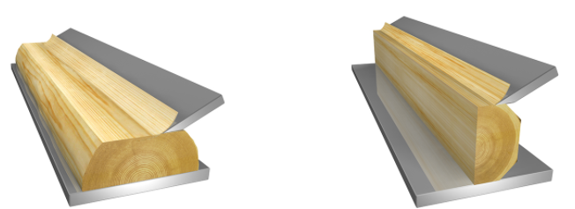
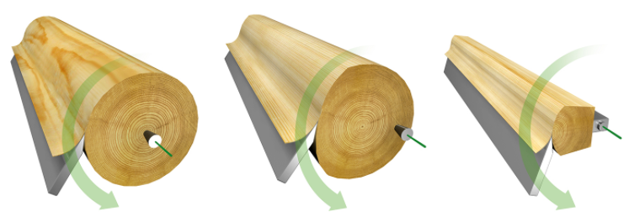
Peeling
The production of LVL is based on peeling: 3 mm thick veneer sheets are peeled off the sturdy logs and glued together under heat and pressure.
The density, moisture content, and elastic modulus of each sheet of veneer are measured.
The sheets are placed in the order that enables the best utilisation of the strongest veneer grades.
Industrial veneer manufacturing is based on either peeling or slicing.
The cheapest tree species are typically peeled, while the more valuable ones are sliced for the most demanding applications of veneer.
The manufacturing method affects the appearance and surface treatment properties of the veneer's grain pattern.
Carpenters may also produce individual veneer surfaces by sawing.
Tangential slicing Radial slicing
Images: Puupro
Veneer peeling Eccentric peeling Staylog peeling
Images: Puupro

Slide 19
Peeling
Sliced veneer is made by planing veneer sheets from the log, which helps preserve the natural grain pattern.
Slicing results in thin veneer sheets, minimising the loss of raw material.
No cracks that would impede the processing of the veneer are formed on the surface, unlike in peeling.
Sliced veneer is more expensive to manufacture than peeled veneer, but its properties are better in many respects.
Veneer sliced from valuable tree species is used as surface material for e.g. furniture, hardwood doors, and decorative boards and panels.

Slide 20
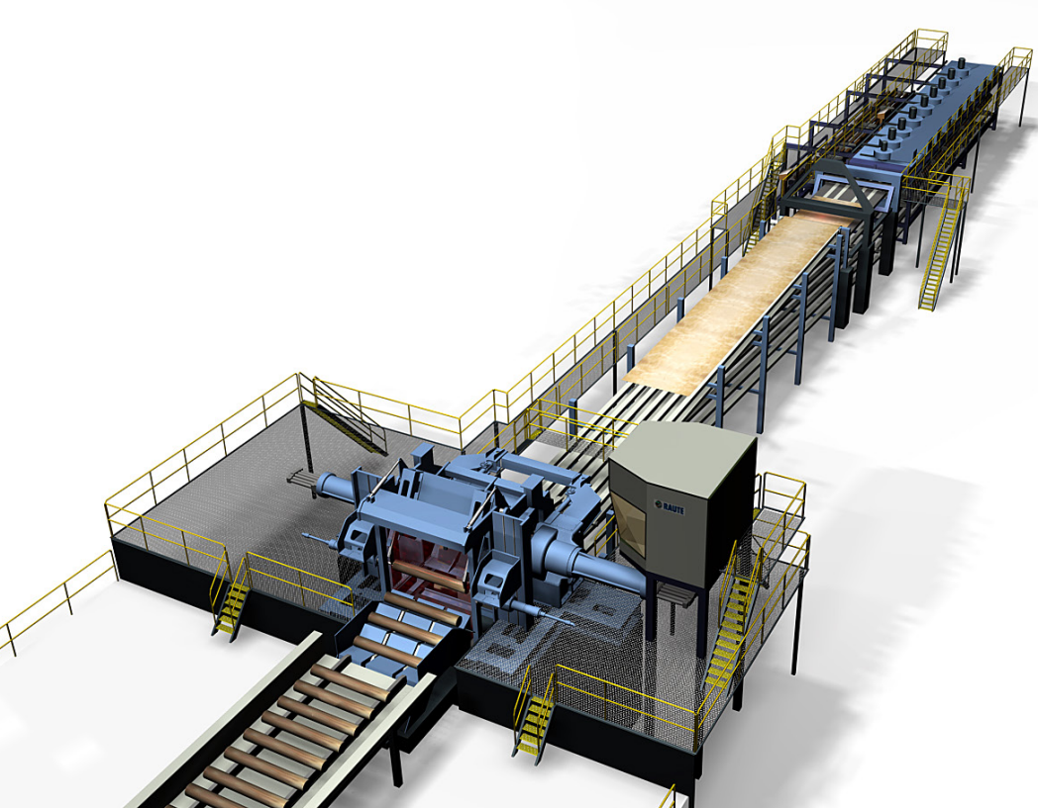
Peeling
The appearance of sliced veneer will depend on the slicing direction.
Veneer cut in the radial direction has a more even appearance than veneer cut in the tangential direction.
Peeled veneer is cheaper, and the sheets are much wider than in sliced veneer.
Peeled veneer is mainly used in the production of plywood, but in Finland, the best birch material is peeled into thin veneer for veneering.
In veneer peeling, a log is spun in a veneer-peeling machine while a blade peels "veneer mat" off the surface of the log.
After all the usable wood has been peeled off, all that remains is the centre section of the log.
LVL veneer peeling line, image: LVL-Handbook

Slide 21
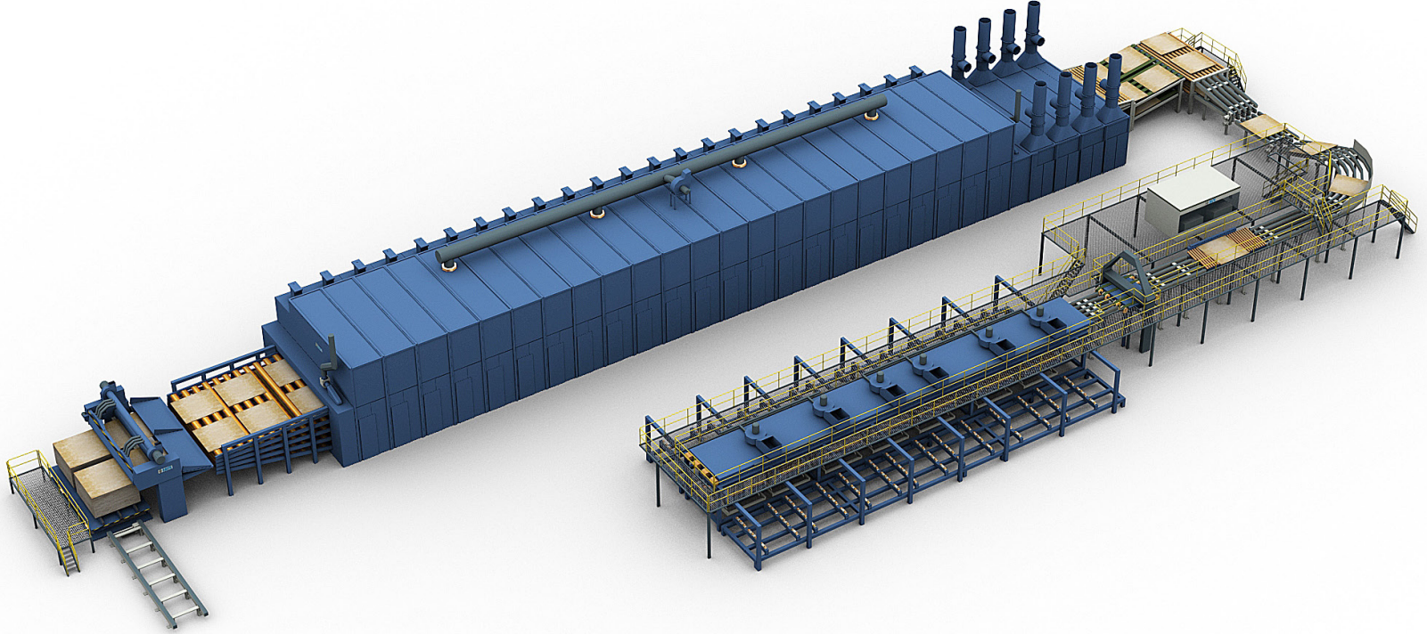
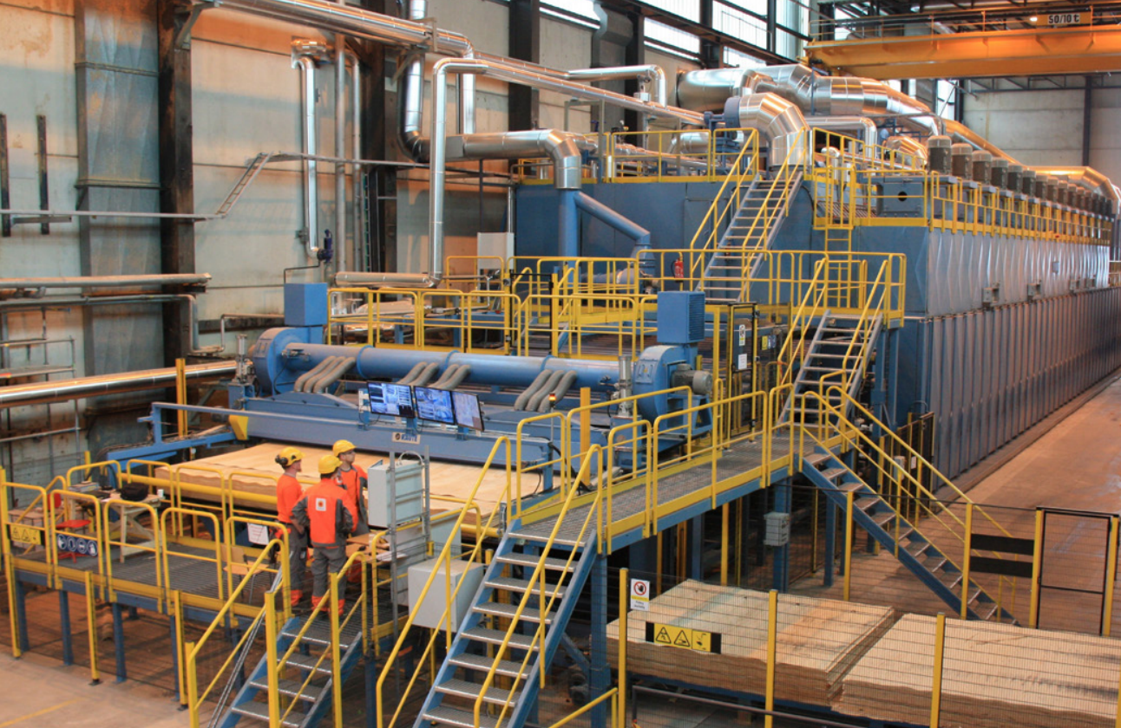
Drying and grading
Veneer drying line, image: LVL-Handbook
The sheets of veneer are dried and stress and quality graded.
After peeling or slicing, the veneer sheets are dried on the drying line.
During the drying process, the veneer is normally bent back and forth in the lateral direction to ensure that it is as smooth and tension-free as possible.
The drying time depends on the tree species and the strength of the veneer. Typically, drying takes a couple of minutes.
Properly dried veneer does not crack or mould and has good machinability.
The right moisture content is between 8 and 12% depending on the application.

Slide 22
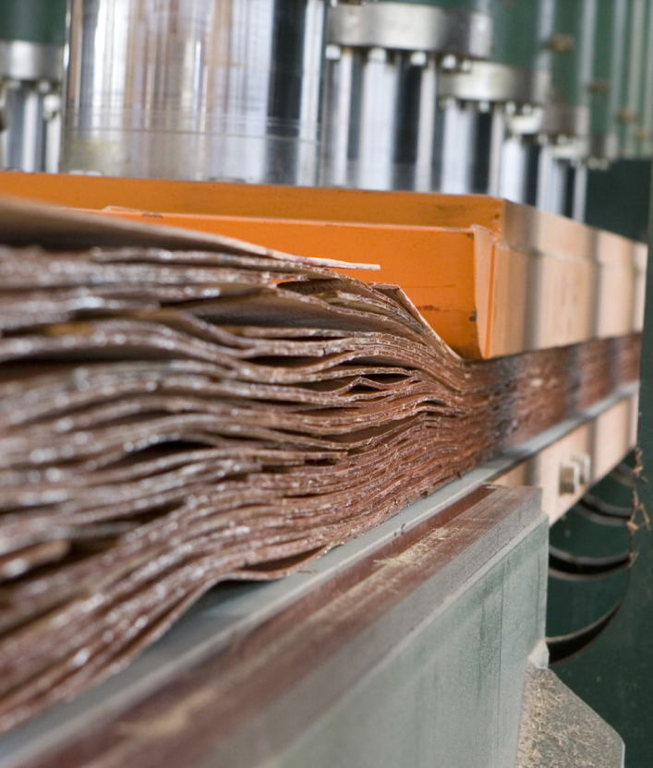
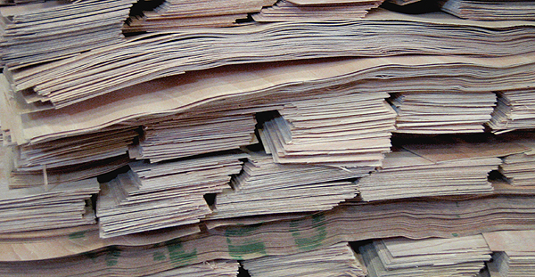
Pre-pressing
After drying, the veneers are post-processed.
The ends and edges of the sheets are cut straight, and the sheets are stacked into small bundles and tied with a string.
After marking the bundles, all the veneer sheets obtained from a single log are carefully kept together and stored in a humidity-controlled environment.

Slide 23
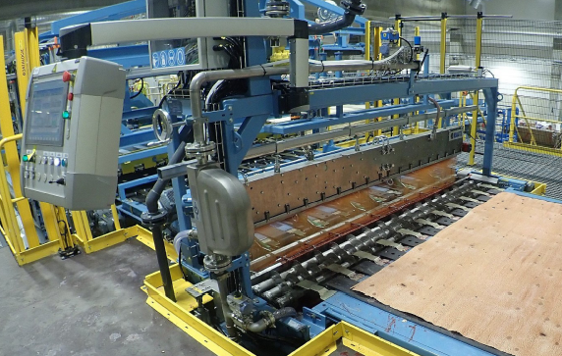
Gluing
Adhesive is applied to the top surfaces of the veneers, and the sheets are laid up to form a staggered, continuous 1.8 or 2.5 m wide billet.
The adhesive is weather-resistant phenol formaldehyde resin.
A colourless melamine adhesive is used for the scarf joints in the top bevels of the face veneer for appearance.
The billet is hot pressed to cure the adhesive joints.
After hot pressing, the billet is cut to size according to the specifications in the orders.

Slide 24
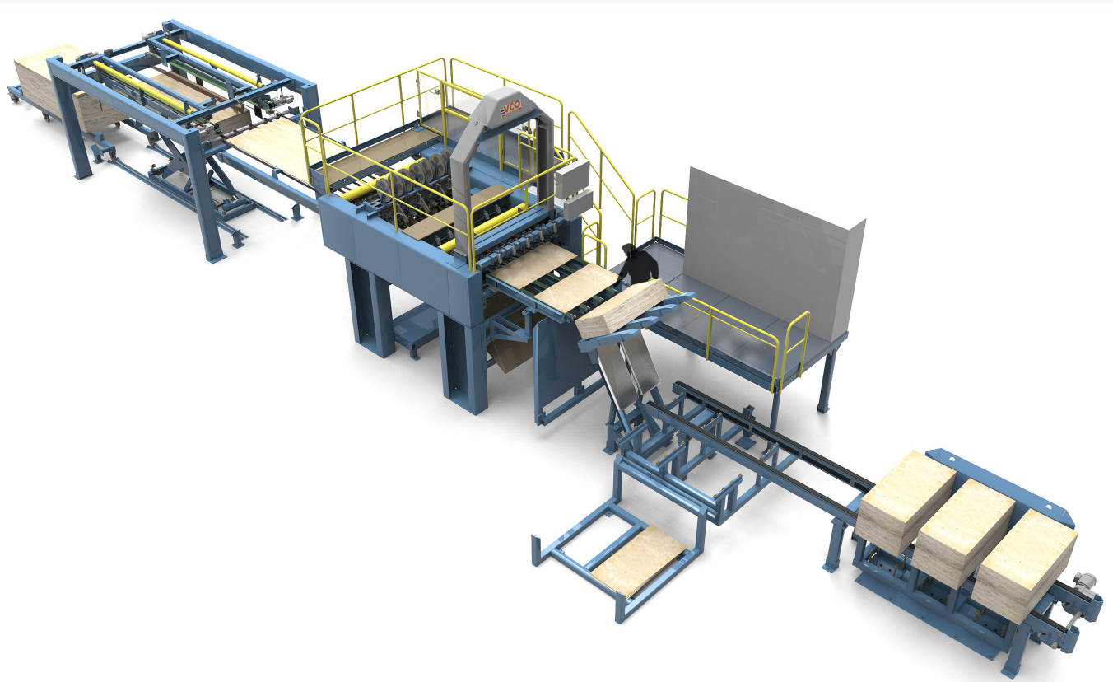
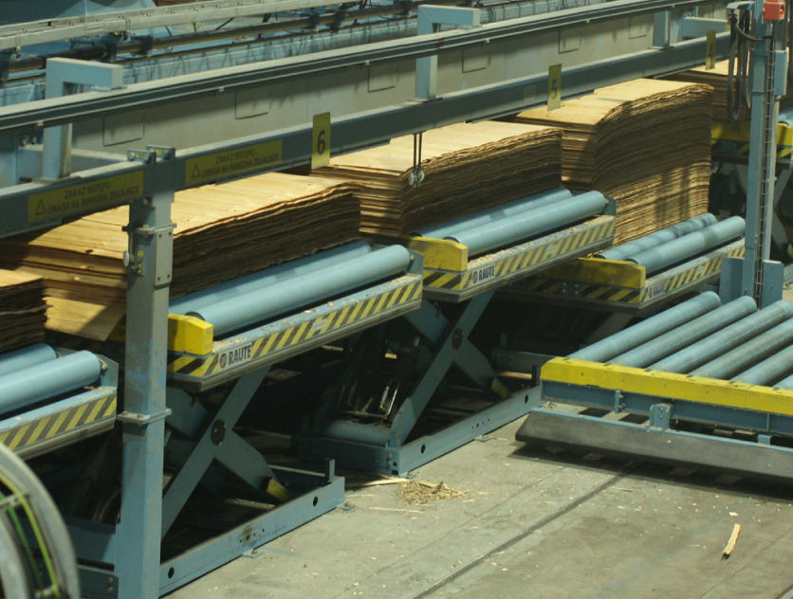
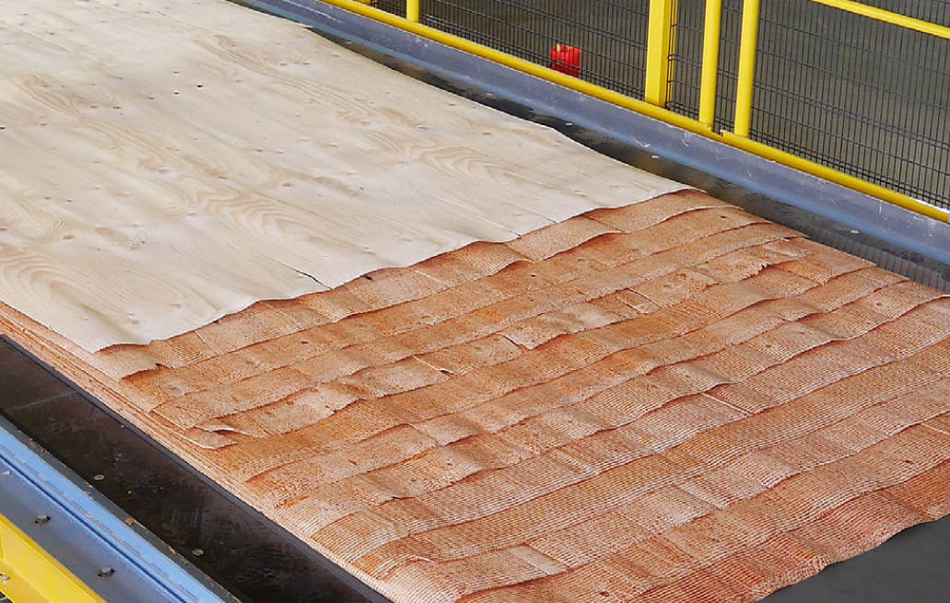
Lay-up
Lay-up, images: LVL-Handbook

Slide 25
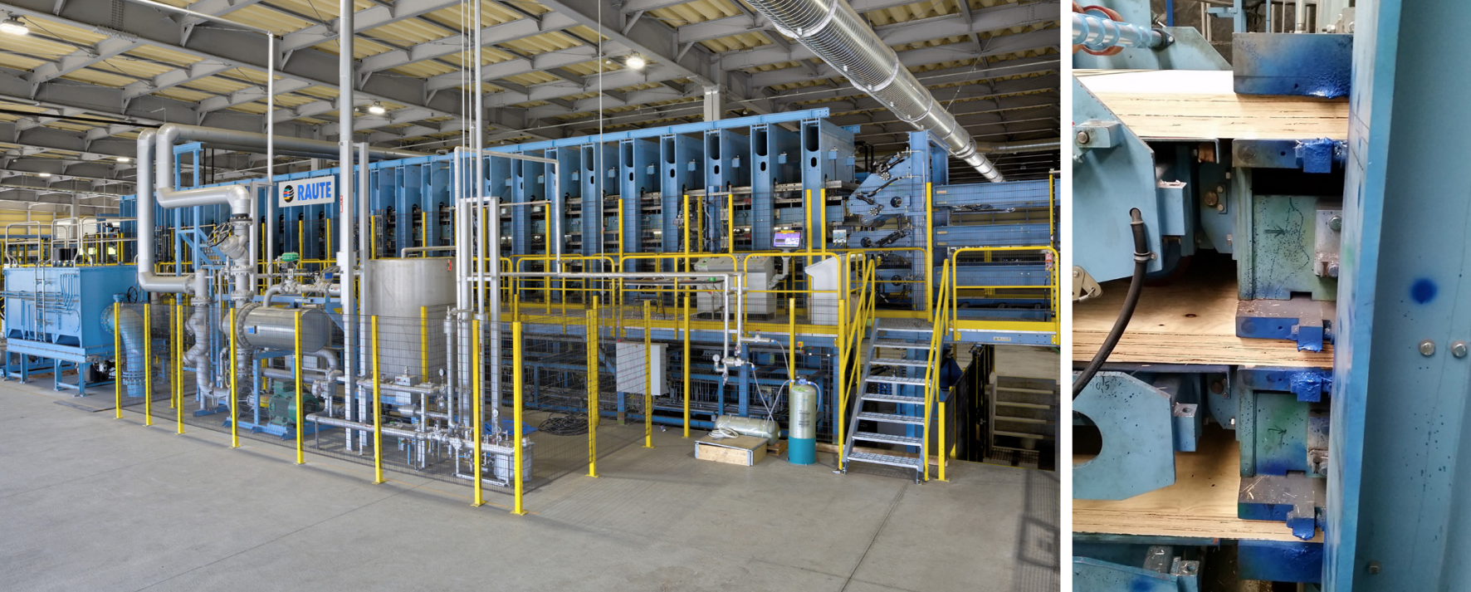
Hot pressing
Hot press
3-level hot press
Images: LVL-Handbook

Slide 26
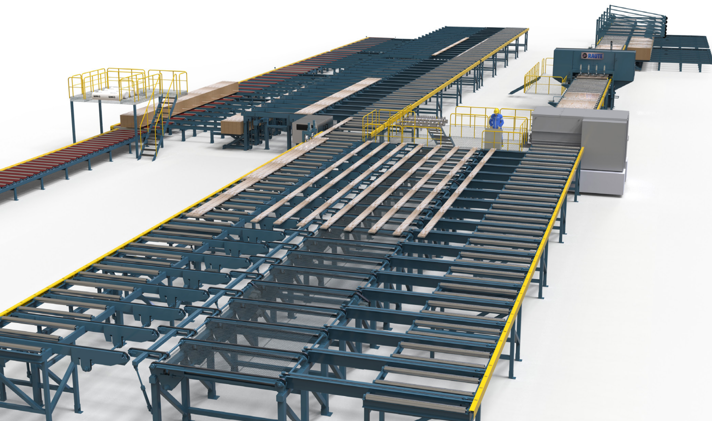
Cut to size
Sawing and packaging line, image: LVL-Handbook

Slide 27
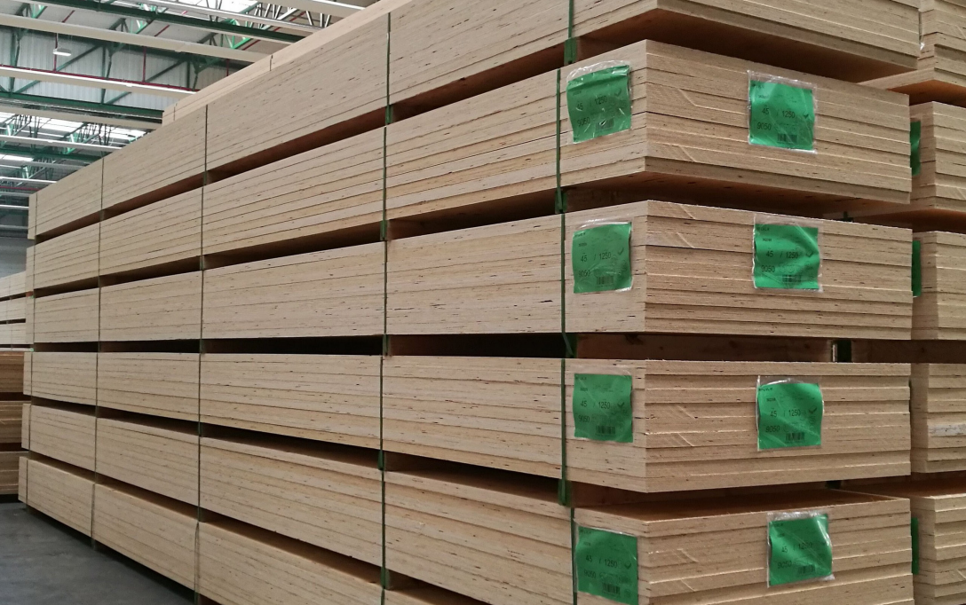
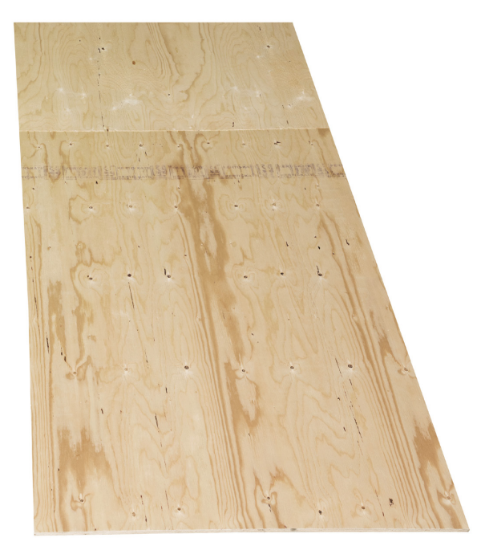
Packaging and delivery
LVL packages
LVL-C panel, images: LVL-Handbook

Slide 28
Machining LVL panels

Slide 29
Machining LVL components
The panels are machined with a CNC machining centre in accordance with the 3D model obtained from the designer.
The 3D model is inserted into the integrated CAD or CAM software, where the machining designer selects the blades, speeds, and machining directions used for the piece.
The size of the piece, the locations of the machining tracks, the surface quality of the panel and the strength, length, and width of the panel must be taken into account.
In addition, the machining order of the workpiece, the selection of blades, the cutting direction of the blade, and the machining speed must be considered.
The workpiece is fastened to the worktop with screws if needed. This helps prevent the machine from breaking and the workpiece from moving.

Slide 30
Machining LVL components
The large rip blades or crosscut blades (up to 1,020 mm in diameter) used for machining LVL panels have been specifically developed for the purpose.
The rotation speed of the blade may not exceed 1,500 rpm. Cutting through LVL panels is very demanding on the blade.
It has also been challenging for blade suppliers to enable both ripping and cross-cutting.
A blade of this size has a machining depth of approximately 400 mm.

Slide 31
Machining LVL components
The machining of billets has also uncovered problems with large circular saw blades: as the blade blunts, it can start to turn in relation to the cutting line, which means that even inclined cuts can easily become curved in relation to the cutting line.
Blades with a smaller diameter provide better cutting precision for the panels.
Blades with a diameter of 800 mm can achieve a machining depth of 250 mm, which is enough for most LVL panels.
Even a machining depth of 150 mm is sufficient, enabled by a blade 600 mm in diameter.

Slide 32
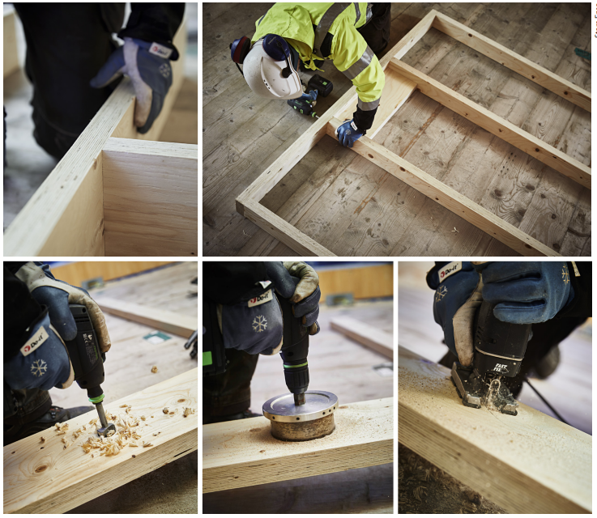
Machining prefabricated
LVL units
The straight cutting lines have first been sawn off the workpiece with a circular saw, after which the curved cuts are made with a shank pick.
Shank pick machining is also required when the openings are removed from the middle of the workpiece.
The use of shank picks should be avoided, as the blades blunt and get worn out very quickly.

Slide 33
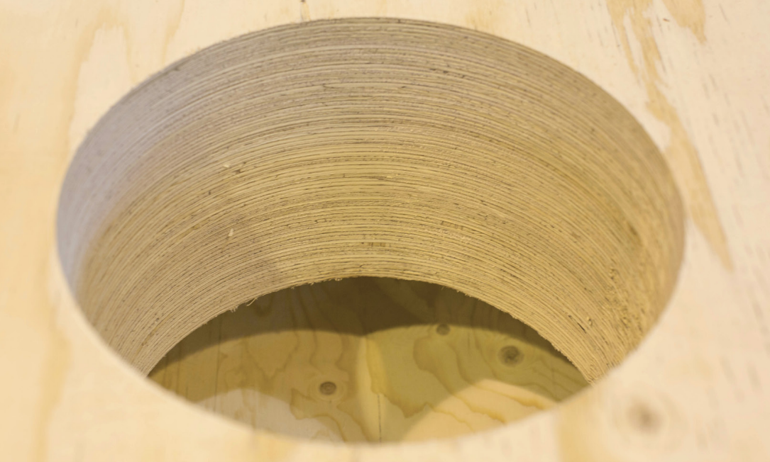
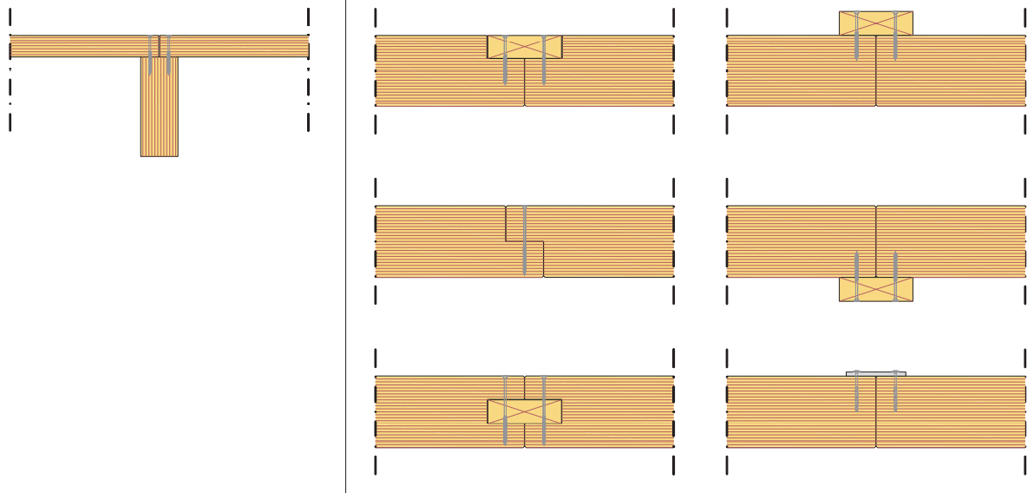
Machining LVL components
The HVAC, plumbing, and electrical designs of a wooden building should be taken into account already in the production of LVL panels.
It is also recommended that the holes and openings for pipes are made already at the prefabrication factory.
Making missing or incorrectly placed holes and openings at the construction site may prove challenging, as holes made in load-bearing building elements often directly affects their load-bearing capacity.
Similarly, firestops for building service penetrations must be designed on a case-by-case basis for each building element.

Slide 34
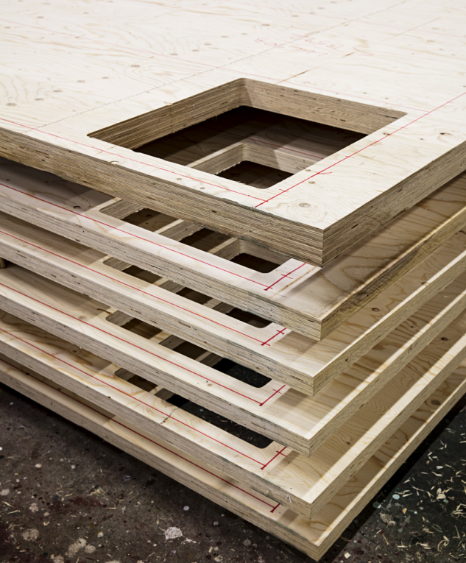
Machining LVL components
The wirings must be designed so that the holes
made to the fire protection boards and acoustic
sheathing can be minimised.
If the switch boxes and electrical cables penetrate the
sheathing of a fire-separating structure, the switch
boxes and the fire stops for the cable penetrations
must meet fire protection requirements.
The penetrations of the switch boxes and electrical
cables in sound-insulated building elements must be
acoustically tight and firestopped.
If necessary, the switch boxes are enclosed with sheathing or e.g. situated so that the penetrations for the boxes are not in the same place on two sides of the same building element.

Slide 35
Lifting and moving LVL units
LVL units must be equipped with the necessary lifting accessories.
In the lifting of solid timber units, a common method is to use a screw and a detachable lifting hook: long screws are attached to the upper part of the solid wood panel (sometimes also to the lower part) where the lifting hooks can be attached during lifting.
The same screws can be used both at the factory and at the site. After on-site installation, the screws can be cut off.
The screws must be installed according to the drawings in order to be able to withstand lifting and keep the unit level and balanced.

Slide 36
Lifting and moving LVL units
Wall units are typically designed to be lifted vertically and horizontal units horizontally to facilitate installation on site.
Loading, i.e. whether the units are transported in a vertical or horizontal position, must also be taken into account when deciding on the lifting points.
Moving or lifting must not cause visible damage to the units (caused by e.g. the lifting forks of the forklift).

Slide 37
Dry chain and packaging
Kuivaketju10 (Dry Chain 10) is an operating model developed for moisture management during the construction process to reduce the risk of moisture damage throughout the building's life cycle.
Moisture risk management is based on a chain where risks are prevented at all stages of the construction process, and the success of the prevention measures is verified in a reliable manner.
The operating model is comprised of the Kuivaketju10 risk list and the risk verification instructions, which cover ten most significant moisture risks.
Appropriate management of these risks avoids over 80% of the consequential costs of moisture damage.
The dry chain begins at the factory, where LVL panels are carefully packaged in protective plastics for transportation and on-site storage to prevent exposure to moisture.
The plastics also provide protection against dirt and damage.
Packages are marked with symbols, so that they can be easily identified at the construction site.

