Slide 1



Industrial wood construction
Teaching materials for industrial wood construction education
2022

Slide 2
Origin of the materials
Use of the materials
These learning materials for industrial wood construction have been prepared in a project led by Puuinfo Oy in 2021–2022. Also involved in the project were
Lappia Vocational College,
TTS-Työtehoseura ry
South-Eastern Finland University of Applied Sciences,
Metropolia University of Applied Sciences,
Jyväskylä University of Applied Sciences,
University of Tampere, and
Federation of the Finnish Woodworking Industries Puutuoteteollisuus ry
The project was funded by the Ministry of the Environment.
The materials are intended to be used as extensively as possible in industrial wood construction education and studies.
The materials are released under the Creative Commons licence Attribution-ShareAlike (CC BY-SA), which requires that the author be properly credited when the materials are used and that derivative works may only be distributed under the same licence as the original work.
The original materials and any updates to them by Puuinfo will be published on the Library of Open Educational Resources website (aoe.fi) and the Puuinfo.fi website.

Slide 3
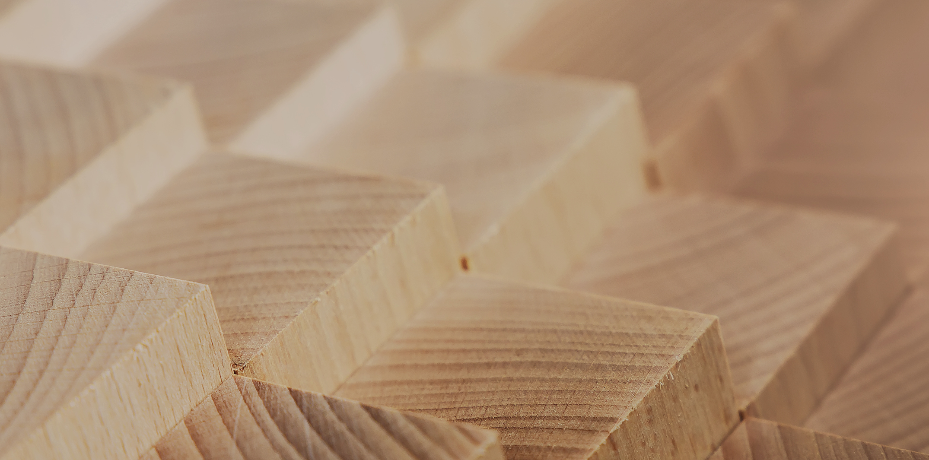
Manufacture of log structures

Slide 4
Authors
Martti Mylly, Lappia Vocational College
Release date: 10/06/2022

Slide 5
Basic concepts of log structures

Slide 6
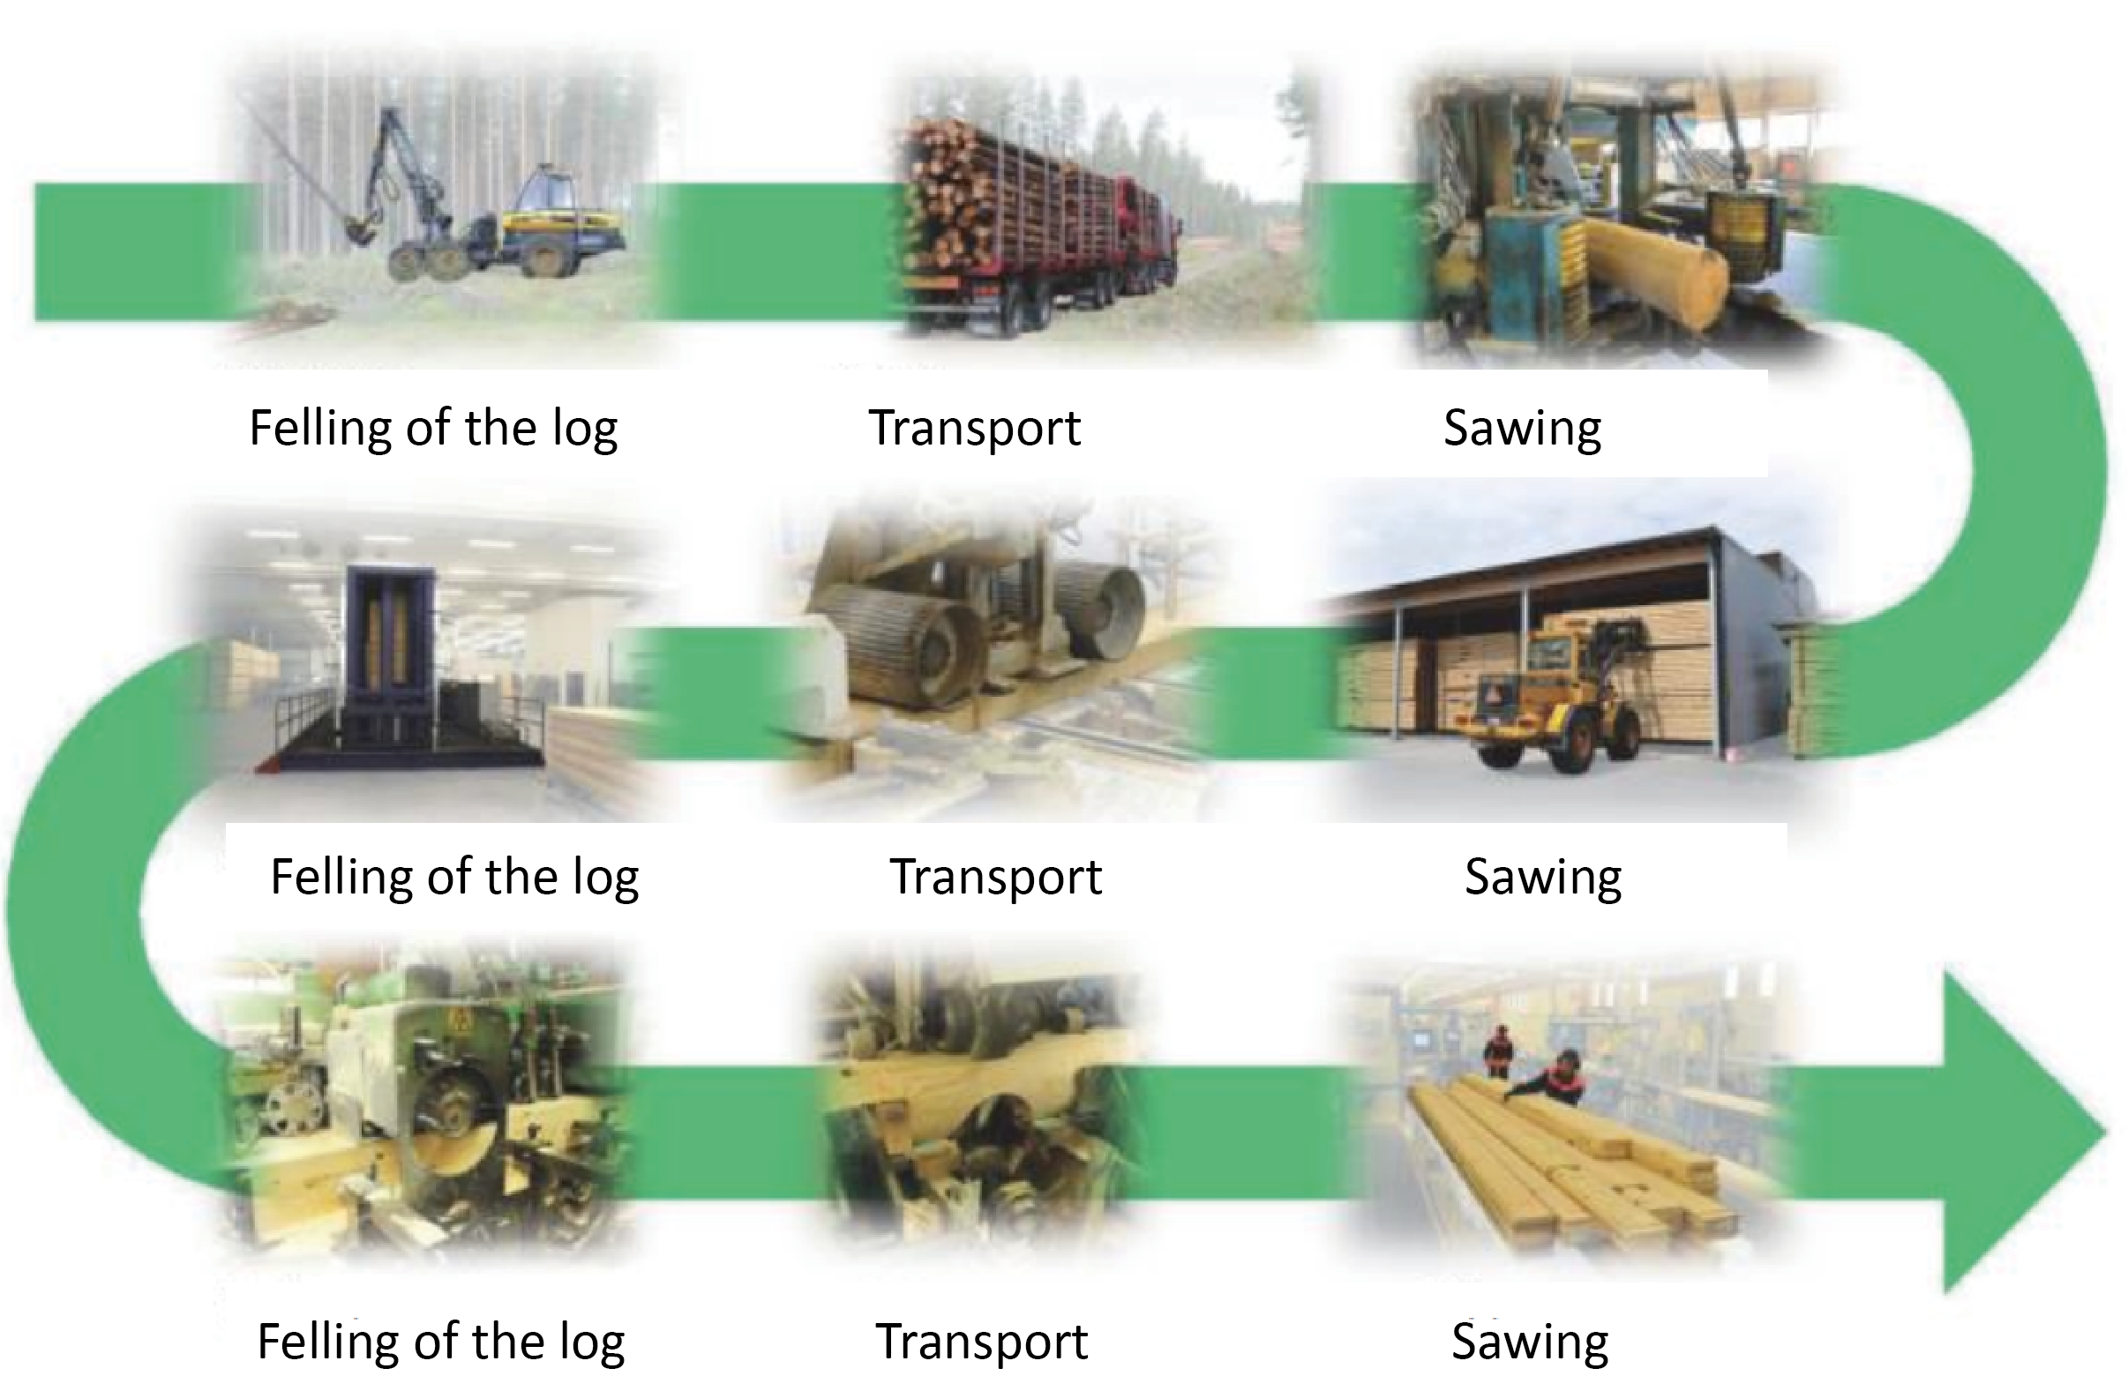
Production diagram
Image Kontiotuote Oy

Slide 7

Log construction
Log construction is a traditional method of wood construction in which the load-bearing walls of the building are built with logs.
In Finland, the logs are usually placed horizontally and joined together by notching at the corners.
Another method of log construction is using vertical logs. The advantage of this method is that it is non-settling, as there is little or no shrinkage in wood in the direction of the grain.
The problem with a vertical log structure is keeping the vertical seams sealed as the wood shrinks.
Image Kontiotuote Oy

Slide 8
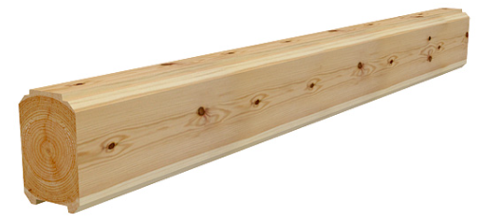
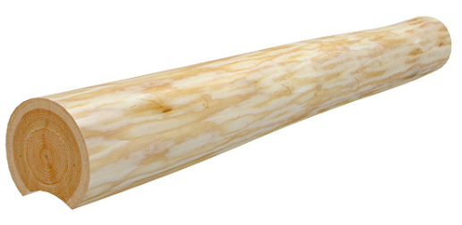
Log
A log is a thick building product made of solid wood and shaped by hand, by planing, or by turning on a lathe.
A log may be round or have corners, and it can be made out of solid wood or by gluing wooden battens together.
Logs are usually made from spruce or pine.
Other tree species can also be used for making logs, but this is less usual.
Images Puu Pro-keskus / Puuproffa

Slide 9
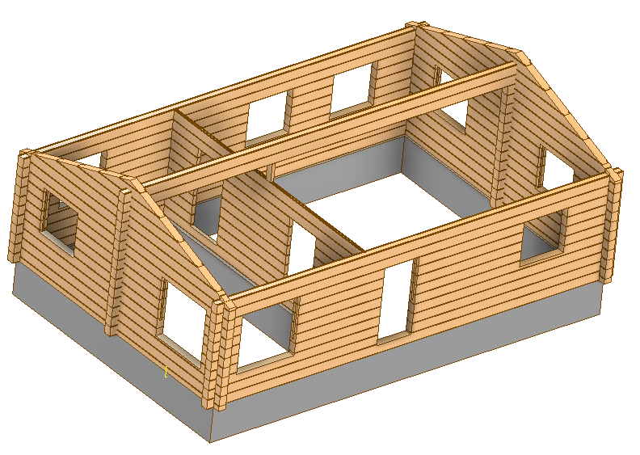
Layer/course of logs
A layer of logs is a wall structure composed of logs.
The walls may be exterior or interior walls.
The logs in a layer are kept together by joints.
A course is a single horizontal layer of logs.

Slide 10
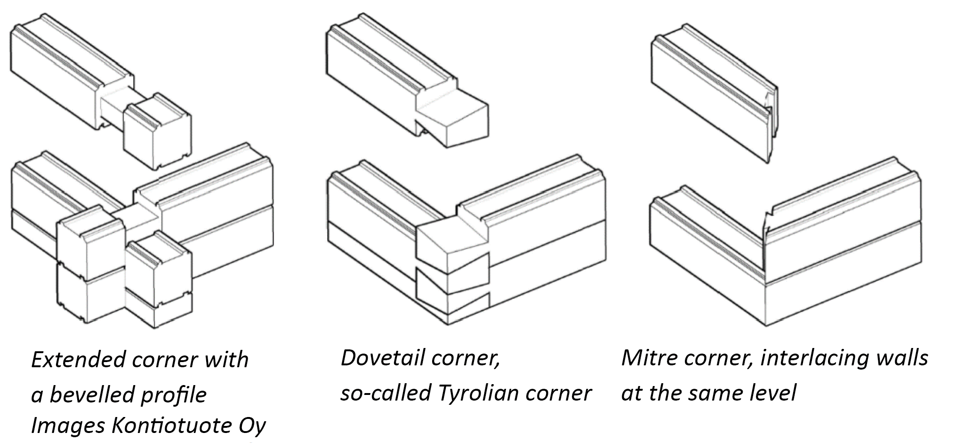
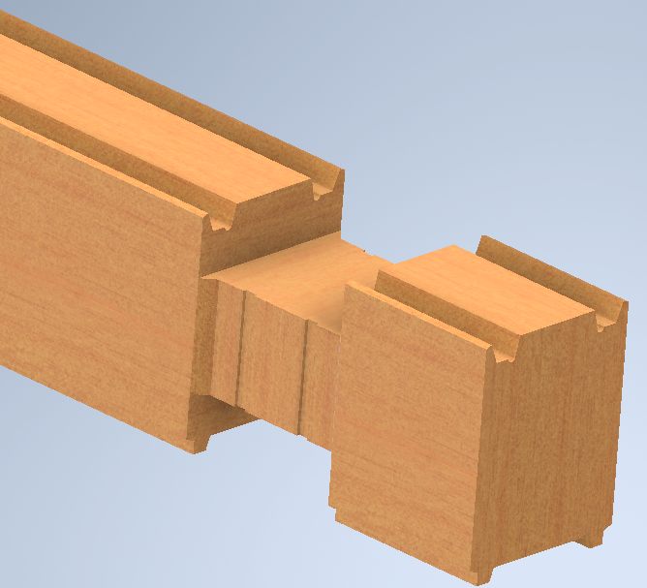
Joint
Logs are connected to each other with joints, which may be long or short. The joints make it possible to connect logs in the corner of a building so that they overlap by one half of a layer.

Slide 11
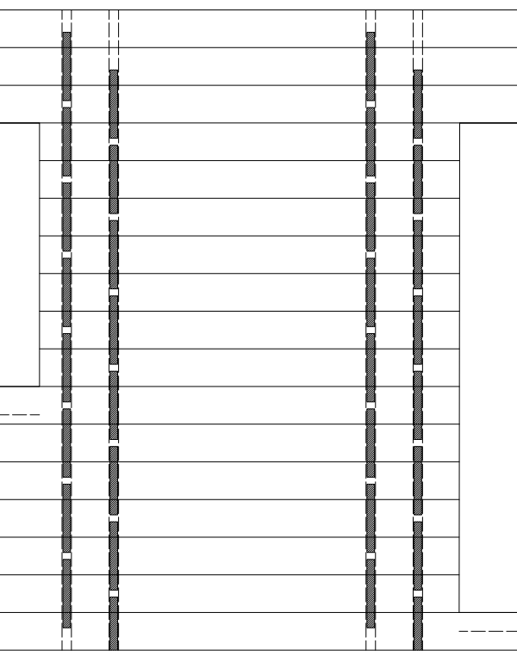
Dowelling
Dowels prevent the layer of logs from buckling.
This is achieved by joining together two or more courses of logs with dowels. Instead of dowels, screws can also be used.
Dowelling is usually located close to joints and openings.
In a continuous log wall, dowels must be placed at a distance of 1600-2000 mm from each other.
Two holes through the log side by side are made for dowelling.

Slide 12
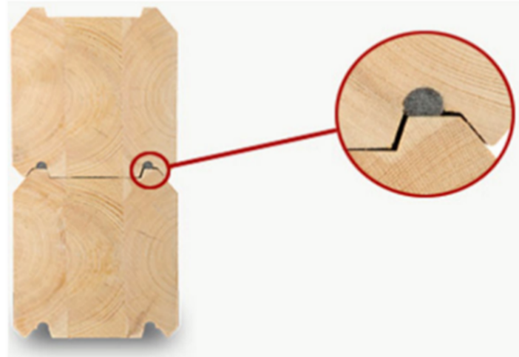
Lateral groove
A lateral groove is cut into the underside of the log.
It is used for sealing and insulation purposes.
A seal is placed in the groove on the outside of the log to prevent rain from penetrating the joint between the logs.
In the inside groove, a thin insulation strip is placed to stop heat from escaping through the joint.
Image Kontiotuote Oy

Slide 13
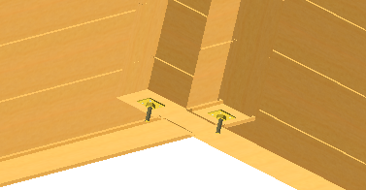
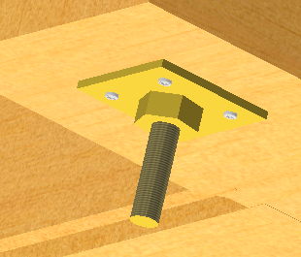
Threaded rod
Threaded rods are used for tightening courses of logs. The rods are placed in holes reserved for them, the size of which is 20…40 mm depending on the factory.
The threaded rods are placed on either side of joints and openings.
A washer and a nut are placed on either end of threaded rods.
The rods are adjusted as the log structure settles.
No threaded rods are used in a log layer made from non-settling logs.

Slide 14
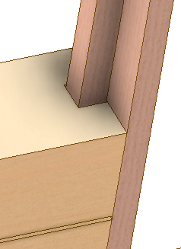
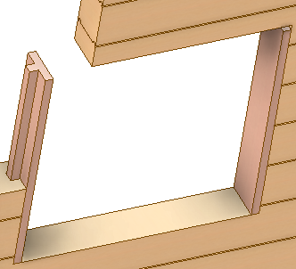
Stud
A buck is installed in a groove cut in the ends of the logs on the sides of an opening in a log wall.
The windows and doors placed in the openings are attached to the buck.
Only the bottom side of the buck can be fixed to the log layer to allow for settlement.
The bucks also prevent the logs from moving sideways in relation to each other at the opening end.
No bucks are needed if non-settling logs are used.
Images Hirsitaloteollisuus ry

Slide 15
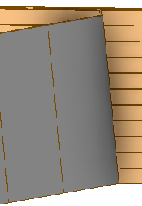
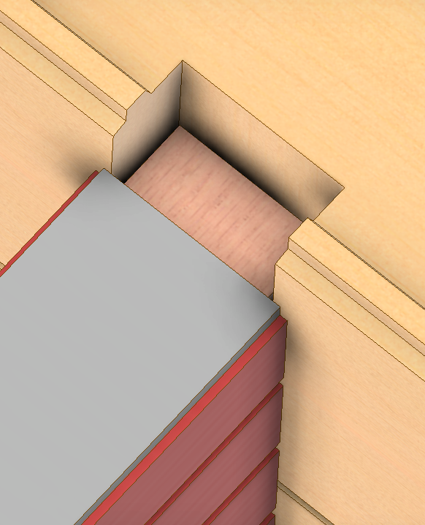
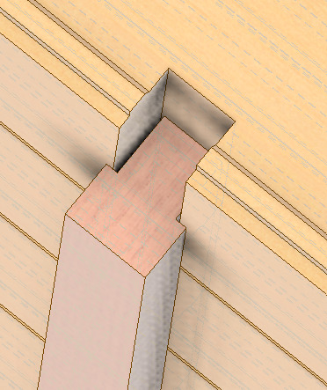
Buck groove / buck
A buck groove is a groove cut for the buck at the end of the log.
The buck groove is slightly larger than the buck so that it can be sealed and insulated to prevent drafts.
Buck grooves are made on either side of window and door openings for the bucks.
Buck grooves are also used when a log wall is joined to a non-settling partition.

Slide 16
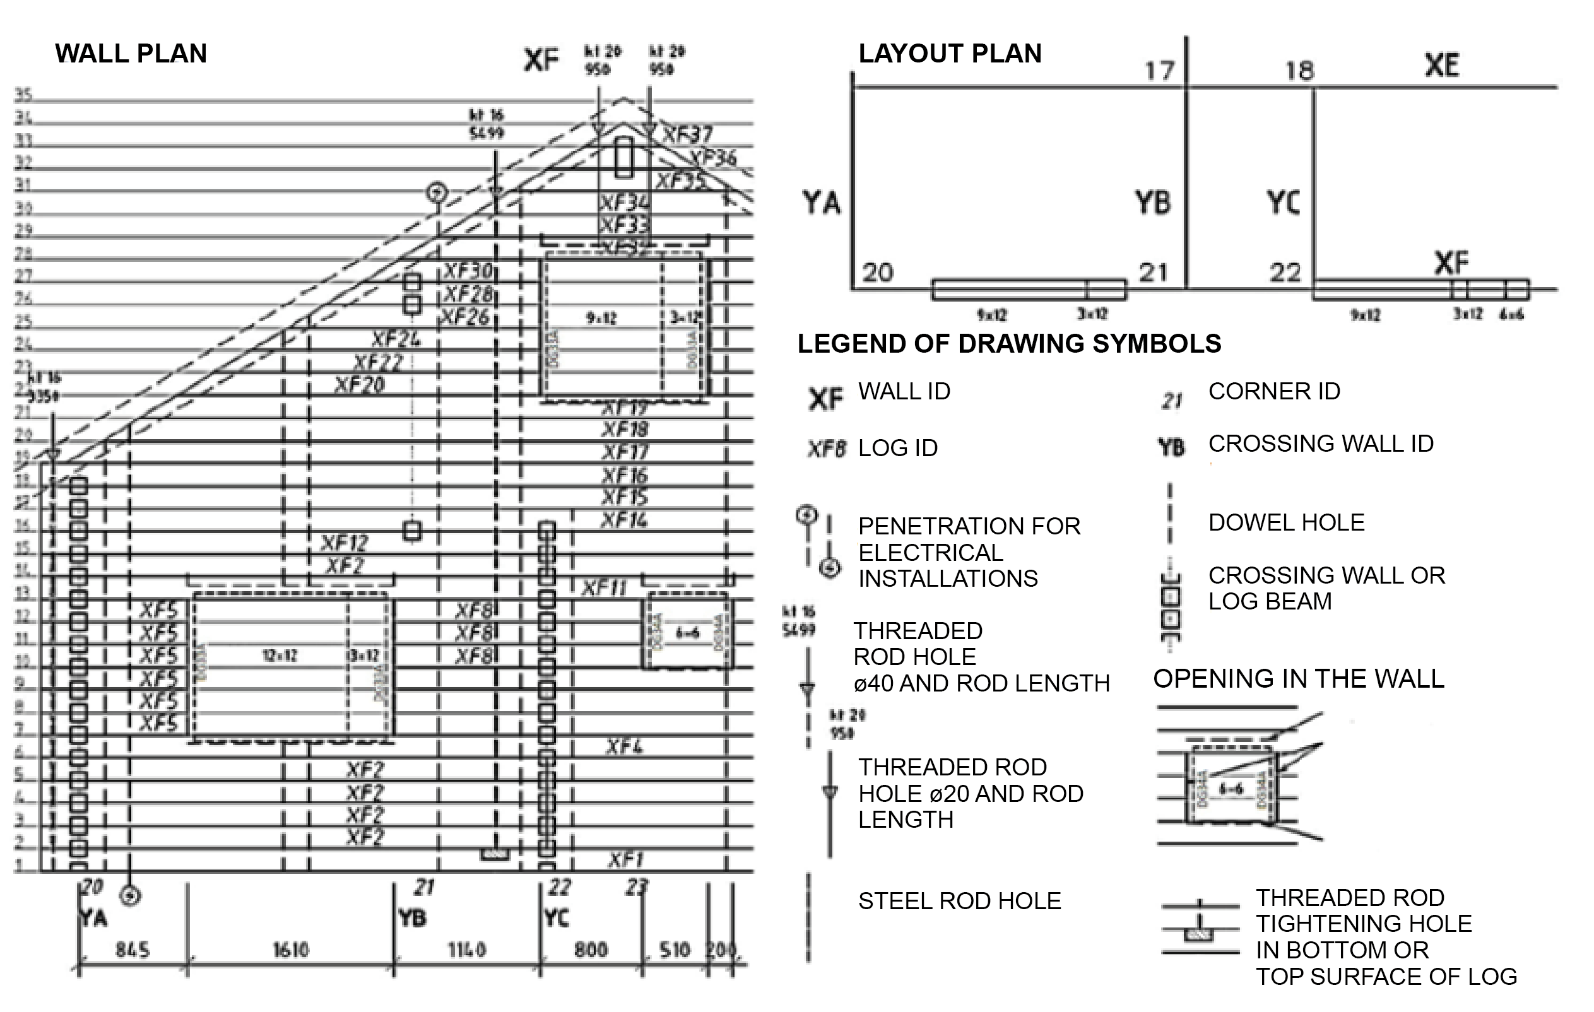
Log wall diagram
The log wall diagram shows the log IDs and the machining of the logs carried out at the factory.
Image Kontiotuote Oy

Slide 17
Log beam
A log beam is made by joining two or more logs together.
Threaded rods are usually used for joining them.
Screws can also be used in non-settling logs.
The threaded rods must be placed close enough to each other (at 400…600 mm intervals) in order for the structure to function as a single beam.
A log beam and any finger joints used in it must be strength graded (at minimum C24).

Slide 18
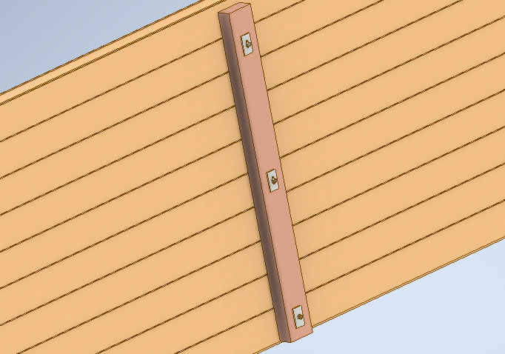
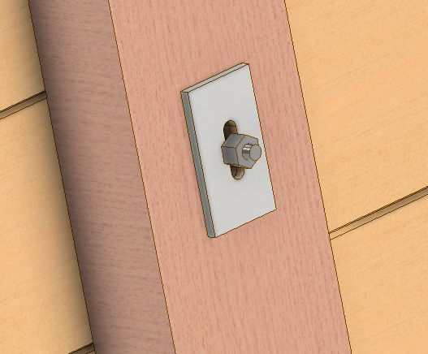

Follower
High log walls may buckle, and long ones be subject to local buckling.
To prevent this, followers are used.
A follower is a vertical support timber that is attached to the layer of logs on either one or both sides.
When used on both sides of the wall, followers are usually fixed to each other with bolts.
A follower on one side only is fixed directly to the logs.
Settlement does not need to be allowed for when using non-settling logs.

Slide 19
Settlement
Settlement refers to the sinking of a log wall caused by shrinkage resulting from drying out of the wood, or by loading due to the weight of the building and compression of the wall joints.
Settlement is strongest during the first two years after the building is completed. Settlement is gradually reduced and finally stops altogether. However, the height of a log structure changes along with fluctuations in wood moisture throughout its life span.
Settlement cannot be prevented as wood always has a certain equilibrium moisture content, depending on temperature and relative humidity. However, the harms caused by settlement can be eliminated using adjustable jacks, bucks and threaded rods.
The extent of settlement depends on the log type. Non-settling logs are not subject to any settling in practice, which is why settlement need not be allowed for when using them. Solid timber settles more than glued logs, and a round log more than a square one.

Slide 20
Log extensions
In long walls, it is often necessary to join two or more logs to each other.
At the corner joints, a so-called half-lap, straight butt, slanted or butt-and-pass joint can be used.
In a half-lap joint, a steel plate is used to join the logs together.
The steel plates are attached to the logs with nails or screws.
The extensions are sealed and insulated in the same way as normal joints.

Slide 21
Pre-treatment stages of sawn timber

Slide 22
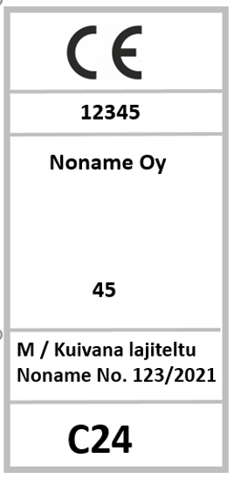
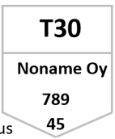

Strength grading of sawn timber
Sawn timber used for logs is usually not strength graded.
If the logs are used as beams, the sawn timber used for this purpose must be strength graded.
Sawn timber is graded according to INSTA 142 standard.
INSTA complies with strength grading in standard EN 14801.

Slide 23
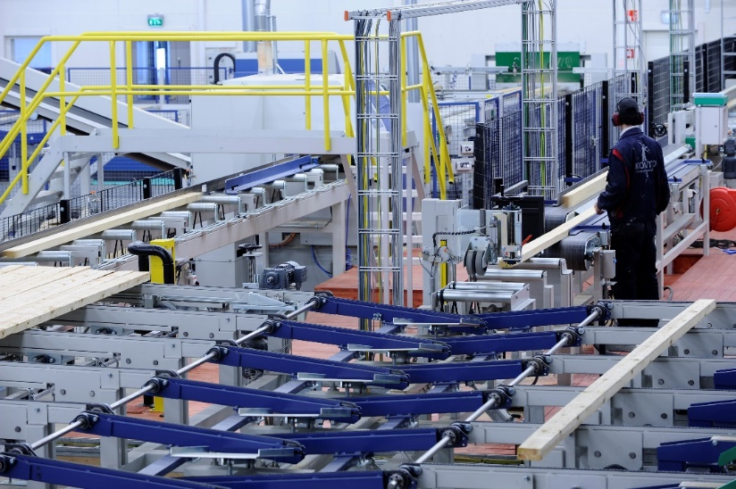
Finger-jointing sawn timber
Finger-jointing of dried sawn timber takes place after quality control.
In quality control, the moisture and grade of sawn timber are measured automatically.
Finger joints are only made in sawn timber that meets the criteria.
Image Kontiotuote Oy.

Slide 24
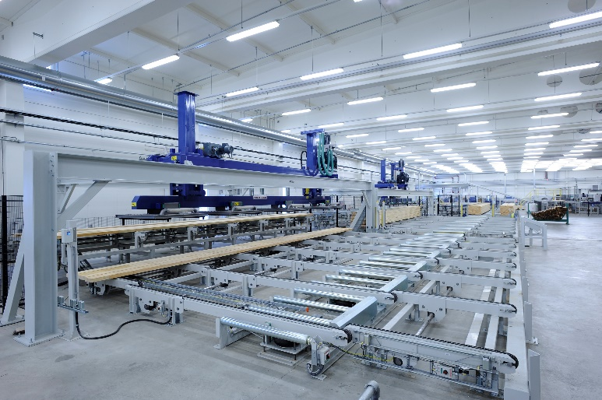
Planing of sawn timber
After finger-jointing of log lamellae, they move on to the planing stage.
Surface and middle lamellae are sorted into bundles.
For visual reasons, the surface lamellae are of better quality than the middle ones.
Pneumatic hoists are used to hoist lamellae to avoid damaging them.
Image Kontiotuote Oy.

Slide 25
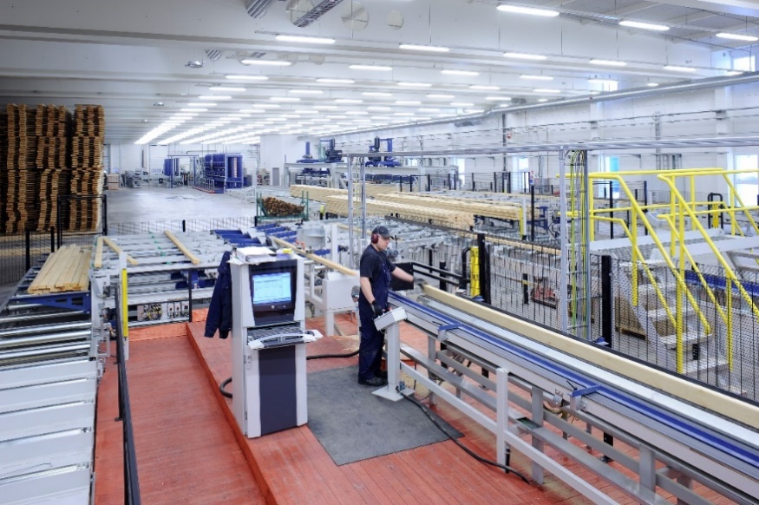
Gluing of sawn timber to produce billets
Sawn timber is glued under supervision to produce billets.
Before gluing, the functioning of the nozzles and the volume of glue they produce are checked.
In order for the gluing to be successful, the temperature and relative humidity must be compliant with regulations.
Image Kontiotuote Oy.

Slide 26
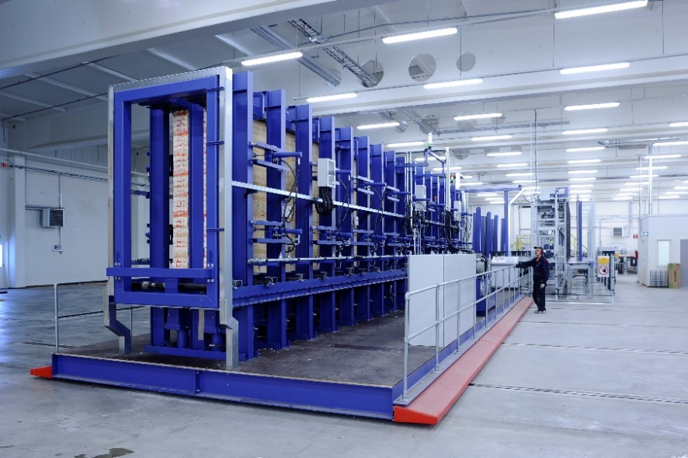
Gluing of sawn timber to produce billets
The log lamellae are glued to produce billets and pressed in a hydraulic press.
Glue is injected onto the surfaces to be glued, after which they go into the press.
The billets for several log houses are produced in one pressing batch.
Image Kontiotuote Oy.

Slide 27
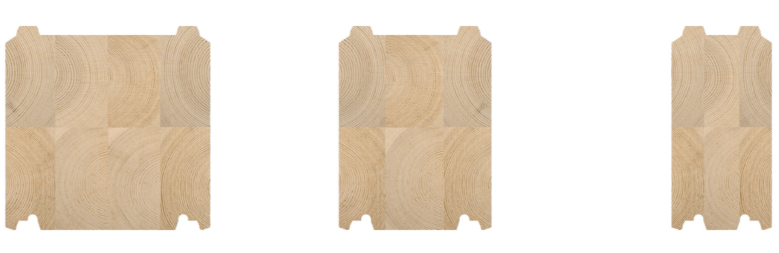
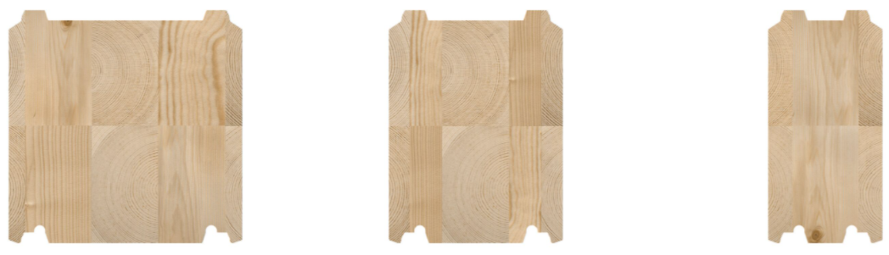
Profiling of a billet
The glued billet is shaped (profiled) by planing.
In this process, the billet receives its accurate cross-sectional dimensions.
The planing also removes any glue that might be visible.
When the billet is profiled, its tongues and grooves, grooves in the upper surface and corner bevels are made.
Images Kontio

Slide 28
Log machining

Slide 29
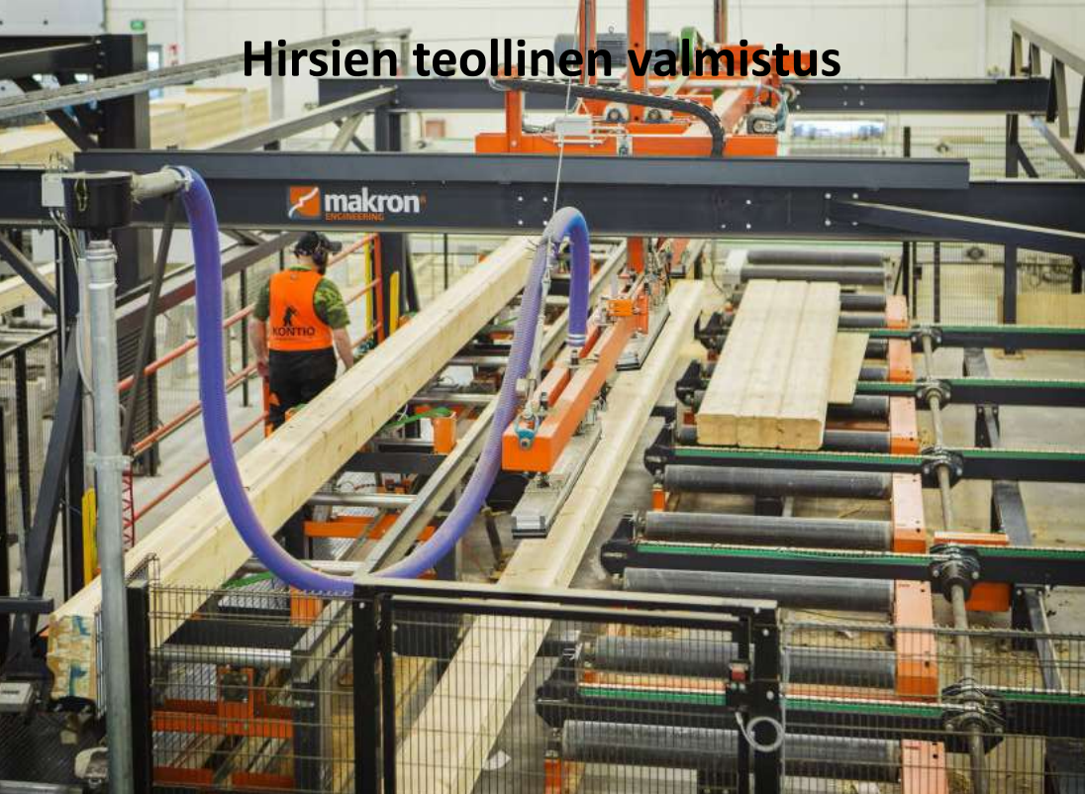
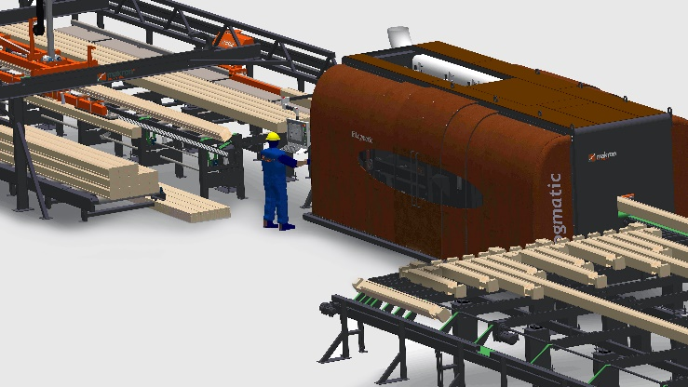
Profiling machines
Industrial manufacturing of logs
The machining of logs is done by a so-called profiling machine, which produces not only joints but also holes, buck grooves and other machining required before the logs are installed.
Images Pinomatic / Makron

Slide 30
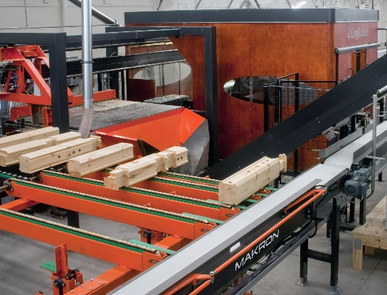
Joints
The most typical joint type is an overhang corner.
At a distance of approx. 200–300 mm from the log end, holes of the same size are made in the top and bottom surface, making it possible to install logs of a vertical wall both above and below it.
A gap of approx. 4–6 mm is left for insulation between the joints.
A gap for insulation is also provided on the sides of the joints to ensure that they are well sealed.
The top joint only can be provided for if another log will only be installed above the log to be machined.
Similarly, the bottom joint only can be provided for if another log will only be installed below the log to be machined.
When using the overhang corner joint, crossing logs overlap by a half of a log course.
Images Pinomatic / Makron

Slide 31
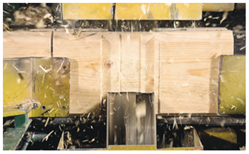
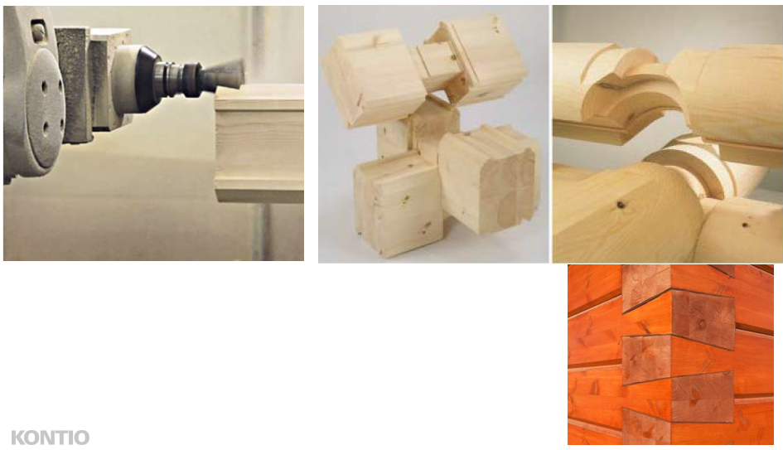
Joints
Finished long corner joints, images Kontiotuote Oy
Machining long corner joints, image Kontiotuote Oy

Slide 32
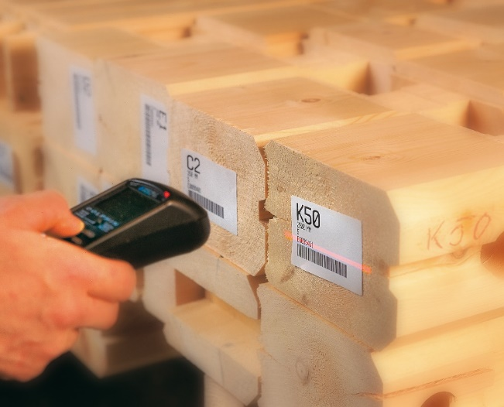
Packaging of logs
Each log has its ID and bar code, based on which the logs are installed in the layer of logs.
On this basis, the logs are packaged in their installation order, and the information in the bar code is read to assist the packaging.
Image Kontiotuote Oy.

Slide 33
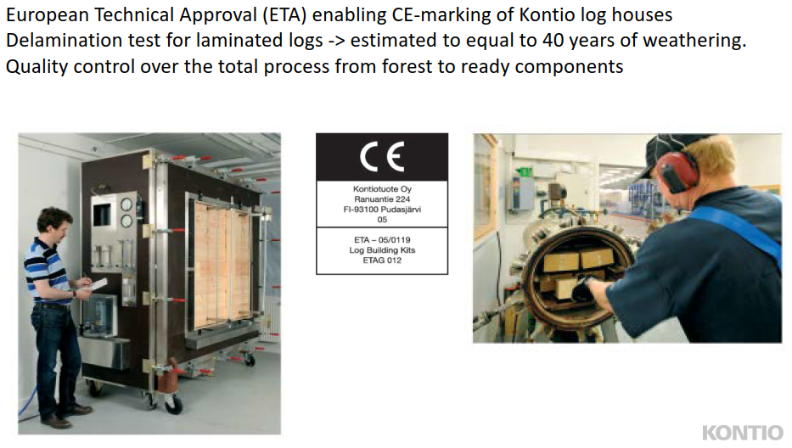
Testing of the glued bonds in logs
In the delamination test, a test piece is immersed in water (temperature 65…75 °C) and any air inside the wood is removed using a vacuum.
The pressure in the tank is increased (to a minimum of 600 kPa), which causes water to penetrate into the wood cells, and glued bonds open.
After drying, the lengths of the opened glued joints are measured.
The glued joints are then split, and the percentage of glue in them is estimated.
This estimate is based on a visual inspection rather than accurate measurements.
A report is produced on the test results, which must be kept on file. The test pieces must also be numbered and archived.

Slide 34
Installation of logs

Slide 35
Installation of a layer of logs
The logs are installed one course at a time.
Installation of interlacing logs:
the installation starts with the walls where an upper half is the bottom-most log.
the installation then progresses one course of logs at a time on alternating walls
Installation of logs placed at the same level:
the logs are installed one course at a time
The joints and grooves in each layer of logs are insulated
Dowels are installed following instructions
Threaded rods are installed when the entire layer of logs has been assembled
Log framed houses in evening light, image Kontio

Slide 36
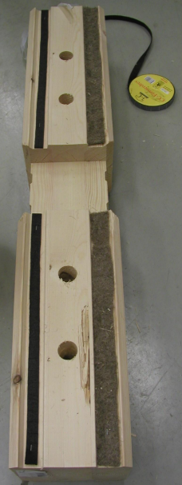
Insulating grooves
A sealing tape is placed in the outside tongue and groove of the log to prevent moisture from rain entering at the joint between the logs.
EPDM tape or similar material is used for sealing.
A thin strip of heat insulation is placed in the interior groove, which makes the seam airtight and thus prevents heat convection.

Slide 37
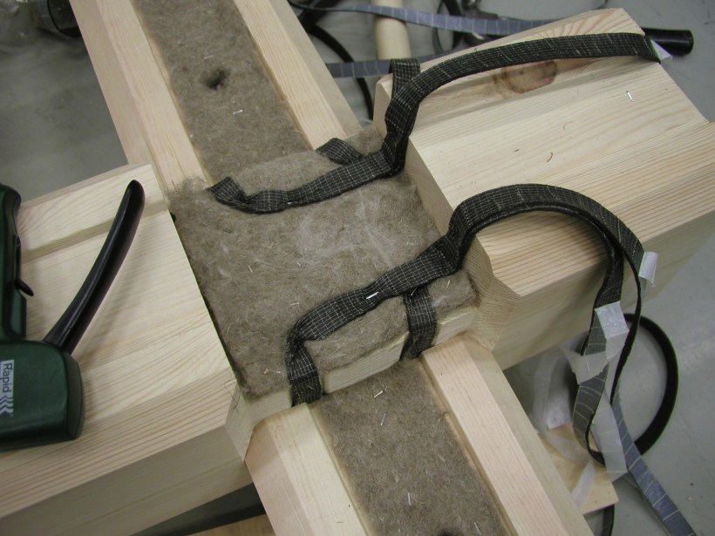
Insulation of joints
The corner joints of logs are sealed and insulated to seal the corner as well as possible.
EPDM tape is usually used as sealing material, and a thin strip of mineral wool or polyethene tape is used for insulation.
In some log types, the insulation is wound around the entire joint.

