Slide 1



Industrial wood construction
Teaching materials for industrial wood construction education
2022

Slide 2
Origin of the materials
Use of the materials
These learning materials for industrial wood construction have been prepared in a project led by Puuinfo Oy in 2021–2022. Also involved in the project were
Lappia Vocational College,
TTS-Työtehoseura ry
South-Eastern Finland University of Applied Sciences,
Metropolia University of Applied Sciences,
Jyväskylä University of Applied Sciences,
University of Tampere, and
Federation of the Finnish Woodworking Industries Puutuoteteollisuus ry
The project was funded by the Ministry of the Environment.
The materials are intended to be used as extensively as possible in industrial wood construction education and studies.
The materials are released under the Creative Commons licence Attribution-ShareAlike (CC BY-SA), which requires that the author be properly credited when the materials are used and that derivative works may only be distributed under the same licence as the original work.
The original materials and any updates to them by Puuinfo will be published on the Library of Open Educational Resources website (aoe.fi) and the Puuinfo.fi website.

Slide 3
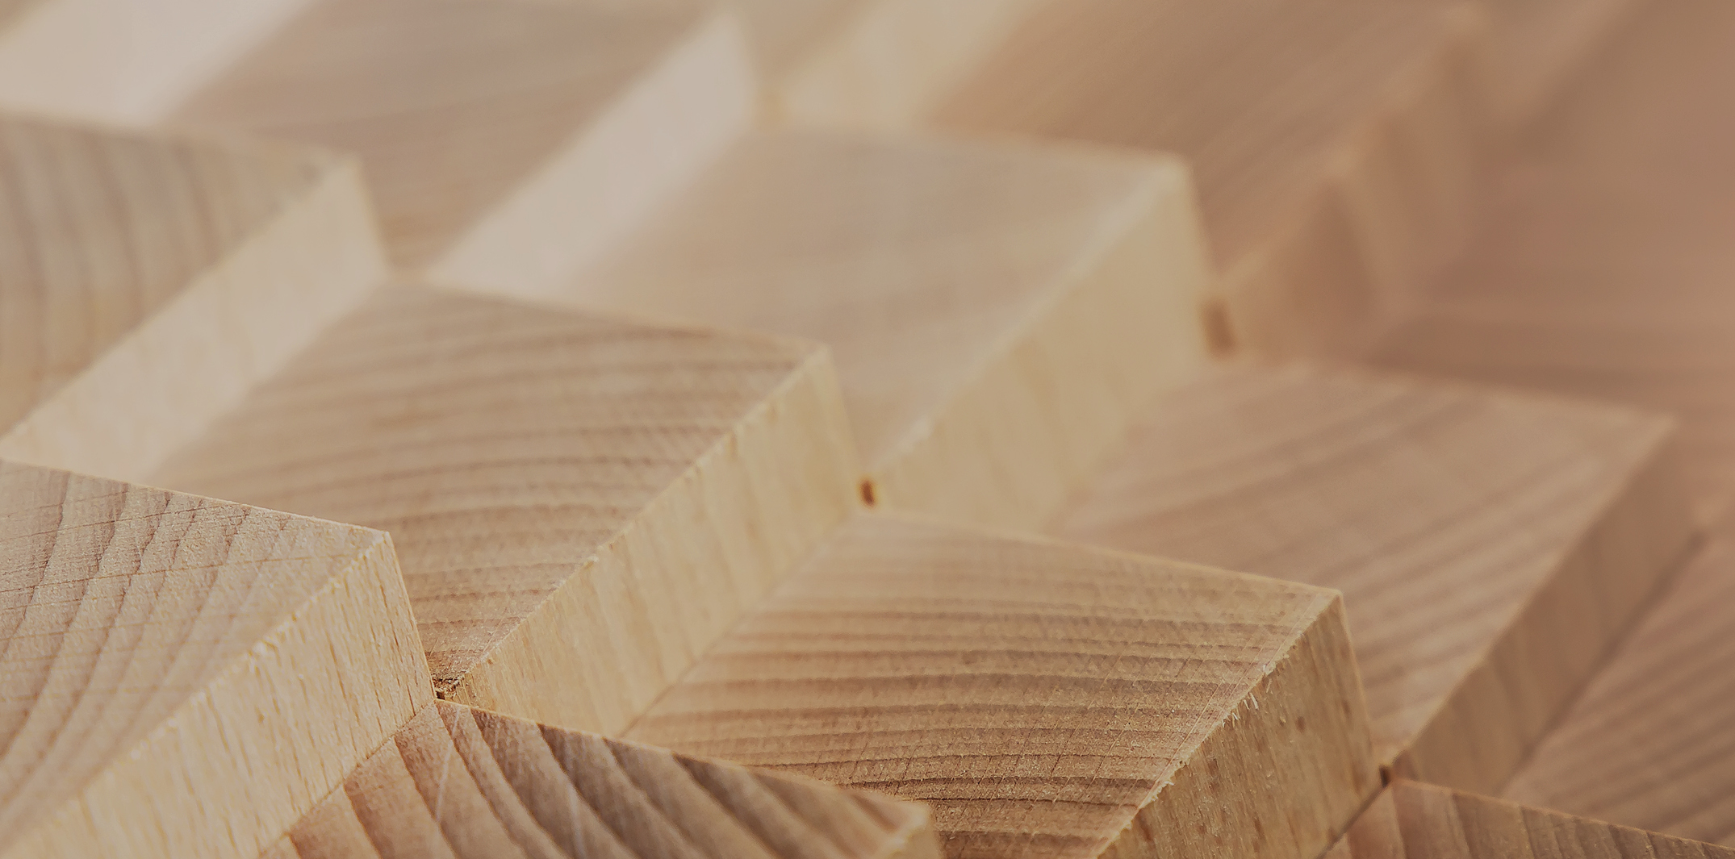
Manufacture of CLT panels

Slide 4
Authors
Martti Mylly, Lappia Vocational College
Release date: 10/06/2022

Slide 5
Production lines

Slide 6
Production line
The production line consists of the following work stages (depends on the manufacturer’s production line setup and prefabrication stages)
reception of timber,
planing of sawn timber,
finger jointing of sawn timber,
profile planing of sawn timber,
lay-up and gluing of sawn timber,
panel press,
intermediate storage of panels,
panel machining line,
panel finishing,
panel storage for transport, and
loading of panels for transport

Slide 7
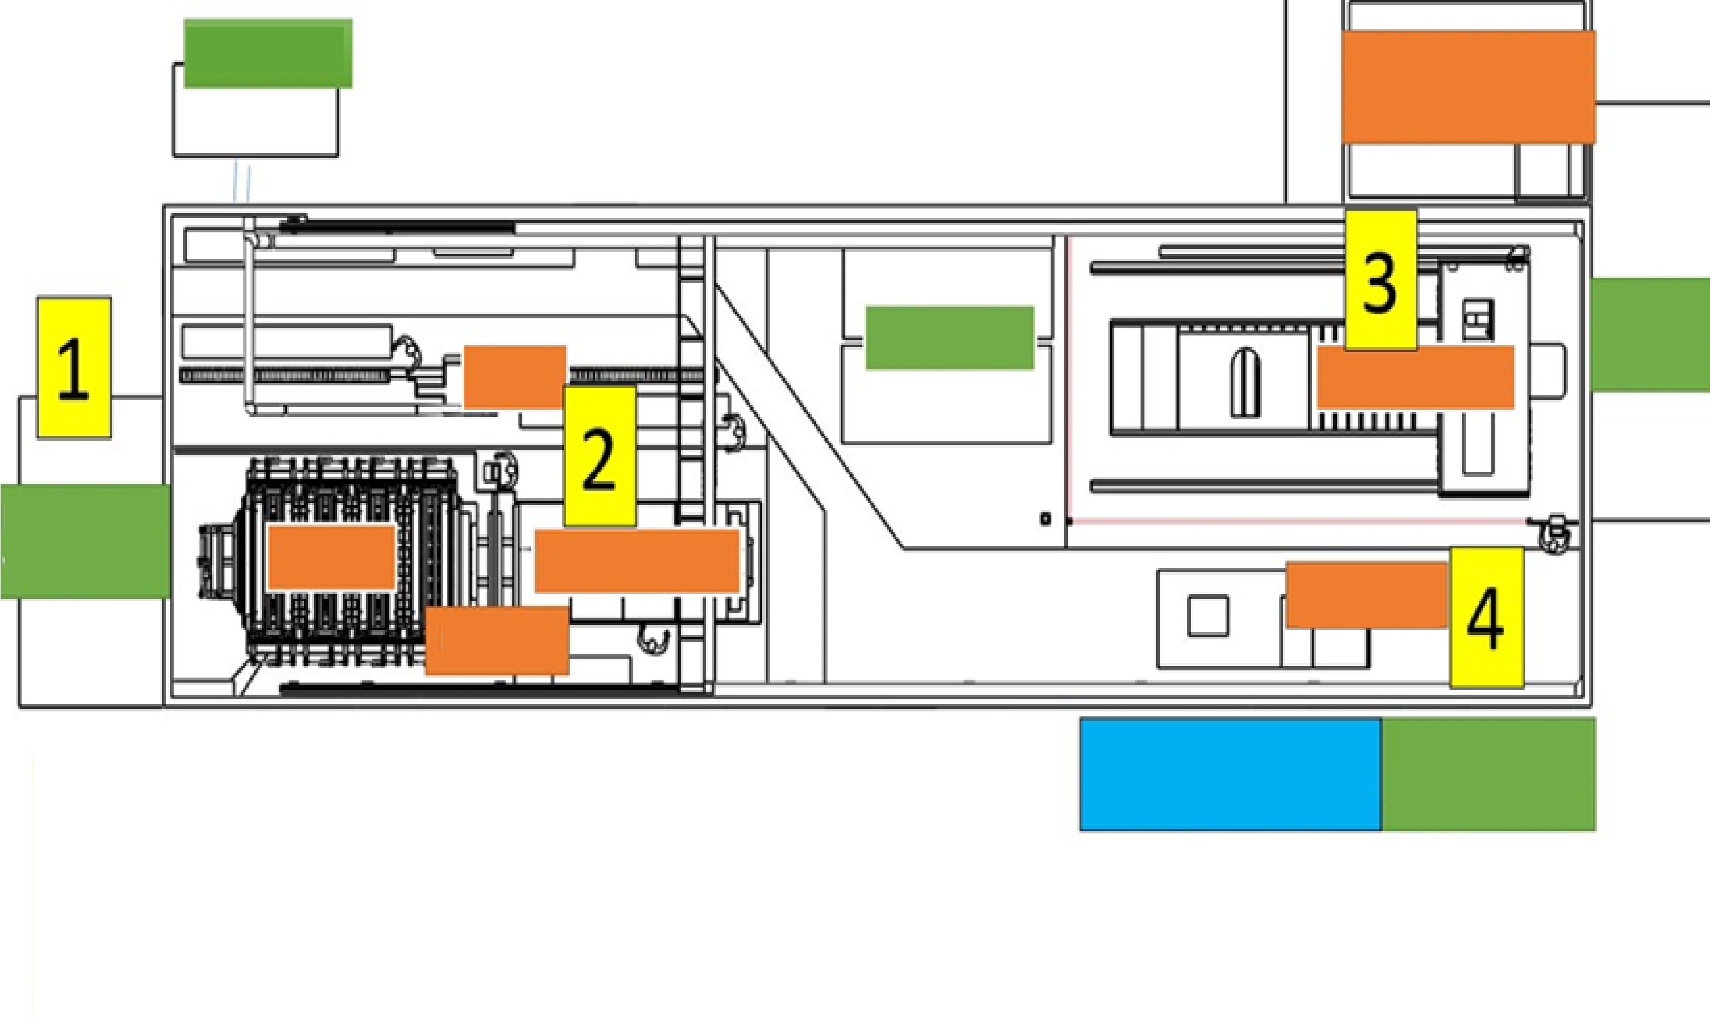
Sawdust container
Shear strength test
Warehouse for finished panels
Intermediate
storage
Plane
Machining centre
Raw material warehouse
Panel press
Lay-up table
packaging
Gluing machine
Plastic and Cutoff metal waste container
1. Raw material reception report
2. Planing and pressing report
3. Machining centre production report
4. Unit packaging and labelling
Main processes of a CLT production line, image Lappia Vocational College

Slide 8
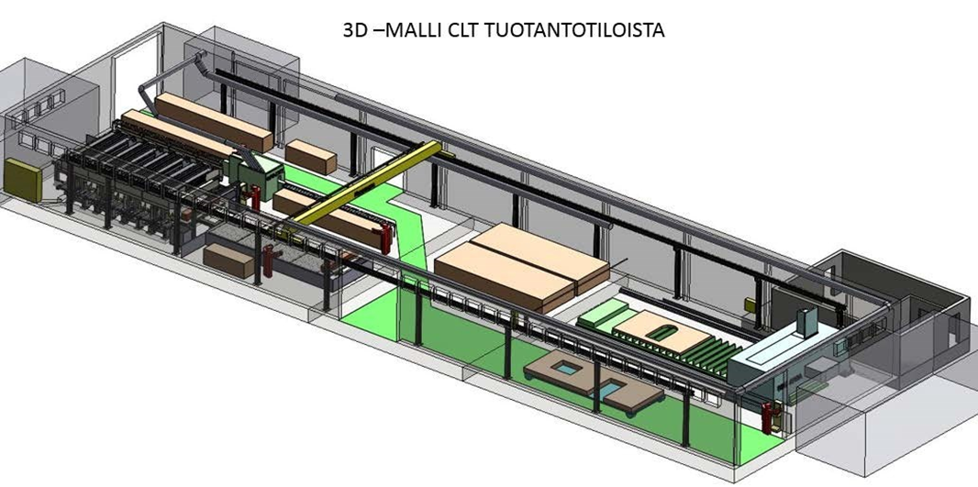
3D MODEL OF A CLT PRODUCTION FACILITY
Example of a compact production line

Slide 9
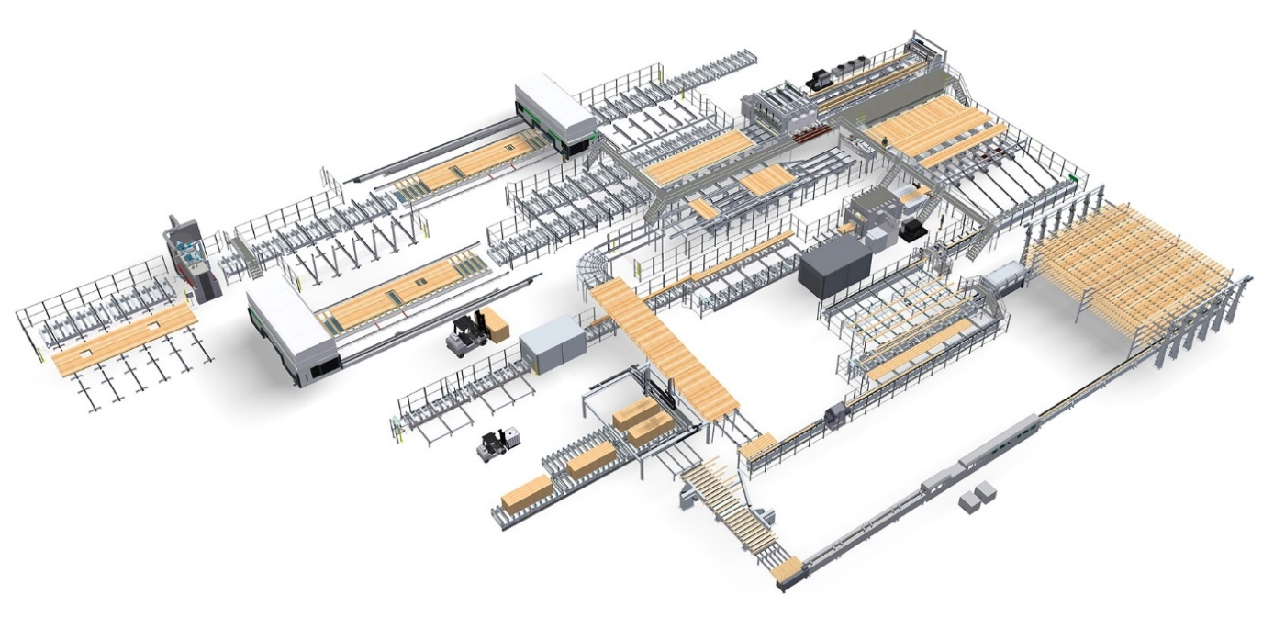
Large CLT production line,
Image Ledinek

Slide 10
CLT panel properties

Slide 11
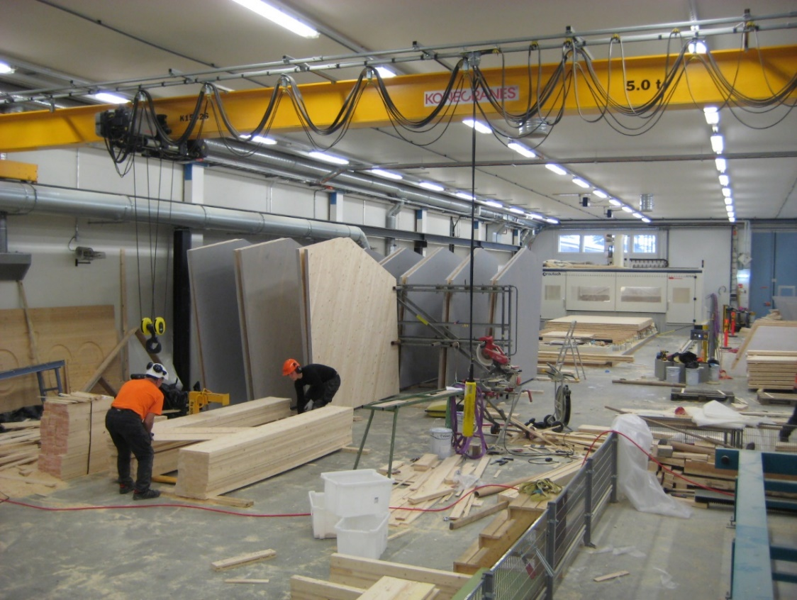
CLT panel properties and materials
CLT, which stands for Cross Laminated Timber, is also a well-established product title in Finland.
CLT is a solid timber panel product designed for load-bearing structures.
CLT panels consist of overlapping layers of laminated board glued together, with adjacent layers perpendicular to each other.
Strength class C24 sawn spruce or pine timber is usually used as the raw material for lamellae.
The panel derives its structural strength from overlapping laminated board layers that are glued together (face gluing of lamellae).

Slide 12
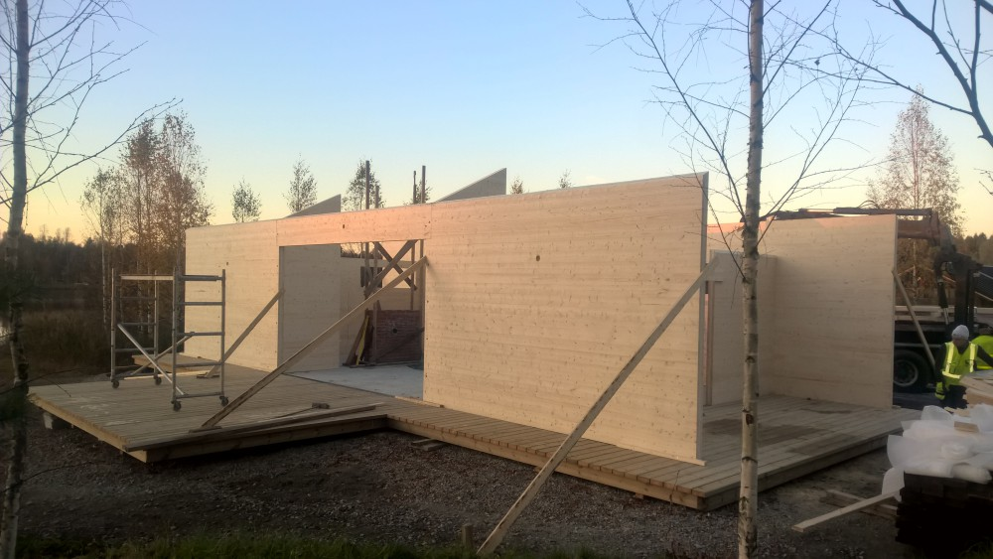
CLT panel properties and materials
Depending on the manufacturer, the lamellae may be first edge glued, after which the laminated board layers are face glued.
Edge gluing cannot be accounted for in the strength design of the panel.
Edge gluing helps to eliminate cracks in joints between CLT panel surface lamellae (shrinkage).
As lamellae shrink, however, an edge-glued CLT panel may crack here and there, whereas in CLT panels with no edge gluing, the shrinkage of lamellae is seen as gaps between the lamellae.
Image Paloniitty Oy

Slide 13
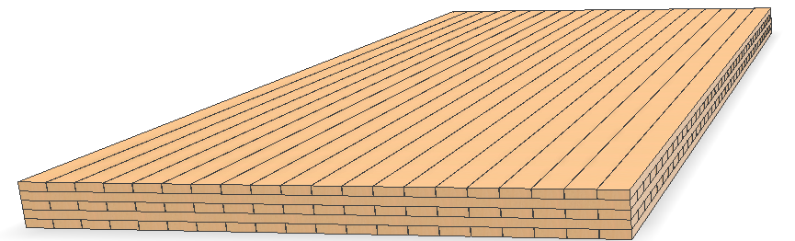
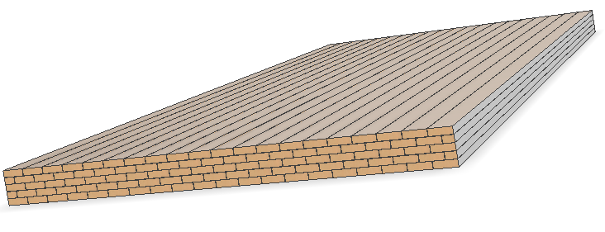
CLT panel types
CLT panels can be assembled in two main ways: the orientation of panel surface layers is either longitudinal or transverse considering the lengthways direction of the panel.
In most cases, the panel is assembled with longitudinal and transverse layers in turn. In panels with seven or more layers, the orientation of the two outmost layers may be the same.
When the orientation of the surface layer is parallel with the lengthways direction of the panel, this is known as an L panel.
When the orientation of the surface layer is transverse in the lengthways direction of the panel, this is known as a C panel.
CLT panel (cross laminated)
GLT panel (the orientation of the lamellae is the same)
The lamellae overlap in layers

Slide 14
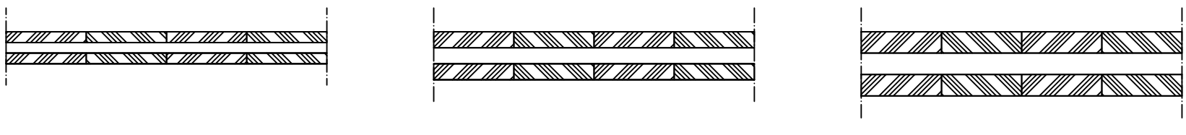
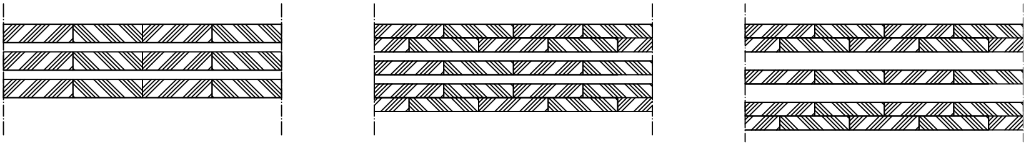
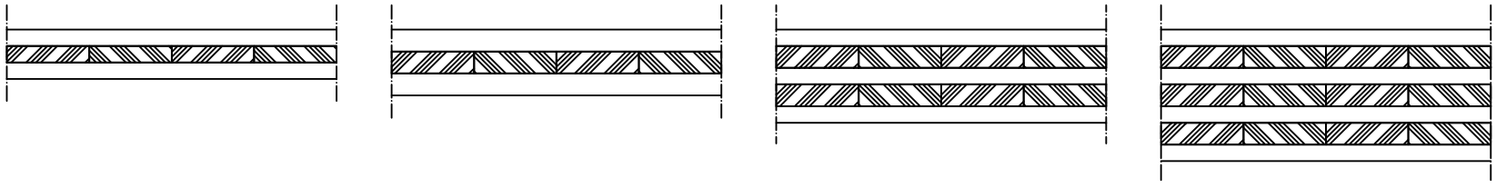
CLT panel types
L3-60 (20/20/20) L3-90 (30/30/30) L3-120 (40/40/40)
When the orientation of the surface layer is parallel with the lengthways direction of the panel, this is known as an L panel.
When the orientation of the surface layer is transverse in the lengthways direction of the panel, this is known as a C panel.
CLT panel lamella thicknesses usually are 20, 30, or 40 mm, from which manufacturers put together their own panel thicknesses.
The dimensions and lamella thicknesses of CLT panels depend on the manufacturer.
Usually, the thickness is in the range 60…400 mm, width between 2450…3500 mm and length between 12…16 m.
The most commonly used panels are 80…150 mm thick.
L5-160 (40/20/40/20/40) L7-190 (30/30/20/30/20/30) L7-230 (30/30/40/30/40/30/30)
C3-90 (30/30/30) C5-170 (30/40/30/40/30)
C3-120 (40/40/40) C5-240(30/40/30/40/30/40/30)

Slide 15
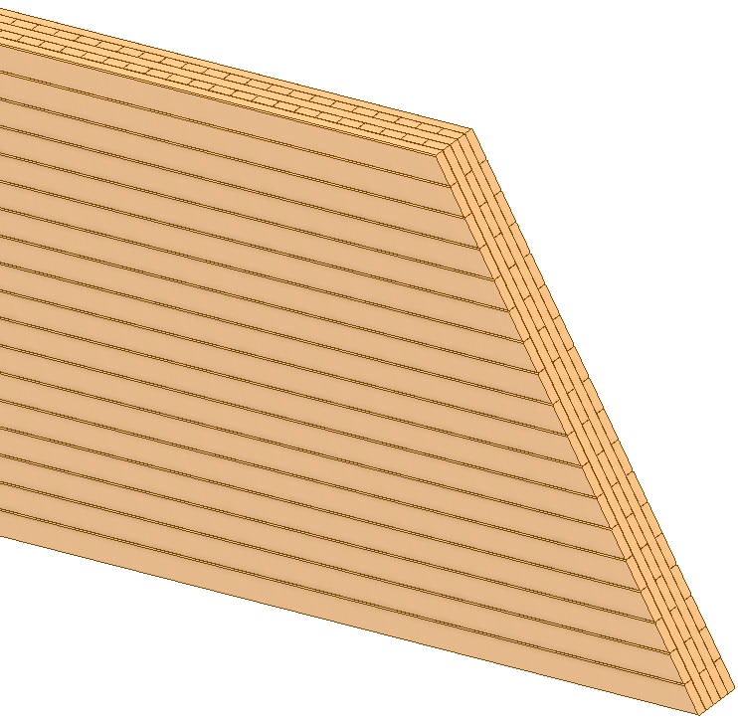
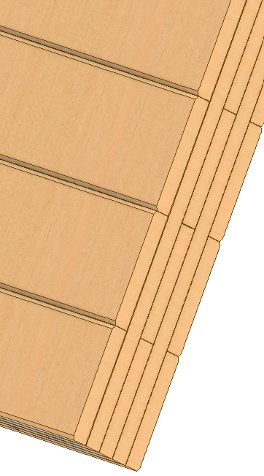
CLT panel types
.
CLT panels intended for a wall structure can also be bevelled on the edges if the panel surfaces are to be visible.
This makes the panels look like exterior cladding panels.
Bevels 3–5 mm in size do not undermine the strength properties of the board.

Slide 16
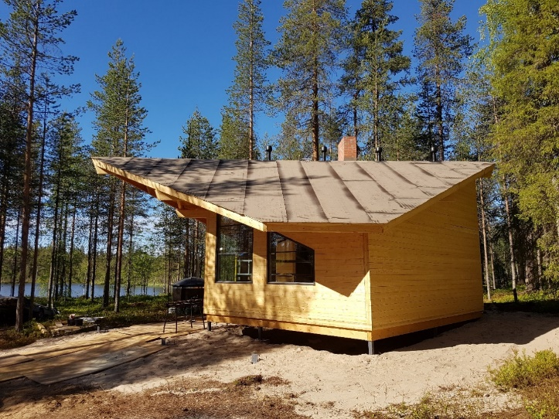
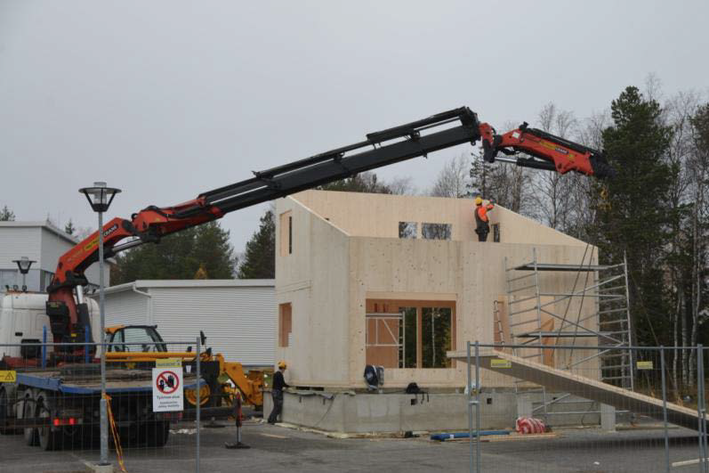
Possibilities of using CLT panels
CLT panels have many uses.
The main use is exterior walls of a building.
They are also commonly used as load-bearing structures of intermediate floors.
They can also be used as a load-bearing structure in roofs, base floors and partitions.
Experimental house with CLT structure, image Kemi Technology Park

Slide 17
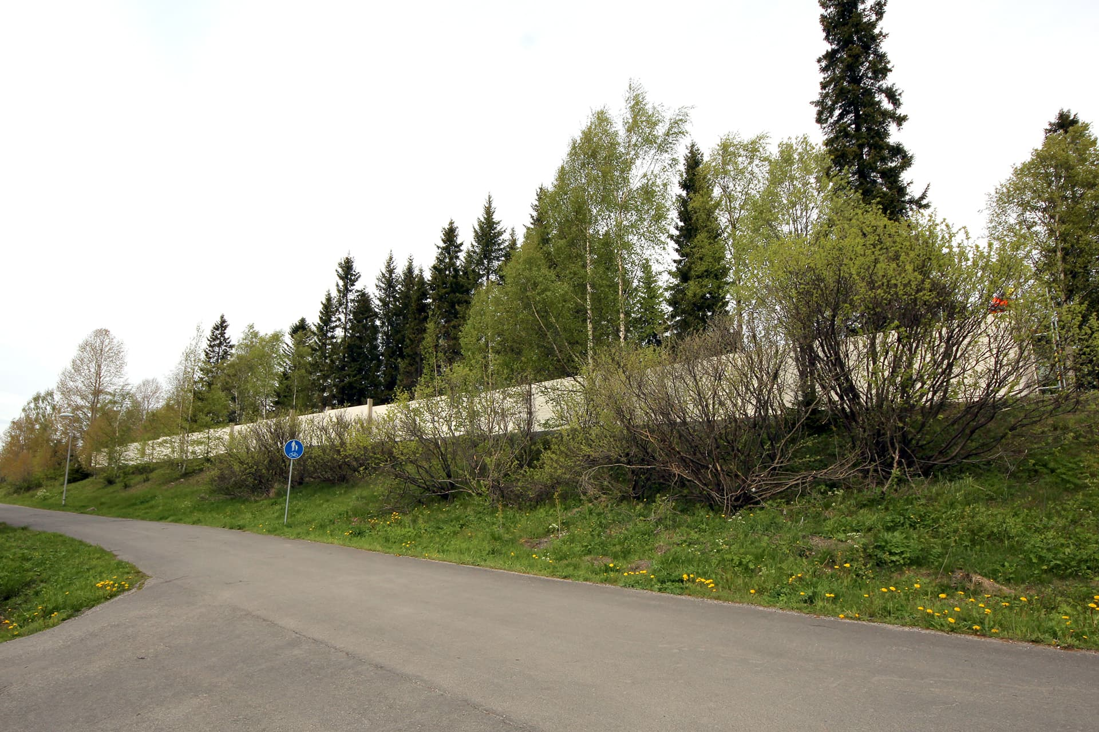
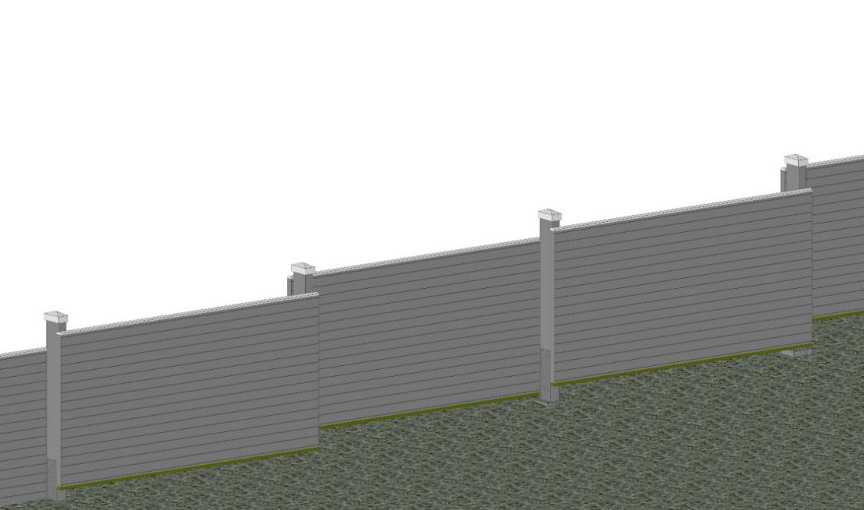
Possibilities of using CLT panels
In infrastructure construction, the main use is noise barrier walls.
CLT boards can also be used e.g. in bridge structures, however accounting for their poor surface durability, especially in bridges intended for motor traffic.
CLT is much better suited for a bridge structure for pedestrians and bicycles.
CLT panels can also be used as a so-called hybrid structure where the lower surface is made from CLT, with a layer of concrete cast on top.

Slide 18
Lay-up and gluing of CLT boards

Slide 19
Initial tasks before manufacturing
The first step in the gluing of sawn timber is checking the amount of glue spread by the glue applicator per square metre (g/m²).
The glue amount is monitored regularly by taking a sample of the glue.
The glue amount of the sample is weighed and a value that is compared to the manufacturer's reference value is calculated.
Usually the glue amount is tested once.

Slide 20
Initial tasks before manufacturing
The following information is recorded of each panel to be glued:
project number (or site name),
date,
tree species of the timber,
lamella layers (mm),
atmospheric humidity,
ambient temperature,
start time of gluing,
time the lamellae stay open,
pressing start time,
pressing end time, and
the operator’s name.

Slide 21
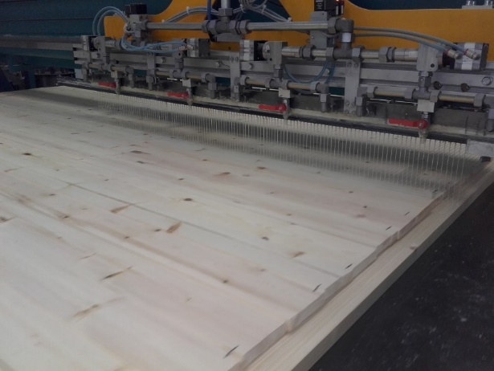
Lay-up and gluing of the panel
The gluing of the panel begins with entering the layer thicknesses, width and length of the panel to be glued in the control panel of the machine.
The glue is spread by an automated glue applicator.
The applicator stays in place, while the press table moves into the press according to the length entered in the control unit.
Glue application

Slide 22
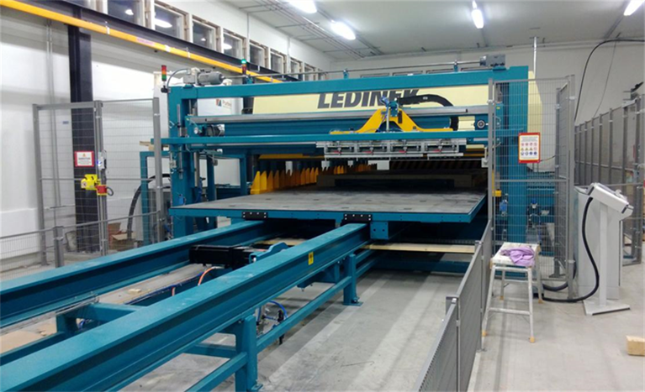
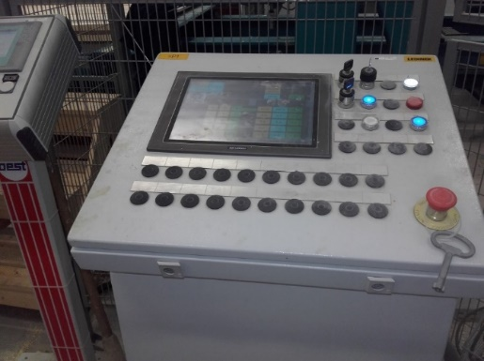
Pressing
As the glue application begins, the press performs a preliminary positioning using its top cylinders.
When the table has stopped, the top cylinders start descending electrically towards the surface to be pressed, and the longitudinal press starts moving.

Slide 23
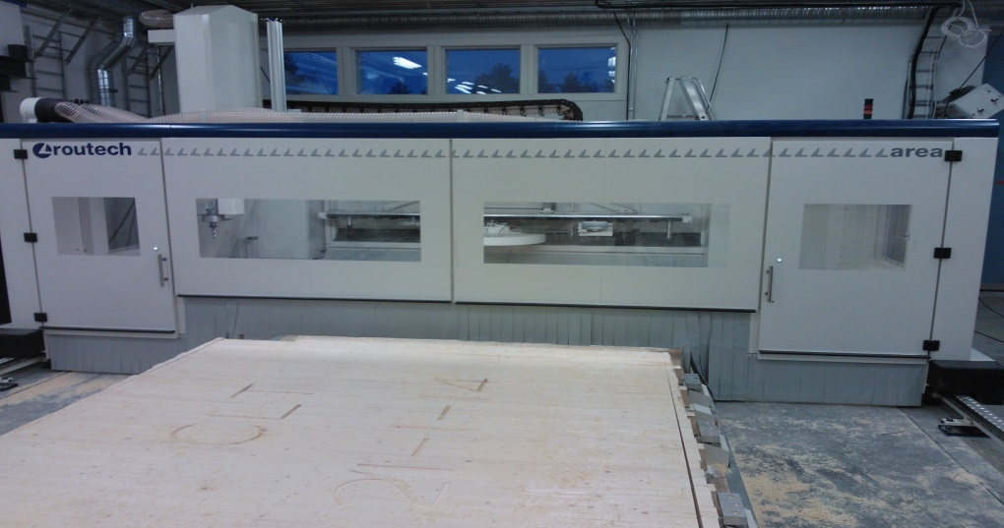
Pressing
When the specified pressing time has been reached, the press opens automatically, and the piece to be pressed moves out of it.
The manufactured panels are taken to the warehouse to wait for machining.
Before machining, the glue on the compressed panel must be allowed to dry for at least 10 hours.
After this, the piece can be machined, and test pieces can be subjected to test compression to test the glued bond.

Slide 24
Machining CLT panels

Slide 25
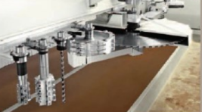
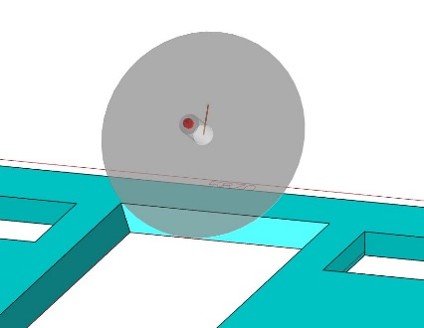
Machining CLT panels
The panels are machined at a CNC centre in accordance with a 3D model produced by a designer.
The 3D model is imported into the integrated CAD or CAM software, which the machining designer uses to select the blades, speeds, and machining directions used for the piece.
The size of the piece, toolpath locations, surface quality of the panel and the strength, length, and width of the panel must be taken into account.
In addition, the machining order of the workpiece, the selection of blades, the cutting direction of the blade, and the machining speed must be considered.

Slide 26
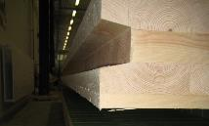
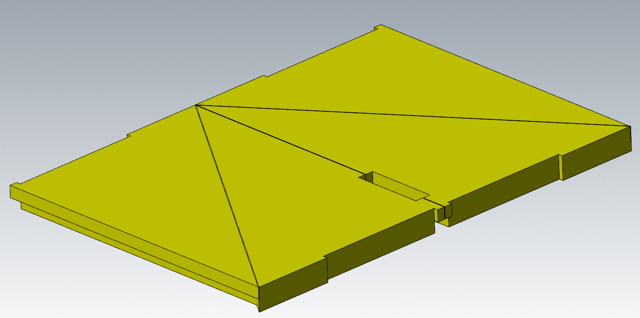
Machining CLT panels
The large rip blades or crosscutting blades (up to 1,020 mm in diameter) used for machining CLT panels have been specifically developed for this purpose.
The rotation speed of the blade may not exceed 1,500 rpm.
Cutting through CLT panels is very demanding on the blade.
A blade of this size has a machining depth of approximately 400 mm.

Slide 27
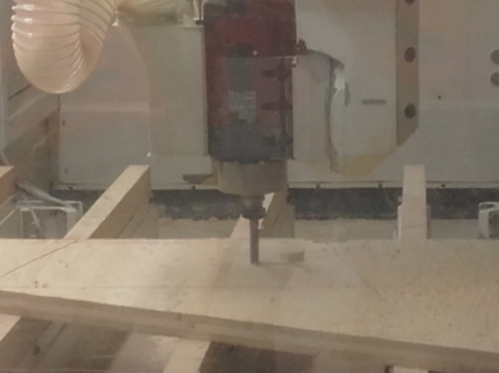
Machining CLT panels
The machining of panel billets has also revealed the problems of large circular saw blades: as the blade blunts, it can start to turn in relation to the cutting line, which means that even inclined cuts can easily become curved in relation to the cutting line.
Blades with a smaller diameter provide better cutting precision for the panels.
Blades with a diameter of 800 mm can achieve a machining depth of 250 mm, which is enough for most CLT panels.
Even a machining depth of 150 mm is sufficient, enabled by a blade 600 mm in diameter.

Slide 28
Machining CLT panels
The machining designer selects suitable parts of the panel for taking test pieces for the shearing test of the glued joint.
Before the actual machining, each machine used in the machining programme is simulated to avoid accidents.
A machined and marked CLT unit whose dimensions have been checked is taken to the warehouse to wait for the results of glued joint shear tests.
The unit is then packaged and the package is labelled as set out in the order.
The following information on CNC machining is recorded in a table:
project number,
date,
blades used for machining,
dimensions of the panel to be machined,
panel type,
start time of machining,
machining time,
test pieces taken from the glued joint, and
the operator.

Slide 29
CLT panel finishing
The panel must be sanded if the lamella surfaces will be visible, as some glue used for the panel billet ends up on the panel surface during pressing.
A glue stain on the panel surface is usually caused by the pressure.
Glue may appear on the panel surface because of many factors, including a crack in a knot, or a dry ring around a knot whose edges are loose.

Slide 30
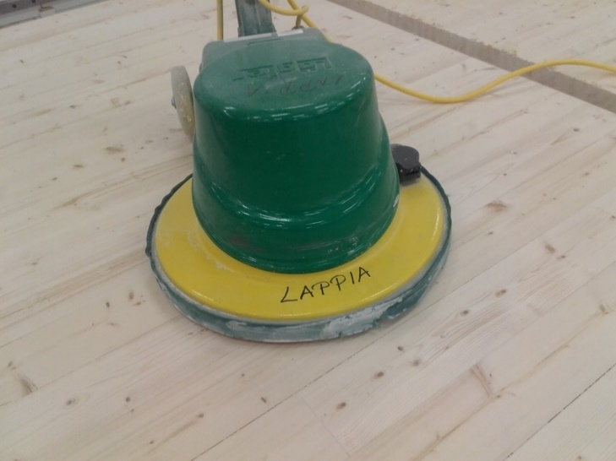
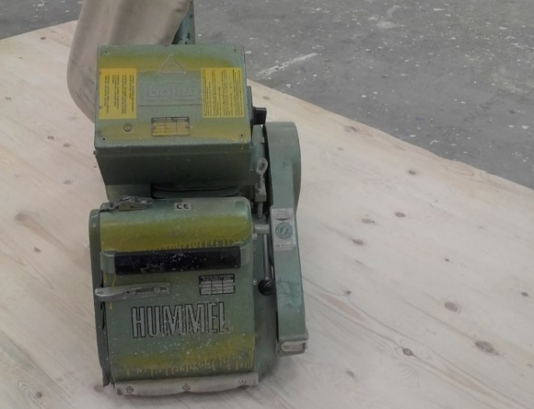
CLT panel finishing
A membrane of glue on the panel surface prevents the timber from absorbing surface treatment substances.
Especially translucent surface treatments are a major challenge.
If the wood surface is intended to be visible and there is a glue stain on the panel surface, the surface first becomes blotchy when treated, and later UV light will turn the glue a yellowish colour.
This means that later on, the glue will be seen through the surface treatment as a yellowish blotch.

Slide 31
Hoisting and loading units

Slide 32
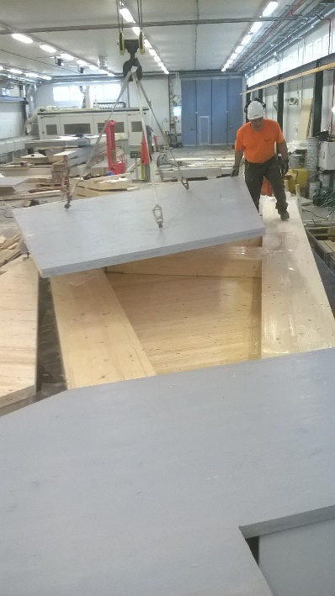
Hoisting and moving of units
Solid timber units must be equipped with the necessary lifting accessories.
When hoisting solid timber units, a common method is to use a screw and a detachable hoisting hook: long screws are attached to the upper part of the solid wood panel (sometimes also to the lower part) where the hoisting hooks can be attached during hoisting.
The same screws can be used both at the factory and at the site.
After on-site installation, the screws can be cut off.
The screws must be installed according to the drawings in order to be able to withstand hoisting and keep the unit level and balanced.

Slide 33
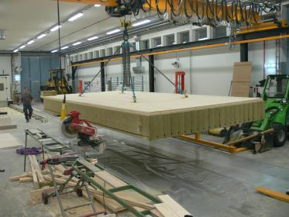
Hoisting and moving of units
Wall units are typically designed to be hoisted vertically and horizontal units horizontally to facilitate installation on site.
Loading, or whether the units are transported in a vertical or horizontal position, must also be taken into account when deciding on the hoisting points.
A solid timber unit 240 mm in thickness weighs around 300-350 kg/m², depending on the equipment of the unit and moisture in the timber.
Moving or hoisting must not result in visible damage to the units (caused by e.g. the lifting forks of the forklift).

Slide 34
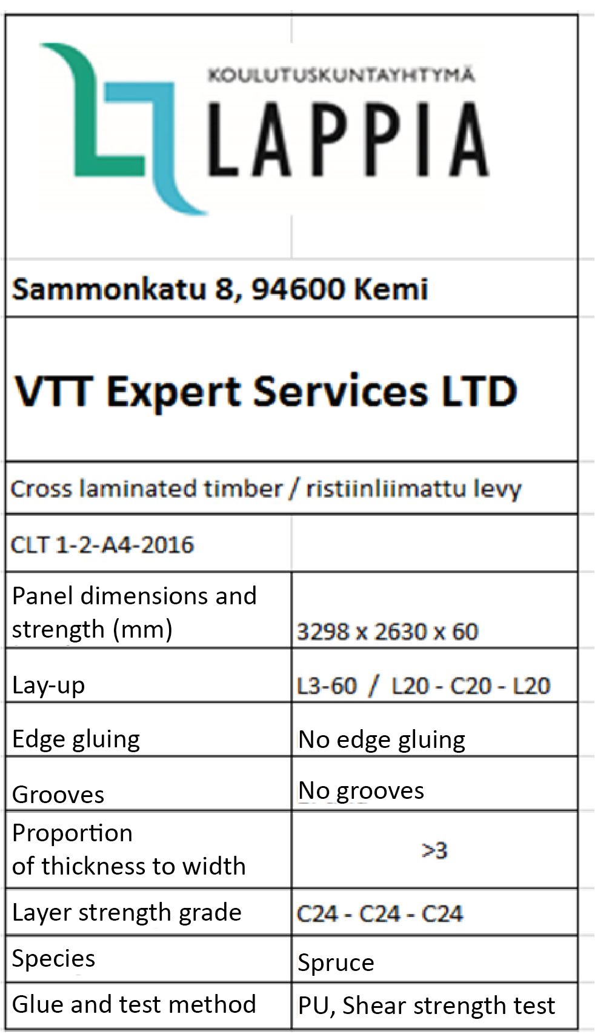
Loading
The units are loaded onto a combined vehicle, transport container or other similar vehicle intended for goods transport following a loading diagram or other corresponding document.
The loading diagram is drawn up to ensure that the units can be unloaded in the correct order, making it possible to instal them directly, or to store them in the correct order for installation.
Another principle of drawing up a loading diagram is that the loaded units should take as little space as possible.
This will achieve cost savings in transport.

Slide 35
CLT panel testing

Slide 36
Testing
The glued joints of a CLT panel can be tested using two different methods: a delamination test or a shear test.
The delamination test is intended for load-bearing timber structures in which type I glues are used (e.g. EPI, PUR or MUF).
This test is performed in accordance with standards EN 14080 (laminated logs and glued laminated timber) or EN 16351 (CLT). In this test, the glued piece of wood is stressed in a vacuum and at excess pressure in a pressure cooker filled with water and dried in a hot environmental simulation test cabinet in a standardised air current.
The purpose of the delamination test is to verify the resistance of CLT panel glue joints over long term when stressed by changes in temperature and moisture. The test is based on visual inspection and does not produce numerical data.

Slide 37
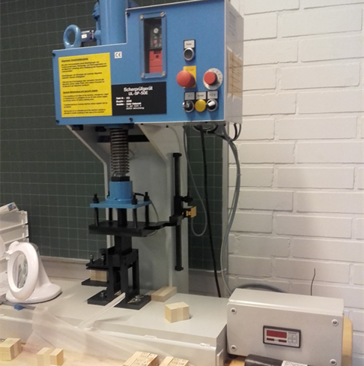
Testing
The shear test is a newer and easier method for testing glued joints.
The shear test is performed by cutting a test piece 40x40 mm in size out of the panel to be tested, going through the full thickness of the panel.
The test piece is placed in a shear test device and each joint is cut open one by one.
Equipment for testing glued joint shear strength

Slide 38
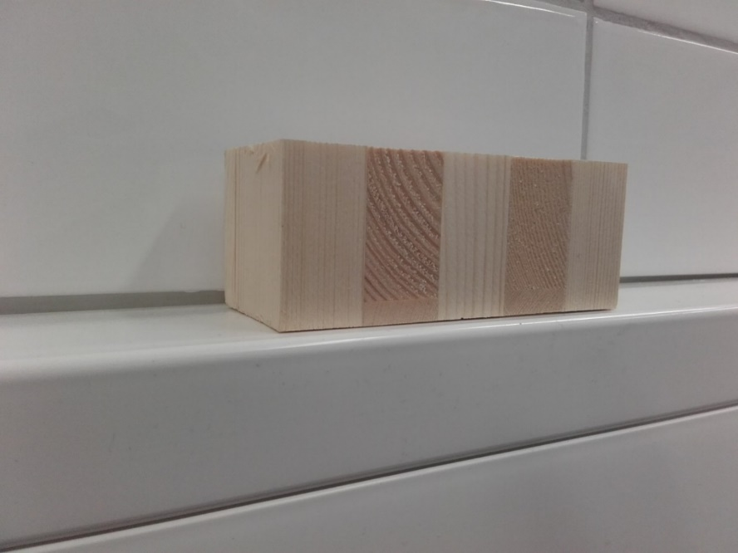
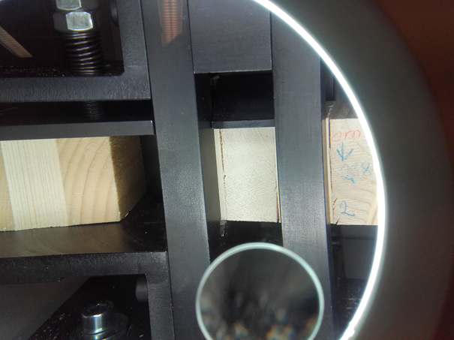
Testing
The test results are interpreted as follows:
The joint to be tested must endure at minimum 20 seconds of even compression and achieve a measurement result of at minimum 1.7 kN, which gives a shear strength of 1.0 N/mm².
The logarithmic average of one hundred most recent test pieces must always be calculated.
As logarithmic averages are used for the calculation, high test values have less of an impact on the result.
In a logarithmic average, the impact of one poor value is considerably large.

Slide 39
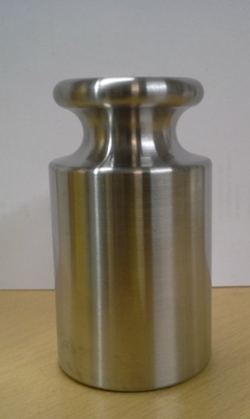
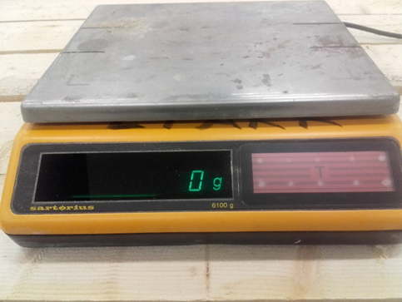
Measuring equipment
The glue amount is weighted with a scales suitable for this purpose.
The scales is also checked at regular intervals with an official weight.
The scales is checked at regular intervals with an official test weight of one kilogramme.

