Slide 1



Industrial wood construction
Teaching materials for industrial wood construction education
2022

Slide 2
Origin of the materials
Use of the materials
These learning materials for industrial wood construction have been prepared in a project led by Puuinfo Oy in 2021–2022. Also involved in the project were
Lappia Vocational College,
TTS-Työtehoseura ry
South-Eastern Finland University of Applied Sciences,
Metropolia University of Applied Sciences,
Jyväskylä University of Applied Sciences,
University of Tampere, and
Federation of the Finnish Woodworking Industries Puutuoteteollisuus ry
The project was funded by the Ministry of the Environment.
The materials are intended to be used as extensively as possible in industrial wood construction education and studies.
The materials are released under the Creative Commons licence Attribution-ShareAlike (CC BY-SA), which requires that the author be properly credited when the materials are used and that derivative works may only be distributed under the same licence as the original work.
The original materials and any updates to them by Puuinfo will be published on the Library of Open Educational Resources website (aoe.fi) and the Puuinfo.fi website.

Slide 3
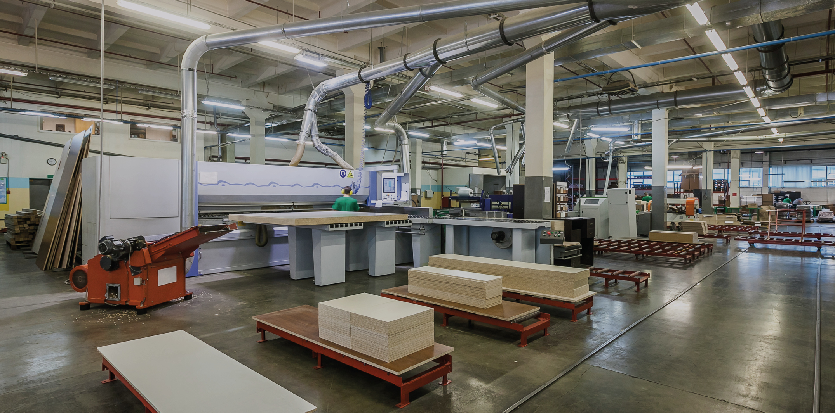
Prefabrication of units

Slide 4
Authors
Martti Mylly, Lappia Vocational College
Release date: 10/06/2022

Slide 5
Wooden units

Slide 6
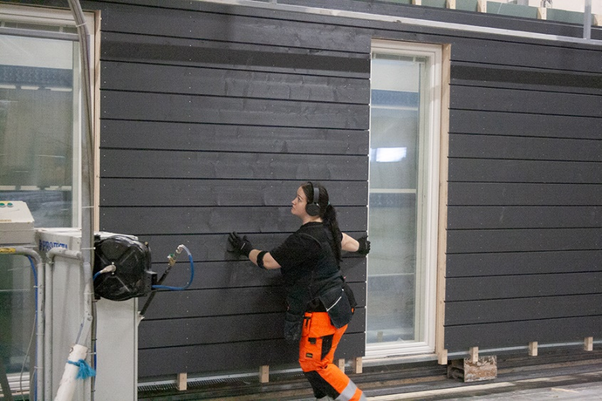
Prefabricated wall panels
Prefabricated wall panels are structures with ready-made framing, insulation, sheathing, and cladding.
The degree of pre-assembly varies by supplier and site.
The units can be built of solid timber or around a frame.
Prefabricated wall panel surface-treated,
photo: Jukkatalo Oy

Slide 7
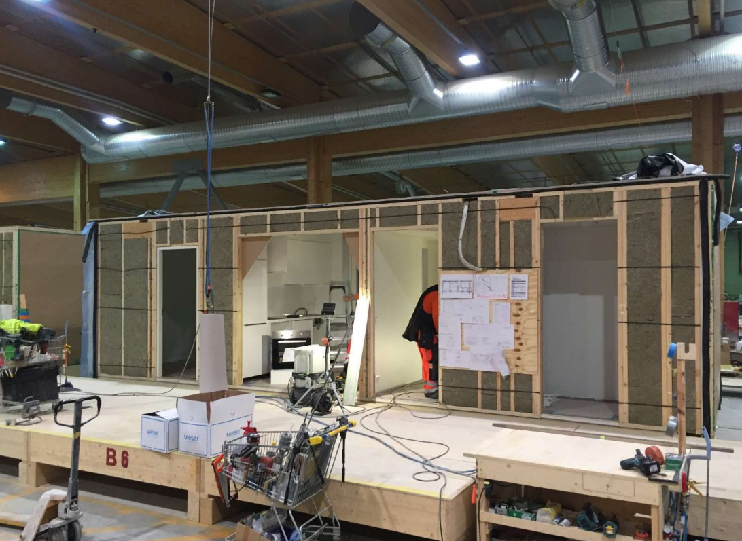
Prefabricated box units
Prefabricated box units are torsionally rigid and transportable ready-made modules.
The use of prefabricated box units significantly shortens the construction time and improves the quality of construction.
A prefabricated box unit is a building element that comprises at least the attic floor, base floor, and end walls.
Production of prefabricated box units, photo: Puuinfo Oy.

Slide 8
Large roof units
Large roof units are roof elements that comprise the load-bearing structures and roof-covering sheeting.
The units are usually delivered in approx. 50 m² parts, which enables the rapid protection of the underlying structures from whether.
Penetrations, fire hatch doors, roof outlets, etc. are partly pre-installed at the factory, which enables waterproofing already under factory conditions.
Sleeves for penetrants are pre-built at the factory in dry and controlled conditions.
Sleeves for HVAC and electrical wirings can also be manufactured and partially installed in advance.
Roof walkways, roof ladders, and snow guards can also be installed beforehand.

Slide 9
Thin-shell panels
Wooden thin-shell panels are frame-structured and typically designed to serve as non-load-bearing building elements.
The panels can be either horizontal or vertical.
The panels form an entirely separate outer wall structure, meaning that the inner shell of the sandwich panel will, in principle, not contribute to the functioning of the exterior wall.
An installation clearance is left between the wooden panel and the sandwich panel and implemented as a warm, closed air cavity.

Slide 10
Prefabrication of the frame

Slide 11
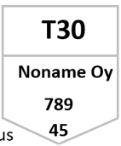

Stress grades of the frame parts
All parts of the frame must be checked not only for dimensions but also for their stress grade before manufacture.
The stress grade is indicated by a stamp on the face of the piece of sawn timber or respective end product.
The stress grade to be used is indicated in the drawings for the unit.
The minimum stress grade for wall structures is C18, and C24 for horizontal structures.

Slide 12
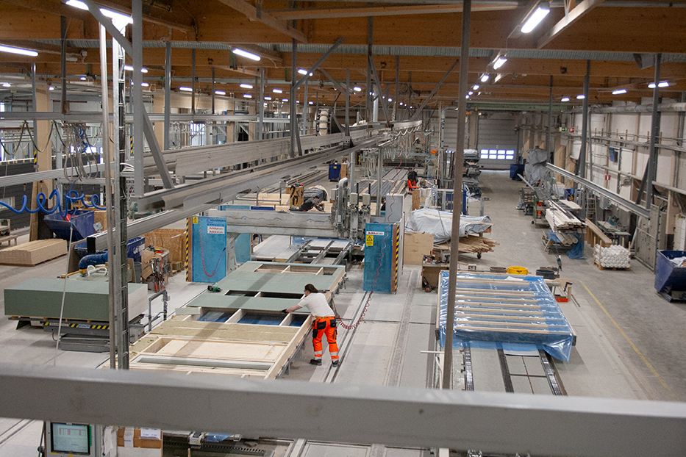
Manufacturing methods
The manufacture of prefabricated units begins with the manufacture of the frame components. The production methods can be roughly divided into three categories:
production on a computer-controlled automation line, where the frame components are manufactured utilising input data from the 3D model,
production with computer-controlled panel sizing saw in accordance with the drawings, and
production by processing long sawn timber with hand-operated equipment in accordance with the drawings.
Prefabrication factory, photo: Jukkatalo Oy

Slide 13
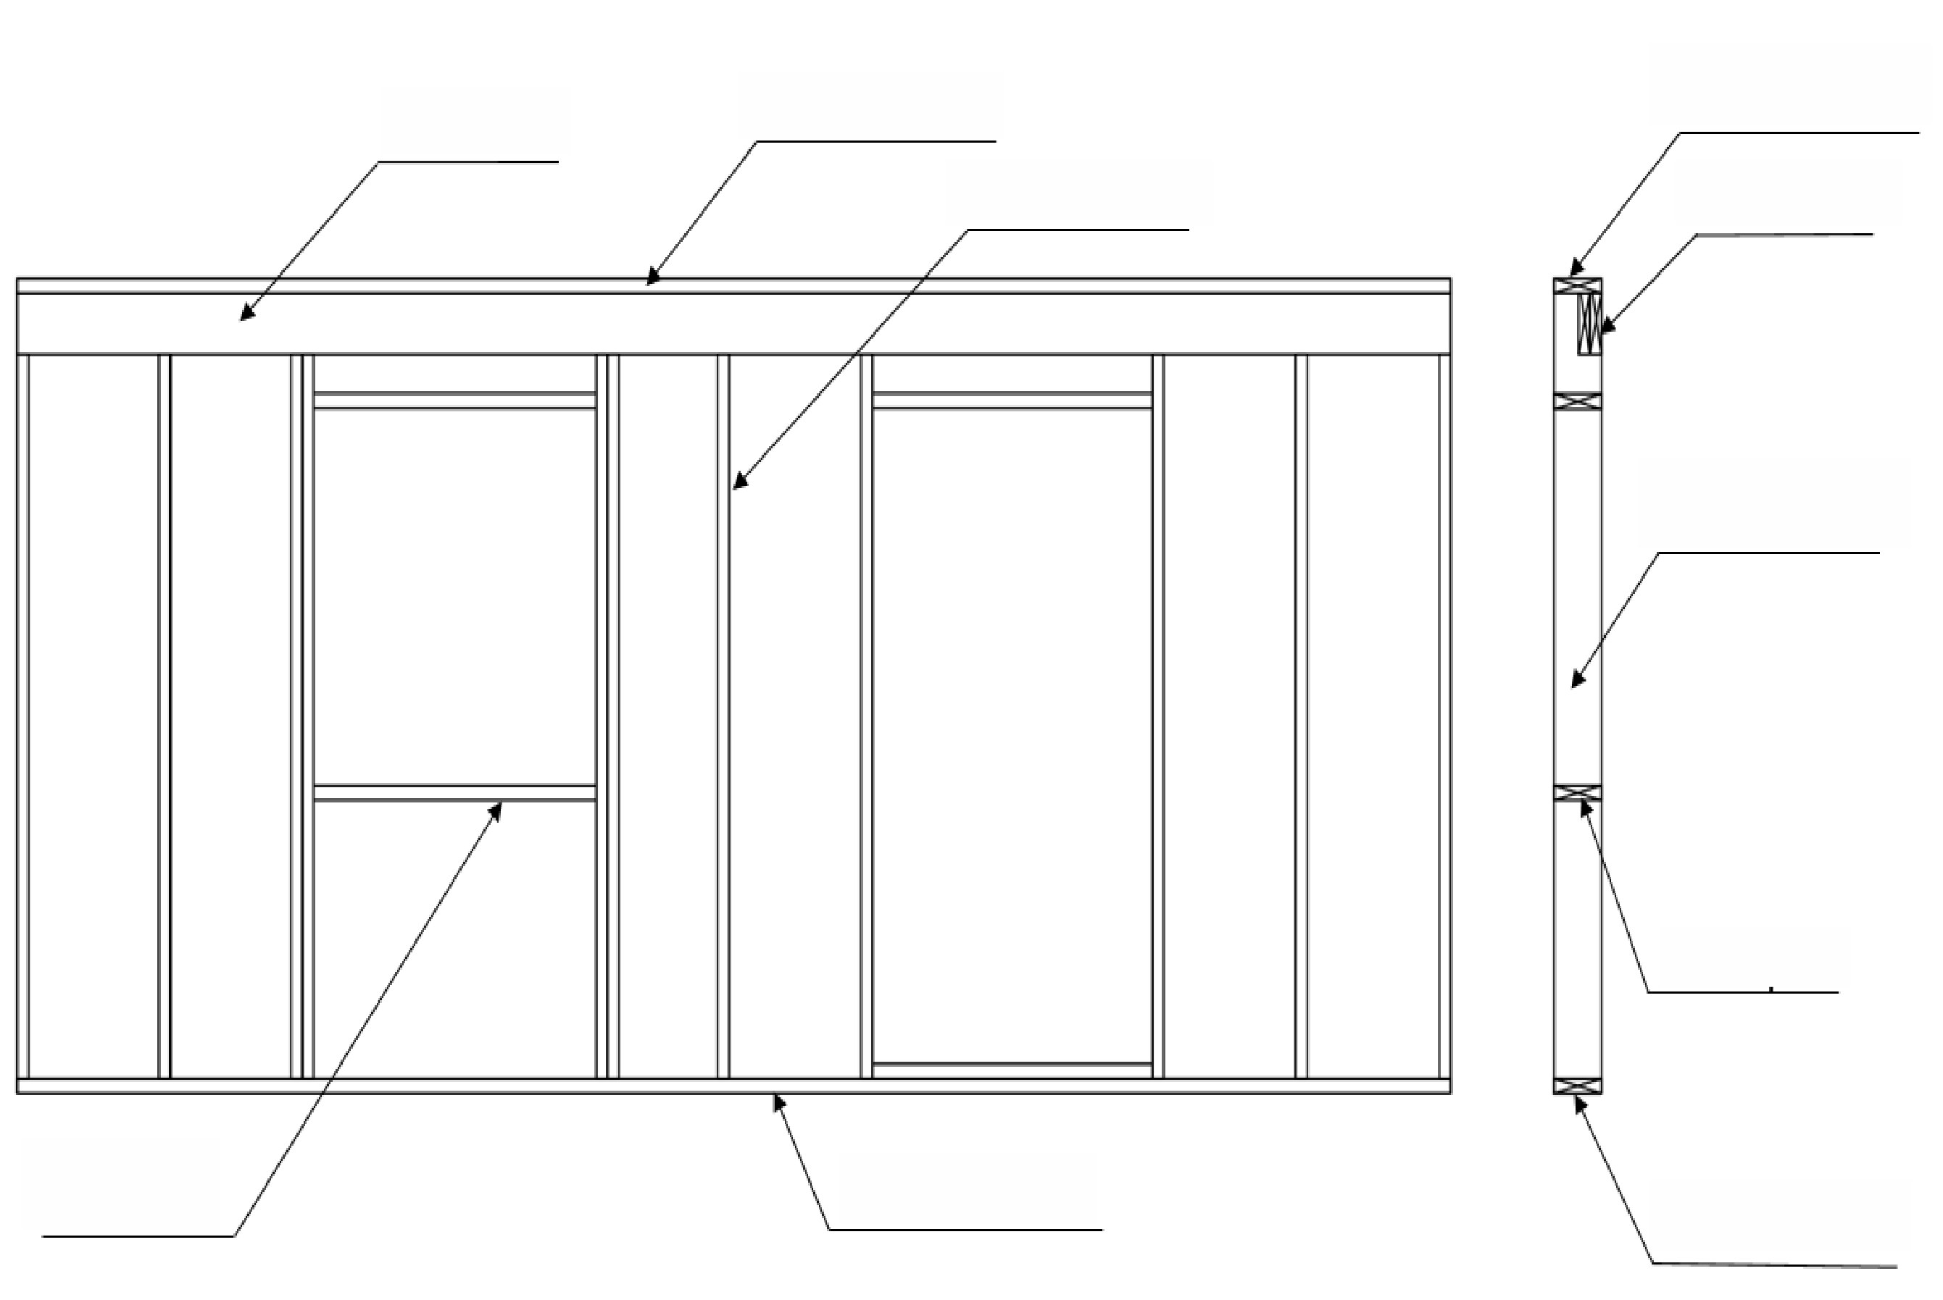
Parts of the frame
top beam
top plate
top plate
wall stud
top beam
wall stud
sill trimmer
sill trimmer
bottom plate
bottom plate

Slide 14
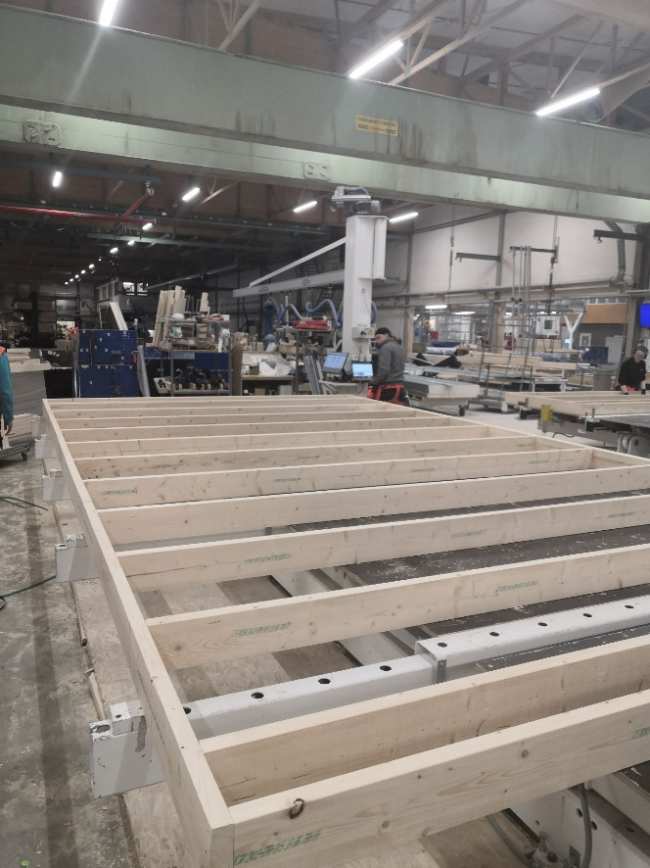
Assembling the frame
All dimensions shown in the drawings must be verified on the unit before assembly.
The so-called cross-measure of the unit must also be checked to ensure the perpendicularity of the corners.
The frame is typically assembled on an assembling table with the inside of the frame facing up.
The stud span of a wooden frame is typically 600 mm on centres.
The frame is typically assembled using 90x3.1 machine nails.
After assembly, both main and cross measures are verified.
Maximum tolerance is 5 mm.
Photo: Jukkatalo Oy

Slide 15
Installing a window to the frame
Windows are installed to the frame at the factory, whereas doors are typically installed at the site.
This is because the lower part of the door must match the finished floor surface.
Prefabricated box units in which the floor structure is completed at the factory form an exception to the rule.
Photo: Jukkatalo Oy

Slide 16
Sheathing and insulation

Slide 17
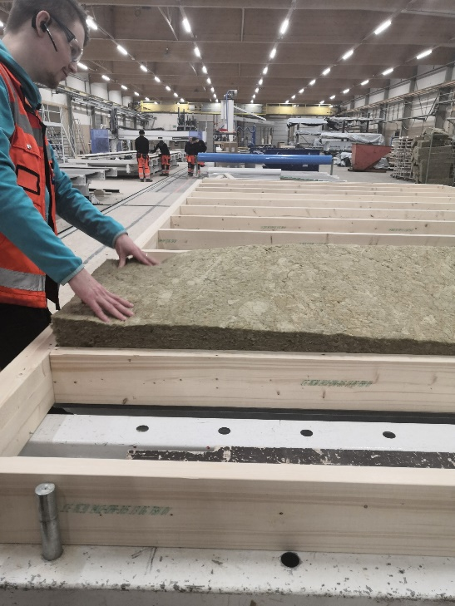
Insulation of wooden units
Thermal insulation material is typically installed from the inside of the frame.
If two insulating sheets are used, the second insulating sheet should be installed from the outside, after the unit has been flipped.
Particular attention must be paid to ensuring that the insulation sheets are installed tightly against the studs.
Photo: Jukkatalo Oy

Slide 18
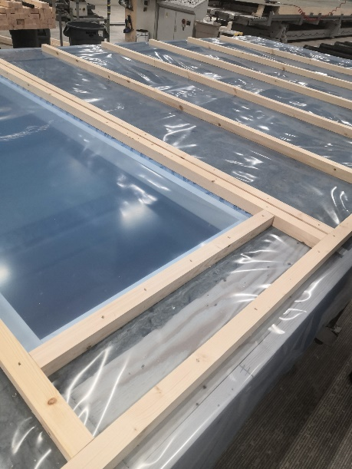
Installation of vapour barrier plastic
In wooden units with a framed structure, the vapour barrier plastic is installed on top of the thermal insulation on the inside.
Vapour barrier plastic is not used in solid wood structures.
The vapour barrier plastic is extended at least 200 mm over the edges of the finished unit on all sides, so that it can be taped to the adjacent structures.
Photo: Jukkatalo Oy

Slide 19
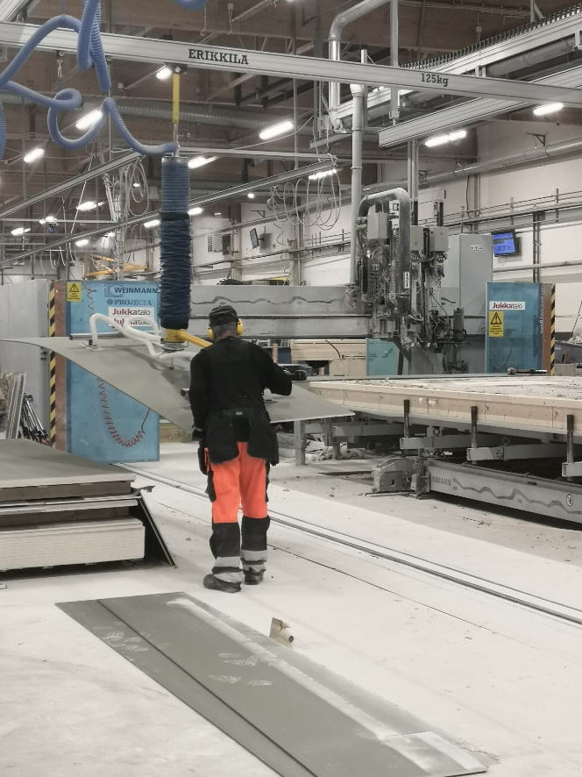
Sheathing of wooden units
Wooden units with a framed structure are sheathed from both the inside and the outside.
Exterior sheathing is for wind protection and interior sheathing is mainly cladding.
In wall structures between flats, sheathing can count as compartmentation.
Sheathing is typically used for stiffening the load-bearing structures, and it must therefore be performed in accordance with the manufacturer's instructions and unit drawings.
Photo: Jukkatalo Oy

Slide 20
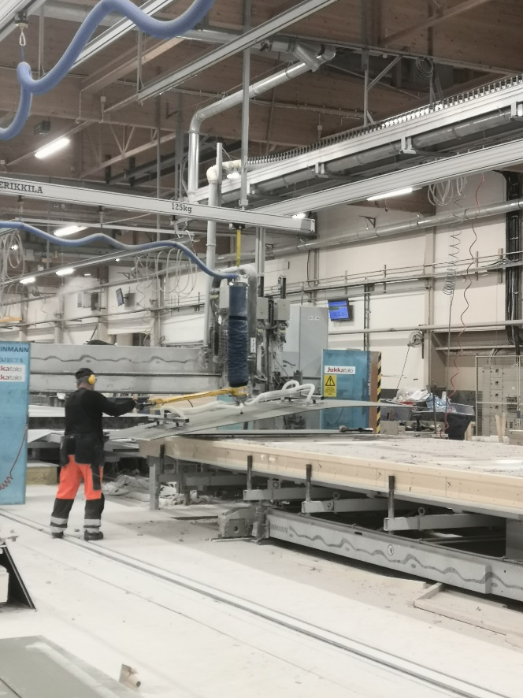
Interior sheathing
Interior sheathing can be done partly or entirely at the site.
Plasterboards, plywood, and other panels intended for interior sheathing may be used.
In fire-separating structures, fire protection and acoustics requirements
must be taken into account in accordance with the unit drawings.
Fire protection requirements must also be taken into account in solid timber structures.
The interior sheathing can also be done with lining boards.
Photo: Jukkatalo Oy

Slide 21
Wind protection boards
Before installing the wind protection boards, the unit is flipped on the assembly table or if using a butterfly table, onto the other assembly table.
The boards are fastened onto the frame studs.
The 600 mm stud span enables the installation of 1,200 mm wide boards in their entirety.
The cut-offs are made at openings and edges.
This way, the smooth seams of the boards can be securely fastened against each other in the middle of the unit.
Photo: Jukkatalo Oy

Slide 22
Installing the exterior cladding

Slide 23
Installing battens for the ventilation cavity
The installation of the exterior cladding begins with the fastening of the battens for the ventilation cavity.
The batten span is 600 mm. In horizontal cladding, vertical battens are enough.
In vertical cladding, two batten layers are required; the vertical batten layer serves as the ventilation cavity, while the horizontal battens on top serve as fixing battens for the cladding boards.
In units with a framed structure, the battens are fastened to the frame by nailing them through the wind protection board.

Slide 24
Exterior cladding ventilation
The back of the façade cladding must always be ventilated to enable it to dry sufficiently after getting wet.
The fixing surface of the wood cladding must also be sturdy enough to avoid harmful deformation of the façade cladding.
The thickness of the battens behind horizontal cladding boards must at least match the thickness of the cladding board, preferably be as thick as 32 mm.
The horizontal battens behind vertical cladding boards must be at least as thick as the cladding board, and the vertical batten installed on top of the wind protection board must be at least 22 mm thick.

Slide 25
Installing the exterior cladding
Wood cladding must be fixed with stainless or hot-galvanized fasteners.
If the fasteners are too thick, the boards may split.
To avoid cracking caused by nailing, fasten the nails at least 70 mm away from the ends of the board.

Slide 26
Wood cladding
Wood cladding can be either horizontal or vertical.
When installing cladding boards, the adjacent units must be taken into account.
The horizontal board rows of adjacent units must start at the same level.
The seams of the cladding boards between units installed on top of each other must also be taken into consideration.
In units with vertical cladding, the joints between units must be taken into account in order to ensure that the boards can be installed without having to saw them smaller.

Slide 27
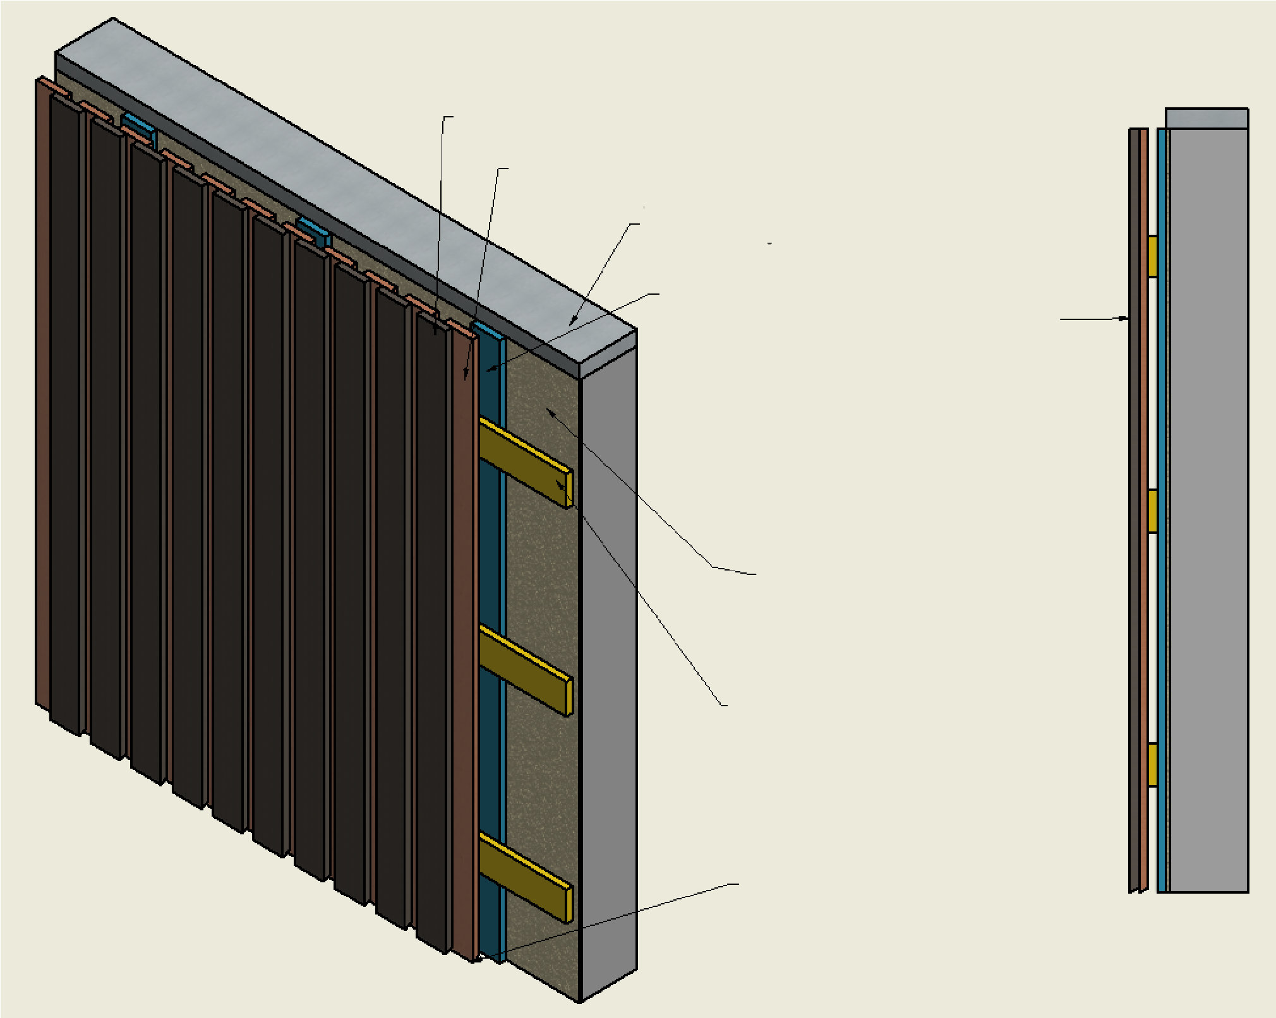
Vertical cladding
The illustration shows a vertical exterior cladding that requires double studding:
the horizontal battens serve as fixing boards for the cladding boards and the vertical battens form the ventilation cavity.
The bottom edge of the exterior cladding is typically lower than the bottom edge of the frame.
Sawn board
Sawn batten
Top plate
Vertical board, ensures the circulation of air in the ventilation cavity
n.15mm
Wind protection board
Horizontal board
Drip mould at the bottom edge of the cladding board

Slide 28
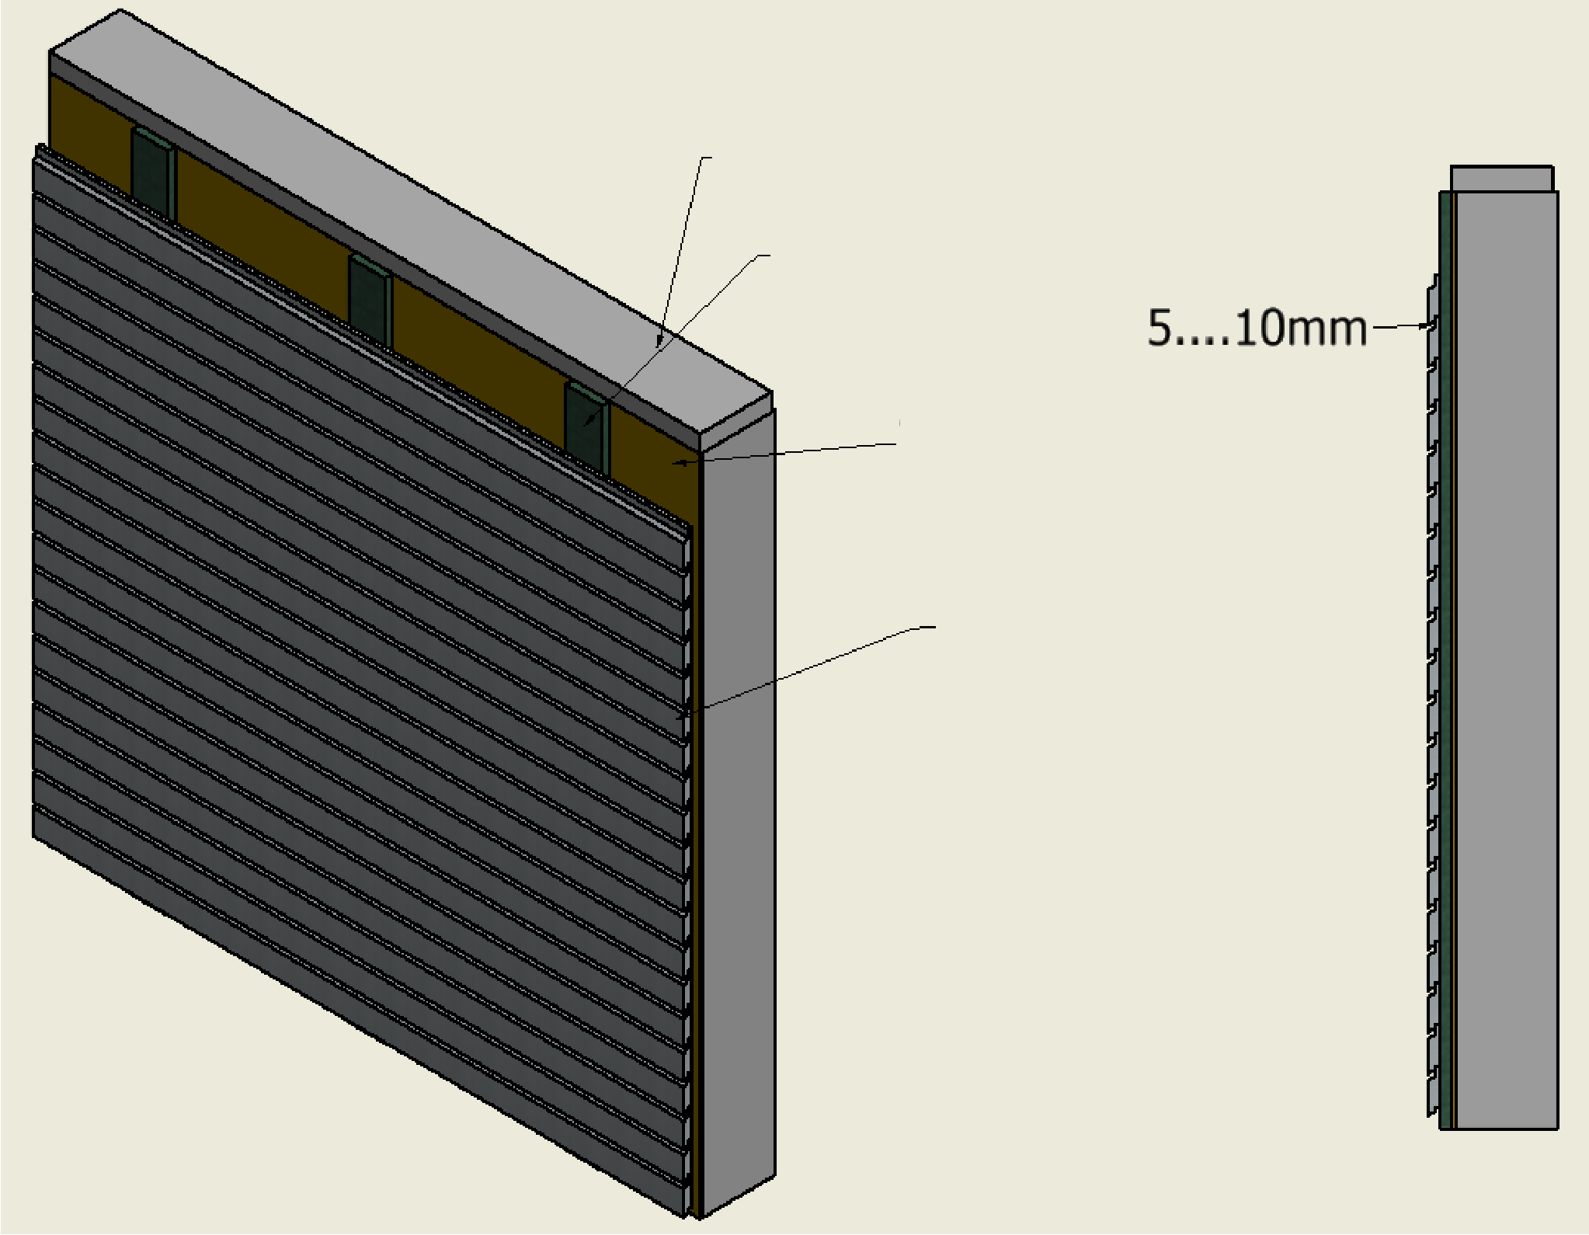
Horizontal cladding
The illustration shows a horizontal exterior cladding.
The vertical studs serve both as fixing boards for the exterior cladding boards and as a ventilation cavity.
The bottom edge of the exterior cladding is typically lower than the bottom edge of the frame.
The bottom boards of the exterior cladding are installed at the construction site to prevent the grooves and tongues from breaking during transportation.
Top plate
Fixing board / ventilation cavity
Wind protection board
Exterior cladding board

Slide 29
Long-term durability of wood cladding
Exterior wood cladding can have a considerable service life and a maintenance paint interval of 10 to 15 years when following the relevant instructions.
Key aspects that contribute to the long-term durability of exterior wood cladding:
the cladding board is thick enough, at least 23 mm,
the quality of the wood is as good as possible (preferably spruce or pine heartwood),
the cladding board is sufficiently dry when installed and surface treated (moisture content < 18 %), and
joints and unprotected board ends that are susceptible to weather are avoided as far as possible.

Slide 30
Corner boards
Corner boards can be installed at the corners of the building.
Corner boards are fixed vertically on both faces of the corner.
The corner boards cover the ends of the cladding boards, hiding any uneven ends.
The corner boards also protect the ends of the cladding boards from the weather.

Slide 31
Penetrations

Slide 32
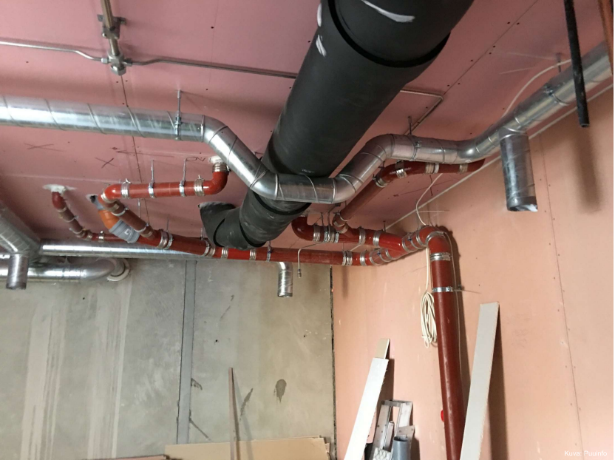
Heating, plumbing, and air-conditioning (HPAC) installations
The prefabrication factory makes the openings and penetrations for HPAC installations in accordance with the drawings.
The actual HPAC installations are carried out by HPAC installation professionals.
After HPAC installations, the penetrations and other openings are sealed in accordance with the designs.
Particular attention to sealing must be paid in the exterior walls, the base floor and the attic floor, and in fire-separating structures.
Heating, plumbing, air conditioning, and electrical installations, photos: Puuinfo Oy

Slide 33
Electrical installations
The prefabrication factory makes the holes and penetrations for electrical installations in accordance with the designs.
The actual electrical installations are carried out by electrical installation professionals.
The wirings must be designed so that the holes made to the fire protection boards and acoustic sheathing can be minimised.
The holes for the switch boxes and wirings in sound-insulated building elements must be acoustically sealed.

Slide 34
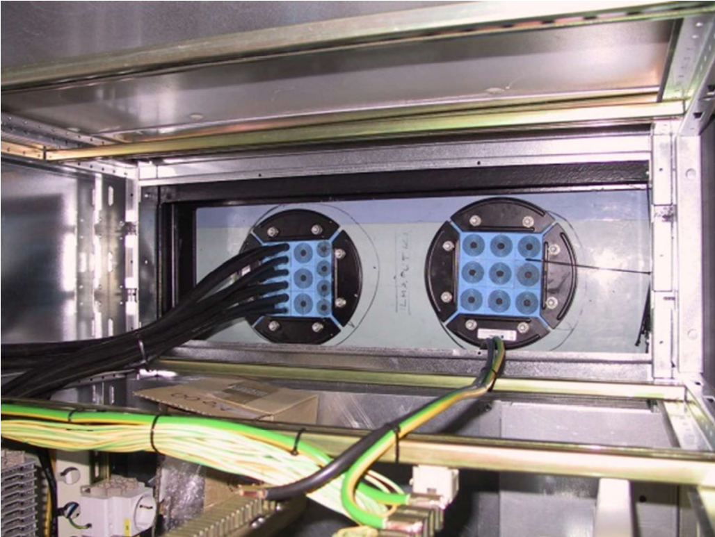
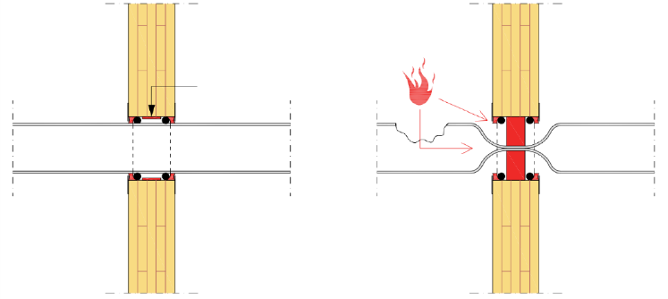
Fireproofing and firestops
If the fire class of the surface material must be B-s1,d0, it can be fireproofed with fire retardant paint, for example.
The penetrations in fire-separating structures must be sealed with firestop mortar, firestop collars, or modular firestop solutions.
Fire protection boards are used to protect load-bearing and fire-separating structures.
Fire protection insulation boards are used for thermal insulation in wooden structures in situations where not only thermal insulation but also fire resistance is required from the insulation board.
Firestop profiles are used in the ventilation cavities behind the exterior cladding of wooden blocks of flats.
Fire doors are required for walls passing through fire compartments.
Plastic drain
Firestop collar
Operating principle of a firestop collar, photo: Puuinfo Oy

Slide 35
Lifting and transportation of units

Slide 36
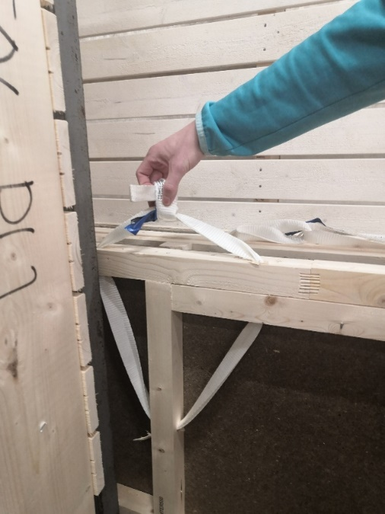
Lifting prefabricated units
Wooden units must be equipped with the necessary lifting accessories.
Units with a framed structure are often fitted with lifting slings or round slings with a lifting capacity of 500–1000 kg.
To ensure safe lifting under all circumstances, a single lifting eye can be used to lift only half of its lifting capacity.
The same lifting slings are used both at the factory and at the site.
After on-site installations, the lifting slings can be cut off.
The lifting slings must be installed according to the unit designs to ensure balance during lifting.
Photo: Jukkatalo Oy

Slide 37
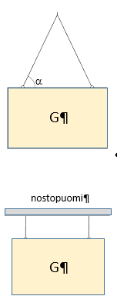
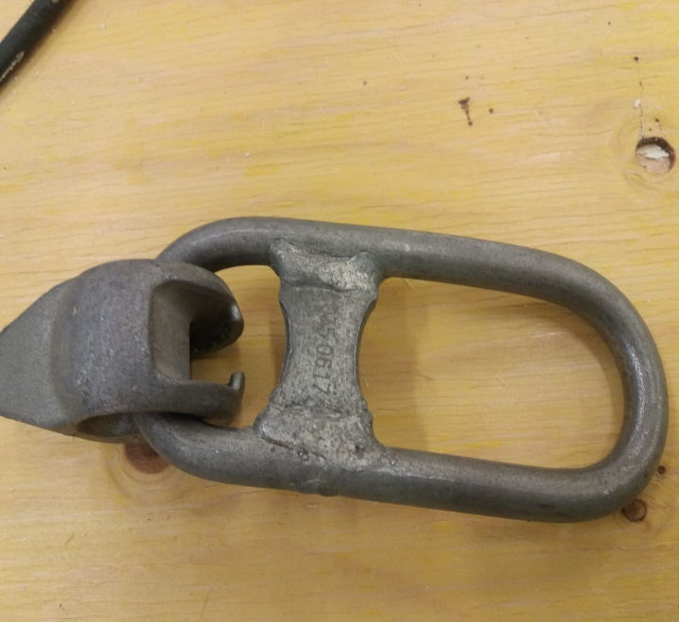
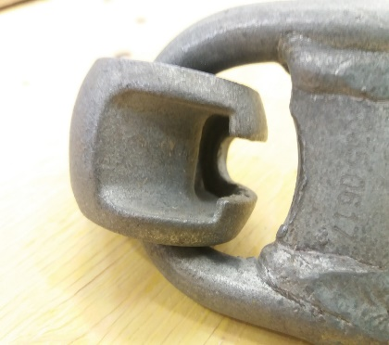
Lifting prefabricated units
Impact of lift angle
angle | mass | force/cable
30 ° | G | 1.00 x G
45 ° | G | 0.71 x G
60 ° | G | 0.58 x G
Impact of the lifting angle on the pressure on the cable during lifting. The lifts in the table have been calculated using two cables.
There must always be a sufficient safety factor applied to the lifting eyes and hooks. For example, a lifting sling with a 1,000 kg capacity can be used to lift a weight of 500 kg (safety factor 2.0). Multiple lifting slings can be fixed to the same lifting hook if needed. The permitted lifting capacities must also be taken into account when using lifting beams, bridge cranes, or other lifting equipment.
lifting beam

Slide 38
Kuivaketju
Kuivaketju10 (Dry Chain 10) is an operating model developed for moisture management during the construction process to reduce the risk of moisture damage throughout the building's life cycle.
Moisture risk management is based on a chain where risks are prevented at all stages of the construction process, and the success of the prevention measures is verified in a reliable manner.
The operating model is comprised of the Kuivaketju10 risk list and the risk verification instructions, which cover ten most significant moisture risks.
Appropriate management of these risks avoids over 80% of the consequential costs of moisture damage.

