Slide 1



Industrial wood construction
Teaching materials for industrial wood construction education
2022

Slide 2
Origin of the materials
Use of the materials
These learning materials for industrial wood construction have been prepared in a project led by Puuinfo Oy in 2021–2022. Also involved in the project were
Lappia Vocational College,
TTS-Työtehoseura ry
South-Eastern Finland University of Applied Sciences,
Metropolia University of Applied Sciences,
Jyväskylä University of Applied Sciences,
University of Tampere, and
Federation of the Finnish Woodworking Industries Puutuoteteollisuus ry
The project was funded by the Ministry of the Environment.
The materials are intended to be used as extensively as possible in industrial wood construction education and studies.
The materials are released under the Creative Commons licence Attribution-ShareAlike (CC BY-SA), which requires that the author be properly credited when the materials are used and that derivative works may only be distributed under the same licence as the original work.
The original materials and any updates to them by Puuinfo will be published on the Library of Open Educational Resources website (aoe.fi) and the Puuinfo.fi website.

Slide 3
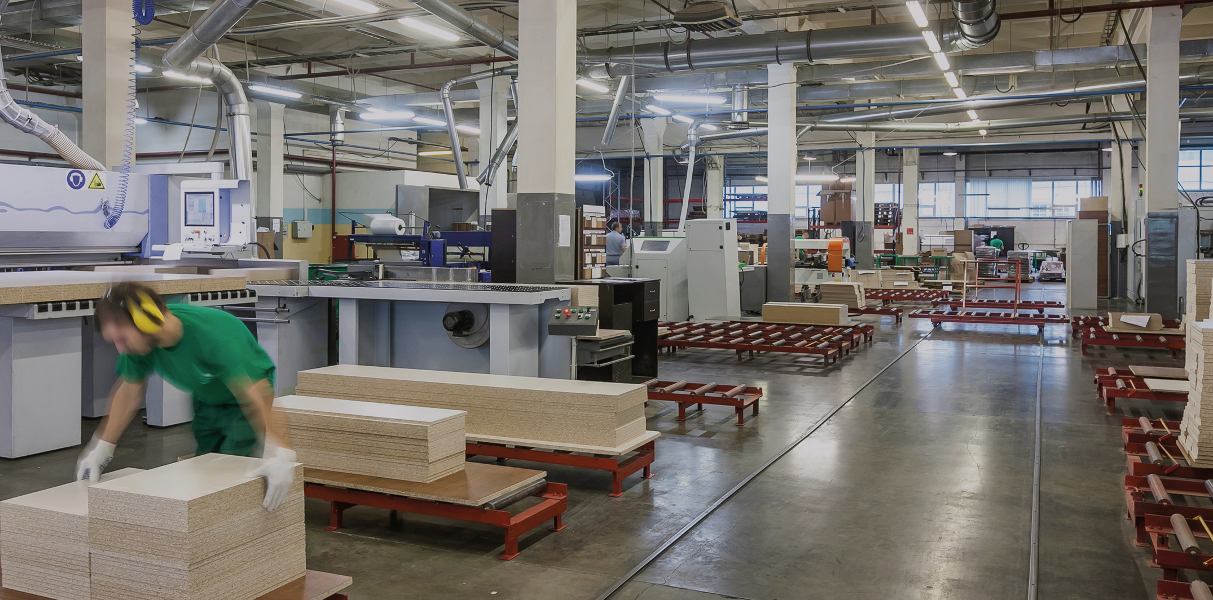
Industrial prefabrication

Slide 4
Authors
Martti Mylly, Lappia Vocational College
Release date: 10/06/2022

Slide 5
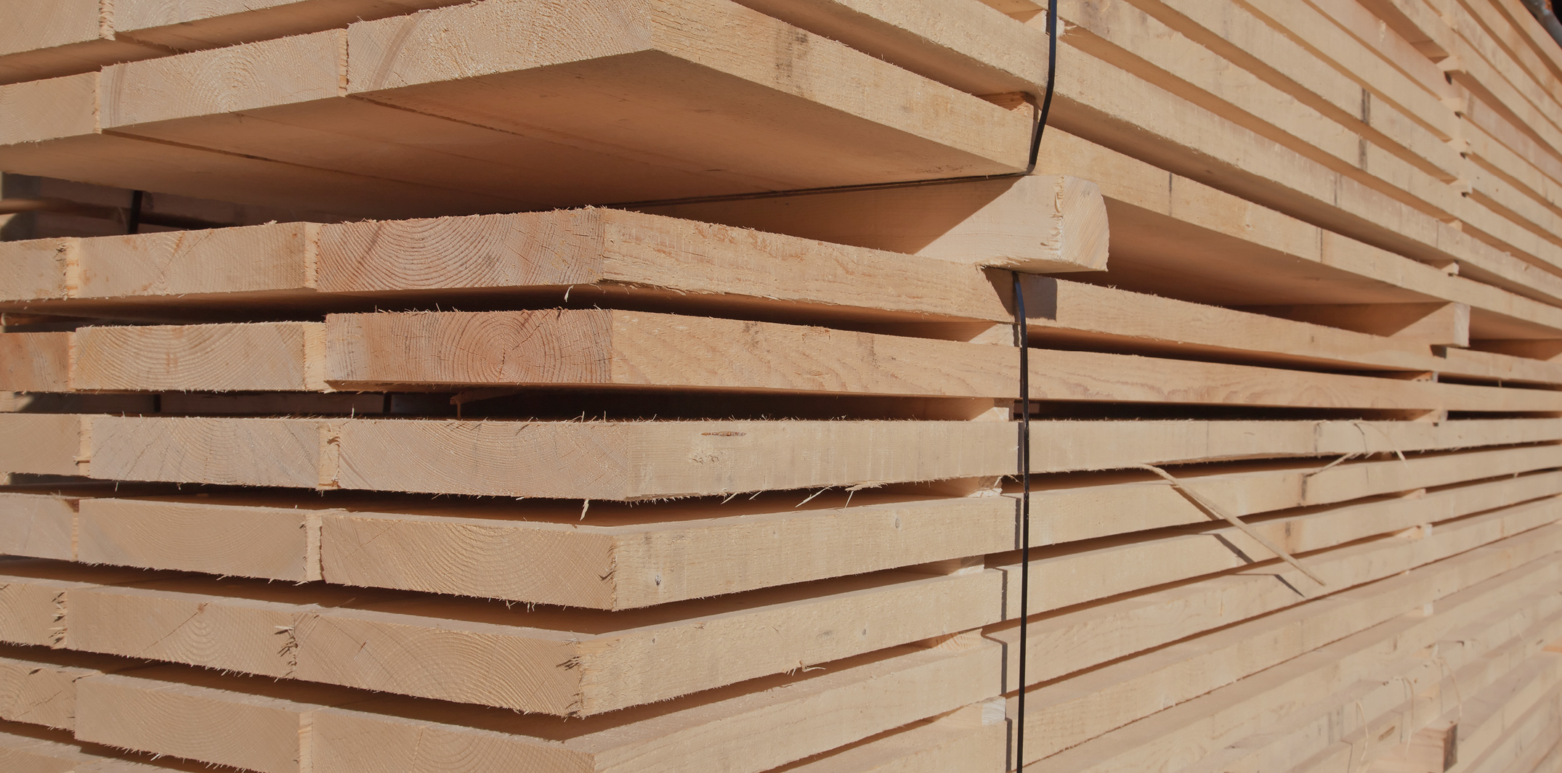
Processing sawn timber

Slide 6
Storing sawn timber

Slide 7
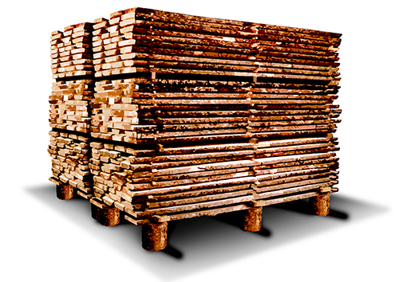
Storing unedged sawn timber
Sawn timber can be stored in the field, under a shelter, or indoors.
The timber must be shielded from direct sunlight, and the stack must be properly ventilated.
The platform is made on solid soil, it must be level, and have supporting points at sufficiently small intervals (every 60–80 cm).
The platform must be high enough (60–80 cm from the ground) to enable the circulation of air under the stack.
Full stack, photo: Puupro

Slide 8
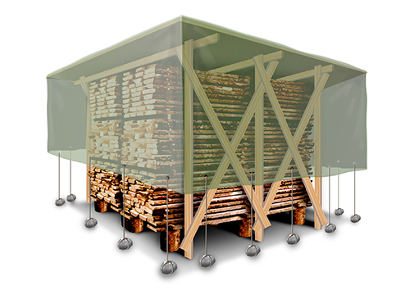
Stack protection
Sufficient ventilation must be ensured when using protective covering.
The tarpaulin must not touch the ground, and there must be approximately 0.5 m clearance between the tarpaulin and the stack.
The tarpaulins must be large enough to protect the stack from the rain, snow, and sunlight.
The moisture content and dimensions are documented immediately upon unloading the timber.
Protected stack, photo: Puupro

Slide 9
Grading sawn timber

Slide 10
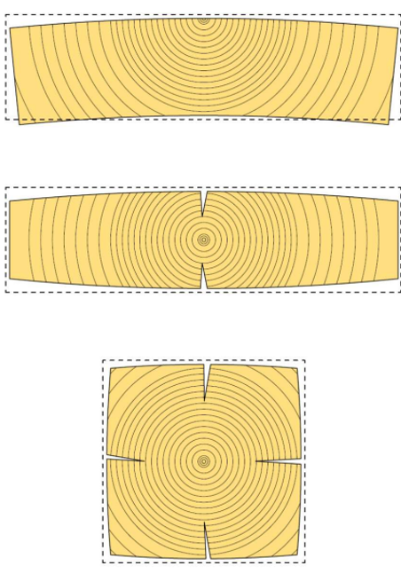
Quality grading of sawn timber
In Finland, half of the sawn timber production consists of pine and half of spruce.
The appearance of the timber determines its quality grade.
The size, number, and place of knots are the most important quality criteria.
Other factors examined include shakes, wanes, resin pockets, bark pockets, scars, slant grain, top fractures, compression wood, warp, discolouration, and defects resulting from the handling of sawn timber.
A piece of sawn timber is graded according to the following principles:
all sides are examined individually,
quality is determined on the basis of the outside face and both edges, and
the inside face is allowed to be of one grade lower quality.
Image: Puuinfo Oy

Slide 11
Stress grading and CE marking of sawn timber
Stress grading is performed in accordance with the standards applicable to the products made from the timber. For example, if the sawn timber used to produce CLT is finger-jointed, this is controlled by product standard FprEN 16351:2015 (E).
The person responsible for grading the layers for laminated timber must have valid INSTA 142 LT stress grading qualification. The INSTA 142 standard complies with the grading procedures laid down in the European standards EN 1912 and EN 14081 – 1.
The standard defines the visual stress grades, named T3 - T2 - T1 in descending order of strength. The values correspond to characteristic bending strength values 30 N/mm², 24 N/mm², and 18 N/mm².
According to the EN 338 standard, sawn conifer timber is stress graded in accordance with the table. Categories C14...C30 can be graded either visually or mechanically, and categories C35...C50 only mechanically.

Slide 12
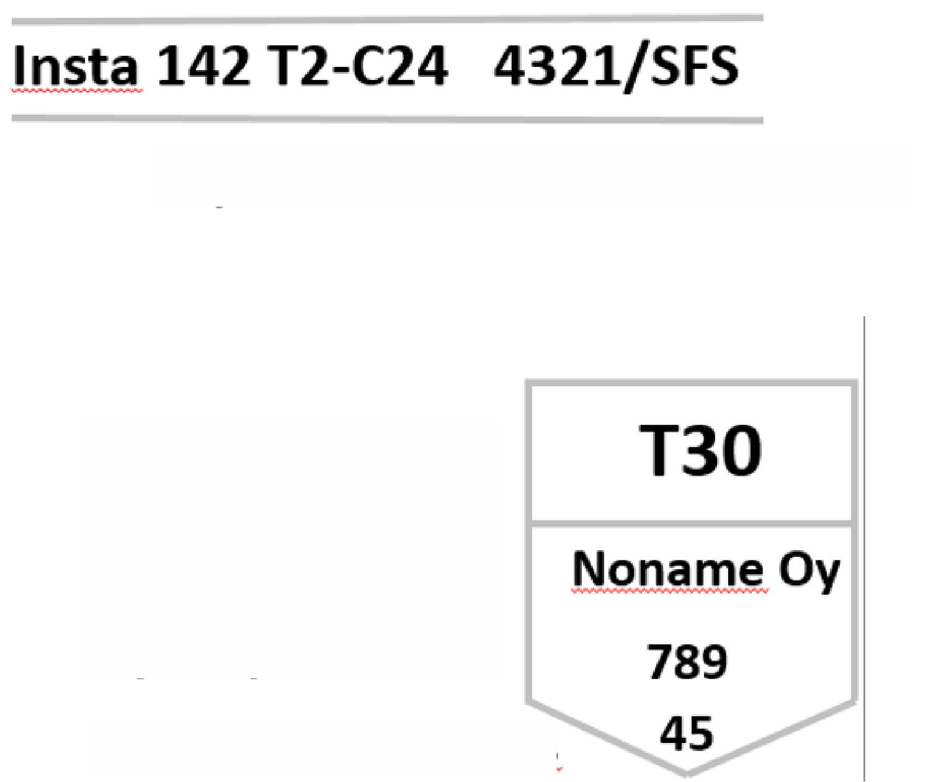
Grade stamps on stress-graded timber
Each piece or package of stress-graded sawn timber, industrially manufactured units, and finger-jointed sawn timber must be grade-stamped.
The stamping requirement also applies to all visually graded articles.
In practice, mechanically graded structural sawn timber is always stamped
Grade
Grader identifier
Grade
Manufacturer
Grader identifier
Thickness of the sawn timber

Slide 13

CE marking of wood products
The CE marking is a conformity marking indicating that the construction product complies with the relevant harmonised product standard and meets the appropriate safety and health requirements set out in the Construction Products Directive.
Construction products bearing the CE mark can be freely exported and sold in the internal European market.
The conformity of a CE marked product placed on the market is attested through internal quality assurance by the manufacturer and through verification, inspection, and testing by a notified body.
M / Graded dry

Slide 14
Finger-jointing sawn timber

Slide 15
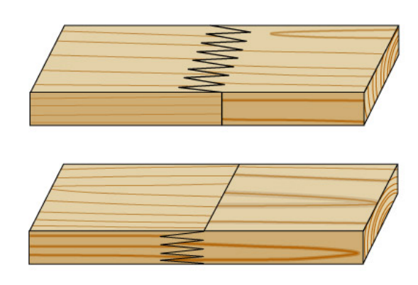
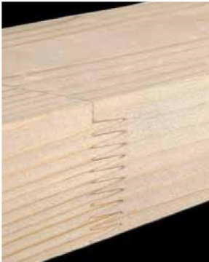
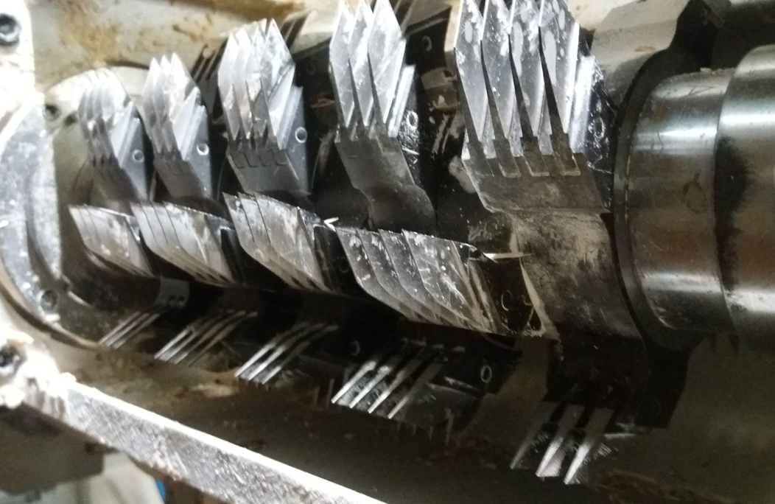
Finger joints in sawn timber
Finger jointed structural sawn timber refers to pieces of timber whose length has been increased with finger joints, resulting in a longer piece of timber that meets the strength requirements set for structural sawn timber.
Finger joints can be either parallel to the edge or parallel to the face.
Finger joint cutters. Photo: Lappia Vocational College

Slide 16
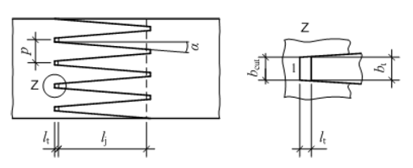
Finger joint measurements
In stress-graded finger joints, the machining of the fingers is precisely defined.
l_{j} = finger length p = distance between fingers
a = finger angle l_{t} = allowance
b_{cut 0} width of allowance b_{t} = width of finger at the tip at the tip
1 = height of cut

Slide 17
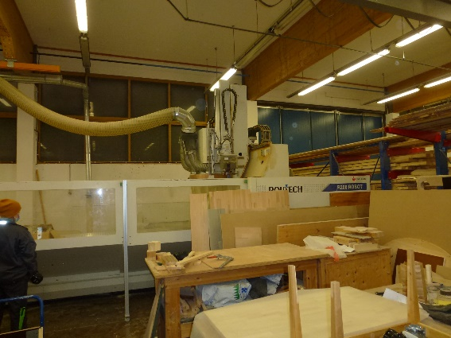
Gluing finger joints
Gluing must take place immediately after milling. The operating instructions of the machine and the instructions of the adhesive manufacturer must be followed.
The amount of adhesive is adjusted with injectors and manoeuvring speed, in accordance with the dimensions of the joint.
The cramping pressure must be sufficient to achieve a good grip between the fingers.
No shakes that would weaken the piece may form at the bottoms of the fingers.

Slide 18
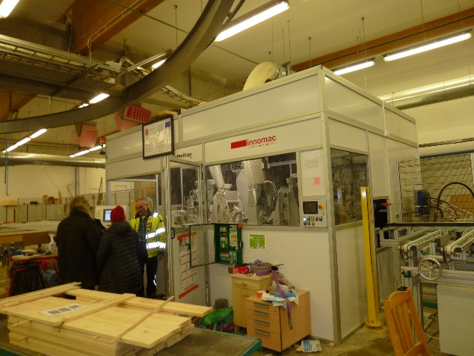
Gluing finger joints
The cramping duration depends on e.g. the dimensions of the sawn timber, the heating of the timber or joint, the adhesive, and post-gluing processing of the sawn timber.
How the sawn timber is processed after cramping must be in line with the selected curing method.
Cutting, moving, and packaging must be done without stressing the joint.

Slide 19
Finger joint production lines
In industrial production, the finger joint line typically forms part of a larger production system.
At sawmills, for example, the sawn timber is first sawn and seasoned, and only then jointed.
In glulam beam industry, on the other hand, the piece is first jointed before being planed and cramped.
The finger jointing process is the same in both production line types, however.

Slide 20
Finger joint production lines
Finger joint lines can be divided into lines suitable for extending short timber and lines suitable for extending long timber.
The division into lines suitable for short or long timber is not always straightforward.
It is simpler to categorise the lines according to how the sawn timber is fed into the machines.
This way, the lines can be divided into three groups:
1. longitudinal feed lines,
2. transverse feed lines, and
3. batch feed lines.

Slide 21
Adhesives in finger joints
Modern industrial finger joint adhesives are tailored to the needs of the wood industry, and they are constantly being developed further.
There are a few adhesives used in structural wood gluing that have certain chemical differences.
The most common types of adhesives are:
phenol-based (phenol-formaldehyde, PF),
phenol-resorcinol-formaldehyde (PRF)
resorcinol-formaldehyde adhesive(RF)
amino-resin-based (melamine-urea-formaldehyde adhesive MUF)
moisture curing polyurethane adhesive (PU or PUR), and
emulsion polymer isocyanate adhesive (EPI)
The choice of adhesive depends on the requirements set for the end product, the use class of the site (1,2 or 3), and the production line.

Slide 22
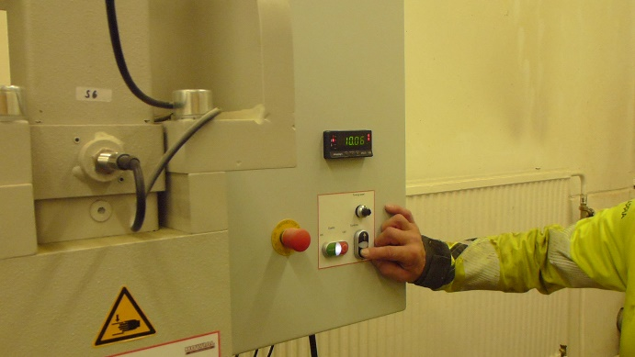
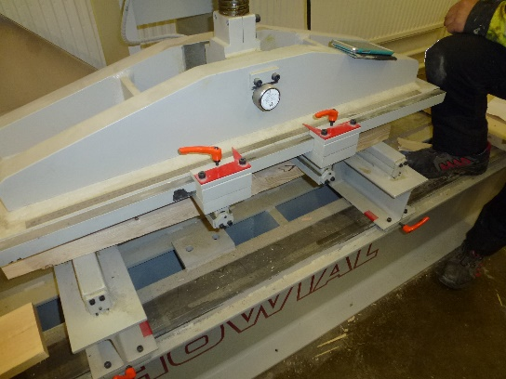
Finger joint bending tests
The strength of the finger joints must be verified e.g. with a bending test in accordance with standards EN 16351 and EN 15497. The device used for testing must be type-approved.
At least one test must be performed on each production lot. The test result is based on the average of the last 100 test results, the standard deviation, and the number of approved test values.
Tests must be recorded, and each test must be reported on a separate form.

Slide 23
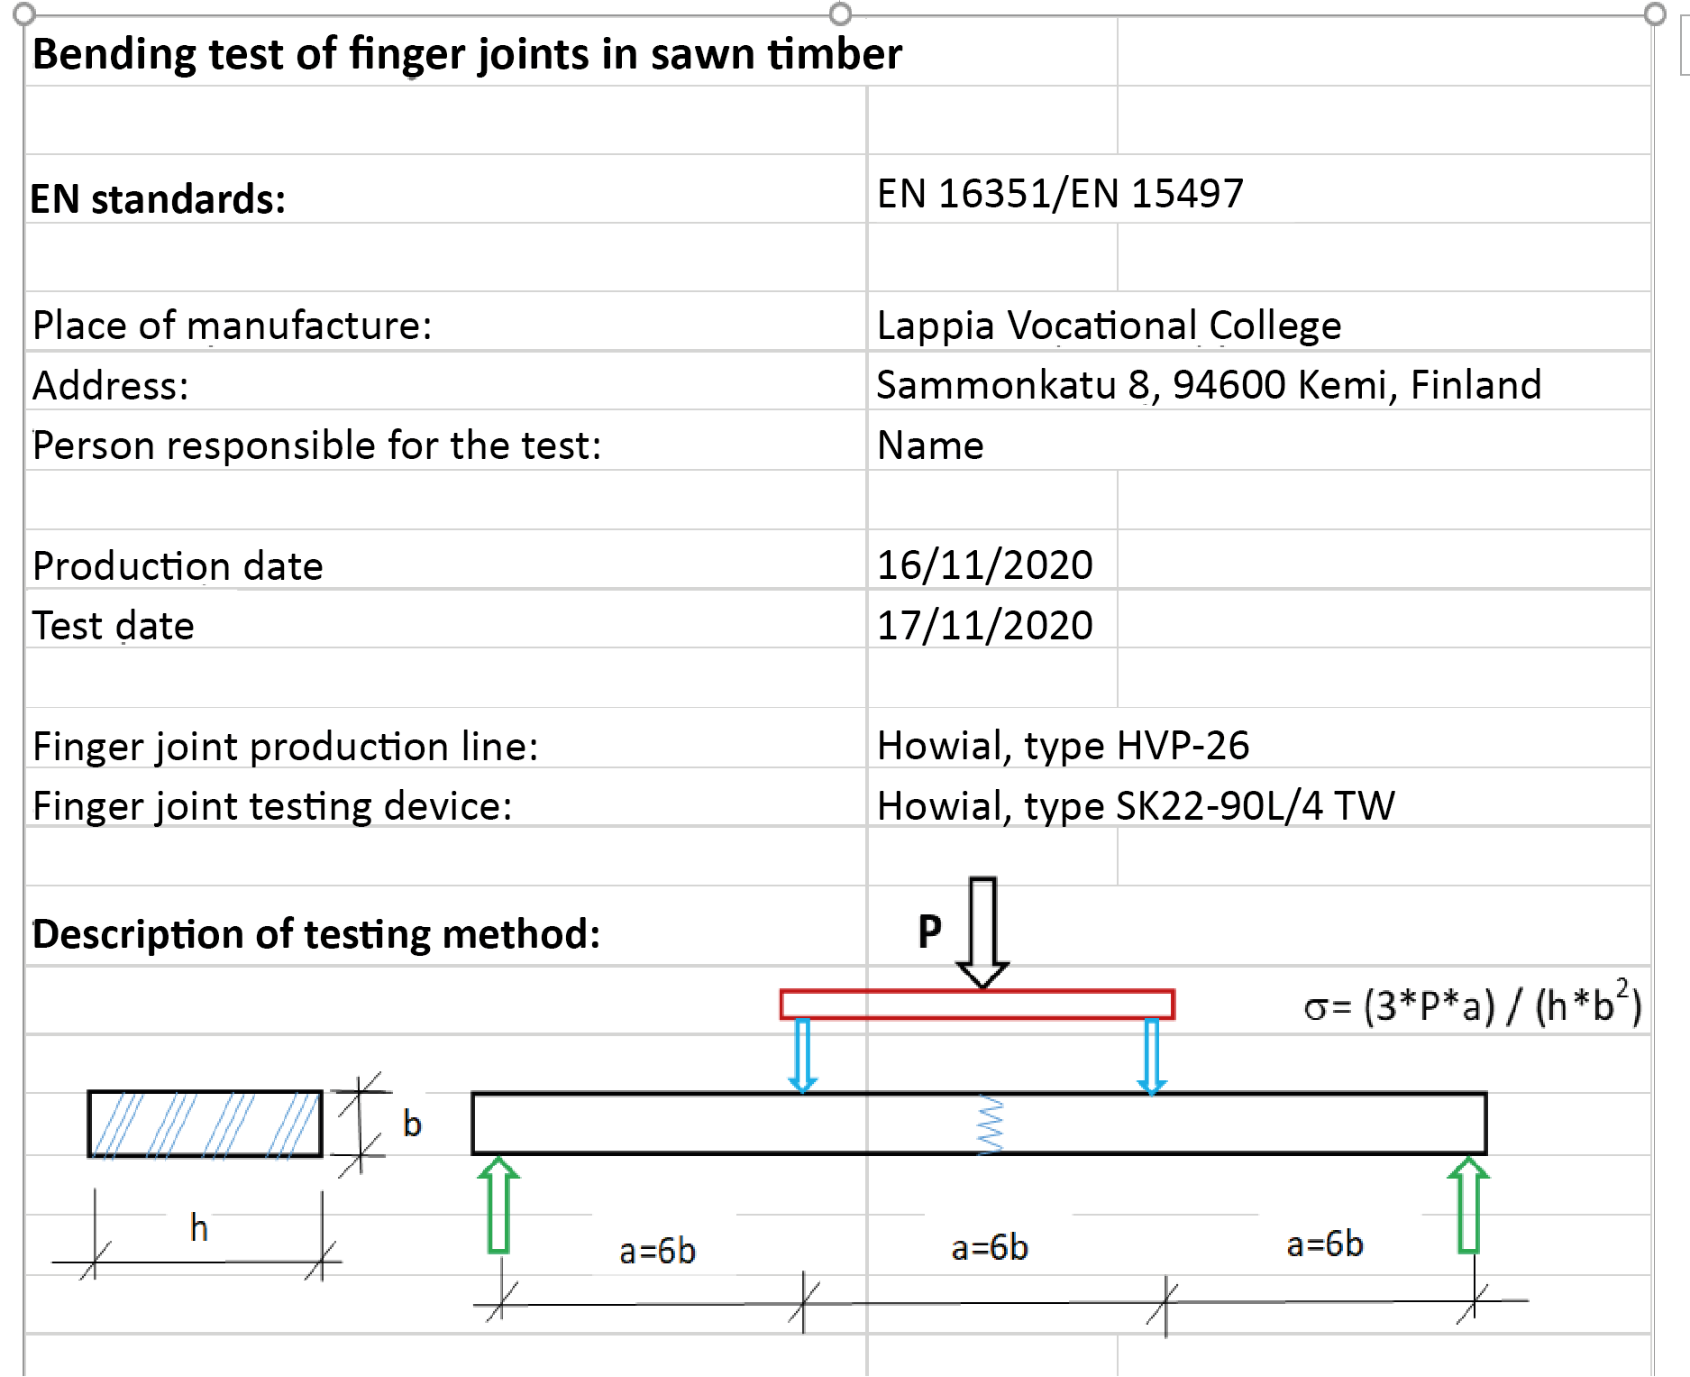
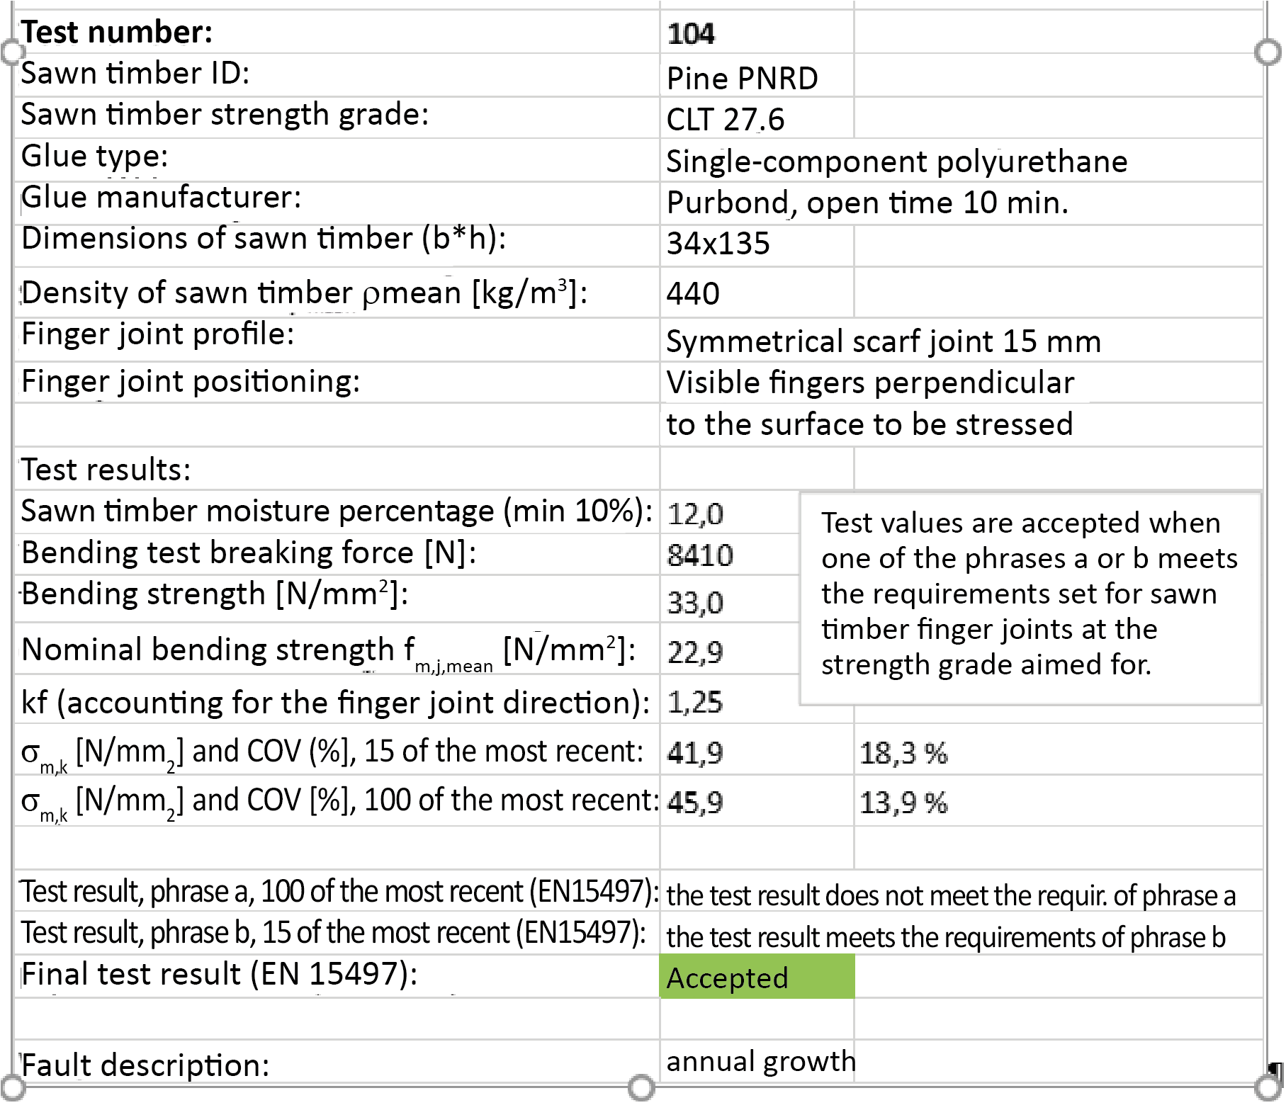
Finger joint bending tests

Slide 24
Planing sawn timber

Slide 25
Planing sawn timber
Planing is further processing of sawn timber.
The purpose of planing is to achieve either precise cross-sectional dimensions (dimensioned sawn timber) or a smooth surface and a specific shape (e.g. mouldings and cladding boards).
Typically, only the side cutters and the top cutter are used for dimensioning, i.e. timber is only planed on three sides.
When planing all four sides, the bottom cutter is also used, in which case the product is called 'smooth-planed'.
Most planing machines have a fifth cutter under the planer. This so-called 'smoothing cutter' is used to finish the face of the piece that will remain visible.

Slide 26
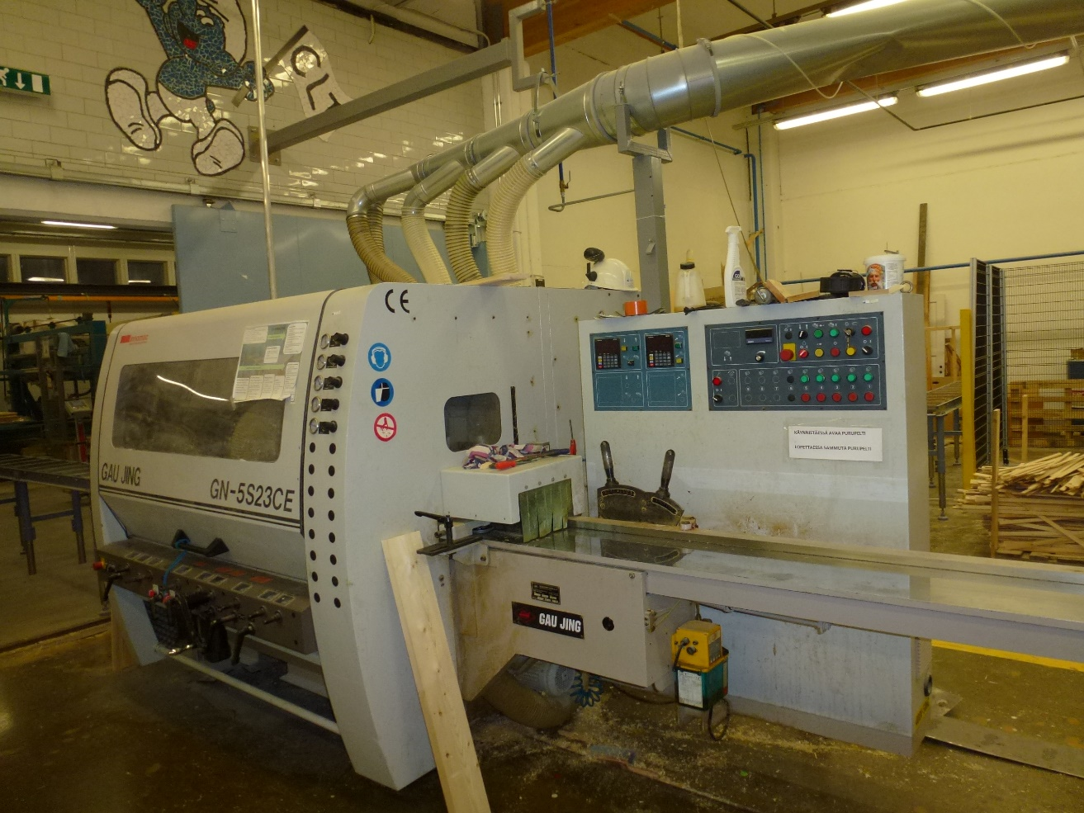
Common planing machine types
The most common planer types include:
universal plane (large and medium size)
moulding planes, and
panel planes.
Planing machines are controlled from the right-hand side of the machine in relation to the direction of feed.

Slide 27
Power of the planing machine
The typical feed rates of large universal planes equipped with powerful feed motors vary between 70 and 150 m/min.
The typical feed rates of medium-sized universal planes and panel planes vary between 40 and 100 m/min, and those of moulding panels vary between 30 to 60 m/min.
The feed rate of high-power planes is up to 300 m/min.
High feed rates may reduce planing quality. The feed rate must be selected according to the required quality.

Slide 28
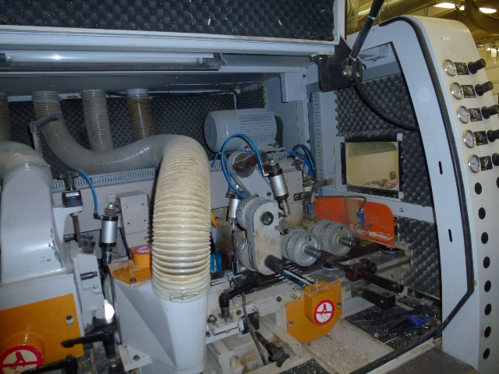
Planing machine parts
Planing machines comprise e.g. cutters, mill cutters, and circular saws.
These are attached to a spindle shaft, which is furnished with bearings at least at one end and positioned either vertically or horizontally in the machine.
Blades are the wood-cutting part of the cutters.
The blades are attached to cutterheads.

Slide 29
Planing machine parts
In a milling cutter, the blades are fixed to the cutterhead.
Milling cutters are designed to keep their shape and profile even when sharpened.
Milling cutters can be smooth or profiled.
They are attached to a vertical or horizontal spindle shaft by using precise centring devices.

Slide 30
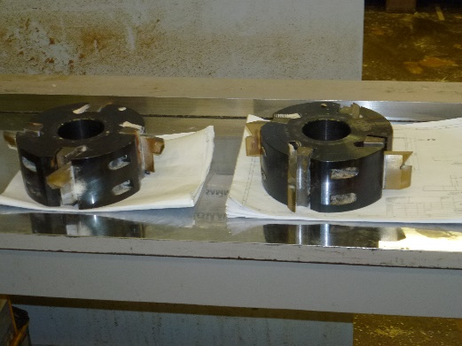
Planing machine parts
Milling cutters have the following advantages when compared to cutterhead + detachable blade combinations:
higher feed rate, milling cutters typically have 6 to 8 blades,
faster sharpening and always the right profile, and
faster installation, as the blades are already attached to the cutterhead.
Typically, cutters and detachable blades are only used when manufacturing special profiles in small quantities.
New systems where 4 or 6 thick blades are attached to a round cutterhead and the blades are sharpened at their faces represent an intermediate form between cutters and milling cutters.

Slide 31
Presses
It is very important for the planed timber to be secured in place when it is fed by the spindles.
Special pressure equipment is used for this purpose; the equipment differs in structure depending on the part of the planer it is located at.
The planer is typically fed with a special automated feeding table and an accelerator conveyor, or a simple feed belt.
Feeding tables are used particularly in planing machines that have a high feed rate.
The table serves as a buffer storage.

Slide 32
Woodworking machine maintenance

Slide 33
Most common woodworking machines
Basic woodworking machines refer to machines that are typically used for processing timber and timber slabs.
Virtually all modern basic machines include automation and advanced technology, e.g. for response control, blade settings, or feeding equipment.
Basic machines include:
various circular saws,
band saws,
surface planing machine,
planer and thicknesser,
vertical spindle moulder,
trim router,
multi-spindle drilling machine,
various abrasive belt grinders,
presses, and
CNC machines.

Slide 34
Maintenance of woodworking machines
The purpose of maintenance is to prevent breakage. The machine or device under maintenance is inspected and repaired in accordance with the pre-prepared programme.
The maintenance programme is based on prior experience with similar equipment.
In other words, maintenance work is carried out before the machine or equipment is expected to break.
The purpose of maintenance is to avoid situations where repair work is required.
Benefits of maintenance: increased machine reliability, improved safety, extended machine service life, improved quality of work.

Slide 35
Maintenance of woodworking machines
Maintenance instructions are machine-specific, so no universal and comprehensive instructions can be given.
However, there are some measures that can be taken on virtually all machines.
All maintenance instructions mention cleaning.
Machining waste and dirt may e.g. send incorrect impulses to limit switches, hinder the free movement of adjusting screws, cause dimensional inaccuracies in precise machining, enter the hydraulic and pneumatic systems, form an insulation layer around electrical equipment and cause overheating.
Professionals always clean their machines and tools after working, whether hand-held or CNC controlled.

Slide 36
Maintenance of woodworking machines
Almost all machinery needs lubrication.
It is important that lubrication is done according to the machine's lubrication instructions and with the right oil.
Maintenance monitoring refers to e.g. the recording of changes.
Changes are symptoms of something, and their causes must be investigated.
Today, companies are putting more and more responsibility on the machine operator.
The operator's eyes or ears can detect changes, slower rotation speeds, and new sounds, which is why operators play a crucial role in noticing if the machine is broken.

Slide 37
Maintenance of woodworking machines
The user's senses of hearing, smell, sight, and touch are not always enough to notice abnormalities.
Tools such as meters can help; metered variables include temperature, clearances, and eccentricities.
One way to monitor the need for maintenance is to mark down operating hours in a spreadsheet and schedule the maintenance measures in advance.
It is a good idea to ask the machine supplier for a maintenance table, in which you can mark all the maintenance measures to be performed on the machine.

Slide 38
Maintenance of woodworking machines
When a machine breaks, the first thing to do is to make sure that there is no risk of accident.
Knowledge of the machine and powers of deduction are needed in examining the breakage.
When reporting a fault, the aim is to describe the fault as accurately and systematically as possible, so that all the causes of the failure can be determined.
Troubleshooting is facilitated by a troubleshooting diagram that accompanies the machine.

Slide 39
Maintenance of woodworking machines
Repair decisions are made on a case-by-case basis: the operator does whatever they can, but e.g. electrical and hydraulic work must be left to the professionals.
Work safety must be ensured during repair work.
The risk of accidents can arise if people are not aware about the repair work and attempt to start the machine, or if the repair worker causes the machine to start.
Accidental start-up may not occur, and repair work must be properly communicated to the staff.

