Slide 1



Industrial wood construction
Teaching materials for industrial wood construction education
2022

Slide 2
Origin of the materials
Use of the materials
These learning materials for industrial wood construction have been prepared in a project led by Puuinfo Oy in 2021–2022. Also involved in the project were
Lappia Vocational College,
TTS-Työtehoseura ry
South-Eastern Finland University of Applied Sciences,
Metropolia University of Applied Sciences,
Jyväskylä University of Applied Sciences,
University of Tampere, and
Federation of the Finnish Woodworking Industries Puutuoteteollisuus ry
The project was funded by the Ministry of the Environment.
The materials are intended to be used as extensively as possible in industrial wood construction education and studies.
The materials are released under the Creative Commons licence Attribution-ShareAlike (CC BY-SA), which requires that the author be properly credited when the materials are used and that derivative works may only be distributed under the same licence as the original work.
The original materials and any updates to them by Puuinfo will be published on the Library of Open Educational Resources website (aoe.fi) and the Puuinfo.fi website.

Slide 3
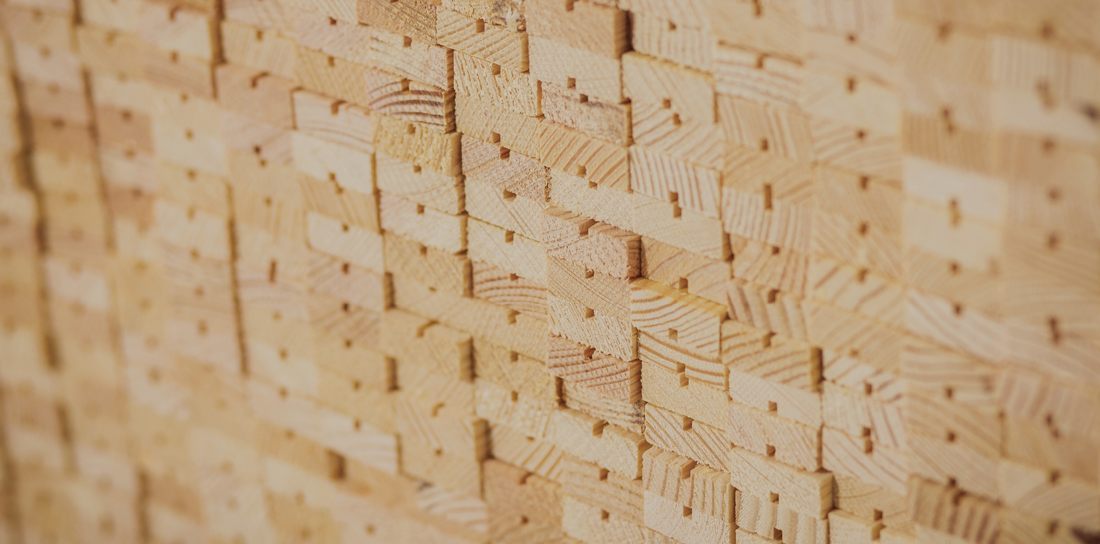
Construction physics

Slide 4
Authors
Tero Lahtela, Insinööritoimisto Tero Lahtela Oy
Release date: 18/08/2021

Slide 5
Acoustics

Slide 6
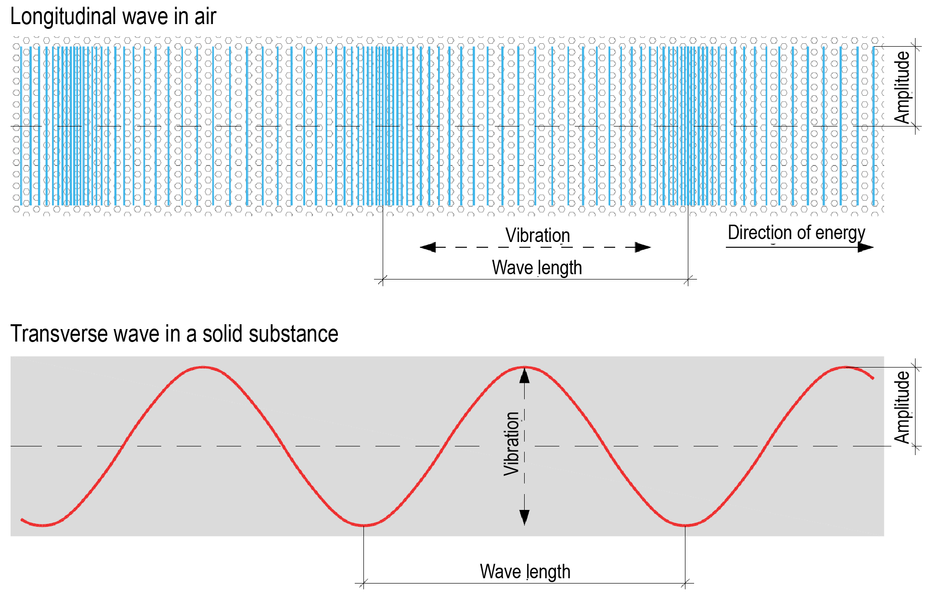
Sound
Sound is a wave that travels through a medium.
The medium may be a gas, liquid or solid matter.
In air, sound travels as a longitudinal wave
In a solid matter, sound moves both as a traverse and longitudinal wave

Slide 7
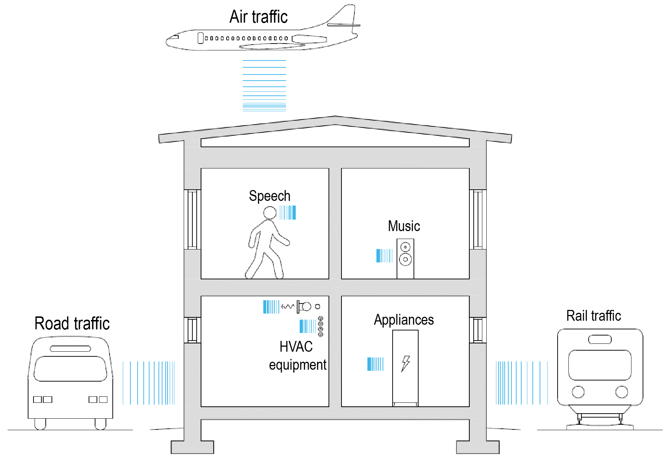
Airborne sound
Sound that travels through air is known as airborne sound
The human ear can detect airborne sound at frequencies of 20…20000 Hz
We also sense strong low-frequency vibration through our bodies
Airborne sounds are created inside and outside buildings

Slide 8
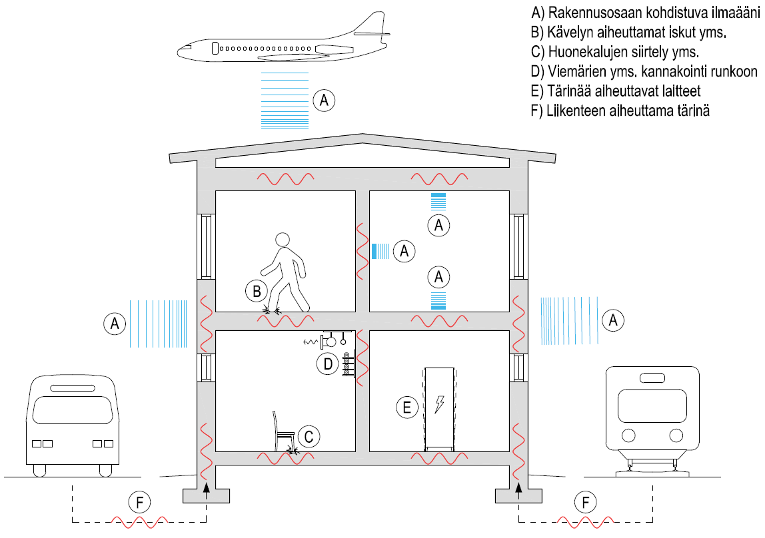
Structure-borne sound
A) Airborne sound at a building element
B) Impact caused by walking, etc.
C) Moving furniture, etc.
D) Supporting drains etc. to the frame
E) Appliances causing vibration
F) Vibration caused by traffic
Sound moving through the frame of a building is known as structure-borne sound
Structure-borne sound generates airborne sound and vice versa
Vibration in a building element generates vibration in the air surrounding this element and airborne sound
When airborne sound comes into contact with a building element, it makes the element vibrate, creating structure-borne sound

Slide 9
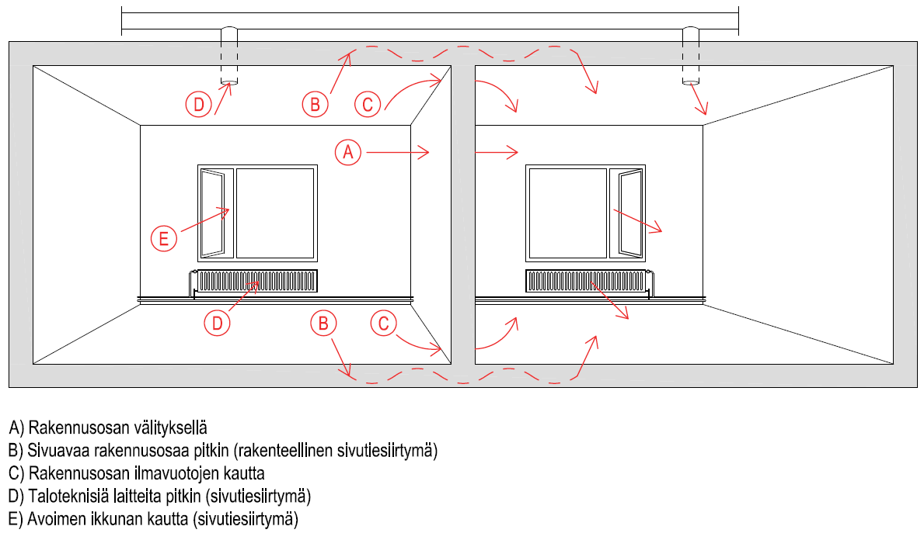
Sound propagation paths
In acoustic design, the building must always be examined as a whole
All sources of sound and its propagation paths must be accounted for
Only examining individual structural elements is not enough
Flanking transmission may significantly impair sound insulation between spaces
A) Through the building element
B) Through a flanking building element (flanking transmission)
C) Through air leaks in the building element
D) Through building services equipment (flanking transmission)
E) Through an open window (flanking transmission)

Slide 10
Sound pressure [Pa]
Sound pressure p [Pa] is a change in air pressure compared to static pressure
The greater the change in air pressure, the louder the sound appears to our ears
The smallest air pressure change the human ear can hear as a sound is 0.00002 Pa (hearing zone)
The threshold of pain of the human ear is reached at an air pressure change of 20 Pa

Slide 11
Sound pressure level [dB]
A logarithmic scale of decibels has been developed for indicating sound pressure levels L_{p} [dB], as indicating them as sound pressure p [Pa] is challenging
For instance, the ratio between the air pressures of the hearing zone and the threshold of pain is one to a million.
In practice, the logarithmic scale of decibels also makes it easier to perceive the sound pressure level
As a numeric value, for example, 60 dB is a better indication of volume than 0.02 Pa

Slide 12
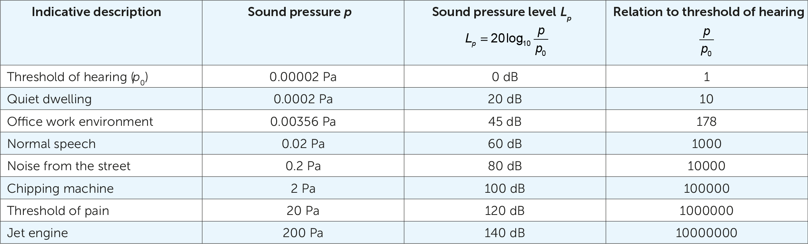
Association between sound pressure and sound pressure level

Slide 13
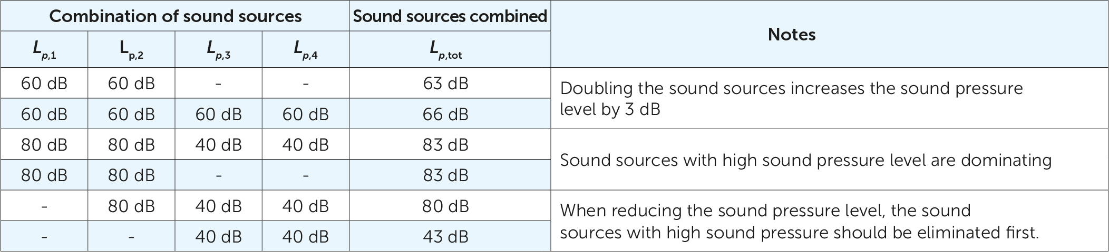
Impact of several sound sources

Slide 14
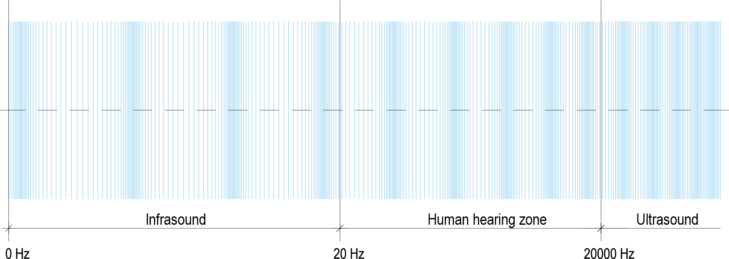
Sound frequency [Hz]
Number of sound wave oscillations per second
The greater the frequency, the higher the sound appears to us
Phenomena dependent on audio frequency
Sound pressure level produced by the source of sound
Acoustic operation of a building element
Sound insulation capacity of a building element

Slide 15
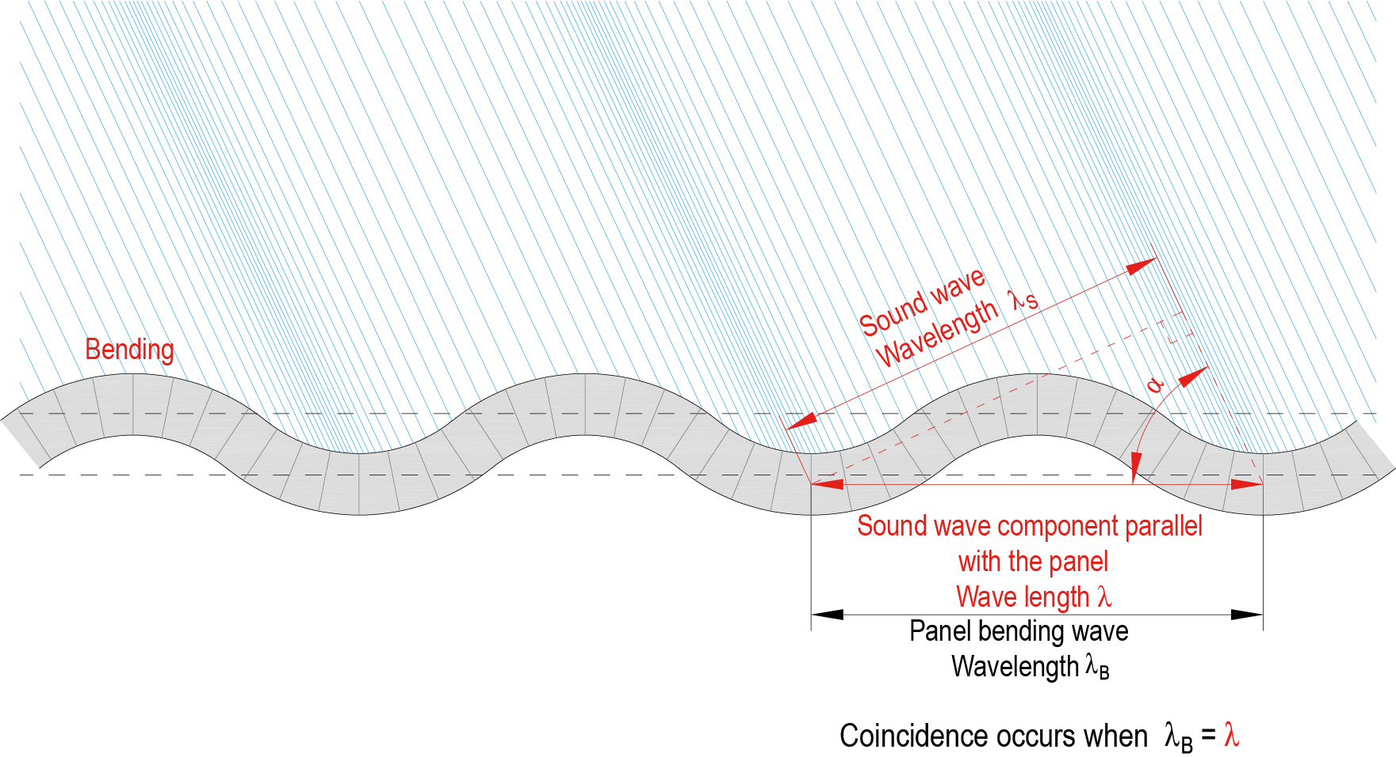
Coincidence phenomenon
The vibration that a sound wavefront causes in a panel when it hits the panel surface at a certain angle has the same wavelength as the wavefront component parallel with the panel
The sound wavefront hitting the panel and the panel bending wave have the same phase, and the sound waves penetrate the panel

Slide 16
Coincidence cut-off frequency f_{c}
At coincidence cut-off frequency, the airborne sound insulation of a building element impairs significantly
Coincidence cut-off frequency is impacted by the panel’s
Thickness
Density
Poisson’s ratio
Modulus of elasticity
Cross-laminated timber panels (e.g. plywood, LVL, CLT) have different coincidence cut-off frequencies in different plane directions (bending stiffness)
The coincidence phenomenon is a particular challenge associated with wood panels

Slide 17
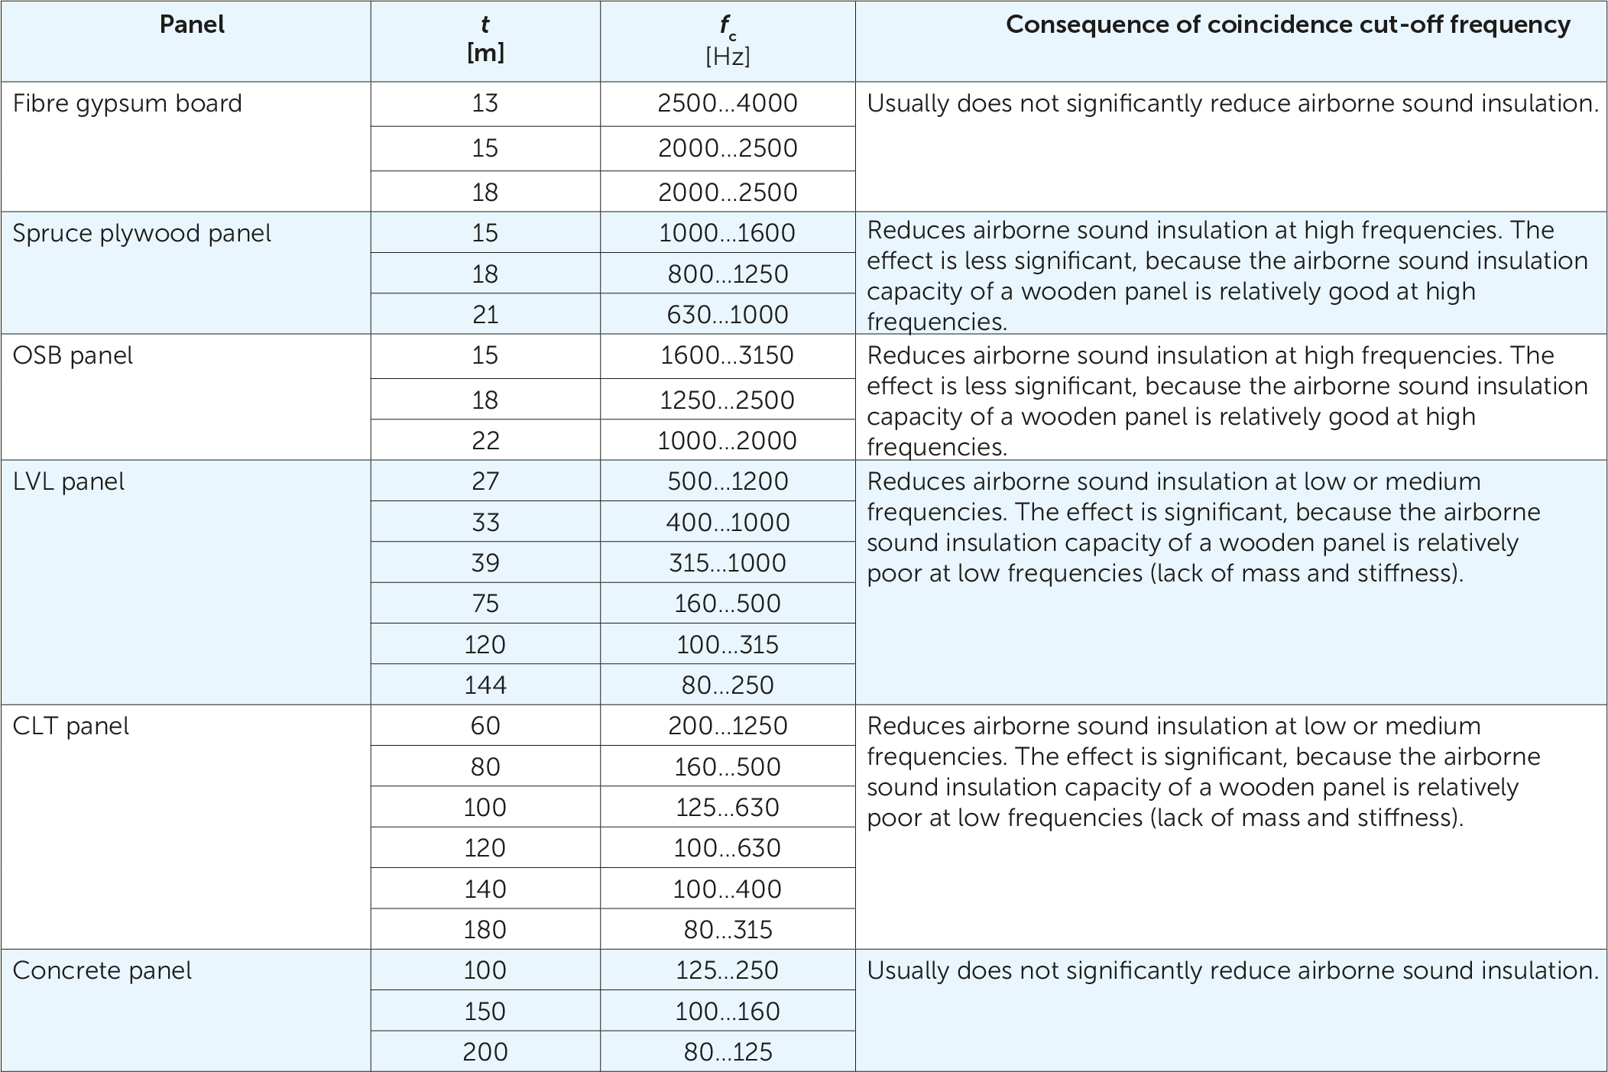
Indicative coincidence cut-off frequencies

Slide 18
Natural frequency f
The strongest vibration is created at the natural frequency of a material
Above the lowest natural frequency, other natural frequencies exist
Each natural frequency has its natural vibration form
The natural frequency depends on the following properties of the building element, structural component set or other similar system
Mass
Stiffness
Dimensions

Slide 19
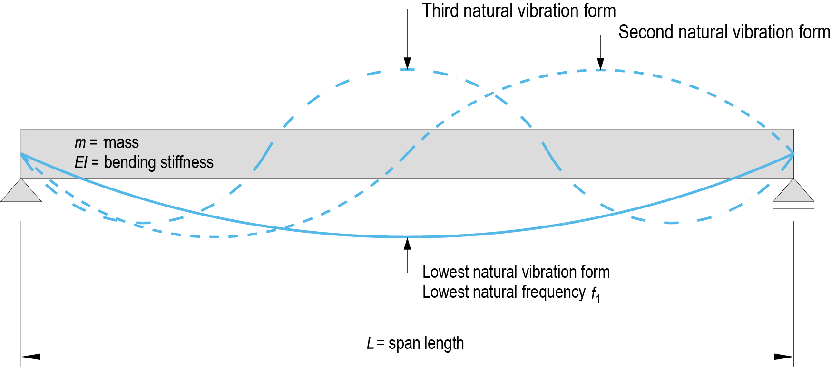
Natural vibration forms of a building element

Slide 20
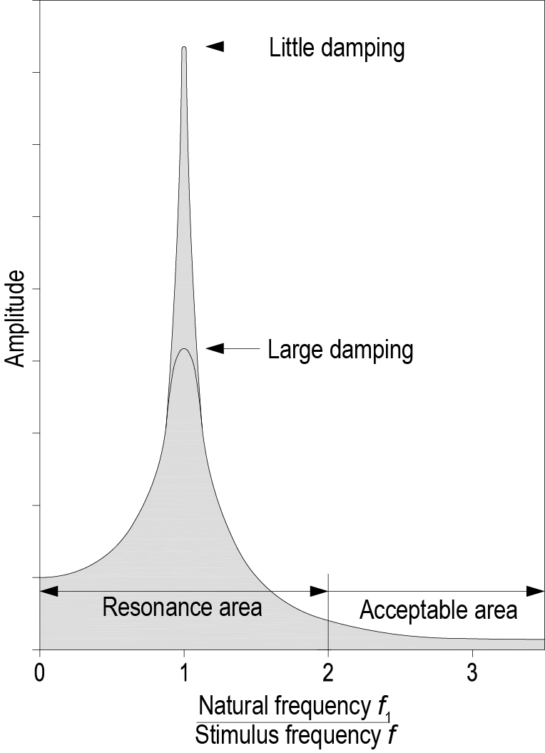
Resonance
Resonance is generated when the frequency of an external stimulus corresponds to the natural frequency of a material
Sound insulation deteriorates in the resonance range but improves efficiently above it
The lowest natural frequency of a building element used for soundproofing must be as low as possible to ensure that the element insulates sound effectively in frequency range 100…3150 Hz

Slide 21
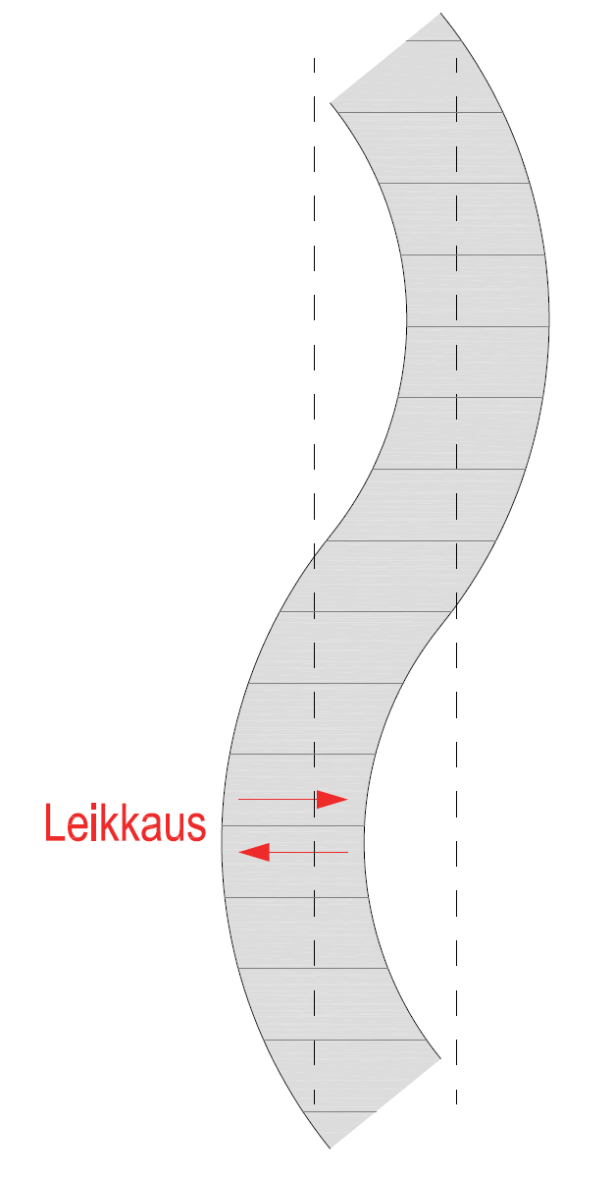
Shear wave cut-off frequency f_{h}
In addition to bending waves, shear waves occur in a panel
The shear wave curbs the increase in sound insulation capacity above the shear wave cut-off frequency
Significant in the case of thick panels at great frequencies
Concrete structures
Solid timber panel structures
Shear

Slide 22
Airborne sound insulation
The purpose of airborne sound insulation is to reduce airborne sound travelling to the other side of a soundproofing building element
The airborne sound insulation capability of a building element is given as its sound reduction index R_{w}
Airborne sound insulation between spaces is given as standardized level difference D_{nT,w}
Flanking transmissions should be accounted for
Surface area of the soundproofing building element
Reverberation and size of the space
Airtightness of a building element is highly significant for airborne sound insulation
Flanking transmission is highly significant for airborne sound insulation

Slide 23
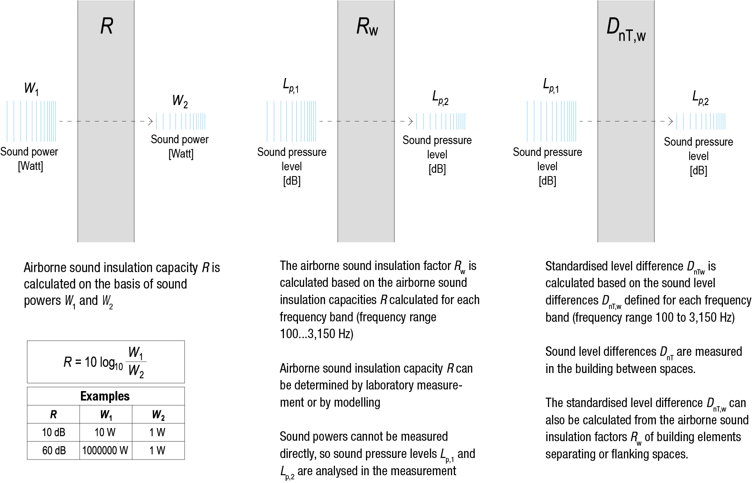
Determination of airborne sound insulation

Slide 24
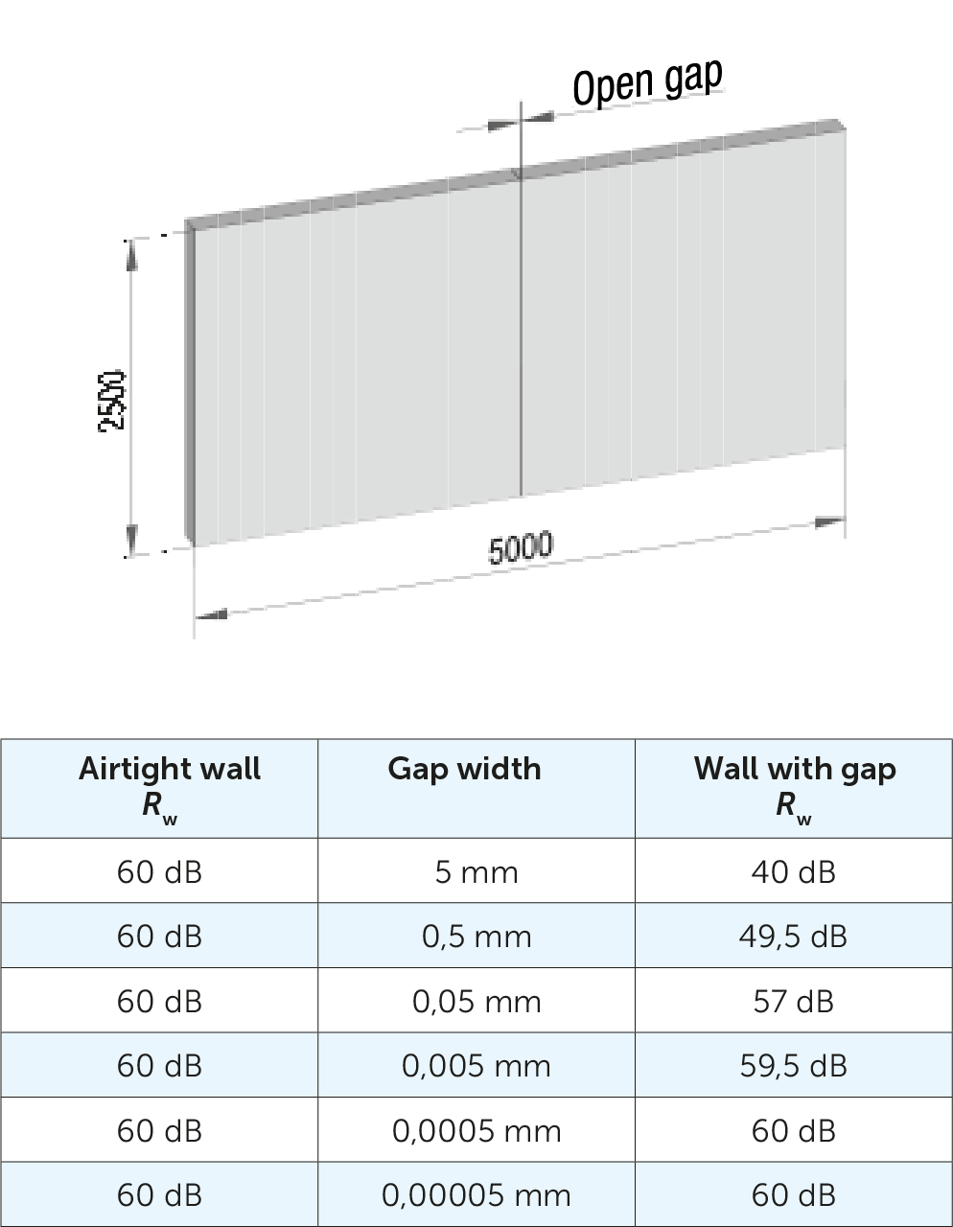
Building element airtightness
Airtightness of a building element is a basic condition for airborne sound insulation, as sound travels through air
An air gap in a building element has some sound insulating effect but in practice, sound coming into contact with it can be expected to travel through the gap from one space to another

Slide 25
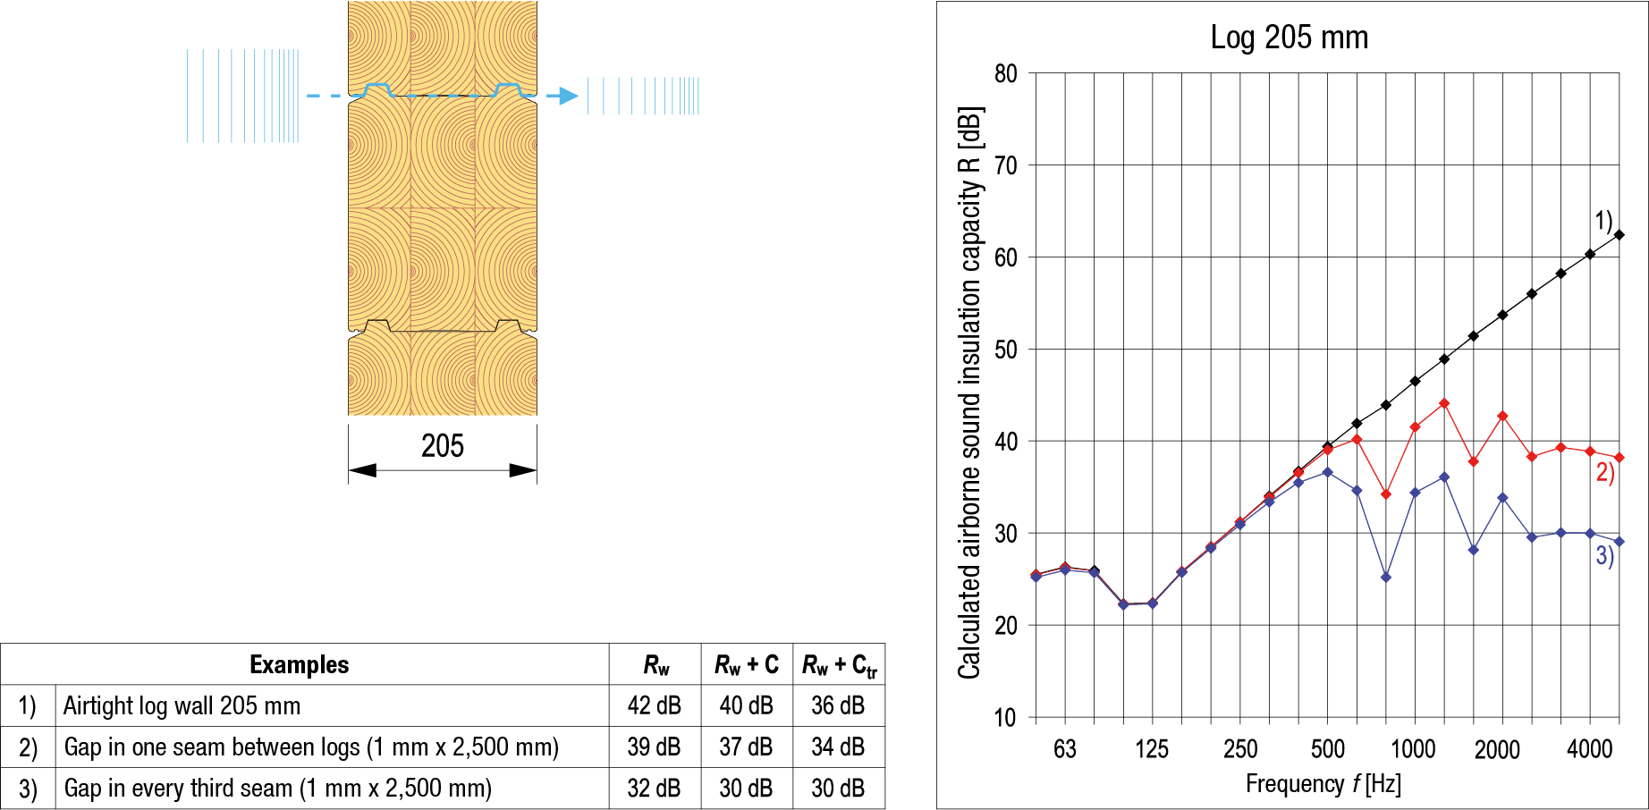
Building element airtightness
Air leaks can be seen in the measurement graph at high frequencies

Slide 26
Measuring airborne sound insulation
The airborne sound insulation of an individual building element can be tested with laboratory measurements
Field measurements can be conducted to examine building elements and the impacts of their joints and joining components on airborne sound insulation
A field measurement can be conducted
In an actual building
In a test building constructed with actual structures
As the sound source, an omnidirectional loudspeaker is usually used
The sound pressure level (90…100 dB) of the noise produced by the loudspeaker is roughly similar in each frequency band in the area 100…3150 Hz

Slide 27
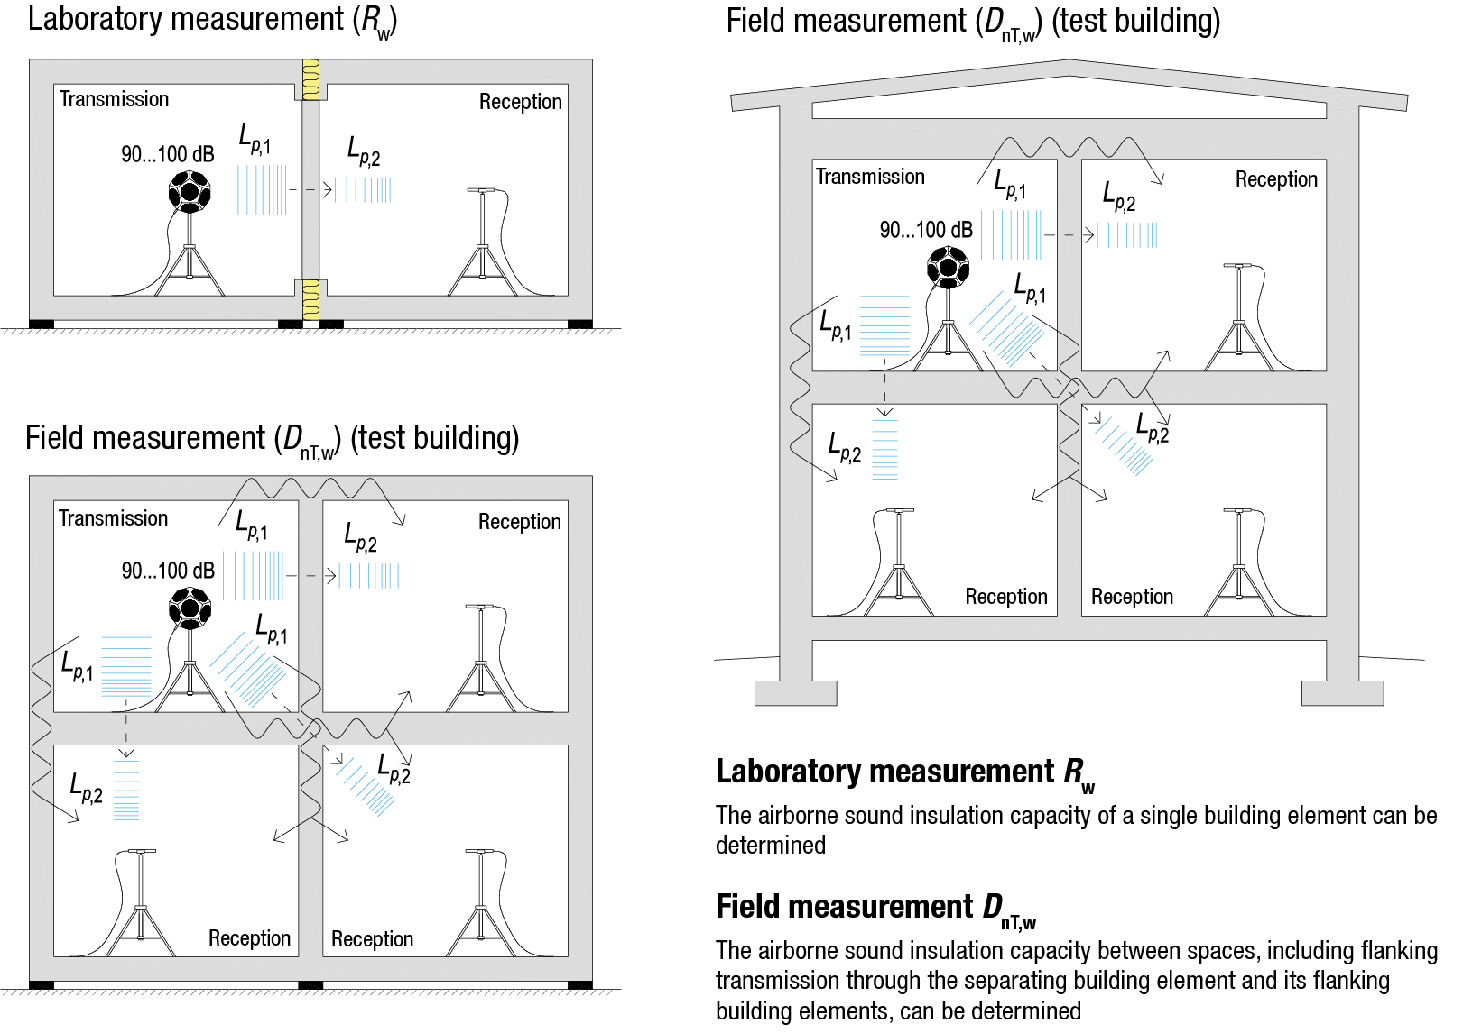
Measuring airborne sound insulation

Slide 28
Airborne sound insulation measurement result
The standardized level difference D_{nT,w} between spaces is calculated for each frequency band based on measured level differences D_{nT} (measurement range 100…3150 Hz) using the reference curve method set out in standard ISO-717-1
The standardized level difference D_{nT,w} is read in the reference curve at 500 Hz (the greater the numeric value, the better the airborne sound insulation)
The location on the reference curve is determined by moving it at 1 dB intervals, so that the sum of the curve values and the deviations of measured values below it is no more than 32 dB

Slide 29
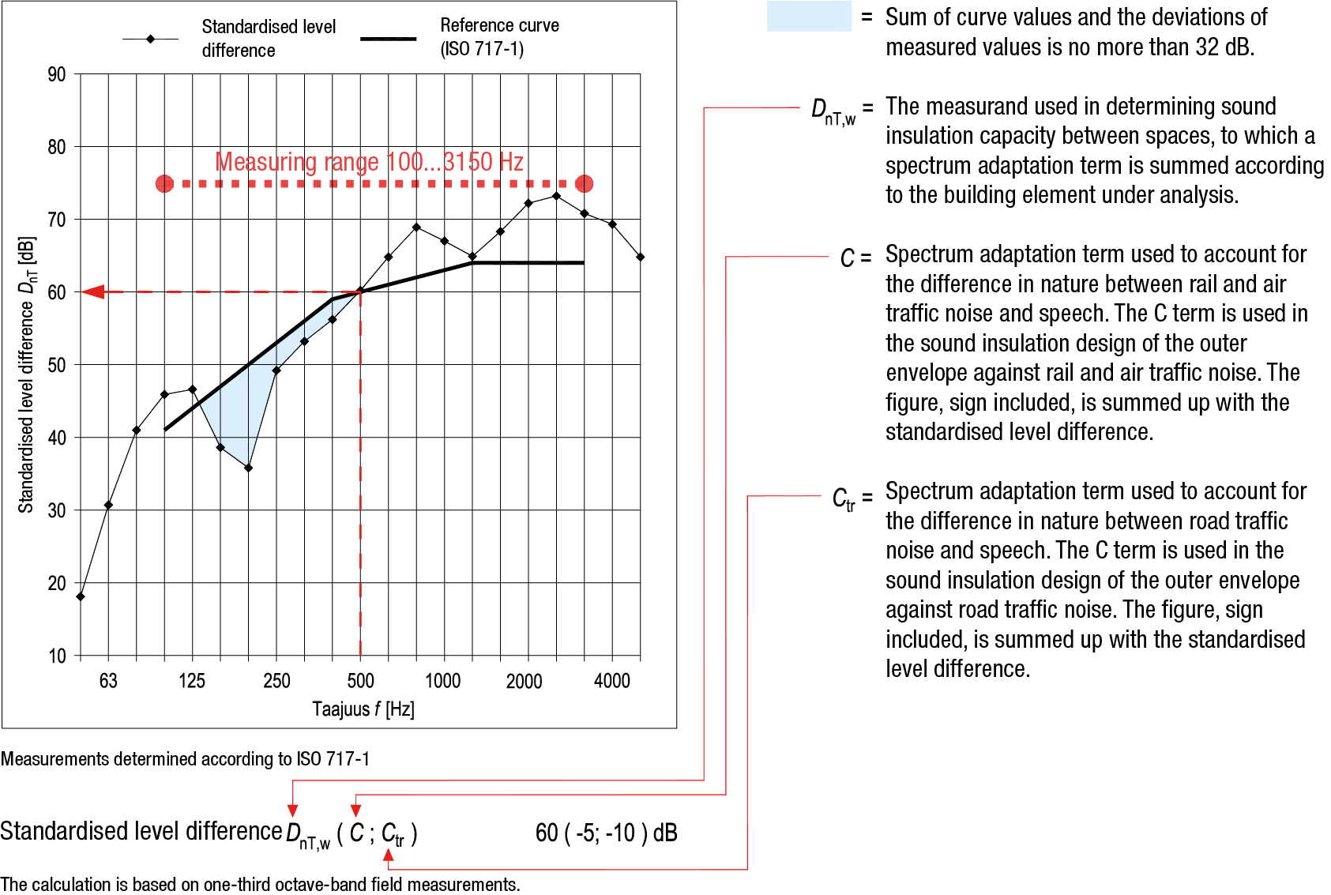
Airborne sound insulation measurement result

Slide 30
Impact noise insulation
The purpose of impact noise insulation is to reduce the sound pressure level of impacts on the intermediate floor below the intermediate floor and in adjoining spaces
The impact noise insulation between spaces is given as the impact sound level index L’_{nT,w}
Flanking transmissions should be accounted for
The airtightness of a building element is highly significant for impact noise insulation
Flanking transmission is highly significant for impact noise insulation

Slide 31
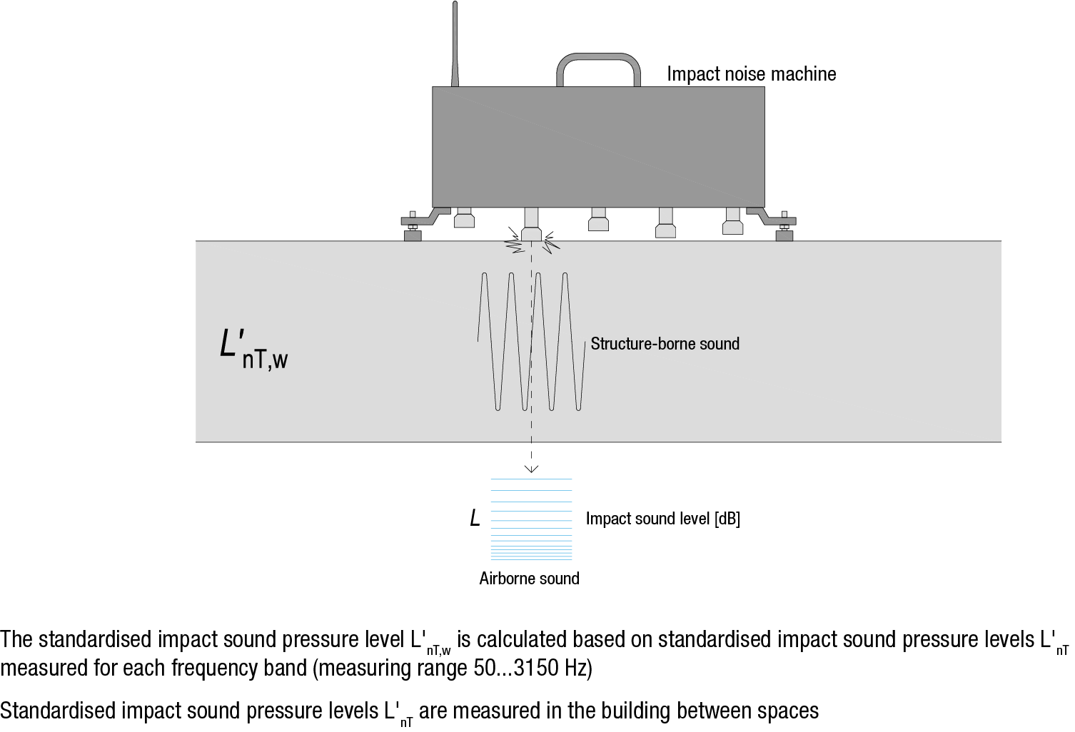
Determining impact noise insulation
Impact noise level L, which is usually detected in the space below, is examined using an impact noise machine placed on the intermediate floor
Rather than imitating walking on the intermediate floor, the impact noise machine produces continuous similar impacts on the intermediate floor, making it possible to measure the impact noise levels produced by them in another space

Slide 32
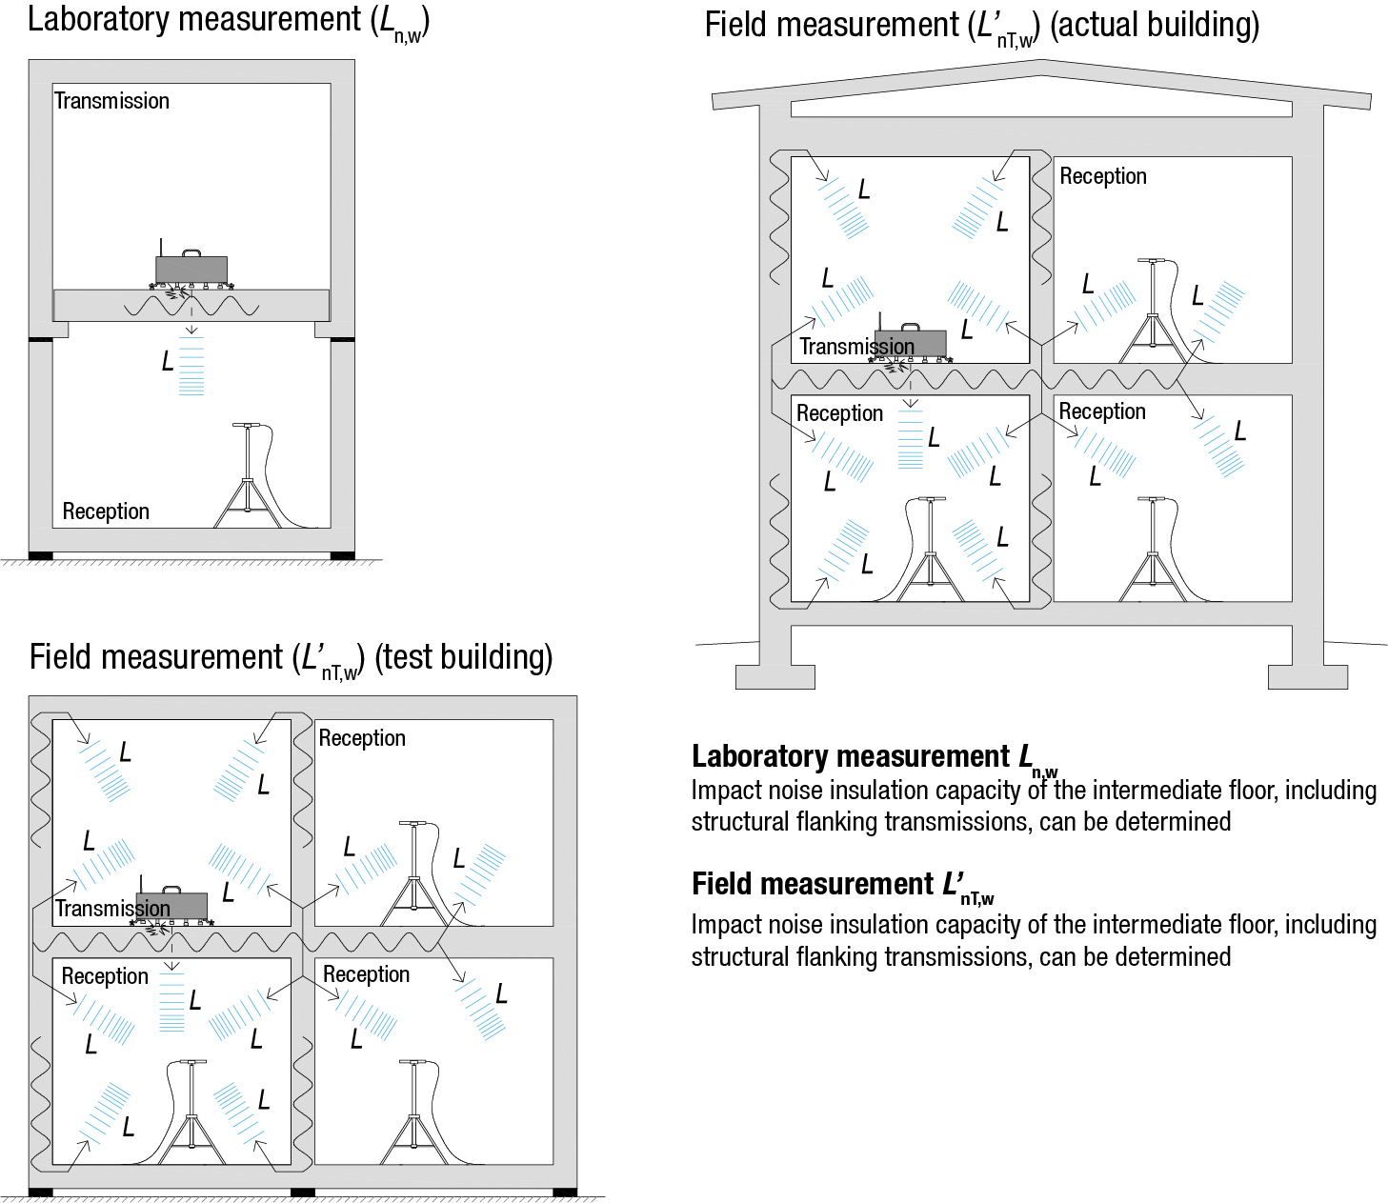
Measuring impact noise insulation

Slide 33
Impact noise insulation measurement result
The standardized level difference for impact noise L_{nT,w} between spaces is calculated for each frequency band based on measured impact noise differences L_{nT} (measurement range 50…3150 Hz) using the reference curve method set out in standard ISO-717-2
The standardized level difference for impact noise L_{nT,w} is read in the reference curve at 500 Hz (the smaller the numeric value, the better the impact sound insulation)
The location on the reference curve is determined by moving it at 1 dB intervals, so that the sum of the curve values and the deviations of measured values above it is no more than 32 dB
Under regulations, spectral adaptation term C_{l,50-2500}, which accounts for frequencies below 100 Hz, must be included in the standardised level difference for impact noise

Slide 34
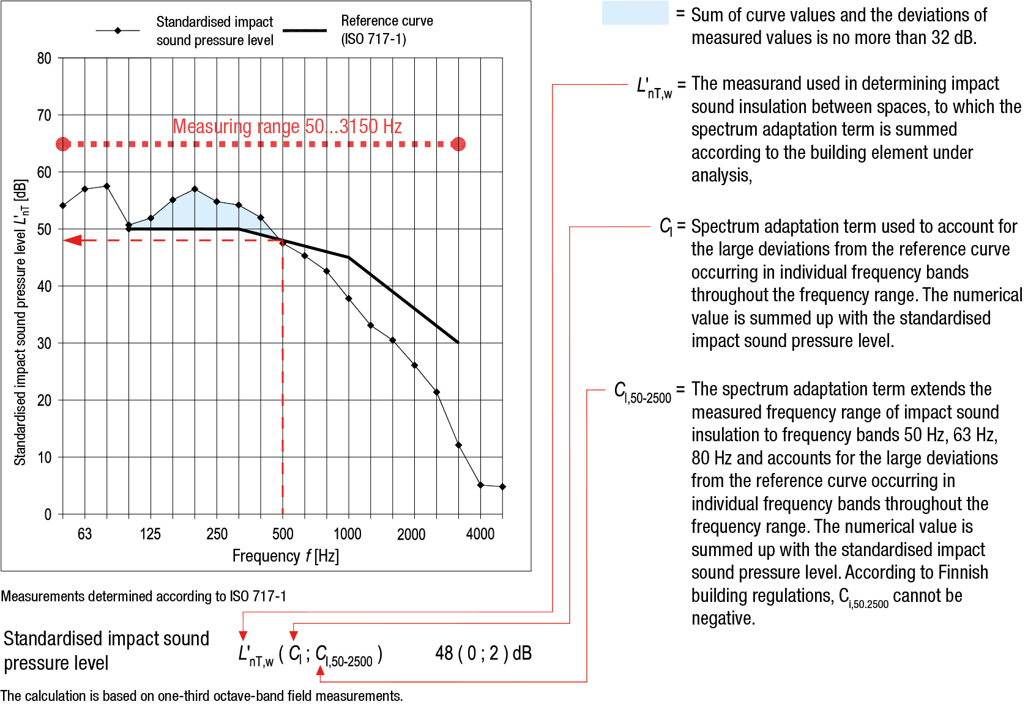
Impact noise insulation measurement result

Slide 35
Single-layer acoustics
Structures are considered to be single-layer when the same material is used throughout the structure or when different layers of materials are so closely bound together that they vibrate as a whole
Factors significant for designing airborne sound insulation are
Mass
Stiffness
Airtightness
Impact of flanking transmissions
In addition, flexibility of the surface structure (e.g. flooring) is also a significant factor in impact noise insulation design

Slide 36
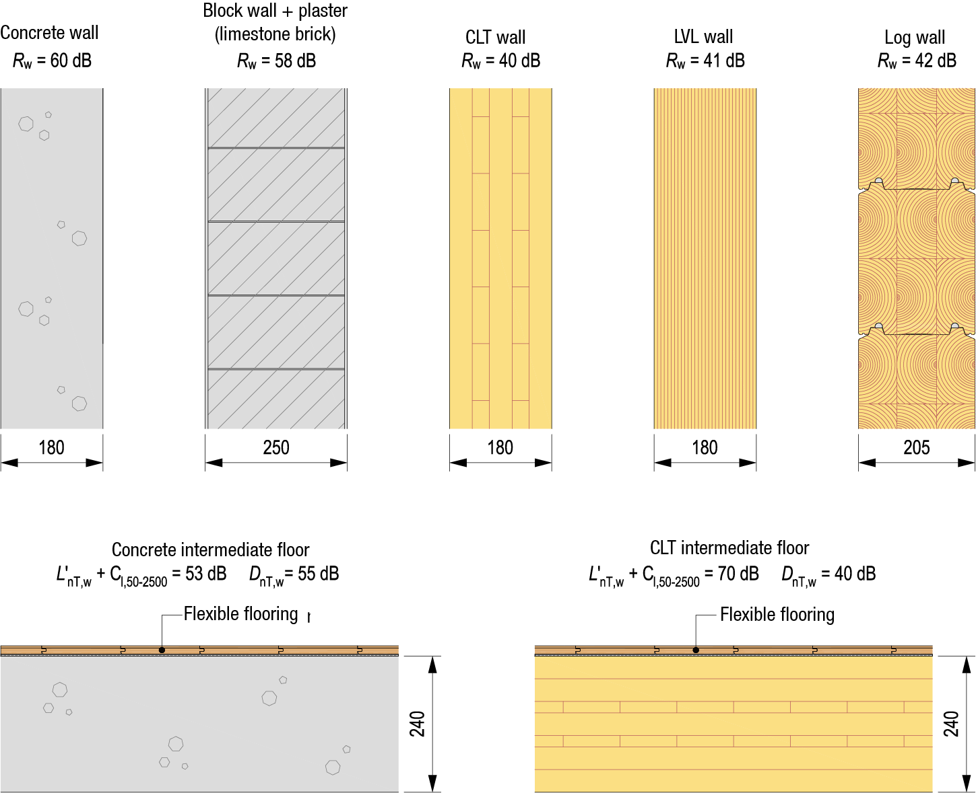
Acoustically simple structures

Slide 37
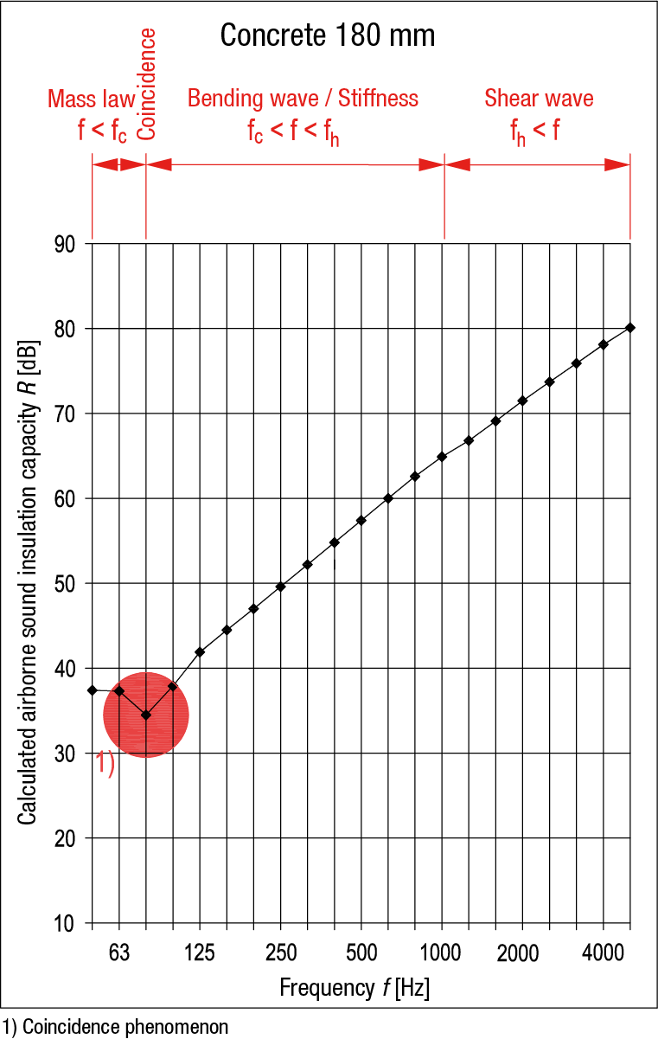
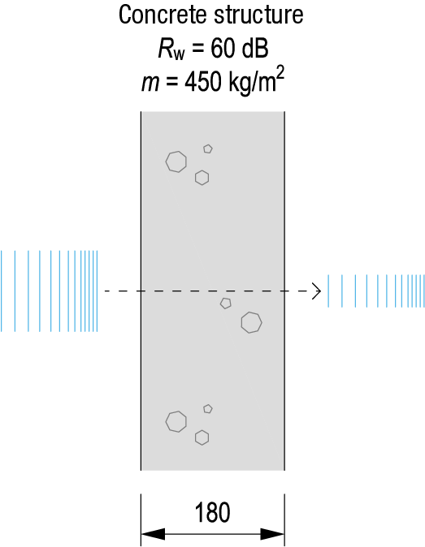
Airborne sound insulation of a simple structure
The airborne sound insulation of an airtight simple structure is mainly based on mass and stiffness
According to the Mass Law, the airborne sound insulation of a structure increases by approx. 6 dB when
The mass of the structure is doubled
The sound frequency is doubled
Airborne sound insulation increases highly efficiently above the coincidence cut-off frequency up till the shear wave range

Slide 38
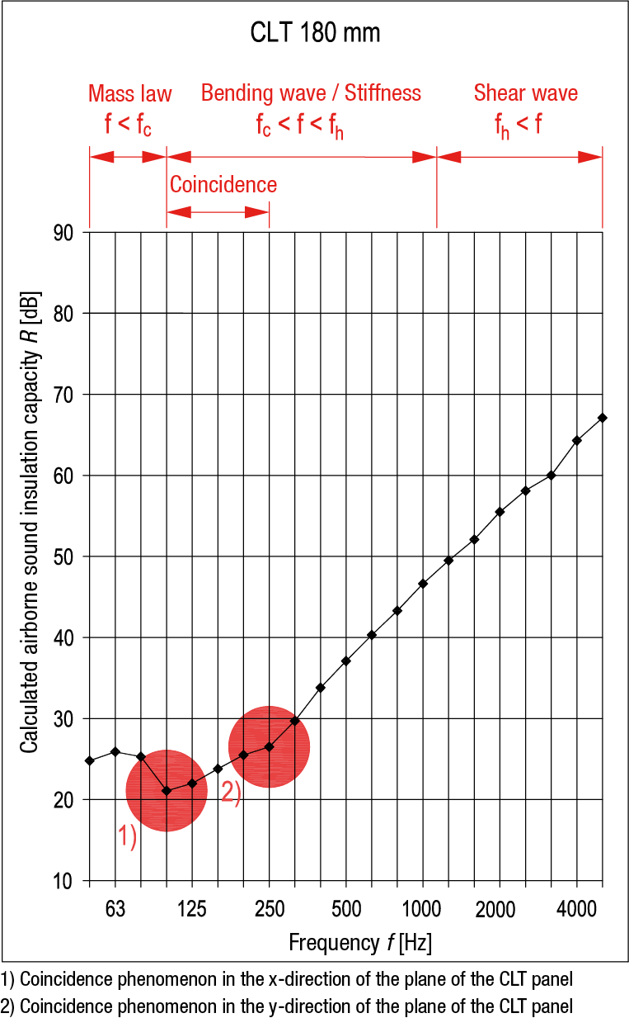
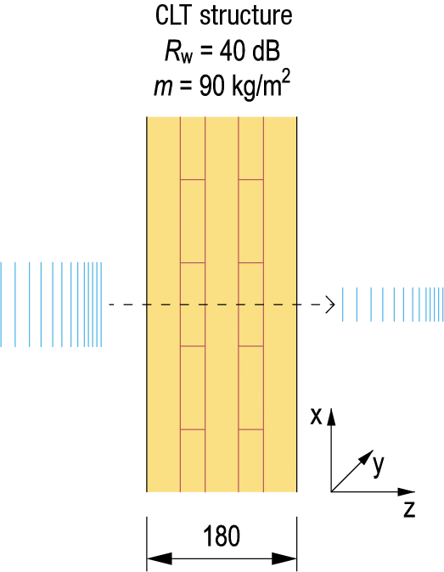
Airborne sound insulation of a simple structure
A solid timber structure should be almost 600 mm in thickness to match the airborne sound insulation of a concrete structure 180 mm in thickness
Coincidence significantly impairs airborne sound insulation when the structure is light (also a concrete structure m < 300 kg/m²)

Slide 39
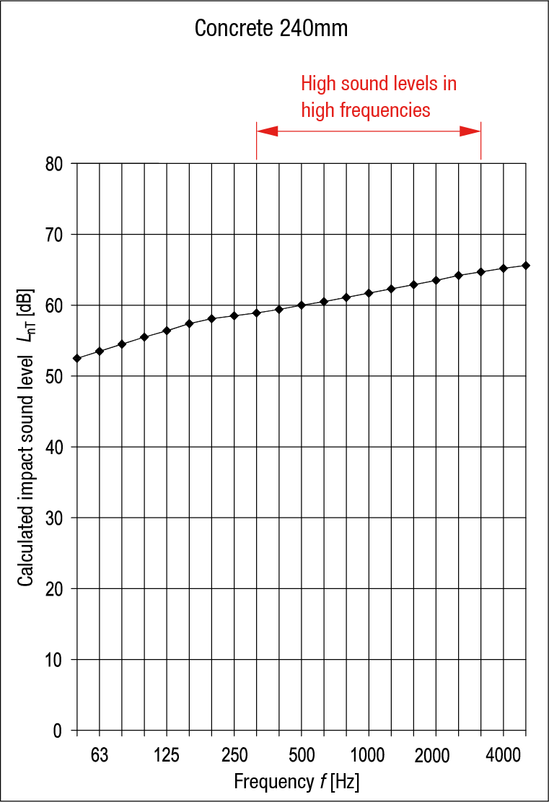
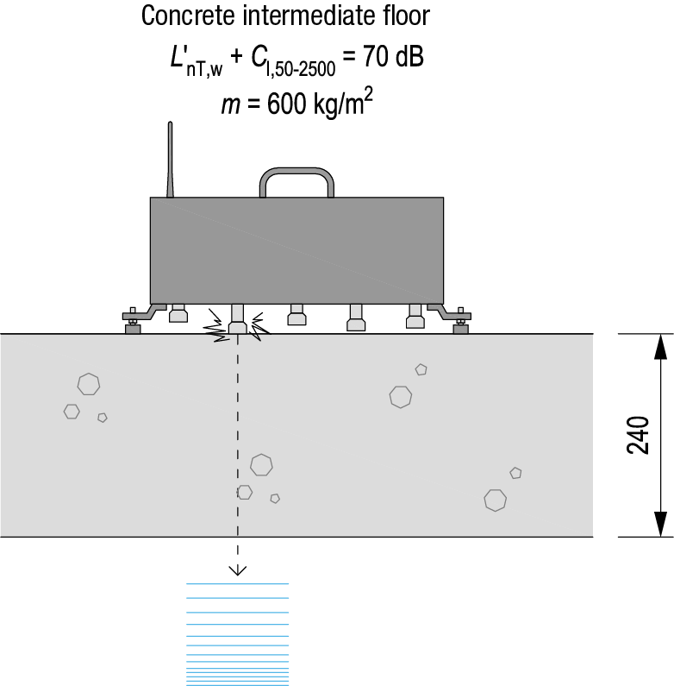
Impact noise insulation of a simple structure
The impact noise insulation of an airtight simple structure is mainly based on mass and rigidity
A flexible flooring is highly significant for impact noise insulation
The impact noise levels produced by a simple concrete intermediate floor are low at low frequencies but increase with high frequencies

Slide 40
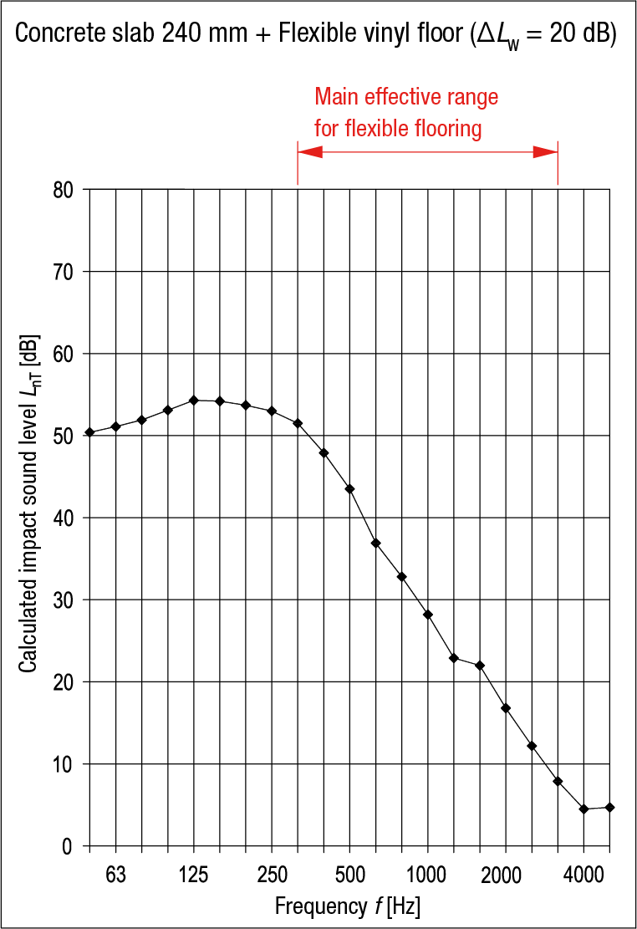

Impact noise insulation of a simple structure
A flexible flooring or a floating surface plate is usually needed on top of a simple intermediate floor of concrete to reduce the impact noise levels at high frequencies
If the flooring is flexible, its impact noise reduction index ΔL_{w} must be examined (not directly applicable to wooden intermediate floors)

Slide 41
Dual-layer acoustics
A dual-layer structure has two plates (m₁ and m₂) with an air gap between them (k)
The air gap in dual-layer structures is called a spring, and its effectiveness as an insulator depends on the thickness of the air gap
The air gap acts as a spring when it is thicker than the wavelength of the sound applied to the structure
The looser the spring, the less it transmits vibration between the plates m₁ and m₂ (and the better the airborne sound insulation)
Rather than acting as a spring, a thin air gap connects the plates together, impairing the airborne sound insulation of the structure

Slide 42
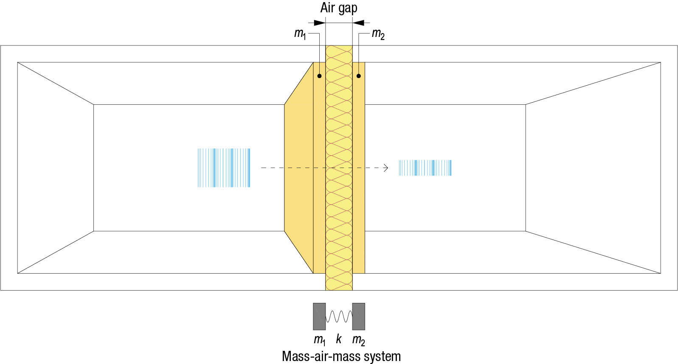
Ideal dual-layer structure

Slide 43
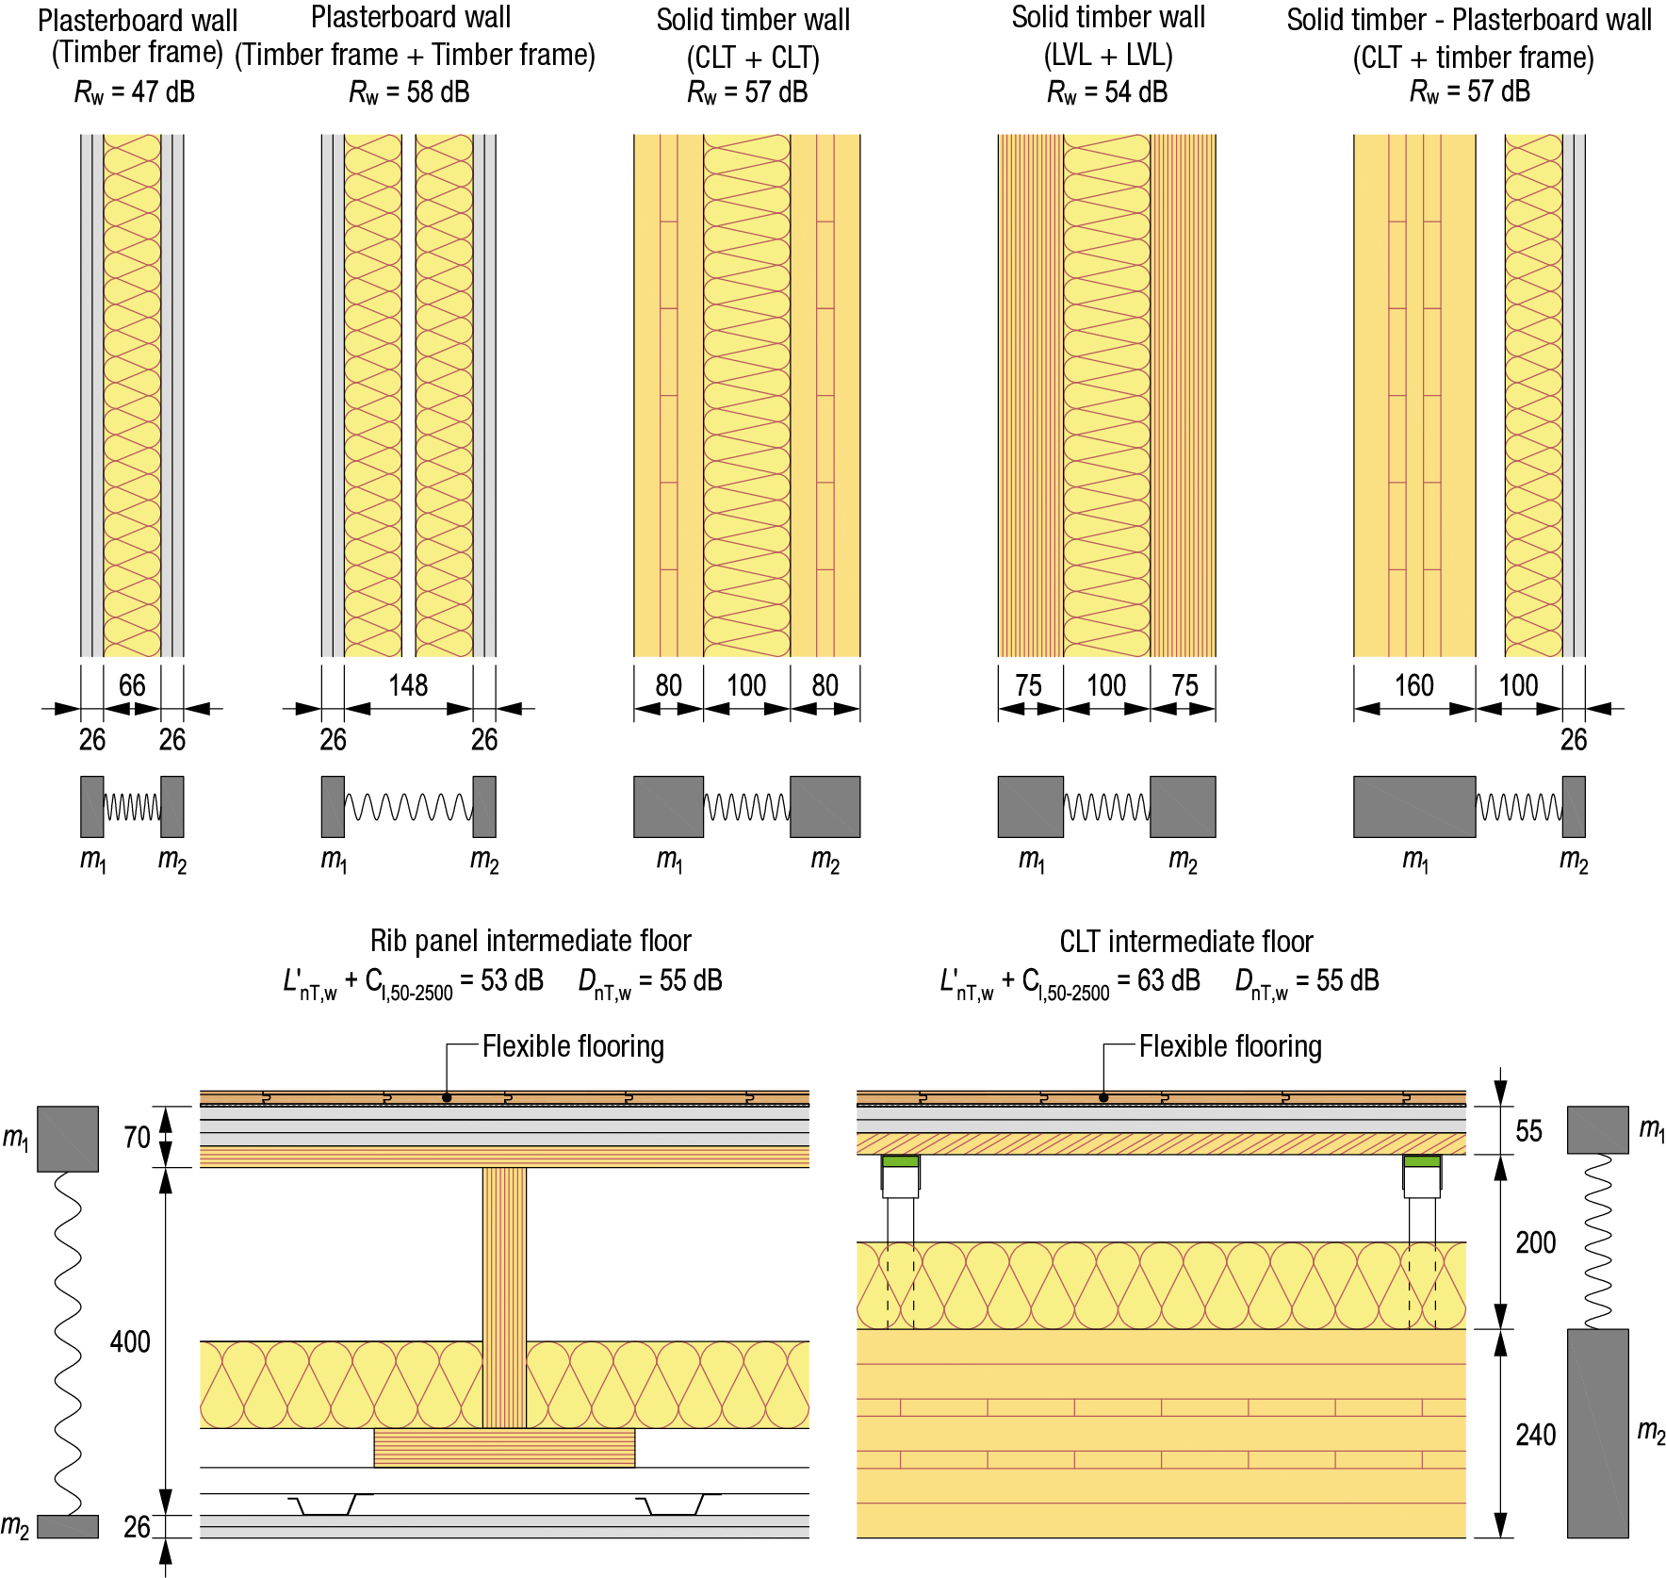
Wood structures with dual-layer acoustics

Slide 44
Dual-layer acoustics
Factors that are significant for designing the airborne sound insulation of a dual-layer structure are
Weight of the plates, coincidence cut-off frequency and airtightness
Resonance frequency of the mass-spring-mass system
Mechanical connection between the plates
Thickness of the air gap (rigidity of the spring)
Impact of flanking transmissions

Slide 45
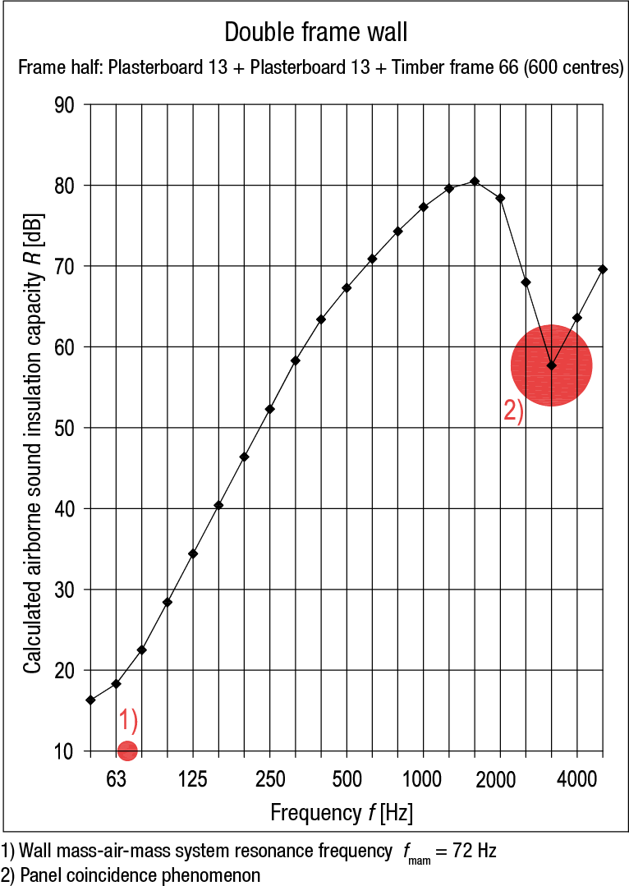
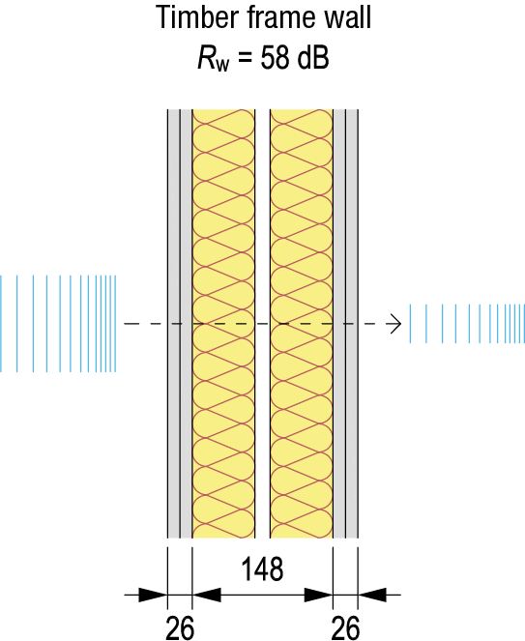
Airborne noise insulation of a double wall
The airborne noise insulation of a double framed wall increases effectively above the resonance frequency up till the coincidence cut-off frequency
Coincidence impairs airborne sound insulation
When coincidence cut-off frequency is at the top end of the measurement range (3150 Hz), it has no significant negative impact on airborne sound insulation

Slide 46
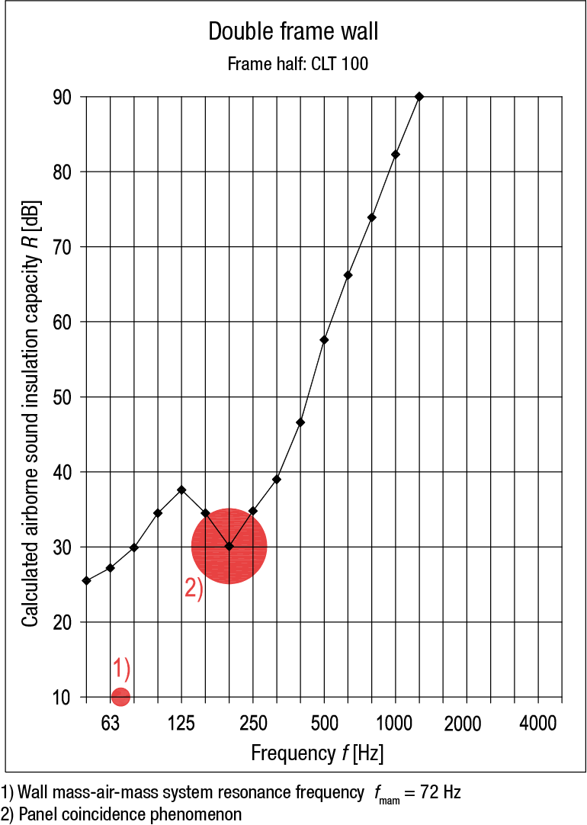
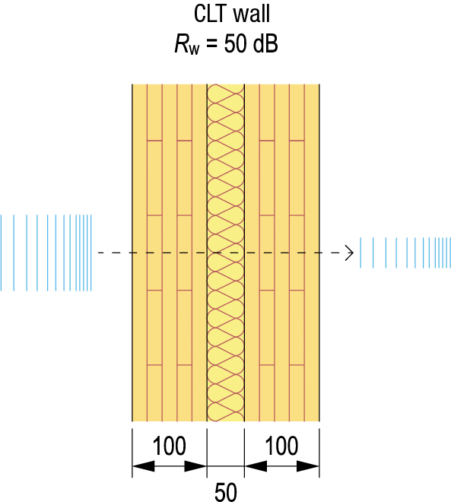
Airborne noise insulation of a double wall
The airborne noise insulation of a double framed wall with solid timber panel structure increases effectively above the resonance frequency up till the coincidence cut-off frequency
Coincidence impairs airborne sound insulation
When coincidence cut-off frequency is low, this significantly impairs airborne sound insulation

Slide 47
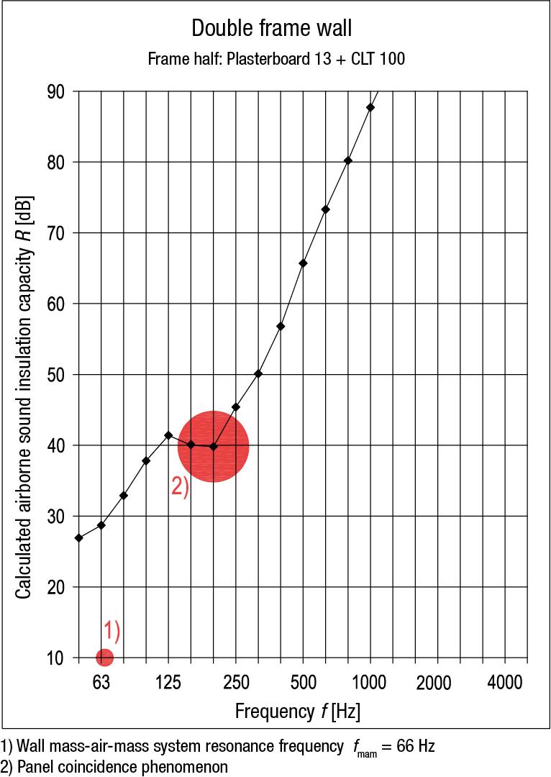
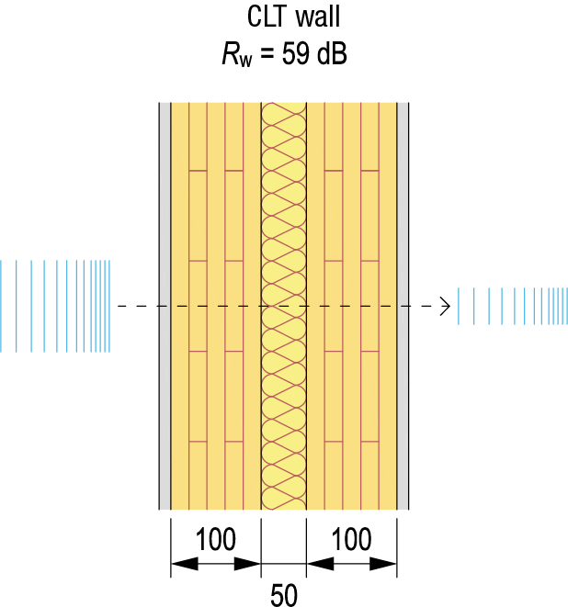
Airborne noise insulation of a double wall
A plasterboard is often needed on a solid timber panel wall to meet the requirements set for a partition between flats
Plasterboard installed on a solid timber panel
Improves airborne sound insulation at low frequencies
Reduces the impact of coincidence on airborne sound insulation
Plasterboard can also be installed on the side of the air gap

Slide 48
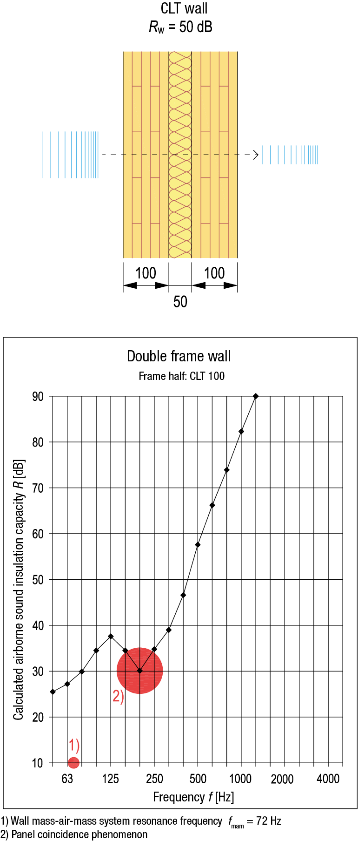
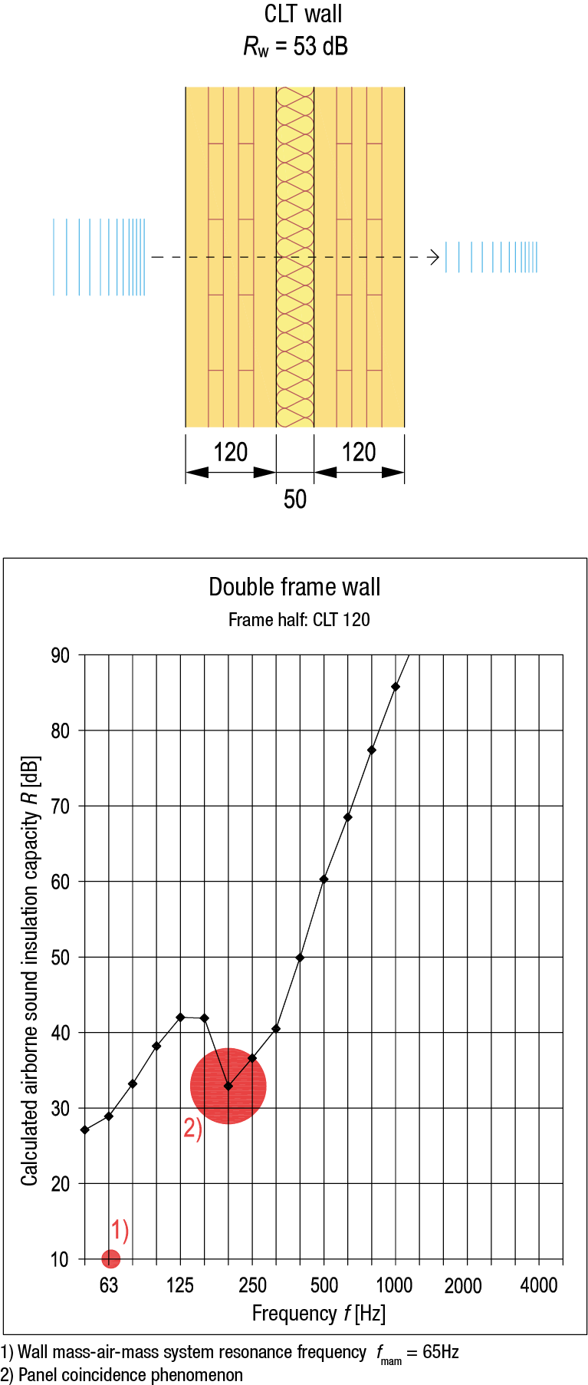
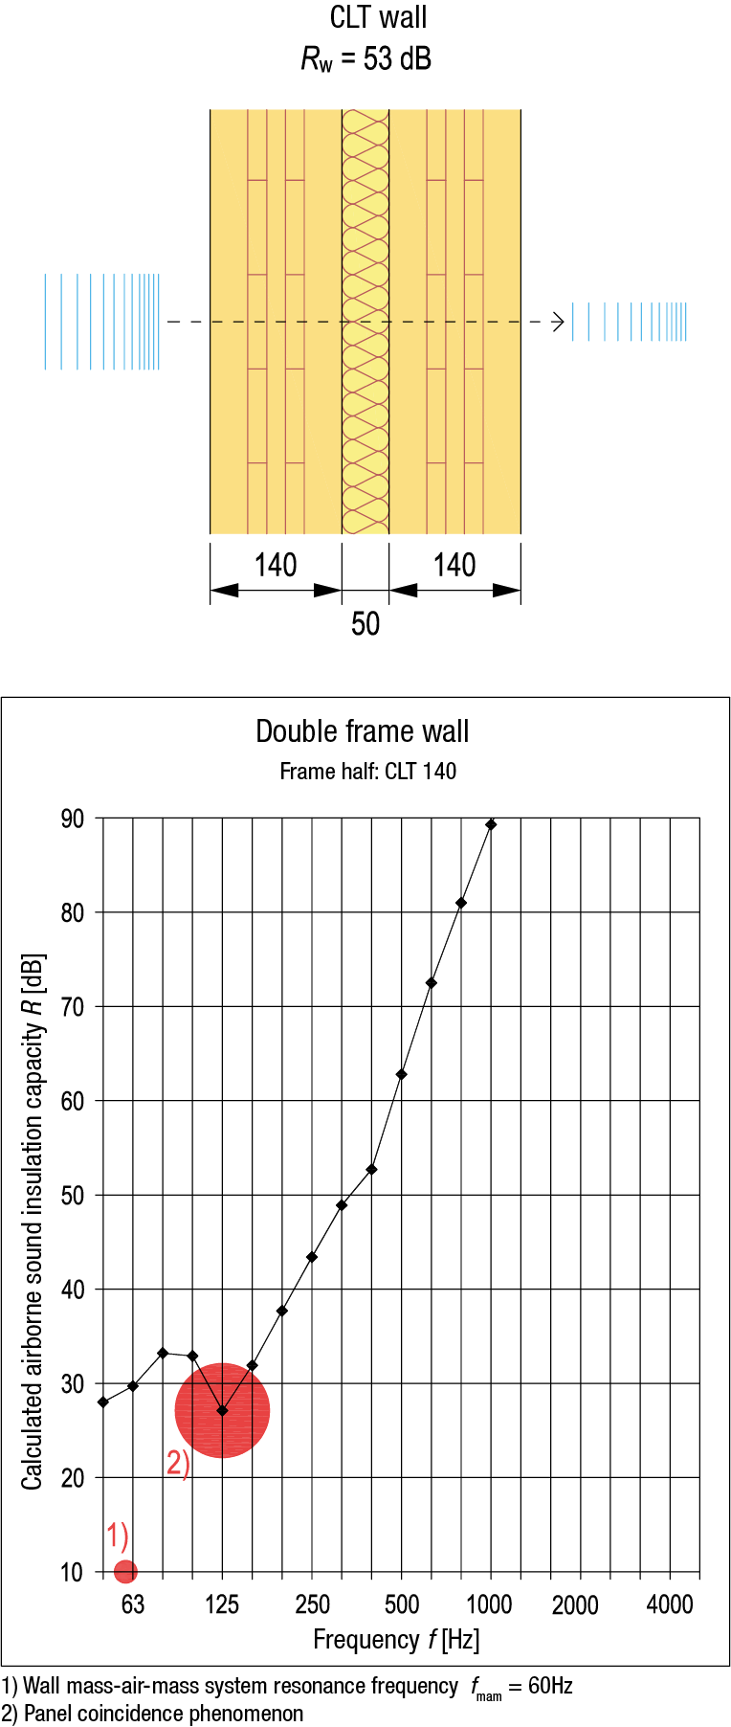
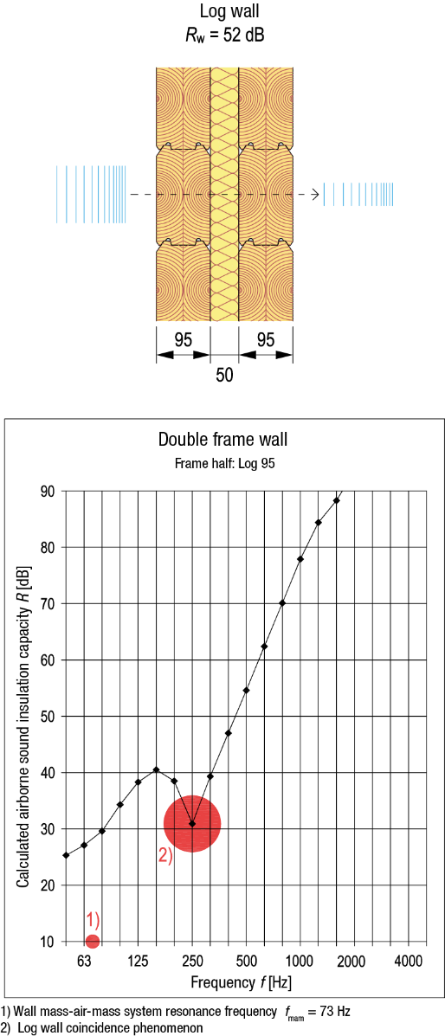
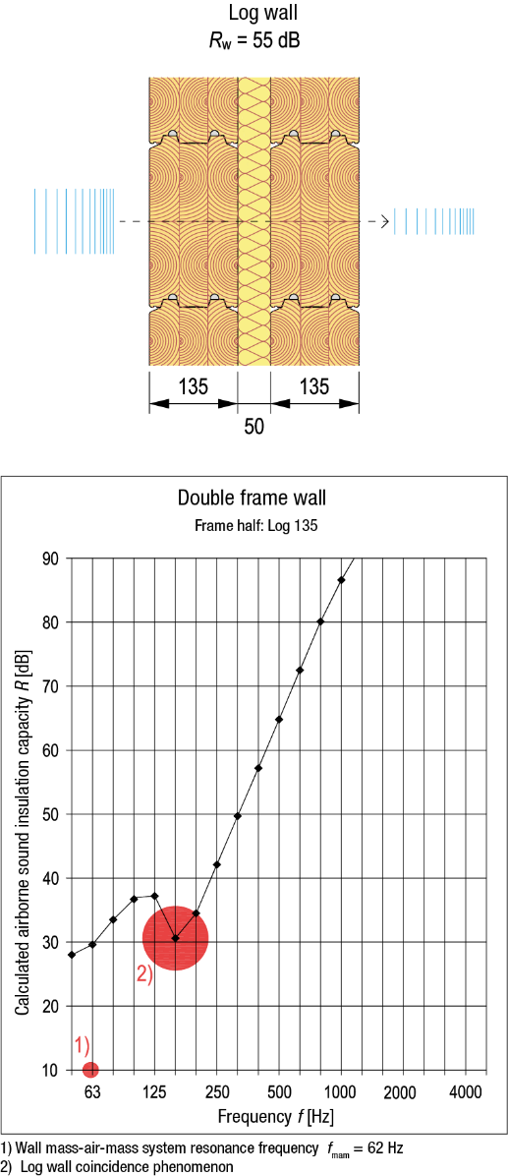
Impact of the thickness of solid timber

Slide 49
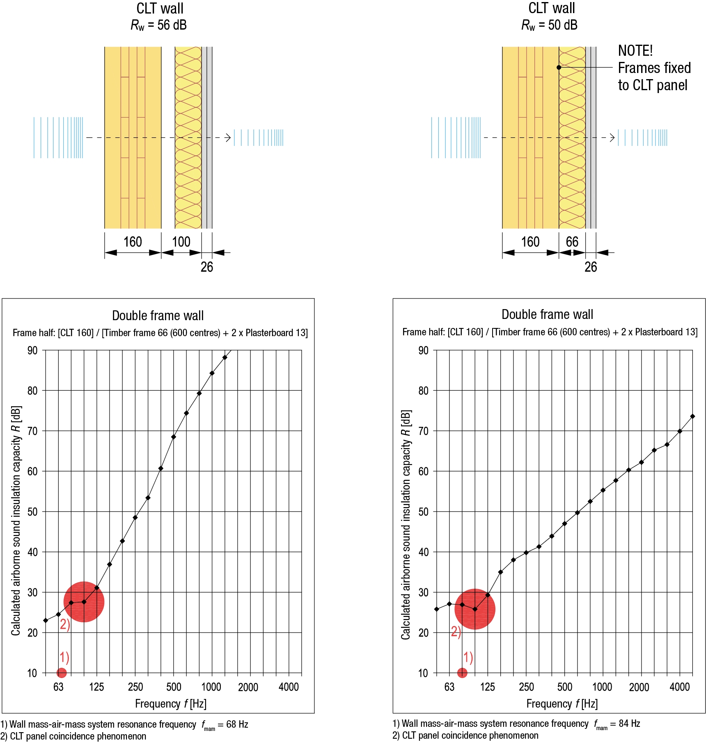
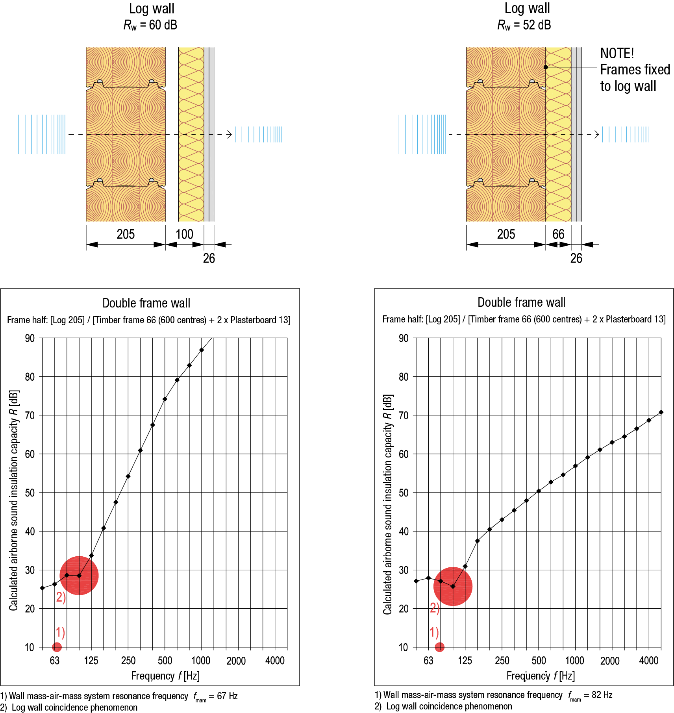
Unsymmetrical wall structures

Slide 50
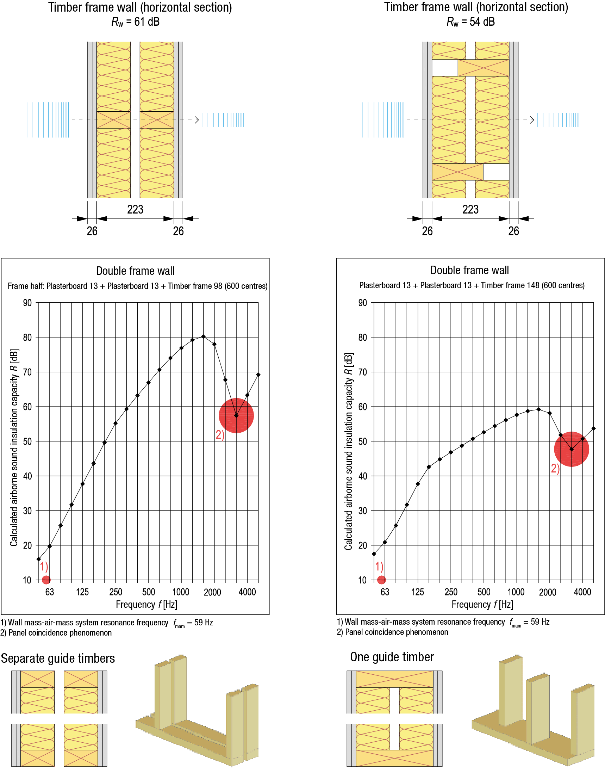
Impact of guide pieces
Both frame halves should have their separate guide timbers
Adjacent guide timbers can be replaced with a single one that is the width of the gap in the wall if this is approved by the acoustics designer of the site
Coupling of frame halves with a guide timber impairs airborne noise insulation

Slide 51
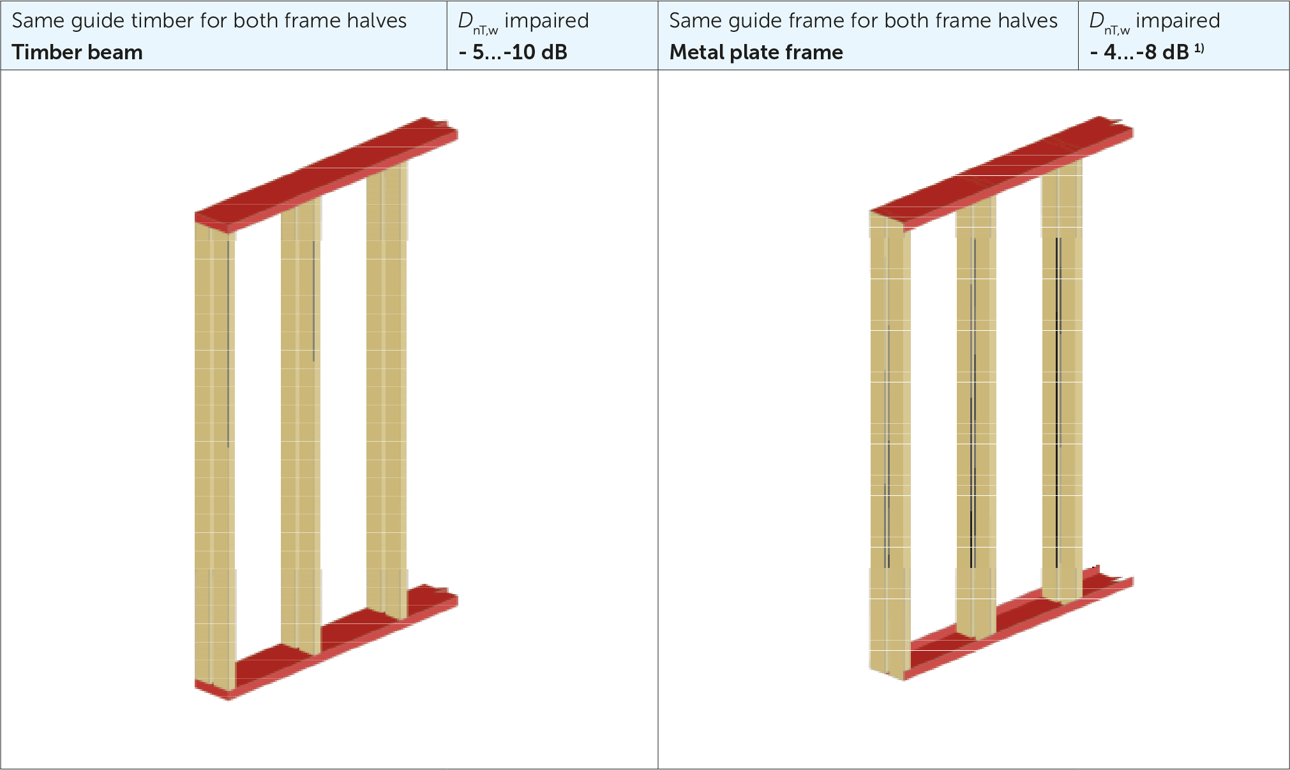
Impacts of connecting frame halves

Slide 52
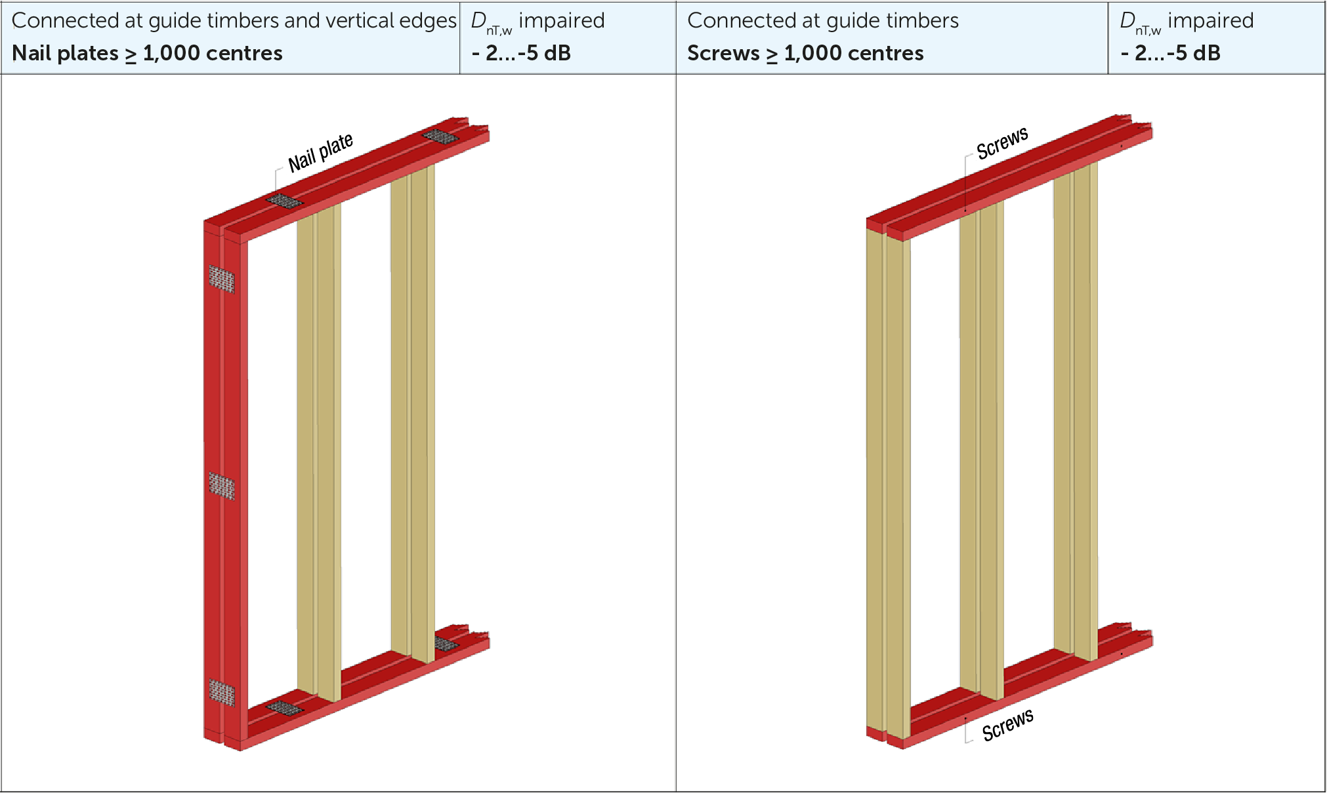
Impacts of connecting frame halves

Slide 53
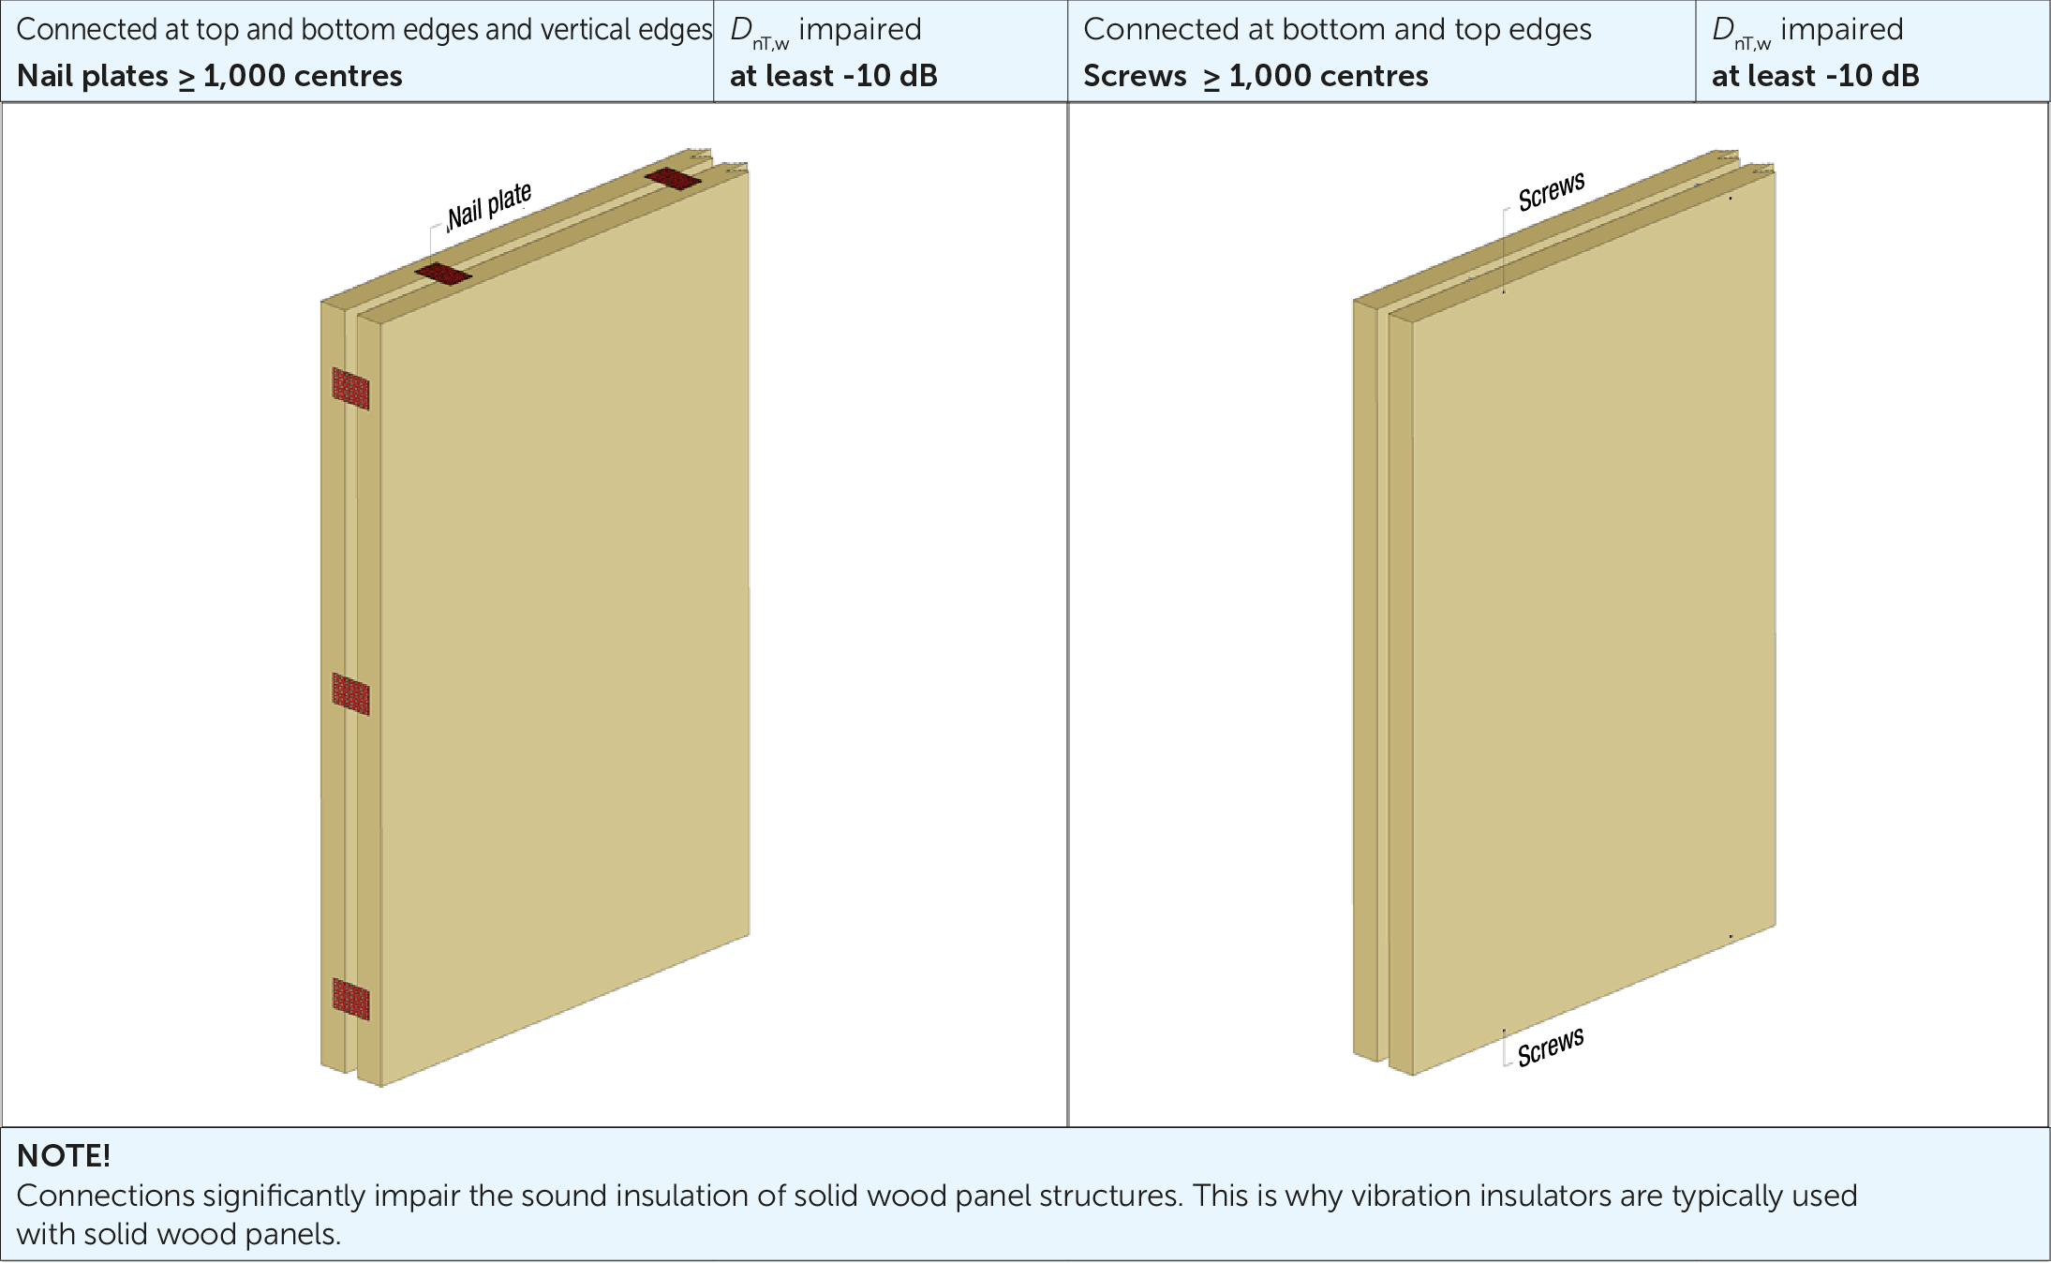
Impacts of connecting frame halves

Slide 54
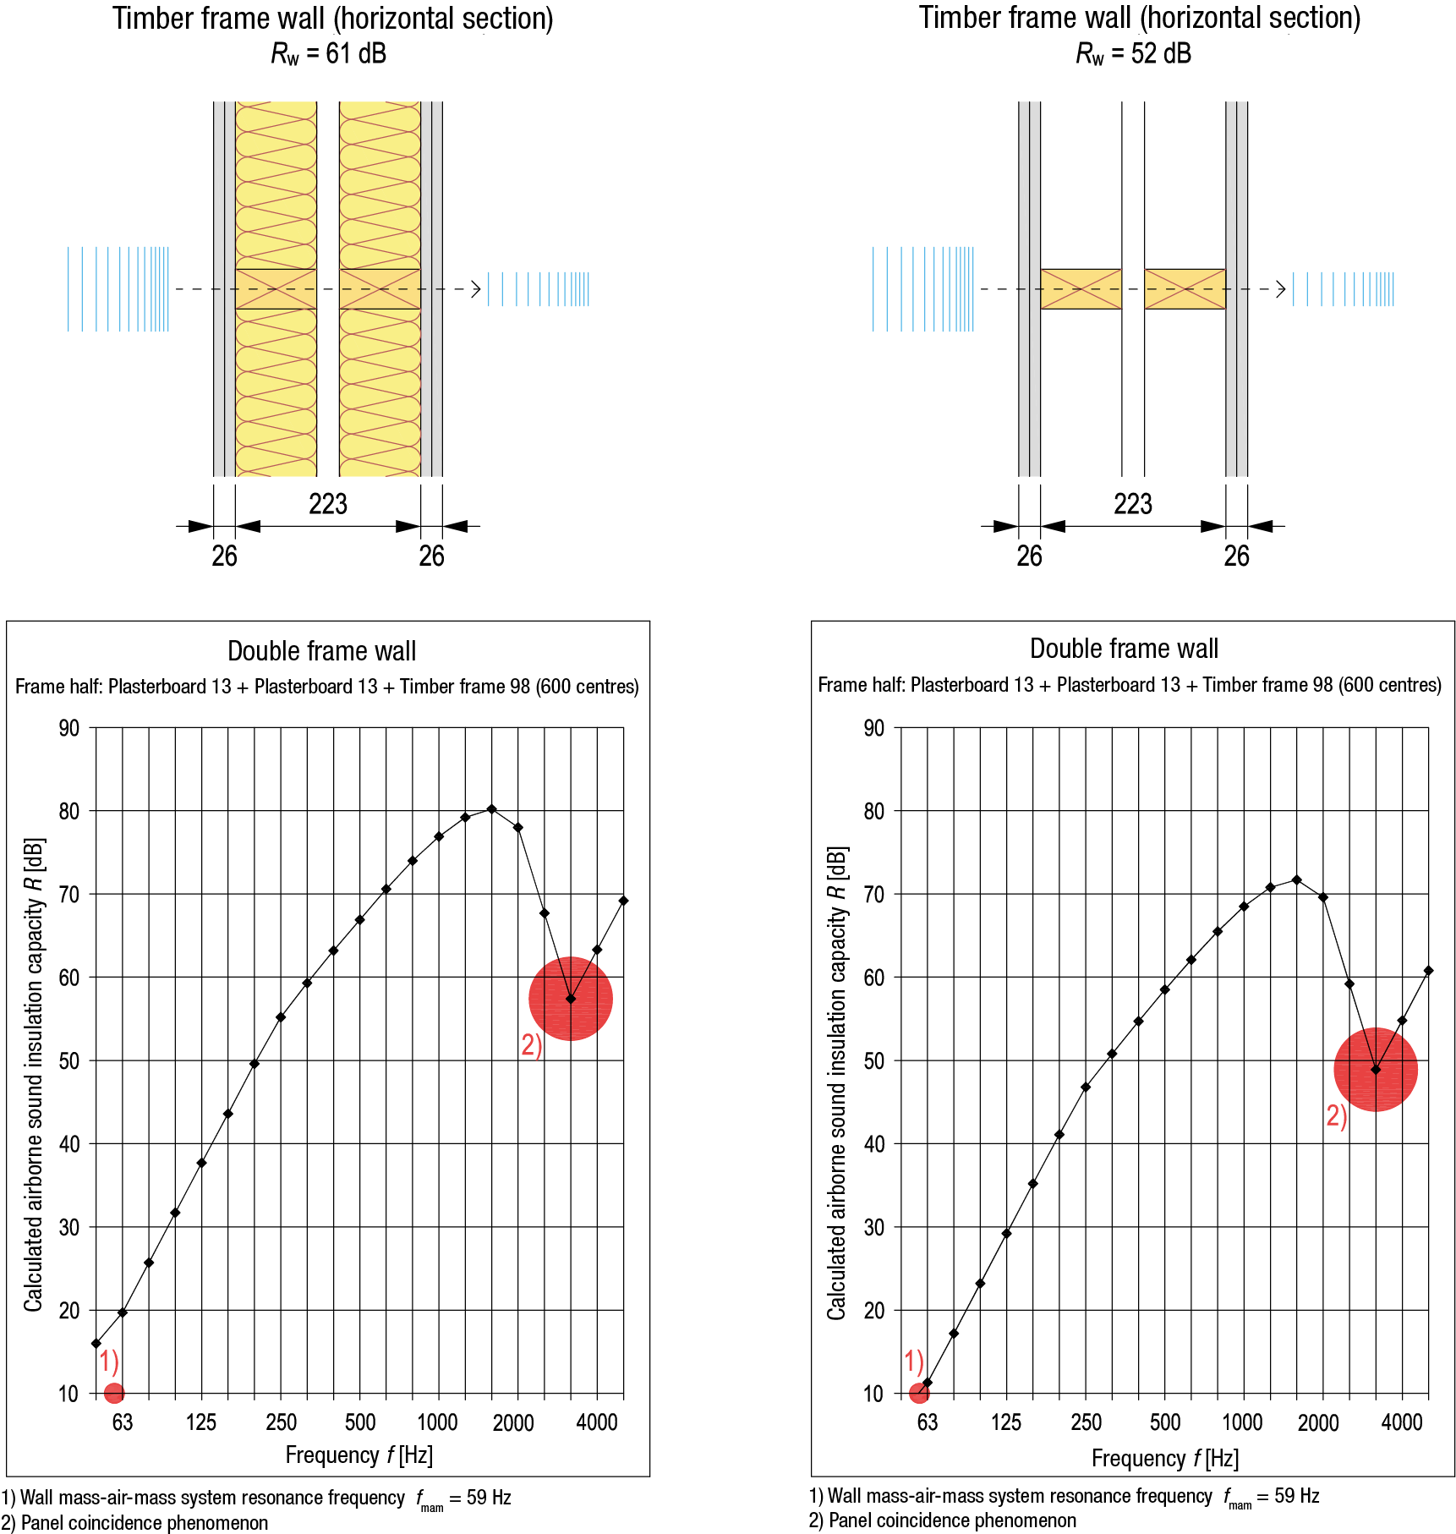
Impact of sound-absorbing material in a wall gap
Natural vibration of air (standing sound waves) is generated in the empty air gap of a double framed wall
In practice, the sound echoes in the empty air gap, which significantly impairs the airborne noise insulation of the wall
To prevent echoing in the air gap, it must contain sound-absorbing material (absorption ratio at high frequencies 0.8…0.9), covering at least one half of the air gap thickness

Slide 55
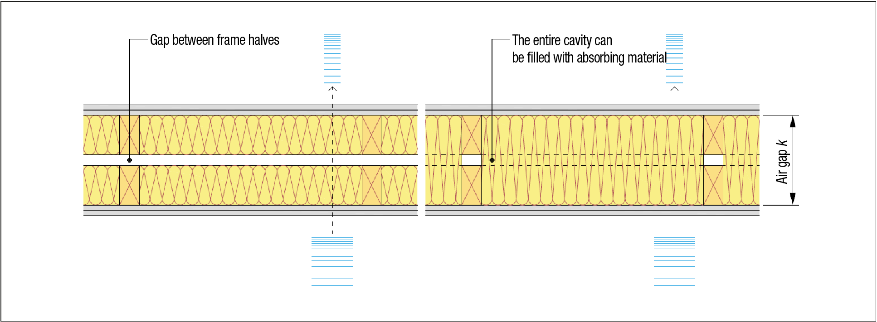
Sound absorbing material in a wall gap

Slide 56

Impacts of wall gap thickness
Increasing the thickness of the air gap in a double framed wall (k) significantly improves the airborne sound insulation of the wall
The thicker the air gap, the less it connects the plates of frame halves to each other

Slide 57

Impacts of wall gap thickness
Dual-layer solid timber structures should have thin structural layers with large air gaps between them
Thick partitions between flats are today possible as only 200 mm of the walls are included in the permitted building volume
The solid timber product must be thick enough from the perspective of the structure’s load-bearing capacity

Slide 58

Impact noise insulation of a dual-layer intermediate floor
Impact noise insulation is in a key role in the acoustic design of intermediate floors
The impact noise levels of wooden intermediate floors are high at low frequencies and low at high frequencies
Low frequencies are a challenge associated with wooden intermediate floors
In wooden intermediate floors, mass is required to insulate low frequencies

Slide 59

Impacts of a spring suspension ceiling
A spring suspension ceiling significantly improves the airborne sound and impact noise insulation of a wooden intermediate floor
The positive impact on sound insulation generated by a spring suspension ceiling already begin at around 50 Hz
The more flexible and heavier the spring suspension ceiling is, the better the airborne sound and impact noise insulation

Slide 60

Natural frequency of a floating floor
A floating floor acts as sound insulation at frequencies above its resonance range
The smaller the lowest natural frequency of a floating floor is, the better sound insulation is achieved
The dynamic rigidity of impact noise insulation and the mass of a floating floor influence the lowest natural frequency of a floating floor

Slide 61


Impact of a floating floor

Slide 62

Impact of flooring
The flooring does not have a significant impact on airborne sound insulation
In wooden intermediate floors, a flexible flooring affects impact noise insulation when the intermediate floor has a fixed surface floor
In case of a floating floor, the impact of flexible flooring on impact noise insulation has almost no significance

Slide 63


Impact of intermediate floor frame
The impact of the rigidity and support types of the load-bearing frame of a wooden intermediate floor can be considered insignificant
The frame rigidity and support types of the wooden intermediate floor have a significant impact in intermediate floor vibration design (e.g. vibration caused by walking)

Slide 64


Impact of a gap in intermediate floor
The same acoustic principles apply to an air gap in a dual-layer intermediate floor as to a dual-layer wall
The greater the air gap, the better the airborne sound and impact noise insulation
Echoing in the intermediate floor air gap is eliminated with a sound-absorbing material (min 100 mm)

Slide 65


Suspended floors
Suspended floors are well suited for use together with solid timber panel intermediate floors
It may be possible to use solid timber panel as the visible ceiling surface (surface quality)
The suspended floor and solid timber panel make up a dual-layer acoustic structure
The same acoustic principles mainly apply to intermediate floors with a suspended floor as to other wooden intermediate floors

Slide 66

Intermediate floors of prefabricated box units
The ceiling of a lower prefabricated box unit and the floor of an upper one make up a dual-layer acoustic structure
The same acoustic principles apply to intermediate floors of prefabricated box units as to other wooden intermediate floors

Slide 67
Structural flanking transmission
Structural flanking transmission is caused when a structural element that continues from one space to another propagates sound between the spaces (structure-borne sound)
In a building with wooden structure, structural flanking transmission is a greater challenge than in a concrete building because
The mass and stiffness of building elements cannot be used to reduce flanking transmission in wooden structures
The number of available wooden structure solutions is large, which is why design solutions must be selected case by case from the perspective of flanking transmissions
The joints between wooden structures have more structural components, which is why even minor changes in these components may have a very significant impact on flanking transmissions

Slide 68

Vibration insulators
Image: Getzner

Slide 69

Vibration insulator in joints between CLT panels
Image: Getzner

Slide 70

Vibration insulator in joints between CLT panels
Image: Getzner

Slide 71

Structural flanking transmission

Slide 72

Structural flanking transmission

Slide 73

Structural flanking transmission

Slide 74

Structural flanking transmission

Slide 75

Structural flanking transmission

Slide 76

Structural flanking transmission

Slide 77

Structural flanking transmission

Slide 78

Structural flanking transmission

Slide 79

Structural flanking transmission

Slide 80

Structural flanking transmission

Slide 81

Structural flanking transmission

Slide 82

Structural flanking transmission

Slide 83

Structural flanking transmission

Slide 84

Structural flanking transmission

Slide 85

Structural flanking transmission

Slide 86

Structural flanking transmission

Slide 87

Structural flanking transmission

Slide 88

Association between airborne sound insulation and speech

Slide 89

Regulations
Apartment unit, Accommodation unit, Patient rooms of a residential institution

Slide 90


Regulations
Apartment unit, Accommodation unit, Patient rooms of a residential institution

Slide 91


Guidelines
Schools

Slide 92


Guidelines
Day-care centres

Slide 93


Guidelines
Offices

Slide 94
Building services equipment
Building services equipment usually means equipment of the water supply and sewage systems as well as the ventilation, cooling and heating systems
Lifts, compressors, built-in vacuum systems and carpet vacuum cleaners as well as communal laundry room appliances (e.g. washing machine, spinner, tumble drier, mangle) are also regarded as building services equipment.
An air source heat pump is also a piece of building services equipment, and particular attention should be paid to the placement and vibration insulation of its external unit

Slide 95
Concepts relating to building services equipment
L_{Aeq,T} refers to the equivalent continuous sound level of the equipment
L_{AFmax,T} refers to the maximum sound level of the equipment when operating
EXAMPLE
The equivalent continuous sound level is measured from the time a toilet is flushed until the sewage has left the pipe system and the noise is no longer audible
The maximum sound level is the momentaneous peak sound level value during this measurement period

Slide 96
Concepts relating to building services equipment
Continuous wide-frequency sound
For example, the ‘humming’ of the ventilation system
Narrow-frequency sound
For example, the ‘whistling’ of ventilation system terminal device
Impulse noise
For example, the ‘clonk’ of the elevator mechanism when stopping
Wide-frequency sound is experienced as less disruptive than narrow-frequency and impulse noise
From health perspective, narrow-frequency and impulse noise are experienced as harmful

Slide 97

Regulations
Building services equipment and lifts

Slide 98

Guidelines
Building services equipment and lifts

Slide 99

Methods for reducing noise from HVAC equipment

Slide 100

Legend of HVAC equipment symbols

Slide 101
Horizontal drains
Noise in drainage pipes is created by the substance flowing in the pipe
Sewers are usually placed in the intermediate floor
They generate noise in the storey below, which is a space they do not serve
The number of drains in intermediate floors should be minimised
The drain should be supported with heavy and rigid structural components
Leading the drain from the toilet seat directly to the HVAC conduit is advisable
Spaces that contain drains serving the same purpose should be centralised and placed side by side in the layout solution

Slide 102


Supporting pipes with a rail system

Slide 103

Horizontal drain sound insulation methods

Slide 104

Horizontal drain sound insulation methods

Slide 105

Horizontal drain sound insulation methods

Slide 106

Horizontal drain sound insulation methods

Slide 107

Horizontal drain sound insulation methods

Slide 108

Horizontal drain sound insulation methods

Slide 109

Horizontal drain sound insulation methods

Slide 110

Horizontal drain sound insulation methods

Slide 111

Horizontal drain sound insulation methods

Slide 112

Horizontal drain sound insulation methods

Slide 113

Horizontal drain sound insulation methods

Slide 114

Horizontal drain sound insulation methods

Slide 115

Horizontal drain sound insulation methods

Slide 116

Horizontal drain sound insulation methods

Slide 117

Horizontal drain sound insulation methods

Slide 118

Vertical drains
Usually led through a HVAC conduit
The loudest noise is created when substance travelling in the drain hits the drain corner at the bottom
The angle of drain junctions should be 45° or less
The drain should be supported with heavy and rigid structural components
Fire technical issues are particularly important
Conduit construction materials and surface classes
Compartmentation properties of the conduit

Slide 119

Sound insulation methods for vertical drains

Slide 120

Sound insulation methods for vertical drains

Slide 121

Sound insulation methods for vertical drains

Slide 122

Sound insulation methods for vertical drains

Slide 123
Domestic water and heat distribution system
The noise in water pipes is mainly caused by water flow in the pipe and sound propagated along the pipes
The faster the water flows in the pipe, the more noise the pipe generates
The pipe material has no impact on the loudness of the noise created by the pipe, but it can affect the way the sound is propagated along the pipe
Domestic water and heat pipes should be supported with heavy and rigid structural components
Plastic pipes inside sheathing are an advisable solution from the viewpoint of sound propagation

Slide 124
Ventilation system
The sound produced in a ventilation system is mainly created by air flow in the ventilation channels
The noise of the air flow is generated by the regulating and terminal devices in the channels as a consequence of changes in flow speed and pressure
When selecting the ventilation machine, attention should be paid to the following
Noise level caused by fan motors
Flexible connection method of channels to the machine to avoid structure-borne sound in the channel
Vibration insulation of the mechanism

Slide 125

Ventilation system
The floor of the ventilation machine room must be as heavy and rigid as possible
No floating floors
When selecting the ventilation machine, attention should be paid to the following
Noise level caused by fan motors
Flexible connection method of channels to the machine to avoid structure-borne sound in the channel
Vibration insulation of the mechanism

Slide 126

Example of supporting a ventilation machine

Slide 127


Penetrations
The penetrations for pipes, channels, cables, power sockets etc. in sound insulating and fire compartmentalising building elements must be sealed
Even a minor air leak in a penetration undermines significantly the sound insulation of the building element
By space specific building services solutions, penetrations can be reduced significantly

Slide 128
Lift shaft
The noise of a lift is caused by the lift mechanism and movements of its equipment
The wall of a wooden lift shaft must be a dual-layer acoustic structure
A wooden lift shaft must be separated from the frame of the building

Slide 129

Lift shaft

Slide 130
Exit passageways
Exit passageways refer to stairwells and balcony access
Stairways and landings must be separated from flat frame structures to prevent harmful levels of structure-borne sound travelling into the flat
The following acoustic requirements must be met in a building that contains flats, accommodation units or patient rooms
Wall between an exit and a flat D_{nT,w} ≥ 39 dB when there is a door in the wall
Wall between an exit and a flat D_{nT,w} ≥ 55 dB when there is no door in the wall
Landings L’_{nT,w} + C_{I,50-2500} ≤ 63 dB in the horizontal direction from the exit passageway to the flat
Stairwell reverberation time T ≤ 1.3 seconds

Slide 131


Stairwell and balcony access

Slide 132
Sound insulation of external sheathing
External noise is caused by e.g.
Road, rail and air traffic
Activities in an industrial estate
External units of refrigeration appliances (compressor)
Noise coming into contact with external sheathing may be
Momentary (e.g. aircraft)
Continuous (e.g. urban traffic)
From the viewpoint of housing health and comfort, the most harmful noise includes
Continuous impulse noise
Narrow-frequency sound
Low-frequency noise

Slide 133
Sound level difference between outdoors and indoors
The sound insulation requirement for external sheathing is given as standardised level difference ΔL_{A} [dB]
Difference between the noise level coming into contact with external sheathing and permitted indoor noise level
E.g. daytime equivalent continuous sound level difference L_{Aeq,u} - L_{Aeq,s} (A weighted)
The external sheathing must insulated sound as a whole so that the standardised level difference requirement ΔL_{A} in question is met in all spaces consistent with the main use of the building
The requirement for the standardised level difference of the external sheathing ΔL_{A} is given
Primarily in zoning regulations
An indicative minimum value also in building regulations

Slide 134


Requirement for standardised level difference (ΔL_{A})

Slide 135
Determining the sound insulation of external sheathing
The sound insulation of external sheathing consists of the sound insulation of the exterior walls, windows, doors and roof
The sound insulation achieved through this whole is affected by
Sound insulation of the building elements
Relative shares of building elements (e.g. impaired by a large surface area of windows)
In the standardised level difference index of the external sheathing, spectrum adjustment terms are used to account for the difference in nature between traffic noise and speech
In connection with rail and air traffic noise R_{w} + C
In connection with road traffic noise R_{w} + C_{tr}

Slide 136
Determining the sound insulation of external sheathing
Airborne noise insulation indexes are determined for exterior wall building elements (wall, window, door) using e.g. the design method set out in Ympäristöopas no 108
Design methods that are more accurate than those in Ympäristöopas 108 are today available that make it possible to optimise the sound insulation of external sheathing building elements, achieving more cost-effective solutions

Slide 137

Acoustic operation of an external wall

Slide 138

Acoustic operation of an external wall

Slide 139

Impact of window properties

Slide 140

Impact of window properties

Slide 141

Indicative airborne sound insulation figures

Slide 142

Roof sound insulation
Roof sound insulation does not usually affect the sound insulation in connection with road and rail traffic noise
If noise from air traffic must be accounted for, the roof is usually designed to have 5 dB better sound insulation than the wall structure
Supply air noise sound suppressor is usually provided for in eaves
Not needed in all cases (determined by acoustic designer)

Slide 143

Acoustic operation of the roof

Slide 144

Acoustic operation of the roof

Slide 145
Room acoustics
Room acoustics is an important design area that requires special expertise
Echoing in a space, for example, significantly impairs speech clarity and also makes the space acoustically unpleasant in other respects
Depending on the purpose of the space, acoustics can be adjusted e.g. in the following ways
In a space intended for making speeches, reflective surfaces are used to direct sound, and absorbing surfaces to improve speech clarity
In spaces intended for relaxing and having conversations, absorption is used to shorten the reverberation time, which improves speech clarity and gives the space a calm feel in general
In an open-plan office, the reflection of sound between workstations is reduced with powerful attenuation at the workstations

Slide 146
Attenuation of a space
The larger the surface area of sound-absorbing material in a space, the more the sound power transmitted into or created in the space is reduced
Increasing the sound absorption in the space improves its soundscape but not sound insulation between the building elements connecting the spaces
Excessive sound absorption should be avoided
Excessive sound absorption hampers e.g. conversation (speech is not carried)
In high-absorption spaces, people must use a higher sound pressure level to be heard (increases the sound power coming into contact with sound insulating building elements)

Slide 147
Absorption materials
Porous fibre-based products are normally used
Mineral wool
Cotton fibre wool
Polyester wool
Textiles
Melamine foam
Sound energy causes the fibrous structure of the product to move, resulting in energy dissipation
When selecting products, attention should be paid to their fire technical properties (surface class)

Slide 148

Sound absorption ratio
Absorption ratio α indicates the ratio between the sound intensity absorbed and coming into contact with the product
A product with α = 0 does not absorb the sound intensity that comes into contact with it at all
A product with α = 1 absorbs all sound intensity that comes into contact with it
The sound absorption ratio varies by sound frequency

Slide 149

Sound absorption ratio
The absorption ratio is also affected by the product's
Thickness
Density
Coating
Installation technique
In practice, sound absorption products can be used to effectively attenuate high frequencies (short wavelength)

Slide 150

Reverberation time
Reverberation time refers to the time during which the sound pressure level produced by a sound source is reduced by 60 dB, counted from the time when the source stops operating
In buildings with wooden structure, the wall and ceiling surfaces are mainly constructed with panels, which in themselves absorb some of the sound at low frequencies

Slide 151

Reverberation time

Slide 152
Speech transmission index
Speech transmission index (STI) is a numeric value that indicates speech transmission in a space
STI = 1: all words can be heard clearly and correctly
STI = 0: words cannot be made out at all
The STI value also indicates how well speech transmission between a speaker and a listener can be prevented
In some spaces, an excessively high STI value is a disadvantage
E.g. workstations in an open-plan office

Slide 153
Speech transmission index
The speech transmission index describes the comprehensive acoustic properties of a space, and it is affected by
Reverberation time of the space
Sound reflection in the space
Background noise level in the space
Shape of the space
Location of absorption materials in the space
Sound level of speech
Distance between speaker and listener
Properties and adjustments of sound reproduction equipment

Slide 154

Speech transmission index

Slide 155

Regulations and guidelines

Slide 156
Repairs and alterations
As the starting point for acoustic requirements is regarded the regulations that were valid when the building was first completed
However, the acoustic properties may be better than the level set out in the regulations valid at the time of the building's completion
The acoustic properties and sound conditions of a building can never be impaired
An acoustic survey is carried out on a building to be repaired/altered to determine its current acoustic properties and sound conditions

Slide 157
Repairs and alterations
When carrying out significant alterations, the acoustic requirements are examined on a case-by-case basis in connection with the building permit
The following are examples of significant alterations
Alteration of flooring
Alteration of floor surface structure
Alteration of ceiling structure
Alteration of sewer locations
Alteration of water pipe locations
Alteration relevant to ventilation
Alteration of the locations of spaces on a storey
Retro-fitting of a lift in a building

Slide 158


Repairs and alterations
In connection with facade repairs, it may be necessary to remove the exterior shell of a sandwich element
If the interior shell is thinner than 150 mm, the flanking transmission caused by it must be reduced, e.g. using plates installed on spring elements

Slide 159

Repairs and alterations
The suspended floor must be dimensioned for vibration
When building an additional storey, the old concrete roof pad of the building becomes an intermediate floor structure
The recommendation is that the intermediate floor between the highest storey with concrete structure and the additional storey is designed to have better sound insulation than required
Installation space for building services
New
New

Slide 160

Repairs and alterations
Sound insulation of partitions may need to be improved, e.g. in a case where the purposes of use of spaces in a building are altered
A mass-spring-mass system can be improved using plates and/or an ‘air spring’
Sound insulation of an old building element can be improved with a mass-spring-mass system

Slide 161

Repairs and alterations
Sound insulation must be examined as a whole, also accounting for the impact of possible structural flanking transmissions
In some cases, acoustic improvements are also needed in the floor and ceiling of a space due to structure flanking transmissions
Flanking transmission

Slide 162



Slide 163



Slide 164



Slide 165



Slide 166



Slide 167



Slide 168



Slide 169



Slide 170



Slide 171


Example of a suspended floor
Image: Lindner
Image: Lindner

Slide 172



Slide 173



Slide 174



Slide 175



