Slide 1



Industrial wood construction
Teaching materials for industrial wood construction education
2022

Slide 2
Origin of the materials
Use of the materials
These learning materials for industrial wood construction have been prepared in a project led by Puuinfo Oy in 2021–2022. Also involved in the project were
Lappia Vocational College,
TTS-Työtehoseura ry
South-Eastern Finland University of Applied Sciences,
Metropolia University of Applied Sciences,
Jyväskylä University of Applied Sciences,
University of Tampere, and
Federation of the Finnish Woodworking Industries Puutuoteteollisuus ry
The project was funded by the Ministry of the Environment.
The materials are intended to be used as extensively as possible in industrial wood construction education and studies.
The materials are released under the Creative Commons licence Attribution-ShareAlike (CC BY-SA), which requires that the author be properly credited when the materials are used and that derivative works may only be distributed under the same licence as the original work.
The original materials and any updates to them by Puuinfo will be published on the Library of Open Educational Resources website (aoe.fi) and the Puuinfo.fi website.

Slide 3
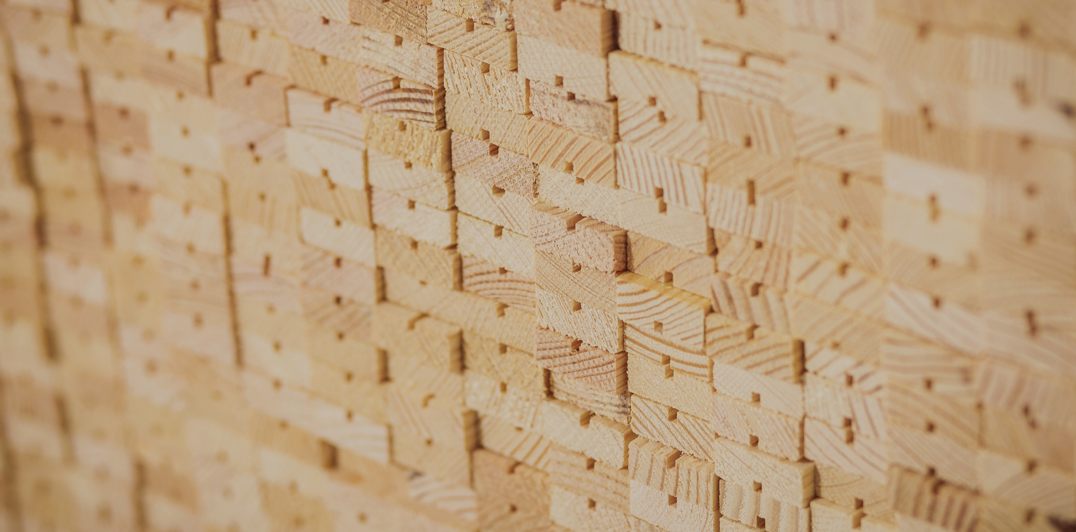
Construction physics

Slide 4
Authors
Jani Pitkänen, XAMK
Release date: 18/02/2022

Slide 5
Moisture engineering

Slide 6
Moisture properties of timber
1/16
Wood is a hygroscopic material, which means that wood has the ability to absorb and dispose of moisture according to the variations in the relative humidity of the air.
Wood always adjusts to the equilibrium moisture content of its surroundings.
Wood maintains its hygroscopic properties at all its stages, as even surface treatments only slow down changes in moisture.
As a result of moisture fluctuations, wood shrinks or swells.
As anisotropic material (fa physical property which has a different value when measured in different directions), longitudinal changes to wood due to moisture are minor, but transverse changes due to moisture are significant and must be taken into account when designing structures and details.

Slide 7
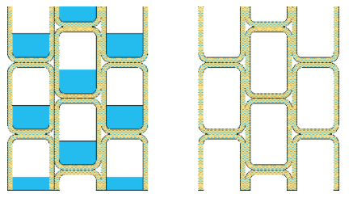
Moisture properties of timber
2/16
When wood begins to dry, the free water in its cell lumen is released first.
The wood’s moisture state where free water has been released from the cell lumen, but the cell walls contain the maximum amount of water, is called the saturation point for the wood’s grain.
The wood’s moisture content is then approximately 30%.

Slide 8
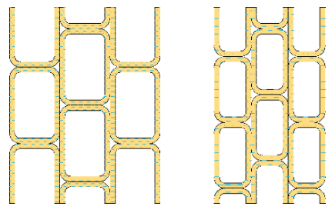
Moisture properties of timber
3/16
After the release of the free water from the cell lumen, the water bound to the cell walls begins to disappear, resulting in the wood shrinking.
Shrinkage causes the wood to change shape, which in turn causes internal stress in the wood.
Internal stress cause cracks in the wood, and the effect of internal stress in sawn timber can also be seen as e.g. twisting.

Slide 9
Moisture properties of timber
4/16
When the moisture content of wood is less than 20%, it is usually safe from wood-rotting fungus, mould and other biological pests.
In addition, the strength and stiffness properties of dry wood are better than those of wet wood.
The improvement of strength properties as the wood dries is based on the cell walls moving closer together and fixing to one another.

Slide 10
Moisture properties of timber
5/16
Spruce and pine have similar strength and stiffness properties, but there are differences in their moisture behaviour.
Spruce reacts more slowly to moisture fluctuations in its surrounding environment than pine.
This is because the flaps of the pores on the cell walls (toruses) close all over when spruce dries but open on the surface of pine wood when it dries.
The pores of corewood in pine are clogged with reside.
The characteristics of cell wall pores also mean that the pressure impregnation of spruce is difficult and that impregnating agents in pine can only penetrate to the surface wood.

Slide 11
Moisture properties of timber
6/16
The moisture content of the wood is expressed as a percentage and refers to the ratio of the weight of the water in the wood to the absolute dry weight of the wood.
Moisture content is determined with a hygrometer.
The moisture content of fresh softwood is approximately 30% (grain saturation point), from which point different drying methods can be used to change the moisture content to the desired magnitude depending on the application.
In normal use, the moisture content of wood varies between 8% and 25%.

Slide 12
Moisture properties of timber
7/16
The moisture content is not an absolute value. Instead, it changes according to the relative humidity of the air (moisture ratio at equilibrium).
When placed in a dry space, wood dries and when in humid conditions it absorbs moisture.
Thus, its moisture varies according to season and application.
For this reason, it is particularly important to ensure that the moisture content of timber is not able to vary greatly from the recommended value for the application during storage, transport and installation.

Slide 13
Moisture properties of timber
8/16
A timber yard will recommend measuring the moisture of the timber before delivery to the customer.
Site of use | Moisture content (recommendation)
Frame | < 24 %
External cladding | < 18 %
Internal cladding | < 16 %
Floor boards | < 10 %
Moisture ratio at equilibrium (recommendation)

Slide 14
Moisture properties of timber
9/16
As sawn timber dries, it shrinks, changes shape and surface cracks may form.
In addition, as is characteristic of wood, the strength and stiffness properties increase as the wood dries.
The magnitude of deformation in a sawn item due to moisture may be determined approximately with the values shown in the table.
Deformations caused by moisture should be taken into account, for example, in connection with match boarding and installation of joints, as the measurement changes to the cross-section of the sawn article may be several millimetres.

Slide 15
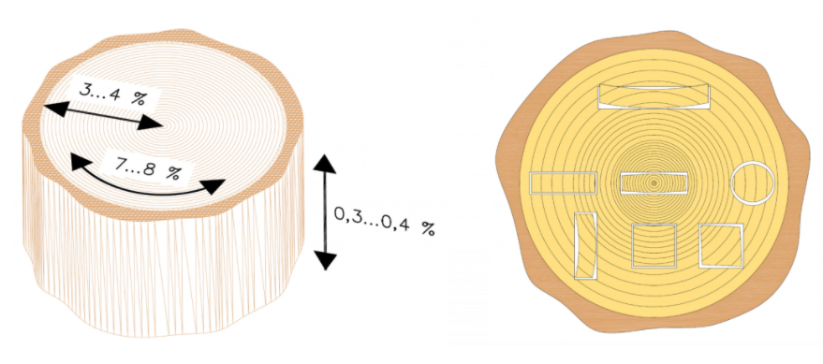
Moisture properties of timber
9/16
Change in moisture content of sawn timber
Changes in the dimensions of the cross-section | 0.25%
Change in the length measurement | 0.02%
Indicative values for the determination of deformation in softwood sawn timber due to moisture changes
Pine and spruce wood shrink from their fresh dimensions (when the wood dries from a moisture content of 30% to 10%):
5-6% in the direction of the annual ring
2-3% in the direction of the radius
0.2-0.3% in the direction of the height of the tree
As moisture increases, the wood swells in the same proportion.

Slide 16
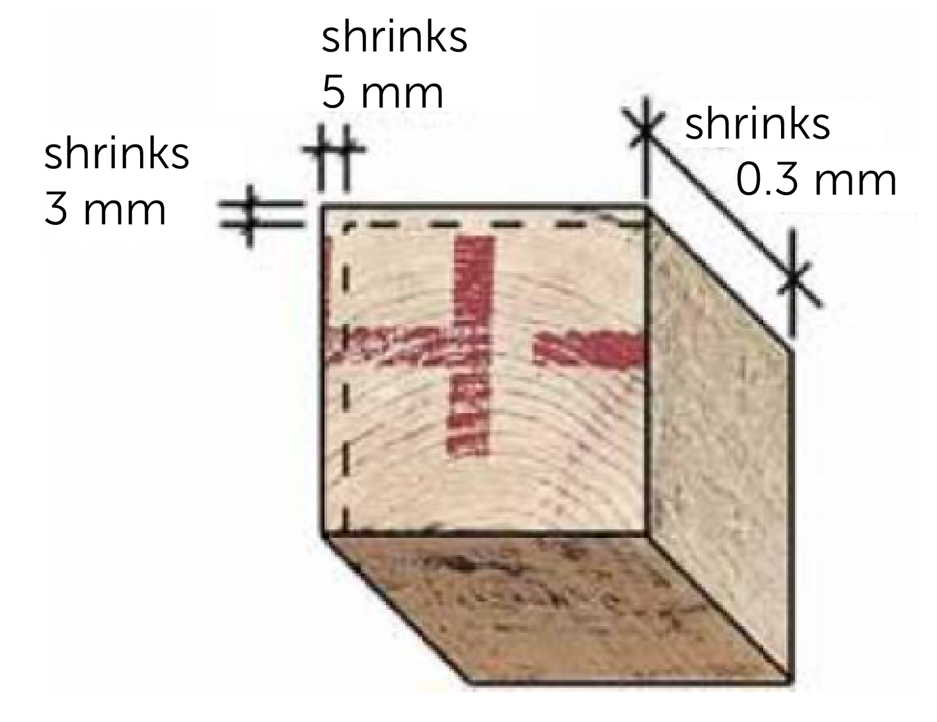
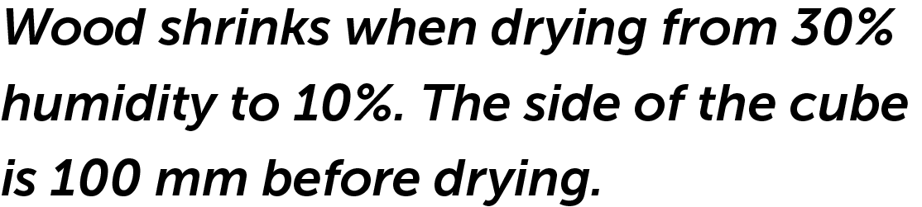
Moisture properties of timber
10/16
Pine and spruce wood shrink from their fresh dimensions (when the wood dries from a moisture content of 30% to 10%):
5-6% in the direction of the annual ring
2-3% in the direction of the radius
0.2-0.3% in the direction of the height of the tree
As moisture increases, the wood swells in the same proportion.

Slide 17
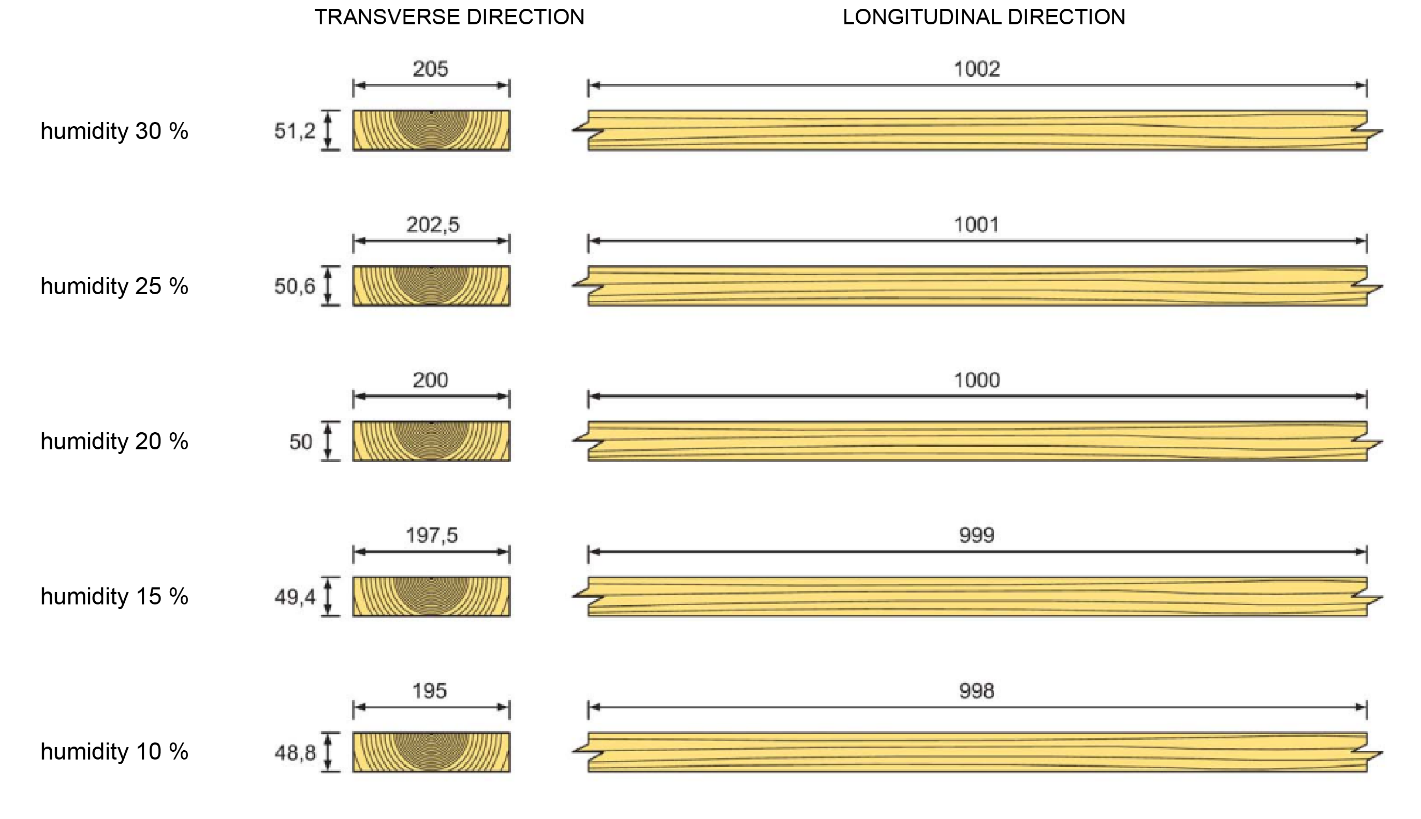
Moisture properties of timber
11/16

Slide 18
Moisture properties of timber
12/16
Moisture moves differently in pine and spruce wood.
Water moves very poorly in pine’s corewood, but easily in its surface wood as the pores are open.
The pores in spruce wood close throughout and water moves clearly more slowly than in pine’s surface wood. The slow flow of water is an advantage in outdoor conditions.

Slide 19
Moisture properties of timber
13/16
Wood begins to be damaged if its moisture stays above 20% for long periods of time
In this case, the relative humidity of ambient air is usually over 80-90%.
Wood begins to mould within a few months if the relative humidity of the surrounding air remains above 80% during this period.
After the air’s relative humidity has been exceeded, 90%, the wood begins to rot.
However, the precondition for the moulding and decaying of wood is a temperature between + 0 °C and + 40 °C.

Slide 20
Moisture properties of timber
14/16
Although the relative humidity of the air in freezing temperatures may exceed 85% for long periods, the wood is not damaged because the temperature is not sufficient for mould and decay.
Mould spores and wood-decay fungus also require oxygen and nutrients that are usually sufficient in both wood and ambient air.
Mould cannot penetrate deeper than the surface of the wood, so it is not harmful to the strength of the wood.

Slide 21
Moisture properties of timber
15/16
On the other hand, spores spread by mould are harmful to health because they can cause different allergic reactions and mild toxic effects to humans, such as continuous rhinitis, dizziness and headaches.
For this reason, the presence of mould must always be taken seriously.

Slide 22
Moisture properties of timber
16/16
Blue-stained wood is often erroneously thought to be mouldy.
The blue colour wood is staining caused by Blue stain fungi which extends deep into the structure of the wood.
Blue stain fungi spread as spores as mycelium growth and appear especially on stored softwood.
Blue stain fungi do not develop in temperatures below +5 °C.
Blue staining does not substantially affect the strength of wood.

Slide 23
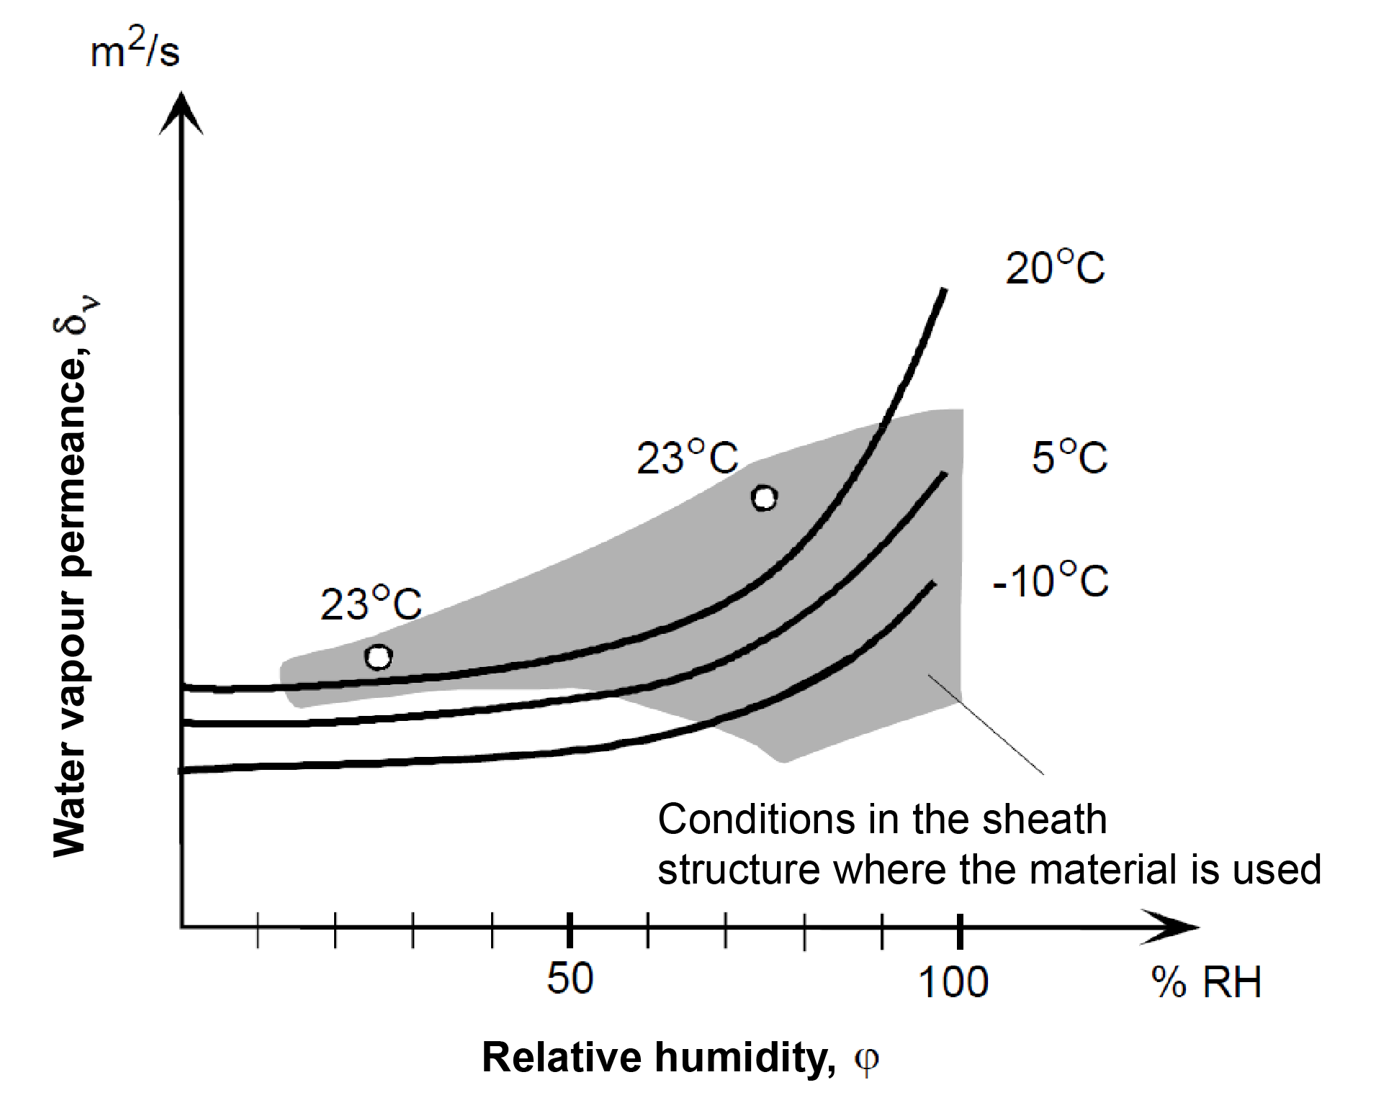
Water vapour resistance for wood products
1/3
the value measured in dry conditions should be used to calculate a material’s vapour permeance, δ_{ν,dry}, (ϕ ≤ 50 % RH)

Slide 24
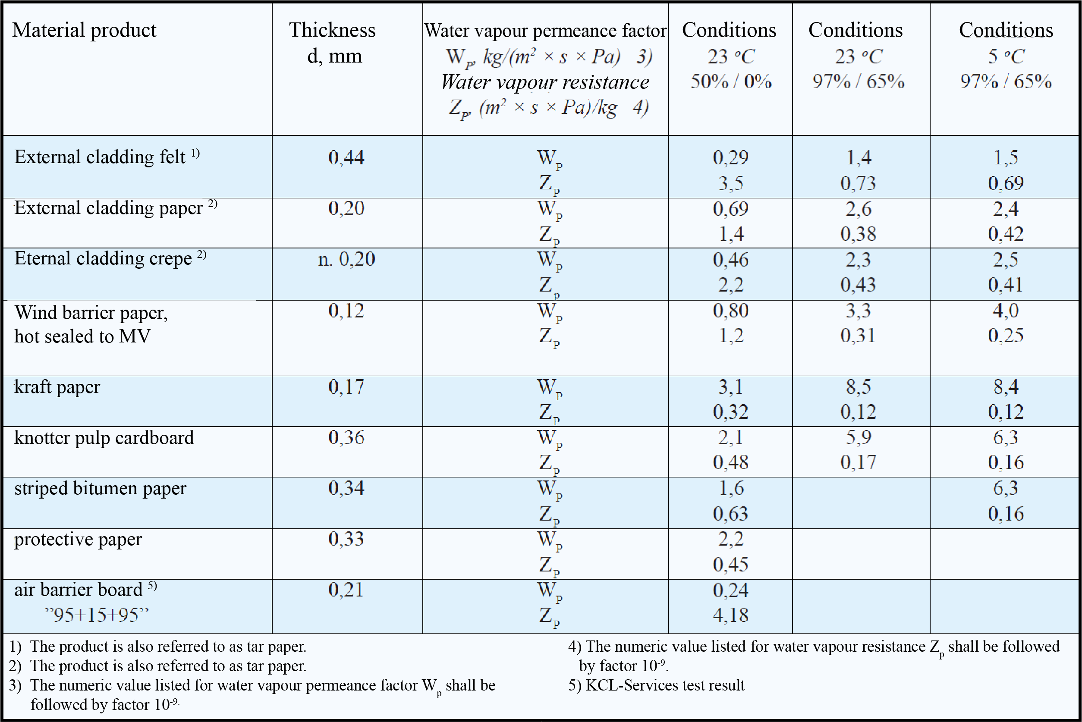
Water vapour resistance for wood products
2/3
Table 1. Water vapour penetration properties of porous construction papers in humid and dry environments and at two temperatures (BREATHABLE WOOD FIBRE STRUCTURE, 2002)

Slide 25
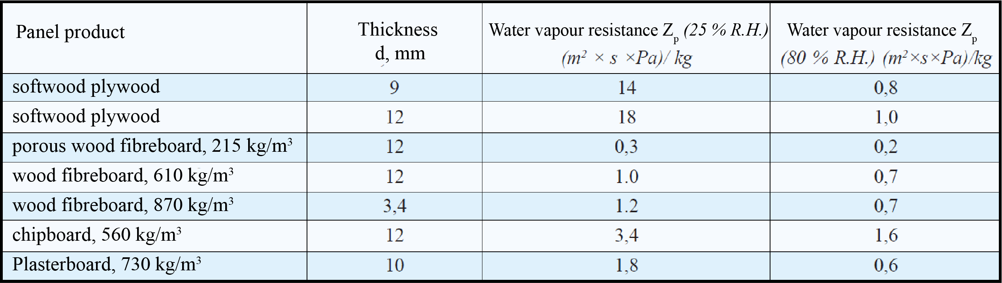
Water vapour resistance for wood products
3/3
Table 2. Vapour resistance values for certain panel-like construction products (2). A factor of 10-9 shall be added after the Zp values. (BREATHABLE WOOD FIBRE STRUCTURE, 2002)
Table 2 shows some water vapour resistances based on data from literature /1/. The given figures must be considered first and foremost as magnitude data, as the data varies by manufacturer and product and due to dispersion due to manufacture technology.
/1/ Erkki Kokko, Tuomo Ojanen, Mikael Salonvaara, Antti Hukka & Hannu Viitanen. Puurakenteiden kosteustekninen toiminta. VTT Press releases No 1991. VTT Technical Research Centre of Finland Ltd. Espoo 1999. p. 160

Slide 26
Moisture engineering design of structures
1/4
The following discusses the movement of moisture and its impacts on structures.
The analysis mainly concerns movement of water in the form of water vapour.
The analysis does not apply to waterproofing measures, i.e. sealing against water in liquid form.
The movement of water vapour in structures must be known to avoid structural, economic and health hazards caused by moisture.

Slide 27
Moisture engineering design of structures
2/4
Excessive moisture may cause, for example, decay of wooden structures, deterioration of coatings, metal corrosion, a decline in the ability of thermal insulation to insulate and moulding of structures and surfaces.

Slide 28
Moisture engineering design of structures
3/4
Diffusion is the movement of gas molecules, as a result of which the individual gas concentration differences (or partial pressure differences) in the gas mixture attempt to equalise.
In diffusion, the net gas flow occurs from a higher concentration to a lower concentration.
In building physics, the most important gas to analyse is water vapour.
Other gases to be analysed include carbon dioxide, radon and other gaseous pollutants in indoor air.
The water vapour permeability of the material is not a constant, but depends on the temperature and relative humidity of the pore air.

Slide 29
Moisture engineering design of structures
4/4
At a certain temperature, the air can only contain a certain precise amount of water vapour.
This partial pressure corresponding to the maximum amount of water vapour is called saturation pressure, which increases as the air temperature rises.
Thus, each air temperature corresponds to a certain water vapour saturation pressure (tabulated) and the other way round each water vapour partial pressure corresponds to a certain air temperature below which the temperature cannot descend without the water vapour condensing into water.
In this case, the partial weight has risen into the saturation pressure. This temperature is called the dewpoint or dewpoint temperature.

Slide 30
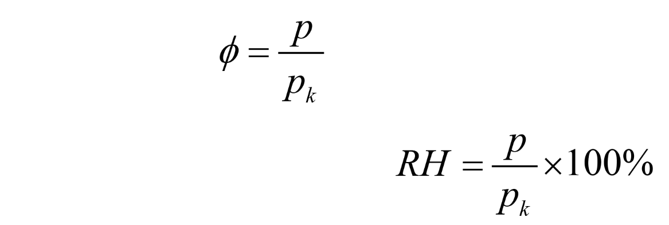
How water vapour content is expressed
1/11
The air’s water vapour concentration is usually expressed as relative humidity, which indicates the percentage of the water vapour partial pressure is at the same temperature as the saturation pressure.
The relative humidity is calculated using pressure as follows:
Ratio:
As relative humidity:
where
p = prevailing partial pressure of the water vapour [Pa or kPa]
p_{k} = water vapour saturation pressure at the same temperature [Pa or kPa]

Slide 31
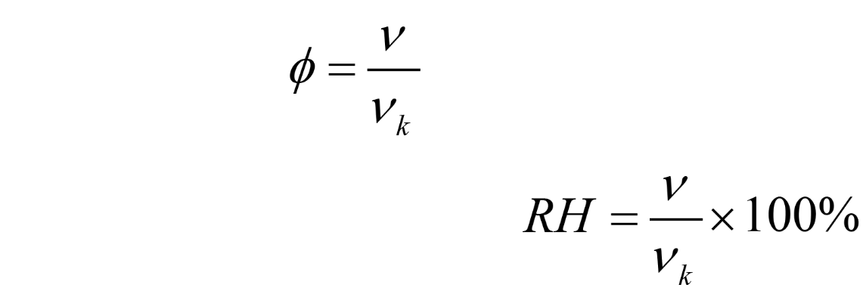
How water vapour content is expressed
2/7
The relative humidity is calculated using the humidity content as follows:
Ratio:
As relative humidity:
where
ν = the water vapour’s prevailing moisture content [g/m3], (ν = nyy)
ν_{k} = Moisture content of air impregnated with water vapour at the same temperature [g/m3]

Slide 32
How water vapour content is expressed
3/7
The temperature dependence of the saturated water vapour concentration can be described using experimental mathematical functions. The formula below is valid for the following temperature range -20 °C to +80 °C (Nevander / Elmarsson):
where
t = temperature [°C] to be analysed

Slide 33
How water vapour content is expressed
4/7
The connection between the prevailing water vapour concentration and the partial pressure of the corresponding water vapour is as follows:
where
ν = the water vapour’s prevailing moisture content [g/m3]
T = prevailing temperature in Kelvin [K], (273 K + t °C)

Slide 34
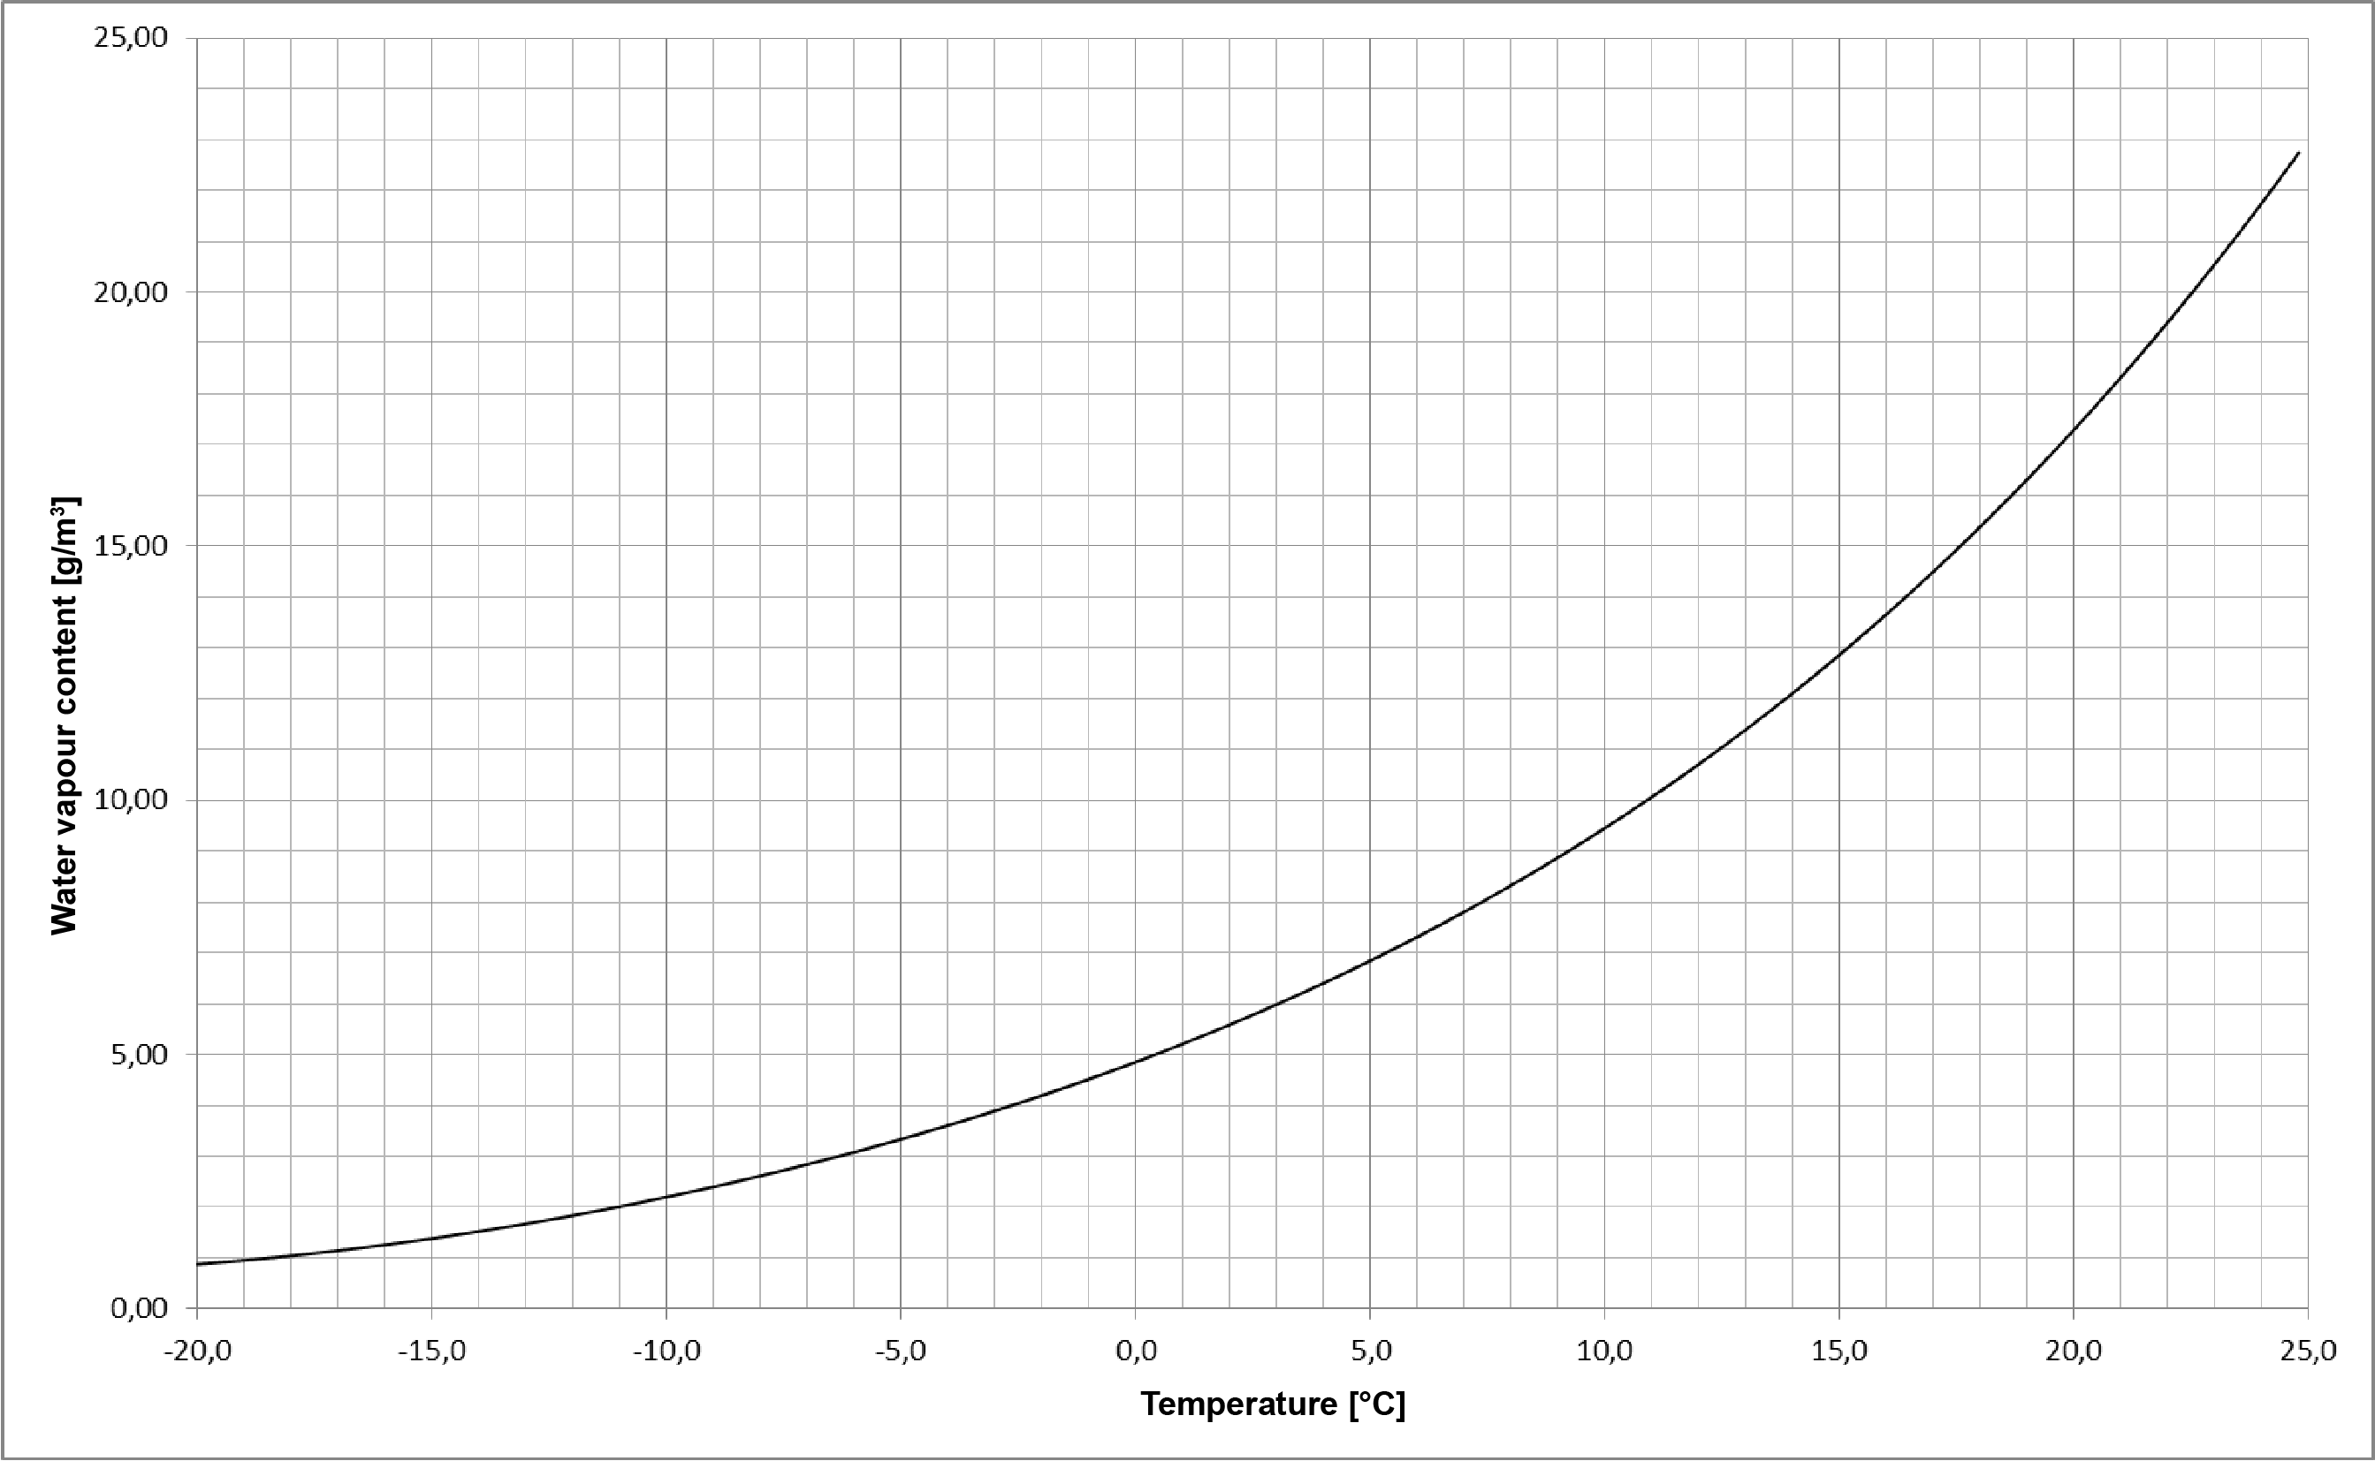
How water vapour content is expressed
5/7
Image: Moisture content of air impregnated with water vapour in relation to temperature

Slide 35
How water vapour content is expressed
6/7
The water vapour saturation pressure can also be calculated using the formula below (no temperature-related limitations):
after which saturated water vapour concentration is calculated with the following formula:
where
T = prevailing temperature in Kelvin [K], (273 K + t °C)

Slide 36
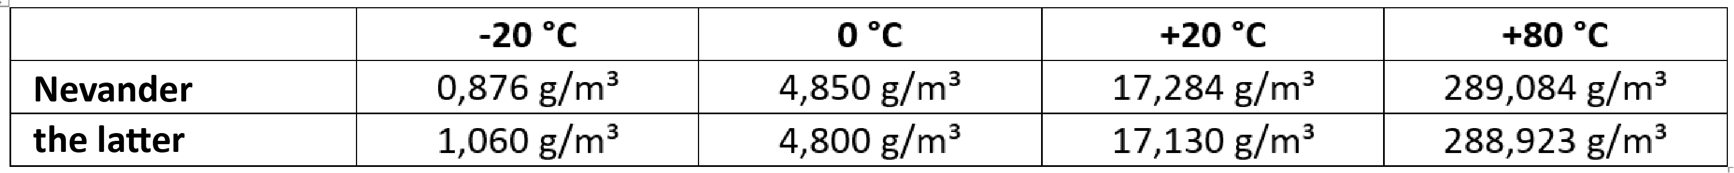
How water vapour content is expressed
7/7
The difference between Nevander and the latter formulas is small:
after which saturated water vapour concentration is calculated with the following formula:
where
T = prevailing temperature in Kelvin [K], (273 K + t °C)

Slide 37
Humidity of outdoor and indoor air
1/6
As a rule, the relative humidity of outdoor air is determined by the prevailing weather.
E.g. when it is rainy and foggy, for example in the autumn, humidity is 95...100%, and in dry and warm weather, for example in early summer, relative humidity is 35...40%.
During the year, relative humidity is highest in early winter and lowest in early summer. Absolute humidity is lowest in winter and highest in late summer.

Slide 38
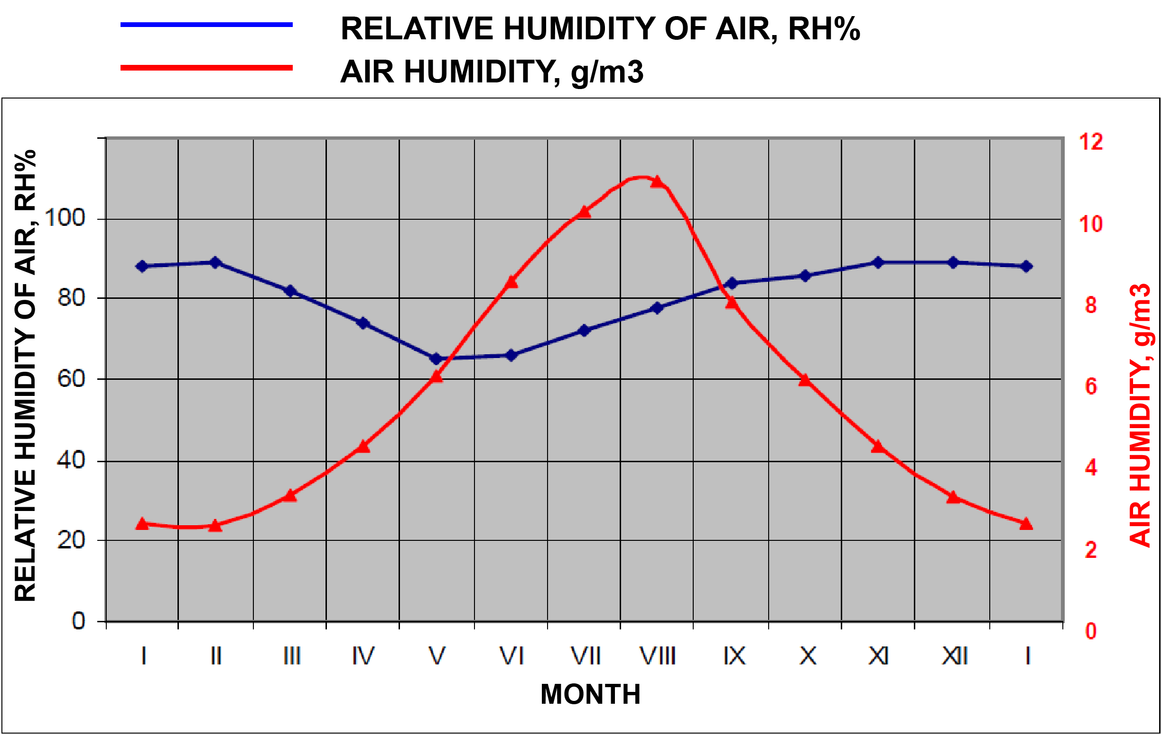
Humidity of outdoor and indoor air
2/6
Image: Variation of atmospheric humidity by month

Slide 39
Humidity of outdoor and indoor air
3/6
During the heating season, the relative humidity of indoor air is normally 20% to 40%.
It is at its lowest when temperatures are below zero, as at that time the absolute humidity of outdoor air is low.
During the heating season, the absolute humidity is higher indoors than outdoors, as people, plants, household work, etc. generate moisture.
For this reason, the relative humidity is also higher than that corresponding to the relative humidity of the outside air.

Slide 40
Humidity of outdoor and indoor air
4/6
A very low relative humidity is harmful to the respiratory system, which is why humidifiers may be used in buildings with mechanical ventilation.
In the summer, humidity conditions are nearly identical indoors and outdoors.
The water vapour content of indoor air is affected by the water vapour content of outdoor air, indoor moisture sources, indoor ventilation, the amount of water vapour in the air expelled through structures and the binding of water vapour to building materials.
The latter two factors are generally of relatively low importance.

Slide 41
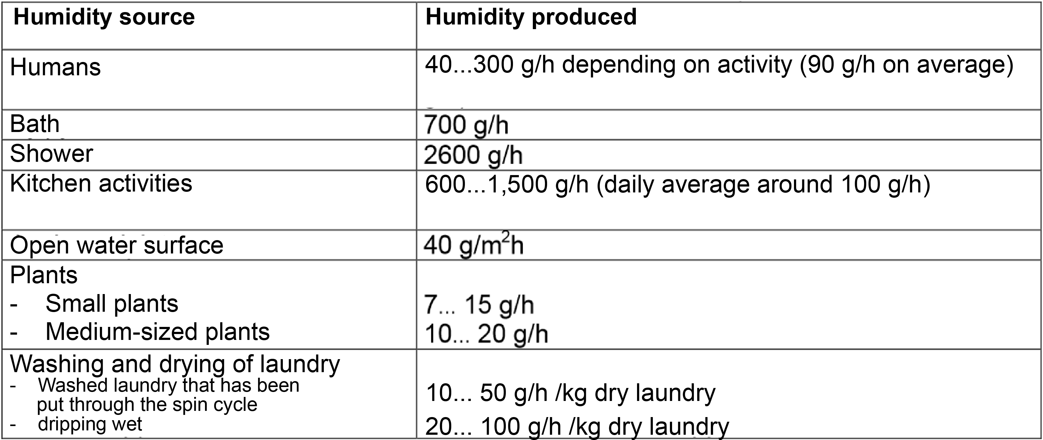
Humidity of outdoor and indoor air
5/6
Table: Humidity production values inside residential buildings

Slide 42
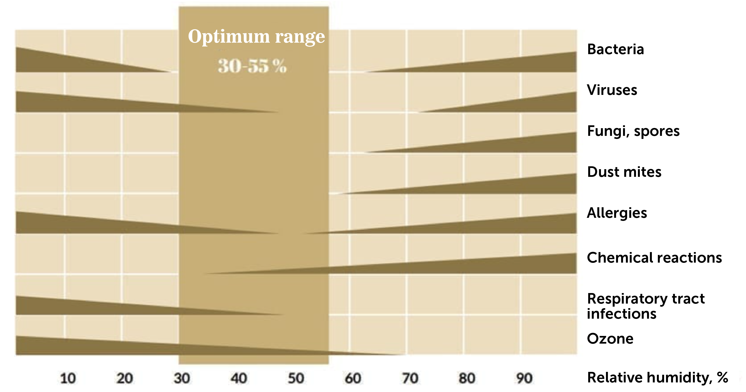
Humidity of outdoor and indoor air
6/6
Image: Impact of humidity on indoor air quality

Slide 43
Diffusion of water vapour
1/1
In an unevenly distributed gas mixture, the gas molecules try to move in such a way that a uniformly distributed gas mixture is formed.
This phenomenon is called diffusion.
Therefore, if the partial vapour pressure differs in the different parts of the enclosed space when the air is stationary, the water vapour is diffused so that the partial pressures form an equilibrium.
If the space is divided into two parts on a porous wall, the water vapour is diffused through the wall in the direction where the partial pressure of the water vapour is lowest.

Slide 44
Diffusion of water vapour
2/15
Thus, diffusion sees the moisture being transferred from the higher partial vapour pressure in the direction of the lower partial vapour pressure, to find an equilibrium.
In the Finnish climate, conditions are normally such that in the winter diffusion takes place from indoor areas through external sheathing towards the outdoor air.
During the summer, the direction of the diffusion flow may vary depending on the outdoor and indoor conditions.
The amount of water vapour diffused through a material layer or structure depends on its porosity (density), the structure of the pores, the water content and temperature of the material.

Slide 45
Diffusion of water vapour
3/15
In practice, diffusion calculations provide a fairly good picture of the moisture performance of structures.
The simultaneous impact of many different factors can also be taken into account in computation.
At their simplest, diffusion calculations can be performed manually, so they are suitable for assessing moisture behaviour in practical structures.
Calculations can be used to assess whether moisture is condensed and, on the other hand, how high the amount of condensation is during a certain period of time, i.e. during the wetting period.

Slide 46
Diffusion of water vapour
4/15
The amount of moisture removed during the drying period is assessed similarly.
Diffusion calculations often use averages of temperature and humidity as dimensioning climates.
The results on the safe-side are obtained when the worst case scenario for three days is calculated. For example in Southern Finland, with an outside temperature and humidity of -20 °C / RH 90% and the corresponding indoor temperature and humidity of +21 °C / RH 50%.
It is assumed in calculations that the conditions remain constant at all times (steady state, stationary state), although in reality, e.g., the outdoor temperature and humidity may vary by hour.

Slide 47
Diffusion of water vapour
5/15
A material’s water vapour permeance, i.e. the diffusion factor δ_{p}, indicates the volume of water vapour that in the steady-state and a specific time unit permeates a homogeneous layer that is as large as the surface unit and as thick of the length unit when the water vapour partial pressure difference on different sides of the material layers is equal to the pressure unit [Pa] or the water vapour content difference is equal to unit [kg/m³]. For example, concrete δ_{p} = 2…10 x 10⁻¹² [kg/msPa].

Slide 48
Diffusion of water vapour
6/15
The water vapour permeance factor i.e. water vapour permeability W_{p} of the material indicates the amount of water vapour that in the steady-state passes through an item equal to the size of the surface unit in the time unit when the difference in water vapour partial pressures or the difference in water vapour concentrations on different sides of the item are equal to the unit.
Some sources present diffusion factors for thin layers of material in this way, which means that the strength of the material is no longer taken into account separately. For example, 13 mm plasterboard W_{p} = 2…10 x 10⁻⁹ [kg/m²sPa].

Slide 49
Diffusion of water vapour
7/15
The water vapour resistance of a materials , i.e. the diffusion resistance Zp, indicates the difference in water vapour content or water vapour partial pressures on the surfaces of a layer of material that is of uniform thickness or on the different sides of a structure made of such material, and the relation of the water vapour flow diffused per time unit in the steady-state through the material layer or the structure. In practice, water vapour resistance is the inverse of the water vapour permeance factor.

Slide 50
Diffusion of water vapour
8/15
Water vapour resistance of the material layer:
the unit for this is [x10⁹ m²sPa/kg]
where
d = thickness of layer [mm]
δ_{p} = water vapour permeance or diffusion factor [kg/msPa]

Slide 51
Diffusion of water vapour
9/15
The above-mentioned water vapour penetration factors and resistances for the most common construction materials are tabulated in different sources, such as RIL 107, SFS-EN ISO 12524, etc.
The water vapour resistance of cardboard, plastic films, paint layers, and other thin equipment or materials. should be determined either from the certificate, CE marking or in the EEA opinion.

Slide 52
Diffusion of water vapour
10/15
In addition, when the water vapour resistance factor μ in standard SFS-EN iso 12524 and the water vapour diffusion-equivalent air layer thickness sd are taken into account and the air-to-air layer the water vapour diffusion equivalent sd, the dependence of the above (diffusion resistance, water vapour permeance factor, diffusion factor and water vapour resistance factor) is as follows:

Slide 53
Diffusion of water vapour
11/15
The total water vapour resistance of the structure, i.e. the total resistance to vapour diffusion, is calculated using the following formula:
the unit for this is [x10⁹ m²sPa/kg]
where
d_{n} = thickness of the material layer [m]
δ_{pn} = water vapour permeance or diffusion factor [kg/msPa]
In water vapour diffusion, the surface resistances are negligible as they are so small and therefore do not need to be taken into account.

Slide 54
Diffusion of water vapour
12/15
The partial vapour partial pressure p inside the structure is calculated with the following formula:
, where the unit is [Pa]
where
p_{s} = partial vapour pressure indoors [Pa]
p_{u} = partial vapour pressure outdoors [Pa]
Z_{x} = water vapour resistance of the part of the structure which is located between the internal
surface and the point x in question [m²sPa/kg]
Z_{p} = total water vapour resistance of the structure [m²sPa/kg]

Slide 55
Diffusion of water vapour
13/15
The same can be calculated via the water vapour content, i.e. the water vapour content ν within the structure is determined with the following formula:
, where the unit is [g/m³]
where
ν_{s} = water vapour content indoors [g/m3]
ν_{u} = water vapour content outdoors [g/m3]
Z_{x} = water vapour resistance of the part of the structure which is located between the internal
surface and the point x in question [m²sPa/kg]
Z_{p} = total water vapour resistance of the structure [m²sPa/kg]

Slide 56
Diffusion of water vapour
14/15
It is assumed that the change in partial pressure in the homogeneous material layer occurs in a straightforward manner.
Moisture builds up in the structure if the partial vapour pressure calculated at any point is greater than the saturation pressure.
In this case, the water vapour that exceeds the amount of saturated water condenses, but some of this vaporizes again and goes back through the structure.

Slide 57
Diffusion of water vapour
15/15
The moisture in the place in question begins to grow.
The generation of condensation depends on the partial pressure and temperature conditions of the water vapour.
The structure cannot be such that its moisture content increases.
A more detailed calculation can be obtained, for example, with the WuFi program, which can be used to examine long periods of time (years). The program takes into account changing conditions (heat, moisture, sun, wind, rain, etc.)

