Slide 1



Industrial wood construction
Teaching materials for industrial wood construction education
2022

Slide 2
Origin of the materials
Use of the materials
These learning materials for industrial wood construction have been prepared in a project led by Puuinfo Oy in 2021–2022. Also involved in the project were
Lappia Vocational College,
TTS-Työtehoseura ry
South-Eastern Finland University of Applied Sciences,
Metropolia University of Applied Sciences,
Jyväskylä University of Applied Sciences,
University of Tampere, and
Federation of the Finnish Woodworking Industries Puutuoteteollisuus ry
The project was funded by the Ministry of the Environment.
The materials are intended to be used as extensively as possible in industrial wood construction education and studies.
The materials are released under the Creative Commons licence Attribution-ShareAlike (CC BY-SA), which requires that the author be properly credited when the materials are used and that derivative works may only be distributed under the same licence as the original work.
The original materials and any updates to them by Puuinfo will be published on the Library of Open Educational Resources website (aoe.fi) and the Puuinfo.fi website.

Slide 3
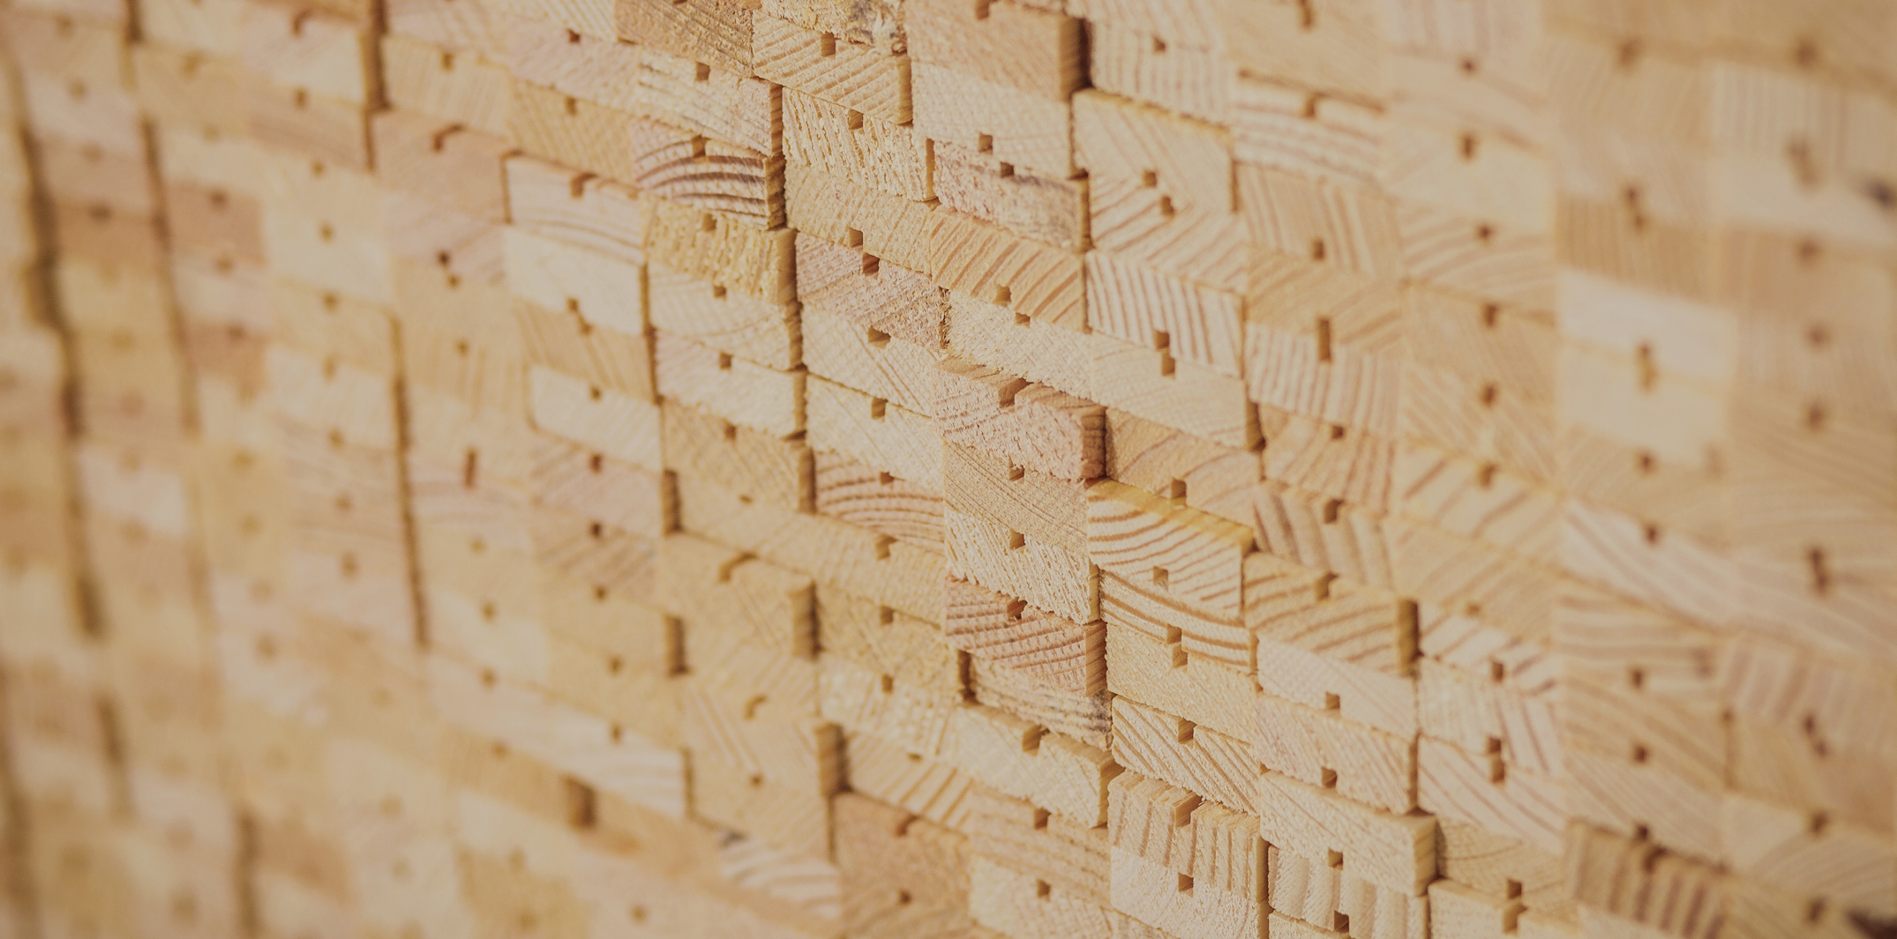
Construction physics

Slide 4
Authors
Further information
Jani Pitkänen, XAMK
Release date: 13/05/2022
Further information:
Rafnet 2020 learning material (in Finnish)
Decrees of the Ministry of the Environment
  1010/2017
  788/2017
  1048/2017
RT-80-10974
Motiva
Energy performance certificate guide 2018 (in Finnish)

Slide 5
Thermal engineering

Slide 6
Energy performance of buildings
1/7
The Decree of the Ministry of the Environment on the Energy Performance of New Buildings (1010/2017) determines the following concerning energy performance:
“Section 3: Minimum requirements for building energy performance
  A principal designer, special designer and building designer shall, in accordance with their
  respective duties, see to the design of a new building so that it, in accordance with its intended
  use:
  is in compliance as regards its energy performance with either the calculated energy performance reference value (E-value) or structural energy efficiency;
  creates conditions for energy demand with low energy loss;
  is energy efficient as regards its calculated room temperature in the summer, its energy consumption measurement, its heat and electrical energy demand and, where using a mechanical ventilation system, also as regards the specific fan power of its ventilation system.”

Slide 7
Energy performance of buildings
2/7
The Decree of the Ministry of the Environment on the Energy Performance of New Buildings (1010/2017) determines the following concerning energy performance:
“Section 4: Requirement levels for the calculated energy performance reference value for each intended use category
  The calculated energy performance reference value (E-value), the unit of which is kWh_{E}/(m²a), is a building’s calculated annual consumption of delivered energy weighted by energy carrier factors per the building’s net heated area. The E-value calculated in accordance with the building’s intended use category shall not exceed the following limits:”
The limits for 9 intended use categories can be found in the Ministry of the Environment Decree (1010/2017)

Slide 8
Energy performance of buildings
3/7
Intended use category | Limit for E-value [kWh_{E}/(m²a)]
Category 1: Small residential buildings Detached houses and link-detached houses with a net heated area (A_{net}) of 50–150 m² Detached houses and link-detached houses with a net heated area (A_{net}) exceeding 150 m² but not exceeding 600 m² Detached houses and link-detached houses with a net heated area (A_{net}) exceeding 600 m² Terraced houses and blocks of flats with residential storeys on a maximum of two storeys | 200–0.6 A_{net} 200–0.6 A_{net} 92 105
Category 2: Blocks of flats with residential storeys on at least three storeys | 90
Category 3: Office buildings, health centres | 100
Category 4: Commercial buildings, department stores, shopping centres; wholesale and retail trade buildings, excluding grocery trade units under 2,000 m²; shopping halls, theatres, opera, concert and congress halls, cinemas, libraries, archives, museums, art galleries, exhibition halls | 135

Slide 9
Energy performance of buildings
3/7
Intended use category | Limit for E-value [kWh_{E}/(m²a)]
Category 4: Commercial buildings, department stores, shopping centres; wholesale and retail trade buildings, excluding grocery trade units under 2,000 m²; shopping halls, theatres, opera, concert and congress halls, cinemas, libraries, archives, museums, art galleries, exhibition halls | 135
Category 5: Accommodation establishment buildings, hotels, boarding houses, assisted living accommodation, retirement homes, residential care institutions | 160
Category 6: Education and training buildings and daycare centres | 100
Category 7: Buildings for sports and physical exercise, excluding indoor swimming pools and indoor ice rinks | 100
Category 8: Hospitals | 320
Category 9: Other buildings, warehouses, transport and communications buildings, indoor swimming pools, indoor ice rinks, grocery trade units under 2,000 m², portable buildings | no limit

Slide 10
Energy performance of buildings
6/7
The National Building Code of Finland publication Energy efficiency, Calculation of power and energy needs for heating of buildings (in Finnish) introduces the calculation principle for E-value.
The calculation includes U_{c}-values and a balancing calculation, but it also contains many other additional factors.
E-value is a calculated annual consumption per net heated area, so it is not based on actual consumption figures.
The energy purchased is weighted by coefficients for forms of energy.
The energy type factors can be found in the Government Decree on the numerical values of coefficients for forms of energy used in buildings (788/2017).

Slide 11
Energy performance of buildings
7/7
If the heating system used for the building is district heating, a geothermal heat pump or an air-to-water heat pump, the fulfilment of the requirements set for the energy performance of a building (E-value) may be verified also on the basis of so-called structural energy efficiency.
In practice, this means compensating for heat loss with stricter than normal U values, air leakage rate and heat recovery factor.
Separate instructions for calculation can be found from the National Building Code of Finland publication Example calculations 2018 The demonstration of compliance of the structural energy performance (in Finnish).

Slide 12
Energy performance certificate of a building
1/4
An energy performance certificate states the E-value, i.e., the calculated consumption of purchased energy.
It also states the actual consumption of purchased energy, if available (not for new buildings).
For a building already in use, the certificate can also include recommendations of measures that could potentially improve the energy performance.
The Decree of the Ministry of the Environment on Energy Performance Certificates of Buildings (1048/2017) has been issued for preparation of the energy performance certificates.

Slide 13
Act on Energy Performance Certificates of Buildings (50/2013)
2/4
“When a building, part of a building or an apartment as referred to in Section 4(1), or their right of possession is sold or leased, a valid energy performance certificate of the building or a part thereof shall be made available to the prospective buyer or tenant. The energy performance certificate shall be issued either in original or in copy to the buyer or tenant.”
“The energy performance certificate shall remain valid until it is replaced with a new energy performance certificate, or up to a maximum of ten years from the date on which it was drawn up.”

Slide 14
Act on Energy Performance Certificates of Buildings (50/2013)
3/4
“The energy performance certificate may be drawn up by a person whose qualifications have been verified and are valid, who is registered in the register of the accredited energy assessors and for whom the general conditions for the pursuit of the activity are fulfilled.”
“The energy assessor shall hold an appropriate diploma in the technical field, or equivalent professional experience in accordance with the level of complexity of the task of drawing up the energy performance certificate, as well as knowledge of legislation related to the energy performance certificates and their preparation, as demonstrated by an acceptable performance in the energy assessor examination.”

Slide 15
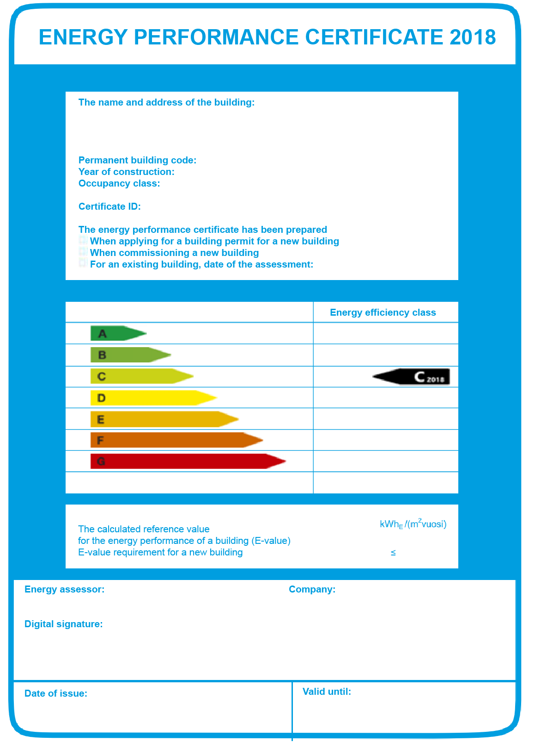
Act on Energy Performance Certificates of Buildings (50/2013)
4/4
The accreditation shall be valid for a period not exceeding seven years from the date of the decision. In order to renew their accreditation, the energy assessor shall maintain their professional competence by drawing up energy performance certificates, by participating in training that maintains their professional competence or in a similar manner.”

Slide 16
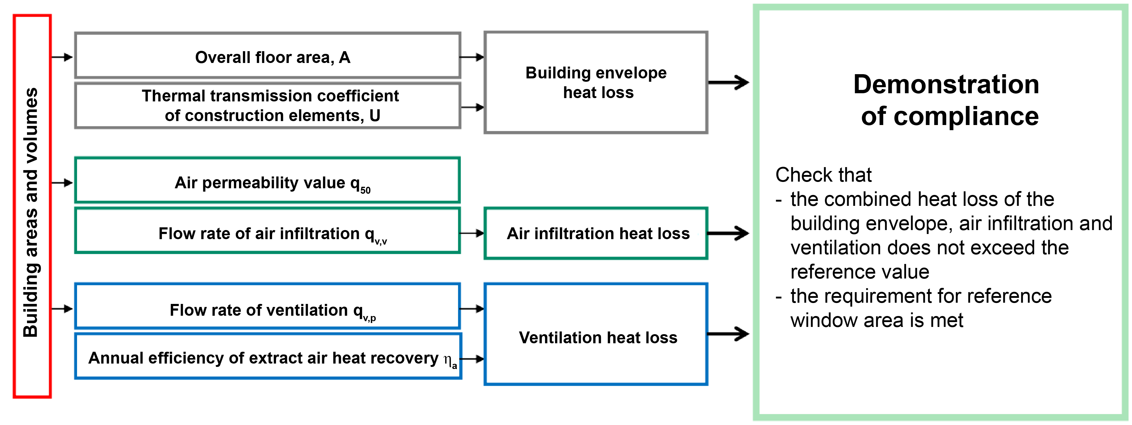
Factors needed for determining E-value

Slide 17
Importance of air tightness to energy efficiency
1/3
Air leakage and air tightness of a building are very important when examining and determining the heat loss and energy consumption of the building.
If the building envelope is airtight, it can improve the energy efficiency class of the energy performance certificate, and air tightness can also compensate for other heat losses in the building.
Primarily, the level of air tightness should be used to improve the energy efficiency without reducing the thermal insulation capacity of the building envelope of the efficiency of heat recovery.

Slide 18
Importance of air tightness to energy efficiency
2/3
The air leakage rate of a building has a significant impact on the total energy consumption of the building.
  For example, the calculated total energy consumption in detached houses increases by an average of 4% for each increase of total units in the n₅₀-figure.
The air leakage rate figure n₅₀ means the average hourly rate of leakage air flow of the building envelope at a pressure differential of 50 Pa between the interior and exterior spaces.
According to building regulations of 2010, the design value of air leakage rate figure is 4.0 m³/(h·m²).

Slide 19
Importance of air tightness to energy efficiency
3/3
In a detached house like this, the total energy consumption is 6–20% higher than in a detached house with an excellent level of air tightness (n₅₀ = 4.0 m³/(h·m²).

Slide 20
Thermal bridges and their impact
1/10
Thermal bridges are those parts of the structures that have a lower thermal resistance than their surroundings.
In other words, they form a “bridge” for heat to pass through from warm space to cold.
It could very well also be called a heat bridge, as that would describe the resulting heat loss.
Thermal bridges must naturally be avoided in structures, but they are inevitable in, for example, balcony supports, certain connections between base and intermediate floors and external walls or in building services technology components placed in the structure.

Slide 21
Thermal bridges and their impact
2/10
The thermal bridges that are characteristically repeated in the structure are taken into account when calculating the U-value, e.g. wall ties, brackets or support and frame structures that are typical in the structure throughout the envelope area it presents.
Repeating and point thermal bridges are taken into account when calculating the E-value.

Slide 22
Thermal bridges and their impact
3/10
TIE WIRE MATERIAL: BRUSHED COPPER MS 85
STAINLESS STEEL V 18/3

Slide 23
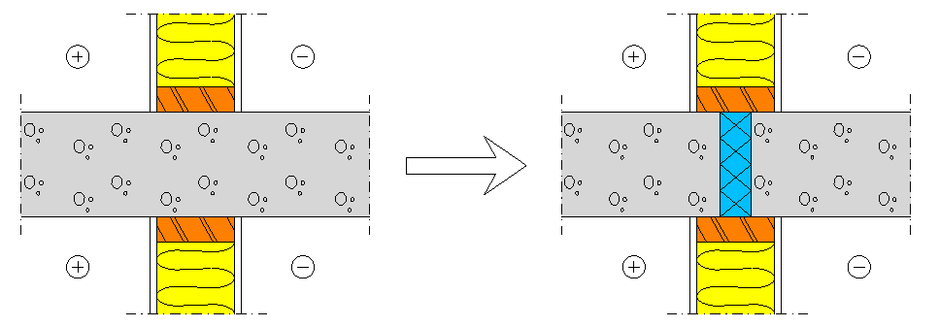
Thermal bridges and their impact
4/10

Slide 24
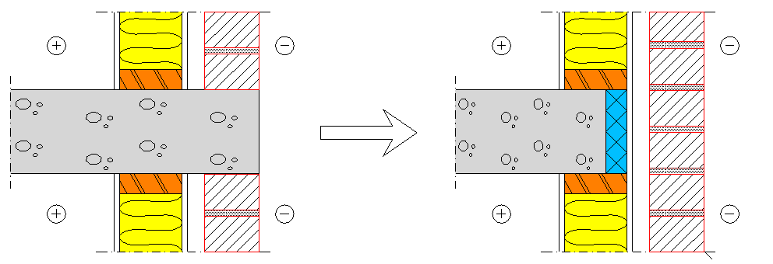
Thermal bridges and their impact
4/10

Slide 25
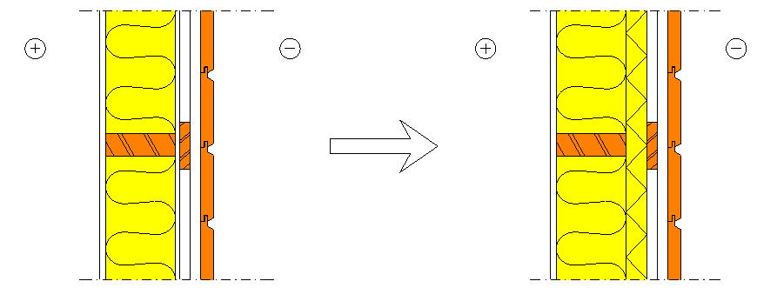
Thermal bridges and their impact
6/10

Slide 26
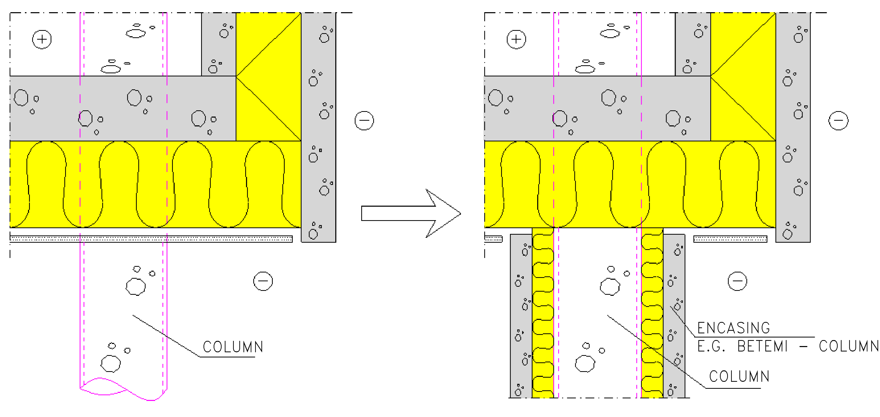
Thermal bridges and their impact
7/10

Slide 27
Thermal bridges and their impact
8/10
The adverse effects of thermal bridges depend greatly on both the quality and extent of the thermal bridge and the indoor air temperature, humidity and air flow rate past the thermal bridge surface. Examples of the impact of thermal bridges:
Thermal bridges cause heat loss and may affect the building’s overall energy requirement (E-value)
Low wall temperature may cause condensation on the wall surface, but this also depends on the humidity of the indoor air
Uneven wall surface temperature causes uneven collection of dirt, as cold surfaces become dirty more easily than warm surfaces

Slide 28
Thermal bridges and their impact
9/10
Types of thermal bridging that do not need to be taken into account when determining the U-value of the structure (Note! These must, however, be taken into account when determining the E-value):
The junctions of the building envelope exteriors, such as corners, connection between the exterior wall and the roof, connection between the exterior wall and the base floor
Window and door openings’ jamb structures
Structures that penetrate or reduce the envelope’s thermal insulation, such as balcony supports, supporting beams and walls
Building services penetrations, such as ducts, channels, pipes, etc.

Slide 29
Thermal bridges and their impact
10/10
When the design thermal conductivity of the thermal bridge material (λ-value) differs more than fivefold from the design thermal conductivity of the adjacent material, the material/structure in question is a thermal bridge (C4 NBCF, 2002).

Slide 30
Determining the U-value
1/7
The thermal transmittance U indicates the heat flow density which permeates a building component in steady-state when the temperature difference between the environment on different sides of the building component is the unit of temperature. Thermal transmittances are calculated using the following formula:
, where the unit is [W/(m²K)]
and where
R_{T} = total thermal resistance of a building component [m²K/W]

Slide 31
Determining the U-value
2/7
So the thermal transmittance coefficient, i.e. the U-value of a component indicates the heat flow density (quantity of heat) which permeates a building component, and therefore can be used, for example,
when calculating heat losses of buildings or the quantity of energy required for their heating
to express the thermal resistance of a component e.g. in official regulations
in planning and implementation of thermal insulation.
The U-value is calculated according to Standard SFS-EN ISO 6946 (RIL 225-2021), which is a pan-European standard.

Slide 32
Determining the U-value
3/7
Rules for rounding the result
if U<0.08 round upwards to the nearest 0.001 [W/(mK)]
if 0.08<U<0.20 round upwards to the nearest 0.005 [W/(mK)]
if 0.20<U<2.00 round upwards to the nearest 0.01 [W/(mK)]
if U>2.00 round upwards to the nearest 0.1 [W/(mK)]

Slide 33
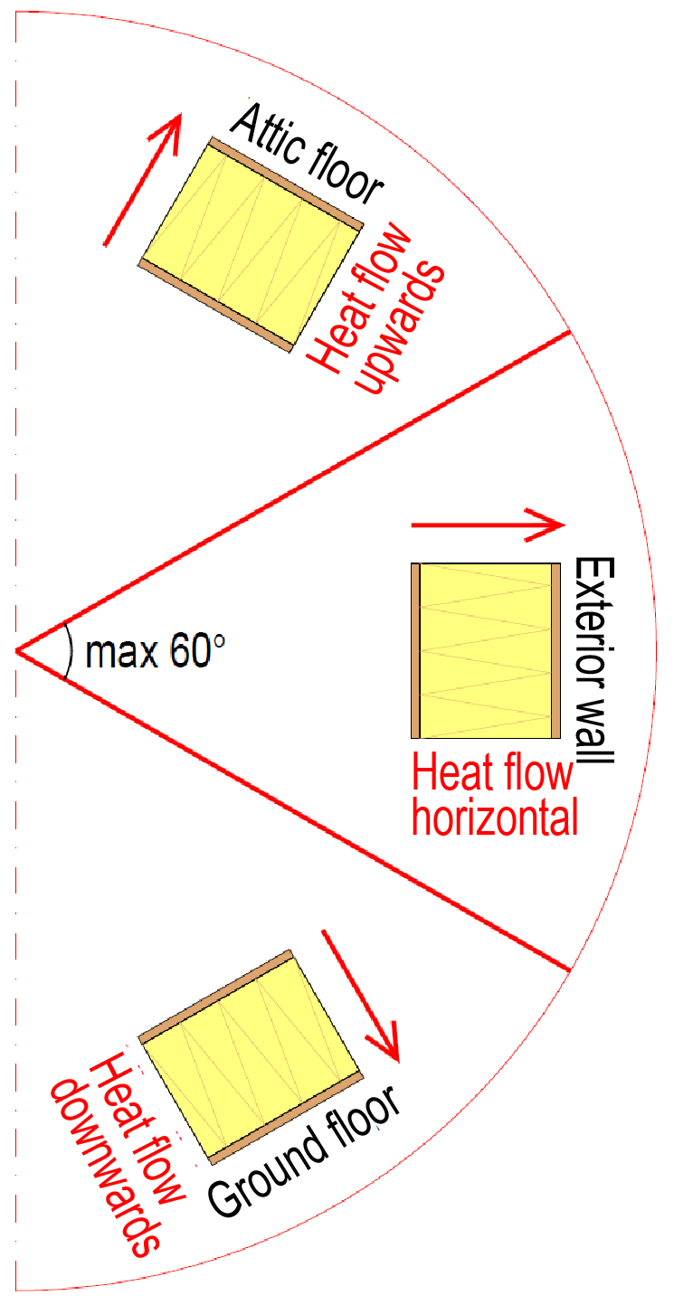
Determining the U-value
4/7
The directions of the heat flow are defined as shown in the adjacent figure.

Slide 34
Reference values for U (1010/2017)
5/7
The reference value for the building envelope heat loss for a warm space of a cooled cold space is calculated using the following reference values as the thermal transmittance coefficients (U-values) for the building elements:
wall 0.17 W/(m²K)
mass timber wall with an average thickness of at least 180 mm 0.40 W/(m²K)
roof and base floor bounded by outdoor air 0.09 W/(m²K)
base floor bounded by crawl space 0.17 W/(m²K)
building element against the ground 0.16 W/(m²K)
window, roof window, door, dome rooflight, smoke and exit hatch 1.0 W/(m²K)

Slide 35
Reference values for U (1010/2017)
6/7
The reference value for the building envelope heat loss for a portable building and a semi-warm space is calculated using the following reference values as the thermal transmittance coefficients for the building elements:
wall 0.26 W/(m²K)
mass timber wall with an average thickness of at least 180 mm 0.60 W/(m²K)
roof and base floor bounded by outdoor air 0.14 W/(m²K)
base floor bounded by crawl space 0.26 W/(m²K)
building element against the ground 0.24 W/(m²K)
window, roof window, door, dome rooflight, smoke and exit hatch 1.4 W/(m²K)

Slide 36
Reference values for U (1010/2017)
7/7
For a detached or semi-detached house designed for use as a holiday dwelling for at least four months per year, the reference value for building envelope heat loss shall be calculated by using the following reference values as the thermal transmittance coefficients of the building elements:
wall 0.24 W/(m²K)
mass timber wall with an average thickness of at least 180 mm 0.80 W/(m²K)
roof and base floor bounded by outdoor air 0.15 W/(m²K)
base floor bounded by crawl space 0.19 W/(m²K)
building element against the ground 0.24 W/(m²K)
window, roof window, door, dome rooflight, smoke and exit hatch 1.4 W/(m²K)

Slide 37
Determining thermal resistance R
1/16
Thermal resistance of a material layer of a uniform thickness or a layered structure in the thermal steady-state indicates the temperature difference between the isothermal surfaces on both sides of the structure divided by the heat flow density through the material layer.
So the thermal resistance R indicates the heat transfer resistance which is the reciprocal of the thermal conductivity figure. Thermal resistance means how much a layer of material “resists” thermal conductivity.

Slide 38
Determining thermal resistance R
2/16
Thermal resistance of a layer of material is the reciprocal of λ / d,
, where the unit is [m²K/W]
and where
λ = thermal conductivity [W/(mK)]
d = thickness of layer [mm]

Slide 39
Determining thermal resistance R
3/16
Total thermal resistance for components consisting of homogeneous layers
When the material layers in a building component are homogeneous and of uniform thickness and the heat flow is perpendicular to the layers, the total thermal resistance R_{T} of the component is calculated using the following formula:

Slide 40
Determining thermal resistance R
4/16
, where the unit is [m²K/W]
and where
R_{si} = internal surface resistance
R₁ = d₁ / λ₁ (1. material layer)
R₂ = d₂ / λ₂ (2. material layer)
R_{n} = d_{n} / λ_{n} (nth material layer)
R_{se} = external surface resistance

Slide 41
Determining thermal resistance R
5/16
Total thermal resistance for components consisting of inhomogeneous layers
A simplified calculation method is used for calculating the thermal resistance of building components consisting of thermally inhomogeneous layers.
This method cannot be used if the ratio of the upper limit to the lower limit of the thermal resistance exceeds 1.5, or for structures where insulation layer is penetrated by a metal component. For metal fasteners, the method may be used without taking account of the fasteners and then correcting the result with the correction ΔU_{f}.

Slide 42
Determining thermal resistance R
6/16
If a building component has layers with different thermal conductivity that are parallel to the heat flow (image, horizontal section of a wall), upper and lower limits are calculated for the component’s total thermal resistance.

Slide 43
Determining thermal resistance R
7/16
The total thermal resistance of the component is the arithmetic mean of these limits, calculated as follows:
, where the unit is [m²K/W]
and where
R_{T}’ = the upper limit of the total thermal resistance of the component
R_{T}’’ = the lower limit of the total thermal resistance of the component

Slide 44
Determining thermal resistance R
8/16
When calculating the upper limit of the total thermal resistance of a component, the building component is considered to consist of a number of independent sections parallel to the heat flow and extending through the whole component. These sections are formed of layers with different thermal conductivity, located one after another in direction of the heat flow (image).
Direction of heat flow
Direction of observation

Slide 45
Determining thermal resistance R
9/16
This way the parallel layers with different thermal conductivity are placed in independent sections. The total thermal resistance of each section thus formed is calculated according to a component consisting of homogeneous layers.
Direction of heat flow
Direction of observation

Slide 46
Determining thermal resistance R
10/16
Finally, the total thermal resistances of the sections are entered in the formula below to calculate the upper limit of the total thermal resistance of the component.
Direction of heat flow
Direction of observation
, where the unit is [W/(m²K)]

Slide 47
Determining thermal resistance R
11/16
and where
R_{T}’ = the upper limit of the total thermal resistance of the component
f_{a} , f_{b} , … f_{n} = the fractional areas of the sections a, b,…, n from the area of the component perpendicular to the direction of heat flow [ - ]
R_{Ta} , R_{Tb} , … R_{Tn} = the total thermal resistances for sections a, b,…, n [m²K/W]

Slide 48
Determining thermal resistance R
12/16
When calculating the lower limit of the total thermal resistance of a component, the building component is considered to consist of layers perpendicular to the heat flow and extending through the whole component. Each of these layers is isothermal in the direction of heat flow (image).
Direction of heat flow
Direction of observation

Slide 49
Determining thermal resistance R
13/16
Next, the thermal resistances for each thermally inhomogeneous parallel section are combined layer by layer using the formula below:
Direction of heat flow
Direction of observation
, where the unit is [W/(m²K)]

Slide 50
Determining thermal resistance R
14/16
Direction of heat flow
and where
R_{j}’’ = an equivalent thermal resistance of an inhomogeneous layer [m²K/W]
f_{a} , f_{b} , … f_{n} = the fractional areas of the sections a, b,…, n from the area of the component perpendicular to the direction of heat flow [ - ]
R_{aj}, R_{bj}, … R_{nj} = the combined thermal resistance for each thermally inhomogeneous parallel section a, b,..., n combined in layer j [m²K/W]
b₂
Direction of observation
b₁
a₁
a₂

Slide 51
Determining thermal resistance R
15/16
After the thermal resistances of each thermally inhomogeneous parallel section are combined, the lower limit of the total thermal resistance for the component is calculated using the below formula:
, where the unit is [m²K/W]

Slide 52
Determining thermal resistance R
16/16
and where
R_{T’’} = the lower limit of the total thermal resistance of the component [m²K/W]
R_{si} = internal surface resistance (SFS-EN ISO 6946, Section 5.2, Table 1 design values)
R_{se} = external surface resistance (SFS-EN ISO 6946, Section 5.2, Table 1 design values)
R₁’’, R₂’’, … , R_{j}’’ = the combined thermal resistances of parallel sections in layers a, b,..., j

Slide 53
Internal and external surface resistance R_{si} and R_{se}
1/4
The surface resistances (R_{si} and R_{se}) indicate the thermal resistance of the border layer between the surface of a building component and the air space.
Surface resistance depends on, for example, air movements (such as wind) on the surfaces of a building component, barriers and other radiating surfaces.
The surface resistance values used in the calculations are from Standard SFS-EN ISO 6946, Section 5.2, Table 1 typical values.

Slide 54
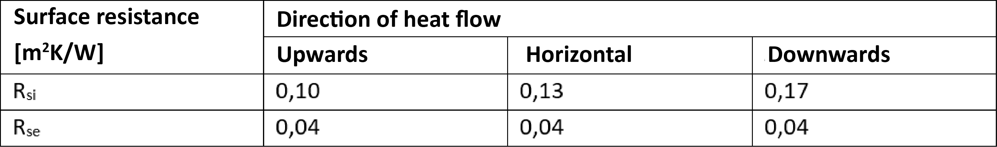
Internal and external surface resistance R_{si} and R_{se}
2/4
The values in the table are design values. For the purposes of declaration of the thermal transmittance of components and other cases where values independent of heat flow direction are required, it is recommended that the values for horizontal heat flow are used.
The surface resistances apply to surfaces that are in contact with air. The surface resistances do not apply to surfaces that are in contact with other materials.

Slide 55
Internal and external surface resistance R_{si} and R_{se}
3/4
If the component contains a well-ventilated air layer, its total thermal resistance is obtained by disregarding the thermal resistance of the air layer and all other layers between the air layer and external environment, and including an external surface resistance corresponding to still air (see SFS-EN ISO 6946, Annex A).
Alternatively, the R_{si} value from the table may be used.

Slide 56
Internal and external surface resistance R_{si} and R_{se}
4/4
A well-ventilated air layer is one for which the openings between the air layer and the external environment exceed:
1,500 mm² per m length for vertical air layers
1,500 mm² per m² of surface area for horizontal air layers.
Example: Vertical studs 22x100 h600 with a ventilation gap underneath exterior wall cladding (horizontal).
22 mm x (600 – 100) mm = 11,000 mm² > 1,500 mm² => R_{se} = R_{si} = 0.13
If we calculate a so-called minimum ventilation gap for this structure that can be interpreted to be a well-ventilated air layer,
1,500 mm² / (600 – 100) mm = 3 mm => ventilation gap minimum 3 mm

Slide 57
Corrections to thermal transmittance
1/12
The thermal transmittance obtained by the procedures given in this international standard shall be corrected where relevant to allow for the effects of
air voids in insulation,
mechanical fasteners penetrating an insulation layer, and
precipitation on inverted roofs.
Note! An inverted roof is one which has an insulation layer above the waterproof membrane

Slide 58
Corrections to thermal transmittance
2/12
The corrected thermal transmittance of a component (U_{c}) is obtained by adding a correction term, ΔU, to the thermal transmittance coefficient (U). The correction term is calculated as follows:
, where the unit is [W/(m²K)]
and where
U = thermal transmittance coefficient of the component [W/(m²K)]
ΔU = thermal transmittance coefficient correction term of the component [W/(m²K)]

Slide 59
Corrections to thermal transmittance
3/12
The correction term (ΔU) is given by:
, where the unit is [W/(m²K)]
and where
ΔU_{g} = correction for air voids [W/(m²K)]
ΔU_{f} = correction for mechanical fasteners [W/(m²K)]
ΔU_{r} = correction for inverted roofs [W/(m²K)]

Slide 60
Corrections to thermal transmittance
4/12
Correction for air voids, ΔU_{g}, is calculated as follows:
, where the unit is [W/(m²K)]
and where
ΔU’’ = lower limit from the table [W/(m²K)]
R₁ = the thermal resistance of the layer containing gaps (if there are many layers, the sum of resistances of the different layers) [m²K/W]
R_{T,h} = the total thermal resistance of the component ignoring any thermal bridging [W/(m²K)]

Slide 61
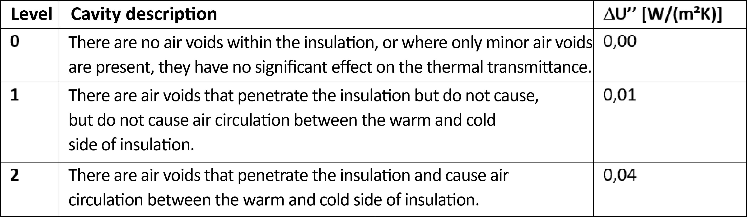
Corrections to thermal transmittance
5/12
Air void correction, lower limit (SFS-EN ISO 6946 section 5.2 table 1 design values)

Slide 62
Corrections to thermal transmittance
6/12
Correction level 0 examples
Correction level 1 examples
INSULATION IS MISSING/INSUFFICIENT
Correction level 2 examples

Slide 63
Corrections to thermal transmittance
7/12
Correction for mechanical fasteners, ΔU_{f}, is calculated as follows (approximate procedure):
, where the unit is [W/(m²K)]
and where
α = 0.8, if the fastener fully penetrates the insulation layer
, if the fastener partly penetrates the insulation layer
1 PLASTIC COVER
2 FASTENER EMBEDDED IN THE HEAT INSULATION
3 HEAT INSULATION

Slide 64
Corrections to thermal transmittance
8/12
In these expressions
λ_{f} = thermal conductivity of the fastener [W/(m K)]
n_{f} = the number of fasteners per m²
A_{f} = the cross-sectional area of one fastener [m²]
d₀ = the thickness of the insulation layer containing the fastener [m]
d₁ = the length of the fastener that penetrates the insulation layer [m]
R₁ = the thermal resistance of the insulation layer penetrated by the fasteners [m²K/W]
R_{T,h} = the total thermal resistance of the component ignoring any thermal bridging [W/(m²K)]

Slide 65
Corrections to thermal transmittance
9/12
Correction for inverted roofs, ΔU_{r}, is calculated as follows:
, where the unit is [W/(m²K)]
and where
p = is the average rate of precipitation during the heating season, based on data relevant for the location (e.g. weather station) or given through local, regional or national regulations, or other national documents or standards. Usually a value of 0.5 mm/day can be used (C4 NBCF draft, 2012) [mm/day]
f = the drainage factor giving the factor of p reaching the waterproofing membrane

Slide 66
Corrections to thermal transmittance
10/12
Correction for inverted roofs, ΔU_{r}, is calculated as follows:
, where the unit is [W/(m²K)]
...continues
x = the factor for increased heat loss caused by rainwater flowing on the membrane [(W·day)/(m²·K·mm)]
R₁ = the thermal resistance of the layer of insulation above the waterproofing membrane [m²·K/W]
R_{T} = the total thermal resistance of the construction before application of the correction [m²·K/W]

Slide 67
Corrections to thermal transmittance
11/12
Correction for inverted roofs
Values of p may be specified on a national basis.
For a single layer of insulation above the membrane, with butt joints and open covering such as gravel, (f·x) = 0.04.
NOTE! The single layer of insulation with butt joints and open covering is considered to be the layout giving the highest ΔU.

Slide 68
Corrections to thermal transmittance
12/12
Correction for inverted roofs
Lower values of f·x can apply for roof constructions that give less drainage through the insulation. Examples are different jointing arrangements (such as shiplap or tongue-and-groove joints), or different types of roof build-up. In these cases, where the effect of the measures are documented in independent reports, values smaller than 0.04 for f·x may be used.

Slide 69
Calculating temperatures in structures
1/7
The temperature of internal surface is important when assessing the characteristics of the exterior wall. It affects, for example, whether water vapour condensation can be expected on the surface of the interior wall or whether there is an unpleasant feeling of draft on the surface of the wall.
It is necessary to know how temperature changes inside a component in order to determine the flow of moisture in the component and the possible condensation or freezing limits for that moisture.
The temperature changes inside a component can be determined using either an analytical or graphic method, and a graph can also be used to illustrate the change.

Slide 70
Calculating temperatures in structures
2/7
The internal surface temperature can be calculated using
, where the unit is [W/(m²K)]
and where
t_{sp} = interior surface temperature [°C]
t_{s} = indoor temperature[°C]
t_{u} = outdoor temperature [°C]
R_{si} = interior surface thermal resistance [m²K/W]
R_{T} = the total thermal resistance of the component [m²K/W]

Slide 71
Calculating temperatures in structures
3/7
The exterior surface temperature can be calculated using
, where the unit is [W/(m²K)]
and where
t_{s} = indoor temperature[°C]
t_{up} = exterior surface temperature [°C]
t_{u} = outdoor temperature [°C]
R_{se} = exterior surface thermal resistance [m²K/W]
R_{T} = the total thermal resistance of the component [m²K/W]

Slide 72
Calculating temperatures in structures
4/7
It is necessary to know how temperatures change inside a component in order to determine the flow of moisture in the component and the possible condensation or freezing limits for that moisture. The temperature changes inside a component can be determined using either an analytical or graphic method, and a graph can also be used to illustrate the change.
In a homogeneous layer of material, it is assumed that the temperature change is steady between the different sides of the layer.

Slide 73
Calculating temperatures in structures
5/7
Therefore, when considering temperatures in layered components, the temperatures are usually calculated for the interfaces of the layer and by combining the points obtained, temperatures inside the layer of material can be read from a line.
The assumption here is that the layer is homogeneous not only in structure but also in humidity, which in practice most often is not the case. For example, the temperature calculation for a timber frame wall disregards the timber frame.

Slide 74
Calculating temperatures in structures
6/7
Temperature at an arbitrary point of the component:
, where the unit is [W/(m²K)]
and where
t_{s} = indoor temperature[°C]
t_{up} = exterior surface temperature [°C]
t_{u} = outdoor temperature [°C]
R_{se} = exterior surface thermal resistance [m²K/W]
R_{T} = the total thermal resistance of the component [m²K/W]
R₁, R₂, R_{i} = thermal resistances of different layers of material [m²K/W]
d_{p} = distance of point p from the inner edge of an equivalent layer [m]
λ_{n} = thermal conductivity of an equivalent layer n [W/(mK)]

Slide 75
Calculating temperatures in structures
7/7
Calculation of temperature change layer by layer:
, where the unit is [W/(m²K)]
and where
t_{s} = indoor temperature[°C]
Δt_{n} = temperature difference between the surfaces of the layer [°C]
t_{u} = outdoor temperature [°C]
R_{n} = thermal resistance of the layer n [m²K/W]
R_{T} = the total thermal resistance of the component [m²K/W]

Slide 76
The effect of building services technology on E-value
1/6
The type of heat production directly affects the E-value
The biggest factor affecting the E-value is the form of energy used for heating the building and domestic water.
If heating is produced by district heating, a geothermal heat pump or biofuels (e.g. pellets), the E-value requirement is easily met without any significant energy efficiency improvement measures.
In case of electric heating, the building must be constructed to be highly energy efficient. In order to meet the requirements of the E-value, an energy-efficient building using electric heating often also needs energy production systems based on renewable energy.

Slide 77
The effect of building services technology on E-value
2/6
Coefficients for forms of energy when calculating an E-value
  electricity 1.2
  district heating 0.5
  district cooling 0.28
  fossil fuels 1.0
  renewable fuels used in a building 0.5.

Slide 78
The effect of building services technology on E-value
3/6
Building services technology is emphasised in the fulfilment of the E-value requirement.
The trend seems to be increasing the building services technology used and, on the other hand, ensuring the reliability of performance values affecting the energy efficiency of the building services technology equipment.
The Technical Research Centre of Finland (VTT) has already long been active in developing building services technology solutions for energy-efficient buildings.
The performance values of building services technology can be reliably demonstrated, for example, with a VTT product certificate.

Slide 79
The effect of building services technology on E-value
4/6
The energy and cost-efficiency of buildings may be improved by such a simple measure as equipment adjustments.
For example, ventilation must not cause a feeling of draft and it must operate at the correct air volumes.
Even the temperature control automation that affects consumption and comfort by producing a constant indoor temperature may be incorrectly adjusted.

Slide 80
The effect of building services technology on E-value
5/6
The E-value is calculated using the guideline values provided in the regulations and normally these cannot be changed, even though some values can be adjusted.
The lightning power used for the calculation of E-value can be reduced if a separate explanation is provided.
However, the requirements for lightning level must be met.
Other values that can be adjusted are related to thermal insulation, air tightness and ventilation heat recovery, which have been included in the regulations already for years.
Changing the type of heat production has the greatest impact on the E-value.

Slide 81
The effect of building services technology on E-value
6/6
E-value is a reference value calculated with new weather data from Helsinki, even if the building is located in Lapland.
According the new data, the coldest winter temperature in Helsinki is –20 °C.
If the winters are colder, energy consumption may increase significantly from the calculated level.
This is because, in mild weather conditions, buildings are largely heated by their heat loads (equipment, people, the sun).

Slide 82
Waste water heat recovery
1/6
Heat recovery from waste water is based on the second law of thermodynamics.
According to the second law, thermal energy always passes from a higher temperature to a colder temperature.
This serves as the basis for heat recovery, which is used to design and install heat recovery equipment in economically viable sites.
By utilising the surplus heat generated in the processes, significant energy savings are achieved.

Slide 83
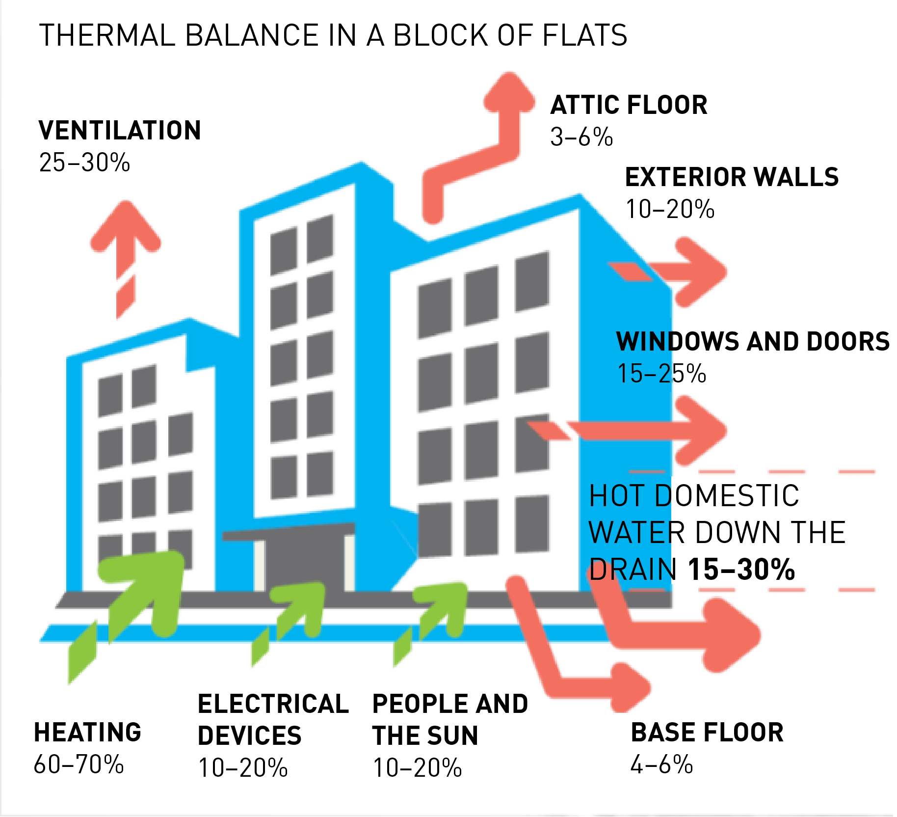
Waste water heat recovery
2/6
The relative share of hot domestic water:
15–25% in old buildings
25–35% in modern buildings
Over 50% in zero-energy buildings

Slide 84
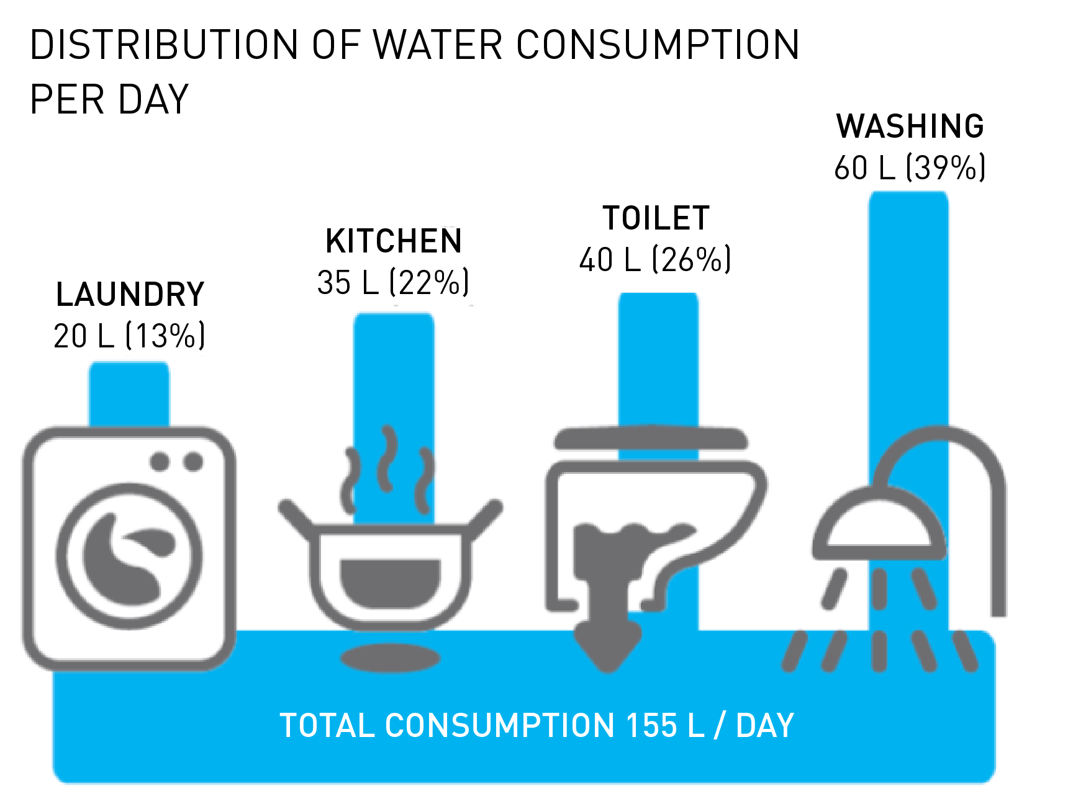
Waste water heat recovery
3/6
Waste water directed to drains:
average consumption in Finland 155 l/day/person
average temperature 26 °C

Slide 85
Waste water heat recovery
4/6
The heat recovery systems used in Finland include
Heatex heat recovery well
OSO ES
Ensavetec
Heat recovery centre by Wavin Finland Oy
Ecowec hybrid exchanger

Slide 86
Waste water heat recovery
5/6
From these systems,
Heatex and Ensavetec are intended for shower water heat recovery.
OSO ES is a greywater heat recovery unit for best suited for smaller residential buildings.
Wavin heat recovery centre is intended for greywater.
OSO ES and Wavin heat recovery centre should have a double drainage system for better heat recovery efficiency.
Blackwater contaminates heat transfer surfaces and the systems require more cleaning and maintenance.

Slide 87
Waste water heat recovery
6/6
Ecowec hybrid exchanger can recover heat also from blackwater and is suitable for sites that have a combined system of sewerage.
Wavin heat recovery centre and Ecowec hybrid exchanger are used in residential blocks of flats, but they are also suitable for properties that produce more wastewater.

