Slide 1



Industrial wood construction
Teaching materials for industrial wood construction education
2022

Slide 2
Origin of the materials
Use of the materials
These learning materials for industrial wood construction have been prepared in a project led by Puuinfo Oy in 2021–2022. Also involved in the project were
Lappia Vocational College,
TTS-Työtehoseura ry
South-Eastern Finland University of Applied Sciences,
Metropolia University of Applied Sciences,
Jyväskylä University of Applied Sciences,
University of Tampere, and
Federation of the Finnish Woodworking Industries Puutuoteteollisuus ry
The project was funded by the Ministry of the Environment.
The materials are intended to be used as extensively as possible in industrial wood construction education and studies.
The materials are released under the Creative Commons licence Attribution-ShareAlike (CC BY-SA), which requires that the author be properly credited when the materials are used and that derivative works may only be distributed under the same licence as the original work.
The original materials and any updates to them by Puuinfo will be published on the Library of Open Educational Resources website (aoe.fi) and the Puuinfo.fi website.

Slide 3

HVAC technology

Slide 4
‹#›
Authors
Further information
Pentti Kuurola, Sweco Talotekniikka Oy
Rauno Häll, Sweco Talotekniikka Oy
Esa-Matti Lampela, Sweco Talotekniikka Oy
Maija Ekholm, Sweco Rakennetekniikka Oy
Mauri Konttila, Metropolia University of Applied Sciences
Release date: 18/05/2022
Further information:
https://ym.fi/rakentamismaaraykset
https://talotekniikkainfo.fi/
https://www.toptenrava.fi/asp2/default.aspx
https://puuinfo.fi/

Slide 5
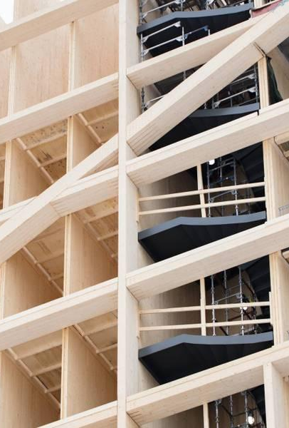
Contents
On construction and energy efficiency in general
Building service solutions in wood construction in general
HVAC/sprinkler system technology
Fire and sound engineering
Vertical ducts
Coordination of plans
Construction site

Slide 6
Pay attention to
Fire engineering and acoustic engineering
Moisture and leakage management
Placement of ducts and technology
Coordination of plans
Site operations

Slide 7
On construction and energy efficiency in general

Slide 8
General information on construction legislation
Design and construction comply with the legislation, regulations and directives in force at the time
The regulations do not repeat anything already stated elsewhere in an act or in regulations issued under an act -> need to be aware of all the acts, decrees and directives that guide construction
In this respect, wood construction does not differ from other construction
DOMESTIC LEGISLATION
EU LEGISLATION
Acts
e.g. Land Use and Building Act
Decree
Applicable as such
Ecodesign regulation
Directive
Legislative guideline
Regulations
Energy efficiency directive
Orders, decrees and instructions from authorities
Decision
Obliges those the decision concerns

Slide 9
Energy and life cycle performance of a building
Geometry
Building envelope and thermal bridges
Openings and their orientation
Airtightness
Heating
Cooling
Ventilation
Water and sewage
Building automation
Architectural and structural plans
HVAC systems
User
Electricity
User devices
Use of facilities and equipment
Maintenance and management
Lighting
Building equipment
Own production

Slide 10
Optimising life cycle performance
Individual optimisation of pyramid components usually leads to a solution with increased costs (life cycle or investment)
Considering components 1–5 together is the right approach, no separate optimisation
Investment in a system that is right for the whole building project can bring more added value
The whole building can be examined using a multi-objective building optimisation tool (e.g. MOBO) to achieve a cost-optimal solution for several variables, i.e., the best value for money
5
Self-generation of renewable energy
4
Energy production solutions
3
Efficient building services systems
2
Facade design
1
Massing and form

Slide 11
Building service solutions in wood construction in general

Slide 12
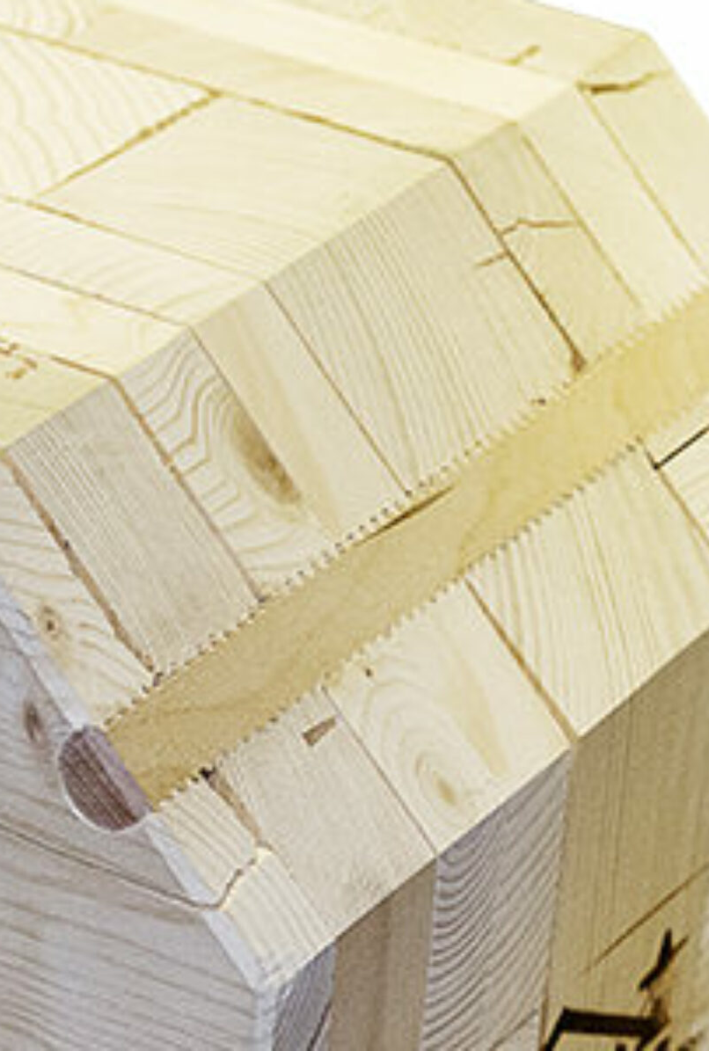
Characteristics of wood construction
The design time is longer and more front-loaded due to the dimensional accuracy requirements of prefabrication and equipment level of the elements
Involve specialists already in the preliminary planning phase of the building
The construction time, however, is shorter due to the prefabricated parts used
The role of design is emphasised because the construction takes place in a production facility instead of a construction site

Slide 13
Characteristics of wood construction
Prefabrication contributes to productivity growth and ensures consistent quality
Structural system solutions in wood construction have an impact on building services solutions and options
Settlements, shrinkages and deflections etc. must be taken into account in piping installations, depending on the structural system

Slide 14
HVAC/sprinkler system technology

Slide 15
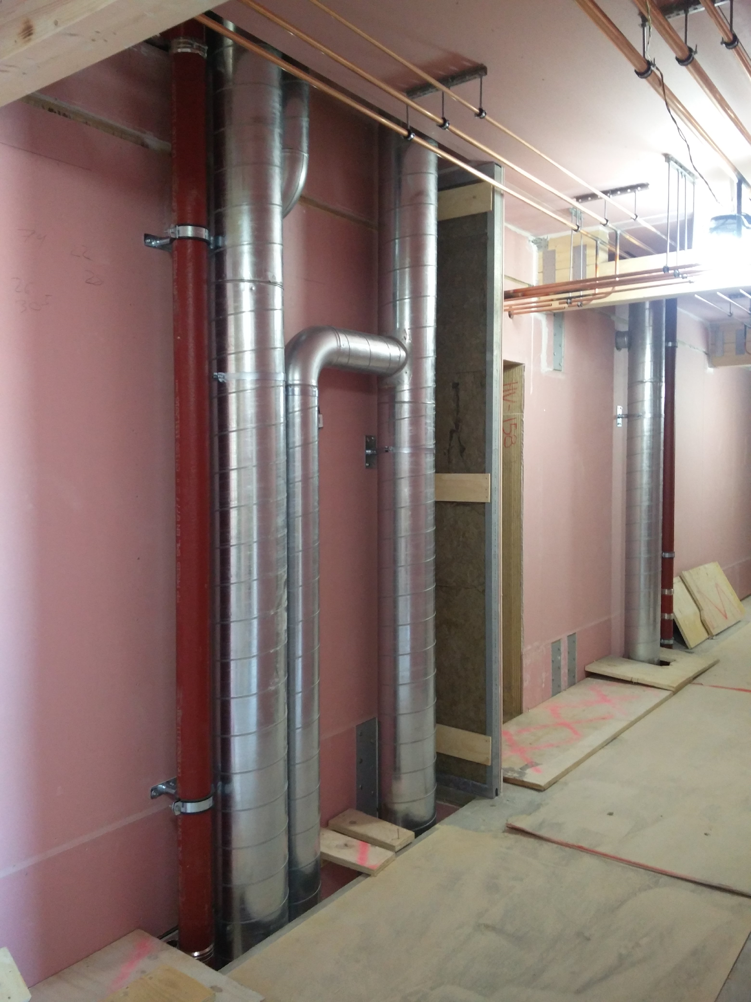
Water and sewage systems, general
In a building with a wooden frame, particular attention should be paid to the acoustic supporting of horizontal drains in order to find structural elements (for the building frame) that are as massive and rigid as possible, so that the drain supports can then be attached to them.
Water pipes can be made of commonly used water pipe materials Note the area-specific recommendations for the use of plastic/composite piping.

Slide 16
Water and sewage systems, general
It is advisable to use manufacturers’ complete systems with known properties that have been tested, for example, for how they are secured and joined to the frame of the building.
When comparing products, note the DIN/SFS-EN standard according to which measurements have been made. Different standards are not comparable. The site designer is responsible for selecting suitable products that meet, for example, the acoustic requirements and are tested for how they connect to the frame of the building

Slide 17
Water systems, residential construction
Supporting must be clearly defined and planned, and the contractor must be given sufficient instructions.
Awareness of the fire area borders for ribbed floor structures is needed, as it affects the positioning of water pipes
See also fire engineering and acoustic engineering

Slide 18
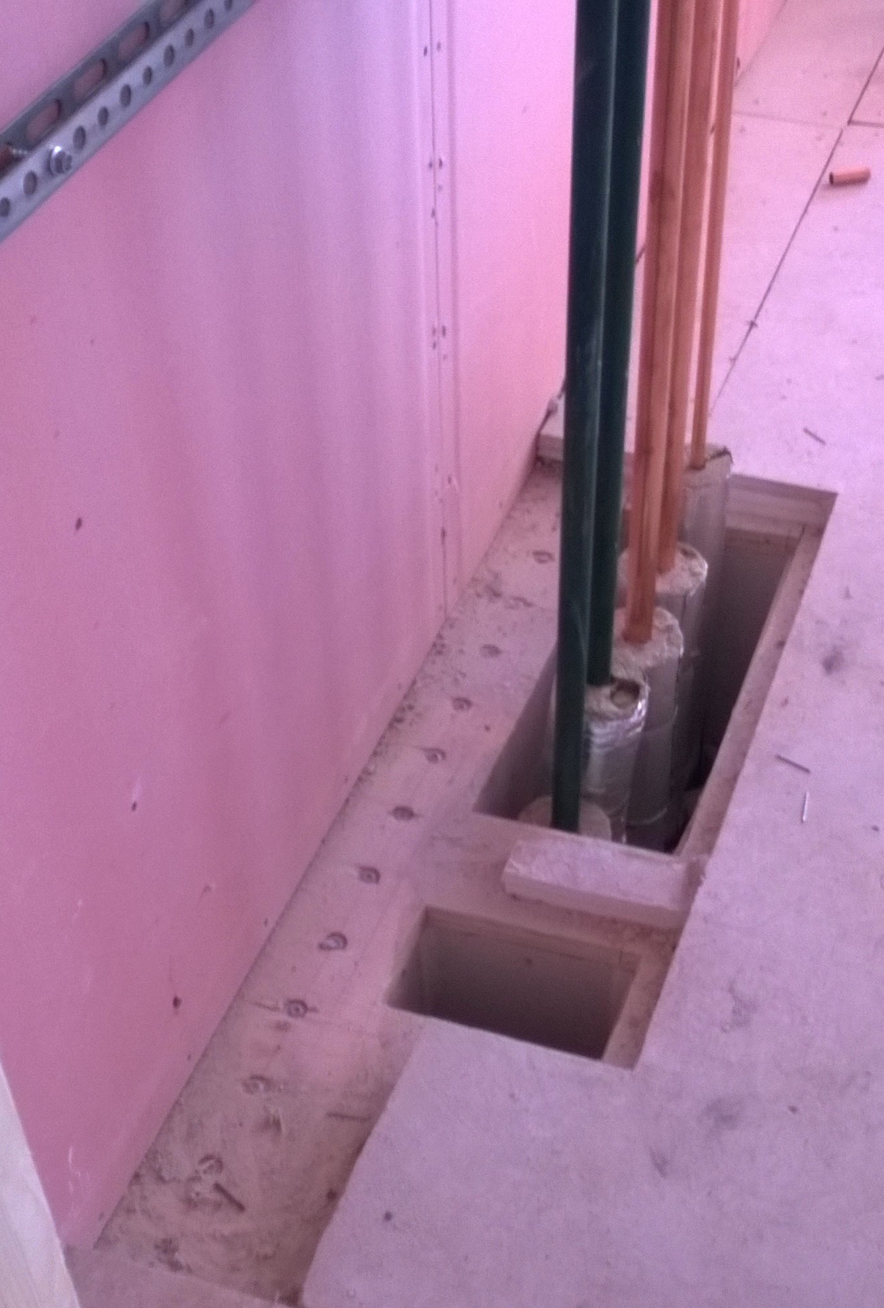
Water systems, residential construction
Water pipes are brought to the flats centrally via the stairwell or they are distributed via wet area ducts that can be maintained from the stairwell.
Flat-specific consumption measurement requires central risers, in which case the distribution into flats is located at one point.

Slide 19
Water systems, residential construction
For water piping, it is recommend to install plastic pipe as a protective pipe, because it allows small motions without damage.
Horizontal drains are usually placed in the intermediate floor, which means they generate noise on the storey below, i.e. on the space that the drains do not serve.
Small motions of vertical drain frames should be taken into account with expansion sockets etc.

Slide 20
Water systems, residential construction
Leading the drain from the toilet seat directly to the HVAC conduit is advisable. This way the horizontal drains that generate the most noise can be removed from the intermediate floors while at the same time penetration of the floor waterproofing can be avoided.
As a rule, drain noise in a wooden frame building is managed according to the same principles as in buildings constructed from other frame materials.

Slide 21
Water systems, residential construction
Wet spaces are centred on the same line on top of each other, so that the drainage distances are as short as possible and, on the other hand, the acoustic challenges are easier to manage.
Note that suspended ceilings are acoustically suitable.

Slide 22
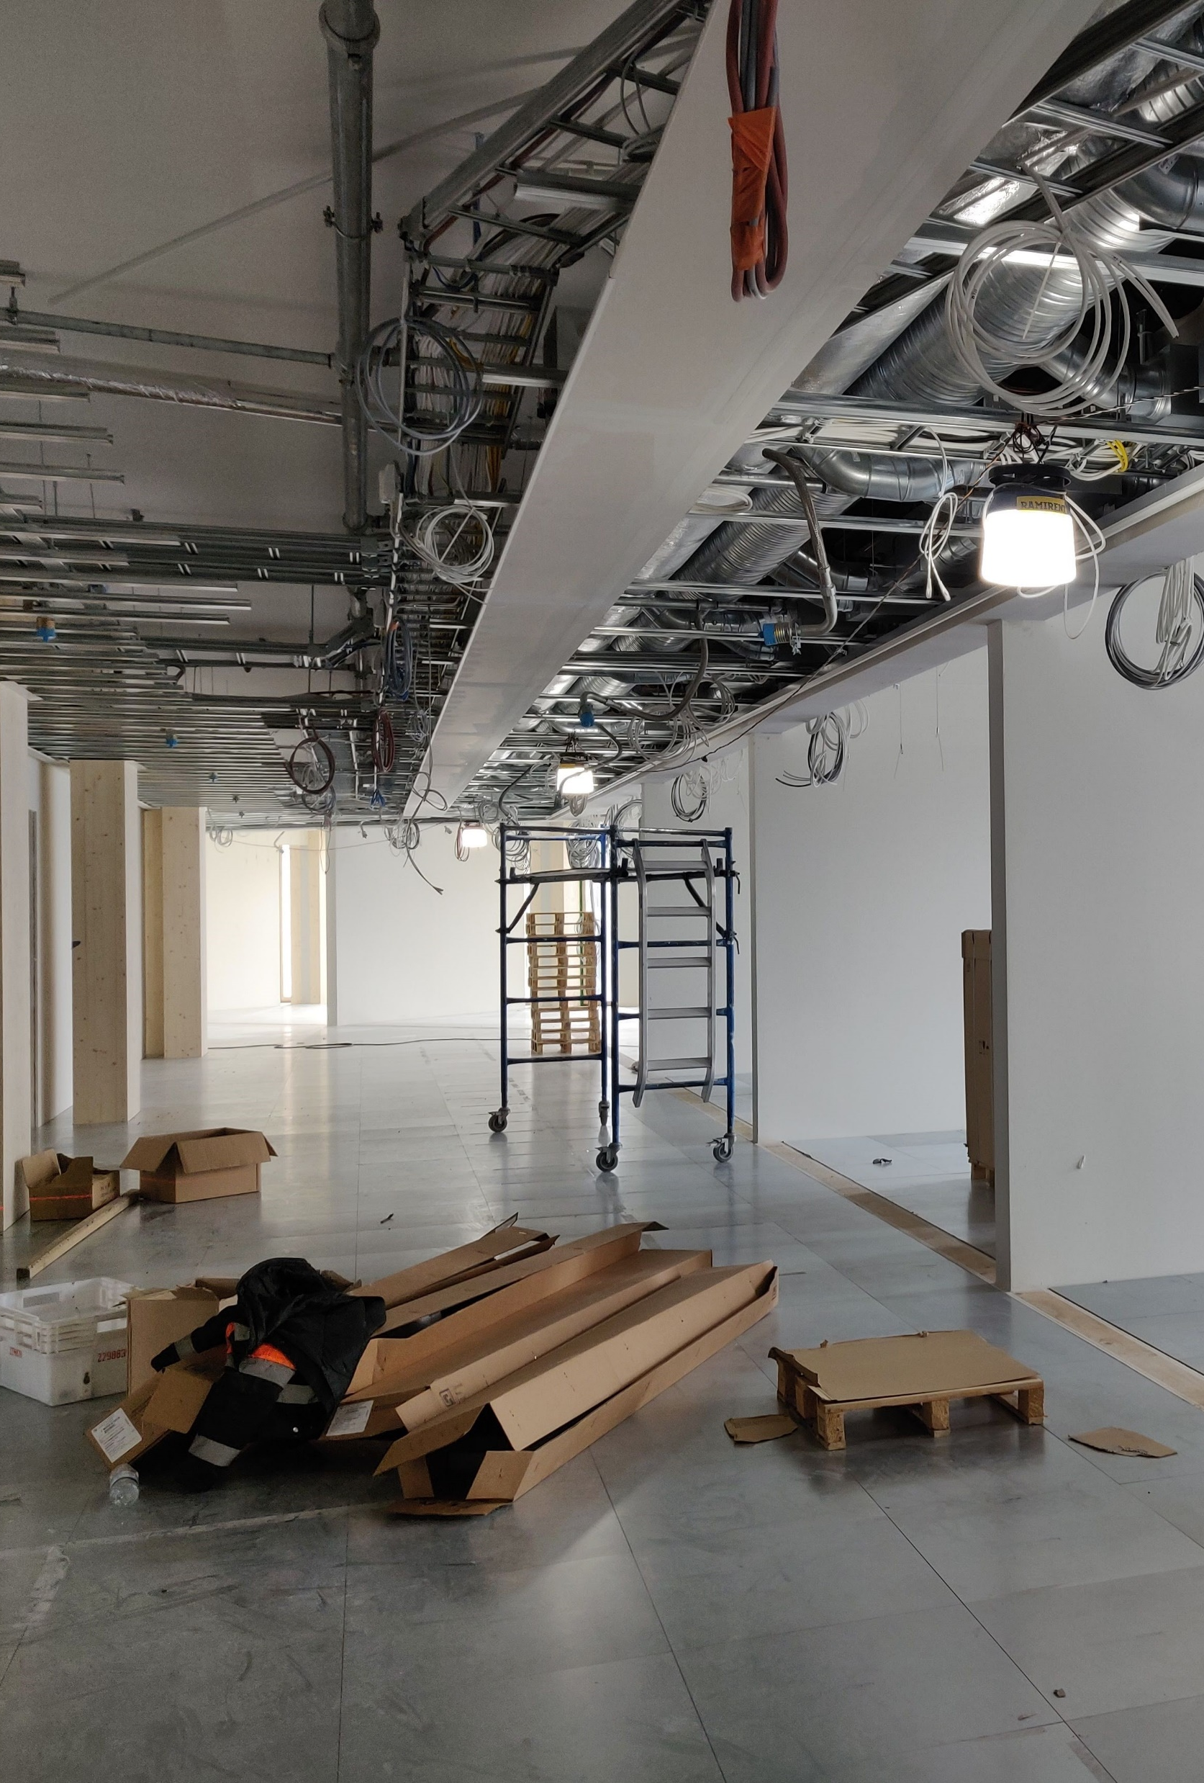
Water systems, facility construction
Pipe risers are positioned so that leak detection can be directed to toilets and other such spaces.
Possible requirements for separate measurements are taken into account for consumption measurements.
Adaptability must be taken into account where possible.

Slide 23
Water systems, facility construction
The sewage system is designed according to the same principles as in other frame solutions, taking the options for openings into account.
As a rule, drain noise in a wooden frame building is managed according to the same principles as in buildings constructed from other frame materials.
Small motions of vertical frames should be taken into account with expansion sockets etc.

Slide 24
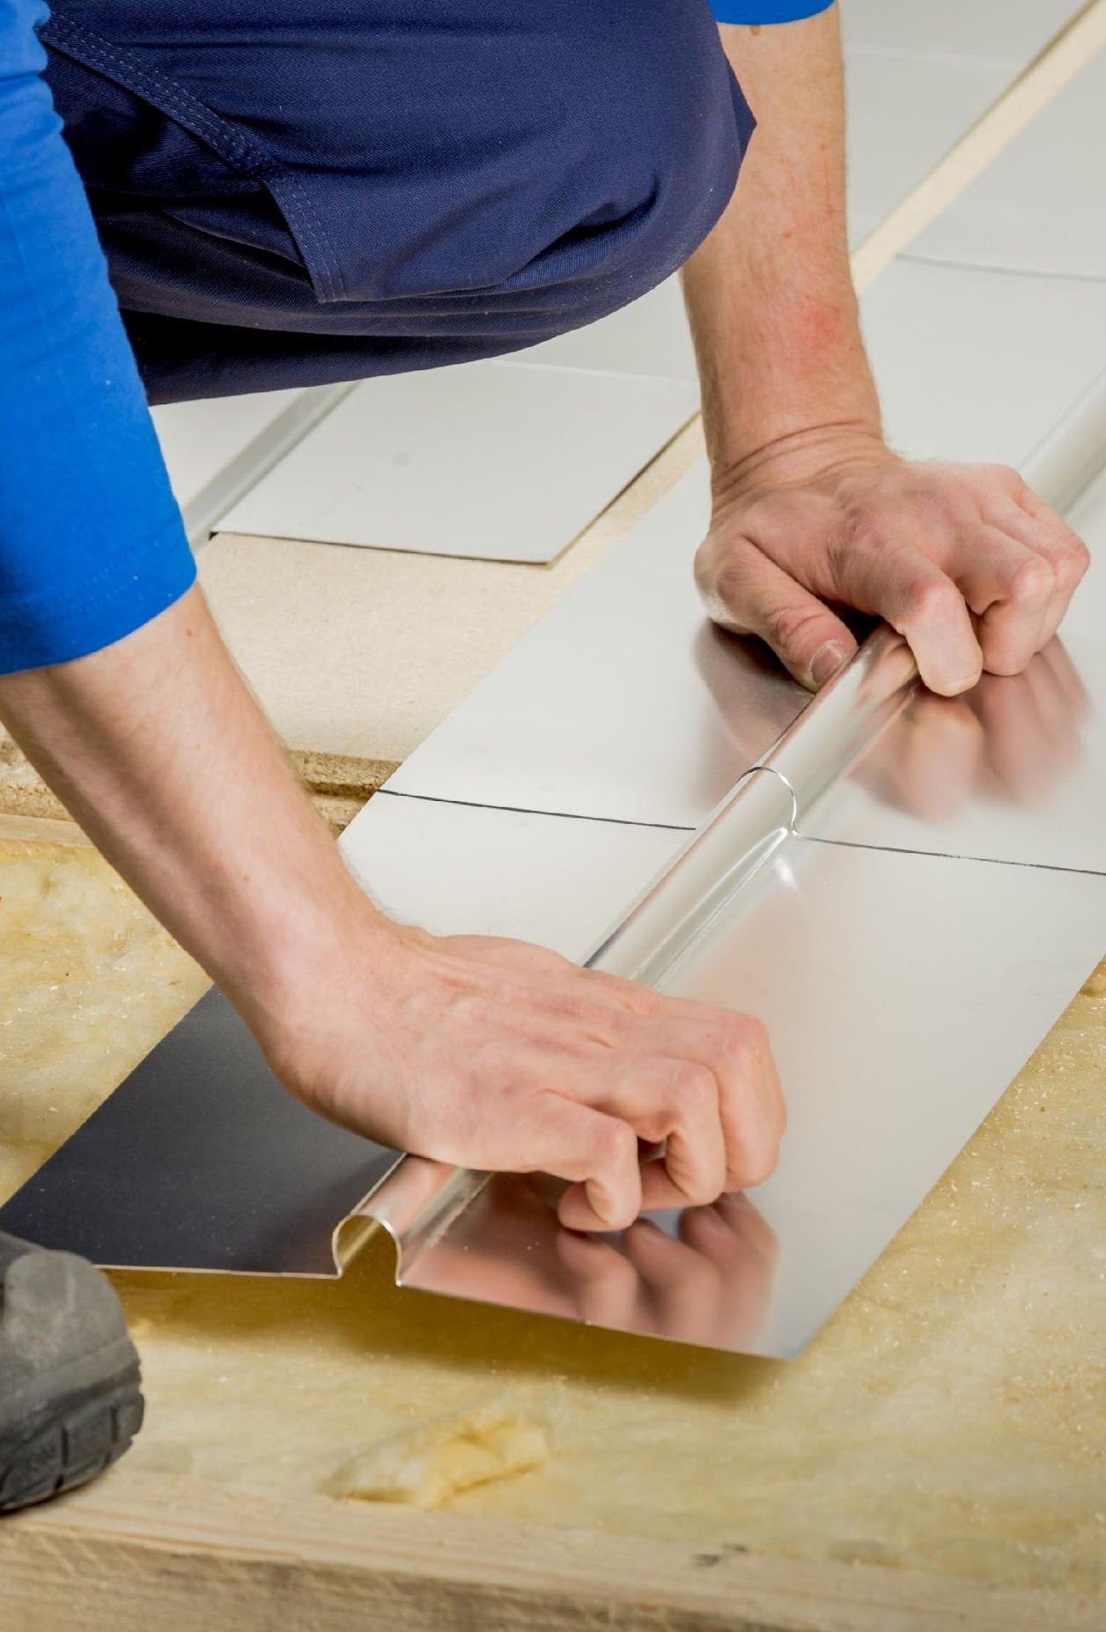
Heating systems, general
The dimensioning of the heating system is done in the same way as in other buildings
The choice of heat distribution method is influenced by the selected heat production method (does not differ from other construction)
As to heating, summer heating and drying of wet areas must also be taken into account (does not differ from other construction)
Image: Koskisen Oy

Slide 25
Heating systems, general
In cases with floor heating, leak water must be mechanically directed to where they can be seen (decree 782/2017)
It is sensible to direct leak water primarily to spaces with floor drains, in which case the manifolds must be located, for example, in connection with or near groups of toilet facilities.
Image: Koskisen Oy

Slide 26
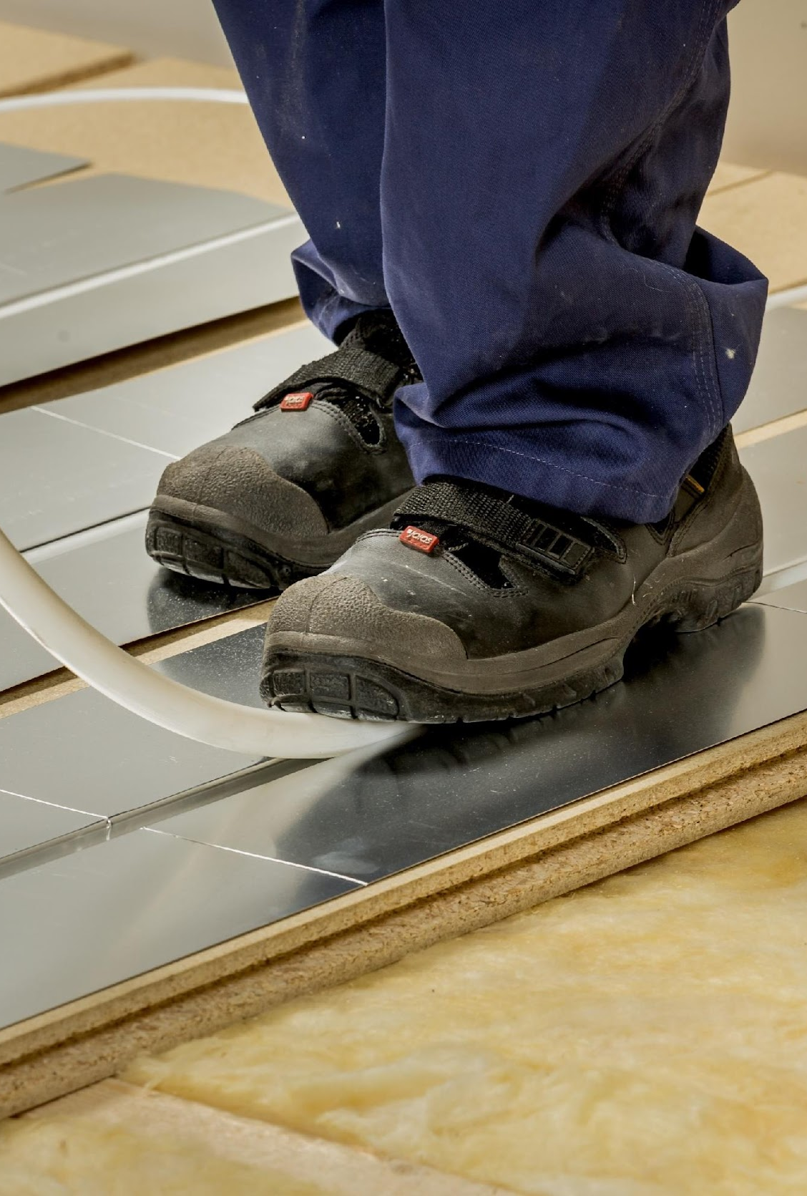
Heating systems, residential buildings
The risers of the heat distribution system are placed either centrally, for example in the stairwell, or on the external walls, where from the room distribution of radiators is then made.
Flat-specific energy measurement requires centralised risers. In principle, the insulated structures between rooms enable flat-specific thermal energy measurements
Centralised vertical risers mean better adaptability and avoiding unnecessary structural penetrations
Image: Koskisen Oy
Image: Koskisen Oy

Slide 27
Heating systems, residential buildings
The room distribution of heating pipes can be placed inside the frames of intermediate floors or partitions or in the insulation layer of a floating floor. Surface installations are also possible.
Room-specific heating pipes are steel, copper or plastic pipes with a diameter of 15–20 mm
Floor heating is a widely used method of heat distribution, as it eliminates the thermal cables that run along the external wall (that reduce sound insulation with the moisture-related dimensional changes of the frame)
Image: Koskisen Oy
Image: Koskisen Oy

Slide 28
Heating systems facility construction
The risers of the heat distribution system are placed either on external wall lines (sound insulation must be taken into account) or in a central location in terms of operations. The position from the wall frame must be taken into account for example with ribbed plates. In some locations, must be directed all the way to the detail level.
The room distribution of heating pipes can be placed inside the frames of intermediate floors or partitions or in the insulation layer of a floating floor. Surface installations are also possible.
Image: Koskisen Oy
Image: Koskisen Oy

Slide 29
Heating systems facility construction
The size of heating pipes depends on the heating capacity: they are steel, copper or plastic pipes with a diameter of 15–50 mm.
The heat distribution methods used include floor heating, direct heating and traditional radiator heating.
The thermal cable frames are primarily placed in the ceiling, not in the intermediate floor structure.
Image: Koskisen Oy
Image: Koskisen Oy

Slide 30
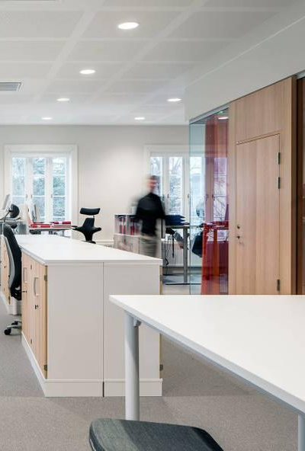
Cooling and heat pump systems
The cooling requirement of the building increases the cost-effectiveness of a heat pump system.
Cooling in a residential apartment block is still a rarity.
Note the demands in decree 1010/2017 concerning calculated summer temperature and consequent requirements
Image: Koskisen Oy

Slide 31
Cooling and heat pump systems
The goal is to utilise the collector loop of a geothermal system primarily for cooling.
Utilising waste heat from cold-air machines in, for example, domestic water production
https://ym.fi/rakennusten-energiatehokkuus
Image: Koskisen Oy

Slide 32
Ventilation systems, residential buildings
The following can be used as a ventilation system (does not differ from other construction):
building-specific balanced ventilation with heat recovery
flat-specific balanced ventilation with heat recovery
floor-specific balanced ventilation with heat recovery
In terms of ventilation, the surfaces that mark the boundaries of a flat must be absolutely airtight
Image: Koskisen Oy

Slide 33
Ventilation systems, residential buildings
Differences in air pressure between flats must not cause odours etc. to drift from one flat to another.
In a block of flats, ventilation pipes are not placed in between beams for fire technical reasons, but rather below the protective cladding under the beams, where the pipes are then enclosed or covered with a ceiling.
https://talotekniikkainfo.fi/sisailmasto-ja-ilmanvaihto-opas
https://talotekniikkainfo.fi/esimerkit/ilmanvaihdon-mitoituksen-perusteet
Image: Koskisen Oy

Slide 34
Ventilation systems facility construction
The same ventilation systems can be used as in other construction.
Acoustic requirements must be taken into account when positioning ventilation machines.
In terms of ventilation, the surfaces that mark the boundaries of ventilation service areas must be absolutely airtight.
Load-bearing wall and beam structures must be taken into account in the positioning of canals/ducts.
Image: Koskisen Oy

Slide 35
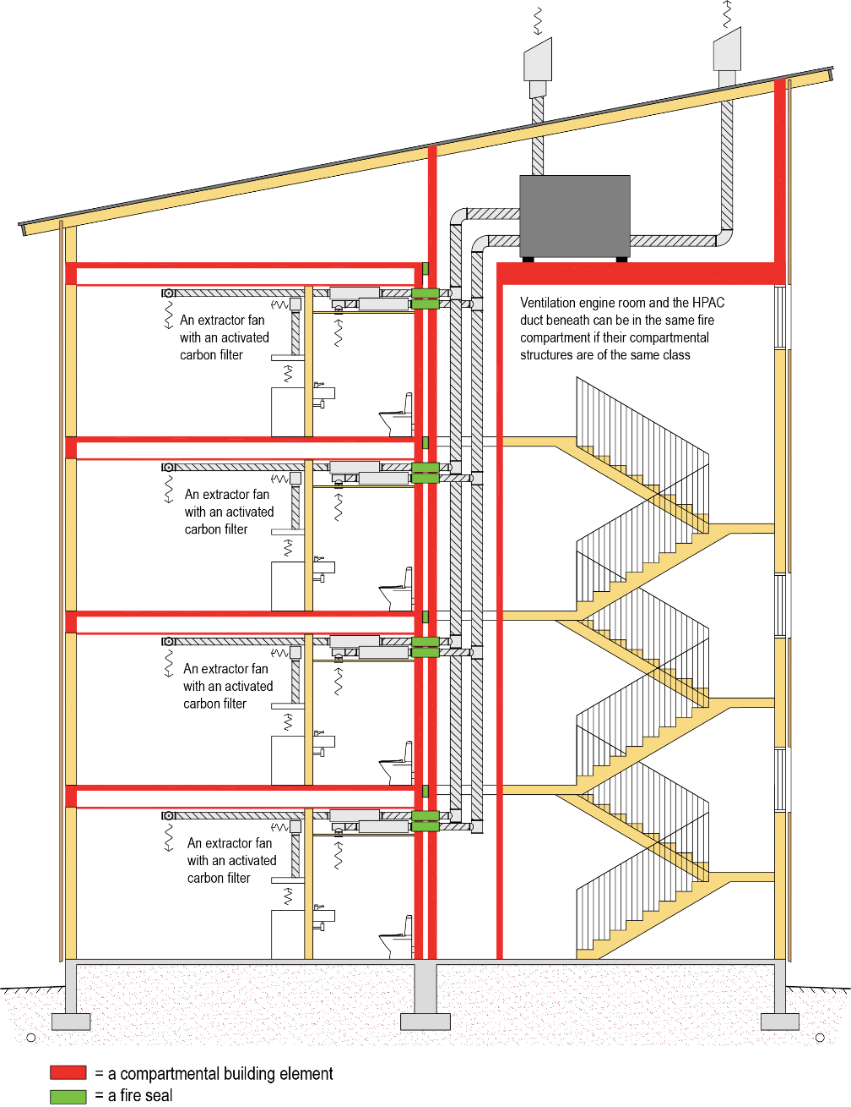
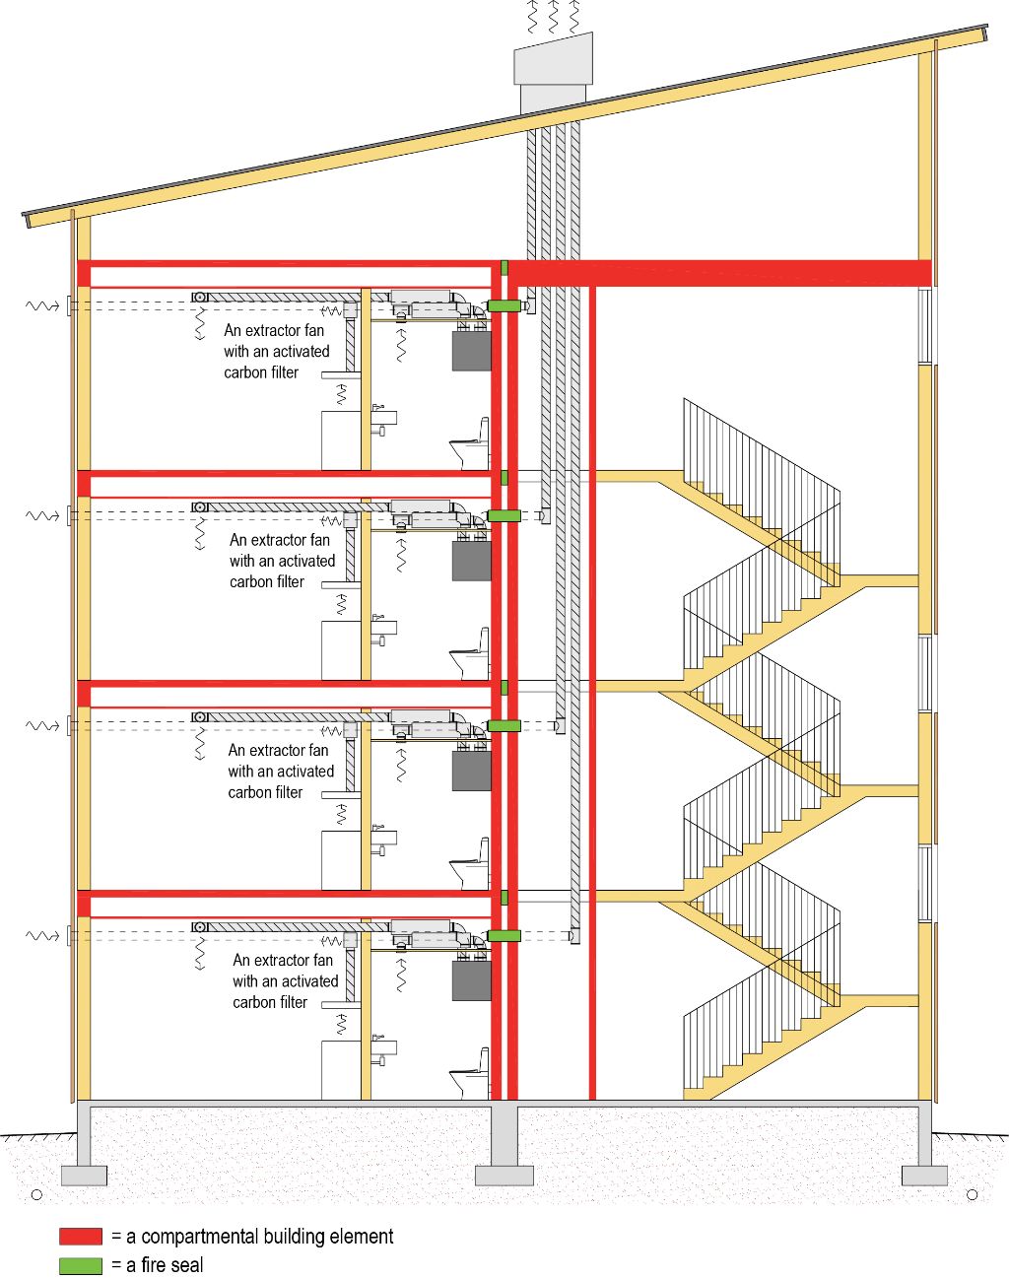

Slide 36
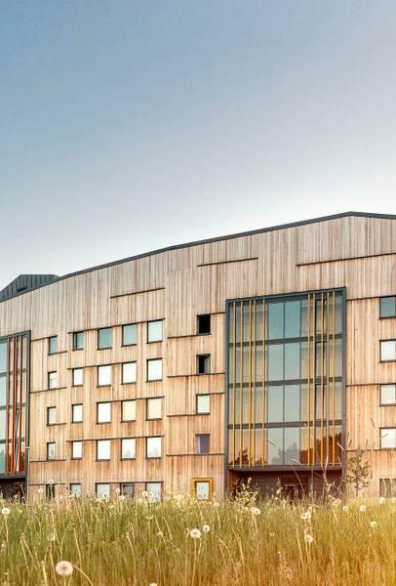
Natural ventilation
The airflow varies depending on the weather conditions, as it is driven by temperature differences and wind.
Calculational demonstration of conformity and measurements made in connection with the commissioning are challenging.
The building must be designed as a whole, as the operation is affected by such factors as duct placement and height differences.
Image: Koskisen Oy

Slide 37
Natural ventilation
The placement of ducts affects the structural solution
The goal is to place the duct groups on the roof as close as possible to roof ridge or the highest point.
Observe the limitations of outdoor air filtration and noise reduction (not suitable for noise impact areas)
Natural ventilation guide, Ministry of the Environment (in Finnish)
https://ym.fi/documents/1410903/38439968/PVIV-OPAS-3729E8C3_9173_4EA5_ADB9_CD33C1432A01-143101.pdf/2ab85b97-a5fd-cee7-c096-930b297a8435/PVIV-OPAS-3729E8C3_9173_4EA5_ADB9_CD33C1432A01-143101.pdf?t=1603260091107
Image: Koskisen Oy

Slide 38
Automatic fire-extinguishing system
In terms of fire safety, protecting the frame structure is the most important thing in a wooden apartment block.
The protection is implemented actively with an automatic fire-extinguishing system and passively with fire protection casing.
Generally, different water mist systems are used when permitted by the OH classification

Slide 39
Automatic fire-extinguishing system
In buildings for residential occupancies with 3–4 storeys, the requirement is a fire-extinguishing equipment designed in accordance with the Standard SFS-EN 16925 (automatic residential sprinkler systems).
The Standard SFS-EN 16529 specifies requirements and gives recommendations for the design, installation, water supplies and backflow prevention, commissioning, maintenance and testing of fixed residential fire sprinkler systems in buildings for residential occupancies.

Slide 40
Automatic fire-extinguishing system
In non-residential buildings with 3–4 storeys and in residential buildings with 5–8 storeys, the requirements are defined in the Standard SFS-EN 12845 (OH).
The Standard SFS-EN 12845 defines the design, installation and maintenance of fixed fire-extinguishing systems.
The type of sprinkler system affects the needed supports (e.g. low pressure system)
Supports must be type-approved

Slide 41
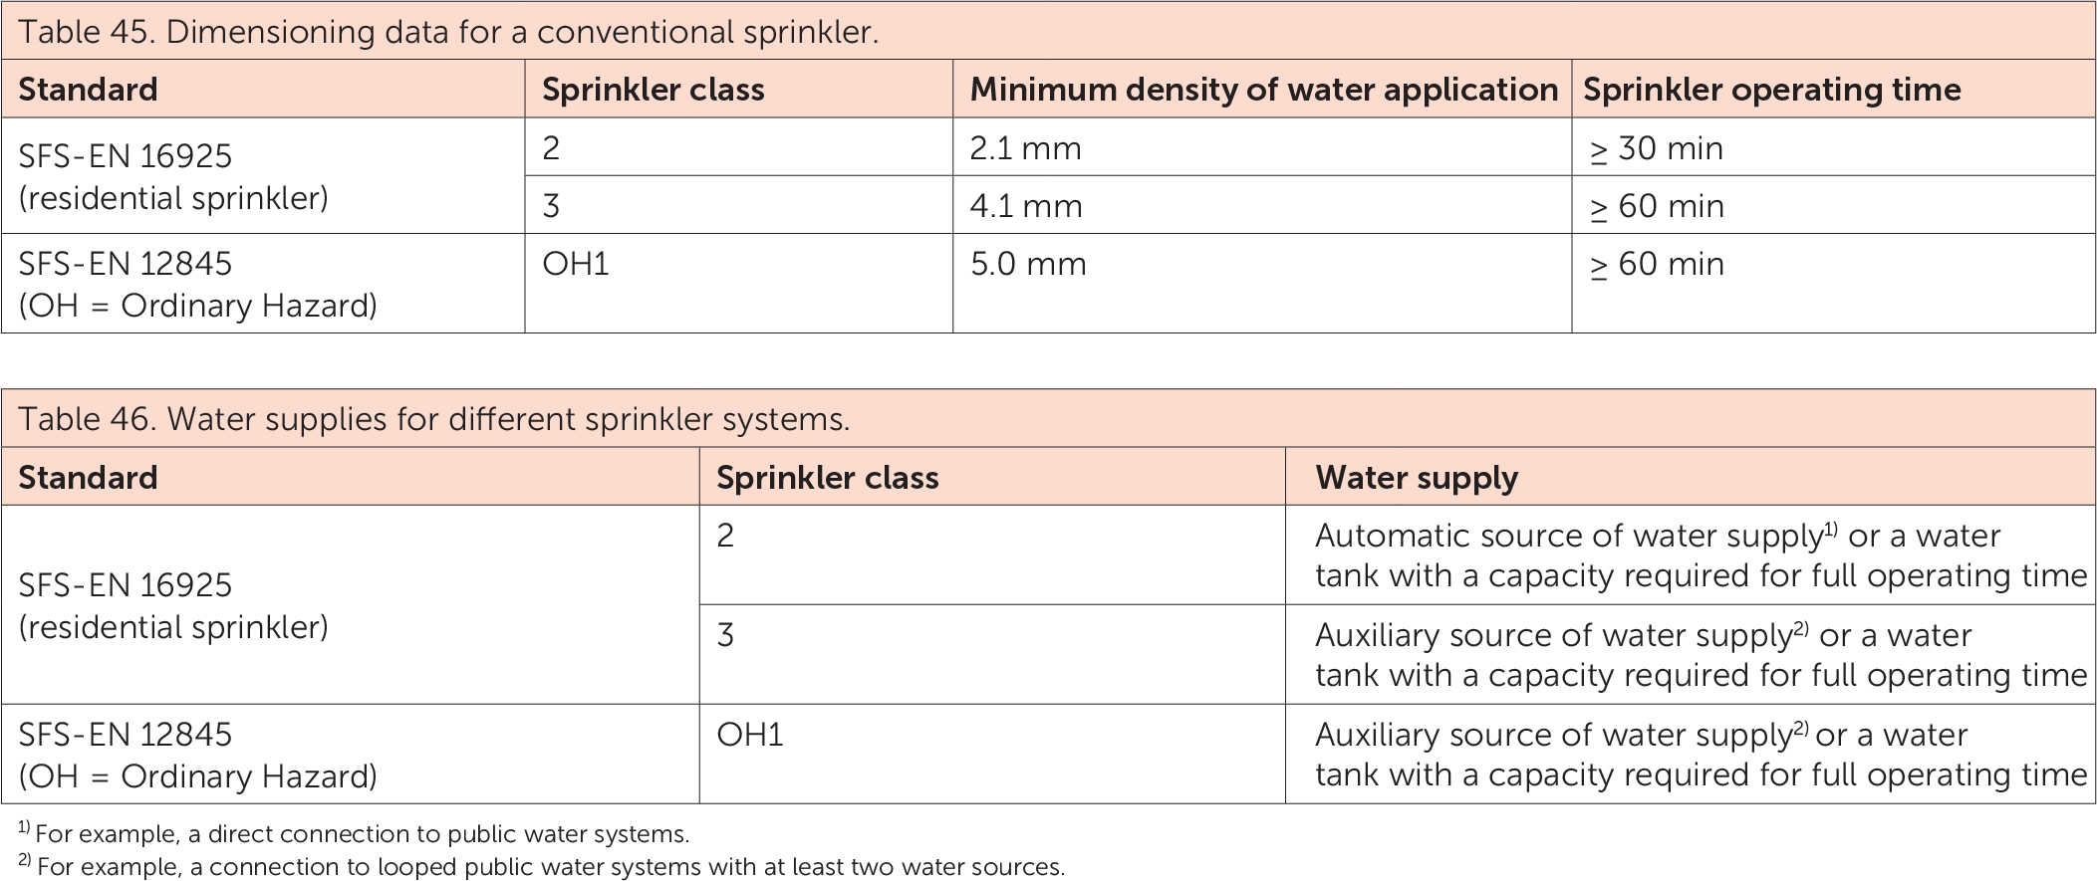
Automatic fire-extinguishing system

Slide 42
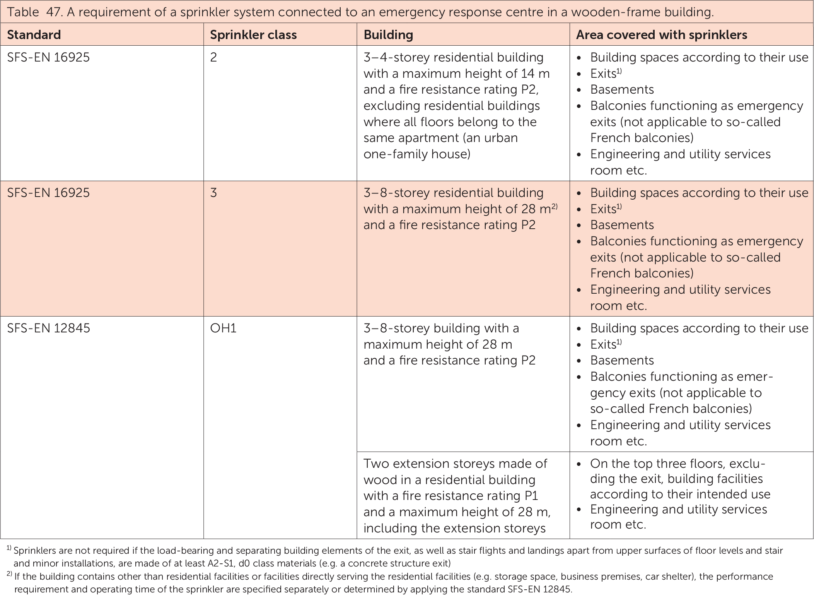
Automatic fire-extinguishing system

Slide 43
Automatic fire-extinguishing system
When water mist systems are used, the water flux density and fire suppression capability in the above-mentioned cases must correspond to the water flux densities specified in the standards.
All fire-extinguishing systems must have an approval certificate from an independent classification society (FM, Vds) or equivalent, according to which the system has a corresponding fire suppression capability with a conventional sprinkler system complying with the standards referred to above.

Slide 44
Automatic fire-extinguishing system
https://puuinfo.fi/wp-content/uploads/2021/05/Palokirja_netti_kokonainen.pdf
https://tukes.fi/tuotteet-ja-palvelut/pelastustoimen-laitteet/sammutuslaitteistot

Slide 45
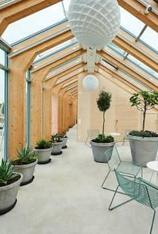
Connections between units
Pipe connections inevitably occur in prefabrication
Water pipe connections must be positioned in such a way that a possible leak becomes visible in a controlled manner in accordance with valid regulations (Decree ME 782/2017)

Slide 46
Connections between units
According to the Decree on the Moisture Performance of Buildings (ME 782/2017), if there is a risk of water leakage from a system, it must be available for inspection, repair and replacement.
As regards heating systems, this has been interpreted by Topten building control authorities so that the heating pipes in a flat can be connected in structures as far as piping between prefabricated units is concerned.

Slide 47
Connections between units
For prefabricated box units, the piping connections and equipment of the sprinkler system are inspected at the unit factory. The inspection is carried out by an authorised installation company
For prefabricated box units, the installations of the water and sewerage/ventilation systems must be inspected by a water and sewerage/ventilation site manager approved by the building control services.

Slide 48
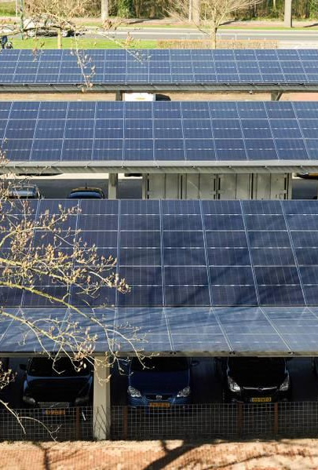
Electrical, telecommunications and security technology
The same systems can be used as electrical, telecommunications and security systems as in other construction
Wooden buildings are equipped with a fire alarm or fire detection system in accordance with regulations
With good design, all wiring and electrical installations can be flush-mounted

Slide 49
Electrical, telecommunications and security technology
In log construction, the locations of vertical holes in log walls must be taken into account well in advance so that flush-mounted installations are possible.
For external walls, flush-mounting should be avoided if only possible.
Best structures for flush-mounting are floor structures, roof structures, possible light partition walls and furniture.

Slide 50
Electrical, telecommunications and security technology
When fixing vertical cable management such as vertical cable racks, trunking and ducting or strips, the settling of logs must be taken into account.
The settling must also be considered with wall channel wirings. The wiring must be left loose to allow the logs to settle.

Slide 51
Fire and sound engineering

Slide 52
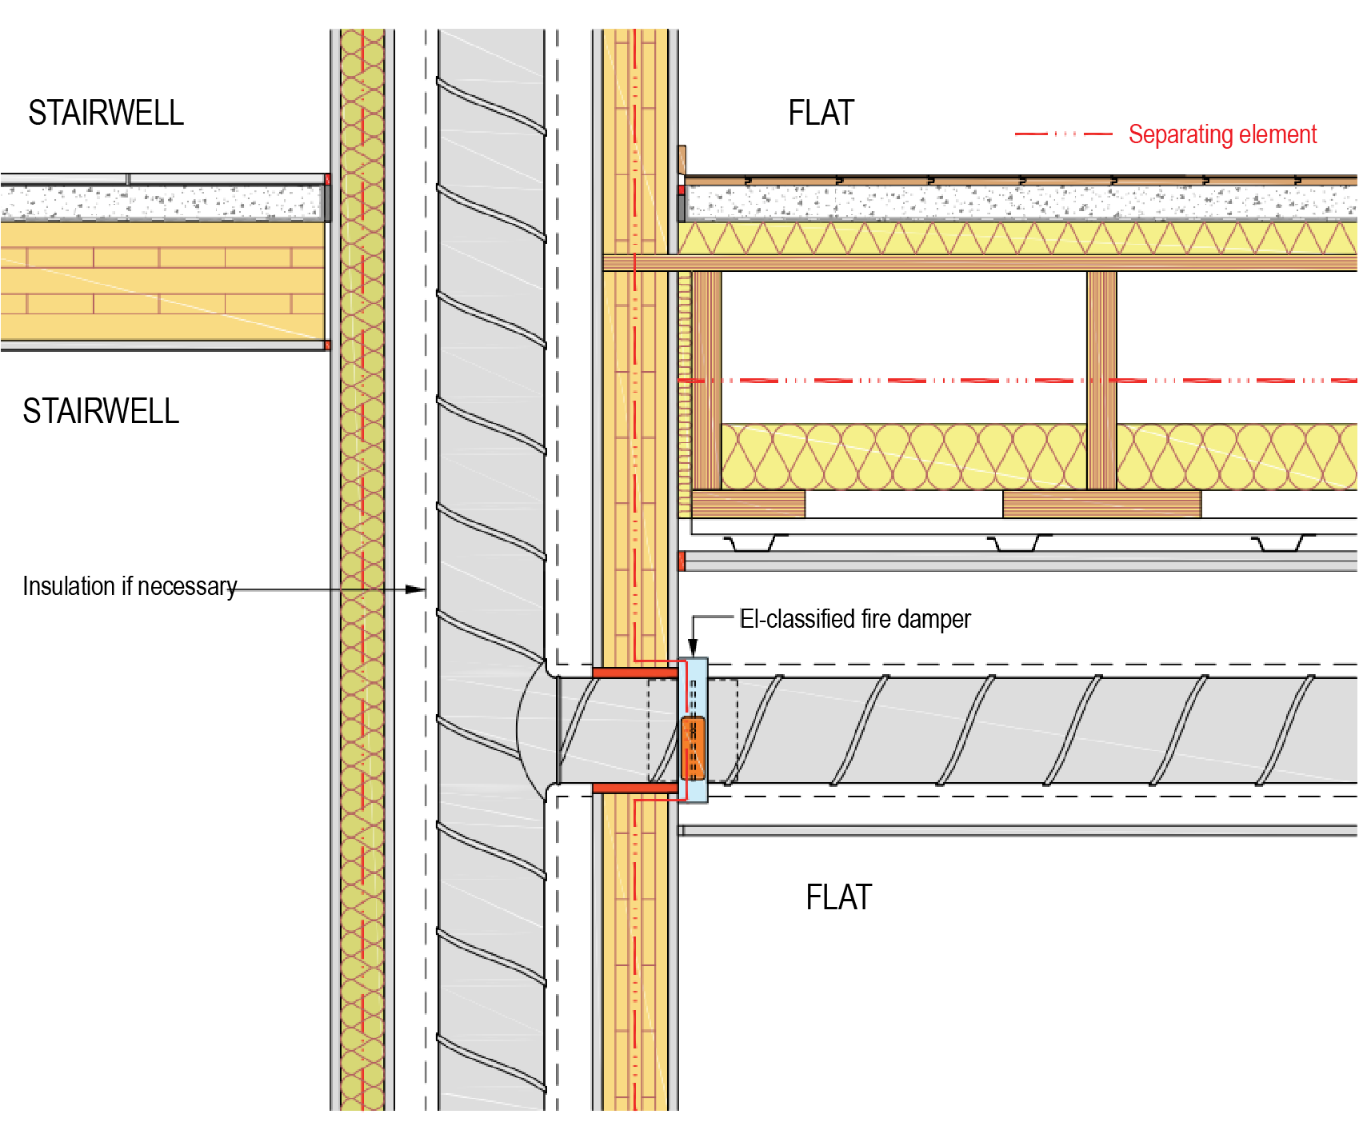
Fire safety and acoustic engineering
The necessary piping can be penetrated through a fire-separating element, provided that the separating qualities of the element are not significantly impaired.
Floor compartmentation vs. flat compartmentation
From a fire technical point of view, ducts and channels are significant for the spreading of the fire, but they are also acoustically important as they penetrate structures.

Slide 53
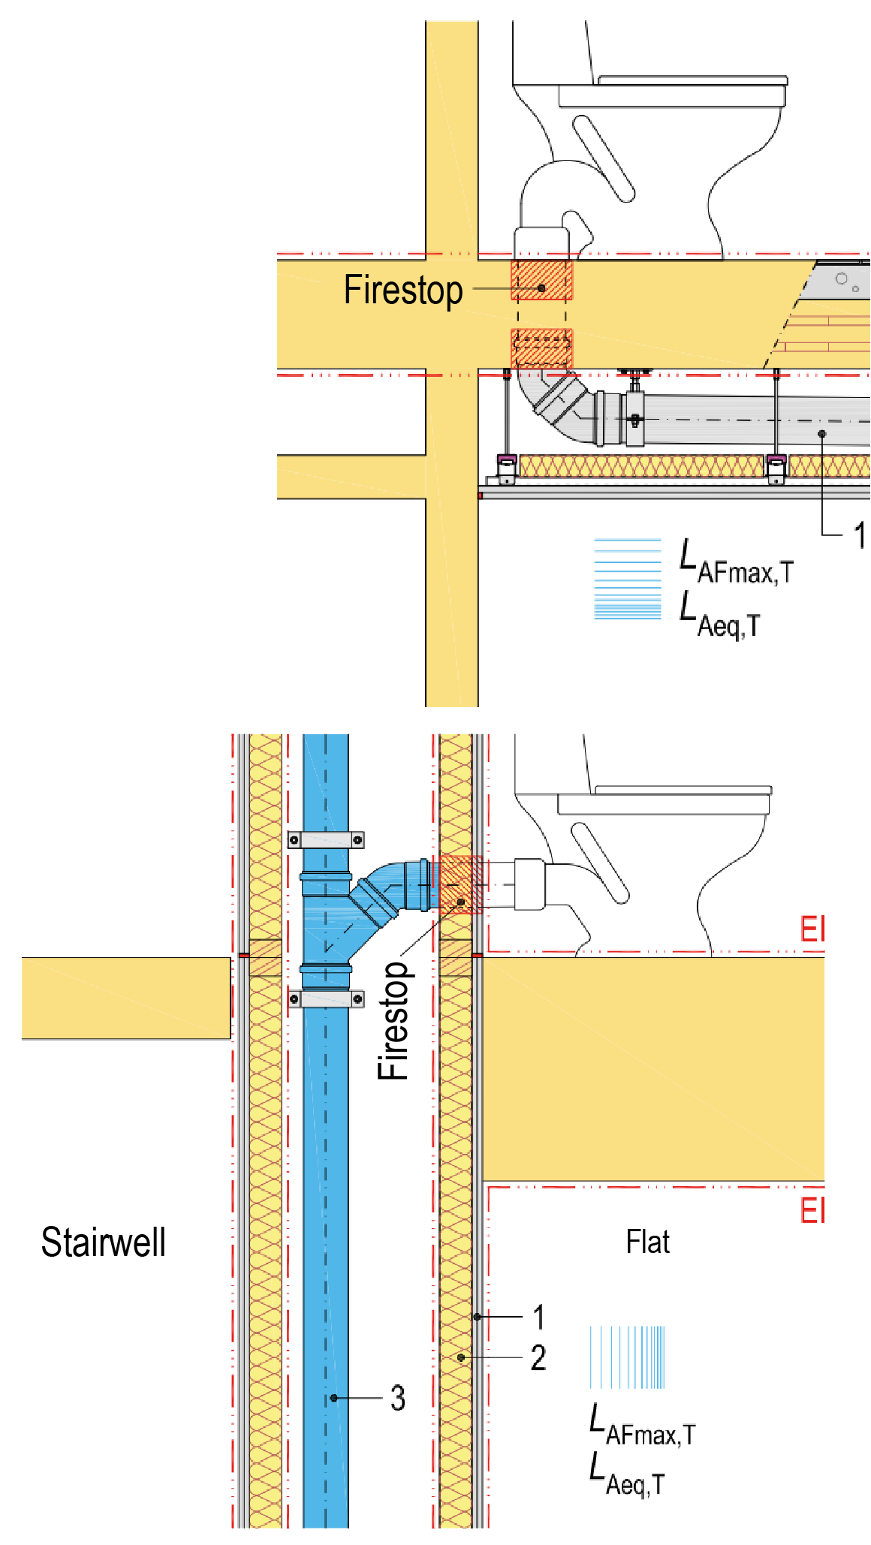
Fire safety and acoustic engineering
The low number of fire-stopping products approved for wood construction has been a challenge. However, the availability of products has increased as wood construction has increased
Fire-stops must be of the same product family according to product approval

Slide 54
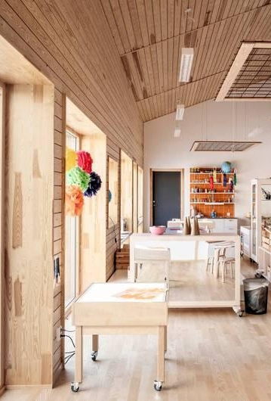
Fire safety and acoustic engineering
The necessary piping can be penetrated through a fire-separating element, provided that the separating qualities of the element are not significantly impaired.
Floor compartmentation vs. flat compartmentation
From a fire technical point of view, ducts and channels are significant for the spreading of the fire, but they are also acoustically important as they penetrate structures.

Slide 55
Fire safety and acoustic engineering
The low number of fire-stopping products approved for wood construction has been a challenge. However, the availability of products has increased as wood construction has increased.
Fire-stops must be of the same product family according to product approval.
https://talotekniikkainfo.fi/ilmanvaihtolaitosten-paloturvallisuus-opas

Slide 56
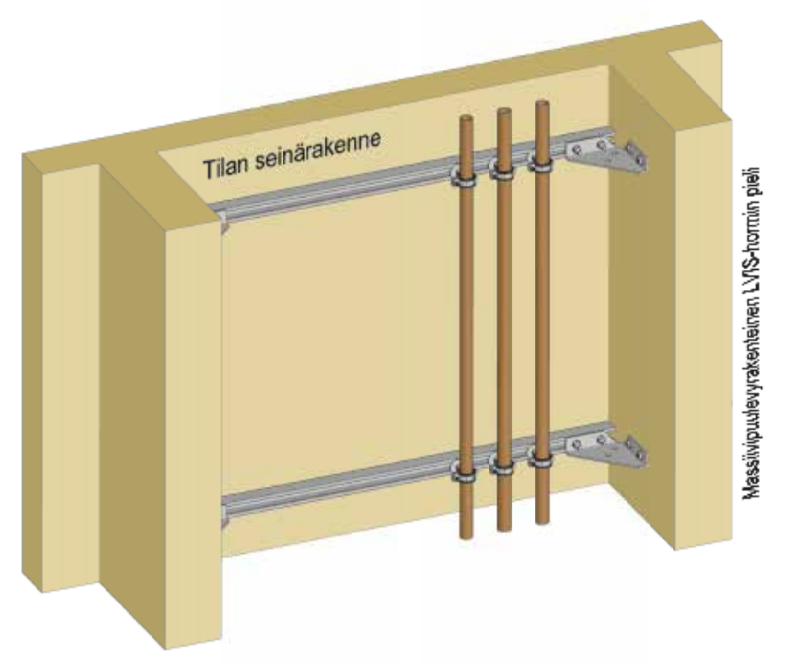
Acoustic engineering, general
Acoustic engineering as a whole must be taken into account in design and equipment selections
Implementation is carried out according to plans
System flows are adjusted and correct
The aim is to place the pipes so that they do not run on another flat’s side
Pumps, heat exchanger packages, ventilation machines are separated from the structures using vibration isolation
Wall structure of the space
HVAC duct jamb with a solid timber panel structure

Slide 57
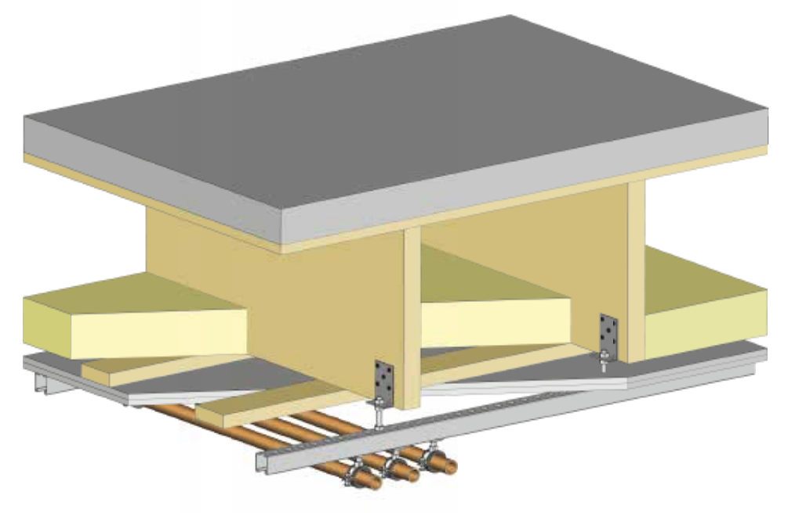
Acoustic engineering, general
Low-speed pumps are used
Excessive and unadjusted flow causes flow noise in pipe systems and, for example, in radiator thermostats
Horizontal drain installations must be centralised in the wet spaces, not in the rooms.
If the structures are light, the installations need vibration-isolating steel structure supporting that is attached to the solid structure.

Slide 58
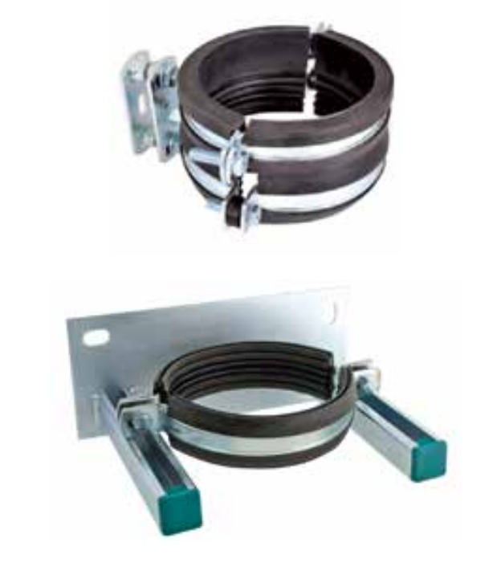
Acoustic engineering, general
In a building with a wooden frame, particular attention should be paid to the supporting of sanitary drains in order to find structural elements that are as massive and rigid as possible, so that the drain supports can then be attached to them.
The supports must have a sound-proofing rubber and the thermal motion of the pipe must be accounted for in the supporting.
Drain pipes should not be attached directly to wall structures between flats.
Typically, a vertical drain supporting is created in, for example, the intermediate floor structure.

Slide 59
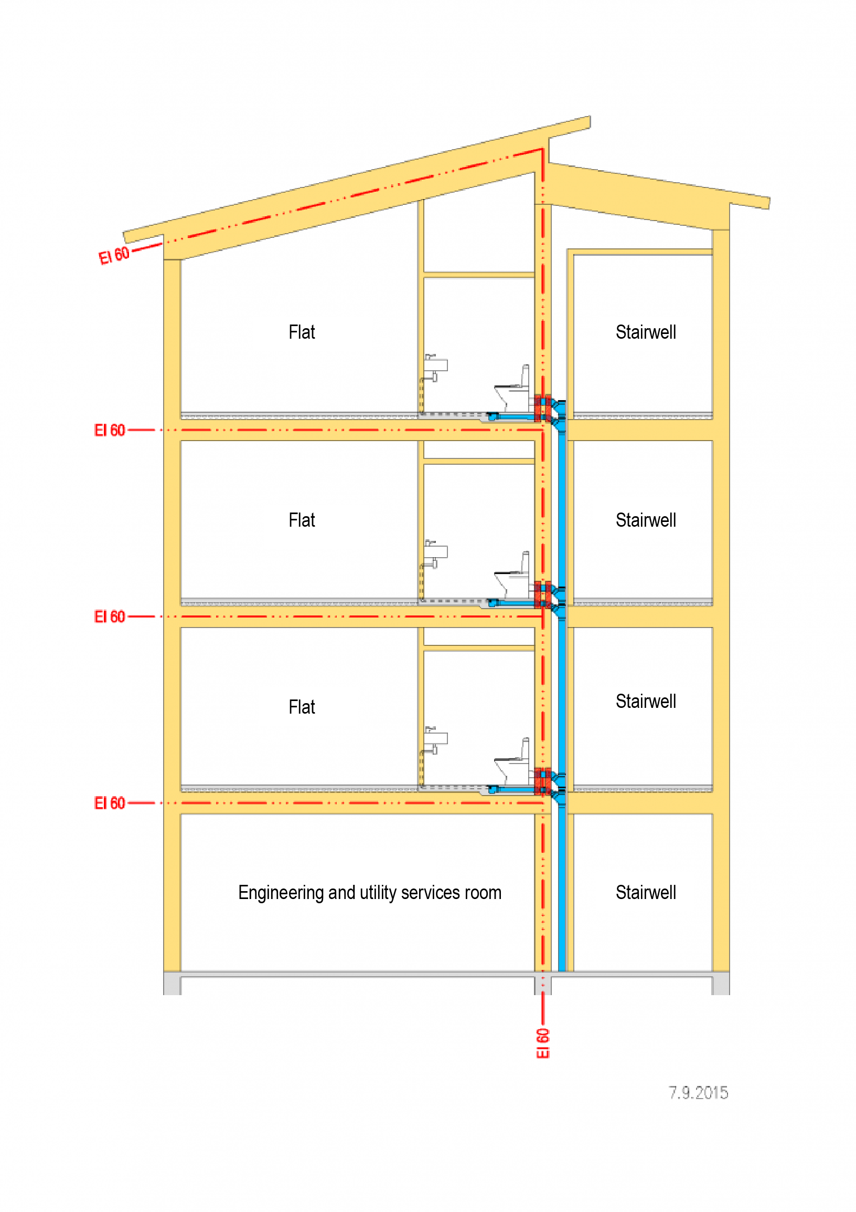
Acoustic engineering, general
The bottom bend of a sanitary drain is implemented as slight as possible, and it is placed in the basement under a concrete intermediate floor or under the base floor so that a concrete casting can be done around the bend
A vertical collector drain must be designed in a way that it is vertical all the way down to the bottom bend without any lateral shifts

Slide 60
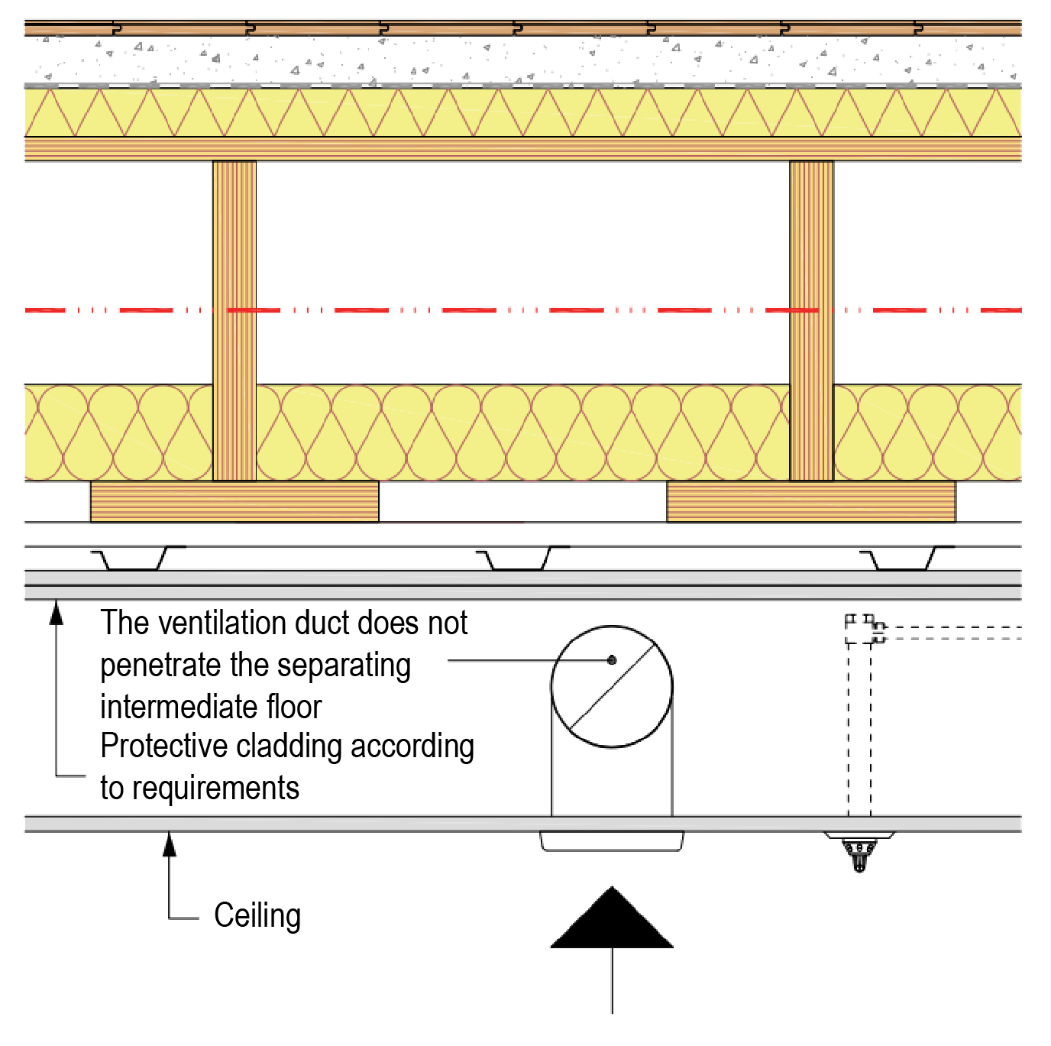
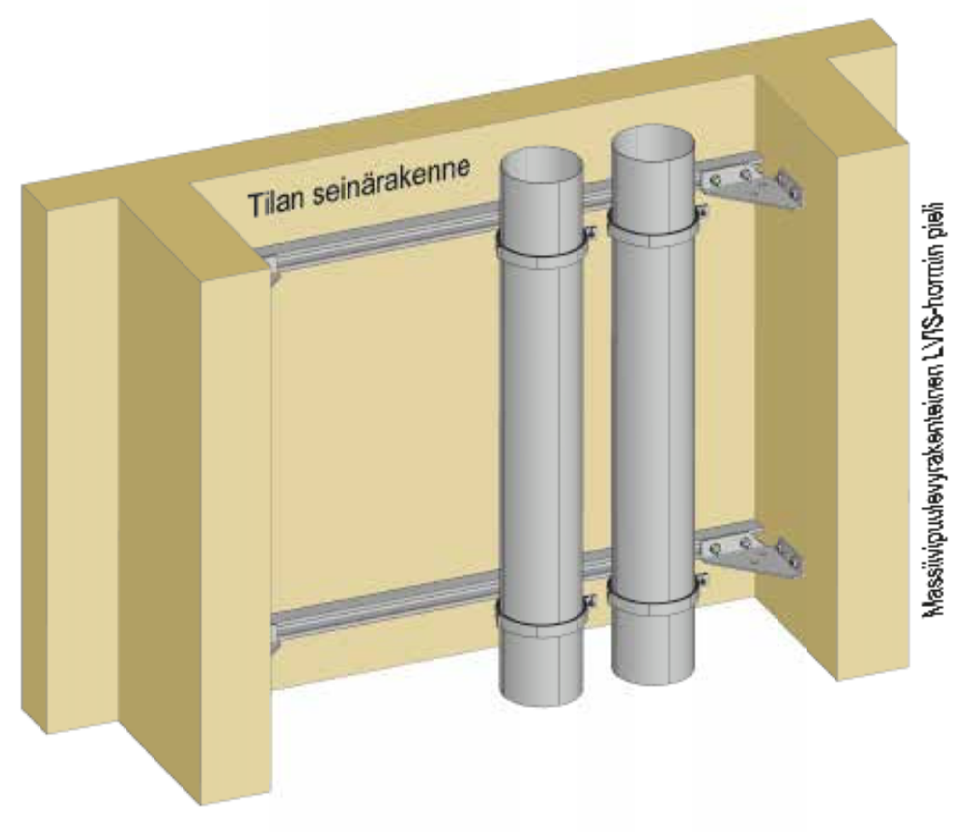
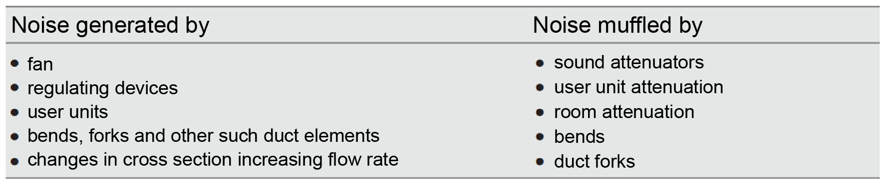
Acoustic technology in ventilation
In a flat-specific ventilation system, flexibility is needed when fixing the machine to the structures.
The passage of sound through the channel section between the ventilation machine and the sound attenuator should be taken into account.
When choosing a central machine, the elevated sound levels between rooms must be taken into account and attempt to prevent these with attenuators.
Wall structure of the space
HVAC duct jamb with a solid timber panel structure

Slide 61
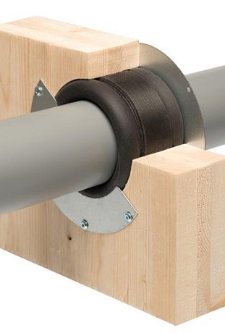
Penetrations, general
Holes for penetrations and even penetration installations can be completed already at the prefabricated unit factory, if this is planned for in the design.
The designer must ensure that the fire-stopping product has been approved for wood structures -> site-specific approval.

Slide 62
Penetrations, general
A fire-stopping product must be approved on the basis of an EN standard certificate, on the basis of a CE/CTA technical approval, or the approval must be based on approvals issued by an external, authorised test laboratory for the suitability of the product for its use (e.g. VTT Technical Research Centre of Finland certification).

Slide 63
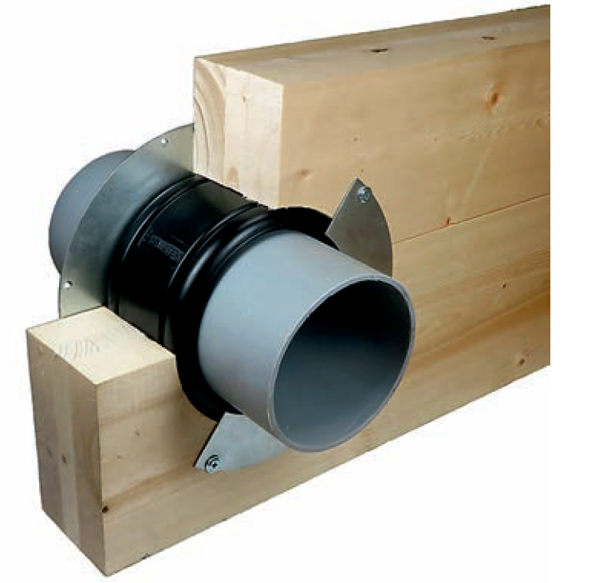
Penetrations, general
If a fire-stopping product has an ETA approval, it needs to have a CE marking. So far, fire-stopping products have no harmonised European product standard. The manufacturer of the product with a CE marking is responsible for ensuring that the product meets the requirements and the manufacturer must ensure the quality of the products and draw up a report on the quality control of the product.

Slide 64
Penetrations, general
However, a CE marking in itself is not an indication of the suitability of a fire-stopping product. It must always be separately checked whether the product’s characteristics meet the requirements and what are the preconditions and installation methods needed to achieve the promised performance level of the product.

Slide 65
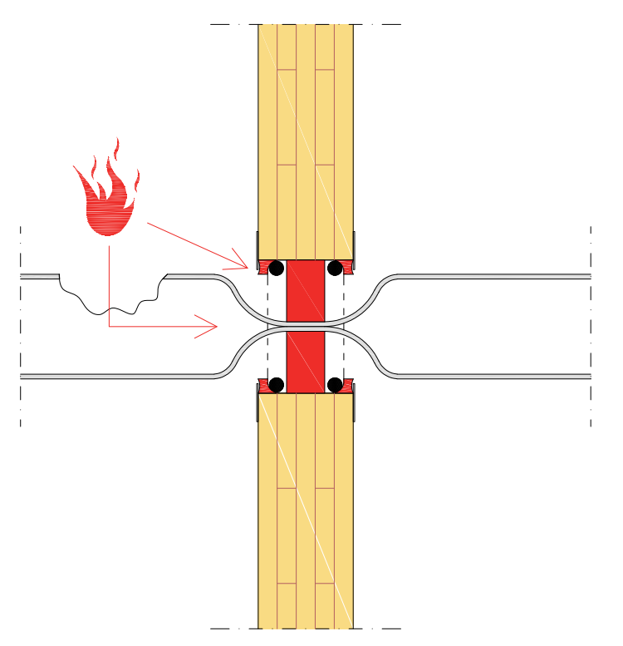
Penetrations, design considerations
Pipes, shafts, ducts, channels, cables, flues and penetrations required by conveyors that are mounted through a fire-separating building element must not essentially reduce the fire compartmenting capacity of the building element (Decree 848/2017).
A personal certificate training and qualification are available for a fire seal installer.
No special qualification requirements have been set for the person preparing the fire seal plan. However, the person preparing the plan must be able to demonstrate their qualification for the task on the basis of their training and experience.

Slide 66
Penetrations, design considerations
When granting a permit, building control services will consider whether the quality and scope of the project are such that the demonstration of compliance with the requirements for fire-stops requires the submission of a fire-stop plan to the building control authorities as a special plan before commencing the work in question.
The requirement for a site-specific fire-stop plan has been presented in, for example, PKS card E1-703 (pksrava.fi, in Finnish).

Slide 67
Penetrations, design considerations
A fire-stop plan is a plan created by a special designer. It is drawn up in the implementation planning phase of a project in accordance with the fire compartmentation and fire-separating element requirements of the site. The plan is inspected by a building control authority and the installation work is carried out according to it.
A fire-stop plan must include location diagrams, fire-stop details, used fire-stopping products and a work specification (Palokatko-opas 2019, in Finnish).

Slide 68
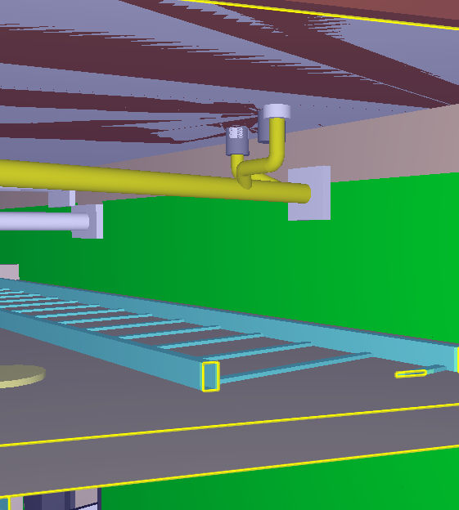
Penetrations, design considerations
Even if no separate fire-stop plan is required for the site, the site must still comply with the instructions according to the ETA approval and CE marking of the fire-stopping products used.
https://palokatkoyhdistys.fi/pdf/Palokatko-opas-22052019.pdf
https://www.finlex.fi/fi/laki/alkup/2017/20170848

Slide 69
Penetrations, design considerations
A fire-stop must be marked with a sticker or a plate that is secured in place.
The plate must contain at least the following information:
name and contact details of the fire-stop contractor, name of the installer, date of installation
installed products and their fire resistance classes, the suitability of
the products or solution
The fire-stop must be available for inspection in order to verify its condition.

Slide 70
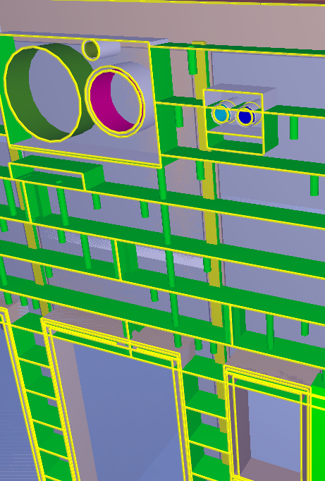
Penetrations, design considerations
The centre-to-centre distances of the pipes must be correct:
Space required by insulations taken into account
The mutual ctc distances of the fire-stop penetrations in accordance with the ETA approval have been taken into account
The pipe placement and elevation positions are such that they can be implemented
The supporting for fire-stop penetrations can be implemented according to the manufacturer’s instructions

Slide 71
Penetrations, design considerations
Design considerations when using penetrations installed at the prefabricated unit factory:
Use penetration product models in planning
Observe the suitability of the used product/product model for the pipe dimension
Product model-based design requires precision

Slide 72
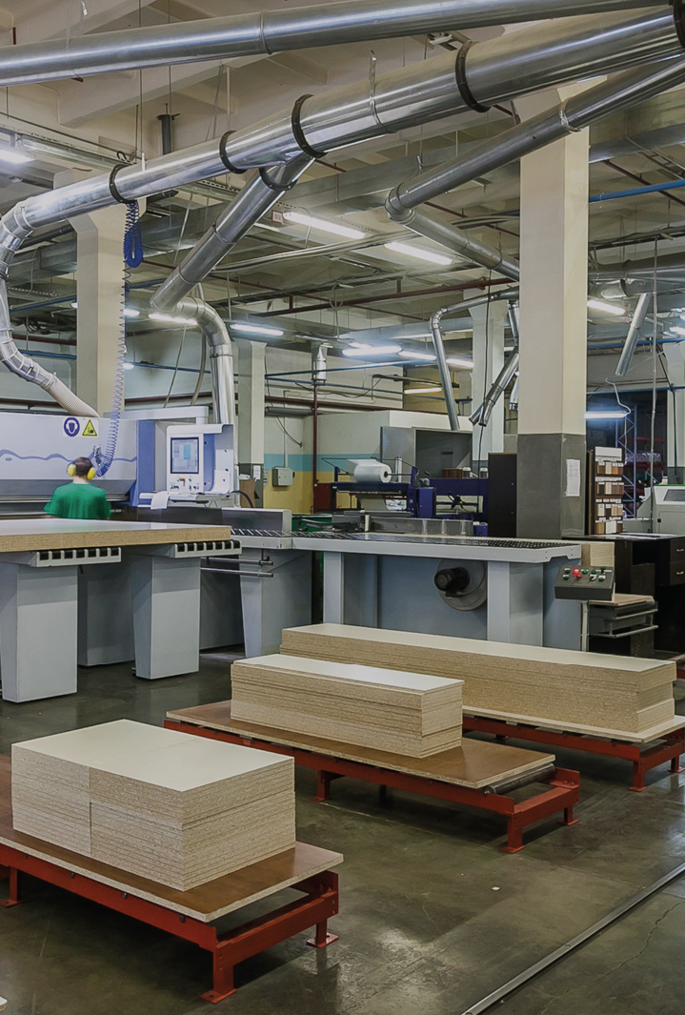
Air tightness
Air tightness is an essential part of fire and acoustic engineering.
Good air tightness ensures the physical functioning of the external envelope structure, housing comfort and reduced energy consumption.
A detail design is needed to ensure air tightness.
Details and constructability must be considered already at the design stage.

Slide 73
Prefabricated box units
The buyer determines the level of prefabrication
The necessary building engineering connections are made at the construction site
The building engineering in a prefabricated box unit has been inspected at the factory and the necessary pressure tests etc. have been carried out.
Adequate space for joining and installation of HVAC technology must be ensured
Usually the buyer does the basic planning and the prefabricated unit supplier carries out the as-built plans.

Slide 74
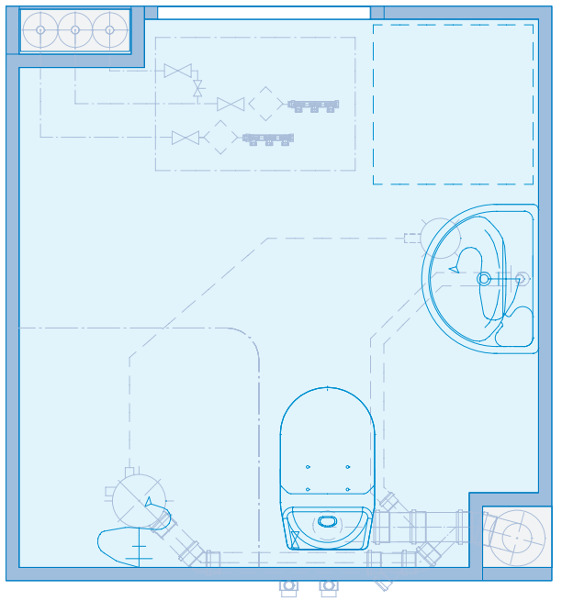
Prefabricated box units
In building engineering design, the technology interfaces must be taken into account and agreed on with the unit manufacturer.
The connection interfaces are usually on one side of the unit, with the exception of drains.
The use of prefabricated units also affects the planning and decision-making schedules – front-loaded planning requires precision!!
RT38784 Parma Kylpyhuoneet

Slide 75
Vertical ducts

Slide 76
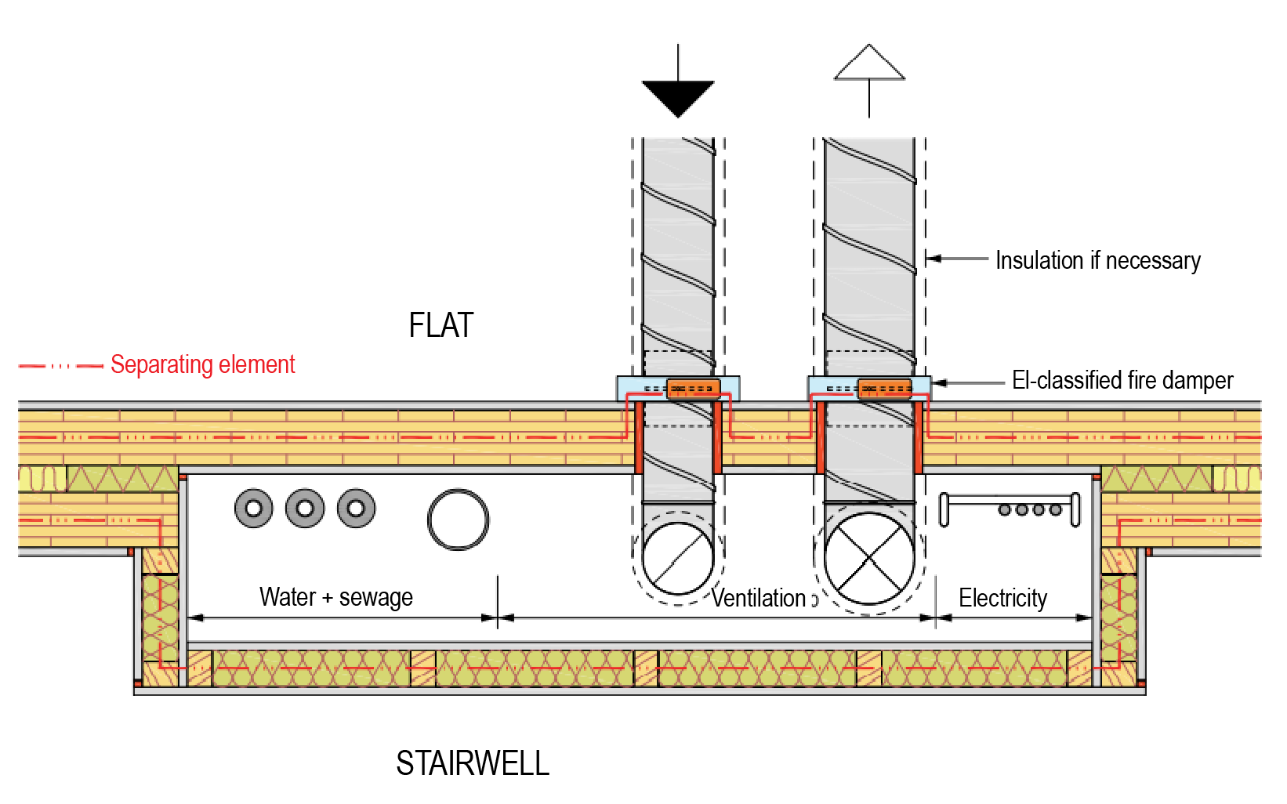
Vertical ducts
Most of the vertical building services technology between the floors are carried in vertical ducts.
The ducts can be either ready-made elements or constructed on site.
When considering structural solutions, vertical ducts must be coordinated with structural designers and architects.

Slide 77
Vertical ducts
The pipe mounting in ducts must also be planned, because especially drain pipes generate noise.
The mounting of pipes to the walls of the flats should be avoided.
When considering the duct placements, matters related to fire and acoustic engineering, visibility of moisture and leaks as well as the maintainability of the technology must be taken into account.

Slide 78
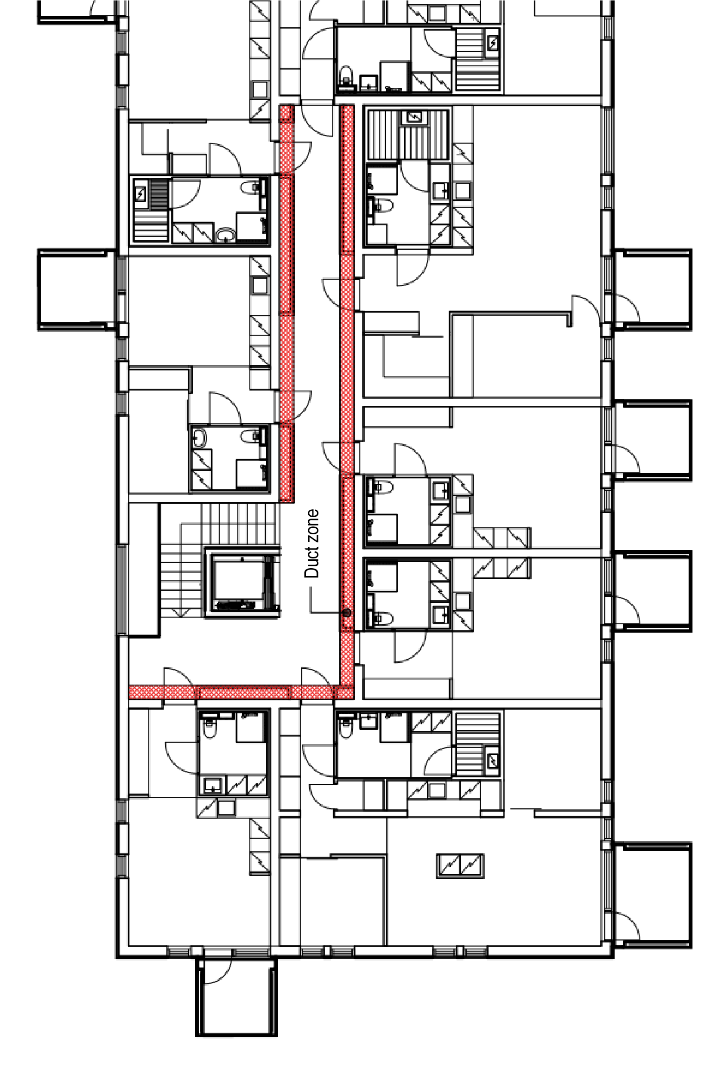
Vertical ducts
Vertical ducts should be placed primarily on the side of the stairwells in the “duct zone”
This way, the intermediate floor penetrations that are challenging in terms of acoustic and fire engineering can be avoided in the flats.
Technology maintenance/checking and possible repairing is easy
Less noise from the drains
HVAC technology can be installed after the frame of the building has been erected
Also enables construction using prefabricated box units

Slide 79
Vertical ducts
The ducts must be closed on a floor-by-floor basis in accordance with the new building decree
In the placement and structure of the duct, it must be taken into account that the sound cannot travel through a lateral structure or, for example, a ventilation duct
Wool damping in the duct wall structure to attenuate reverberation (80 kg/m3, 50 mm)

Slide 80
Vertical ducts
Motions caused by moisture-related dimensional changes in wood and structural deflection can break the air tightness of a duct. The ducts must, therefore, be made of the same plate material so that the structural connections and penetrations can be sealed also acoustic engineering-wise.
Remember the possible fire insulation in the drains. Acoustic excess attenuation can also be achieved with other products.

Slide 81
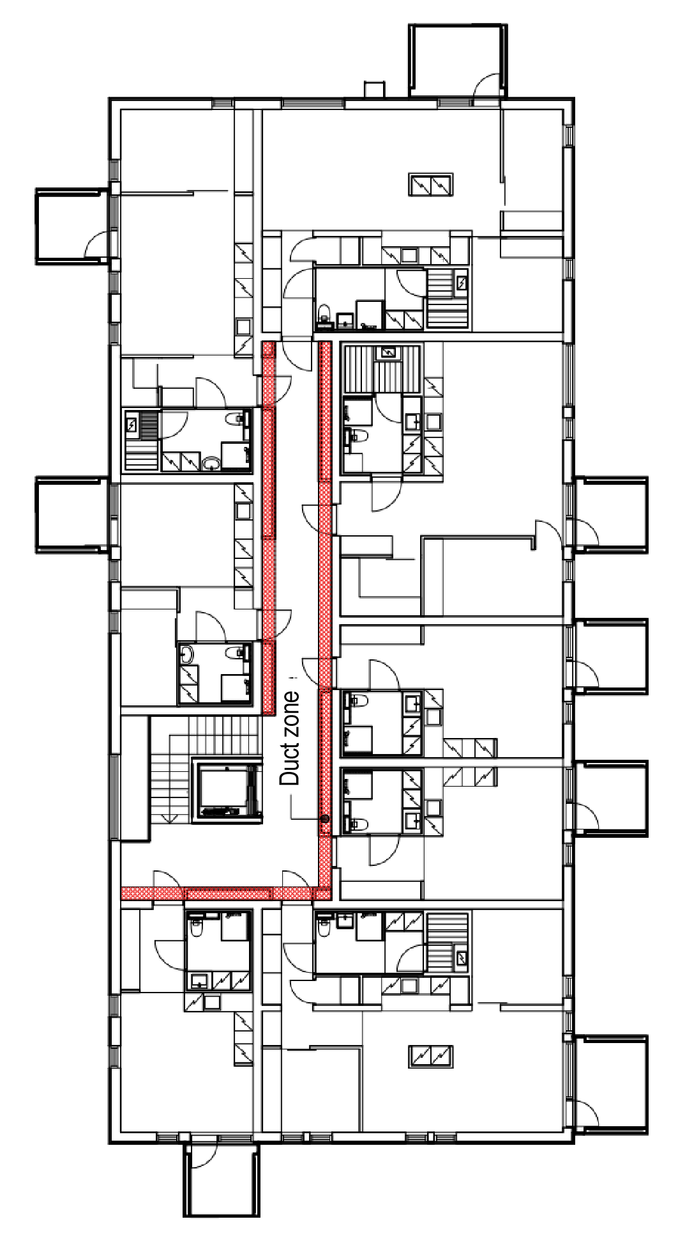
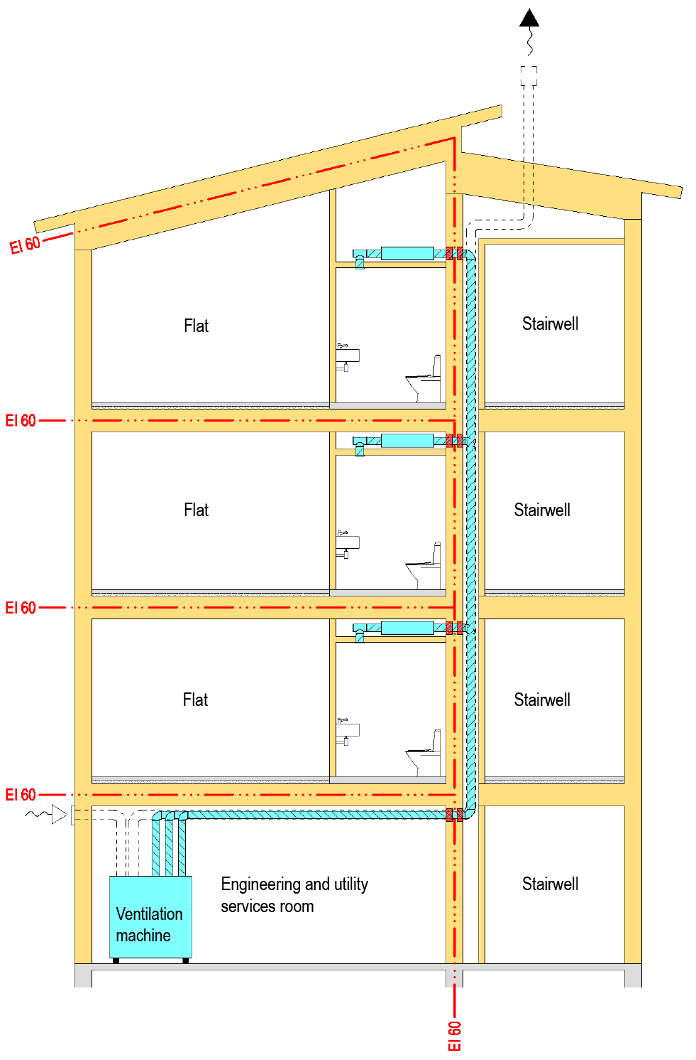
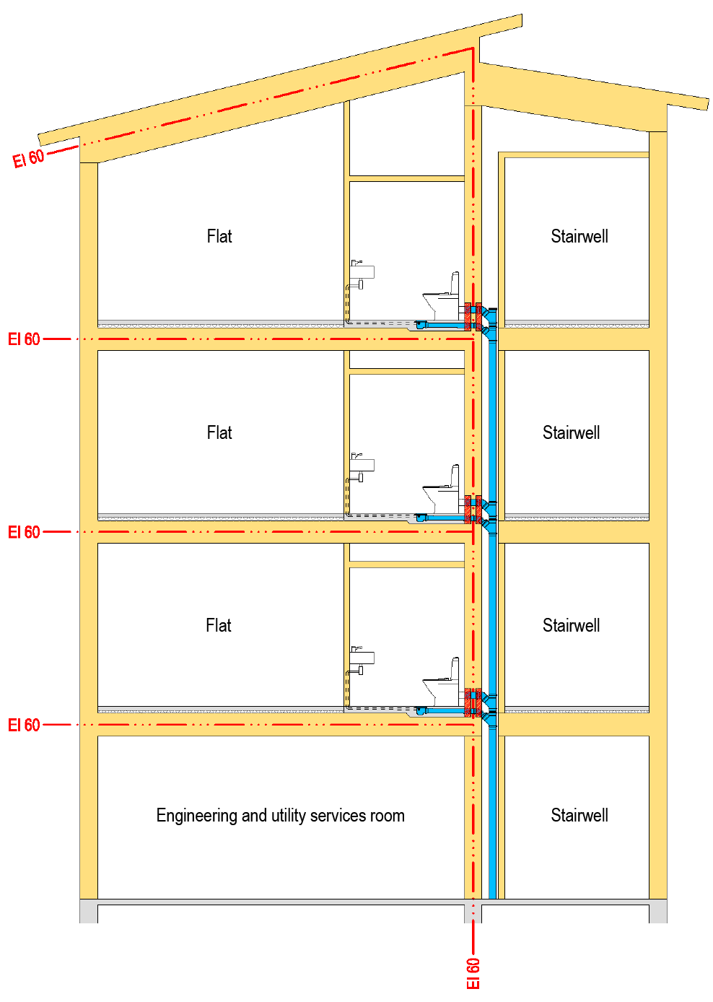
Vertical duct placement

Slide 82
Coordination of plans

Slide 83
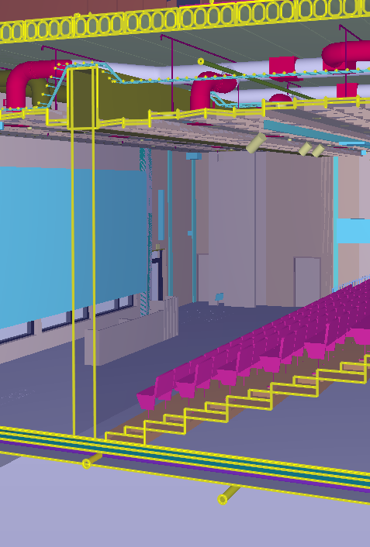
Coordination of plans
Special plans are prepared as a data model, taking into account the level requirements of the data model.
The coordination of routes and overlapping in the data model is an important work stage.
Coordination must be carried out throughout the design process to avoid technical overlapping.
As to structural engineering, coordination is needed for openings and structural solutions.

Slide 84
Coordination of plans
Construction with prefabricated units creates a more front-loaded design also in terms of decisions and purchases.
In this way, a sufficient level of planning can be achieved in regard to, for example, unit manufacturing.
The coordination is carried out via a data model, the content and accuracy of which are defined in advance.

Slide 85
Site

Slide 86
Site
Changes in the weather and rain must be carefully taken into account in wood construction.
Installation work begins when the external envelope is waterproof (a tent or a roof and exterior walls are sealed).
As far as building services technology is concerned, the protection and storage of construction materials does not differ from other construction work.

Slide 87
Site
Installation work is carried out according to plans and the planned details.
The installer must also be familiar with the special requirements of wood construction in installation techniques.

