Slide 1



Industrial wood construction
Teaching materials for industrial wood construction education
2022

Slide 2
Origin of the materials
Use of the materials
These learning materials for industrial wood construction have been prepared in a project led by Puuinfo Oy in 2021–2022. Also involved in the project were
Lappia Vocational College,
TTS-Työtehoseura ry
South-Eastern Finland University of Applied Sciences,
Metropolia University of Applied Sciences,
Jyväskylä University of Applied Sciences,
University of Tampere, and
Federation of the Finnish Woodworking Industries Puutuoteteollisuus ry
The project was funded by the Ministry of the Environment.
The materials are intended to be used as extensively as possible in industrial wood construction education and studies.
The materials are released under the Creative Commons licence Attribution-ShareAlike (CC BY-SA), which requires that the author be properly credited when the materials are used and that derivative works may only be distributed under the same licence as the original work.
The original materials and any updates to them by Puuinfo will be published on the Library of Open Educational Resources website (aoe.fi) and the Puuinfo.fi website.

Slide 3
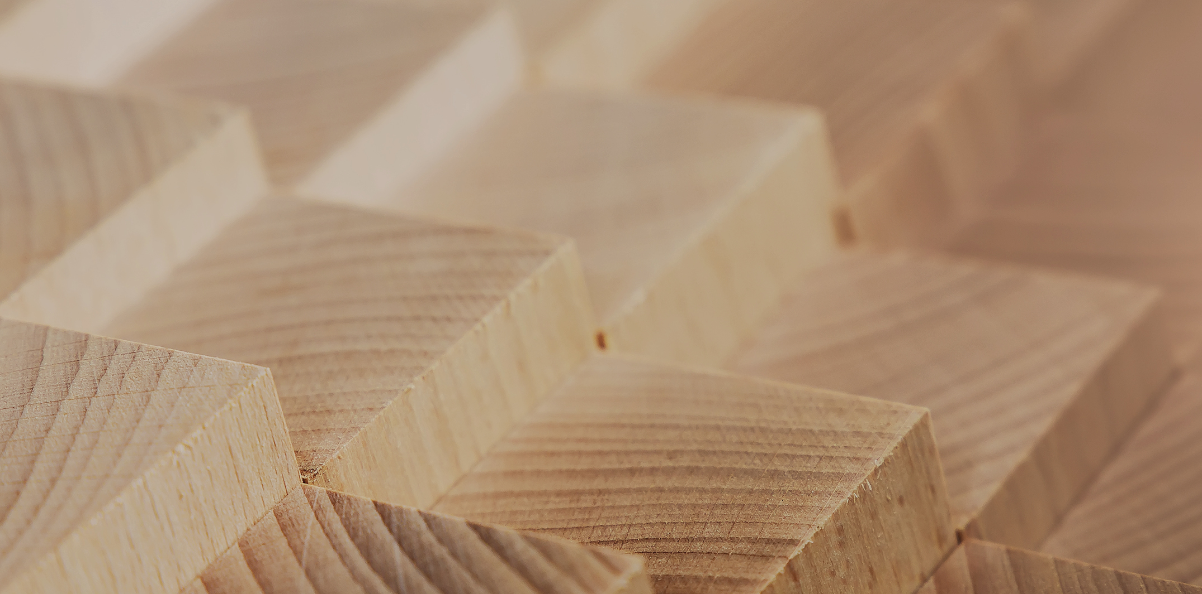
Structural design

Slide 4
Authors
Jani Pitkänen, XAMK
Release date: 20/01/2022

Slide 5
Adhesive screw joint

Slide 6
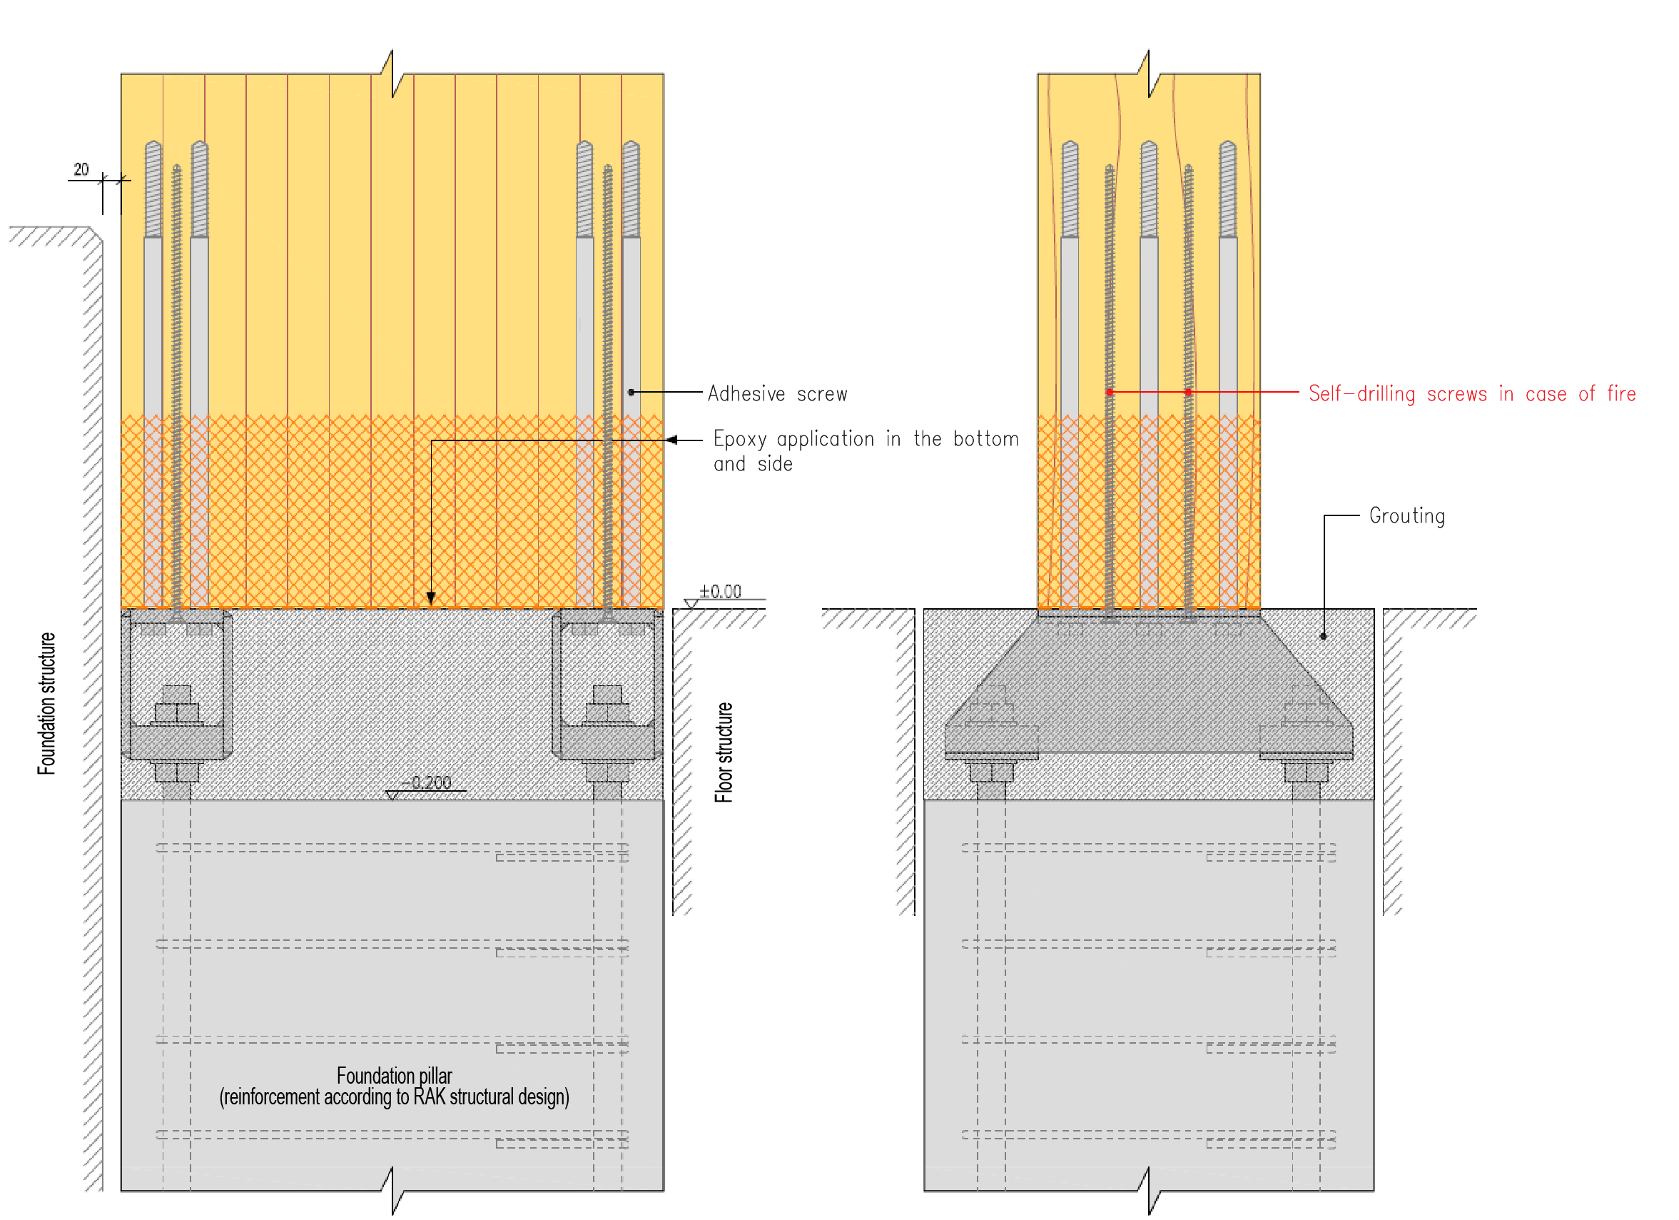
Torsionally rigid adhesive screw joint (cantilever pillar)

Slide 7
Torsionally rigid adhesive screw joint (cantilever pillar)
General considerations
The dimensioning instructions are based on report VTT-S-05701-14
This instruction applies to coach screws glued using epoxy and polyurethane adhesive in the direction of the grain
They are threaded at 100 to 150 mm at the tip part
Glue wood
Spruce or pine
Minimum strength class GL30c

Slide 8
Torsionally rigid adhesive screw joint (cantilever pillar)
General considerations
Adhesive screws
D = 19 mm and grip length, La = 400...490 mm (in wood)
S235JRG2 (EN10025)
5.8 (ISO EN 892-1) => epoxy glue must always be used
This guideline does not apply to the following cases:
Dimensioning of the fire resistance of the adhesive screw joint
Joint with long-term exposure to temperatures above 50°C
Joint with dynamic reverse stress load
Usage class of the joint: 1 or 2

Slide 9
Torsionally rigid adhesive screw joint (cantilever pillar)
General considerations
Work instructions:
A 20 mm hole is drilled to the depth of the smooth part of the screw
Then a 16 mm hole is drilled in the bottom of the above hole so that the overall depth of the hole corresponds to the grip length of the screw, L_{a}

Slide 10
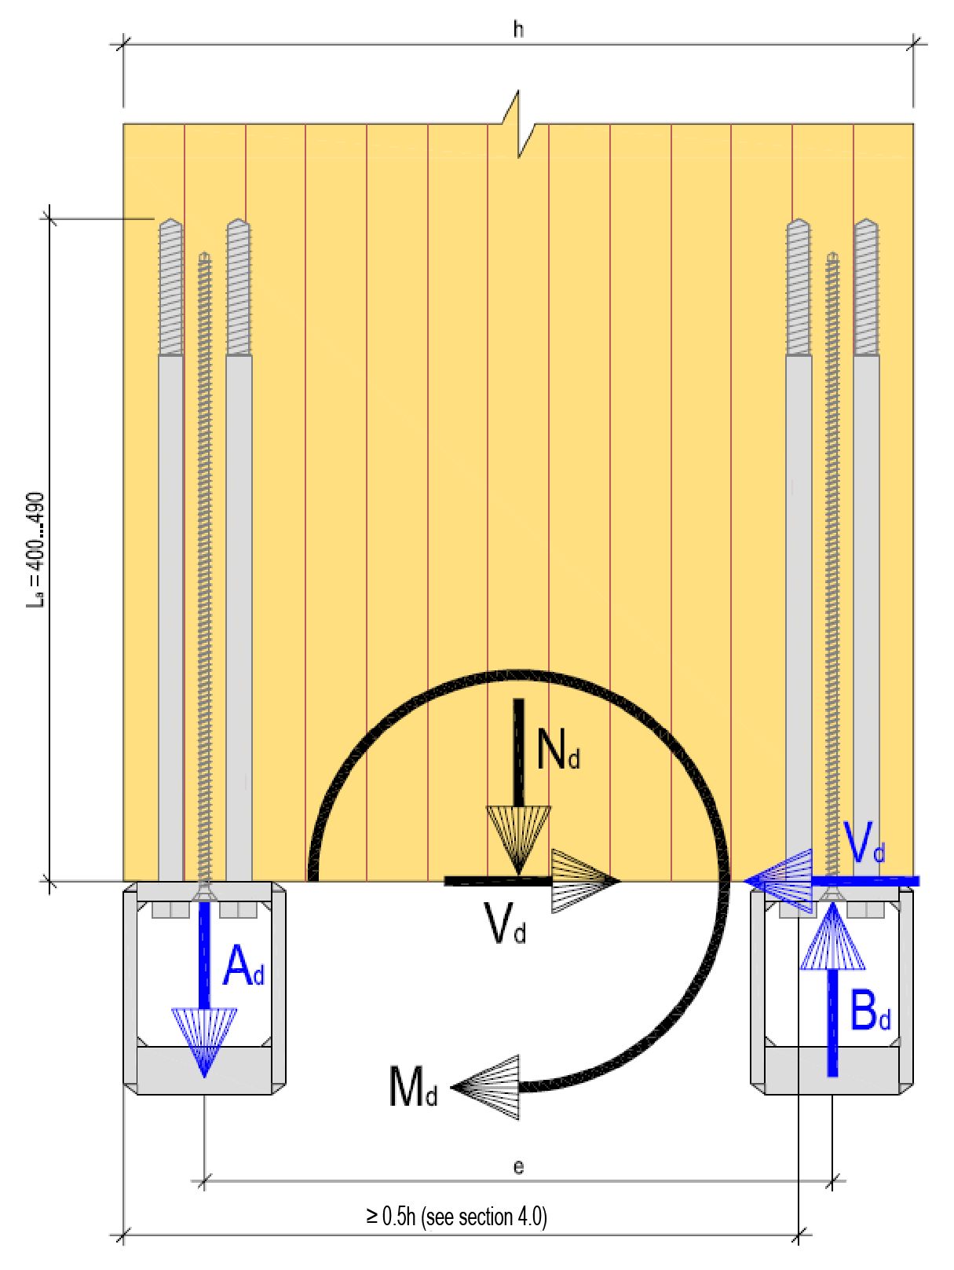
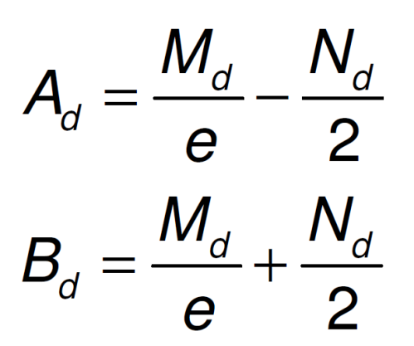
Torsionally rigid adhesive screw joint (cantilever pillar)
Dimensioning
wood EC 5, steel EC 3 and concrete EC 2
Pillar shoe traction and compression force:

Slide 11
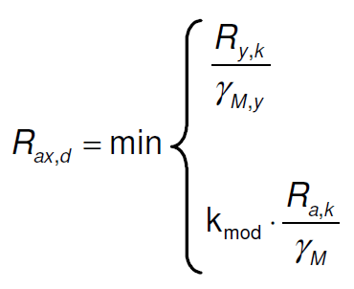
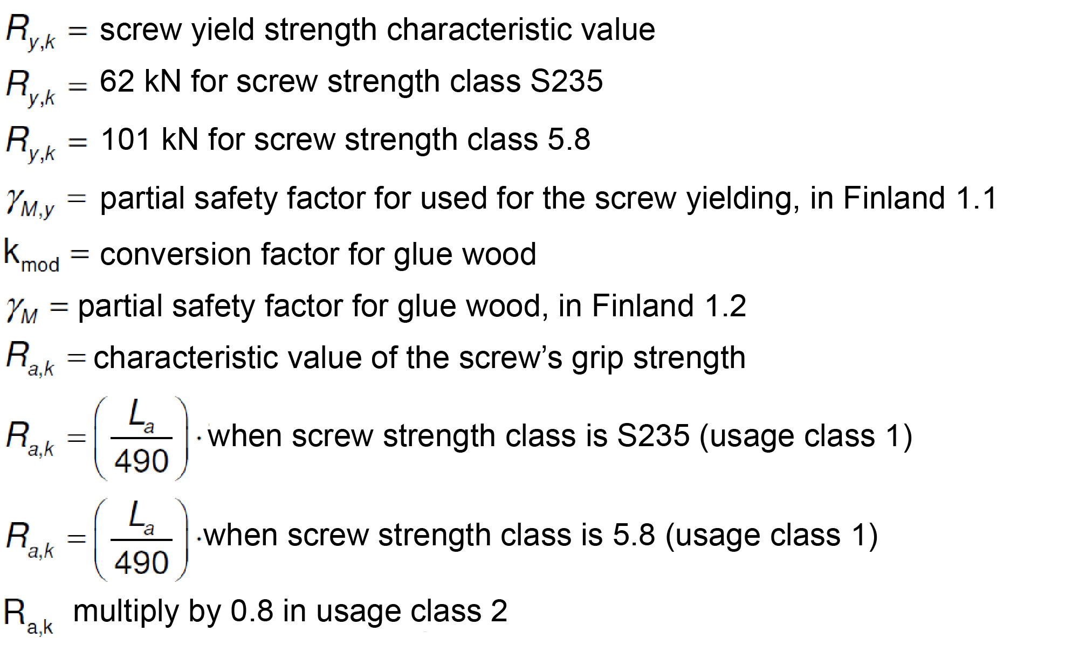
Torsionally rigid adhesive screw joint (cantilever pillar)
Dimensioning
Rated value for normal force strength of the adhesive screw:

Slide 12
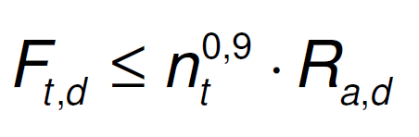
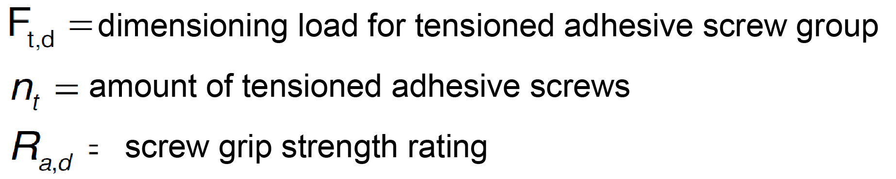
Torsionally rigid adhesive screw joint (cantilever pillar)
Dimensioning
In addition, the tensile stressed adhesive screw group must meet the following condition:

Slide 13
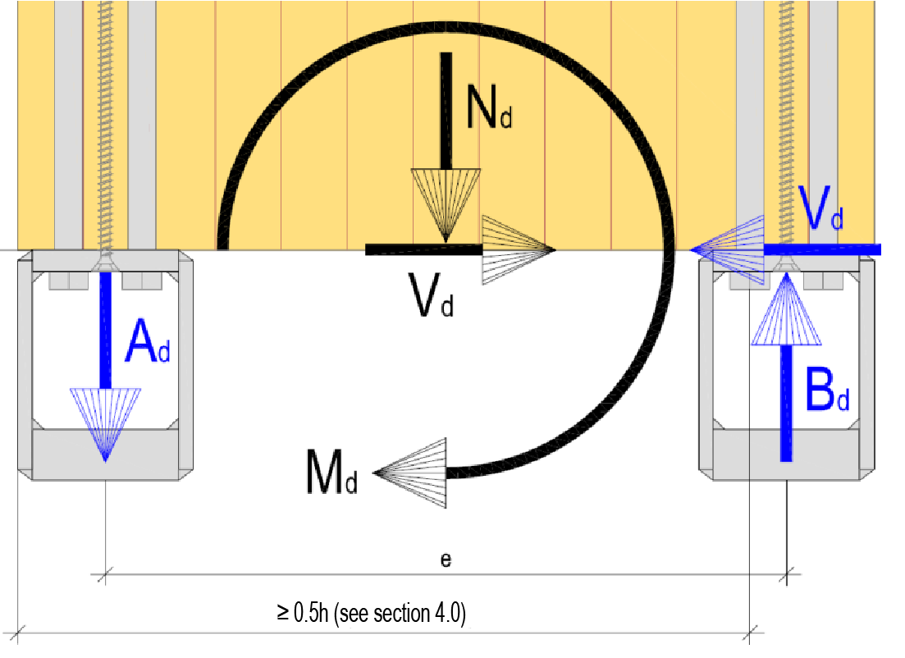
Torsionally rigid adhesive screw joint (cantilever pillar)
Dimensioning
Rated value for the shear strength of the adhesive screw:
The shear force V_{d} in the joint is received by the adhesive screws on the pressed edge of the pillar
Tensile stressed adhesive screws are assumed not to have a shear strength
The shear strength of pressed adhesive screws can be utilised when the distance of the screw from the shear loaded edge of the glue wood cross section is > 0.5 h

Slide 14
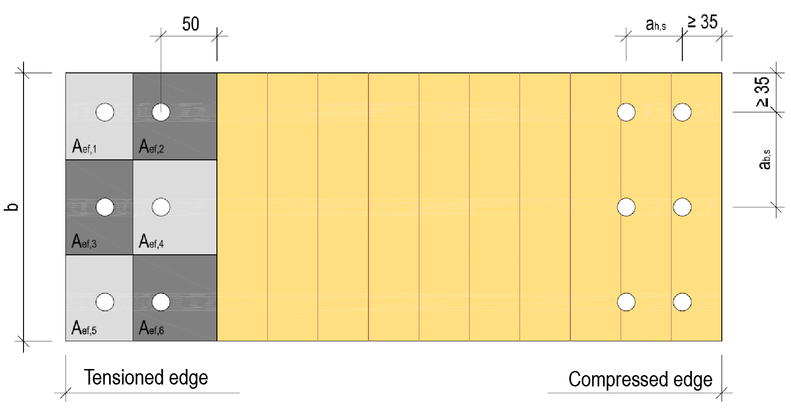
Torsionally rigid adhesive screw joint (cantilever pillar)
Dimensioning
Tensile strength of the glue wood:
The rectangular effective surface area of one adhesive screw A_{ef,i} extends up to 50 mm from the centre of the screw hole
An area corresponding to a 16 mm drill hole (200 mm2) is subtracted from the surface area A_{ef,i}
The A_{ef,i} surface areas of adjacent adhesive screws must not overlap

Slide 15
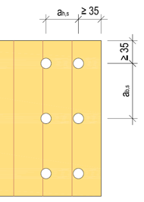
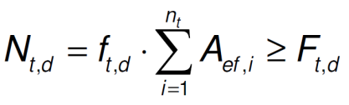
Torsionally rigid adhesive screw joint (cantilever pillar)
Dimensioning
Adhesive screw distances:
GENERAL CENTRAL DISTANCES OF ADHESIVE SCREWS
a_{b,s} = 50 mm, when the screw is S235 and the momentary duration category is dimensioning
a_{b,s} = 60 mm in other cases
a_{h,s} = 65 mm, when the screw is S235 and the momentary duration category is dimensioning
a_{h,s} = 75 mm in other cases
MINIMUM CENTRAL DISTANCES OF ADHESIVE SCREWS
a_{b,}s = 40 mm, when the tensile strength of glue wood fulfils the condition in 5.0
a_{h,s} = 40 mm, when the tensile strength of glue wood fulfils the condition in 5.0
ADHESIVE SCREW INSTALLATION ACCURACY
Drill hole alignment accuracy ± 2 mm
drill hole skew L/100

Slide 16
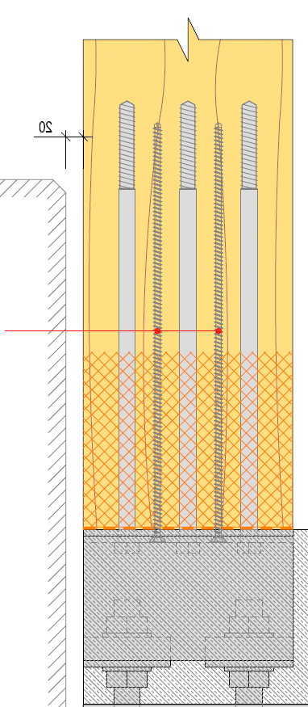
Torsionally rigid adhesive screw joint (cantilever pillar)
Dimensioning
Fire design
If fire resistance is required of the joint, the joint is dimensioned on the adhesive screws not exposed to fire or the joint is dimensioned on the self-drilling screws installed in the direction of the grain
Self-drilling screws are installed in the direction of the grain, so α = 0°
The dimensioning of the screws is carried out based on the tested bond strength of the screw
Steel parts are protected using fire protection painting according to steel construction guidelines

Slide 17
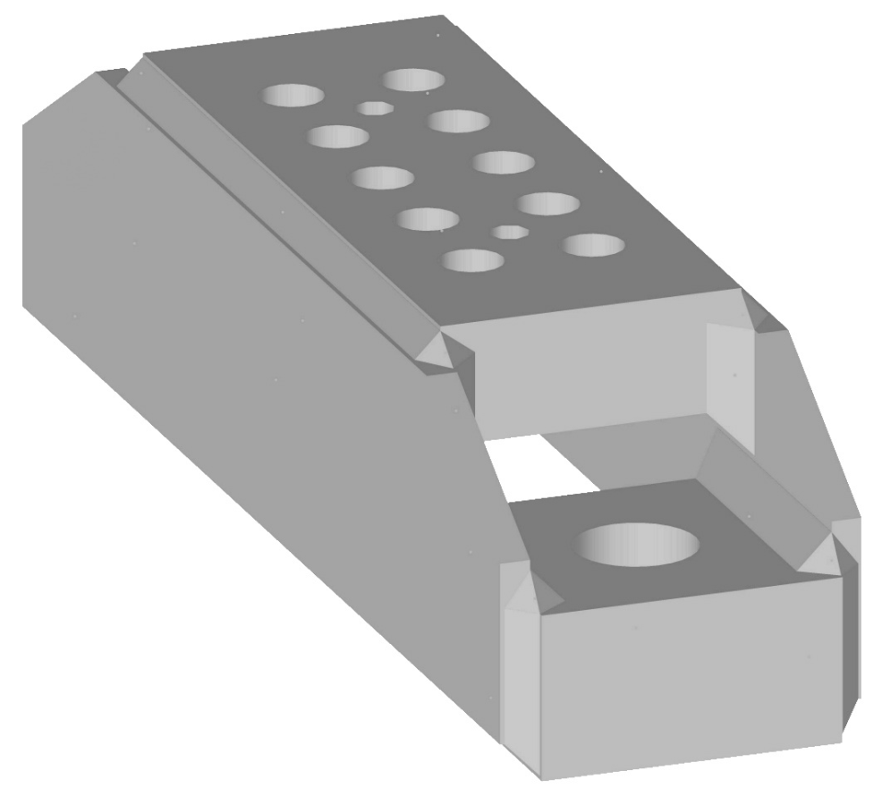
Torsionally rigid adhesive screw joint (cantilever pillar)
Dimensioning
Glue wood pillar shoe – Technical manual and capacity tables:
Client: Finnish Wood Research Oy
Dimensioning: A-insinöörit Suunnittelu Oy

Slide 18
Torsionally rigid adhesive screw joint (cantilever pillar)
Dimensioning
Glue wood pillar shoe
The glue wood pillar shoe is used in joining the glue wood pillar to the foundations
The pillar shoe transfers the forces from the glue wood pillar to the foundation bolts
The purpose of the dimensioning table is to enable the table dimensioning of the pillar shoe in normal pillar shoe cases at pillar widths 115, 140, 165, 190, 215, 240 and 265 mm
This instruction provides the permitted normal force strengths for the glue wood pillar shoe in installation and final situations.
Permissible values are shown in the N_{Rd} tables for different pillar shoe widths and adhesive screw quantities

Slide 19
Torsionally rigid adhesive screw joint (cantilever pillar)
Dimensioning
Glue wood pillar shoe
The table does not comment on the durability of the entire joint. The related parts such as foundation bolts, grouting and adhesive screws must be dimensioned separately.
The capacities given in the instructions apply to the pillar shoes shown in the appendix and their versions for different amounts of adhesive screws
The dimensioning of components is based on standards SFS-EN1993-1-1, SFS-EN1993-1-5 and SFS-EN1993-1-8 and their national appendices

Slide 20
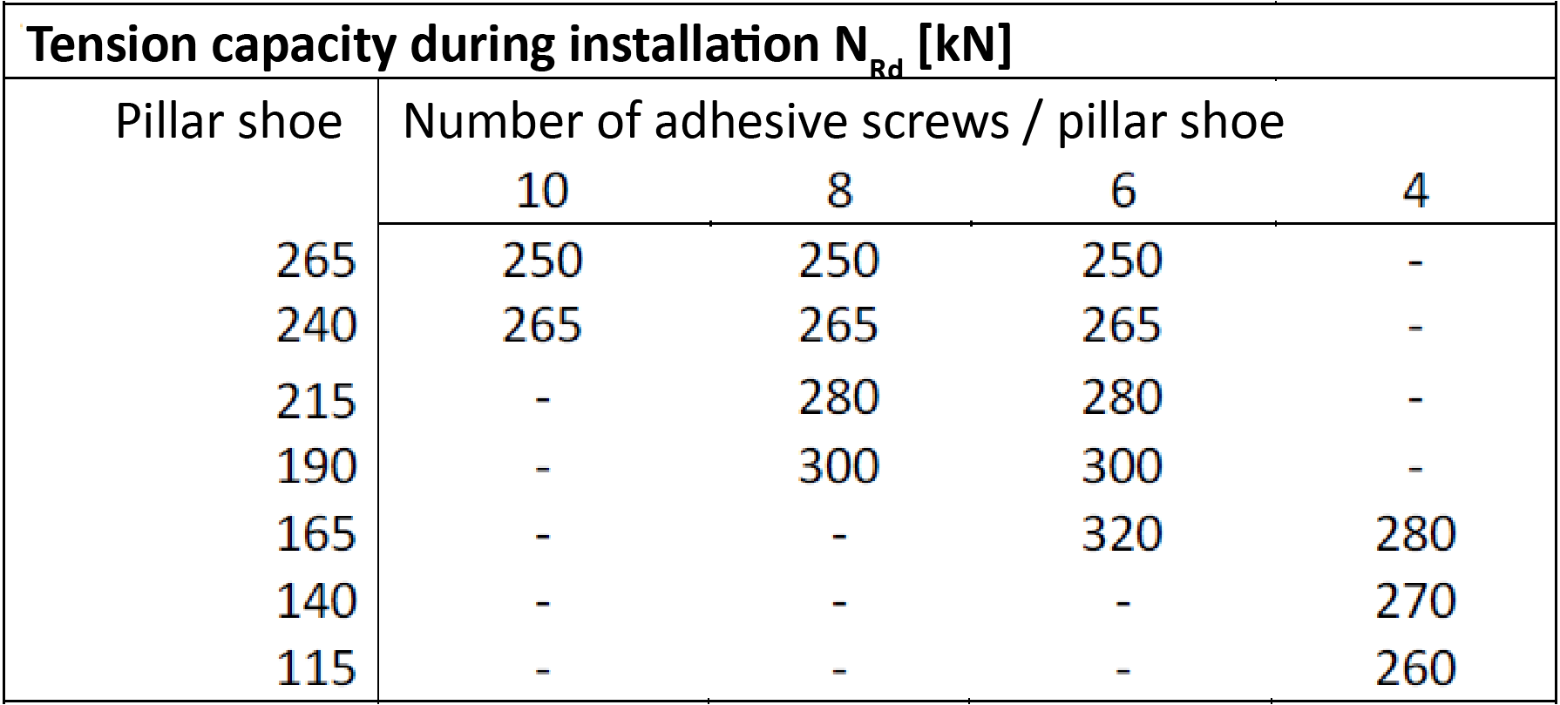
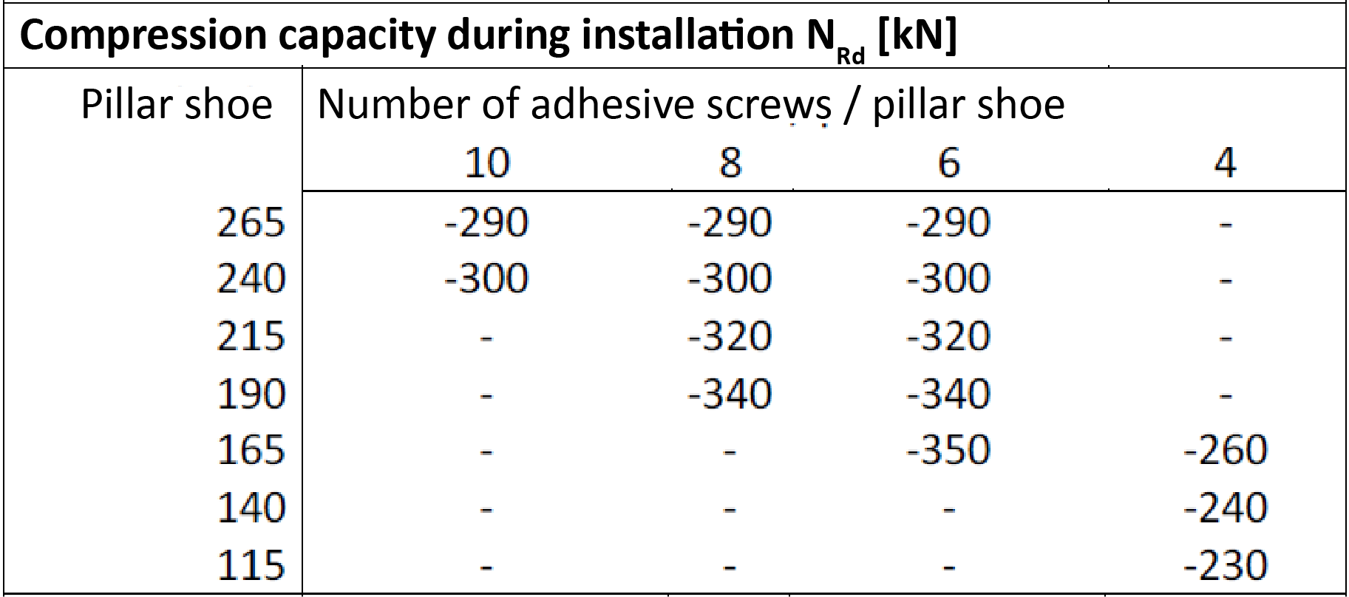
Torsionally rigid adhesive screw joint (cantilever pillar)
Dimensioning
Glue wood pillar shoe capacity tables:

Slide 21
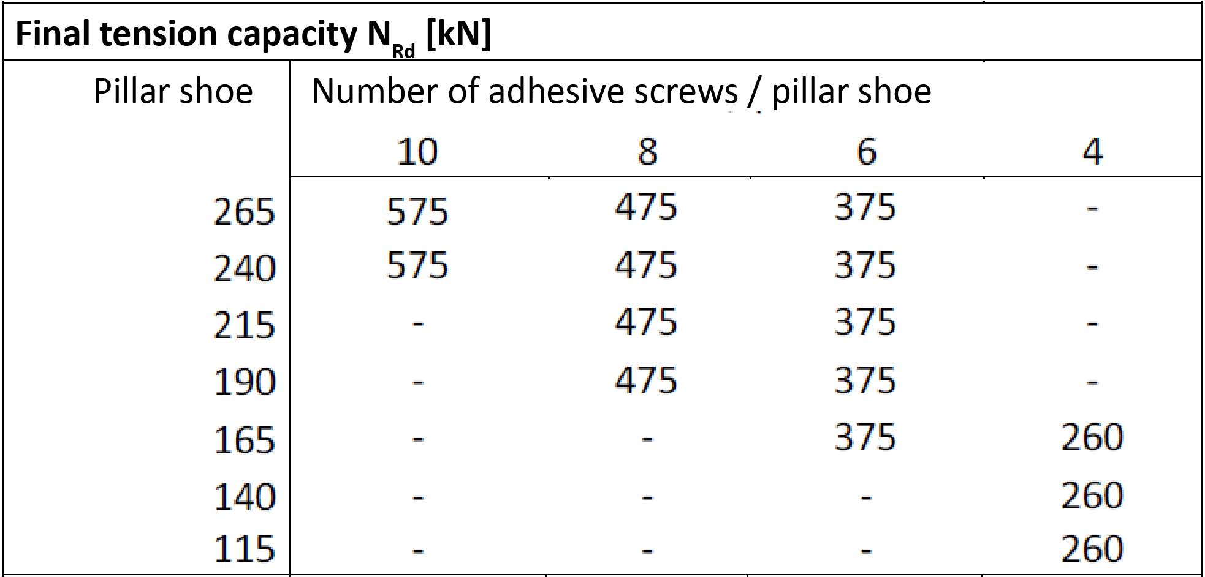
Torsionally rigid adhesive screw joint (cantilever pillar)
Dimensioning
Glue wood pillar shoe capacity tables:

Slide 22
Torsionally rigid adhesive screw joint (cantilever pillar)
Dimensioning
Glue wood pillar shoe, joint implementation:
Grouting is carried out as a pressure box casting, using grouting mortar
The strength class of the mass depends on the strength of the foundation structures, but is at least C 40/50
The mass must be easily condensing and the maximum grain size must not exceed 3 mm
Drying shrinkage of the mass should be minimal
During curing, deformation of the joint must be prevented

Slide 23
Torsionally rigid adhesive screw joint (cantilever pillar)
Dimensioning
Glue wood pillar shoe, joint implementation:
During installation, the pillars must be supported horizontally
The implementation must follow the manufacturer’s instructions
Restrictions on the use of adhesive screws are determined according to the instructions for the adhesive screws used.
Restrictions on the use of foundation bolts are determined according to the foundation structures and the foundation bolt instructions

Slide 24
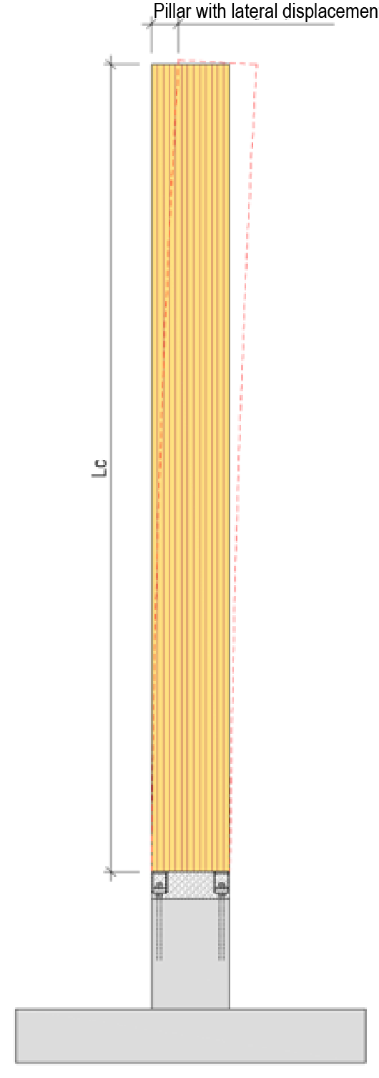
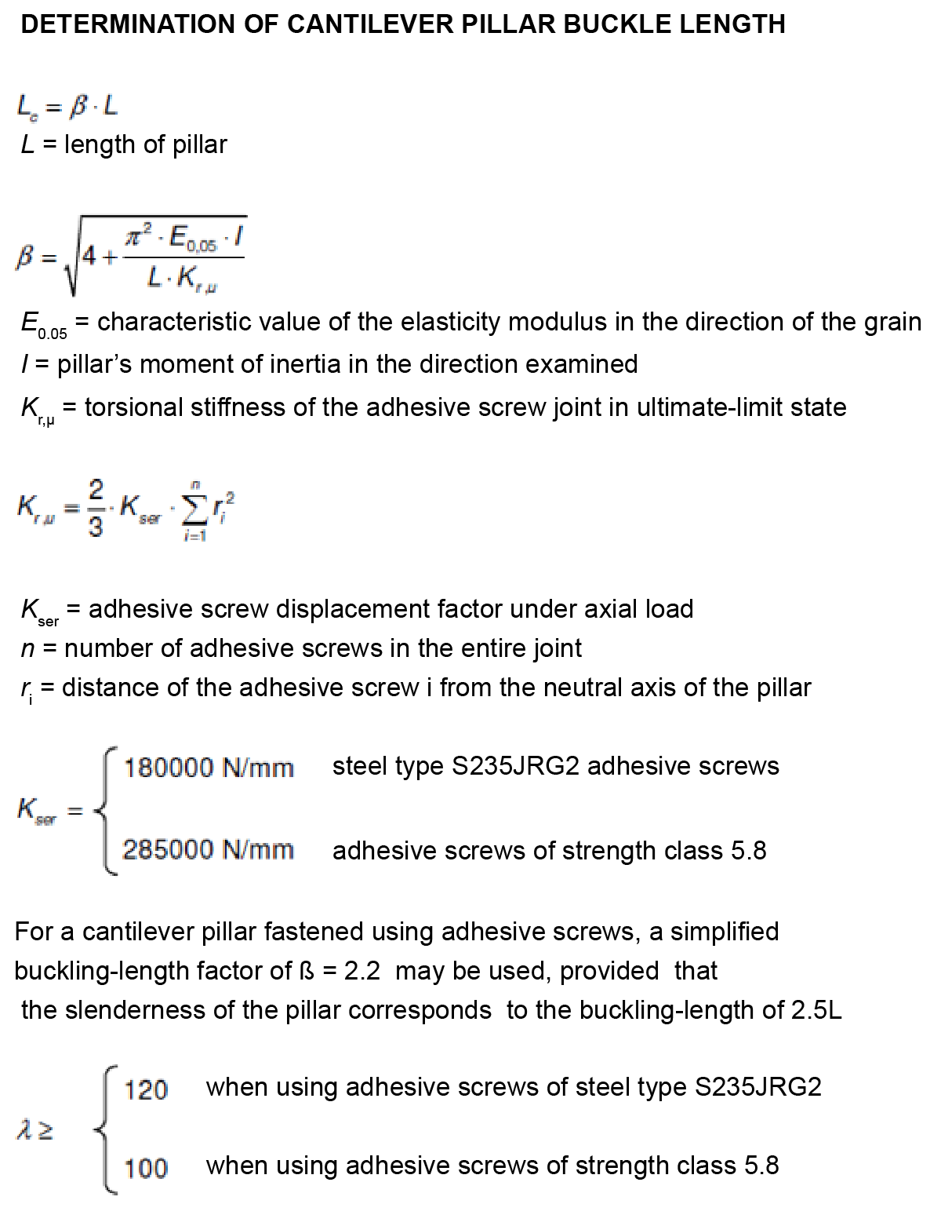
Torsionally rigid adhesive screw joint (cantilever pillar)
Dimensioning

