Slide 1



Industrial wood construction
Teaching materials for industrial wood construction education
2022

Slide 2
Origin of the materials
Use of the materials
These learning materials for industrial wood construction have been prepared in a project led by Puuinfo Oy in 2021–2022. Also involved in the project were
Lappia Vocational College,
TTS-Työtehoseura ry
South-Eastern Finland University of Applied Sciences,
Metropolia University of Applied Sciences,
Jyväskylä University of Applied Sciences,
University of Tampere, and
Federation of the Finnish Woodworking Industries Puutuoteteollisuus ry
The project was funded by the Ministry of the Environment.
The materials are intended to be used as extensively as possible in industrial wood construction education and studies.
The materials are released under the Creative Commons licence Attribution-ShareAlike (CC BY-SA), which requires that the author be properly credited when the materials are used and that derivative works may only be distributed under the same licence as the original work.
The original materials and any updates to them by Puuinfo will be published on the Library of Open Educational Resources website (aoe.fi) and the Puuinfo.fi website.

Slide 3

Structural design

Slide 4
Authors
Jani Pitkänen, XAMK
Release date: 20/01/2022

Slide 5
Glued-in rod joint

Slide 6
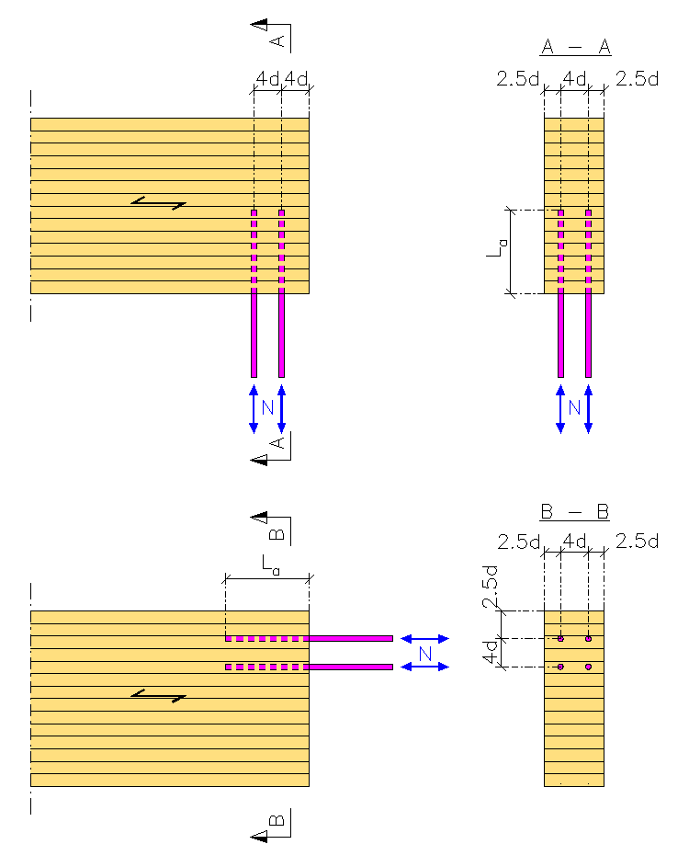
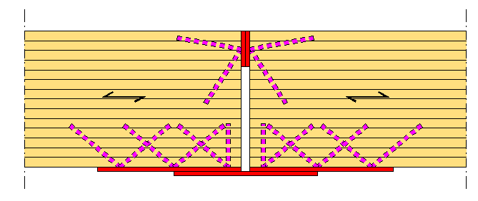
Glued-in rod joint

Slide 7
Glued-in rod joint
General considerations
A certificate is required for the manufacture of structural glued-in rod joints
The glued-in rod joints use the following materials approved by the manufacturers
Adhesives
Manufacturing methods
Quality assurance procedures
These instructions are based on RIL 205 design instructions

Slide 8
Glued-in rod joint
General considerations
Applies to glued-in rod joints of categories 1 and 2 using
Epoxy glue
Circular rods of non-alloy steel or austenitic* stainless steel with threads, brushes or similar profilings
The design of glued-in rod joints may also follow the manufacturer-specific design guidelines for RIL 205 replacements or complementary design guidelines set in the EEA or given in a verification certificate
*) The most common type of stainless steel is austenitic steel, e.g. AISI 304 (1.4301) and AISI 316 (1.4401)

Slide 9
Glued-in rod joint
General considerations
The tensile strength of the material can be used for the dimensioning of tension rods (f_{u,k})
However, a value greater than f_{u,k} = 800 N/mm² should not be used
The dimensioning of pressed bars uses the yield strength of the material (F_{y,k}) or the minimum 0.2 limit (f_{y})
When determining the gripping capacity of a rod, the gripping surface may be calculated according to the diameter of the hole drilled, provided that it does not exceed 1,25 x the diameter of the rod.

Slide 10
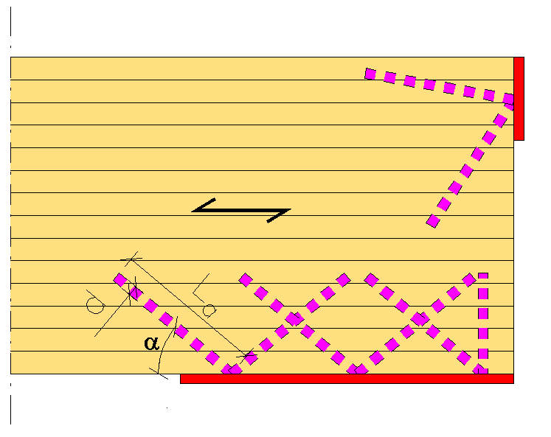
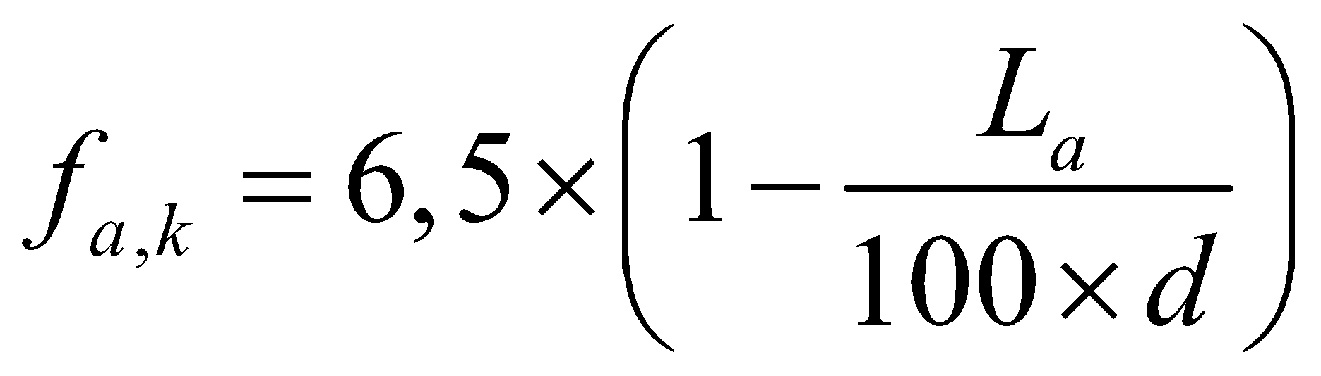
Glued-in rod joint
General considerations
When the orientation angle α > 15° to the direction of the wood, the specific capacity of the glue joint is calculated using the following formula:
where
d = thickness of the rod [mm]
L_{a} = grip length in wood [mm]

Slide 11
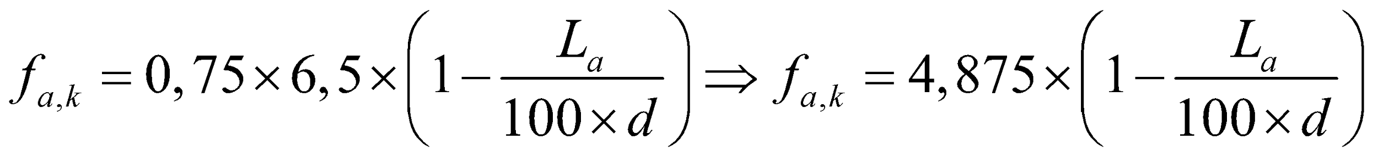
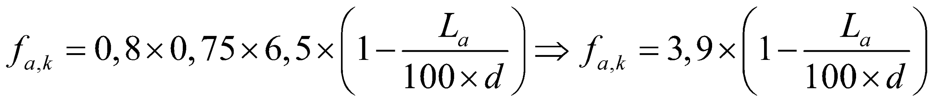
Glued-in rod joint
General considerations
In use class 1, for cylindrically bonded tension rods, the calculation is based on the above formula, but the adhesion strength is reduced by a factor of 0.75:
In use class 2, the cyclic adhesion strength is reduced by a further 20%:
Intermediate values are interpolated linearly

Slide 12
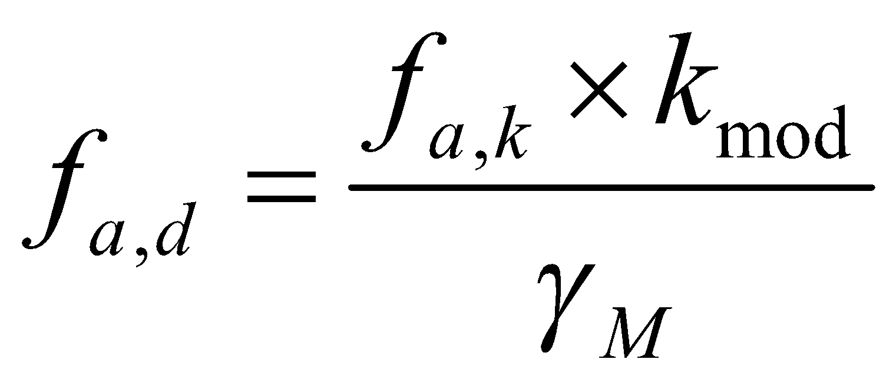
Glued-in rod joint
General considerations
The dimensioing value of the adhesion strength is calculated using the k_{mod} coefficient and the partial uncertainty factor γ_{M}:
where
k_{mod} = coefficient of the wooden section
γ_{M} = partial safety coefficient of the joint

Slide 13
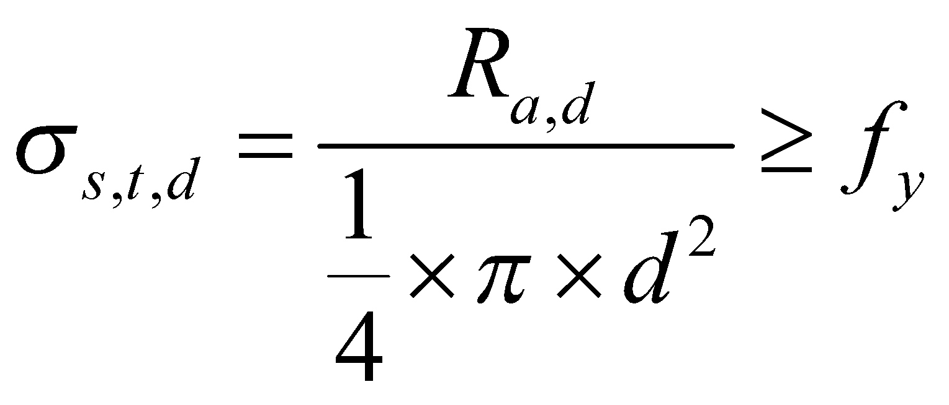
Glued-in rod joint
General considerations
Joints are designed so that the drawn steel bars yield (ductile fracture)
In this case, the length of the drawn bars shall be such that the tensile stress σ_{s,t,d} of the bar corresponding to the design value R_{a,d} of the grip strength of the time class to be dimensioned satisfies the condition:
, where fy is the yield strength of the rod or
the minimum limit of 0.2

Slide 14
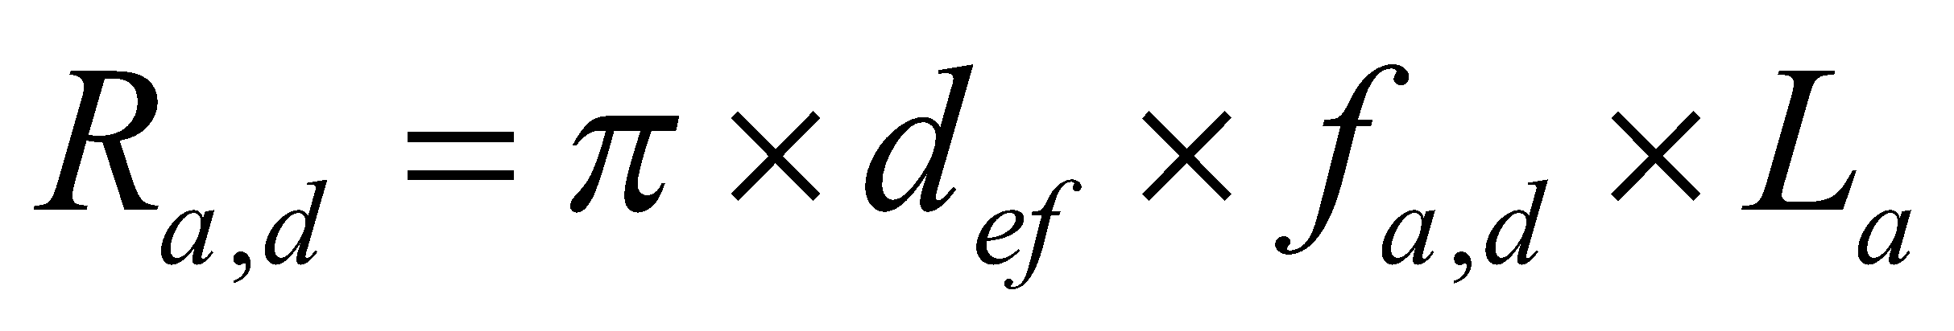
Glued-in rod joint
General considerations
The design value for the grip strength of a steel rod is calculated using the following formula:
where
d_{ef} = is the diameter of the hole drilled in the wood (< 1,25 x d) [mm]
f_{a,d} = dimensioning value of adhesion strength [N/mm²]
L_{a} = grip length of the bar in wood [mm]

Slide 15
Glued-in rod joint
General considerations
When dimensioning the shear joints, the instructions given for sheared bolted joints are applied
The moisture content of the wood at the time of gluing the bars must be on average a maximum of 3 per cent units higher than the lowest design moisture content of the structure
The end surfaces should be coated with, for example, epoxy paint to prevent the transfer of moisture

Slide 16
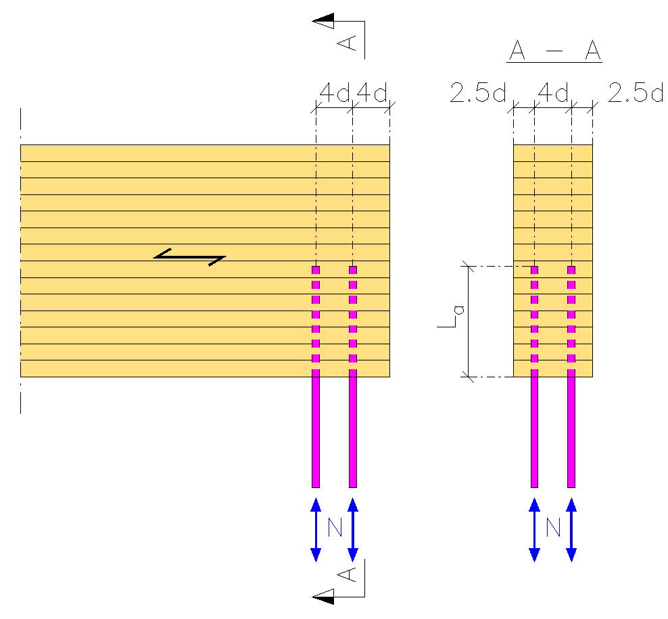
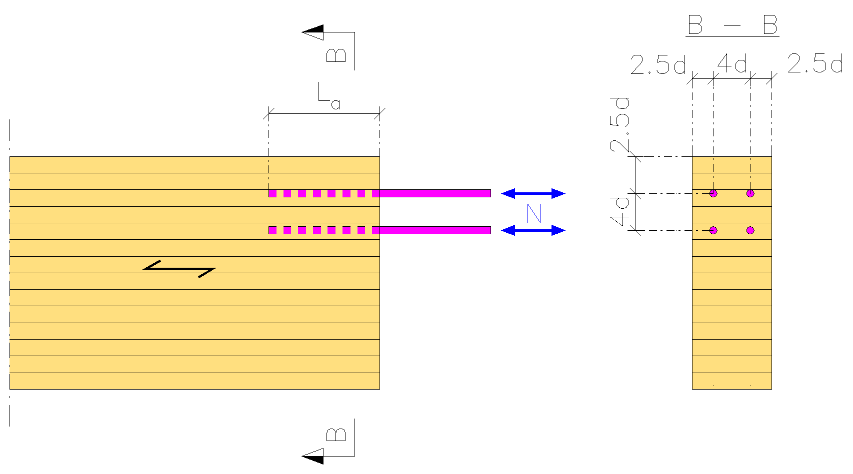
Glued-in rod joint
Longitudinally loaded bars
The minimum permitted distances for the rods are shown in the illustrations below.
With the exception of pillars where manufacturer-specific distances can be used (special reports by Eurofins)

Slide 17
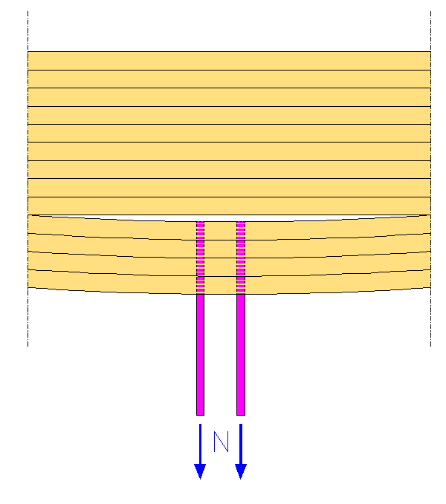
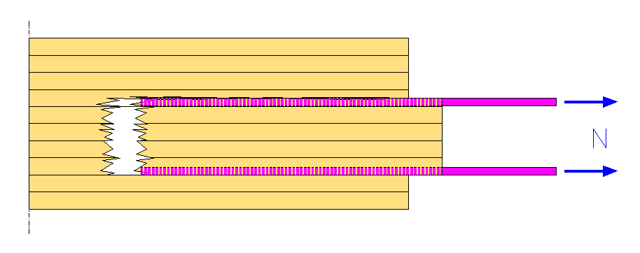
Glued-in rod joint
Longitudinally loaded bars
In drawn joints, the fracture of the joint area along with the bar group should also be checked
Cracking of the wood at the level of the ends of the glued-in rod joints drawn perpendicular to the grain
Fracture cracking in end-grain joints

Slide 18
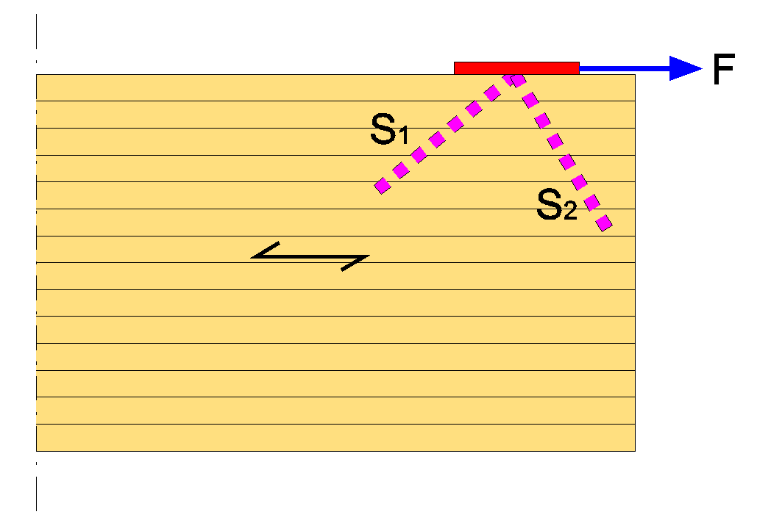
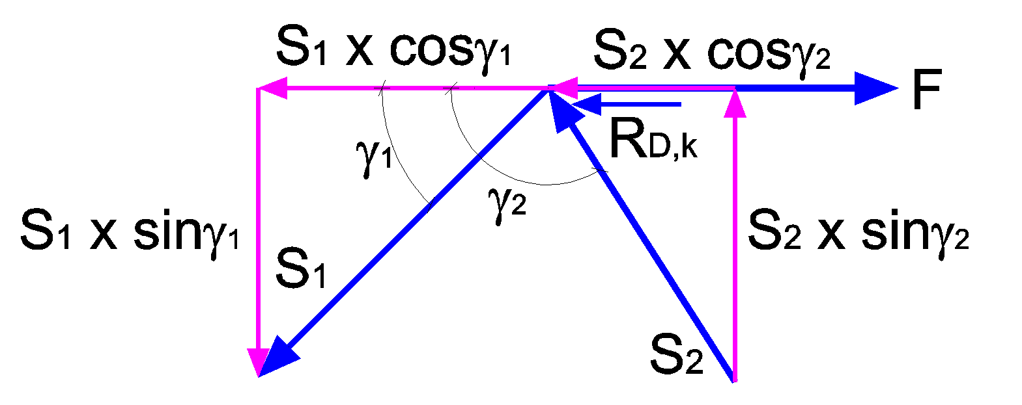
Glued-in rod joint
Diagonal bar joints
Diagonal bar joints consist of two pairs of bars, e.g. of brush steel, bonded diagonally to each other (S₁ and S₂)
These bars are attached to each other to form a whole

Slide 19
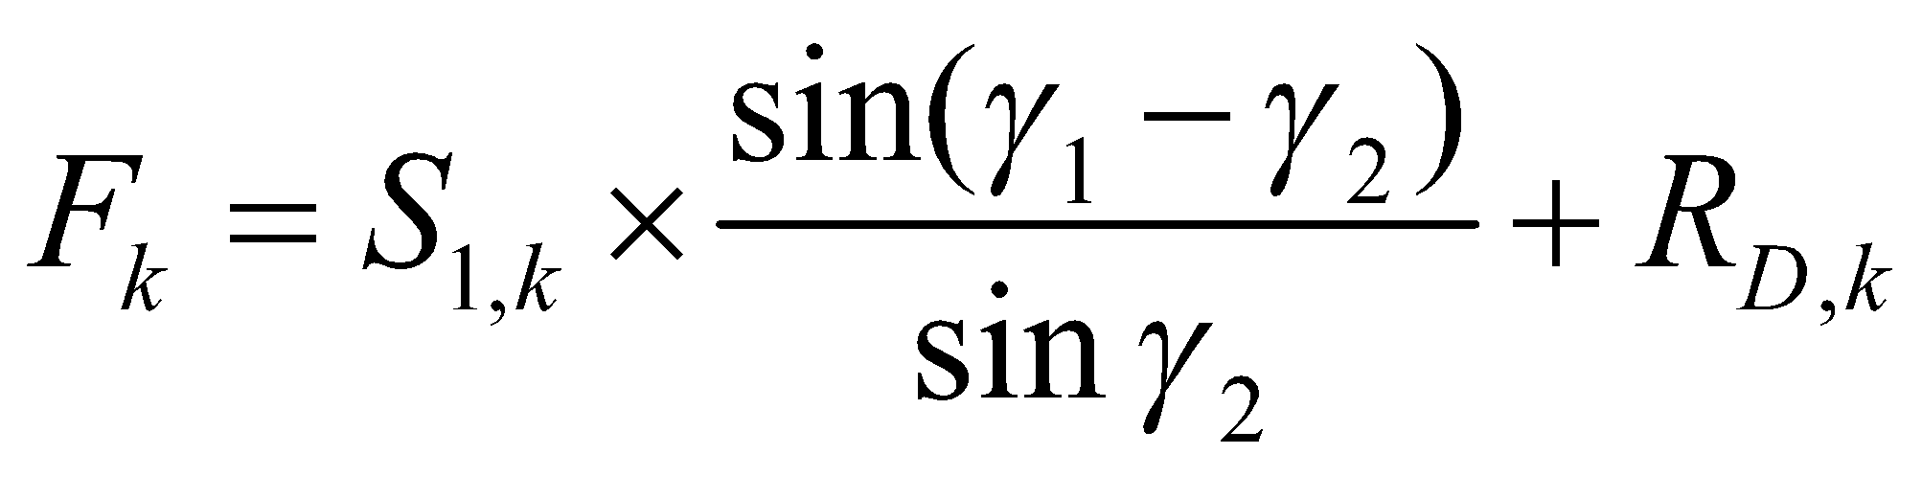
Glued-in rod joint
Diagonal bar joints
The specific strength per pair of bars is obtained from the formula
where
S_{1,k} = tensile strength of the characteristic bar
γ₁ and γ₂ = directional angles of the bars
R_{D,k} = the stiffness of the pressed bars, which can be calculated from the formulae for a shear-loaded steel plate 1-piece bolted joint
provided that γ₂ = 90°…130°

Slide 20
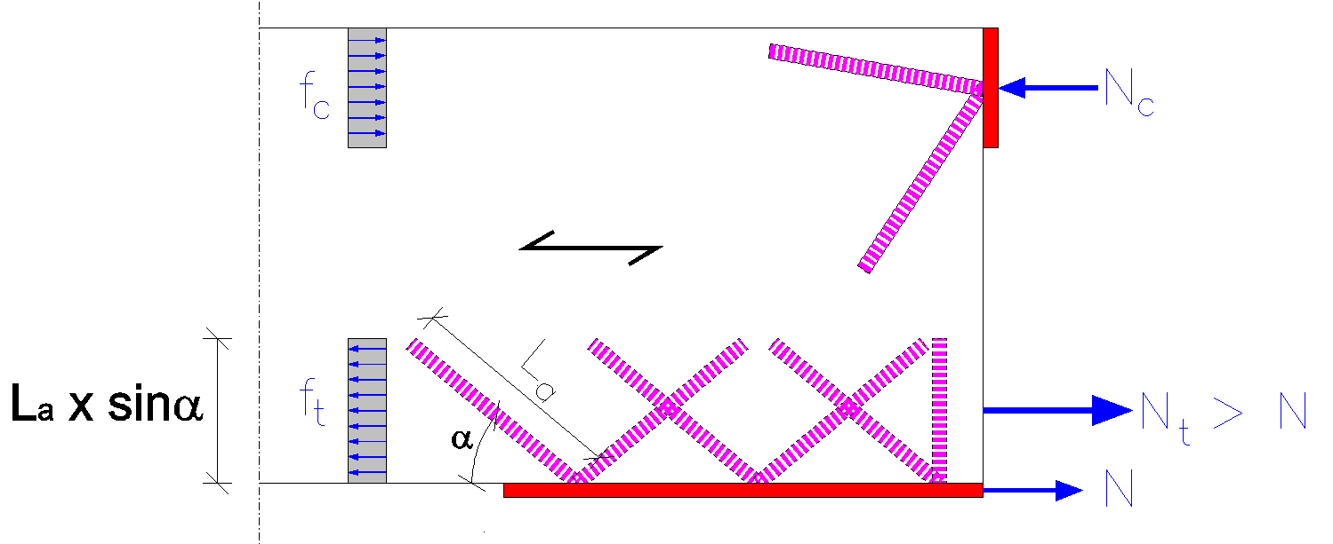
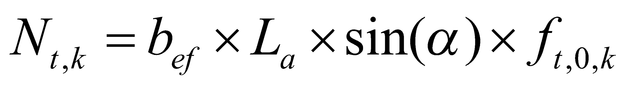
Glued-in rod joint
Diagonal bar joints
The resistance of wood to splitting N_{t,k} in a transverse diagonal beam joint is determined for the effective cross-section of the wood in the joint area by this formula:
where
L_{a} = length of steel rod in wood
α = the angle between the steel bar and the direction of the wood grain
f_{t,0,k} = specific tensile strength of wood

Slide 21
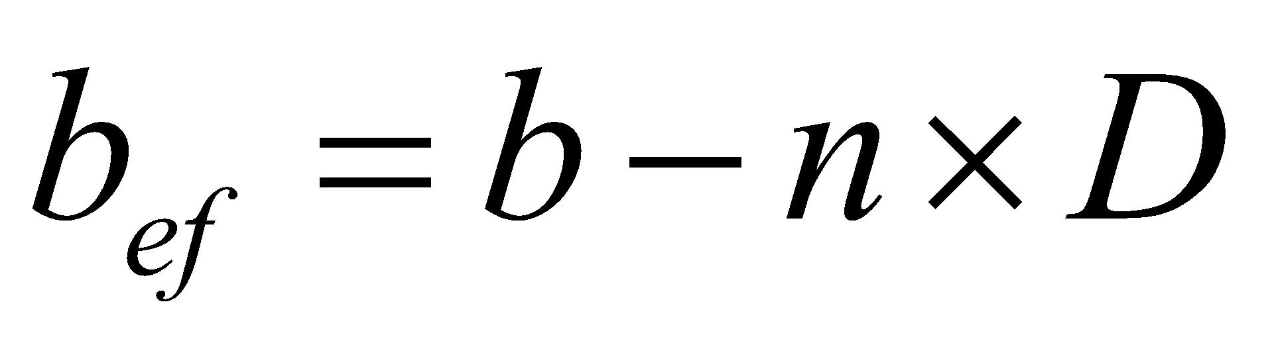
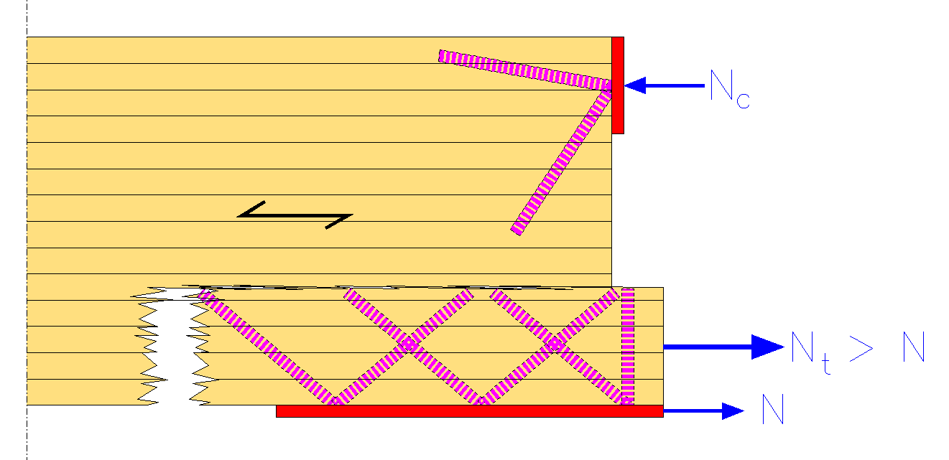
Glued-in rod joint
Diagonal bar joints
The effective width b_{ef} is given by this formula:
where
b = width of the cross-section
n = number D of adjacent boreholes furthest from the joint seam
D = diameter of boreholes

Slide 22
Glued-in rod joint
Diagonal bar joints
The tensile component perpendicular to the direction of rotation is displaced by separate rods
The steel parts related to the rods are dimensioned according to the EN1993 design guidelines for steel structures
The minimum permitted distances between the bars and diagonal joints are as follows:
along the grain: a₁ = 10d
perpendicular to the direction of the grain: a₂ = 3d
end distance in along the grain: a₃ = 10d (7d, when γ₂=90°)
distance from the edge: a₄ = 1.5d

