Slide 1



Industrial wood construction
Teaching materials for industrial wood construction education
2022

Slide 2
Origin of the materials
Use of the materials
These learning materials for industrial wood construction have been prepared in a project led by Puuinfo Oy in 2021–2022. Also involved in the project were
Lappia Vocational College,
TTS-Työtehoseura ry
South-Eastern Finland University of Applied Sciences,
Metropolia University of Applied Sciences,
Jyväskylä University of Applied Sciences,
University of Tampere, and
Federation of the Finnish Woodworking Industries Puutuoteteollisuus ry
The project was funded by the Ministry of the Environment.
The materials are intended to be used as extensively as possible in industrial wood construction education and studies.
The materials are released under the Creative Commons licence Attribution-ShareAlike (CC BY-SA), which requires that the author be properly credited when the materials are used and that derivative works may only be distributed under the same licence as the original work.
The original materials and any updates to them by Puuinfo will be published on the Library of Open Educational Resources website (aoe.fi) and the Puuinfo.fi website.

Slide 3
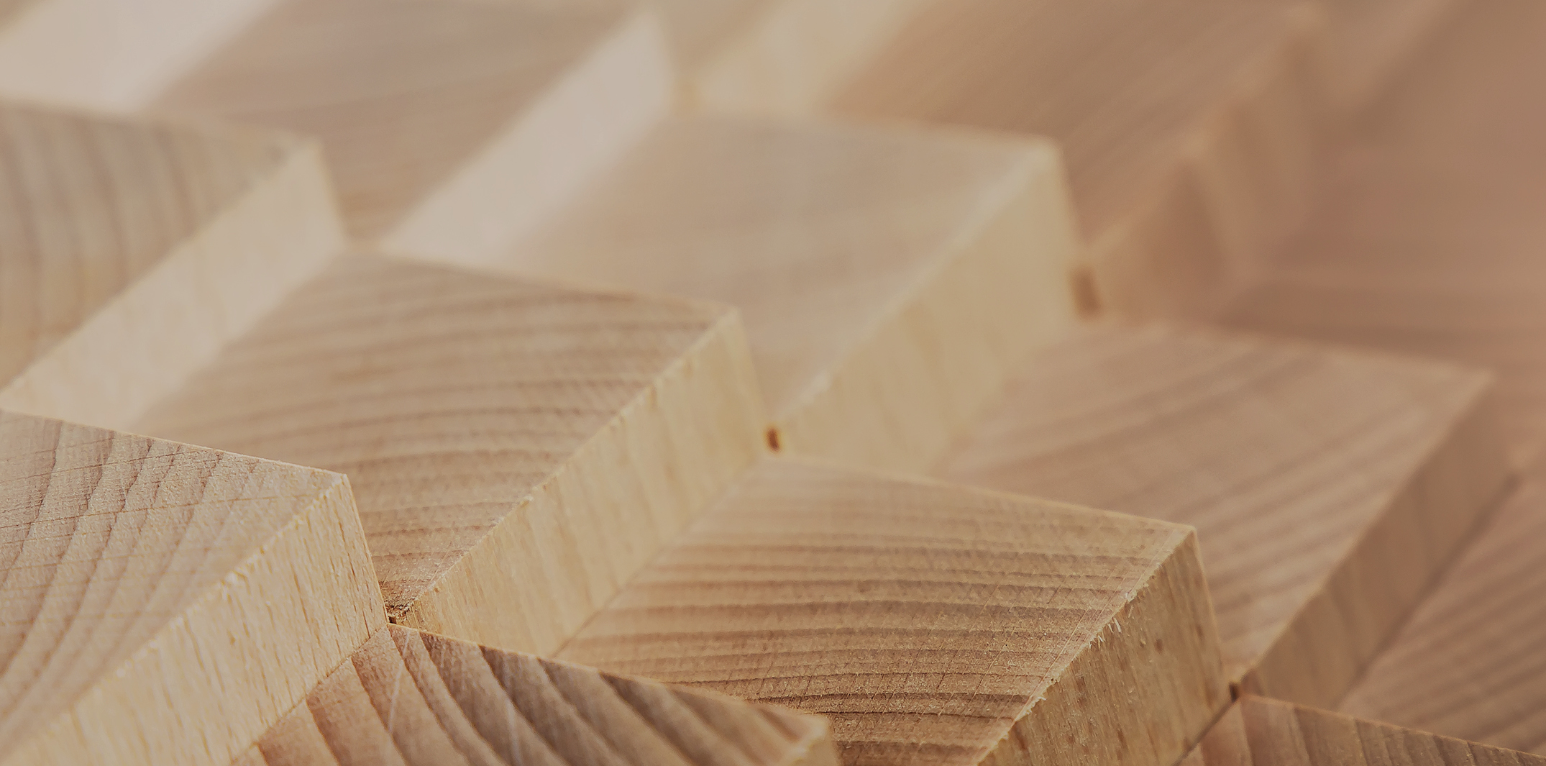
Structural design

Slide 4
Authors
Jani Pitkänen, XAMK
Release date: 20/01/2022

Slide 5
Fork board joint

Slide 6
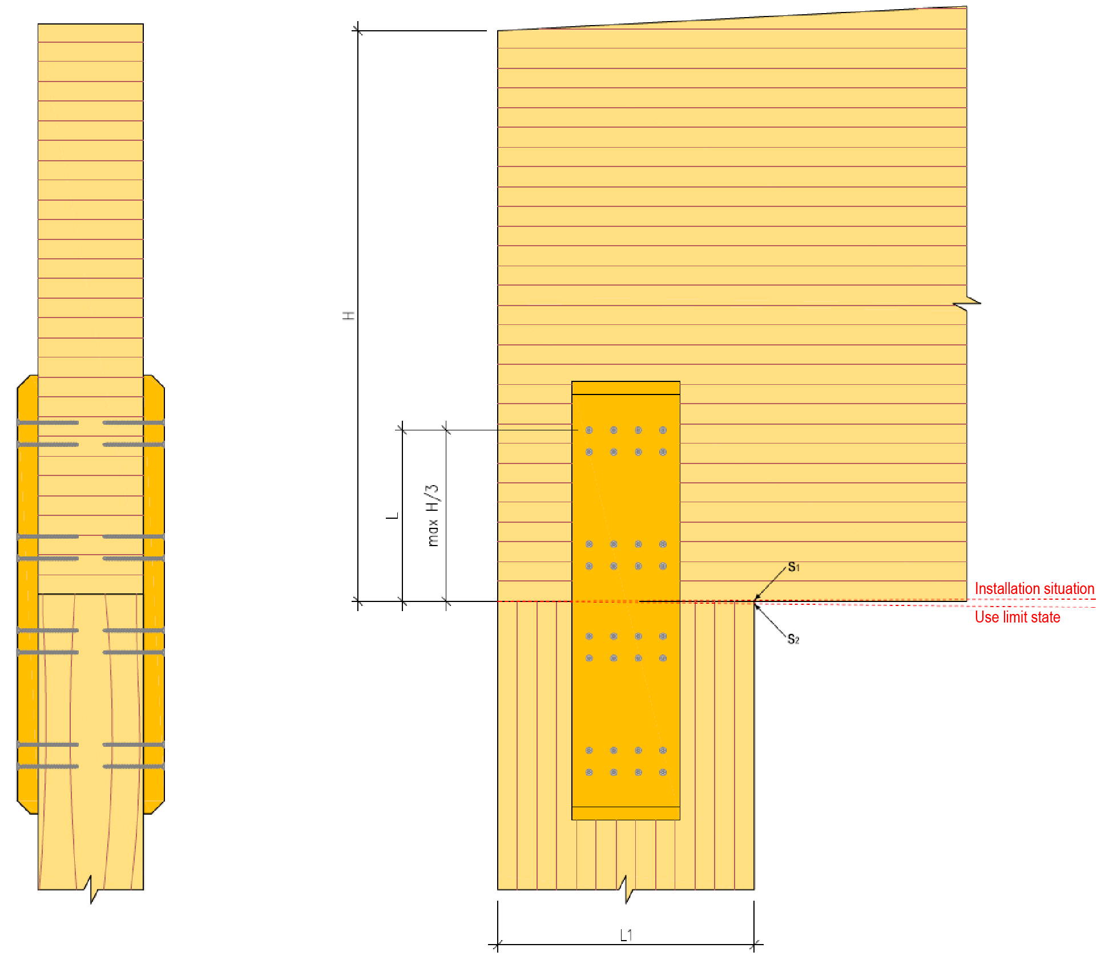
Fork board joint of glue wood pillar and beam

Slide 7
Fork board joint of glue wood pillar and beam
History of the fork board joint
The fork board joint is a traditional type of joint
No detailed instructions for dimensioning have previously been presented
Earlier, the joint was often dimensioned for the horizontal force at the end of the pillar Hd. In other words, only the forces in the direction of the frame were taken into account in the calculation.
The position of the fork board varied (front edge of the pillar, middle, back edge)
The connectors were from a few nails to several bolts

Slide 8
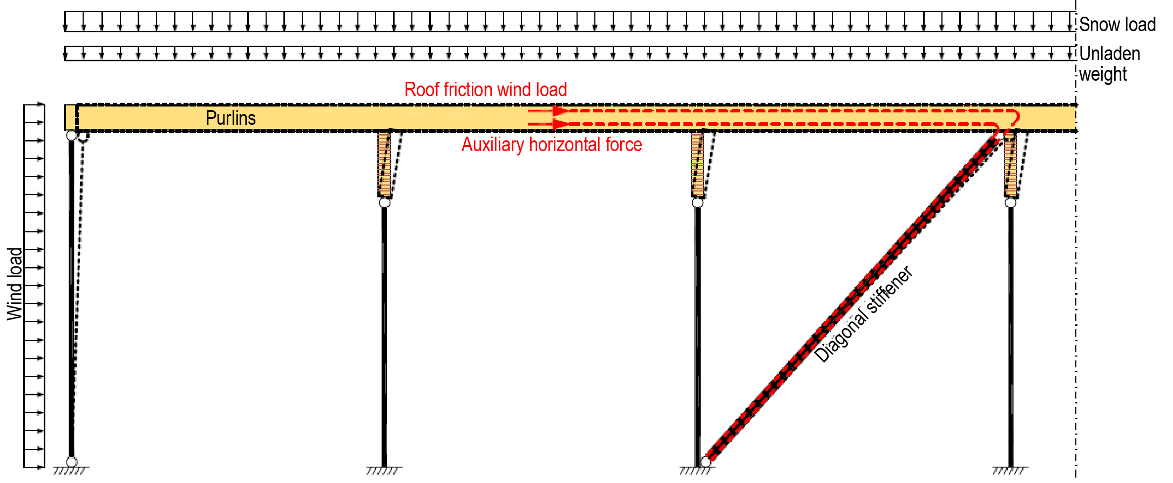
Fork board joint of glue wood pillar and beam
History of the fork board joint
HalliPES 1.0 presents a dimensioning method in which the forces of the fork board joint are determined based on the deformation of the frame in the longitudinal and transverse directions.

Slide 9

Fork board joint of glue wood pillar and beam
History of the fork board joint
This dimensioning method is under continuous development
All improvement suggestions and comments are welcome

Slide 10
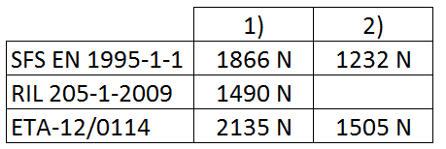
Fork board joint of glue wood pillar and beam
Factors to be taken into account in the dimensioning
As a rule, the connectors (screws) become the determining factor
It is recommended to use glue wood as the fork board, e.g. GL30cs
It is advisable to use the ETA reports of the screw manufacturers (d_{ef} = d) => the rope effect is utilised => the capacity of the joints increases
1) with rope effect
1) without rope effect

Slide 11
Fork board joint of glue wood pillar and beam
Factors to be taken into account in the dimensioning
Screws should be fully threaded, so that the joint can be dimensioned for just the threads (tension), and there is no need to find out data for the head (f_{head,k}, no general value)
Attention must be paid to the distances and minimum thicknesses of the connectors (fork board)
RIL 205, EN 1995 and ETA(s) => different values
Pre-drilling of the fork board => mounting screws in screw groups easier

Slide 12
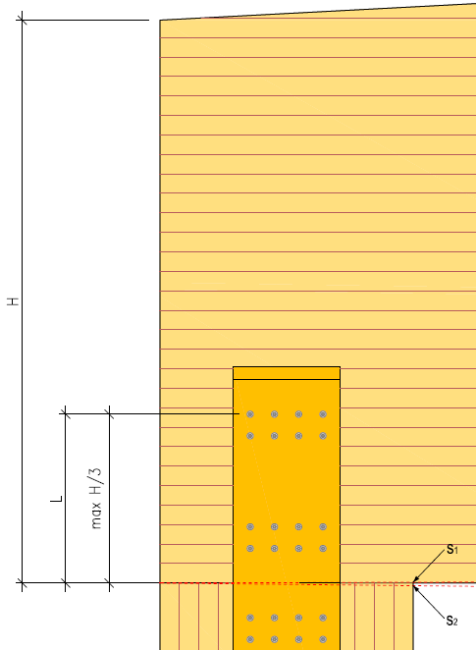
Fork board joint of glue wood pillar and beam
Factors to be taken into account in the dimensioning
No pre-drilling on the beam
Angle between force and grain, between connector and grain or between force and connector? Depends which instruction the dimensioning follows ☺
The effect of the change in the moisture of the main support is taken into account in that L is limited to H/3.
The fork board does not significantly prevent deformation due to moisture in the beam

Slide 13
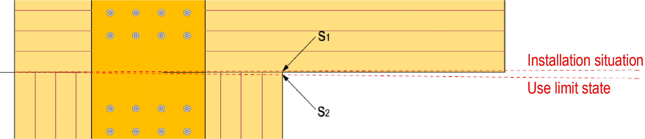
Fork board joint of glue wood pillar and beam
Factors to be taken into account in the dimensioning
Angle changes in the main support are taken into account by installing the fork board at the middle of the pillar
Impact of angle change minor
During installation, there is usually a gap S₁ between the pillar and the support when the main support is pre-elevated
Deformation S₂ in the main support occurs when the main support bends

Slide 14
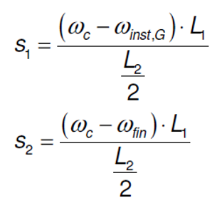
Fork board joint of glue wood pillar and beam
Factors to be taken into account in the dimensioning
S₁ and S₂ can be estimated using the following formulas:
ω_{c} = main support pre-elevation
ω_{inst,G} = main support temporary deflection from permanent load
ω_{fin} = main support final deflection
L₁ = pillar side measure
L₂ = main suppor span length

Slide 15
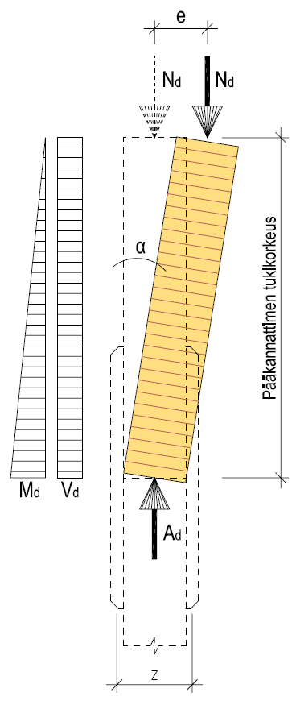
Fork board joint of glue wood pillar and beam
Dimensioning
The joint between the main bracket and the pillar is made into a moment extension by using a fork board joint
The force N_{d} passes through the joint to the pillar and the foundation
If this is not done, a horizontal stiffening rod must be designed at the top of the pillar to support the joint laterally
Support height of the main support

Slide 16
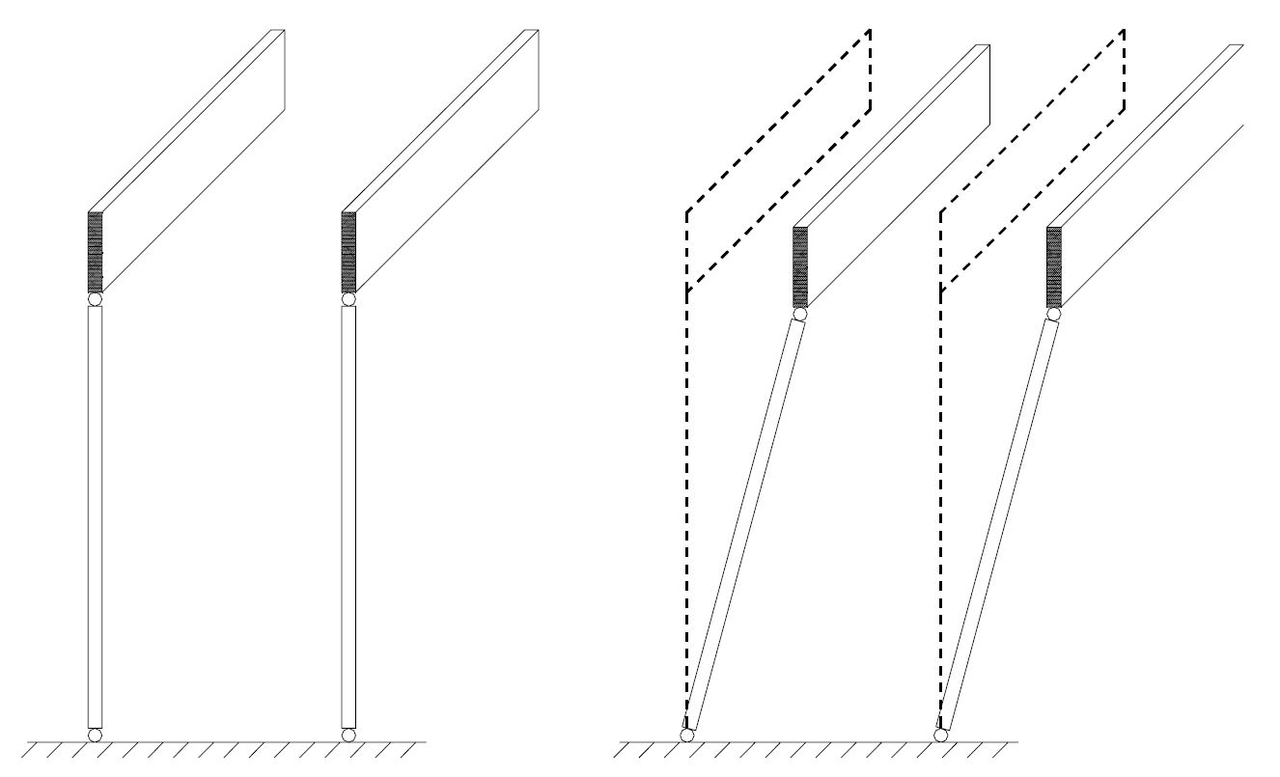
Fork board joint of glue wood pillar and beam
Dimensioning

Slide 17
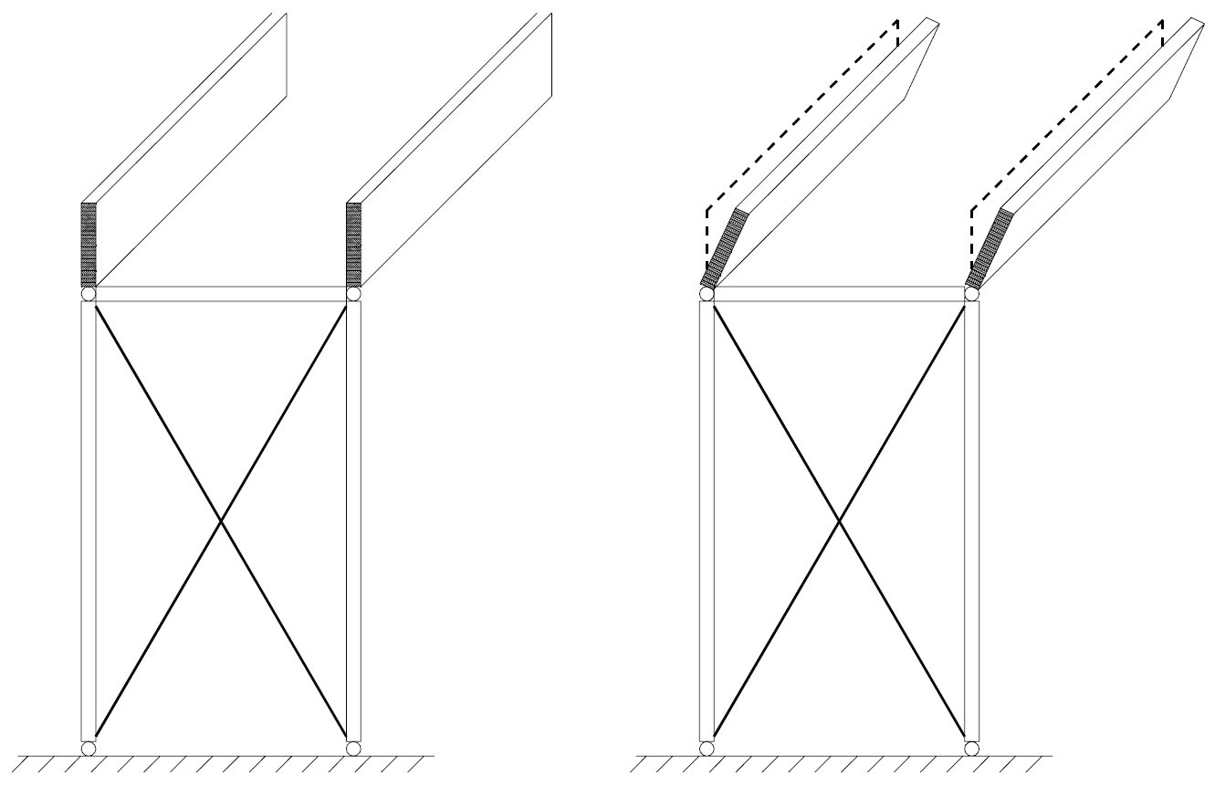
Fork board joint of glue wood pillar and beam
Dimensioning

Slide 18
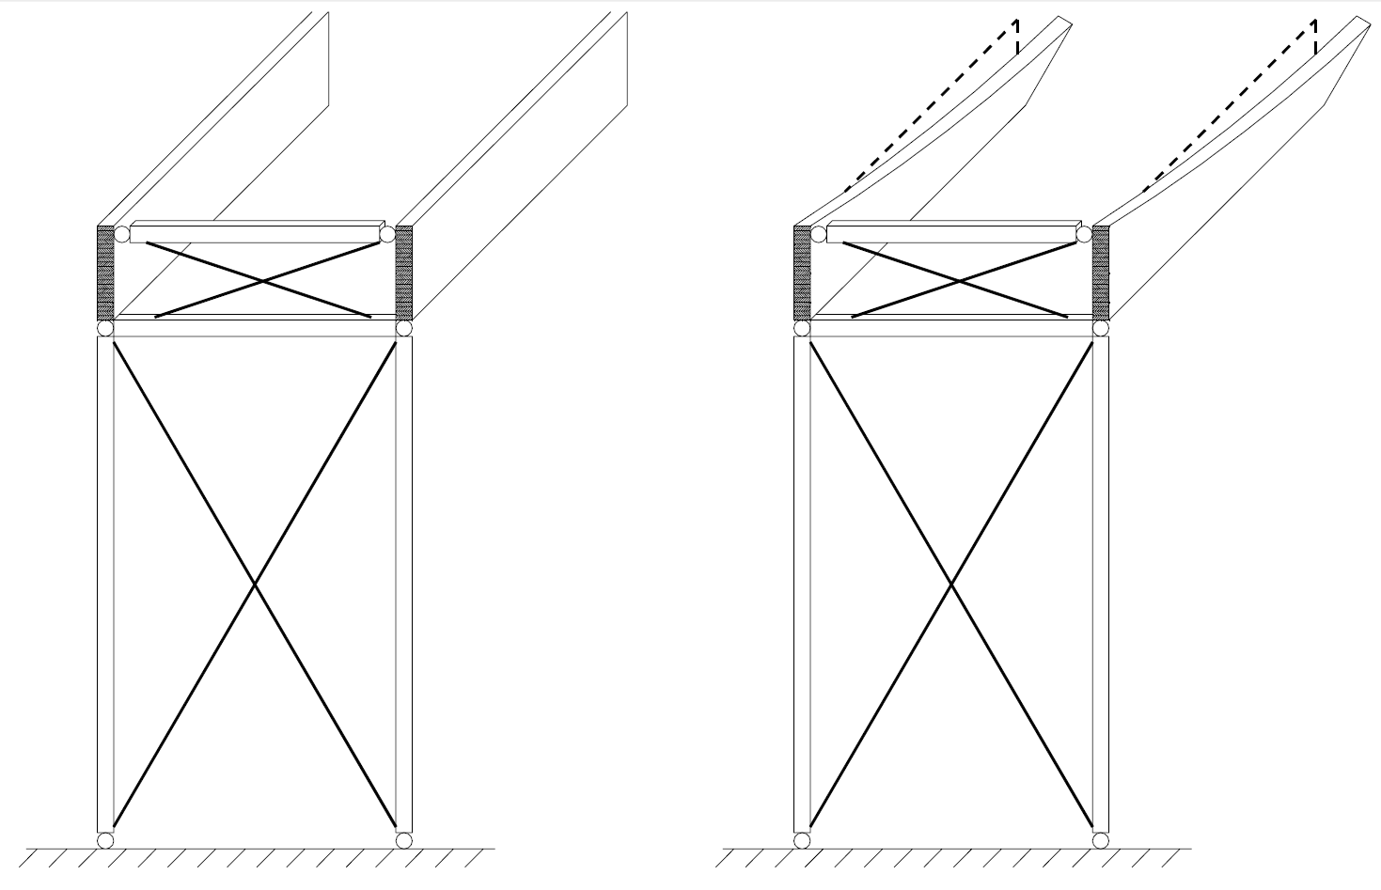
Fork board joint of glue wood pillar and beam
Dimensioning

Slide 19
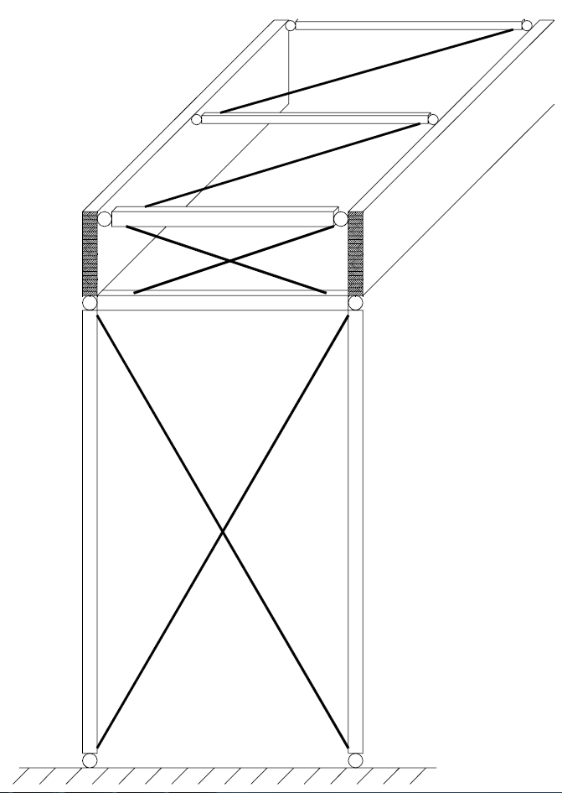
Fork board joint of glue wood pillar and beam
Dimensioning

Slide 20
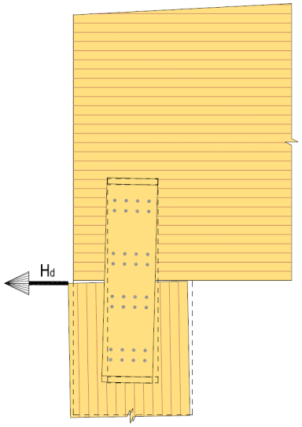
Fork board joint of glue wood pillar and beam
Dimensioning
The magnitude of the forces generated in the fork board depends most of all on how much of an incline it can reach
Displacement of the upper edge of the main support relative to the lower surface of the main support (eccentricity e)
This eccentricity causes moment and shear force in the fork board joint
Support height of the main support

Slide 21
Fork board joint of glue wood pillar and beam
Dimensioning
Eccentricity e derives from:
Mounting accuracy (mounting slant) of the main support
Main support top edge displacement from wind load
Main support top edge displacement from main support stiffening load
Main support top edge displacement from additional horizontal force
Displacements b, c and d depend on the stiffness of the longitudinal stiffeners of the hall
In instructions RIL 205, the displacement of the stiffeners of roof structures is limited in to L/500 of the load in the ultimate-limit state (e.g. L = 30 m => displacement < 60 mm)

Slide 22
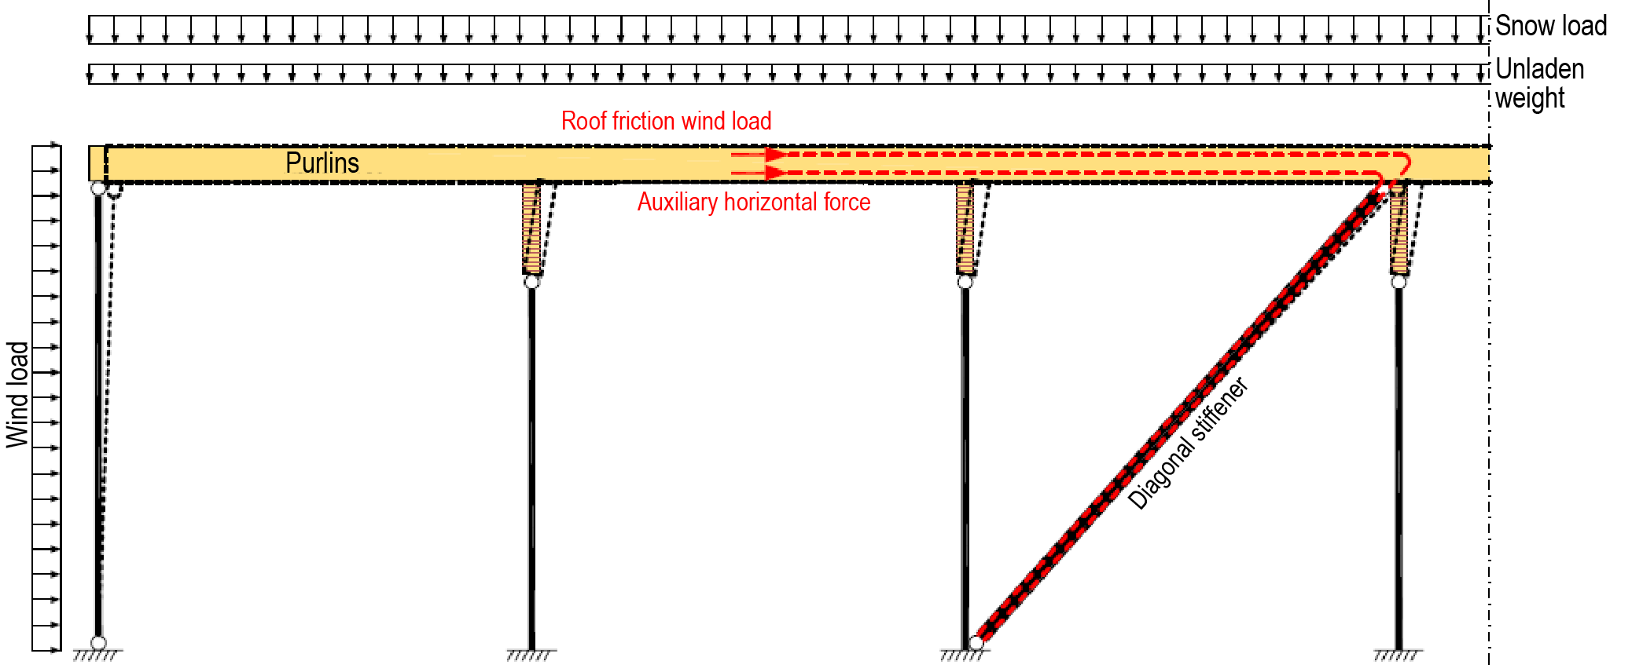
Fork board joint of glue wood pillar and beam
Dimensioning
The additional horizontal force in the roof plane and the wind load caused by the friction of the roof are transferred through the purlins directly to the horizontal and vertical stiffeners, causing loads on the fork board joint through the flexibility of the stiffeners in question

Slide 23
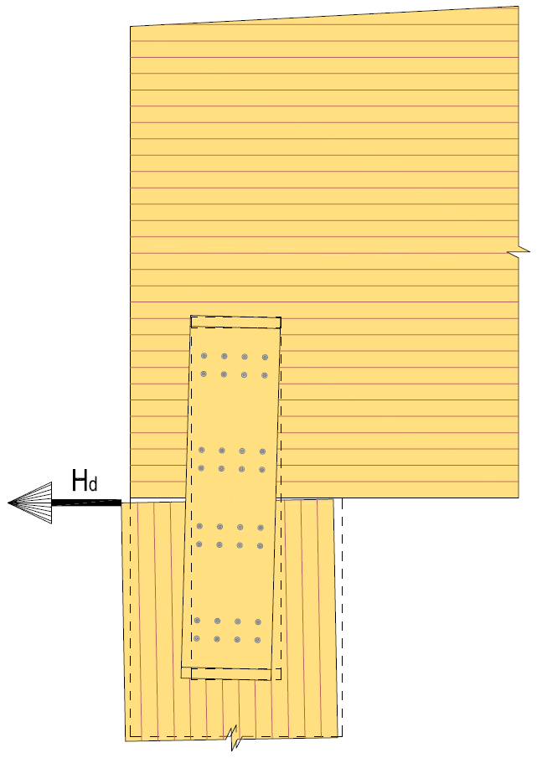
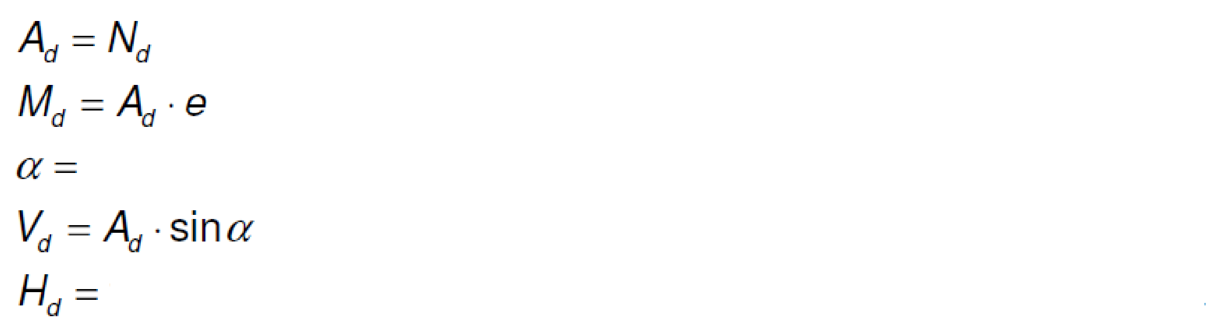
Fork board joint of glue wood pillar and beam
Dimensioning
This dimensioning method does not take into account the stabilising effect of the main support reaction on the joining forces
The forces affecting the joint are calculated using the following formulas:
Support height of the main support
(main support support reaction)
Slope of the main support
support reaction due to wind suction load at the top of the pillar

Slide 24
Fork board joint of glue wood pillar and beam
Dimensioning (connectors)
Self-drilling screws are recommended
Holes are pre-drilled in the fork board
In addition, the screws are fully threaded
When dimensioning according to RIL 205, it is recommended to use screws with outer diameter d > 9 mm
Thread inside diameter is 0.6d < d_{i} < 1.1d (SFS EN 14592)
The effect of the threaded portion of the screw should be taken into account when determining durability using effective diameter d_{ef} = 1.1 x d_{i} (d_{i} = inside diameter of thread)

Slide 25
Fork board joint of glue wood pillar and beam
Dimensioning (connectors)
When dimensioning according to RIL 205, it is recommended to use screws with outer diameter d > 9 mm
For partially threaded screws with diameter d_{ef} > 6 mm, the rules in section 8.5.1 apply (transversely loaded bolts)
For partially threaded screws with diameter d_{ef} < 6 mm, the rules in section 8.3.1 apply (transversely loaded nails)
The screw does not require pre-drilling if the screw has a drill tip => no pre-drilling on the side of the beam
When using ETA reports, def = d can be used

Slide 26
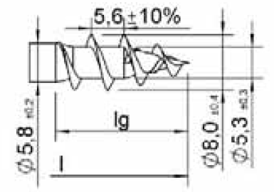
Fork board joint of glue wood pillar and beam
Dimensioning (connectors)
Example: Würth ASSY VG Plus d = 8 mm (di = 5.3 mm)
RIL 205: d_{ef} = 1.1 x d_{i} = 5,83 mm < 6 mm
=> Dimensioning according to nails
ETA: d_{ef} = d = 8 mm > 6mm
=> Dimensioning according to bolts
Bolt distances smaller than nails => smaller joining area

Slide 27
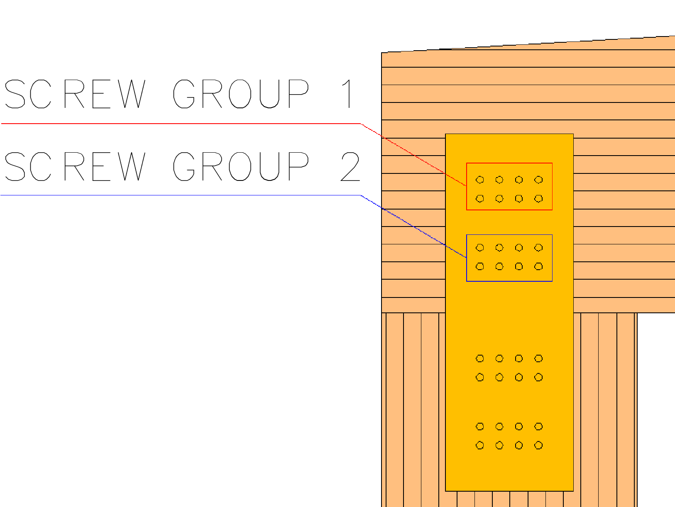
Fork board joint of glue wood pillar and beam
Dimensioning (joining forces)
The following forces are generated in screw group 1 of the fork board joint when the joint has 2 screw groups/fork board half (2 pcs)

Slide 28
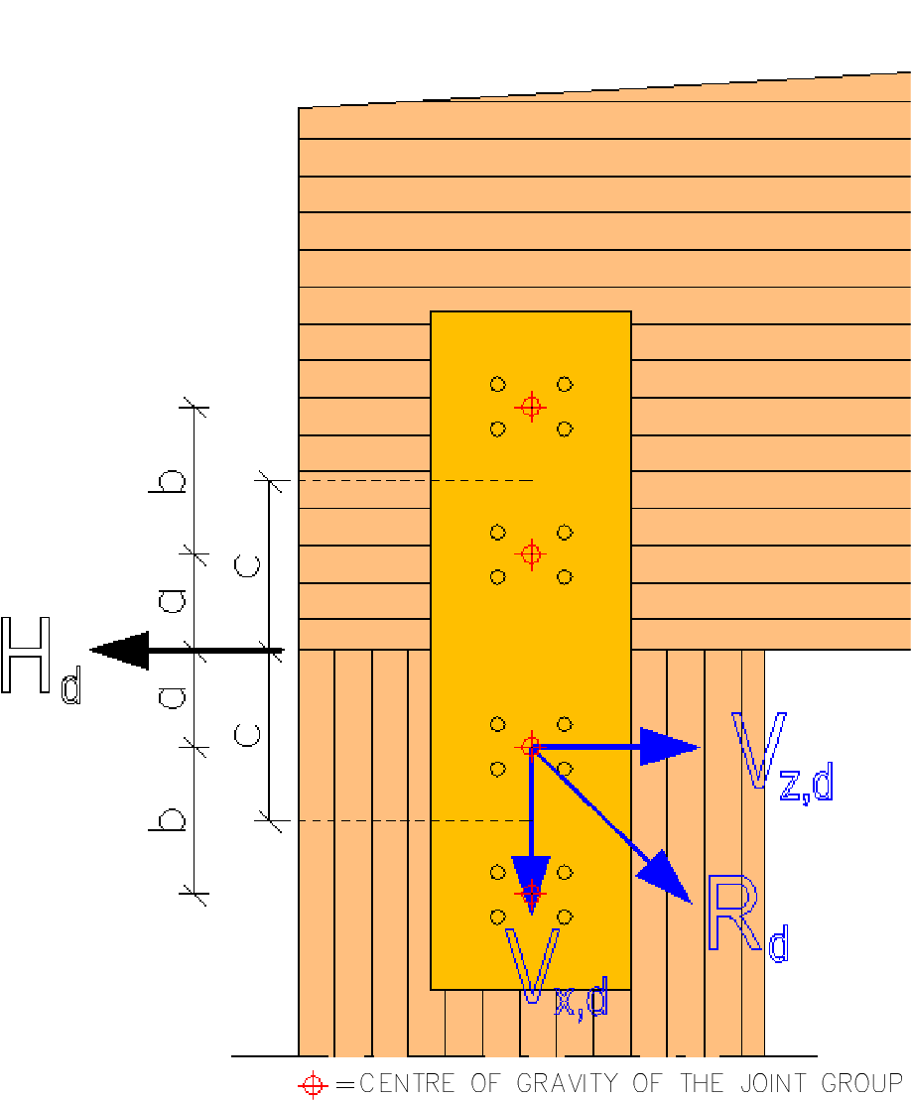
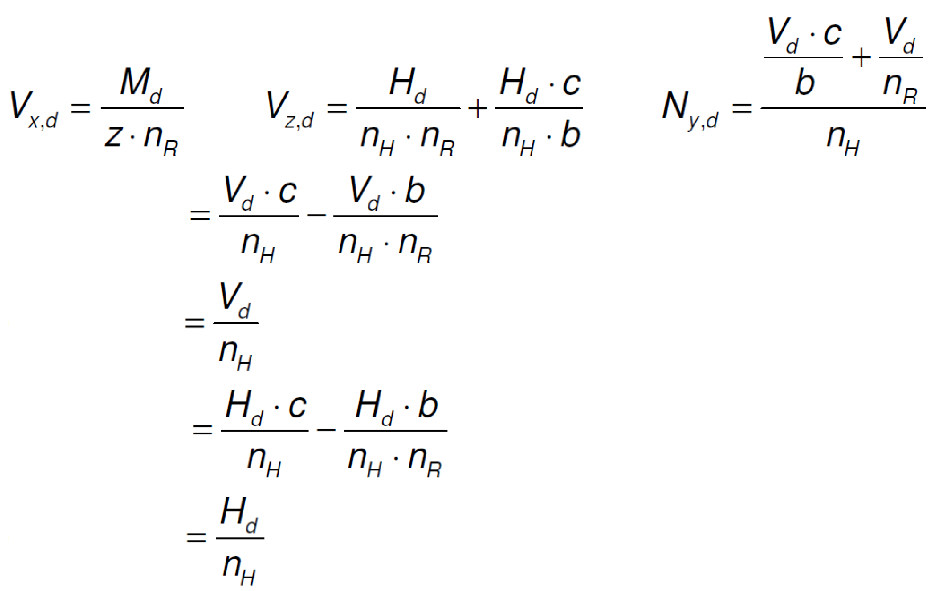
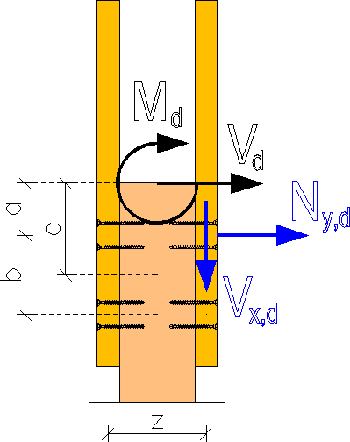
Fork board joint of glue wood pillar and beam
Dimensioning (joining forces)
n_{R} = number of sets of screws/halves of fork board (2 pcs)
n_{H} = number of fork boards/joint (2 pcs)
M_{z,d,fork board}
(around the z-axis)
Q_{z,d,fork board}
M_{y,d,fork board}
(around the y-axis)
Q_{y,d,fork board}

Slide 29
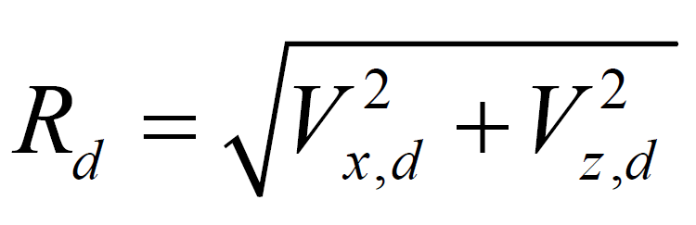
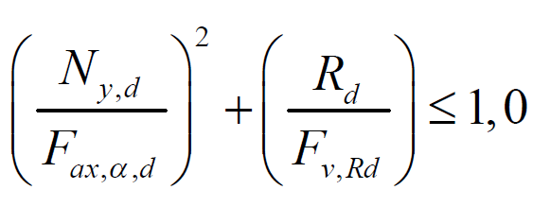
Fork board joint of glue wood pillar and beam
Dimensioning (screw group dimensioning)
The screw group is dimensioned for the resultant of forces V_{x,d} and V_{z,d}:
In addition, for the combined effect of the force in the direction of the screw N_{y,d} and the shear force R_{d}:

Slide 30

Fork board joint of glue wood pillar and beam
Dimensioning (fork board dimensioning)
The shear strength of the fork board is checked for the shear forces:
The bending strength of the fork board is checked for the moments:
The tensile and compression strength of the fork board is checked for the force:
Q_{z,d,fork board} and Q_{y,d,fork board}
M_{z,d,fork board} and M_{y,d,fork board}

Slide 31
Fork board joint of glue wood pillar and beam
Dimensioning (fork board dimensioning)
The strength of the fork board is also checked for the following combined loads:
Tension + Bending
Compression + Bending

Slide 32
Fork board joint of glue wood pillar and beam
Dimensioning (fire design of the fork board)
If fire resistance is required of the joint, the joint is dimensioned as follows:
R 30 joint: The dimensions of the fork board are increased by afi (see RIL 205-2-2019)
R 60 joint: The dimensions of the fork board are increased by the size of the charring and the connectors are protected using e.g. a fire protection plate

