Slide 1



Industrial wood construction
Teaching materials for industrial wood construction education
2022

Slide 2
Origin of the materials
Use of the materials
These learning materials for industrial wood construction have been prepared in a project led by Puuinfo Oy in 2021–2022. Also involved in the project were
Lappia Vocational College,
TTS-Työtehoseura ry
South-Eastern Finland University of Applied Sciences,
Metropolia University of Applied Sciences,
Jyväskylä University of Applied Sciences,
University of Tampere, and
Federation of the Finnish Woodworking Industries Puutuoteteollisuus ry
The project was funded by the Ministry of the Environment.
The materials are intended to be used as extensively as possible in industrial wood construction education and studies.
The materials are released under the Creative Commons licence Attribution-ShareAlike (CC BY-SA), which requires that the author be properly credited when the materials are used and that derivative works may only be distributed under the same licence as the original work.
The original materials and any updates to them by Puuinfo will be published on the Library of Open Educational Resources website (aoe.fi) and the Puuinfo.fi website.

Slide 3
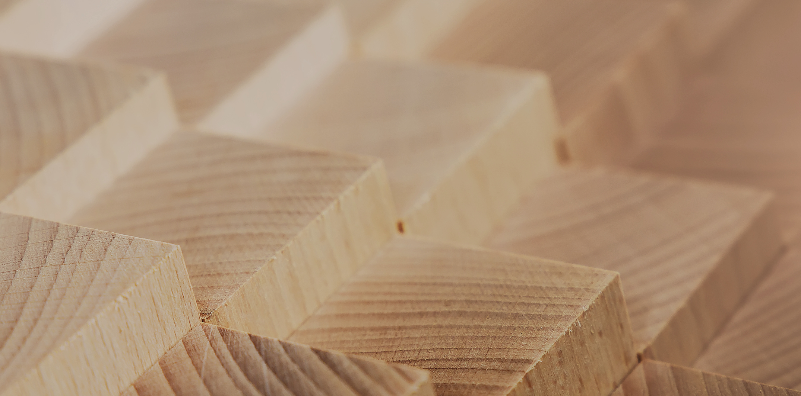
Structural design

Slide 4
Authors
Jani Pitkänen, XAMK
Release date: 20/01/2022

Slide 5
Dowelled grid

Slide 6
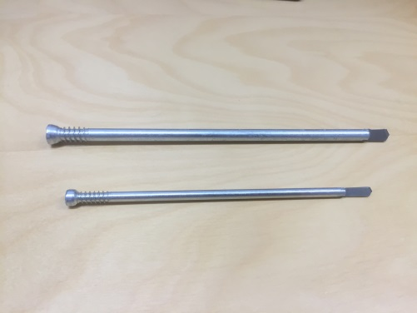
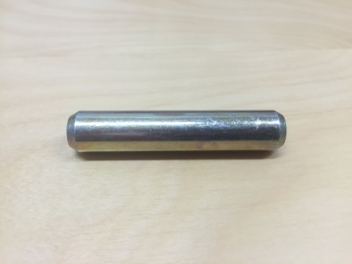
Dowelled grids
Dowel
A smooth, straight round steel rod
The heads are bevelled or rounded so that they do not break the wood when installing the dowel (pre-drilling)
Thickness of dowels is 6...30 mm
The ends of the dowel can be threaded, making it a so-called through bolt or a tie bolt.
The through bolts bind the joint area in a transverse direction and can be dimensioned like a dowel

Slide 7
Dowelled grids
Dowel
At least 1 in 10 of the number of dowels of the connector group in the joint area must be tie bolts (ultimate limit state).
In the event of a fire, every fourth dowel in the joint must be a tie bolt
At least one tie bolt must be placed in the row closest to the end of the edge piece
Dowel material is usually S235 or S355
Central Europe uses smaller diameter dowels (6 mm) than in Finland (12 mm)

Slide 8
Dowelled grids
Dowel
Smaller diameter dowel provide toughness to the fracturing method of the joint, while thicker ones make for a brittle fracturing method.
Pre-drilled holes (wood/steel)
  The diameter must not exceed the nominal thickness d of the dowel, but must not be less than 0,95 x d
  Typically, holes of the same size are drilled in steel plates as in wood
  Holes 2 mm larger than the diameter of the dowel can be drilled in the steel plates (must be taken into account in sizing)
  Drilling can be done simultaneously in wood and steel plate or separately

Slide 9
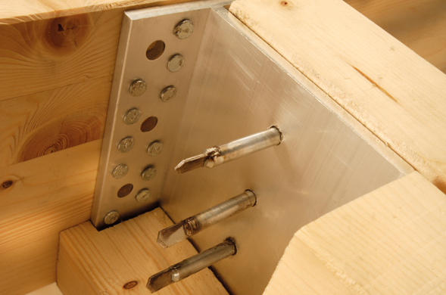
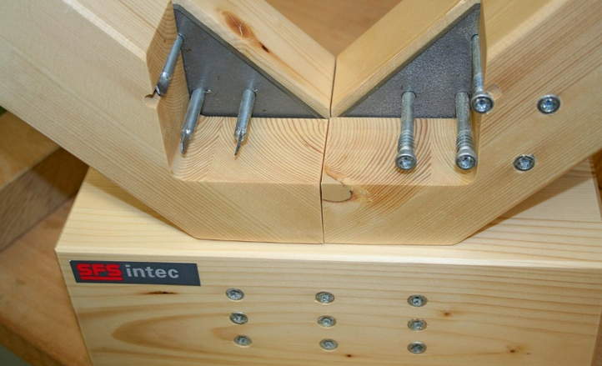
Dowelled grids
Dowel
The dowel can also be installed without pre-drilling
(cf. WS system)

Slide 10
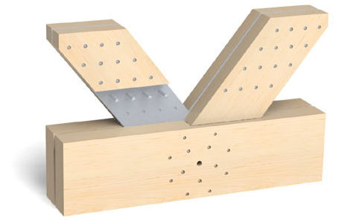
Dowelled grids
Dowel vs. bolt
Joint groups are smaller because of the precise fitting of the connecting parts
The joint is easy to protect from fire
The joint is usually quite discreet
A straight rod is cheaper than a bolt

Slide 11
Dowelled grids
Steel plates for joints
The capacity of the dowel joint can be increased by using steel plates in the joint
Steel plates can be used as lateral or central parts of the joint, making them work more efficiently
By using steel plates in joints, smaller wood dimensions can also be reached because this joint type does not determine the size of the structures as much as conventional joints do.
The steel plate material is usually S235 or S355

Slide 12
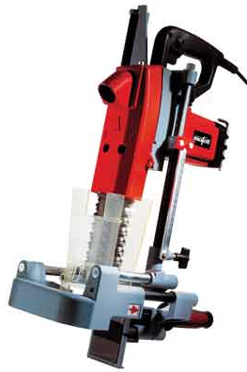
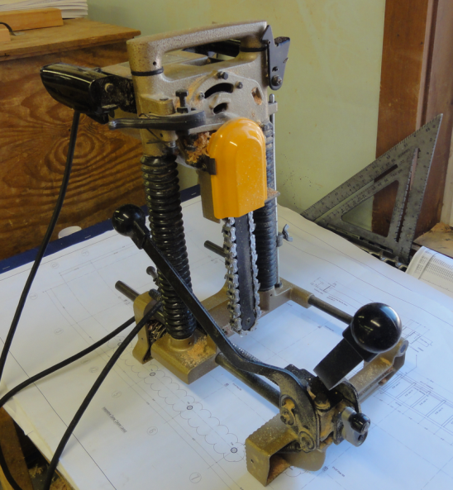
Dowelled grids
Steel plates for joints
The thickness used, with 12 mm dowel pins, is 8 mm thick steel plate
The number of steel plates in the joint can vary from one to several
Usually, one or two steel plates are used to prevent the width of wooden parts from becoming too large
For example, a 10 mm groove is machined into the wood for an 8 mm steel plate, and the steel plate is mounted into this groove.

Slide 13
Dowelled grids
Timber
The following are used as timber:
  Homogeneous glued laminated timber (GL30h)
  Laminated veneer lumber (LVL), either glued laminated or in separate wood parts
Glued laminated timber (glulam) is usually used because it has a better appearance than LVL
Combined glulam (GL30c) is not well suited for glulam grids because it has better wood on the top and bottom and weaker wood in the middle => all joints are located in the middle area of the glulam. => RIL 2017 partial safety factor for joints changed on 1.3, but homogeneous glulam is still recommended to be used

Slide 14
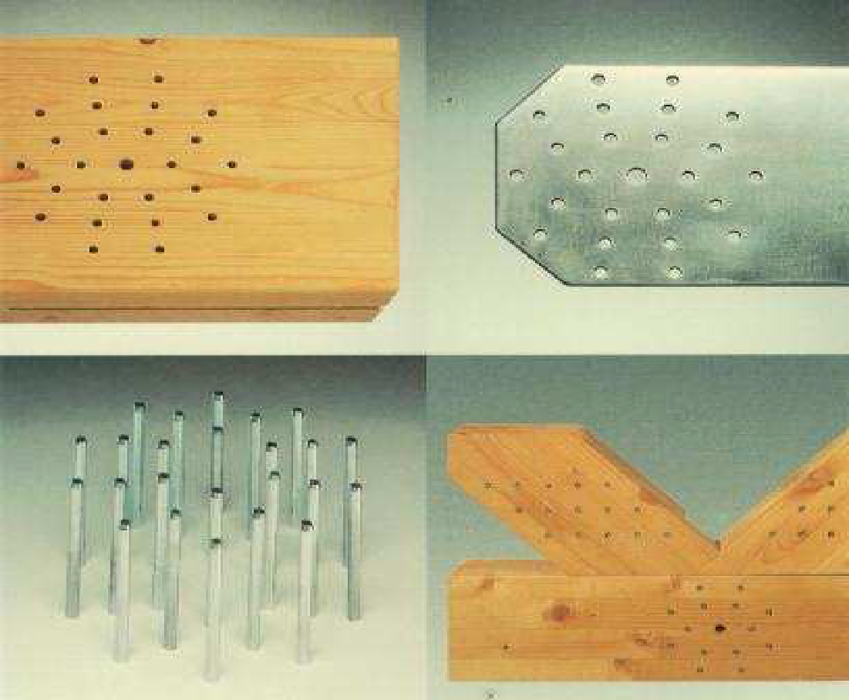
Dowelled grids
Joint systems BSB system
The Swiss BSB joint (Blumber system bauweise) is the best-known steel plate dowel joint system.
The joint can be made with a computer-controlled saw drilling system called "Blumber line”
The joint can also be made manually, in which case the drilling is carried out with a column drilling machine and the grooves of the wooden parts are machined with a saw

Slide 15
Dowelled grids
Joint systems BSB system
The BSB system comprises of:
Dowels: The diameter is 6.3 mm and the length is 80...400 mm
Steel plates: Thickness is 5 mm
Holes to be drilled into wooden parts are 6 mm in diameter and 7 mm in steel parts
Distance between steel plates is 40 mm

Slide 16
Dowelled grids
Joint systems WS system (SFS-Intec)
The connectors are drill-tipped and drill through both wood and steel plates at the same time
Connectors are installed using either the manual CF WS/M installation tool or the semi-automatic CF WS/P installation machine.
Joints can use
  1 to 3 pieces of 5 mm thick plates for 5 mm connectors
  1 to 3 pieces of 5 mm thick plates or one 10 mm plate for 7 mm connectors

Slide 17
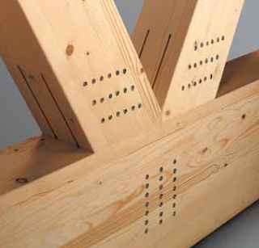
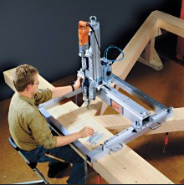
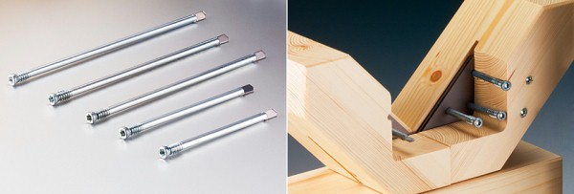
Dowelled grids
Joint systems WS system (SFS-Intec)
The system is suitable for
Grid joints
For the joints of columns and beams
Corner joints in a ring
Extension joints
The system can also be used to implement site connections

Slide 18
Dowelled grids
Joint systems The Merk Holzbau method
A steel-plated dowel joint can also be made manually
In this case, the drilling is carried out with a column drill
For this purpose, the German company Merk Holzbau has developed a drill bit for drilling a hole in both wood and steel plates
The drill bit makes a larger hole in the steel plate than in the wooden part
This makes the joint as tight as possible

Slide 19
Dowelled grids
Joint systems The Merk Holzbau method
In this method:
  First, the wood is machined
  Steel plates are placed in the groove
  Drilling is performed
The problem may be the looseness of the holes in the top wood sections

Slide 20
Dowelled grids
Joint systems The Merk Holzbau method
When drilling is performed at the same time on a steel plate, the drilling chips on the steel plate may enlarge the holes in the top wooden parts when coming out.
The speed of drilling plays a key role in preventing holes from enlargening

Slide 21
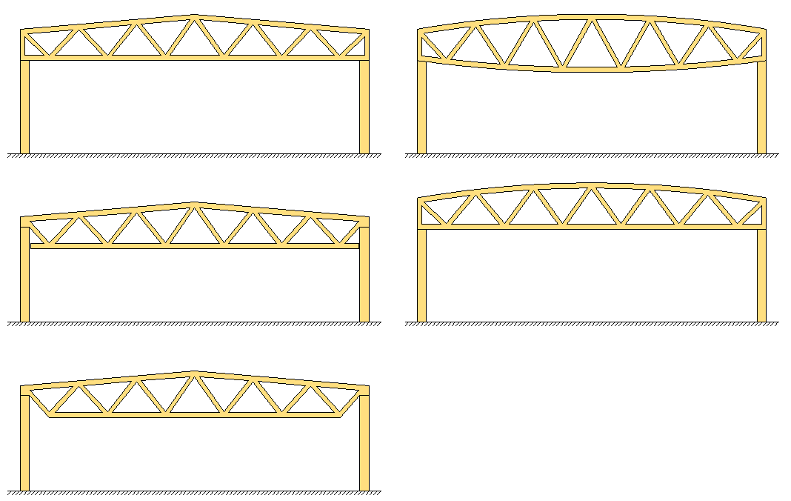
Grid shapes

Slide 22
Dowelled grids
Applications
A steel-plated dowel joint is best suited for large span rod structures
Such structures can be found, for example, in Norway:
  Olympic Hall Hamar
  Olympic Hall Amphi
  Haakons Hall
  Agder Hall
  Gardenmoen Terminal

Slide 23
Dowelled grids
Applications
There are a few public sites in Finland, such as
  Joensuu Areena
  Pirkka Hall in Tampere
These sites have a few common denominators:
  Large spans
  Spectacular wooden poles
It goes without saying that the main supports remain visible and serve as an important architectural feature inside the building.

Slide 24
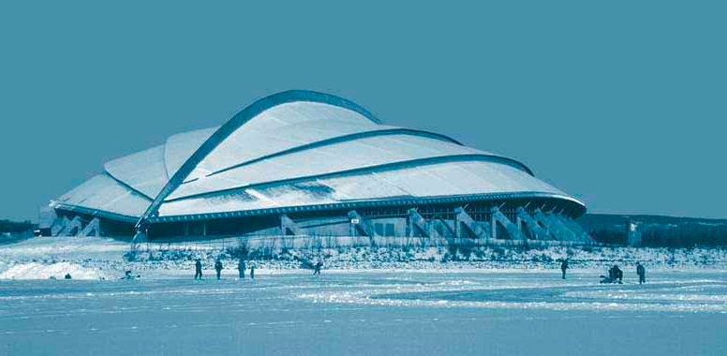
Hamar Olympic Hall ”The Viking Ship”
Length: 260 m
Maximum span: 96.4 m
Cap. 10,600/20,000 people

Slide 25
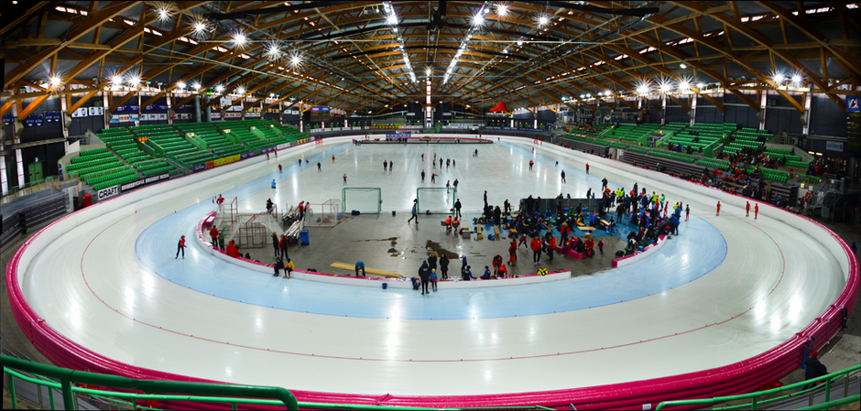
Hamar Olympic Hall ”The Viking Ship”

Slide 26
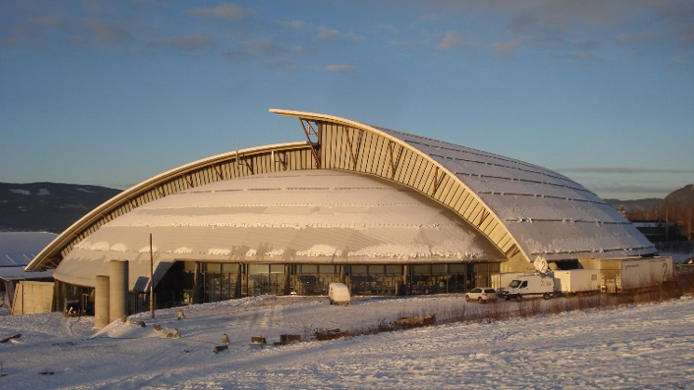
Haakons Hall
Length: 127 m
Maximum span: 85.8m
Cap. 11,500 people

Slide 27
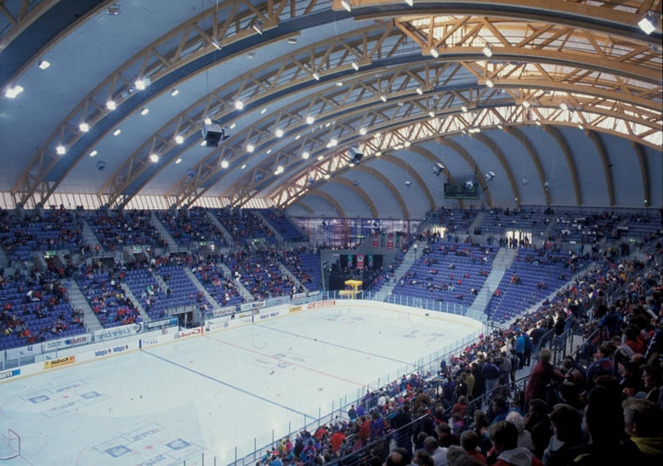
Haakons Hall

Slide 28
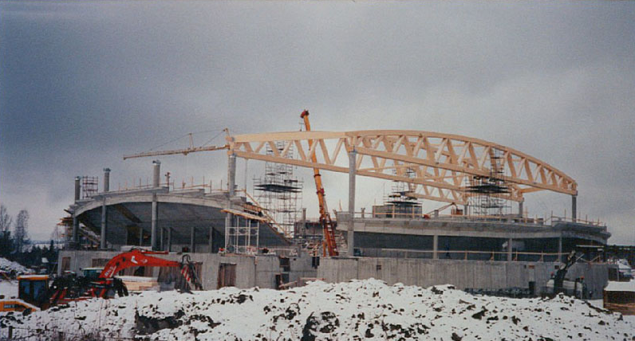
Olympic Amphitheatre
Length: 95 m
Maximum span: 70 m
Cap. 6,000 people

Slide 29
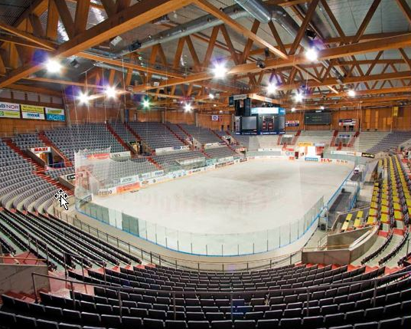
Olympic Amphitheatre

Slide 30
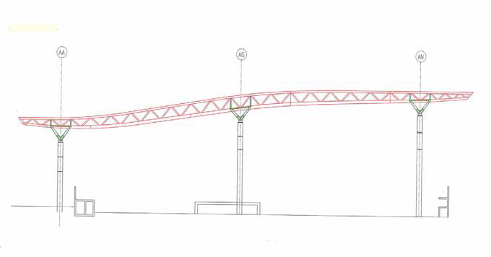
Gardenmoen Terminal
Grid length: 136 m

Slide 31
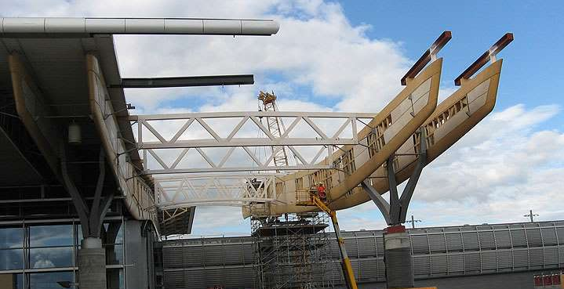
Gardenmoen Terminal

Slide 32
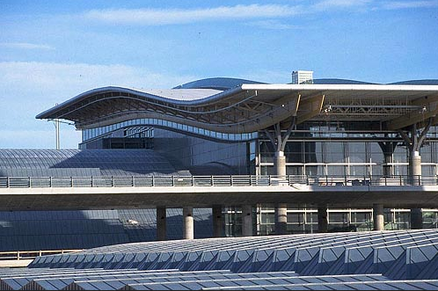
Gardenmoen Terminal

Slide 33
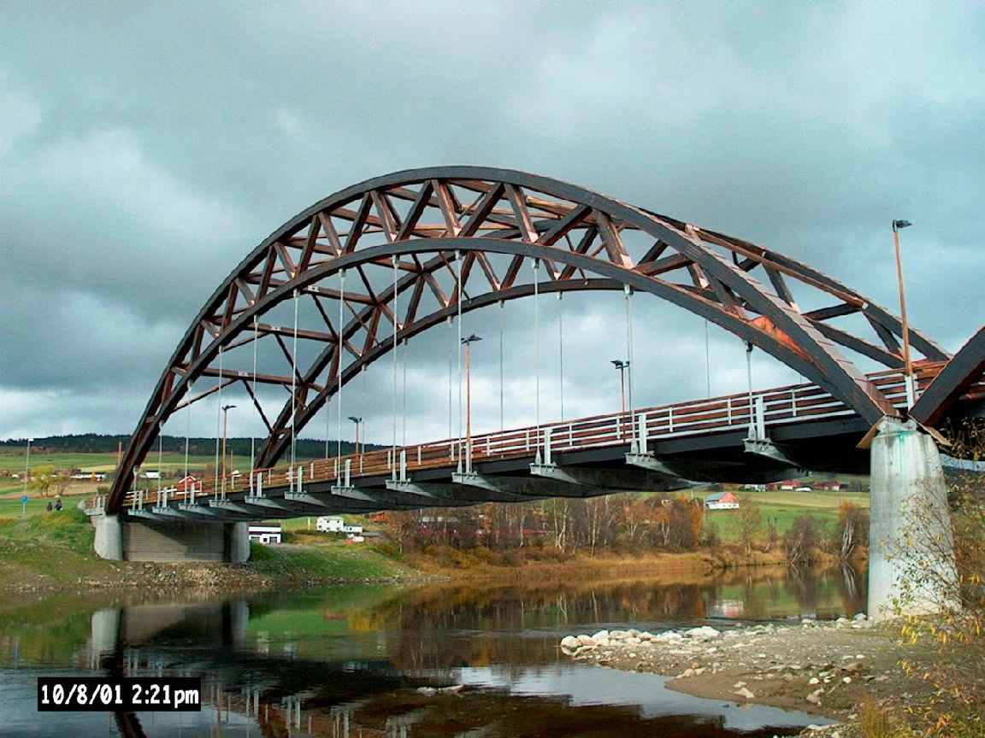
Tynset Bridge
Total length: 125 m
Maximum span: 70 m

Slide 34
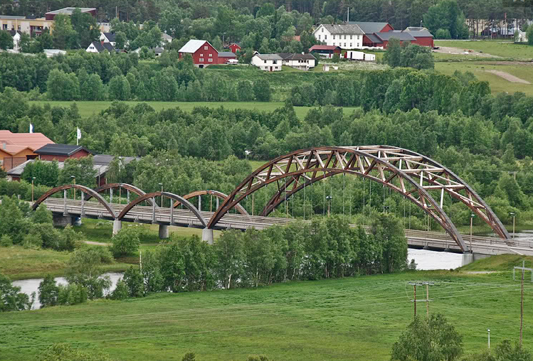
Tynset Bridge

Slide 35
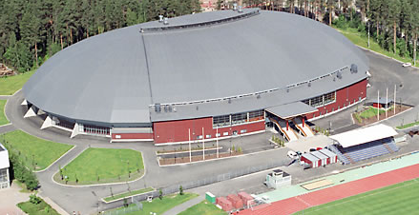
Joensuu Areena
Length: 150 m
Maximum span: 110 m
Cap. 7,000 people

Slide 36
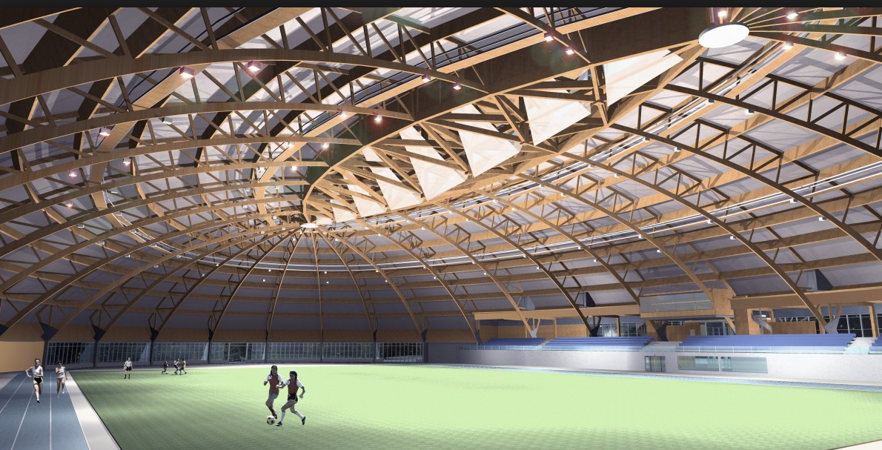
Joensuu Areena (3D model)

Slide 37
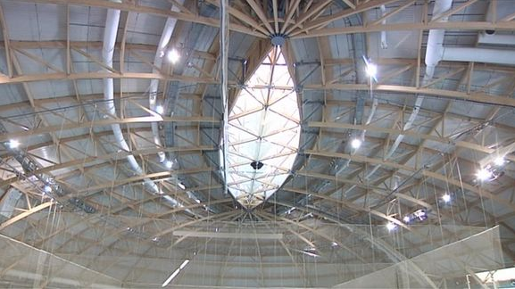
Joensuu Areena

Slide 38
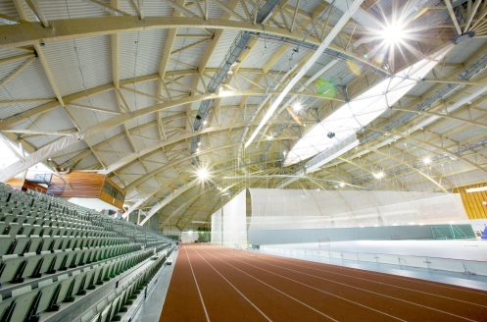
Joensuu Areena

Slide 39
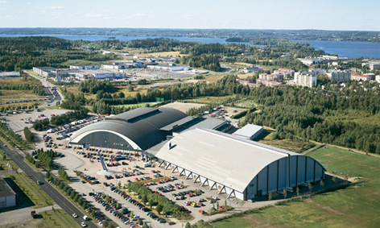
Pirkkahalli
Size: 64 m x 100 m
Cap. 4,000 people

Slide 40
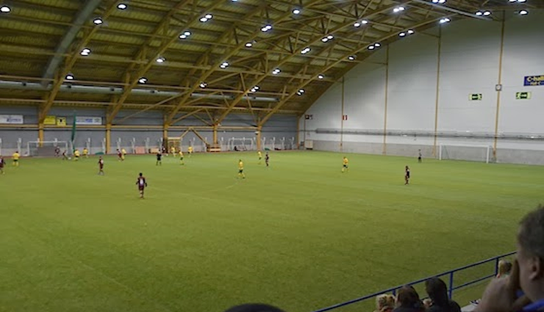
Pirkkahalli

Slide 41
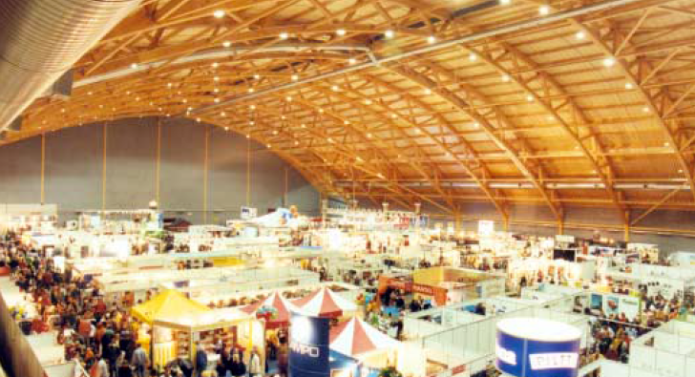
Pirkkahalli

Slide 42
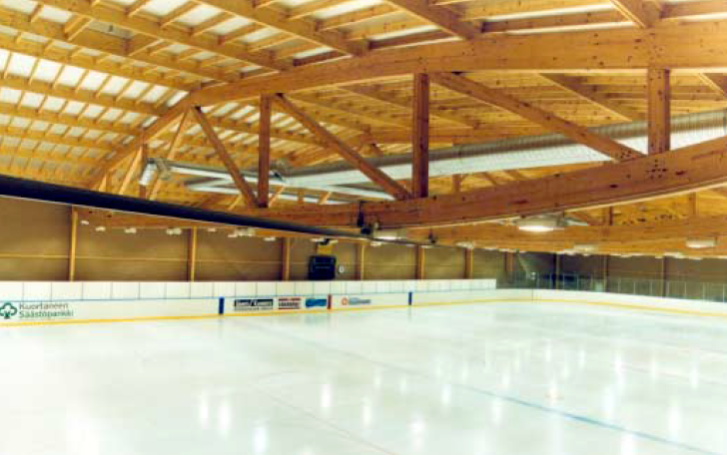
Kuortane Ice Hockey Arena

Slide 43
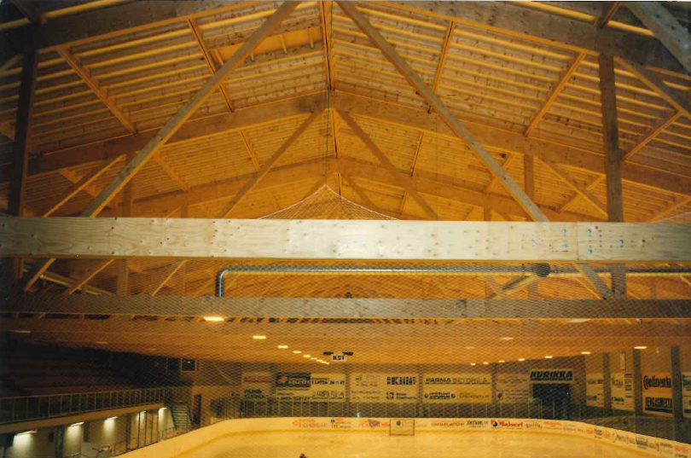
Kurikka Ice Hockey Arena

Slide 44
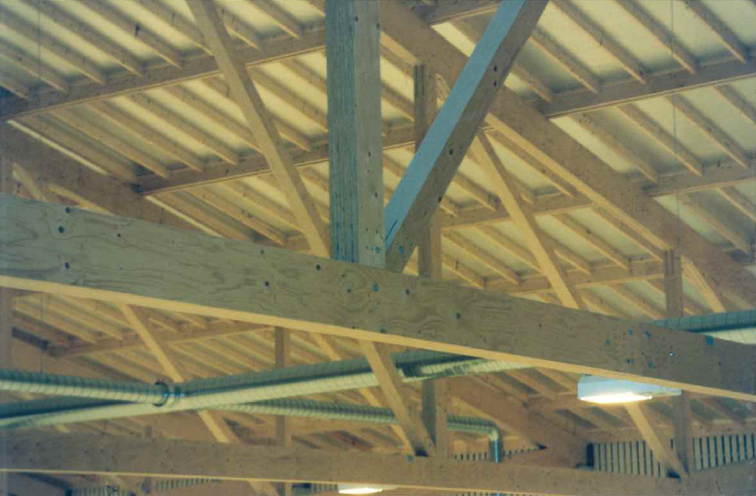
Kurikka Ice Hockey Arena

Slide 45
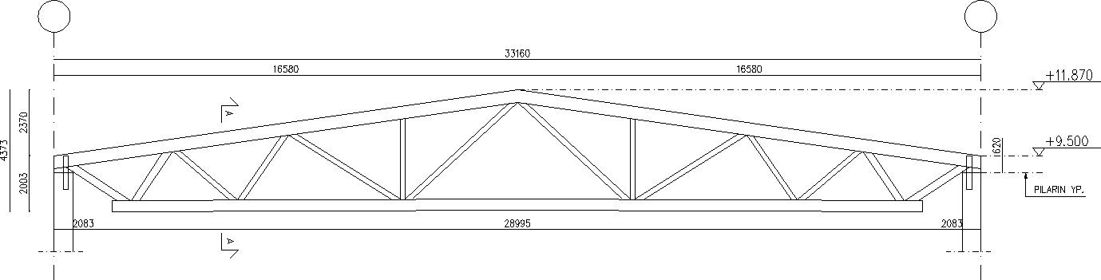
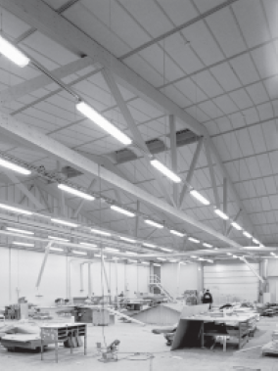
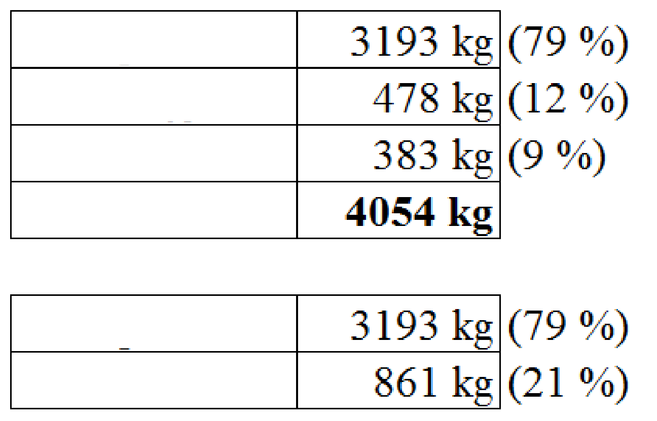
Industrial Hall
CIRC. OF A PILLAR
Glued laminated timber:
Steel plates:
Dowels:
Total amount:
Glued laminated timber:
Steel:

Slide 46
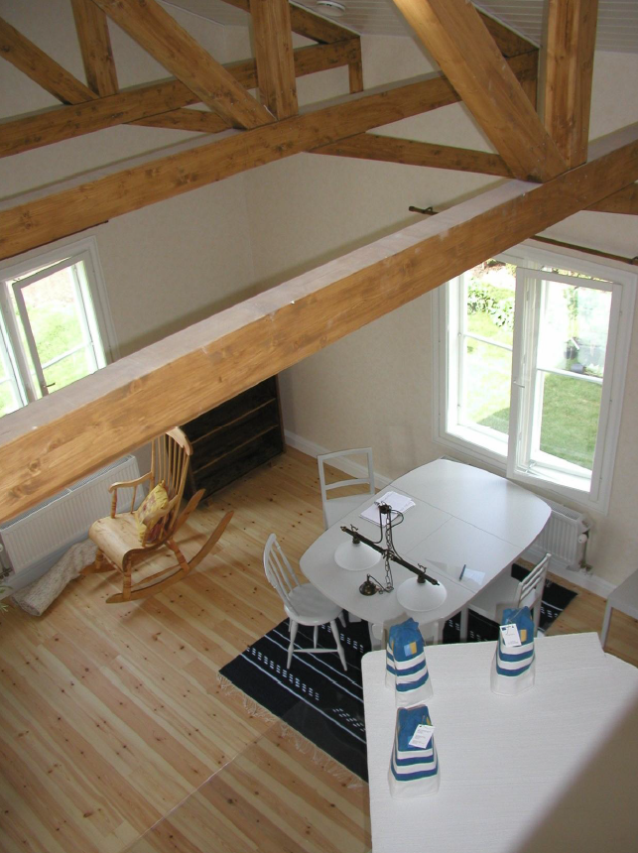
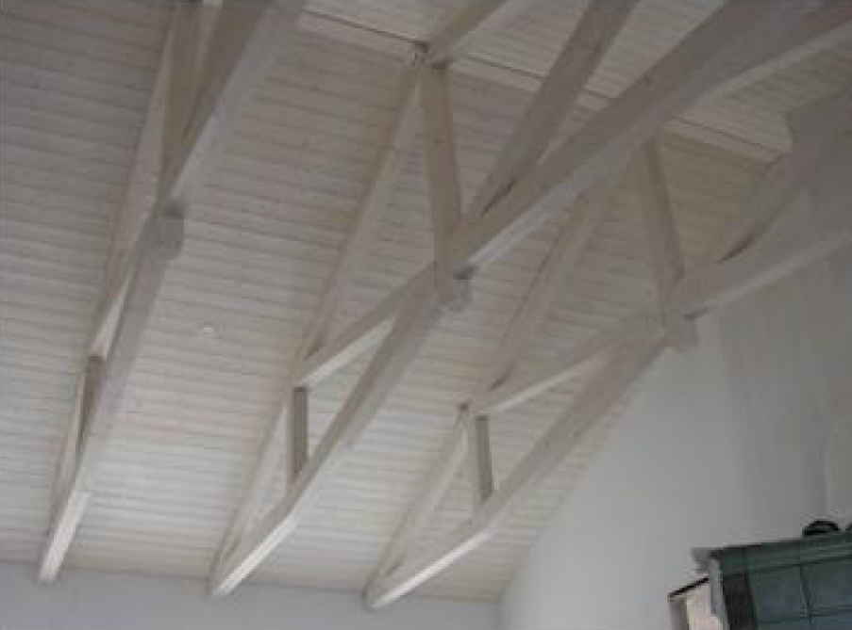
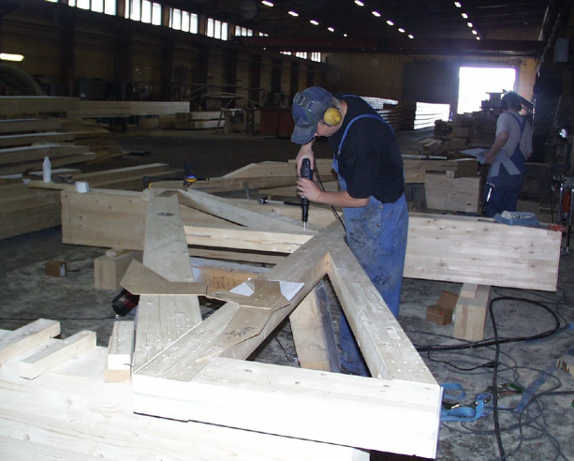
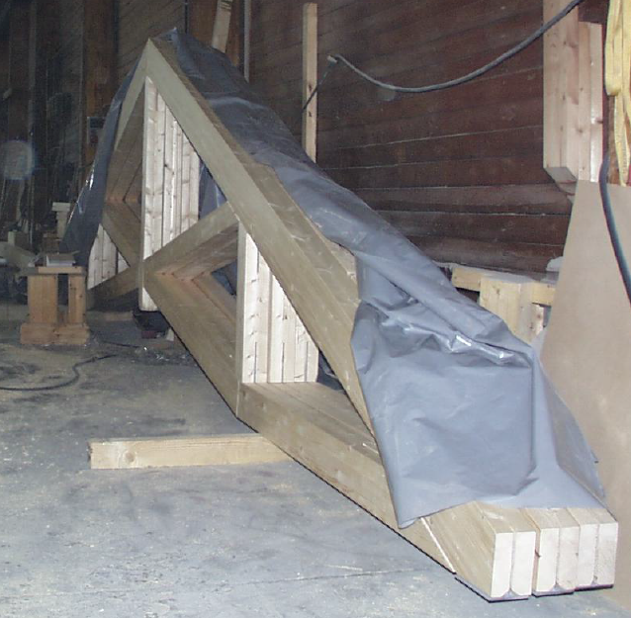
Hirssaari Housing Fair (Saaristolaistalot)

