Slide 1



Industrial wood construction
Teaching materials for industrial wood construction education
2022

Slide 2
Origin of the materials
Use of the materials
These learning materials for industrial wood construction have been prepared in a project led by Puuinfo Oy in 2021–2022. Also involved in the project were
Lappia Vocational College,
TTS-Työtehoseura ry
South-Eastern Finland University of Applied Sciences,
Metropolia University of Applied Sciences,
Jyväskylä University of Applied Sciences,
University of Tampere, and
Federation of the Finnish Woodworking Industries Puutuoteteollisuus ry
The project was funded by the Ministry of the Environment.
The materials are intended to be used as extensively as possible in industrial wood construction education and studies.
The materials are released under the Creative Commons licence Attribution-ShareAlike (CC BY-SA), which requires that the author be properly credited when the materials are used and that derivative works may only be distributed under the same licence as the original work.
The original materials and any updates to them by Puuinfo will be published on the Library of Open Educational Resources website (aoe.fi) and the Puuinfo.fi website.

Slide 3
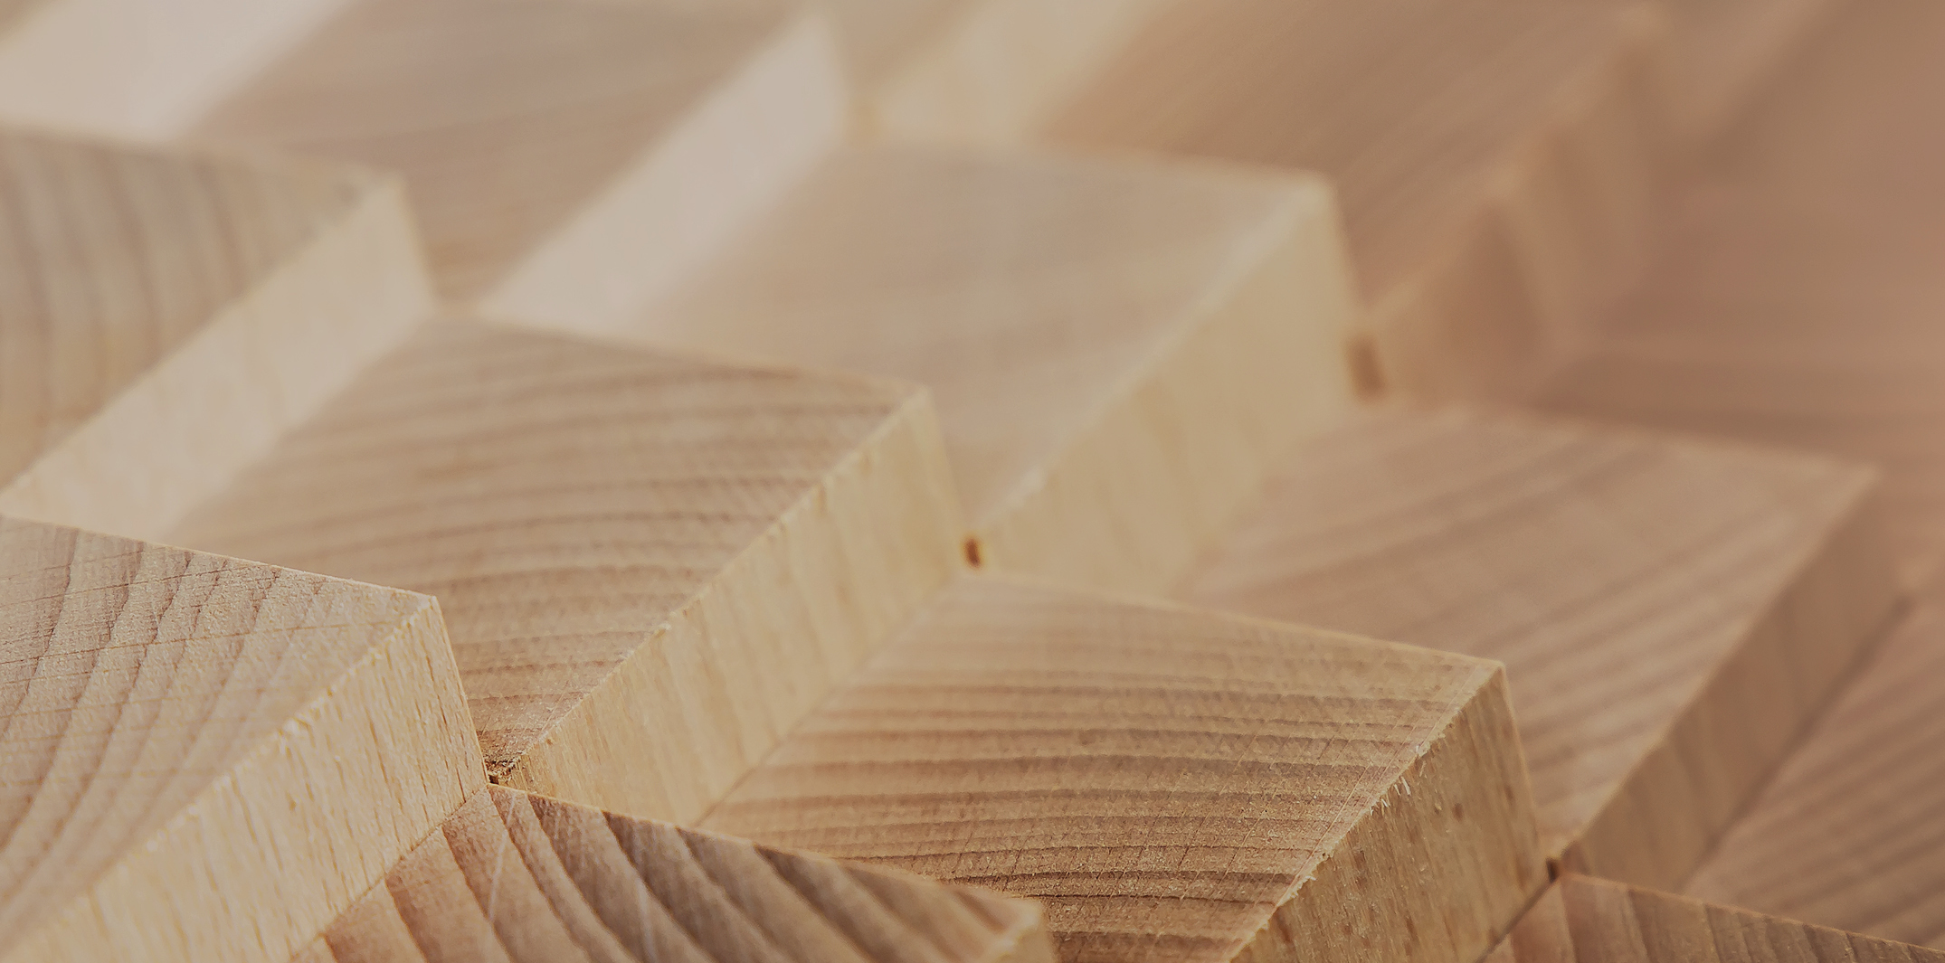
Structural design

Slide 4
Authors
Jani Pitkänen, XAMK
Release date: 20/01/2022

Slide 5
Variable cross-section beams

Slide 6

Shapes and materials
Ridge beam
Fish-bellied beam
Lean-to girder

Slide 7
Shapes and materials
Materials: Usually made of glued laminated timber
Slope of the roof: 1:16…1:6
Recommended span: 10–30 m
Beam height: L/30…L/16
Maximum economical height is approx. 2,100 mm
After this, it is necessary to plane the beam manually, which increases the production costs of the beam
You should ask the major manufacturers, such as Versowood and LATE, about heights

Slide 8
Shapes and materials
The material used is usually glued laminated timber
Veneer wood (LVL) can also be used
In addition to closed cross-sections, box and I cross sections can be used
Often the beams are 1-slot, but they can also be made with multiple slots (ridge beams and lean-to girders).
In addition, protrusions may be made on the beams
Multi-bay halls often use both ridge beams and fish-bellied beams
For example, for a 3-bay hall the arrangement would be as follows:

Slide 9
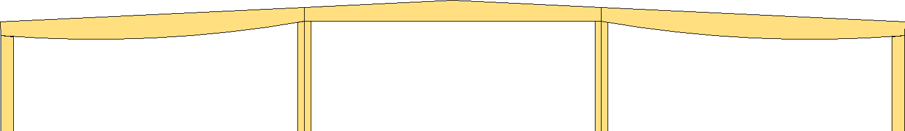

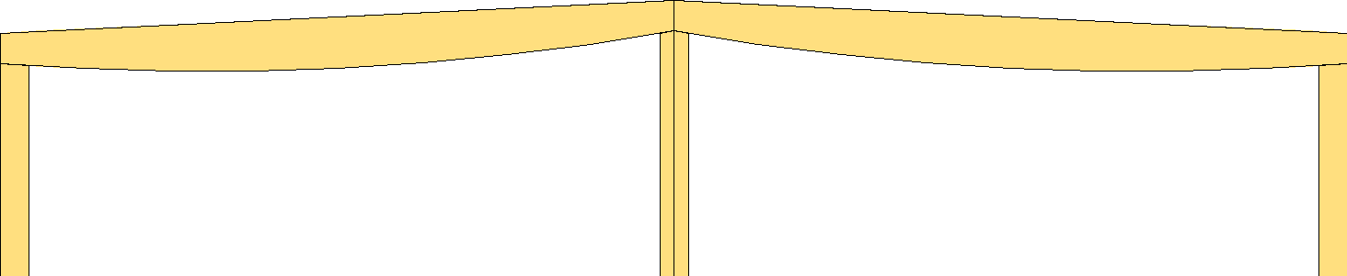
Shapes and materials
3-bay circle
1- and 2-bay circle

Slide 10
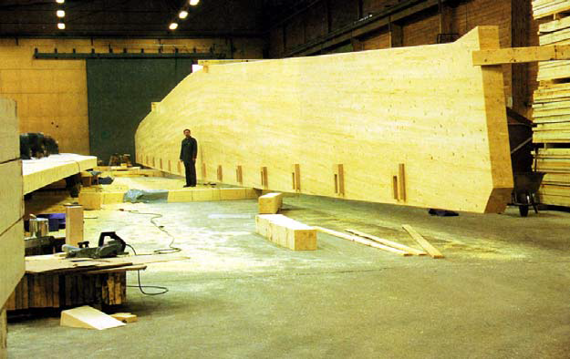
Shapes and materials

Slide 11
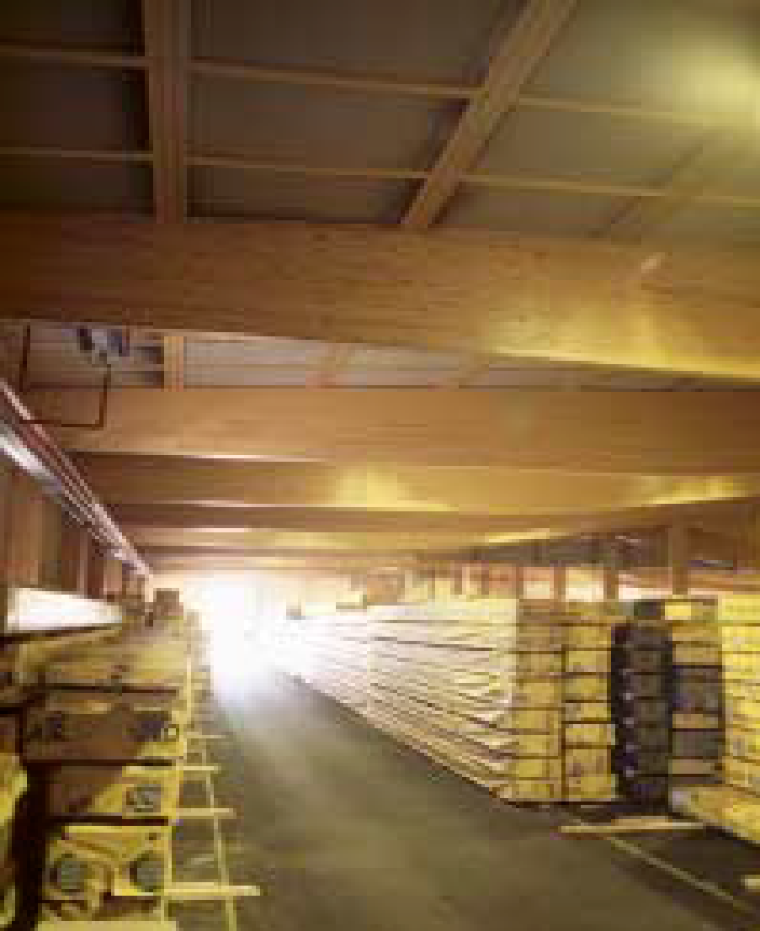
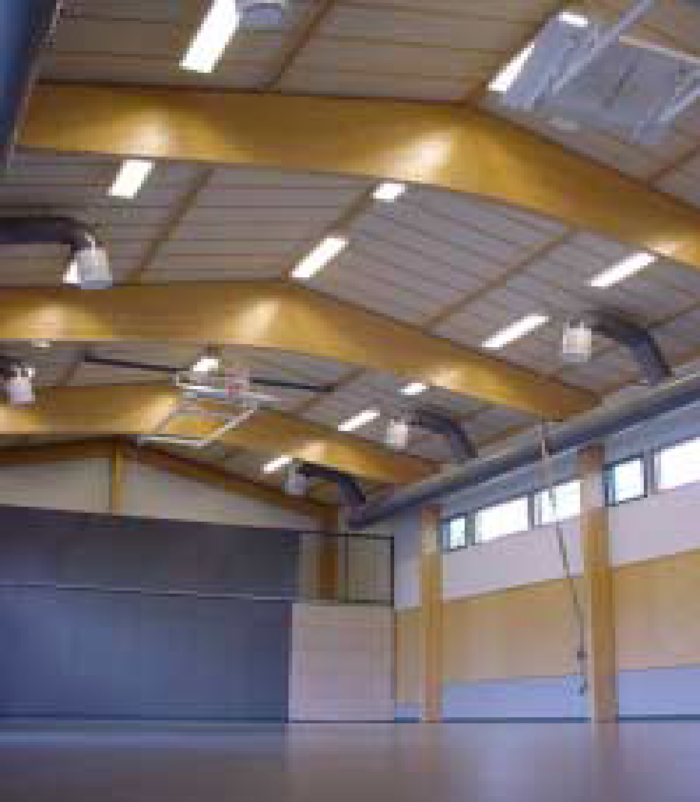
Shapes and materials

Slide 12
Dimensioning
Compared to a normal, flat beam, additional dimensioning is caused by both the inclined surfaces of the beams and, in the case of the ridge, fish-bellied, curved and boomerang beams, the stresses in the ridge area.
If the inclined surface is compressed, then there will be transverse compression and, correspondingly, transverse traction on the drawn inclined surface.
The sharper the angle, the greater the forces
This is one reason why the fish-bellied beam has been developed for the current structure

Slide 13
Dimensioning
Considerations on the ridge beam dimensioning
Bending resistance in dimensioning cross-section
Bending resistance on ridge
Transverse tensile strength on ridge
Combined transverse traction and shear resistance on ridge (asymmetric load)
Shearing strength at maximum bending stress
Shearing strength with support
Bearing pressure tolerance
Deflection assessment
Lateral buckling strength

Slide 14
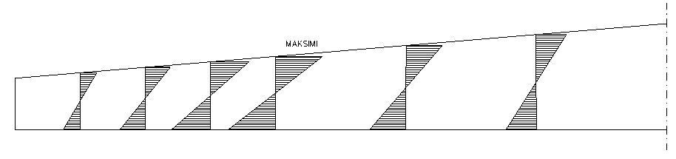
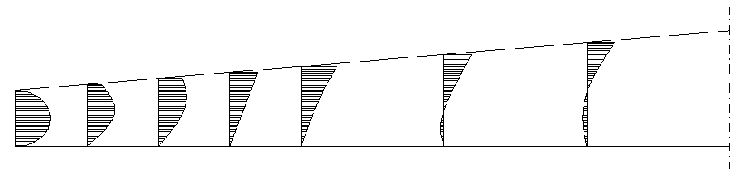
Dimensioning
Bending stress:
MAXIMUM
Shear stress:

Slide 15
Dimensioning
Fish-bellied beam dimensioning, examinations:
Bending resistance in dimensioning cross-section
Bending resistance in the centre of the beam
Shearing strength with support
Bearing pressure tolerance
Deflection assessment
Lateral buckling strength

Slide 16
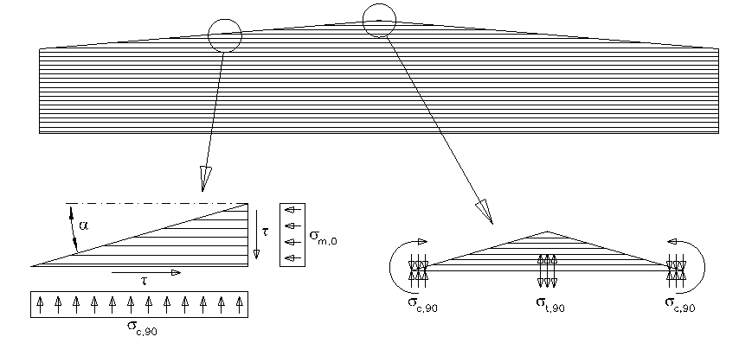
Special features of dimensioning
Transverse tensions of the ridge and fish-bellied beam on diagonal surfaces:
Ridge beam

Slide 17
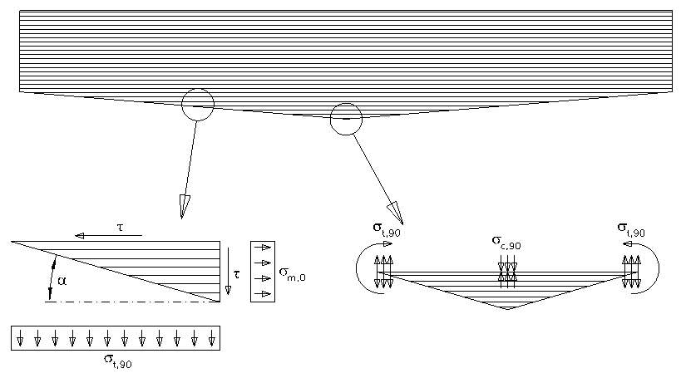
Special features of dimensioning
Transverse tensions of the ridge and fish-bellied beam on diagonal surfaces:
Fish-bellied beam

Slide 18
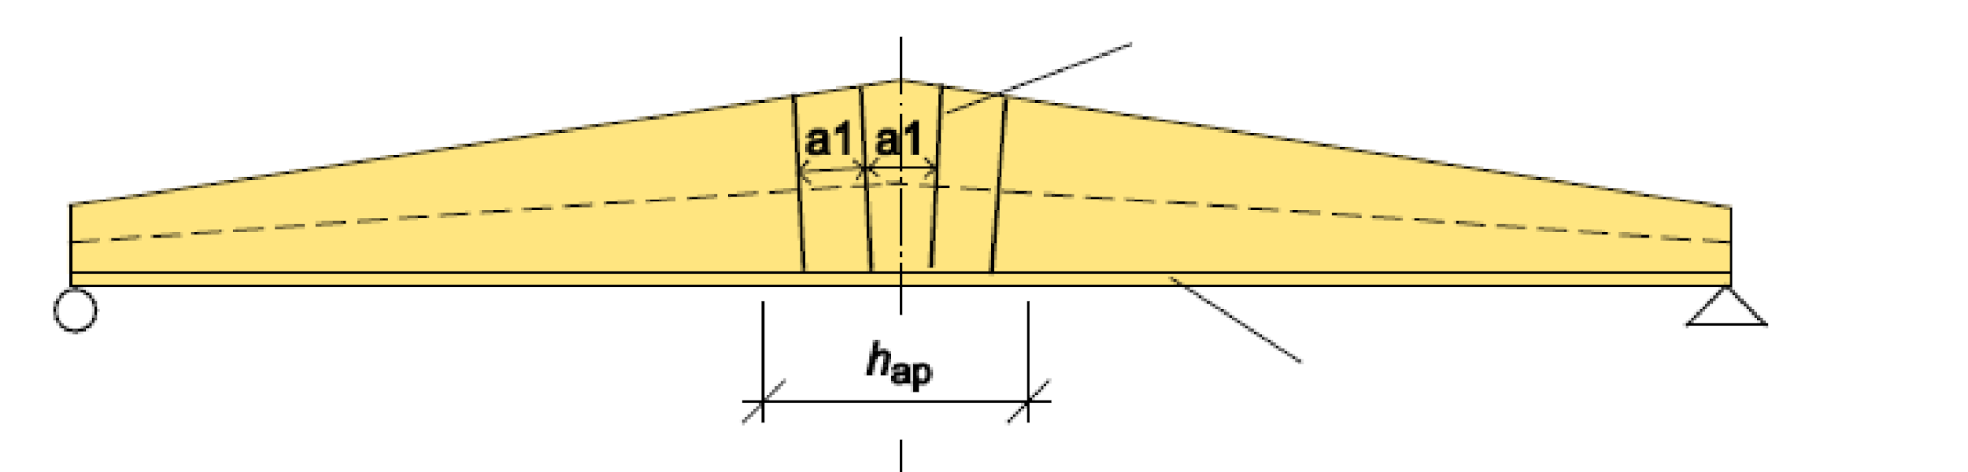
Special features of dimensioning
Both beams can be strengthened against transverse forces, as in curved structures, for example with screws and drillable threaded rods.
Adhesive screw
Possible surface lamella covering the reinforcement

Slide 19
Fish-bellied beam
History...
Originally, the fish-bellied beams were inverted ridge beams, where the lamellas were parallel to the beam

Slide 20
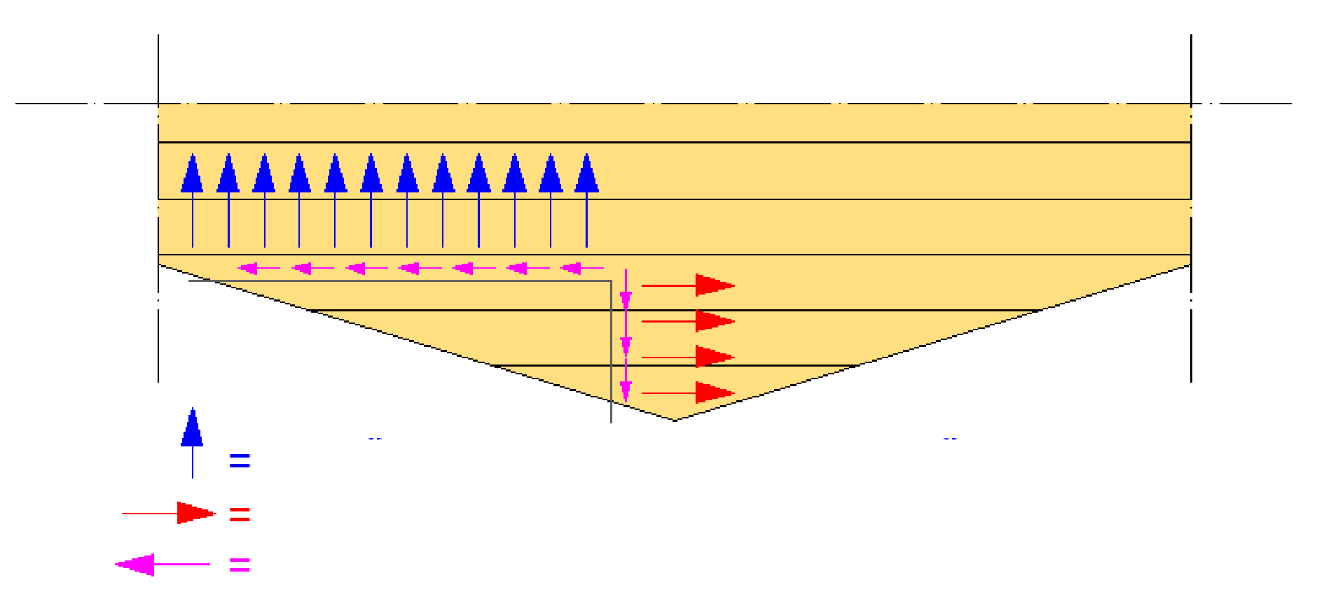
Fish-bellied beam
Problems
The perpendicular stresses σ₉₀ against the grain increase as the slope of the diagonal edge increases
If the beam is turned upside down, i.e. the sloped edge is on the traction side, there will be perpendicular tensile stresses σ_{t,90}
TENSILE STRENGTH PERPENDICULAR TO GRAIN
DIRECTIONAL TENSION
SHEAR STRESS

Slide 21
Fish-bellied beam
Problems
The pulling force perpendicular to the grain may cause a fragile fracture with a very low stress value
Therefore, the gradient of the diagonal edge should be limited
The tilt angle must not exceed 2...3° on the traction side

Slide 22
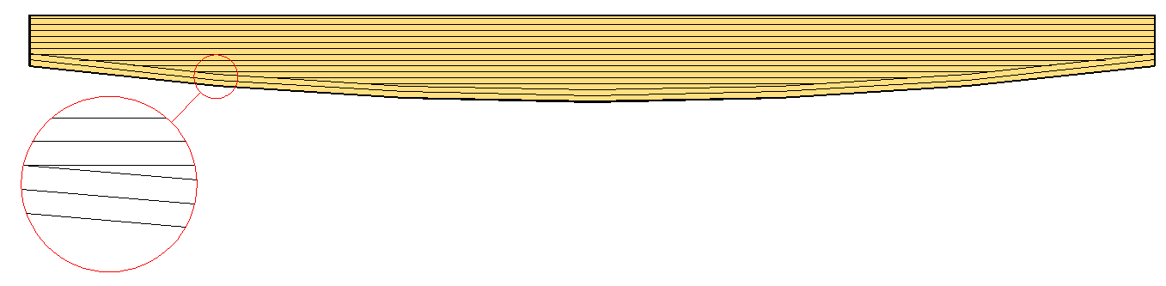
Fish-bellied beam
...History
Due to the perpendicular stresses, in the next stage of development, the two lower lamellas were bent into a curved shape, forming a continuous lamella structure from support to support at the bottom of the beam.
Problem => No dimensioning guidelines

Slide 23
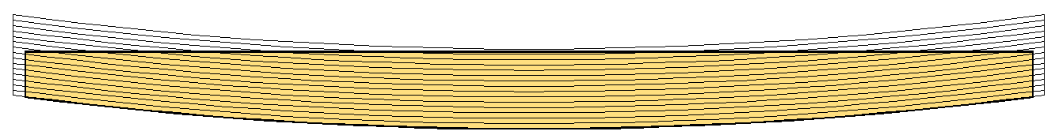
Fish-bellied beam
Today
The latest development is that all the lamellas of the beam are bent and then the beam is sawn to shape.

Slide 24
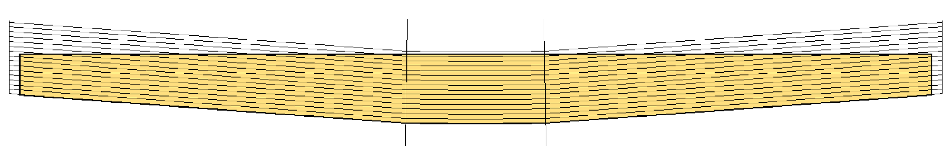
Fish-bellied beam
Today
It is also possible to make the fish-bellied beam so that only the ridge section is bent and otherwise the lamellas are straight.
BENT AREA

Slide 25
Fish-bellied beam
Benefits
The lamellas on the curved edge are continuous, but the lamellas on the top edge are sawn diagonally
This does not cause direct tensions

Slide 26
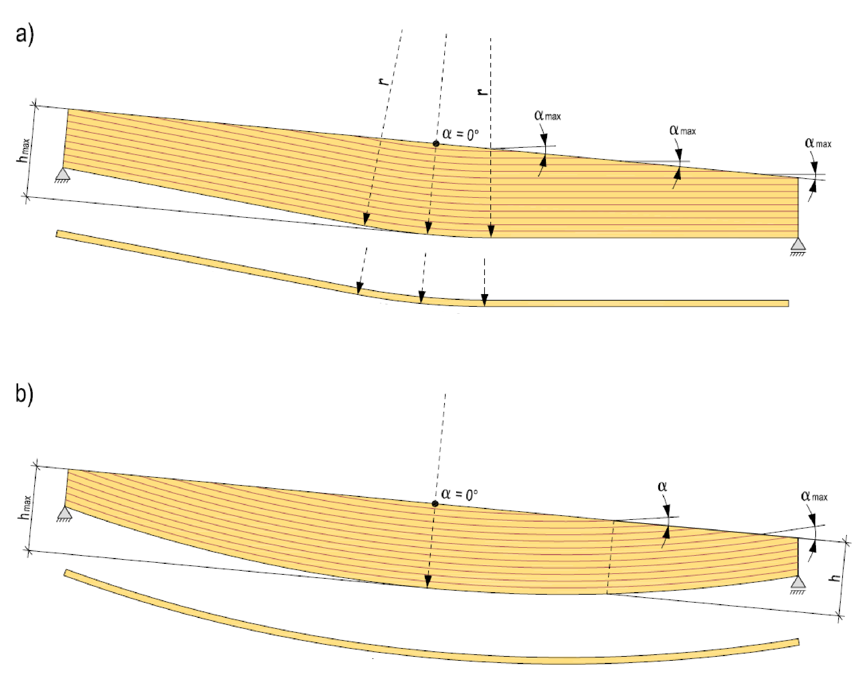
Fish-bellied beam
Radius of curvature r
Straight
Curved section
Top rounded
Straight
Radius of curvature r
Curved lamella along the entire length of the beam

Slide 27
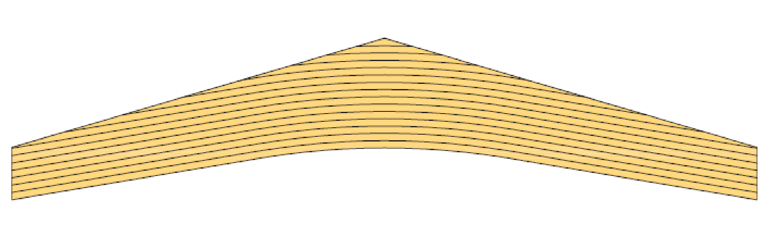
Boomerang or curved ridge beam
The boomerang beam is usually made with a separate hat piece, i.e. As a curved beam with the hat screwed on.
There are similarities between the dimensions of the curved beam and the boomerang beam
The boomerang beam can also be strengthened against transverse forces, for example with screws and drillable threaded rods

Slide 28
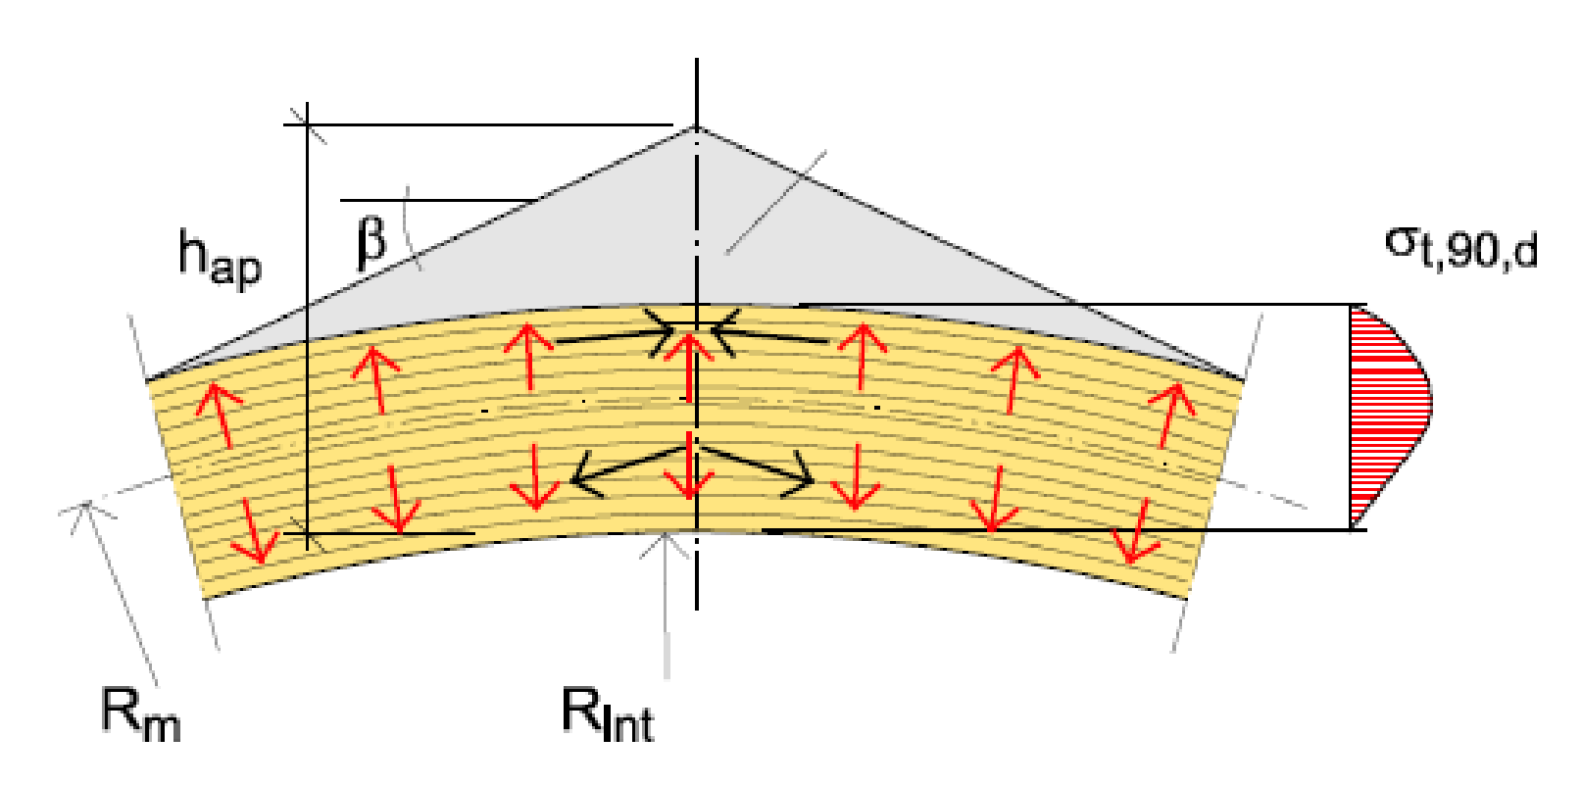
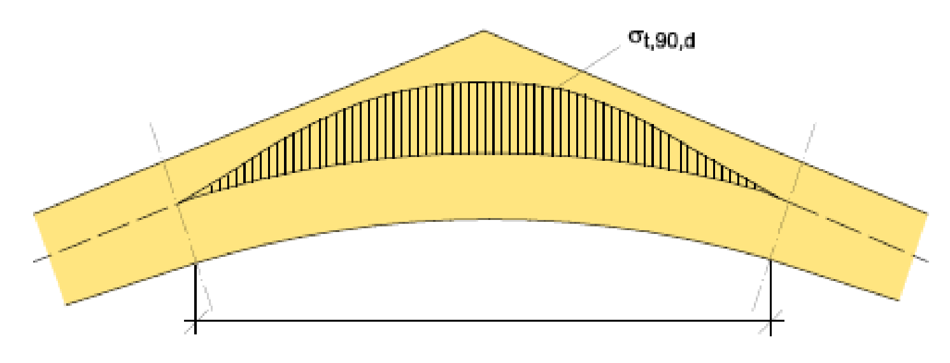
Boomerang or curved ridge beam
"Separate ridge piece”
Curved part of the beam
The boomerang beam is usually made with a separate hat piece, i.e. As a curved beam with the hat screwed on.
There are differences between the dimensions of the curved beam and the boomerang beam
The boomerang beam can also be strengthened against transverse forces, for example with screws and drillable threaded rods

Slide 29
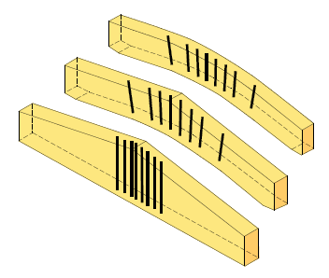
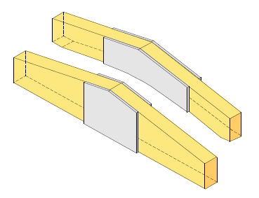
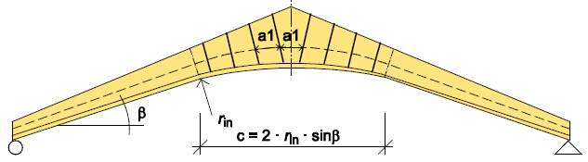
Boomerang or curved ridge beam

Slide 30
Boomerang or curved ridge beam
Special features of dimensioning:
Transverse compression of the ridge area => a curved beam and a separate ridge part are recommended (mechanical fixation)
Horizontal transitions and static model:
  in normal dimensioning, horizontal offset allowed => "roller bearing support”
  Horizontal displacement can also be prevented, but then the static model becomes statically indeterminate and axial compression is introduced into the structure
  This "blocking" of the horizontal displacement can be achieved, for example, by a drawbar from one support to another support

