Slide 1



Industrial wood construction
Teaching materials for industrial wood construction education
2022

Slide 2
Origin of the materials
Use of the materials
These learning materials for industrial wood construction have been prepared in a project led by Puuinfo Oy in 2021–2022. Also involved in the project were
Lappia Vocational College,
TTS-Työtehoseura ry
South-Eastern Finland University of Applied Sciences,
Metropolia University of Applied Sciences,
Jyväskylä University of Applied Sciences,
University of Tampere, and
Federation of the Finnish Woodworking Industries Puutuoteteollisuus ry
The project was funded by the Ministry of the Environment.
The materials are intended to be used as extensively as possible in industrial wood construction education and studies.
The materials are released under the Creative Commons licence Attribution-ShareAlike (CC BY-SA), which requires that the author be properly credited when the materials are used and that derivative works may only be distributed under the same licence as the original work.
The original materials and any updates to them by Puuinfo will be published on the Library of Open Educational Resources website (aoe.fi) and the Puuinfo.fi website.

Slide 3
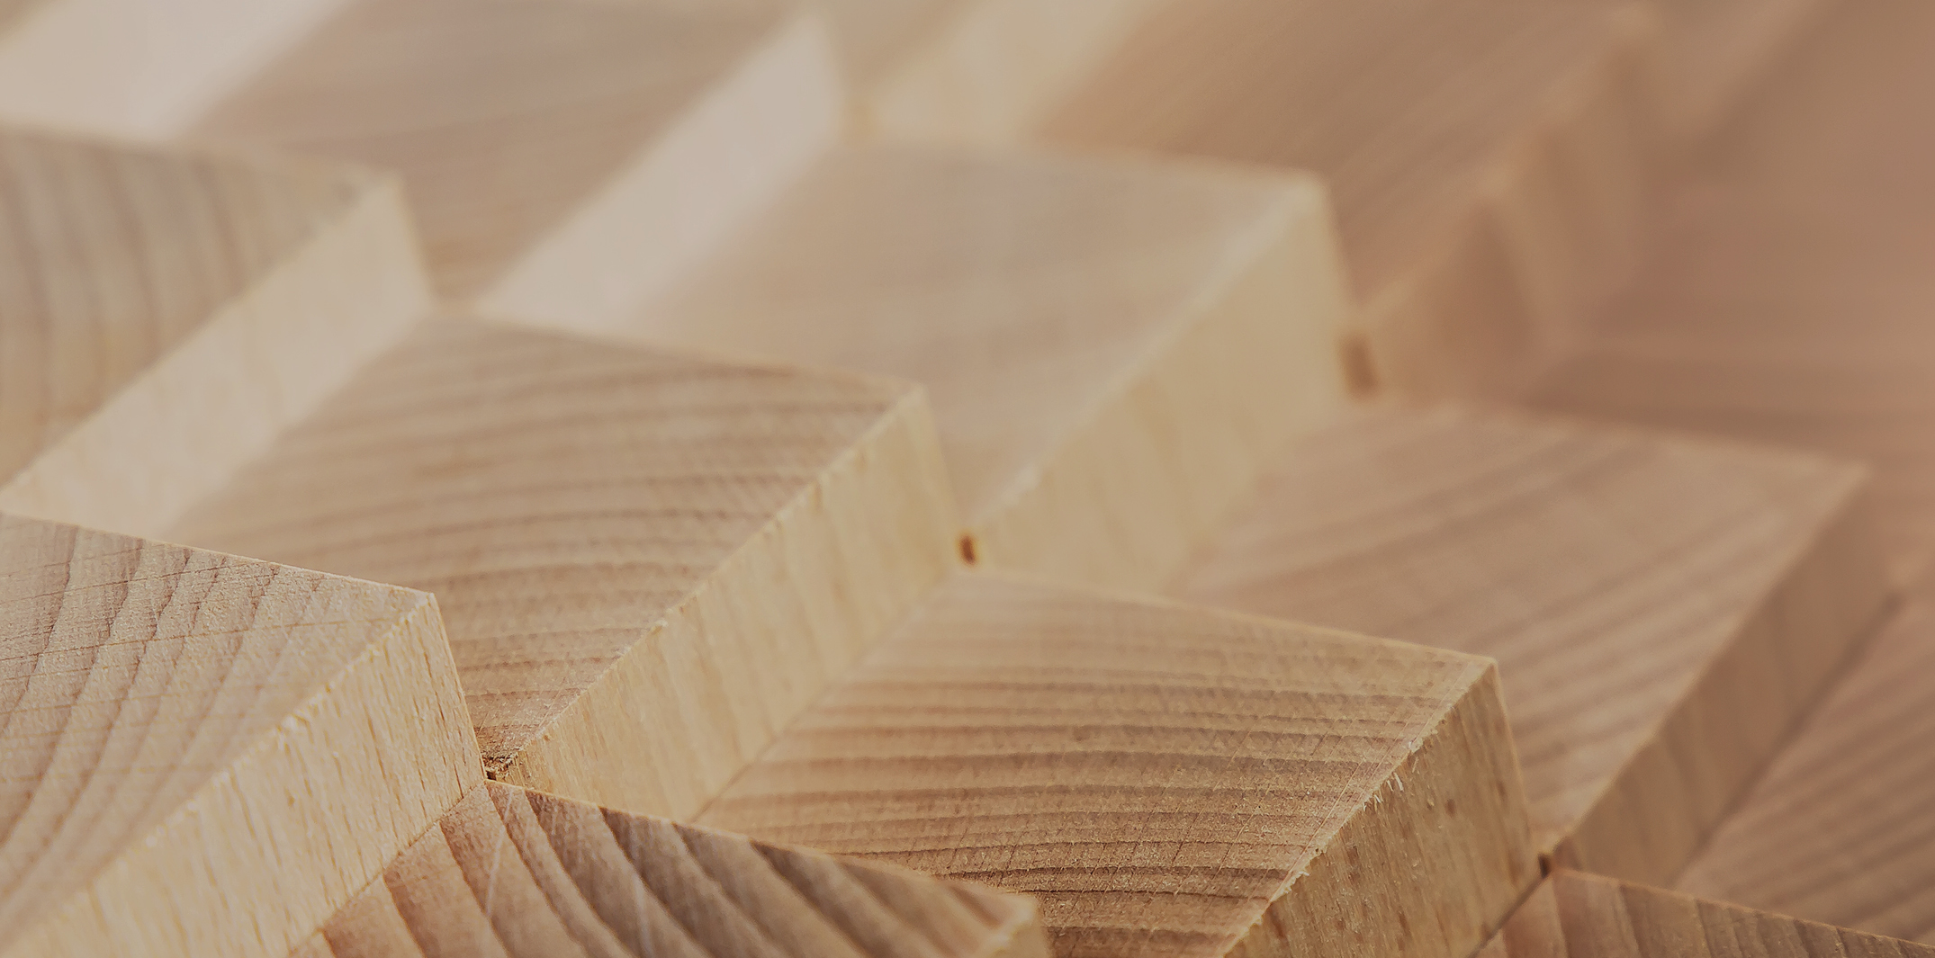
Structural design

Slide 4
Authors
Jani Pitkänen, XAMK
Release date: 20/01/2022

Slide 5
3-pin-jointed truss

Slide 6
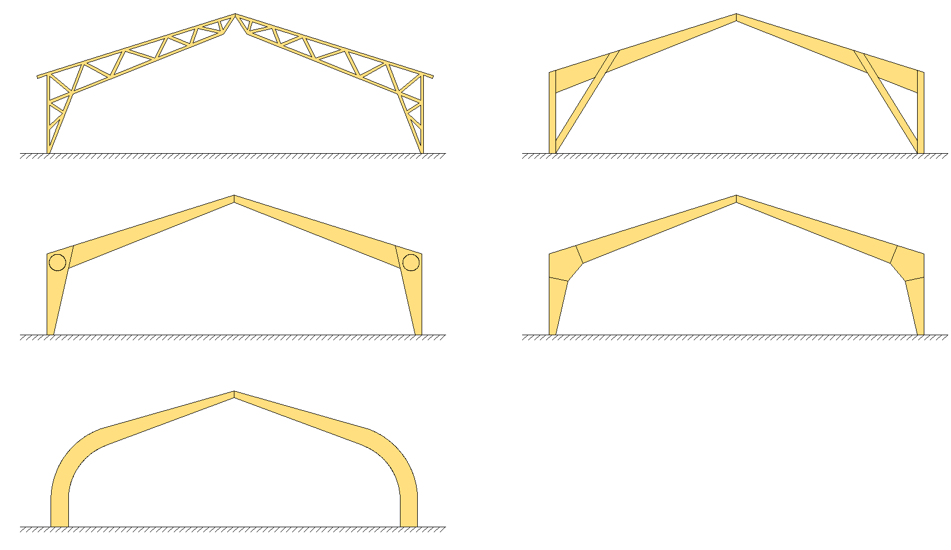
3-pin-jointed trusses in general
Design

Slide 7
3-pin-jointed trusses in general
Benefits
Stable in the direction of the circumferential plane against horisontal forces
Static-determined structures
  The distribution of torques is not affected by uneven deflection of foundations and deformation of joints
Jointed base connection makes foundations lighter
On poor foundations, the horisontal load can be handled by drawbars between the supporting joints
Affordable solution when you need high free space

Slide 8
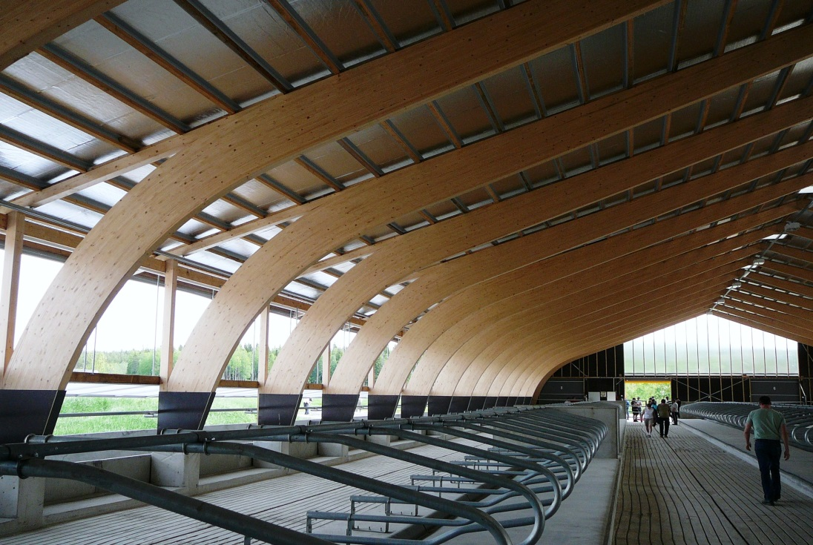
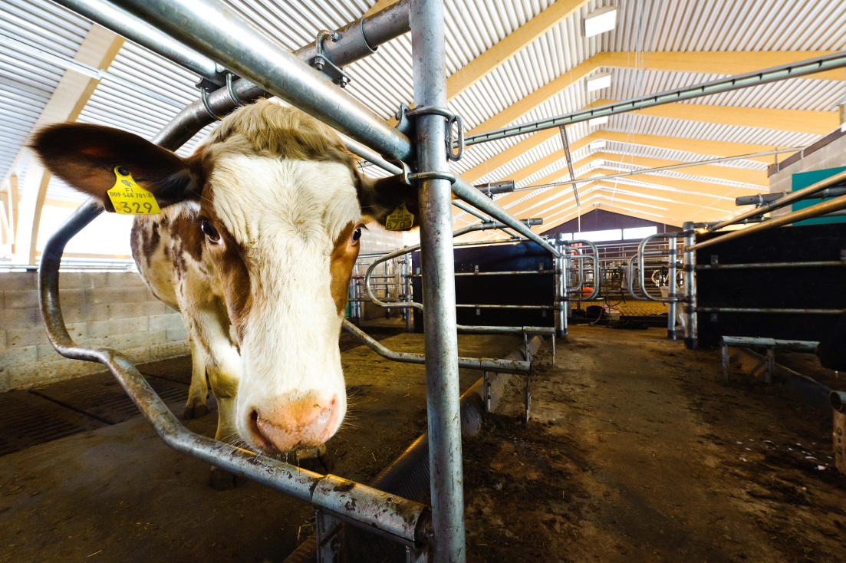
3-pin-jointed trusses in general
Applications
Sports halls (e.g. covered riding schools)
Industrial halls
Warehouses
Farm buildings (e.g. free-range areas)

Slide 9
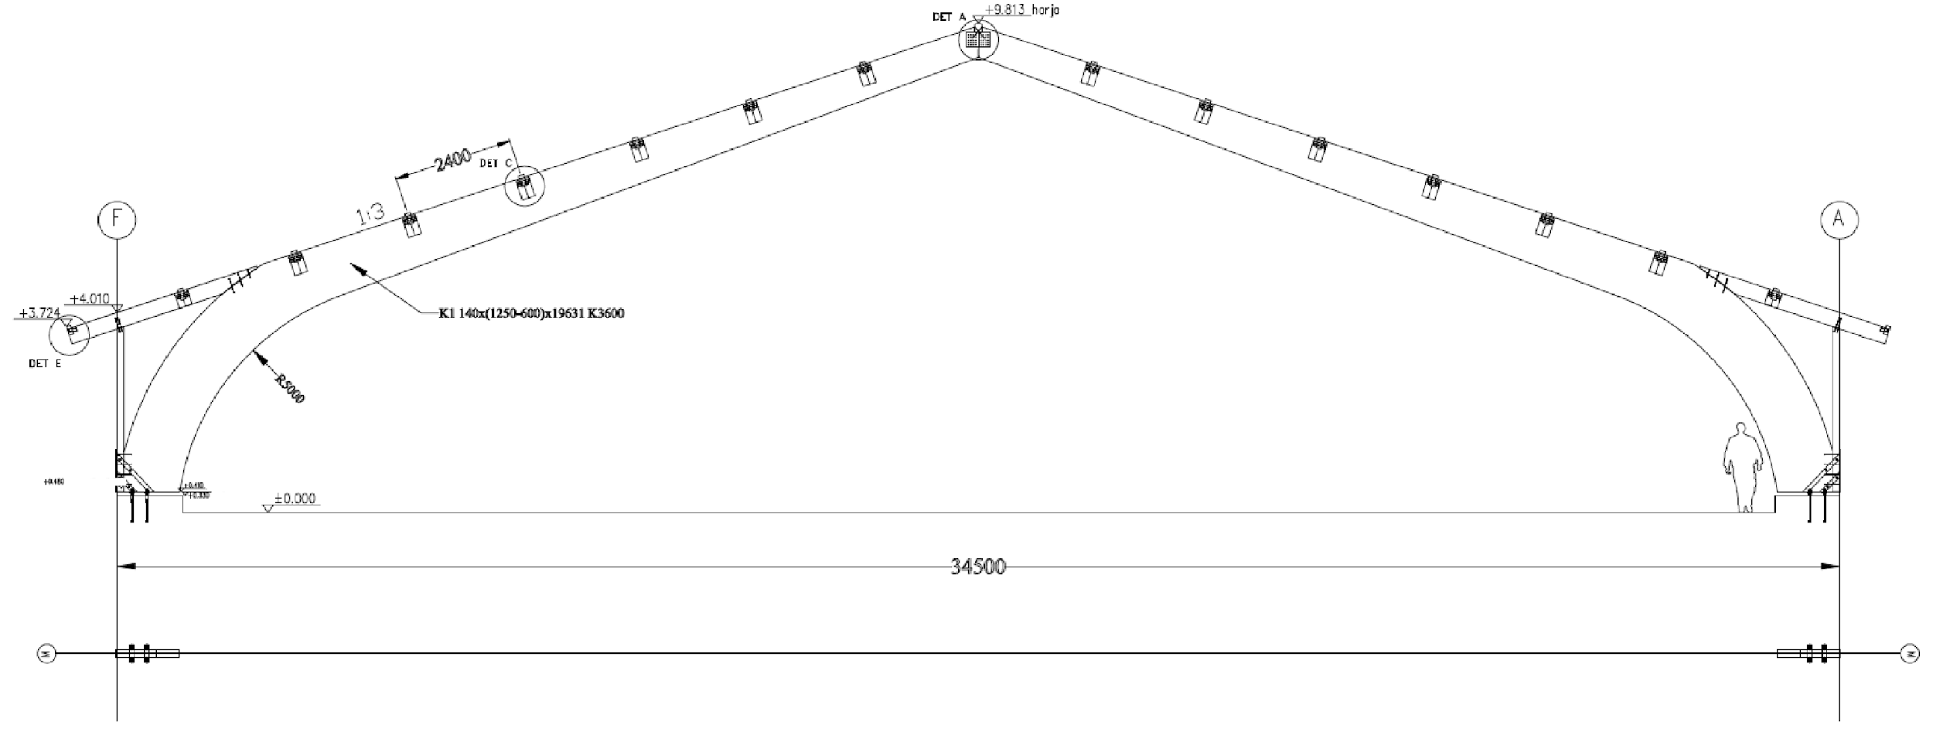
3-pin-jointed trusses with curved corners
top surface of the base bolt
puusa starting point
grid tray
top surface of lifting

Slide 10
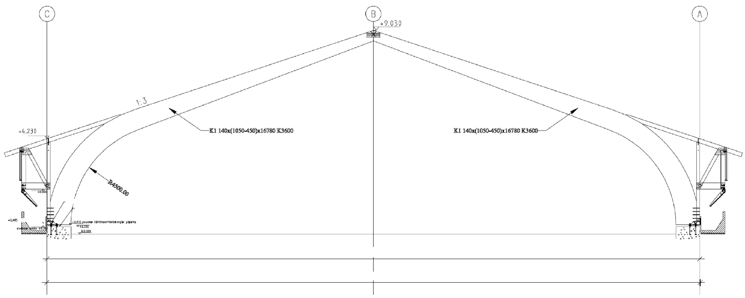
3-pin-jointed trusses with curved corners
BOLT-THROUGH M16
POST-CASTING
to the bottom of the whole frame with an unshrinkable mass
e.g. Vetonit 600/3
top surface of the base bolt
top surface of lifting
grid tray
28800 OUTER SURFACE OF THE FRAME
28840 STEEL SHOE REAR WALL

Slide 11
3-pin-jointed trusses with curved corners
Manufacture
First, the individual lamellae are finger-extended to obtain long lamelae (30 to 40 m)
They are then cut to the appropriate length and stacked on top of each other
The order of indoor and outdoor lamellae is considered in the manufacture of the combined glue laminated timber.
To reduce internal stress due to differences in moisture content, the core side of the lamellae is always turned in the same direction
However, the outer lamellae are always turned outwards

Slide 12
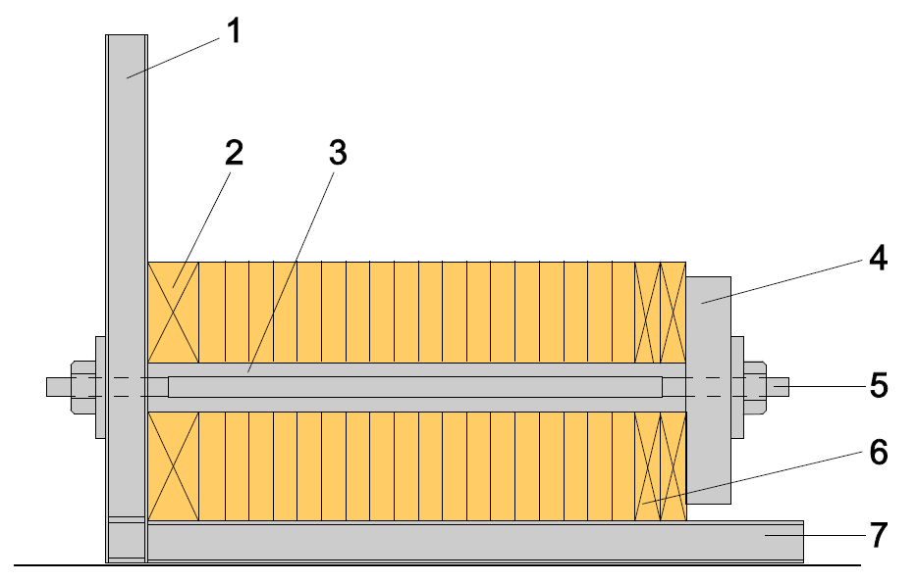
3-pin-jointed trusses with curved corners
Manufacture
Finger-extended lamellae are allowed to harden for a few hours (for the time required by the glue type) before the lamellae are planed and glued immediately afterwards
The glued lamellae bundle is lifted into the press and pressed at the appropriate pressure
This must be done before the glue starts to harden, i.e. within approximately one hour
Vertical response
Pressure compensating base piece, possibly a pre-raising model (“esikorotusmalli”)
Spacer
Clamping piece
Locking screws
Compression levelling boards
Horisontal response

Slide 13
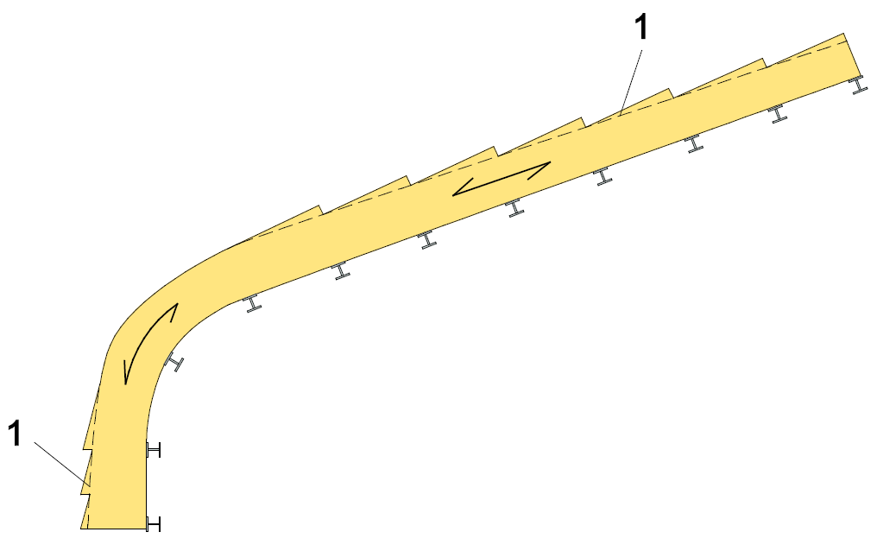
3-pin-jointed trusses with curved corners
Manufacture
Accurate time depends on glue type and hall temperature
Pre-elevated or curved shapes can be made by bending the lamellae when loading into the press
The glue can then harden under controlled humidity and temperature conditions
If necessary, the press can be heated
2
Edge cutting
Vertical response

Slide 14
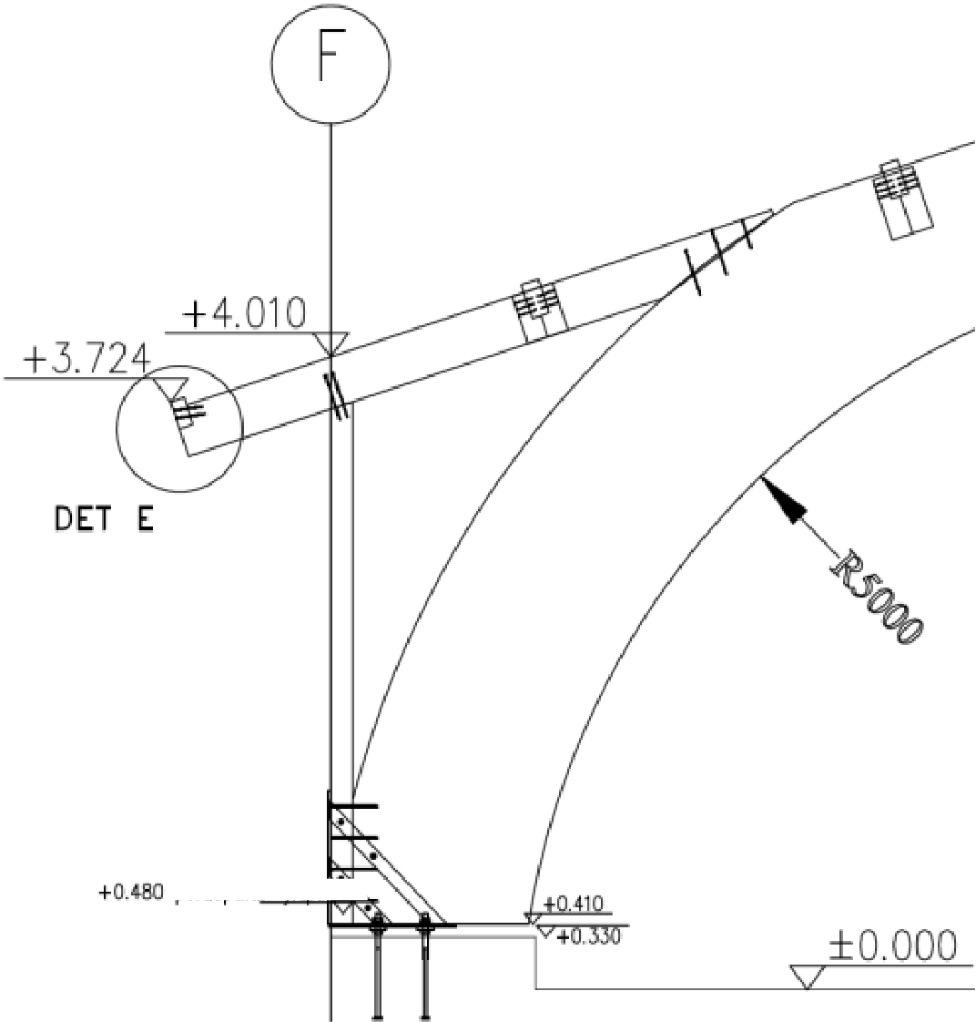
3-pin-jointed trusses with curved corners
Manufacture
After the glue has hardened, the compression pressure is removed and the building elements with glue laminated timber are lifted from the press onto the plane, where they are finished to the desired quality class.
After this, finish machining such as
  Edge cutting
  Drilling holes
  Pre-drilling for fasteners
  Mounting of possible eaves elements
top surface of the base bolt
puusa starting point
top surface of lifting

Slide 15
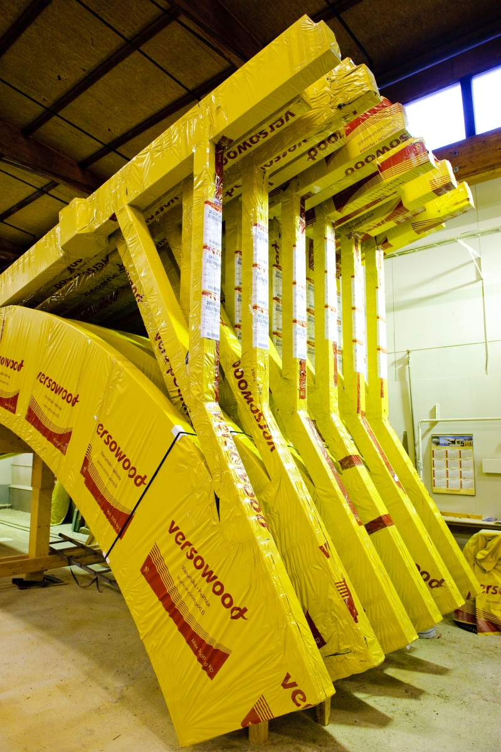
3-pin-jointed trusses with curved corners
Manufacture
If necessary, the building elements are surface-treated in the factory
Then, the visual check and marking is completed
Finally, the building elements are packaged and placed in storage or transported to the construction site

Slide 16
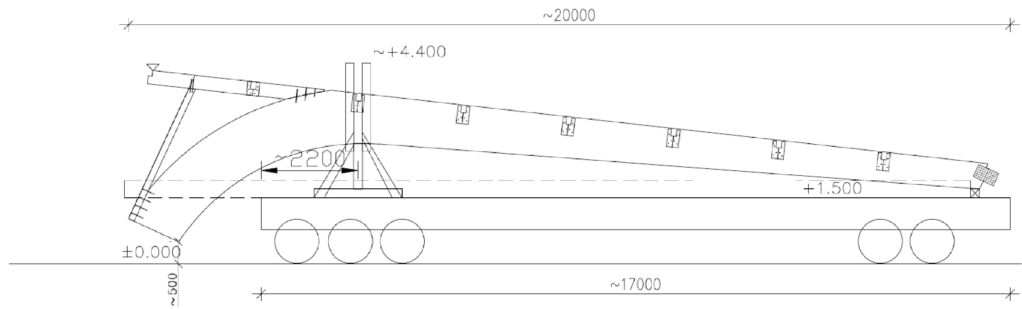
3-pin-jointed trusses with curved corners
Transport and installation
HEIGHT ABOVE GROUND
PALLET SURFACE
GROUND SURFACE

Slide 17
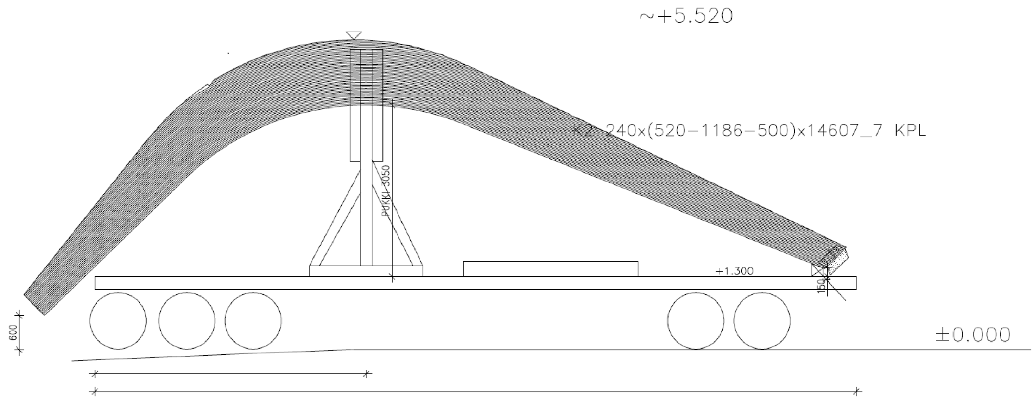
3-pin-jointed trusses with curved corners
Transport and installation
HEIGHT ABOVE GROUND
PARTS OF CORNERS
PALLET SURFACE
Support piece ~150mm
GROUND SURFACE
CENTER OF STAND 4800
Pallet 13500

Slide 18
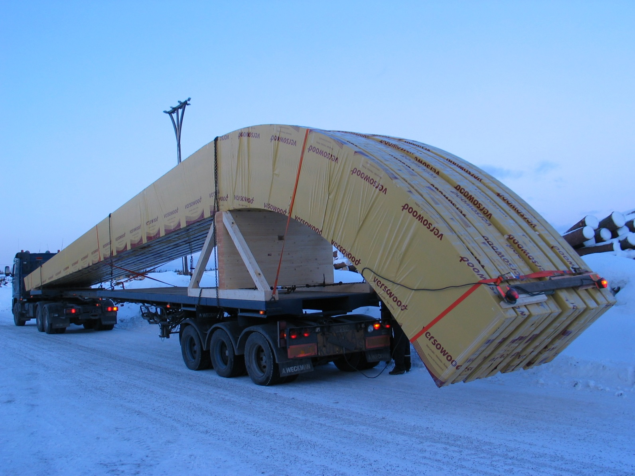
3-pin-jointed trusses with curved corners
Transport and installation

Slide 19
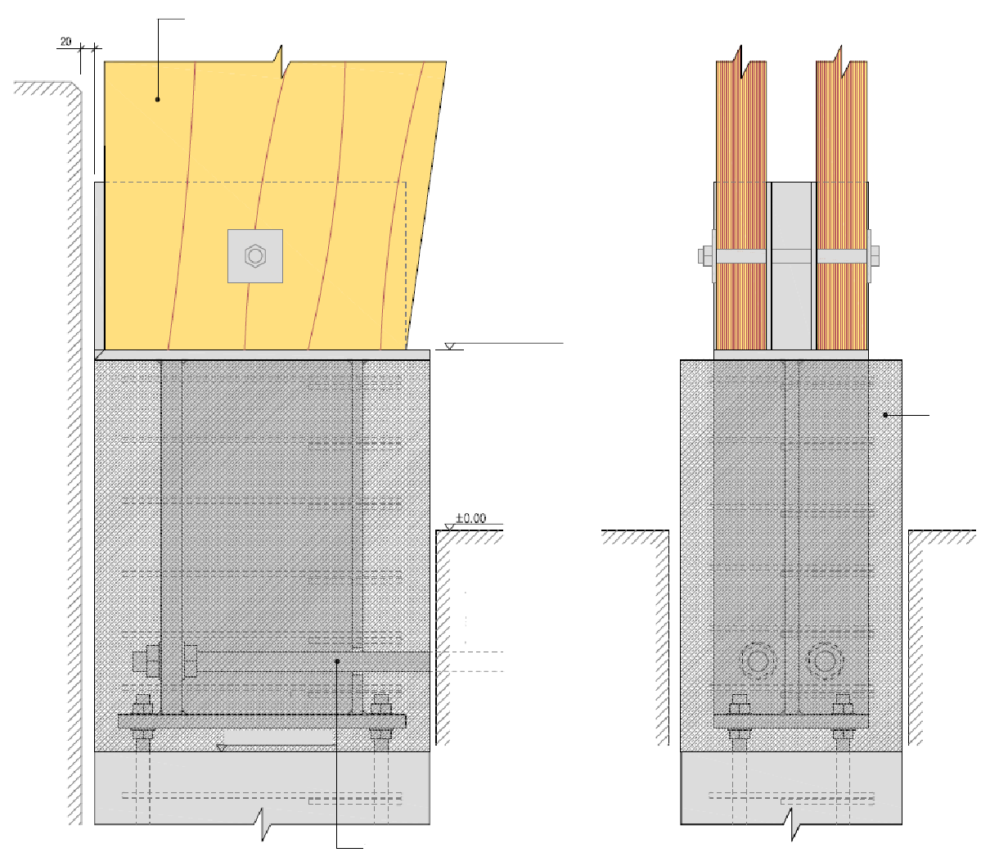
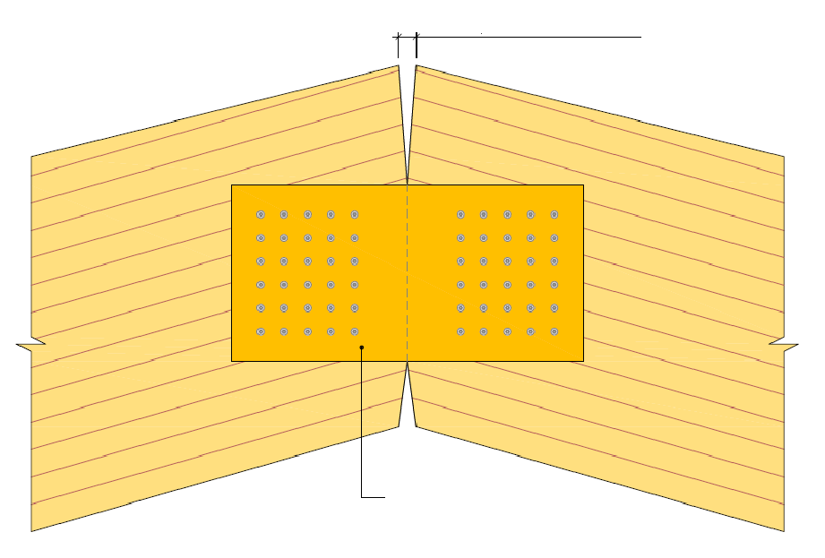
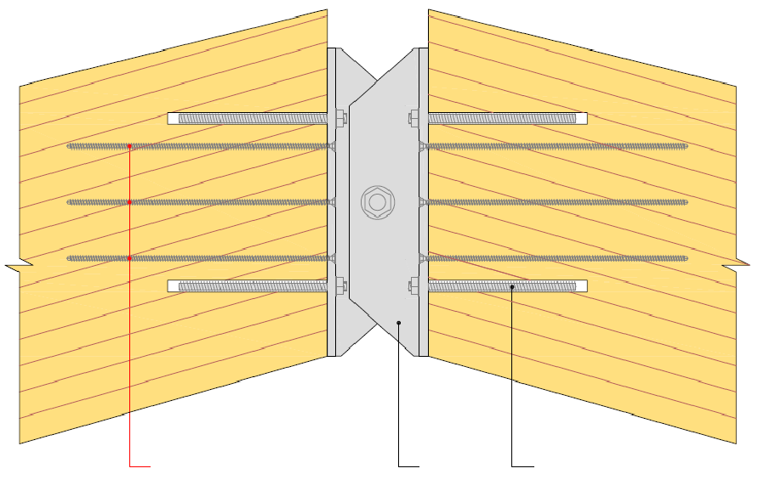
3-pin-jointed trusses with curved corners
Transport and installation
The 3-pin-jointed trusses consist of two parts which are normally fixed
  with steel parts to the concrete foundation (joint)
  Steel-wood connecting parts from roof ridge beam (joint)
3-pin-jointed truss made of glue laminated timber
ON A CASE-BY-CASE BASIS
Measurement by angle change of beams
Foundation structure
Post-moulding
Floor structure
ON A CASE-BY-CASE BASIS
Basic pillar
(reinforcement according to RAK structural design)
Plywood panel
Drawbars
Self-drilling screws in case of fire
T profile
Threaded rod with epoxy (licensed glueing)

Slide 20
3-pin-jointed trusses with curved corners
Transport and installation
Large structures are installed with a car crane the easiest and safest using a movable mounting tower under the ridge
When installing, both frames are lifted in place with a car crane
The frame base is attached to the bracket on the foundation
The ridge piece is placed on the mounting tower and the parts are attached together

Slide 21
3-pin-jointed trusses with curved corners
Transport and installation
After lateral support, the mounting tower is moved to the next line

Slide 22
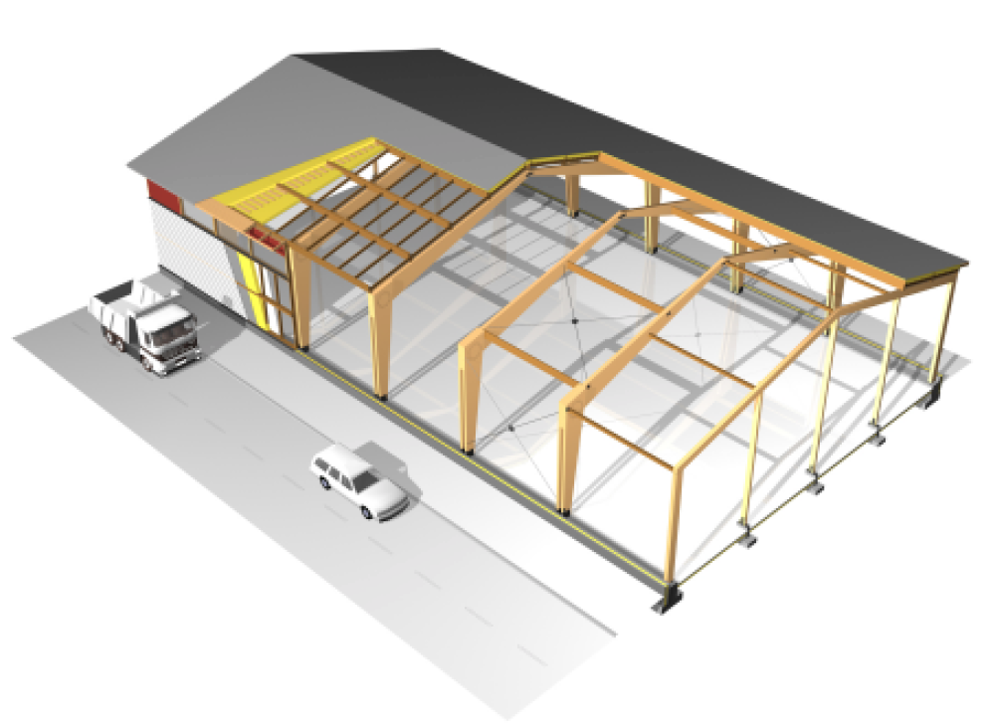
3-pin-jointed trusses with curved corners
Stiffening (3-pin-jointed trusses in general)

Slide 23
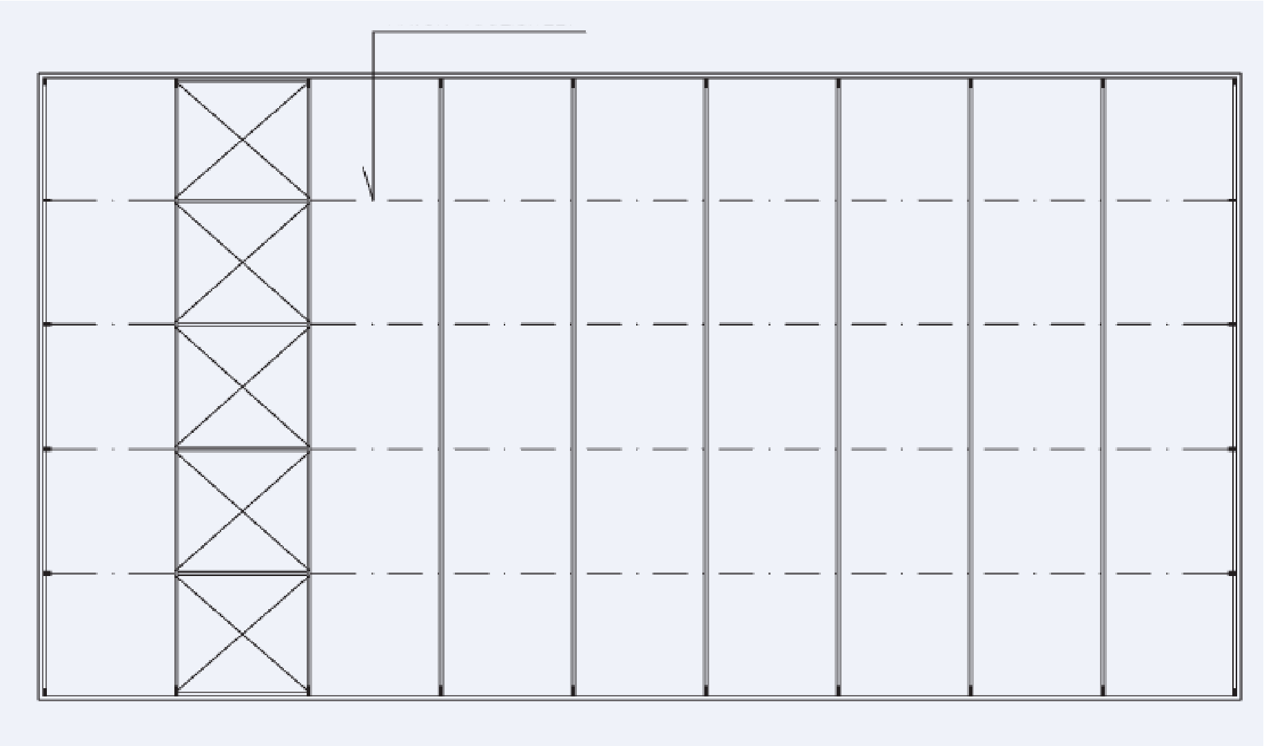
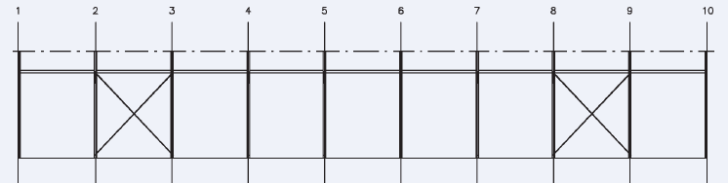
3-pin-jointed trusses with curved corners
WALL WIND BRACE LATTICE
WIND BRACES
WALL WIND BRACE LATTICE
Stiffening (3-pin-jointed trusses in general)
WALL WIND BRACE LATTICE
WALL WIND BRACE LATTICE

Slide 24
3-pin-jointed trusses with curved corners
Dimensioning
Bending strength at the maximum bending moment
Compressive strength at maximum compressive force
Displacements
Circular base
  Shearing strength with support
  Compression strength with support
  Combined compression and bending
  Buckling phenomenon of weaker cross-sectional orientation
  Lateral buckling

Slide 25
3-pin-jointed trusses with curved corners
Dimensioning
Curved section
  Combined compression and bending
  Buckling phenomenon of weaker cross-sectional orientation
  Lateral buckling
Framing beam
  Ridge shear resistance
  Ridge compression resistance
  Combined compression and bending
  Buckling phenomenon of weaker cross-sectional orientation
  Lateral buckling

Slide 26
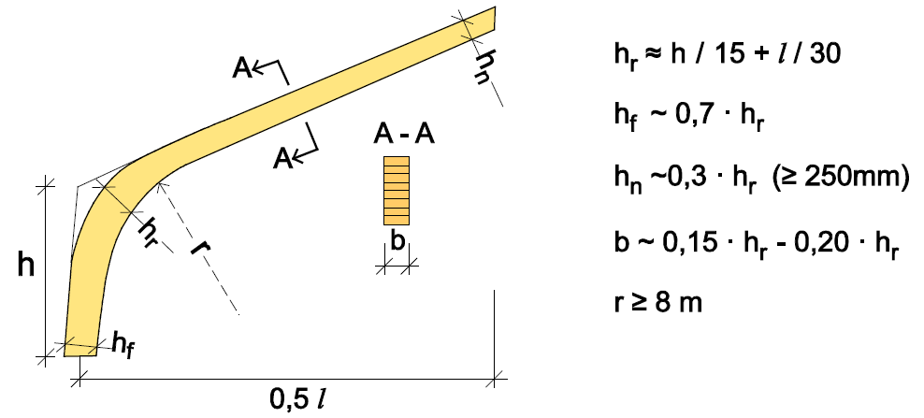
3-pin-jointed trusses with curved corners
Dimension special features
Variable cross-section in beam and base k_{m,α} factor
Curved part (corner) => k_{r} factor
Curved section compression side => lateral buckling
Transport height => Preferably less than 4.4 m

