Slide 1


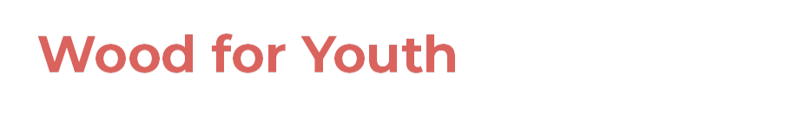
Industrial wood construction
Teaching materials for industrial wood construction education
2022

Slide 2
Origin of the materials
Use of the materials
These learning materials for industrial wood construction have been prepared in a project led by Puuinfo Oy in 2021–2022. Also involved in the project were
Lappia Vocational College,
TTS-Työtehoseura ry
South-Eastern Finland University of Applied Sciences,
Metropolia University of Applied Sciences,
Jyväskylä University of Applied Sciences,
University of Tampere, and
Federation of the Finnish Woodworking Industries Puutuoteteollisuus ry
The project was funded by the Ministry of the Environment.
The materials are intended to be used as extensively as possible in industrial wood construction education and studies.
The materials are released under the Creative Commons licence Attribution-ShareAlike (CC BY-SA), which requires that the author be properly credited when the materials are used and that derivative works may only be distributed under the same licence as the original work.
The original materials and any updates to them by Puuinfo will be published on the Library of Open Educational Resources website (aoe.fi) and the Puuinfo.fi website.

Slide 3
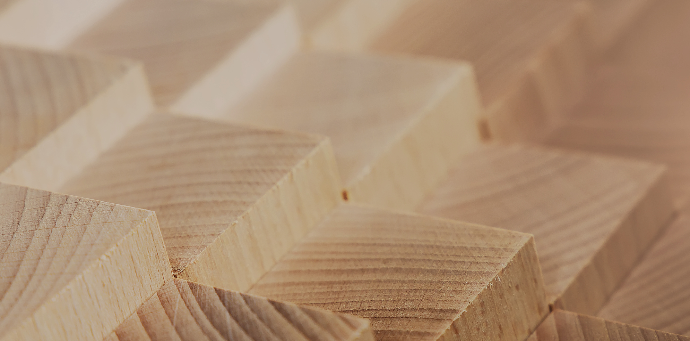
Structural design

Slide 4
Authors
Jani Pitkänen, XAMK
Release date: 20/01/2022

Slide 5
3-hinged arch

Slide 6
Cross-sections and shapes of an arch
Flat-height solid cross-section (most common)
Truss frames (glued laminated timber and LVL)
Box cross-section
I cross-section
The shape of the arch is selected so that the torques become as small as possible
This means that the load follows the compression line of the dominant load combination

Slide 7
Cross-sections and shapes of an arch
Because there are several load combinations, it is necessary to make compromises
The most common arch shapes are the circle and the parabola
It is possible to use other shapes as well, such as an elliptical shape
It is recommended to use 3-hinged arches because they are statically prescribed
2-hinged arches and fully rigid arches should be avoided (statically unassigned) as internal tensions are caused by, for example, possible displacement of supports

Slide 8
Cross-sections and shapes of an arch
In addition, large spans encounter possible transport problems, which means that large arches cannot be transported whole, but are often transported in two (3-hinged arches) or even four parts (requires torque-rigid joints).
The arches can be supported directly on foundations or pillars
Whatever the method of support, in addition to the vertical load on the supports, the horizontal force must be taken into account.

Slide 9
Cross-sections and shapes of an arch
Horizontal force is usually handled with drawbars
In the case of an arch placed at the top of the pillars, the drawbars are suspended from the arch
In the case of an arch supporting the foundations, the drawbars are placed underground at the foundation level.

Slide 10
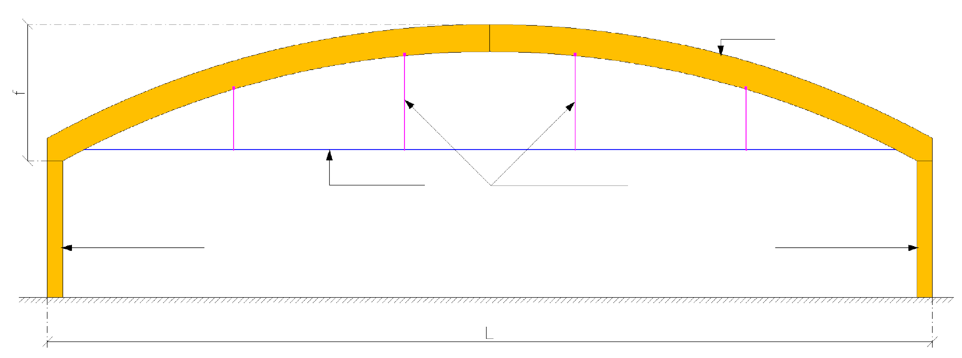
Shapes and materials
Arch with a drawbar (on top of the pillars)
ARCH
TENSION BARS
SUPPORT RODS FOR DRAWBARS
MAIN COLUMN
MAIN COLUMN

Slide 11
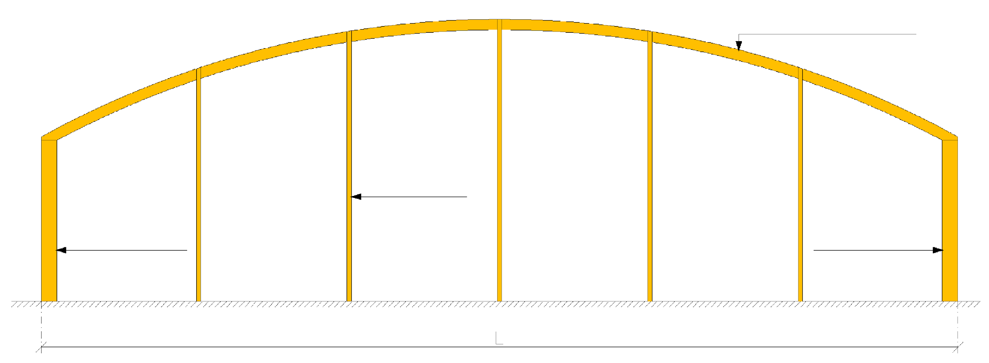
Shapes and materials
The top of an arch with a drawbar (on top of columns)
CURVED TRUSS
WIND COLUMNS
CORNER COLUMN
CORNER COLUMN

Slide 12
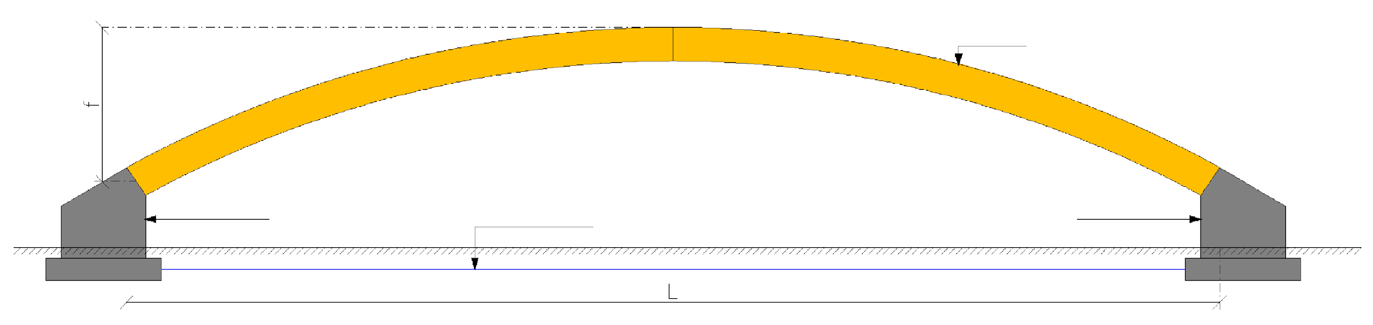
Shapes and materials
An arch supported by the foundation
ARCH
FOUNDATION
TENSION BARS
FOUNDATION

Slide 13
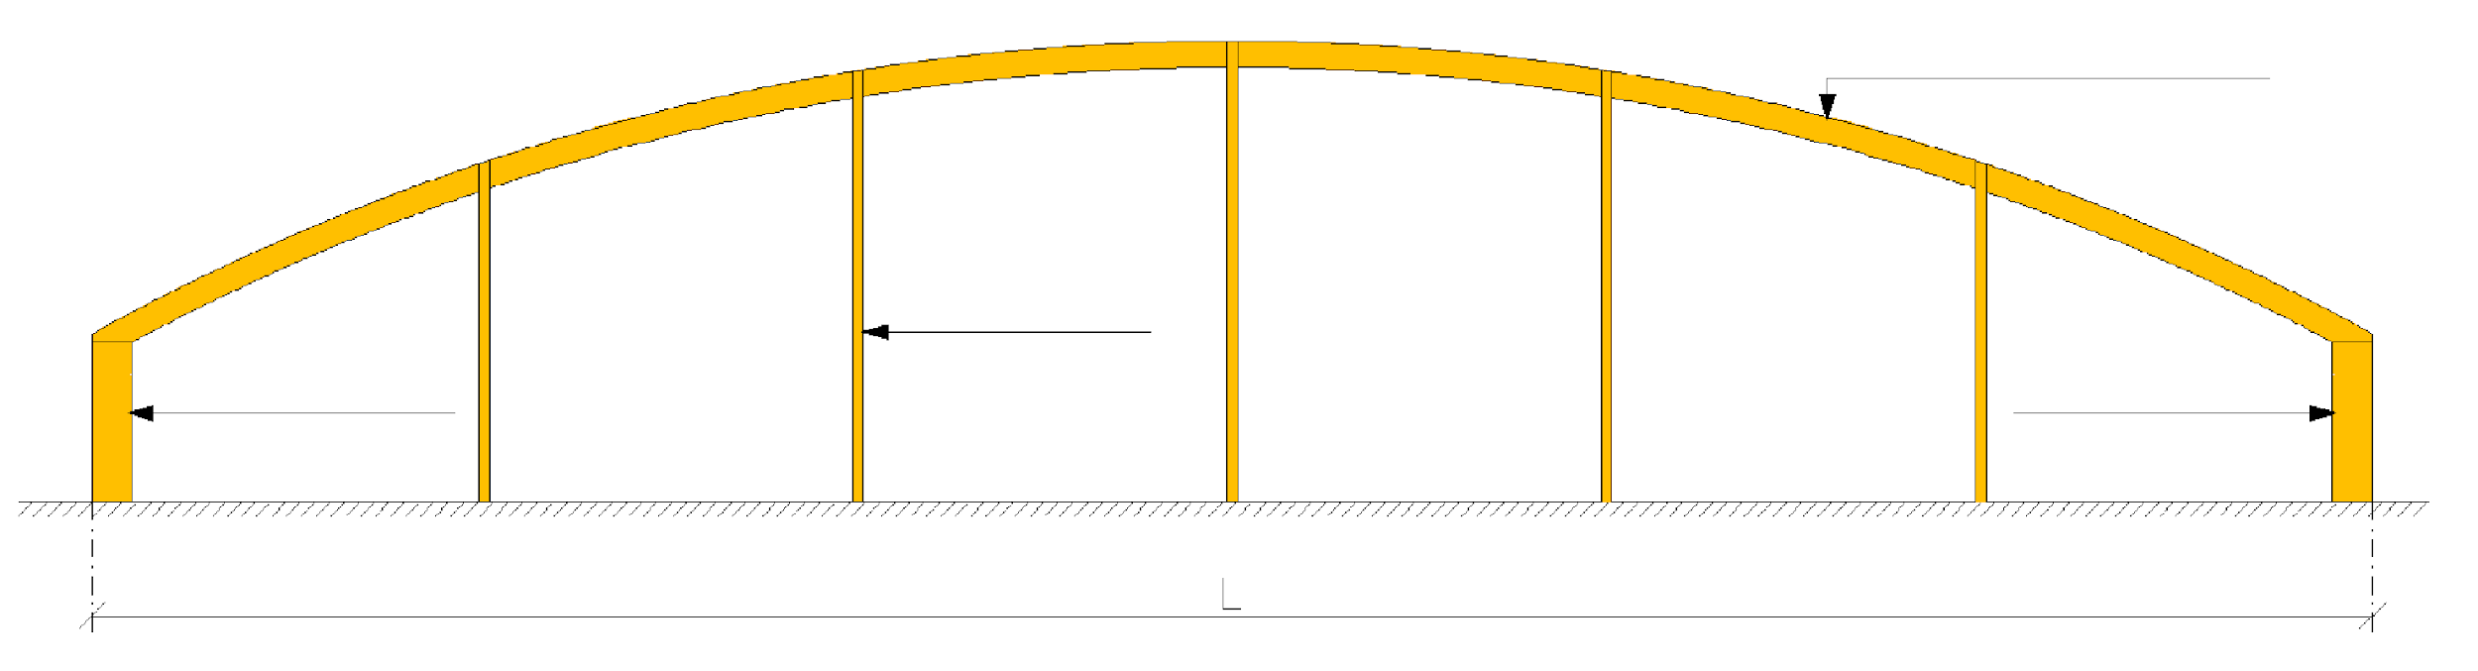
Shapes and materials
The top of an arch supported by the foundation
CURVED TRUSS
WIND COLUMNS
CORNER COLUMN
CORNER COLUMN

Slide 14
Cross-sections and shapes of an arch
The recommended spans for arches with drawbars that supported by the tops of a column are 25...50 m
The recommended spans for arches supported by foundations are 40...100 m
In both cases, the arch section height is approximately the span (L) / 35
This also depends on the distribution of arches
Recommended arch distribution
4.8...8.4 m for a pillar-and-arch frame
6.0...9.6 m for a foundation-supported

Slide 15
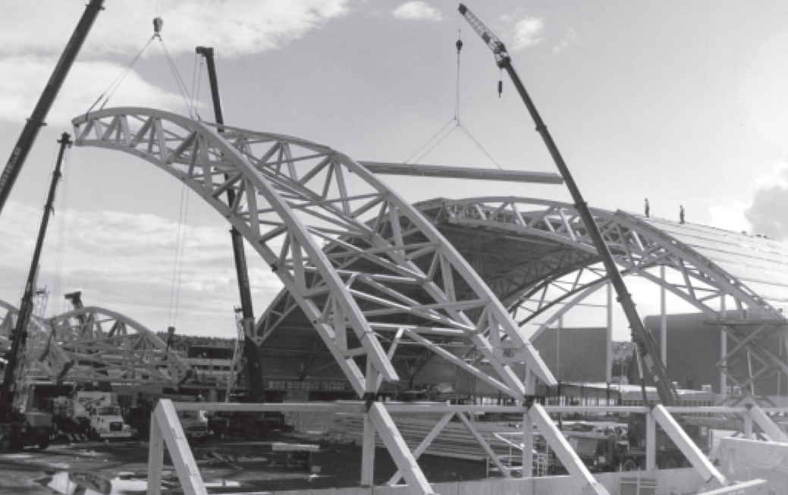
Truss-structure arch (glued laminated timber, LVL)

Slide 16
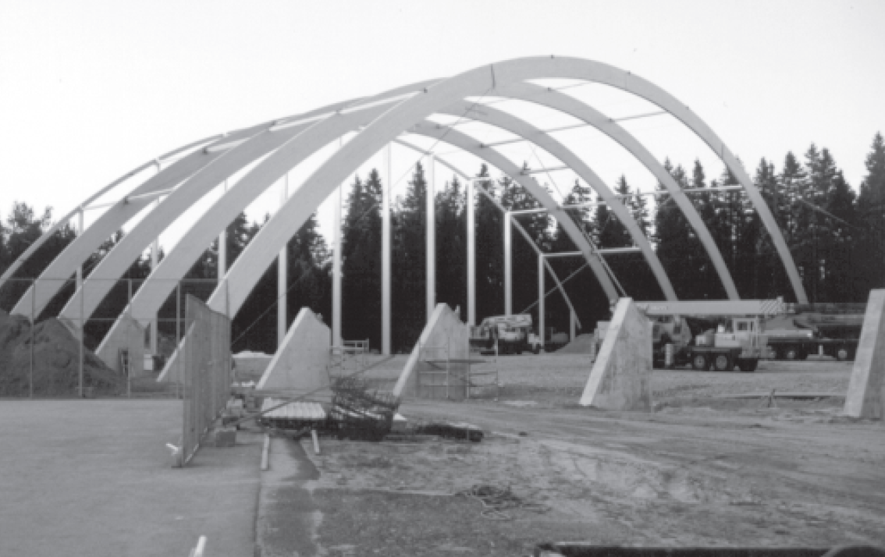
Solid arch (glued laminated timber)

Slide 17
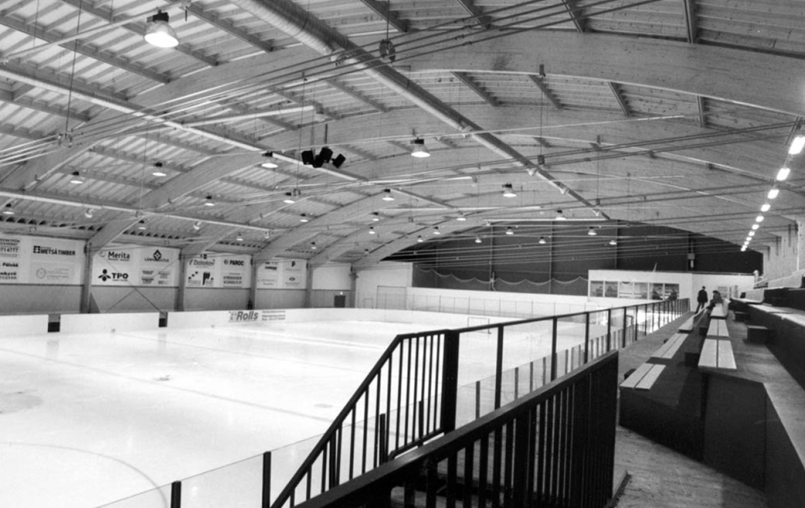
Solid arch, with a drawbar (glued laminated timber)

Slide 18
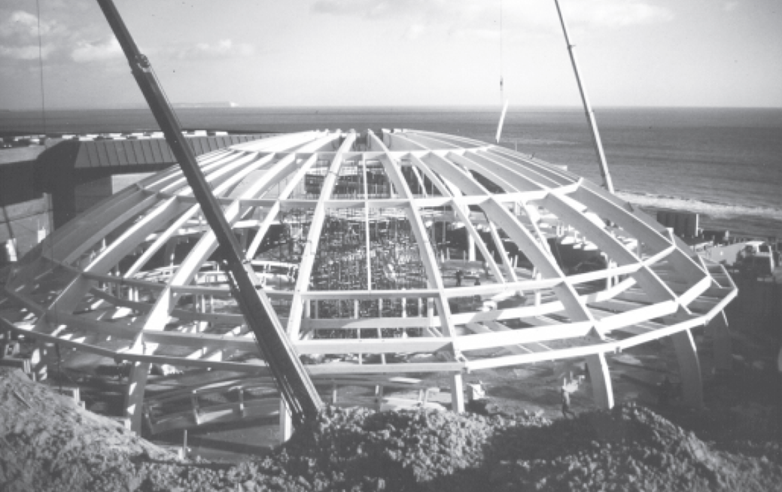
Solid arch, dome (glued laminated timber)

Slide 19
Dimensioning
When dimensioning, it is often necessary to divide the arch into several parts (cross line)
The arch should be divided into a sufficient number of parts, e.g. 8 parts per half of the arch
Even if converted to a cross-line, the loads must still be considered according to the arch, not, for example, the perimeter.
In addition, the pitch of the arch (f) should be set high enough to avoid excessive horizontal forces.

Slide 20
Dimensioning
The pitch of the arch is compared to the span (L), giving a dependence between them.
Recommended ratio is f/L > 0.144
It is recommended to use a FEM programme, because calculating displacements by hand is very laborious.
In addition, there may be several load combinations when considering the following:
Use limit state
Ultimate limit state
Accident limit state

Slide 21
Dimensioning
The following dimensioning analyses are performed on the arch:
Bending strength at the maximum moment
Compressive strength at maximum compressive force
Compressive strength in weaker cross section direction
Maximum shear stability at shear force
Combined bending and compressive strength
Transverse traction

Slide 22
Dimensioning
The following dimensioning analyses are performed on the arch:
Lateral buckling strength
Lateral buckling strength of the upper edge
Combined compressive and lateral buckling strength of the upper edge
Lateral buckling strength of the lower edge
Combined compressive and lateral buckling strength of the lower edge
The offset assessments of the arch (vertical and horizontal offsets)

Slide 23
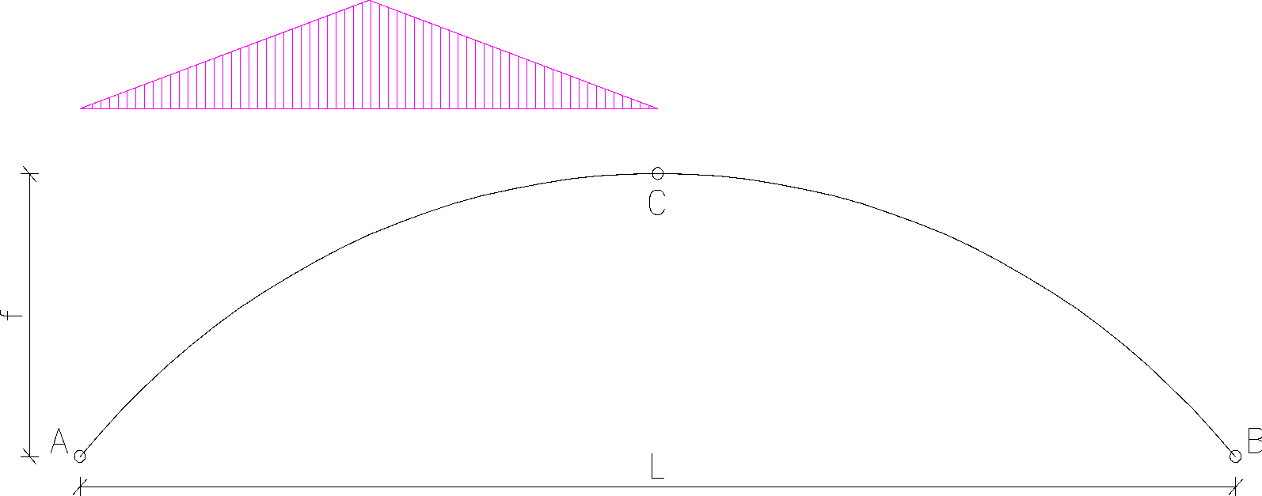
Special features of dimensioning
Transverse traction

Slide 24
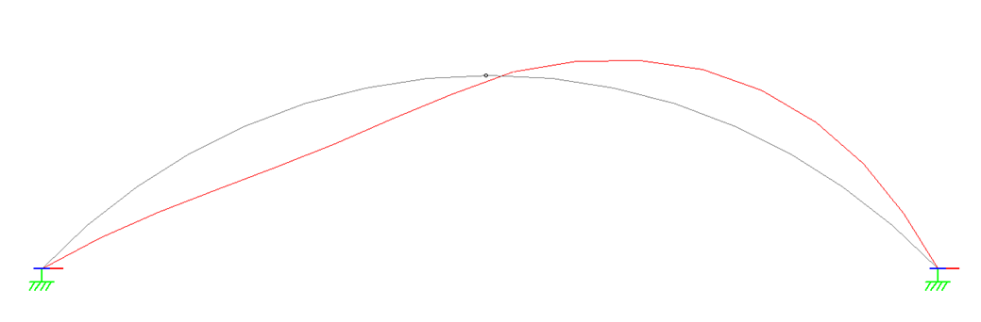
Special features of dimensioning
Transverse traction

Slide 25
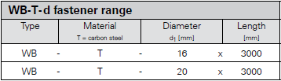
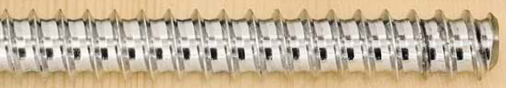
Special features of dimensioning
Reinforcement against transverse traction:
Structures can be strengthened, for example, with threaded bars
For example, SFS-Intec WB-T threaded bars
Diameter: 16 mm and 20 mm
Length: 3,000 mm (cut to appropriate length)
Dimensioning: DIN 1052: 2008-12

Slide 26

Special features of dimensioning
Reinforcement against transverse traction:
Structures can be strengthened, for example, with threaded bars
For example, SFS-Intec WR screws
Diameter: 9 mm and 13 mm
Length: (9 mm) 250...500 mm and (13 mm) 400...1,000 mm
Dimensioning: ETA 12/0062

Slide 27
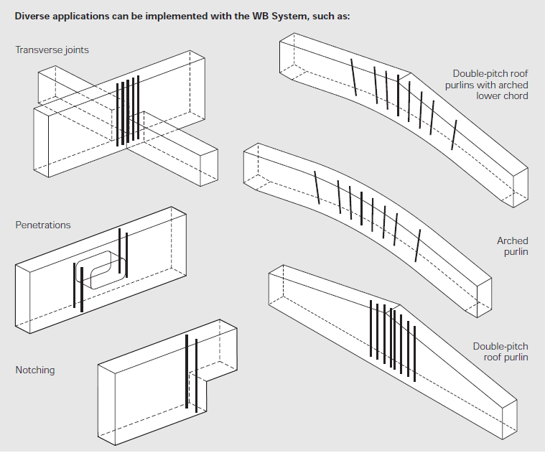
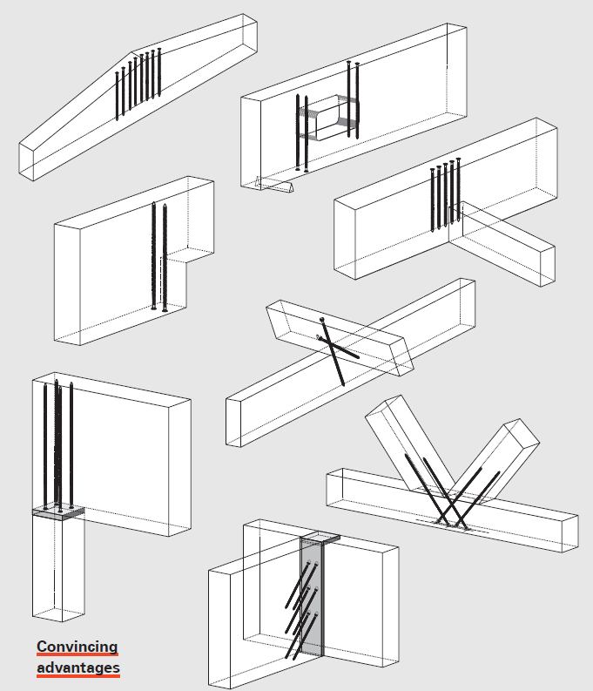
Special features of dimensioning
Reinforcement against transverse traction:
Threaded bar Screw

