Slide 1



Industrial wood construction
Teaching materials for industrial wood construction education
2022

Slide 2
Origin of the materials
Use of the materials
These learning materials for industrial wood construction have been prepared in a project led by Puuinfo Oy in 2021–2022. Also involved in the project were
Lappia Vocational College,
TTS-Työtehoseura ry
South-Eastern Finland University of Applied Sciences,
Metropolia University of Applied Sciences,
Jyväskylä University of Applied Sciences,
University of Tampere, and
Federation of the Finnish Woodworking Industries Puutuoteteollisuus ry
The project was funded by the Ministry of the Environment.
The materials are intended to be used as extensively as possible in industrial wood construction education and studies.
The materials are released under the Creative Commons licence Attribution-ShareAlike (CC BY-SA), which requires that the author be properly credited when the materials are used and that derivative works may only be distributed under the same licence as the original work.
The original materials and any updates to them by Puuinfo will be published on the Library of Open Educational Resources website (aoe.fi) and the Puuinfo.fi website.

Slide 3
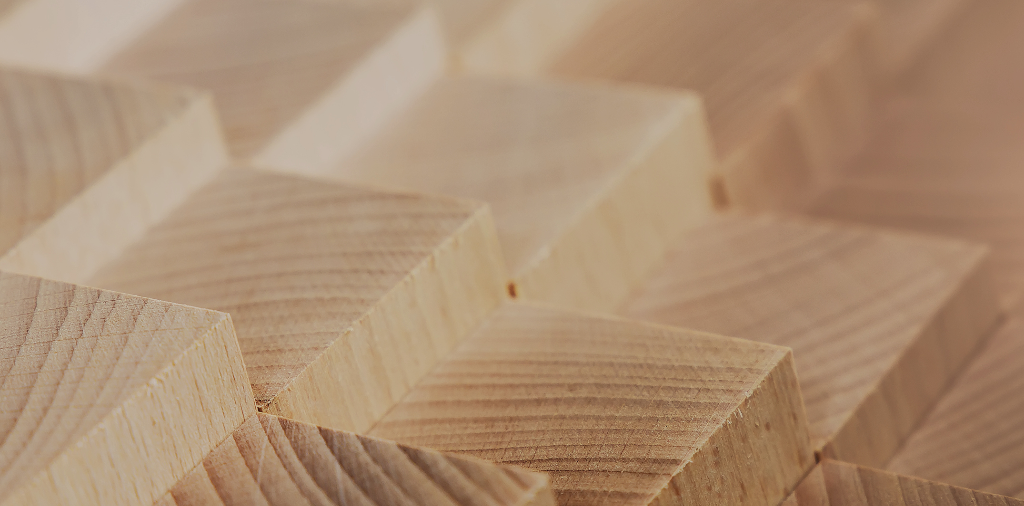
Structural design

Slide 4
Authors
Tero Lahtela,
Insinööritoimisto Tero Lahtela Oy
Release date: 14/10/2021

Slide 5
Log structures

Slide 6
Log structure terms
Log
  A massive building material made by planing or turning, at least 68 mm thick, mainly used in a wall. A log may have lateral grooves and crack-steering grooves. A log can be finger-jointed.
Laminated log
  A log glued together from two or more layers. The layers may be horizontal, vertical or diagonal in relation to each other.
Non-settling log
  A log in which some of the layers are vertical in grain direction, minimising the settlement caused by the drying of the log/wall. The terms ‘cross-laminated log’ and ‘cross-glued log’ are also used.

Slide 7
Log structure terms
Joint
  Corner joint of logs
Lateral groove
  The shape of the seam between logs.
Pegging
  Preventing the lateral movement of individual logs in the log wall by joining two or more logs vertically, usually using wood or metal pegs.
Dowel
  A wood or metal peg used to peg a log wall. Instead of the dowel peg, the fastening of the logs to each other can also be done using screws, nails or dowel plates.

Slide 8
Log structure terms
Through-bolting
  A tightenable threaded rod that extends through the height of the entire wall or log beam and reinforces the structure.
Log beam
  A load-bearing beam structure consisting of one or more connected logs.
Screw jack
  A steel part in a post or wall which can be used to adjust the height position of non-settling structures as the settlement of the log walls progresses.

Slide 9
Log structure terms
Buck
  A vertical post installed in a groove made in the log wall to which non-settling structures are attached. The buck permits the settlement of the log wall, but prevents the lateral displacement of the attached building element.
Support post
  Vertical wooden pilaster attached to one or both sides of the log wall to prevent the buckling of the walls.

Slide 10
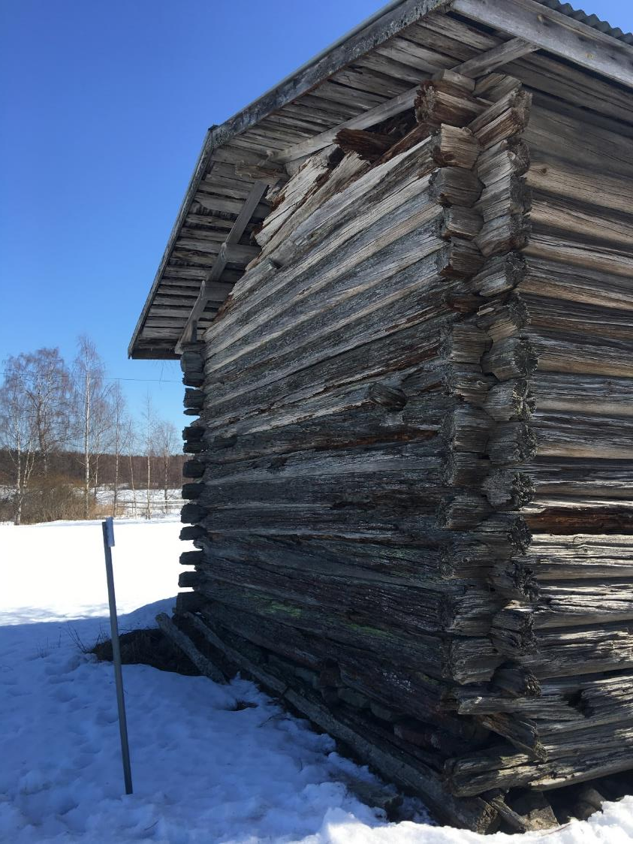
History of log construction
The log frame is hundreds of years old as a construction system
Historically, the roots of log construction are in northern and eastern Europe
Later, log construction spread to North America
Pictured: the Tarsia wilderness storehouse from 1441
Image: Tero Lahtela

Slide 11
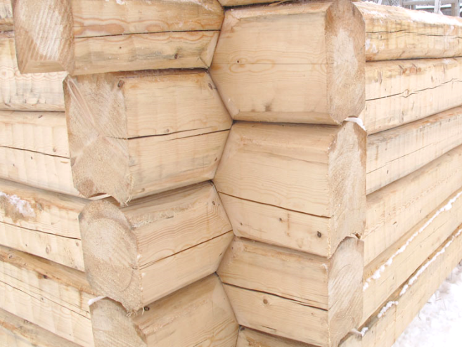
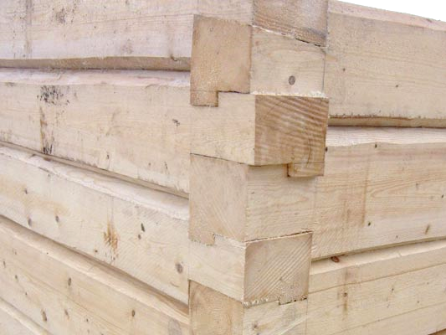
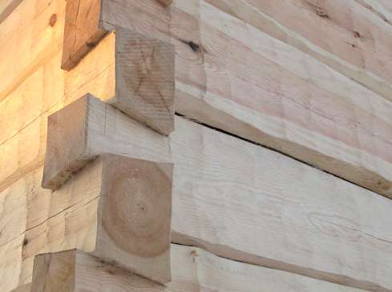
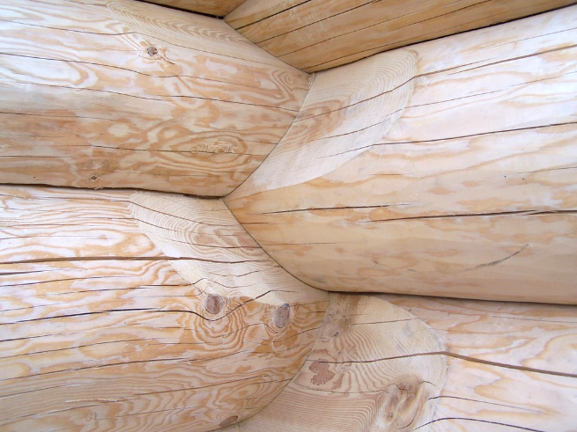
Traditional corner joints of logs
The log frame used to be hand-sculpted using an axe
Corner joints have been developed in various cultures
In addition to visual aspects, corner joints also contain technical features
  For example, the “Norwegian Corner” and the “saddle corner” are tightened as the log frame settles, because the joining surfaces are wedged
  The tightening maintains airtightness
Norwegian corner
Lock corner
Dove-tail corner
Saddle corner
Photos: www.hongos.fi

Slide 12
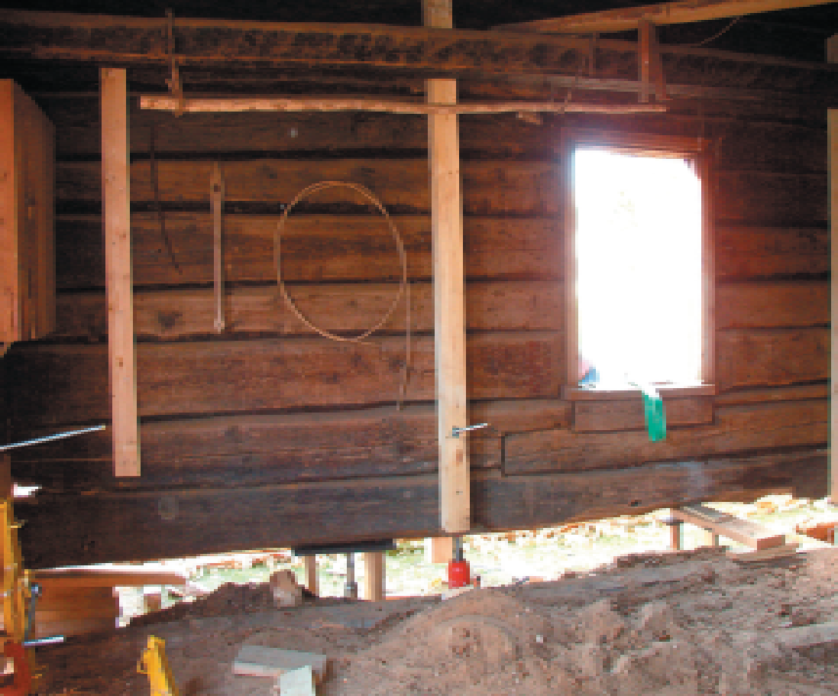
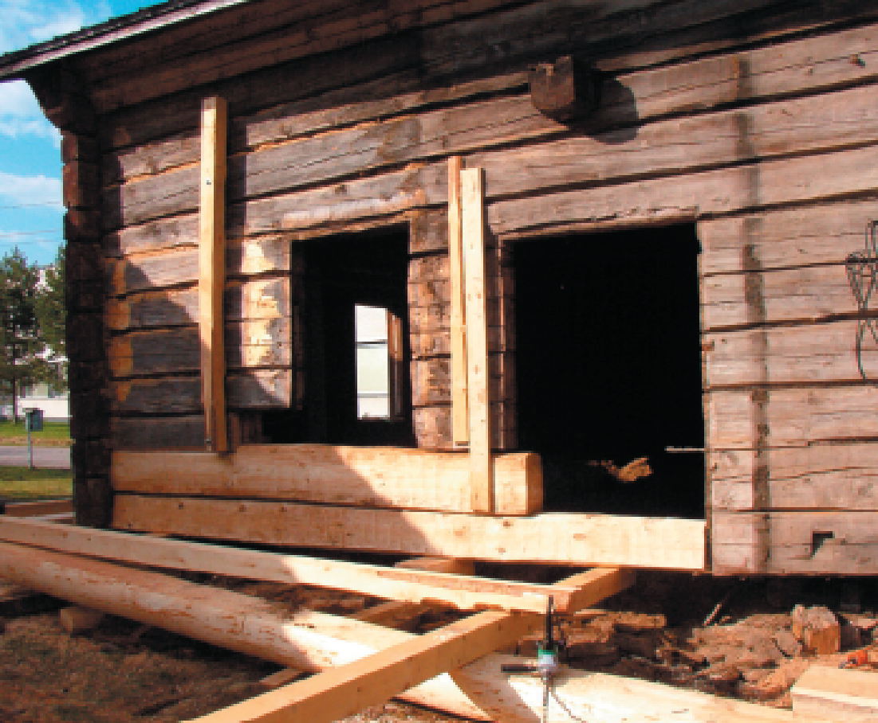
“Shoeing” a log building
Logs in a log frame can be replaced with new ones
Usually, the replaced log layers are near the building’s foundation
Changing the lowest layers of logs is called “shoeing” a log building
Images: Pohjois-Pohjanmaan korjausrakentamiskeskus

Slide 13
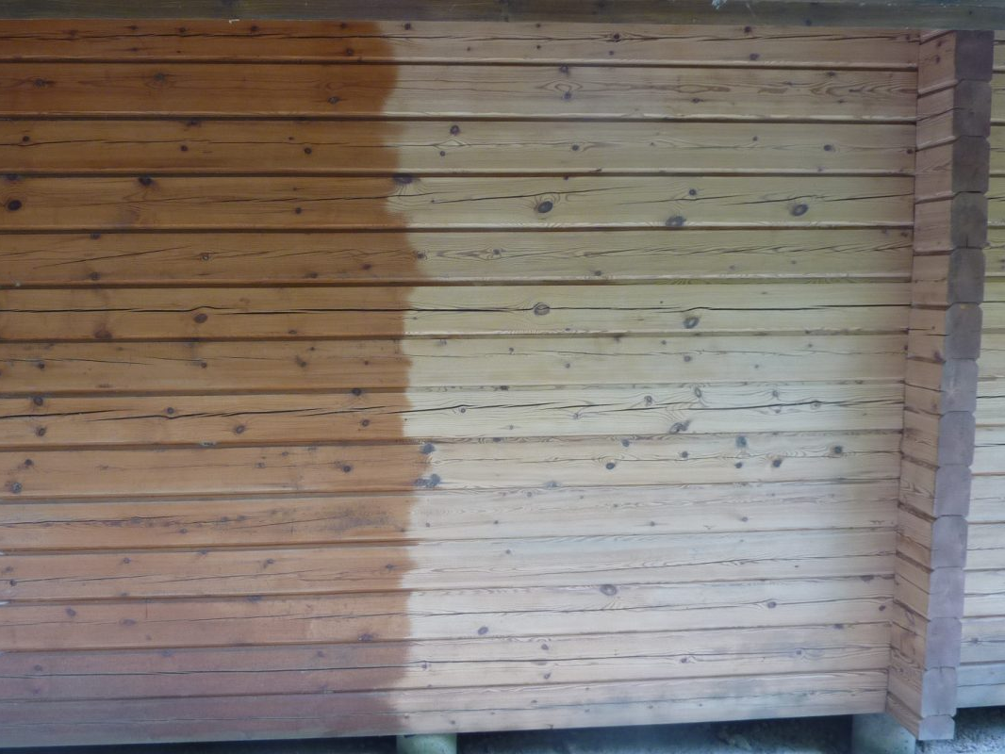
Cleaning a log wall
In connection with repair construction, the log walls may need to be cleaned
The soda wash method is a gentle cleaning method for sensitive surfaces
Photo: www.soodapuhallus.fi

Slide 14
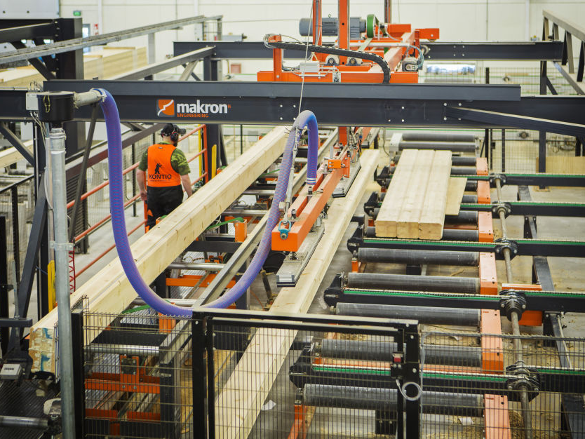
Industrial log construction
Today, the production of log frames is an industrial process
Logs are manufactured on computer-controlled industrial lines
Modern, accurately sized logs glued together from layers allow large log buildings to be built
Image: Makron

Slide 15
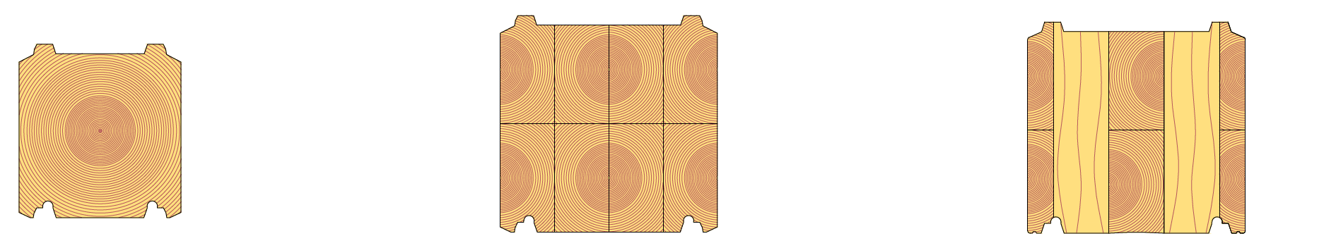
Solid wood logs
Solid wood log
Width: 95...205 mm
Height: 170...220 mm
Length: ≤13 m
Dimensions and profile shape vary by manufacturer
Laminated log
Width: 95...275 mm
Height: 170...275 mm
Length: ≤13 m
Dimensions. laminated structure and profile shape vary by manufacturer
Non-settling log
Width: 135...275mm
Height: 220...275 mm
Length: ≤13 m
Dimensions, laminated structure and profile shape vary by manufacturer

Slide 16
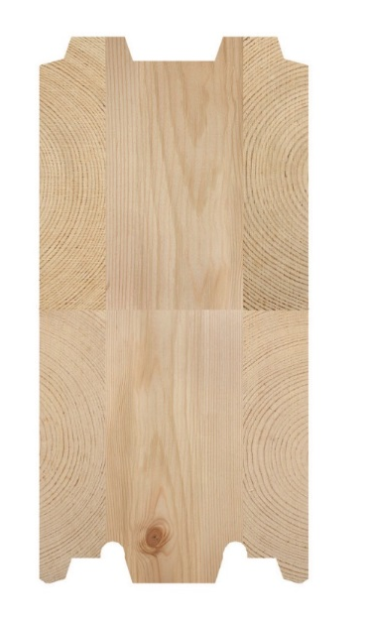
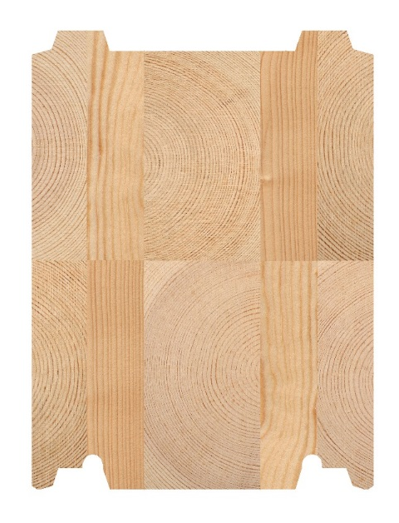
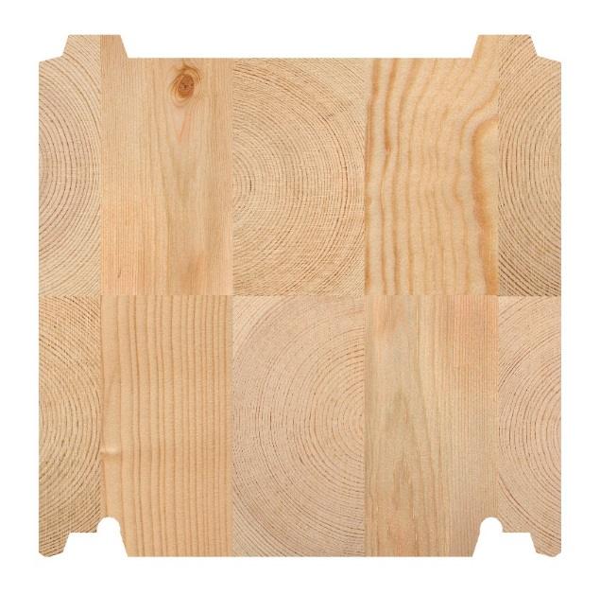
Non-settling log
Non-settling log refers to a cross-laminated log product
Non-settling is achieved by using vertical lamellae that function as the load-bearing element
A non-settling log makes up a building element resembling a CLT panel wall
Images: Kontiotuote

Slide 17
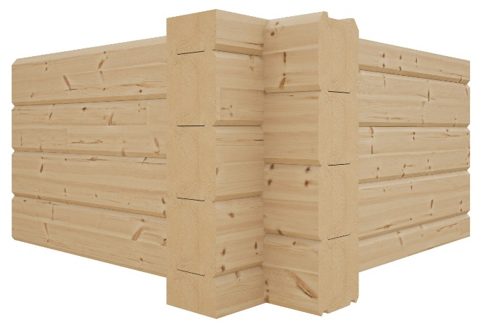
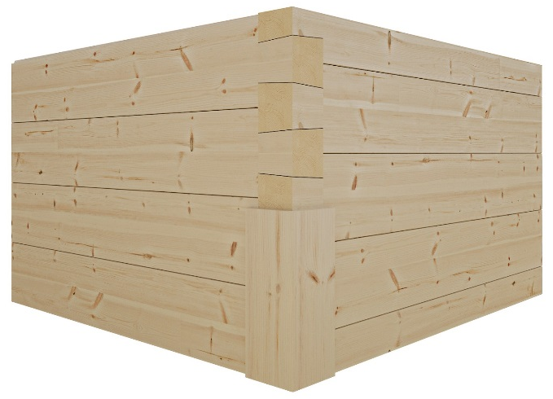
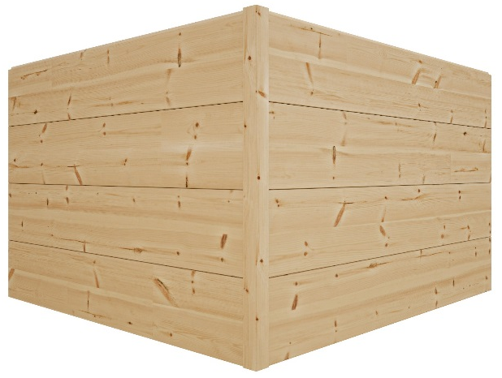
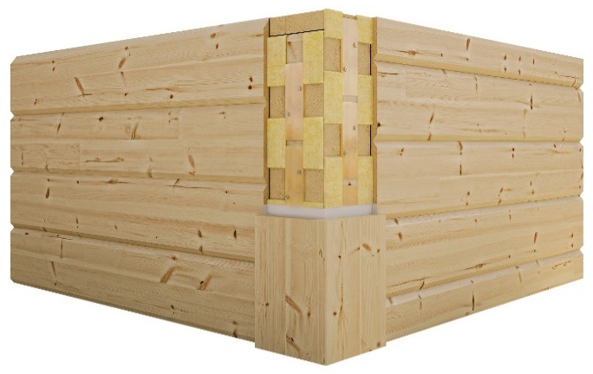
Corner options for industrial logs
1)
2)
There are several options for the corners of solid wood log walls
  Extended corner (1)
  Dove-tail corner (2)
  Mitre corner (3)
  City corner (4)
3)
4)
Images: Kontiotuote

Slide 18
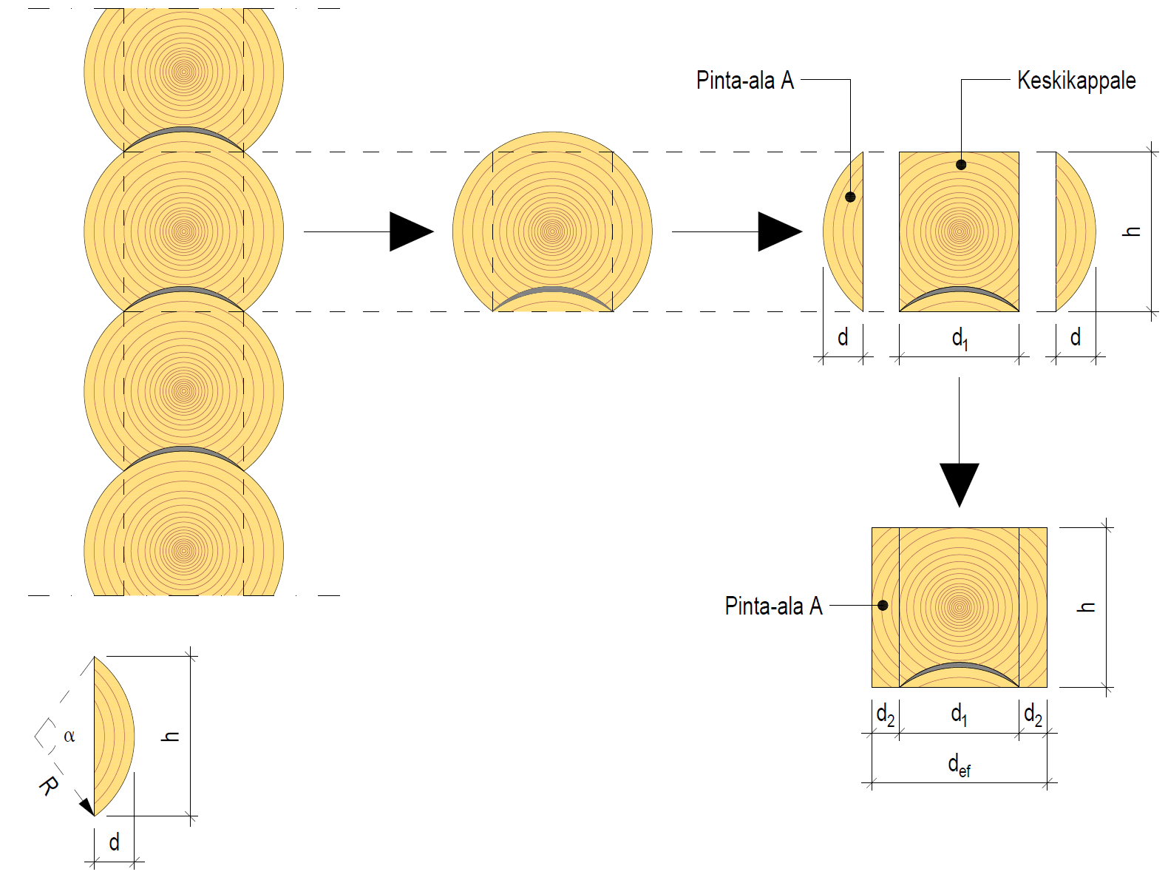
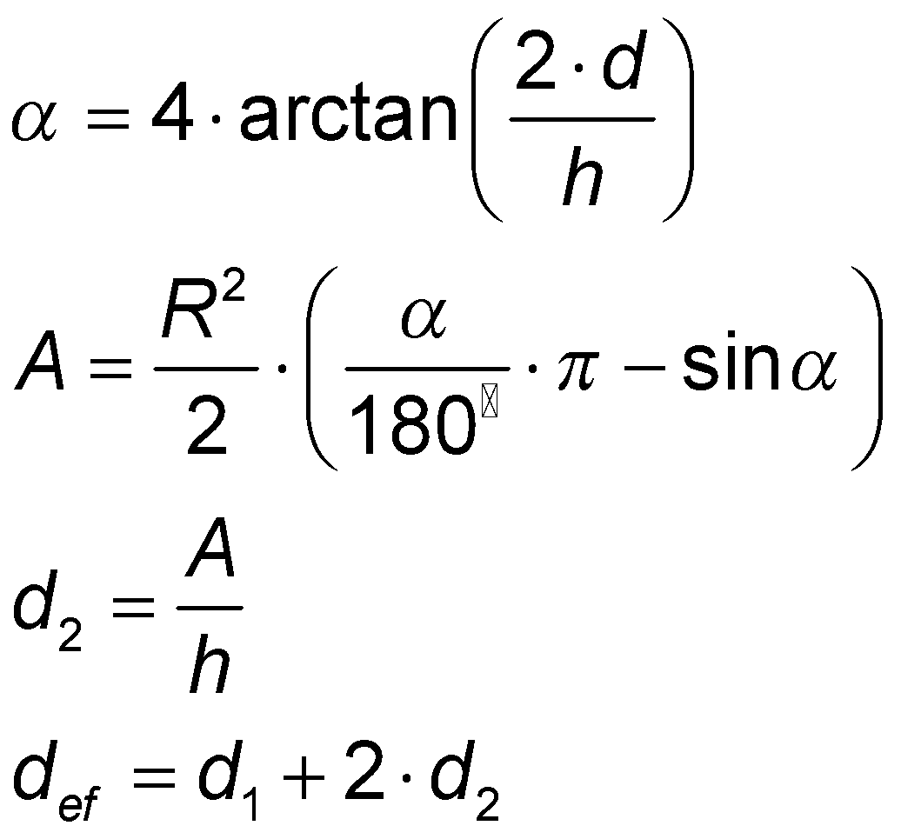
Effective thickness of the log
The round profile is converted into a rectangle and effective thickness d_{ef} is used in the U-value calculation
Studies have shown that chinking and log cracks are insignificant in terms of U value
Normal small bevels in the edges of the planed logs do not need to be taken into account in the U-value calculation
Surface area A
Centre piece
Surface area A

Slide 19
Settlement of the log wall
In a manually sculpted round log wall, you should anticipate a settlement of approximately 50 mm/m
In an industrially manufactured planed log wall you should anticipate a settlement of approx. 25 mm/m
In a cross-laminated log wall, the settlement is almost non-existent
The causes of settlement must be minimised
The effects of settlement must be taken into account in structures connected to log walls, etc.

Slide 20
Settlement of the log wall
Property | Cause | Minimisation method
Horizontal direction of the wood relative to the load | • Drying shrinkage large • Compression due to load | • Dry log • Cross-laminated log
Groove type | • Vertical compressing looseness in the groove | • Compact groove • Groove form
Central cracking of logs | • A round log tends to spread and lower as it cracks | • Dry log • Rectangular log • Laminated log

Slide 21
Settlement of the log wall
Example | Effect of settlement | Alternative design solutions
Vertical pipe | Pipe is not flexible Pipe clamps move with the wall | Pipe joint and fasteners allowing vertical movement
Horizontal sewer connected to vertical sewer | Pipe slope changes | Larger slope Pipe joint allowing vertical movement
Main distribution board on the wall | The metal casing is not flexible | Fastening allowing vertical movement at the upper end Attachment to a single layer of logs
Radiator | Radiator body is not flexible | Fastening allowing vertical movement at the upper end Attachment to a single layer of logs
Fixture standing on the floor | Fixture is not flexible | Fastening allowing vertical movement at the upper end Wall mounting not performed Separate furniture frame
Kitchen top cabinet | Cabinet is not flexible Cabinet moves with the wall | Fastening allowing vertical movement at the upper end and settlement clearance at the bottom of the cabinet Attachment to one layer of logs and clearance at the bottom of the cabinet Separate furniture frame

Slide 22
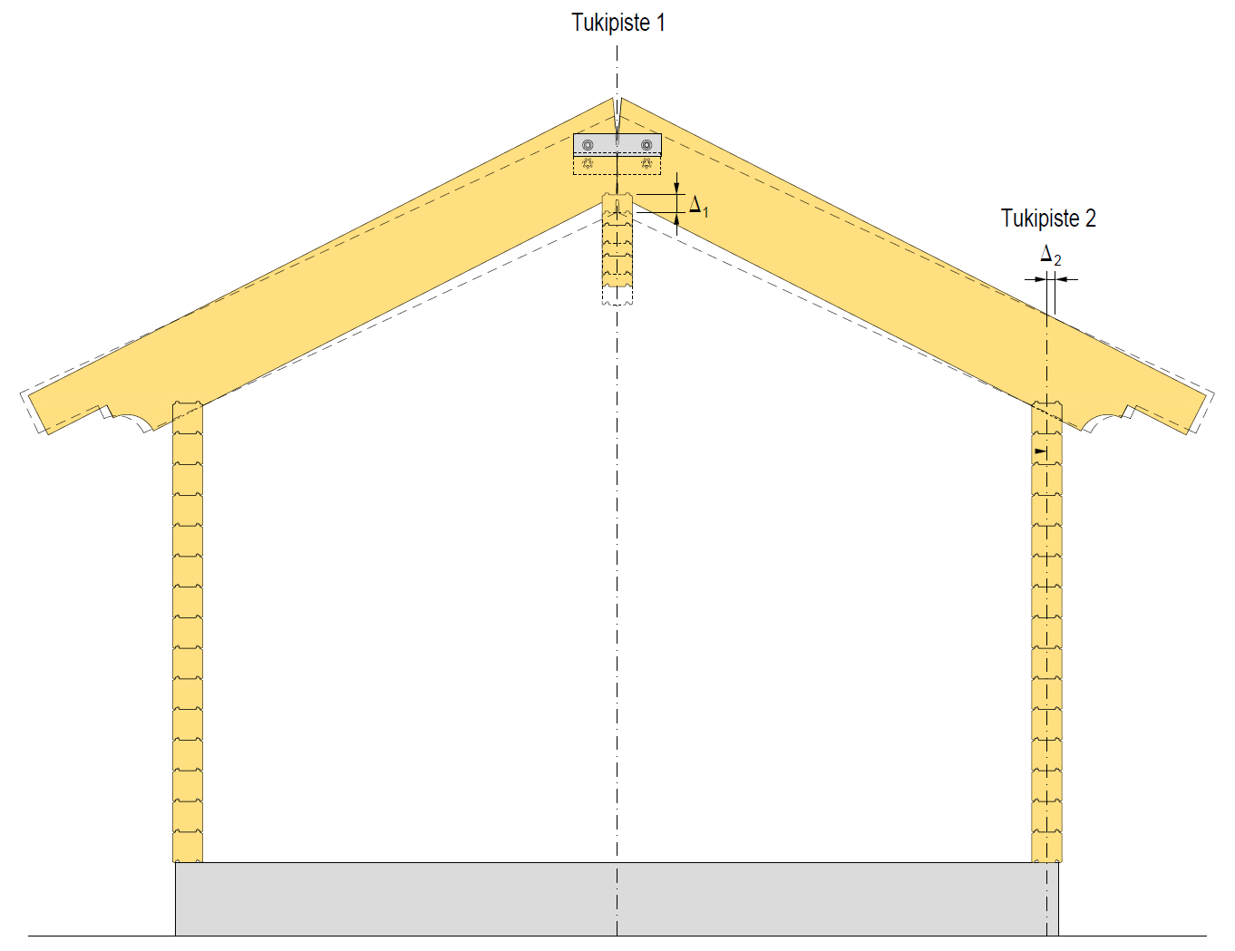
Settlement of the log wall
Fulcrum 1
Settlement of log walls causes vertical and horizontal movement, e.g. in the ceiling joists
  Flexible joints allowing sliding
Anchoring stiffening log walls is challenging as the wall settles (the anchoring loosens)
Fulcrum 2

Slide 23
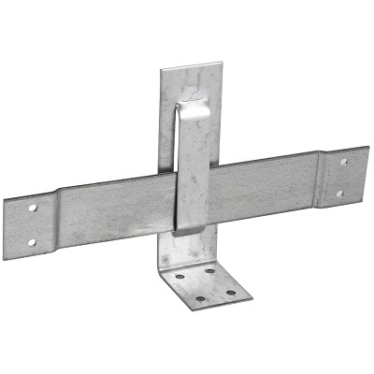
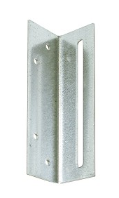
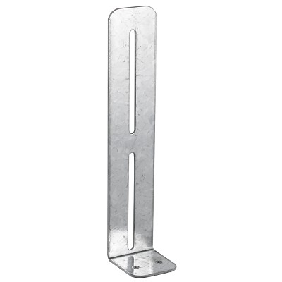
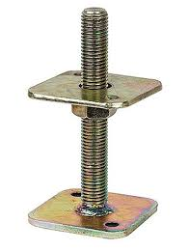
Settling log frame fasteners
Ceiling joist sliding fastener
Frame sliding fastener
Sliding fastener
Screw jack

Slide 24
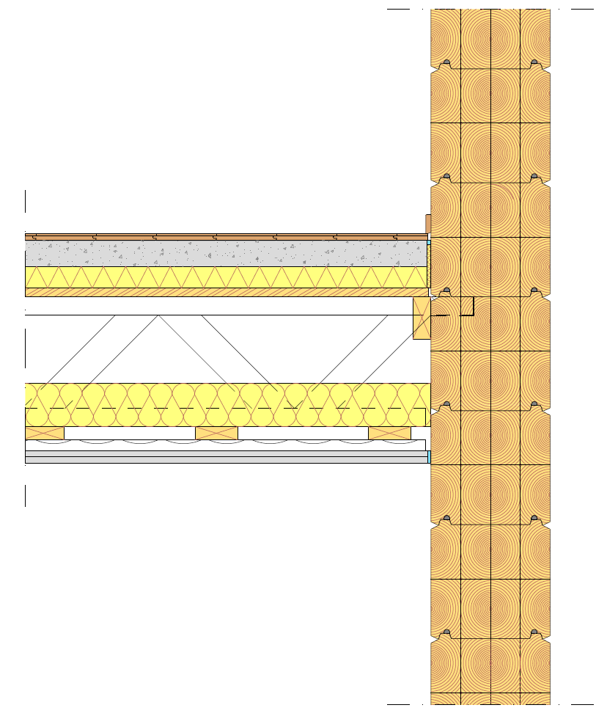
Settlement of the log wall
Aspects including the following must be taken into account in connecting the intermediate floor into the log wall:
  Supporting the intermediate floor into one layer of logs
  The intermediate floor should descend with the settling wall to prevent rupture of the seals
For example, a truss supported from the top chord can be used as a support for the intermediate floor.
  The log has a groove for the top chord

Slide 25
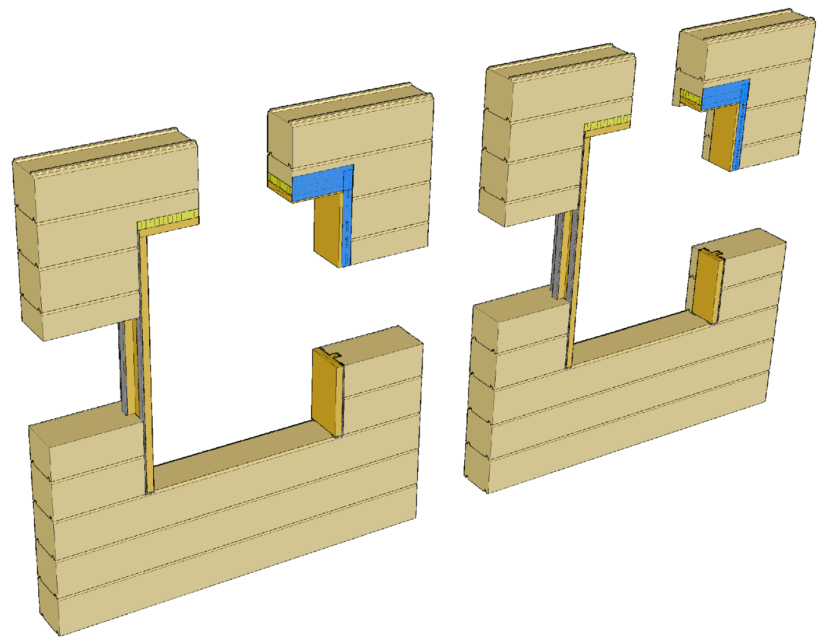
Settlement of the log wall
A settling log wall must have bucks at the edges of openings to which the windows and doors are attached
There must be sufficient clearance over the opening, which is insulated and sealed
For example, tape products for this purpose can be used in sealing
  The taping remains hidden behind the cover strips at the edges of the opening

Slide 26
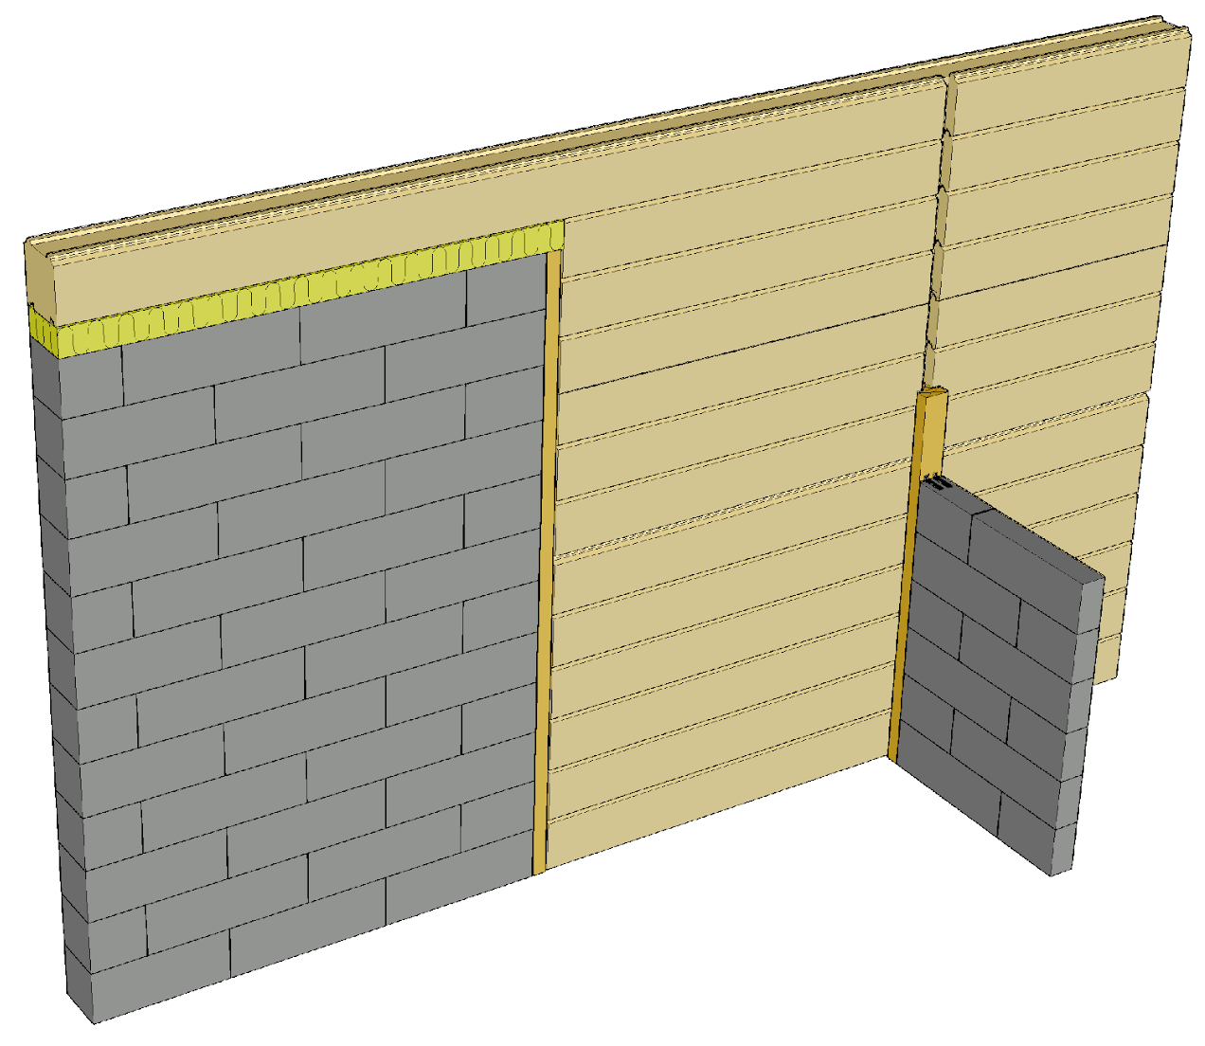
Settlement of the log wall
Masonry and other non-settling building elements are separated from the log wall using bucks
If necessary, seals are used in combination with the buck
  Acoustics between facilities
  Wall airtightness requirement
  Heat insulation

Slide 27
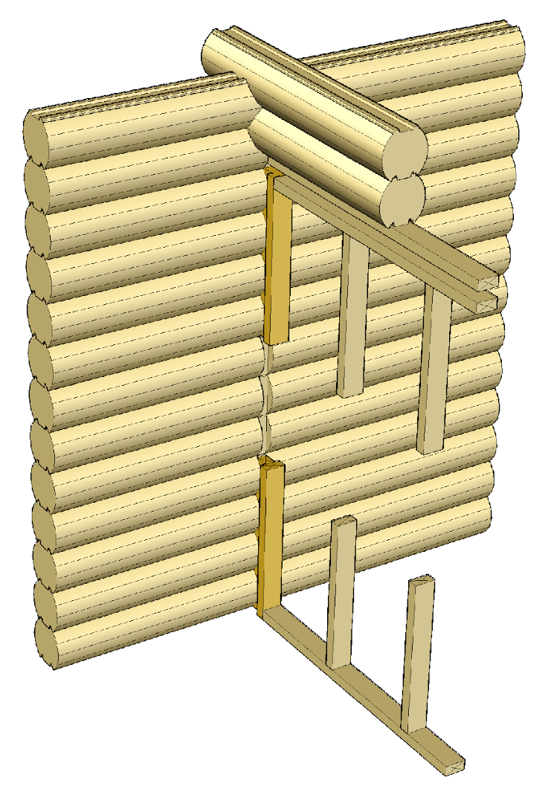
Settlement of the log wall
Skeleton-structured partitions are separated from the log wall using a buck
There must be sufficient settlement clearance on top of a skeleton-structured wall
If necessary, seals are used in combination with the buck
  Acoustics between facilities
  Wall airtightness requirement
  Heat insulation

Slide 28
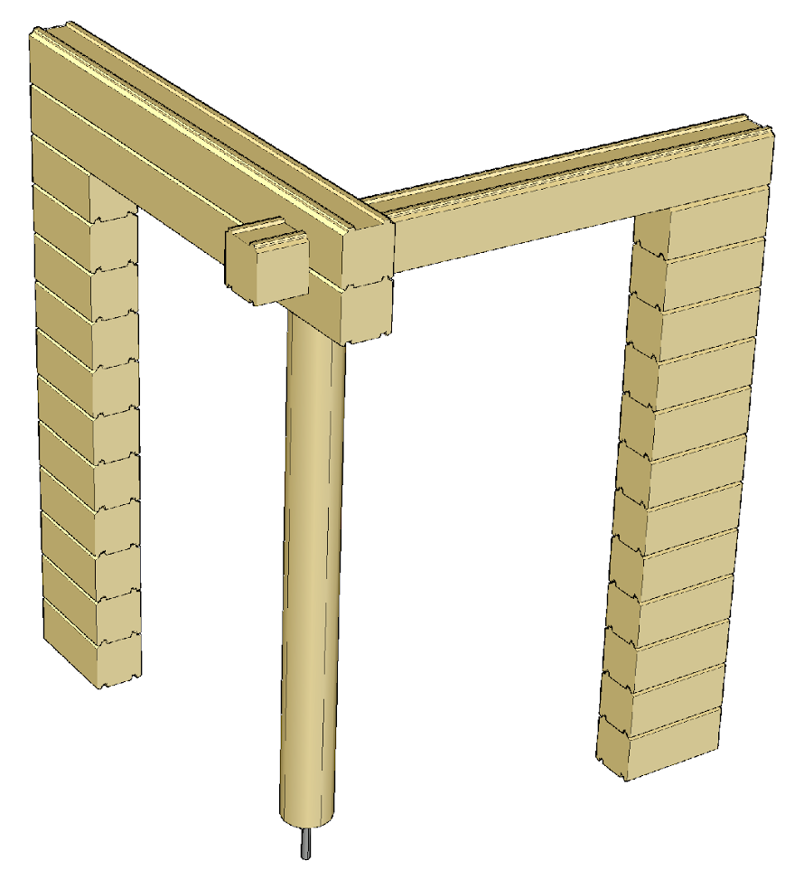
Settlement of the log wall
Posts must have a screw jack for adjusting the height of the post as the log walls settle.
The compression and buckling resistance of the screw jack must be such that it can withstand the load of the post
The screw jack causes a high local compression load on the material underneath

Slide 29
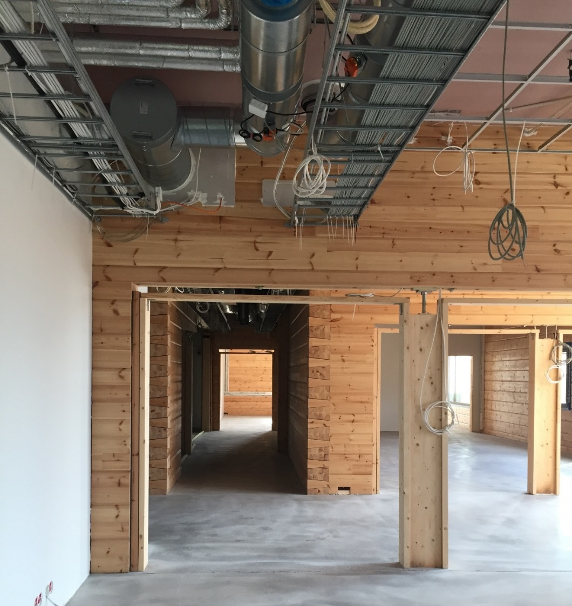
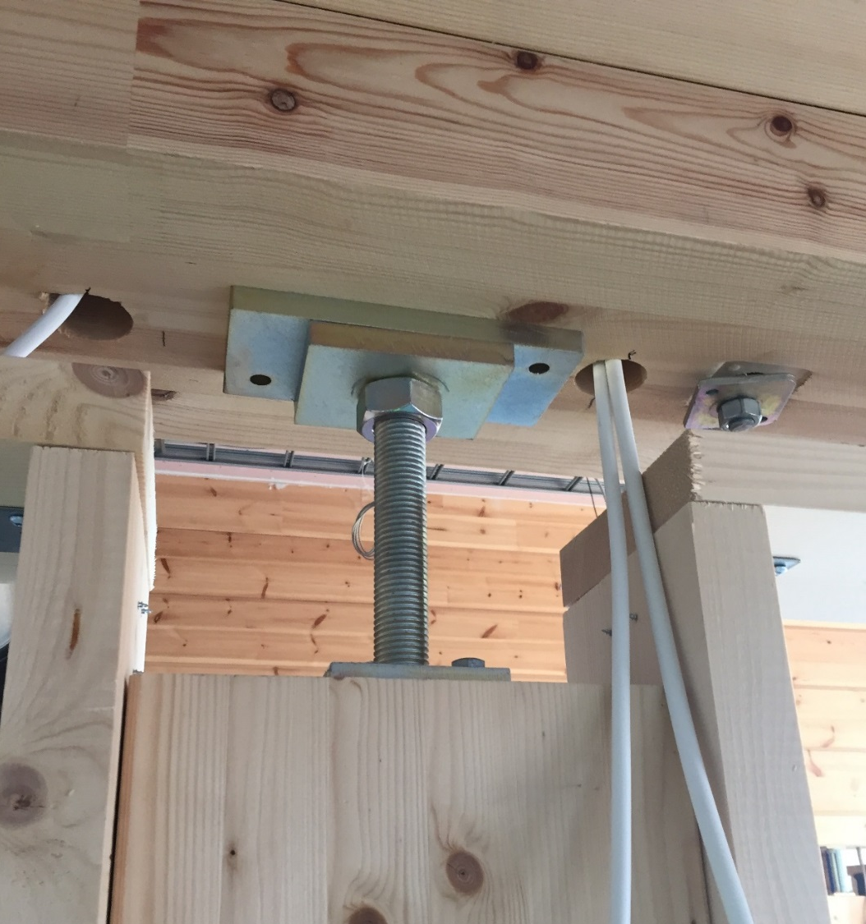
Settlement of the log wall
Image: Puuinfo
Image: Puuinfo

Slide 30
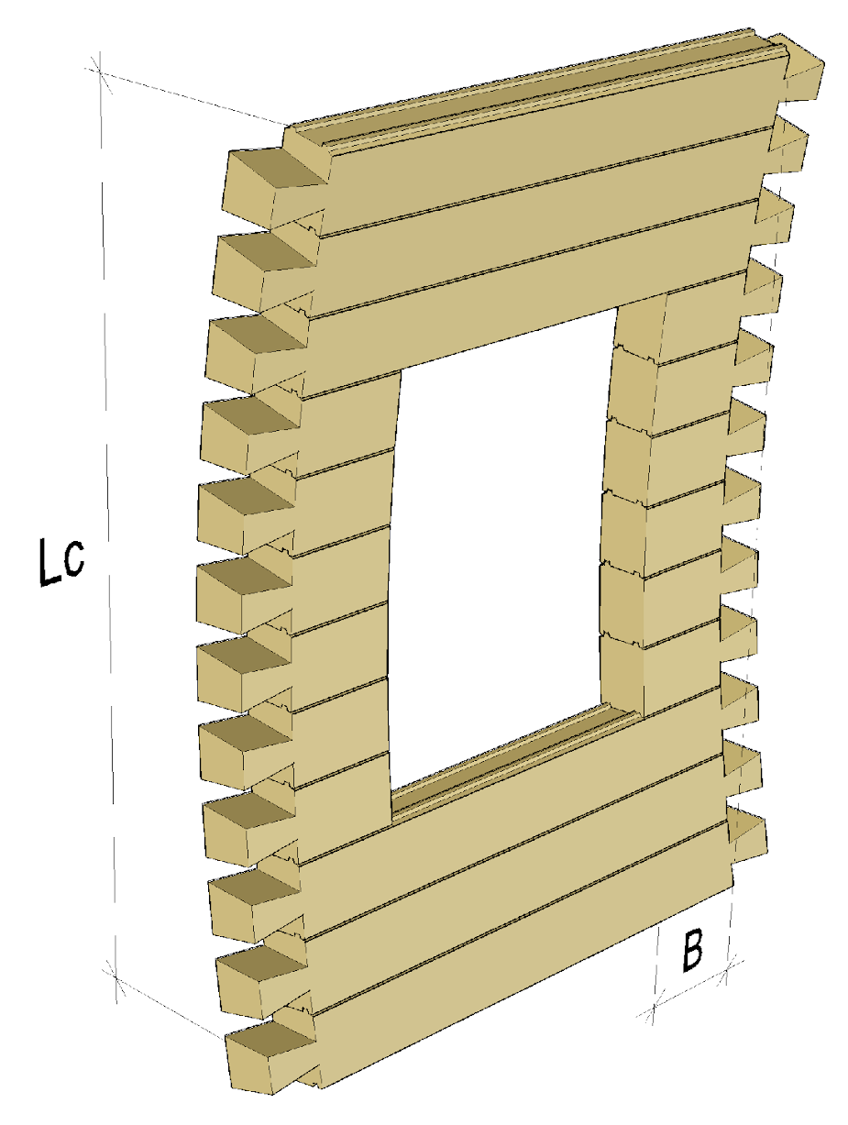
Log wall buckling from level
A log wall consists of separate logs on top of each other
The log wall does not receive bending in the vertical direction of the wall
From the point of view of the buckling resistance of the log wall, the significant factor is lateral wall support
Widening the log increases buckling resistance

Slide 31
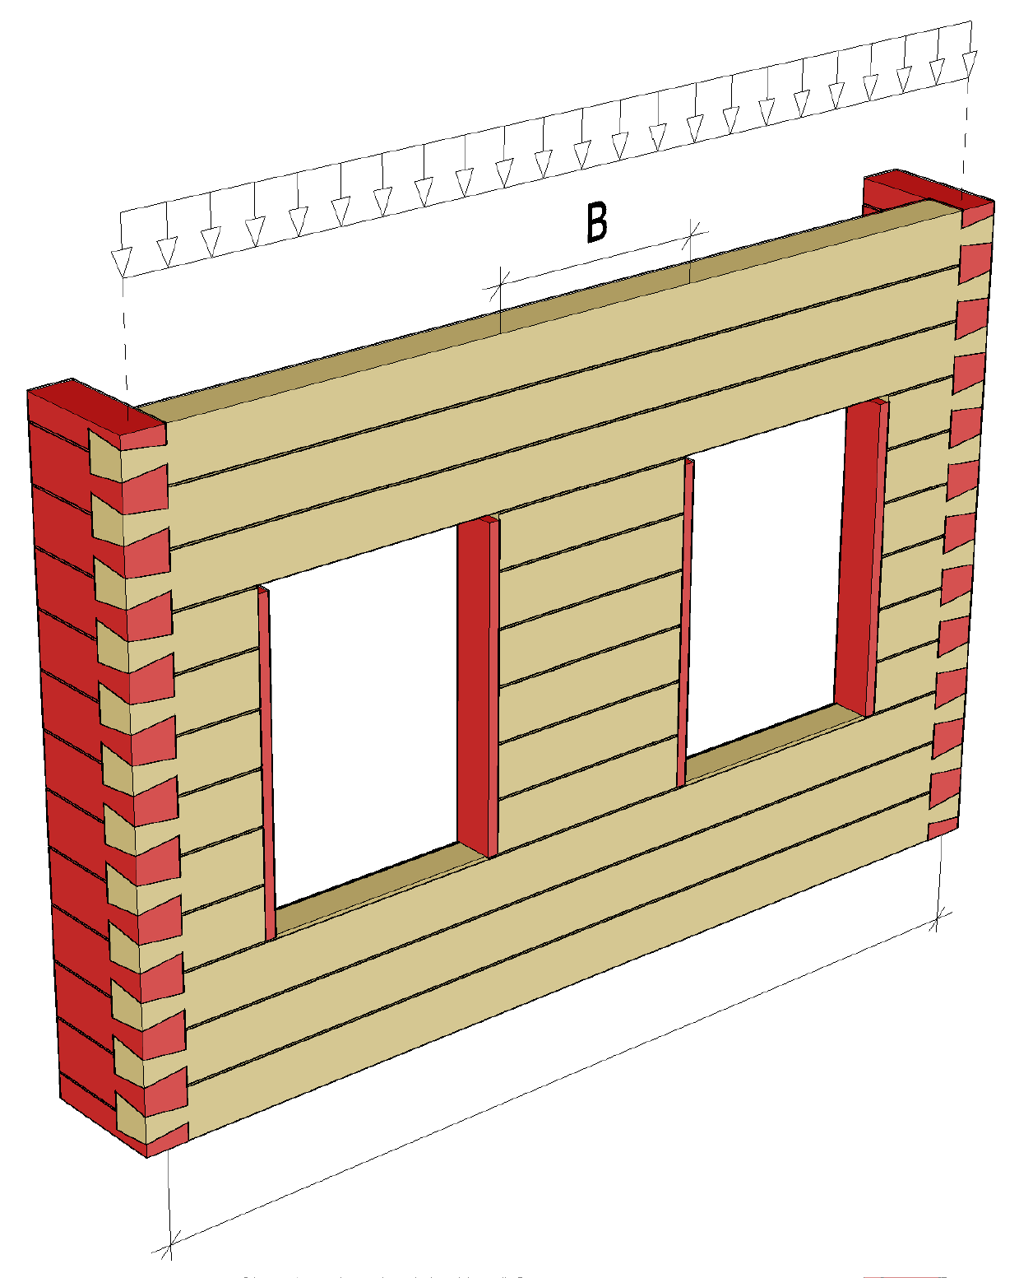
Functioning of log wall for vertical load
The dimensioning of the buckling resistance of a log wall is based on information obtained from experimental loading
A load-bearing log wall must always have transverse walls or parts of the wall with the required k division to support the wall against buckling
The bucks on the sides of openings are used for buckling support of the jambs
Maximum distance of transverse support

Slide 32
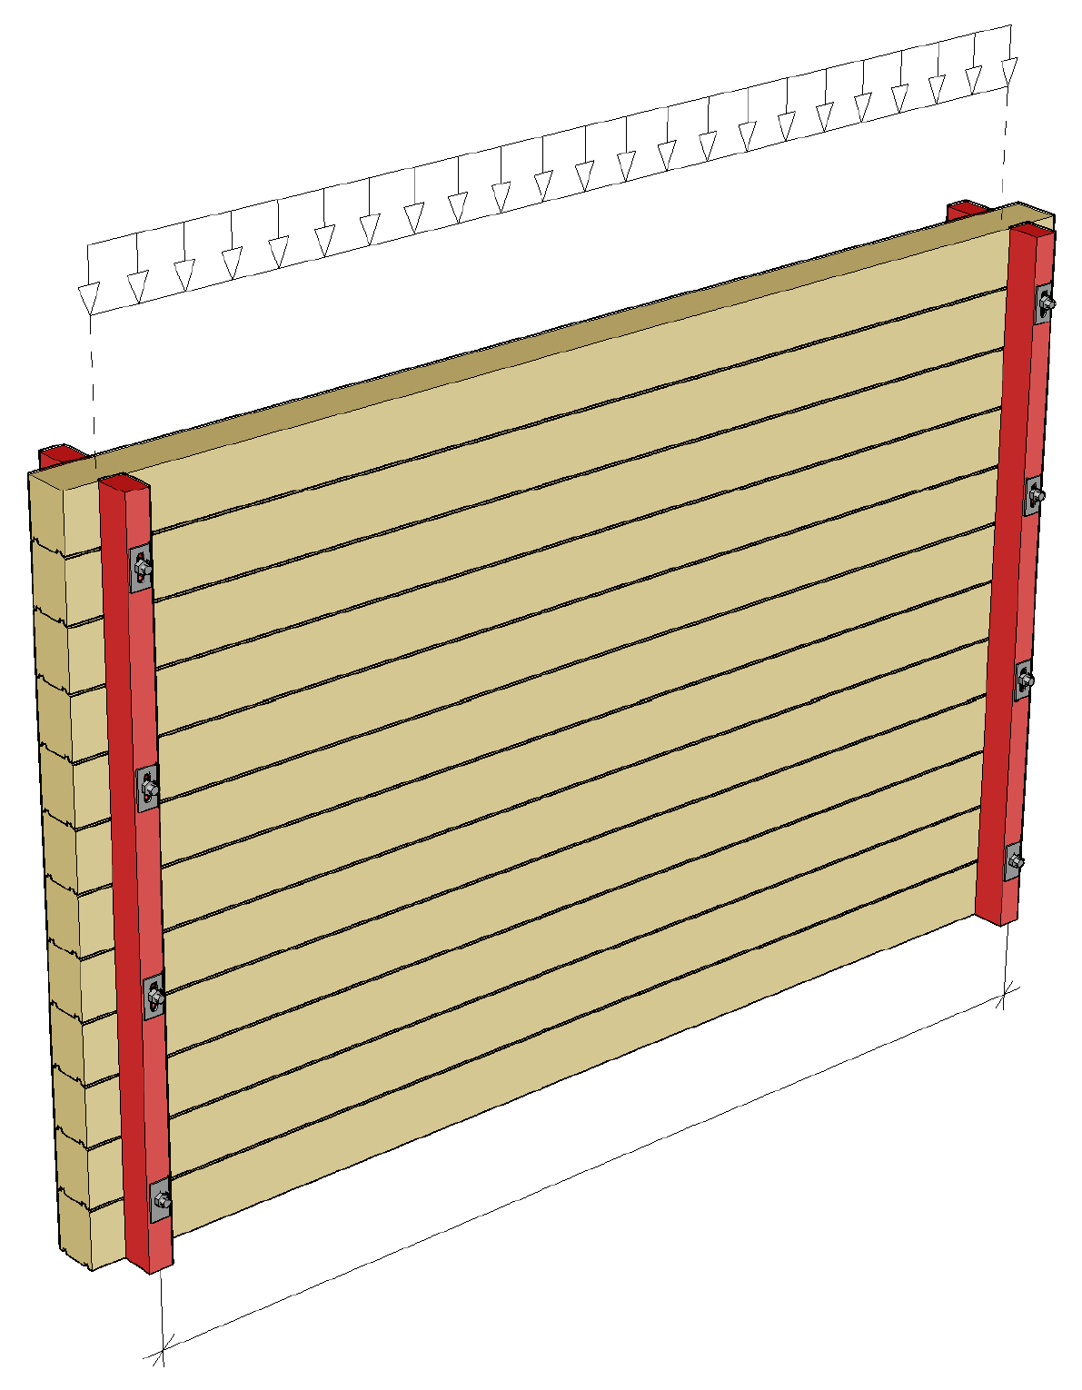
Log wall buckling support
Vertical supports can be used as buckling supports for log walls
The settling of the log wall must be accounted for when using vertical supports
The spacing between the vertical supports has a significant impact on the buckling resistance of the wall
Maximum distance of transverse support

Slide 33
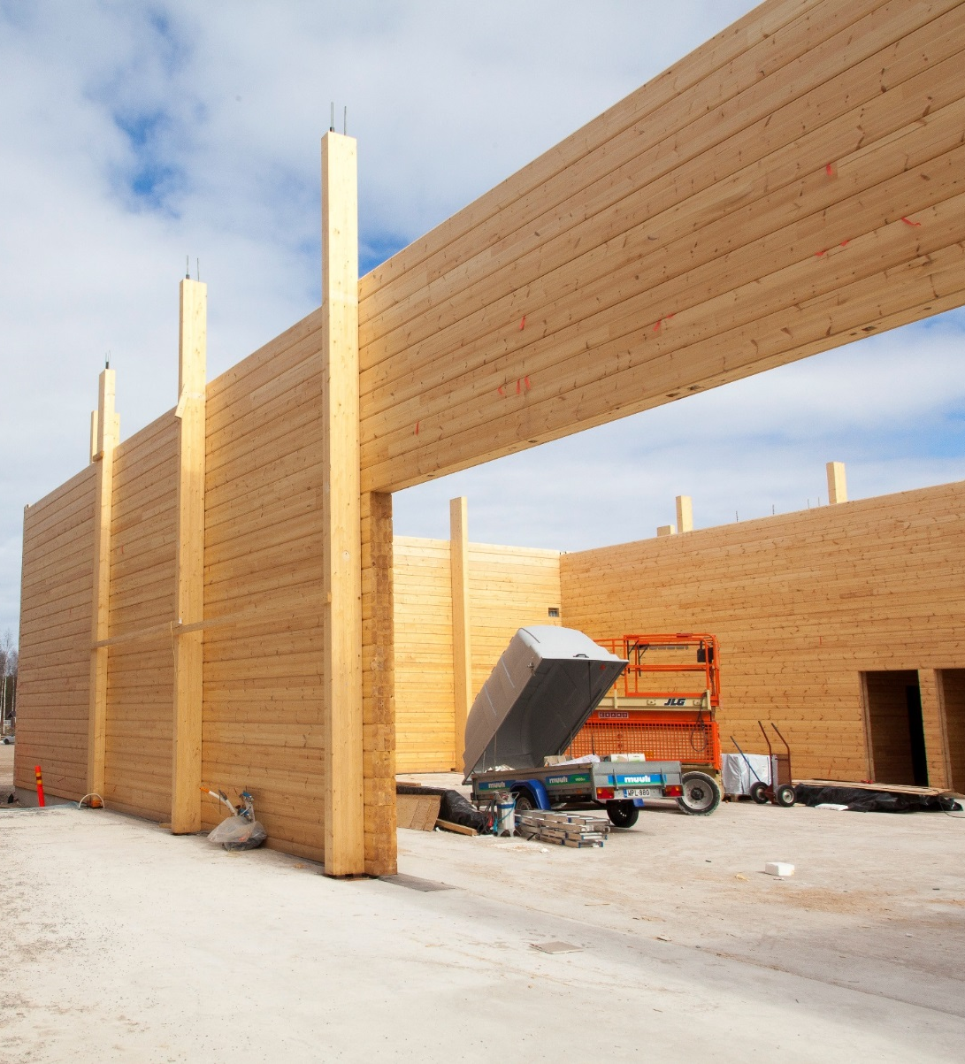
Vertical support of a log wall
Main posts, which support e.g. the main props, can also be used as vertical supports.
The logs function as horizontal beams between the vertical supports and transfer e.g. wind load to the vertical supports
Image: Puuinfo

Slide 34
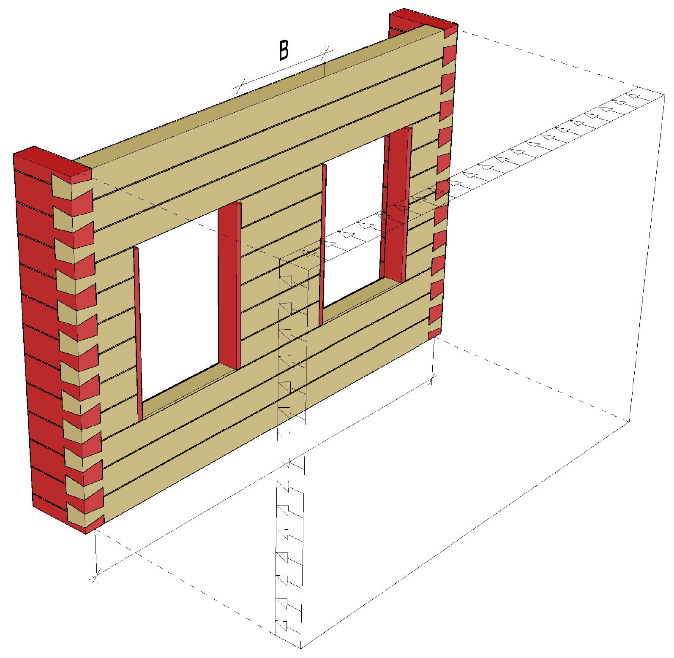
Functioning of the log wall for horizontal load
Unlike, for example, a wall with a skeleton structure, an outer wall with a log structure transfers the wind load to the transverse walls rather than to the base floor, intermediate floor and roof
A load-bearing log wall must always have transverse walls or parts of the wall with the required k division to support the wall against horizontal load
Maximum distance of transverse support

Slide 35
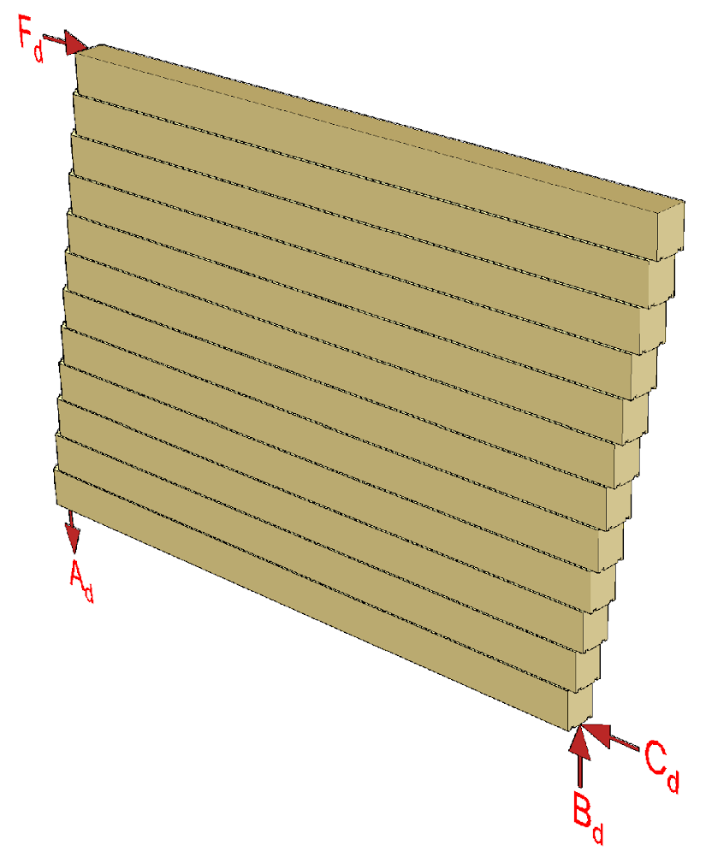
Stiffening log wall
A log wall can function as a stiffening building element when the adjacent logs are attached to the each other for the shear force affecting the wall
In dimensioning a stiffening log wall, the dowels between the logs are usually a dimensioning factor
Moment causes the need to anchor a stiffening wall if the dead weight does not cancel out the anchoring force

Slide 36
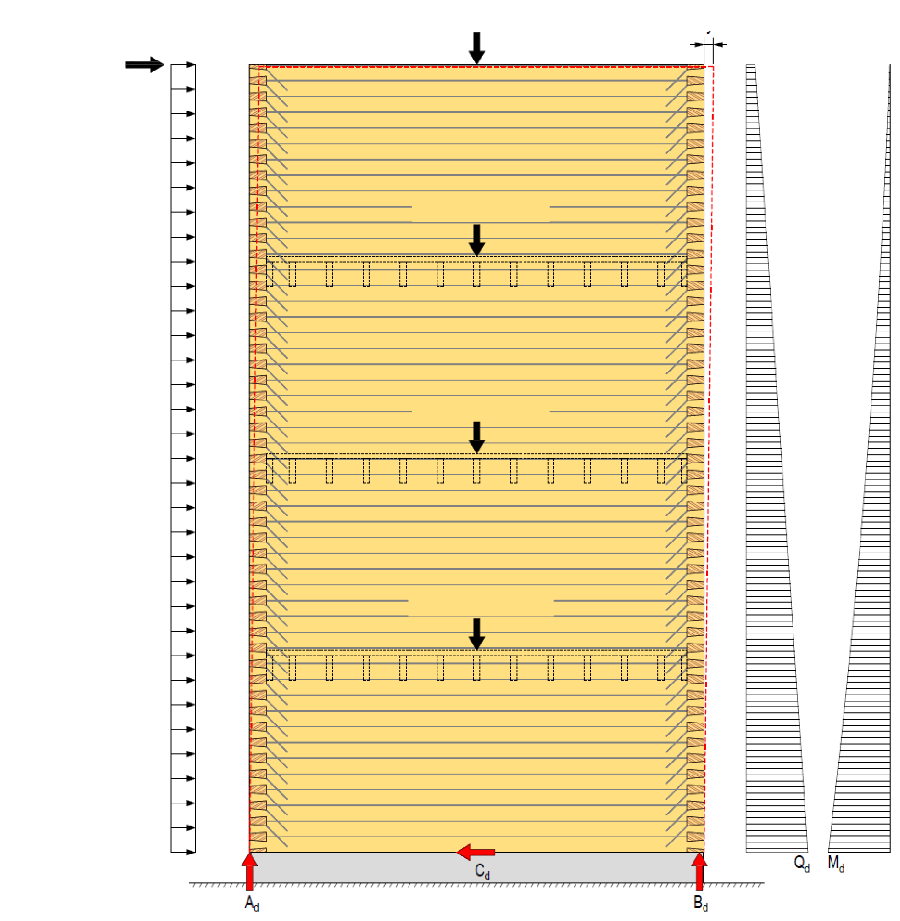
Stiffening log wall
Wall dead weight
Displacement
Wind load from
roof projection
As much dead weight as possible should be obtained for the stiffening wall to cancel out the anchoring force
The dead weight can be transferred to a stiffening wall using intermediate floors
Horizontal displacement of the stiffening wall is mainly formed by the displacement of the dowels
Dead weight of intermediate floor
Dead weight of intermediate floor
Wind load
Dead weight of intermediate floor

Slide 37
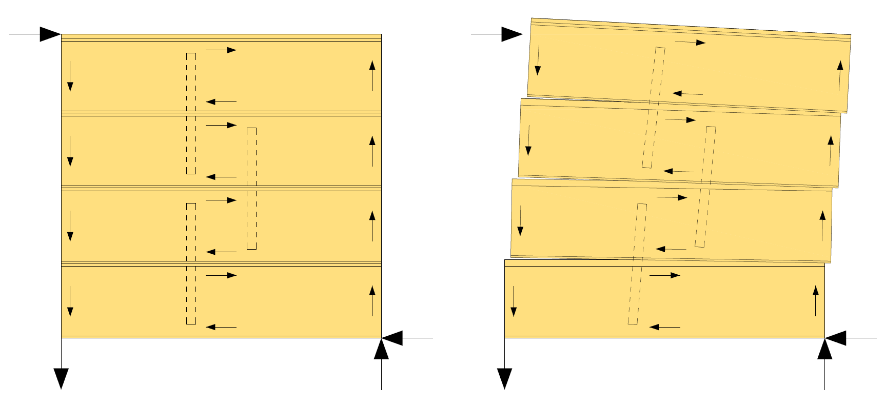
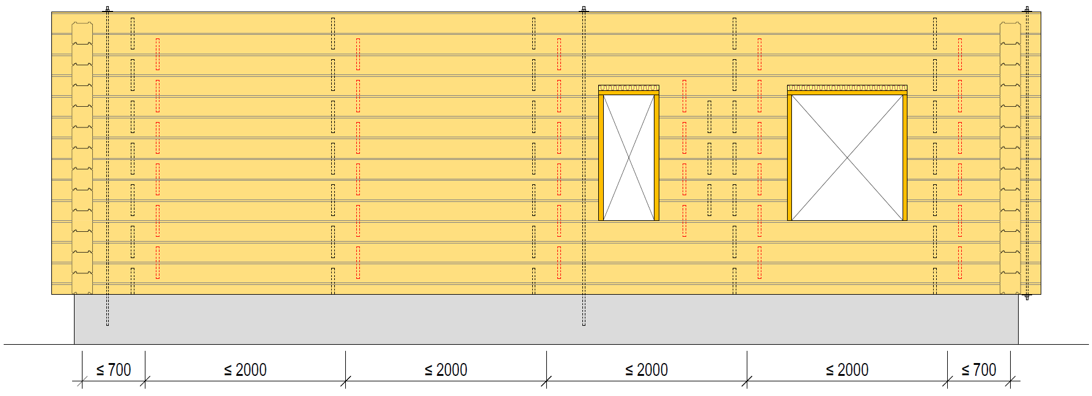
Dowelling and anchoring methods
Pegging (wooden dowels) is a traditional method of dowelling logs
Due to the low shear strength, dowelling carried out with wooden pegs is only suitable for single-family house and summer cottage construction
Traditionally, the anchoring of logs has been implemented using threaded rods, which are tightened as the settlement of the log frame progresses

Slide 38
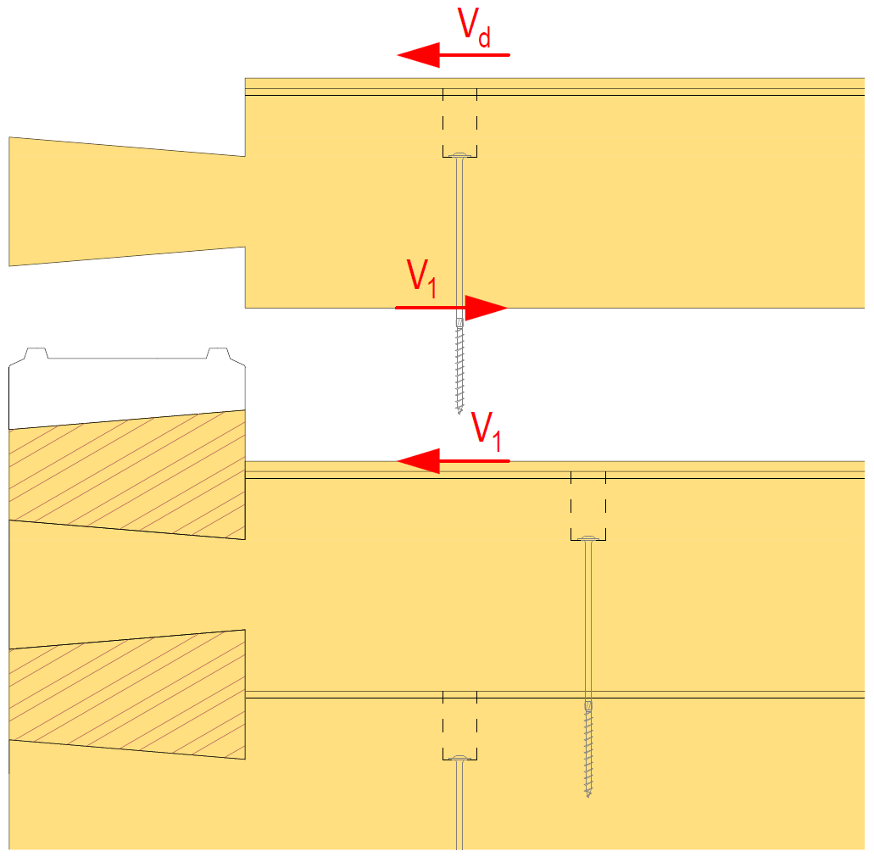
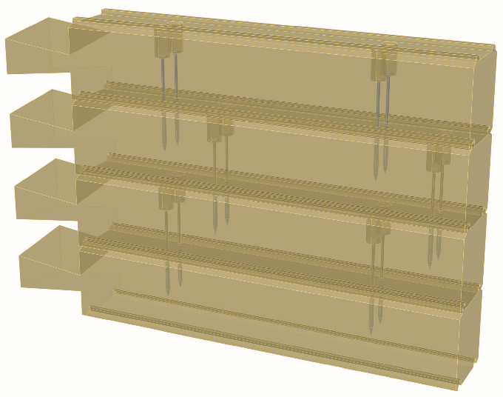
Dowelling and anchoring methods
Screw dowelling implemented using smooth-shaft screws can be used in a log wall
Shear force between logs causes the shear force on screws
Log manufacturers have shear strength resistances for screw-dowel connections based on test loading
  A better shear capacity than calculated is obtained

Slide 39
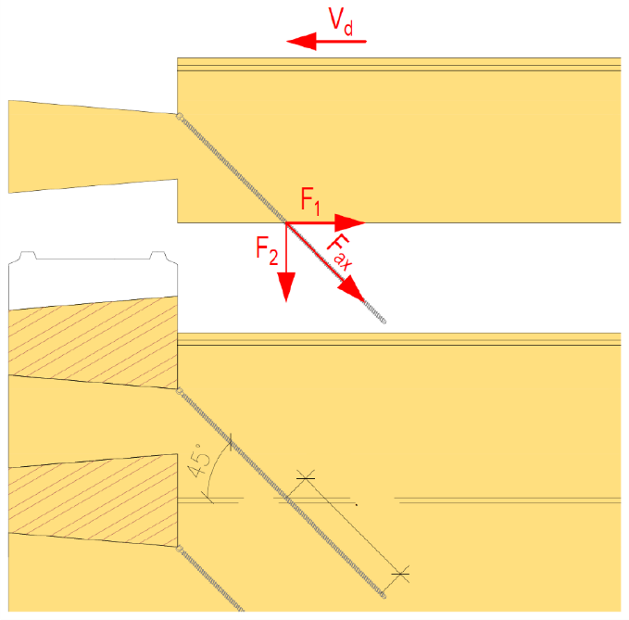
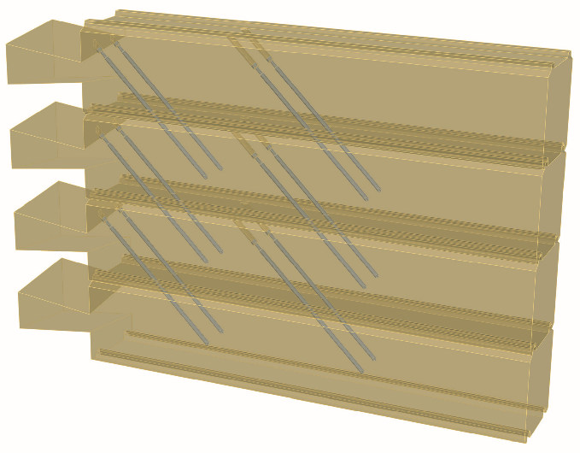
Dowelling and anchoring methods
Angled-screw dowelling implemented with full thread screws can be used for non-settling logs
In an angled-screw joint, the shear force between logs causes axial force on the angled screws
Angled-screw dowels are dimensioned so that the screws are tensioned
Length of threaded part in log
Screw

Slide 40
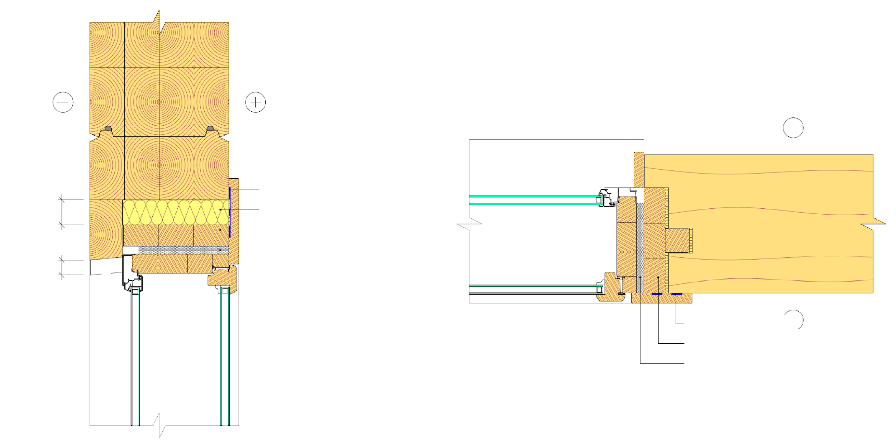
Example of window junction
Taping
Heat insulation
Mounting plank
Sealing the frame as usual
Settlement clearance
Settlement
Taping
Buck
Sealing the frame as usual

Slide 41
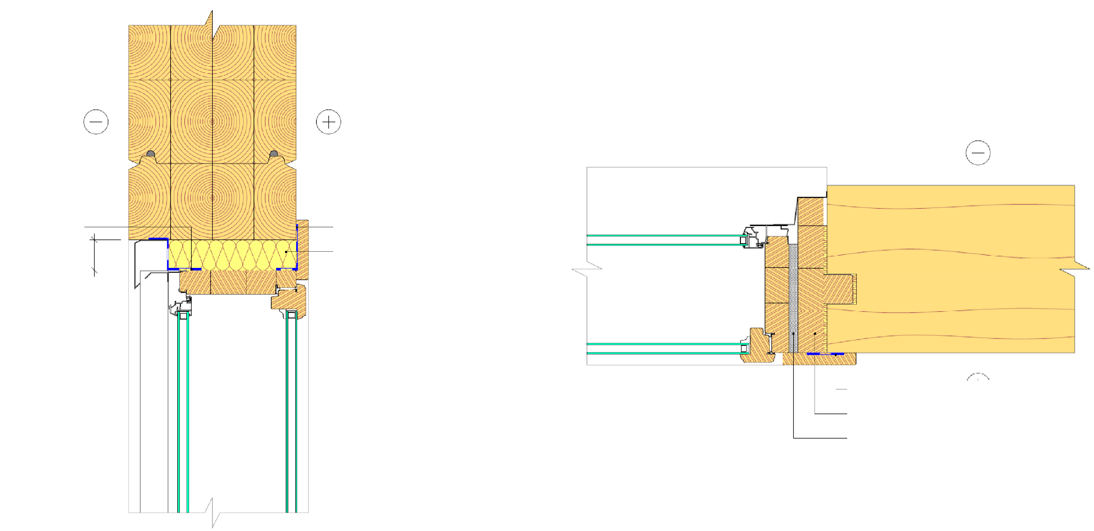
Example of window junction
Wind protection cloth
Taping
Heat insulation
Settlement clearance
Taping
Buck
Sealing the frame as usual

Slide 42
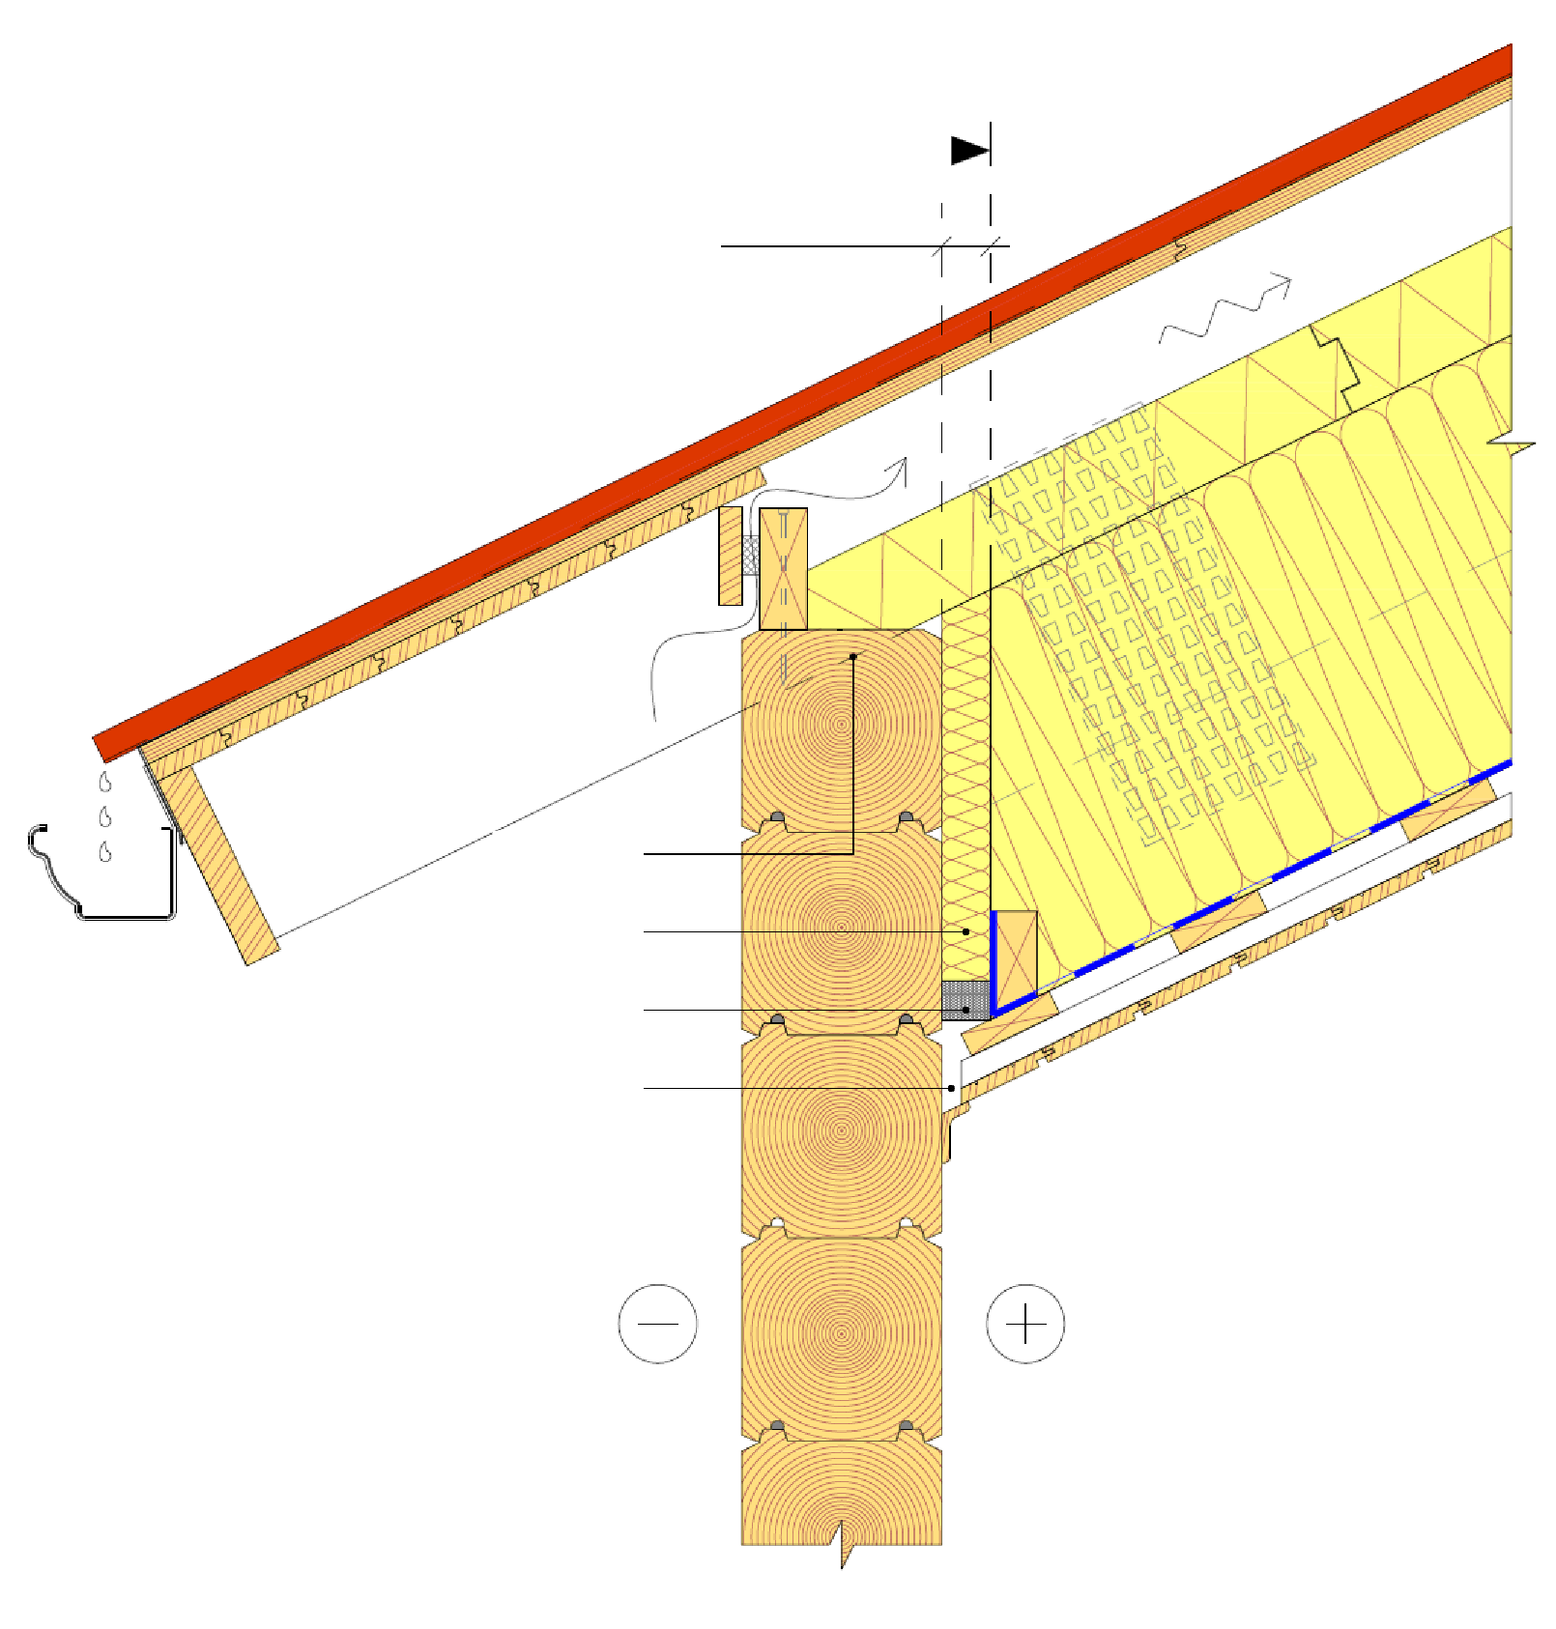
Example of sealing the edges of the roof
End of ceiling joist
Slide clearance
Horizontal glide in the beam-structed roof occurs in connection with a settling log frame
The glide in the roof poses challenges to, for example, the air and vapour barrier details of the roof
For example, a swelling seam band that allows gliding of the roof beam can be used in connection with the air and vapour barrier
Nail plate structure dowel beam
Groove for the
beam
Continuous wool
Expansive seam band
Clearance

Slide 43
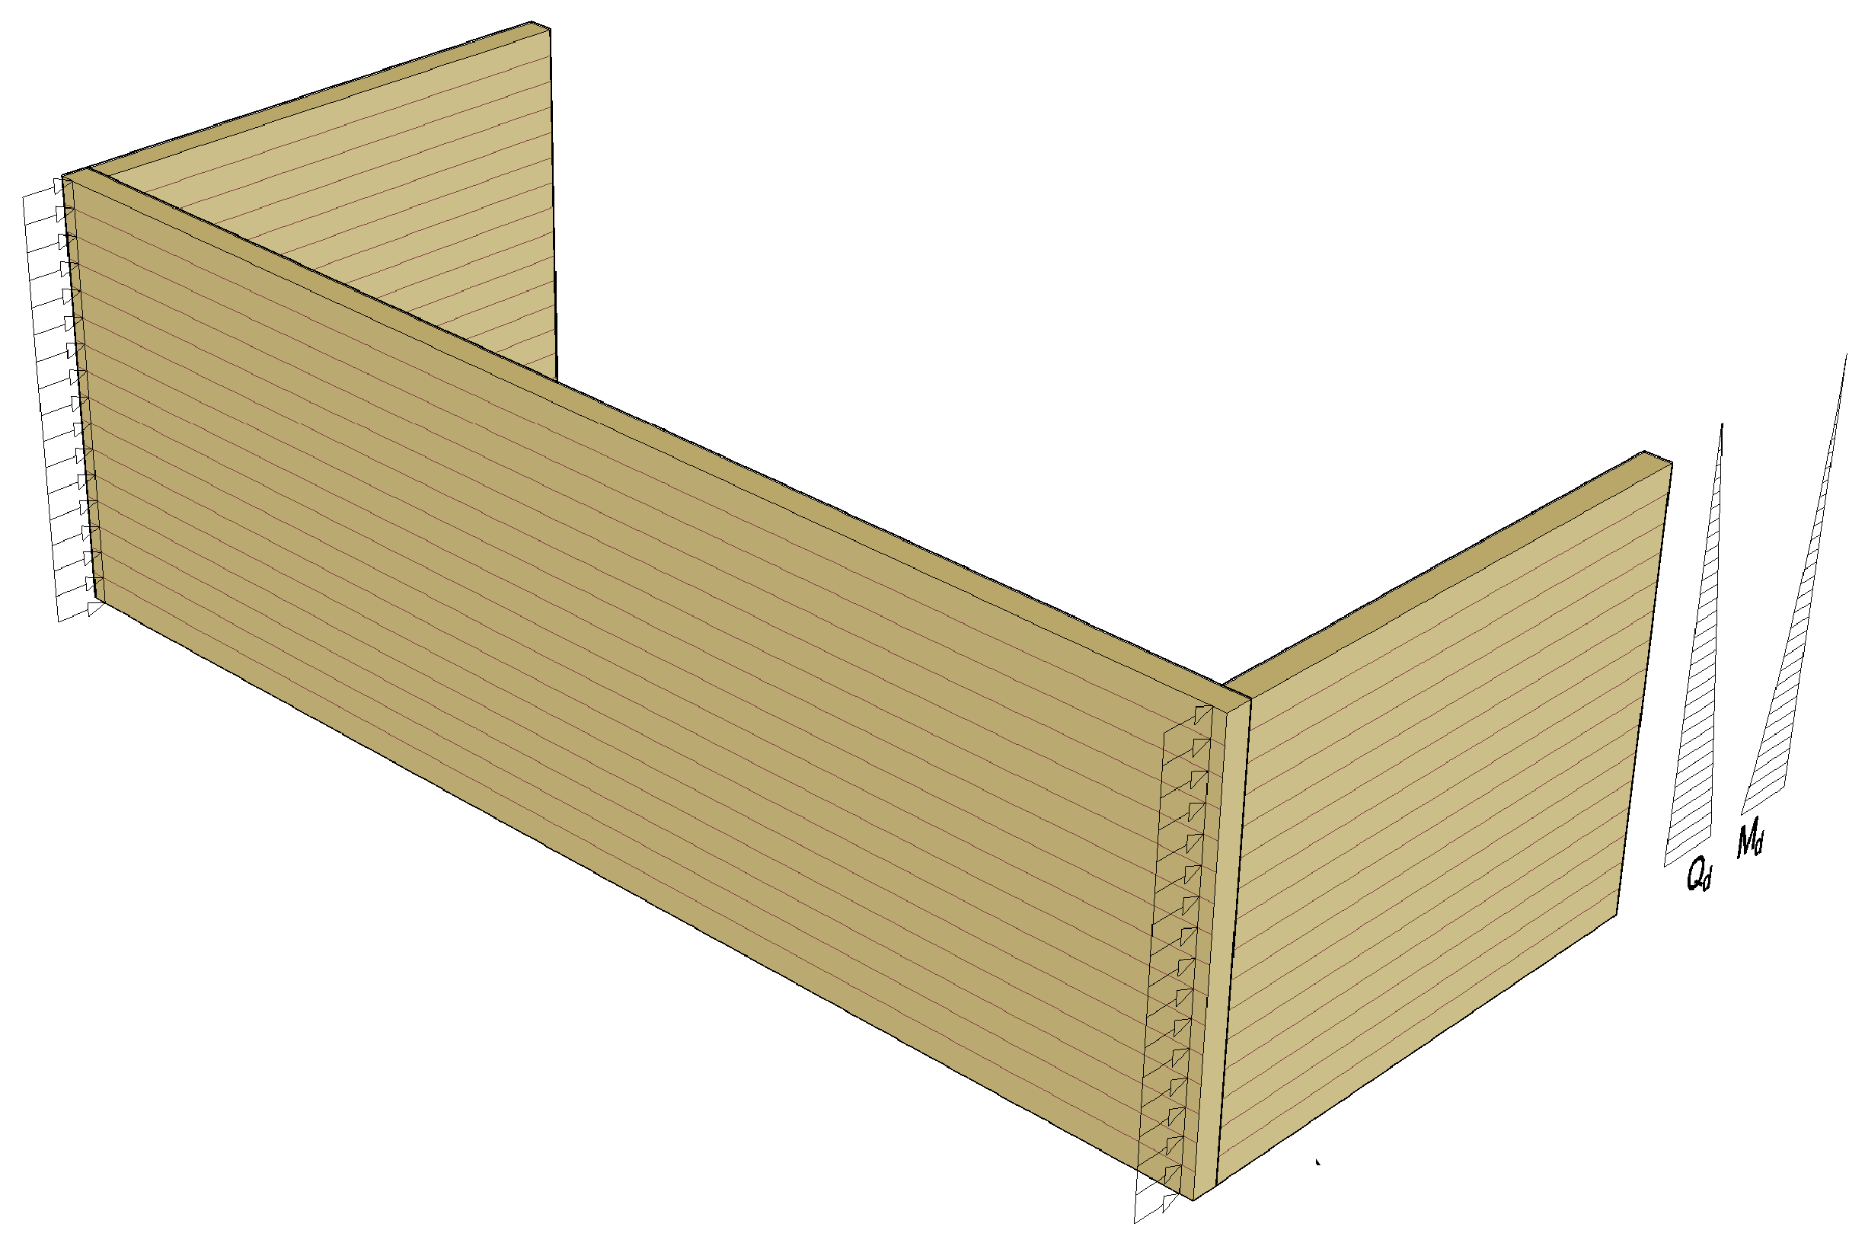
Example of stiffening wall loads
Stiffening wall

Slide 44
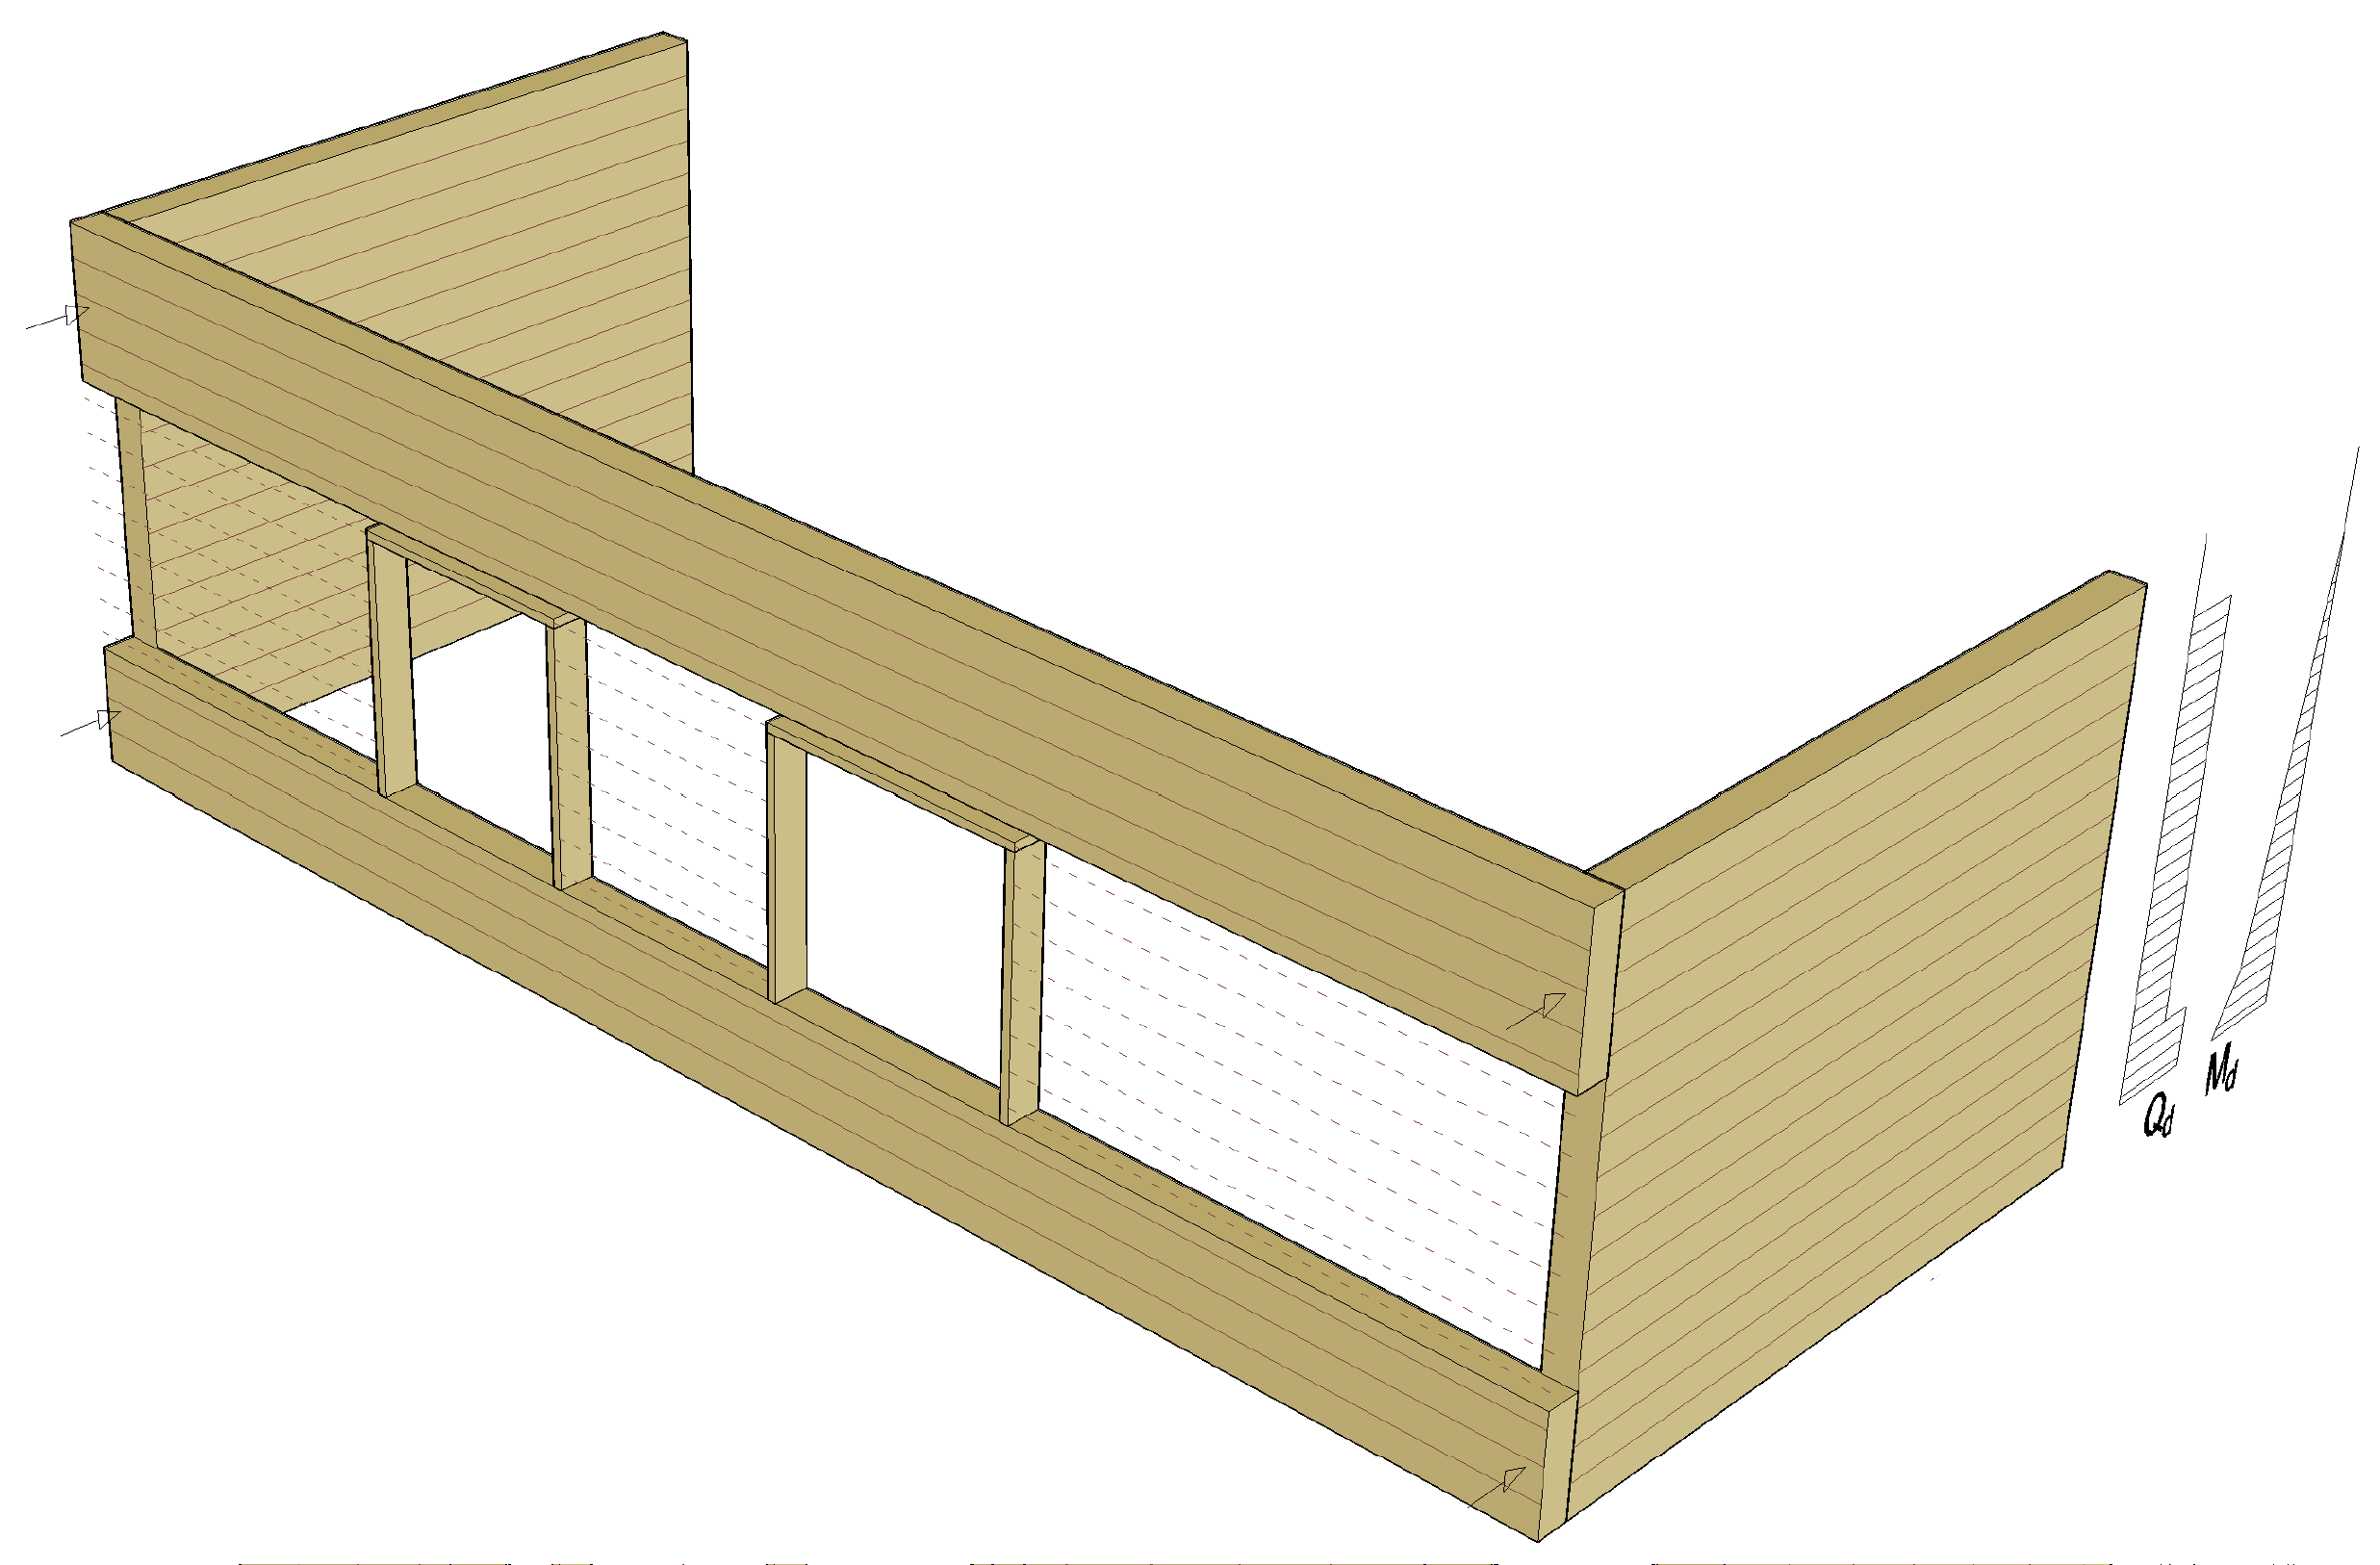
Example of stiffening wall loads
Stiffening wall

Slide 45

Example of stiffening wall loads
Stiffening wall

Slide 46

Example of stiffening wall loads
Roof projection
Stiffening wall

