Slide 1



Industrial wood construction
Teaching materials for industrial wood construction education
2022

Slide 2
Origin of the materials
Use of the materials
These learning materials for industrial wood construction have been prepared in a project led by Puuinfo Oy in 2021–2022. Also involved in the project were
Lappia Vocational College,
TTS-Työtehoseura ry
South-Eastern Finland University of Applied Sciences,
Metropolia University of Applied Sciences,
Jyväskylä University of Applied Sciences,
University of Tampere, and
Federation of the Finnish Woodworking Industries Puutuoteteollisuus ry
The project was funded by the Ministry of the Environment.
The materials are intended to be used as extensively as possible in industrial wood construction education and studies.
The materials are released under the Creative Commons licence Attribution-ShareAlike (CC BY-SA), which requires that the author be properly credited when the materials are used and that derivative works may only be distributed under the same licence as the original work.
The original materials and any updates to them by Puuinfo will be published on the Library of Open Educational Resources website (aoe.fi) and the Puuinfo.fi website.

Slide 3
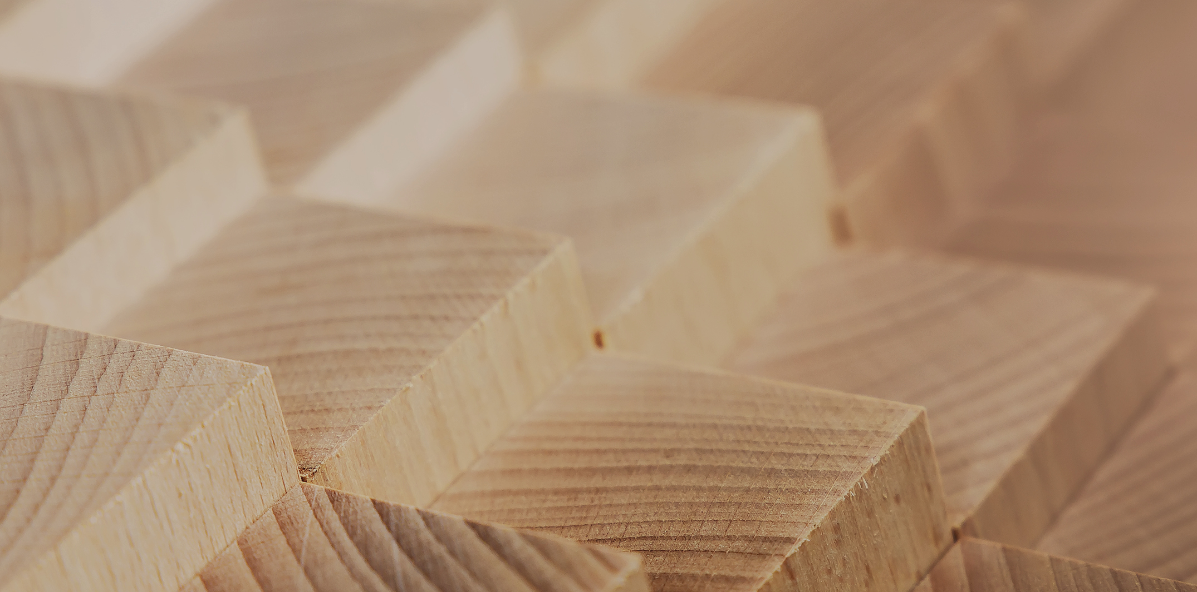
Structural design

Slide 4
Authors
Tero Lahtela, Insinööritoimisto Tero Lahtela Oy
Release date: 28/02/2022

Slide 5
Solid wood panels

Slide 6
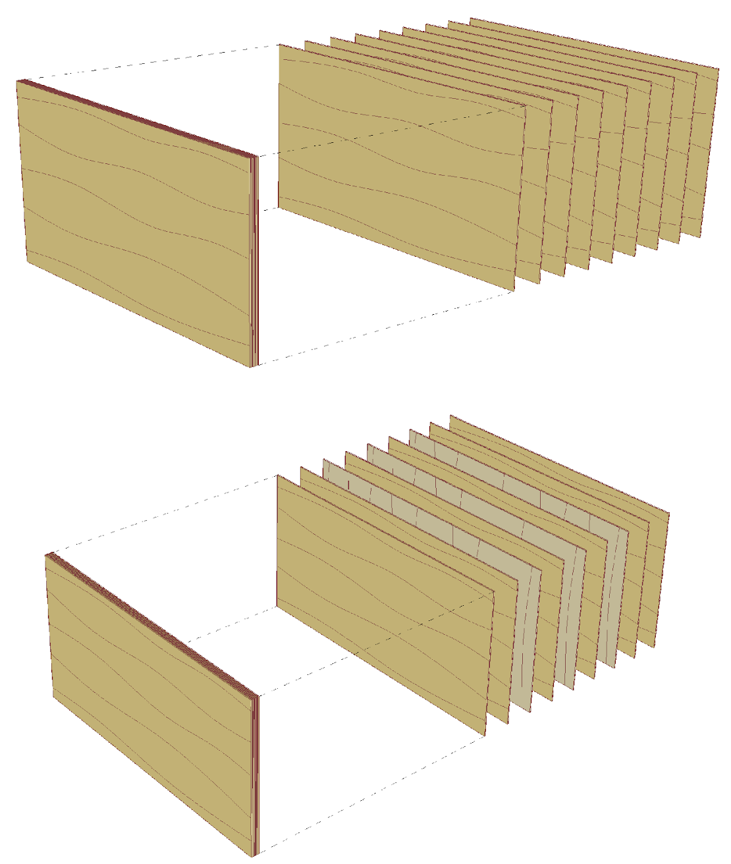
LVL (Laminated Veneer Lumber)
LVL for structural use is typically made of 3 mm thick veneers rotary-cut from spruce logs
The veneers are glued using phenol-based glue so that in the LVL product
All veneers are in the same grain direction
Some veneers are glued across the main grain direction
LVL products for structural use are also manufactured from beech

Slide 7
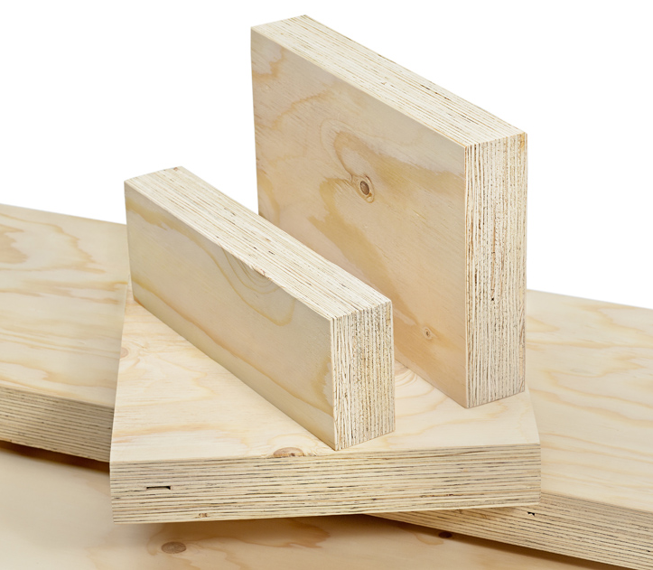
Standard dimensions (same direction of grains)
Applications
Beams
Posts
Cross-section thickness [mm]
27, 33, 39, 45, 51, 57, 63, 75
Cross-section height [mm]
200, 225, 260, 300, 360, 400, 450, 500, 600
Length [mm]
6000, 8000, 12000 (max 25000)
Image: Puuinfo

Slide 8
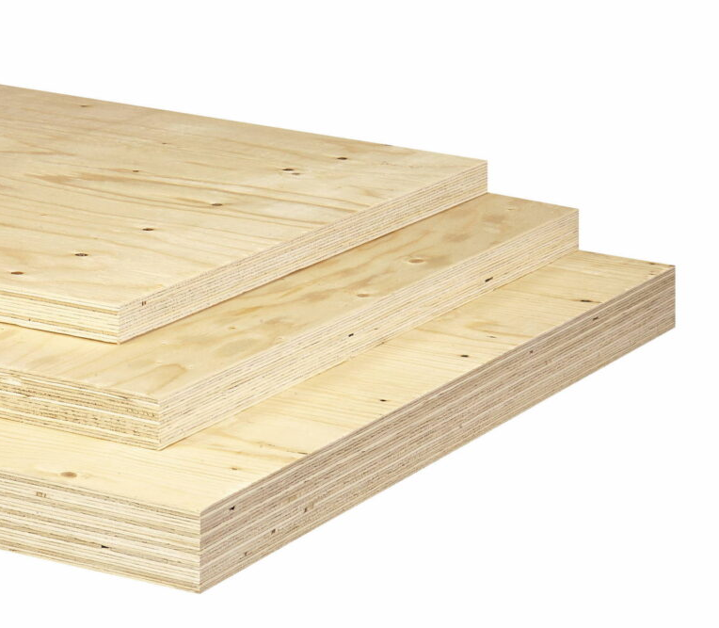
Standard dimensions (some veneers across)
Applications
Laminar structures
Beams
Cross-section thickness [mm]
21, 27, 33, 39, 45, 51, 57, 63, 69, 75
Cross-section width [mm]
900, 1200, 1800, 2500
Length [mm]
By order (max 25000)
Image: Puuinfo

Slide 9
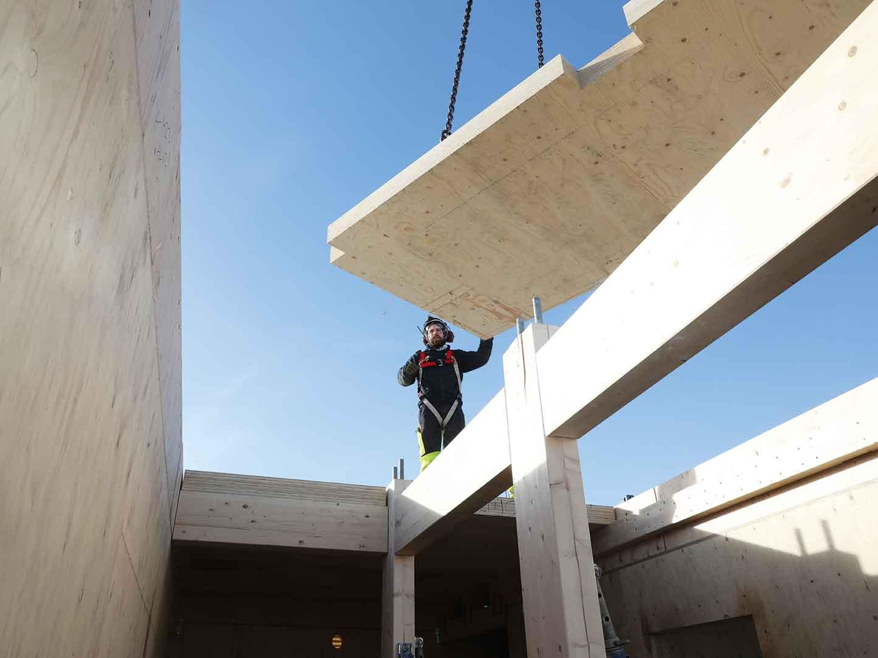
Glued laminated LVL
Applications
Beams
Laminar structures (such as CLT)
Dimensions vary by manufacturer
Cross-section thickness [mm]
84…350
Cross-section width [mm]
1800…3150
Length [mm]
Max 18000…19000
Image: Stora Enso

Slide 10
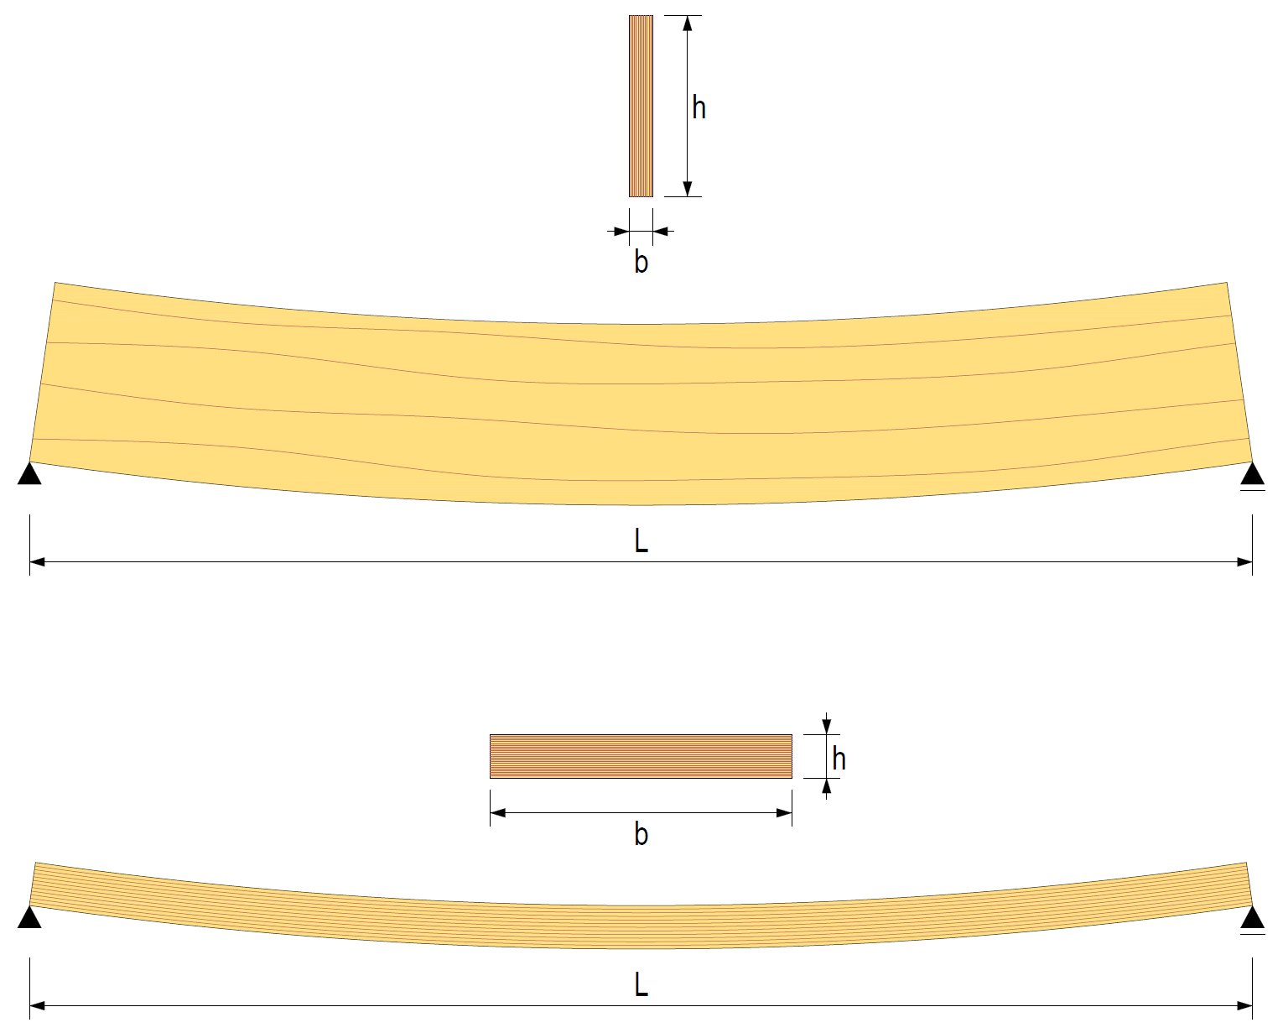
Mechanical functioning of LVL
The strength and rigidity values of LVL products are reported on a product-by-product basis, including
Impact of the veneer structure of the product
Impact of product thickness
As a result, LVL products can be handled in dimensioning as homogeneous cross-sections

Slide 11
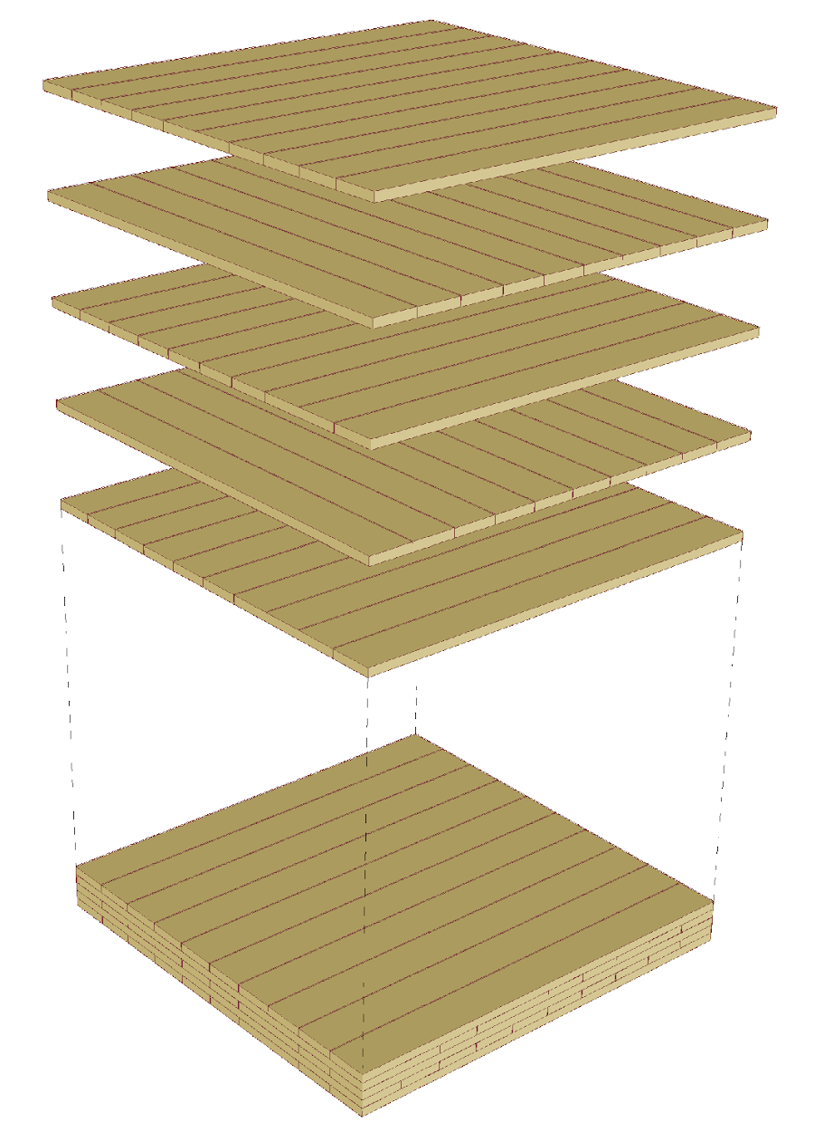
CLT (Cross Laminated Timber)
CLT intended for structural use is made from coniferous wood layers
The layers are usually glued using a polyurethane-based adhesive so that in the CLT product
Each layer changes direction
The same layer has two layers in line
Standard layer thicknesses are 20 mm, 30 mm, 40 mm

Slide 12
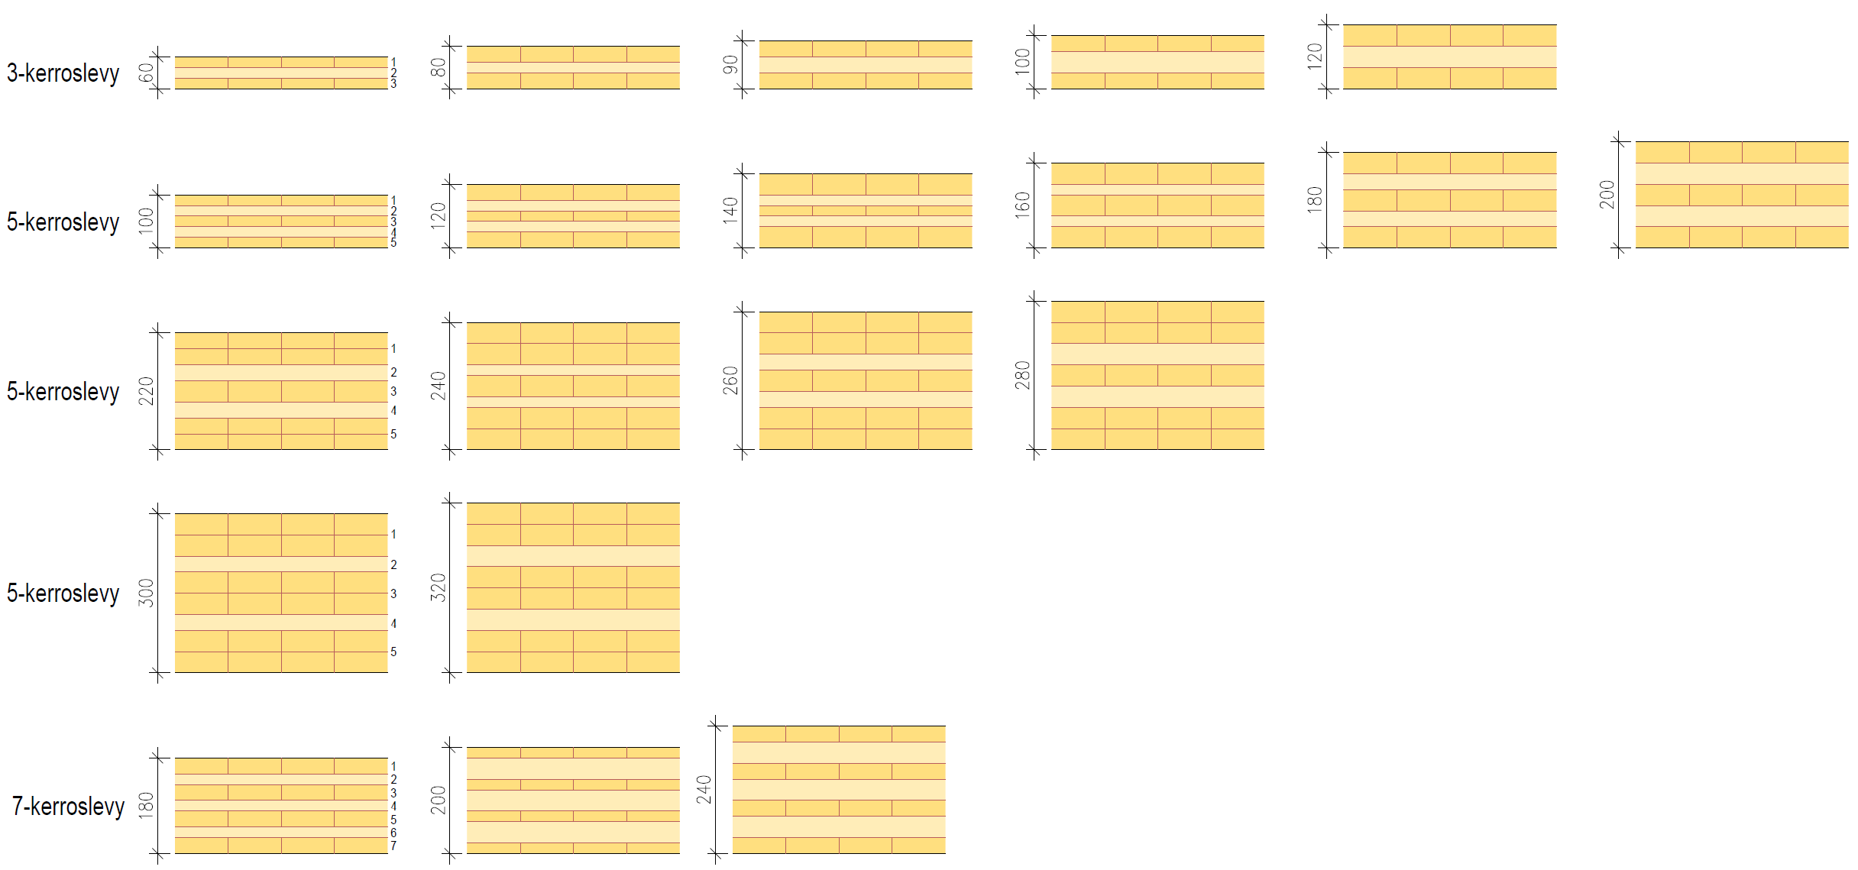
Examples of standard CLT thicknesses
3-layer panel
5-layer panel
5-layer panel
5-layer panel
7-layer panel

Slide 13
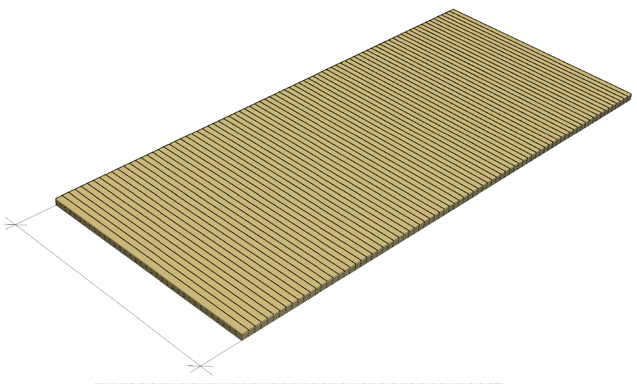
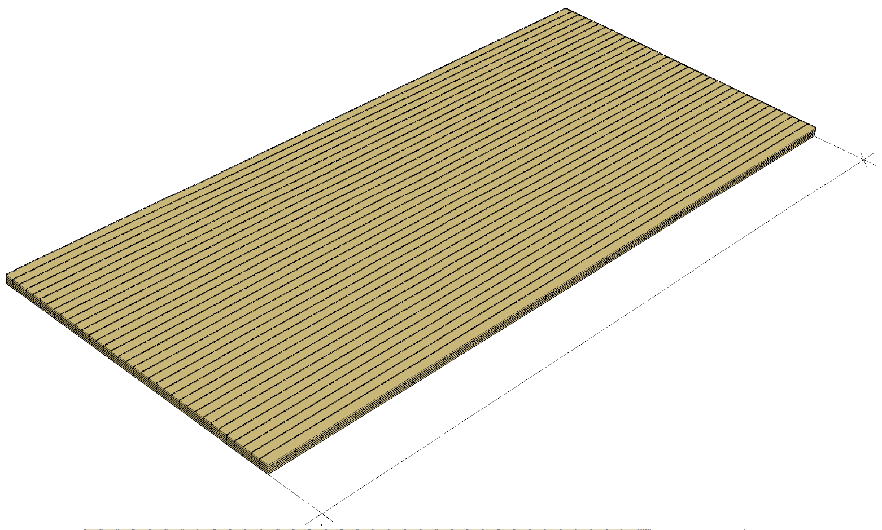
CLT panel main direction
Indicated as C and L
C panels are designed for vertical structures
Surface layers in load direction (buckling resistance)
L panels are designed for horizontal structures
Surface layers in span direction (bending strength)
C panels can be used for horizontal structures when the span is in the C direction
L panels can be used in vertical structures when the load is in the L direction
Direction C
Direction L

Slide 14
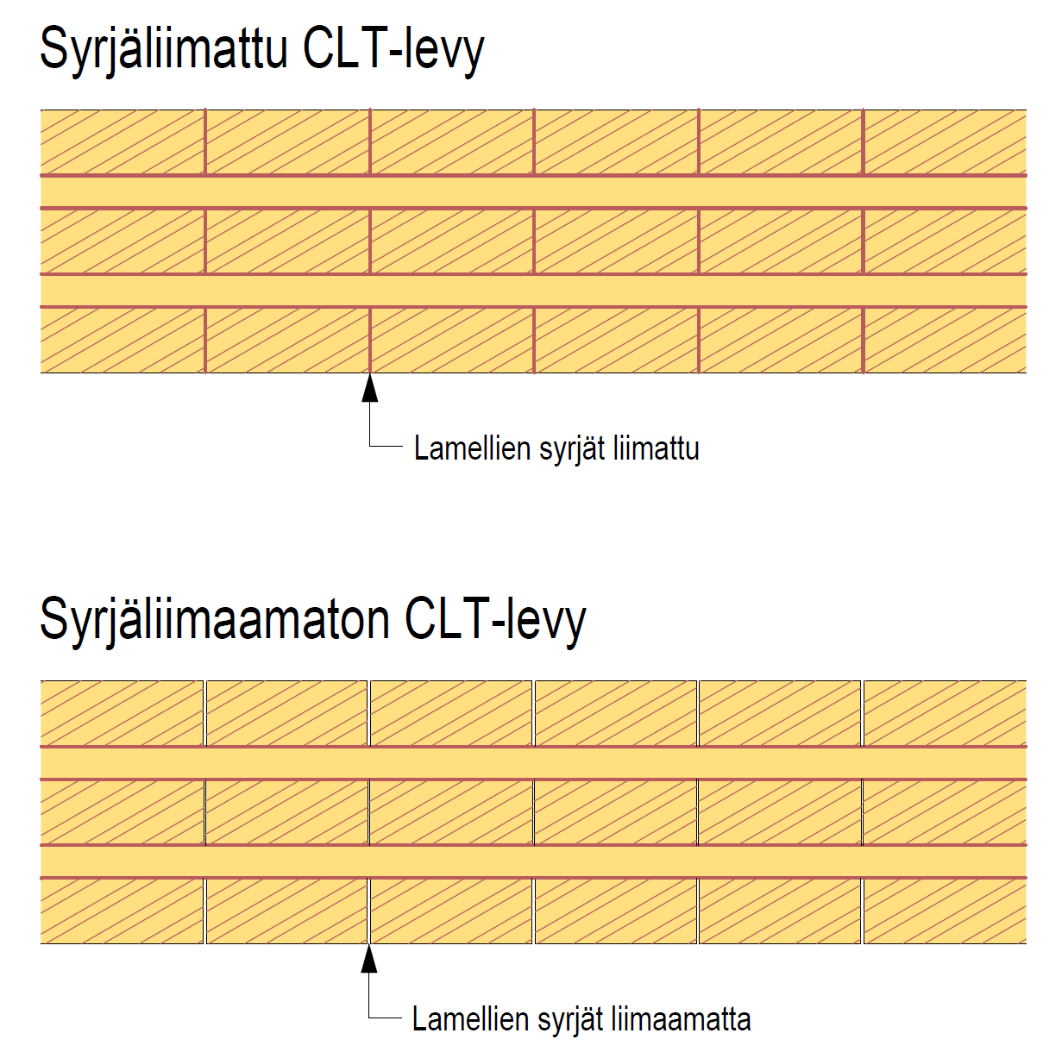
Edge-glued and non-edge-glued CLT
Edge-glued CLT panel
CLT panel is manufactured
Edge-glued
Non-edge-glued
Edge-glueing relates to the appearance of the CLT panel
Edge-glueing prevents potential gaps between layers (dimensional changes due to moisture)
Edge-glueing is not taken into account in strength dimensioning
Layer edges glued
Non-edge-glued CLT panel
Layer edges not glued

Slide 15
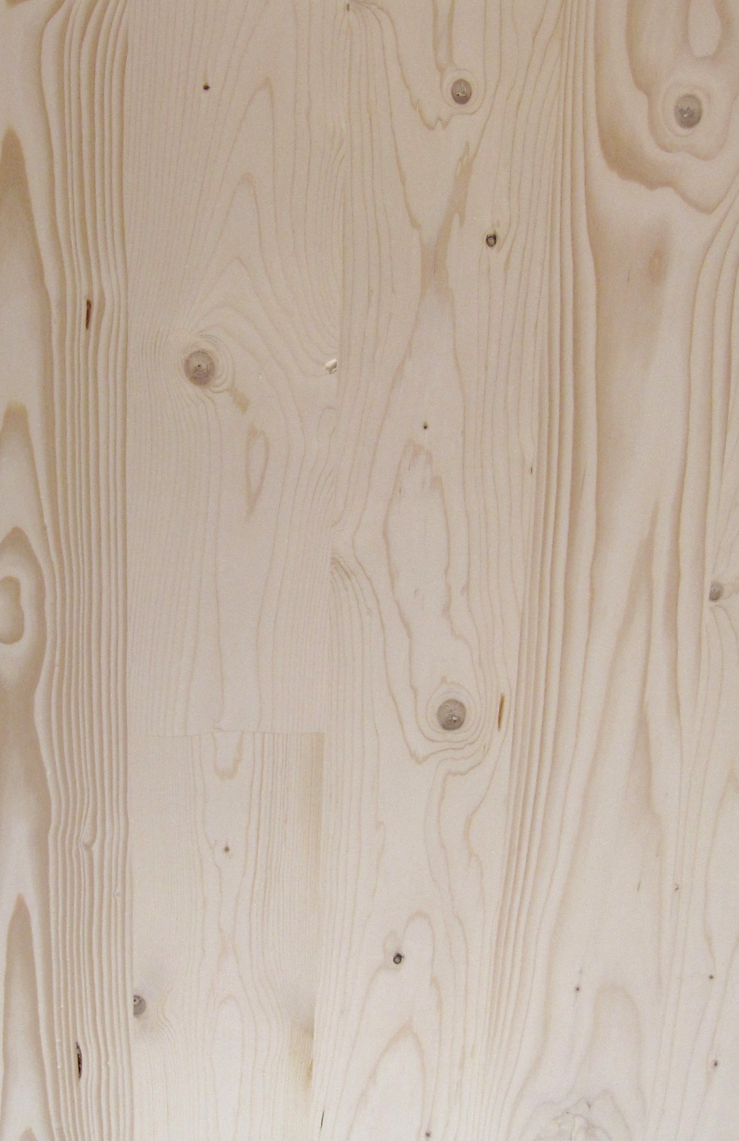
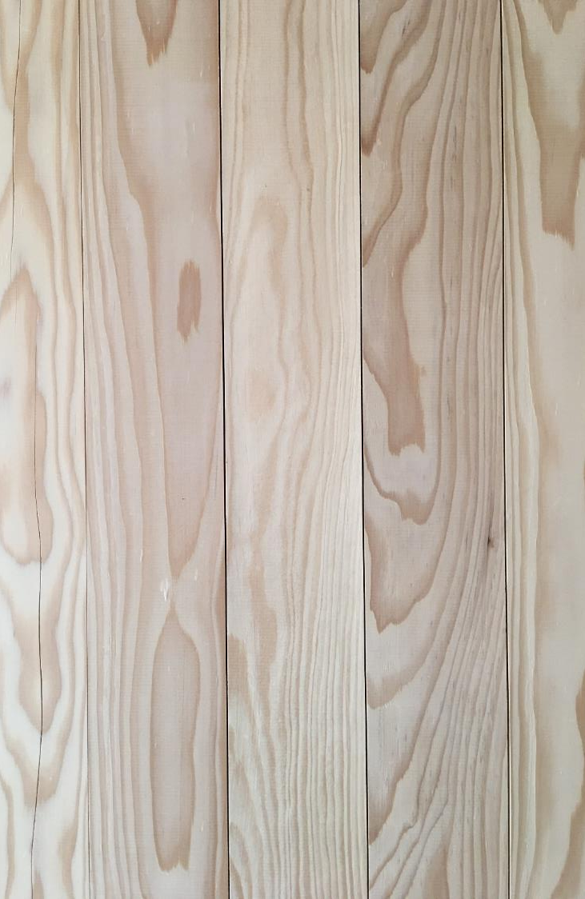
Edge-glued and non-edge-glued CLT
Cracking of surface layers in edge-glued CLT may occur due to the drying of the layers
In non-edge-glued CLT, the shrinkage caused by the drying of the layers is visible in the seams between the layers
Hair cracks may also occur in layers
The cracks do not affect strength
Edge-glued CLT
Non-edge-glued CLT
Image: Tero Lahtela
Image: Tero Lahtela

Slide 16
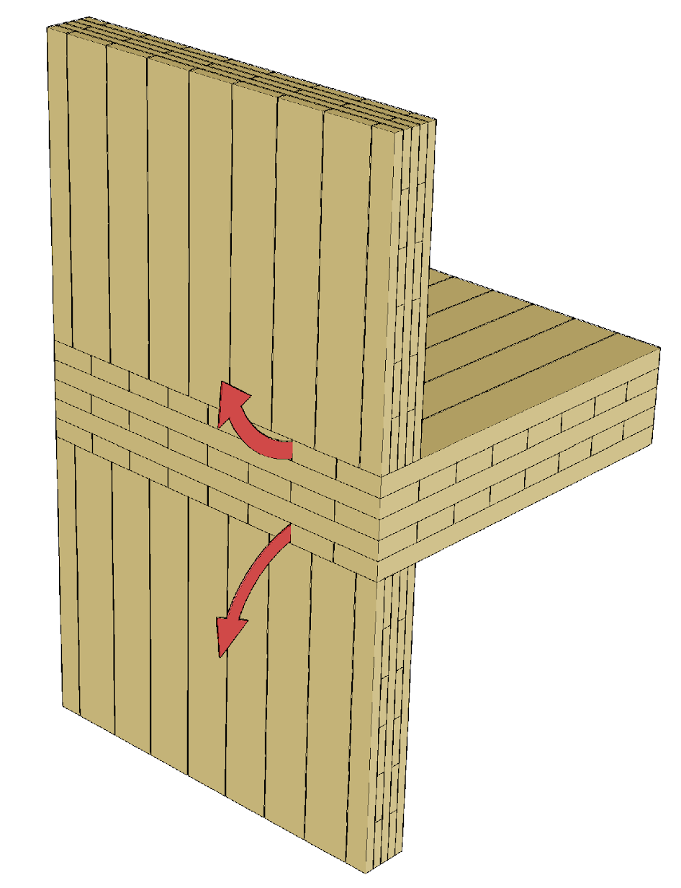
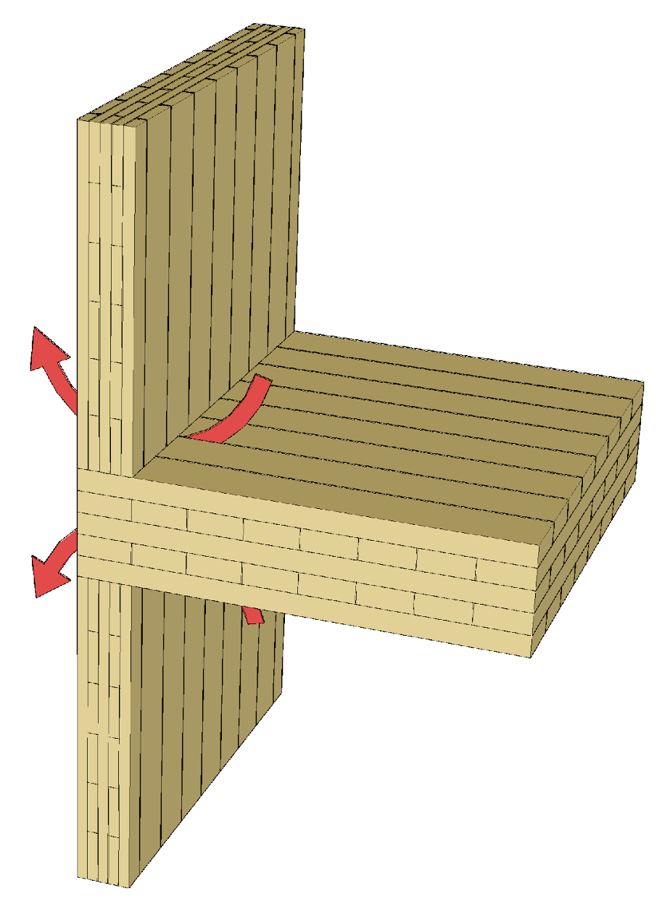
Cracks and gaps in layers
When using CLT panels, any gaps between or cracks in the surface layers must be accounted for in the airtightness of the junctions.
Especially when using CLT panels where the edges are not glued, any gaps between the layers should be checked for.
The use of a separate air-barrier layer is recommended

Slide 17
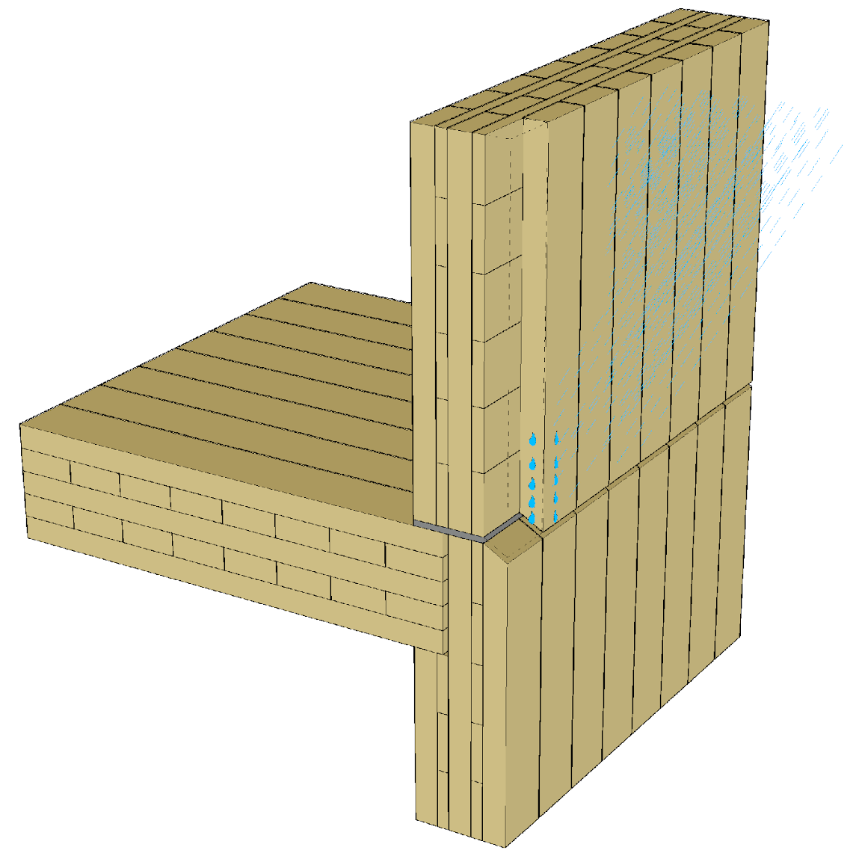
CLT panel usage class
CLT panels are intended for use in usage classes 1 and 2
Permitted usage classes are presented in CLT documents (e.g. ETA)
Use of CLT panels as facade (usage class 3) involves risks
Waterproofing of element joints is challenging to implement
Water may flow inside the junction detail through gaps/cracks in vertical layers

Slide 18
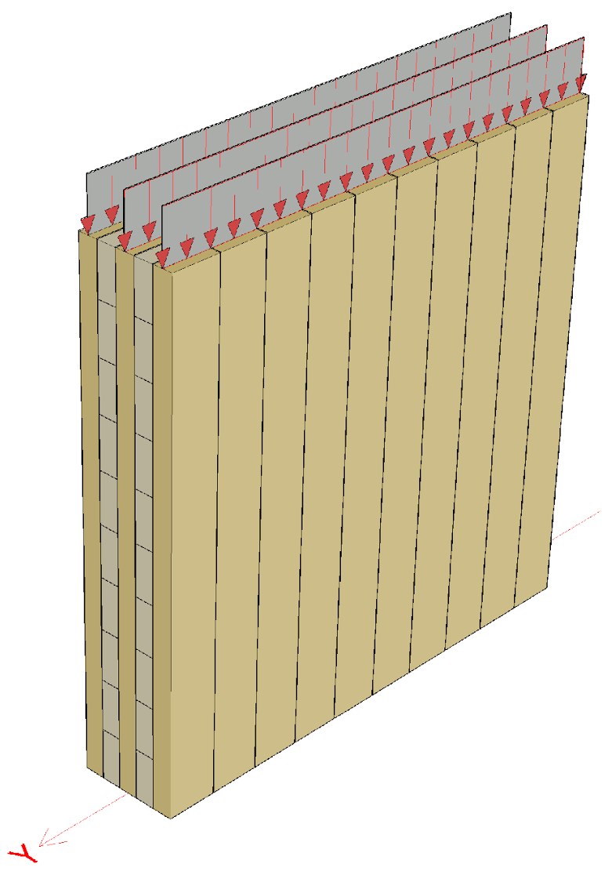
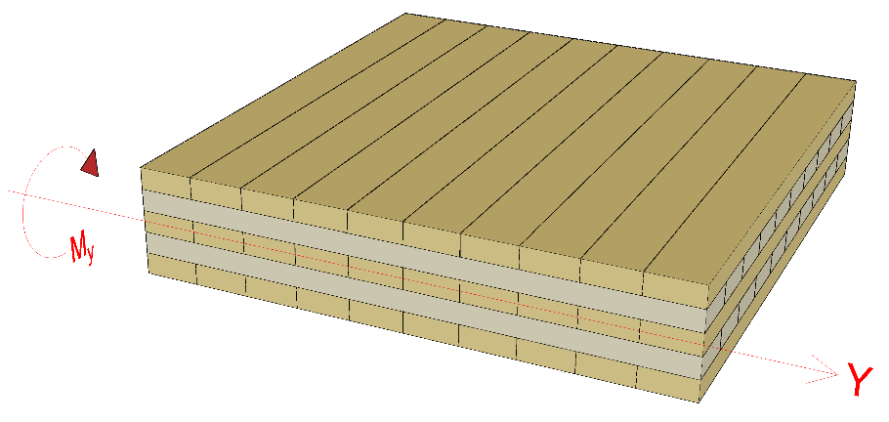
Functional layers of CLT panels
In a vertical structure, vertical loads are only received by layers parallel to the load
In a horizontal structure, bending in the direction of the span is only received by layers in the direction of the span
Depending on the manufacturer, the strength class of a panel’s layers is:
The same in all layers
Different in surface and core layers

Slide 19
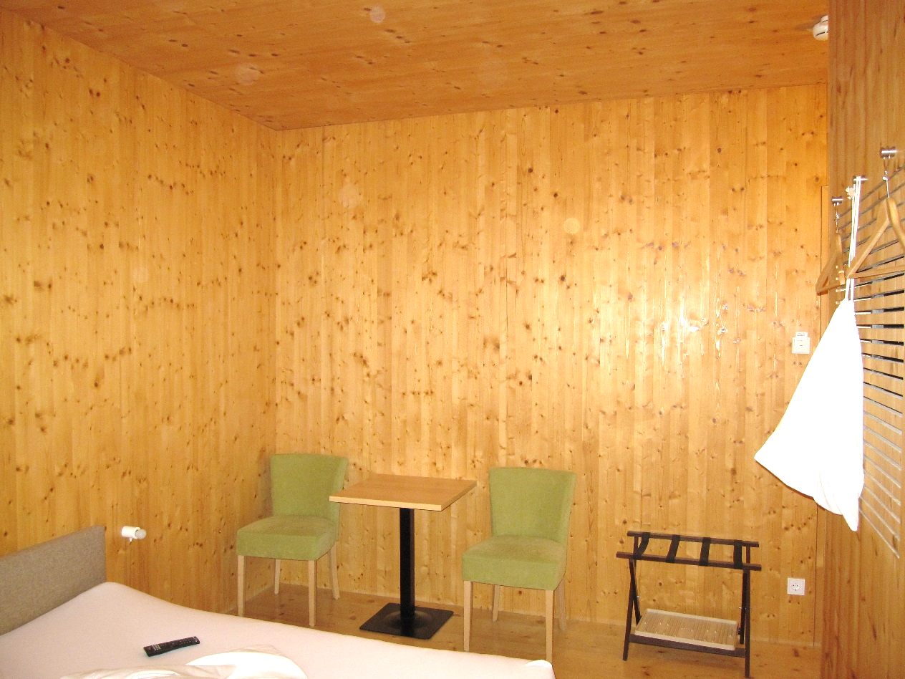
CLT panel surface quality grades
CLT panel manufacturers have their own quality grades for the panel surface
Quality grade definitions vary by manufacturer
Typical CLT panel surface quality grades
Non-visible quality
Visible industrial quality
Visible quality
Some manufacturers also offer CLT panels with hardwood surface layers
Image: Tero Lahtela

Slide 20
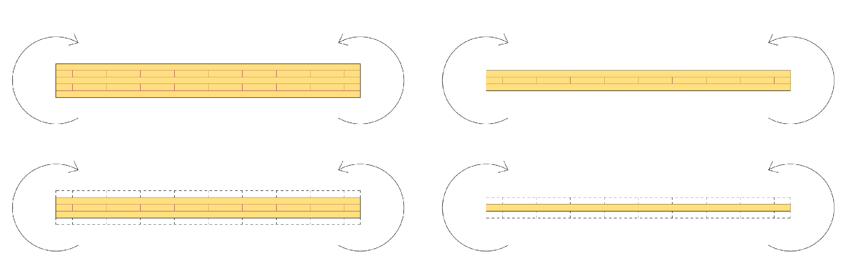
CLT panel’s strong and weak orientation
CLT panel 1
“Strong orientation”
CLT panel 2
“Strong orientation”
CLT panel 1
“Weak orientation”
CLT panel 2
“Weak orientation”

Slide 21
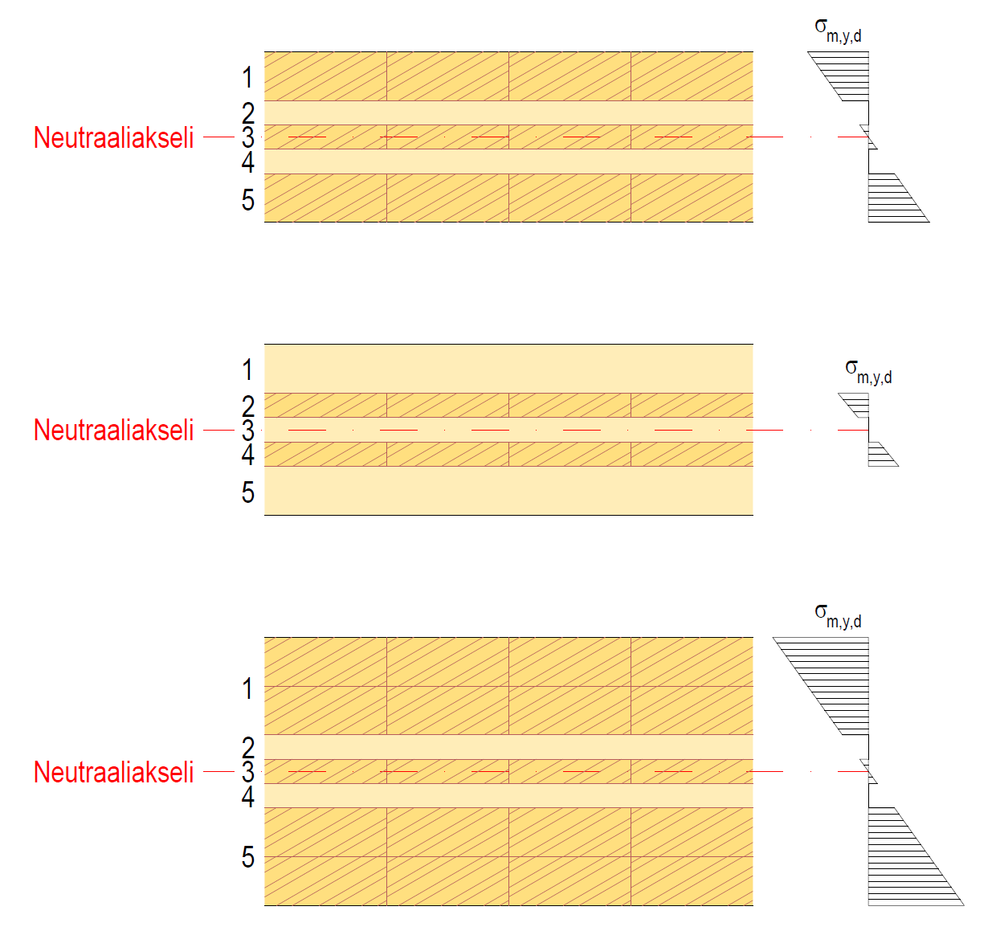
The functioning of CLT in flat bending
The CLT panel is examined as a layered structure
The transverse layers in the cross section do not receive the bending
The effective bending stiffness of the CLT panel EI_{ef} can be determined using the γ method described in the euro code (max 5-layer panel)
Neutral axis
Neutral axis
Neutral axis

Slide 22
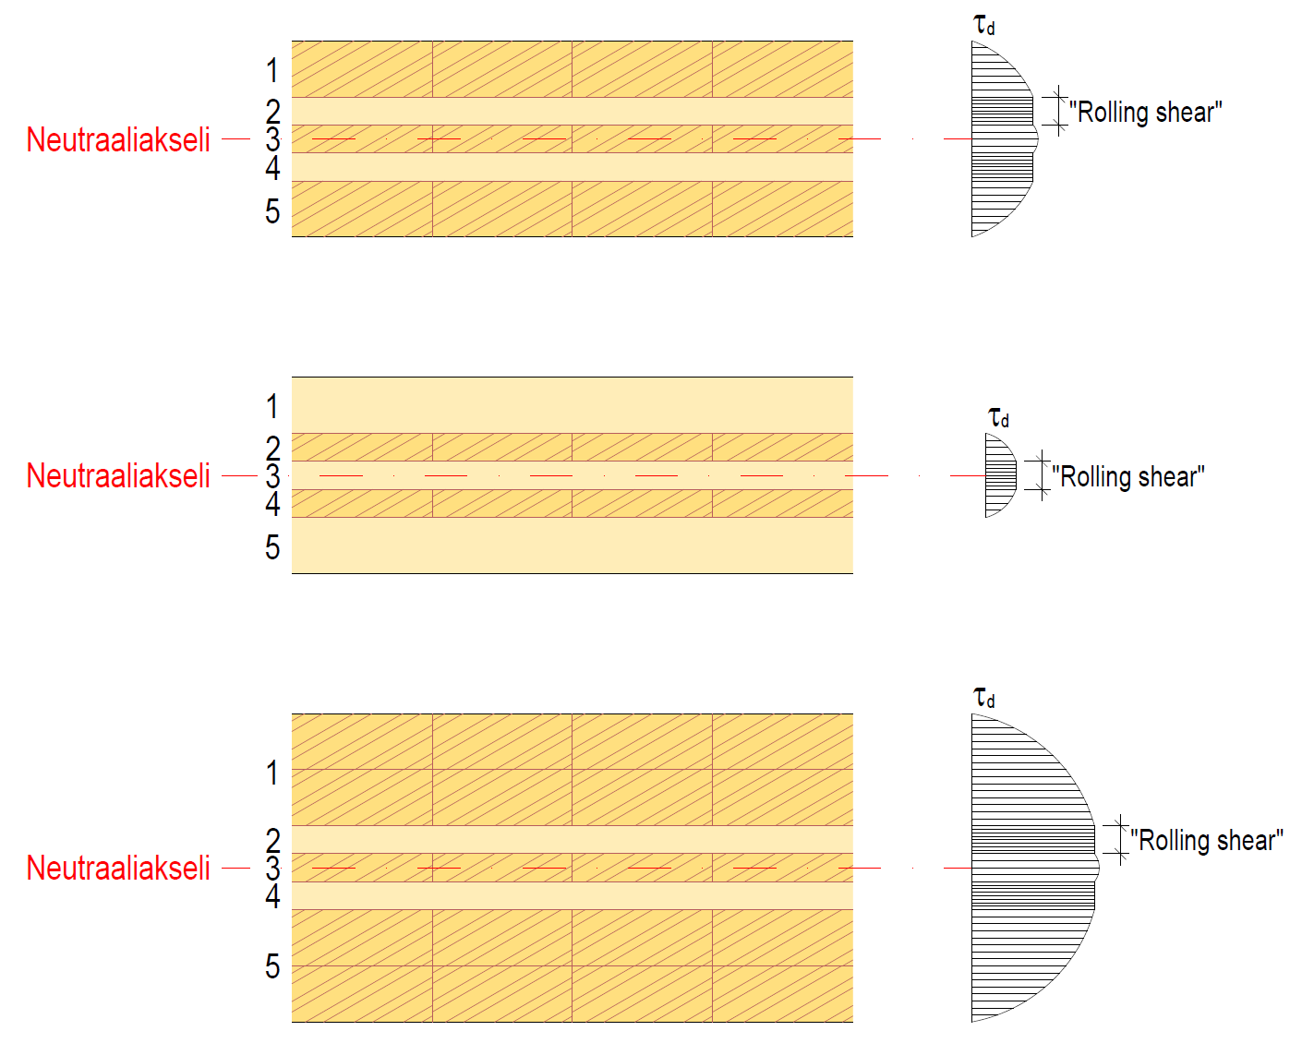
The functioning of CLT in flat bending
The transverse layers in the cross section are the most significant factor from the perspective of the shear strength of the CLT panel
The shear strength of wood perpendicular to the grain direction is weak (“rolling shear”)
The shear tension of the transverse layer in the cross section is constant for the entire perpendicular length (thickness) of the layer
Neutral axis
Neutral axis
Neutral axis

Slide 23
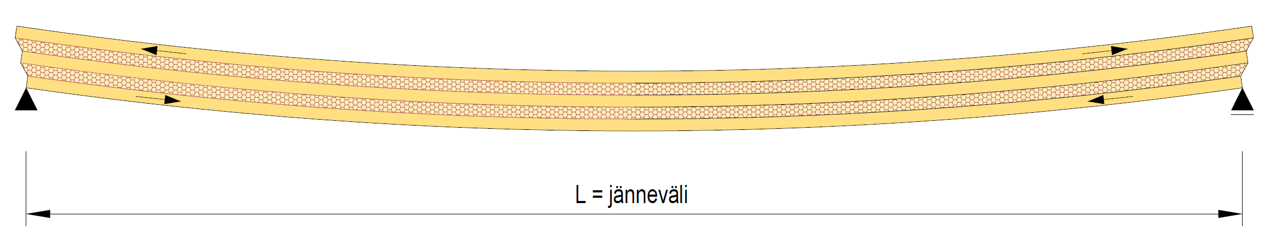
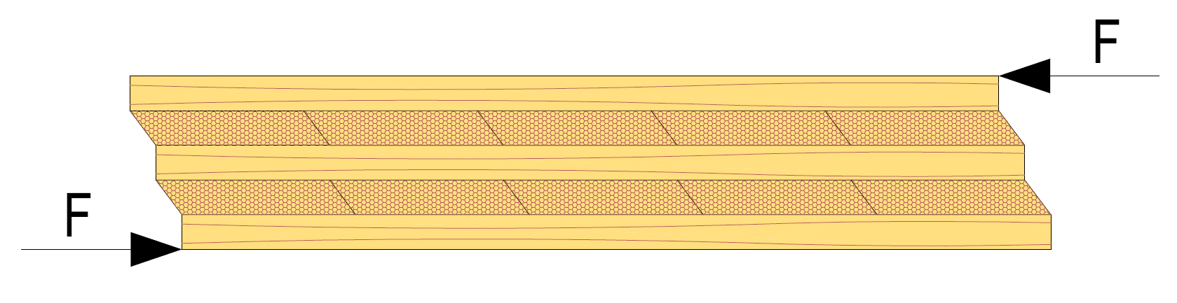
CLT’s “rolling shear”
In the transverse layers of the cross section, shear tension is perpendicular to the grain direction of the layer
Low shear strength
Glide modulus is low
In a flat bent CLT panel, the shear tensions are typically relatively low because the shear area is large (e.g. 1-m-wide piece)
L = span length

Slide 24
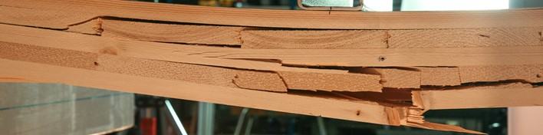
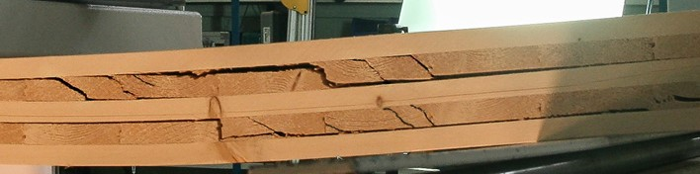
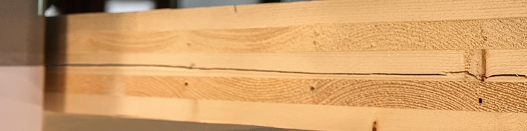
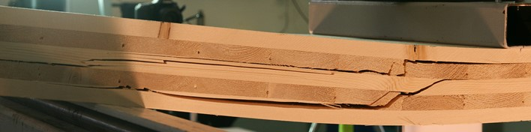
Ways a flat bent CLT panel can shear
Bending shear
Shear of transverse layers (“rolling shear”)
Shear of longitudinal layers
Shear of longitudinal and transverse layers
Images: NC State University

Slide 25
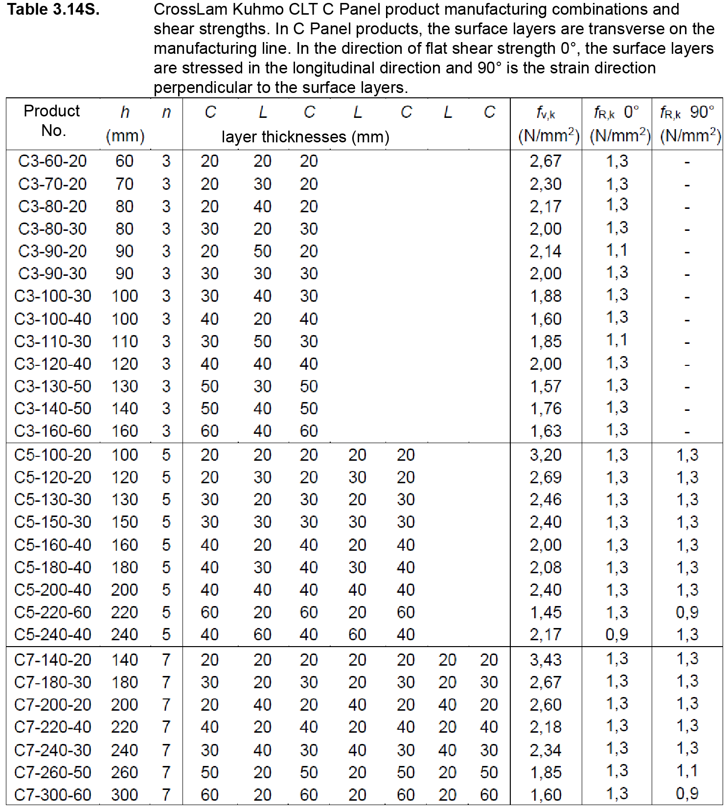
Ready-made strength values for cross-sections
Some manufacturers have pre-tabulated strength values for standardised cross-sections
The table below shows one manufacturer’s shear strengths for standard cross-sections in different panel directions

Slide 26
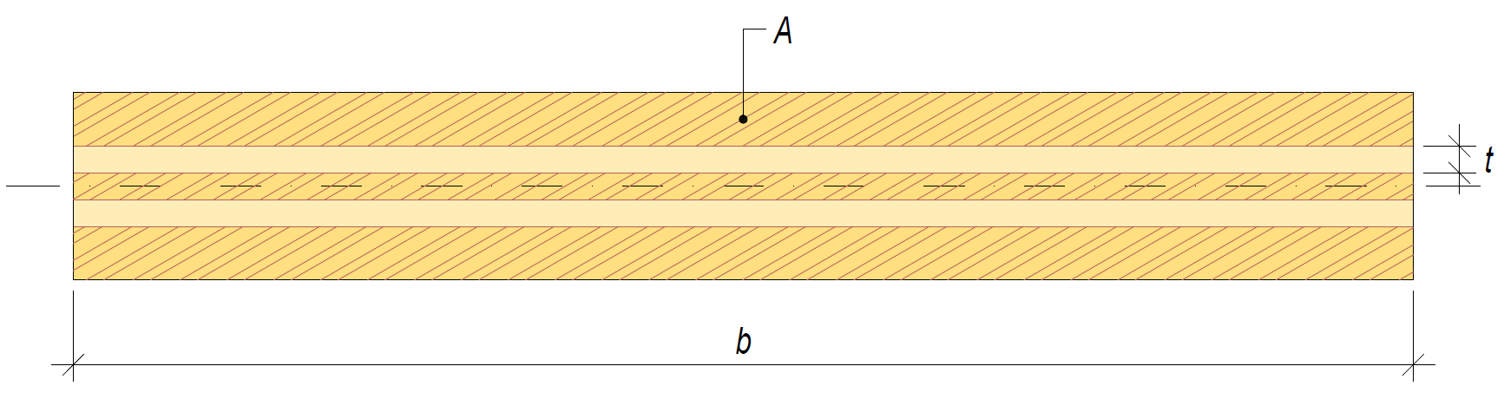
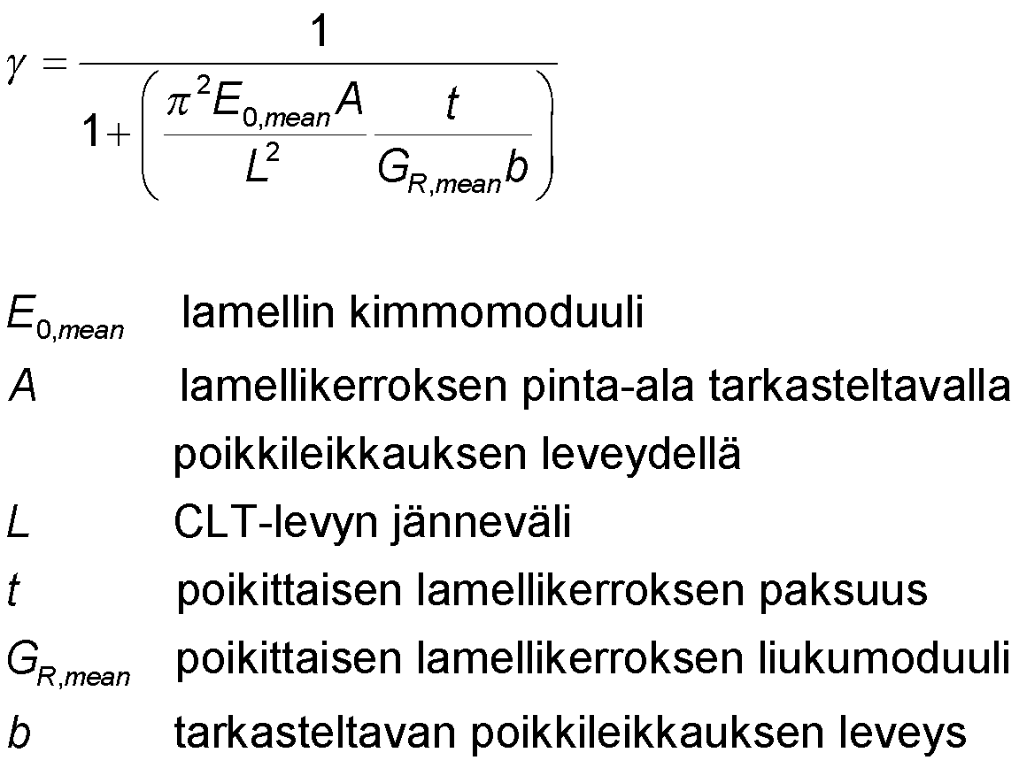
CLT’s effective moment of inertia
In a bent CLT panel, the transverse layers in the cross section cause sliding between layers
Bending stiffness decreases (EI_{ef})
The thicker the transverse layer in the cross-section, the more it reduces the bending stiffness of the CLT panel
Sliding is taken into account by using the γ factor
layer’s elasticity modulus
the surface area of the layer in the examined cross section
CLT panel span length
transverse layer thickness
transverse layer’s glide modulus
width of the examined cross section

Slide 27
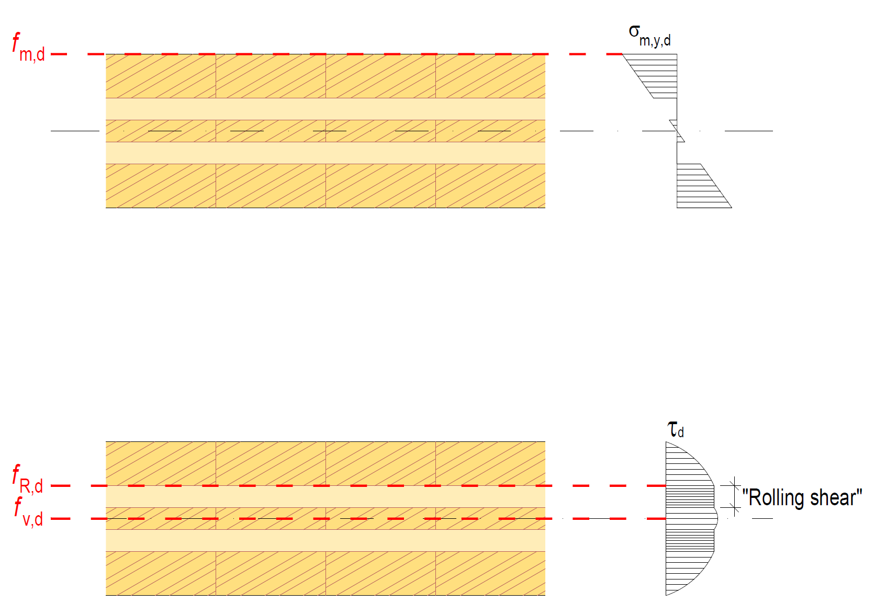
Stress assessment of the flat bending of CLT
Bending strength
Effective bending resistance W_{ef}
Bending tension assessment of a layer σ_{m,y,d} ≤ f_{m,d}
Shear strength “rolling shear”
Effective static moment S_{ef}
Shear tension assessment of a layer τ_{d} ≤ f_{R,d}
Shear strength
Effective static moment S_{ef}
Shear tension assessment of a layer τ_{d} ≤ f_{v,d}

Slide 28
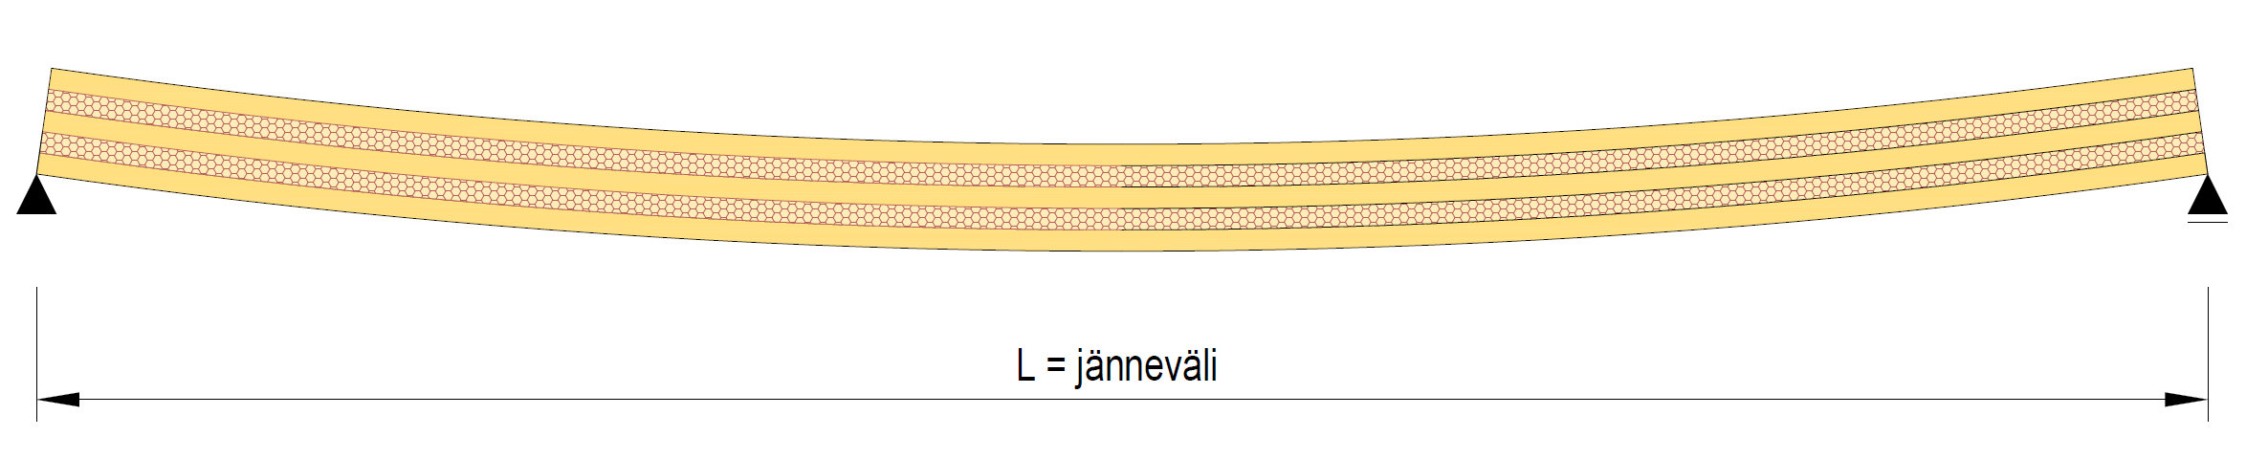
Deflection in the flat bending of CLT
Deflection by the bending moment is determined using the effective bending stiffness of the cross section EI_{ef}
The value for the layer in the grain direction is used as the elasticity modulus
Creep is taken into account by using k_{def}
If necessary, the deflection caused by the shear force is taken into account
L = span length

Slide 29
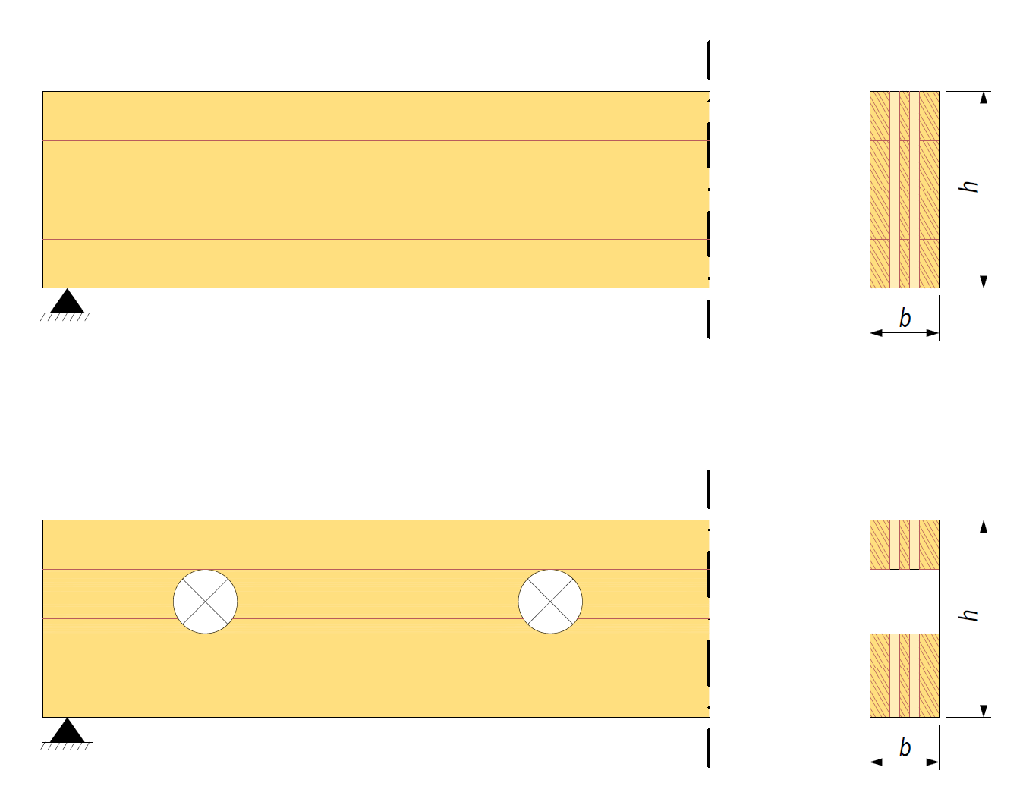
The functioning of a CLT beam
A CLT panel can be dimensioned to function as a beam
In the CLT beam, vertical fin layers of the cross section can be used to reinforce holes and grooves
The cross-section of a CLT beam is examined layer by layer

Slide 30
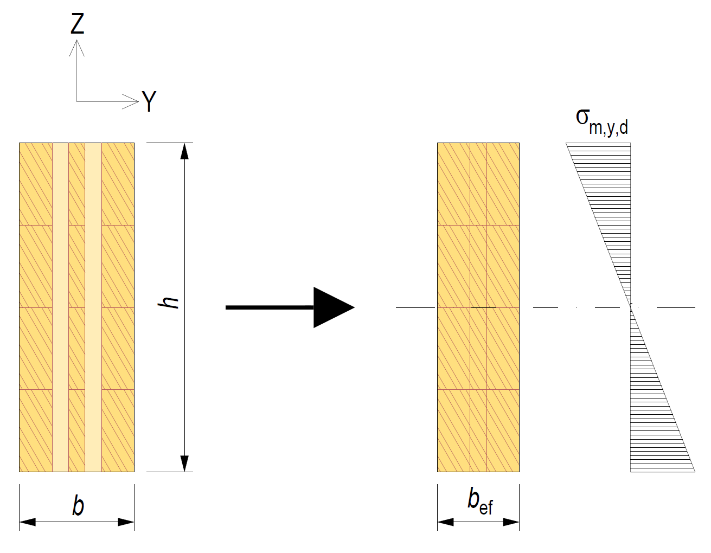
The functioning of a CLT beam
In a CLT beam, only layers parallel to the span can be taken into account as layers receiving bending
In the rotation assessment of a CLT beam, the entire cross-section is assessed
Critical bending tension is determined for the effective width b_{ef} using the effective moment of inertia of the cross section of the beam I_{ef,z}

Slide 31
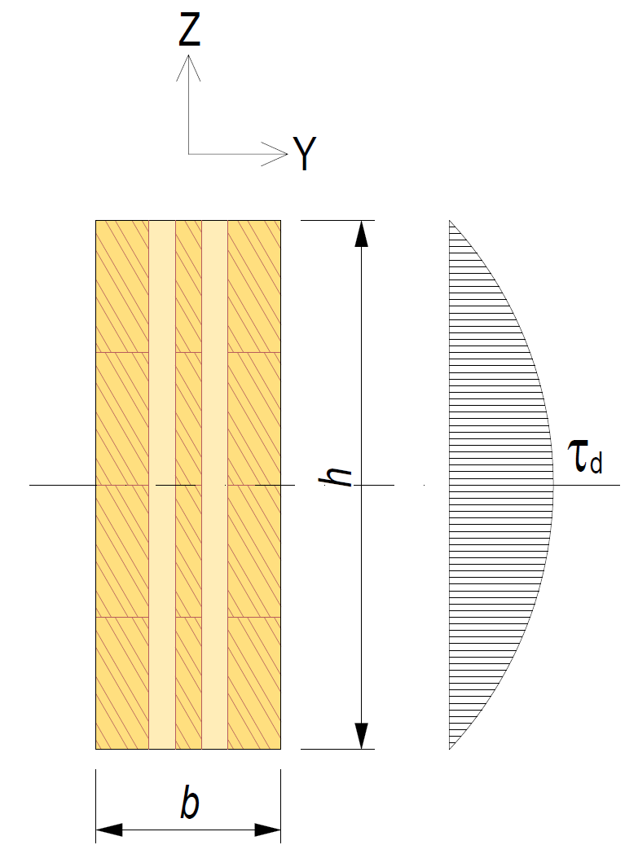
The functioning of a CLT beam
In a CLT beam, when dimensioning shear strength, the whole cross-section is used
The shear force must not be reduced in the vicinity of supports (use of V_{red} prohibited)

Slide 32
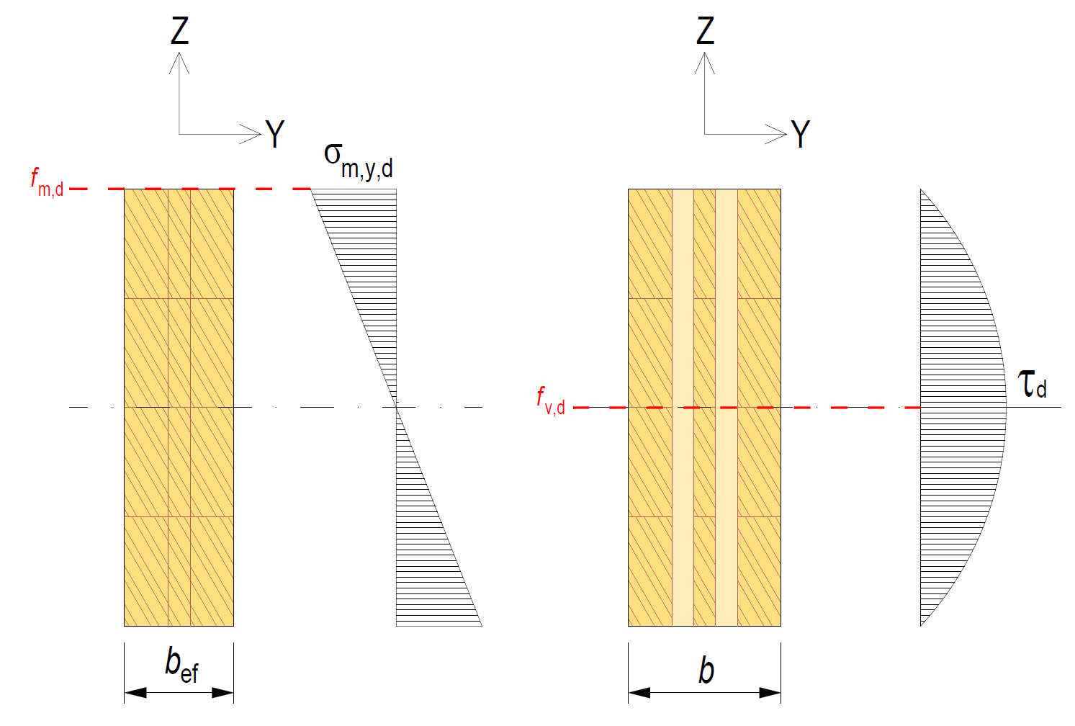
Tension assessment of a CLT beam
Bending strength
Effective width b_{ef}
Bending tension assessment of a layer σ_{m,y,d} ≤ f_{m,d}
Shear strength
Whole cross section A
Shear tension assessment of a layer τ_{d} ≤ f_{v,d}

Slide 33
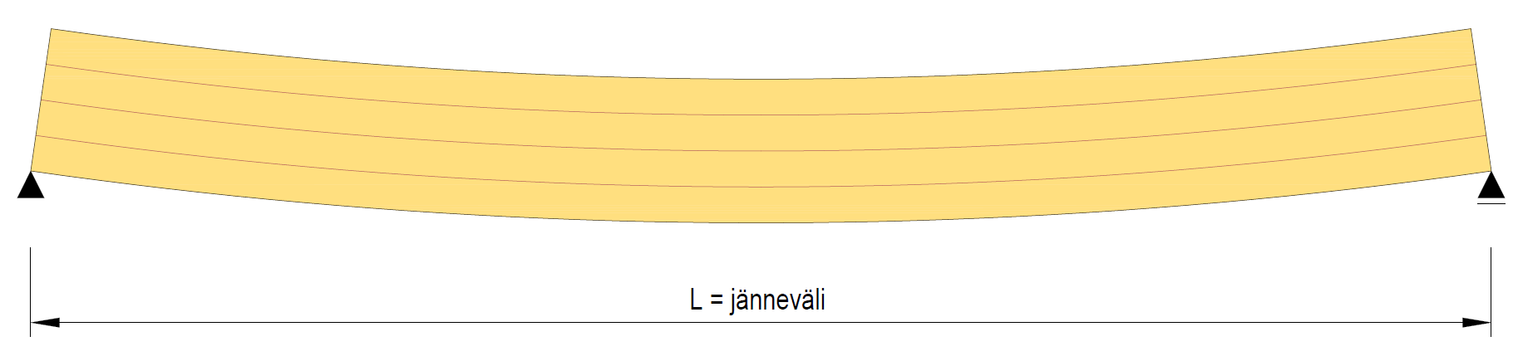
CLT beam deflection
Deflection caused by the bending moment is determined for the effective cross-section (b_{ef})
The value for the layer in the grain direction is used as the elasticity modulus
Creep is taken into account by using k_{def}
If necessary, the deflection caused by the shear force is taken into account
L = span length

Slide 34
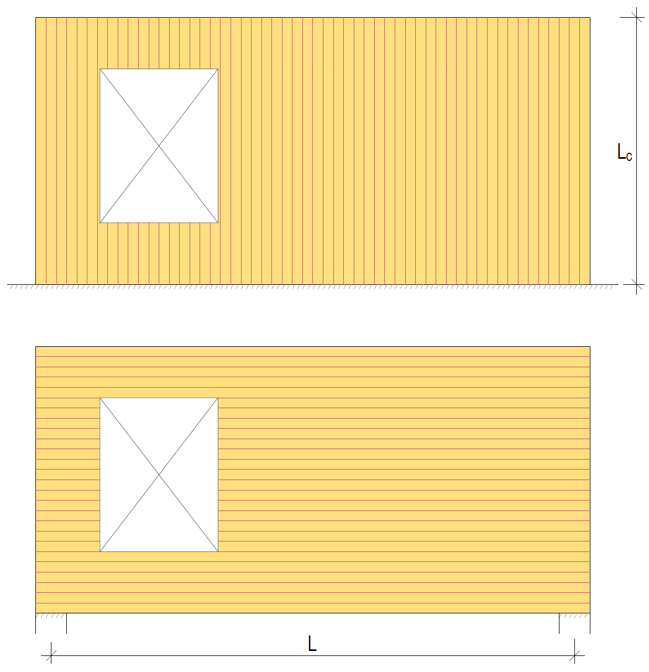
The functioning of a load-bearing CLT wall
In a load-bearing wall, the CLT panel has
Axial compression (vertical load)
Bend (eccentricity, wind load, etc.)
In a load-bearing wall on a continuous support, the surface layers of the CLT panel must be vertical
Maximizing load carrying capacity
A CLT panel can also be dimensioned to function as a wall-like beam
Horizontal layers function as load bearing

Slide 35
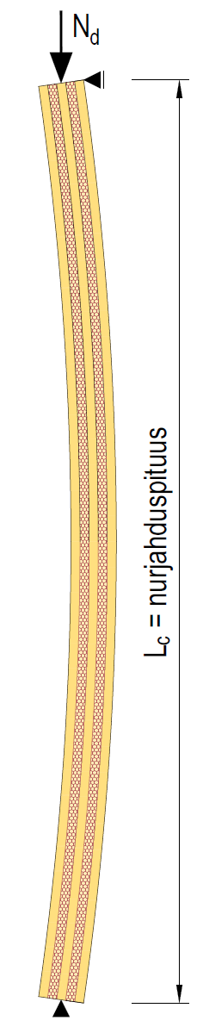
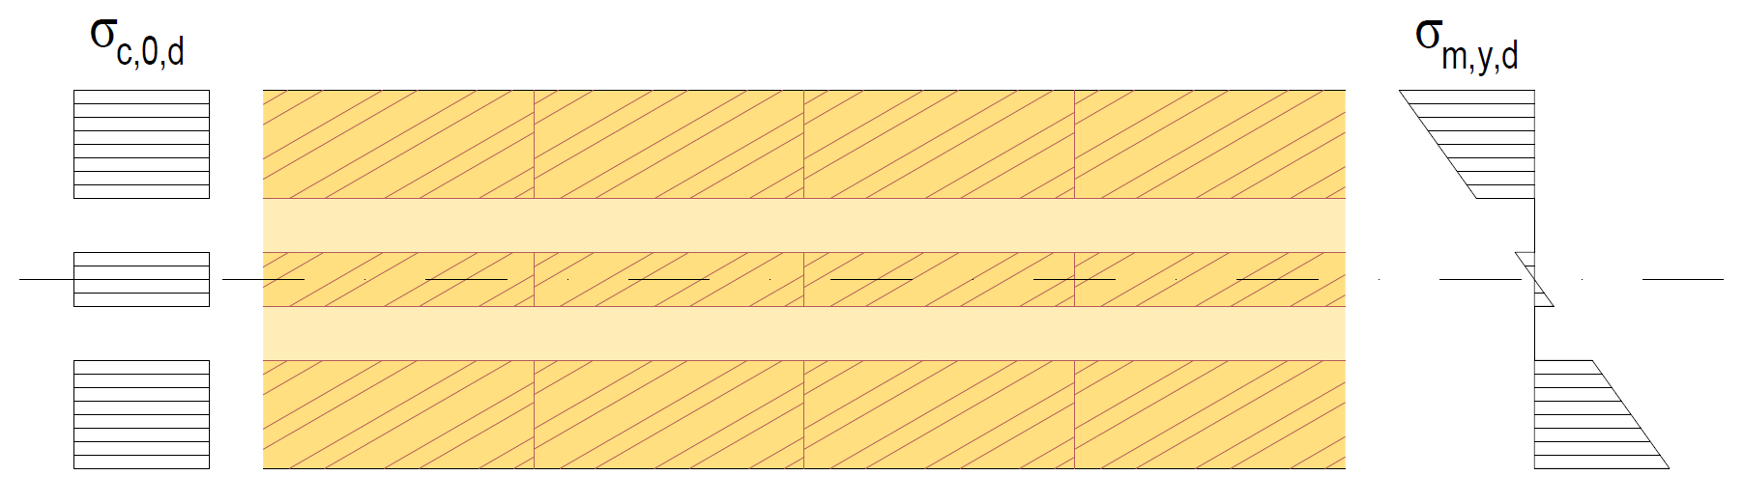
The functioning of a load-bearing CLT wall
The effective moment of inertia I_{ef} of the cross section is used in the dimensioning
The buckling assessment is carried out as for a wooden rod
Tensions and deflection caused by flat bending are examined as in CLT bending
The combined effects of buckling and bending are examined as for a wooden rod
L_{c} = buckling length

Slide 36
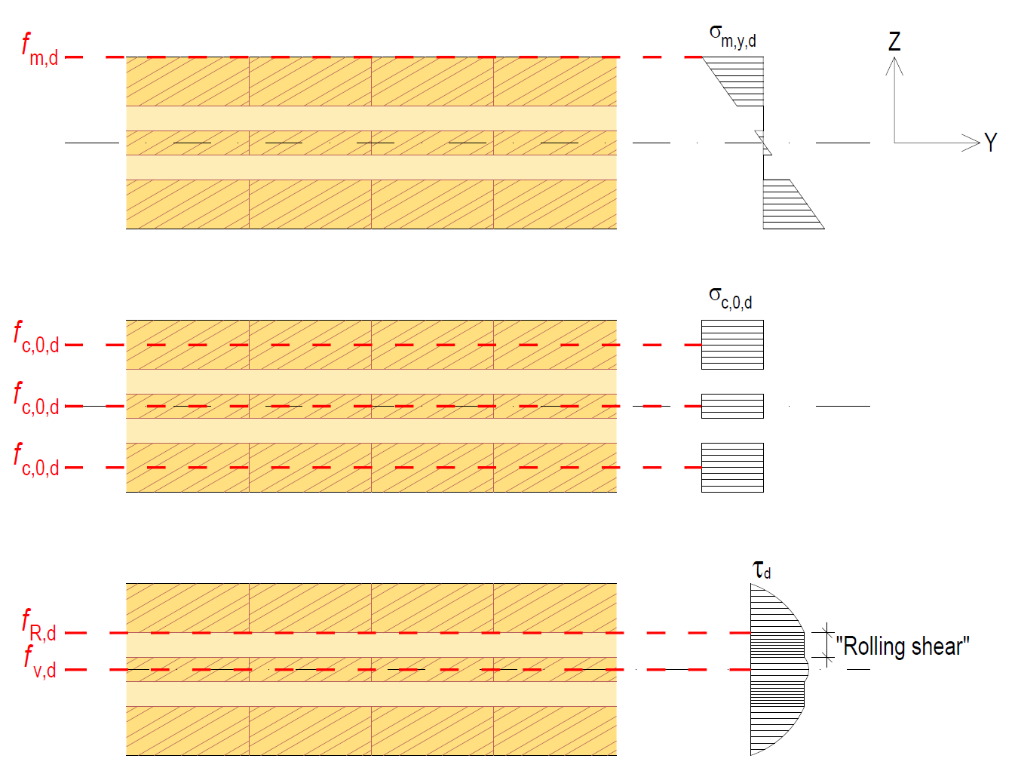
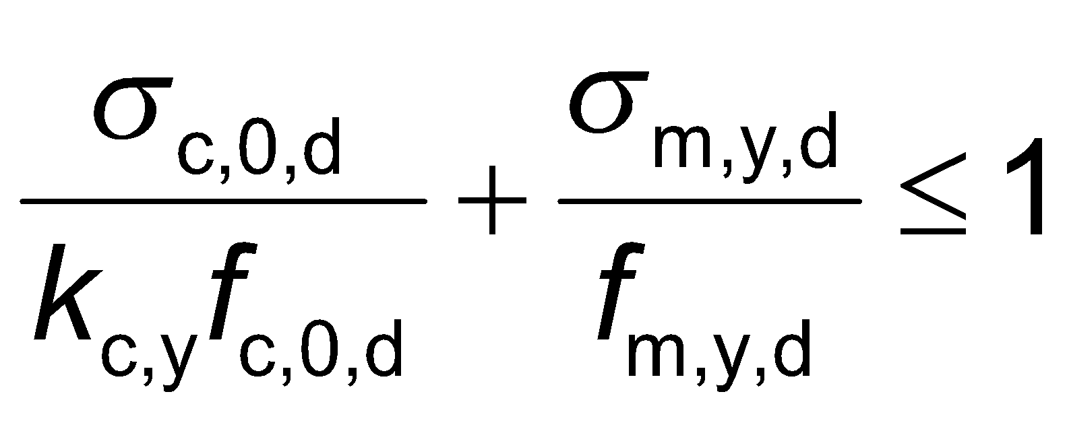
Stress assessment of a CLT wall
Bending strength
σ_{m,y,d} ≤ f_{m,d}
Buckling resistance
Shear strength “rolling shear”
τ_{d} ≤ f_{R,d}
Shear strength
τ_{d} ≤ f_{v,d}

Slide 37
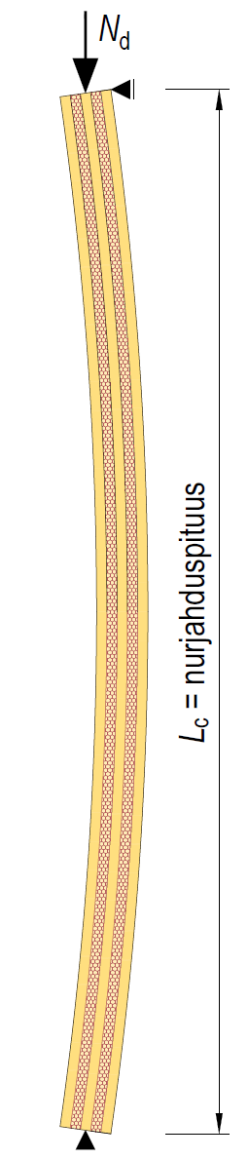
Deflection in a CLT wall
Deflection by the bending moment is determined using the effective bending stiffness of the cross section EI_{ef}
The value for the layer in the grain direction is used as the elasticity modulus
Creep is taken into account by using k_{def}
If necessary, the deflection caused by the shear force is taken into account
L_{c} = buckling length

Slide 38
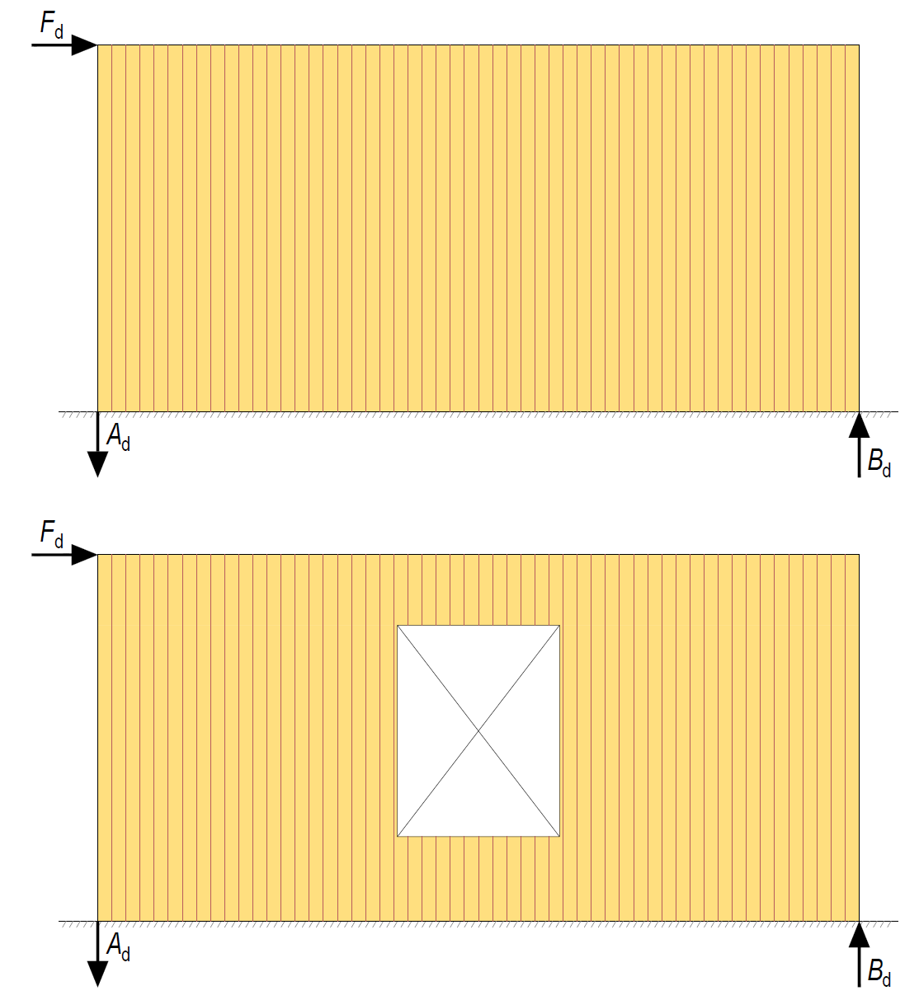
The functioning of a stiffening CLT wall
Large and efficient stiffening structures can be implemented with CLT panels
A CLT panel can be dimensioned to function as a uniform stiffening panel even if it has holes
Stiffening capacity decreases
Horizontal displacement increases

Slide 39
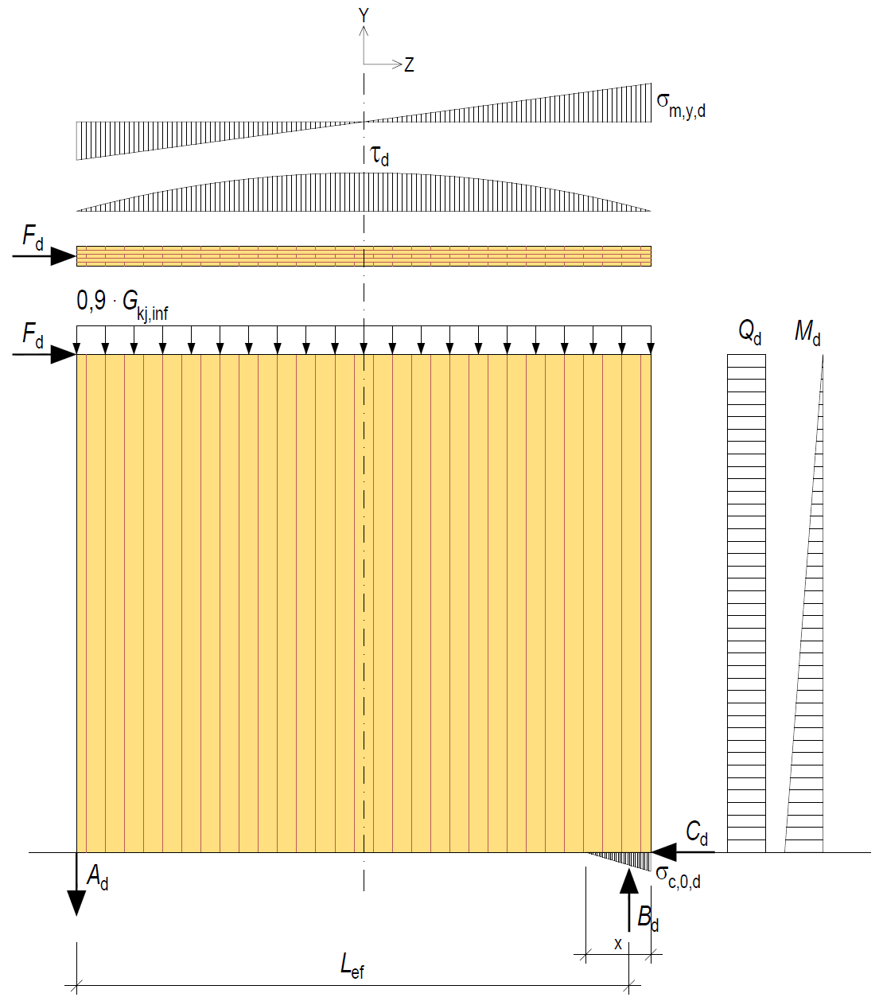
The functioning of a stiffening CLT wall
A stiffening CLT wall typically serves as a cantilever beam which has shearing and bending
In a stiffening wall, the shear strength and horizontal displacement are usually dimensioning (excluding narrow stiffening walls)
Point-form support reactions A_{d} and B_{d} are created at the ends of the wall
The compression side support reaction is received by the vertical layers of the CLT panel

Slide 40
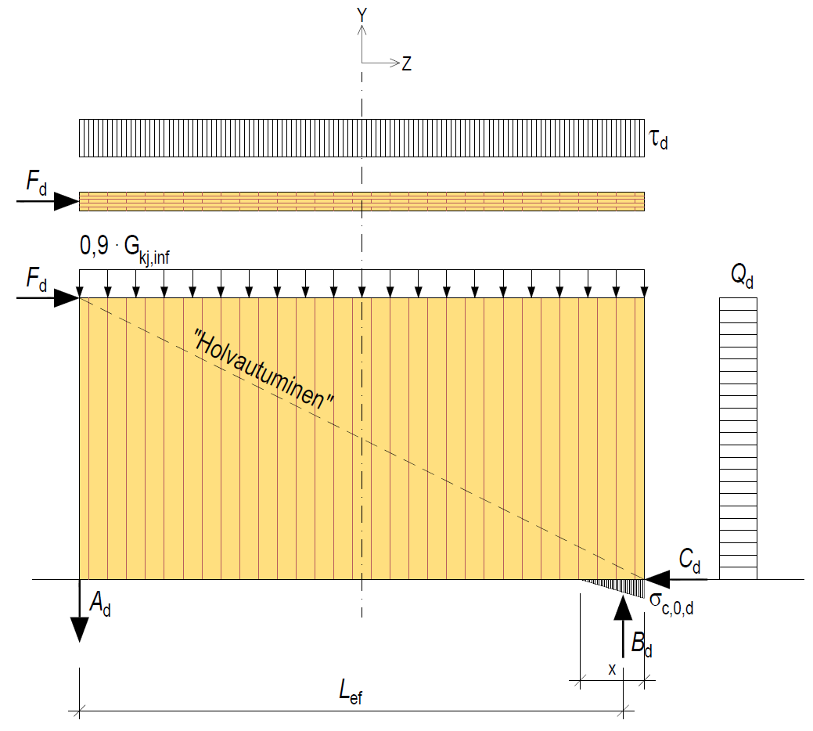
The functioning of a stiffening CLT wall
Depending on the ratio of the length and height of the stiffening CLT wall, only shear may occur in the wall
However, the dimensioning of the shear strength of a CLT wall is carried out in the same way as in a wall acting as a cantilever beam
“Arching”

Slide 41
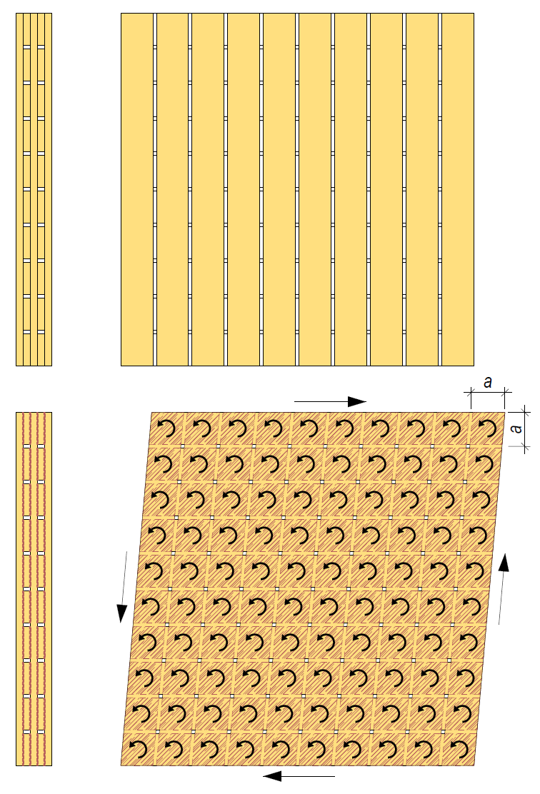
The functioning of a stiffening CLT wall
The shear strength of a CLT panel is mainly based on the torsional shear strength of the flat adhesion between the layers
Edge-glueing between layers is not taken into account in shear strength
Torsional shear strength is examined on the basis of the contact surface (axa) of adjacent layers
Some CLT manufacturers provide ready-made shear strength values for standard cross-sections

Slide 42
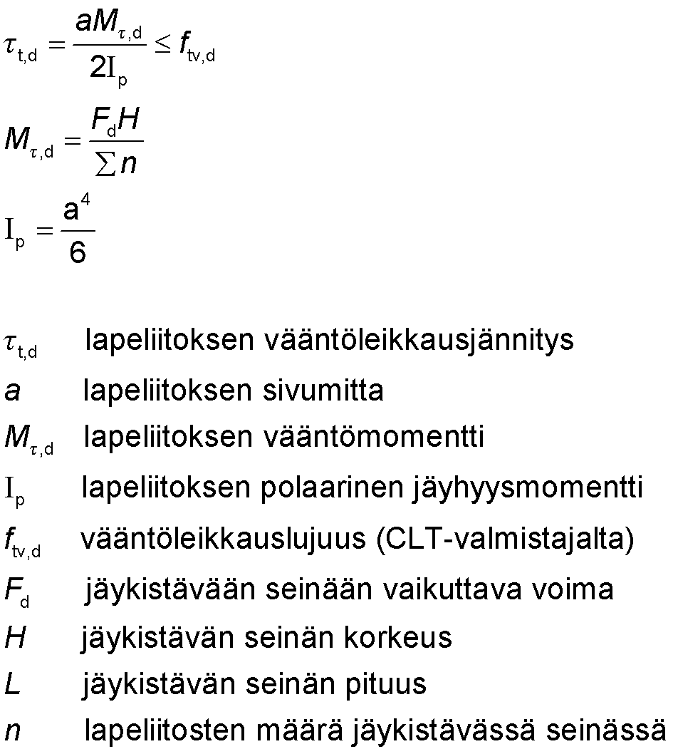
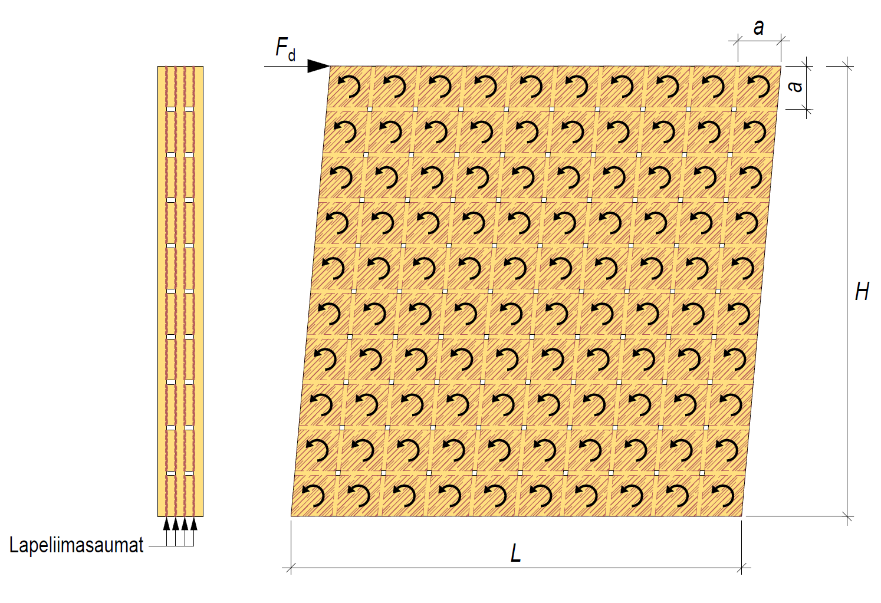
The functioning of a stiffening CLT wall
torsional shear strength of a flat joint
side length of a flat joint
torsional moment of a flat joint
polar moment of inertia of a flat joint
torsional shear strength (from CLT manufacturer)
force acting on the stiffening wall
stiffening wall height
stiffening wall length
number of flat joints in the stiffening wall
Flat glue bonds

Slide 43

The functioning of a stiffening CLT wall
A CLT panel can also shear from a panel shear, like building boards
The shear area of a CLT panel is determined by the net surface area of the cross section
Some CLT manufacturers provide ready-made shear strength values for standard cross-sections
Shear layers (net surface area)
Shear

Slide 44


The functioning of a stiffening CLT wall
shear tension
shear force in wall per unit of length
surface area of sheared layers
panel shear strength (from CLT manufacturer)
force acting on the stiffening wall
stiffening wall length
Shear layers (net surface area)

Slide 45


The functioning of a stiffening CLT wall
Horizontal displacement of a stiffening CLT wall can be determined based on shear stiffness
shear stiffness
stiffening wall height
stiffening wall length
CLT panel thickness
CLT panel layer glide modulus
stiffening wall shear displacement
stiffening wall shear force

Slide 46

The functioning of a stiffening CLT wall
The compressed edge of a stiffening CLT wall may collapse and rotate due to vertical loading
The vertical load on the compressed edge consists of the vertical load on the wall and the vertical support reaction caused by horizontal force
Typically, the edges of the stiffening wall are connected to the transverse walls, allowing the compressed edge to be laterally supported
Wall vertical load
Wall compressed edge

Slide 47

Bearing pressure resistance of CLT
Only layers parallel to the load can be taken into account in the bearing pressure dimensioning of the CLT panel
The dimensioning of the bearing pressure resistance is carried out according to the same principles as for sawn timber
For the flat surface of the CLT panel, the factor is k_{c,90} = 1,25 (as in sawn timber)

Slide 48

Bearing pressure resistance of CLT
The length of the effective contact surface is determined according to the same principles as for a skeleton-structured wall.
l_{c,90,ef is} determined for each layer parallel to the load
Bearing pressure resistance is checked for each layer parallel to the load using the l_{c,90,ef} measurement of the layer
Layer 1
Layer 2

Slide 49

Moisture behaviour of solid wood panels
Dimensional changes due to moisture in cross-laminated solid wood panels are very low
However, a solid wood panel swells and shrinks in the perpendicular direction (thickness) of the panel
Must be taken into account in the design of junctions and joints
Dimensional changes due to moisture in a CLT panel can be estimated using the instructions for sawn timber
Dimensional changes due to moisture in a LVL panel can be estimated using the panel manufacturer’s instructions

Slide 50

Moisture behaviour of solid wood panels
The effect of different moisture conditions on the different sides of the solid wood panel on the panel must be taken into account in the design
For example, a high solid wood exterior wall without separate thermal insulation may exhibit curvature caused by dimensional changes due to moisture
Inner surface shrinks
Exterior surface swells

Slide 51

Ordering solid wood panels
Solid wood panels based on panel-specific drawings
The order drawing shows
Panel ID
Panel type
Direction of surface layers
Quantity
Dimensions
Surface quality grade
Details of desired CNC machinings

Slide 52


Solid wood panel machining
Slab length
When designing the machining of solid wood panels, the properties of the CNC machine used must be determined
Machining directions
Machining depths
Size of the panel to be machined
Etc.
Slab width
Drilling depth
Direction of drilling
Image: Stora Enso
Image: Ledinek

Slide 53


Solid wood panel machining
Machining
Edge planing
Tool
Circular saw
Machining information
Machining
Curved edge or hole
Tool
Pin mill Ø20 / Ø 40
Machining information
Blade tilt range 0°...90 °
Blade dirigibility 360°
α₁ = 0°...90° depending on h measure
h = max 310 mm
α₂ = 0°...90°
Both angles can be active at the same time.
Blade tilt range 0°...90 °
α₁ = 15°...90° depending on h measure
h = max 120 mm (pin mill Ø 20 mm)
h = max 200 mm (pin mill Ø 40 mm)
d = min 20 mm
Both angles can be active at the same time
Image: Stora Enso
Source: Crosslam Kuhmo

Slide 54


Solid wood panel machining
Machining
Edge toothing
Tool
Pin mill Ø 20 / Ø 40
Machining information
Machining
Edge bevel
Tool
Disc mill Ø 300 / Circular saw
Machining information
Blade tilt 0°... 90°
α₁ = no limit
α₂ = no limit
h = max 120 mm (pin mill Ø 20 mm)
h = max 200 mm (pin mill Ø 40 mm)
b = no limit
R = 10 mm (pin mill Ø 20 mm)
R = 20 mm (pin mill Ø 40 mm)
The dimension h may be larger, but then the panel must be turned.
Blade tilt range 0°...90 °
α₁ = 0°...90°
b = max. 310 mm (circular saw)
b = no limit (disc mill)
Image: Stora Enso
Source: Crosslam Kuhmo

Slide 55


Solid wood panel machining
Machining
Rebate
Tool
Disc mill Ø 300
Machining information
Machining
Small straight-edge opening
Tool
Pin mill Ø 20 / Ø 40
Machining information
b = no limit above the panel
b = max 100 mm below the panel
h = no limit above the panel
h = min 27 mm below the panel
Blade tilt range 0°...90 °
a - 20 mm →
h = max 120 mm (pin mill Ø 20 mm)
h = max 200 mm (pin mill Ø 40 mm)
R = 10 mm (pin mill Ø 20 mm)
R = 20 mm (pin mill Ø 40 mm)
NOTE!
The corners of the opening are round due to the pin mill. This should be taken into account, for example, in the fitting dimensions of the window. Rounding can be removed using hand tools.
Image: Stora Enso
Source: Crosslam Kuhmo

Slide 56


Solid wood panel machining
Machining
Large straight-edge opening
Tool
Circular saw / Pin mill Ø 20 / Ø 40
Machining information
Machining
Curved edge or hole
Tool
Pin mill Ø20 / Ø 40
Machining information
Blade tilt 0°... 90°
h = max 120 mm (pin mill Ø 20 mm)
h = max 200 mm (pin mill Ø 40 mm)
R = 10 mm (pin mill Ø 20 mm)
R = 20 mm (pin mill Ø 40 mm)
NOTE I
Big openings (e.g. window, door) are made using a circular saw, because it’s a faster machining method than the pin mill. Because of this the quality is not as clean as that of a pin mill.
The corners of the opening are made using a pin mill, so the corners are round due to the pin mill.This should be taken into account, for example, in the fitting dimensions of the window. Rounding can be removed using hand tools.
Blade tilt range 0°...90 °
b = min 20 mm
h = max 120 mm (pin mill Ø 20 mm)
h = max 200 mm (pin mill Ø 40 mm)
NOTE!
The direction of the groove should be parallel to the surface layer, so that the surface layers do not break and thus reduce the durability of the panel.
Image: Stora Enso
Source: Crosslam Kuhmo

Slide 57

Solid wood panel machining
Machining
Groove
Tool
Circular saw
Machining information
Blade tilt 0°... 90°
b = min 6 mm
h = max 310 mm
Image: Stora Enso
Source: Crosslam Kuhmo

Slide 58

Solid wood panel machining
Opening pieces are waste which the customer pays for
Opening pieces can be left at the factory or delivered to the customer
Minimising opening pieces should be taken into account in the planning of the openings
Image: Stora Enso

Slide 59

Solid wood panel machining
Rounding up to the radius of the pin milling unit remains at the corners of the holes made with a pin milling unit
Rounding affects, for example, the fitting of windows
Rounding can be removed on request at the CLT factory
Image: Tero Lahtela

Slide 60

Solid wood panel machining
High walls can use horizontal structure CLT panels (L panel) that are mounted vertically
Large openings can be implemented using a separate CLT beam
A CLT beam can be connected to the CLT wall using a rebate joint
CLT panel upright
Image: Tero Lahtela

Slide 61

Seams in solid wood panels
Sealing tape
4 mm bevel in visible quality

Slide 62

Seams in solid wood panels
Plywood strip
Sealing tape
4 mm bevel in visible quality

Slide 63

Solid wood panel installation tools
Various tools have been developed for installing solid wood panels
In the picture, a clamping tool for the seam of the horizontal structure panels
Image: CLT Handbook

Slide 64

Applications of CLT
CLT is not effective in small beams and pillars => Glue wood, LVL etc.

Slide 65

Applications of CLT

Slide 66

Applications of CLT
Wall-like beam
Span
Overhang
Span
Span
Span

Slide 67

Applications of CLT
Stiffening wall
Stiffening pillar
Stiffening wall

Slide 68

Applications of CLT

Slide 69

Solid wood panel contact joints
CNC-machined contact joints can be utilised for solid wood panels
Contact joints bring, among other things, the following benefits
Less steel parts needed
Fire-resistance-wise, contact joints are easier to design and implement than steel component joints
Image: Willmott Dixon Ltd

Slide 70

Solid wood panel contact joints
CNC-machined contact joints are typically used in stiffening building element joints
The picture shows stiffening building elements of an 8-storey apartment block implemented using contact joints
Image: Eurban

Slide 71


Solid wood panel joints
Image: Rothoblaas
Image: Rothoblaas

Slide 72


Solid wood panel joints
Image: Rothoblaas
Image: Rothoblaas

