Slide 1



Industrial wood construction
Teaching materials for industrial wood construction education
2022

Slide 2
Origin of the materials
Use of the materials
These learning materials for industrial wood construction have been prepared in a project led by Puuinfo Oy in 2021–2022. Also involved in the project were
Lappia Vocational College,
TTS-Työtehoseura ry
South-Eastern Finland University of Applied Sciences,
Metropolia University of Applied Sciences,
Jyväskylä University of Applied Sciences,
University of Tampere, and
Federation of the Finnish Woodworking Industries Puutuoteteollisuus ry
The project was funded by the Ministry of the Environment.
The materials are intended to be used as extensively as possible in industrial wood construction education and studies.
The materials are released under the Creative Commons licence Attribution-ShareAlike (CC BY-SA), which requires that the author be properly credited when the materials are used and that derivative works may only be distributed under the same licence as the original work.
The original materials and any updates to them by Puuinfo will be published on the Library of Open Educational Resources website (aoe.fi) and the Puuinfo.fi website.

Slide 3

Structural design

Slide 4
Authors
Tero Lahtela, Insinööritoimisto Tero Lahtela Oy
Release date: 08/04/2022

Slide 5
Nail plate truss roof

Slide 6
Nail plate structures
The nail plate was invented in the United States in the 1950s
The nail plate is a connector made of 1,0...1,3 mm thick zinc-coated steel plate by shearing (punching)
The length of the nail plate spikes varies between 8 mm and 14 mm
Nail plates are also made of acid-resistant steel plate (special product)
Nail plate structure refers to the wood structure assembled using nail plate joints (abbreviation NR = nail plate structure)
Industrial manufacture of NR trusses in Finland began in the 1970s

Slide 7
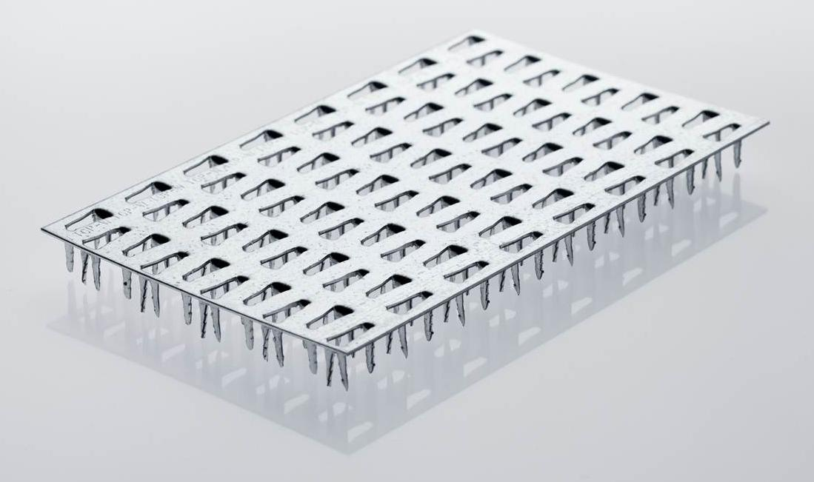
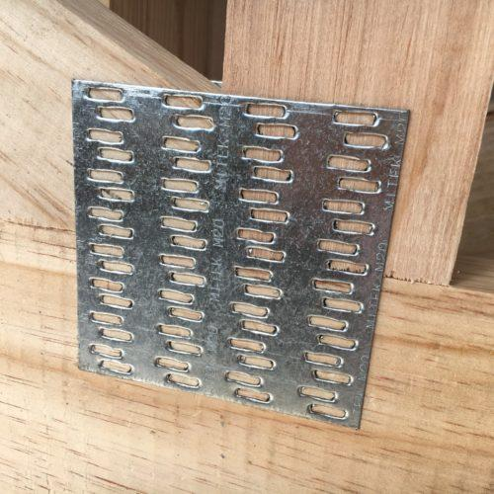
Examples of nail plates
Image: Mitek Oy
Image: Mitek Oy

Slide 8
Characteristics of nail plate structures
Very diverse load-bearing structures can be implemented using nail plate structures
The most typical nail plate structure is the roof support (NR truss)
The large capacity of the nail plate joint allows the wooden parts to be thin
A nail plate truss’s span length can be up to 32 m, but recommended spans are shorter
Designing and implementing the stability support is the most challenging part of the nail plate truss structure, as the truss rods are very thin (buckling)

Slide 9
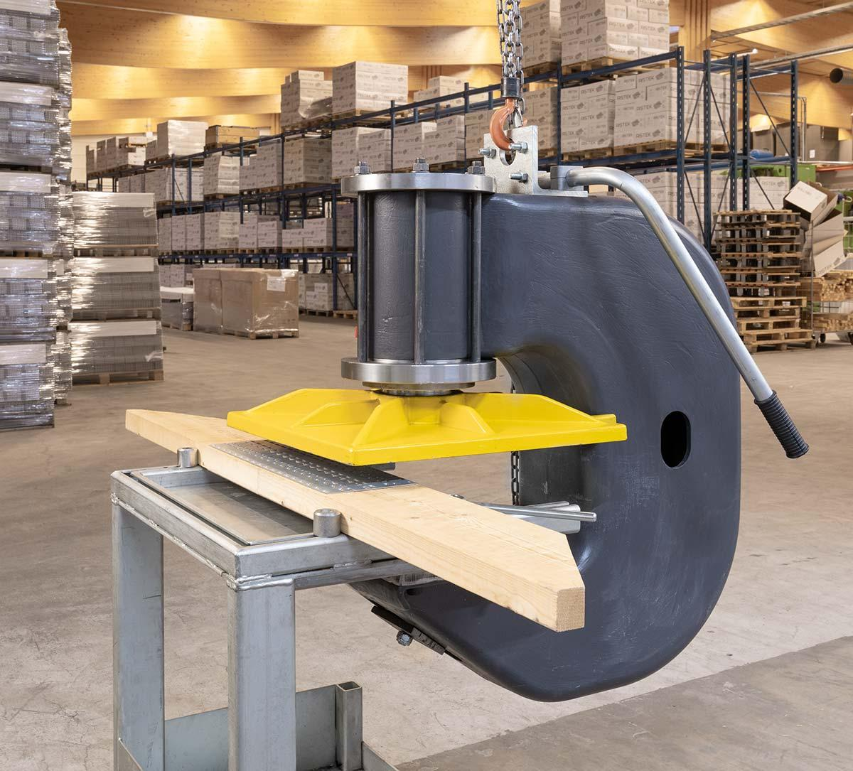
Manufacture of a nail plate truss
The design and manufacture of a nail plate truss is highly industrialised
The parts of the truss are cut using a computer-controlled circular saw
The nail plates can be installed
manually using a C-frame press
on an automatic production line (press + mangling)
Image: Ristek Oy

Slide 10
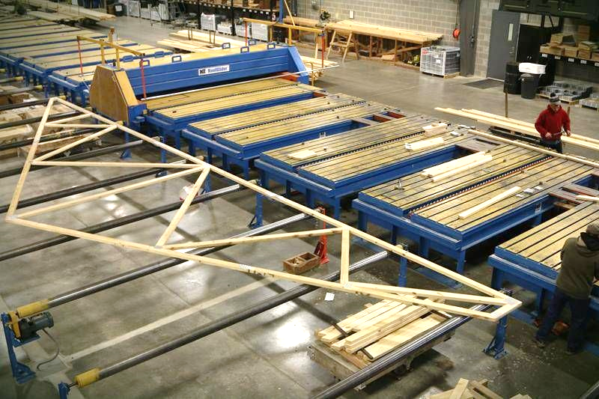
Manufacture of a nail plate truss on a production line
Image: www.yorkpbtruss.com

Slide 11
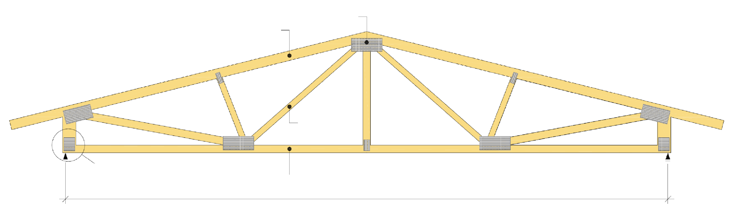
The parts of a nail plate truss
Nail plate
Top chord
Web rod
Support from bottom chord
Bottom chord
Span

Slide 12
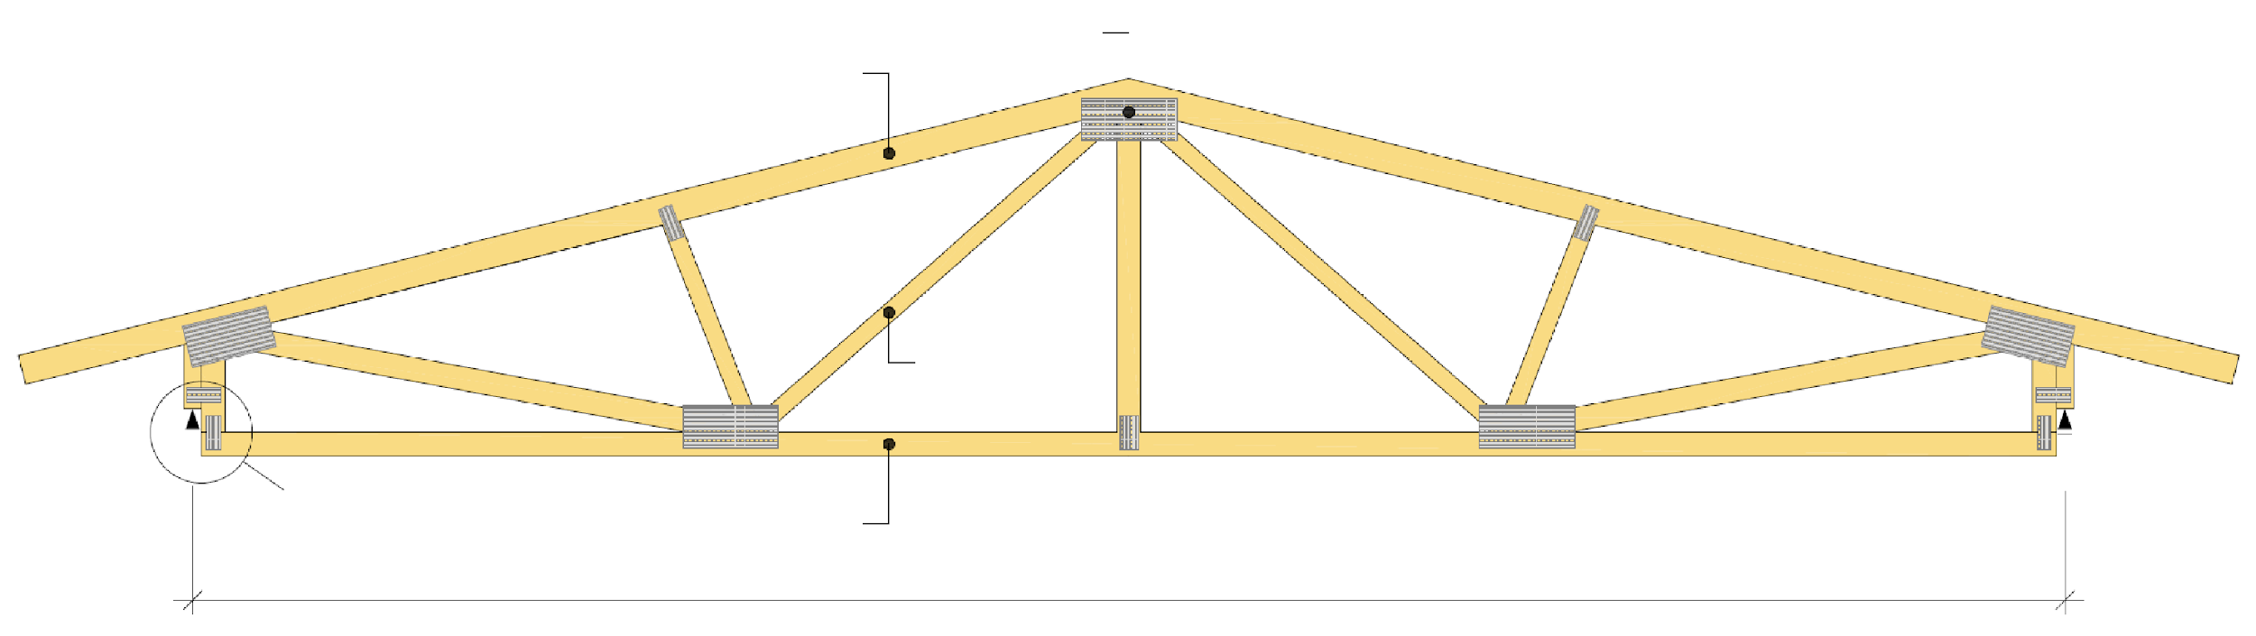
The parts of a nail plate truss
Nail plate
Top chord
Web rod
“Armpit support”
Bottom chord
Span

Slide 13
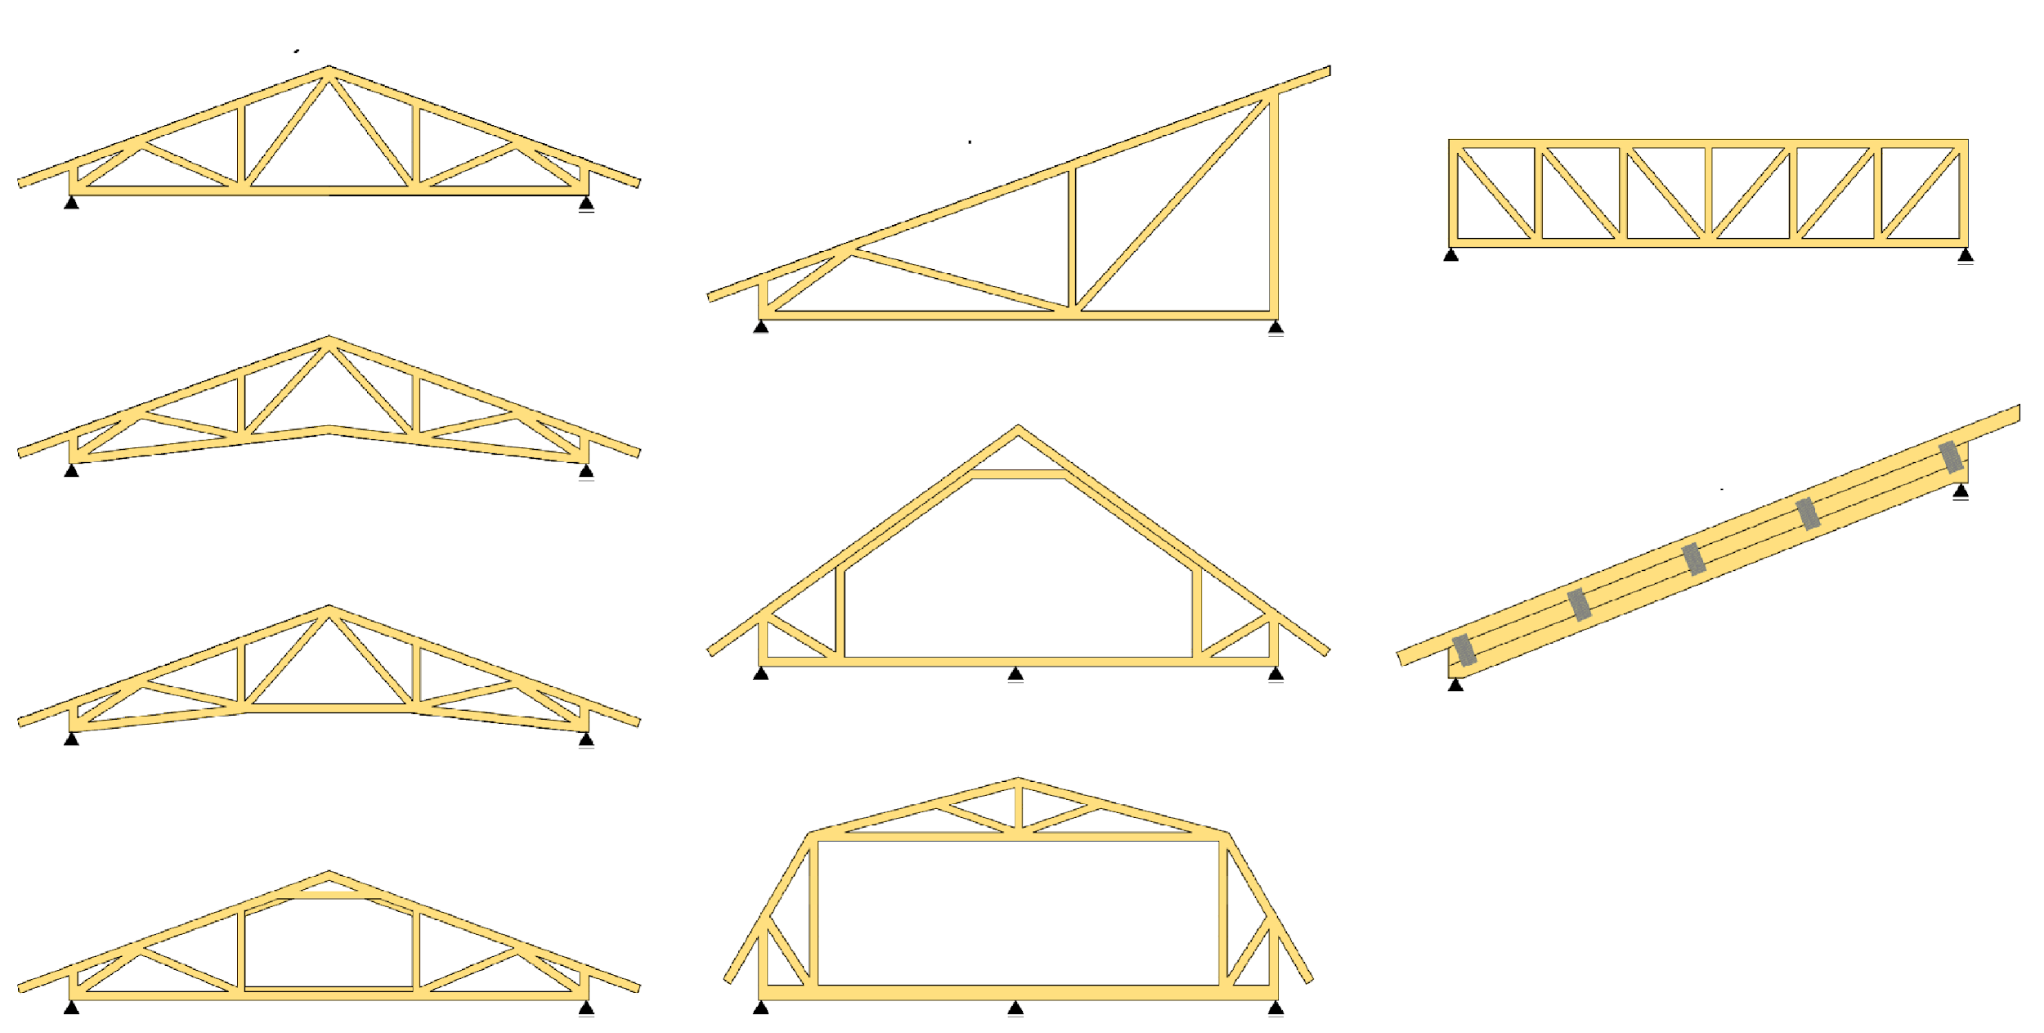
Typical nail plate truss structures
Ridge truss
Single-pitch truss
Beam truss
Scissors truss
Frame truss
Built-up beam
T-scissors truss
Mansard truss
Attic frame truss with straight bars

Slide 14
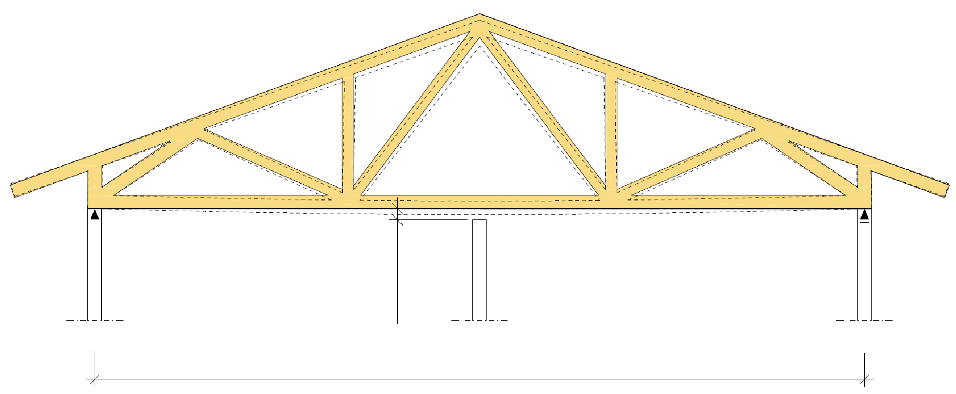
Truss supports
Trusses must always be supported only at the points for which the truss is designed
Additional support points change the mechanical functioning of the truss
Rod forces change
Joining forces change
Non-load-bearing walls must not bear the truss
Settlement clearance
NR truss support
Non-load-bearing wall, etc.
NR truss support
Span

Slide 15
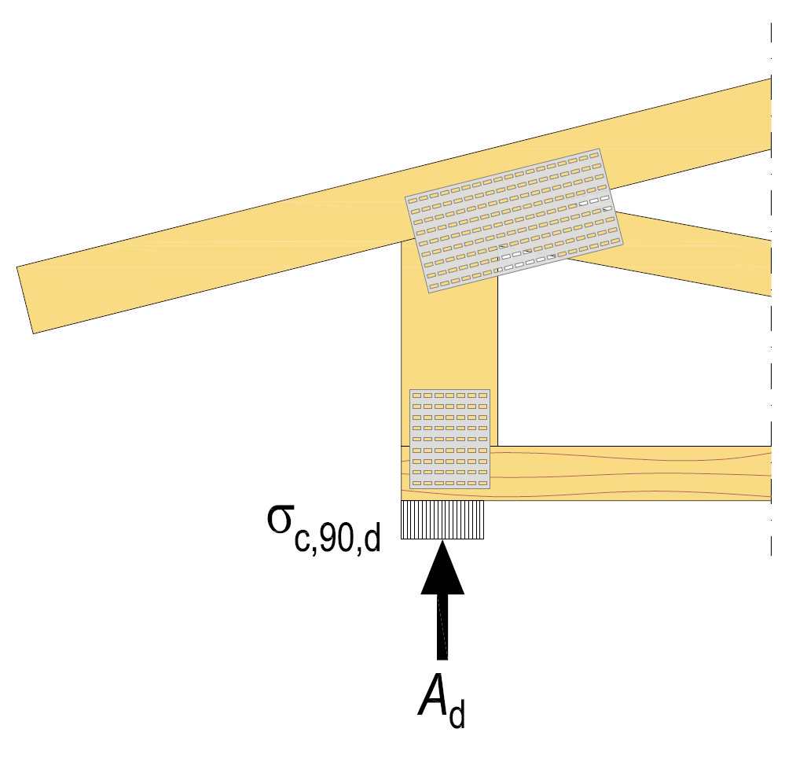
Bearing pressure resistance
Bearing pressure resistance is a significant dimensioning factor
A high compression stress, perpendicular to the grain, is generated in the NR truss support
In the bottom chord when the grid is supported by the bottom chord
In the building element bearing the truss (the wall’s top plate wood, beam, etc.)

Slide 16
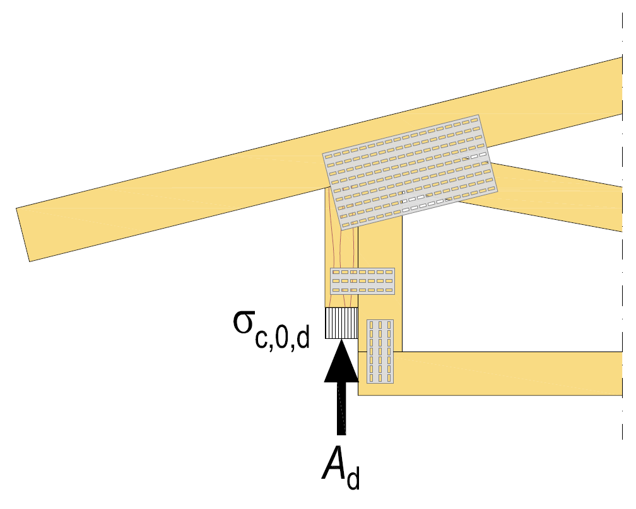
NR truss “armpit support”
At the factory, the NR truss is designed to include a groove where the trusses are supported
The bearing pressure in the NR truss is aligned with the grain
Bearing pressure resistance can be improved by using a cross-veneered LVL stiffening beam
The stiffening beam can be utilised in spanning window and door openings

Slide 17
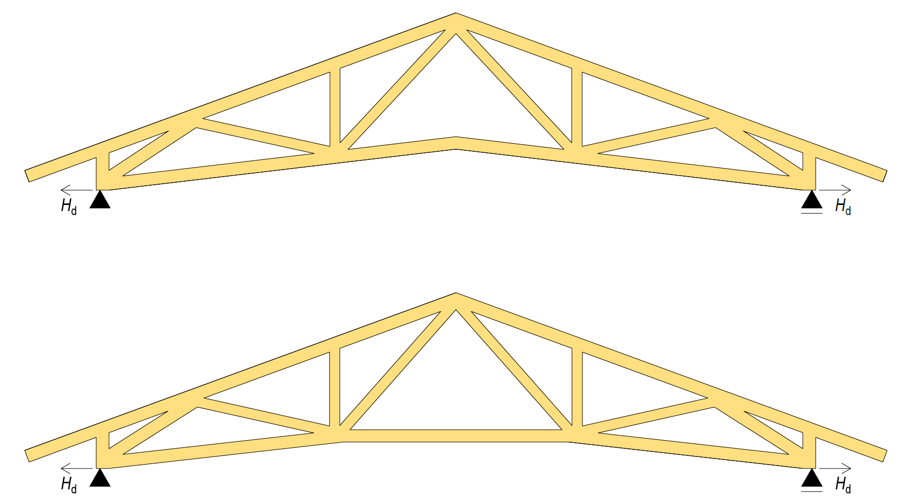
Horizontal force of the support in a scissors truss
In a scissors truss, a horizontal force of H_{d} is generated in the support
The horizontal force is caused by the deformation of the bottom chord (stretch)
The horizontal force must be taken into account when planning support structures

Slide 18
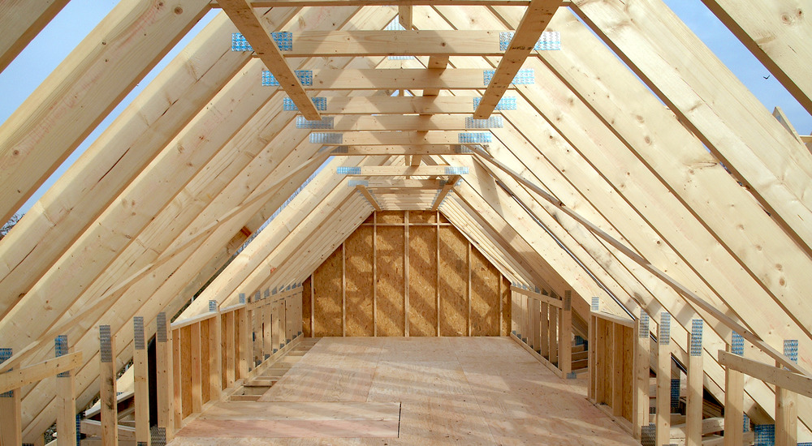
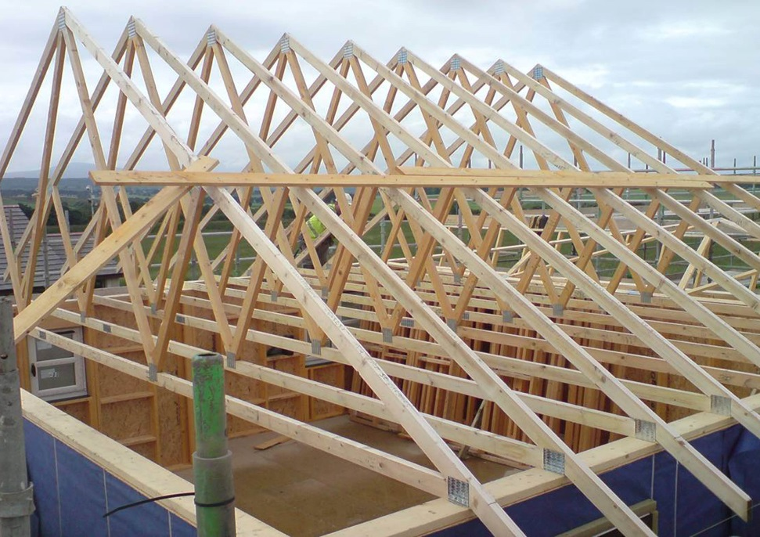
Examples of NR truss structures
Image: www.kingspan.com
Image: www.acj-group.co.uk

Slide 19
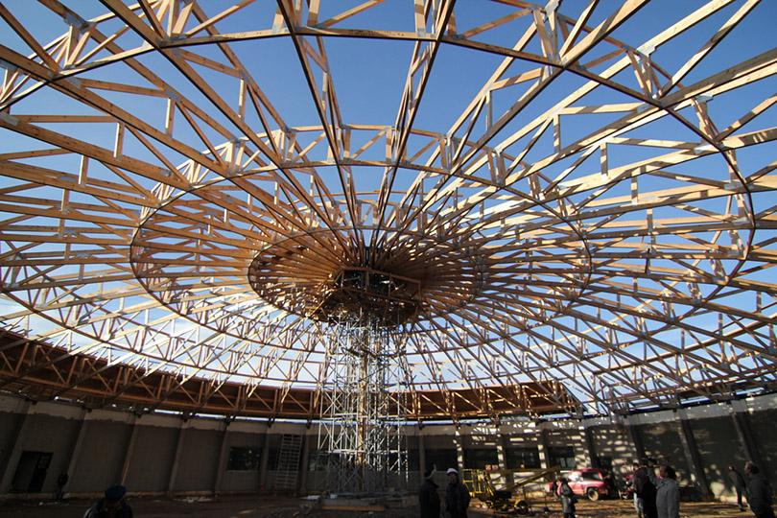
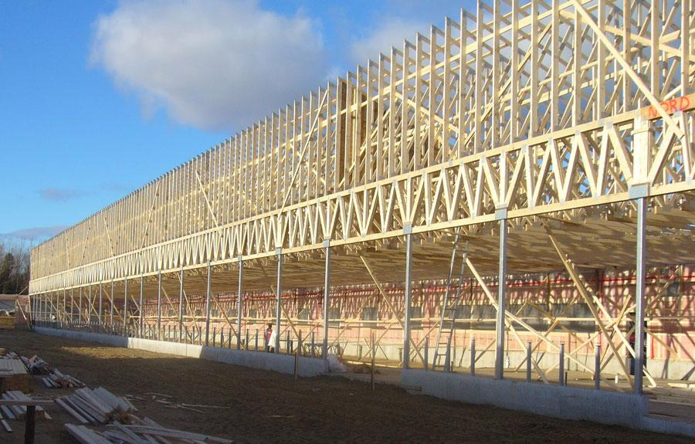
Examples of NR truss structures
Image: MiTek
Image: www.quebecwoodexport.com

Slide 20
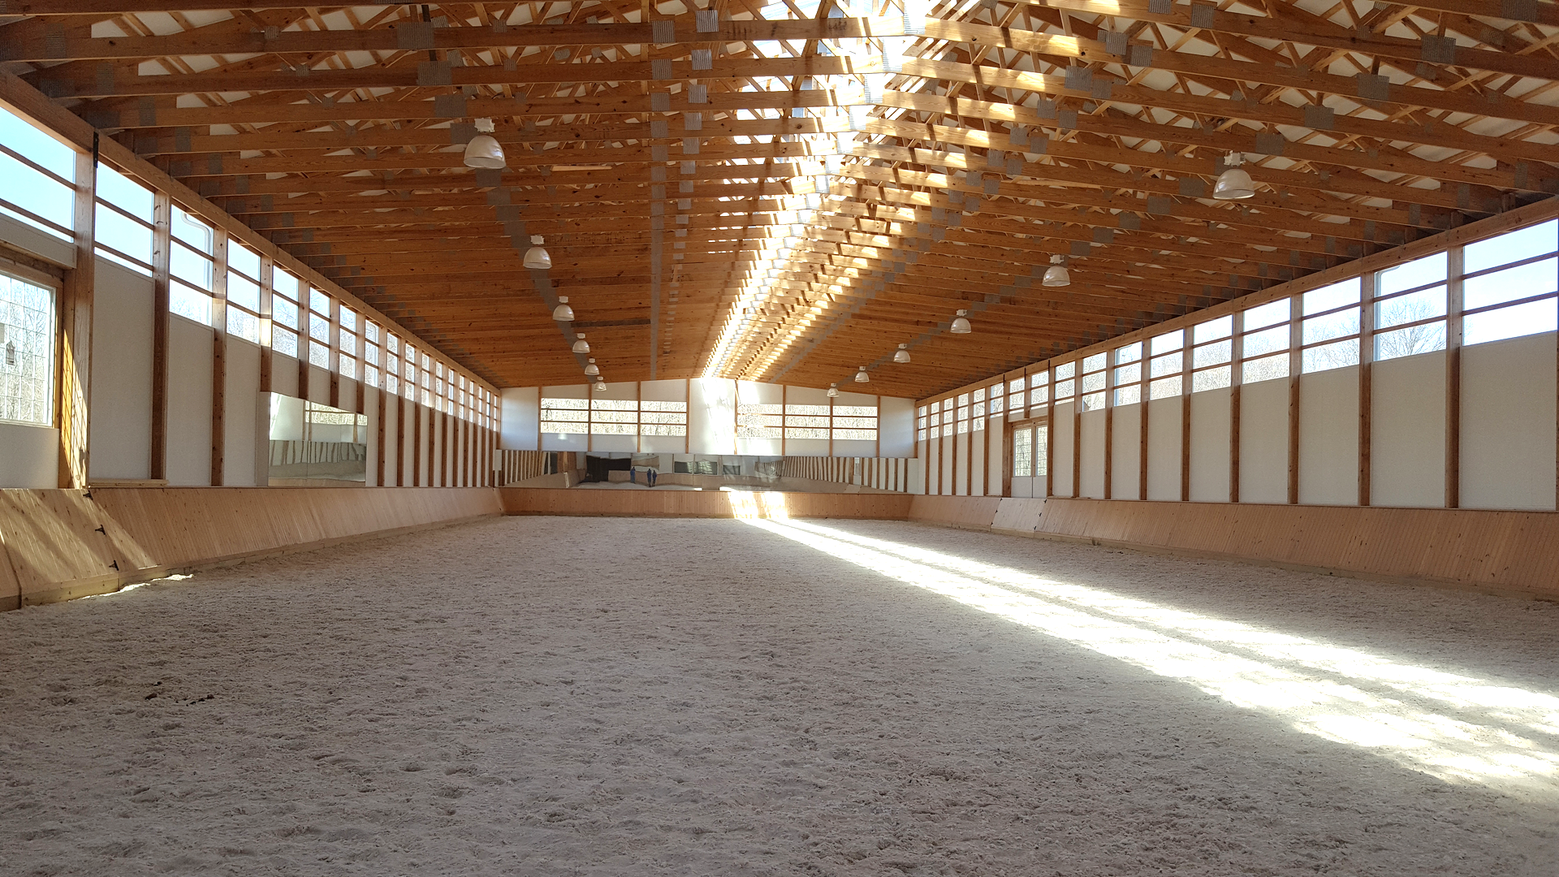
Example of an NR truss structure
Image: www.corestructuresinc.com

Slide 21
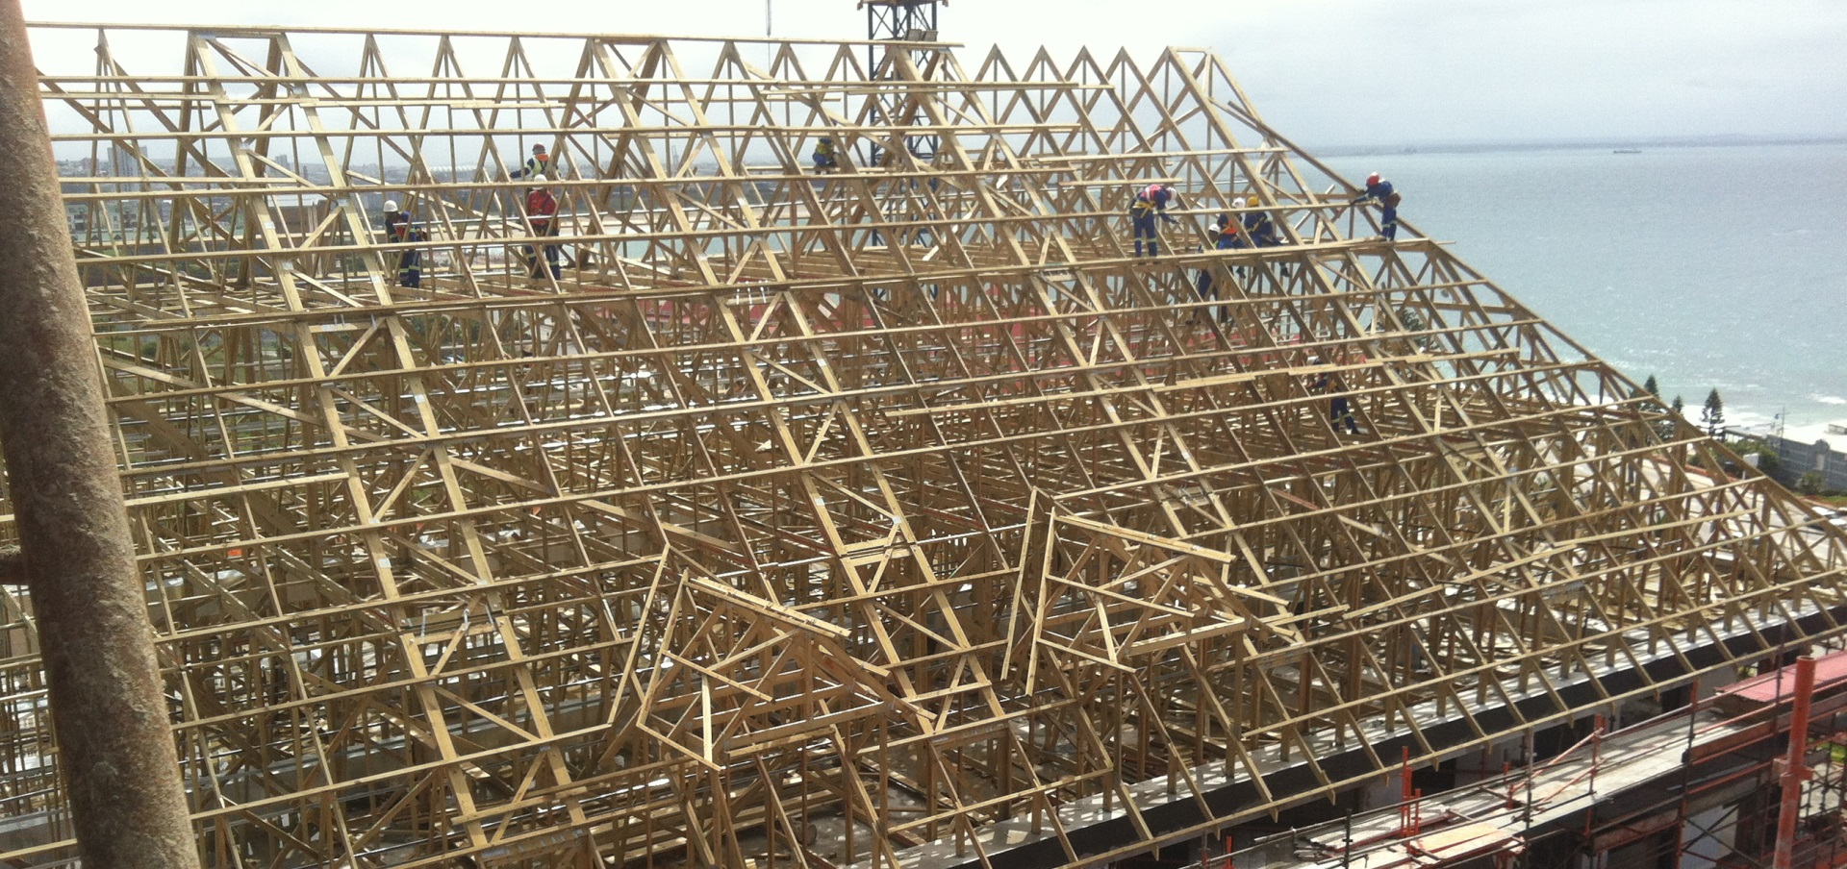
Example of an NR truss structure
Image: MiTek

Slide 22

Accidents
The collapses of NR truss structures are almost always due to the following:
Incomplete or incorrect buckling support on the upper chord
Incomplete or incorrect buckling support on a thin, compressed web rod
Inadequate or incorrect support from the perspective of trusses falling over
Image: www.ienga.net

Slide 23
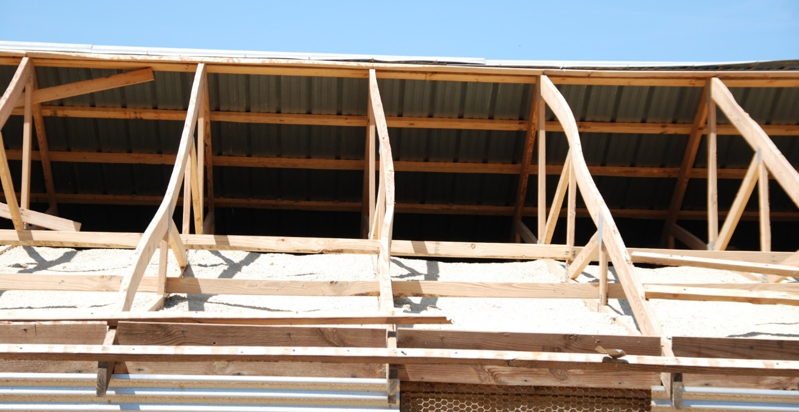
Inadequate buckling support on the top chord
Image: The University of Georgia

Slide 24
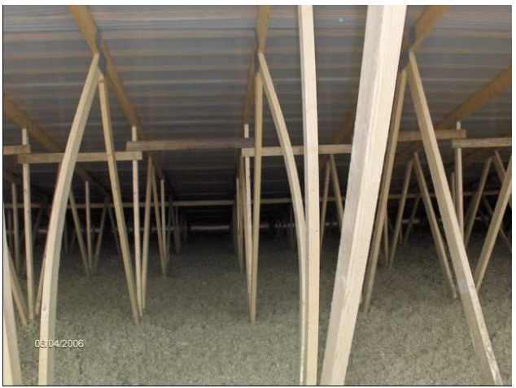
Inadequate buckling support on a web rod
Image: KPM-Engineering

Slide 25
NR truss design process
1. Architectural design
Truss geometry
Installation plans Lifting and handling Support during work Total stiffening Supporting the web rods Tolerances Moisture control
2. Structural design
4. Site
Truss diagrams Stiffening plans
Image: www.quebecwoodexport.com
3. Nail plate structure design
Truss dimensioning Supported web rods

Slide 26
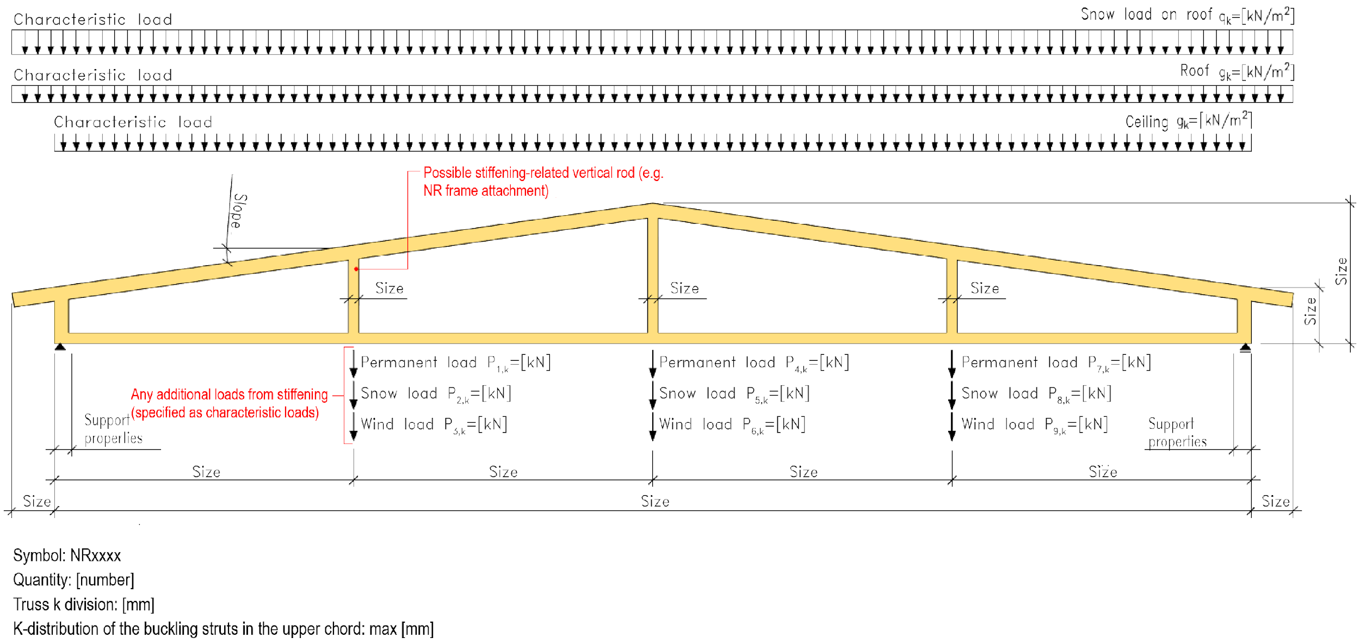
Example of an NR truss order diagram

Slide 27
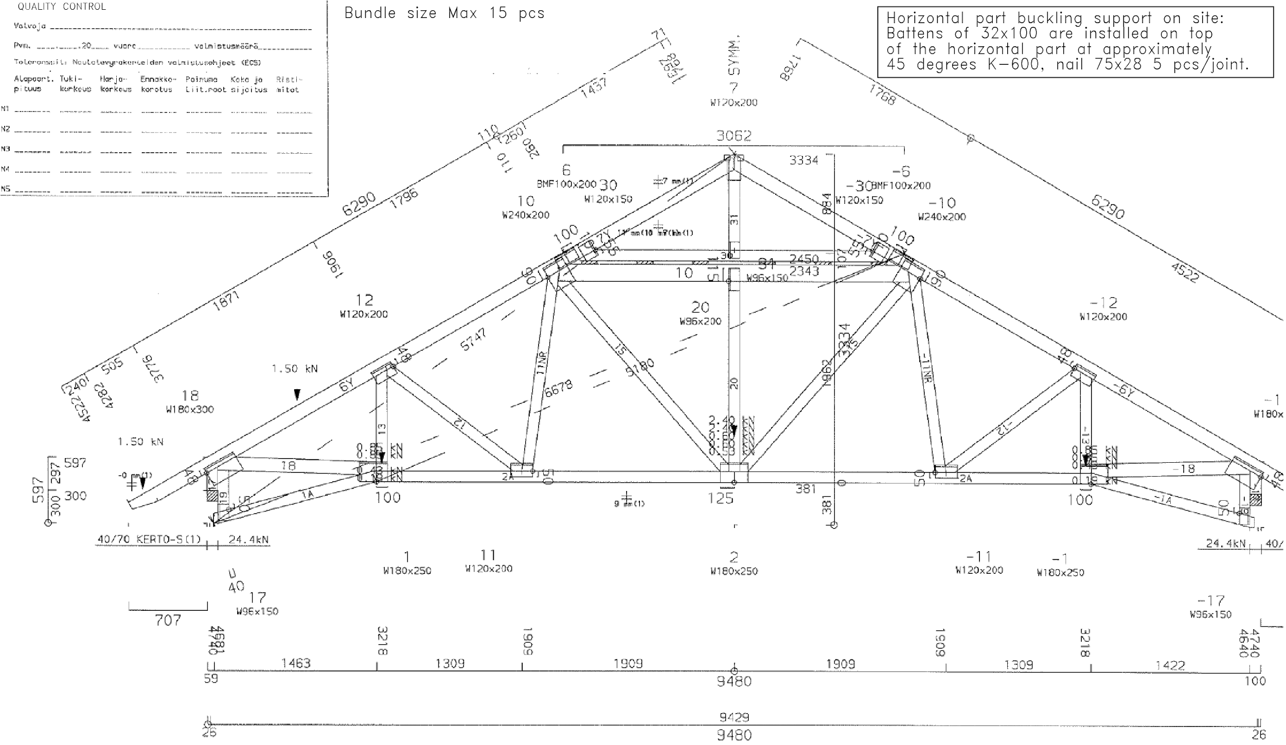
NR truss plan

Slide 28
Need for buckling struts on a top chord
The top chord of the NR truss must be equipped with buckling struts throughout the area of the roof
If there are several NR trusses side by side (bundle truss), all trusses in the bundle must be equipped with buckling struts
Deficiencies in the buckling support of the upper chord usually occur at the following points
Under the cross ridge
Under a roof window etc.
In the horizontal part of a frame truss

Slide 29
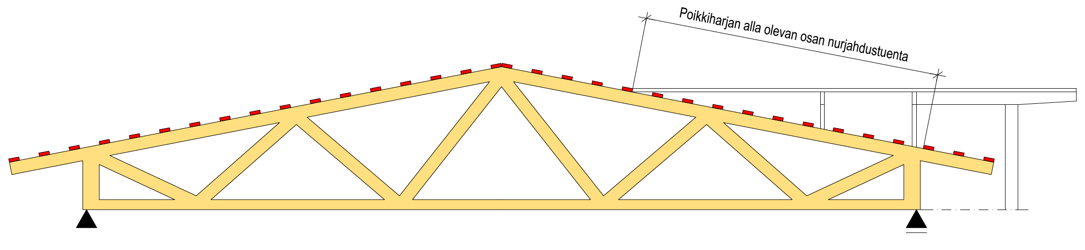
Need for buckling struts on a top chord
Buckling struts under the cross ridge

Slide 30
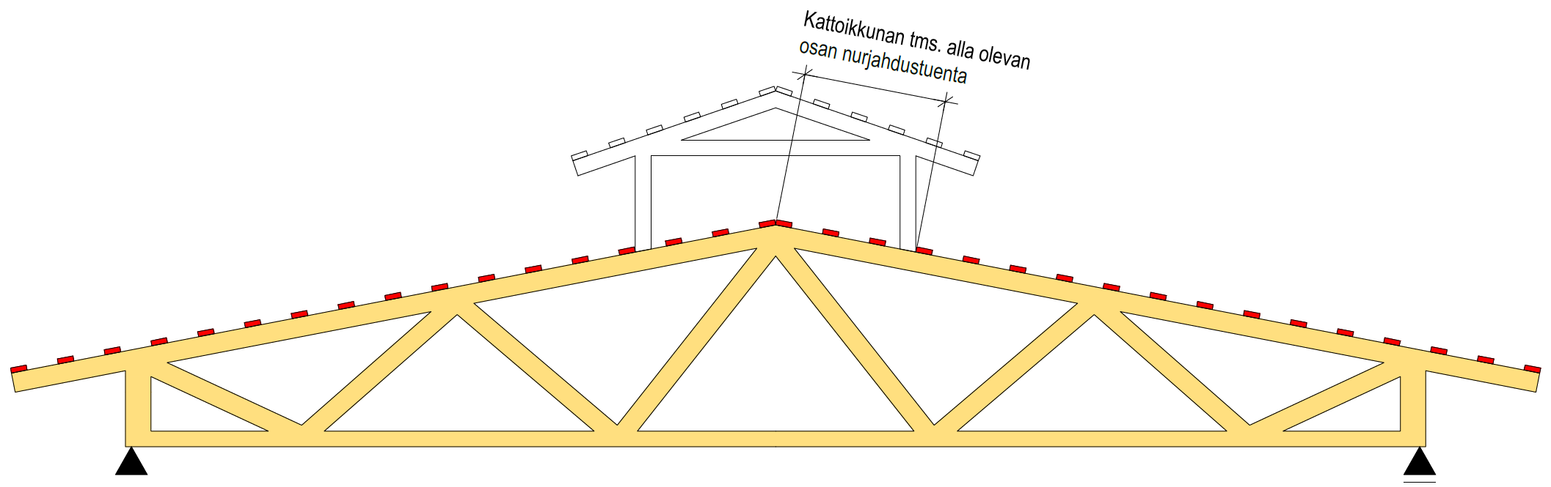
Need for buckling struts on a top chord
Buckling struts under a roof window etc.

Slide 31
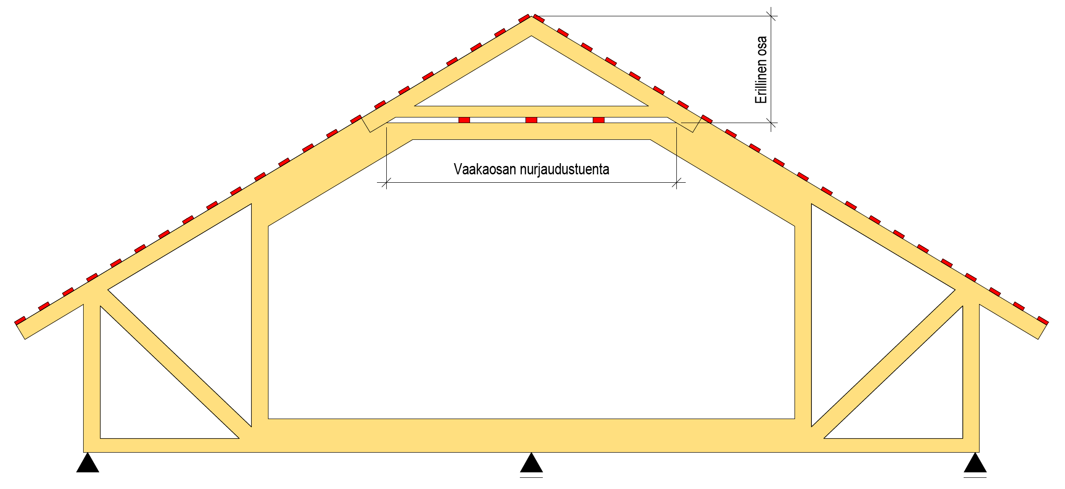
Need for buckling struts on a top chord
Separate part
Buckling struts on a horizontal part

Slide 32
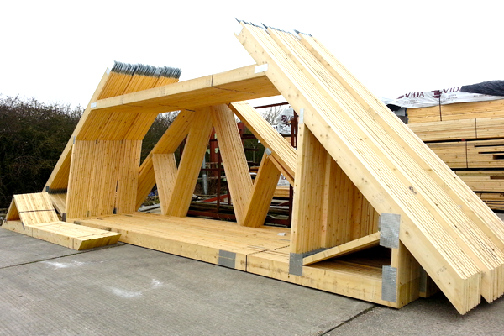
Frame truss with separate ridge part
Image: www.davidsmith.co.uk

Slide 33
Web rod buckling struts
NR trusses may include compressed web rods so thin that they need separate buckling struts installed at the site
The beams to be supported are shown in the NR truss plan
Inadequate or improper support of a thin compressed web rod may be the most common factor causing collapses of NR truss roofs

Slide 34
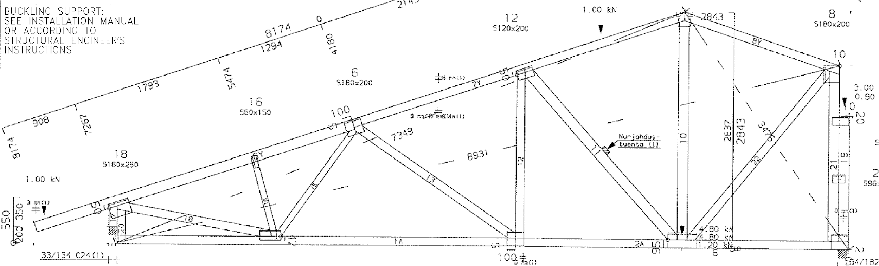
Web rod buckling struts

Slide 35
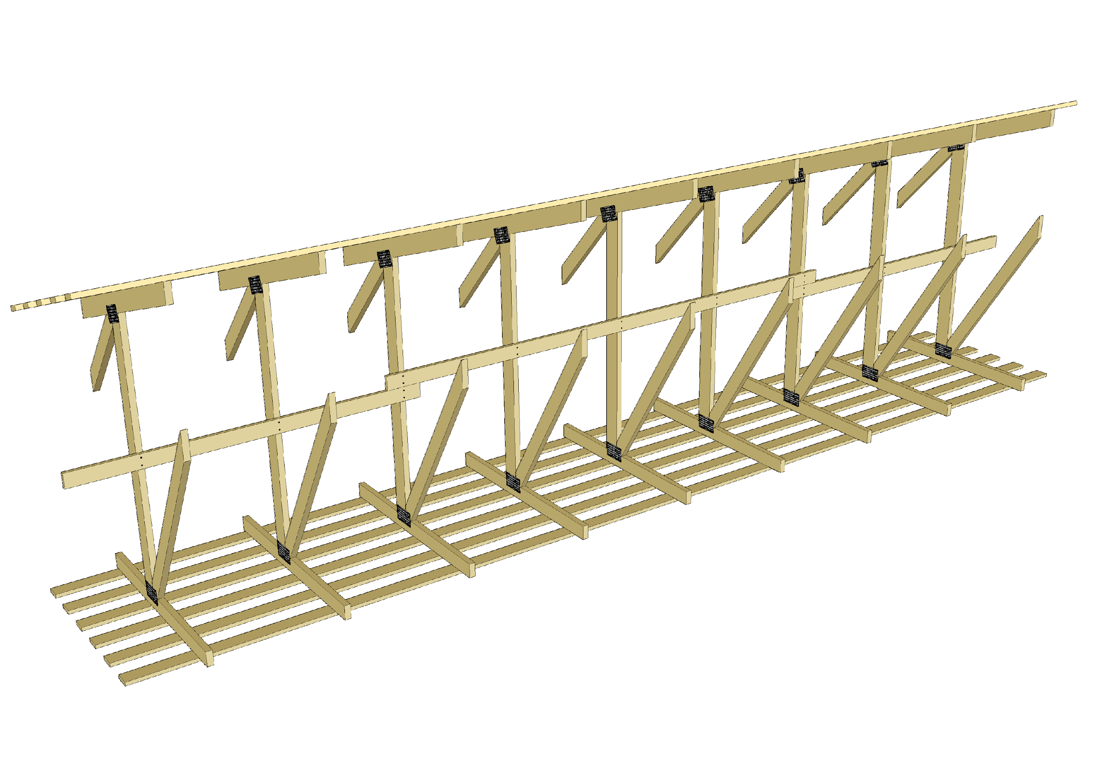
Web rod buckling struts
The buckling struts of thin compressed web rods can be implemented by means of a system where the compressed web rods are connected to each other using horizontal boards
However, a horizontal board by itself doesn’t stiffen anything

Slide 36
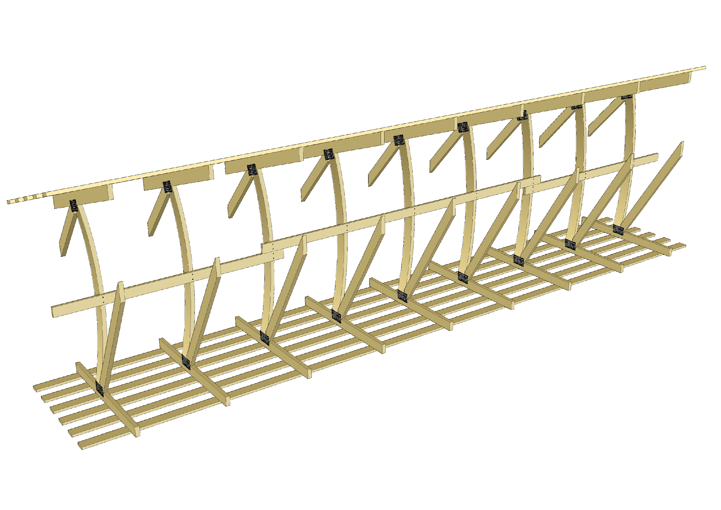
Web rod buckling struts
Horizontal boards alone cannot prevent the buckling of rods if the horizontal force generated in the board is not directed to the stiffener
Diagonal boards can be used as stiffeners, directing the force of buckling to the ends of the rods

Slide 37
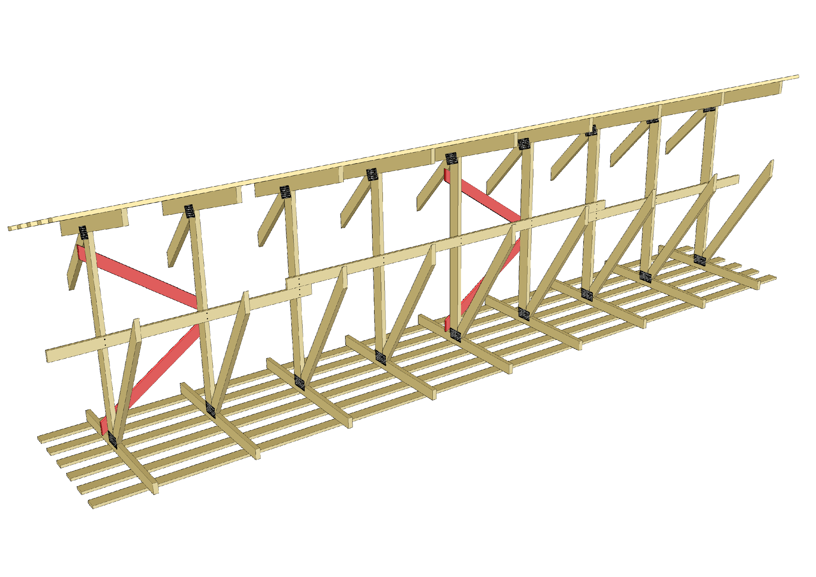
Web rod buckling struts
The red diagonal boards (traction boards) in the illustration direct the horizontal force of buckling to the ends of the compressed rod
The boarding on top of the top chord and under the bottom chord return the horizontal support reaction created at the ends of the diagonal boards back to the rods stiffened using said diagonal boards

Slide 38
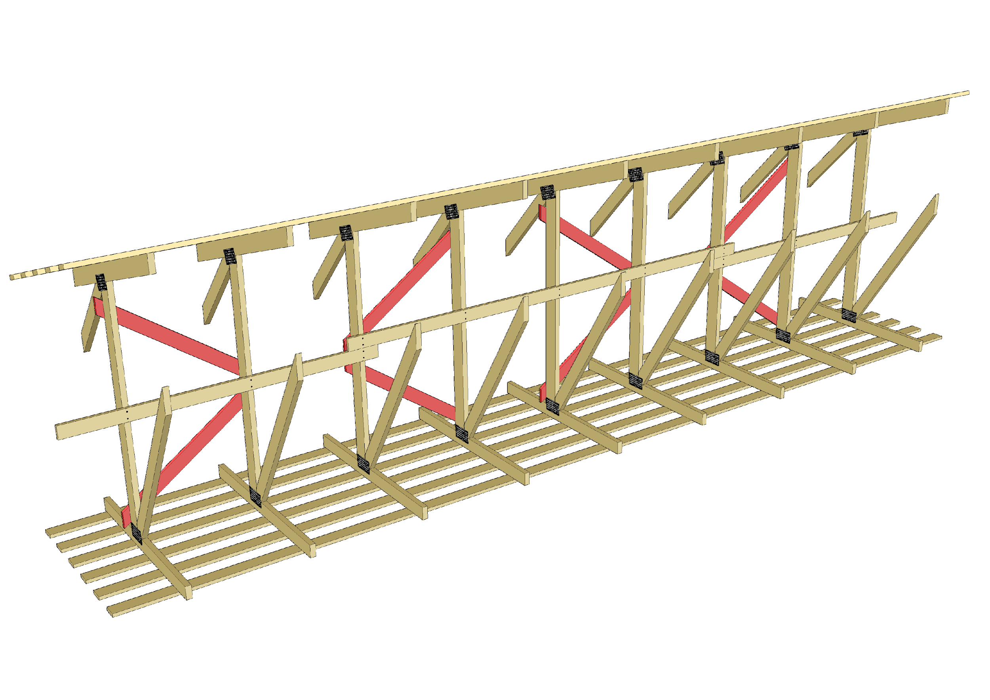
Web rod buckling struts
Diagonal boards are also needed in the other direction if the boards are only sized for traction
The magnitude guideline is that a single diagonal board stiffener is used to stiffen 4 thin compressed web rods
The more rods are stiffened using one diagonal stiffener, the greater the joining forces

Slide 39
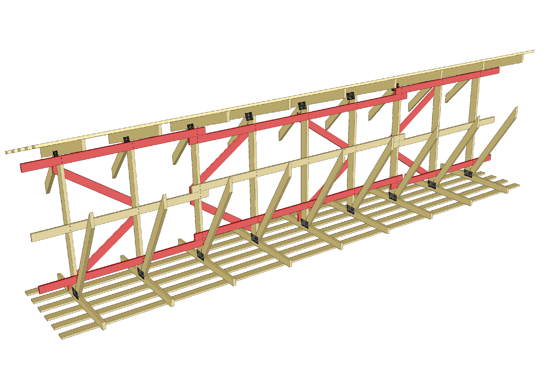
Web rod buckling struts
If the boards on top of the top and bottom chords are unable to return the support reaction created at the ends of the diagonal boards to the other rods, separate horizontal boards at the ends of the compressed rods

Slide 40
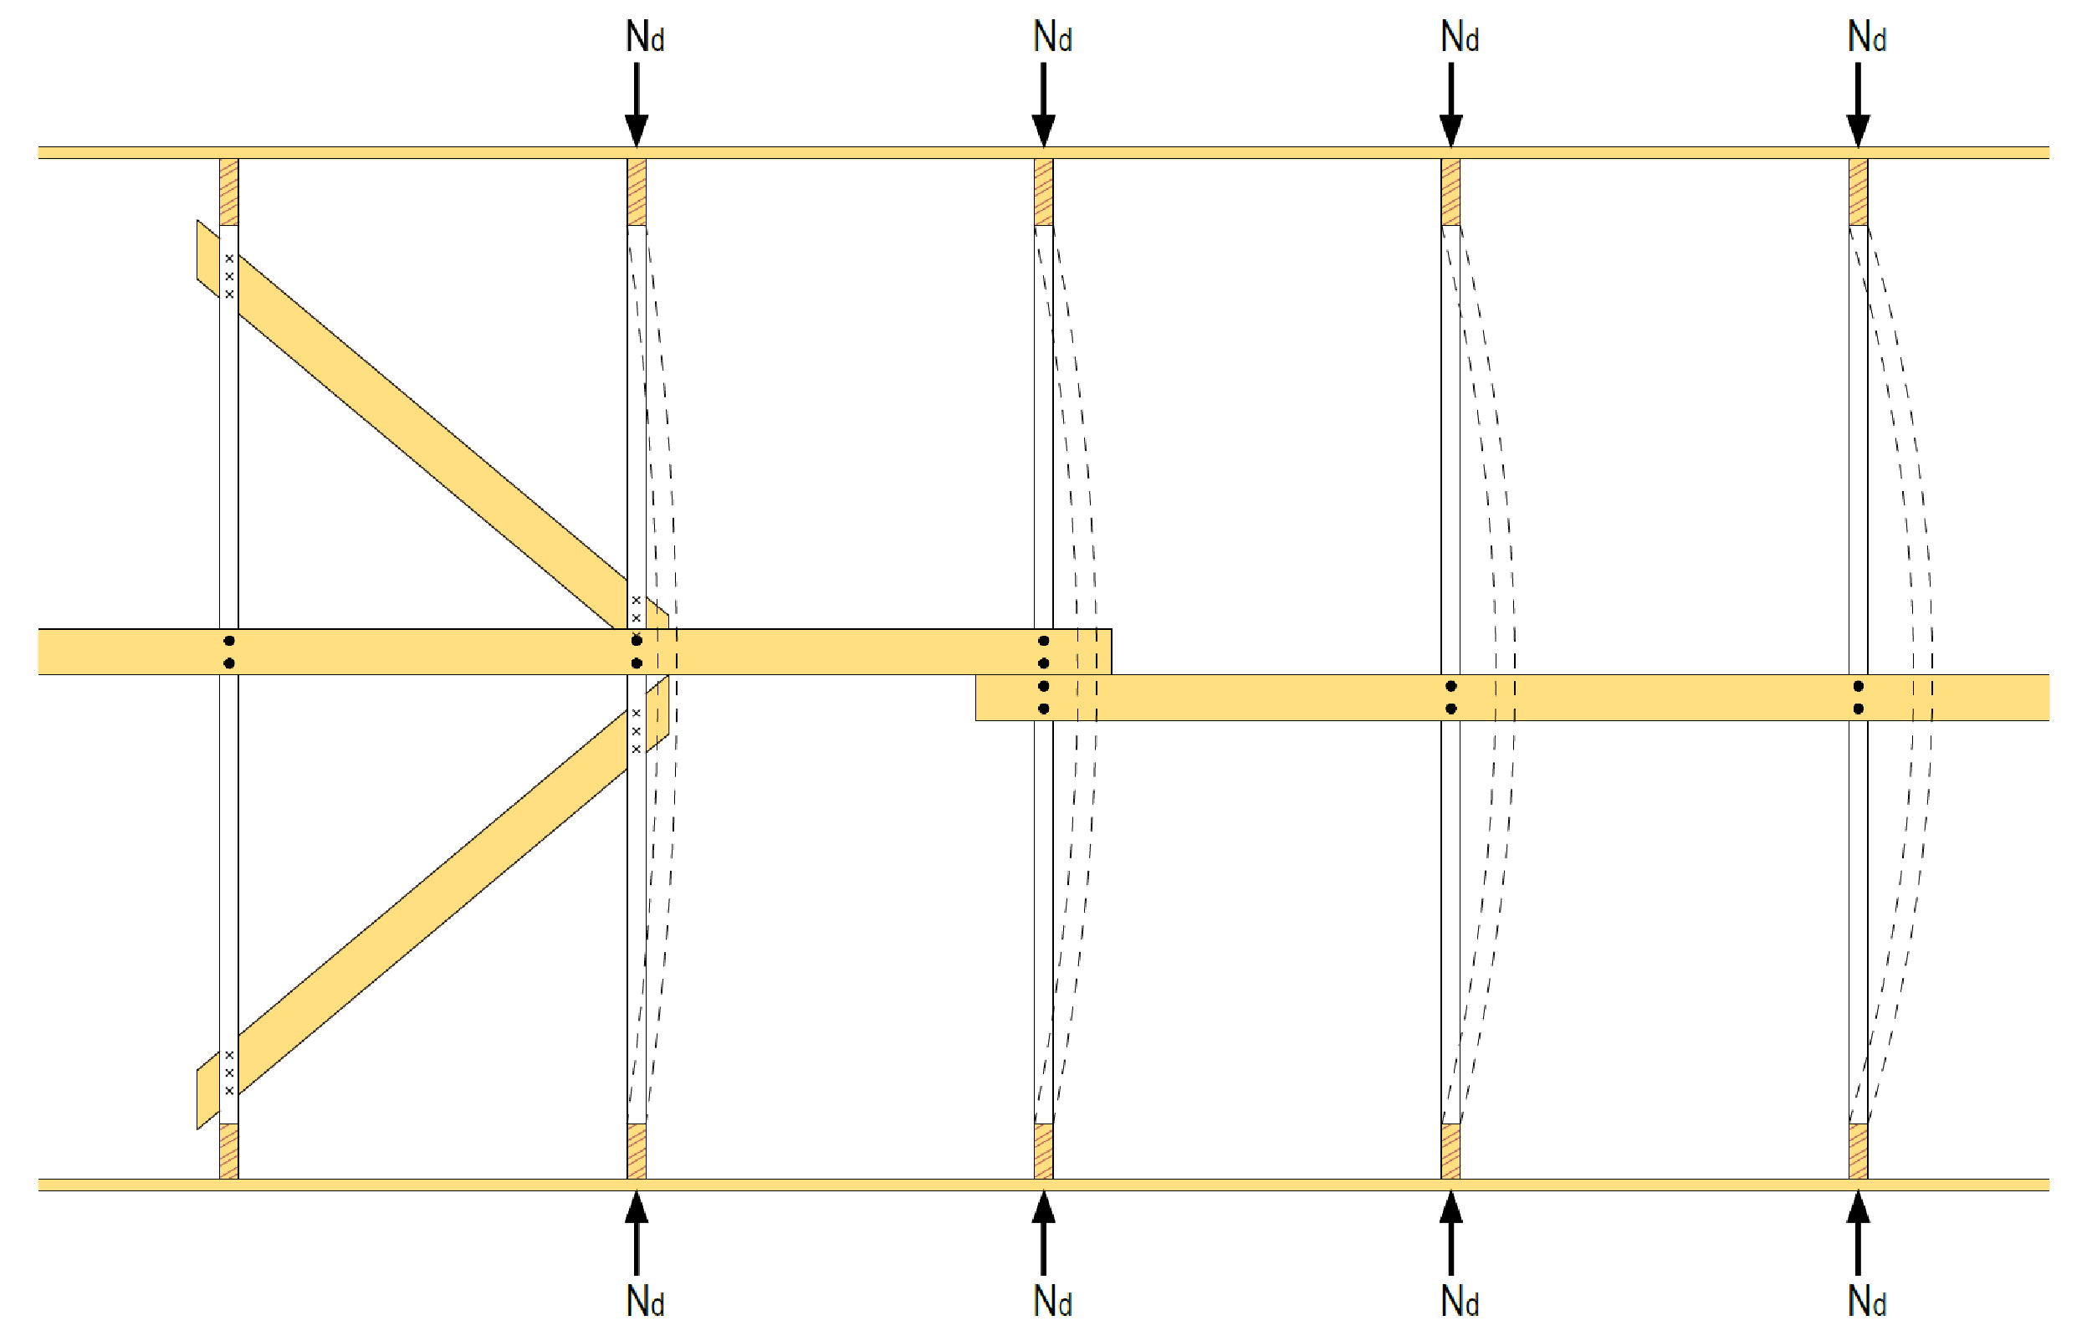
Web rod buckling struts
Traction board
Traction board
Traction board
Traction board

Slide 41
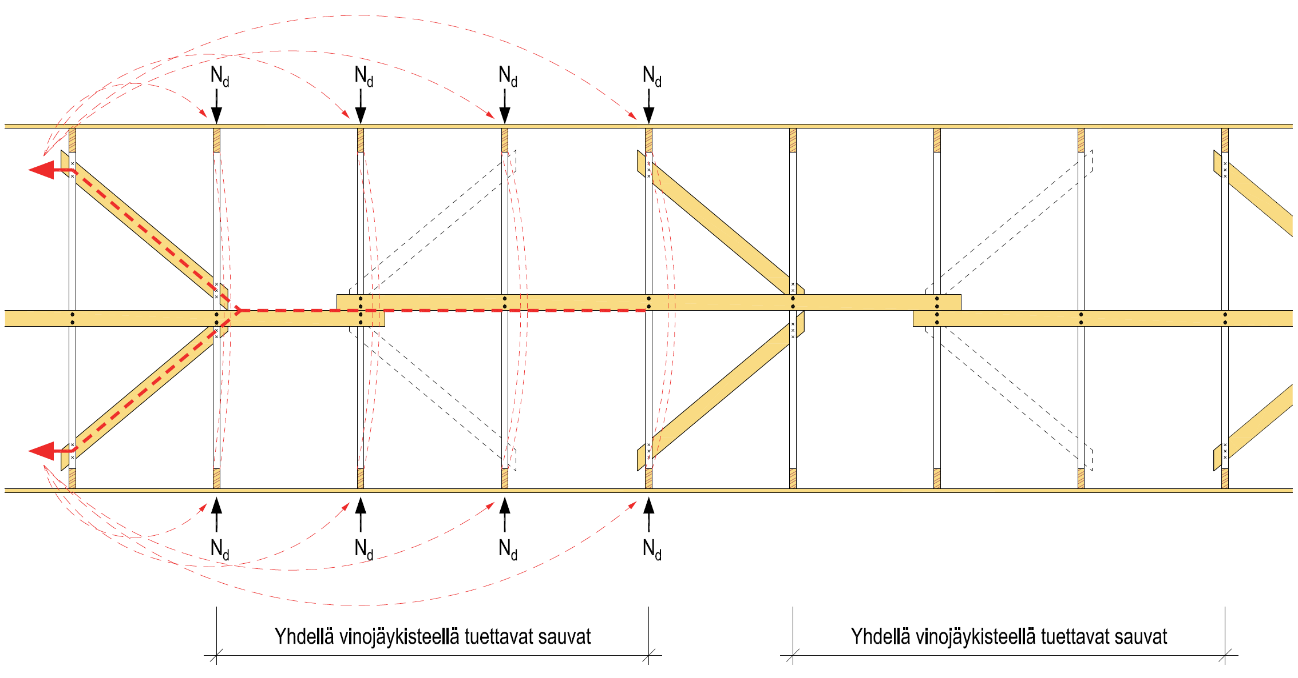
Web rod buckling struts
Rods supported using a single diagonal stiffener
Rods supported using a single diagonal stiffener

Slide 42
Stability support of the NR truss
The NR truss must have horizontal supports at the following points
The vertical supports
The discontinuity points of the top chord (e.g. the ridge)
The functions of the horizontal supports are as follows:
Prevent trusses from falling over
Transfer the forces at discontinuity points to the stiffening system
The top chord of the NR truss may buckle into
the 1st shape (one direction)
the 2nd shape (S buckle)

Slide 43
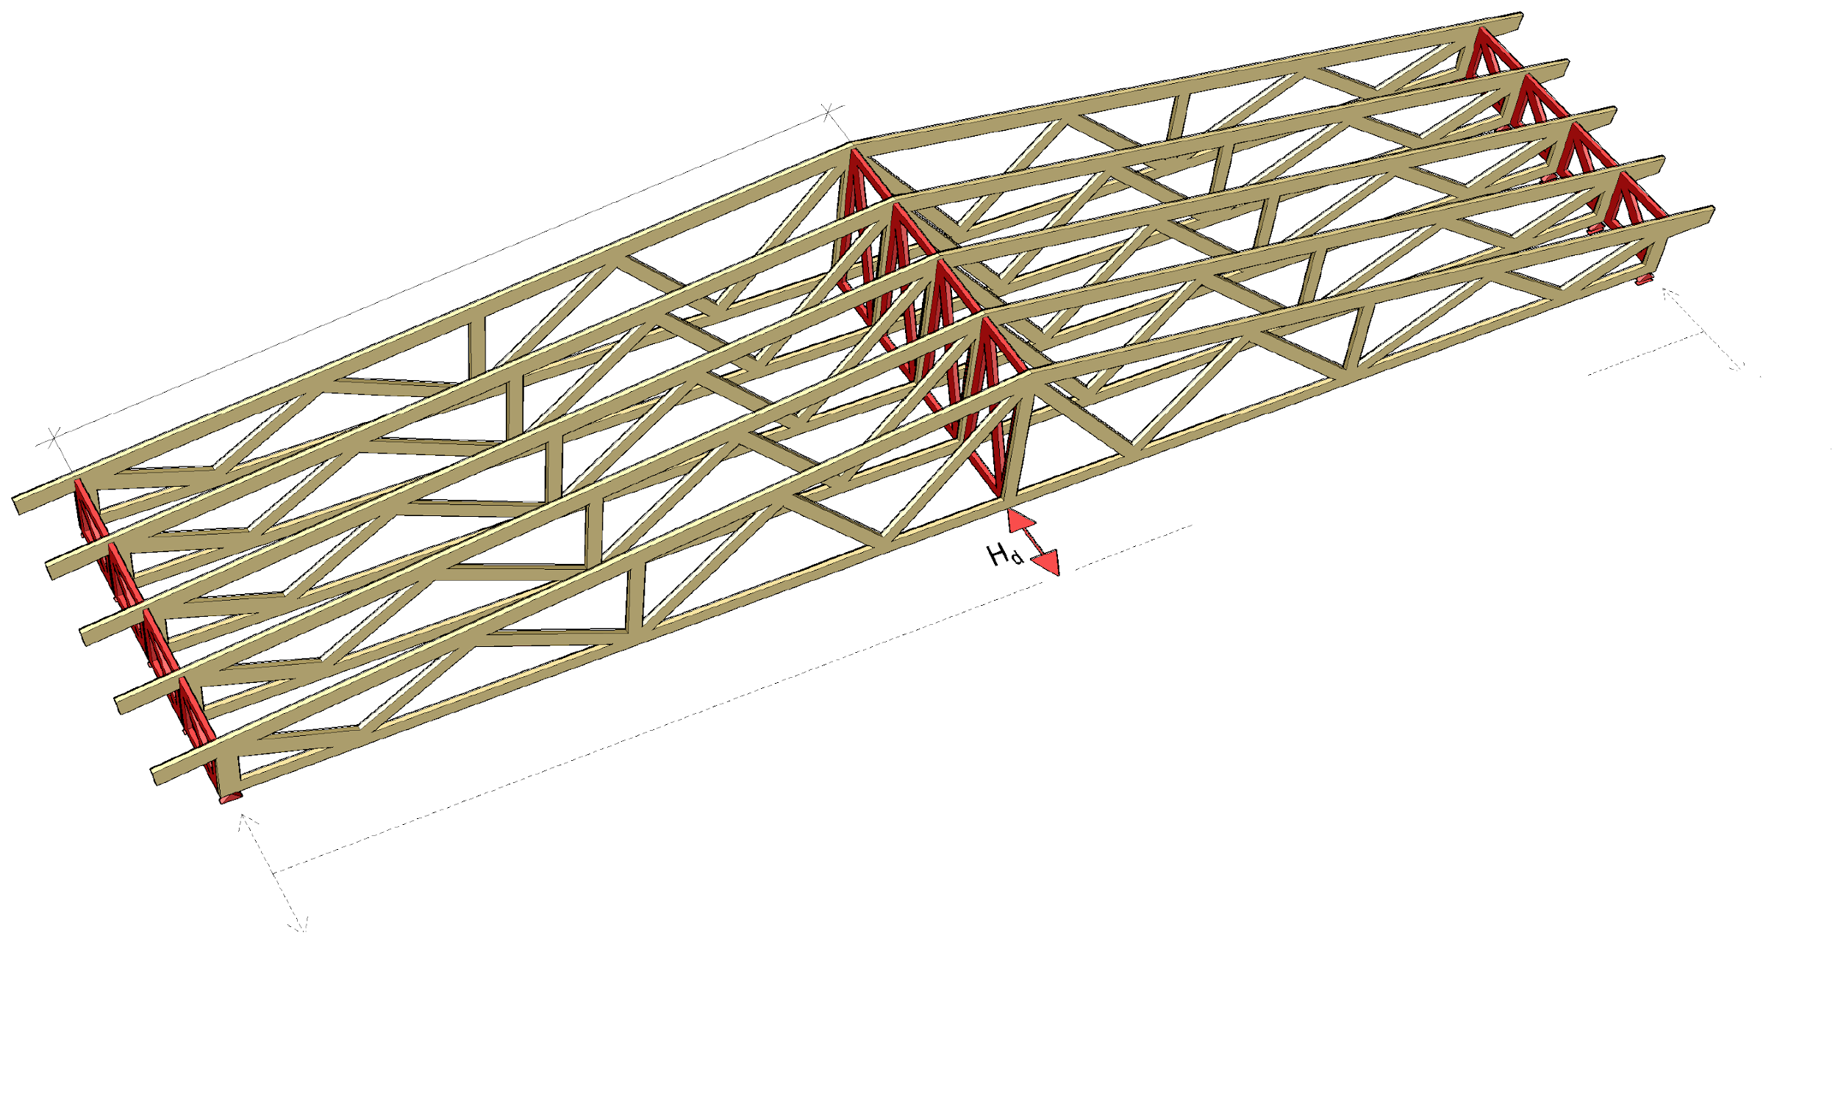
Example of horizontal supports of a truss
Stiffening system span l
The horizontal support reactions must be transferred to the truss supports using, for example, a stiffener plate at the bottom chord plane, diagonal boarding, etc.
Horizontal support at the truss support
Horizontal support at the point of discontinuity of the top chord
Horizontal support at the truss support

Slide 44
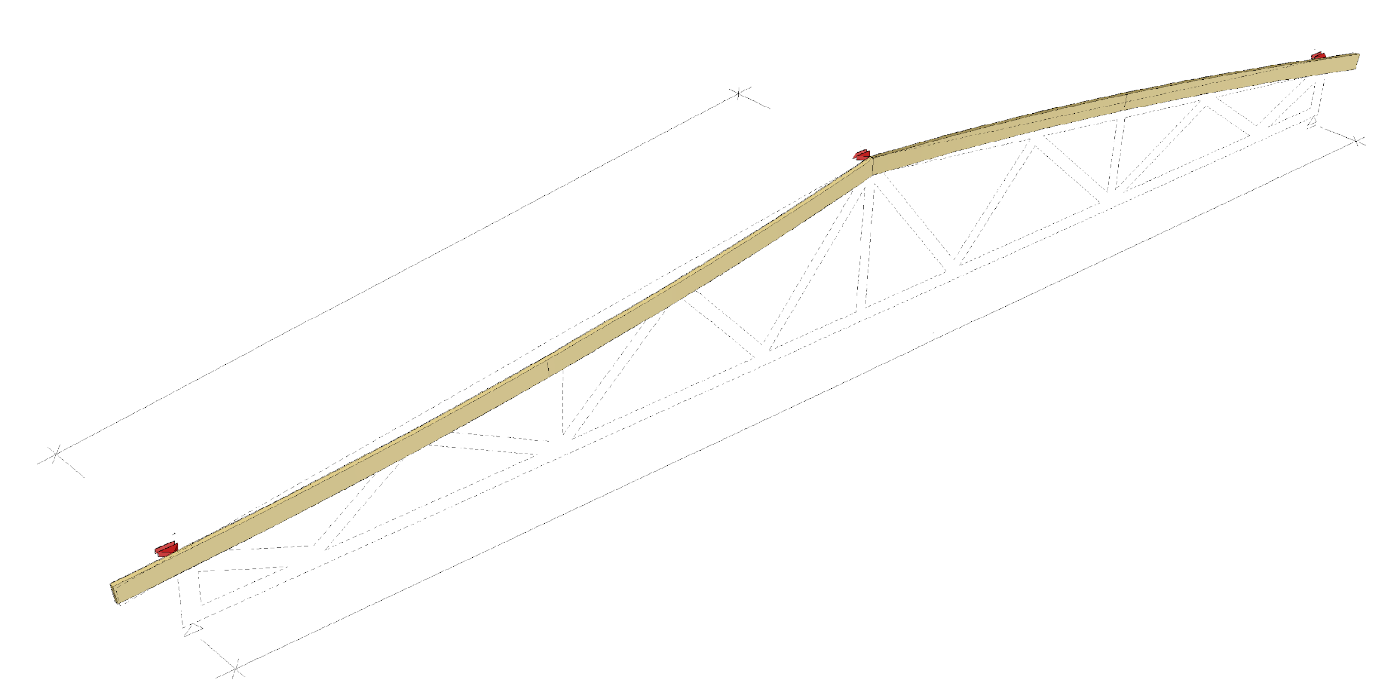
Shape 1 of the buckle of a top chord
Horizontal support of a truss
Horizontal support of a truss
Stiffening system span l
Span
Horizontal support of a truss

Slide 45
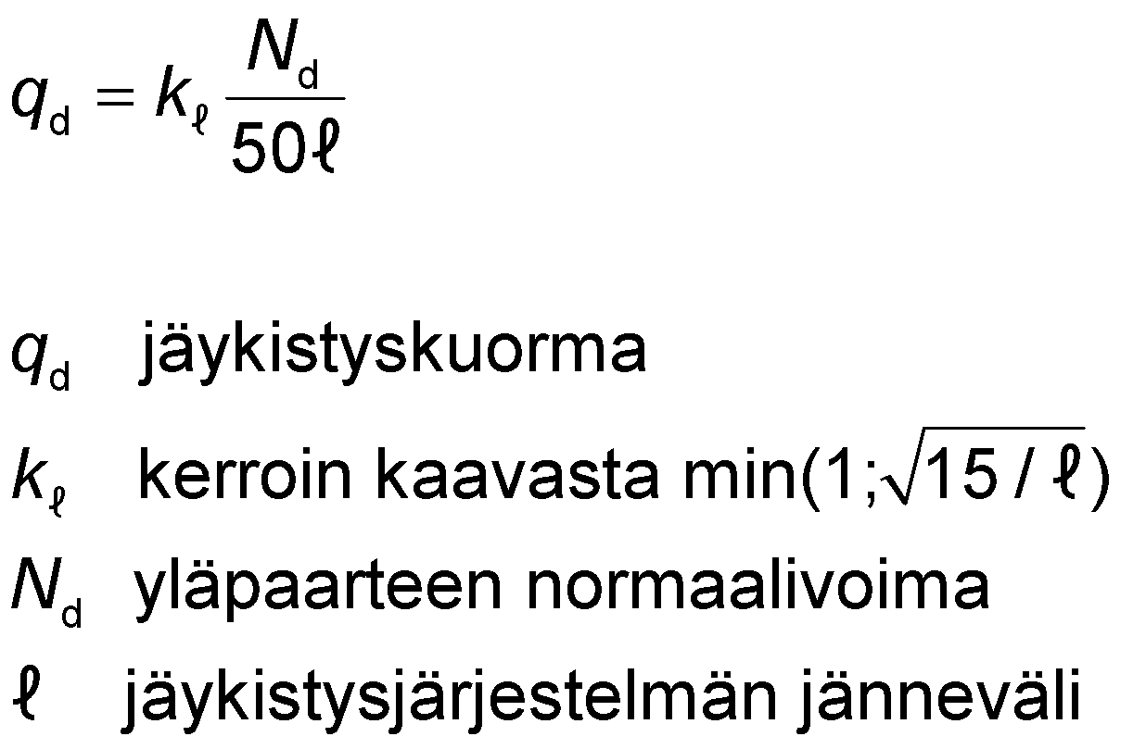
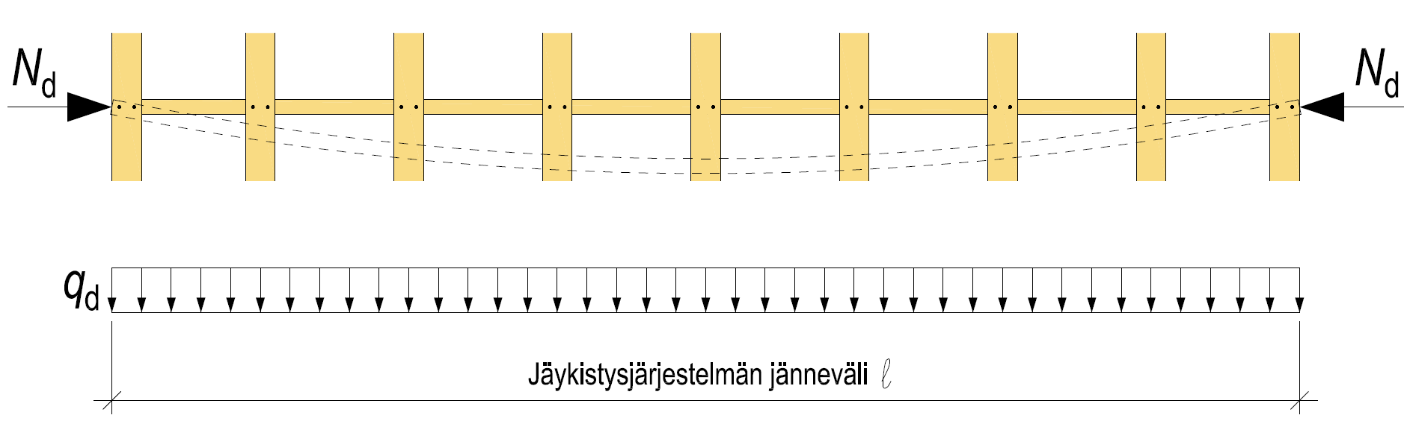
Shape 1 of the buckle of a top chord
The first shape of buckling occurs between the horizontal supports of the truss (span of the stiffening system l)
The buckling generates a force of q_{d} (stiffening load) that is transferred to the buckling strut system
stiffening load
factor calculated from min
normal force of the top chord
span of the stiffening system
Stiffening system span l

Slide 46
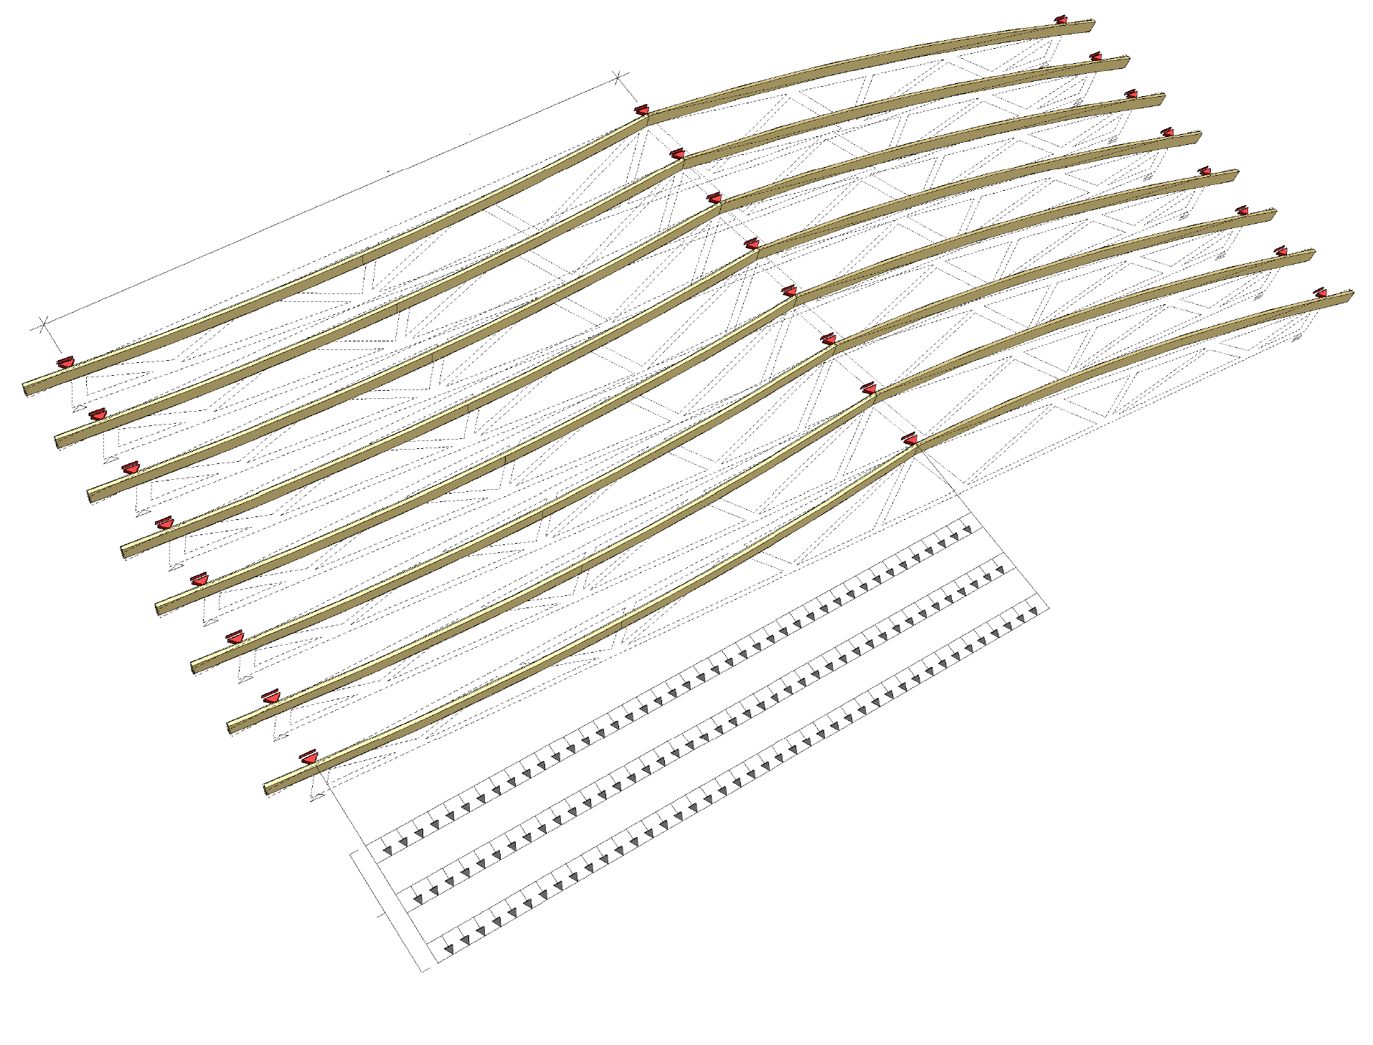
Loads of the buckling strut system (1st shape)
The load accumulated on the buckling strut system consists of:
roof level wind load q_{w,d}
NR truss additional horizontal force Σq_{H,d,i}
top chord stiffening load Σq_{d,i}
Wind load and additional horizontal force (external loads) must always be transferred to foundations
The stiffening load does not need to be transferred to the foundations if the stiffening system is closed (internal load)
Stiffening system span length l
Wind load q_{w,d}
Additional horizontal force Σq_{H,d,i}
Stiffening load Σq_{d,i}
The loads accumulated on the buckling support system

Slide 47
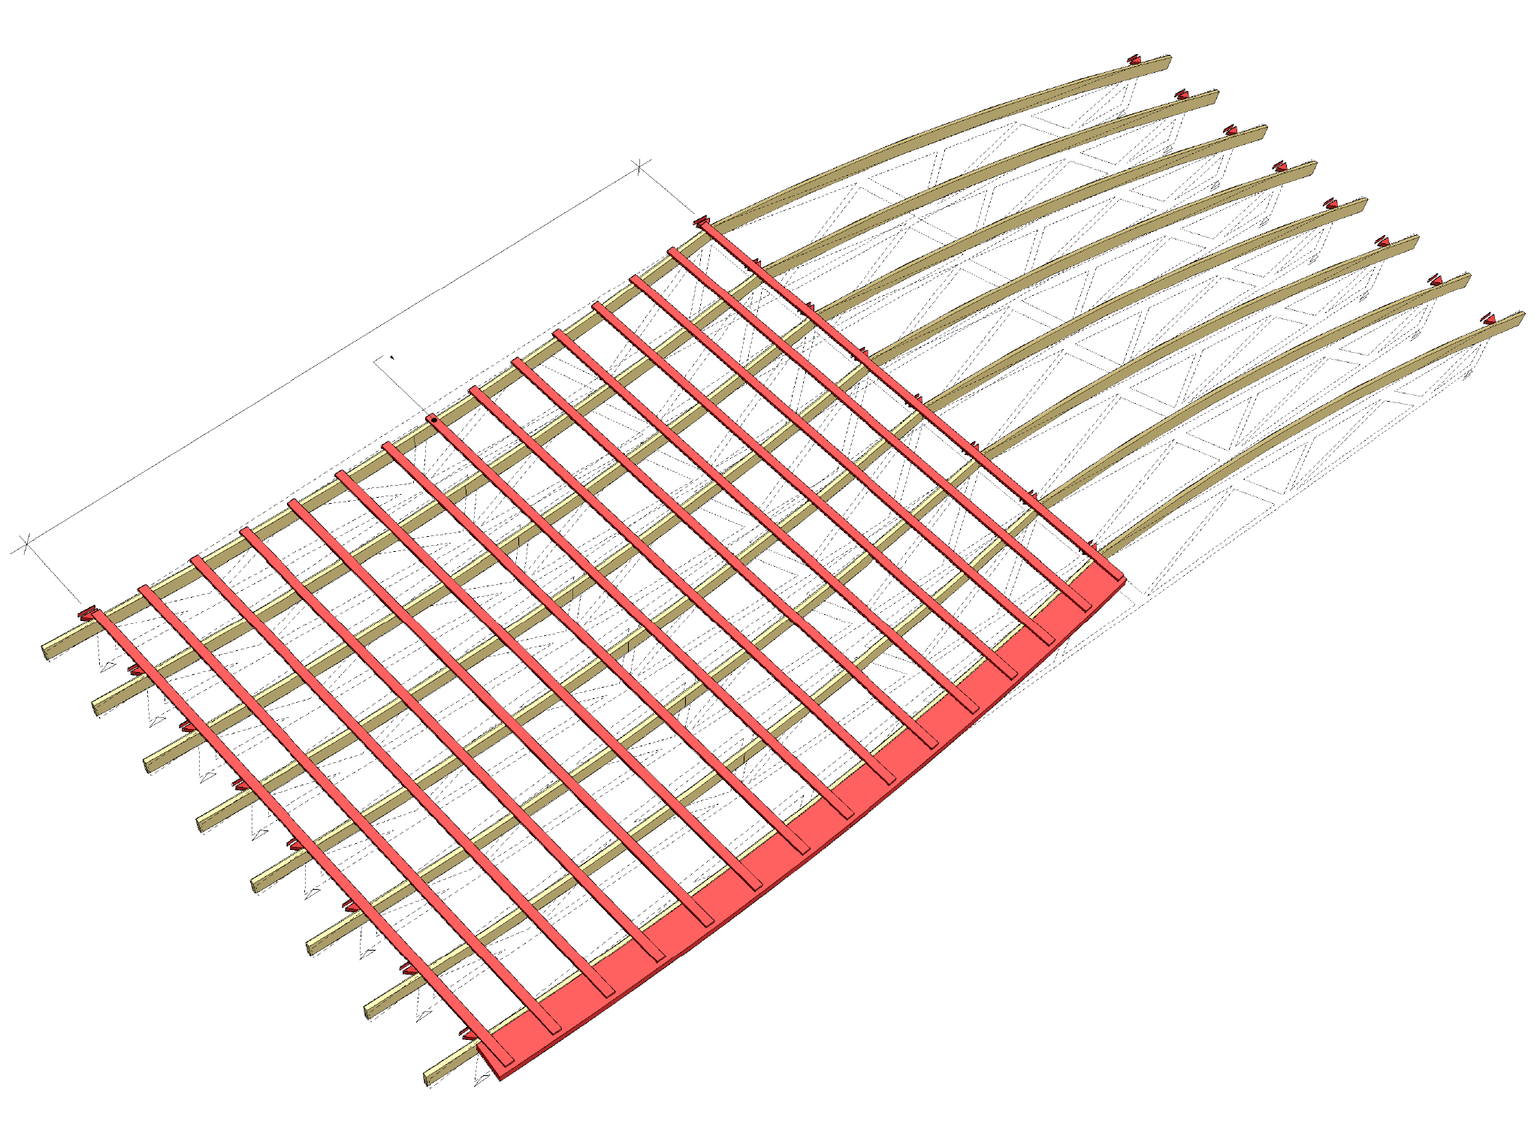
Displacement of the buckling strut system (1st shape)
Each buckling strut must meet the rigidity requirement C_{min}
In addition, the end-state displacement u_{fin} must not exceed l/500 of the design load of the ultimate-limit state, which consists of:
roof level wind load q_{w,d}
NR truss additional horizontal force Σq_{H,d,i}
top chord stiffening load Σq_{d,i}
All displacements in the buckling strut system must be taken into account
Displacement of support furthest from stiffener u_{fin}
Stiffening system span length l
Stiffener deflection u_{fin} max. l/500

Slide 48
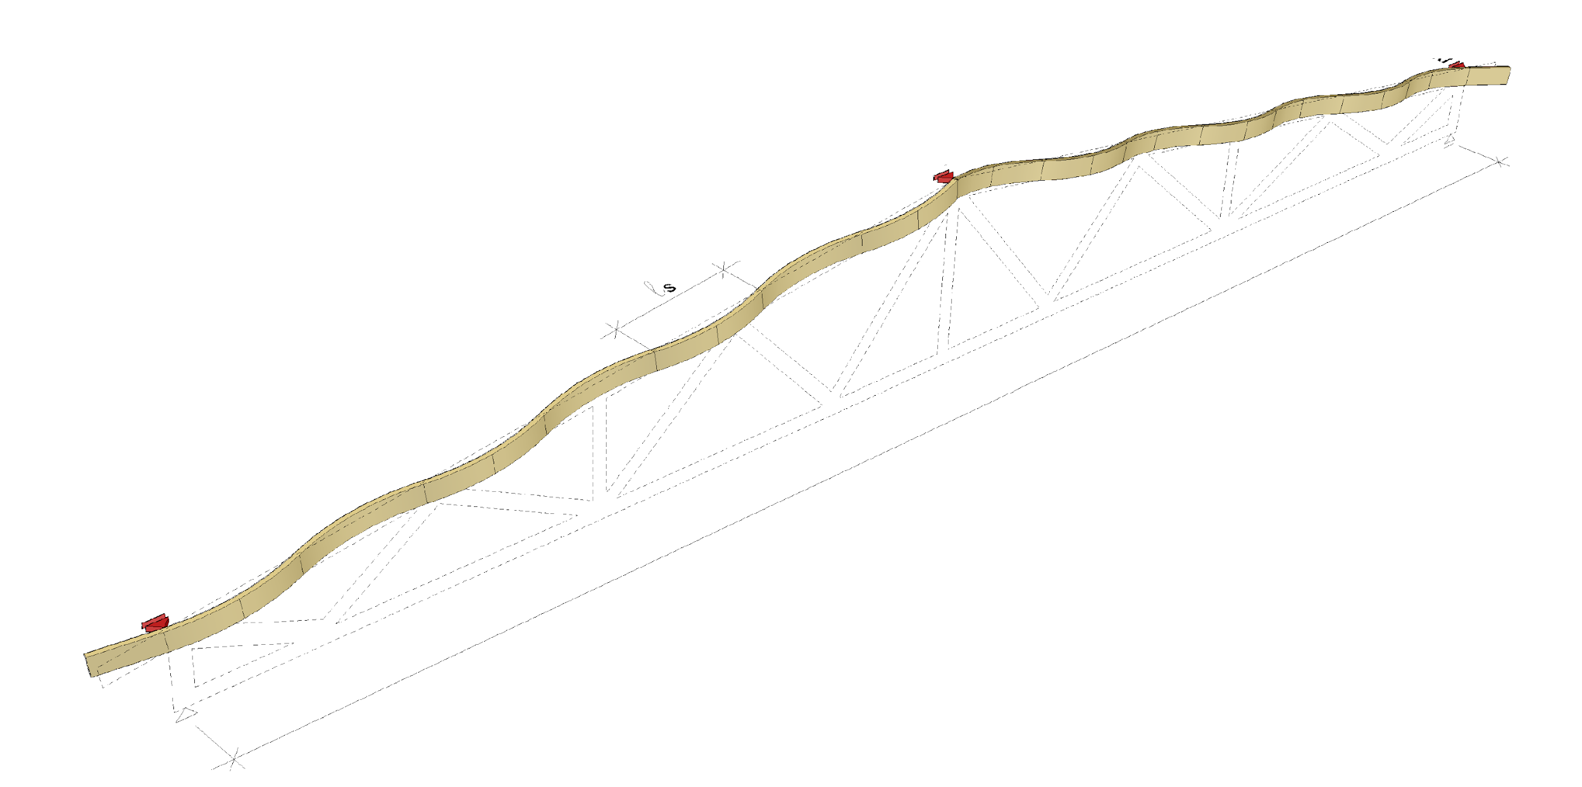
Shape 2 of the buckle of a top chord
Horizontal support of a truss
Horizontal support of a truss
Buckling wave length
Span
Horizontal support of a truss

Slide 49
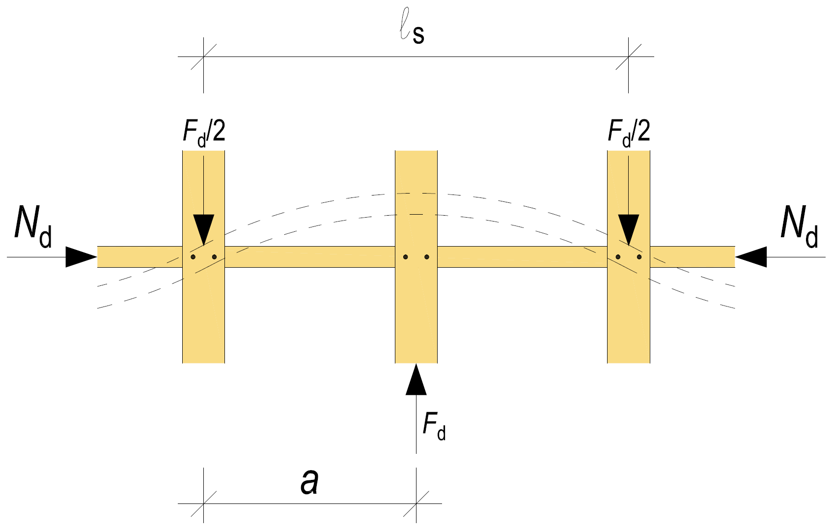
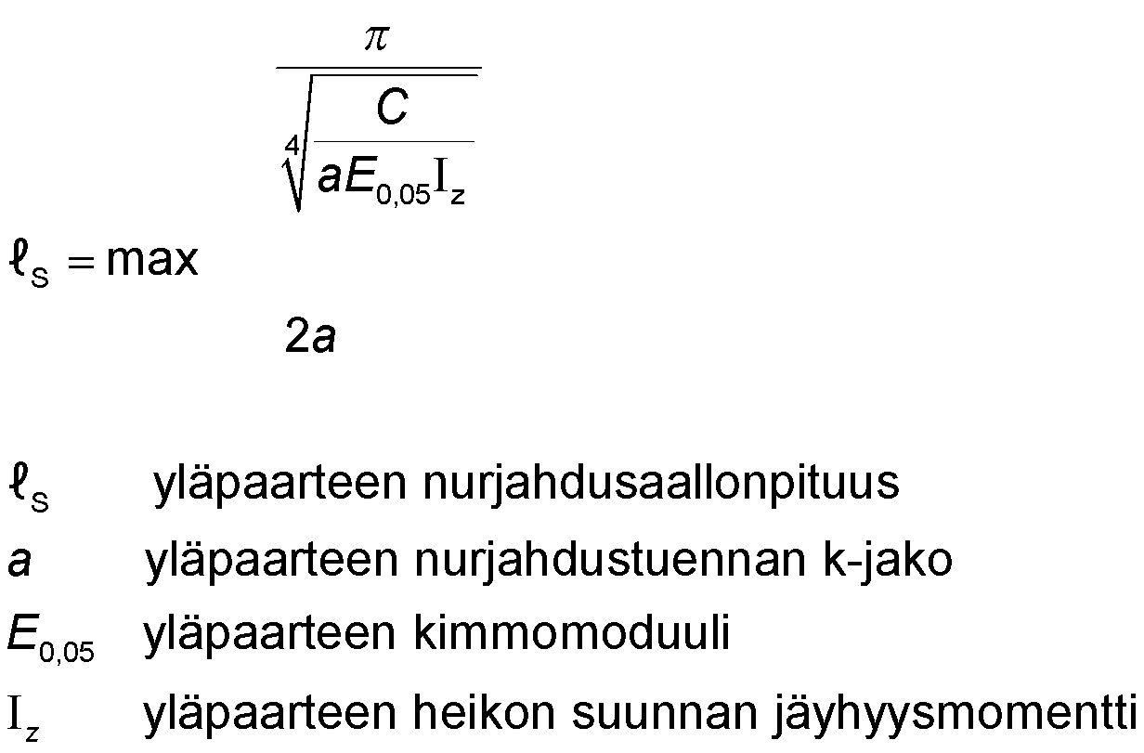
Shape 2 of the buckle of a top chord
The buckling wavelength of the second shape of buckling, ls, can be calculated
buckling wavelength of the top chord
k-distribution of the buckle support of the top chord
elasticity modulus of the top chord
moment of inertia of the top chord

Slide 50
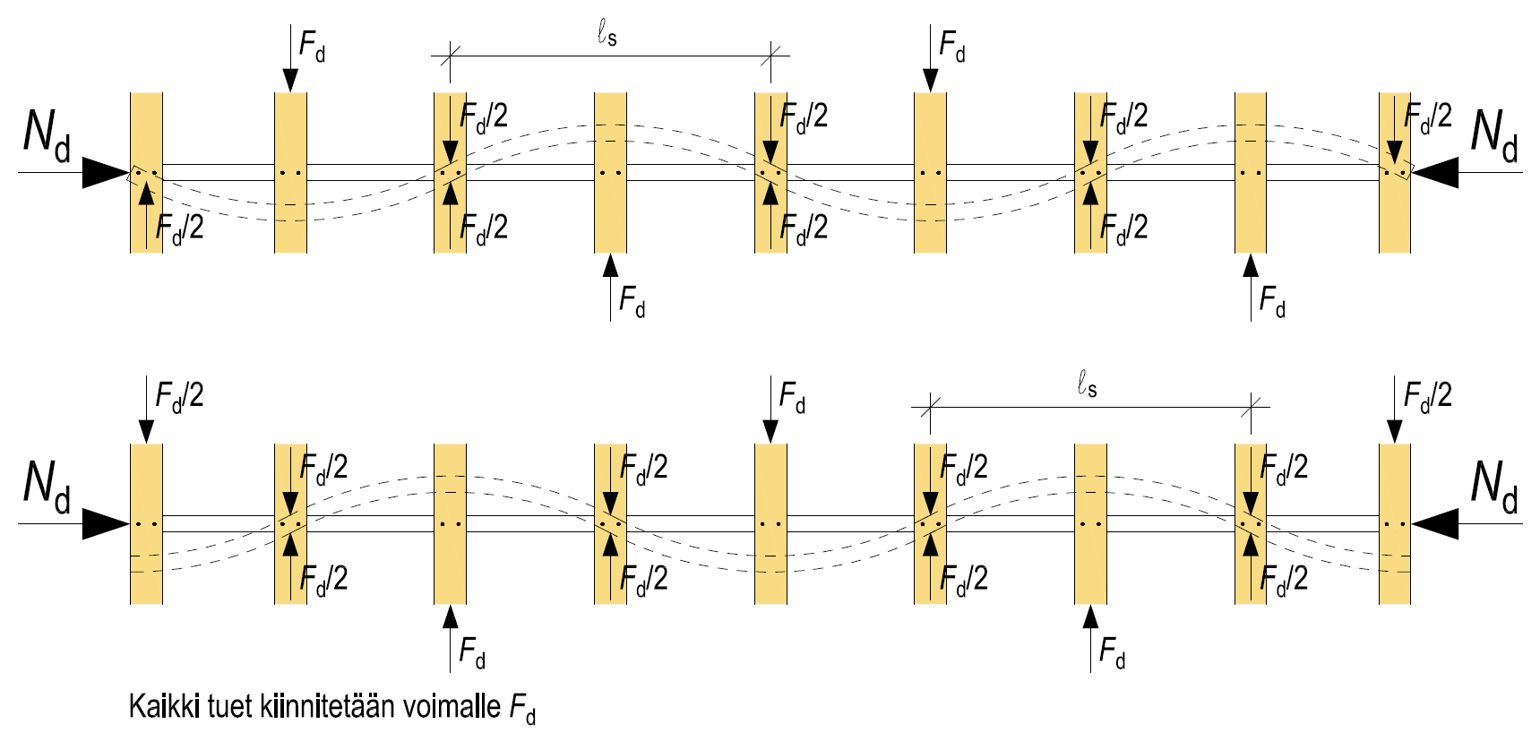
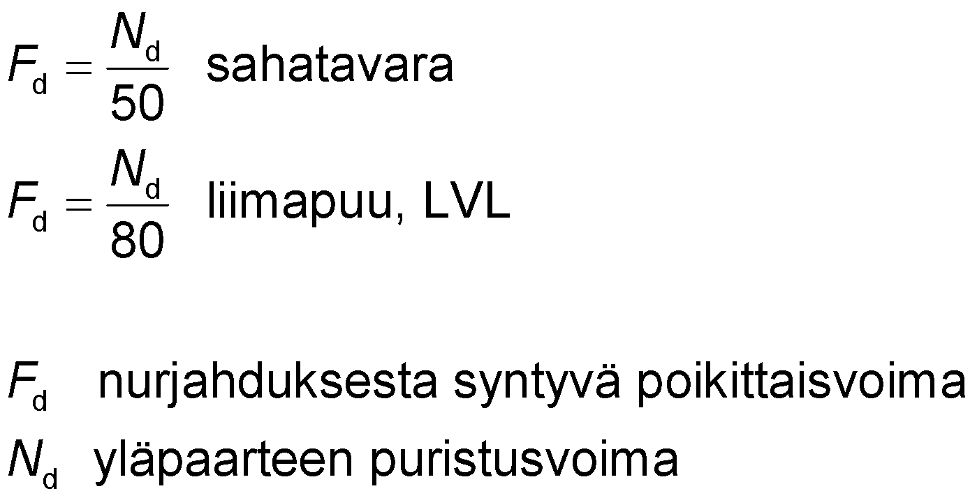
Shape 2 of the buckle of a top chord
Polywave buckling can start anywhere, so all rod supports must be attached to force F_{d}
The buckling generates the force F_{d} on an individual strut, which is transferred to the buckling strut system
sawn timber
glued laminated timber, LVL
transverse force from buckling
compression force of the top chord
All supports must be attached to force F_{d}

Slide 51
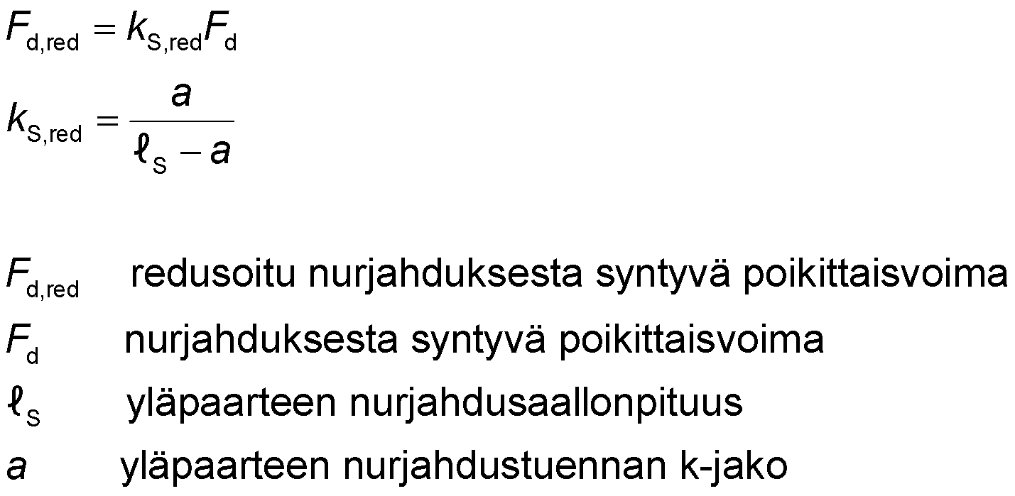
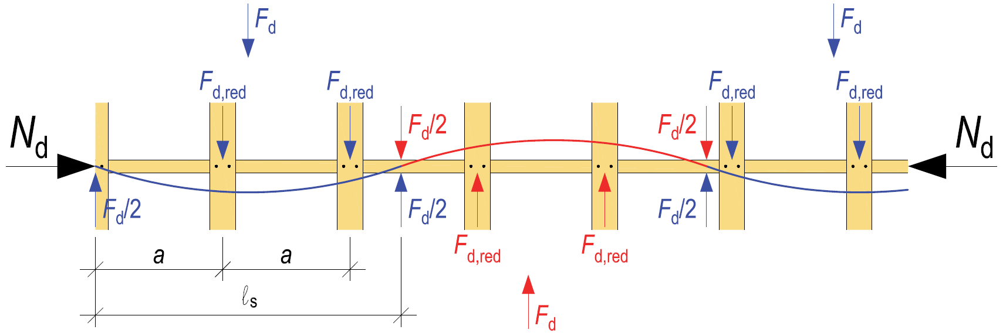
Shape 2 of the buckle of a top chord
The force F_{d} caused by the buckling of a top chord supported at four points or more can be reduced by a factor of k_{S,red}
Force F_{d} decreases when there is more than one buckling strut per length l_{s}
reduced transverse force from buckling
transverse force from buckling
buckling wavelength of the top chord
k-distribution of the buckle support of the top chord

Slide 52
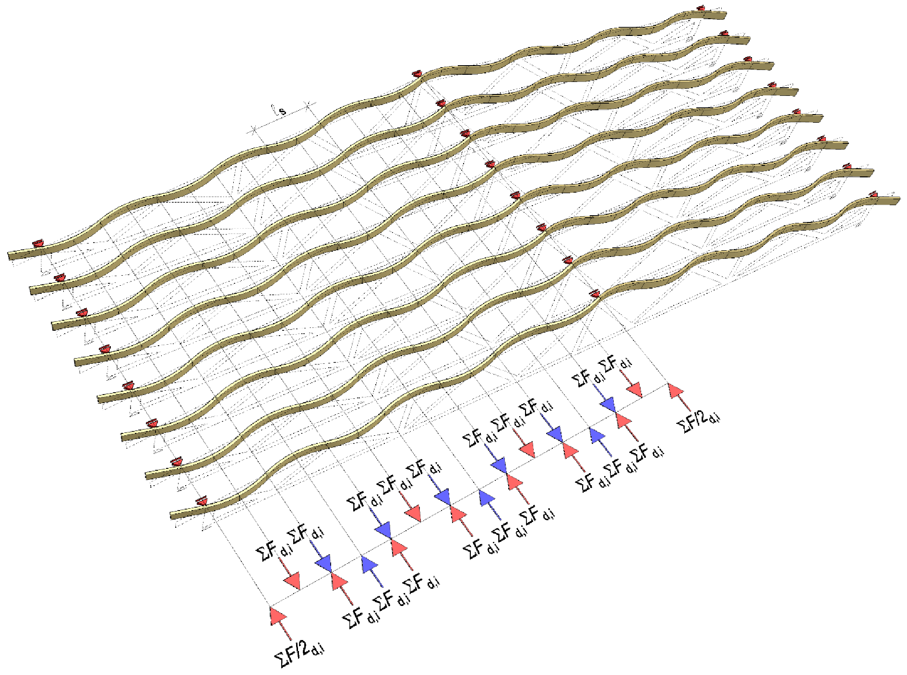
Loads of the buckling strut system (2nd shape)
The buckling strut system is loaded with ΣF_{d,i}
Force of buckling struts along the buckling wavelength (F_{d} or F_{d,red})
The load accumulating on the buckling strut system ΣF_{d,i} easily grows very large when several parallel truss top chords are stiffened using one buckling strut system
Buckling wave length

Slide 53
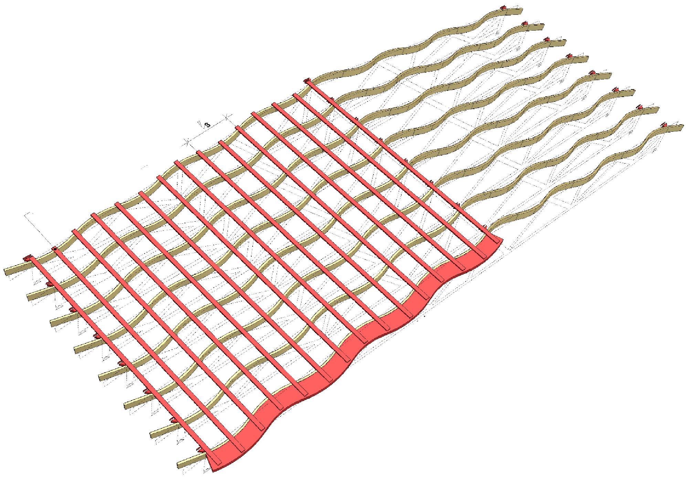
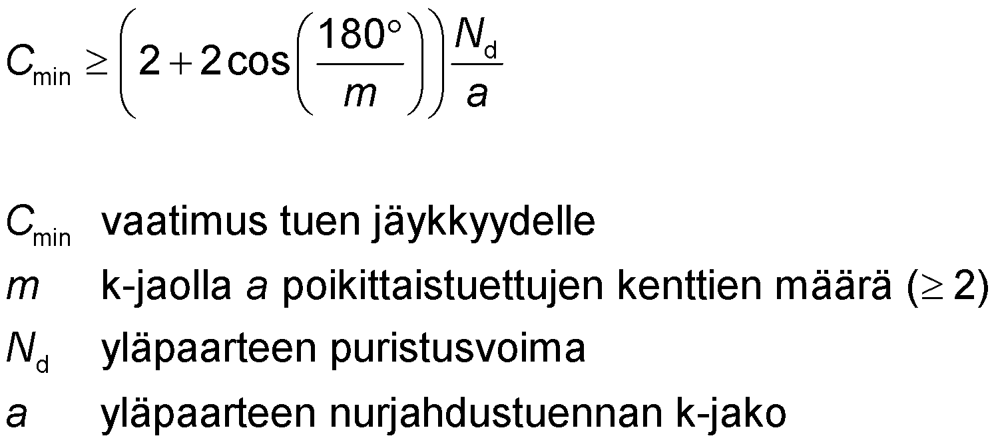
Displacement of the buckling strut system (2nd shape)
Each buckling strut must meet the rigidity requirement C_{min}
Spring stiffness is examined on the basis of displacement u_{f}
The bigger the displacement, the looser the support
Buckling wave length
Displacement of support furthest from stiffener u_{fin}
Stiffener
requirement for rigidity of the support
number of transverse supported fields on k distribution a (≥2)
compression force of the top chord
k-distribution of the buckle support of the top chord

Slide 54
Loads on the buckling support system
The first shape of buckling (incl. additional horizontal force and wind load) causes significantly smaller forces on the buckling support system components and joints than the second shape of buckling
The span length of the stiffening system has plenty of buckling struts (e.g. batten) that receive parallel force
The wavelength of the 2nd shape of buckling is so short that it typically only holds one buckling strut (e.g. batten)
One buckling strut must prevent buckling along the entire buckling wave, which increases the joining force of the buckling support, for example

Slide 55
Loads on the buckling support system
The larger number of trusses the forces are collected from to the stiffener, the more challenging it is to dimension the buckling support system
Joining forces increase
Forces in the components of the support system increase
Displacements in the support system increase, which means that the rigidity of the support system must be increased
S-buckling should be prevented for each truss and not collect the forces from several trusses to stiffeners
Joining forces decrease
Displacements are reduced, making it easier to implement spring rigidity condition C
The size of components in the support system decreases

Slide 56
Total stiffening based on NR frames
NR frame stiffening provides e.g. the following benefits
NR frames also function as stiffeners during working
Simple to design
Simple to implement
NR frames act as horizontal supports for the top chord, between which the top chord is stiffened using e.g. a board or batten on top of the top chord
The first and second shapes of buckling are prevented on a truss-specific basis using the same stiffening system
Additional horizontal force and wind load at the roof level are also received by the stiffening system described above

Slide 57
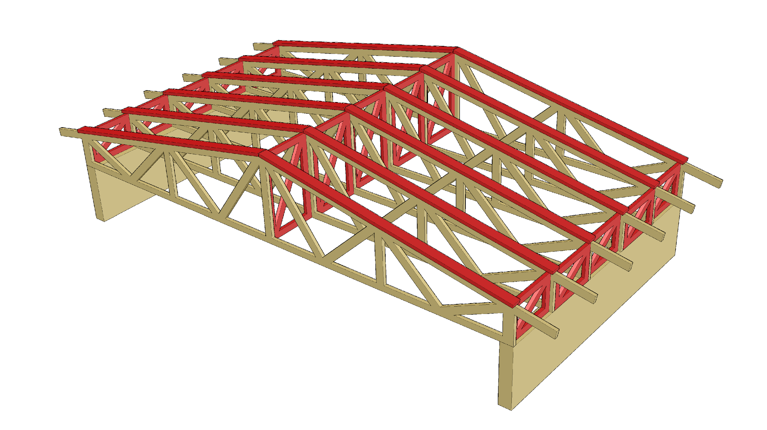
Stiffening based on NR frames
Top chord stiffening between NR frames

Slide 58

Stiffening based on NR frames
Top chord stiffening between NR frames
At stiffener extension
NR frames are required

Slide 59

Stiffening based on NR frames
Top chord stiffening between NR frames

Slide 60

Stiffening based on NR frames
Top chord stiffening between NR frames
At stiffener extension
NR frames are required

Slide 61

Top chord stiffening
A board or batten on top of the top chord acts as a stiffener between NR frames
Top chord stiffener receives the stiffening load q_{d,i} per truss
Stiffening load q_{d,i}

Slide 62

Top chord stiffening
A board or batten on top of the top chord acts as a stiffener between NR frames
Top chord stiffener receives the stiffening load q_{H,d,i} per truss

Slide 63

Top chord stiffening
A board or batten on top of the top chord acts as a stiffener between NR frames
The top chord stiffeners receive the wind load q_{w,d} at the roof level
The battens transfer the wind load to the stiffeners
Wind load q_{w,d}

Slide 64

Top chord stiffening
A board or batten on top of the top chord acts as a stiffener between NR frames
The top chord stiffener receives the forces from the S-buckling F_{d,i} per truss, so the joining forces in the stiffener remain relatively low

Slide 65

Additional forces in the NR trusses
Stiffening NR frames can be designed for all truss spaces
Alternatively, stiffening NR frames can be designed for only some truss spaces
Stiffening NR frames cause an additional vertical force on the NR trusses
The additional forces are presented to the NR planner in the truss order diagrams

Slide 66


Example of NR frame stiffening
Image: Tero Lahtela
Image: Tero Lahtela

Slide 67

Mounting of top chord stiffener (1st shape)
The stiffener on top of the top chord is fixed to force A_{d} = B_{d}
Stiffening load q_{d,i} + Auxiliary horizontal force q_{H,d,i} + Wind load q_{w,d,i}
Batten
NR frames
NR frames
Horizontal stiffener
NR frames
NR frames
A_{d} = B_{d} = support reaction from loads q_{d,I}, q_{H,d,i,} q_{w,d,i}

Slide 68

Mounting of top chord stiffener (2nd shape)
The stiffener on top of the top chord is fixed to force F _{d} or F_{d,red}
At the end of the stiffener, the force is halved
and
and
and
NR frames
NR frames
Horizontal stiffener
NR frames
and
and
NR frames
and
and
and
and

Slide 69


NR frame horizontal displacement (1st shape)
Permissible horizontal displacement of the NR frame at end state u_{fin,1} is determined by the ultimate-limit-state deflection limit l/500

Slide 70


NR frame horizontal displacement (2nd shape)
The permissible horizontal displacement of the NR frame at end state u_{fin,2} is determined by the following variables:
Strut spring rigidity requirement C
Effective force at NR frame F_{d}, F_{d,red}, F_{d}/2, F_{d,red}/2
Effective force at NR frame

Slide 71

Example of an overhang structure
Overhang element
Sheeting fixing board
Sheeting
Top chord stiffening

Slide 72
Other total stiffening methods
The total stiffening of the NR truss roof can also be implemented using the following methods
stiffening trusses between top chords
stiffener panel on top of top chord (waterproofing base plates)
diagonal boarding on the upper or lower surface of top chords
Tongue-and-groove panelling on top of the top chord cannot be used as a stiffener like stiffener panels (with the exception diagonal boarding)
Tongue-and-groove joints between boards do not receive shear force, so the boarding does not form a stiffener panel

Slide 73

Stiffening trusses between top chords
Horizontal loads in the plane of the top chord are transferred to the NR stiffening trusses between the top chords using battens
Significant dimensioning factors in the stiffening system include
Batten durability
Batten joint durability
Implementation of batten extensions
Displacements of batten joints

Slide 74

Stiffener panel over top chords

Slide 75
Considerations in stiffener panel design
The edge of the sheet rigidity must have a chord that receives the moment of the stiffener panel
Challenging to implement on the side of the NR truss which is in line with the struts
Plates can only be attached to NR trusses, so there are unattached edges on the stiffener plate
Stiffening capacity is decreases
Displacement increases
NR truss support must have horizontal stiffeners which
hold the NR trusses upright
transfer stiffener panel support reactions to the lower chord plane and external loads to the building’s stiffening elements

Slide 76

Example of a stiffener panel
Image: Tero Lahtela

Slide 77
Benefits of a stiffener panel
Top chord buckling support using one structural component (1st and 2nd shape)
Stiffener panels can be used to stiffen the entire building
Continuous stiffener panels at the top chord plane free the bottom chord plane from extra stiffeners
The plates serve as the substructure for waterproof roofing
The plates function as a working plane (safety)
A simple and guaranteed solution for stiffening
Reduces the risk of work errors in the stiffening structure

Slide 78

Installation tolerances for NR trusses
Variable | Symbol | Maximum deviation
Top chord curvature | Δ1 | ≤ L₁/300 not exceeding 50 mm
Bottom chord curvature | Δ2 | ≤ L₂/300 not exceeding 50 mm
Web rod curvature | Δ3 | ≤ 15 mm
Deviation from vertical | Δ4 | ≤ 10 mm + H/200 not exceeding 25 mm
H = height at examined point

