Slide 1



Industrial wood construction
Teaching materials for industrial wood construction education
2022

Slide 2
Origin of the materials
Use of the materials
These learning materials for industrial wood construction have been prepared in a project led by Puuinfo Oy in 2021–2022. Also involved in the project were
Lappia Vocational College,
TTS-Työtehoseura ry
South-Eastern Finland University of Applied Sciences,
Metropolia University of Applied Sciences,
Jyväskylä University of Applied Sciences,
University of Tampere, and
Federation of the Finnish Woodworking Industries Puutuoteteollisuus ry
The project was funded by the Ministry of the Environment.
The materials are intended to be used as extensively as possible in industrial wood construction education and studies.
The materials are released under the Creative Commons licence Attribution-ShareAlike (CC BY-SA), which requires that the author be properly credited when the materials are used and that derivative works may only be distributed under the same licence as the original work.
The original materials and any updates to them by Puuinfo will be published on the Library of Open Educational Resources website (aoe.fi) and the Puuinfo.fi website.

Slide 3

Structural design

Slide 4
Authors
Tero Lahtela,
Insinööritoimisto Tero Lahtela Oy
Release date: 29/03/2022

Slide 5
Frame structured panel stiffener

Slide 6
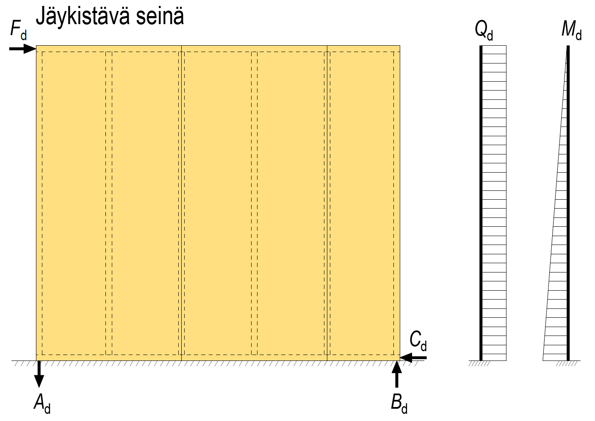
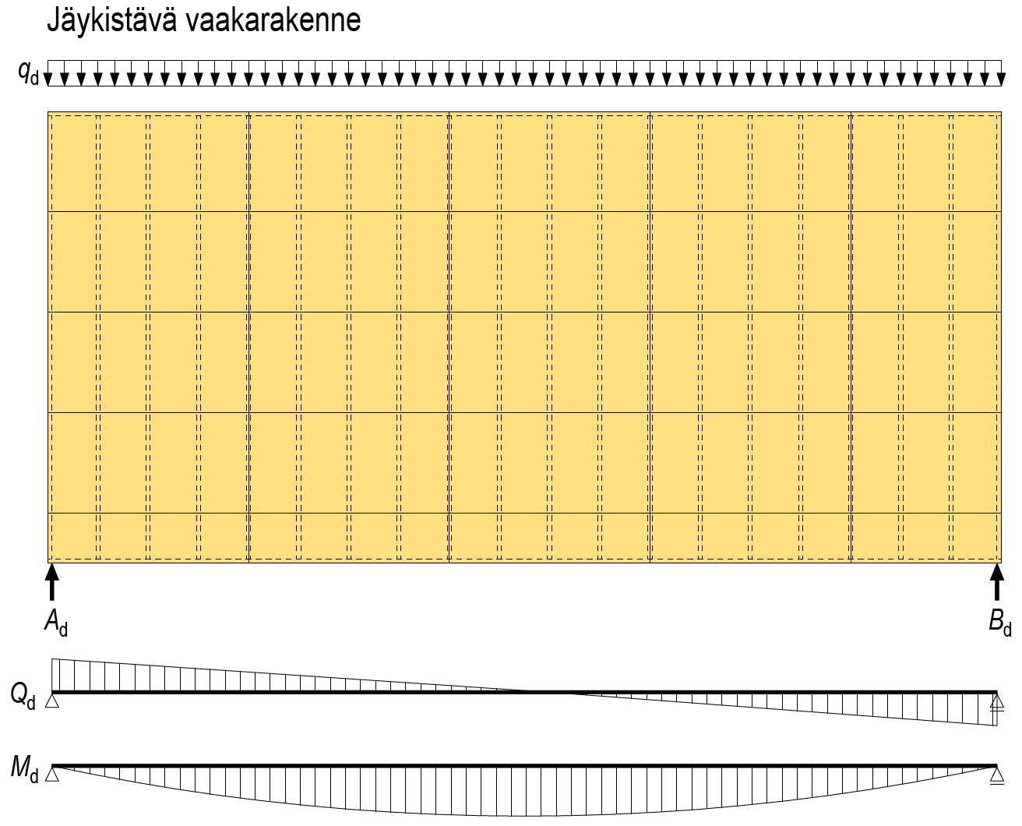
Panel stiffener panel types
Stiffening wall
Wood-based panels can be dimensioned according to Eurocode 5
Wood-based panels
Plywood panel
OSB panel
LVL panel
Chipboard
Other panels are dimensioned according to panel-specific approvals
Other panels
Porous wood fibreboard
Plasterboard etc. mineral panels
Stiffening horizontal structure

Slide 7
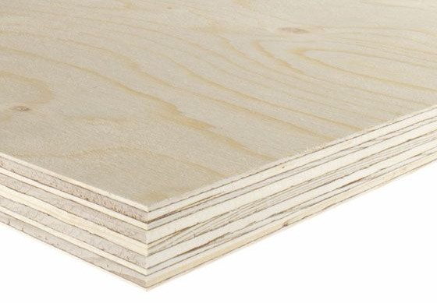
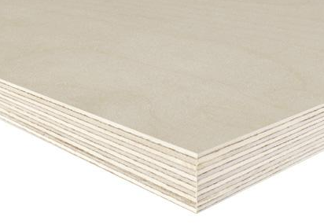
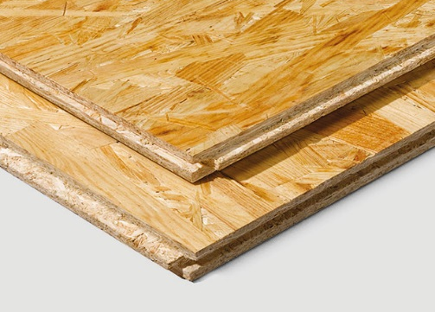
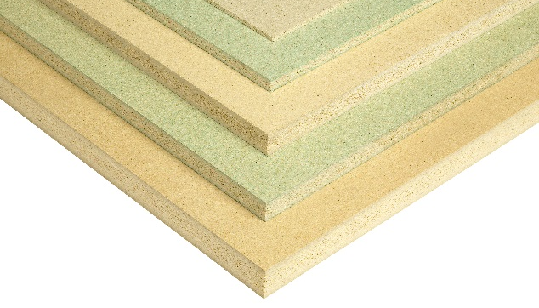
Panel stiffener panel types
When selecting a panel type pay attention to the following
Shear strength of the panel’s joints
The thickness of the panel
The panel’s shear modulus G_{mean} (veneer thickness influences the value)
The panel’s moisture resistance
Softwood plywood panel
- thick veneer G_{mean} = 350 N/mm² (e.g.)
- thin veneer G_{mean} = 530 N/mm² (e.g.)
Birch plywood panel
- thin veneer G_{mean} = 620 N/mm² (e.g.)
OSB panel
- G_{mean} = 1080 N/mm² (e.g.)
Chipboard
- G_{mean} = 830 N/mm² (e.g.)
Image: UPM
Image: UPM
Image: EGGER
Image: Puuinfo

Slide 8
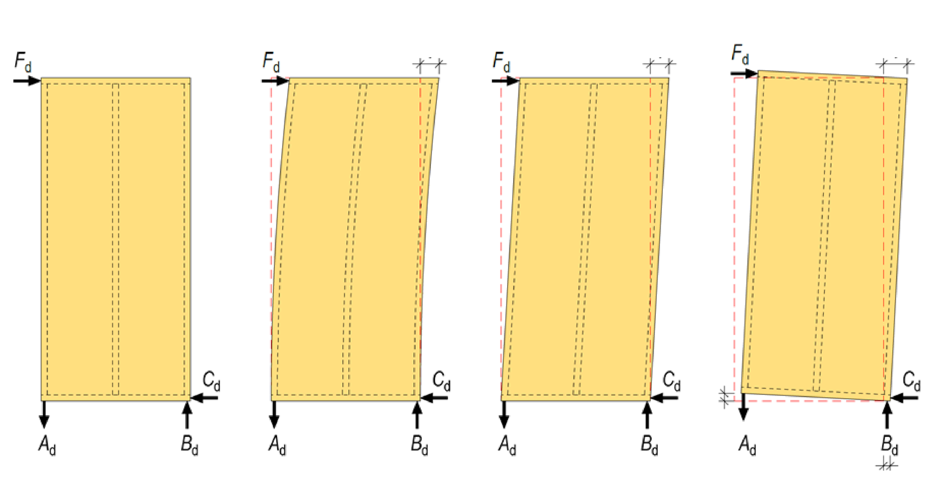
Panel stiffener stresses and displacement
Panel stiffener Bending Shear Displacement of supports
Displacement
Displacement
Displacement
Displacement
Displacement

Slide 9
Panel stiffener stresses and displacement
The horizontal displacement of stiffening walls is a significant factor, as it influences the buildings horizontal displacement
In an apartment block this is a very important factor
Too large of a horizontal displacement will cause a building to sway
The ratio between the height of stiffening walls and their width should be ≤ 1, in which case
The wall’s stiffening capacity grows
The relation between the anchoring force and the wall’s stiffening capacity decreases
The shear displacement is decisive
The shear displacement of the panel stiffener is influenced by
Location of panel’s connectors and displacement factor for connectors
The shear modulus for the panel shear

Slide 10
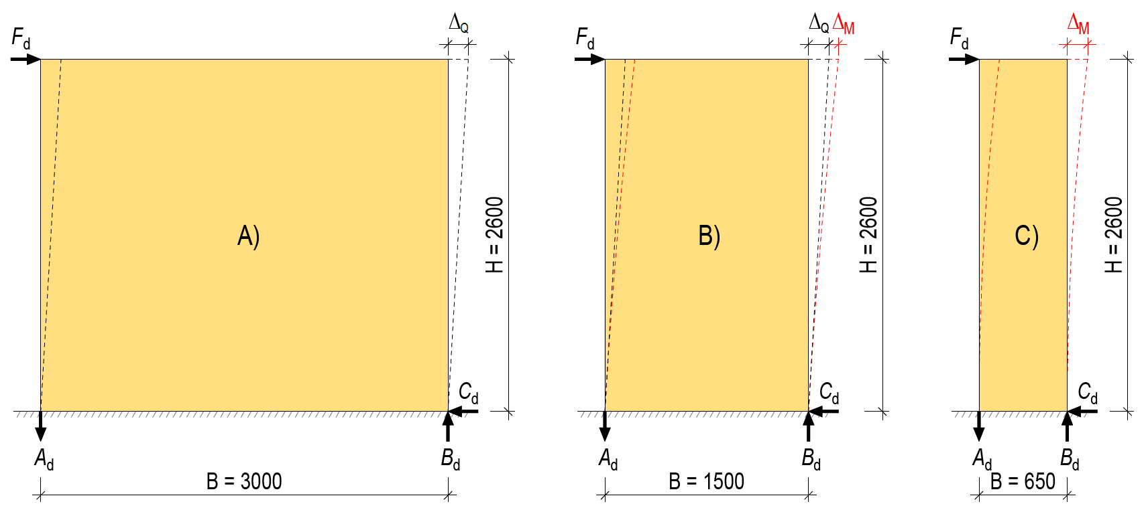
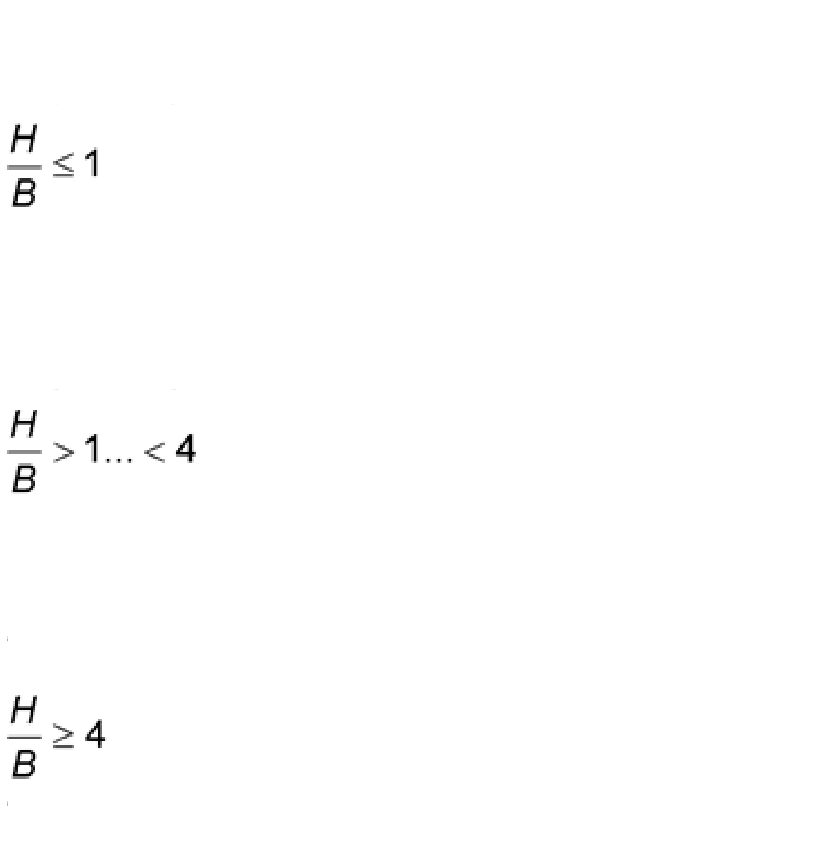
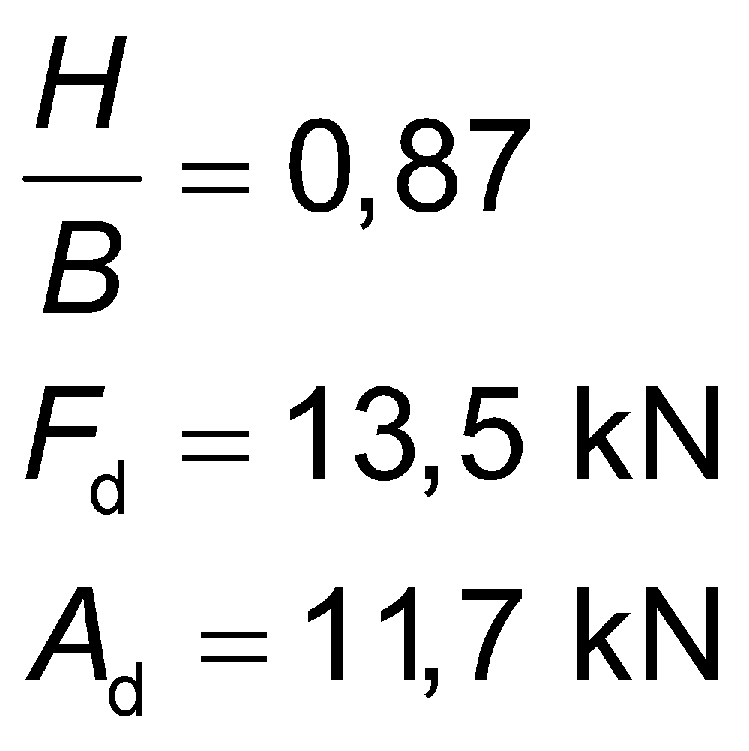
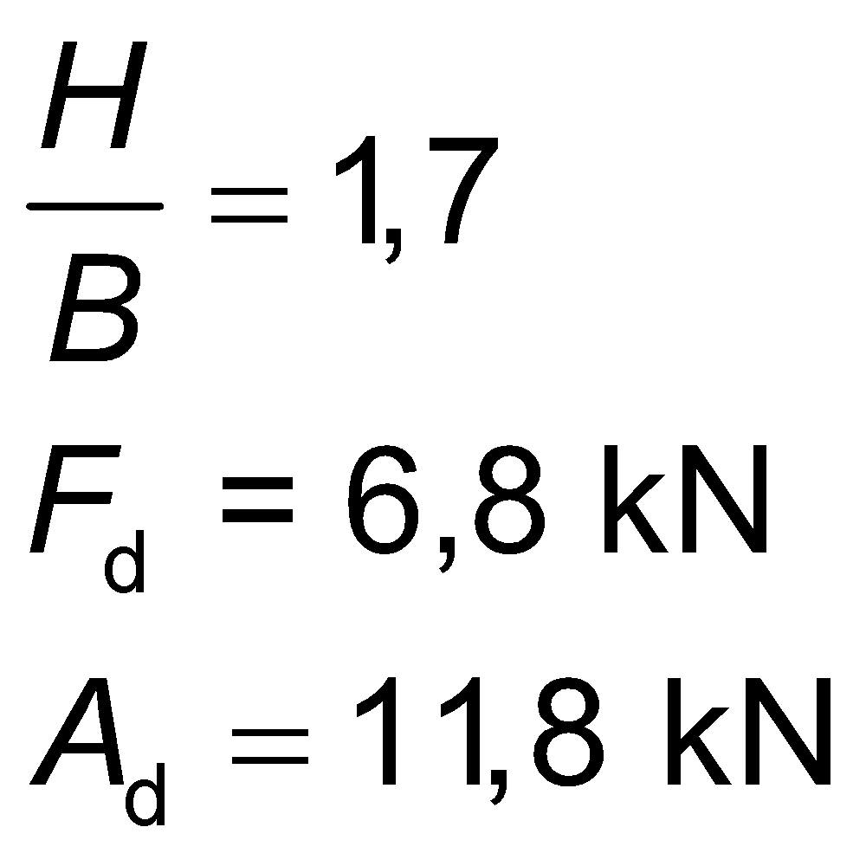
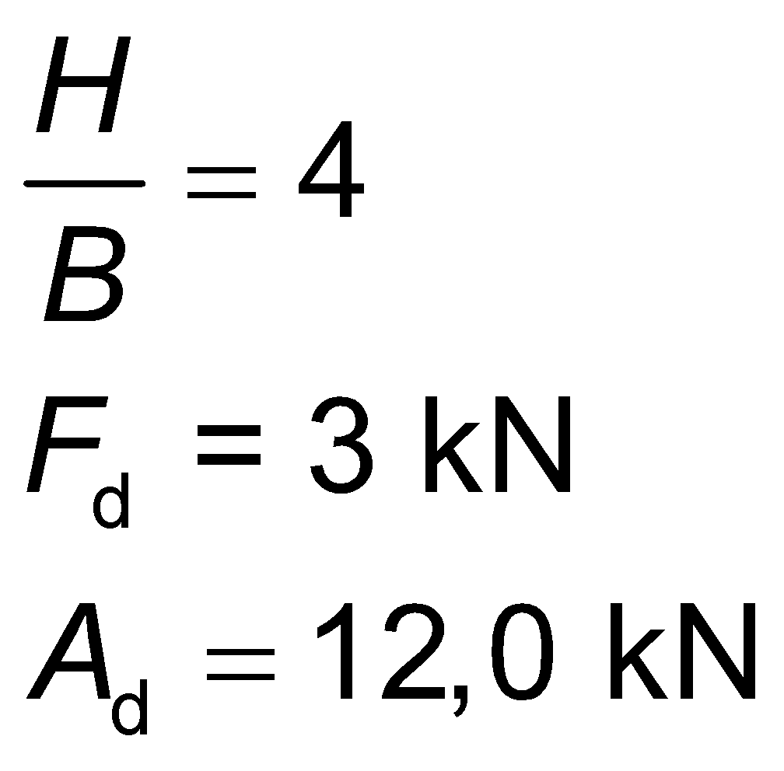
The horizontal displacement of the panel stiffener
INDICATIVE INSTRUCTIONS
Case A)
Shear displacement (Δ_{Q}) decisive
Case B)
Shear displacement (Δ_{Q}) and deflection (Δ_{M})
Case C)
Deflection (Δ_{M}) decisive

Slide 11
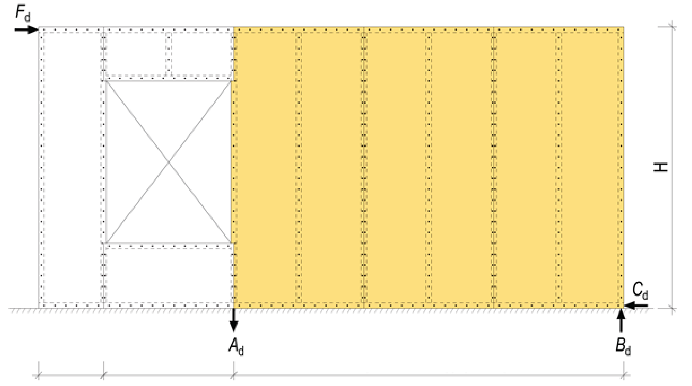
Openings in panel stiffener
Panel stiffener consisting of separate panels
In practice, the locations of the openings cannot be taken into account as stiffening because the panels above and below the openings do not work as a whole with other panels
In practice, the panelling along the jambs of narrow openings cannot be taken into account as stiffening because their stiffening capacity is small in relation to a functioning panel stiffener
Narrow jamb Location of the opening B (functioning panel stiffener)

Slide 12
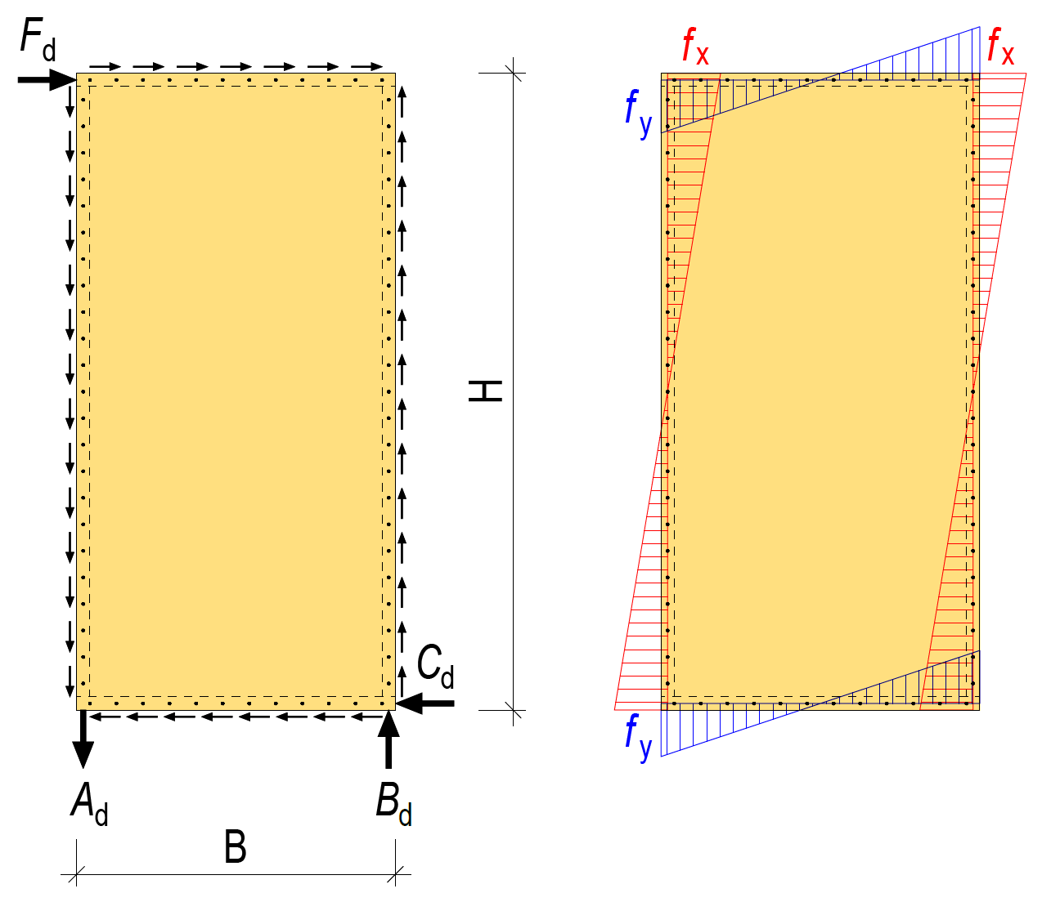
The panel is fastened along all its edges
External force F_{d} directs a force to the stiffening panel that it in the direction of its edges
The stiffening panel should be fastened at the minimum along all four of its edges
The forces exerted at the connectors f_{x} and f_{y} are mainly born by connector row and frames at the edges of the panel
The stiffening capacity increases
Horizontal displacement decreases

Slide 13
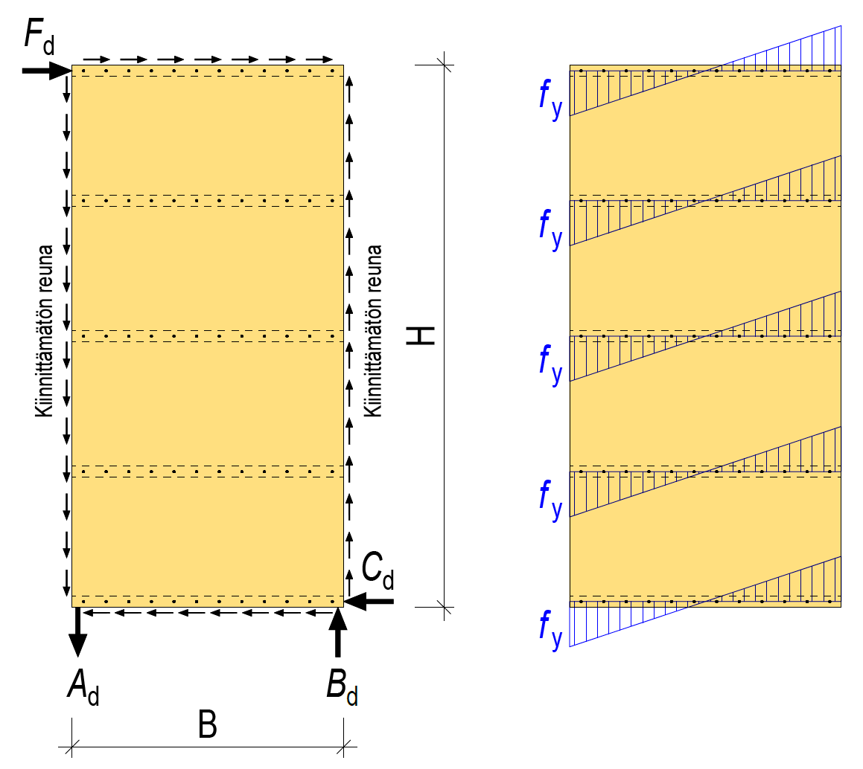
The panel has unfastened edges
The unfastened edges of the panel cause the following
Stiffening capacity is decreases
The horizontal displacement increases
Unfastened edges are subjected to force caused by external force F_{d} , but there is no connector line or frame in the direction of the force.
The stiffening capacity is determined on the basis of the force f_{y} that the connectors are subjected to (rotational durability)
Unfastened edge
Unfastened edge

Slide 14
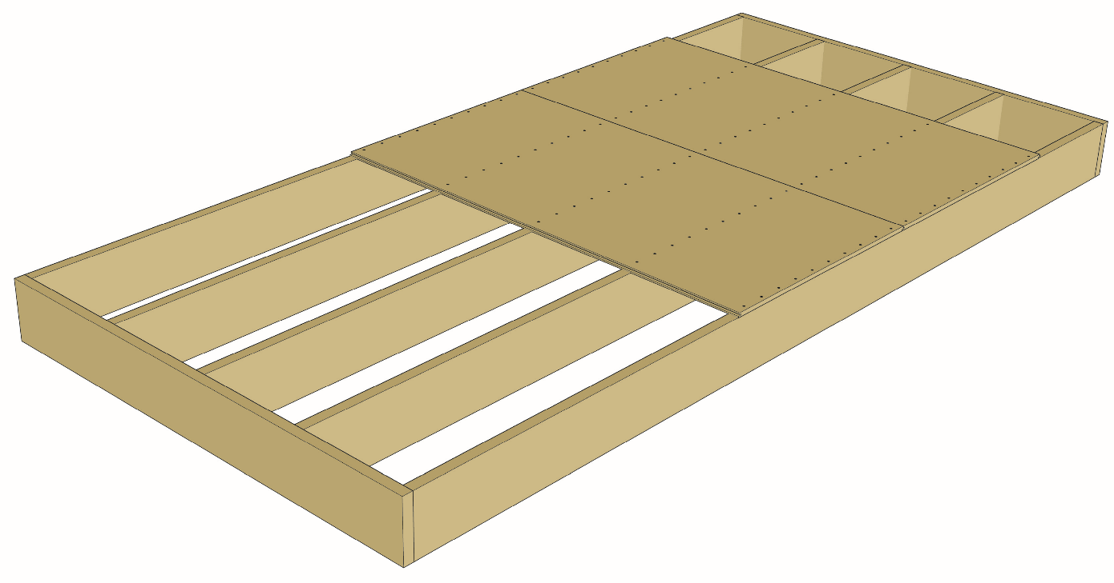
The panel has unfastened edges
Unfastened panel edges are found for example in beam structures in the intermediate floor
The panel is only fastened along the connector lines in the direction of the beam
The force directed at the edge of the long side of the panel is not carried by anything, because there is no connection

Slide 15
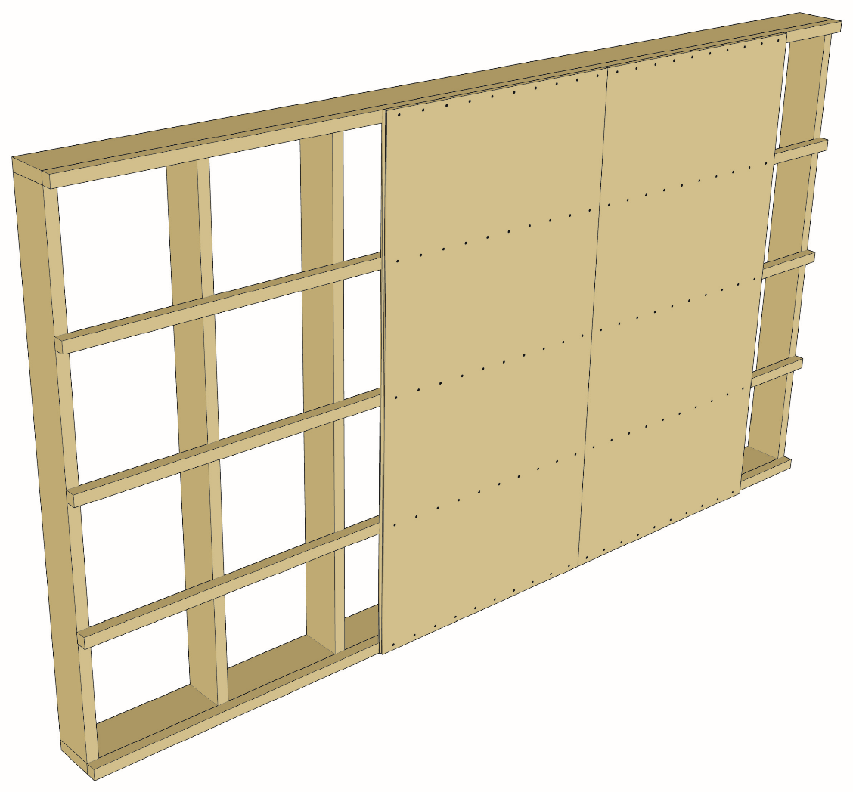
The panel has unfastened edges
Unfastened panel edges are found for example in beam structures in a wall’s horizontal rainscreen
The panel is only fastened along the connector lines in the direction of the horizontal rainscreen
The force directed at the edge of the long side of the panel is not carried by anything, because there is no connection

Slide 16
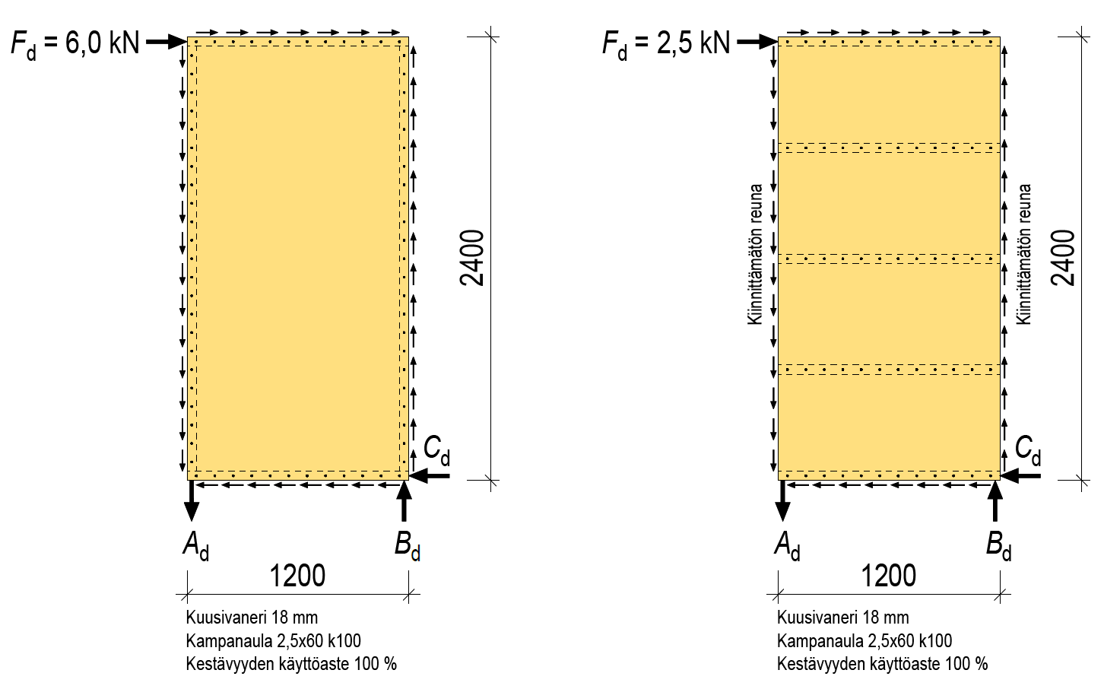
Impact of the fastening method on durability
Unfastened edge
Unfastened edge
Spruce plywood 18 mm
Ring shanked nail 2.5x60 k100
Strength utilisation factor 100%
Spruce plywood 18 mm
Ring shanked nail 2.5x60 k100
Strength utilisation factor 100%

Slide 17
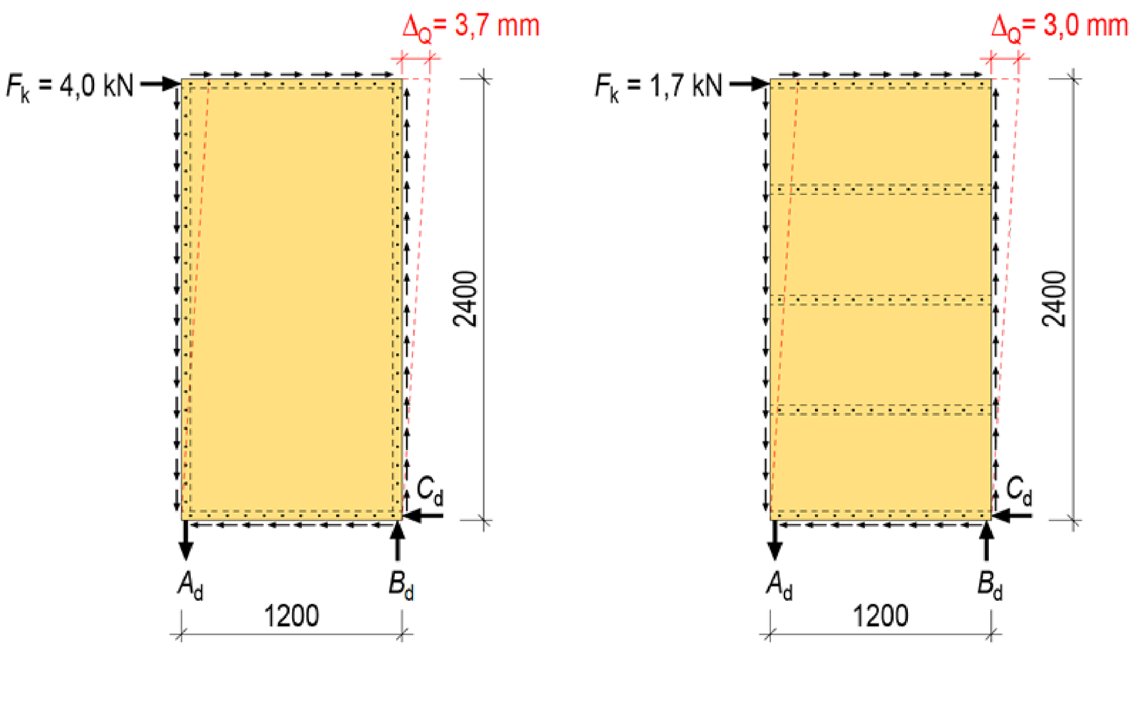
Impact of the fastening method on displacement
Unfastened edge
Unfastened edge
Spruce plywood 18 mm
Ring shanked nail 2.5x60 k100
Strength utilisation factor 100%
Spruce plywood 18 mm
Ring shanked nail 2.5x60 k100
Strength utilisation factor 100%

Slide 18
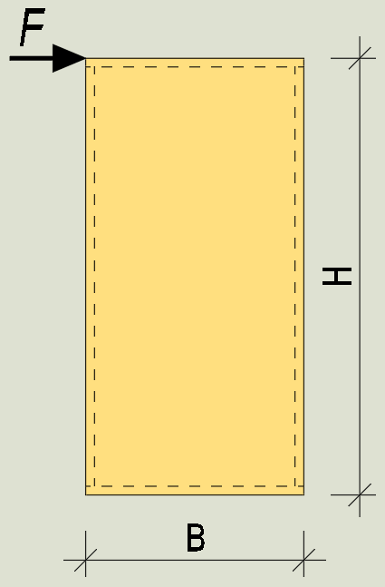
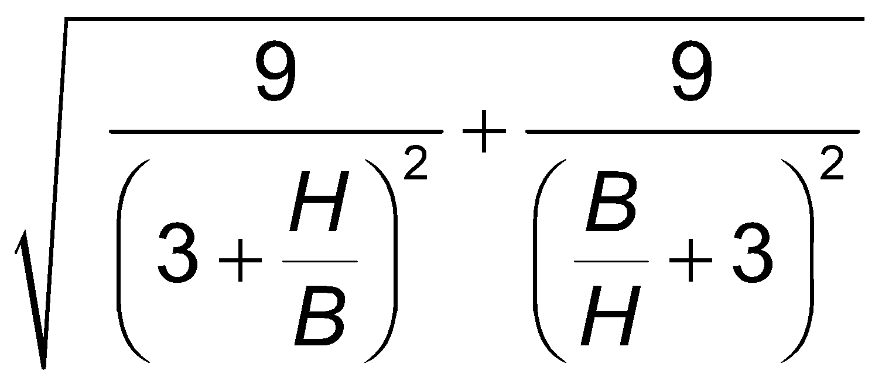
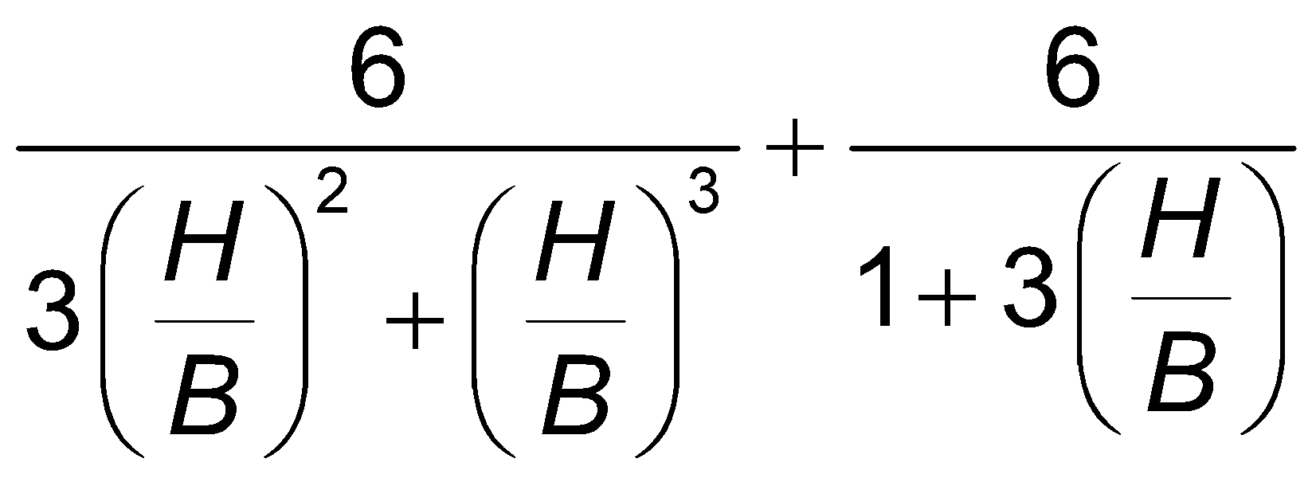
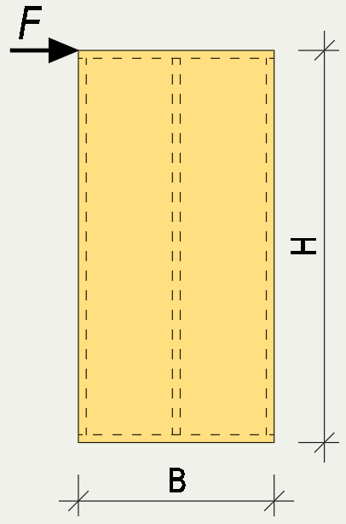
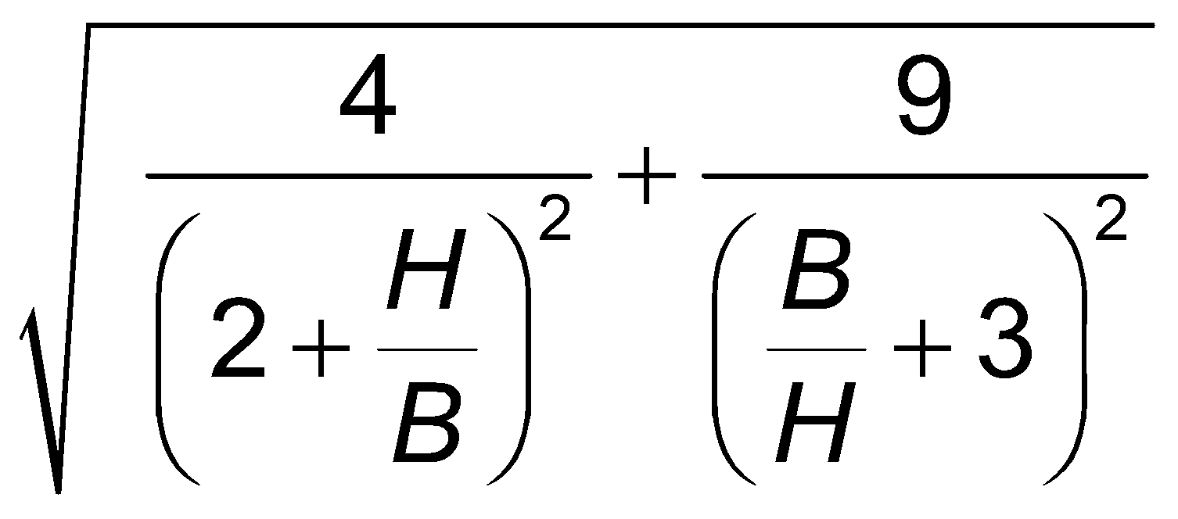
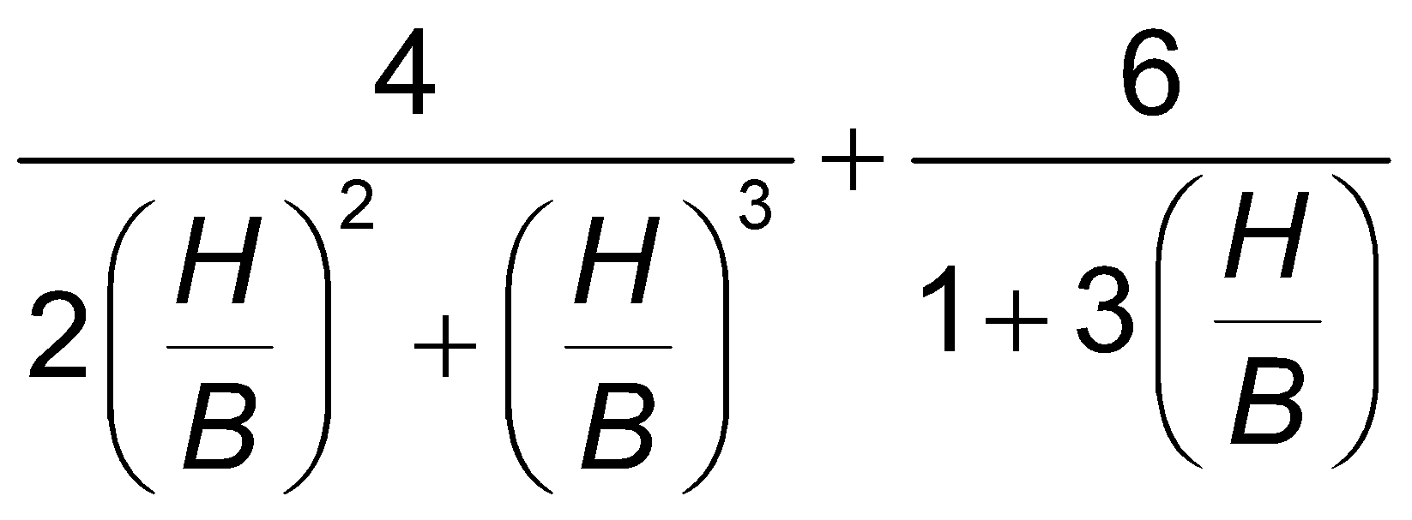
Factors for method of attachment
No | Attachment method | G factor | B factor
1
2

Slide 19
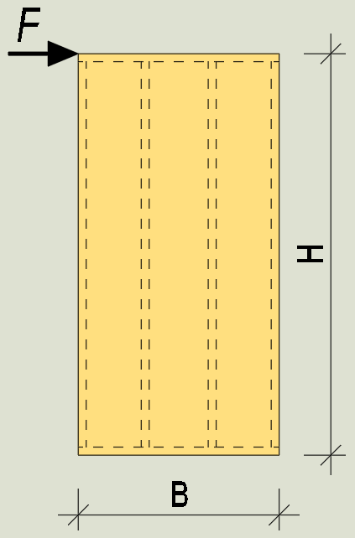
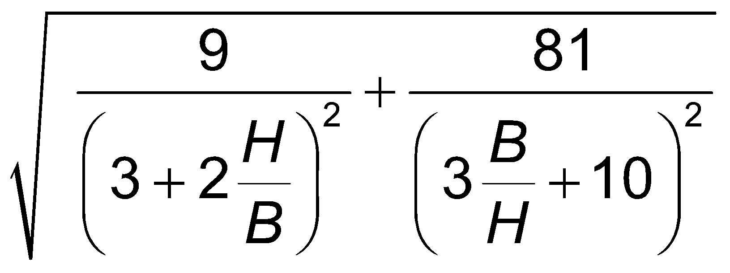
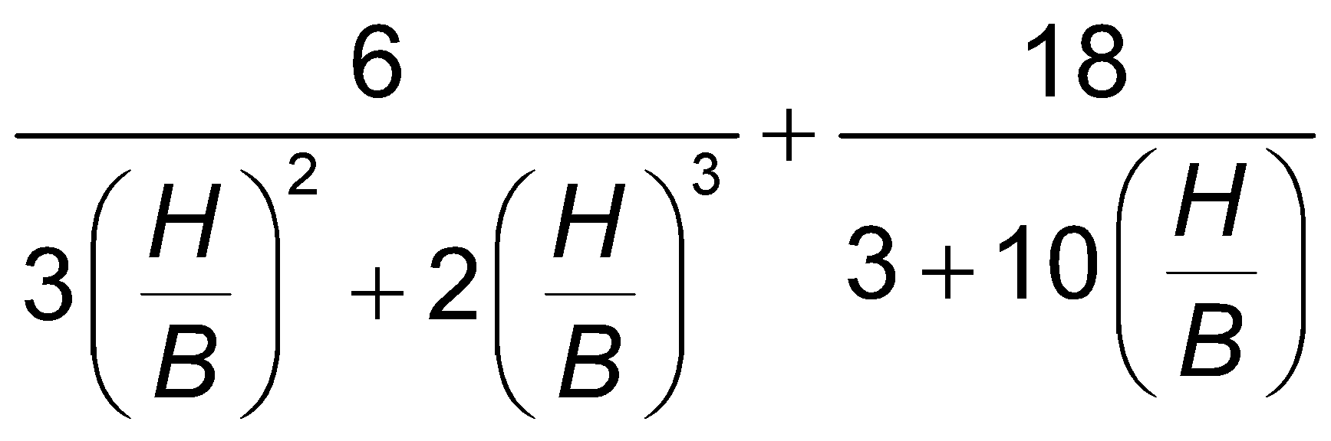
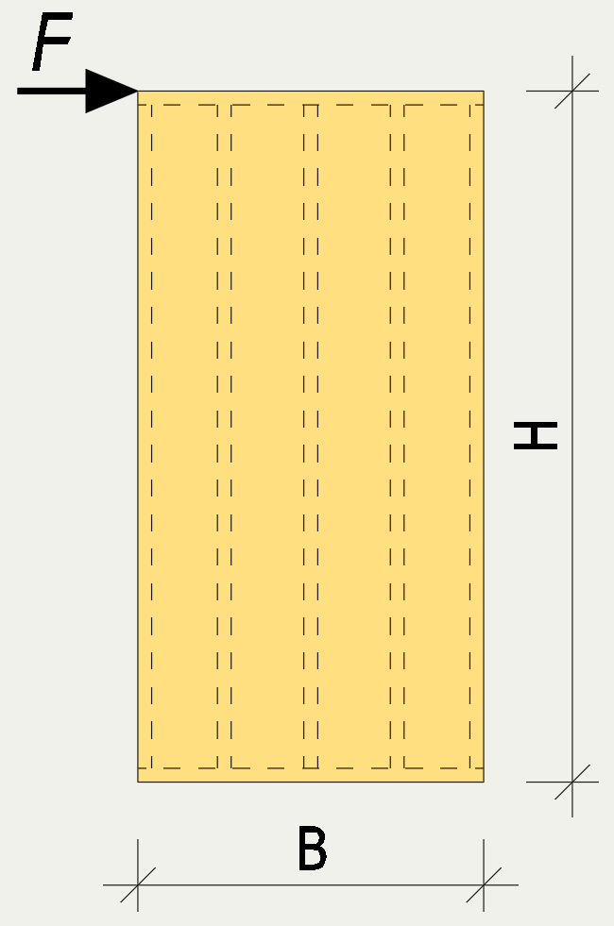
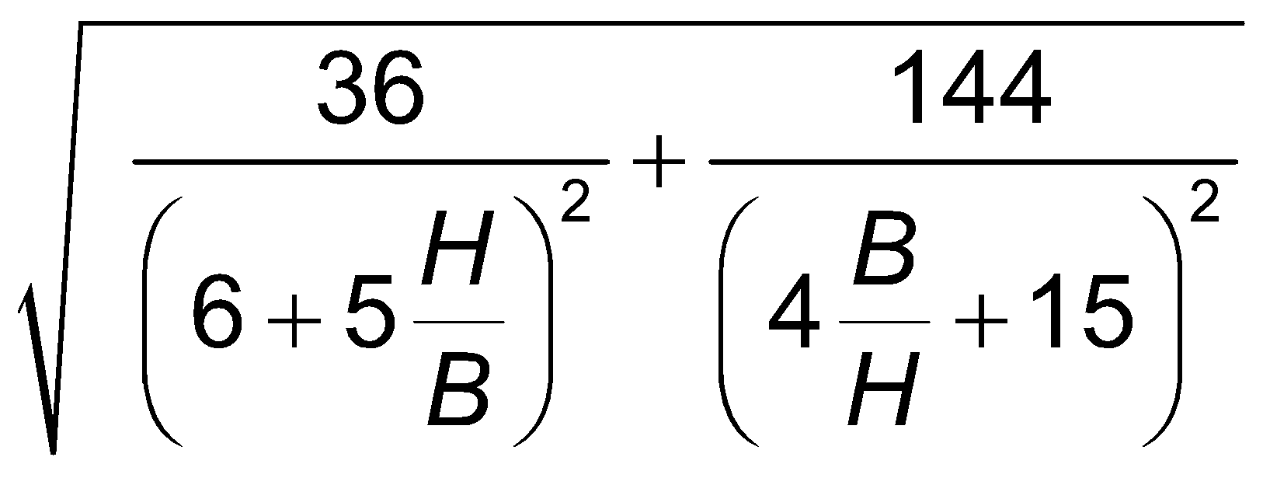
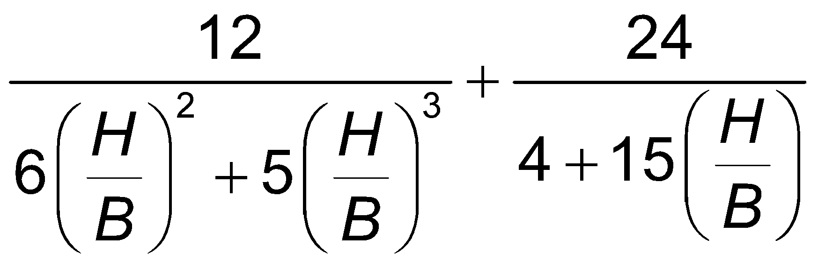
Factors for method of attachment
No | Attachment method | G factor | B factor
3
4

Slide 20
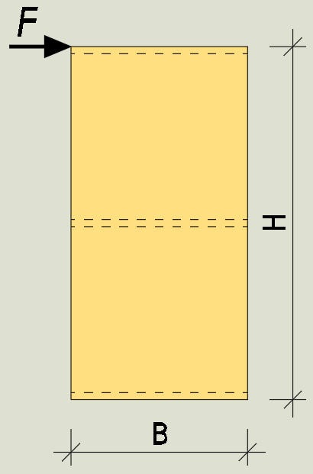
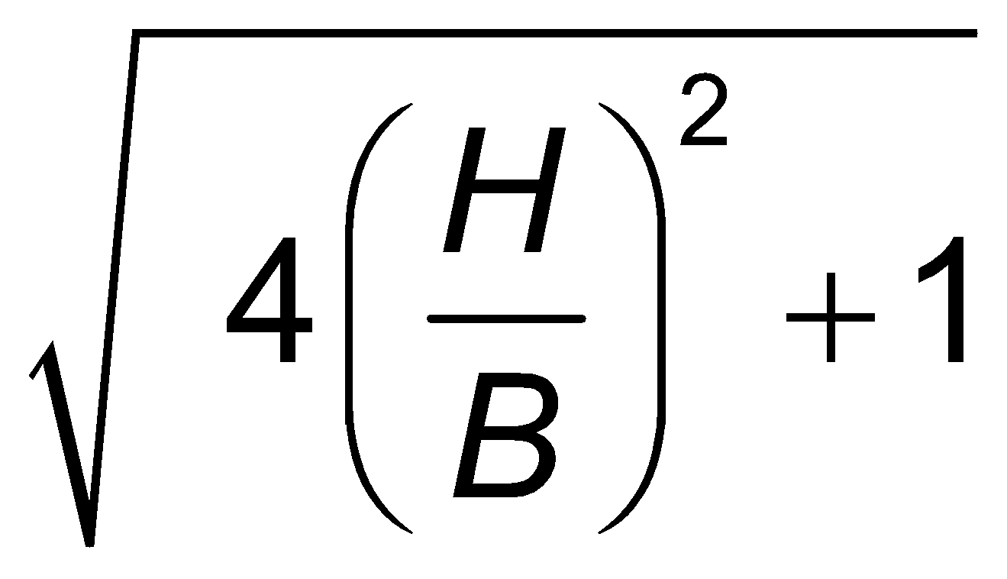
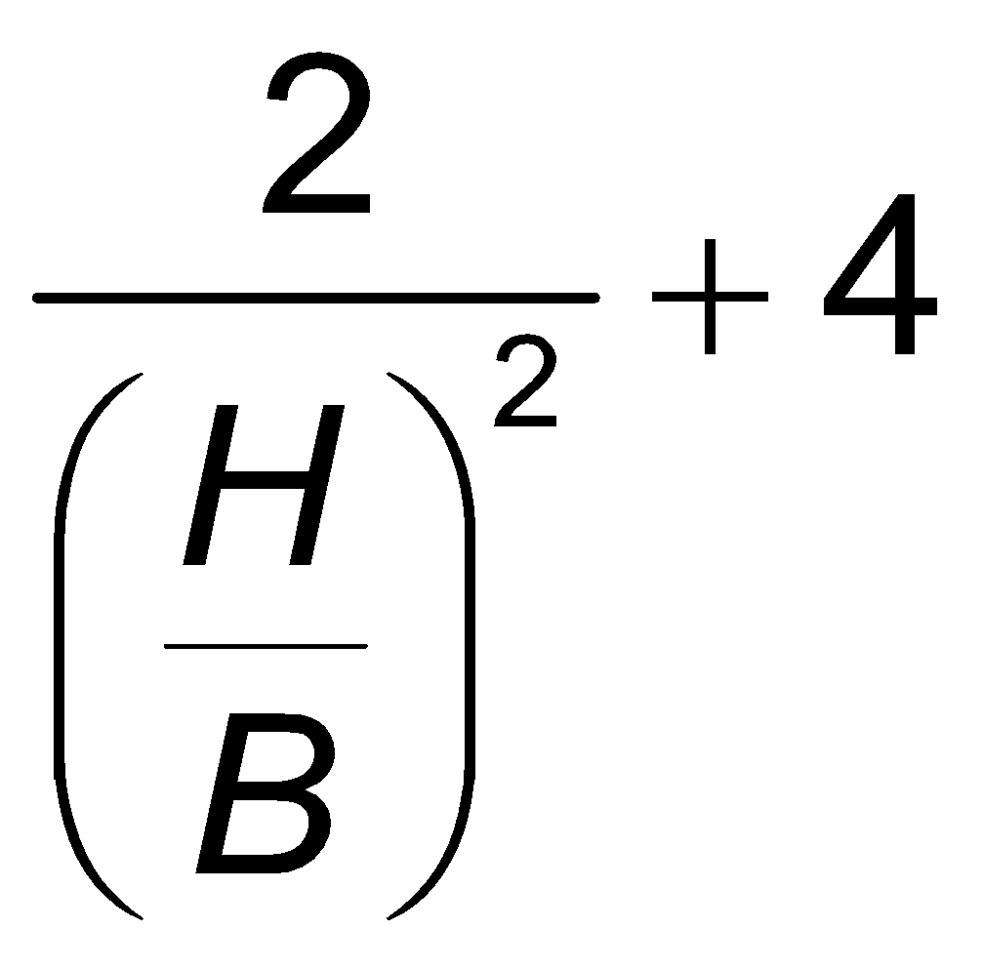
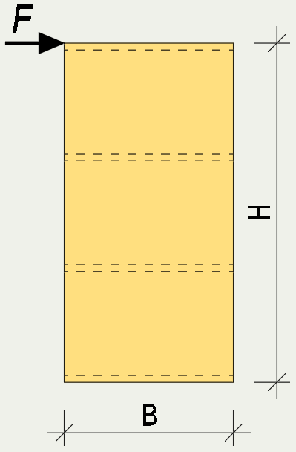
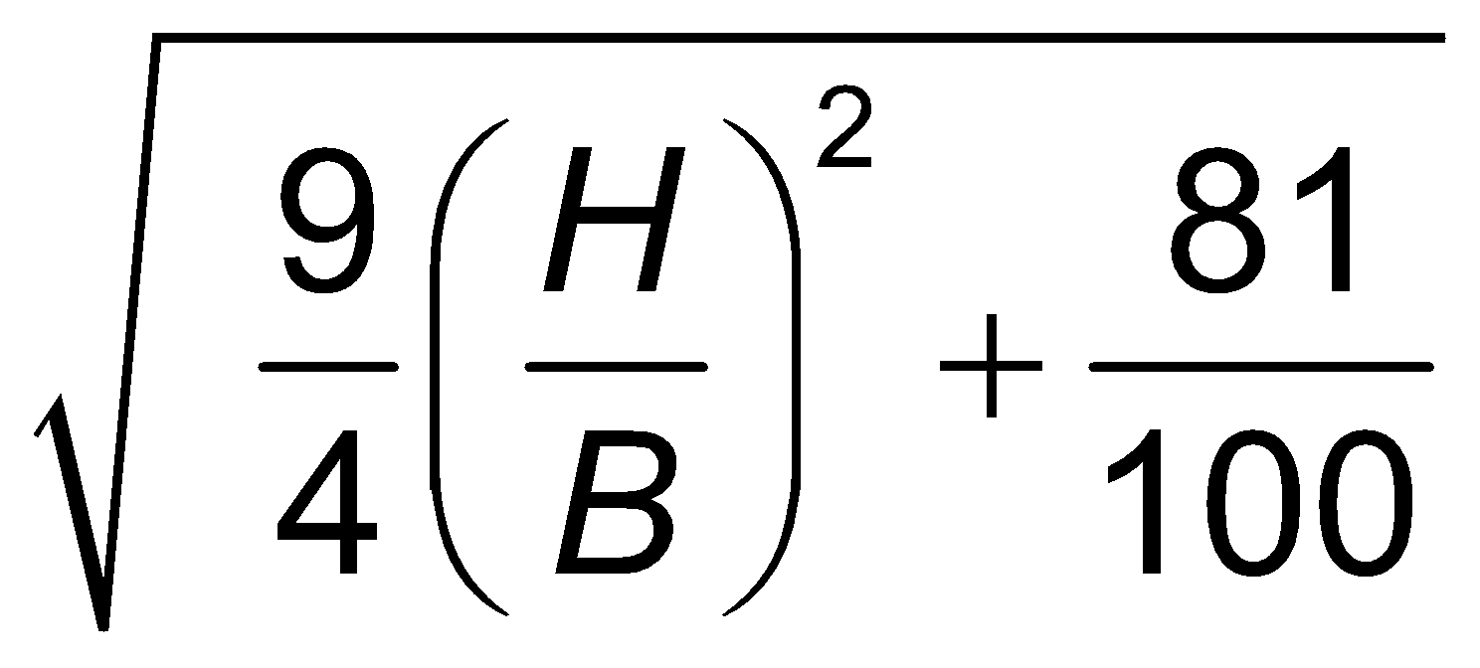
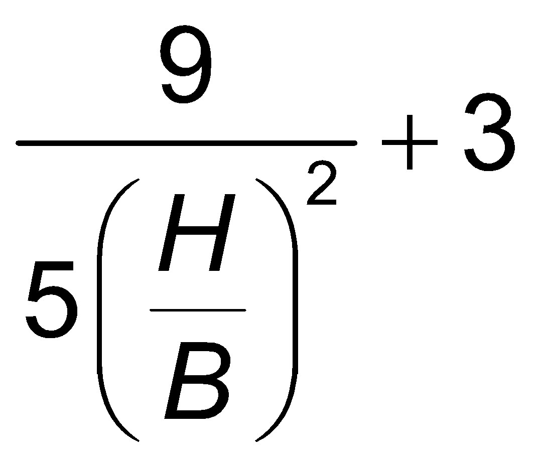
Factors for method of attachment
No | Attachment method | G factor | B factor
5
6

Slide 21
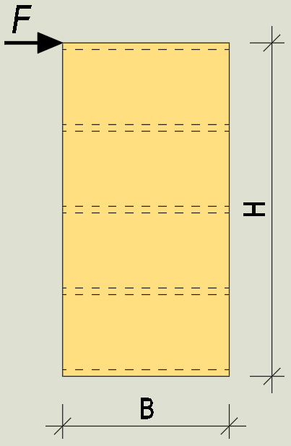
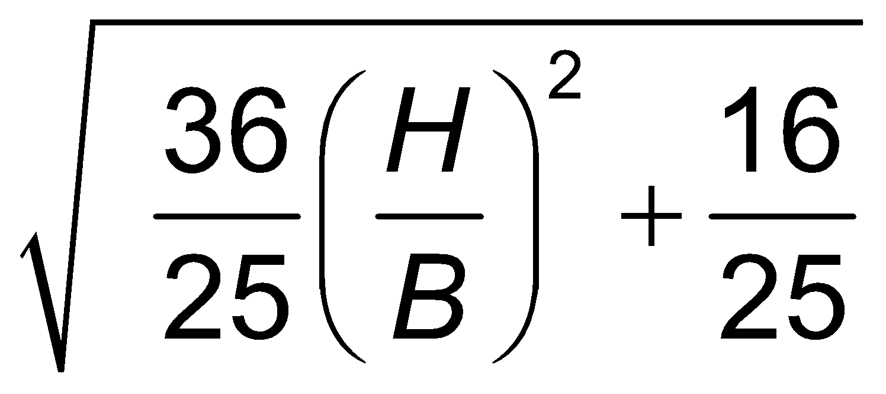
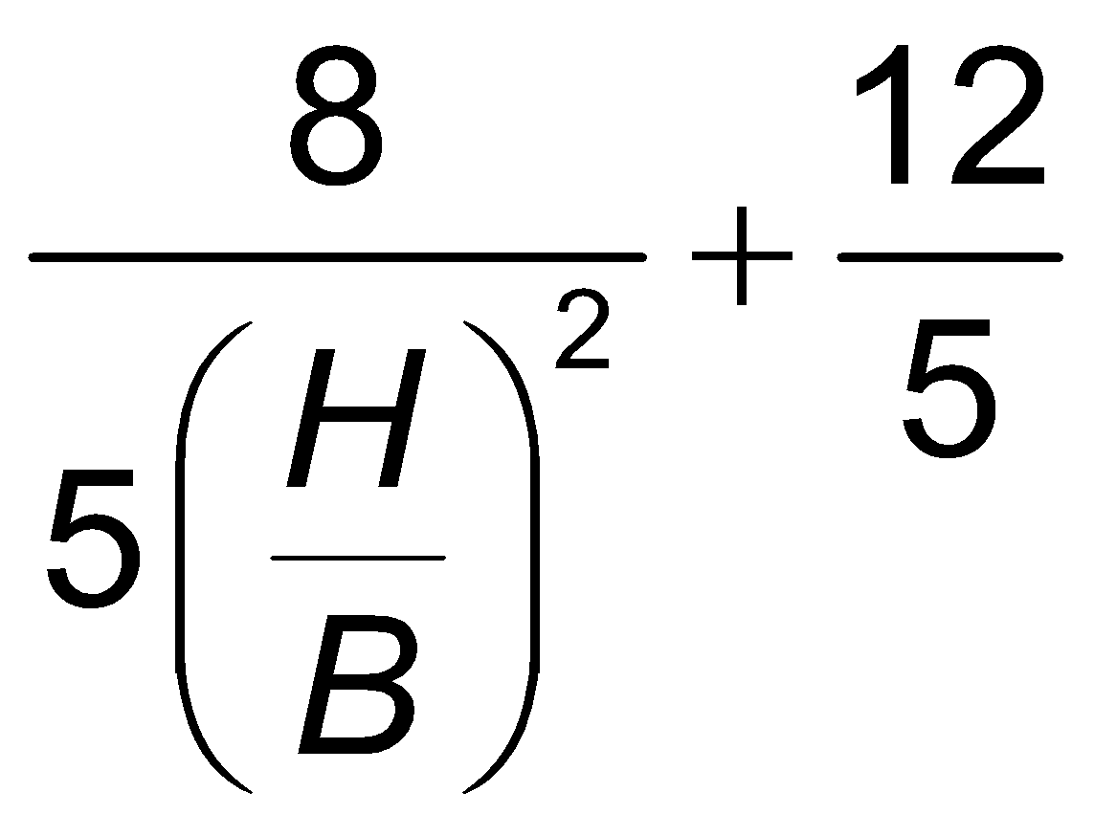
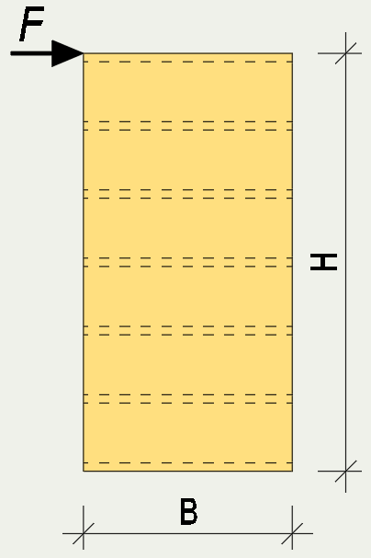
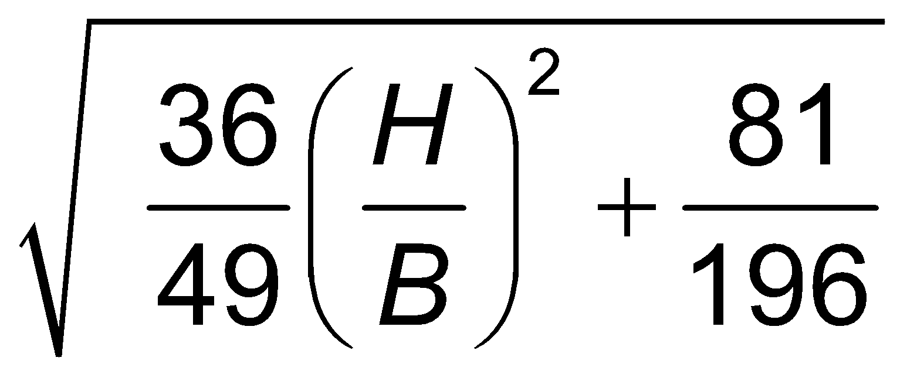
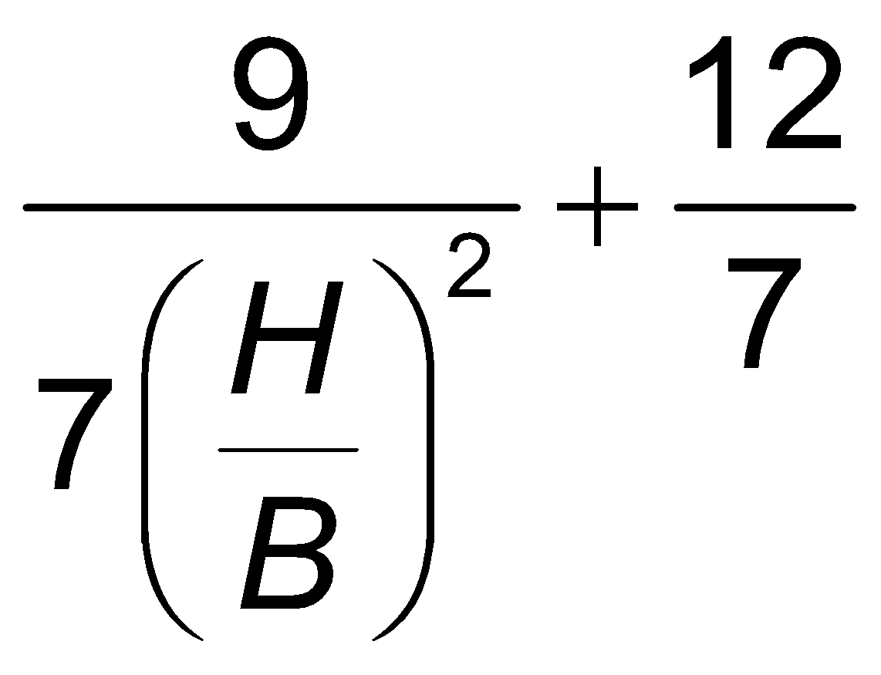
Factors for method of attachment
No | Attachment method | G factor | B factor
7
8

Slide 22
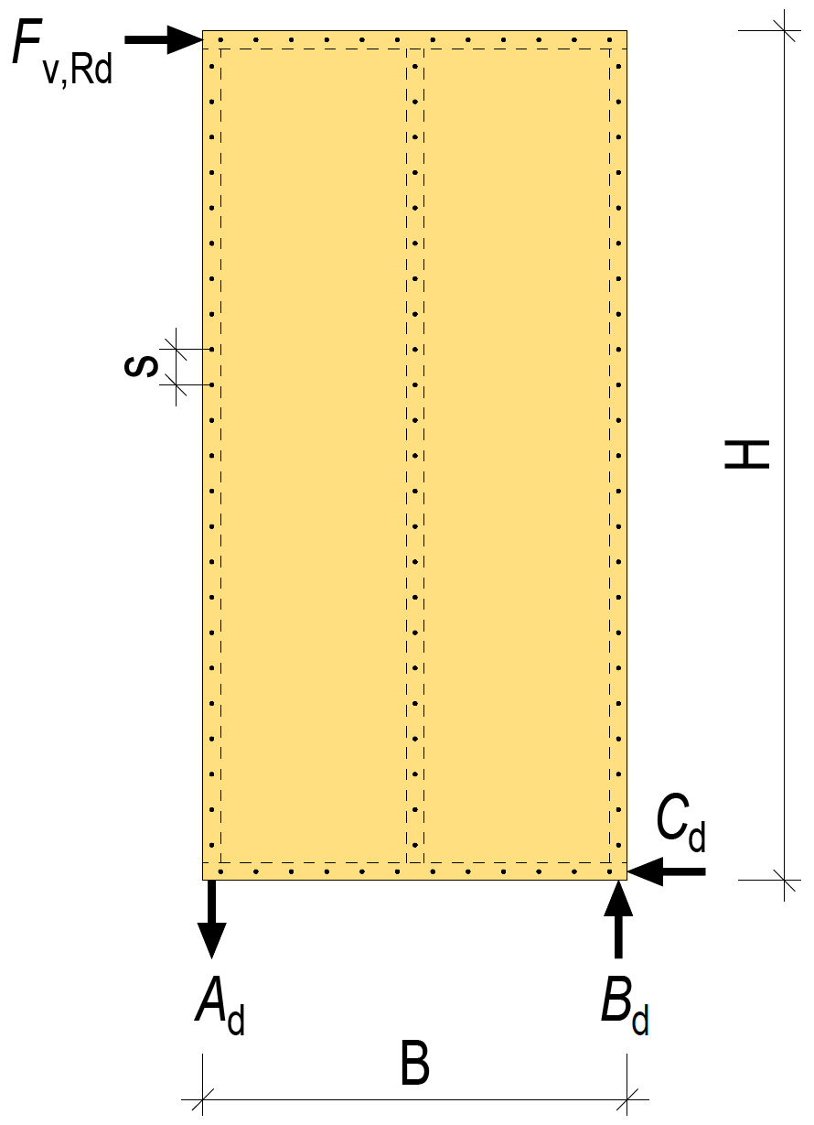
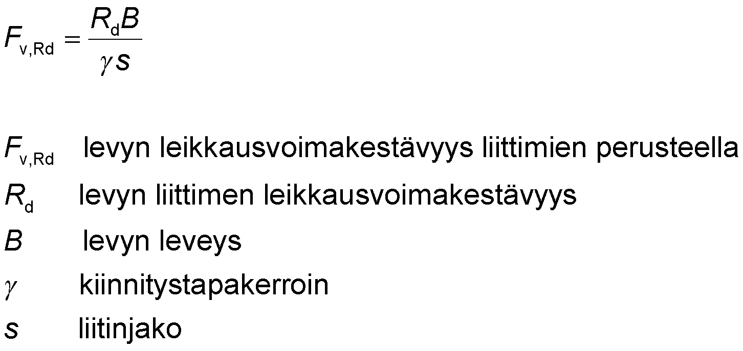
Shear strength of the panel’s connectors
The shear strength of the panel’s connectors is often a dimensioning factor in the panel stiffeners strength dimensioning
the shear strength of the panel on the basis of the connectors
shear strength of the panel’s connectors
width of panel
factor for method of attachment
spacing of connectors

Slide 23
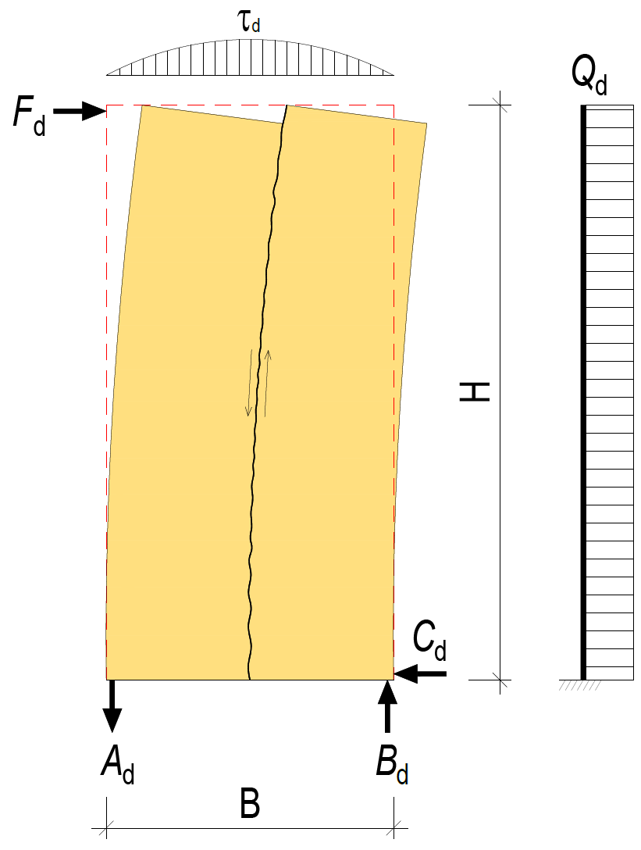
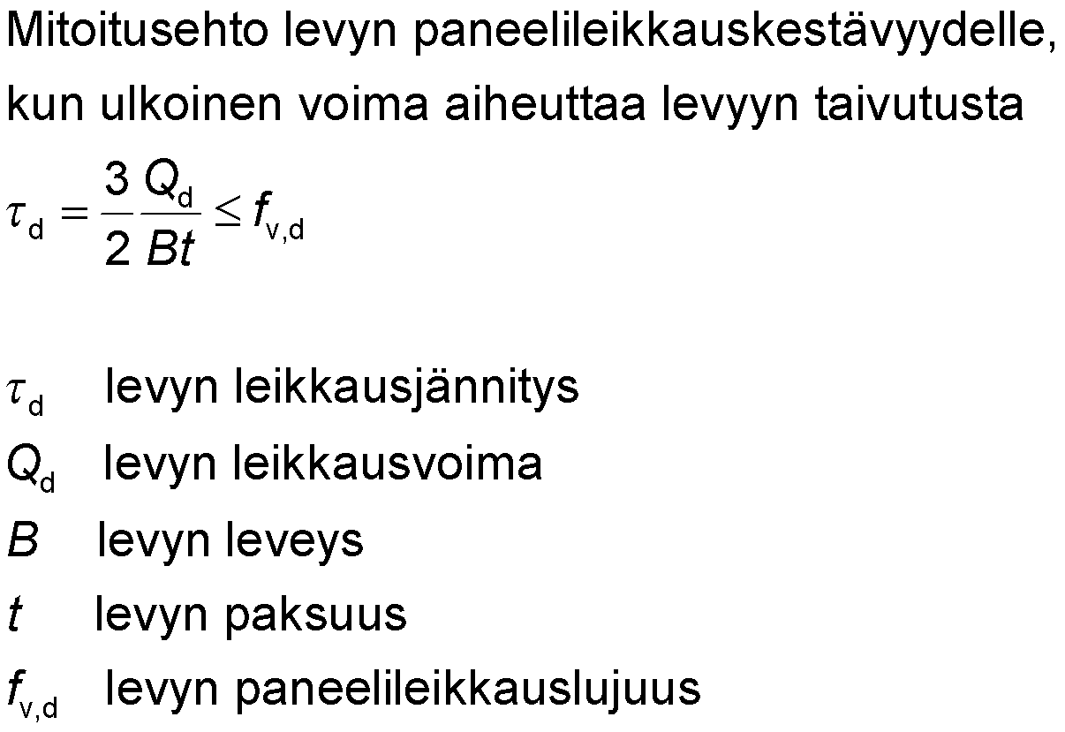
The panel’s panel shear strength
External force F_{d} exerts shear force Q_{d} on the panel
The dimensioning condition for the panel shear strength when an external force causes bending to the panel
the panel’s shear stress
the panel’s shear force
width of panel
thickness of the panel
panel shear strength of panel

Slide 24
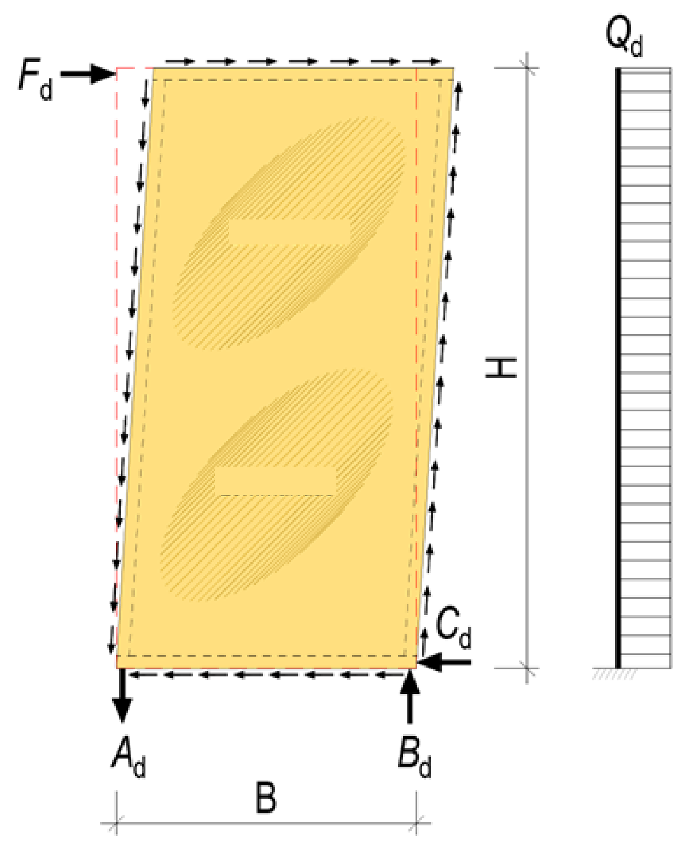
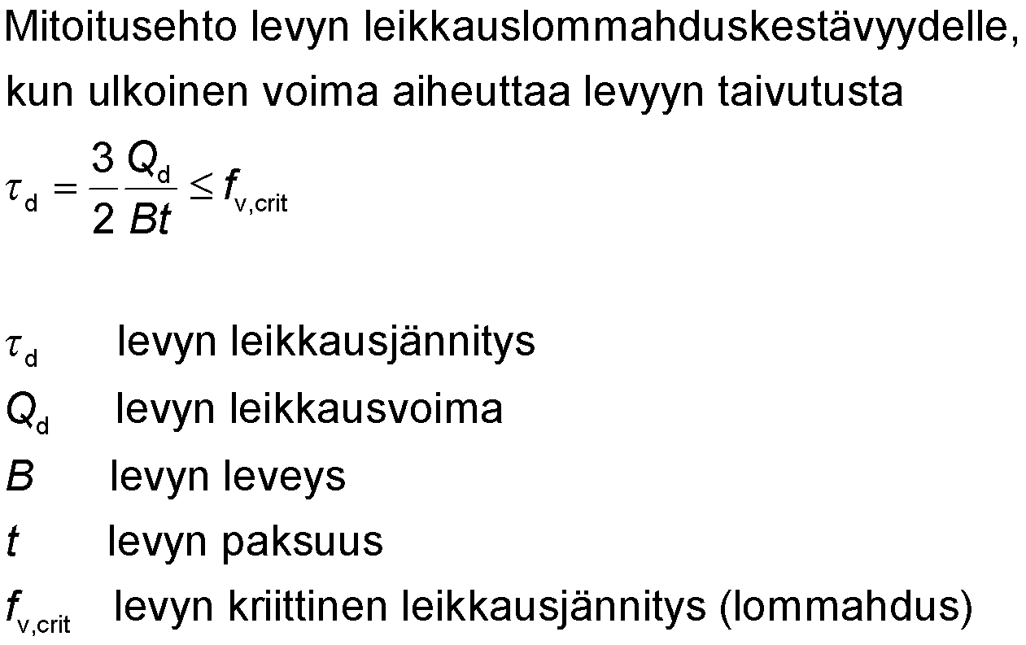
Local buckling resistance
External force F_{d} exerts shear force Q_{d} on the panel
Local buckling
The dimensioning condition for the shear local buckling resistance when an external force causes bending to the panel
Local buckling
the panel’s shear stress
the panel’s shear force
width of panel
thickness of the panel
the panel’s critical shear stress (local buckling)

Slide 25
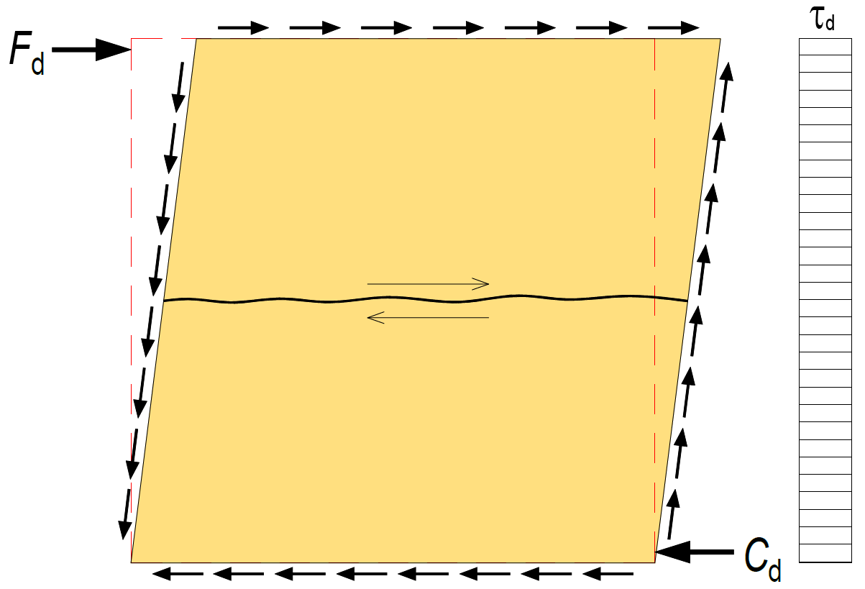

The panel’s panel shear and local buckling resistance
External force F_{d} can also only cause shear to the panel
Dimensioning condition for the panel’s panel shear and shear local buckling resistance, when an external force only causes shear to the panel
the panel’s shear stress
the panel’s shear force
width of panel
thickness of the panel
panel shear strength of panel
the panel’s critical shear stress (local buckling)

Slide 26


The panel’s critical shear stress
the panel’s critical shear stress in terms of local buckling
local buckling factor
panel bending stiffness per unit length (around the z-axis)
panel bending stiffness per unit length (around the x-axis)
the panel’s moment of inertia per unit length
thickness of the panel
the spacing of the panel’s edge supports
NOTE!
The characteristic value E _{0,05} is used for the modulus of elasticity

Slide 27

The spacing of the panel’s edge supports (a and c)

Slide 28


Local buckling factor
The spacing of the panel’s edge supports
The spacing of the panel’s edge supports
panel bending stiffness per unit length (around the z-axis)
panel bending stiffness per unit length (around the x-axis)
torsional stiffness of the panel

Slide 29


Torsional stiffness of the panel
The glide modulus of the panel (panel shear)
thickness of the panel
NOTE!
The characteristic value E_{0,05} is used for the modulus of elasticity
The characteristic value G_{0,05} is used for shear modulus

Slide 30

Factor k₂ when the panel has a tongue-and-groove joint
When determining the k factor for local buckling k₂ = 4, when there’s an unfastened tongue-and-groove joint between the stiffening panels
In the aforementioned case, the panel’s stiffening characteristics must be determined so that both the opposite edges of the panel are unfastened (even if the other edge is fastened)
Full tongue-and-groove joint

Slide 31

The panel’s bending strength
In addition to review of buckling, a plate with unfastened edges must be tested for bending strength with respect to the y-axis
In the case shown in the adjacent illustration, the plate is a bent protruding beam, for which the following should be checked
Tensile strength on the edge with traction
Lateral buckling resistance on compressed edge (lateral buckling on span a)
Traction on the edge of the panel
Compression on the plate edge

Slide 32


Dimensioning condition for plate bending strength
Tensile strength (bending in relation to the y-axis)
Compression strength (bending in relation to the y-axis)
Traction on the edge of the panel
shear strength of the panel’s connectors
factor for method of attachment
spacing of the panel’s connectors
thickness of the panel
The spacing of the panel’s edge supports
The spacing of the panel’s edge supports
The panel’s tensile strength (in direction z)
lateral buckling factor for the protruding beam with measurement a
the panel’s compression strength (in direction z)
Compression on the plate edge

Slide 33

The panel’s bending strength
The bending strength of the panel’s unfastened edge does not need to be checked, if the conditions in the table are met
Momentary duration category
Category of use 1, 2
Panel | Thickness of veneer [mm] | B = c [mm] | t [mm] | a_{max} [mm] | F_{v,Rd} [kN]
Softwood plywood ¹⁾ | 2.6…3.2 | 1200 | 15 | ≤ 600 | ≤ 7.0
Softwood plywood ¹⁾ | 2.6…3.2 | 1200 | 18 | ≤ 900 | ≤ 5.1
Softwood plywood ¹⁾ | 2.6…3.2 | 1200 | 21 | ≤ 1200 | ≤ 4.6
Softwood plywood ¹⁾ | 1.4 | 1200 | 15 | ≤ 600 | ≤ 7.6
Softwood plywood ¹⁾ | 1.4 | 1200 | 18 | ≤ 900 | ≤ 5.8
Softwood plywood ¹⁾ | 1.4 | 1200 | 21 | ≤ 1200 | ≤ 5.1
Chipboard | - | 600 | 22 | ≤ 600 | ≤ 11.0
The grain direction of the surface veneer is in the direction of measurement a
Full tongue-and-groove joint
Full tongue-and-groove joint

Slide 34


Stiffness modulus of the panel (shear)
Displacement
Displacement
stiffness modulus of the panel (shear)
factor for method of attachment
spacing of connectors
height of the panel
width of panel
thickness of the panel
the panel’s displacement factor
the panel’s glide modulus

Slide 35

Displacement caused by shear force
Displacement
Displacement
displacement of an individual panel from shear force
horizontal force that subjects loading to an individual panel
stiffness modulus of an individual panel (shear)

Slide 36

Distribution of external force on the panel
The panel’s stiffness modulus C_{v} can be used to determine the distribution of external force F_{d} on the stiffening panels
external force on an individual panel
stiffness modulus of an individual panel
sum of the stiffness moduli of the plates in the row
external force applied to a row of panels

Slide 37


Distribution of external force on the panel
Stiffness factor C_{v,1}
Stiffness factor C_{v,2}
EXAMPLE

Slide 38

Distribution of external force on stiffeners
Stiffeners and the stiffness of building elements that combine these have a significant effect on the distribution of external force F_{d} on stiffening building elements

Slide 39

Distribution of external force on stiffeners
Stiffeners and the stiffness of building elements that combine these have a significant effect on the distribution of external force F_{d} on stiffening building elements

Slide 40

Distribution of external force on stiffeners
Stiffeners and the stiffness of building elements that combine these have a significant effect on the distribution of external force F_{d} on stiffening building elements

Slide 41

Vertical bearing reactions of stiffening walls
Vertical forces cancel out in joints between the same types of panels, when the panels are fastened to the same frame

Slide 42


Vertical bearing reactions of stiffening walls
The favourable portion of the permanent strain can be taken into account when determining the stiffening wall’s support reactions
(resultant for the affordable section of the sustained load)
(affordable section of the sustained load)

Slide 43

Vertical bearing reactions of stiffening walls
Support reaction B_{d} causes transverse compression stress to the bottom plate
Due to the support pressure strength and the buckling resistance of the frames, several frames are usually needed side by side
The panelling should be attached to all frames (buckling support)
(resultant for the affordable section of the sustained load)
(affordable section of the sustained load)

Slide 44

Vertical bearing reactions of stiffening walls
A wall with a horizontal rainscreen will require, blocks at support reactions A_{d} and B_{d} to transfer forces between the stiffening panelling and the load-bearing frame
Fastening of stiffening panelling to a horizontal rainscreen is not recommended
Blocks

Slide 45

Vertical bearing reactions of stiffening walls
Stiffening panel on a wall with horizontal rainscreen should be fastened directly to the bearing frame, so as to achieve the following
Greater strength of stiffener
Greater stiffness of stiffener
Easier implementation of the stiffener

Slide 46

Overlapping walls
The stress on a stiffening wall can be seen from the shear force and torque surfaces
In the case of overlapping walls it should be noted that anchoring may be needed also between the overlapping walls

Slide 47

Stiffening horizontal structure
The panelling of a stiffening horizontal structure forms a panelling line that resembles a stiffening wall
The greatest shear force is located at near the support
From a manufacturing point of view, it is recommended to attach all panels with the same connector spacing
There are usually unfastened panel edges on horizontal structures (tongue-and-groove joints)
Tongue-and-groove joint

Slide 48


Stiffening horizontal structure
Continuous chords, to which torsion is exerted, are needed at the edges of a stiffening horizontal structure
Chord
Chord

Slide 49


Displacement of stiffening horizontal structure
Average displacement caused by shear force can be determined on the basis of the displacement of rows of panels
Displacement caused by shear force is usually decisive
displacement from shear force
(horizontal structure with double support)
displacement of an individual row of panels

Slide 50


Displacement of stiffening horizontal structure
Displacement caused by torque can be determined on the basis of the deformation of chords
Deformations in extensions of chords will increase displacement
displacement from torque (double support horizontal structure)
horizontal torque
span of a horizontal structure
mutual distance between chords
area of a chord’s cross-section
the chord’s average modulus of elasticity

Slide 51

Implementation of a horizontal structure
The panelling of the horizontal structure built on site usually overlaps
in an element-based horizontal structure the fastening of the element joints to shear force is a notable dimensioning aspect
Horizontal structure built on site
Elemented horizontal structure
Elemented horizontal structure
Element 1 Element 2 Element 3 Element 4 Element 5
Element 1 Element 2 Element 3 Element 4 Element 5
panel
panel
E.g. LVL panel

Slide 52

Modelling of the stiffening framed structure
Stiffeners can be modelled with a simple wire-frame model
A rod structure can help in creating stiffening panel or a model that illustrates the entire element
Displacement can be adjusted to correspond with the stiffening panel’s or element’s displacement by altering the stiffness of diagonal rods
Displacement
Displacement

Slide 53

Modelling of the stiffening framed structure
Rod structure can be utilised to model in particular horizontal structures
The horizontal structure model’s results will be
Displacements
Chord forces

Slide 54

Opening in a horizontal structure
Chord
There must be chords at the edge of the horizontal structure’s opening, which must be anchored to the panelling next to the opening
Anchoring will exert additional shear force at panels to which the chord is attached
The intact panelling at the location of the opening must be able to endure the shear force at the location of the opening
Chord
Chord
Chord

Slide 55

Example of an intermediate floor’s displacement
The image shows the average displacement of the intermediate floor formed by four identical elements based on the shear displace of the panel
The displacement of connections between elements will increase the average displacement of the intermediate floor
Connection stiffness is a significant factor

Slide 56

Example of an intermediate floor’s displacement
The image shows how the average displacement of the intermediate floor is determined on the basis of the shear displacement of the panelling, when there is an opening in the intermediate floor
An opening will increase the intermediate floor’s displacement
Z direction free
X direction closed
Z direction free
X direction free

Slide 57

Example of an intermediate floor’s chord forces
The sum of the wire-frame model is chord forces.
A chord must be continuous between the supports for the intermediate floor
The horizontal structure in element structures is usually a separate beam or similar, to which to element is fastened
Chord force
Chord force

Slide 58

Example of an intermediate floor’s chord forces
The sum of the wire-frame model is chord forces.
The chords on the edge of the opening must be anchored to the panelling along the edge of the opening
Anchoring force will increase the panelling's shear stress
Chord force
Chord force
Chord force
Chord force

