Slide 1



Industrial wood construction
Teaching materials for industrial wood construction education
2022

Slide 2
Origin of the materials
Use of the materials
These learning materials for industrial wood construction have been prepared in a project led by Puuinfo Oy in 2021–2022. Also involved in the project were
Lappia Vocational College,
TTS-Työtehoseura ry
South-Eastern Finland University of Applied Sciences,
Metropolia University of Applied Sciences,
Jyväskylä University of Applied Sciences,
University of Tampere, and
Federation of the Finnish Woodworking Industries Puutuoteteollisuus ry
The project was funded by the Ministry of the Environment.
The materials are intended to be used as extensively as possible in industrial wood construction education and studies.
The materials are released under the Creative Commons licence Attribution-ShareAlike (CC BY-SA), which requires that the author be properly credited when the materials are used and that derivative works may only be distributed under the same licence as the original work.
The original materials and any updates to them by Puuinfo will be published on the Library of Open Educational Resources website (aoe.fi) and the Puuinfo.fi website.

Slide 3
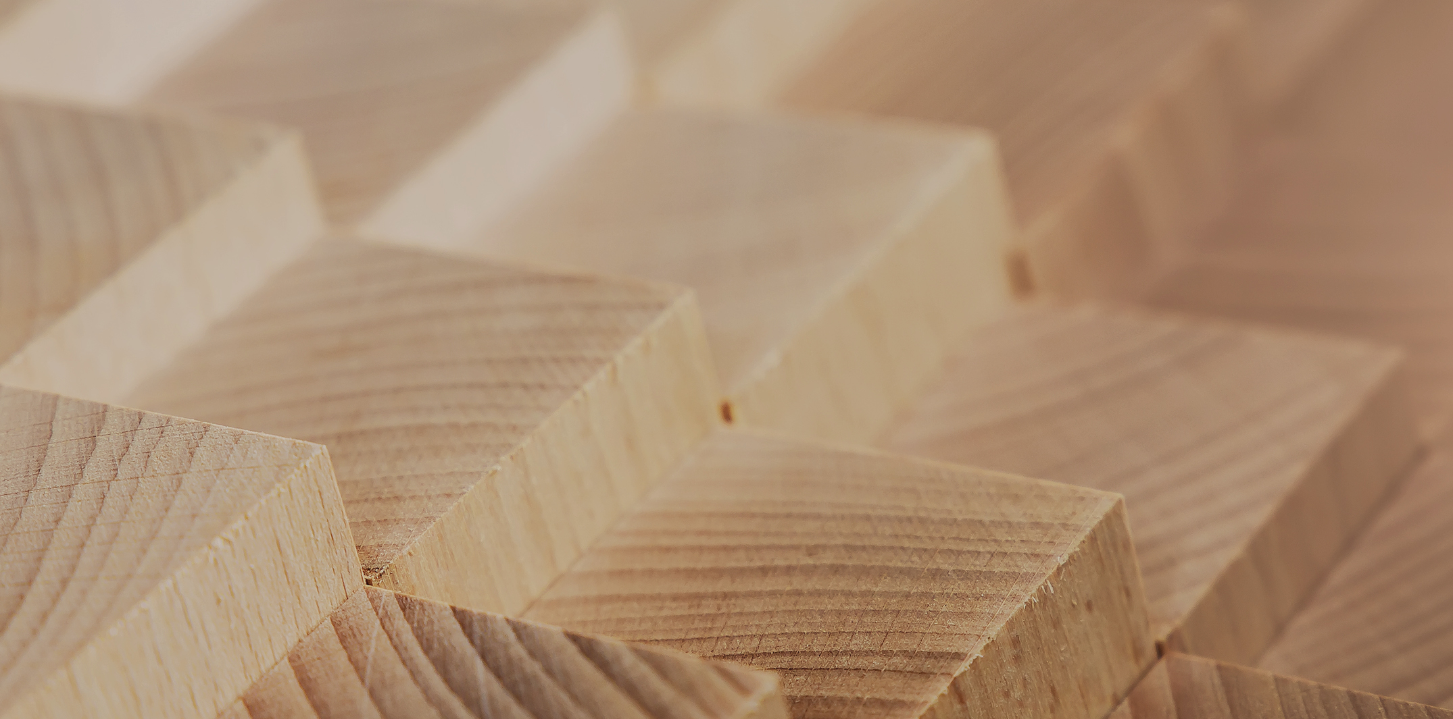
Structural design

Slide 4
Authors
Sami Pajunen, University of Tampere
Release date: 31/03/2022

Slide 5
Joints 1 – Screw connections

Slide 6
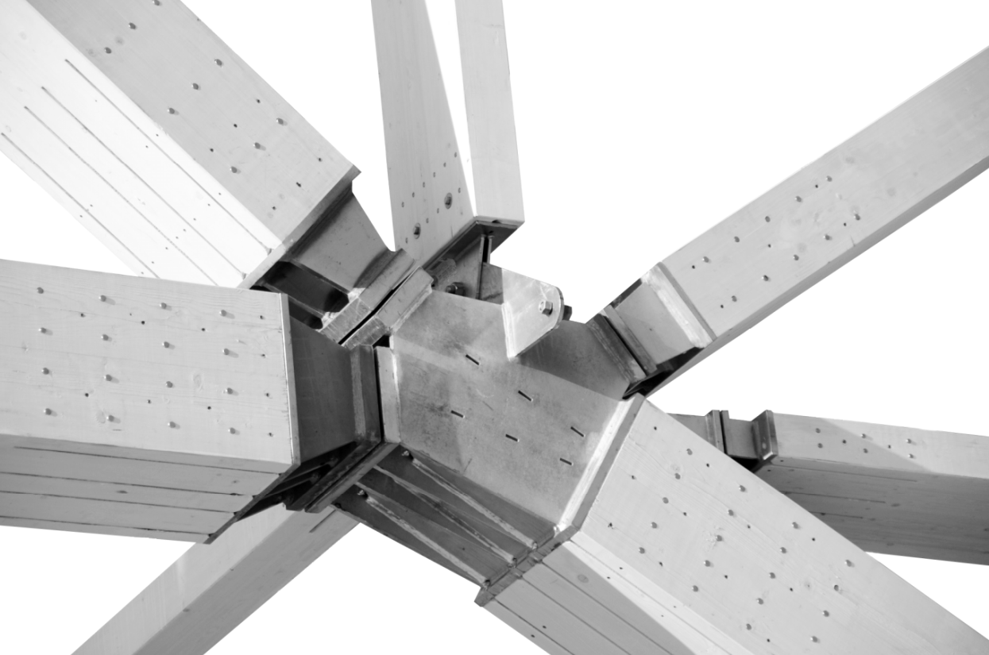
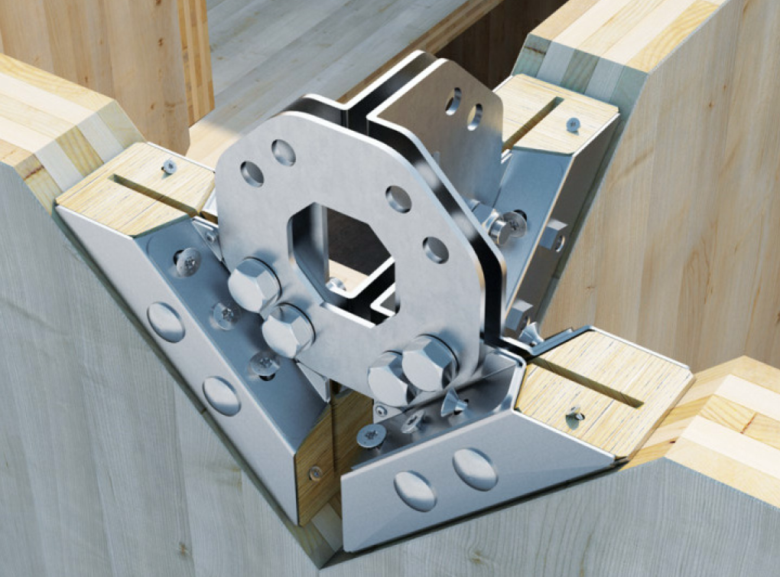
General principles of joint design
The design of a structure can be divided into the design of structural elements (beam, column, etc.) and joints.
The joint must have sufficient strength to withstand the stresses it is subjected to.
It must be possible to determine the rigidity of the joint in different directions, as this has a significant impact on the behaviour of the entire building.

Slide 7
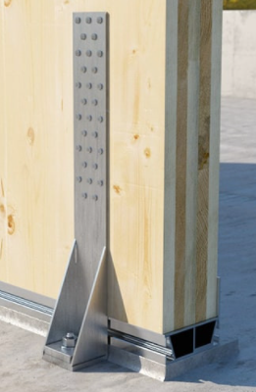
General principles of joint design
The actual operation of the joint and the model used in the design must be compatible:
The joint dimensioned as a joint must be able to twist without damage
A joint that is rigid in a certain direction must be able to accept the stresses created in that direction.
The more tough the joint is (i.e. the more deformation it tolerates without losing its carrying capacity), the more efficient it is to utilise the capacity of individual connectors

Slide 8

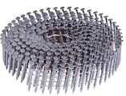
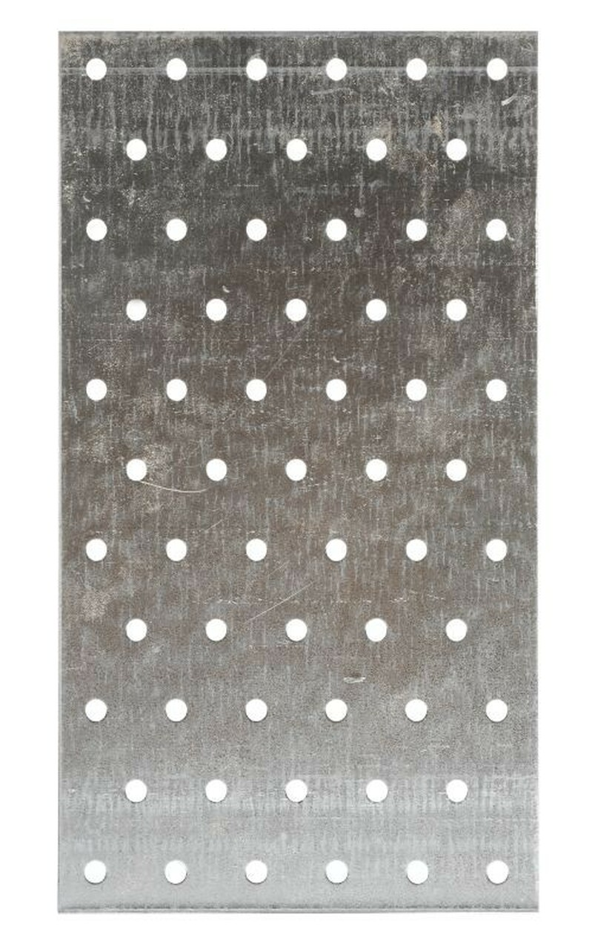
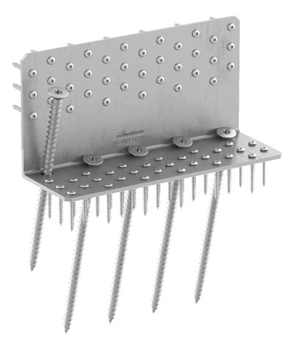
Various knives
Pin connectors
All rod-type connectors transmitting joint forces by shear and/or normal force
The sizing of screw connectors is based on screw connection theory, the general idea of which is essential for connector sizing
Pin connectors are used to join wood, wood-to-wood plate and wood-to-steel plate in joints
Plate-like fittings
Used especially in roof trusses (NR) made of sawn timber and in spatial element construction
Ring, plate and tooth dowels
Industrial connections (joist hangers, corner plates, etc.)

Slide 9
Different pin connectors
Connector | For consideration | Examples of applications
nail | Numerous conditions are given in EC5 for the diameter, penetration, thickness of the nail (as well as for the other connectors listed below), the thickness of the parts to be connected, the possible pre-drilling and the nail spacing and edge distances of the nail groups. | Sawn timber joints Single joints for single-family house construction not requiring high load bearing capacity
screw | Screw types can be divided into self-drilling and cap screws (required pre-drilling). The threaded portion of the screws and the diameters of the smooth portion affect the operation of the screw The screw joint has several fracture types from the nail joint, which must be checked according to EC5 The rope effect is also taken into account in the screw connection | Joints requiring higher force transmission capacity Especially efficient wood-steel plate in joints Skewed joints (which are considerably stronger and more rigid than the straight-run joints)
Bolt and dowel | The different operation of the bolt and screw can be seen especially in the dimensioning of the longitudinal load Surgical-loaded bolt instructions apply to the pin stud with certain exceptions | Bolt joints The dowel is used almost exclusively for steel plate joints immersed in wood.
Adhesive screw and rod |  | Foundation joins, reinforcements

Slide 10
Matters to be taken into account when designing the joint 1/2
Number of cuts in the joint (single or multi-cut)
Make sure that the durability is calculated according to the weakest cut, cf. EC5:8.1.3
Type of connector correctly selected by target (rod, dowel, nail plate, ...)
Ensure that there is no breakage perpendicular to the grain
This fracture type is fragile and therefore particularly dangerous, cf. EC5: 8.1.4
In the case of a connector group, dowel or nail plate, consideration shall be given to the possibility of partial fragmentation or full fragmentation.
Cf. EC5: Annex A
If the forces applied to the joint can change direction, this must be taken into account.
Cf. EC5: 8.1.5
Operation of the joint in use limit state (transitions, possible loosening)

Slide 11
Matters to be taken into account when designing the joint 2/2
Defining the properties of the materials and products in the joint
Spacing and edge distances between connectors
Determining the durability of a single connector → the durability of a group of connectors
Note the effective number of connectors, cf. EC5 (8.1). The durability of the connector group does not always increase linearly in relation to the number of connectors
Calculation of the dimensioning load on the joint with a realistic model
If the joint is eccentric, the resulting moment load must be taken into account!
Check that the resistance is greater than the stress on the joint, taking into account all fracture types
EC5 contains instructions and formulas for all the above mentioned points, the most important of which are mentioned above
In these slides are presented the key aspects of joint dimensioning, but not all the details-level issues found in EC5.

Slide 12
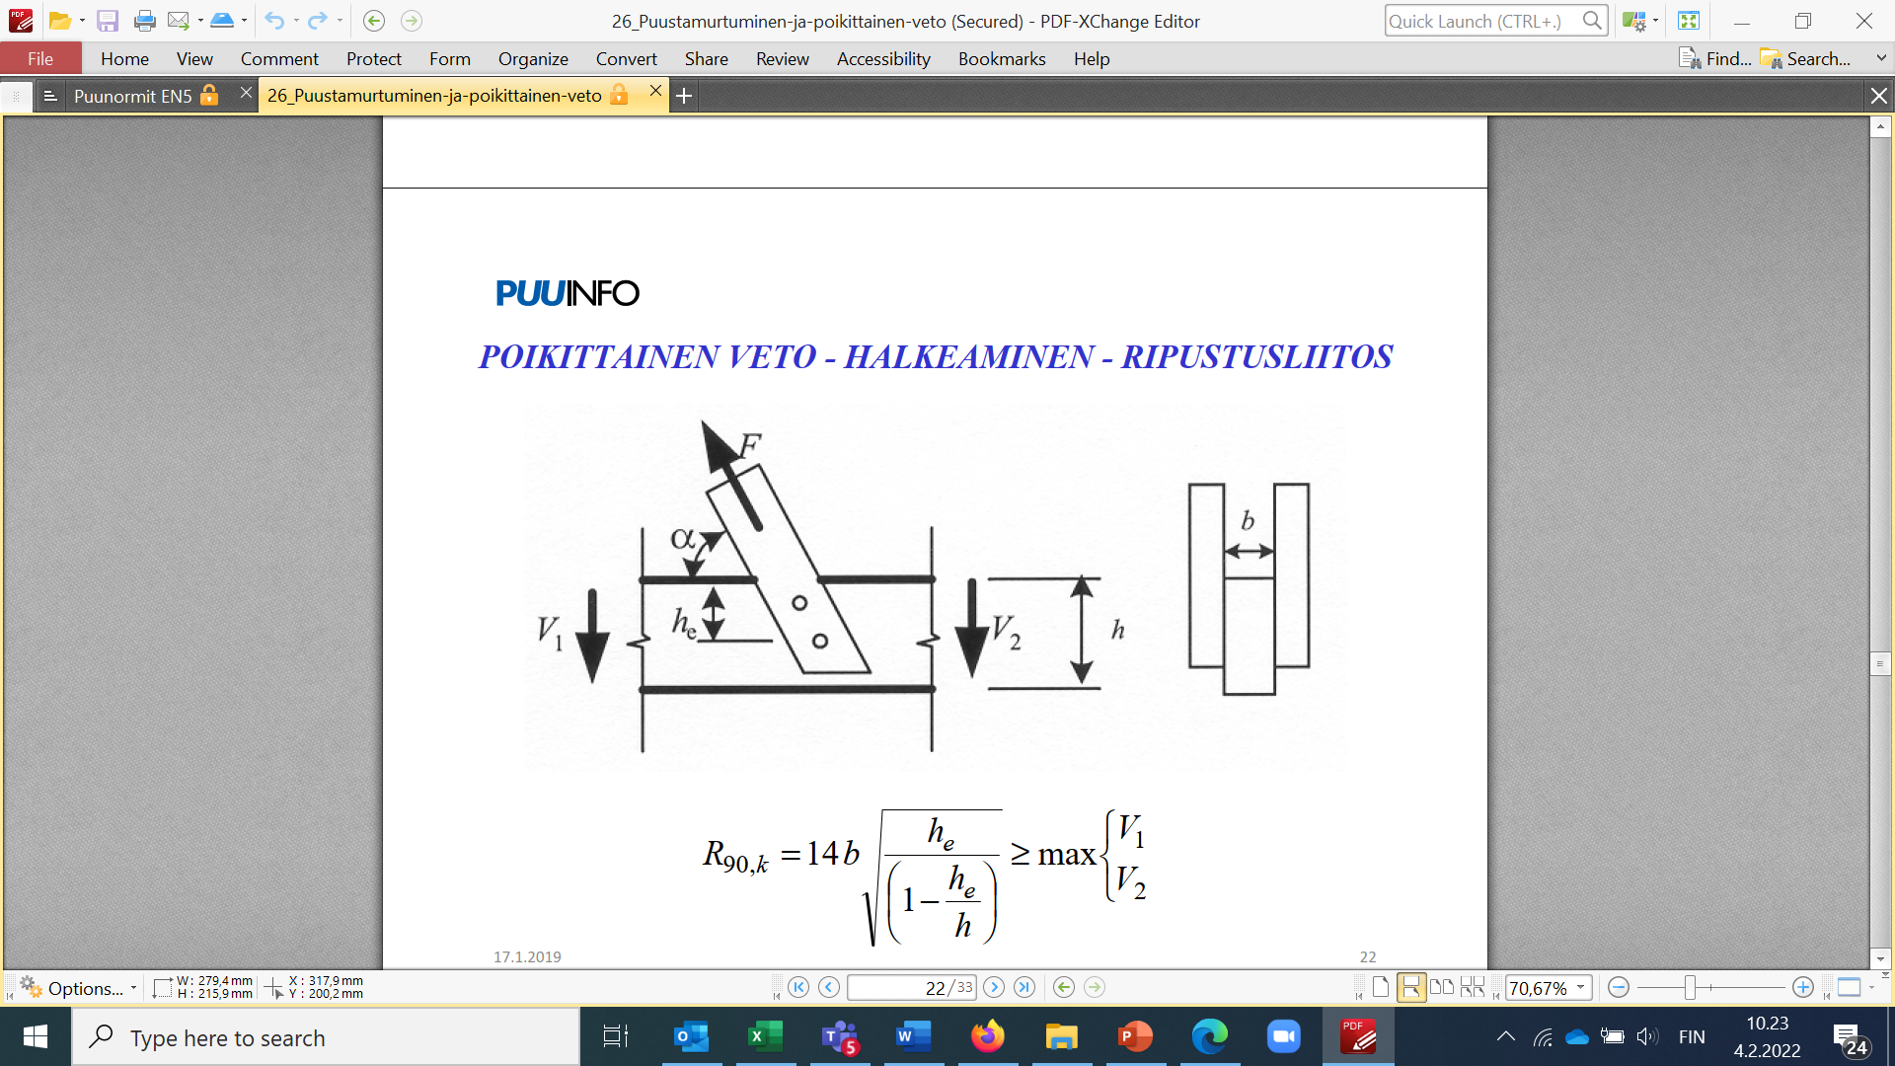
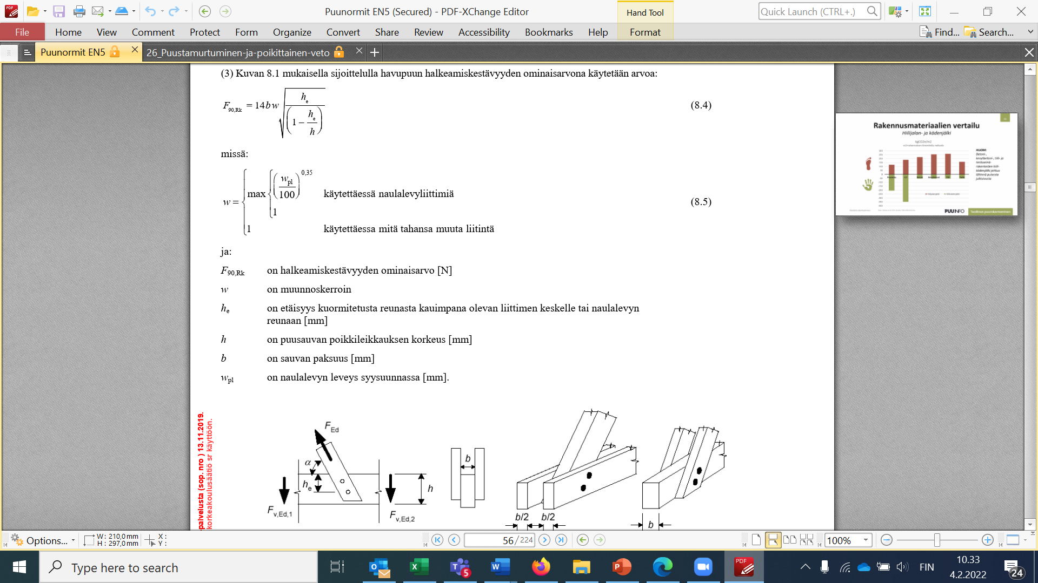
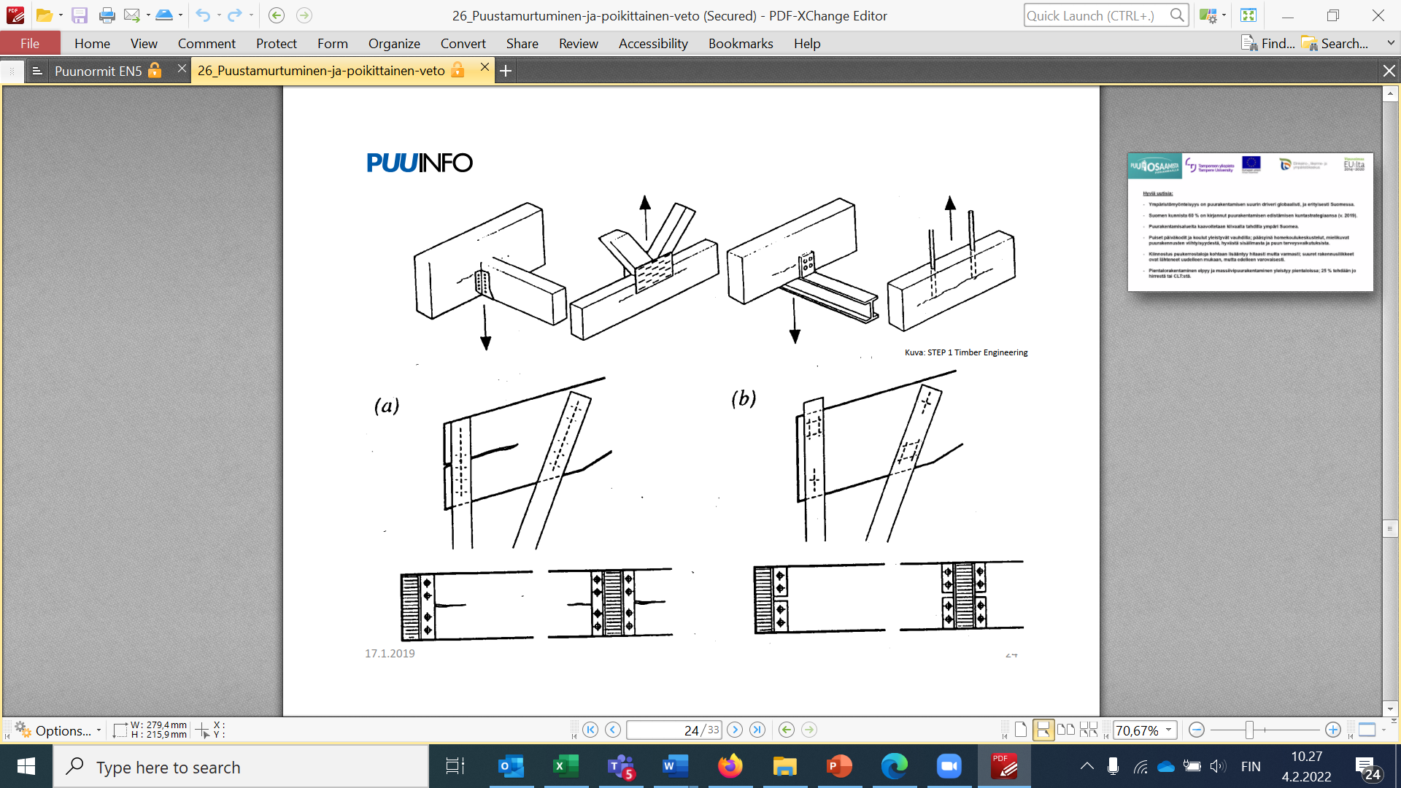
Perpendicular fracture to grain
If the wooden structure is subjected to a load with a force component in the perpendicular direction to the grain, the possibility of cracking must be taken into account
In a situation similar to the upper figure, the crack resistance of the joint is
Where w = 1 for pin connectors and nail plates according to the EC5 formula (8.5)
The lower figure shows improperly made joints where the joint distance from the edge is too small

Slide 13
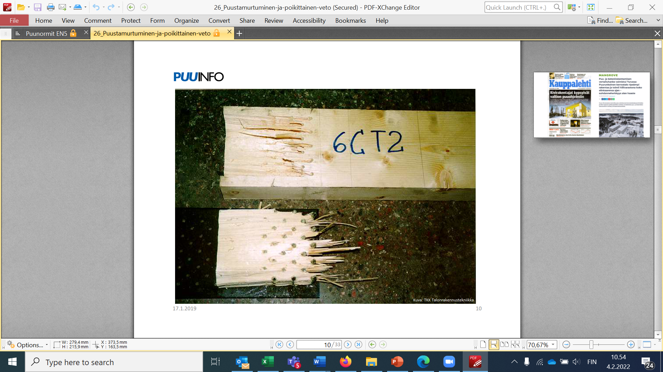
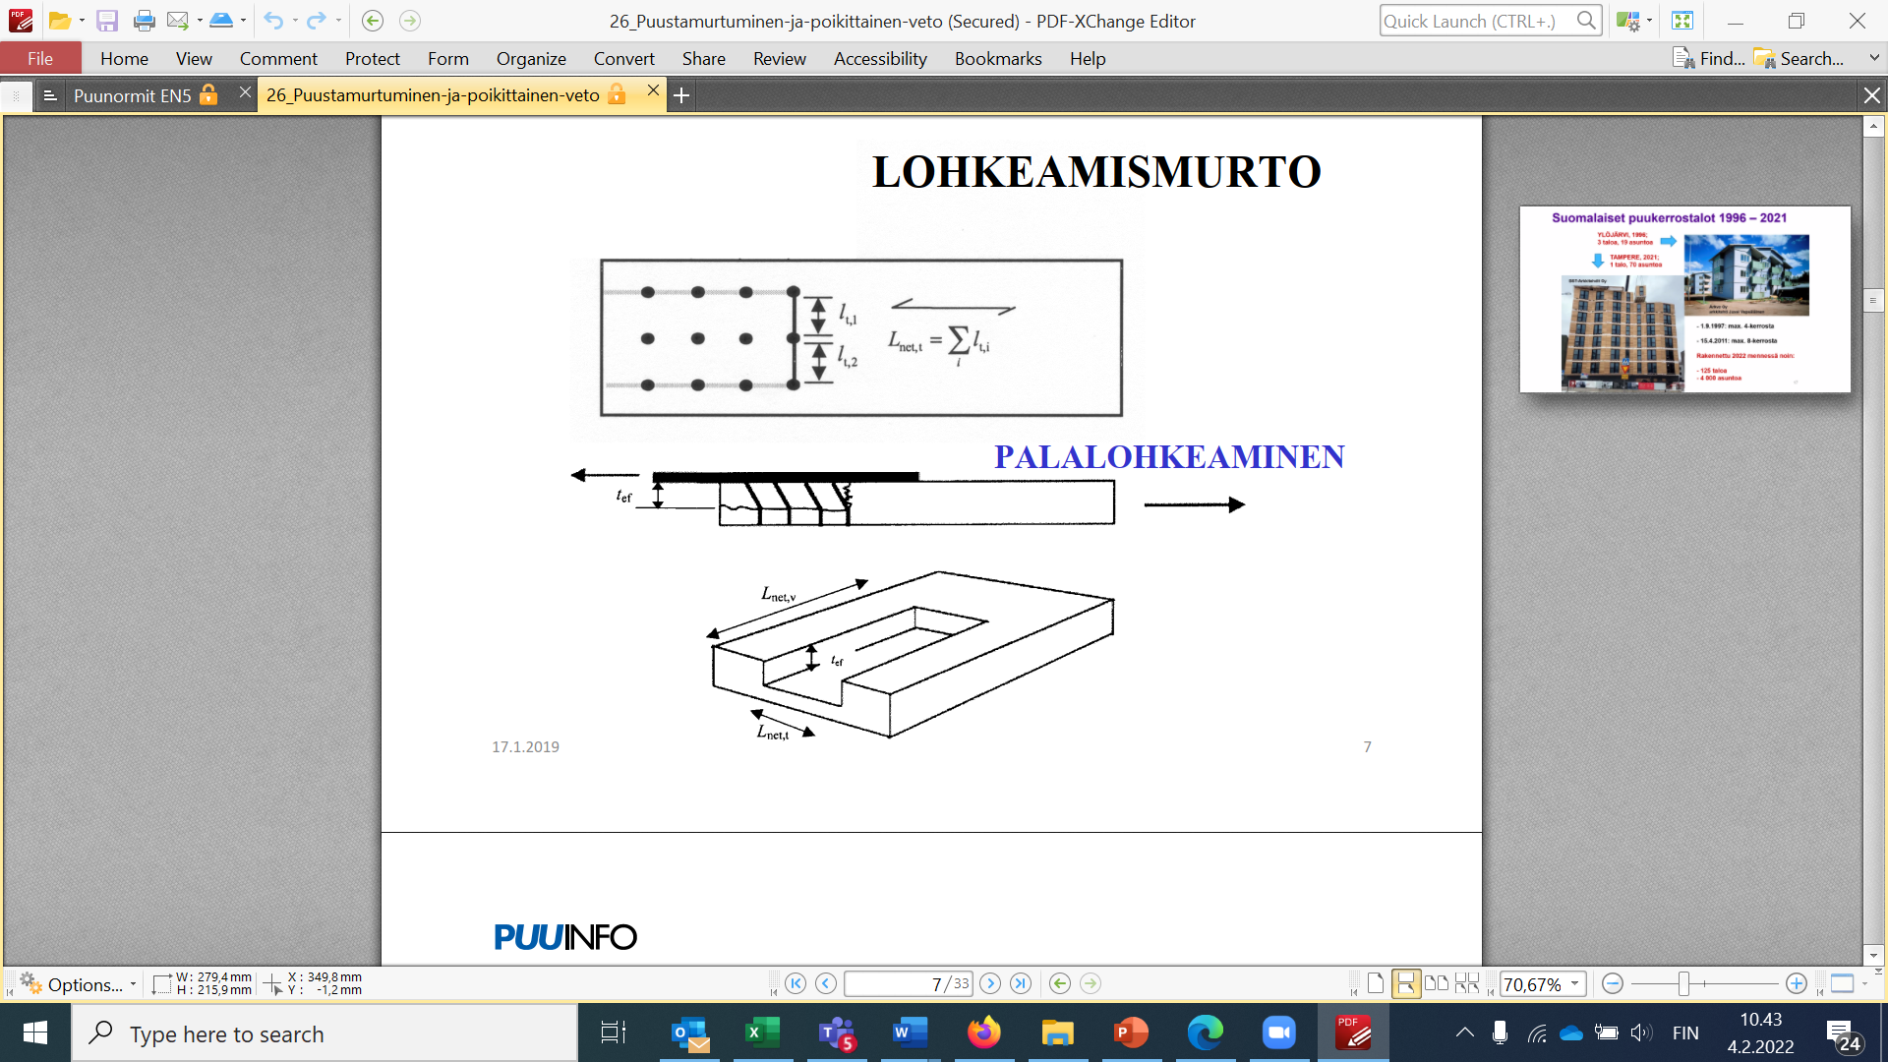
Partial fracturing
Partial fracturing must be checked for, especially in joints between a steel plate and wood.
The resistance of the joint to fracturing is obtained from the shear and tensile strengths of the surfaces of the cut-off piece of wood (EC5, Annex A)

Slide 14
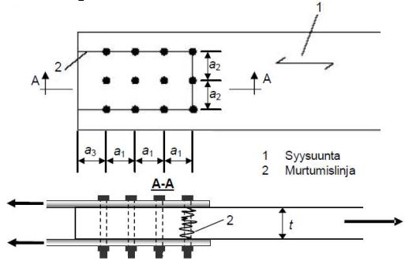
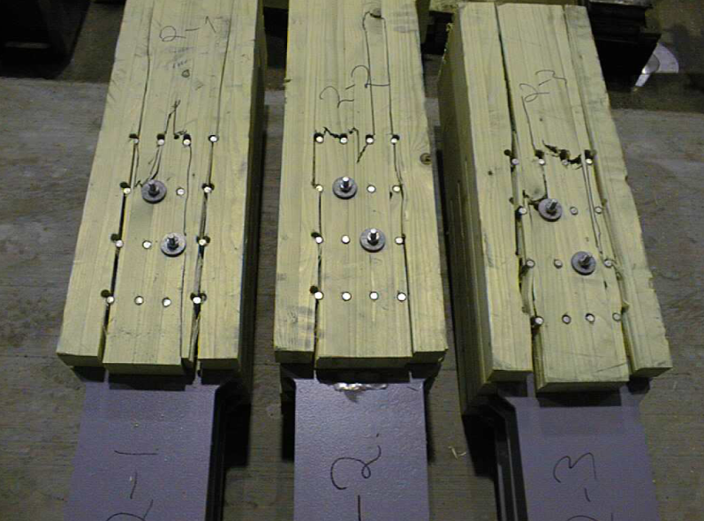
Fracturing
Check for breakthroughs in bolt and dowel connections.
The resistance of the joint to fracturing is obtained from the shear and tensile strengths of the surfaces of the cut-off piece of wood (EC5, Annex A)
1 Grain direction
2 Fracture line

Slide 15
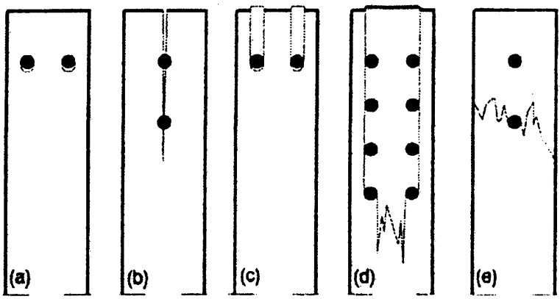
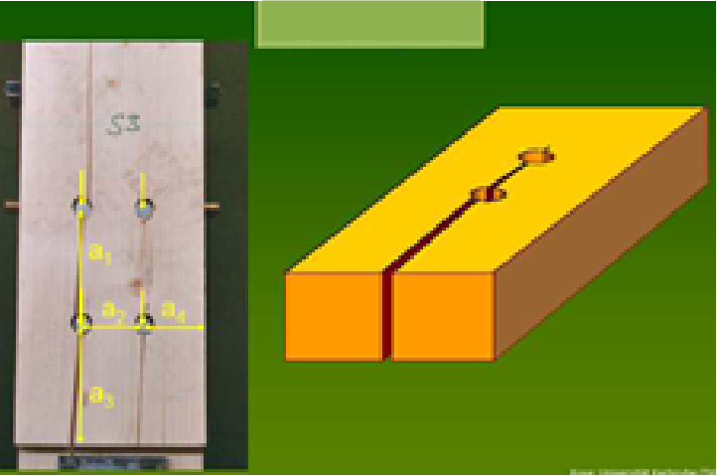
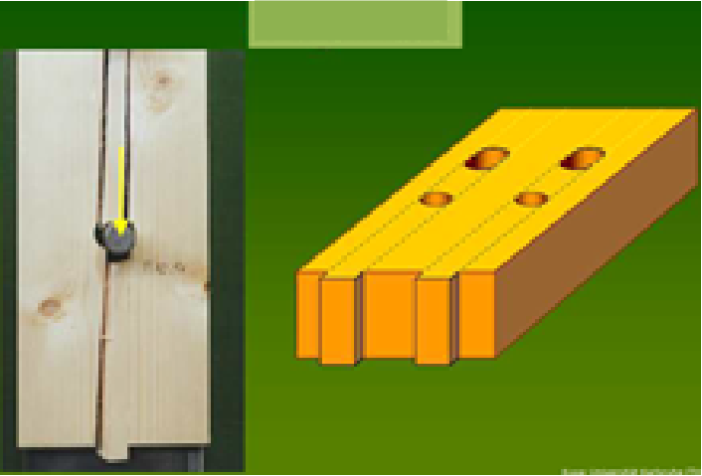
Spacing and edge distances between connectors
A joint in traction parallel to grain can fracture in several ways, as shown in the figure
Fracture type (b): Connectors too close to each other
Fracture type (c): Connectors too close to the edge
Other fracture types
(a): the edge compression strength of the wood is exceeded
(d): chippings (described above)
(e): tensile strength of wood (possibly caused by a voltage build-up next to the connector)
Cracking
Line cut

Slide 16

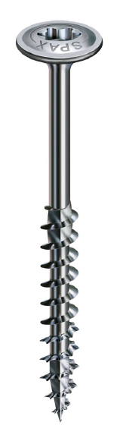
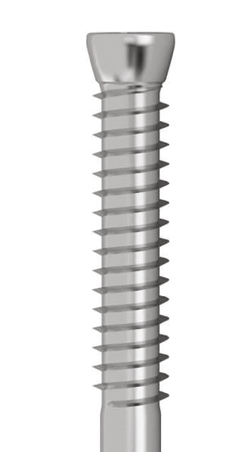
ETA approval of connectors
The EC5 contains general dimensioning formulas that require the material values of the product or the values of other properties.
For example, for wood material these values can be found in a table, but for various new connectors the values must be obtained from the product manufacturer.
If there is no harmonised product standard for a construction product, it is covered by the CE marking by ETA approval (ETA = European Technical Assessment)
The ETA approval is always product-specific and contains technical values and dimensioning instructions for the product in question.
For example, the websites of different screw manufacturers contain ETA approval reports for screws

Slide 17
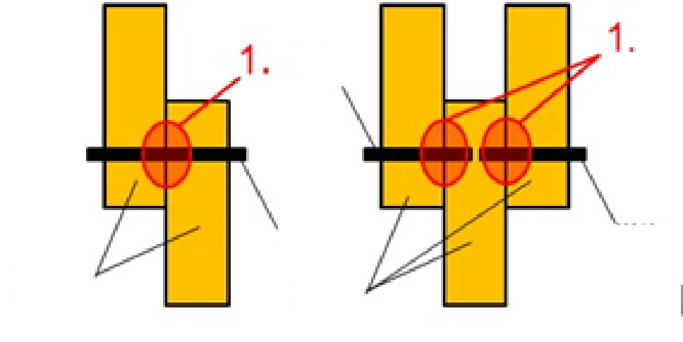
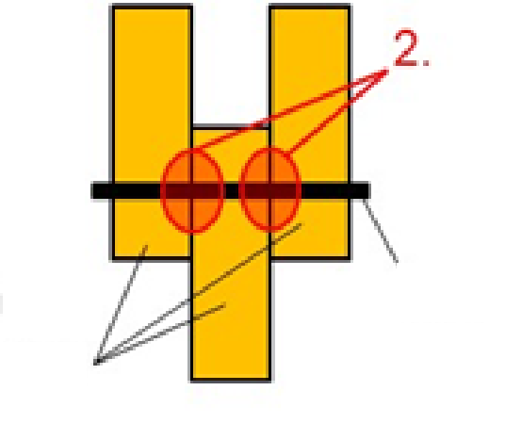
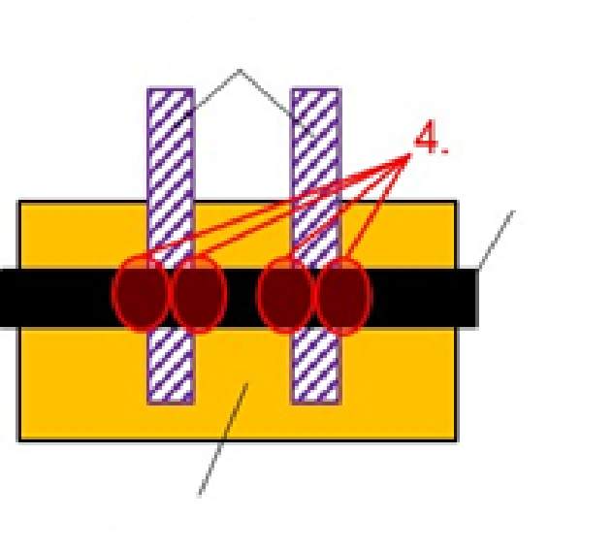
Dimensioning of joint with screw connection theory
The bearing capacity of the joint is determined by the plastic moment of the metal connector and the edge compressive strength of the wood. In addition, the pull-out resistance of the connector can be utilised through the so-called cable effect.
For each type of single-shear and double-shear joint, the shear stengths associated with the different fracture types are derived, and the value of the smallest of these dimensions the joint.
The shear strengths are given in EC5 for one clipping plane and one connector.
In addition to the screw connection theory, the bending moments caused by the possible eccentricity of the joint must be taken into account in the dimensioning of the connectors.
In a m-shear joint durabilitt m * durability of the weakest shear
connector
connector
connector
wood
wood
connector
wood
steel
connector
wood

Slide 18
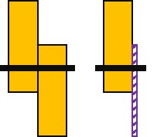
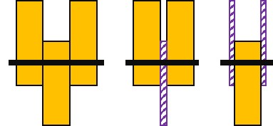
Dimensioning of joint with screw connection theory
EC5 formulas include the following single- and double-shear connections: wood-wood, wood-wood panel and wood-steel plate.
The terms used in the formulas for the edge compression strength of wood and wood panel, the yield of the connector, are mainly given in EC5.
There are no gaps between the parts to be connected in the traditional screw connection theory, but the new EC5 will also contain screw connections containing rod gaps (= intermediate screw connections).

Slide 19
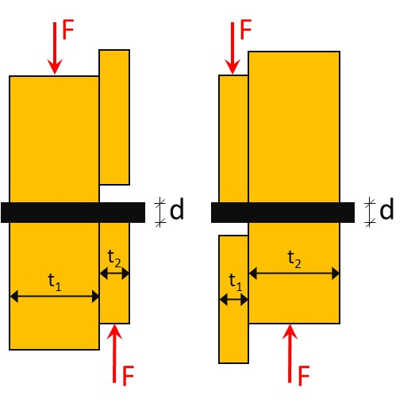
Single-shear joint (wood-wood or wood-wood panel)
Fracture type 1: exceeding the bearing strength of the wood in another wood part
(a): F = f_{1,h,k}t₁d
(b): F = f_{2,h,k}t₂d
The letters a and b above refer to EC5 markings (formula 8.6)
(a) (b)

Slide 20
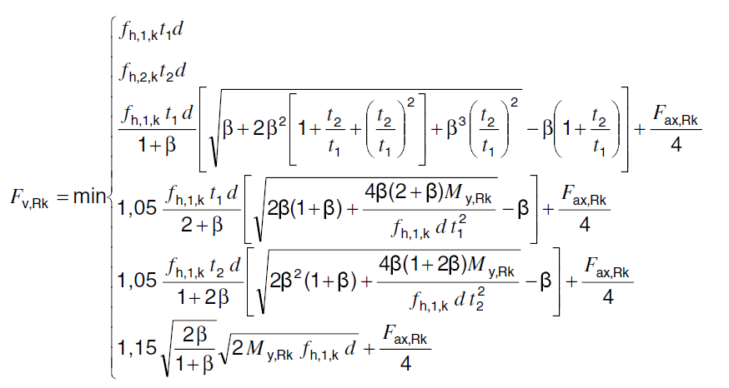
Single-shear joint (wood-wood or wood-wood panel)
F
Fracture type 2: exceeding the bearing strength of the wood in both wood parts
(c): F =
Above β is the ratio of the edge compressive strengths of the parts and the last term takes into account the pull-out resistance of the connector.
d
t₂
t₁
F

Slide 21
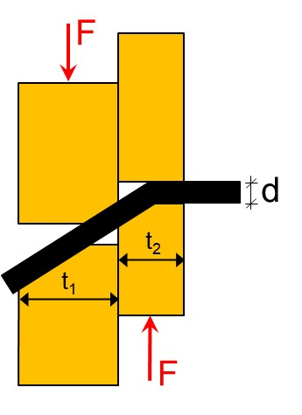
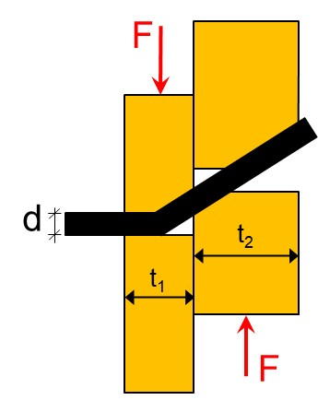
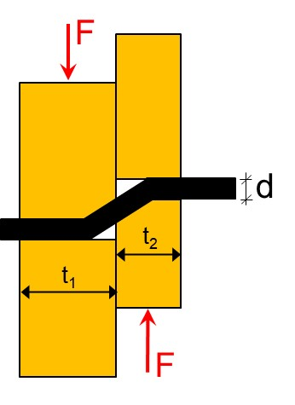
Single-shear joint (wood-wood or wood-wood panel)
d)
e)
The first three fracture types involve the breaking of a piece of wood or wood panel alone. Other fracture types are combinations in which steel also yields. The shear strength values given can be calculated using the theory of plasticity
F =
(d)
f)
(e)
(f)

Slide 22
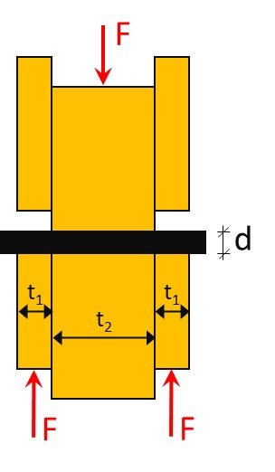
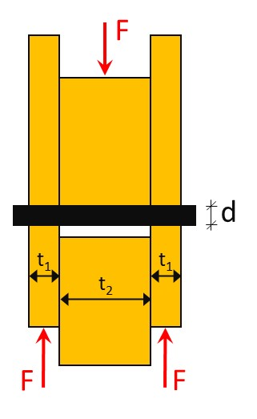
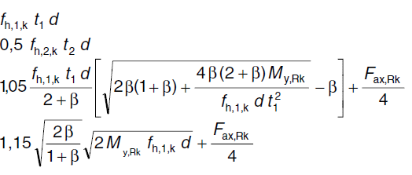
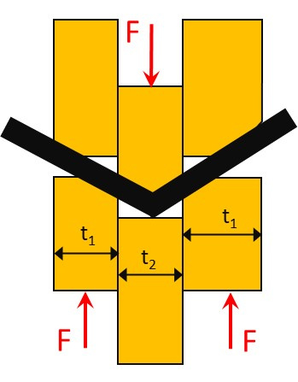
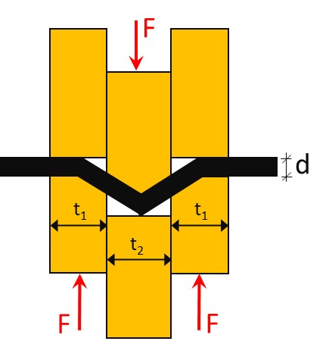
Double-shear joint (wood-wood or wood-wood panel)
(g) (h)
For a two-section (symmetric) joint, EC5 shows the fracture types shown in the images
F =
Note: In multi-shear cases, each shear can be viewed using the above double-shear case formulas.
(g)
(h)
(j)
(k)
F/2
F/2
F/2
F/2
(j) (k)
F/2
F/2
F/2
F/2

Slide 23
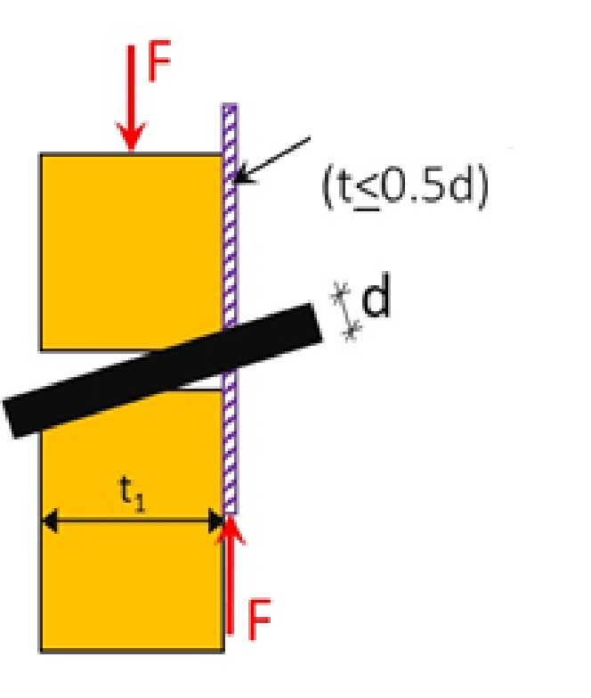
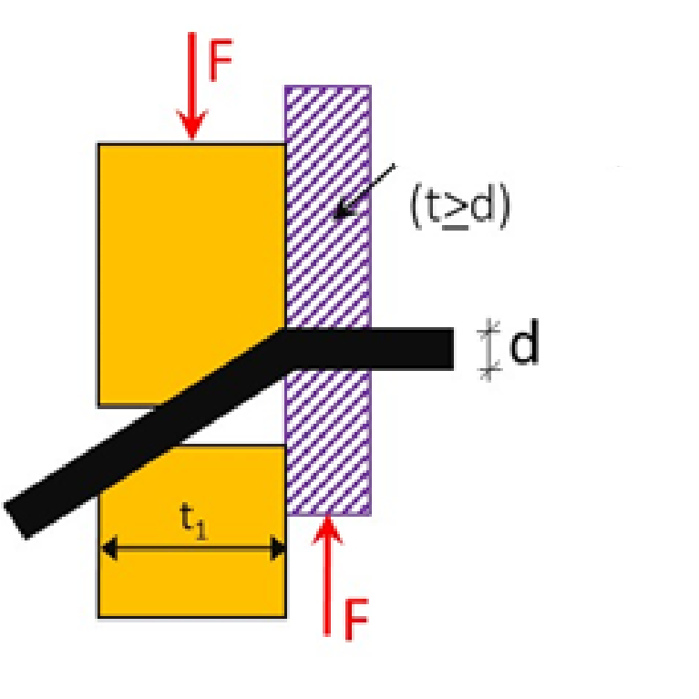
Joint between wood and steel plate
Thin plate
A steel plate is defined as a thin sheet if its thickness does not exceed half of the diameter of the connector d
A thin steel plate articulates the connector
A thick steel plate, on the other hand, is at least as thick as the diameter d of the connector
A thick steel plate also provides torque support for the connector, which may also cause the connector to become plastised
If the thickness of the steel plate is between thin and thick, the strength of the joint is interpolated with the results of the thin and thick plate
Thick plate

Slide 24
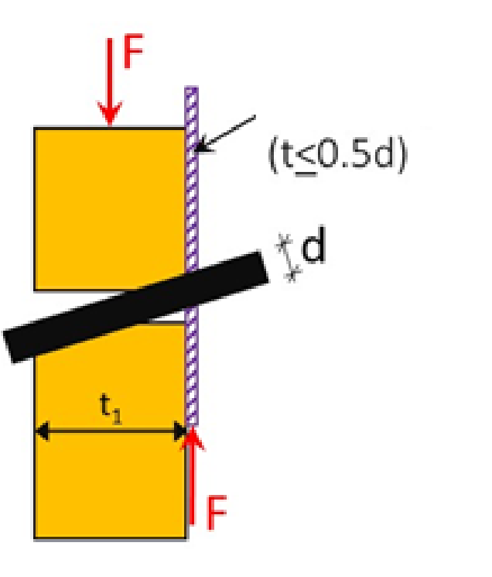
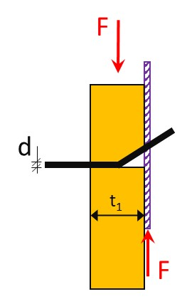
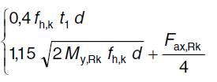
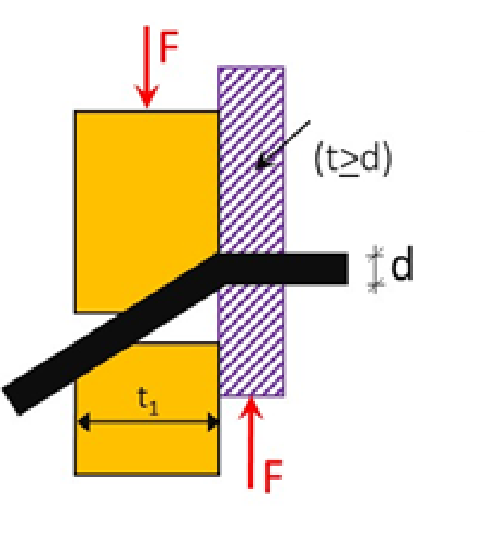
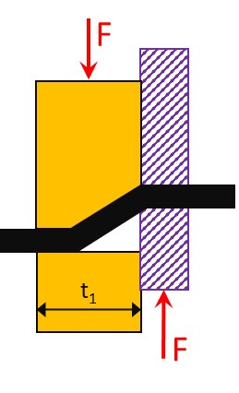
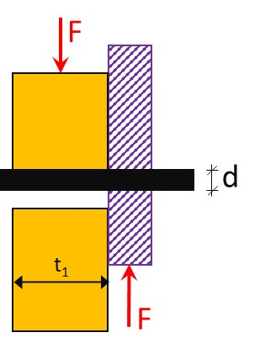
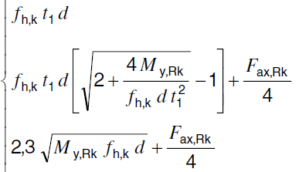
Single-shear joint (wood-steel)
Thin plate
For single-shear joints, EC5 shows the following durability formulas (per connector)
The durability of the steel plate must be checked separately!
Thin steel plate:
Thick steel plate:
a) b)
(a)
(b)
(c)
(d)
(e)
F =
Thick plate
F =
c) d) e)

Slide 25
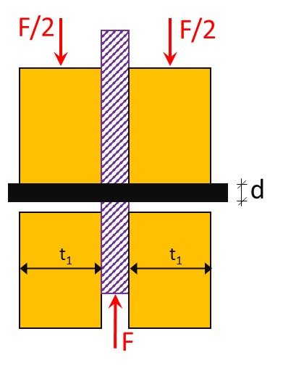
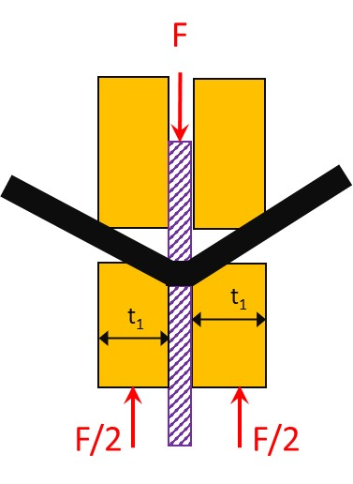
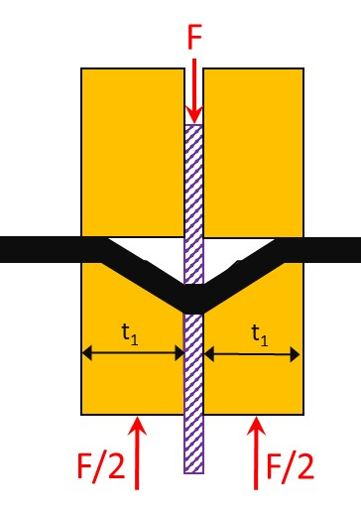
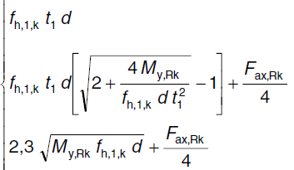
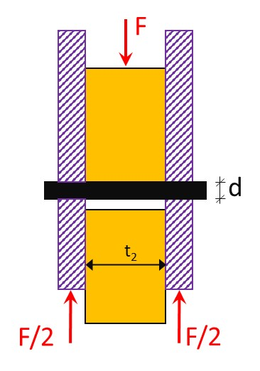
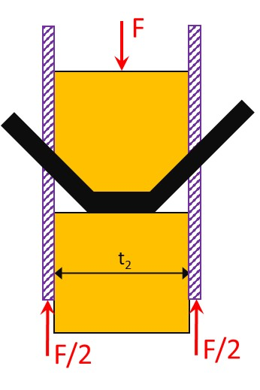
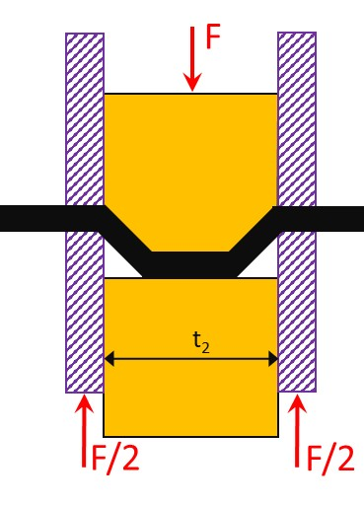


Double-shear joint (wood-steel)
A double-shear joint has the corresponding expressions:
All steel plates:
Thin steel plate:
Thick steel plate:
f) g) h)
(f)
(g)
(h)
(j)
(k)
(l)
(m)
F =
j&l) k) m)
F =
F =

Slide 26


Nails, bolts and screws in joints
The above screw connection theory is the basis for the design and sizing of all nail, bolt and screw joints.
The behaviour of each type of connector under shear load is the same, but under longitudinal load they behave differently
Each connector also has a list of fracture types specific to that connector which must be checked
For example, the loosening of the screw head or the resistance of the bolt washer are unique to these connectors.

Slide 27



Nail connections
When applying the formulas of the screw connection theory, it should be noted that
in a single-shear joint:
t₁ = thickness of the wooden part on the base side
t₂ = tip side penetration
in a double-shear joint:
t₁ = min (thickness of the wood part on the stem side, penetration on the tip side)
t₂ = thickness of the wood in the middle
in a joint of three wooden parts:
The nails may touch each other if t₁- t₂ > 4d

Slide 28


Nail connections
The dimensioning of screw connections is presented in EC5 based on the screw connector theory, and EC5 also provides calculation formulas for the terms needed in it:
yield moment
edge compression strength
pull-out strength
Instead, the design guideline RIL-205-1-2017 presents a simplified, safe-side sizing method with certain limitations.
The designer must proceed with the either and the sources must not be cross-used!

Slide 29



Nail connections
According to EC5:
Yield moment M_{y,Rk}=
Edge compression strength f_{h,k} =
Pull-out strength* F_{ax,Rk} = min( , )
*) Formula for a smooth nail. See variable definitions and pullout strength clause for other nails EC5 8.3.2(4)
round nails
square nails and grooved nails
0.082ρ_{k}d^{-0.3} Mpa (without pre-drilling)
0,082(1-0,01d)ρ_{k} Mpa (pre-drilled)

Slide 30



Nail connections
Both design instructions (EC5, RIL205) also contain instructions on the following essential matters:
Distances between nails and edge distances separately for joints: wood-wood, wood-wood panel and wood-steel plate
Nail diameter and penetration conditions for different nail types
Need for pre-drilling in relation to nail diameter and wood density
Longitudinal load of the nail

Slide 31







Bolts and dowels
The yield moment of a bolt is , where is the specific value of the tensile strength of the bolt.
In addition, the calculation of the edge compression strength takes into account the direction of the force α with respect to the direction of the grain:
,,
for softwood
for LVL
for hardwood

Slide 32



Bolts and dowels
For wood-wood panel joints, in addition to the above, the edge compression strength of the wood panel shall be considered in accordance with EC5 8.5.1.2.
Edge distance requirements are presented separately
For bolted joints EC5 8.5.1.1(3)
For dowels EC5 8.6(3)
A washer must be used under the bolt nut and the heel, with the more detailed restrictions given in EC5 10.4.3.

Slide 33


Screw connections
Screws are divided into two categories:
Cap screws
Partial threaded screw with a threaded part having a diameter equal to the diameter of the smooth part
Pre-drilling required
Self-drilling screws
Fully threaded screws, or partially threaded screws with a threaded part that has a diameter greater than the diameter of the smooth part
Usually no pre-drilling (cf. EC5 or the ETA certificate)

Slide 34


Screw connections
The sizing of bolted joints against shear loads is based on the effective diameter d_{ef} of the bolt:
d_{ef} ≤ 6 mm → nail connection instructions
d_{ef}> 6 mm → bolted connection instructions
The effective diameter d_{ef} is determined by the diameter d of the smooth part of the bolt or the inside diameter d_{inner} of the threaded part:
For cap screws d_{ef} = d when penetration ≥ 4d
For other cap screws and all self-drilling screws d_{ef} = 1.1d_{inner}
Cap crew
d_{smooth}
d_{inner}
Self-drilling screw
d_{inner}

Slide 35

Screw connections
Effective diameter d_{ef} is used for
calculating yield moment
calculating edge compression strength
The outer diameter of the threaded part is used
in edge and end distances
in determining connector distances
in calculating the effective number of connectors n_{ef}

Slide 36




Screw connections
For axially loaded screws, the following fracture types are checked
Screw tensile strength
Pull-out tensile strength of the cap
Buckling
Pull-out fracture
In steel plate joints as well
Detachment of the cap

Slide 37

Screw connections
Skewed screw joint
Carries the joint force mainly as axial force of the bolt, shear force has only a small effect
The joint is dimensioned by the pull-out, pull-through and traction resistance and are given EC5 clauses (EC5 8.7.2)
Higher durability compared to straight screw

Slide 38

Shear strength of the screw connection group
The screw connection theory calculates durability per connector and shear
In addition, the fracture types specific to each connector type are checked
Partial and full breaking must be checked for the entire connector group in accordance with Annex A of EC5
The endurance of a row of connectors in the direction of cause is obtained by multiplying the durability of one connector by the effective number of connectors in the row of connectors n_{ef}, as defined for the different types of connectors in EC5 8.3.1.1(8) and 8.5.1.1(4).
No reduction in the number of connectors perpendicular to the grain
In a m-shear joint durabilitt m * durability of the weakest shear

Slide 39


Shear strength of the screw connection group
If the external force exerted on the joint is not applied to the centre of the connector group, the shear forces from the torque due to the eccentricity shall be calculated for the different connectors.
Note that the direction of the shear force due to the torque is different depending on the position of the connector
This is discussed in more detail in the example calculation

Slide 40


Determining the stiffness of joints
Displacements due to deformations of the joint are, as a rule, always calculated in the use limit state (ULS)
In ultimate limit state (UltLS), the joint displacements must be determined in at least two cases:
If the stiffness of the joint is used to support the stability of the surrounding structures (for example, there may be a risk that an overly flexible joint does not provide sufficient support against buckling of the adjacent part)
If excessive displacements of the joint could lead to dangerous damage to the use of the building

Slide 41



Joint stiffness in operating use limit state
Slip modulus K_{ser} describes the rigidity of the joint in the cutting direction
If the wood parts to be joined are different, the density in the formulas is calculated using the formula
If the second part of the joint is a steel panel or concrete, its elasticity is assumed to be insignificant, using 2*K_{ser} for the connector offset factor
Connector type
Dowels
Bolts with or without clearance
Screws
Nails (hole pre-drilled)
Nails (without pre-drilling)
Fastenings

Slide 42

Joint stiffness in operating use limit state
Due to the flexibility of the joint and the surrounding wood material, the joint will be displaced as shown in the figure below
The momentary offset between the parts to be joined is calculated by the formula
u= F_{d} / K_{ser}+ c
Where F_{d} is the force acting on the joint (perpendicular to connector) and c is the possible clearance (usually only with bolts)
The final offset can be calculated as the offsets are usually different in the following cases:
ULS and the parts to be connected have similar material properties
ULS and the parts to be connected have different material properties
UltLS
a: joint between two wooden parts
b: joint between a steel and a wooden part

Slide 43

Joint stiffness in operating use limit state
1 clipping plane
2 clipping plane
If there are n connectors in one cutting plane, the slip modulus of the joint is n*K_{ser} (fig. a)
If there are still two cutting levels, the slip modulus is 2*n*K_{ser} (fig. b)
If the corresponding joints are "connected", the slip modulus of the whole is calculated as shown in figures c and d
Single-shear joint
n connectors
Double-shear joint
n connectors
n connectors
n connectors
Joint made of two single-shear joints
n connectors
n connectors
Joint made of two single-shear joints

Slide 44

Joint stiffness in operating breaking limit state
The values of the conversion factor K_{ser} are tabulated in EC5 and these values are intended as such for calculations according to the KRT
The function of a typical nail or screw joint is as illustrated below. Typically the KRT loads of the joint are approximately 40% of the joint's carrying capacity.
MRT calculations use a slip modulus determined by a force of 60%–70% of the load capacity. This reduces slip modulus as shown in the illustration.
In EC5, a decision has been taken to use the value K_{u} for the transition coefficient in MRT.
K_{u} = 2/3*K_{ser}
Typical nail/screw joint

Slide 45

Factors affecting joint rigidity
The stiffness of the drawn skewed screw is many times that of the straight screw
Drying of the wood and moisture loss in general cause clearance in the joint
Compression of the wood in a direction perpendicular to the grain can cause clearance in the joint
Bolt joints must always be retightened to equilibrium after drying
A partially threaded screw may cause compressive force between the parts to be connected
Fully threaded screw joins the parts together but does not compress the parts together

