Slide 1



Industrial wood construction
Teaching materials for industrial wood construction education
2022

Slide 2
Origin of the materials
Use of the materials
These learning materials for industrial wood construction have been prepared in a project led by Puuinfo Oy in 2021–2022. Also involved in the project were
Lappia Vocational College,
TTS-Työtehoseura ry
South-Eastern Finland University of Applied Sciences,
Metropolia University of Applied Sciences,
Jyväskylä University of Applied Sciences,
University of Tampere, and
Federation of the Finnish Woodworking Industries Puutuoteteollisuus ry
The project was funded by the Ministry of the Environment.
The materials are intended to be used as extensively as possible in industrial wood construction education and studies.
The materials are released under the Creative Commons licence Attribution-ShareAlike (CC BY-SA), which requires that the author be properly credited when the materials are used and that derivative works may only be distributed under the same licence as the original work.
The original materials and any updates to them by Puuinfo will be published on the Library of Open Educational Resources website (aoe.fi) and the Puuinfo.fi website.

Slide 3

Structural design

Slide 4
Authors
Tero Lahtela,
Insinööritoimisto Tero Lahtela Oy
Release date: 03/03/2022

Slide 5
Straight beams and columns

Slide 6
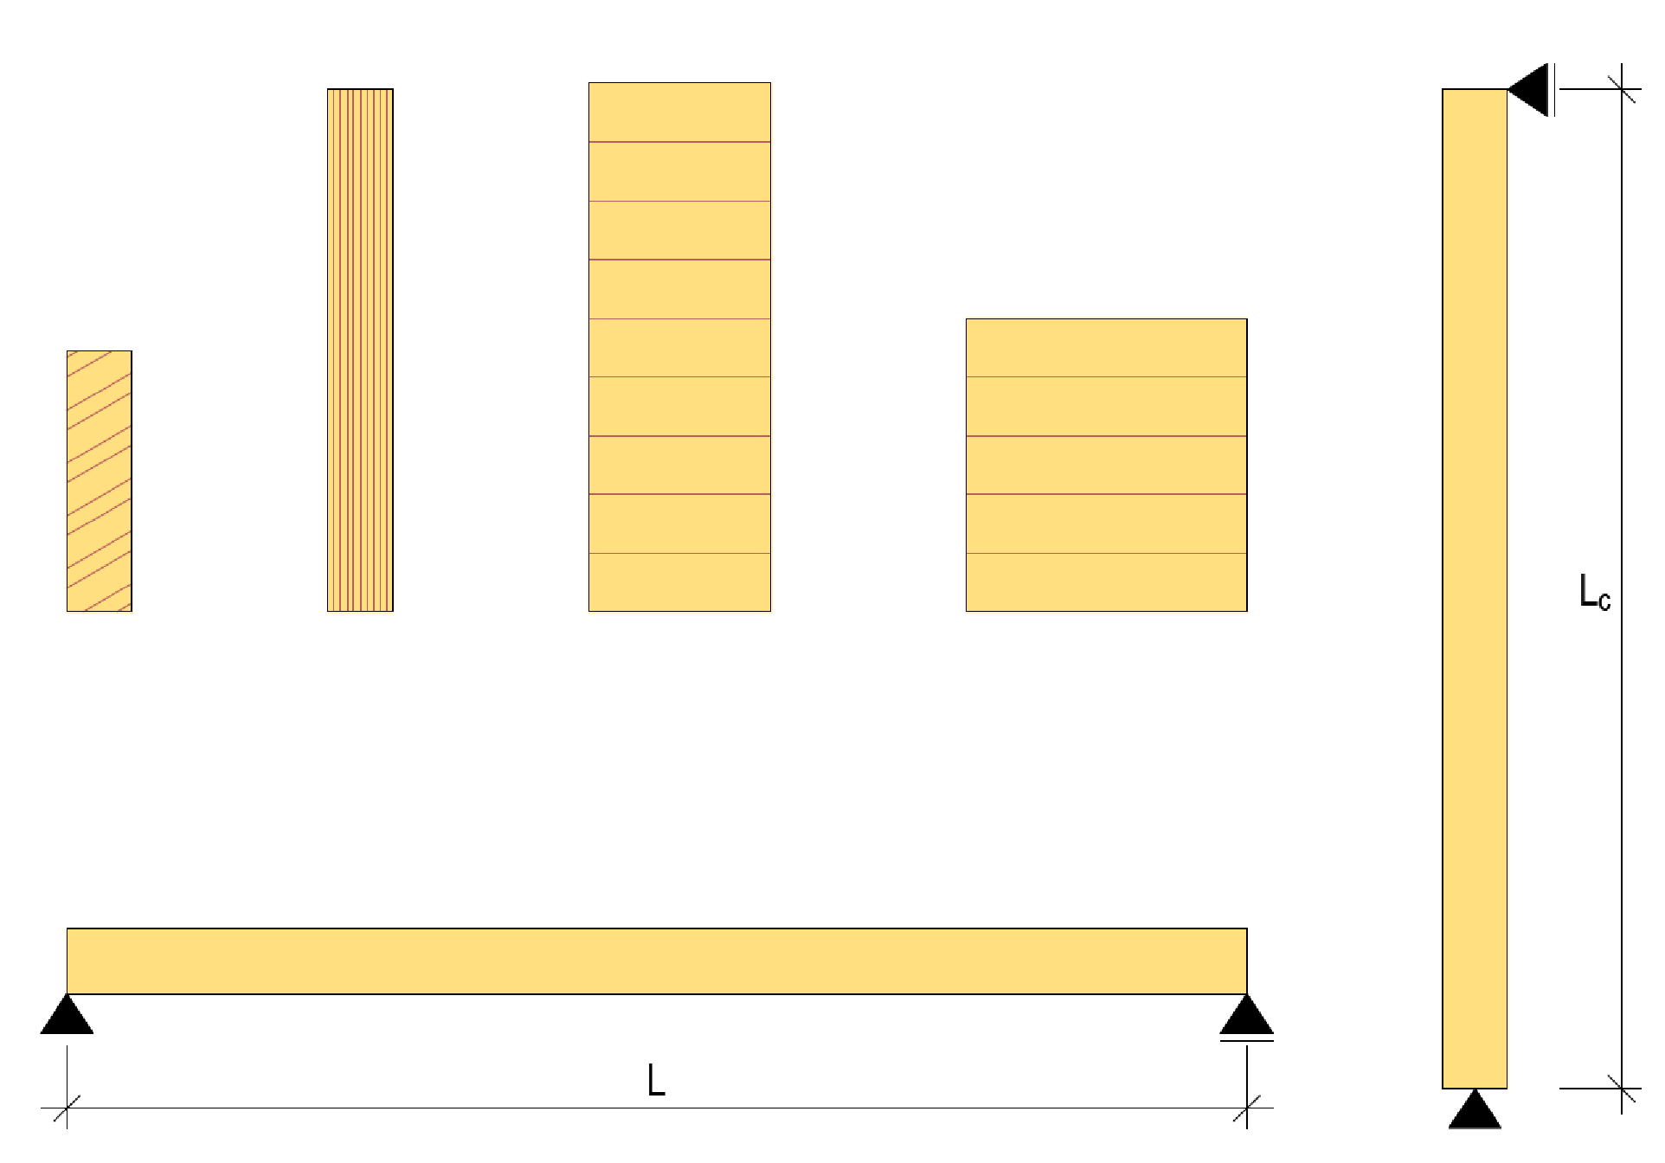
Straight beams and columns
LVL
Glued laminated timber
Straight beams and columns refer to building elements in which:
  The cross section size will not change with beam/column length
  The beam is straight in the direction of span L
  The column is straight in the direction of the effective length L_{c}
Sawn timber
Glued laminated timber

Slide 7
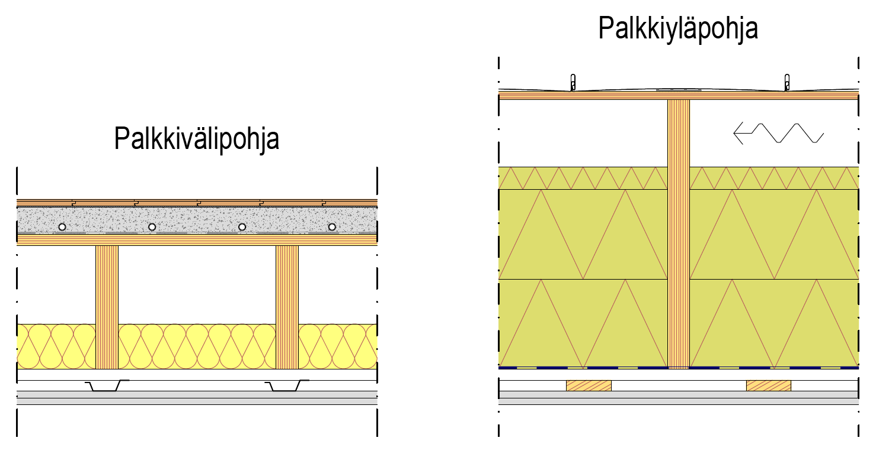
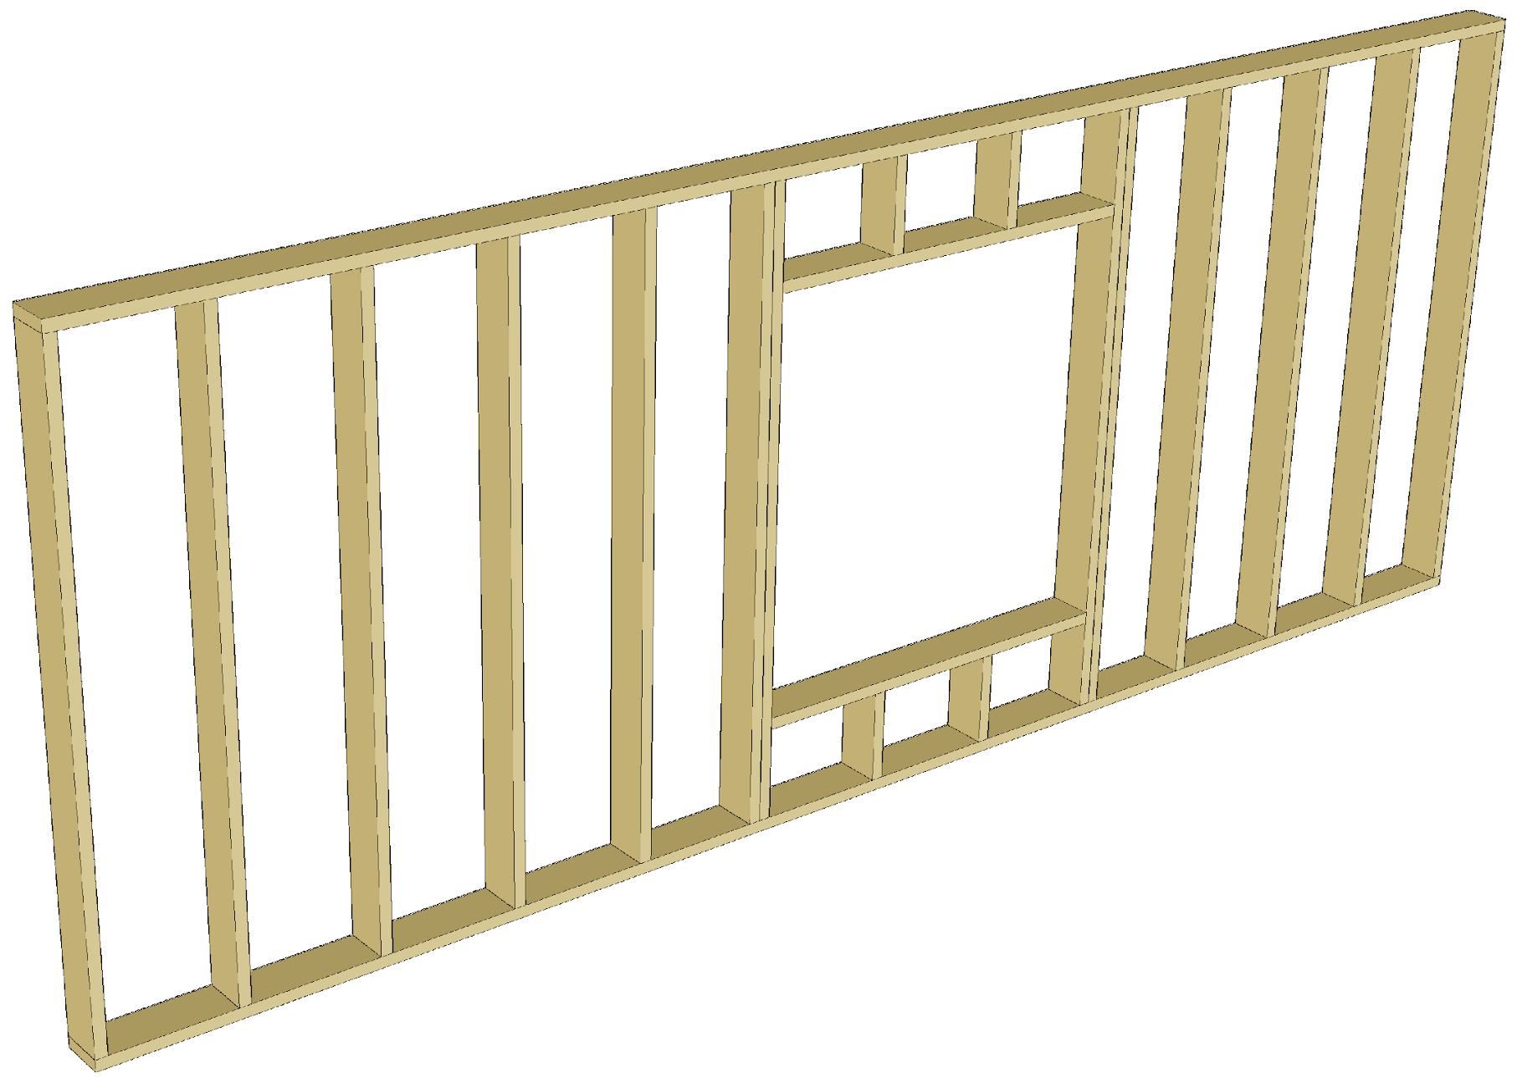
Examples of beam and column structures
Girder floor
Structures made up of straight beams often comprise
  Load-bearing frame for the intermediate floor
  Load-bearing frame for the roof
  Primary beams for the column-beam frame
Structures made up of straight columns often comprise
  Load-bearing frame of the wall with framed structure
  Primary columns of the column-beam frame
Girder floor

Slide 8
Specifications of beam and column structures
Benefits of beams and columns
  Little wood in relation to the load-bearing
  Large number of manufacturers (affordable cost)
  Simple to dimension
  Can be applied in numerous structural solutions
  Can be machined with simple tools (e.g. cut-off saw)
Disadvantages of beams and columns
  Stability support is a significant dimensioning factor (buckling, lateral buckling)
  Small cross-section width will make fire dimensioning challenging
  Small cross-section width will make bearing pressure dimensioning challenging

Slide 9
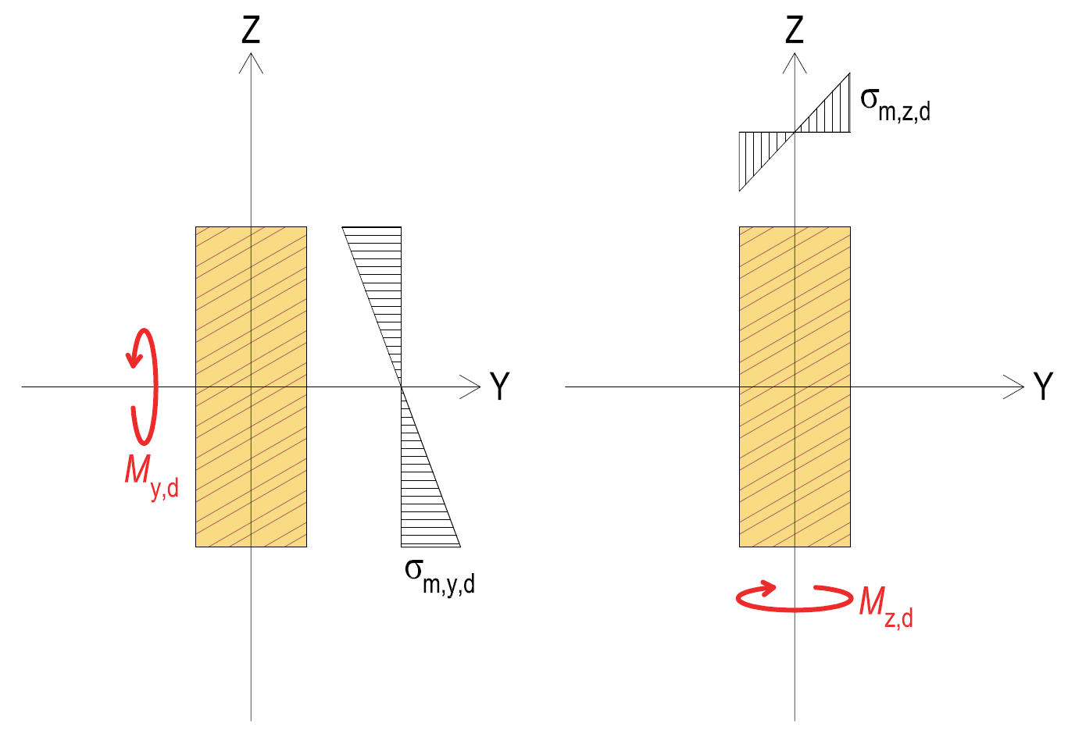
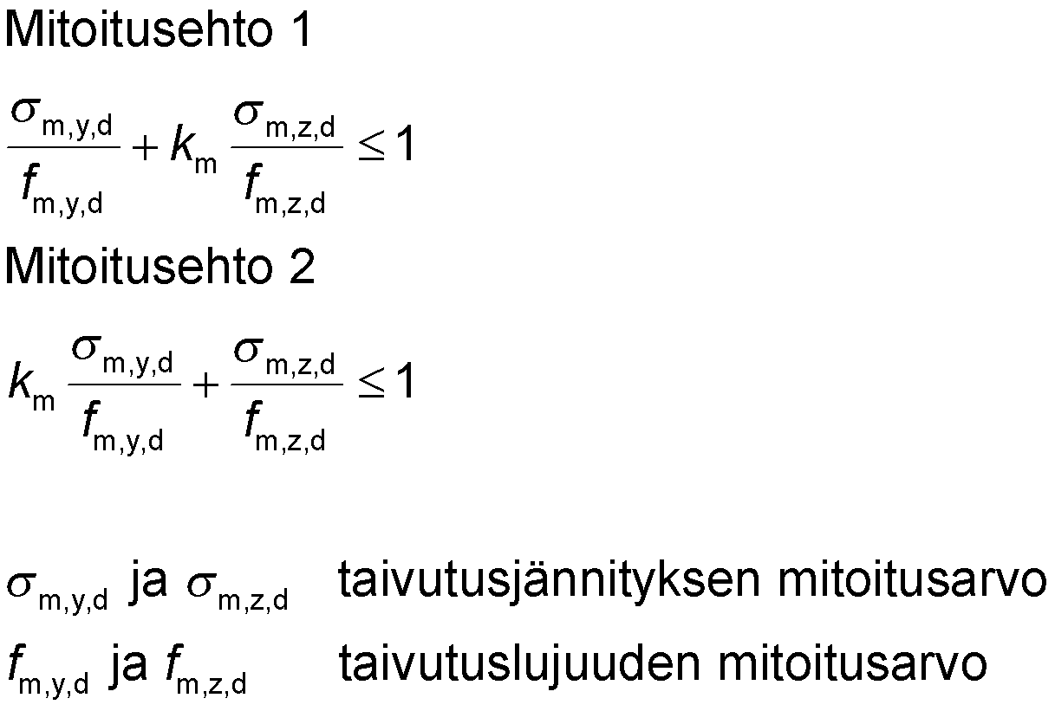
Bending
Dimensioning condition 1
Dimensioning condition 2
σ_{m,y,d} and σ_{m,z,d} rated value of bending stress
f_{m,y,d} and f_{m,z,d} rated value of bending strength
Factor k_{m} takes into account the effect of stress distribution and the inhomogeneity of wood on the bending strength of a cross-section bent in two directions
For rectangular cross-section k_{m} = 0.7 (sawn timber, glued laminated timber, LVL, CLT)
For other cross-sections and wood products k_{m} = 1.0

Slide 10
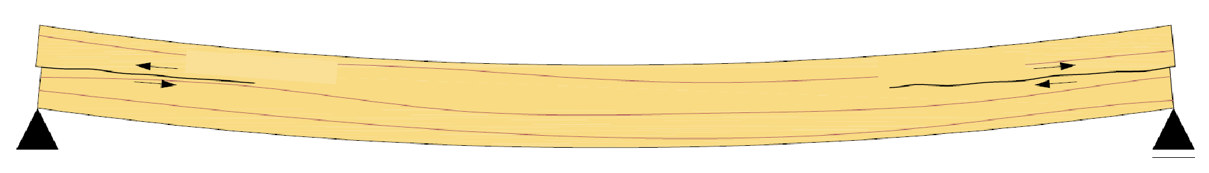
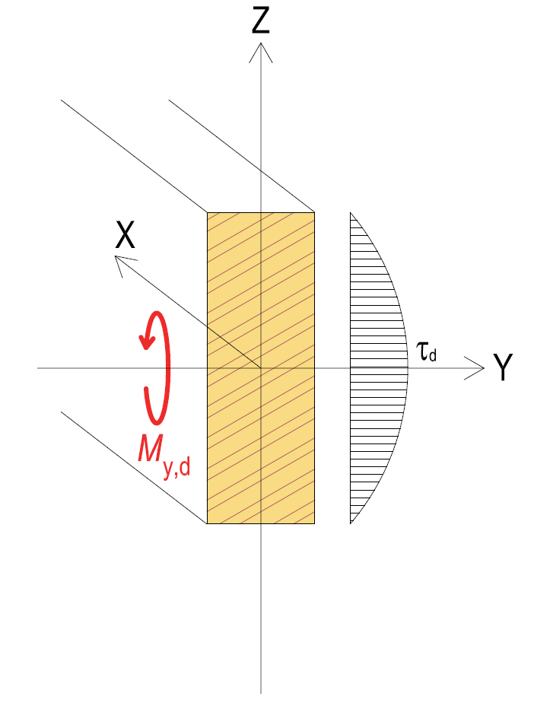
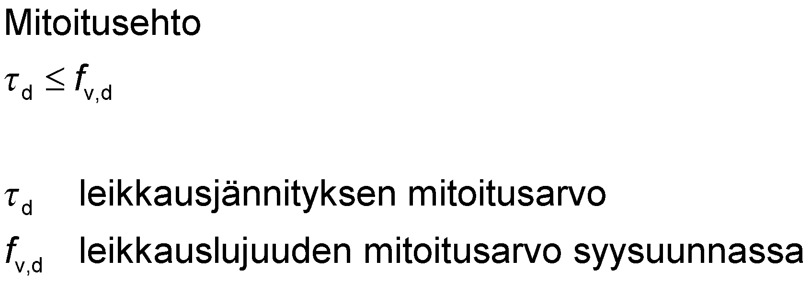
Shear caused by bending
The shear strength of wood in parallel to the grain is weaker than opposite to the grain
A bent wooden rod intersects in the x-axis direction
Cracking is taken into account with the cracking factor k_{cr}
Shear
Shear
Dimensioning condition
rated value of shearing stress
rated value of shearing strength parallel to the grain

Slide 11
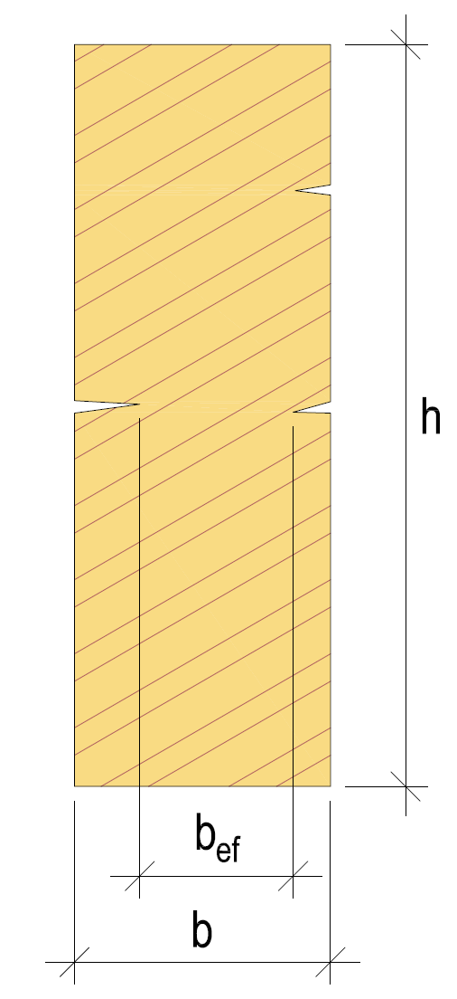
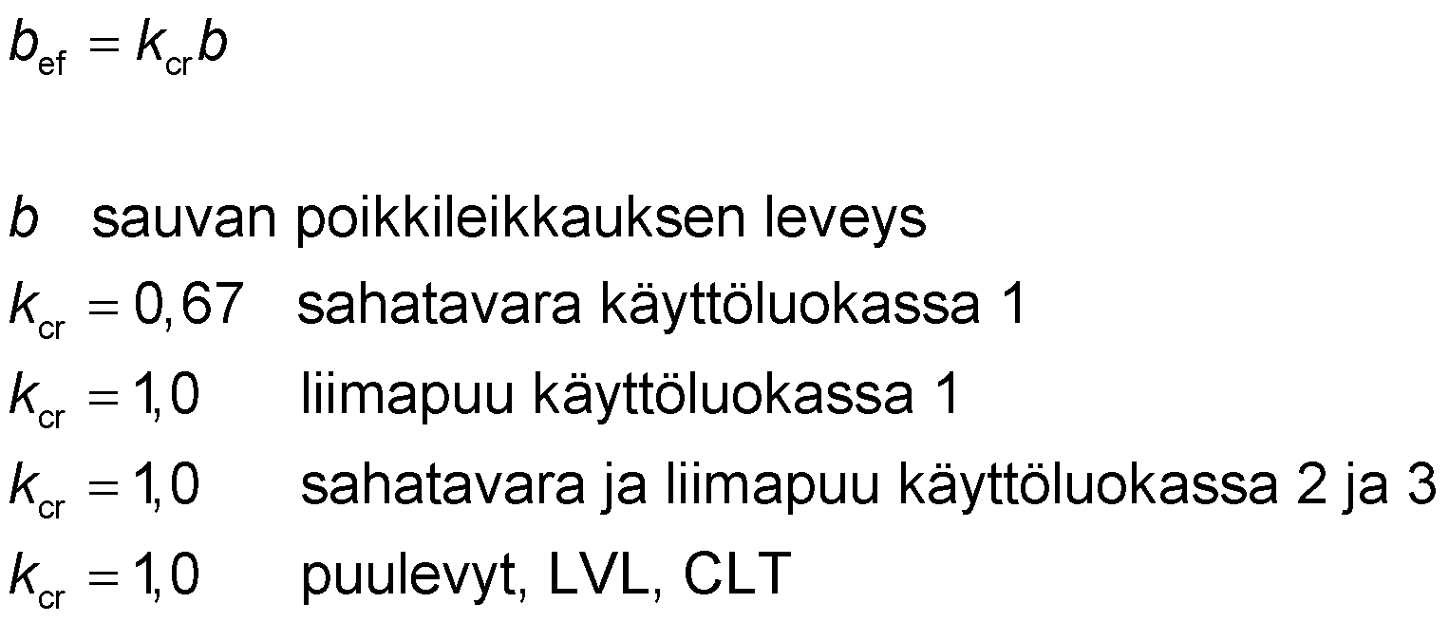
Crack factor k_{cr}
Effective width b_{ef} is used in the shear-durability dimensioning of bent rods
b width of the rod’s cross-section
k_{cr} = 0.67 sawn timber in use class 1
k_{cr} = 1.0 glue laminated timber in use class 1
k_{cr} = 1.0 sawn timber and glue laminated timber in use classes 2 and 3
k_{cr} = 1.0 wood-based panels, LVL, CLT

Slide 12
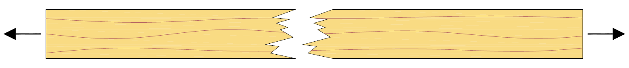
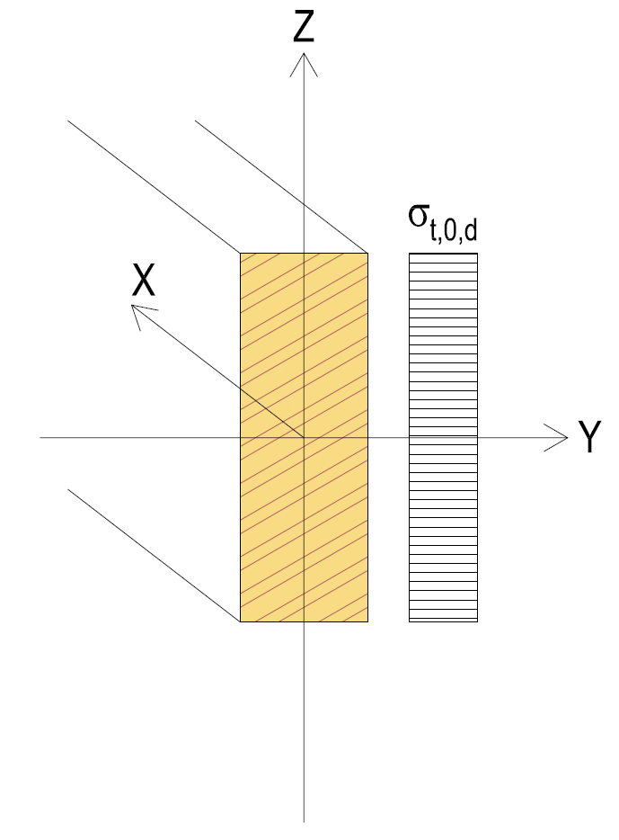
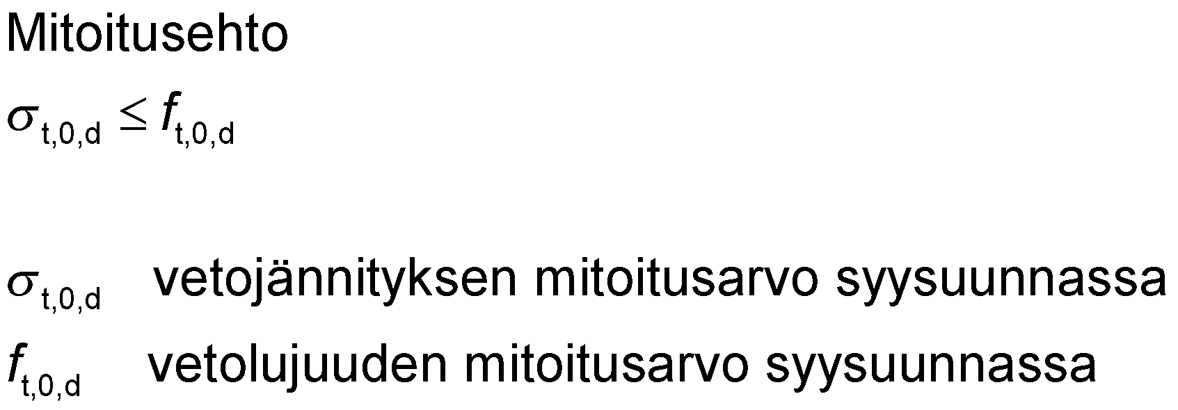
Traction parallel to the grain
The size of the rod’s cross-section will impact tensile strength
  Sawn timber: k_{h} factor
  Glued laminated timber: k_{h} factor
  LVL: k_{l} factor
Dimensioning condition
rated value for tensile stress parallel to the grain
rated value for tensile strength parallel to the grain

Slide 13
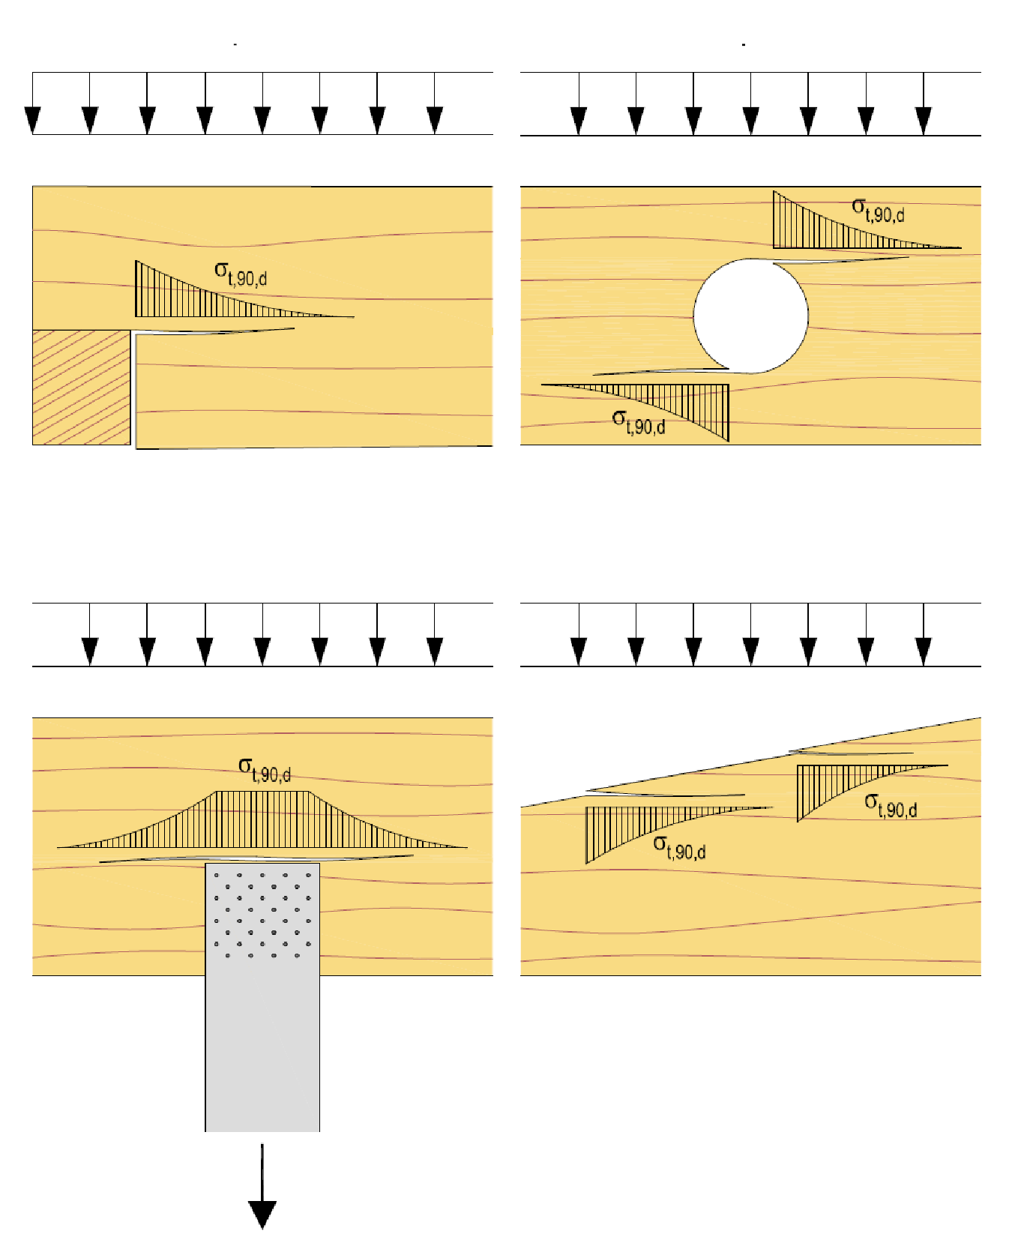
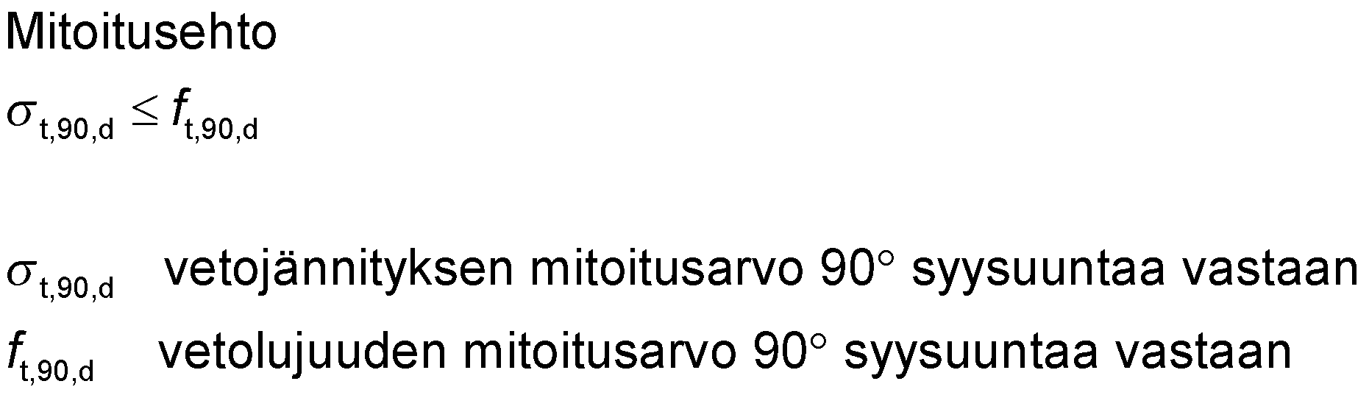
Traction 90° opposite to the grain direction
Groove in beam
Hole in beam
The size of the rod’s cross-section will impact tensile strength
  Glued laminated timber: k_{vol} factor
  LVL: k_{vol} factor
Suspension joint on beam
Sawn beam top
Dimensioning condition
rated value of tensile stress 90° opposite to the grain direction
rated value of tensile strength 90° opposite to the grain direction

Slide 14
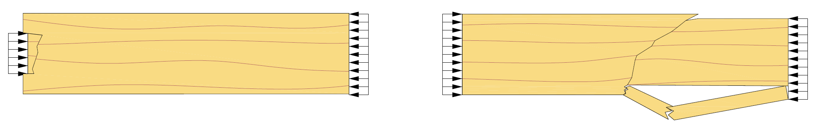
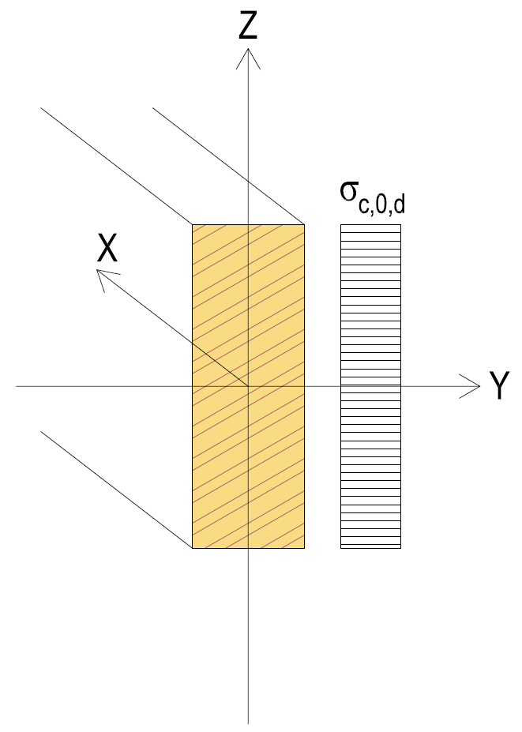
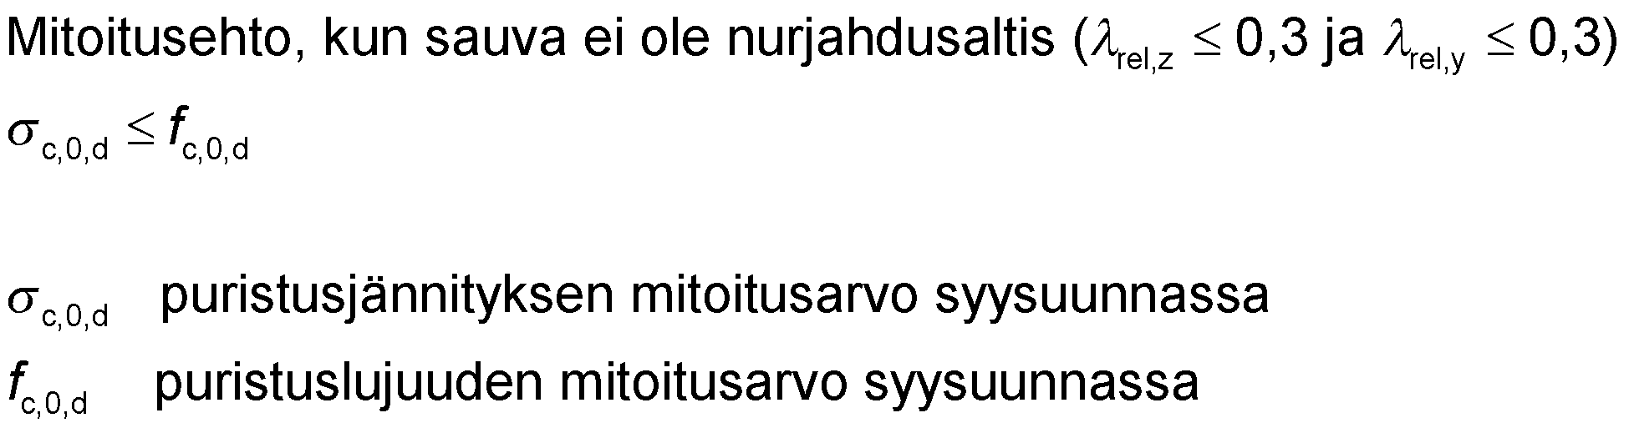
Compression parallel to the grain
Compression strength parallel to the grain is in question in the following
  A compressed rod that is not prone to buckling
  A connection area (local compression in the connection joint)
A dimensioning condition when the rod is not prone to buckling
rated value of compression stress parallel to the grain
rated value of compression strength parallel to the grain

Slide 15
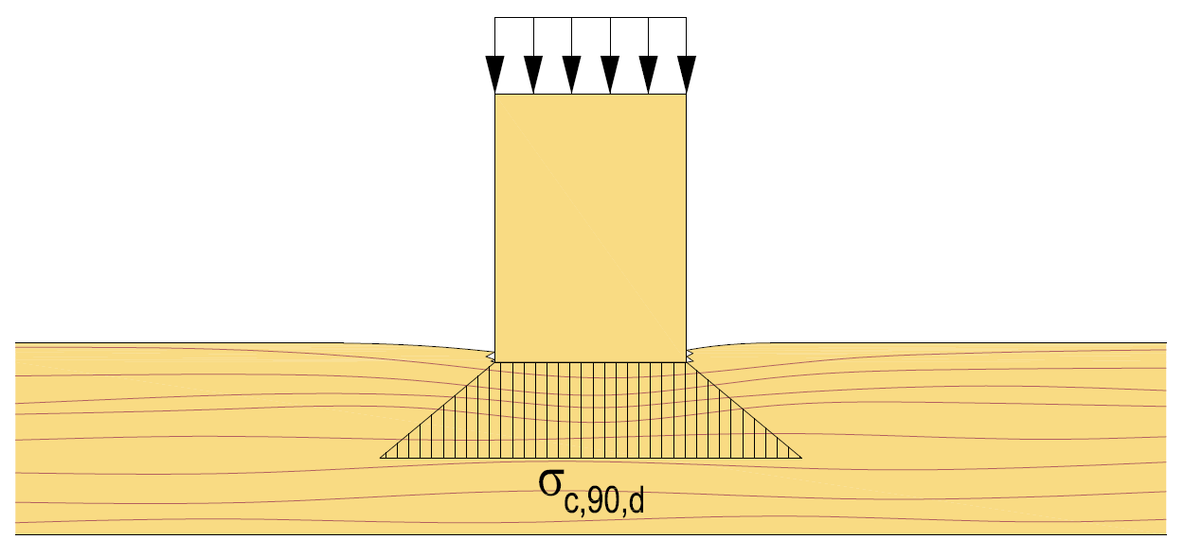
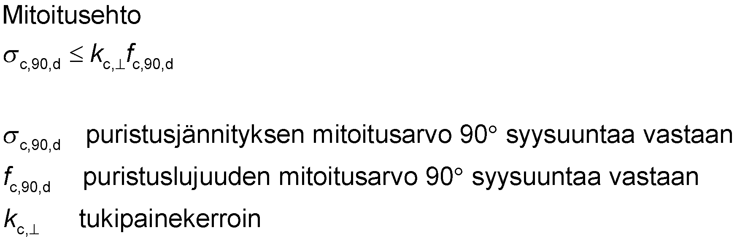
Compression 90° opposite to the grain direction
The wood’s grain structure distributes the compression stress parallel to the grain
The distribution of the compression stress parallel to the grain is taken into account with a support pressure factor
Dimensioning condition
rated value of tensile strength perpendicular to the grain
rated value of tensile strength perpendicular to the grain
support pressure factor

Slide 16
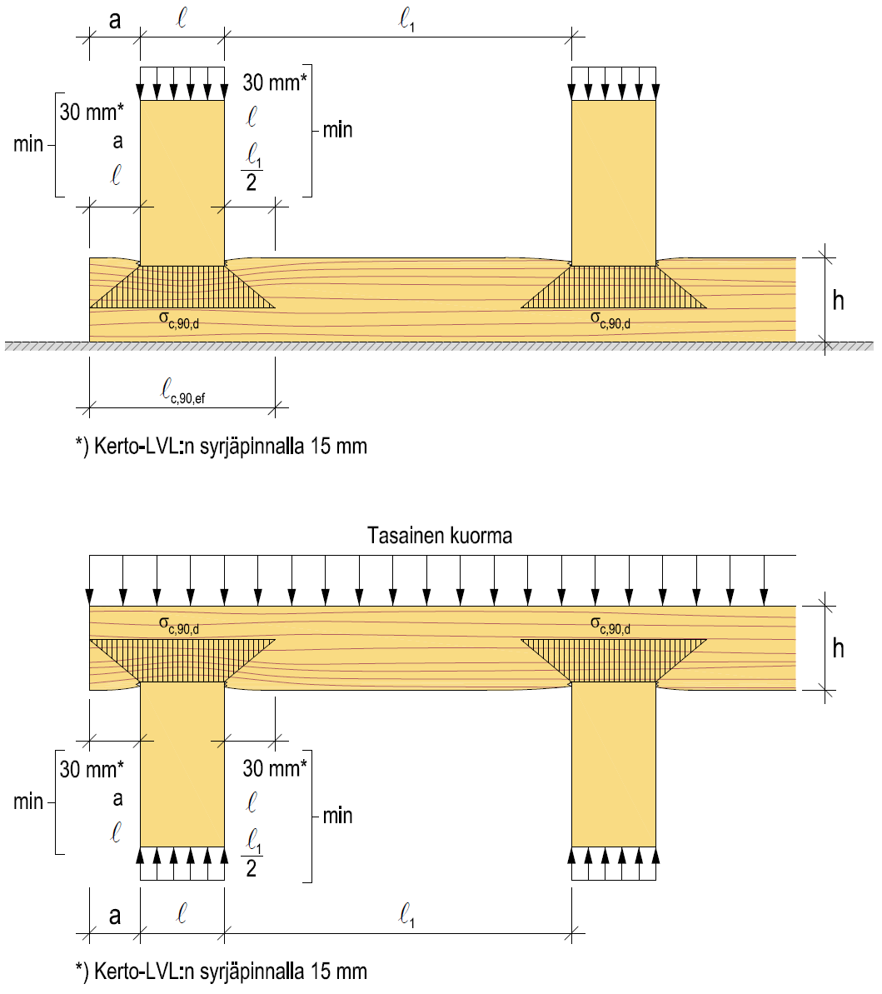
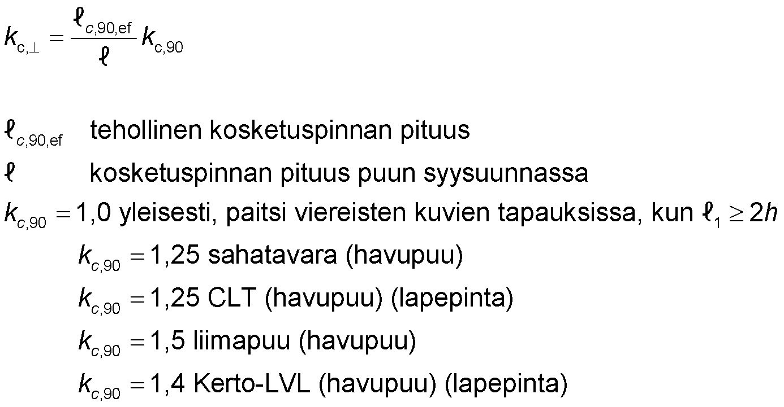
Support pressure factor
Factor k_{c,90} takes into account:
  The location of the contact surface
  Cracking of wood
  Decompression of wood
*) 15 mm on the peripheral surface of Kerto LVL
Uniformly distributed load
length of effective contact surface
the length of the contact surface parallel to the wood’s grain
1.0 in general, except for adjacent images when l₁ ≥ 2h
k_{c,90} = 1.25 sawn timber (softwood)
k_{c,90} = 1.25 CLT (softwood) (flat surface)
k_{c,90} = 1.5 glued laminated timber (softwood)
k_{c,90} = 1.4 Kerto-LVL (softwood) (flat surface)
*) 15 mm on the peripheral surface of Kerto LVL

Slide 17
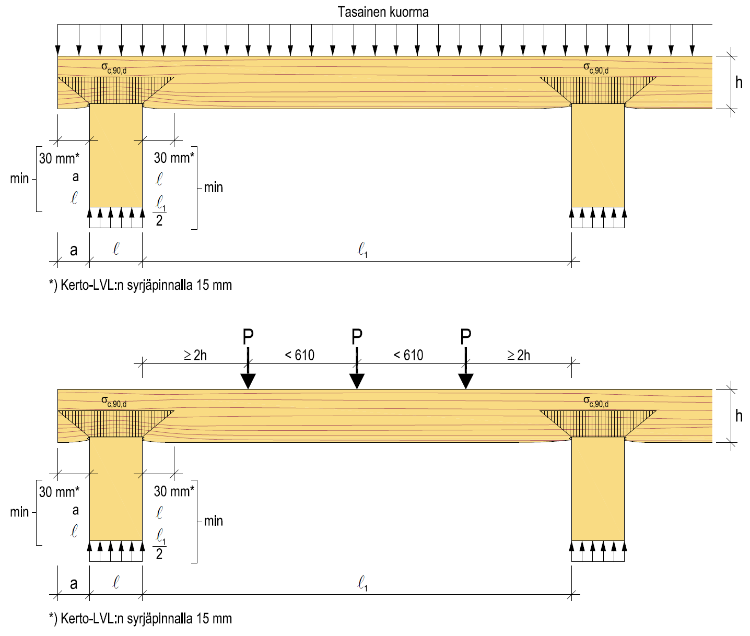
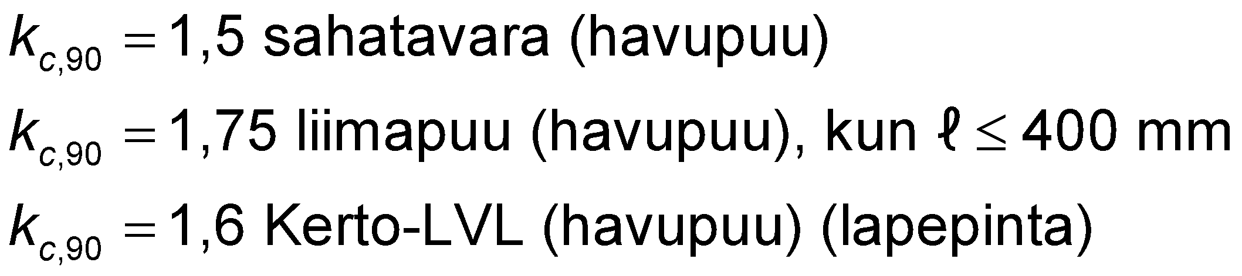
Support pressure factor
Uniformly distributed load
The increased k_{c,90} factor can be used in the cases shown in the adjacent images
*) 15 mm on the peripheral surface of Kerto LVL
k_{c,90} = 1.5 sawn timber (softwood)
k_{c,90} = 1,75 glued-laminated timber (softwood),
when l ≤ 400 mm
k_{c,90} = 1.6 Kerto-LVL (softwood) (flat surface)
*) 15 mm on the peripheral surface of Kerto LVL

Slide 18
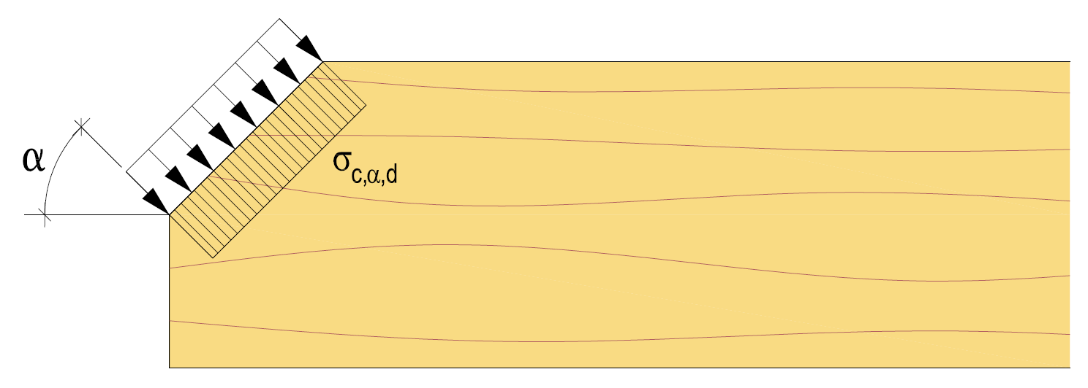
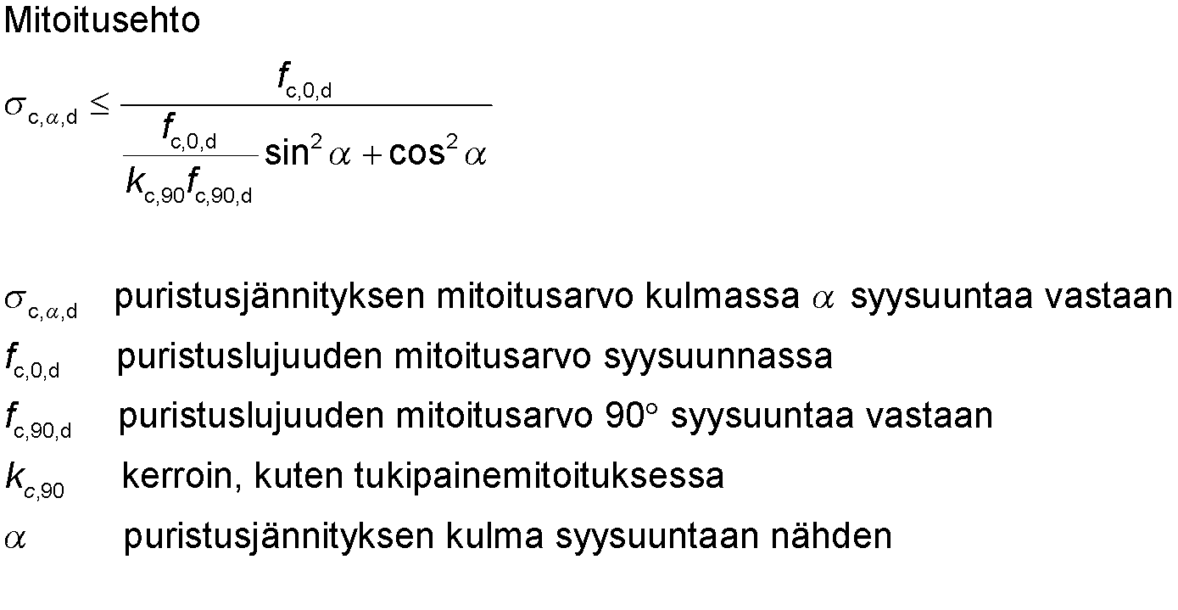
Compression diagonally opposite to the grain
The combined effect of pressure stress components affecting in different directions must be taken into account
Dimensioning condition
rated value of tensile strength at an angle α opposite to the grain
rated value of compression strength parallel to the grain
rated value of tensile strength perpendicular to the grain
factor, the same as for support pressure dimensioning
Angle of compression stress in relation to the grain direction

Slide 19
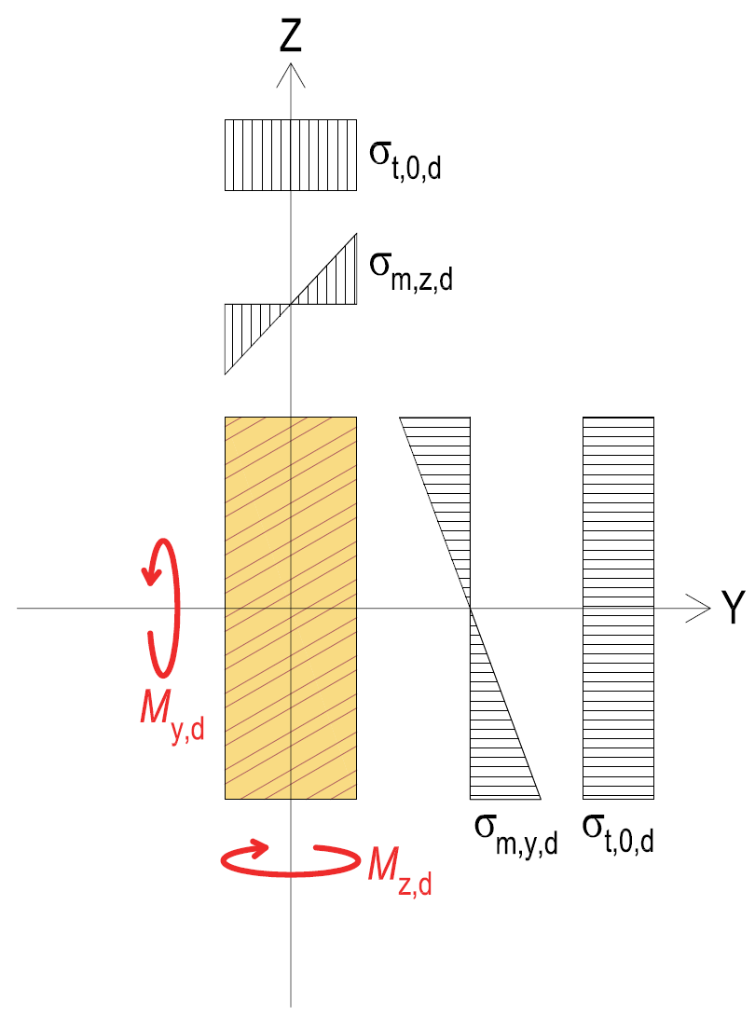
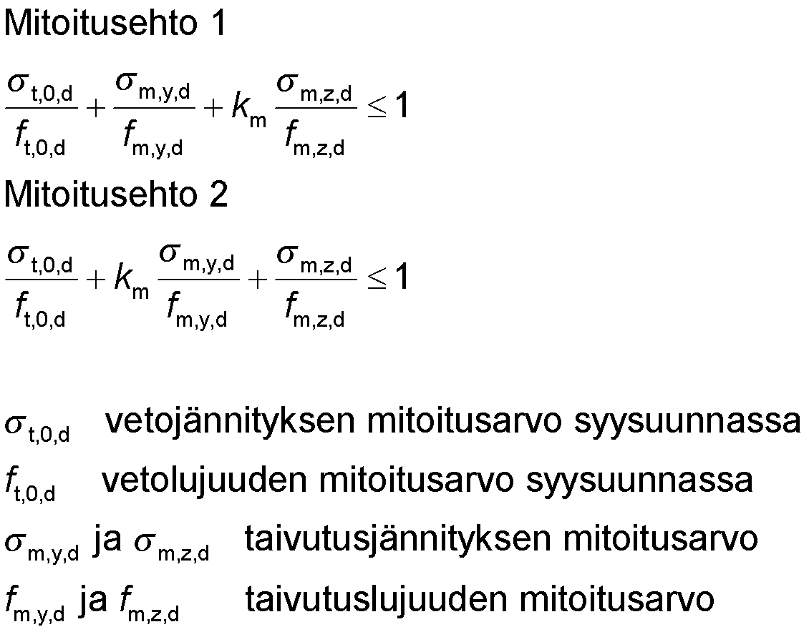
Combined effect of bend and tension
Dimensioning condition 1
Dimensioning condition 2
rated value for tensile stress parallel to the grain
rated value for tensile strength parallel to the grain
σ_{m,y,d} and σ_{m,z,d} rated value of bending stress
f_{m,y,d} and f_{m,z,d} rated value of bending strength
Factor k_{m} takes into account the effect of stress distribution and the inhomogeneity of wood on the bending strength of a cross-section bent in two directions
For rectangular cross-section k_{m} = 0.7 (sawn timber, glued laminated timber, LVL, CLT)
For other cross-sections and wood products k_{m} = 1.0

Slide 20
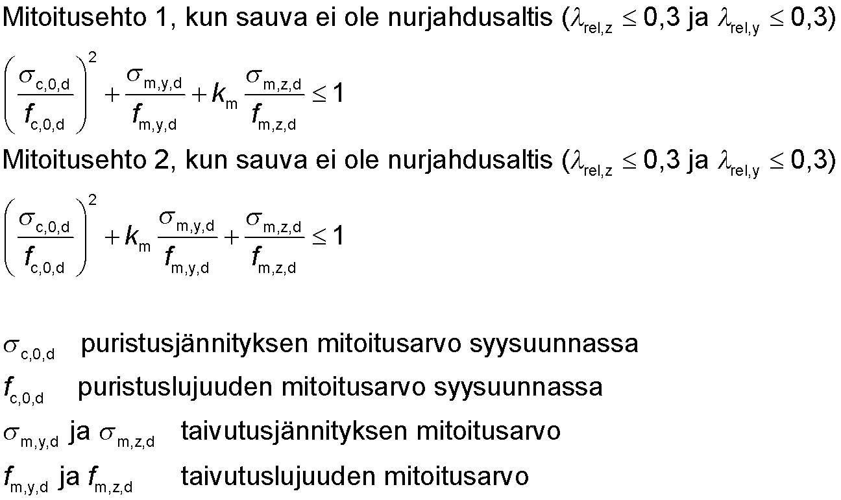
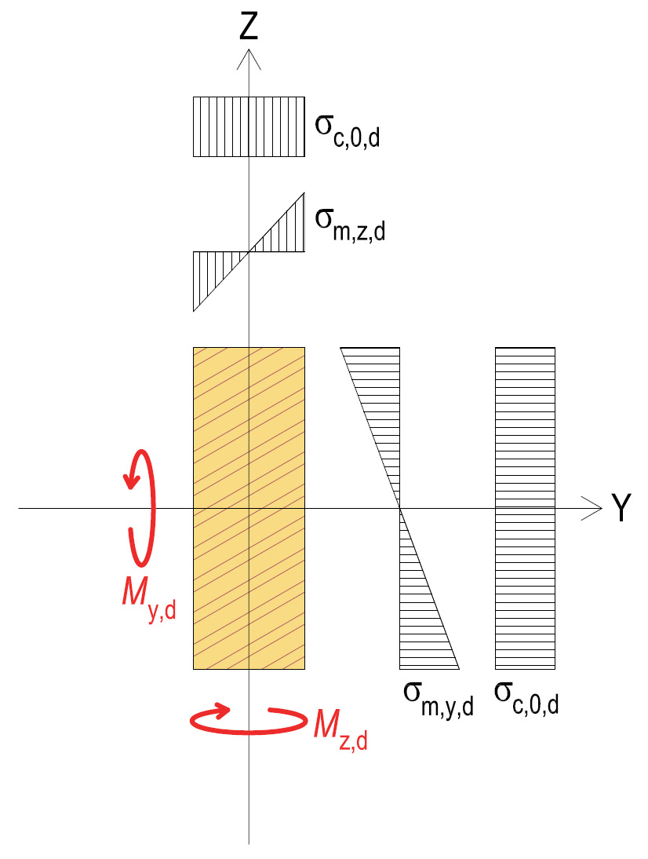
Combined effect of bend and compression
Dimensioning condition 1 when the rod is not prone to buckling
and
Dimensioning condition 2 when the rod is not prone to buckling
and
rated value of compression stress parallel to the grain
rated value of compression strength parallel to the grain
rated value of bending stress
rated value of bending strength
σ_{m,y,d} and σ_{m,z,d} rated value of bending stress
f_{m,y,d} and f_{m,z,d} rated value of bending strength
Factor k_{m} takes into account the effect of stress distribution and the inhomogeneity of wood on the bending strength of a cross-section bent in two directions
For rectangular cross-section k_{m} = 0.7 (sawn timber, glued laminated timber, LVL, CLT)
For other cross-sections and wood products k_{m} = 1.0

Slide 21
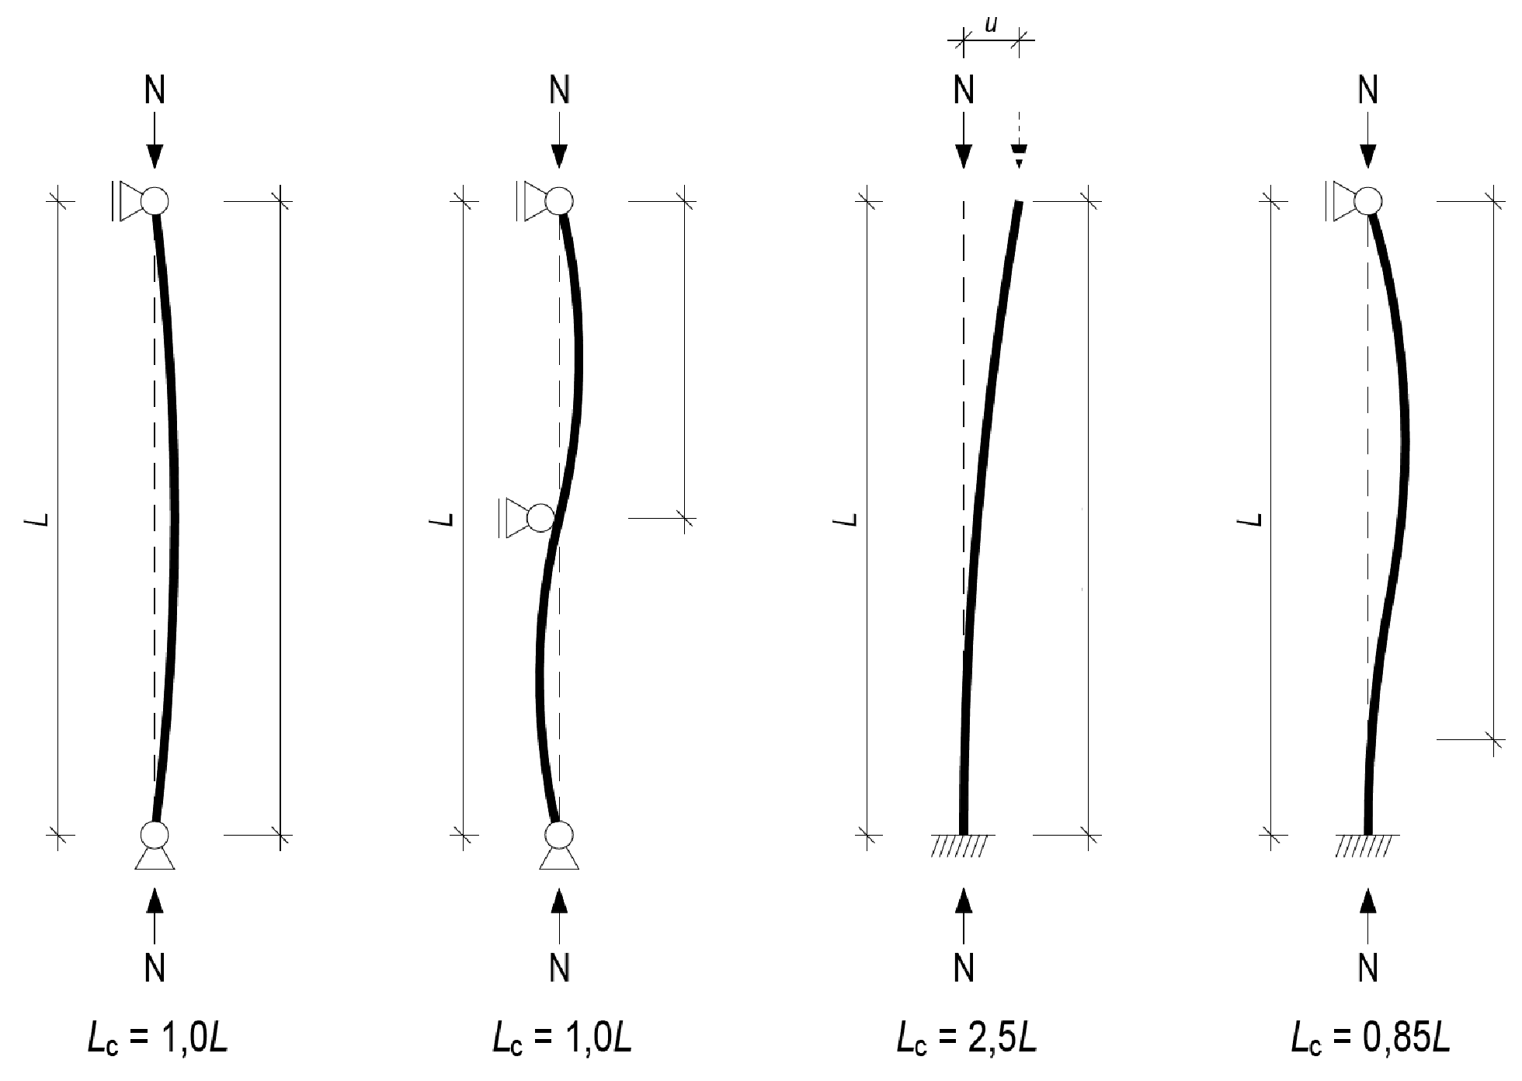
Buckling length of compressed rod
The buckling length is impacted by
  Support type (joint, rigid)
  Possible buckling support
  Stiffness of rigid support
In wooden structures, a torque rigid joint is usually only considered in a cantilever column’s foundation joint
In connection with the cantilever column attached with an adhesive screw joint, L_{c} = 2,2L (see VTT-S-05679-14)
Buckling length L_{C}
Buckling length L_{C}
Buckling length L_{C}
Buckling length L_{C}

Slide 22
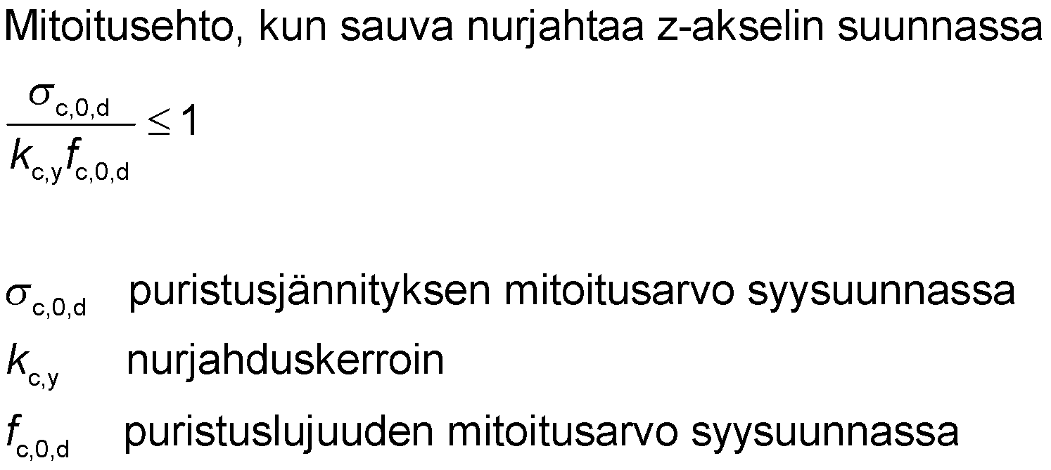
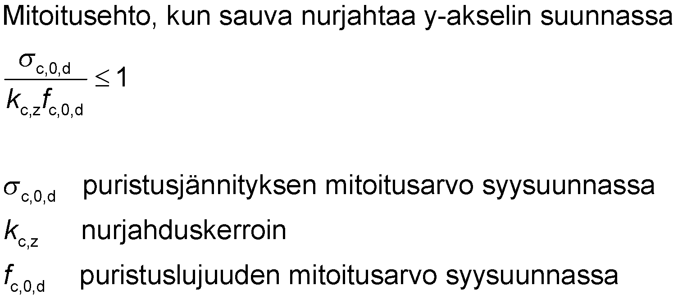
Buckling resistance of compressed rod
In the dimensioning of the rod's buckling resistance, the rated value of the rod’s compression stress is reduced by the buckling factor k_{c,y} and k_{c,z}
When k_{c,i} = 1, the rod is not susceptible to buckling in the direction of the axis in question
Dimension condition when rod buckles in the z-axis direction
Dimension condition when rod buckles in the y-axis direction
rated value of compression stress parallel to the grain
buckling factor
rated value of compression strength parallel to the grain
rated value of compression stress parallel to the grain
buckling factor
rated value of compression strength parallel to the grain

Slide 23
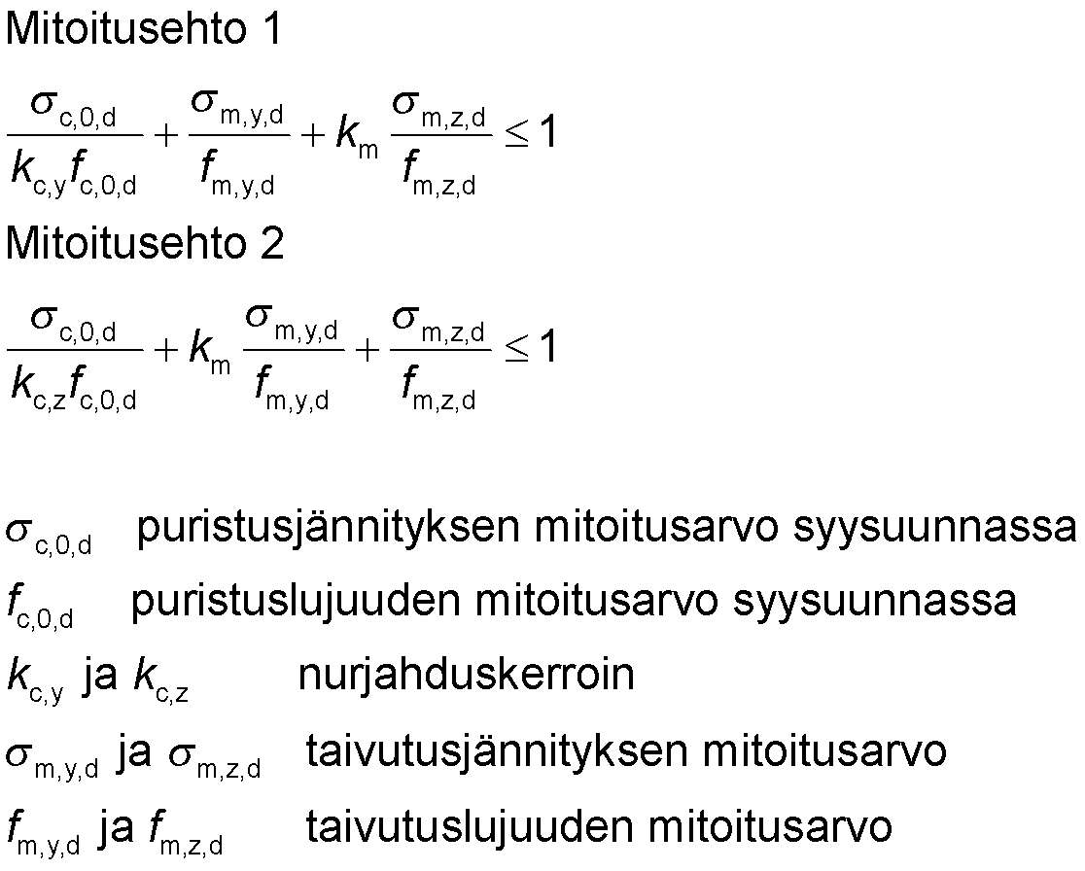
Combined effect of bending and buckling
Dimensioning condition 1
Dimensioning condition 2
rated value of compression stress parallel to the grain
rated value of compression strength parallel to the grain
k_{c,y} and k_{c,z} buckling factor
σ_{m,y,d} and σ_{m,z,d} rated value of bending stress
f_{m,y,d} and f_{m,z,d} rated value of bending strength
Factor k_{m} takes into account the effect of stress distribution and the inhomogeneity of wood on the bending strength of a cross-section bent in two directions
For rectangular cross-section k_{m} = 0.7 (sawn timber, glued laminated timber, LVL, CLT)
For other cross-sections and wood products k_{m} = 1.0

Slide 24
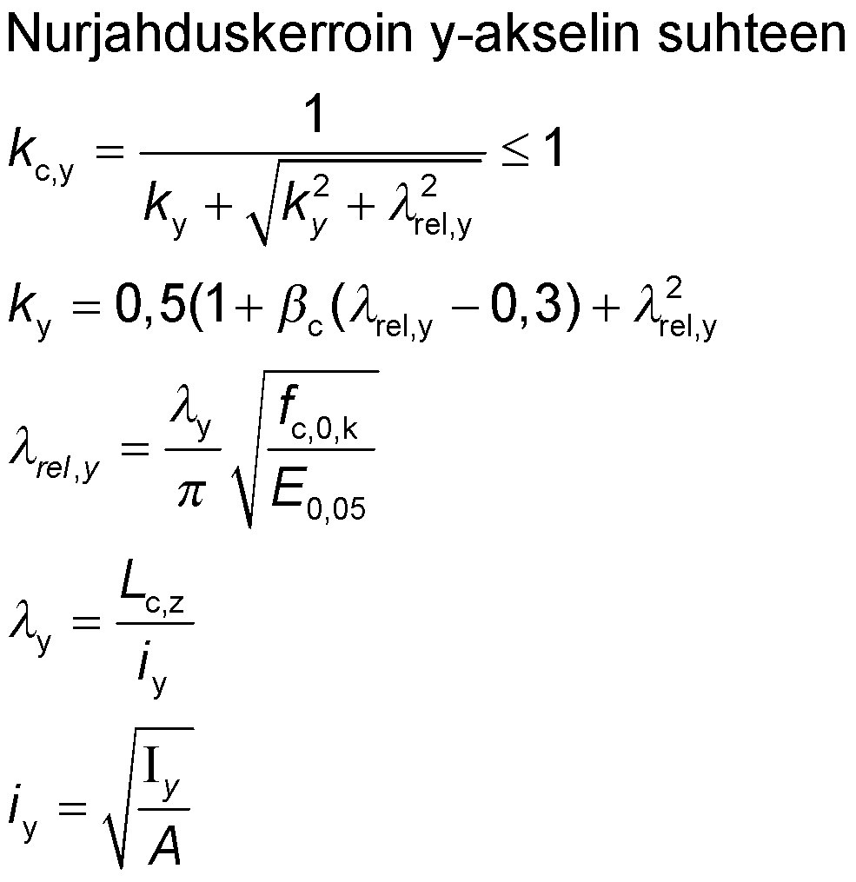
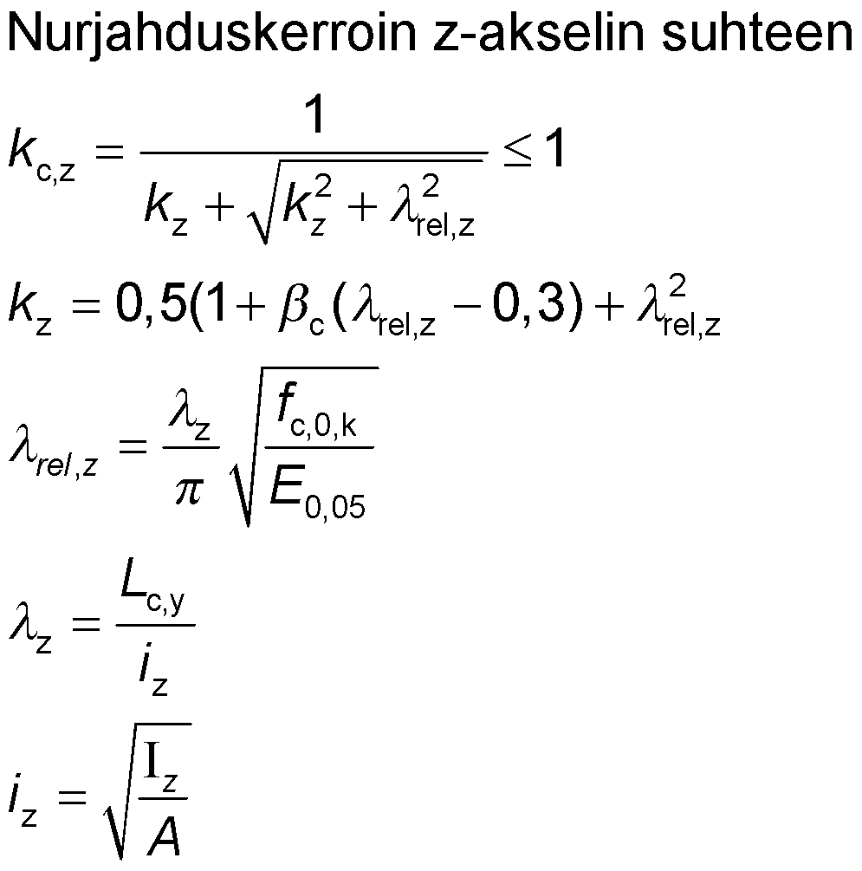
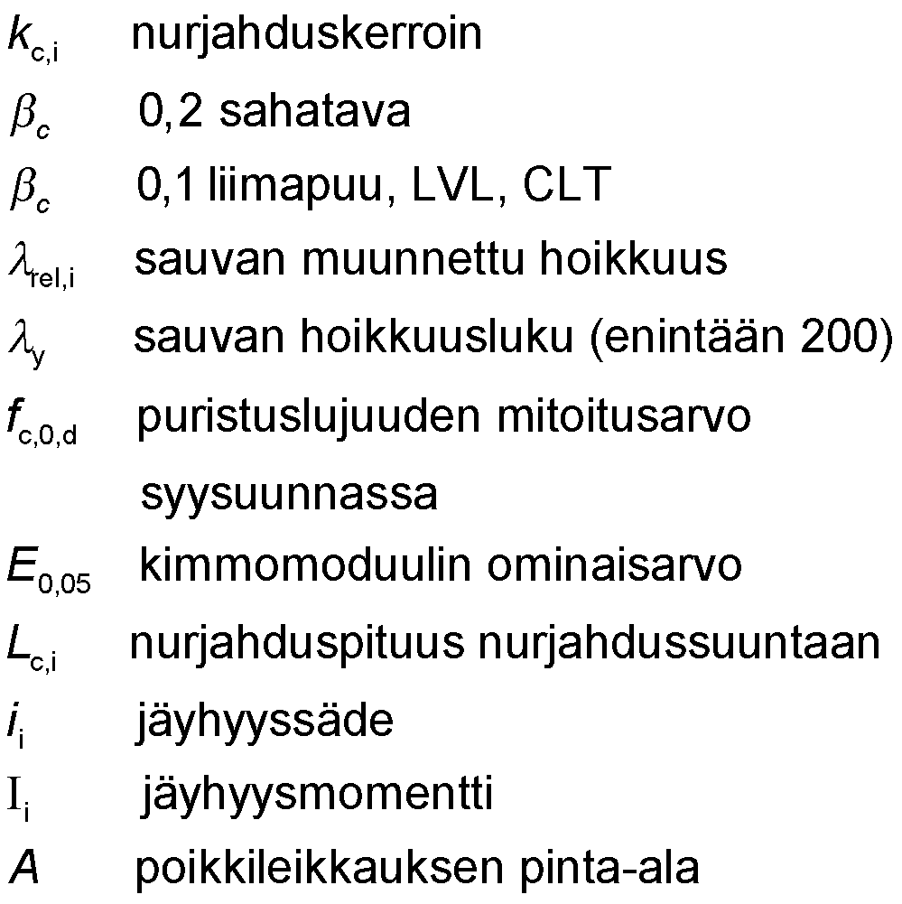
Buckling factor
Buckling factor in relation to the y-axis
Buckling factor in relation to the z-axis
buckling factor
0.2 sawn timber
0.1 glued laminated timber, LVL, CLT
modified slenderness of the rod
rod slenderness figure (max. 200)
rated value of compression strength
parallel to the grain
characteristic value of the modulus of elasticity
buckling length in the direction of buckling
radius of gyration
moment of inertia
area of cross-section

Slide 25
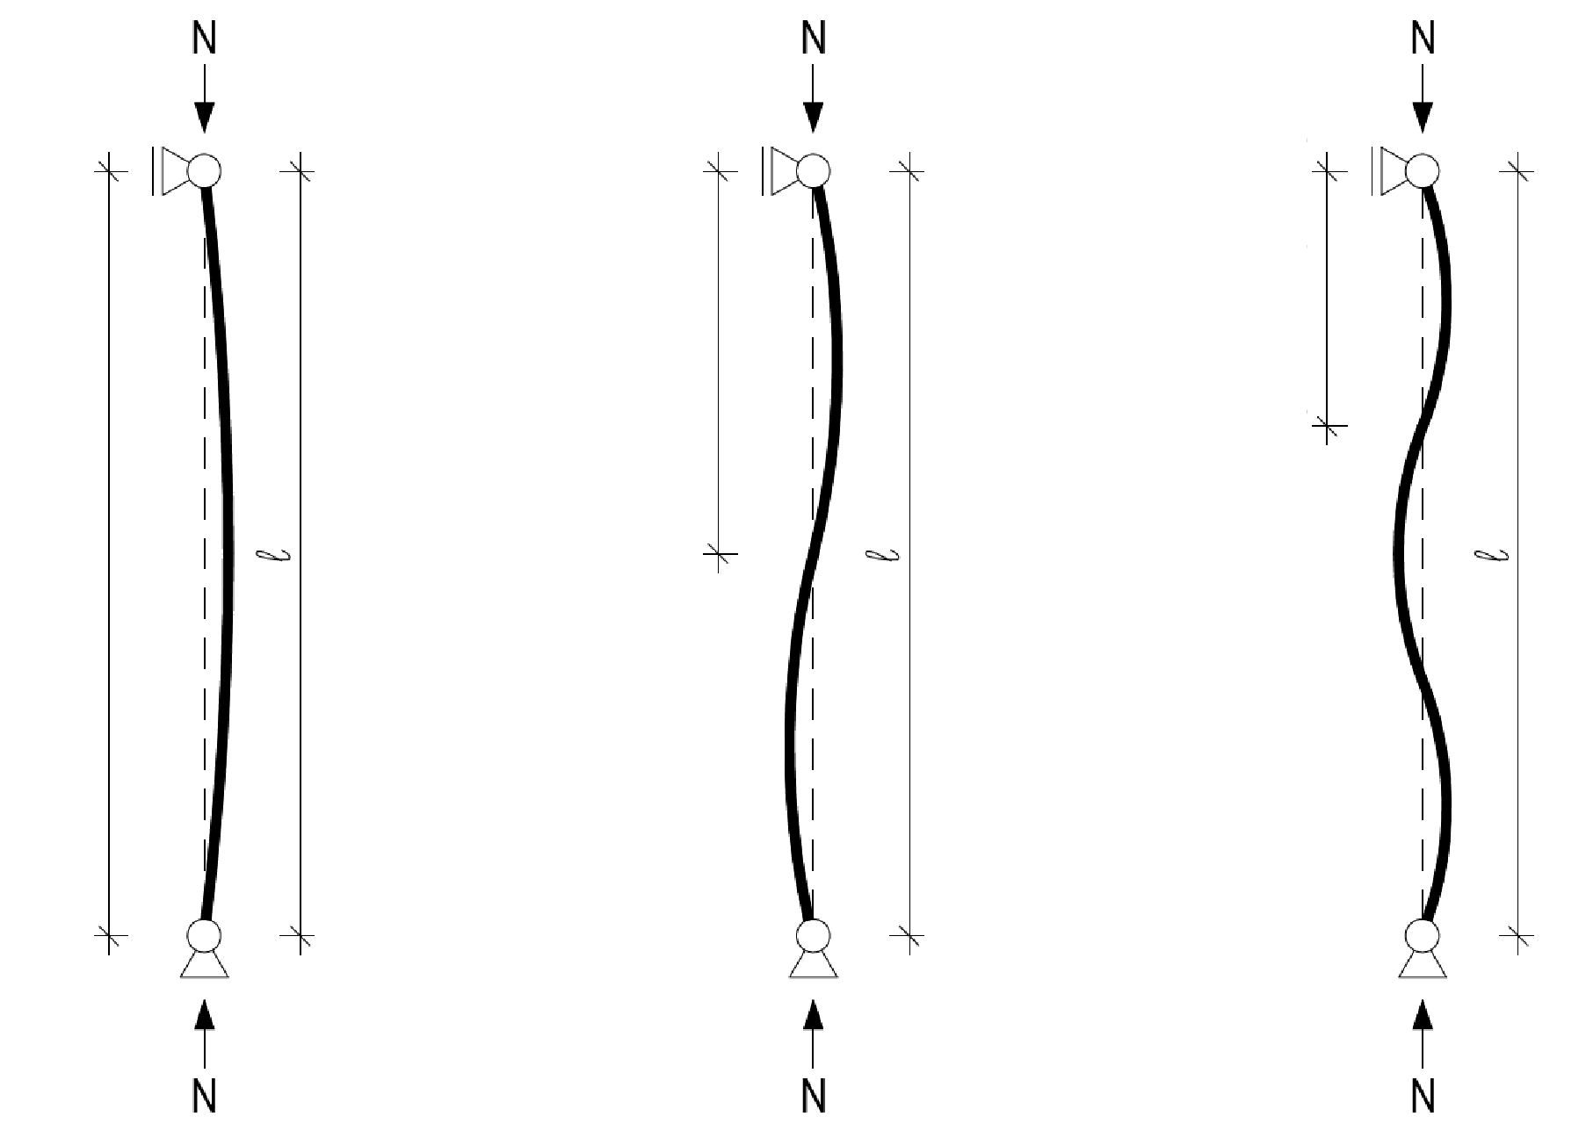
Forms of buckling for compressed rod
The buckling form of a compressed rod can be:
  Single wave (1st form)
  Multiwave (2nd form)
Multiwave buckling comprises of two or more buckling waves along the length of the rod
Multiwave buckling does not occur if l_{s} > 0,5l
Buckling wavelength l_{s}
Buckling wavelength l_{s}
Buckling wavelength l_{s}

Slide 26
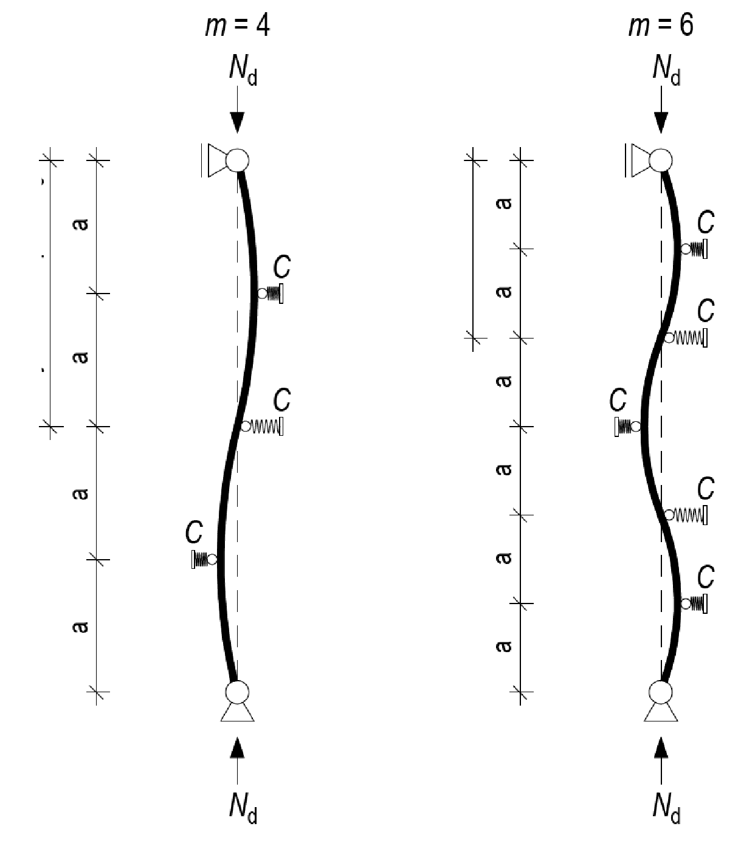
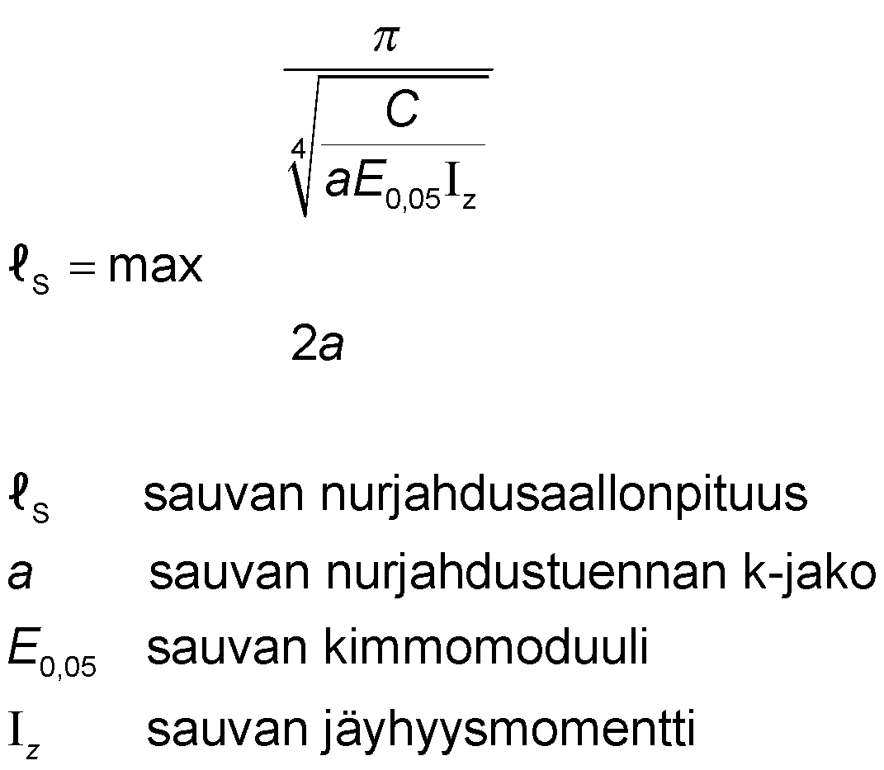
Buckling wave length of compressed rod
The buckling wavelength of the second shape of buckling, ls, can be calculated
Buckling wavelength l_{s}
Buckling wavelength l_{s}
buckling wave length of rod
k-distribution of the buckling support of a rod
a rod’s modulus of elasticity
a rod’s moment of inertia

Slide 27
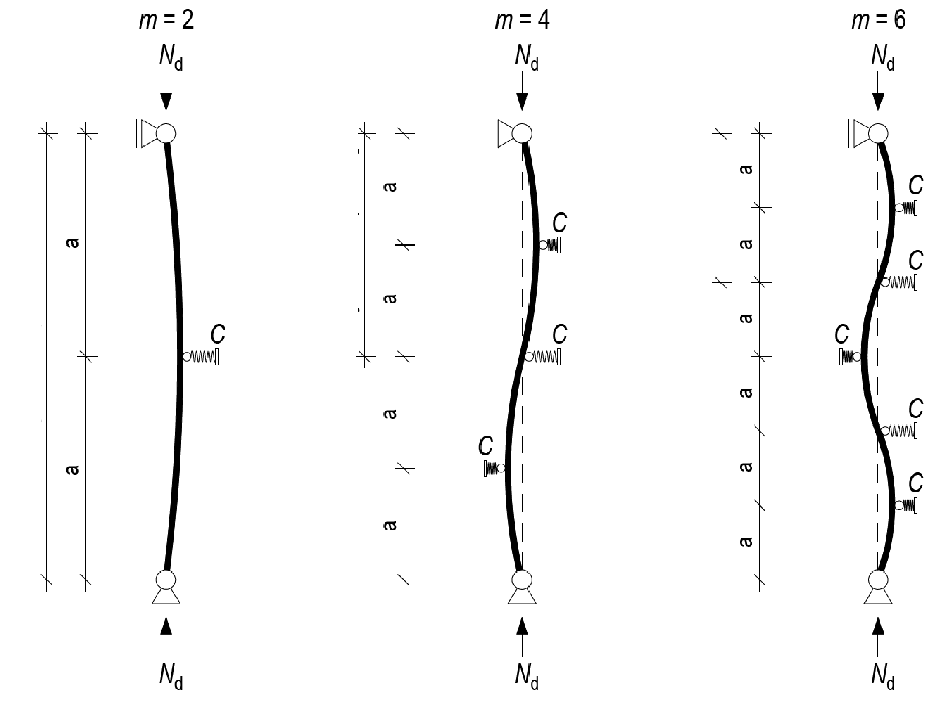
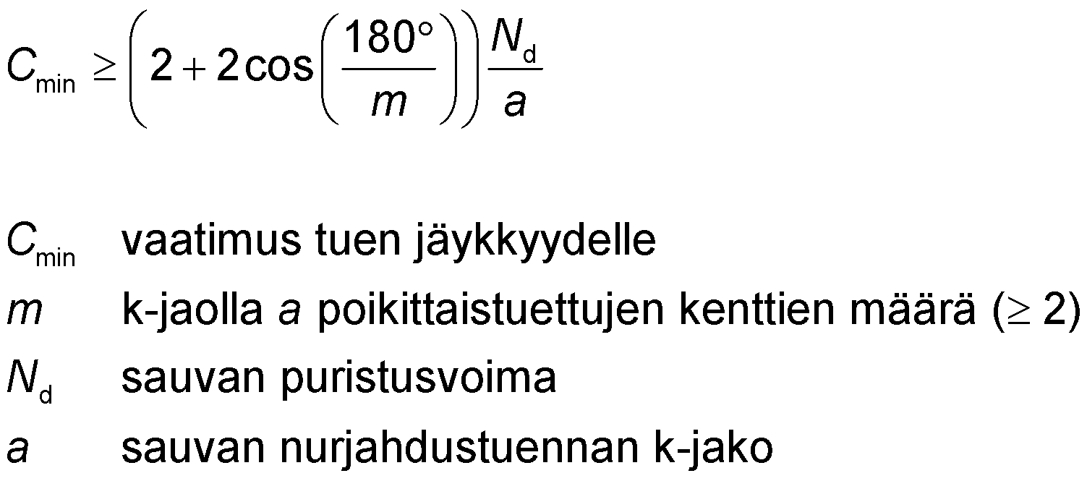
Spring rigidity of a compressed rod buckling support
Each buckling strut must meet the rigidity requirement C_{min}
Buckling wavelength l_{s}
Buckling wavelength l_{s}
Buckling wavelength l_{s}
C_{min} requirement for rigidity of the support
m Number of transverse supported fields on
k distribution a (≥2)
N_{d} a rod’s compression force
a k-distribution of the buckling support of a rod

Slide 28
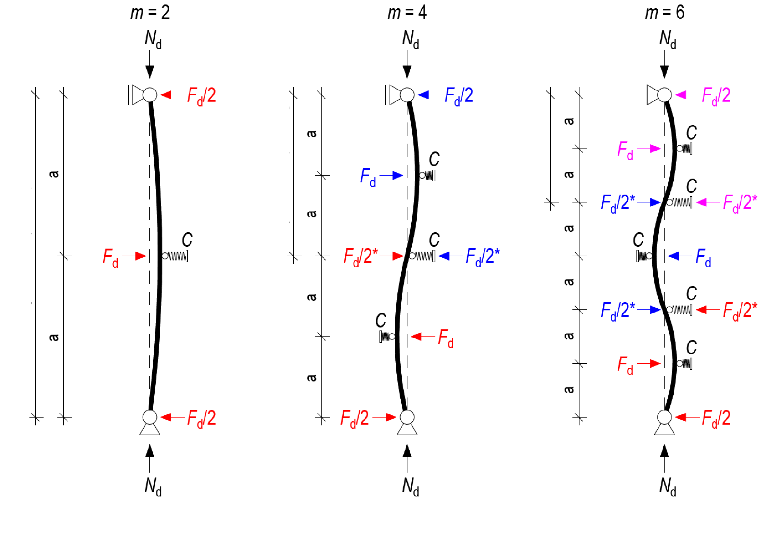
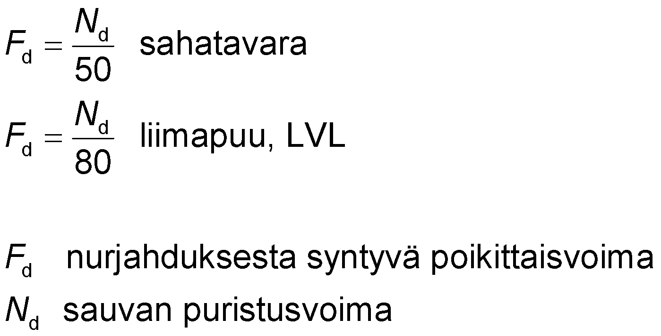
Force of a compressed rod buckling support
Polywave buckling can start anywhere, so all rod supports must be attached to force F_{d}
Buckling results in force F_{d} in a single spring support
Buckling wavelength l_{s}
Buckling wavelength l_{s}
Buckling wavelength l_{s}
sawn timber
glued laminated timber, LVL
transverse force from buckling
a rod’s compression force
*) However, the support is attached to force F_{d}, as the centre of the buckling wave can be at the location of any support

Slide 29
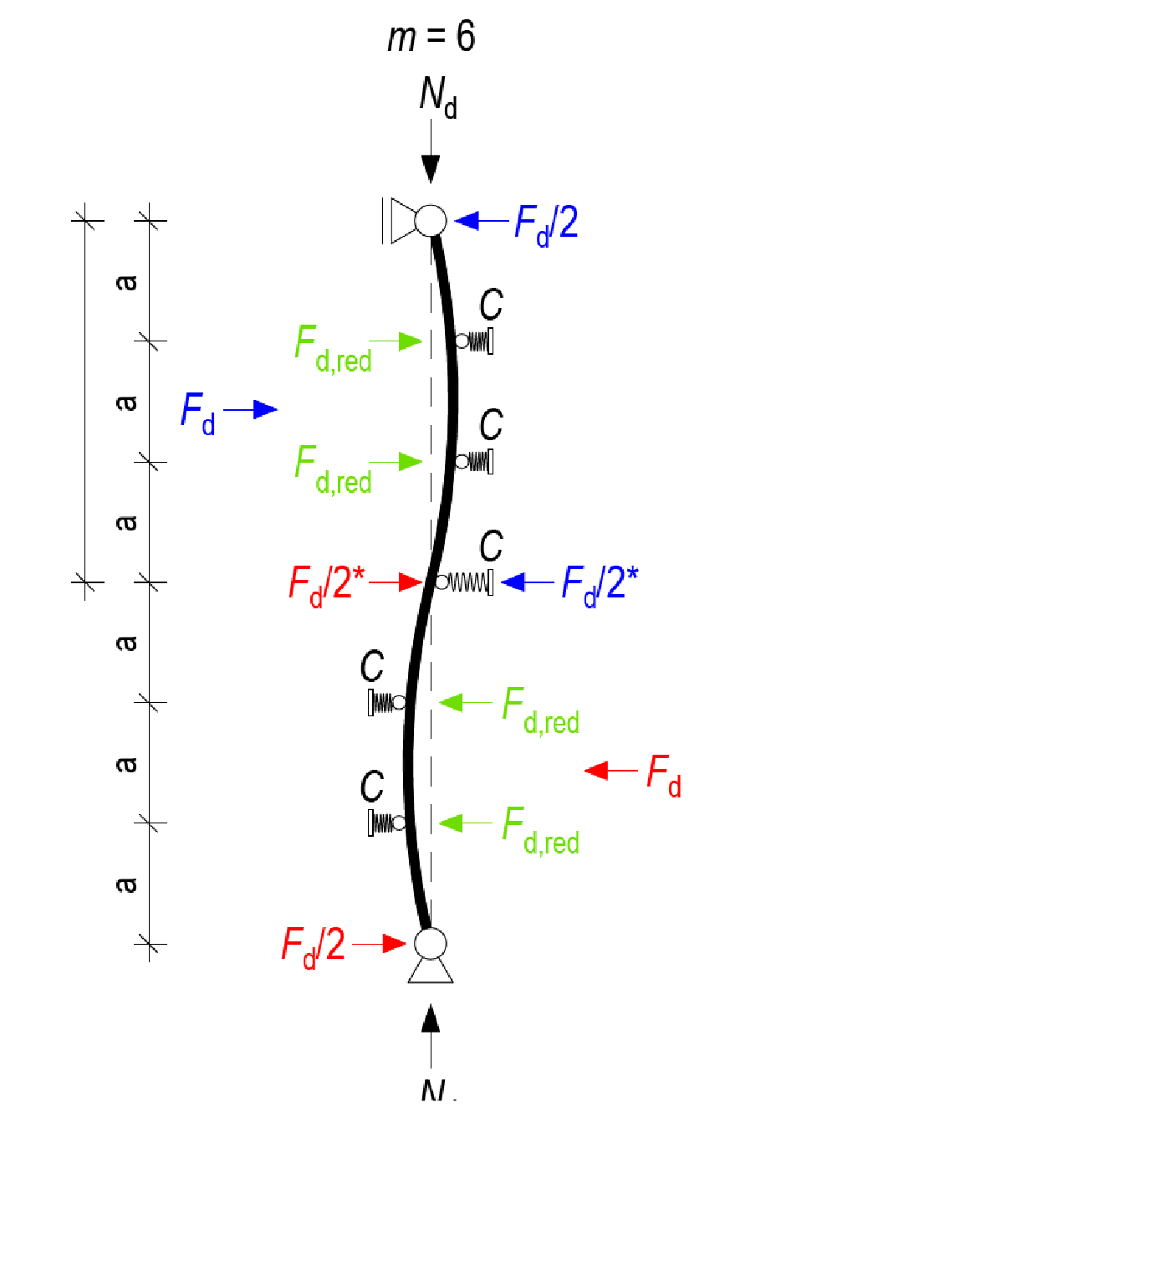
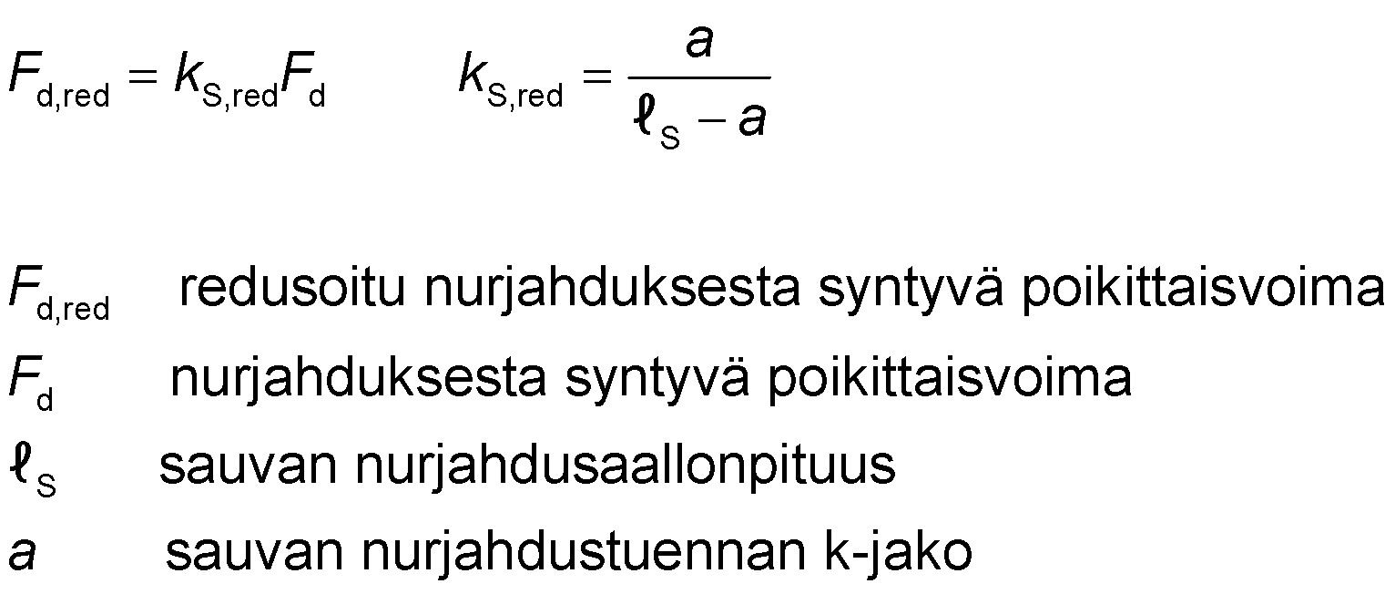
Force of a compressed rod buckling support
Force F_{d} can be reduced by a factor of k_{S,red} in a rod that is supported in at least four points with even spacing
Force F_{d} in the middle of the lateral buckling wave decreases when there is more than one support to prevent buckling per length l_{s}
Buckling wavelength l_{s}
reduced transverse force from buckling
transverse force from buckling
buckling wave length of rod
k-distribution of the buckling support of a rod
*) However, the support is attached to force F_{d},, as the centre of the buckling wave can be at the location of any support

Slide 30

Buckling support on compressed rod
The buckling supports are spring supports that must meet the rigidity requirement C_{min}
Buckling results in horizontal force F_{d}, which is in the middle of the buckling wave
Support reaction F_{d}/2 to force F_{d} is created at the ends of the buckling wave
Support that prevents buckling is effective when the sum of the transverse forces at the length of the rod is zero
Buckling wavelength l_{s}
Buckling wavelength l_{s}
Buckling wavelength l_{s}
*) However, the support is attached to force F_{d},, as the centre of the buckling wave can be at the location of any support

Slide 31
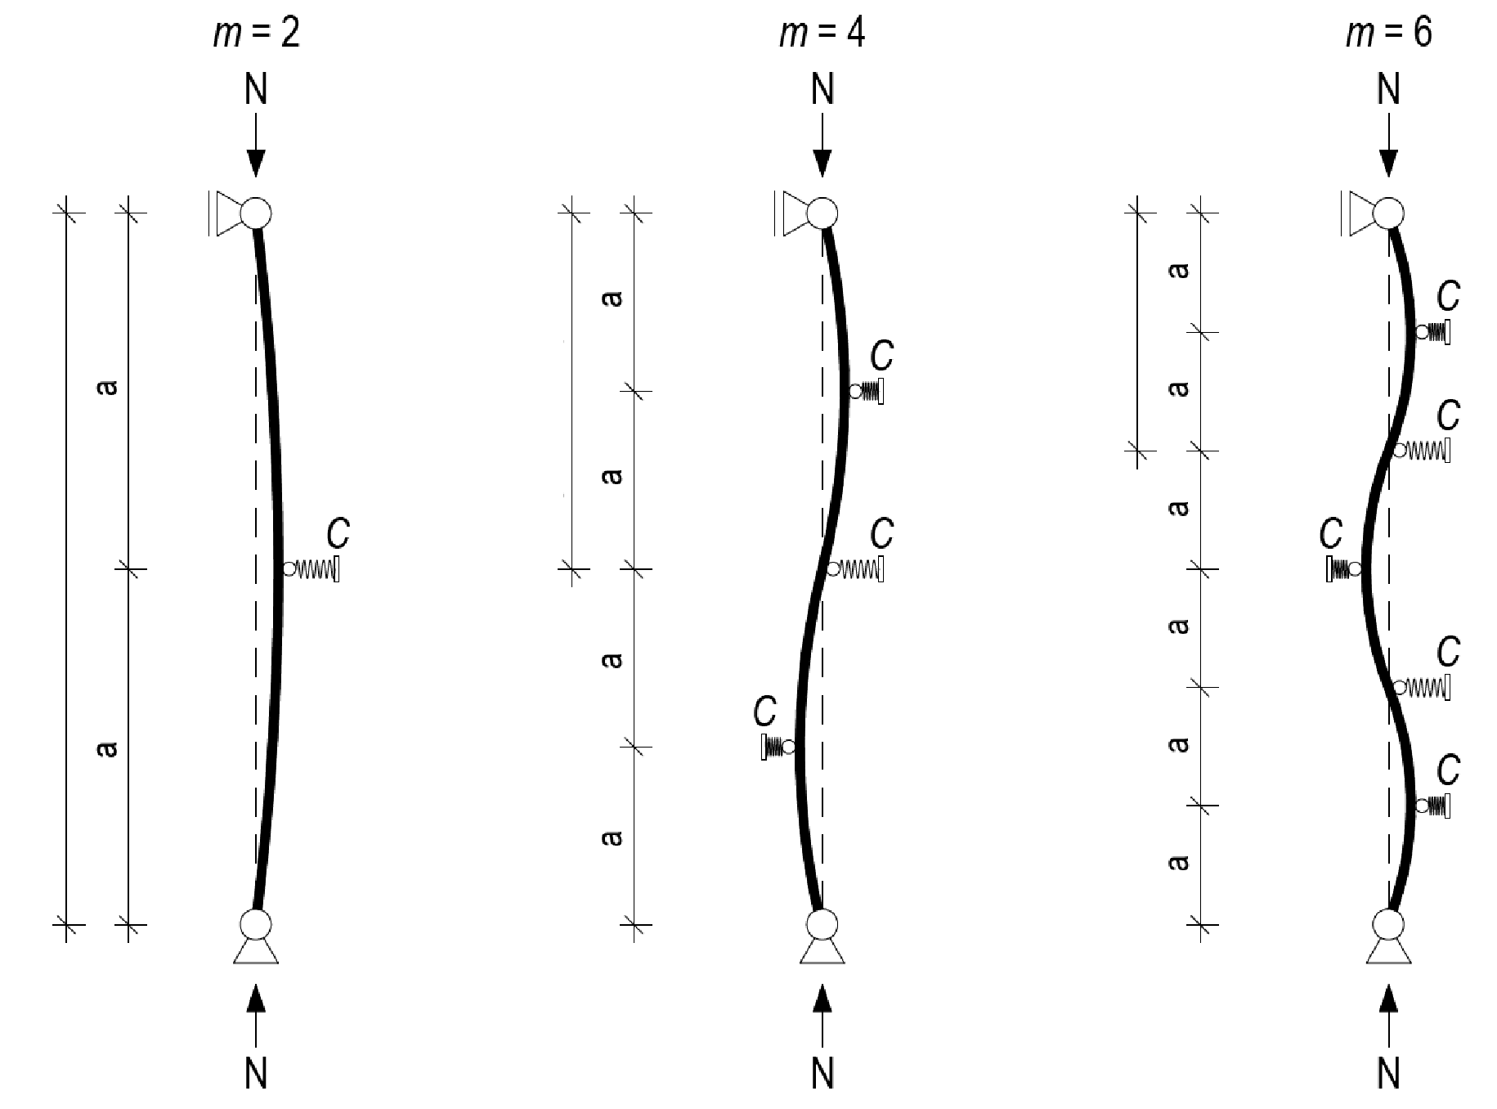
Buckling support on compressed rod
The rod is not continuously supported when m = 2
The rod is continuously supported when m > 2
m is the number of a-dimensions
Buckling wavelength l_{s}
Buckling wavelength l_{s}
Buckling wavelength l_{s}

Slide 32
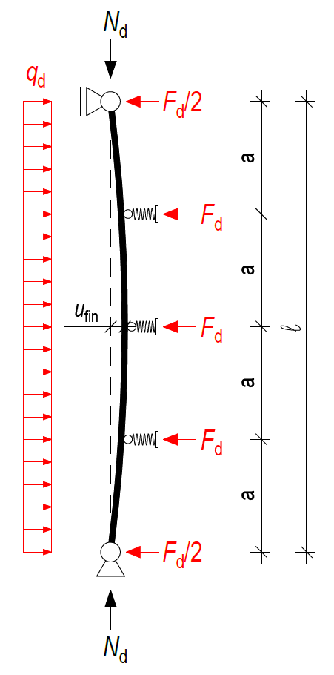
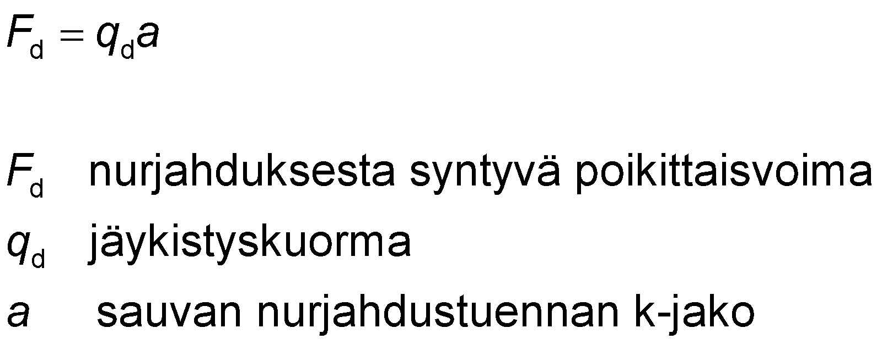
Stiffening load from buckling
When a continuously supported rod buckles only in one direction (1st form) the buckling results in an evenly distributed stiffening load q_{d}
The buckling supports system must be so stiff that the final deflection u_{fin} at the rod's ultimate limit state does not exceed the value l/500
transverse force from buckling
stiffening load
k-distribution of the buckling support of a rod

Slide 33
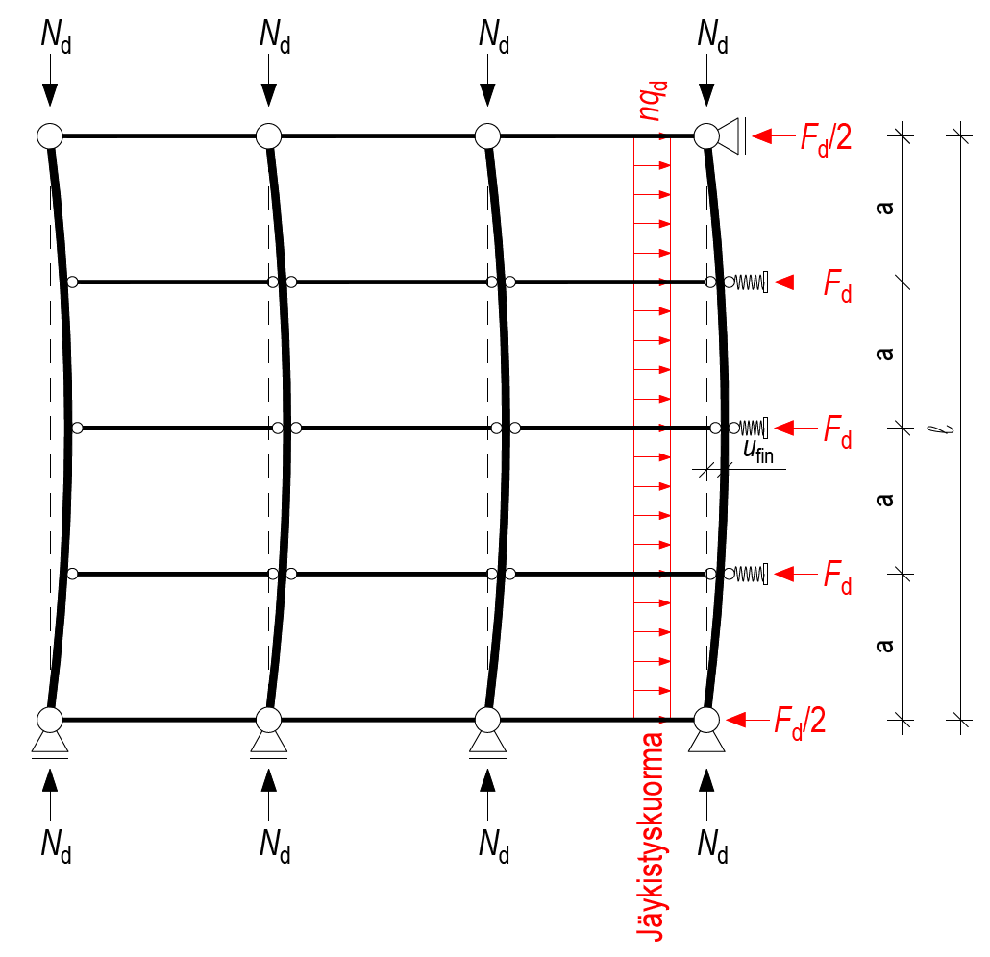



Stiffening load from buckling
The stiffening load can be specified for one rod or rod assembly
stiffening load from buckling
factor that takes into account the effect of the rod length
number of rods from which stiffening load accumulates on stiffeners
normal force of rod
the length of the rod between its end supports
Stiffening load

Slide 34

Stiffening load
Wind load and additional lateral force shall be included in the stiffening load if the buckling supports system is also used to stiffen the aforementioned external loads
When the structure assembly contains n-number of parallel rods fastened to one another, the buckling supports system is subject to a stiffening load of nq_{d} + (q_{w,d} + q_{H,d})
Wind load
Stiffening load
Additional horizontal force

Slide 35




Non-continuously supported rod (basic case) m=2
Will be determined
Support stiffness requirement
Stiffening load
Support force max
Will be checked
Support stiffness requirement C_{min} with connection displacements (K_{u,fin})
Durability of support when subjected to force F_{d}
Final displace u_{fin} max l/500 (MRT) for stiffening load q_{d}
including any wind load and additional lateral force
(sawn timber),

Slide 36



Continuously supported rod m>2 l_{s} ≤ 0,5l
Will be determined
Buckling wave length
Support stiffness requirement
Stiffening load
Support force max
Will be checked
Support stiffness requirement C_{min} with connection displacements (K_{u,fin})
Durability of support when subjected to force F_{d}
Final displace u_{fin} max l/500 (MRT) for stiffening load q_{d}
including any wind load and additional lateral force
Buckling wavelength l_{s}
(sawn timber),

Slide 37


Continuously supported rod m>2 l_{s} > 0,5l
Will be determined
Support stiffness requirement
Stiffening load
Support force
NOTE! Multiwave buckling does not occur if l_{s} > 0,5l
Will be checked
Support stiffness requirement C_{min} with connection displacements (K_{u,fin})
Durability of support when subjected to force F_{d}
Final displace u_{fin} max l/500 (MRT) for stiffening load q_{d}
including any wind load and additional lateral force

Slide 38
Non-closed and closed stiffening system
In a non-closed stiffening system, the forces that the stiffener is subject to do not return to the supports of the stiffening rod(s) within the system
  External forces are created outside the stiffening system, which must be transmitted to the rod supports using a separate stiffening system
In a non-closed stiffening system, the forces that the stiffener is subject to return to the supports of the stiffening rod(s) within the system
  No external force is generated outside the stiffening system
The stiffening system should always be closed
  However, this is not possible as there may be discontinuity points in the stiffener rod, in which the stiffening building element must be cut

Slide 39

Non-closed stiffening system
NOTE!
External force due to a non-closed stiffening system
NOTE!
The force accumulated on the stiffness leaves an external force at the ends of the rod because it is a non-closed stiffening system
n number of rods

Slide 40

Closed stiffening system
NOTE!
The force accumulated on the stiffener returns to the ends of the rod because it is a closed stiffening system
n number of rods

Slide 41

Closed stiffening system
Stiffener beam
Stiffener beam
Stiffener beam
Stiffener beam
n number of rods

Slide 42

Closed stiffening system
Stiffener beam
n number of rods

Slide 43

Closed stiffening system
Wavelength
Stiffener beam
Wavelength
Stiffener beam
n number of rods
n number of rods

Slide 44

Lateral buckling of a bent rod
Loss of stability
Lateral buckling means loss of stability at the compressed edge of a bent rod
The length of a lateral buckling wave can be calculated, the same way as the buckling wavelength
Lateral buckling support is dimensioned with the same principle as buckling support for a compressed rod
Lateral buckling wavelength l_{s}
Loss of stability
Lateral buckling wavelength l_{s}

Slide 45


Normal force of compressed edge N_{d}
The normal force N_{d} on the compressed edge of a bent rod can be calculated
normal force of the compressed edge of the bent rod
lateral buckling factor for rod with no support to prevent lateral buckling
determined according to effective lateral buckling length l _{ef}
rated value of the rod’s bending moment
height of the rod’s cross-section in the direction of the bending moment

Slide 46

Effective lateral buckling length
Effective buckling length l_{ef} is influenced by
  Rod support
  Load type
  Load position in h-dimension direction
Support | Location of evenly distributed load q_{d} | l_{ef}
Joint - Joint Twisting around the rod’s longitudinal axis is prevented | On the compressed edge | 0.9l + 2h
 | On the centre of gravity | 0.9l
 | On the edge with traction | 0.9l - 0,5h
Source: RIL 205

Slide 47

Effective lateral buckling length
Effective buckling length l_{ef} is influenced by
  Rod support
  Load type
  Load position in h-dimension direction
Support | Location of the point load P_{d} | l_{ef}
Joint - Joint Twisting around the rod’s longitudinal axis is prevented | On the compressed edge | 0.8l + 2h
 | On the centre of gravity | 0.8l
 | On the edge with traction | 0.8l - 0,5h
Source: RIL 205

Slide 48

Effective lateral buckling length
Effective buckling length l_{ef} is influenced by
  Rod support
  Load type
  Load position in h-dimension direction
Support | Location of the moment M_{d} | l_{ef}
Joint - Joint Twisting around the rod’s longitudinal axis is prevented | On the compressed edge | 1.0l + 2h
 | On the centre of gravity | 1.0l
 | On the edge with traction | 1.0l - 0,5h
Source: RIL 205

Slide 49

Effective lateral buckling length
Effective buckling length l_{ef} is influenced by
  Rod support
  Load type
  Load position in h-dimension direction
Support | Location of evenly distributed load q_{d} | l_{ef}
Free - Stiff Twisting around the rod’s longitudinal axis is prevented | On the compressed edge | 1.0l + 2h
 | On the centre of gravity | 1.0l
 | On the edge with traction | 1.0l - 0,5h
Source: RIL 205

Slide 50

Effective lateral buckling length
Effective buckling length l_{ef} is influenced by
  Rod support
  Load type
  Load position in h-dimension direction
Support | Location of the point load P_{d} | l_{ef}
Free - Stiff Twisting around the rod’s longitudinal axis is prevented | On the compressed edge | 1.0l + 2h
 | On the centre of gravity | 1.0l
 | On the edge with traction | 1.0l - 0,5h
Source: RIL 205

Slide 51

Effective lateral buckling length
Effective buckling length l_{ef} is influenced by
  Rod support
  Load type
  Load position in h-dimension direction
Support | Location of the moment M_{d} | l_{ef}
Free - Stiff Twisting around the rod’s longitudinal axis is prevented | On the compressed edge | 2.0l + 2h
 | On the centre of gravity | 2.0l
 | On the edge with traction | 2.0l - 0,5h
Source: RIL 205

Slide 52

Effective lateral buckling length
When the rod’s compressed edge is supported to precent lateral buckling, the effective lateral buckling length l_{ef} is influenced by
  K distribution of lateral buckling supports
  Load transfer to rod
  Load position in h-dimension direction
Load is transmitted directly to the rod
Support | Load location | l_{ef}
Twisting around the rod’s longitudinal axis is prevented | On the compressed edge | a + 2h
 | On the edge with traction | a - 0.5h
Source: RIL 205

Slide 53

Effective lateral buckling length
When the rod’s compressed edge is supported to precent lateral buckling, the effective lateral buckling length l_{ef} is influenced by
  K distribution of lateral buckling supports
  Load transfer to rod
  Load position in h-dimension direction
The load is transmitted to the rod via the lateral bucking supports P_{d}
Support | Load location | l_{ef}
Twisting around the rod’s longitudinal axis is prevented | On the compressed edge | a
 | On the edge with traction | a
Source: RIL 205

Slide 54




Lateral buckling resistance of a bent rod
The rated value for the rod’s bending stress in the design of the rod’s lateral buckling resistance is reduced with the factor k_{crit}
When k_{crit}= 1, the rod is not susceptible to lateral buckling
Dimensioning condition
Lateral buckling factor
Relative slenderness of the rod
when
when
when
rated value of bending stress
lateral buckling factor
rated value of bending strength
relative slenderness
characteristic value of bending strength
critical bending stress

Slide 55

Critical bending stress
Critical bending stress of rectangular cross-section
Product | c factor
softwood timber | 0.78
Split glued-laminated timber GL30cs | 0.72
Split glued-laminated timber GL30hs | 0.70
Glued-laminated timber GL30c | 0.70
Glued-laminated timber GL30h | 0.68
Kerto-S-LVL | 0.58
Kerto-T-LVL | 0.58
Kerto-Q-LVL | 0.67
critical bending stress
product-specific factor
width of the cross-section
height of the cross-section in the direction of the bending moment
lateral buckling length
characteristic value of the modulus of elasticity

Slide 56


Combined effect of lateral buckling and buckling
Combined effect must be checked when
  Compression force N_{d}
  Bending moment M_{y,d}
  Lateral buckling factor k_{crit} < 1
Direction of buckling
Direction of lateral buckling
Dimensioning condition
Dimensioning condition
rated value of bending stress
lateral buckling factor
rated value of bending strength
rated value of compression stress parallel to the grain
buckling factor
rated value of compression strength parallel to the grain

Slide 57
Holes in rod
No large holes (permitted d ≤ 30 mm) may be made in rods manufactured from timber
RIL 205-1-2017 only gives instructions for the design of holes in glue-laminated or LVL rods
The parameters are based on the design method set out in DIN EN1995-1-1/NA.
Holes in Kerto-LVL rods can also be designed in accordance with VTT certificate 184/03.

Slide 58


Geometry requirements for holes
(d ≤ 50 mm, d > 50 mm)
Holes should be
  Round
  Rectangular with rounded corners
  r ≥ 15 mm
Conditions 1...6 must be met
  With round hole h_{d}=0.7d
however l_{z} ≥ 300 mm
h_{ro} and h_{ro} ≥ 0,35h
however, with a round hole d ≤ 0,3h

Slide 59

Shape and position of holes when d ≤ 30 mm
When the diameter of a round hole is less than or equal to d=30 mm
  Holes are taken into account in the design only as a reduction in the cross-section’s area
  Holes can also be made in a rod made pf sawm timber
  The edge and mutual distances shown in the adjacent figure must be realised

Slide 60


Transverse tensile stress
transverse tensile stress at the hole
transverse pulling force at the hole
shear force at the hole
bending moment at the hole
rectangular hole
round hole
rectangular hole
round hole

Slide 61


Design inspections at the hole
BENDING IN RELATION TO THE Y-AXIS
Tensile stress perpendicular to the grain σ_{t,90,d} ≤ f _{t,90,d}
Shear stress τ_{d} ≤ f _{v,d}
Tensile stress parallel to the grain σ_{t,0,d} ≤ f_{t,0,d} (when the rod has normal force N_{d})
Compression stress parallel to the grain σ_{c,0,d} ≤ f_{c,0,d} (when the rod has normal force N_{d})
Bending stress on the compressed edge σ_{m,y,d} ≤ f _{m,y,d}
Bending stress on the tensioned edge σ_{m,y,d} ≤ f _{m,y,d}
Combined effect of bending and compression stress on compressed edge
Combined effect of bending and tensile stress on the tensioned edge
NOTE!
Possible bending regard the Z axis will be taken into account in the combined effect formula
A lateral buckling check will be carried out normally on rods susceptible to lateral loading
Cross-section from which hole’s area
has been subtracted

Slide 62

Reinforcing holes
Holes can be reinforced in which case larger holes can also be made
Holes can be reinforced with
  Full-thread screws
  Glued steel bars
  Plywood panel glued to the side of the rod
Instructions for reinforcement methods
  DIN EN1995-1-1/NA
  Instructions from the screw manufacturer

Slide 63

Notched and bevelled rods
A notch or a bevel cause peak stress to the bent rod, because the grain structure of the wood breaks
Notches and bevels should generally be avoided in particular on the rod's tensioned edge
Notches should usually be reinforced

Slide 64

Notched and bevelled rods
The peak stress caused by a notch does not need to be taken into account in durability design in the following cases
  A rod, which has compression or tensile stress parallel to the grain
  A bent rod in which the gradient of the bevel is at most j1:10
Gradient ≤ 1:10
Gradient ≤ 1:10

Slide 65

Beams notched or bevelled at the support
The effect of a notch or bevel will be taken into account in the design of a beam’s shear force strength by reducing the beam’s shear strength by factor k_{v}
The value of factor k_{v} will vary case-by-case (a, b, c, d)

Slide 66

Beams notched or bevelled at the support
A rectangular beam notched and bevelled at the support must meet the following dimensioning condition
rated value of shearing stress
rated value of shear force
the effective width of the beam’s cross-section (with cracking factor k_{cr} taken into account)
effective height of the beam cross-section
factor, which takes into account the impact of a notch or a bevel
rated value of shearing strength

Slide 67


Beams notched or bevelled at the support
Factor k_{v} = 1, when the beam is notched or bevelled on the side opposite to the support (compressed edge)
Variable i = 0, when measurement l = 0 meaning the impact of the bevel is not taken into account
sawn timber
glue wood
LVL in general
Kerto-S-LVL
Kerto-S-LVL

Slide 68

Reinforcing notches and bevels
A notch or a bevel can be reinforced with the same methods as a hole using
  Full-thread screws
  Glued steel bars
  Plywood panel glued to the side of the rod
  Cross-laminated wood products
  (CLT, LVL)

Slide 69
Vibration design of the intermediate floor
Typical causes of vibration to the intermediate floor are
  Walking (most common)
  Laundry machine
  Vibration caused by traffic
A person who is walking does not generally feel the vibration they cause
Vibration is generally best sensed by a person sitting in place
Vibration can be sensed
  As feelings in one’s body (most sensitive are 4…8 Hz)
  Movement of leaves on plants and objects
  Sound caused by dished and objects

Slide 70

Vibration design of the intermediate floor
Phenomena examined in vibration design
  Vibration of floor (Resonance)
  Wobbling of the floor (deflection)
Vibration must be investigated in
  Lightweight intermediate floors
  Composite structures with long spans
  Floating floors
  Elevated floors

Slide 71

Vibration design limit values
Vibration design examines
  The natural frequency of the intermediate floor
  Deflection caused by 1 kN point load
Difficult to set limit values
An abundance of research has been done around the world
Different limit values in different countries
EC 5 does not provide a direct answer
The national annex determines what is used
Image: VTT Press releases 2124

Slide 72

Vibration design limit values in Finland
The intermediate floor should be dimensioned as a high-frequency intermediate floor
Lowest natural frequency ≥ 9 Hz
temporary deflection in the intermediate floor frame
≤ 0,5 mm caused by a point load of 1 kN
The deflection limit can be increased with the factor given in the adjacent image
Deflection limit grossing-up factor
Increased room dimension in directions l or B [m]

Slide 73

Research results
Disturbance caused by vibration is subjective
Vibration design limits have also been determined based on the senses of the test subjects
From the perspective of vibration, an intermediate floor is considered better when
  The intermediate floor’s natural frequency grows (f₁ ≥ 8 Hz)
  The deflection of the intermediate floor from a 1 kN point load decreases (δ ≤ 0.5 mm)
Source: Toratti T., Talja A. (2006), Classification of human induced floor vibrations

Slide 74

Limit values for deflection in various countries
Source:
Zhang B., Rasmussen B., Jorissen A., Harte A. (2013) Comparison of vibrational comfort assessment criteria for design of timber floors among the European countries

Slide 75

Disturbances caused by walking
The stimulus from walking includes periodic and impact-like components
The lowest periodic load at walking frequency 1.6…2.2 Hz
Load components also occur in the range 3.2...8.8 Hz
Impact-like components
Periodic components
Force
F = 1 kN
Force [kN]
Time [s]
Source: VTT Press releases 2124

Slide 76

Low-frequency and high-frequency intermediate floor
Low-frequency intermediate floor
  Natural frequency f₁ < 9 Hz
  Low-frequency intermediate floor
  Resonance controls vibration
High-frequency intermediate floor
  Natural frequency f₁ ≥ 9 Hz
  High-frequency intermediate floor
  Bending controls vibration (transient vibration)
Low-frequency intermediate floor
High-frequency intermediate floor
Acceleration (m/s₂)
Acceleration (m/s₂)
Time (s)
Time (s)

Slide 77

Natural frequency of the intermediate floor
Vibration design examines the lowest natural frequency f₁ of the intermediate floor
The natural frequency is influenced by the intermediate floor span, mass and bending stiffness
Low natural frequency when
  Large mass
  Large span
  Small bending stiffness
Natural frequency 3rd form
Natural frequency 2nd form
m = mass
El = bending stiffness
Natural frequency 1st form (lowest natural frequency)
L = span length

Slide 78

Natural frequency of the intermediate floor
Natural frequency can be determined with the FEM program
2. Form: 11 Hz
1. Form: 9.4 Hz
3. Form: 16 Hz

Slide 79

Resonance
Little damping
Resonance happens when the natural frequency of the intermediate floor and the stimulus are at the same frequency
An intermediate floor in resonance vibrates very strongly
When the stimulus is continuous (walking) resonance continuously gains more energy
  The amplitude of the vibration grows
The resonance phenomenon is usually a challenge in low-frequency intermediate floors
Amplitude
Large damping
Resonance area
Acceptable area
Natural frequency f₁
Stimulus frequency f

Slide 80

Low-frequency intermediate floor f₁ < 9 Hz
Resonance feels like strong vibration in an intermediate floor
Resonance vibration only damps when the stimulus (walking) ends
In Finland, low-frequency intermediate floors cannot be designed at this time, because the design criteria do not exist
Acceleration (m/s₂)
Time (s)

Slide 81

High-frequency intermediate floor f₁ ≥ 9 Hz
Transient vibration feels like the wobbling of the intermediate floor
  Intermediate floor deflect under steps
Vibration has time to be damped entirely between steps
In Finland, all wood-structured intermediate floors must today be designed to be high-frequency intermediate floors
Acceleration (m/s₂)
Time (s)

Slide 82

Stiffnesses and directions of the intermediate floor
Intermediate floor span l
Direction of intermediate floor
Intermediate floor width B
Transverse direction

Slide 83

Distribution of the point load in a girder floor
In a beam-structured intermediate floor, the distribution of a 1 kN point load on the beams can be improved with
  A cast surface plate
  A deck structure on top of the beams (sheathing, rainscreen, etc)
  A transverse stiffener

Slide 84

Distribution of the point load in a girder floor
A transverse stiffening beam can be used as a transverse stiffener when using the truss girders
Image: www.openjoisttriforce.com

Slide 85

Location of transverse stiffener

Slide 86

Location of transverse stiffener

Slide 87

Distribution of the point load in a CLT panel
A CLT panel’s lamella structure distributes the point load effectively in direction B
Direction l
Direction B
Image: www.timberbiz.com.au

Slide 88


Natural frequency of intermediate floor with one opening
the lowest natural frequency of an intermediate floor that is bearing in one direction can be calculated
The bending stiffness of the intermediate floor surface plate and similar deck structure can be summed up as the bending stiffness of the frame
When the intermediate floor is supported by the main girders, the system's normal frequency will be inspected if necessary
L = span length
lowest natural frequency
span
bending stiffness in the direction of the span
intermediate floor mass [kg/m²] + 30 kg/m²

Slide 89


The system’s natural frequency
Intermediate floor
the system’s natural frequency
lowest natural frequency in the direction of the intermediate floor
lowest natural frequency in the direction of the main girders
intermediate floor span
main girders span
bending stiffness in the direction of the intermediate floor’s span
bending stiffness in the direction of the main girder’s span
intermediate floor mass [kg/m²] + 30 kg/m²
m₁ + mass of the main girder [kg/m²]
Main girder

Slide 90



Deflection from 1 kN point load
The deflection of an intermediate floor with one opening due to a 1 kN point load located at the centre of the span will be used to calculate
1000 N
span
bending stiffness in the direction of the span
bending stiffness in the transverse direction
spacing of beams and solid timber panel in the a beam-based intermediate floor, the width to be reviewed
the width of the intermediate floor in the transverse direction (will depend on the structure of the intermediate floor)

Slide 91
Width of the intermediate floor in the transverse direction (B measurement)
Intermediate floor type | Structural layers in B direction | Points to take note of with regard to stiffness (EI)_{B} | Structural layers in B direction | B measurement
Girder floor built on site | Cast plate Deck structure Transverse stiffener | Cast plate Deck structure Transverse stiffener | Along width B of the intermediate floor Along width B of the intermediate floor Along width B of the intermediate floor | Intermediate floor width B
Element structured girder floor | Cast plate Deck structure Transverse stiffener | Cast plate - - | Along width B of the intermediate floor - - | Intermediate floor width B
Element structured girder floor | Deck structure Transverse stiffener | Deck structure Transverse stiffener | Along the width of the element Along the width of the element | Width of the element
A CLT or LVL structured intermediate floor | Cast plate Solid timber panel | Cast plate - | Along width B of the intermediate floor - | Intermediate floor width B
A CLT or LVL structured intermediate floor | Solid timber panel | Solid timber panel | Along the width of the CLT-/LVL panel | Width of the CLT-/LVL panel

Slide 92

Deflection of surface flooring
In addition to the structure of the intermediate floor, the flexibility of the intermediate floor’s surface structure must be inspected, even when the dimensioning criteria for the intermediate floor apply to the intermediate floor’s structure
A surface structure that is too flexible will make the intermediate floor of poor vibration technical standard even if the frame structure is vibration-free.

Slide 93
Vibration caused by laundry machines
In the 1990s, the vibration caused by laundry machines was considered a major problem
However, respondents have not highlighted vibration caused by laundry machines in resident surveys
VTT has studied the stimulus caused by laundry machines and the floor vibrations caused by the stimulus (in 2003)
VTT has developed methods for computational assessment of floor vibration and limit values for permissible vibration levels
Stimuli generated by laundry machines are in the frequency range
5 Hz...60 Hz

Slide 94
Vibration caused by laundry machines
The frequency range of vibration caused by laundry machines is so extensive that the natural frequency of some floor type is almost certainly in the same frequency range as the stimulus
  A laundry machine’s spin cycle may cause resonance
Whether there is resonance or not will depend on
  The brand and type of laundry machine
  The floor’s natural frequency
The actual spin cycle speeds of a laundry machine cannot be known in advance
  Before their final spin cycle with a nominal cycle speed, laundry machines have intermediate spin cycles

Slide 95
Vibration caused by laundry machines
There is a risk of resonance vibration with all commonly used floor solutions and laundry machine types
A laundry machine should not be placed in the centre of a span but preferably close to load-bearing structures
Changing a laundry machine to one of a different brand may affect the level of vibration and alleviate the possible issue
  Different laundry machines have different stimulus frequencies

Slide 96
Improved intermediate floor properties
Increase in stiffness in the direction of the span
  Increases natural frequency
  Reduced deflection
Increased stiffness in the traverse direction
  Reduces characteristic normal modes and normal mode clustering
  Reduced deflection
Increases damping
  Reduces resonance issues
  (Difficult to implement, because this is naturally high in wood structures)
Avoiding excessively soft surface layers
  Reduced deflection

Slide 97
Impact of the type of intermediate floor on the limit values
There is one set of limit values for wood intermediate floors, even though there are different types of wood intermediate floors
  Lightweight (e.g. beam structure)
  Medium-heavy (e.g. solid wood panel structure)
  Heavy (e.g. timber-concrete slab)
However, the limit values should be assessed according to the type of intermediate floor, as
  For example, a light intermediate floor behaves differently than a medium-heavy one, etc.

Slide 98

Impact of the type of intermediate floor on the limit values
Heavyweight intermediate floor
Natural frequency < 9 Hz
Low-frequency intermediate floor
The intermediate floor is so heavy and stiff that the load caused by the walking does not cause the intermediate floor to bend
The vibration that occurs is reonance vibration, which is only dampened when walking on the intermediate floor ends
Medium-weight intermediate floor
Natural frequency ≥9 Hz
High-frequency intermediate floor
The intermediate floor is heavy, but the stiffness of the intermediate floor is low in relation to its mass
The load caused by walking causes the medium-weight mass to move and accelerate strongly
Due to mass, the vibration only has time to slightly dampen between steps, making the vibration feel undampened
The vibration that occurs is a combination of resonance vibration and transient vibration
Lightweight intermediate floor
Natural frequency ≥9 Hz
High-frequency intermediate floor
The intermediate floor is light in weight and the stiffness of the intermediate floor is high in relation to its mass
The load caused by walking causes the intermediate floor to bend and the vibration cannot be absorbed completely between steps
The vibration that occurs is a type of transient vibration that feels like the intermediate floor is swaying underneath one’s feet
Acceleration (m/s₂)
Acceleration (m/s₂)
Acceleration (m/s₂)
Time (s)
Time (s)
Time (s)
Example
Example
Example

