Slide 1



Industrial wood construction
Teaching materials for industrial wood construction education
2022

Slide 2
Origin of the materials
Use of the materials
These learning materials for industrial wood construction have been prepared in a project led by Puuinfo Oy in 2021–2022. Also involved in the project were
Lappia Vocational College,
TTS-Työtehoseura ry
South-Eastern Finland University of Applied Sciences,
Metropolia University of Applied Sciences,
Jyväskylä University of Applied Sciences,
University of Tampere, and
Federation of the Finnish Woodworking Industries Puutuoteteollisuus ry
The project was funded by the Ministry of the Environment.
The materials are intended to be used as extensively as possible in industrial wood construction education and studies.
The materials are released under the Creative Commons licence Attribution-ShareAlike (CC BY-SA), which requires that the author be properly credited when the materials are used and that derivative works may only be distributed under the same licence as the original work.
The original materials and any updates to them by Puuinfo will be published on the Library of Open Educational Resources website (aoe.fi) and the Puuinfo.fi website.

Slide 3
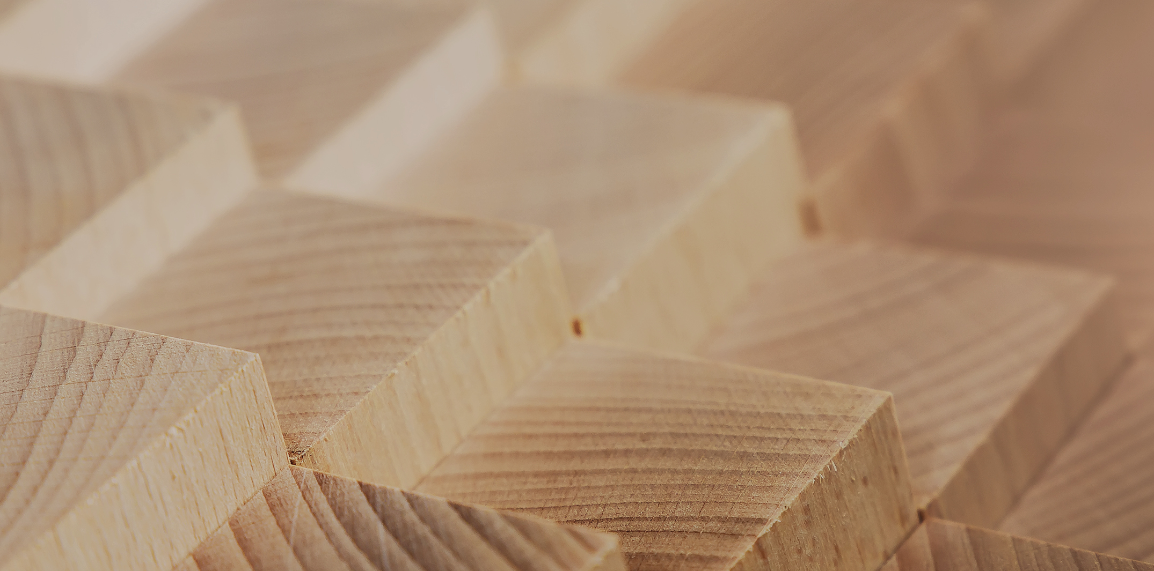
Structural design

Slide 4
Authors
Tero Lahtela,
Insinööritoimisto Tero Lahtela Oy
Release date: 18/11/2021

Slide 5
Fire design of a CLT panel

Slide 6
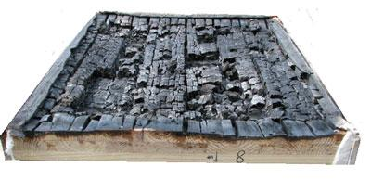
Charring of a CLT panel
There is no official fire design for CLT panels in Finland
Delamination may occur when a CLT panel is charred
Delamination is due to the fact that the adhesive joints on the CLT panel cannot withstand the fire exposure
Delamination occurs in CLT panels made with polyurethane adhesive
Image: www.fpl.fs.fed.us

Slide 7
Charring of a CLT panel
Due to delamination, the increase in the charring depth of the CLT panel is not linear (cf. sawn timber, glue laminated timber, LVL)
New glue types are being developed for CLT panel manufacturing to prevent delamination
Image: www.fpl.fs.fed.us

Slide 8
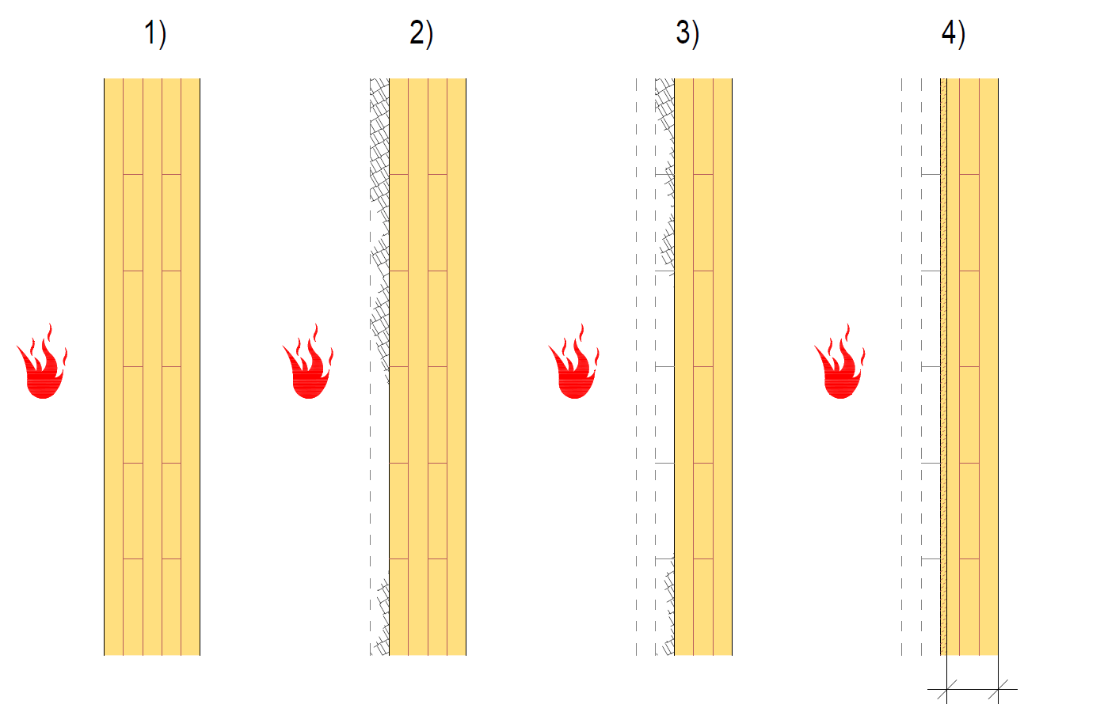
Charring of a CLT panel
In delamination, it is assumed that the charred lamella layer comes off, causing the protective carbon layer to be lost
The next lamella layer begins to char at much higher rate than normal
  Heated lamella layer
It is assumed that the charring rate returns to normal when the charring depth is 25 mm
1) Original cross-section
2) The charring reaches adhesive join 1 (delamination)
3) The charring reaches adhesive join 2 (delamination)
4) Residual cross-section
Effective cross-section

Slide 9
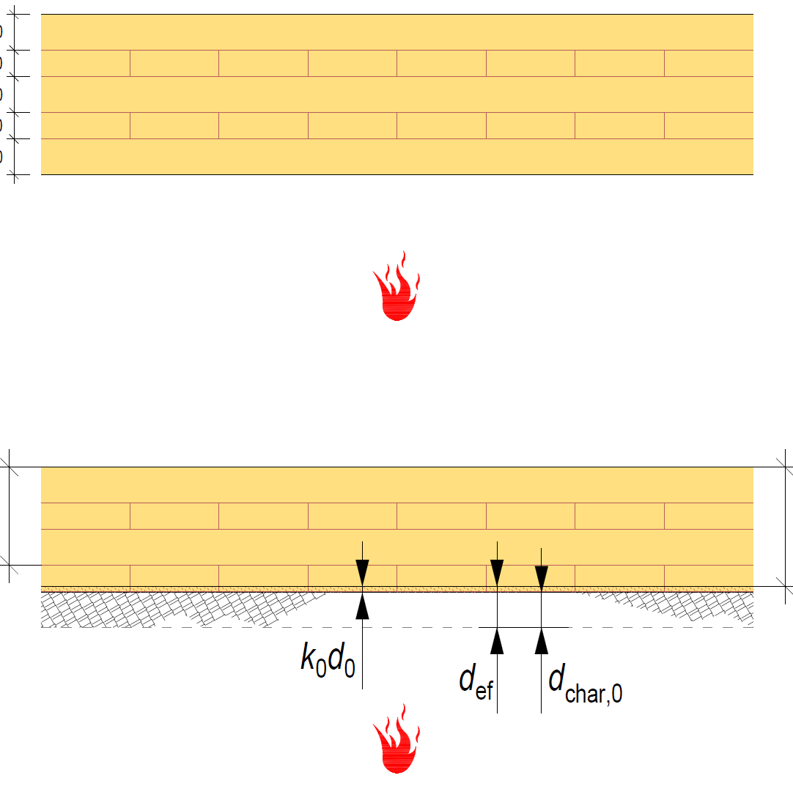
Charring of a CLT panel
From the perspective of fire design, it would be advantageous if the lamellas of the CLT panel were thick
If the surface lamella layer is so thick that it does not char during the fire resistance time up to the adhesive joint, delamination will not occur.
Delamination of horizontal structures is stronger than that of vertical structures
Functional cross-section
Effective cross-section

Slide 10
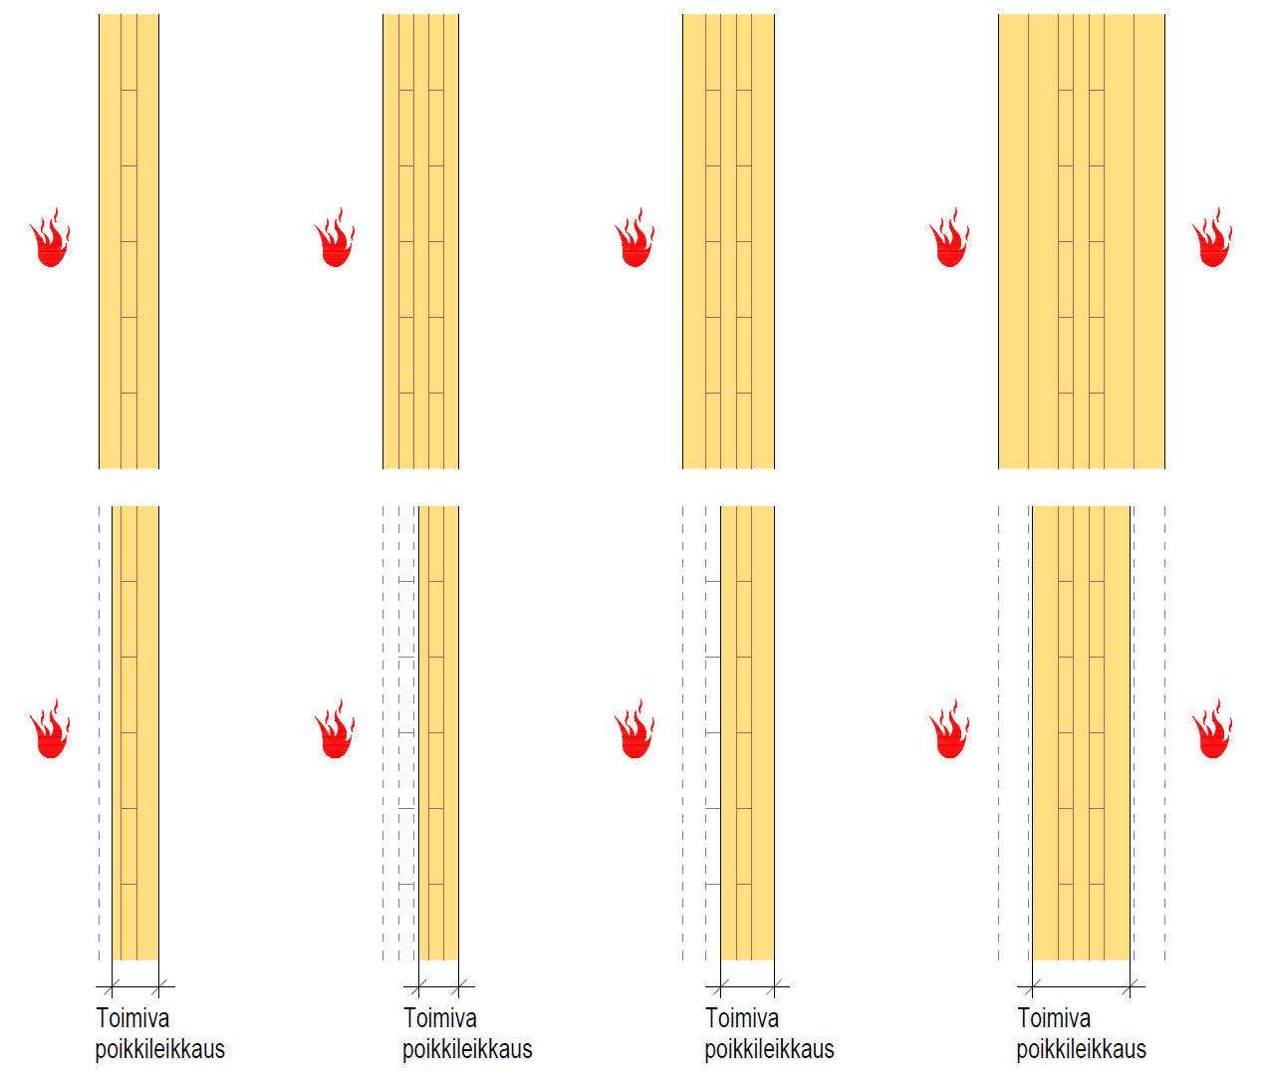
Functional cross-section of CLT panel
A functional cross-section must always have lamella layers parallel to the bending on both surfaces
Lamella layers transverse to the bending direction should be reduced from the effective cross-section
A three-layer CLT panel is challenging from a fire technical perspective
  If the surface lamella is charred off, there will be no functional cross-section of the panel
Functional cross-section
Functional cross-section
Functional cross-section
Functional cross-section

Slide 11
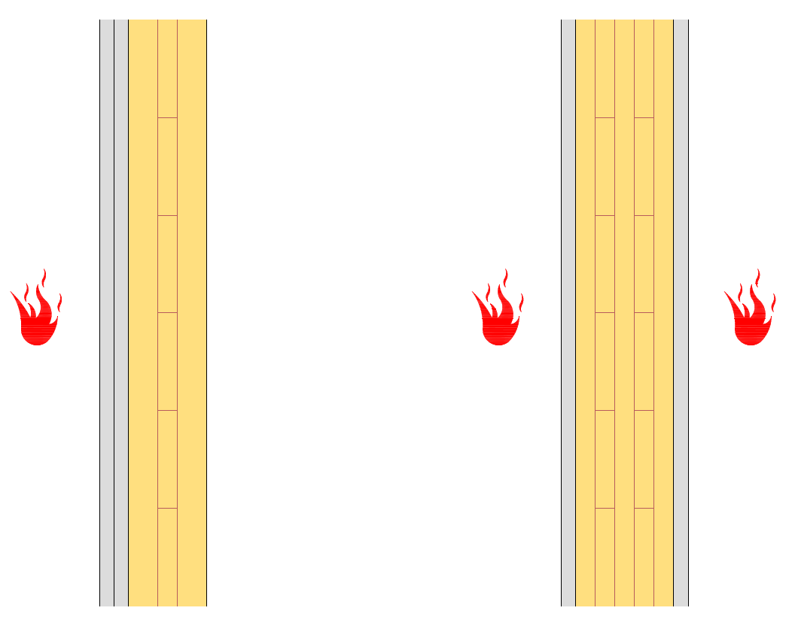
Fire protection of a CLT panel
Like other wooden structures, CLT panels can be fire-protected for the whole fire resistance period or just for a part of it
Fire protection also contributes to the non-linear increase in the charring depth of a CLT panel
  CLT panels heat up under the fire protection
It is recommended to protect the CLT panel for the entire fire resistance period, thus making fire design simple

Slide 12
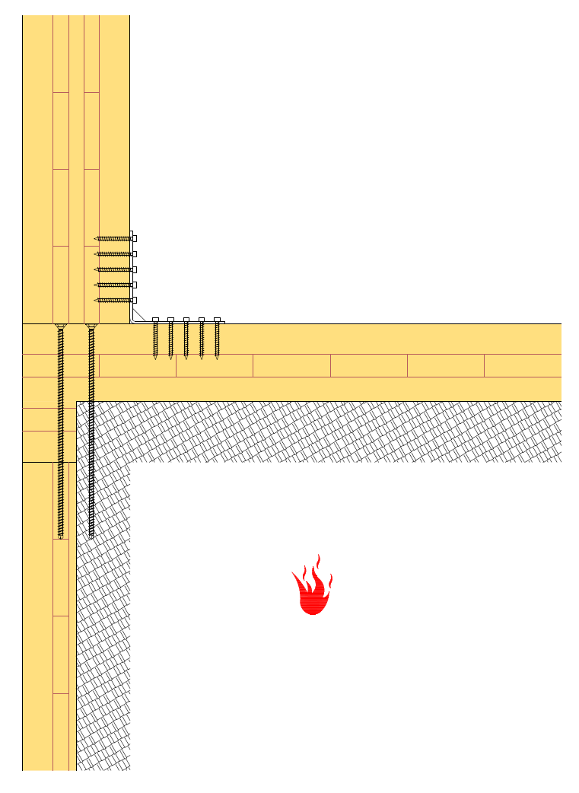
CLT panel joints
The steel joints of a CLT panel must be fire-protected the same as other wooden structures
If CLT panels are also used as a visible interior surface, the following should be taken into account:
  The steel parts of the joints should be designed into the CLT panel
  The charring of a CLT panel must not weaken the functioning of the joints in a fire situation

Slide 13
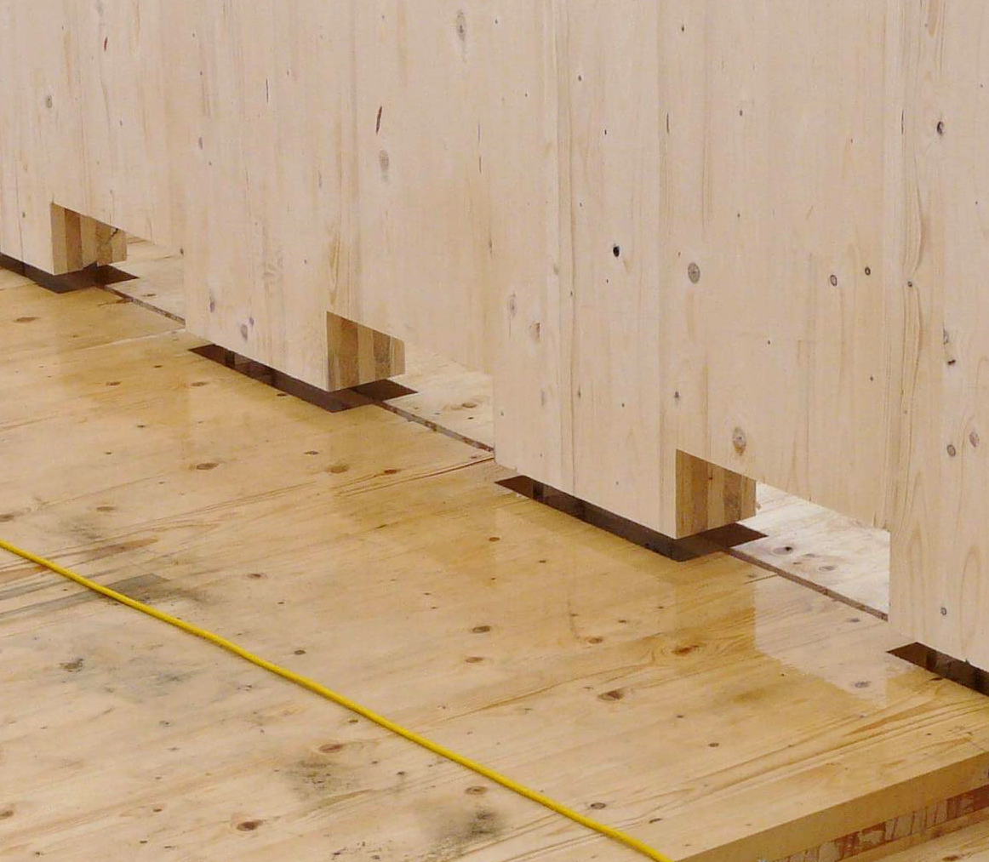
CLT panel joints
Contact joints machined into CLT panels are preferred in charred structures because they
  do not require steel parts
  function as long as there is effective joint area remaining
Image: Willmott Dixon Ltd

