Slide 1



Industrial wood construction
Teaching materials for industrial wood construction education
2022

Slide 2
Origin of the materials
Use of the materials
These learning materials for industrial wood construction have been prepared in a project led by Puuinfo Oy in 2021–2022. Also involved in the project were
Lappia Vocational College,
TTS-Työtehoseura ry
South-Eastern Finland University of Applied Sciences,
Metropolia University of Applied Sciences,
Jyväskylä University of Applied Sciences,
University of Tampere, and
Federation of the Finnish Woodworking Industries Puutuoteteollisuus ry
The project was funded by the Ministry of the Environment.
The materials are intended to be used as extensively as possible in industrial wood construction education and studies.
The materials are released under the Creative Commons licence Attribution-ShareAlike (CC BY-SA), which requires that the author be properly credited when the materials are used and that derivative works may only be distributed under the same licence as the original work.
The original materials and any updates to them by Puuinfo will be published on the Library of Open Educational Resources website (aoe.fi) and the Puuinfo.fi website.

Slide 3

Structural design

Slide 4
Authors
Tero Lahtela, Insinööritoimisto Tero Lahtela Oy
Release date: 18/11/2021

Slide 5
Fire-proofed wooden structures

Slide 6
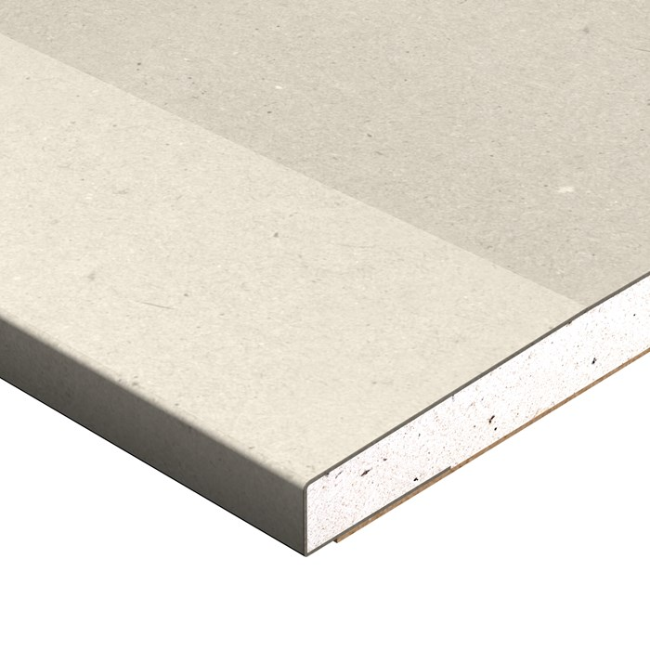
Fire-proofing materials for wooden structures
The following products are usually used for fire proofing:
Plasterboard
Stone wool panel
Wood-based panel
Wood panelling
Fire proofing can also be designed by combining the above products
Image: Gyproc

Slide 7
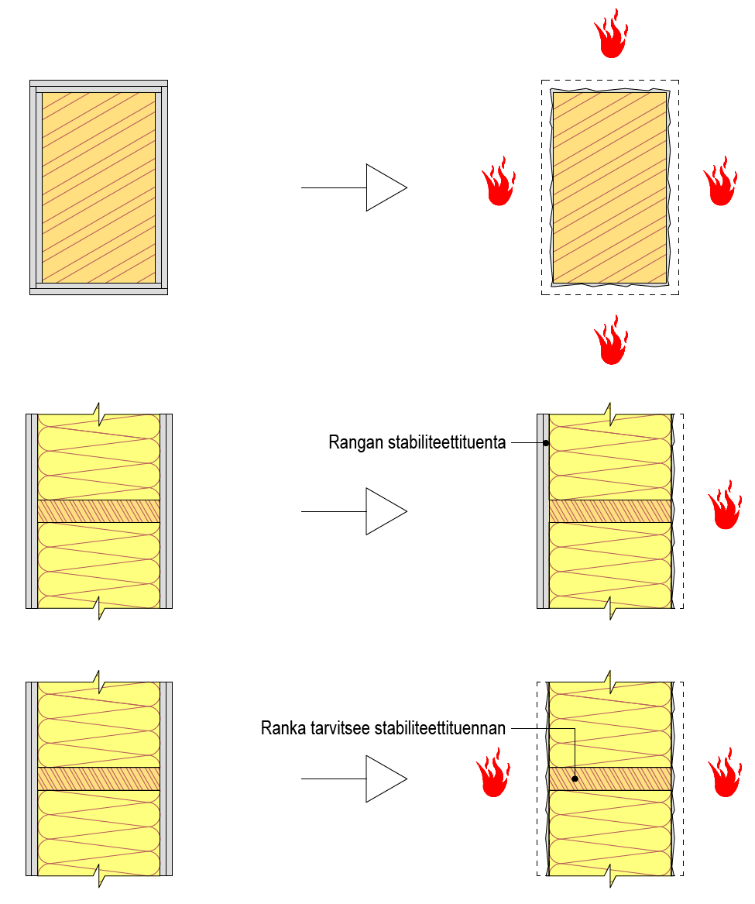
Design bases
A wooden structure can be fire technically engineered to be protected throughout the required fire resistance time
The product used for fire proofing protects the wooden structure from charring throughout the fire resistance time
Throughout the required fire resistance time, there is no such charring in the wooden structure that would change its dimensions
Stability support of the frame
The frame needs a stability support

Slide 8
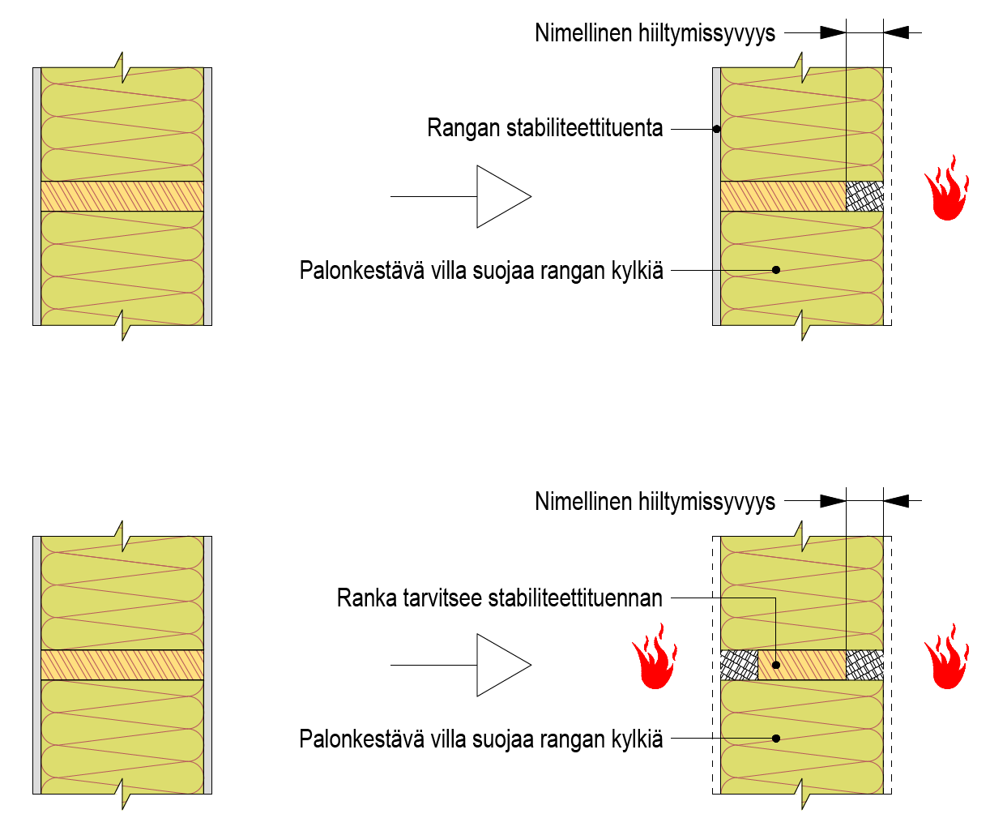
Design bases
A wooden structure can be fire technically engineered to be protected for part of the required fire resistance time
The product used for fire proofing protects the wooden structure from charring for part of the fire resistance time and the wooden structure is allowed to char for rest of the time
There is charring in the wooden structure that changes is dimensions
Nominal charring depth
Stability support of the frame
Fire-resistant wool protects the frame sides
Nominal charring depth
The frame needs a stability support
Fire-resistant wool protects the frame sides

Slide 9
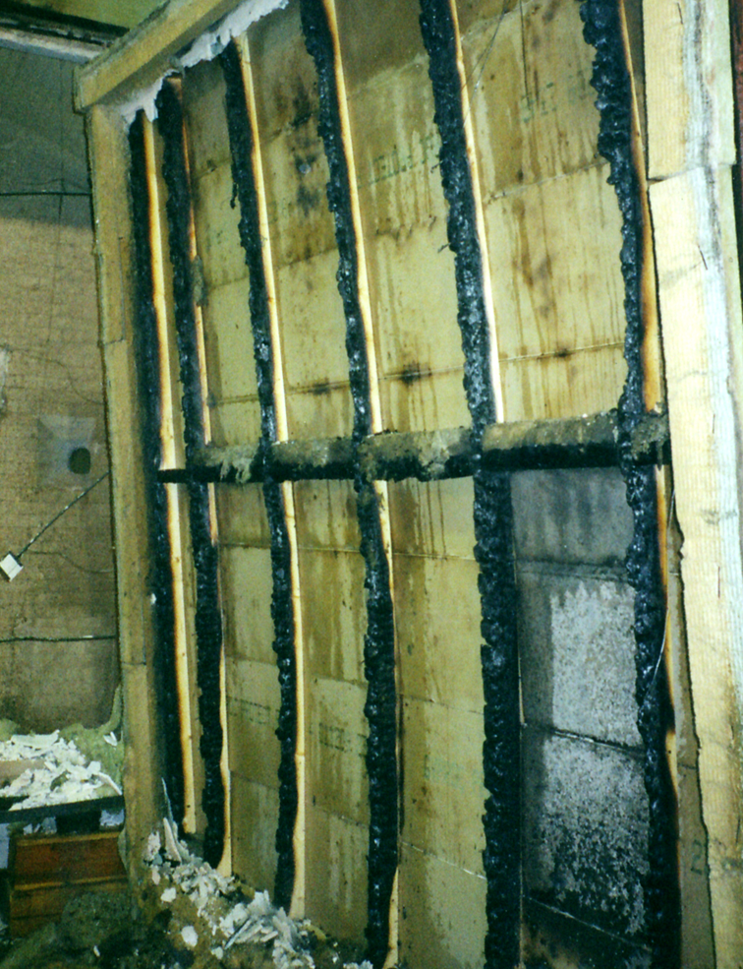
Design bases
Rock wool can be used for the fire protection of wooden parts in accordance with Eurocodes
The thickness of the stone wool must be at least 28 kg/m³
In the adjacent picture, stone wool panels have been used to protect the sides in a frame wall.
Image: Tero Lahtela

Slide 10
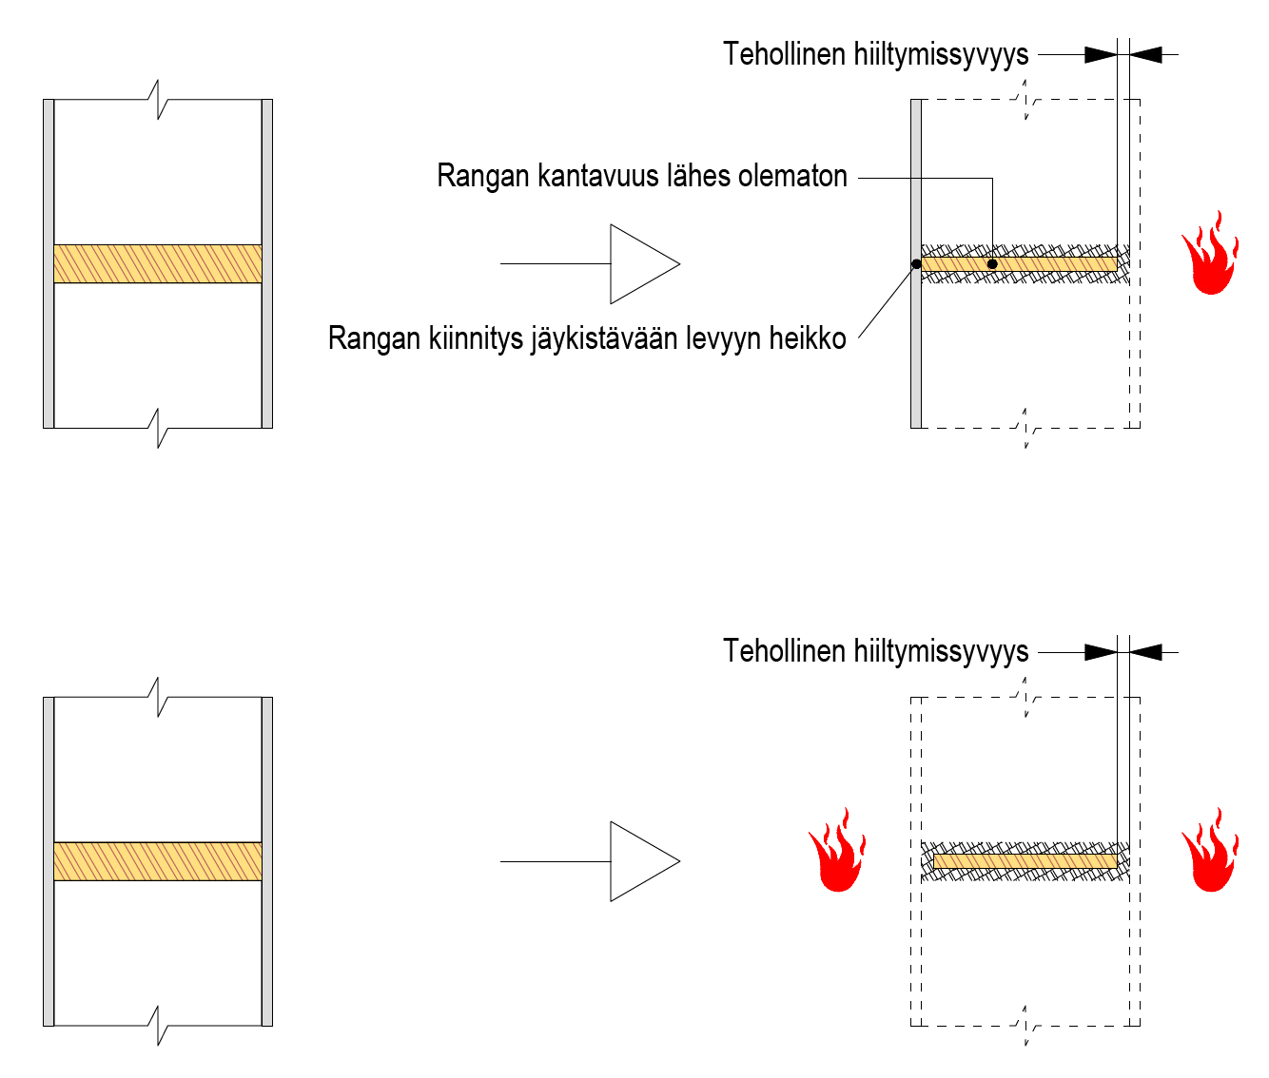
Design bases
If the structure is fire-proofed for part of the fire resistance time, stone wool insulation is usually needed in the cavities of the structure to protect the slender wooden structures from charring.
For example, the stud sides in a frame wall must be fire-proofed, so that the studs will not completely char away.
Effective charring depth
Nearly non-existent load-bearing capacity of the frame
Weak frame fixing to a stiffening plate
Effective charring depth

Slide 11
Design bases
The following times must be determined for fire technical dimensioning of fire protection:
t_{ch} = the time when a wooden structure begins to carbonise
Determined for plasterboards and combinations of wood panels and plasterboards using table data (RIL 205-2)
Calculated for wood-based panels and solid wood panelling
t_{f} = the time when the fire protection breaks down and stops working
Determined for plasterboards and combinations of wood panels and plasterboards using tables (RIL 205-2)
Calculated for wood-based panels and solid wood panelling
t_{a} = the time when the charring rate returns to normal or the charring
depth is 25 mm (charring rate normalises)
Calculated

Slide 12
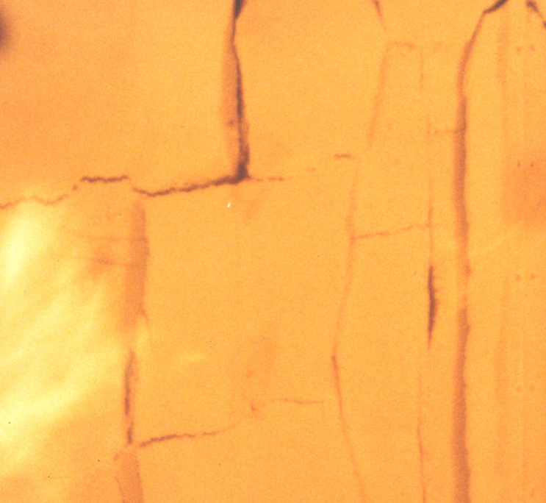
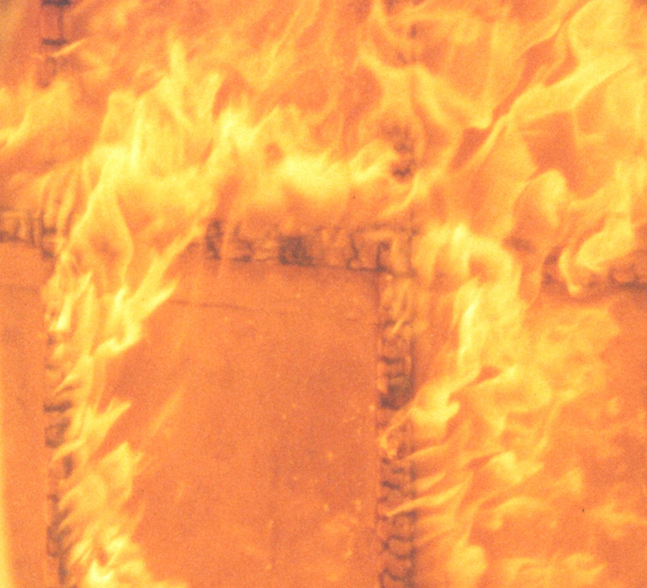
Design bases
Wood heated behind fire protection chars faster
Plasterboard at point of breaking
Strong fire after plasterboard fell
Image: Tero Lahtela
Image: Tero Lahtela

Slide 13
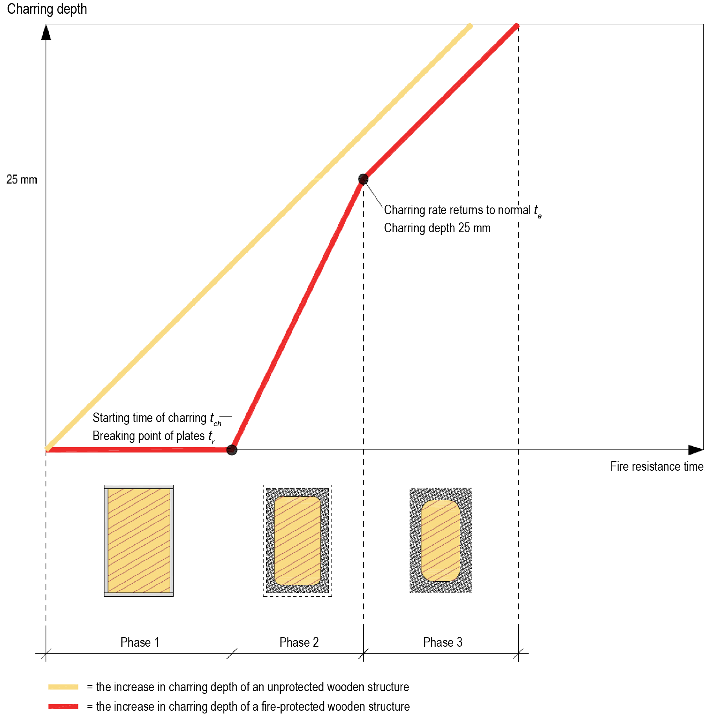
Design bases
Fire protected for part of the fire resistance time
Phase 1:
Plates protect¹⁾ (no charring)
Phase 2:
Plates broken (fast charring)
Phase 3:
Wooden structure charring with a characteristic rate
¹⁾ Plates are usually regular plasterboard, wood panels or
a combination of these

Slide 14
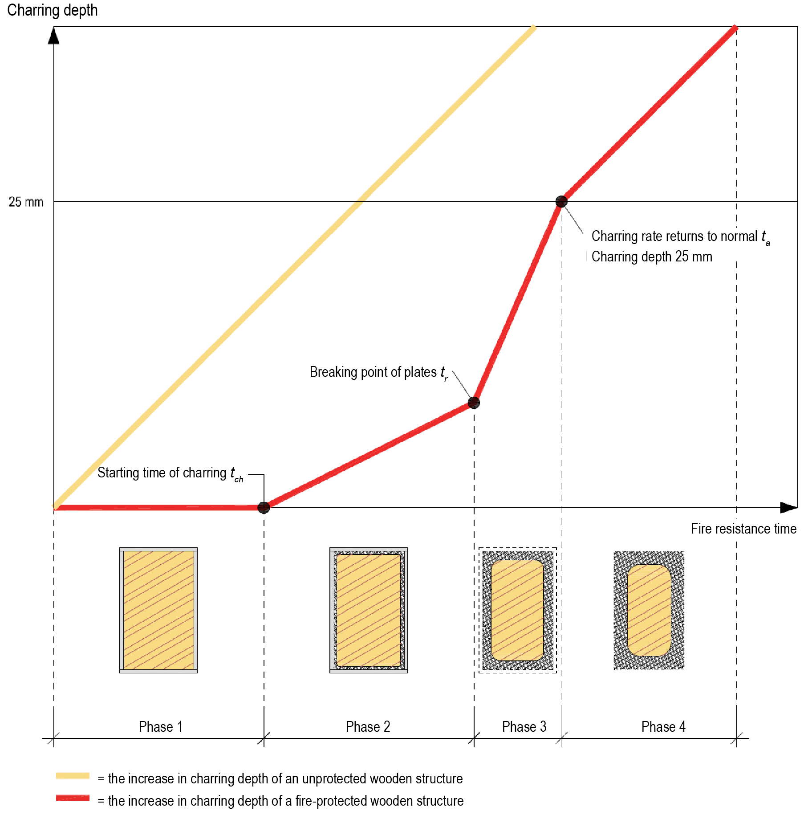
Design bases
Fire protected for part of the fire resistance time
Phase 1:
Plates protect¹⁾ (no charring)
Phase 2:
Plates broken (fast charring)
Phase 3:
Wooden structure charring with a characteristic rate
¹⁾ Plates are usually regular plasterboard, wood panels or
a combination of these

Slide 15
Design bases
Phase 1:
Plates protect¹⁾ (no charring)
Phase 2:
Plates in place (slow charring behind the plates)
Phase 3:
Plates broken (fast charring)
Phase 4:
Wooden structure charring with a characteristic rate
¹⁾ Plates are fireproof plasterboard or a combination of fireproof plasterboard and wood-based panels/regular plasterboard

Slide 16
Design bases
Regular plasterboard (including extra strong), wood-based panels, solid wood panelling and their combinations
The wooden structure begins to char when the fire protection breaks (t_{ch} = t_{f})
k_{mod} is determined according to the fire dimensioning method (RIL 205-2)
In a fire, g_{M} = 1
An example of charring stages
0 min
15 min
35 min
60 min
no charring
fast charring
normal charring
15 min
Phase 1:
20 min
Phase 2:
25 min
Phase 3:
t_{ch} = t_{f}
t_{a}
t

Slide 17
Design bases
Fireproof plasterboard and combinations with fireproof plasterboard
The charring of the wooden structure begins behind the fire protection before the protection breaks
k_{mod} is determined according to the fire dimensioning method (RIL 205-2)
In a fire, g_{M} = 1
An example of charring stages
0 min
55 min
70 min
75 min
90 min
slow charring
fast charring
normal charring
no charring
55 min
Phase 1:
15 min
Phase 2:
15 min
Phase 4:
t_{ch}
t_{f}
t_{a}
t
5 min
Phase 3:

Slide 18
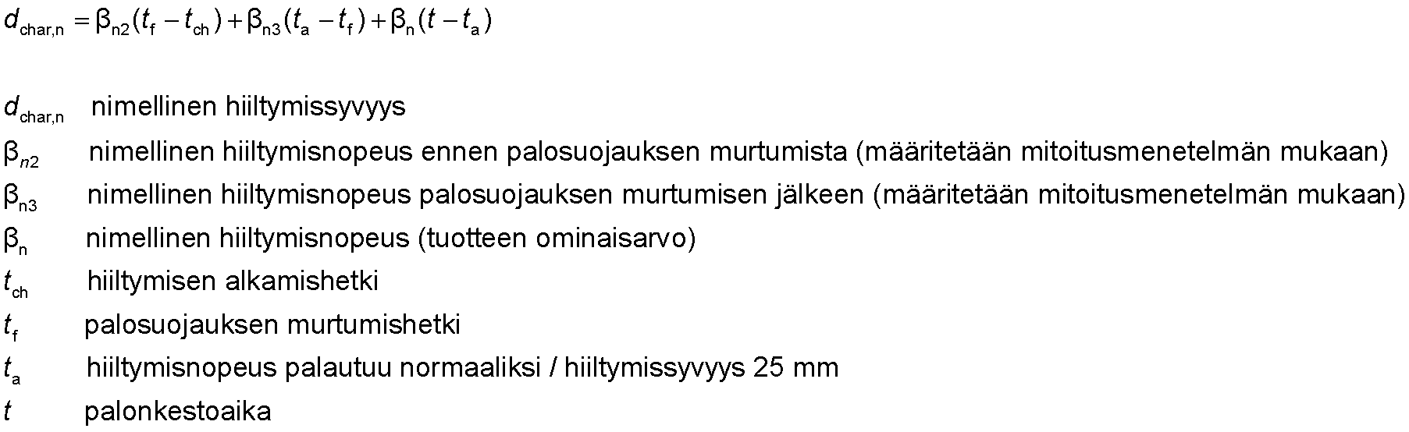
Design bases
Nominal charring is determined as a sum of different stages
nominal charring depth
nominal charring depth before the fire protection breaks (determined according to the dimensioning method)
nominal charring depth after the fire protection breaks (determined according to the dimensioning method)
nominal charring depth (characteristic product value9
starting time of charring
breaking point of fire protection
charring rate normalises / charring depth 25 mm
fire resistance time

Slide 19
Design bases
The following three dimensioning methods for fire-protected structures are presented in the Eurocode (RIL 205-2)
FIRE-PROTECTED BEAMS AND COLUMNS
1) RIL 205-2 chapter 3.4.3
Fire resistance time is not limited
k_{mod,fi} =1.0
Dimensioning is done using the effective cross-section method
WALL STRUCTURES AND INTERMEDIATE AND UPPER FLOOR STRUCTURES
2) RIL 205-2 chapter 4.3.2.1S
Cavity filled with insulation
Fire resistance time of walls is limited to 90 minutes (R 90)
Fire resistance time of intermediate and upper floors is limited to 60 minutes (R 60)
k_{mod,fi} = calculated (using table data)
Dimensioning is done using the nominal reduced cross-section method
3) RIL 205-2 chapter 4.3.2.2S
Cavity is uninsulated (empty)
Fire resistance time is not limited
k_{mod,fi} =1.0
Dimensioning is done using the effective cross-section method

Slide 20
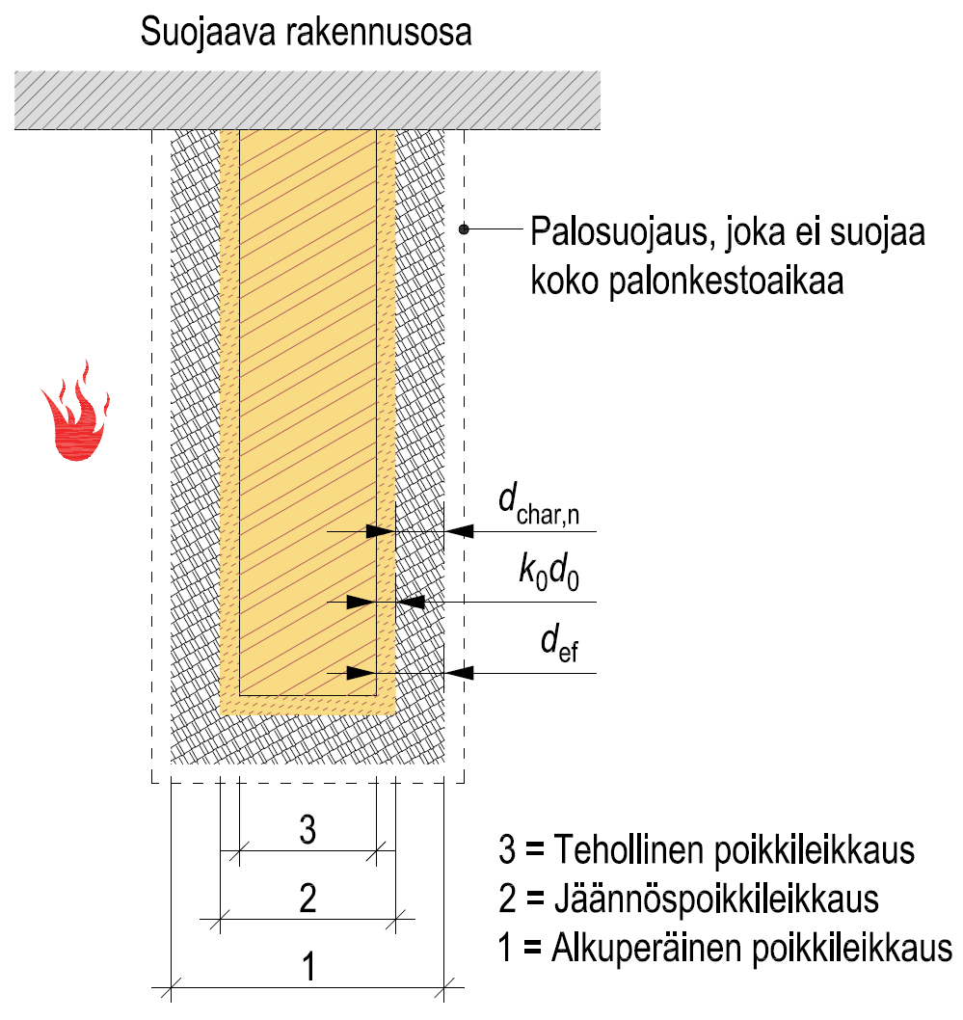
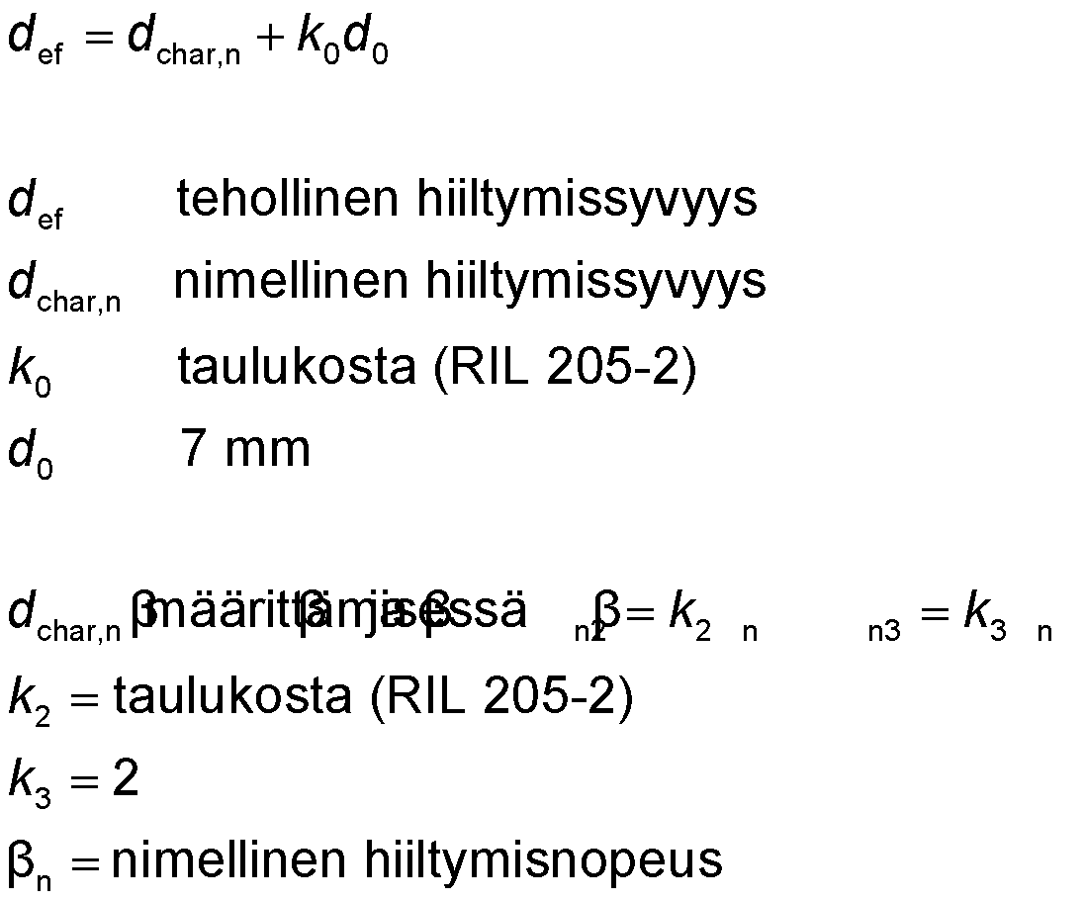
Fire-protected structures (beams and columns)
Fire-protecting building element
Effective cross-section method is used in dimensioning
Fire resistance time is not limited
Fire protection that does not protect for the entire fire resistance time
effective charring depth
nominal charring depth
from the table (RIL 205-2)
7 mm
3 = Effective cross-section
2 = Reduced cross-section
1 = Original cross-section
when determined,
from the table (RIL 205-2)
nominal charring rate

Slide 21
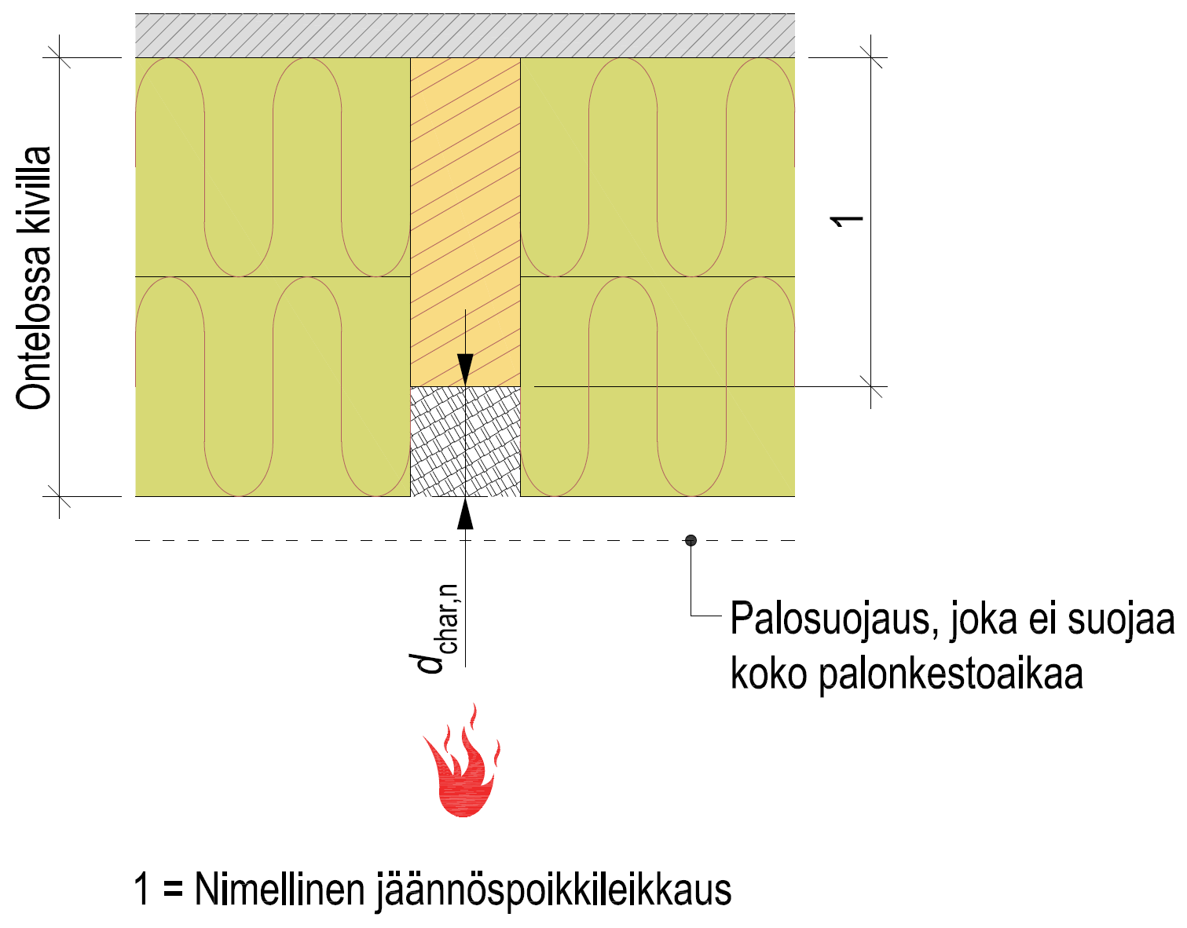
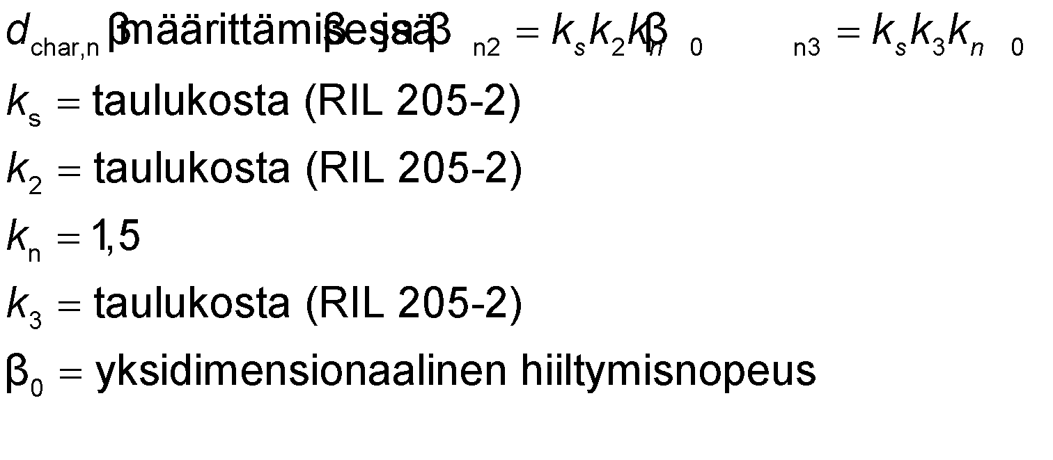
Fire-protected structures (cavity filled)
Nominal reduced cross-section is used in dimensioning
Fire resistance time is limited
Wall structures R 90
Horizontal structures R 60
Stone wool in the cavity
Fire protection that does not protect for the entire fire resistance time
when determined,
from table data (RIL 205-2)
from table data (RIL 205-2)
1.5
from table data (RIL 205-2)
one-dimensional charring rate
1 = Nominal reduced cross-section

Slide 22
Fire-protected structures (cavity filled)
Cavities are either completely filled with stone wool or have a layer at least 100 mm thick
Insulation density should be at least 28 kg/m³
The insulation must be installed on the side that is exposed to fire to be on the level of the support edge, so that it protects the faces from charring.
The height of the cavity is limited to the value h_{cavity}/h_{beam} ≤ 0,6
The maximum height of the cavity is 300 mm
If the insulation is glass wool, the empty cavity dimensioning method is used

Slide 23
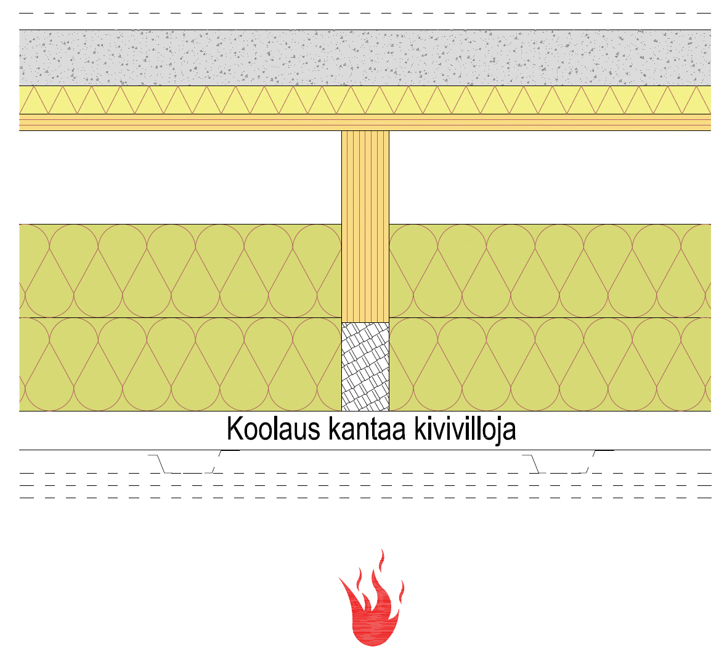
Fire-protected structures (cavity filled)
When the wool slabs in the cavity are used for fire-protecting the frame sides, their stationariness must be ensured
In horizontal structures, the studs bearing the wool slabs and their connectors must be fire-dimensioned
Studs are usually thick
Connectors are usually long
By protecting the structure for the entire fire resistance time, this can be avoided
Studs bear the stone wool

Slide 24
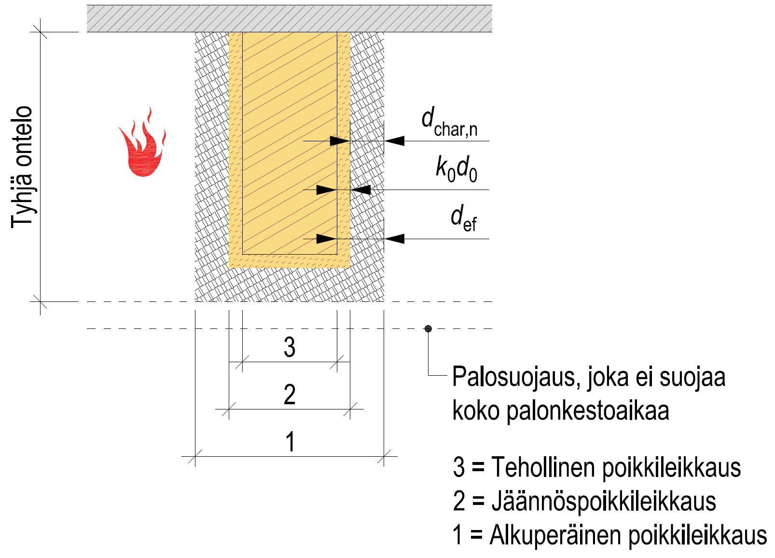
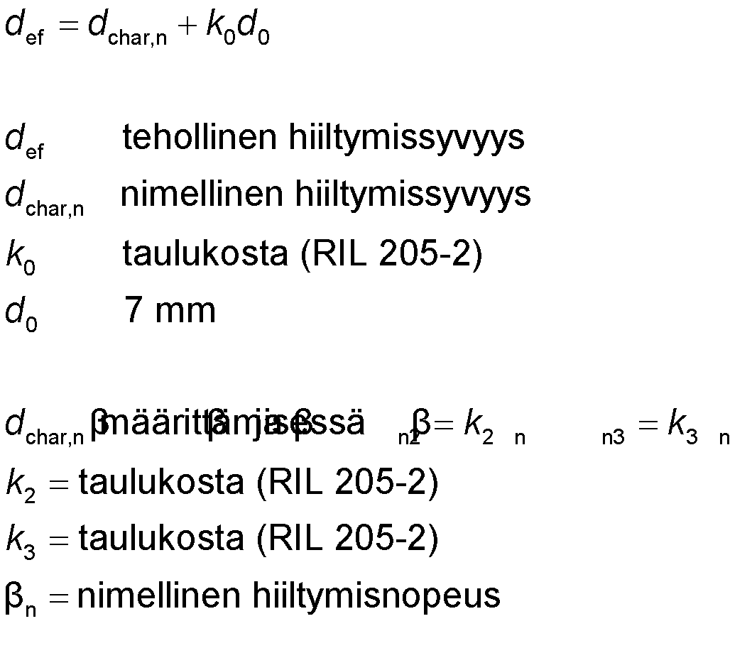
Fire-protected structures (cavity empty)
Effective cross-section method is used in dimensioning
Fire resistance time is not limited
Cavity empty
effective charring depth
nominal charring depth
from the table (RIL 205-2)
7 mm
Fire protection that does not protect for the entire fire resistance time
3 = Effective cross-section
2 = Reduced cross-section
1 = Original cross-section
when determined,
from the table (RIL 205-2)
from the table (RIL 205-2)
nominal charring rate

Slide 25
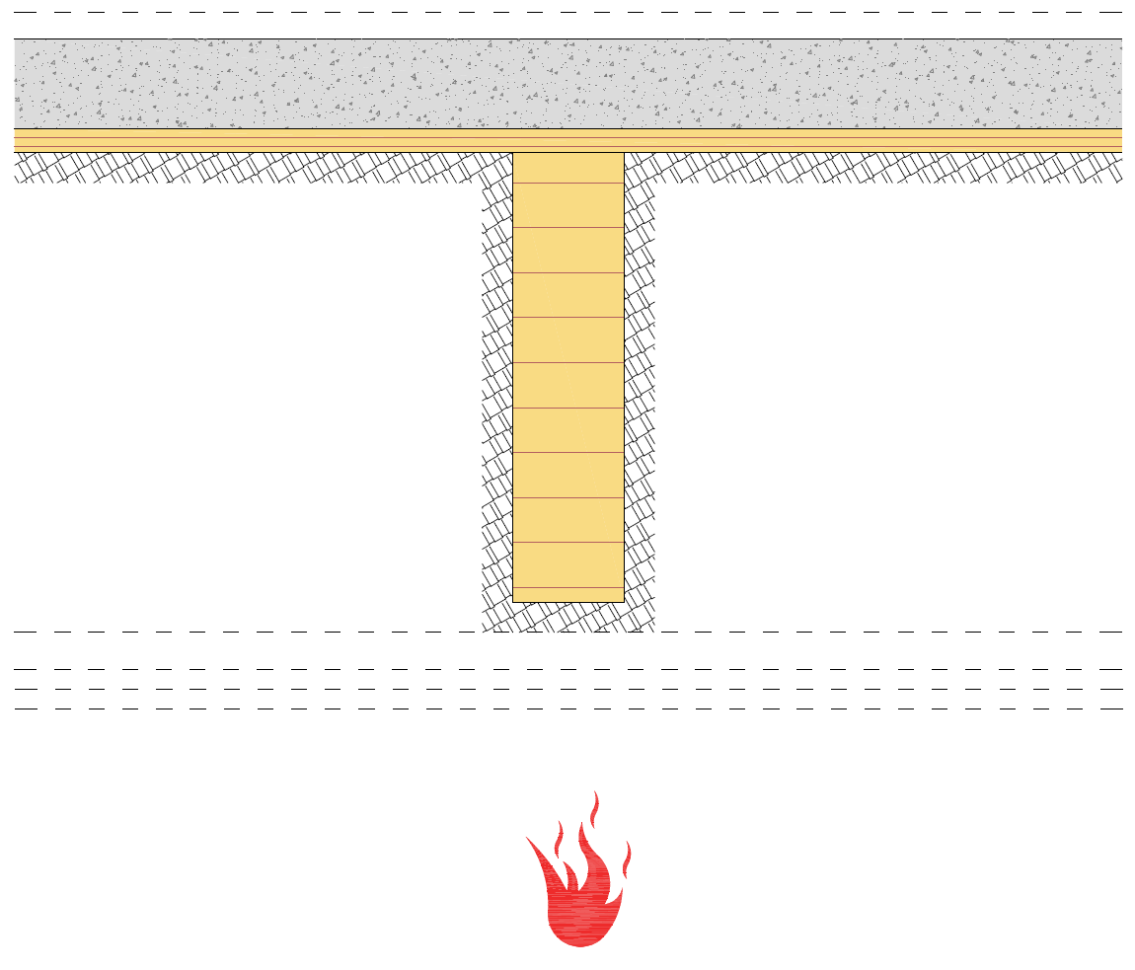
Fire-protected structures (cavity empty)
Fire that enters an empty cavity can be challenging in terms of dimensioning
No load-bearing structural part is allowed to lose its load-bearing capacity in the event of fire
For example, the intermediate floor beams and superstructure must be more robust in order to achieve an adequate effective cross-section
By protecting the structure for the entire fire resistance time, this can be avoided

Slide 26
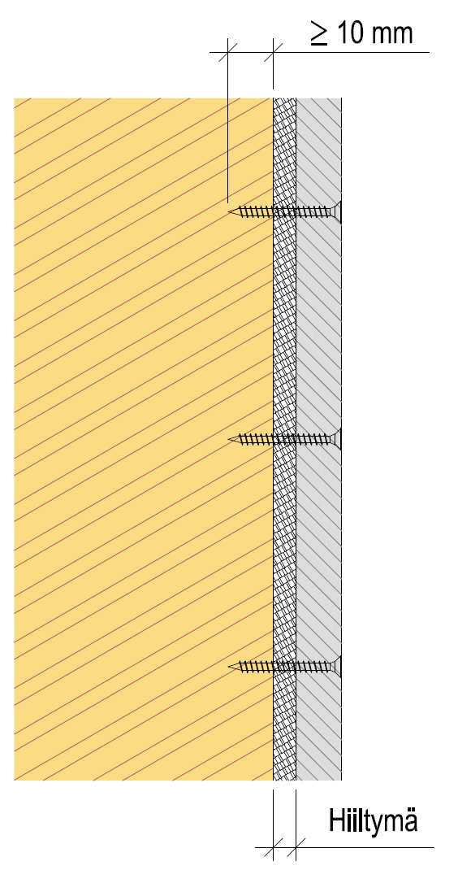
Attaching fire protection
Fire protection products are attached according to the manufacturer's instructions
The penetration of the connector tip into the non-charred wood must be ensured
Fire design method-specific dimensioning instructions RIL 205-2
Particular attention must be paid to the length of the connectors in cases where charring occurs behind fire protection before it breaks
Charring

Slide 27
Stability in the event of fire
Before the actual fire dimensioning of wooden structures, the functioning of the structural components and the frame of the building must be examined from the perspective of stability
In some cases, a completely new stability support must be designed for the event of fire
For example, a double frame wall between flats
The stability support for the event of fire must be designed so that it works for the entire required fire resistance time
The most critical detail in the structures used for stability support for the event of fire is their joints

Slide 28
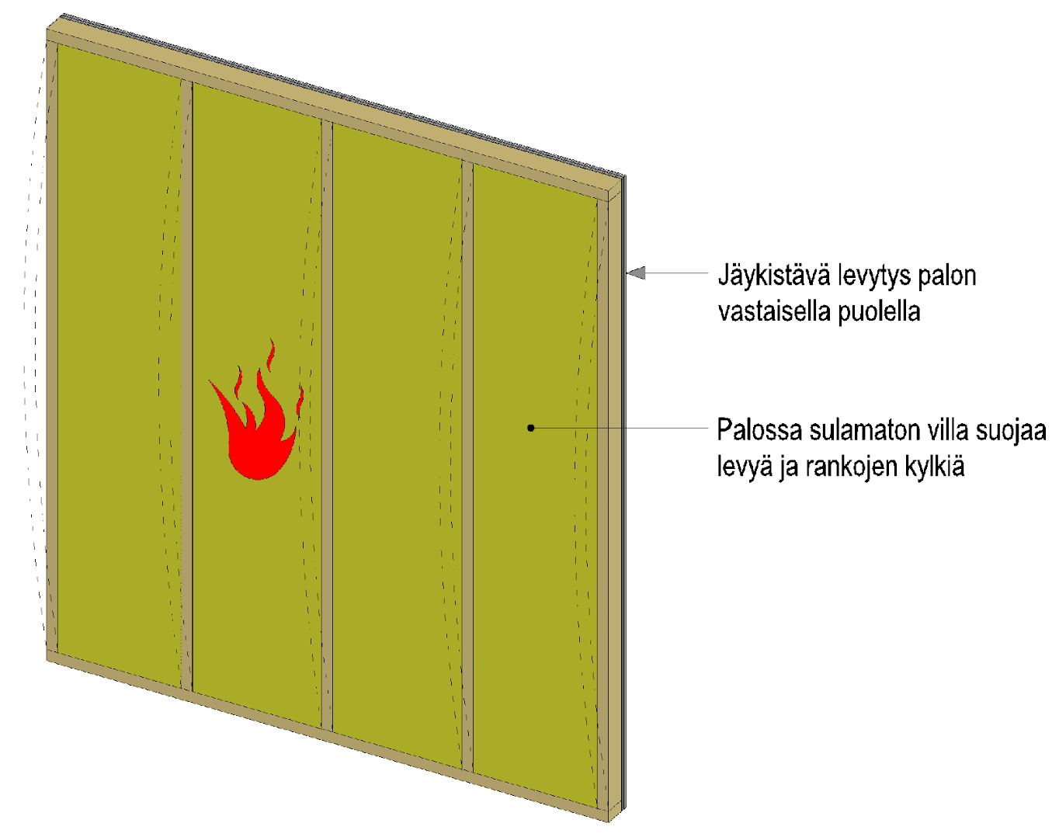
Stability in the event of fire
The plates on the other side of the fire prevent the load-bearing wall poles from buckling
Stiffening plates on the other side of the fire
Wool that does not melt in the event of fire protects the plate and the frame sides

Slide 29
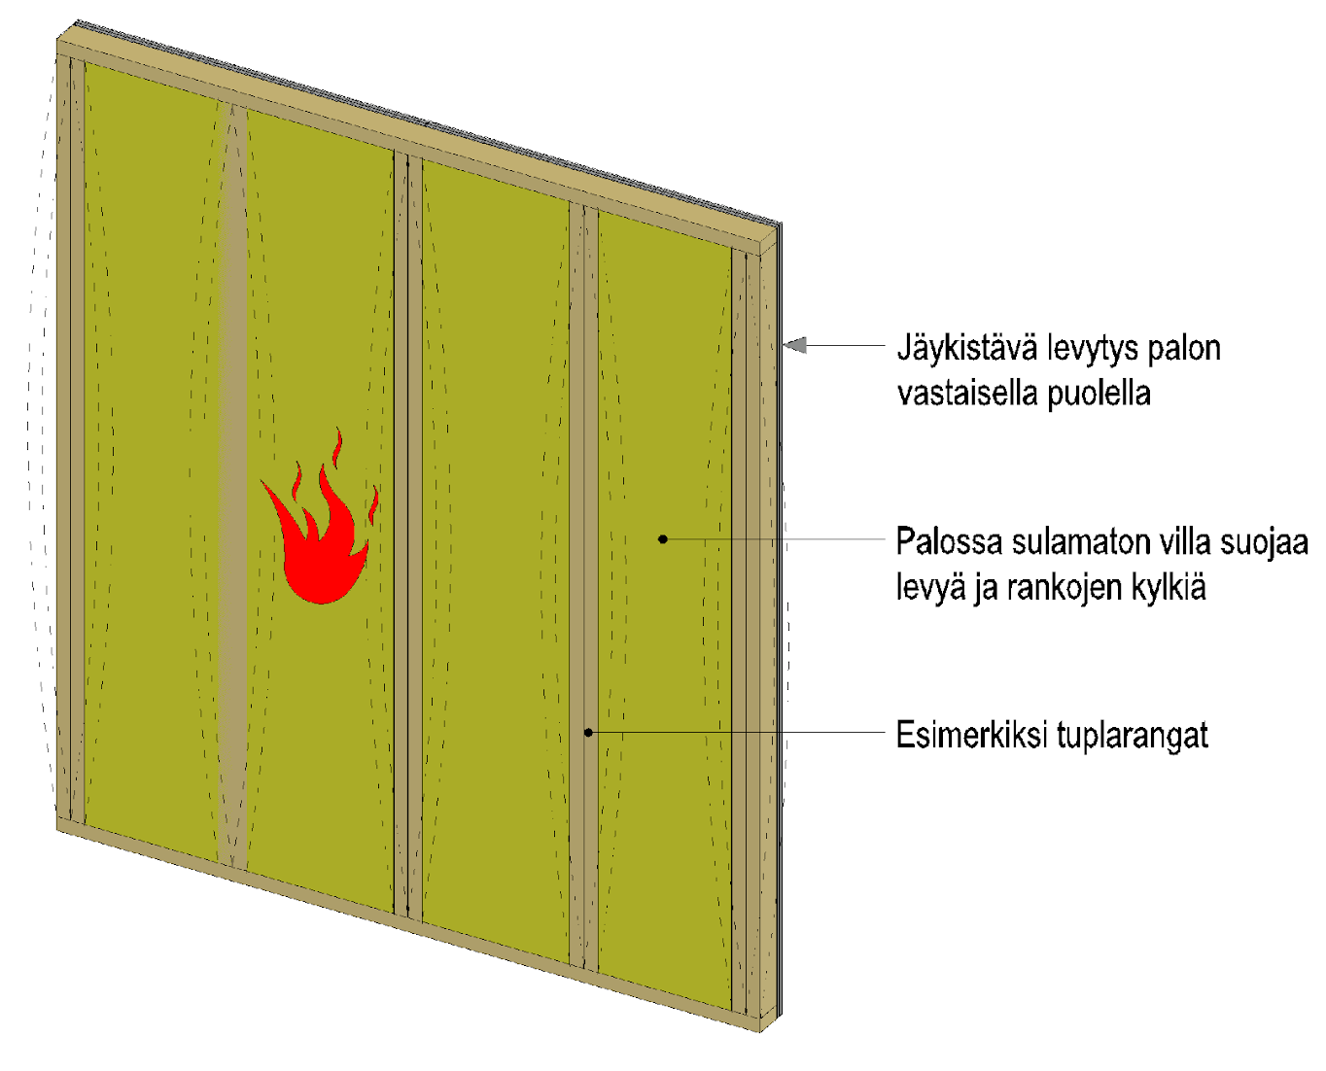
Stability in the event of fire
All structural elements that require stability support must be attached to a support system
Stiffening plates on the other side of the fire
Wool that does not melt in the event of fire protects the plate and the frame sides
For example, double frames

Slide 30
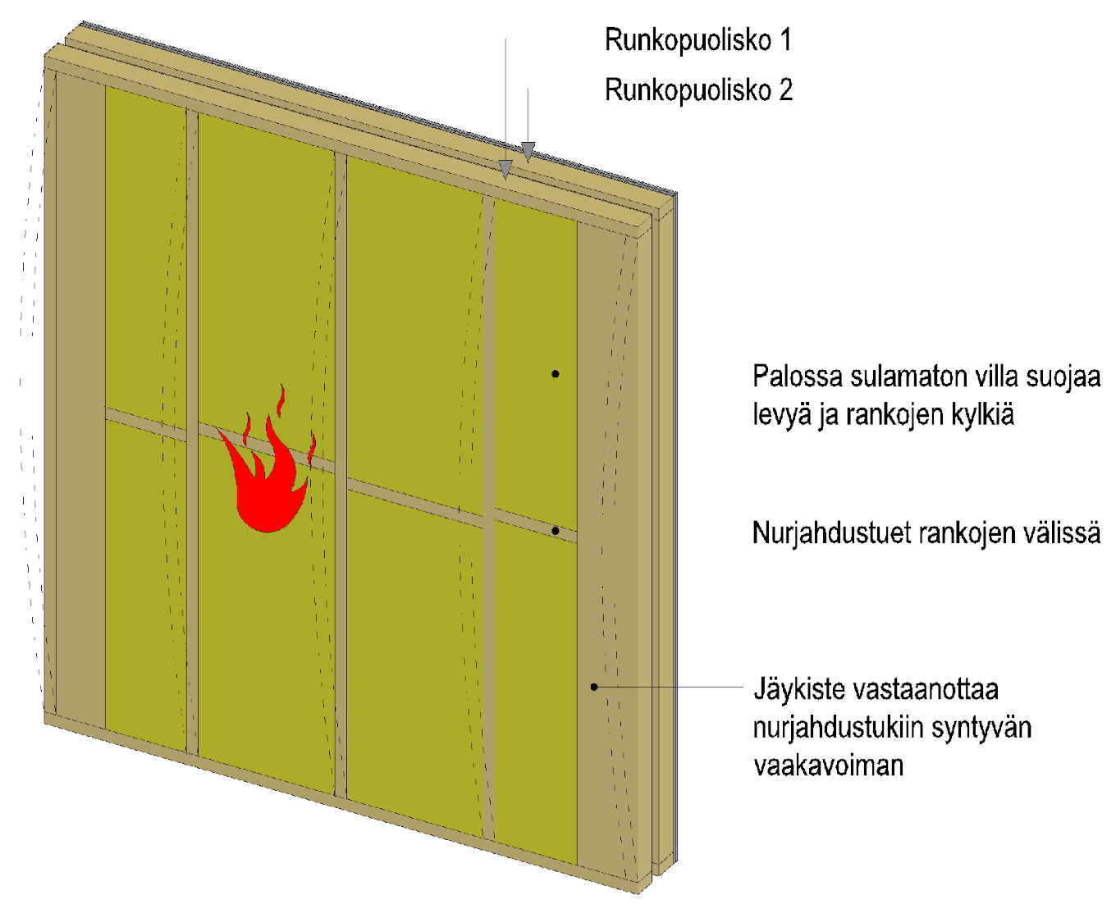
Stability in the event of fire
In a double frame wall between flats, a separate buckling support system is usually required in the frame half on the side of the wall fire
Frame half 1
Frame half 2
Wool that does not melt in the event of fire protects the plate and the frame sides
Buckling supports between frames
The stiffener receives the horizontal force resulting in the buckling supports

Slide 31
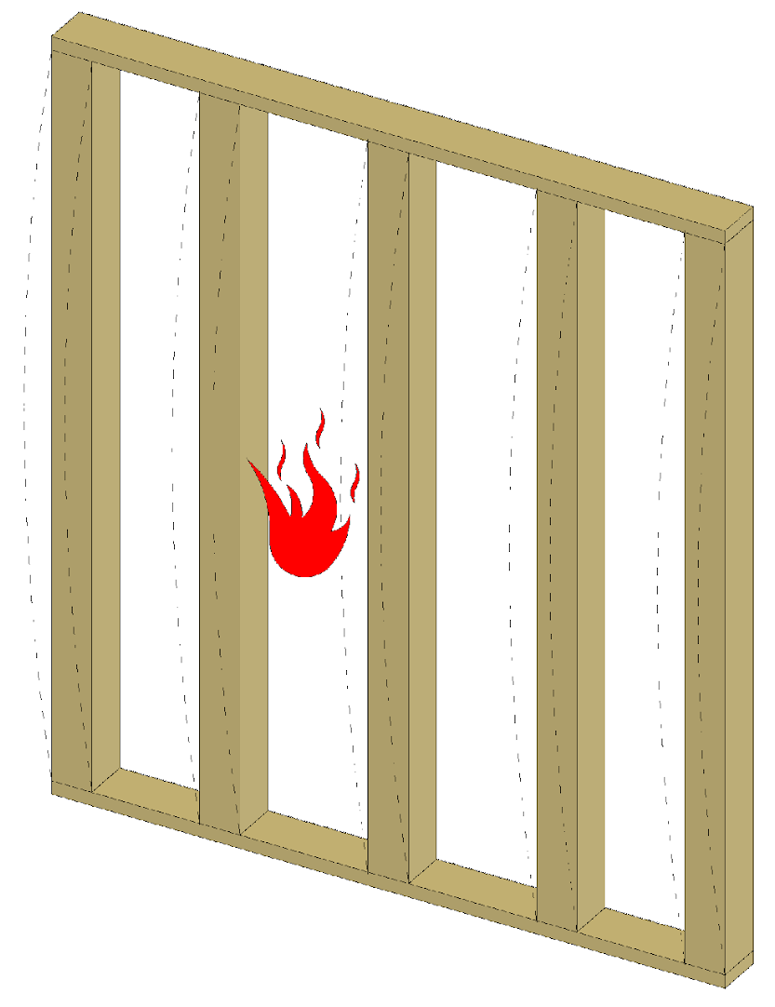
Stability in the event of fire
If the frames are sturdy enough, they can be designed to function without buckling support

Slide 32
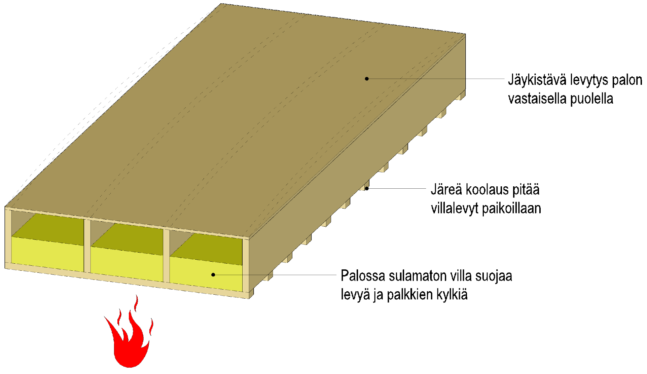
Stability in the event of fire
The plates on the other side of the fire prevent the beams from buckling laterally in the event of fire underneath
Stiffening plates on the other side of the fire
Sturdy studs keep the wool slabs in place
Wool that does not melt in the event of fire protects the plate and the beam sides

Slide 33
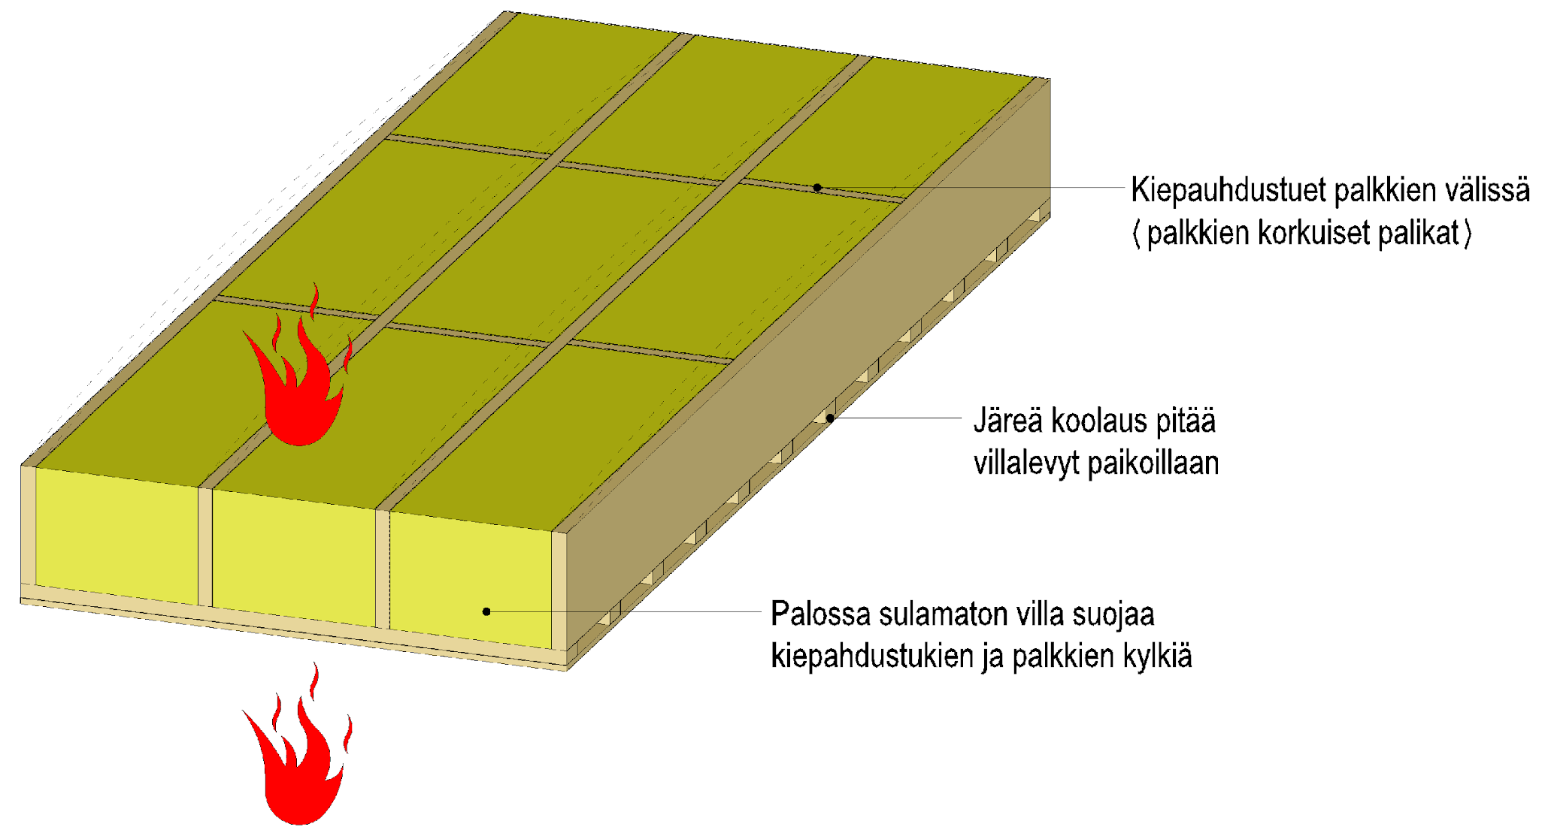
Stability in the event of fire
Lateral buckling supports prevent beams from buckling laterally in the event of fire underneath or above
Lateral buckling supports between beams (blocks the height of the beams)
Sturdy studs keep the wool slabs in place
Wool that does not melt in the event of fire protects the buckling supports and the beam sides

Slide 34
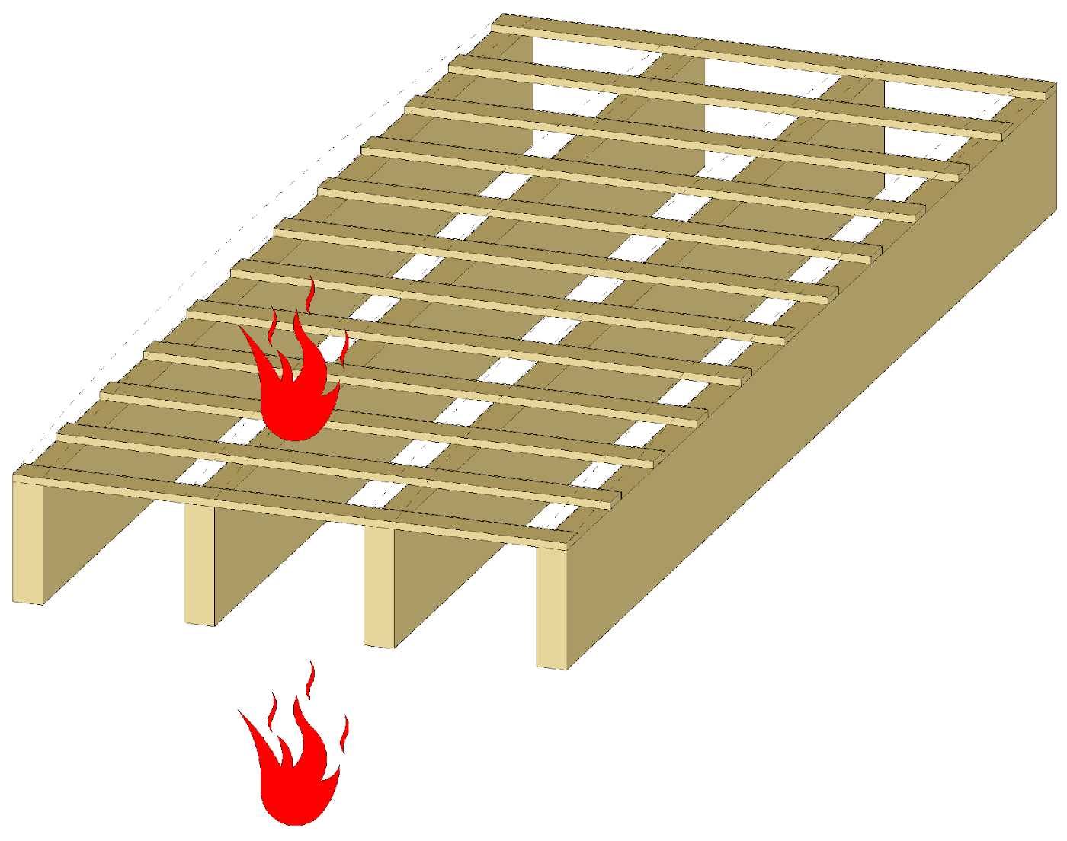
Stability in the event of fire
If the beams are sturdy enough, they can be designed to function without buckling support in the event of fire underneath or above

