Slide 1



Industrial wood construction
Teaching materials for industrial wood construction education
2022

Slide 2
Origin of the materials
Use of the materials
These learning materials for industrial wood construction have been prepared in a project led by Puuinfo Oy in 2021–2022. Also involved in the project were
Lappia Vocational College,
TTS-Työtehoseura ry
South-Eastern Finland University of Applied Sciences,
Metropolia University of Applied Sciences,
Jyväskylä University of Applied Sciences,
University of Tampere, and
Federation of the Finnish Woodworking Industries Puutuoteteollisuus ry
The project was funded by the Ministry of the Environment.
The materials are intended to be used as extensively as possible in industrial wood construction education and studies.
The materials are released under the Creative Commons licence Attribution-ShareAlike (CC BY-SA), which requires that the author be properly credited when the materials are used and that derivative works may only be distributed under the same licence as the original work.
The original materials and any updates to them by Puuinfo will be published on the Library of Open Educational Resources website (aoe.fi) and the Puuinfo.fi website.

Slide 3
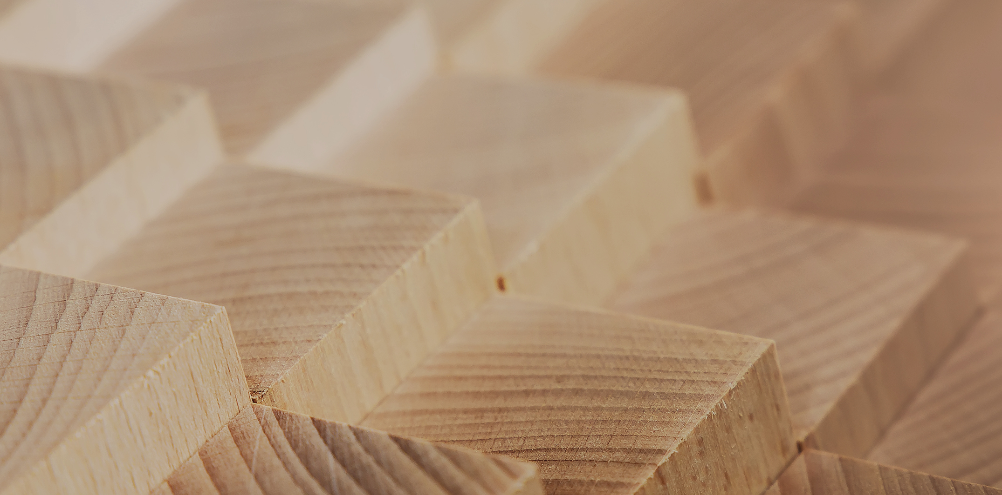
Structural design

Slide 4
Authors
Tero Lahtela, Insinööritoimisto Tero Lahtela Oy
Release date: 03/11/2022

Slide 5
Non-fire resistant wooden structures

Slide 6
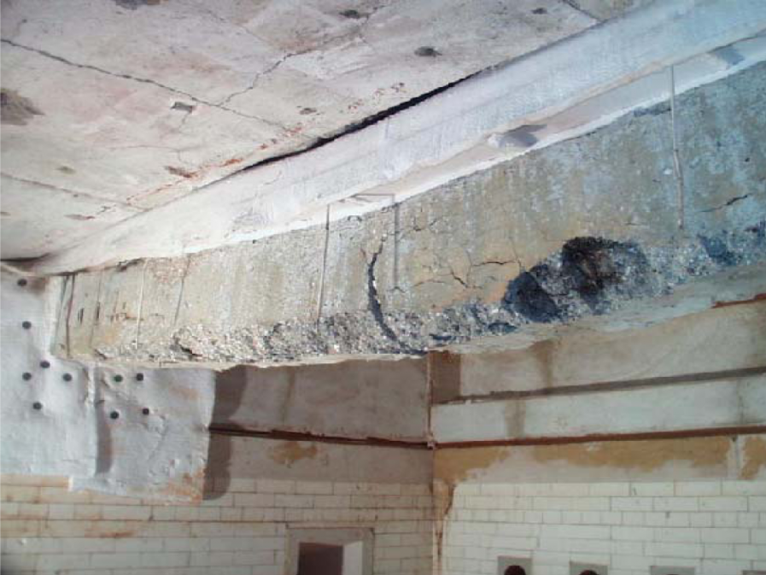
Material behaviour in a fire
Water is extracted from concrete structures in the event of a fire
At approximately 100 °C, free water in the pores is discharged
Chemically bound water is removed at higher temperatures
Pressure from water evaporation breaks concrete and the removal of chemically bound water breaks cement adhesive
Concrete flakes off and cracks
The steel parts soften
Deformations are permanent and relatively large
Image: www.frpdistributors.com

Slide 7
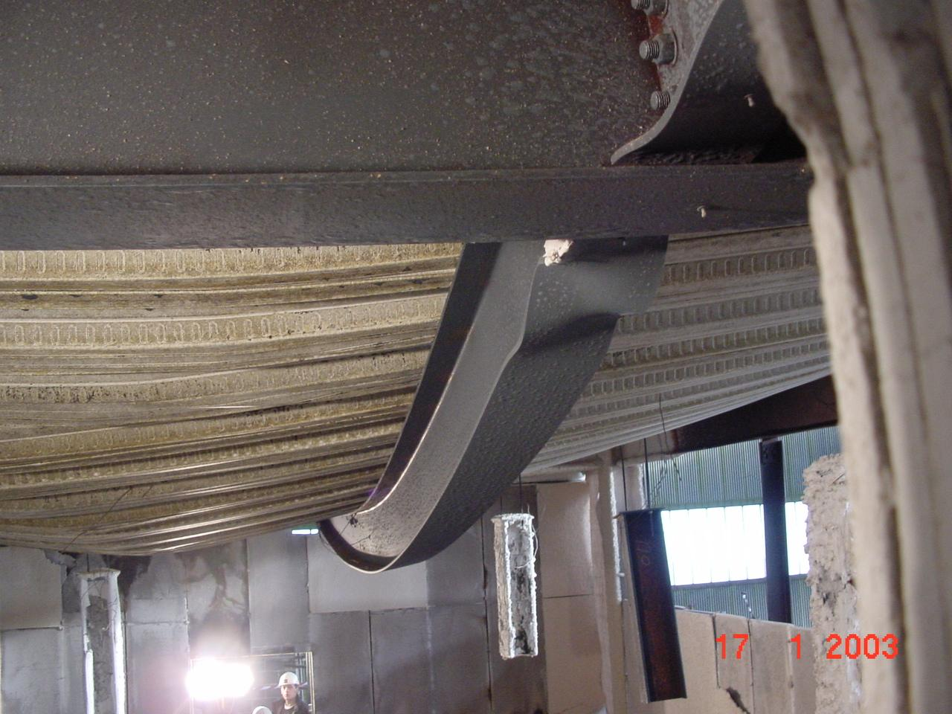
Material behaviour in a fire
Unprotected steel structure withstands standard fire exposure 10...30 min.
When the critical temperature of the steel profile (450 to 600 °C) is reached, its strength and rigidity is severely reduced
Steel structures soften
Deformations are permanent and significant
Image: www.dec.uc.pt

Slide 8
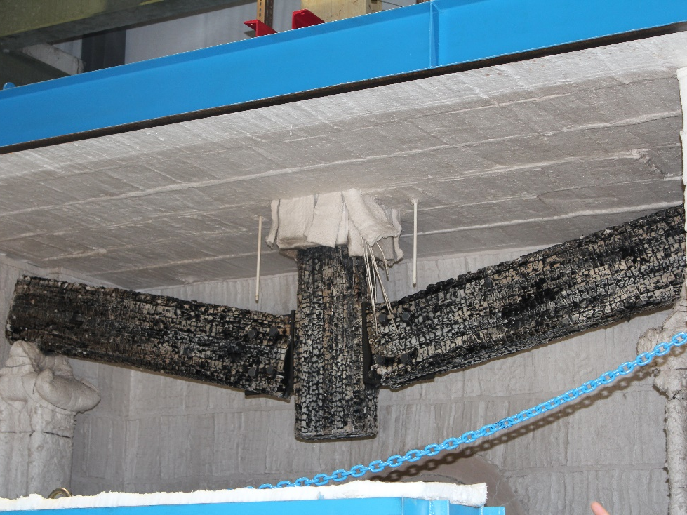
Material behaviour in a fire
Unprotected wooden structure chars at its specific rate of charring
A stationary carbon layer serves as a protective layer
Relatively small deformations in strong structures
Large effective cross-section
Image: www.lakeheadu.ca

Slide 9
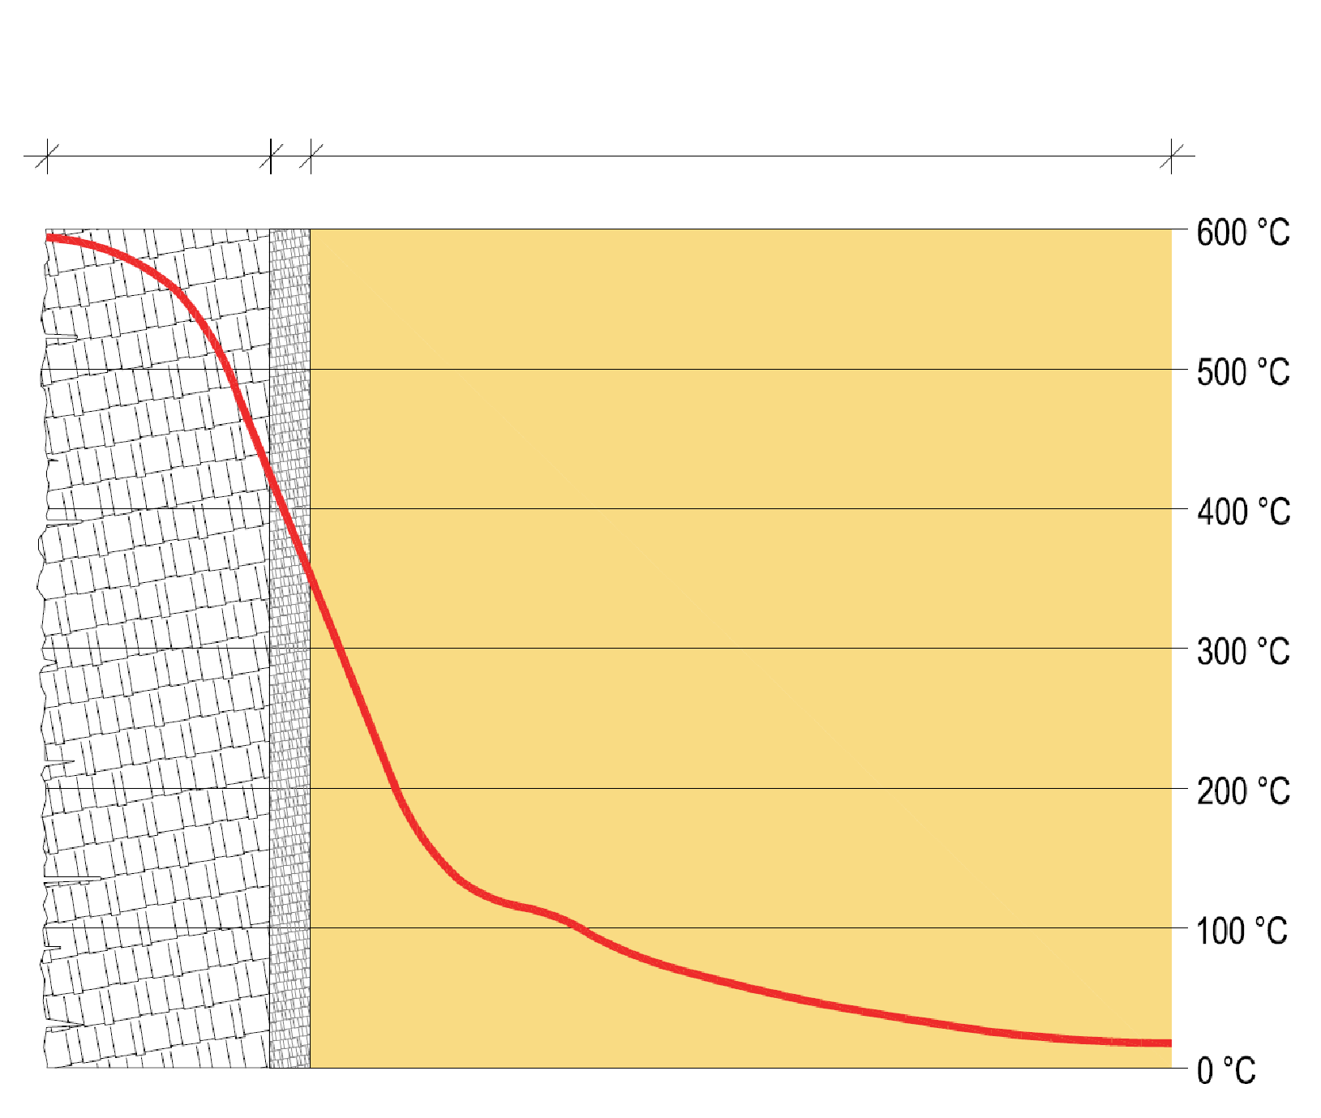
Wood charring
A stationary carbon layer acts as a heat insulator
Charring continues as long as the wood structure is exposed to fire
The increase in the charring depth of an unprotected wooden structure is linear when the charred layer remains stationary
Pyrolysis
Charring
Uncharred wood

Slide 10
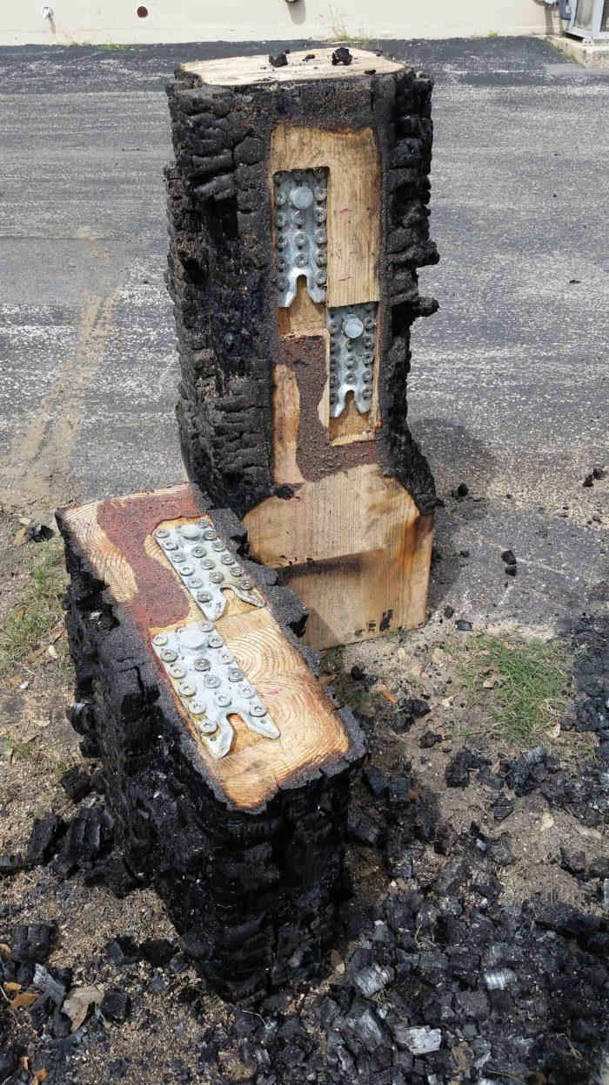
Wood charring
A wood product can also be used for fire protection of connecting parts
As a rule, it is advisable to design the joints of wood structures so that the joining parts made of metal can be placed inside the wooden parts
Image: www.greenbuildingadvisor.com

Slide 11
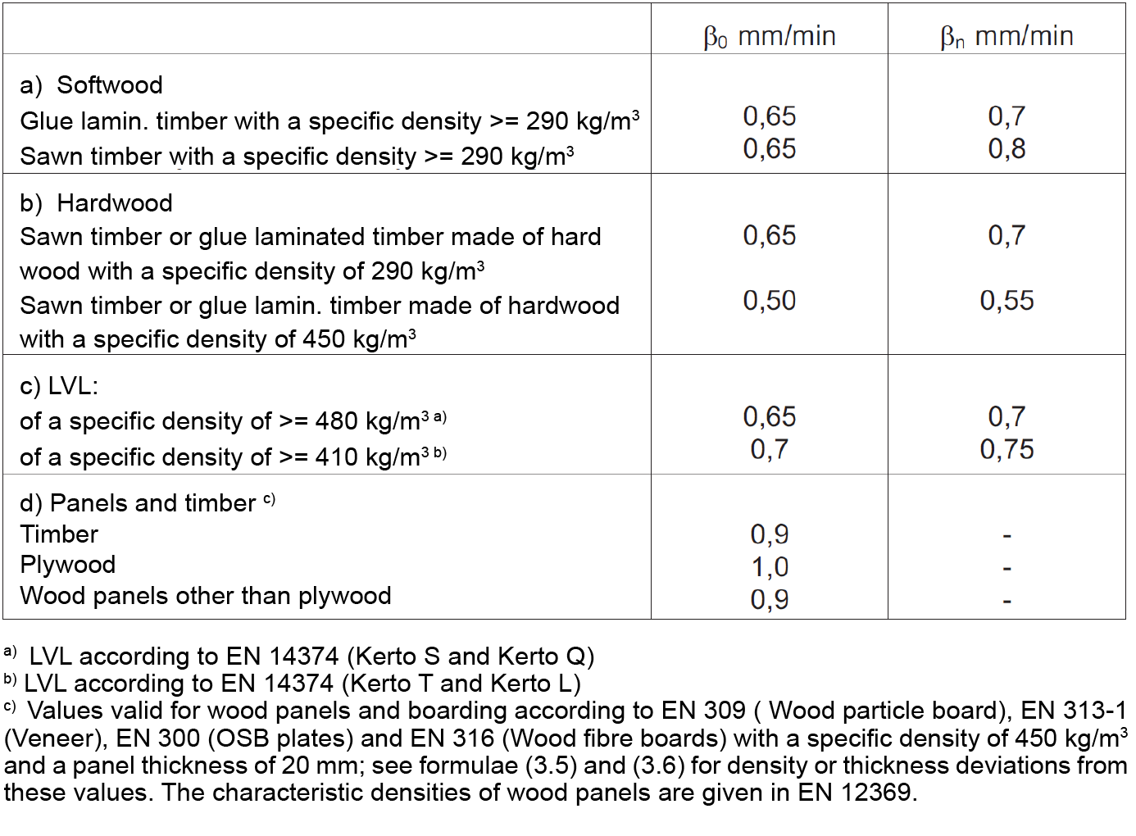
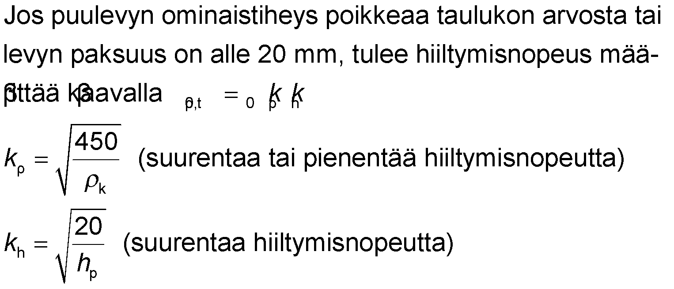
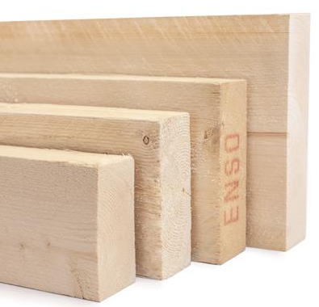
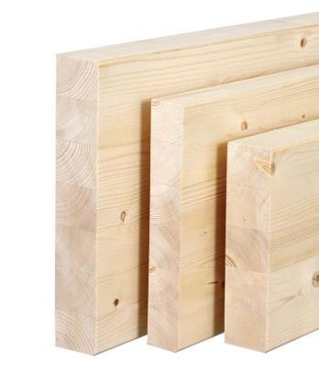
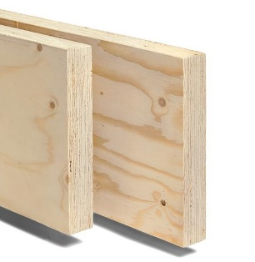
Wood charring rate
A wood product has two speeds of charring
One-dimensional charring rate β₀ (usually only for plate structures)
Nominal charring rate β_{n} (usually in fire designs for wooden structures)
If the specific density of a wooden board differs from the value in the table or the thickness of the board is less than 20 mm, the charring rate should be determined by β_{0,ρ,t} = β₀,k_{ρ}k_{h}
Source: RIL 205:2
Sawn timber
Glued laminated timber
LVL
(increases or decreases the charring rate)
(increases charring rate)
Images: Puuinfo

Slide 12
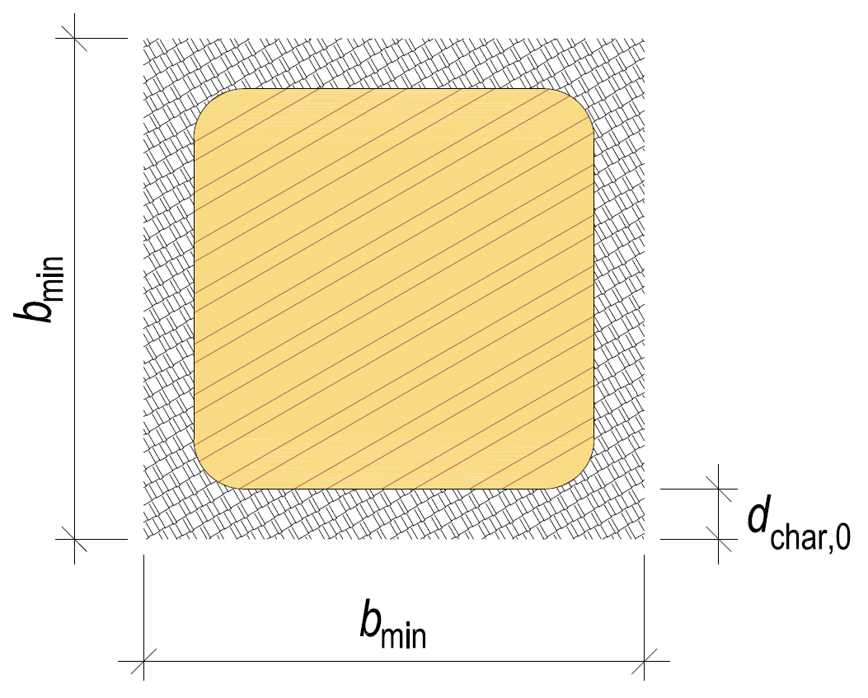
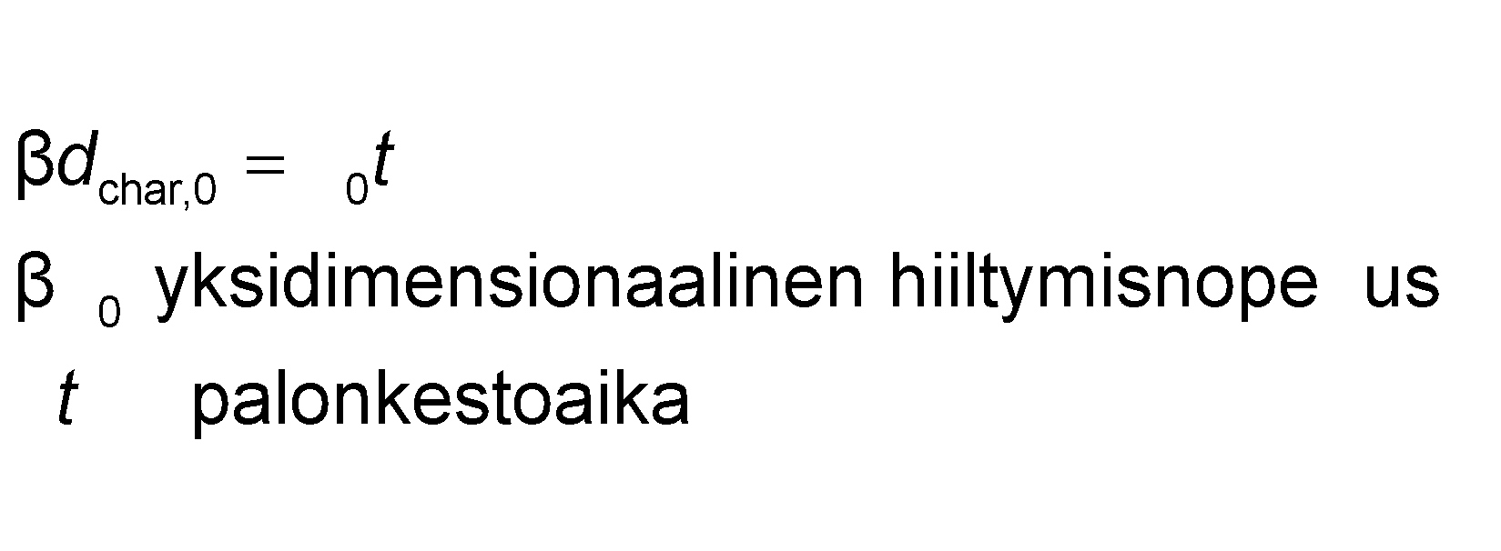
One-dimensional charring depth d_{char,0}
Structure exposed to fire on one side
Also suitable for structures that are exposed to fire from several sides at the same time as rounded corners is taken into account and the b_{min} measurement is filled
Angle rounding radius r = d_{char,0}
R 15: b_{min} = 80 mm
R 30: b_{min} = 119 mm
R 60: b_{min} = 158 mm
R 90: b_{min} = 197 mm
R 120: b_{min} = 236 mm
one-dimensional charring rate fire resistance time

Slide 13
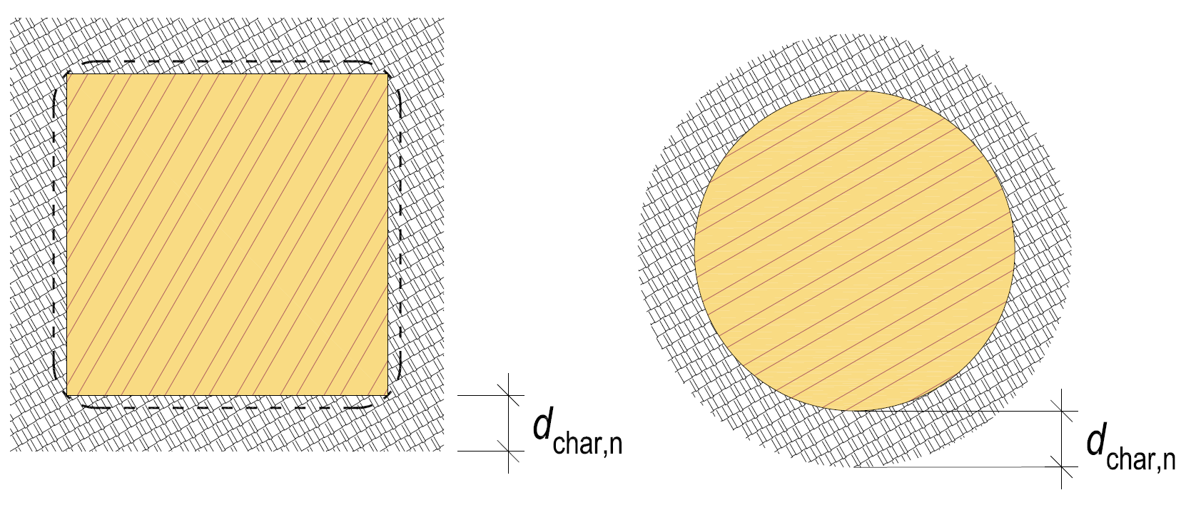
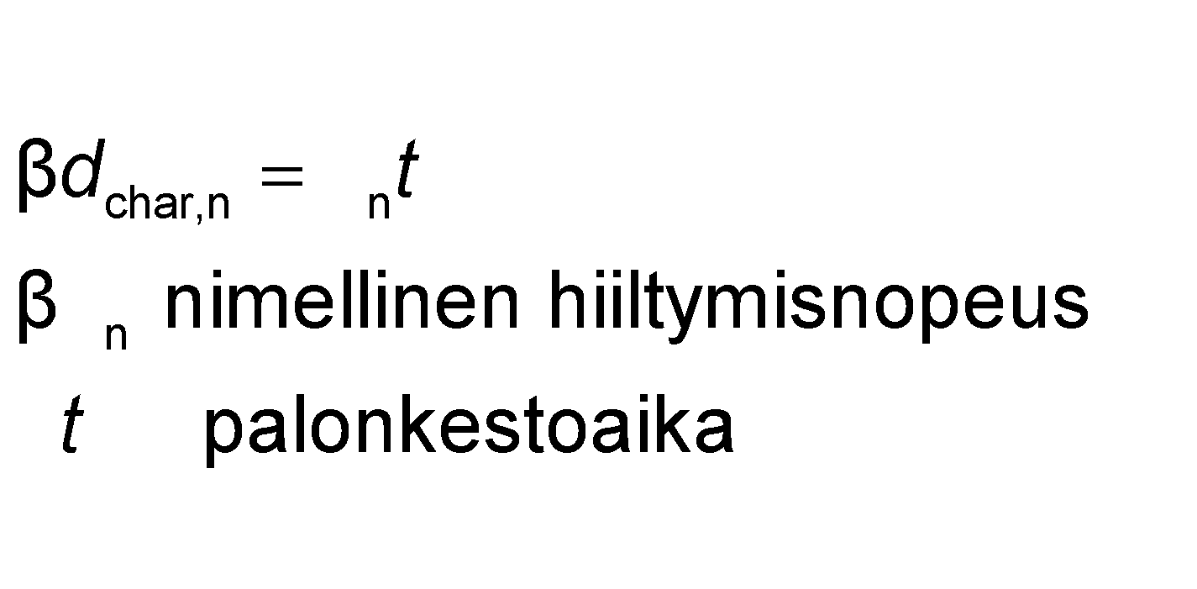
Nominal charring depth d_{char,n}
Construction exposed to fire from several sides at the same time
Nominal charring depth includes rounded corners and impact of cracks
Also used for circular cross-sections
nominal charring rate fire resistance time

Slide 14
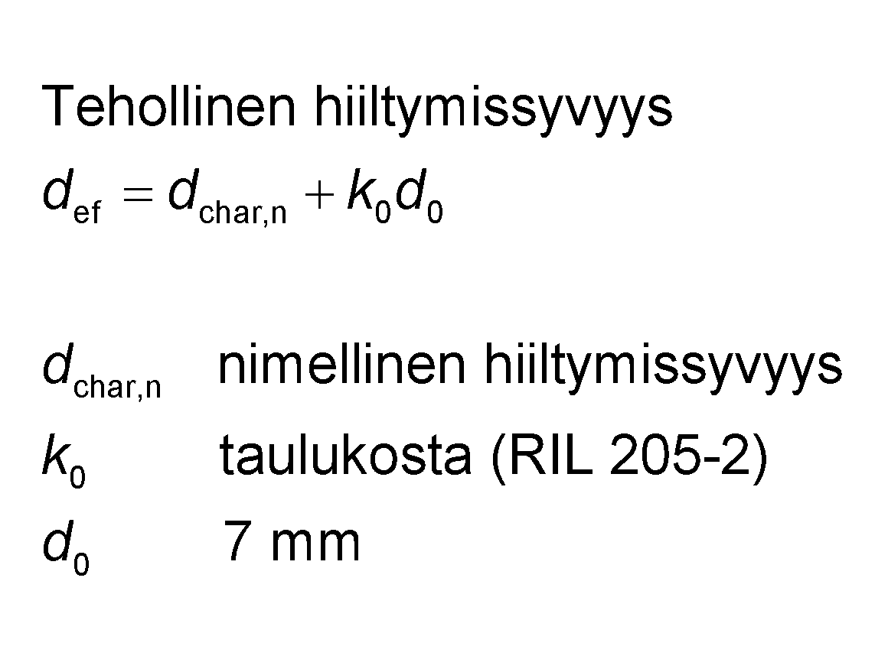
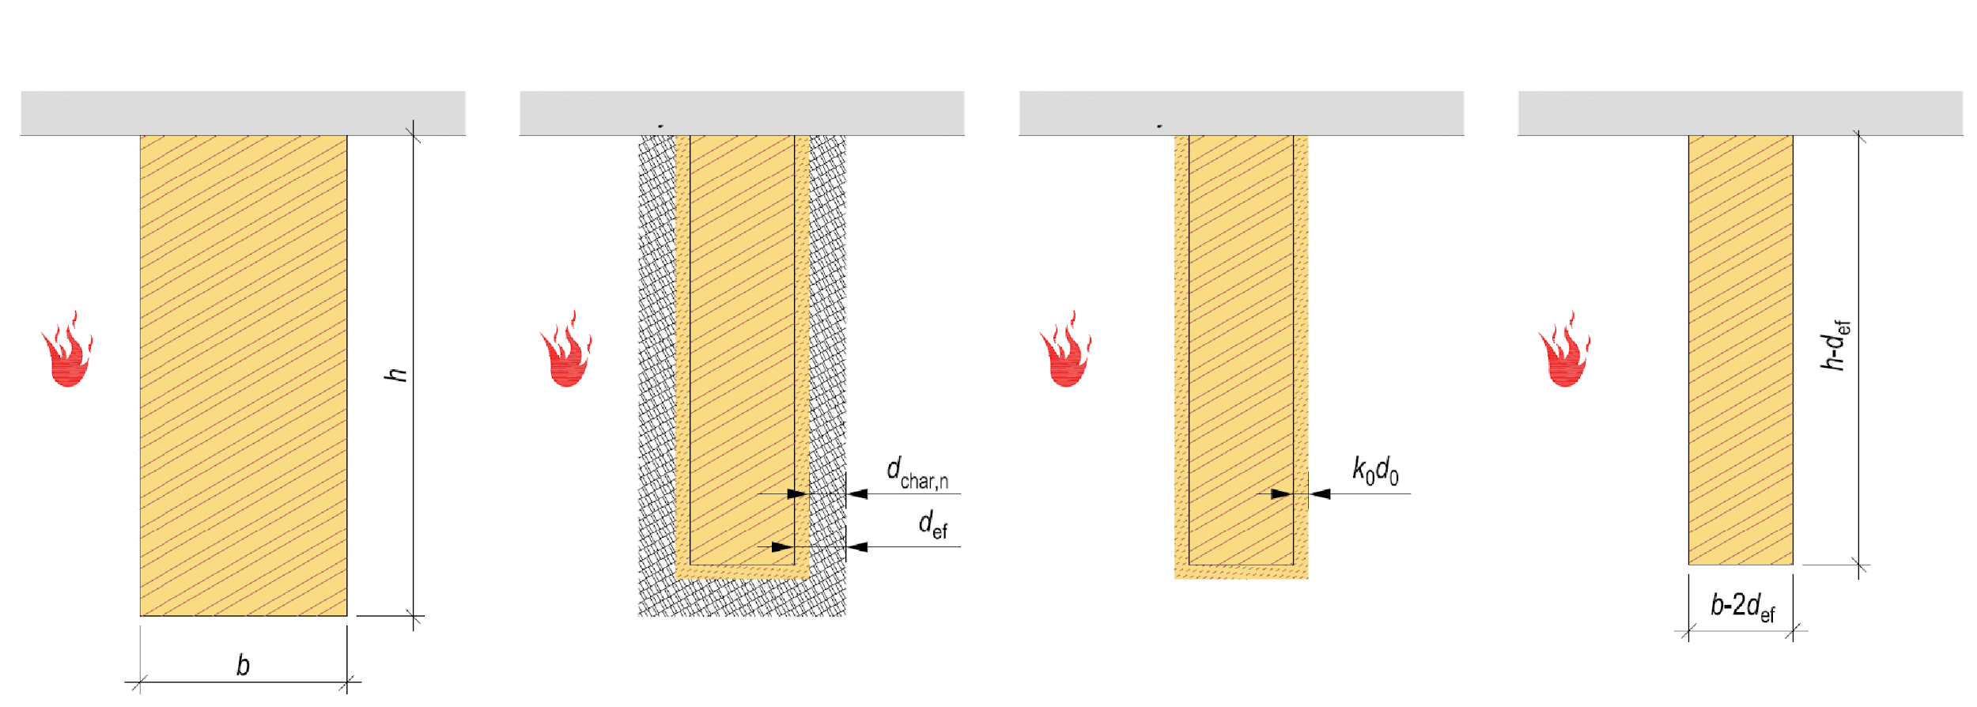
Effective cross-section method
Effective charring depth
Original cross-section Charred cross-section Residual cross-section Effective cross-section
Fire-protecting building element
Fire-protecting building element
Fire-protecting building element
Fire-protecting building element
nominal charring depth from table (RIL 205-2)
NOTE!
If d_{char,n} = 0 → d_{ef} = k₀d₀
Non-fire resistant structure
Fire resistance time | k₀
t < 20 min | t / 20
t ≥ 20 min | 1.0

Slide 15
Effective cross-section method
Effective charring depth d_{ef} is deducted from surfaces exposed to fire
Effective cross-section is used in the dimensioning of the structure
The effective cross-section method applies to all fire resistance classes R
Fire resistance time is not limited
Layer k₀d₀ has no strength and rigidity properties
In the effective cross-section method, the modification factor is k_{mod,fi} = 1,0
The reduction in strength in a fire is considered in the formula d_{ef} = d_{char,n} + k₀d₀

Slide 16
General information on the durability dimensioning of a fire situation
In case of fire, a 20% fraction of the strength characteristic is used
There is no need to check compression against grain direction perpendicular to it
No need to verify shear resistance with round and rectangular cross-section
In a notched beam, a residual cross-section near the notch of at least 60% of the cross-section required at normal temperature
If the lateral bucklings lose their grip in a fire situation, the dimensioning is carried out without lateral buckling
If the lateral bucklings lose their grip in a fire situation, the dimensioning is carried out without lateral buckling

Slide 17
General information on the durability dimensioning of a fire situation
A buckling and twisting analysis is performed using an effective cross-section or a nominal residual cross-section depending on the calculation method.
If the pressed or bent building blocks are also dimensioned as rigid structures, it must be checked that the rigidity is maintained during the required fire resistance period
Rigidity is assumed to be preserved if the residual cross-sectional area or the residual thickness of the wooden panels is 60% of the required cross-section or thickness of the normal temperature and the joints are made with nails, screws, pin studs or bolts

Slide 18
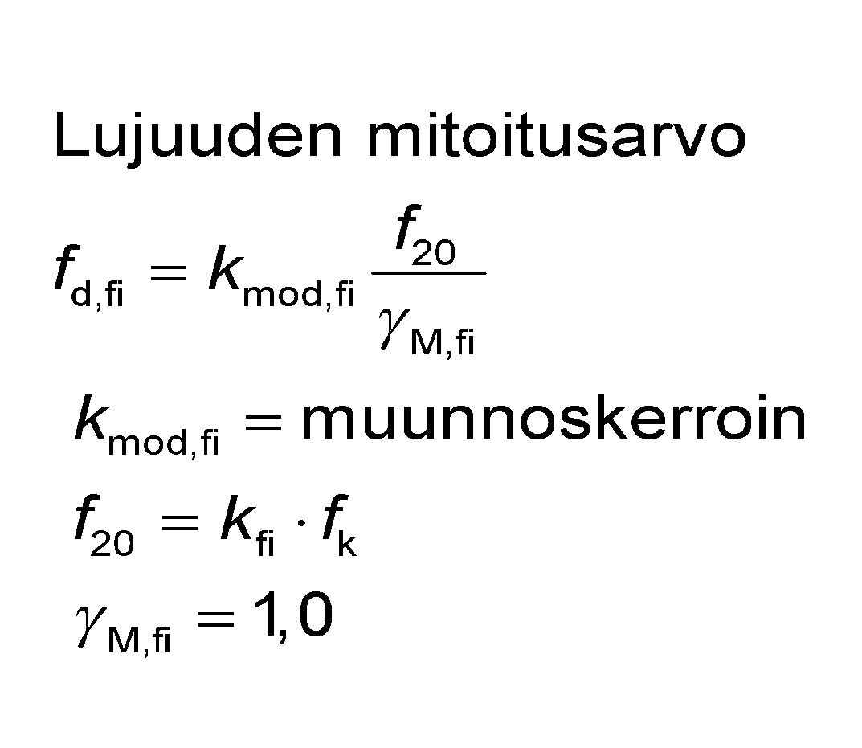
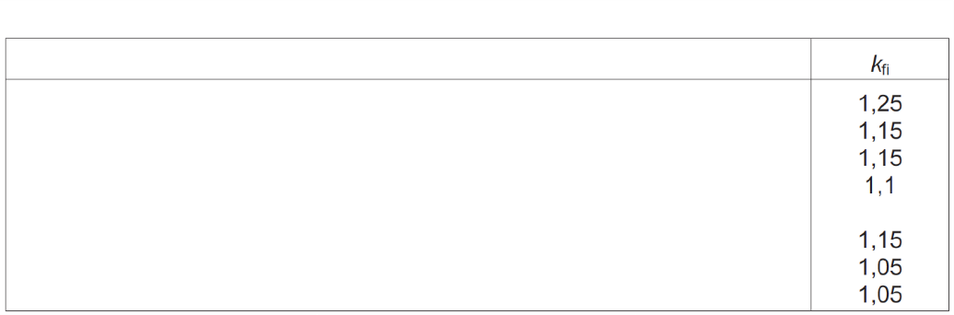
General information on the durability dimensioning of a fire situation
The modification factor k_{mod,fi} considers the decrease in strength properties in a fire
Depending on dimensioning method
In buckling and twisting dimensions
λ_{rel} and σ_{m,crit} are determined with E_{0,05} values
E_{mean} values in transition review
In calculation of total impact factor k_{h}
Effective cross-section/nominal residual cross-section height h_{fi}
or
Original cross-section height h
Strength dimensioning value
modification factor
Table 2.1. Values of the factor k_{fi}.
Sawn timber
Glued laminated timber
Wood-based panels
Laminated veneer lumber, LVL
A joint made up of intersecting connectors in which the side pieces are of wood or wood-based panel
A joint made up of intersecting connectors in which the side pieces are of metal Joints with longitudinal load on connectors
Source: RIL 205:2

Slide 19
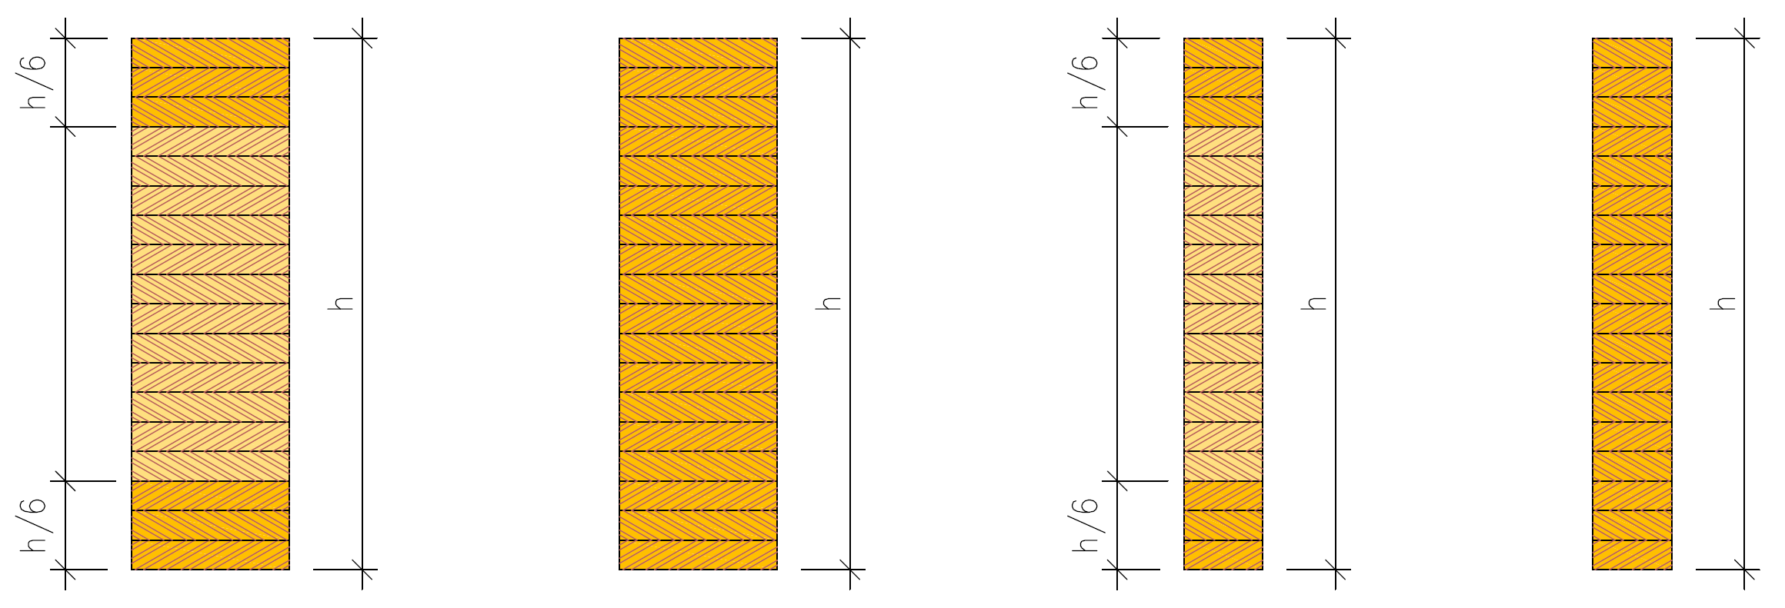
Strength values of laminated timber
Cross-laminated timber
GL24c, GL30c
Homogeneous laminated timber
GL24h, GL30h
In fire design, the strength values of cross-laminated timber are used as such, even though edge lamellas with higher strength may burn completely
Split cross-laminated timber GL30cs
Split homogeneous laminated timber GL30hs

