Slide 1



Industrial wood construction
Teaching materials for industrial wood construction education
2022

Slide 2
Origin of the materials
Use of the materials
These learning materials for industrial wood construction have been prepared in a project led by Puuinfo Oy in 2021–2022. Also involved in the project were
Lappia Vocational College,
TTS-Työtehoseura ry
South-Eastern Finland University of Applied Sciences,
Metropolia University of Applied Sciences,
Jyväskylä University of Applied Sciences,
University of Tampere, and
Federation of the Finnish Woodworking Industries Puutuoteteollisuus ry
The project was funded by the Ministry of the Environment.
The materials are intended to be used as extensively as possible in industrial wood construction education and studies.
The materials are released under the Creative Commons licence Attribution-ShareAlike (CC BY-SA), which requires that the author be properly credited when the materials are used and that derivative works may only be distributed under the same licence as the original work.
The original materials and any updates to them by Puuinfo will be published on the Library of Open Educational Resources website (aoe.fi) and the Puuinfo.fi website.

Slide 3
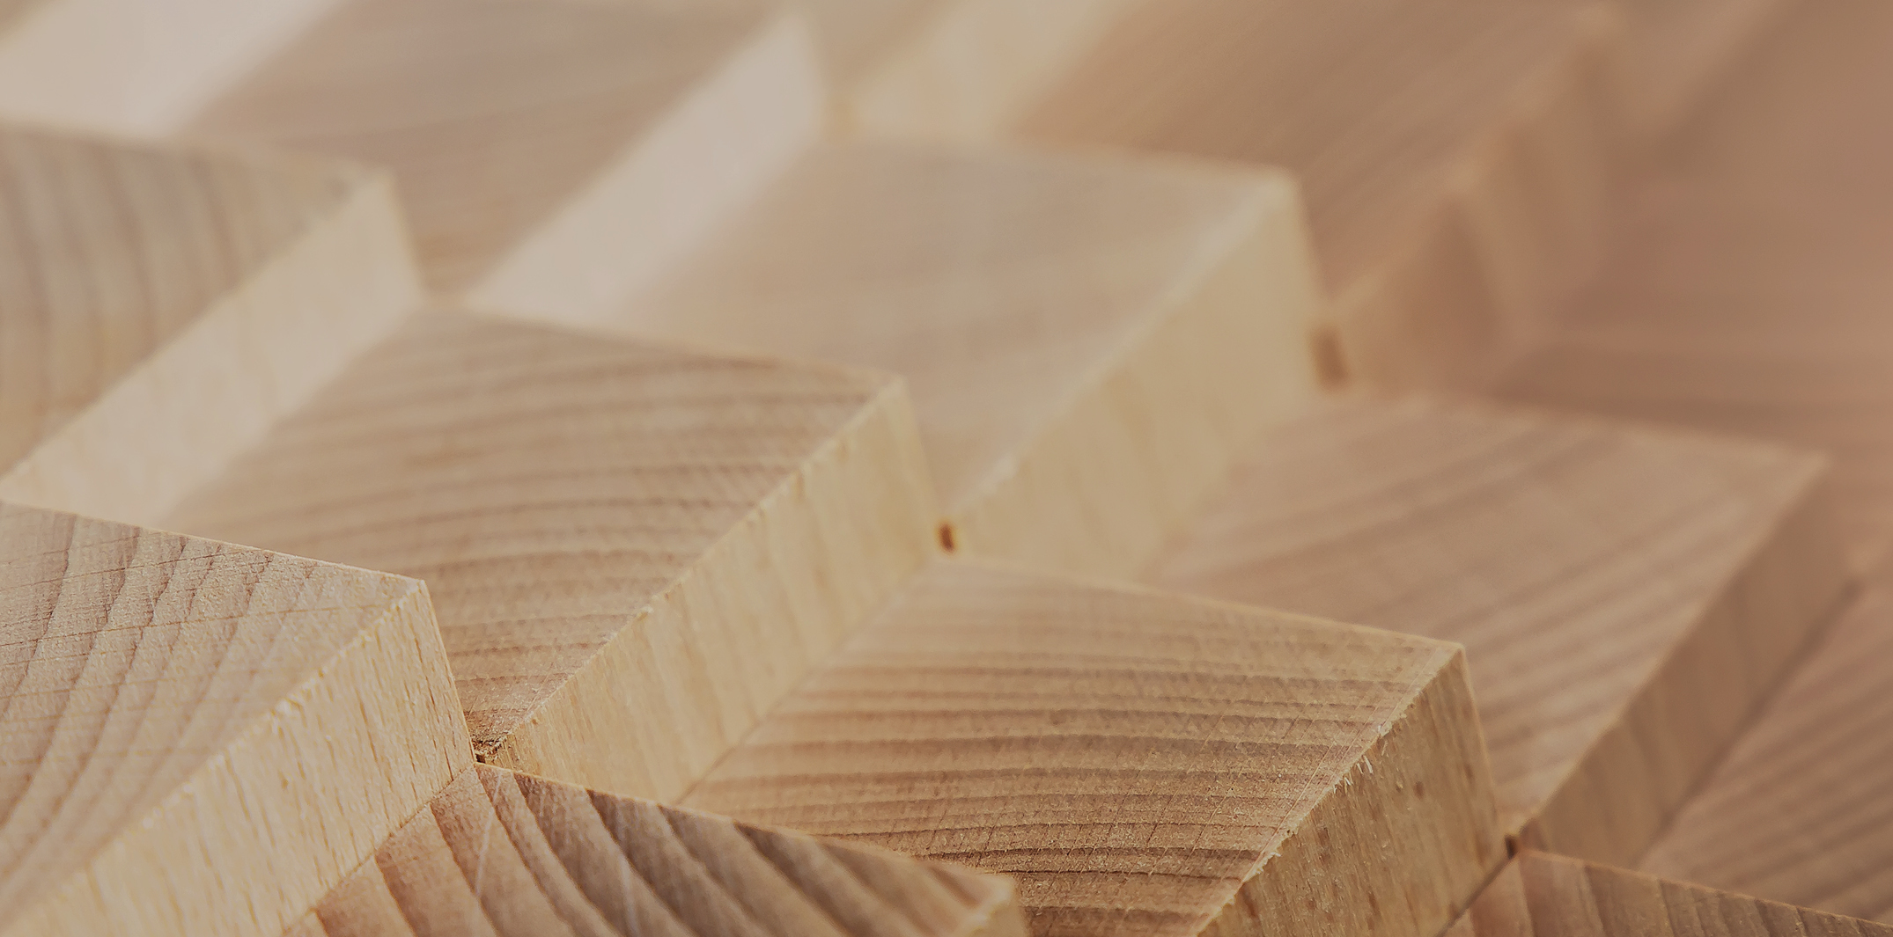
Structural design

Slide 4
Authors
Jani Pitkänen, XAMK
Release date: 20/01/2022

Slide 5
Non-fire proof screwed connection

Slide 6
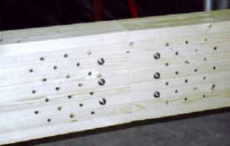
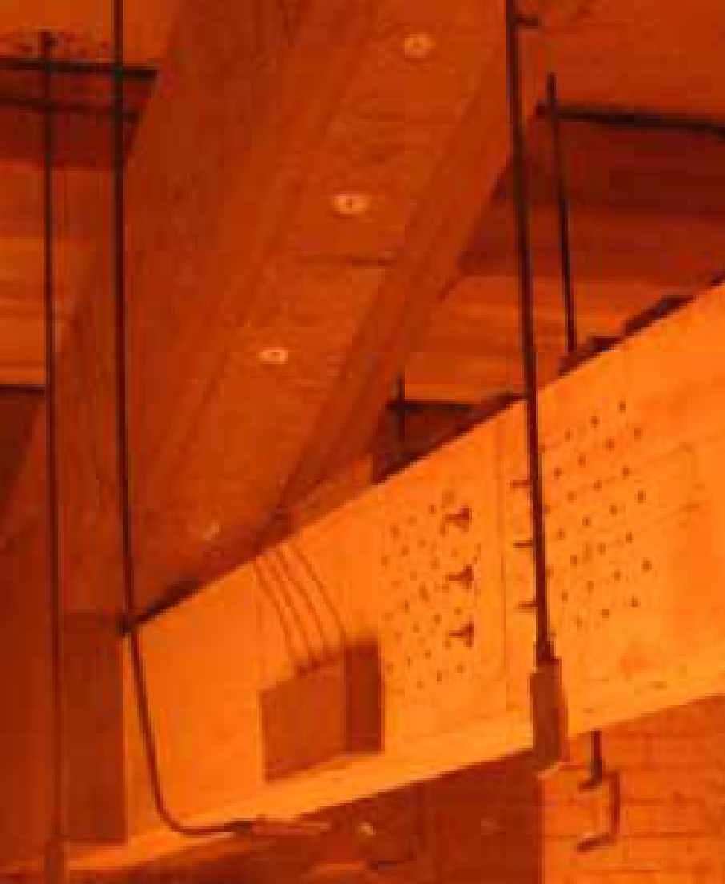
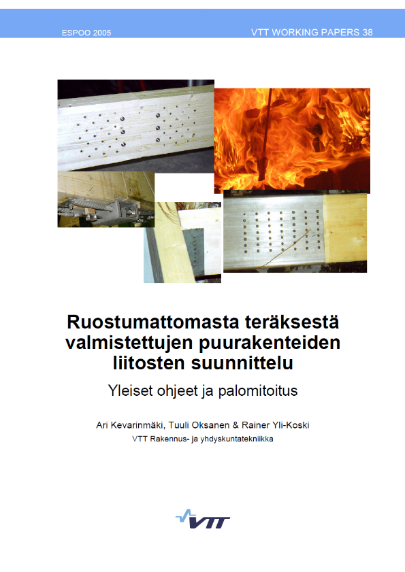
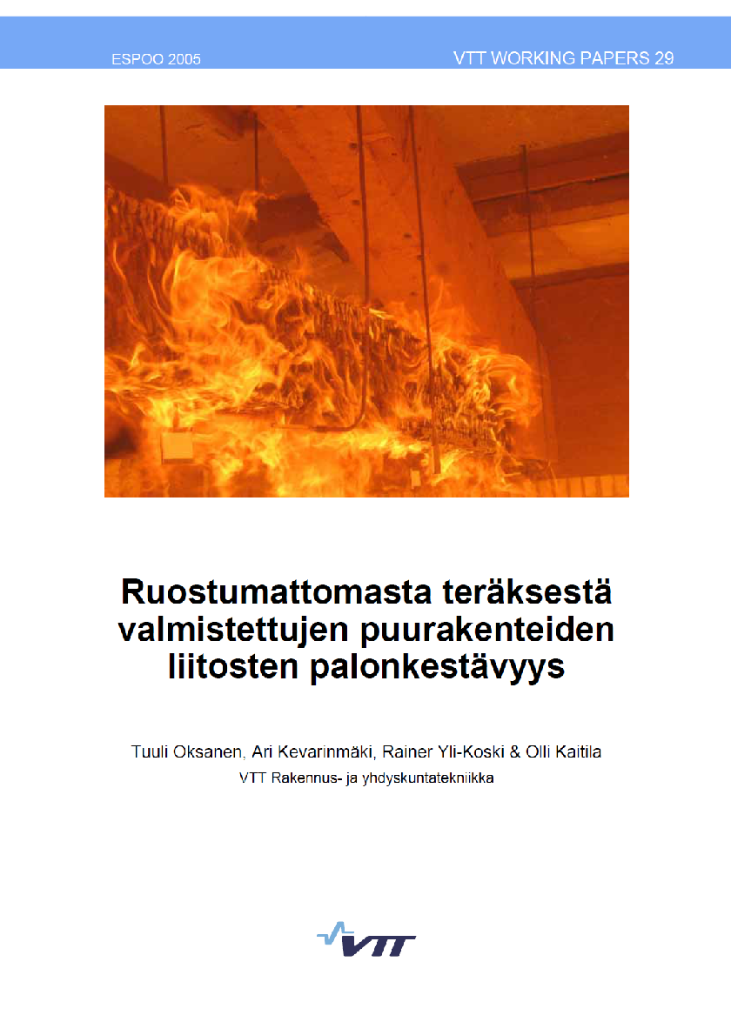
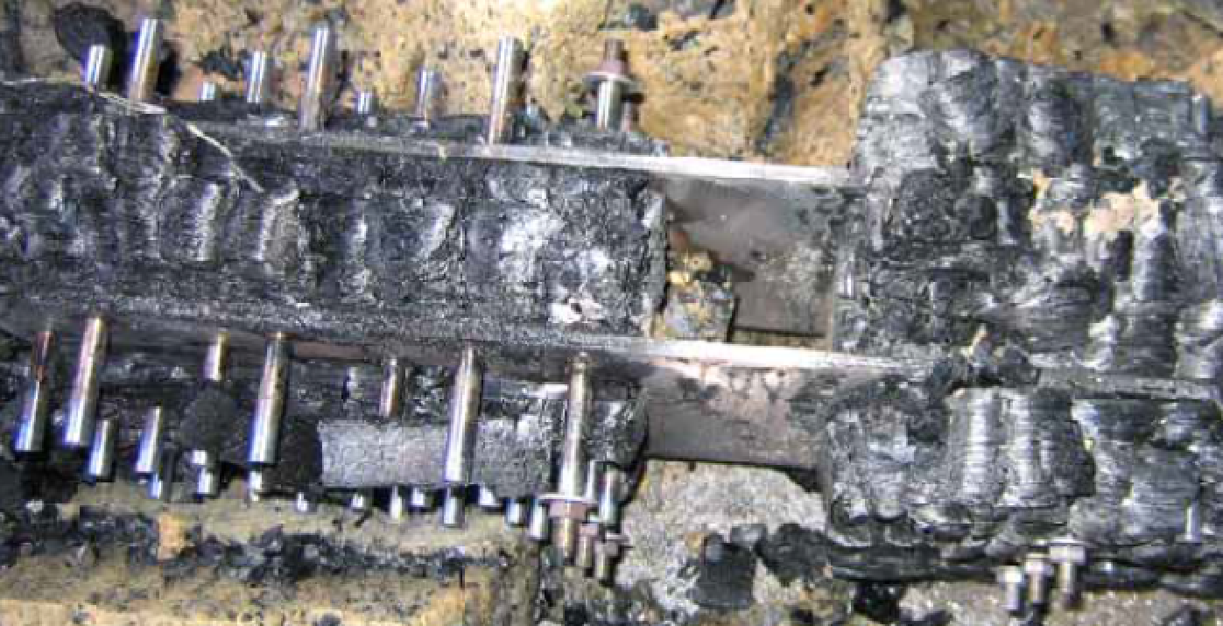
Non-fire proof screwed connection

Slide 7
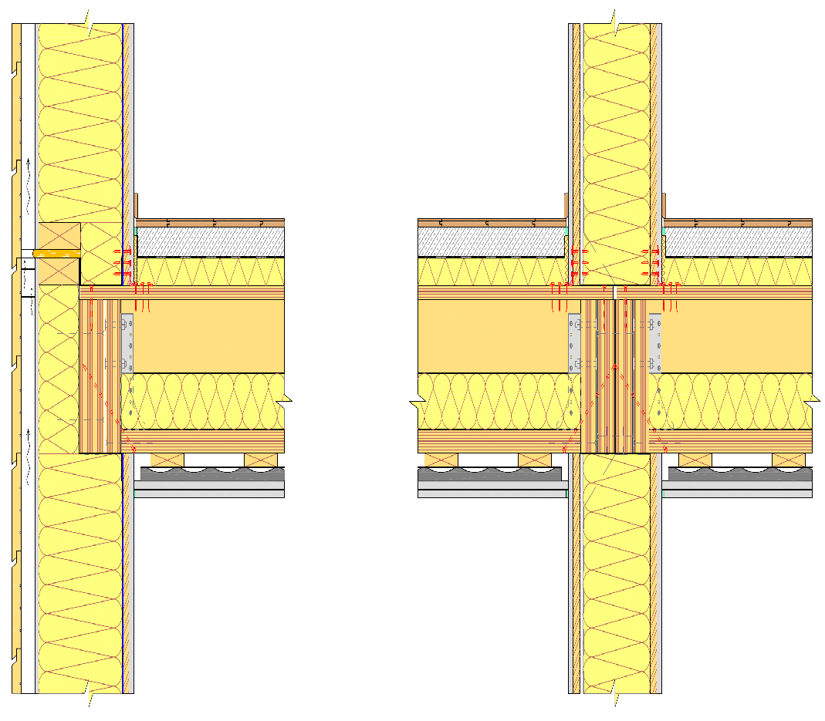
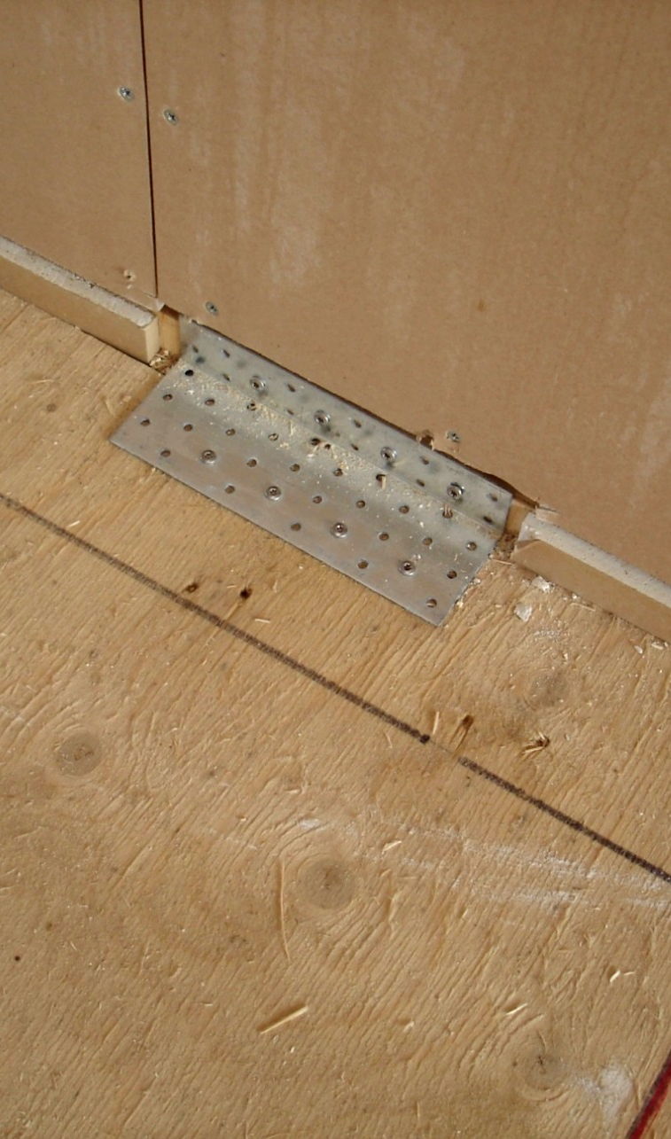
Non-fire proof screwed connection
In a wooden apartment block, connections are usually protected

Slide 8
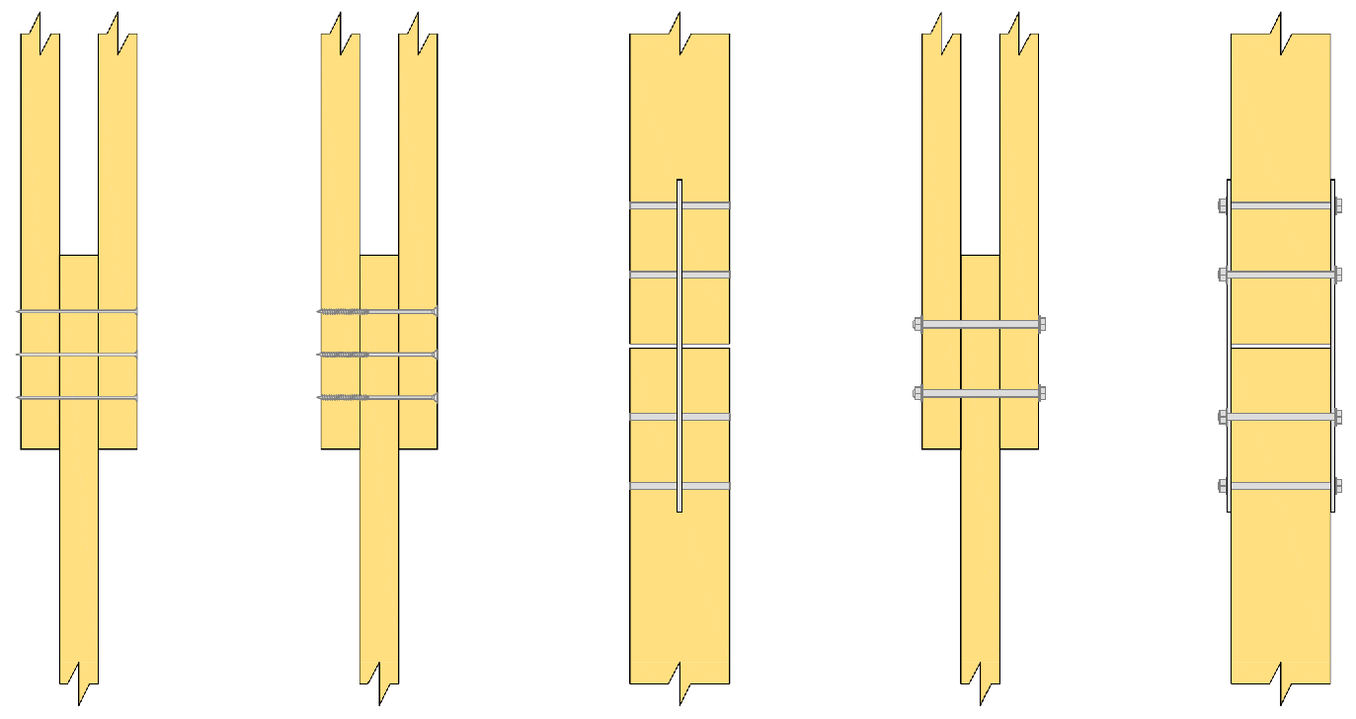
Non-fire proof screwed connection
Screw connections
Nails, screws, dowel pin and bolt (wood-wood and wood-steel joints)
If the fire proofing requirement for a joint is at most R30 => unprotected joint
If the fire proofing requirement for a joint is more than R30 => protected joint

Slide 9
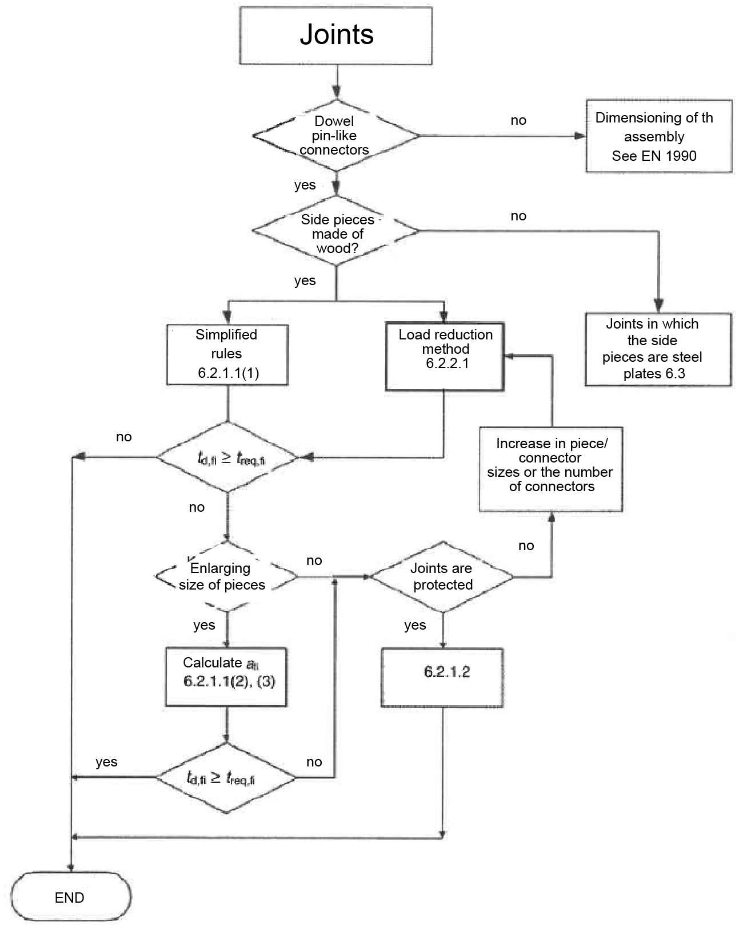
Non-fire proof screwed connection
Dimensioning methods for connections
Simplified
Rules
6.2.1.1(1)
Recommended method
Load
reduction
method
6.2.2.1
Method that is not recommended

Slide 10
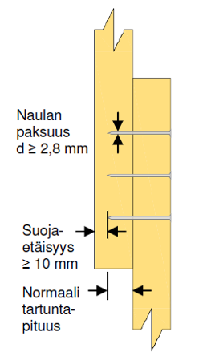
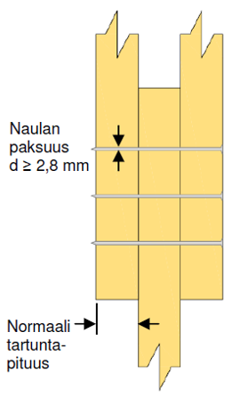
Non-fire proof screwed connection
Simplified instructions (nail connection)
15 minutes when the connection meets the strength and geometry requirements for normal temperature and the conditions in the images
Nail thickness d ≥ 2,8 mm
Nail thickness d ≥ 2,8 mm
Safety distance ≥ 10 mm
Normal grip length
Normal grip length

Slide 11
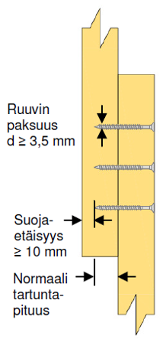
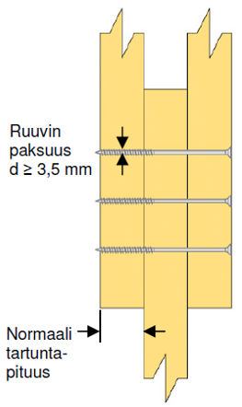
Non-fire proof screwed connection
Simplified instructions (screw connection)
15 minutes when the connection meets the strength and geometry requirements for normal temperature and the conditions in the images
Screw thickness d ≥ 3,5 mm
Screw thickness d ≥ 3,5 mm
Safety distance ≥ 10 mm
Normal grip length
Normal grip length

Slide 12
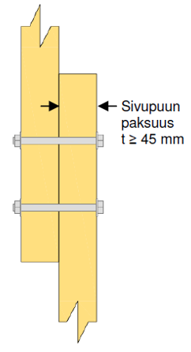
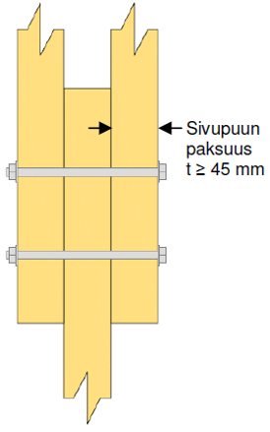
Non-fire proof screwed connection
Simplified instructions (bolted connection)
15 minutes when the connection meets the strength and geometry requirements for normal temperature and the conditions in the images
Thickness of sidebar
t ≥ 45 mm
Thickness of sidebar
t ≥ 45 mm

Slide 13
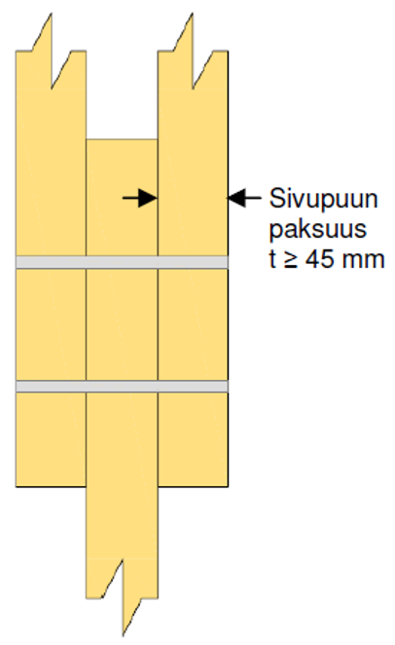
Non-fire proof screwed connection
Simplified instructions (dowel pin connection)
20 minutes when the connection meets the strength and geometry requirements for normal temperature and the conditions in the image
Thickness of sidebar
t ≥ 45 mm

Slide 14
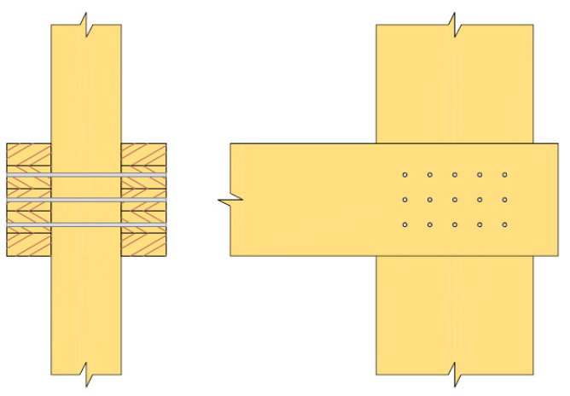

Non-fire proof screwed connection
Simplified instructions (dimensioning principles)
Rules for double shear connections, but can also be applied for single shear
At most R 15…R 20 for unprotected pin connectors
The fire proofing of unprotected nail, screw or dowel pin connections can be increased at most by 30 minutes by increasing the dimensions of the connected wood parts, as well as determining the side and end distances of the connectors a_{fi} (connectors have a protruding base)

Slide 15
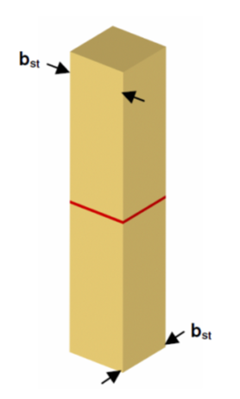
Non-fire proof screwed connection
Simplified instructions (dimensioning principles)
All the edges of the steel plate are unprotected
30 min when b_{st} > 200 mm and the thickness of the streel plate is at least 2 mm
60 min when b_{st} > 280 mm and the thickness of the streel plate is at least 2 mm

Slide 16
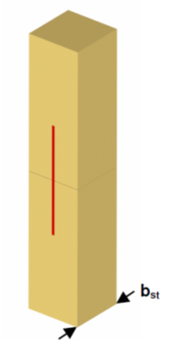
Non-fire proof screwed connection
Simplified instructions (dimensioning principles)
1 or 2 of the steel plate’s edges are unprotected
30 min when b_{st} > 120 mm and the thickness of the streel plate is at least 2 mm
60 min when b_{st} > 280 mm and the thickness of the streel plate is at least 2 mm

Slide 17
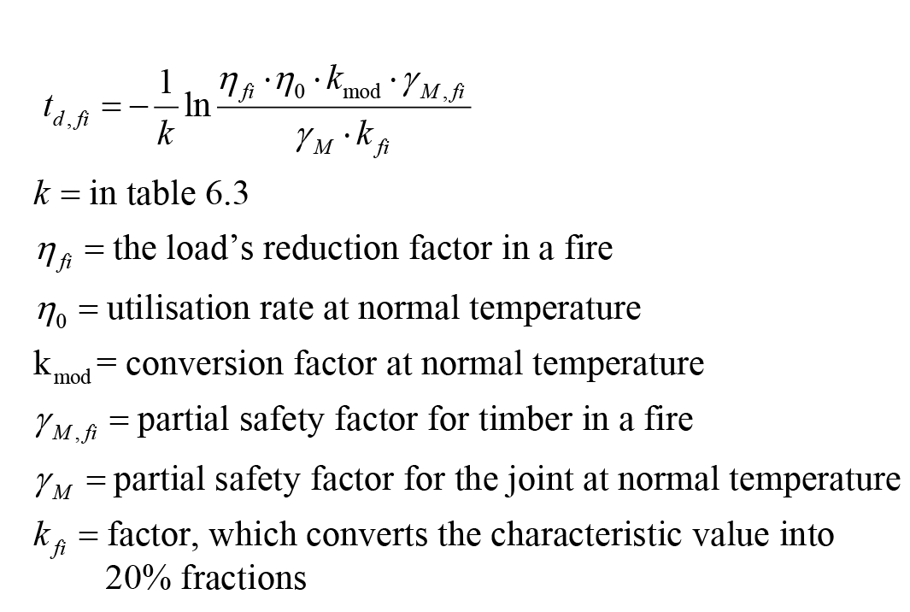
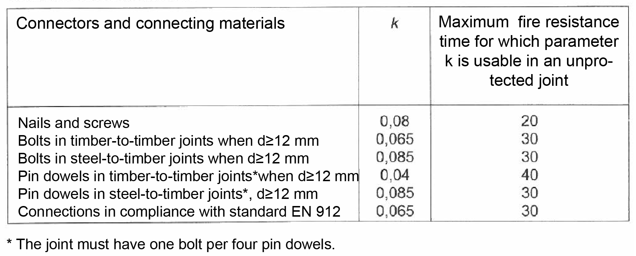
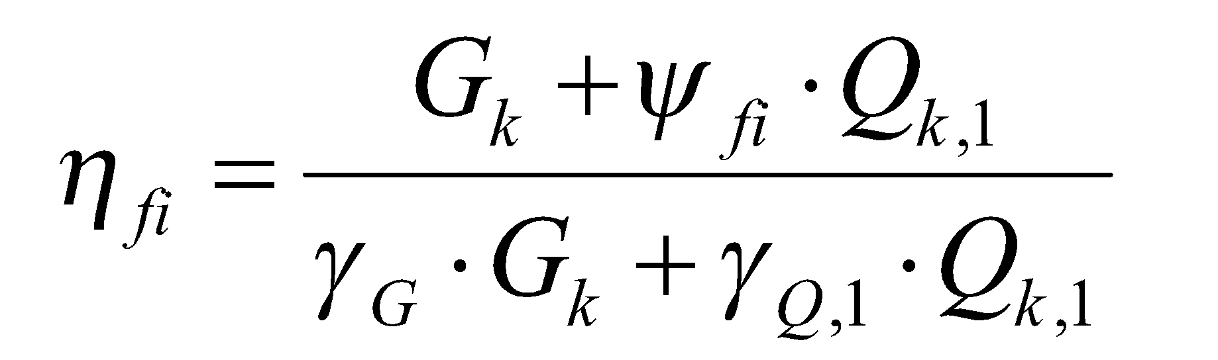
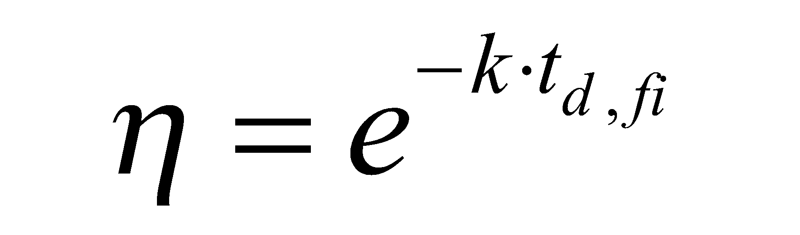
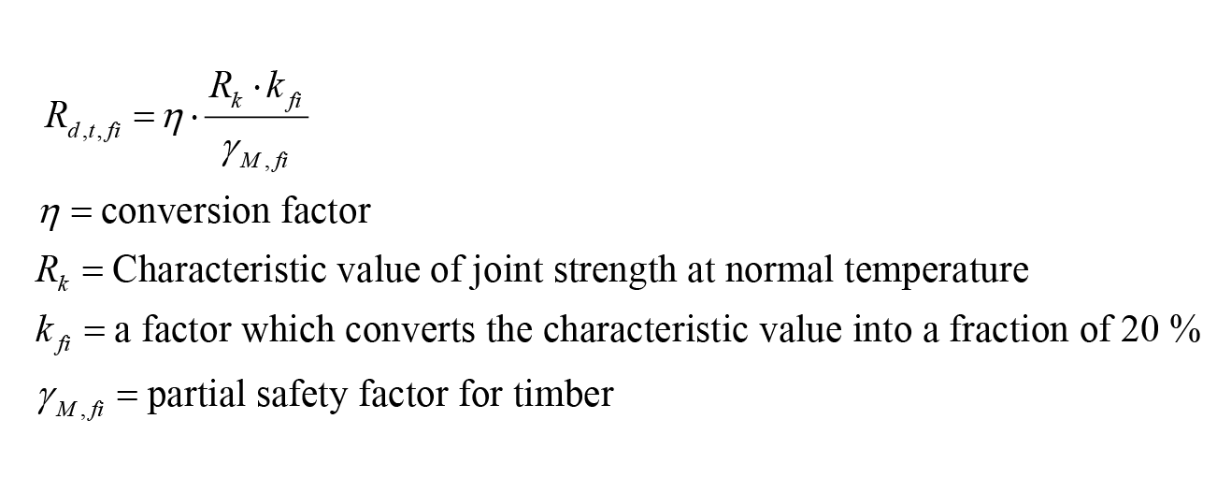
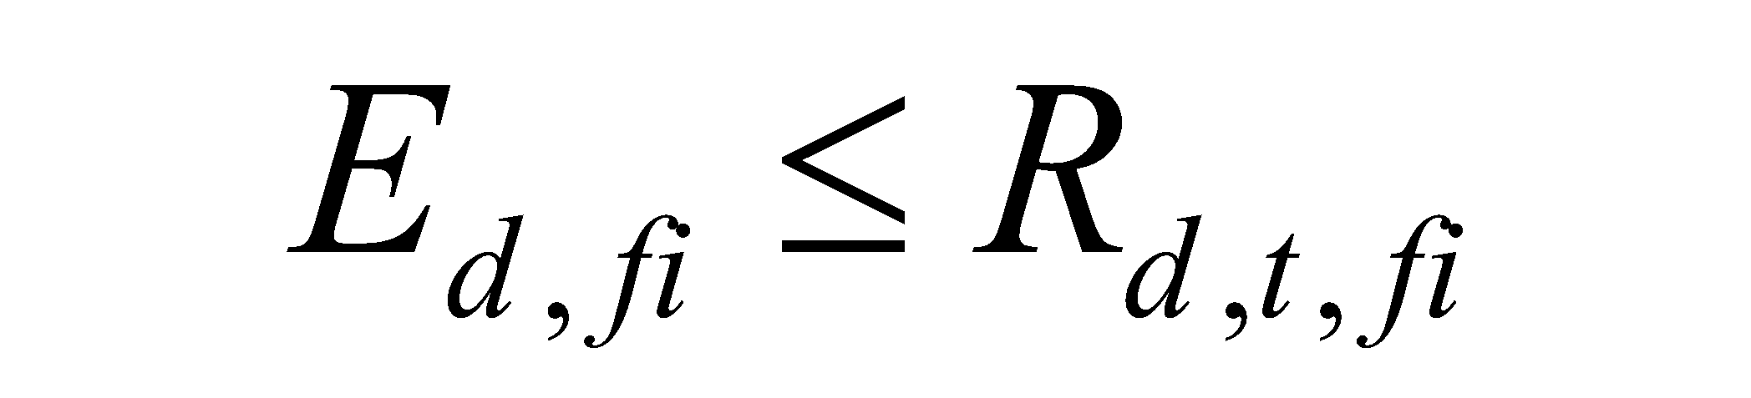
Non-fire proof screwed connection
Load reduction method

Slide 18
Non-fire proof screwed connection
Load reduction method
The following page contains 3 example calculations for the load reduction method.
Double shear timber to timber bolted connection
In the calculations, the utilisation rates for the ultimate limit state are as follows:
First calculation 53%
Second calculation 84%
Third calculation 98%

Slide 19
