Slide 1



Industrial wood construction
Teaching materials for industrial wood construction education
2022

Slide 2
Origin of the materials
Use of the materials
These learning materials for industrial wood construction have been prepared in a project led by Puuinfo Oy in 2021–2022. Also involved in the project were
Lappia Vocational College,
TTS-Työtehoseura ry
South-Eastern Finland University of Applied Sciences,
Metropolia University of Applied Sciences,
Jyväskylä University of Applied Sciences,
University of Tampere, and
Federation of the Finnish Woodworking Industries Puutuoteteollisuus ry
The project was funded by the Ministry of the Environment.
The materials are intended to be used as extensively as possible in industrial wood construction education and studies.
The materials are released under the Creative Commons licence Attribution-ShareAlike (CC BY-SA), which requires that the author be properly credited when the materials are used and that derivative works may only be distributed under the same licence as the original work.
The original materials and any updates to them by Puuinfo will be published on the Library of Open Educational Resources website (aoe.fi) and the Puuinfo.fi website.

Slide 3
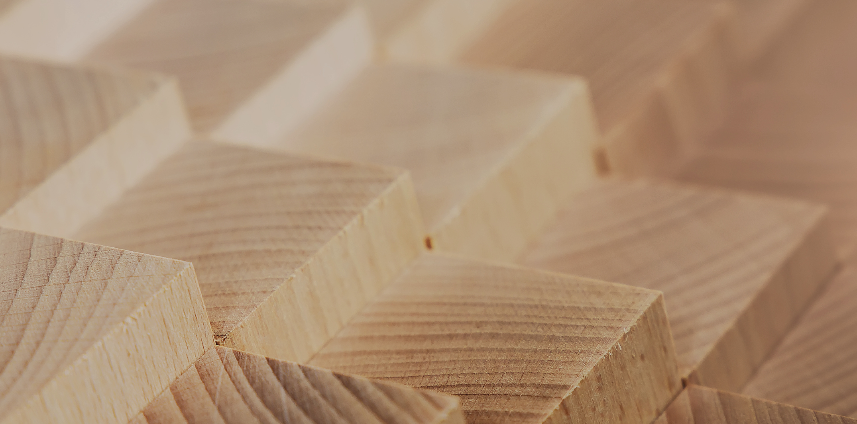
Structural design

Slide 4
Authors
Tero Lahtela,
Insinööritoimisto Tero Lahtela Oy
Release date: 22/10/2021

Slide 5
Stiffening of the cantilever column hall

Slide 6
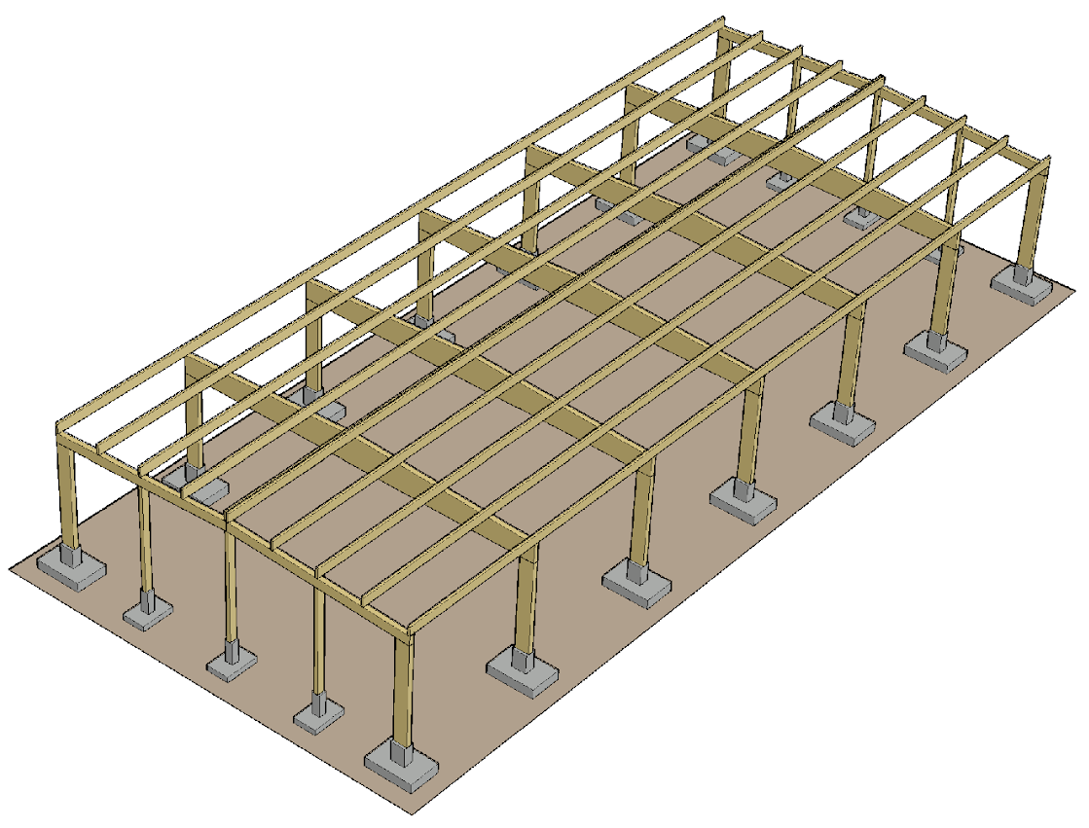
Cantilever column frame
A cantilever column frame is the most common type of frame system in industrial and commercial premises
Benefits of the cantilever column frame include
  The transversal length of the hall is stiffened with cantilever column ring-beam so that there is no limitation on the length of the hall
  Highly prefabricated frame and exterior shell building components
  Quick installation on site
  Cost effective

Slide 7
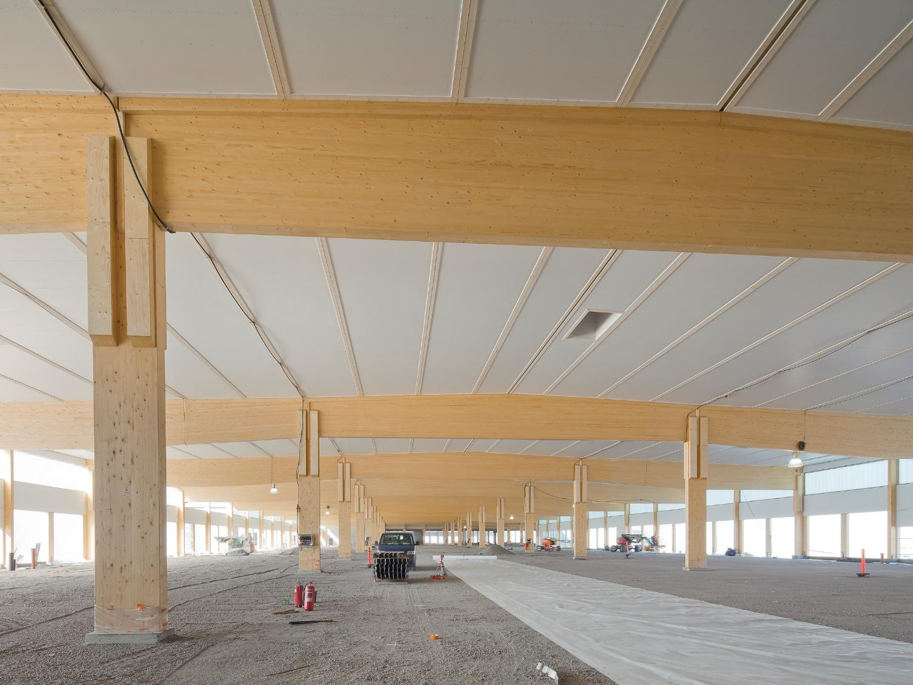
Example of a multi-bay hall with cantilever columns
Image: Puuinfo

Slide 8
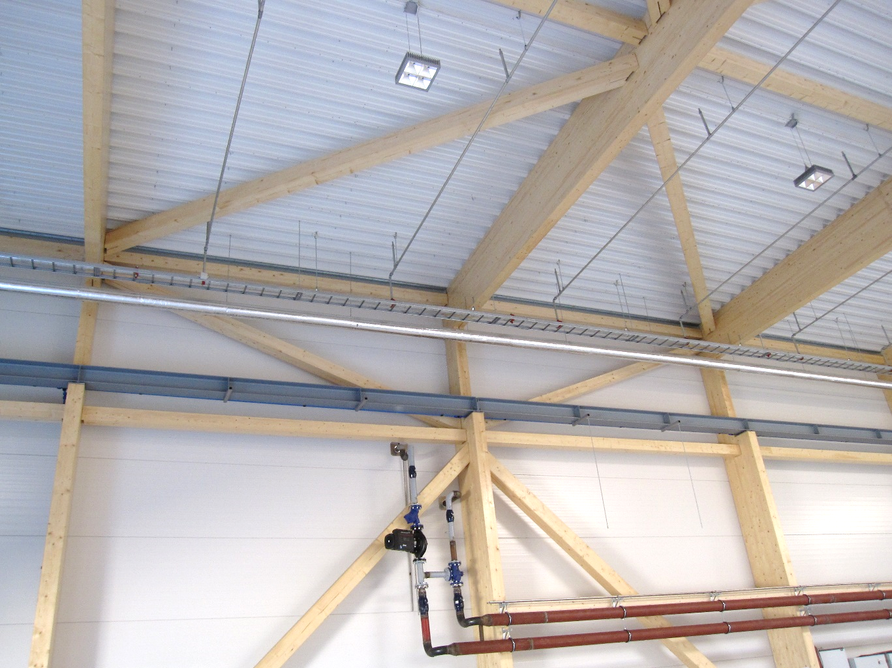
Bridge crane
A cantilever column frame can also be used to shape the column containing the crane console
In a wooden hall, the crane usually has a capacity of 5...10 tonnes.
If necessary, the notches in the pillar are reinforced with transverse full-thread screws, etc., to prevent cracking.
Image: Tero Lahtela

Slide 9
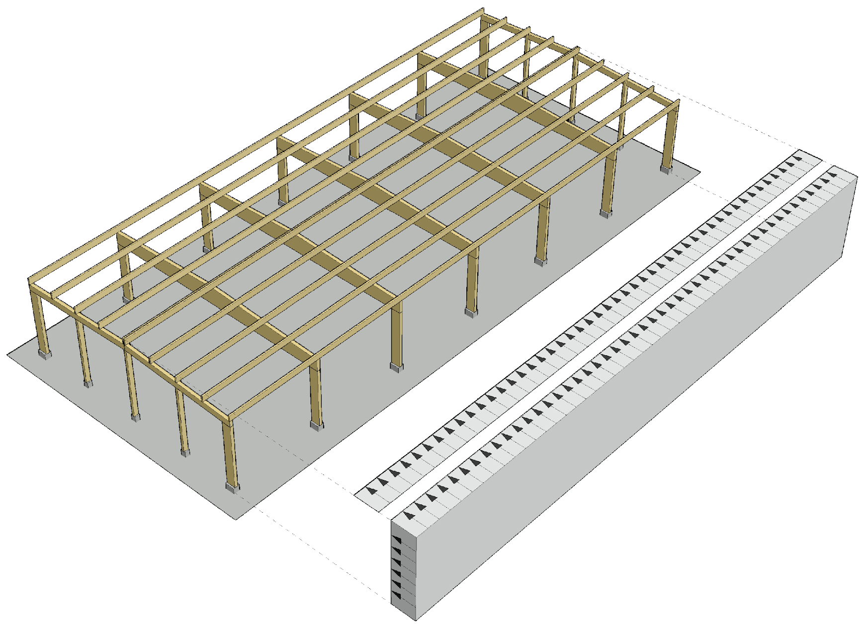
Stiffening the frame transversely
Horizontal loading in the transverse direction consists of:
  Wind load
  Additional horizontal force
Wind load can be examined as
  Total wind load
  The sum of wind loads on surface patches

Slide 10
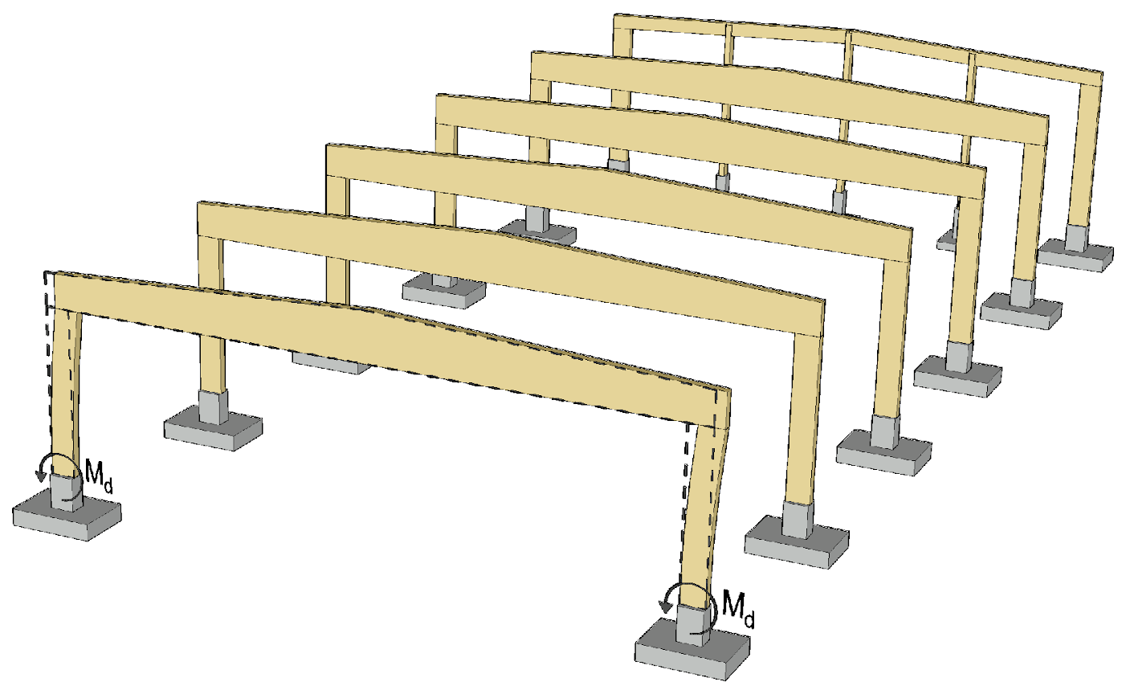
Stiffening the frame transversely
Stiffening the cantilever column frame in the transverse direction of the building is relatively simple
  The stiffening is based on the foundation joint of the torque rigid column
When selecting the frame’s dimensions, check the following
  Horizontal displacement of top of cantilever column
  Capacity of the moment joint
  Base size
  The pillar’s size

Slide 11
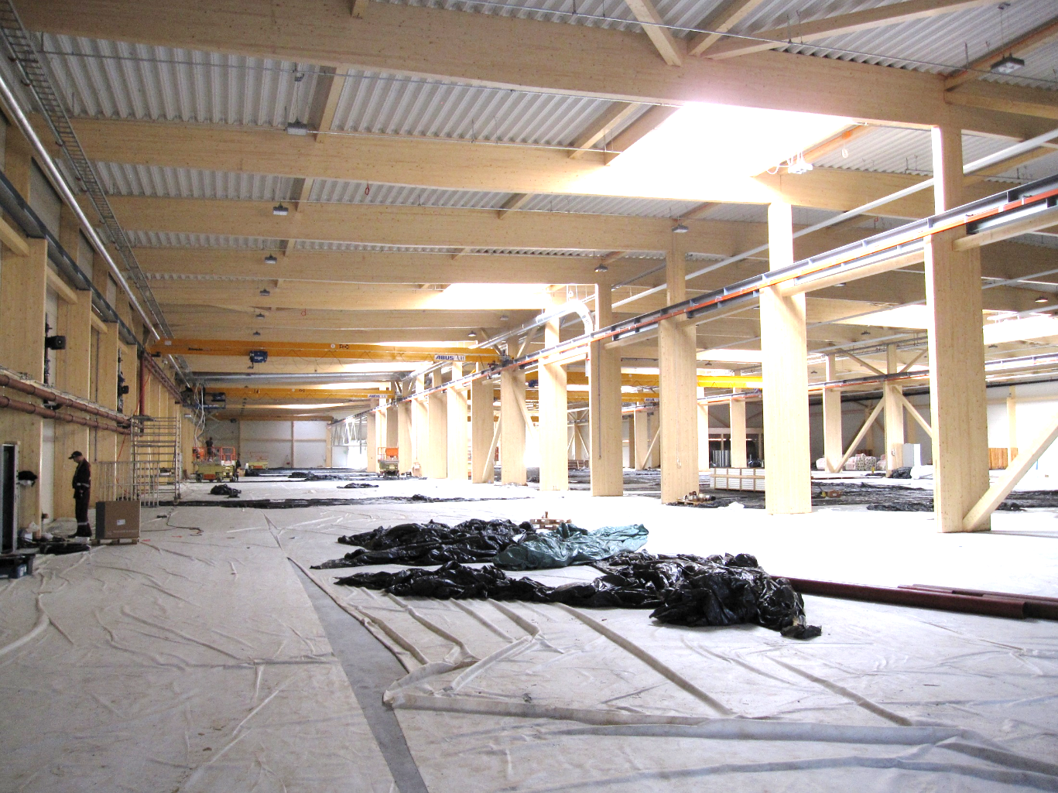
Stiffening the frame transversely
In a multi-bay hall, cantilever columns can also be placed on the centre lines of the building, in which case the columns on the exterior walls can be articulated
Image: Tero Lahtela

Slide 12
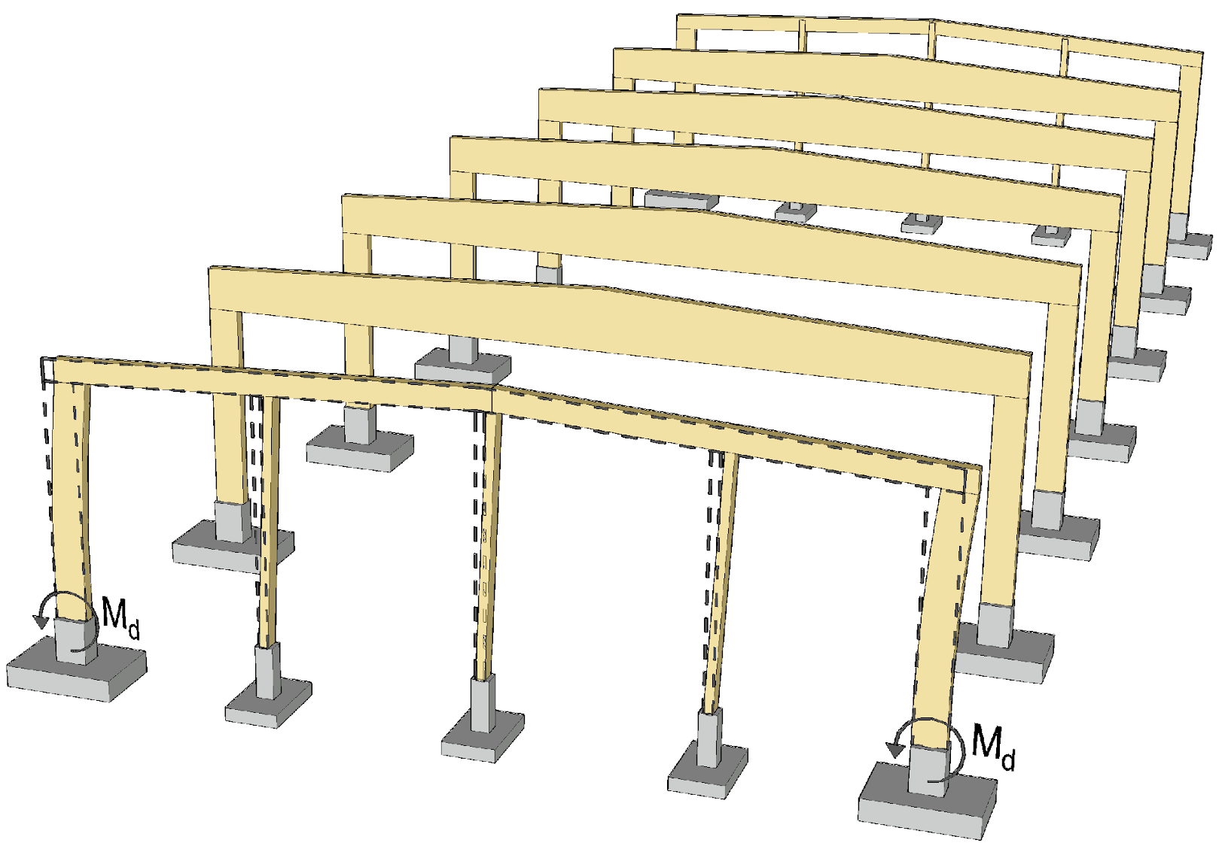
Stiffening the frame transversely
The end wall is usually stiffened with corner cantilever columns, whereby
  Door openings can be placed more freely in the end wall
  If necessary, it is simple to continue the hall frame
The end wall’s intermediate columns are usually articulated rods

Slide 13
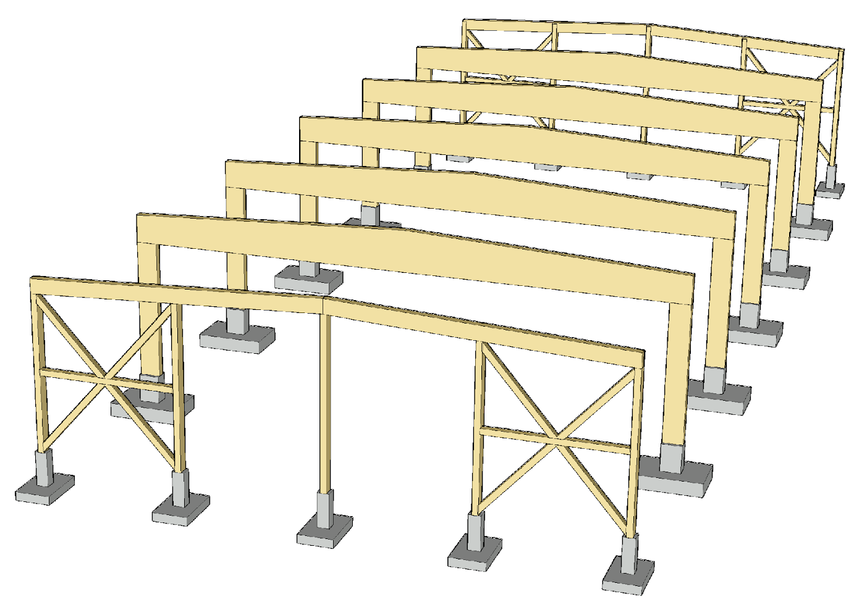
Stiffening the frame transversely
The end wall can also be stiffened with separate diagonal stiffeners
Diagonal stiffening results in the following benefits and challenges
  The amount of wood material on the end wall columns will decrease
  The amount of concrete on bases will decrease
  Torque rigid joints are not required
  Diagonal stiffeners increase the amount of material and connections in the end wall frame

Slide 14
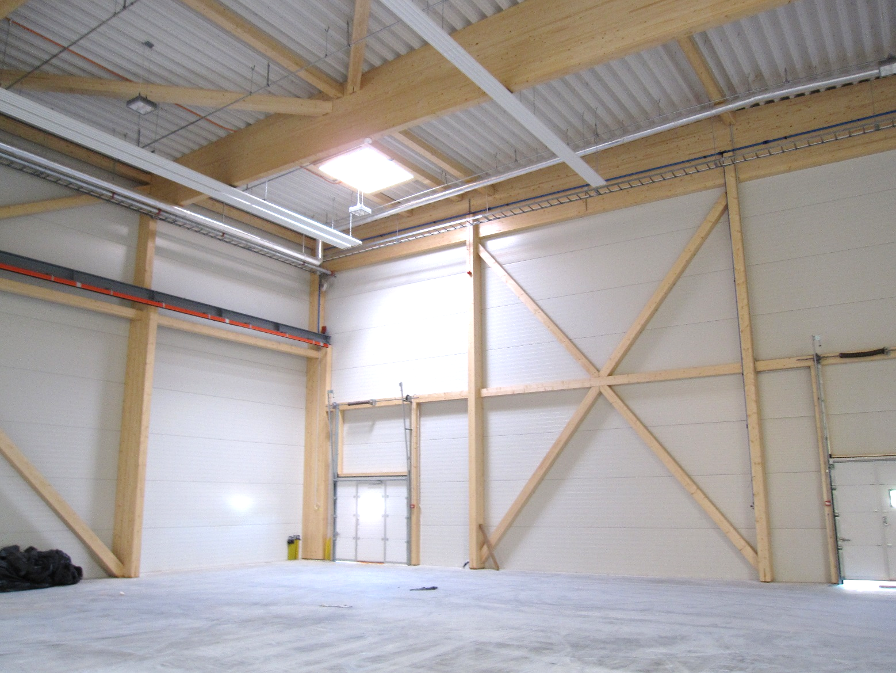
Example of diagonal stiffening of the end wall
Image: Tero Lahtela

Slide 15
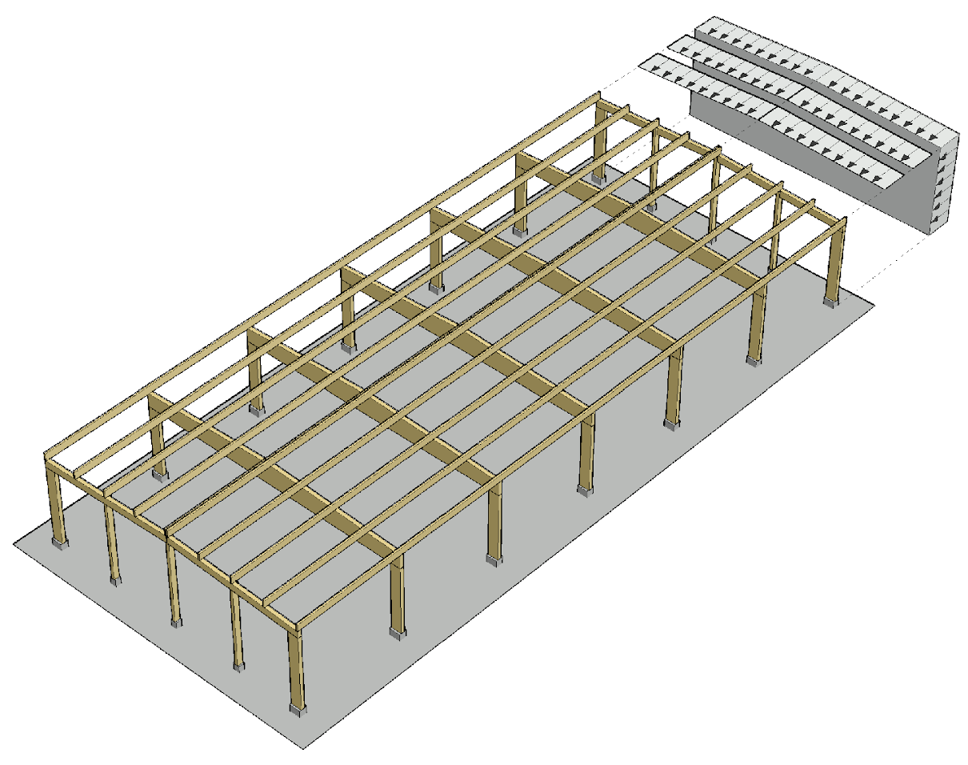
Stiffening the frame longitudinally
Horizontal loading in the longitudinal direction consists of:
  Wind load
  Stability support forces for main girders
  Additional horizontal force
Wind load can be examined as
  Total wind load
  The sum of wind loads on surface patches

Slide 16
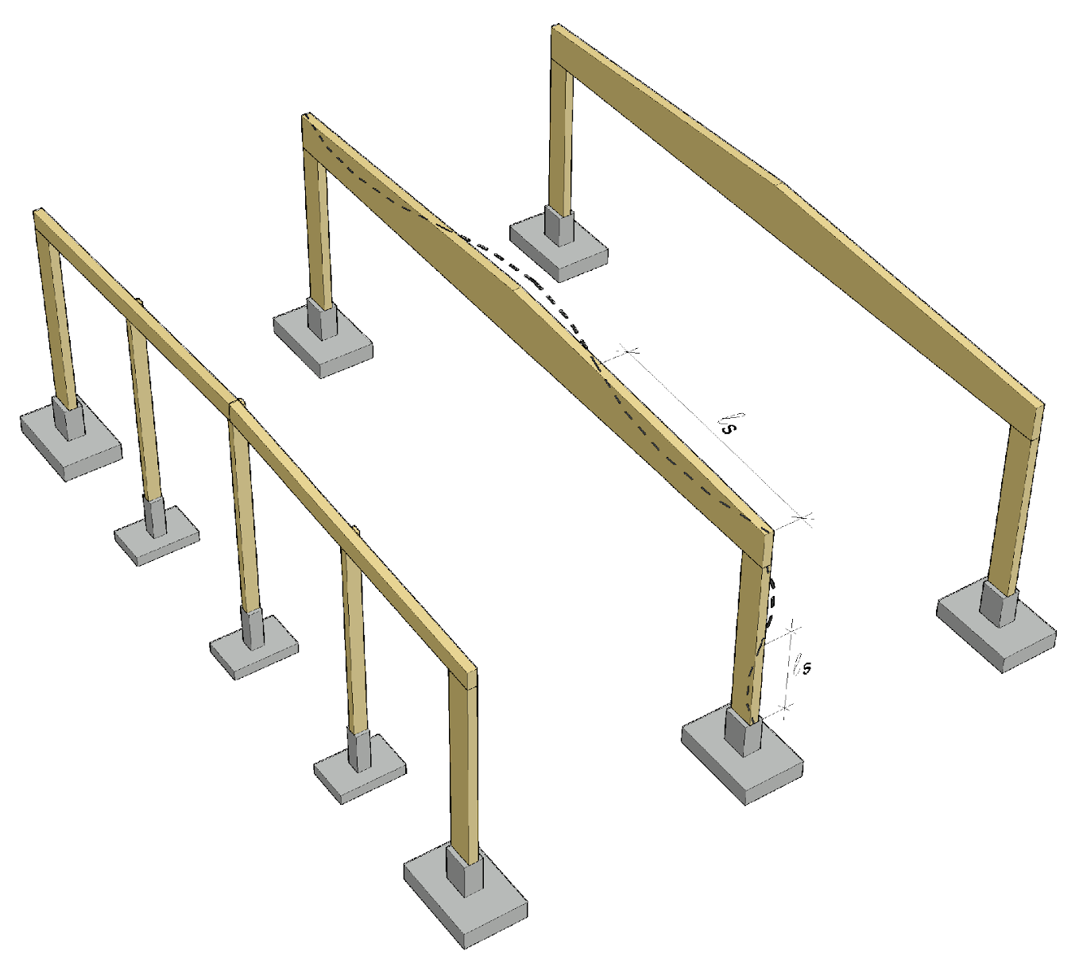
Stiffening the frame longitudinally
The design of stiffening structures in the longitudinal direction also includes the forces arising from the lateral buckling and buckling of the main girders and columns
The width-to-height ratio of the main girders and columns should be such that multiwave lateral buckling and buckling do not occur
The more slender the beams and columns, the stronger the stiffeners

Slide 17
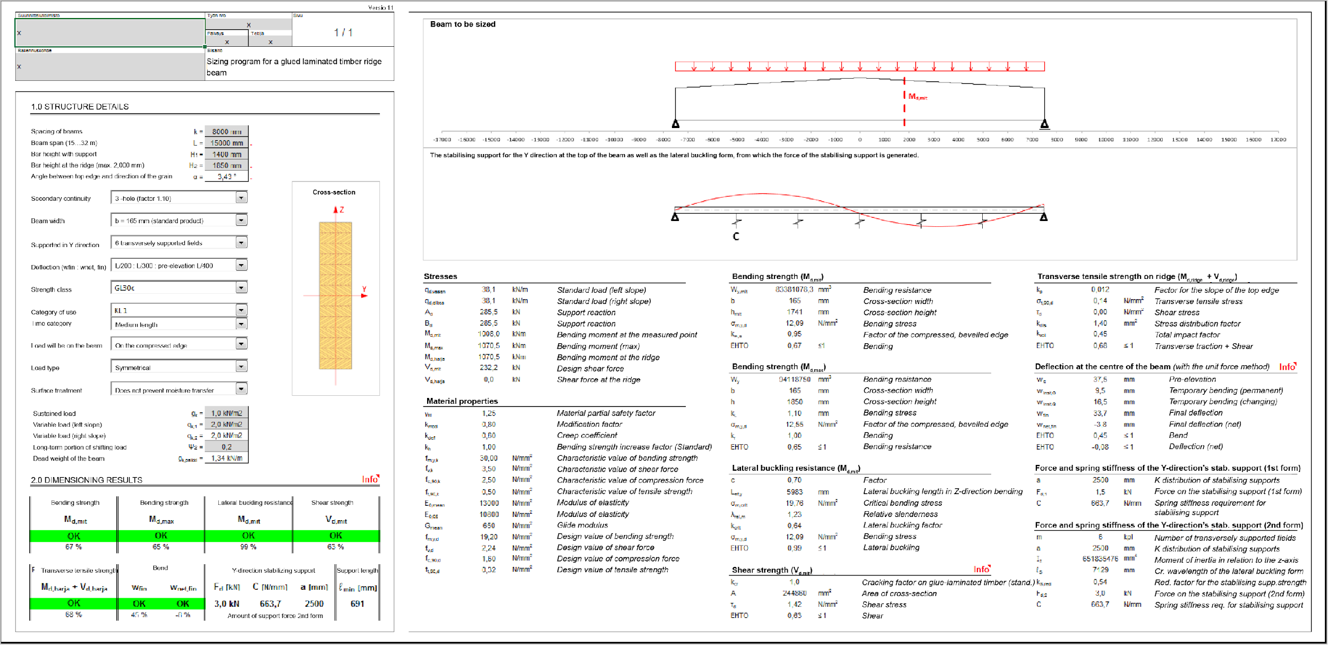
Main girder lateral buckling wavelength
Volume of glued-laminated timber beam 4.0 m³

Slide 18
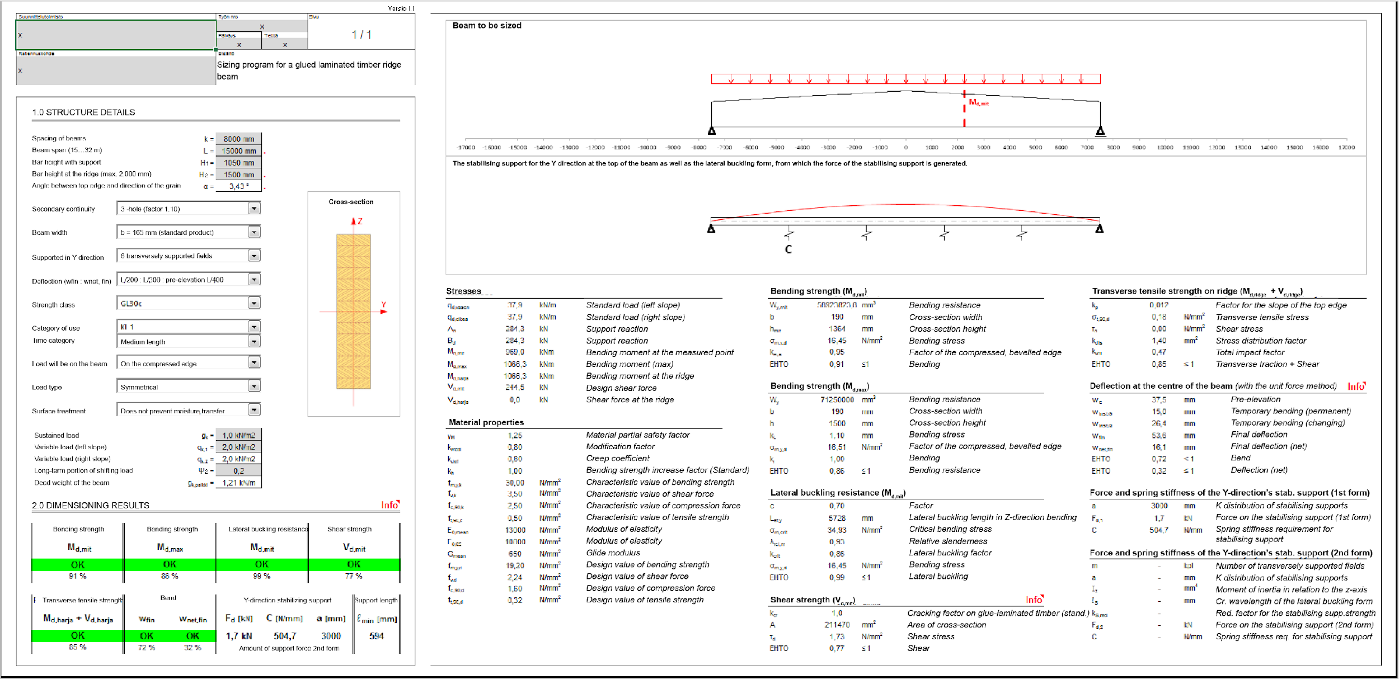
Main girder lateral buckling wavelength
Volume of glued-laminated timber beam 3.6 m³

Slide 19
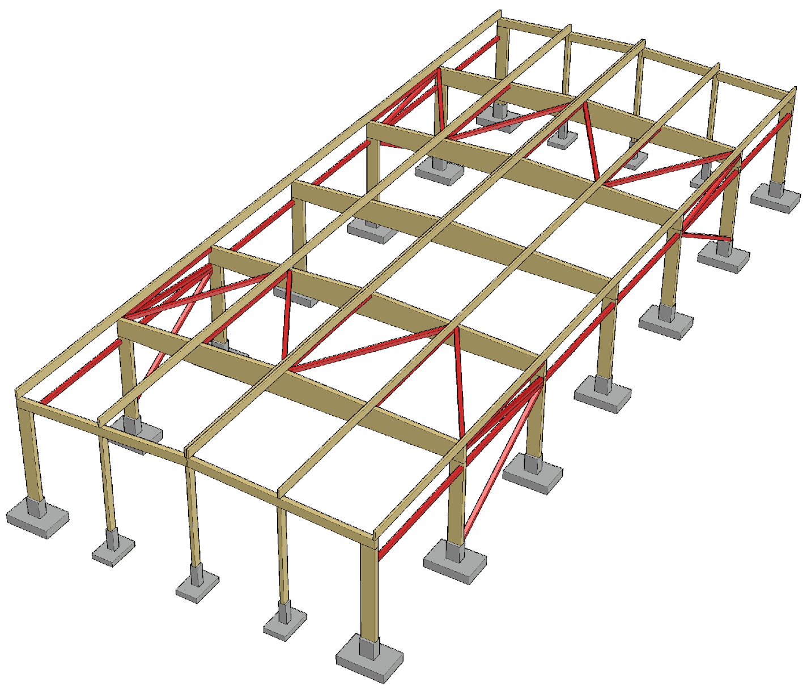
Stiffening the frame longitudinally
The use of stiffening truss in the attic floor and walls is a traditional method of stiffening a cantilever column hall in the longitudinal direction
Usually the attic floor’s secondary girders are used to transfer horizontal loads to stiffening trusses
  The secondary girder then becomes compressed and bent

Slide 20
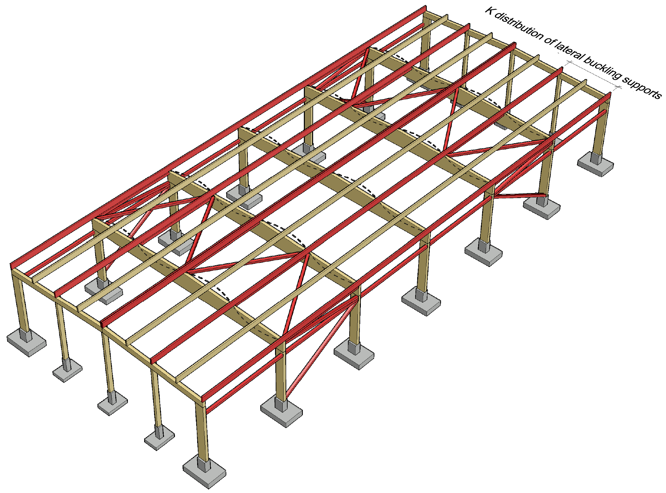
Stiffening the frame longitudinally
The diagonal cell points of the secondary girders and the stiffening truss for the attic floor must be aligned so that the girders can support against lateral buckling for the main girders
The girders between the nodes do not function as support against lateral buckling because they have no stiffener

Slide 21
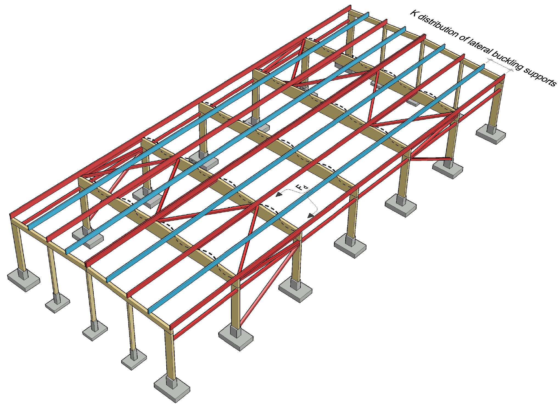
Stiffening the frame longitudinally
If the girders between the stiffening truss nodes in the attic floor are to be used as support, against lateral buckling, the force generated in the girder must be transferred with a separate stiffener to the girders at the nodal points (red girders)

Slide 22
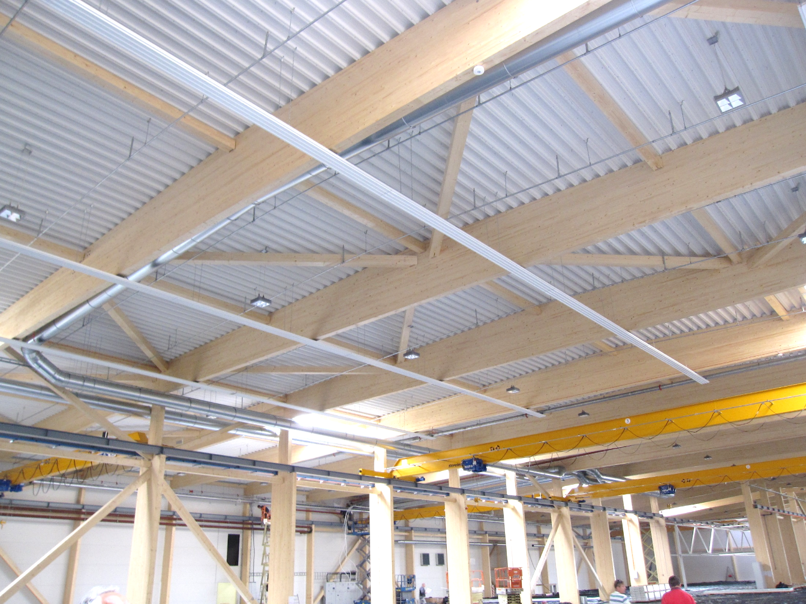
Stiffening the frame longitudinally
Supports preventing the lateral buckling of the main girders can also be made with separate wood rods between the main girders
The roof then does not play a role in supporting the stability of the main girders
Image: Tero Lahtela

Slide 23
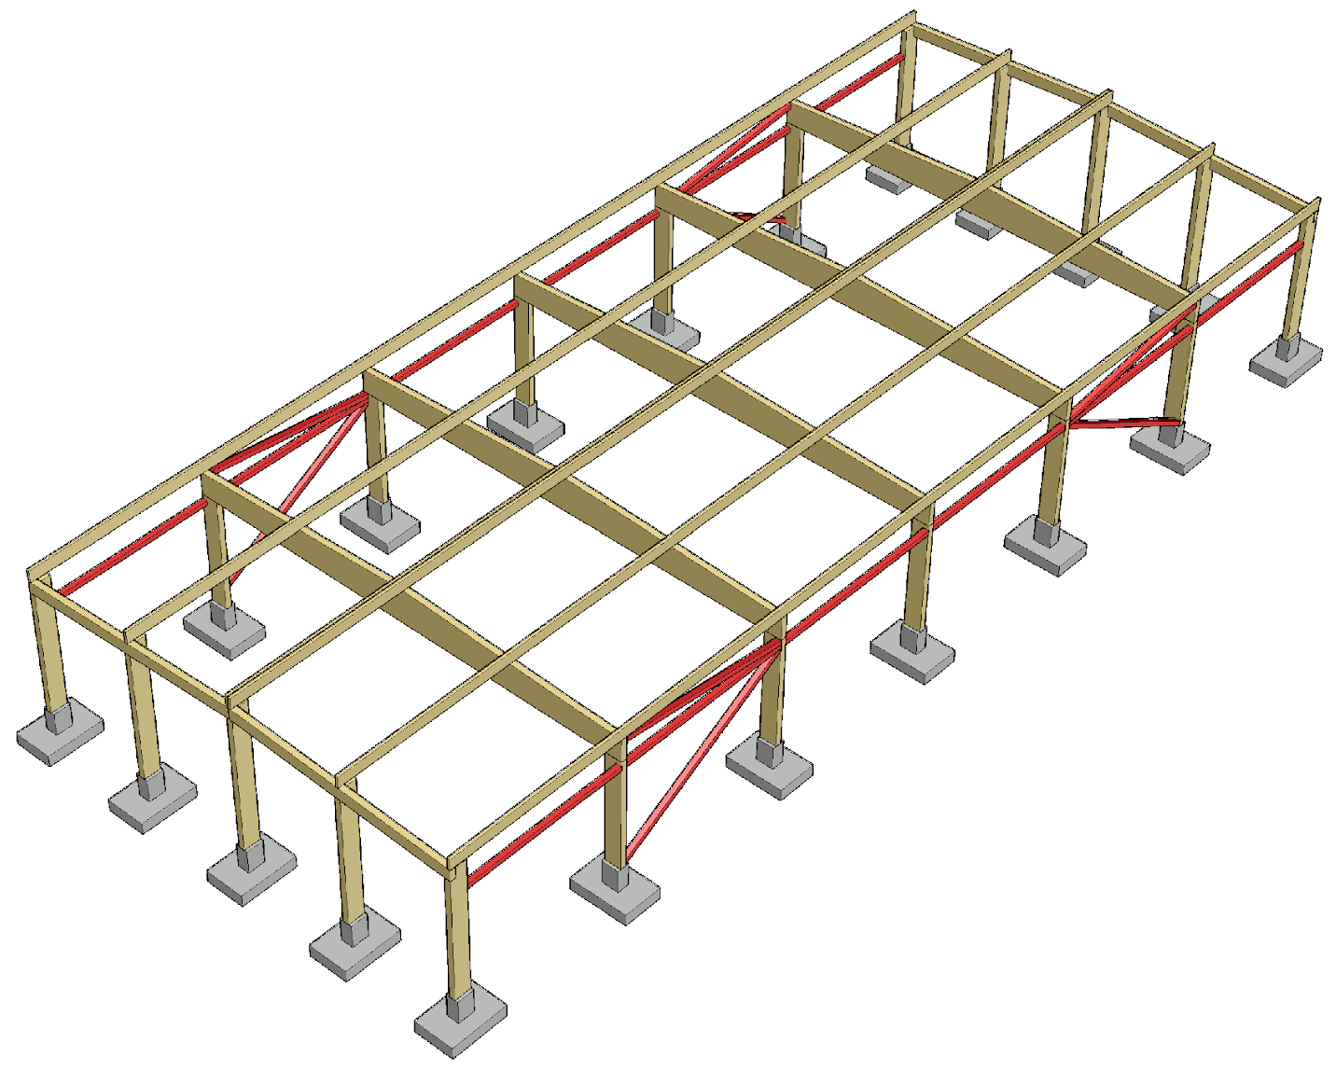
Stiffening the frame longitudinally
Stiffening of the attic floor can also be done with cantilever columns at the end wall
  Cantilever column stiffening is a simple function mechanically speaking
  Cantilever columns generally become study, because the displacement of the top of the column is limited (stiffness requirements for stability support)
  Bases generally become large because columns have little vertical loading

Slide 24
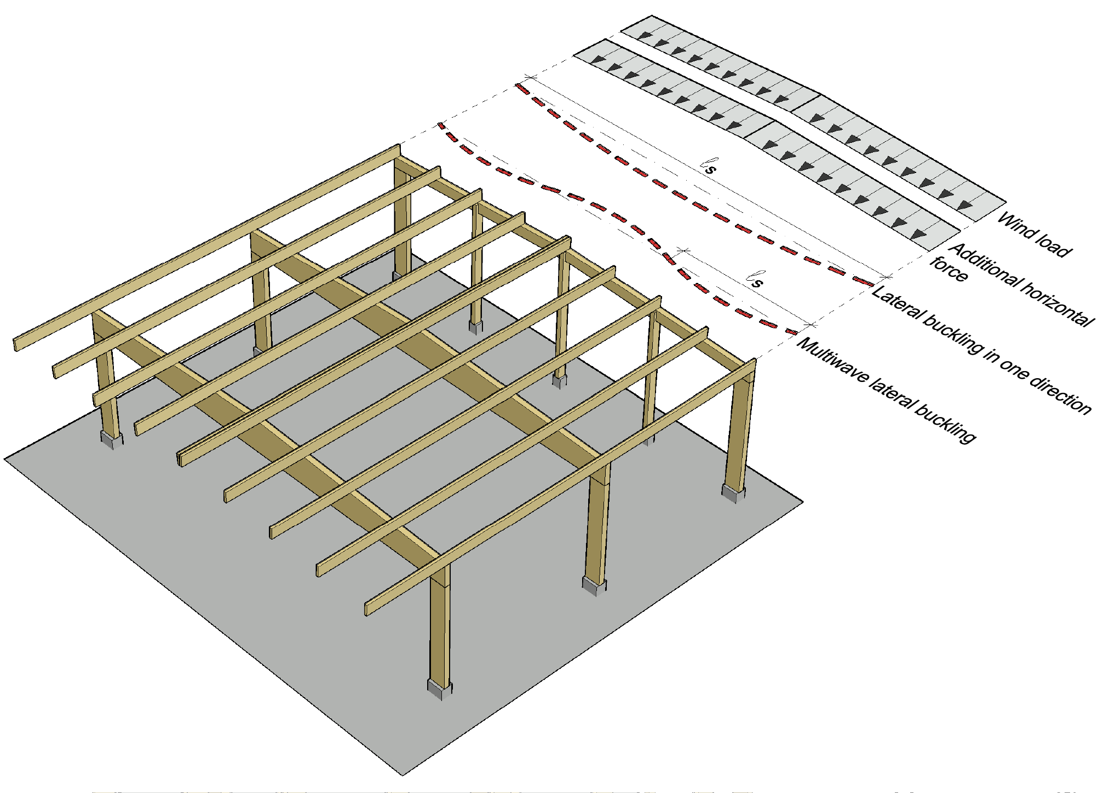
Stiffening the frame longitudinally
The following loads have an effect at the attic floor level
  Wind load
  Additional horizontal force
  Forces generated by lateral buckling
The width-to-height ratio of the beams should be such that multiwave lateral buckling does not occur
  Reduced forces on stiffeners and their joints
  (Not possible with long spans)

Slide 25
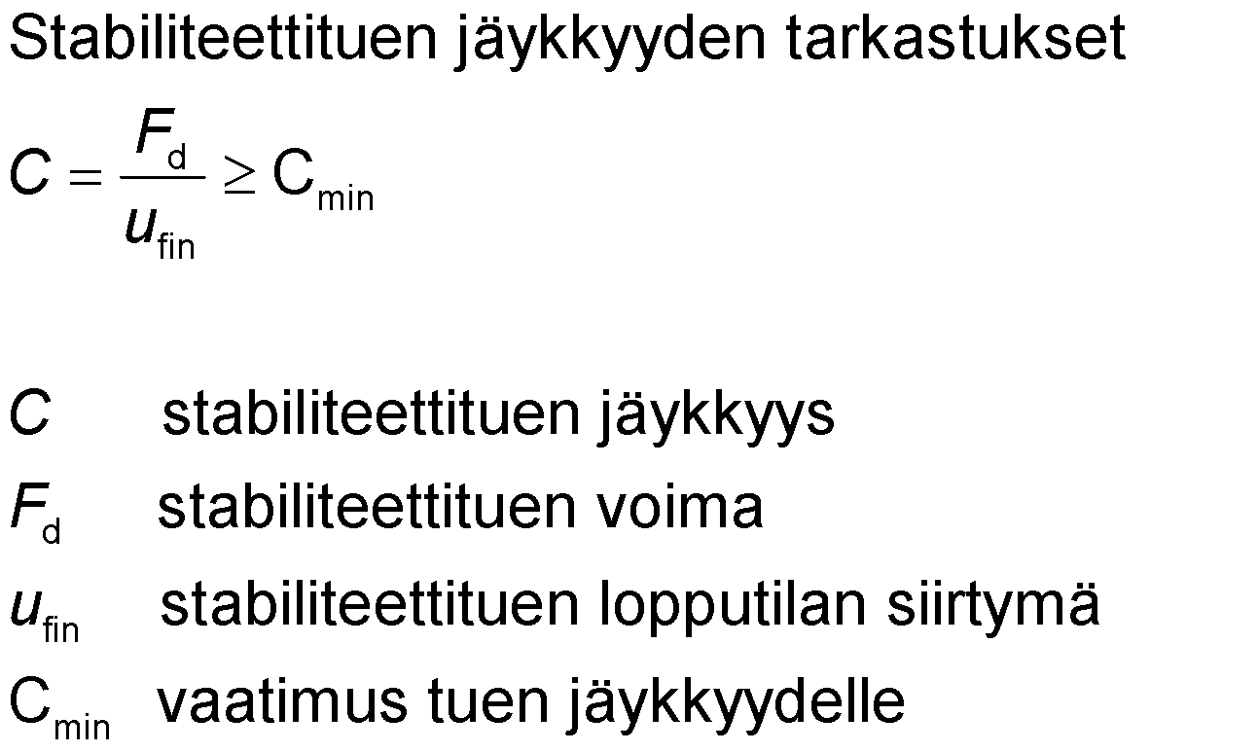
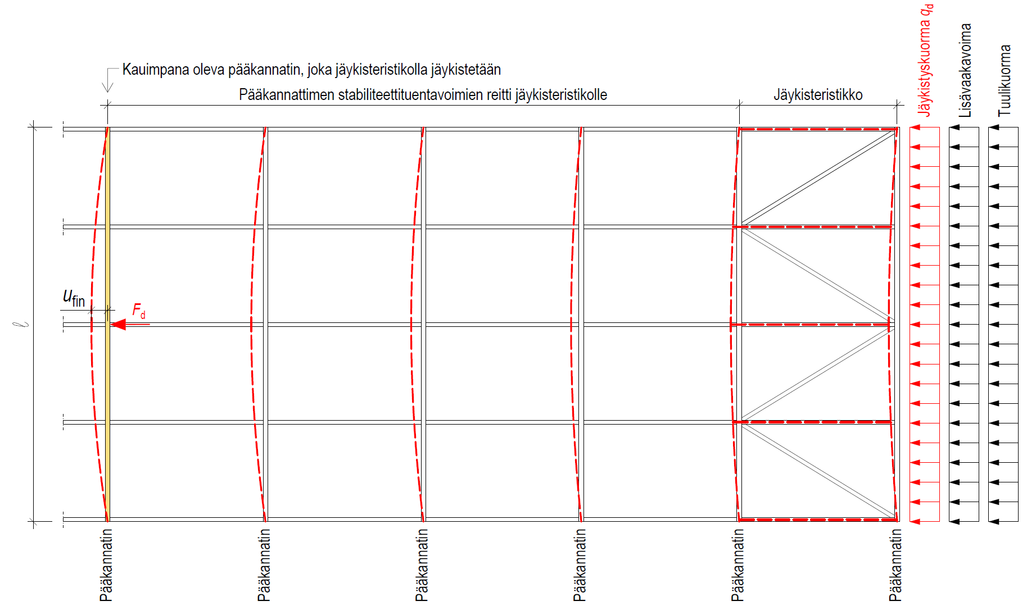
Spring stiffness requirement for support against lateral buckling
Review of the stiffness of stability support
Additional horizontal force
The outermost main girder. which is stiffened with the stiffening truss
Stiffness load q_{d}
Wind load
Stability support forces for main girders
Stiffening truss
Stiffness of stability support
Force of stability support
End-state displacement of stability support
requirement for rigidity of the support
u_{fin} is established from deformations that happened along the stability support force path (incl. joint displacements) and bending of the stiffening truss (load q_{d})
In addition the bending in the end-state of the stiffening truss’s ultimate limit state should be checked. This should be at most l/500 including additional lateral force and wind load.
Main support
Main support
Main support
Main support
Main support
Main support

Slide 26
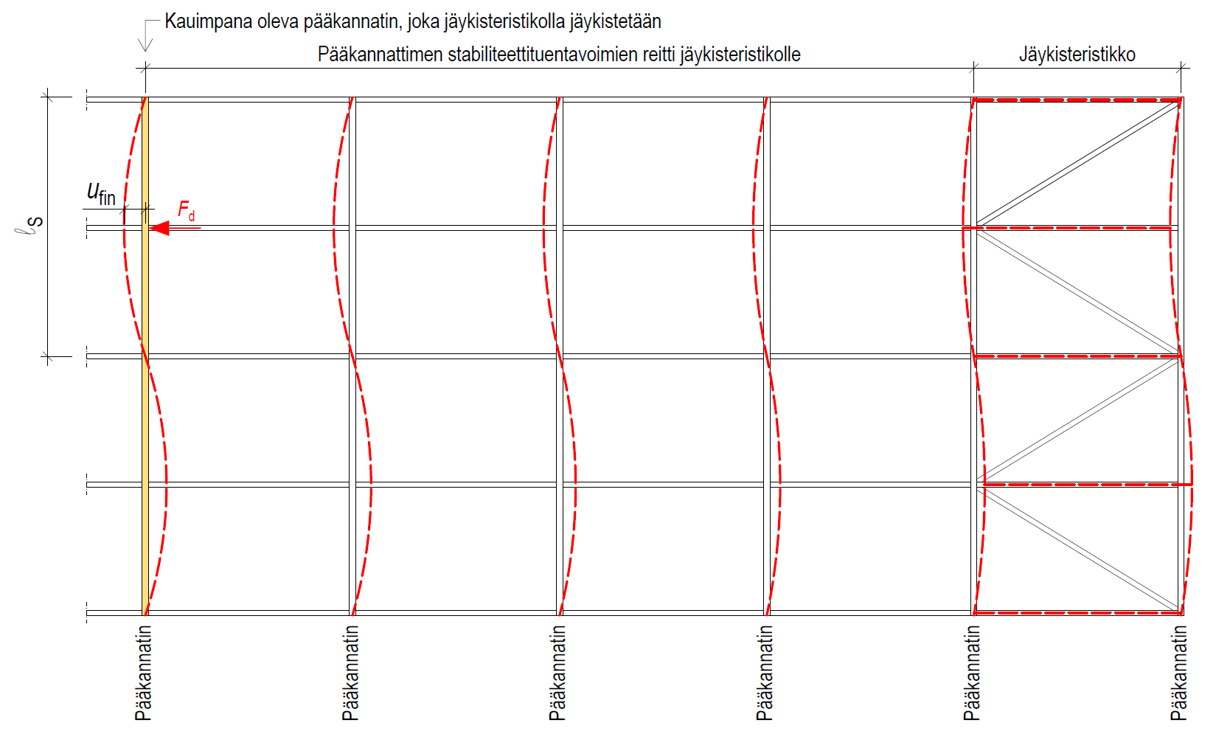
Spring stiffness requirement for support against lateral buckling
Review of the stiffness of stability support
The outermost main girder. which is stiffened with the stiffening truss
Stability support forces for main girders
Stiffening truss
Stiffness of stability support
Force of stability support
End-state displacement of stability support
requirement for rigidity of the support
u_{fin} is established from deformations that happened along the stability support force path (incl. joint displacements) and bending of the stiffening truss caused by the forces accumulated on the stiffener by forces F_{d}
Main support
Main support
Main support
Main support
Main support
Main support

Slide 27
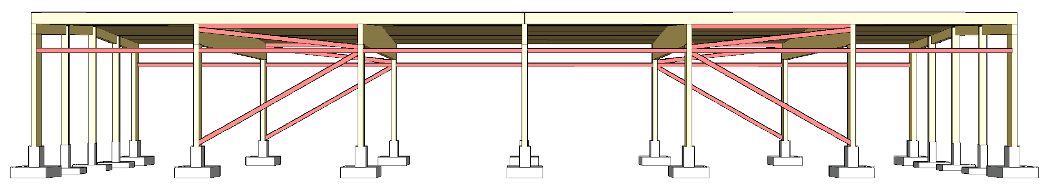
Panel stiffening of the attic floor
The longitudinal stiffeners of the attic floor may be replaced by a panel stiffeners formed by roof elements.
The recommended roof element type for panel stiffening is a box element made of LVL panel
  Stiff element-sized LVL panel
  Industrial adhesive joints

Slide 28
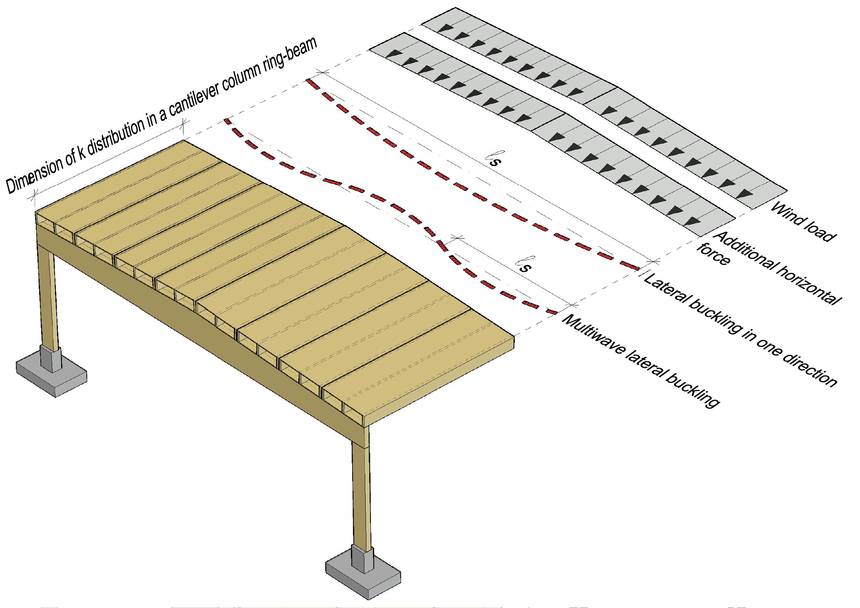
Attic floor’s individual panel stiffener
An individual panel stiffener formed from roof elements receives
  Wind load
  Additional horizontal force
  Forces generated by lateral buckling
Forces for supporting against lateral buckling are transferred to the panel stiffening to the ends of the main girder girder-specifically.
  Closed stiffening system

Slide 29
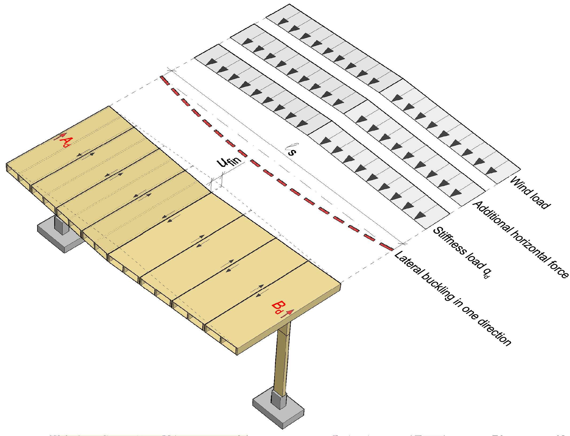
Panel stiffening of the attic floor
In one-way lateral buckling, the panel stiffness formed by roof elements is designed to function as a double-supported beam that transfers the lateral loads to the ends of the main girder (A_{d}, B_{d})
A panel stiffener system must meet stiffness requirements
  C ≥ C_{min}
  u_{fin} ≤ l/500

Slide 30
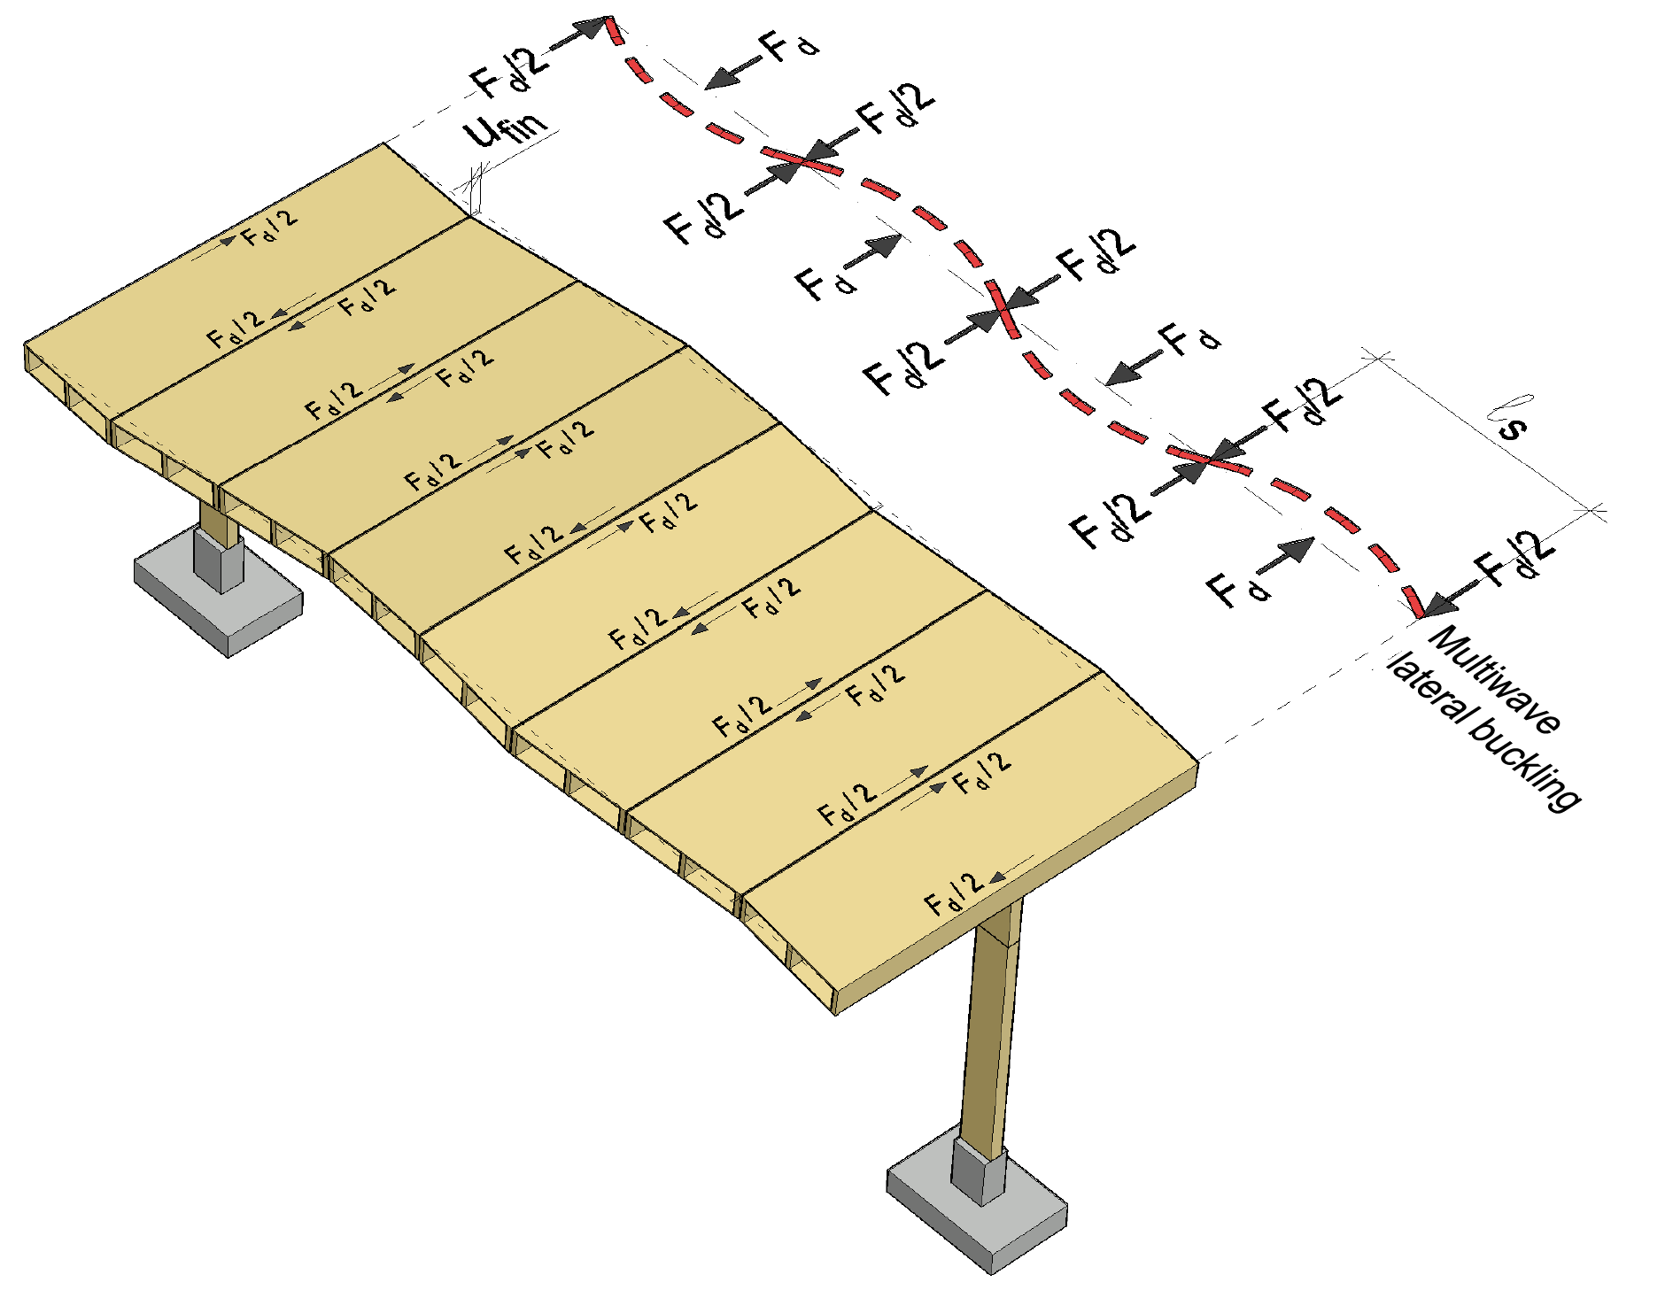
Panel stiffening of the attic floor
In multiwave lateral buckling, the panel stiffness formed by roof elements is designed to function so that the roof elements transfer forces F_{d} to the 0 point of the lateral buckling wave (l _{S} )
A panel stiffener system must meet the stiffness requirement
  C ≥ C_{min}

Slide 31
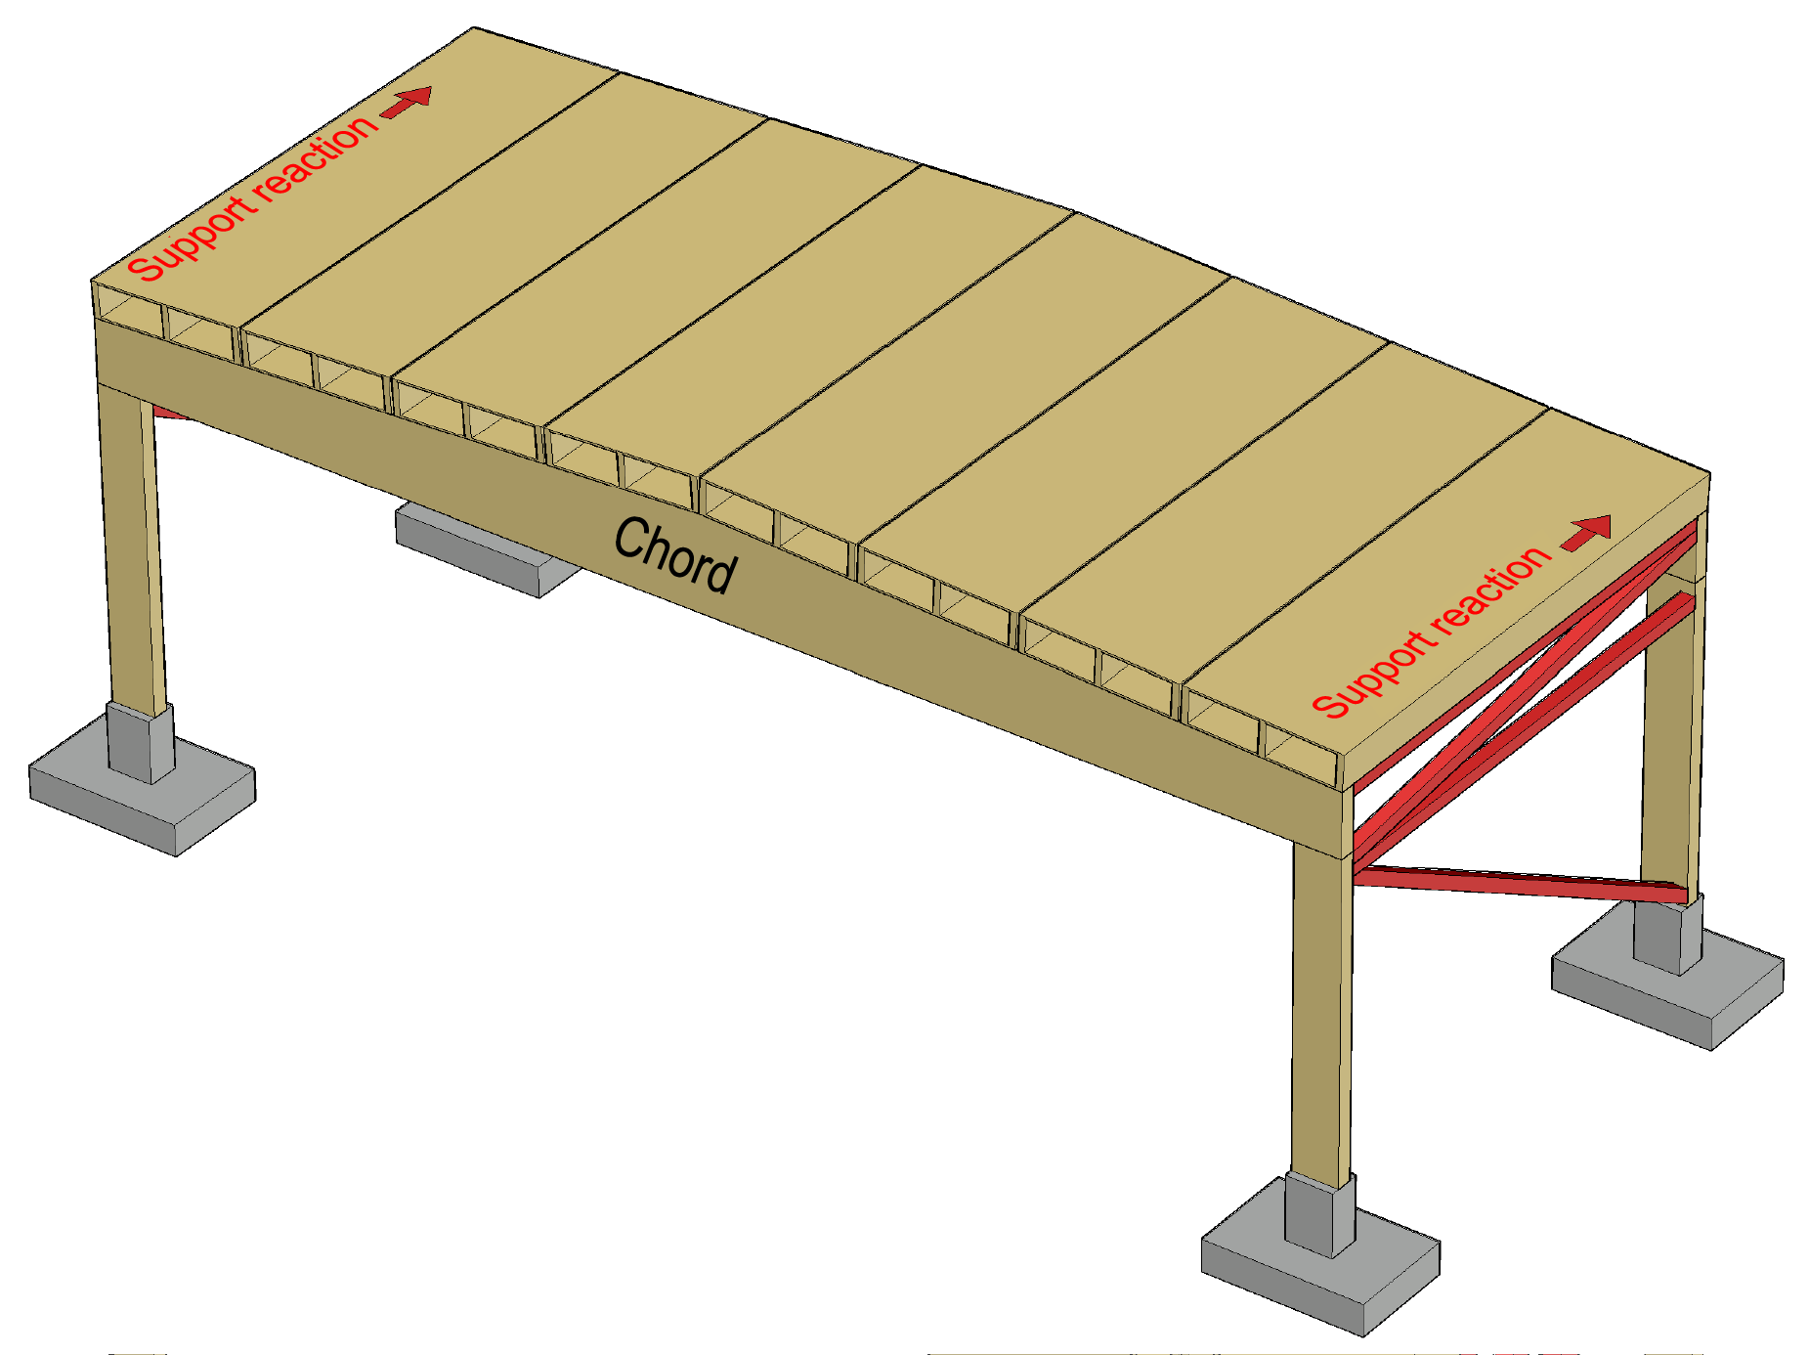
Panel stiffening of the attic floor
The support reactions created at the edge of the attic floor’s panel stiffening are transported to the wall stiffener
Wall stiffening is used to transfer external loads to foundations
Main girders act as traction and compression chords for each individual panel stiffener

Slide 32
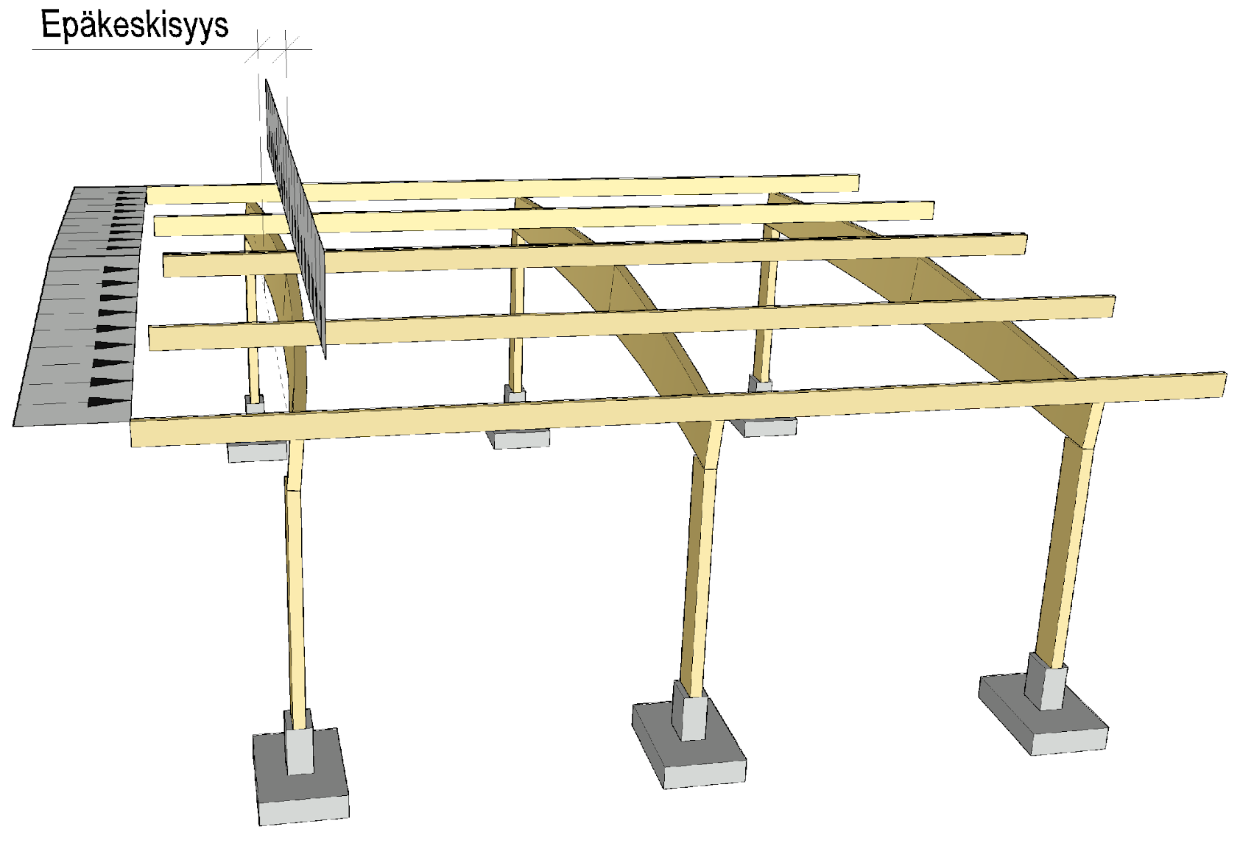
Joint between the cantilever column and the main girder
The supports for the main girder must be designed do that the girder does not fall (“fork bearing”)
The lateral load at the top edge of the main girder is caused by
  Wind load, additional lateral force and stiffening load q_{d}
Eccentricity of vertical load is caused by
  Lateral displacement
  Installation accuracy of the main girder (vertical straightness)
Eccentricity

Slide 33
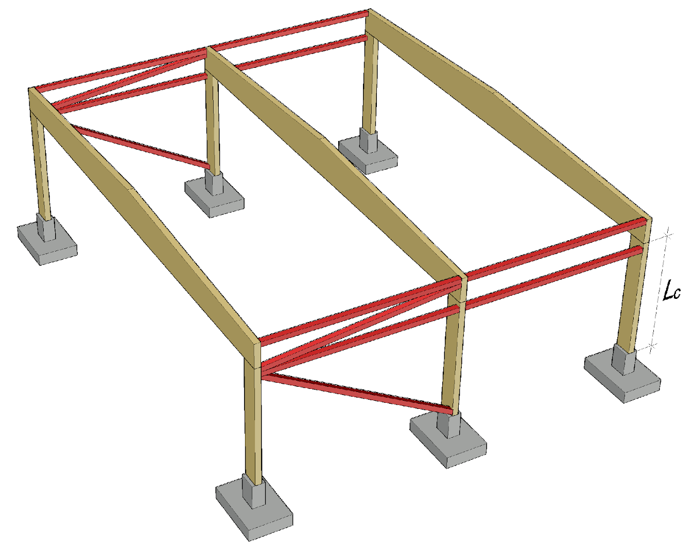
Joint between the cantilever column and the main girder
The joint between the cantilever column and main girder should be implemented with lateral support
Wall stiffening can be utilised for lateral support
The buckling length of the cantilever column in the cross-section’s weaker orientation can then be determined by the length of the column

Slide 34
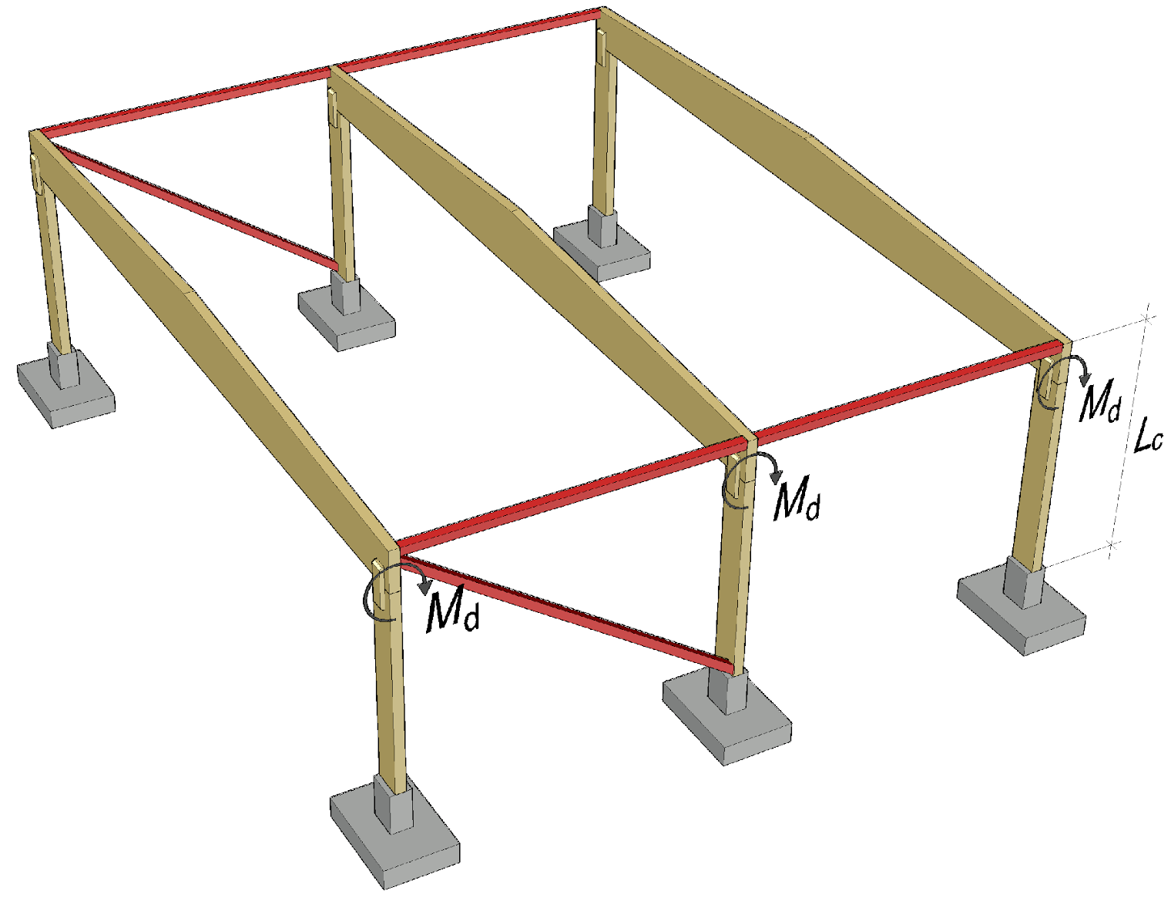
Joint between the cantilever column and the main girder
If the joint between the cantilever column and the main girder is not supported laterally, the joint must be torque-rigid
The buckling length of the cantilever column in the cross-section’s weaker orientation is then determined from the top of the main girder

Slide 35
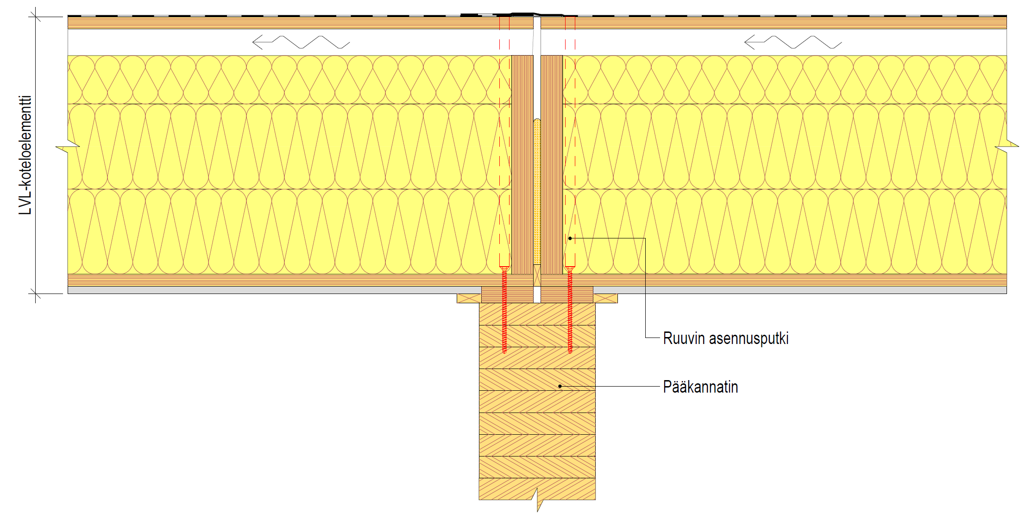
Joint between the roof element and the main girder
The joint between the roof element and the main girder must meet
  Strength requirements
  Stiffness requirements (spring stiffness requirement)
The adjacent image shows one example of the connection of the roof element to the main girder
  Mounting pipe with roof element screws
LVL box element
Screw installation pipe
Main support

Slide 36
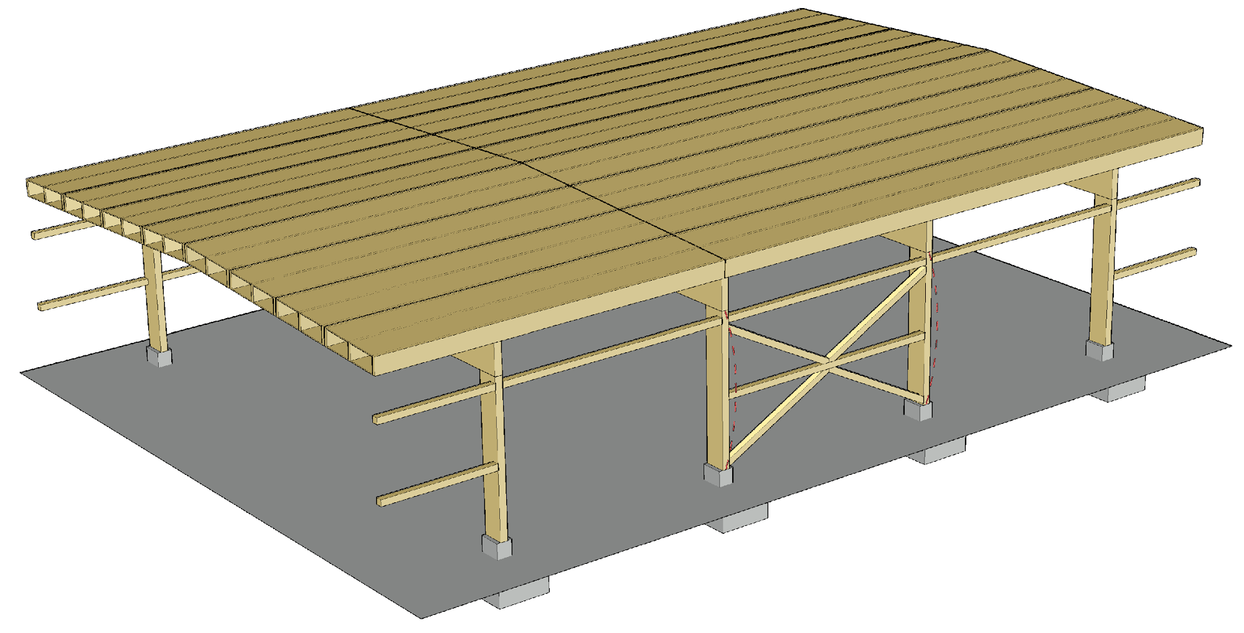
Support against buckling in the column’s weak orientation
The buckling support for the weak orientation of column cross-sections breaks at the openings in the walls
A separate stiffening system for to support against buckling in the column’s weak orientation must be arranged in the wall sections between the openings.

Slide 37
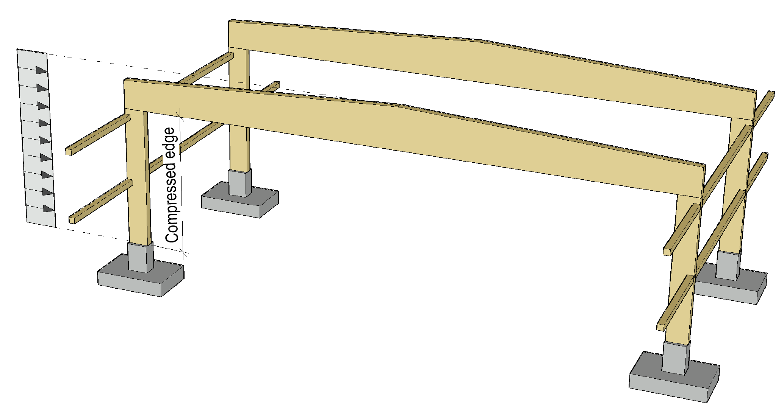
Compressed edge of a cantilever column
The wall girders for a cantilever column are on the traction side of the column’s cross-section, which means that they do not support the cantilever column’s compressed edge in the cross-section's weak orientation
The cross-section width of the cantilever column should be selected so that the column is not susceptible to lateral buckling (k_{crit} = 1)

Slide 38
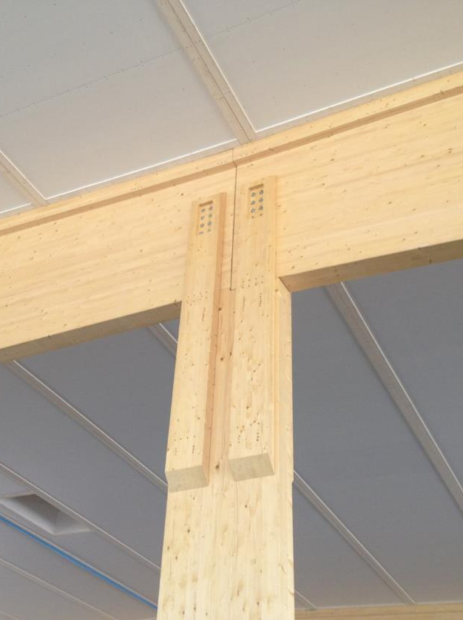
Joint at the top end of a cantilever column
The most common joint between a cantilever column and the main girder is the so-called fork board joint
When designing a fork board joint, the following must be taken into account
  Dimensional changes to main girder due to moisture
  Angle change due to bending of the main girder
  Joint resistance to lateral forces from the main girder (torque and shear strength)
Image: Metsä Wood

Slide 39
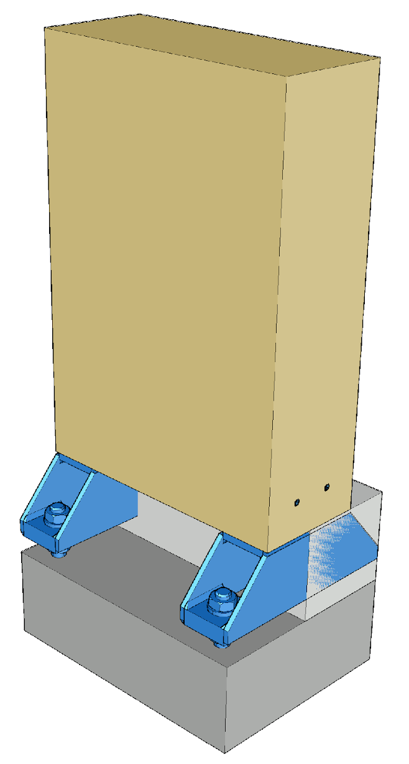
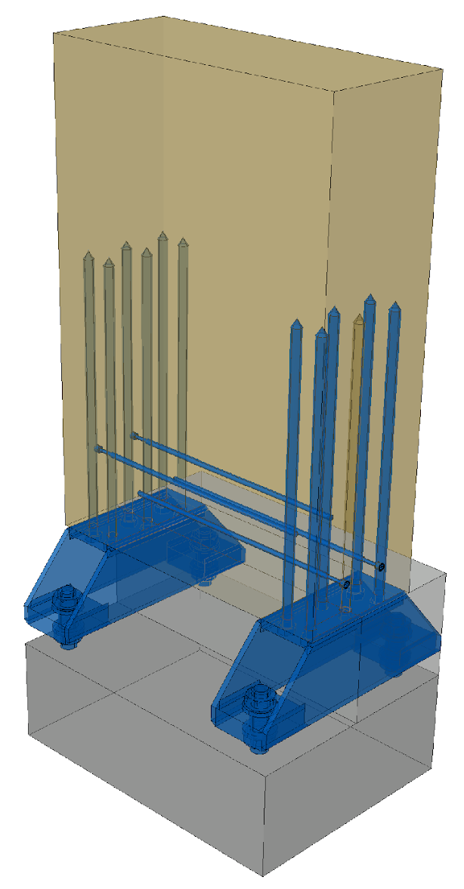
Joint between the cantilever column and the foundation
The most common joint between the cantilever column and the foundation is a column shoe fastened with adhesive screws
The dimensioning is carried out on the joint according to an existing opinion
If necessary, the joint is reinforced with lateral full-thread screws, etc., to prevent cracking.
In adhesive screw joints, the function of the joint must be ensured in the event of a fire

Slide 40
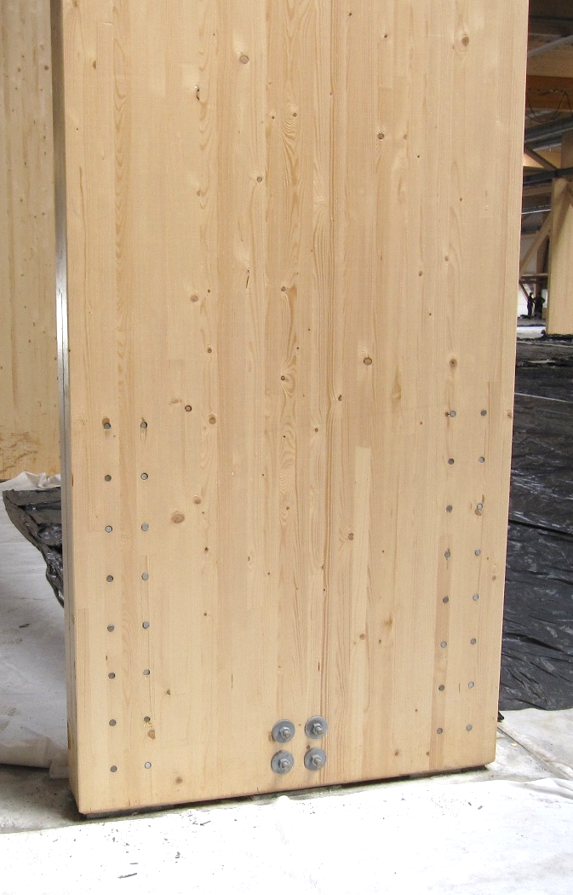
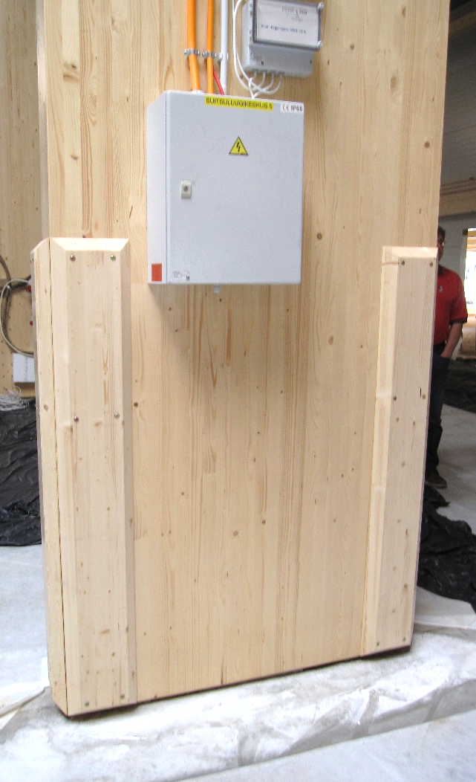
Joint between the cantilever column and the foundation
The joint between a cantilever column and the foundation can also be made with steel plates that are fastened to the wood column with dowel pins.
The fireproofing of a dowel pin connection can be implemented
  With a wooden batten installed on top of the joint
  By covering the groove in the steel plate with a bar and pin dowel holes with wooden pins
Image: Tero Lahtela
Image: Tero Lahtela

