Slide 1



Industrial wood construction
Teaching materials for industrial wood construction education
2022

Slide 2
Origin of the materials
Use of the materials
These learning materials for industrial wood construction have been prepared in a project led by Puuinfo Oy in 2021–2022. Also involved in the project were
Lappia Vocational College,
TTS-Työtehoseura ry
South-Eastern Finland University of Applied Sciences,
Metropolia University of Applied Sciences,
Jyväskylä University of Applied Sciences,
University of Tampere, and
Federation of the Finnish Woodworking Industries Puutuoteteollisuus ry
The project was funded by the Ministry of the Environment.
The materials are intended to be used as extensively as possible in industrial wood construction education and studies.
The materials are released under the Creative Commons licence Attribution-ShareAlike (CC BY-SA), which requires that the author be properly credited when the materials are used and that derivative works may only be distributed under the same licence as the original work.
The original materials and any updates to them by Puuinfo will be published on the Library of Open Educational Resources website (aoe.fi) and the Puuinfo.fi website.

Slide 3

Structural design

Slide 4
Authors
Tero Lahtela,
Insinööritoimisto Tero Lahtela Oy
Release date: 02/12/2021

Slide 5
Stiffening of a wooden apartment block

Slide 6
Stiffening methods for a wooden apartment block
The most common method of stiffening a wooden apartment block is
  Panel-stiffened walls + Panel-stiffened intermediate floors
The pillar and beam frame can be stiffened using
  Cantilever pillars (max 4-floor building)
  Diagonal stiffeners
  Stiffener panels
Concrete staircase towers can also be used to stiffen a wooden apartment block

Slide 7
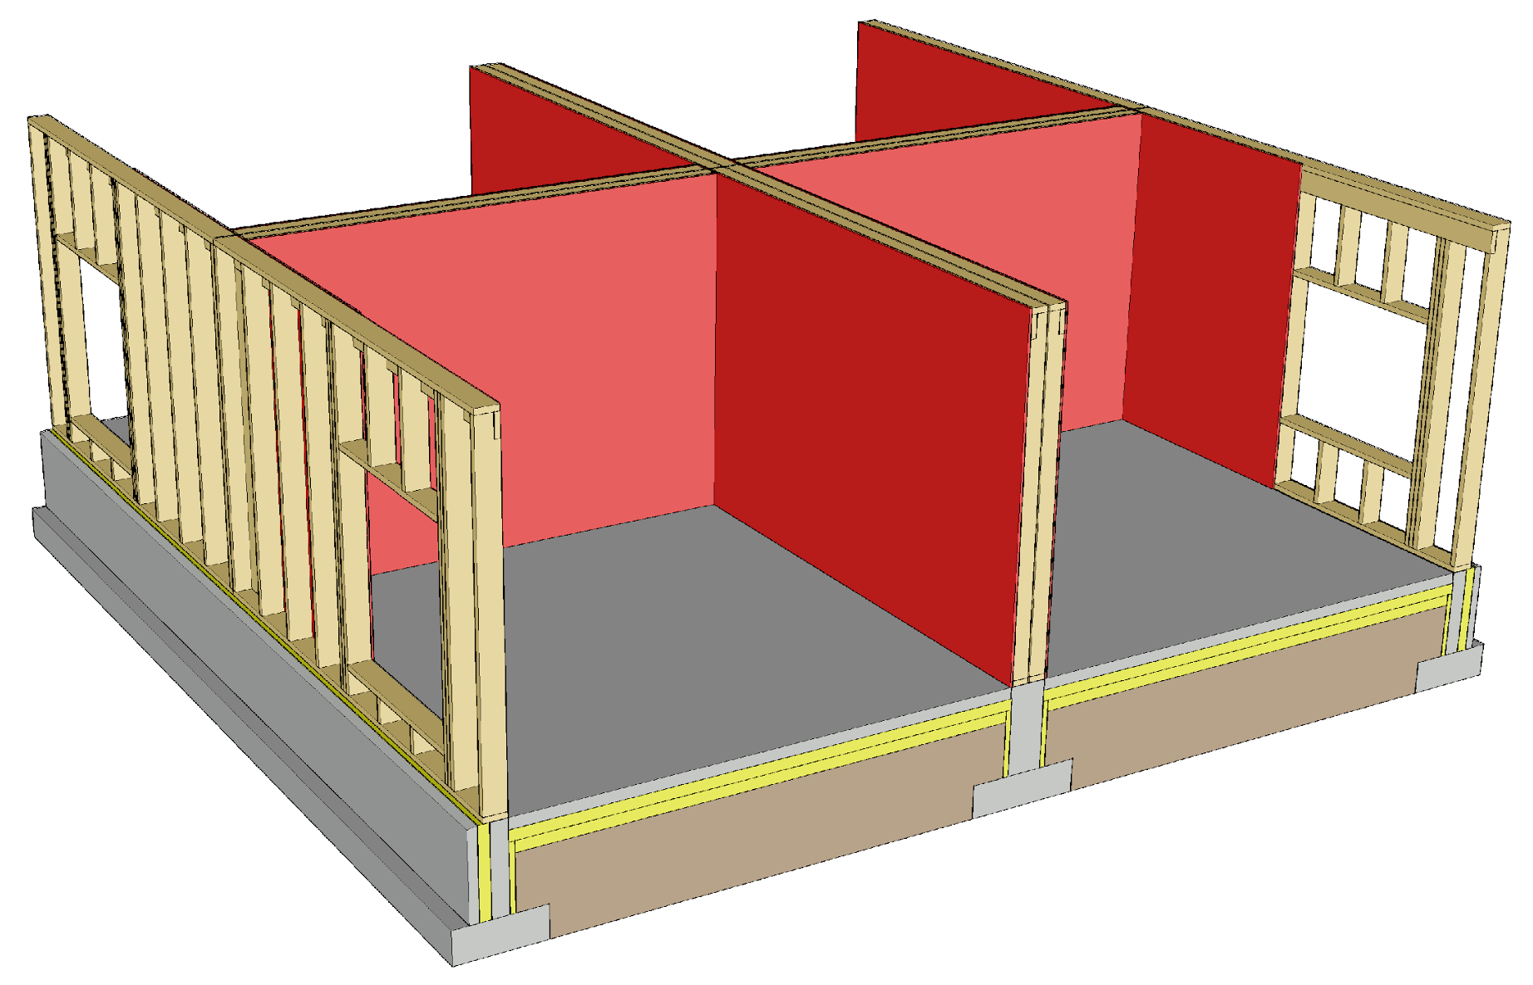
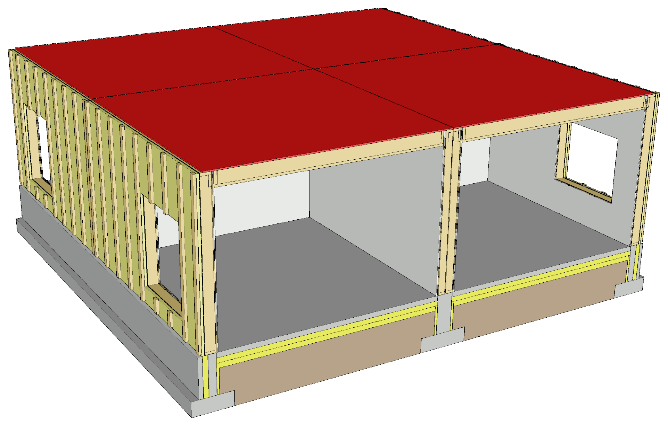
Plate-stiffened wooden apartment block

Slide 8
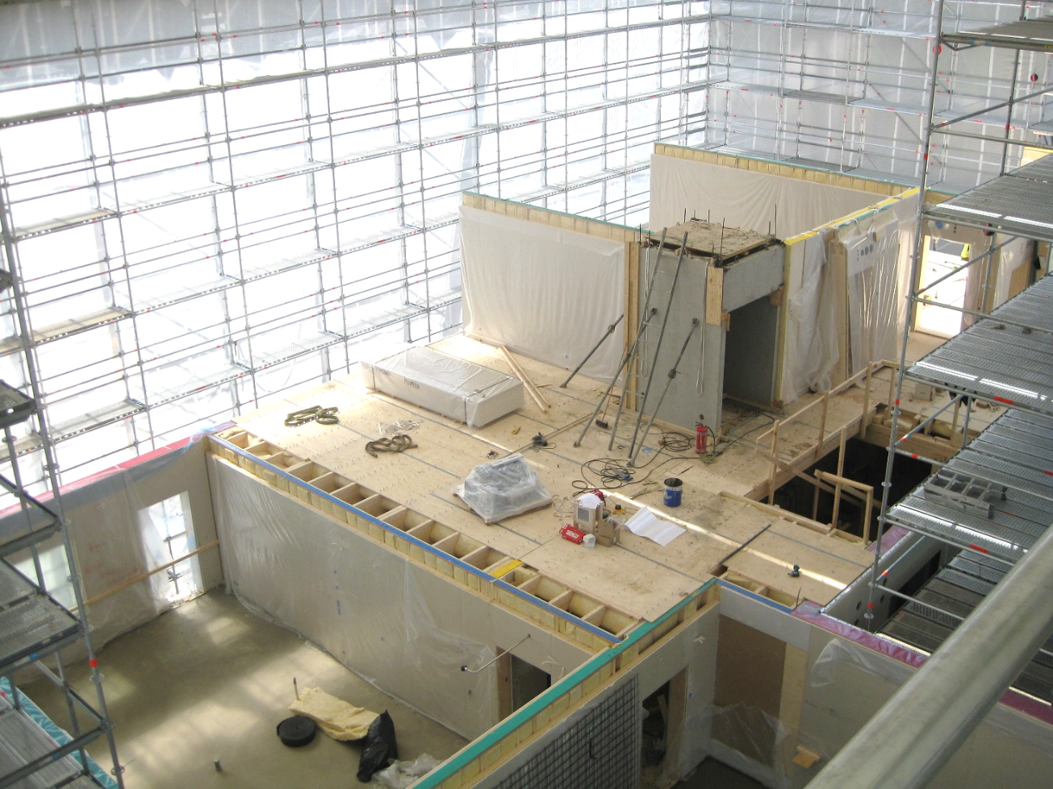
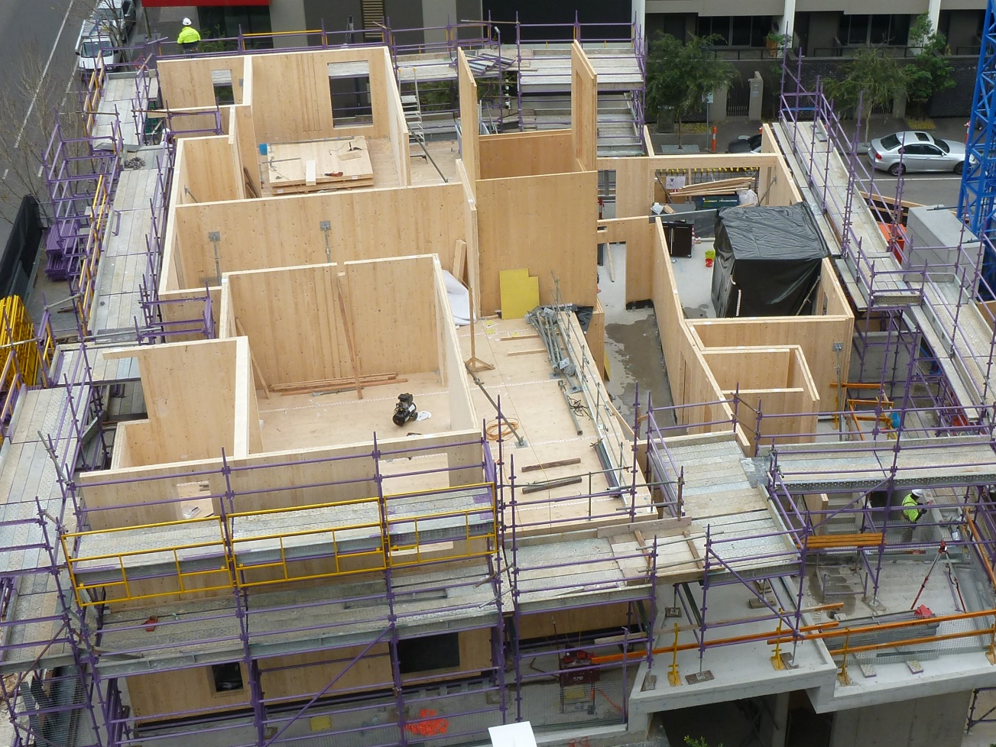
Plate-stiffened wooden apartment block
Image: Puuinfo
Image: www.aiff.net.au

Slide 9
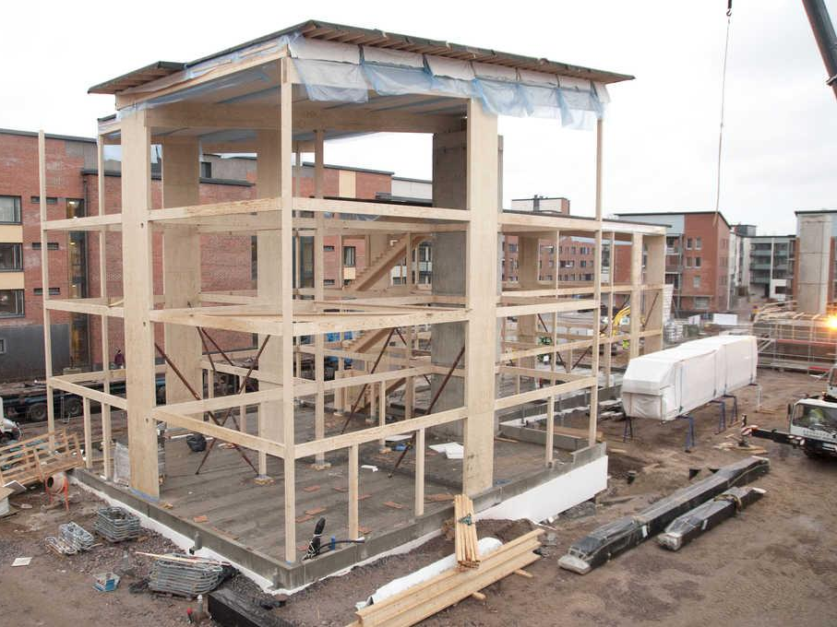
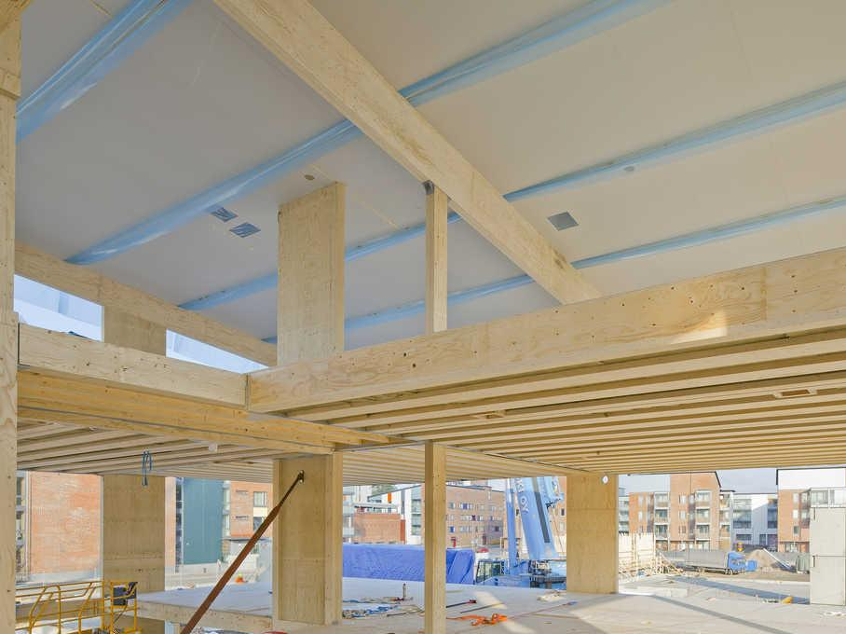
Cantilever-pillar-stiffened wooden apartment block
Image: Metsä Wood
Image: Metsä Wood

Slide 10
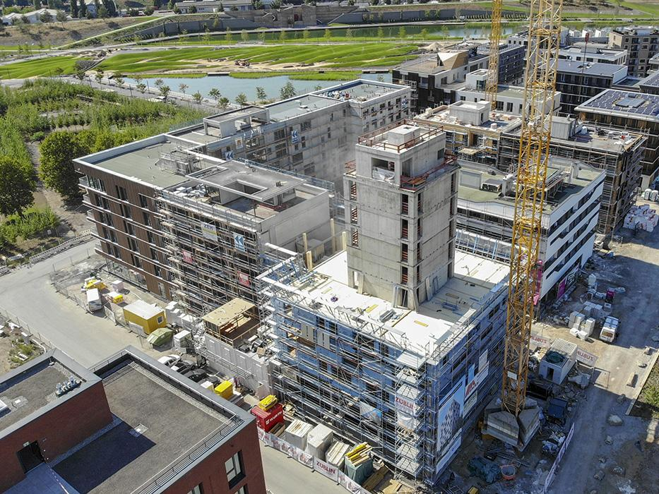
A wooden apartment block stiffened using concrete structures
The picture shows a CLT-structured wooden apartment block stiffened using a concrete-structured staircase tower.
The use of staircase towers in stiffening requires that the apartments are designed around it
It must be possible to attach the intermediate floor tiles to the staircase tower
Image: bauart-construction.de

Slide 11
Impact of stiffening on architectural design
The stiffening walls should be placed as evenly as possible throughout the building
The stiffening walls must have a sufficiently long panelled portion
Stiffening walls cannot have large openings consecutively
The stiffening walls must be located at the same location on different floors
The length of the stiffening walls must be approximately the same so that there are no major differences in horizontal displacements

Slide 12
Impact of stiffening on architectural design
The bearing directions of the intermediate floors should be chosen so that the intermediate floors transfer as much weight as possible to the stiffening walls (reducing anchoring force)
Large extensions cannot be made in a wooden apartment block using intermediate floors
Structure types, junction details and power connection types must be planned to draft level together with the structural designer already in the early stages of the project
A wooden apartment block cannot be made as slim in depth as a concrete apartment block

Slide 13
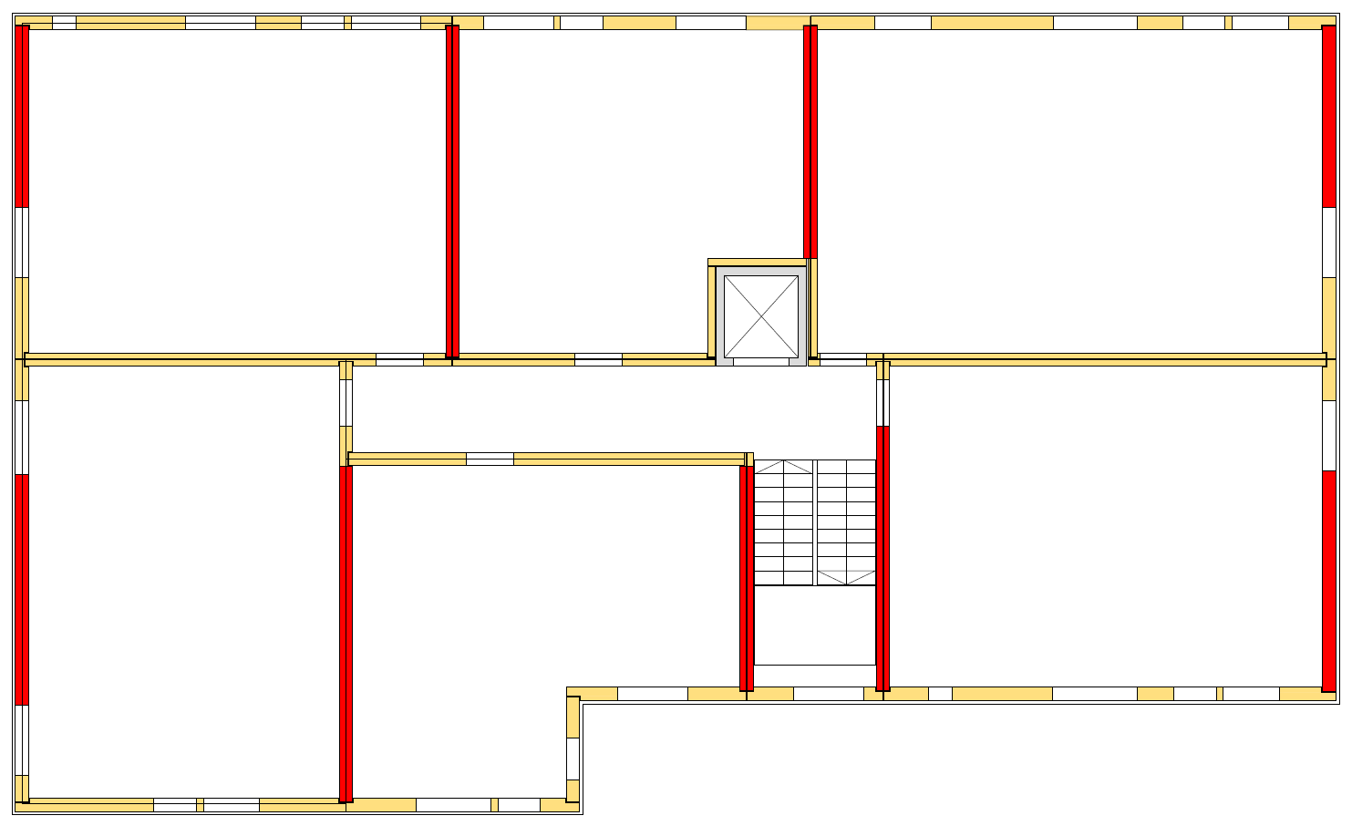
Example of stiffening wall placement

Slide 14
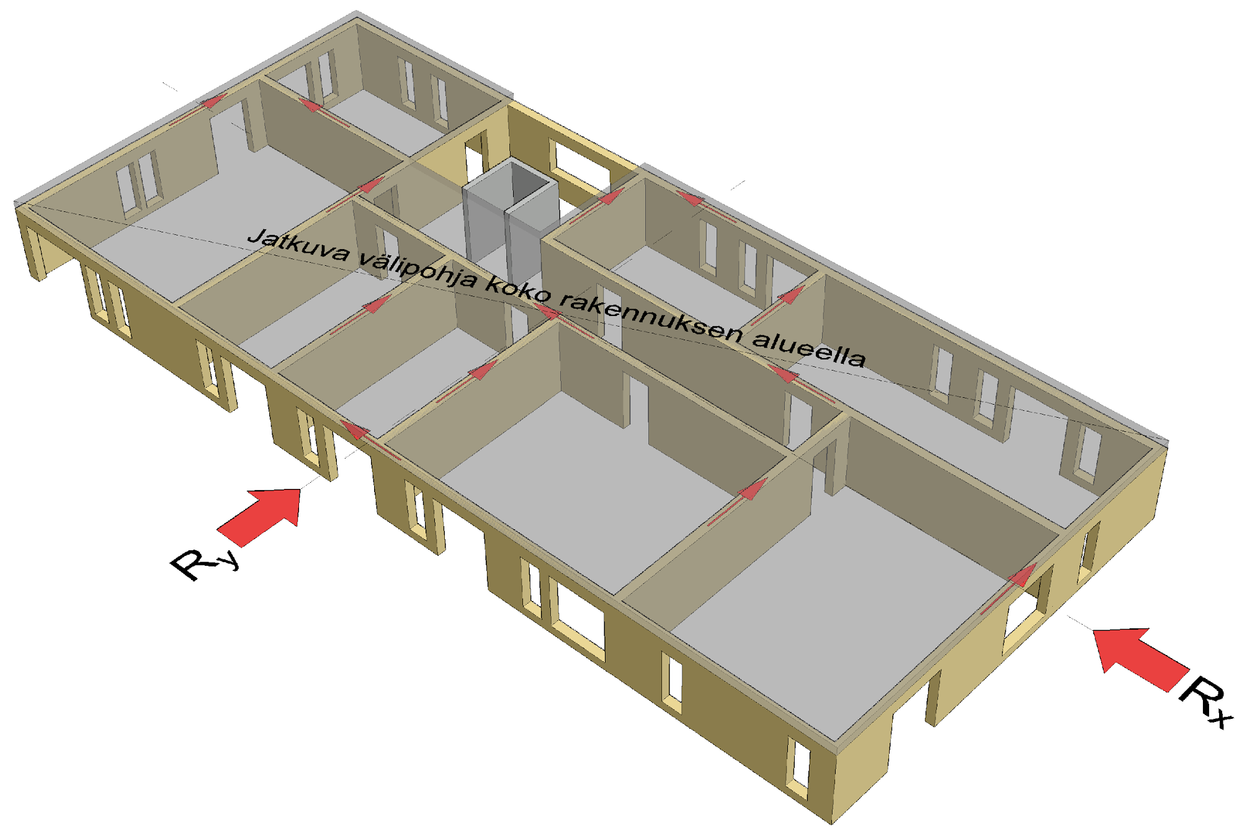
General functioning of the intermediate floor
Stiffening technology in the intermediate floor plays a key role in the stiffening of an apartment block
In a concrete building, the intermediate floor is usually treated as a uniform stiffening panel that distributes the horizontal load onto the stiffening walls
  Stiffening walls receive horizontal load relative to wall stiffness
Continuous intermediate floor throughout the building

Slide 15
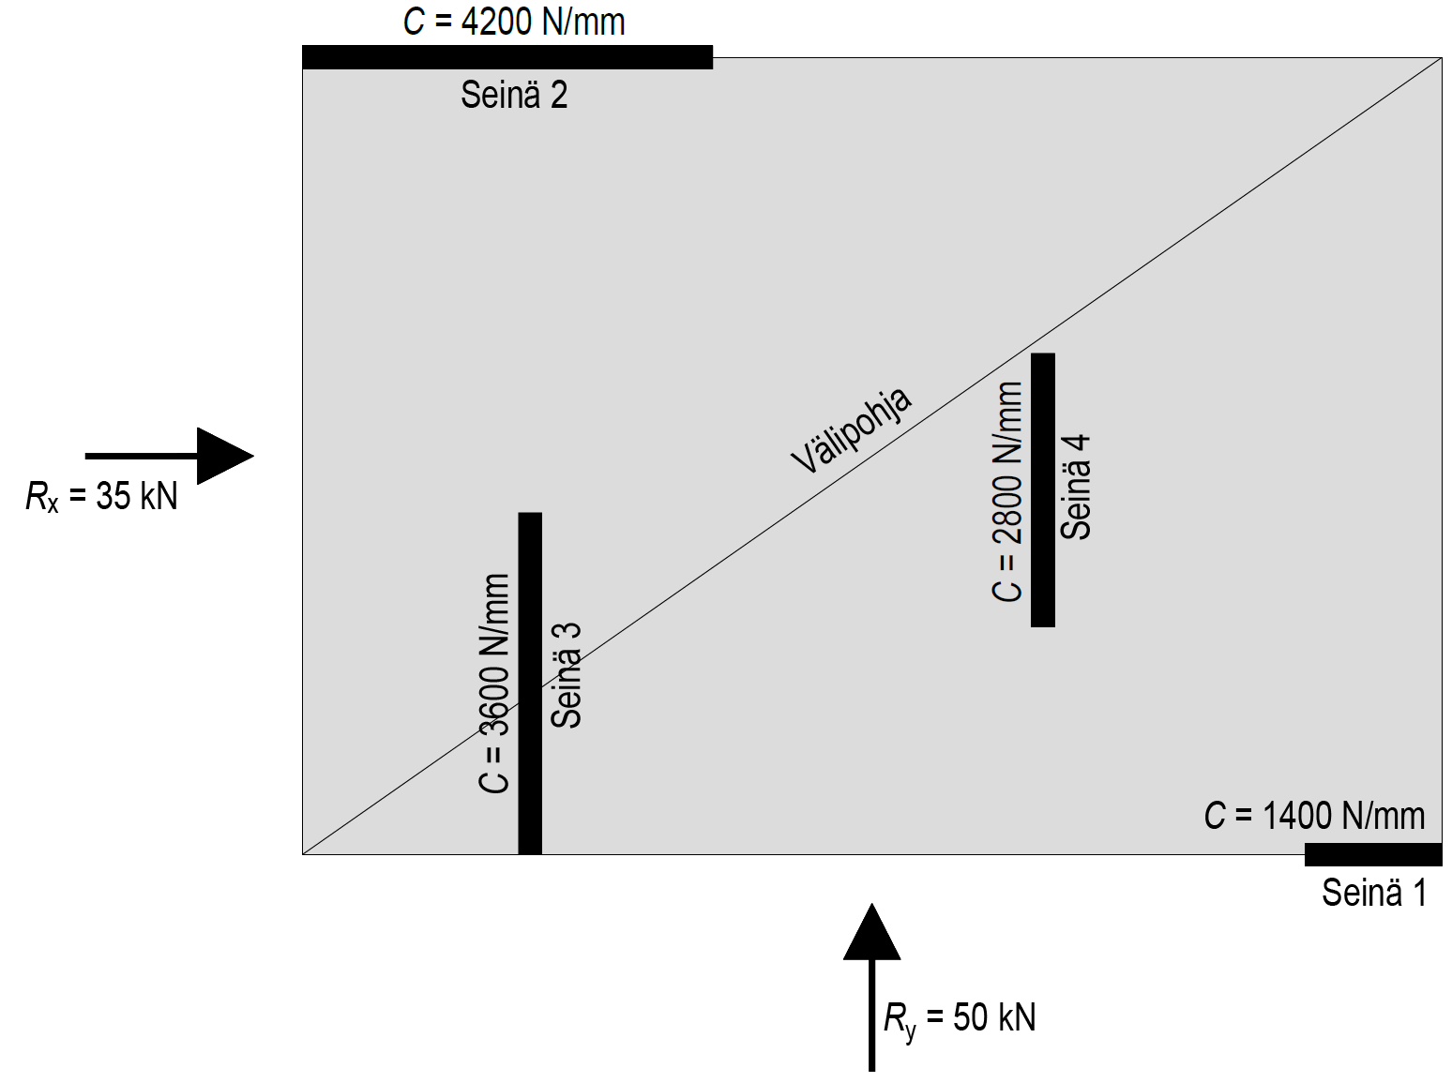
Functioning of a rigid intermediate floor
A rigid intermediate sole is dimensioned to function as a uniform piece that distributes the horizontal loading resultant walls into stiffening walls
The load on stiffening walls can be determined from the rigidity of the walls and the torque centre of the intermediate floor
Wall 2
Intermediate floor
Wall 4
Wall 3
Wall 1

Slide 16
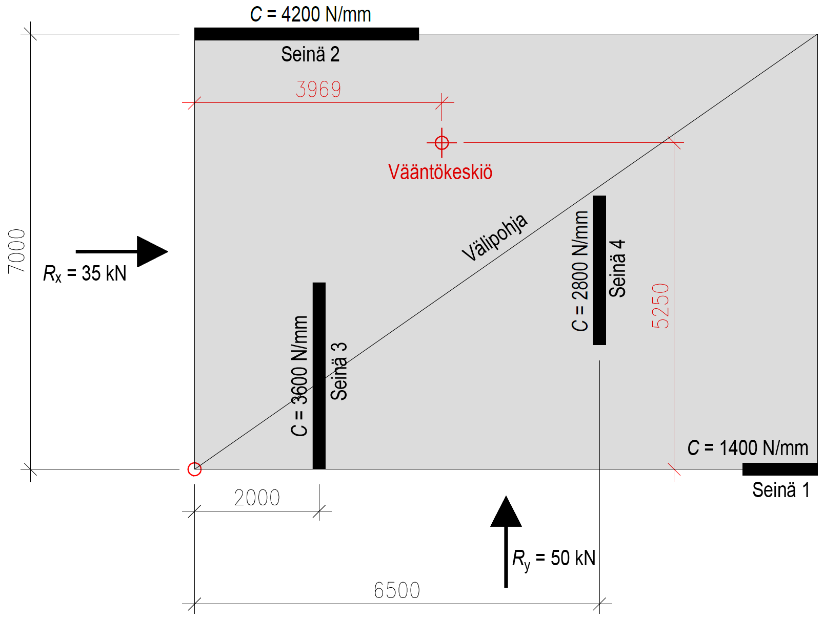
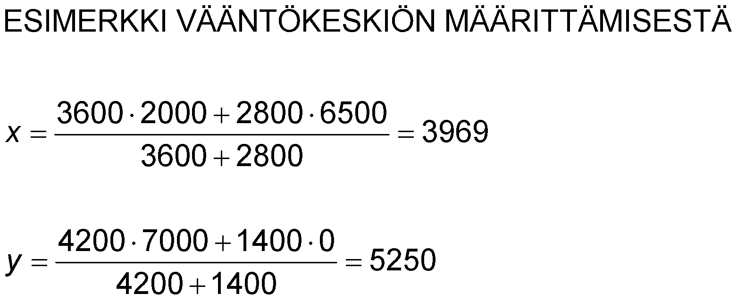
Functioning of a rigid intermediate floor
Both x-directional and y-directional walls are taken into account when determining the torque centre
Wall 2
Torque centre
Intermediate floor
EXAMPLE OF DETERMINING THE TORQUE CENTRE
Wall 4
Wall 3
Wall 1

Slide 17
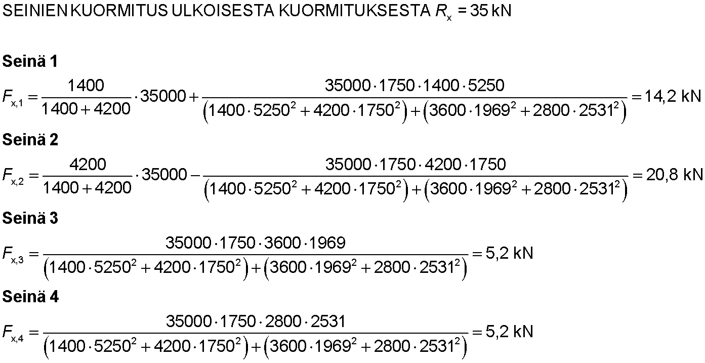
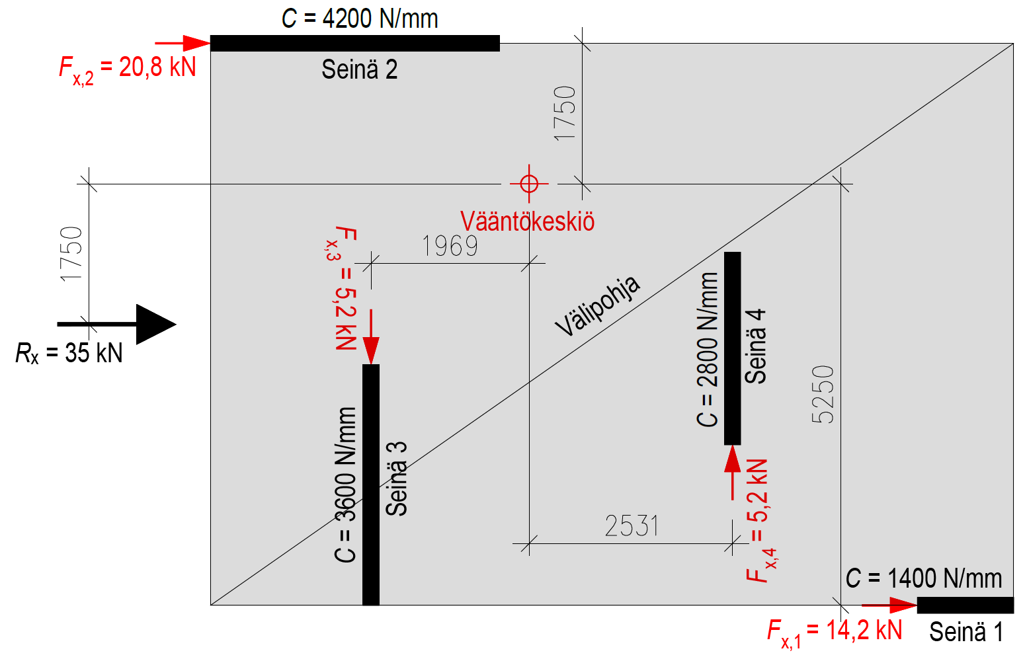
Functioning of a rigid intermediate floor
WALL LOAD FROM EXTERNAL LOAD R_{x} = 35 kN
Wall 1
Wall 2
Wall 2
Torque centre
Intermediate floor
Wall 4
Wall 3
Wall 3
Wall 4
Wall 1

Slide 18
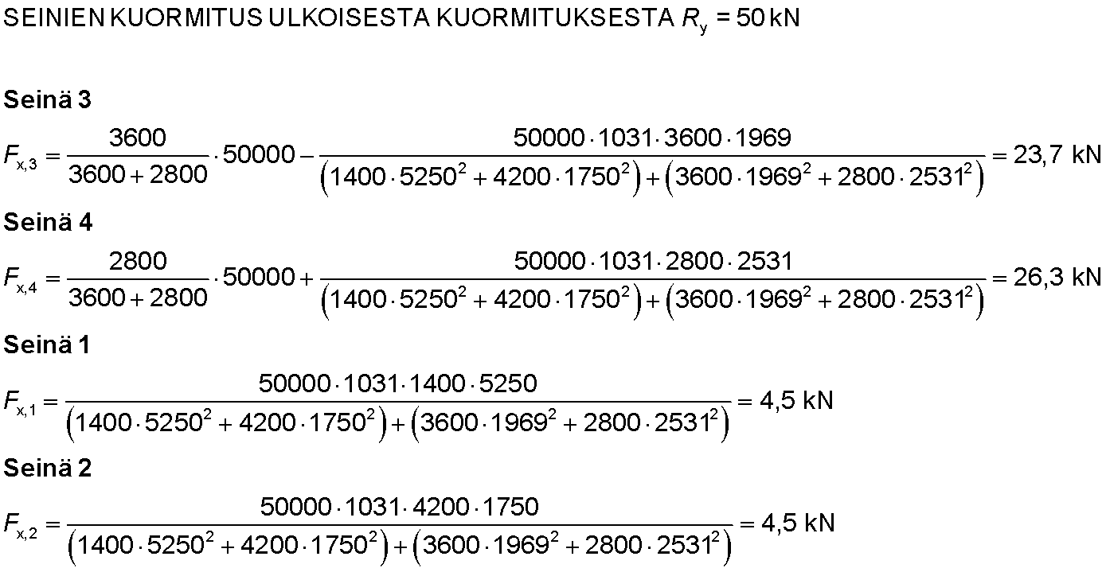
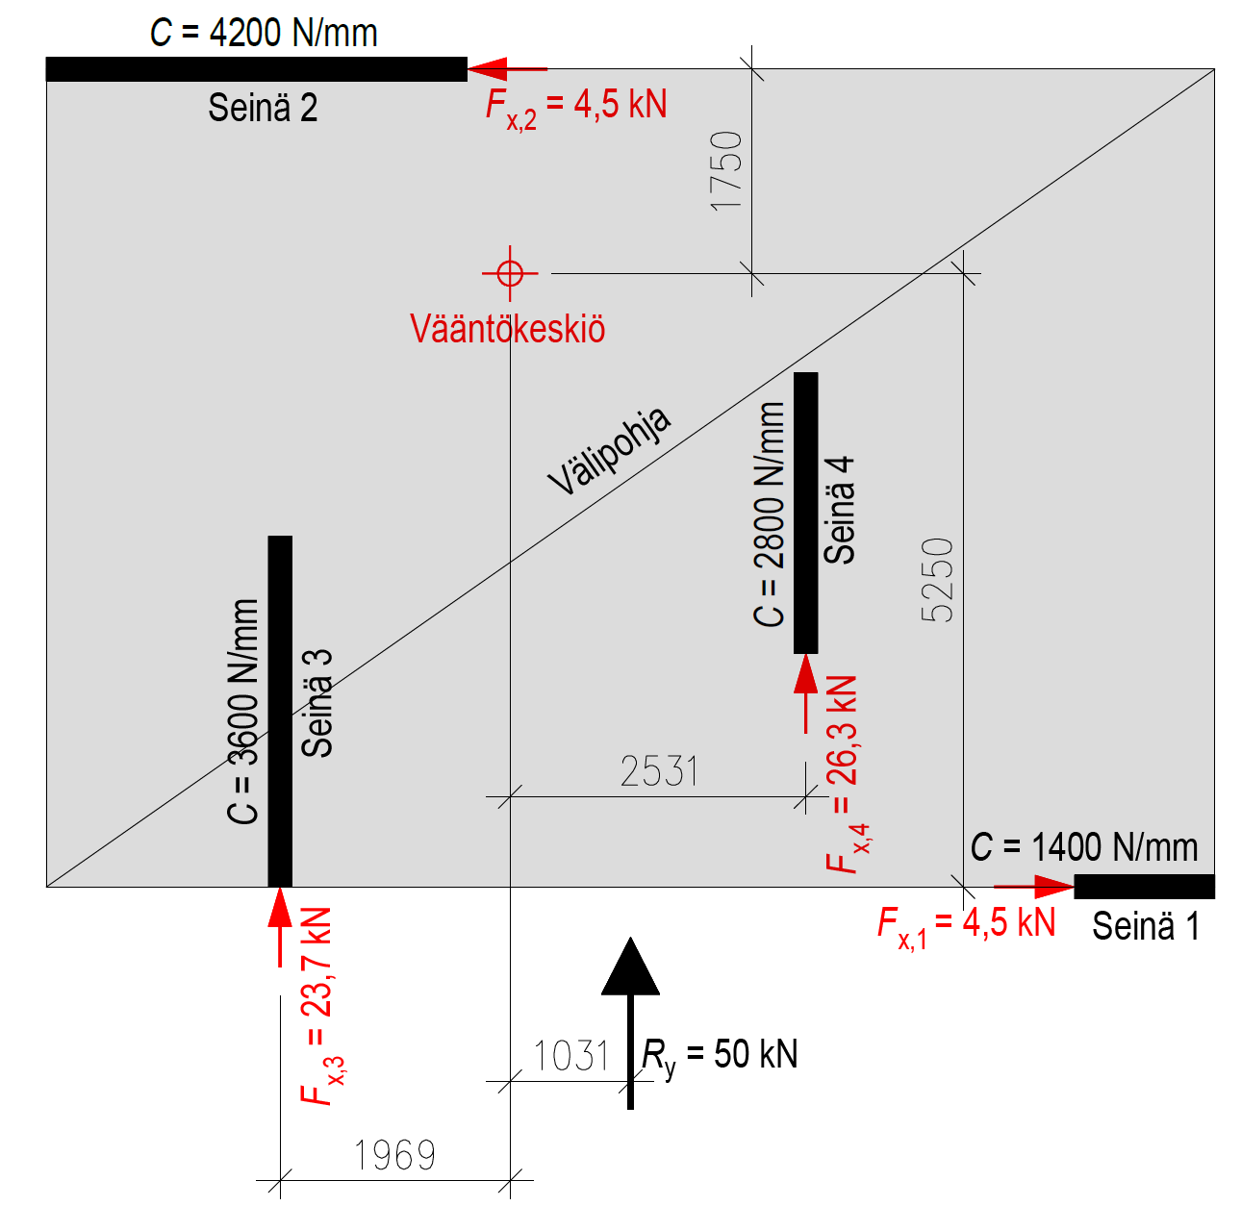
Functioning of a rigid intermediate floor
WALL LOAD FROM EXTERNAL LOAD R_{y} = 50 kN
Wall 3
Wall 2
Wall 4
Torque centre
Intermediate floor
Wall 4
Wall 1
Wall 3
Wall 2
Wall 1

Slide 19
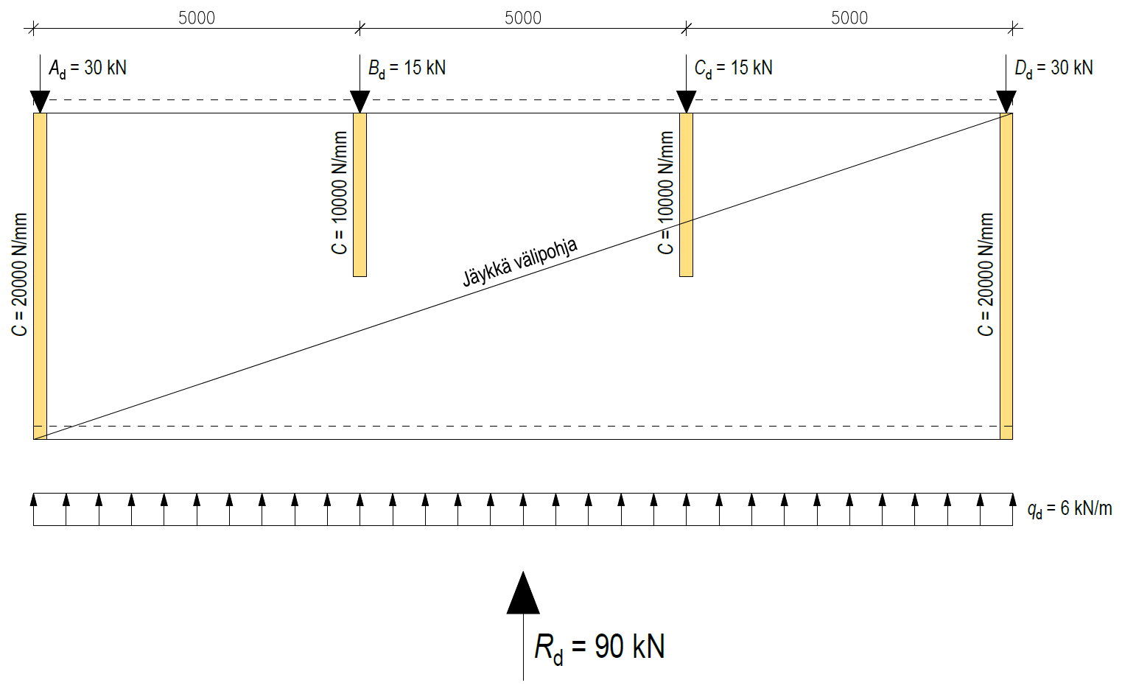
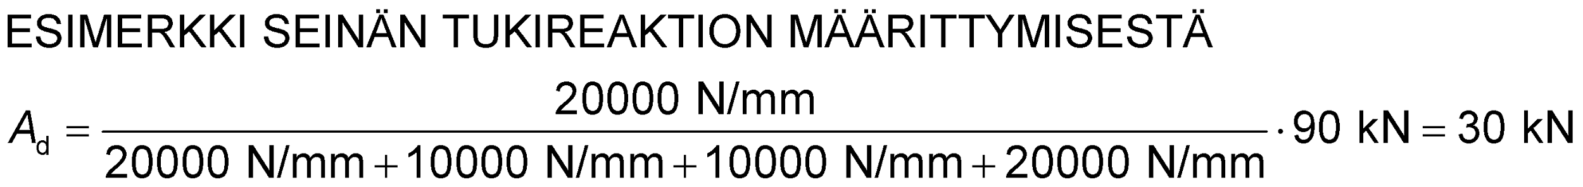
Functioning of a rigid intermediate floor
The intermediate floor in the picture is an rigid, stiff piece
External load is distributed into stiffening walls in proportion to their rigidity
An intermediate floor must meet the rigidity requirement so that the intermediate floor can be treated as a rigid piece
Stiffening intermediate floor
EXAMPLE OF HOW WALL SUPPORT REACTION IS DETERMINED

Slide 20
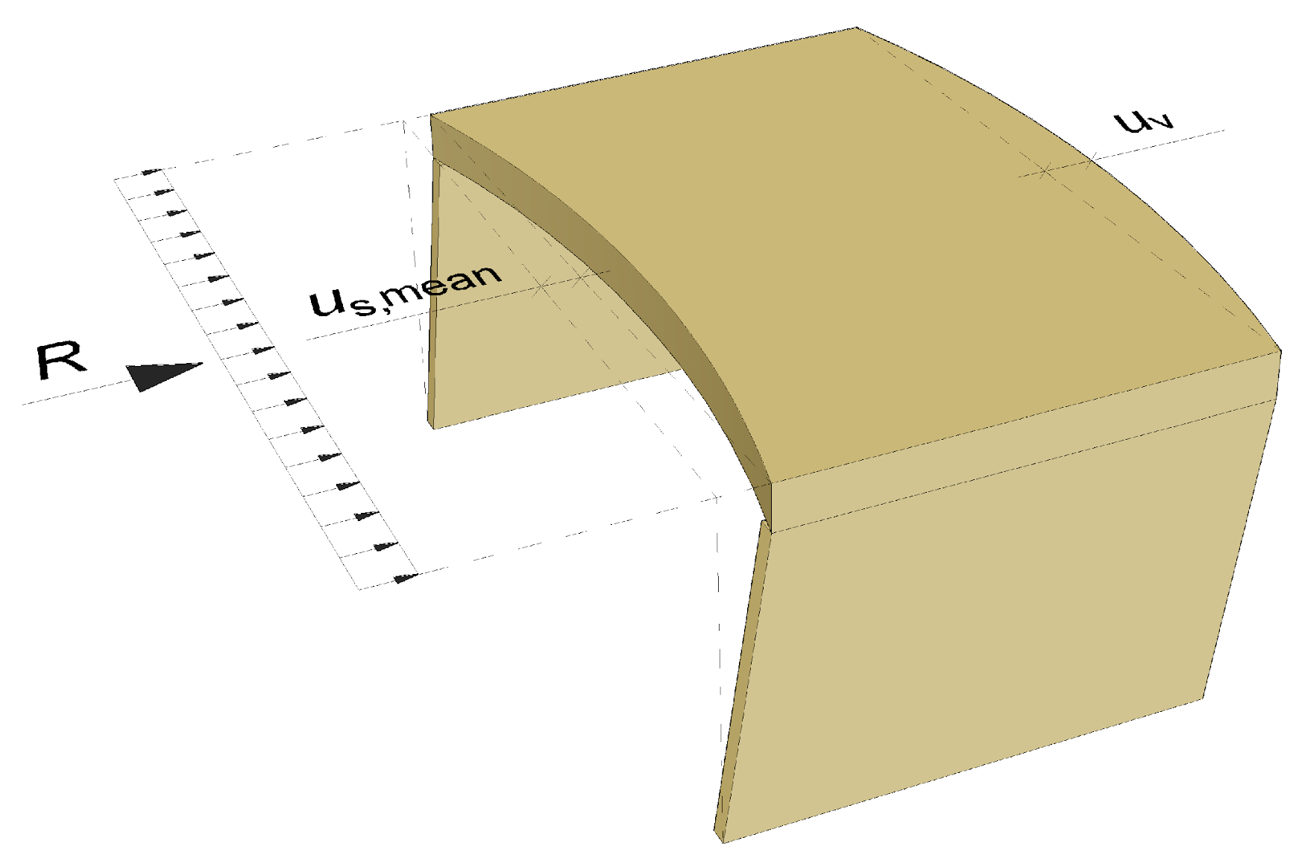
Rigidity requirement for intermediate floor
There are various guidelines around the world for the relationship between the rigidity of the intermediate floor and the rigidity of stiffening walls
Example
  Rigid intermediate floor
    u_{v} ≤ 0,5∙u_{s,mean}
  Stiff intermediate floor
    0,5∙u_{s,mean} < u_{v} ≤ 2,0∙u_{s,mean}
  Flexible intermediate floor
    u_{v} > 2,0∙u_{s,mean}
u_{v} = intermediate floor displacement
u_{s,mean} = mean horizontal displacement of walls

Slide 21
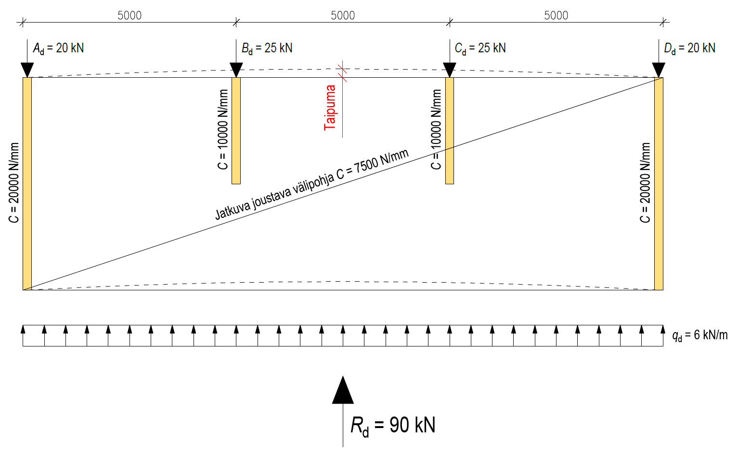
Functioning of a flexible intermediate floor
The intermediate floor in the picture is flexible
Rigidity C of the stiffening intermediate floor affects the load on the walls
Rigidity C of the stiffening walls affects the load on the walls
Bend
Continuous flexible intermediate floor C = 7500 N/mm

Slide 22
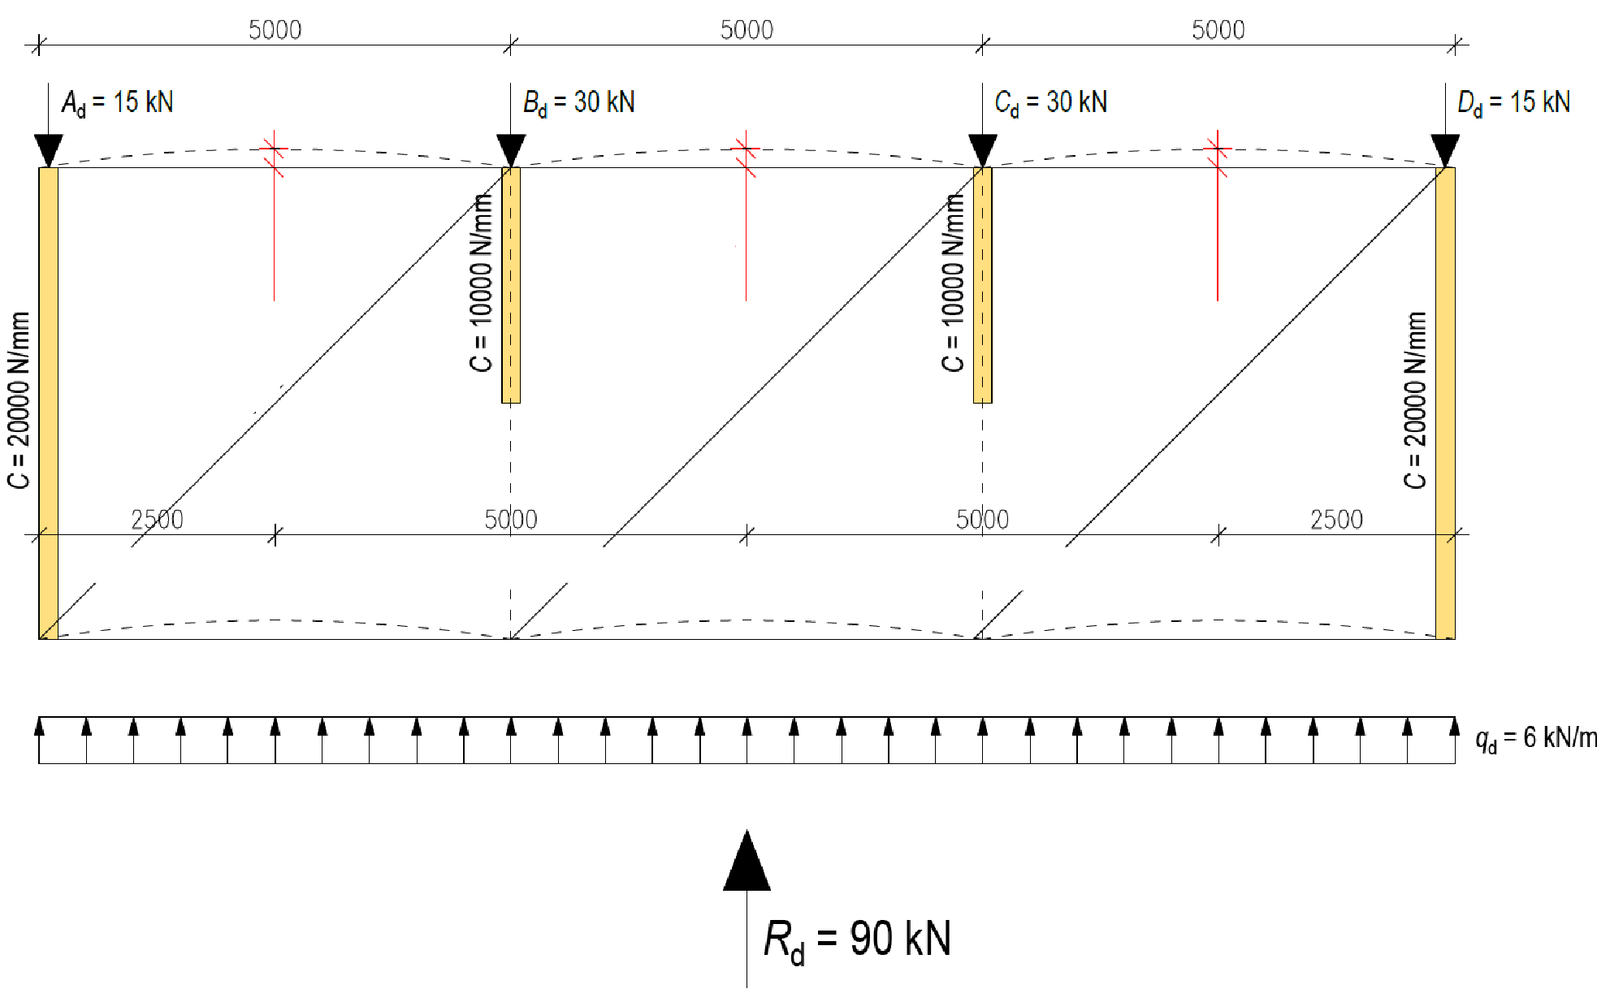
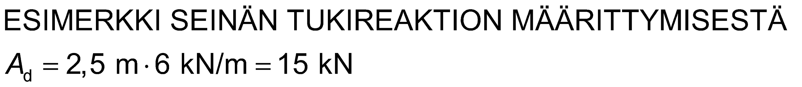
Functioning of an intermediate floor consisting of parts
The intermediate floor in the picture consists of several independently functioning parts
Rigidity C of the stiffening walls does not affect the load on the walls
External load is distributed to stiffening walls in proportion to their load areas
Bend
Bend
Bend
Intermediate floor
Intermediate floor
Intermediate floor
Load area (A_{d})
Load area (B_{d})
Load area (C_{d})
Load area (D_{d})
EXAMPLE OF HOW WALL SUPPORT REACTION IS DETERMINED

Slide 23
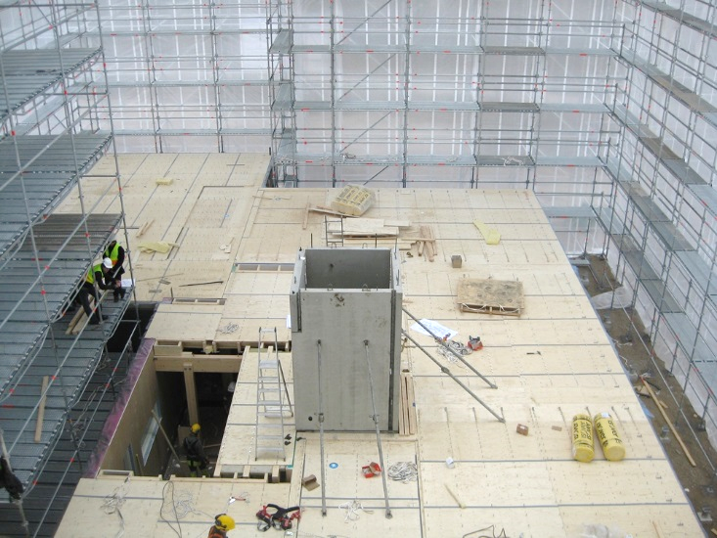
Wooden intermediate floors
Wooden intermediate floors are treated as a flexible building element
  Wooden intermediate floors have many mechanical connectors (flexible joints)
A wooden intermediate floor cannot be made rigid and continuous from one apartment to another
  Acoustics
  Vibration
  Lots of components and flexible connections
Image: Puuinfo

Slide 24
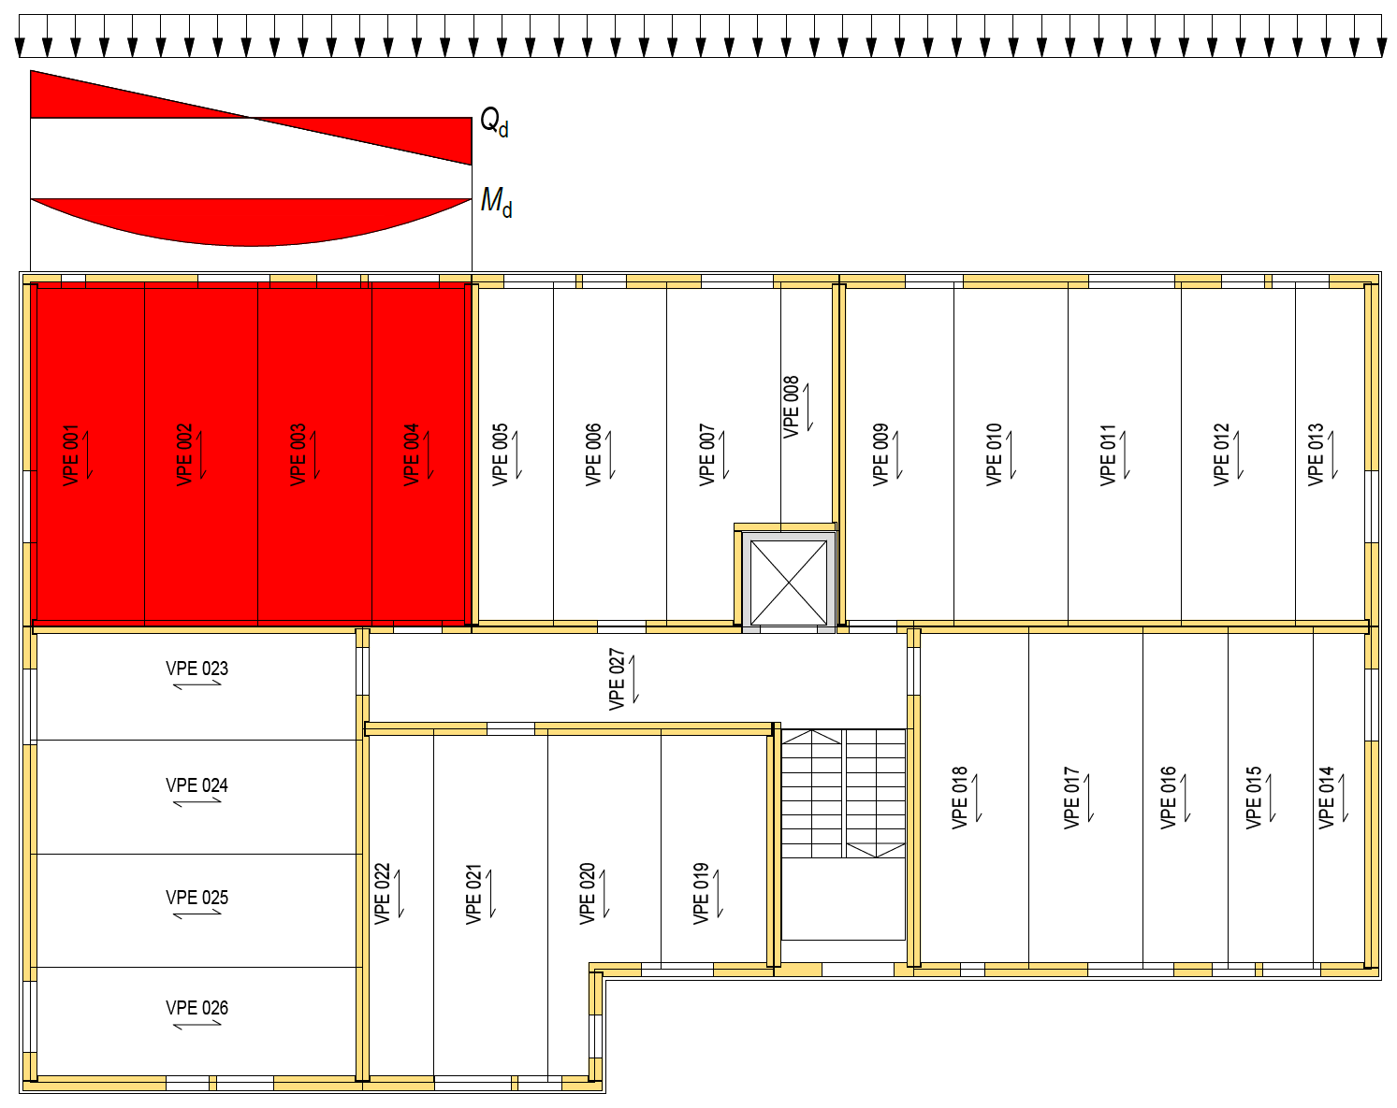
Wooden intermediate floors
In a wooden apartment block, stiffening intermediate floors are designed for individual apartments
An apartment-specific intermediate floor works like a single-hole beam
An apartment-specific intermediate floor transfers horizontal load to stiffening walls
  Outer walls
  Walls between apartments (frame half)

Slide 25
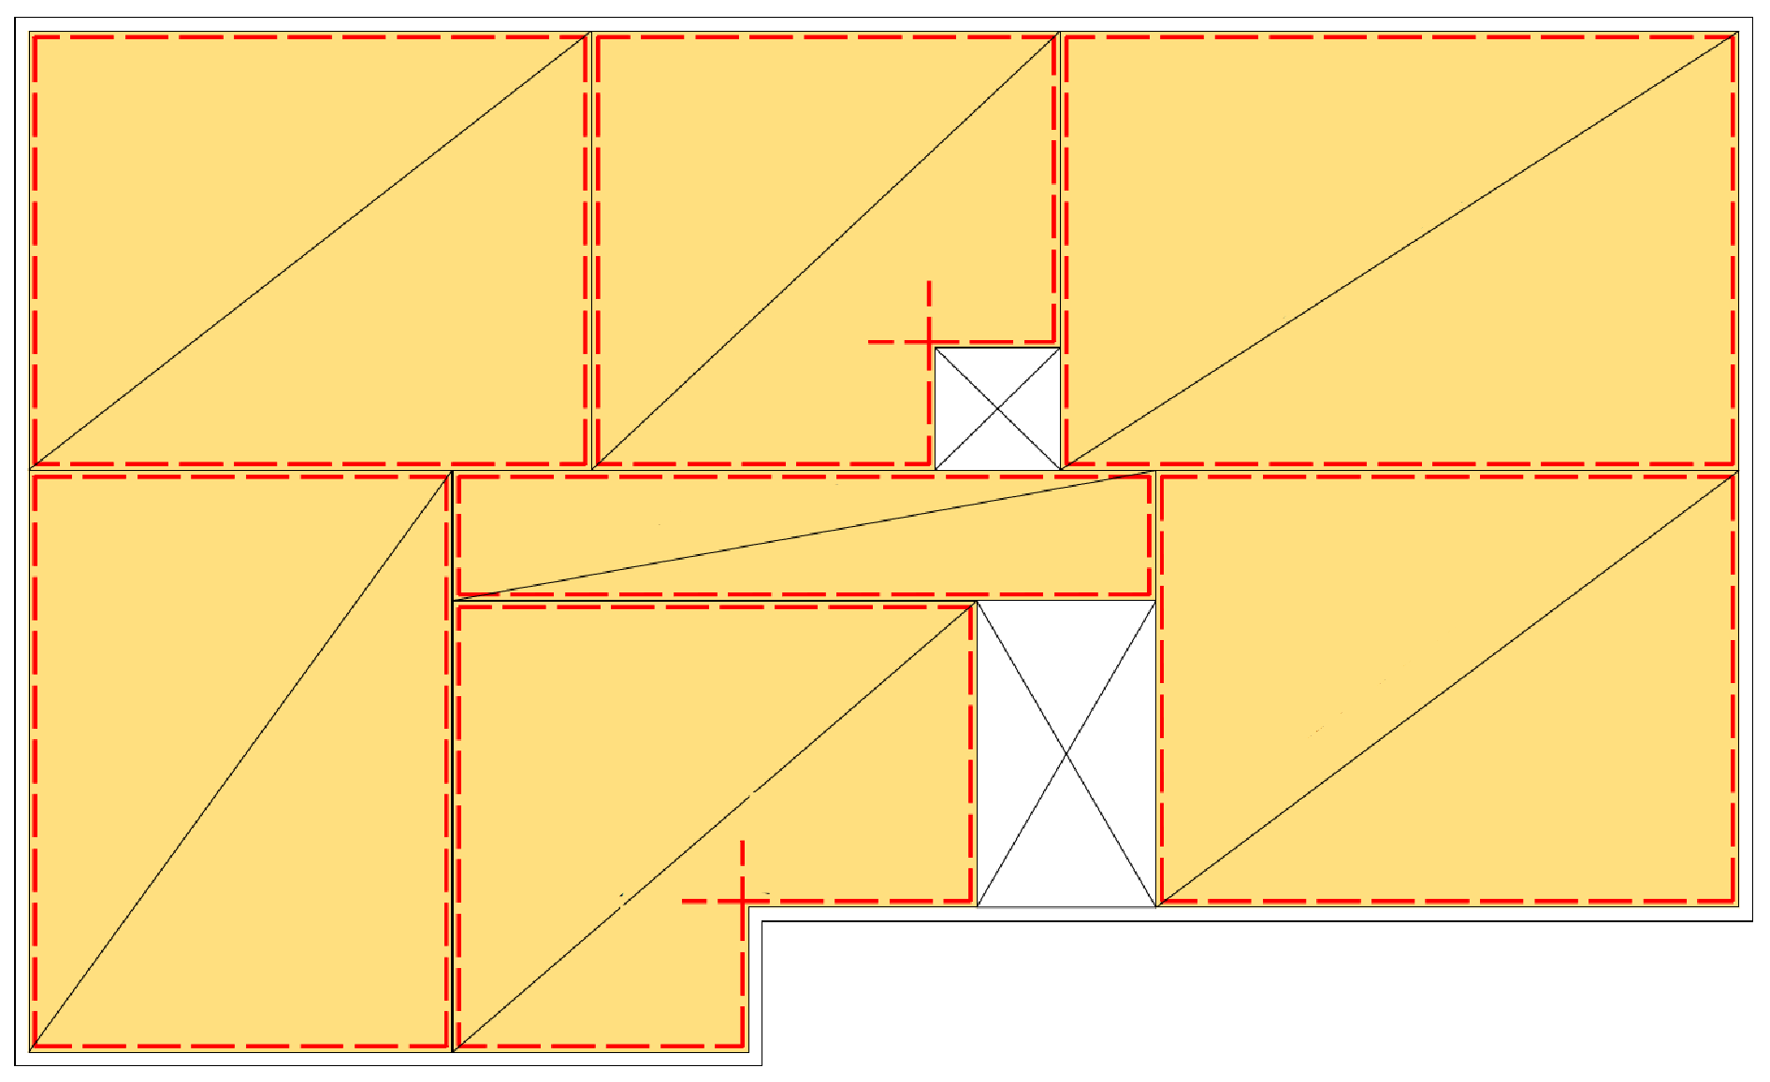
Wooden intermediate floors
Apartment-specific stiffening intermediate floors must have chords on all sides
  At the edges of the openings and the inner corners of the intermediate floor, the chords should be anchored in the rigid panels
Stiffening intermediate floors must be fastened to each other so that one intermediate floor assembly is formed.
  The impact of the fastening on acoustics should be assessed
Stiffening intermediate floor 1
Stiffening intermediate floor 2
Stiffening intermediate floor 3
Anchoring
Anchoring
Stiffening intermediate floor 7
Stiffening intermediate floor 4
Stiffening intermediate floor 6
Stiffening intermediate floor 5
Anchoring
Anchoring

Slide 26
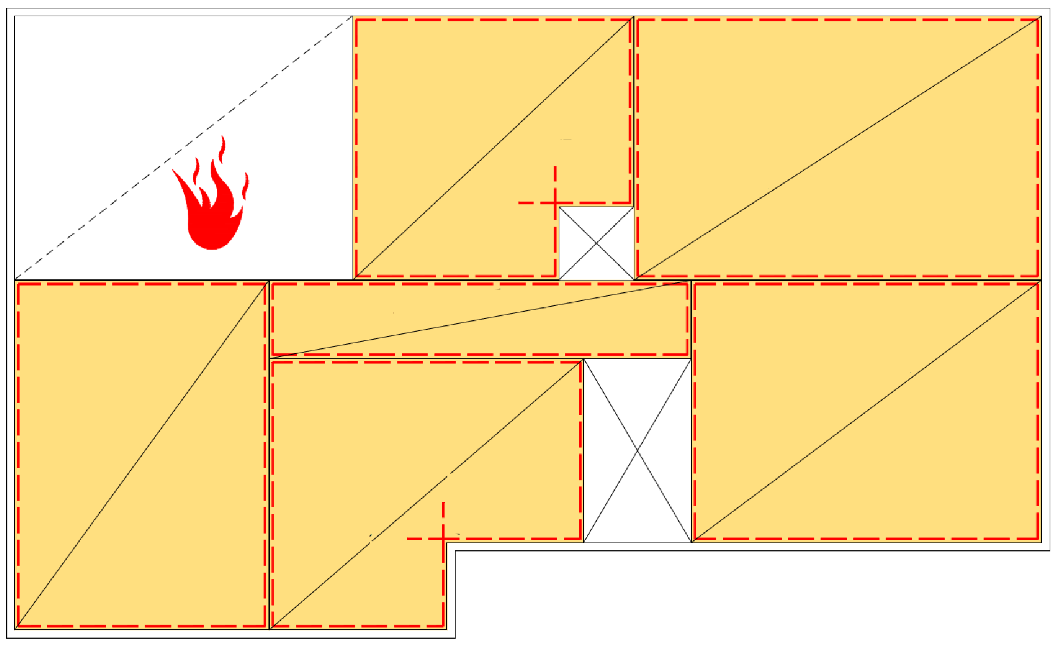
Wooden intermediate floors
An assembly consisting of independent stiffening intermediate floors is a good solution in case of an accident
In an accident, the stiffening structures next to the damaged apartment are functional
Stiffening intermediate floor 1
Stiffening intermediate floor 2
Anchoring
Stiffening intermediate floor 3
Anchoring
Stiffening intermediate floor 7
Stiffening intermediate floor 4
Stiffening intermediate floor 6
Stiffening intermediate floor 5
Anchoring
Anchoring

Slide 27
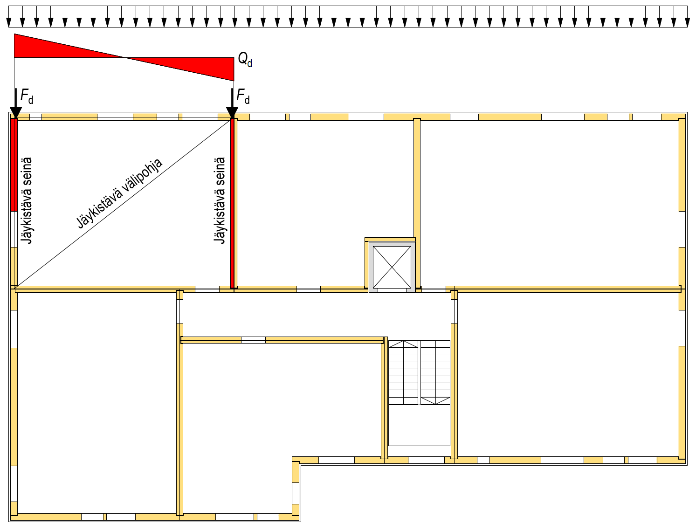
Stiffening walls
Apartment-specific stiffening intermediate floor transfers horizontal load to the rigid walls
The stiffness of the walls must be designed in such a way that there is no significant torsion in the intermediate floor from the flexibility of the walls
Stiffening intermediate floor
Stiffening wall
Stiffening wall

Slide 28
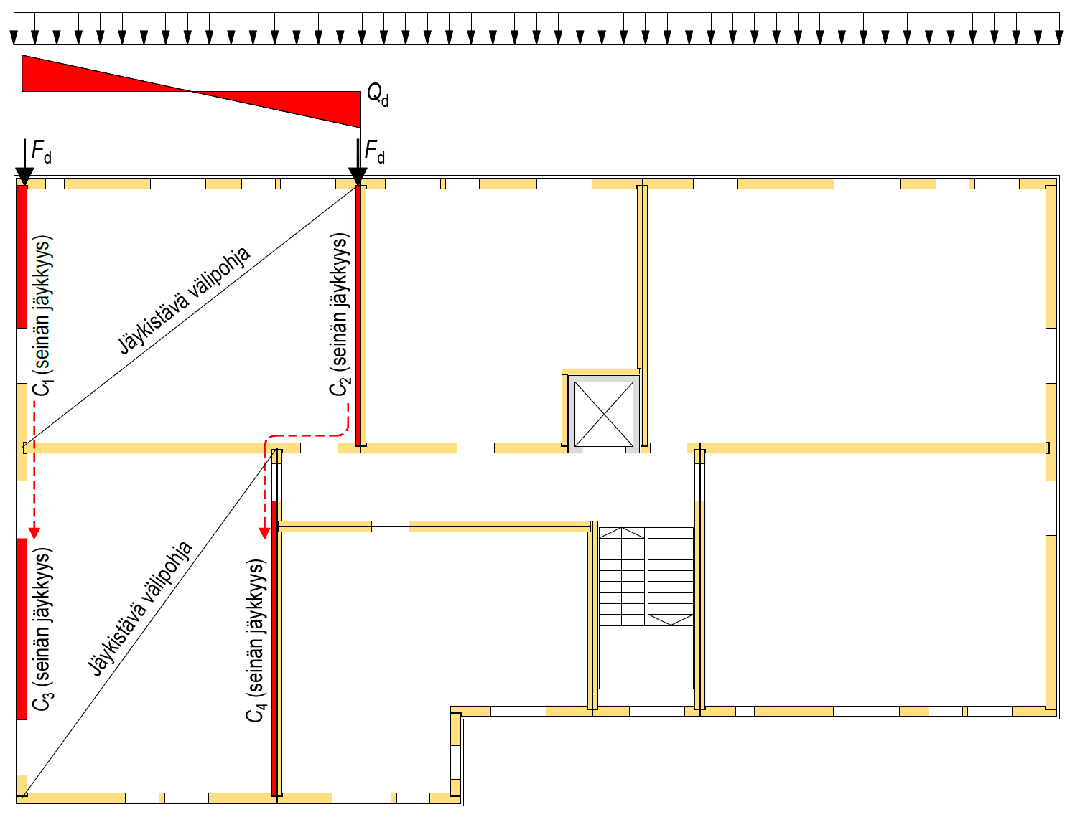
Stiffening walls
Intermediate floors can be used to distribute horizontal load to stiffening structures outside the apartment-specific combination of stiffening structures
  The load is distributed in proportion to the rigidities of the walls, taking into account all flexible structural components on the load transfer route
Acoustic factors must be taken into account when connecting the intermediate floors
C₁ (Wall rigidity)
Stiffening intermediate floor
C₂ (Wall rigidity)
Stiffening intermediate floor
C₃ (Wall rigidity)
C₄ (Wall rigidity)

Slide 29
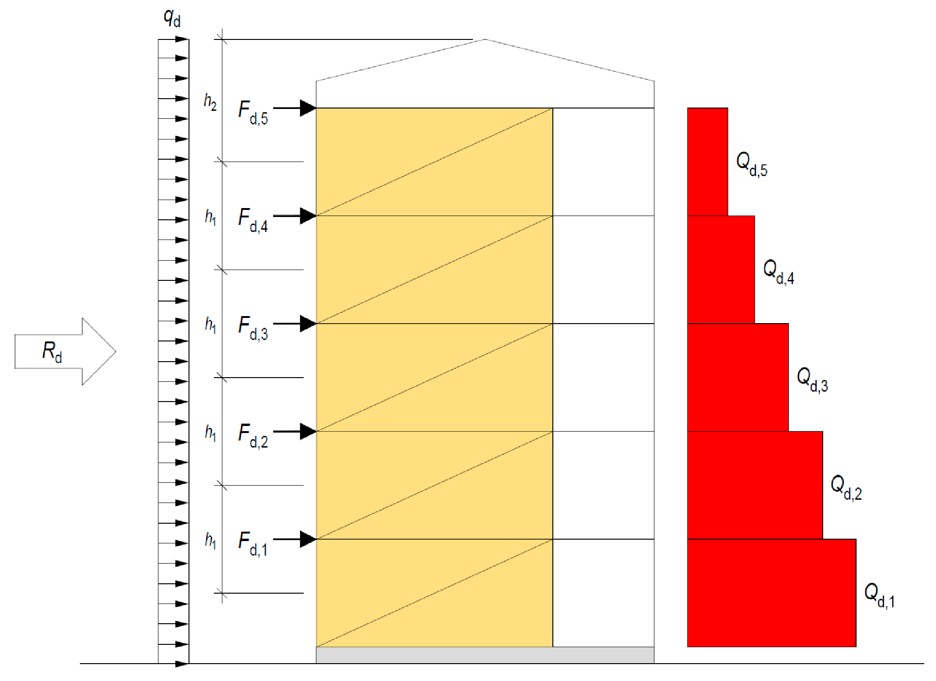
Stiffening walls
The horizontal load on the stiffening walls consists of:
  Wind load
  Additional horizontal load
A smaller additional horizontal force may be used if measurement confirms that the set skew tolerance is achieved in each layer
The shear force of the rigid walls increases when moving towards the foundations
Stiffening wall
Stiffening wall
Stiffening wall
Stiffening wall
Stiffening wall

Slide 30
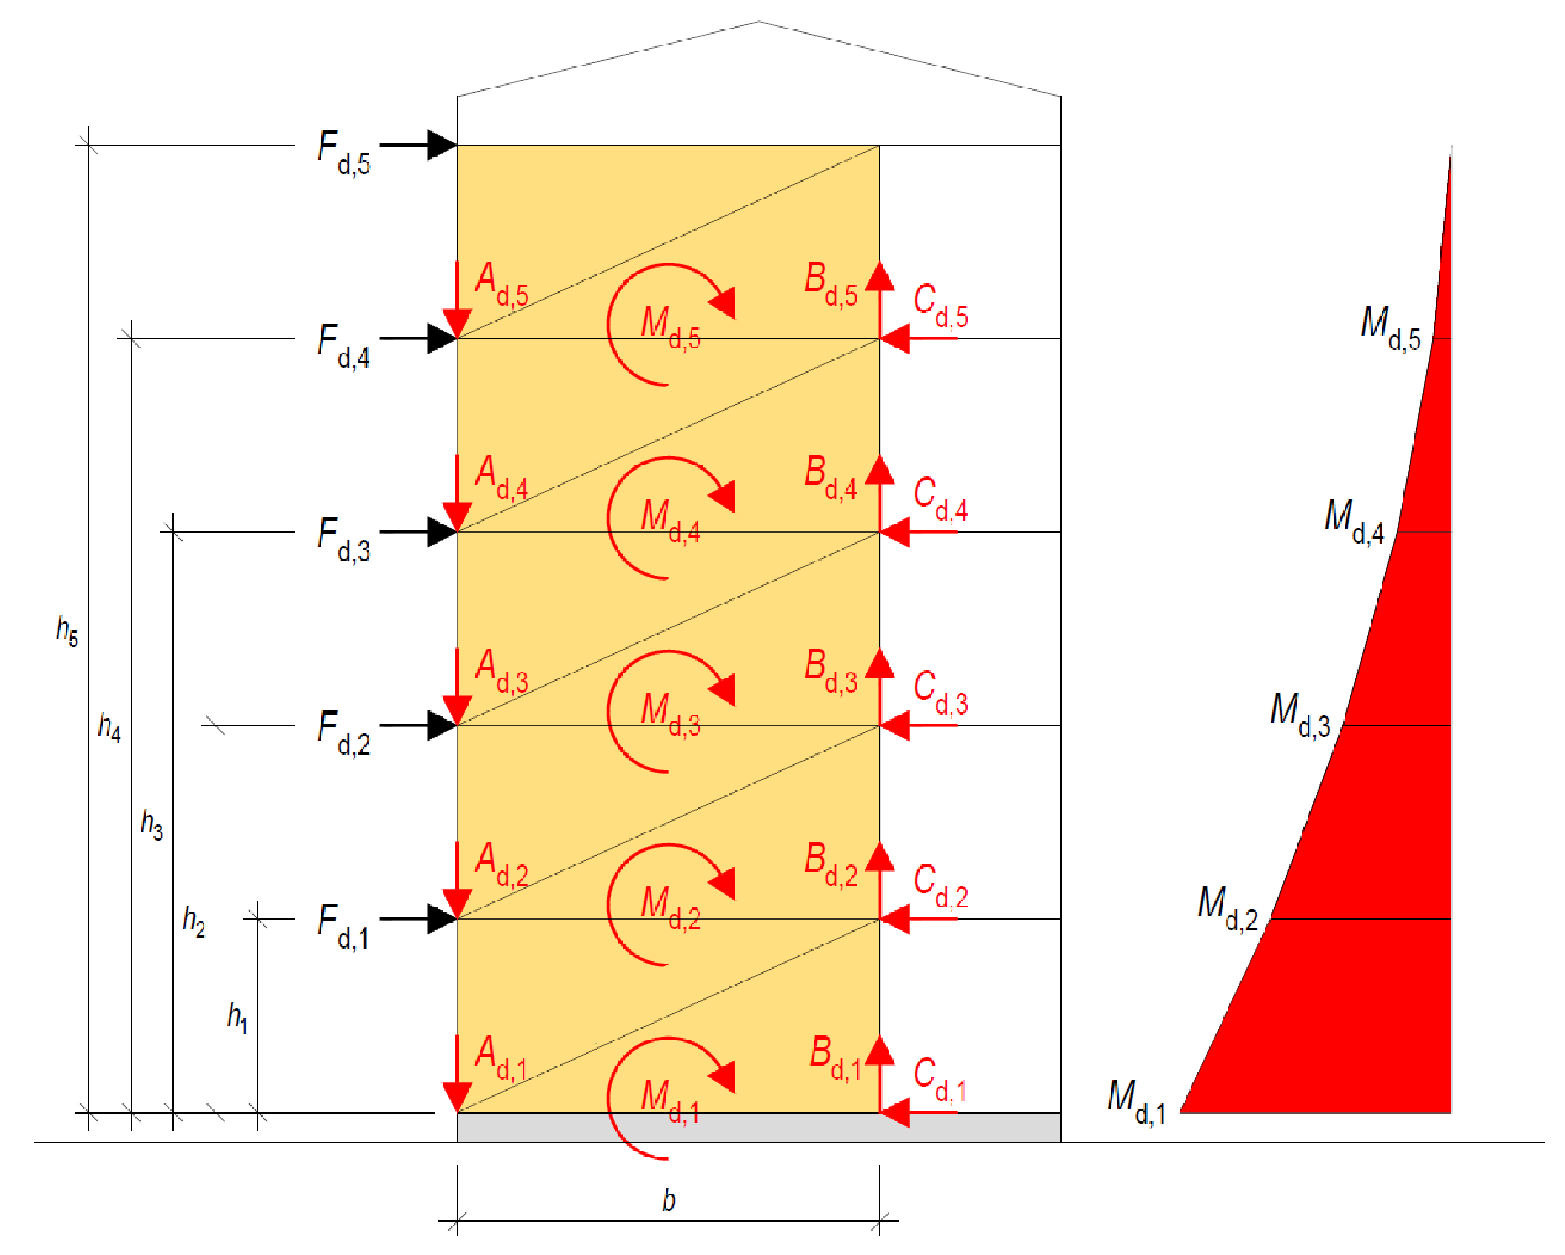
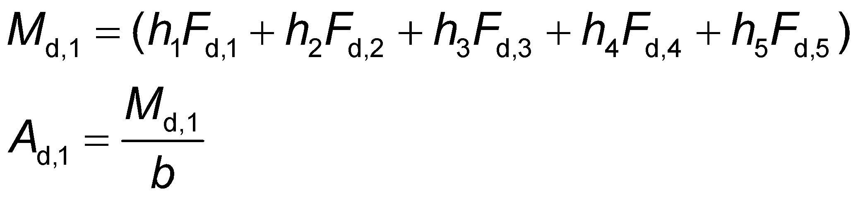
Stiffening walls
The overturn moment of stiffening walls due to external horizontal load increases when moving towards the foundations
The stiffening walls must be anchored if the dead weight cannot overcome the anchoring force
Stiffening wall
Stiffening wall
Stiffening wall
Stiffening wall
Stiffening wall

Slide 31
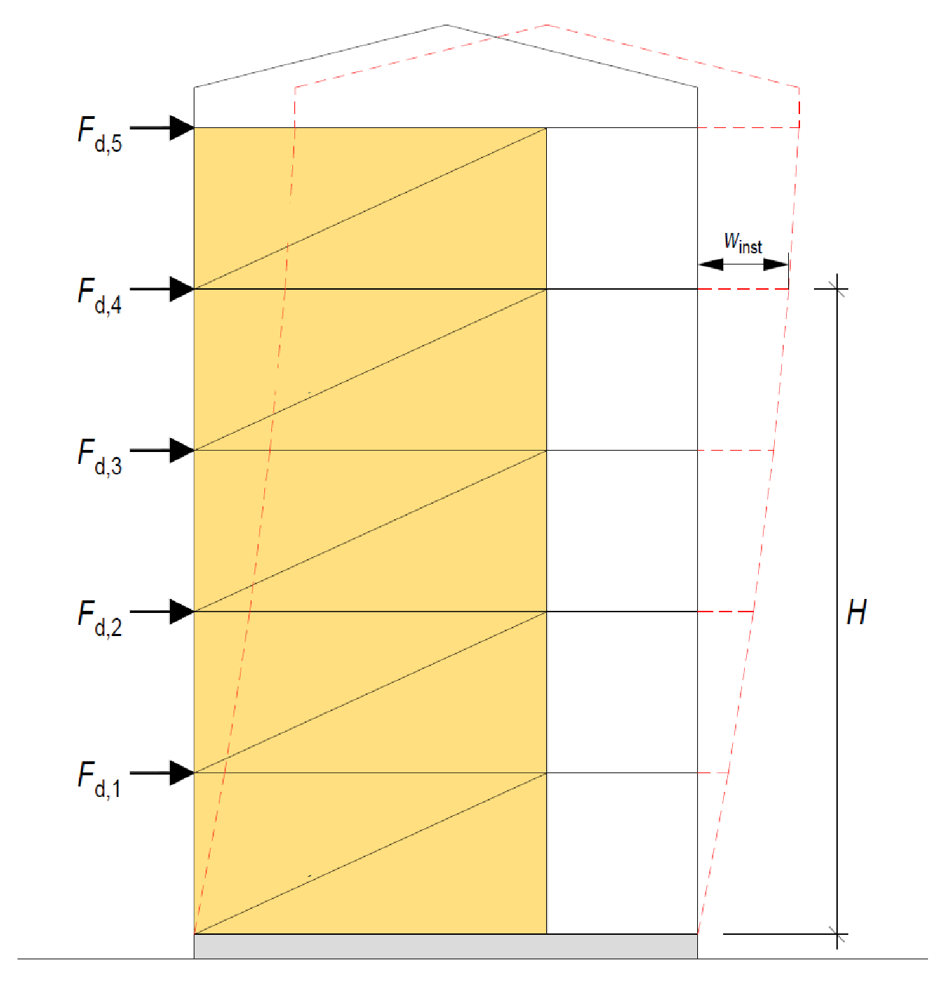
Stiffening walls
Horizontal displacement of the frame is formed by the horizontal displacement of overlapping stiffening walls and their joints
In an apartment block, the horizontal displacement in the use limit state must not exceed H/500 at the floor level of the top floor (RIL 205)
Stiffening wall
Stiffening wall
Stiffening wall
Stiffening wall
Stiffening wall

Slide 32
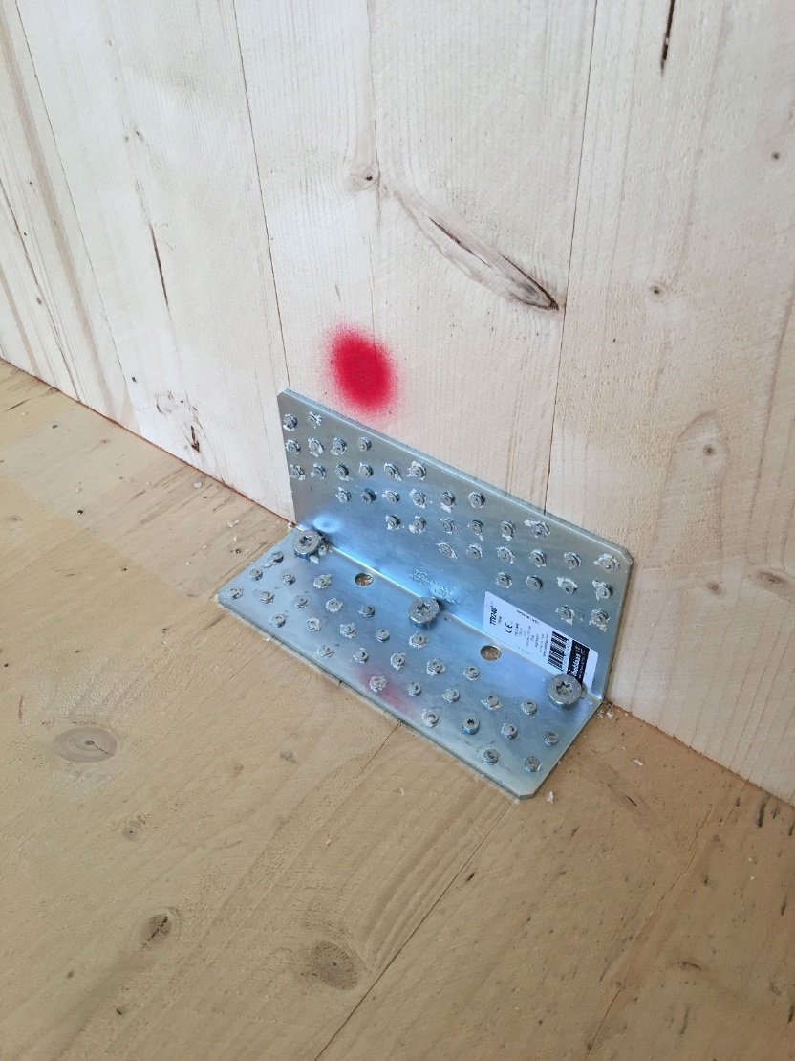
Joints between stiffening building elements
Large forces are created in the joints of stiffening building elements
When designing a junctions, e.g. the following must be taken into account
  Joint strength and stiffness
  Force transfer route between stiffening building elements
  Acoustic and fire technical aspects
  Fabricability of the joint
  Wood structure dimensional changes due to moisture
Image: Tero Lahtela

Slide 33
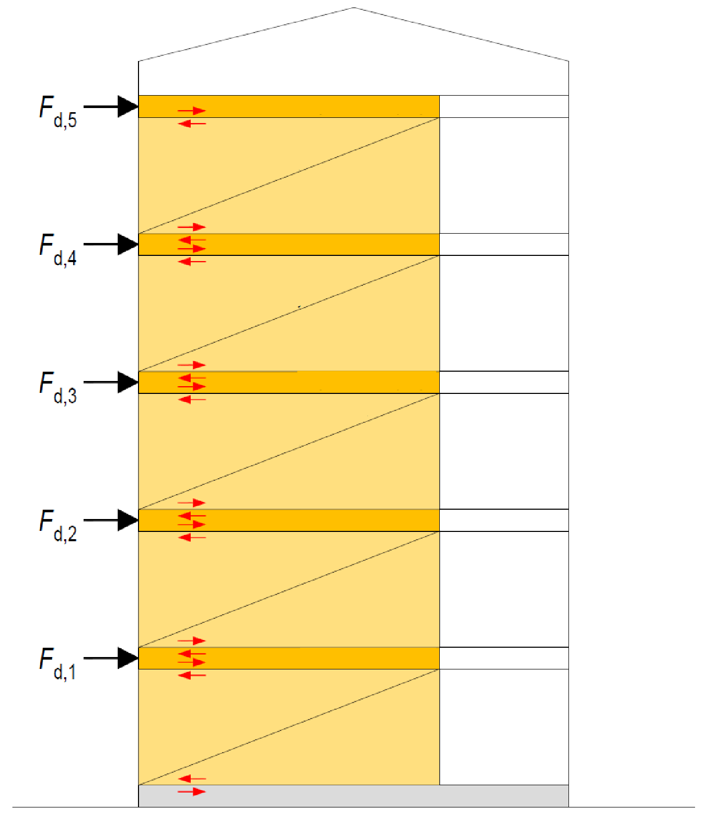
Joints between stiffening building elements
Large horizontal forces are created between the stiffening walls and intermediate floors when the horizontal load is transferred to the foundations
The more connections between stiffening building elements, the more challenging the structural design of the joints is
Stiffening intermediate floor
Joining forces
Stiffening wall
Stiffening intermediate floor
Stiffening wall
Stiffening intermediate floor
Stiffening wall
Stiffening intermediate floor
Stiffening wall
Stiffening intermediate floor
Stiffening wall

Slide 34
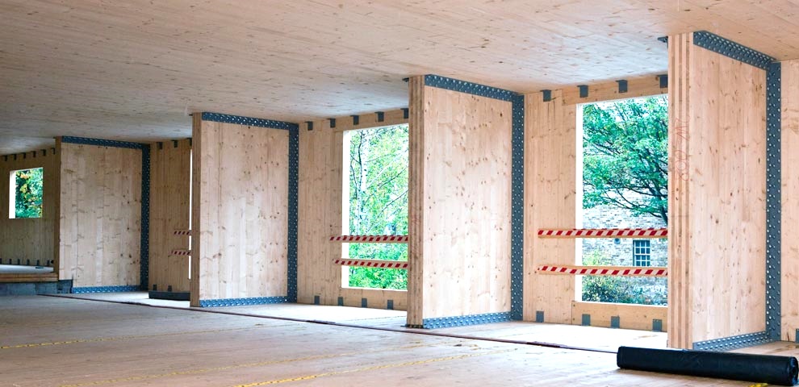
The higher the building, the sturdier the joints
Image: KLH

Slide 35
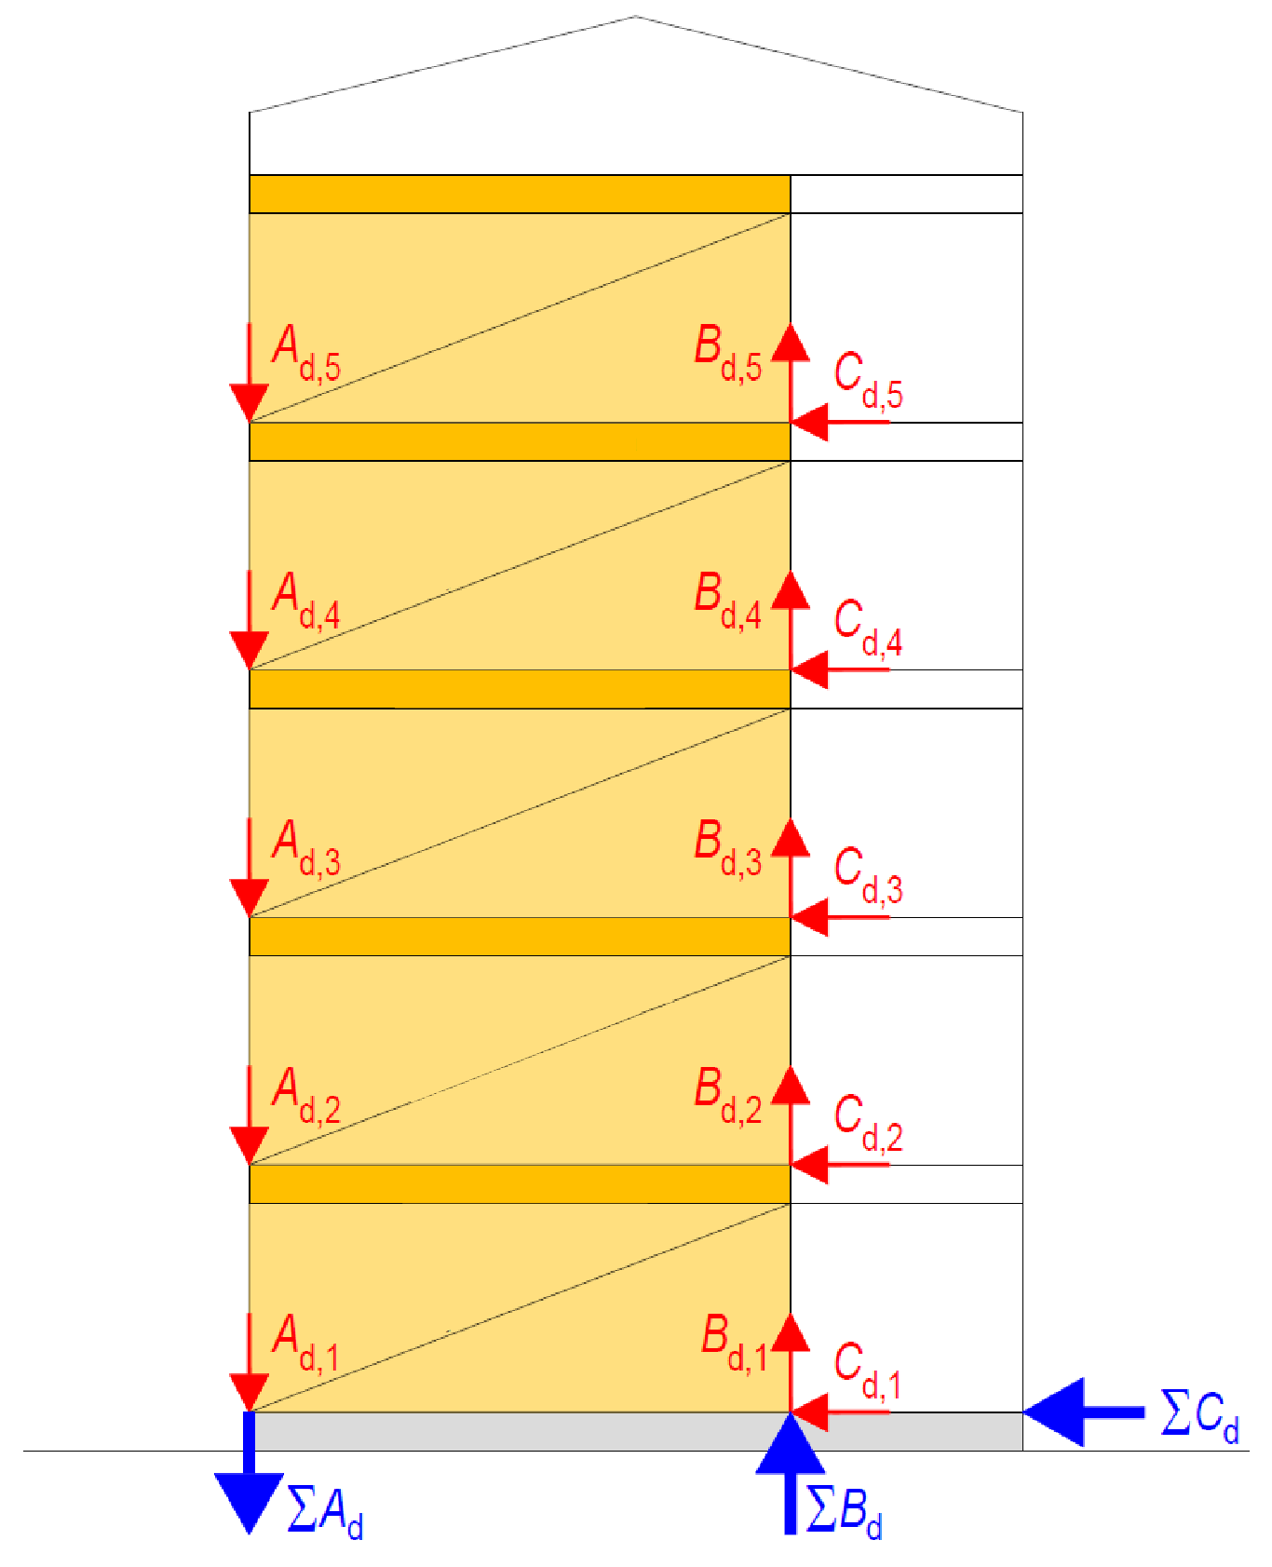
Anchoring the stiffening walls
Due to the light weight of the building elements, it is challenging to avoid anchoring stiffening walls in a wooden apartment block
The anchoring force generated at the foundation level may become very high as it accumulates on the foundations from all stiffening walls requiring anchoring
Stiffening intermediate floor
Stiffening wall
Stiffening intermediate floor
Stiffening wall
Stiffening intermediate floor
Stiffening wall
Stiffening intermediate floor
Stiffening wall
Stiffening intermediate floor
Stiffening wall

Slide 36
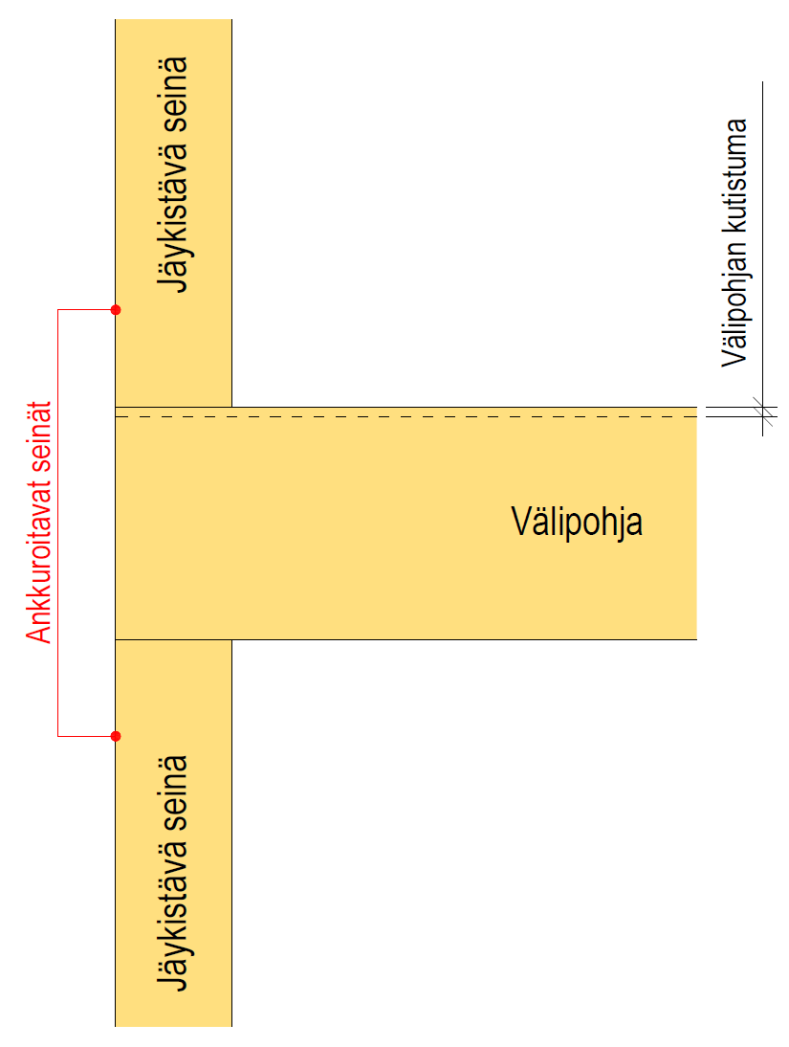
Anchoring the stiffening walls
When planning the anchoring method, e.g. the following should be assessed:
  Will anchoring remain functional over time (not loosen)
  Does the shrinkage of the intermediate floor affect the functioning of the anchoring and the connecting parts?
  Do the anchoring parts cause transverse tension in the wooden structure?
  Acoustic and fire technical aspects
Stiffening wall
Intermediate floor shrinkage
Anchored walls
Intermediate floor
Stiffening wall

Slide 37
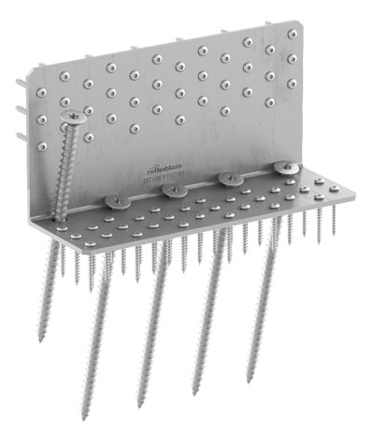
Anchoring the stiffening walls
Fastener manufacturers have new solutions for the joints of stiffening walls that can receive both shear force and anchoring force
Connecting parts that are anchored through the intermediate floor using threaded rods should not be used as the shrinkage of the intermediate floor causes the threaded rod nuts to loosen
Image: Rothoblaas

