Slide 1



Industrial wood construction
Teaching materials for industrial wood construction education
2022

Slide 2
Origin of the materials
Use of the materials
These learning materials for industrial wood construction have been prepared in a project led by Puuinfo Oy in 2021–2022. Also involved in the project were
Lappia Vocational College,
TTS-Työtehoseura ry
South-Eastern Finland University of Applied Sciences,
Metropolia University of Applied Sciences,
Jyväskylä University of Applied Sciences,
University of Tampere, and
Federation of the Finnish Woodworking Industries Puutuoteteollisuus ry
The project was funded by the Ministry of the Environment.
The materials are intended to be used as extensively as possible in industrial wood construction education and studies.
The materials are released under the Creative Commons licence Attribution-ShareAlike (CC BY-SA), which requires that the author be properly credited when the materials are used and that derivative works may only be distributed under the same licence as the original work.
The original materials and any updates to them by Puuinfo will be published on the Library of Open Educational Resources website (aoe.fi) and the Puuinfo.fi website.

Slide 3
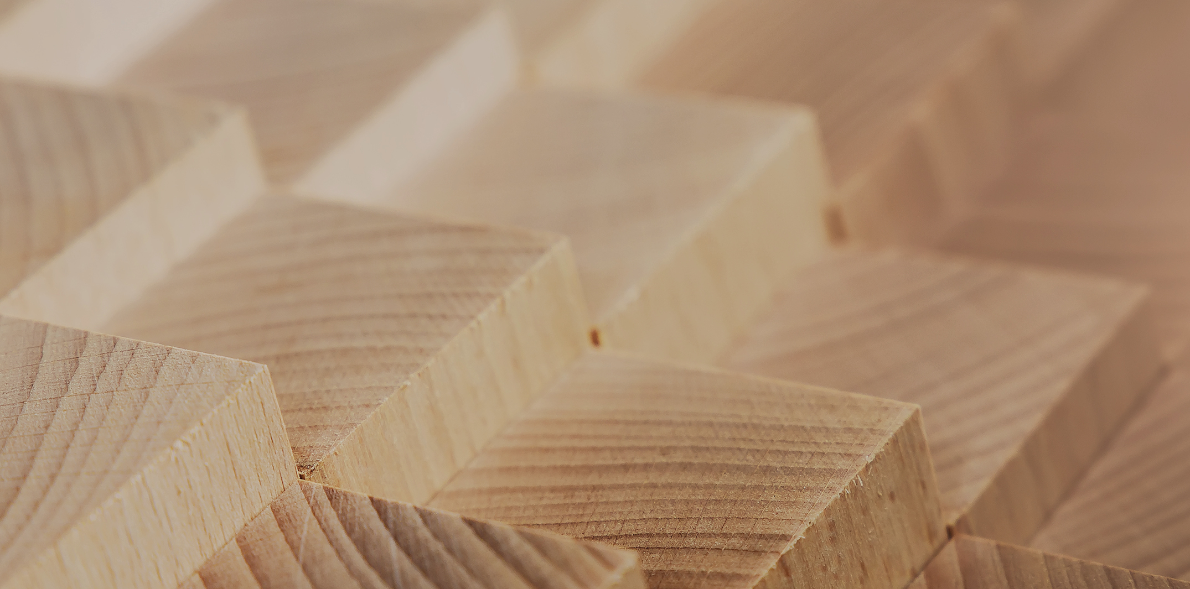
Structural design

Slide 4
Authors
Tero Lahtela, Insinööritoimisto Tero Lahtela Oy
Release date: 26/02/2022

Slide 5
Design bases

Slide 6
Effect of load duration and moisture
Time and moisture content in wood affect strength and stiffness properties of wood
Specific strengths and stiffness characteristics are determined as follows:
5-minute load time
Humidity RH 65% (up to 12 %)
The strength properties of dry wood are better than those of damp wood
Modification factor k_{mod} considers the load duration and the effect of wood moisture
The stiffness characteristics of dry wood are better than those of damp wood
Creep coefficient k_{def} considers the effect of moisture on bending and deformation state
Combination factor Ψ₂ considers the effect of the sustained part of the variable load on the bending and deformation state

Slide 7
Impact of load duration (duration factor)
Duration factor | Magnitude of impact | Examples
Permanent | Over 10 years | Unladen weight Permanently mounted machinery, equipment, light partition walls Ground pressure
Long-term | 6 to 10 years | Goods load (category E) for storage facilities, water tank
Medium | 1 week... 6 months | Snow load Payloads for floors and balconies (categories A to D) Payloads for garages and traffic areas (categories F and G) Loads due to moisture fluctuations
Short-term | Less than 1 week | Payloads for stairs Payload point load (Q_{k}) Horizontal load on partition walls and rails Maintenance and person load on the roof (category H) Vehicle load (category E) and means of transport load Installation load
Temporary |  | Wind load Accident load

Slide 8
Effect of moisture (category of use)
Category of use | Wood moisture | Examples
1 | Softwood moisture does not exceed 12% (Attention on the risk of cracking) | Wood structures in heated indoors spaces Wood structures in the insulation layer Wood beams in the insulation layer with tension zone inside the insulation
2 | Softwood moisture does not exceed 20% | Dry wood structures outdoors Wood structures in the ventilated base floor Wood structures in the attic (The wood structure must be covered and ventilated and protected from moisture from underneath and the sides)
3 | Operating conditions lead to higher humidity values than in Category 2 | Wood structures exposed to weather outdoors Wood structures exposed to water Wood structures in a humid space

Slide 9
Modification factor (k_{mod})
Product | Use class | Modification factor (k_{mod}) by duration factor
 |  | Permanent | Long-term | Medium | Short-term | Instantaneous
Sawn timber, Round timber, Glue laminated timber, LVL, Plywood, CLT | 1 2 3 | 0.60 0.60 0.50 | 0.70 0.70 0.55 | 0.80 0.80 0.65 | 0.90 0.90 0.70 | 1.10 1.10 0.90
Chipboard P4¹⁾, Chipboard P5, OSB/2¹⁾, Hard fibreboard | 1 2 | 0.30 0.20 | 0.45 0.30 | 0.65 0.45 | 0.85 0.60 | 1.10 0.80
Chipboard P6¹⁾, Chipboard P7, OSB/3, OSB/4 | 1 2 | 0.40 0.30 | 0.50 0.40 | 0.70 0.55 | 0.90 0.70 | 1.10 0.90
Semi-hard fibreboards: MBH.LA¹⁾, MBH.HLS, MDF.LA¹⁾, MDF.HLS | 1 2 | 0.20 - | 0.40 - | 0.60 - | 0.80 0.45 | 1.10 0.80
¹⁾ Only in category 1

Slide 10
Creep coefficient (k_{def})
Product | Standard | Creep coefficient k_{def} by use class
 |  | 1 | 2 | 3
Sawn timber, round timber | EN 14081-1 | 0.60 | 0.80 | 2.00
Glued laminated timber | EN 14080
LVL, CLT edgewise | EN 14374
Plywood, Kerto-Q flatwise, CLT flatwise | EN 636, VTT 184/03 | 0.80 | 1.00 | 2.50
OSB panel | EN 300: OSB/2 EN 300: OSB/3, OSB/4 | 2.25 1.50 | - 2.25 | - -
Chipboard | EN 312: P4 and P5 EN 312: P6 and P7 | 2.25 1.50 | 3.00 2.25 | - -
Hard fibreboard | EN 622-2: HB.LA, HB.HLA | 2.25 | 3.00 | -
Semi-hard fibreboard | EN 622-3: MBH.LA, MBH.HLS | 3.00 | 4.00 | -
MDF panel | EM 622-5: MDF.LA, MDF.HLS | 2.25 | 3.00 | -

Slide 11
Material partial safety factor
Ultimate limit state | Partial safety factor g_{M}
Sawn timber and round timber | 1.3
Glue laminated timber, CLT | 1.25
LVL, plywood, OSB | 1.2
Chipboard, fibreboard | 1.3
Joints | 1.3
Nail plate joints Grip Strength of nail plate (steel) | 1.25 1.1
Accident limit state | Partial safety factor g_{M}
All of the above products | 1.0

Slide 12
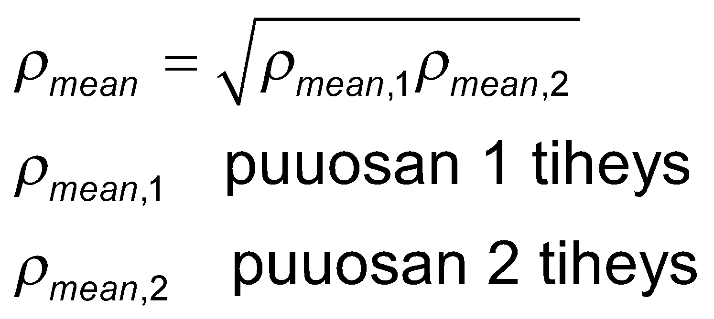
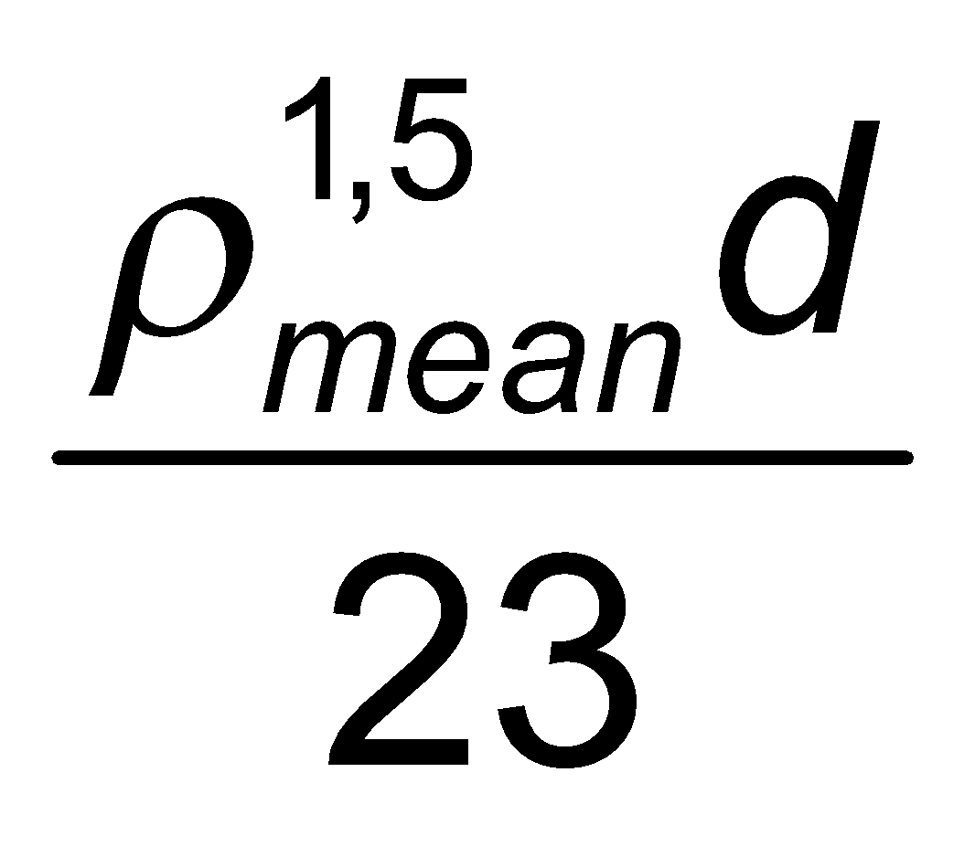
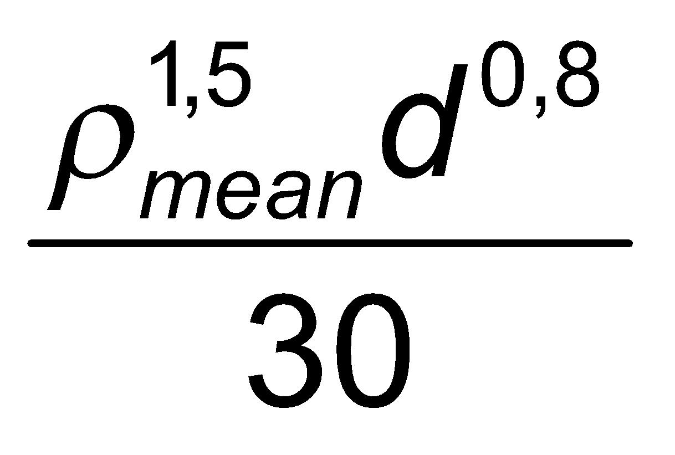
Connector transition coefficient in serviceability limit state
When the densities of the wooden parts to be joined is different, the density is used
In the following cases, the K_{ser} value (r_{mean} = wooden part) is multiplied by two
Steel-to-wood joint
Concrete-to-wood joint
Connector | Transition coefficient K_{ser} Towards cutting plane and connector
Dowels Bolts¹⁾ Screws Nails (pre-drilling)
Nails (no pre-drilling)
¹⁾ Hole clearance is added to bolted joint displacement
density of wooden part 1
density of wooden part 2

Slide 13
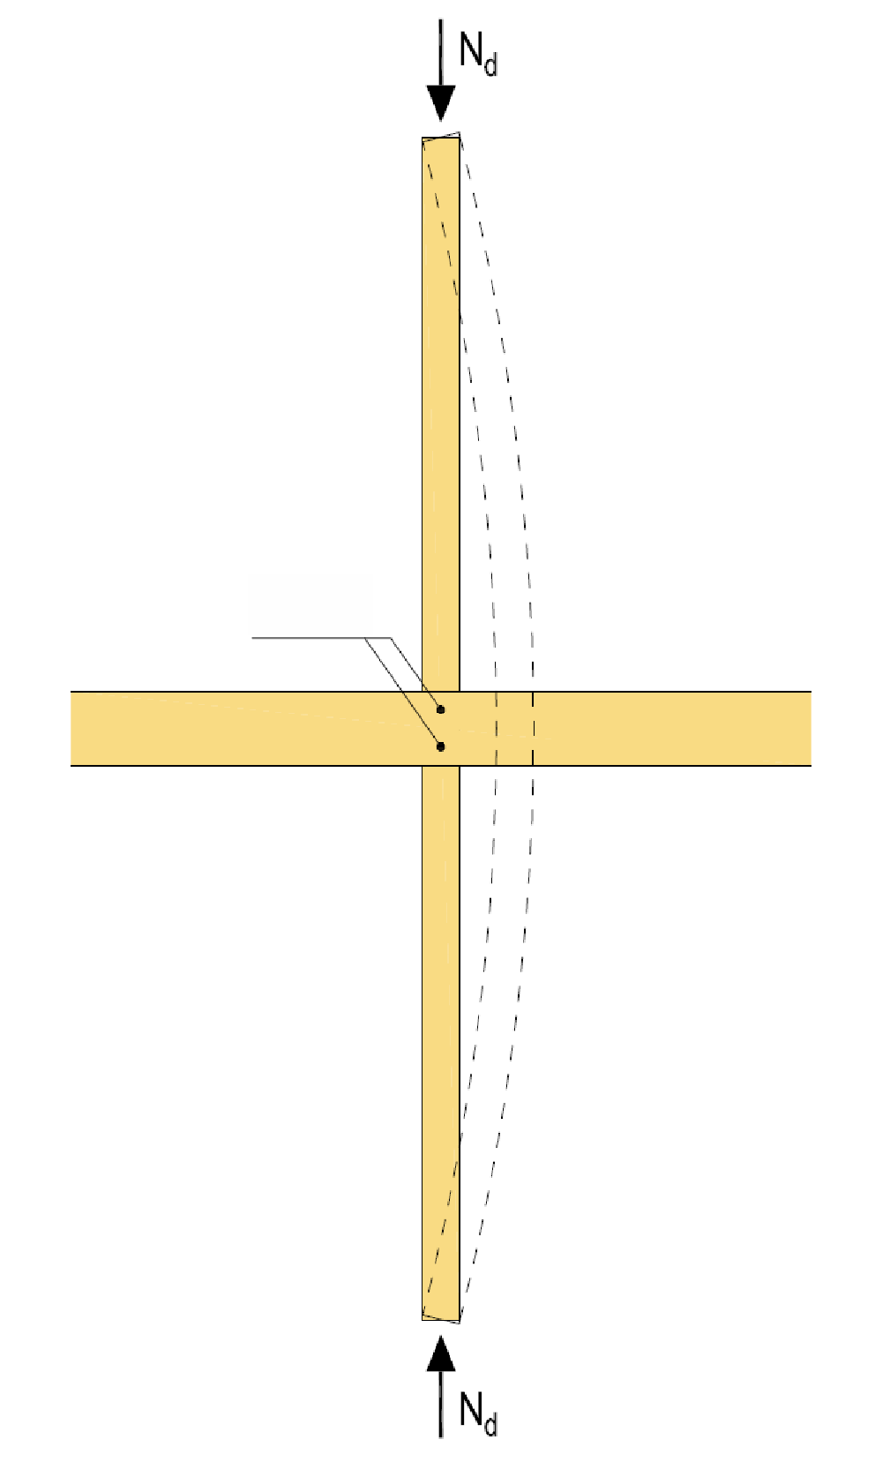
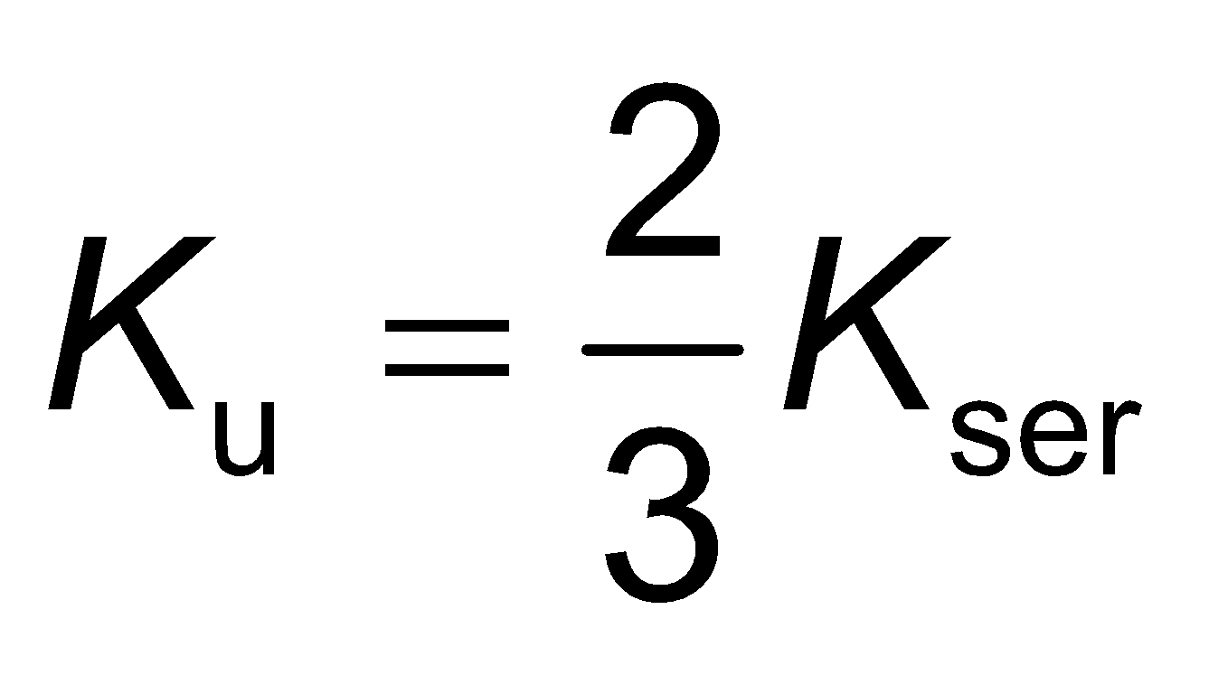
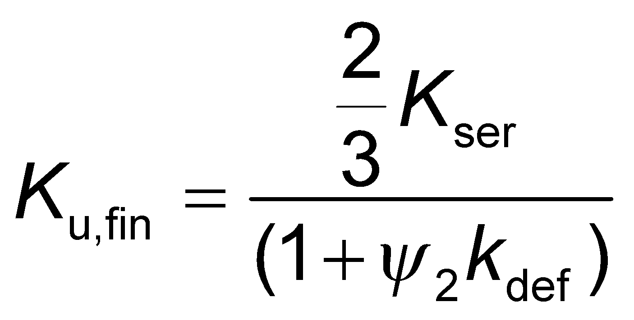
Transition coefficient of the connector ultimate limit state
The transition coefficient represents the rigidity of the joint
For the average transition coefficient of the joint that affects the ultimate limit state, the value K_{u} shall be used
Joint
Buckling support
End state value K_{u,fin} is used, e.g. when dimensioning the joint of the buckle support
The joint creep weakens the buckling support operation (spring stiffness C)

Slide 14
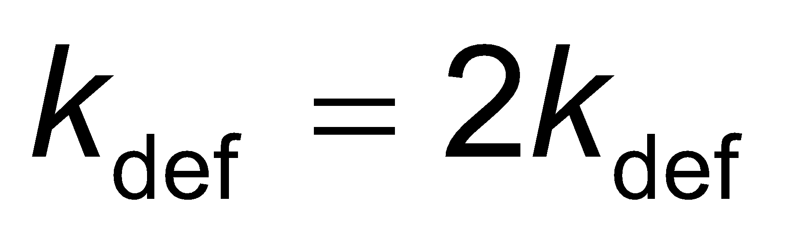
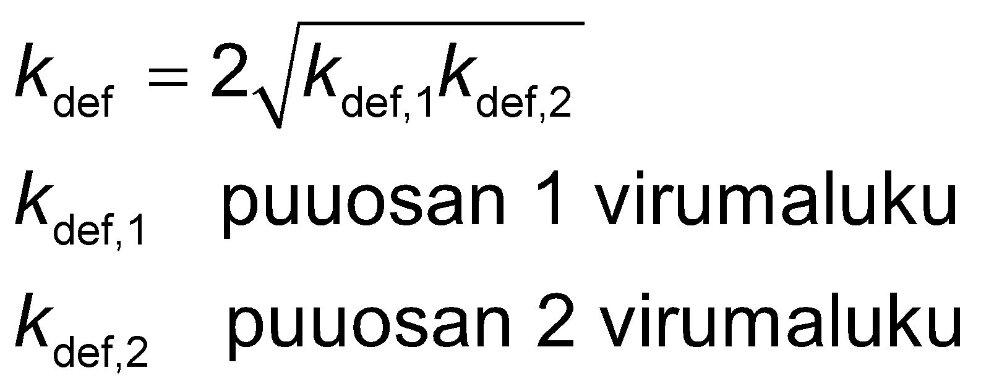
Joint creep coefficient (k_{def})
When the connector joins wooden parts with a similar time-dependent function, the value the of the joint’s creep factor is used
When the connector joins wooden parts with a different time-dependent function, the value the of the joint's creep factor is used
creep coefficient of wood part 1
creep coefficient of wood part 2

Slide 15
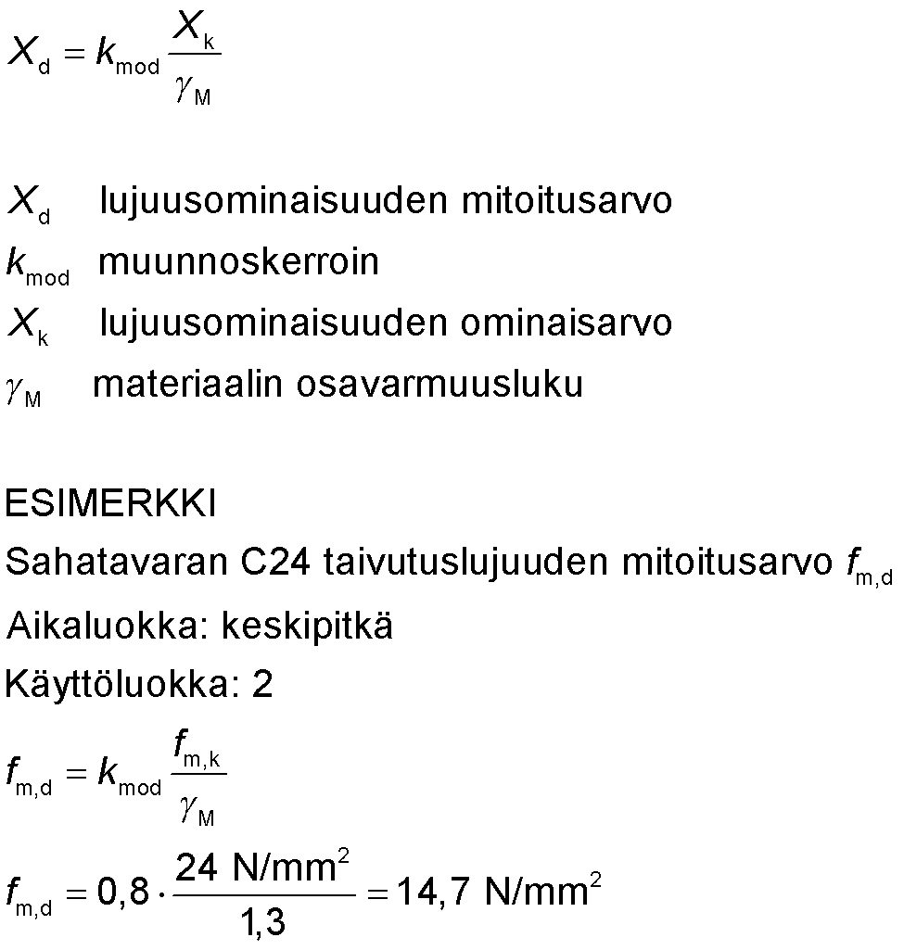
Rated value of strength properties
The rated value of the strength property X_{d} is calculated using the adjacent formula
Partial reliability of material g_{M} increases reliability from the point of view of wood strength
Modification factor k_{mod} considers the duration of the load (time) and the effect of wood moisture
rated value of strength properties
modification factor
characteristic value of strength properties
material partial safety factor
EXAMPLE
Rated value f_{m,d} of bending strength in sawn timber C24
Duration factor: medium
Category of use: 2

Slide 16
Stiffness properties (E, G)
Mean values E_{mean}, G_{mean} are used when geometrically analysing the structure linearly according to linear elasticity theory and the time-dependent properties of the components of the structure are similar
End state mean values E_{mean,fin}, G_{mean,fin} are used when geometrically analysing the structure linearly according to linear elasticity theory and the time-dependent properties of the structural components are different
Rated values E_{d} ja G_{d} that do not consider load duration are used when geometrically analysing the structure as non-linear according to linear elasticity theory
E_{d} = (E_{mean}/g_{M})
G_{d} = (G_{mean}/g_{M})

Slide 17
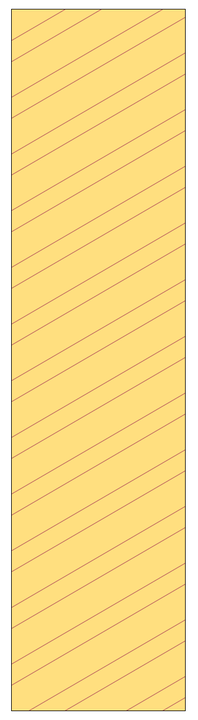
Stiffness properties in transition coefficient and serviceability limit state
When the time-dependent operation of structural components is similar, the mean values of rigidity properties are used
E_{mean} = mean elasticity modulus
G_{mean} = mean shear modulus
K_{ser} = slip modulus

Slide 18
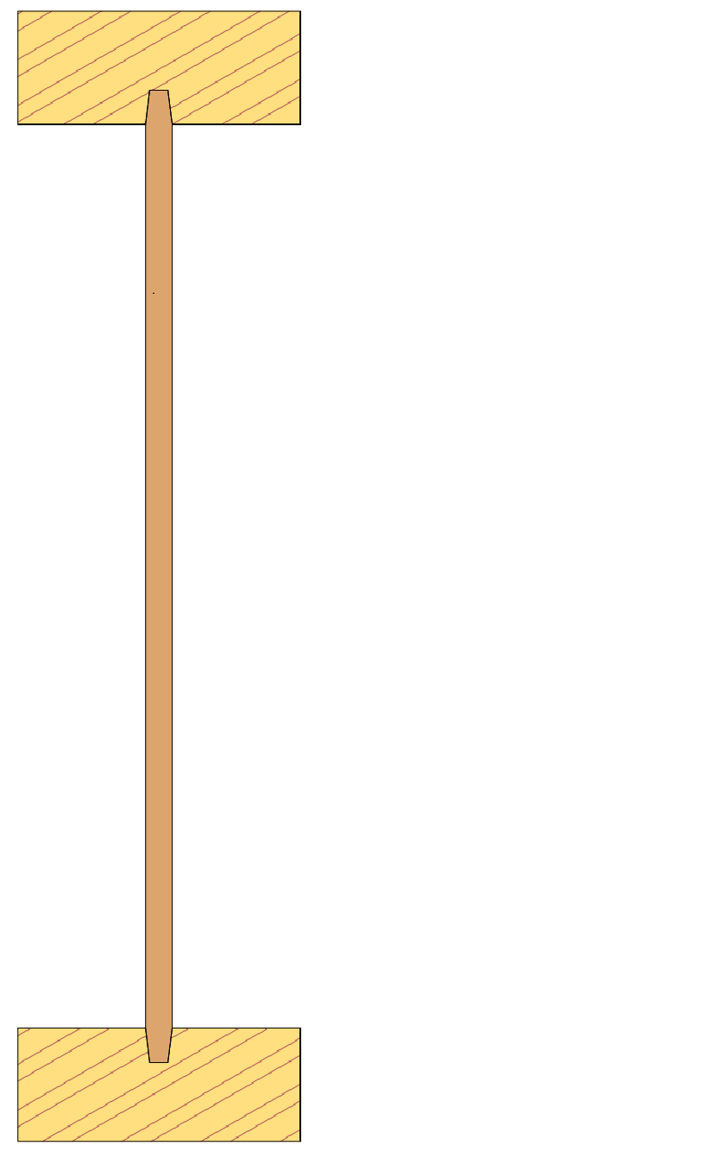
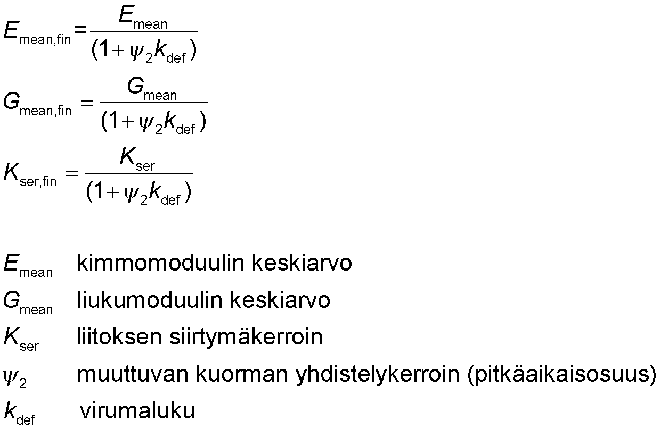
Stiffness properties in ultimate limit state
When the structure consists of components with different time-dependent performance, the mean values of the end state of the rigidity properties are used
Sawn timber C24
Plywood board, etc.
mean elasticity modulus
mean shear modulus
slip modulus
variable load aggregation factor (long-term part)
creep coefficient
Sawn timber C24

Slide 19

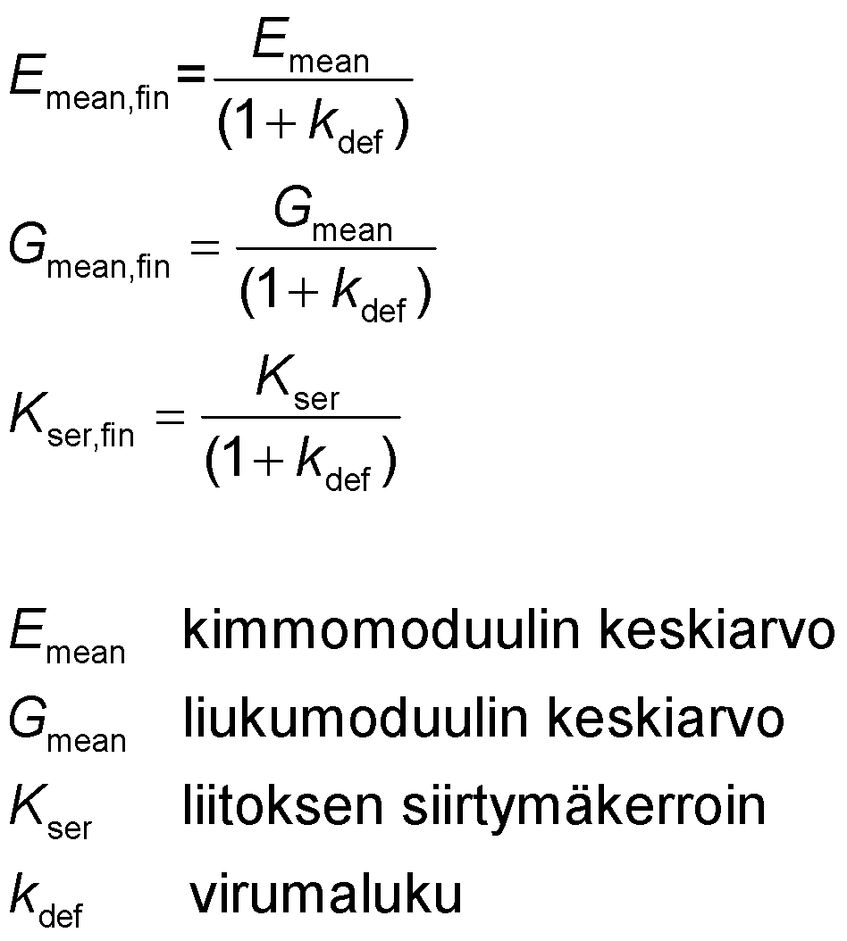
Stiffness properties in serviceability limit state
When the structure consists of components with different time-dependent performance, the mean values of the end state of the rigidity properties are used
Sawn timber C24
Plywood board, etc.
mean elasticity modulus
mean shear modulus
slip modulus
creep coefficient
Sawn timber C24

Slide 20
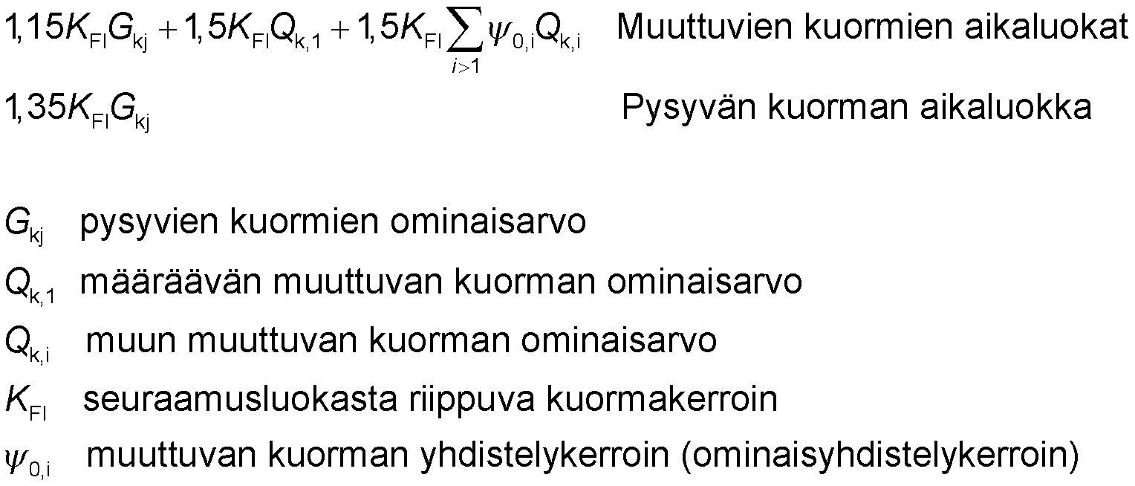
Design load
Structure durability in ultimate limit state
Duration factor depends on the shortest load duration
Variable load duration classes
Sustained load duration class
sustained load characteristic value
determining variable load characteristic value
Other variable load characteristic value
consequence class dependent load factor
variable load aggregation factor (characteristic combination coefficient)

Slide 21
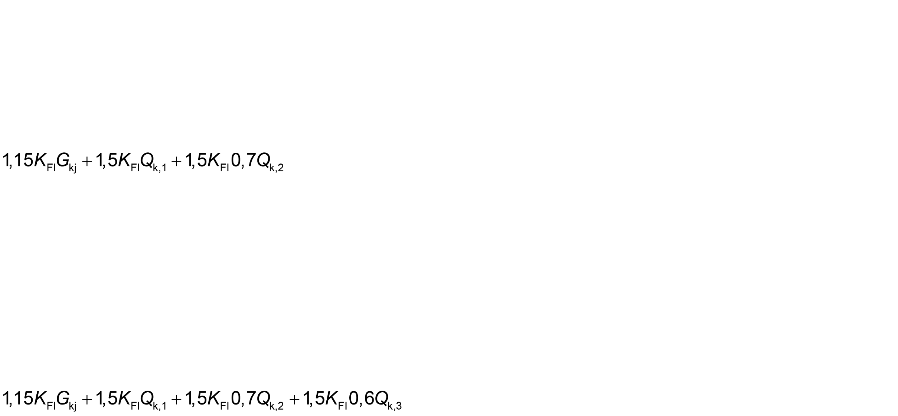
Design load
Load case 1, Medium duration factor, Ultimate limit state
K_{FI} 1,0 (consequence class CC2)
G_{kj} own weight
Q_{k,1} snow load (medium) (determining shifting load)
Q_{k,2} intermediate floor payload (medium) (Ψ_{0,1} =0,7)
(Sustained 100% + Snow 100% + Payload 70%)
Load case 2, Temporary duration factor, Ultimate limit state
K_{FI} 1,0 (consequence class CC2)
G_{kj} own weight
Q_{k,1} intermediate floor payload (medium) (determining shifting load)
Q_{k,2} snow load (medium) (Ψ_{0,2} =0,7)
Q_{k,3} wind load (temporary) (Ψ_{0,3} = 0,6)
(Sustained 100% + Payload 100% + Snow 70% + Wind 60%)

Slide 22
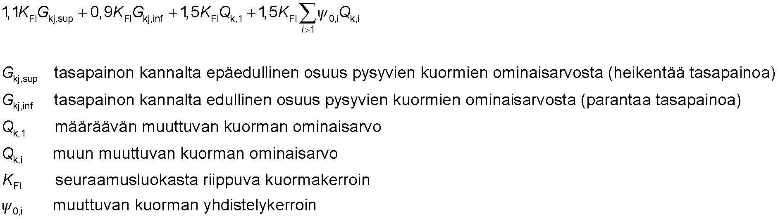
Design load
Static balance of the structure in ultimate limit state
E.g. stiffening structures, anchoring joints, continuous beam support lifting force
unfavourable proportion of the characteristic value of sustained loads (decreases balance)
favourable proportion of the characteristic value of sustained loads (improves balance)
determining variable load characteristic value
Other variable load characteristic value
consequence class dependent load factor
variable load aggregation factor

Slide 23
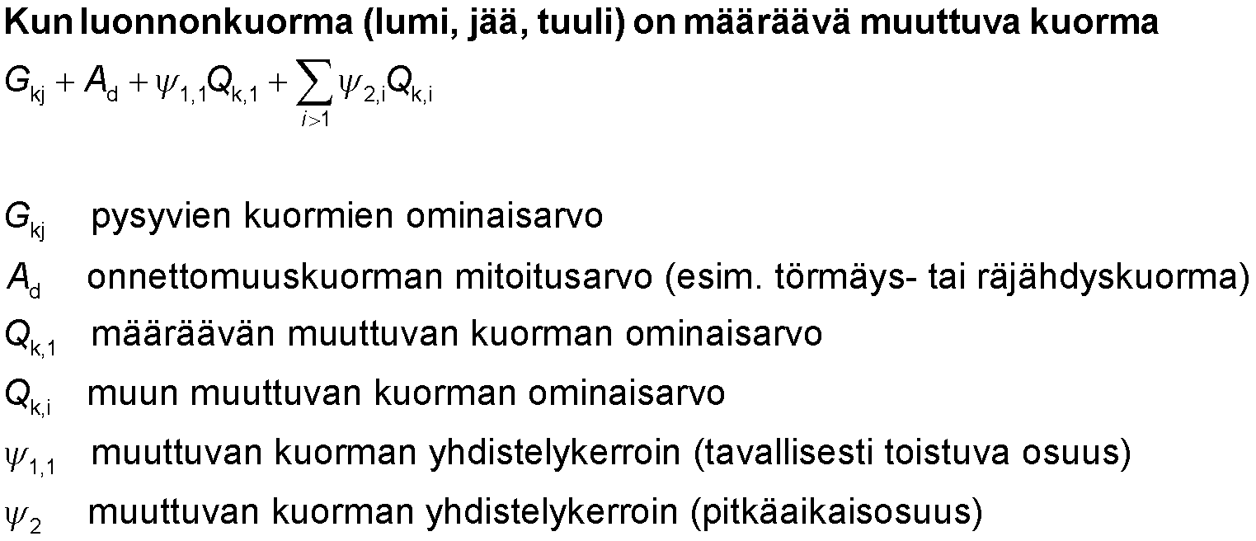
Design load
Structure durability in accidental limit state
E.g. fire, prevention of continuous collapse
sustained load characteristic value
rated accident load (e.g. collision or explosion load)
determining variable load characteristic value
Other variable load characteristic value
variable load aggregation factor (normally repeating part)
variable load aggregation factor (long-term part)

Slide 24
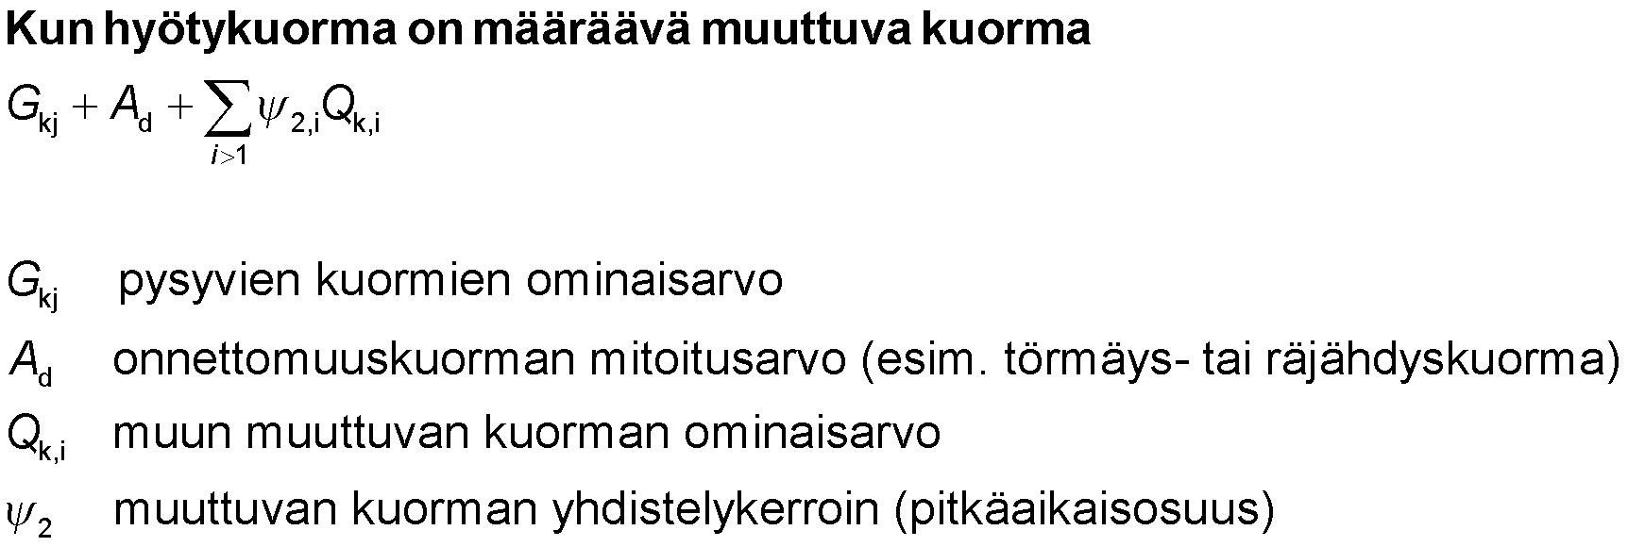
Design load
Structure durability in accidental limit state
E.g. fire, prevention of continuous collapse
When payload is a determining shifting load
sustained load characteristic value
rated accident load (e.g. collision or explosion load)
Other variable load characteristic value
variable load aggregation factor (long-term part)

Slide 25
Total deformation Time-dependent operation of structural elements is similar
Total deformation is caused by a temporary deformation and additional deformation caused by creep
Temporary deformation is caused by the temporary part of the load
Caused by creep
Sustained load
Long-term portion of shifting load c₂
When the structure has materials and joints with similar creep, one uses
mean values of mean elasticity modulus, mean shear modulus and slip modulus
Characteristic combination of load

Slide 26
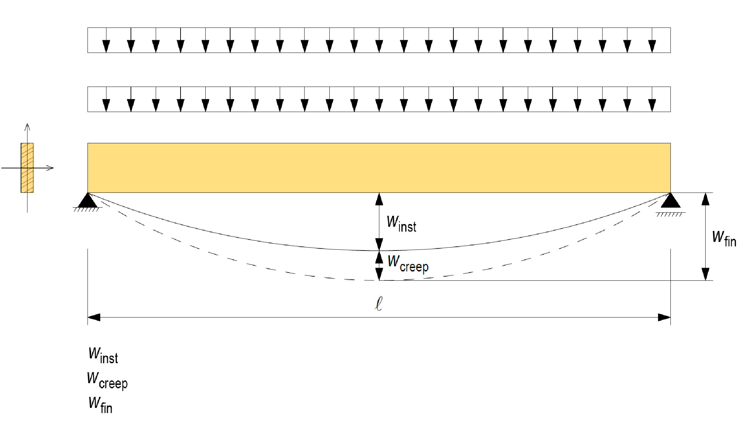
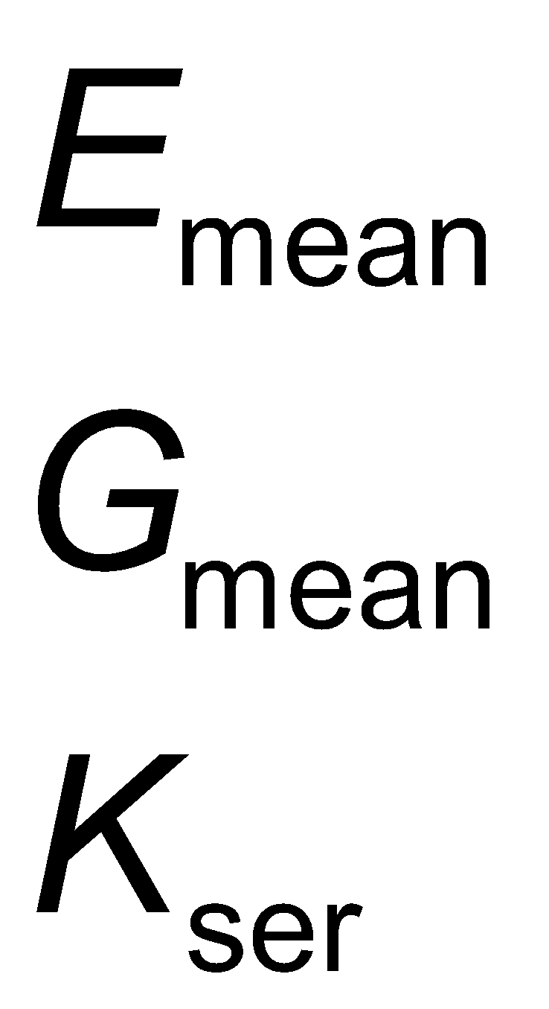
Total deformation Time-dependent operation of structural elements is similar
Shifting load (long-term portion Ψ₂)
Sustained load
= Temporary bending
= Bending due to creep
= Total bending (final bending)

Slide 27
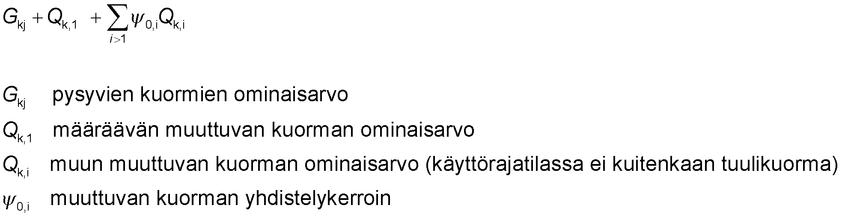
Characteristic combination (w_{inst}, u_{inst}) Time-dependent operation of structural elements is similar
Temporary bending of the structure w_{inst} or deformation state u_{inst} in serviceability limit state
Materials and joints with similar creep
sustained load characteristic value
determining variable load characteristic value
other variable load characteristic value (excluding wind load in serviceability limit state)
variable load aggregation factor

Slide 28
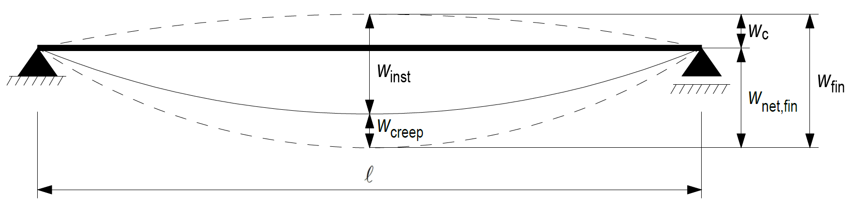
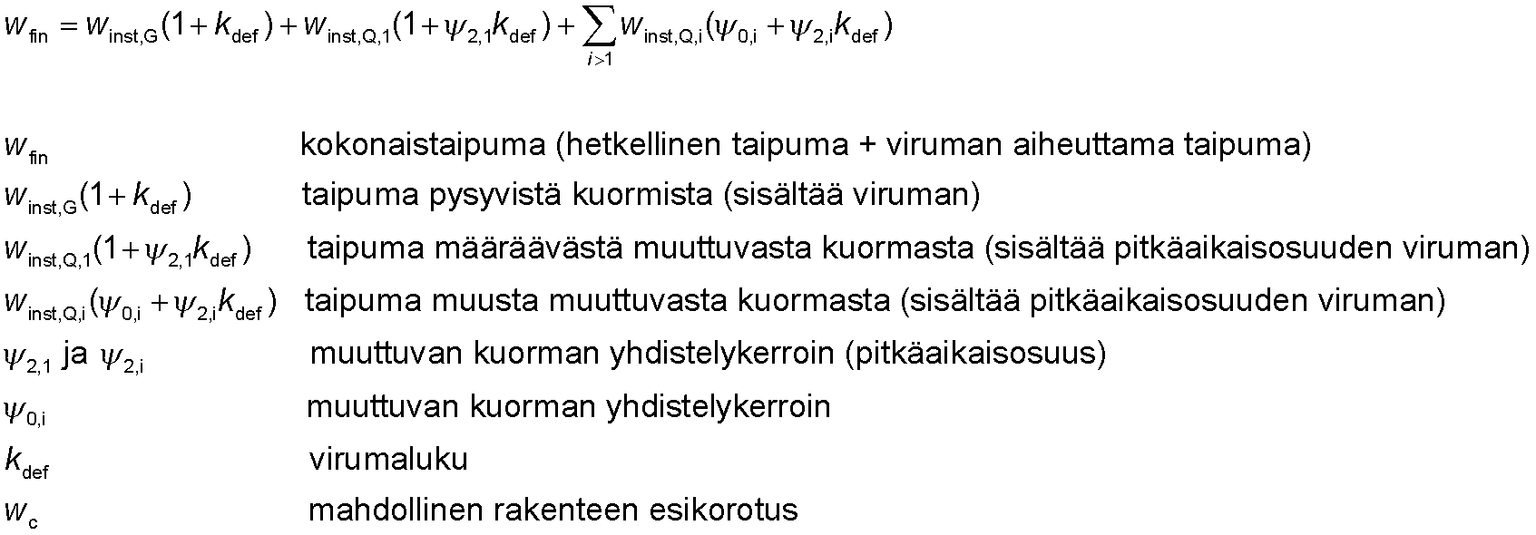
Total deformation Time-dependent operation of structural elements is similar
NOTE!
Temporary deformation is determined by E_{mean}, G_{mean}, K_{ser}
The effect of creep is considered by adding the additional deformation determined by creep factor k_{def} to the temporary deformation
total bending (temporary bending + bending caused by creep)
creep from sustained loads (includes creep)
bending from a determining shifting load (includes the long-term part of creep)
bending from other shifting loads (includes long-term creep)
variable load aggregation factor (long-term part)
variable load aggregation factor
creep coefficient
possible structural pre-elevation

Slide 29
Total transformation Time-dependent operation of structural elements is different
Total deformation is caused by a temporary deformation and additional deformation caused by creep
Temporary deformation is caused by the temporary part of the load
Caused by creep
Sustained load
Long-term portion of shifting load c₂
When a structure has materials and joints with different creeps, one uses
For temporary part of shifting load
Mean values of mean elasticity modulus, mean shear modulus and slip modulus and characteristic combination of the temporary part of the shifting load
For sustained load and the long-term part of a shifting load
Mean values of end state of mean elasticity modulus, mean shear modulus and slip modulus, and long-term combination of loads

Slide 30
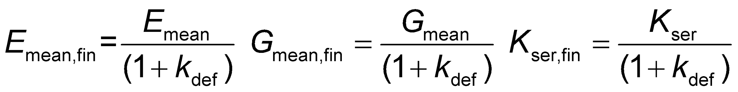
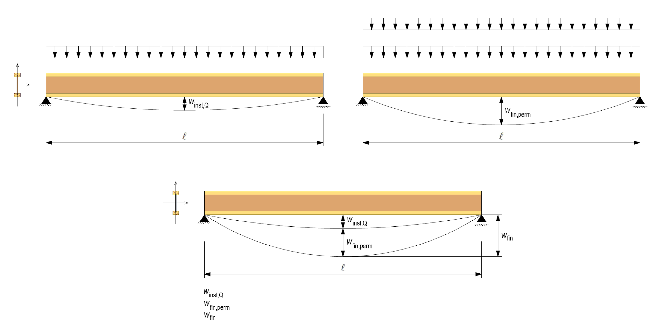

Total transformation Time-dependent operation of structural elements is different
Shifting load (long-term portion Ψ₂)
Shifting load (temporary part)
Sustained load
= Temporary bending
= Long-term bending (includes bending caused by creep)
= Total bending (final bending)

Slide 31
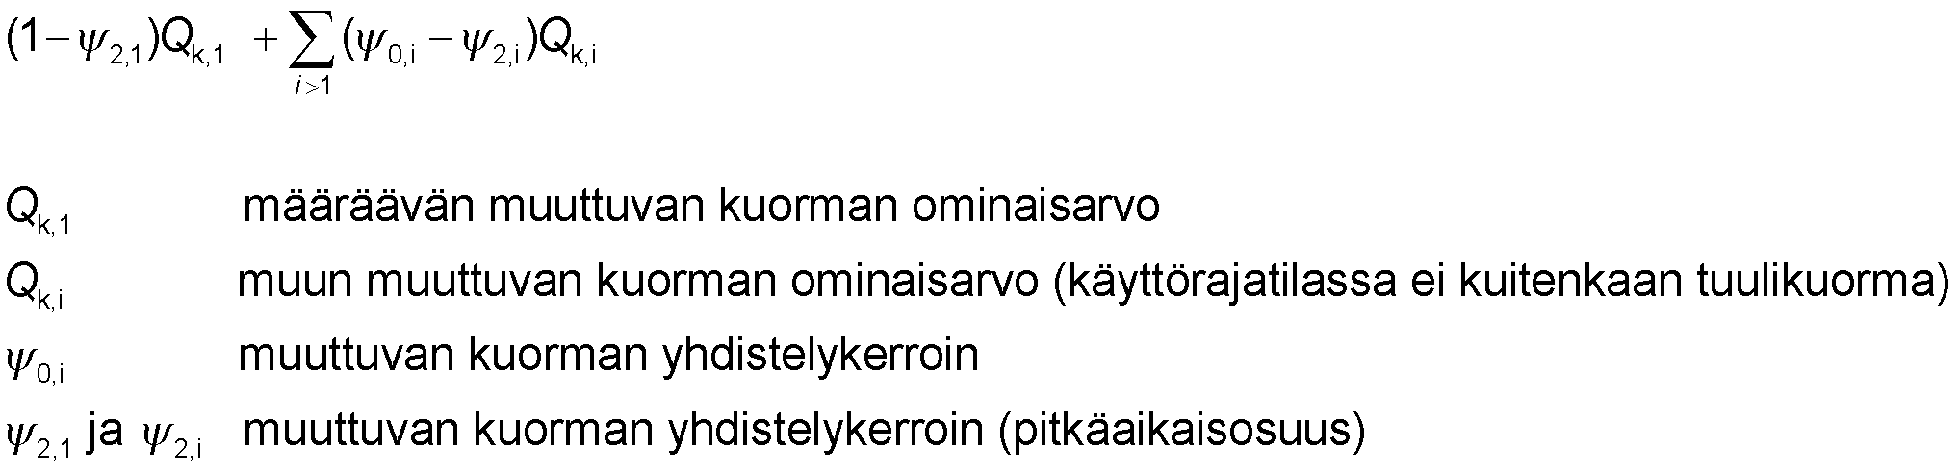
Characteristic combination (w_{inst}, u_{inst}) Time-dependent operation of structural elements is different
Temporary bending of the structure w_{inst} or deformation state u_{inst} in serviceability limit state
Characteristic combination of temporary part of shifting load
determining variable load characteristic value
other variable load characteristic value (excluding wind load in serviceability limit state)
variable load aggregation factor
variable load aggregation factor (long-term part)

Slide 32
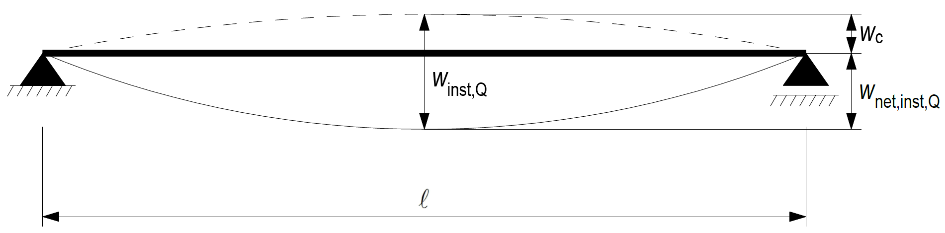
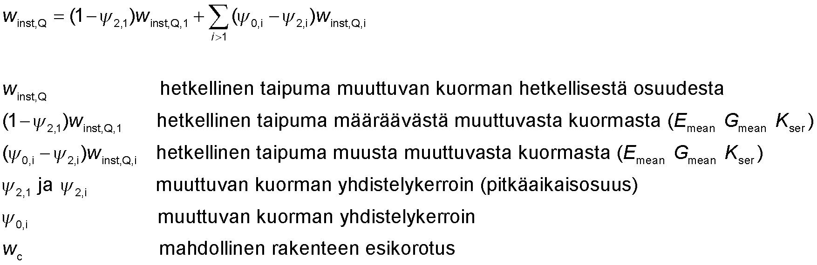
Temporary transformation (w_{inst}, u_{inst}) Time-dependent operation of structural elements is different
temporary bending from temporary part of shifting load
temporary bending from a determining shifting load (E_{mean} G_{mean} K_{ser})
temporary bending from another shifting load (E_{mean} G_{mean} K_{ser})
variable load aggregation factor (long-term part)
variable load aggregation factor
possible structural pre-elevation

Slide 33
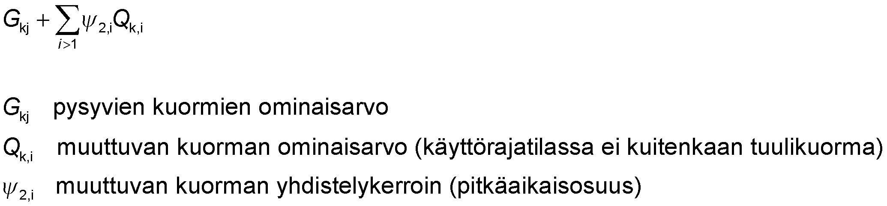
Long-term combination (w_{inst}, u_{inst}) Time-dependent operation of structural elements is different
Long-term bending of the structure w_{perm,fin} or transformation state in u_{perm,}serviceability limit state (includes creep)
Long-term load combination
sustained load characteristic value
the characteristic value of shifting load (with the exception of wind load in the serviceability limit state)
variable load aggregation factor (long-term part)

Slide 34
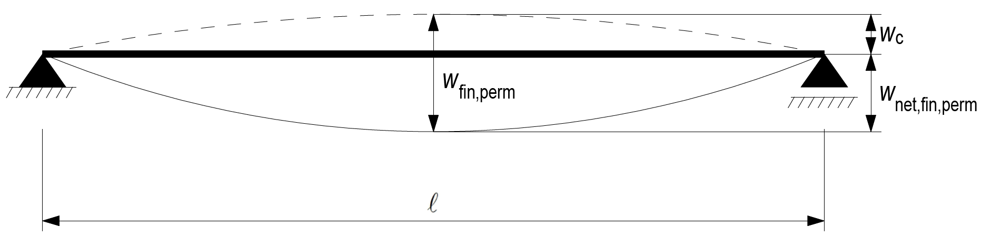
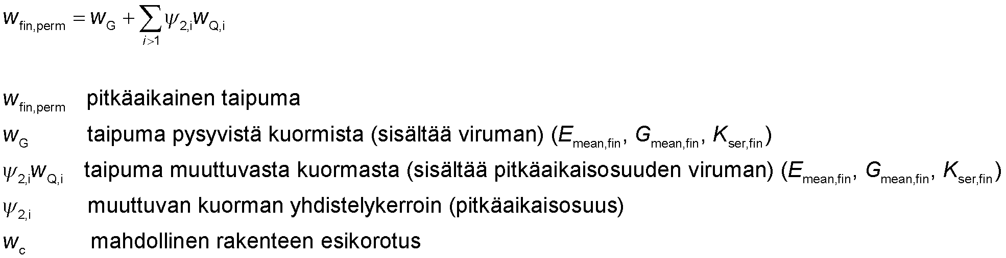
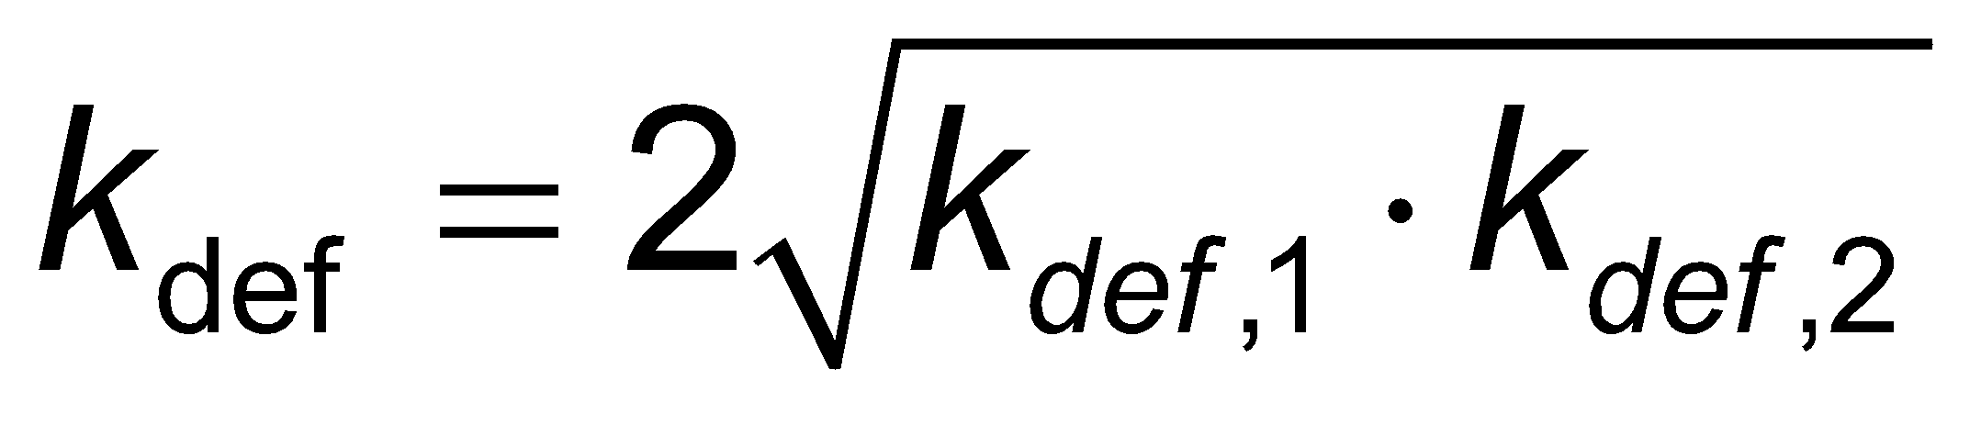
Long-term transformation (w_{perm,fin}, u_{perm,fin}) Time-dependent operation of structural elements is different
NOTE!
Transformation (incl. creep) is determined by values
E_{mean,fin}, G_{mean,fin}, K_{ser,fin}
When the connector connects wooden components with different time-dependent behaviors, the final state of transformation is determined using the following creep coefficient
long-term bending
Creep from sustained loads (includes creep) (E_{mean,fin}, G_{mean,fin}, K_{ser,fin})
Bending from shifting load (includes long-term creep) (E_{mean,fin}, G_{mean,fin}, K_{ser,fin})
variable load aggregation factor (long-term part)
possible structural pre-elevation

Slide 35
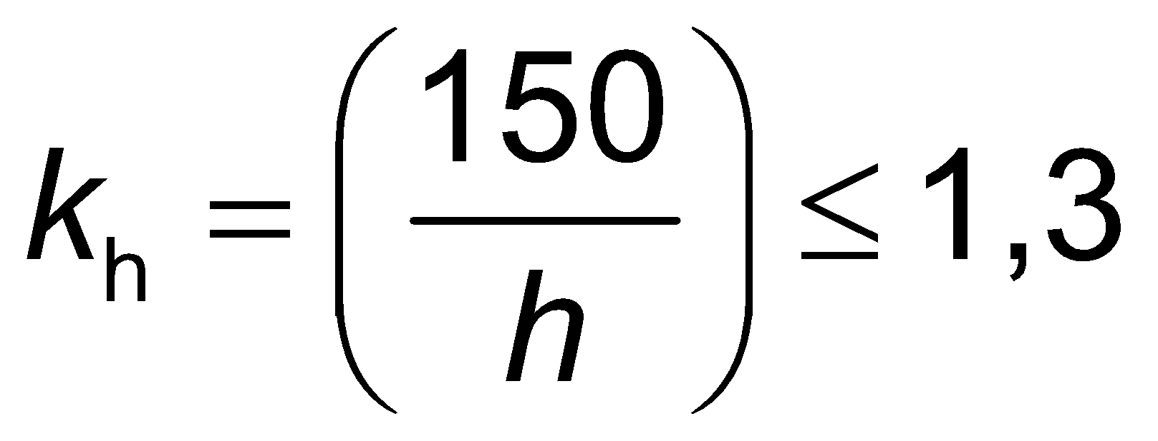
Sawn timber
The sawn timber must comply with EN 14081-1
Stress-sorted construction timber must be CE marked
Finger joints must comply with EN 15497
Crack factor k_{cr} = 0.67 in shear calculations in operating class 1
When the height of the bent sawn timber beam h is less than 150 mm, the characteristic value of the bending strength f_{m,k} may be increased by the factor k_{h}
When the larger lateral dimension of the tensile sawn timber rod h is less than 150 mm, the characteristic value of tensile strength f_{t,0,k} may be increased by the factor k_{h}

Slide 36
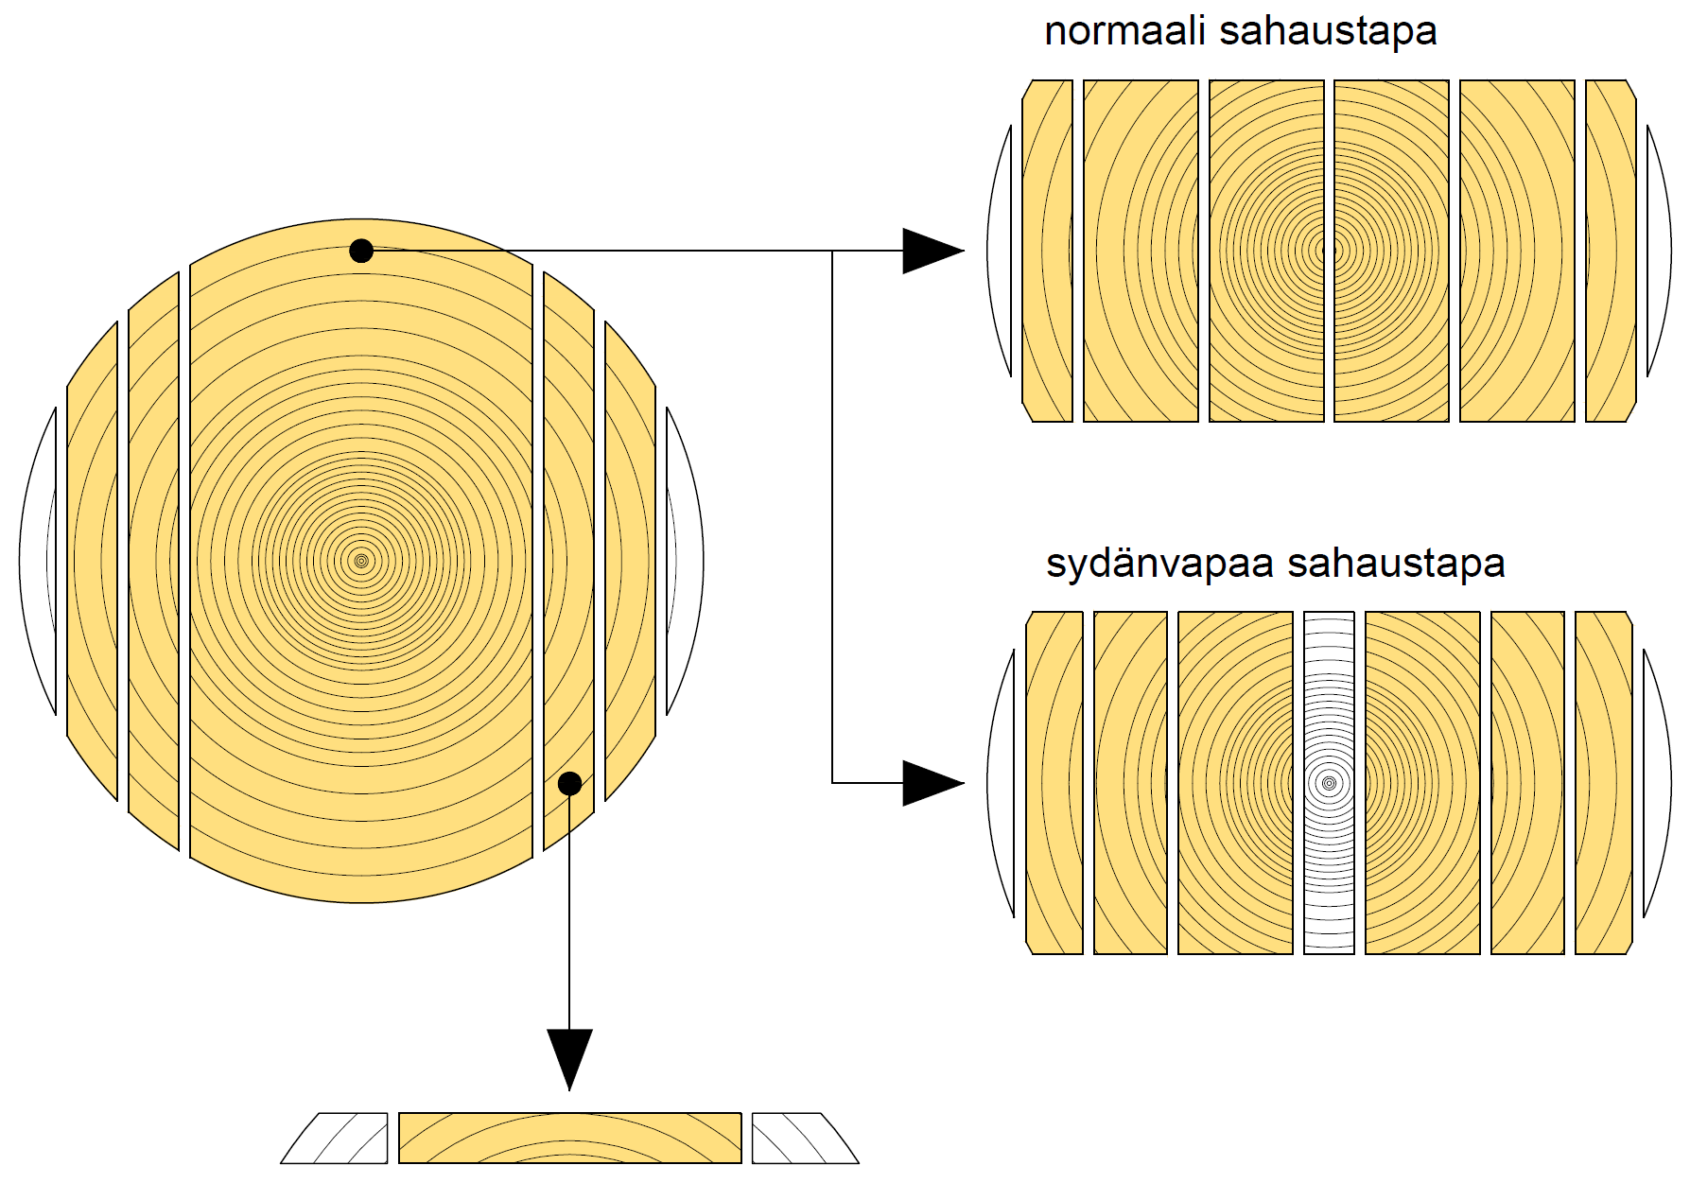
Nordic cutt
normal cut
pith-free cut

Slide 37
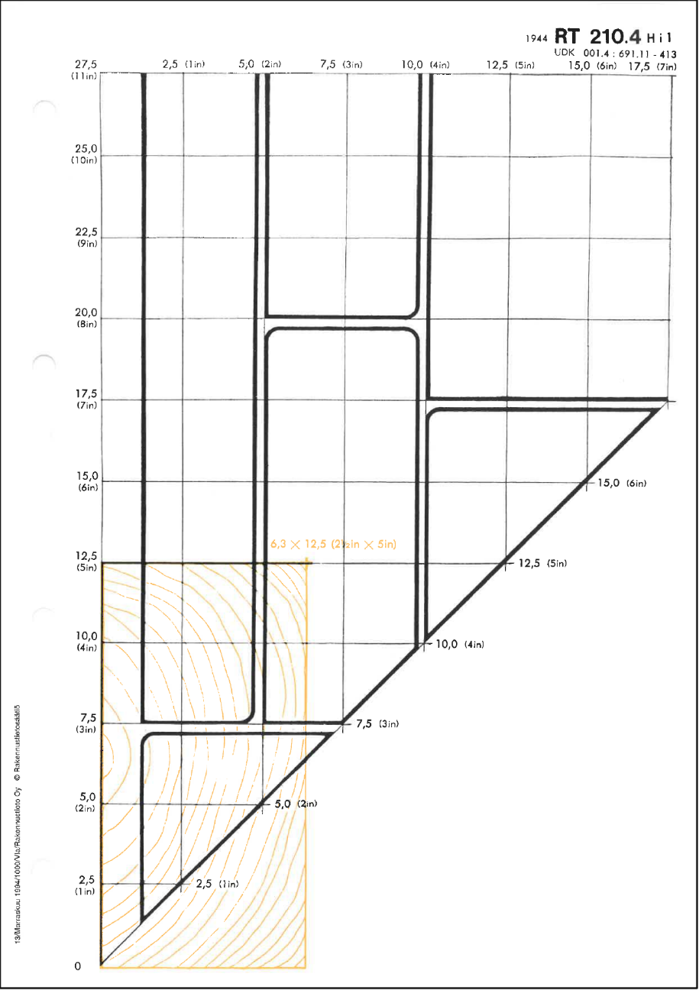
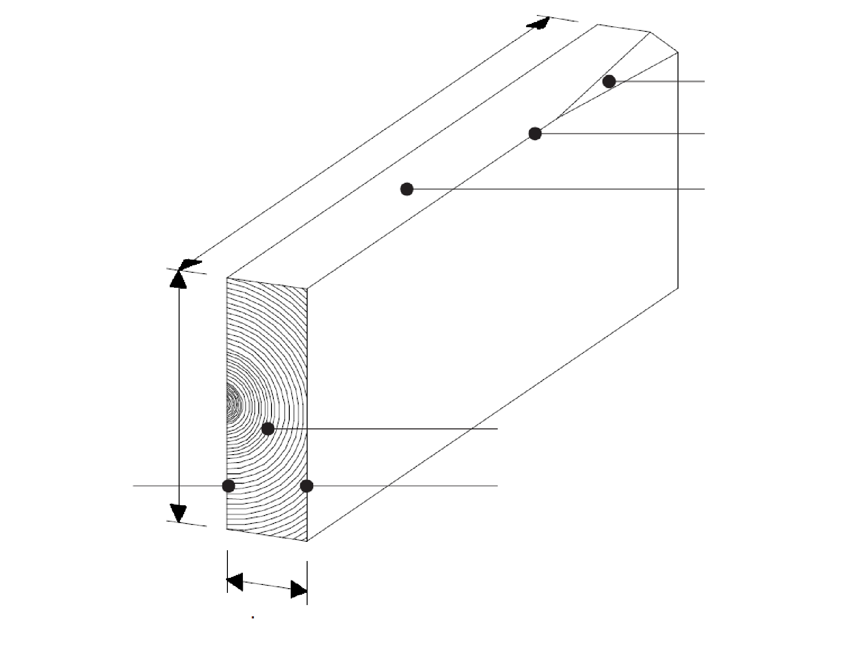
Names of sawn timber
TIMBER, names
wane
board
“bräda” (a long board)
plank
“planka” (plank)
“parru” (spar) “bjälke”
length
arris
edge
“saira” “regel”
“piiru” (rafter) “spira”
width
growth rings
inside face
outside face
“rima” (strip) “läkt”
The coordinate system has wood dimensions in centimetres 1:1 on the vertical and horizontal axis, in inches in brackets. The thick lines restrict the naming areas.
The names of planed timber based on sawn timber.
In the coordinate system, the example timber is 6.3 cm thick and 12.5 cm wide. The point 6.3 x 12.5 is in the “saira” area, which determines the name.
thickness
Source: RT 210.4

Slide 38
Sawn timber
Sawn timber | Name | Examples of applications | Stress grading | Quality sorting (appearance)
Sawn surface | Rima (strip), Lauta (board), Soiro, Lankku (plank), Piiru (rafter), Parru (spar) | Concrete moulds, lathes , temporary structures | Not usually | Yes
Coarse planed (Measured) (Also finger-joined) | Rima (strip), Lauta (board), Soiro, Lankku (plank) | Load-bearing frame, frame structures in general | Strength class C24 48x98, 48x123, 48x148, 48x173, 48x198, 48x223 Other sizes Not usually | Yes
Planed (Planed clean) | Rima (strip), Lauta (board), Soiro, Lankku (plank) | Interior, visible structures | Not usually | Yes
Pressure saturated (Measured) | Rima (strip), Lauta (board), Soiro, Lankku (plank) | Yard construction, platforms | Not usually | Not usually
Heat-treated | Rima (strip), Lauta (board), Soiro (plank) | Interior decoration, outer cladding, garden construction | Not possible | Yes

Slide 39
Strength grading of sawn timber
Softwood strength classes according to EN 338 (visual or mechanical sorting)
All strength classes | C14, C16, C18, C20, C22, C24, C27, C30, C35, C40, C45, C50
The most common strength classes in Finland | C18, C24, C30, C35, C40
Softwood strength classes according to INSTA 142 (visual sorting) INSTA = INternordisk STAndardisering
All strength classes | T0, T1, T2, T3
Equivalent to EN 338 | T0 = C14, T1 = C18, T2 = C24, T3 = C30
Special cases | Strength class
Unsorted round timber and round, planed or solid wooden logs | C24 (assumed)
Unsorted sawn timber for own use for a single-family house or agricultural building | C24 (assumed)
Unsorted sawn wood of a thickness of less than 40 mm, square sawn timber Unsorted sawn wood with a maximum length of 50 mm, square sawn timber | C18 (assumed)

Slide 40
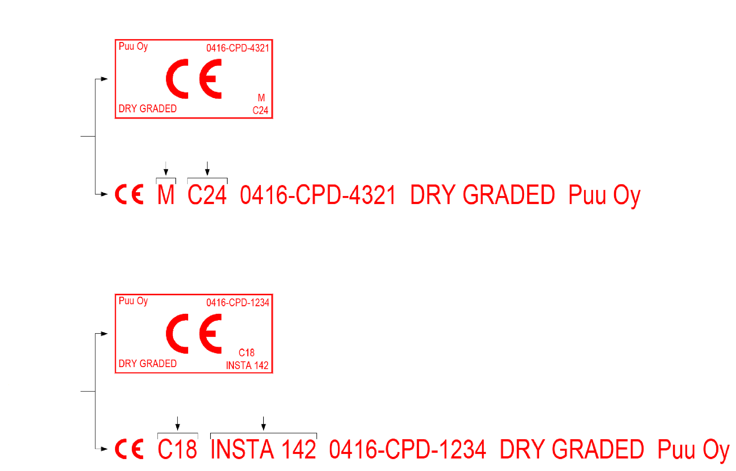
Strength grading of sawn timber
MECHANICAL STRENGTH SORTING
Optional
Machine-sorted Strength class
VISUAL STRENGTH SORTING
Optional
Strength class
Sorting standard

Slide 41
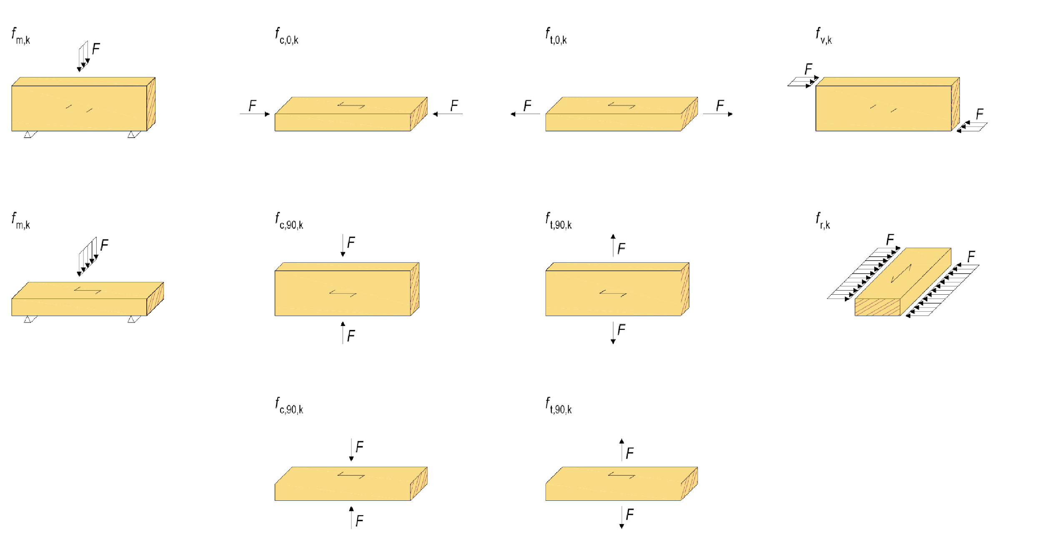
Strength values of sawn timber
Compression in the grain direction
Traction in the grain direction
Bending on the edge
Shearing
Compression transversely opposite the grain direction
Tranction transversely opposite the grain direction
Shearing transversely opposite the grain direction
Bending flatwise
("rolling shear")
Compression transversely opposite the grain direction
Tranction transversely opposite the grain direction

Slide 42
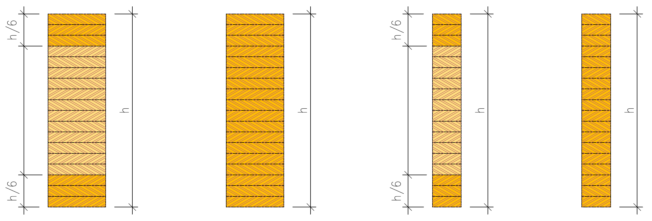
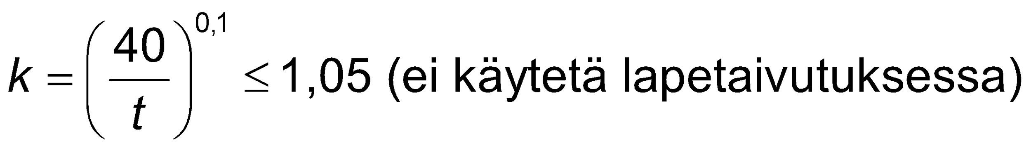
Horizontal glue laminated timber
Cross-laminated timber
GL24c, GL30c
Homogeneous laminated timber
GL24h, GL30h
In horizontal glue laminated timber
The lamellae overlap
2 or more layers of lamellae
GL strength classes in use
Thickness of lamellae max. 45 mm
In category 3 up to 35 mm
When the lamella thickness is less than 40 mm, the characteristic value of the bending strength may be f_{m,k} increased by the factor k
Splitting glue laminated timber reduces its strength
Split cross-laminated timber GL30cs
Split homogeneous laminated timber GL30hs
(not used for side of plank bending)

Slide 43
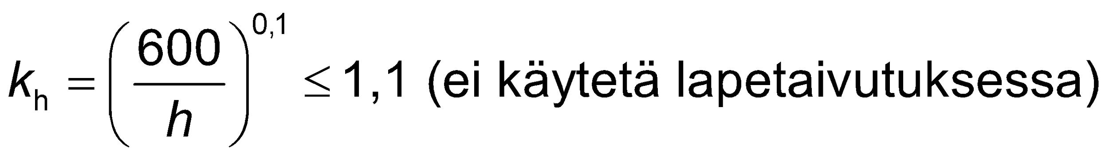
Horizontal glue laminated timber
Glue laminated timber must comply with EN 14080
Glue laminated timber must be CE marked
When the height of the bent glue laminated timber beam h is less than 600 mm, the characteristic value of the bending strength f_{m,k} may be increased by the factor k_{h}
When the larger lateral dimension h of tensile glue laminated stick is less than 600 mm, the characteristic value of tensile strength f_{t,0,k} may be increased by the factor k_{h}
(not used for side of plank bending)

Slide 44
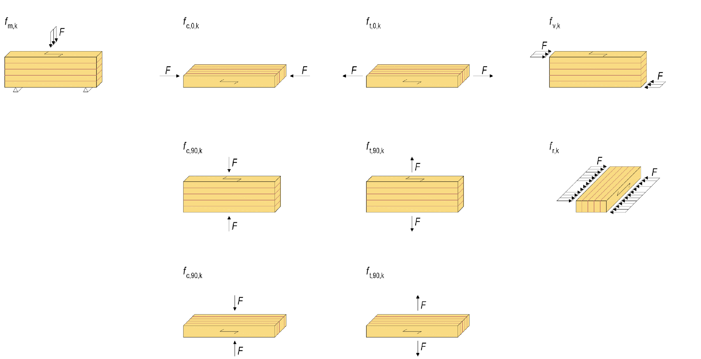
Strength values of horizontal glue laminated timber
Bending on the edge
Compression parallel to the grain
Traction parallel to the grain
Shear
Compression transversely opposite the grain direction
Tranction transversely opposite the grain direction
Shearing transversely opposite the grain direction
("rolling shear")
Compression transversely opposite the grain direction
Tranction transversely opposite the grain direction

Slide 45
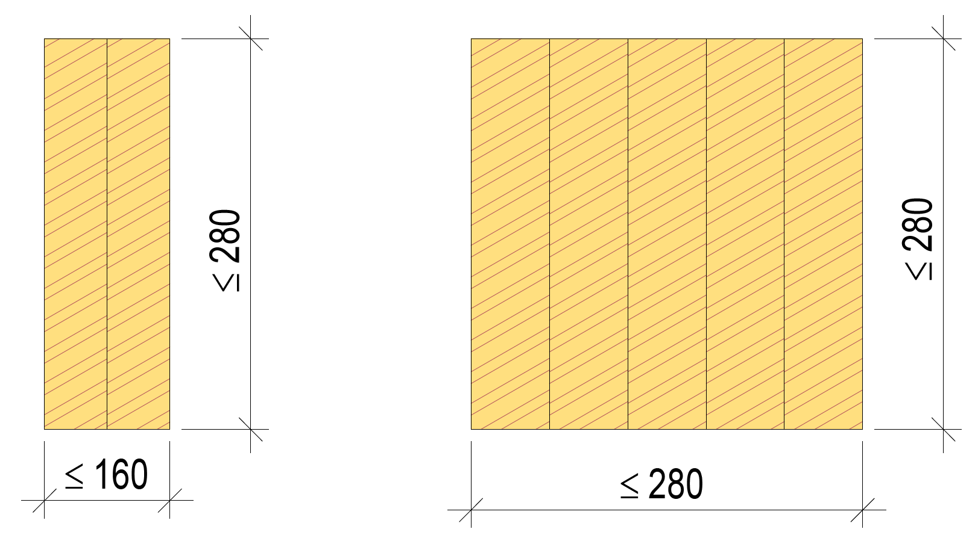
Glued sawn timber
Glued sawn timber must comply with EN 14080
Glued sawn timber must be CE marked
The lamella thickness shall not exceed 45 to 85 mm
The number of lamellae may be 2...5 pcs
The cross-section size should be as shown in the adjacent images
Strength and stiffness characteristics
By category of lamellae (e.g. C24)
Product-specific classification possible

Slide 46
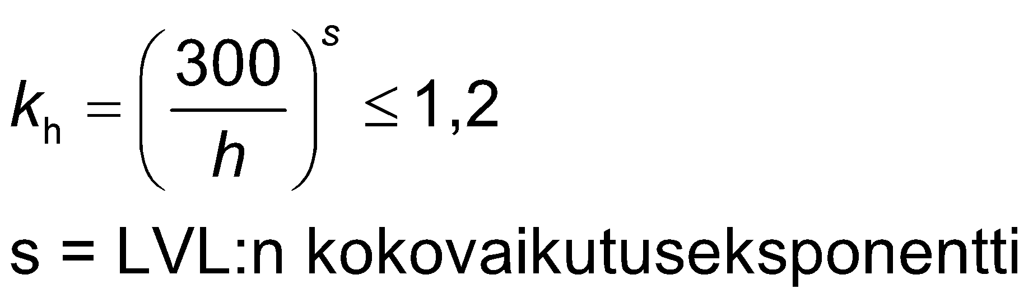
LVL= Laminated Veneer Lumber
LVL must comply with EN 14374
LVL must be CE marked
When the height of the LVL beam h is less than 300 mm, the characteristic value of edge-bending strength f_{m,k} may be increased by the factor k_{h}
When the height of the LVL beam h is over 300 mm, the characteristic value of edge-bending strength f_{m,k} may be decreased by the factor k_{h}
LVL's total impact exponent

Slide 47
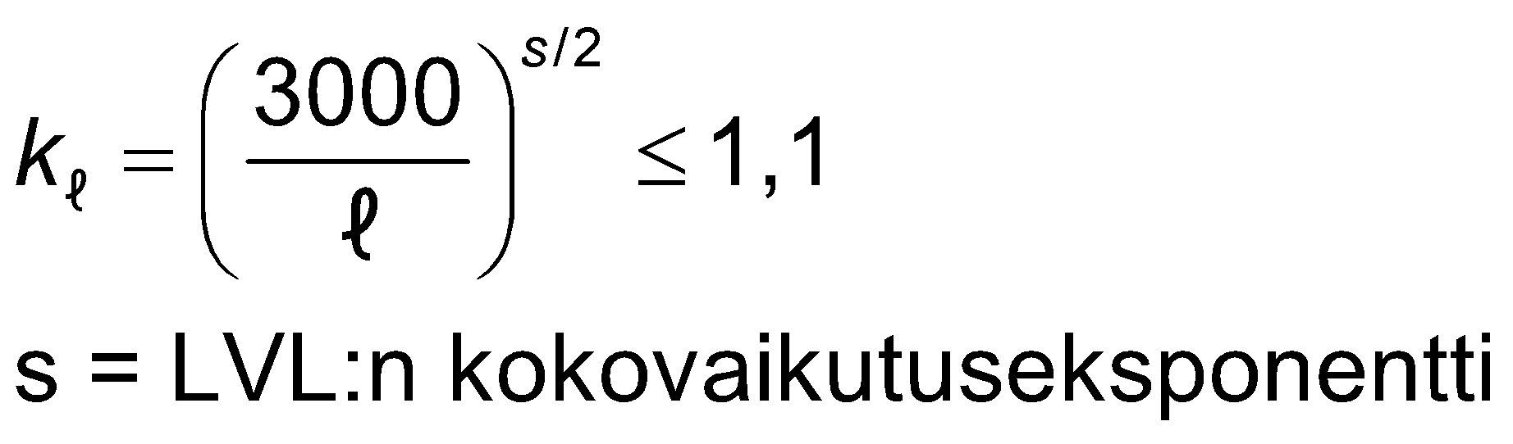
LVL= Laminated Veneer Lumber
When the length of the tensile LVL rod is less than 3000 mm, the tensile strength characteristic value f_{t,0,k} may be increased by the factor k_{l}
When the length of the tensile LVL rod is over 3000 mm, the tensile strength characteristic value f_{t,0,k} may be decreased by the factor k_{l}
LVL's total impact exponent

Slide 48
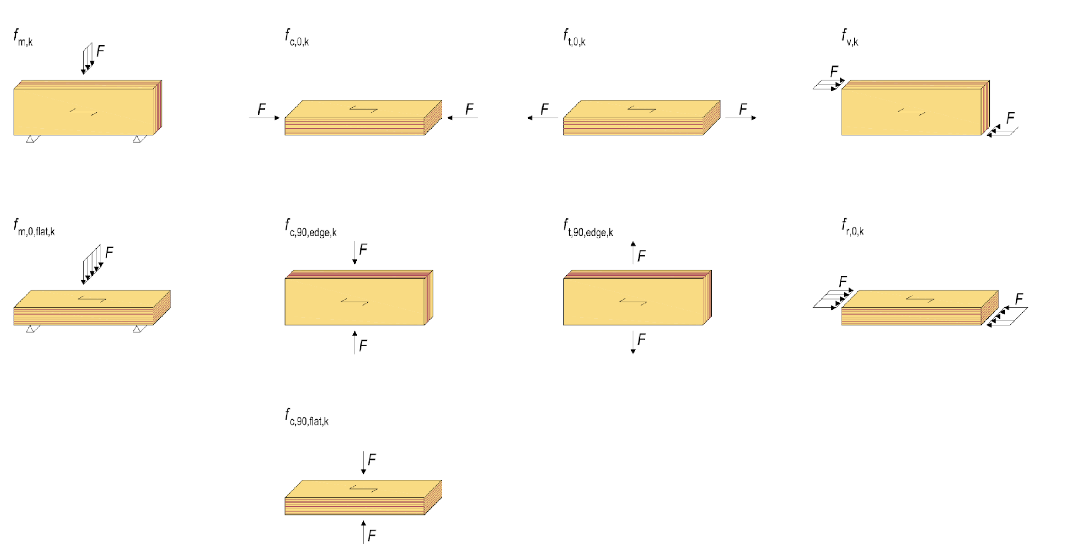
LVL strength values
Bending on the edge
Compression parallel to the grain
Traction parallel to the grain
Cutting edgewise
Bending flatwise
Edgewise compression against grain
Edgewise traction against grain
Cutting on the side in the direction of face ply
Edgewise compression on the side

Slide 49
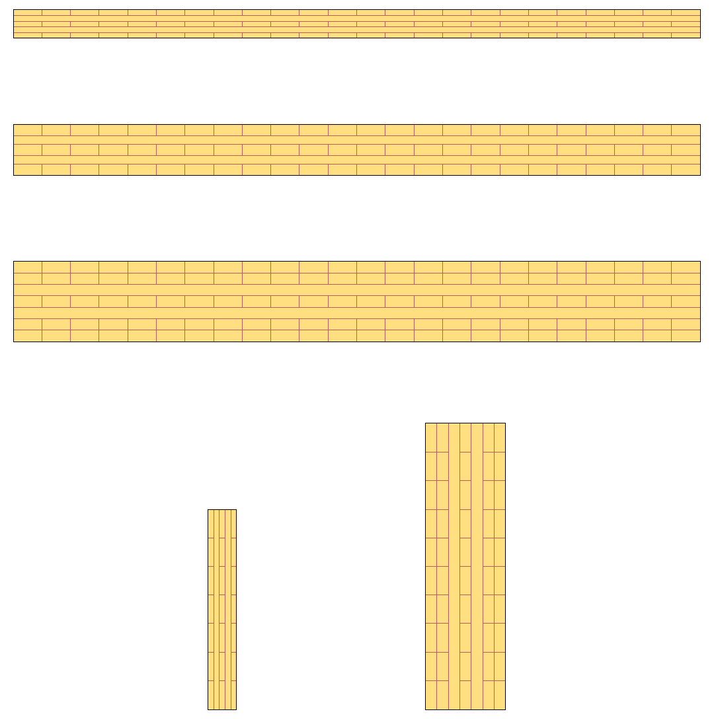
CLT= Cross Laminated Timber
The CLT panel is a solid wood panel assembled by gluing strength-sorted lamellae together.
Typically, the lamella thicknesses are 20 mm, 30 mm, 40 mm
A CLT panel may contain lamellae of different thicknesses
There is currently no harmonised product standard for CLT panels
The CE marking may be completed under the ETA European Technical Assessment:

Slide 50
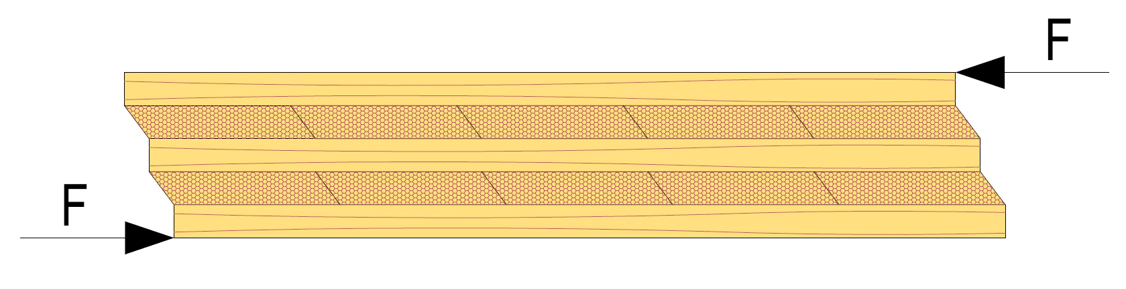
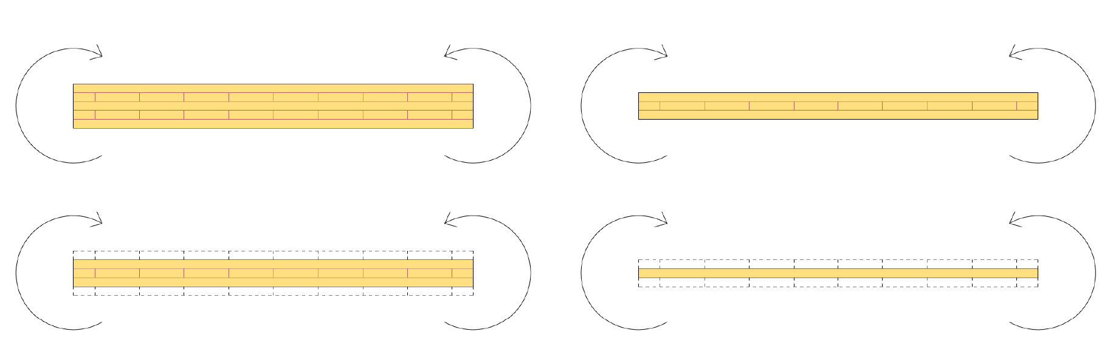
CLT= Cross Laminated Timber
The CLT panel is examined as a layered structure
The effective bending stiffness of the CLT panel EI_{ef} can be determined using the g method described in the euro code (max 5-layer panel)
Some manufacturers have pre-tabulated strength values for standardised cross-sections
CLT has a "strong" and "weak" orientation
CLT panel 1
“Strong orientation”
CLT panel 2
“Strong orientation”
CLT panel 1
“Weak orientation”
CLT panel 2
“Weak orientation”

Slide 51

Industrially manufactured logs
Industrially manufactured logs include:
Solid timber log
Laminated log
Cross-laminated log (non-compressed)
There is currently no harmonised product standard for logs
The CE marking may be completed under the ETA European Technical Assessment:
The strength and rigidity characteristics of the logs are presented in the manufacturer's documentation
Laminated log
Width: 95...275 mm
Height: 170...275 mm
Length: ≤13 m
Dimensions. laminated structure and profile shape vary by manufacturer
Solid timber log
Width: 95...205 mm
Height: 170...220 mm
Length: ≤13 m
Dimensions and profile shape vary by manufacturer
Non-settling timber
Width: 135...275mm
Height: 220...275 mm
Length: ≤13 m
Dimensions, laminated structure and profile shape vary by manufacturer

Slide 52



Wood-based panels
Spruce plywood panel
Chipboard
OSB panel
Image: UPM
Image: Puuinfo
Image: EGGER

Slide 53
Plywood panel
Spruce plywood panels are typically used in construction
Other types of plywood panels can also be used on a case-by-case basis
Moisture resistance important when selecting a panel type
The strength and rigidity values of plywood panels are presented in a table
Depending on panel thickness and veneer direction
Plywood panels must comply with EN 13986
Plywood panels must be CE marked
In some cases, a plywood panel can be replaced with an LVL panel

Slide 54


Plywood panel
For example: 9 mm
“Strong orientation”
Plywood panels have a "strong" and "weak" orientation
Must be considered in dimensioning and panel installation
The grain direction of the face ply must be perpendicular to the brackets
In the plate size marking, the first digit indicates the grain direction of the face ply
“Weak orientation”
For example:
For example:
Grain direction of face ply
Grain direction of face ply

Slide 55

Illustration shows incorrect wall panelling
Correct grain direction
Incorrect grain direction
Unsupported panel seam
Unsupported panel seam
Steel profile
Steel profile
Steel profile
Incorrect grain direction
Incorrect grain direction
Image: Tero Lahtela

Slide 56
Chipboard
Chipboard can only be used in categories 1 and 2
Some particle board types only in category 1
The strength and rigidity values of the chipboard are presented in a table
By plate thickness and strength class
Chipboard strength classes: P4, P5, P6, P7
Chipboard must comply with EN 13986
Chipboard must be CE marked

Slide 57
OSB = Oriented Strand Board
OSB can only be used in category 1 and 2
Some OSB types only in category 1
The strength and rigidity values of OSB are presented in a table
By plate thickness and strength class
OSB strength classes are OSB/2, OSB/3, OSB/4
OSB has a "strong" and "weak" orientation
Must be considered in dimensioning and panel installation
The main direction of the panel should be perpendicular to the brackets
OSB must comply with EN 13986
OSB must be CE marked

Slide 58

Loss of flexural strength of timber
Bending strength exceeded (f_{m,d})
Branches, etc. defects reduce bending strength

Slide 59

Loss of flexural strength from bending
Shear strength perpendicular to grain exceeded (f_{v,d})
Cracks and other faults deteriorate shear strength

Slide 60

Shear strength of wood (90° against grain direction)
The rolling shear strength is exceeded (f_{r,d})
A highly significant phenomenon in the dimensioning of a CLT panel

Slide 61

Compression strength of wood (in the grain direction)
Compression strength in the grain direction exceeded (f_{c,0,d})
A loss of compression strength occurs when the rod is too small to buckle it

Slide 62

Compression strength of wood (90° against grain direction)
DISTRIBUTION IN THE GRAIN DIRECTION
The distribution of compression stress can be considered with the support pressure factor k_{c}, ┴
Compression strength perpendicular to grain direction exceeded (f_{c,90,d})
The dimensioning can consider the distribution of compression stress caused by the grains of wood (l_{c,90,ef})
The grains of the tree function as "ropes"
Transversal compression causes a significant vertical compression
DISTRIBUTION PERPENDICULAR AGAINST GRAIN DIRECTION
In practice, compression stress is slightly distributed, but this cannot be considered with the support pressure factor k_{c}, ┴

Slide 63



Tensile strength of wood (in the grain direction)
Partial fracturing
Tensile strength in the grain direction exceeded (f_{t,0,d})
The size of the rod affects tensile strength
Branches, etc. defects reduce tensile strength
Loss of tensile strength may also occur in the joint area
Partial fracturing
Fracturing
Joint area
Fracturing
Joint area

Slide 64

Tensile strength of wood (90° against grain direction)
Groove in beam
Hole in beam
Perpendicular tensile strength against grain direction exceeded (f_{t,90,d})
The size of the rod affects tensile strength
Branches, etc. defects reduce tensile strength
A perpendicular loss of tensile strength can occur, for example:
Near a groove
Near a hole
In the joint area
At the prepared edge of a beam (e.g. top of a roof ridge beam)
Suspension joint on beam
Sawn beam top

Slide 65


Panel shear strength of a building board
Panel shear strength exceeds (f_{v,d})
Plate thickness of the panel significantly affects panel shear strength
The panel shear strength of the building board is given in the board specifications
Very relevant, for example:
In the dimensioning of bracing panels
In I-beam web plate dimensioning

