Slide 1



Industrial wood construction
Teaching materials for industrial wood construction education
2022

Slide 2
Origin of the materials
Use of the materials
These learning materials for industrial wood construction have been prepared in a project led by Puuinfo Oy in 2021–2022. Also involved in the project were
Lappia Vocational College,
TTS-Työtehoseura ry
South-Eastern Finland University of Applied Sciences,
Metropolia University of Applied Sciences,
Jyväskylä University of Applied Sciences,
University of Tampere, and
Federation of the Finnish Woodworking Industries Puutuoteteollisuus ry
The project was funded by the Ministry of the Environment.
The materials are intended to be used as extensively as possible in industrial wood construction education and studies.
The materials are released under the Creative Commons licence Attribution-ShareAlike (CC BY-SA), which requires that the author be properly credited when the materials are used and that derivative works may only be distributed under the same licence as the original work.
The original materials and any updates to them by Puuinfo will be published on the Library of Open Educational Resources website (aoe.fi) and the Puuinfo.fi website.

Slide 3
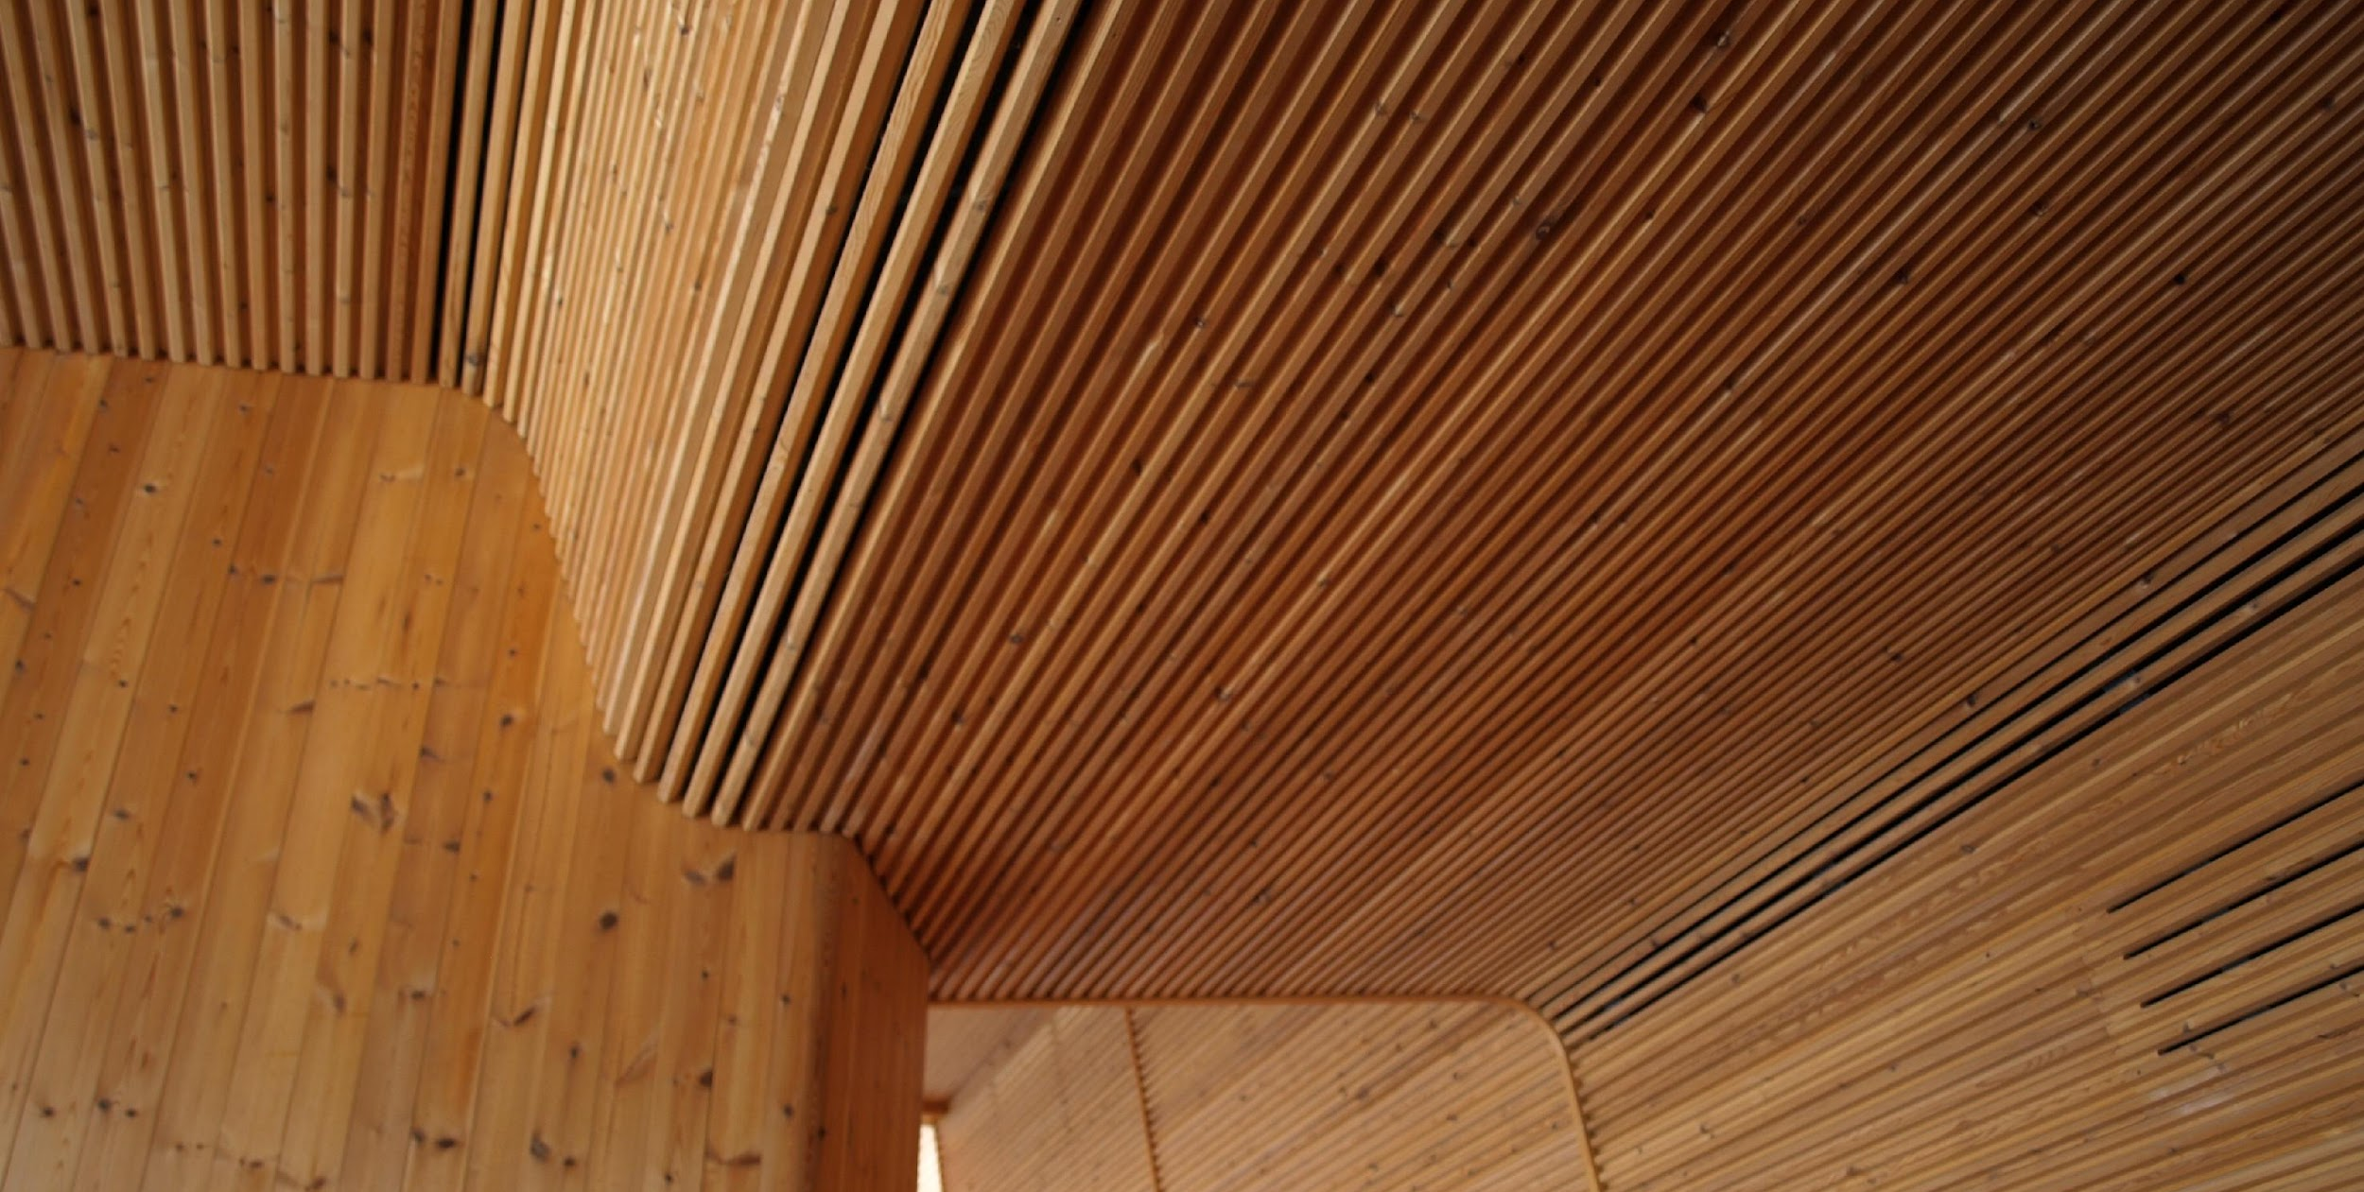
Architectural design

Slide 4
Authors
Markku Karjalainen, Architect D.Sc. (Tech.), Professor
Henri Käpynen, Architect, Researcher
University of Tampere
Release date: 12/05/2022

Slide 5
Architectural design – content
‹#›
Introduction – Wood construction and architecture
Planning and building types from the perspective of wood architecture
land use planning processes, land transfer, building codes, wood architecture and building types
Building regulations from the perspective of wood use in construction
housing design, energy efficiency and thermal insulation, fire safety and sound insulation
Construction processes and the potential of wood at different stages of the construction process
project planning, architectural planning, cooperation with structural planning and HVAC planning

Slide 6
Introduction – Wood construction and architecture

Slide 7
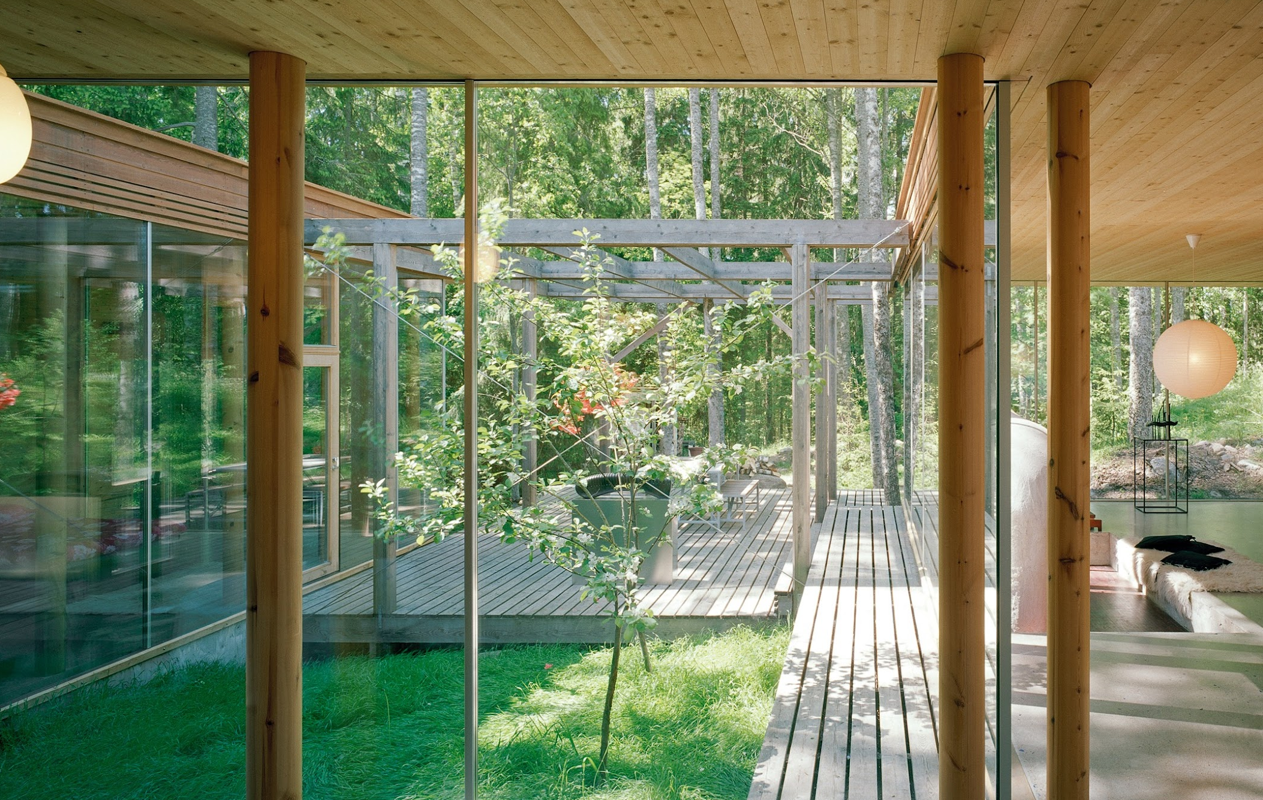
‹#›
First of all, some general observations about wood as a construction material...
Villa Lena, Architect Olavi Koponen
Image: Jussi Tiainen

Slide 8
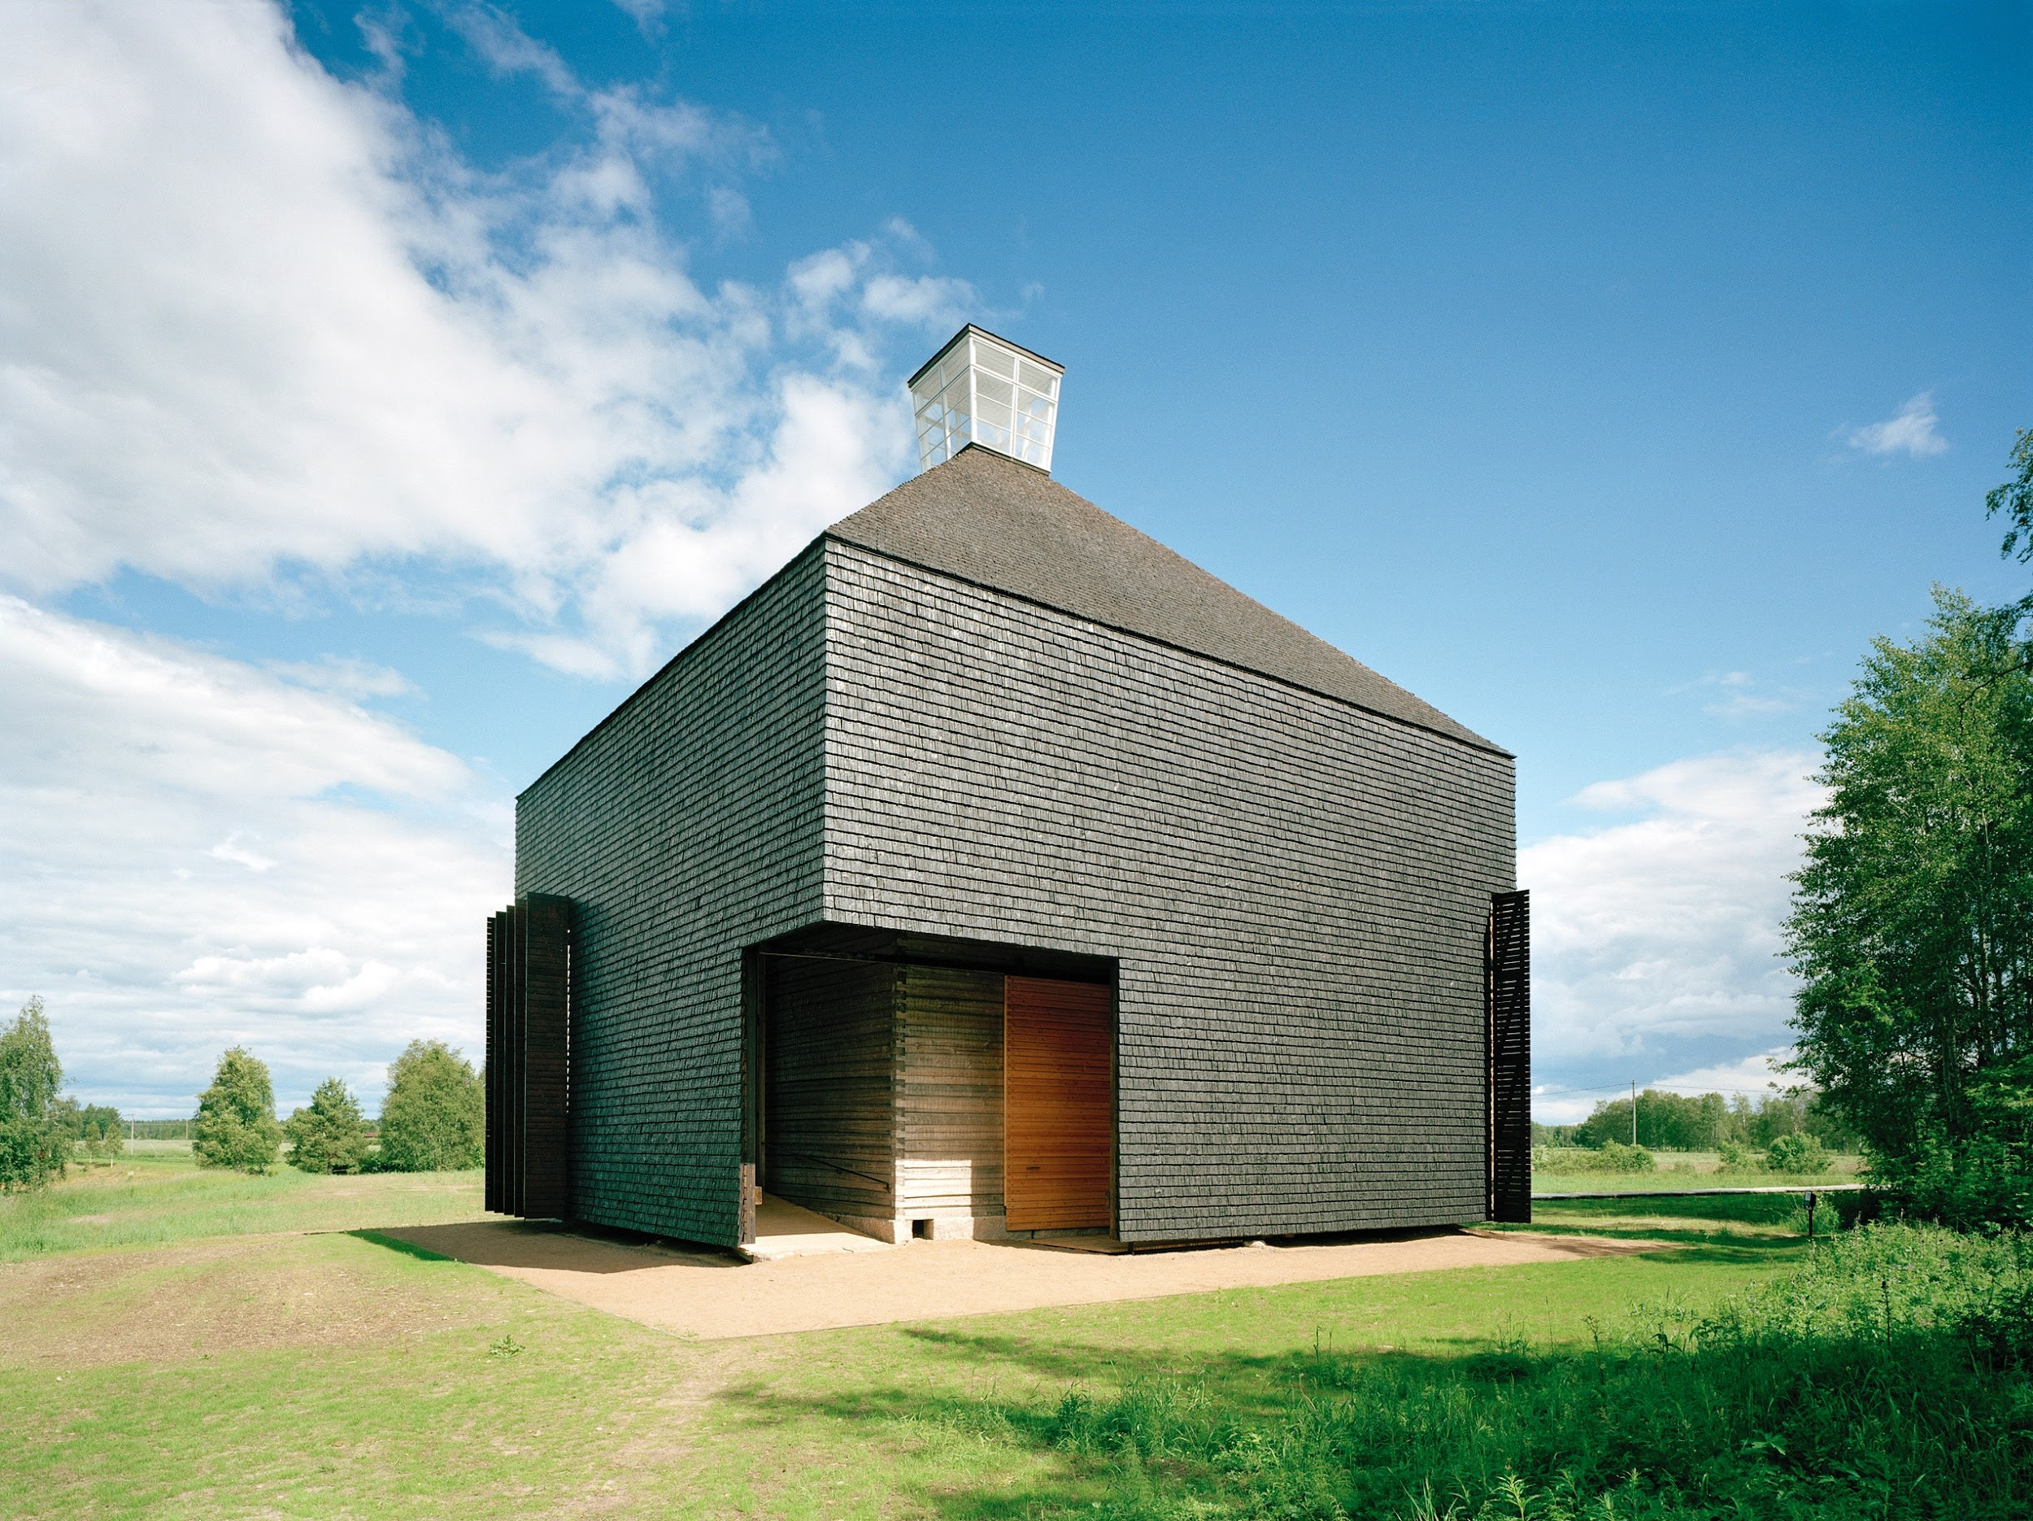
‹#›
..for a successful outcome, the designer needs to know, among other things, the right species of wood for the project.
Image: Shingle Church of Kärsämäki

Slide 9
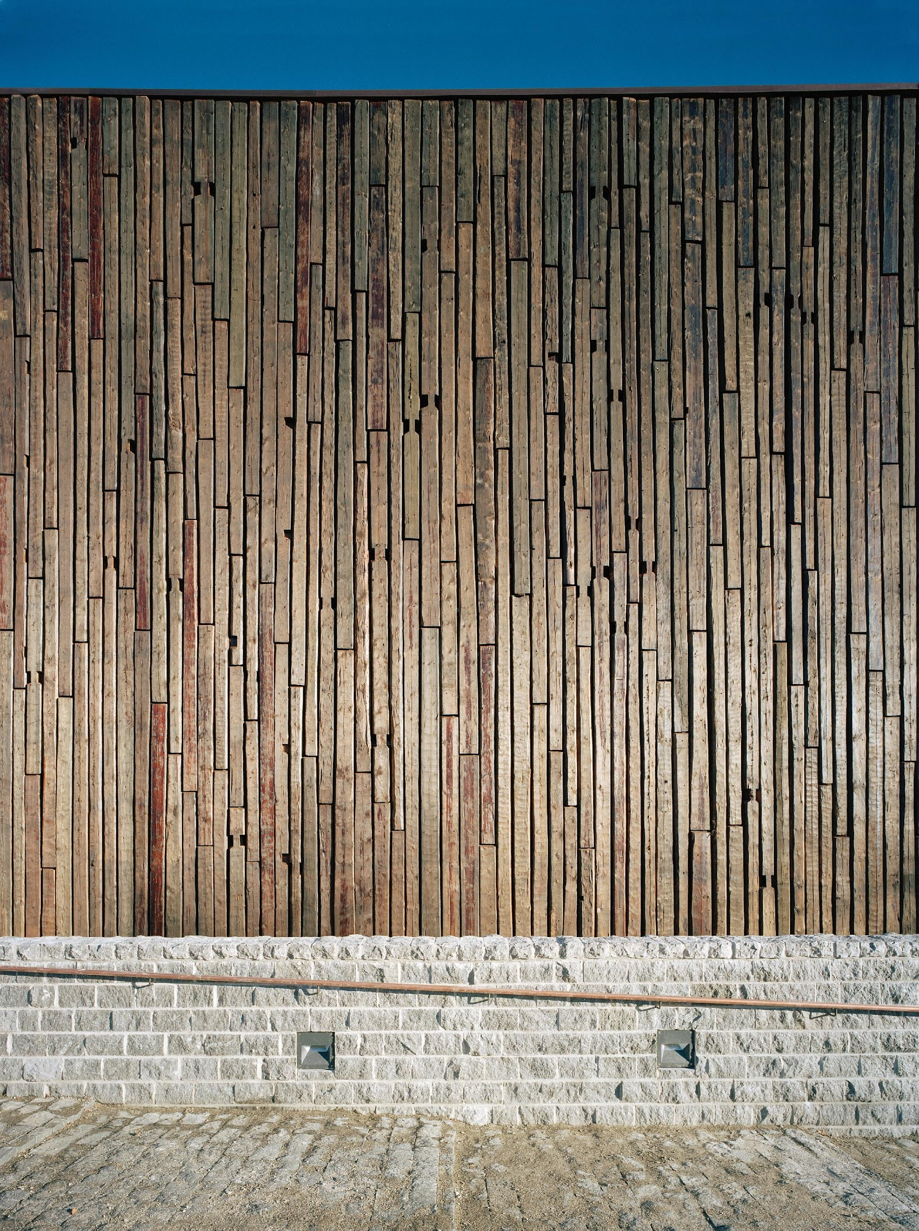
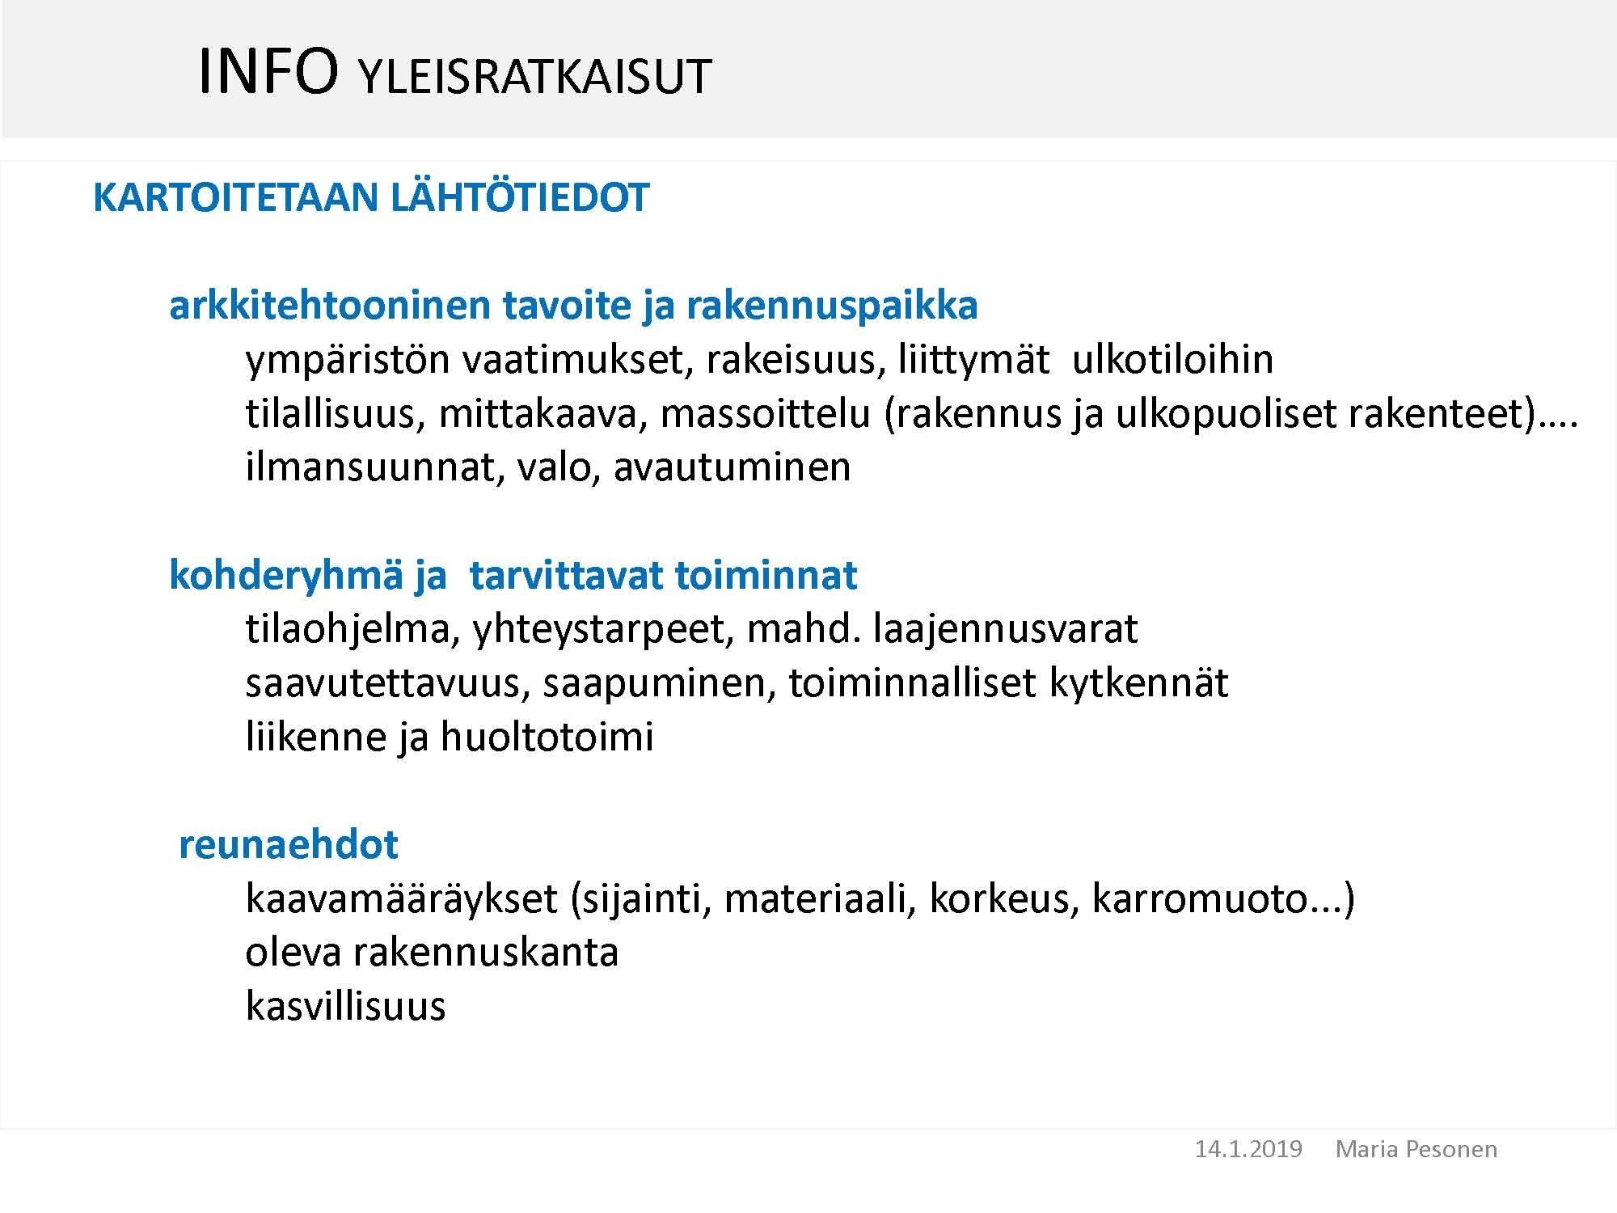
Above all, it is important for the work of the architect to take note of the starting data of the site
‹#›
Architectural objective and construction site
environmental requirements, integration into the surrounding environment, spatiality, scale, architectural modelling, orientation, natural light, opening up views
Target group and activities required
spatial programme, connectivity needs, expansion capacity, accessibility, arrival, operational links, transport and maintenance
Preconditions
planning regulations (location, material, height, roof form, building regulations), building stock in the area, history, building traditions, vegetation
Arkkitehtitoimisto Sarc, Metla-Talo
Image: Jussi Tiainen

Slide 10
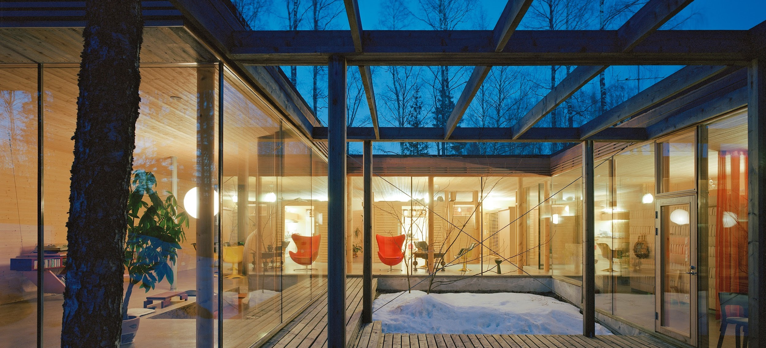
‹#›
What are the most common tree species used in construction?
Villa Lena, Architect Olavi Koponen
Image: Jussi Tiainen

Slide 11
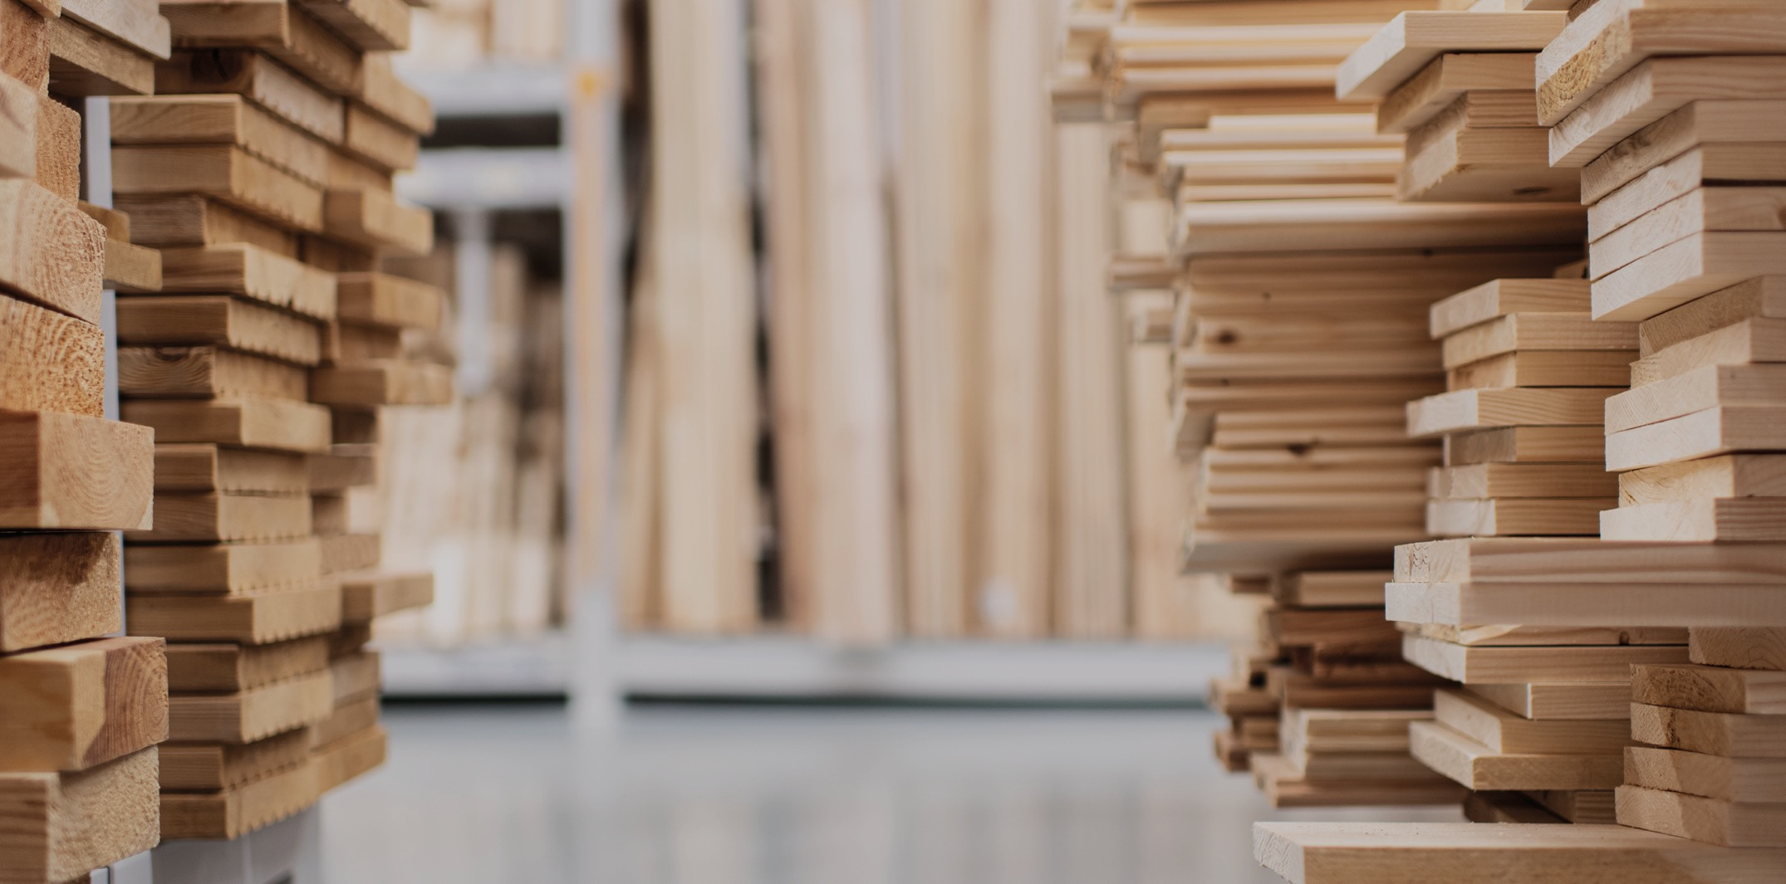
‹#›
Pine and spruce are the most common building tree species. The properties of pine and spruce are relatively close to each other, and in structures, for example, their permitted tensile strengths are equal. The pine is slightly harder and heavier than spruce.

Slide 12
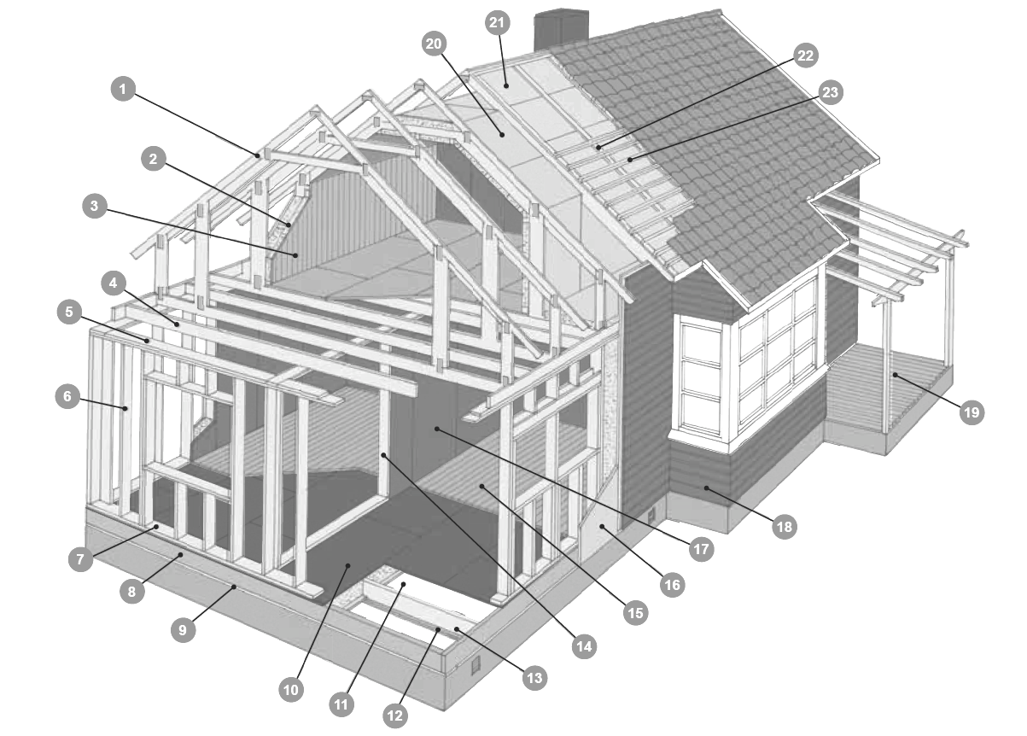
‹#›
Which tree species or wood product is used in which part of the building?
Source: Puuinfon puutavaraopas 2019

Slide 13
Products
‹#›
Substructural panel of the waterproofing
Attic floor wind protection plate
Ventilation strip
Prefabricated nail plate truss
Roof batten for waterproofing
Possible additional studs
Inner lining board
Joist
Top plate for exterior wall
Wall stud for exterior wall
Terrace board
Exterior cladding board
Bottom plate for exterior wall
Wall construction plates
Framing beam
Exterior wall wind protection plate
Bottom plate
Floorboard
Wall stud for a load-bearing partition wall
Bottom floor plate
Base floor beam
Base floor wind protection plate
Wind protection plate support board
Source: Puuinfon puutavaraopas 2019

Slide 14
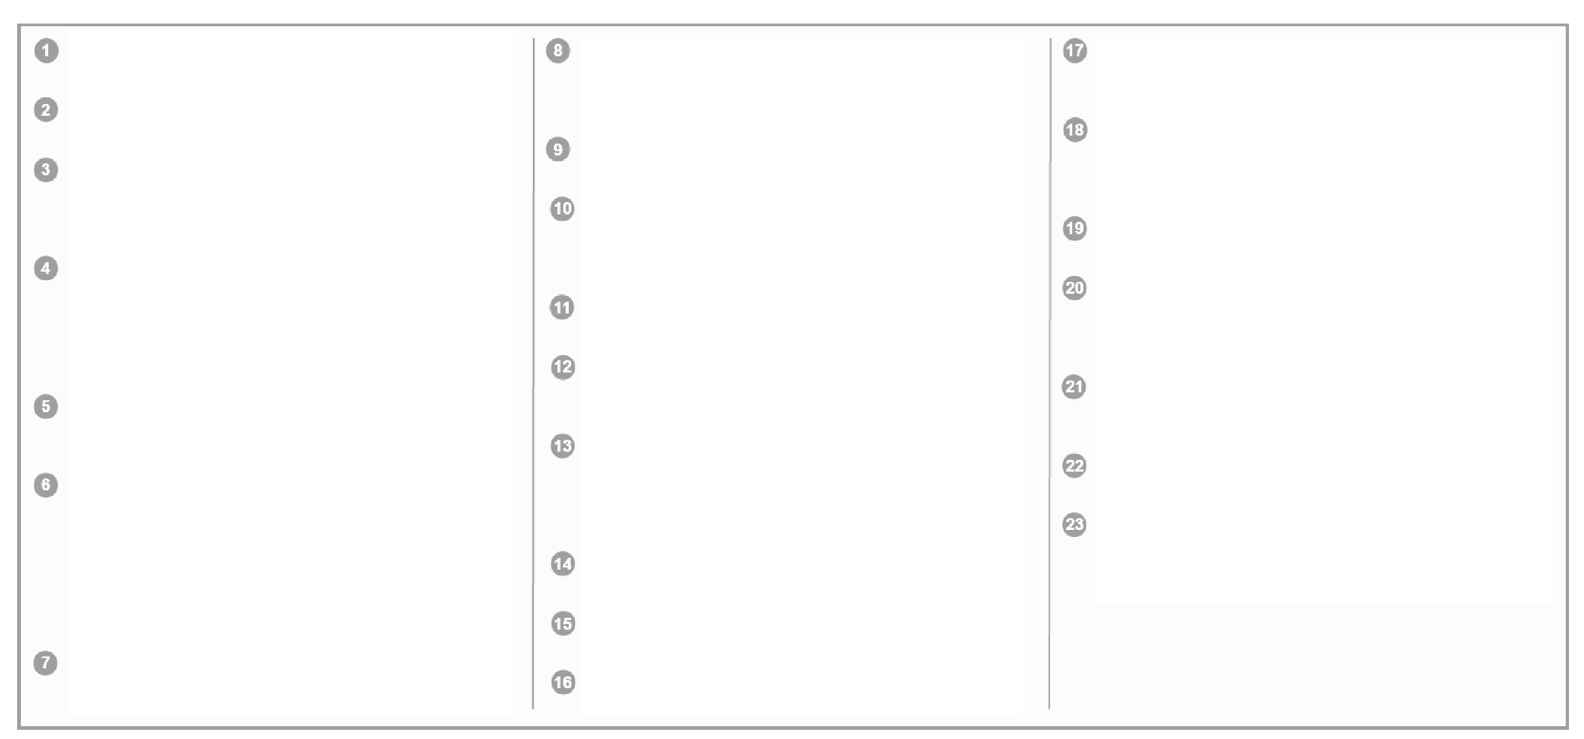
Product tree species and dimensions
‹#›
Prefabricated nail plate truss
According to the structure plan.
Possible additional studs
For example: 48 x 48
Inner lining board
Planed lumber, e.g. STV 13,5 x 95, quality TK. Nailed with a single countersunk nail or with ring shanked nails or threaded nails.
Joist
According to the structure plan. E.g. sawn timber C24. Dimensioned with taking the vibration into account. Nail the top guide from an angle against the tree. If necessary, the joints are reinforced with metal beam shoes. The designer's instructions are followed in the selection of fasteners.
Top plate for exterior wall
According to the structure plan. E.g. sawn timber C24. Cf. wall stud for exterior wall
Wall stud for exterior wall
According to the structure plan. E.g. sawn timber C24. Possible additional studs for thermal insulation e.g. 48 x 48. The wall frames are assembled horizontally on top of the working platform. The frame components are attached in accordance with the structural plan. The wall frame is lifted upright as a whole and attached to the base and adjacent wall frames.
Bottom plate for exterior wall
According to the structure plan.
E.g. sawn timber C24
Framing beam
According to the structure plan. E.g. sawn timber C24. Possible additional studs for thermal insulation, e.g. 48 x 48.
Bottom plate
According to the structure plan. E.g. sawn timber C24.
Subfloor plate
According to the structure plan. For example, tongued and grooved spruce veneer is fixed by gluing and nailing or screwing it to the base floor beams.
Base floor wind protection plate
Porous wood fibreboard, 25 mm thick
Wind protection plate support board
In addition, transverse support boards are placed at least at the continuation joints of the plates.
Base floor beam
According to the structural plan, e.g. sawn timber C24. Dimensioned with taking the vibration into account. Possible additional studs for thermal insulation, e.g. 48 x 48. Fixed according to the structural plan
Wall stud for a load-bearing partition wall
According to the structural plan, e.g. sawn timber C24
Floorboard
For example: HLL 28 x 95, quality OM, special dried, tongued and grooved ends.
Exterior wall wind protection plate
Porous wood fibreboard, 25 mm thick
Wall construction plates
E.g. plywood, chipboard, wood fibreboard. Nail with ring shanked threaded nails.
Exterior cladding board
For example: UTV 28 x 145, spruce, fine-cut, primed, quality according to RT 21-11212. Nail with hot galvanized wire nails or hot galvanized threaded nails.
Terrace board
For example: SHP 28 x 120. Acid resistant ring shanked nails.
Attic floor wind protection plate
Porous wood fibreboard, 25 mm thick Fixed according to the instructions of the board manufacturer and the structural engineer.
Substructural panel of the waterproofing
According to the structure plan. For example, a sheeting veneer with tongued and grooved long sides. Fixed to a nail plate grid.
Ventilation strip
According to the structure plan. Hot galvanized wire nails.
Roof batten for waterproofing
According to the structure plan. Nail with hot galvanized wire nail at each intersection.
Source: Puuinfon puutavaraopas 2019

Slide 15
Example: façade
‹#›
A well-designed, surface-treated and serviced wood façade lasts for decades. Finland has numerous examples of wood façades that are over 100 years old and still in good condition.
Source: Puuinfo, Kestävät puujulkisivut

Slide 16
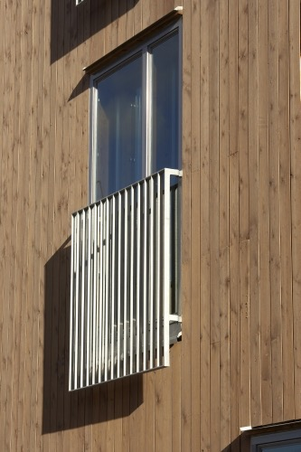
Long-term durability
‹#›
Thick board (recommended min. 28 mm)
Quality timber
Dry timber
Structural protection, careful with the details
Preferrably no extensions
Good surface treatment combination
Background ventilation
Maintenance

Slide 17

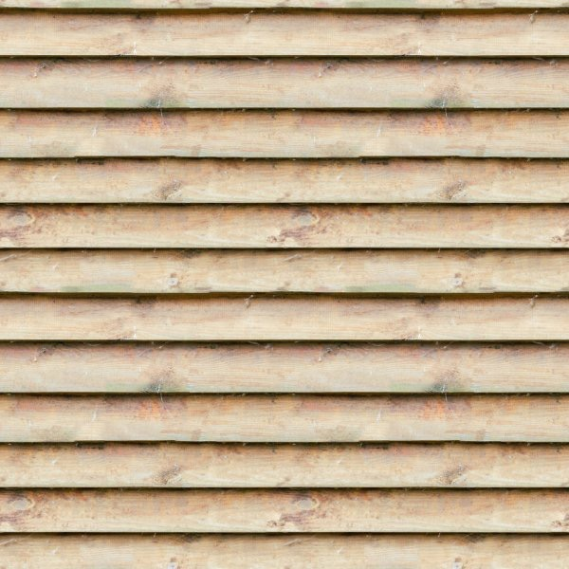
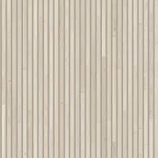
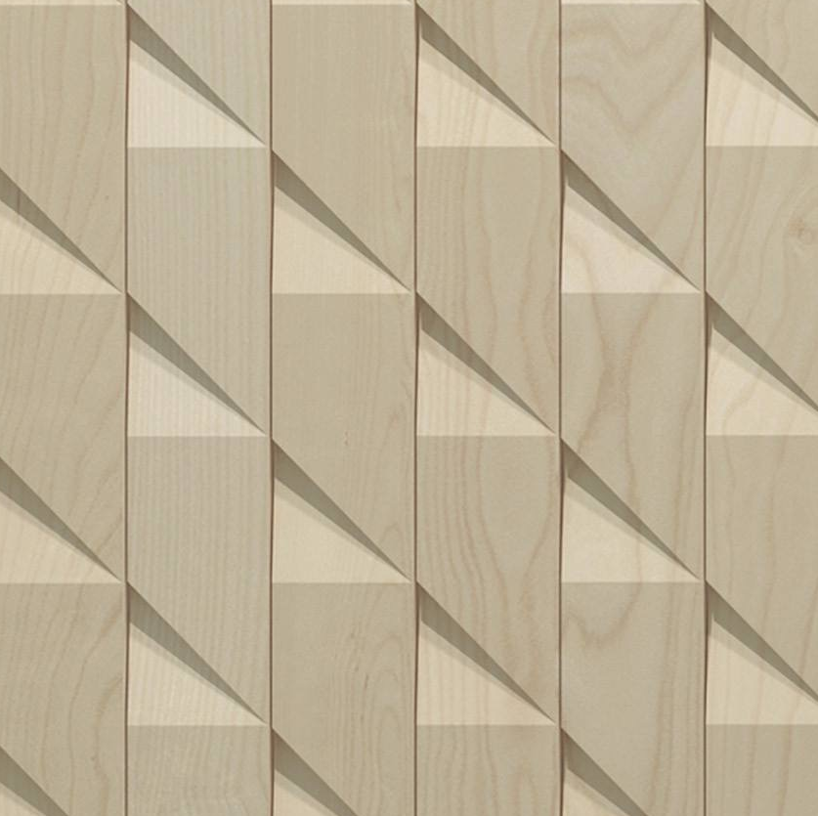
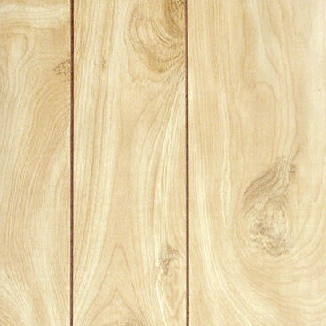
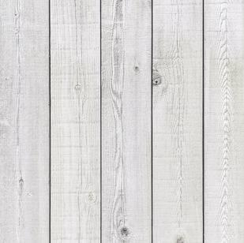
Wood use in façades
‹#›
Textures
CLT unit
raw board
battening
CNC-milled board
panel
stained

Slide 18
Helsinki Central Library Oodi ALA Arkkitehdit

Slide 19
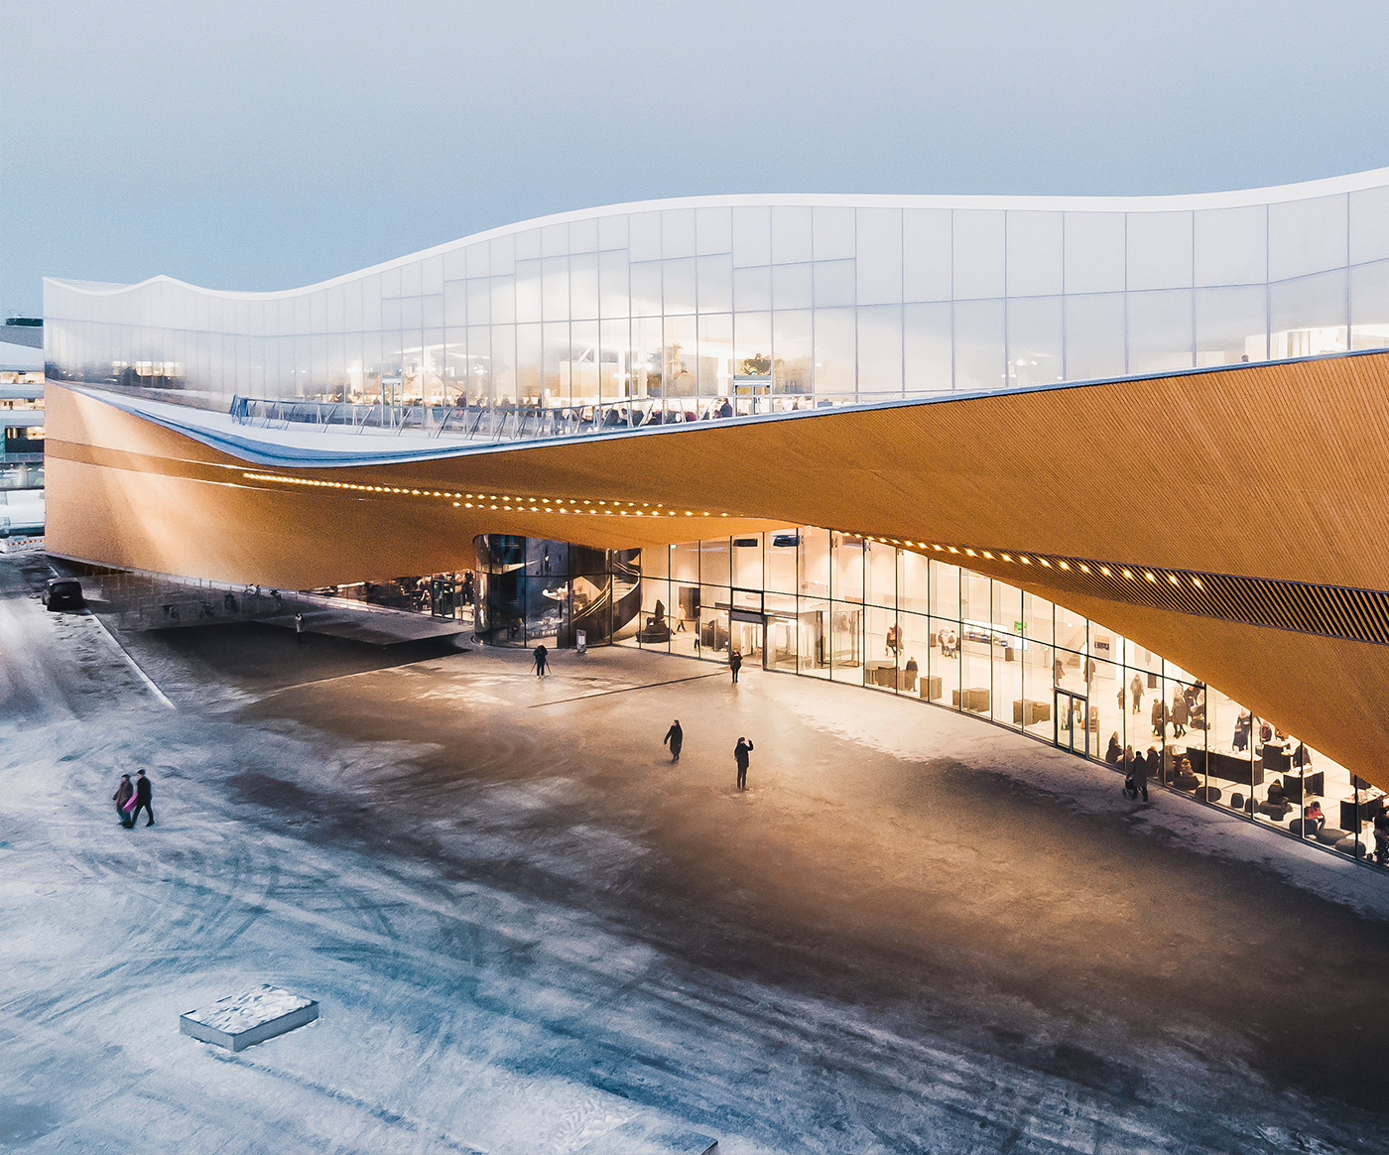
Helsinki Central Library Oodi
‹#›
a challenging site
complex geometry
public building

Slide 20
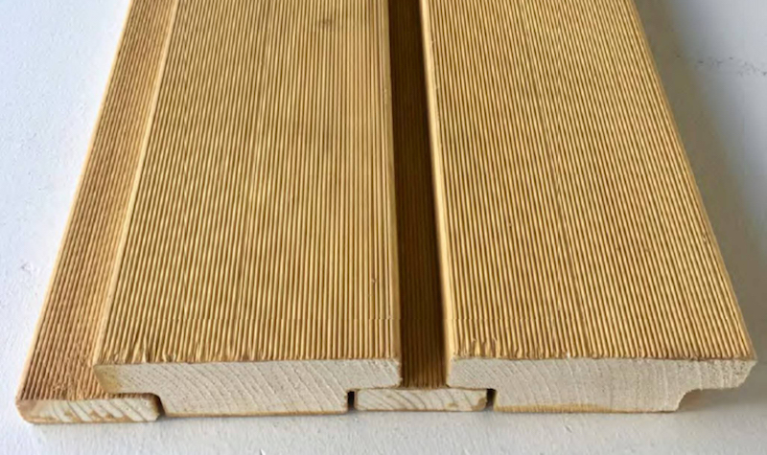
Helsinki Central Library Oodi
‹#›
board façade
product developed for the project

Slide 21
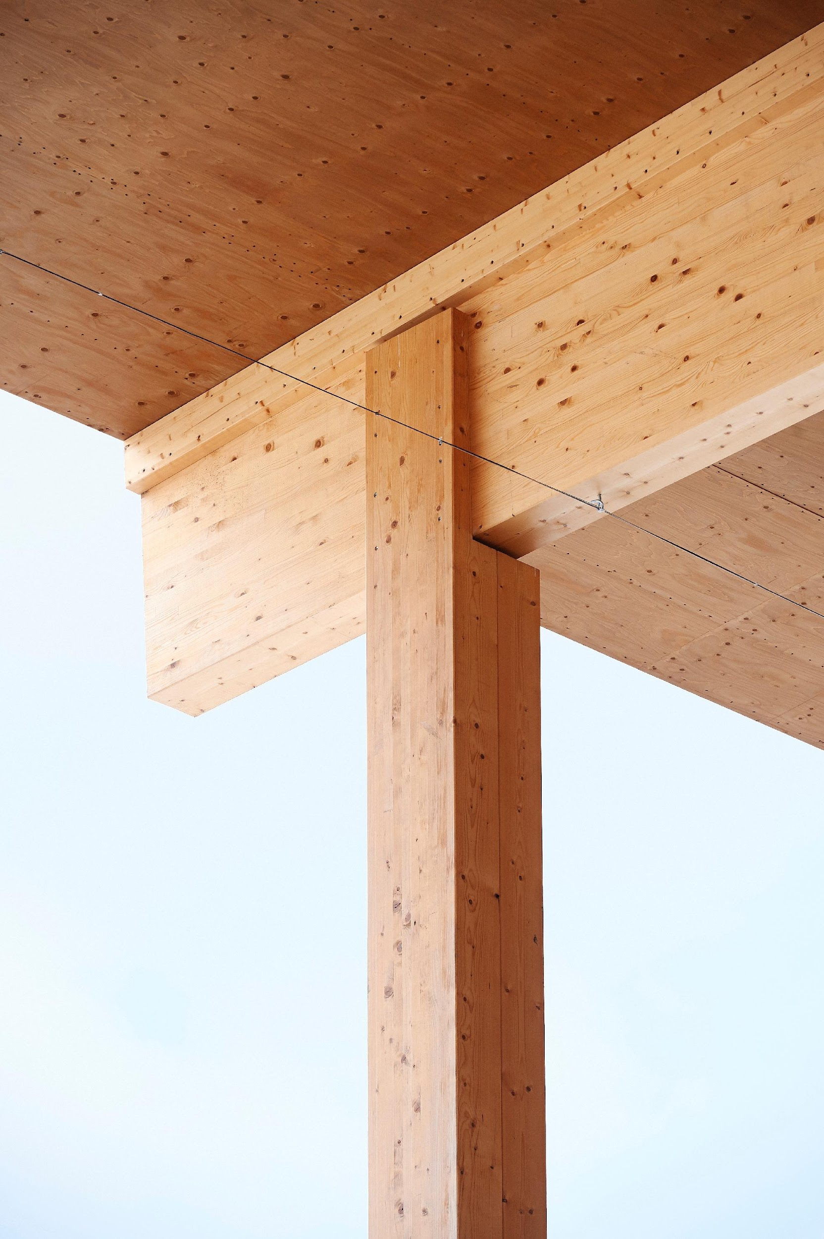
‹#›
Wood is a natural material that can be returned to the ecological cycle after use without damaging the environment. It is easy to work on wood with simple tools.

Slide 22
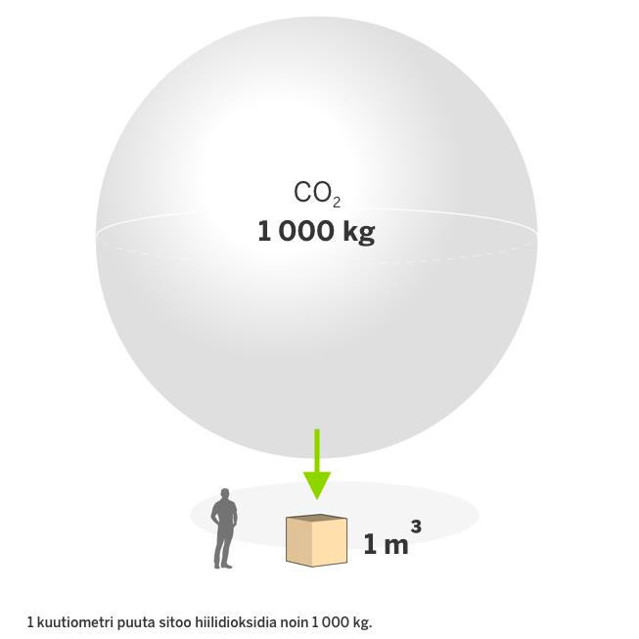
Wood absorbs carbon dioxide efficiently
‹#›
1 cubic metre of wood binds approximately 1,000 kg of carbon dioxide.
Image: Metsä Group

Slide 23
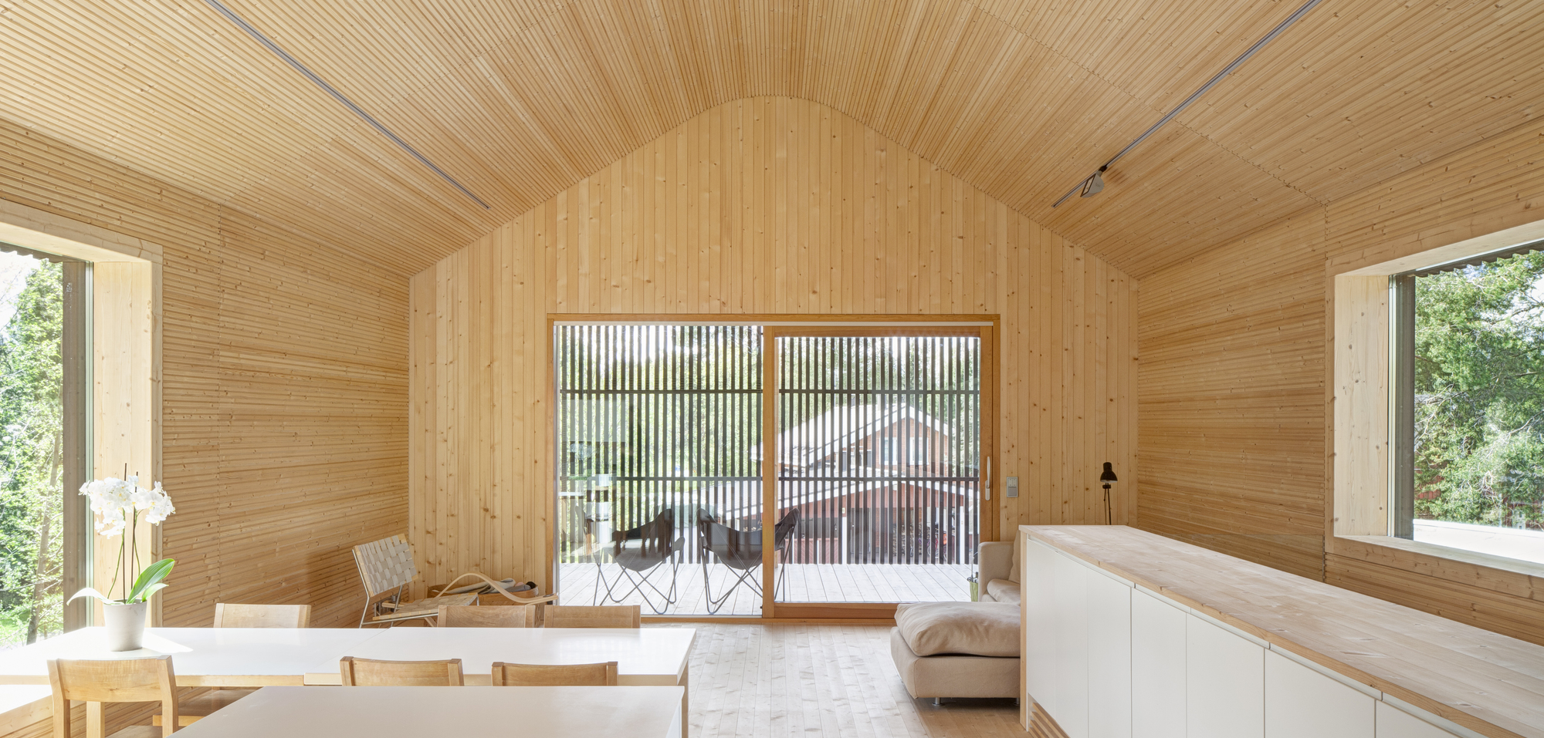
Wood absorbs carbon dioxide efficiently
‹#›
For example, a Finnish wooden single-family house binds an average of 30 tonnes of carbon dioxide in its structures. This carbon fixation value of wood is equivalent to more than 10 years of carbon dioxide emissions from an average consumer car.
Source: https://www.metsafibre.com/fi/media/Erinomaisuus-ja-Innovaatiot/Pages/Sahatavara-sitoo-hiilta-koko-elinkaarensa-ajan.aspx

Slide 24
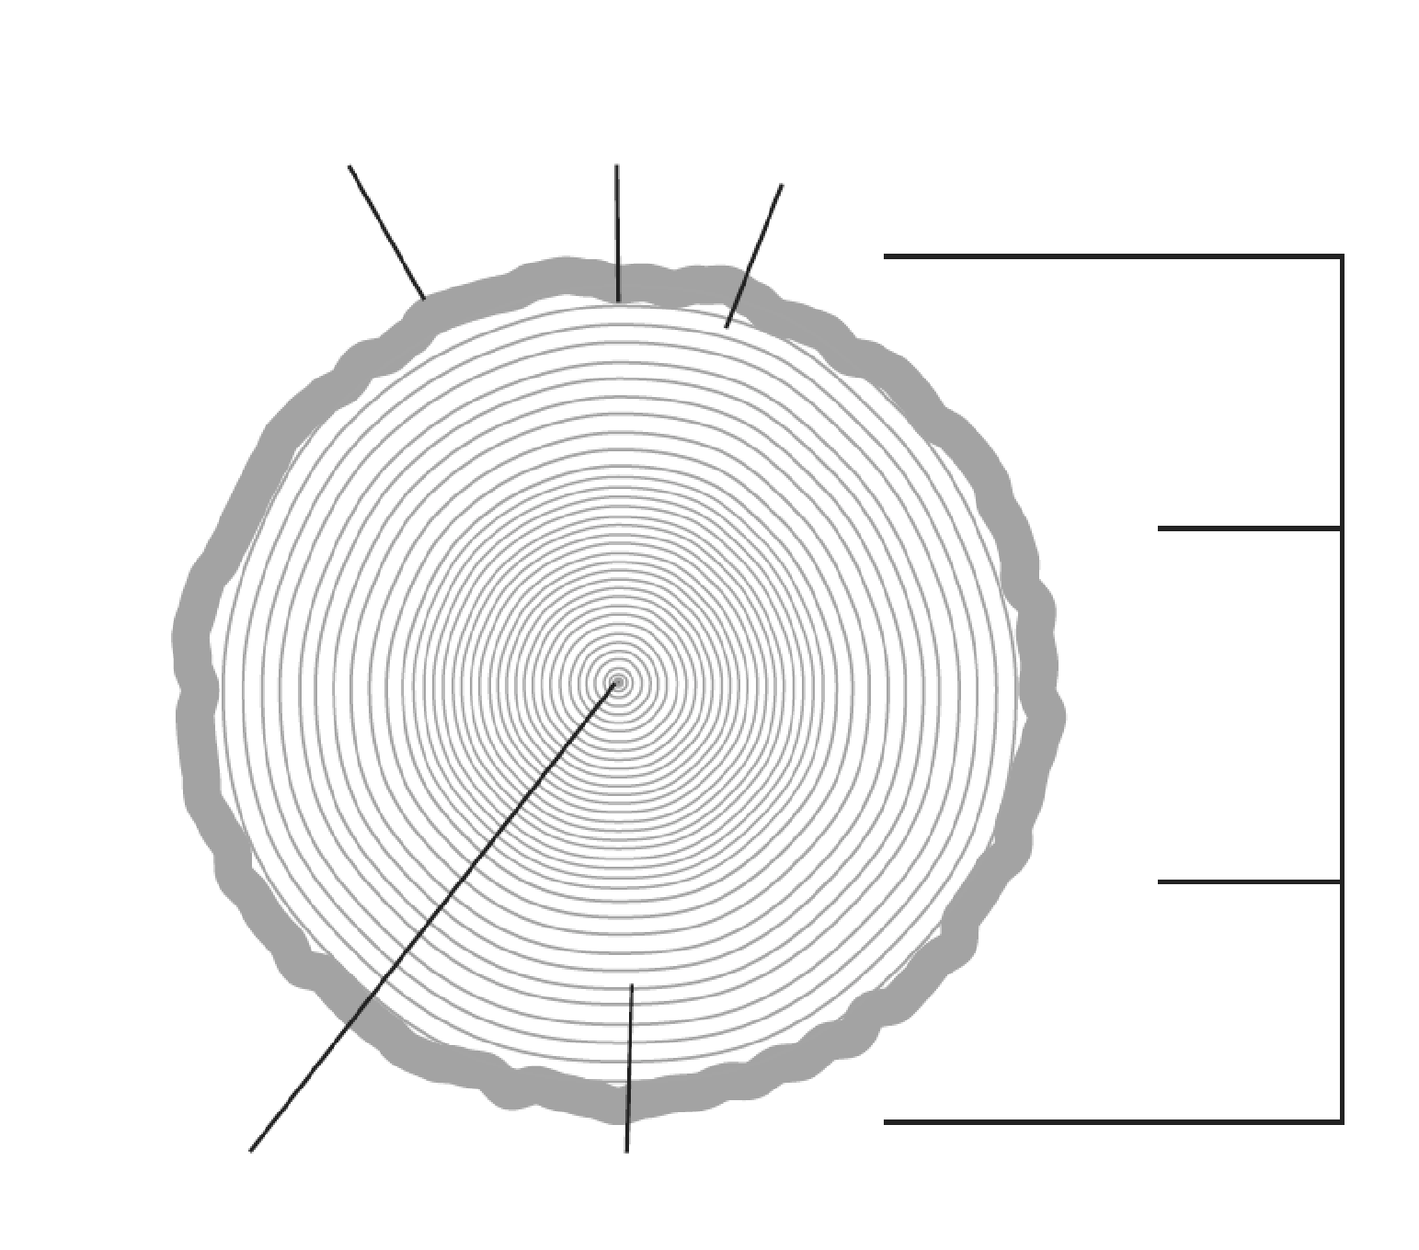
‹#›
Outer shell i.e. bark
Inner lining i.e. bast
Wood is strong and light. As a natural material, wood has different properties that vary, such as appearance, strength and other physical properties.
Cambium
Sapwood
Heartwood
Sapwood
Pith
Growth rings
Source: Puuinfon puutavaraopas 2019

Slide 25
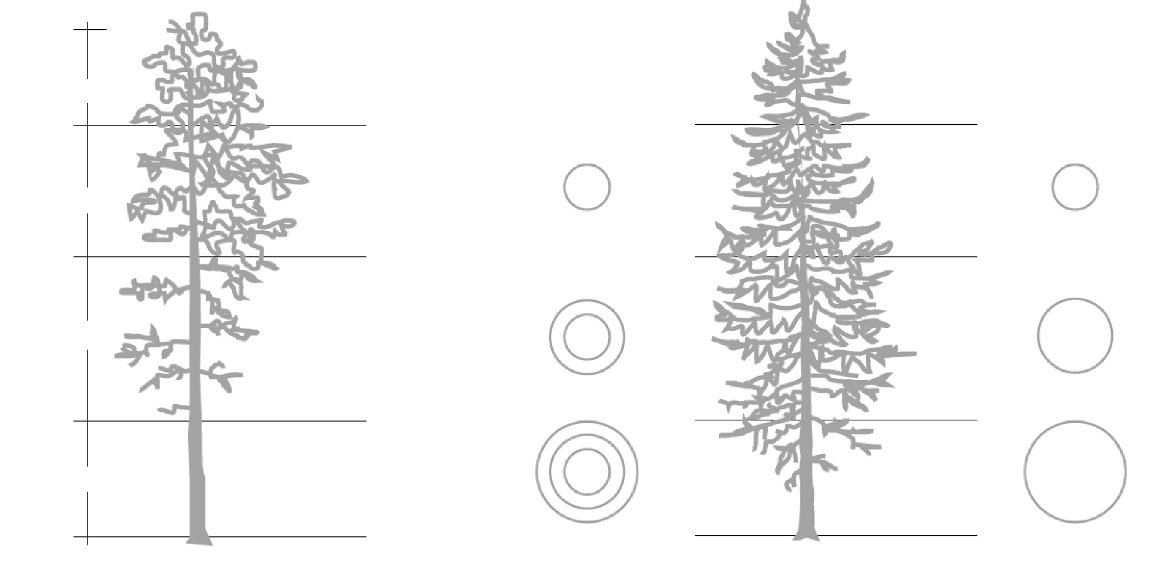
Breakdown of sawn timber from different parts of the wood into quality grades
‹#›
Logs are sorted by quality using ABC sorting: The best branchless butt log is A-grade, a sound top log is B-grade and the middle log is C-grade.
approx. 3 m
Sound side boards: grade VII middle boards: grades V and VI
Sound knotted
approx. 4 m
Butt log Middle log Top log
Sound black knots
approx. 5 m
Removable black-knot side boards: grades V, VI (and VII) middle boards: grades V and VI
Surface almost knotless pith the same as in middle and top logs, side boards: grades US I...US IV (V, VI, VII) middle boards: grads US IV, V and VI
Black and sound knots
approx. 3.5 m
approx. 0.3 m
Source: Puuinfon puutavaraopas 2019

Slide 26
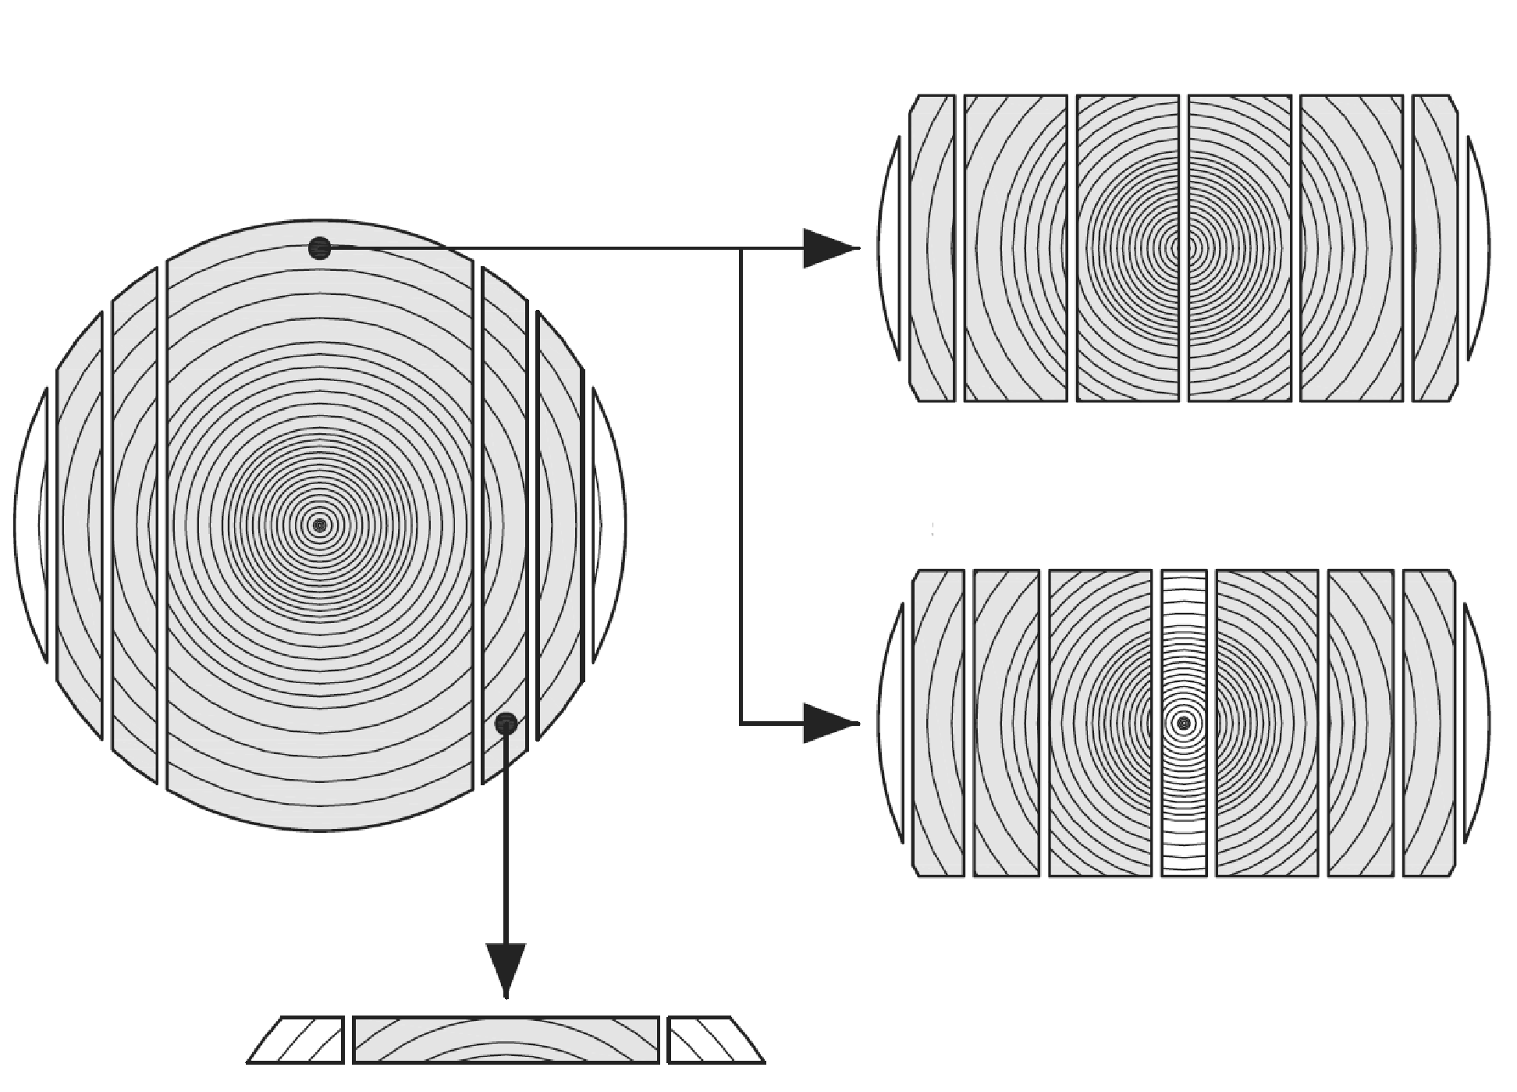
Cutting
‹#›
Nordic sawing practice consists of two sawing methods, the normal cut and the pith-free cut.
Nordic sawing is a common sawing method in the Finnish sawmill industry and provides good dimensional stability of the sawn pieces, as internal stresses in the wood are removed during the sawing process.
This is done in normal cutting with the help of pith splitting and in pith-free cutting by removing the pith of the wood from the actual main products.
normal cut
pith-free cut
Source: Puuinfon puutavaraopas 2019

Slide 27
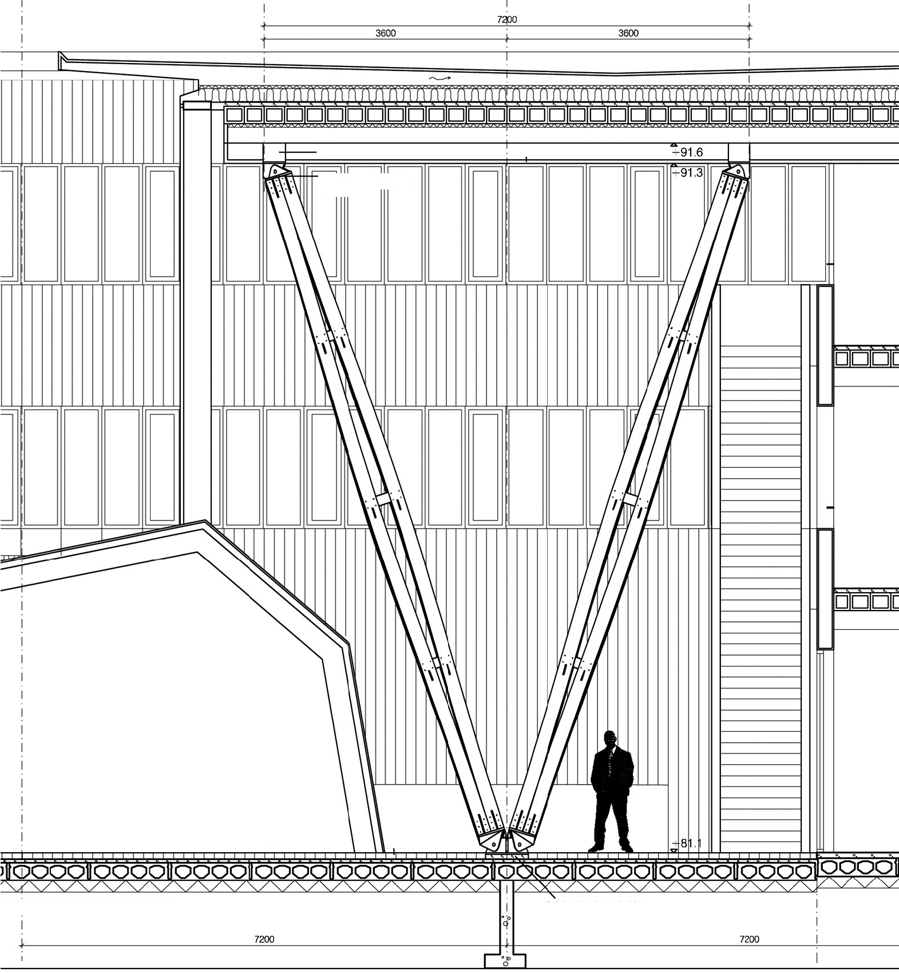
Strength of wood
‹#›
beam
ceiling
Supporting the top end of the beam in the direction of the building
Relative to its weight, wood is stronger than any other building material.
The density of air-dry spruce and pine wood, unit of which is kg/m³, is only 1/13 of the density of steel and 1/4 of concrete.
top base the same as the halved bottom base, the bottom of the base plate bottom side up to ceiling level
auditorium
studded floor
PROJECTION FROM CENTRE OF OF A CLUSTERED COLUMN 1/25
support the pillar against the load-bearing subfloor according to the construction plan, the bottom plate of the base to the level of the finished floor
Arkkitehtitoimisto Sarc, Metla-Talo

Slide 28
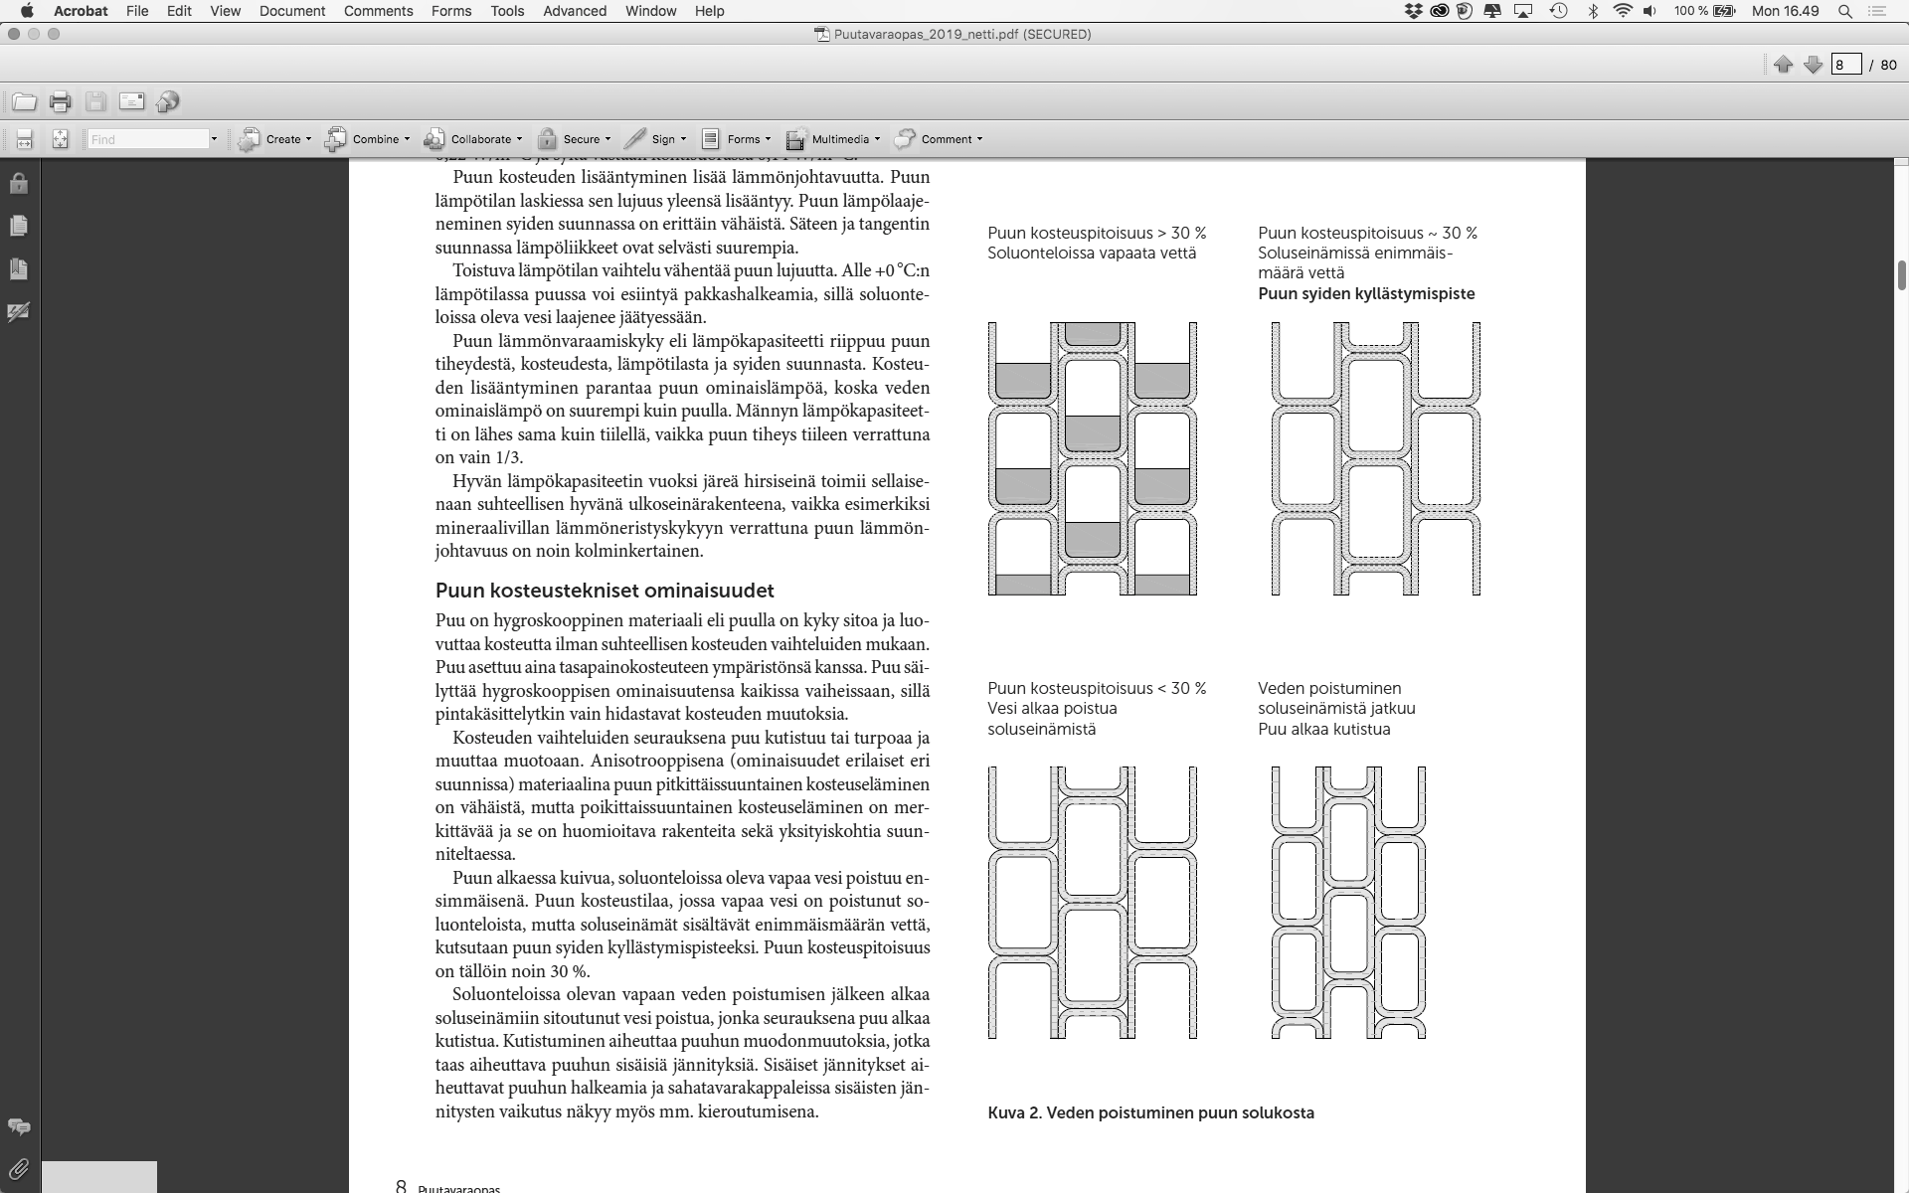
Extraction of water from tree tissue
‹#›
Moisture content in wood > 30% Free water in cellular cavities
Moisture content in wood~ 30% Maximum volume of water in the cell walls
Fibre saturation point
Wood moisture content < 30% Discharging water from the cell walls begins
Continued discharge of water from cell walls
Wood begins to shrink
Source: Puuinfon puutavaraopas 2019

Slide 29
Thermal insulation capacity of wood
‹#›
The thermal insulation capacity of wood is 400 times better than that of steel, 1,500 times better than aluminium and 12 times better than concrete when comparing the thermal conductivity of the materials. This is why moisture does not condense on the surface of the wood and it feels comfortable in both hot and cold conditions. Wood expands only a third as much as steel and concrete when exposed to heat. On the other hand, wood swells somewhat when it gets wet and shrinks when it dries.

Slide 30
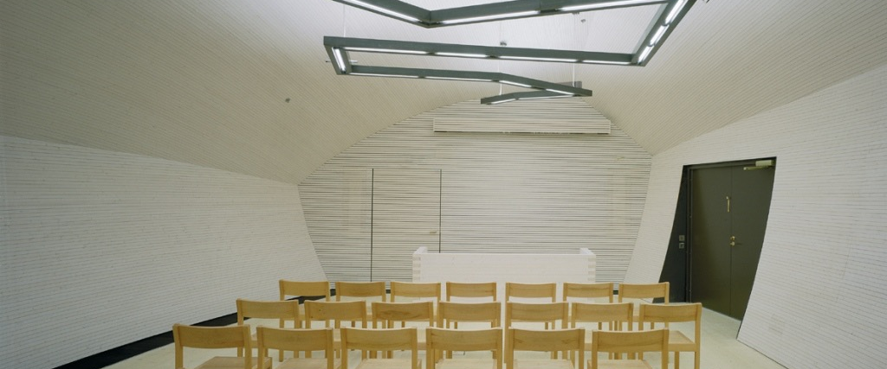
There are also specific issues to be aware of in wood construction:
Source: Puuinfon puutavaraopas 2019

Slide 31
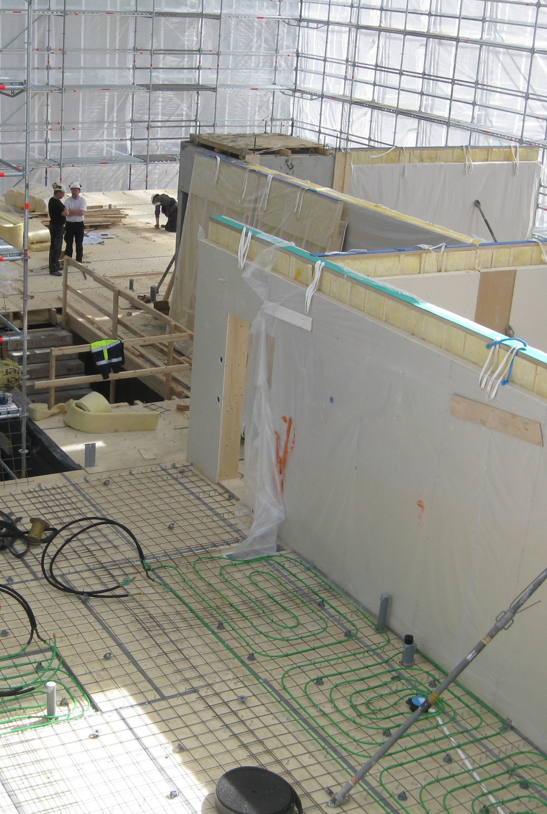
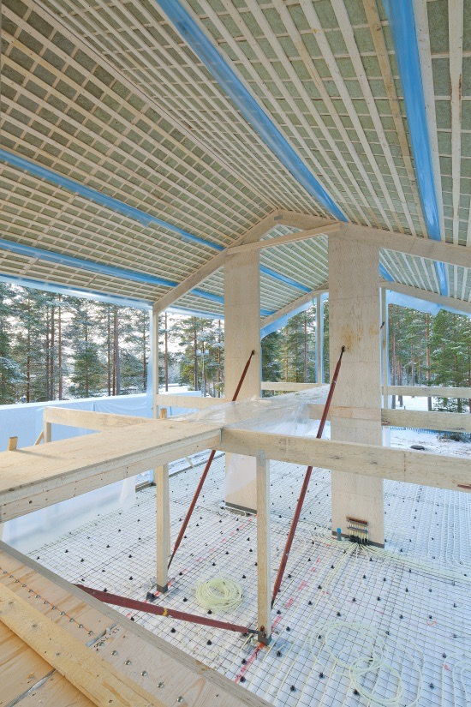
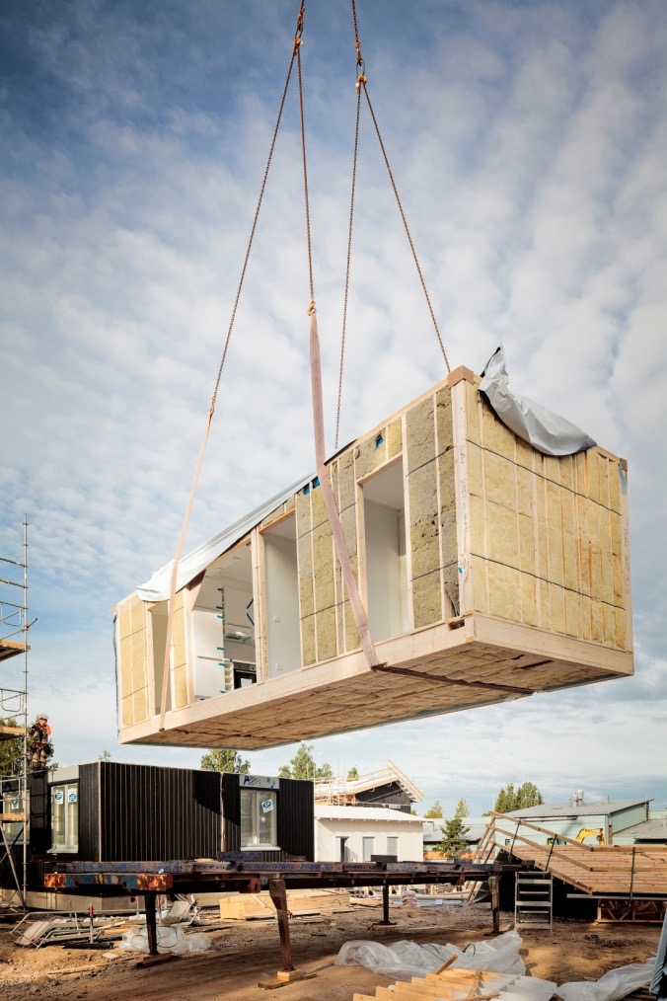
Frame systems The frame system of a wooden building should be known and included in the design before the first line of the house is drawn.
‹#›
Prefabricated panel units
Column-and-beam
Prefabricated box units

Slide 32
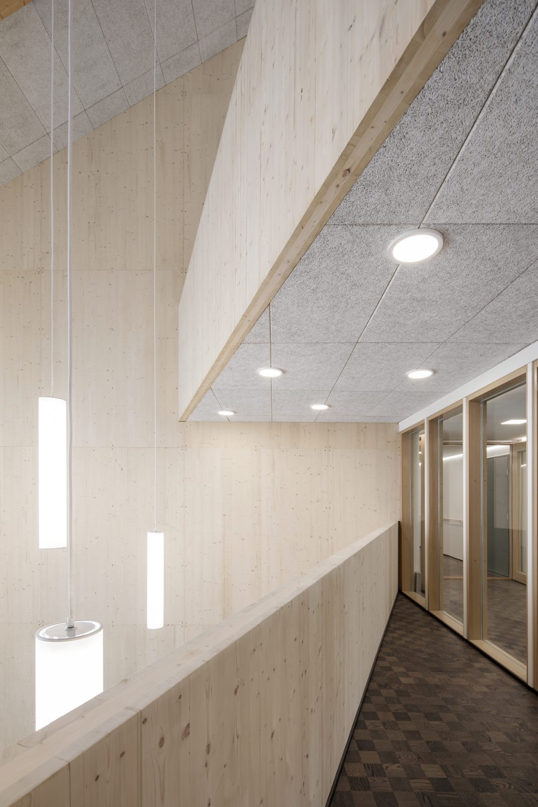
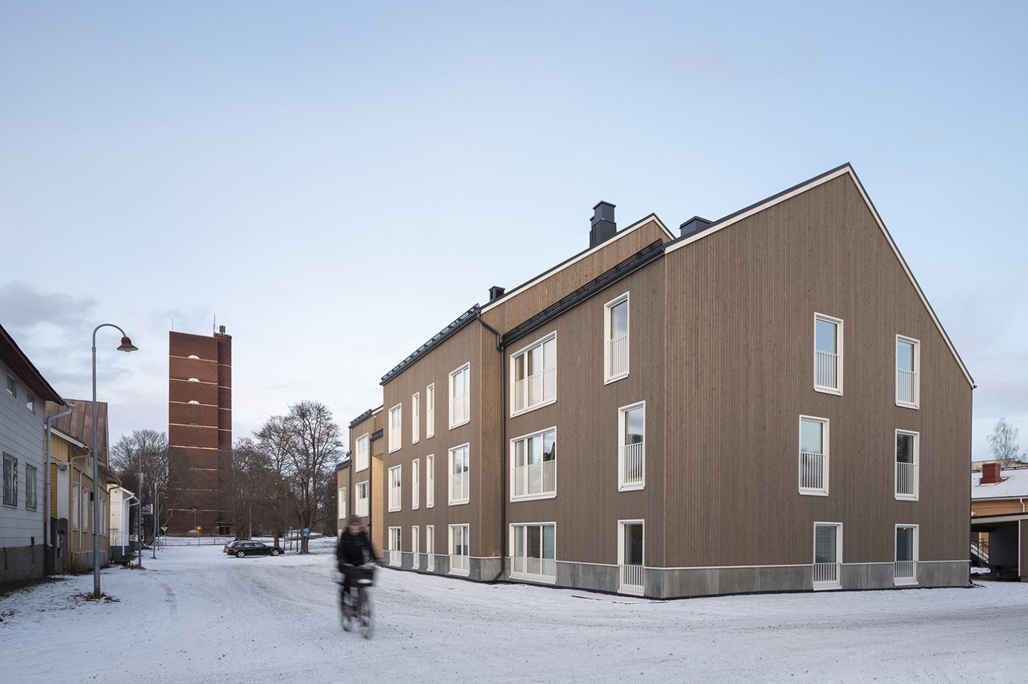
Prefabricated panel unit
‹#›
Arkkitehdit Rudanko-Kankkunen Oy / Trekoli, Pori, 2018
Image: Rudanko-Kankkunen

Slide 33
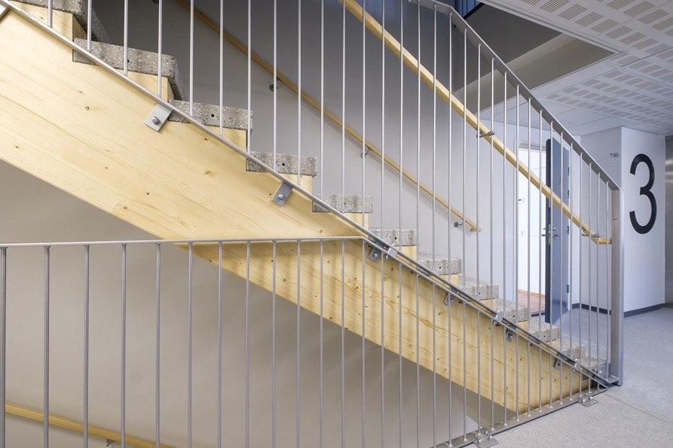
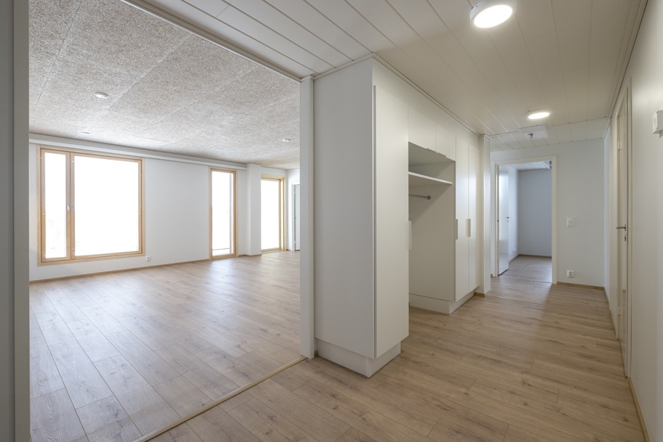
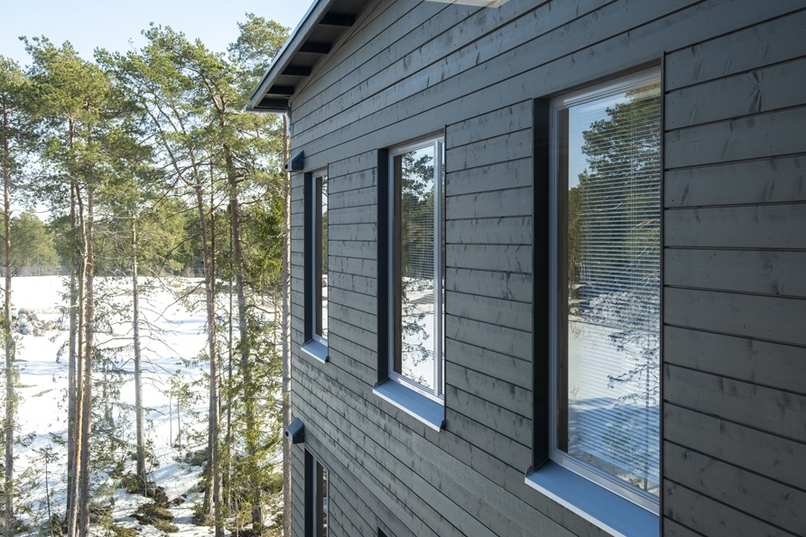
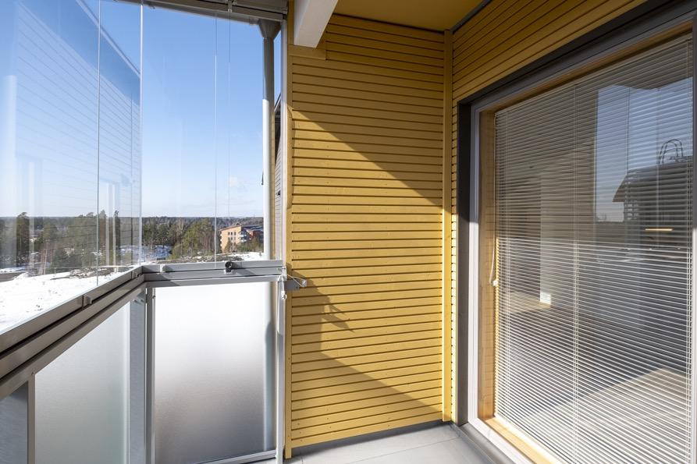
Prefabricated box unit
‹#›
Arkkitehtitoimisto Avarion, architect Markku Ranne
Photos: a-kruunu.fi

Slide 34
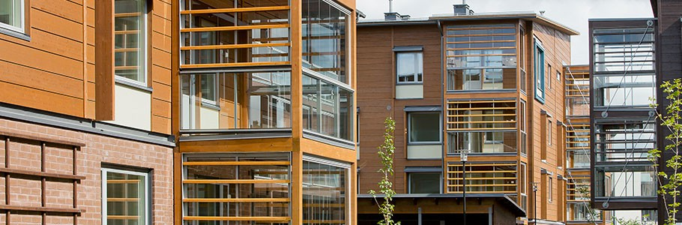
Column-and-beam
‹#›
Latokartano in Viikki, Helsinki, 2012
Image: Metsä Wood

Slide 35
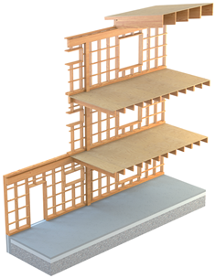
The column-beam system
‹#›

Slide 36
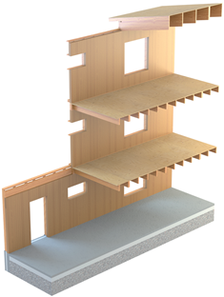
CLT technology
‹#›

Slide 37
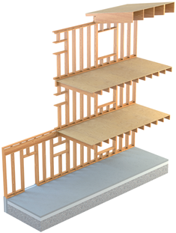
Large prefabricated house with a frame
‹#›

Slide 38
A few things about building regulations...

Slide 39
Finnish building regulations were revised from 1 January 2018 onwards
Housing design: Decree of the Ministry of the Environment on Residential, Accommodation and Work Premises 1008/2017 + Decree on Accessibility 241/2017
Energy efficiency and thermal insulation: Decree of the Ministry of the Environment on the Energy Performance of Buildings 1010/2017
Fire safety: Decree of the Ministry of the Environment on the Fire Safety of Buildings 848/2017
Sound insulation: Decree of the Ministry of the Acoustic Environment of Buildings 796/2017

Slide 40
Can wood construction be controlled, for example, by land use planning?

Slide 41
Yes. Wood construction can be specified in the local detailed plan and local detailed plan regulations for façades as well as in the building structure.
Decision of the Supreme Administrative Court of 10 April 2015; Record No 2337 / 1 / 13

Slide 42
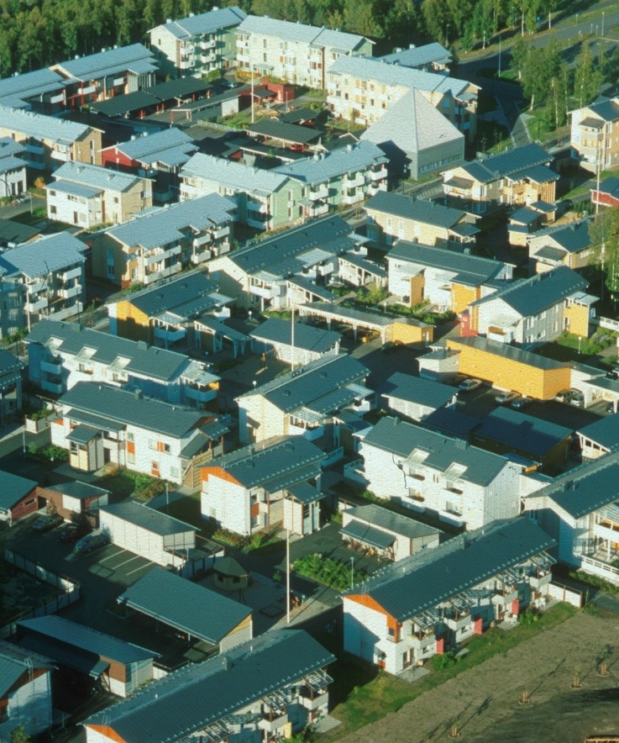
Decision of the Supreme Administrative Court of 10 April 2015; Record No 2337 / 1 / 13
Wood construction can be specified in the local detailed plan and local detailed plan regulations for façades as well as in the building structure.
Another effective way is to determine and steer wood construction on the basis of the terms and conditions of land transfer.

Slide 43
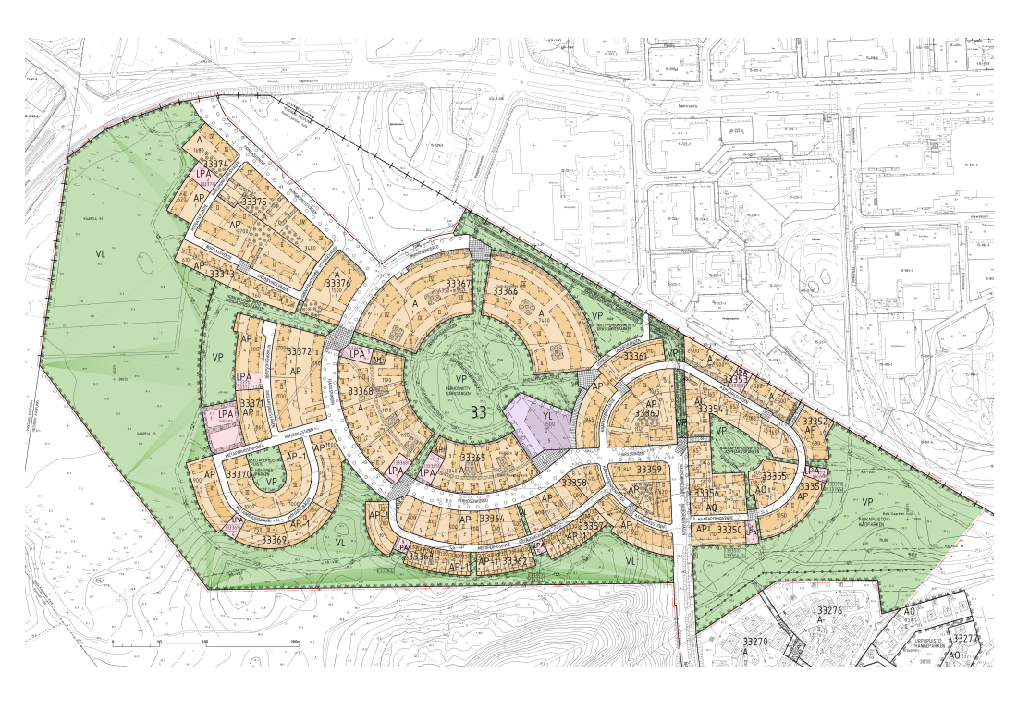
Case: The Honkasuo local detailed plan
Honkasuo, Helsinki, 2017
Image: City of Helsinki

Slide 44
Extract from the summary of Honkasuo local detailed plan
“The local detailed plan allows for the construction of a dense ecological urban village of almost 1,600 inhabitants in Honkasuo. The total floor area is approximately 65,000 m².
The area will have a diverse building stock, from single-family houses to townhouses, from terraced houses to detached houses and low-rise apartment blocks. Honkasuo will follow the principles of low-energy construction. The equipment intended for producing renewable energy will be designed as part of the architectural appearance of buildings.
Honkasuo is a wood construction area. The area will have a day-care centre and facilities for the lower grades of comprehensive school. Commercial spaces and workspaces that enable remote work and the creation of local services are allocated to the ground floors of the residential buildings. At the heart of the area is a meadow park that wraps around a rocky knoll, with all its parcels of greenery, playing fields and playgrounds. Smaller block parks will be established alongside the construction. A regionally significant recreation route from south to north will be built at the edge of the geologically valuable peat bog in the western part of Honkasuo.”

Slide 45
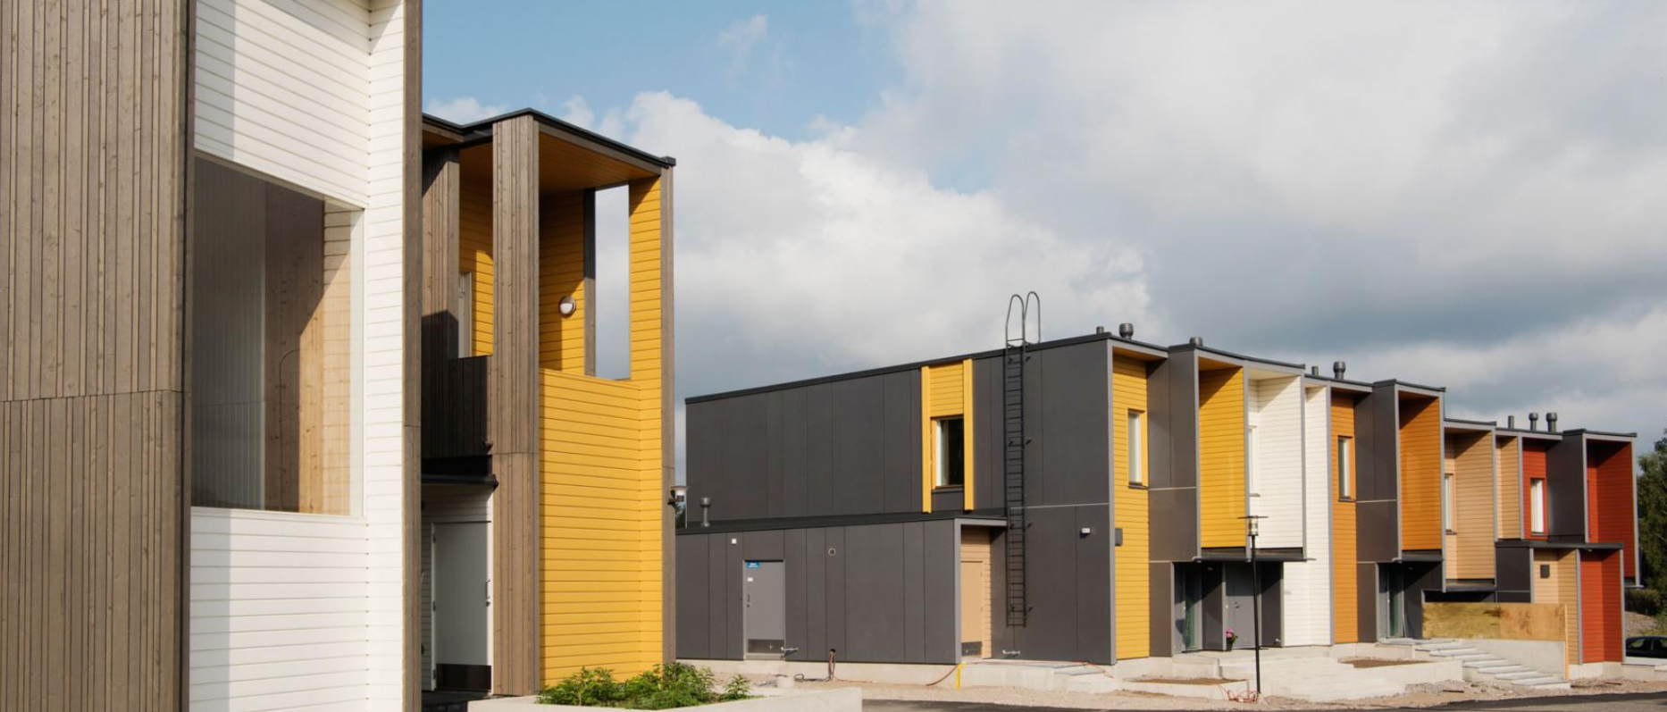
Honkasuo, Helsinki, 2017
Image: City of Helsinki

Slide 46
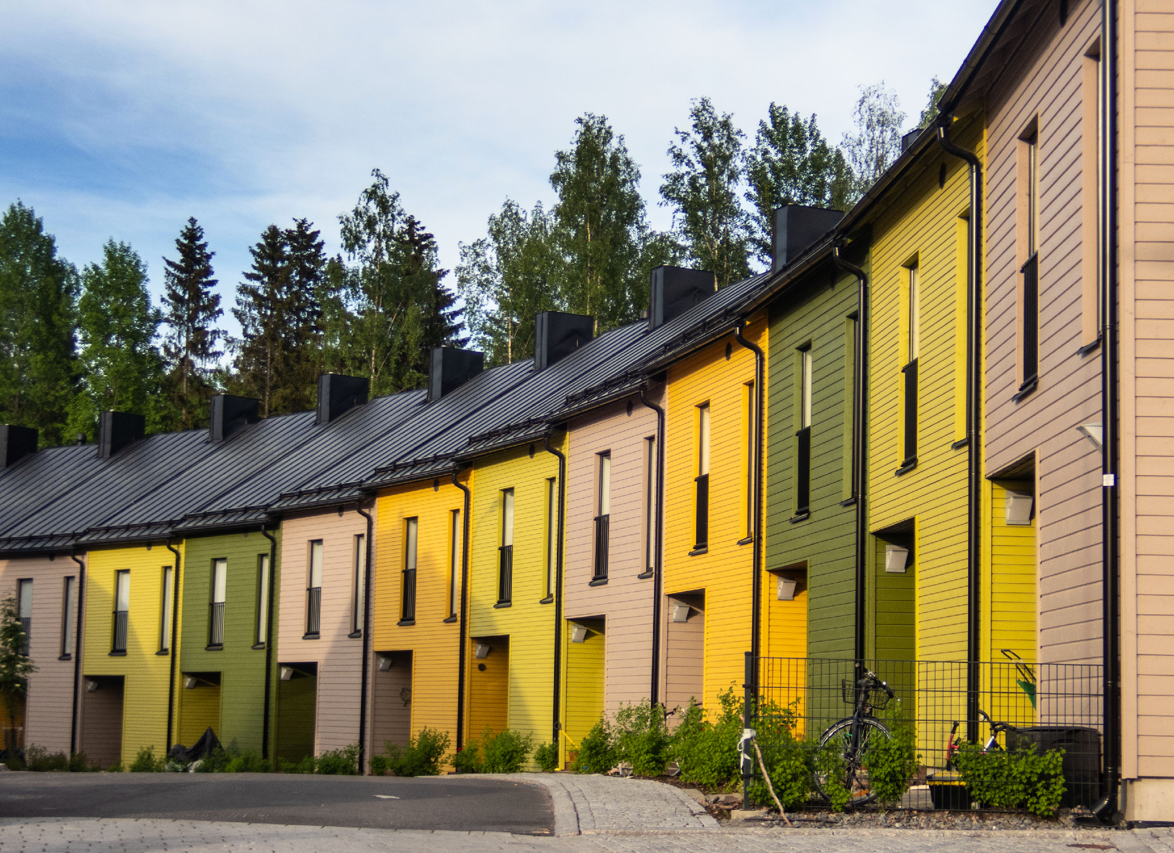
Honkasuo, Helsinki, 2017
Image: City of Helsinki

Slide 47
Another effective way is to determine and steer wood construction on the basis of the terms and conditions of land transfer, but more on that later...
Decision of the Supreme Administrative Court of 10 April 2015; Record No 2337 / 1 / 13

Slide 48
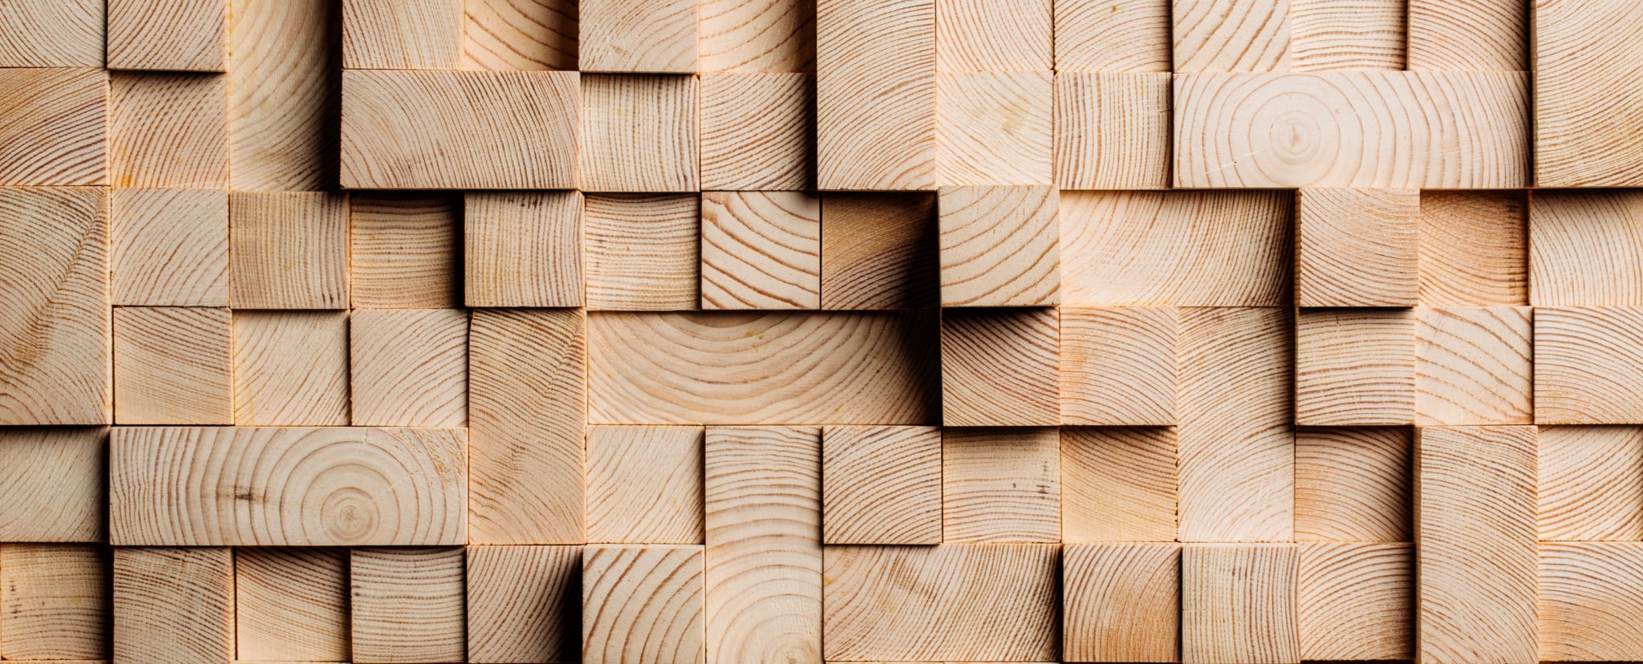
Now we can start studying the possibilities of industrial wood construction in architectural design!

