Slide 1



Industrial wood construction
Teaching materials for industrial wood construction education
2022

Slide 2
Origin of the materials
Use of the materials
These learning materials for industrial wood construction have been prepared in a project led by Puuinfo Oy in 2021–2022. Also involved in the project were
Lappia Vocational College,
TTS-Työtehoseura ry
South-Eastern Finland University of Applied Sciences,
Metropolia University of Applied Sciences,
Jyväskylä University of Applied Sciences,
University of Tampere, and
Federation of the Finnish Woodworking Industries Puutuoteteollisuus ry
The project was funded by the Ministry of the Environment.
The materials are intended to be used as extensively as possible in industrial wood construction education and studies.
The materials are released under the Creative Commons licence Attribution-ShareAlike (CC BY-SA), which requires that the author be properly credited when the materials are used and that derivative works may only be distributed under the same licence as the original work.
The original materials and any updates to them by Puuinfo will be published on the Library of Open Educational Resources website (aoe.fi) and the Puuinfo.fi website.

Slide 3

Industrial construction systems

Slide 4
Tero Lahtela,
Insinööritoimisto Tero Lahtela Oy
Release date: 22/10/2021

Slide 5
Ring-beam construction and arched frames
Construction of industrial halls

Slide 6
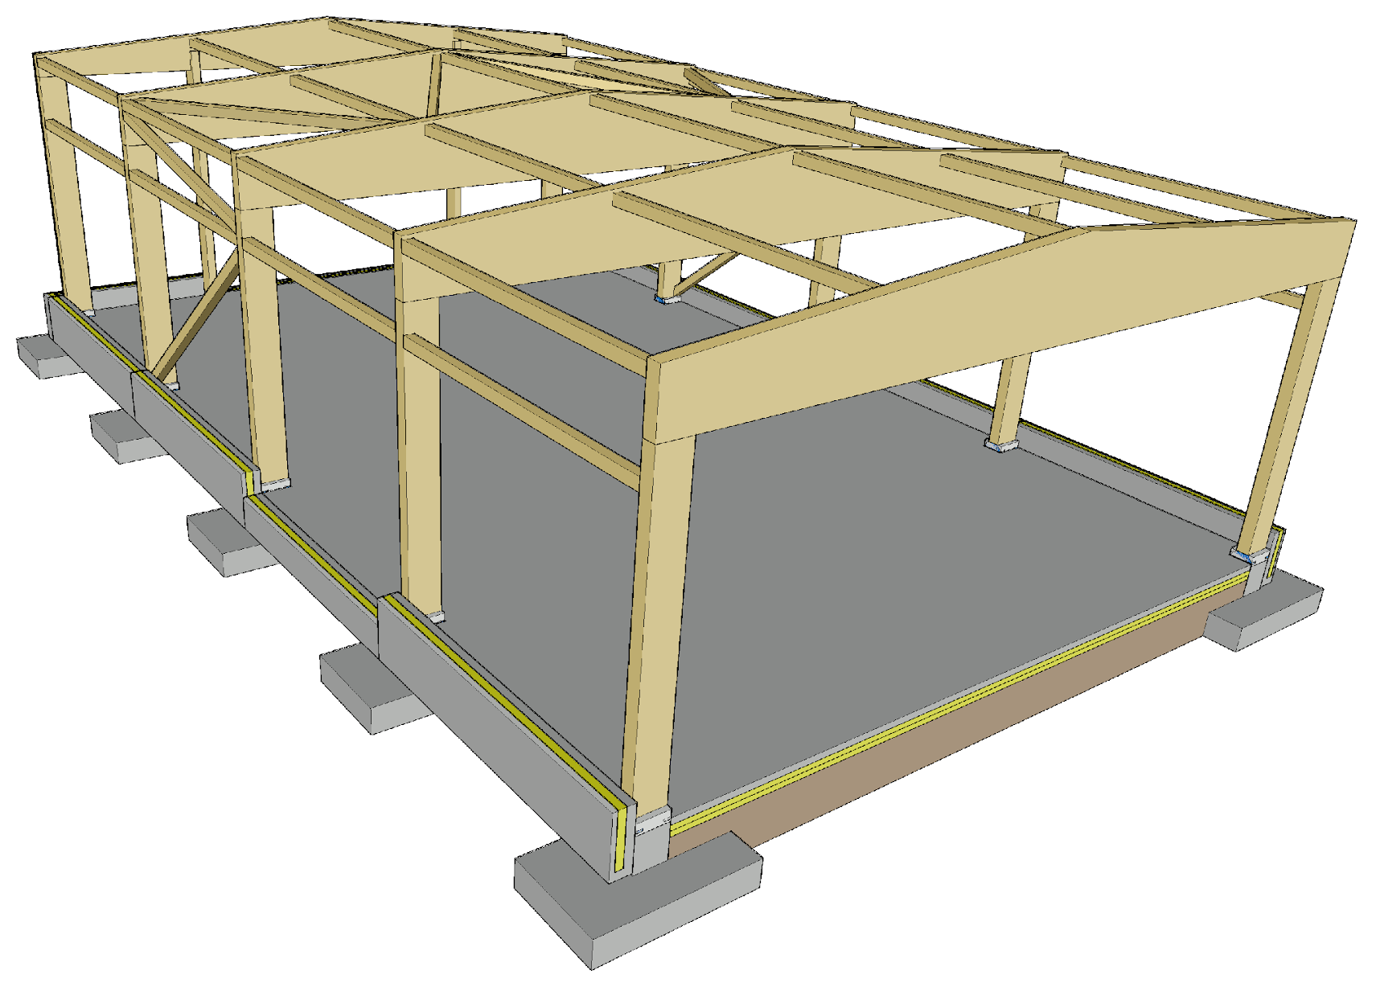
Cantilever column frame
Traditional construction system for industrial halls
Enables the use of different types of end supports
Typical uses
  Production buildings
  Warehouse buildings
  Commercial premises
  Agricultural buildings

Slide 7
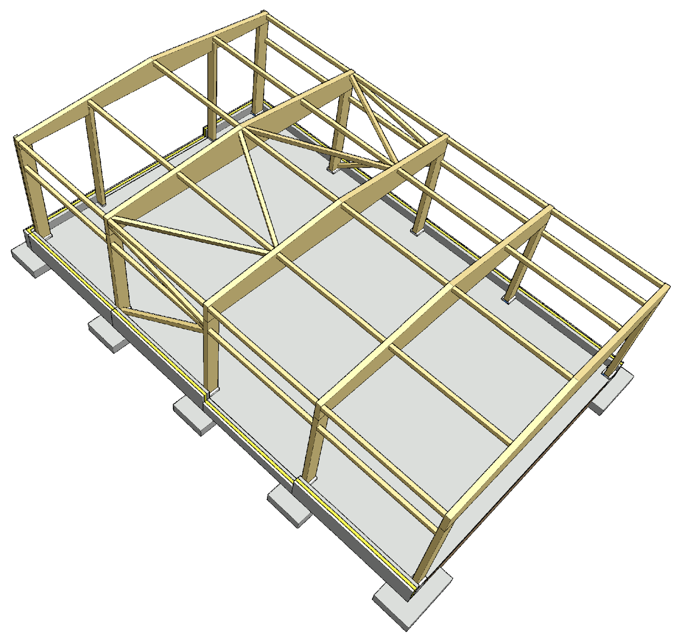
Parts of a cantilever column frame
3
Main support
Main column
End beam
Corner column
Wind column
Stiffeners
  Lateral supports for the main support
  End wind load
5
4
6
6
1
2

Slide 8
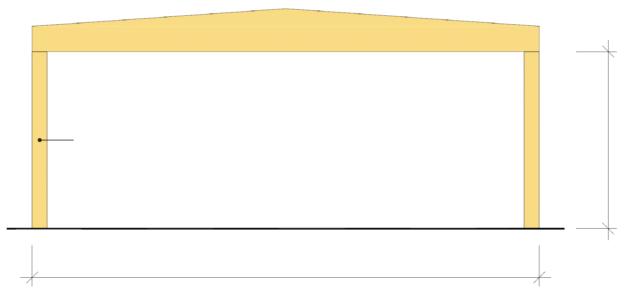
Cantilever column frame
A cantilever column frame is a ring-beam system
A ring-beam building with cantilever columns is stiff at the ring-beam level, which is why the length of the building does not affect its transversal stiffening
Stiffening a ring-beam system in the longitudinal direction of the building is challenging (wind load + lateral supports of main supports)
Ridge beam
Cantilever columns k6000...k8000
max 6m
Recommendation 24...32 m

Slide 9
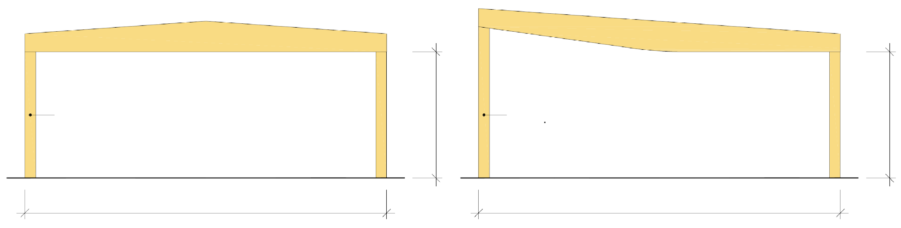
Most typical main supports
Ridge beam
Fish-bellied beam
Cantilever columns k6000...k8000
max 6m
Cantilever columns k6000...k8000
max 6m
Recommendation 24...32 m
Recommendation 24...32 m

Slide 10
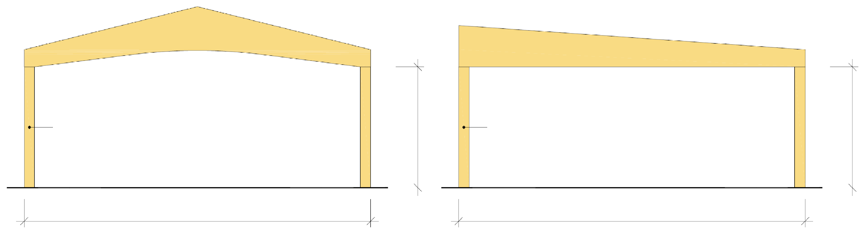
Special end supports
Boomerang beam
Lean-to girder
Cantilever columns k6000...k8000
max 6m
Cantilever columns k6000...k8000
max 6m
Recommendation 15...20 m
Recommendation 15...20 m

Slide 11
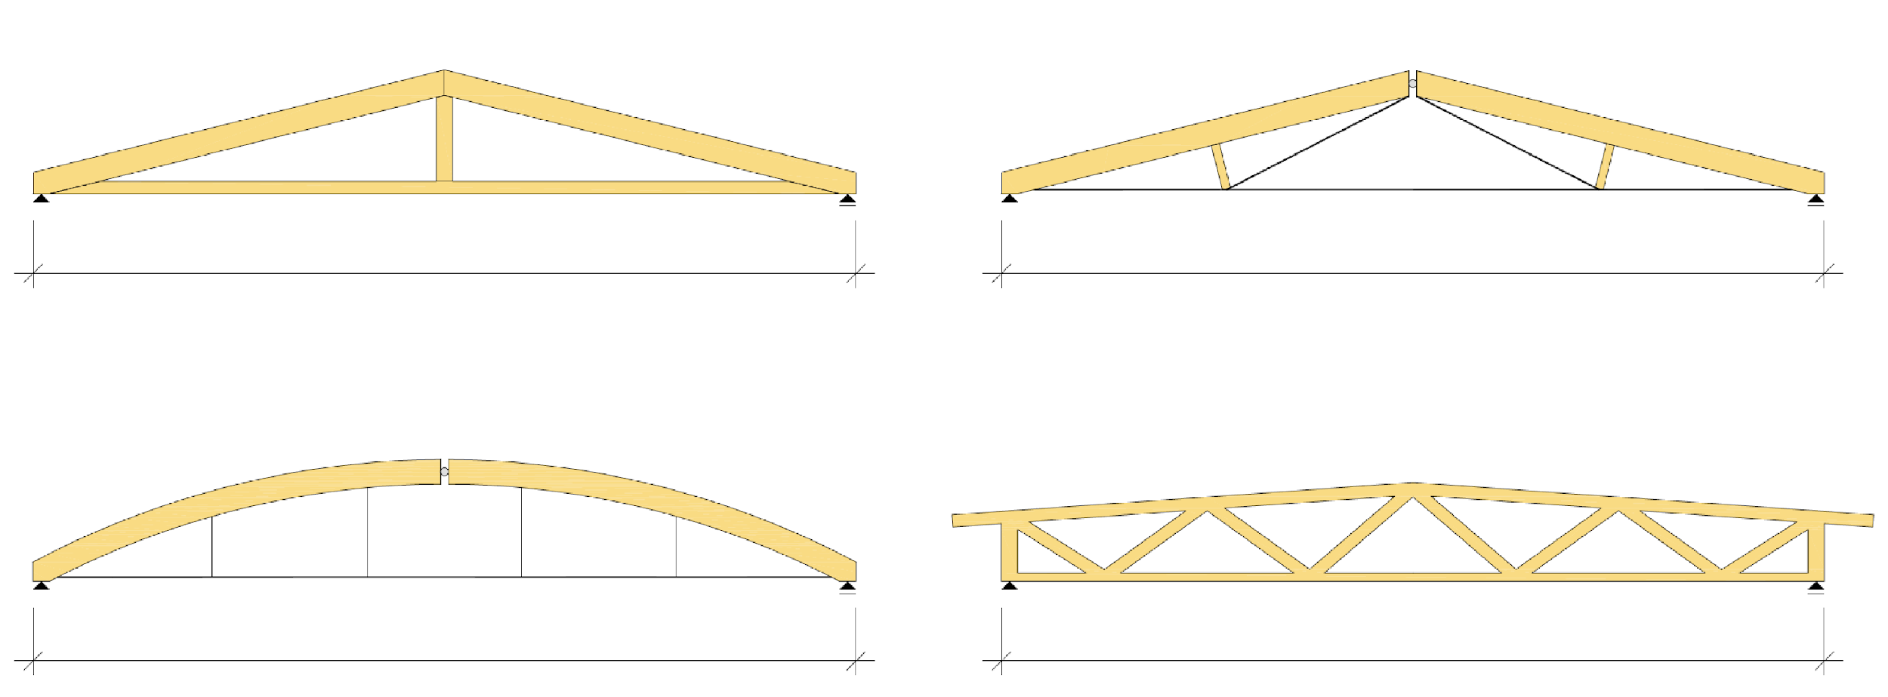
Other special end supports
A support
Truss support
Recommendation 15...30 m
Recommendation 25...50 m
Drawbar arch beam
Dowelled grid
Recommendation 25...50 m
Recommendation 25...65 m

Slide 12
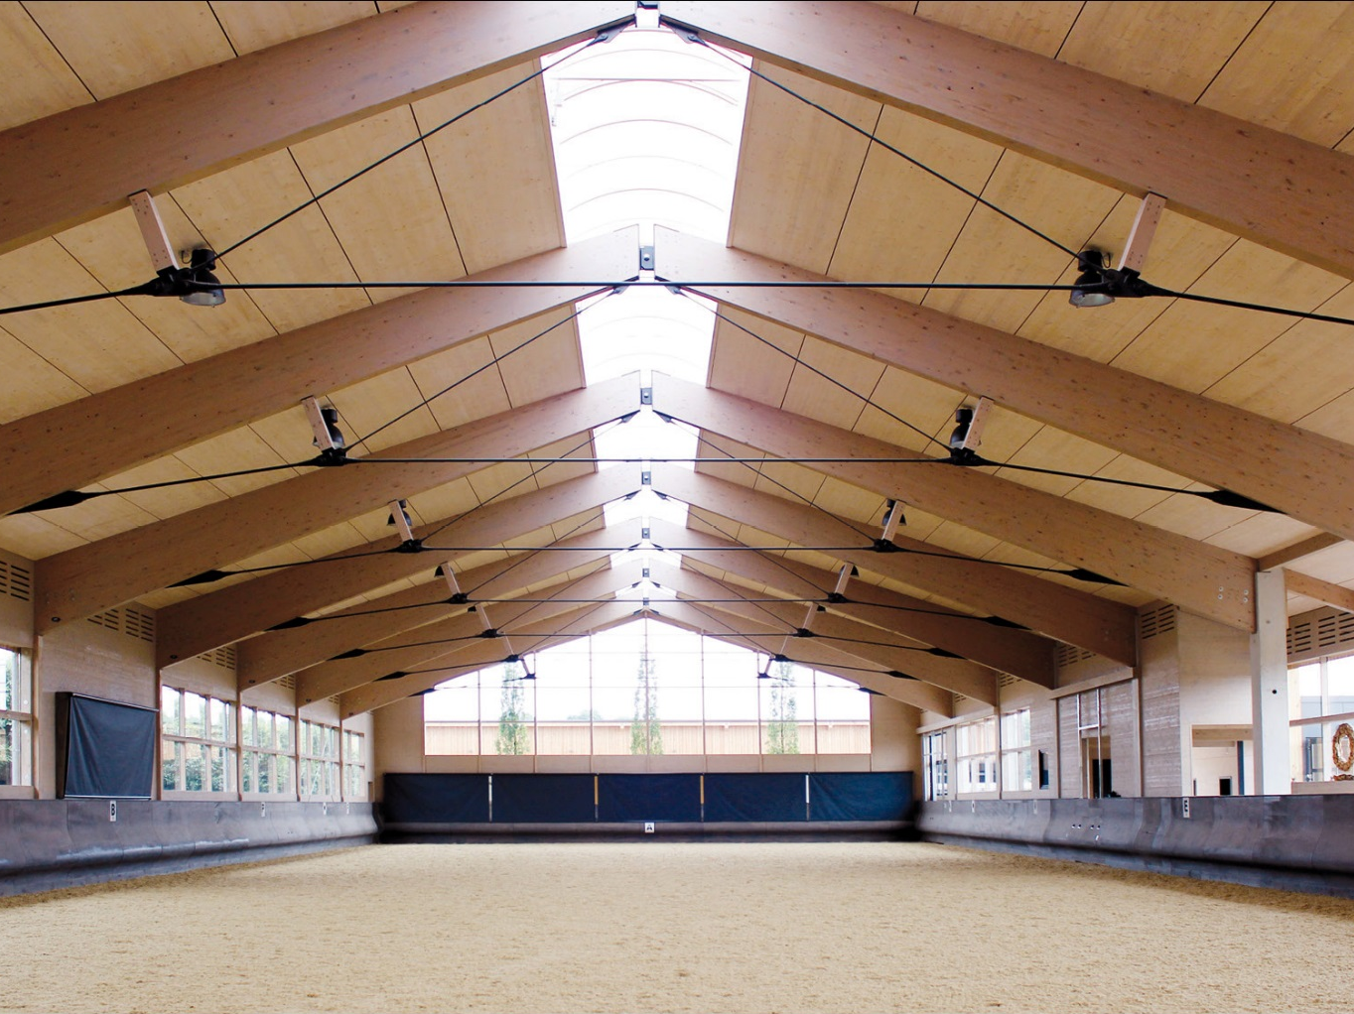
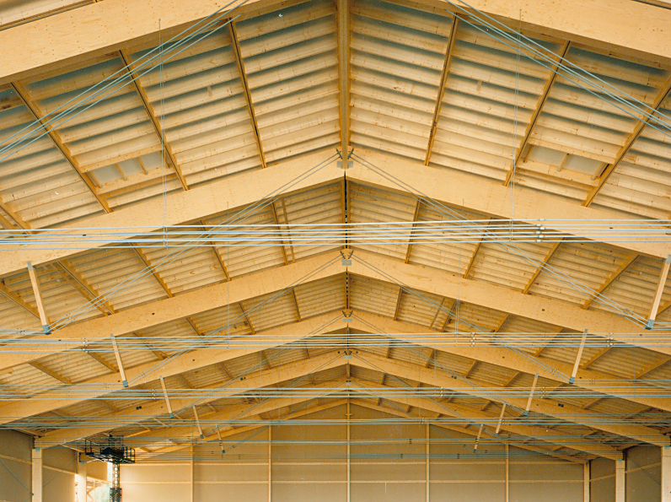
Special end supports
Image: Binderholz
Image: Puuinfo

Slide 13
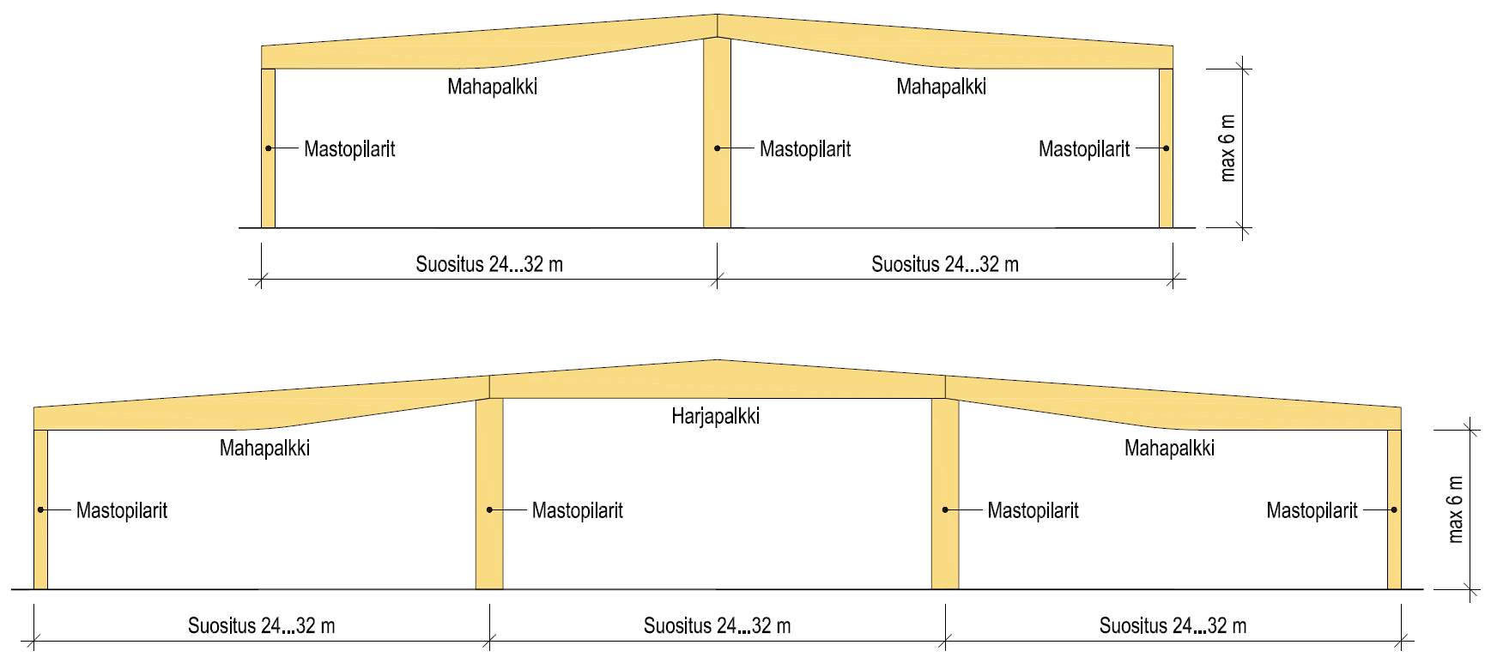
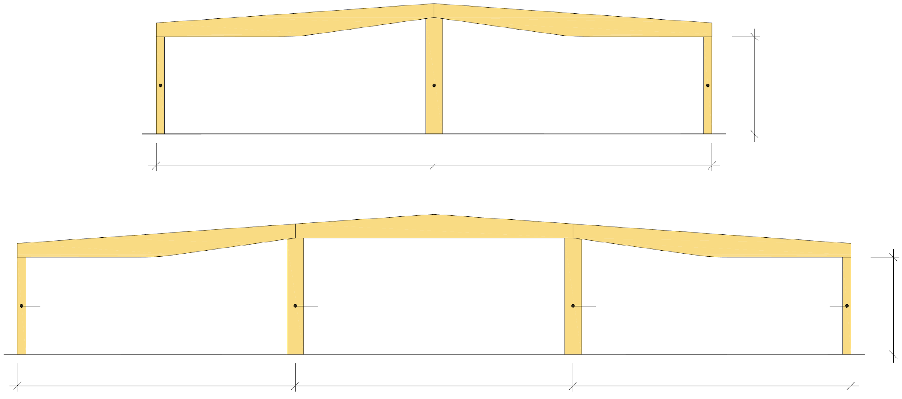
Multi-span cantilever column hall
Fish-bellied beam
Fish-bellied beam
Cantilever columns
Cantilever columns
Cantilever columns
max 6m
Recommendation 24...32 m
Recommendation 24...32 m
Ridge beam
Fish-bellied beam
Fish-bellied beam
Cantilever columns
Cantilever columns
Cantilever columns
Cantilever columns
max 6m
Recommendation 24...32 m
Recommendation 24...32 m
Recommendation 24...32 m

Slide 14
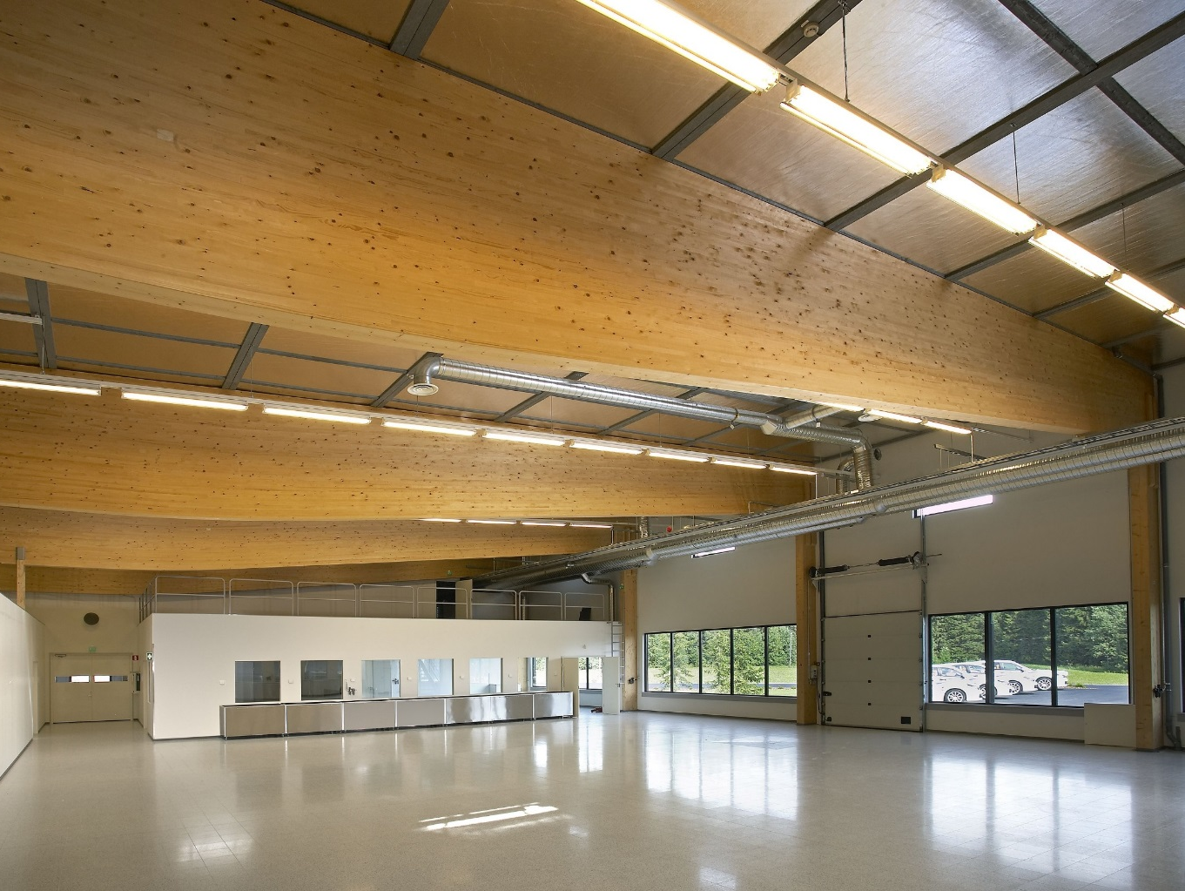
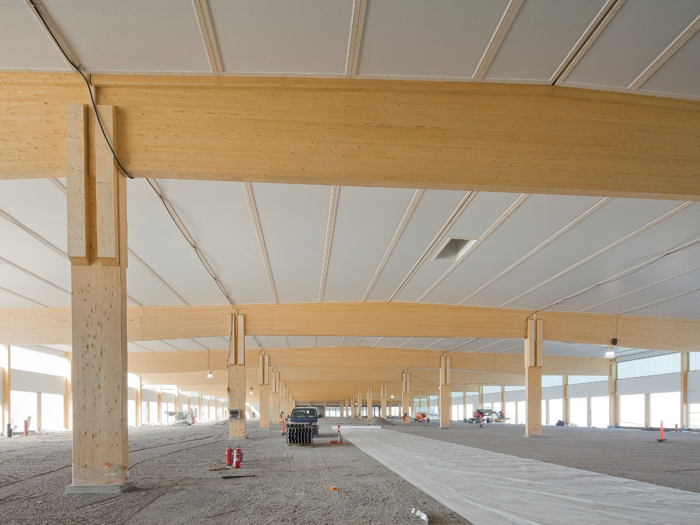
Cantilever column halls
Image: Puuinfo
Image: Puuinfo
Image: Binderholz

Slide 15
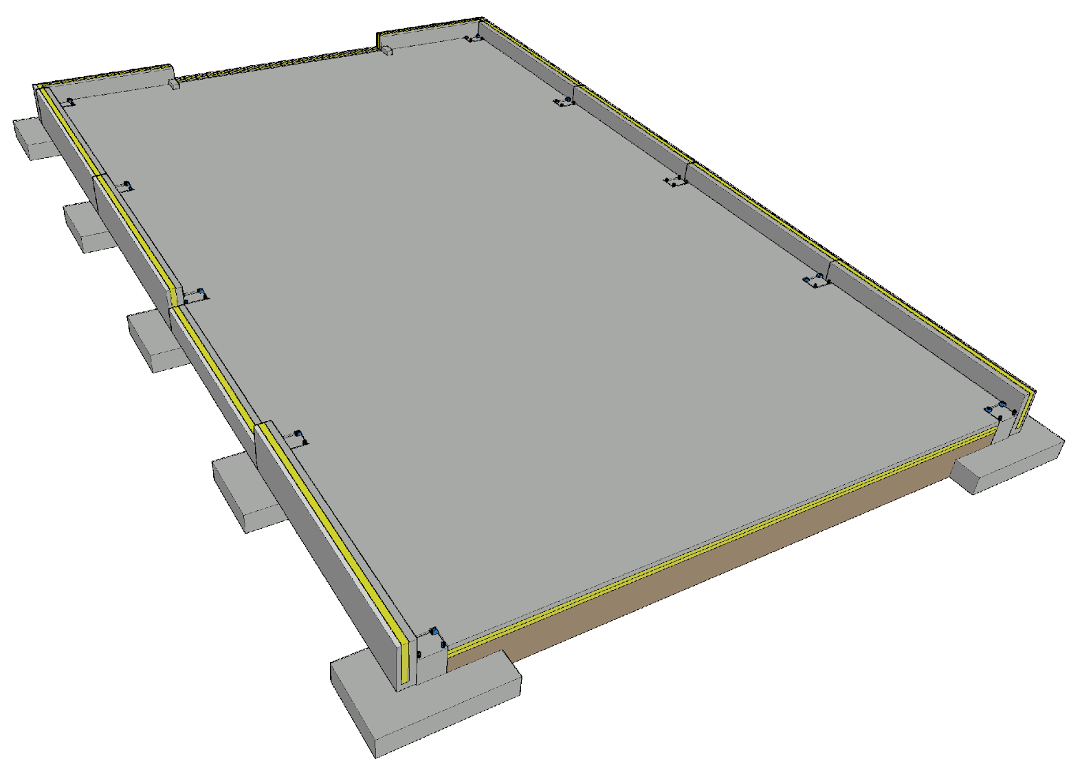
Foundation of a cantilever column hall
The foundations of cantilever columns are relatively large if the vertical load is small
For the foundations, plinth beams are usually used
Challenges
  Junction between the column and the foundation
  Vertical dimensional accuracy of the foundation
  Dimensional accuracy of foundation bolt locations

Slide 16
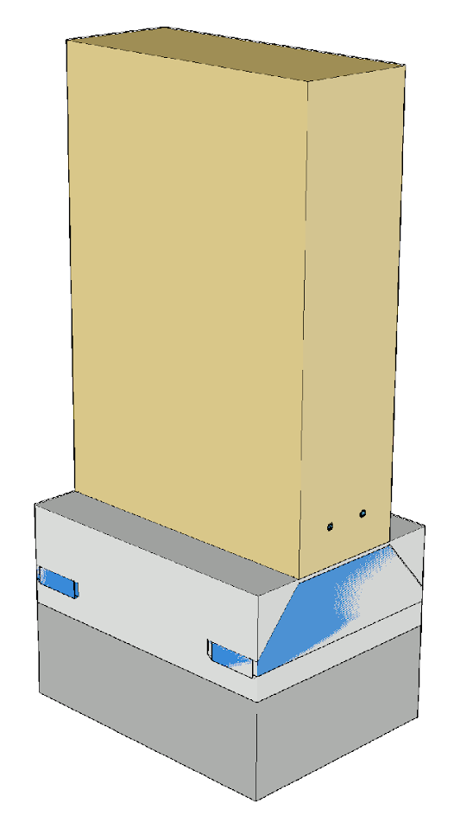
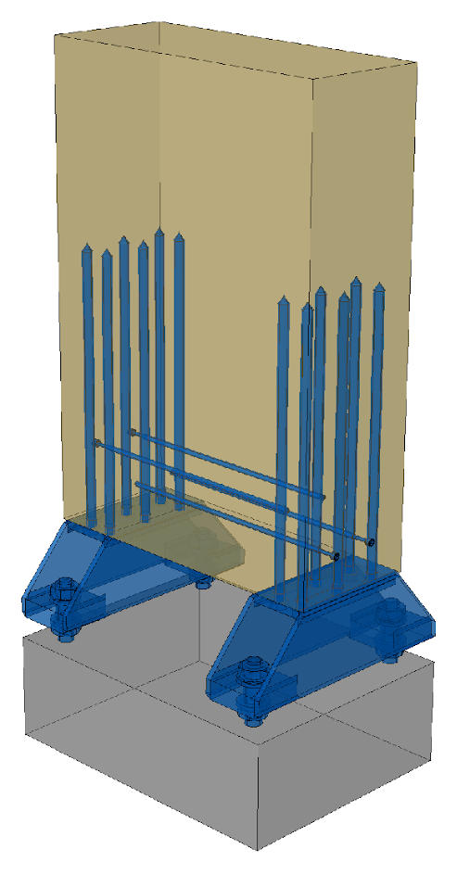
Joint between a cantilever column and the foundation
For the joint between a cantilever column and the foundation, e.g. a column shoe is used, which is attached to the column with a glued-in rod joint
The gap between the wood column and the foundation column is filled with grouting
Waterproofing between the timber and concrete
The column is reinforced as needed, to prevent cracking due to drying

Slide 17
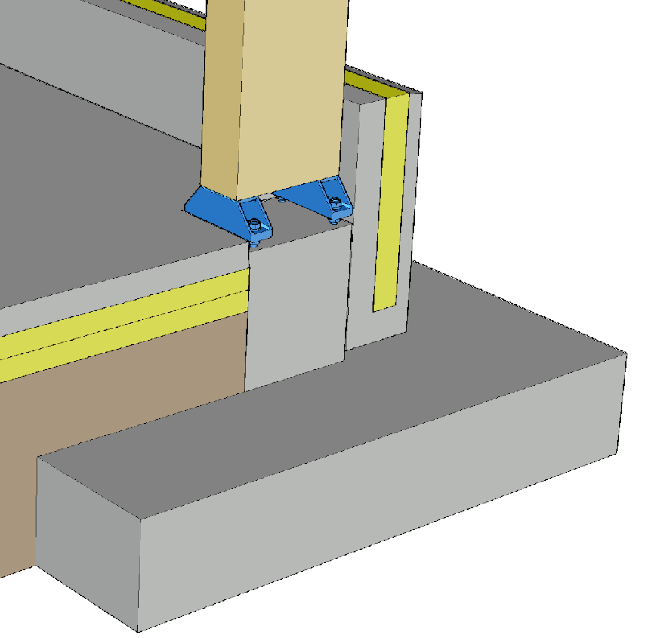
Joint between a timber column and the foundation
At least in production and storage buildings, having the bottom edge of a timber column above the floor level is recommended (moisture stress)
The height of the column shoes affects the timing of the slab-on-grade casting (ease of installation)
Grouting of the joints will affect the workflow and work schedule

Slide 18
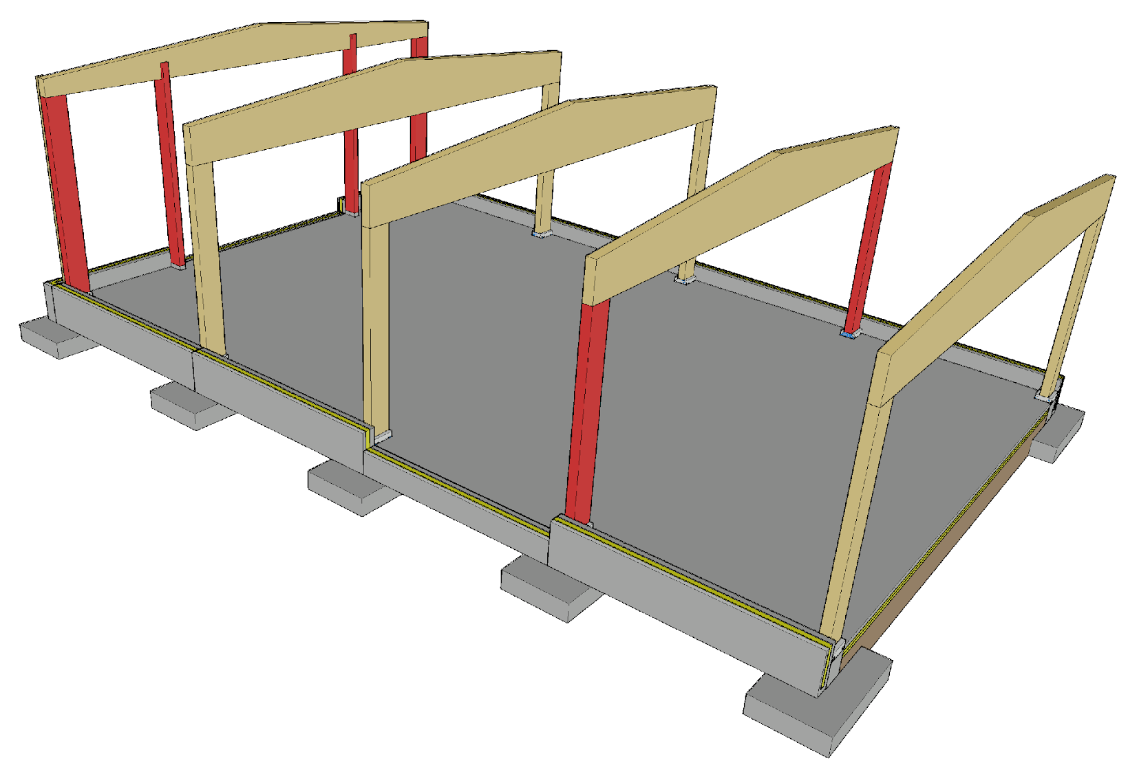
Vertical load transfer
The bearing pressure resistance of the joint between the main column and main support is often a challenge
The large vertical load of the main column is an advantage from the perspective of foundation stability
The wind columns and corner columns of the end wall transfer the vertical load to the foundations

Slide 19
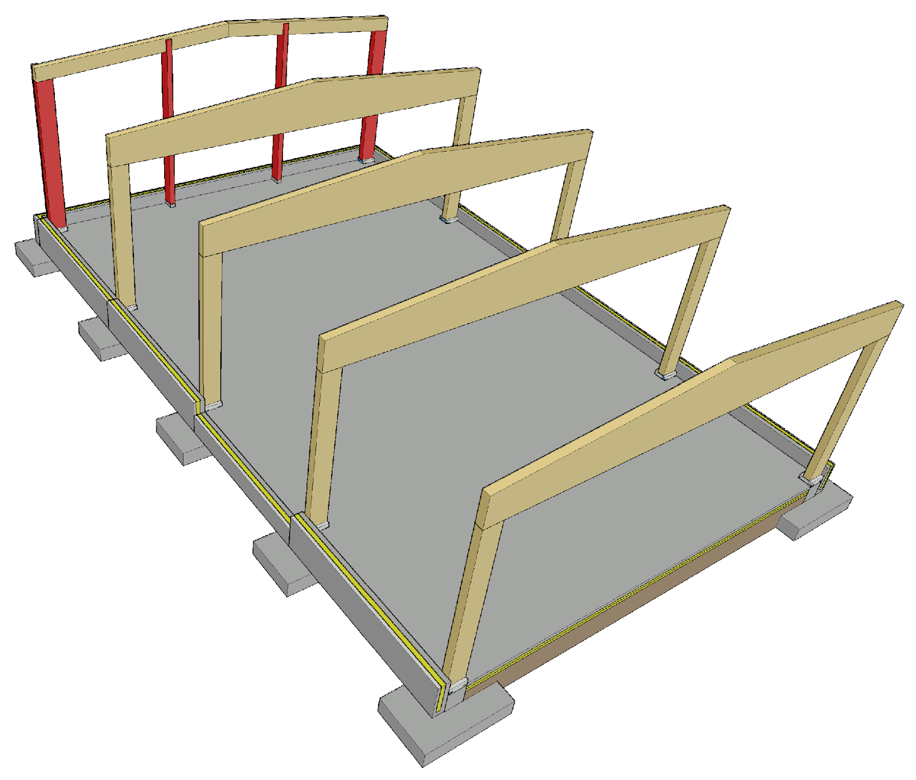
Vertical load transfer
For the end wall, straight beams fitted to the roof slope can also be used
If there is e.g. a wide door in the middle of the end wall, a separate beam must be placed on top of the opening if necessary, because the wind pillar cannot be placed in the middle of an opening

Slide 20
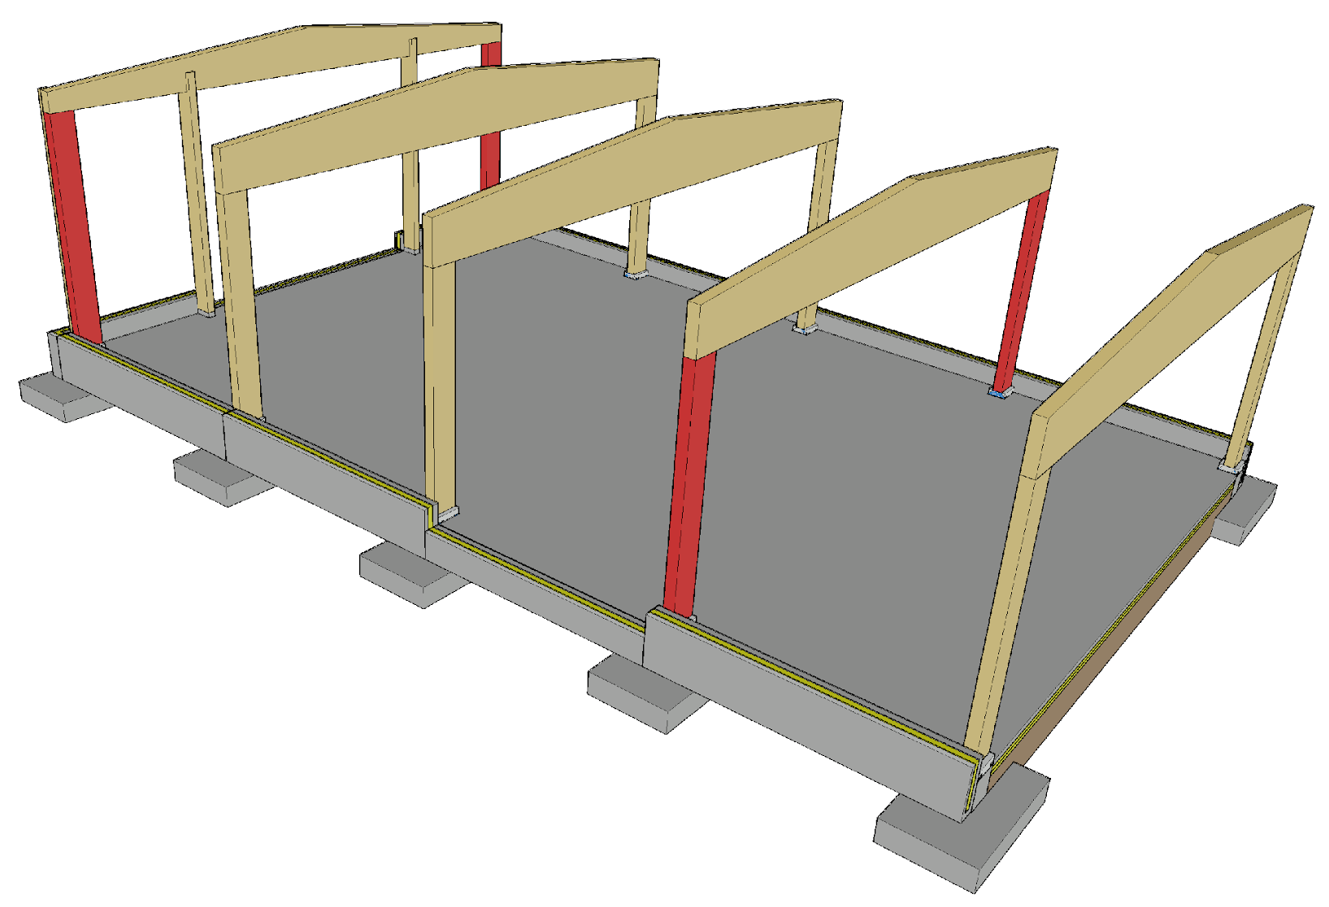
Transversal stiffening of a cantilever column frame
For transversal stiffening of the hall, the cantilever columns of the side walls are used
The hall length does not affect the transversal stiffening because the cantilever column ring-beam is a stiffening structural component at its level

Slide 21
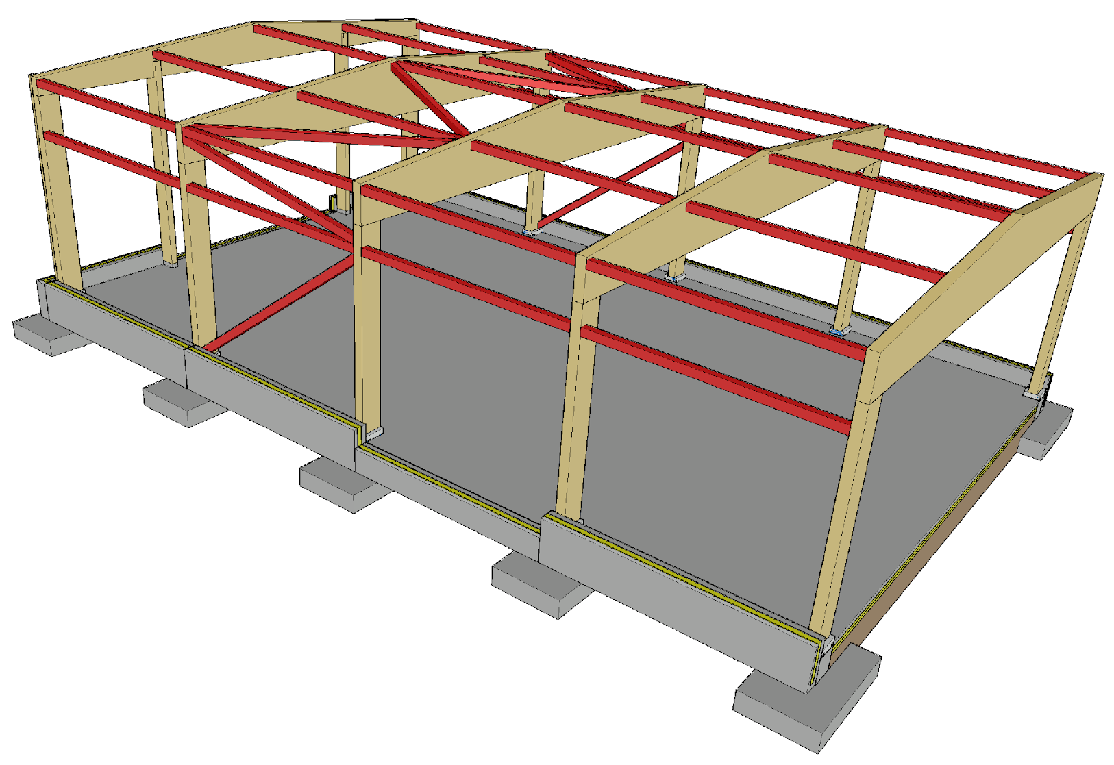
Longitudinal stiffening of a cantilever column frame
Stiffening a ring-beam structure in the longitudinal direction of the building is more challenging than in the transversal direction
Loads that affect longitudinal stiffeners are created by
  The end wind load
  Transversal supports of load-bearing structures
  Additional horizontal load

Slide 22
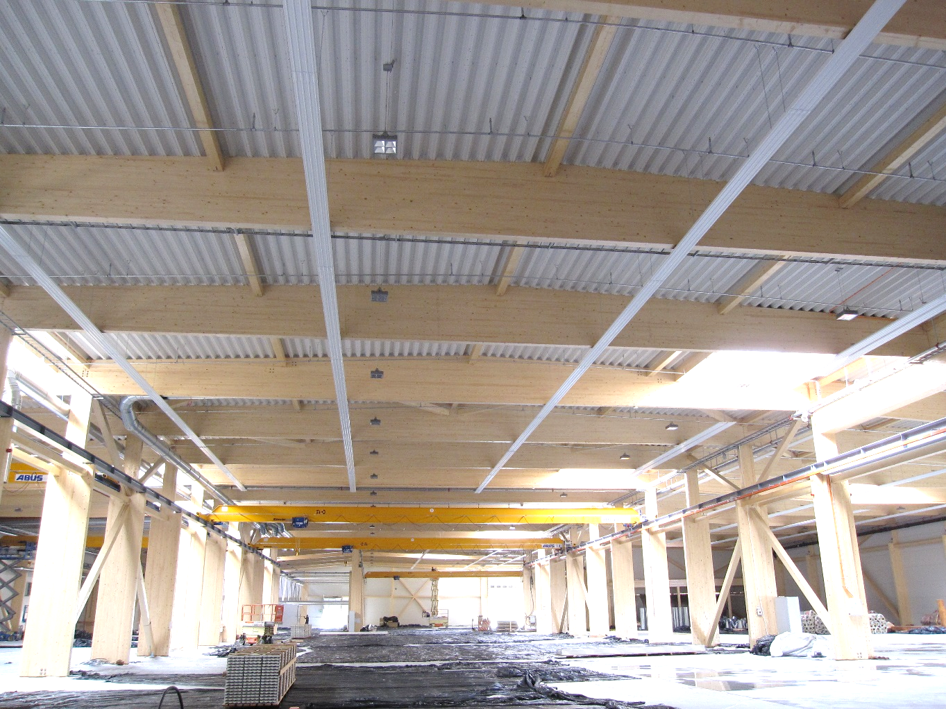
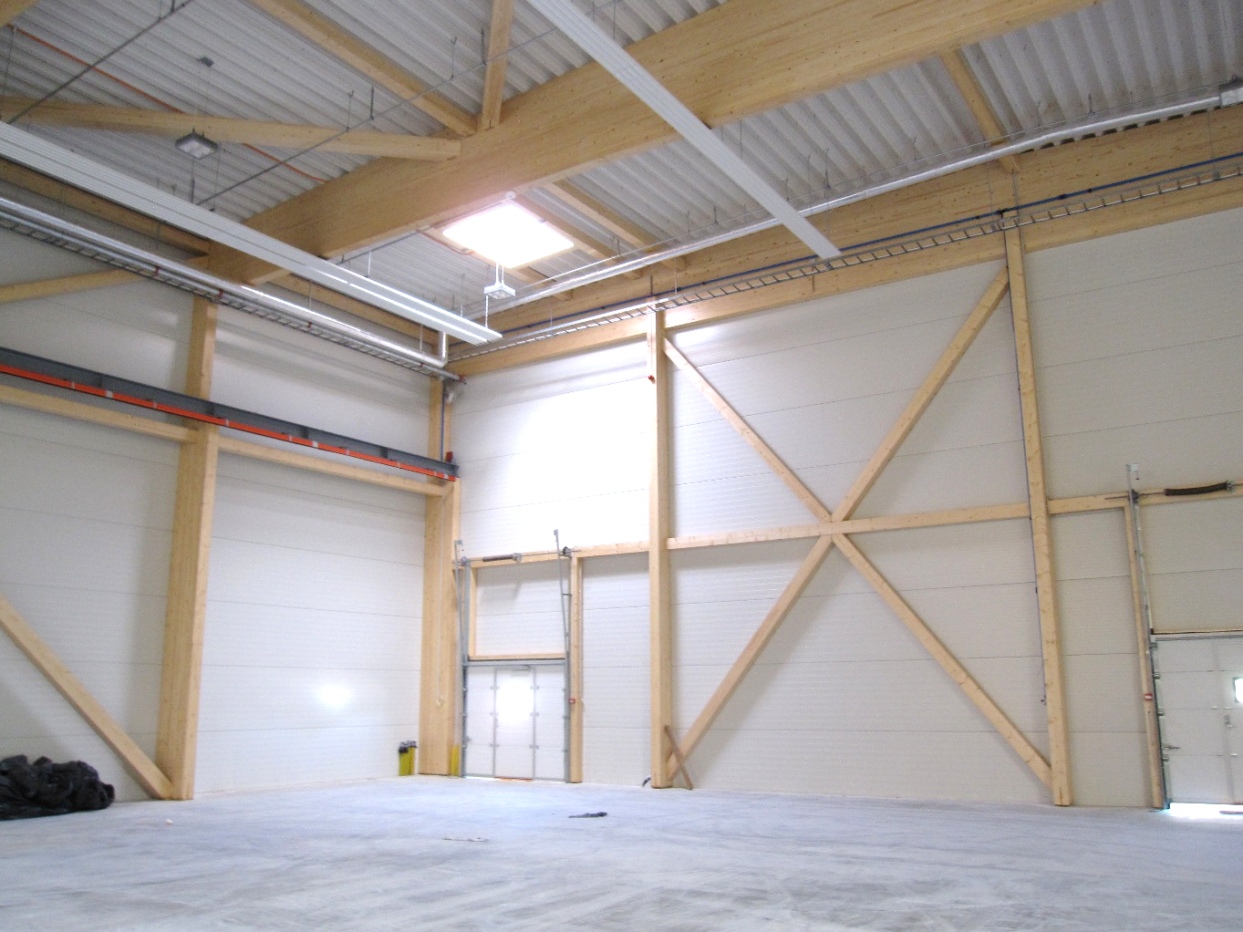
Stiffeners for a cantilever column frame
Image: Tero Lahtela
Image: Tero Lahtela

Slide 23
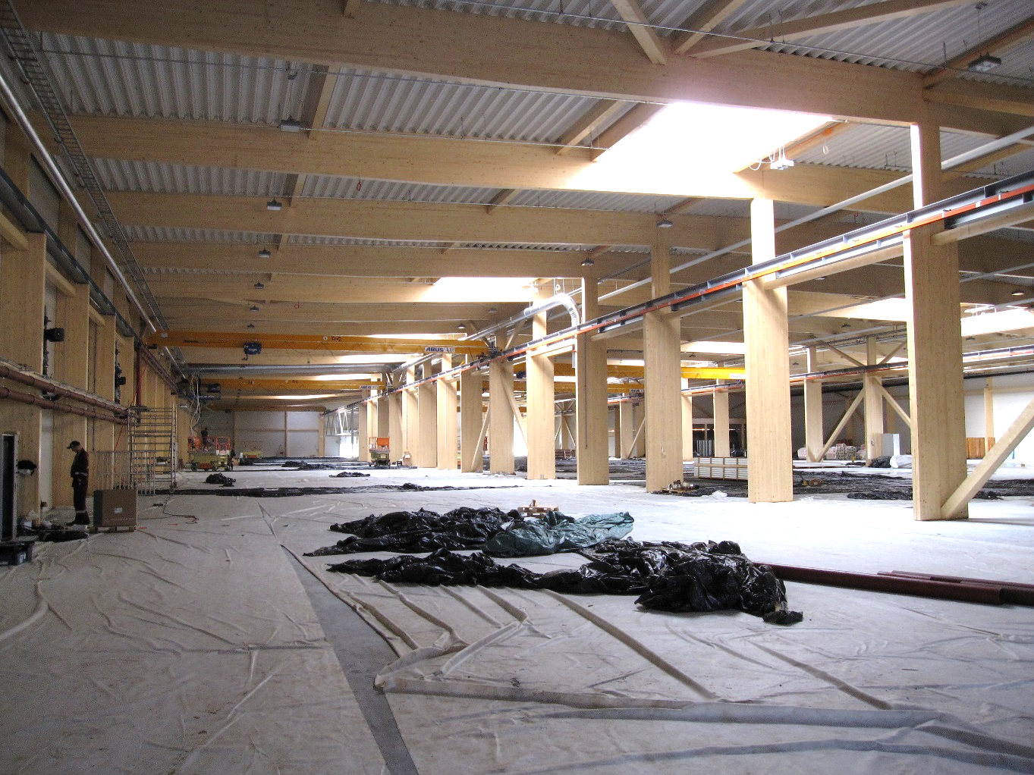
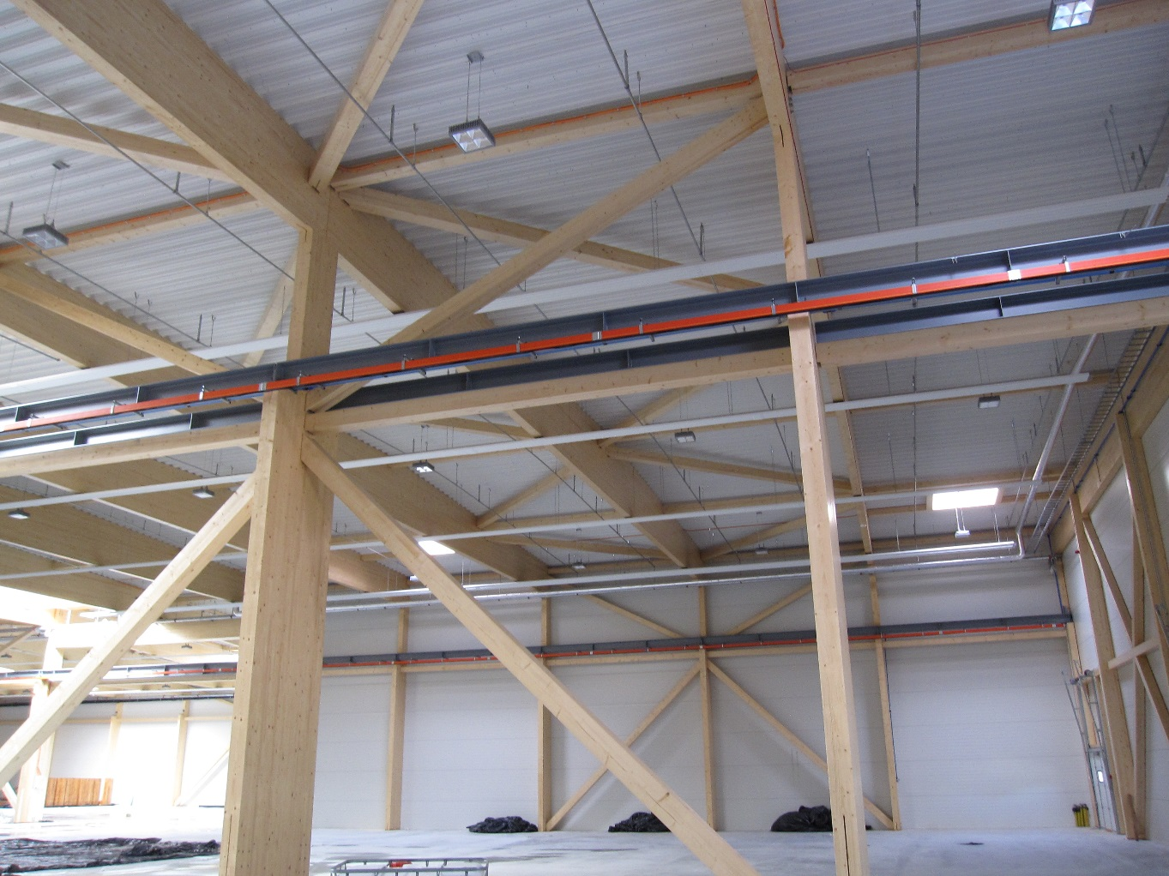
Stiffeners for a cantilever column frame
Image: Tero Lahtela
Image: Tero Lahtela

Slide 24
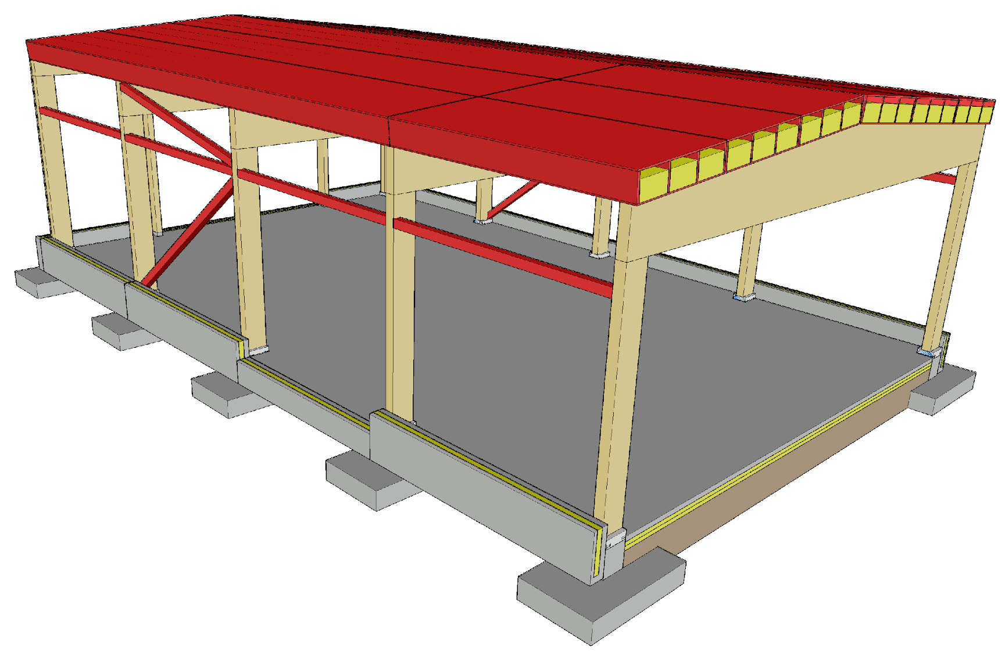
Longitudinal stiffening of a cantilever column frame
A roof structure that works as a stiffening plate can be designed using stiffening roof elements
This provides the following advantages
  The stiffening plate can be designed as the lateral buckle support structure of the main support, in which case separate roof stiffeners are not needed
  The stiffening plate transfers the end wind load and the additional horizontal load to the side wall stiffeners

Slide 25
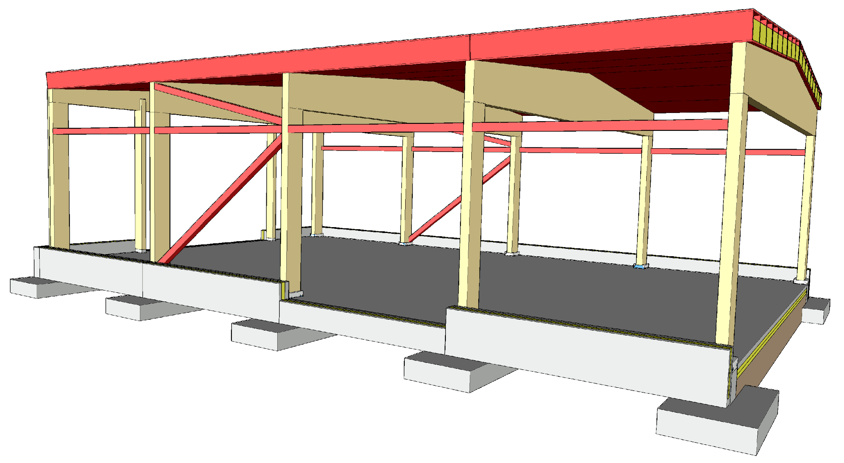
Roof stiffening plate

Slide 26
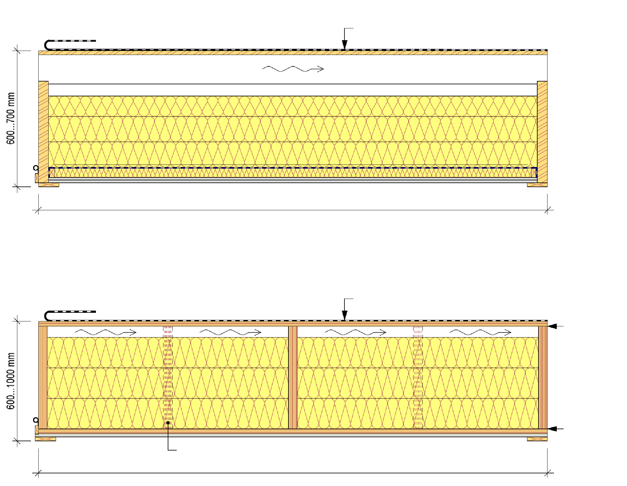
Roof element
With a beam structure
Asphalt roll or PVC roofing
Roof units are manufactured to order, with properties and dimensions specific to the site
A roof unit with beam structure is the traditional roof unit type
Roof units are usually designed to have multiple openings
max 2500mm
Kerto closed rib panel
Asphalt roll or PVC roofing
Structural gluing at the factory
Additional ribs if necessary
Structural gluing at the factory
max 2500mm

Slide 27
Roof element
With a beam structure
Asphalt roll or PVC roofing
Unit with beam structure
  Length ≤ 24 m
  Span 4…9 m
  R 15, R 30, R 60
Kerto closed rib panel
  Length ≤ 25 m
  Span ≤ 18 m
  R 15, R 30, R 60
max 2500mm
Kerto closed rib panel
Asphalt roll or PVC roofing
Structural gluing at the factory
Additional ribs if necessary
Structural gluing at the factory
max 2500mm

Slide 28
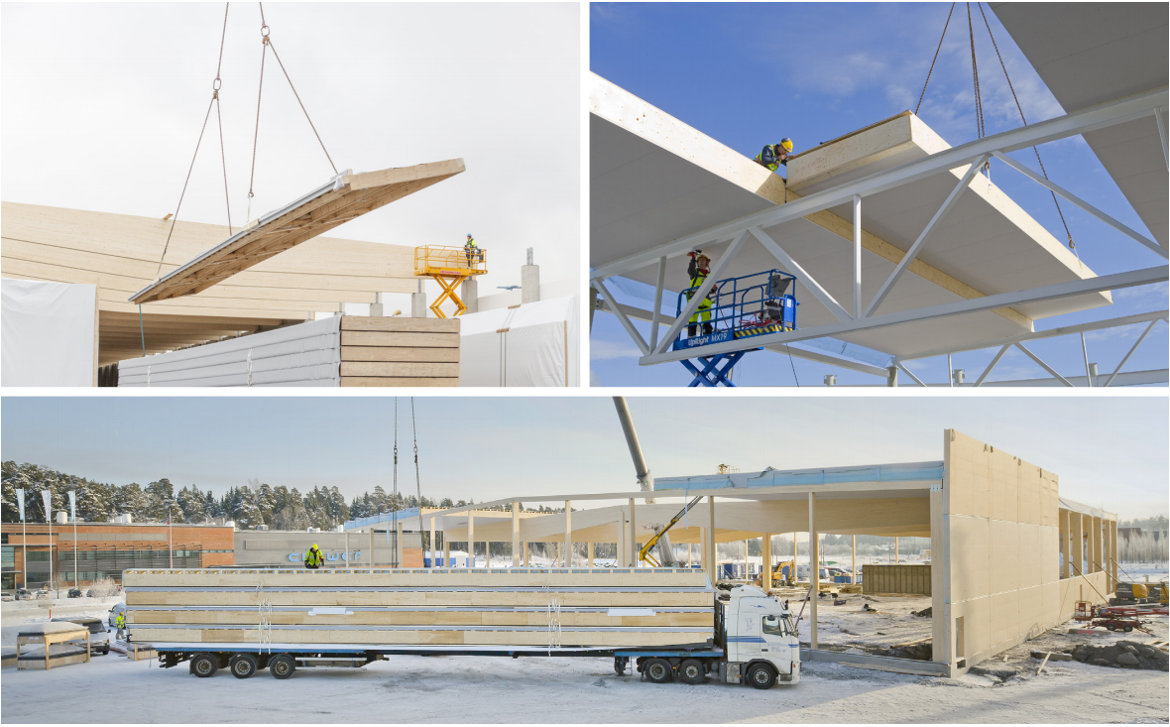
Installation of roof units
Images: Metsä Wood

Slide 29
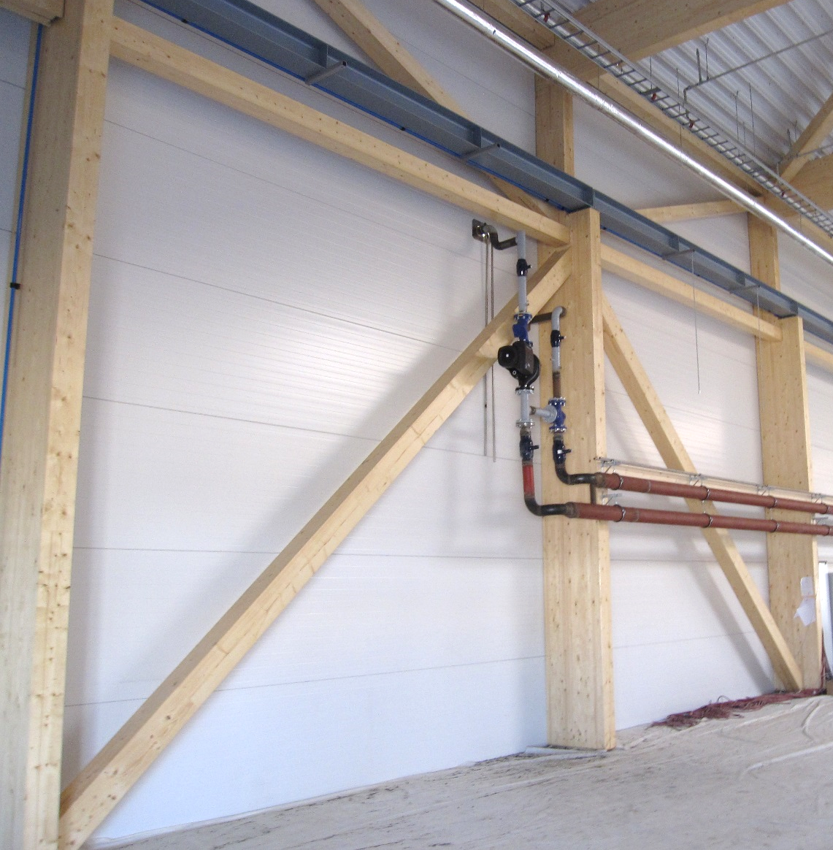
Exterior walls of a cantilever column hall
For the exterior walls of hall buildings with ring-beam structure, the following are usually used
  Timber units
  Metal sandwich units
The exterior walls of hall buildings with ring-beam structure are non-load-bearing building elements
Image: Tero Lahtela

Slide 30
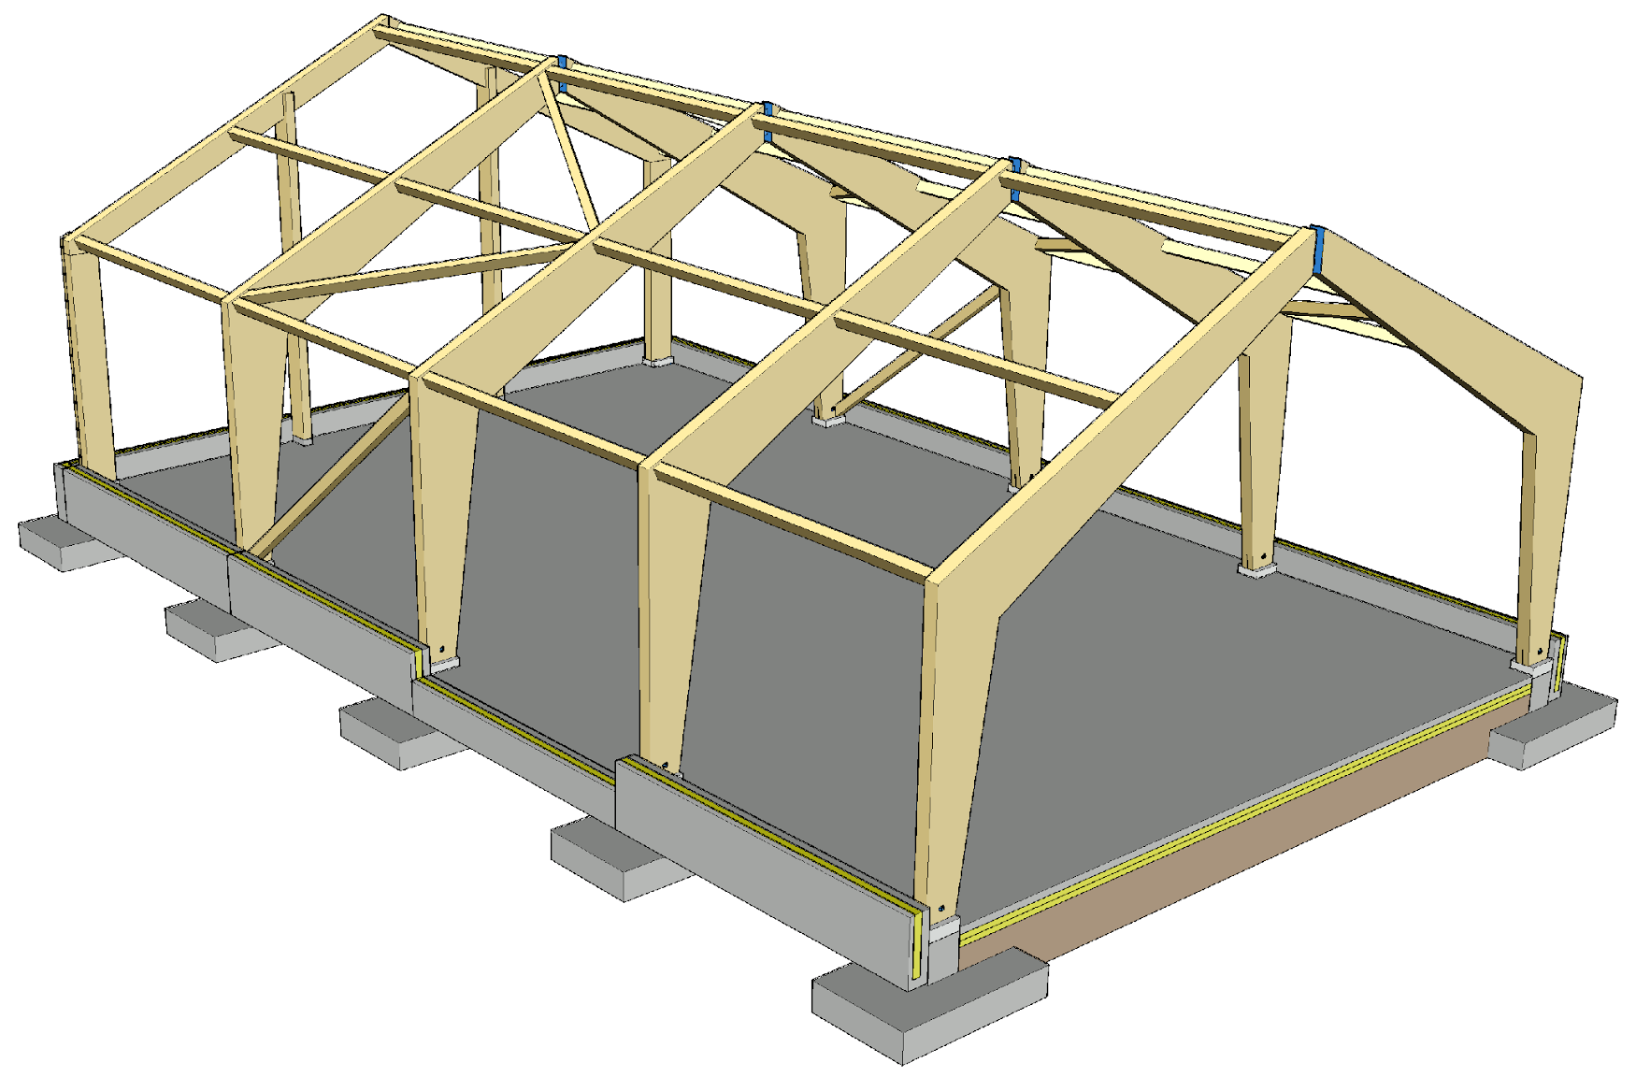
Frame with 3-pin joints
Traditional construction system for industrial halls
Enables
  a high space
  a wide continuous space
Typical uses
  Agricultural buildings
  Production facilities
  Sports facilities

Slide 31
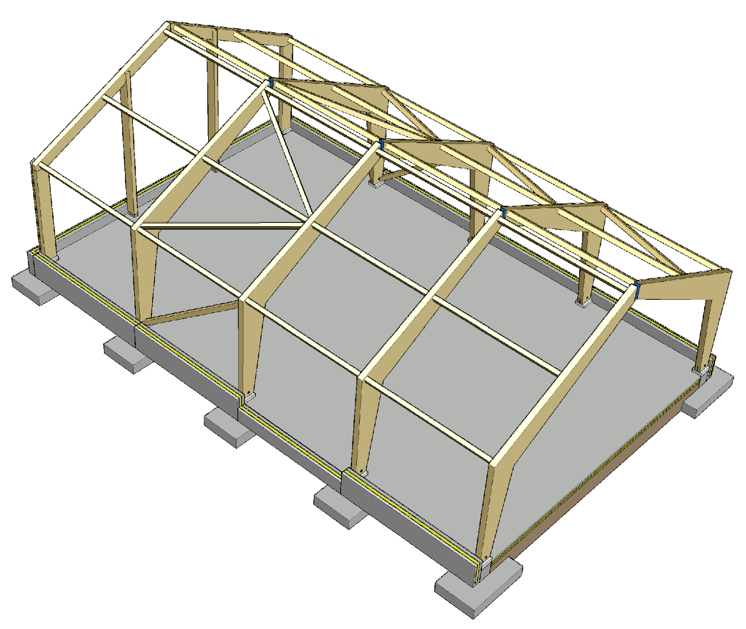
Components of a frame with a 3-pin joint ring-beam
2
3-pin joint ring-beam
End beam
Corner column
Wind column
Stiffeners
  Sideways support of a 3-pin joint ring-beam
  End wind load
4
5
3
5
1

Slide 32
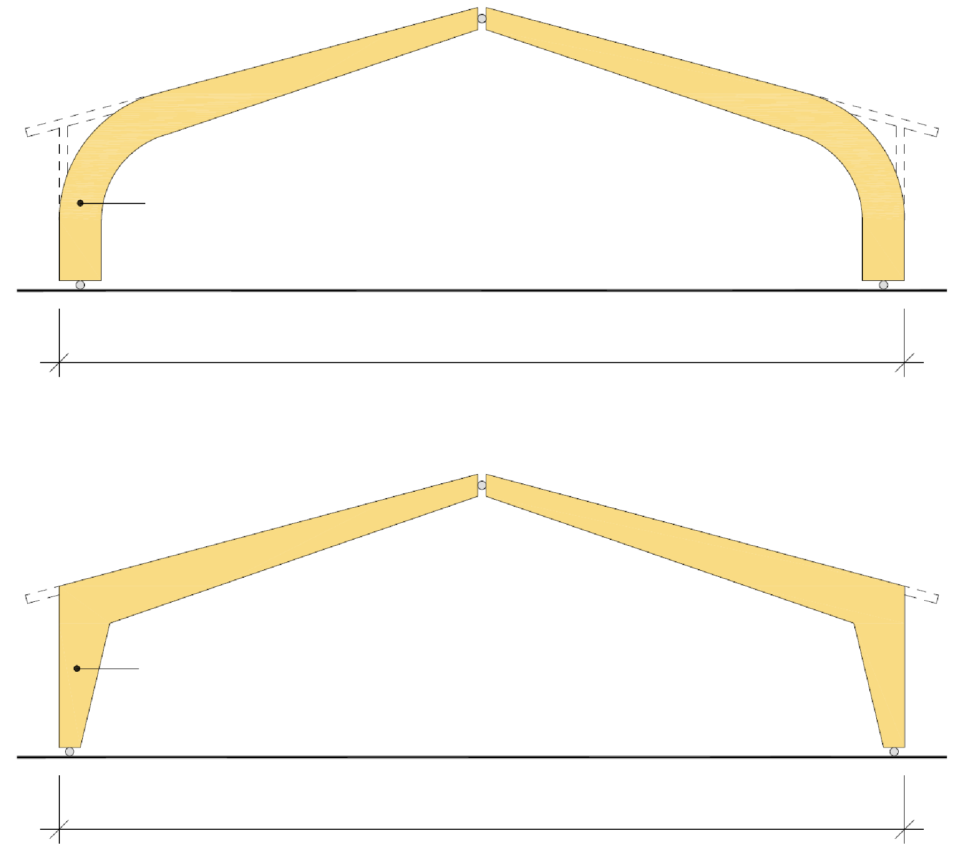
Frame with 3-pin joints
A 3-pin joint ring-beam is built with
  Curved corners
  Sharp corners
A 3-pin joint ring-beam building is stiff at the ring-beam level, which is why the length of the building does not affect its transverse stiffening
Stiffening a ring-beam system in the longitudinal direction of the building is challenging (wind load + lateral supports for the 3-pin joint ring beam)
Curved-corner 3-pin joint ring-beam
k4800...k8000
Recommendation 20...40 m
3-pin joint ring-beams
k4800...k8000
Recommendation 10...20 m

Slide 33
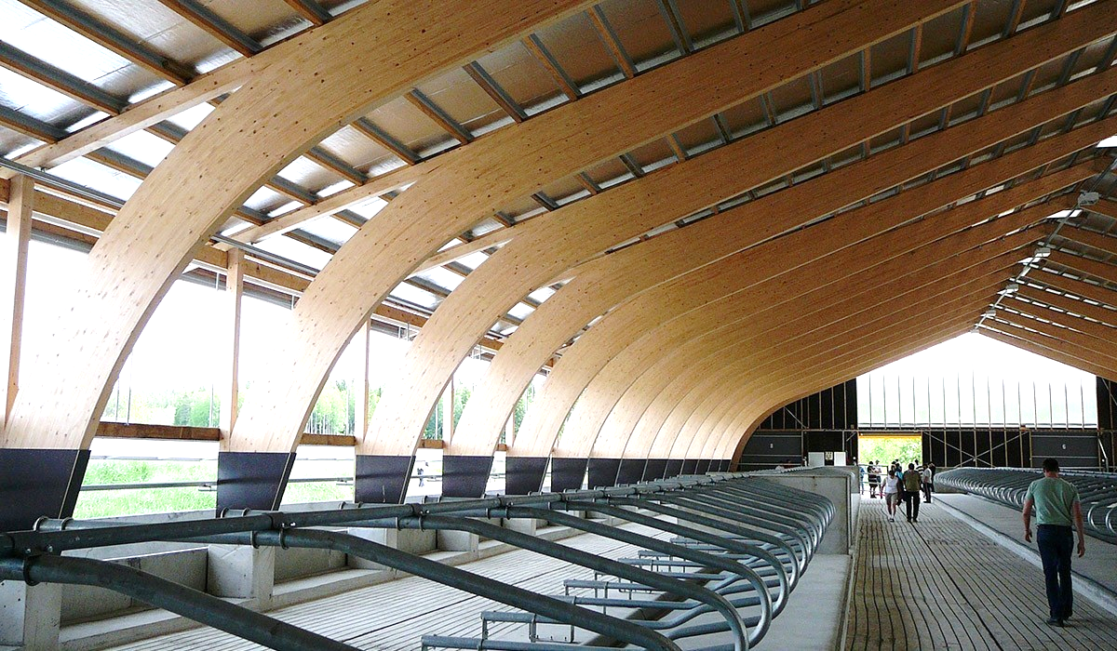
3-pin joint ring-beam with curved corners
Image: Versowood

Slide 34
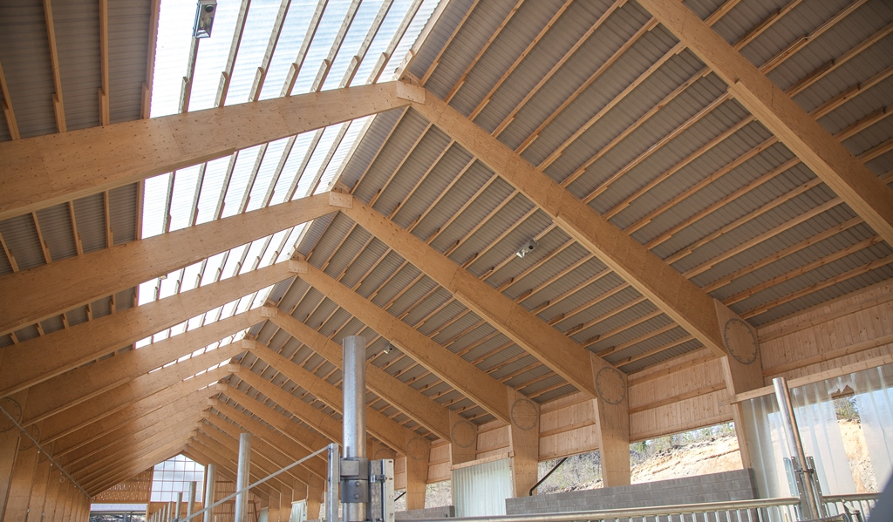
3-pin joint ring-beam with sharp corners
Image: Puuinfo

Slide 35
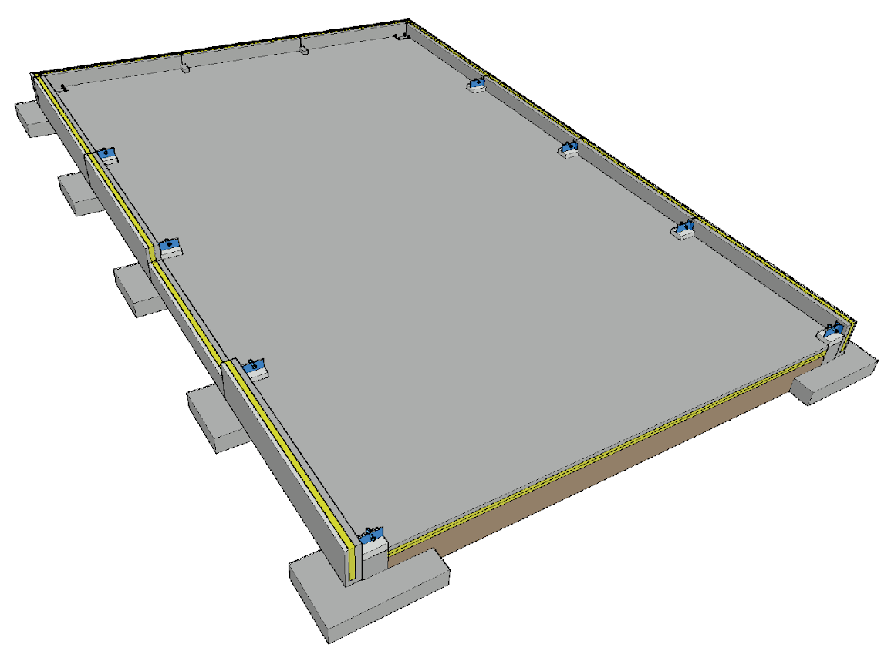
Foundation of a 3-pin joint ring-beam hall
The 3-pin joint ring-beam creates a horizontal load on the foundation
For the foundations, plinth beams are usually used
Challenges
  Junction between a 3-pin joint ring-beam and the foundation
  Vertical dimensional accuracy of the foundation
  Dimensional accuracy of joint component locations
  Horizontal load on the foundation

Slide 36
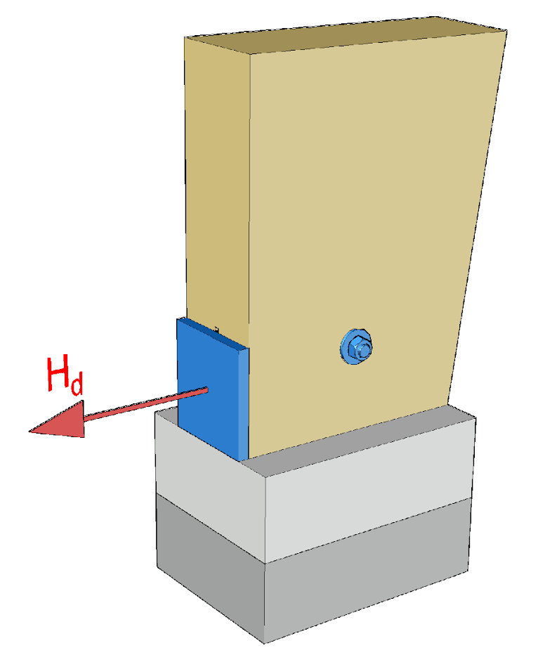
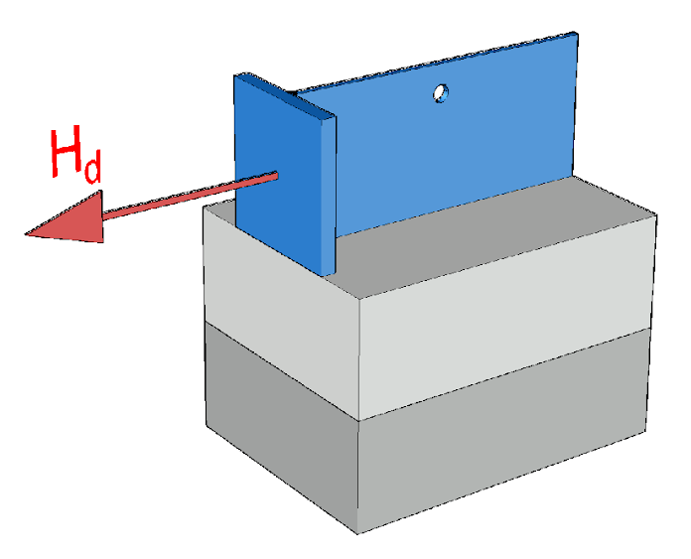
Joint between a 3-pin joint ring-beam and the foundation
A contact joint to support the vertical load is recommended
Horizontal loads are supported using ties that connect the foundation pads of the ring-beam
The steel part should be equipped with height adjustment
The support surface for the vertical load should be implemented with grouting
Waterproofing between the timber and concrete

Slide 37
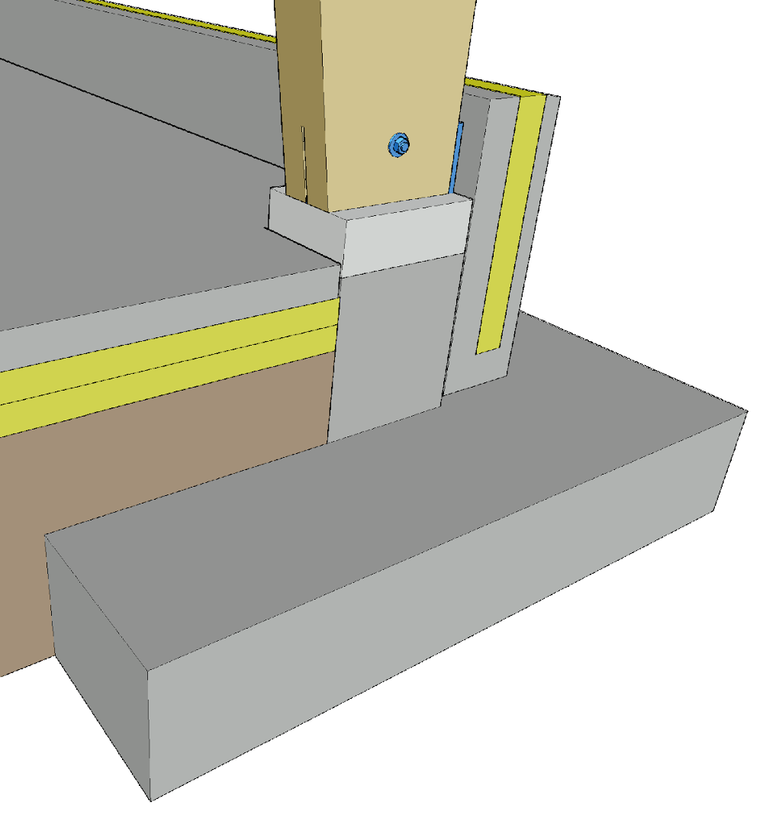
Joint between a 3-pin joint ring-beam and the foundation
At least in production and storage buildings, having the foot of the ring-beam above the floor level is recommended (moisture stress)
The height of the steel parts affects the timing of the slab-on-grade casting (ease of installation)
Grouting of the joints will affect the workflow and work schedule

Slide 38
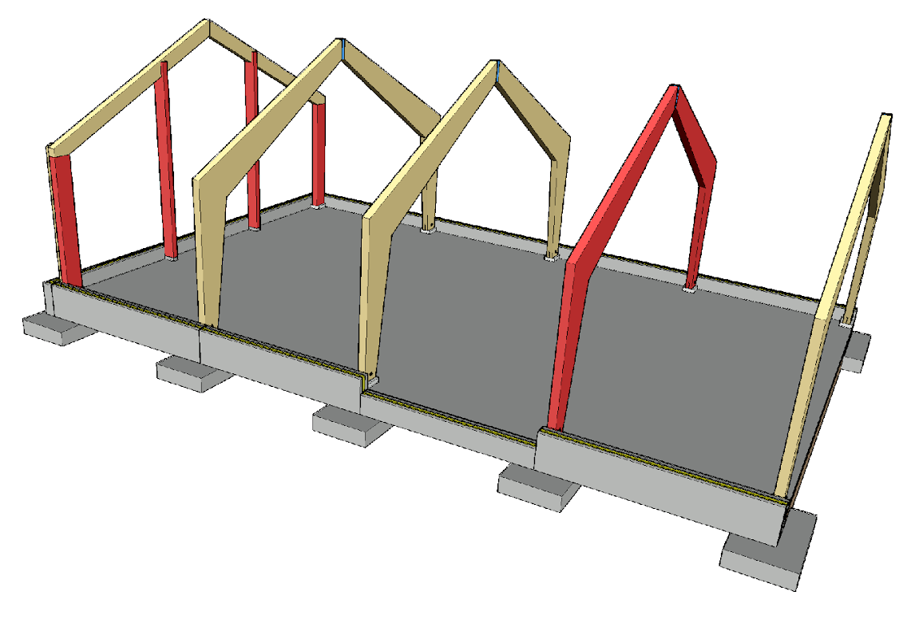
Vertical load transfer
The 3-pin joint ring-beam transfers the vertical load directly to the foundation
The wind columns and corner columns of the end wall transfer the vertical load to the foundations

Slide 39
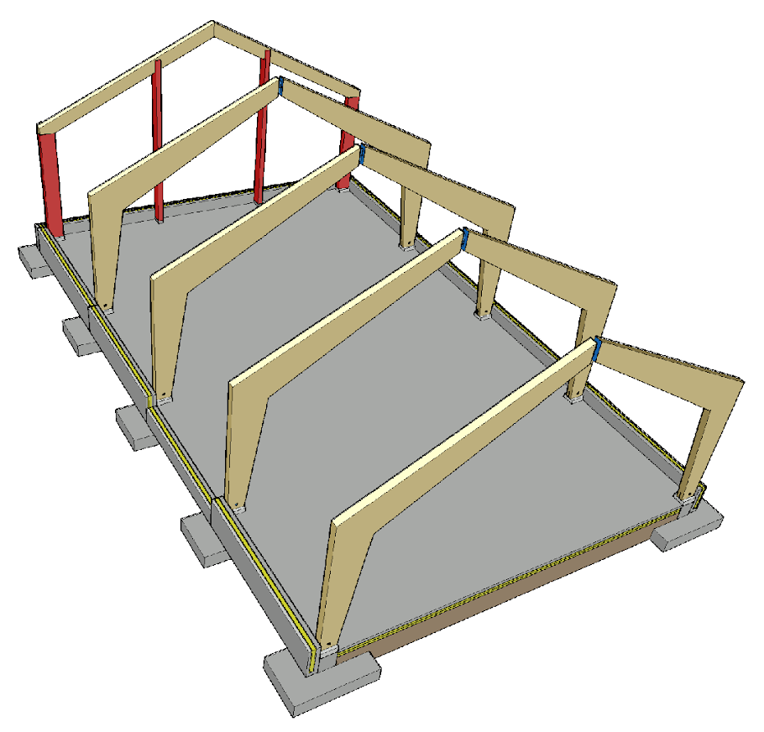
Vertical load transfer
For the end wall, straight beams fitted to the roof slope are usually used
If there is e.g. a wide door in the middle of the end wall, a separate beam must be placed on top of the opening if necessary, because the wind pillar cannot be placed in the middle of an opening

Slide 40
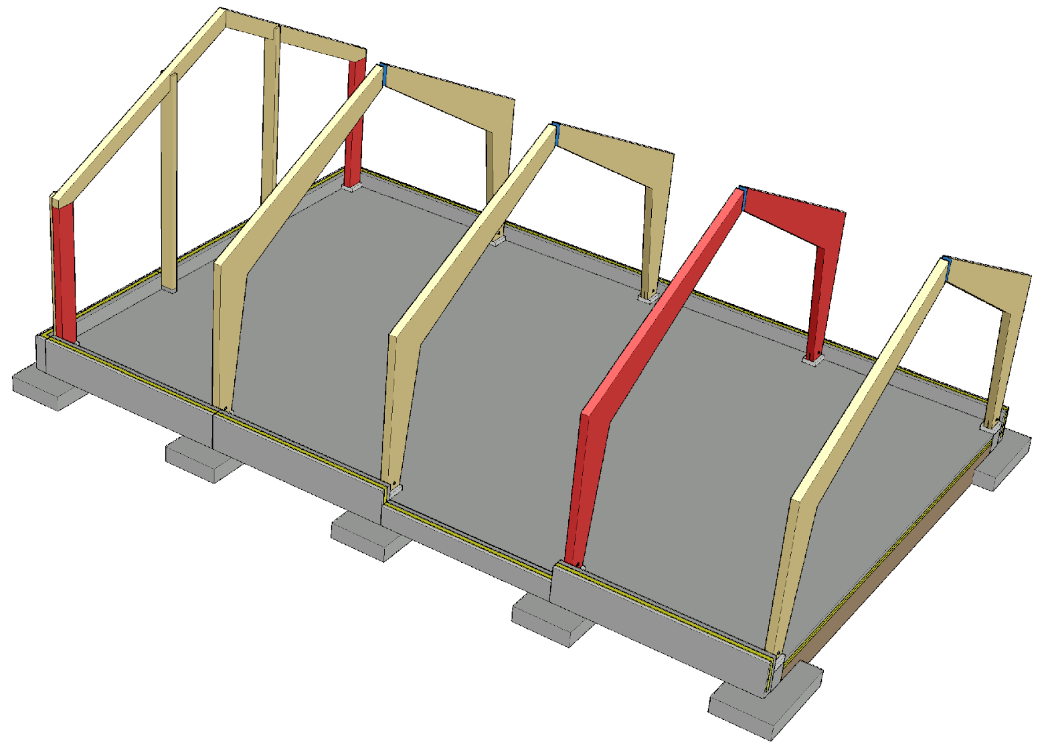
Transversal stiffening of a 3-pin joint ring-beam structure
In the transversal direction, 3-pin joint ring-beams and the cantilever columns of the end walls are used to stiffen the hall
For stiffening the end wall, diagonal stiffeners can also be used, in which case there is no need for cantilever columns
The hall length does not affect the transversal stiffening because the 3-pin joint ring-beam is a stiffening structural component at its level

Slide 41
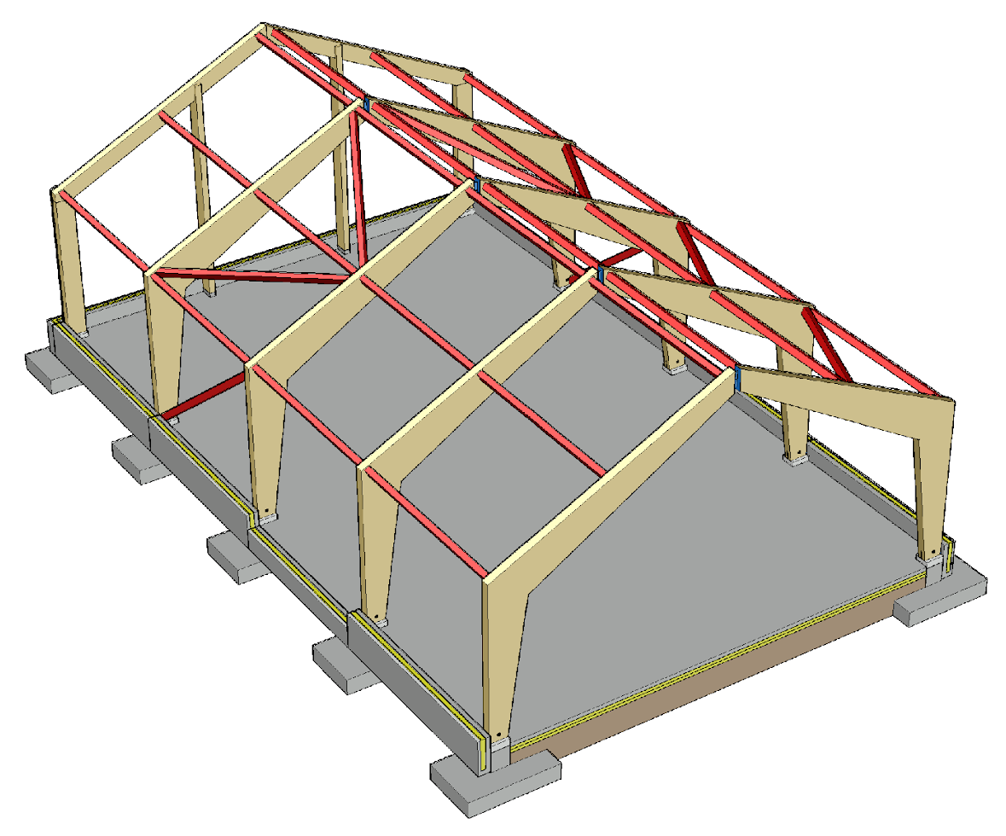
Longitudinal stiffening of a 3-pin joint ring-beam structure
Stiffening a ring-beam structure in the longitudinal direction of the building is more challenging than in the transversal direction
Loads that affect longitudinal stiffeners are created by
  The end wind load
  Transversal supports of load-bearing structures
  Additional horizontal load

Slide 42
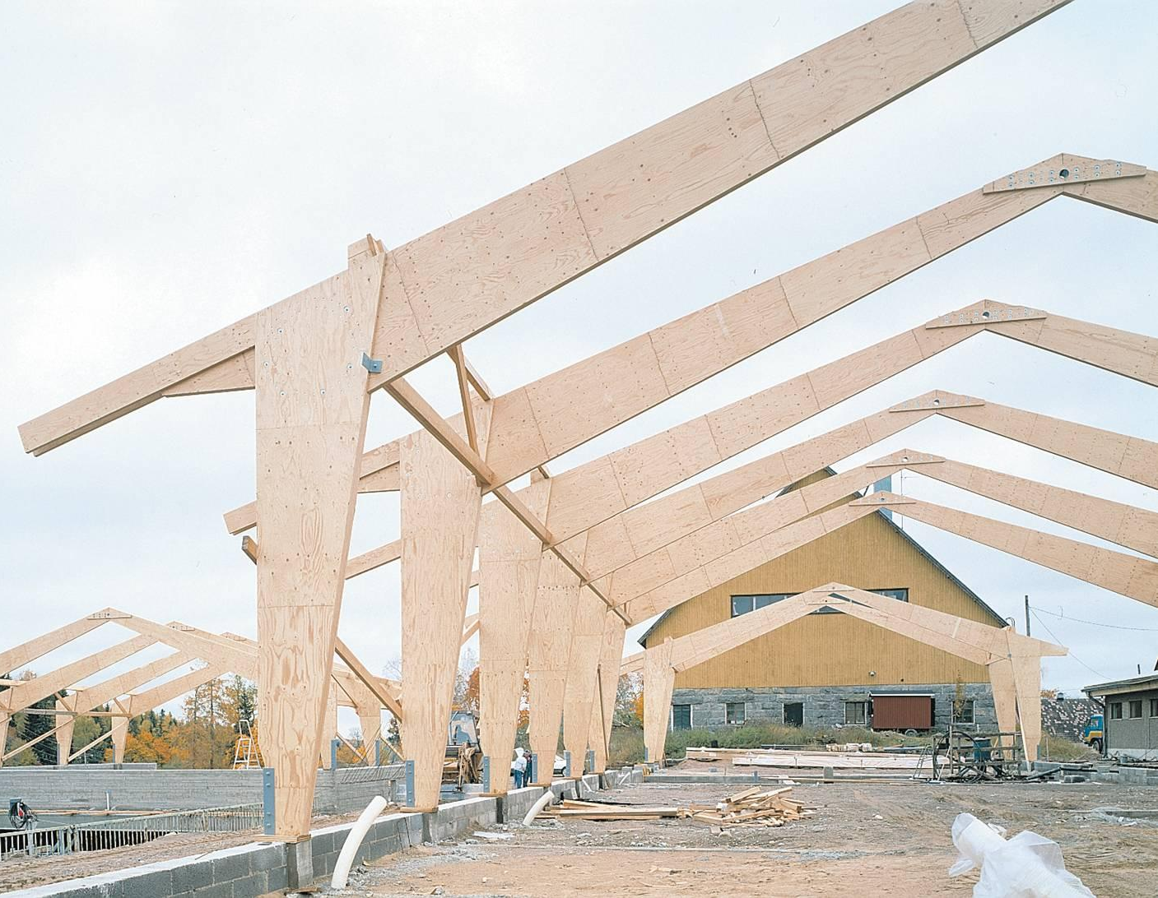
Sideways support of a 3-pin joint ring-beam
In the structural components of a 3-pin joint ring-beam, the pressed edge may be on the external or internal edge
Lateral support may also be needed on the inner edge of the 3-pin joint ring-beam
The cross-section width of the 3-pin joint ring-beam should be large enough to avoid lateral supports on the inner edge
Lateral support of the inner edge
Image: Metsä Wood

Slide 43
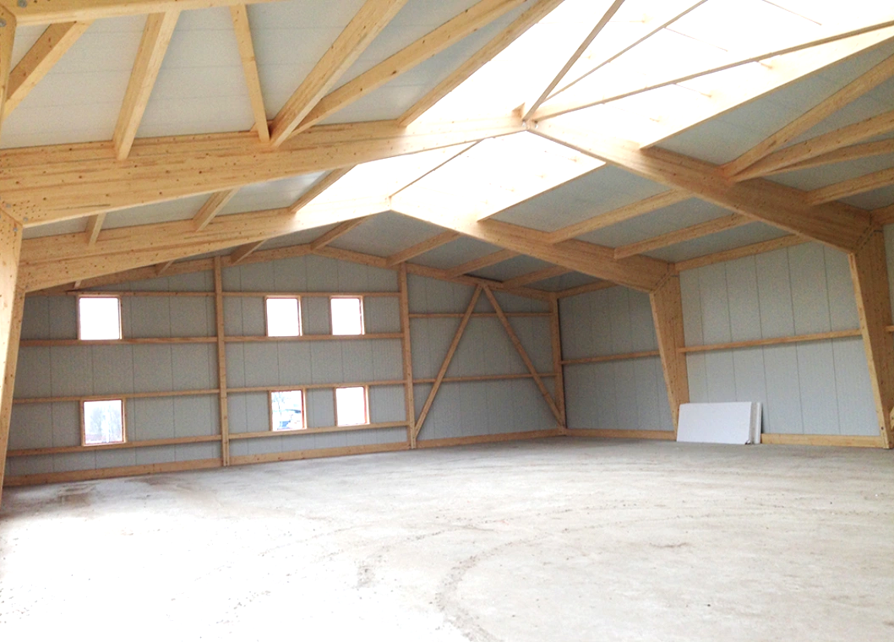
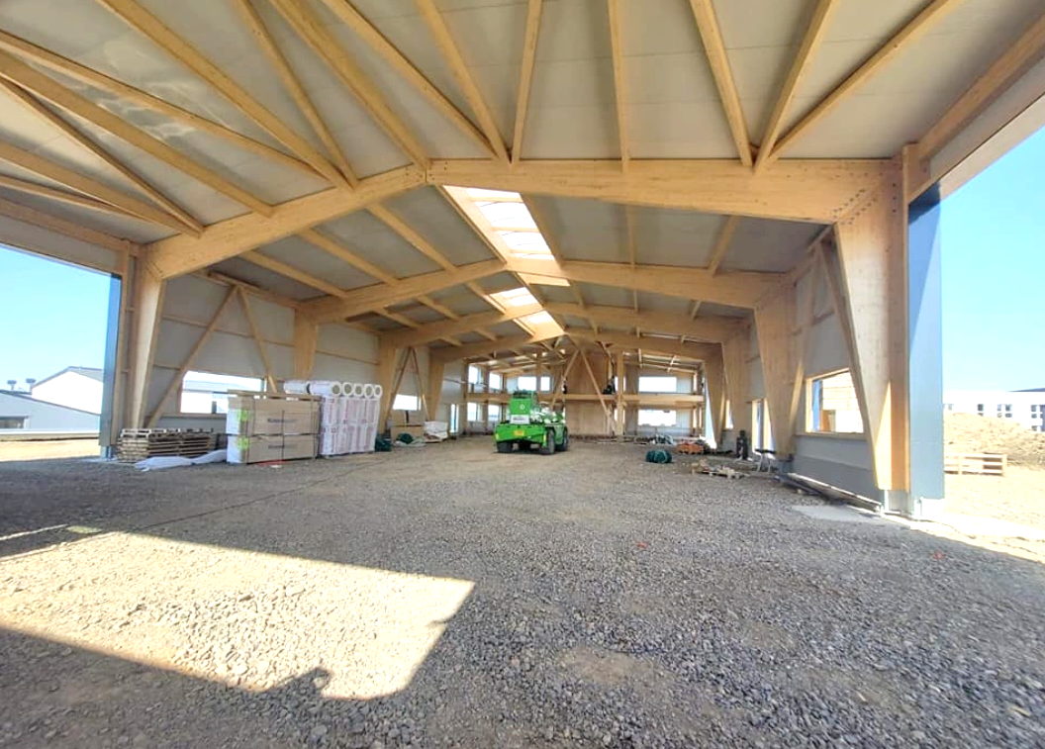
Stiffeners for a 3-pin joint ring-beam structure
Image: Ligna-systems
Image: Ligna-systems

Slide 44
External sheathing of a 3-pin joint ring-beam hall
Roof units can be used in a 3-pin joint ring-beam hall in the same way as in a cantilever column hall
Stiffening roof units can be used for stiffening in the same way as in a cantilever column hall
For the exterior walls, timber or metal can be used, similarly to a cantilever column hall

Slide 45
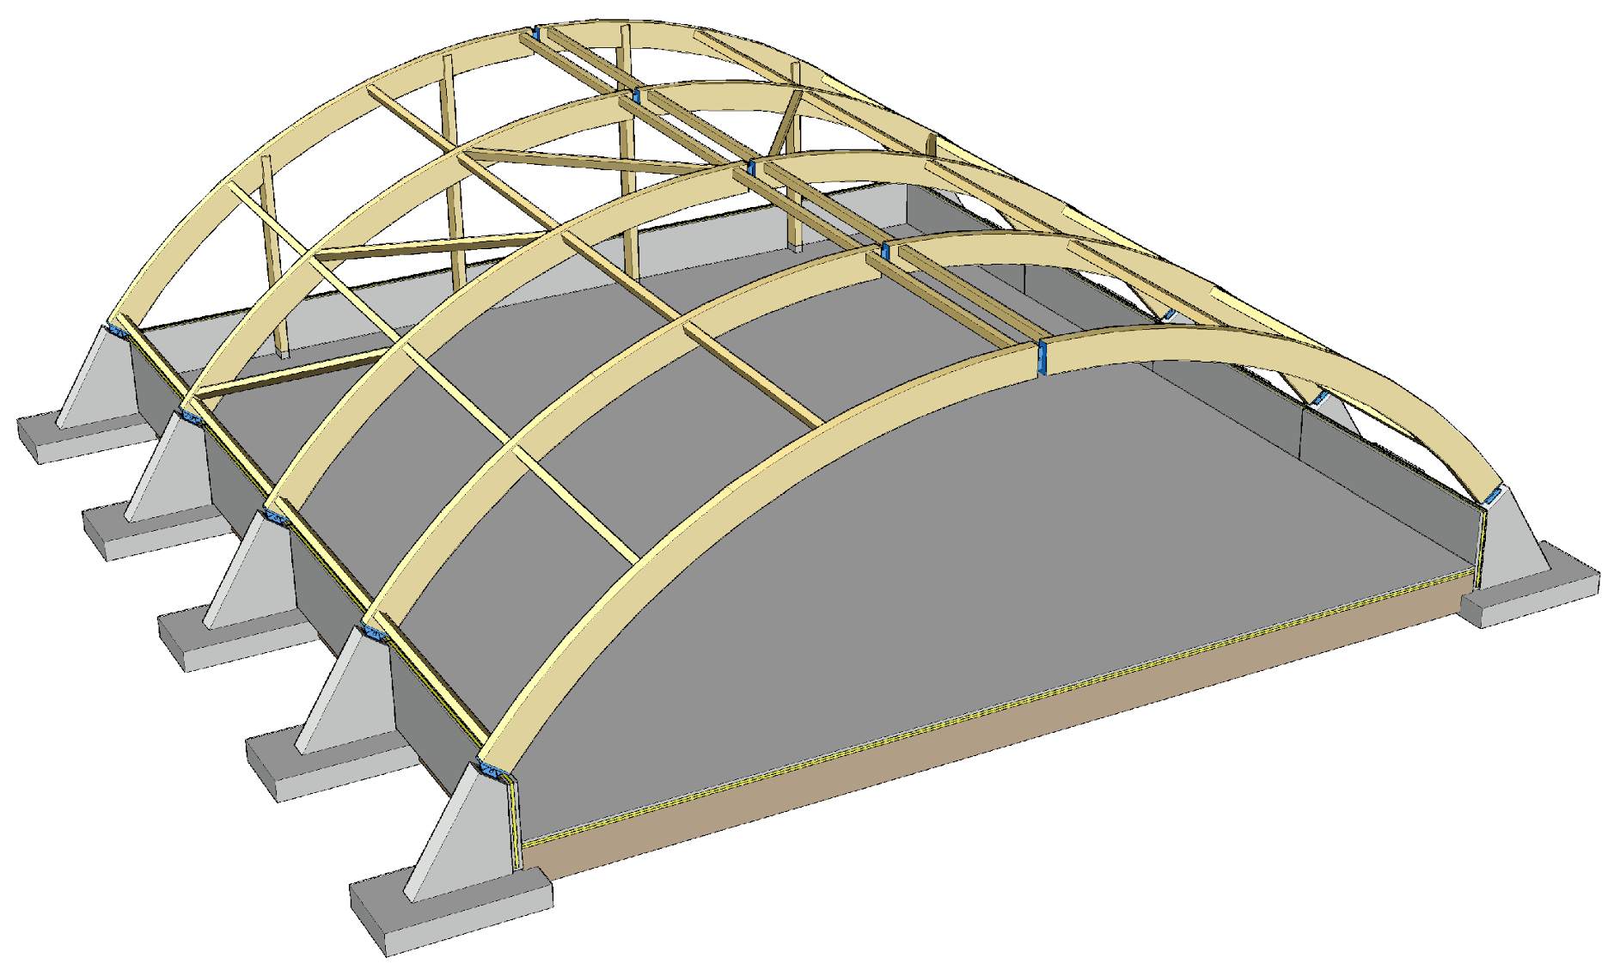
Arched frame with 3-pin joint
Traditional construction system for industrial halls
Enables
  a high space
  a wide continuous space
Typical uses
  Sports facilities
  Fair facilities

Slide 46
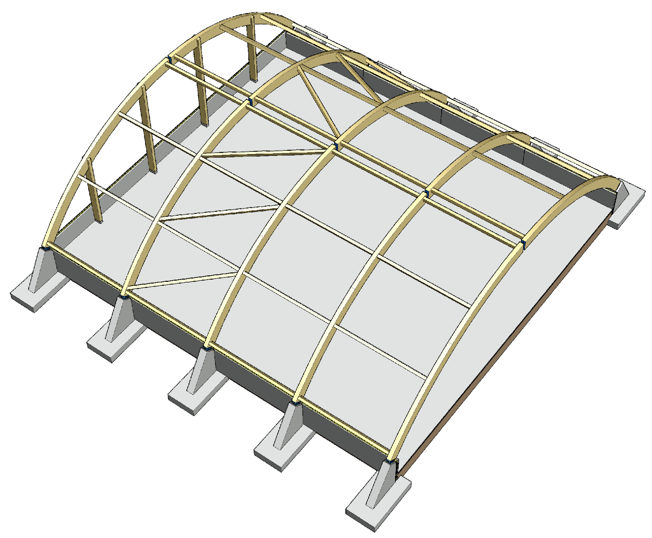
Components of a 3-pin joint arched frame
3-pin joint arch
Wind column
Stiffeners
  Lateral supports of a 3-pin joint arch
  End wind load
2
3
3
1

Slide 47
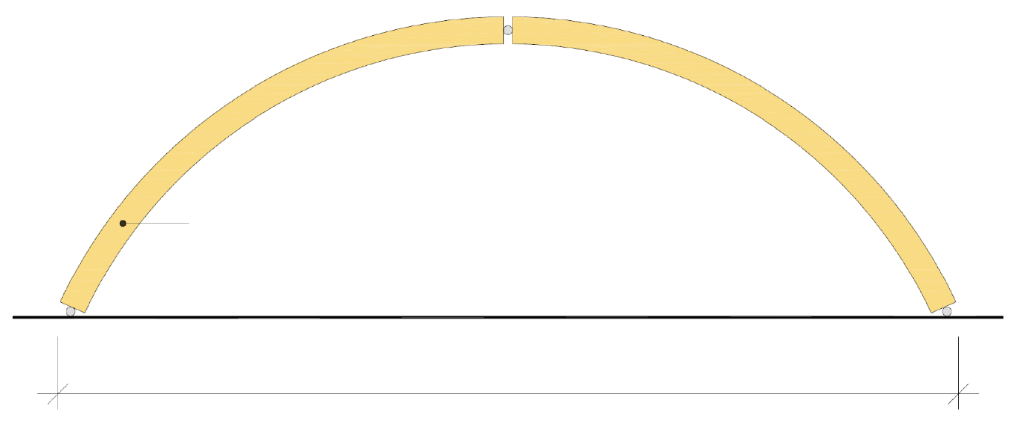
Arched frame with 3-pin joint
A 3-pin joint arch is stiff at the arch level, which is why the length of the building does not affect its transverse stiffening
Stiffening an arched frame in the longitudinal direction of the building is challenging (wind load + lateral supports of the 3-pin joint arch)
3-pin joint arches k6000...k8000
Recommendation 50...100 m

Slide 48
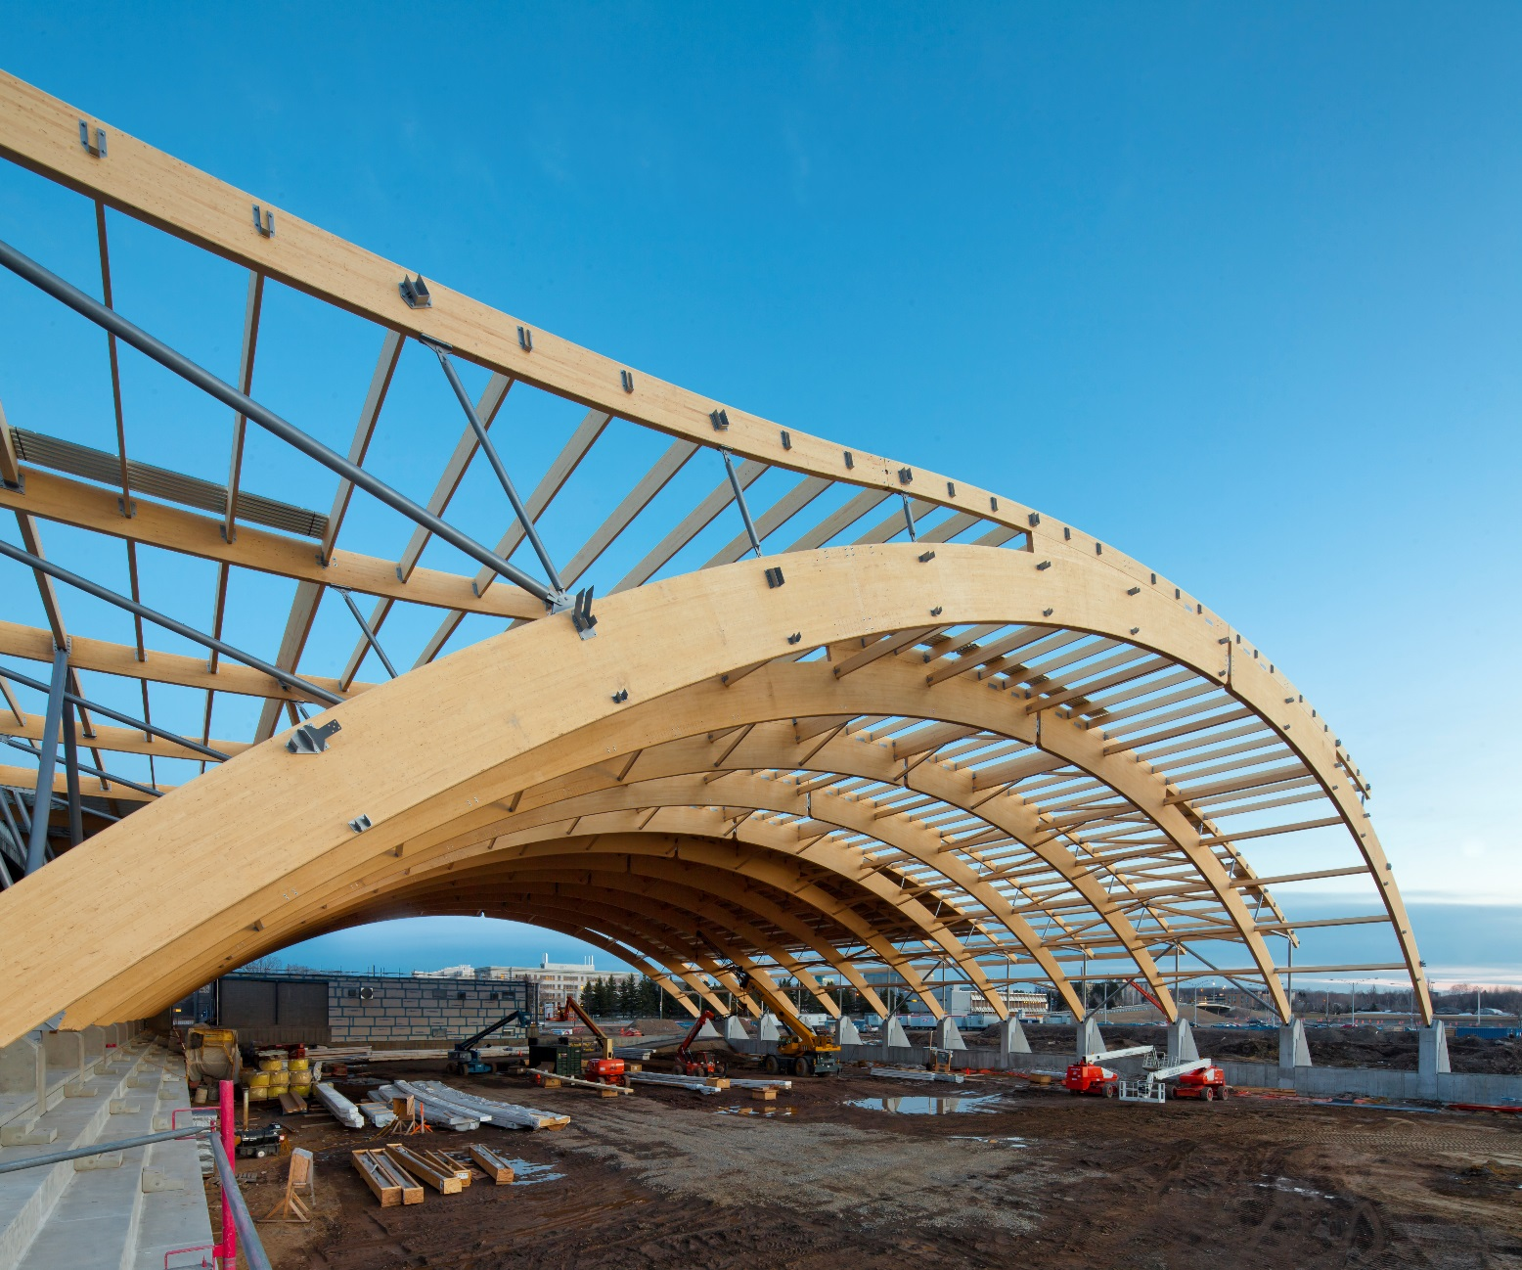
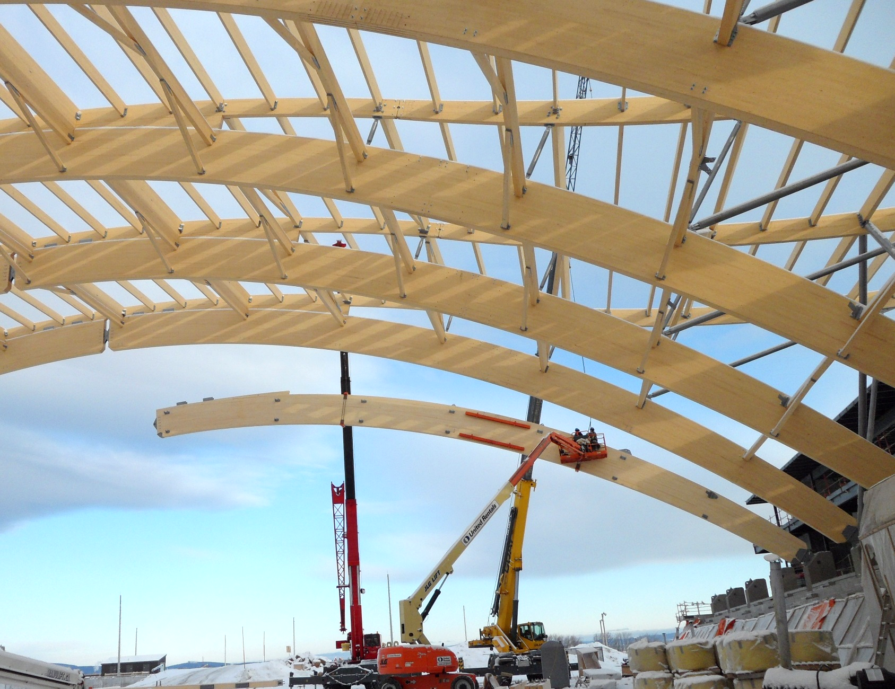
Installation of a 3-pin joint arch
Image: Stéphane Groleau
Image: FGP Construction

Slide 49

Foundation of a 3-pin joint ring-beam hall
The 3-pin joint arch creates a horizontal load on the foundation
For the foundations, plinth beams are usually used
Challenges
  Junction between a 3-pin joint and the foundation
  Vertical dimensional accuracy of the foundation
  Dimensional accuracy of joint component locations
  Horizontal load on the foundation

Slide 50

Joint between a 3-pin joint and the foundation
The horizontal load can be supported using ties connecting the foundation pads of the arch under the floor
The joint component should eliminate all work on site except joining the steel parts with a bolt or pin

Slide 51


Joints of a 3-pin joint arch
Ridge joint
Foundation joint
Image: FGP Construction
Image: ABCP architecture

Slide 52

Vertical load transfer
The 3-pin joint arch transfers the vertical load directly to the foundation
The wind columns of the end wall transfer the vertical load of the end arch to the foundations
The end arch can also be replaced by separate beams that extend from one column to the next

Slide 53

Transversal stiffening of a 3-pin joint arched frame
3-pin joint arches are used to stiffen the hall in the transversal direction
If the end arch is replaced with a column-and-beam frame, diagonal stiffeners must be used to stiffen the end wall
The hall length does not affect the transversal stiffening because the 3-pin joint arch is a stiffening structural component at its level

Slide 54

Longitudinal stiffening of a 3-pin joint arch frame
Stiffening a ring-beam structure in the longitudinal direction of the building is more challenging than in the transversal direction
Loads that affect longitudinal stiffeners are created by
  The end wind load
  Transversal supports of load-bearing structures
  Additional horizontal load

Slide 55

Lateral supports of a 3-pin joint arch
Lateral support of the inner edge
In the structural components of a 3-pin joint arch, the pressed edge may be on the external or internal edge
Lateral supports may also be needed on the inner edge of the 3-pin joint arch
The cross-section width of the 3-pin joint arch should be large enough to avoid lateral supports on the inner edge
Image: Stéphane Groleau

Slide 56
External sheathing of a hall with 3-pin joint arch structure
In a 3-pin joint arch hall, almost the entire stretch of external sheathing is part of the roof structure
Roof units can be used in a 3-pin joint arch hall in the same way as in a cantilever column hall
Stiffening roof units can be used for stiffening in the same way as in a cantilever column hall

Slide 57

Preventing progressive collapse
Local damage is permitted in hall type buildings
The permissible collapse area in a single-bay hall with cantilever columns is L x 2K
The permissible collapse area in a multi-bay hall with cantilever columns is
  L x 2K, when an edge column is lost
  2L x 2K, when a centre column is lost
Hall stability must be maintained
Local damage
Permitted area of collapse

Slide 58

Preventing progressive collapse
Local damage is permitted in hall type buildings
The permissible collapse area in a hall with 3-pin joint arch structure is L x 2K
Hall stability must be maintained
Local damage
Permitted area of
collapse

Slide 59

Preventing progressive collapse
Local damage is permitted in hall type buildings
The permissible collapse area in a hall with 3-pin joint arch structure is L x 2K
Hall stability must be maintained
Local damage
Permitted area of collapse

Slide 60

Preventing progressive collapse
The preferred method for preventing progressive collapse is the alternative load transfer path
Using
  Continuity of the horizontal structures
  Continuity of primary columns
  Joint components between prefabricated units
Image: Tero Lahtela

