Slide 1



Industrial wood construction
Teaching materials for industrial wood construction education
2022

Slide 2
Origin of the materials
Use of the materials
These learning materials for industrial wood construction have been prepared in a project led by Puuinfo Oy in 2021–2022. Also involved in the project were
Lappia Vocational College,
TTS-Työtehoseura ry
South-Eastern Finland University of Applied Sciences,
Metropolia University of Applied Sciences,
Jyväskylä University of Applied Sciences,
University of Tampere, and
Federation of the Finnish Woodworking Industries Puutuoteteollisuus ry
The project was funded by the Ministry of the Environment.
The materials are intended to be used as extensively as possible in industrial wood construction education and studies.
The materials are released under the Creative Commons licence Attribution-ShareAlike (CC BY-SA), which requires that the author be properly credited when the materials are used and that derivative works may only be distributed under the same licence as the original work.
The original materials and any updates to them by Puuinfo will be published on the Library of Open Educational Resources website (aoe.fi) and the Puuinfo.fi website.

Slide 3

Industrial construction systems

Slide 4
Authors
Tero Lahtela, Insinööritoimisto Tero Lahtela Oy
Release date: 01/07/2021

Slide 5
Panelised units + Nail plate trusses Construction of industrial halls

Slide 6
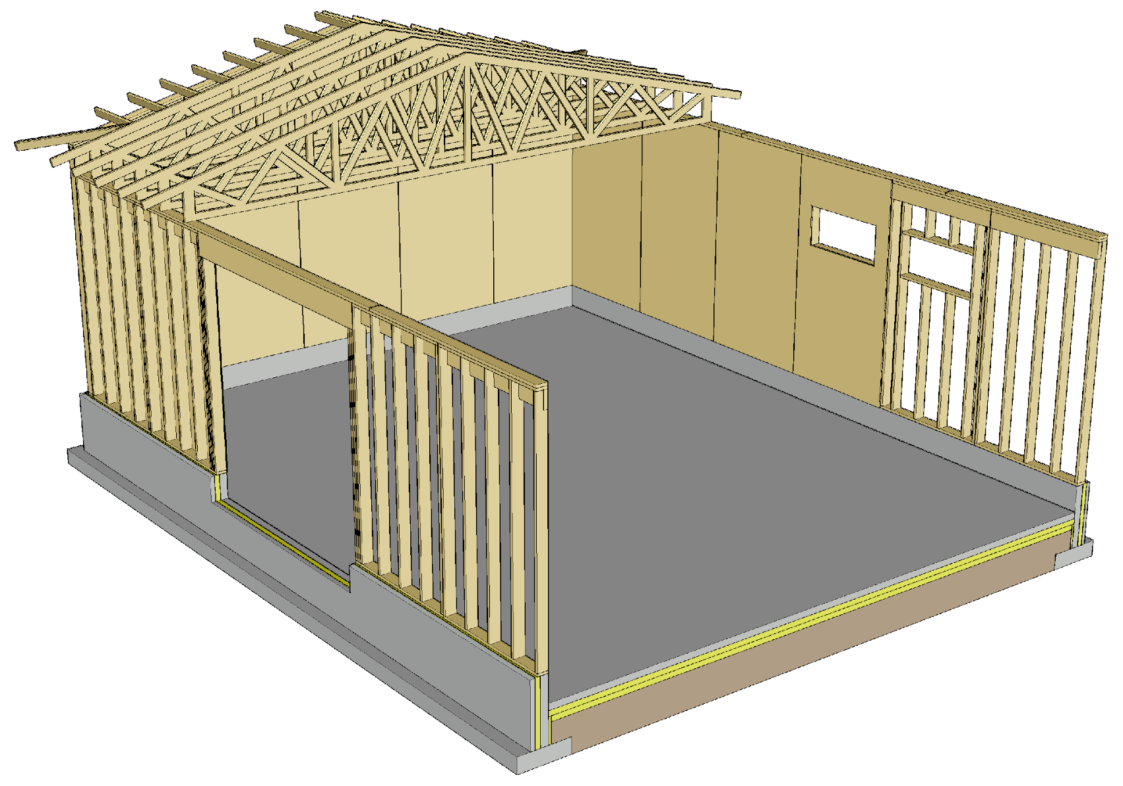
Load-bearing panelised units + Nail plate trusses
Traditional construction system for small industrial halls
Due to the nail plate trusses, best suited for fire class P3 buildings
Typical uses
Production buildings
Warehouse buildings
Commercial premises
Agricultural buildings

Slide 7
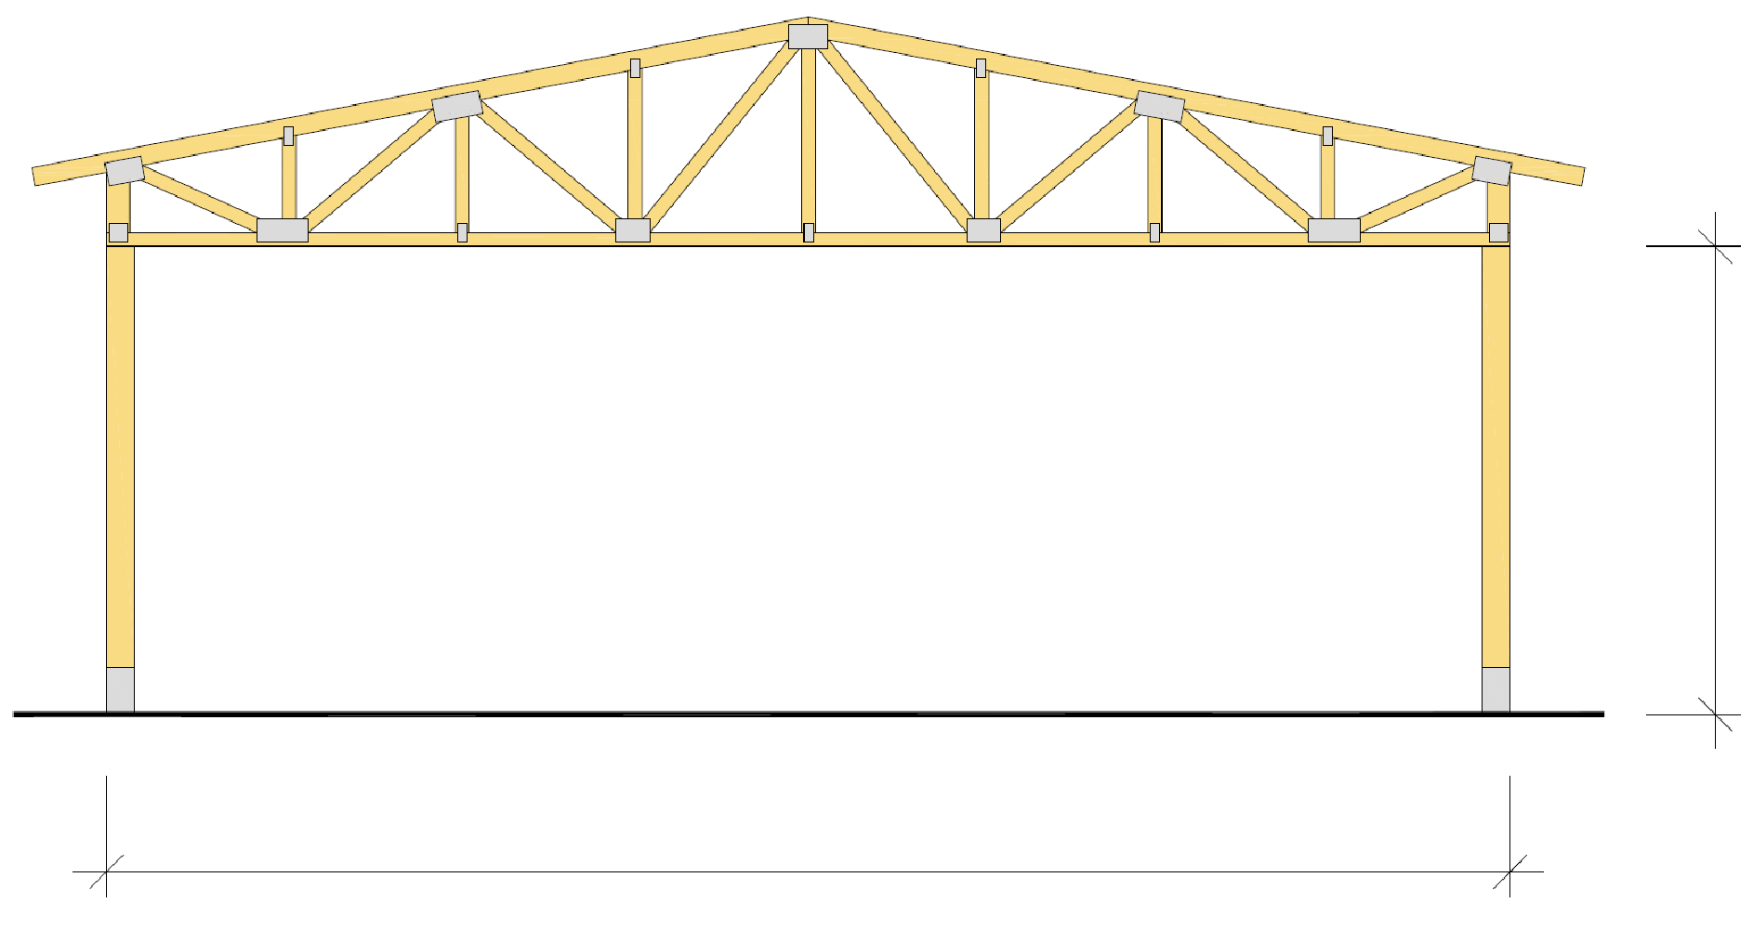
Load-bearing panelised units + Nail plate trusses
Design challenges that limit the size of the building
Stiffening of the building
Stiffening of nail plate truss roof
Fire resistance of a nail plate truss roof
Load-bearing capacity of a wall with framed structure
Load-bearing walls can also be built with solid wood panel units
Nail plate trusses
Load-bearing wall
Load-bearing wall
Max 5m
Recommended max 15...20 m

Slide 8
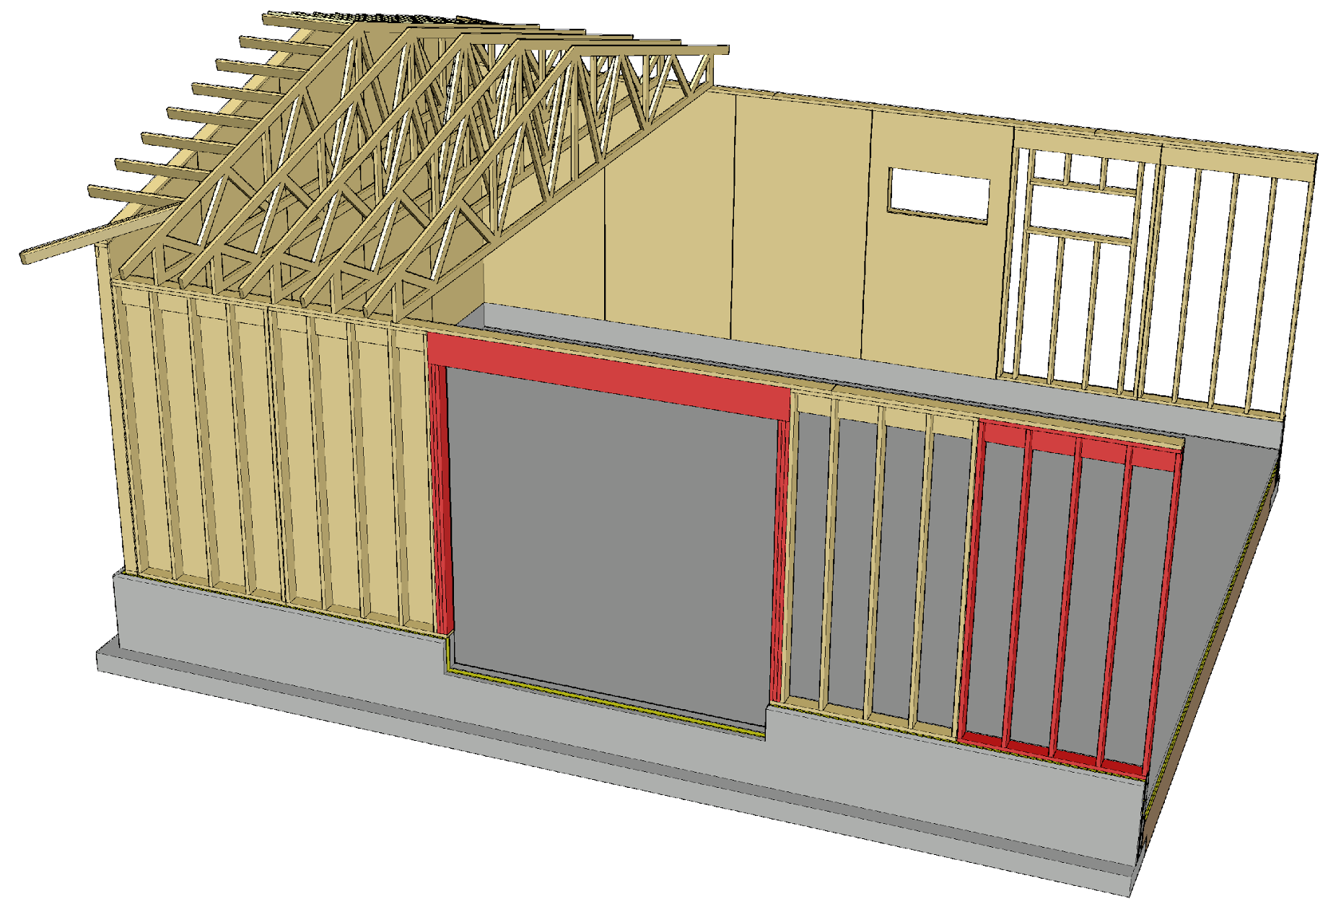
Load-bearing panelised units + Nail plate trusses
Due to internal height, wall units are usually vertical elements that are transported flat or on their sides
Door openings are typically large, which is why their jambs are subjected to large point loads

Slide 9
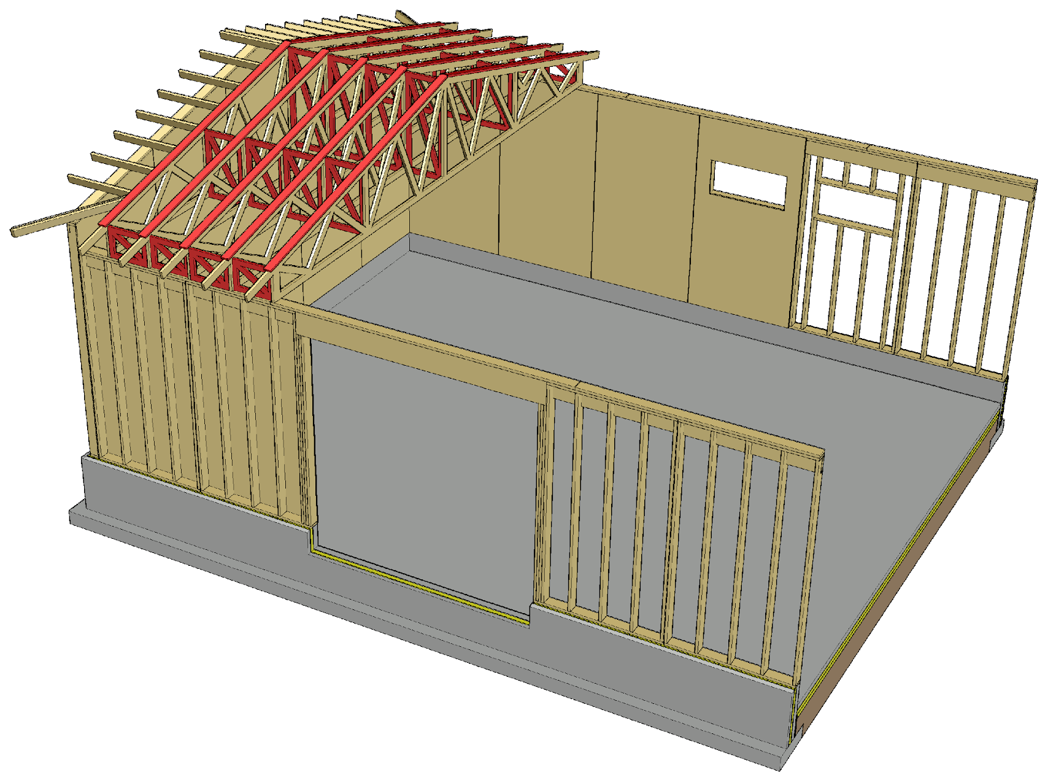
Load-bearing panelised units + Nail plate trusses
The stiffening of a nail plate truss roof is a challenging design task
Large span of trusses
Trusses are often high
Using joists between nail plate trusses and a stiffener above the top chord (board/plank) as stiffeners for nail plate trusses is advisable

Slide 10
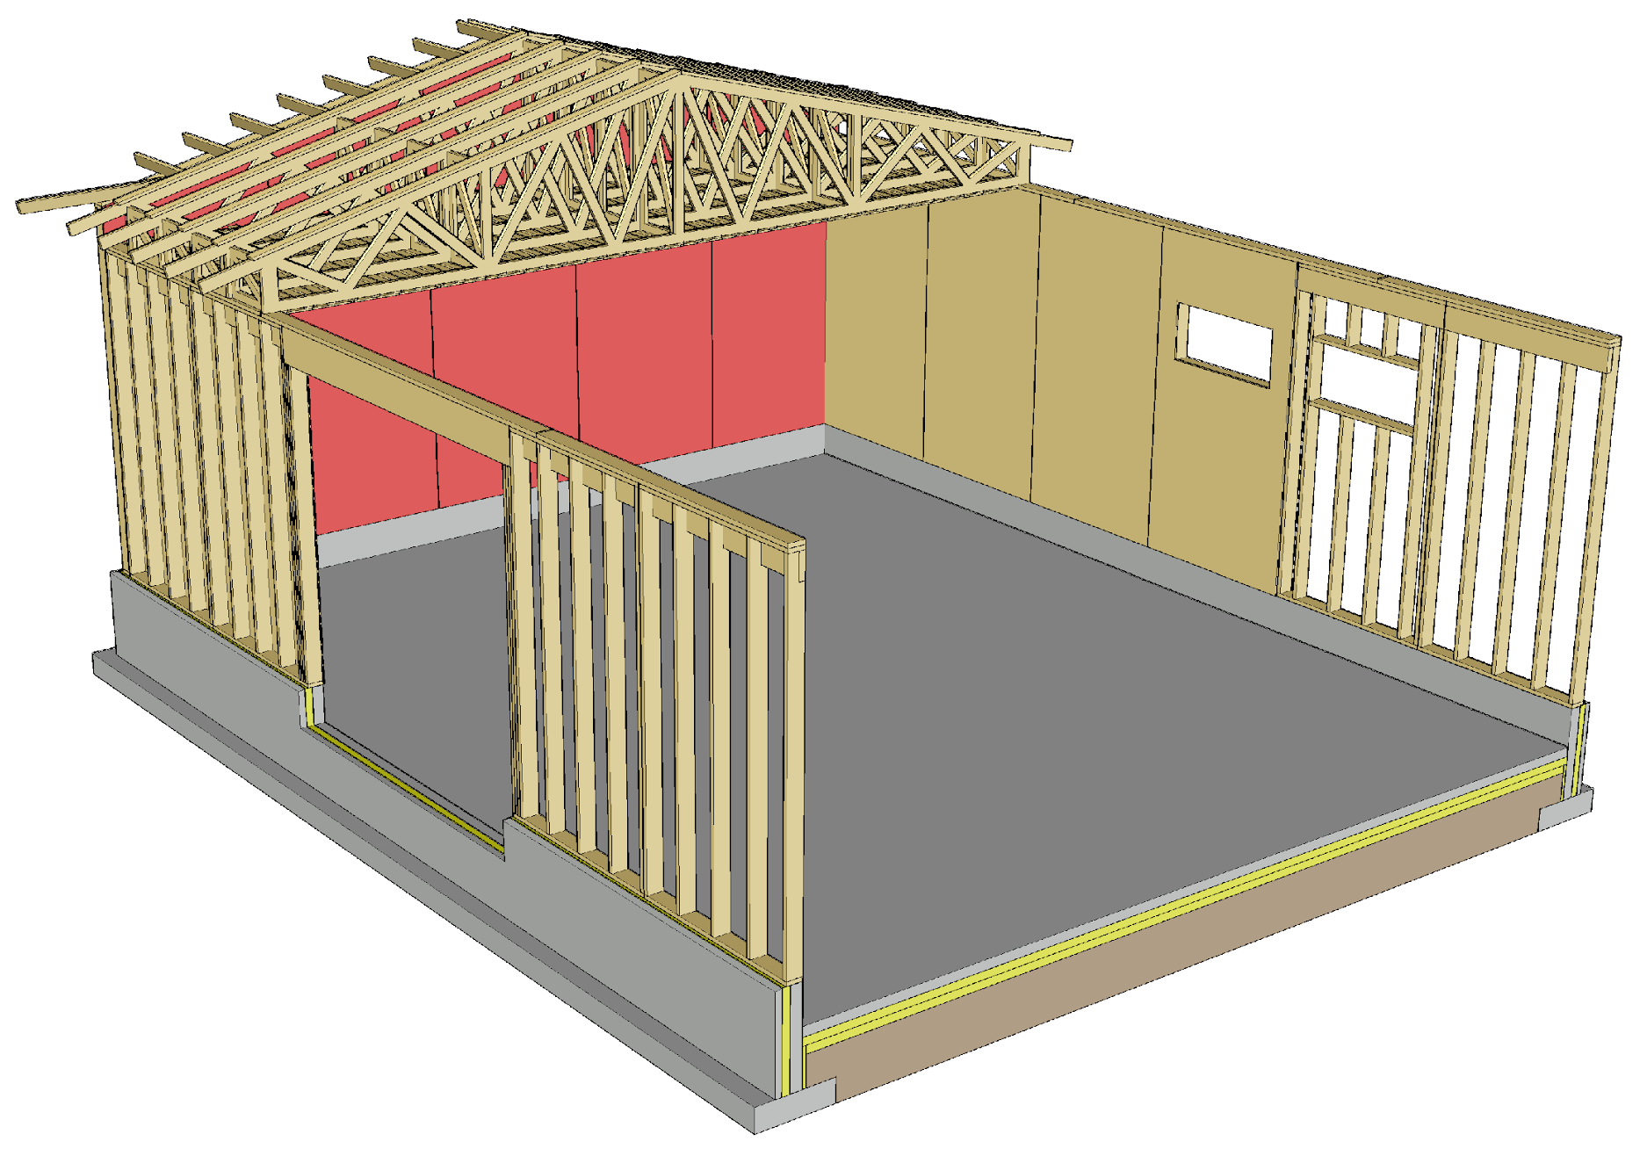
Load-bearing panelised units + Nail plate trusses
For transversal stiffening of the building, stiffening plates in end walls are used
In a long hall, the end walls are exposed to a heavy horizontal load, and the stiffening capacity of the roof must be large to enable it to transfer the horizontal loads to the end walls
The end walls cannot have large doors
The stiffening plates can be replaced by transverse stiffeners (batten or board)

Slide 11
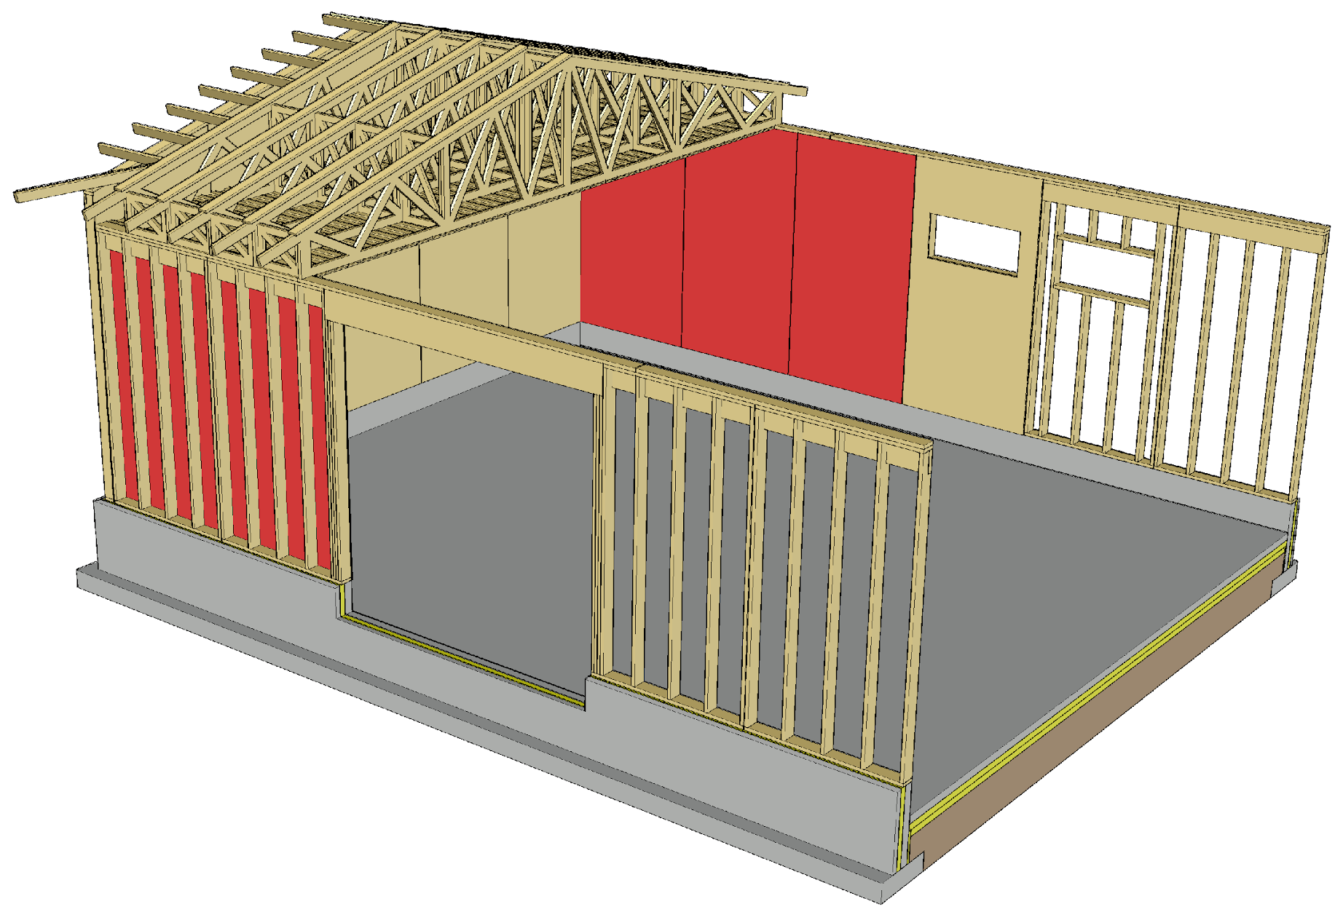
Load-bearing panelised units + Nail plate trusses
For longitudinal stiffening of the building, stiffening plates in side walls are used
A sufficient area of stiffening wall must be left between door openings
Wall units with framed structure that have openings do not work as stiffening plates
The stiffening plates can be replaced by transverse stiffeners (batten or board)

Slide 12
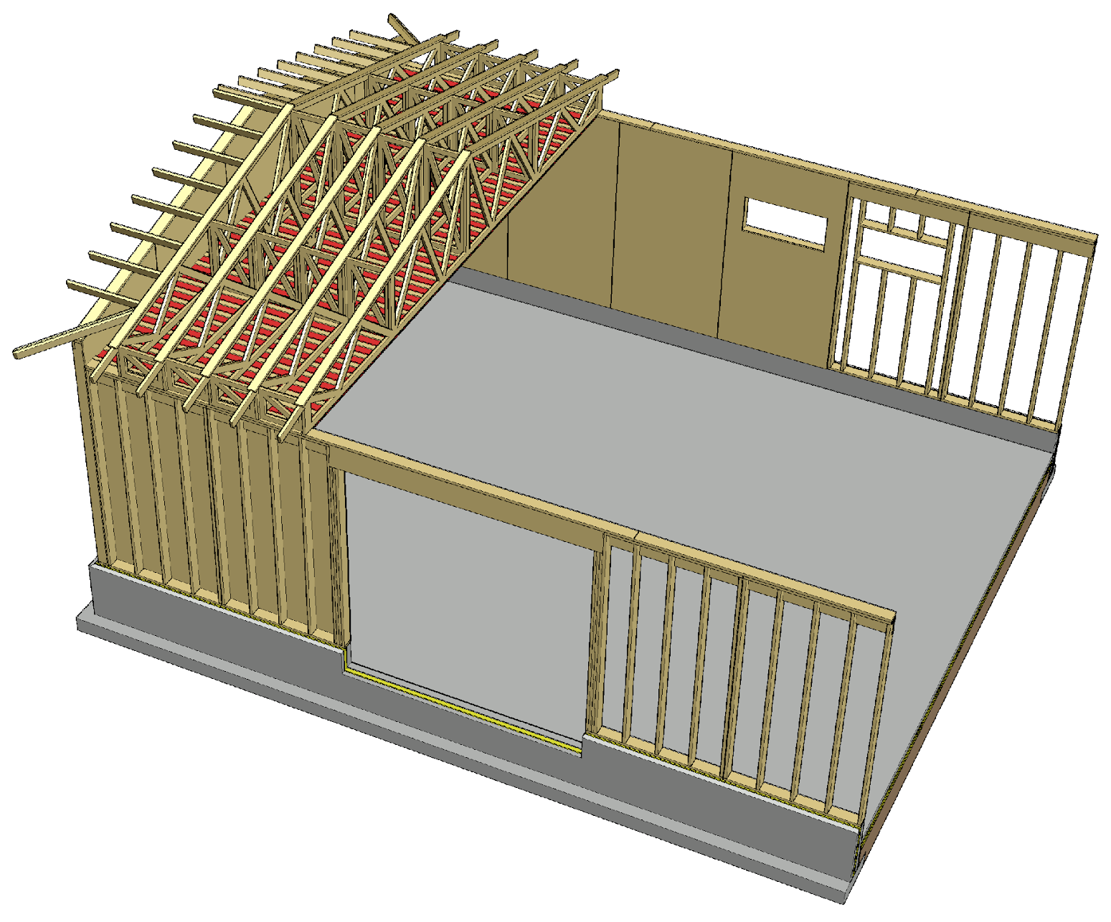
Load-bearing panelised units + Nail plate trusses
A stiffening plate at the bottom chord level is used for
Stiffening the building
Stiffening nail plate trusses
A stiffening plate at the bottom chord level can be replaced by transverse stiffeners (batten or board)

Slide 13
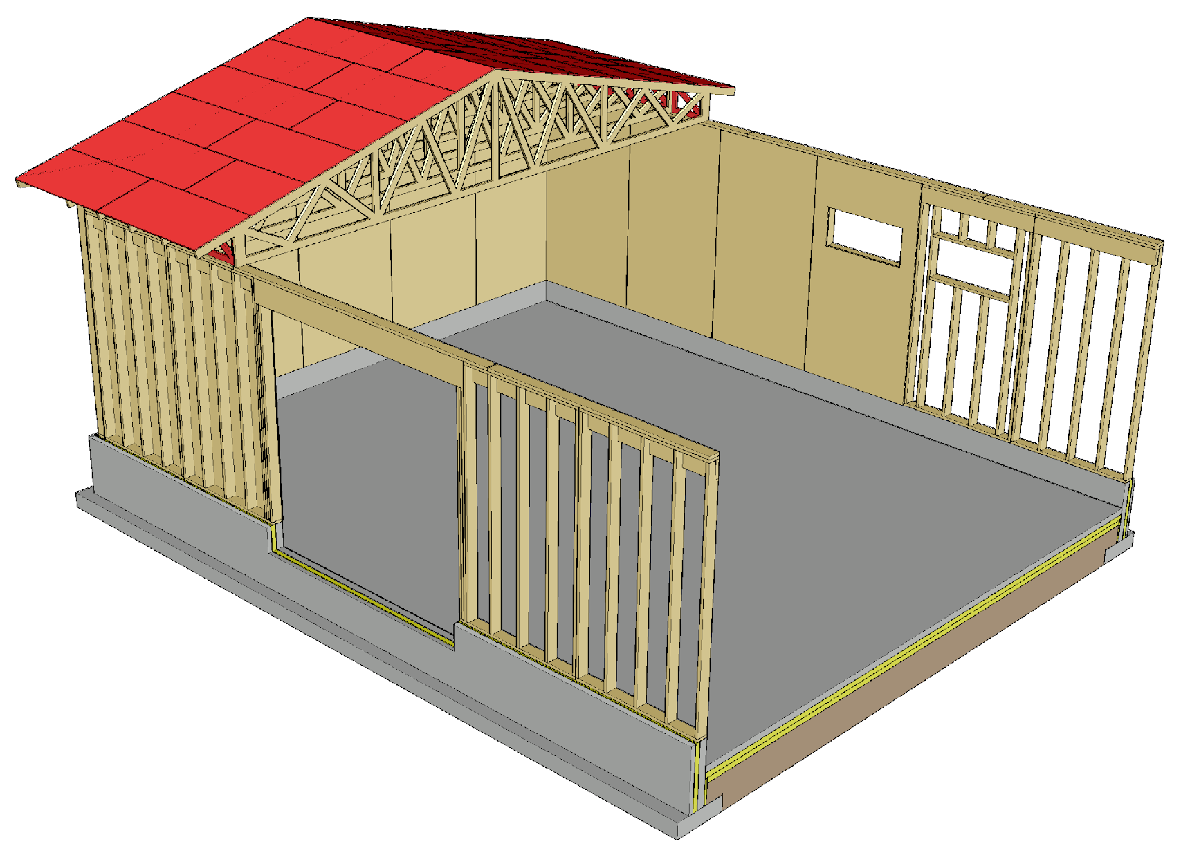
Load-bearing panelised units + Nail plate trusses
The roof stiffener and nail plate truss stiffener needed for stiffening the building can be implemented with a stiffening plate on top of the top chord
For the stiffener, tongue-and-groove plywood board or LVL panel designed for this purpose are used

Slide 14
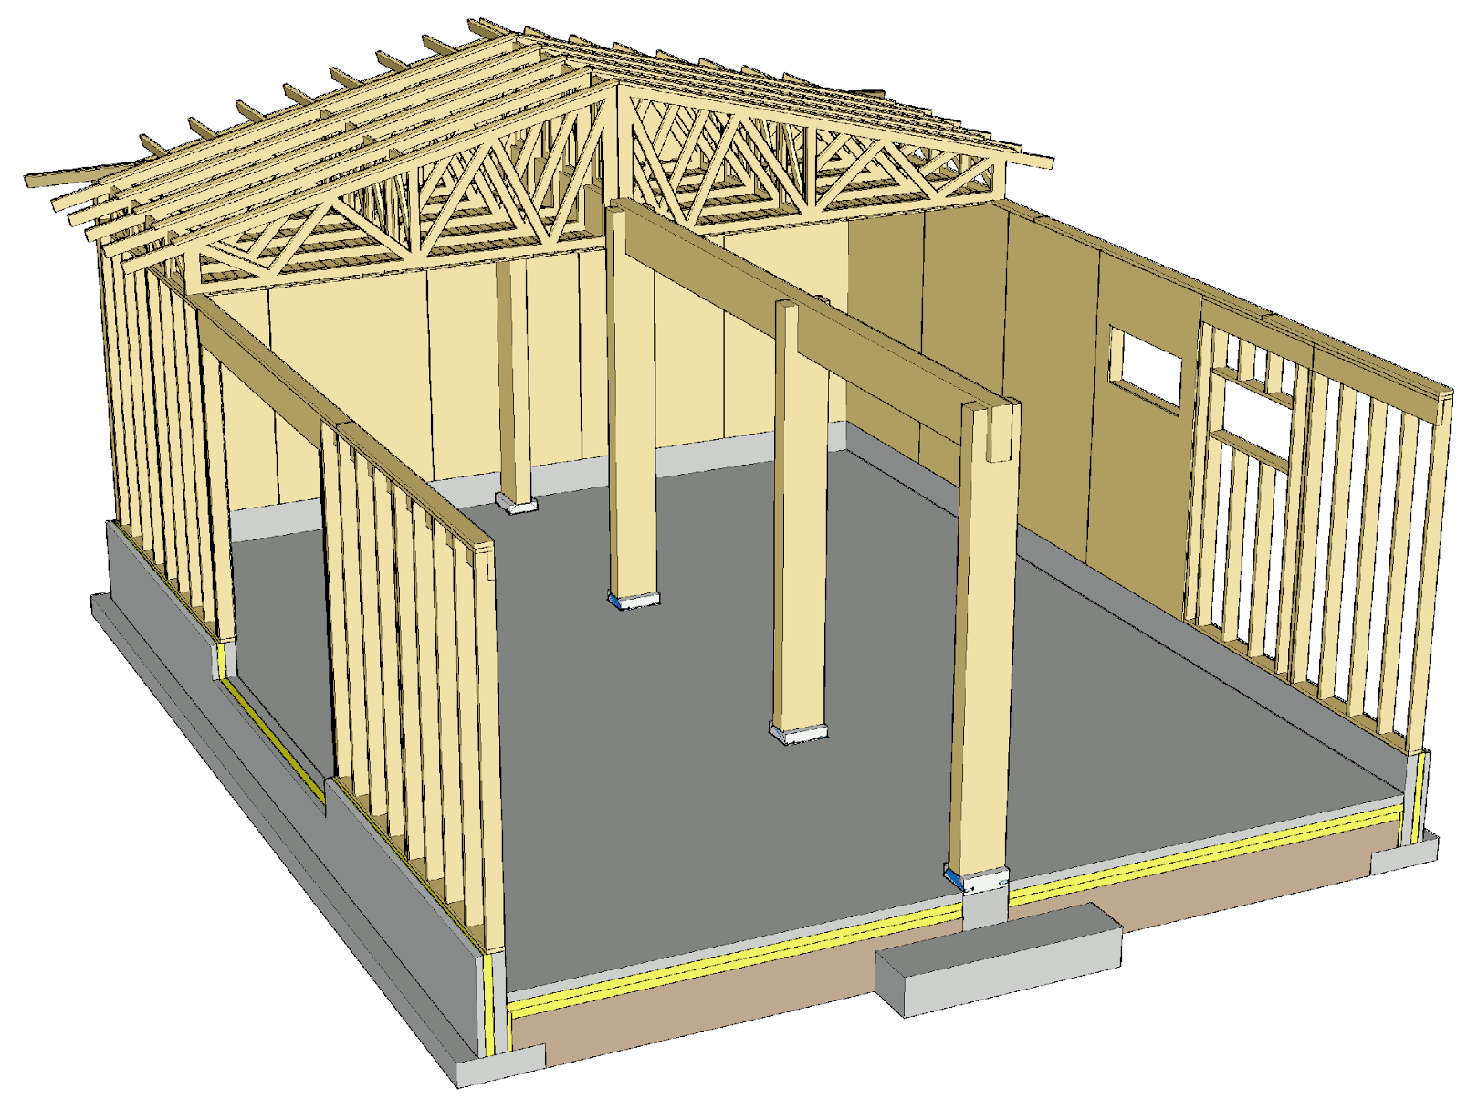
Load-bearing panelised units + Nail plate trusses
In a system with foundation walls, a multi-bay hall can be built using rows of cantilever columns
Using cantilever columns makes stiffening the hall simpler than only using plate stiffeners

Slide 15
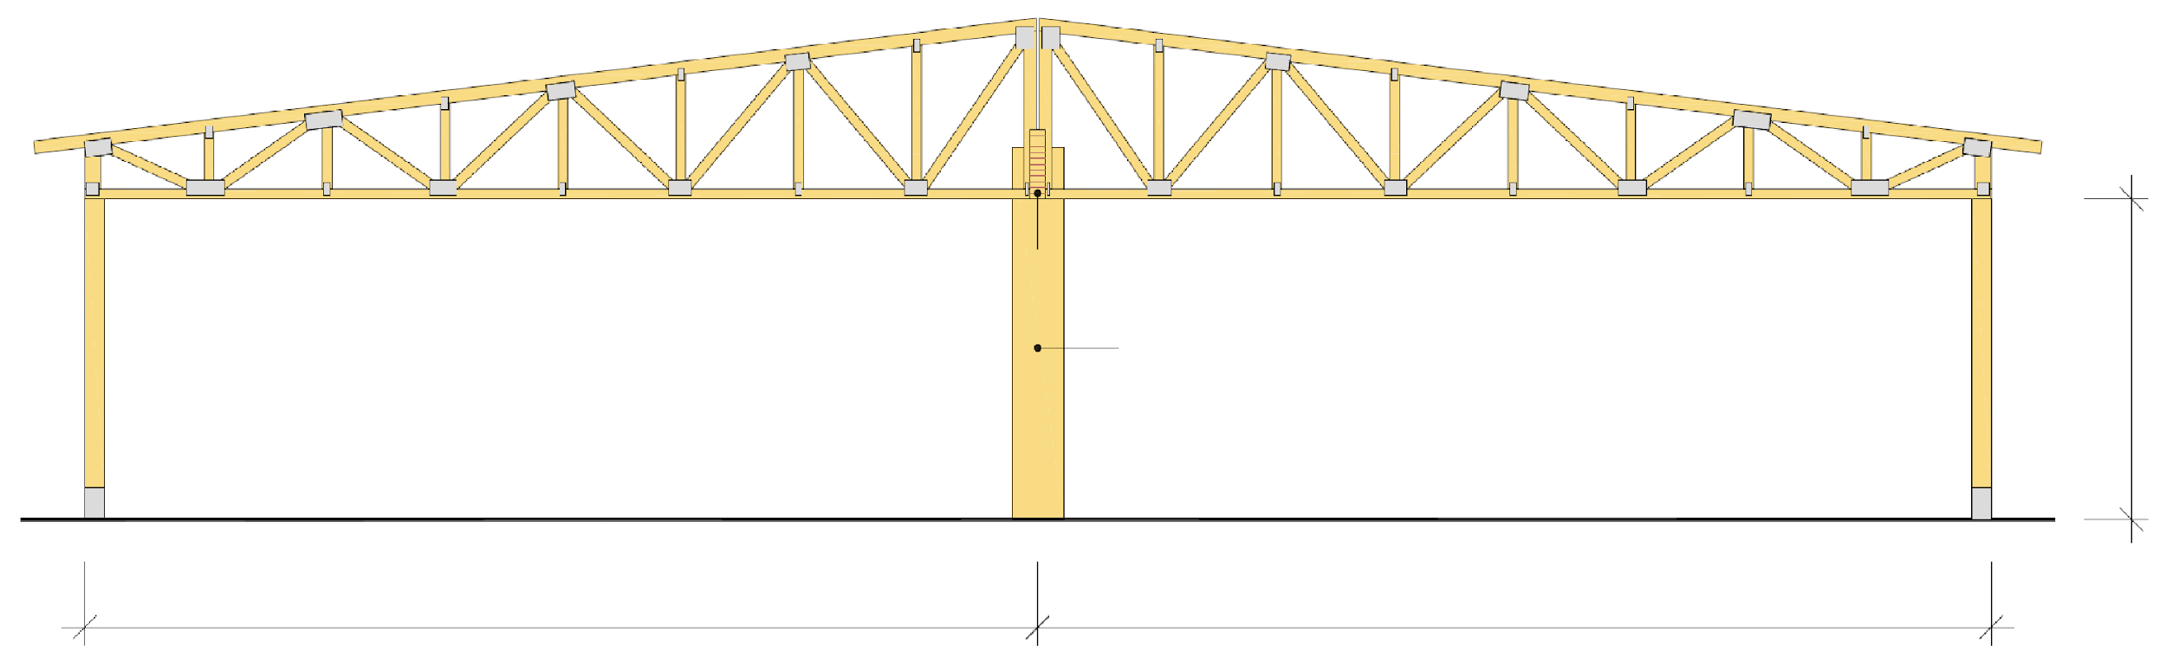
Load-bearing panelised units + Nail plate trusses
Nail plate trusses
Beam
Nail plate trusses
Load-bearing wall
Load-bearing wall
Cantilever columns e.g. k6000
Max 5m
Recommended max 15...20 m
Recommended max 15...20 m

Slide 16
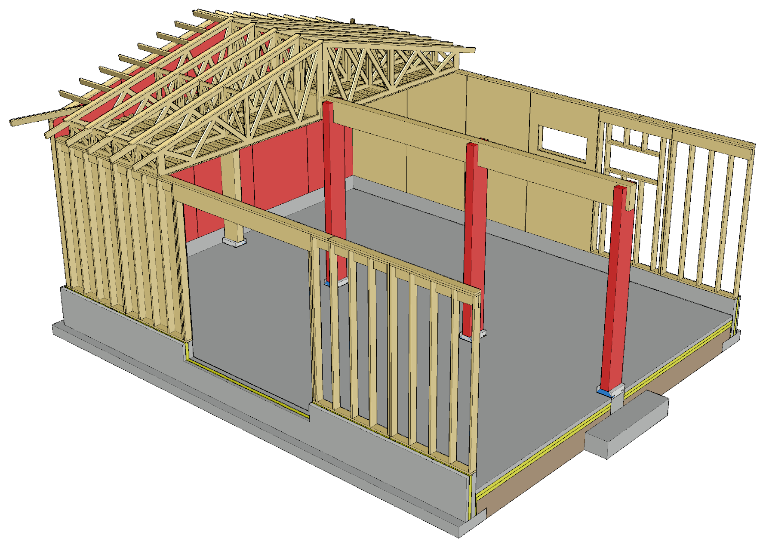
Load-bearing panelised units + Nail plate trusses
For transversal stiffening of the building, cantilever columns and stiffening plates in end walls are used
The stiffening of nail plate trusses as in a single-bay hall
The stiffening plates can be replaced by transverse stiffeners (batten or board)

Slide 17
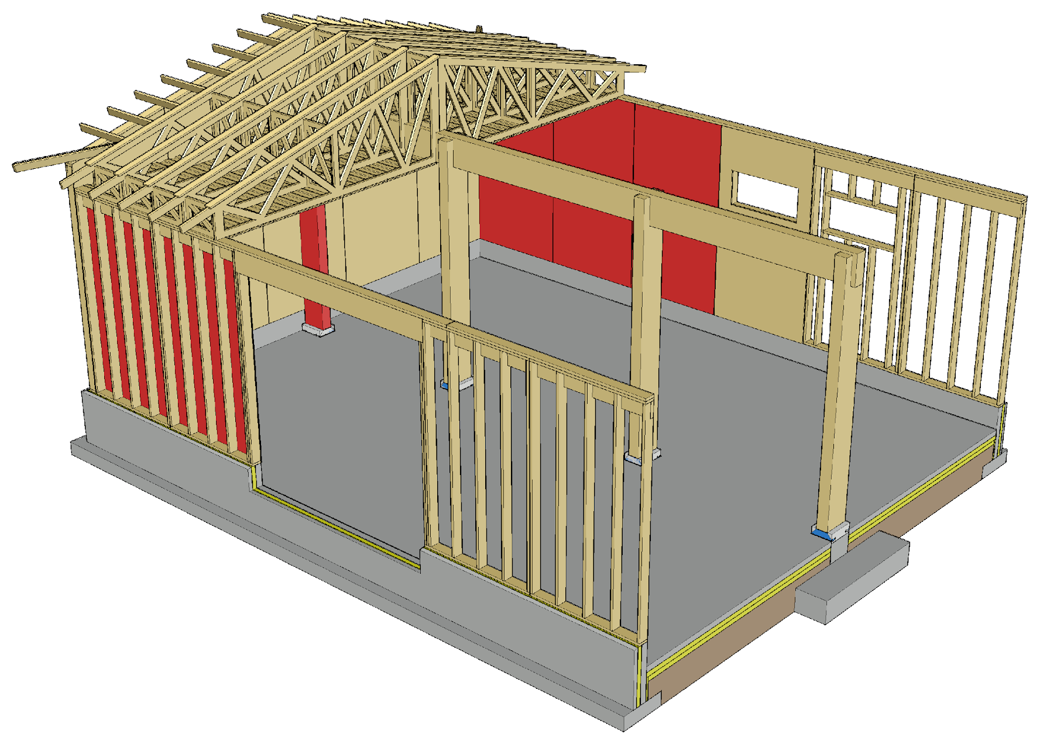
Load-bearing panelised units + Nail plate trusses
Longitudinal stiffening of the building is implemented with cantilever columns and stiffening plates in side walls
The stiffening of nail plate trusses as in a single-bay hall
The stiffening plates can be replaced by transverse stiffeners (batten or board)

Slide 18
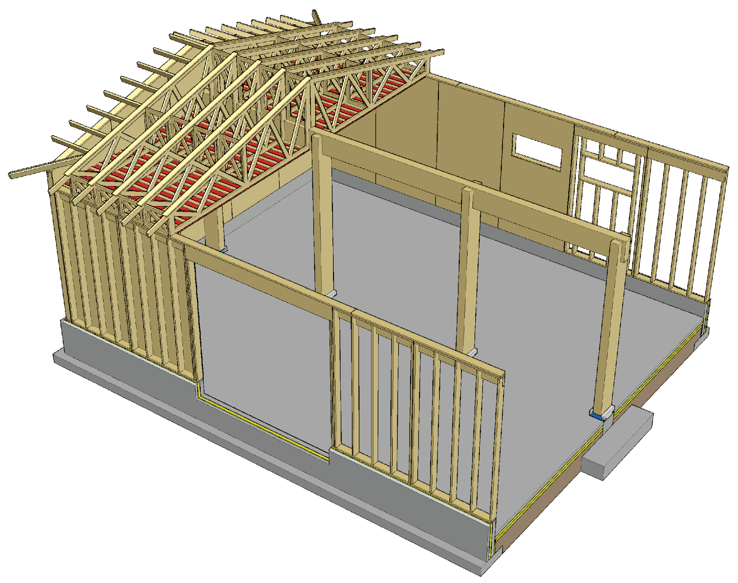
Load-bearing panelised units + Nail plate trusses
A stiffening plate at the bottom chord level is used for
Stiffening the building
Stiffening nail plate trusses
A stiffening plate at the bottom chord level can be replaced by transverse stiffeners (batten or board)

Slide 19
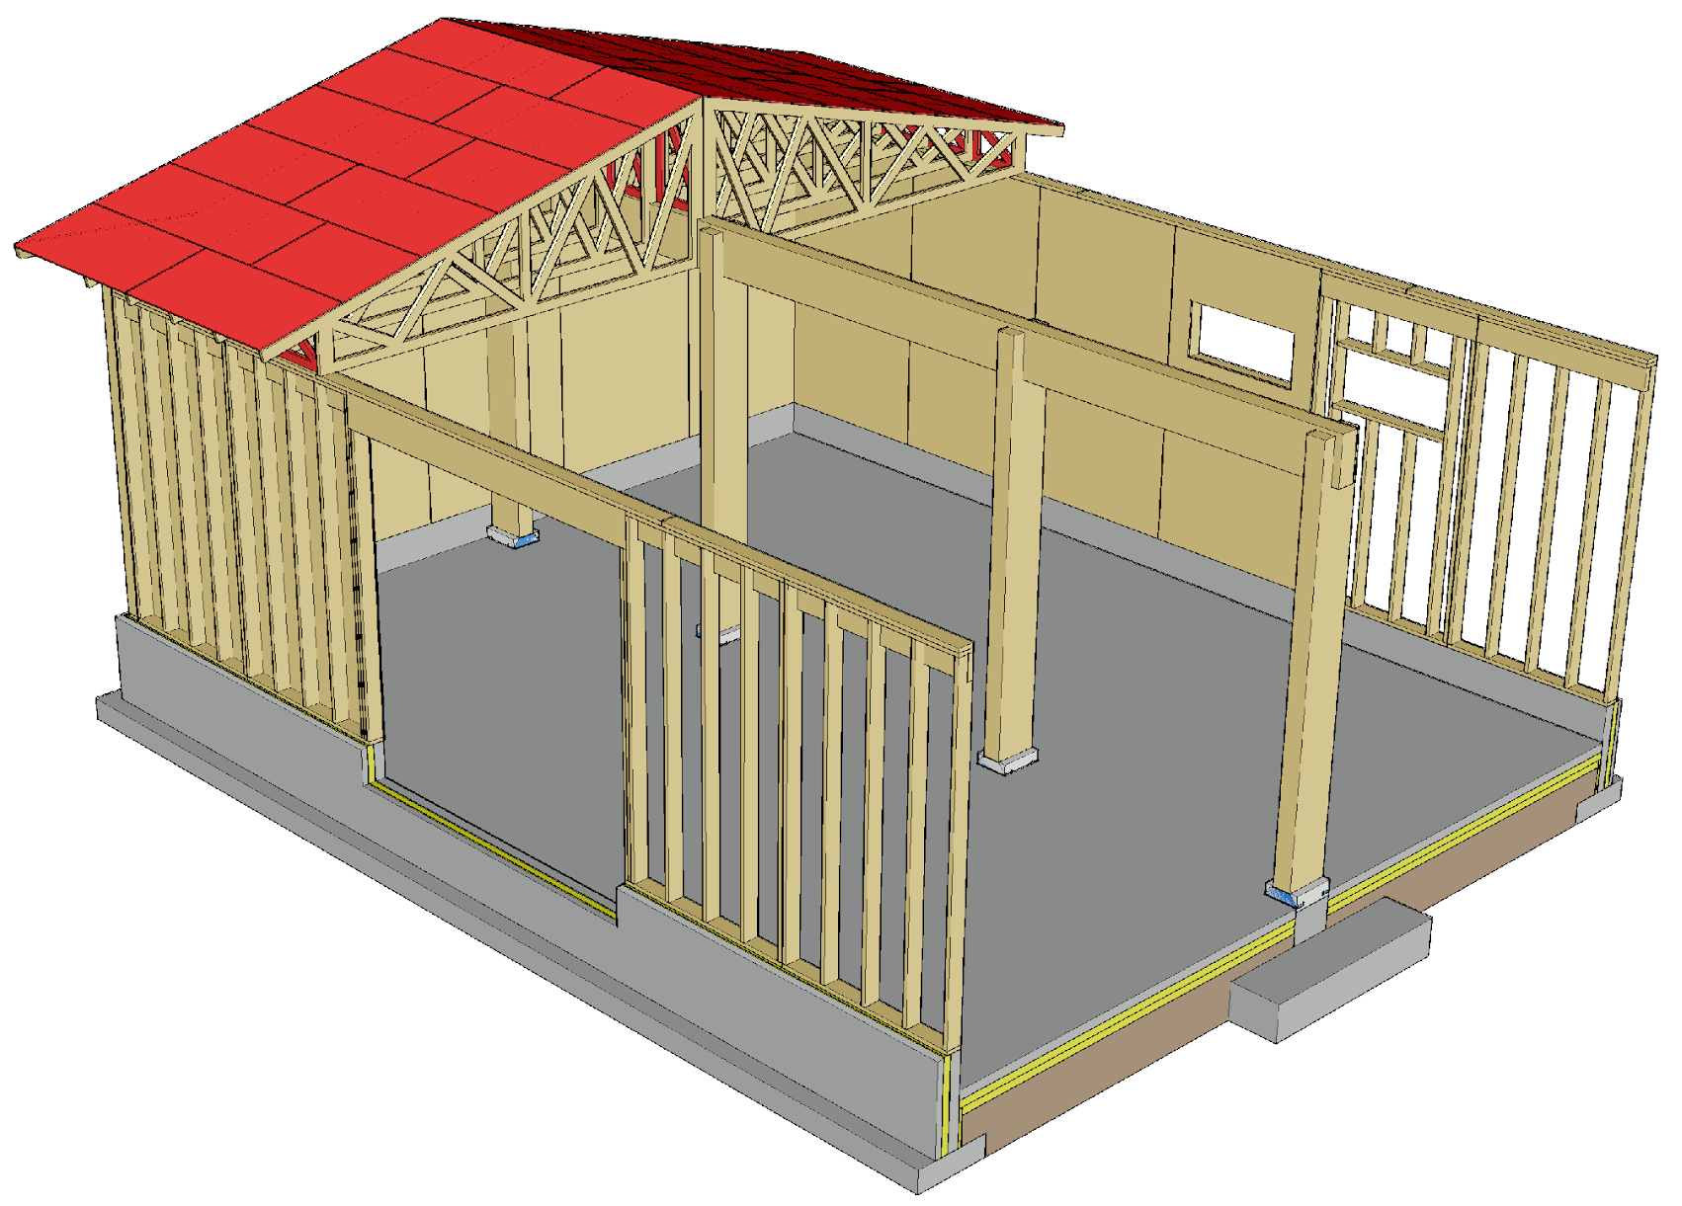
Load-bearing panelised units + Nail plate trusses
The roof stiffener and nail plate truss stiffener needed for stiffening the building can be implemented with a stiffening plate on top of the top chord
For the stiffener, tongue-and-groove plywood board or LVL panel designed for this purpose are used

Slide 20
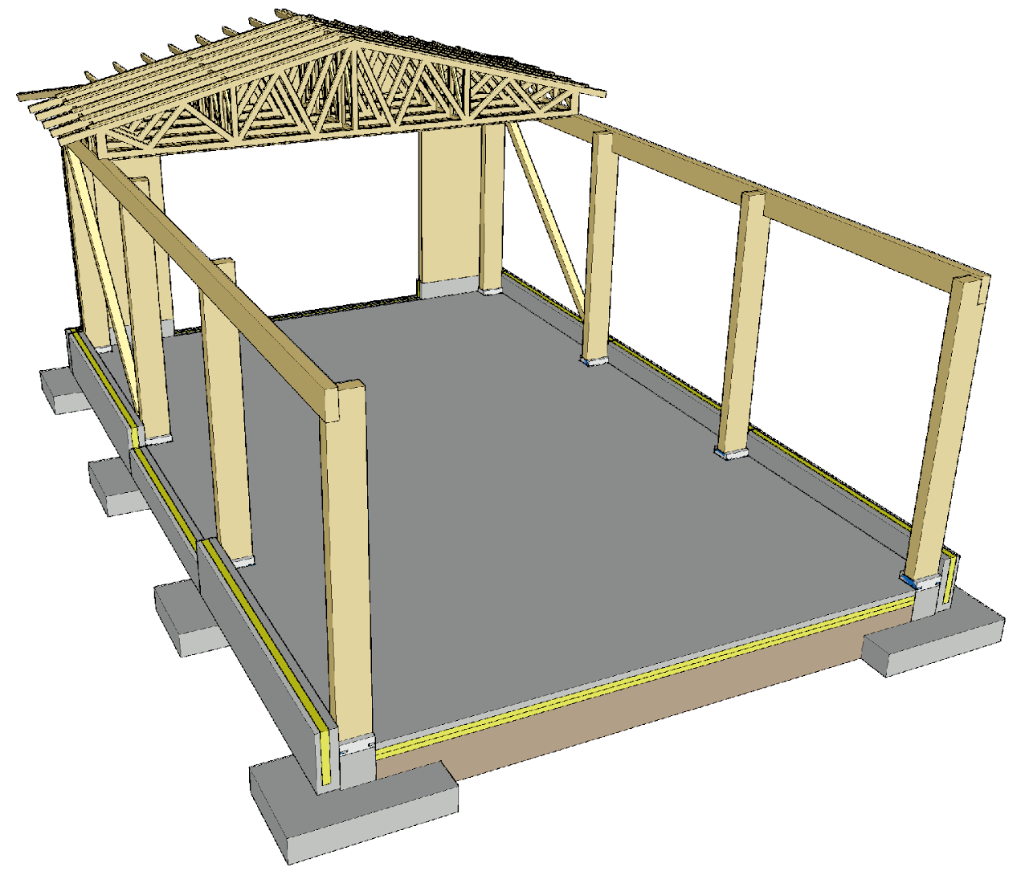
Cantilever columns + nail plate trusses
The frame of a hall with a nail plate truss roof can be implemented using cantilever columns
The advantages of cantilever columns are
Simple method for stiffening the building
No restrictions on hall length
Great indoor height

Slide 21
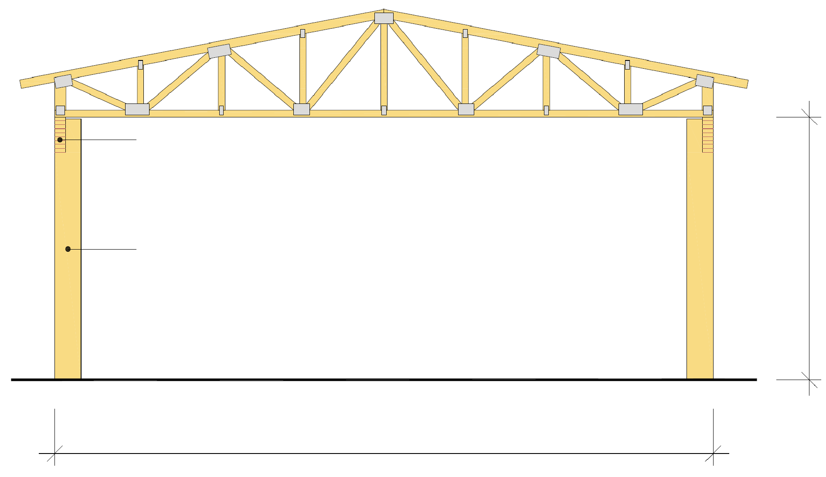
Cantilever columns + nail plate trusses
Load-bearing walls can be replaced by cantilever columns
In this case, exterior walls are built as non-load-bearing structures from timber units or sandwich elements with metal structure
Using cantilever columns, a hall with a single or multiple bays can be built
Beam
Cantilever columns e.g. k6000
Max 6m
Recommended max 15...20 m

Slide 22
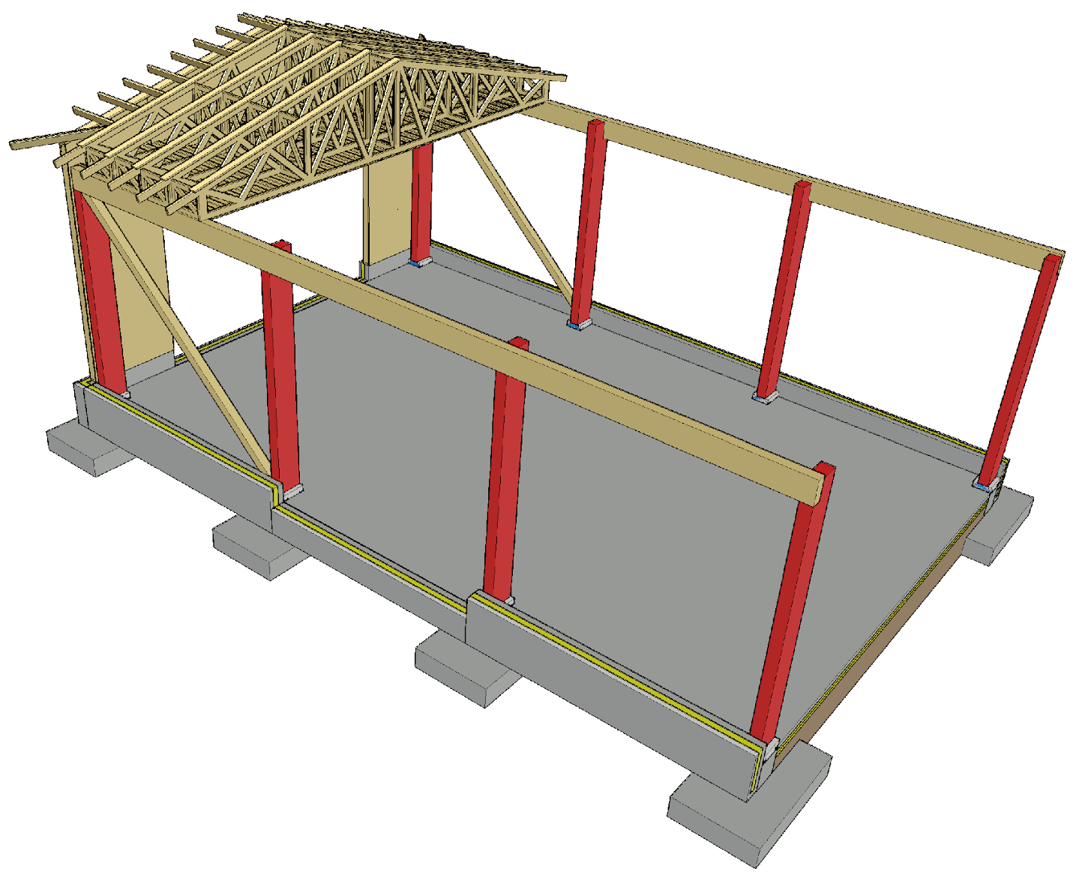
Cantilever columns + nail plate trusses
For transversal stiffening of the building, cantilever columns are used
The stiffening of nail plate trusses as in a load-bearing wall system
The end walls need not work as stiffeners, and large doors can be provided in them

Slide 23
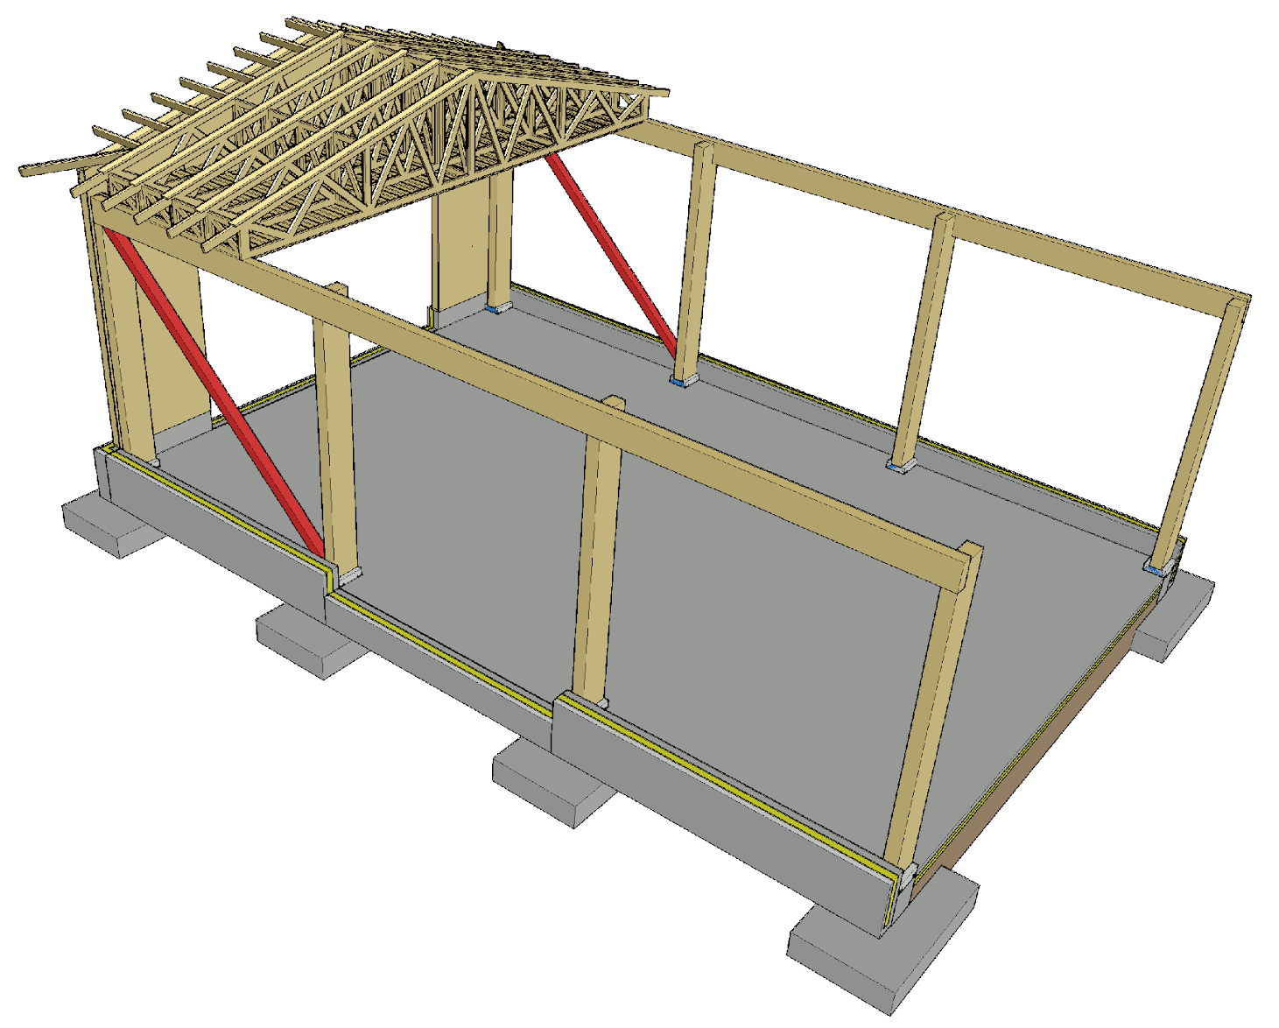
Cantilever columns + nail plate trusses
For the longitudinal stiffening of the building, diagonal stiffeners along the column lines are used
The stiffening of nail plate trusses as in a load-bearing wall system

Slide 24
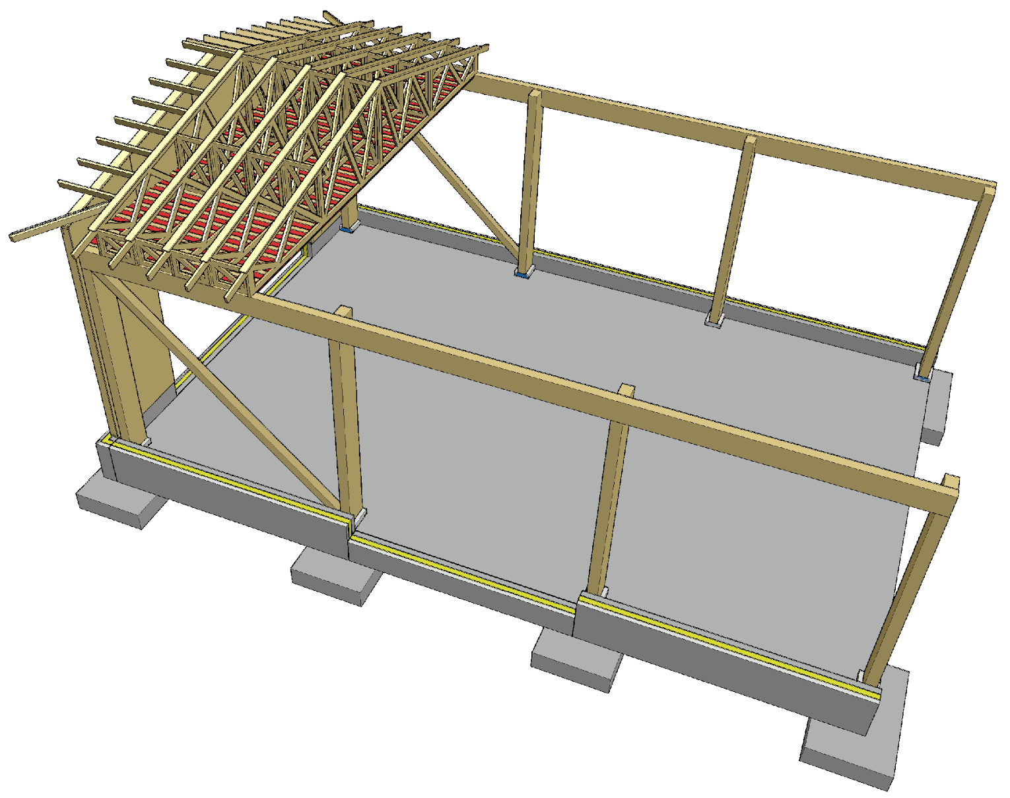
Cantilever columns + nail plate trusses
A stiffening plate at the bottom chord level is used for
Stiffening the building
Stiffening nail plate trusses
A stiffening plate at the bottom chord level can be replaced by transverse stiffeners (batten or board)

Slide 25
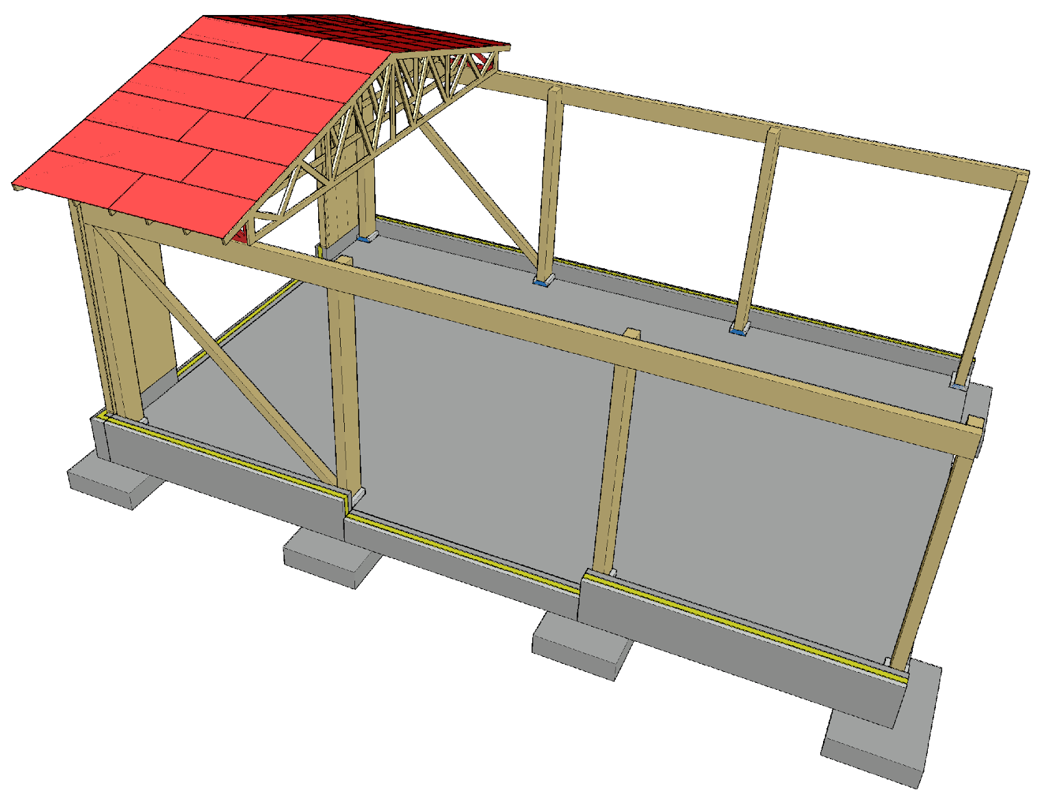
Cantilever columns + nail plate trusses
The roof stiffener and nail plate truss stiffener needed for stiffening the building can be implemented with a stiffening plate on top of the top chord
For the stiffener, tongue-and-groove plywood board or LVL panel designed for this purpose are used

Slide 26
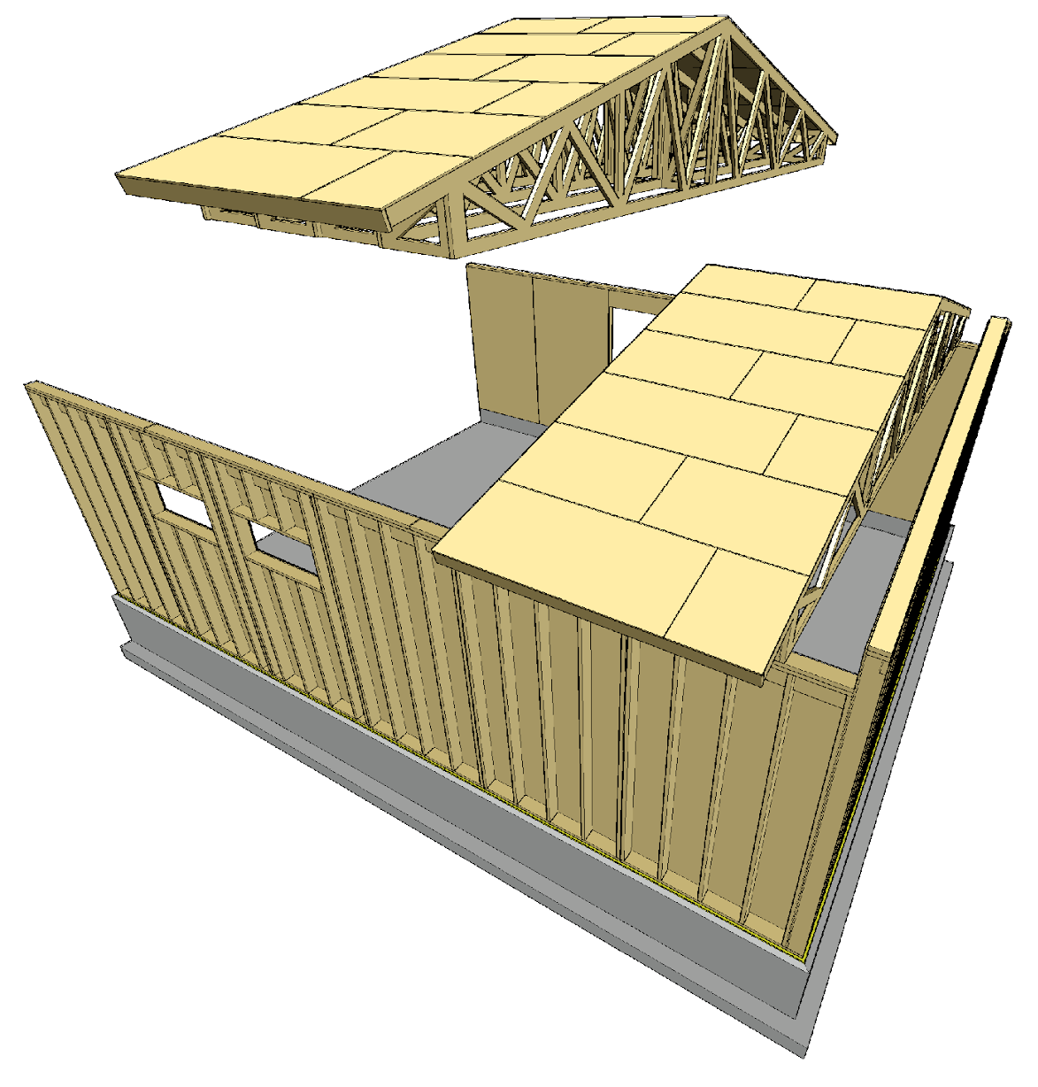
Nail plate truss blocks
Nail plate trusses can be assembled into roof blocks on site
Roof blocks enable
Faster and
Safer construction
Less need for scaffolding
Roof blocks can also be assembled at the factory if this is technically possible
The end overhang can be built as a panelised unit

Slide 27
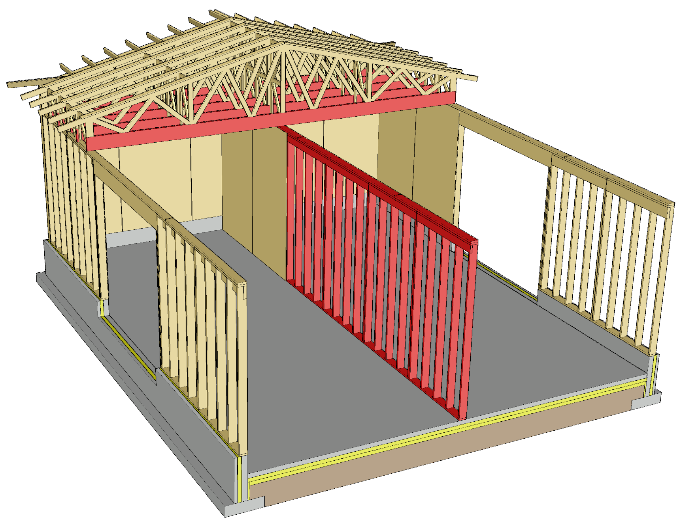
Nail plate trusses in case of fire
Nail plate trusses with a long span are challenging from fire technical point of view if load-bearing capacity is required of the roof in a fire
In an attic fire, the load-bearing capacity of the nail plate truss roof is designed to depend on the bottom chord in case of a fire
Partitions are often needed to reduce the bottom chord span

Slide 28
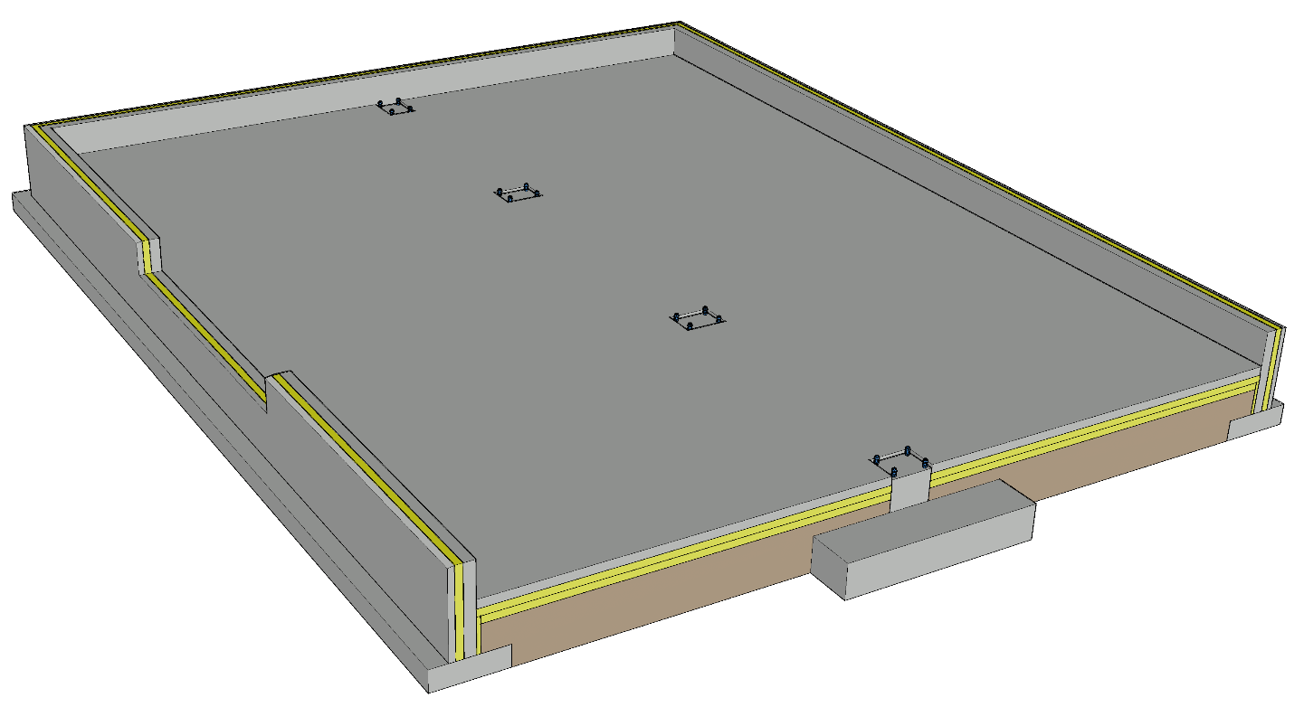
Foundation of an industrial hall
Ribbon foundation for load-bearing walls and column foundations for columns
The foundations of cantilever columns are relatively large if the vertical load is small
Challenges
Junction between the wall and the foundation
Junction between the column and the foundation
Vertical dimensional accuracy of the foundation
Dimensional accuracy of foundation bolt locations

Slide 29
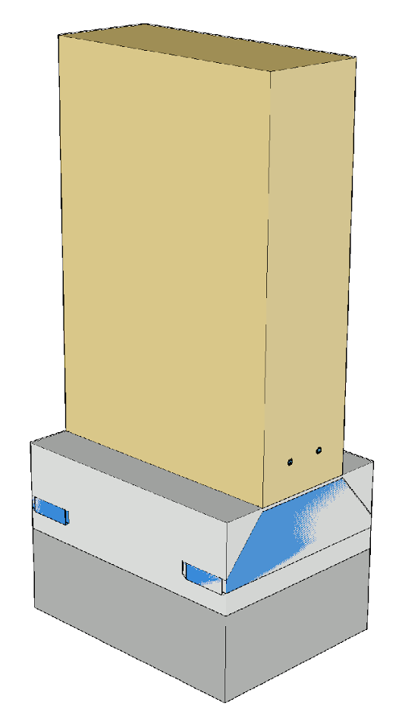
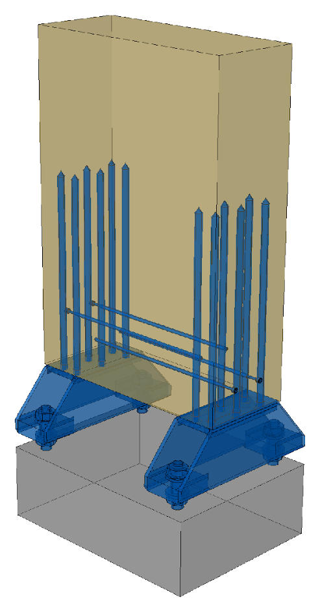
Joint between a cantilever column and the foundation
For the joint between a cantilever column and the foundation, e.g. a column shoe is used, which is attached to the column with a glued-in rod joint
The gap between the wood column and the foundation column is filled with grouting
Waterproofing between the timber and concrete
The column is reinforced as needed, to prevent cracking due to drying

Slide 30
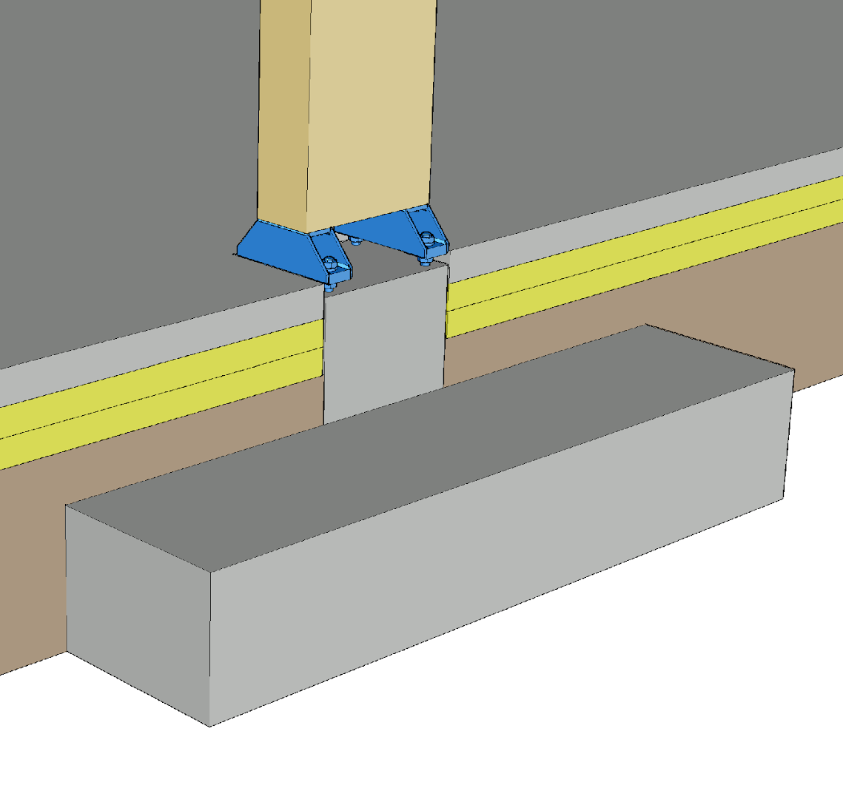
Joint between a timber column and the foundation
At least in production and storage buildings, having the bottom edge of a timber column above the floor level is recommended (moisture stress)
The height of the column shoes affects the timing of the slab-on-grade casting (ease of installation)
Grouting the column joints will affect the workflow and work schedule

Slide 31
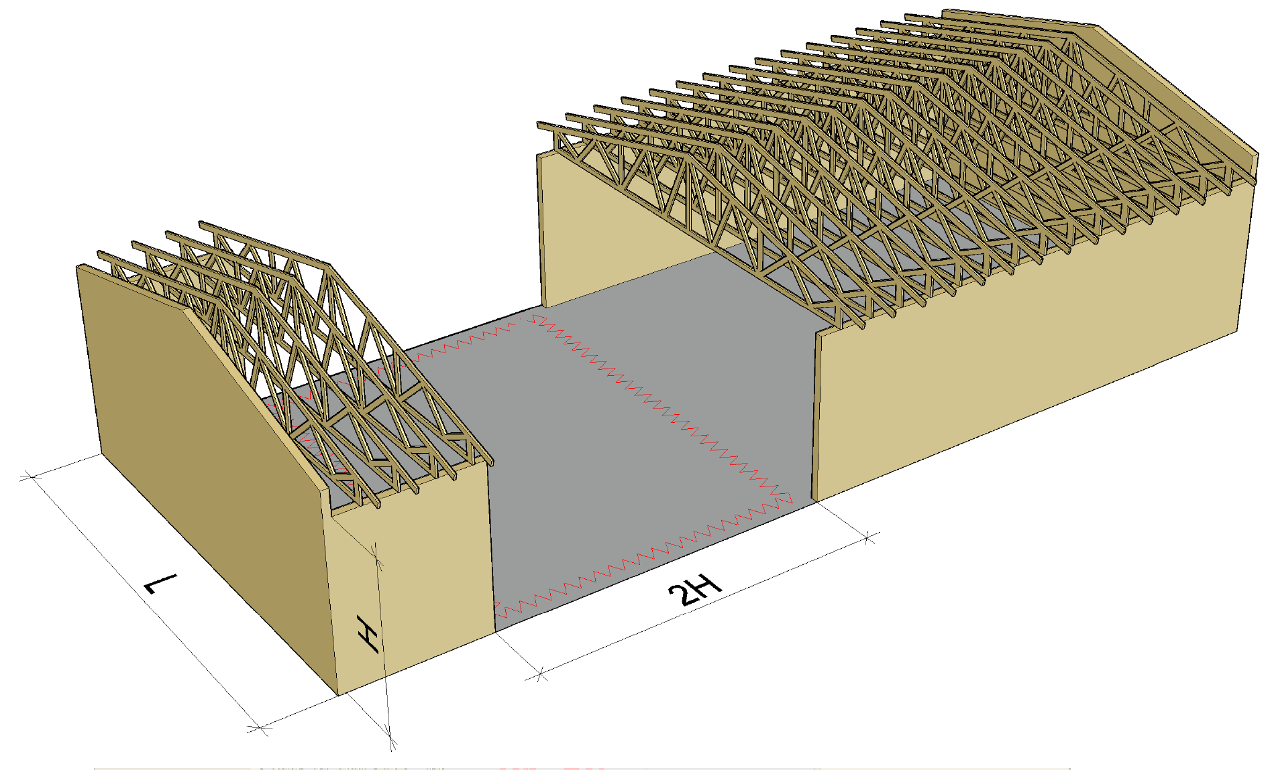
Preventing progressive collapse
Local damage is permitted in hall type buildings
The permissible collapse area in a single-bay hall with load-bearing walls is L x 2H
The permissible collapse area in a multi-bay hall with load-bearing walls is
L x 2H, when the side line is lost
2L x 2H, when the centre line is lost
Hall stability must be maintained
Local damage
Permitted area of collapse

Slide 32
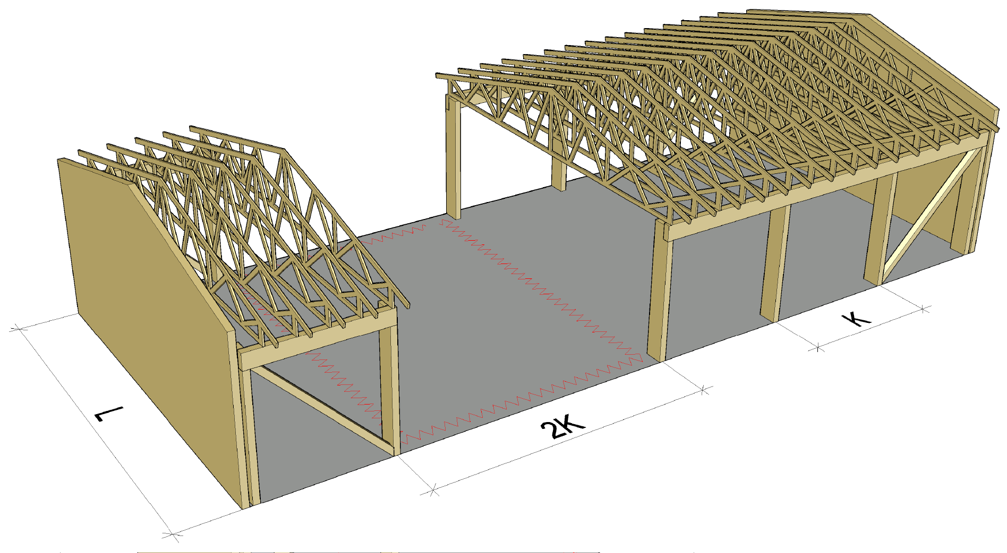
Preventing progressive collapse
Local damage is permitted in hall type buildings
The permissible collapse area in a single-bay hall with cantilever columns is L x 2K
The permissible collapse area in a multi-bay hall with cantilever columns is
L x 2K, when an edge column is lost
2L x 2K, when a centre column is lost
Hall stability must be maintained
Local damage
Permitted area of collapse

Slide 33
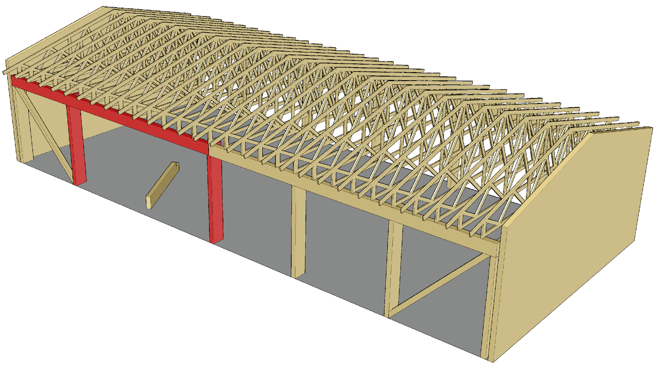
Preventing progressive collapse
The preferred method for preventing progressive collapse is the alternative load transfer path
Using
Continuity of primary columns
Joint components between beams and columns

Slide 34
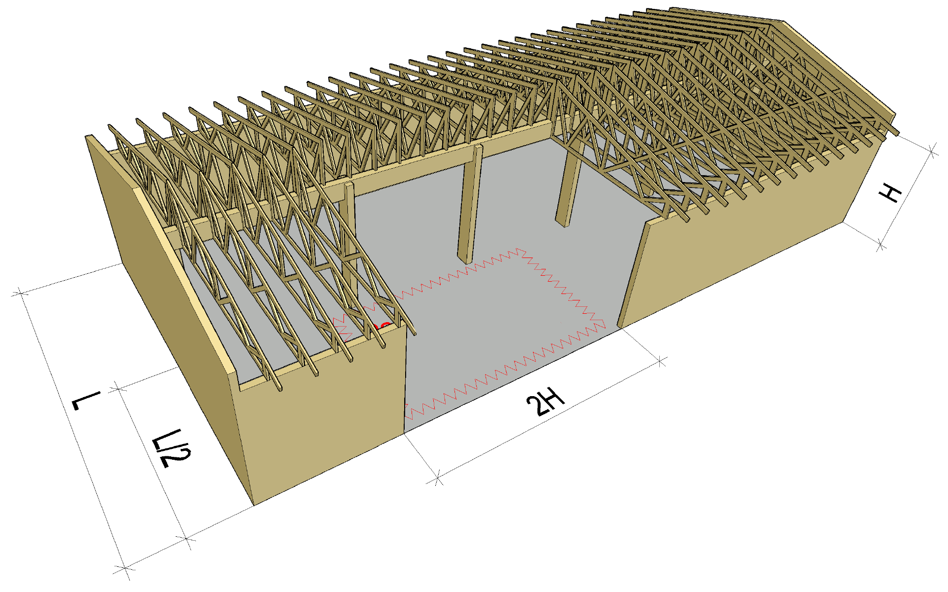
Preventing progressive collapse
Local damage is permitted in hall type buildings
The permissible collapse area in a two-bay hall with load-bearing walls and a column line is
L/2 x 2H, when a load-bearing wall on the side line is lost
Hall stability must be maintained
Local damage
Permitted area of collapse

Slide 35
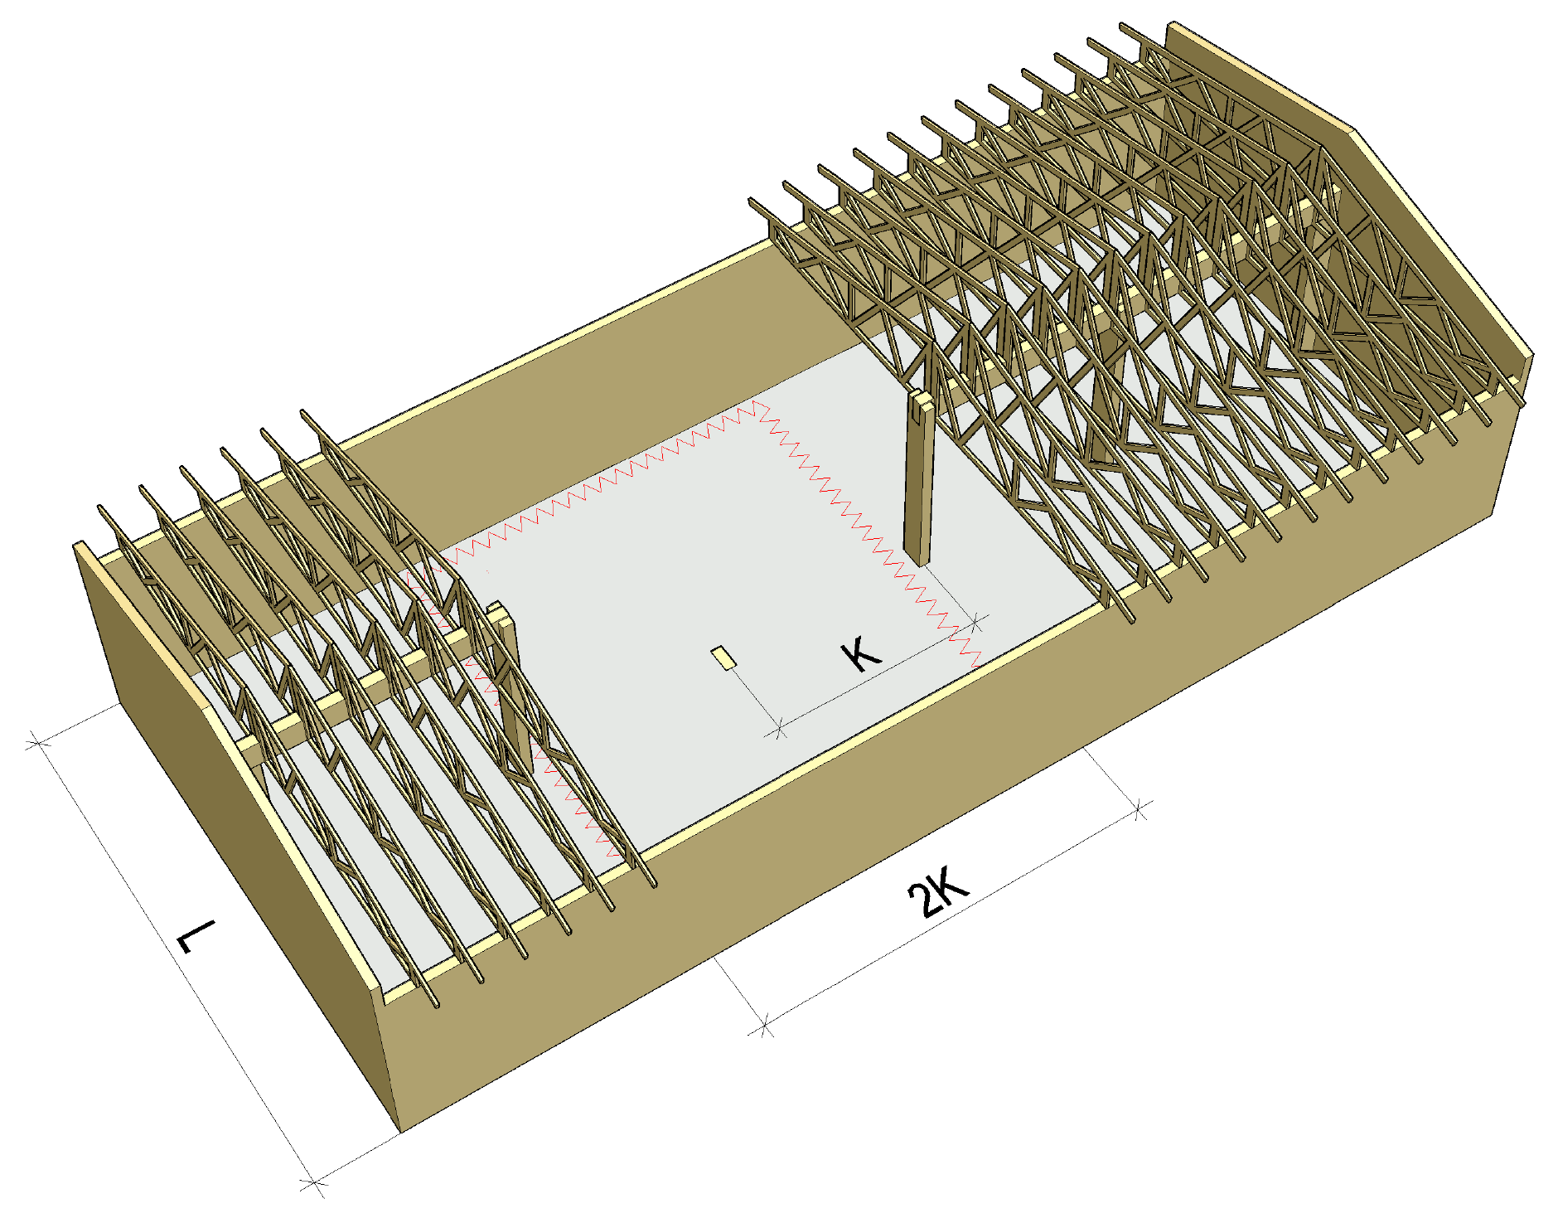
Preventing progressive collapse
Local damage is permitted in hall type buildings
The permissible collapse area in a two-bay hall with load-bearing walls and a column line is
L x 2K, when a centre column is lost
Hall stability must be maintained
Local damage
Permitted area of collapse

Slide 36
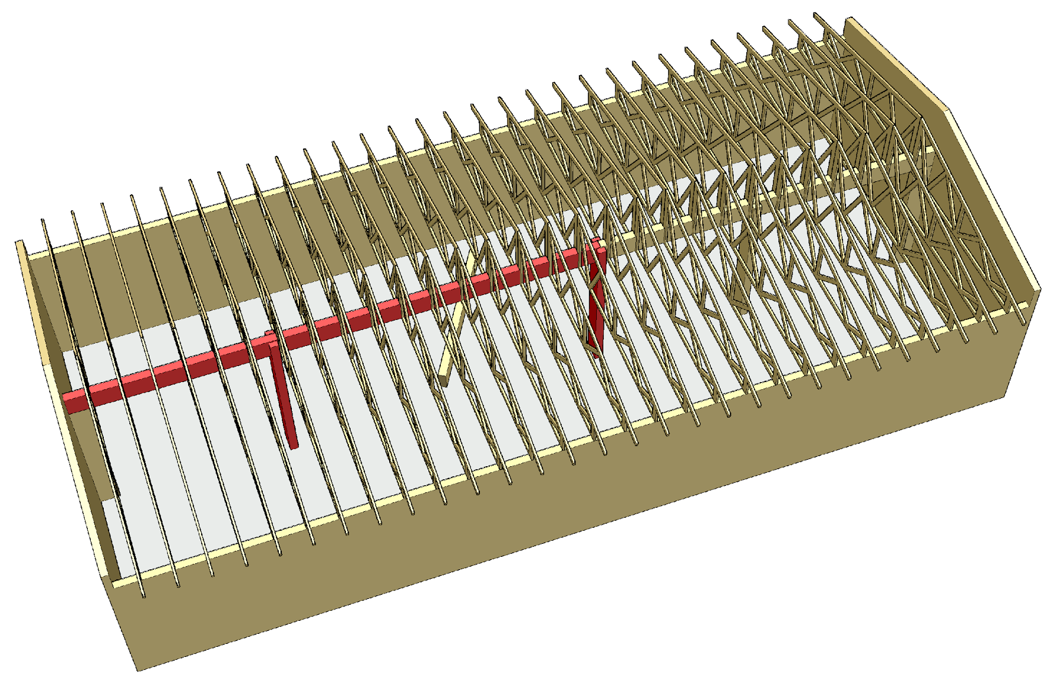
Preventing progressive collapse
The preferred method for preventing progressive collapse is the alternative load transfer path
Using
Continuity of primary columns
Joint components between beams and columns

