Slide 1



Industrial wood construction
Teaching materials for industrial wood construction education
2022

Slide 2
Origin of the materials
Use of the materials
These learning materials for industrial wood construction have been prepared in a project led by Puuinfo Oy in 2021–2022. Also involved in the project were
Lappia Vocational College,
TTS-Työtehoseura ry
South-Eastern Finland University of Applied Sciences,
Metropolia University of Applied Sciences,
Jyväskylä University of Applied Sciences,
University of Tampere, and
Federation of the Finnish Woodworking Industries Puutuoteteollisuus ry
The project was funded by the Ministry of the Environment.
The materials are intended to be used as extensively as possible in industrial wood construction education and studies.
The materials are released under the Creative Commons licence Attribution-ShareAlike (CC BY-SA), which requires that the author be properly credited when the materials are used and that derivative works may only be distributed under the same licence as the original work.
The original materials and any updates to them by Puuinfo will be published on the Library of Open Educational Resources website (aoe.fi) and the Puuinfo.fi website.

Slide 3

Industrial construction systems

Slide 4
Authors
Tero Lahtela, Insinööritoimisto Tero Lahtela Oy
Release date: 01/07/2021

Slide 5
Load-bearing panelised units with framed structure Residential and commercial construction

Slide 6
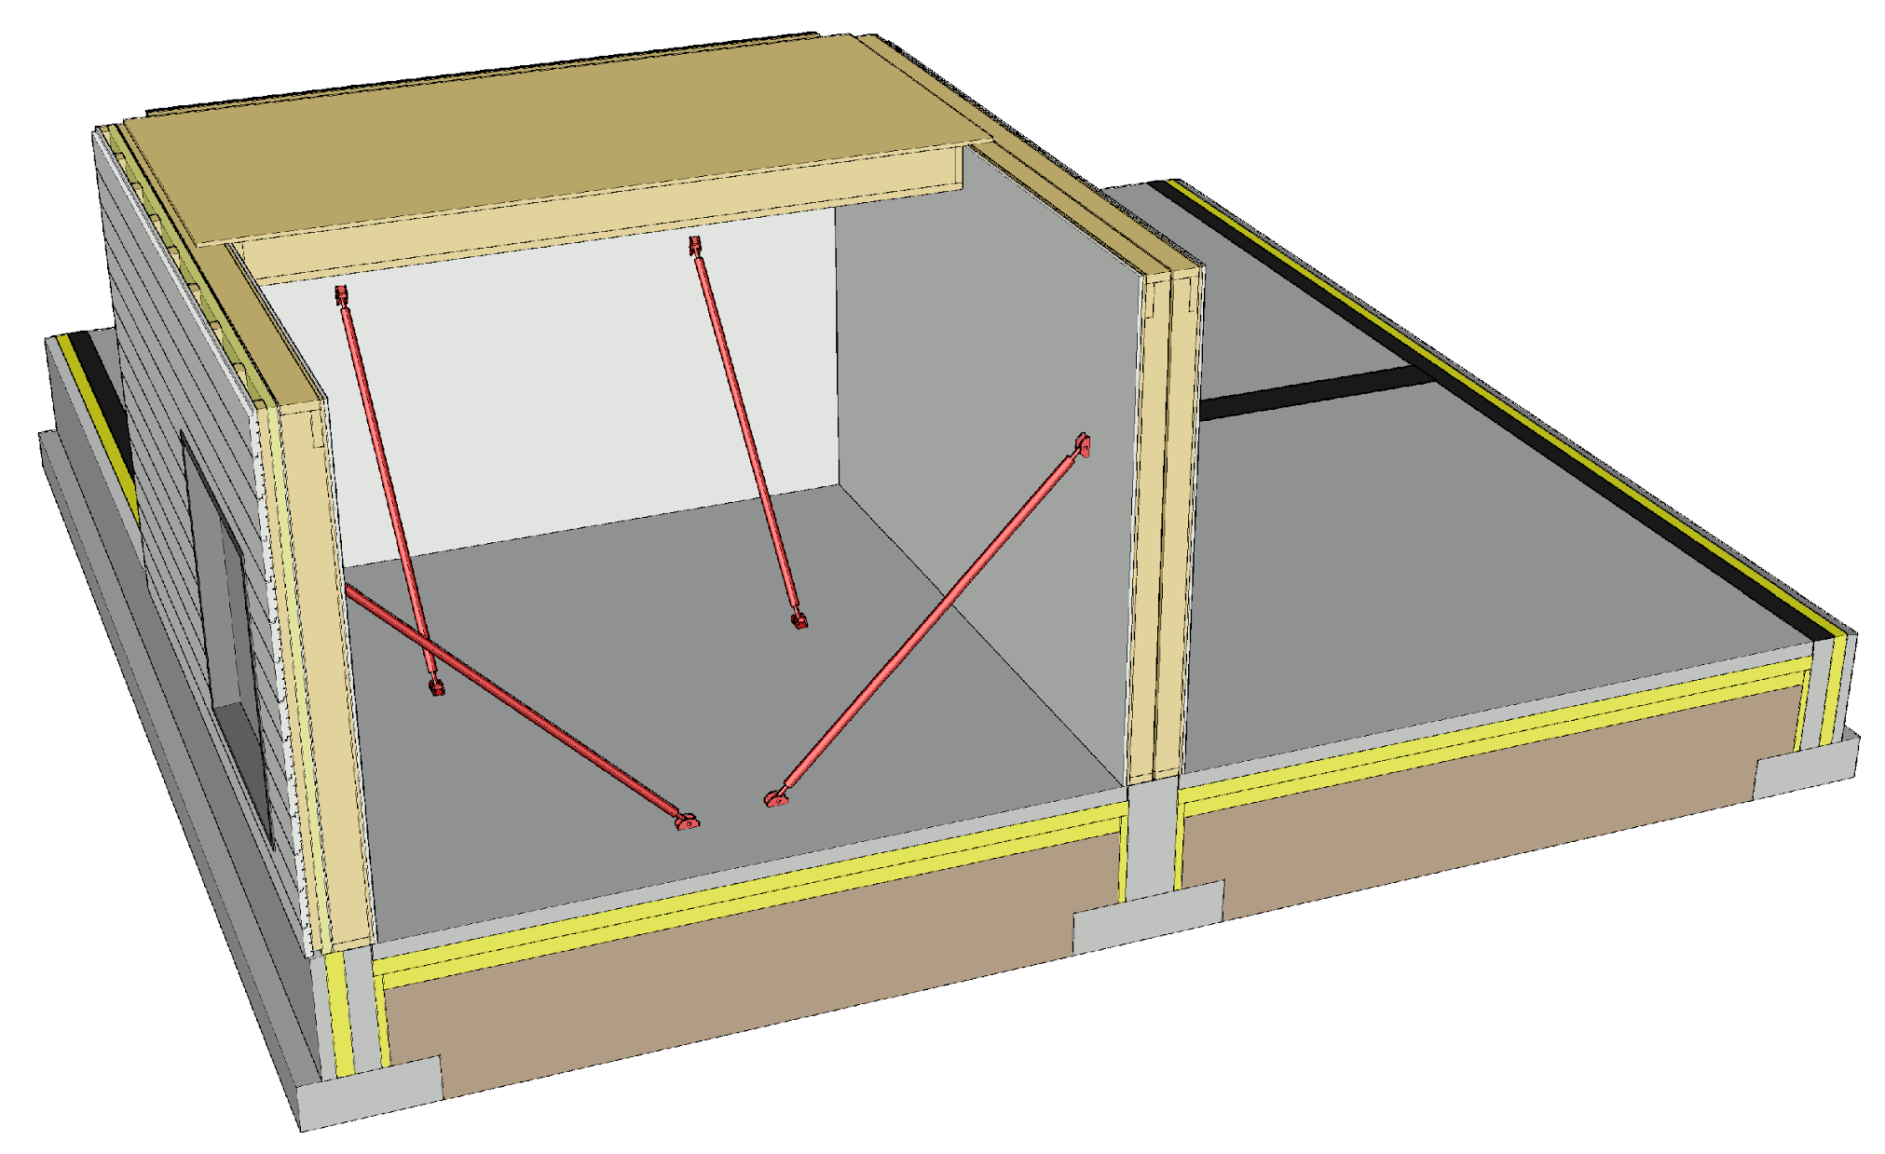
Elements of a framed structure system
Load-bearing exterior walls
Load-bearing partition walls
Intermediate floors
Attic floor
Panelised unit with beam structure
Typically nail plate truss
A nail plate truss roof can be built as blocks on site or in the factory

Slide 7
Applications
Load-bearing panelised units with framed structure are primarily used in
Detached houses, terraced houses and blocks of flats
Accommodation buildings and residential institutions
School and day-care centre buildings
Panelised units with framed structure can also be used as an element in other building systems (load-bearing or non-load-bearing)
The panelised unit system with a framed structure has been used in different forms for decades

Slide 8
Strengths and challenges of framed structures
Strengths
Simple to manufacture
Large number of manufacturers
Lightweight design
Affordable purchasing price
Challenges
Durability and stiffness
Vertical load
Bearing pressure
Stiffening
Joints
Anchoring
Settlement in intermediate floor

Slide 9
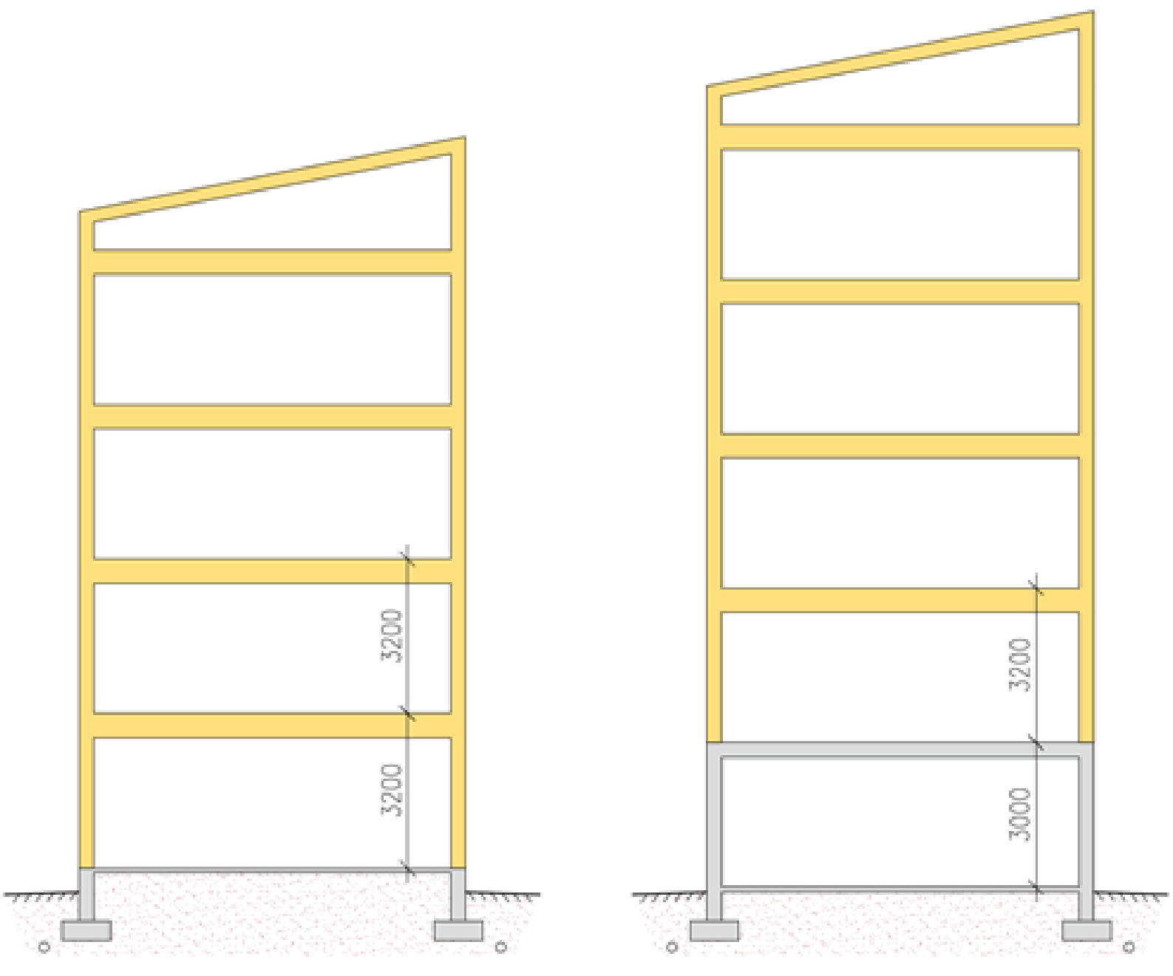
Number of storeys when using framed structures
Factors affecting the number of storeys
Bearing pressure resistance of a wall with a framed structure
Buckling resistance of a wall with a framed structure
Stiffening plate capacity
Capacity of the joints between stiffening building elements
Recommended number of storeys
5 timber-framed storeys at most
Floor-to-floor height
3,200 mm (residential buildings)
3,800 ... 4,000 mm (public areas)
5th storey
4th storey
4th storey
3rd storey
3rd storey
2nd storey
2nd storey
1st storey
1st storey

Slide 10
Panelised unit with framed structure
The load-bearing frame consists of timber frames and/or beams
An effort should be made to coordinate the spacing of frames and beams with the width of wool slabs (600 mm spacing)
There are no standardized dimensions for panelised units
Panelised units are manufactured to order as required by designs
Panelised units can be either horizontal or vertical
Horizontal units create fewer vertical joints than vertical units
A higher space can be created with vertical units than horizontal ones

Slide 11
Prefabrication degree of panelised units with framed structure
An effort is made to prefabricate panelised units with framed structure to a high degree of completion at the factory as this reduces the amount of work to be performed on site
Typical panelised units contain
Heat insulation
Panelling
Exterior cladding (exterior cladding panel, panel-type exterior cladding etc.)
Windows, external doors and their jamb structures
Electrical installations
Building-service penetration products
Joint seals (possibly)

Slide 12
Dimensions of panelised units with framed structure
Wall unit (indicative)
Height ≤ 3.2 m
Length ≤ 12 m
Intermediate floor unit (indicative)
Width ≤ 2.4 m…2.5 m
Length ≤ 12 m (shorter span)
Roof unit
Width ≤ 2.4 m…2.5 m
Length ≤ 12 m (shorter span)

Slide 13
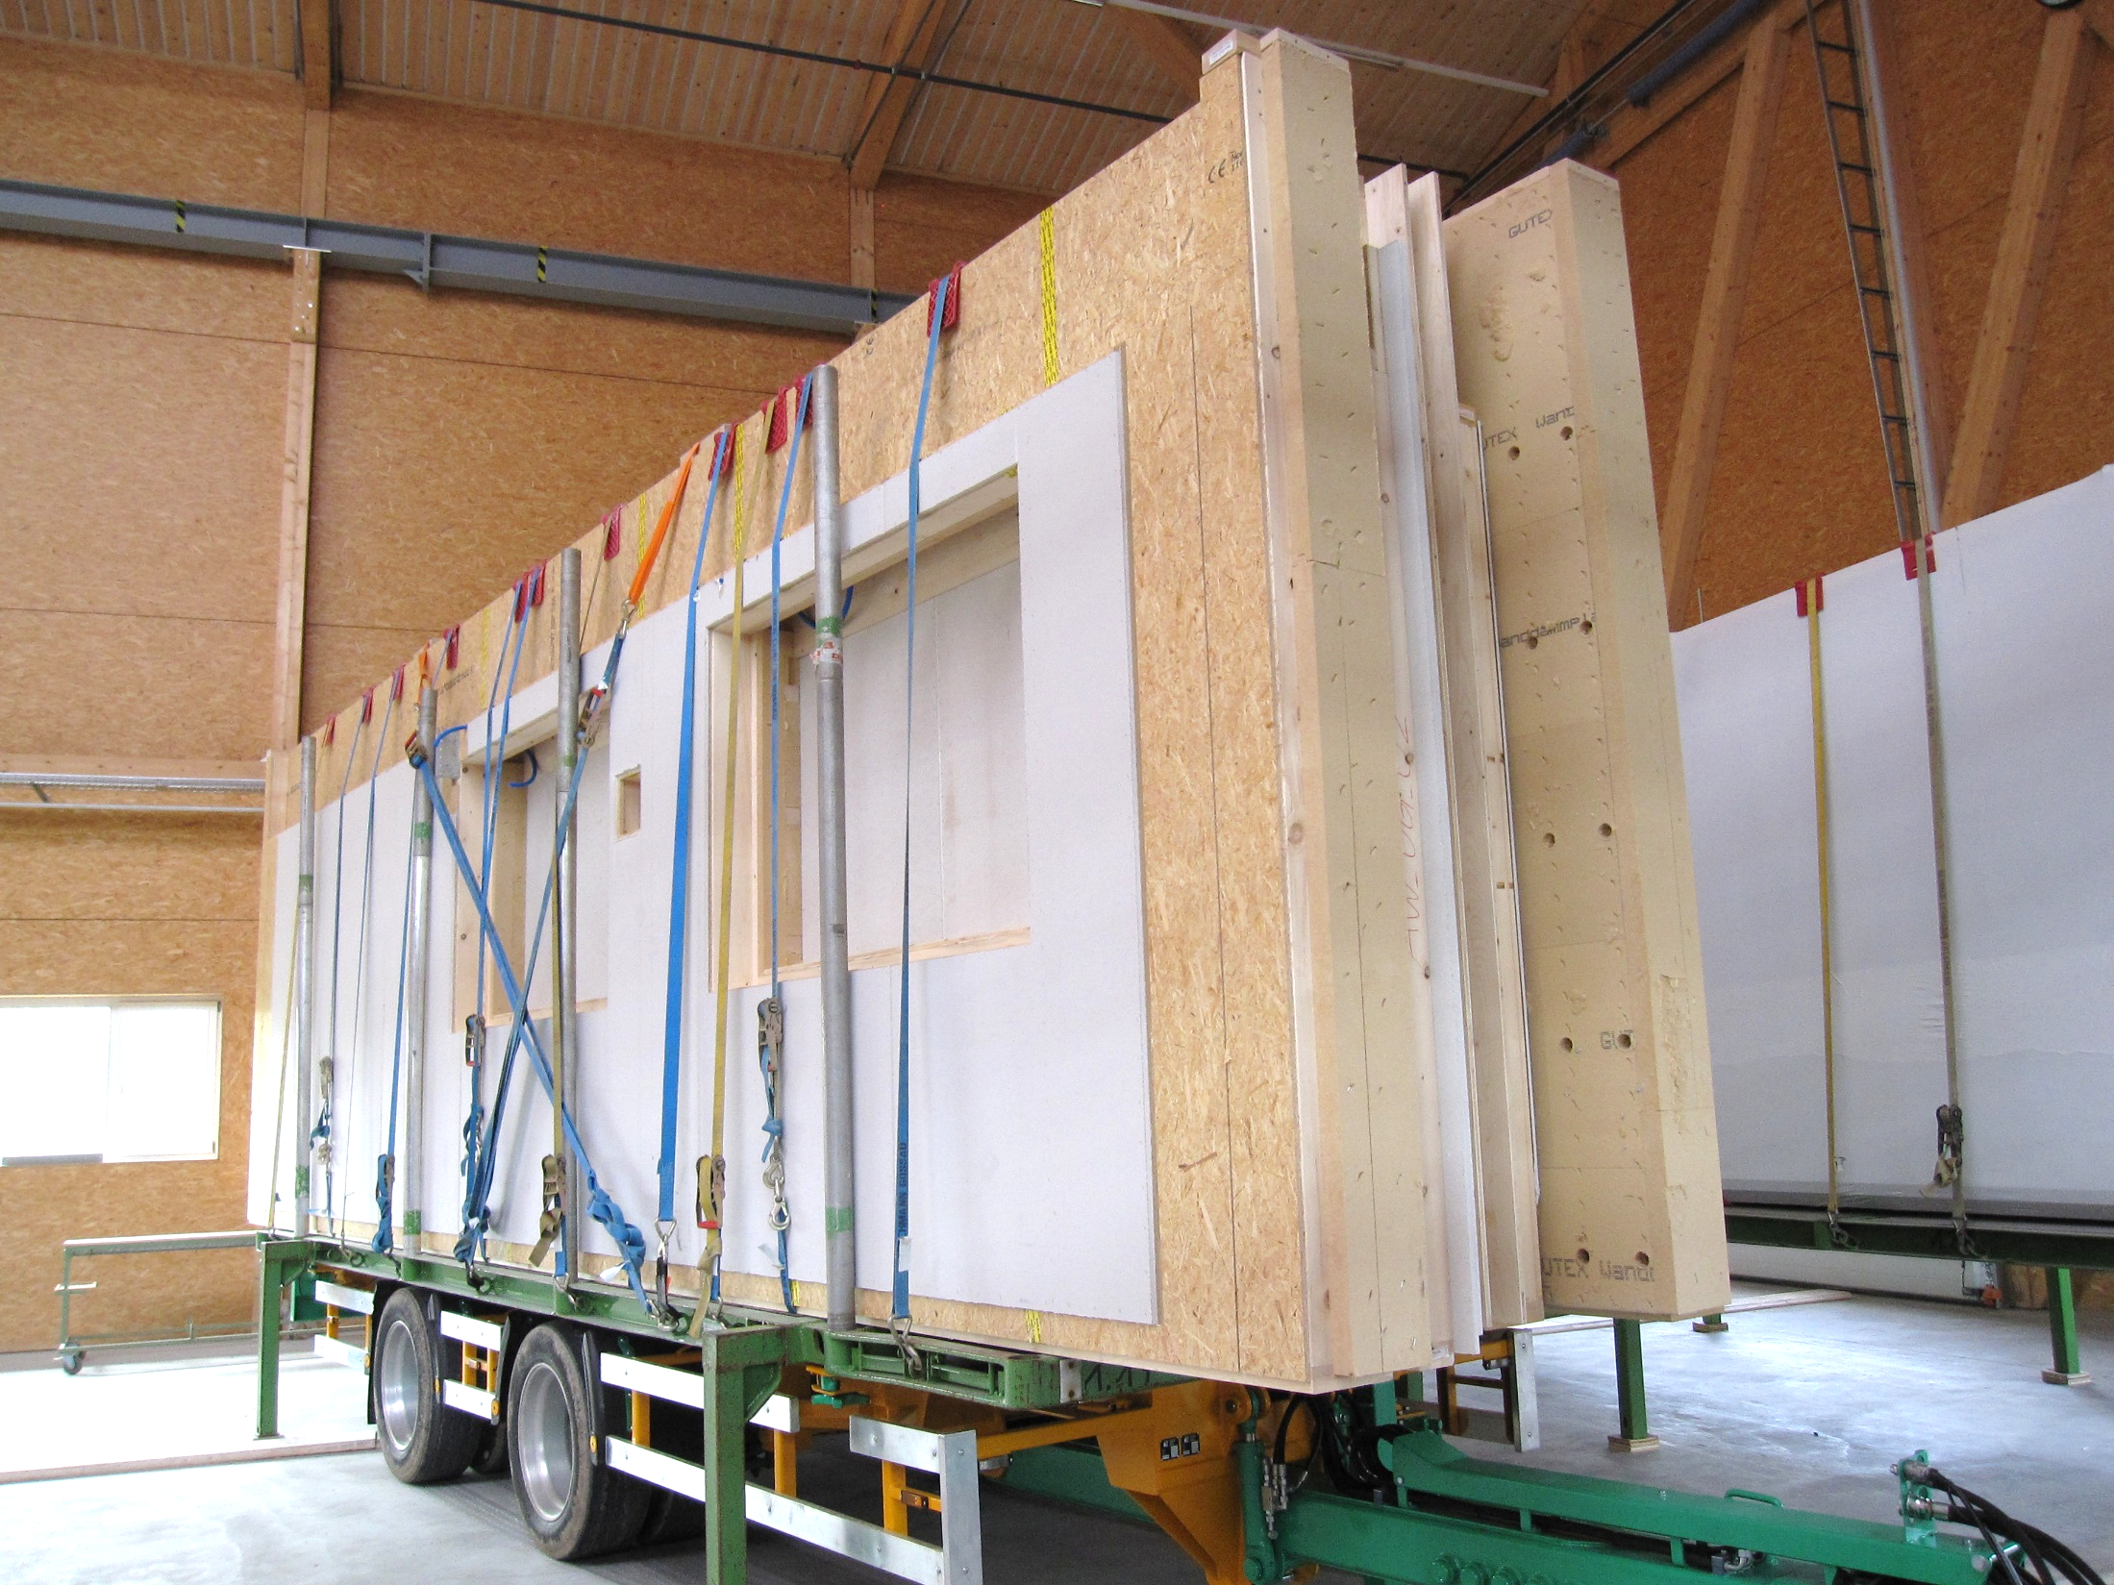
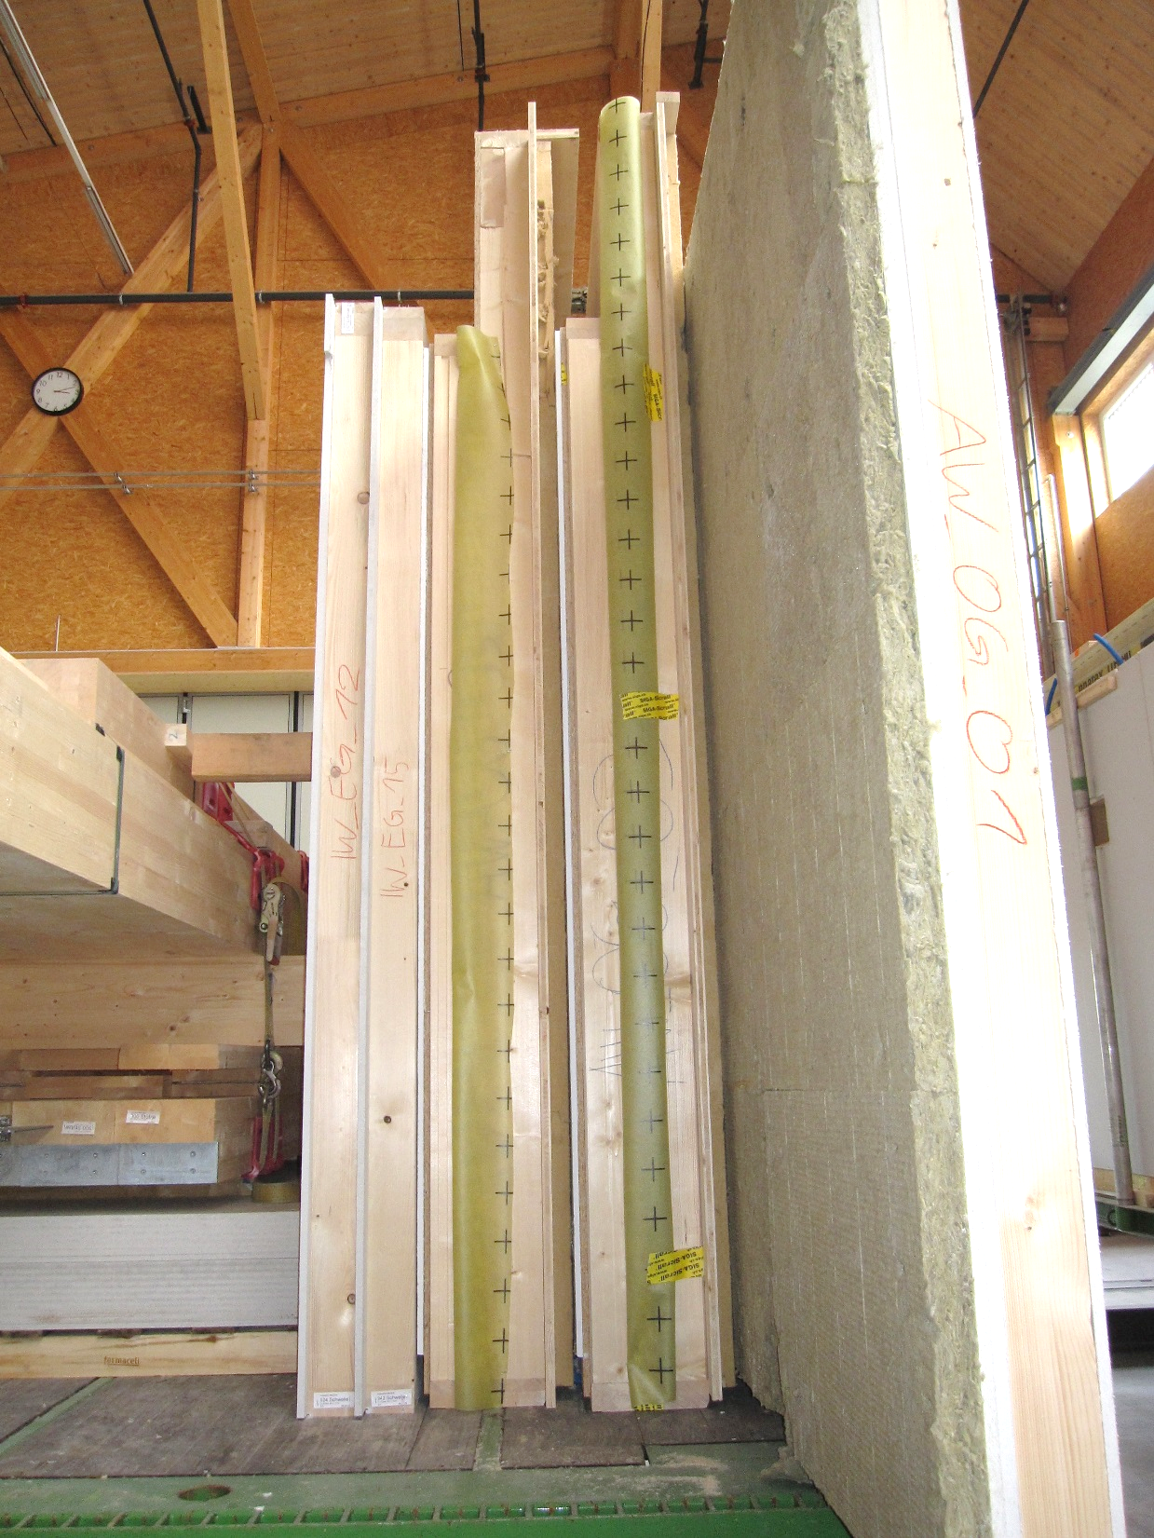
Wall units with framed structure
Image: Tero Lahtela
Image: Tero Lahtela

Slide 14
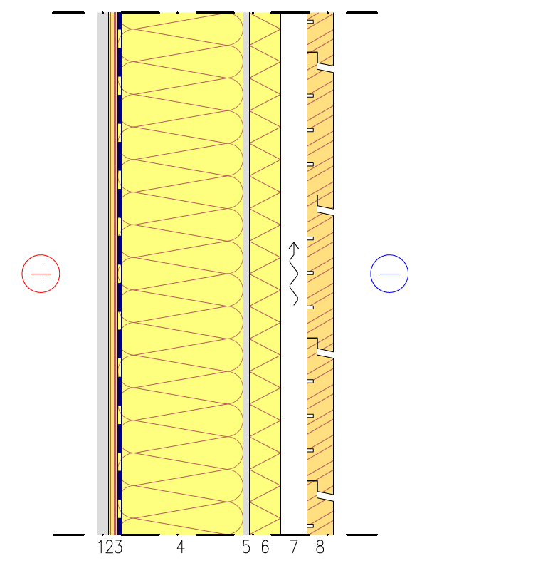
Exterior wall structure
Load-bearing exterior wall
Plates are used for
Stiffening
Fire protection technology
Acoustics
Load carrying capacity of frames
Bearing pressure resistance (often design)
Buckling resistance
External heat insulation
Improves thermal and humidity performance
1 Plasterboard
2 Spruce plywood (stiffening plates)
3 Air and vapour barrier
4 Load-bearing frame + Mineral wool
5 Plasterboard for wind proofing
6 Stiff mineral wool for wind protection
7 Exterior cladding fastening studs (vertical or in a grid)
8 Exterior cladding

Slide 15
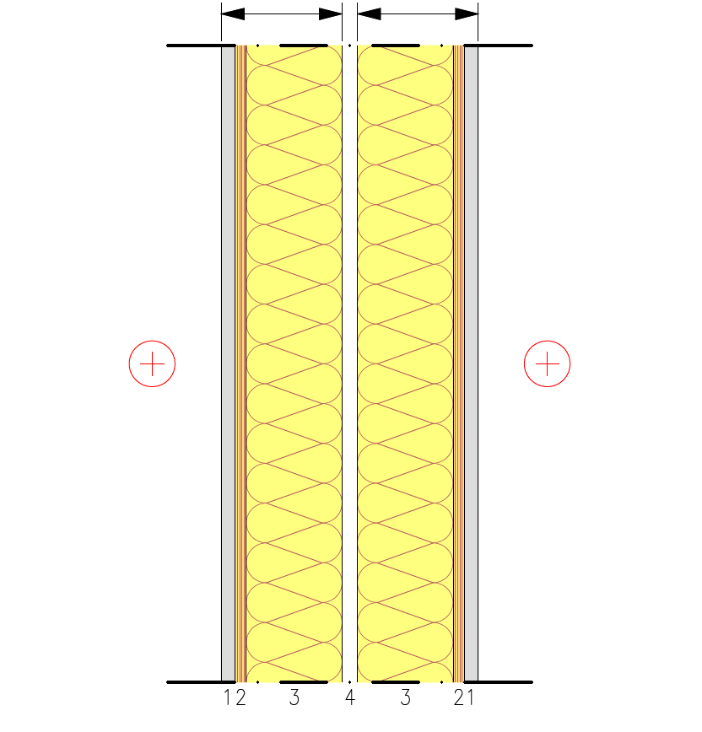
Partition structure
Load-bearing wall between flats
Separate frame halves
Frame 1
Frame 2
Plates are used for
Stiffening
Fire protection technology
Acoustics
Load carrying capacity of frames
Bearing pressure resistance (often design)
Buckling resistance
Double frame
Enables airborne sound insulation between spaces of D_{n,T,w} ≥ 55 dB
1 Plasterboard
2 Spruce plywood (stiffening plates)
3 Load-bearing frame + Mineral wool
4 Gap between frame halves

Slide 16
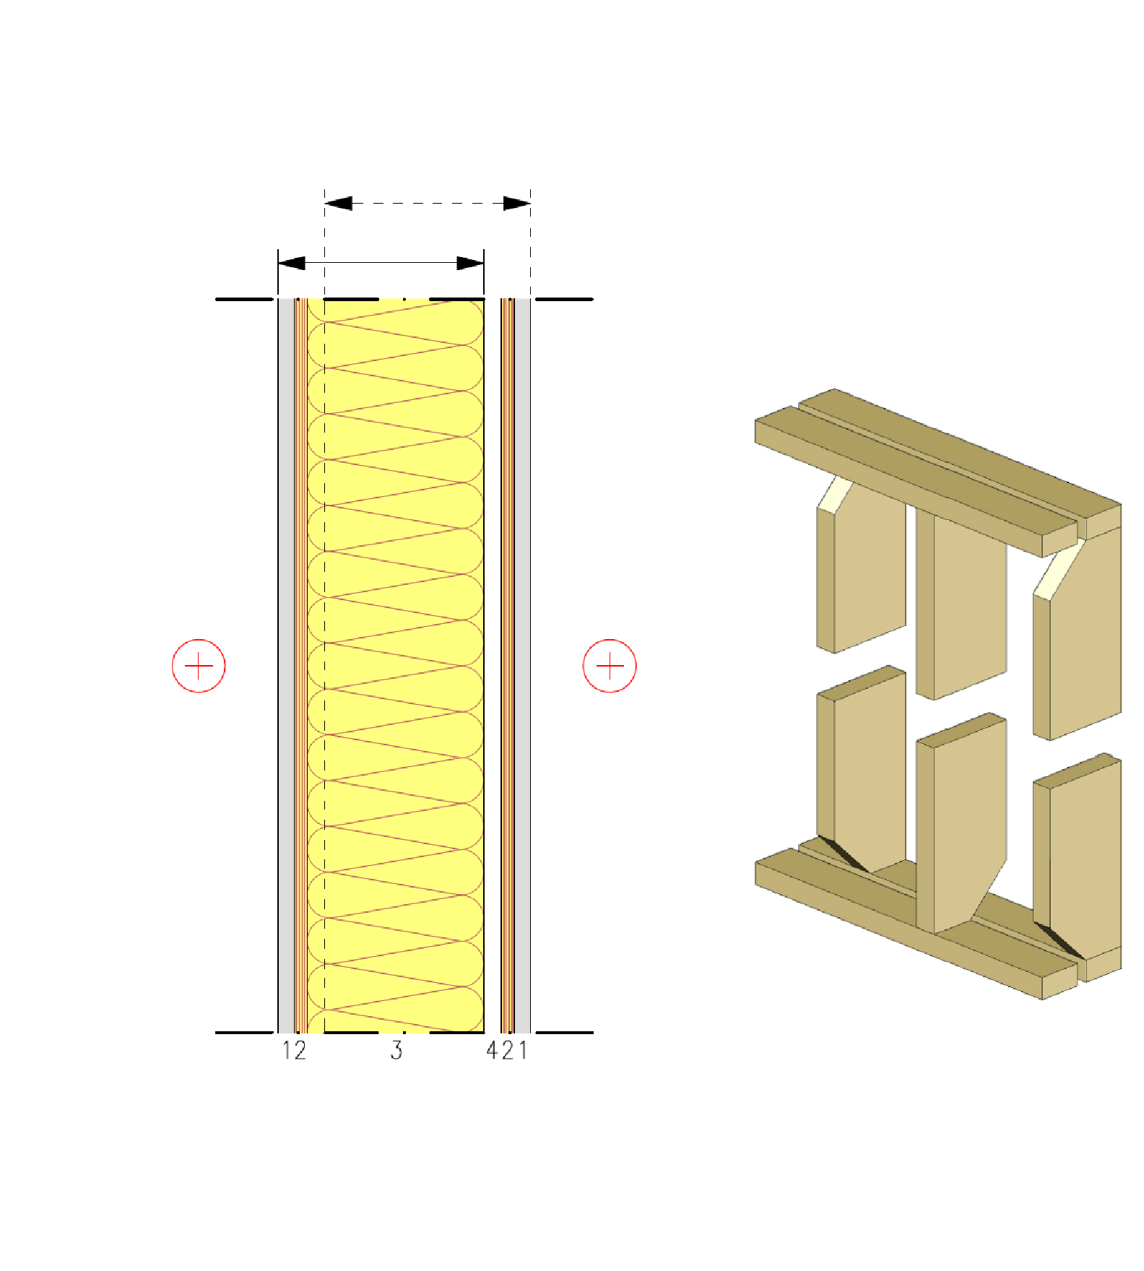
Partition structure
Load-bearing wall between flats
Separate frame halves
Frame 2
Plates are used for
Stiffening
Fire protection technology
Acoustics
Load carrying capacity of frames
Bearing pressure resistance (often design)
Buckling resistance
A zigzag frame enables
Sturdier framed structures in walls (buckle resistance)
Frame 1
Principle of using guide pieces
1 Plasterboard
2 Spruce plywood (stiffening plates)
3 Load-bearing frame + Mineral wool
4 Gap between frame halves

Slide 17
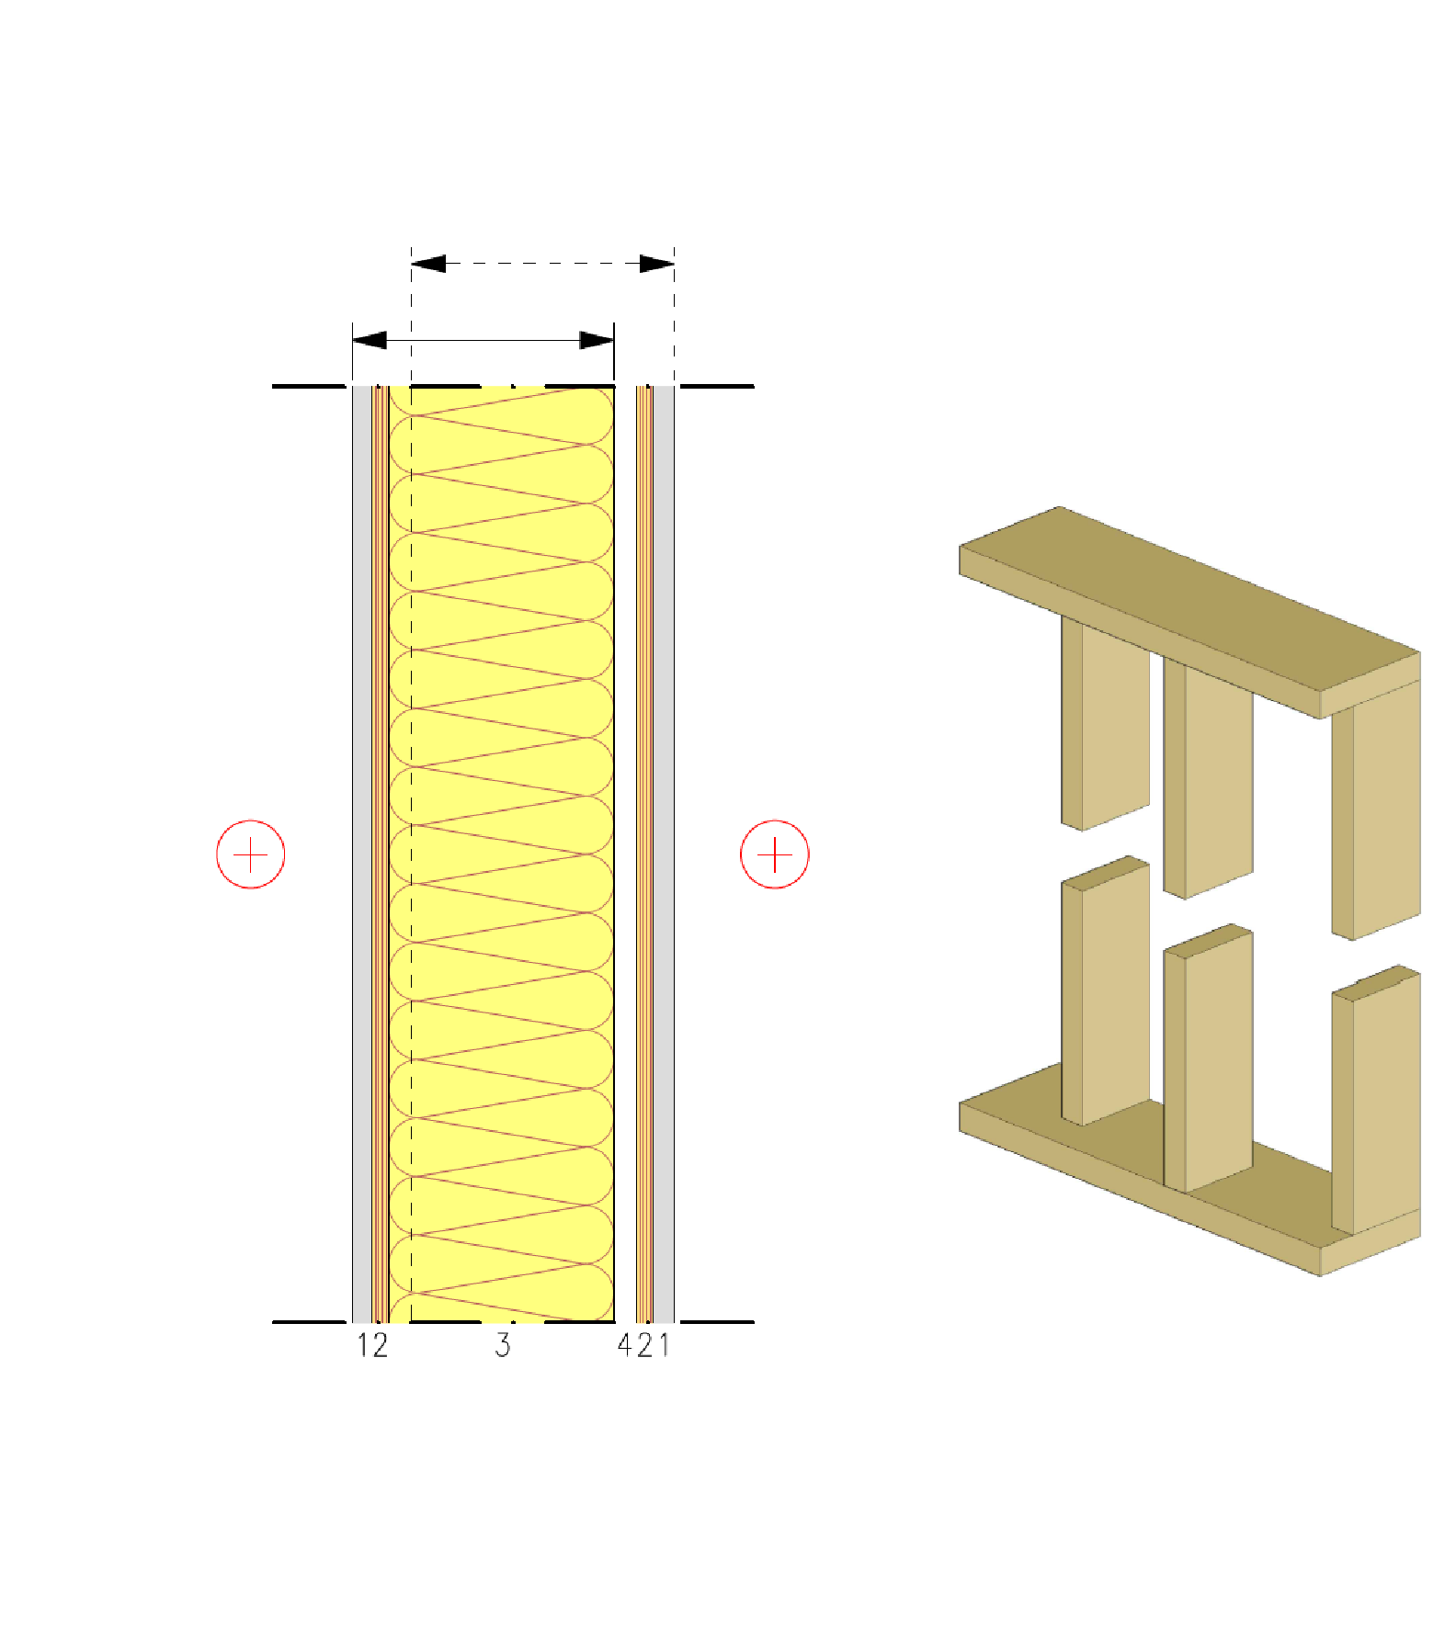
Partition structure
Load-bearing wall between flats
Separate frame halves
Frame 2
Continuous guide pieces that connect the frame halves can also be used in a zigzag frame
This must be approved by the acoustics designer of the site, however
Frame 1
Principle of using guide pieces
1 Plasterboard
2 Spruce plywood (stiffening plates)
3 Load-bearing frame + Mineral wool
4 Gap between frame halves

Slide 18
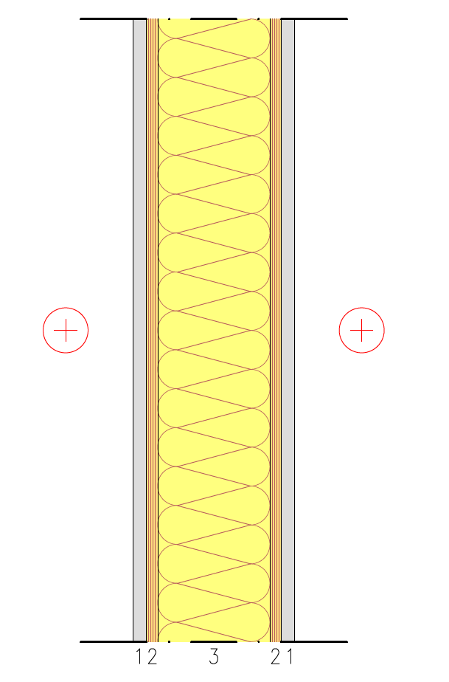
Partition structure
Load-bearing partition
Plates are used for
Stiffening
Fire protection technology
Acoustics
Load carrying capacity of frames
Bearing pressure resistance (often design)
Buckling resistance
Sound insulation
Airborne sound insulation between spaces of D_{n,T,w}≈ 40 dB must be achieved
1 Plasterboard
2 Spruce plywood (stiffening plates)
3 Load-bearing frame + Mineral wool

Slide 19
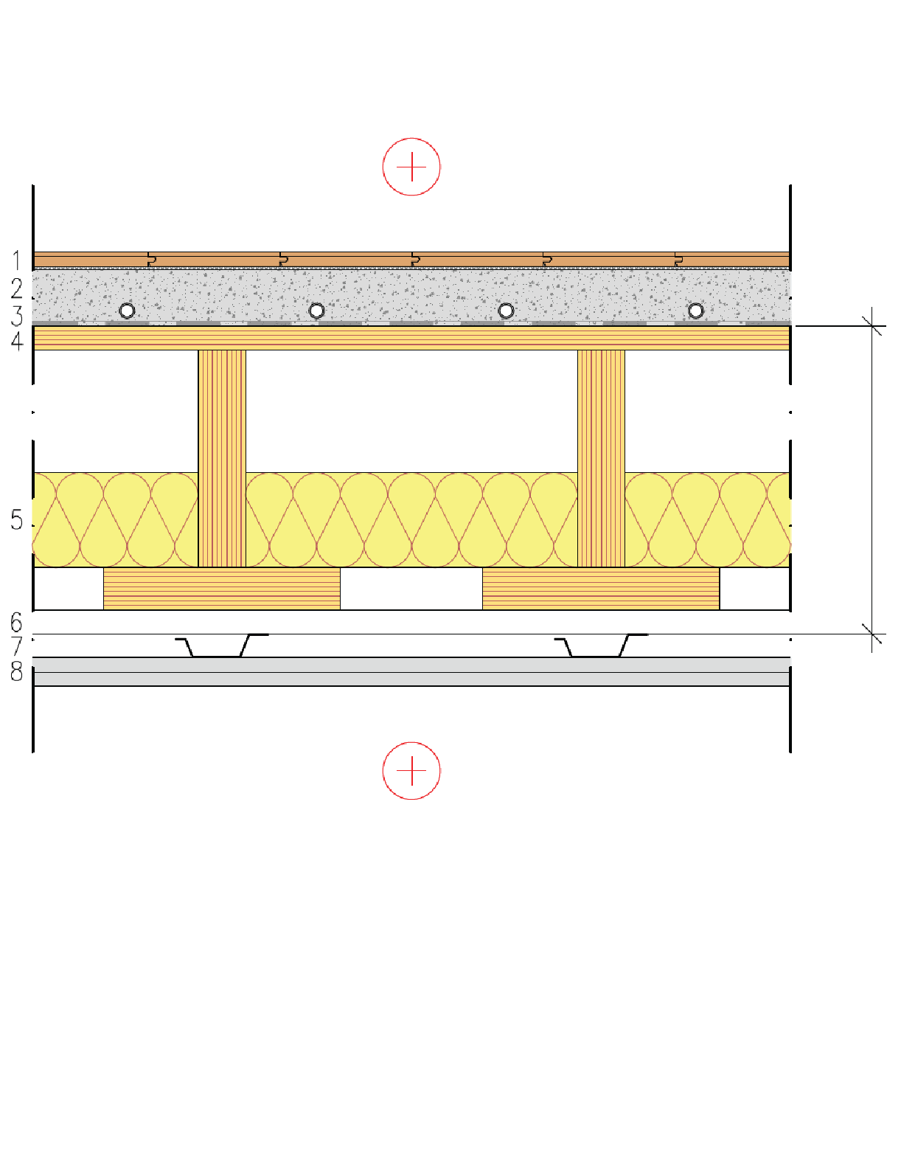
Intermediate floor structure
Intermediate floor between flats
The top surface panel is used for
Stiffening
Plasterboard and castings are used for
Fire protection technology
Acoustics
The height of the rib panel depends on
Vibration (often design)
Bending and shearing stress
Bend
Prefabricated unit
1 Floor coating
2 Cast floor (possible underfloor heating)
3 Protective fabric between concrete and wood
4 Industrially manufactured LVL semi-open rib panel or LVL rib panel
5 Mineral wool
6 Studs
7 Acoustic ceiling profiles
8 2 x plasterboard

Slide 20
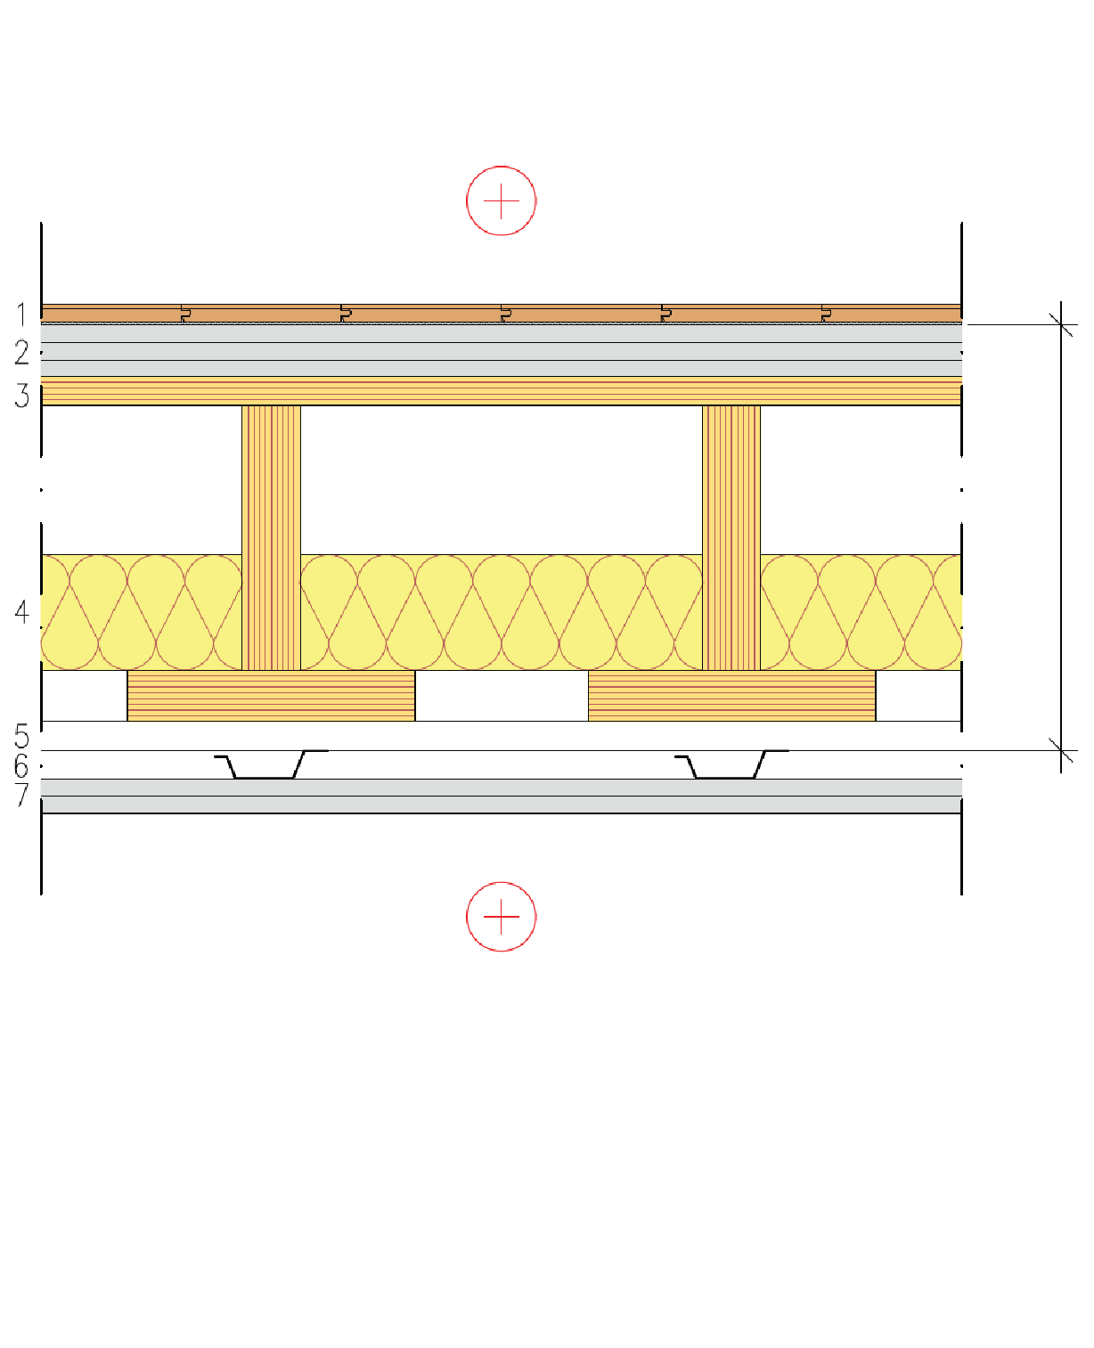
Intermediate floor structure
Intermediate floor between flats
The top surface panel is used for
Stiffening
Plasterboards are used for
Fire protection technology
Acoustics
The height of the rib panel depends on
Vibration (often design)
Bending and shearing stress
Bend
Prefabricated unit
1 Floor coating
2 3 x Floor plasterboard
3 Industrially manufactured LVL semi-open rib panel or LVL rib panel
4 Mineral wool
5 Studs
6 Acoustic ceiling profiles
7 2 x plasterboard

Slide 21
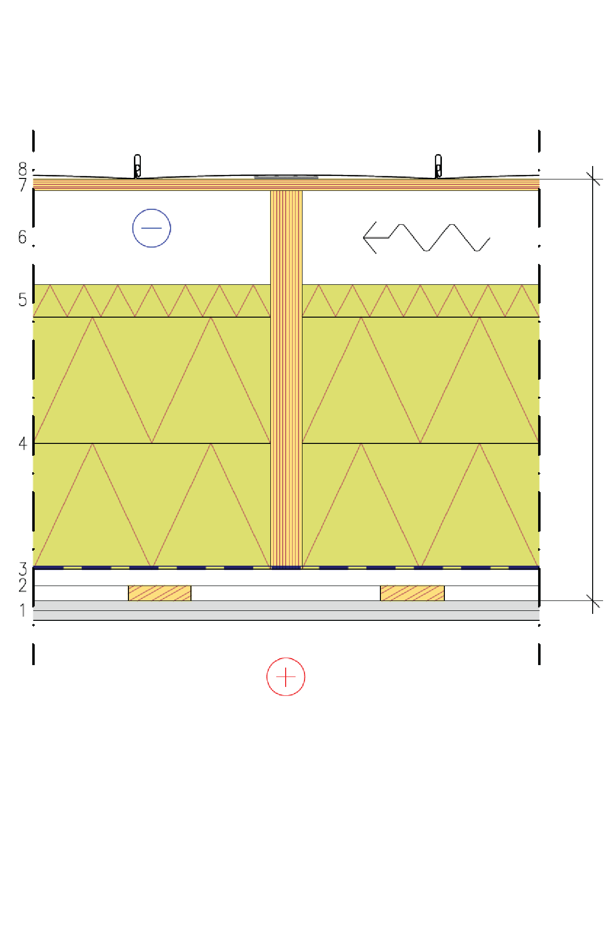
Roof structure
Beam frame roof structure
The panel on top of the beams is used for
Stiffening
Plasterboards are used for
Fire protection technology (fire underneath)
Rock wool panels are used for
Fire protection technology (fire above)
The height of the beams depends on
Bending and shearing stress
Bend
Prefabricated unit
1 2 x plasterboard
2 Studs in a grid
3 Air and vapour barrier
4 Beams + Rock wool panels
5 Stiff mineral wool for wind protection
6 Ventilation gap
7 Spruce plywood or LVL (stiffening plate)
8 Water resistant roof material

Slide 22
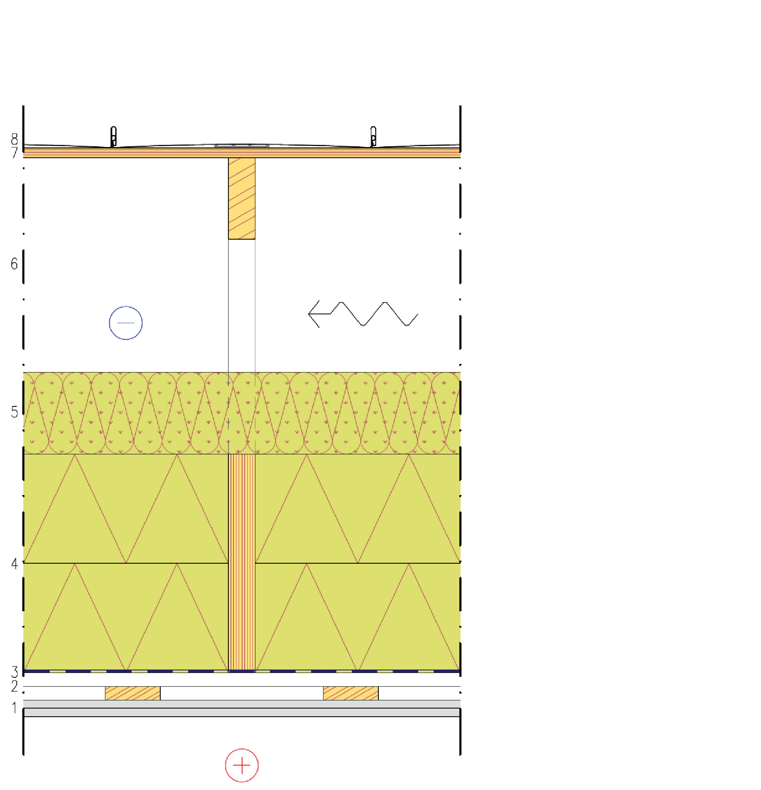
Roof structure
Nail plate truss
The panel on top of the truss is used for
Stiffening
Plasterboards are used for
Fire protection technology (fire underneath)
Rock wool panels are used for
Fire protection technology (fire above)
The height of the beams depends on
Bending and shearing stress
Bend
1 2 x plasterboard
2 Studs in a grid
3 Air and vapour barrier
4 Tie beam + Rock wool panels
5 Mineral wool
6 Nail plate trusses and ventilated attic
7 Spruce plywood or LVL (stiffening plate)
8 Water resistant roof material

Slide 23
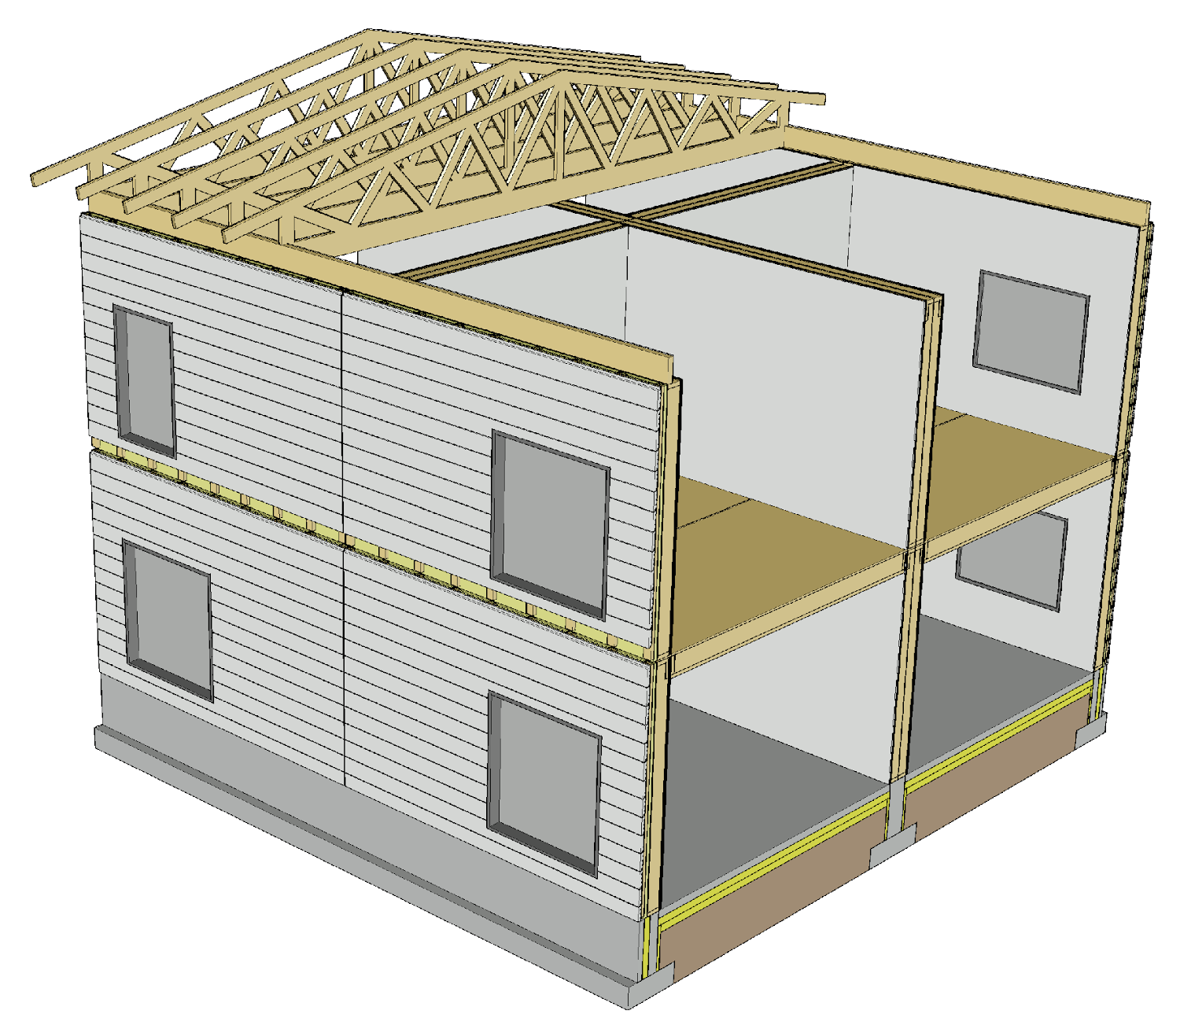
Prefabricated unit joints
Exterior cladding with horizontal panels
Makes it possible to hide horizontal joints between units
E.g. balcony partitions can be used to hide vertical joints in horizontal panels
The frame of a wall unit must not continue past sound insulation walls and intermediate floors (flanking transmission)

Slide 24

Prefabricated unit joints
Exterior cladding with vertical panels
Makes it possible to hide vertical joints between units
E.g. balcony slabs can be used to hide horizontal joints in a vertical panel
The frame of a wall unit must not continue past sound insulation walls and intermediate floors (flanking transmission)

Slide 25
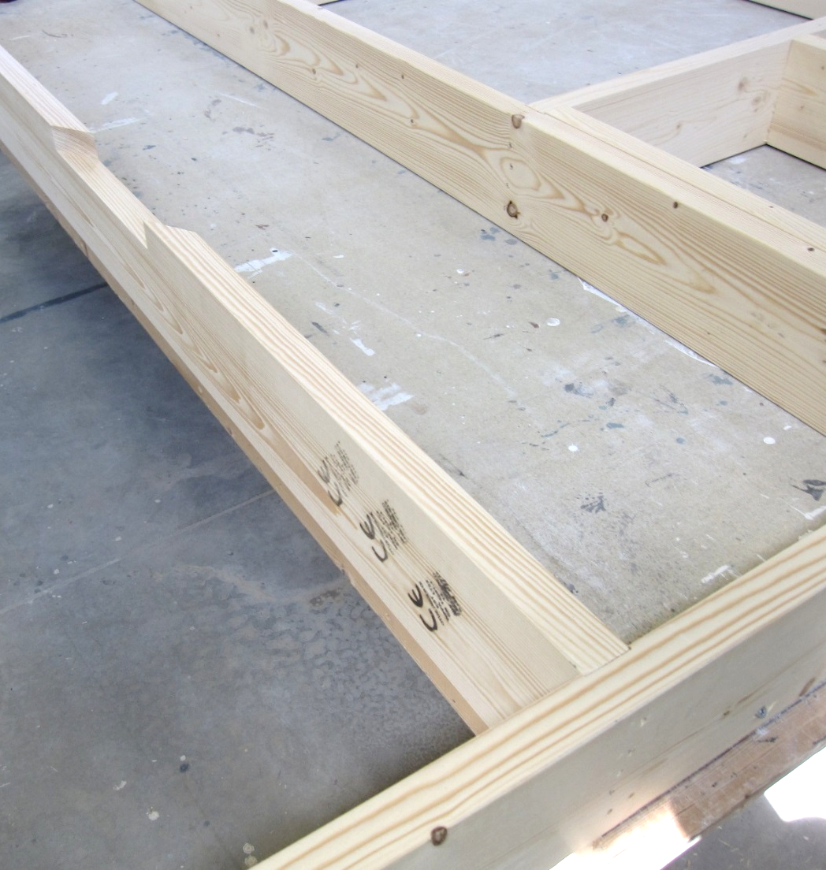
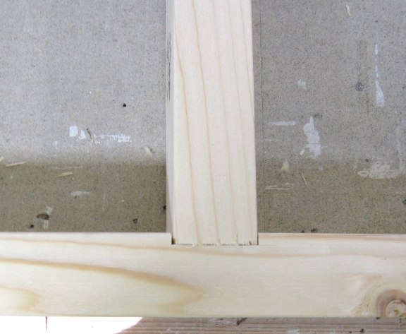
Manufacturing of prefabricated units
At its simplest, a panelised unit with framed structure can be manufactured manually on an element bed
CNC technology in its different forms can be used for machining framed structures
Image: Tero Lahtela

Slide 26
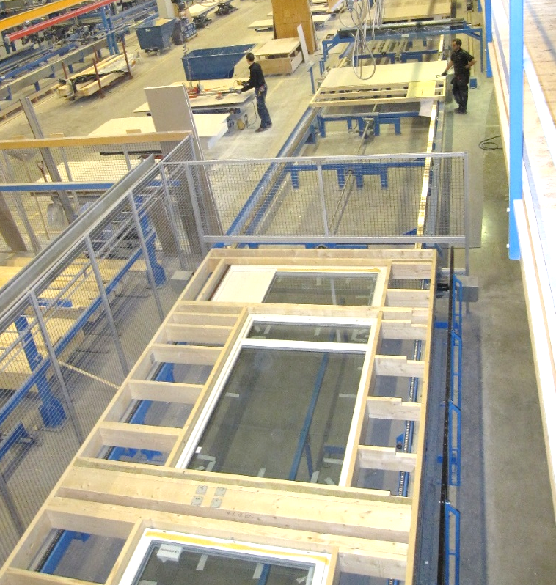
Manufacturing of prefabricated units
Various automated production lines exist for manufacturing wall units with framed structure
The line can be used to manufacture
The frame only
Entire element with heat insulation and plates
Image: Tero Lahtela

Slide 27
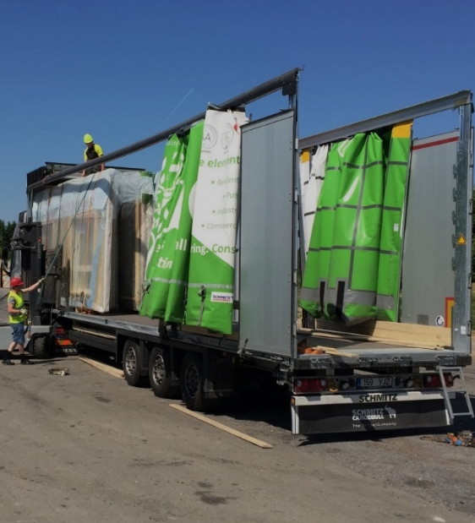
Transport of panelised units
2450
Intermediate floor and roof units 2,400…2,450 mm in width can be transported normally
Special vehicles are used for units higher than 3 m (lowered chassis)
Covered transport equipment can be used to reduce the accumulation of protective plastic at the construction site
13600
3000
Image: Tero Lahtela

Slide 28
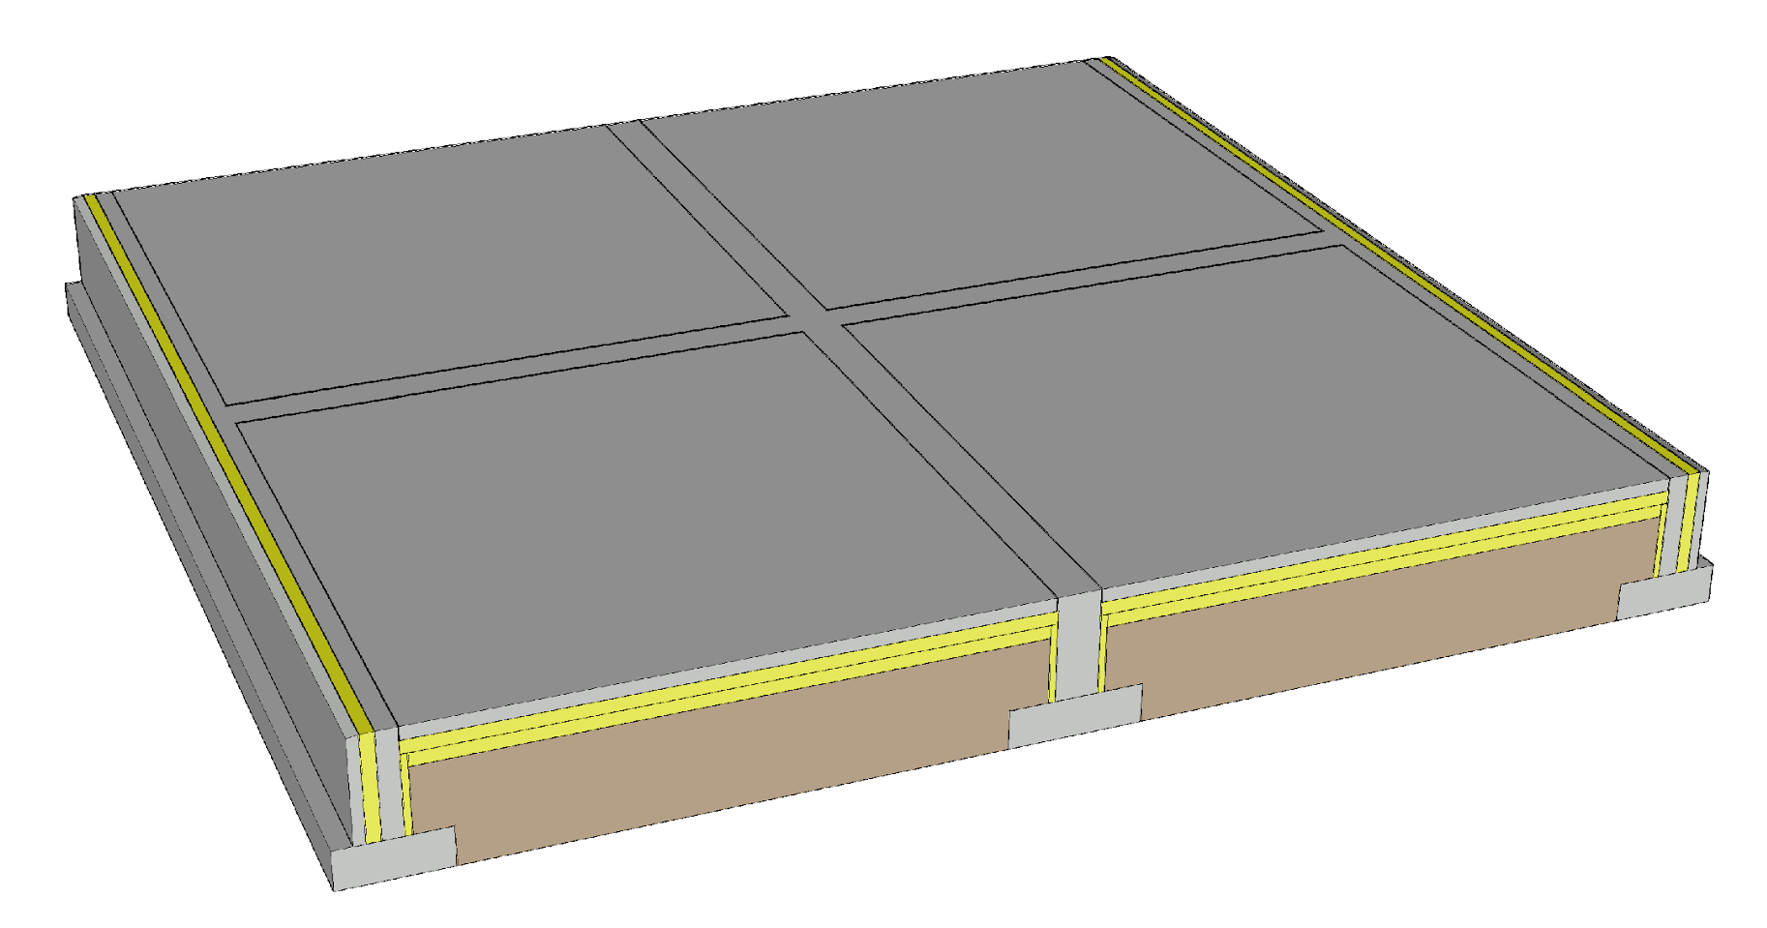
Foundation of units with framed structure
A continuous foundation is needed under load-bearing walls with framed structure
Foundation types
Ground-supported shallow foundation
Ventilated base floor
Basement
Challenges
Junction between the wall and the foundation
Vertical dimensional accuracy of the foundation

Slide 29
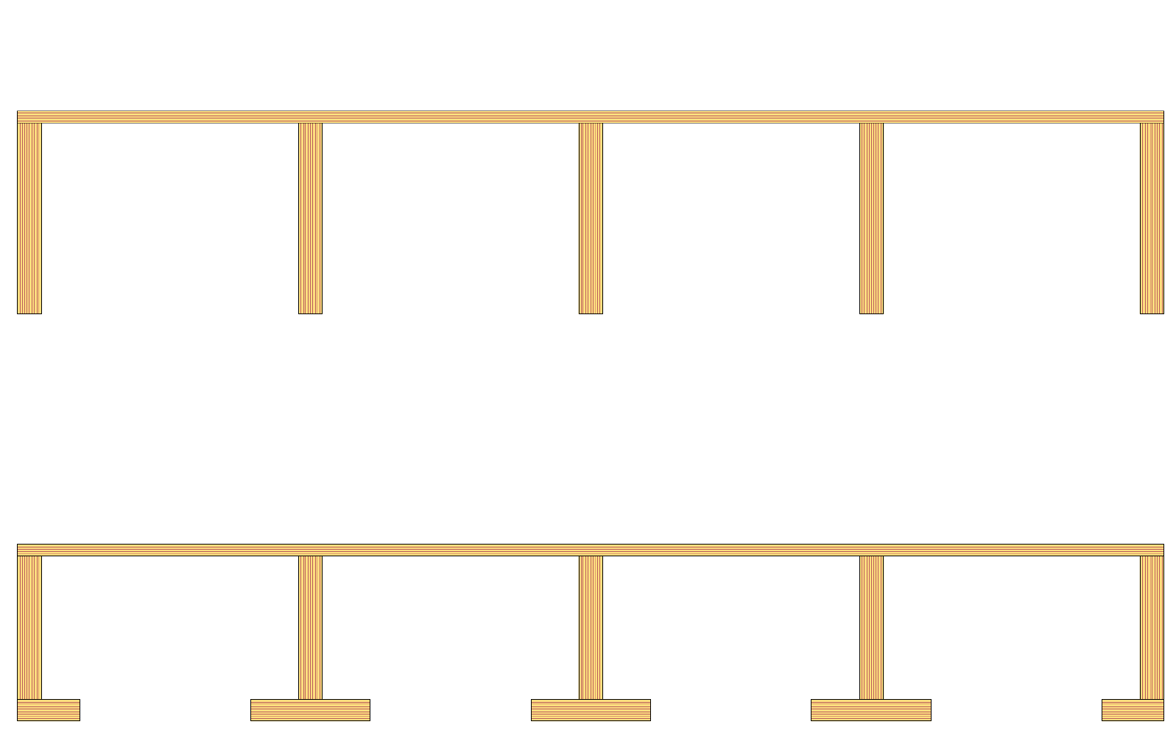
Span of intermediate floor with frame structure
The span of the intermediate floor is usually determined by vibration design
Vibration caused by walking
When using an industrially manufactured glued LVL rib panel or LVL semi-open rib panel, the span is L ≤ 7 m
Industrially manufactured rib panel Structural gluing
Industrially manufactured semi-open rib panel Structural gluing

Slide 30
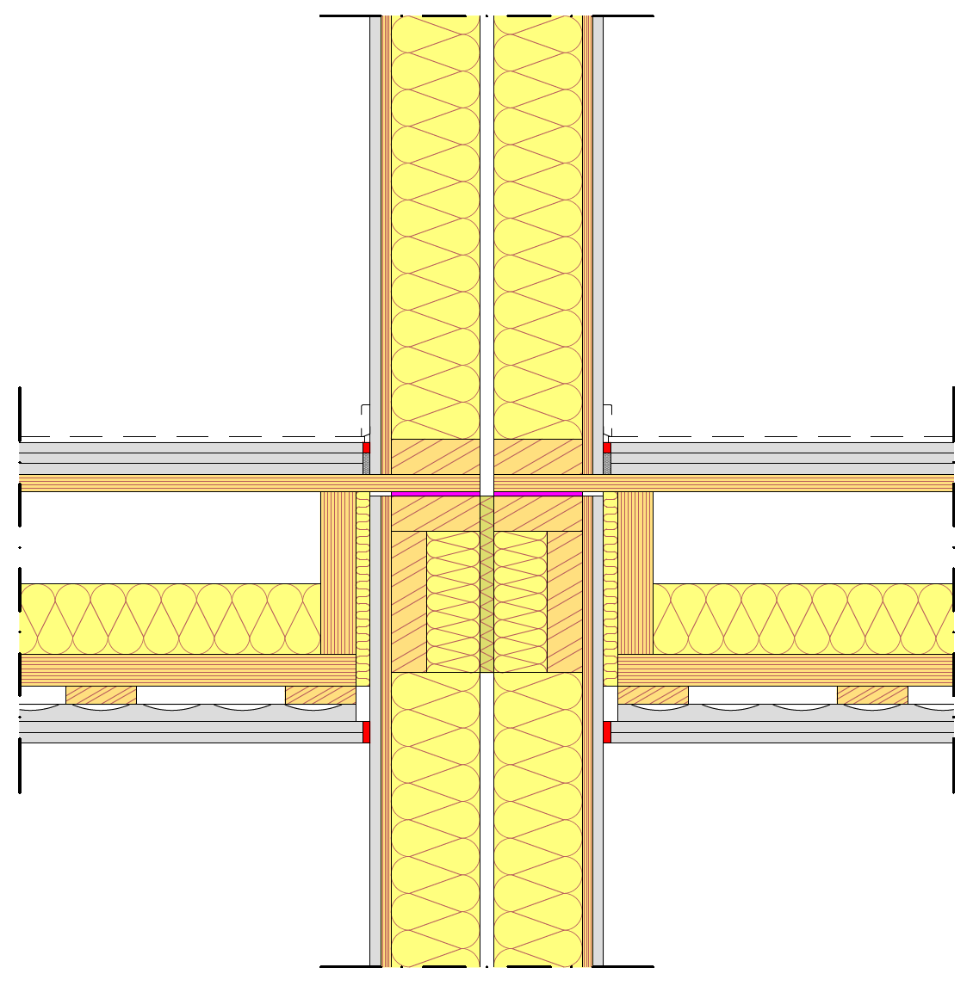
Supporting an intermediate floor with frame structure
Industrially manufactured glued LVL rib panels and LVL semi-open rib panels are supported by the top surface panel
Issues that always require attention in the support area in general
Fire technical issues
Acoustics (flanking transmission)
Vertical load-bearing capacity
Minimisation of settlement
Horizontal load transmission
Preventing progressive collapse

Slide 31
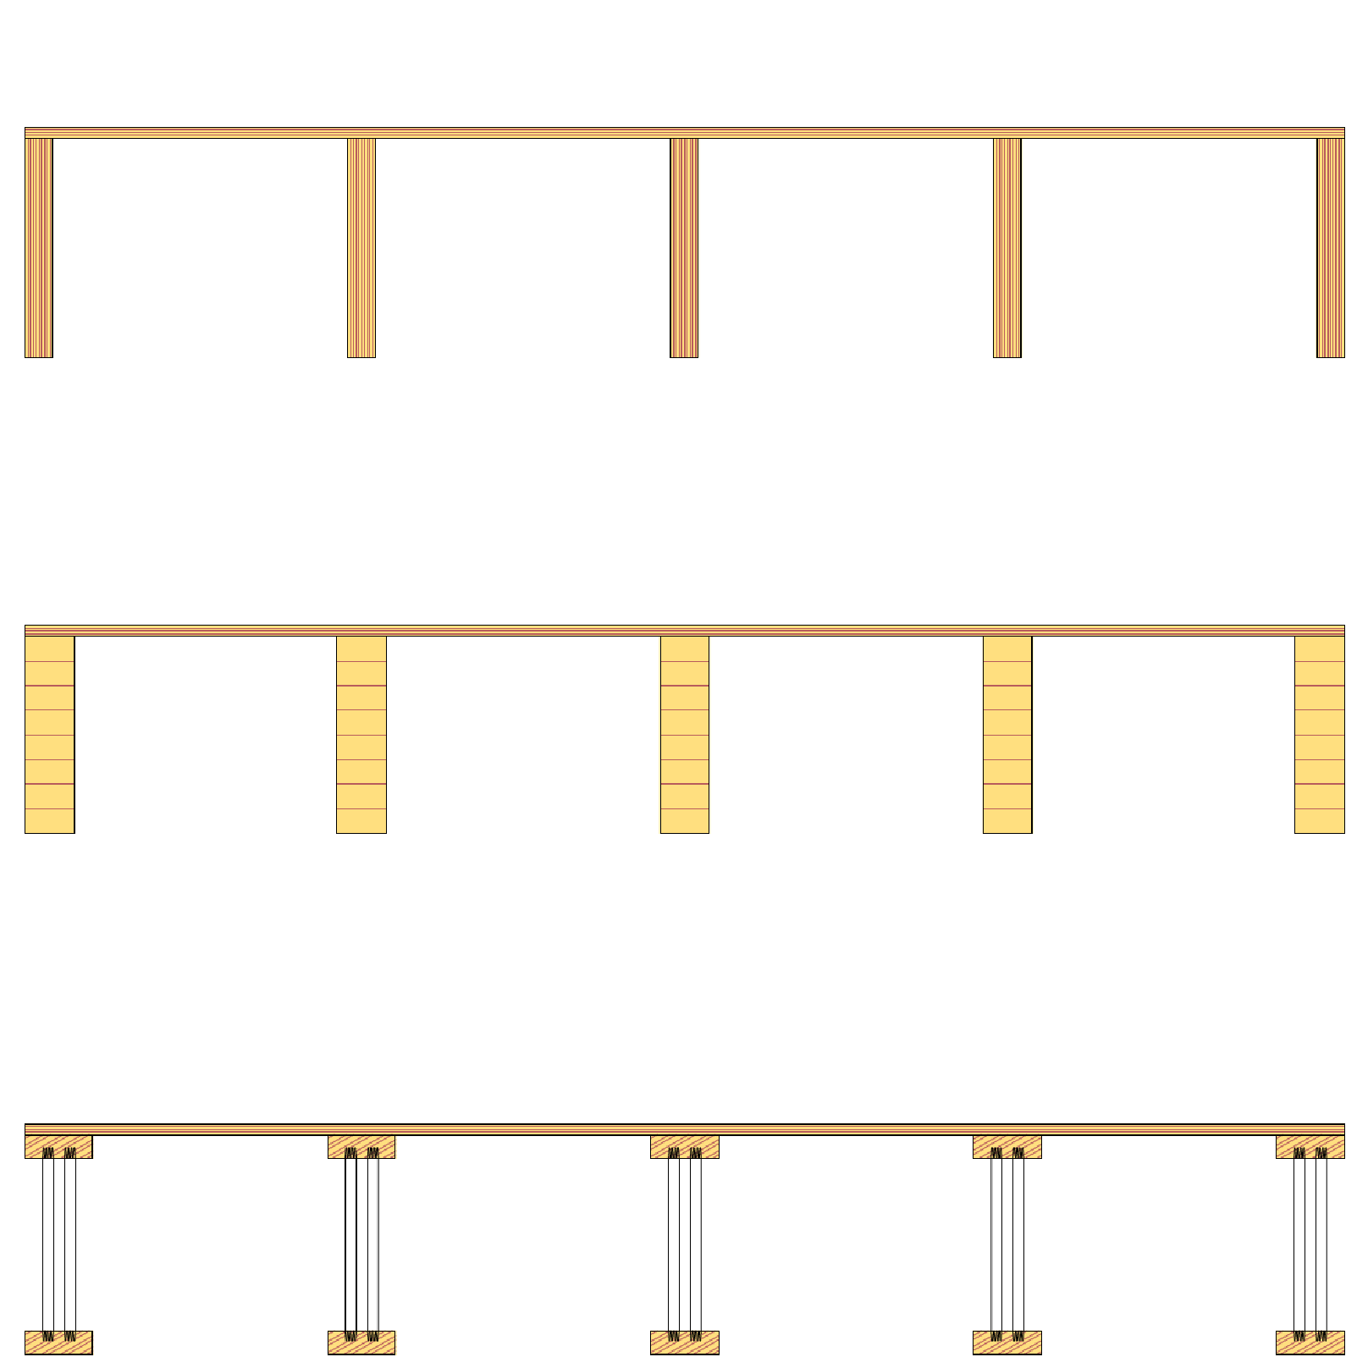
Span of intermediate floor with frame structure
Intermediate floor unit with beam structure
(LVL)
The span of the intermediate floor is usually determined by vibration design
Vibration caused by walking
When using an intermediate floor with beam structure, the span is L ≤ 6 m
Intermediate floor unit with beam structure (glulam timber)
Intermediate floor unit with beam structure (industrially manufactured glued truss)

Slide 32
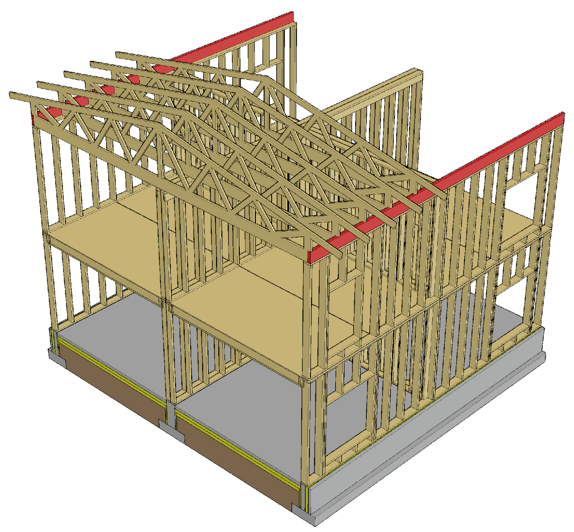
Supporting nail plate trusses
Cross-veneered LVL beam notched for nail plate truss on top of the wall
Beams notched to connect with wall frames and separate beams to span openings can be avoided
A cross-veneered LVL beam enables high bearing pressure tolerance for the nail plate truss
An LVL beam notched for nail plate trusses can be used as a lifting beam when a roof with nail plate trusses is built as prefabricated blocks

Slide 33
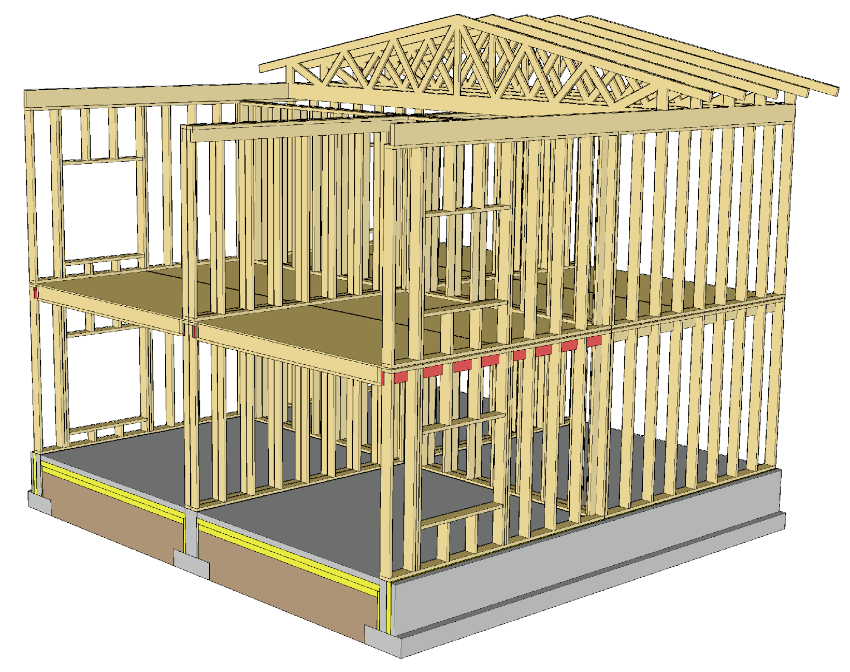
Notched wall beam
A beam is needed at the top end of the wall frame to support the intermediate floor
The beam is notched to attach it to the wall frames
The beam in question can also be used to transfer loading from upper storey wall frames, but for this a significantly higher beam is needed

Slide 34
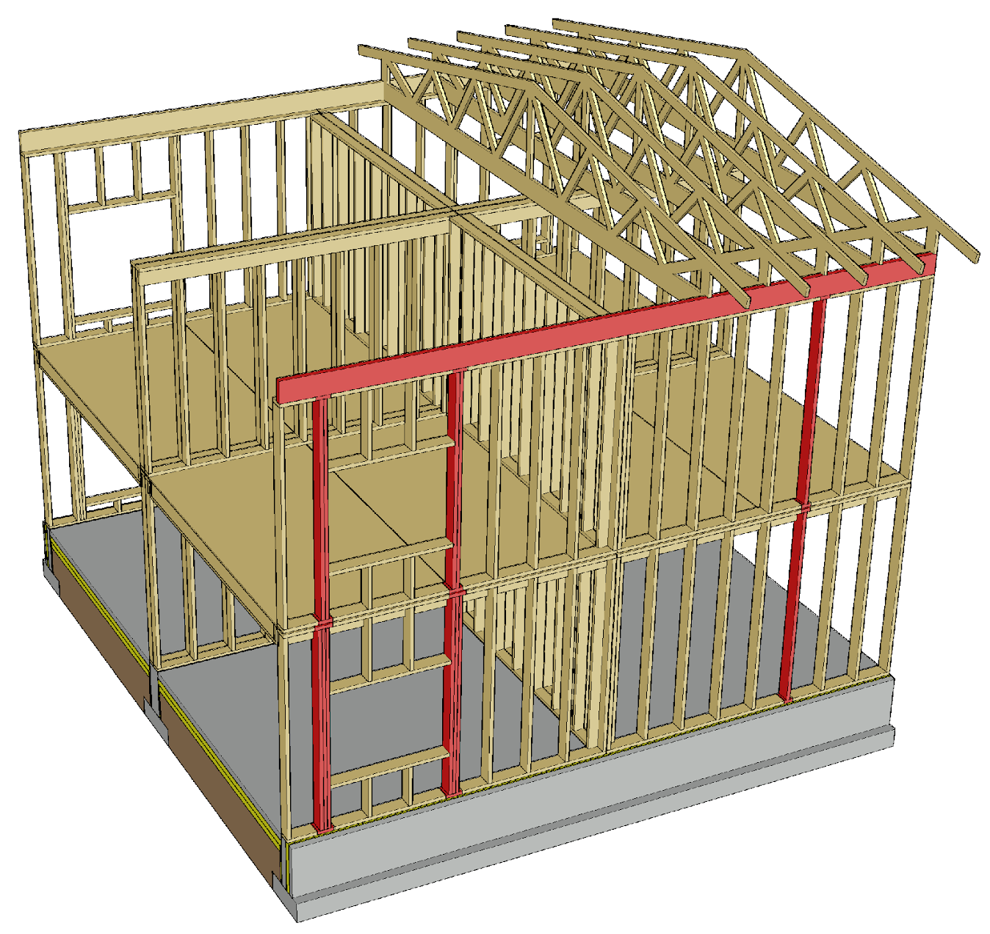
Vertical load transfer
Stacked wall frames should be designed to be placed at the same location
Openings vertically on top of each other should be designed to be placed at the same location
Several frames are needed for the jambs of openings
Bearing pressure resistance is crucial

Slide 35
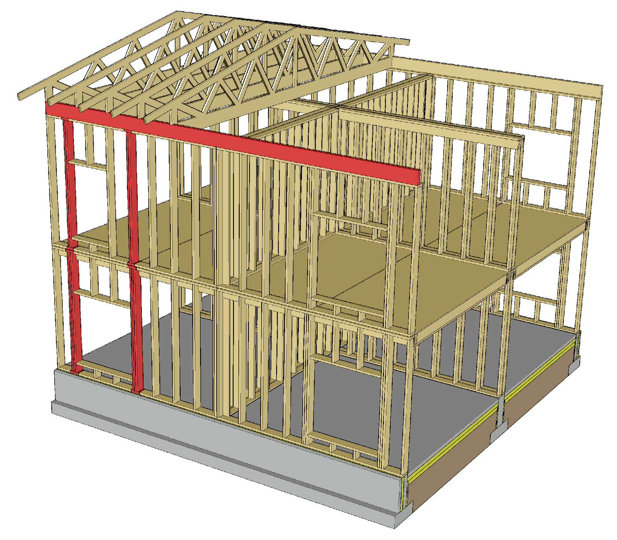
Vertical load transfer
The loading on frames for opening jambs should not be transferred to the top of a lower opening
A wider space can be reserved for a narrower opening, in which case stacked frames can be placed together

Slide 36
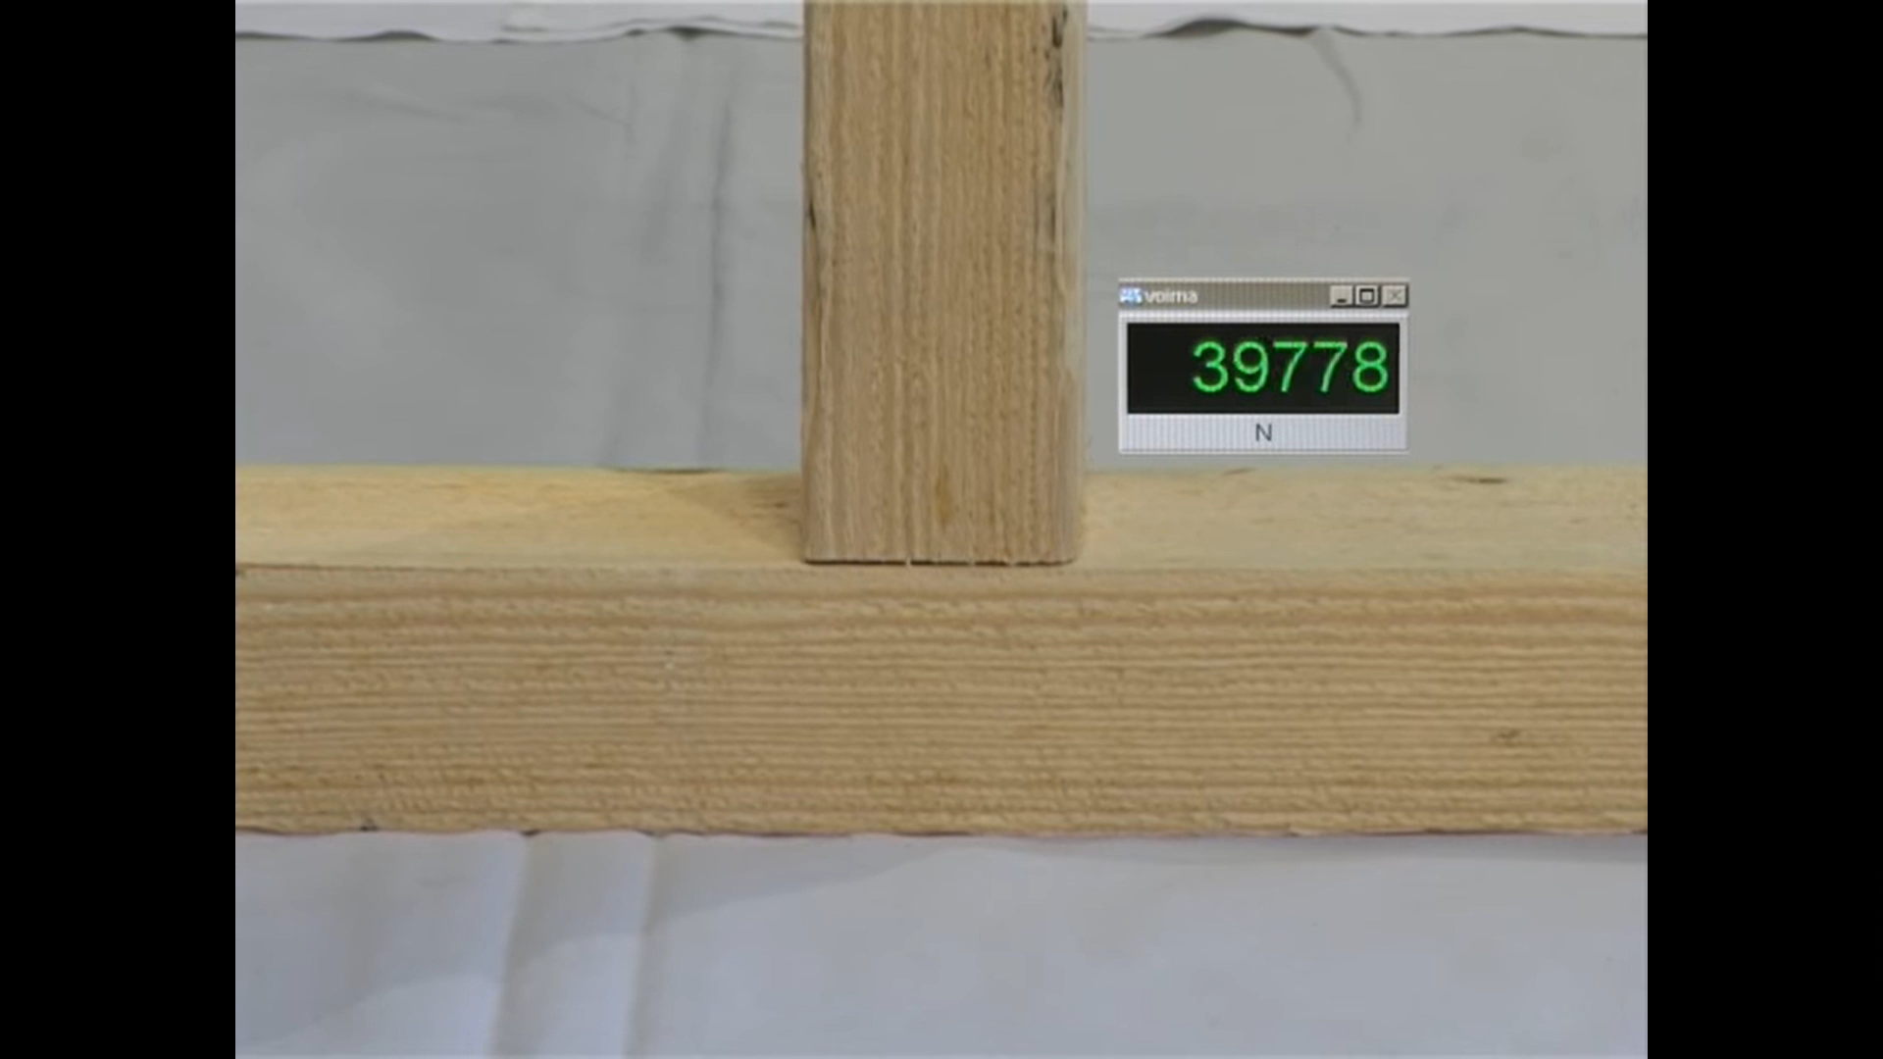
Bearing pressure resistance of the wall frame
In a wall with framed structure, the wall frames are supported by guiding timbers at top and bottom
Bearing pressure resistance is often a determining factor in wall frame design
Bearing pressure resistance is determined by
frame cross-section size
transverse compression strength of guiding timbers
Video: Puuinfo

Slide 37
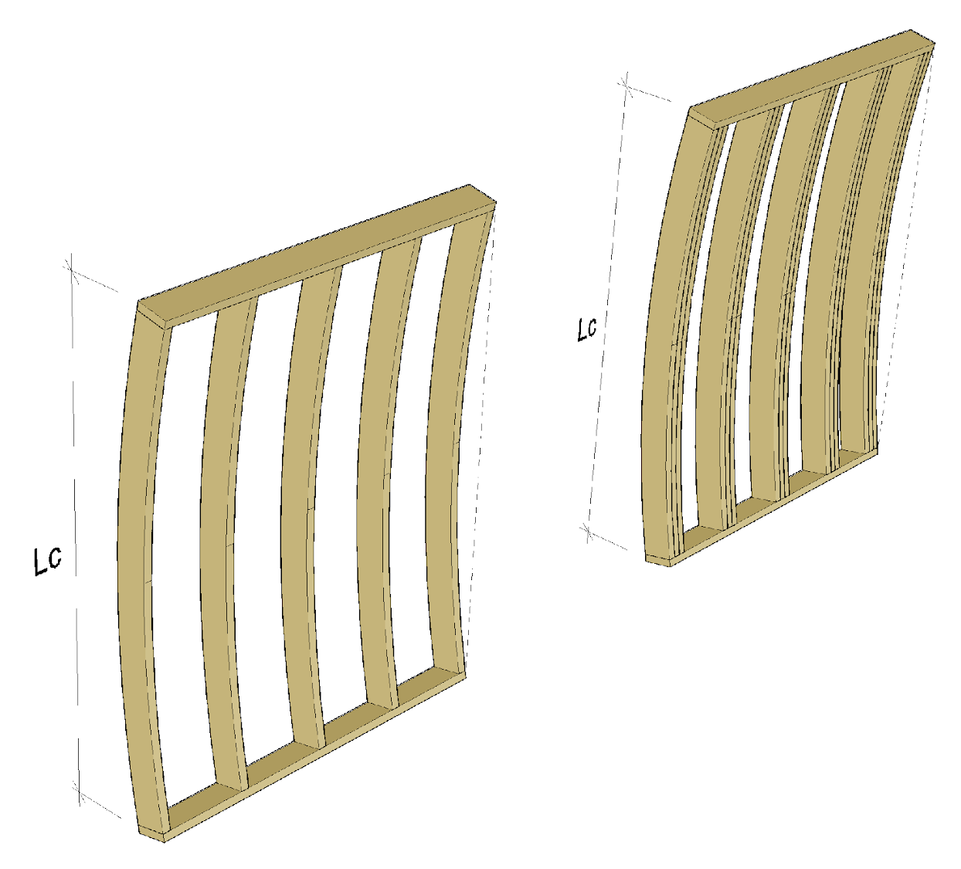
Buckling of a wall with framed structure
Buckling resistance of a wall frame can be increased by
Enlarging the cross-section of the frame
Using several parallel frames
The use of several parallel frames slightly reduces the U-value of an exterior wall

Slide 38
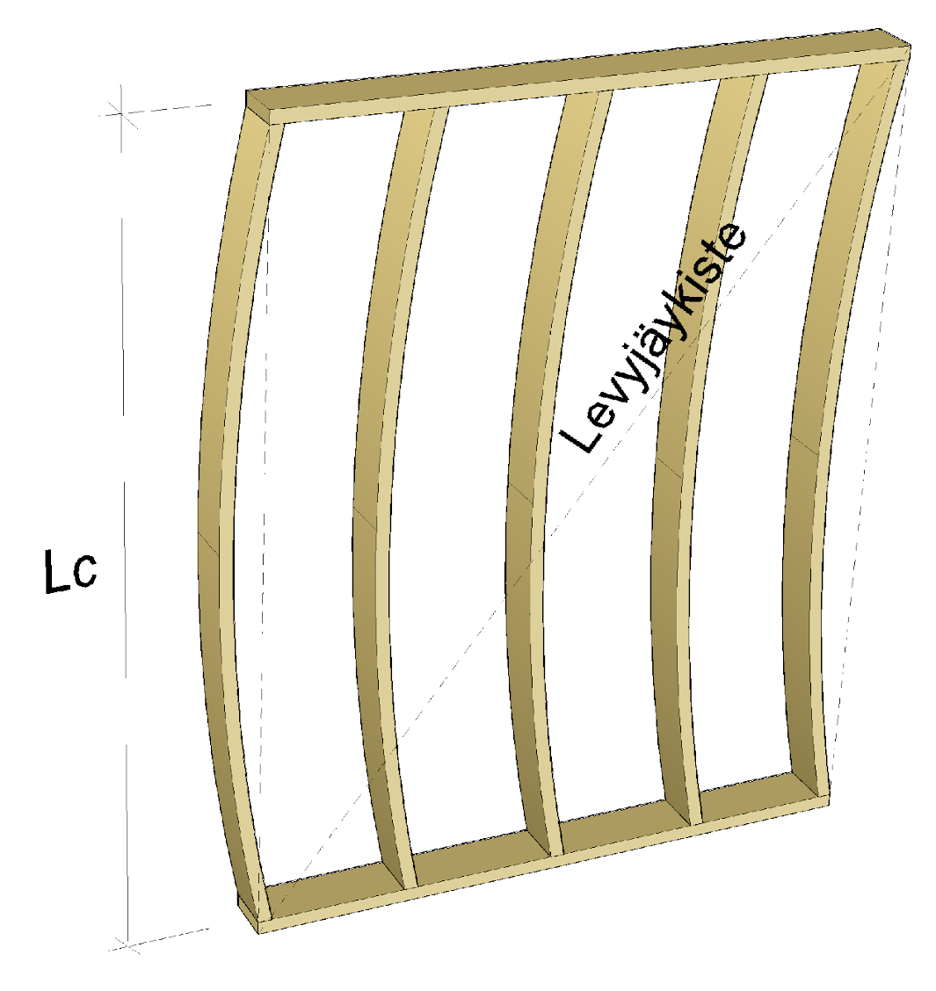
Buckling of a wall with framed structure out of plane
The buckling of the wall frame out of plane can be prevented by plating the wall
All frames in the wall must be connected to the plating (also parallel ones)
Stiffening plate

Slide 39
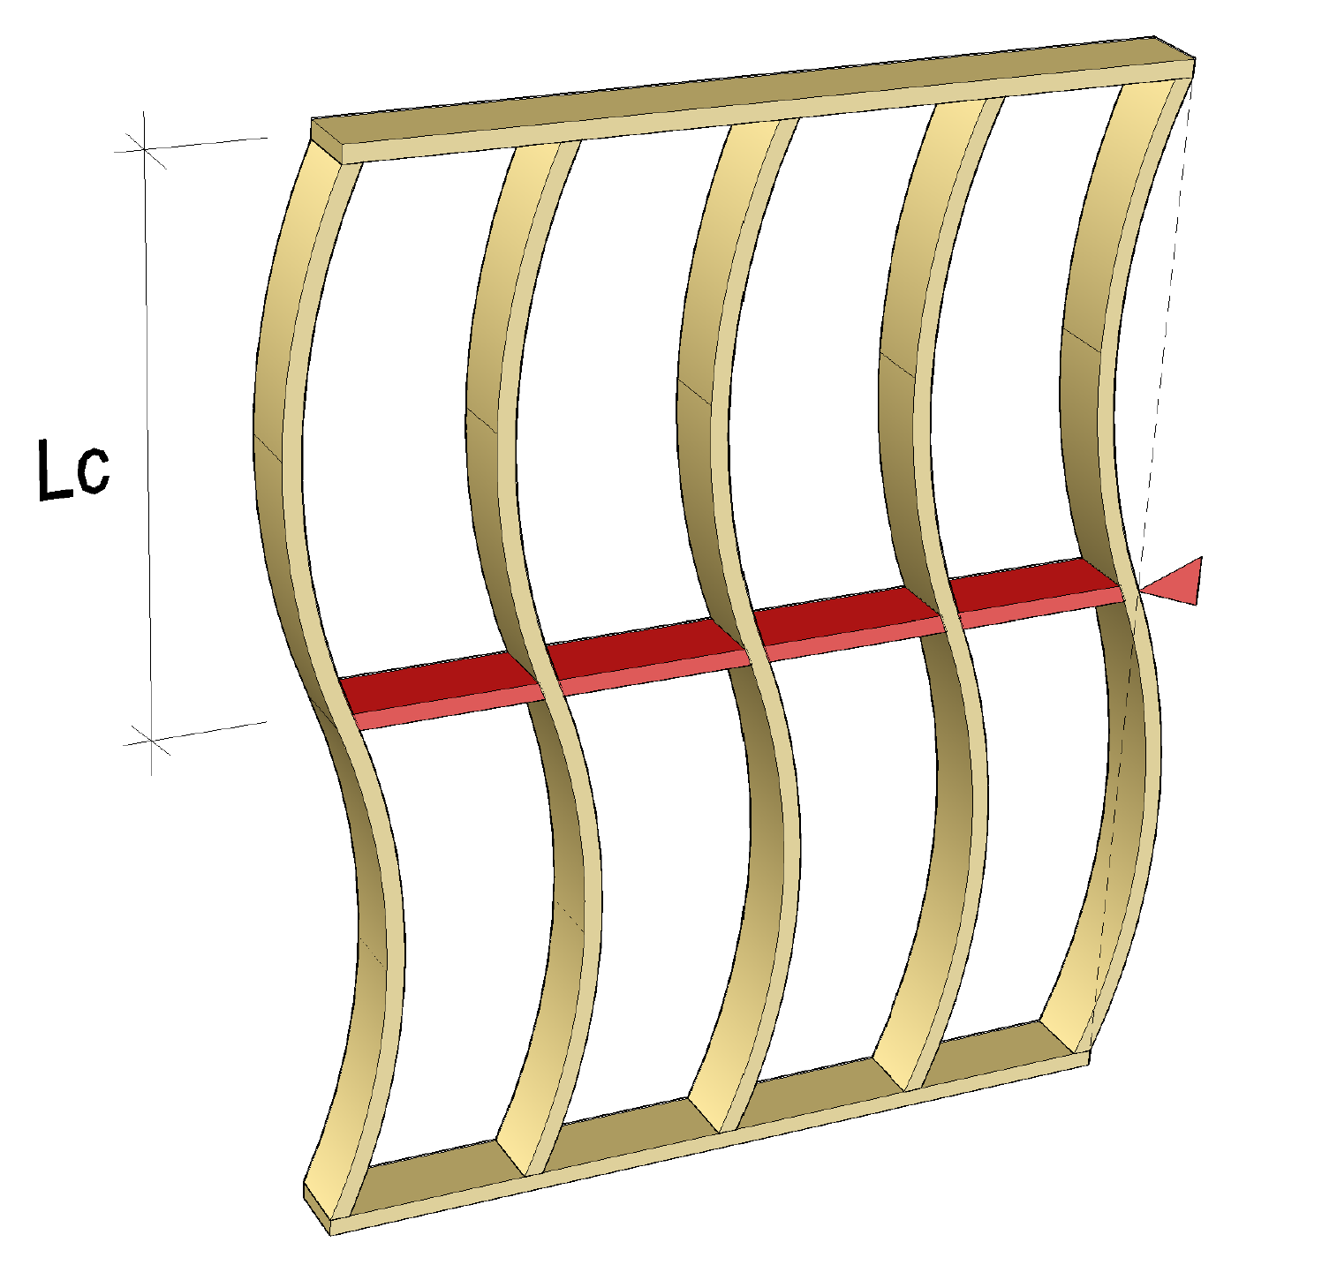
Buckling of a wall with framed structure out of plane
The effective buckling length of wall frames can be shortened with blocks of wood placed between the frames
Horizontal support capable of receiving the force exerted on the support must be designed for these blocks
Support durability
Support stiffness
A dimensioning condition applies to stiffness
Support

Slide 40
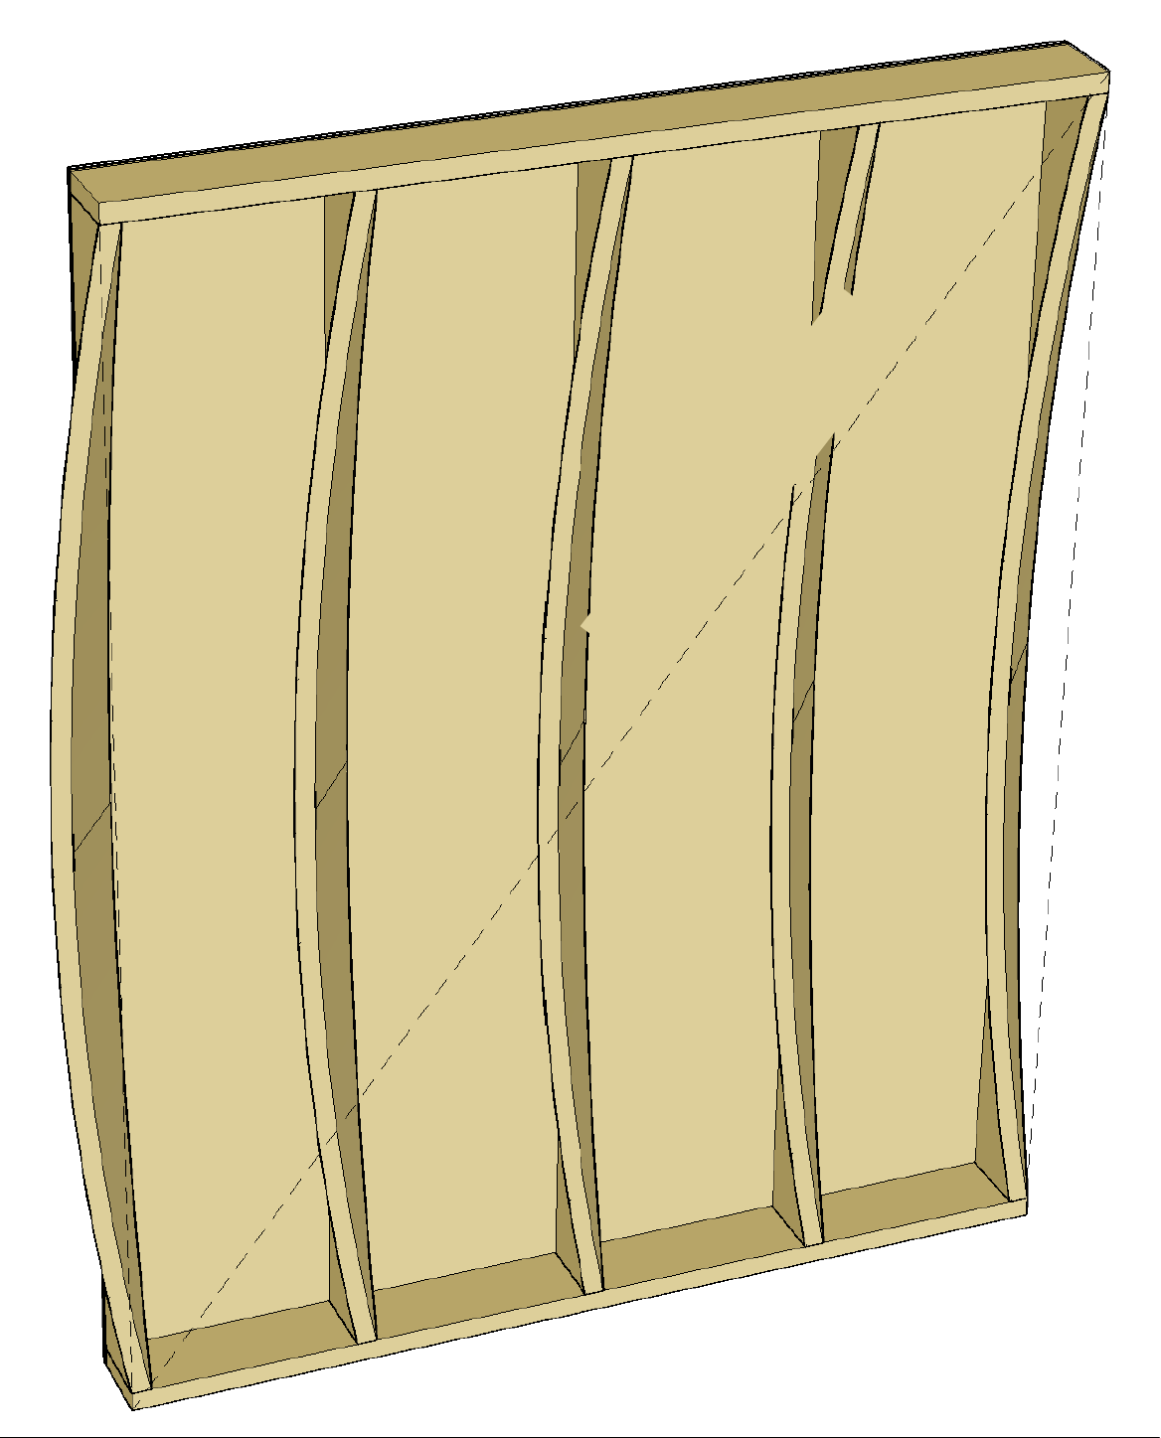
Lateral buckling of a wall with framed structure
The compressed, unsupported edge of a bent frame may buckle laterally
Lateral buckling of frames can be prevented with plates on the compressed edge of frames
All frames in the wall must be connected to the plating (also parallel ones)
Stiffening plate

Slide 41
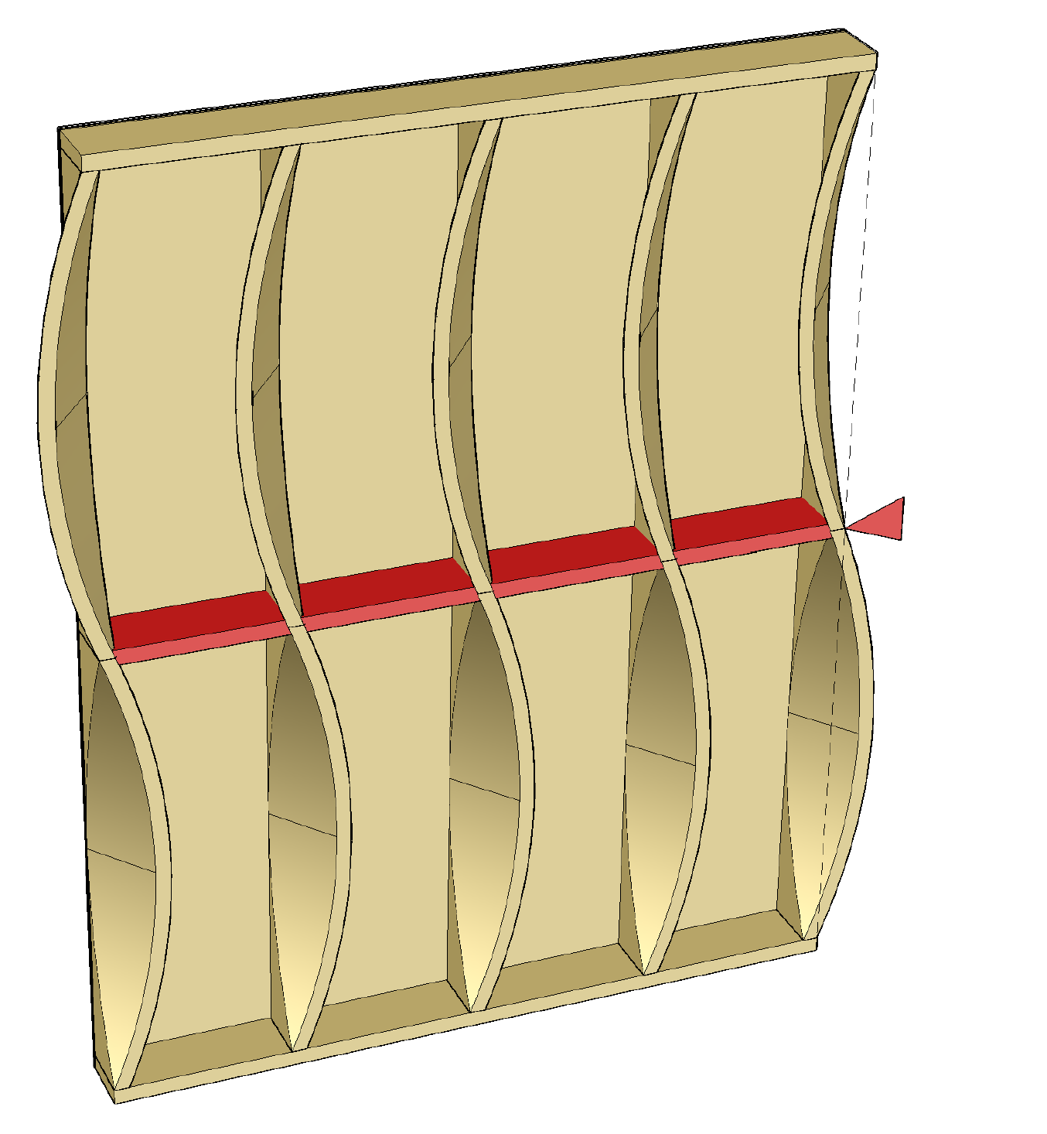
Lateral buckling of a wall with framed structure
Lateral buckling length of wall frames can be shortened with blocks of wood placed between the frames
Horizontal support capable of receiving the force exerted on the support must be designed for these blocks
Support durability and stiffness
A dimensioning condition applies to stiffness
E.g. stiffening plates to which the blocks are attached can function as support
Support

Slide 42
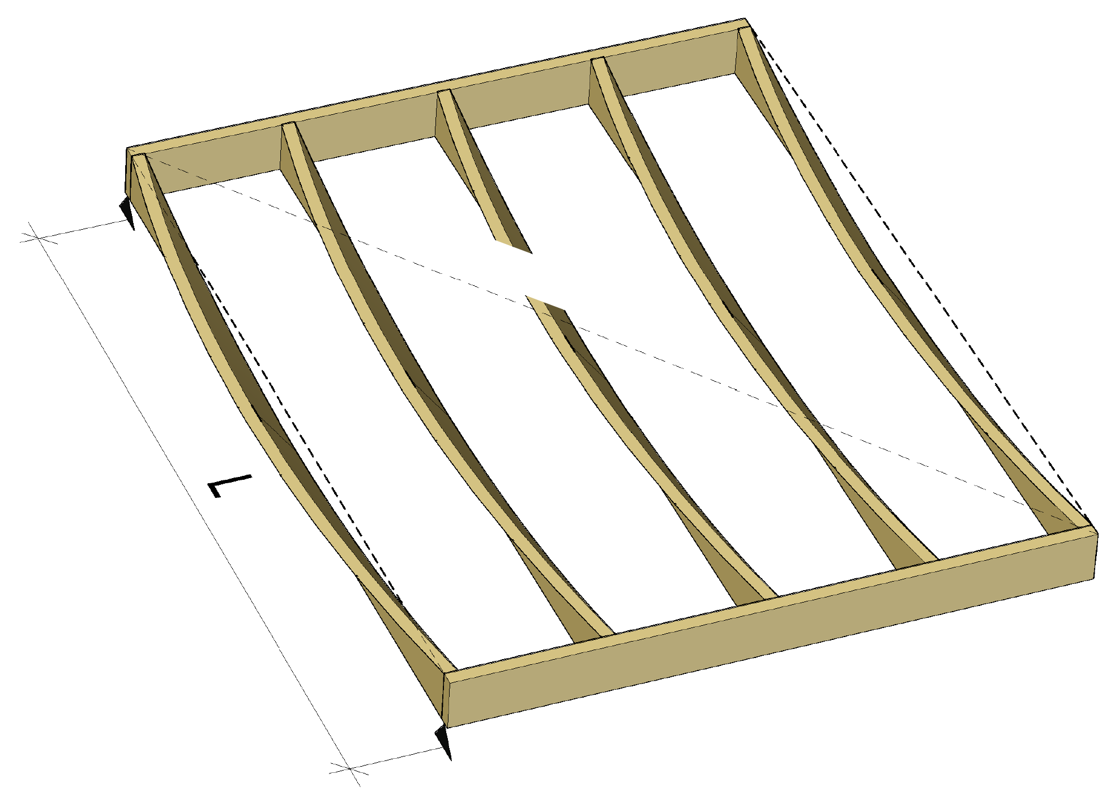
Lateral buckling of beams
The compressed, unsupported edge of a bent beam may buckle laterally
Lateral buckling of beams can be prevented with plates on the compressed edge of beams
All beams must be connected to the plates ( also parallel ones)
Stiffening plate

Slide 43
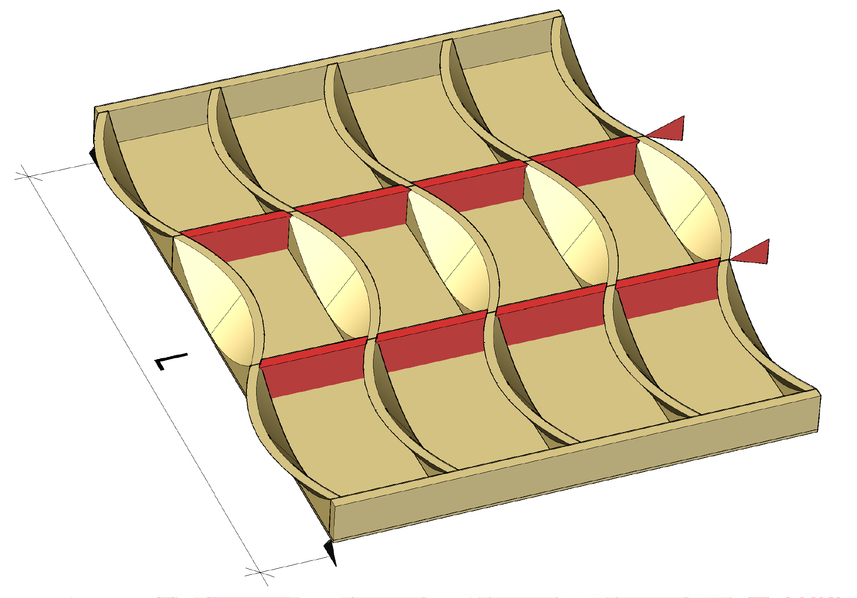
Lateral buckling of beams
The lateral buckling length of the beams can be shortened with blocks of wood placed between the beams
Horizontal support capable of receiving the force exerted on the support must be designed for the blocks.
Support durability and stiffness
A dimensioning condition applies to stiffness
E.g. stiffening plates to which the blocks are attached can function as support
Support
Support

Slide 44
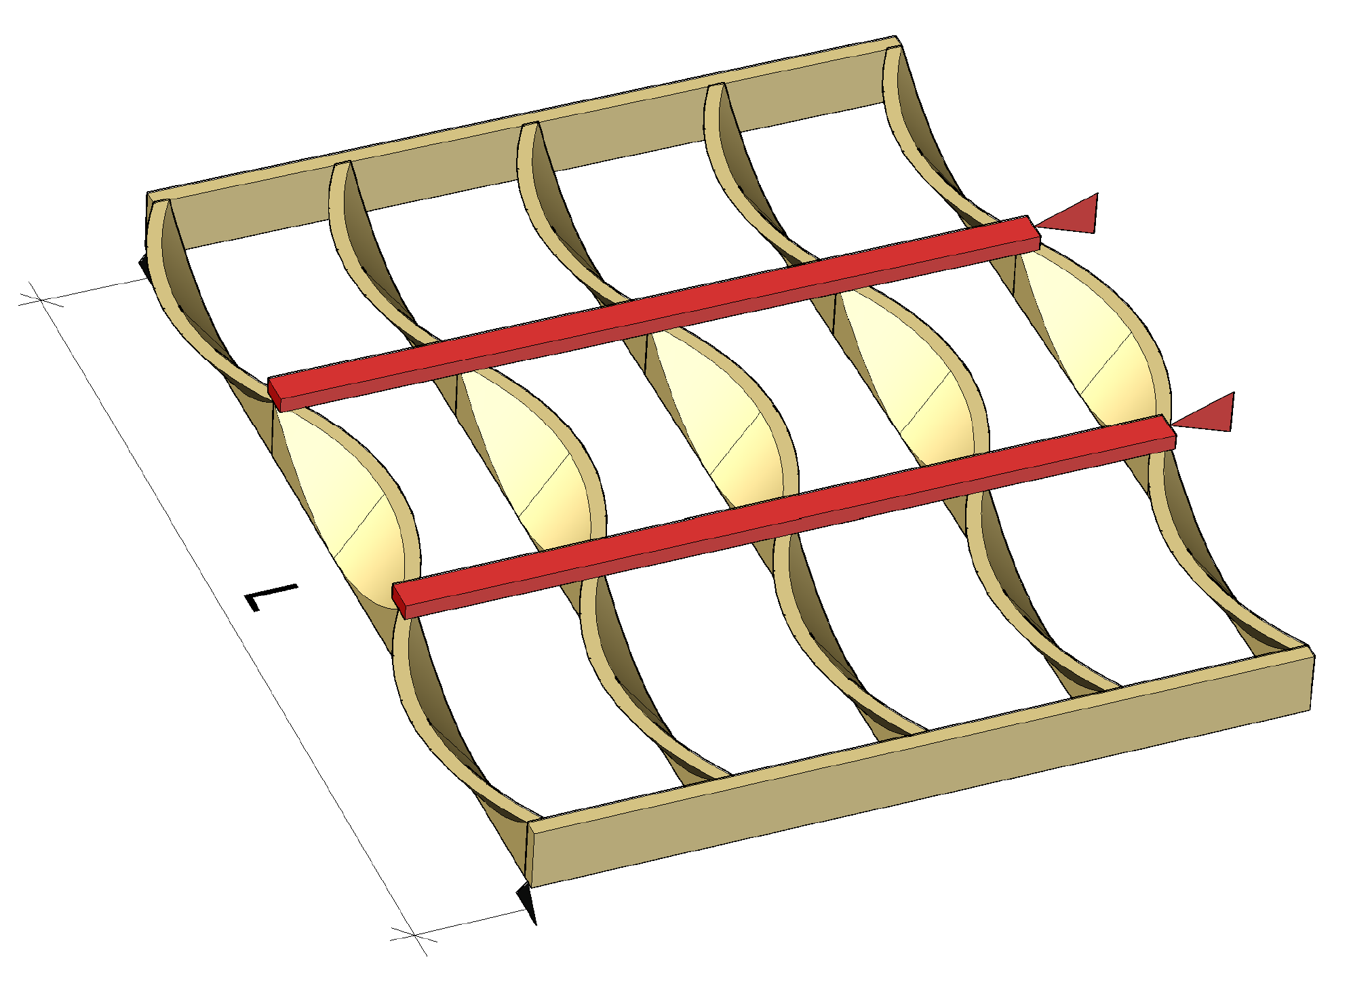
Lateral buckling of beams
The lateral buckling length of the beams can be shortened with battens placed on top of the beams
Horizontal support capable of receiving the force exerted on the support must be designed for the battens.
Support durability and stiffness
A dimensioning condition applies to stiffness
The battens and their joints have relatively poor fire resistance
Support
Support

Slide 45
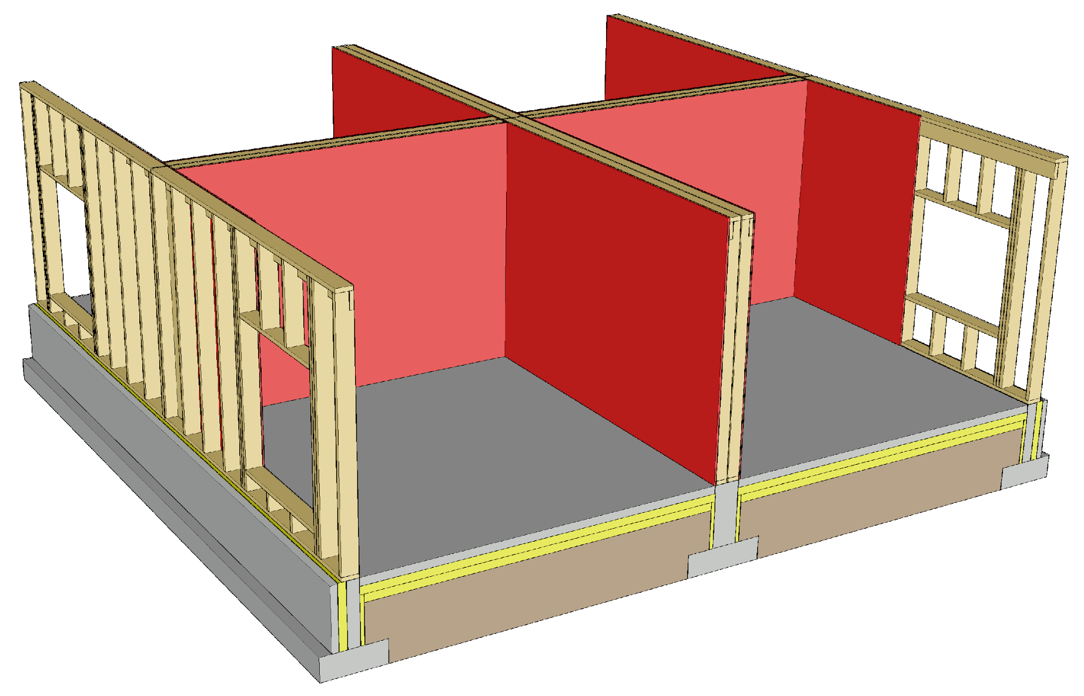
Building stiffening principle
In walls with framed structure, internal stiffening plates are used
The stiffening plates must be attached directly to the load-bearing frame to maximise its durability and stiffness
As stiffening plates are recommended timber panels (plywood, LVL, OSB)
Openings do not function as stiffening sections

Slide 46
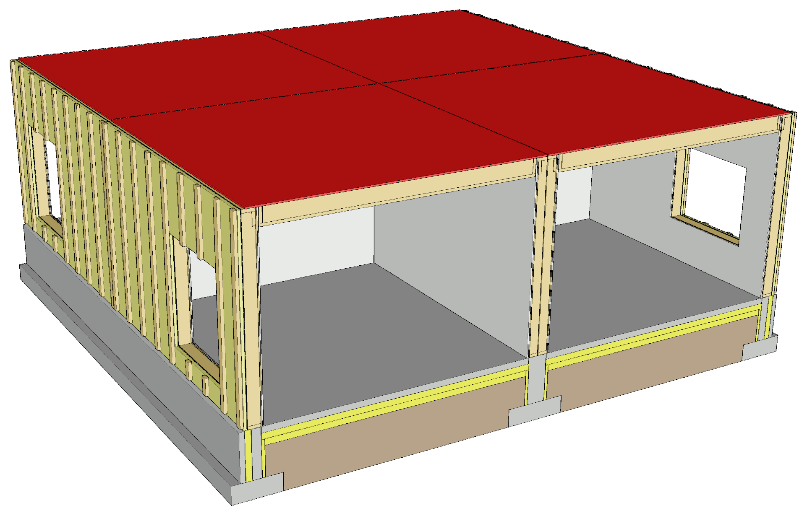
Building stiffening principle
In an intermediate floor with beam structure, the plates on top of the beams function as stiffening plates
The intermediate floors must be cut off at the walls between flats (acoustics and vibration)
If stiffening intermediate floors are the size of flats, they must be interlinked, creating a uniform whole

Slide 47
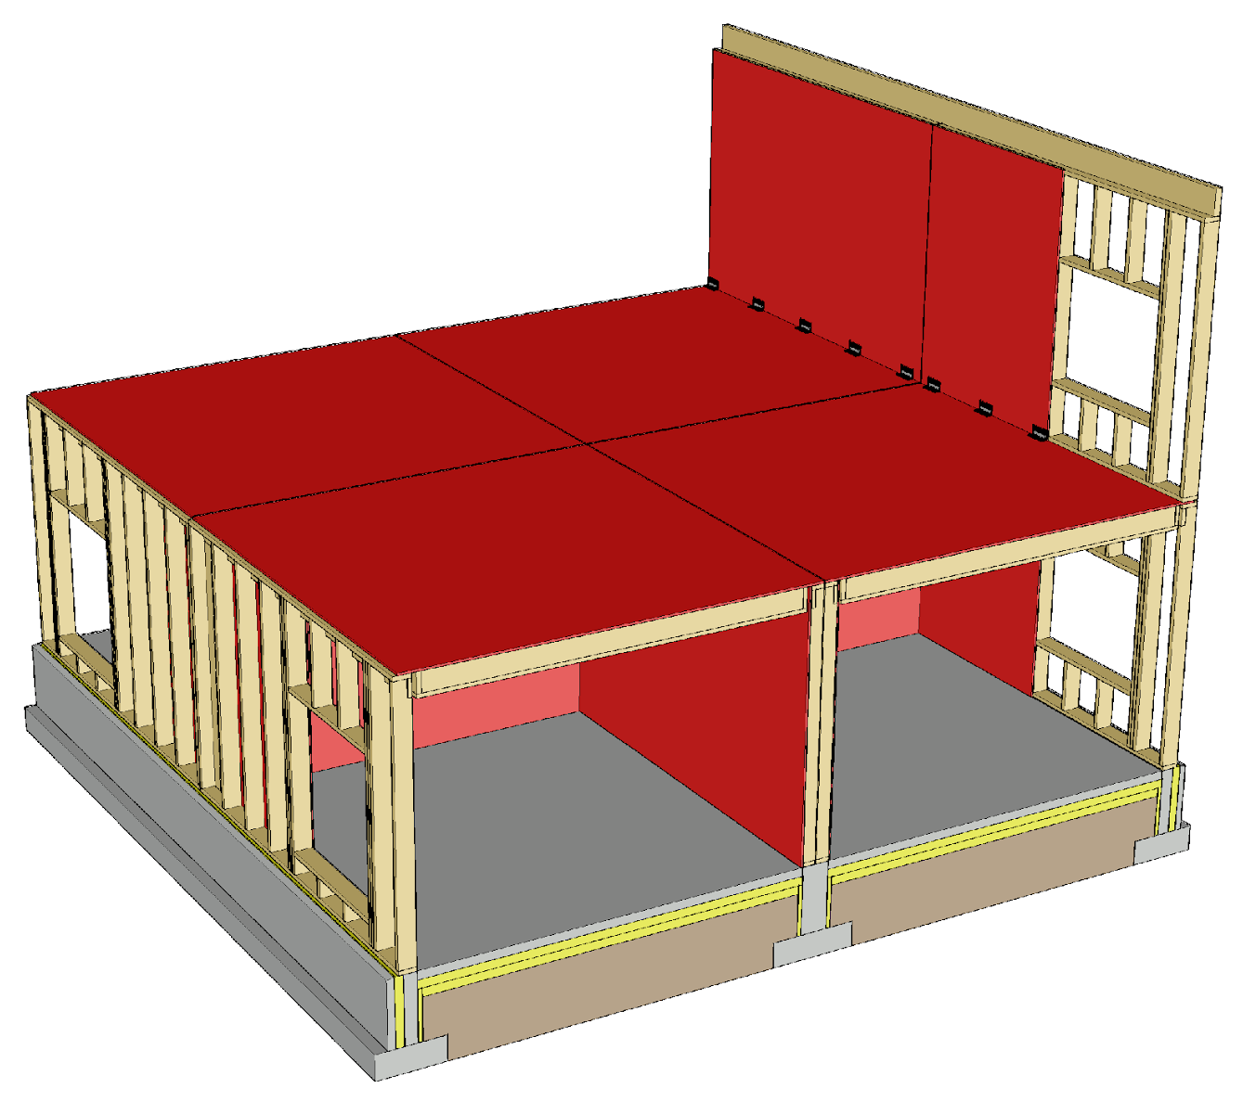
Building stiffening principle
The wall structures should be as long as possible to reduce anchoring forces
The stiffening walls should be placed as evenly as possible throughout the building
Image: Tero Lahtela

Slide 48
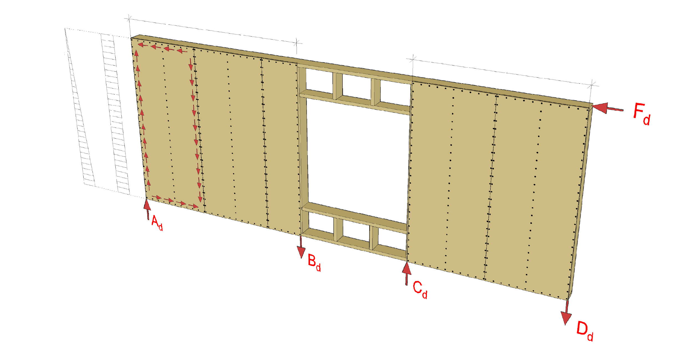
How a stiffening wall works
Stiffener 1
Stiffener 2
M surface with force F_{d}
Q surface with force F_{d}
Image: Tero Lahtela

Slide 49
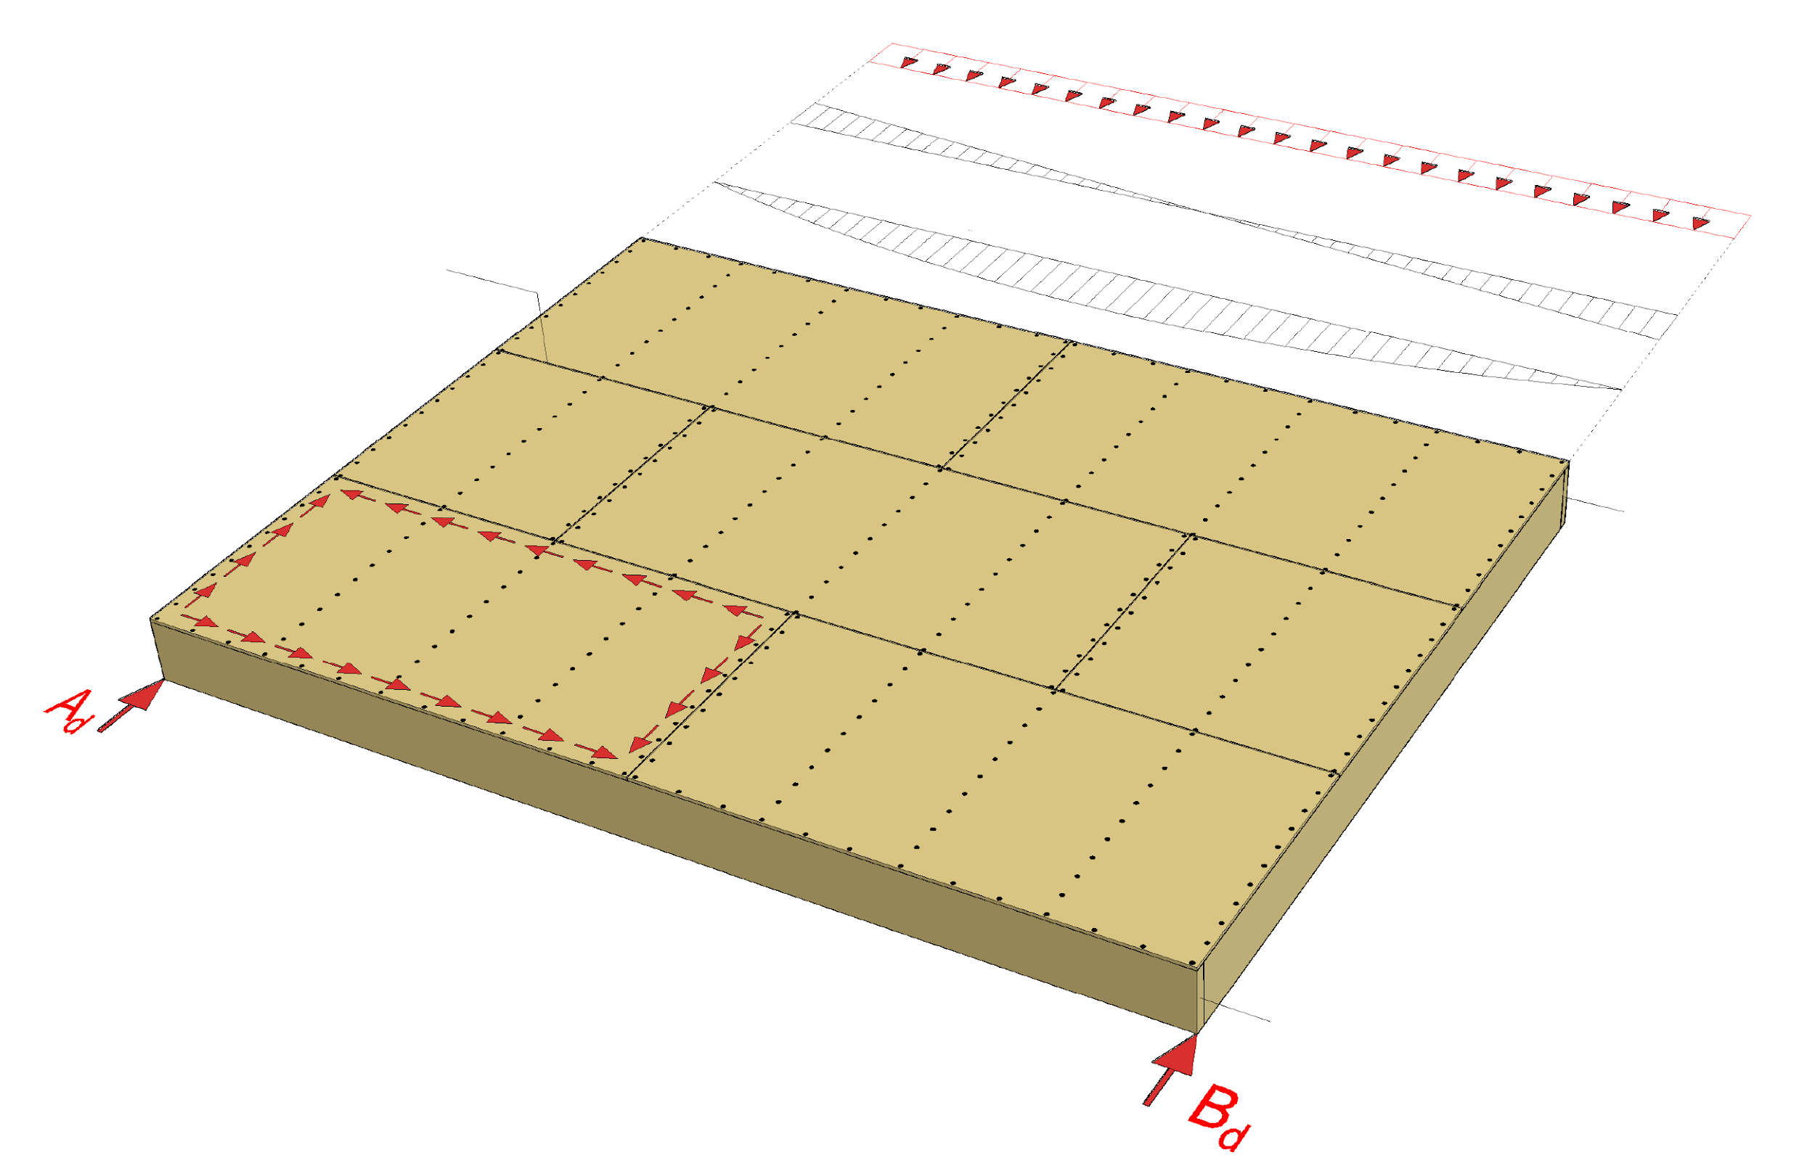
How a stiffening intermediate floor works
Loading
Q surface of loading
Unattached panel edge (tongue-and-groove joint)
M surface of loading
Chord
Chord
Image: Tero Lahtela

Slide 50
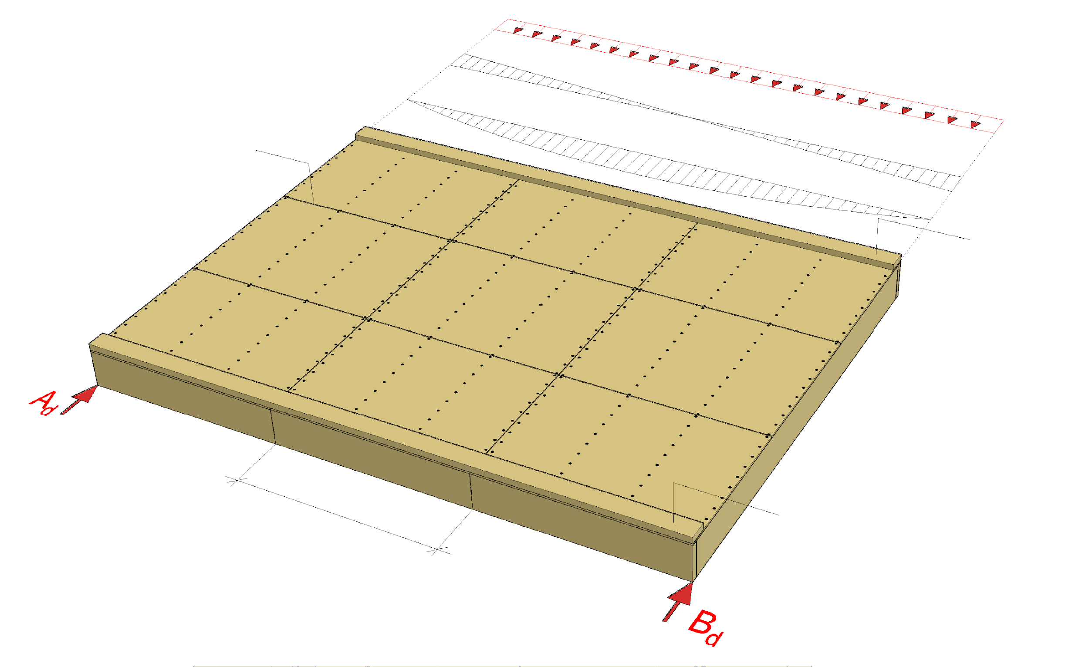
How a stiffening intermediate floor works
Loading
Q surface of loading
Unattached panel edge (tongue-and-groove joint)
M surface of loading
Chord
Prefabricated unit
Chord
Image: Tero Lahtela

Slide 51
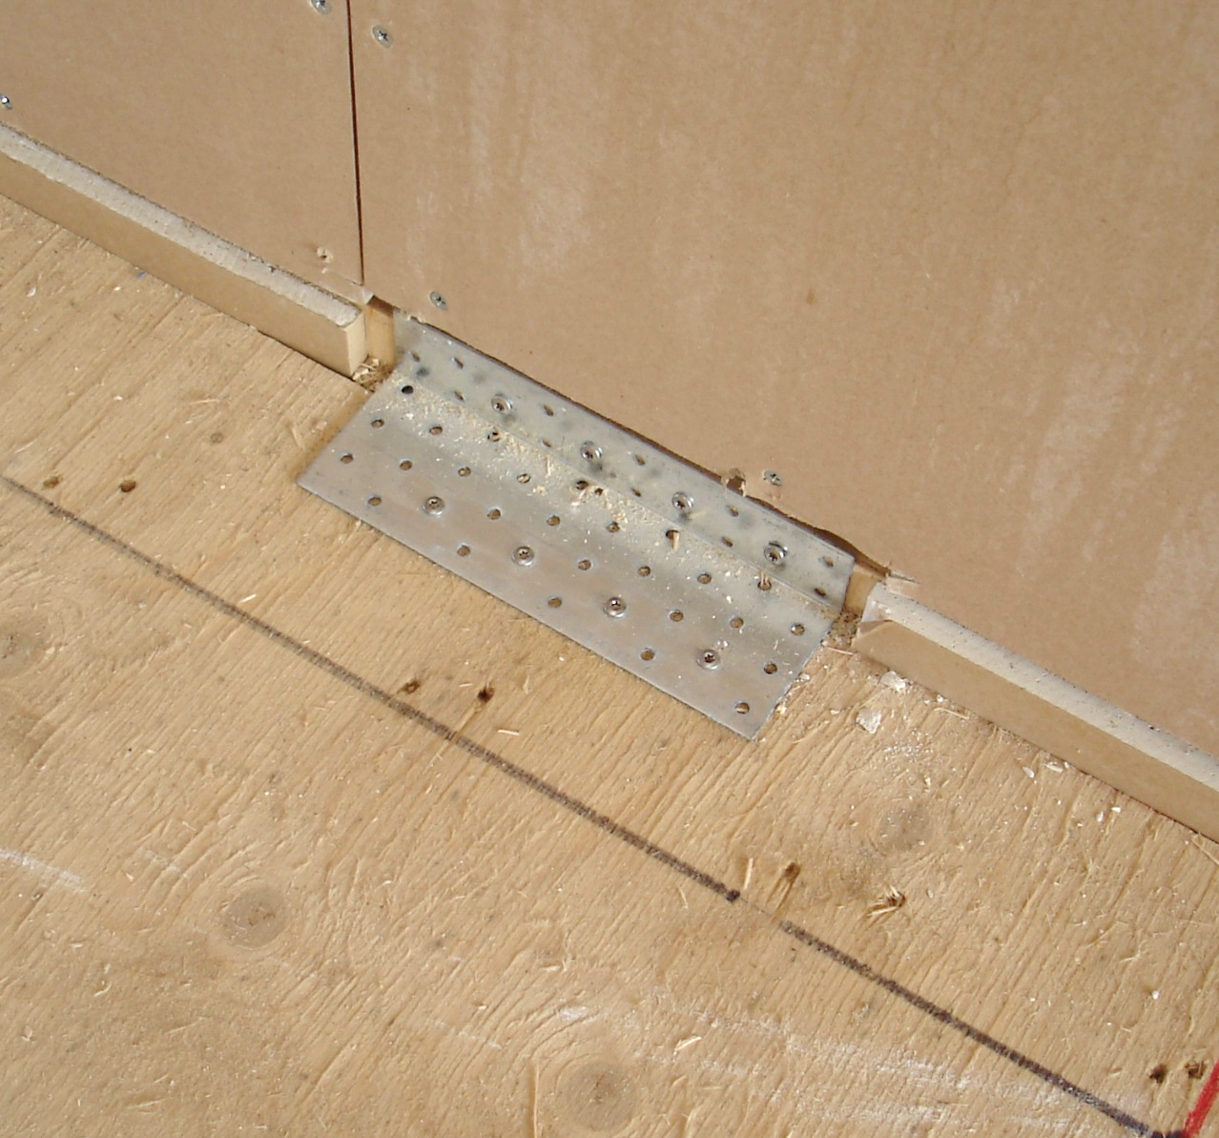
Joint components
Bolted joints with angled screws or corner plate joints are used in joints between panelised units with framed structure
Any plasterboard at the corner plate joint should be removed
Acoustics (flanking transmission) should be accounted for in joints and junctions
Image: Tero Lahtela

Slide 52
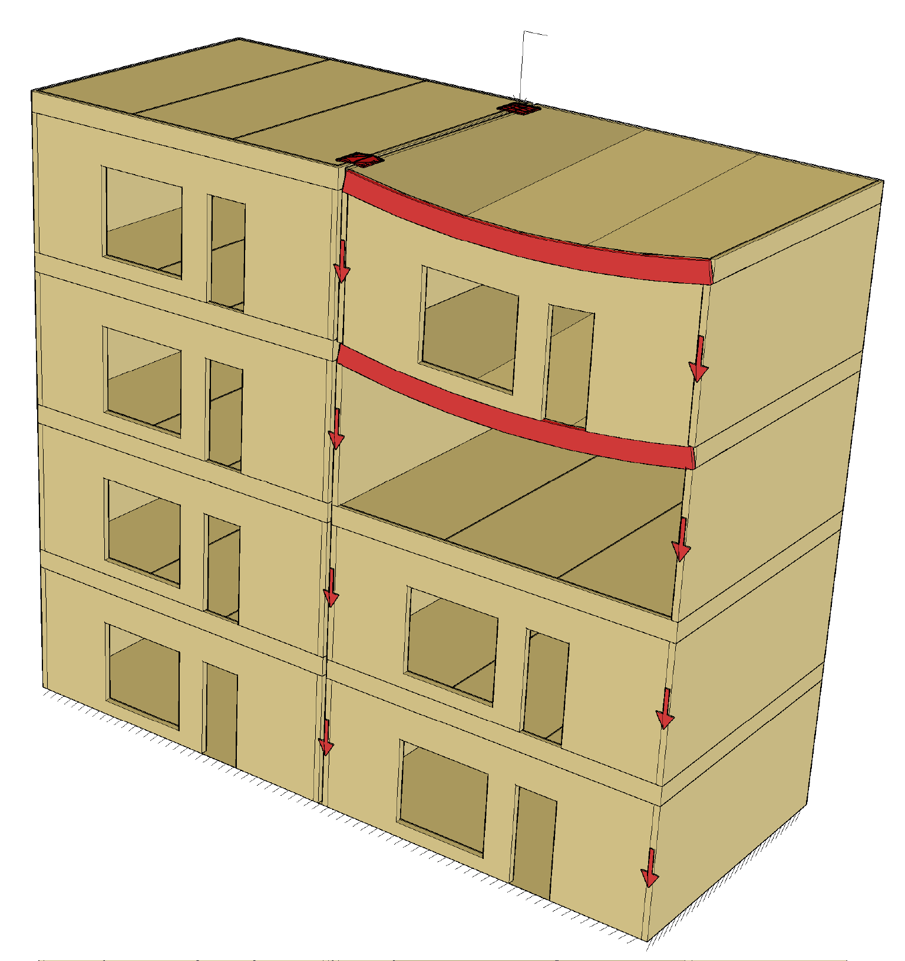
Preventing progressive collapse
Stability joint
The preferred method for preventing progressive collapse is the alternative load transfer path
Using
Beams
Wall-like beams
Joint components between prefabricated units
Image: Tero Lahtela

Slide 53
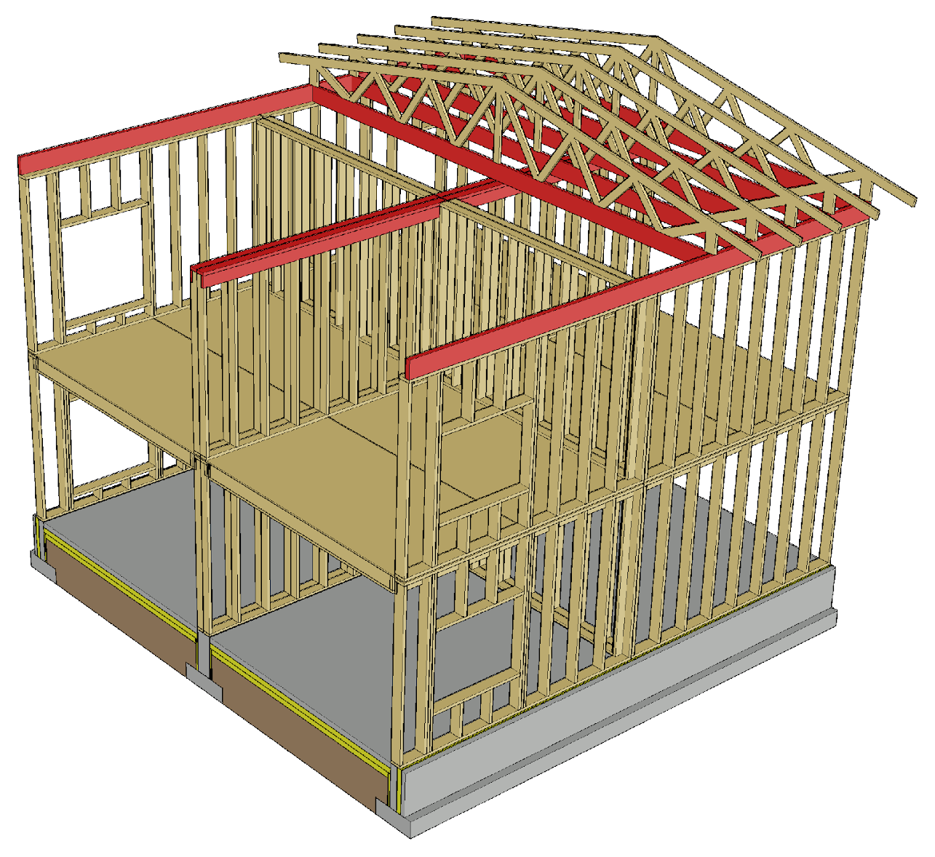
Nail plate truss roof in a fire
The bottom chord is designed to take the loading in case of an attic fire
If the fire is below it, the bottom chord is fireproofed with ceiling plates
Bottom chord joints must be fireproofed
Partitions can be designed to be load-bearing in case of fire

Slide 54
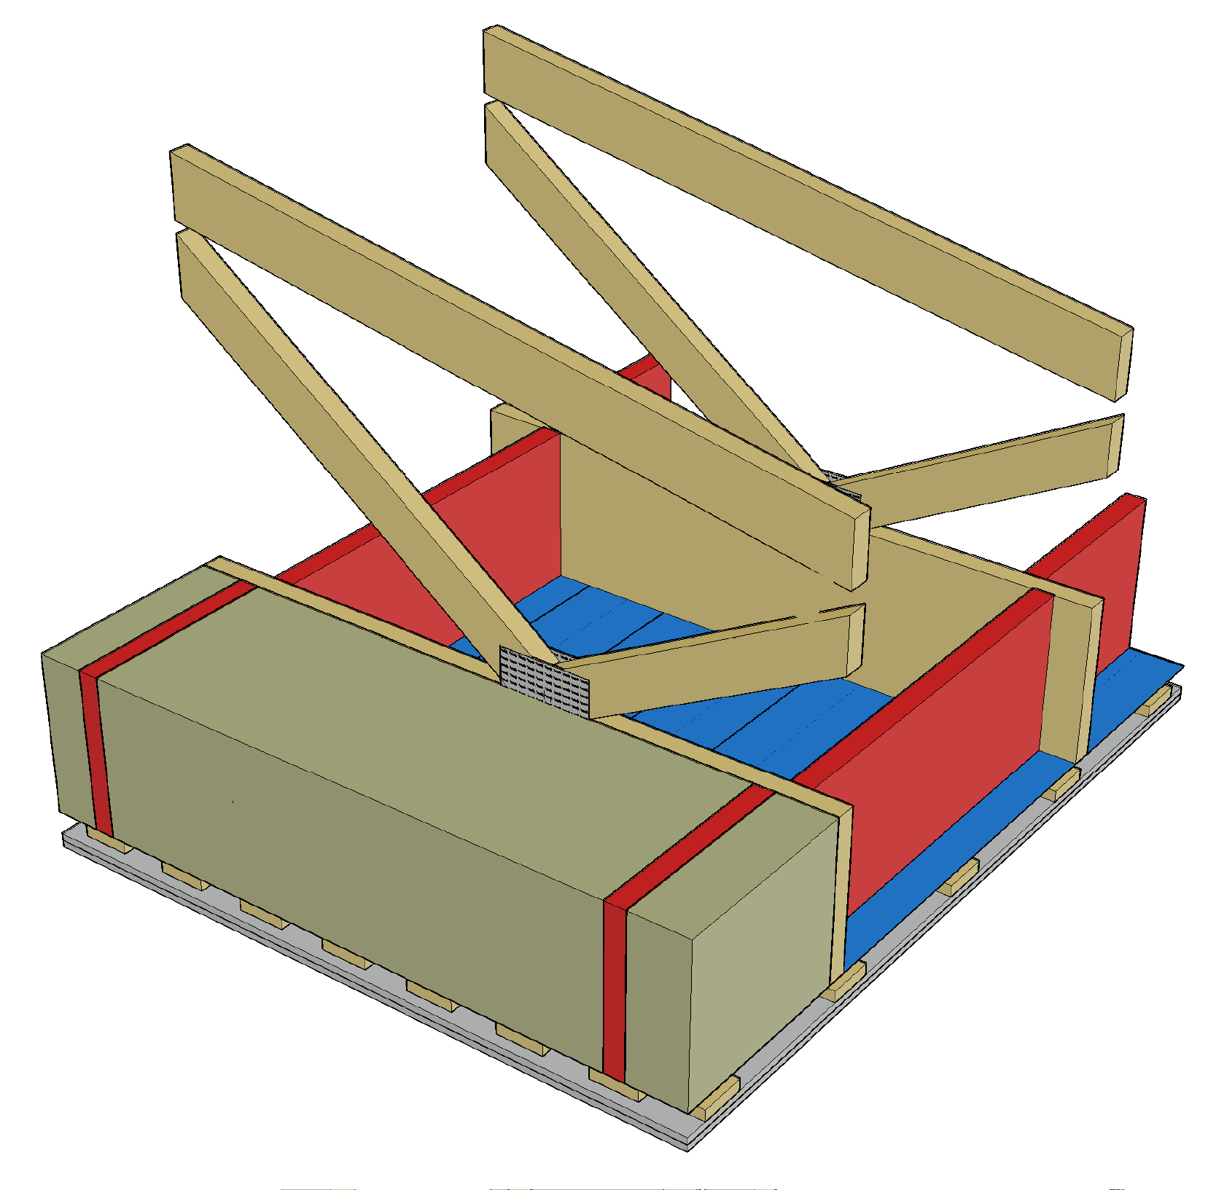
Nail plate truss roof in a fire
Bottom chord sides are protected with rock wool panels
The rock wool panels also protect lateral buckling supports
The lateral buckling supports are attached to the ceiling stiffening plate
These principles are also followed for a roof with a beam structure
Bottom chord
Buckling support
Rock wool panel

Slide 55
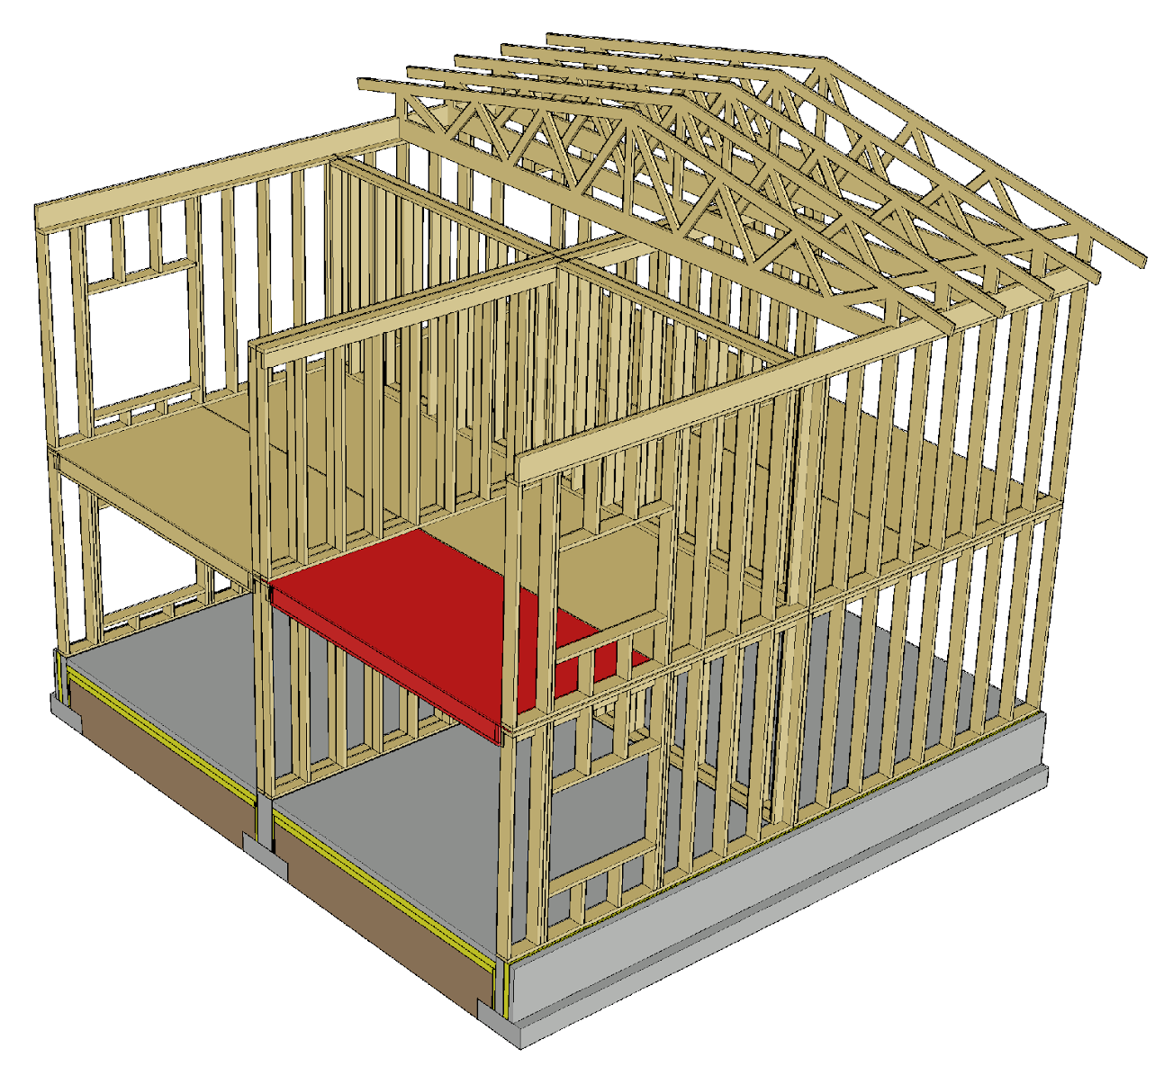
Intermediate floor in case of fire
For fireproofing the intermediate floor are used
The floor surface structure
Ceiling plates
Intermediate floor joints must be fireproofed
The lateral buckling support of beams must work in case of a fire
Partitions can be designed to be load-bearing in case of fire

Slide 56
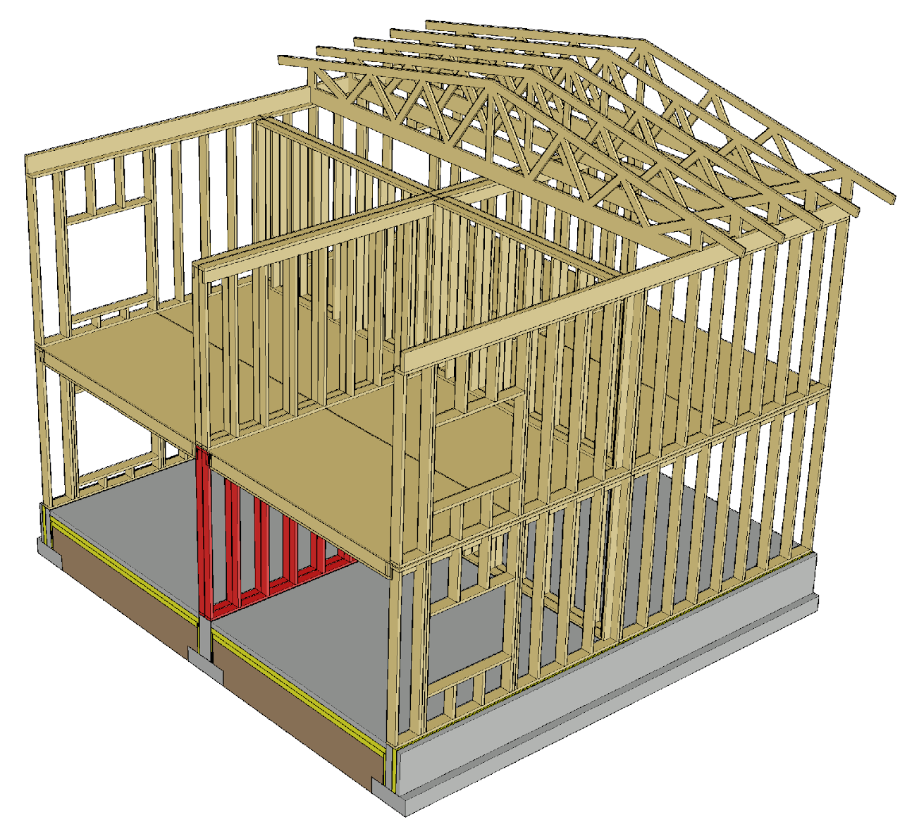
Load-bearing wall in a fire
Wall plates are used to fireproof a load-bearing wall
Joints of a load-bearing wall must be fireproofed
The stability support of the frame must work in case of a fire
If the stiffening plates of the frames are destroyed in a fire, separate stability support is needed

Slide 57
Stiffening in a fire
The aim is to use the same stiffeners in a fire as in the ultimate limit state
Wind protection panels can be used in exterior walls if the interior plates are destroyed by fire
In double frame walls, the frame half on the opposite side can be used if the panel on the side of the fire does not function as stiffener

