Slide 1



Industrial wood construction
Teaching materials for industrial wood construction education
2022

Slide 2
Origin of the materials
Use of the materials
These learning materials for industrial wood construction have been prepared in a project led by Puuinfo Oy in 2021–2022. Also involved in the project were
Lappia Vocational College,
TTS-Työtehoseura ry
South-Eastern Finland University of Applied Sciences,
Metropolia University of Applied Sciences,
Jyväskylä University of Applied Sciences,
University of Tampere, and
Federation of the Finnish Woodworking Industries Puutuoteteollisuus ry
The project was funded by the Ministry of the Environment.
The materials are intended to be used as extensively as possible in industrial wood construction education and studies.
The materials are released under the Creative Commons licence Attribution-ShareAlike (CC BY-SA), which requires that the author be properly credited when the materials are used and that derivative works may only be distributed under the same licence as the original work.
The original materials and any updates to them by Puuinfo will be published on the Library of Open Educational Resources website (aoe.fi) and the Puuinfo.fi website.

Slide 3
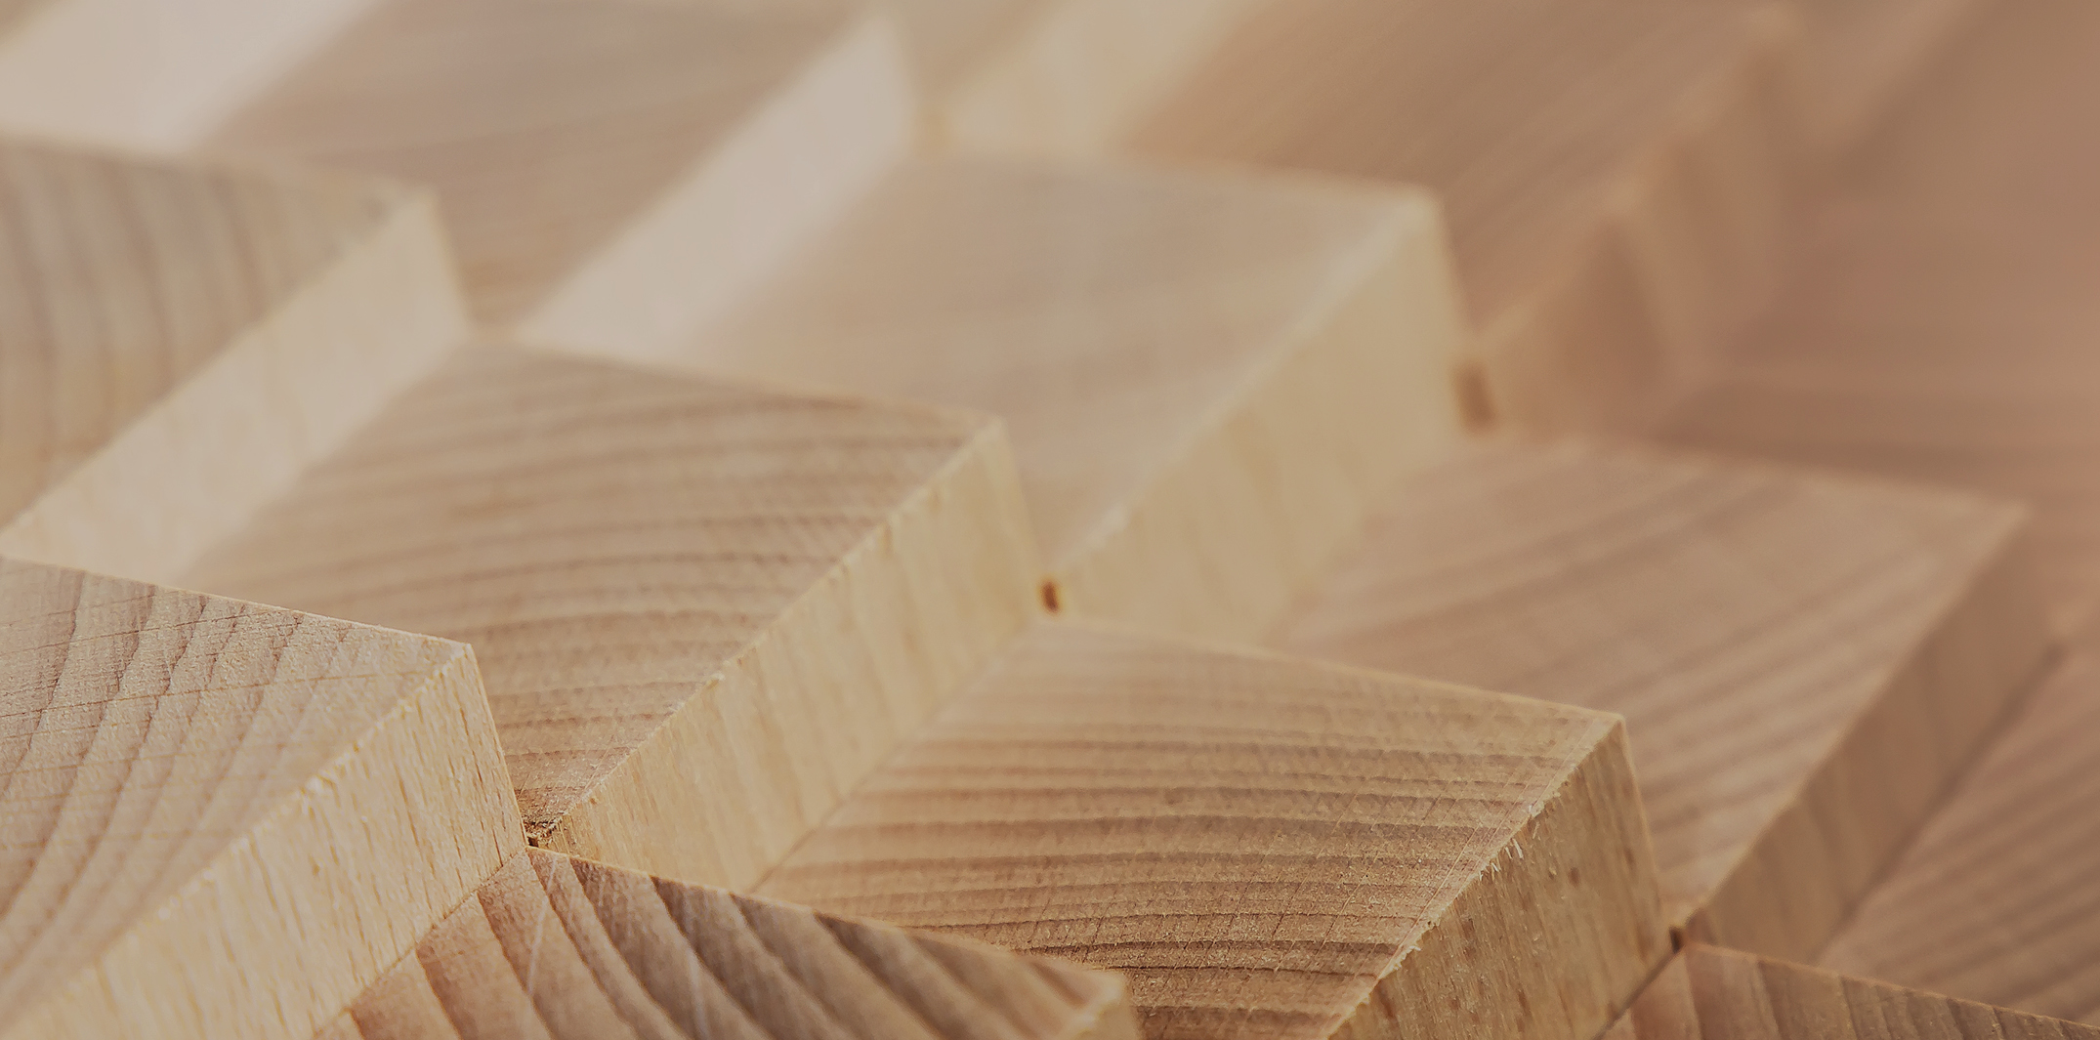
Industrial construction systems

Slide 4
Authors
Tero Lahtela,
Insinööritoimisto Tero Lahtela Oy
Release date: 01/07/2021

Slide 5
Load-bearing solid wood based plane elements for residential and commercial construction

Slide 6
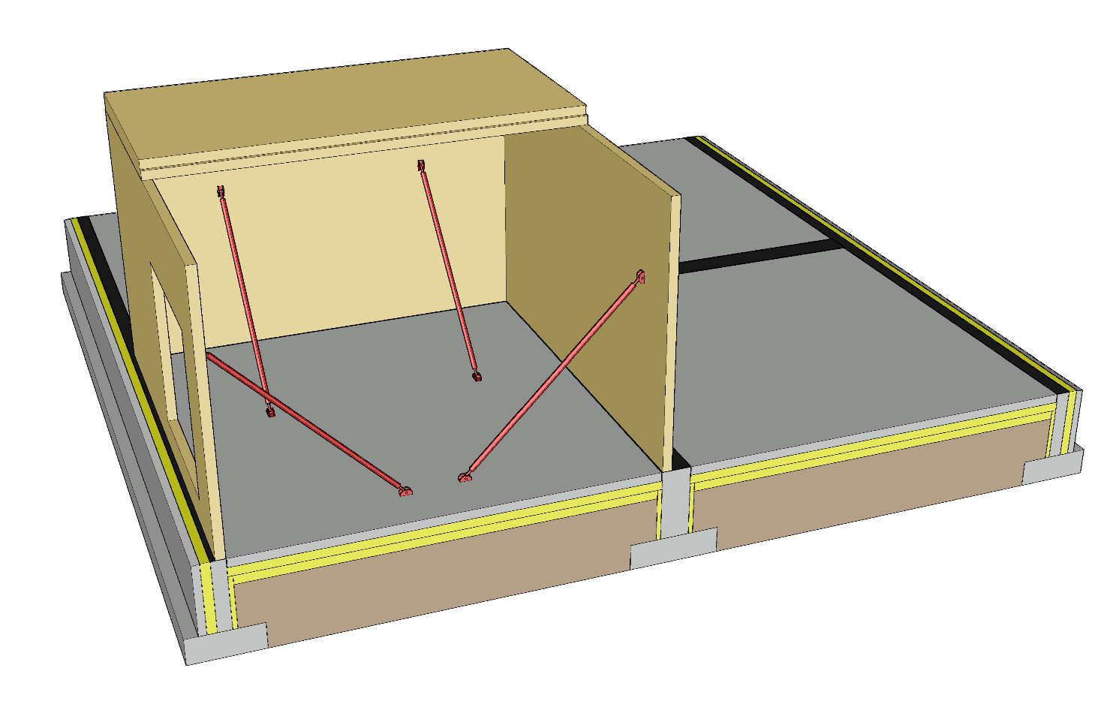
Plane elements of a solid timber panel system
(panels only)
Load-bearing exterior walls
Load-bearing partition walls
Intermediate floors
Attic floor
  Plane element solid timber structure or a beam structure
  Nail plate truss
  A nail plate truss roof can be built as blocks on site or in the factory

Slide 7

Plane elements of a solid timber panel system
(equipped with structure layers)
Load-bearing exterior walls
Load-bearing partition walls
Intermediate floors
Attic floor
  Plane element solid timber structure or a beam structure
  Nail plate truss
  A nail plate truss roof can be built as blocks on site or in the factory

Slide 8

Elements of the solid timber system
(intermediate floor with beam structure)
Load-bearing exterior walls
Load-bearing partition walls
Intermediate floors
Attic floor
  Plane element solid timber structure or a beam structure
  Nail plate truss
  A nail plate truss roof can be built as blocks on site or in the factory

Slide 9
Applications
Load-bearing plane elements with a solid timber structure are primarily used in
  Detached houses, terraced houses and blocks of flats
  Accommodation buildings and residential institutions
  School and day-care centre buildings
Plane elements with solid timber structure can also be used as an element in other building systems (load-bearing or non-load-bearing)
Plane element solid timber systems have only been used in Finland for approximately 10 years

Slide 10
Strengths and challenges of solid timber panels
Strengths
Durability and stiffness
  Vertical load
  Bearing pressure
  Bracing
  Connections
Dimensional accuracy
CNC machining
Minor drying variations in the cross section
Challenges
Few manufacturers
Anchoring
Settlement in intermediate floors
High purchasing cost

Slide 11
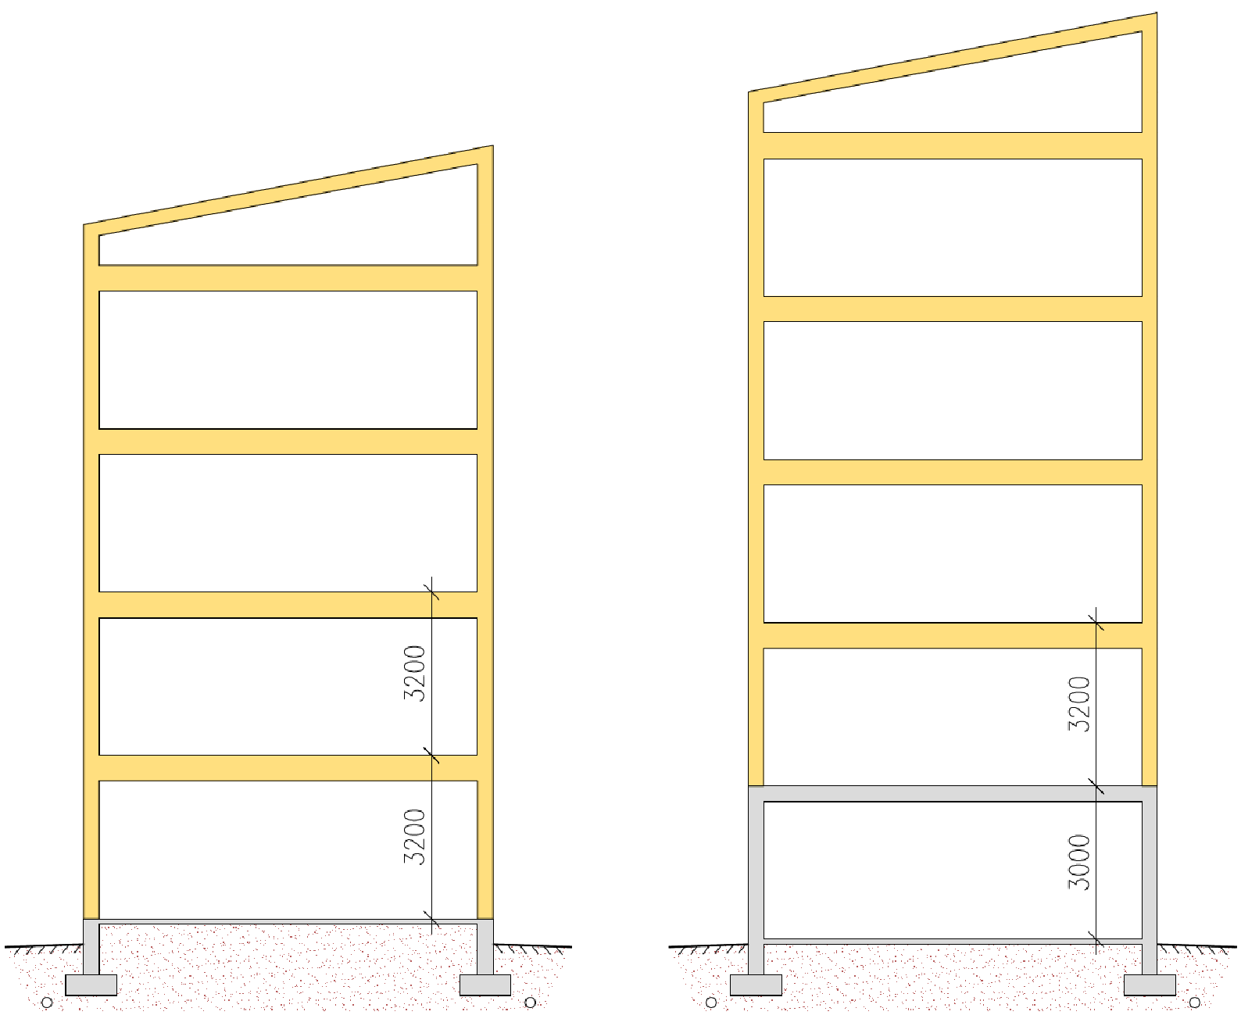
Number of storeys when using solid timber panels
Factors affecting the number of storeys
  Wall bearing pressure resistance
  Buckling resistance of the wall
  Bracing plate capacity
  Capacity of the connections between bracing building elements
Recommended number of storeys
  8 timber-framed storeys at most
Floor-to-floor height
  3,200 mm (residential buildings)
  3,800 ... 4,000 mm (public areas)
5th storey
4th storey
4th storey
3rd storey
3rd storey
2nd storey
2nd storey
1st storey
1st storey

Slide 12
Plane elements with solid timber structure
Load-bearing frame of solid timber panel (CLT or glued laminated LVL)
  Intermediate floor and roof as exceptions, may also have a beam structure
Heat insulation layer is on the exterior of the solid timber panel
There are no standardized dimensions for the elements
Plane elements are manufactured to order as required by designs, using standard panel thicknesses (special panels are available)
Plane elements can be either horizontal or vertical
  Horizontal elements create fewer vertical connections than vertical elements
  A higher space can be created with vertical elements than with horizontal ones

Slide 13
Prefabrication degree of plane elements with solid timber structure
Plane elements with solid timber structure typically are just solid timber panels
Plane elements can be equipped at the factory, including
  Heat insulation
  Panelling
  Exterior cladding (exterior cladding panel, panel-type exterior cladding etc.)
  Windows, external doors and their jamb structures
  Electrical installations
  Building-service penetration products
  Joint seals (possibly)

Slide 14
Dimensions of plane elements with solid timber structure
Wall element (indicative)
  Height ≤ 3.5 m
  Length ≤ 12 m
Intermediate floor element (indicative)
  Width ≤ 2.4 m…2.5 m
  Length ≤ 12 m (shorter span)
Roof element
  Width ≤ 2.4 m...2.5 m
  Length ≤ 12 m (shorter span)

Slide 15
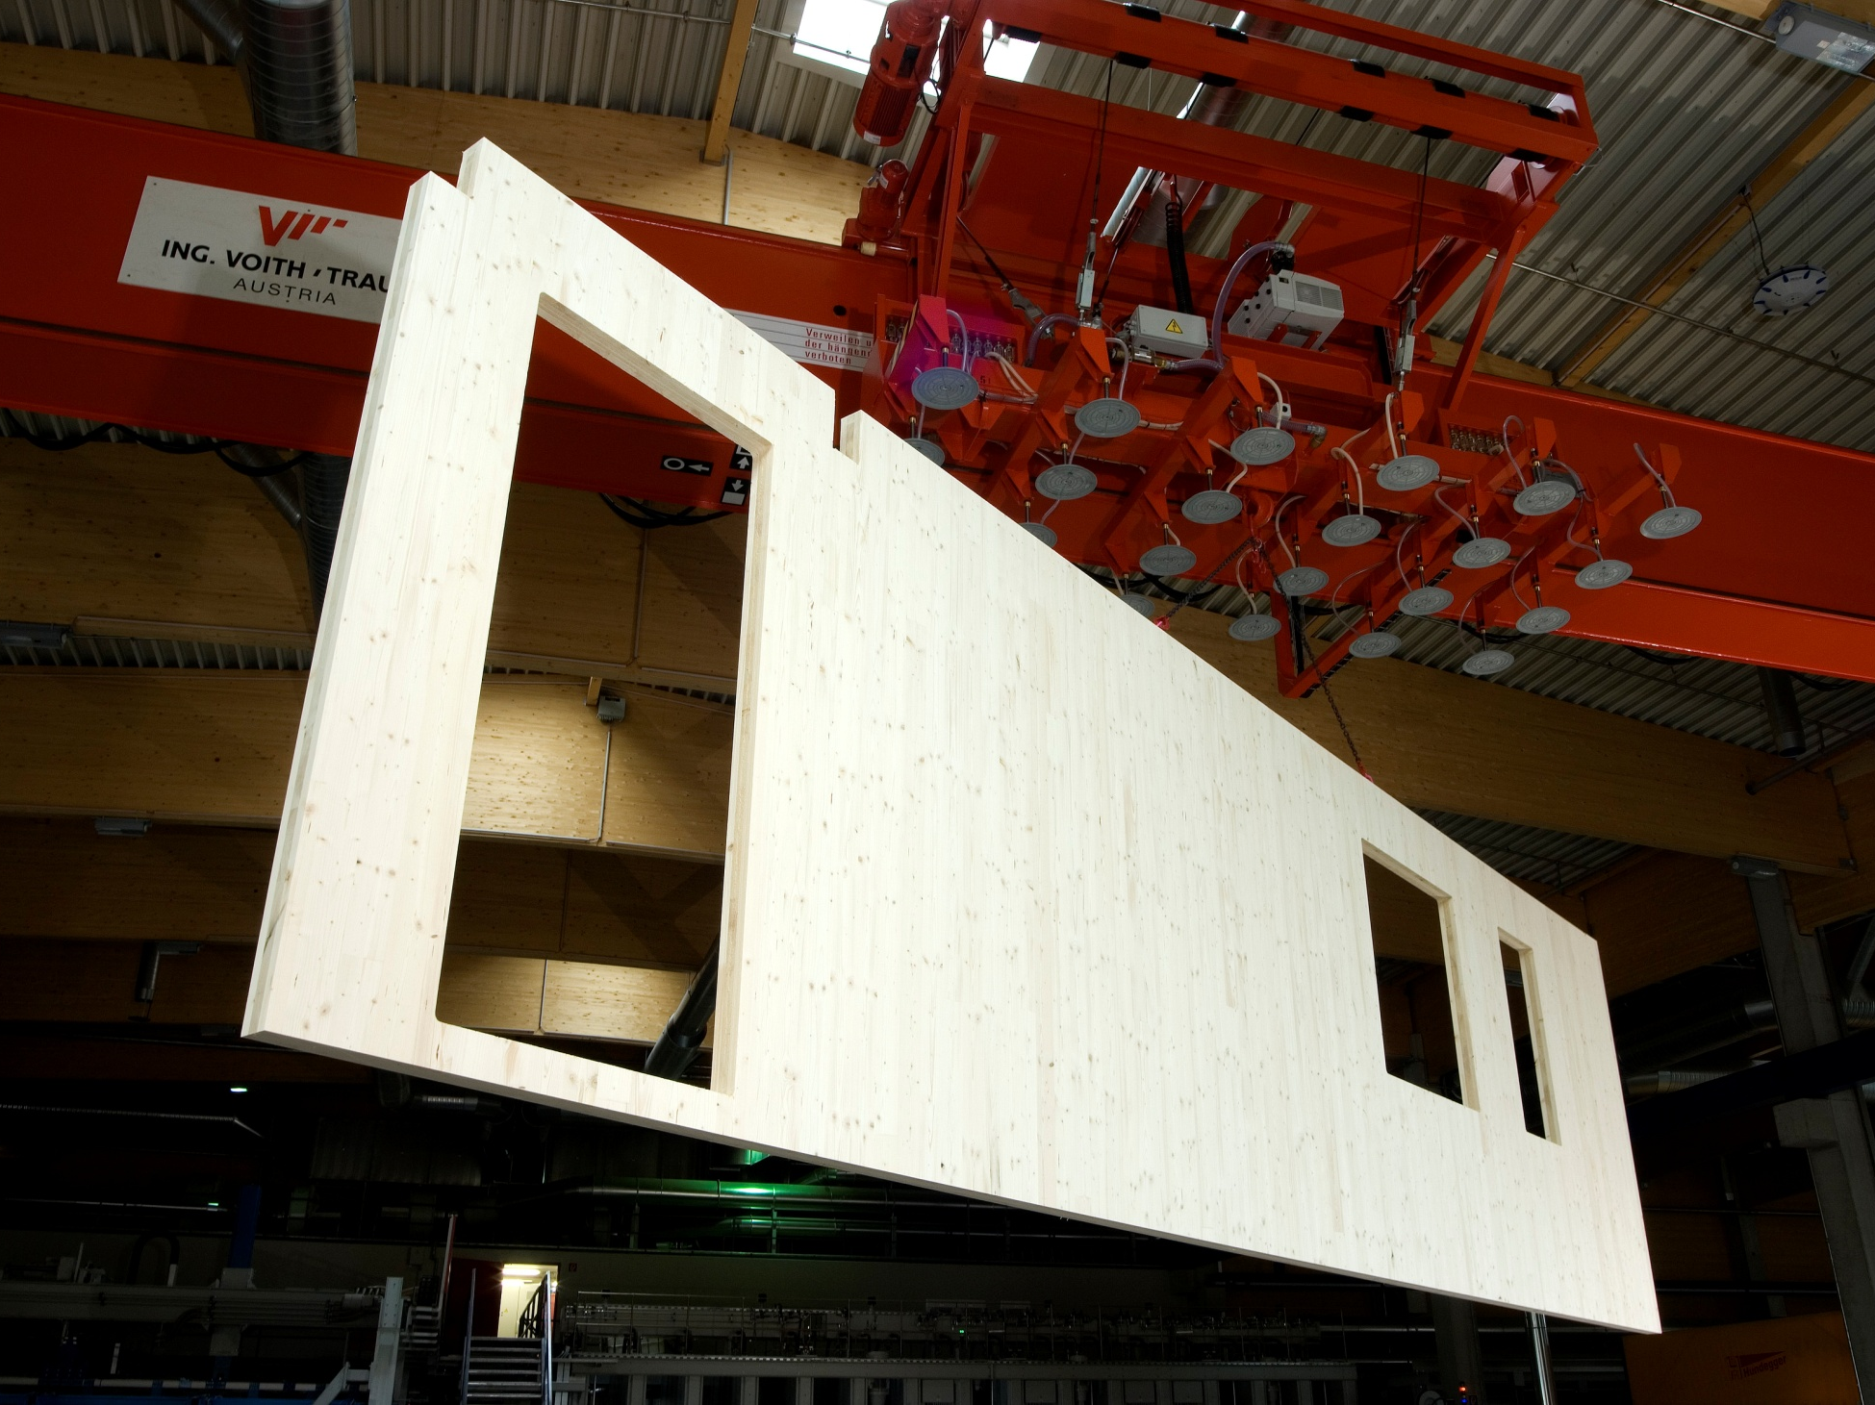
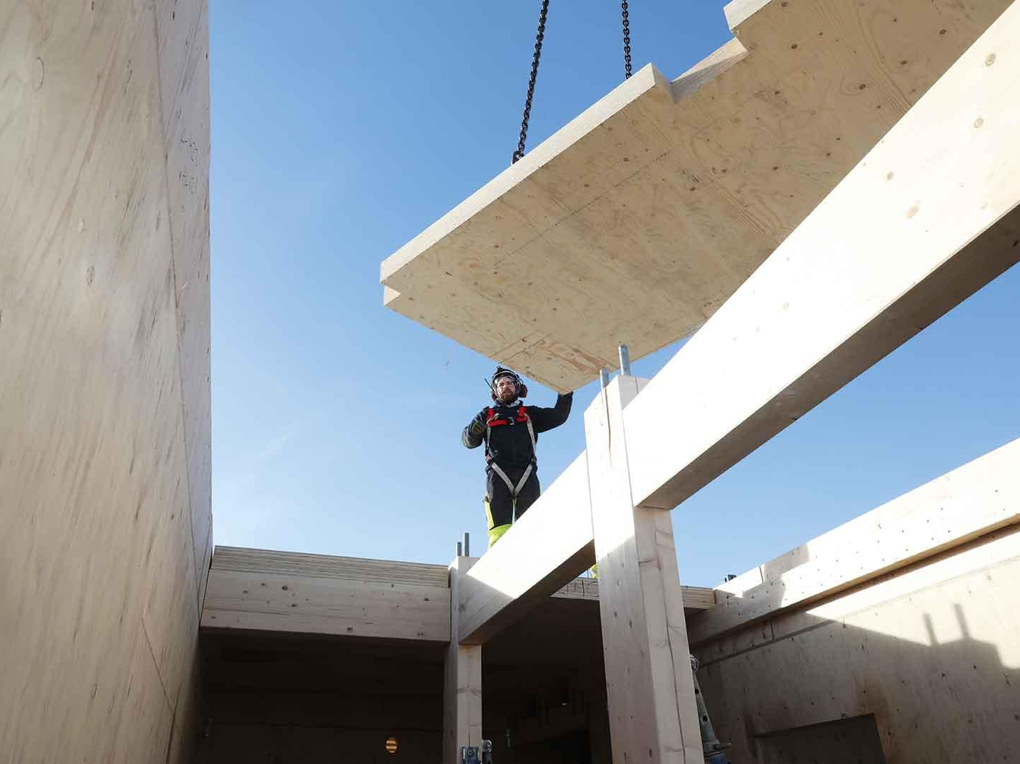
Solid timber plane elements
CLT (Cross Laminated Timber)
LVL (Laminated Veneer Lumber)
Image: Stora Enso
Image: Stora Enso

Slide 16
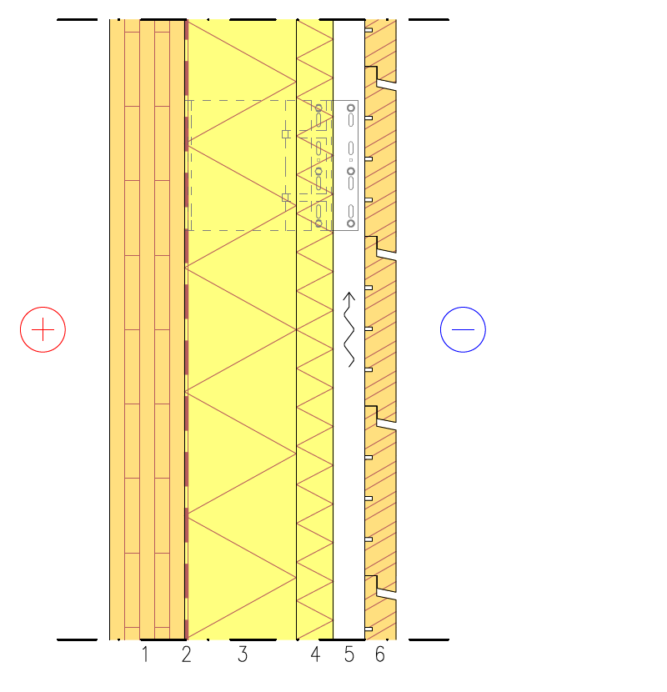
Exterior wall structure
Load-bearing exterior wall
A solid timber panel is a load-bearing and bracing structure
Load-bearing capacity of a solid timber panel
  Bearing pressure tolerance
  Buckling resistance
  Crossings of openings
External heat insulation
  Improves thermal and humidity performance
Fastening of the exterior cladding is challenging
1 CLT or LVL panel
2 Air and vapour barrier fabric (if necessary)
3 Stiff mineral wool
4 Windproof mineral wool
5 Exterior cladding fastening system (studs, vertical or in a grid) Ventilation cavity
6 Exterior cladding

Slide 17
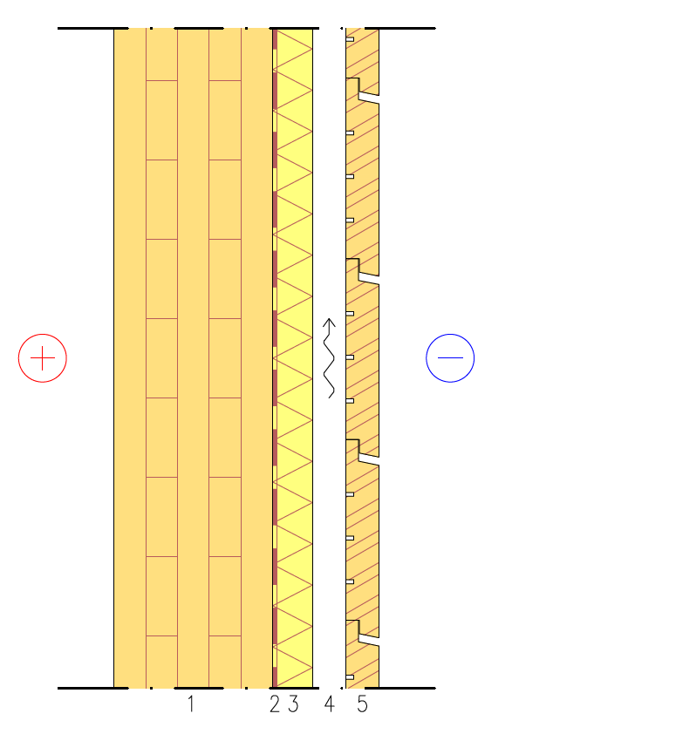
Exterior wall structure
Load-bearing exterior wall
A solid timber panel is a load-bearing and bracing structure
Load-bearing capacity of a solid timber panel
  Bearing pressure tolerance
  Buckling resistance
  Crossings of openings
External heat insulation
  Improves thermal and humidity performance
1 CLT or LVL panel
2 Air and vapour barrier fabric (if necessary)
3 Windproof mineral wool
4 Exterior cladding fastening studs (vertical or in a grid) Ventilation cavity
5 Exterior cladding

Slide 18
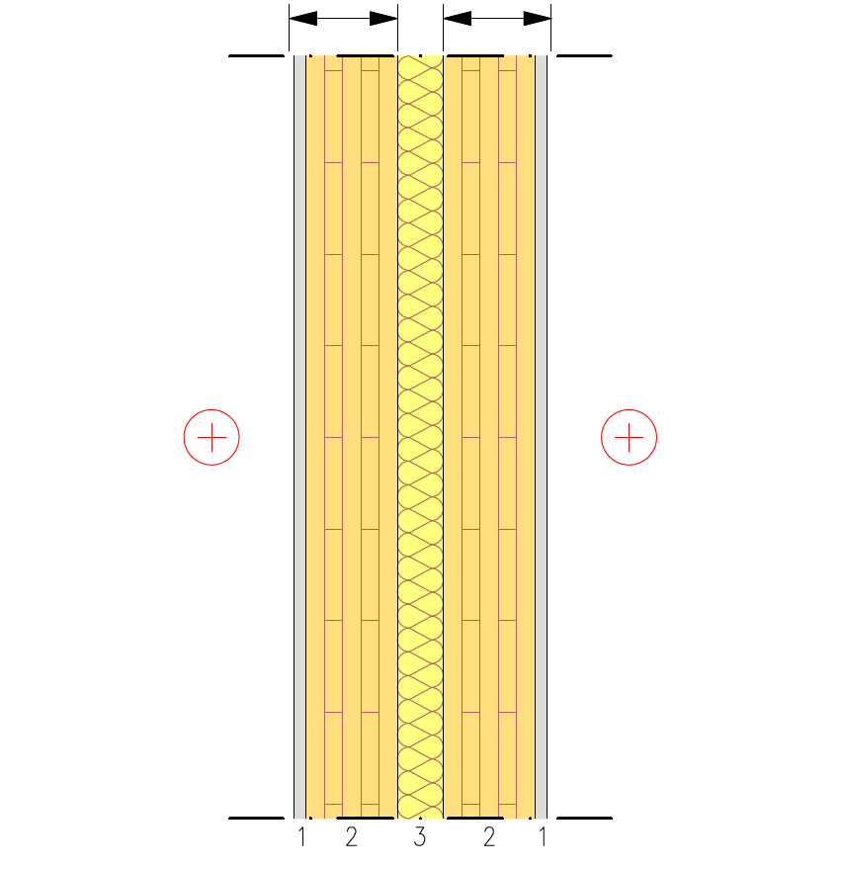
Partition structure
Load-bearing wall between flats
Separate frame halves
Frame 1
Frame 2
A solid timber panel is a load-bearing and bracing structure
Load-bearing capacity of a solid timber panel
  Bearing pressure tolerance
  Buckling resistance
  Crossings of openings
Double frame
  Enables airborne sound insulation between spaces of D_{n,T,w} ≥ 55 dB
Plasterboard for acoustics
1 Plasterboard (acoustics)
2 CLT or LVL panel
3 Gap between frame halves + Mineral wool

Slide 19
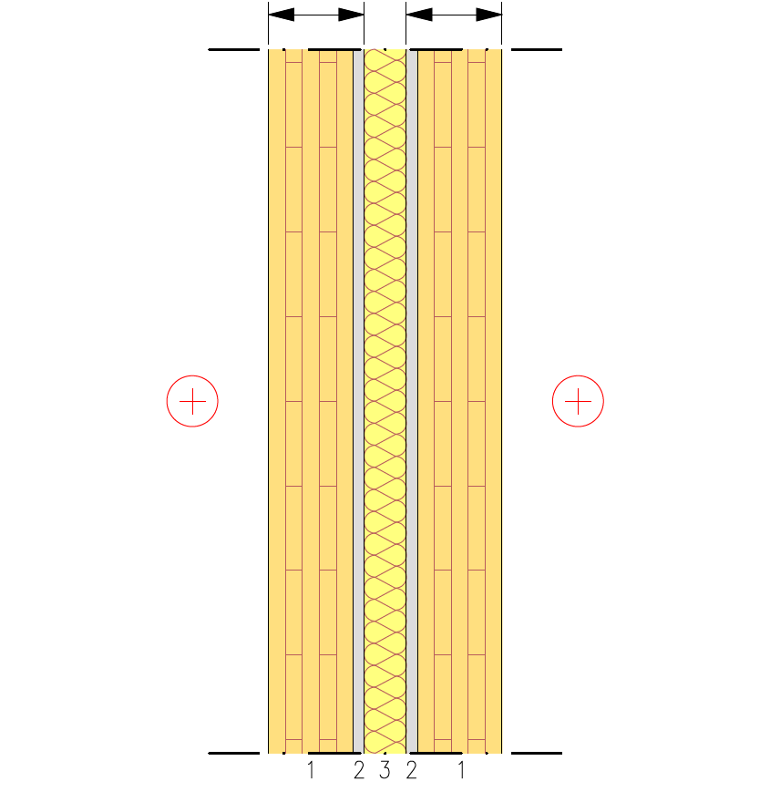
Partition structure
Load-bearing wall between flats
Separate frame halves
Frame 1
Frame 2
A solid timber panel is a load-bearing and bracing structure
Load-bearing capacity of a solid timber panel
  Bearing pressure tolerance
  Buckling resistance
  Crossings of openings
Double frame
  Enables airborne sound insulation between spaces of D_{n,T,w} ≥ 55 dB
Plasterboard for acoustics
1 CLT or LVL panel
2 Plasterboard (acoustics)
3 Gap between frame halves + Mineral wool

Slide 20
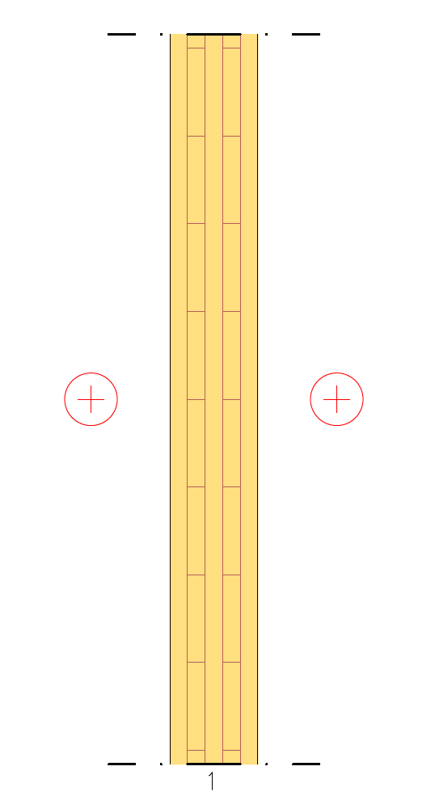
Partition structure
Load-bearing partition
A solid timber panel is a load-bearing and bracing structure
Load-bearing capacity of a solid timber panel
  Bearing pressure tolerance
  Buckling resistance
  Crossings of openings
Sound insulation
  Airborne sound insulation between spaces of D_{n,T,w}≈ 40 dB must be achieved
1 CLT or LVL panel

Slide 21
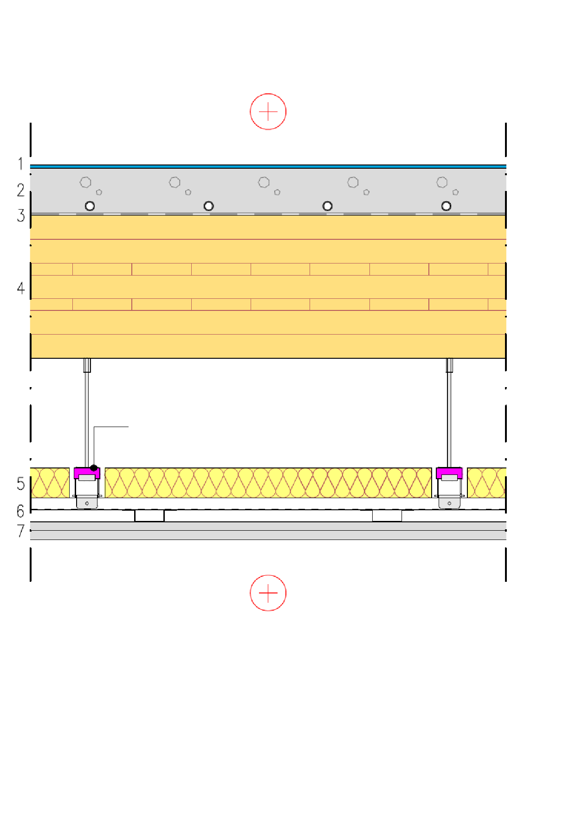
Intermediate floor structure
Intermediate floor between flats
A solid timber panel is a load-bearing and bracing structure
Plasterboard and castings are used for
  Fire protection
  Acoustics
The thickness of the solid timber panel depends on
  Vibration (often governing design)
  Bending and shearing stress
  Deflection
Ceiling profile system
1 Floor coating
2 Concrete slab (possibly composite structure, possible underfloor heating)
3 Protective fabric between concrete and wood
4 CLT or LVL panel
5 Mineral wool
6 Ceiling profile system with vibroinsulators
7 2 x plasterboard

Slide 22
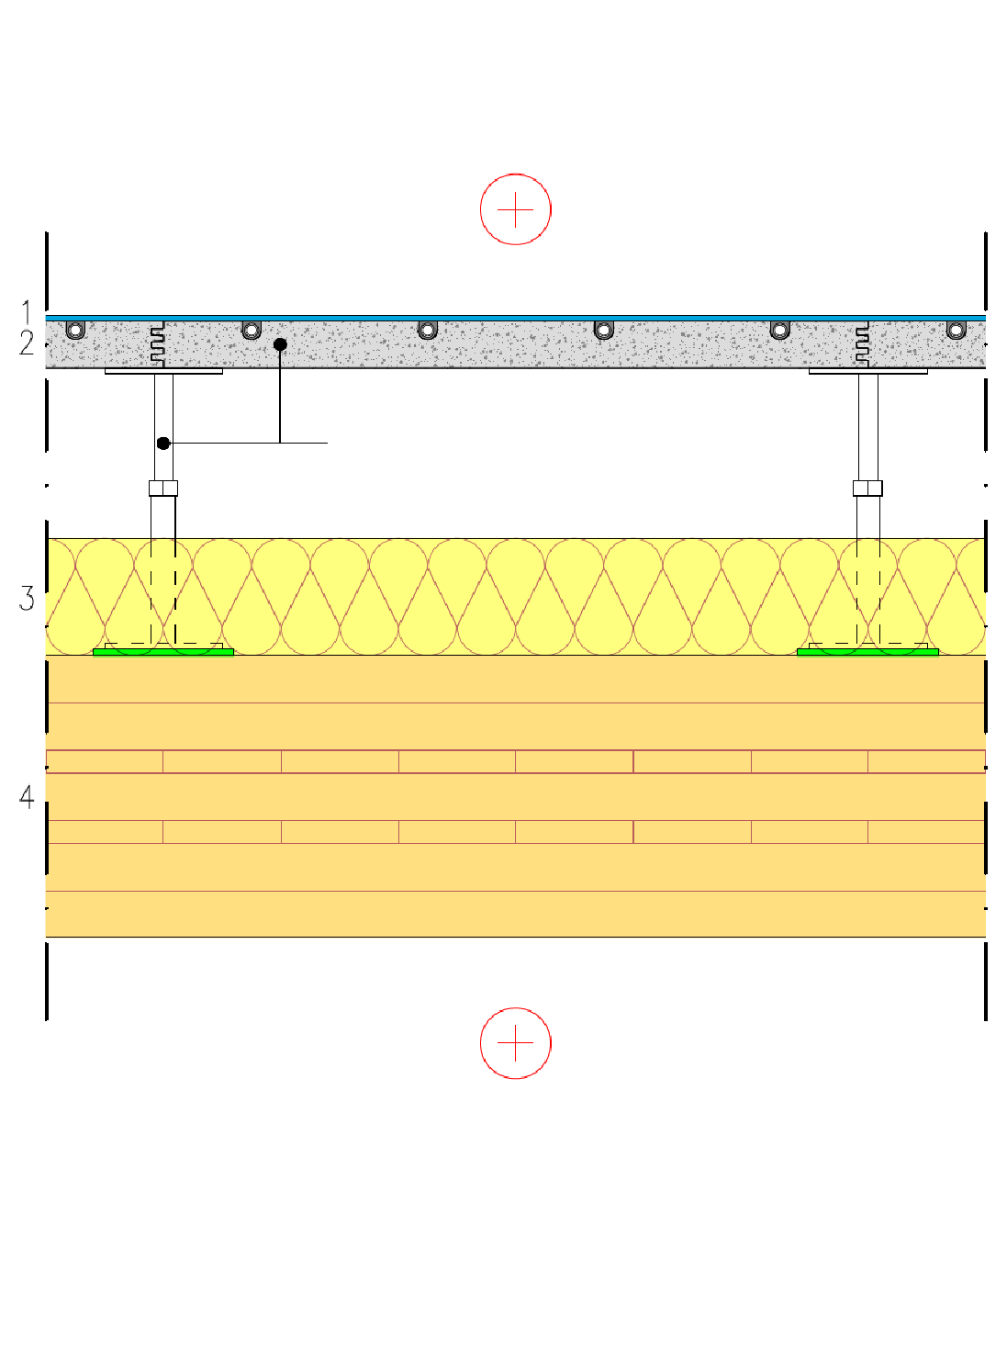
Intermediate floor structure
Intermediate floor
A solid timber panel is a load-bearing and bracing structure
Suspended floors are used for
  Acoustics
The thickness of the solid timber panel depends on
  Vibration (often governing design)
  Bending and shearing stress
  Deflection
Suspended floor system
1 Floor coating
2 Fibre-reinforced calcium sulphate panel (600x600)
3 Mineral wool
4 CLT or LVL panel

Slide 23
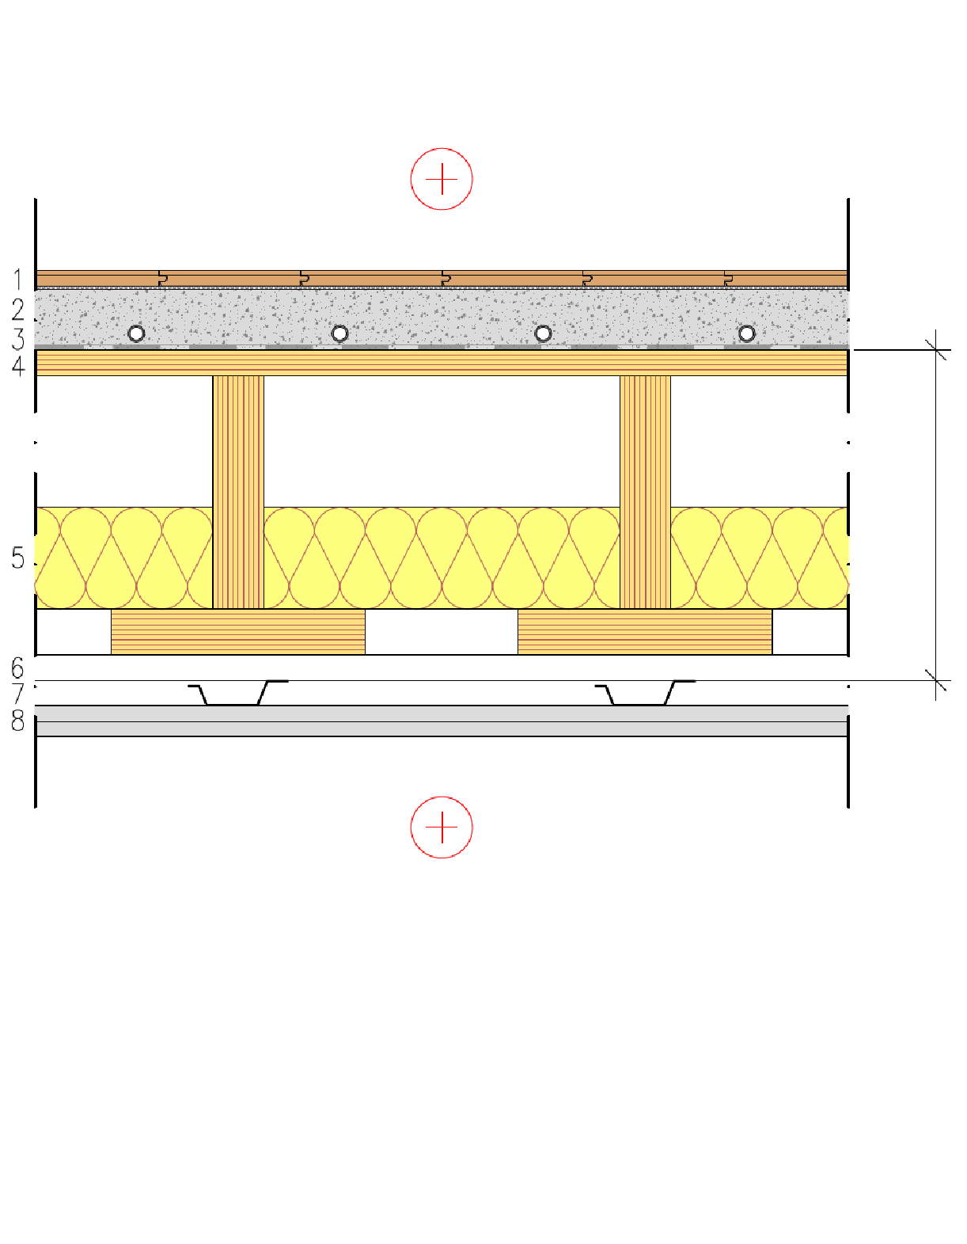
Intermediate floor structure
Intermediate floor between flats
The top surface panel is used for
  bracing
Plasterboard and castings are used for
  Fire protection
  Acoustics
The height of the rib panel depends on
  Vibration (often governing design)
  Bending and shearing stress
  Deflection
Prefabricated unit
1 Floor coating
2 Cast floor (possible underfloor heating))
3 Protective fabric between concrete and wood
4 Industrially manufactured LVL semi-open rib panel or LVL rib panel
5 Mineral wool
6 Studs
7 Acoustic ceiling profiles
8 2 x plasterboard

Slide 24
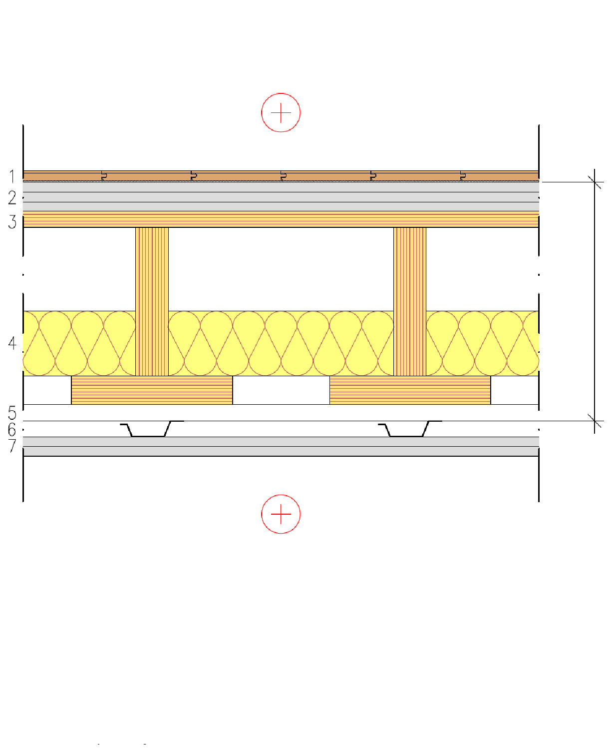
Intermediate floor structure
Intermediate floor between flats
The top surface panel is used for
  bracing
Plasterboards are used for
  Fire protection
  Acoustics
The height of the rib panel depends on
  Vibration (often governing design)
  Bending and shearing stress
  Deflection
Prefabricated unit
1 Floor coating
2 3 x Floor plasterboard
3 Industrially manufactured LVL semi-open rib panel or LVL rib panel
4 Mineral wool
5 Studs
6 Acoustic ceiling profiles
7 2 x plasterboard

Slide 25
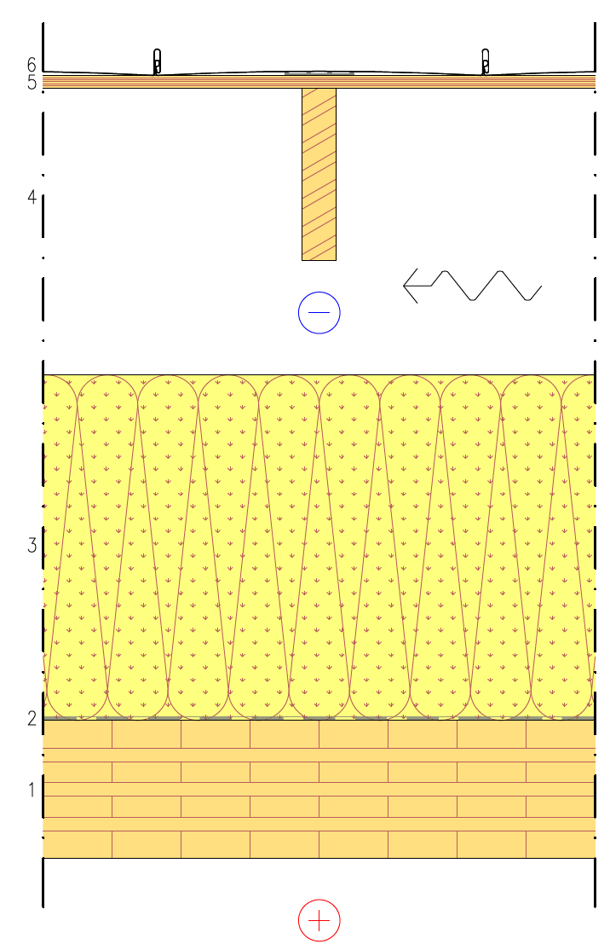
Roof structure
Solid timber panel roof structure
A solid timber panel is a load-bearing and a bracing structure
The roof can be built on top of the solid timber panel
  With beam-framed roof elements
  With nail plate trusses
The panel on top of the beams is used for
  bracing
CLT or LVL panel
Air and vapour barrier fabric
Mineral wool
Roof unit beams and ventilated attic (alternatively, nail plate truss)
Spruce plywood or LVL (stiffening plate)
Water-resistant roof material

Slide 26
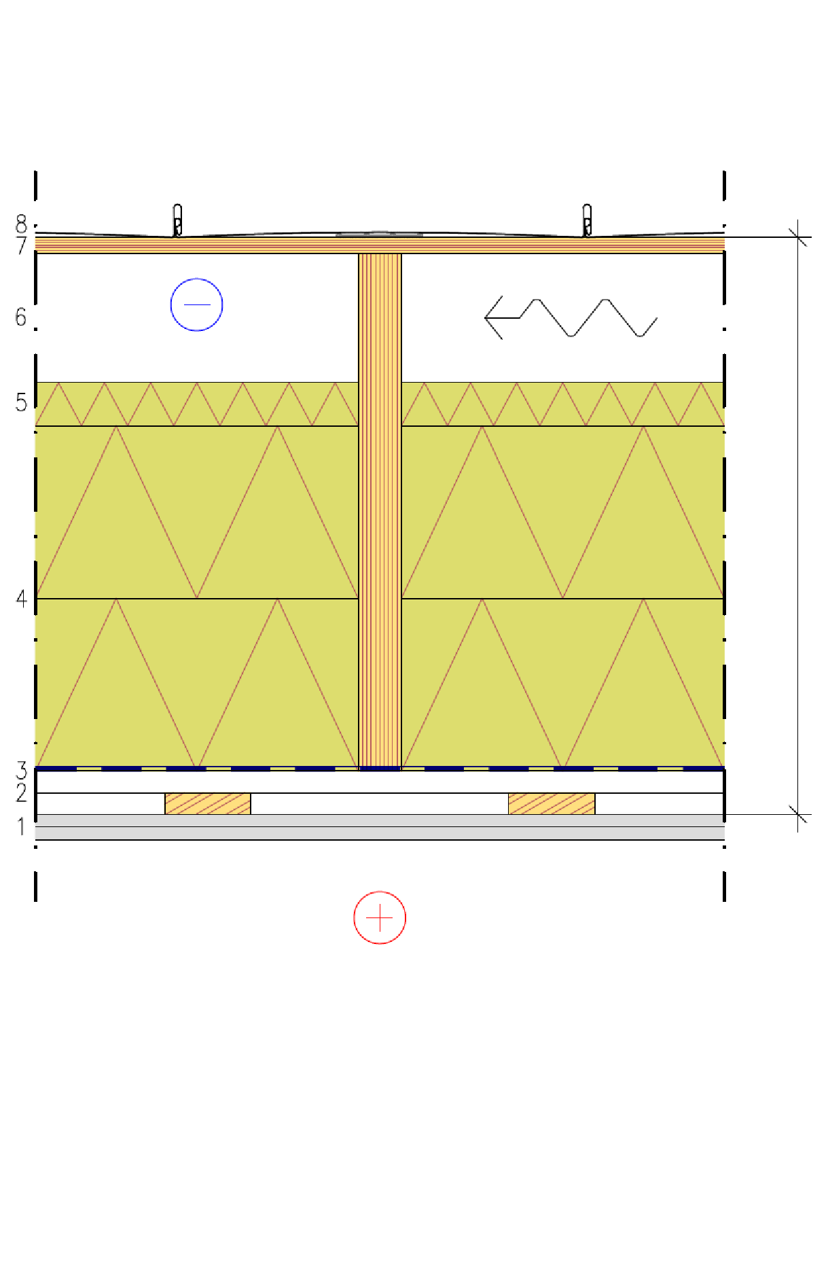
Roof structure
Beam frame roof structure
The panel on top of the beams is used for
  bracing
Plasterboards are used for
  Fire protection (fire from underneath)
Rock wool panels are used for
  Fire protection (fire from above)
The height of the beams depends on
  Bending and shearing stress
  Deflection
Prefabricated unit
1 2 x plasterboard
2 Studs in a grid
3 Air and vapour barrier
4 Beams + Rock wool panels
5 Stiff mineral wool for wind protection
6 Ventilation gap
7 Spruce plywood or LVL (stiffening plate)
8 Water resistant roof material

Slide 27
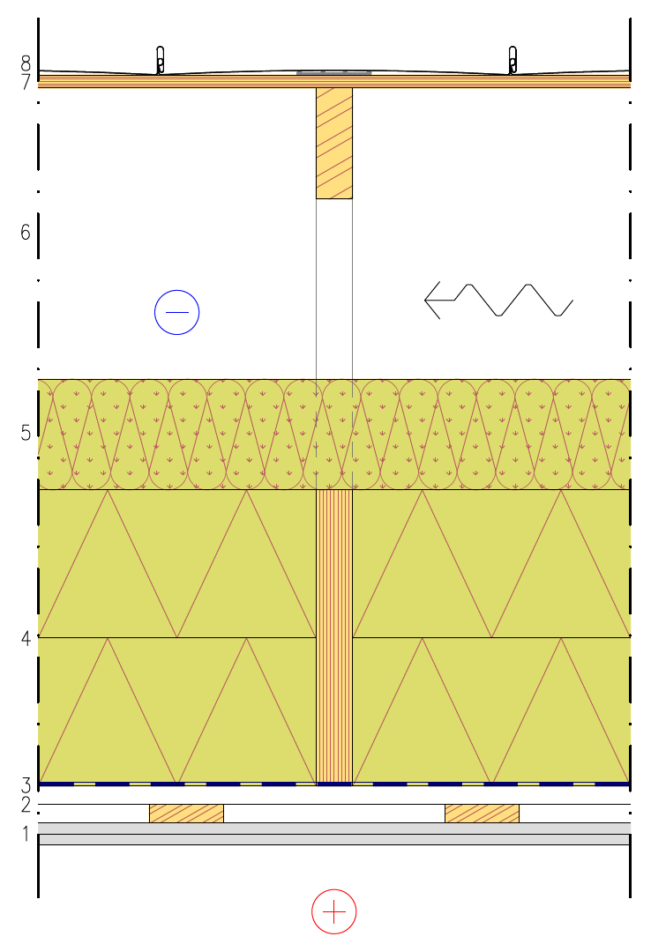
Roof structure
Nail plate truss
The panel on top of the truss is used for
  Bracing
Plasterboards are used for
  Fire protection (fire from underneath)
Rock wool panels are used for
  Fire protection (fire from above)
The height of the beams depends on
  Bending and shearing stress
  Deflection
1 2 x plasterboard
2 Studs in a grid
3 Air and vapour barrier
4 Tie beam + Rock wool panels
5 Mineral wool
6 Nail plate trusses and ventilated attic
7 Spruce plywood or LVL (stiffening plate)
8 Water resistant roof material

Slide 28
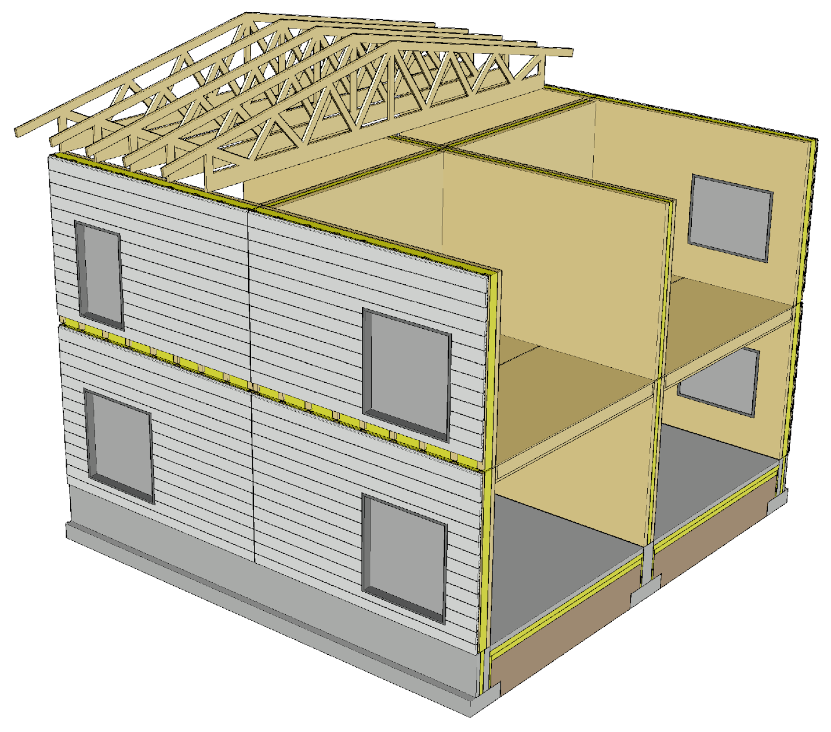
Prefabricated element connections
Exterior cladding with horizontal panels
  Makes it possible to hide horizontal connections between elements
  E.g. balcony partitions can be used to hide vertical connections in horizontal panels
A solid timber panel must not continue across sound insulation walls and intermediate floors (flanking transmission)

Slide 29
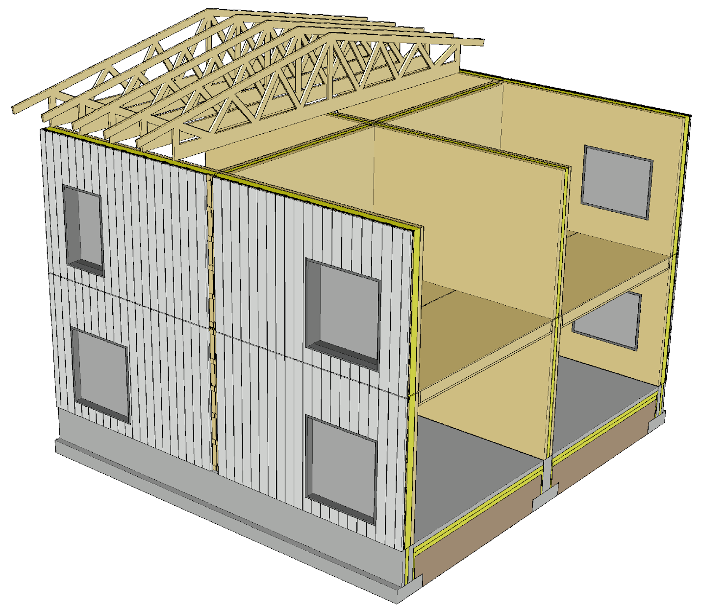
Prefabricated element connections
Exterior cladding with vertical panels
  Makes it possible to hide vertical connections between elements
  E.g. balcony slabs can be used to hide horizontal connections in a vertical panel
A solid timber panel must not continue across sound insulation walls and intermediate floors (flanking transmission)

Slide 30
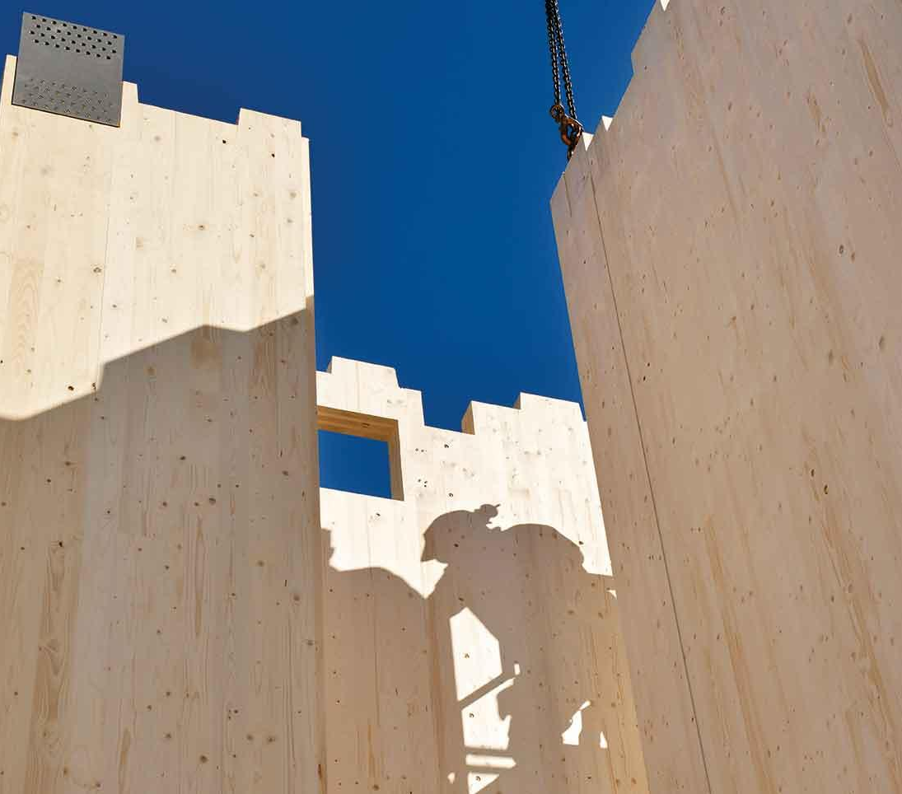
Manufacturing of prefabricated elements
Solid timber panel units are CNC machined
CNC machining increases the price per cubic metre of solid timber panels, but optimally designed machining speeds up installation on site, bringing overall savings
Image: Stora Enso

Slide 31
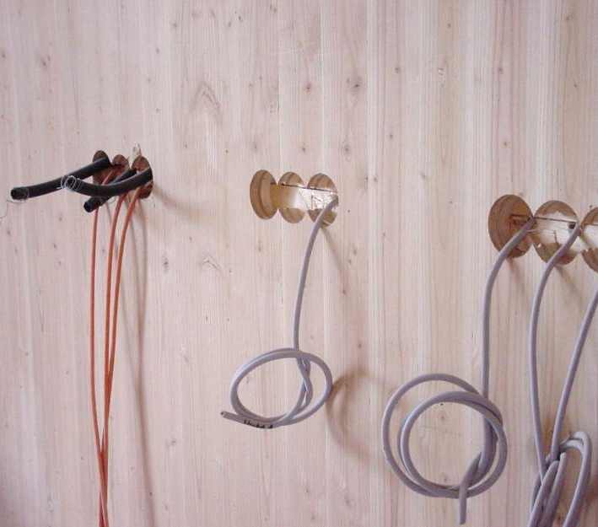
Manufacturing of prefabricated elements
CNC machining is useful for detailing
CNC pre-drilling for screws enables:
  Quick installation of screws
  Correct side and end distances
  Easy quality control
Image: Stora Enso

Slide 32
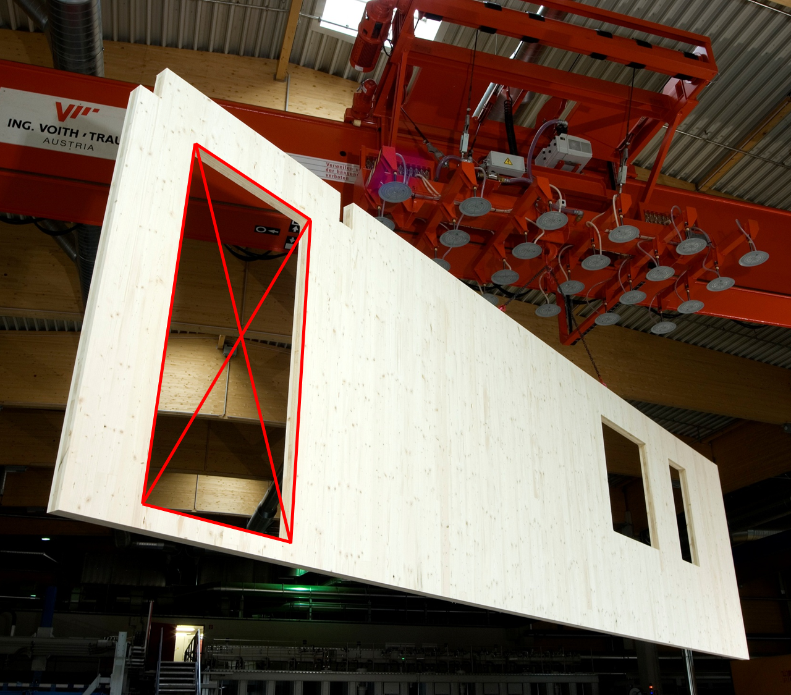
Manufacturing of prefabricated elements
Offcuts from openings are paid by the customer
When designing openings in a solid timber panel, minimising material losses should be considered
Smaller components (stair parts and similar) can be made from large offcuts
Image: Stora Enso

Slide 33
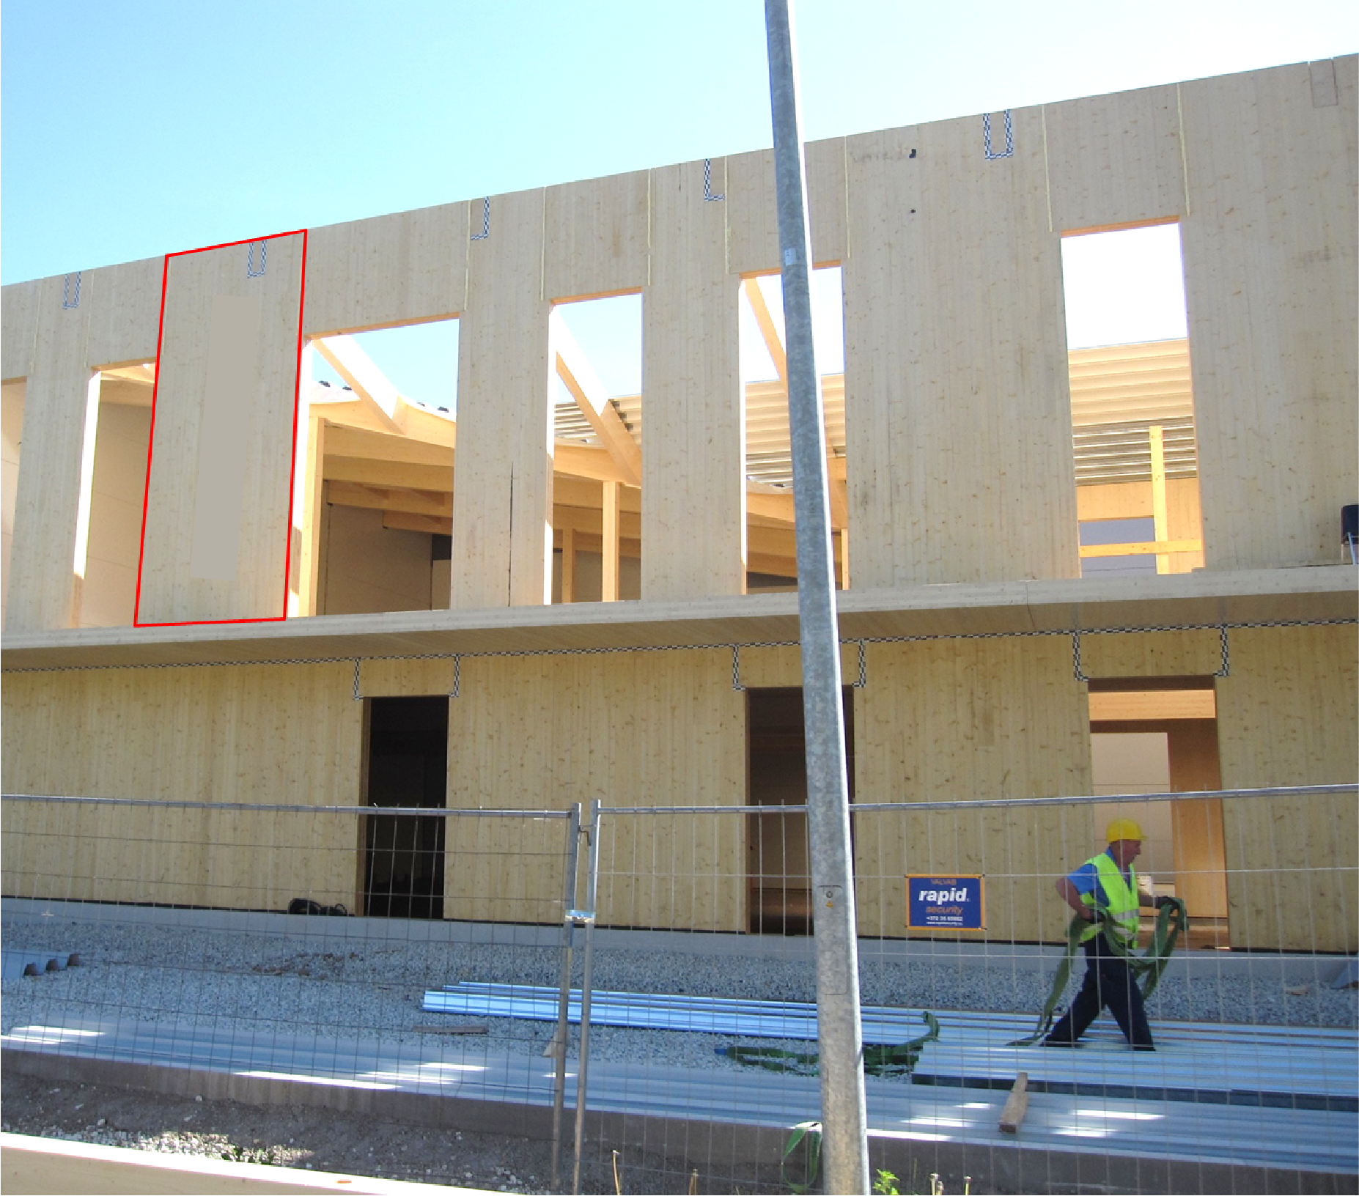
Manufacturing of prefabricated elements
The number of offcuts can be reduced by using separate pieces for spanning openings
Separate opening pieces affect wall appearance in a visible surface and wall bracing capacity
Offcuts are connected with the wall using half-lap joints and screws
Installed CLT panel
Image: Stora Enso
Image: Tero Lahtela

Slide 34
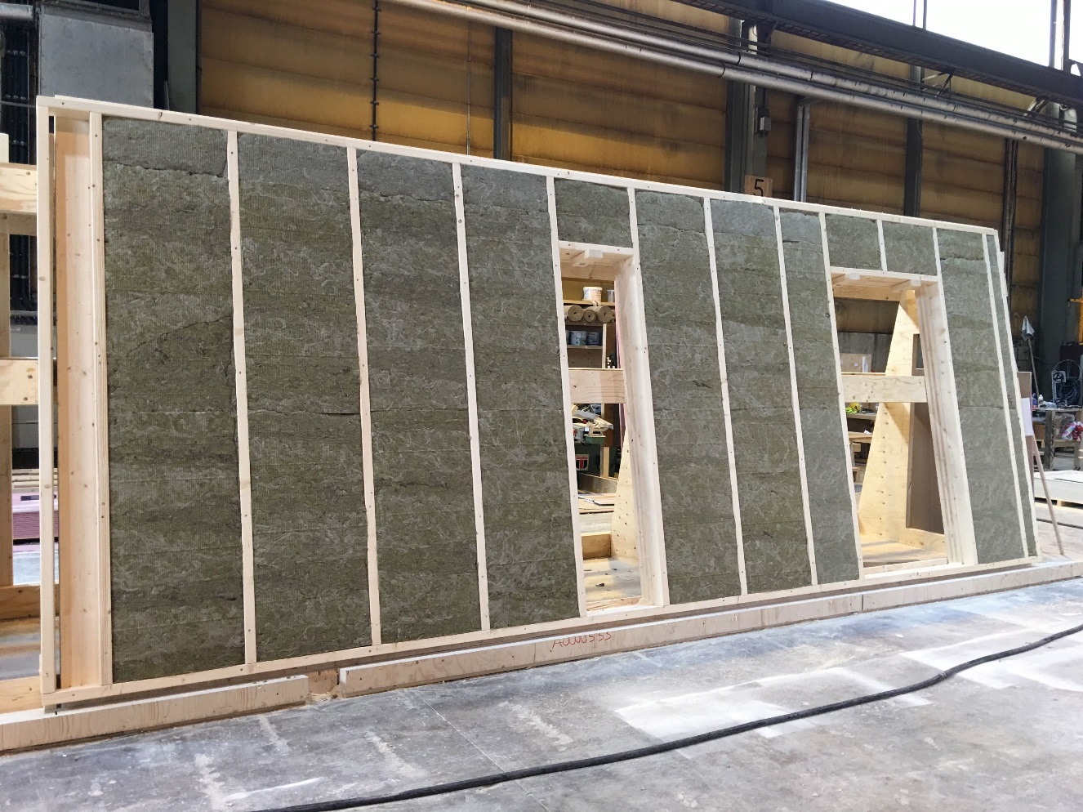
Manufacturing of prefabricated elements
Plane elements with solid timber panel structure can be equipped at the factory
For example, exterior wall elements can be factory equipped with thermal insulation, windows, doors, exterior cladding , etc.
Image: Tero Lahtela

Slide 35
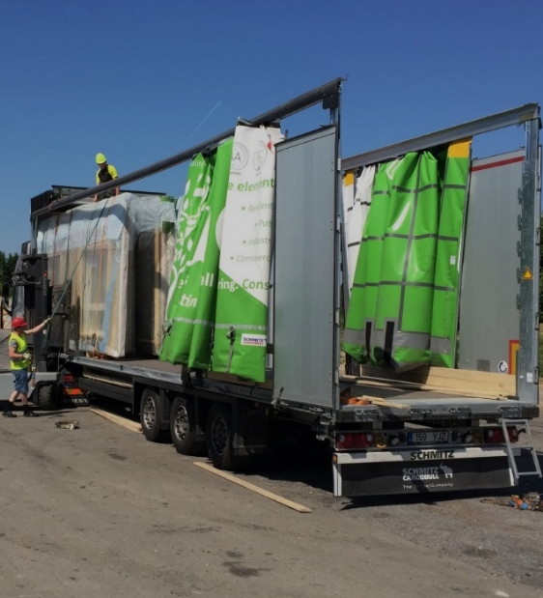
Transport of solid timber panels
2450
Solid timber panel elements 2,400…2,450 mm in width can be transported normally
Special vehicles are used for units higher than 3 m (lowered chassis)
Covered transport equipment can be used to reduce the accumulation of protective plastic at the construction site
13600
3000
Image: Tero Lahtela

Slide 36
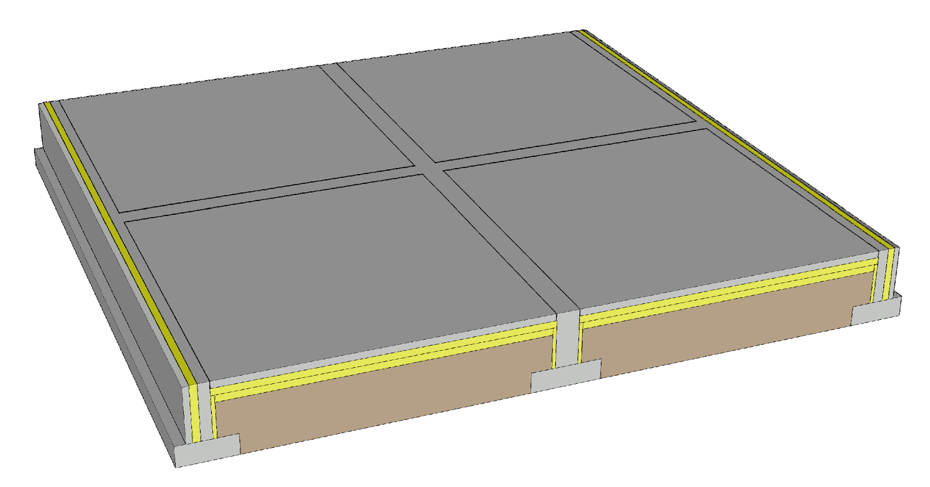
Foundation for solid timber panel elements
A continuous foundation is needed under load-bearing solid timber walls
Foundation types
  Ground-supported shallow foundation
  Ventilated base floor
  Basement
Challenges
  Junction between the wall and the foundation
  Vertical dimensional accuracy of the foundation

Slide 37
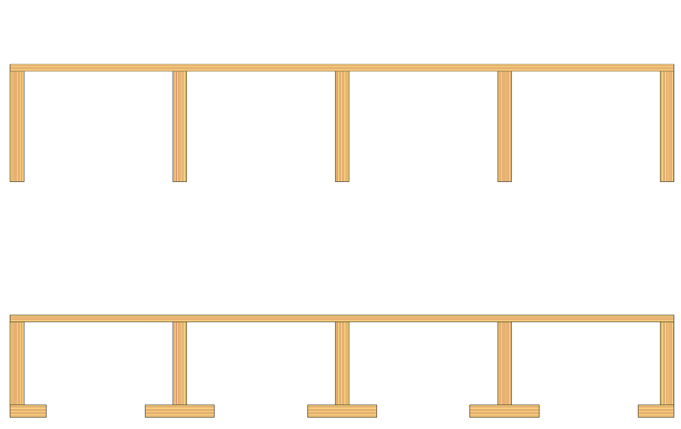
Span of intermediate floor with frame structure
The span of the intermediate floor is usually determined by vibration design
  Vibration caused by walking
When using an industrially manufactured glued LVL rib panel or LVL semi-open rib panel, the span is L ≤ 7 m
Industrially manufactured rib panel Structural gluing
Industrially manufactured semi-open rib panel Structural gluing

Slide 38
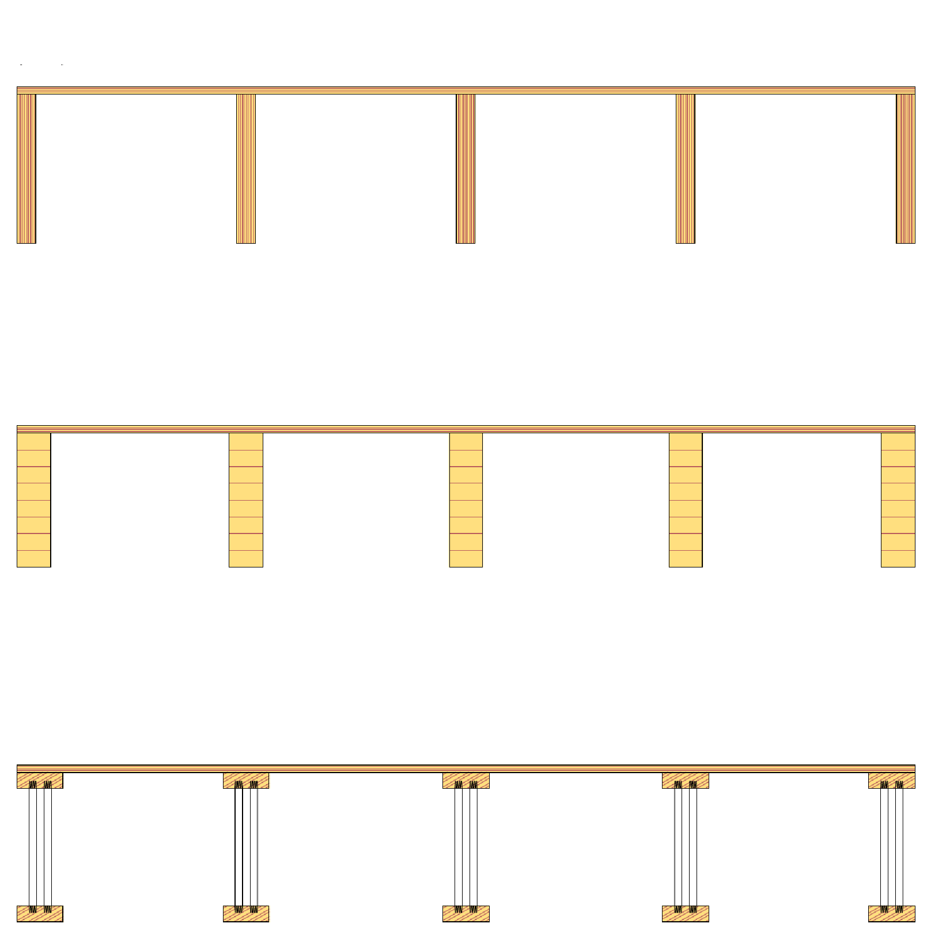
Span of intermediate floor with frame structure
Intermediate floor unit with beam structure
(LVL)
The span of the intermediate floor is usually determined by vibration design
  Vibration caused by walking
When using an intermediate floor with beam structure, the span is L ≤ 6 m
Intermediate floor unit with beam structure (glulam timber)
Intermediate floor unit with beam structure (industrially manufactured glued truss)

Slide 39
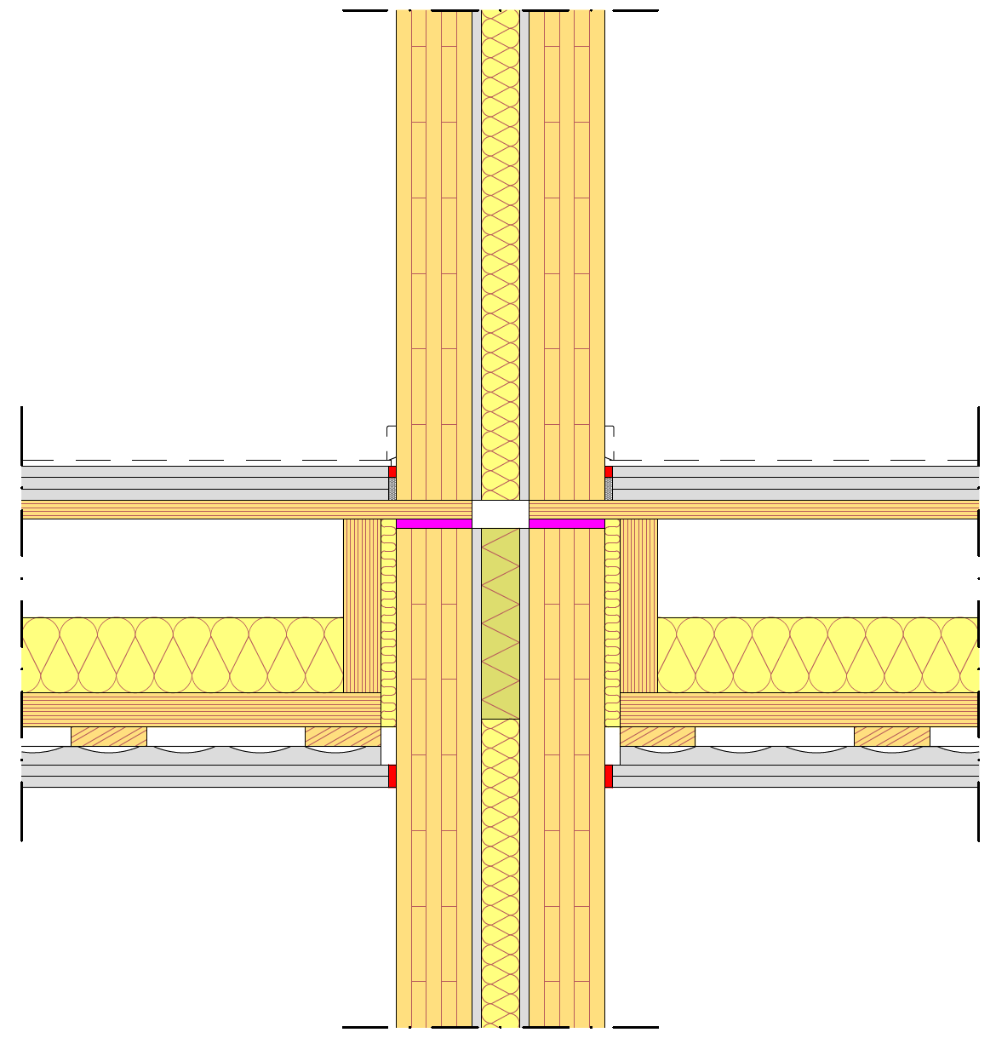
Supporting an intermediate floor with frame structure
Industrially manufactured glued LVL rib panels and LVL semi-open rib panels are supported by the top surface panel
Issues that always require attention in the support area in general
  Fire technical issues
  Acoustics (flanking transmission)
  Vertical load-bearing capacity
  Minimisation of settlement
  Horizontal load transmission
  Preventing progressive collapse

Slide 40
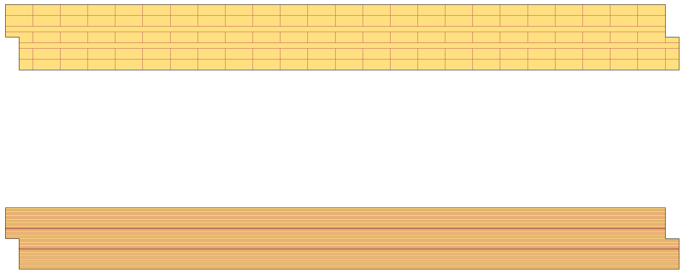
Span of solid timber panel intermediate floor
The span of the intermediate floor is usually determined by vibration design
  Vibration caused by walking
When using an intermediate floor with solid timber panel structure, the span is L ≤ 6 m

Slide 41
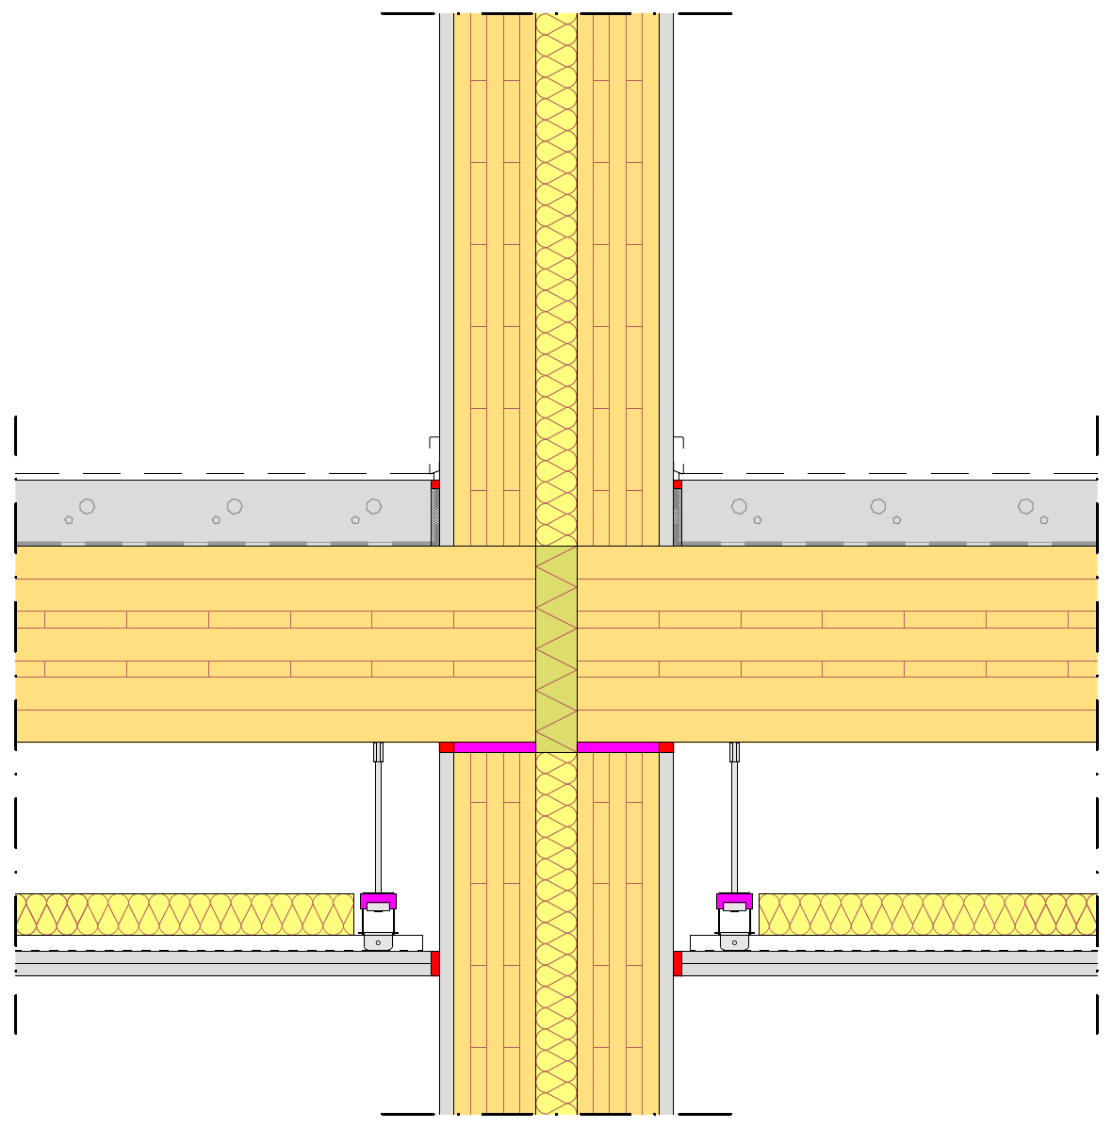
Supporting a solid timber panel intermediate floor
A solid timber panel intermediate floor is usually supported from top of the wall
Issues that always require attention in the support area in general
  Fire technical issues
  Acoustics (flanking transmission)
  Vertical load-bearing capacity
  Minimisation of settlement
  Horizontal load transmission
  Preventing progressive collapse

Slide 42
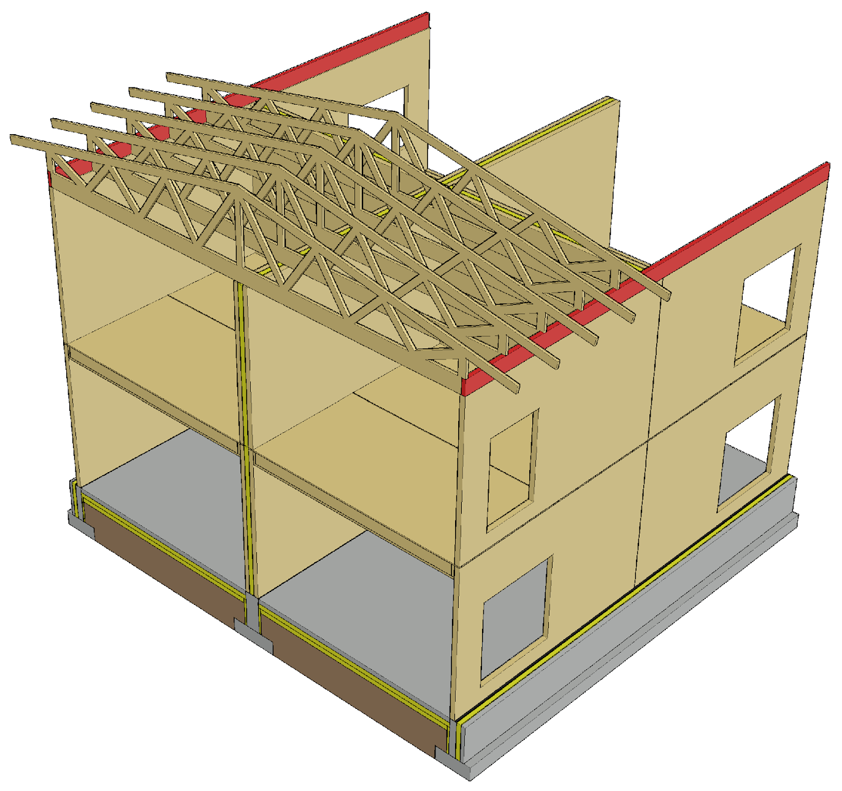
Supporting nail plate trusses
Cross-veneered LVL beam notched for nail plate truss on top of the wall
A cross-veneered LVL beam enables high bearing pressure tolerance for the nail plate truss
An LVL beam notched for nail plate trusses can be used as a lifting beam when a roof with nail plate trusses is built as prefabricated blocks
Fixing the LVL beam on top of the wall is a challenge

Slide 43
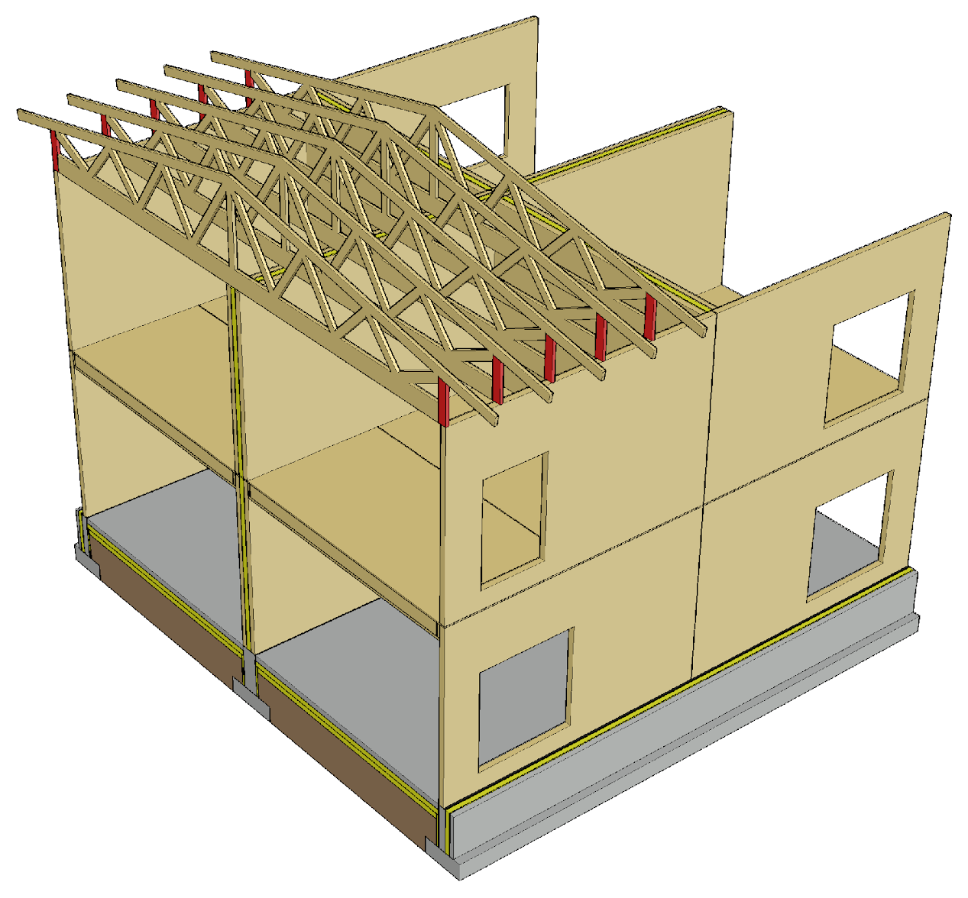
Supporting nail plate trusses
Nail plate trusses can be supported directly on top of a solid timber panel wall
In a CLT panel, only the vertical lamellae can be accounted for in the bearing pressure design
The vertical strut of the nail plate truss end can be designed to provide a supporting surface (f_{c,0,d})

Slide 44
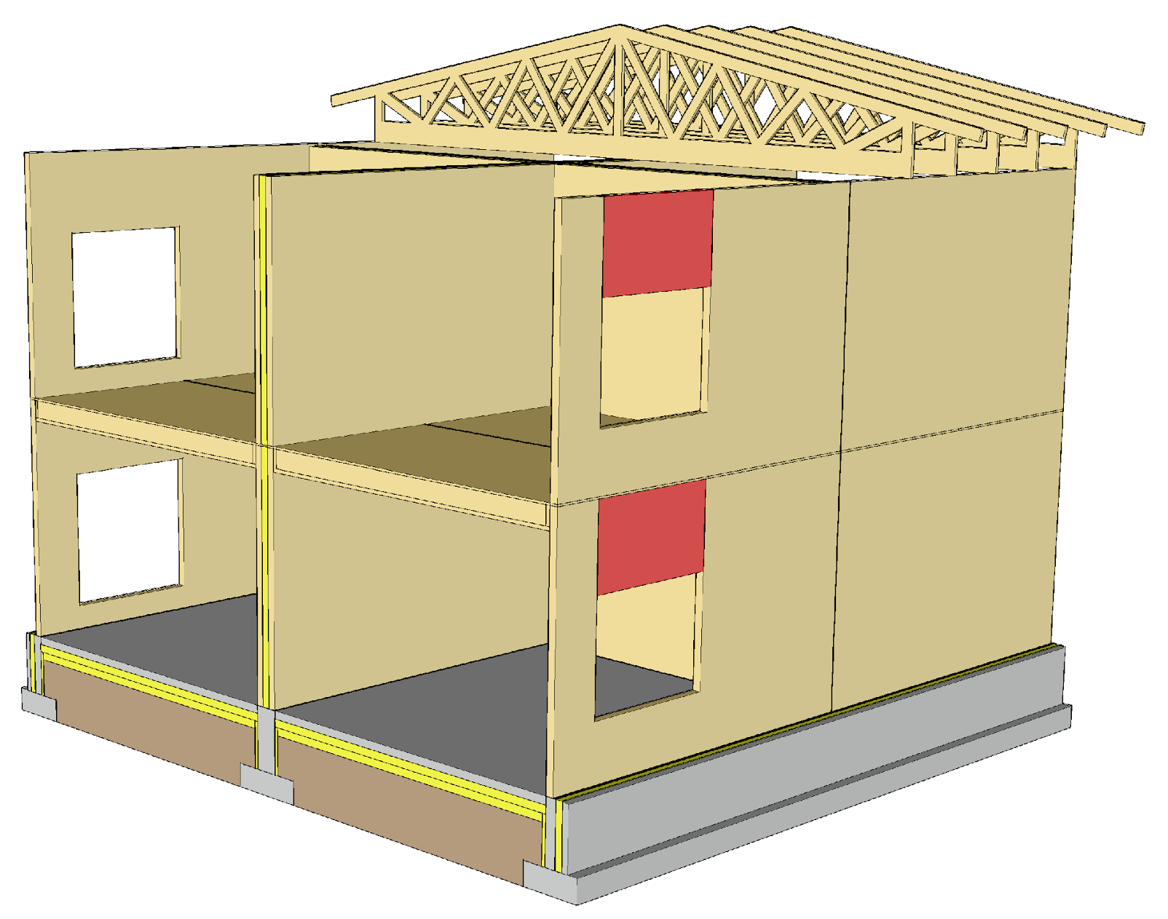
Coupling beam
For spanning openings, a solid timber panel is dimensioned as a beam
A separate solid timber beam can be used for spanning openings, making it possible to minimise the waste generated by offcuts

Slide 45
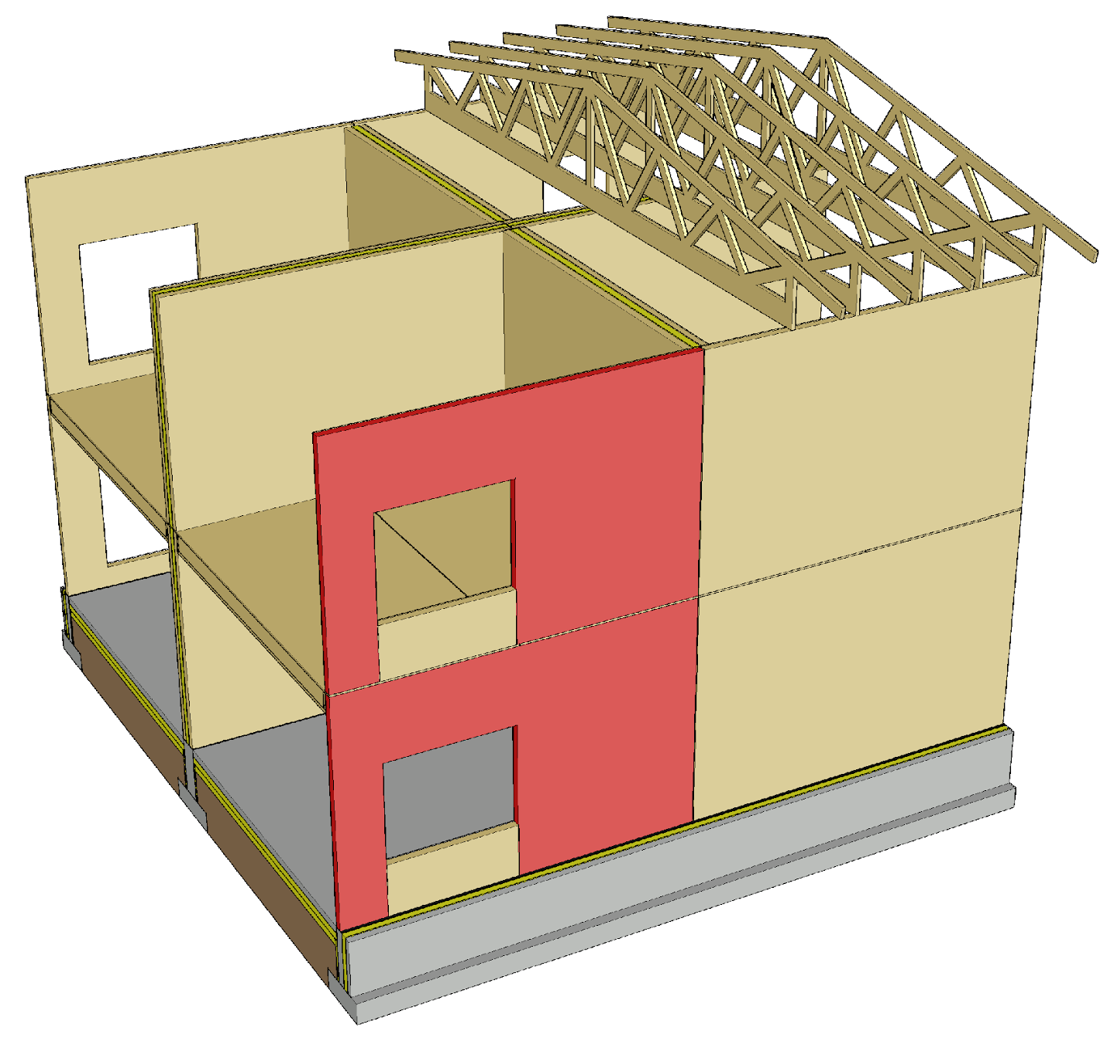
Vertical load transfer
Stacked solid timber panel walls cause linear loading on each other (kN/m)
A sufficiently wide strip of panel (buckling resistance) should be left in the jambs of the openings

Slide 46
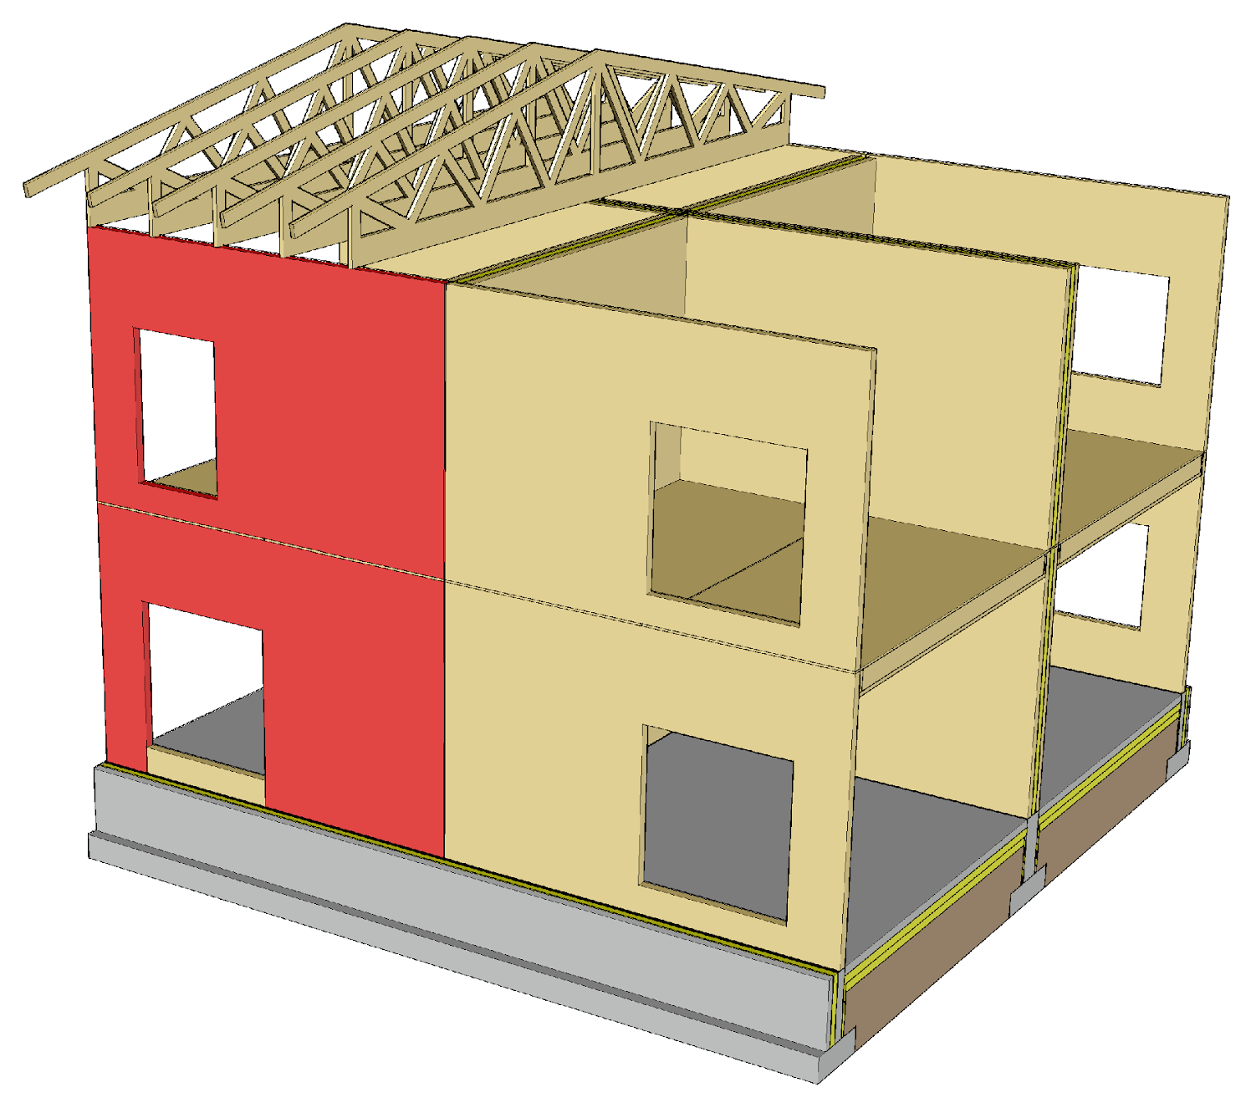
Vertical load transfer
A wall made with a continuous solid timber panel can be dimensioned as a wall-like beam
A wall made with a continuous solid timber panel enables more free placement of openings on top of each other

Slide 47
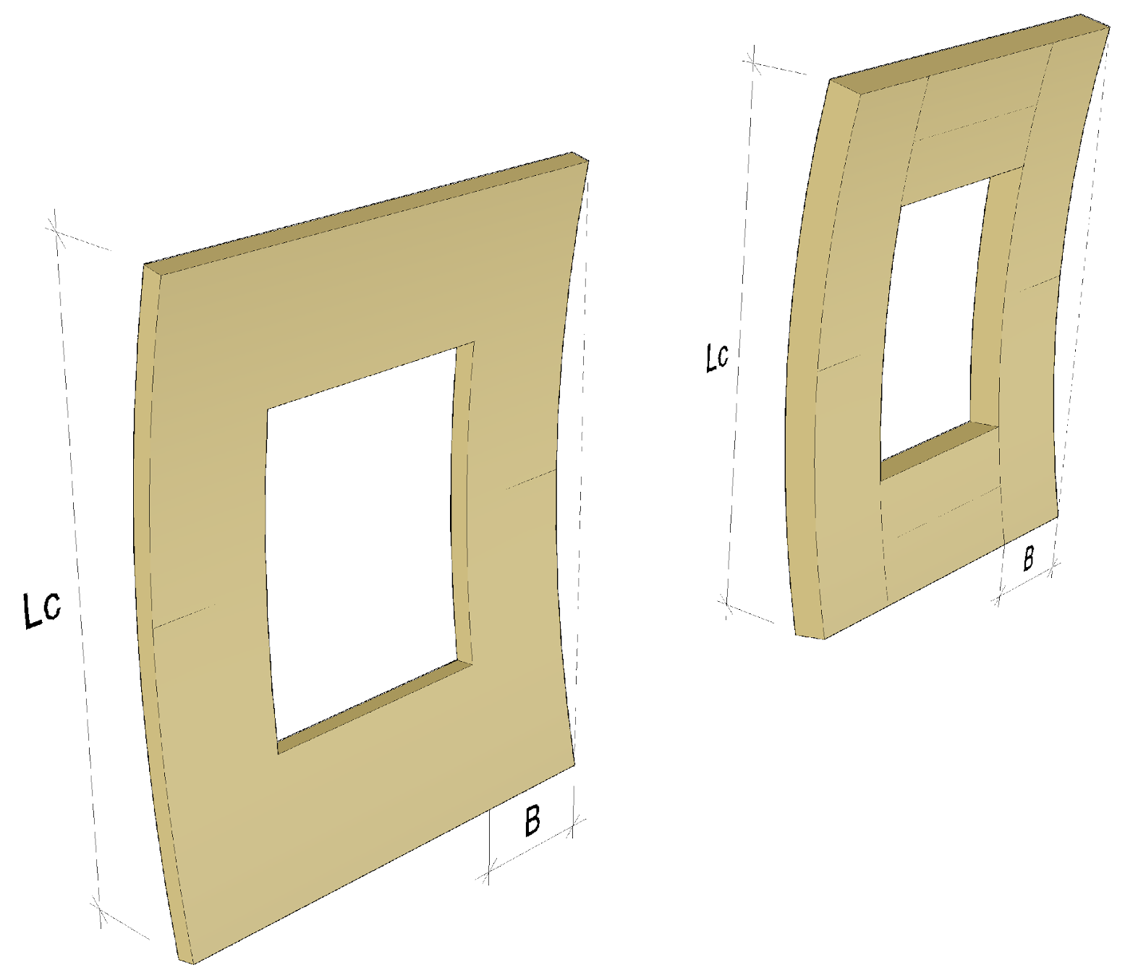
Buckling of solid timber panel out of plane
The buckling resistance of a solid timber panel can be increased by
  Using a thicker panel
  A laminated structure
The thicker the vertical lamellae on the edges of the panel cross-section are, the greater the buckling resistance of the panel

Slide 48
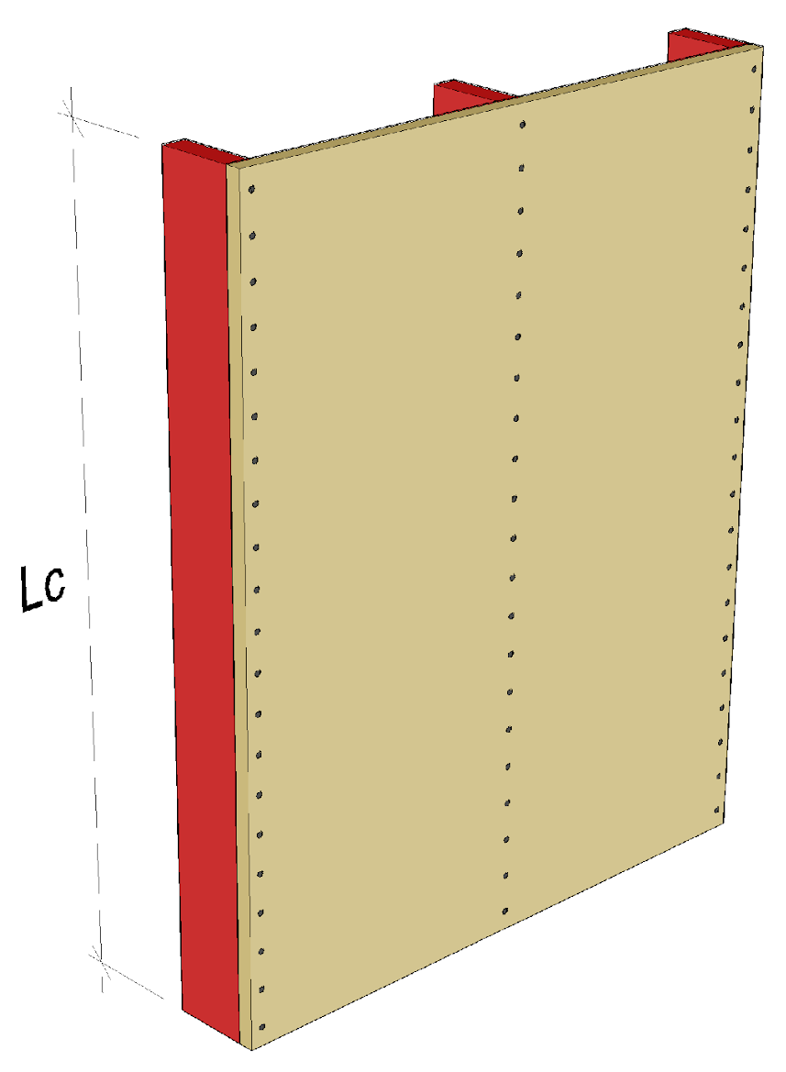
Buckling of solid timber panel out of plane
The buckling resistance of a thin solid timber panel wall can be increased by implementing the cross-section as a rib panel

Slide 49
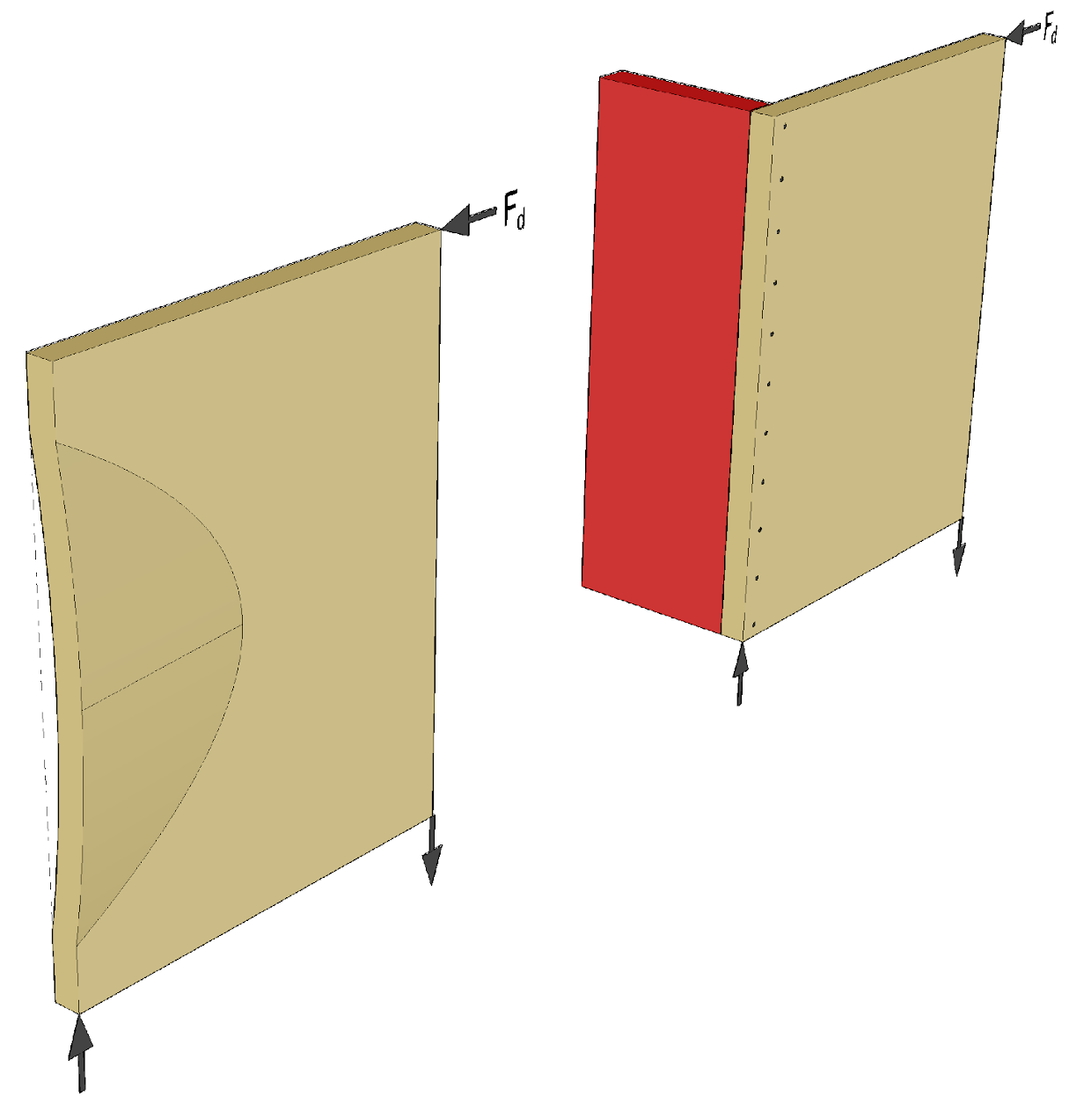
Local buckling of solid timber panel
Local buckling may occur in a stiffening solid timber panel wall as a result of shearing force
Local buckling can be prevented by transverse stiffening

Slide 50
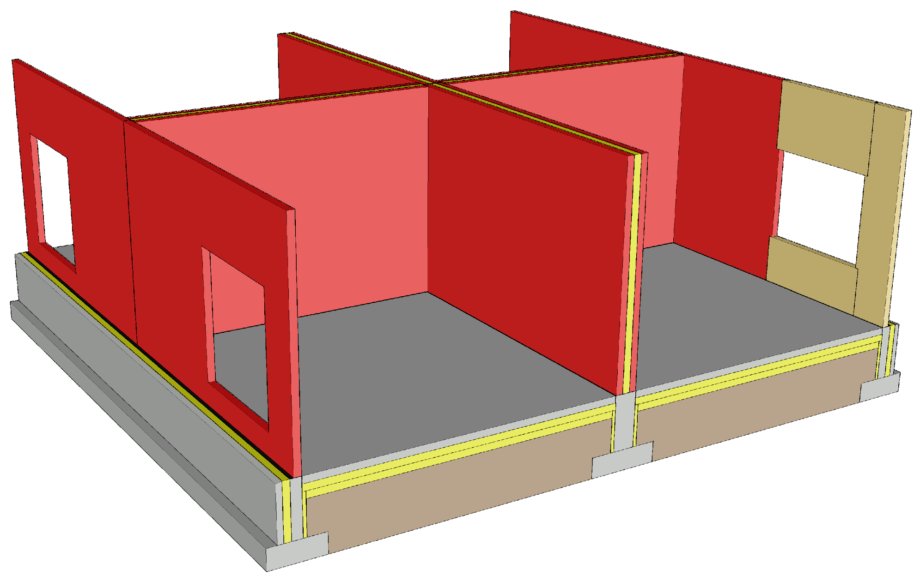
Building bracing principle
Solid timber panel walls are designed to function as stiffening plates
A wall made with a continuous solid timber panel can be designed to function as a stiffener, where also the underside and top of an opening are stiffeners
In a wall assembled from elements, the underside and top or narrow jambs of openings do not function as stiffeners
Wall assembled from elements

Slide 51
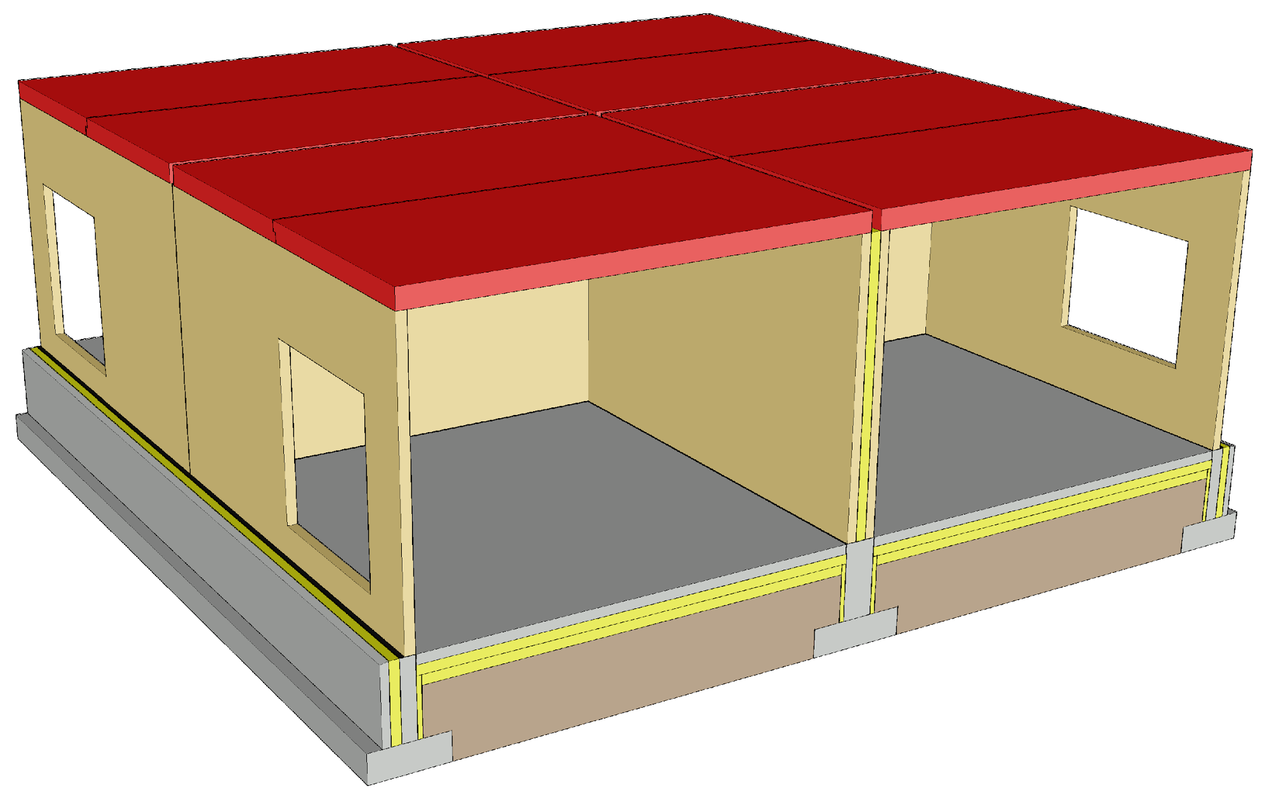
Building bracing principle
Solid timber panel intermediate floors are designed to function as stiffening plates
The intermediate floors must be cut off at the walls between flats (acoustics and vibration)
Stiffening intermediate floors that are the size of flats must be interlinked, creating a uniform space

Slide 52
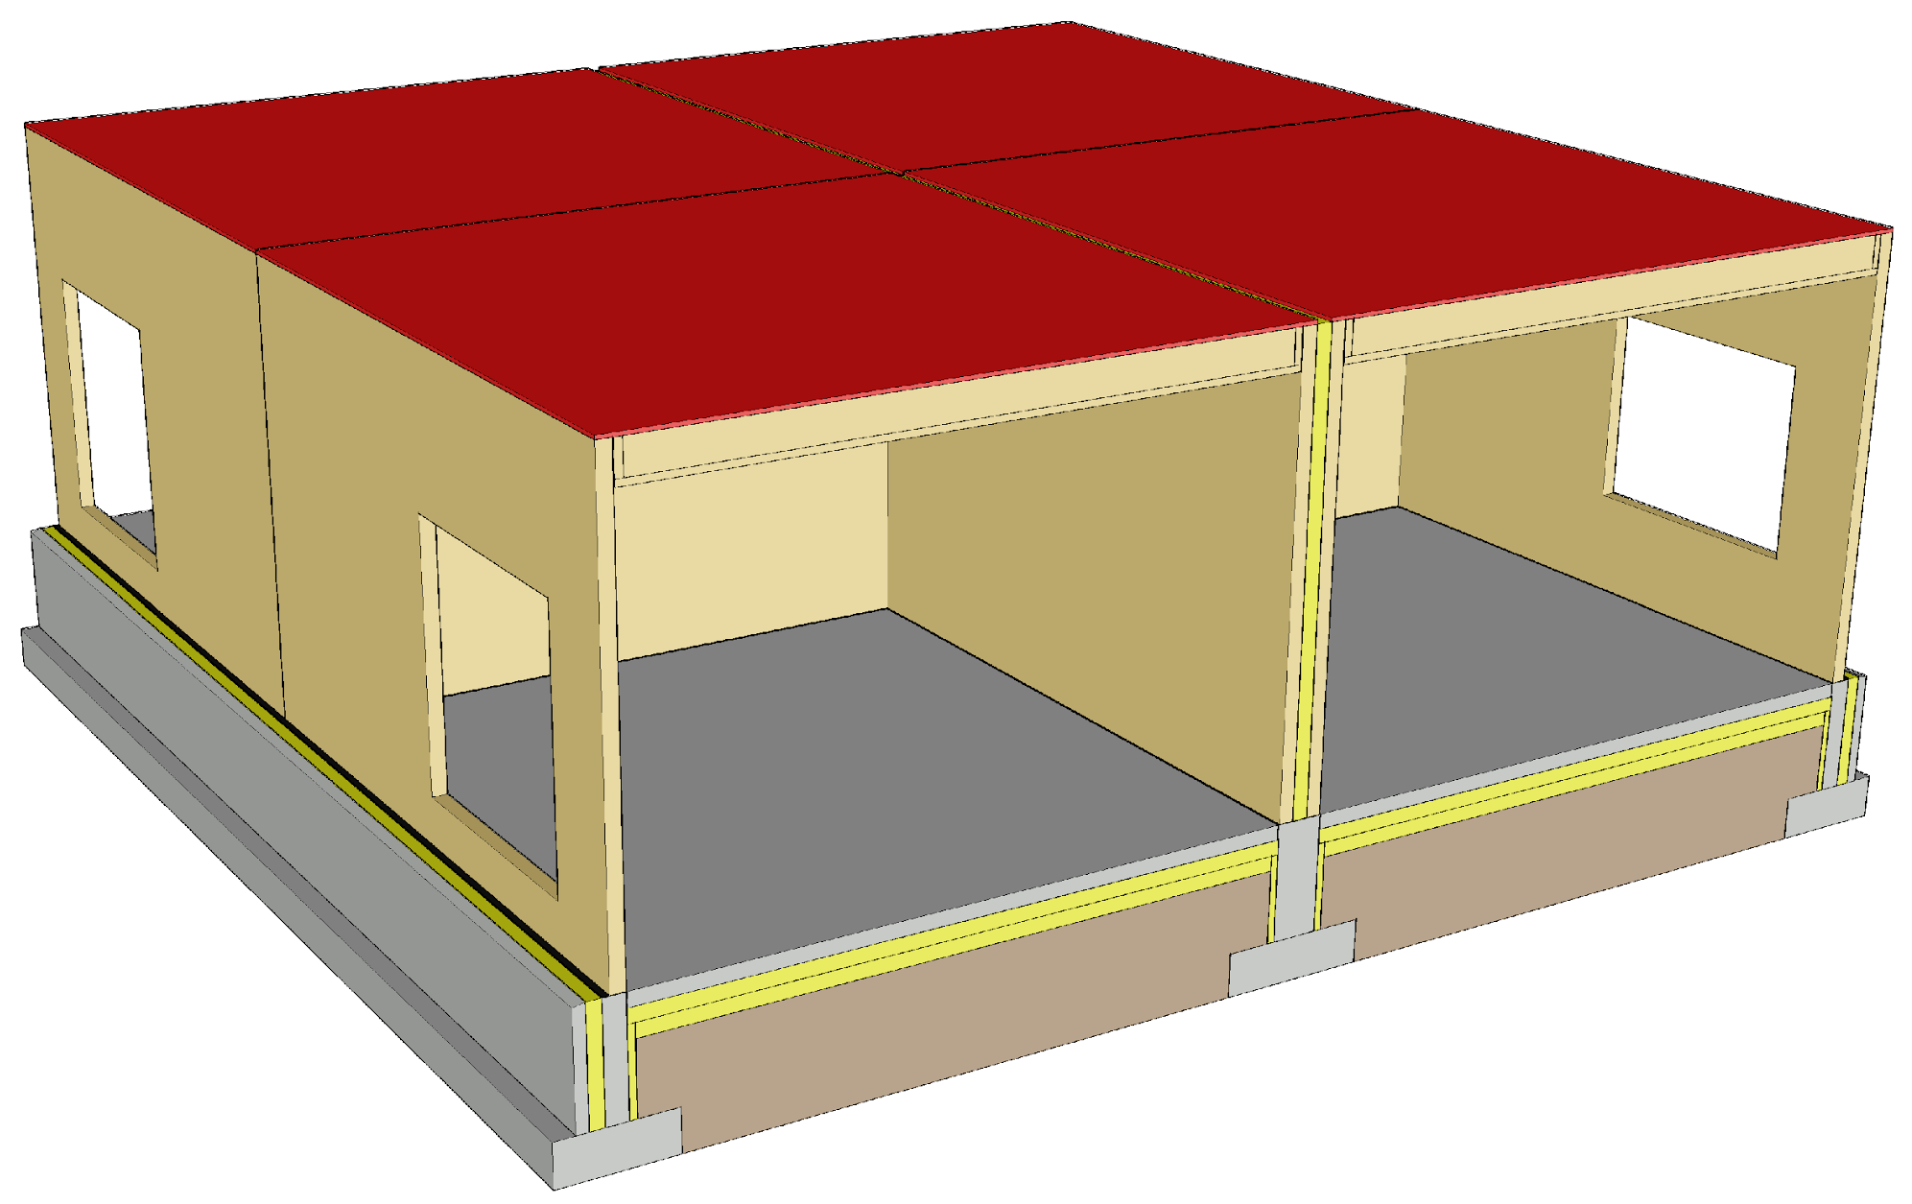
Building bracing principle
In an intermediate floor with beam structure, the plates on top of the beams function as stiffening plates
The intermediate floors must be cut off at the walls between flats (acoustics and vibration)
Stiffening intermediate floors that are the size of flats must be interlinked, creating a uniform space

Slide 53
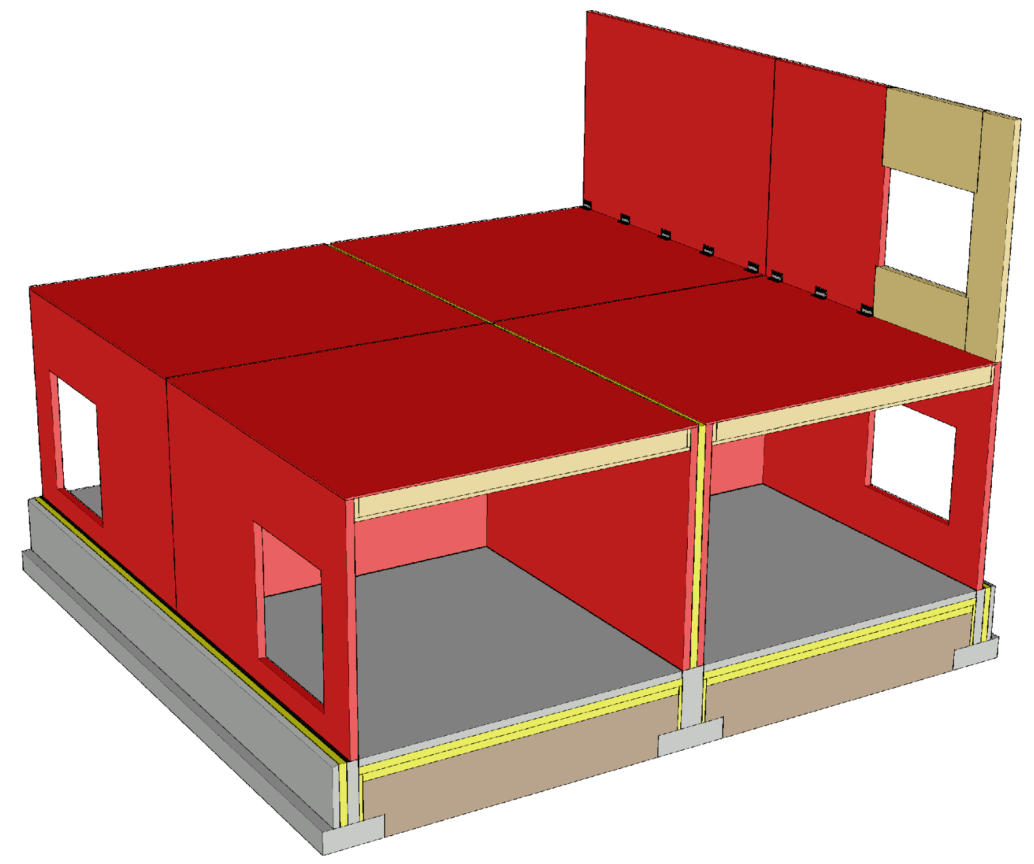
Building bracing principle
The wall structures should be as long as possible to reduce anchoring forces
The stiffening walls should be placed as evenly as possible throughout the building
Image: Tero Lahtela

Slide 54
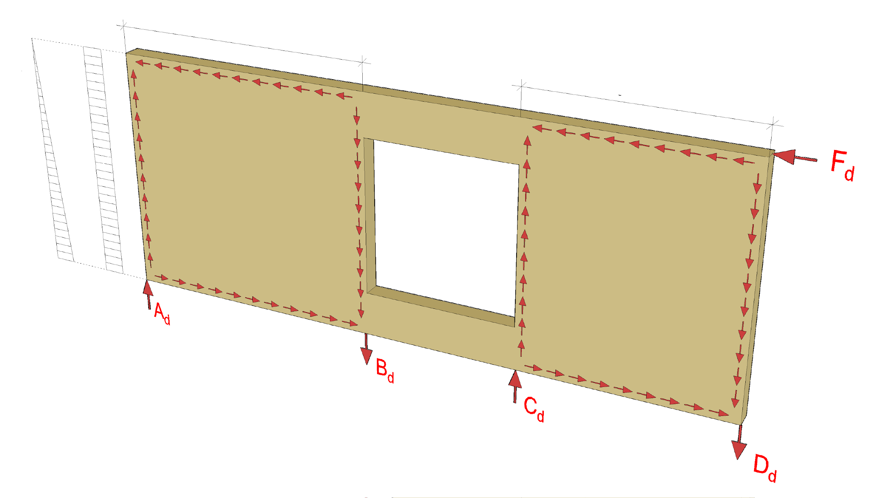
How a stiffening wall works
Stiffener 1
Stiffener 2
M surface with force F_{d}
Q surface with force F_{d}
Image: Tero Lahtela

Slide 55

How a stiffening wall works
Stiffener
M surface with force F_{d}
Q surface with force F_{d}
Image: Tero Lahtela

Slide 56
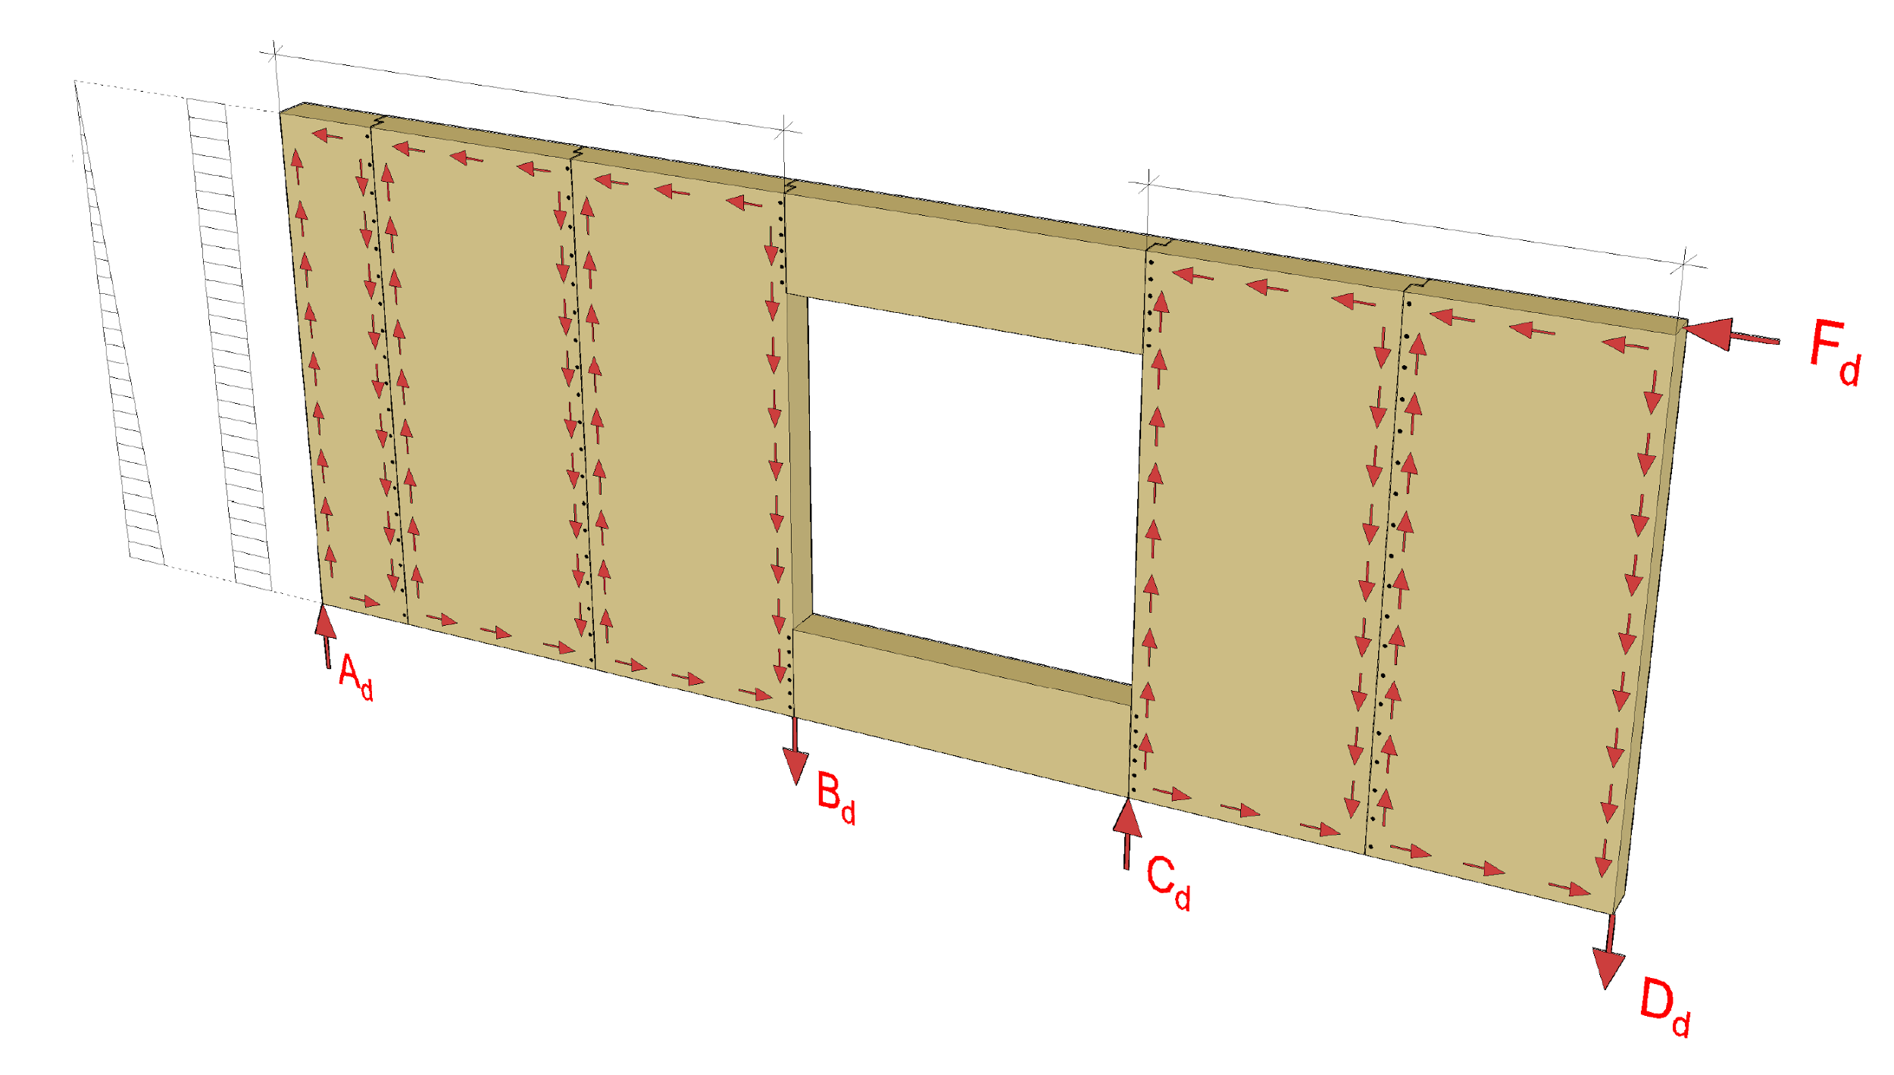
How a stiffening wall works
Stiffener 1
Stiffener 2
M surface with force F_{d}
Q surface with force F_{d}
Image: Tero Lahtela

Slide 57
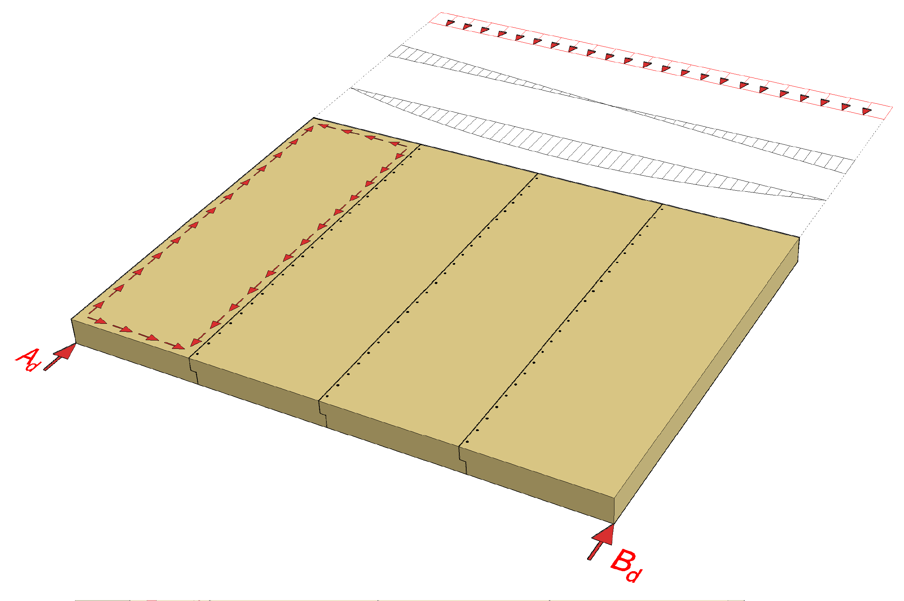
How a stiffening intermediate floor works
Loading
Q surface of loading
M surface of loading
Image: Tero Lahtela

Slide 58
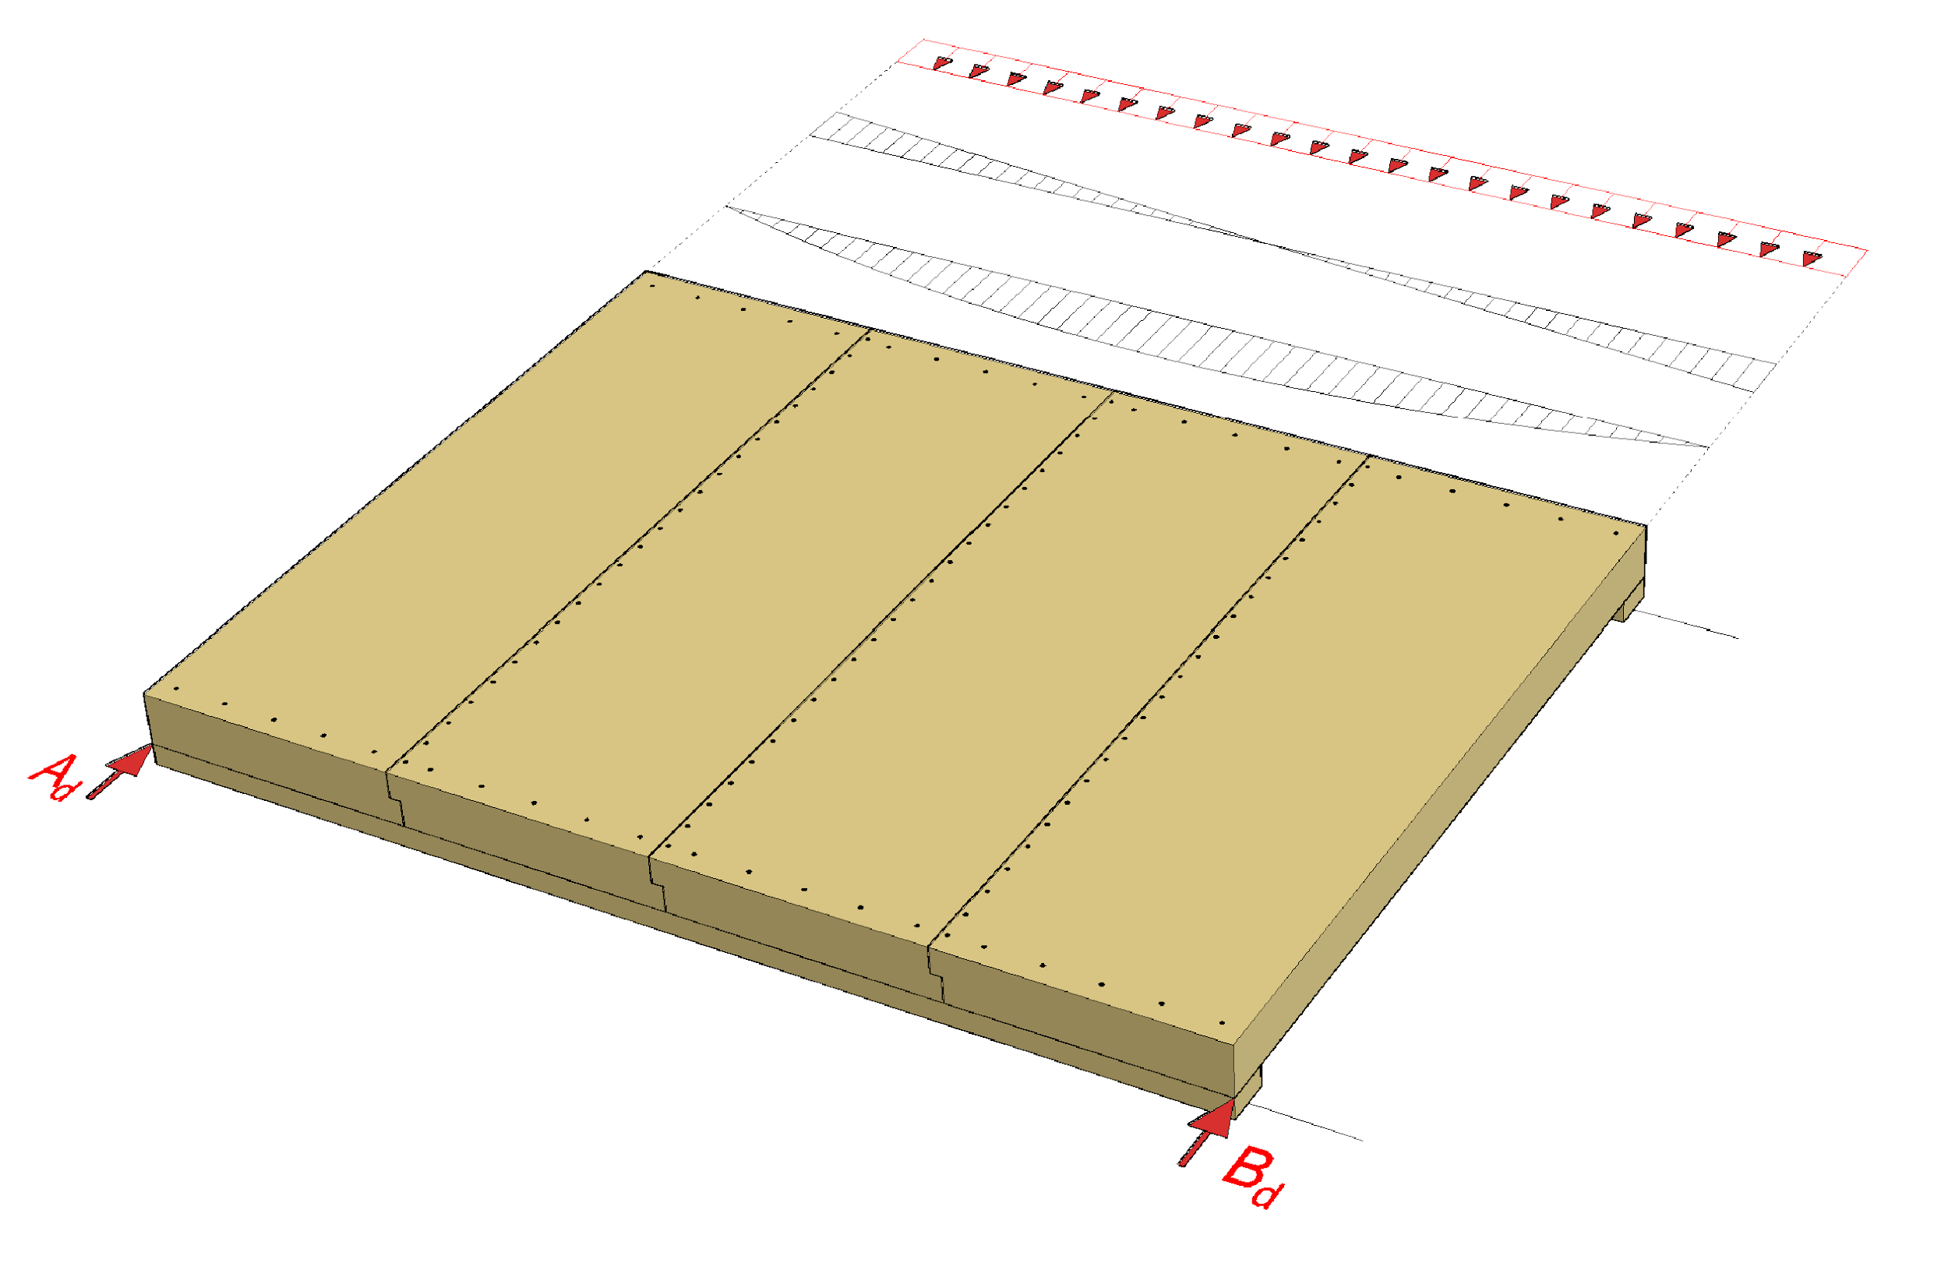
How a stiffening intermediate floor works
Loading
Q surface of loading
M surface of loading
Chord
Chord
Image: Tero Lahtela

Slide 59
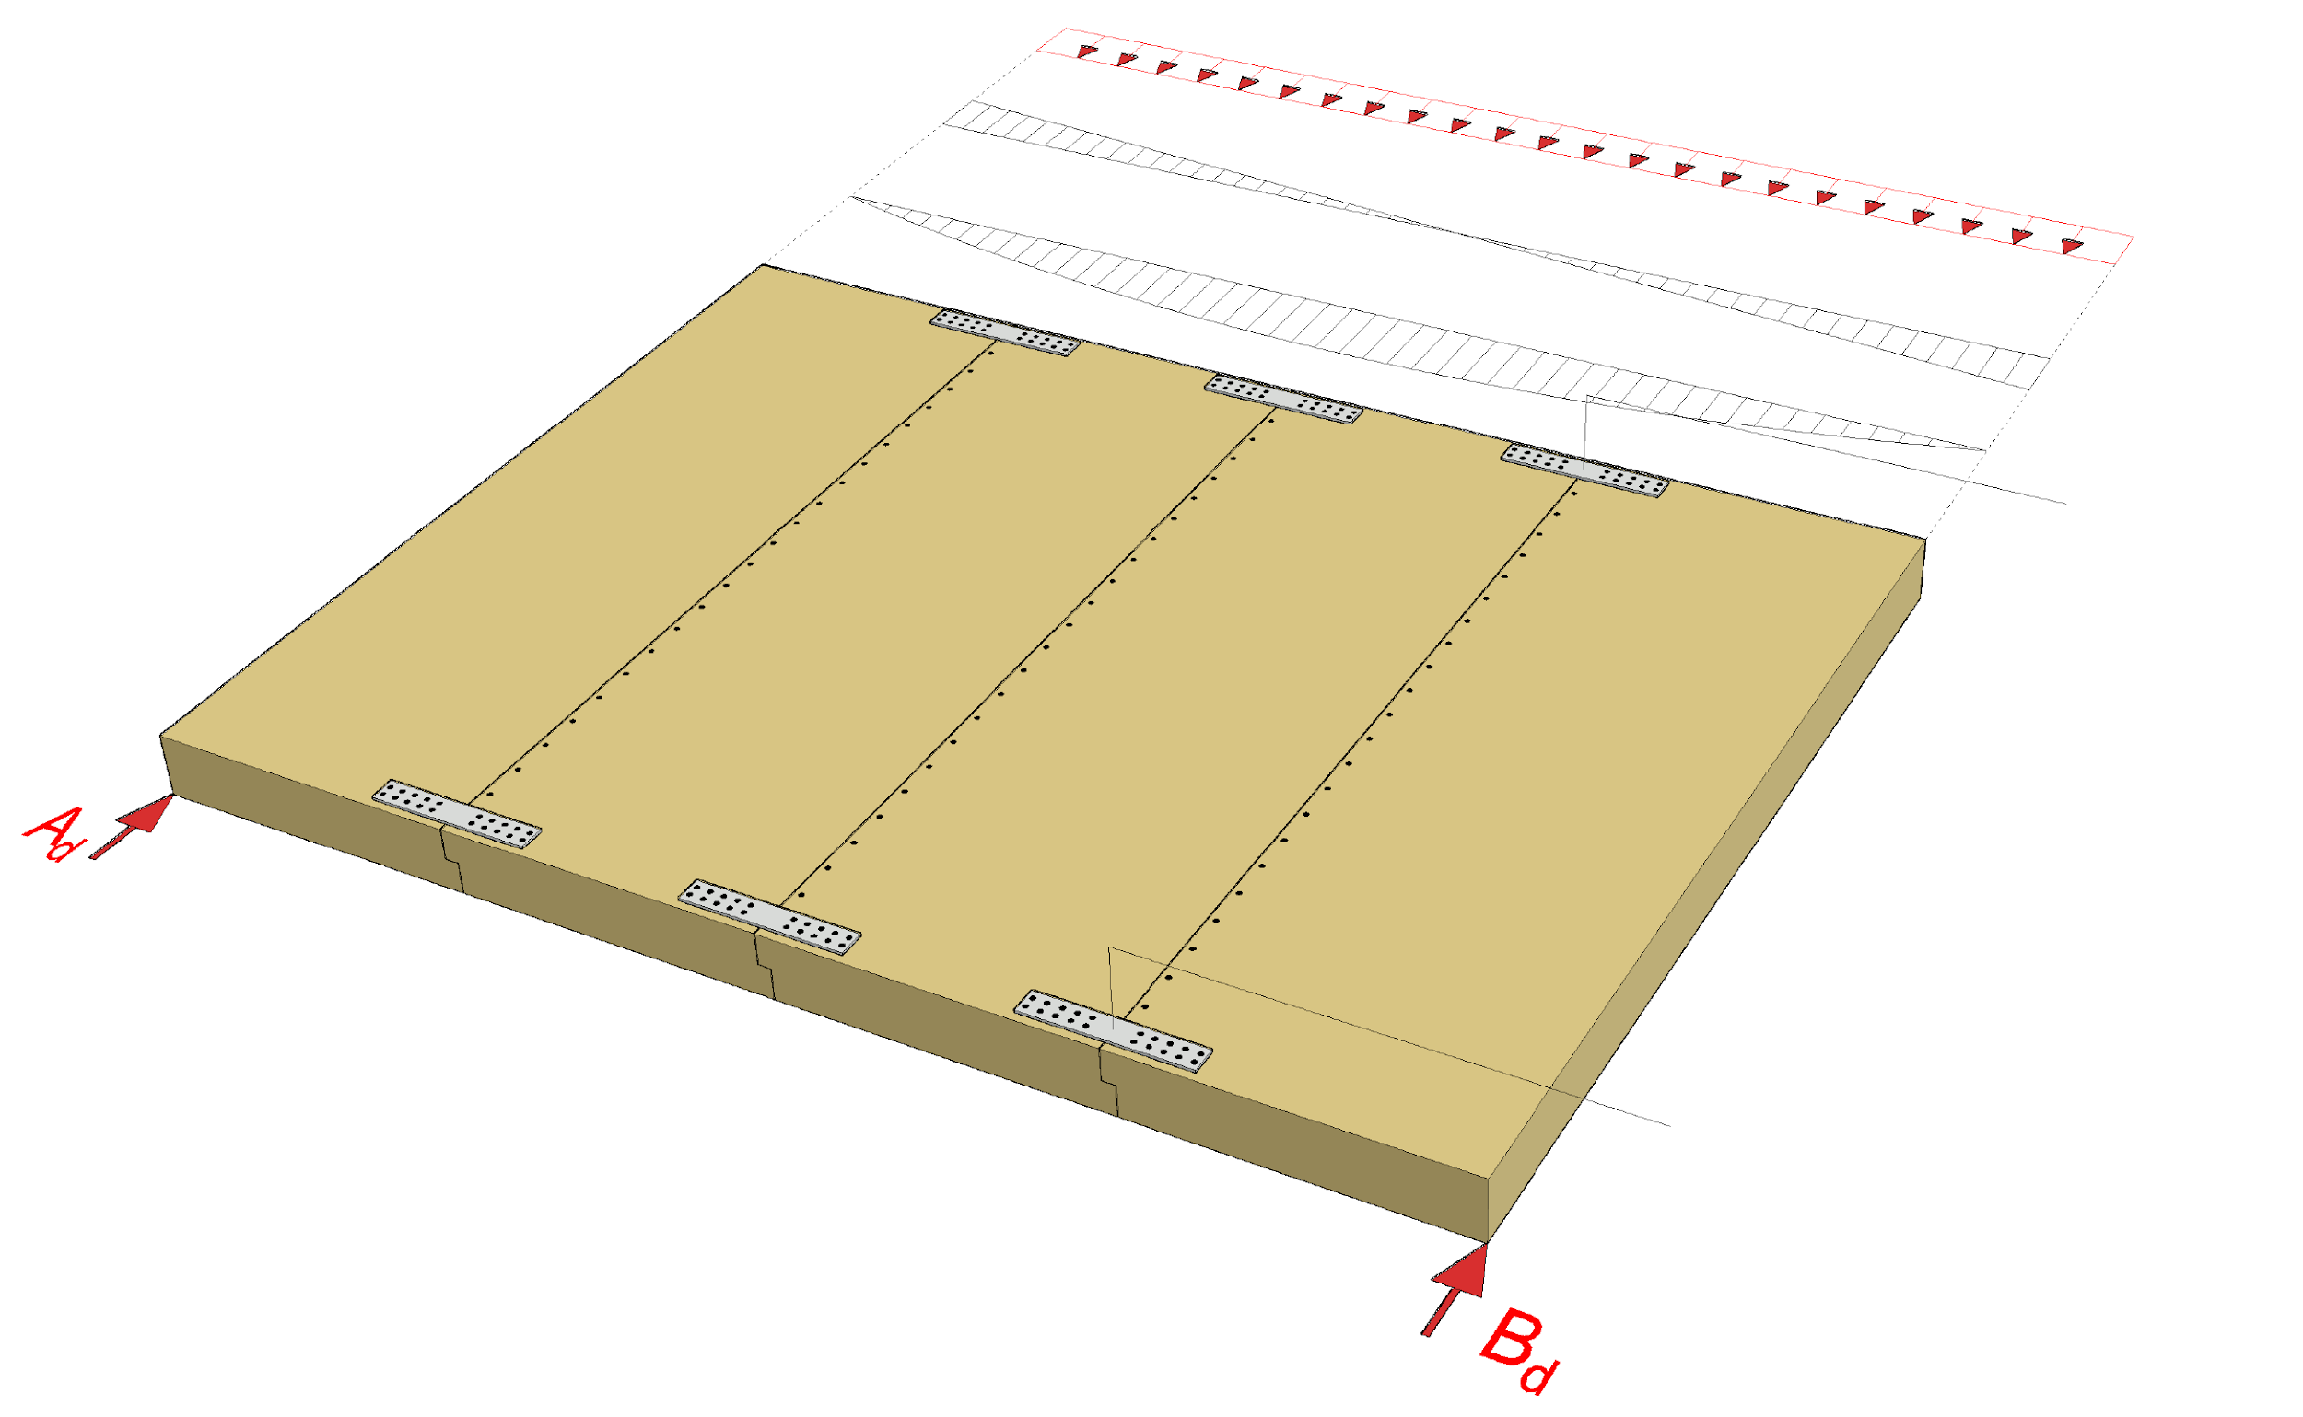
How a stiffening intermediate floor works
Loading
Q surface of loading
M surface of loading
Chord
Chord
Image: Tero Lahtela

Slide 60
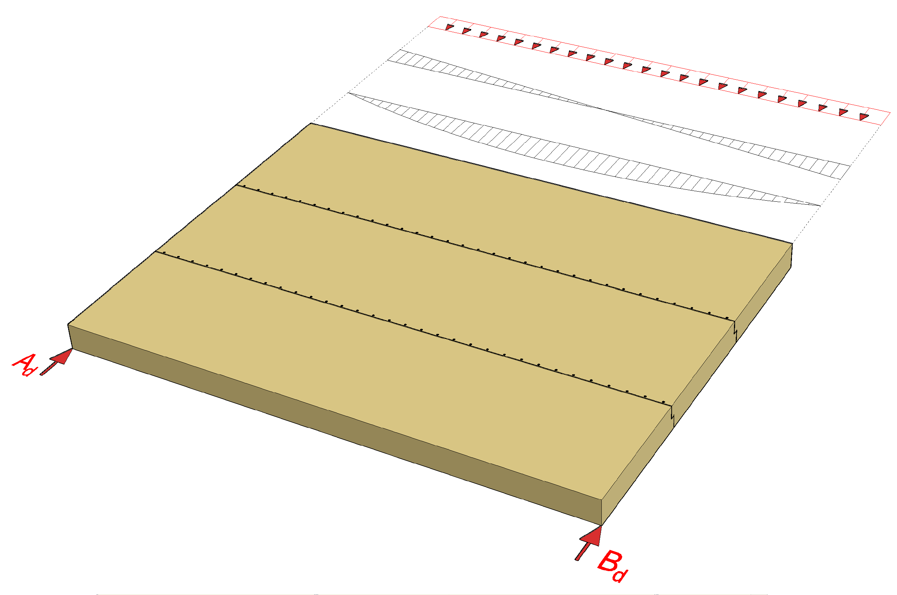
How a stiffening intermediate floor works
Loading
Q surface of loading
M surface of loading
Image: Tero Lahtela

Slide 61
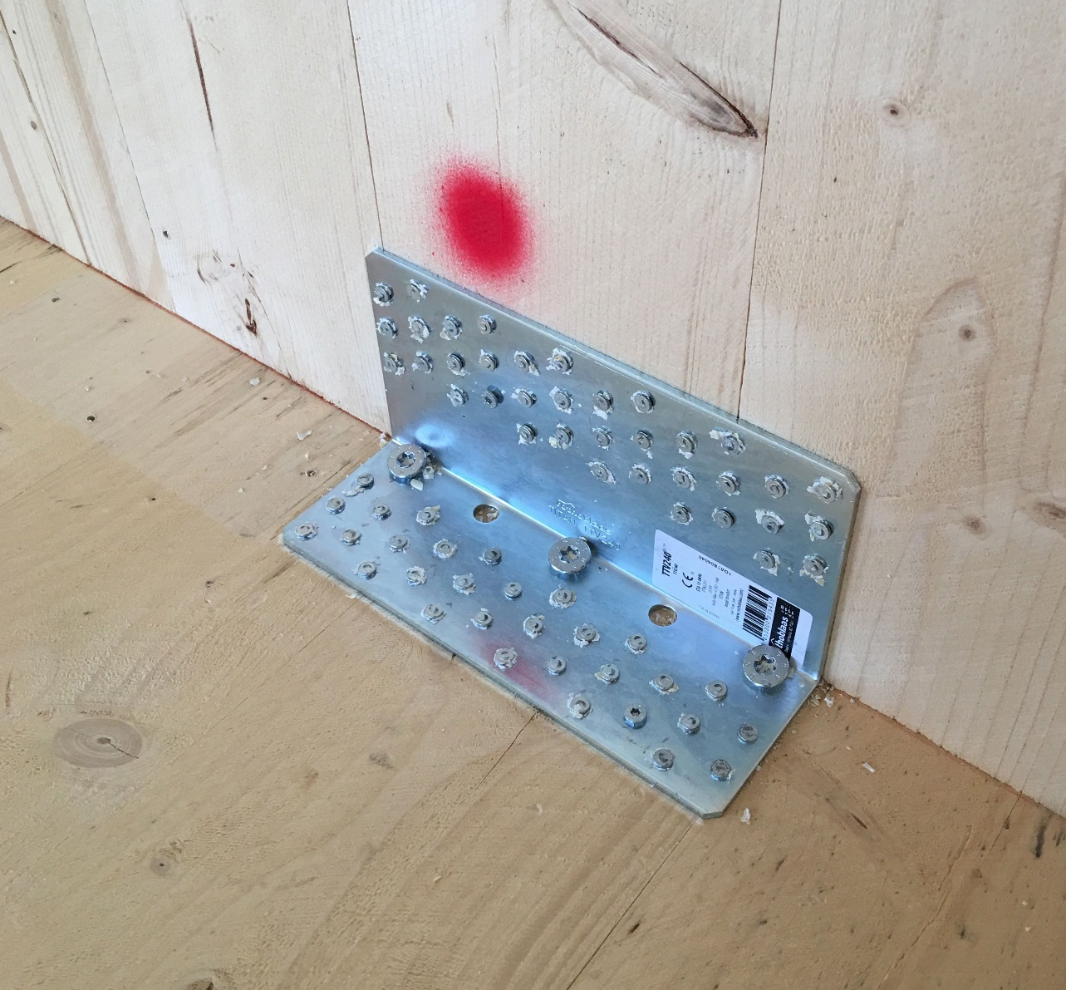
Connection components
Bolted joints with angled screws or corner plate joints are used in connections between plane elements of solid timber panel structures
Any plasterboard at the corner plate connection should be removed
Acoustics (flanking transmission) should be accounted for in connections and junctions
Image: Tero Lahtela

Slide 62


Junction airtightness
When using CLT panels, any gaps between or cracks in the surface lamellae must be accounted for in the airtightness of the junctions.
Especially when using CLT panels where the edges are not glued, any gaps between the lamellae should be checked for.

Slide 63

Preventing progressive collapse
Stability joint
The preferred method for preventing progressive collapse is the alternative load transfer path
Using
  Beams
  Wall-like beams
  Connection components between prefabricated units
Image: Tero Lahtela

Slide 64

Nail plate truss roof in a fire
The bottom chord is designed to take the loading in case of an attic fire
If the fire is from below it, the bottom chord is fireproofed with ceiling plates
Bottom chord connections must be fireproofed
Partitions can be designed to be load-bearing in case of fire

Slide 65

Nail plate truss roof in a fire
Bottom chord sides are protected with rock wool panels
The rock wool panels also protect lateral buckling supports
The lateral buckling supports are attached to the ceiling stiffening plate
These principles are also followed for a roof with a beam structure
Bottom chord
Buckling support
Rock wool panel

Slide 66

Intermediate floor in case of fire
For fireproofing the intermediate floor the following are used
  The floor surface structure
  Ceiling plates
Intermediate floor connections must be fireproofed
The lateral buckling support of an intermediate floor with beam structure must work in case of a fire
Partitions can be designed to be load-bearing in case of fire

Slide 67

Load-bearing wall in a fire
Any panel layers can be used for fireproofing
Connections of a load-bearing wall must be fireproofed
It must be ensured that the joints will remain functional if the wall solid timber panel chars in a fire

Slide 68
Bracing in a fire
The aim is to use the same stiffeners in a fire as in the ultimate limit state
In charring solid timber panels, there must be sufficient functional cross-section left after charring
In double frame walls, the frame half on the opposite side can be used if the panel on the side of the fire does not function as stiffener

