Slide 1



Industrial wood construction
Teaching materials for industrial wood construction education
2022

Slide 2
Origin of the materials
Use of the materials
These learning materials for industrial wood construction have been prepared in a project led by Puuinfo Oy in 2021–2022. Also involved in the project were
Lappia Vocational College,
TTS-Työtehoseura ry
South-Eastern Finland University of Applied Sciences,
Metropolia University of Applied Sciences,
Jyväskylä University of Applied Sciences,
University of Tampere, and
Federation of the Finnish Woodworking Industries Puutuoteteollisuus ry
The project was funded by the Ministry of the Environment.
The materials are intended to be used as extensively as possible in industrial wood construction education and studies.
The materials are released under the Creative Commons licence Attribution-ShareAlike (CC BY-SA), which requires that the author be properly credited when the materials are used and that derivative works may only be distributed under the same licence as the original work.
The original materials and any updates to them by Puuinfo will be published on the Library of Open Educational Resources website (aoe.fi) and the Puuinfo.fi website.

Slide 3
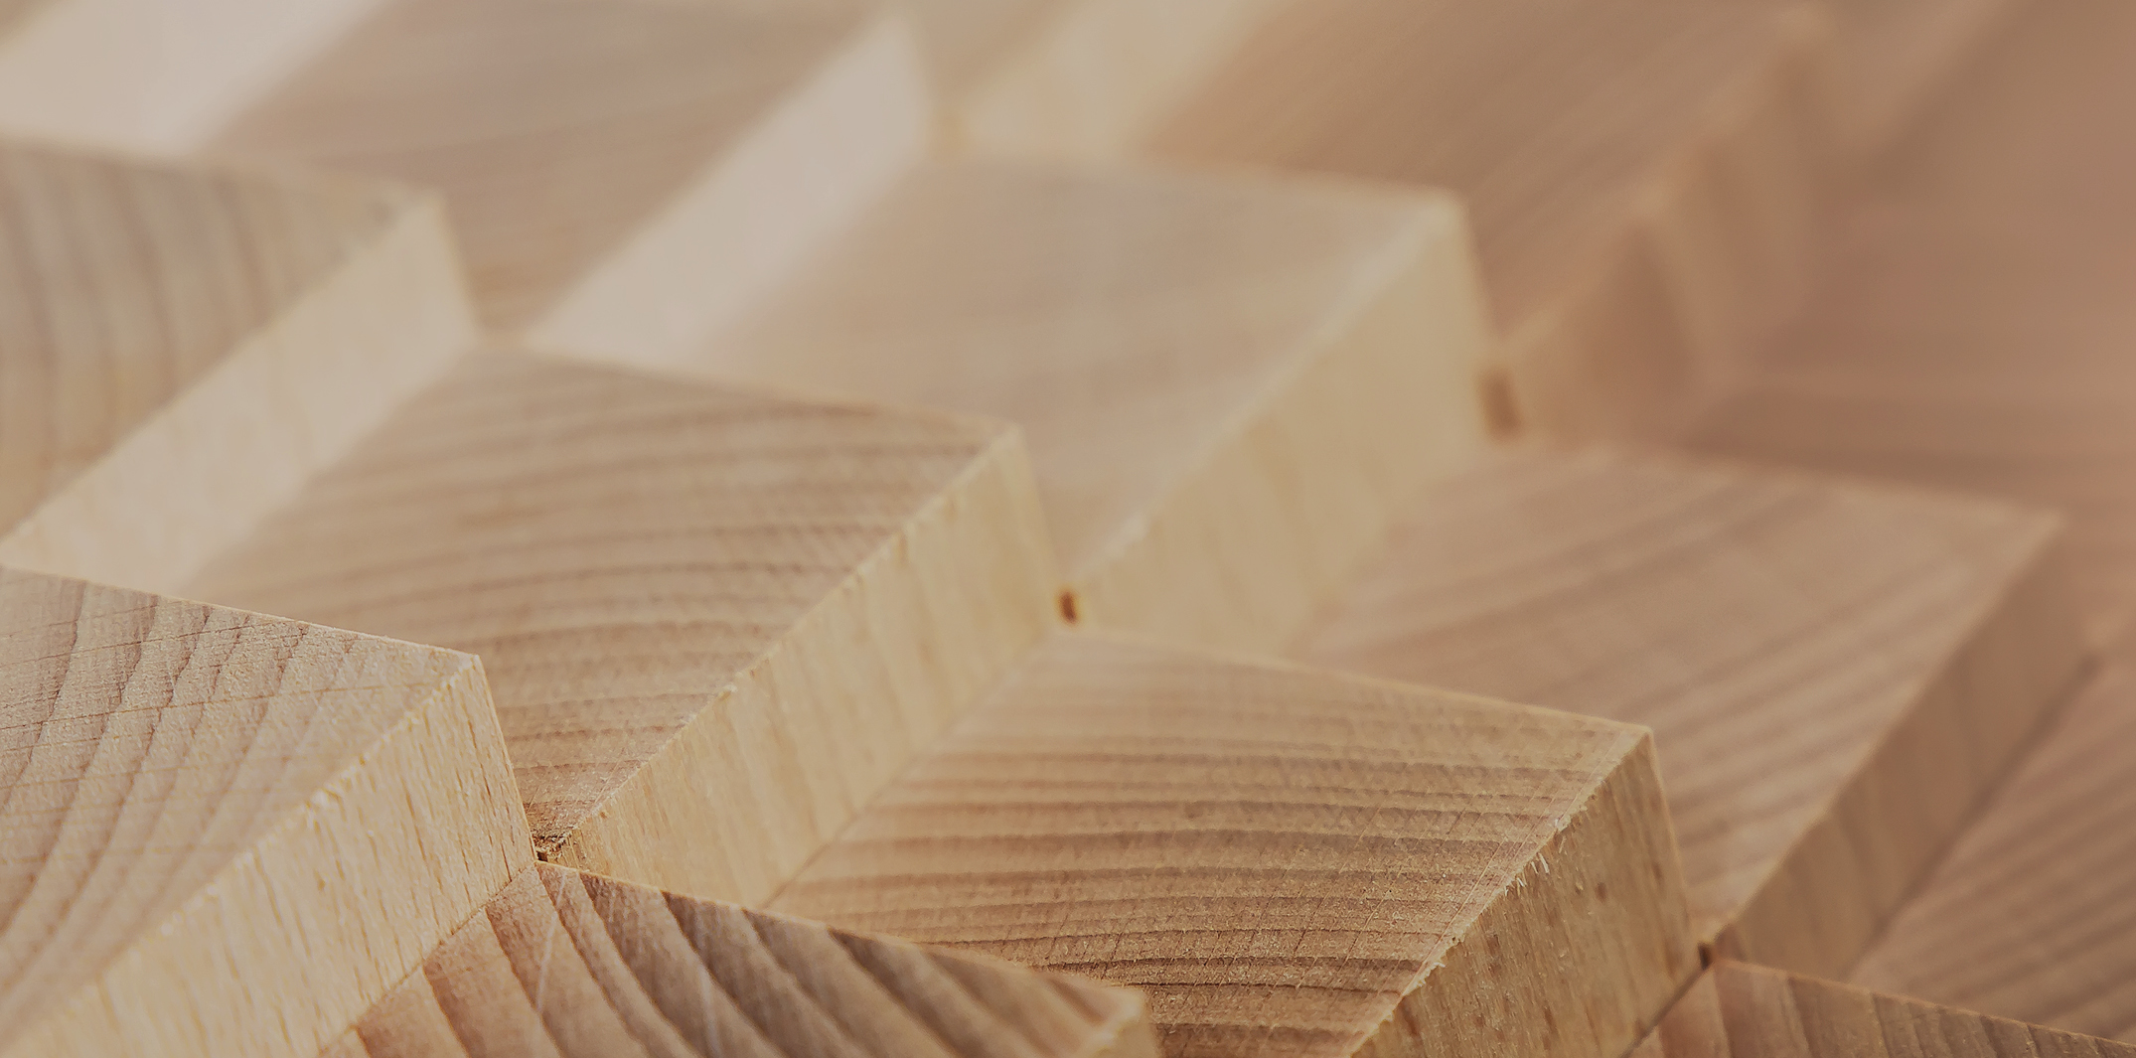
Industrial construction systems

Slide 4
Authors
Tero Lahtela,
Insinööritoimisto Tero Lahtela Oy
Release date: 07/12/2021

Slide 5
Hybrid frames
Residential and commercial construction

Slide 6
Hybrid frame
Hybrid frame refers to a load-bearing framing system in which several different frame materials are used to ensure optimal performance
The various frame materials will form the load-bearing and stiffening frame
Factors that might affect the decision to use a hybrid frame
  Strength
  Connections
  Manufacture
  Fire protection engineering
  Acoustic
  Costs

Slide 7
Applications
In principle, hybrid frames can be applied to all construction systems
Typically, hybrid frames are used in
  Prefabricated panel systems
  Column-and-beam systems
Hybrid frames can be used in virtually all building types

Slide 8
Strengths and challenges in using a hybrid frame
Strengths
Simpler bracing
Simpler connections
Longer spans
Taller buildings
Reduction of building settlement
Simplifying the running of building service ducts and pipes (holes)
Challenges
Materials having different thermal and moisture properties
Dimensional accuracy (concrete structures)
Reconciling the practices of different suppliers

Slide 9
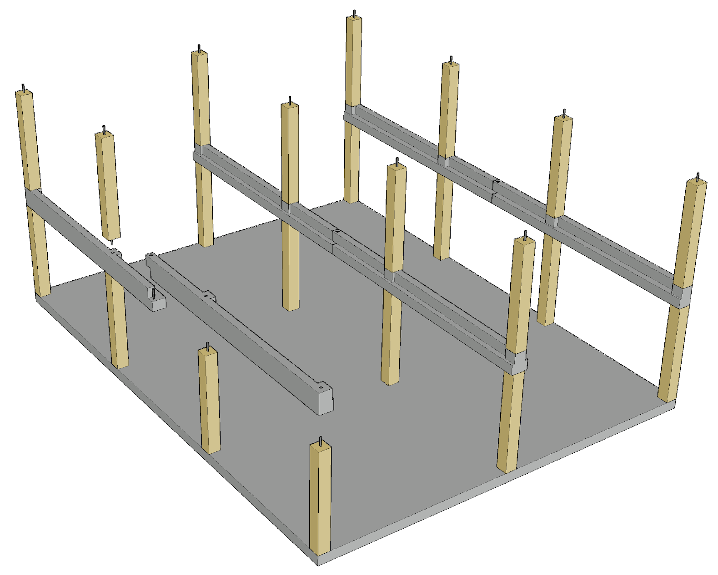
Example of a hybrid frame
In the illustrated example, a primary timber beam has been replaced with an L-shaped concrete beam
Benefits
  Column has high resistance to bearing pressure
  No settlement for the line of columns
  Beam has a long span
  Low beam height
  Simple connection between beam and column (grouting)

Slide 10
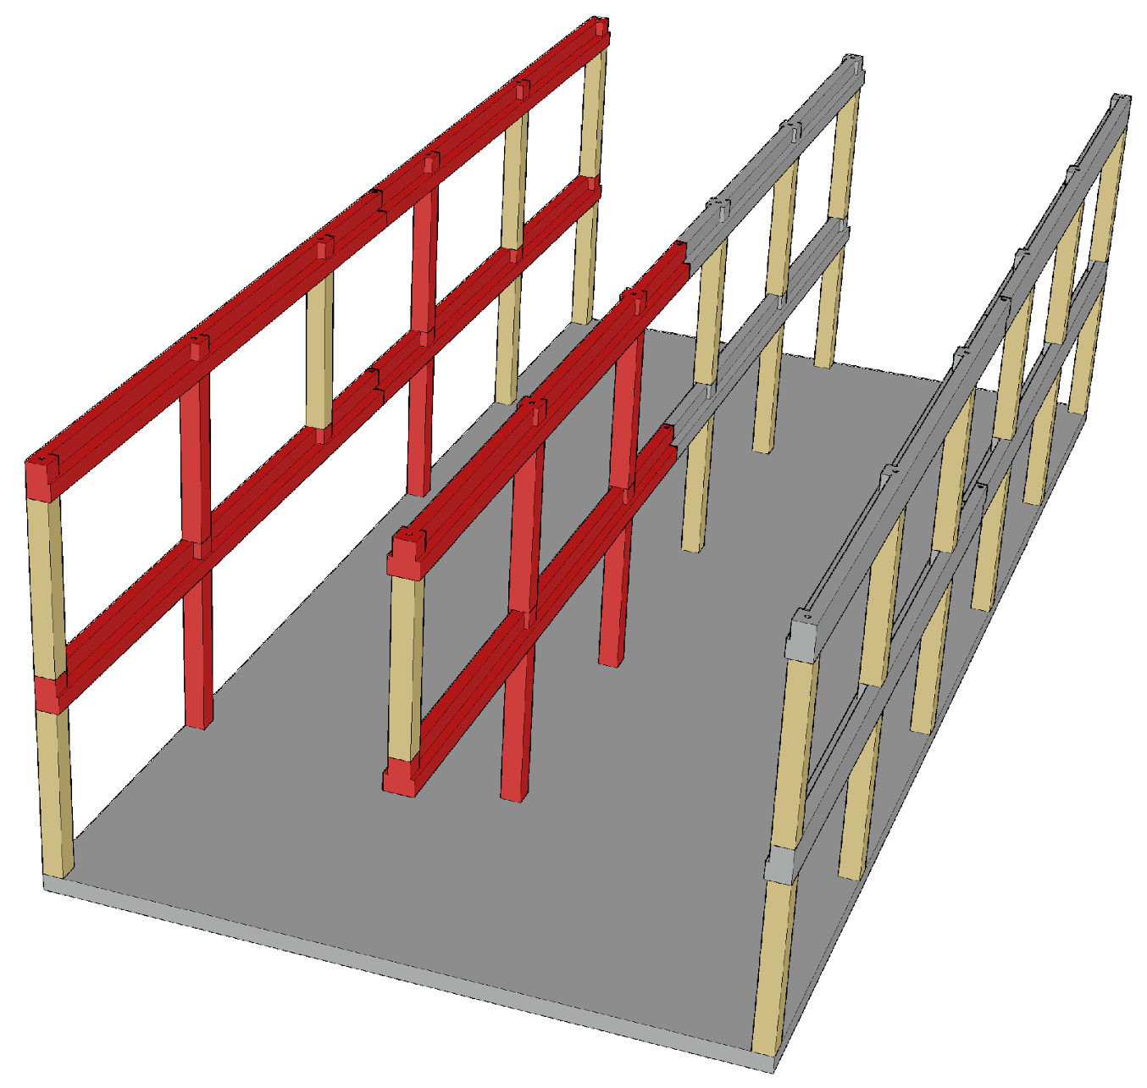
Example of a hybrid frame
Progressive collapse can be prevented with a concrete-and-steel beam
In this example, the alternative load transfer path is implemented through beam continuity

Slide 11
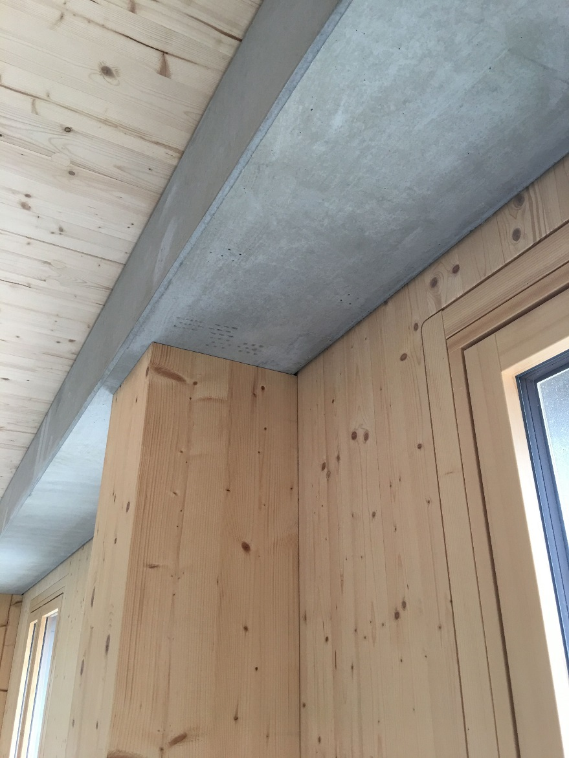
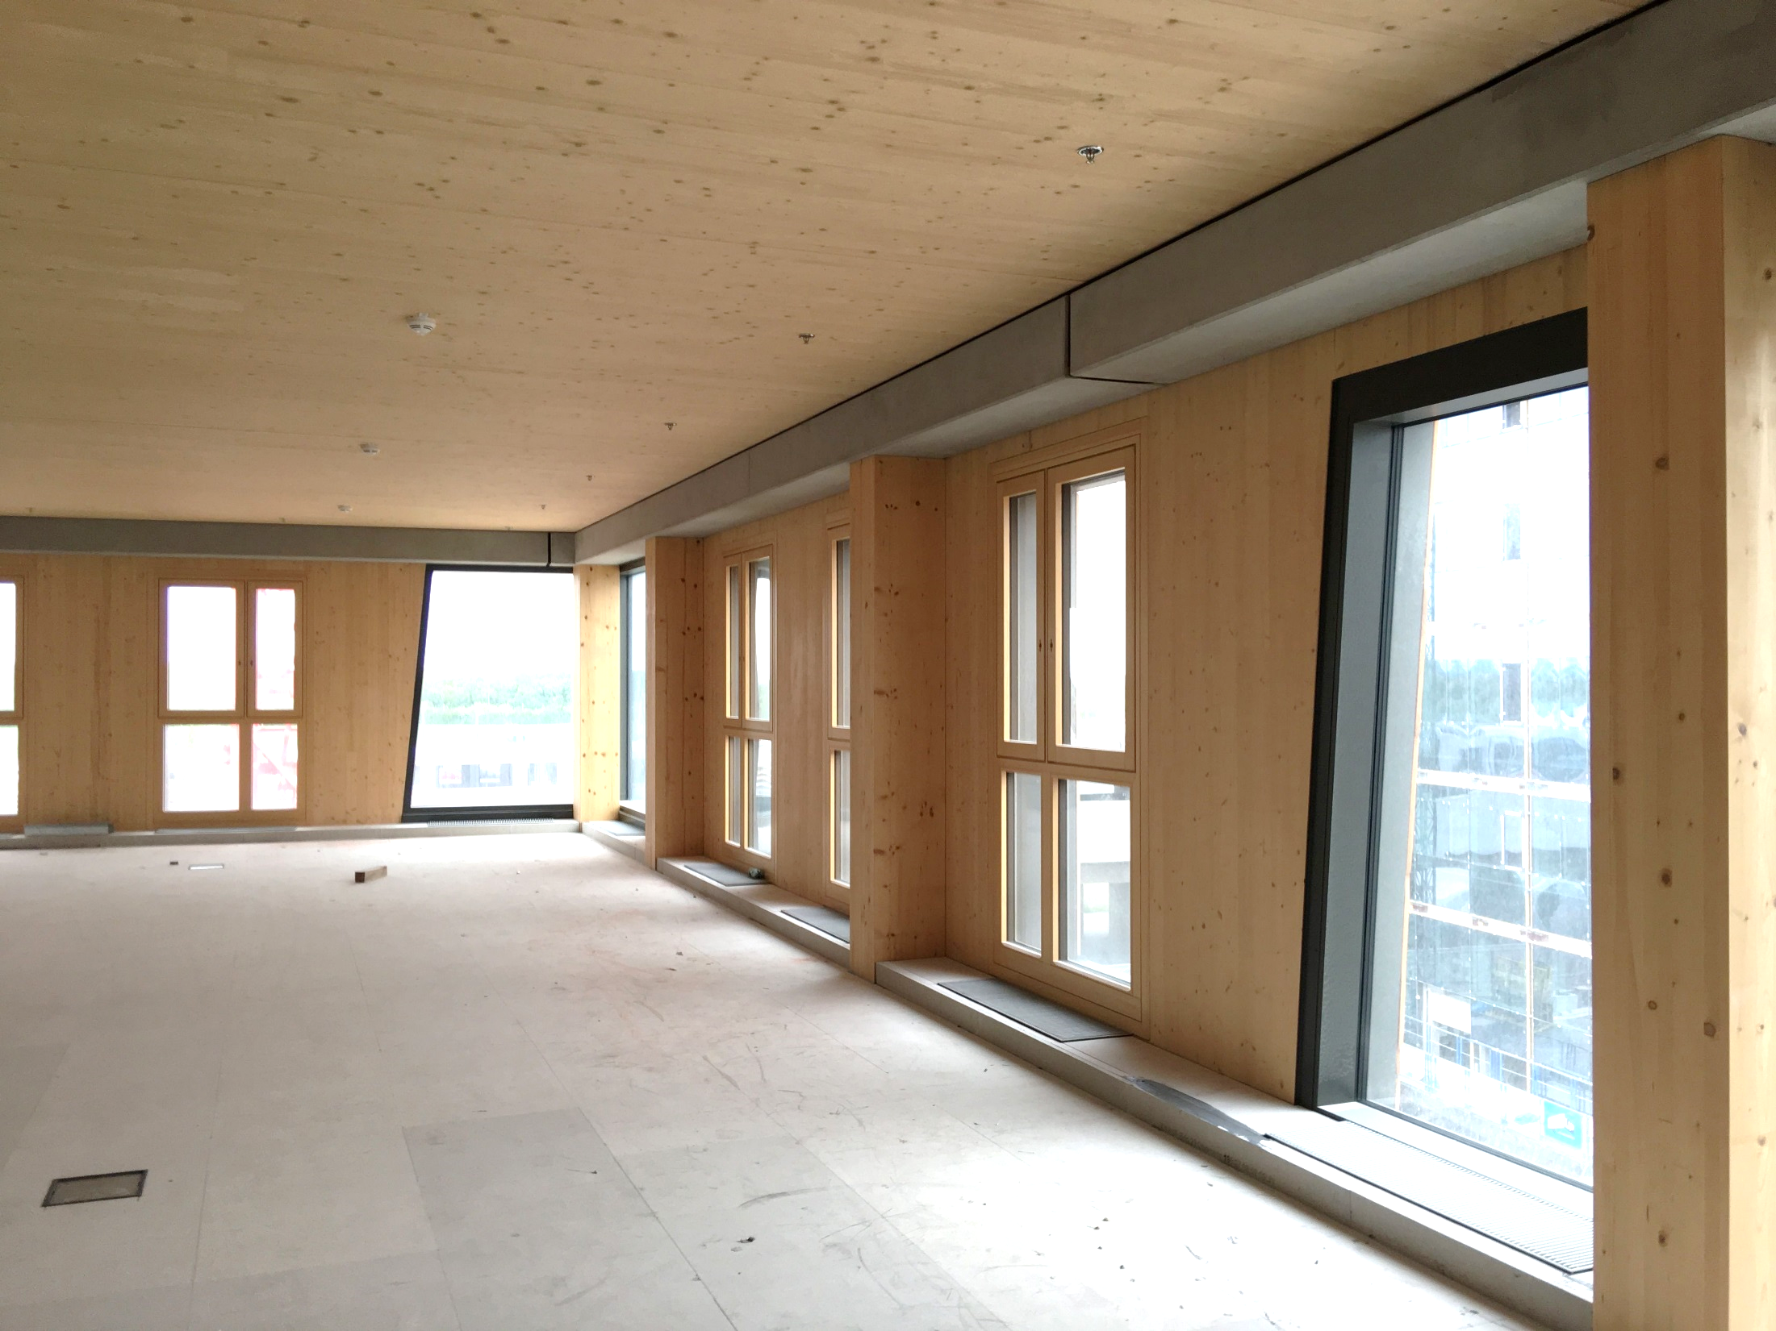
L shaped concrete beam
Image: Tero Lahtela
Image: Tero Lahtela

Slide 12
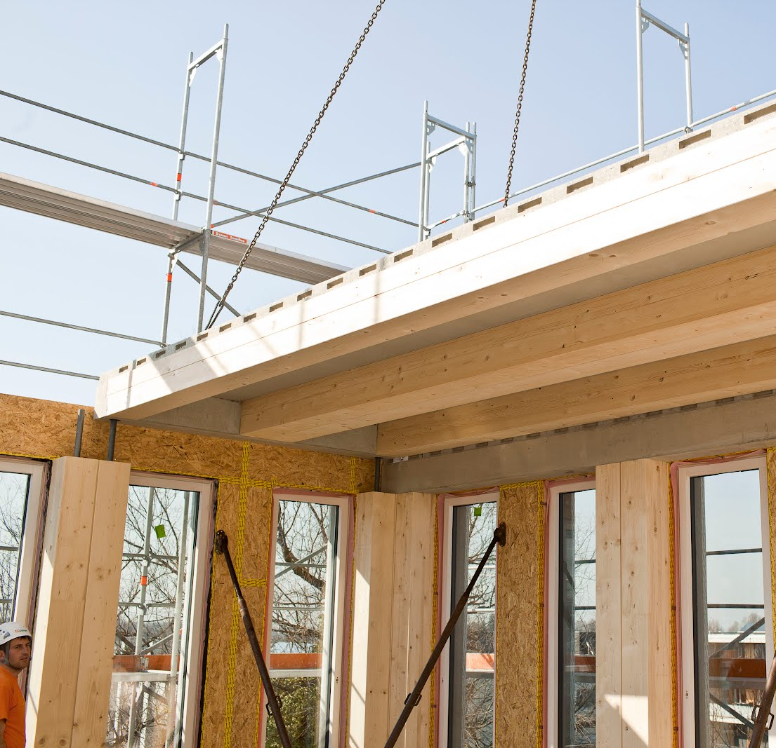
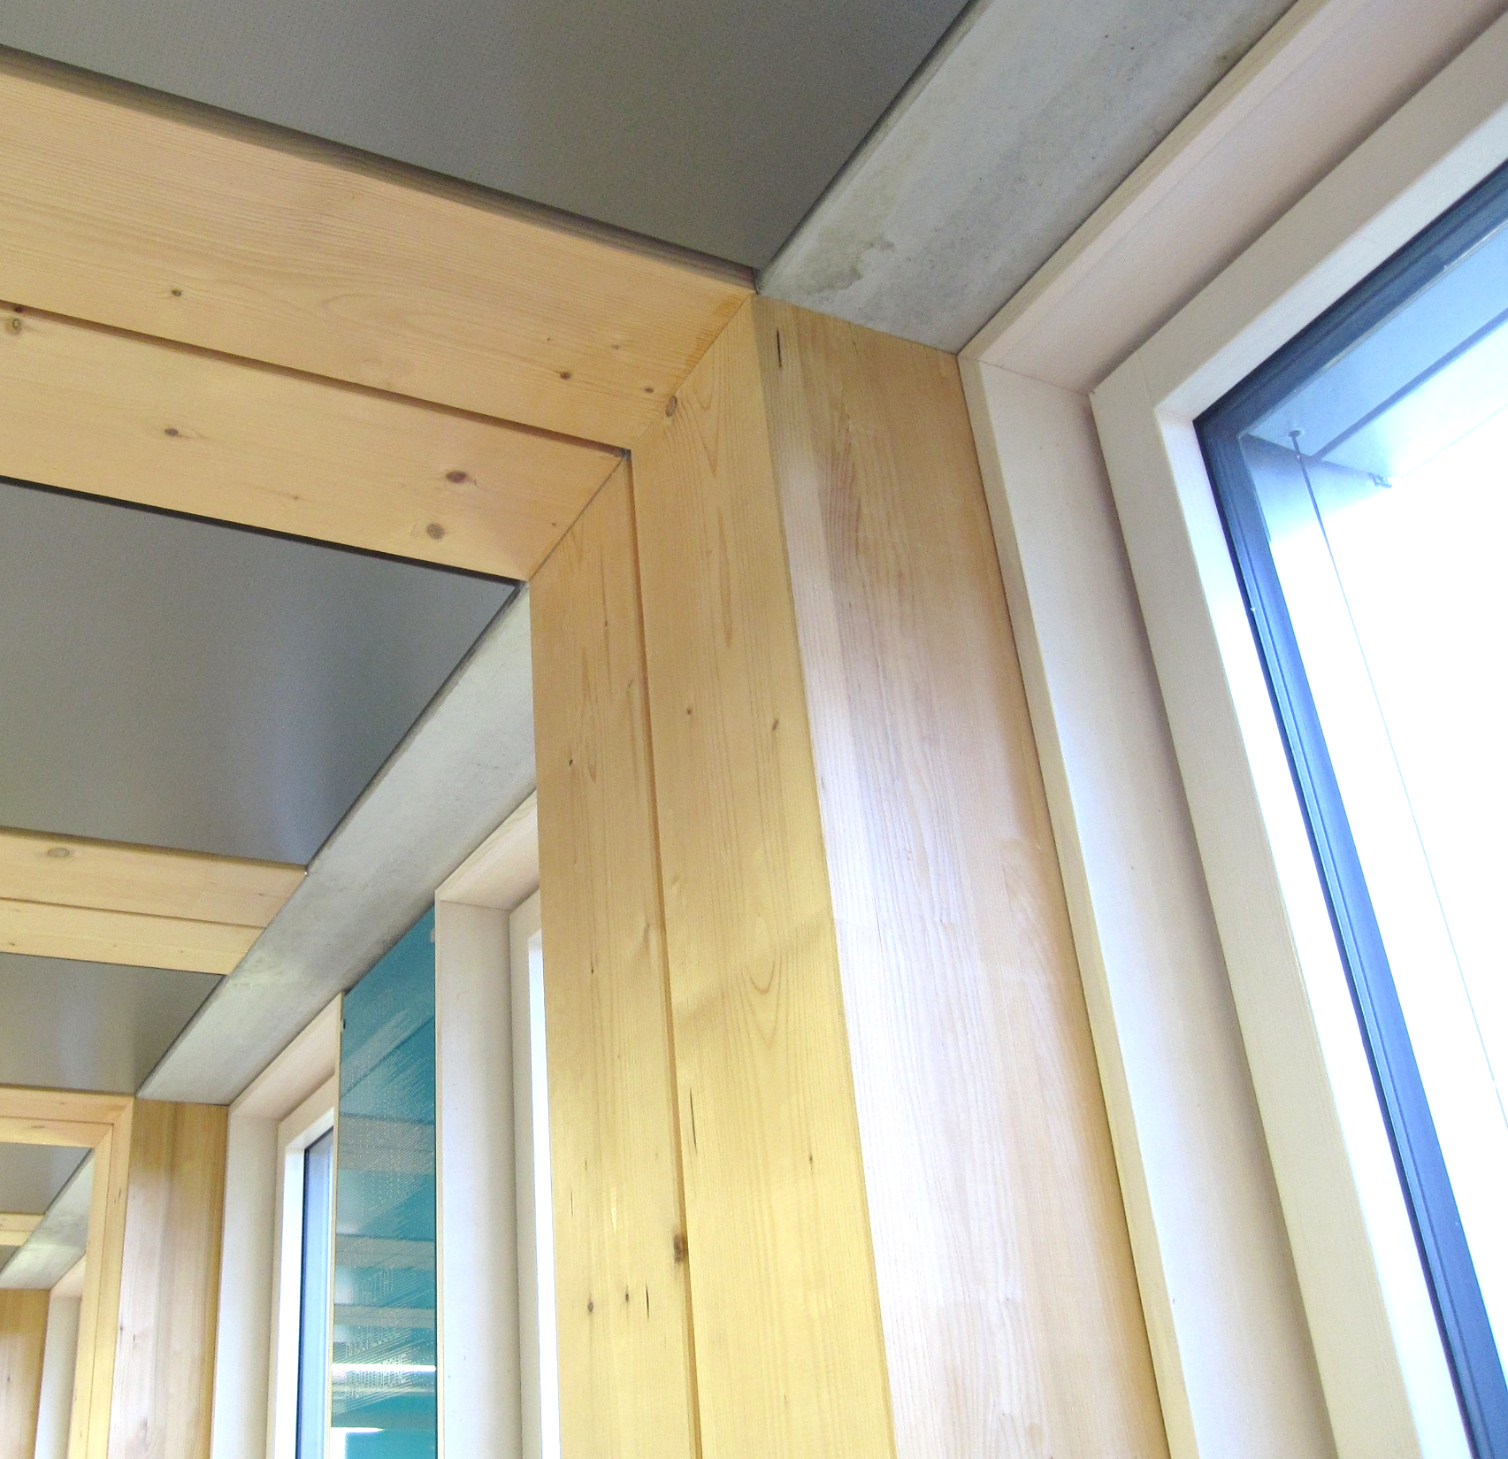
Concrete composite slab end truss
Image: CREE
Image: Tero Lahtela

Slide 13
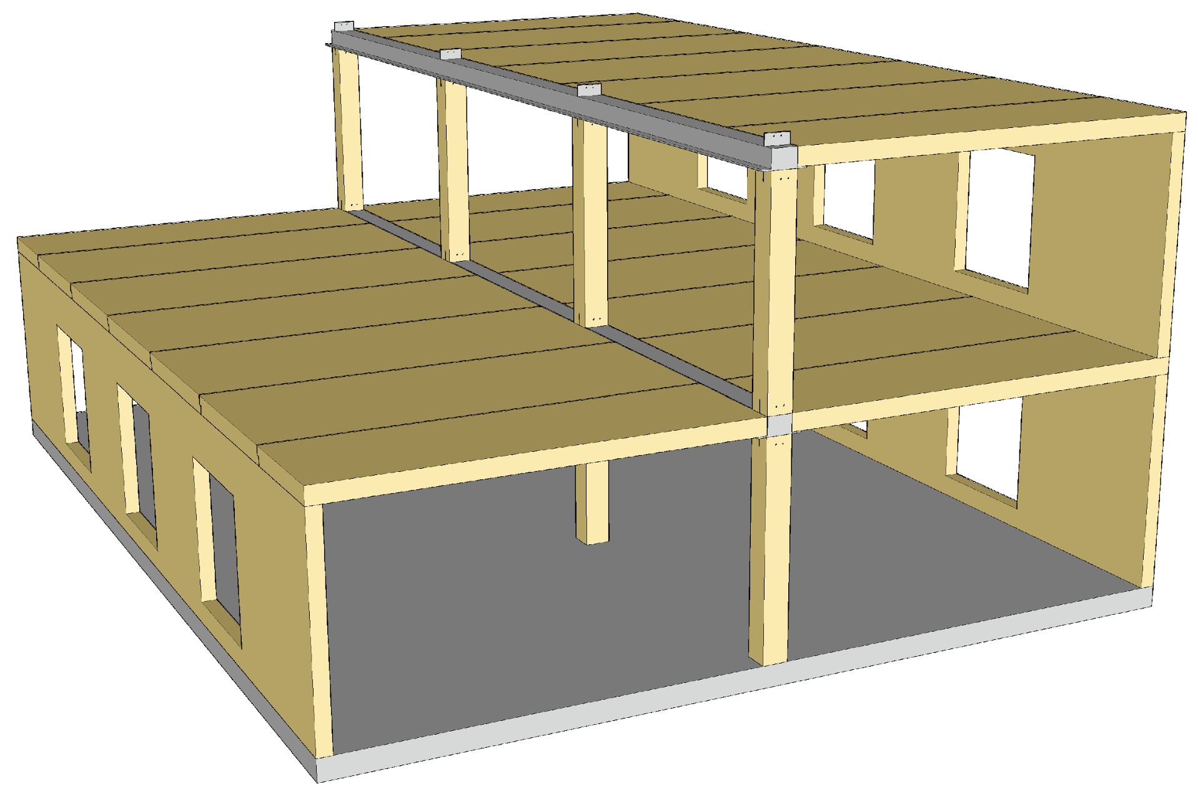
Example of a hybrid frame
In the illustrated example, the primary timber beam has been replaced with an L shaped steel beam
Benefits
  Column has high resistance to bearing pressure
  No settlement for the line of columns
  Low beam height
  Simple connection between column and beam (e.g. dowels)

Slide 14
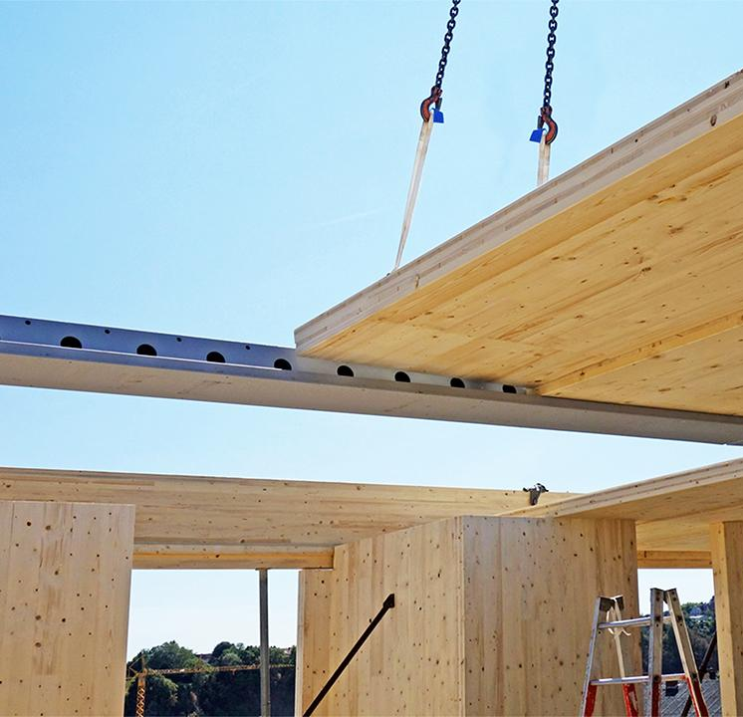
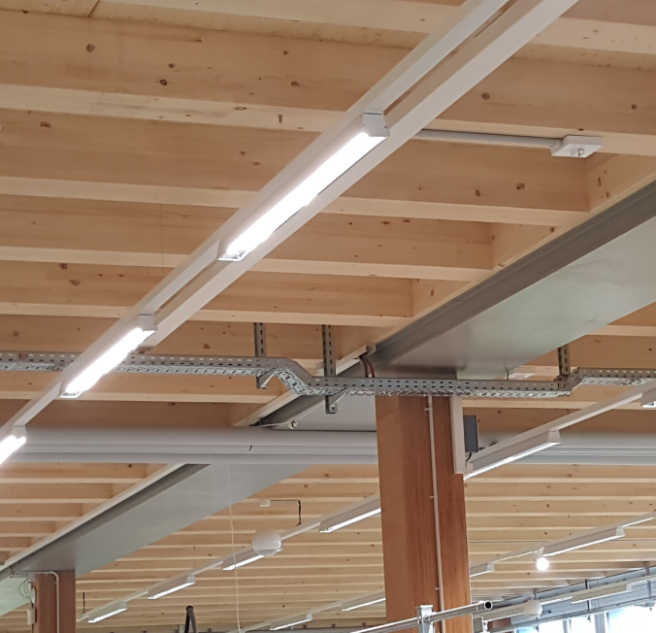
L shaped steel beam
Image: Peikko
Image: Peikko

Slide 15
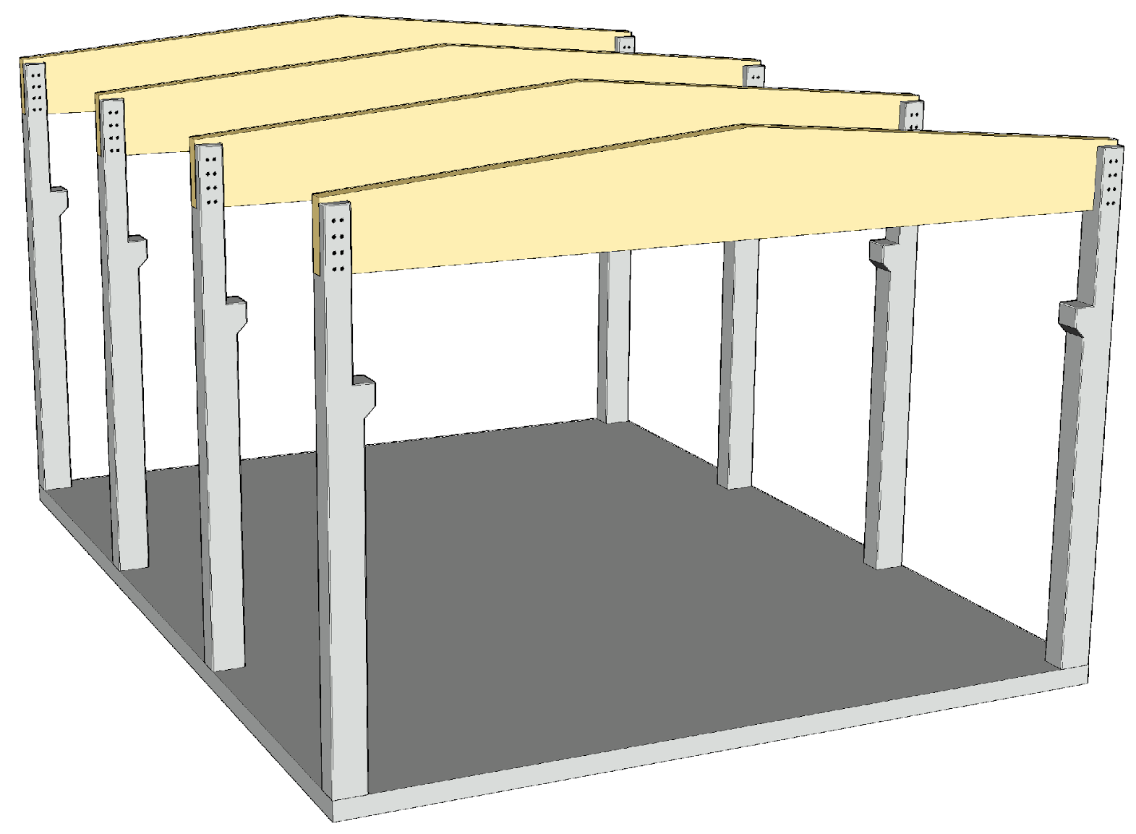
Example of a hybrid frame
In the illustrated example, the timber cantilever column has been replaced with a concrete cantilever column
Benefits
  Taller building due to higher stiffening capacity
  Small horizontal displacement
  Simpler foundation connection
  Simple crane console
  Crane with a higher lifting capacity

Slide 16
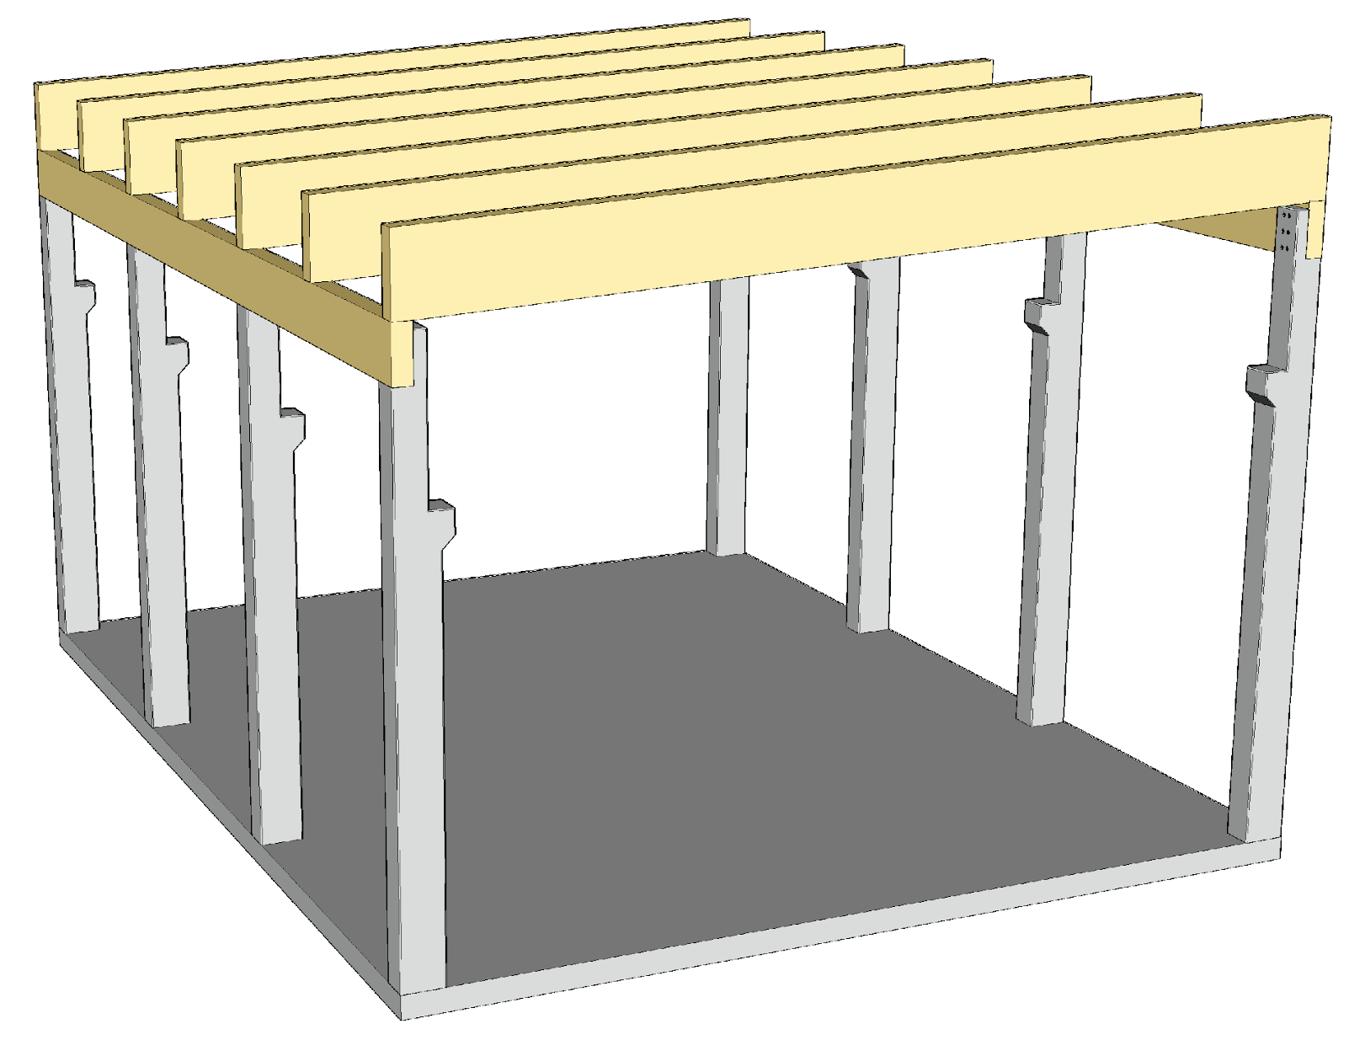
Example of a hybrid frame
In the illustrated example, the timber cantilever column has been replaced with a concrete cantilever column
Benefits
  Taller building due to higher stiffening capacity
  Small horizontal displacement
  Simpler foundation connection
  Simple crane console
  Crane with a higher lifting capacity

Slide 17
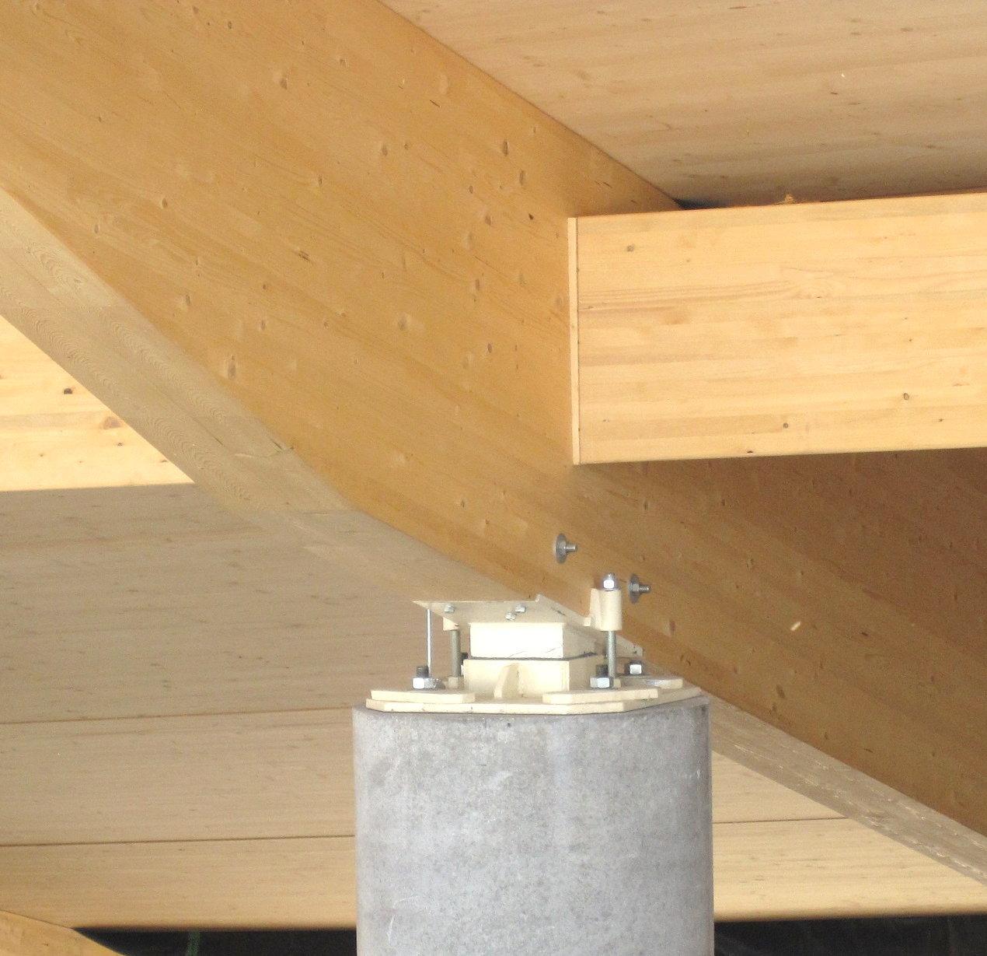
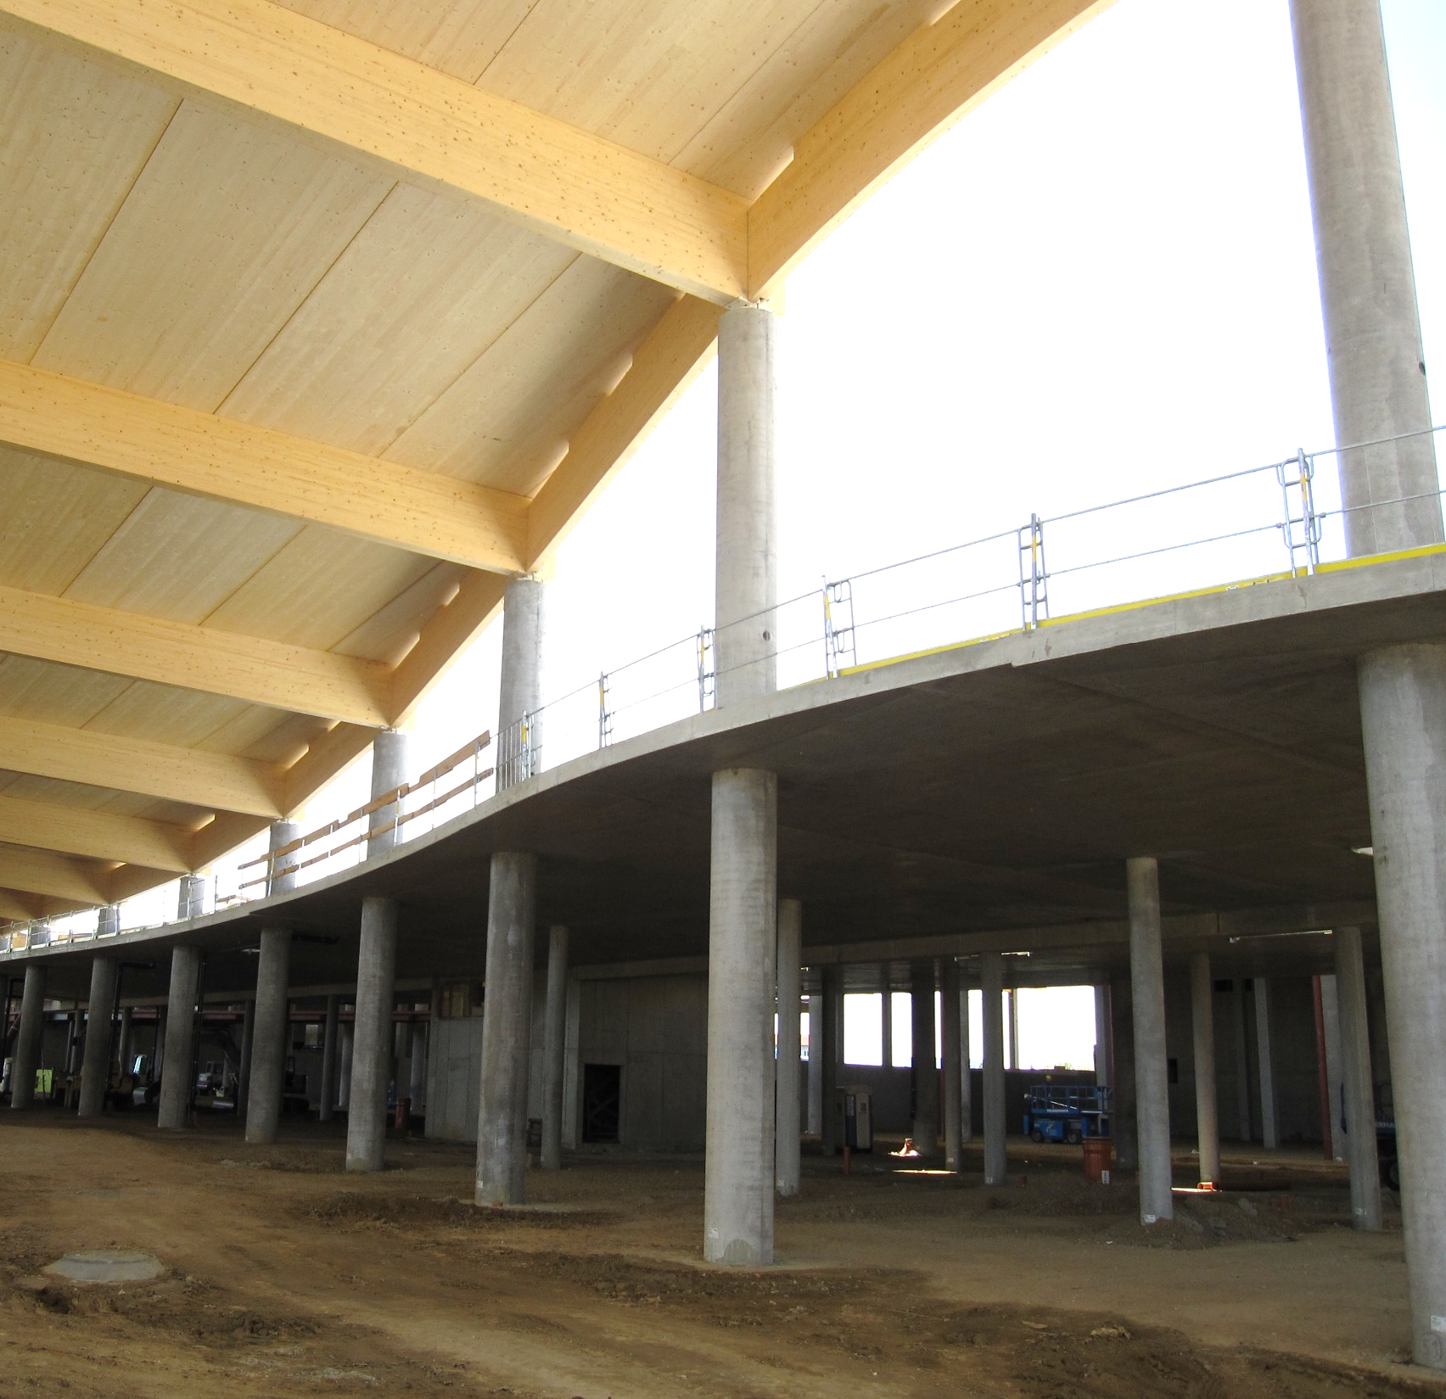
Concrete columns
Image: Tero Lahtela
Image: Tero Lahtela

Slide 18
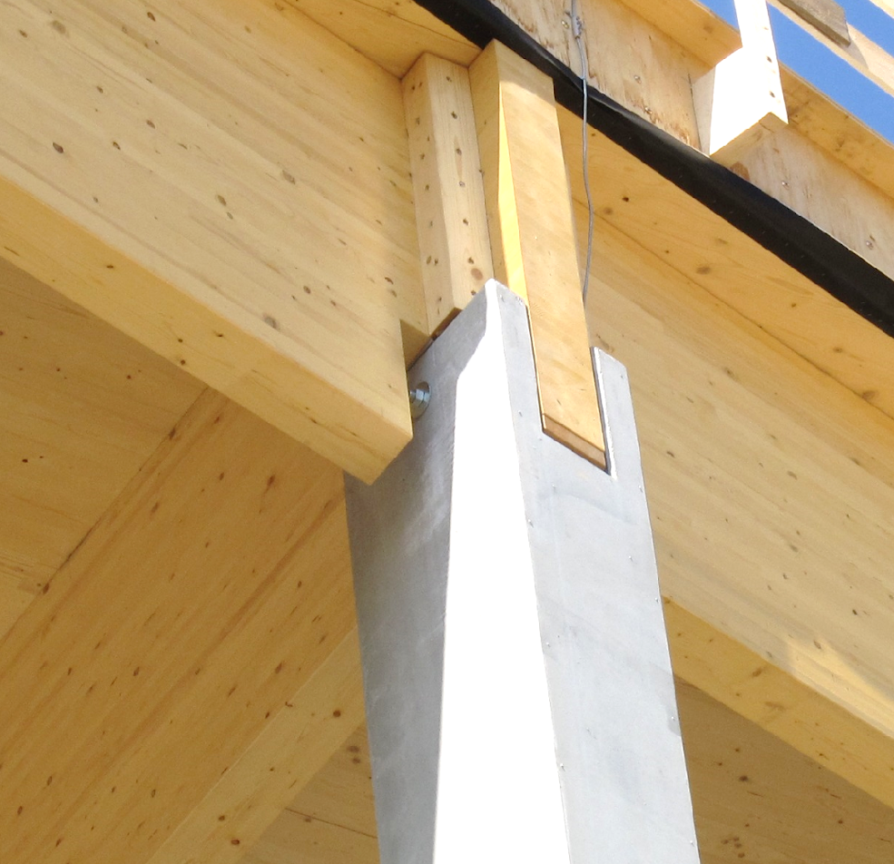
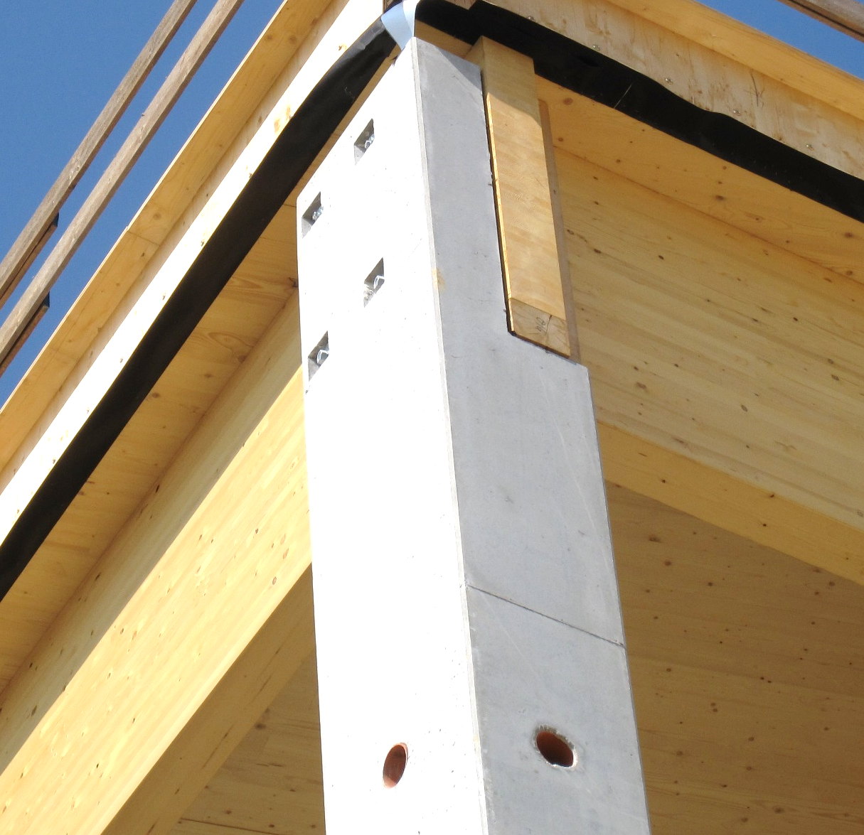
Concrete columns
Image: Tero Lahtela
Image: Tero Lahtela

Slide 19
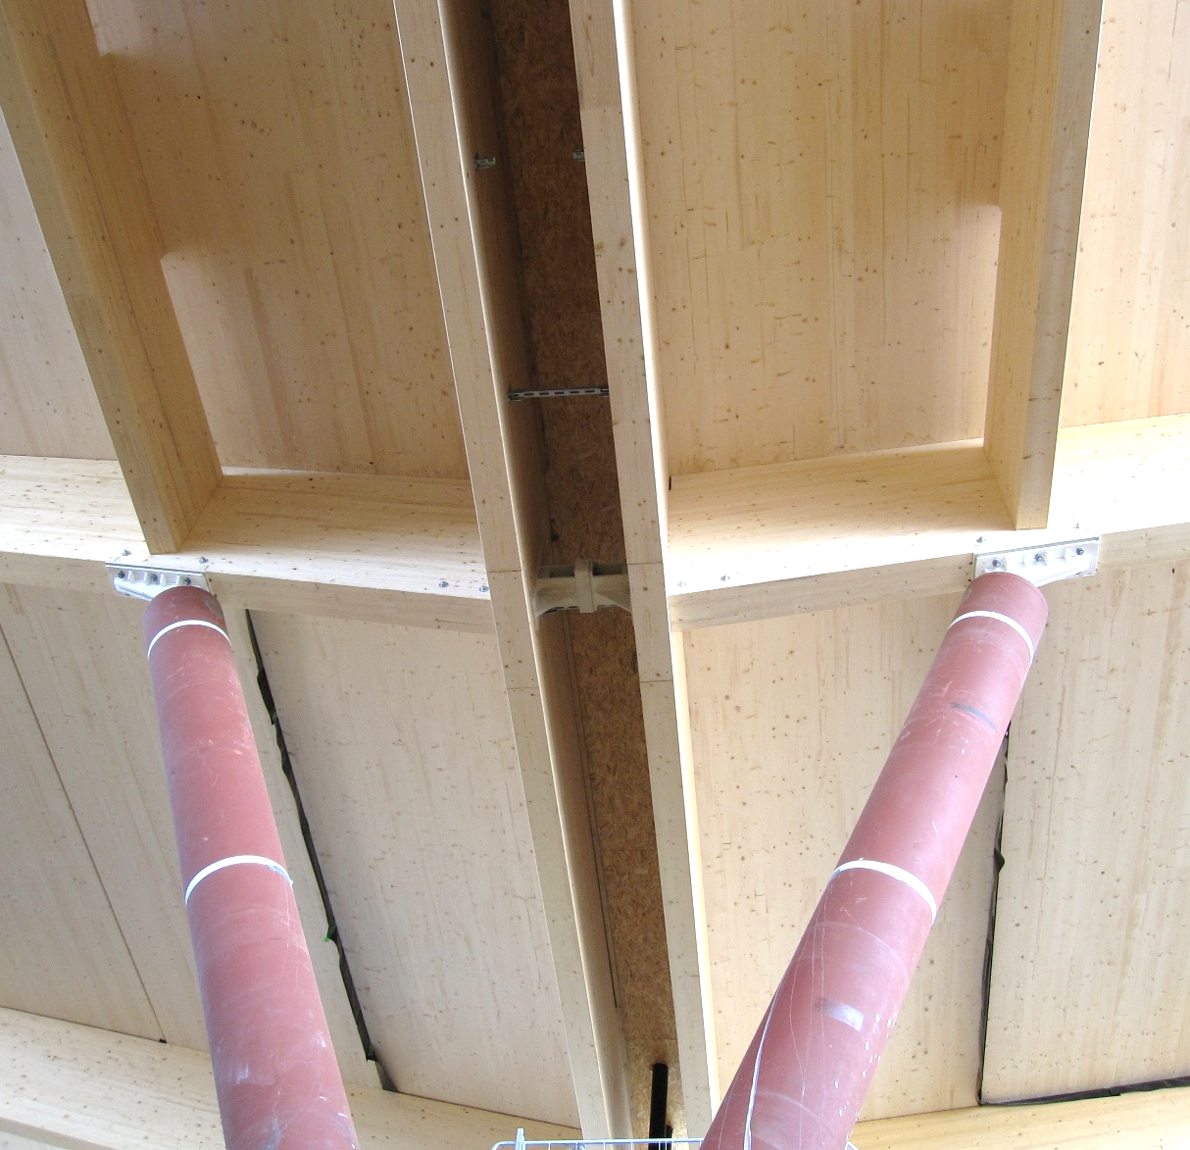
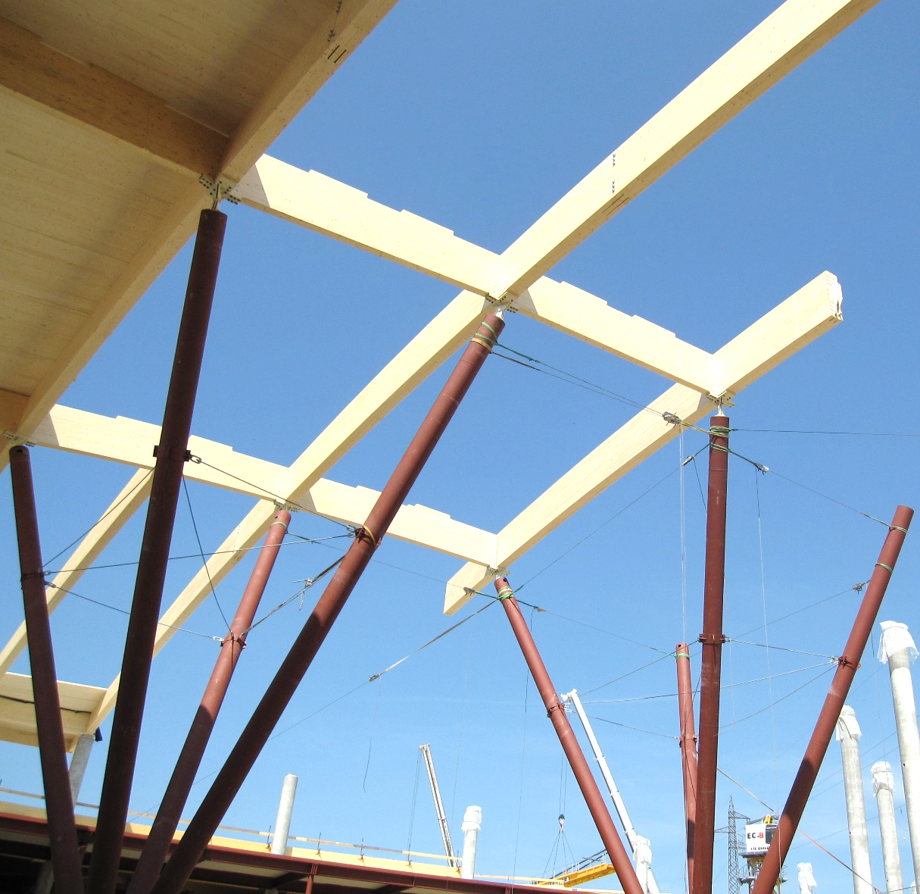
Steel columns
Image: Tero Lahtela
Image: Tero Lahtela

Slide 20
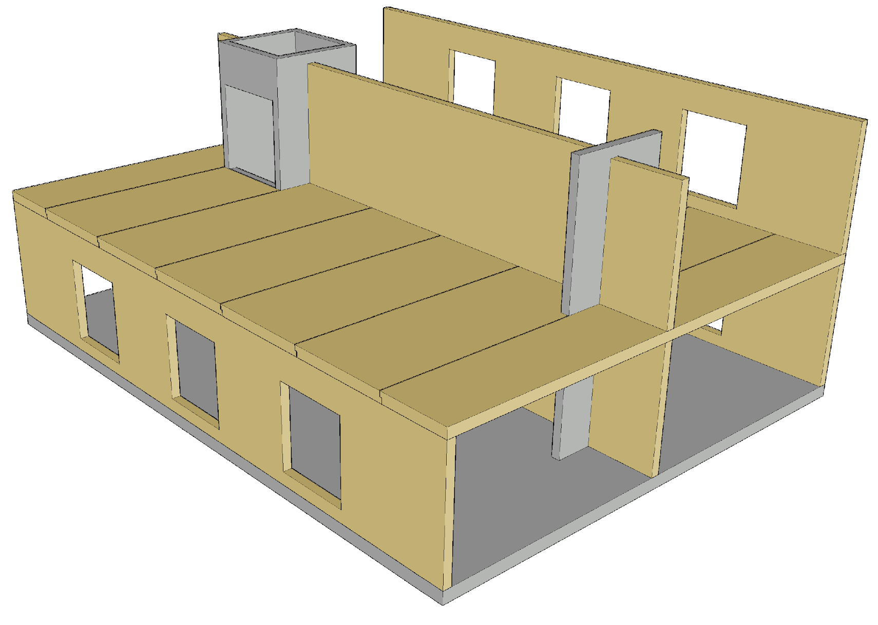
Example of a hybrid frame
In the illustrated example, the building is braced with a concrete lift shaft and a concrete wall
Benefits
  Taller building due to higher stiffening capacity
  Small horizontal displacement
  Simpler structural model for the bracing structure

Slide 21
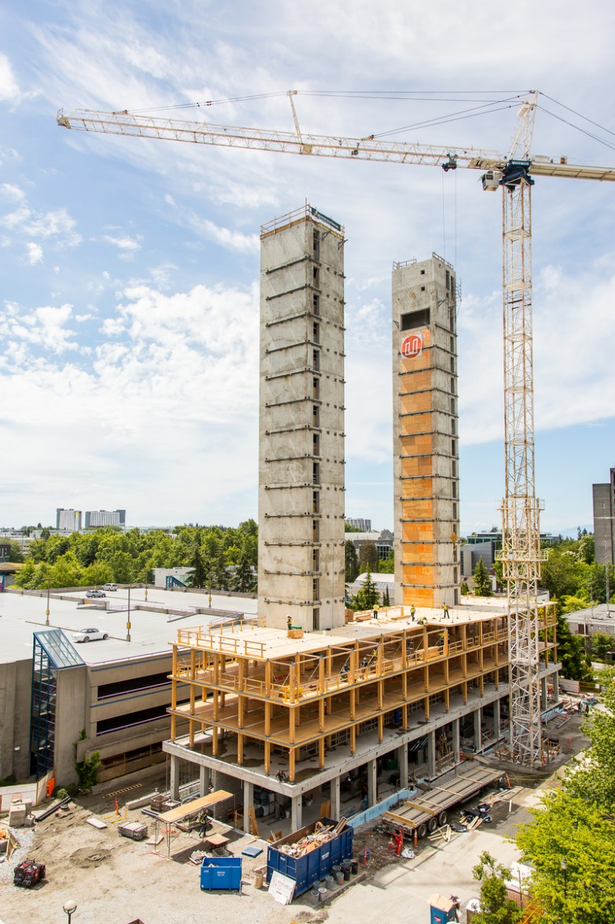
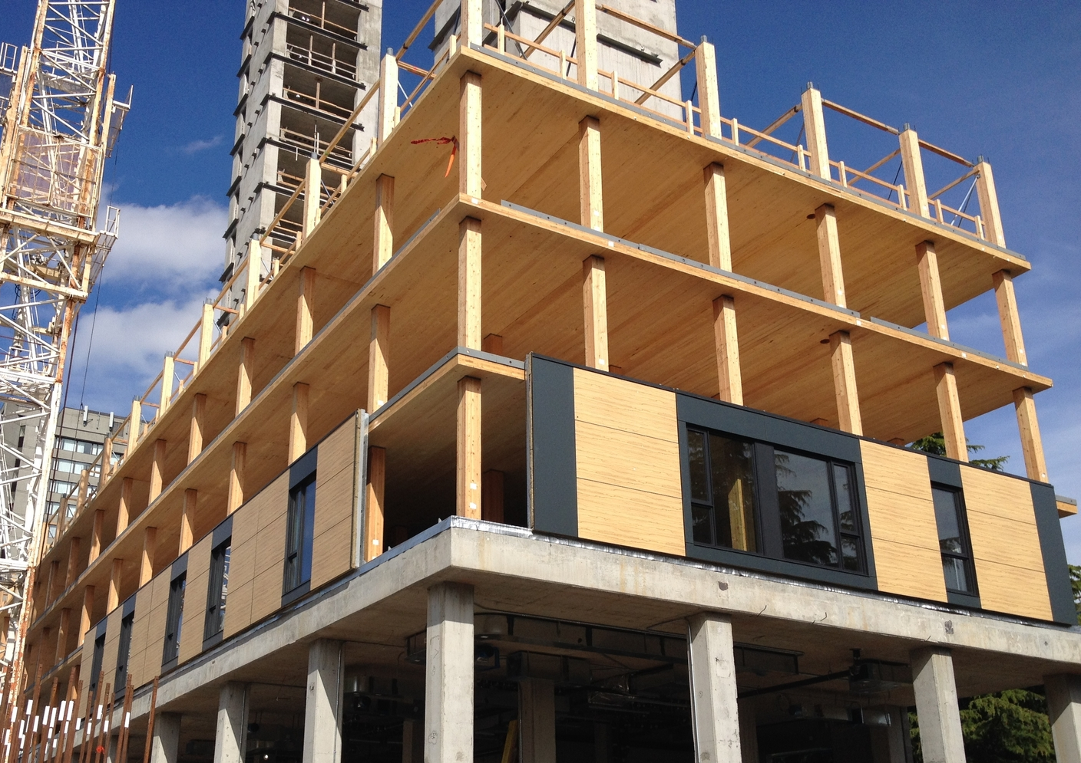
Concrete staircase tower as a stiffening structure
Image: KK LAW
Image: Tim Herron

Slide 22
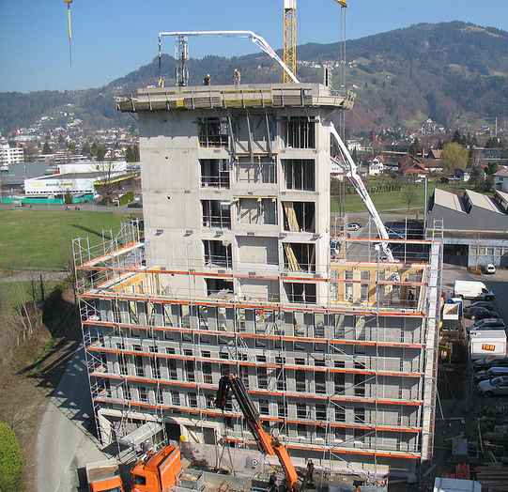
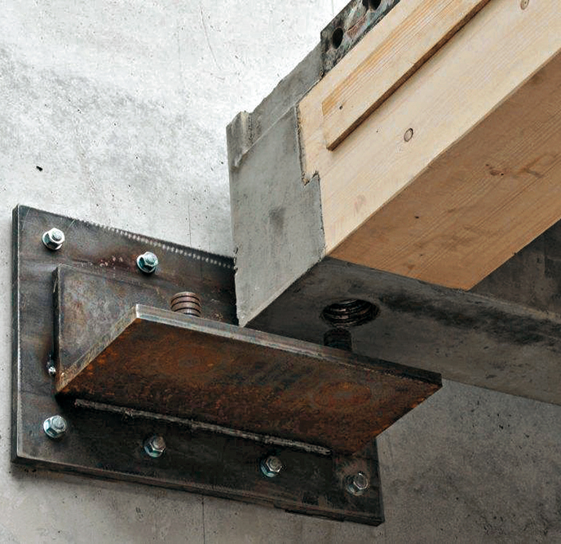
Concrete staircase tower as a stiffening structure
Image: CREE
Image: CREE

Slide 23
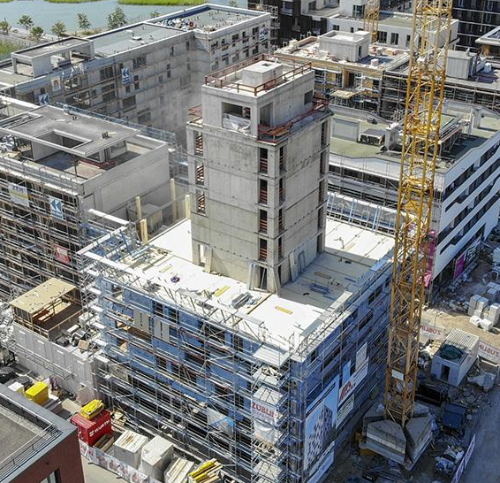
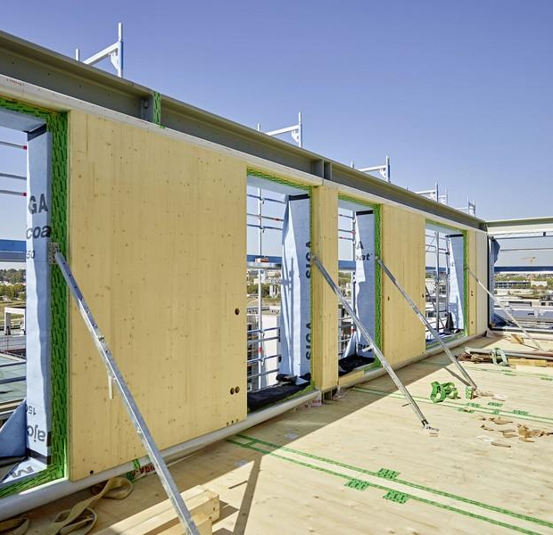
Concrete staircase tower as a stiffening structure
Photo: bauart Konstruktions
Image: Tom Philippi

Slide 24
Designing a hybrid structure
Differences in the behaviour of materials must be taken into account in
  Junction details between building elements
  Connections between building elements
  The frame of the building
  In load-bearing composite structures, the varying properties of the materials affect the strength and deformations of the structure
New design solutions should be tested with full-scale prototypes in order to gain a real understanding of the interaction between different materials

Slide 25
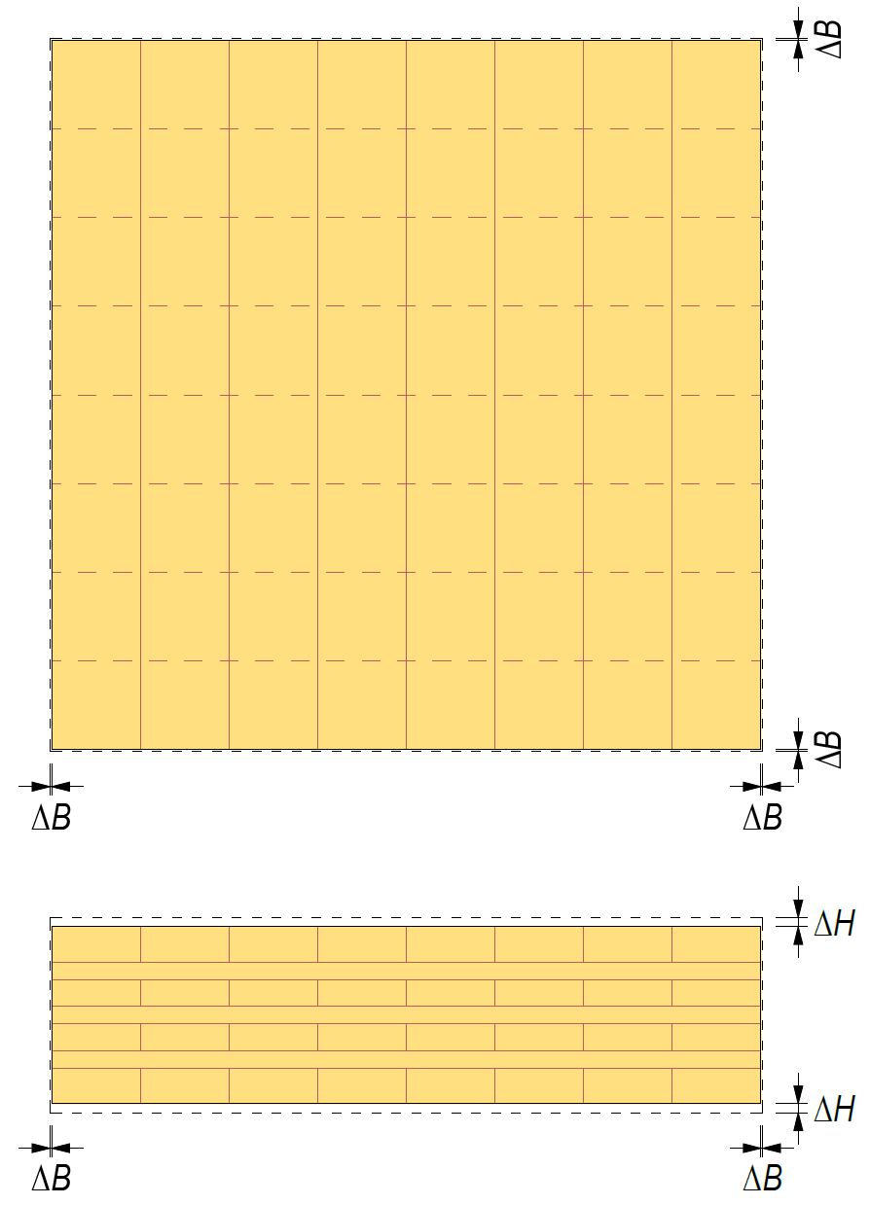
Designing a hybrid structure
Wood dimensions change with moisture variations
The effect of a material characteristic on a hybrid structure can be reduced by the following measures:
  Moisture content of the wood product during construction as close as possible to the end-use moisture content of the structure
  Moisture variation of wood minimised in design solutions
  Use of cross-laminated wood products (CLT, LVL, plywood)

Slide 26
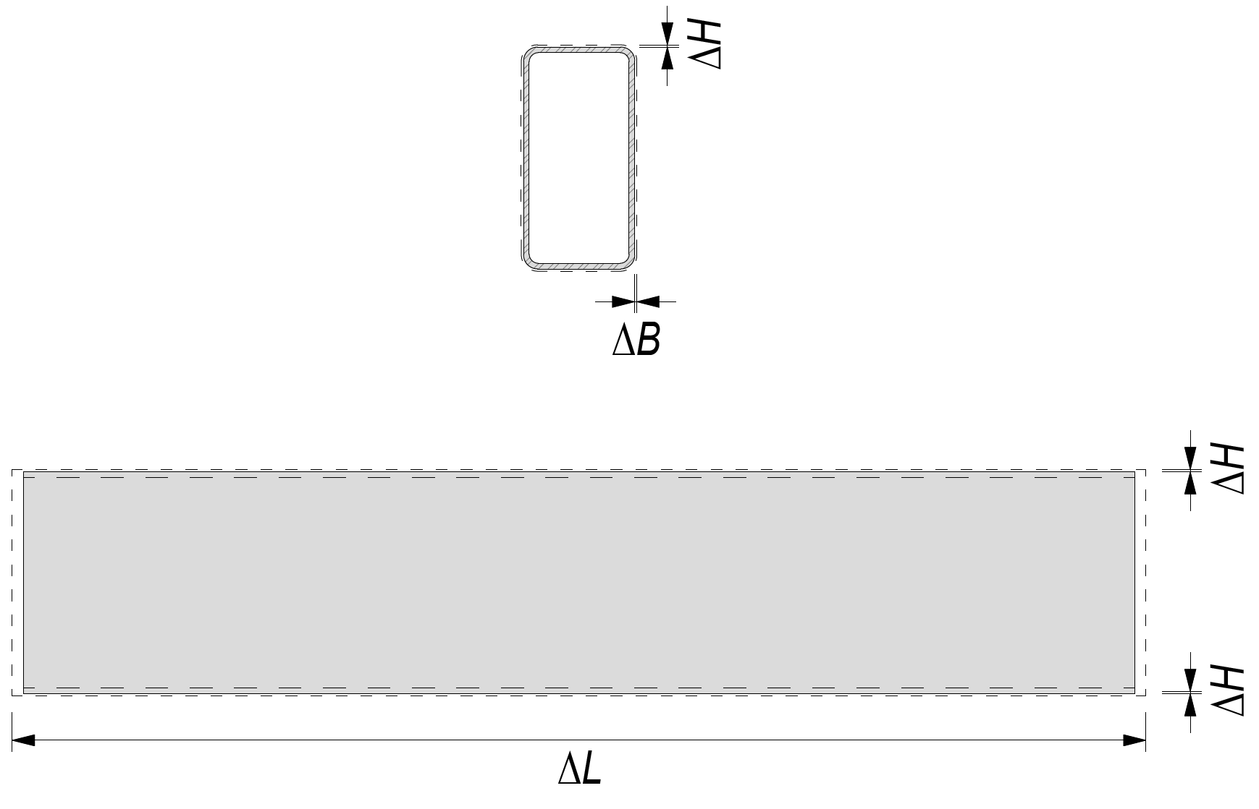
Designing a hybrid structure
Steel dimensions change with temperature variations
The effect of a material characteristic on a hybrid structure can be reduced by the following measures:
  Steel temperature during construction as close as possible to the end-use temperature of the structure
  Temperature variations in the steel minimised in design solutions

Slide 27
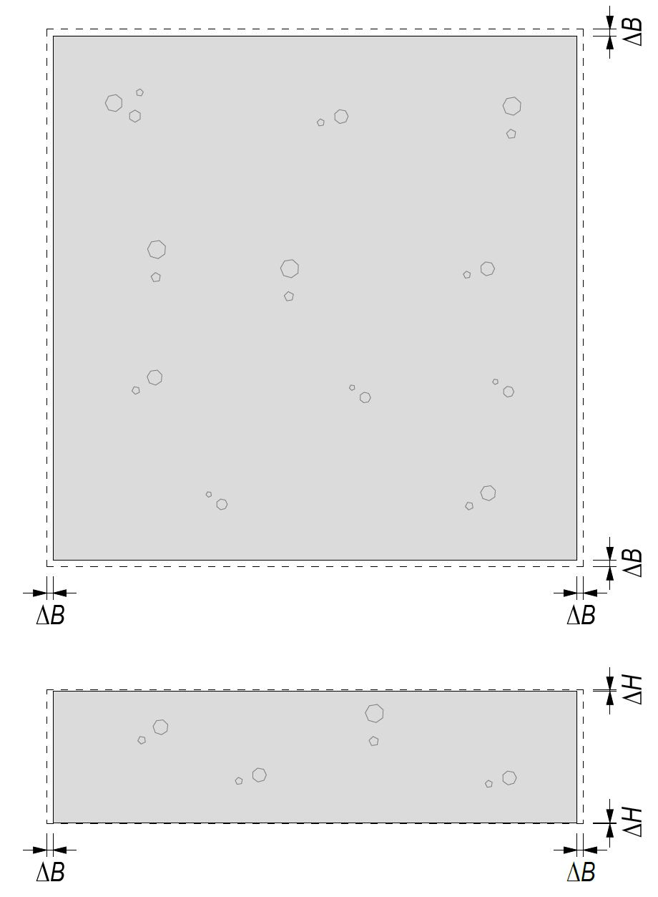
Designing a hybrid structure
Concrete dimensions change with temperature variations
Concrete shrinks after casting
The effect of a material characteristic on a hybrid structure can be reduced by the following measures:
  Concrete temperature during construction as close as possible to the end-use temperature of the structure
  Temperature variations in concrete minimised in design solutions
  Allowing concrete to dry properly before connecting other materials

Slide 28
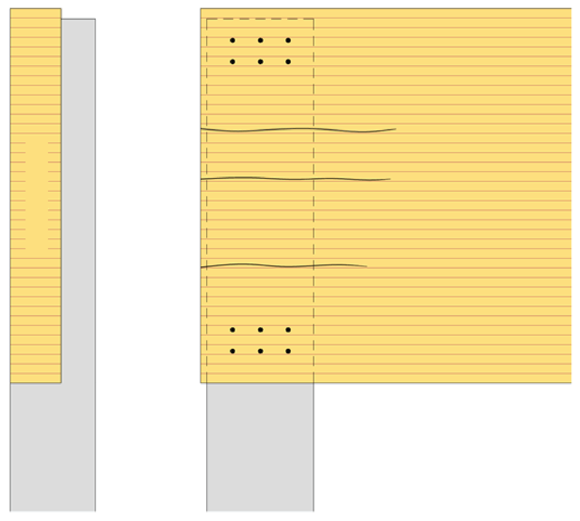
Detailed planning
The illustrated connection is incorrectly designed
The connectors at the edges of the glulam beam and the stiff concrete or steel structure will prevent the glulam beam from shrinking, causing the beam to crack
Glulam beam
Concrete or steel structure

Slide 29
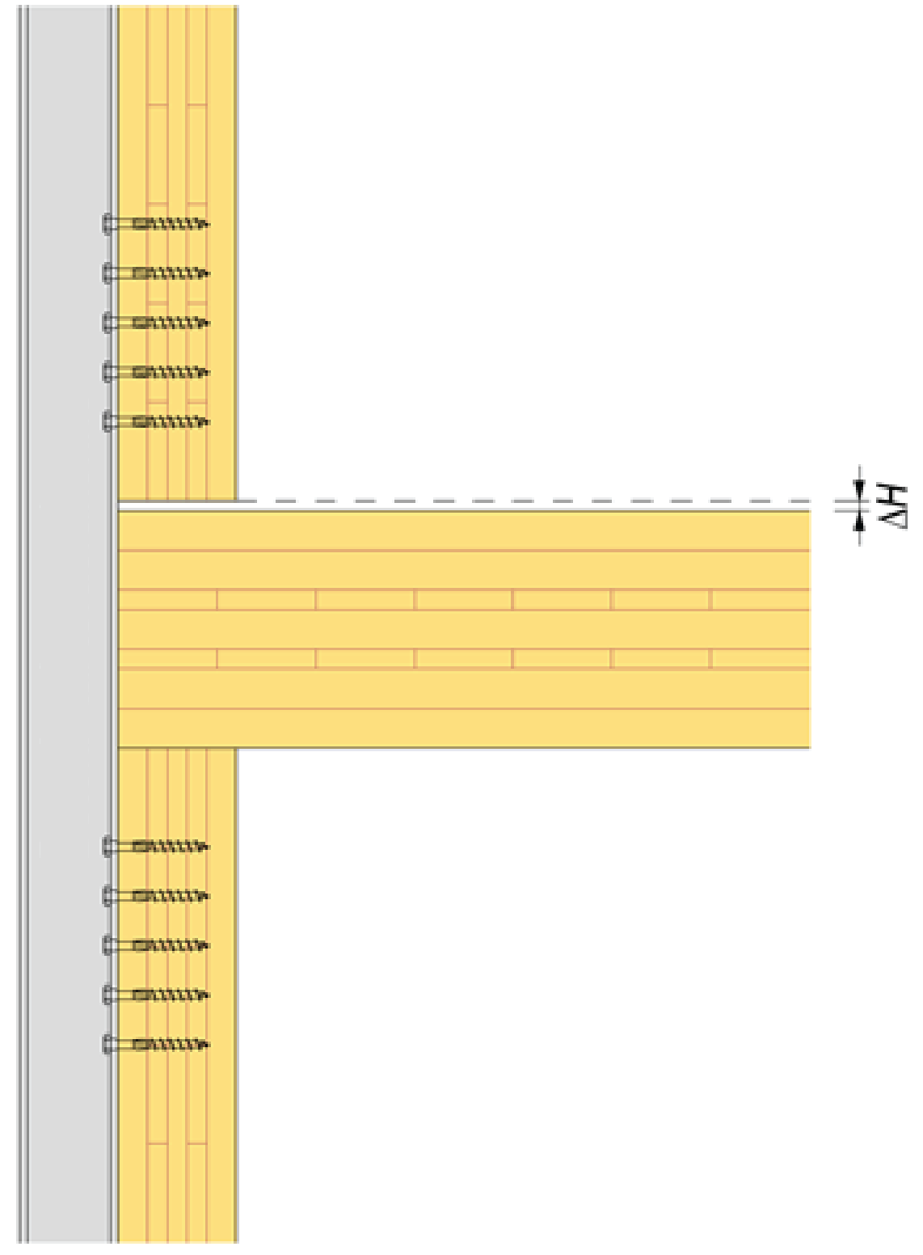
Detailed planning
The illustrated joint is incorrectly designed
The concrete or steel structure designed to extend over the connection will become load-bearing when the CLT panels of the intermediate floor shrink vertically between the load-bearing CLT walls
Concrete or steel structure

Slide 30
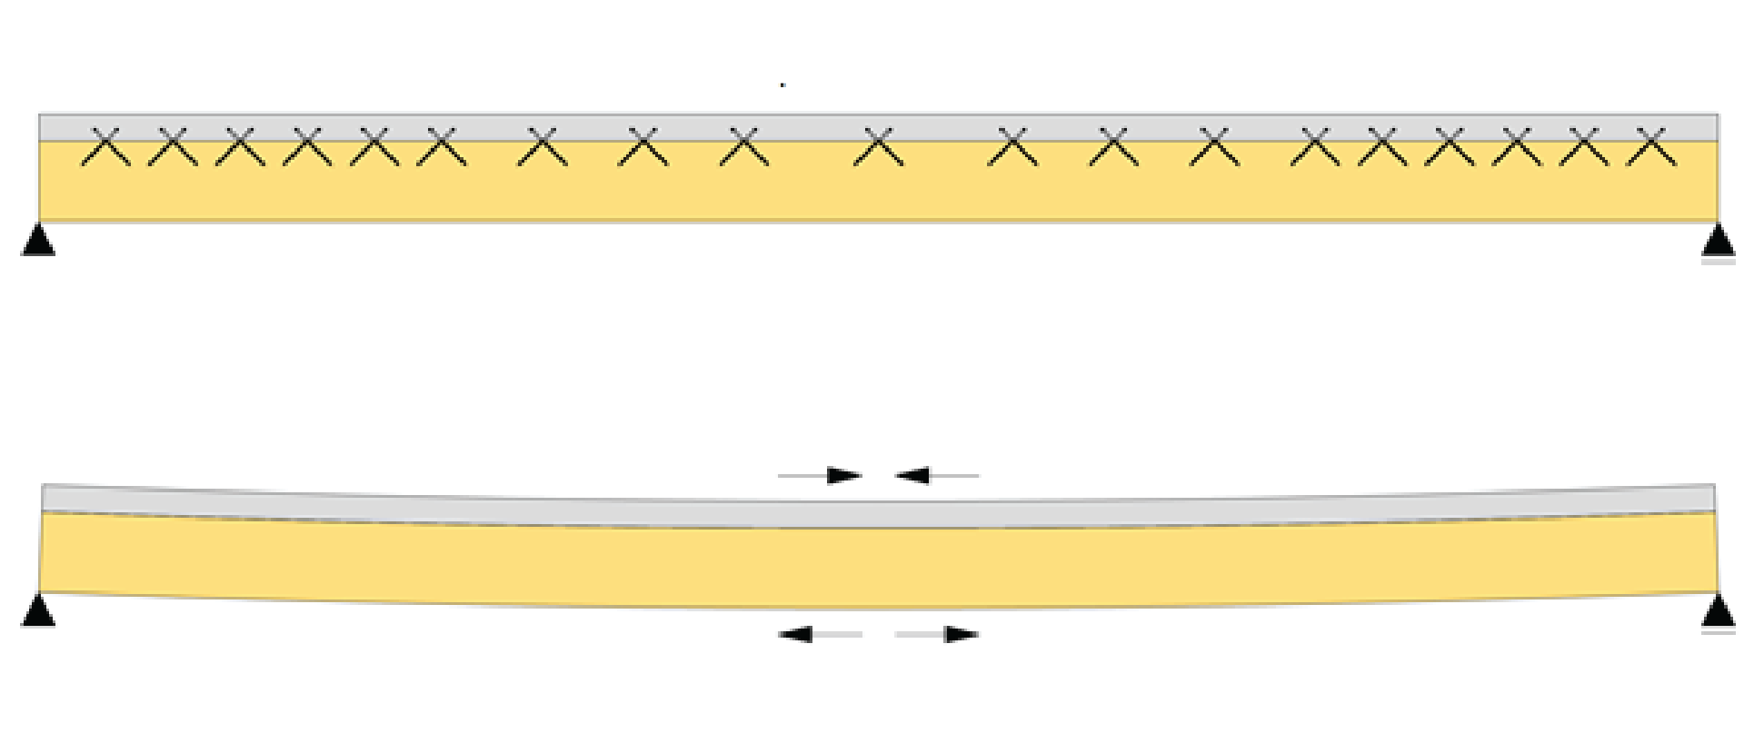
Detailed planning
The differences in the long-term behaviour of materials must be taken into account in composite structures
The composite structure may e.g. bend due to the different properties of the materials
Composite structure
Concrete structure shrinks
Wooden structure stretches

Slide 31
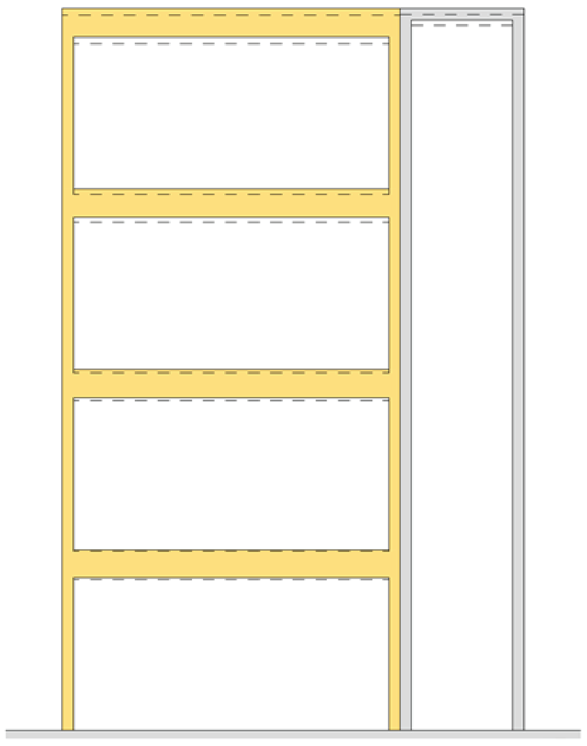
Frame design
The differences in the vertical movement of parts made of different materials must be taken into account
  Connecting parts must accommodate vertical movement
Methods for minimising vertical movement
  Minimising settlement of the wooden frame
  Allowing the concrete structure to dry before assembling the wooden frame
  Dry concrete elements
Settling timber frame
Shrinking concrete structure

Slide 32
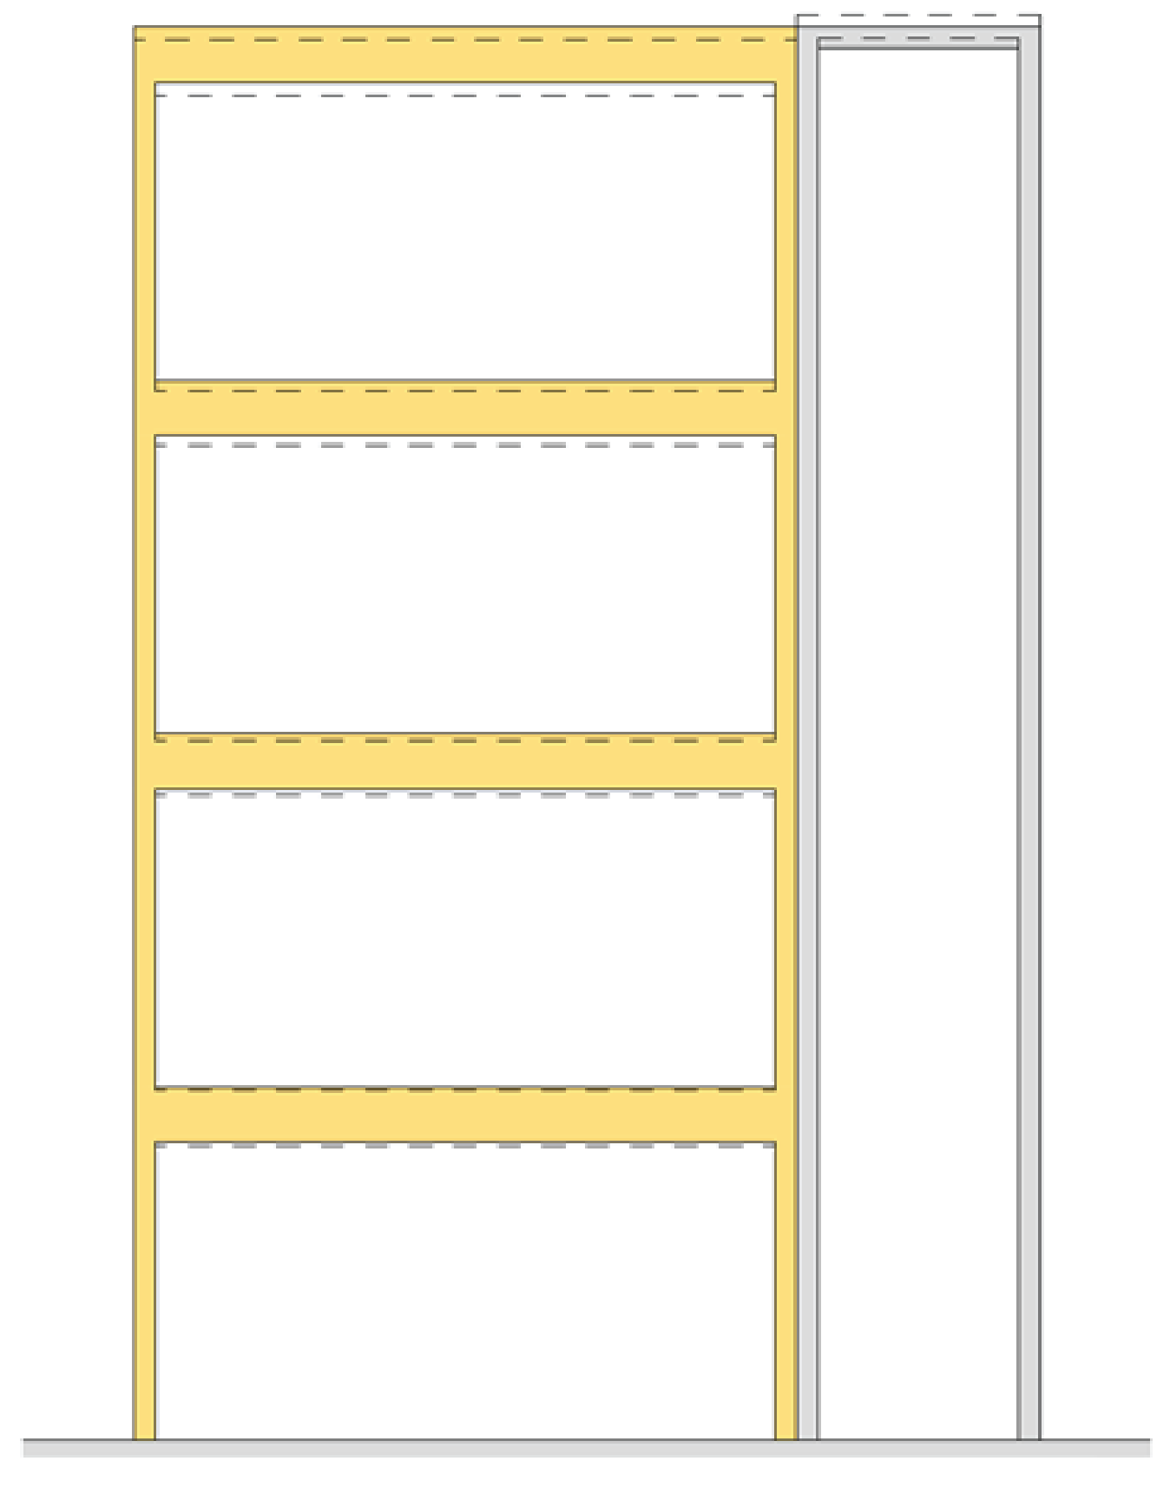
Frame design
Differences in the vertical movement of parts made of different materials must be taken into account
  Connecting parts must accommodate vertical movement
Methods for minimising vertical movement
  Minimising settlement of the wooden frame
  Minimising temperature variation of the thermally expanding element
Settling timber frame
Thermally expanding structure

Slide 33
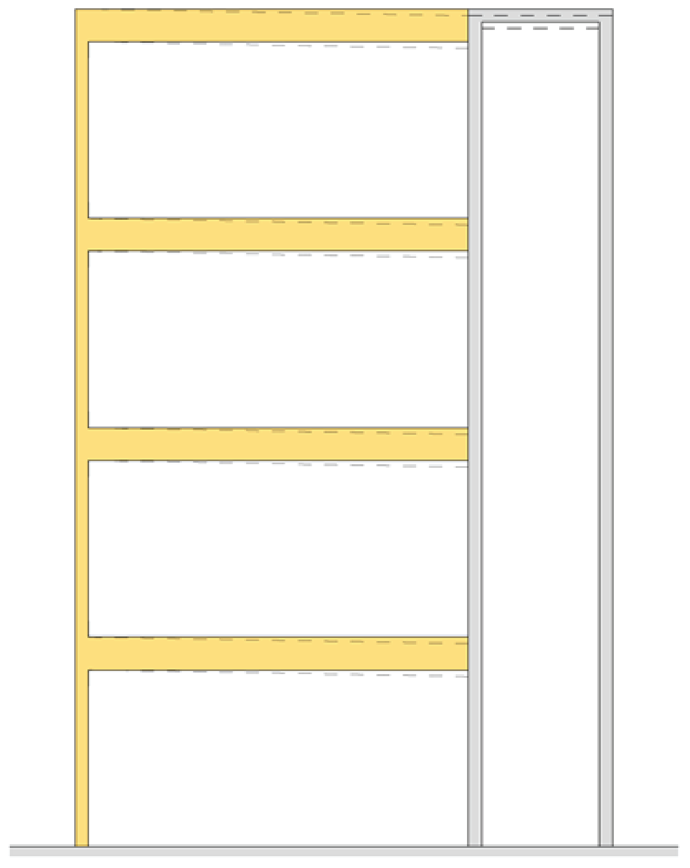
Frame design
Differences in the vertical movement of parts made of different materials must be taken into account
Methods for minimising vertical movement
  Allowing the concrete structure to dry before assembling the wooden frame
  Dry concrete elements
Non-settling timber frame
Shrinking concrete structure

Slide 34
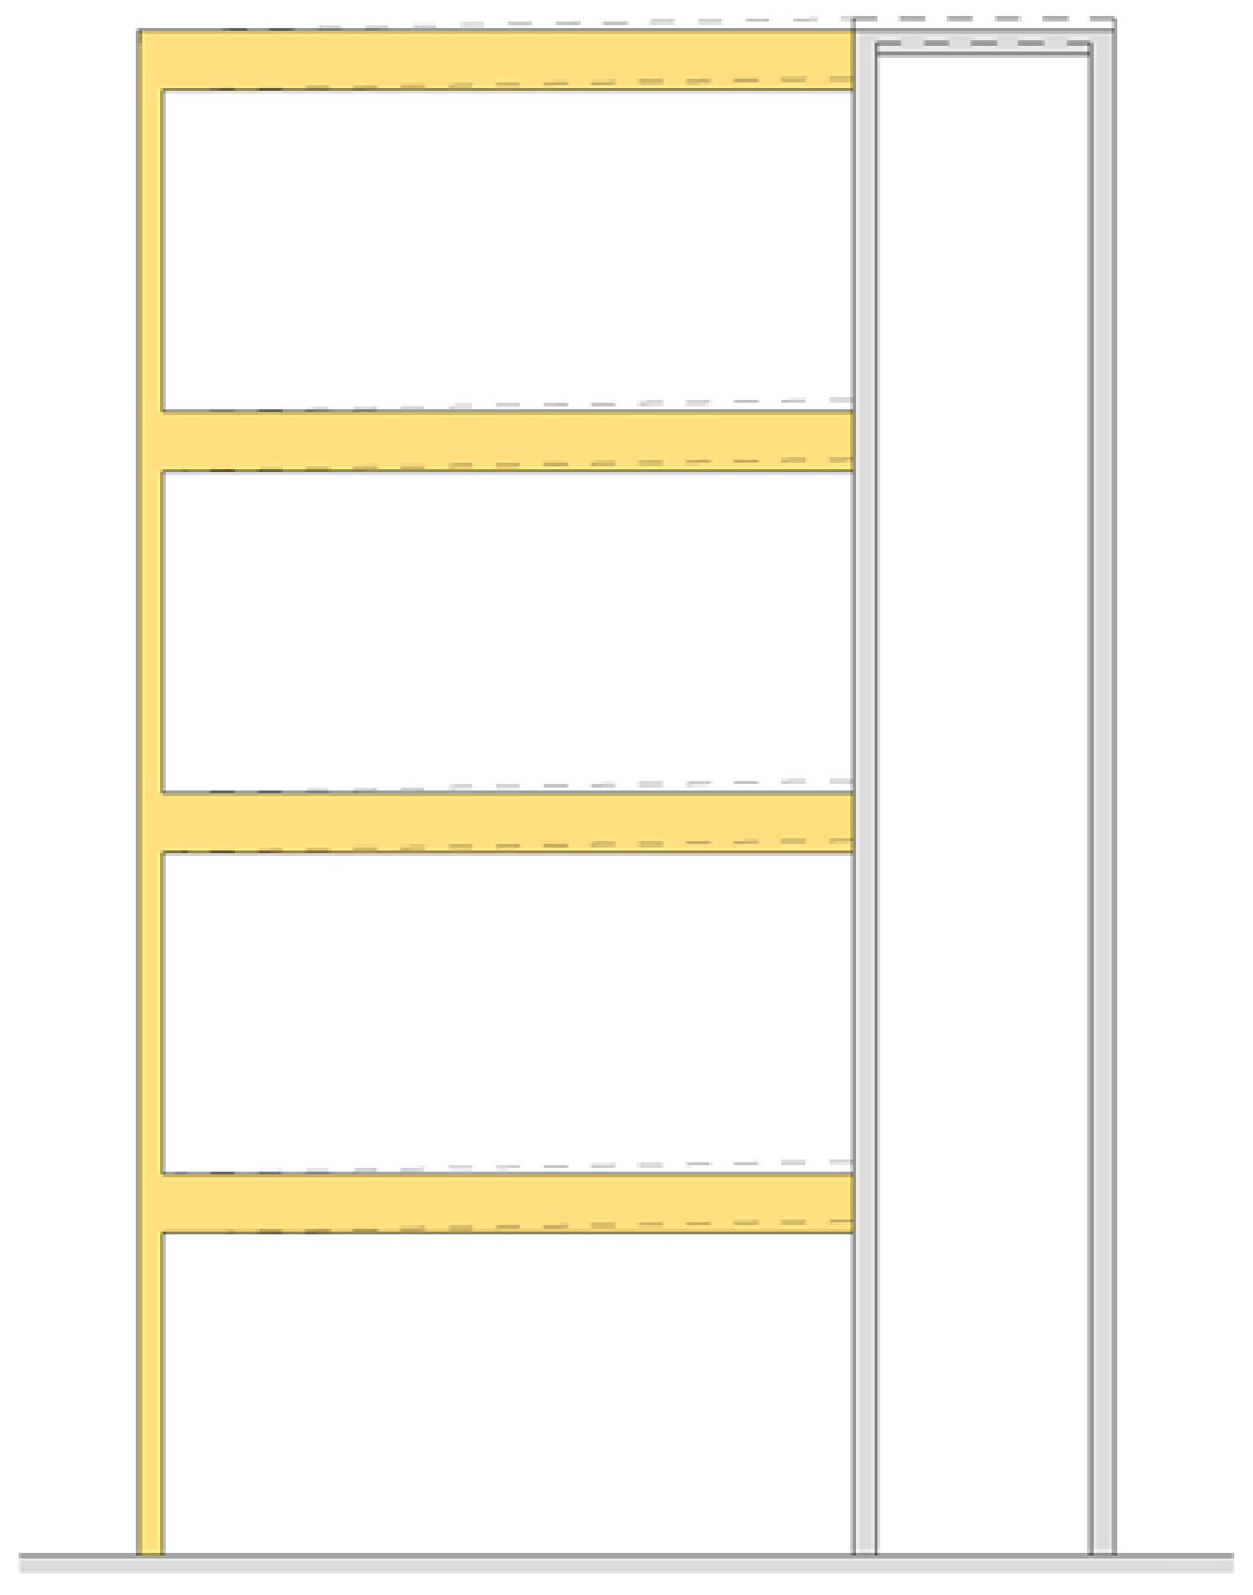
Frame design
Differences in the vertical movement of parts made of different materials must be taken into account
Methods for minimising vertical movement
  Minimising temperature variations of the thermally expanding element
Non-settling timber frame
Thermally expanding structure

