Slide 1



Industrial wood construction
Teaching materials for industrial wood construction education
2022

Slide 2
Origin of the materials
Use of the materials
These learning materials for industrial wood construction have been prepared in a project led by Puuinfo Oy in 2021–2022. Also involved in the project were
Lappia Vocational College,
TTS-Työtehoseura ry
South-Eastern Finland University of Applied Sciences,
Metropolia University of Applied Sciences,
Jyväskylä University of Applied Sciences,
University of Tampere, and
Federation of the Finnish Woodworking Industries Puutuoteteollisuus ry
The project was funded by the Ministry of the Environment.
The materials are intended to be used as extensively as possible in industrial wood construction education and studies.
The materials are released under the Creative Commons licence Attribution-ShareAlike (CC BY-SA), which requires that the author be properly credited when the materials are used and that derivative works may only be distributed under the same licence as the original work.
The original materials and any updates to them by Puuinfo will be published on the Library of Open Educational Resources website (aoe.fi) and the Puuinfo.fi website.

Slide 3
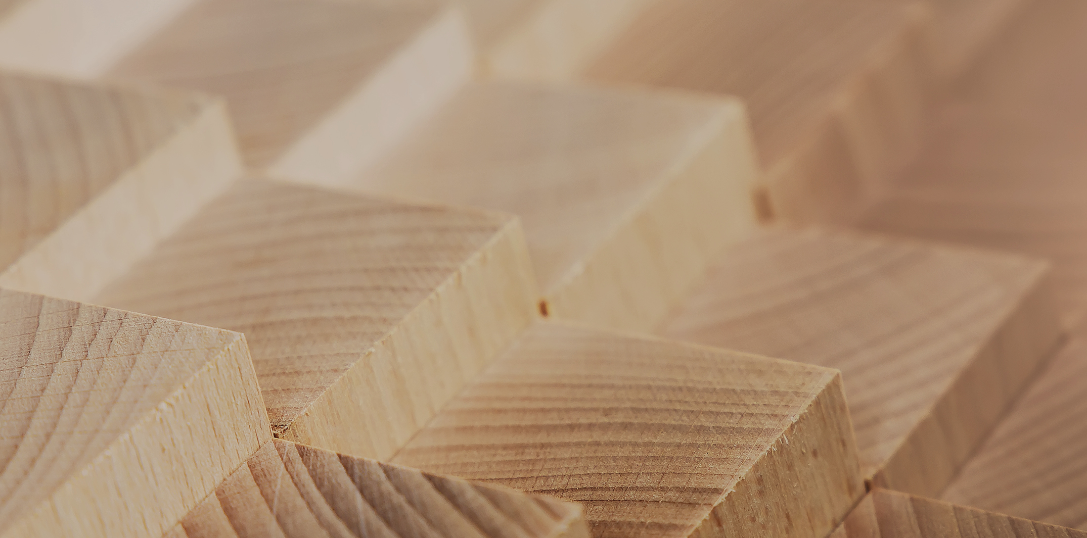
Industrial construction systems

Slide 4
Authors
Tero Lahtela,
Insinööritoimisto Tero Lahtela Oy
Release date: 14/10/2021

Slide 5
Load-bearing solid timber frame
Residential and commercial construction

Slide 6
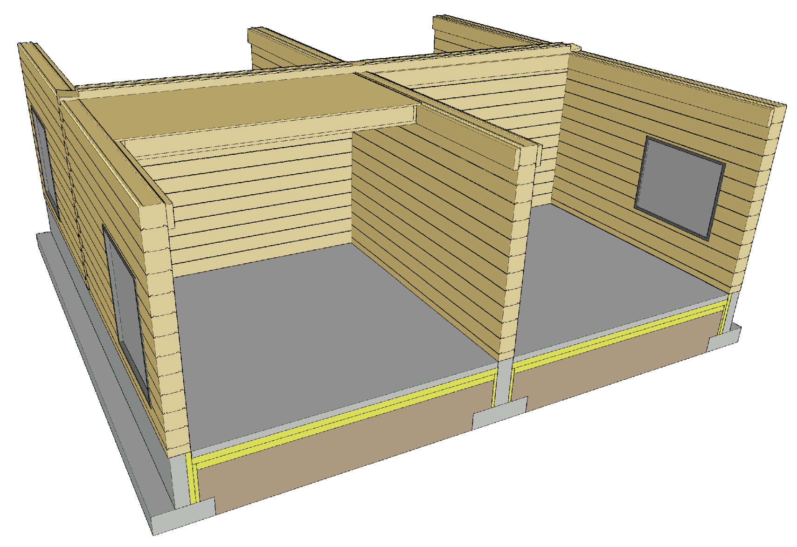
Components of a solid wood system
Load-bearing exterior walls (log)
Load-bearing partitions (log)
Intermediate floors
Roof
  Plane elements with beam structure
  Typically nail plate truss
  A nail plate truss roof can be built as blocks on site or in the factory

Slide 7
Applications
A load-bearing solid timber frame is primarily used for
  Detached and terraced houses
  Leisure time buildings
  Accommodation buildings and residential institutions
  School and day-care centre buildings
A solid timber frame can also be used as an element in other building systems (load-bearing or non-load-bearing)
A solid timber frame is in principle hundreds of years old construction system concept
Large-scale buildings can be constructed using modern industrial timber frame solutions

Slide 8
Strengths and challenges of solid timber
Strengths
Industrial manufacturing
Dimensional accuracy
Easy to transport
Single-material wall structure
Ecological
Challenges
Durability and stiffness
  Vertical load
  Bracing
  Connections
Anchoring
Settlement (excluding non-settling timber)
Acoustic properties

Slide 9
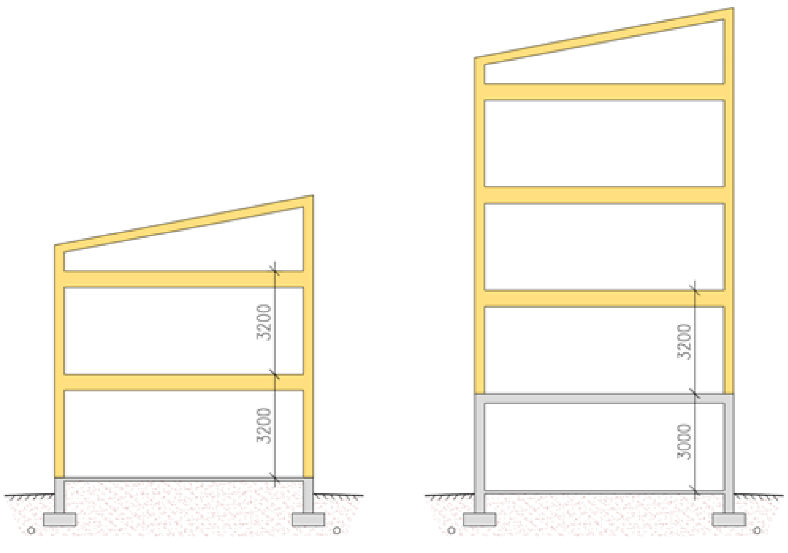
Number of storeys when using a solid timber frame
Factors affecting the number of storeys
  Buckling resistance of the wall
  Bracing capacity of the building
  Capacity of the connections between stiffening building elements
Recommended number of storeys
  3 timber-framed storeys at most
Floor-to-floor height
  3,200 mm (residential buildings)
  3,800 ... 4,000 mm (public areas)
4th storey
3rd storey
2nd storey
2nd storey
1st storey
1st storey

Slide 10
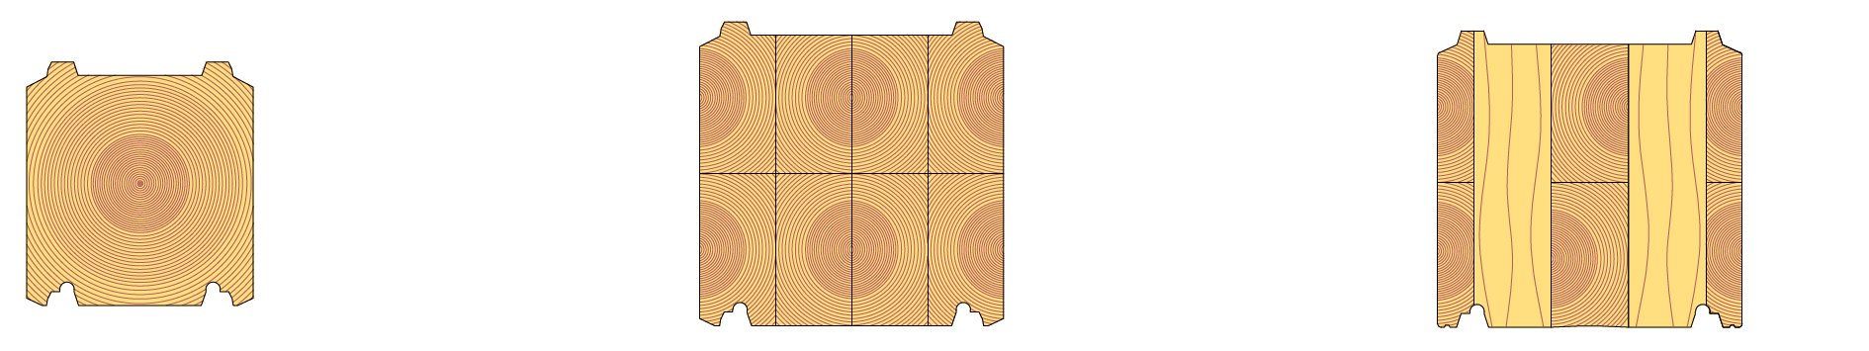
Solid timber logs
Solid timber log
Width: 95...205 mm
Height: 170...220 mm
Length: ≤ 13 m
Dimensions and profile shape vary by manufacturer
Laminated log
Width: 95...275 mm
Height: 170...275 mm
Length: ≤13 m
Dimensions. laminated structure and profile shape vary by manufacturer
Non-settling timber
Width: 135...275 mm
Height: 220...275 mm
Length: ≤13 m
Dimensions. laminated structure and profile shape vary by manufacturer

Slide 11
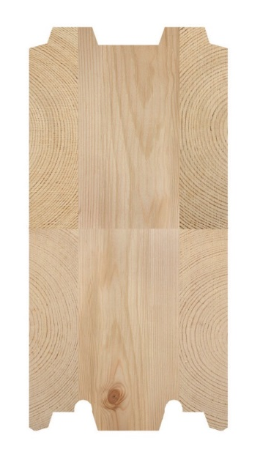
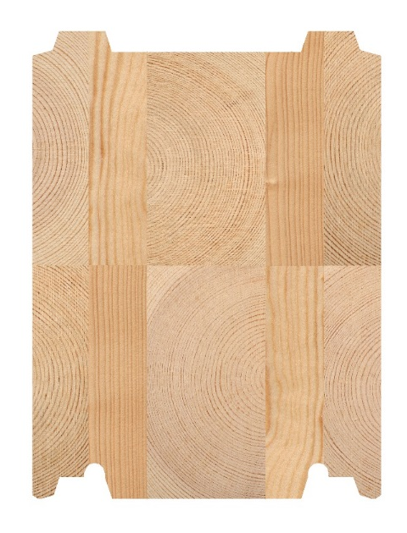
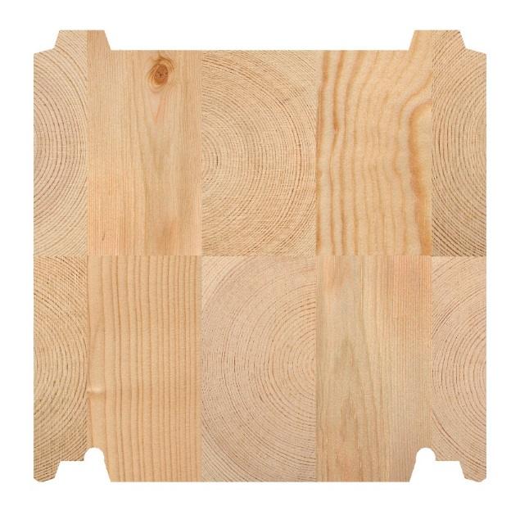
Non-settling timber
Non-settling timber refers to a cross-laminated timber product
Non-settling structure is achieved by using vertical lamellae that function as the load-bearing element
Non-settling timber makes up a building element resembling a CLT panel wall
Images: Kontiotuote

Slide 12
Prefabrication degree of solid timber frames
A timber frame delivery typically includes
  Timber walls
  Possible beams
  Installation accessories for logs
Complementary elements of a timber frame as required
  Intermediate floor elements (beam or solid timber structures)
  Roof elements (beam or solid timber structures)
  Nail plate trusses
  Other beams (glulam timber or LVL)
  Partition elements (with framed or solid timber structure)
  Windows and doors

Slide 13
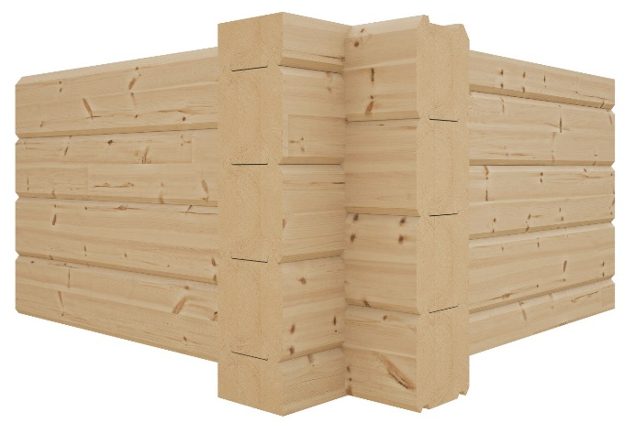
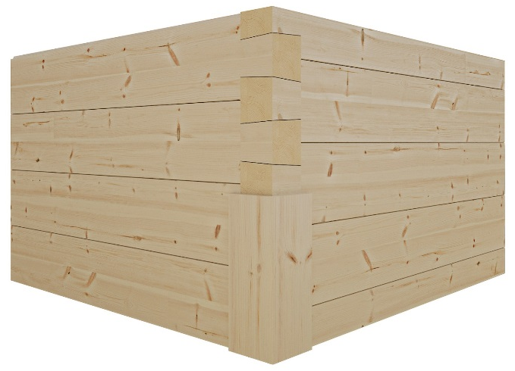
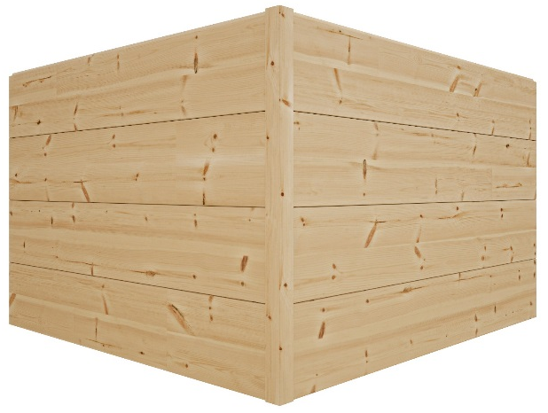
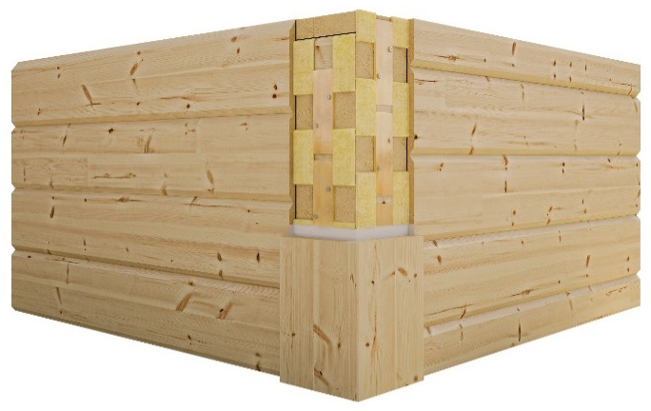
Corner options
1)
2)
There are several options for the corners of solid timber walls
  Extended corner (1)
  Dove-tail corner (2)
  Mitre corner (3)
  City corner (4)
3)
4)
Images: Kontiotuote

Slide 14
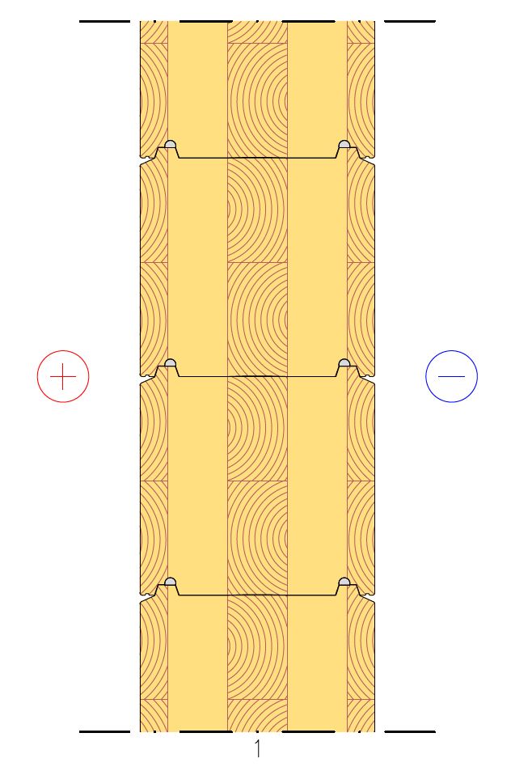
Exterior wall structure
Load-bearing exterior wall
An exterior wall with solid timber structure is simple as it only has one structural layer of a single material
A solid timber wall has a relatively high U value
Load-bearing capacity of a timber wall
  Buckling resistance
1 Non-settling timber

Slide 15
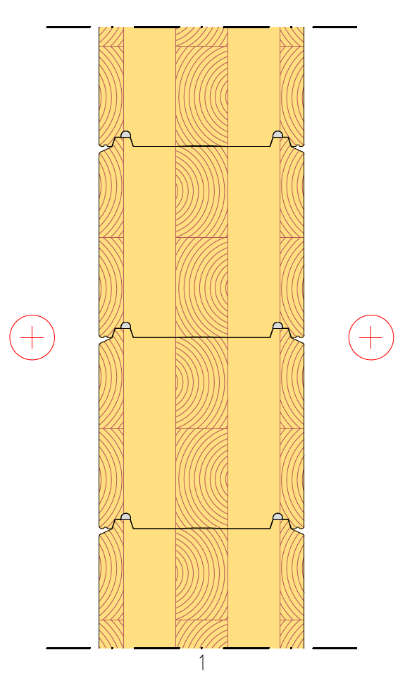
Partition structure
Load-bearing partition
A partition with solid timber structure is simple as it only has one structural layer of a single material
A solid timber wall has a relatively low sound insulation capacity
  D_{n,T,w} ≥ 40 dB
Load-bearing capacity of a timber wall
  Buckling resistance
1 Non-settling timber

Slide 16
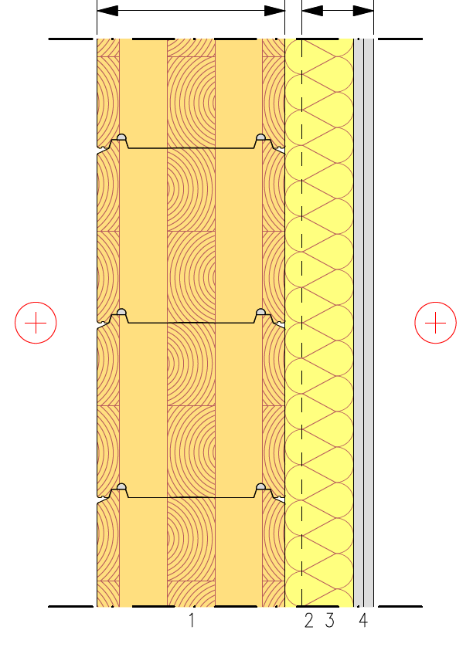
Partition structure
Load-bearing partition
Separate frame halves
Frame 1
Frame 2
The sound insulation capacity of a solid timber partition can be improved by making it into an acoustical double structure
Double frame
  Enables airborne sound insulation between spaces of D_{n,T,w} ≥ 55 dB
When using a framed wall clad with plasterboard, the log wall look is lost on the other side of the wall
1 Non-settling timber
2 Gap between frame halves + Timber frame
3 Mineral wool
4 2 x plasterboard

Slide 17
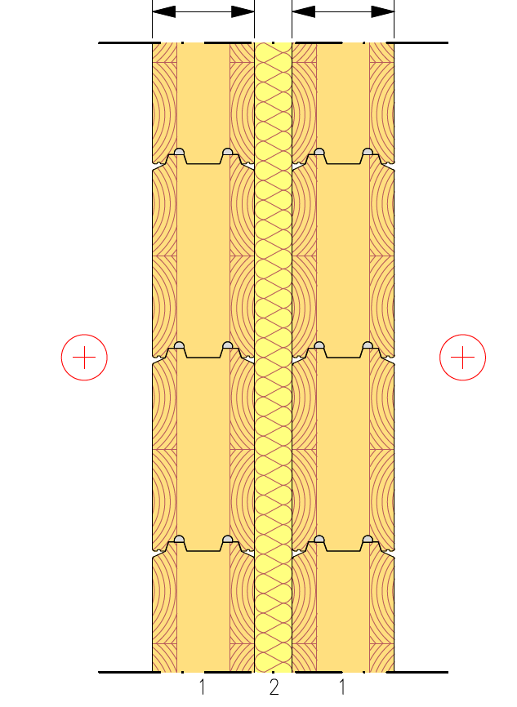
Partition structure
Load-bearing partition
Separate frame halves
Frame 1
Frame 2
The sound insulation capacity of a solid timber partition can be improved by making it into an acoustical double structure
Double frame
  Enables airborne sound insulation between spaces of D_{n,T,w} ≥ 55 dB
1 Non-settling timber
2 Gap between frame halves + Mineral wool

Slide 18
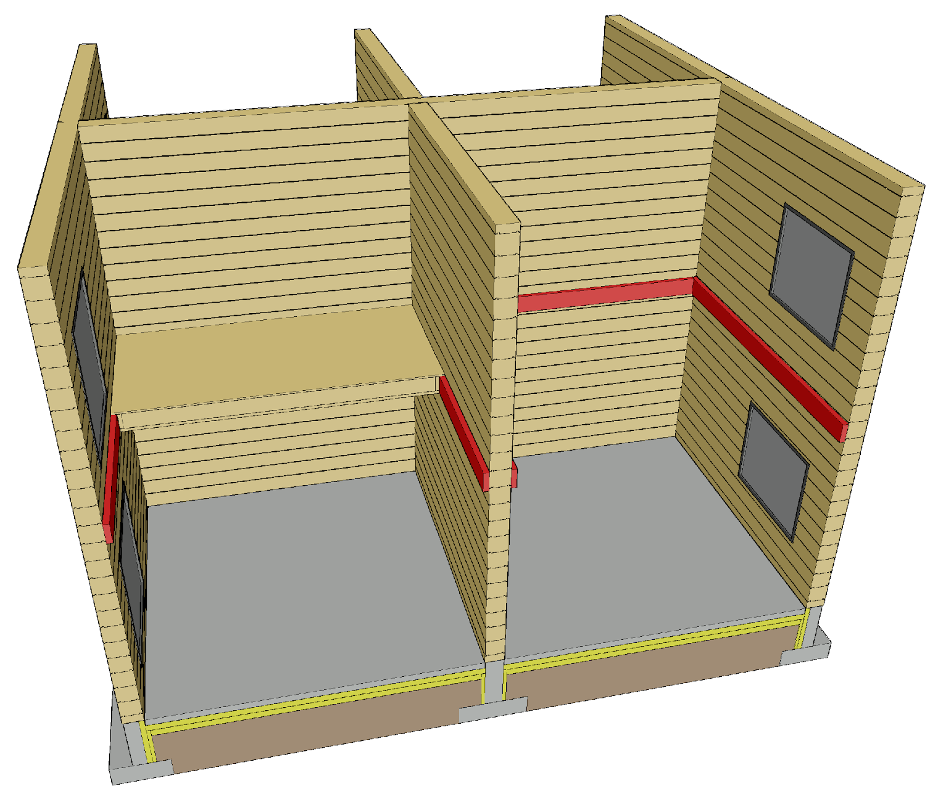
Intermediate floor structure
An intermediate floor can be built using the intermediate floor types of the plane element system
  Rib panels
  Solid timber panels
In a timber frame, the intermediate floor is usually supported by a wall-mounted bracket, as the log walls are continuous past the intermediate floor

Slide 19
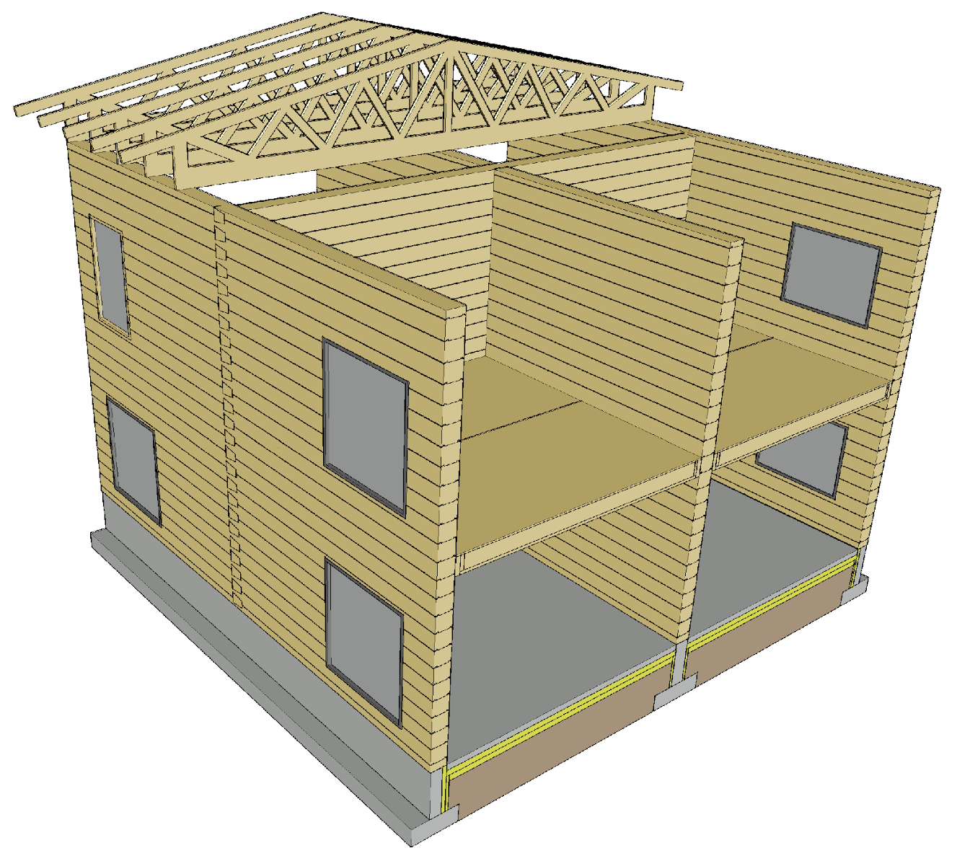
Roof structure
The roof can be built using the roof types of the plane element system
  Nail plate trusses
  Roof elements with beam structures
Plane element system methods can be used to support nail plate trusses

Slide 20
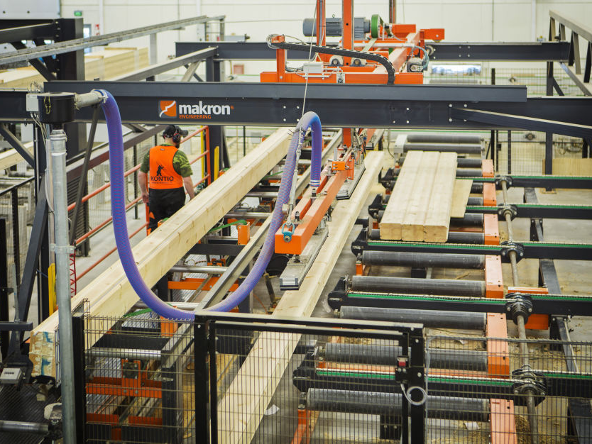
Log manufacture
Computer-controlled production lines are used for the manufacture and machining of industrially produced logs
CNC technology makes dimensionally accurate machining on logs possible, as in the case of CLT and LVL panels
Image: Makron

Slide 21
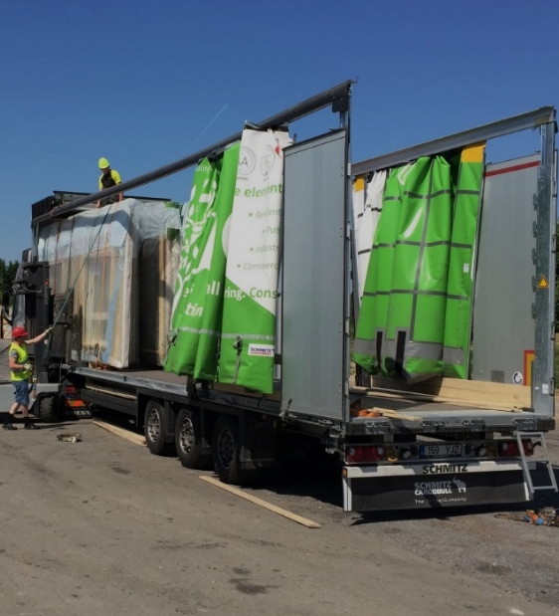
Transport of logs
2450
Transporting logs is efficient, as they can be packed into tight bundles
Covered transport equipment can be used to reduce the accumulation of protective plastic at the construction site
13600
3000
Image: Tero Lahtela

Slide 22
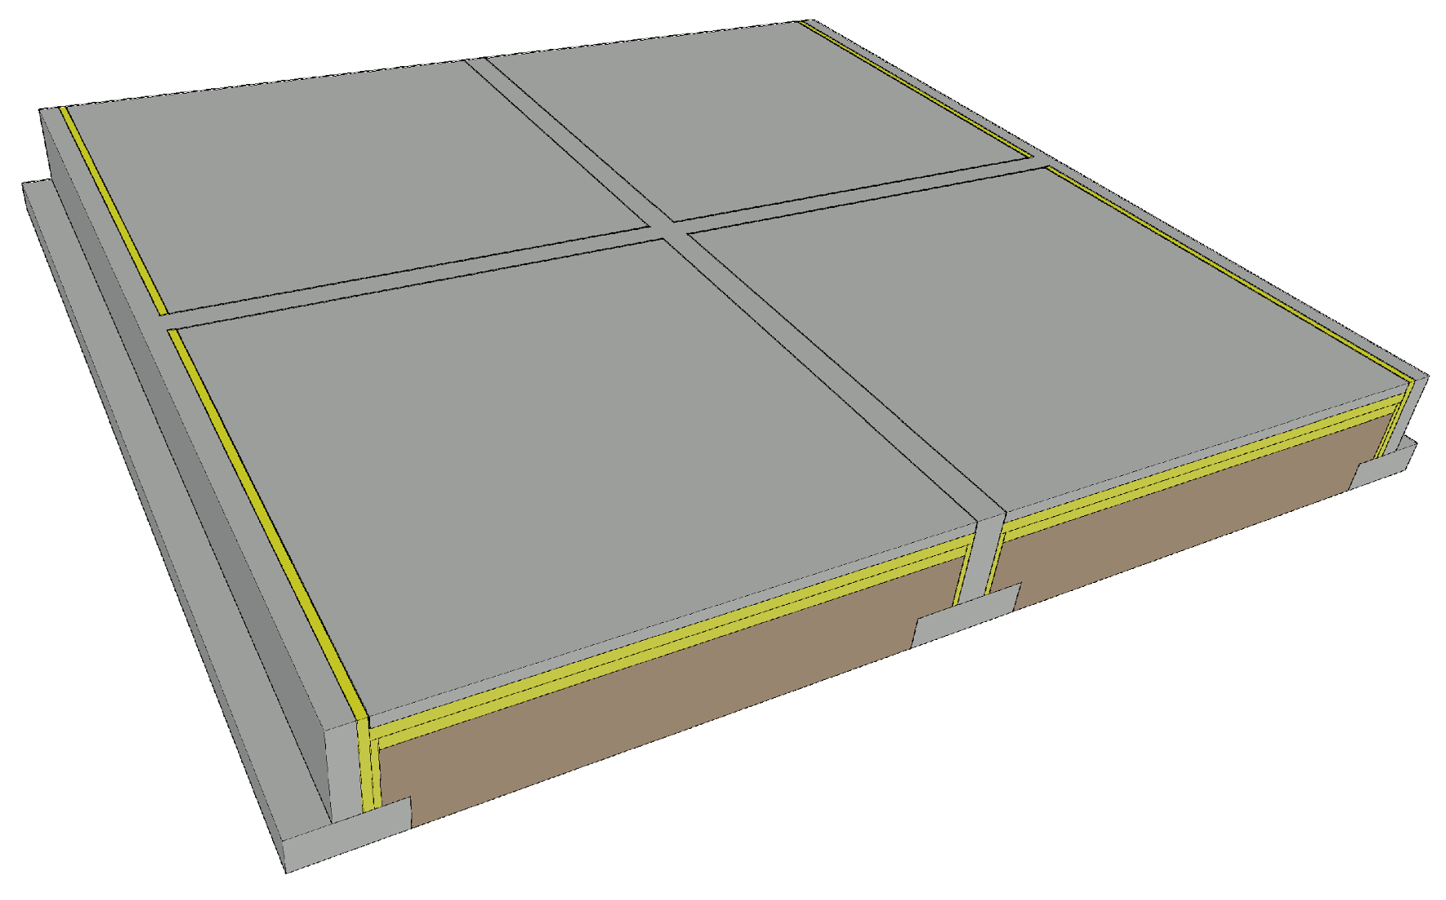
Foundation of a solid timber frame
A continuous foundation is needed under load-bearing timber walls
Foundation types
  Ground-supported shallow foundation
  Ventilated base floor
  Basement
Challenges
  Junction between the wall and the foundation
  Vertical dimensional accuracy of the foundation

Slide 23
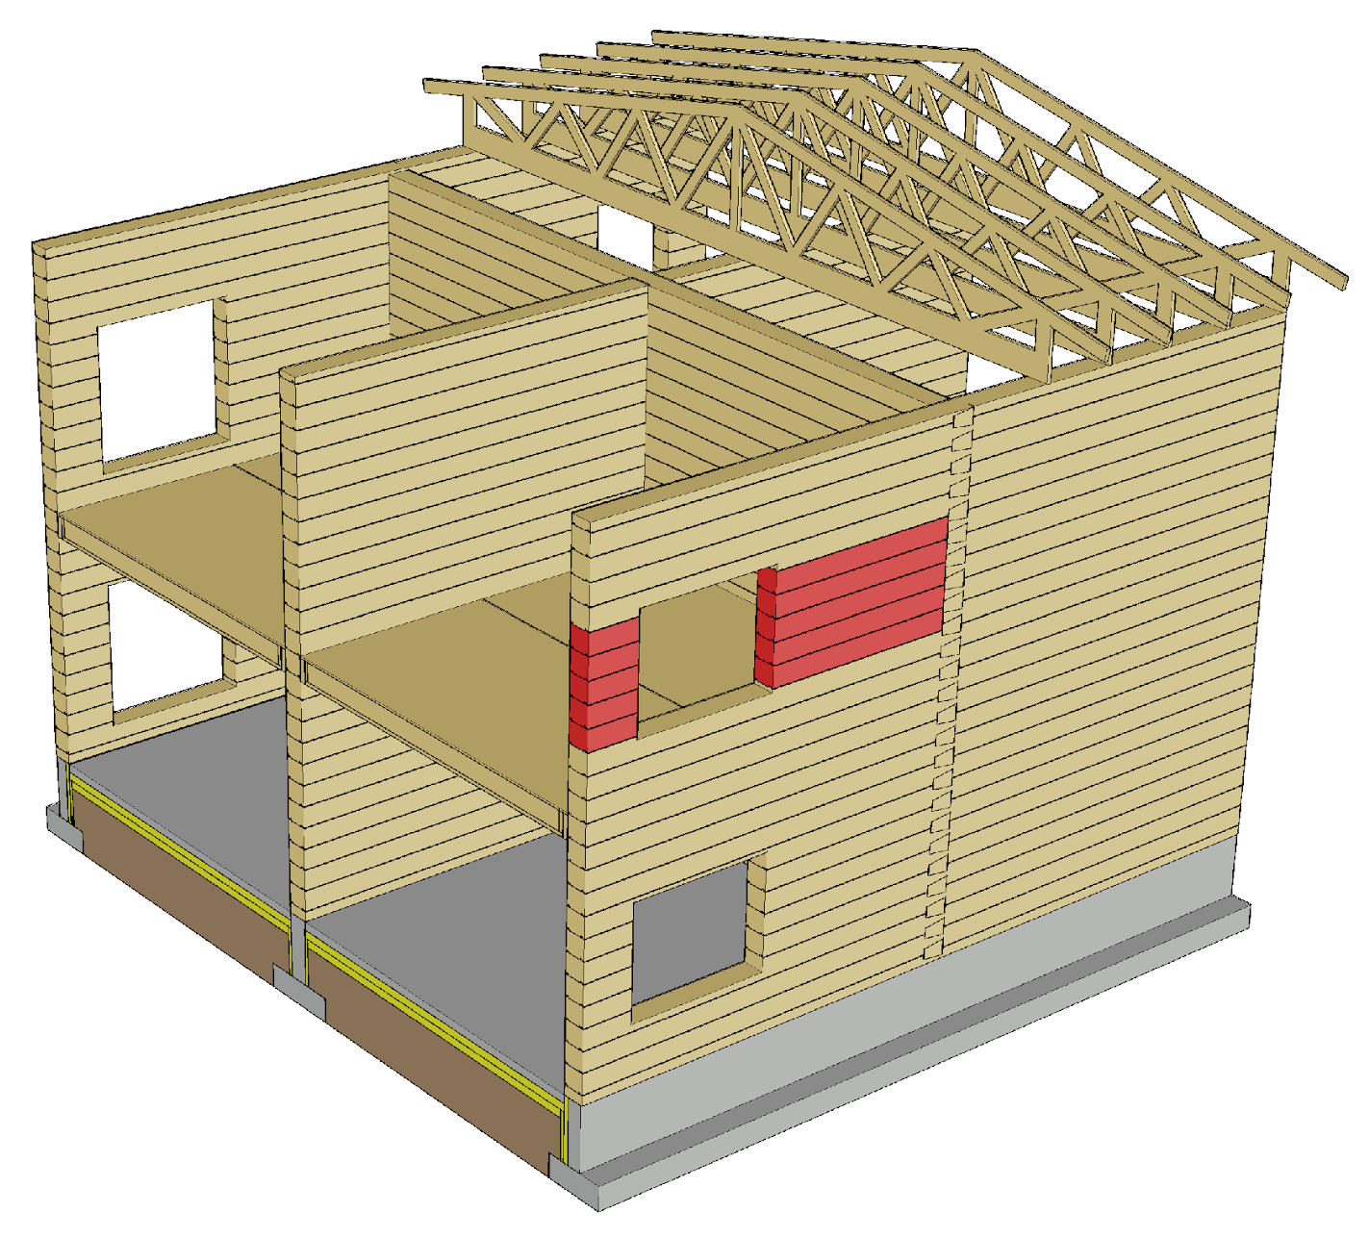
Vertical load transfer
Stacked logs cause linear loading on each other (kN/m)
The jambs of openings play a major role for the vertical and horizontal loading of the wall
Sufficiently wide strip of logs (buckle resistance) should be left in the jambs of the openings

Slide 24
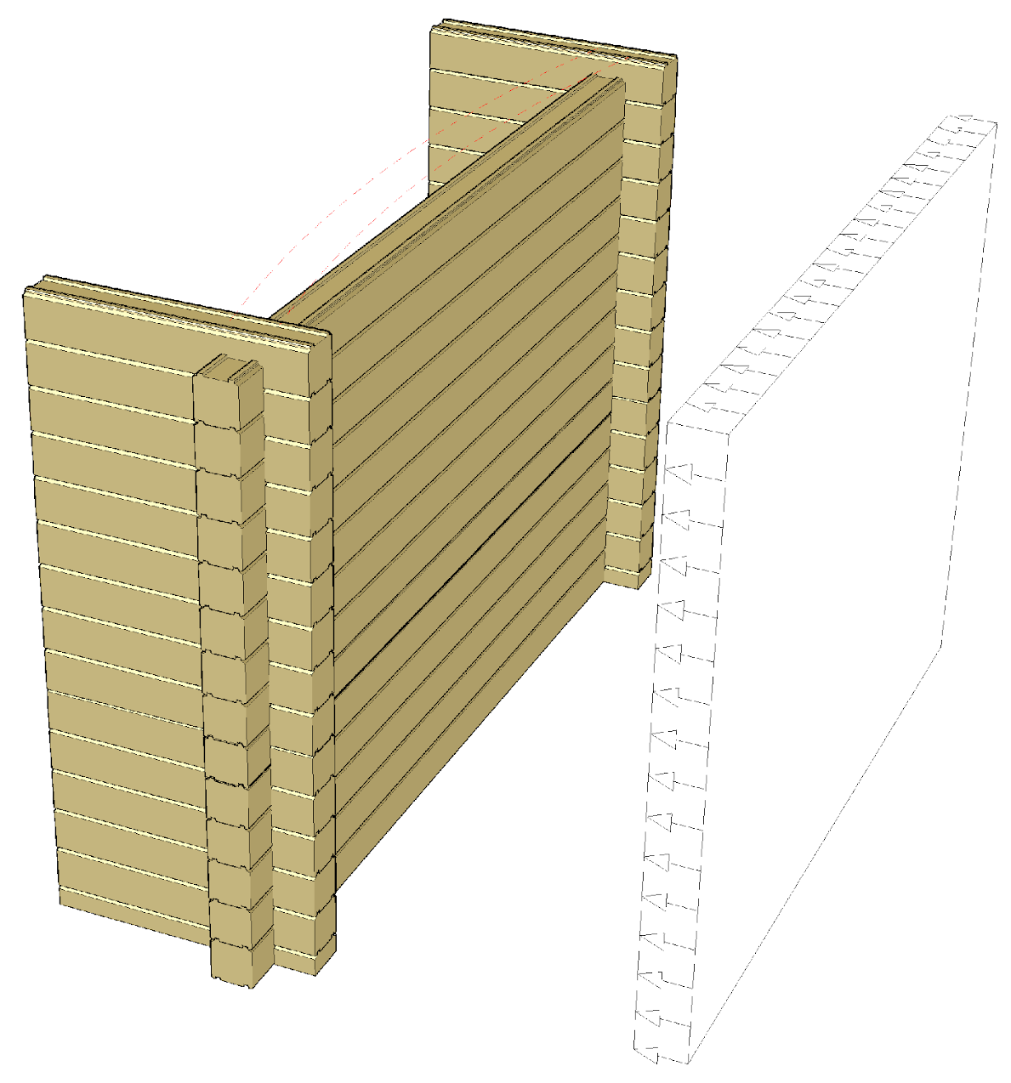
Log wall buckling support
Horizontal support is always needed in a log wall, enabling the wall to function as a load-bearing structure
Unlike a wall with a framed structure, for example, an exterior wall with log structure transfers the wind load to the transverse walls rather than to the base or intermediate floor or the roof

Slide 25
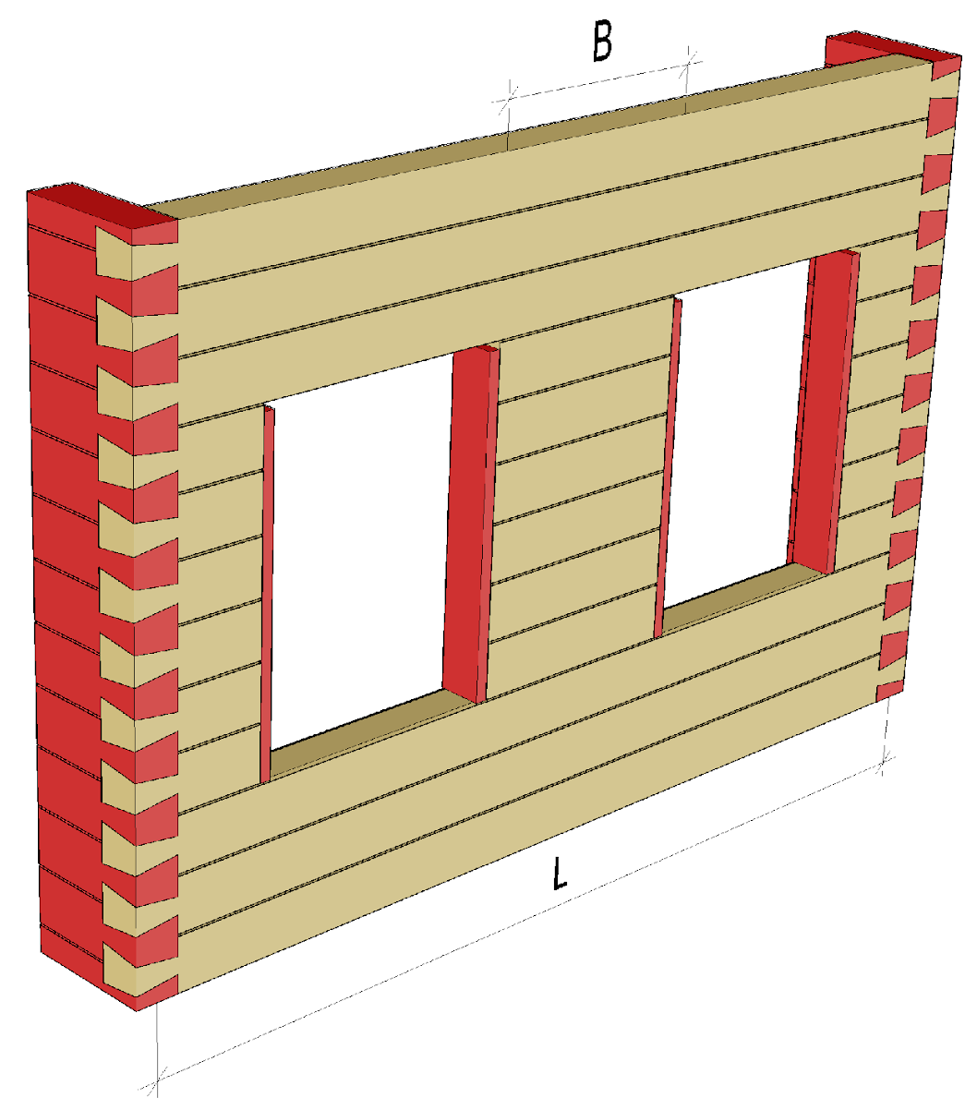
Log wall buckling support
Transverse walls or wall strips can be used for buckling support of a log wall
The studs on opening sides are used for buckling support of the jambs
The spacing between transverse supports (L, B) has a significant impact on the buckling resistance of the wall

Slide 26
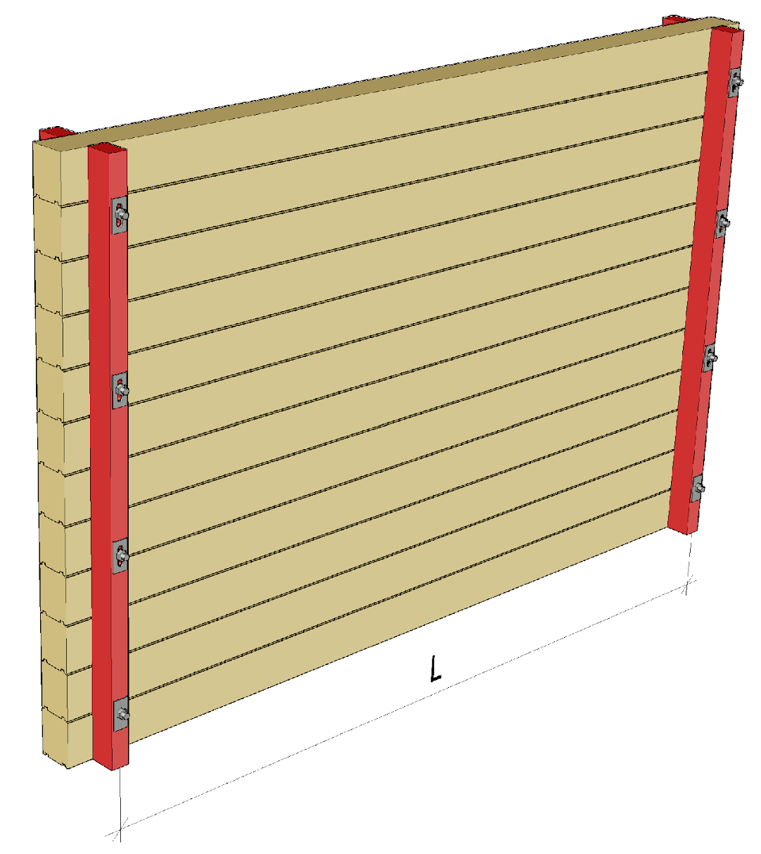
Log wall buckling support
Vertical supports can be used as buckling supports for a log wall
The settling of the log wall must be accounted for when using vertical supports
The spacing between the vertical supports (L) has a significant impact on the buckling resistance of the wall

Slide 27
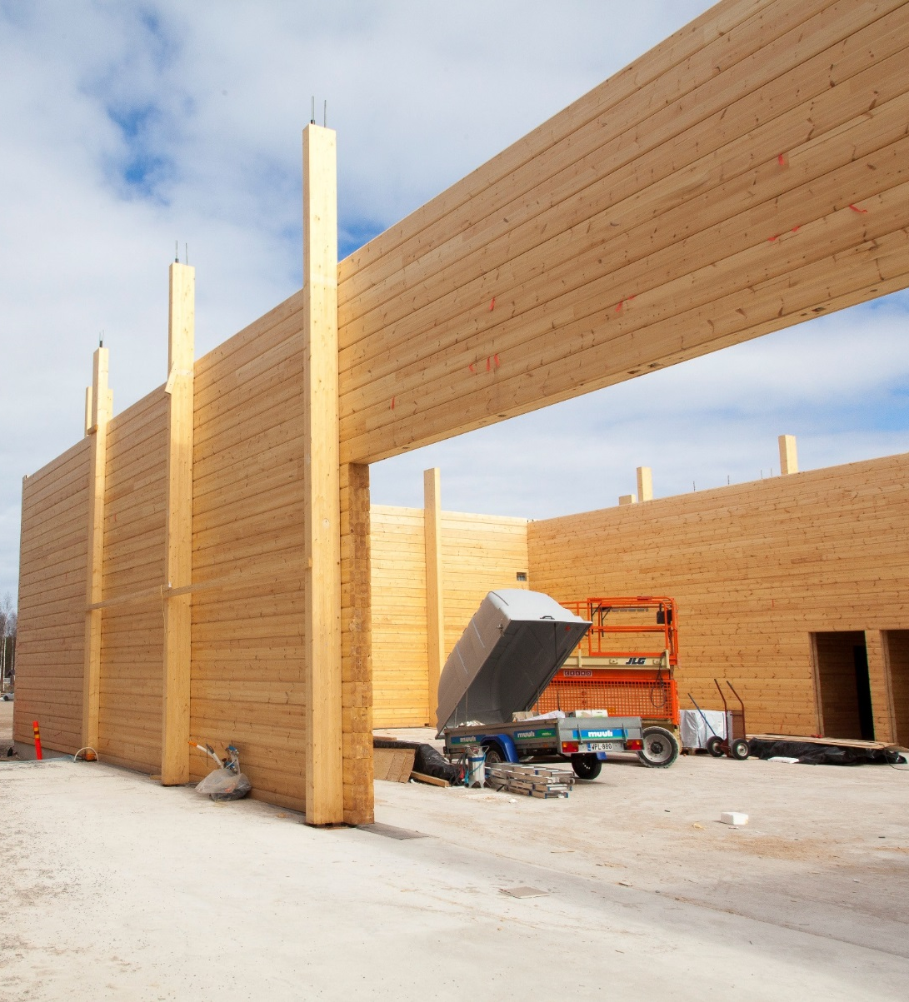
Vertical support of a log wall
Main columns, which support e.g. the main brackets, can also be used as vertical supports.
The logs function as horizontal beams between the vertical supports and transfer e.g. the wind load to the vertical supports
Image: Puuinfo

Slide 28
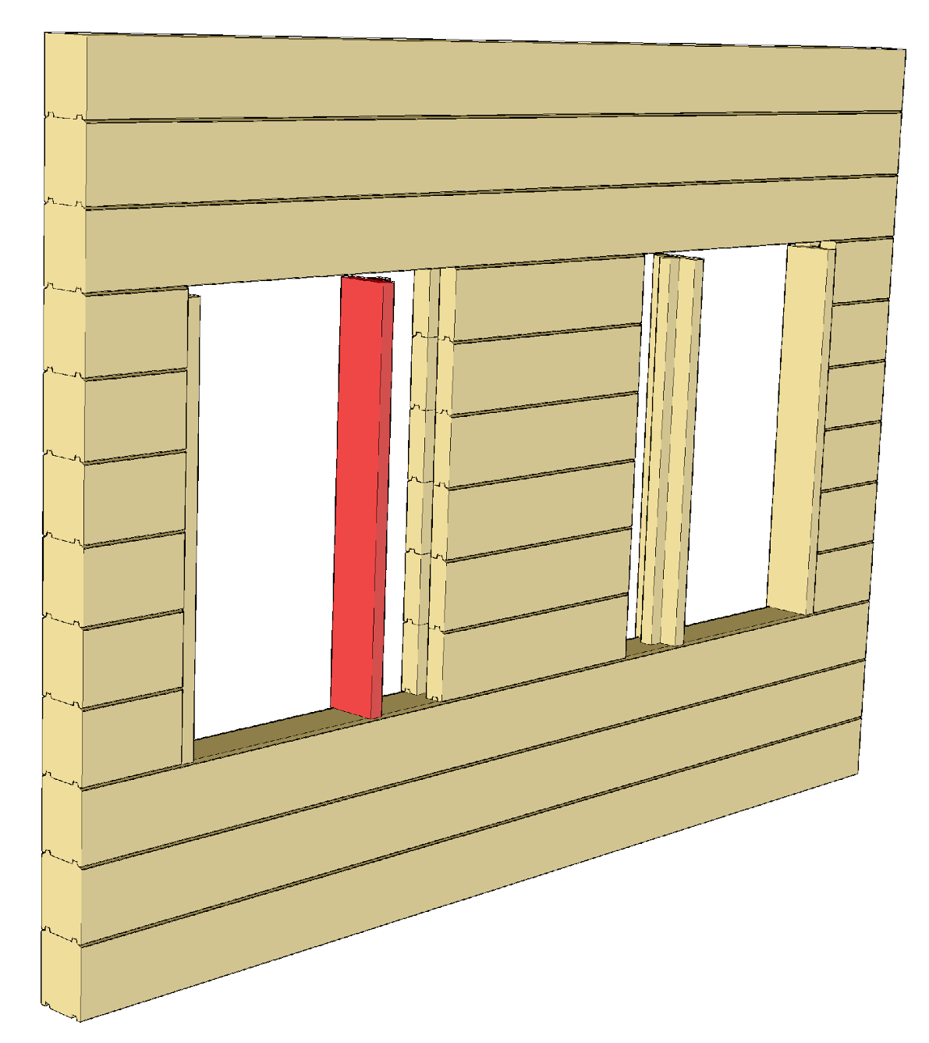
Stud
The stud is installed in a groove milled at log ends
The stud is used to support the jambs of the opening, and it also serves as a mounting surface for the window and door frame
At the top of the stud, space should be left for settlement to ensure that the stud does not end up bearing the wall section above the opening

Slide 29
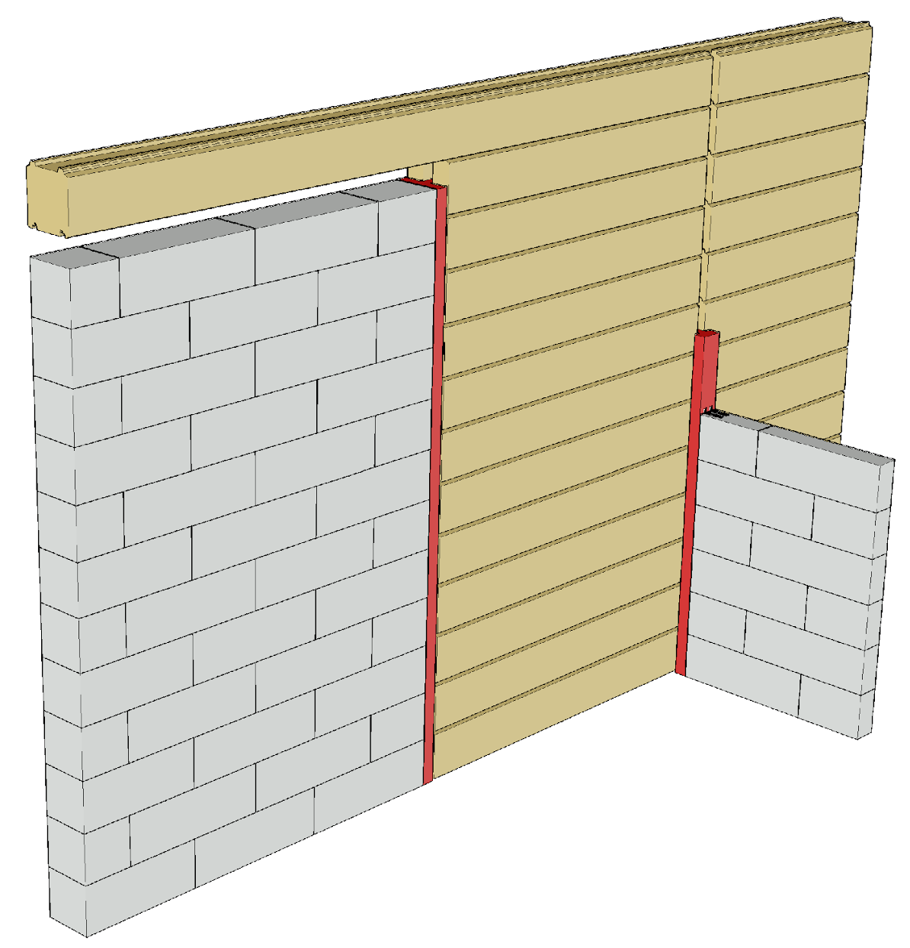
Stud
A stud is also needed in cases where non-settling building elements are connected to a settling log wall
The stud additionally provides a fastening surface for an adjoining building element

Slide 30
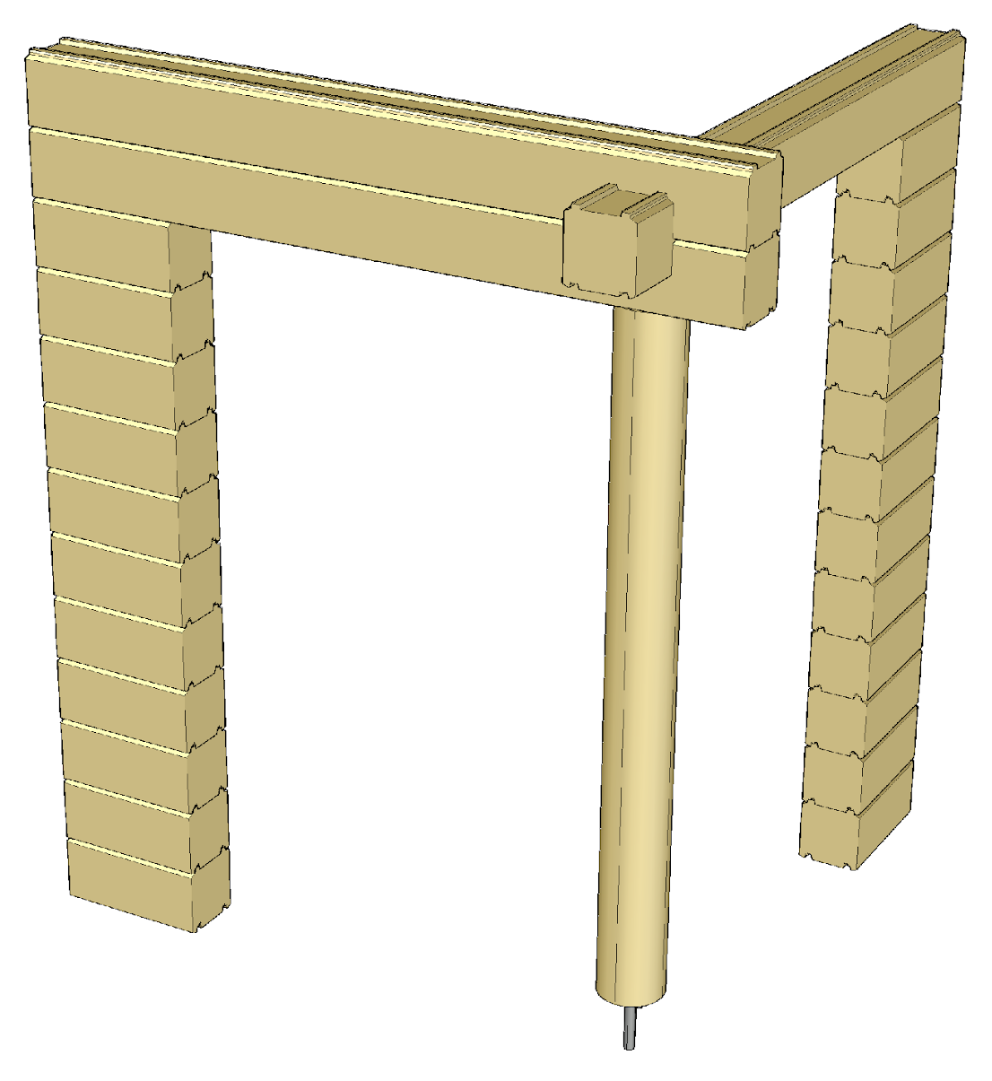
Adjustable columns
When columns are joined to a settling log wall, they must be equipped with adjustable column shoes.
The column shoe causes high local compressive stress on its foundation
The column shoe’s buckling resistance may determine the design of column

Slide 31
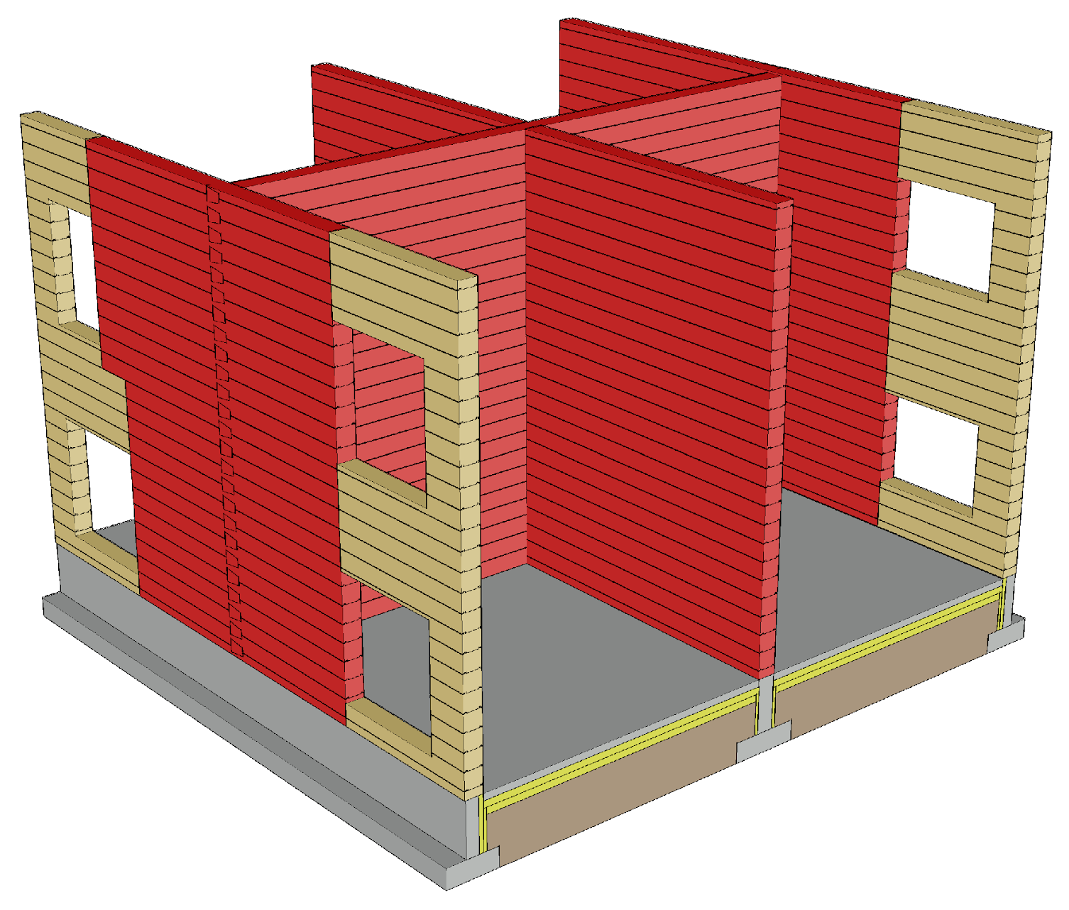
Building bracing principle
The external walls of a log structure transfer the wind load to the transverse walls that support the exterior wall, in which case the intermediate floor and roof do not have a role in bracing
Openings do not function as stiffening sections

Slide 32
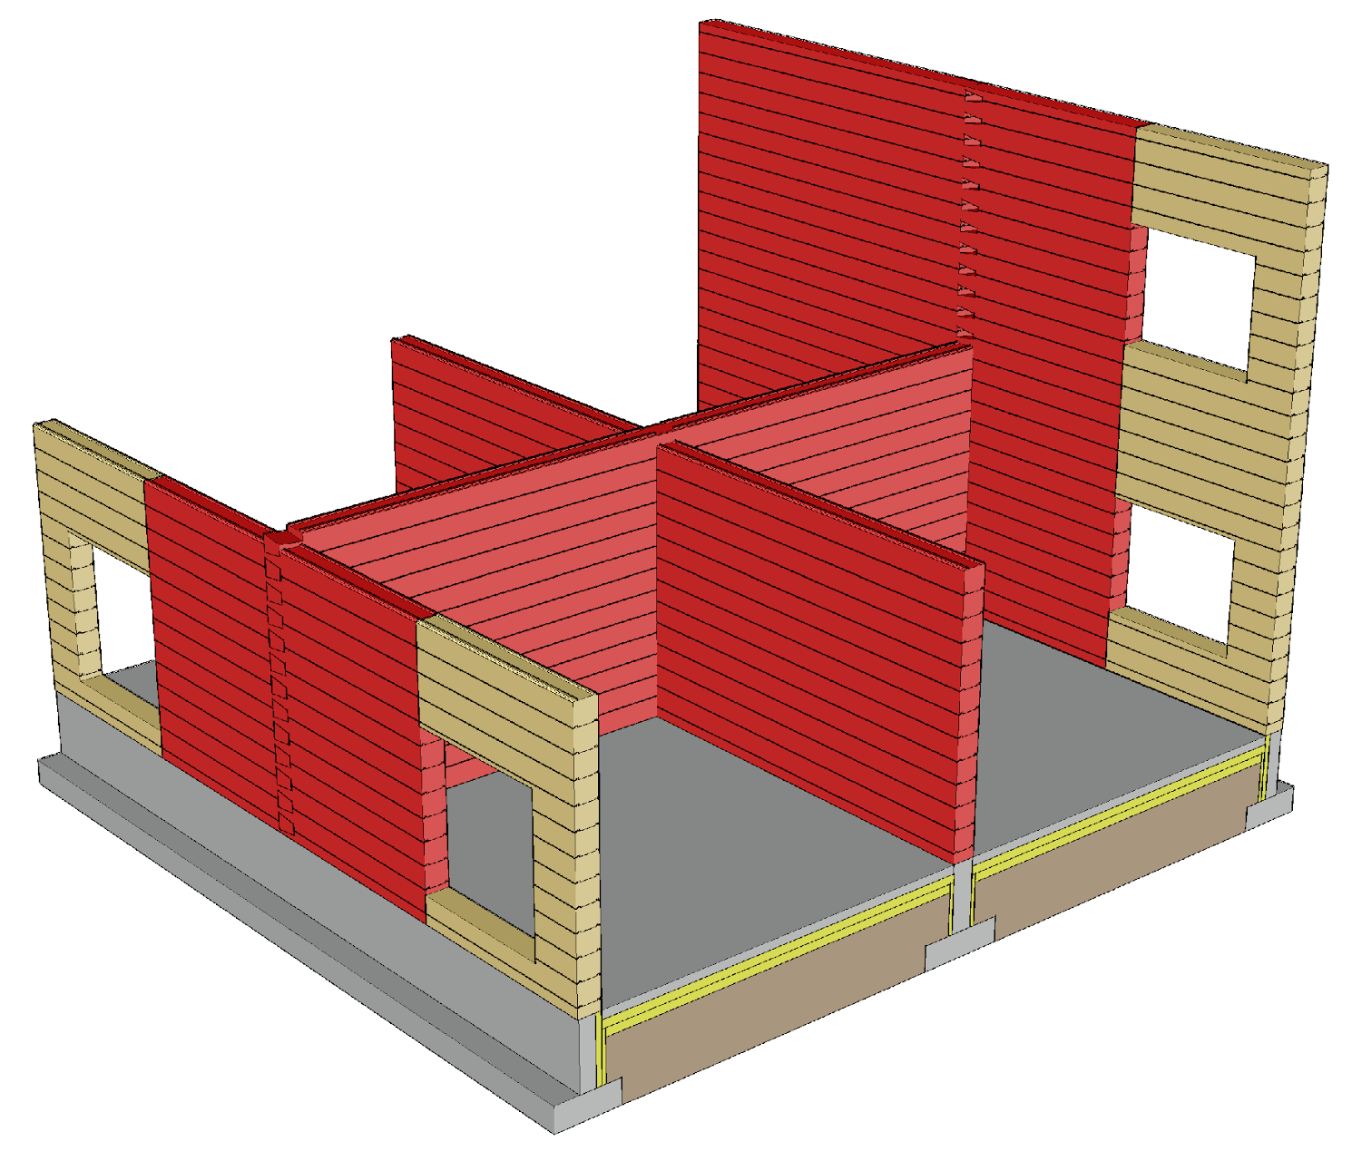
Building bracing principle
The wall structures should be as long as possible to reduce anchoring forces
The stiffening walls should be placed as evenly as possible throughout the building
Image: Tero Lahtela

Slide 33
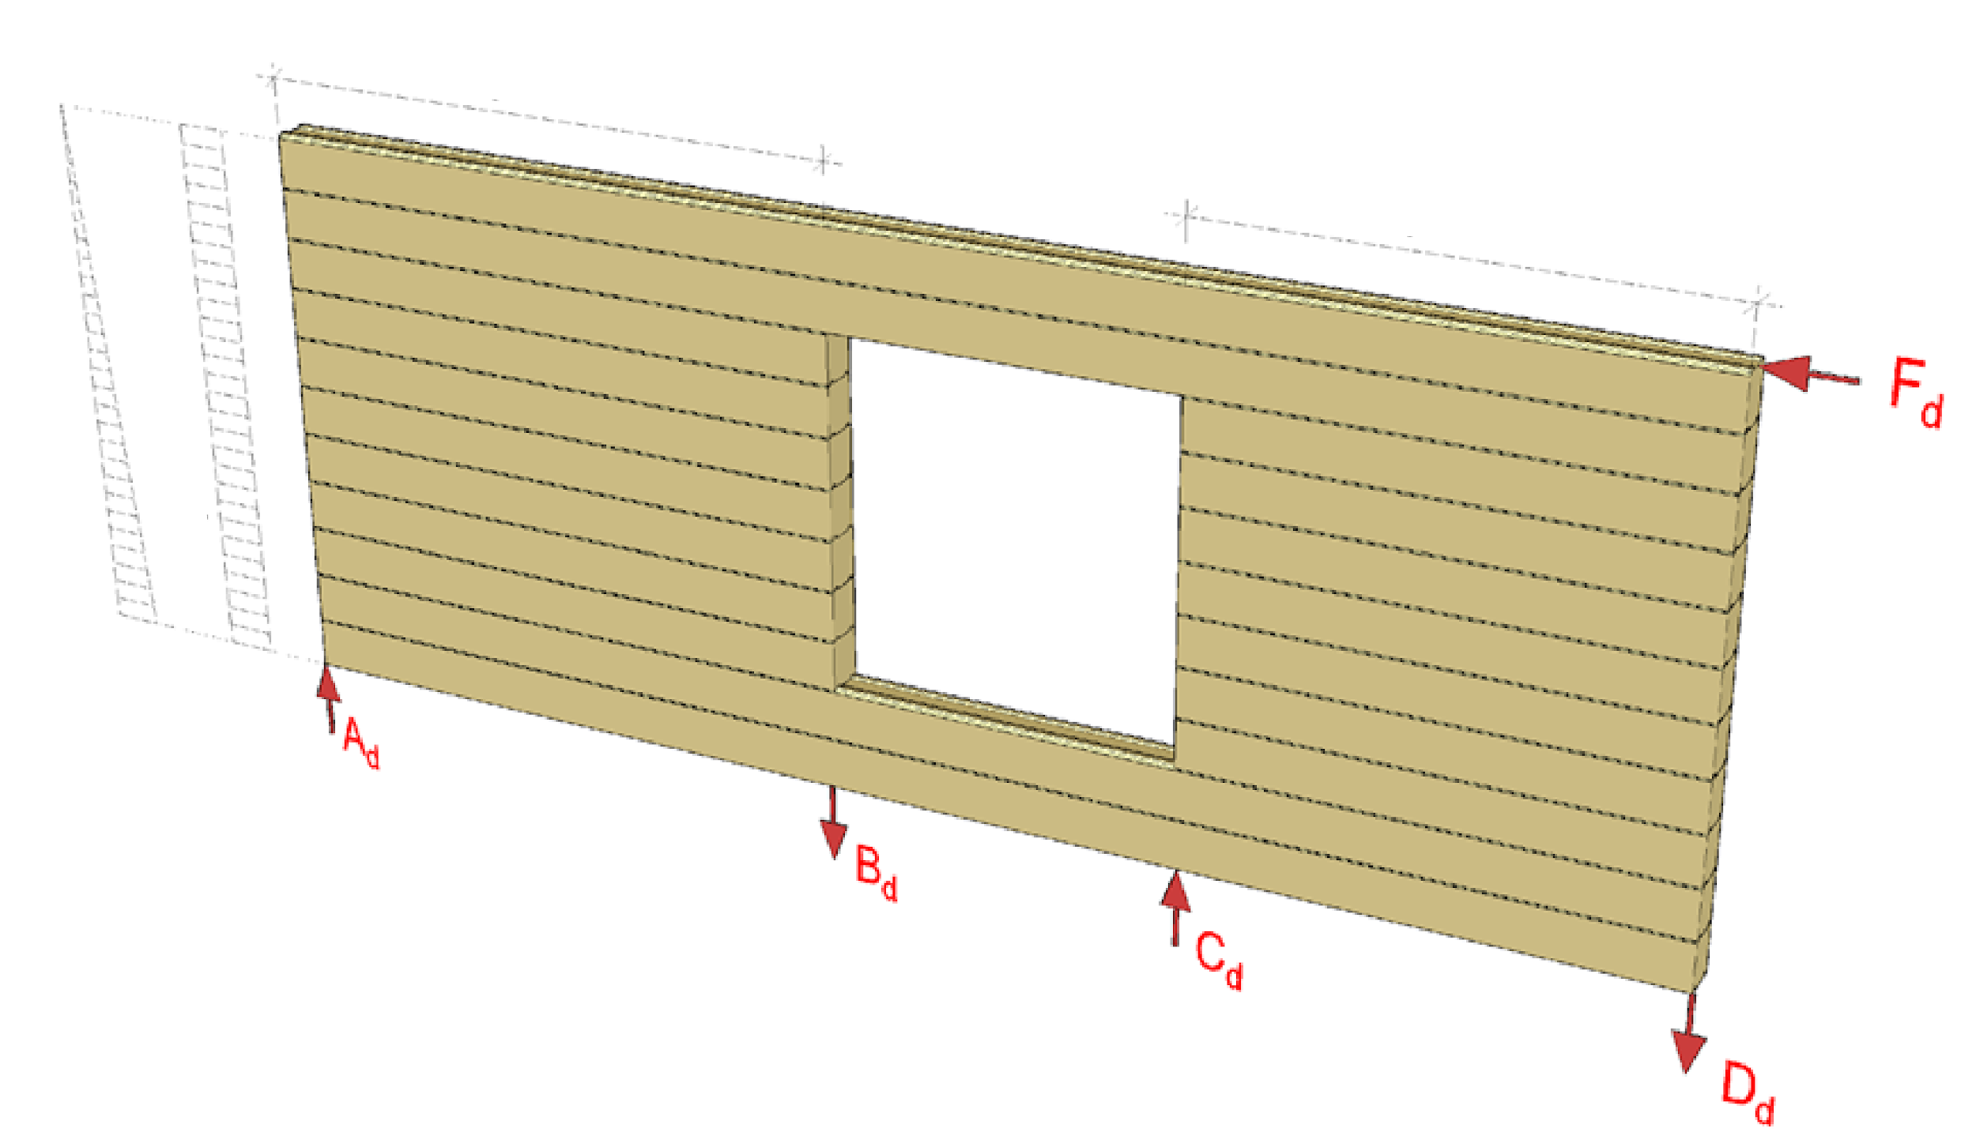
How a stiffening wall works
Stiffener 1
Stiffener 2
M surface with force F_{d}
Q surface with force F_{d}

Slide 34
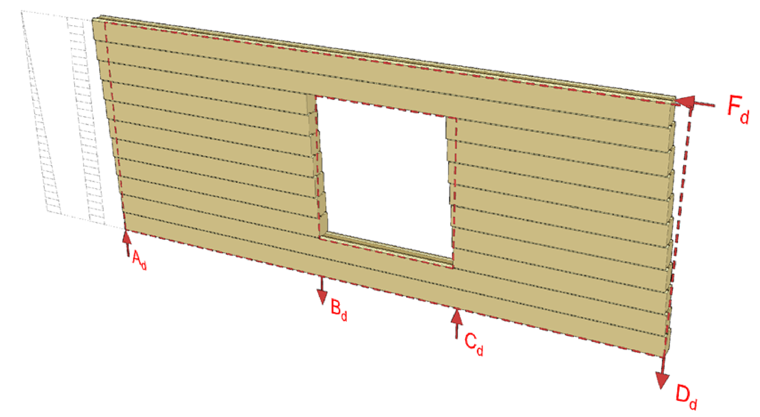
How a stiffening wall works
M surface with force F_{d}
Q surface with force F_{d}

Slide 35
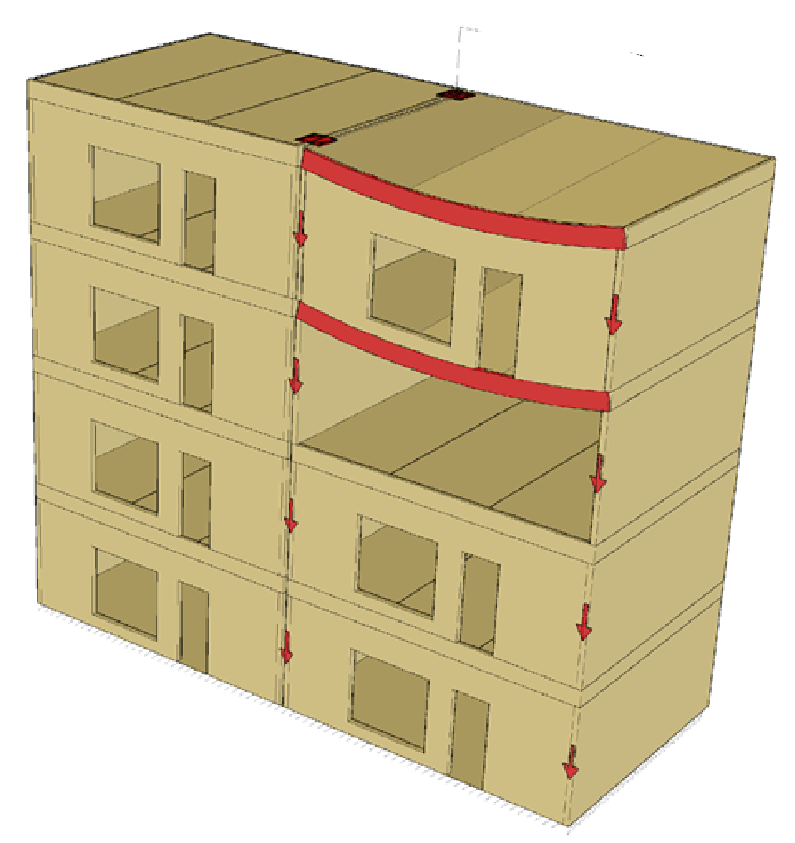
Preventing progressive collapse
Stability joint
The preferred method for preventing progressive collapse is the alternative load transfer path
Using
  Logs in a wall structure
  Beams
  Wall-like beams
  connections between logs
Image: Tero Lahtela

Slide 36
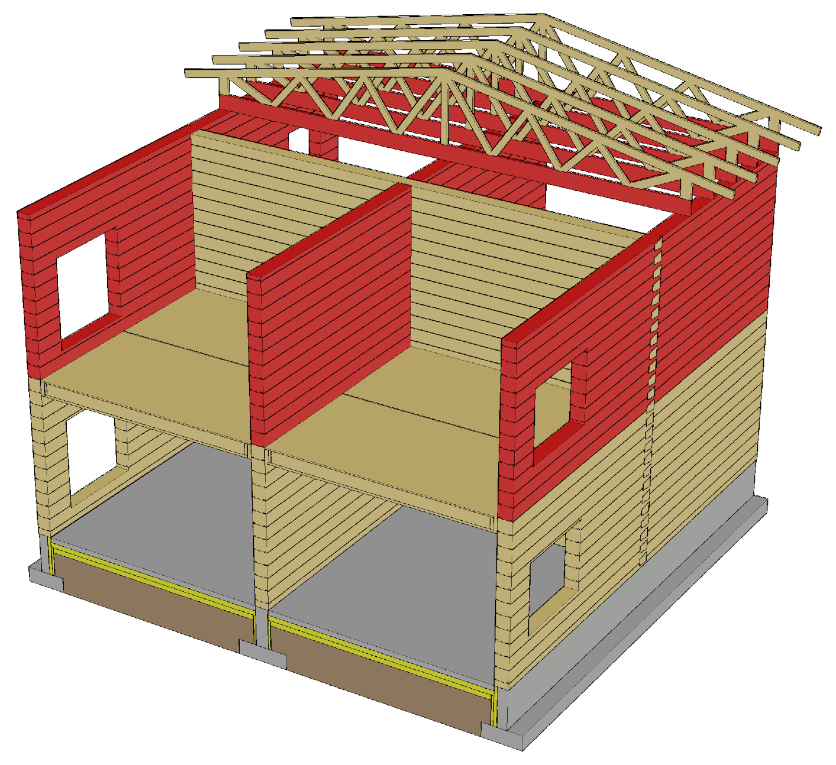
Nail plate truss roof in a fire
The bottom chord is designed to take the loading in case of an attic fire
If the fire is from below, the bottom chord is fireproofed with ceiling plates
Bottom chord connections must be fireproofed
Partitions can be designed to be load-bearing in case of fire

Slide 37
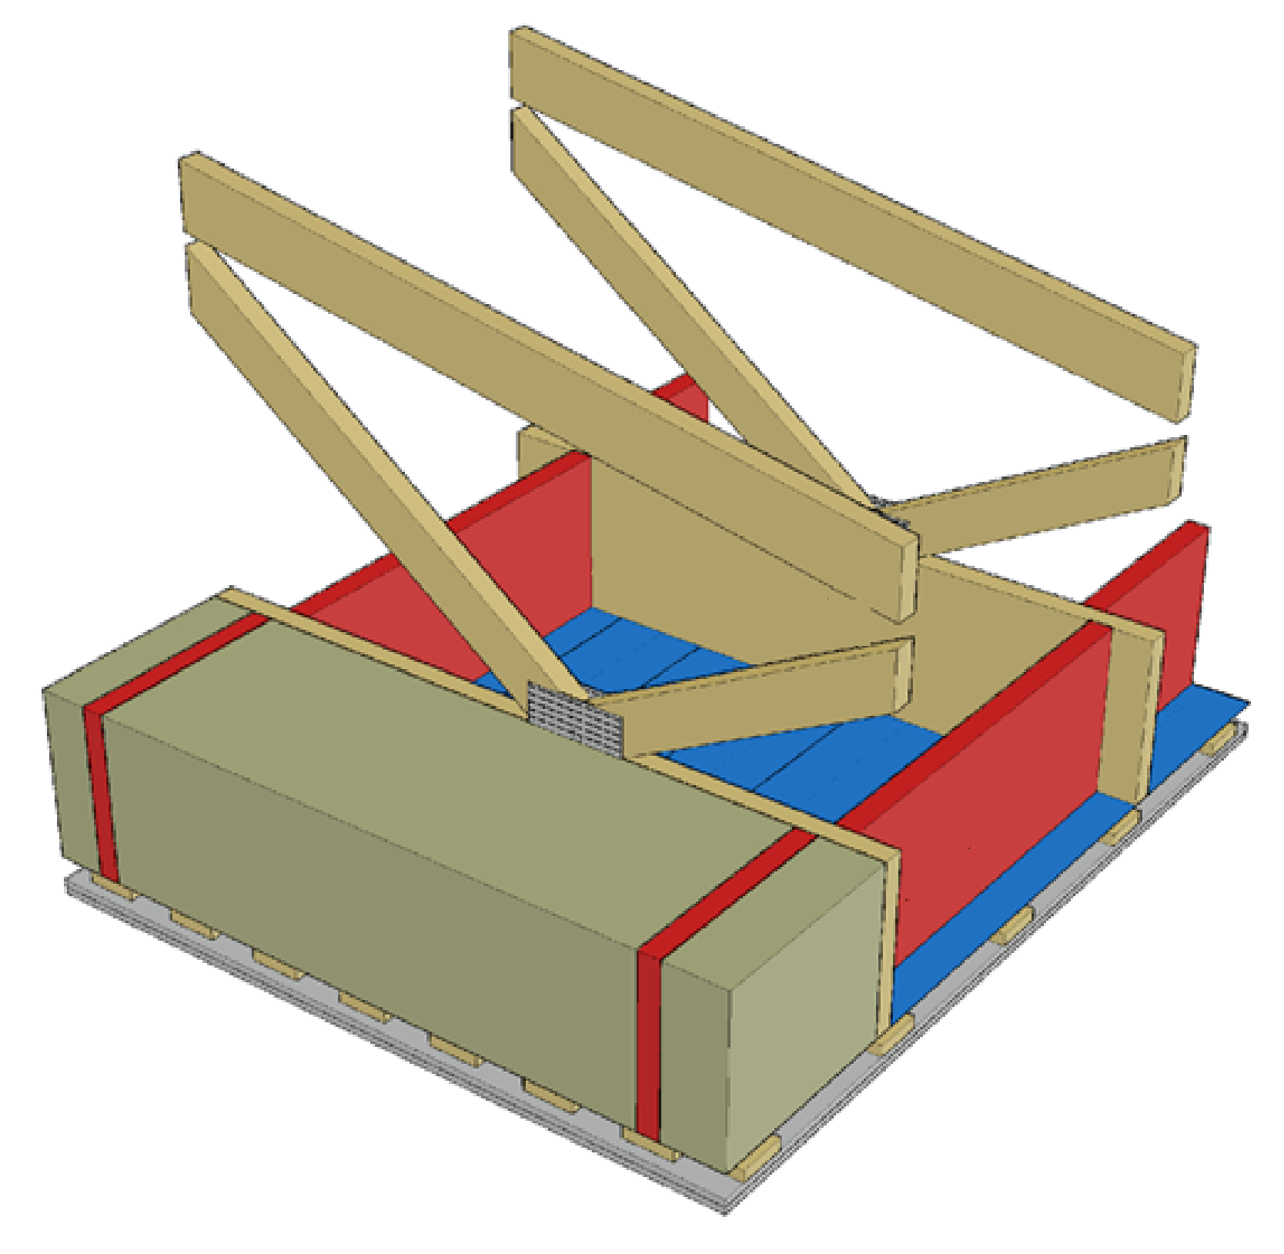
Nail plate truss roof in a fire
Bottom chord sides are protected with rock wool panels
The rock wool panels also protect lateral buckling supports
The lateral buckling supports are attached to the ceiling stiffening plate
These principles are also followed for a roof with a beam structure
Bottom chord
Buckling support
Rock wool panel

Slide 38
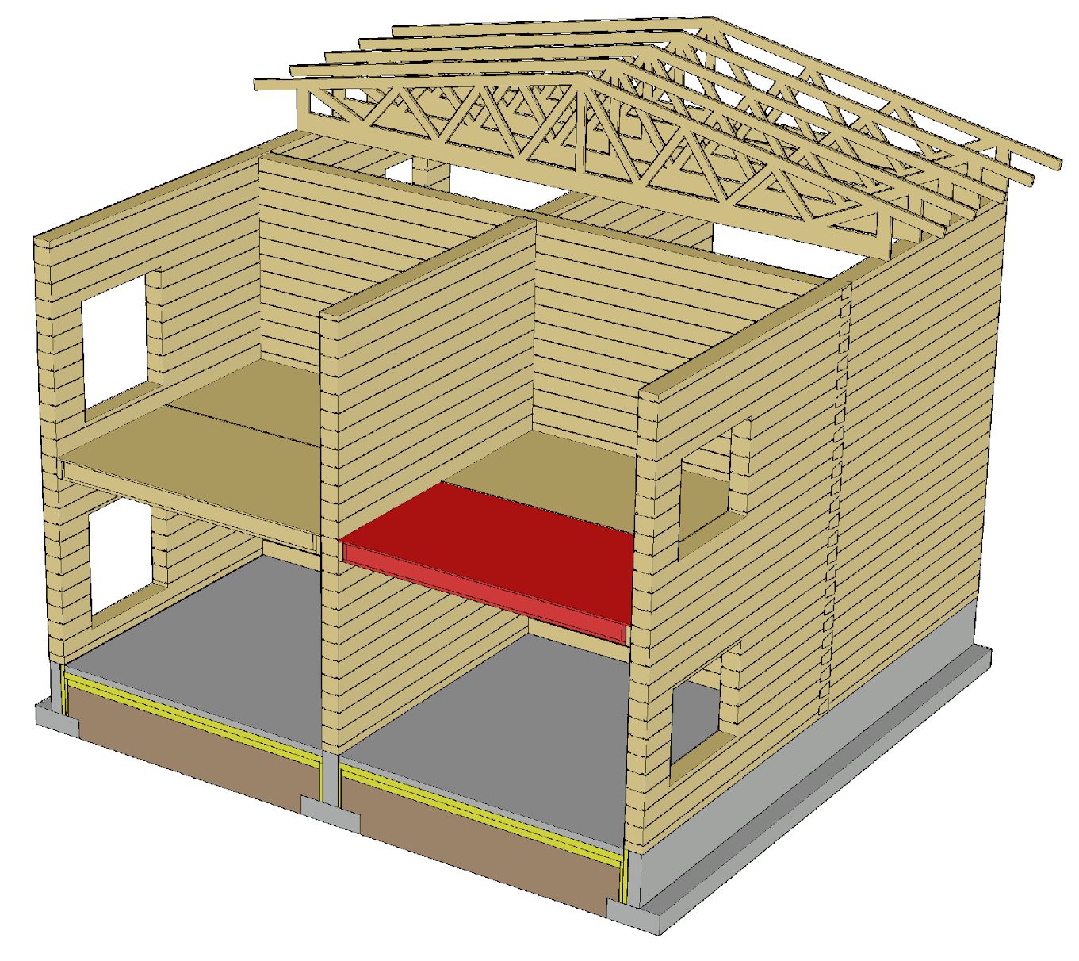
Intermediate floor in case of fire
For fireproofing the intermediate floor are used
  The floor surface structure
  Ceiling plates
Intermediate floor joints must be fireproofed
The lateral buckling support of beams must work in case of a fire
Partitions can be designed to be load-bearing in case of fire

Slide 39
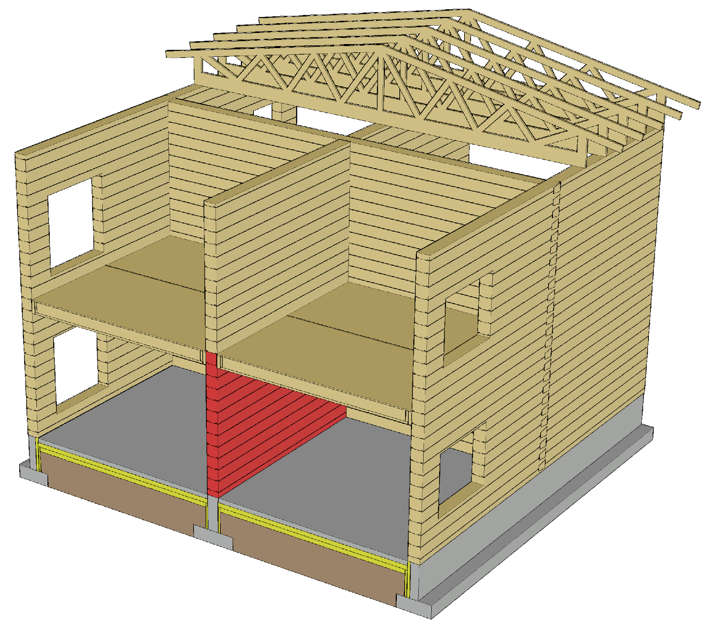
Load-bearing wall in a fire
Log walls are usually not fireproofed
Partitions that are not fireproofed char simultaneously on both sides, which is why the wall thickness must be adequate
Different boards can be used for fireproofing
Connections of a load-bearing wall must be fireproofed

Slide 40
Bracing in a fire
The aim is to use the same stiffeners in a fire as in the ultimate limit state design
Regarding charring log structures, there must be sufficient functional cross-section left after charring
In double frame walls, the frame half on the opposite side can be used if the half on the side of the fire does not function as stiffener

