Slide 1



Industrial wood construction
Teaching materials for industrial wood construction education
2022

Slide 2
Origin of the materials
Use of the materials
These learning materials for industrial wood construction have been prepared in a project led by Puuinfo Oy in 2021–2022. Also involved in the project were
Lappia Vocational College,
TTS-Työtehoseura ry
South-Eastern Finland University of Applied Sciences,
Metropolia University of Applied Sciences,
Jyväskylä University of Applied Sciences,
University of Tampere, and
Federation of the Finnish Woodworking Industries Puutuoteteollisuus ry
The project was funded by the Ministry of the Environment.
The materials are intended to be used as extensively as possible in industrial wood construction education and studies.
The materials are released under the Creative Commons licence Attribution-ShareAlike (CC BY-SA), which requires that the author be properly credited when the materials are used and that derivative works may only be distributed under the same licence as the original work.
The original materials and any updates to them by Puuinfo will be published on the Library of Open Educational Resources website (aoe.fi) and the Puuinfo.fi website.

Slide 3

Industrial construction systems

Slide 4
Authors
Tero Lahtela, Insinööritoimisto Tero Lahtela Oy
Release date: 01/07/2021

Slide 5
Prefabricated modular units with framed and solid timber panel structures Residential and commercial construction

Slide 6
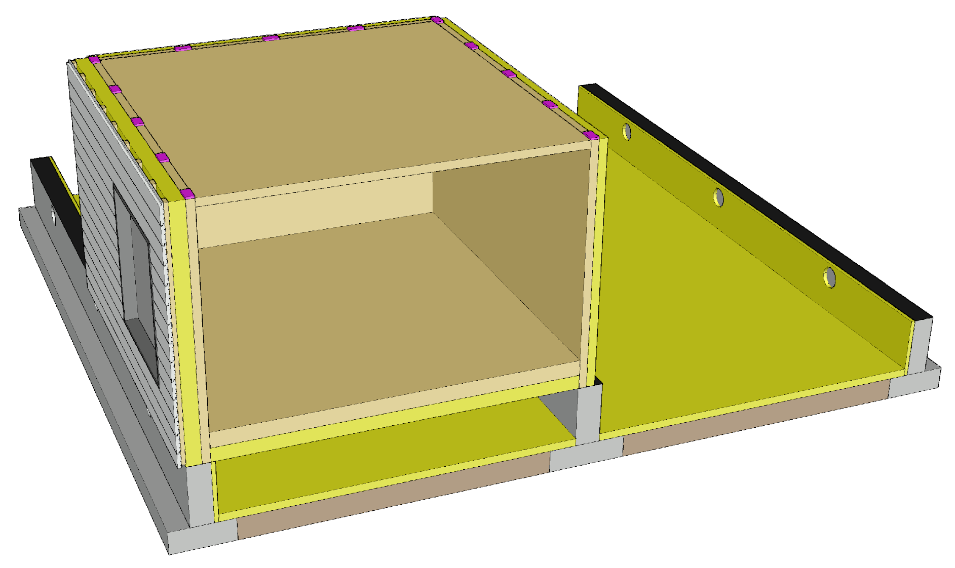
Prefabricated modular unit components
Base floor
Load-bearing exterior walls
Load-bearing partition walls
Intermediate floors
Other features
Exterior cladding
Windows and doors
Building services
Interior surfaces
Furniture

Slide 7
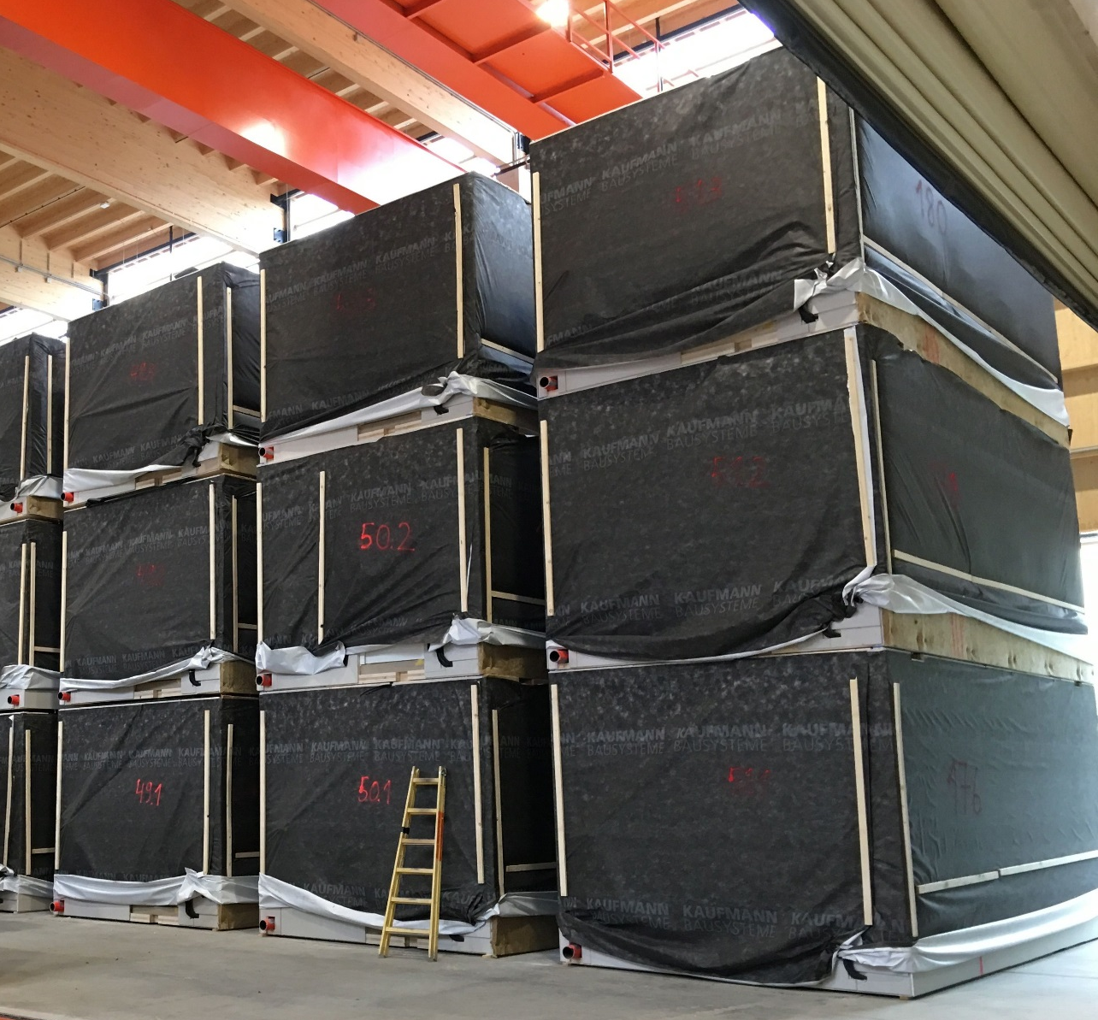
Prefabricated modular units
Prefabricated modular units are manufactured
With framed structure
With solid timber panel structure
As combinations of the above
A prefabricated modular unit system is a system with load-bearing walls in which the building elements function in the same way as in panelised unit systems in principle
Image: Tero Lahtela

Slide 8
Applications
Prefabricated modular units are primarily used in
Detached houses, terraced houses and blocks of flats
Accommodation buildings and residential institutions
School and day-care centre buildings
Prefabricated modular units are primarily manufactured as framed structures
Prefabricated modular units with solid timber panel structures have only been used in Finland for approximately 10 years

Slide 9
Strengths and challenges of using prefabricated modular units
Strengths
The same strengths in each building element as in panelised units with framed and solid timber panel structures
Extremely high degree of prefabrication reduces construction time spent on site
Quality assurance can mainly take place at the factory
Challenges
The same strengths in each building element as in panelised units with framed and solid timber panel structures
Joints between prefabricated modular units
Need for special transport
Strain on the frame structure caused by lifting and assembly

Slide 10
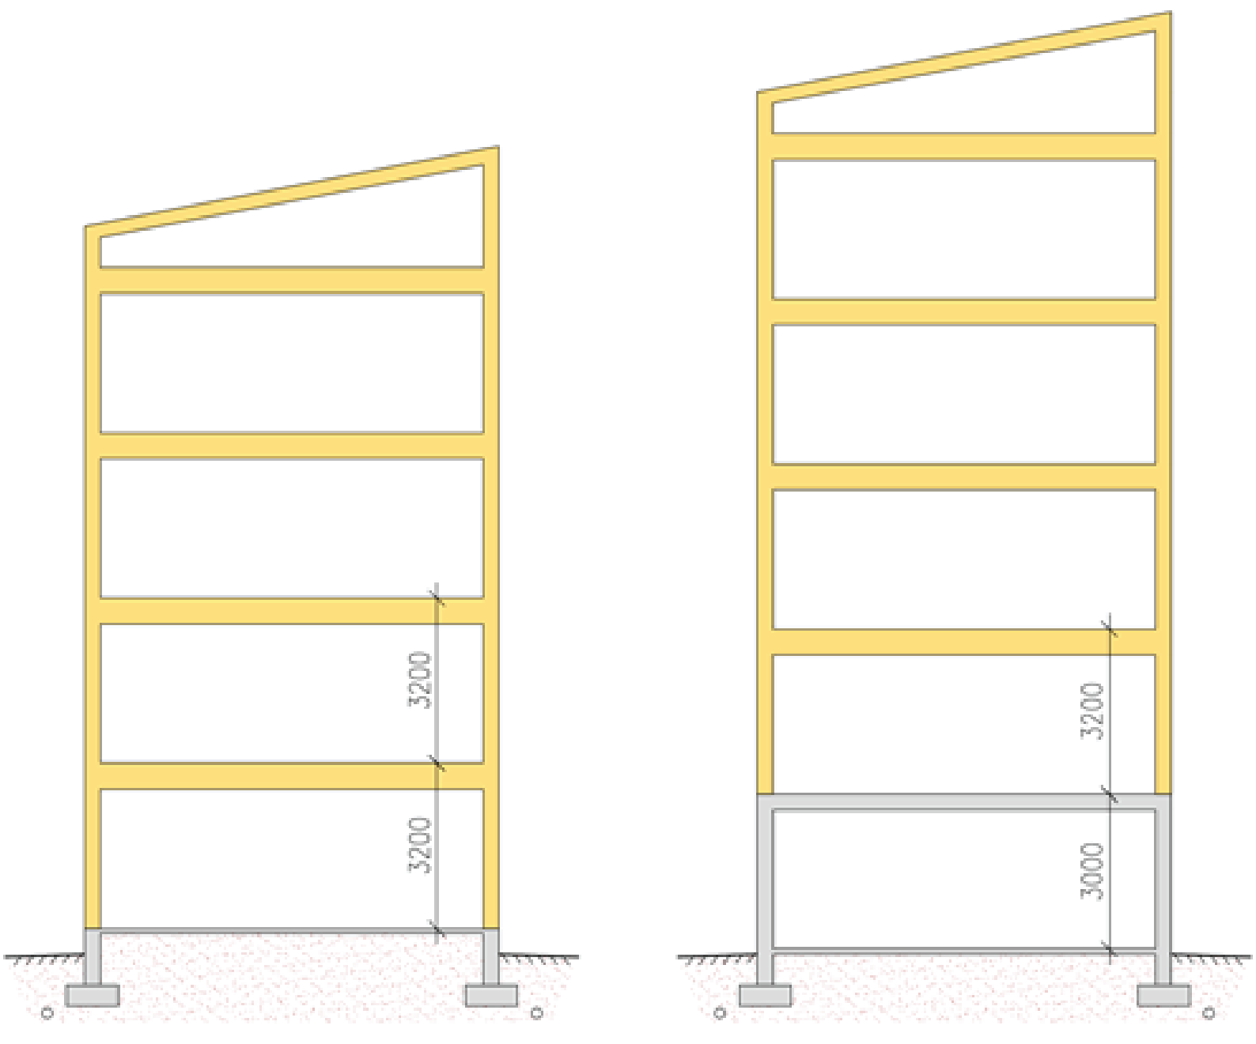
Number of storeys when using prefabricated modular units
The same factors affect the number of storeys as when using panelised units with framed and solid timber panel structures
Recommended number of storeys
When using framed structures, at most 5 timber-framed storeys
When using solid timber panels, at most 8 timber-framed storeys
Floor-to-floor height
3,200 mm (residential buildings)
3,800 ... 4,000 mm (public areas)
5th storey
4th storey
4th storey
3rd storey
3rd storey
2nd storey
2nd storey
1st storey
1st storey

Slide 11
Prefabricated modular unit with framed structure
The load-bearing frame consists of timber frames and/or beams
Solid timber panels can be used (e.g. stiffening building elements)
An effort should be made to coordinate the spacing of frames and beams with the width of wool slabs (600 mm spacing)
There are no standardized dimensions for prefabricated modular units
Prefabricated modular units are manufactured to order as required by designs
As exterior cladding, wood panelling or other exterior cladding material that comes in panels is typically used (factory installation)

Slide 12
Prefabricated modular unit with solid timber panel structure
Load-bearing frame of solid timber panel (CLT or glued laminated LVL)
Beam structures may also be used in the floor and ceiling
Heat insulation is on the exterior of the solid timber panel
There are no standardized dimensions for prefabricated modular units
Prefabricated modular units are manufactured to order as required by designs, using standard panel thicknesses (special panels are available)
As exterior cladding, wood panelling or other exterior cladding material that comes in panels is typically used (factory installation)

Slide 13
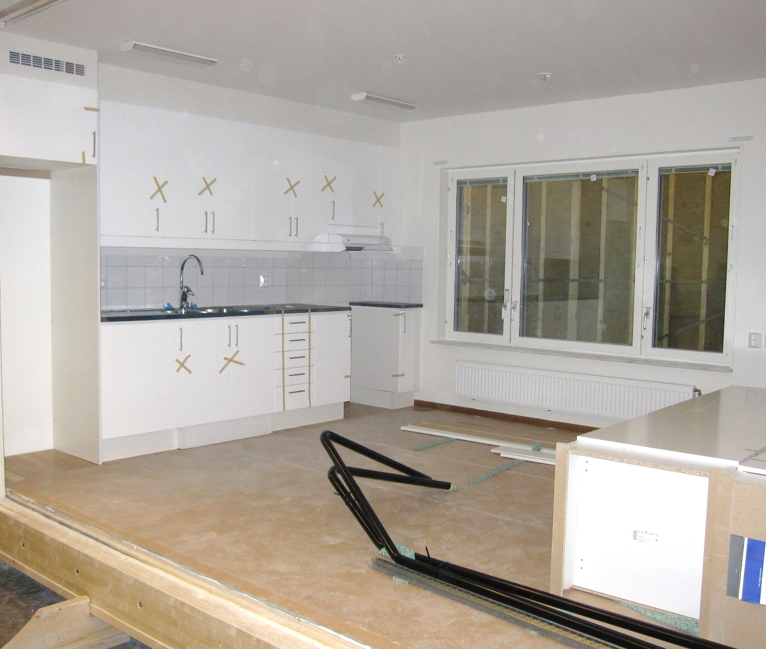
Prefabrication degree of prefabricated modular units
An effort is made to prefabricate the units to as high a degree as possible at the factory, including
Interior surfaces
Furniture
Building services
Windows and doors
External cladding
Image: Tero Lahtela

Slide 14
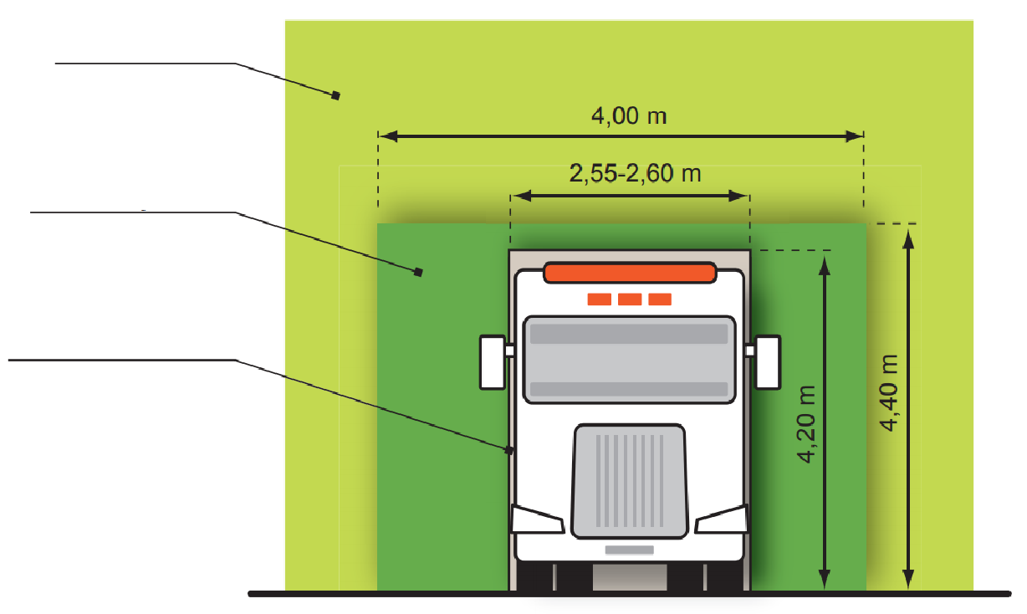
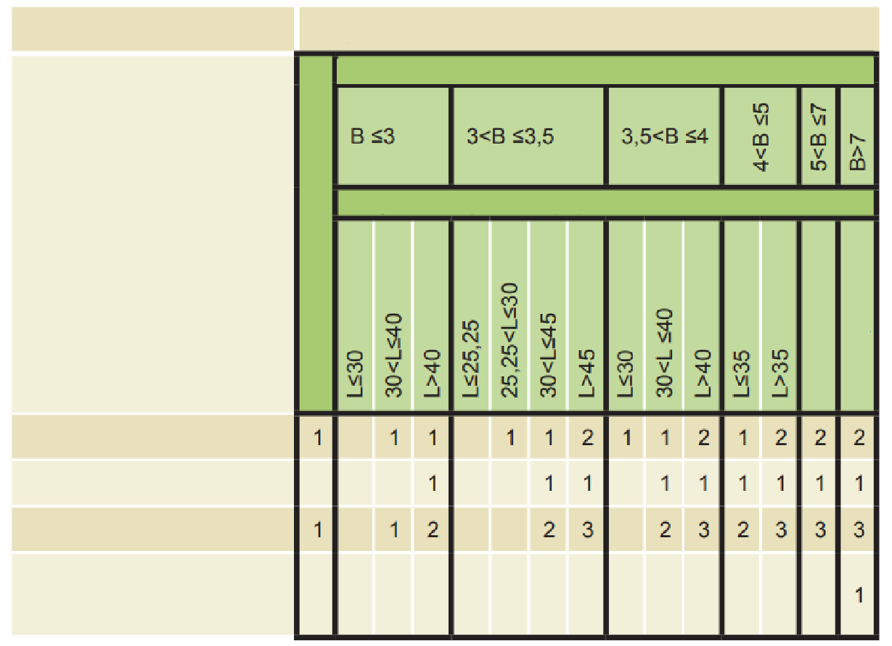
Prefabricated modular unit dimensions (indicative)
Special transport subject to permission
When determining the dimensions of prefabricated modular units, regulations on special transport operations must be taken into account
Recommended prefabricated modular unit dimensions
Width ≤ 4.0 m
Height ≤ 3.2 m
Length ≤ 10 m
Widths of ≤ 4,0 m are advisable, in which case a single escort vehicle can be used in the transport operation (price of transport)
Free dimensions for special transport operations
Dimensions for normal transport
Safety measures
Transport dimensions
Width 8 (m)
Length L (m)
Height over 5 m
All lengths
All lengths
Escort vehicles in front
Escort vehicles behind
Traffic controllers
Police car or escort vehicle and traffic controller
Images: ELY Centre

Slide 15
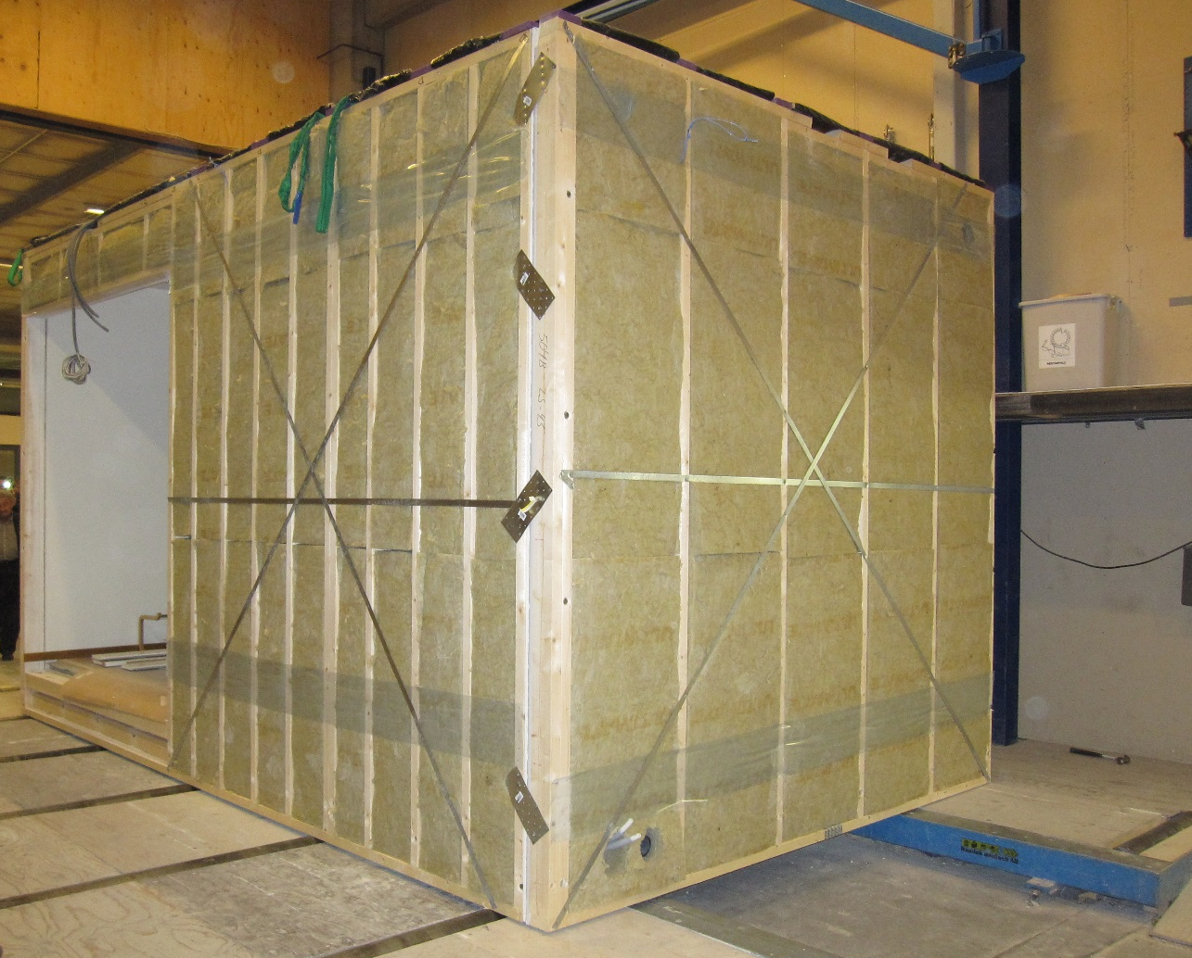
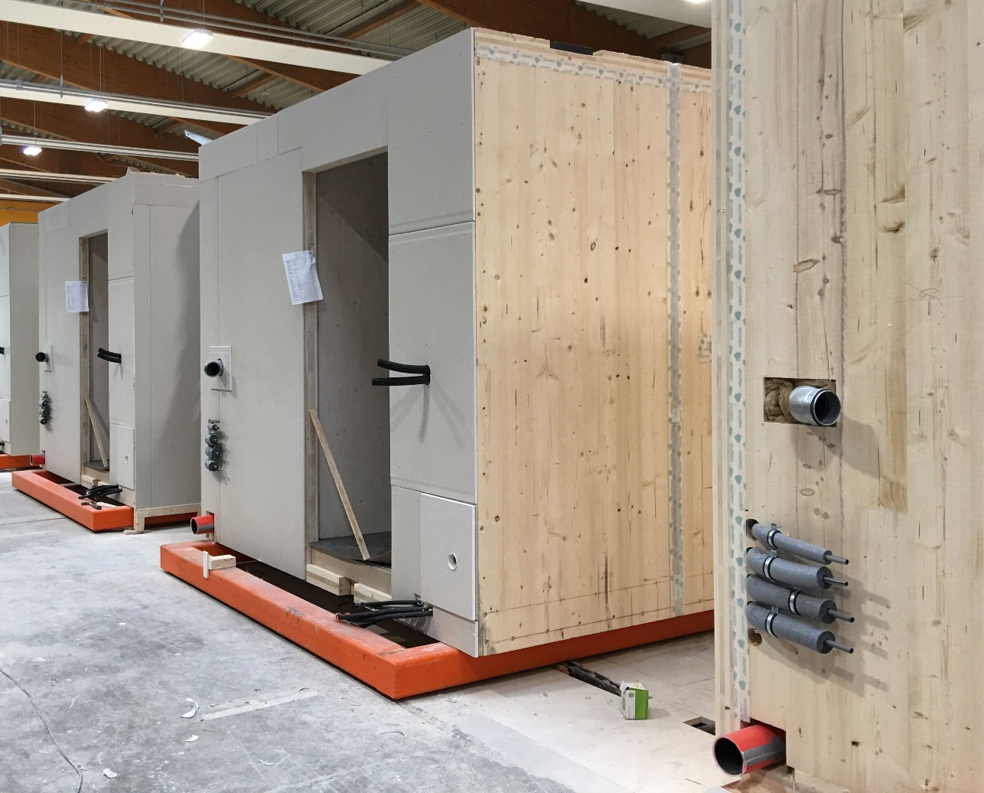
Prefabricated modular units
Framed structure
Solid timber panel structure
Image: Tero Lahtela
Image: Tero Lahtela

Slide 16
Types of structures used in prefabricated modular units
In principle, the same types of structures are used in the wall structures of prefabricated modular units as in panelised structures
The intermediate floor consists of the roof structure of the lower prefabricated modular unit and the floor structure of the upper unit
In the intermediate floor, solid timber panels or frame structures, or their combinations, can be used
The roof is usually implemented with nail plate truss structure blocks
Roof blocks are usually used as weather protection when installing prefabricated modular units

Slide 17
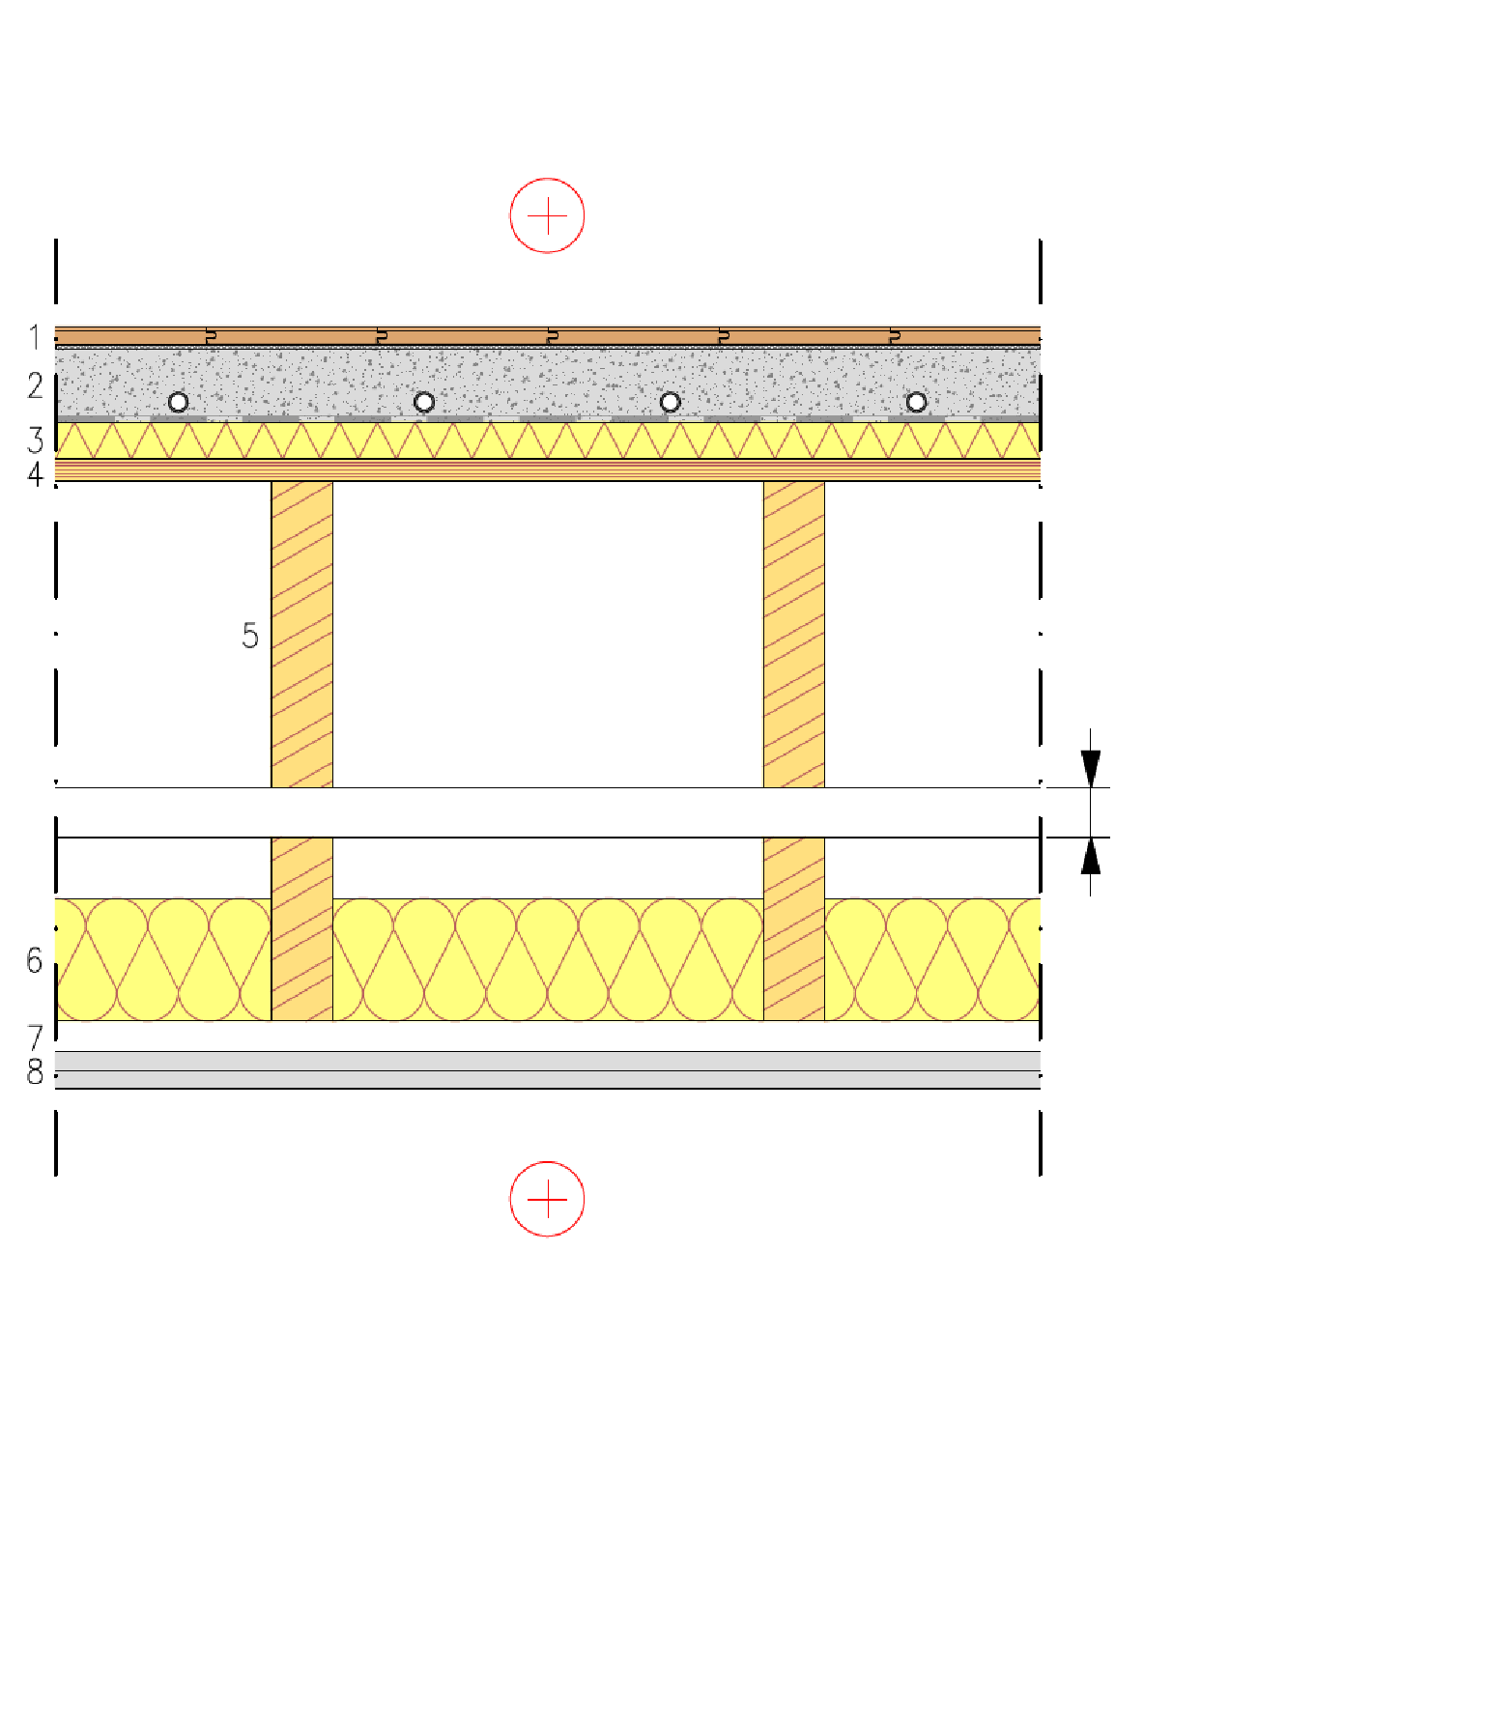
Prefabricated modular unit intermediate floor
Intermediate floor between flats
Upper prefabricated box unit
As stiffening plates are used
Sheathing on top of beams
Sheathing in the roof structure
Plasterboard and castings are used for
Fire protection technology
Acoustics
Beams and studding thickness is affected by
Vibration (in the floor) (often governing in design)
Bending and shearing stress
Bend
Gap between prefabricated box units
Lower prefabricated box unit
1 Floor coating
2 Cast floor (possible underfloor heating))
3 Protective fabric between concrete and wood + Impact sound insulation
4 Industrially manufactured LVL semi-open rib panel or LVL rib panel
5 Beams + Mineral wool
6 Studs
7 2 x plasterboard

Slide 18
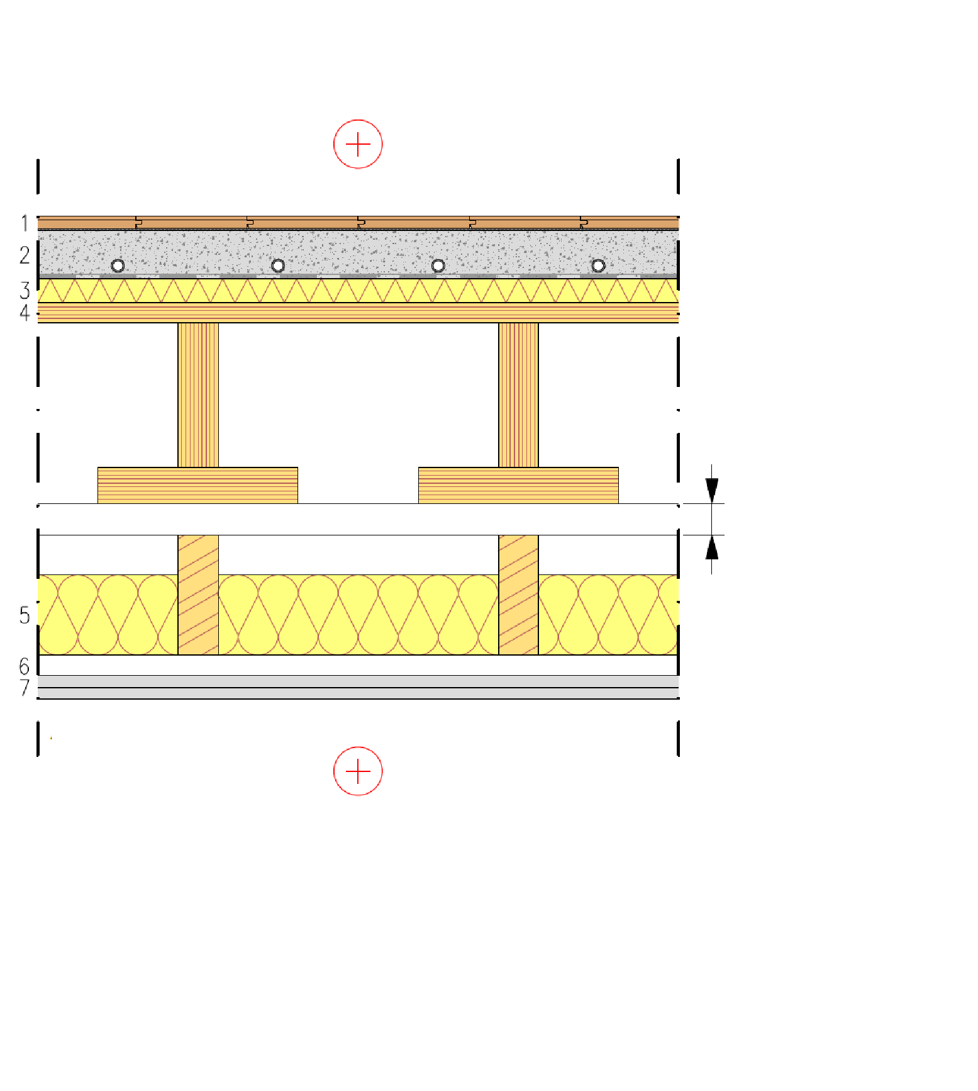
Prefabricated modular unit intermediate floor
Intermediate floor between flats
Upper prefabricated box unit
As stiffening plates are used
Rib or semi-open rib panel sheathing
Sheathing in the roof structure
Plasterboard and castings are used for
Fire protection technology
Acoustics
Beams and studding thickness is affected by
Vibration (in the floor) (often governing in design)
Bending and shearing stress
Bend
Gap between prefabricated box units
Lower prefabricated box unit
1 Floor coating
2 Cast floor (possible underfloor heating))
3 Protective fabric between concrete and wood + Impact sound insulation
4 Industrially manufactured LVL semi-open rib panel or LVL rib panel
5 Beams + Mineral wool
6 Studs
7 2 x plasterboard

Slide 19
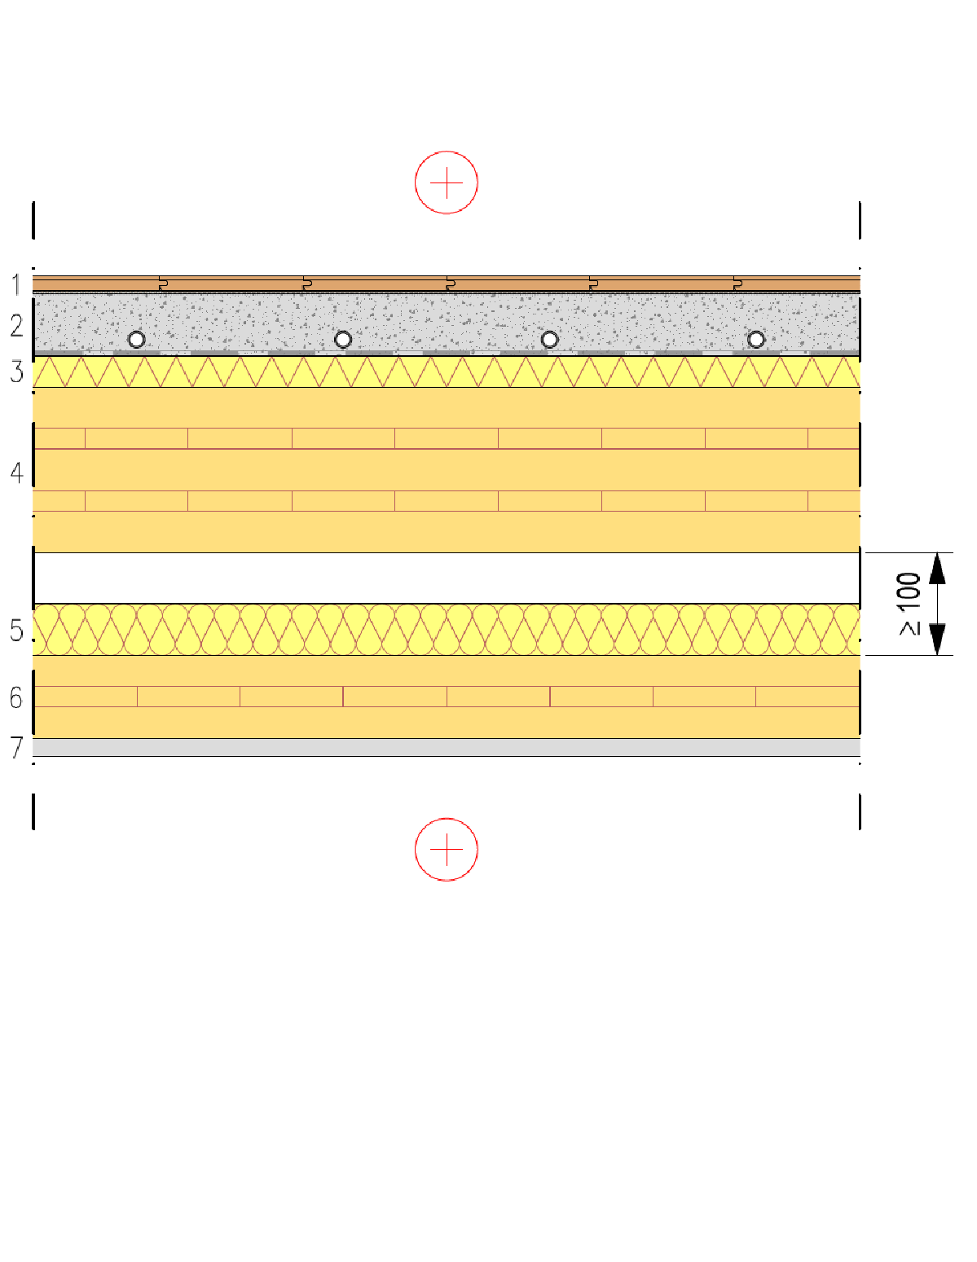
Prefabricated modular unit intermediate floor
Intermediate floor between flats
Upper prefabricated box unit
As stiffening plate is used a solid timber panel in floor or ceiling
Plasterboard and casting are used for
Fire protection technology
Acoustics
The thickness of the solid timber panel depends on
Vibration (in the floor) (often governing in design)
Bending and shearing stress
Bend
Lower prefabricated box unit
1 Floor coating
2 Cast floor (possible underfloor heating))
3 Protective fabric between concrete and wood + Impact sound insulation
4 CLT or LVL panel
5 Mineral wool
6 CLT or LVL panel
7 Plasterboard

Slide 20
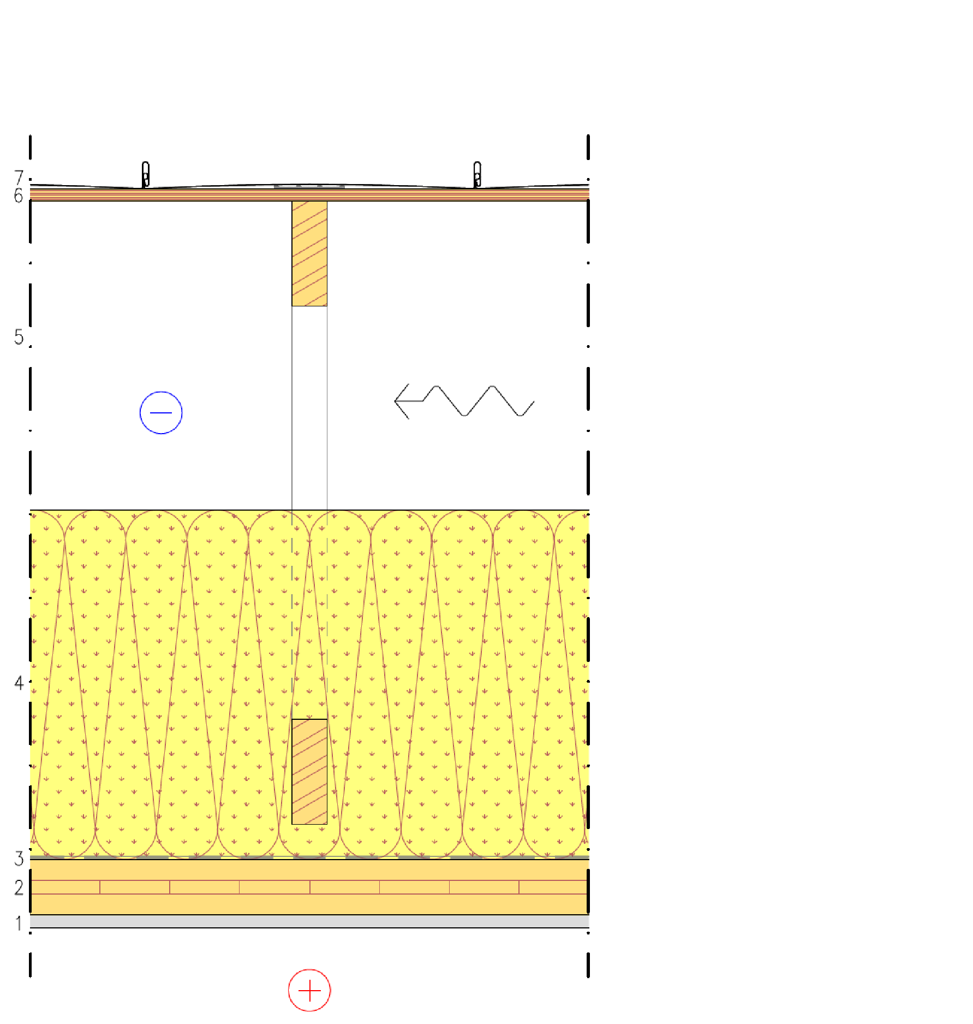
Roof structure
Nail plate truss
Can be implemented with the roof types of the panelised unit system
Nail plate trusses
Roof units with beam structures
Techniques of the panelised unit system can be used to support nail plate trusses
The roof of a prefabricated panel system can be designed to function as stiffening plate
Solid timber panel
Framed structure sheathing
1 Plasterboard
2 CLT or LVL panel
3 Air and vapour barrier fabric
4 Mineral wool
5 Nail plate trusses and ventilated attic
6 Spruce plywood or LVL (stiffening plate)
7 Water resistant roof material

Slide 21
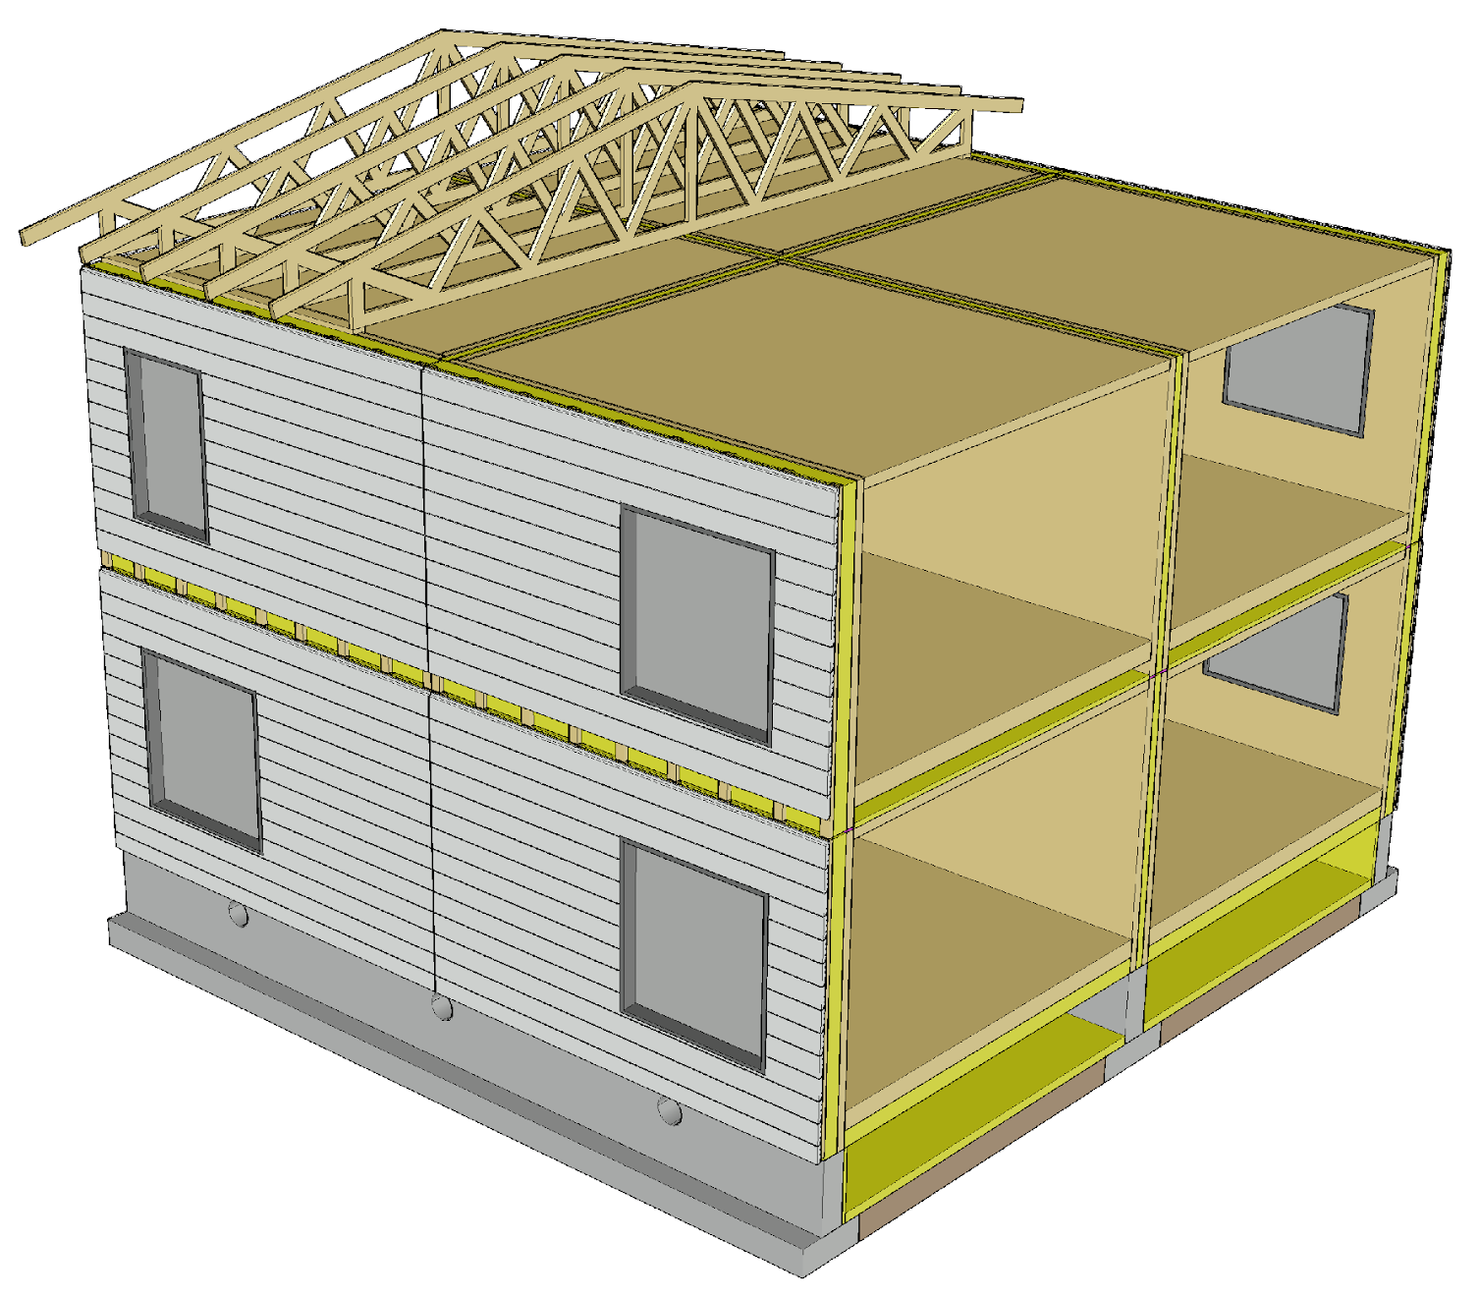
Prefabricated unit connections
Prefabricated unit connections are found on the interfaces between prefabricated modular units
The direction of the timber panelling in exterior cladding affects the visibility of the connection, as in the case of panelised units

Slide 22
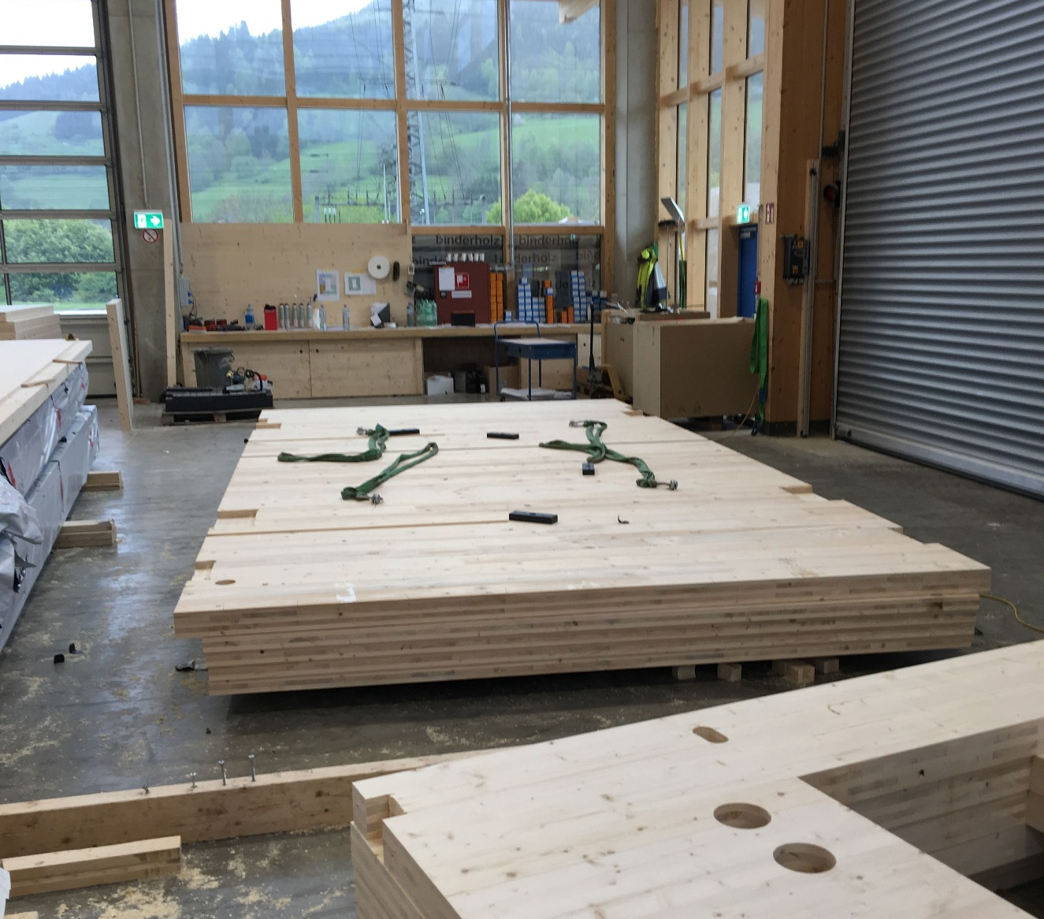
Manufacturing of prefabricated modular units
Prefabricated modular units with solid wood panel structure are made from panelised units with solid wood panel structure
The same principles and methods are followed in the manufacture of prefabricated modular units as for panelised unit systems
Image: Tero Lahtela

Slide 23
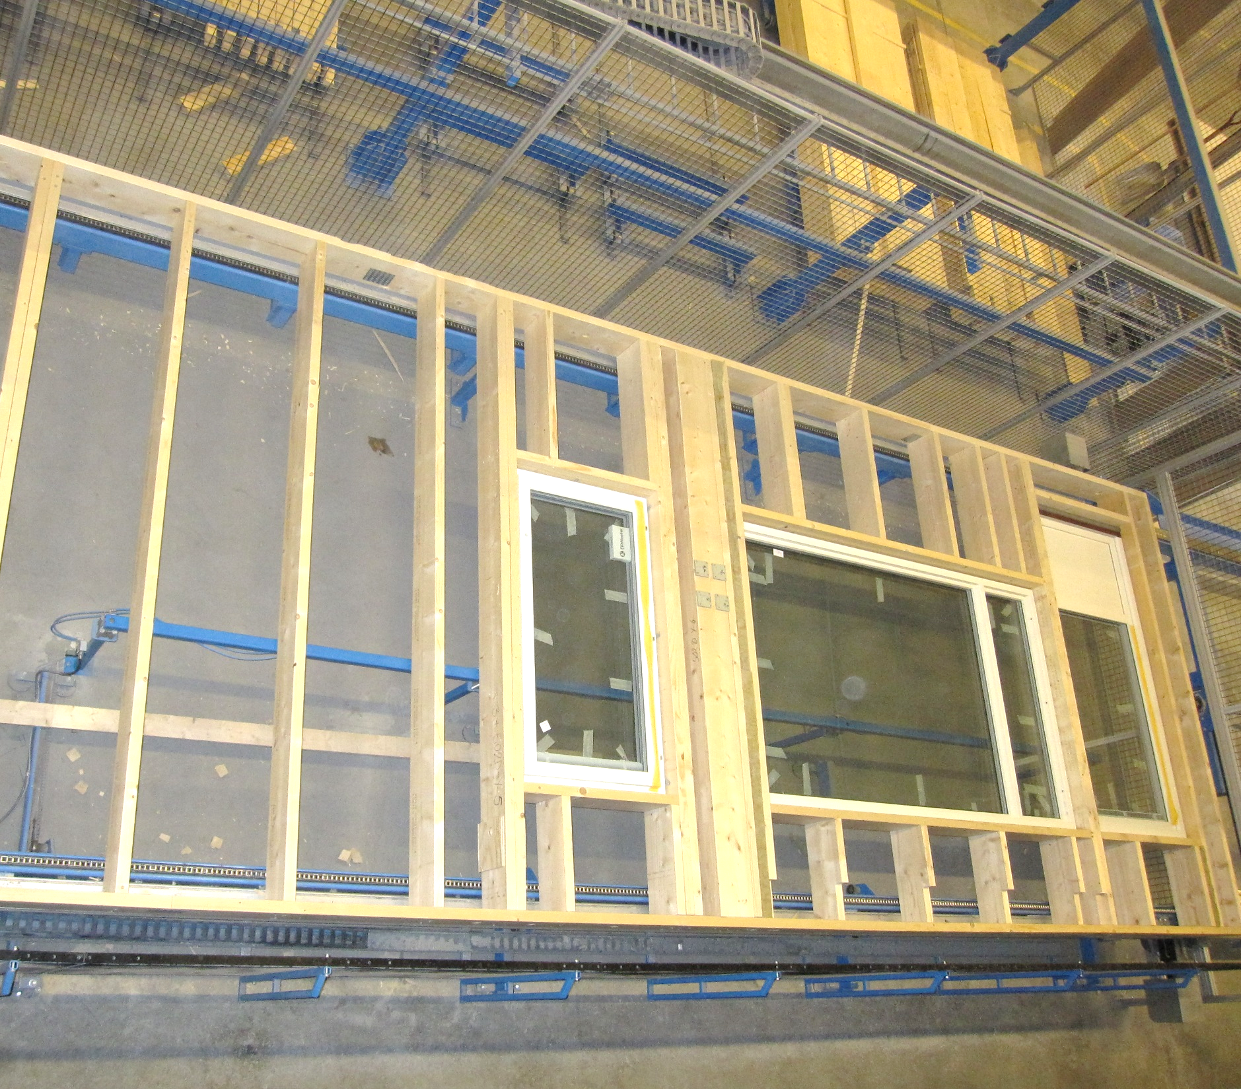
Manufacturing of prefabricated modular units
Prefabricated modular units with framed structure are made by assembling panelised units with framed structure during the manufacturing process
The same principles and methods are followed in the manufacture of prefabricated modular units as for panelised unit systems
Image: Tero Lahtela

Slide 24
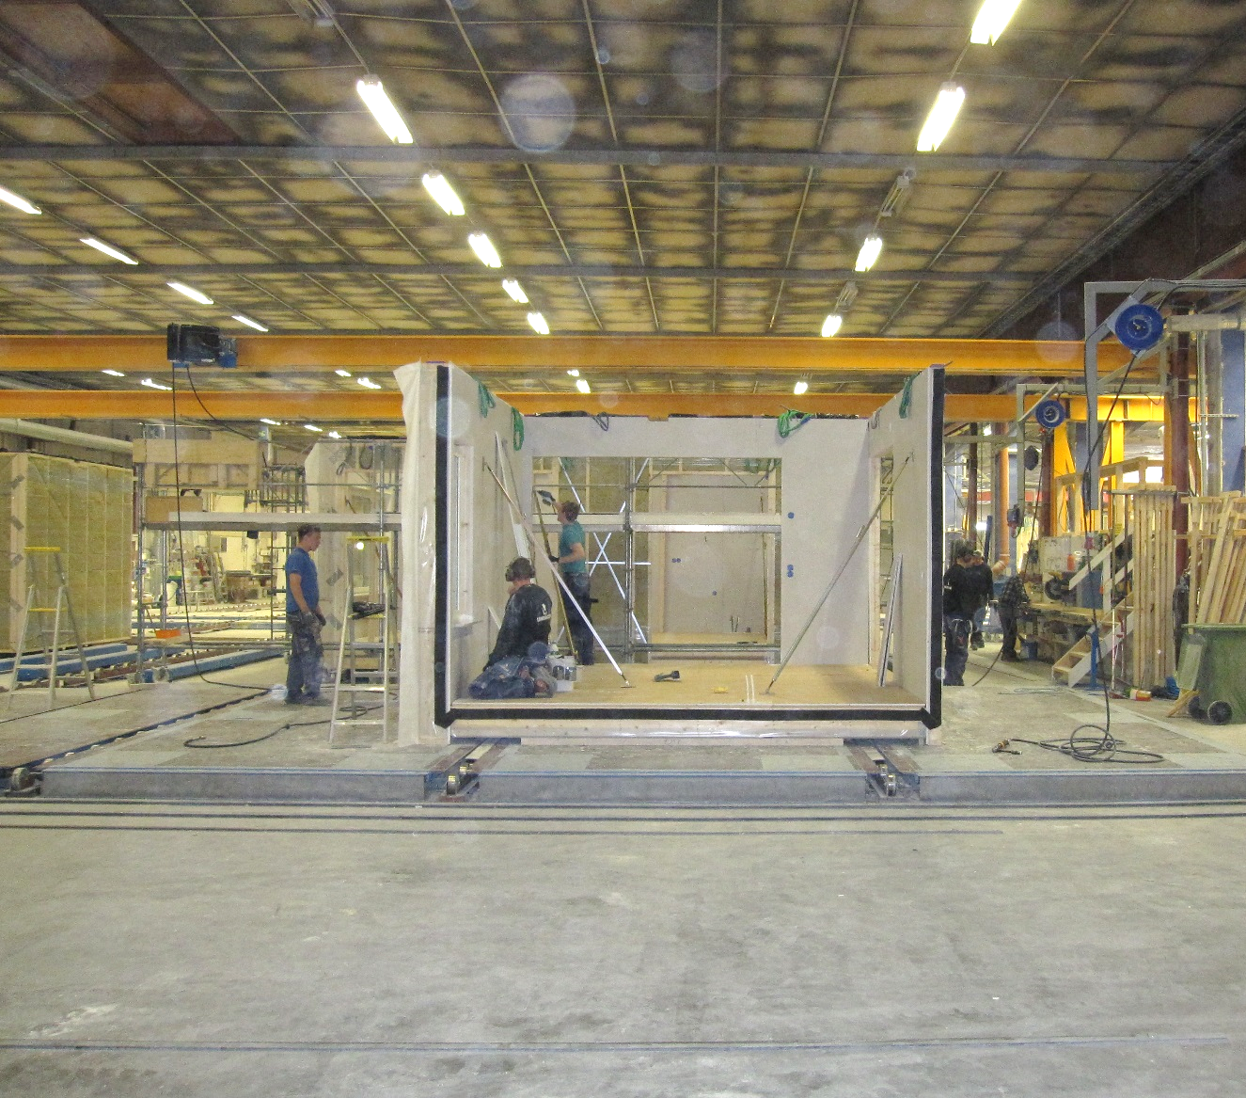
Manufacturing of prefabricated modular units
Prefabricated modular units are made by assembling panelised units during the manufacturing process
The manufacture of prefabricated modular units takes place at different work stations on the production lines
The load-bearing frame is assembled at the beginning of the production line, and furniture is installed at the end
Image: Tero Lahtela

Slide 25
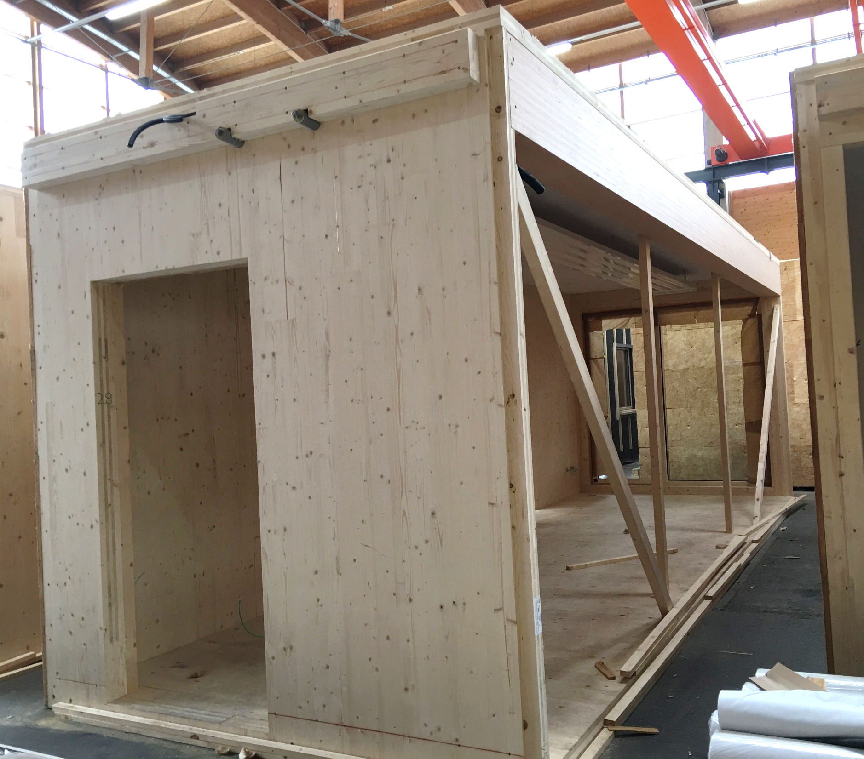
Manufacturing of prefabricated modular units
The prefabricated modular units for school and day-care centre buildings and similar places of assembly are larger than units for residential buildings
Prefabricated modular units can be designed to be open on the sides to provide larger interconnecting spaces
The load-bearing capacity and stiffening of open sides must be provided for as the units are manufactured
Image: Tero Lahtela

Slide 26
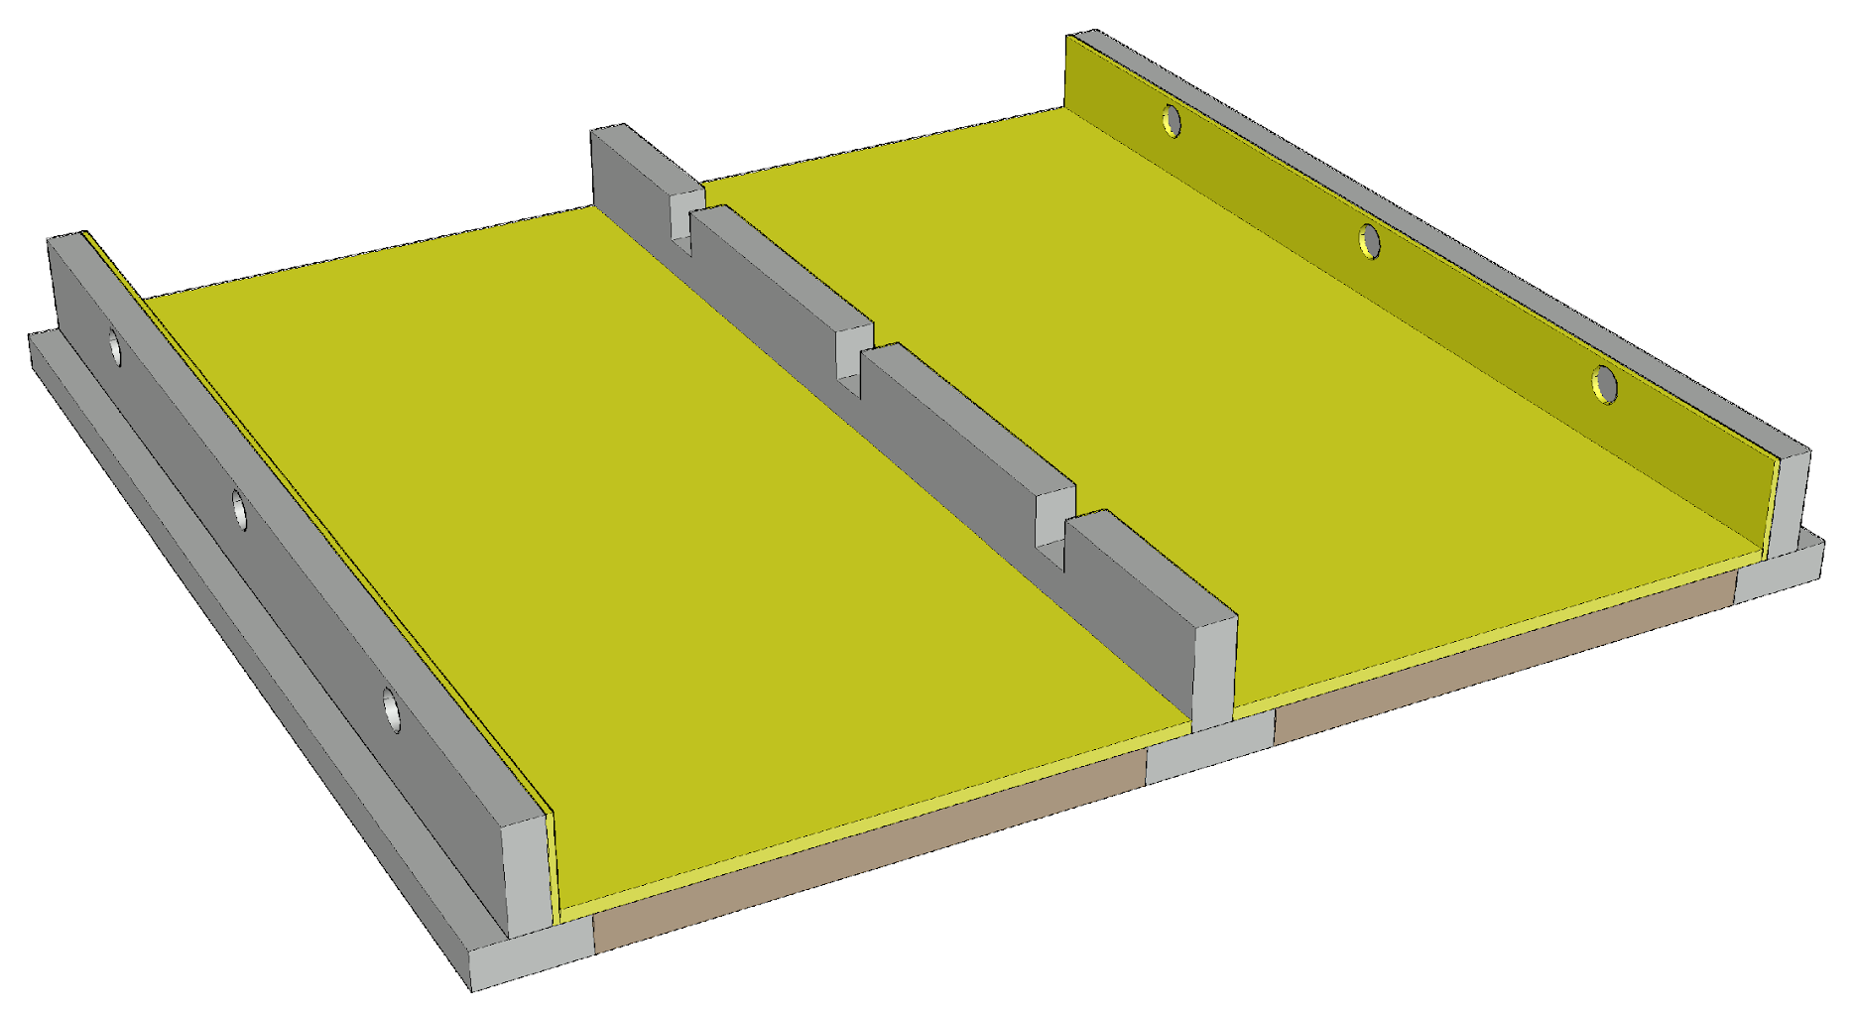
Foundation for prefabricated modular units
A continuous foundation is needed under the load-bearing walls of prefabricated modular units
Foundation types
Ventilated base floor
Basement
Challenges
Junction between the wall and the foundation
Vertical dimensional accuracy of the foundation

Slide 27
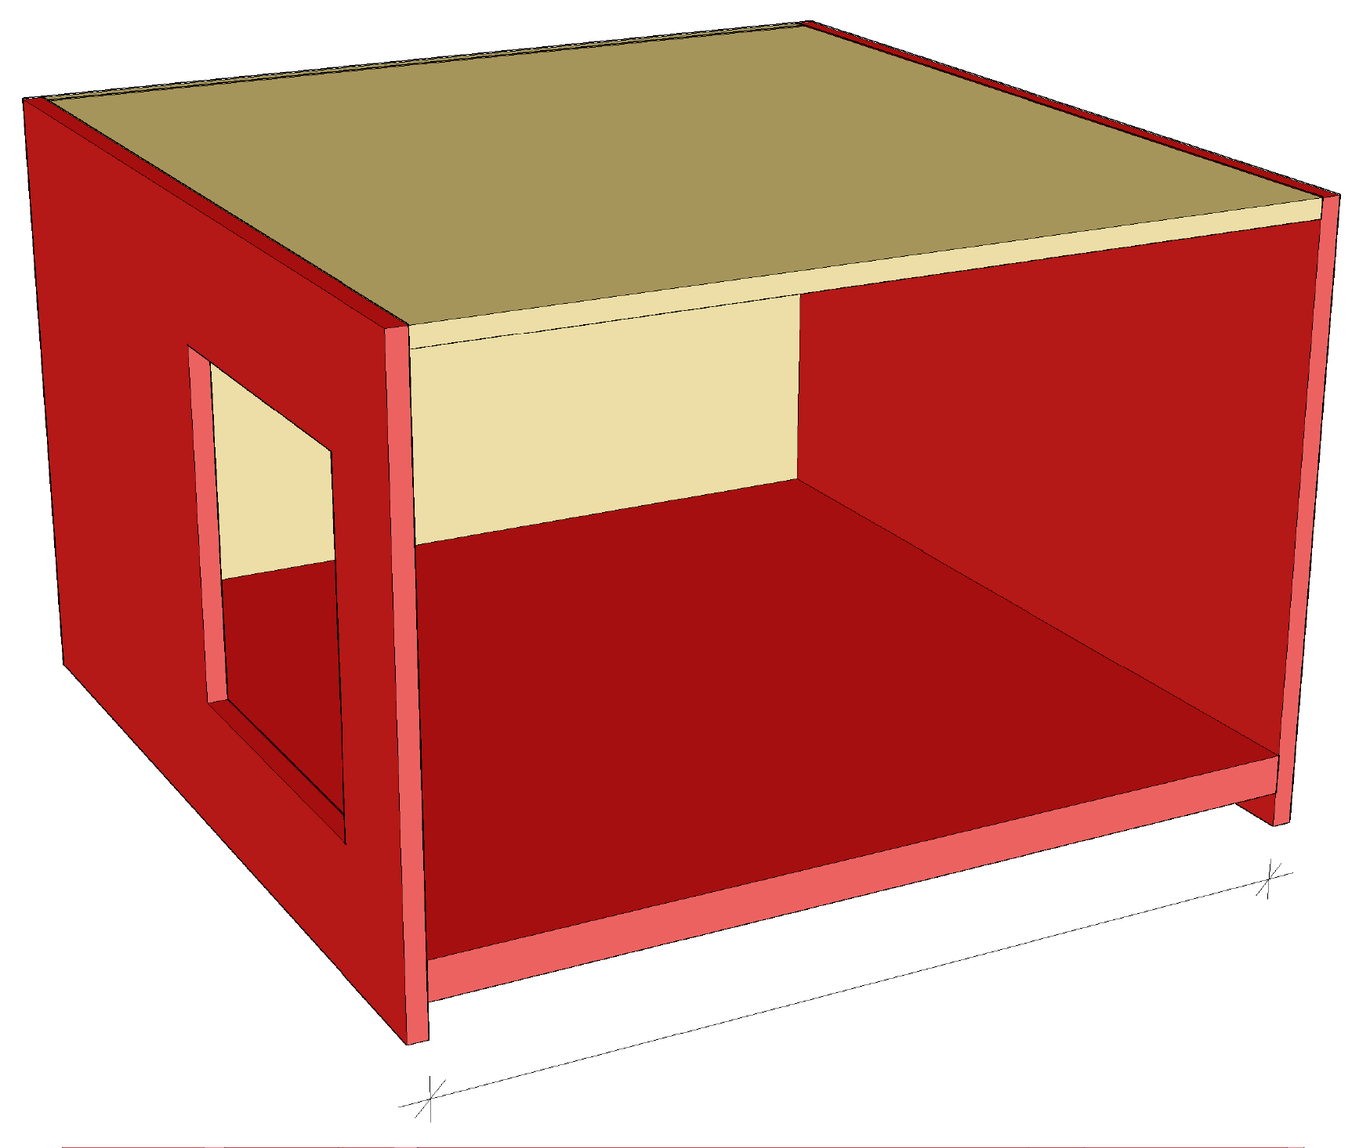
Span of prefabricated modular unit’s intermediate floor
The span of the intermediate floor is usually determined by vibration design
Vibration caused by walking
In a prefabricated modular unit, the intermediate floor span is usually shorter than in a plane element system
The prefabricated modular unit span is often determined by the transport width of the unit
Intermediate floor span

Slide 28
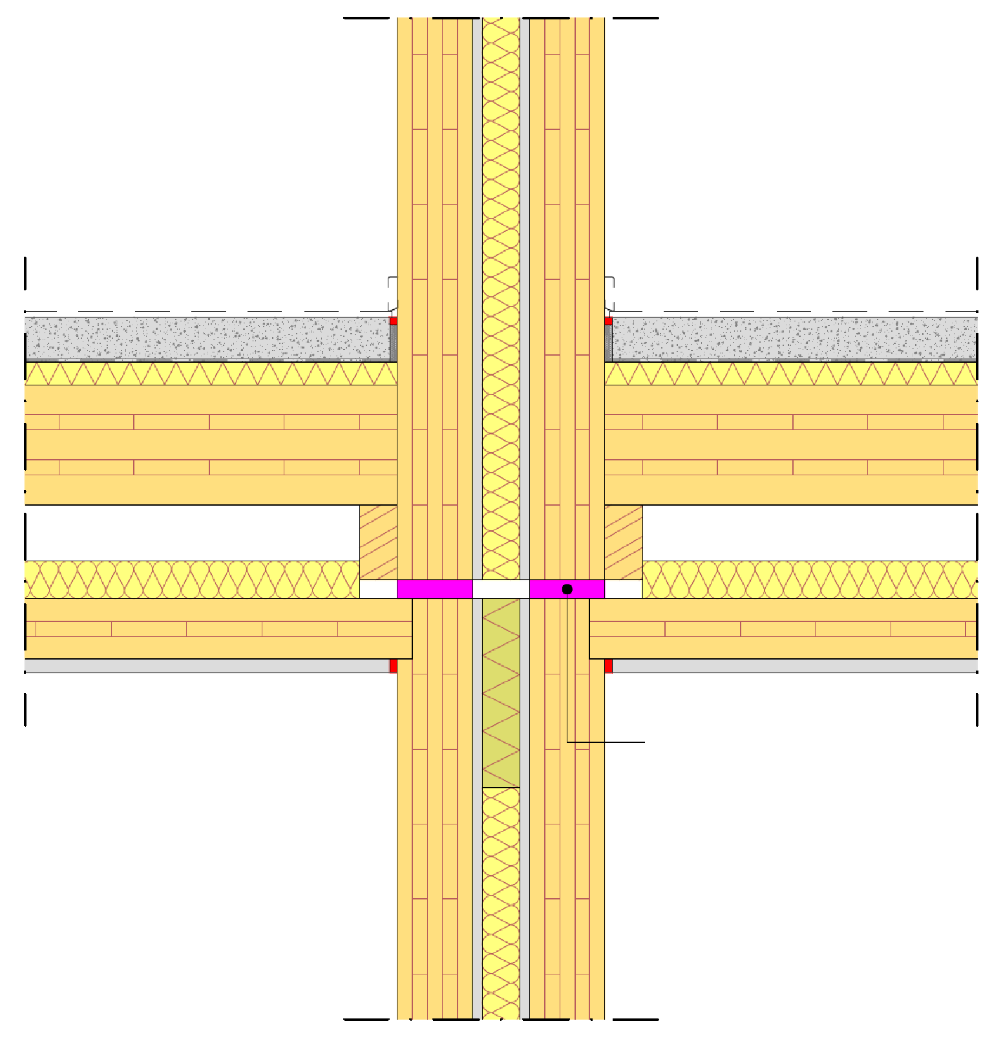
Prefabricated modular unit junctions
In connections between stacked prefabricated modular units, vibration insulators are often used (to avoid acoustic flanking transmission)
Issues that always require attention in the support area in general
Fire technical issues
Acoustics (flanking transmission)
Vertical load-bearing capacity
Minimisation of settlement
Horizontal load transmission
Preventing progressive collapse
Vibration insulator

Slide 29
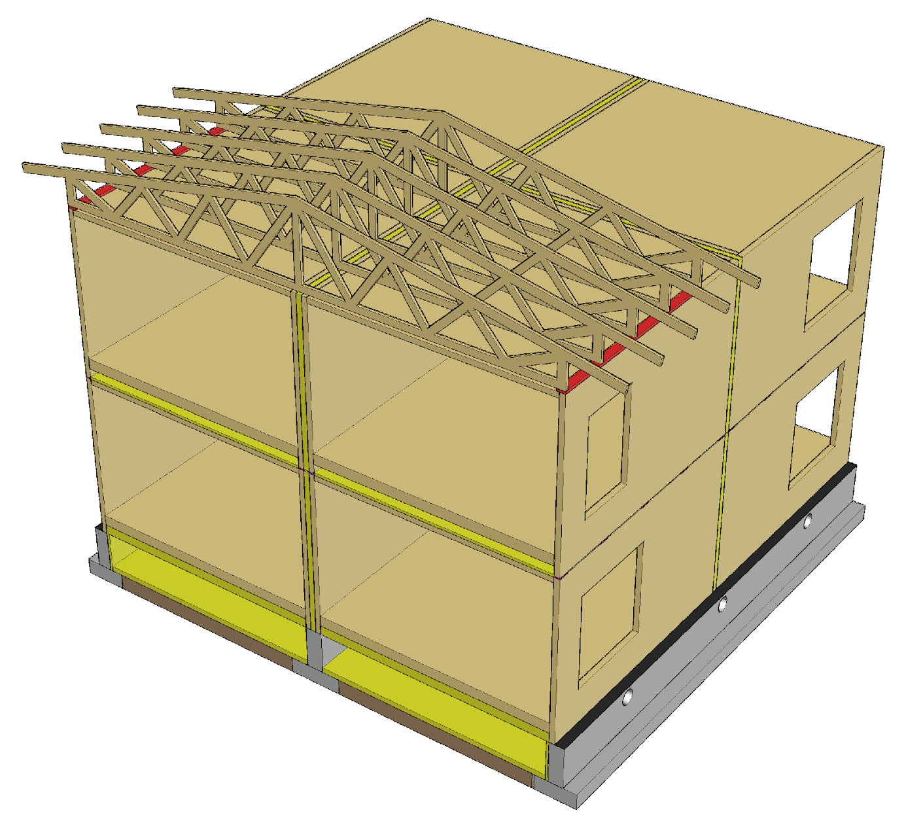
Supporting nail plate trusses
Nail plate trusses are supported by load-bearing exterior and partition walls similarly as in the plane element system
When the prefabricated modular unit roof is designed to function as a load-bearing structure in a fire situation, fire-safe trusses are not needed

Slide 30
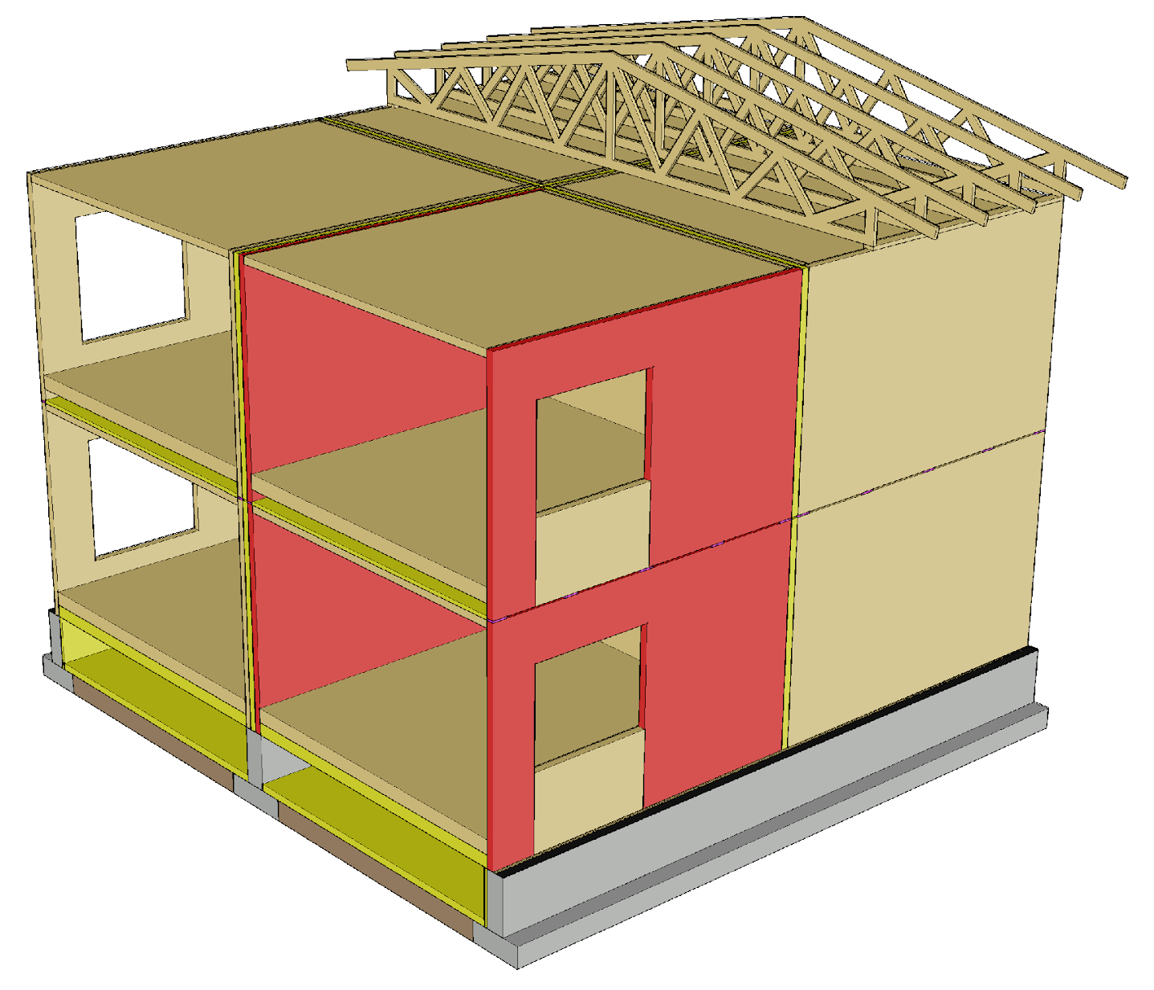
Vertical load transfer
Load-bearing walls of prefabricated modular units transmit vertical loads to the foundations, similarly as in the plane element system
Load-bearing and stiffening building elements are dimensioned as in the plane element system

Slide 31
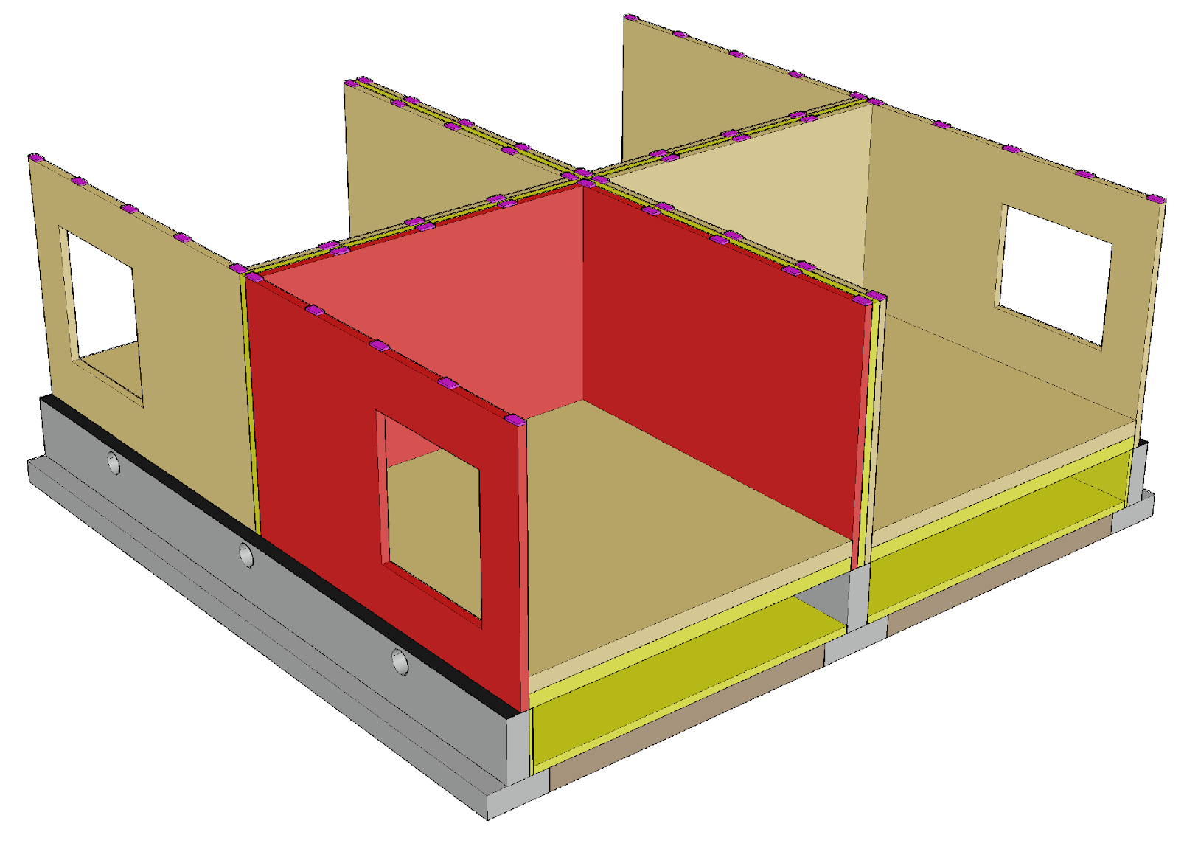
Building stiffening principle
The walls of the prefabricated modular unit are dimensioned to function as stiffening plates, similarly as in the plane element system
In the dimensioning of walls with framed and solid wood panel structures, the same principles are followed as in the plane element system

Slide 32
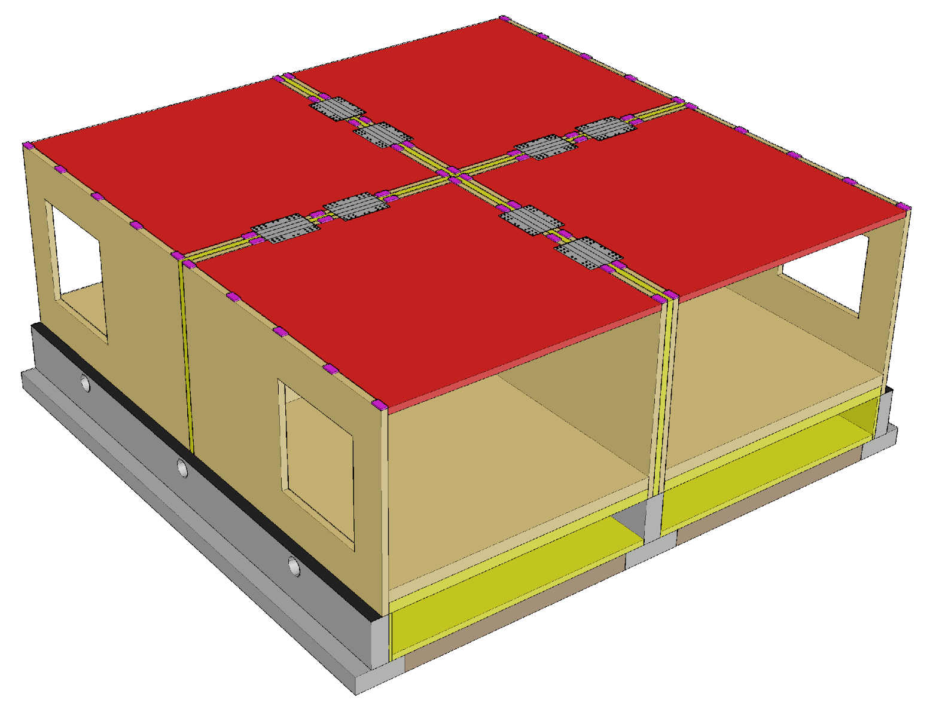
Building stiffening principle
The intermediate floors are dimensioned to function as stiffening plates, similarly as in the plane element system
Floor or roof sheathing can be used as stiffening plate
Stiffening intermediate floors that are the size of prefabricated modular units must be interlinked, creating a connected structure

Slide 33
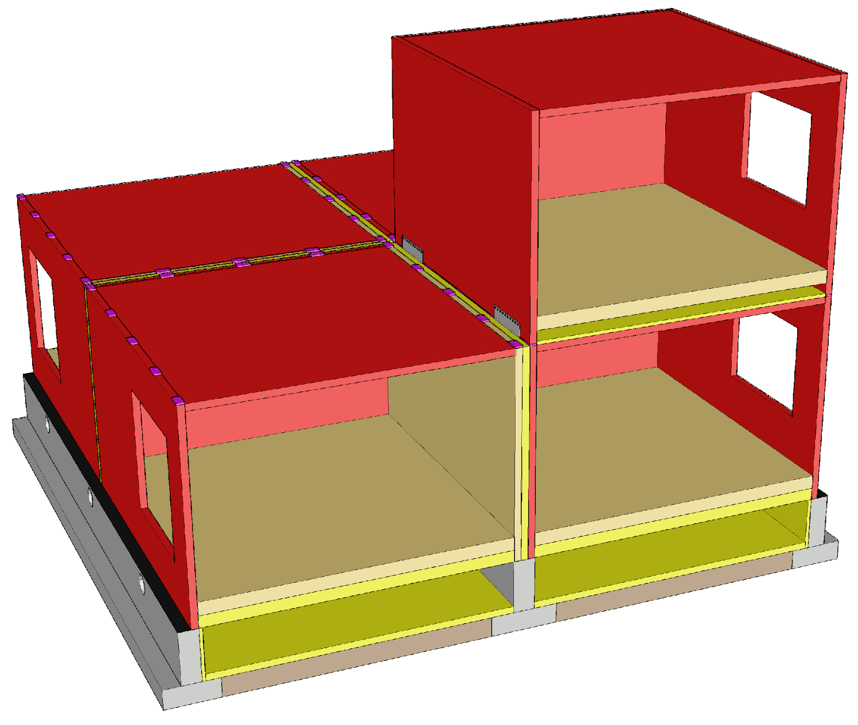
Building stiffening principle
With regard to reducing anchoring forces and the locations of stiffening walls, the same principles apply as in the plane element system
Only one half of a double frame wall can be used unless the joining technique used for the prefabricated modular units allows both halves to have joint components
Image: Tero Lahtela

Slide 34
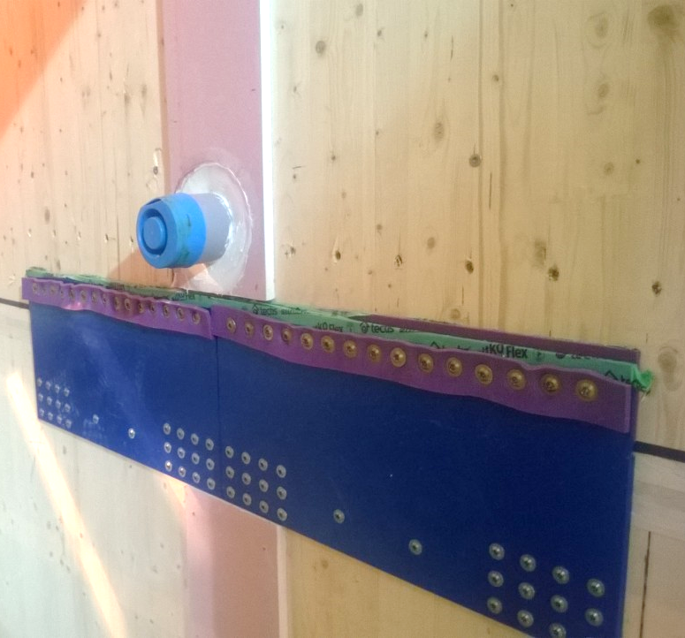
Connection components
Steel plates and screws are typically used in connections between prefabricated modular units
Acoustics should be considered in the design of the connections for flanking transmission
Image: Matti Yli-Sissala

Slide 35
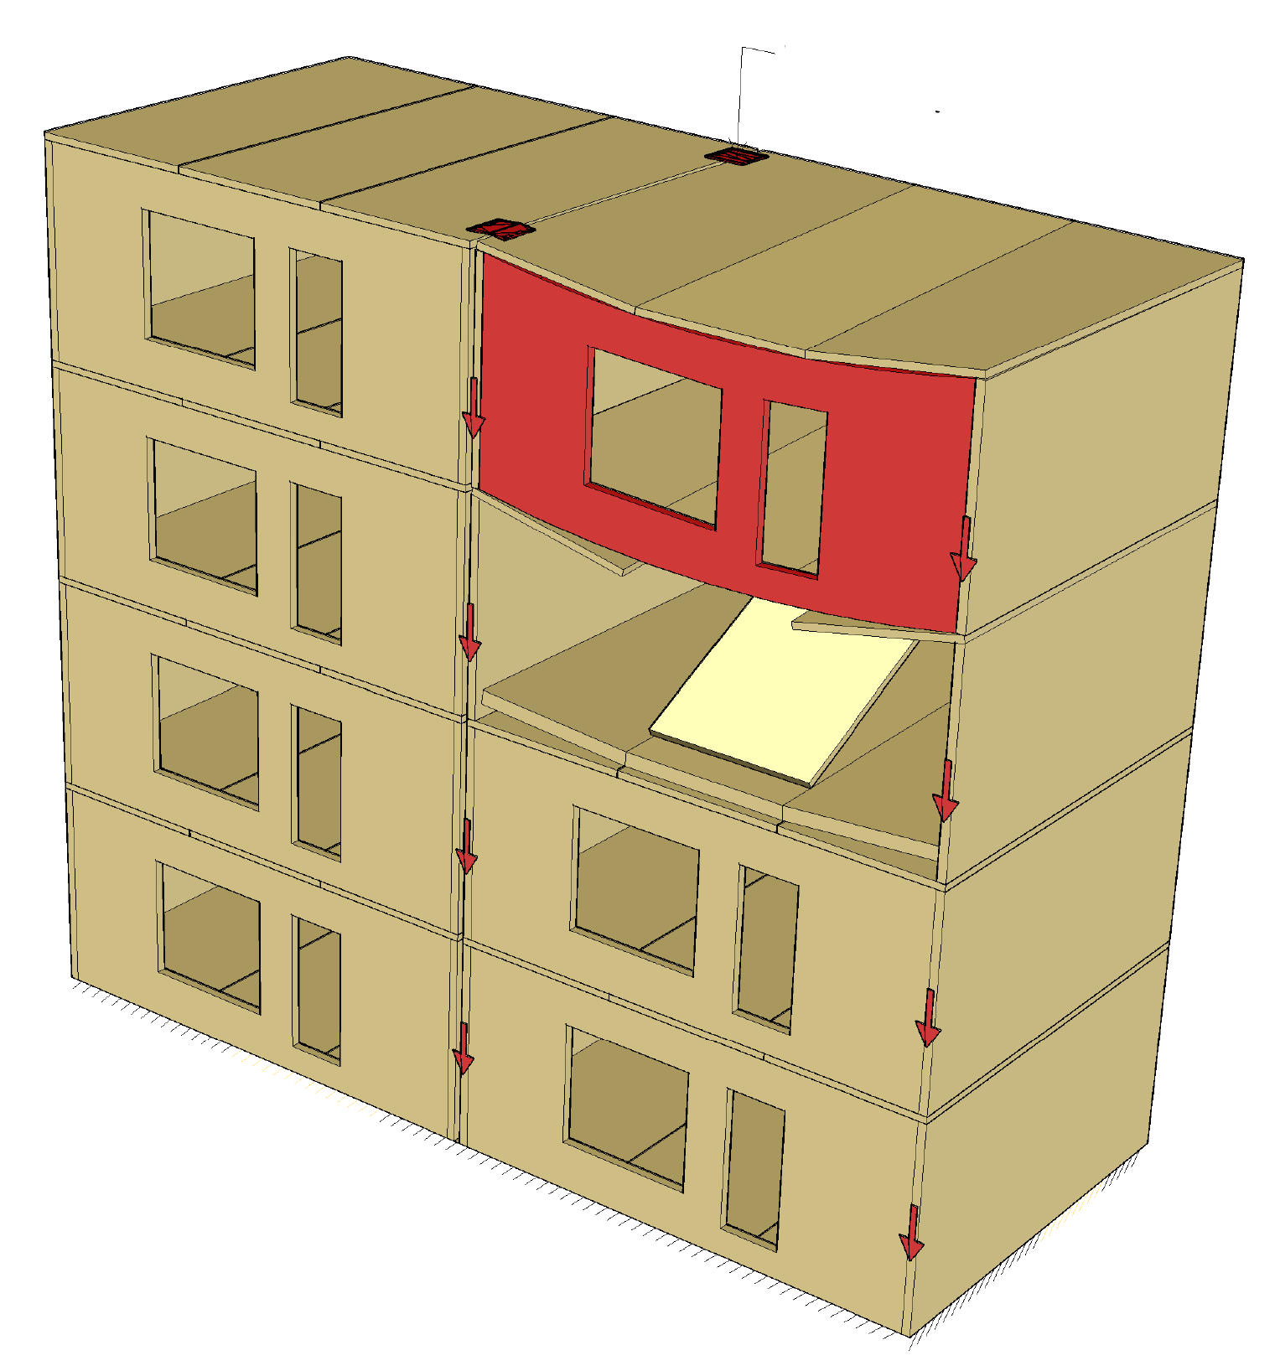
Preventing progressive collapse
Stability joint
The preferred method for preventing progressive collapse is the alternative load transfer path
Using
Beams
Wall-like beams
Connections between prefabricated elements
Image: Tero Lahtela

Slide 36
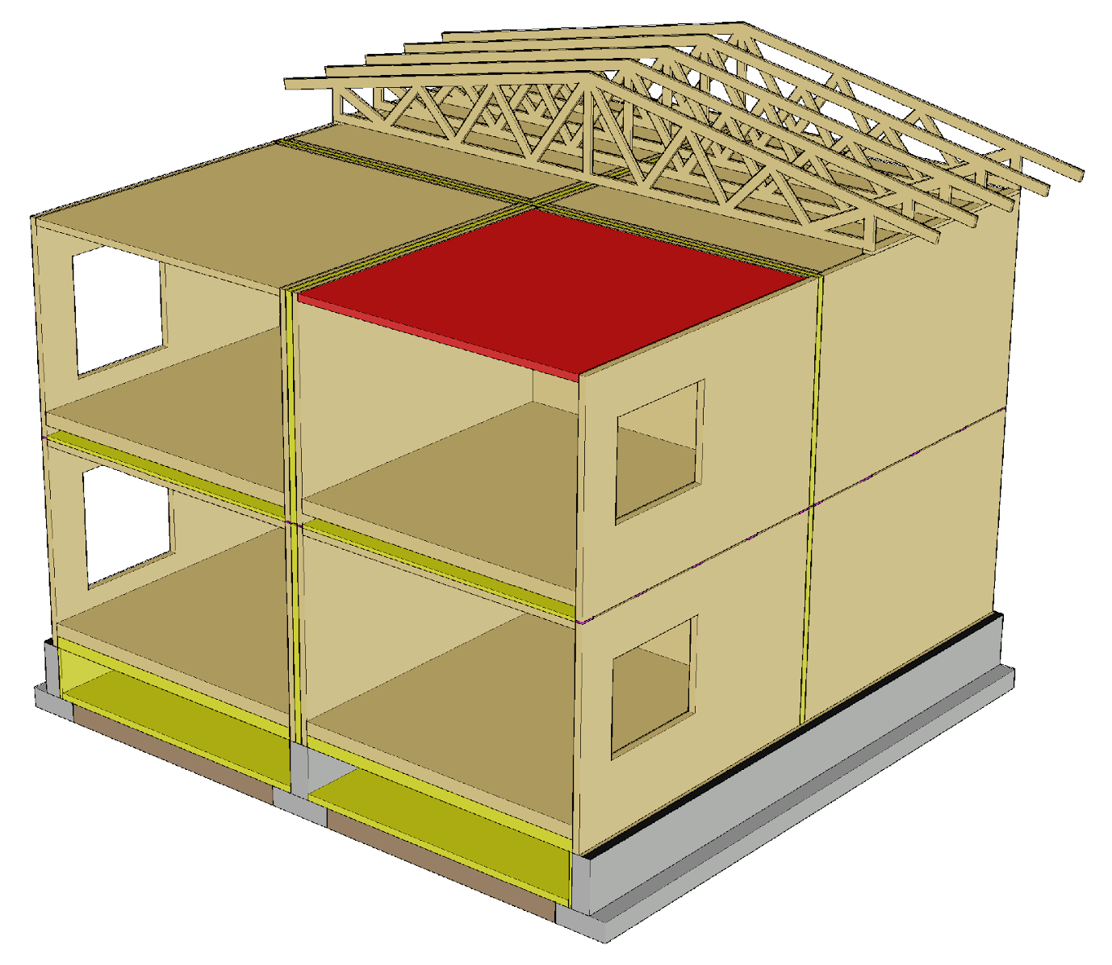
Roof in case of fire
The roof of a prefabricated modular unit is designed to function as a fire-separating building element (floor compartmentalisation) and a load-bearing building element in case of a fire
The prefabricated modular unit roof must function as a load-bearing and fire-separating building element, whether the fire is below or above in the attic

Slide 37
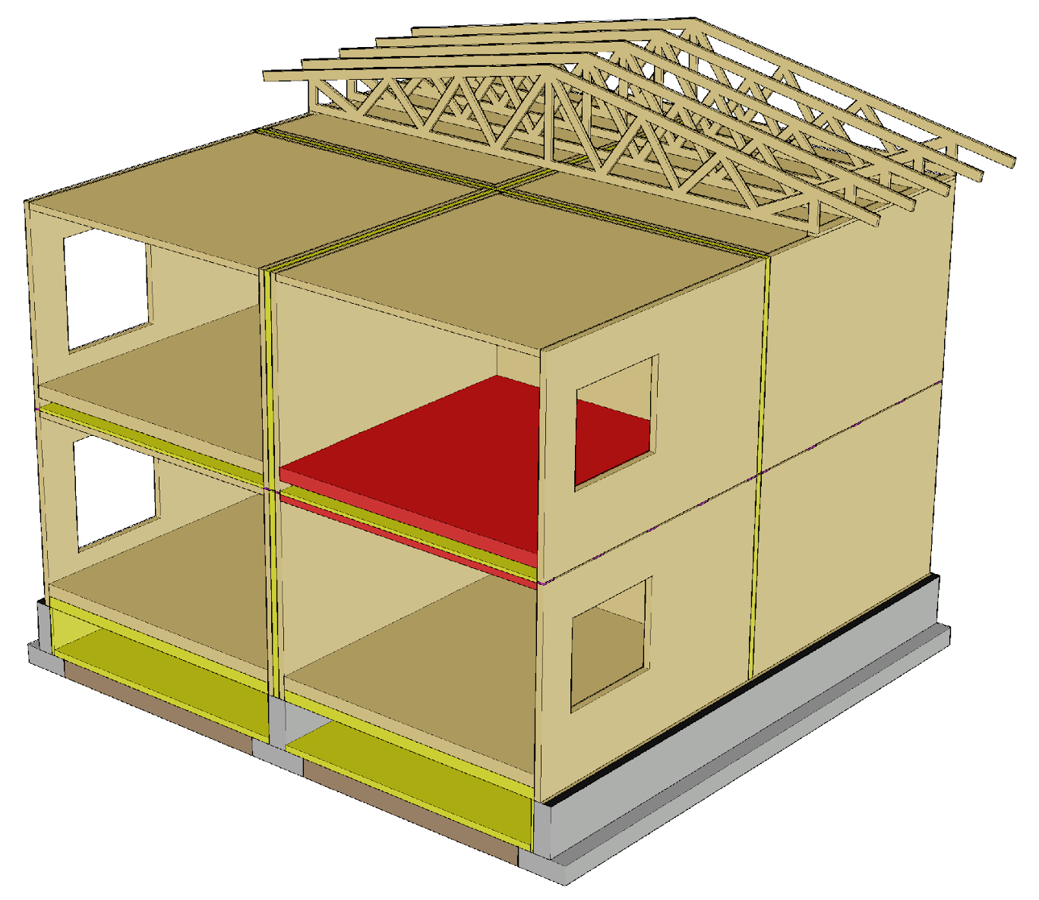
Intermediate floor in case of fire
The floor and roof of the prefabricated modular unit are designed to function as a compartmentalising and load-bearing building element in case of a fire
The design principles are the same as in the plane element system

Slide 38
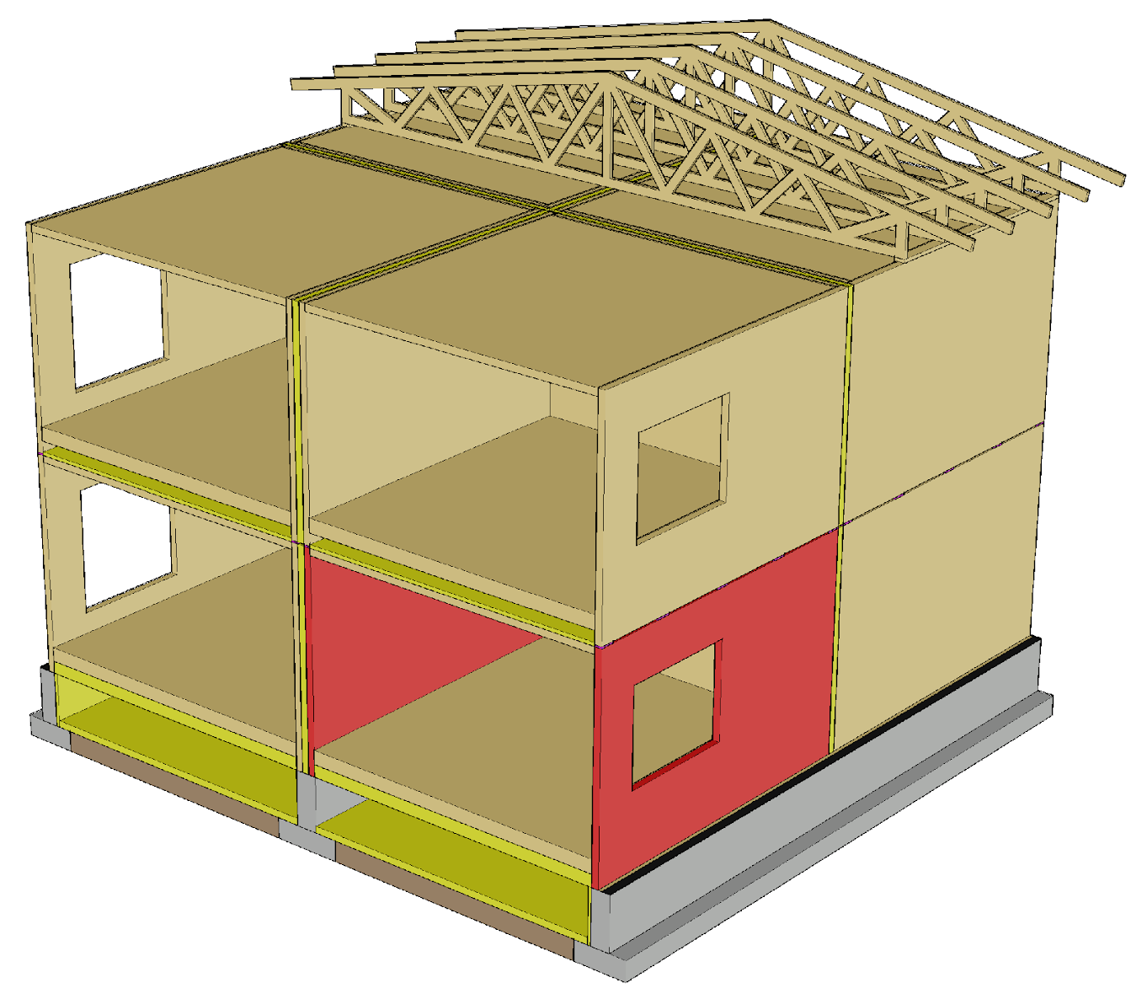
Load-bearing wall in a fire situation
Load-bearing walls are designed to function similarly as in a plane element system in case of a fire
The spans of the horizontal structures in prefabricated modular units are usually so short that it is not necessary to design the partitions for a fire

Slide 39
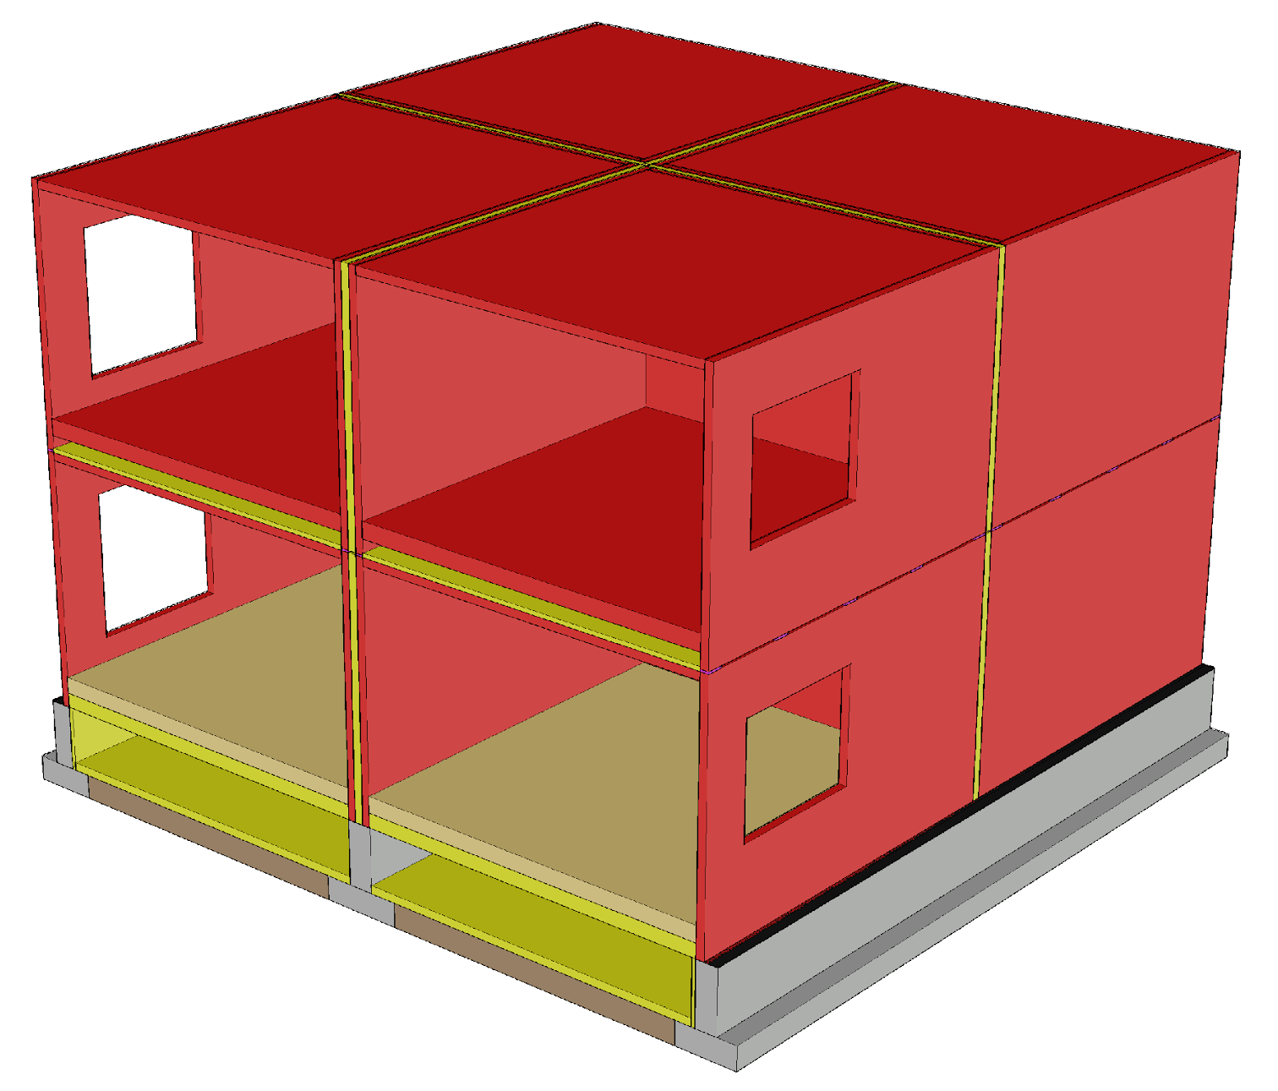
Bracing in a fire situation
The aim is to use the same bracing methods in a fire as in the ultimate limit state design situation
The design principles are the same as in the plane element system

