Slide 1



Industrial wood construction
Teaching materials for industrial wood construction education
2022

Slide 2
Origin of the materials
Use of the materials
These learning materials for industrial wood construction have been prepared in a project led by Puuinfo Oy in 2021–2022. Also involved in the project were
Lappia Vocational College,
TTS-Työtehoseura ry
South-Eastern Finland University of Applied Sciences,
Metropolia University of Applied Sciences,
Jyväskylä University of Applied Sciences,
University of Tampere, and
Federation of the Finnish Woodworking Industries Puutuoteteollisuus ry
The project was funded by the Ministry of the Environment.
The materials are intended to be used as extensively as possible in industrial wood construction education and studies.
The materials are released under the Creative Commons licence Attribution-ShareAlike (CC BY-SA), which requires that the author be properly credited when the materials are used and that derivative works may only be distributed under the same licence as the original work.
The original materials and any updates to them by Puuinfo will be published on the Library of Open Educational Resources website (aoe.fi) and the Puuinfo.fi website.

Slide 3

Industrial construction systems

Slide 4
Authors
Tero Lahtela,
Insinööritoimisto Tero Lahtela Oy
Release date: 10/02/2022

Slide 5
Column-and-beam frame
Office construction

Slide 6
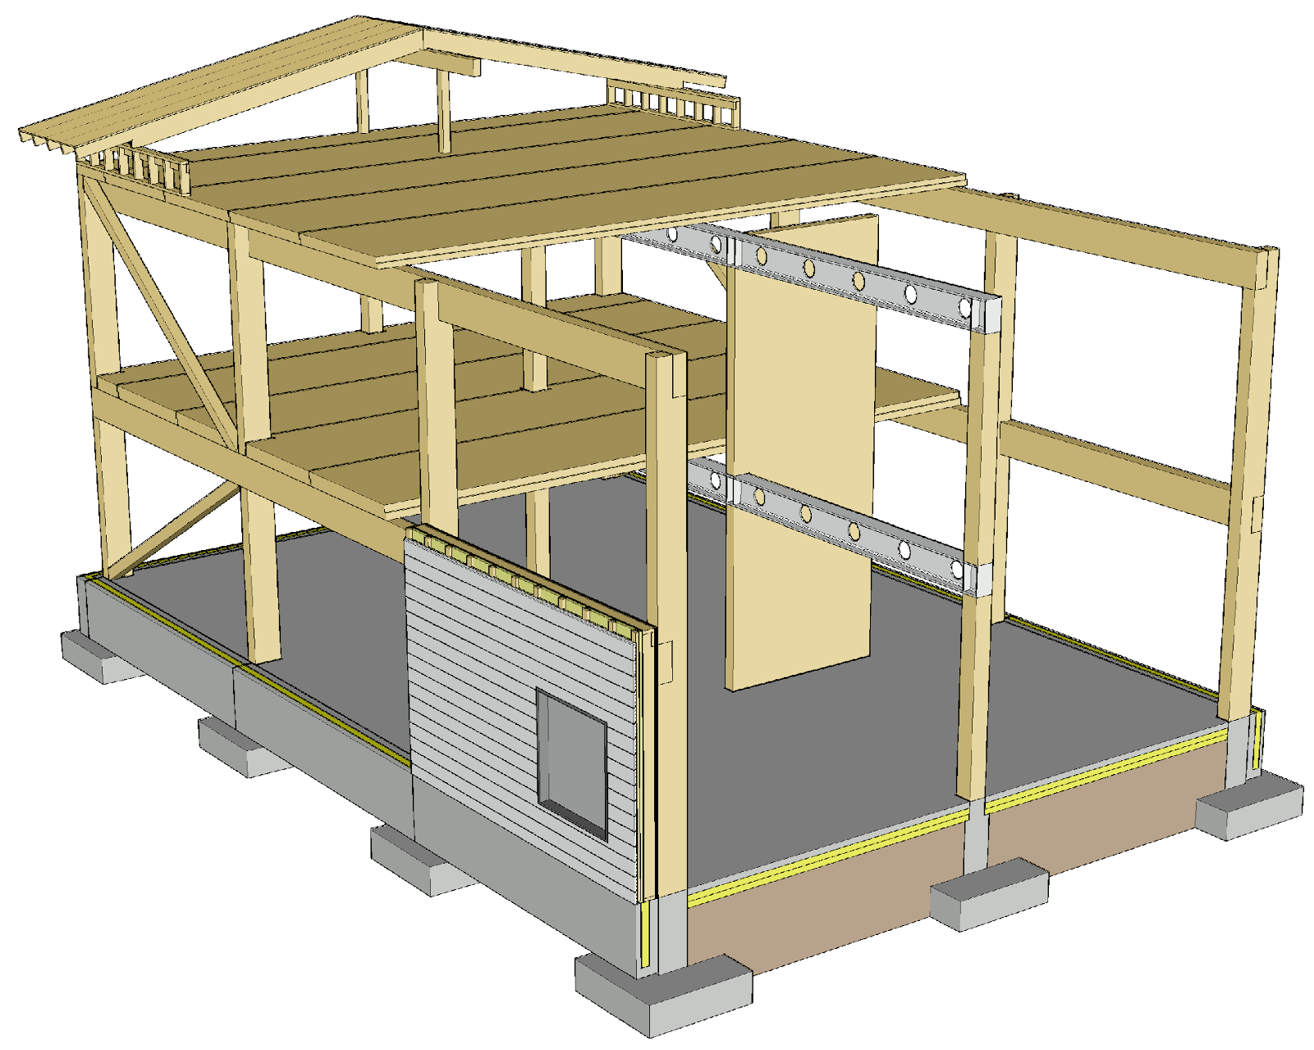
Column-and-beam system components
Primary columns
Primary beams
Stiffeners
  Diagonal stiffeners
  Stiffening walls
Intermediate floors
Roof structures
Non-bearing exterior walls
  Horizontal or vertical

Slide 7
Applications
Column-and-beam frames are used in buildings where large open spaces and adaptability are required
  Offices
  Schools
  Day-care centres
  Commercial premises
  Etc.
The column-and-beam frame can also be used in residential blocks of flats

Slide 8
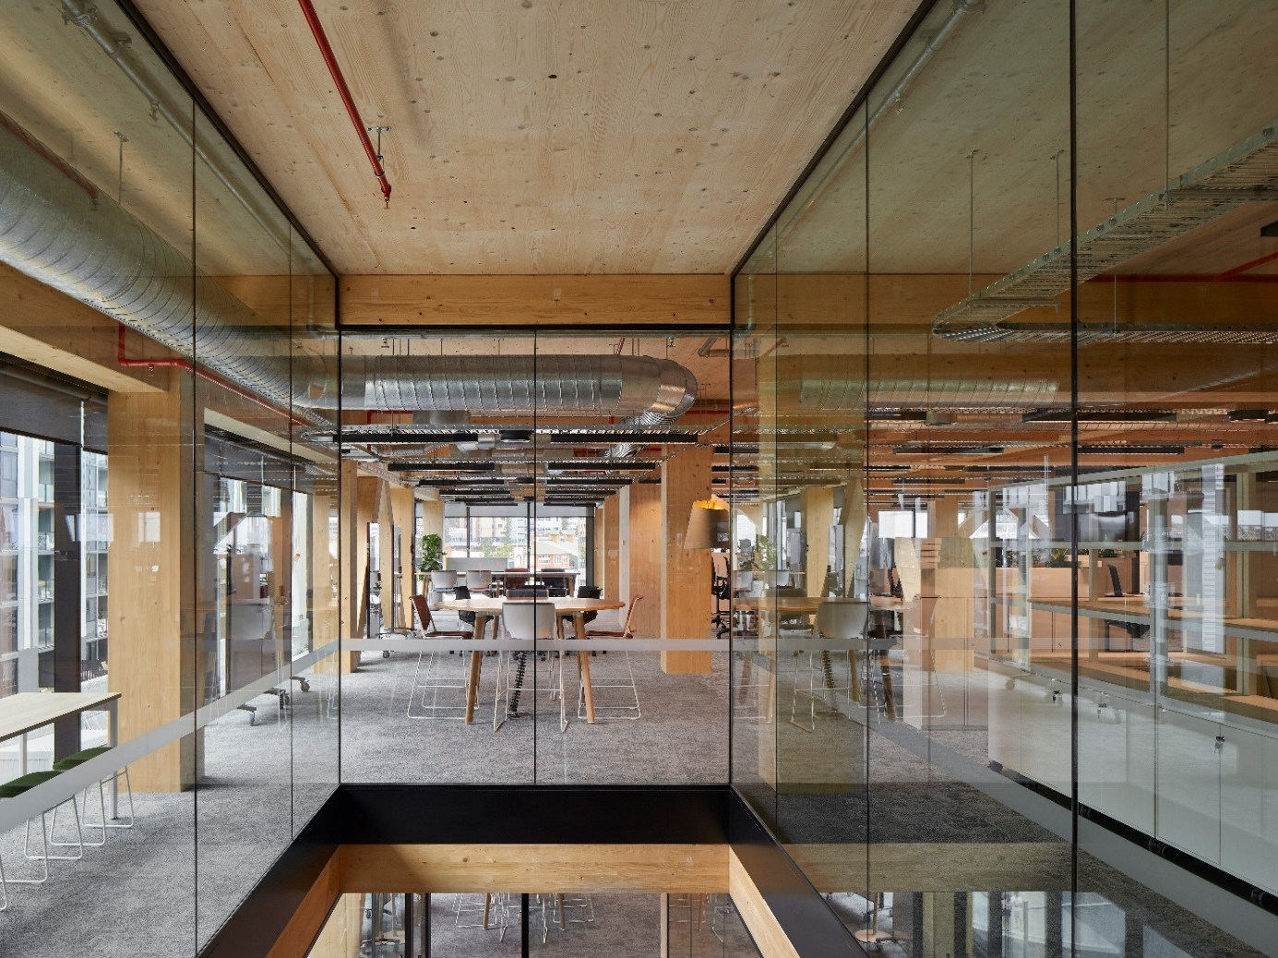
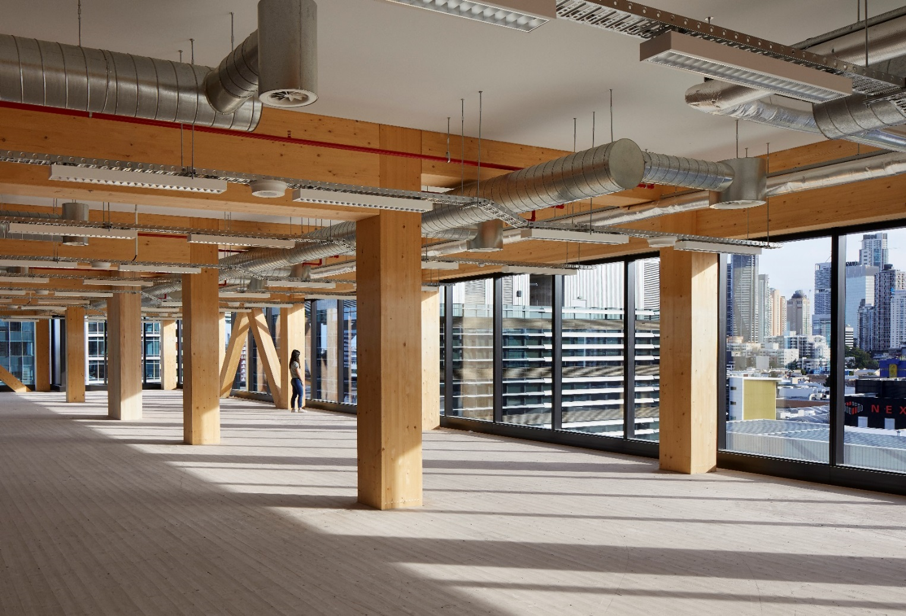
Column-and-beam frame in an office building
Image: Bates Smart
Image: Bates Smart

Slide 9
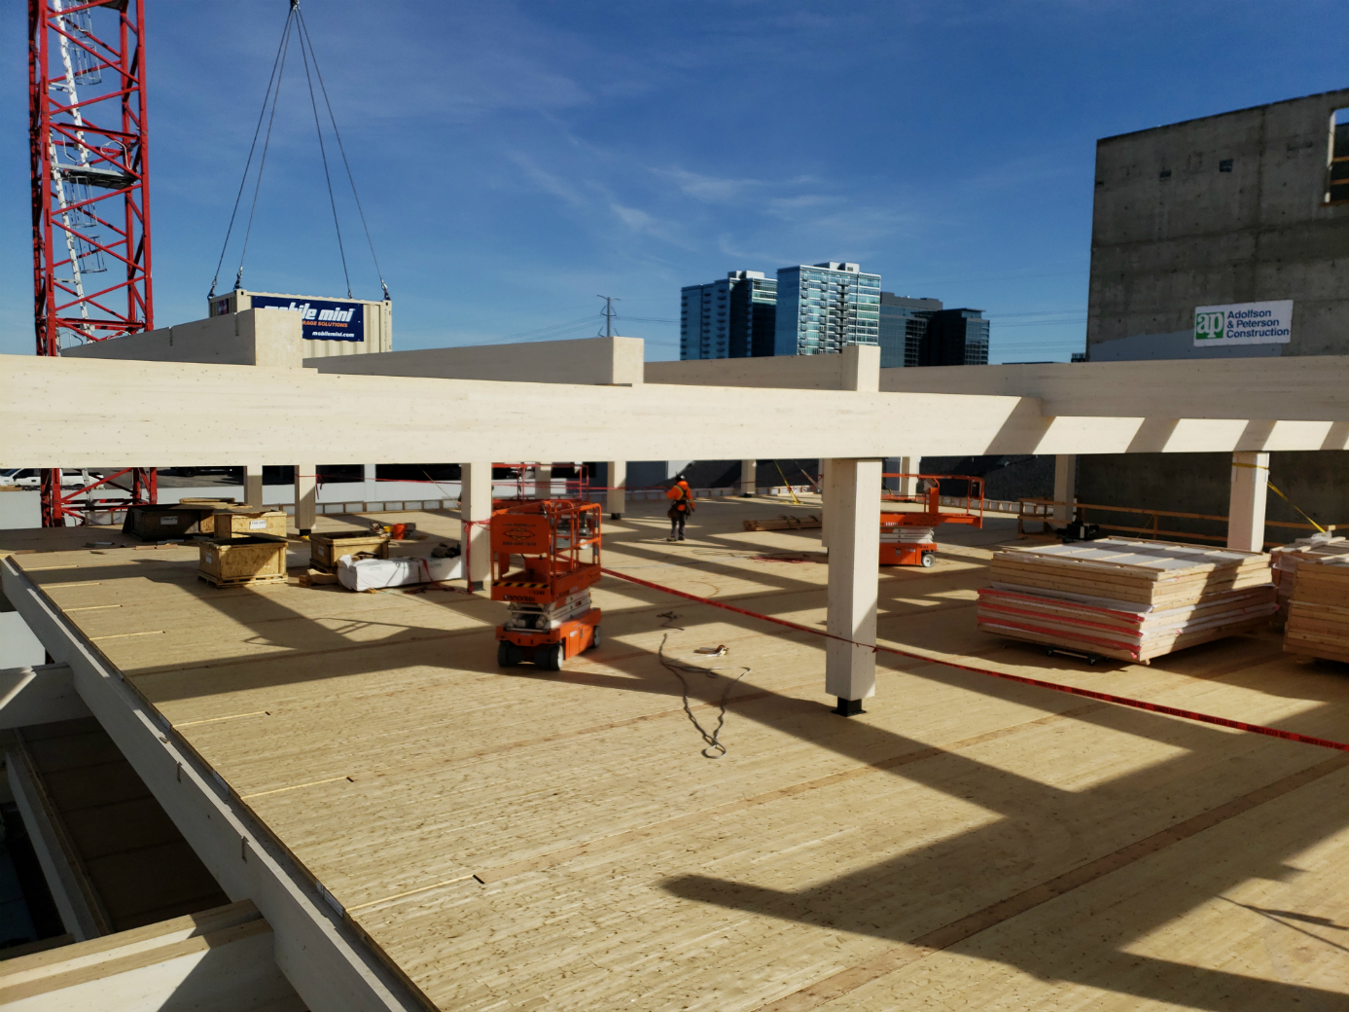
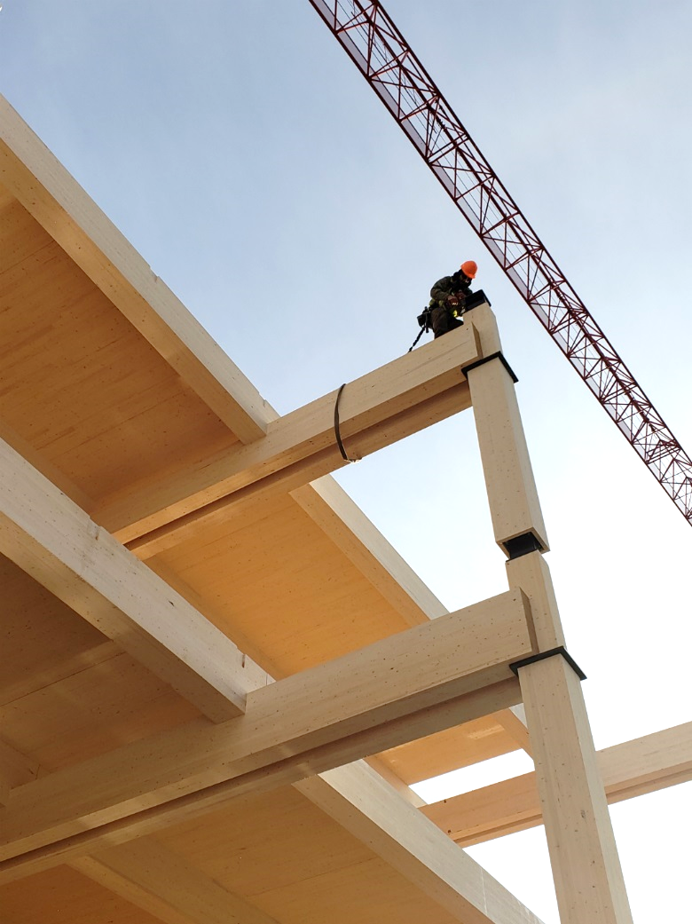
Assembling a column-and-beam frame
Image: FGP Construction
Image: FGP Construction

Slide 10
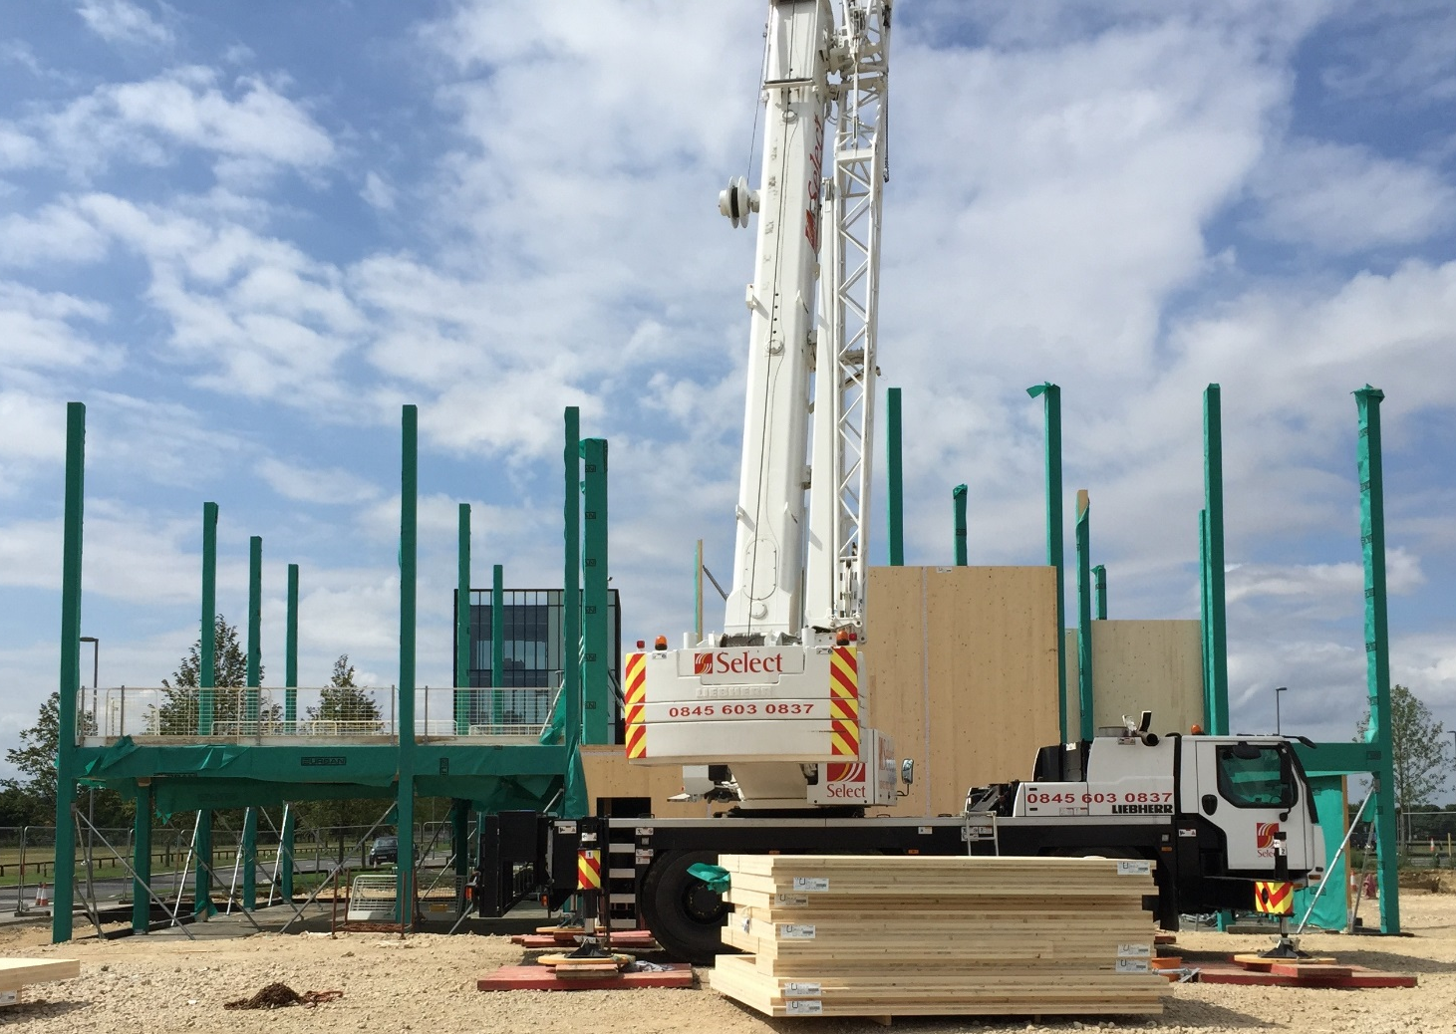
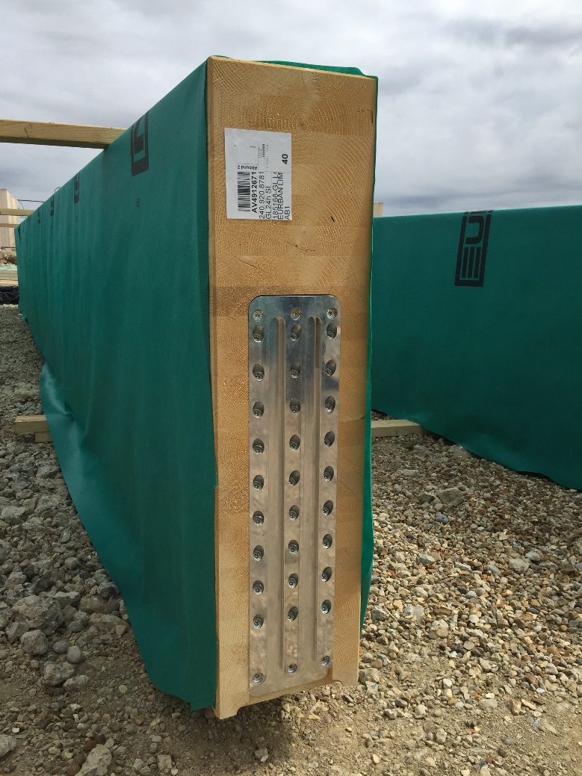
Assembling a column-and-beam frame
Image: Mikko Viljakainen
Image: Mikko Viljakainen
Image: Bates Smart

Slide 11
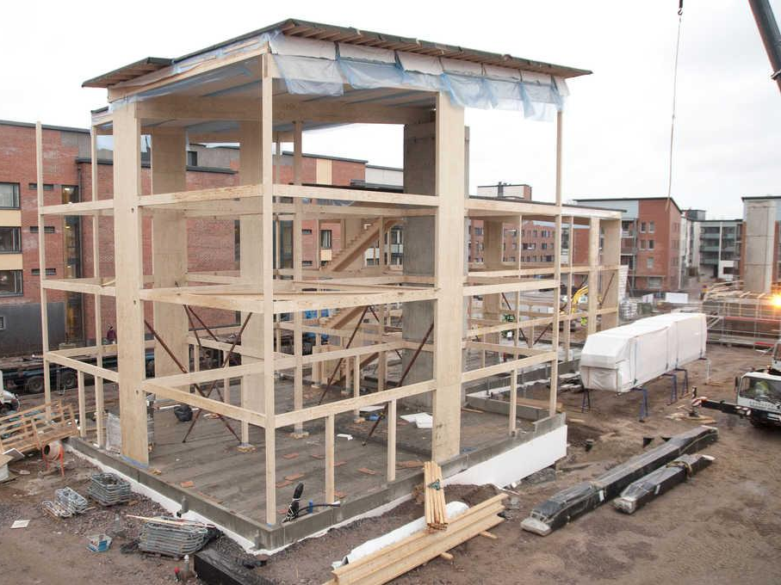
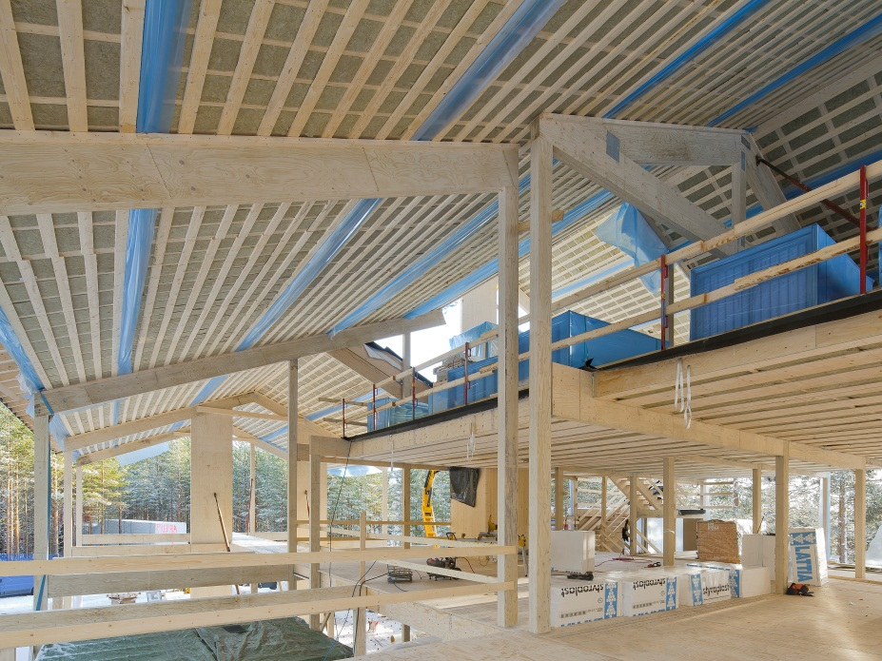
Column-and-beam frame in a residential block of flats
Image: Metsä Wood
Image: Metsä Wood

Slide 12
Strengths and challenges of the column-and-beam system
Strengths
Enables large, open spaces
Robust columns have a high vertical load-bearing capacity
Small settlement (continuous columns)
Frame can be assembled fast
Non-load-bearing exterior walls
  Simple prefabrication
  Several structural design options for exterior walls
Challenges
Holes in wooden beams (ventilation ducts etc.)
Connections between columns and beams
Stiffening of large open spaces
Vibration design of the intermediate floor
  Combined fundamental frequency of the intermediate floor and the main beam

Slide 13
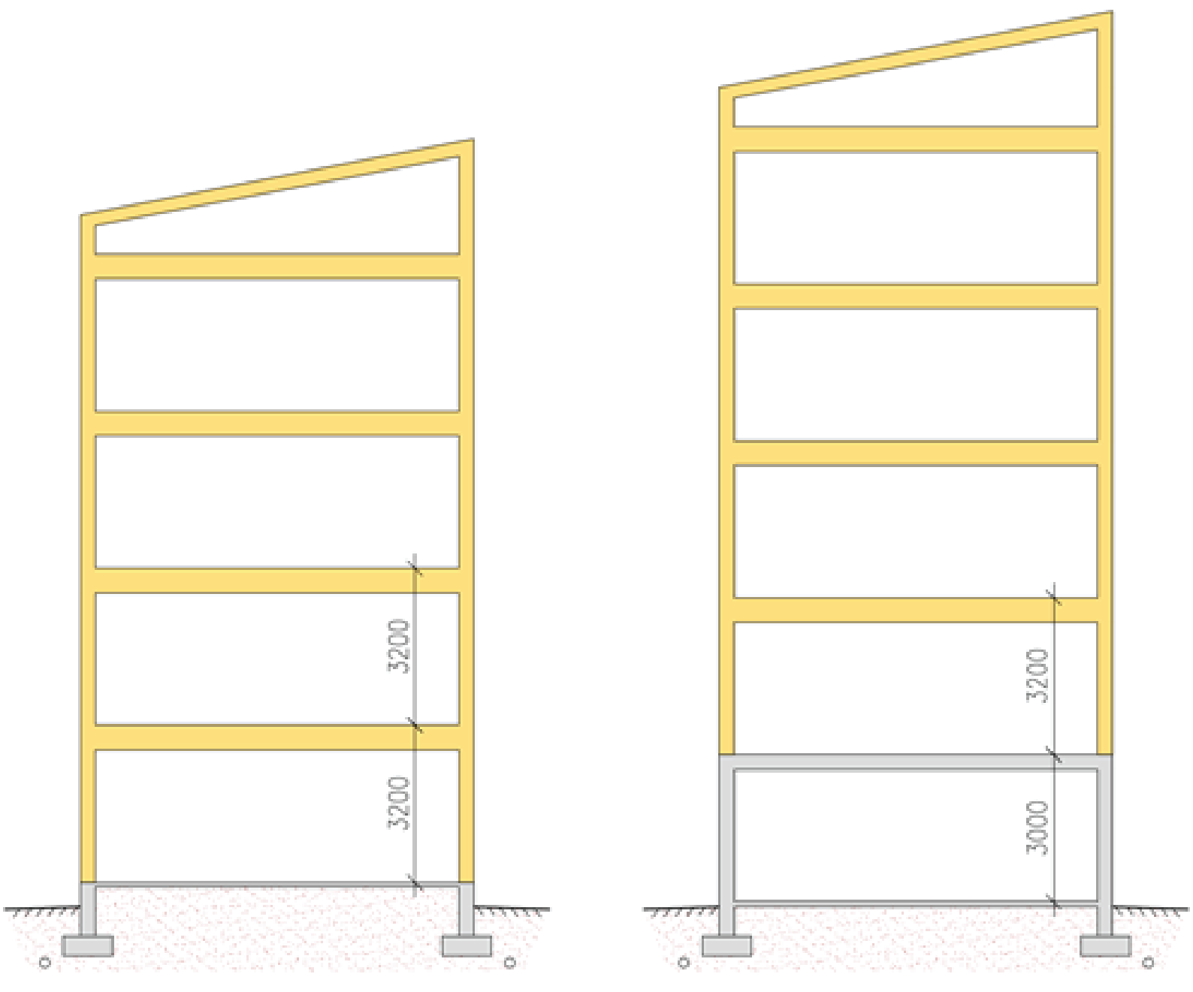
Number of storeys when using a column-and-beam frame
Factors affecting the number of storeys
  Bracing system capacity
  Capacity of the joints between stiffeners
Recommended number of storeys
  8 timber-framed storeys at most
  Stiffened with a cantilever column
    In residential buildings, 4 storeys at most
    In public buildings, 2 storeys at most.
Floor-to-floor height
  3,200 mm (residential buildings)
  3,800 ... 4,000 mm (public spaces)
5th storey
4th storey
4th storey
3rd storey
3rd storey
2nd storey
2nd storey
1st storey
1st storey

Slide 14
Types of structure in a column-and-beam system
In a column-and-beam system, the intermediate floors, attic floor, exterior walls and partition walls are panelised units
  Types of structure virtually the same as in panelised units
The exterior wall plane elements can be either horizontal or vertical
  Horizontal units create fewer vertical joints than vertical units
In the intermediate floor, solid timber panels or frame structures or combinations of thereof can be used
The roof can be implemented with plane elements or as a nail plate truss structure
There are no standardised dimensions for the components of a column-and-beam frame

Slide 15
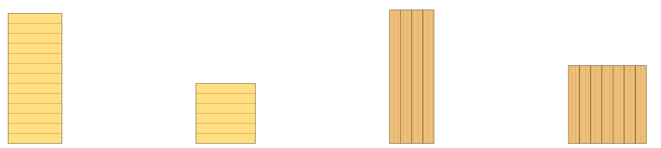
Column types
Glued laminated timber
Rectangular cross-section
Width: 190 mm, 215 mm, 240 mm, 265 mm
Height: Multiples of 45 mm
Length: ≤32 m
Glued laminated timber
Square cross-section
Width: 190 mm, 215 mm. 240 mm. 265 mm
Height: Multiples of 45 mm
Length: ≤32 m
Glued LVL
Rectangular cross-section
Width: manufacturer-specific
Height: manufacturer-specific
Length: ≤24 m
Glued LVL
Square cross-section
Width: manufacturer-specific
Height: manufacturer-specific
Length: ≤24 m

Slide 16
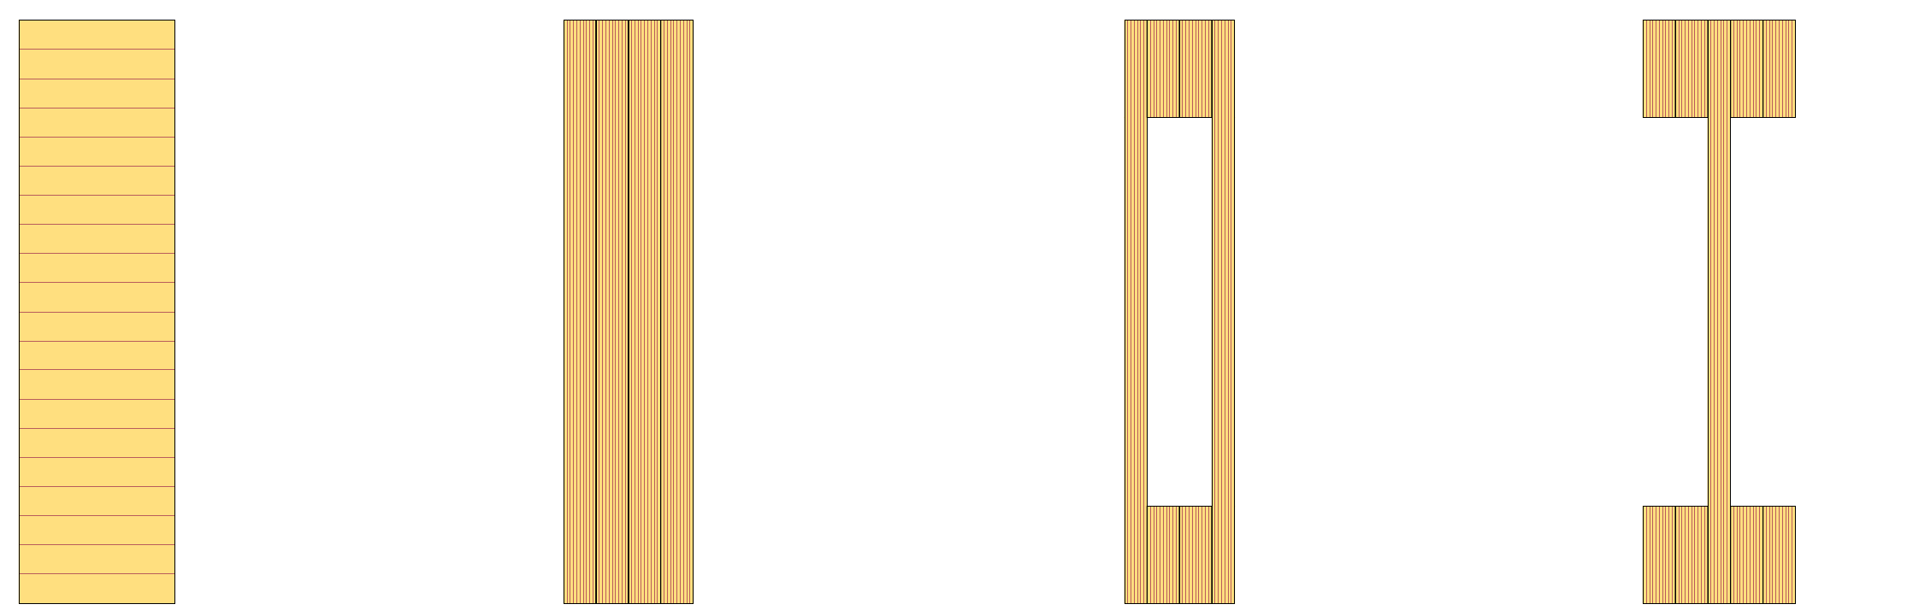
Beam types
Glued laminated timber
Rectangular cross-section
Width: 190 mm, 215 mm, 240 mm, 265 mm
Height: Multiples of 45 mm (max 2,000...2,200 mm)
Length: ≤32 m
Glued LVL
Rectangular cross-section
Width: manufacturer-specific
Height: manufacturer-specific
Length: ≤24 m
Glued LVL
Box beam
Width: manufacturer-specific
Height: manufacturer-specific
Length: ≤24 m
Glued LVL
Thin-web beam
Width: manufacturer-specific
Height: manufacturer-specific
Length: ≤24 m

Slide 17
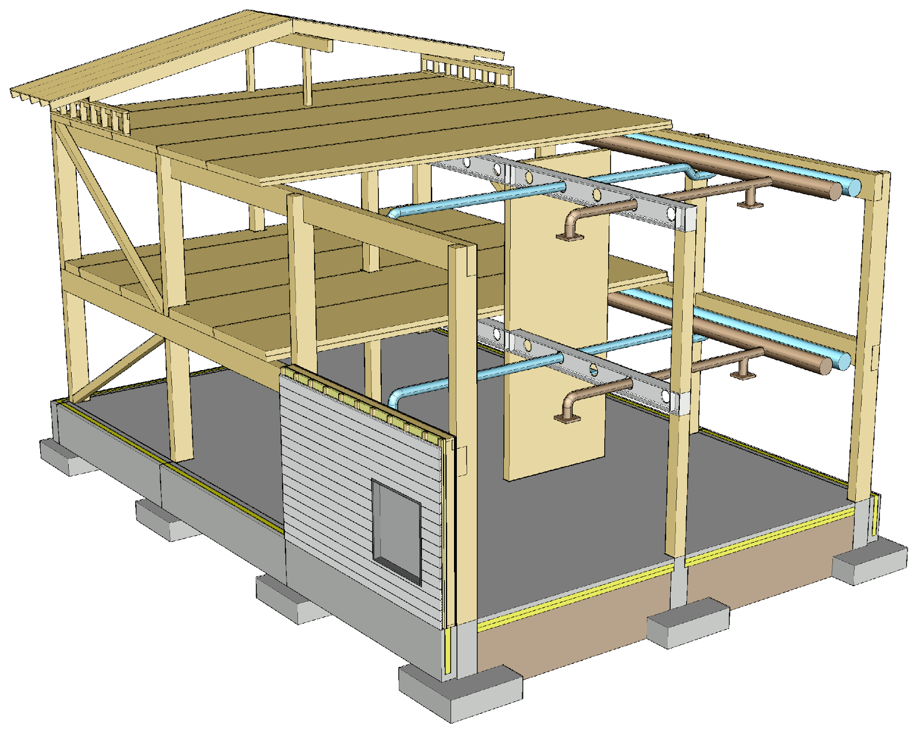
Holes in primary beams
Making holes in primary beams for building services should be avoided, but this is not always feasible
The timber beam can be replaced with a steel beam, which can be perforated
The steel beam must be fireproofed

Slide 18
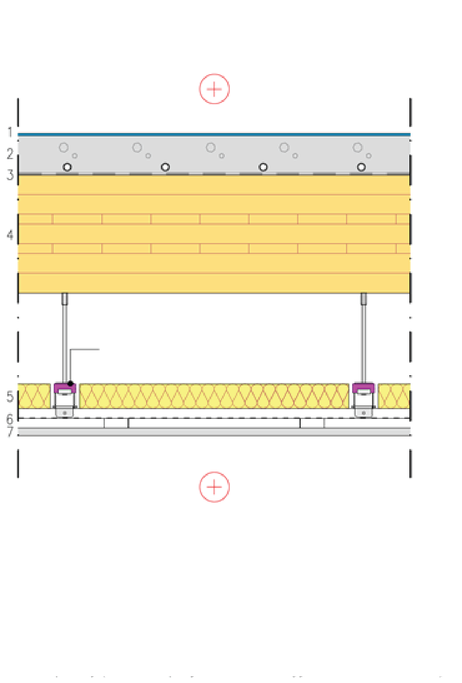
Intermediate floor structure
Intermediate floor
Solid timber panel (e.g. cross laminated timber) is a load-bearing and bracing structure
Plasterboard and castings are used for
  Fire protection
  Acoustics
The thickness of the solid timber panel depends on
  Vibration (often governing)
  Bending and shearing stress
  Deflection
Ceiling profile system
1 Floor coating
2 Concrete slabs (possibly composite structure, possible underfloor heating)
3 Protective fabric between concrete and wood
4 CLT or LVL panel
5 Mineral wool
6 Ceiling profile system with vibroinsulators
7 Plasterboard (number determined according to sound insulation requirements for intermediate floor)

Slide 19
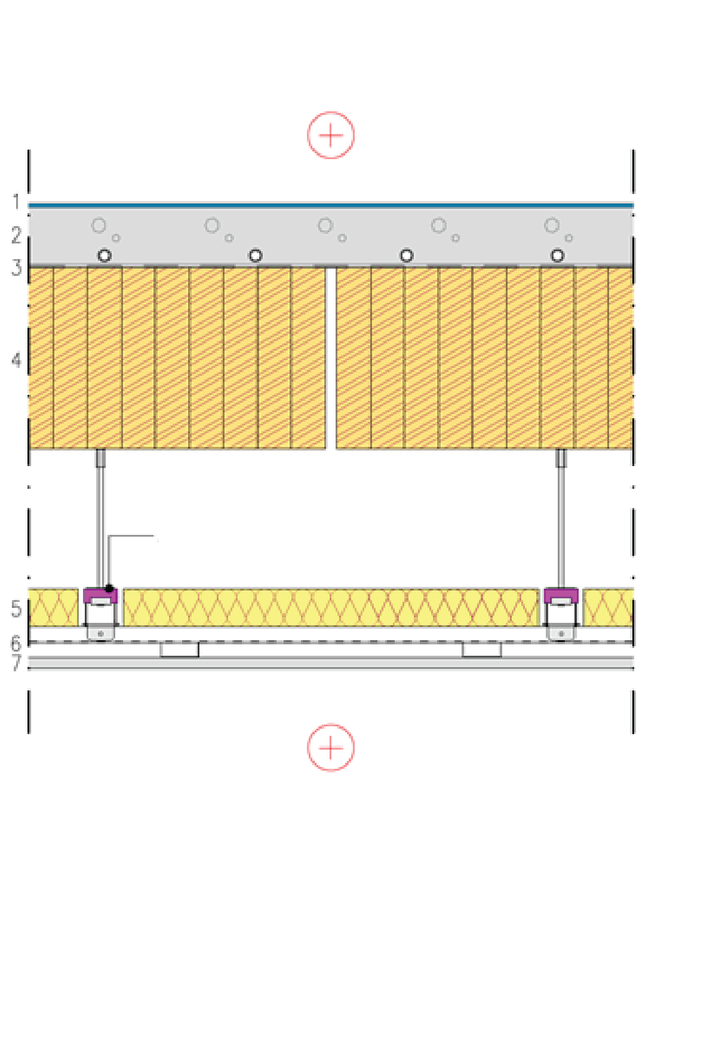
Intermediate floor structure
Intermediate floor
Panels made of edge-glued boards can be used instead of solid timber panels
The load-bearing structure consists of glulam beams lying flat side down (element width can be selected)
The transverse drying deformations of the glulam beam must be taken into account
The glulam beams must be connected to each other if the intermediate floor is a bracing structure
Ceiling profile system
1 Floor coating
2 Concrete slabs (possibly composite structure, possible underfloor heating)
3 Protective fabric between concrete and wood
4 Glulam
5 Mineral wool
6 Ceiling profile system with vibroinsulators
7 Plasterboard (number determined according to sound insulation requirements for intermediate floor)

Slide 20
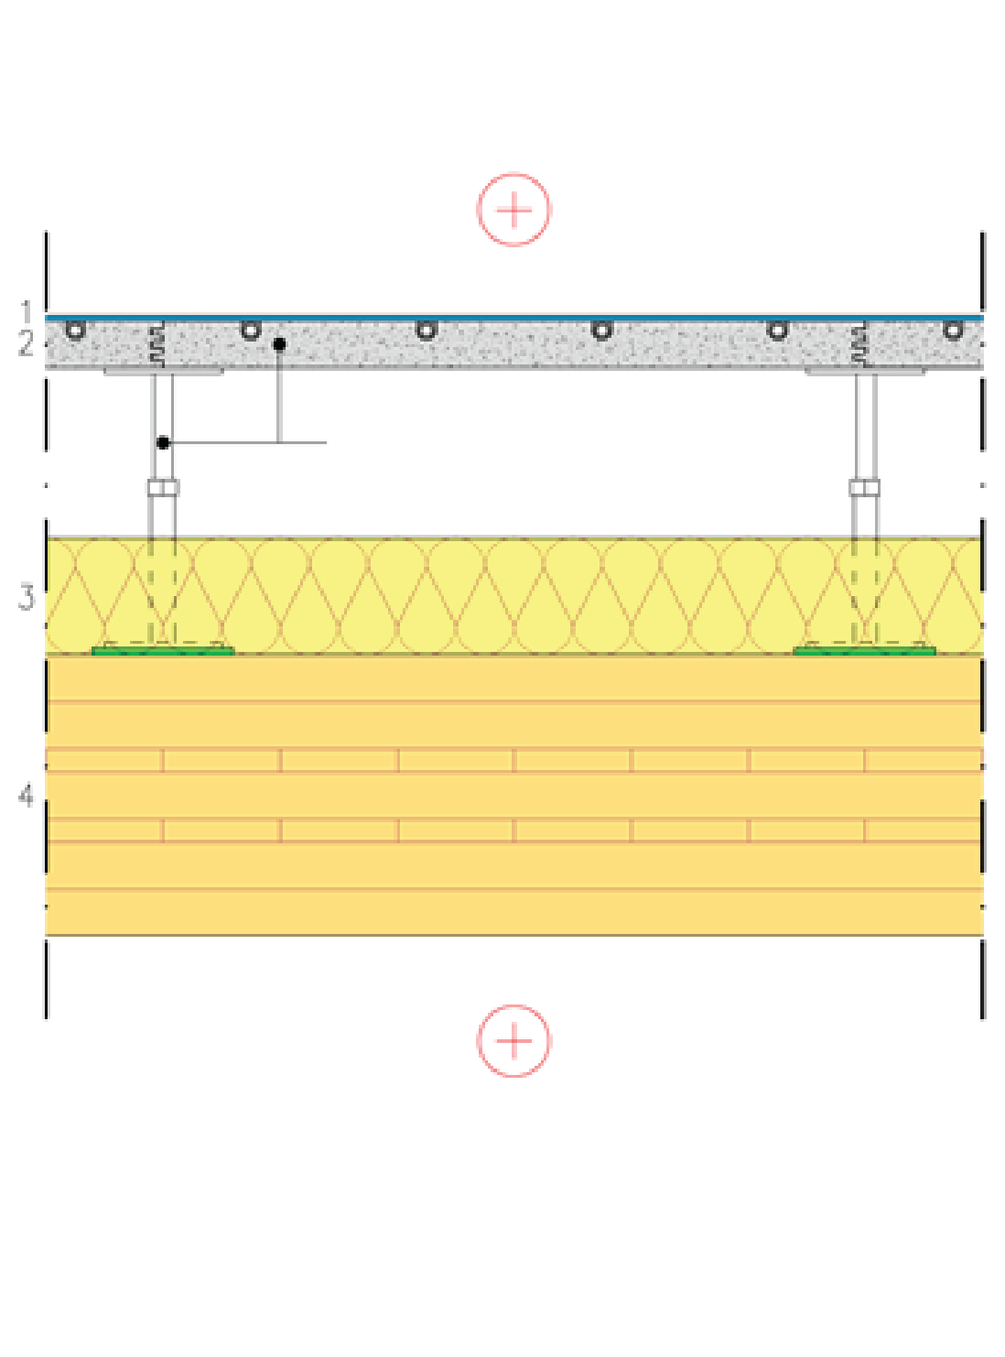
Intermediate floor structure
Intermediate floor
Solid timber panel is a load-bearing and bracing structure
Suspended floors are used for
  Acoustics
The thickness of the solid timber panel depends on
  Vibration (often governing)
  Bending and shearing stress
  Deflection
Suspended floor system
1 Floor coating
2 Fibre-reinforced calcium sulphate panel (600x600)
3 Mineral wool
4 CLT or LVL panel

Slide 21
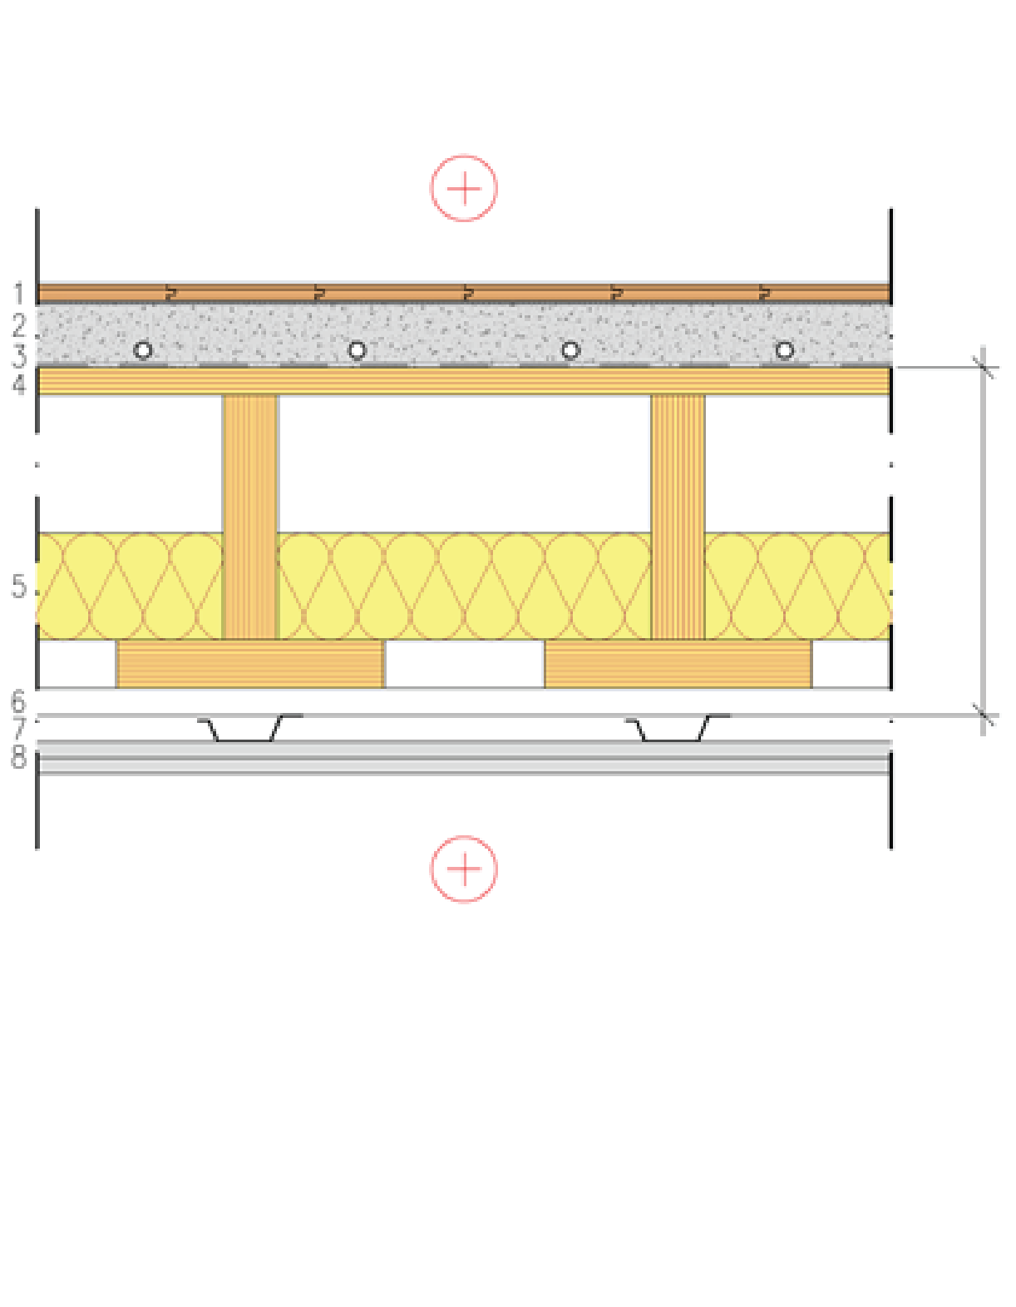
Intermediate floor structure
Intermediate floor between flats
The top panel is used for
  Bracing
Plasterboard and castings are used for
  Fire protection
  Acoustics
The height of the rib panel depends on
  Vibration (often governing)
  Bending and shearing stress
  Deflection
Prefabricated unit
1 Floor coating
2 Cast floor (possible underfloor heating)
3 Protective fabric between concrete and wood
4 Industrially manufactured LVL semi-open rib slab or LVL rib panel
5 Mineral wool
6 Studs
7 Acoustic ceiling profiles
8 2 x plasterboard

Slide 22
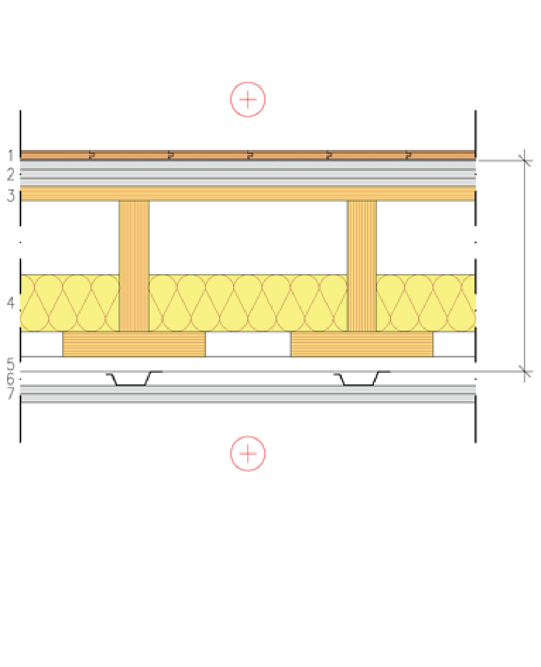
Intermediate floor structure
Intermediate floor between flats
The top panel is used for
  Bracing
Plasterboards are used for
  Fire protection
  Acoustics
The height of the rib panel depends on
  Vibration (often governing)
  Bending and shearing stress
  Deflection
Prefabricated unit
1 Floor coating
2 3 x floor plasterboard
3 Industrially manufactured LVL semi-open rib slab or LVL rib panel
4 Mineral wool
5 Studs
6 Acoustic ceiling profiles
7 2 x plasterboard

Slide 23
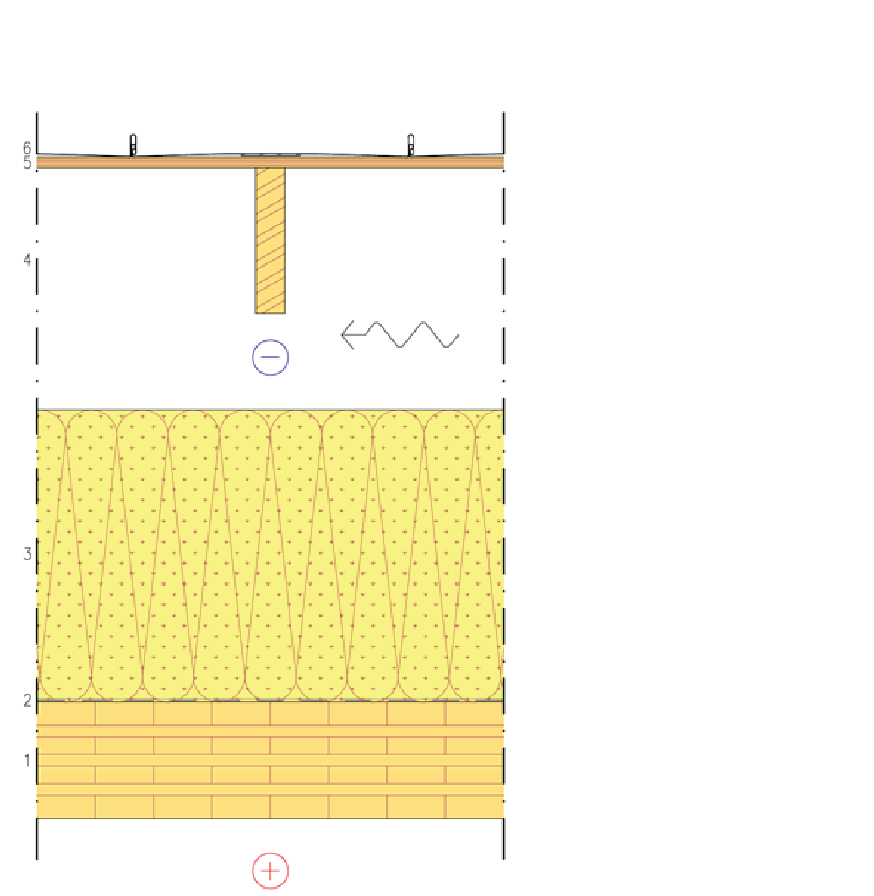
Roof structure
Solid timber panel roof structure
Solid timber panel is a load-bearing and bracing structure
The roof can be built on top of the solid timber panel
  With beam-framed roof elements
  With nail plate trusses
The panel on top of the beams is used for
  Bracing
CLT or LVL panel
Air and vapour barrier fabric
Mineral wool
Roof unit beams and ventilated attic (alternatively, nail plate truss)
Spruce plywood or LVL (stiffening panel)
Water-resistant roof material

Slide 24
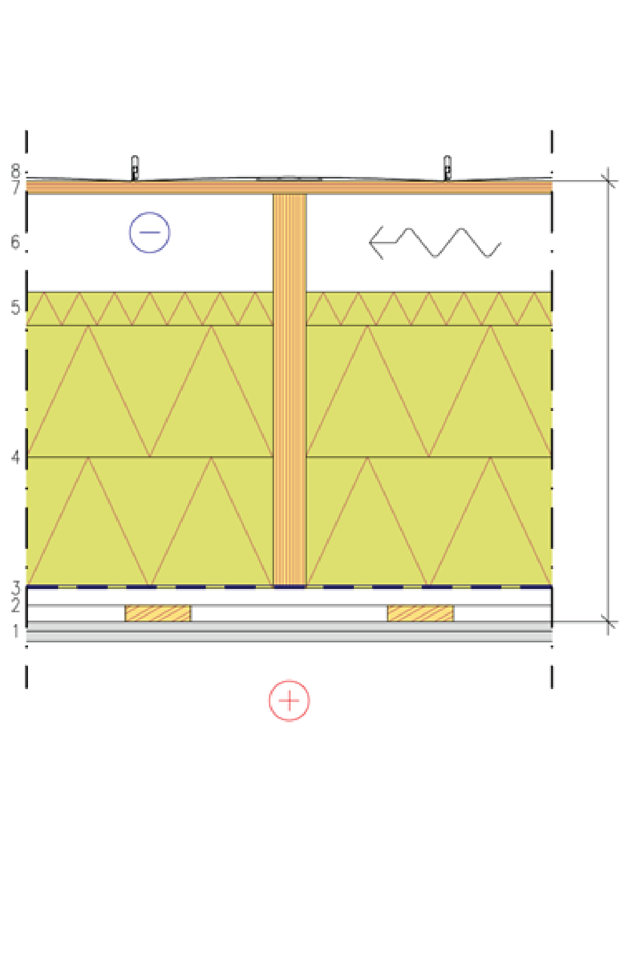
Roof structure
Beam frame roof structure
The panel on top of the beams is used for
  Bracing
Plasterboards are used for
  Fire protection (fire from underneath)
Rock wool layers are used for
  Fire protection (fire from above)
The height of the beams depends on
  Bending and shear stress
  Deflection
Prefabricated unit
1 2 x plasterboard
2 Studs in a grid
3 Air and vapour barrier
4 Beams + Rock wool panels
5 Stiff mineral wool for wind protection
6 Ventilation gap
7 Spruce plywood or LVL (stiffening panel)
8 Water resistant roof material

Slide 25
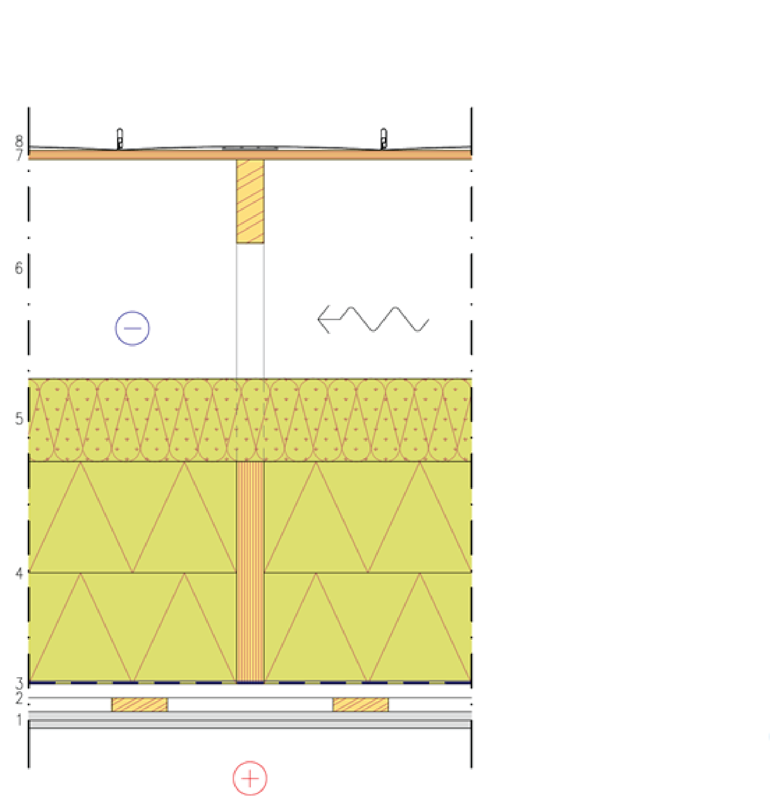
Roof structure
Nail plate truss
The panel on top of the truss is used for
  Bracing
Plasterboards are used for
  Fire protection (fire from underneath)
Rock wool layers are used for
  Fire protection (fire from above)
The height of the beams depends on
  Bending and shear stress
  Deflection
1 2 x plasterboard
2 Studs in a grid
3 Air and vapour barrier
4 Tie beam + Rock wool panels
5 Mineral wool
6 Nail plate trusses and ventilated attic
7 Spruce plywood or LVL (stiffening panel)
8 Water resistant roof material

Slide 26
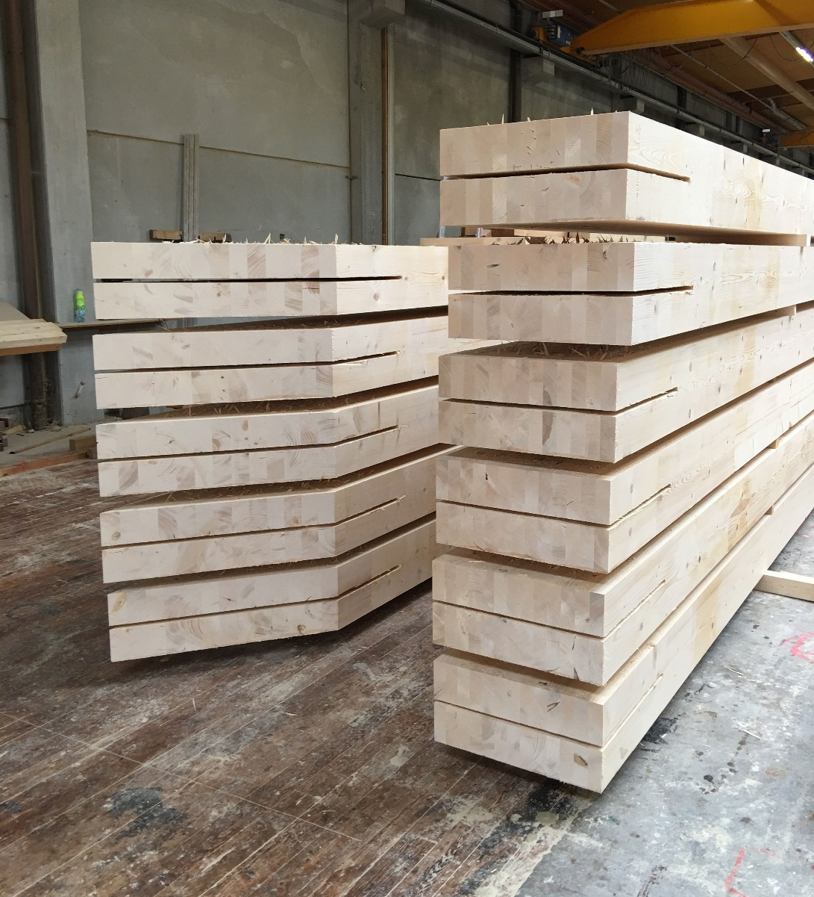
Component manufacture
It is advisable to use CNC machining in the manufacture of the components of the column-and-beam frame for accuracy
Any steel parts used in the joints are installed into the components at the prefabrication factory
Image: Tero Lahtela

Slide 27
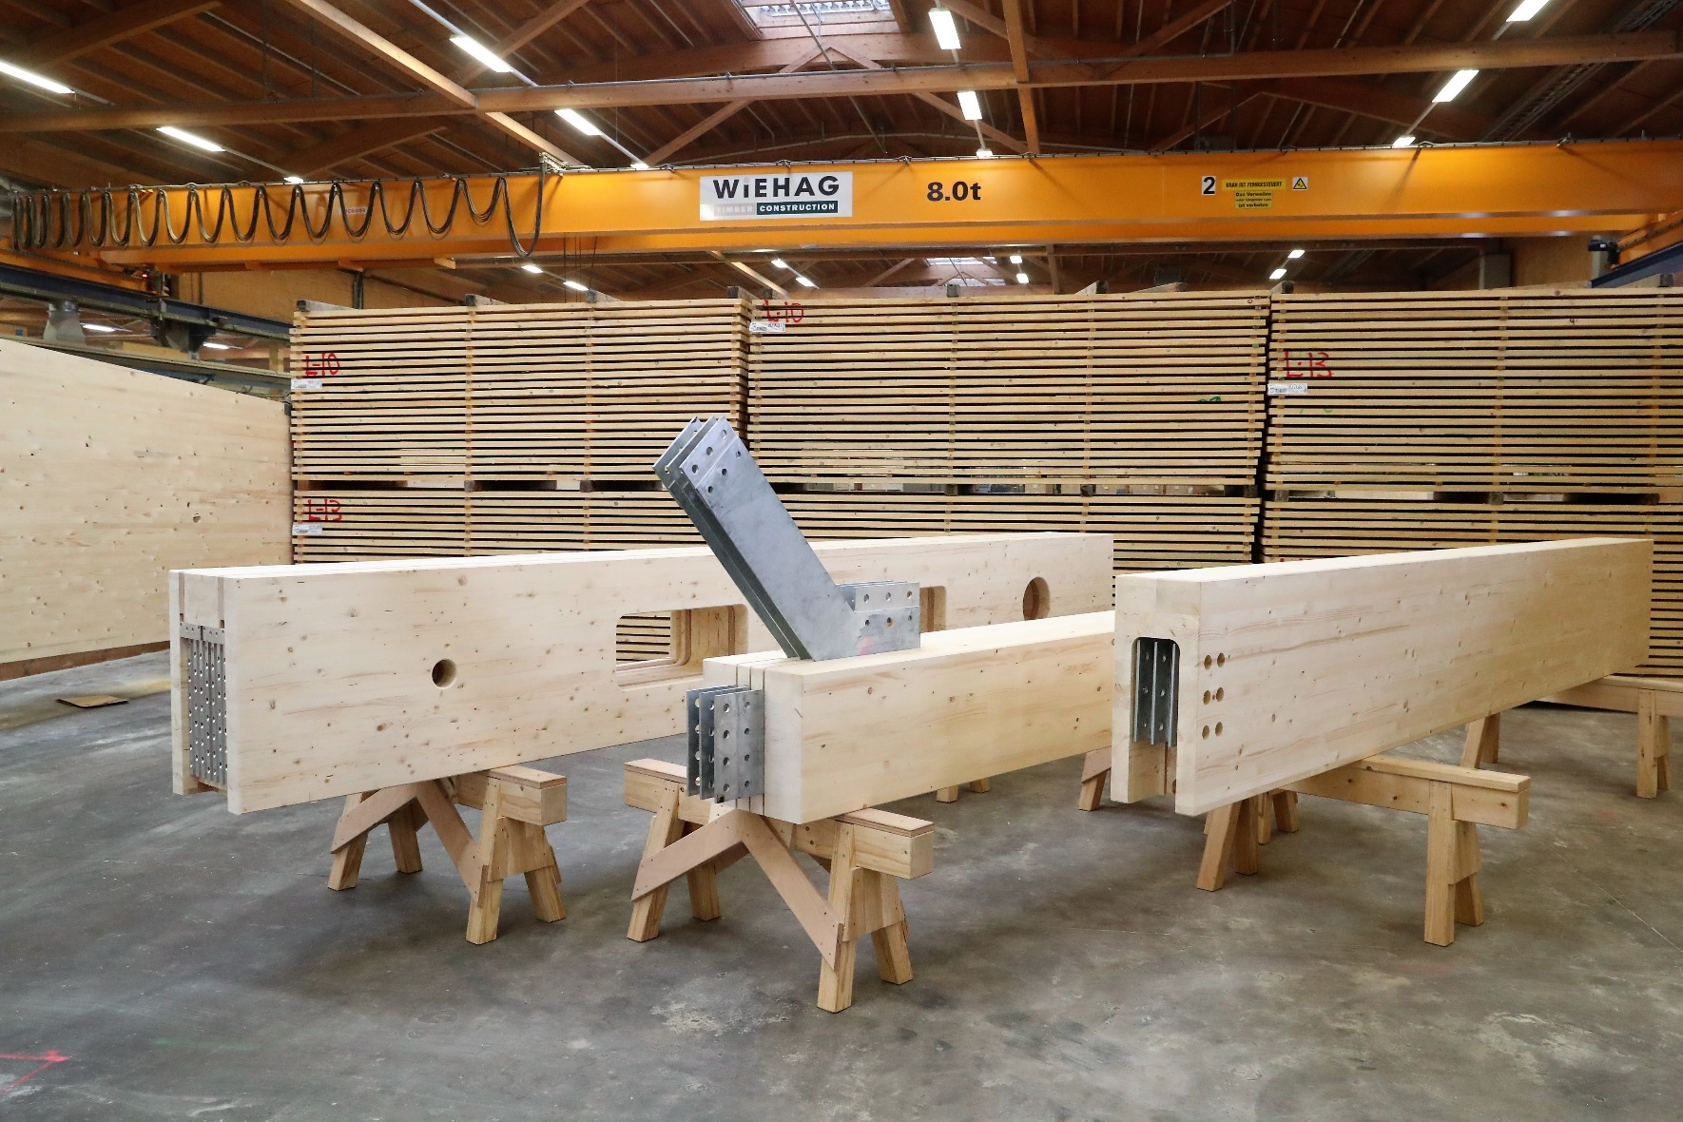
Component manufacture
Image: Bates Smart

Slide 28
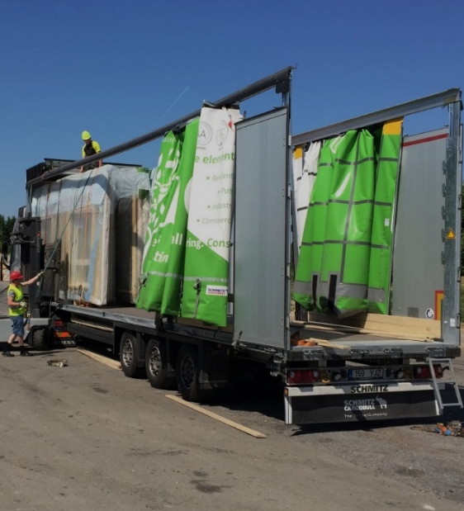
Transport of columns and beams
2450
Transporting columns and beams is efficient, as they can be packed into tight bundles
Covered transport equipment can be used to reduce the accumulation of protective plastic at the construction site
13600
3000
Image: Tero Lahtela

Slide 29
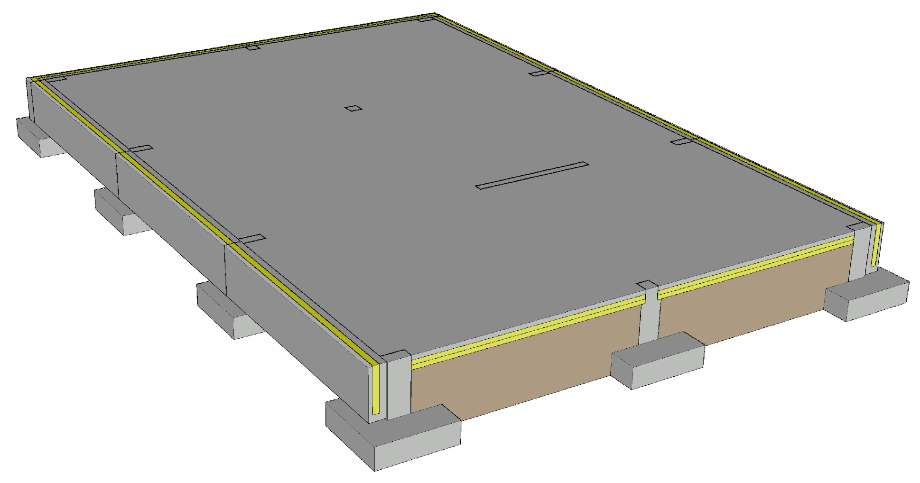
Foundation for a column-and-beam frame
The loads of the primary columns are transferred onto column footings
Foundation types
  Ground-supported shallow foundation
  Ventilated base floor
  Basement
Challenges
  Junction between the stiffening wall and the foundation
  Junction between the column and the foundation
  Vertical dimensional accuracy of the foundation

Slide 30
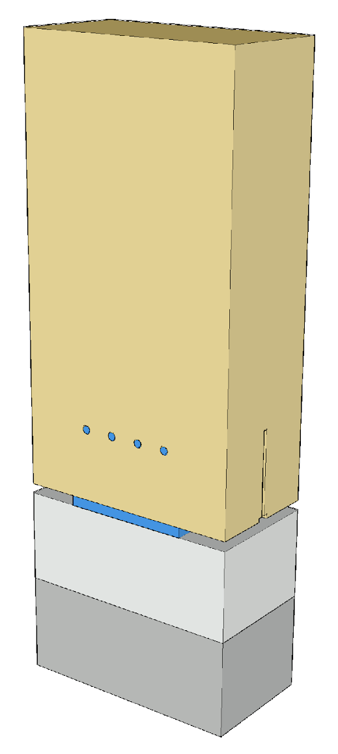
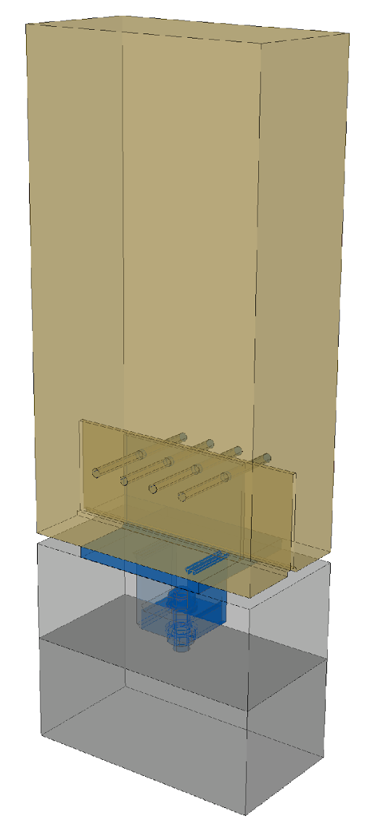
Joint aspects to consider
The pinned joint between the column and the foundation is implemented e.g. with a column shoe, which is attached to the column with dowels
The column shoe can be attached to the foundation e.g. with a foundation bolt and by grouting
Grouting the column joints will affect the workflow and work schedule

Slide 31
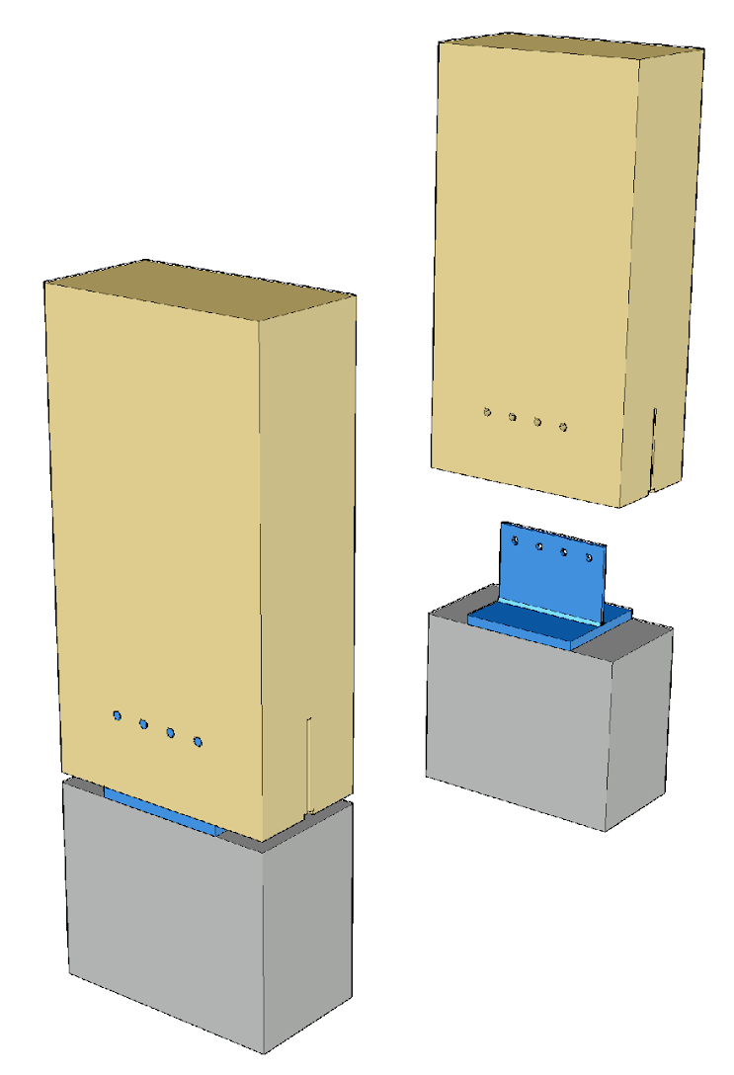
Joint aspects to consider
The column shoe can also be installed directly onto the foundation column in connection with its casting (without grouting)
In this scenario, high dimensional accuracy is required when installing the column shoe, as the positioning of the column cannot be adjusted

Slide 32
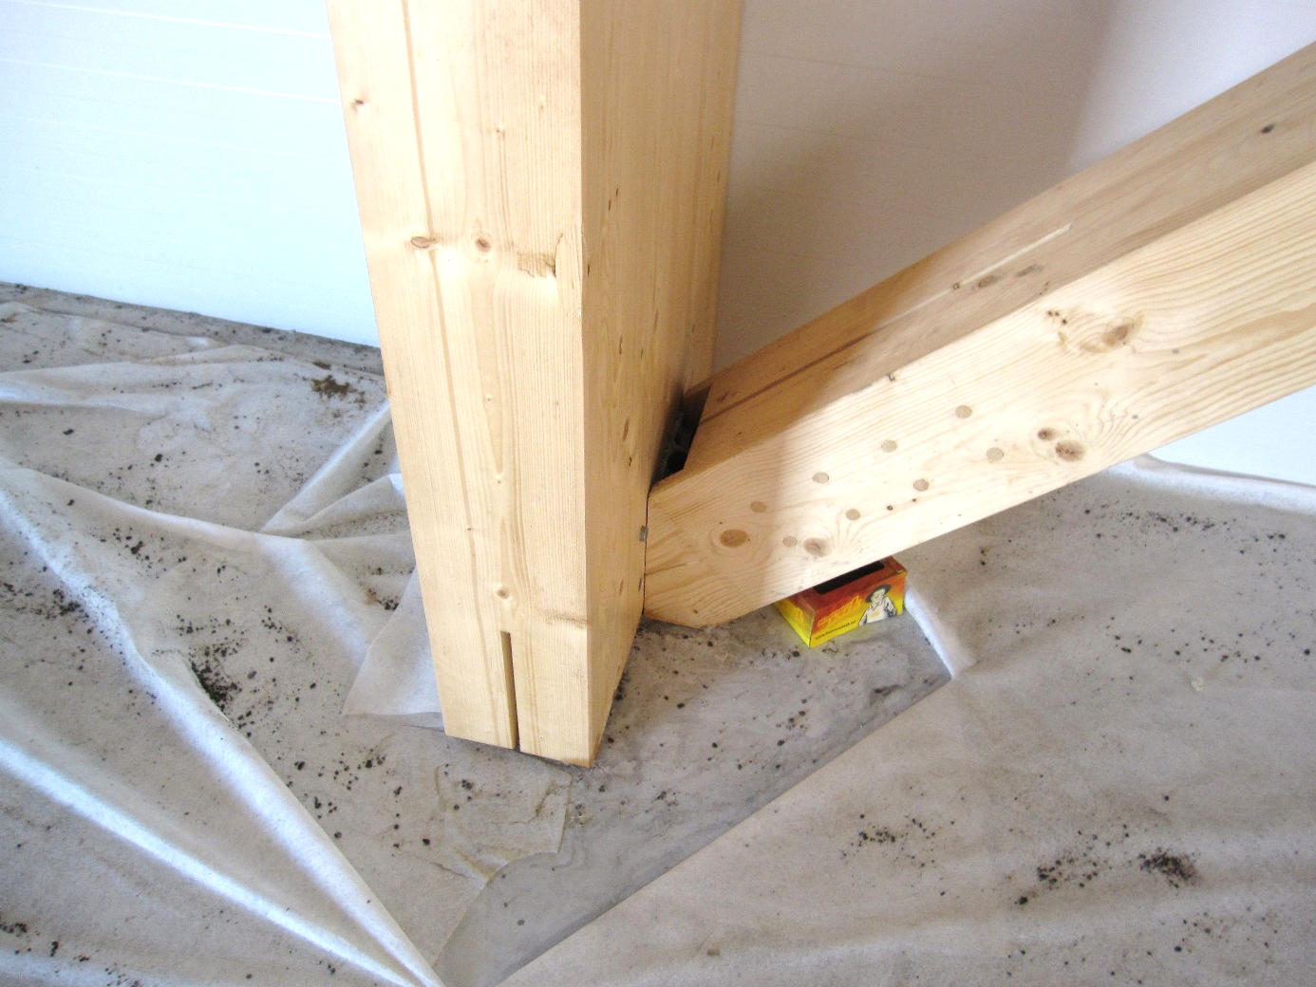
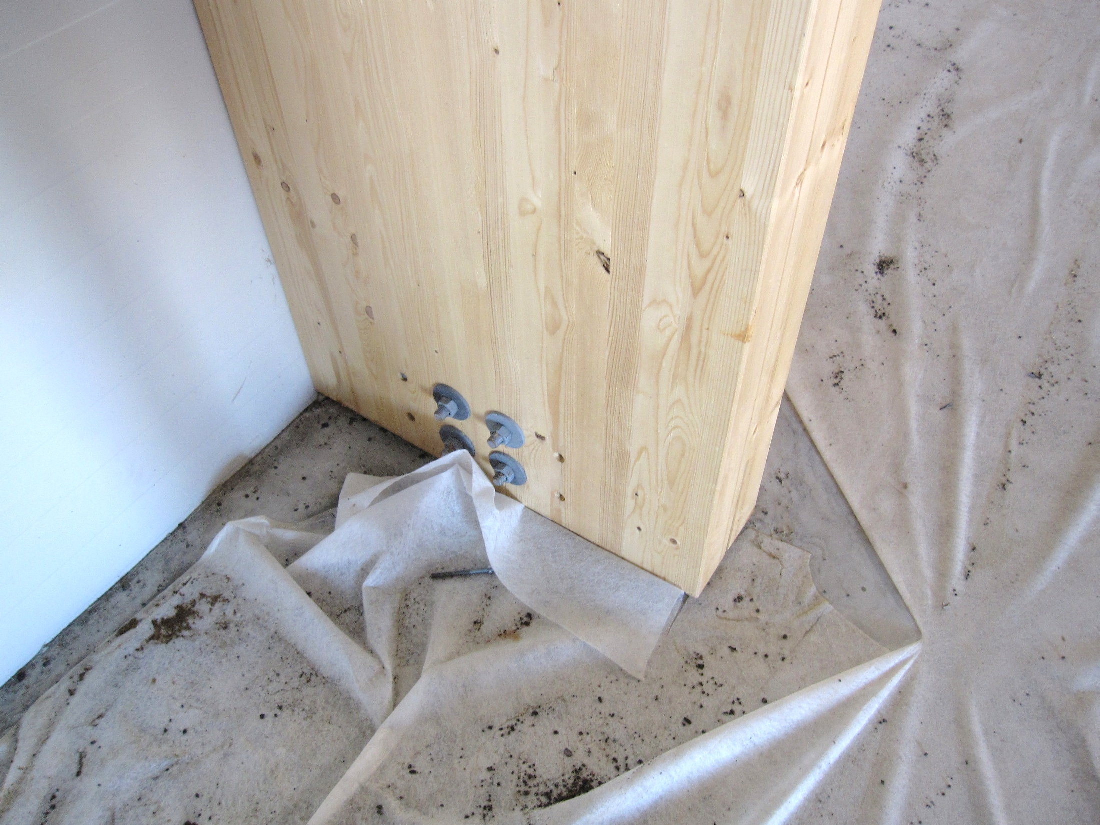
Joints between columns and diagonal stiffeners
Image: Tero Lahtela
Image: Tero Lahtela

Slide 33
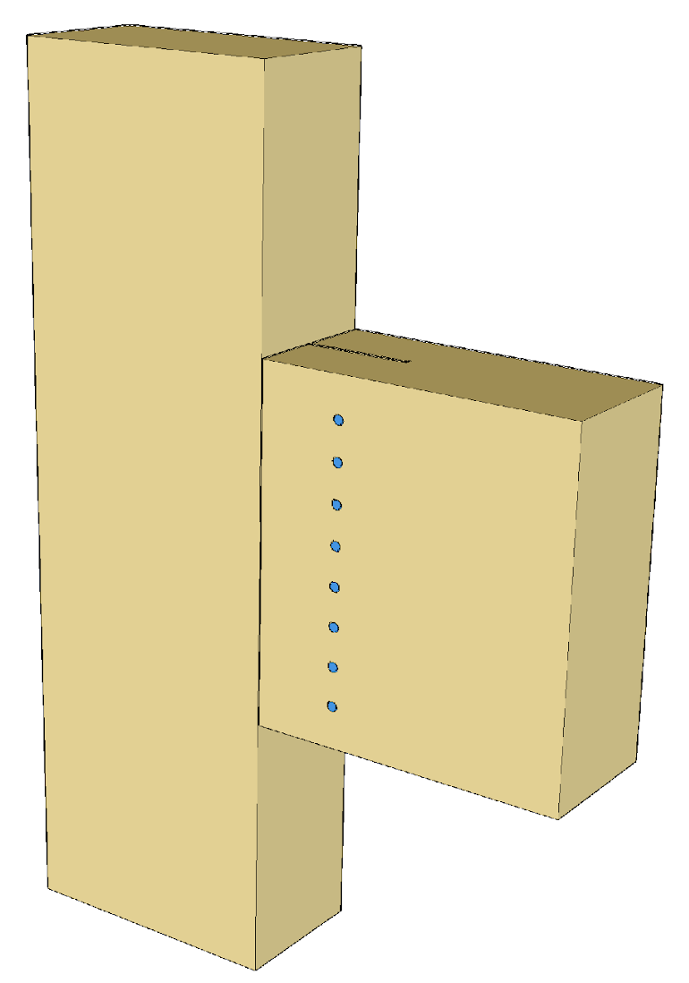
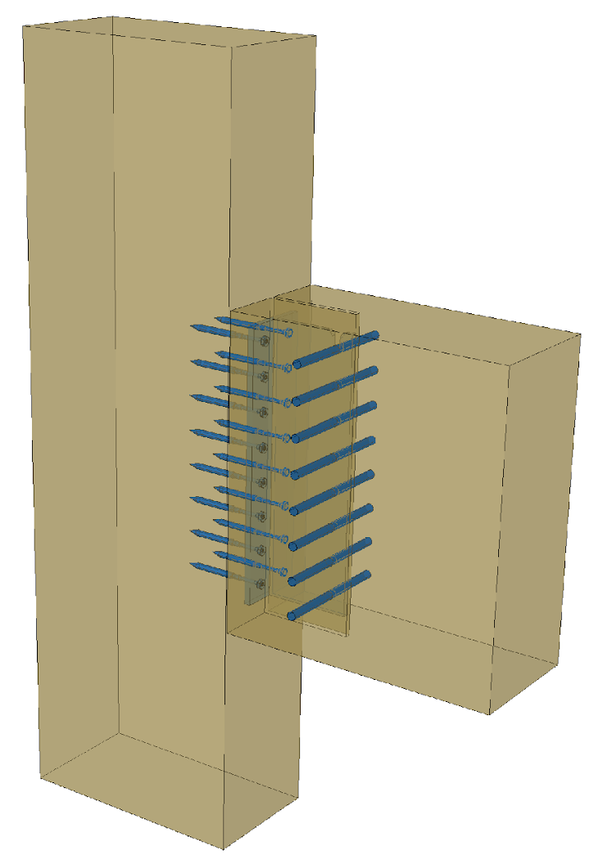
Joint aspects to consider
Beam-to-column joints can be implemented e.g. with beam shoes fastened with screws and dowels
The column is reinforced as needed, to prevent cracking due to drying

Slide 34
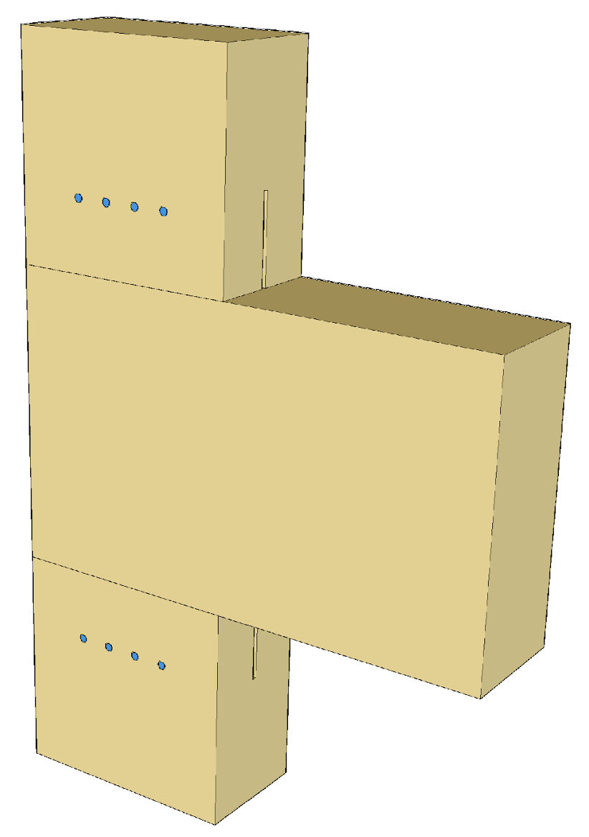
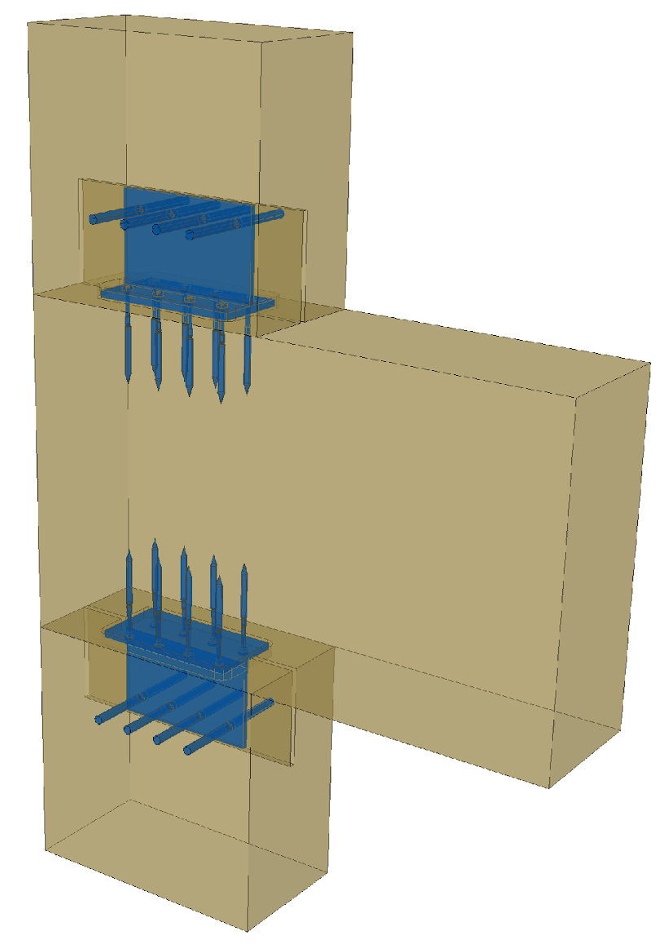
Joint aspects to consider
Column-to-beam joints can be implemented e.g. with beam shoes fastened with screws and dowels
The column is reinforced as needed, to prevent cracking due to drying
Beam settlement caused by drying shrinkage should be taken into account

Slide 35
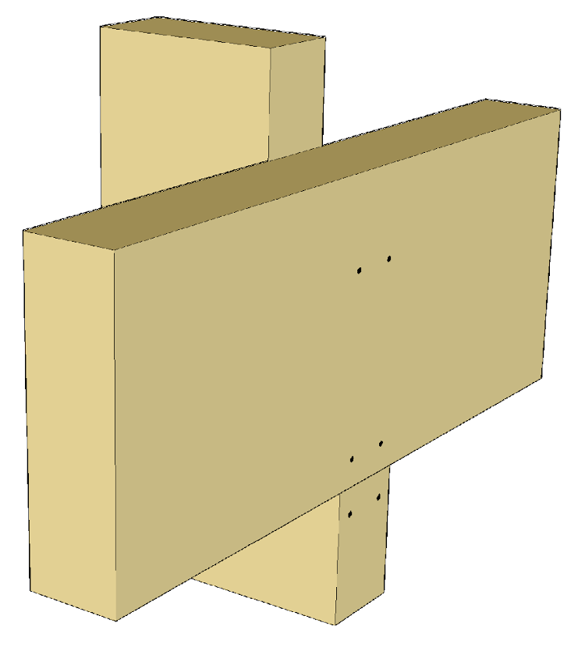
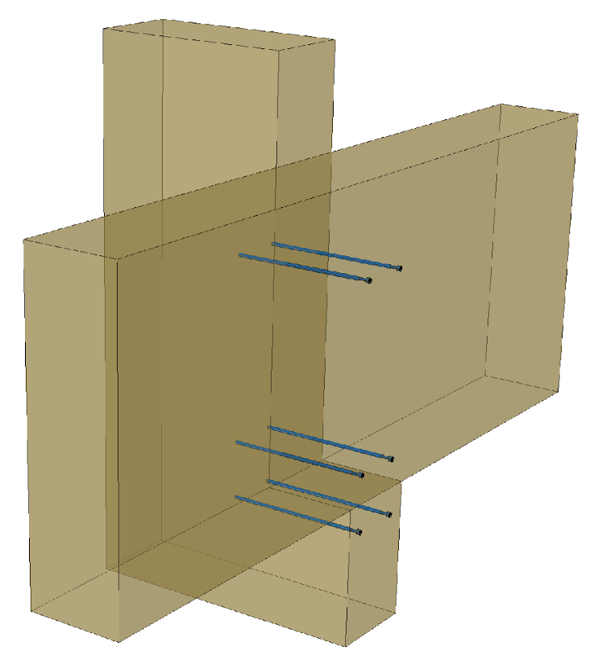
Joint aspects to consider
Beam-to-column joints can be implemented e.g. as notched joints
The joint will receive the full vertical load
Beam deformations must be considered in the fastening
  Drying variations
  Settlement of the support surface
Column is reinforced if needed due to the notch effect

Slide 36
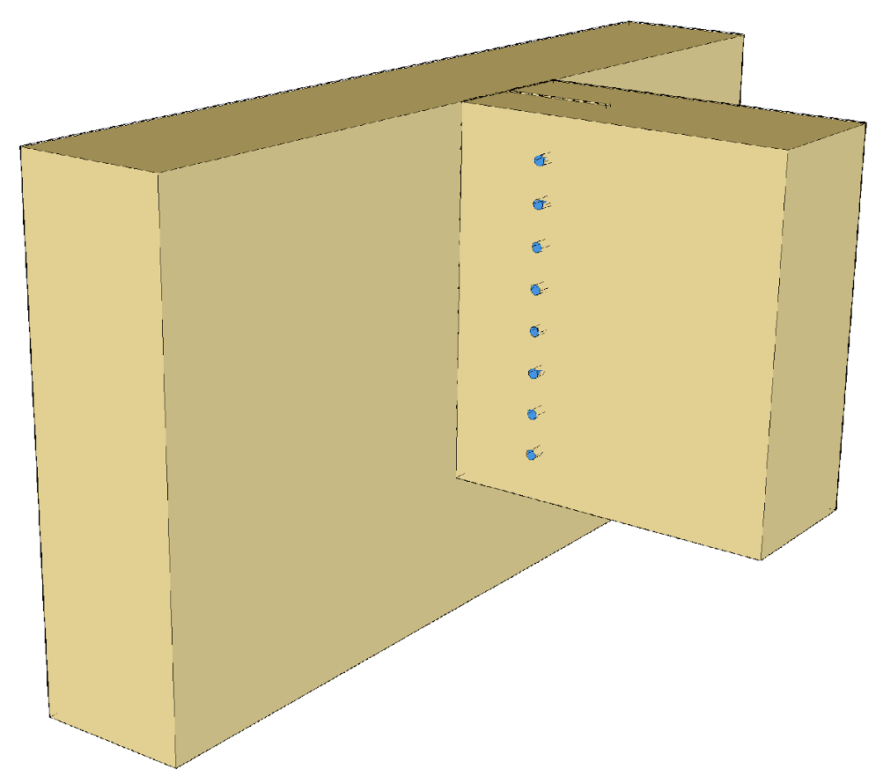
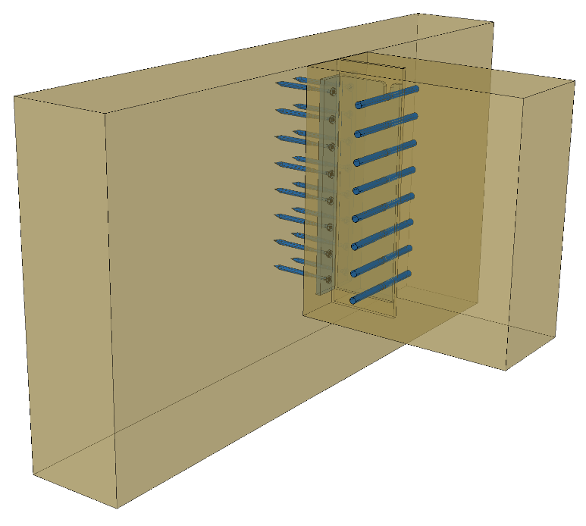
Joint aspects to consider
Secondary beam-to-primary beam joints are implemented e.g. with beam shoes fastened with screws and dowels
The column is reinforced as needed, to prevent cracking due to drying
The effect of the transversal tension on the primary beam must be taken into account in the design

Slide 37
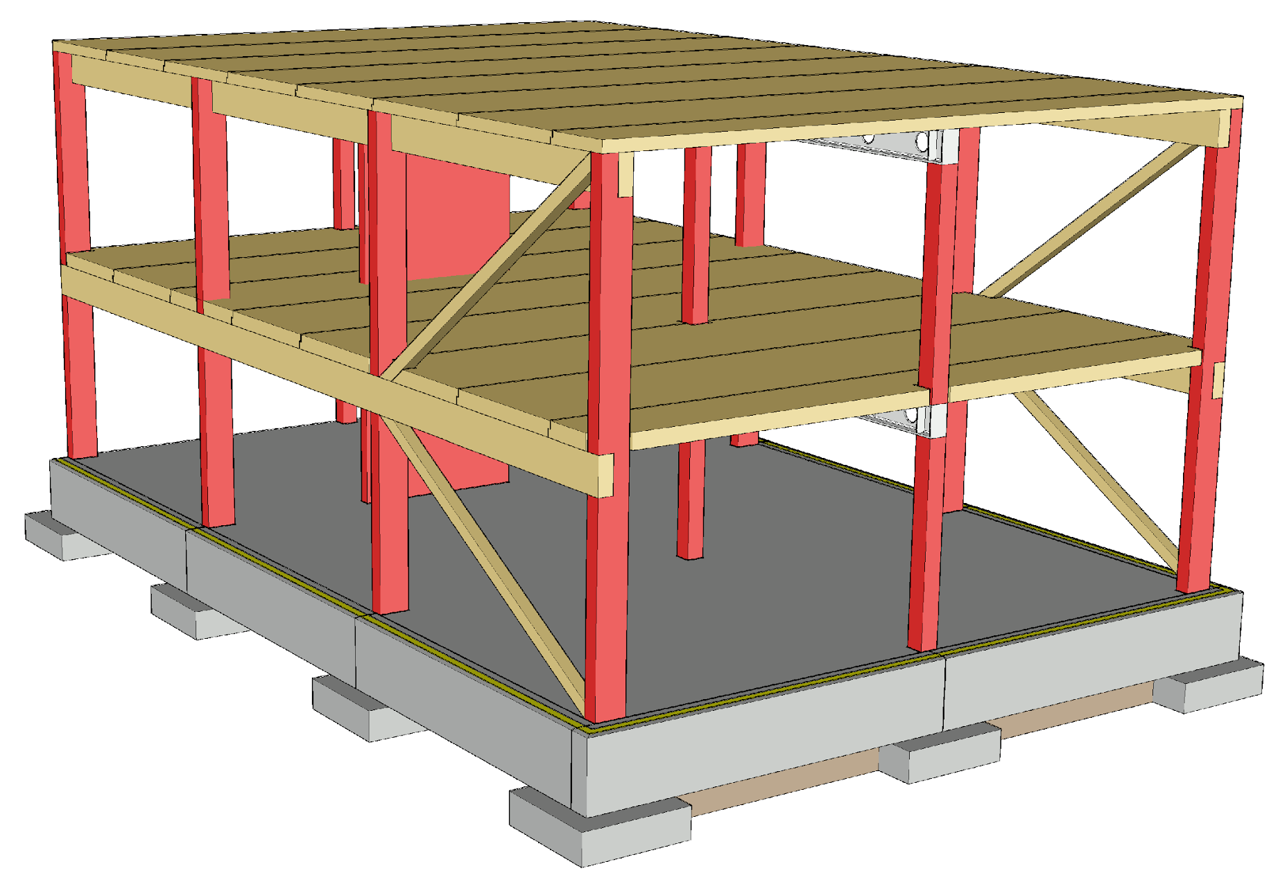
Vertical load transfer
The columns can be floor-high or continuous
  Settlement must be considered
  Acoustics must be considered (flanking transmission)
The beam can also be supported to the load-bearing wall
Primary columns cause a high point load on the foundation

Slide 38
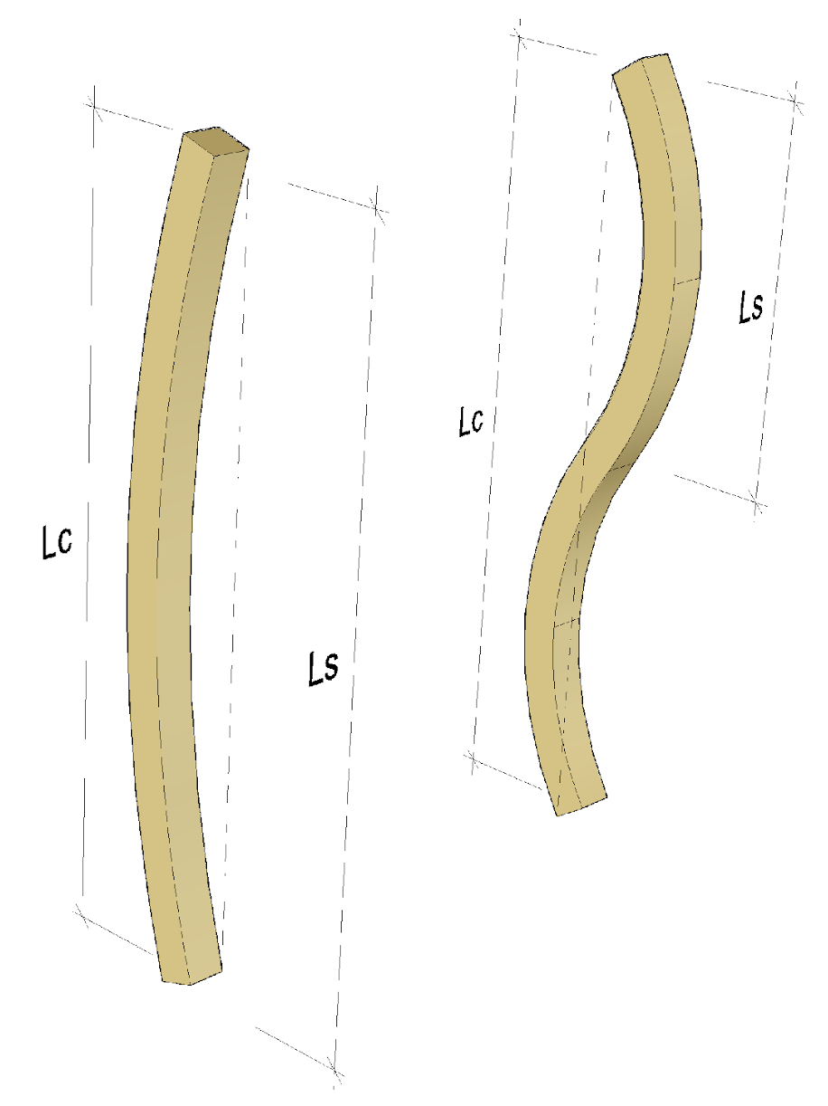
Buckling of columns
When examining the buckling of columns, different buckling directions and shapes must be taken into account
  L_{c} = effective length
  L_{s} = buckling-wave length
The buckling resistance and buckling shape of the column can be influenced by the size of the cross section of the column and buckling supporting

Slide 39
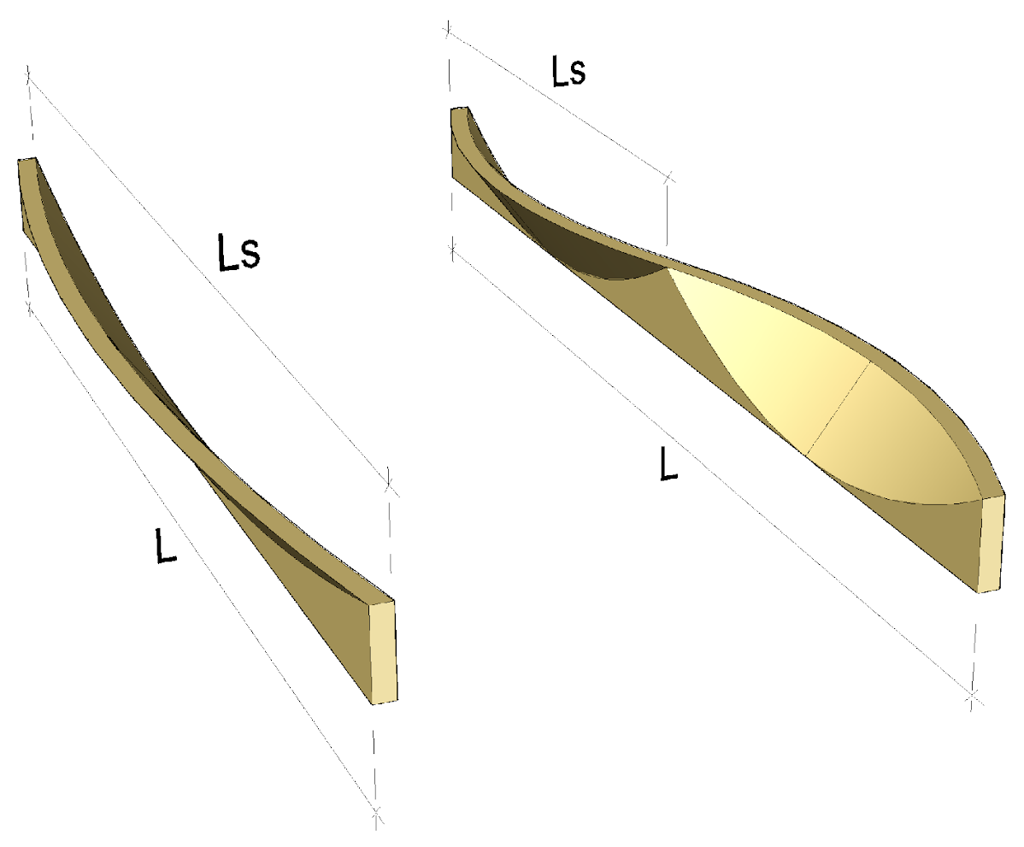
Transverse buckling of beams
When examining the transverse buckling of beams, different buckling shapes must be taken into account
  L_{s} = transverse buckling-wave length
The transverse buckling resistance and transverse buckling shape of the beam can be influenced by the size of the beam cross section and the transverse buckling supports

Slide 40
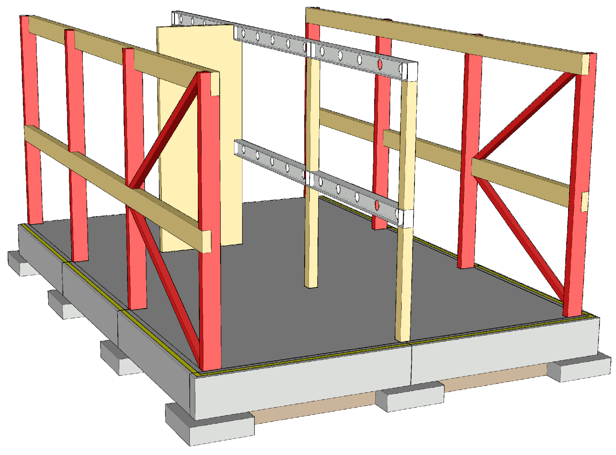
Building bracing principle
The column-and-beam frame can be braced with cantilever columns and diagonal stiffeners
Horizontal structures are stiffener plates that distribute the horizontal load to the stiffeners
Challenges related to the use of a cantilever column:
  Large dimensions of the column
  Large size of the foundation base
  Moment connection with foundation
  Big horizontal displacement towards the top of the column

Slide 41
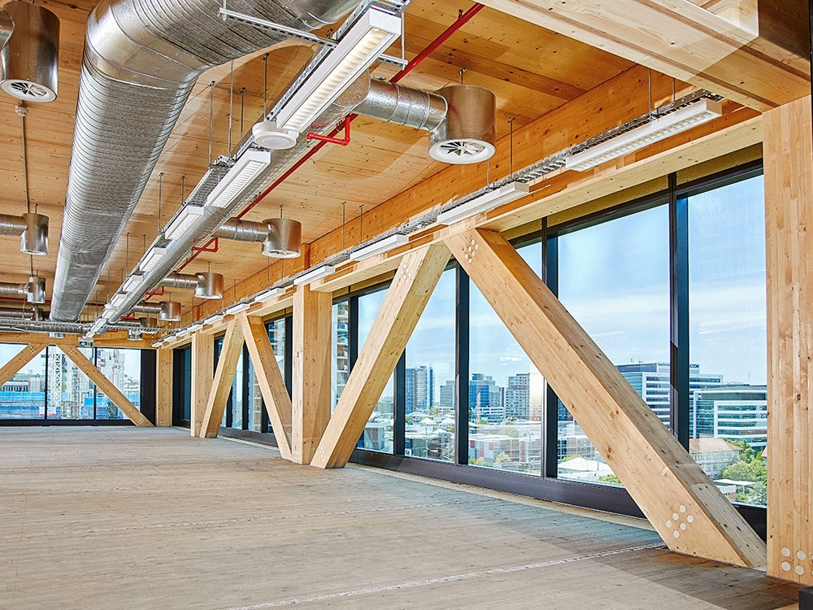
Diagonal stiffener in an office building
Image: Bates Smart

Slide 42
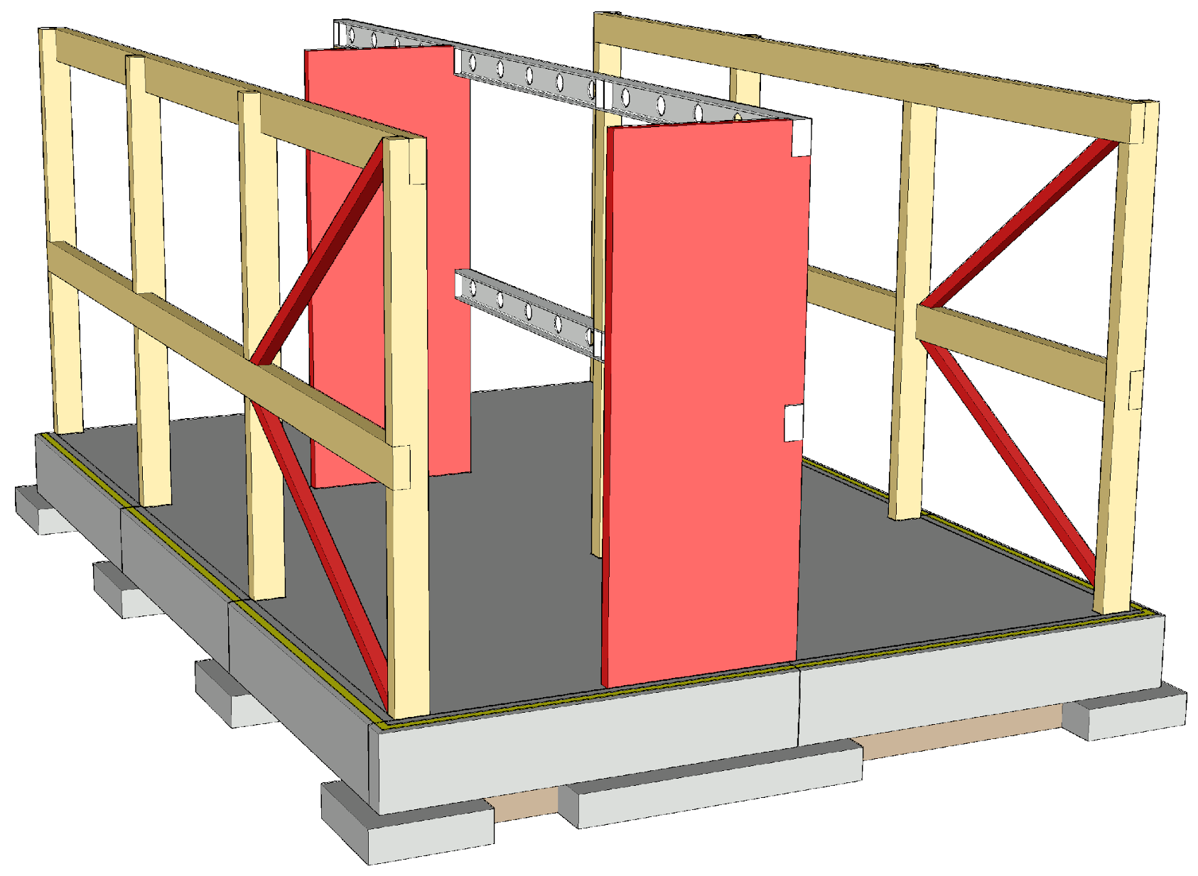
Building stiffening principle
The column-and-beam frame can be stiffened with
  Diagonal stiffeners
  Walls
  Stairwells
  Lift shafts
  Combinations of the above
Horizontal structures are stiffener plates that distribute the horizontal load onto the stiffeners

Slide 43
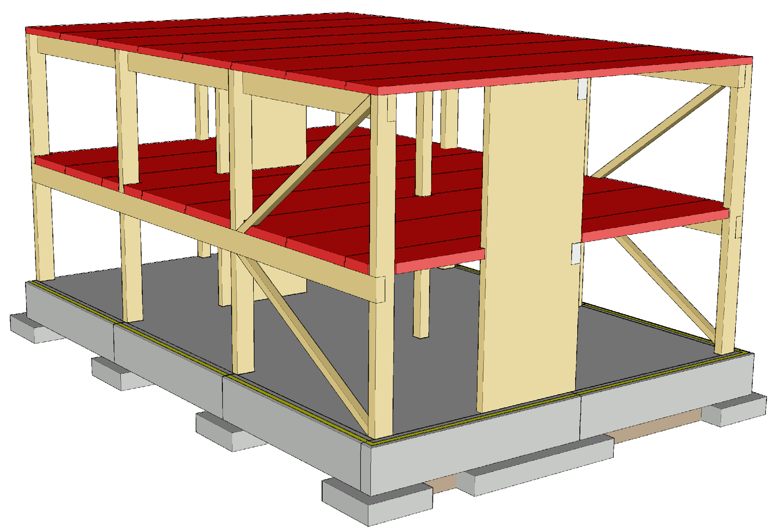
Building bracing principle
Horizontal structures are designed to function as stiffening plates
The effect of a continuous horizontal structure extending from one space to another on the acoustics and vibration of the intermediate floor must be taken into account
In residential buildings, the intermediate floors must be cut off at the walls between flats (acoustics and vibration)

Slide 44
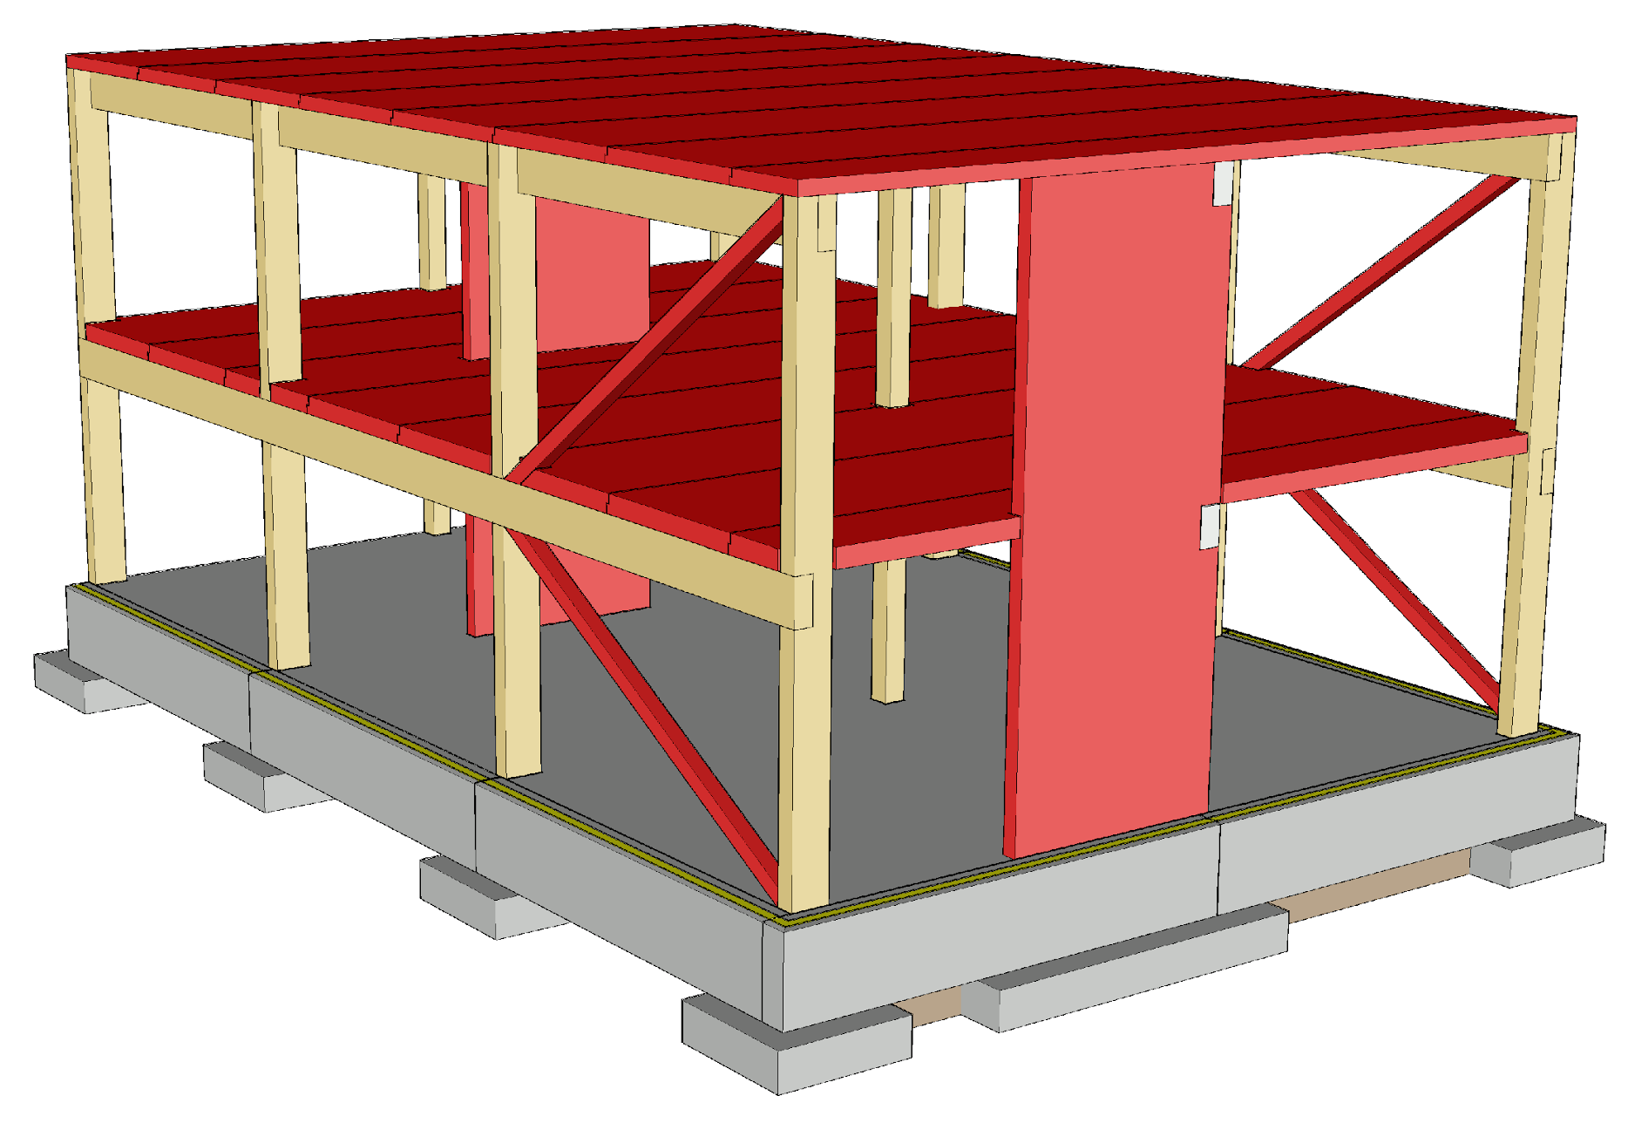
Building bracing principle
The stiffening structures should be as wide as possible, to reduce anchoring forces
The stiffening structures should be placed as evenly as possible throughout the building
Image: Tero Lahtela

Slide 45
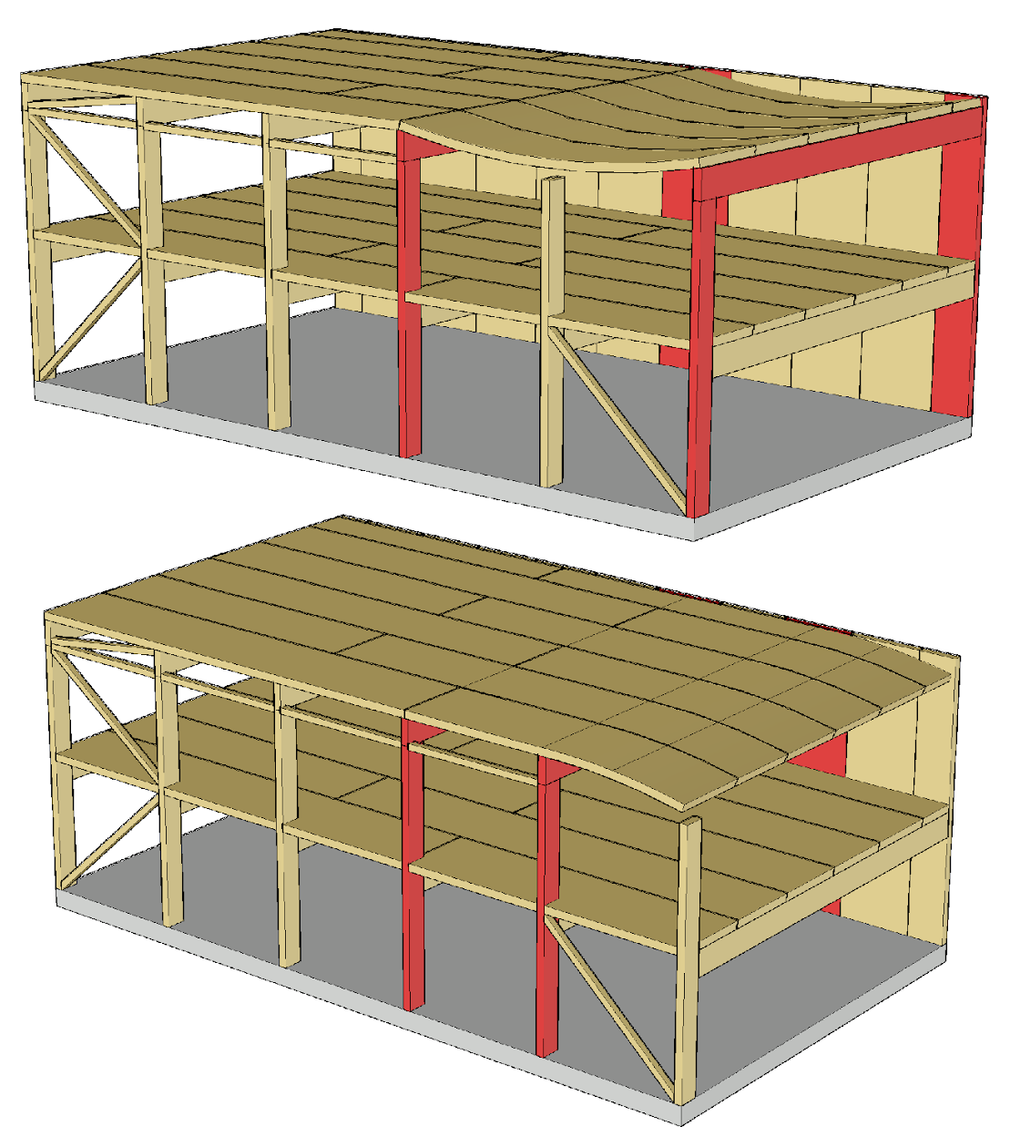
Preventing progressive collapse
The preferred method for preventing progressive collapse is the alternative load transfer path
Utilize
  Continuity of the horizontal structures
  Continuity of the primary columns
  Joint components between prefabricated units
Image: Tero Lahtela

Slide 46
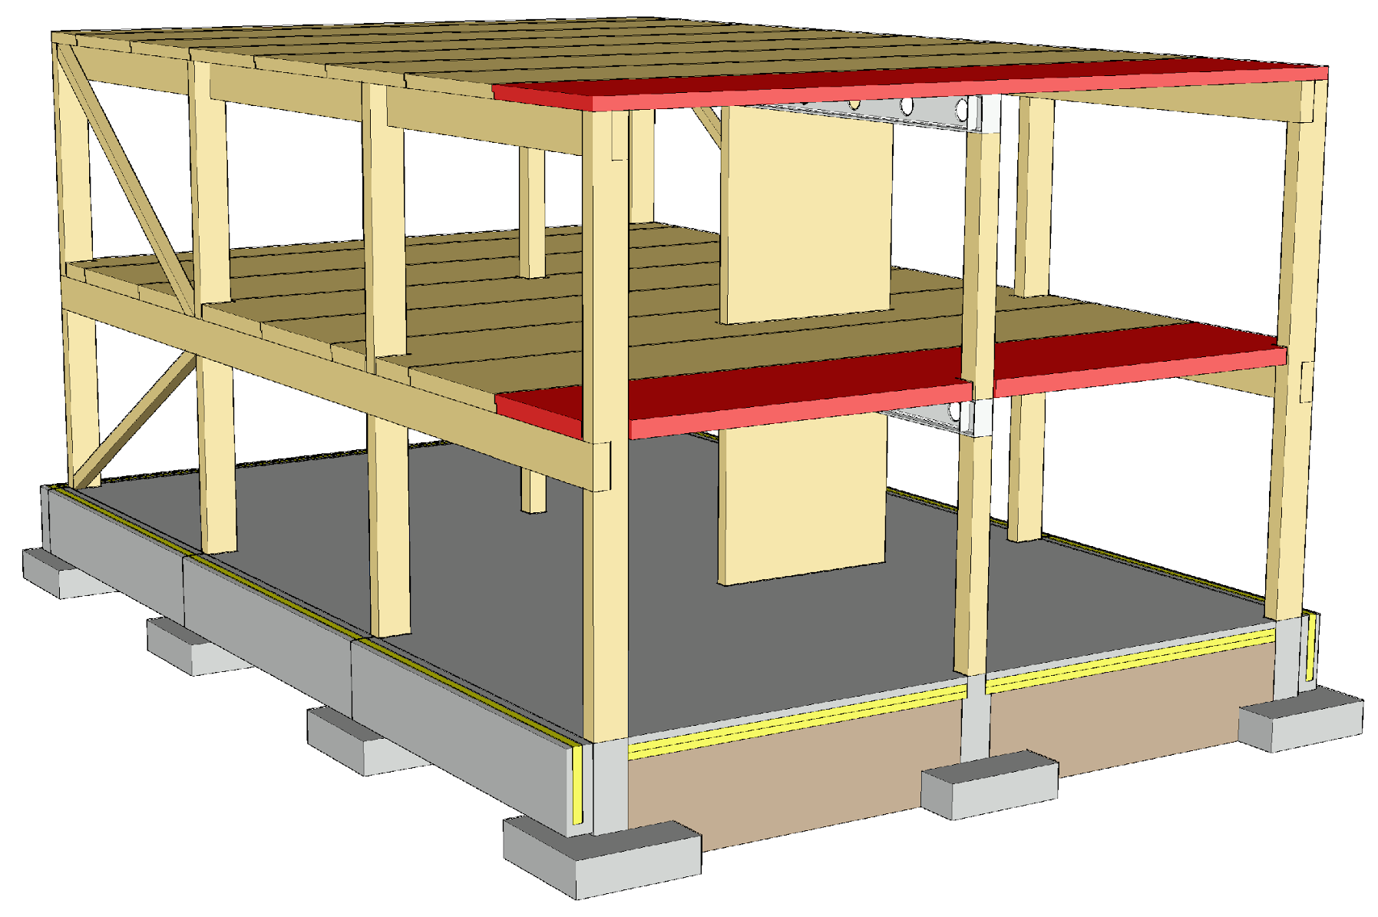
Horizontal structure in a fire
The fire engineering of horizontal structures is the same as in prefabricated panel element systems
Solid timber panels provide a simple structure that can be designed to char as needed in a fire situation
Floor compartmentation can be done simply by means of horizontal solid timber panel structures

Slide 47
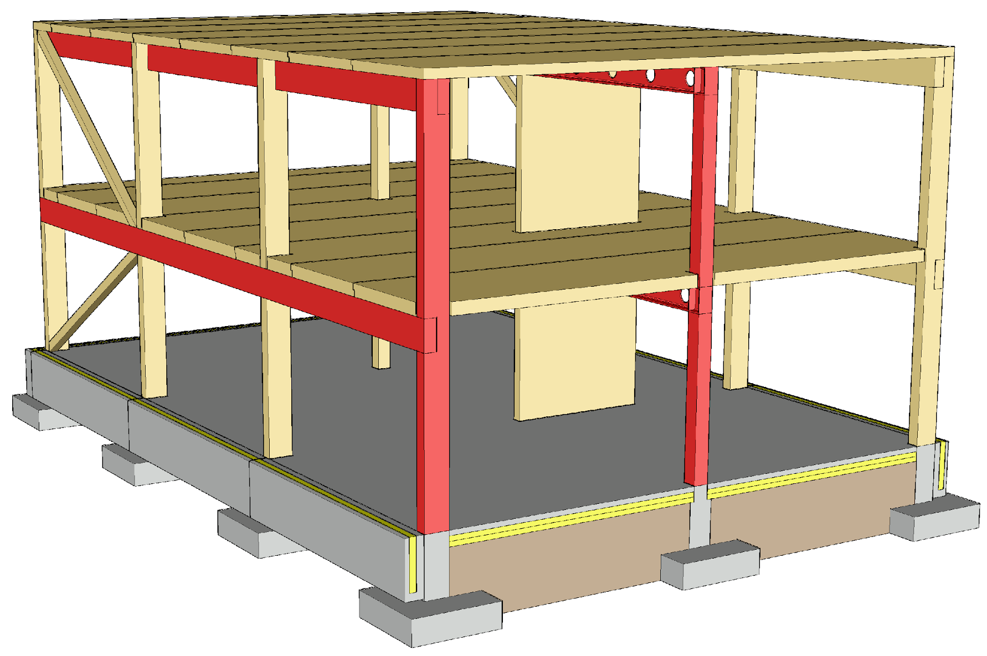
Column-and-beam frame in a fire
The wooden columns and beams are designed robust enough to allow for charring
Steel beams are fireproofed
Joints must be fireproofed
  In wooden structures, joint components placed inside the wooden structure
It must be ensured that the joints will remain functional if the column or beam chars during a fire

Slide 48
Bracing in a fire
The aim is to use the same stiffeners in a fire as in the ultimate limit state
In solid wood structures, there must be sufficient functional cross-section left after charring
The design principles of walls and horizontal structures are the same as in prefabricated plane element systems

