Slide 1



Industrial wood construction
Teaching materials for industrial wood construction education
2022

Slide 2
Origin of the materials
Use of the materials
These learning materials for industrial wood construction have been prepared in a project led by Puuinfo Oy in 2021–2022. Also involved in the project were
Lappia Vocational College,
TTS-Työtehoseura ry
South-Eastern Finland University of Applied Sciences,
Metropolia University of Applied Sciences,
Jyväskylä University of Applied Sciences,
University of Tampere, and
Federation of the Finnish Woodworking Industries Puutuoteteollisuus ry
The project was funded by the Ministry of the Environment.
The materials are intended to be used as extensively as possible in industrial wood construction education and studies.
The materials are released under the Creative Commons licence Attribution-ShareAlike (CC BY-SA), which requires that the author be properly credited when the materials are used and that derivative works may only be distributed under the same licence as the original work.
The original materials and any updates to them by Puuinfo will be published on the Library of Open Educational Resources website (aoe.fi) and the Puuinfo.fi website.

Slide 3

Construction economy and project management

Slide 4
Sauli Ylinen, Federation of the Finnish Woodworking Industries Puutuoteteollisuus ry
Karri Kosonen, Muutostuuli Oy
Release date: 15/07/2022

Slide 5
Construction economy and project management
‹#›
After completing the Construction economy and project management module, the student will
Know the various operators and tasks involved in a construction project
Know the main stages of a construction project
Know the business models of key developers
Know the most important model contracts in construction
Know the most important project management tasks in a construction project
Know the main features of the wood construction market
Know the special features of a wooden house building project
🡪The course prepares the student for more advanced wood construction project development and project management studies

Slide 6
Contents
Contents
Five lectures
Five weekly exercises
Course project
Practising preparing a project plan for a block of flats construction project
The course materials focus on the special features of wood construction – not all terms and basic concepts are extensively discussed in these materials
The course materials use as examples two wooden blocks of flats implemented by TOAS Sr: the TOAS Kauppi and the TOAS Lumipuu. You can visit the project sites at:
- Toas Kauppi, Kuntokatu 11 a, FI-33520 Tampere, FINLAND
- Toas Lumipuu, Makkarajärvenkatu 74, FI-33720 Tampere, FINLAND

Slide 7
Industrial prefabrication

Slide 8
Industrial prefabrication
This presentation covers industrial management in industry and prefabrication
Presentations focusing on working methods in the material “TP7 industrial prefabrication”
Scope
The presentation primarily discusses the production of industrial apartment block elements
The material is based on the authors' experience in wooden apartment block projects and industrial development in the mechanical and electronics industry.
It does not address single-family houses, log houses or schools, for example

Slide 9
Industrial activity
The industrial production method started with standardisation and component standardisation already in the 18th century in the arms industry
Gradually shifting from blacksmith workshops and work spaces to serial production.
Once it had been possible to standardise different parts (axles, bearings, gunstocks, etc.) their manufacture could be centralised and later transferred to subcontractors on the basis of precise dimension requirements, i.e. tolerances.
Arms and automotive industries acted as leaders here (e.g. Beretta ja Ford)
Ford applied the principles of scientific business management (working time studies and method development) as early as the beginning of the 20th century
The efficiency of production could be significantly increased when the work was divided and organised on production lines. At the same time, it was possible to standardise the individual work phase in great detail and develop the methods and tools that were best suited for it
Ford said that you can get the T-model in any colour, as long as it is black. We now have a huge number of different options that the buyer can combine. However, making them is no different and remains equally effective.
Contrary to the general perception, the construction product industry is highly industrialised and, for example, sawmills are very modern industrial plants
Construction itself is not comparable to industry in terms of efficiency

Slide 10
Network-based operating model
Today, it is typical for sub-assemblies to be made in specialised factories, which are able to develop and invest in their manufacture because of their volume. This will bring significant efficiency gains
E.g. in the automotive industry, gearboxes, brakes, engines, seats, wiring harnesses
The actual automotive industry is a network in which the power of these advanced sub-assemblies and components is directed to the assembly plant and they only meet in the final assembly
A significant electronics cluster led by Nokia was created in Finland in the early 2000s. It is still going strong.

Slide 11
Industrial activities in the construction industry
The traditional construction site is significantly less productive than a factory environment. There are obvious reasons for this and, in certain areas, they must be acceptable.
Examples include carrying goods to different floors one stack at a time
Working at the mercy of weather
Performing work over the roof level, for example, when it could have been done at the factory on a desk
However, there is room for improvement in changing the approach to more sophisticated components
Prefabricated box units (ready-made rooms)
Large units (walls)
Prefabricated wet room box units (ready-made bathrooms)
Air conditioning machine rooms
Stairway elements
In component manufacturing, it would be possible to switch to entirely industrial production and reduce the cost of component manufacturing processes through development.
It is unlikely that anyone will question the use of standardised voided slabs produced industrially in the construction sector. The same idea can be taken further

Slide 12
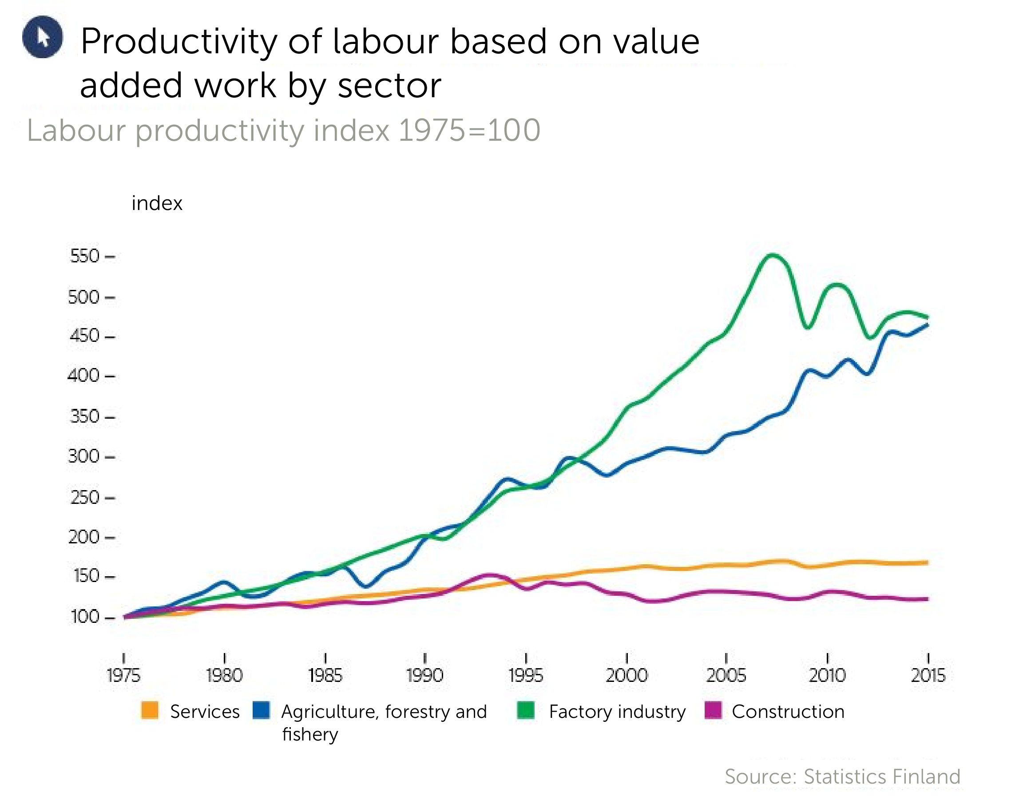
Productivity in the construction sector is stagnant
On 4 July 2022, Arnaud Deboeuf, manager responsible for the production of the group, announced that Stellantis would aim to reduce the manufacturing costs of its electric cars by 40 per cent by 2030.
The difference between the development and objectives in the construction sector is huge!
Image: Rakennuslehti magazine

Slide 13
Significance of operating time
In industrial operating methods, work is smooth and material flows and work stages are established. No one needs to look for anything or think about different methods for completing a job
When we measure the operating time, we get an idea of how successful the development has been. Generally, good factories achieve a 80-85 per cent share in value-added work
Value-added work is the work that actually adds value to the product, i.e. takes it forward.
The above percentage usually includes the so-called ineffective time required by the employee (typically 15 per cent), for example to go to the toilet
Value-added work time does not involve looking for lost tools or other unnecessary work
The LEAN philosophy is aimed at eliminating this "waste" or unnecessary work

Slide 14
Traditional construction model compared to prefabricated box unit construction
Windows
Subcontracting on site
Block of flats
Timber CLT etc.
Roof
elements
Installation on site
Block of flats
Timber
Wet rooms
HVAC parts
Prefabricated box unit elements
Windows
Ministry of the Environment material
Component factories
Semi-finished goods factories
Assembly
site
Building
product factories
Traditional
site
Project duration on site 1.5 years
Project duration 8 months
A large proportion of prefabricated elements significantly reduces lead time
Time-related costs at the site decrease
Logistics become easier especially in confined areas
Much of the work is done in a dry and warm environment

Slide 15
Factory, layout, processes – basics

Slide 16
Prefabrication factory
What is a prefabrication factory
Factory specialising in the manufacture of prefabricated box units or large elements
Assembles material flows and completes the final assembly
Products to the site as ready as possible
For example, aiming to deliver box unit elements "closed" so that there is little need to visit them during the work site phase

Slide 17
On factory layout principles
The best methods and principles learned from other industries should be applied in the production of box unit elements. The manufacturing process must be streamlined and it is a good idea to organise it into a production line. Why a production line and not a cell? The production line has significant benefits:
The material flow to the manufacturing stations (internal logistics) is thinner than in the cell model, as only the materials of one work phase are needed. Next to the line workstation, parts for the next element can be prefabricated and delivered while the previous element is still being assembled.
The work phase-specific organisation makes it possible for the personnel to specialise in the phase in question and thus reduce the learning time. The phases can also be developed and machined one phase at a time. Machines are not required for each cell, but only for the appropriate phase.

Slide 18
On factory layout principles
A multi-phase line can be calibrated to the chosen takt time
Takt time refers to the working time in one work phase, not the working hours, but the duration of the phase: As a simplified example, if there are 8 hours of work at the kitchen installation point and 2 people are working on it, we get a 4-hour takt time. This requires good work planning whenever a new site is started. The elements are likely to vary according to the target, so the people and work phases of the line must be adjusted.
The yield of a takt timed and balanced line is highly predictable. For example, with a four-hour takt time, a finished and wrapped element comes out of the hall every four hours.
A hall with doors at both ends of the hall can also be used in the line model. In practice, moving box unit elements past each other would be difficult and the work phase would be unnecessary.
When we plan and use a production line, the contents, durations of the work phases and the techniques used in the work methods and their development must be known exactly, as the line needs to be adjusted to some extent as the elements change.

Slide 19
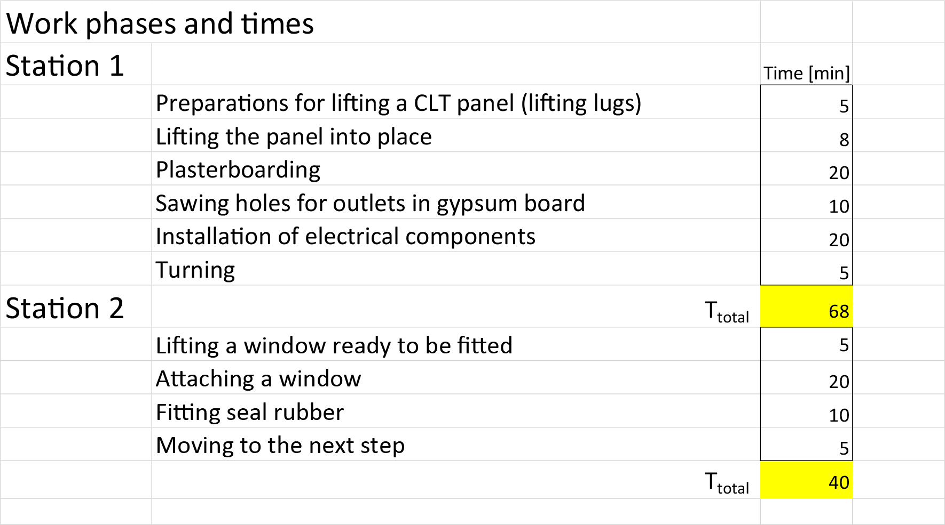
An example of a work phase in the production of a box unit element
Cable harnesses and other electrical parts, small accessories
Pre-cut gypsum or other surface plates
Pre-machined CLT elements in order of installation
Wall station 1
Turning
Wall station 2
Finished window elements
To next phase

Slide 20
Interpretation of the wall example
The working hours in the example are indicative
1 station uses 68 minutes, 2 stations 40. The phases are not entirely balanced
The box unit element requires four walls => the takt time is set to 4h => all four walls must pass through these workstations within four hours
How to allocate resources?
Four walls of 108 mins *4 = 432 mins
Three-person work input over 4h = 3*4*60 = 720 mins
As the work phases are slightly unbalanced, it is probably worth setting up a team of three for these two phases, and two could be too little
There is still room for adjustments and a reasonable amount of time left to manage disruptions
When the work phase develops, the number of persons may be decreased
When you develop this work phase, different tasks can be speeded up or made easier or even eliminated altogether, which also reduces the required working hours.

Slide 21
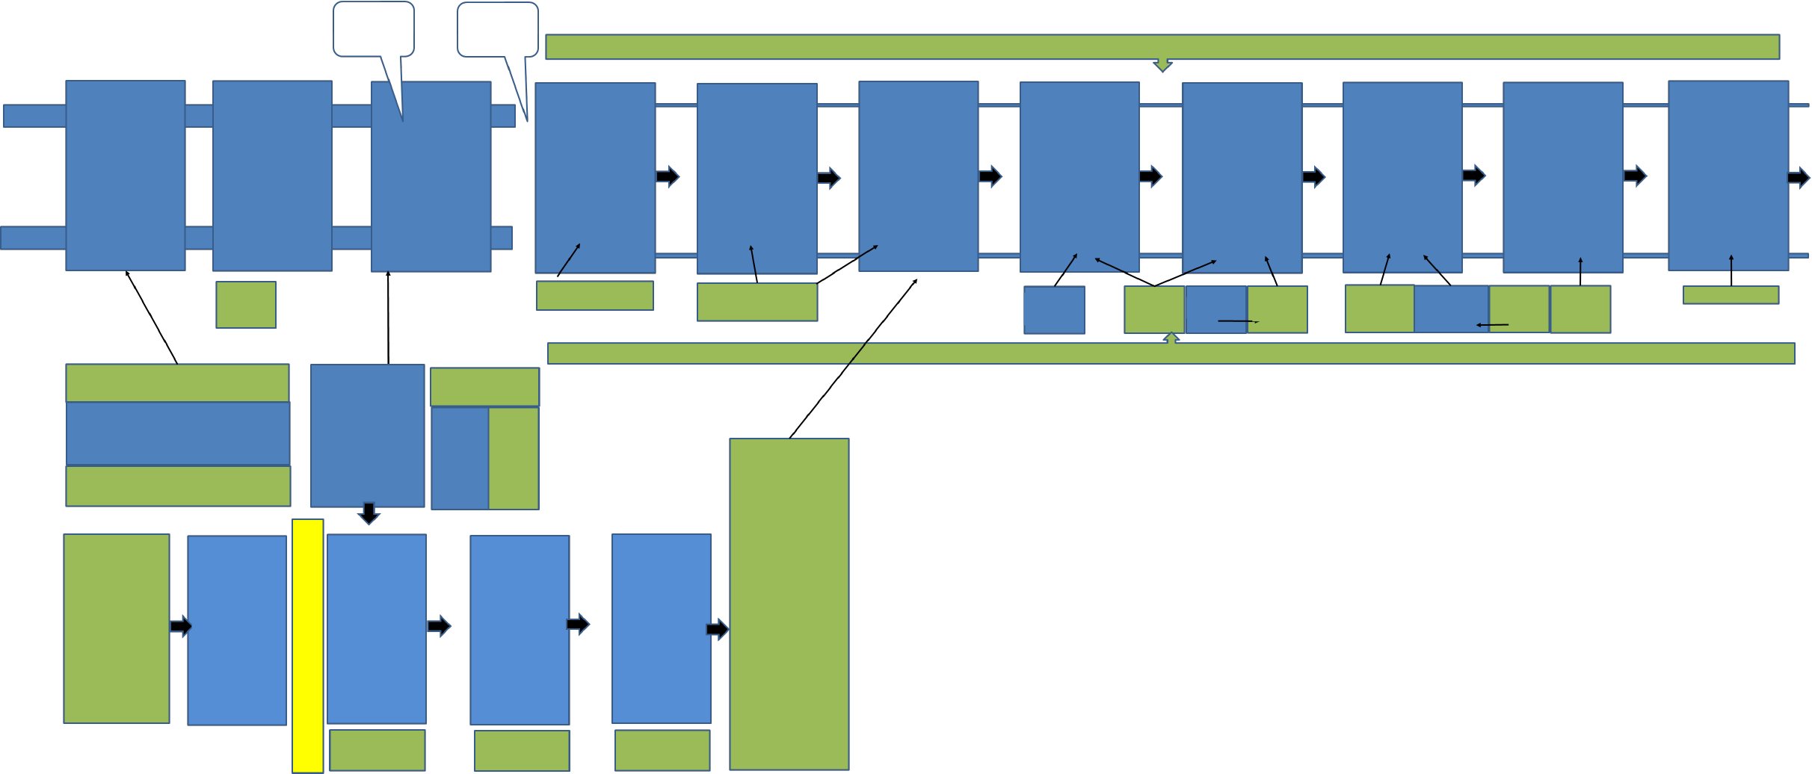
Capacity calculation across the factory
The previously proposed principle of two work phases is extended to cover the entire manufacturing process
The same principles can be applied to calculate the amount of work on the entire line
Just note that sometimes "machine time" is critical, for example in the machining of CLT plates, etc., this depends on the technology used.
We make an effort to compensate for the differences between the different work phases in work cycle time
The line is balanced
Phases with the longest working hours are typically the first items to be examined
Floor mounting on one side, without turning
Taking down from table level roller track to floor level
Feeding material to workstations and buffers
Frame settings and jigging
Jigi and/or laser
Frame assembly
OSB paneling
Adding wool
Wind protection plate
Ducting infrastructure started
Floor heating started
Bathroom installation, floor heating pipes
Cast or dry floor, finishing
Element assembly
Electrical work
Finishing the painting
Door installation?
Furniture installation
Floor
Doors, mounts
Pipe module mounting and connecting
Moulding
Cover plates
Covering the roof lowering point
Finishing and delivery
External work
Packaging
OSB sawn to measure
Bathroom
Materials
Pre-installation of electrical works
Doors
Pre-installation of furniture
Pre-installed furniture
Mouldings, sawn sheets
Pipe module manufacturing
HVAC materials
Window sills
Packaging materials
Finished sawn buffer
Feeding material to workstations and buffers
Finished wool buffer
Centralised cutting
Pre-installation of windows
Centralised wool cutting
Wool bales
For sawing
Wall station 1
Unloading CLT OW and SW CLT preparation (hoisting rings) OW and SW
Installing power outlets OW and PW Punching plates (outlets) OW and SW
Plasterboarding (1 layer)
SW Turning OW and SW
Plasterboarding (3 layer)
OW
Wall station 2
Fitting seal rubber SW Fitting lifters SW Installing temporary plywood SW Lifting window OW Mounting window OW Support frames and temporary plywood OW
Wall station 3
Framing and raised bushing OW Wooling OW Taping OW Papers OW
Wall element buffer and stopping-up, painting
CLT buffer
Tur- ning
Wall station 4
External cladding
Materials
Pre-sawn frames
Pre-sawn panels

Slide 22
Clocked time, value-added work time
Value-added work time is the time it takes to complete a job or work phase with normal pace
Value-added work time includes ineffective time (e.g. 15 per cent)
e.g. food and coffee breaks, recovery, toilet visits
chatting with a supervisor, etc.
The work is divided into parts that are measured by a time survey, and the valua-added work time of the work phase is summed up from these.
Work analysis is the basis for all capacity dimensioning (equipment and personnel)

Slide 23
Productivity

Slide 24

Productivity
Productivity means that a certain input must achieve the best possible output or that a certain output
must be achieved with as little effort as possible.
Outputs
Inputs
Productivity =
Total productivity
Investment productivity
Labour productivity
Material use productivity
For example: How many one-inch iron nails do we get
from a kilo of iron? (material use productivity)

Slide 25
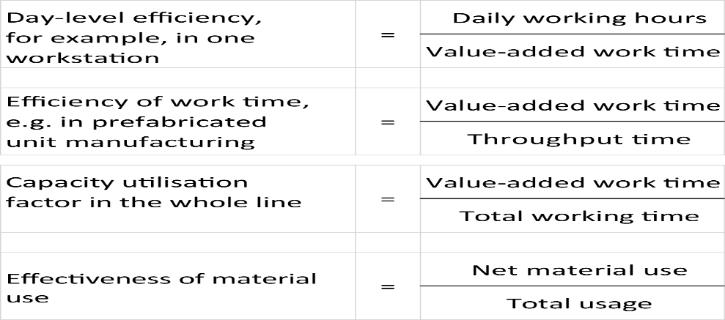
Efficiency
Efficiency refers to how well resources are used, i.e. how much the actual production volumes are in relation to the target quantities. Device efficiency refers to the proportion of time the device is in operation
Examples:

Slide 26
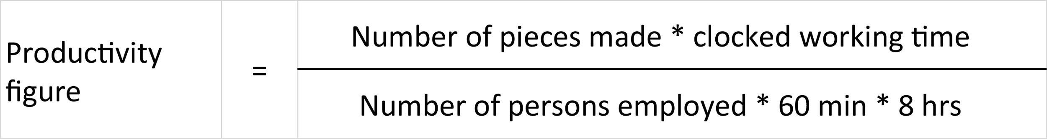
Example of a productivity figure
Minutes worked (value-added work time) / person
The idea is to calculate how much value-added work has been done within a day
Calculation:
The ineffective time (e.g. 15 per cent) must be considered in the definition of value-added work time as well as the daily working time (in this case, 8 hours)
1 is a good level if the employee is consistently committed to the task

Slide 27
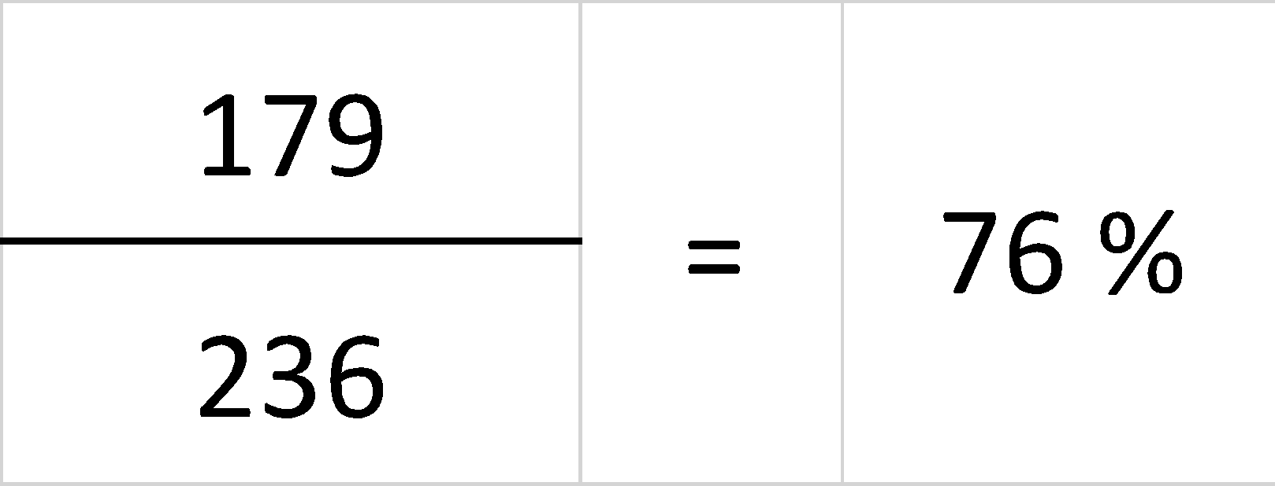
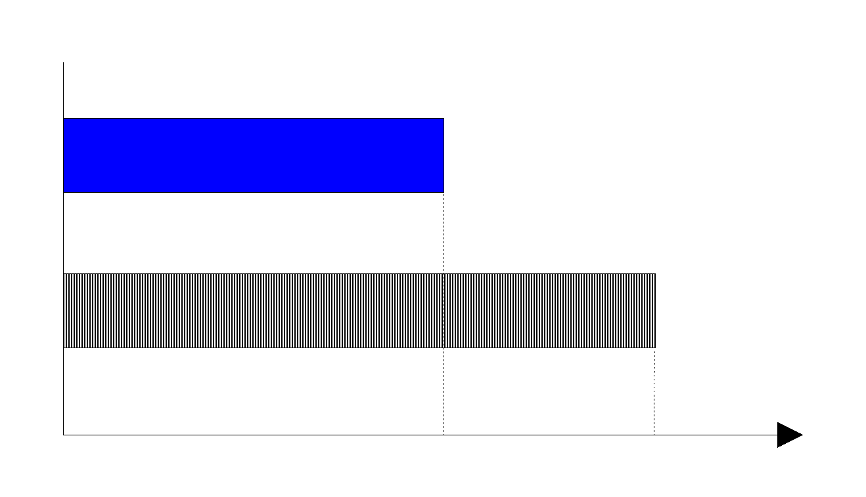
Efficiency / utilisation rate
Value-added work time from work
Hours spent on work
Efficiency rate
Value-added work time
Used work hours
h / min.
179
236

Slide 28
Productivity development
Productivity can be developed in a variety of ways
By developing working methods
By improving product manufacturing qualities
By production automation
By avoiding unnecessary work
Streamlining production
When the flow is good, it is possible to do value-added work all the time and time waiting etc. waste is reduced
The flow improves when
expanding bottlenecks
increasing utilisation rates
increasing capacity where necessary
Oversimplified: we should first work all day and only then automate

Slide 29
Expanding bottlenecks
We analyse the work in the bottleneck
Is all the work necessary and is it done smartly (see step by step)?
Rationalisation = gradual reduction of value-added work time
Reduced value-added work time is removed from capacity calculation and monitoring as soon as the changes have been implemented
Are we doing the right things in the bottleneck?
Does it take time, for example, to fetch materials?
Does it take time to walk and reach, etc. (workstation ergonomics)?
Can the manufacturing qualities of the product or the suitability of the tools be improved?
Can some of the bottleneck work be moved to the previous or next phase?
What happens then to the balance of the line's capacity
Can the share of repair time or other "unnecessary work" be reduced?
Where does the bottleneck transfer as a result of development measures?

Slide 30
Higher capacity utilisation
Is someone working in the bottleneck all the time?
Can the work be levelled out with a material buffer before and after the bottleneck?
Are machines sitting unused in shift change or during breaks?
Can production be increased, for example, by selling more?
Can machines and/or persons (defusing overcapacity) be taken out from the phase?
Can we catch up with the busy times in silent times?
Can we repair broken machines in the bottleneck quickly enough?
Can servicing bottleneck machines be carried out in quiet times?
Transition to preventive maintenance
Can the set-up times be shortened in the bottleneck?

Slide 31
LEAN and continuous improvement

Slide 32
LEAN production philosophy
From Japan
Toyota production system in the background
J. Womack et al: The book "The Machine that Changed the World" made the concept known in the 1980s in Western countries
Aims at reducing waste from processes and thus creating an uninterrupted, flowing value chain
Has long been a guiding production philosophy in industry and is also ideal for construction
LEAN is not just a development process for factories; it is specifically suitable for the entire value chain from sales to delivery
Typical for a lean factory and other process are:
Small stocks and low incomplete production
Clear objectives and indicators
Good, competent production management, which is often order-oriented and based on pull
Good material flow through the factory, short lead times
Good customer service capacity and thus customer satisfaction
Continuously proactive regarding improvement and satisfied personnel

Slide 33
Concepts related to LEAN
MUDA, wasted, unnecessary work
KAIZEN, continuous improvement
KANBAN, visual guidance
Pull control, controlled as needed (also JiT = Just in Time)
Visualisation, processes that show you immediately if everything is in order
Production flow

Slide 34
MUDA – Wasted, unnecessary work
The key to LEAN is to identify wasted or unnecessary work in the process and to try to eliminate it by developing methods
unnecessary material transfer between inventory and production
when box unit elements are lifted, it makes sense to prepare the lifting so that the element rises straight at one go rather than having to be adjusted several times.
searching for tools at the factory because they are not where they belong
making packages so that the goods are in the wrong order for installation

Slide 35
KAIZEN – continuous improvement
Continuous improvement of productivity in small steps – all personnel and all operations actively involved
Reacting as soon as a problem / chance for improvement is detected
5 basic elements: teamwork, discipline, improved morality, quality circles, improvement suggestions
Make action consistent – measure action – compare with requirements – innovate improvements – make new activity consistent – continue infinitely

Slide 36
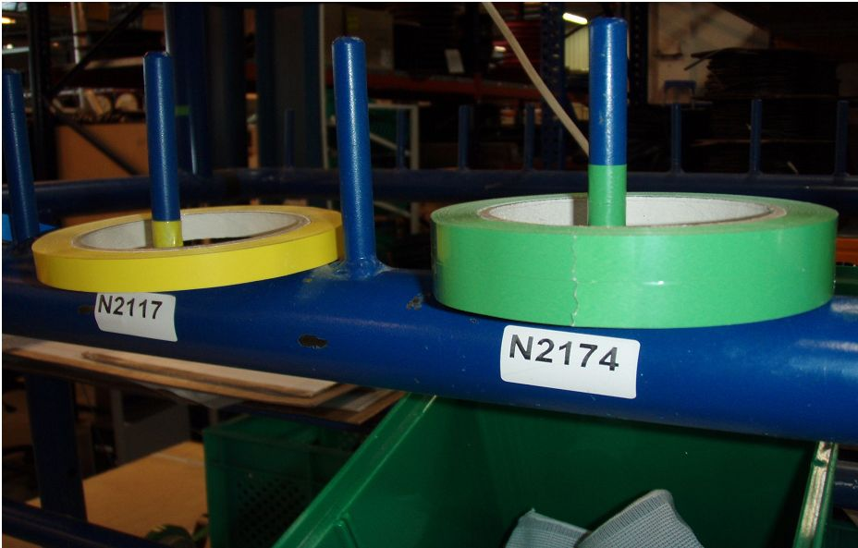
KANBAN
There are many different Kanban control models
The word ‘kanban’ refers to a card or visual output.
Pull control / visual control methods are typical Kanban applications
With the help of Kanban (card/signal), the next operation signals the previous (or material supplier) that it needs more "outputs" (e.g. modules).
It does not always have to be expensive:
the control in the image is based on the fact that when the
used up tape is visible, the warehouse employee can install a new roll.
This will prevent the tape from running out

Slide 37
Pull control
Pull control starts with customer demand, and it absorbs completed parts throughout the production process at the factory.
Information flows upstream and material and parts downstream
JIT is a combination of production control and management philosophy
precise control between required warehouses and production workstations
repeatability of production processes is
significant and material flows are well-defined
small batches => small inventories
short setting times
steady load
components and working methods standardised
high quality
close contacts with subcontractors
flexible, committed staff
product-specific layout
preventive maintenance
continuous improvement

Slide 38
Visualisation
Production visualisation means that, for example, workstations can easily see whether the materials are ready for the next work phase or whether all workstations are operational on the production line.
So-called visual guidance is often used
2-box control (even if the same screws are in two boxes after one another on the shelf, when the first drawer is empty, it acts as a control impulse for filling the material).
The material cart can be arranged so that each part has its own compartment and you can easily see if everything has been filled
Frequently, different signs are also used (small green flag/sign when the product is ready)
Production control boards and kanban cards are also visual control instruments
In a Chinese factory, the materials department personnel had work coats of different colours than the production line personnel. It was easy to see if the tasks and permitted areas were confusing (only materials department employees were allowed to pick up materials from the warehouse as they were also able to remove materials from the balances)

Slide 39
Supervisory work
Presenting only some observations on supervisory tasks in element production, which may differ from normal work site tasks
Daily supervision is very important for the factory's success
The factory supervisor must
Maintain production flow and line balancing
Plan the necessary changes to the working methods as the site changes
Ensure that the prerequisites for production exist before the production of the site begins
Guide continuous improvement of workstations and the line
Define and direct resources to the line according to the situation

Slide 40
The significance of plans in industrial manufacturing

Slide 41
The significance of plans in industrial manufacturing
In industrial manufacturing, the requirement for plan content is significantly higher than in traditional manufacturing
For example, on a construction site, the plan can tell the carpenter how many and what kinds of nails they need to use. A nail robot must be told the position of each nail in all dimensions.
The boundary conditions of production must be considered in the plan of industrial products. Due to the manufacturing method, the components typically have:
Some maximum dimensions W X H X D and any maximum weight
Constraints related to the installability of the product such as tolerances (affecting the details) or lifting order or method of attachment (affecting, for example, the locations of load-bearing walls)
Constraints related to economic implementation
The goal is to utilise standardised semi-finished goods
For example, door size is a typical standardised semi-finished goods
Design for Manufacturing and Assembly (DFMA) is part of other planning, and other planning must enable efficient implementation in terms of production

Slide 42
Definition
DFM or DFMA
DFM (Design for Manufacturing or Manufacturability)
A method that improves the efficiency of industrial manufacturing by means of product development
Reducing factory assembly work
Facilitating completing work phases
Decreasing number of parts
Enabling the use of prefabricated sub-assemblies
Utilising subcontracted parts and sub-assemblies
Standardising design solutions
DFMA (Design for Manufacturing and Assembly)
A broader perspective to the previous, in which the final assembly is taken into account in particular if the product development is carried out on a larger sub-assembly. For example, the design of shipbuilding components considers the requirements of the shipyard's assembly work.

Slide 43
DFMA In box unit element construction
Examples
Reducing factory assembly work
Placement of the kitchen in connection to a wet room
Replacing a lowered roof with a standard prefabricated housings
Facilitating completing work phases
Assembling the floor on one side
Rigidity of the base floor, tolerances
Surface treatment of walls before element assembly
Planning of operations so that the work does not become congested
Decreasing number of parts
Frameworks, screwing, plating
Enabling the use of prefabricated sub-assemblies
Central electric unit, HVAC shaft, kitchen cabinets, countertops, etc.
Utilising subcontracted parts and sub-assemblies
Pre-plugged cables, pre-installed centers
Standardising design solutions
Reviewing drawings on the line is reduced when we are familiar with the details

Slide 44
DFM on the site
Raising the degree of completion of box unit elements
Balconies at the factory
Locking systems at the factory
Corridors easier for on site work
Corridor technology travels with the element
Facades
Air-conditioning devices as elements
Element joints
Delivery logistics

Slide 45
Production planning
When a new site arrives at the factory for element manufacturing, it is important to plan the changes needed for it and calculate the new workloads and phase times.
After this, it is possible to set realistic goals and schedules for manufacturing
Good design and modelling programmes produce good starting points, but this is often not the case, there are many missing details, and planning does not produce enough work method information suitable for the factory
For example:
A new project has a significantly more complex kitchen solution:
So, it must be extended to several workstations, which naturally cause changes to the content of the work and the manning required at these workstations, as well as to the control of the material at the workstations in question. If this is not planned and resolved in advance, the entire line will be sluggish.

Slide 46
Production planning: intermediate floor example 1/3
The simplified example illustrates two different intermediate floor structures, the difference between which is significant for manufacturing
Both can be done, but if the factory production line is designed for a rectangle, it requires a bit of work to determine how to make the slanted and curved structure most efficiently
As the dimensions of the rectangle change, it is easy to make settings at the assembly point, but in case A, it may be necessary to rebuild the entire setting
The impact may also extend to a subcontractor if sawed frames are ordered to measure
A
B

Slide 47
Intermediate floor example 2/3, Comparison from production perspective between alternatives A and B
Assume that both intermediate floors have the same surface area and, as a simplification, assume that both templates contain the same number of materials
Obtain the same quantity of the product to be sold at the same material cost?
Sawing: In B, the intermediate floor beams can be sawn in one setting and a bundle for each element can be assembled directly from the sawing point. In A, each setting must be changed. Alternatively, the shortest pieces are sawn first and then the second to shortest etc. This requires a space where the sawed pieces of different lengths are assembled into element-specific bundles. In A, the packing order of the assembled bundles must also be planned so that its unloading at the workstation takes place in the correct order (avoiding arrangement at the workstation).
Assembly workstation: Option B is ready as a template, which can be used directly after setting (dimensions and month interval). Option A requires its own template.
An alternative to the template is an automated laser system that draws accurate locations regardless of shape.
Investment required
Requires a traditional production image and a fully modelled production image
A
B

Slide 48
Intermediate floor example 3/3, Comparison from production perspective between alternatives A and B
In addition to the preparation phases described above, the performance of non-routine performance h/m2 is greater than with a standard product. The difference can be tens of per cent bigger based on experience
The multiplier effects on other workstations must also be taken into account
Oblique machining of walls, abnormal fastenings, possible effects on facade manufacture, packaging, transport, installation
Impact on overall line balancing! If B is designed to produce 2 intermediate floors / takt time, and only 1.5 A options are produced per takt time? Considered in the workload of the whole factory!
And although it was initially said that the same amount of material is consumed, in reality:
Wools, surface panels and beams require the use of diagonal cuts or cuts that cause material loss
It may be necessary to use more fasteners due to deviations from the standard details
As a conclusion, it can be said that both can be done, but special attention should be paid to determining the correct price. At worst, if incorrectly calculated and planned, it reduces the production volume of the whole factory and this can cost many times the price of the floor itself
A
B

Slide 49
Procurement

Slide 50
Do it yourself or buy it?
The first issue to be resolved in a procurement operation is whether you make the part yourself or purchase it. This is also commonly called the make or buy decision
What to do and what to outsource is one of the company's most important strategic decisions and affects the entire business model
Is there a specialised manufacturer for a product that you cannot compete with with your own production? Manufacturing roof grids as an example.
The decision is influenced not only by the price of the product to be purchased, but also by a number of other factors.
Is there room, enough personnel or other resources to make a new product?
Is it more sensible to invest yourself or invest in a more profitable own investment (limited resources)?
Capacity management. Do you have use for, for example, the entire production of a new machine to be invested in?
Risk management. Do you have to do a critical part yourself so that other production is not endangered even if it is more expensive? On the other hand, can the capacity risk be outsourced by buying the part elsewhere?
Management of the cost structure and, in particular, fixed costs. How much fixed costs are allowed?
Quality, flexibility or competence may be different when done in-house or outsourced

Slide 51
Direct line deliveries
In the manufacturing plan, it is important to understand the impacts on the entire logistic value chain, either on a new factory process or when modifying it for a new site.
The above example of the intermediate floor can also be used to describe this perspective
The floor beams can be made in-house, but the process must be calculated as a whole (material price, storage cost, transport, long goods reception, work, material loss, handling and installation order, transport to line, etc.)
An attractive option would be to order ready-made floor beams from a subcontractor, bundled in the order of installation, to the production line using the JiT principle. In this case, quite a few internal costs would not be incurred.
Such direct delivery models are used quite a lot in industry
E.g. cable harnesses to the truck plant according to the configuration programme of the plant with hourly accuracy
A
B

Slide 52
Supplier partnerships
As has previously been pointed out, a network-like operating method enables the specialisation of actors and thus improves the efficiency of the network as a whole
A good network has "good customer relationships and good deliverers"
In a network, you should understand the importance of genuine co-operation
By forecasting and using your own production plan for joint capacity planning with the supplier, security of supply is generally improved
Partners must also have the opportunity to do business
Joint open product development
Open pricing to enable joint development
For example, if the subcontractor is paid on the basis of a tender and the tender is based on materials and the number of hours worked, which provides an incentive for the open development of the activities if the subcontractor's development work should either be concealed or the invoicing would be reduced. This will certainly not increase innovative development.

Slide 53
Logistics

Slide 54
Logistics
From the perspective of factory manufacturing, logistics can be divided into three parts
Incoming (Inbound)
Internal logistics (In-house, within the factory)
Delivery logistics (Outbound)
All three areas are critical
It is important to consider receiving, inspecting, storing or possible direct delivery of future material, managing material flow and intermediate storage in the factory area, and getting the materials to the site for final assembly in the correct order and without storing too long (JiT principle)

Slide 55
Incoming logistics, Inbound
In inbound logistics, you should consider
Truck unloading capacity
Systematic and system-managed placement of materials
Reception inspections according to the process
Arranging materials according to production needs (facilities, resources) according to the JiT principle, if there are no direct deliveries
Manufacturing inputs to process points
Material reception and poor inbound material management can sometimes be very significant. One large-element plant received window deliveries as a full truck load, as is sensible. However, the plant did not have a systematic way to organise the storage of incoming material, so the windows drifted here and there on the plant shelters. When windows were needed in production, several were lost. First, of course, the deliverer was accused and freight bills were examined, then 10 officers went to read the 5*2cm labels inside the packaging plastics to figure out which was which window. There they were, behind the wool bales.

Slide 56
Internal logistics
In this context, internal logistics refers to material flows within the factory and from warehouses to different workstations.
In element manufacturing, it is easy to establish that the factory's main material flow is the assembly of the element itself. It involves numerous side streams such as deliveries from different prefabrication points to different assembly points.
The main material flow may be L-shaped or U-shaped depending on the space, but a straight line is quite functional, especially if large objects such as space elements are moved along rails. Turning is difficult (and unnecessary work).
It is a good idea to arrange the material input so that it can be visually controlled in the future material squares.
The prefabrication point should naturally be close to the component installation point, avoiding unnecessary traffic
Back and forth material traffic in the factory (especially if the components are large) is a major source of waste

Slide 57
Internal logistics
In the example illustration, the main material flow is formed by the assembly line of the box unit elements.
A corridor has been left next to the line through which materials are fed to the workstations.
The assembly of kitchens as prefabricated components to be lifted on the wall is done next to the installation point, so traffic is minimised and the installation of the kitchen itself in the box unit element becomes significantly faster.
Kitting here refers to the area where different parts and components needed at different workstations of the main material stream can be arranged in the order of installation. The completed sets are taken to the desired workstation in the incoming material box while the previous kit is still being used. This ensures continuous work when the next element comes along the line.
Kitchen prefab- rication
Kitting
Pre-assembly X
Delivery of material to assembly phases
Delivery of material to assembly phases
Kitchen instal- lation
Main material flow

Slide 58
Delivery logistics
Delivery logistics usually focuses on the optimisation and timeliness of transport (costs). This is good, but you should look at the whole set-up
Facade plates were delivered to the renovation site of several large rental blocks of flats in southern Sweden. A large number of plates of different sizes were needed in different parts of the facade. The supplier's basic model was to produce plates of the same size at the factory and send them in bundles to the construction site. They needed a considerable number of bundles and a tarpaulin hall was used to arrange the plates on the construction site in bundles in the order of installation (the scaffoldings of the house progressed one sector at a time forward). The contractor had a lot of work to do and it was expensive. In addition, there was a lot of damage to the plates.
It was decided to make changes to the production programme at the factory, to have them delivered part at a time, and to lift the top plate in the bundle first, etc. In a way, it was a direct delivery for installation. It is important to note that the plant took on more work and that the customer understood to pay for and both actors benefited in costs, time and waste.
Naturally, the large size of the elements is emphasised in deliveries and, consequently, the need for special transports

Slide 59
Warehouses
Warehouses are often regarded as merely an expense item that should go. At the very least, a high turnover rate would be desired
However, storing also has value as a steering tool, and you should strike a balance between the correct cost and controllability.
For example, if element production and assembly site were to be fully timed according to the JiT principle and fully flowing, there would be considerable risks. There may be problems in production, traffic may become congested and some parts of the chain may run idle which is expensive. On the other hand, doing too much upfront ties up a large amount of capital unnecessarily.
As a general principle, storage should take place before the variation point. It is a good idea to store what can be used for a large number of different product variants. E.g. window glass and frame material, no ready-made windows of different sizes
Buffering, i.e. intermediate storage, is used to balance production. This enables the smooth running of the production phase.
For example, at the installation point of the HVAC shaft, a prefabricated shaft element is waiting for the next element in preparation. Therefore, the assembly of the HVAC element is carried out slightly before the need arises.
In general, it is a good idea to pay attention to bottlenecks so that the intermediate storage is not unnecessary.
Outputs from other process stages can also be stored such as plans, contracts for future sites or completed procurement contracts. These also have a warehouse value.

Slide 60
Site operations as part of industrial manufacturing

Slide 61
Optimisation of the site and factory as a whole
Practical matters concerning the site were extensively discussed in “tPUUr TP 8 Installation and construction site operations”.
The customer buys an apartment block, not box unit elements or the main contract for the site
Avoid partial optimisation and factory optimisation only
Sometimes, completing a certain job at the factory can make sense from the perspective of the whole, even if it is not the cheapest option for the factory
As a rule, the work carried out at the factory is significantly more efficient than the work carried out on site, and thus it is worth transferring the work to the factory in general, however,
only partially transferred work can be ineffective. If the work phase cannot be completely removed from the site, the overall efficiency increase and cost savings may not be achieved
Requires system-level planning and standardisation: not only feasibility but also impact on the stability and architecture of the entire structure
The amount of work to be transferred to the factory must be reviewed with the factory (production balancing!), because the factories have a certain number of workstations and resources. New solutions must be planned, as underlined in this presentation, before they are brought into production.

Slide 62
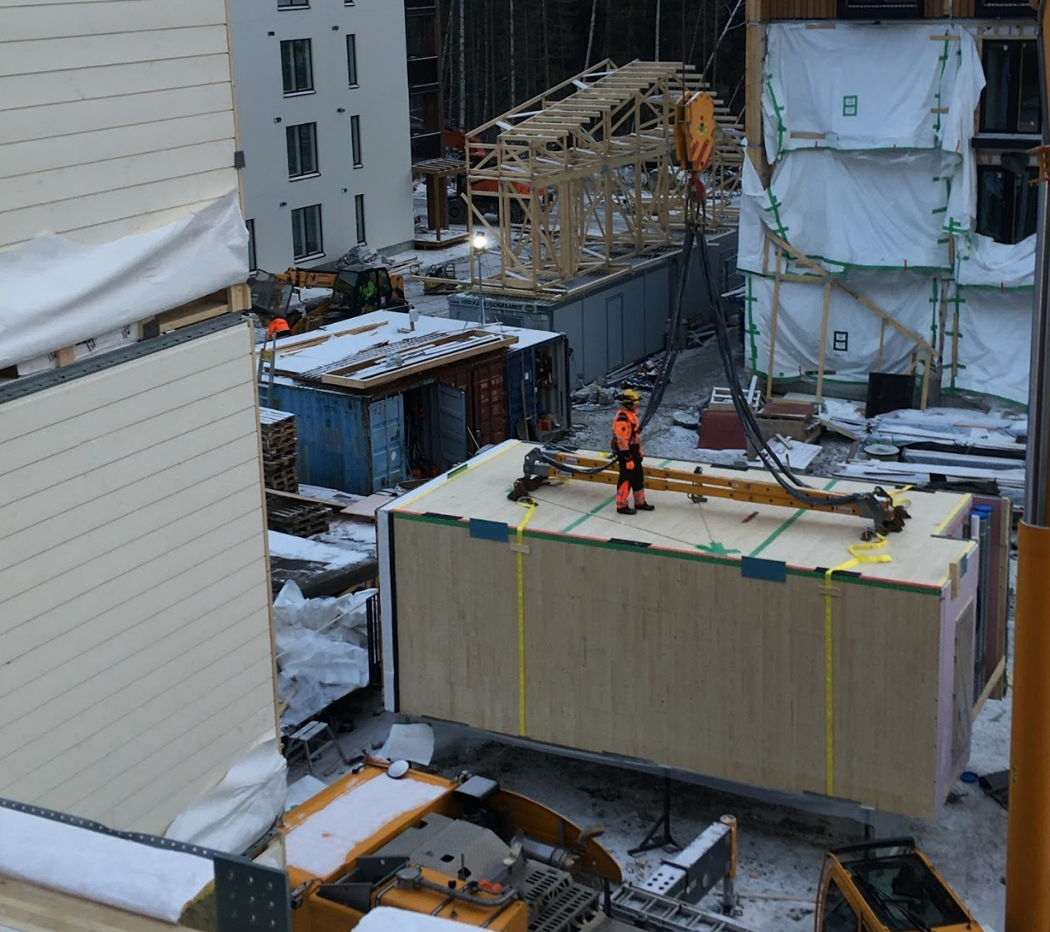
Site optimisation, installation example
The principles presented in this presentation can also be utilised as such in the development of the site
In practice, there is a common basis for takt production and the measures discussed in this presentation. For example, the site can aim for a 4-hour takt time, i.e. morning and afternoon work.
Example of making installation work more efficient in the productivity leap project:
A lot of extra work was done in the installation of the elements at the research sites (waste)
Balancing lifting straps several times for the same element, retrieving fasteners during installation
Removing planning errors
For example, expanding the element floor heating route to continue the installation
Improved standard solutions to facilitate installation
E.g. balanced lifting points in design
No need to climb on the unit box roof during installation
Without investments, the study achieved 67 per cent productivity growth in installation
Balancing the element on site

Slide 63
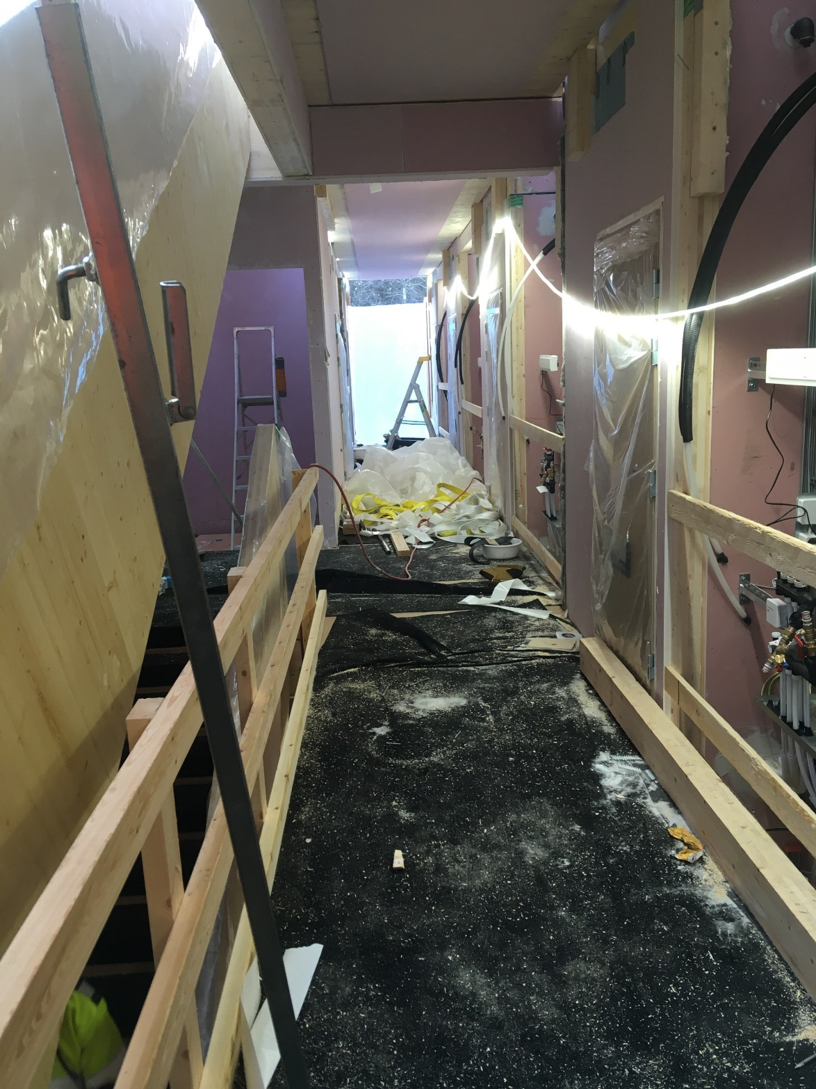
Site optimisation, 2
The greatest impacts can be achieved by eliminating time-dependent work phases and shortening the entire construction time at the construction site
The amount of costs directly related to running a fixed site decreases as the site time decreases
The cash flow (rental/sales) of the object can be started earlier and the object starts producing faster
At present, building technology for corridors at box unit element sites and indoor crafting work in the corridor typically determine the completion time
More extensive utilisation of the elementation of flues in building technology
Developing the details of flues
Adding finished corridor surfaces
Degree of completion of a corridor on site 3 months after element installation

Slide 64
Project development and planning management in industrial construction

Slide 65
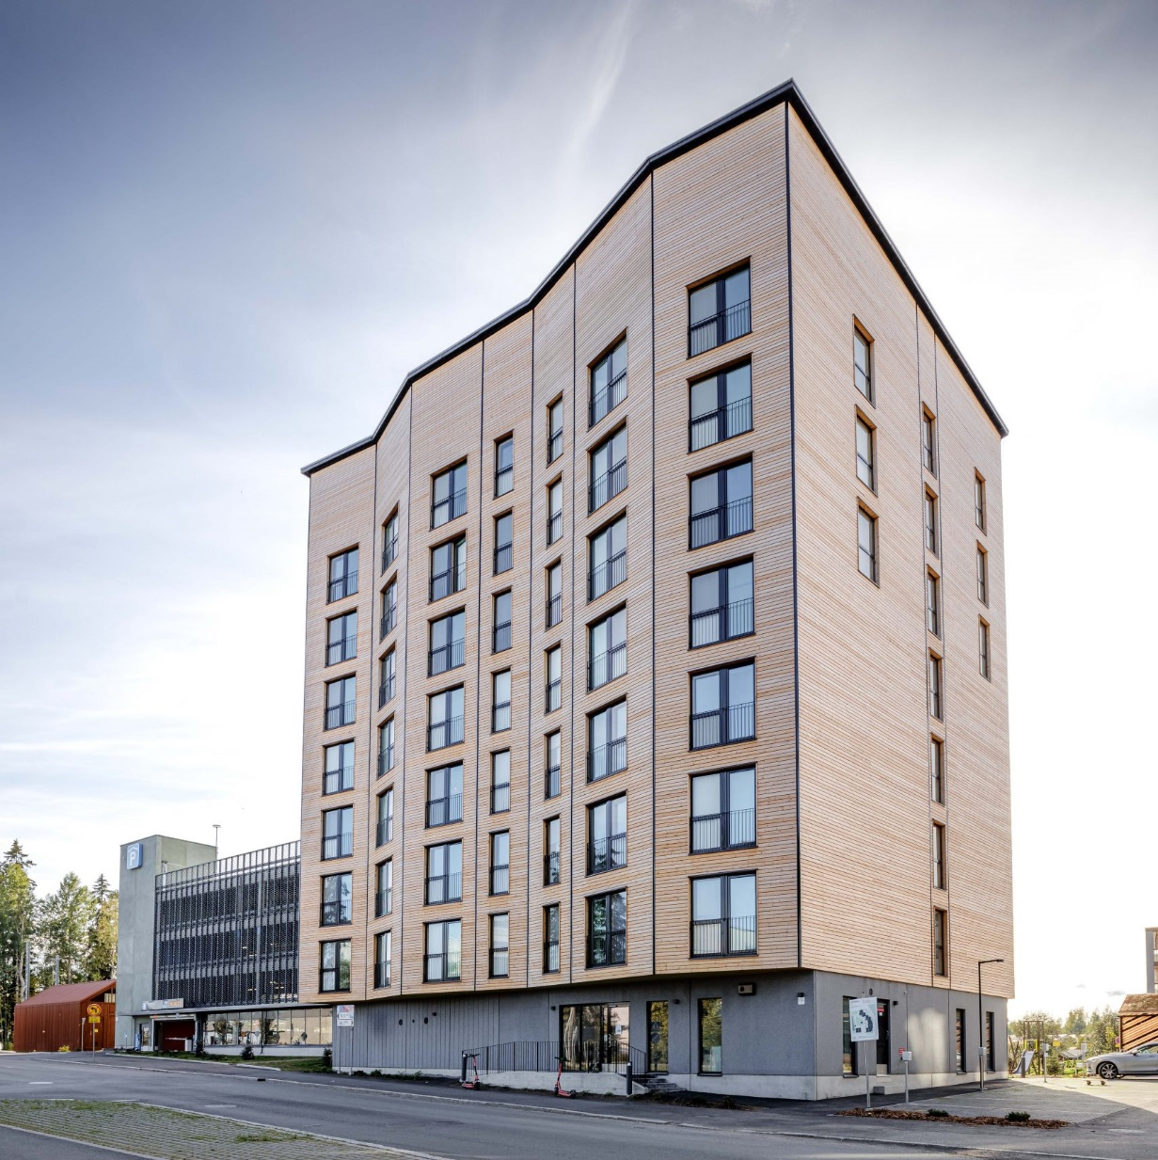
Unique target or standardised concept?
The utilisation of industrial products and box unit elements includes many constraints
It is important to know what you can or cannot do with the elements
Often the most important thing is to identify targets that are not suitable for solutions!
Construction projects are always unique: There are no two identical building sites
You need to know where the technology will not flex and where it does
Typically, the aim is to standardise building technology solutions to issues affecting the facade and cityscape, and to leave degrees of freedom
An industrial product can be used to produce high-quality architecture as long as the marginal conditions are taken into account!
Project development optimises the whole
Sales price 3,000 euros (rural) or 6,000 euros (urban) lead to different design solutions!
Toas Kauppi box unit element block of flats

Slide 66
Basics of project development
The project development of an apartment building project is fundamentally no different no matter what technology or material is used
What does the total investment cost (not just construction)
What is the target's cash flow, sales value, rental income and residual value
What is possible and what is not possible with the plan (boundary conditions)
What risks are associated with the project (any other than construction)
How much space should be built and how much space can be rented or sold? So-called gross net efficiency
For example, a cheaper project in terms of construction costs may be worse than a more expensive solution if the more expensive solution provides more sellable floor space.
What is the project's expected schedule?
What added value does the project bring to its owner in addition to money, for example environmental values.

Slide 67
Possibilities of modularity for design
Industrial manufacturing is not just a constraint on design. Especially automated solutions such as CNC-worked CLT enable non-traditional solutions. The following examples apply to box unit element construction, but all industrial products have their own possibilities
The elements themselves are rigid pieces and this enables, for example, the cost-effective creation of protrusions
Balconies the width of the whole element. Elemented at the factory, labour costs are relatively low even though material costs increase in a large balcony
Non-standard shapes in dry spaces
Automated CNC machining enables moderate additional costs such as oblique facades
As light elements, structures on top of parking garages or other existing structures cost-effectively
Advanced detail and final quality thanks to detailed design

Slide 68
Combining project business and industrial activities
The competitiveness of factory operations is based on a high utilisation rate and steady production
The production time of the project must be reserved in advance
If the project is delayed, e.g. 2 weeks, production can be postponed by months
There are normally no apartment block projects waiting in the queue, i.e. it is usually very difficult to organise replacement production
The problem has been solved abroad so that the factory itself owns construction projects and the projects alternately wait for elements 🡪 The factory is fully loaded
Project order permits and investment decisions affect production time
Typical delivery time for procurements is 2-3 months after ordering. Factory production should not be started until sufficient material buffering at the factory and the supply chain is secured
This leads to the fact that a so-called fast start cannot be done at the factory even though the plans would be ready
Transferring to a construction project 1-2 months forward is fairly common
In factory production, 1 month means approx. 10% of the year's production
The plant cannot bear the risk of the project schedule or its transfer alone

Slide 69
Design control and industrial manufacturing
Efficient use of box unit element manufacturer solutions usually requires that standard solutions are used as a basis for design
Retrofitting increases costs, prolongs schedule, increases error rates and does not achieve the planned benefits of the method
The procurement model must enable the supplier to be tied to the project as early as possible
For example, KVR or SR models provide a total implementation to the supplier
The second option is different collaborative models, such as the alliance contracting model
For sites designed by the client, negotiation procedures, market dialogues and joint preparatory stages are recommended to enable the transfer of knowledge for the benefit of the project.
The client and the planners must commit to the proposed standard solutions
Often a minor change can destroy the full efficiency gain, cf. the intermediate floor example presented earlier
Defining project objectives critical (what can and can not be changed)
Schedule and capacity
Although manufacturing is fast, planning and production scheduling must have its slot in the schedule.
Production time must be reserved for factory workload as part of the construction schedule

Slide 70
Quality assurance in industrial construction and factory – special questions

Slide 71
Quality systems and their significance in industrial manufacturing
Standards and product approval are discussed extensively in the tPUUr TP 9 presentation
When used correctly, quality systems play an important role not only in demonstrating official regulations and product quality
The quality system manages the entire value chain and factory and is the most important tool for management in monitoring and analysing the outcome of the business plan
All measuring data is produced as part of the quality system
Labour costs by product and workstation
Material usage, storage values, waste percentages
All production indicators such as lead time or error percentages
Quality is monitored for quality itself, not for the customer
An error fixed on site costs several times more than the cost of a fix at the factory
Fixing an error in planning is almost free of charge compared to the previous ones

Slide 72
Automation
Automation has developed strongly in all sectors in recent decades
Order/delivery chain management, ERP solutions, material/warehouse management, machine vision for quality control, machining, assembly robots, design system CAD/CAM etc.
In construction, sawmills, log factories and the construction product industry have also been developed with a strong degree of automation
The automation of the actual construction, i.e. assembly work, is in the early stages
This can be improved by transferring the site to the factory and component production, where the requirement of diversity and flexibility also direct more to point-to-point automation
Much can be done before (or regardless of) automation to improve productivity and efficiency
Removing unnecessary work from processes, streamlining, division of labour between plant and site
Standardisation of solutions and development of work stages and methods using current tools
The share of value-added work in the total workload is fairly low

Slide 73
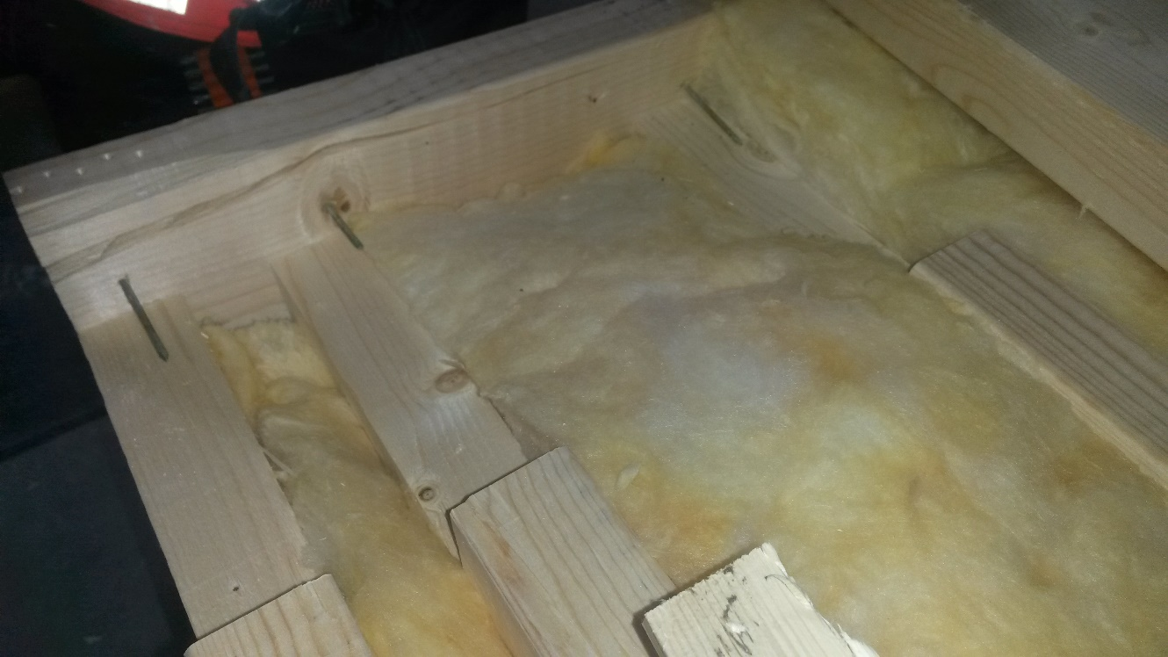
Automation
Pros
Highly efficient in what it is planned for
Requires maintenance but no holidays
Removes boring operations
Does not make its own decisions but does what has been programmed (also if incorrectly controlled)
Cons
Investments can be large
Requires high-precision, detailed design, CAD/CAM solutions. The current planning process does not usually produce this.
Selections restrict activities (e.g. motion paths, largest dimensions, geometry, etc.)
Highly automated element production limits the solutions produced quite a lot, is it sufficient for the legitimate requirements of the market and architecture?
Difficult to apply to site phase
The machine hit the nails according to the programming, just the position of the beam had no been entered.

Slide 74
Reading recommendations
Womack J.P. : The Machine That Changed The World
Modig Niklas: Tätä on Lean
Schonberger R.J.: World Class Manufacturing
Schonberger R.J.: World Class Manufacturing Case Book

