Slide 1



Industrial wood construction
Teaching materials for industrial wood construction education
2022

Slide 2
Origin of the materials
Use of the materials
These learning materials for industrial wood construction have been prepared in a project led by Puuinfo Oy in 2021–2022. Also involved in the project were
Lappia Vocational College,
TTS-Työtehoseura ry
South-Eastern Finland University of Applied Sciences,
Metropolia University of Applied Sciences,
Jyväskylä University of Applied Sciences,
University of Tampere, and
Federation of the Finnish Woodworking Industries Puutuoteteollisuus ry
The project was funded by the Ministry of the Environment.
The materials are intended to be used as extensively as possible in industrial wood construction education and studies.
The materials are released under the Creative Commons licence Attribution-ShareAlike (CC BY-SA), which requires that the author be properly credited when the materials are used and that derivative works may only be distributed under the same licence as the original work.
The original materials and any updates to them by Puuinfo will be published on the Library of Open Educational Resources website (aoe.fi) and the Puuinfo.fi website.

Slide 3

Construction economy and project management

Slide 4
Authors
Sauli Ylinen, Federation of the Finnish Woodworking Industries Puutuoteteollisuus ry
Release date: 29/05/2022

Slide 5
Construction economy and project management
‹#›
After completing the Construction economy and project management module, the student will
Know the various operators and tasks involved in a construction project
Know the main stages of a construction project
Know the business models of key developers
Know the most important model contracts in construction
Know the most important project management tasks in a construction project
Know the main features of the wood construction market
Know the special features of a wooden house building project
🡪The course prepares the student for more advanced wood construction project development and project management studies

Slide 6
Contents
Contents
Five lectures
Five weekly exercises
Course project
Practising preparing a project plan for a block of flats construction project
The course materials focus on the special features of wood construction – not all terms and basic concepts are extensively discussed in these materials
The course materials use as examples two wooden blocks of flats implemented by TOAS Sr: the TOAS Kauppi and the TOAS Lumipuu. You can visit the project sites at:
- Toas Kauppi, Kuntokatu 11 a, FI-33520 Tampere, FINLAND
- Toas Lumipuu, Makkarajärvenkatu 74, FI-33720 Tampere, FINLAND

Slide 7
Wood construction market

Slide 8
Wood construction market in 2021
‹#›
This lecture discusses the demand and supply side of the wood construction market in Finland.
The presentation focuses mainly on new construction and house building volumes. It is worth noting that wood products are also widely used in other applications, such as the furniture industry, infrastructure construction or renovation.

Slide 9
Example calculation of scales
‹#›
Approximately 35,000 apartment blocks were built in 2021
If the average area were 50 m², that equal 1,750,000 square metres built.
At our example site, 0.4 m³ of solid wood products, such as CLT and LVL, are used to build one square metre.
If all were built from wood, this would equal 700,000 m³ of processed wood
As sawn timber, this would mean approx. 1 million m³ of sawn timber
The production of sawn timber in Finland in 2021 was approximately 12 million m³
Even if all apartment blocks were built from wood, it would require less than 10% of the production of sawn timber in Finland!

Slide 10
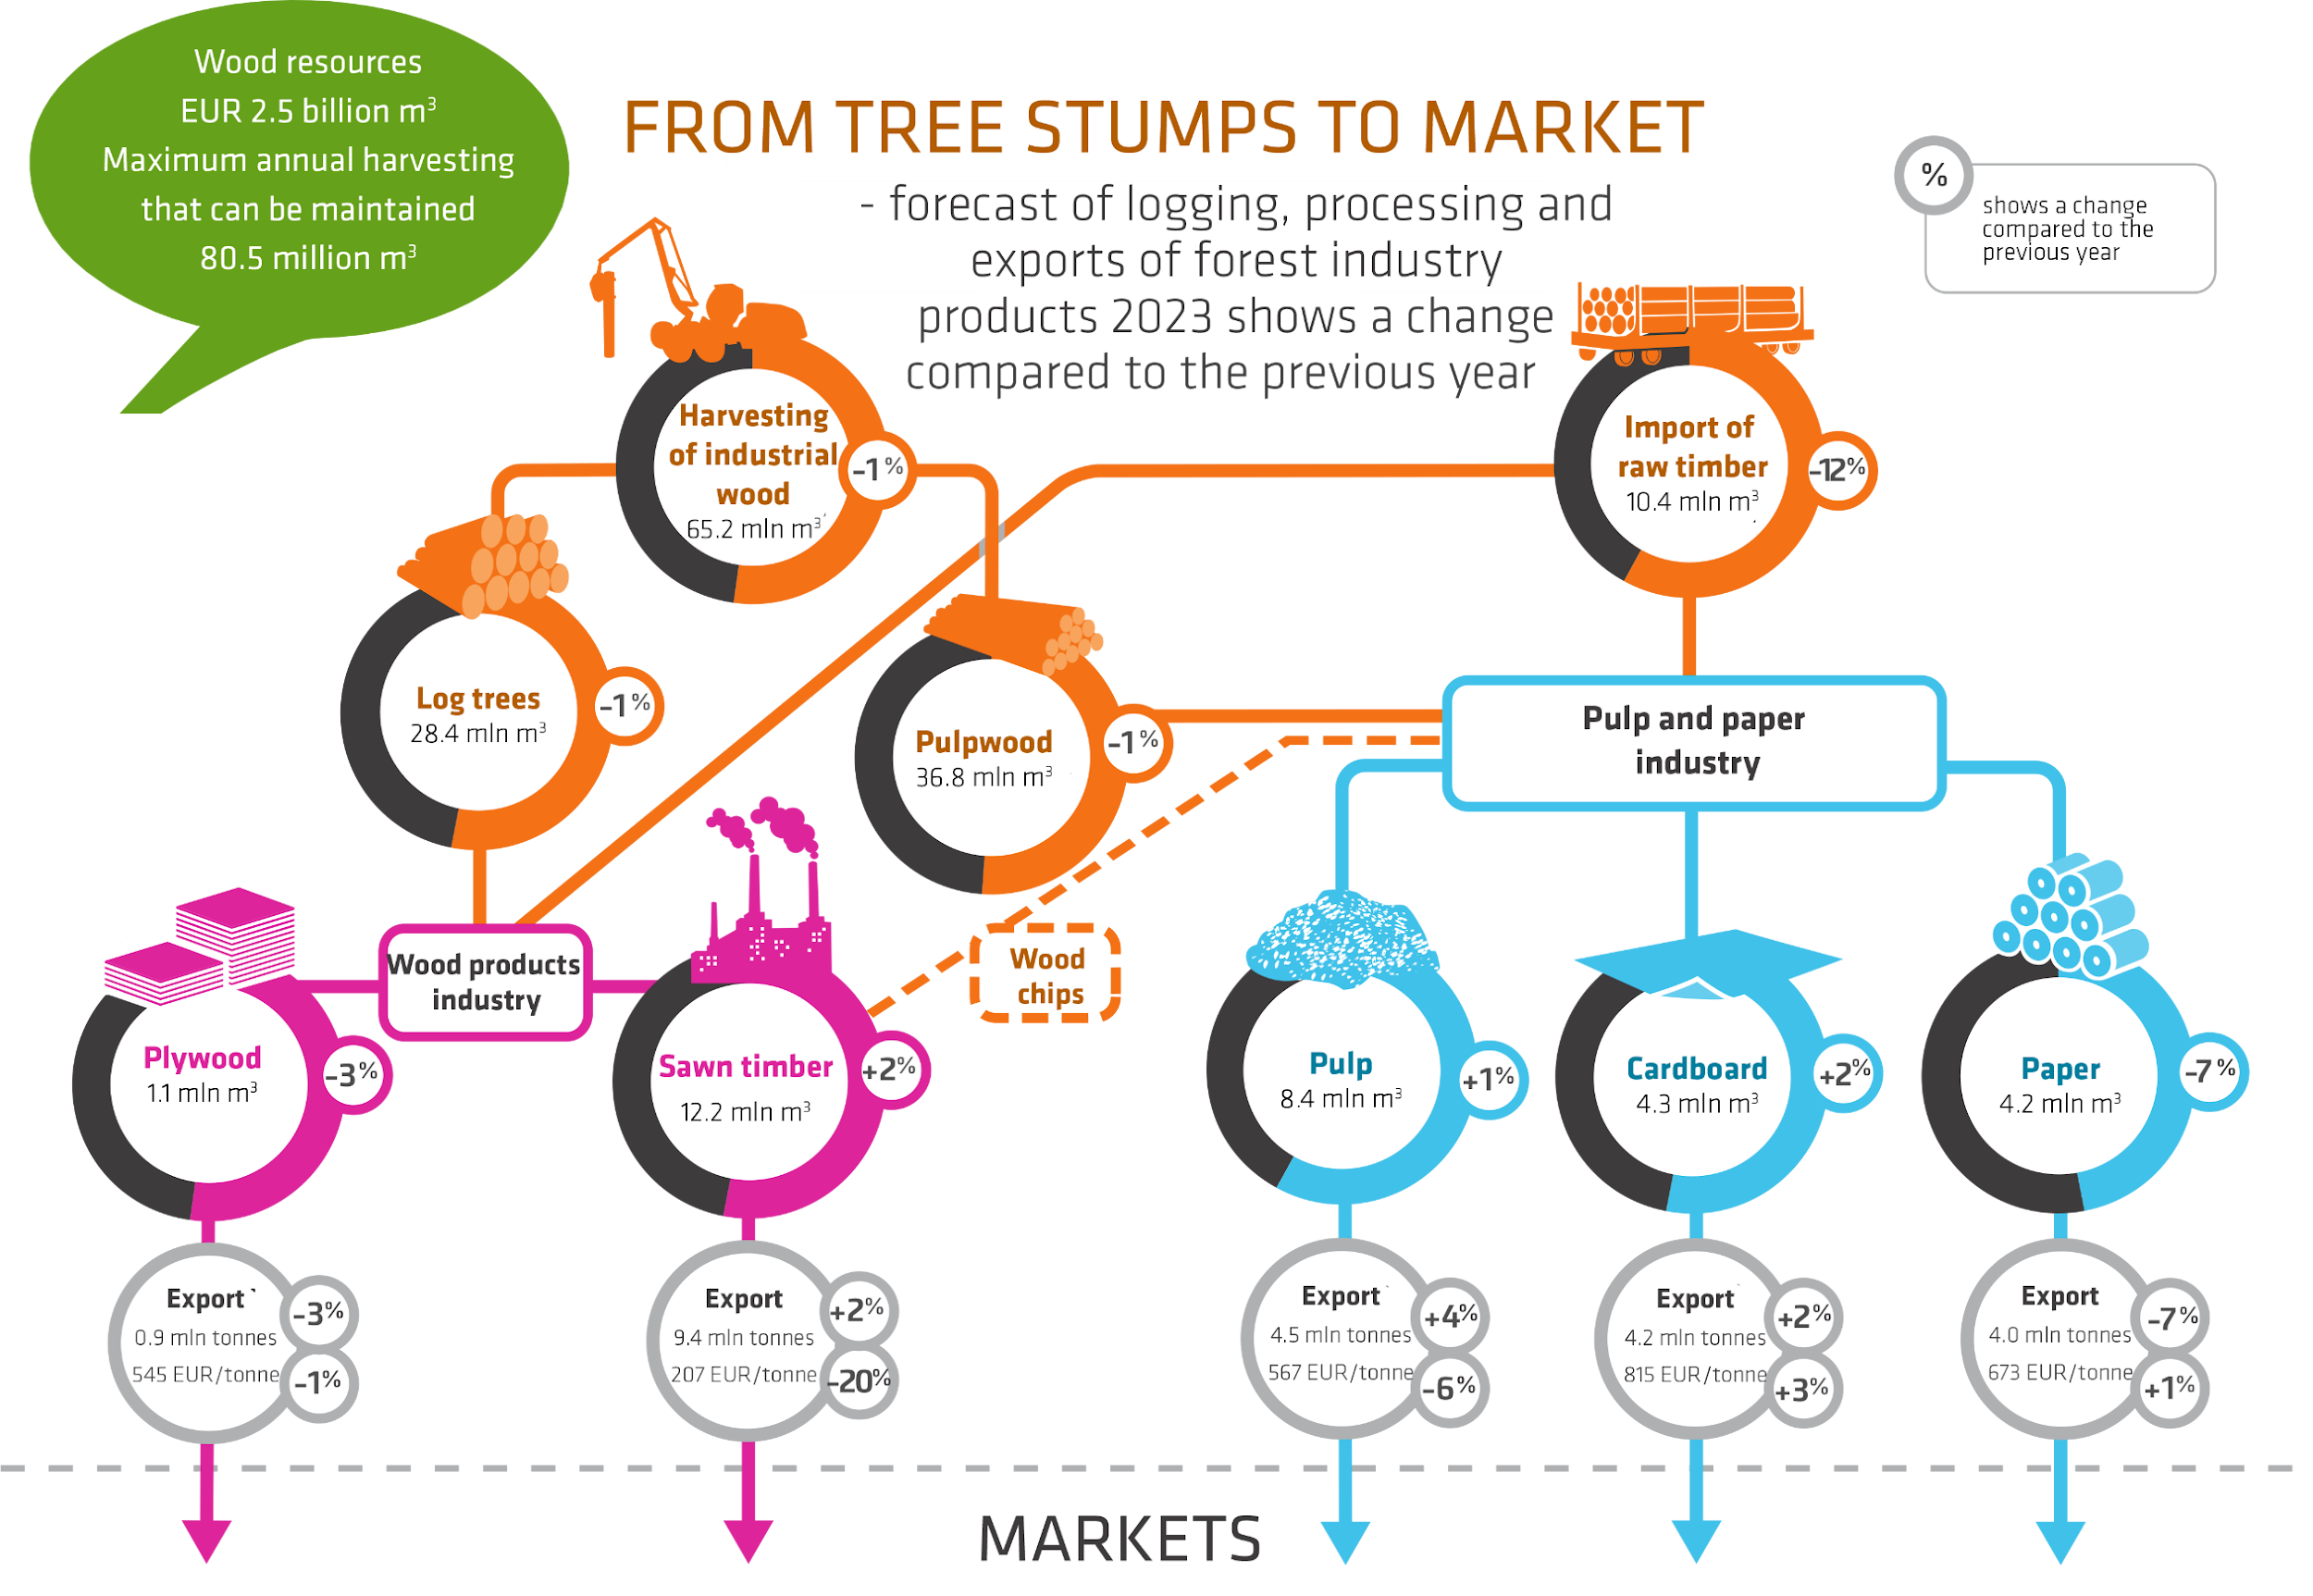
The wood to products route in Finland, 2021
‹#›
Logging volume in 2021 was approx. 65 million cubic metres
Around 12 million cubic metres of sawn timber was produced
Illustration: Luke

Slide 11
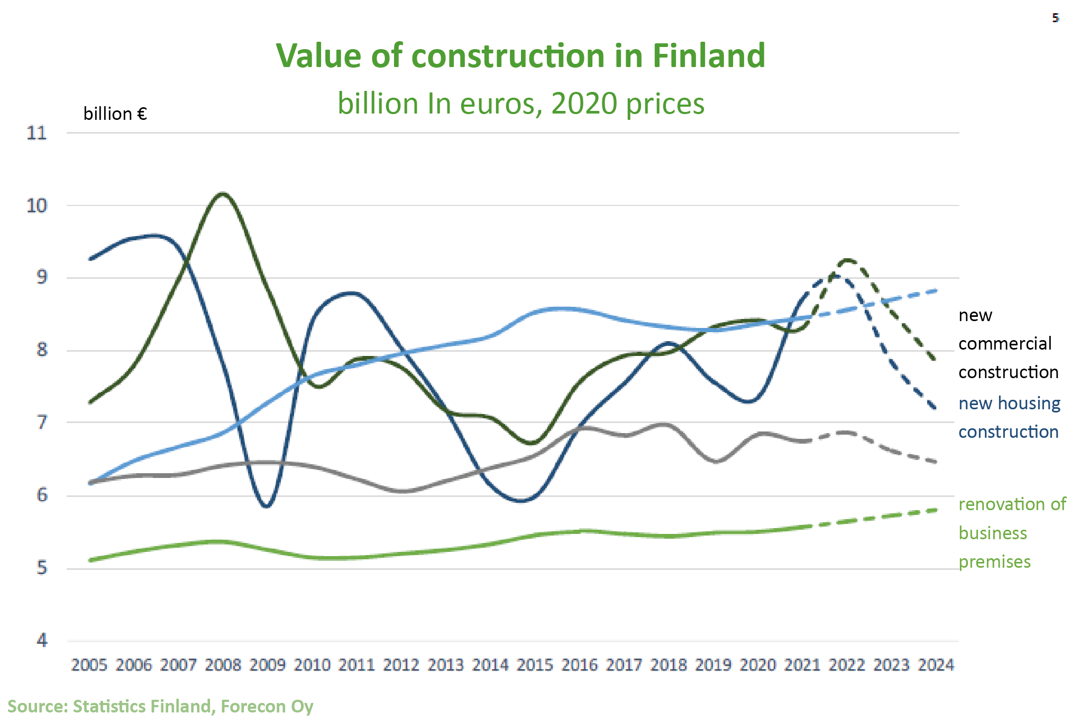
Current state of construction in Finland, 2021
‹#›
The value of construction production in Finland is approximately EUR 39 billion
New construction accounted for approximately EUR 18 billion of this

Slide 12
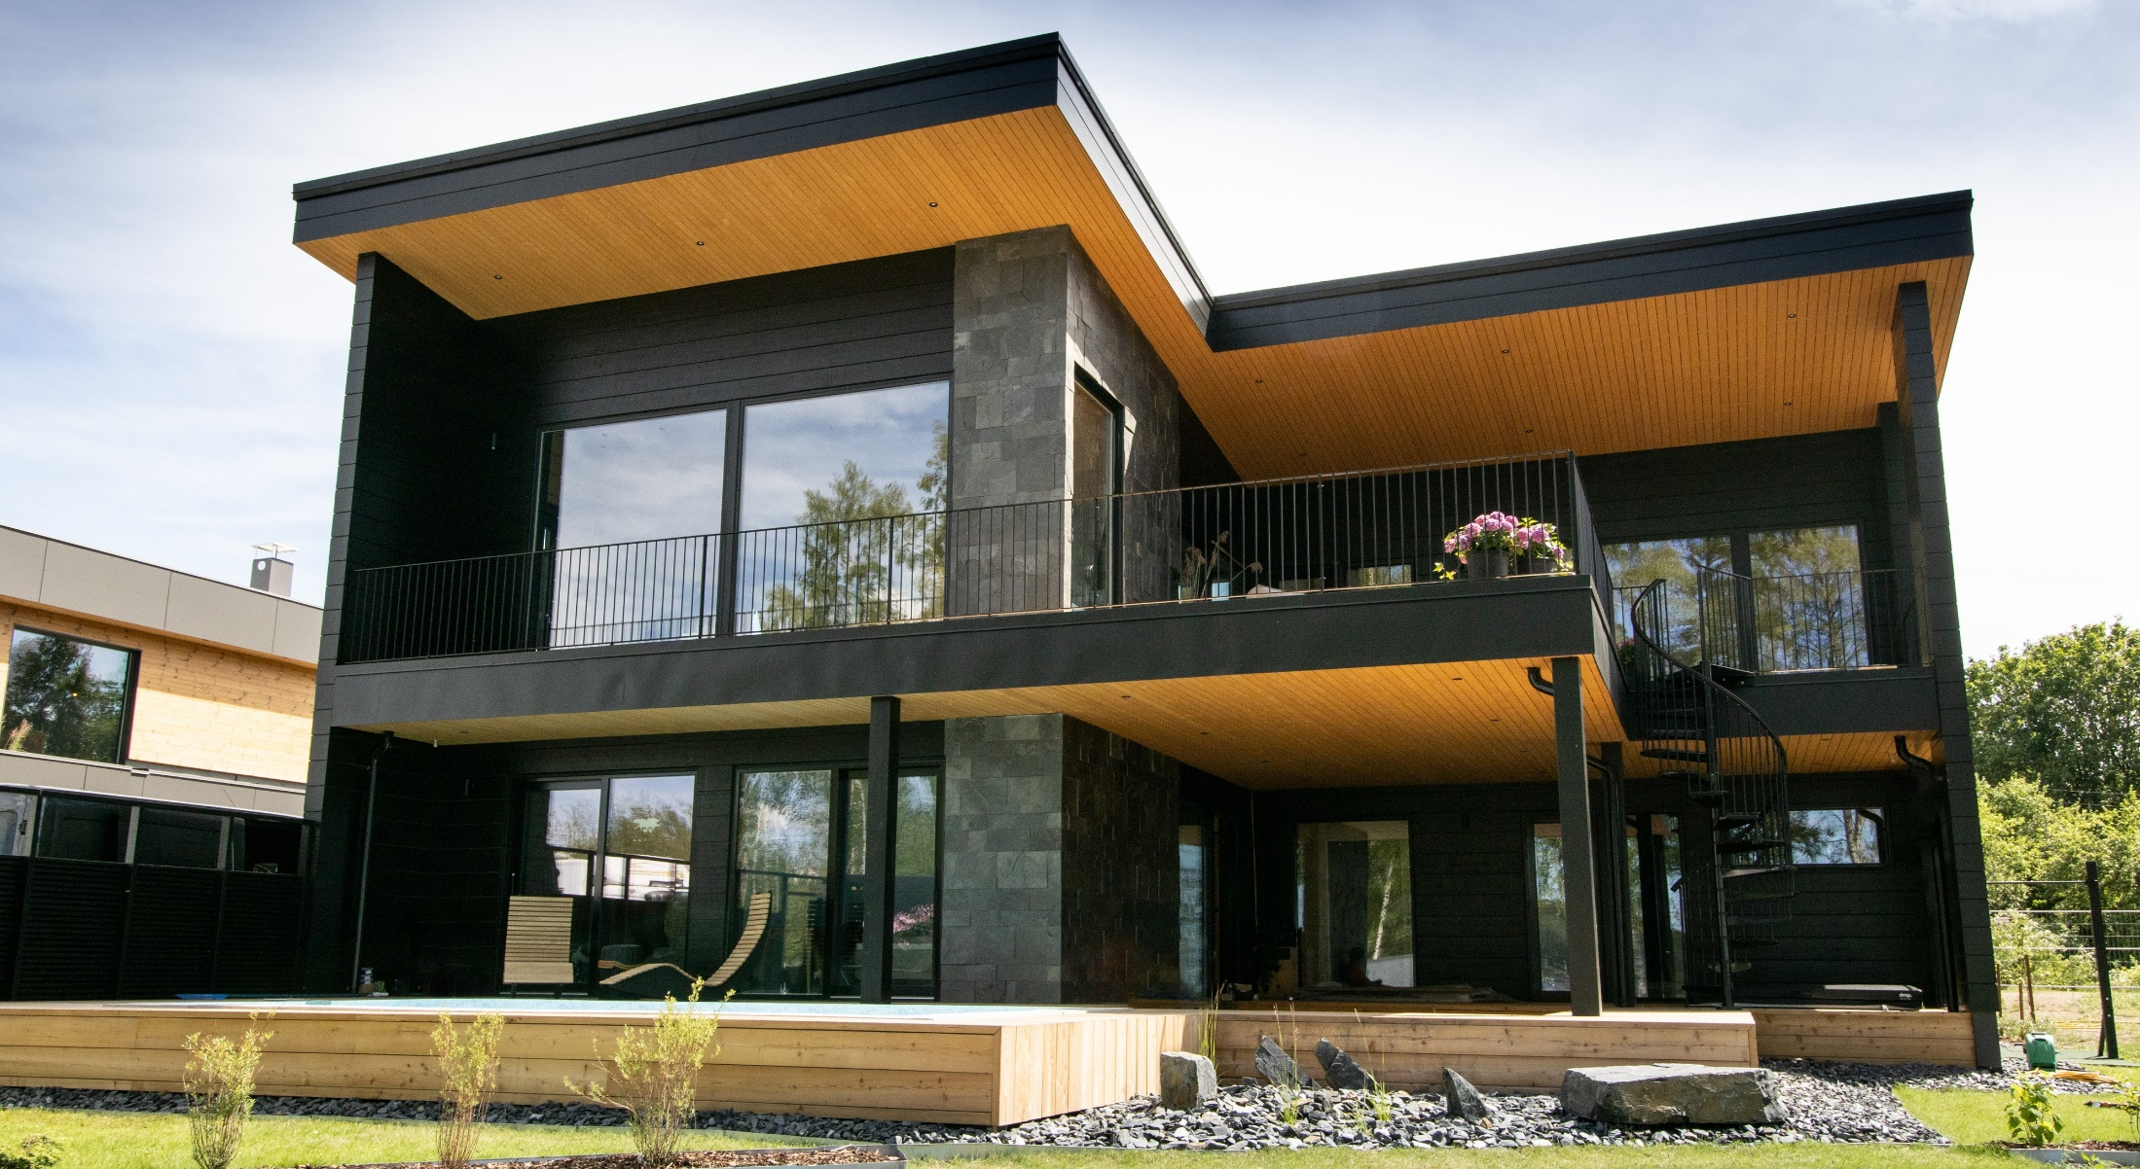
Current state of wood construction, 2021
‹#›
In single-family house construction, wood accounted for 88% of the market by volume
In terraced houses, the market share of wood by volume was 83%
Image: Ollikaisen Hirsirakenne, Housing Fair 2021

Slide 13
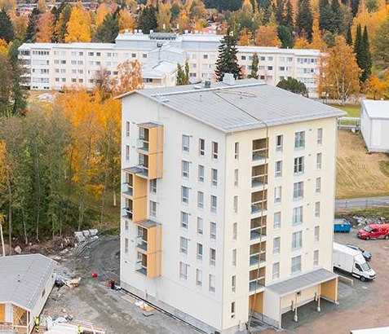
Current state of wood construction, 2021
‹#›
In apartment blocks, wood accounted for 4% of the market share by volume.
In low-rise apartment blocks, the market share of wood by volume was 31%. This counts as a statistical component of apartment block construction.
In dormitories and special needs housing, the market share of wood was 34%.
Image: Julkula wooden apartment block, City of Kuopio

Slide 14
Current state of wood construction, 2021
‹#›
In care buildings, the market share was 15%
In meeting buildings, the market share was 23%
In educational buildings, the market share was 26%
In industrial and warehouse buildings, the market share was 16%
In business, office and transport buildings, the market share was 11%.

Slide 15
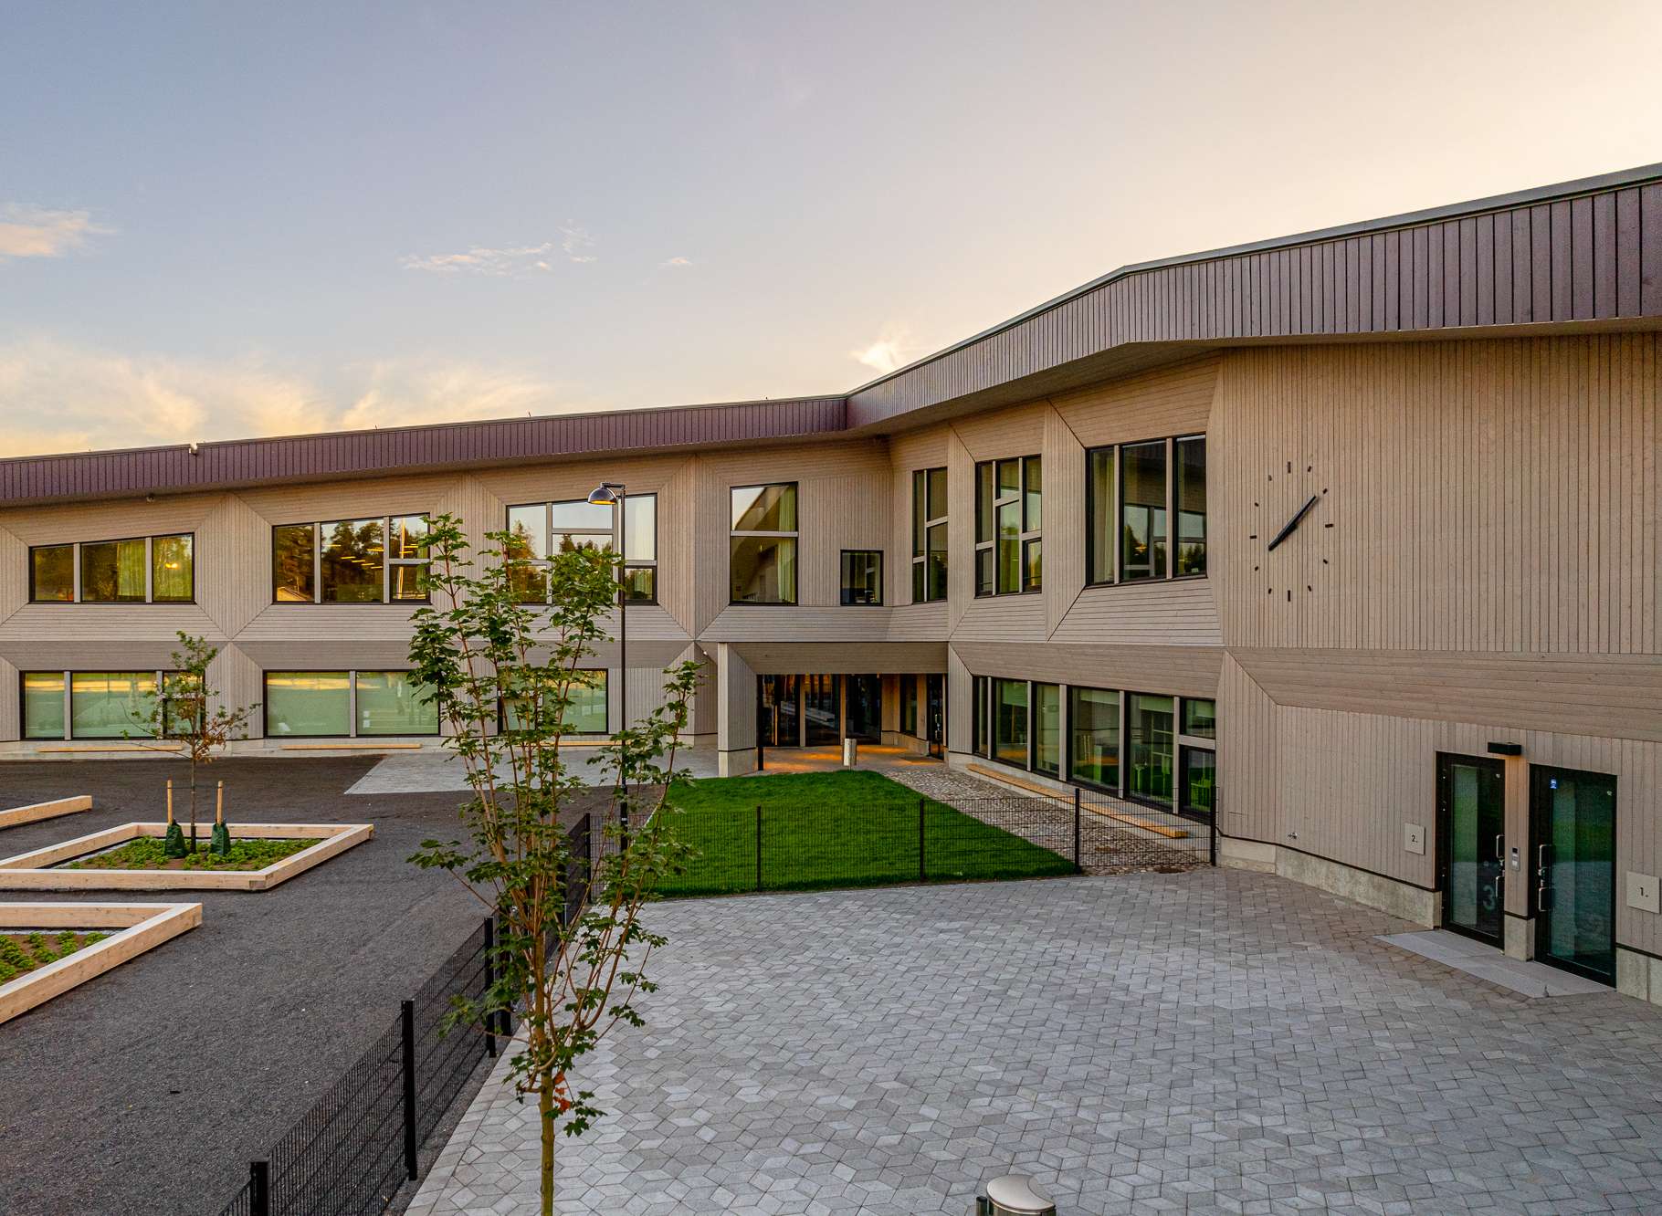
Current state of wood construction, 2021
‹#›
The Finnish-Russian school was completed in 2021
Photo: www.svk-edu.fi

Slide 16
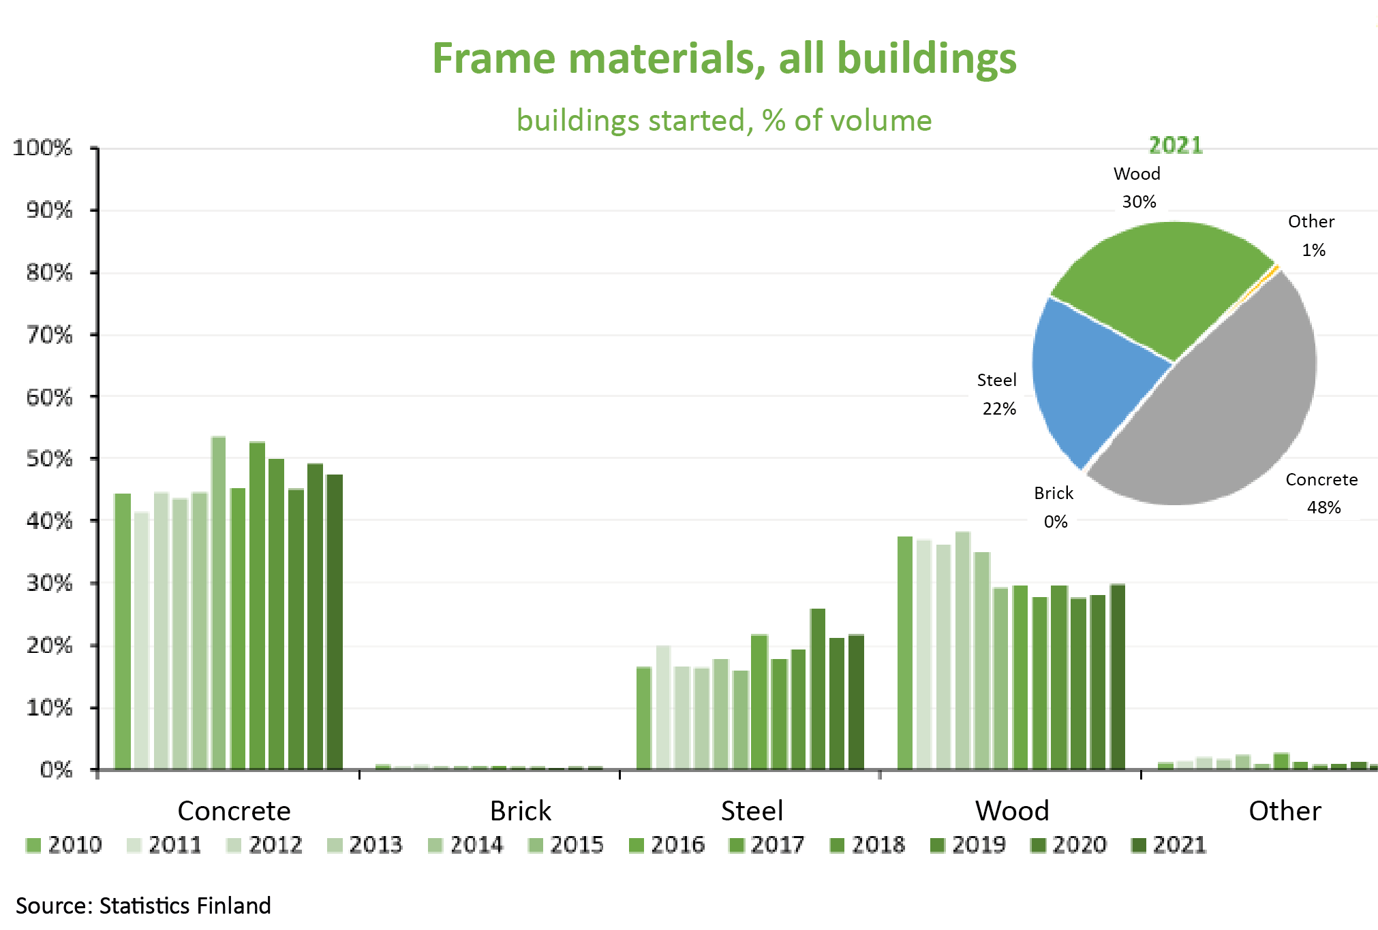
Current state of wood construction, 2021
‹#›
In all construction, the market share of wood was 30%.
Growth from 2020 was two percentage points.

Slide 17
Drivers for wood construction, environmental efficiency
‹#›
Wood construction has two impacts
Wooden buildings act as long-term carbon stores. Carbon present in the atmosphere in the form of carbon dioxide is absent from the atmosphere throughout the lifetime of the product.
Wood construction immediately cuts emissions from construction by 30–40%. The carbon dioxide emissions from manufacturing are significantly lower than those from other construction materials.
Calculating the net emissions impact is a challenge as the calculation is based on many assumptions and agreements – the calculation needs to be improved
The time window chosen is very important for the carbon sink
The forest binds carbon dioxide as it grows. This is not sufficiently taken into account in the calculations if they are carried out in a small area or in the short term.
Doubling wood construction may cut Finland's net emissions in 2035 –1.4 million tons CO₂ equivalent
net emission impact, depending on the type of implementation –1.4 million tons CO₂ equivalent to +0.5 million tons CO₂ equivalent

Slide 18
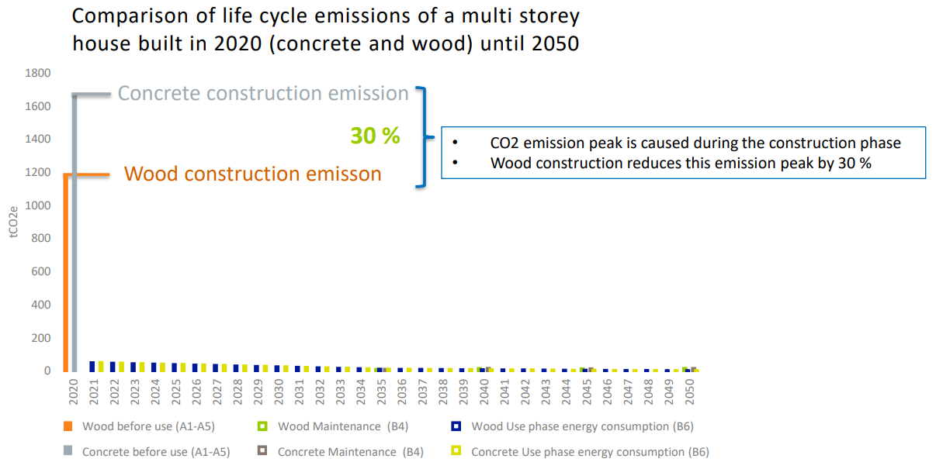
Drivers for wood construction, carbon store
‹#›
In carbon footprint calculations, the significance of energy consumption during use will decrease in the future
The importance of carbon peaks during construction is emphasised

Slide 19
Expected impacts of carbon efficiency on demand
‹#›
Demand for carbon- and eco-efficient investment targets is increasing in general
The financing costs of carbon-efficient construction will be lower than those of traditional construction. For example: Kuntarahoitus’ green bond for green projects.
Investments in the form of a fund and other investors whose objective is not necessarily long-term ownership (ownership of less than 10 years of the investment) will emphasise environmental performance requirements so that the resale value would also be profitable.
Carbon-efficient construction should be considered a priority in land use and land use planning.
Competitive advantage from customers. For example, an RTS certification or a Leed certificate to verify environmental performance.

Slide 20
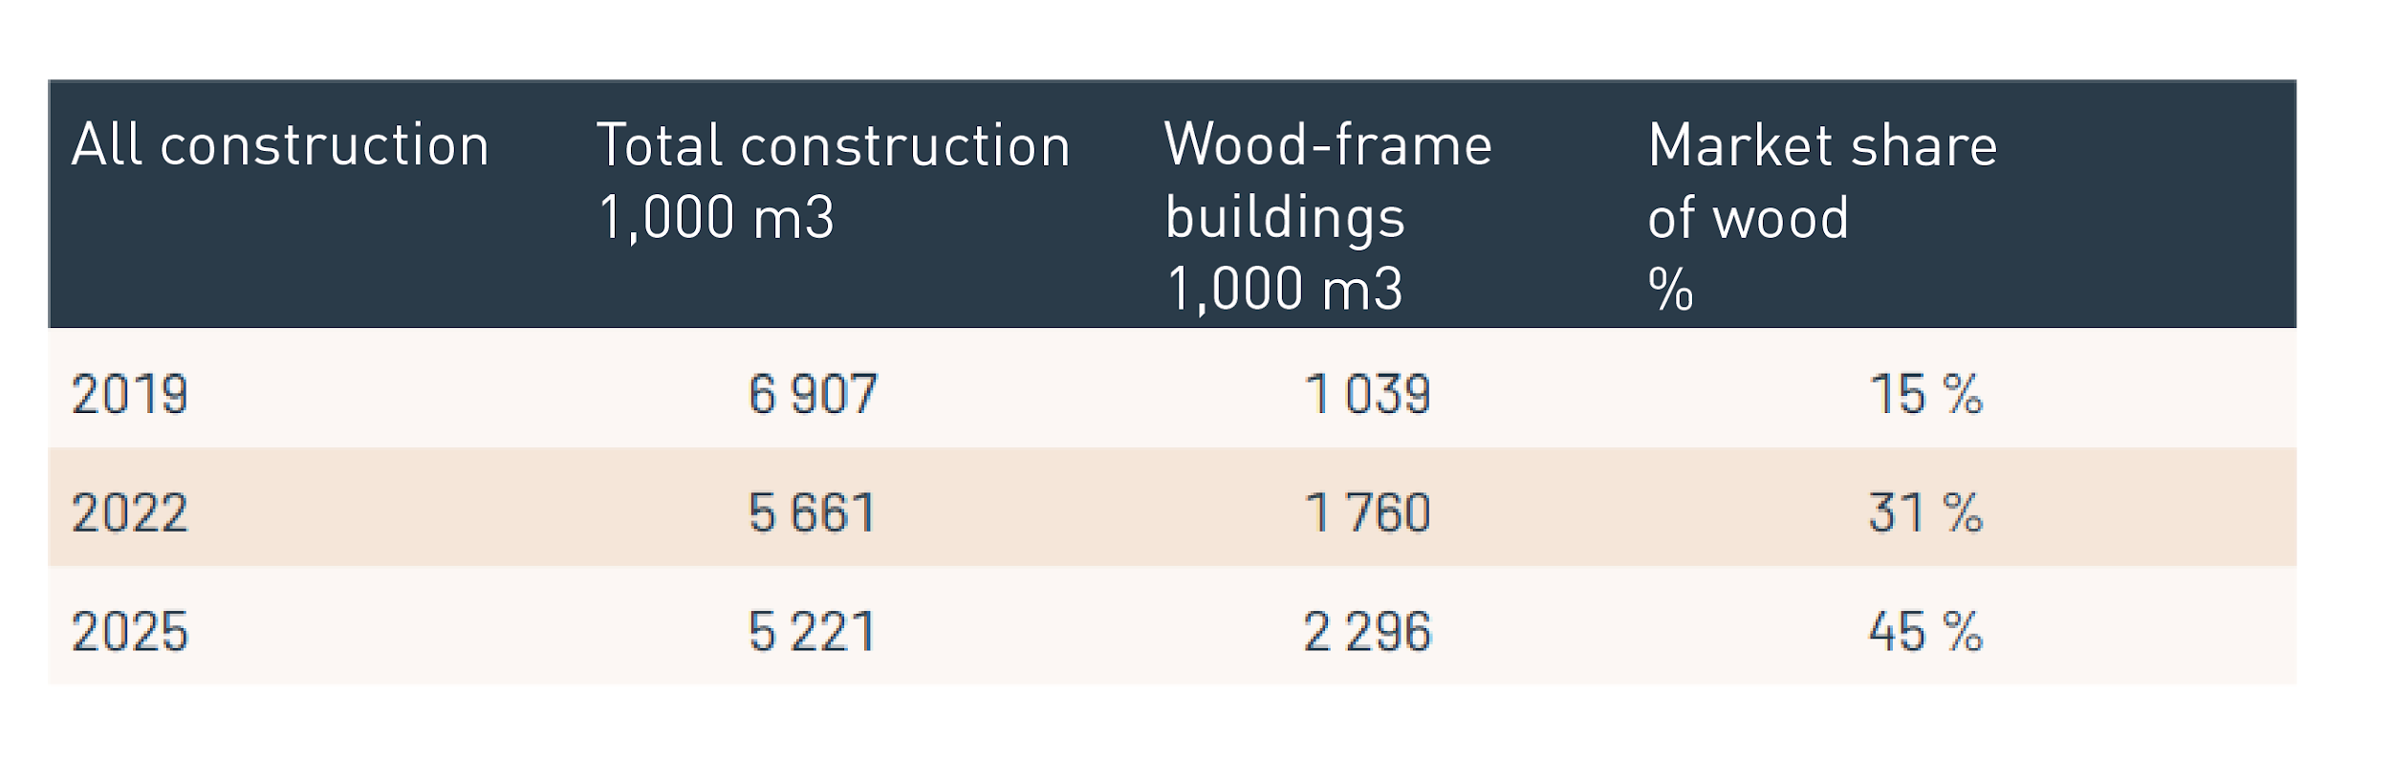
Public objectives of wood construction, Ministry of the Environment
‹#›
The Ministry of the Environment has set national public construction objectives for wood construction.

Slide 21
SUPPLY

Slide 22

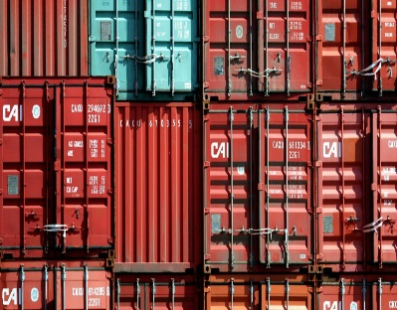

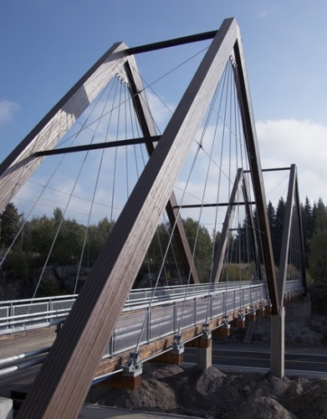
Gross production value
Wood products industry in figures, 2020
‹#›
Export value
3 billion
7.8 billion
Employment
Wood use
28000
30 million m³

Slide 23
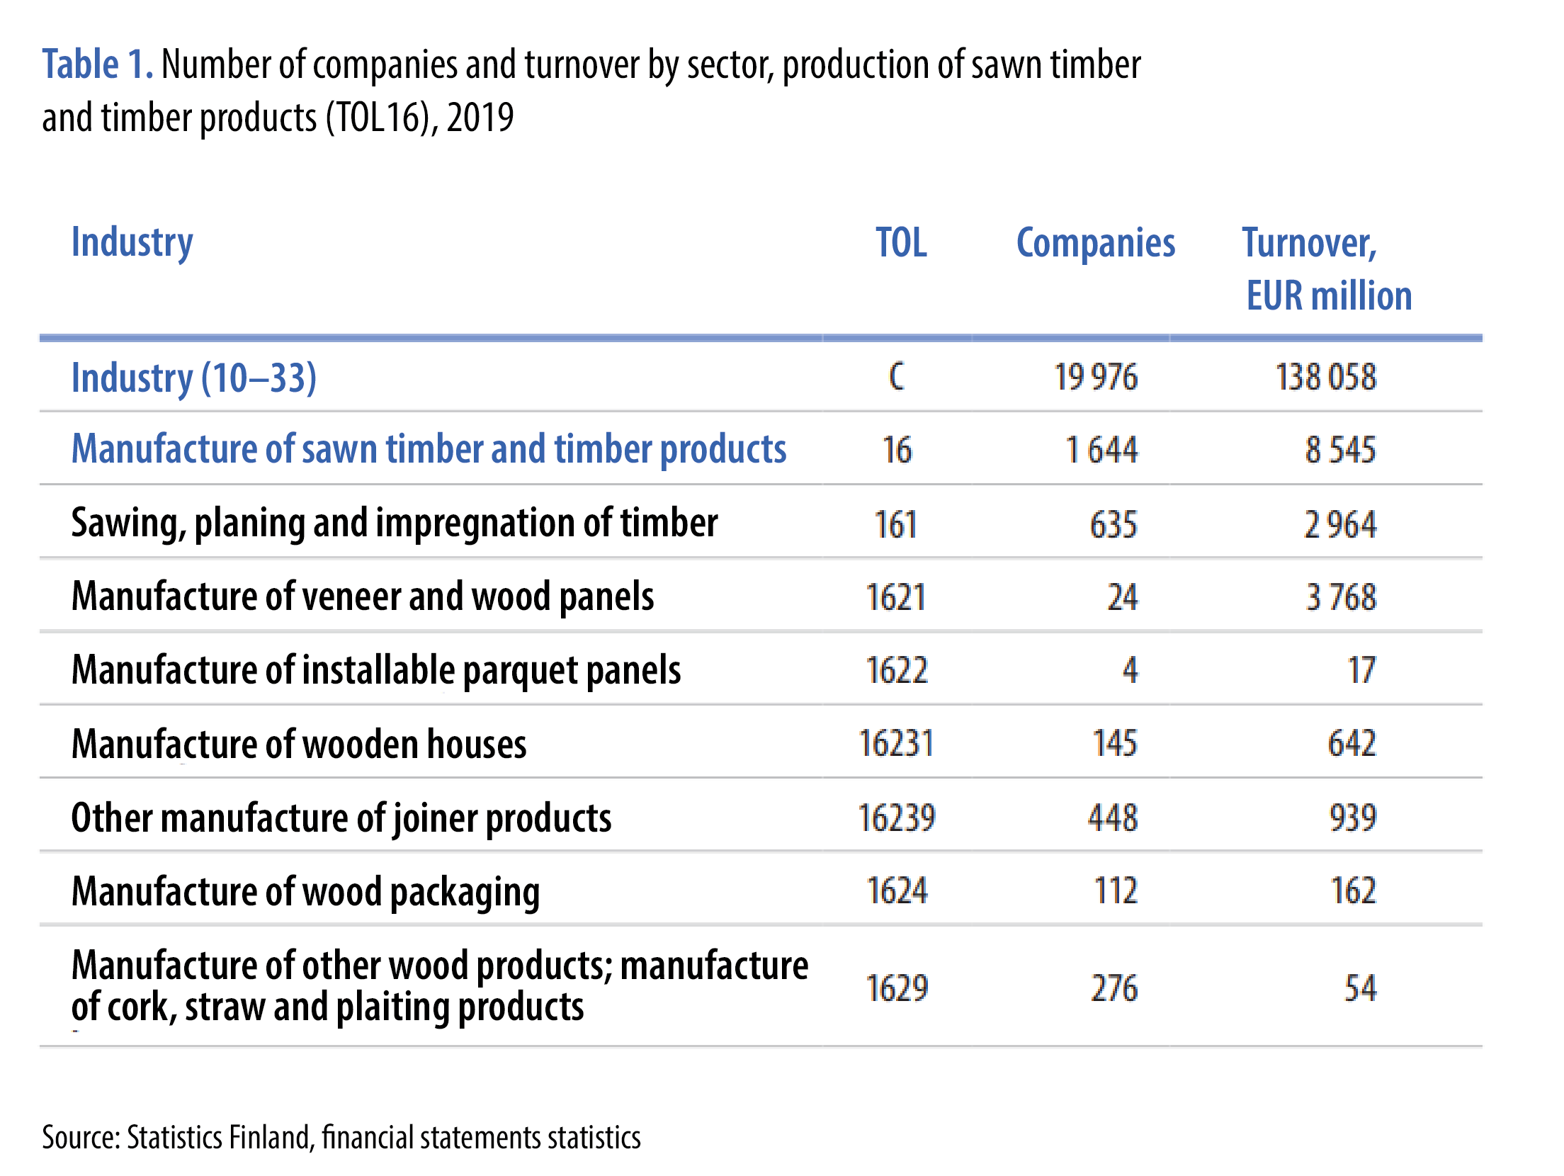
Supply, Finland
‹#›
The wood products industry is consists of very diverse companies.
In 2019, 145 companies were involved in the production of wood buildings

Slide 24
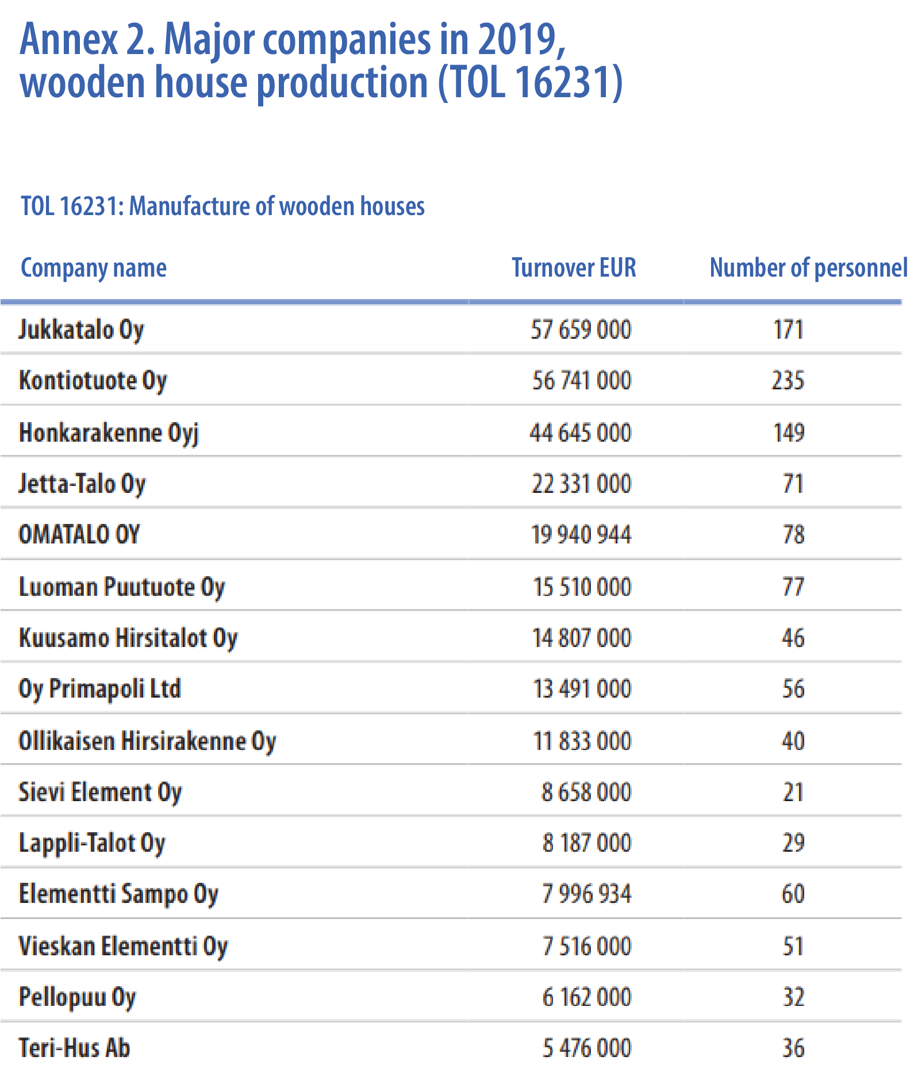
Supply, Finland
‹#›
The largest manufacturers of wood buildings in 2019 were factories making single-family houses
The size of companies is very small, no company has a turnover of more than EUR 100 million

Slide 25
Supply, Finland
‹#›
The TOL classification alone does not give an idea of the value chain of wood construction.
For example, other joiner products have significant wood element operators, such as Lapwall or Woodcomp Oy.
The statistics do not show contractors, developers or other TOL-classified wood builders. For example, Lehto Group Oyj.

Slide 26
Supply, Finland
‹#›
There is great variation between operators and their business models
D&B delivery. For example, JVR-Rakenne Oy.
Timber frame contracting. For example, Puurakentajat Oy.
Production of prefabricated box units. For example, Elementti Sampo Oy.
Production of panelised units. For example, VVR Wood Oy.
Contractors. For example, the Skanska and BoKlok concept.

Slide 27
Supply, other resources
‹#›
Designers
The FISE Certification Service has approximately 100 timber frame designers (2021). Approximately 700 designers are qualified in concrete structures.
https://www.patevyyspalvelu.fi/registry
Foreign wood construction operators can be found in several Baltic countries and Sweden
For example, Harmet, Kodumaja, Timbeco, Matek or Lindbäcks

Slide 28
In a nutshell
‹#›
Wood construction has increased in 2021
There is great demand for wood construction and it is expected to grow
The largest area of wood construction in terms of volume is single-family house construction
The supply of wood construction is diverse and there are no single type of operators
On average, the operators are of small size

Slide 29
H5 Weekly exercise Wood construction market
‹#›
Open the sector report published by the Ministry of Economic Affairs and Employment: https://julkaisut.valtioneuvosto.fi/bitstream/handle/10024/163027/TEM_2021_3.pdf?sequence=1&isAllowed=y
Select three operators in the wood sector from the report and find the following information:
References
Product or service they provide
Explain in free form what other operators you would need for your apartment block project, other than the ones you have already selected, in order to be able to have the building constructed.
What aspects of these operators did you pay attention to as a client? What were the positive aspects and what were the negative?

