Slide 1



Industrial wood construction
Teaching materials for industrial wood construction education
2022

Slide 2
Origin of the materials
Use of the materials
These learning materials for industrial wood construction have been prepared in a project led by Puuinfo Oy in 2021–2022. Also involved in the project were
Lappia Vocational College,
TTS-Työtehoseura ry
South-Eastern Finland University of Applied Sciences,
Metropolia University of Applied Sciences,
Jyväskylä University of Applied Sciences,
University of Tampere, and
Federation of the Finnish Woodworking Industries Puutuoteteollisuus ry
The project was funded by the Ministry of the Environment.
The materials are intended to be used as extensively as possible in industrial wood construction education and studies.
The materials are released under the Creative Commons licence Attribution-ShareAlike (CC BY-SA), which requires that the author be properly credited when the materials are used and that derivative works may only be distributed under the same licence as the original work.
The original materials and any updates to them by Puuinfo will be published on the Library of Open Educational Resources website (aoe.fi) and the Puuinfo.fi website.

Slide 3

Construction economy and project management

Slide 4
Authors
Sauli Ylinen, Federation of the Finnish Woodworking Industries Puutuoteteollisuus ry
Release date: 29/05/2022

Slide 5
Construction economy and project management
‹#›
After completing the Construction economy and project management module, the student will
Know the various operators and tasks involved in a construction project
Know the main stages of a construction project
Know the business models of key developers
Know the most important model contracts in construction
Know the most important project management tasks in a construction project
Know the main features of the wood construction market
Know the special features of a wooden house building project
🡪The course prepares the student for more advanced wood construction project development and project management studies

Slide 6
Contents
Contents
Five lectures
Five weekly exercises
Course project
Practising preparing a project plan for a block of flats construction project
The course materials focus on the special features of wood construction – not all terms and basic concepts are extensively discussed in these materials
The course materials use as examples two wooden blocks of flats implemented by TOAS Sr: the TOAS Kauppi and the TOAS Lumipuu. You can visit the project sites at:
- Toas Kauppi, Kuntokatu 11 a, FI-33520 Tampere, FINLAND
- Toas Lumipuu, Makkarajärvenkatu 74, FI-33720 Tampere, FINLAND

Slide 7
Development activities and the added value of wood construction

Slide 8
Development activities and added value of wood construction
‹#›
The lecture discusses investment activities from the perspective of wood construction
The lecture discusses investment activities in general, from the perspective of wood construction
The lecture discusses what added value wood construction can produce for the buyer apart from that indicated in the profitability calculation, and how it could be measured

Slide 9
Added value for client
‹#›
In a construction project, financial profitability in euros is always a goal
The target level depends on the buyer. A real estate investor might optimise the net present value, while an affordable rental housing operator would primarily be interested in safeguarding the affordable rent level of their clients, which is achieved at a specific construction cost
In addition to the euro-denominated targets, the buyers often have other objectives, including:
Putting the values and vision of their organisation's strategy into practice
Meeting the objectives set by society
Competence development, product development, or other development objectives
Environmental objectives
Quality improvement for end-users
Life cycle cost optimisation
Post-construction risk management and efficient maintenance

Slide 10
Indicators for determining added value
‹#›
Environmental performance can be measured with third-party certifications or other widely used indicators
Examples: energy efficiency class, RTS score, Leed certification
External audits and certifications can be used to demonstrate the quality of the operations and production
Examples: ISO-9001 or national verification certificate
Target values can be demonstrated through calculations, or numerical targets can be set for the project
Examples: limitations for the carbon footprint or carbon handprint
Acoustic performance of a structure exceeding regulatory requirements
The project must be completed by a certain date (target).

Slide 11
Qualitative values
‹#›
Not all values are measurable, but they can still be used to justify the selection of solutions or implementation methods
Benefits of wood construction that are difficult to measure
Experience of softer acoustics
Experience of better indoor air
Architectural options, e.g. uncovered surfaces
Promoting the development of the productivity and quality of construction by ordering projects
Job creation in the value chain also outside growth centres
Smaller disturbance to the neighbourhood during construction

Slide 12
Development management
‹#›
Development activities must be managed in the same way as all other activities
There have traditionally been two approaches to development management
Having a separate development unit and development functions
Advantages include clear resourcing and the opportunity to focus on development activities
Challenges include putting solutions into practice
Using continuous improvement tools as part of the overall management system – no separate development unit
Advantages include development based on genuine customer needs and real problems
Results are applied immediately
Challenges include the allocation of resources and the formation of an overall picture – what is development and what is normal project work?

Slide 13
Product development and its management in wood construction
‹#›
In this presentation, development activities in wood construction are divided into three categories
Business-level development activities, such as productisation and investments
Project-level development activities. Implementing innovations in projects across organisational boundaries. For example, collaborative agreements aim to utilise this
National or sectoral development activities. For example, productivity leap projects in wood product industry.
There is a significant number of external funding sources for development activities in wood construction
Examples include Business Finland, ELY Centres, foundations, Ministry of the Environment, Finnvera, the EU

Slide 14
Business-level development activities
‹#›
Business-level development can be roughly divided into
Business development
Development of customer service and solutions
Contract and agreement models, revenue model
Partnerships, networks
Sales and marketing
Technical development
Products and standardisation
Production development
Procurement development
Design development
Other development
Personnel competence development and training
Corporate governance

Slide 15
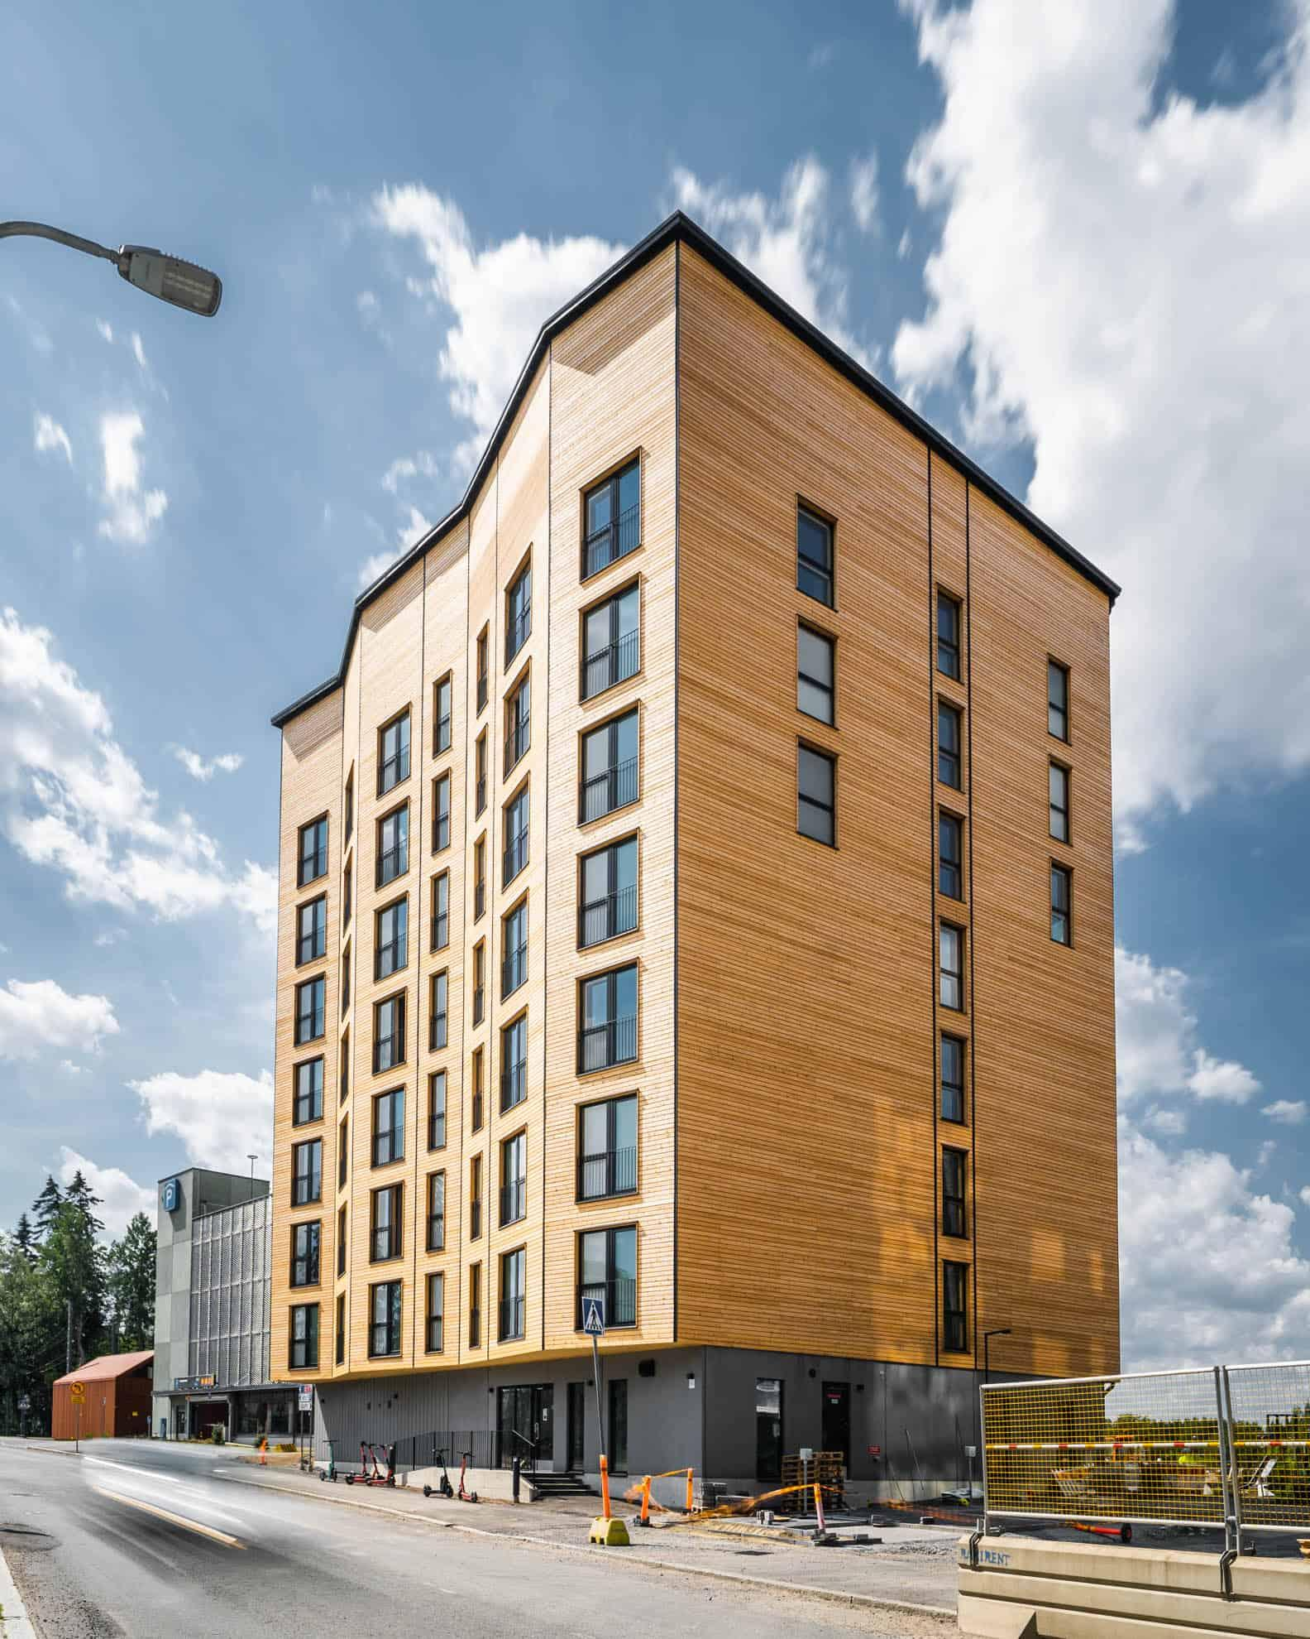
Case study - Kauppi
‹#›
The building is located in a helicopter noise zone
No type of structure against such noise existed
Project management identified the need and consulted an acoustician
The alternatives suggested by the acoustician were review at a workshop
The buyer and the subassembly supplier prepared a feasibility and cost analysis for the different alternatives
The implementation method that met regulatory requirements was selected

Slide 16
Investments as part of business-level development activities
‹#›
Investments aim to increase volume, reduce costs, improve security of supply, or otherwise create value for the company
Investments are strategic decisions for the company
Investments always have a cost and a payback period – hence, the willingness to improve production or sales is not sufficient grounds for making the decision to invest
The investment plan prioritises the implementation of different development areas and examines the profitability of the development projects
Investments in production are not the only investment type. For prefabricated unit manufacturers, investments also include product development, participation in large project development projects (sales investment), and staff recruitment
In addition to direct costs, the value of working capital, collaterals, and other indirect costs must be taken into account in all investments.
For example, in a prefabrication factory, the following aspects need to be taken into account:
Machinery required by the investment
Production facilities
Increase in inventory values with higher production volumes
Recruitment and/or training of staff
Additional needs for infrastructure, e.g. increased storage space
Client demand

Slide 17
Project and national level development
‹#›
Parties engaged in development activities at a national level include
Ministry of the Environment at the legislative level
Advocacy groups and other associations
E.g. Federation of the Finnish Woodworking Industries Puutuoteteollisuus ry, Finnish Association of Civil Engineers RIL
Research institutes and educational institutes
E.g. universities and universities of applied sciences
At the project level, development work is usually needs-based, for example:
A new solution is needed because of the property
The buyer has set a target for the project that must be met

Slide 18
Management of external resources
‹#›
Businesses do not have to do everything themselves – nor should they.
What is done in-house and what is outsourced is a strategic decision
Businesses cannot acquire all the expertise they need into their organisation
Resources can be purchased from subcontractors (e.g. design services), while taking capacity and risk management aspects into account
External resource management is more difficult than internal resource management
Management must be allocated sufficient resources
Transparency is lower towards an external operator
Particular attention should be paid to the utilisation of external expertise– how can we gain benefits?

Slide 19
In a nutshell
‹#›
In addition to the euros, other value created should also be measured as far as possible
Other values should also be taken into consideration, even if they can't always be measured
Operational development can be divided into separate development activities and continuous improvement
Operational development is carried out at the business, project, and national levels
When development is carried out with the help of external resources, particular attention should be paid on management and planning

Slide 20
H4 Weekly exercise, development activities and added value
‹#›
You have developed a new intermediate floor solution (or some other new product) for a block of flats constructed with prefabricated panels
What is the added value created by your new solution? (€, time, quality, other?)
How will you prove the technical feasibility of your solution?
How will you prove that there will be demand for your solution?
Create a SWOT analysis for your product

