Slide 1



Industrial wood construction
Teaching materials for industrial wood construction education
2022

Slide 2
Origin of the materials
Use of the materials
These learning materials for industrial wood construction have been prepared in a project led by Puuinfo Oy in 2021–2022. Also involved in the project were
Lappia Vocational College,
TTS-Työtehoseura ry
South-Eastern Finland University of Applied Sciences,
Metropolia University of Applied Sciences,
Jyväskylä University of Applied Sciences,
University of Tampere, and
Federation of the Finnish Woodworking Industries Puutuoteteollisuus ry
The project was funded by the Ministry of the Environment.
The materials are intended to be used as extensively as possible in industrial wood construction education and studies.
The materials are released under the Creative Commons licence Attribution-ShareAlike (CC BY-SA), which requires that the author be properly credited when the materials are used and that derivative works may only be distributed under the same licence as the original work.
The original materials and any updates to them by Puuinfo will be published on the Library of Open Educational Resources website (aoe.fi) and the Puuinfo.fi website.

Slide 3

Construction economy and project management

Slide 4
Authors
Sauli Ylinen, Federation of the Finnish Woodworking Industries Puutuoteteollisuus ry
Release date: 29/05/2022

Slide 5
Construction economy and project management
‹#›
After completing the Construction economy and project management module, the student will
Know the various operators and tasks involved in a construction project
Know the main stages of a construction project
Know the business models of key developers
Know the most important model contracts in construction
Know the most important project management tasks in a construction project
Know the main features of the wood construction market
Know the special features of a wooden house building project
🡪The course prepares the student for more advanced wood construction project development and project management studies

Slide 6
Contents
Contents
Five lectures
Five weekly exercises
Course project
Practising preparing a project plan for an apartment block construction project
The course materials focus on the special features of wood construction – not all terms and basic concepts are extensively discussed in these materials
The course materials use as examples two wooden apartment blocks implemented by TOAS Sr: the TOAS Kauppi and the TOAS Lumipuu. You can visit the project sites at:
- Toas Kauppi, Kuntokatu 11 a, FI-33520 Tampere, FINLAND
- Toas Lumipuu, Makkarajärvenkatu 74, FI-33720 Tampere, FINLAND

Slide 7
Project development and law

Slide 8
Project development and law
In this lecture you will:
Learn about the impact of the construction regulations framework on wood construction
Learn the principles of land use planning and land acquisition
Get to know different developers and project models
Learn about the parties involved in a construction project and the most important roles in the project
Get to know the different legal ways of carrying out a construction project
Become familiar with the most commonly used contract templates
Learn to assess the risks and opportunities included in different contract models
Learn to recognise the specificities of wood construction in relation to project development and legal issues

Slide 9
Construction regulations for wood construction
Wood construction is governed by the same legislation as other construction. The following should be understood regardless of the material.
Different levels of regulations and recommendations
European legal framework
MRL – Land Use and Building Act and The National Building Code of Finland
Decrees and guidelines of the Ministry of the Environment and various explanatory memorandums
Other laws, such as the Housing Trade Act, the Sale of Goods Act or the Act on the Energy Certificate for Buildings
Planning monopoly and different levels of planning
Practices of building supervision authorities – e.g. top-ten cards
Land transfer terms and other separate agreements
Standards – e.g. the SFS-EN system
Self-monitoring and industry practices, e.g. RT cards or the FISE system
Legal practice

Slide 10
Construction regulations – excerpts related to wood construction
Product verification – CE, ETA, Verification certificate, site-specific approval?
For example, there is no valid harmonised product standard for CLT
No valid harmonised product standard for prefabricated box units
Nationally, products can apply for Ministry of Environment's Verification certificate: https://ym.fi/en/verification-certificate
For new products or products that have not been type-approved, qualification can be demonstrated by site-specific approval.
Not the primary means
Responsibility for demonstrating qualification always rests with the project promoter
To be applied for and approved for each site separately
The decision on approval is always made by the building supervision authority

Slide 11
Construction regulations – excerpts related to wood construction
Planning and other municipal issues
The municipality may require the local detailed plan to include wood construction if it wishes
According to the SAC:2012:56 decision, this can be done
https://www.kho.fi/fi/index/paatokset/vuosikirjapaatokset/1428403349476.html
Infrastructure:
Sprinkling is required in many wood building sites. This places demands on the water supply system, e.g. in terms of pressure and backup.
The local detailed plan may specify a number of factors that affect the implementation method to be chosen
Provisions on the implementation of the façade, e.g. whether the seam of a prefabricated unit can be visible
Frame depths and placement of masses on the plot
Parking solutions
Storey heights and the number of storeys
Roof shapes, façade design, balconies (e.g. the requirement for retracted balconies)
Noise and vibration requirements on the plot
Designing and planning
The number of designers already qualified is low in relation to traditional building methods
For example: Approximately 700 concrete structure designers in FISE, approx. 100 wood structure designers (https://www.patevyyspalvelu.fi/registry)

Slide 12
Construction regulations – excerpts related to wood construction
Optimum frame construction and regulations
The regulations are one factor influencing which frame solution and implementation method can and should be chosen
For example, fire codes allow different combinations for the number of visible surfaces or the use of sprinklers
Functional fire dimensioning can be used to indicate design solutions that differ from the table on a site-by-site basis
A good tool for early stage mapping is Puuinfo's Epuu service
https://epuu.fi/

Slide 13
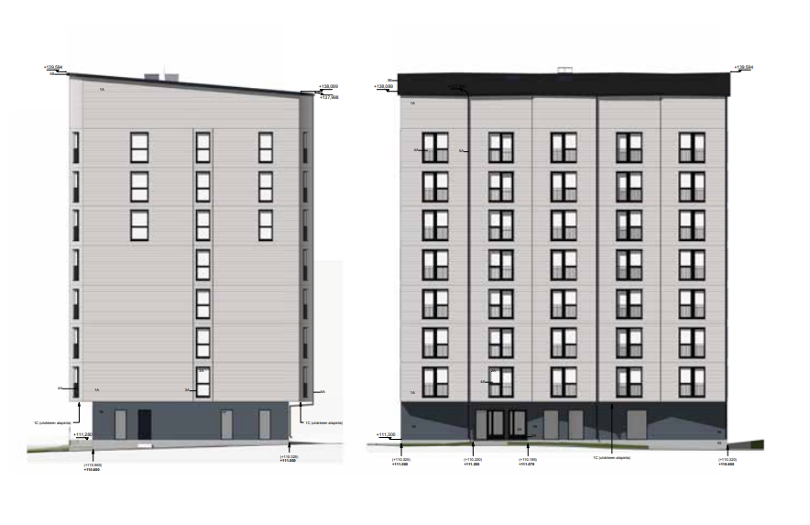
Example of applying regulations – Case Kauppi
Selected implementation method is prefabricated CLT units
Eight storeys
Fire resistance rating P2
The regulations allow for a 20% rule that allows 20% of the load-bearing surfaces of apartments to be left as exposed wood
The ceilings of the apartments were left exposed, showcasing the CLT surface
The target is located in the helicopter noise zone
Requirement for higher sound insulation in the façade
Acoustician's report and solution for improving the sound insulation of the façade compared to the standard structure
Functional dimensioning was utilised in stair wells

Slide 14
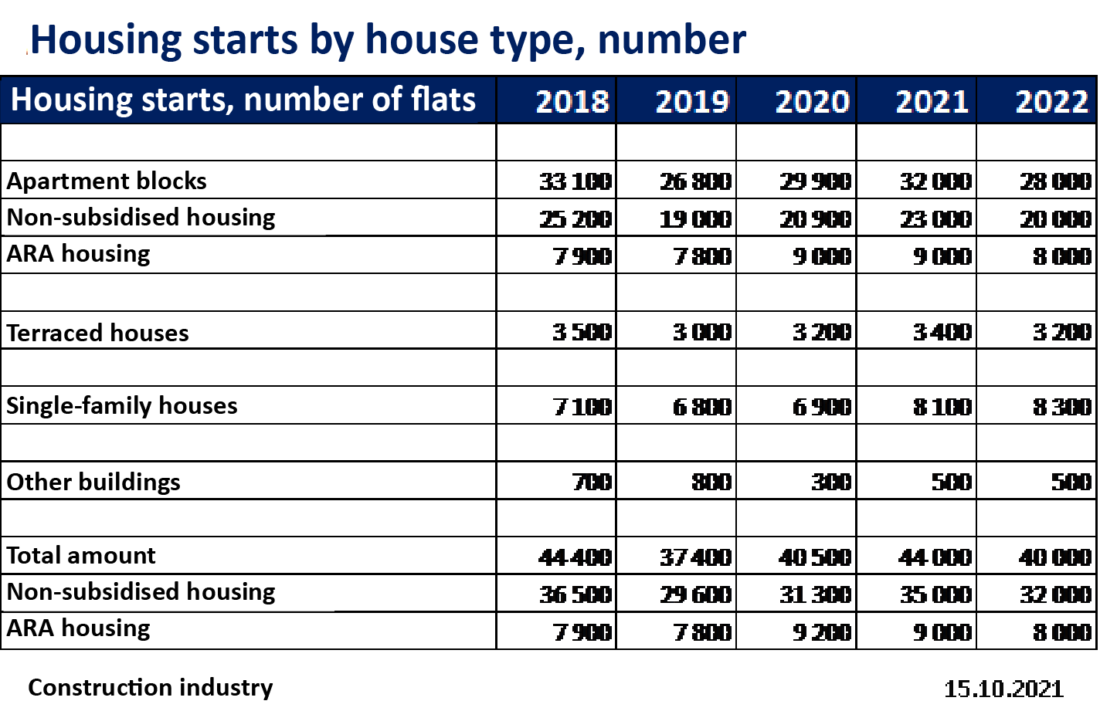
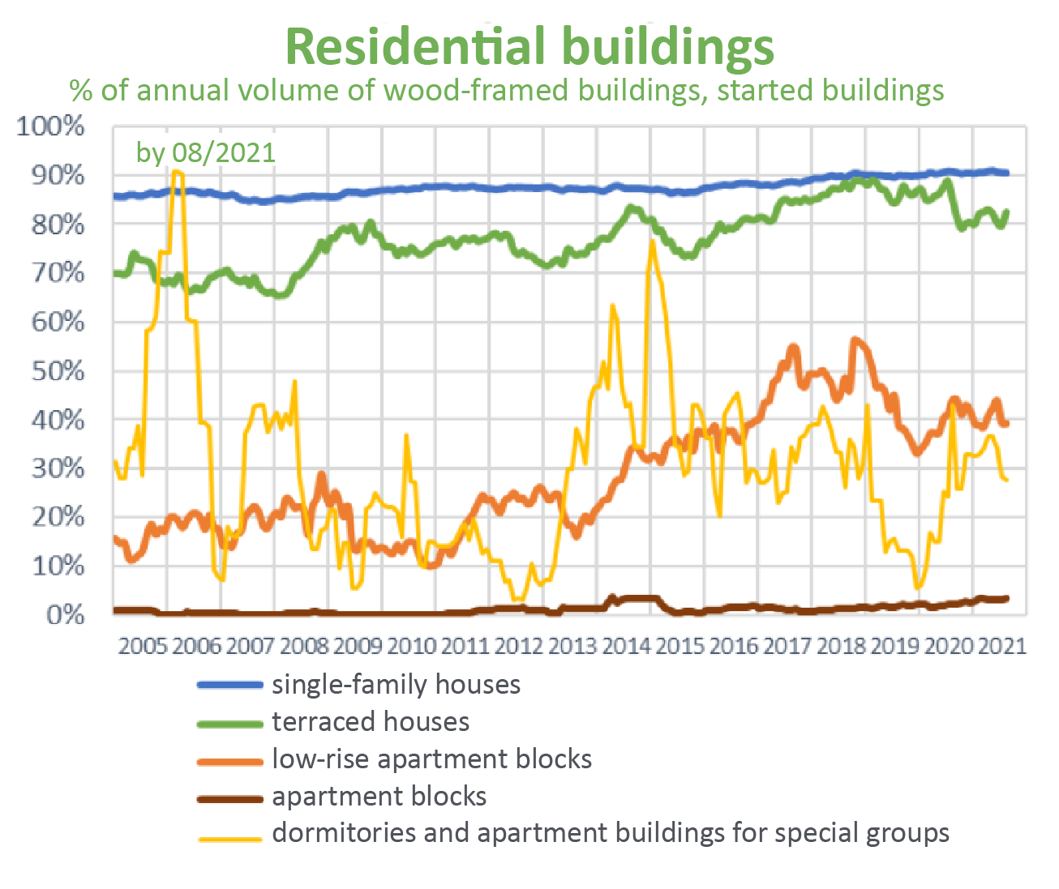
Different customers and project funding
Approximately 40,000 apartments are built in Finland every year
Currently, about 20% of these are ARA-subsidised.
Non-subsidised properties are divided into rental housing owned by real estate investors and owner-occupied housing
Different customers have different business and financing models
Different contractual forms for different customers
Main groups are further divided into different subgroups

Slide 15
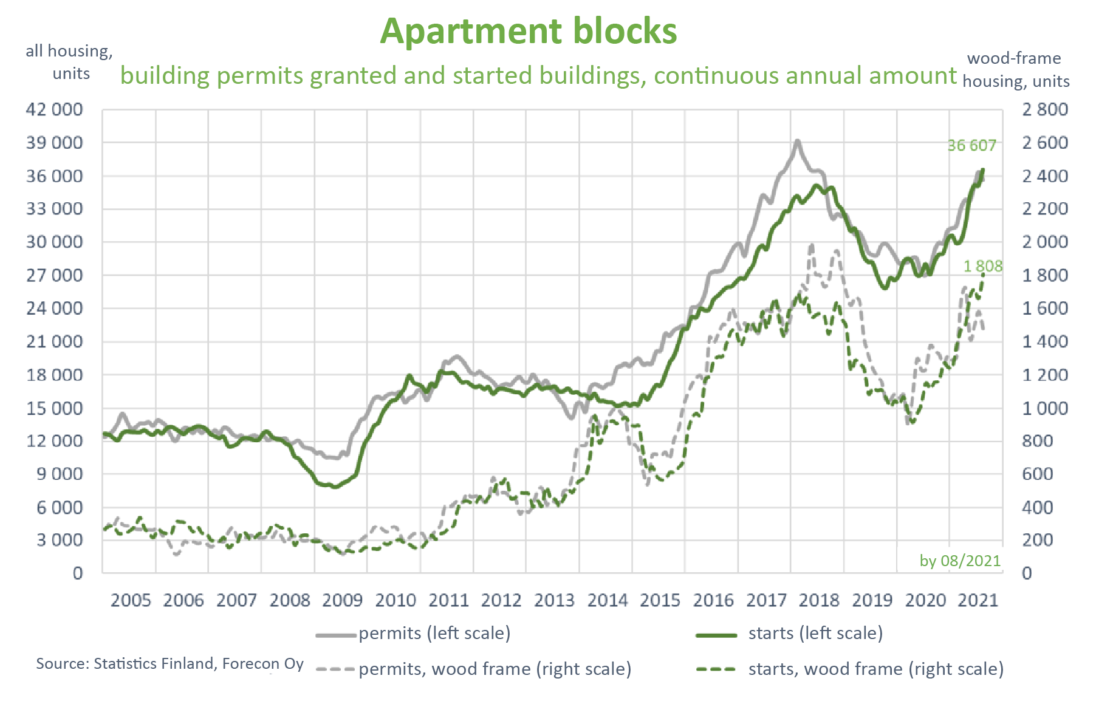
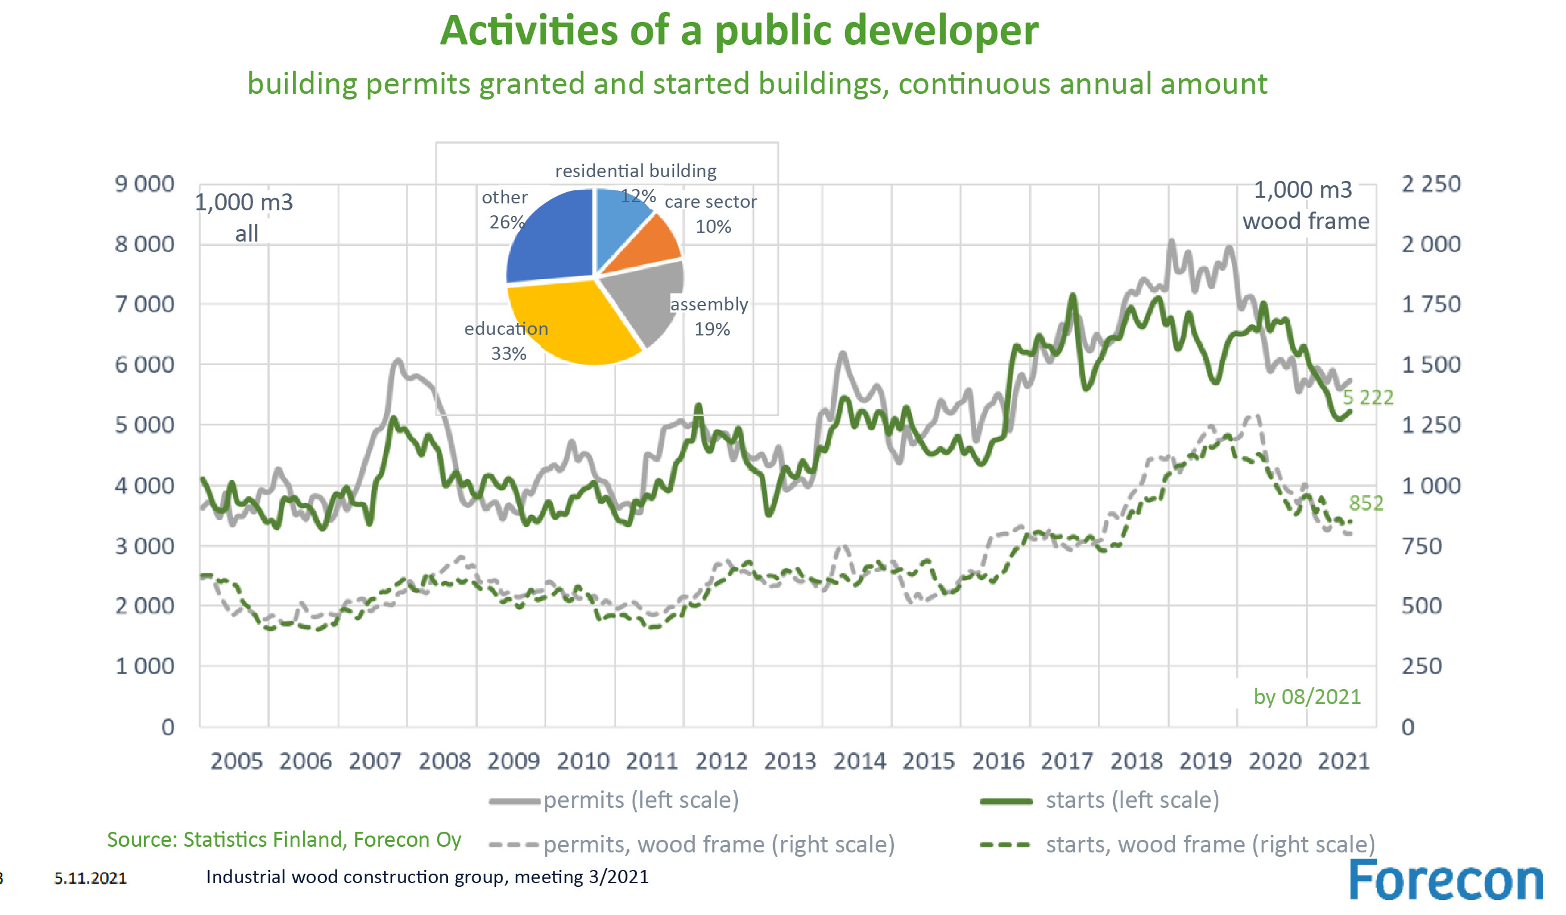
Different customers and project funding

Slide 16
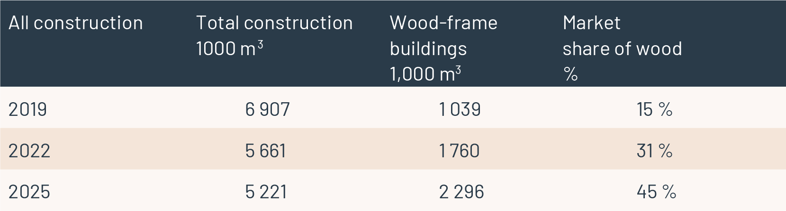
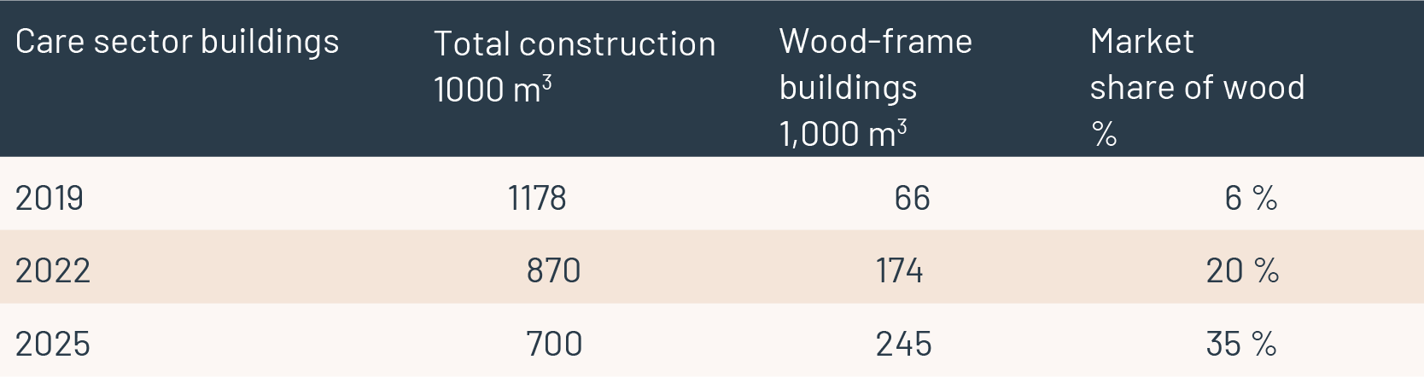
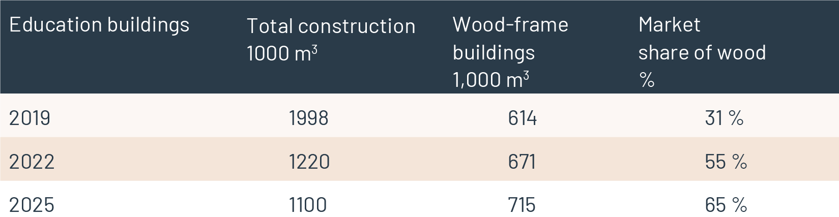
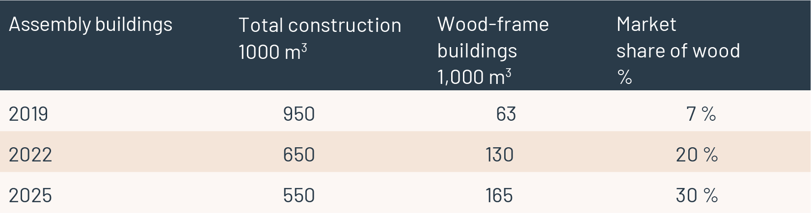
Ministry of the Environment's national objectives for wood construction
Below are the Ministry of the Environment's national objectives of wood construction
Julkisen-puurakentamisen-kansalliset-tavoitteet-45F5028E_8436_408A_8CD7_510C6C1AD000-161609.pdf (ym.fi)

Slide 17
General principles of the Act on Public Contracts*
The Act on Public Contracts must be applied to construction projects implemented by contracting entities. These include state, municipal and joint municipal authorities, state enterprises and public-law institutions and institutions governed by public law, and other comparable operators.
Key principles of public procurement:
Fairness
For example, all potential bidders must be given the same competitive information throughout the process
Non-discrimination
For example, local requirements cannot be imposed and operators from all over the world must have a real ability to participate in the competition.
Transparency
For example, opening up the criteria for comparing tenders to all
Proportionality
The requirements presented must be reasonable. This has been applied, for example, so that too high turnover requirements may not be placed in competitive tendering.
The Act on Public Procurement and Concession Contracts does not therefore preclude the submission of claims, as long as they comply with the spirit and principles of the Act. 🡪 A wooden building can be tendered if these principles are followed
The Act on Public Procurement and Concession Contracts does not apply to research and development services. This may in some cases be relevant when implementing innovative new solutions
* Procurement Act = Act on Public Procurement and Concession Contracts (www.finlex.fi/fi/laki/ajantasa/2016/20161397)

Slide 18
Methods enabled by the Act on Public Procurement and Concession Contracts to require and promote wood construction in public activities
Land use planning
Wood construction can be specified in the local detailed plan and local detailed plan regulations for façades as well as in the building structure (SAC Record No. 2337/1/13)
Land transfer
Conditions may be imposed on the transfer concerning low-carbon construction or wood construction
Tendering for procurement
A requirement to use wood may be included in the contract notice as a minimum requirement for a tender.
Reference and experience in wood construction as a requirement
In quality scoring, e.g. the amount of visible wood surface or the carbon footprint of the building is taken into account
Life cycle and externalities are taken into account when comparing overall cost-effectiveness
Other rebates
The developer may be granted a permit for minor deviations from the planning regulations, for example, in regards to façade and floor area
The developer can be granted discounts on land use fees or land rents

Slide 19
Objectives of public procurement units
Public operators may have many other objectives than the primary function and price of the target (e.g. building a school for children in the most affordable way)
Various climate, indoor air and sustainability objectives and other strategic objectives set by society
Business development, for example by implementing pilot projects
Supporting other strategic objectives of the procurement unit
Wood construction also affects other than the construction of the site itself
Funding for green sites may be cheaper; for example green funding in municipal funding
Development of new competence, performance and industry
Produce jobs, often in industrial construction outside growth centres
Self-sufficiency and security of supply
The obligations laid down in the Act on Public Procurement and Concession Contracts must be fulfilled regardless of other objectives

Slide 20
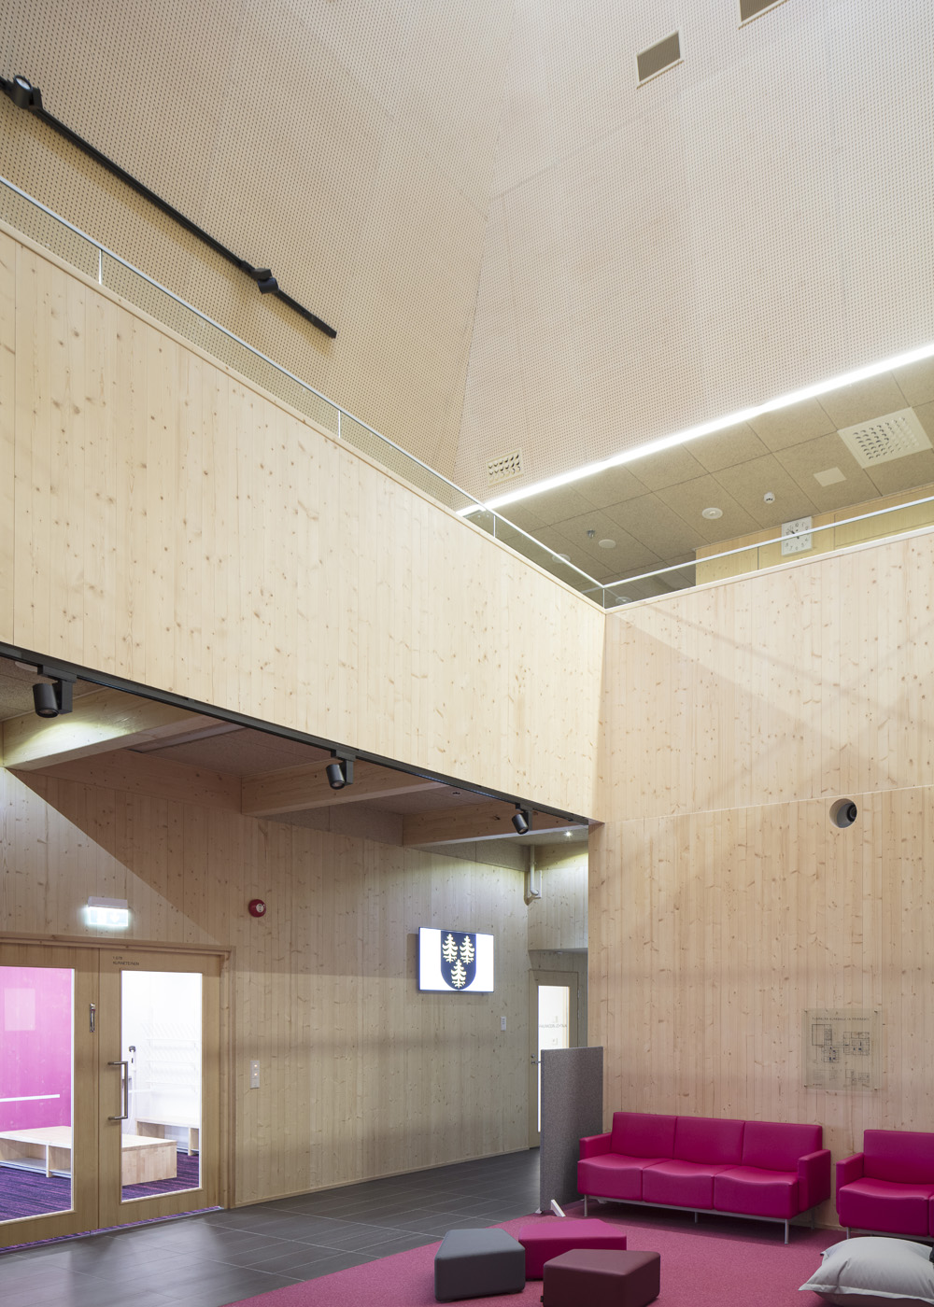
Example: Tuupala School, Kuhmo (2017)
The buyer (municipality) was responsible for the design of the site
The chosen design solution was the CLT frame
The contractor was put out to tender in an open competition
The contractor selected a CLT supplier as its subcontractor
It should be noted that the buyer did not require the use of a local CLT plant in the project; instead, the contractor can select the CLT supplier for the site as it sees fit.
On the CLT plate, the subscriber wanted a spruce surfaces, which reduced the number of bidders and supported the selection of a local product.
Image: Mikko Auerniitty

Slide 21
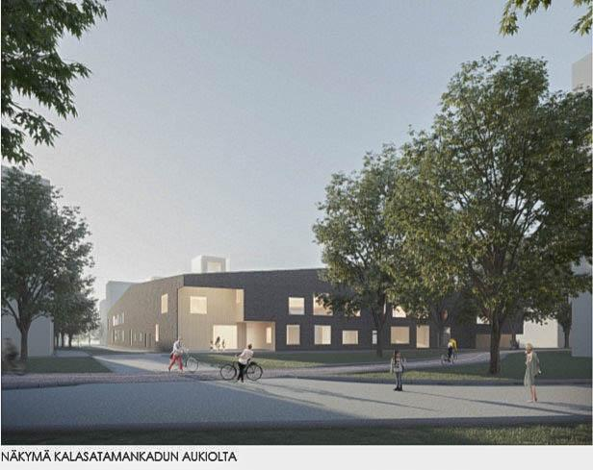
Example: Verkkosaari day care centre, Helsinki (2022)
Competition conducted through a competitive negotiated procedure, no material requirements
Market dialogue for interested parties
Call for tender published in Hilma, minimum criteria for participation in the competition
Qualifying participants will receive a preliminary invitation to tender, on the basis of which an anonymous race proposal will be submitted
Three best proposals were selected and a round of negotiations was held.
Based on the feedback, three bidders submitted the final competition work and a binding offer
Criteria: price (50%) and quality with criteria
17% functional properties
17% architecture
15% technical properties and life cycle
The CLT proposal received the best points for price and quality. The proposal's architecture and use of space were considered particularly successful. The total price of the proposal was the lowest, even though the price per square metre was higher than that of the other proposals.
Places 2 and 3 were remunerated for their participation in the race
Image: AFKS

Slide 22
Examples from Central Europe on public procurement and promotion of wood construction
In France, the competitions are organised as an invitation competition
The competition is drawn up to a very high level of detail, participation is remunerated
Participants are selected through a candidate procedure – the games are long and expensive to buy
The final choice of winner is made on the basis of a political decision
In Austria, social housing is supported by a separate funding system
The ecological nature of the building is scored on the basis of the building permit images
The subsidy is paid on the basis of scoring, the amount of the subsidy is 5–10% of the construction cost
Financial institutions managing the subsidy as part of the funding process of the sites

Slide 23
Observations on wood construction
Completed residential apartment block projects have focused on ARA production
Municipal rental housing operators
Student housing foundations
Other parties producing affordable housing
Traditionally, about 90% of single-family houses have wooden frames
In public buildings, the market share of wood construction has increased in recent years
For example, of schools with wooden buildings in 2019, wood market share approx. 31%
The apartment blocks for sale have been made of wood, but they have not yet hit through extensively, with the exception of single-family and terraced houses.
Wood construction is currently concentrated on developers who build their own sites on their own balance sheets.

Slide 24
Project parties, roles and responsibilities
Key parties – simplified model
The party taking part in the construction project – overall responsibility for everything, usually the customer
Developer – the party that implements and manages the project
May be from your own organisation or purchased as a service as a developer consultant
Contractor – responsible for building the project
Designer – responsible for designing and planning the site
User
Authorities (e.g. planning, building supervision)
In reality, there are many more different stakeholders, and even small projects can have dozens of parties. Typically, financing and the future owner of the property also play a significant role in the project.
Different contract models share these roles in different ways.

Slide 25
On parties in wood construction sites
As a rule, wood construction projects have the same parties as other projects
Industrial manufacturing moves the work away from the site
Selection of contract model – emphasis on the role and competence of factory work
The first wood-building site for many customers
Favours contract models in which the supplier is responsible for the design and construction of the site

Slide 26
Implementation modes
The customer can implement its project in many different ways – here are some of the most common implementation models
The customer has the site designed and planned, and then tenders the building contract
The client hires the designers and tenders the implementation, for example, as a YSE-based overall contract
Contracts with overall responsibility D&B (full responsibility) and D&C (design and construction)
The implementer is responsible for both planning and implementation under one agreement
Shared contract
The customer tenders different parts as their own entities
As a rule, the Customer is responsible for coordinating the whole
Project management contract
A separate project management organisation instead of the main contractor
Collaborative models, e.g. Alliance
Instead of price and content, risk and reward sharing is agreed (management system)
The operators implement the project jointly and share the responsibilities
The following is good to know
Full price contract, invoice contract and target price contract

Slide 27
Implementation models in wood construction
In industrial manufacturing, a larger part of the work is carried out outside the construction site
A shared contract may aim to eliminate overlapping margins in implementation
Requires resources and expertise from the customer
Contract limit must be specified precisely
For complex projects and for projects involving product development
Alliance or other collaborative models may be a solution in projects where it is not known in advance what the best solution would be
In the alliance model, the operating model is an "open book", which means that the customer is informed of the actual costs of the project
D&B and D&C contracts are suitable as an implementation model when the customer organisation does not have enough resources or experience and the risk of implementation is to be transferred to the contractor.
The reverse side of outsourcing the risk is usually a higher price

Slide 28
Example Case – Kauppi and Lumipuu
KAUPPI
Customer's first wooden apartment block
Need to obtain information and accumulate competence
Alliance model was chosen as the contract model
Enabled an initial development phase in which the project was developed
ARA-subsidised site
The project reservation and partial decision phases must be taken into account in the schedule and in the production of the material
Key parties
Customer, the party starting the project
Main contractor, responsible for the site. Supplier of prefabricated box units, responsible for the delivery of prefabricated box units
The customer, the contractor and the supplier of prefabricated box units formed an alliance.
Designers. In addition to the usual, an acoustician and a fire technical designer for fire and sound issues.
In addition to the customer's involvement in the construction, the involvement of maintenance in the project
Lumipuu
Customer's second wooden apartment block
Need to link the operator to the development phase of the project
A shared contract was selected as the contract model
PU was put out to tender after the development phase
ARA-subsidised site
The project reservation and partial decision phases must be taken into account in the schedule and in the production of the material
Key parties
Customer, the party starting the project
Main contractor, responsible for the site. Supplier of prefabricated box units, responsible for the delivery of prefabricated box units
The customer was responsible for planning and implementing the shared contract
Designers. In addition to the usual, an acoustician and a fire technical designer for fire and sound issues.
In addition to the customer's involvement in the construction, the involvement of maintenance in the project

Slide 29
Contract terms
Most common terms and conditions
YSE – General Terms of Contract for Construction – the most used terms and conditions for contracts
RYHT – General terms of purchase and delivery of construction products. Typically used for deliveries of goods
KSE – General Terms and Conditions of Consultation – the most common terms and conditions used for planning
In wood construction, consideration is often given to whether manufacturers of prefabricated goods are subject to YSE or RYHT terms and conditions.
In addition, the Housing Trade Act affects this
The law is applicable to the object of sale and gives rise to contractual obligations protecting the buyers of apartments

Slide 30
Special features of wood construction
Place where the work is actually carried out
The starting point for the authorities and legislation is that construction takes place at the site
For example, a general foreman must be named on the construction site, but not, for example, for the prefabricated box unit factory.
The plant can still make 50% of the value of the project
Factory manufacturing is carried out at the same time as the construction site
Procurements are realised significantly earlier than when building on site
To be taken into account in payment instalments

Slide 31
Special features of wood construction 2
Insurances
Normally, the contracts require insurance for the construction site
Normal liability insurance may not be sufficient if much of the value of the object is realised in the factory
Discussion of insurance interfaces for all contract models
Guarantees
High value from product
In many cases, the contract requires similar guarantees from the factory supplier during the construction and warranty period as from the building contractor.
🡪 All normal terms and conditions in a contract must be reviewed through value generation and checked to ensure that the contract model matches the selected implementation method

Slide 32
H1 Weekly exercise: Project development and law
1. Go to the epuu service
You are building a place with 6 storeys, it is 20 metres high and has 3,000 m² floor area, and fits the homes of 50 people living there. There are stocks of movables in the house.
www.epuu.fi
2nd Please enter a short three-part answer
What fire regulations should you take into account in your project?
What are your frame options for building the house?
What alternative would you start developing for your own project and why with this source data?

