Slide 1
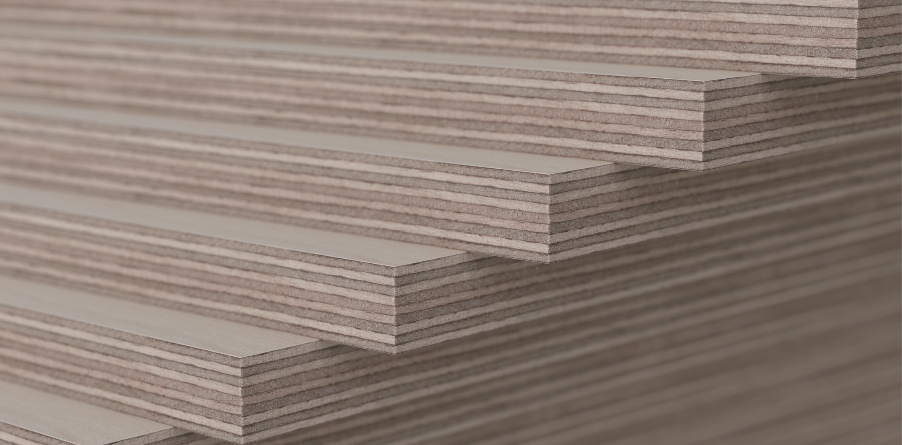


Industrial wood construction
Teaching materials for industrial wood construction education 2022

Slide 2
Origin of the materials
Use of the materials
These learning materials for industrial wood construction have been prepared in a project led by Puuinfo Oy in 2021–2022. Also involved in the project were
Lappia Vocational College,
TTS-Työtehoseura ry
South-Eastern Finland University of Applied Sciences,
Metropolia University of Applied Sciences,
Jyväskylä University of Applied Sciences,
University of Tampere, and
Federation of the Finnish Woodworking Industries Puutuoteteollisuus ry
The project was funded by the Ministry of the Environment.
The materials are intended to be used as extensively as possible in industrial wood construction education and studies.
The materials are released under the Creative Commons licence Attribution-ShareAlike (CC BY-SA), which requires that the author be properly credited when the materials are used and that derivative works may only be distributed under the same licence as the original work.
The original materials and any updates to them by Puuinfo will be published on the Library of Open Educational Resources website (aoe.fi) and the Puuinfo.fi website.

Slide 3
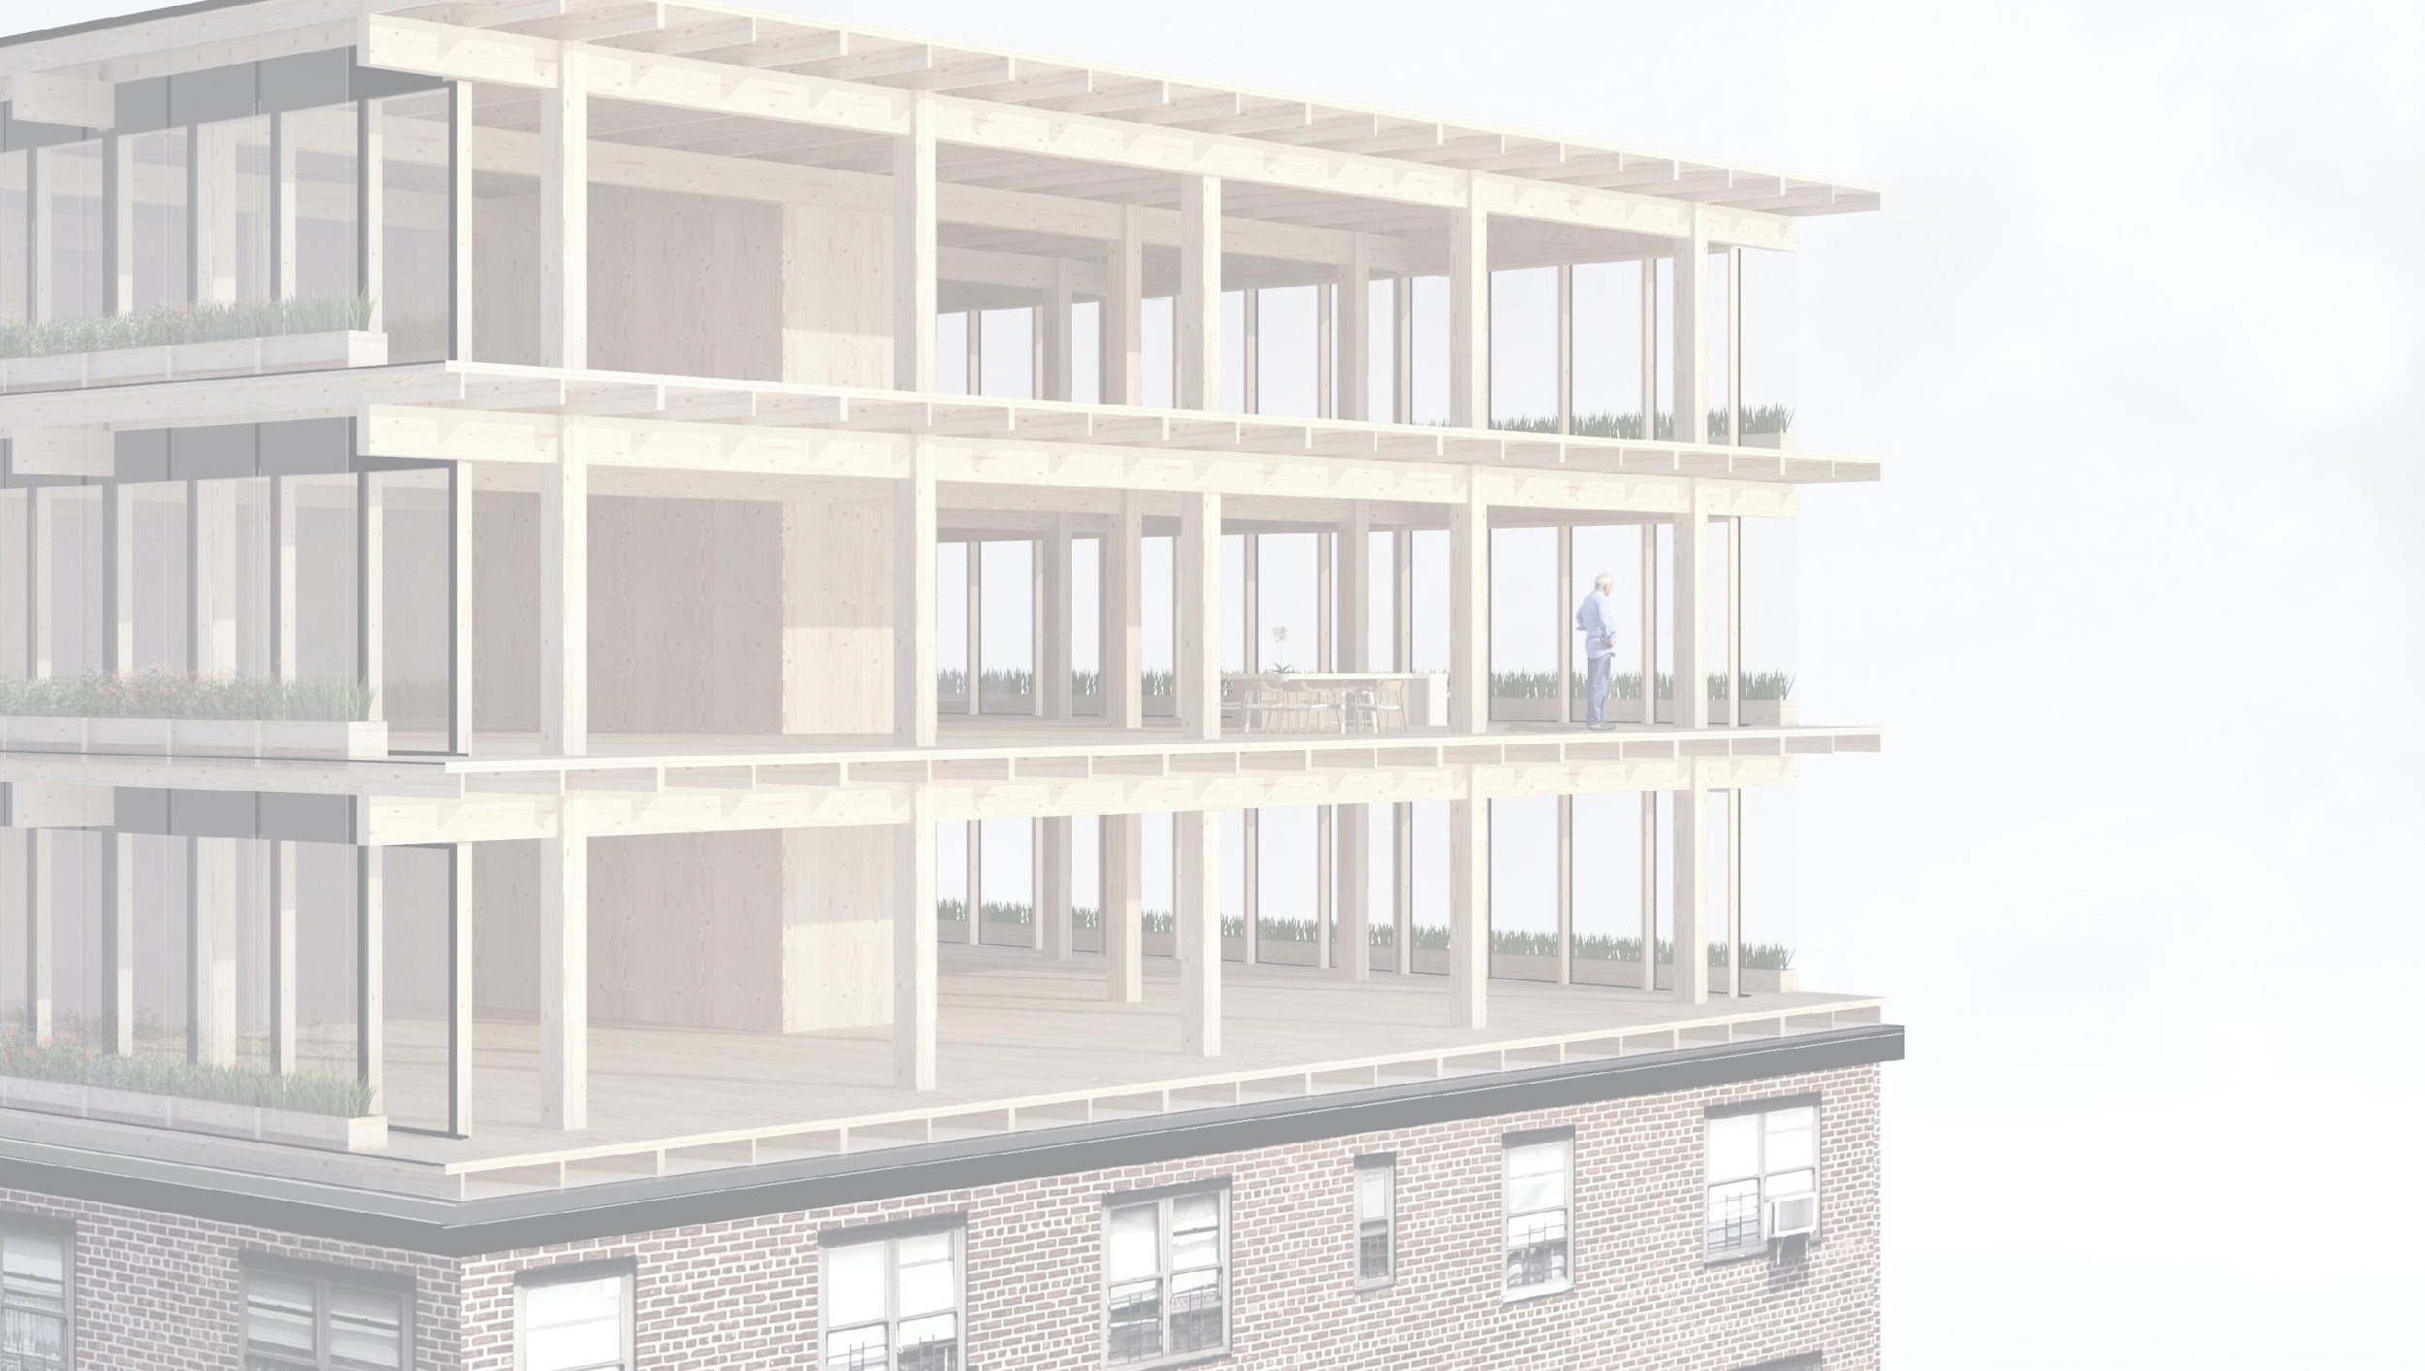
Repair construction of wooden buildings and use of wood in repair construction

Slide 4
Authors
Markku Karjalainen, Architect D.Sc. (Tech.), Professor
Henri Käpynen, Architect, Researcher
University of Tampere
Release date: 29/06/2022

Slide 5
Repairing a wooden building and use of wood in repair construction – contents
‹#›
Introduction - Repair construction
Options for using wood in energy renovation projects of suburban blocks of flats and in adding storeys to buildings
General information on adding storeys
Building systems for adding wooden storeys
Architecture competitions – repair construction
Stages of an additional storey construction project
Adding heat insulation in a wooden building and using wood in repairing a block of flats made of concrete Adding heat insulation in a wooden building and using wood in repairing a block of flats made of concrete
Heat insulation
Overall energy review
Energy performance requirements
Structural types for additional storeys
Energy renovation of a suburban building
Survey on the actual repair construction potential of Finnish blocks of flats 10/2015
Student projects
Wood façade repair
Surface treatment
Breathable structure
Fixing board cladding
Principles of repair work
Repair work step by step
Replacing the bottom logs of a log house ("shoeing")
Replacing logs
Examples
Procedures
Example sites
Wood structure repair
Condition assessment and continuous maintenance
Roof
Foundations and subsurface drains
Load-bearing structures and additional insulation
Ground floor
Exterior wall
Attic floor
External cladding
Windows

Slide 6
Wood structure repair

Slide 7
Contents
Wood structure repair
Condition assessment and continuous maintenance
Roof
Foundations and subsurface drains
Load-bearing structures and additional insulation
Ground floor
Exterior wall
Attic floor
External cladding
Windows

Slide 8
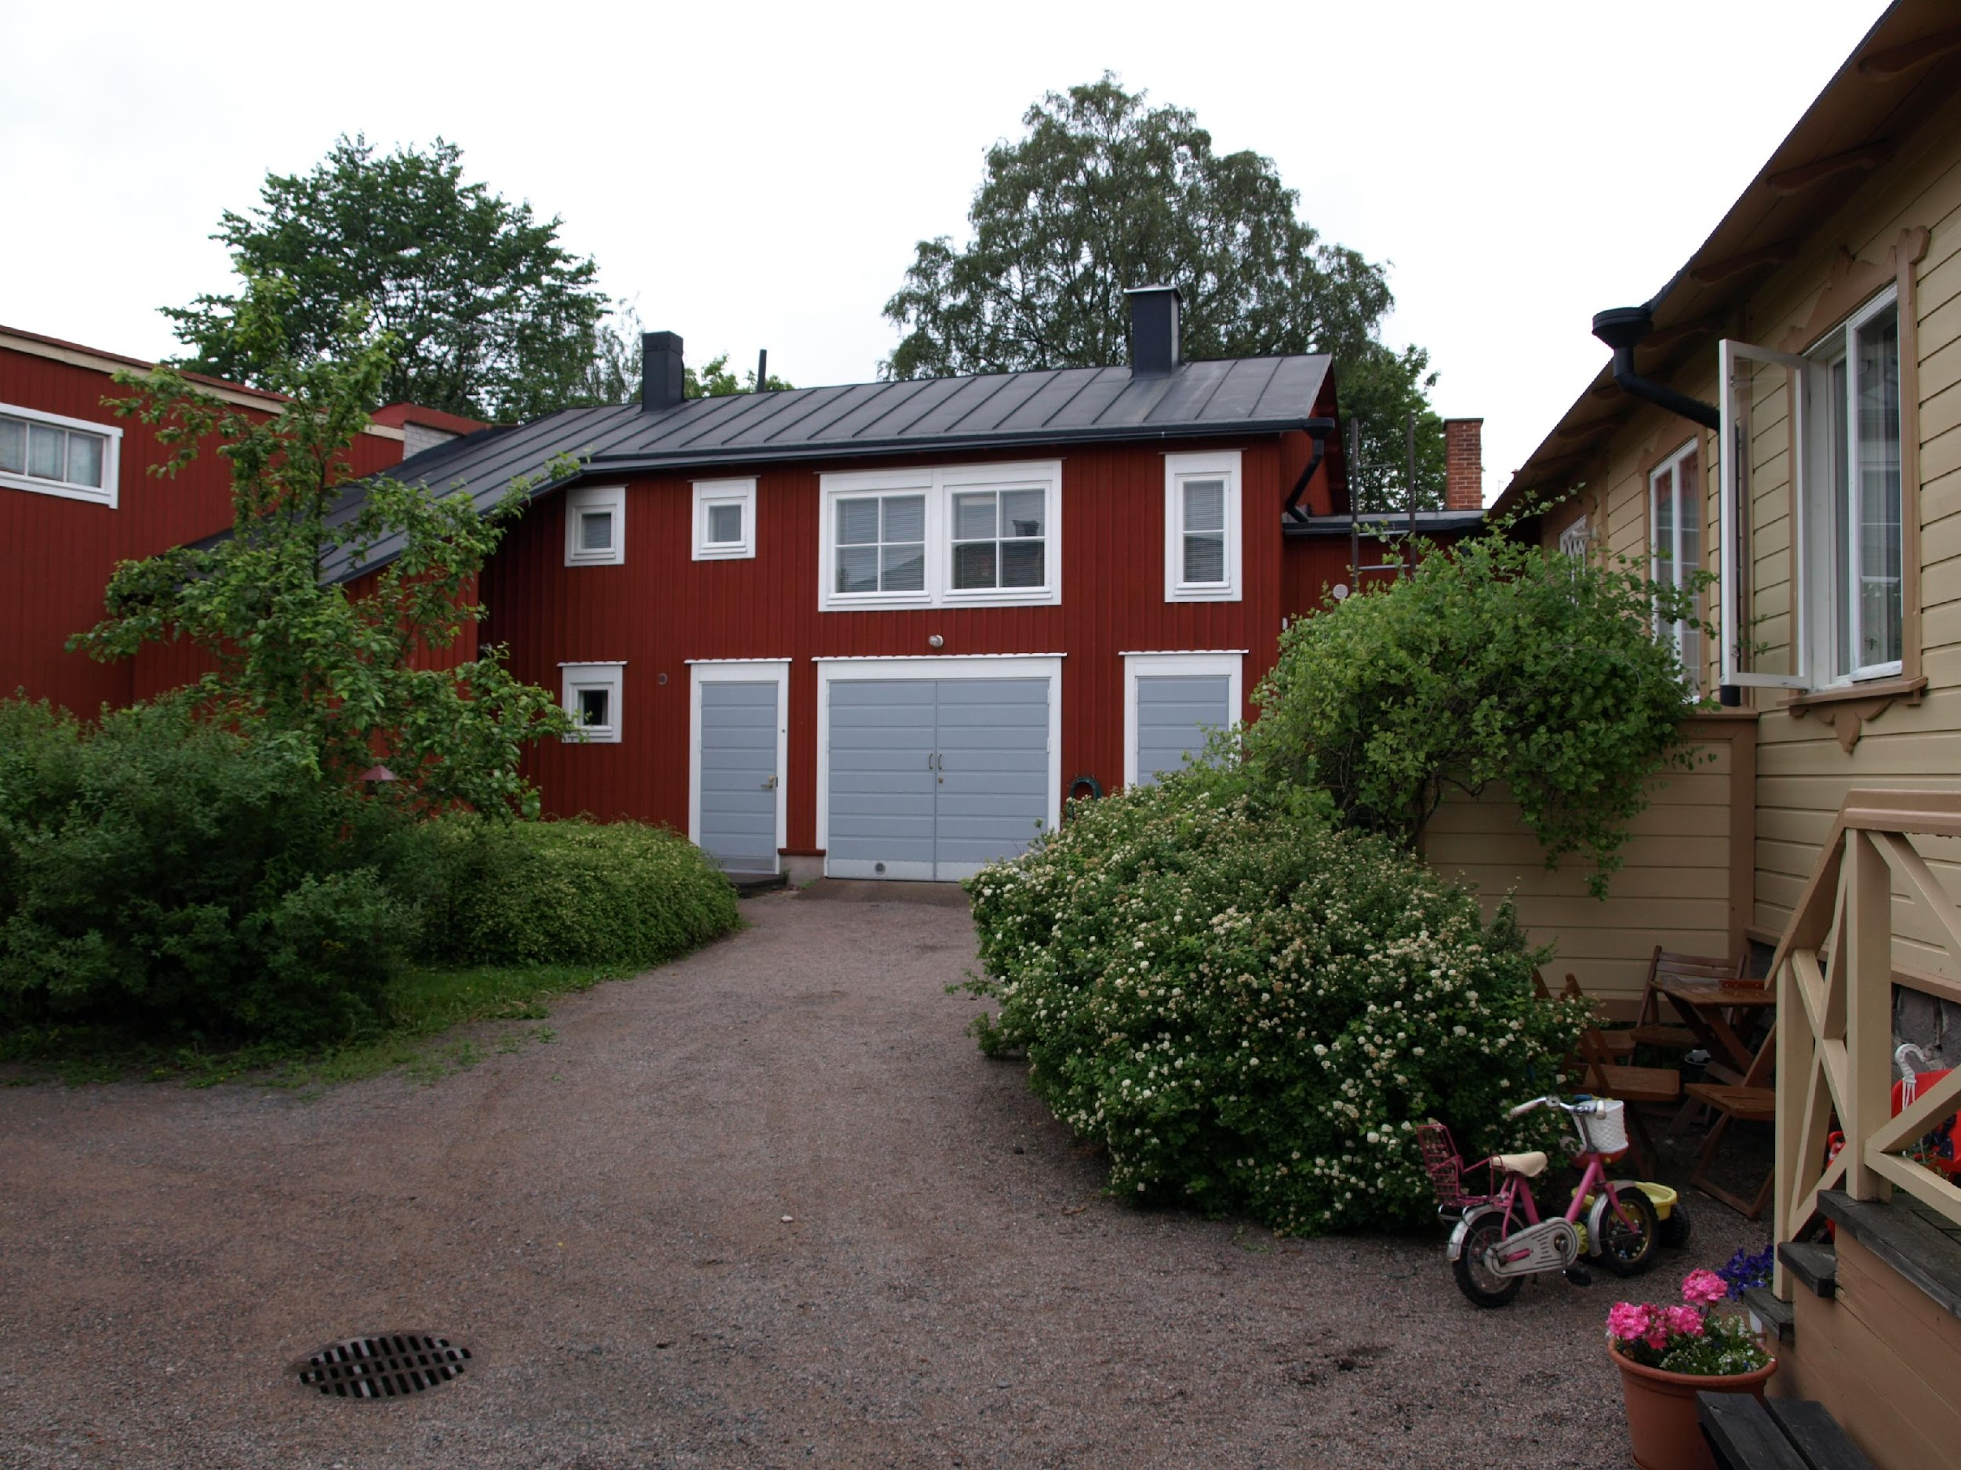
Both the old and the new buildings require regular maintenance and servicing. For example, gutters must be kept clean of leaves and debris. In connection with regular maintenance work, the condition of the building must also be continuously monitored, so that any damage can be detected and repaired well in advance. This will help in avoiding greater damage and costly repairs. Update the condition assessment/service booklet during regular maintenance work.
Source: Puuinfo
Image: Jukka Koivula

Slide 9
Condition assessment and continuous maintenance
The condition assessment is a document drawn up on the basis of visual inspection measures, in which observations are compiled on the technical condition and functionality of different parts of the building. Renovations and changes made over the years should also be recorded in it, and it should be updated every few years, preferably annually. The condition assessment also serves as a "maintenance book" and facilitates the anticipation and planning of future repairs. It is also used to assess whether a part of a building requires a more in-depth study, known as a condition survey.
When preparing a thorough condition assessment, it is a good idea to use a construction professional. If you are buying an old house, agree with the seller to have a condition assessment carried out by an impartial expert approved by both parties.
Source: Puuinfo

Slide 10
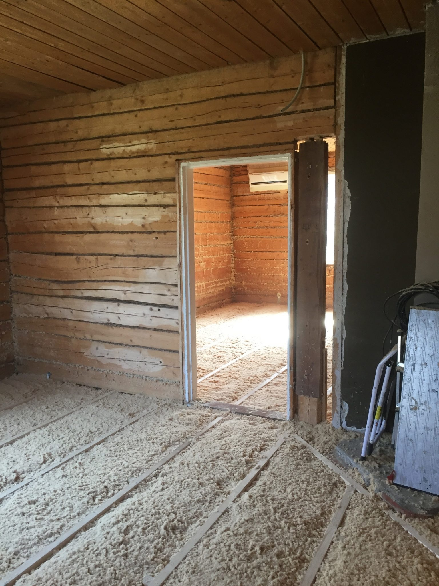
Condition assessment and continuous maintenance
The table on the next page shows some examples of possible damage to the old building and the typical repair procedures.
Always investigate the causes of damage thoroughly and prevent recurrence of damage. Consider repair or maintenance procedures and their scope on a case-by-case basis.
Source: Puuinfo

Slide 11
Condition assessment and continuous maintenance
Possible damage | Possible cause | Repair or maintenance procedure
the paint surface of the external cladding is flaking | weather exposure (sun, rain), internal moisture | paint maintenance
cracked boards in the lower part of the external cladding | weather damage, leaking eaves gutter, splash water | partial replacement of boarding, paint maintenance, lowering of the ground surface
draught indoors, poor thermal insulation | the insulation of the exterior wall has collapsed, insufficient air barrier, insufficient sealing of the gap between the wall and the windows, and inadequately sealed windows | addition of insulation to the upper part of the wall and below the windows, repair of internal air barrier sheets, sealing of the grooves and windows
rotting in the bottom logs of the log wall | raised ground level/ground contact, leaking eaves gutter, splash water | replacement of the lowest logs, lowering of the ground, sloping of the ground away from the building
rot damage in load-bearing structures | long-term water damage, leaking roof | opening of structures, restoration/renewal to the extent necessary
Source: Puuinfo

Slide 12
Nature and complexity of the renovation and repair work
Minor renovations such as surface treatments, partial repairs to external staircases or cladding, etc. can easily be carried out by a do-it-yourself builder.
On the other hand, repairs or changes to the load-bearing frame of a building, etc., usually require the assistance of a construction professional.
Large-scale restoration work requires a condition assessment and plans drawn up by an expert.
Also check with the municipal building inspector whether the planned measures require a building permit.
Source: Puuinfo

Slide 13
General guidelines
As a general guideline, when repairing and maintaining an old building of value, efforts are to be made to preserve the old building components and materials wherever possible. The priority is to renovate and repair a valuable building, not to replace it. Unrepairable structures and building elements should be replaced with materials and methods appropriate to the original character of the building.
Source: Puuinfo

Slide 14
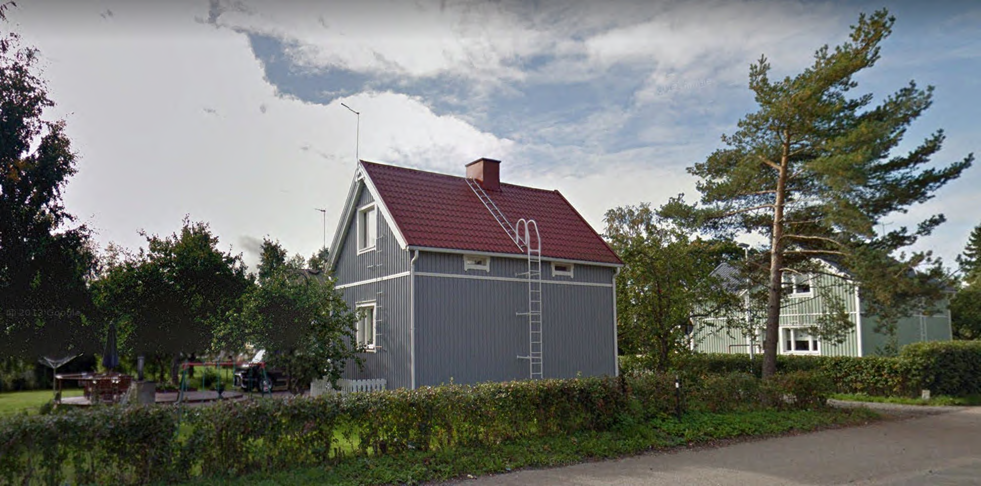
Avoid over-repair; Case Rintamamiestalo
Problems with the example site (photo):
Wall structures swollen outwards with additional insulation
Windows deep in wall structure
Eaves shortened as a result of additional insulation
Original proportions lost
Building battened too heavily

Slide 15
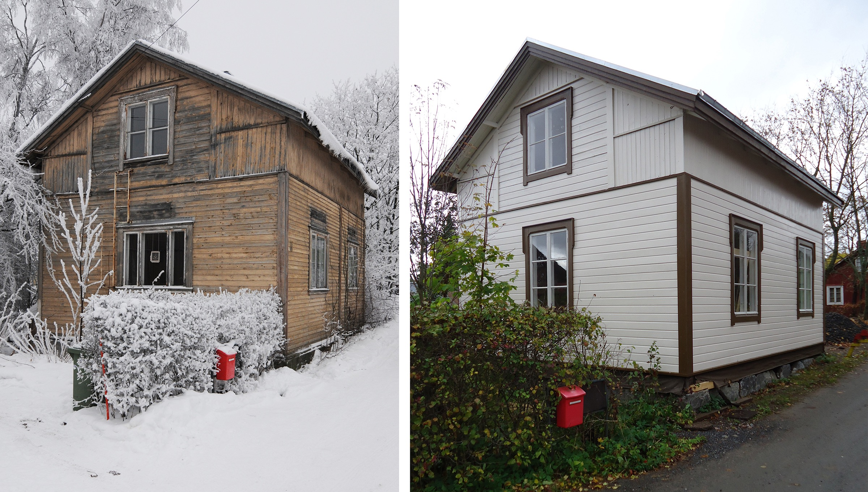
A successful repair site; SAATSI arkkitehdit, Kalliomäki, Forssa
Successful solutions for the example site:
Wall structures are not swollen
Windows on the surface of the wall structure and original look retained
Eaves shortened as a result of additional insulation
Original proportions retained
Building battened according to original model
Original color scheme retained
Successful restoration of a late 19th century log house.

Slide 16
Tips for renovation
Changing from one material to another should be done with careful consideration. There are already a few places in Finland where building supply stores focus on traditional building components. You can also search the internet for old recyclable building parts such as doors, windows, fittings, roof tiles, etc.
Additional internal insulation reduces the size of the rooms to some extent. On the other hand, additional external insulation changes the appearance of the building (shortening eaves, increasing the size of window mouldings) to such an extent – or leads to such laborious and extensive alterations – that it is usually neither advisable nor economically viable.
Avoid overcorrecting. Renovation measures such as new construction that have been taken too far will result in the loss of the original nature and characteristics of the old building. Moderate renovations also save costs.
A key factor in renovating is to determine the causes of the damage. Remove the cause of the problem so that the damage does not recur.
Source: Puuinfo

Slide 17
Typical wall structure and cladding solutions
 | Old structure / insulation | External cladding | Internal cladding
– 1950s | log wall | board | construction paper, wallpaper
1930s to 1950s | framed walls / sawdust, cutter shavings | board | construction paper, wallpaper
1950s – | framed walls/mineral wool | board | planed board, construction board
1960s – | log wall (typically round log) | no cladding, log surface visible | no cladding, log surface visible
Source: Puuinfo

Slide 18
Roof
The condition of the roof is at the core of everything. The roof protects the building from rainwater. A leaking roof easily leads to damage that requires extensive, laborious and costly repairs. Repair the roof or part of the roof found to be in poor condition as soon as possible. Pay particular attention to the roof joints and the junctions between the chimney and other passages. Regular maintenance of the roof will significantly extend its service life.
If you need to replace the entire roof, keep the original roofing membrane if possible. If you change the roof, please note that you often also have to change the roof's substructures, eaves, etc. Also make sure that the roof's gradient is sufficient for the intended new roofing material. You must apply for a permit from the municipal building inspector to change the waterproofing material.
When carrying out repairs, ensure in particular that sufficient and effective ventilation is provided between the roof and the heat insulation in the attic floor and in the cold attic.
Source: Puuinfo

Slide 19
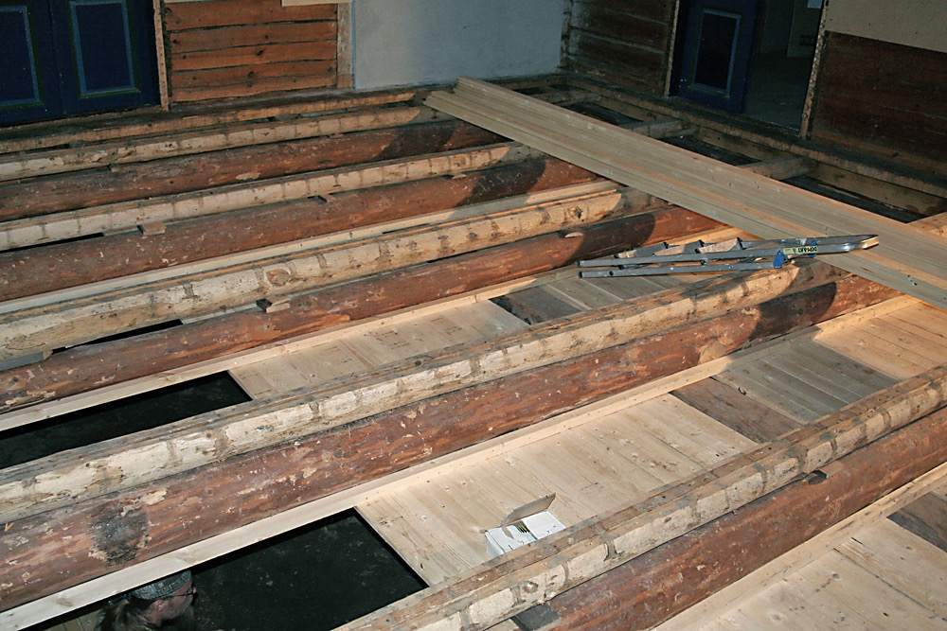
Foundations and subsurface drains
Old houses built before the Second World War are usually cellarless, in which case they are built on a low natural stone plinth or columns. In these cases, the base floor is a so-called ventilated base floor, under which there is an open ventilating crawl space. The foundations have not usually been drained, and subsurface drainage should not be installed afterwards, as large changes in the surrounding soil may cause structural depression. Instead, keep the ground away from the building without blocking the vents of the foundation.
Renovating a ventilated base floor
Source: Puuinfo
Image: Perinnemestari

Slide 20
Foundations and subsurface drains
If the foundations have depressed in some respects, check whether the depression has stopped or whether there are constant changes in the foundations. The depressed area are fixed locally only. The upper structures are raised with a jack and the depressed column or part of the plinth is straightened and/or raised.
Since the 1950s and 1960s, foundations are usually subsurface drained. The foundation is usually either a column foundation or a concrete slab on ground. The functionality of the subsurface drains should be checked every few years.
Source: Puuinfo

Slide 21
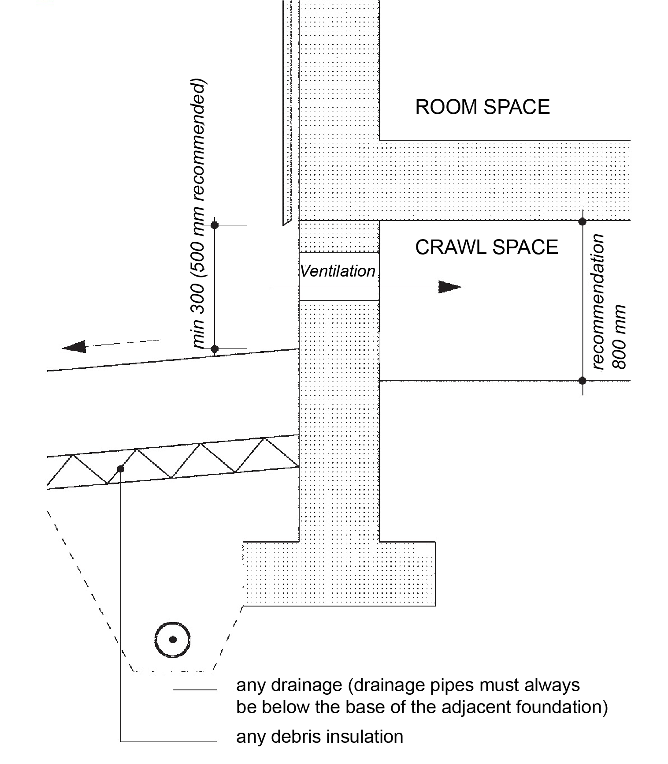
Foundations and subsurface drains
Cross-section of the plinth. The crawl space vents in the plinth are kept open. The ground surface should slope away from the building.
Source: Puuinfo

Slide 22
Load-bearing structures and additional insulation
Unless the maintenance of the wooden house has been neglected, the load-bearing structures do not normally suffer damage that requires repair. Any problems are usually the result of a long-standing leaky roof or other water damage, or of previous construction errors.
With the exception of the attic floor, additional thermal insulation of structures alone is usually so costly that it is usually not economically viable.
If structures have to be opened up for other renovation work, the condition and quantity of thermal insulation should be checked at the same time.
The prevention of potential draught leaks can usually be achieved quite easily and cheaply by improving the tightness of the building using air barrier papers.
When repairing or adding thermal insulation, use insulation material that is similar to or compatible with the original in terms of damp-proofing properties. Sawdust and cutter shavings can be used as an alternative with, for example, wood fibre insulation.
Source: Puuinfo

Slide 23
Load-bearing structures and additional insulation
Old structure / insulation | Materials recommended for additional insulation | Recommended air and vapour barrier
log wall | wood fibre panels wood fibre insulation | air barrier paper
framed walls / sawdust, cutter shavings | wood fibre panels wood fibre insulation | air barrier paper
framed walls/mineral wool | mineral wool, wood fibre insulation | air barrier film
base floor / sawdust, cutter shavings | wood fibre insulation | air barrier paper
base floor / mineral wool | mineral wool, wood fibre insulation | vapour barrier film
attic floor / sawdust, cutter shavings | wood fibre insulation | air barrier paper
attic floor / mineral wool | mineral wool, wood fibre insulation | vapour barrier film
The table above lists additional insulation and air and vapour barrier materials that are compatible with old insulation and are recommended. Always install the air and vapour barrier on the inner surface of the insulator under the internal cladding. Sawdust and cutter shavings can of course still be used as additional insulation in structures where they were originally used.
Source: Puuinfo

Slide 24
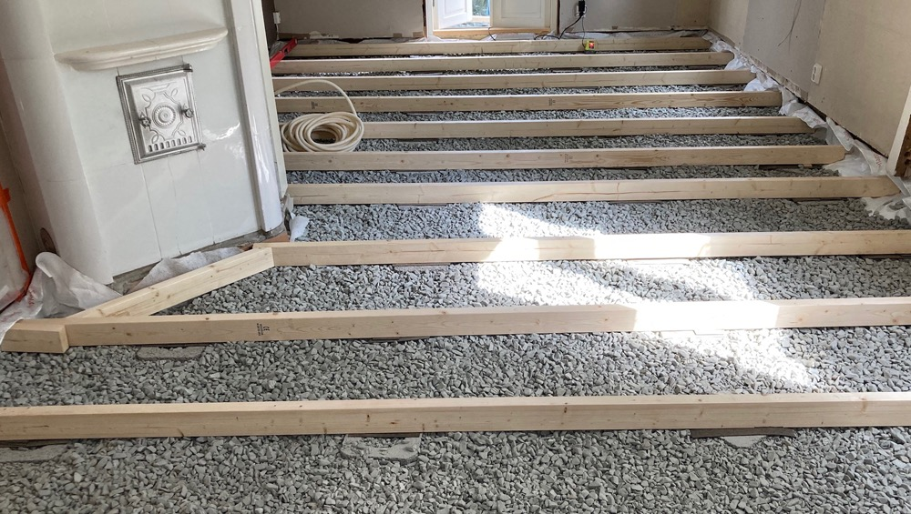
Ground floor
Possible renovation measures for the base floor include work related to additional thermal insulation. The way they are implemented depends on the structure of the base floor. When renovating and insulating the base floor, also make sure that the joints between the floor and the wall structure are tight.
Source: Puuinfo
Image: Perinnemestari

Slide 25
Base floor – ventilated base floor
If there is damage to the ventilated base floor, such as severe buckling at one edge, this may be due to rot damage to the load-bearing beams of the base floor. It may be caused by inadequate ventilation of the ventilated base floor (e.g. blocked vents) or ground contact of load-bearing timber structures (too shallow a crawl space under the base floor). In this case, the base floor structure will have to be opened up and the damaged beams reinforced or replaced with new ones. The work requires the dismantling of the floor's surface layers and insulation.
Check the condition and amount of thermal insulation when renovating the base floor. Defective or depressed insulation is simply repaired by adding more insulation or replacing it with a better insulation.
Source: Puuinfo
Image: Perinnemestari

Slide 26
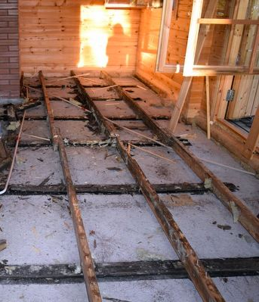
Base floor – Concrete slab on ground
Since the 1960s, concrete slabs became more common as a foundation for detached houses and summer cottages. It consists of floor boards (usually 50×100, 600 mm apart) installed on a concrete slab cast on a gravel layer, the gaps filled with thermal insulation (usually mineral wool, thickness 50...100 mm) and the floor surface material is, for example,tongued and grooved floorboard.
Further insulation of the structure is only possible if a full layer of insulation was not originally installed.
Source: Puuinfo
Photo: rakentaja.fi

Slide 27
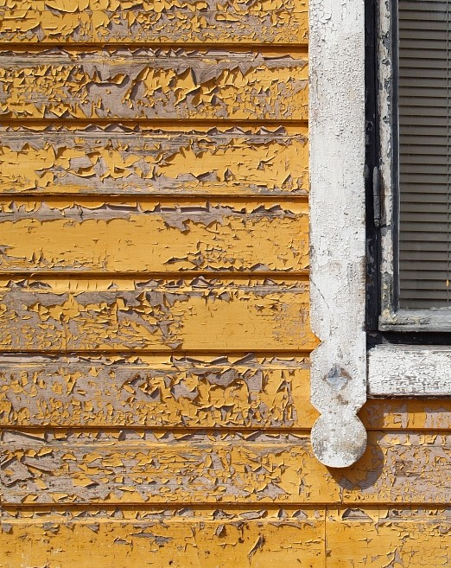
Exterior wall
Damage to timber-framed exterior walls is usually limited to wear and flaking of the paint surface over time. External cladding boards may also show cracking or rot caused by weather stress. The load-bearing frame of the wall is usually in good condition even if the wall appears to be in poor condition. Remember also that wood that has turned grey on the surface is not rotten.
Source: Puuinfo
Image: vastavalo.net

Slide 28
Exterior wall
Possible damage to the wall frame is usually the result of prolonged rainwater access into the wall structure (leaking roof or damaged gutters or downpipes). A plinth that is too shallow or moisture that has risen capillarily into the base floor can also damage the lower part of a wood-framed wall. Before repairing the wall structure, remove the factors that caused the damage.
If the frame structure of the wall (logs or load-bearing wall frames) is damaged, the external cladding, its substructure and, in the case of slatted walls, the thermal insulation will have to be either partially or completely dismantled. The log wall is repaired by replacing only the damaged logs. In this case, the building is temporarily raised with jacks so that the changing of the logs can be carried out.
All demolition work required by the renovation work is carried out carefully to avoid unnecessary damage to intact building elements. If you want to improve the thermal insulation of a log wall, a simple solution is to add one or two layers of 12 or 22 mm fibreboard on the inside.
Source: Puuinfo

Slide 29
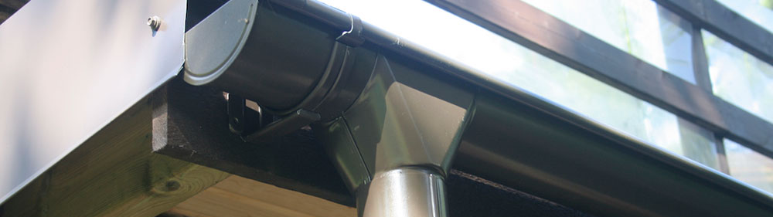
Exterior wall
Possible damage to the wall frame is usually the result of prolonged rainwater access into the wall structure (leaking roof or damaged gutters or downpipes). A plinth that is too shallow or moisture that has risen capillarily into the base floor can also damage the lower part of a wood-framed wall. Before repairing the wall structure, remove the factors that caused the damage.
Image: kattoremontti.pro

Slide 30
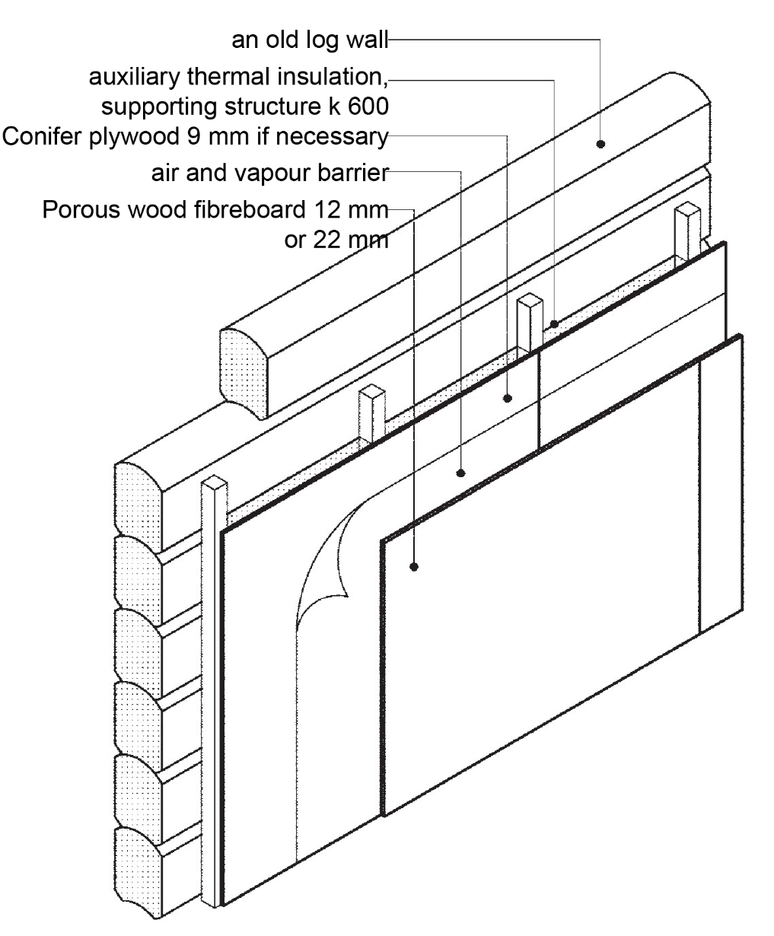
Example of additional thermal insulation on the inside of a log wall
The wood fibreboard is painted or wallpapered. Alternatively, studs can be installed on the inside of the log frame, against which wood fibre insulation is sprayed. An air and vapour barrier and an interior trim, such as panelling or the aforementioned wood fibre sheets, shall be installed on top of the insulation.
Source: Puuinfo

Slide 31
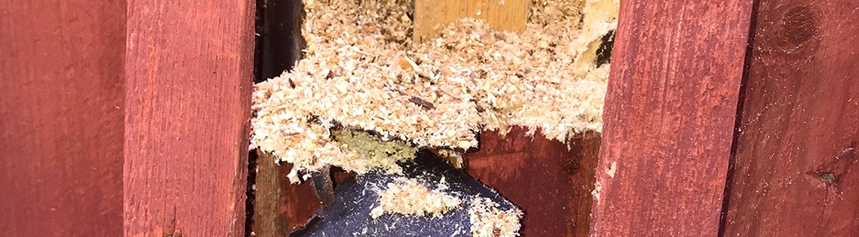
Exterior wall
Old exterior walls with heavy structures are usually insulated with woodchips. They sometimes show thermal leakage due to insulation compression, mainly at the top of the wall and below the windows. Adding insulation requires the partial dismantling of the surface layers inside the wall. If insulation is not completely renewed, use the original insulation material and add the necessary amount. If you renew insulation throughout, wood fibre insulation, for example, would be well suited for a wooden building. An air and vapour barrier will be installed on the inside of the insulation.
Source: Puuinfo

Slide 32
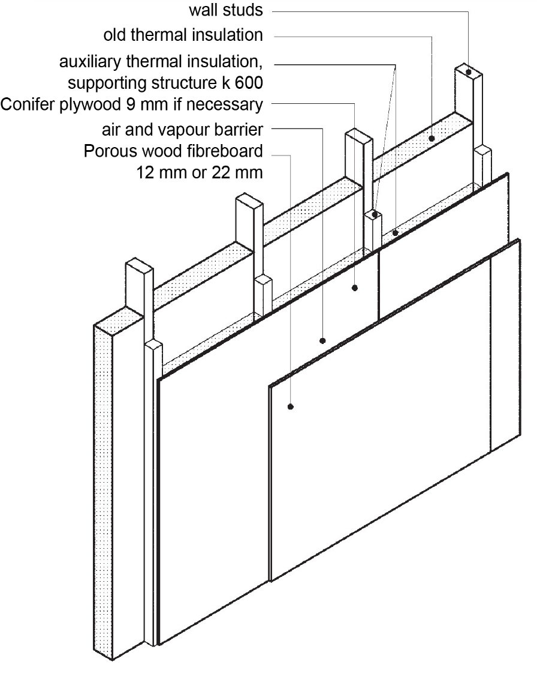
Example of additional thermal insulation on the inside of a slatted external wall
When renovating thermal insulation, also check the caulk on windows and external doors. If necessary, add caulk. Also use the same caulking material as the original or similar products as the heat insulation for the wall. The traditional caulking material has been a linen fibre yarn, but nowadays a wood fibre yarn is also available. Polyurethane foam should not be used in an old wooden building.
Source: Puuinfo

Slide 33
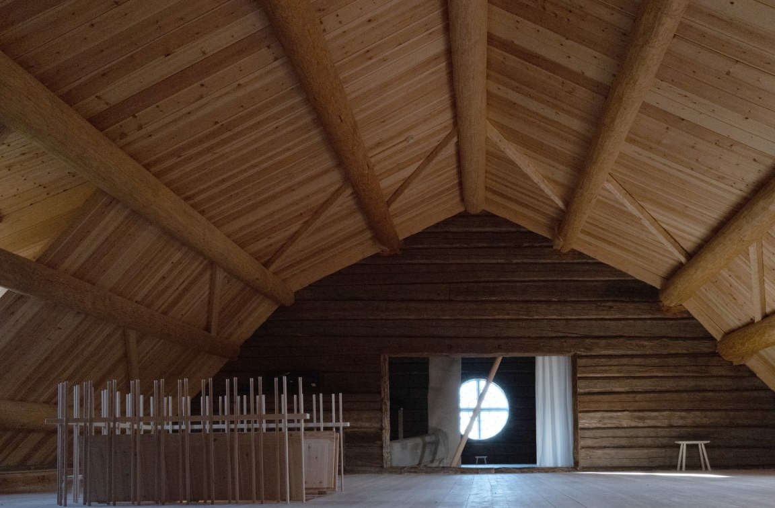
Attic floor
A functional roof and good attic floor ventilation effectively prevent problems in the attic floor structures.
If necessary, the addition of heat insulation to the attic floor is easily done, as long as the attic space is high enough to allow for movement close to the exterior wall. Additional insulation of the attic floor is the easiest and cheapest way to improve the thermal performance of a building, provided that the building is otherwise adequately insulated and airtight.
By insulating and cladding the inside, the high attic space can be converted into additional rooms if necessary. Picture of Akola Manor after renovations.
Source: Puuinfo
Image: Teemu Kurkela

Slide 34
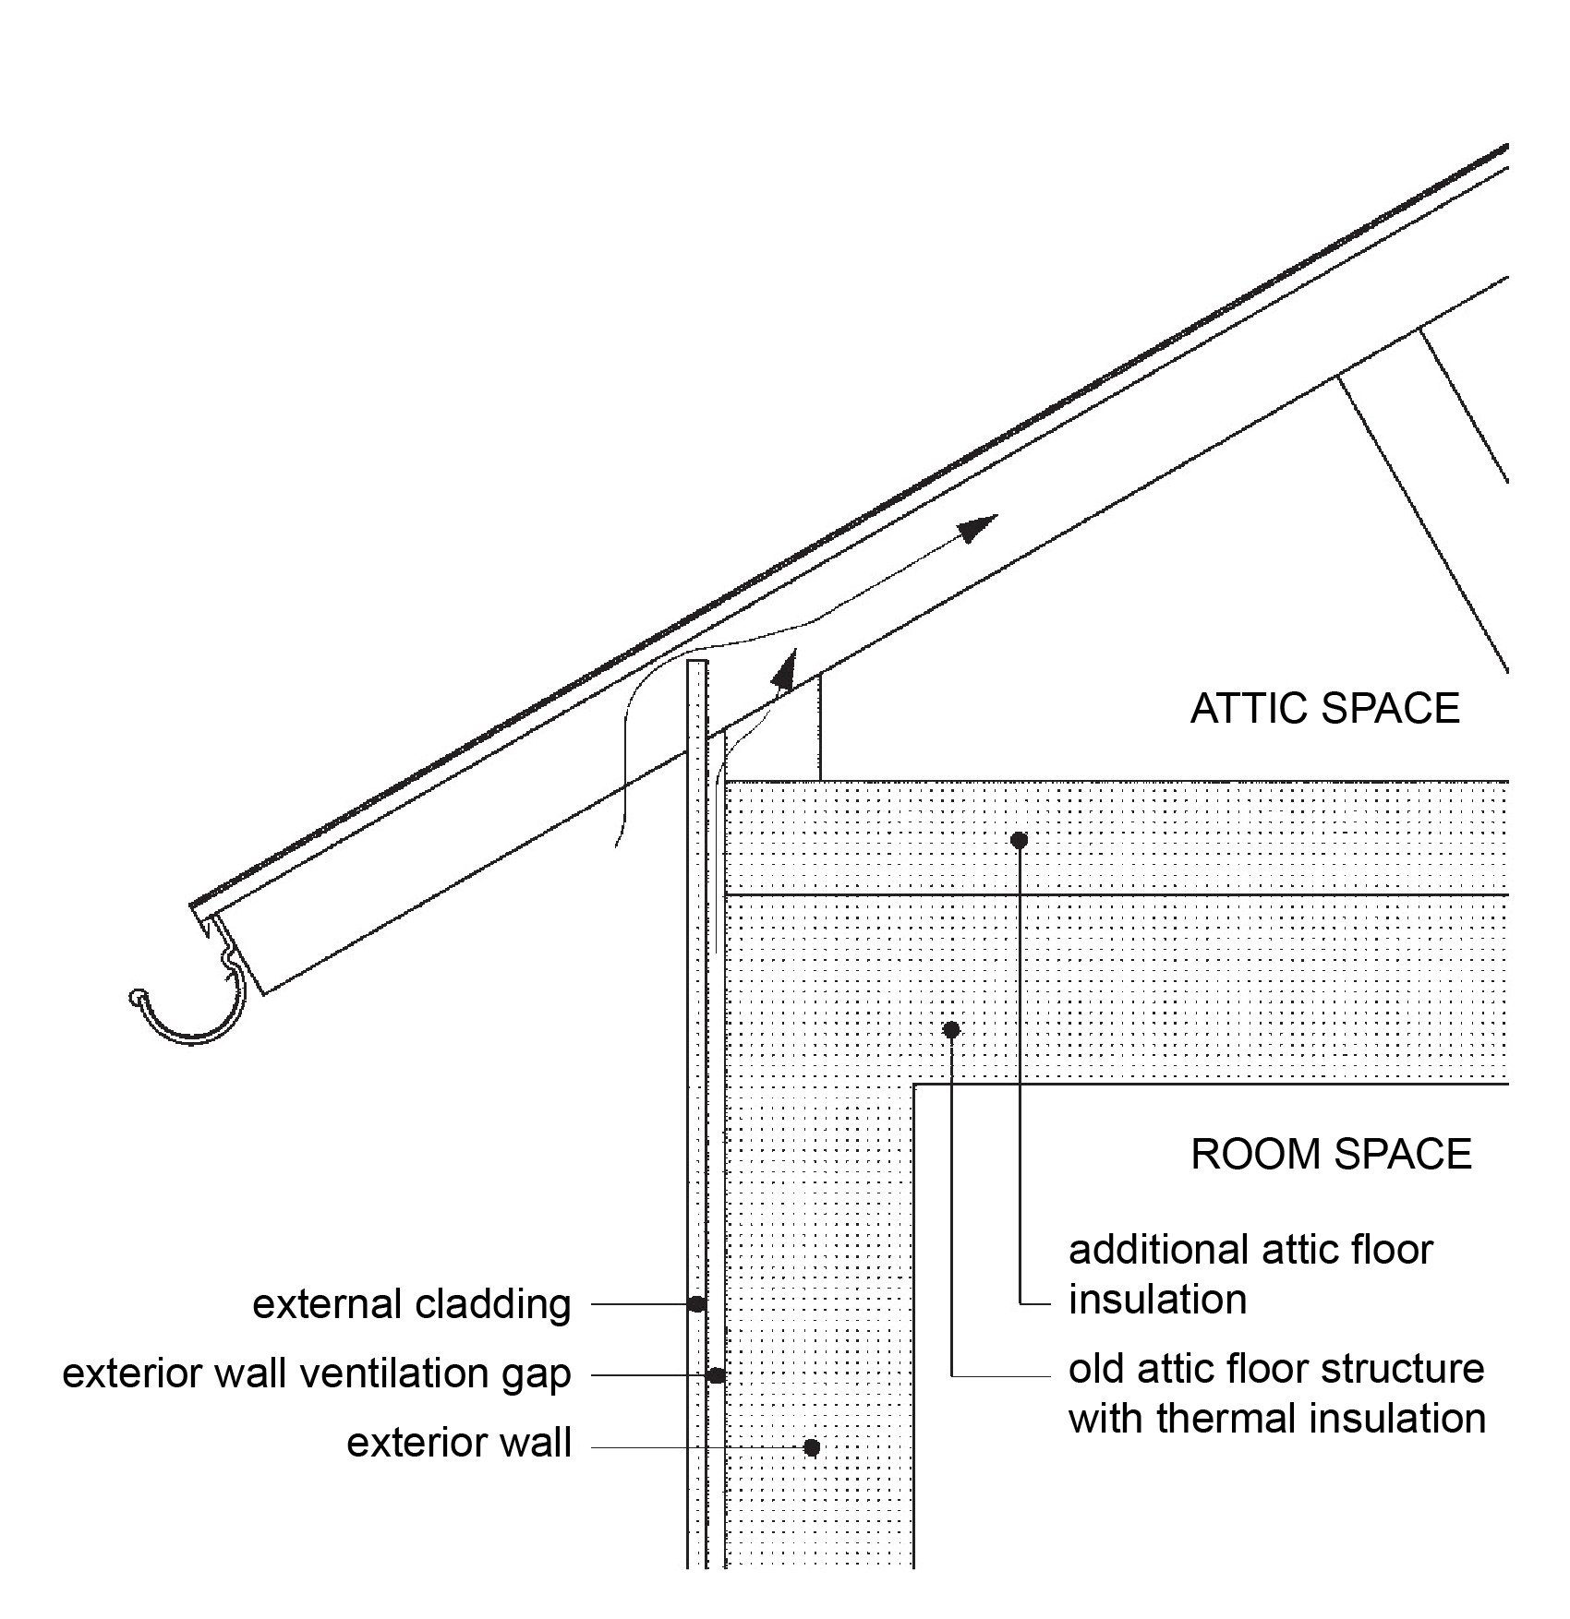
Example of additional insulation of the attic floor
Make sure that:
no obstruction to attic ventilation
the ventilation gap behind the external cladding is not blocked
The conversion of the high attic space to residential use is done by insulating the exterior walls of the attic and installing thermal insulation underneath the old water-roof structure.
Source: Puuinfo

Slide 35
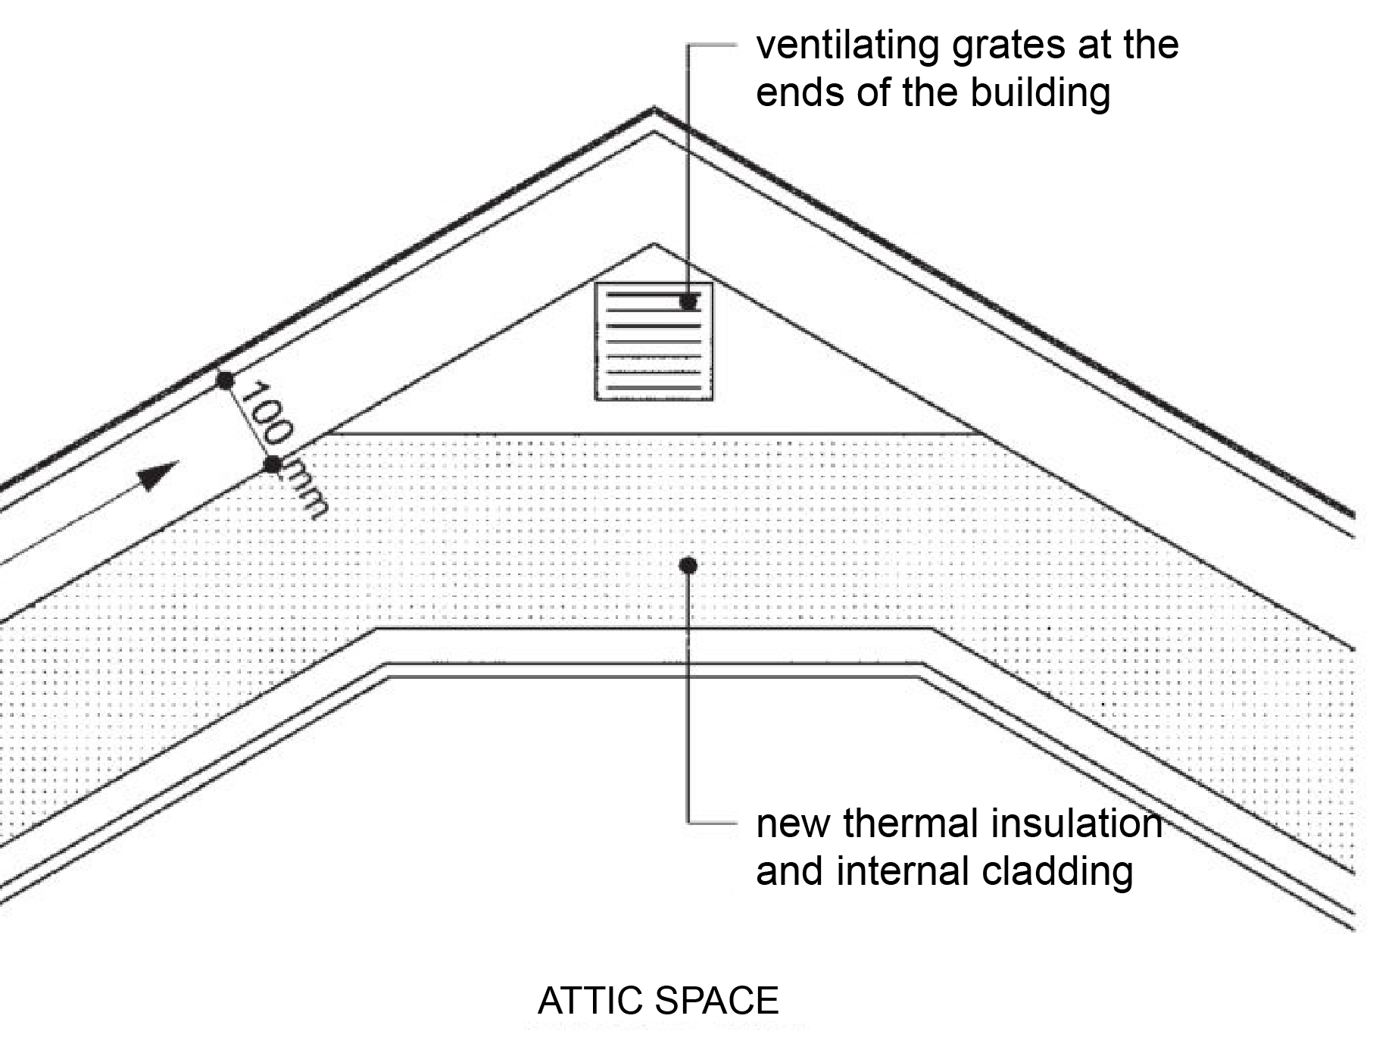
Example of attic floor ventilation
Make sure that:
there must be sufficient ventilation gap between the roof and the thermal insulation
there should be sufficient uninterrupted ventilated space at the ridge of roof (attic floor cavity)
the ventilation gap behind the external cladding is not blocked
Source: Puuinfo

Slide 36
External cladding
If a building's external cladding has been correctly installed from the start and the building has not been neglected in terms of maintenance and upkeep, then the façade cladding will usually last for decades. In fact, it is estimated that weathering only consumes a few millimetres of wood surface over a hundred years. However, if damage to the external cladding is found to require repair, it is usually sufficient to replace the most deteriorated boards. If there is a lot of damage, the cladding can only be renewed for the façade in question. It is rarely necessary to re-clad all the façades of a building.
Source: Puuinfo

Slide 37
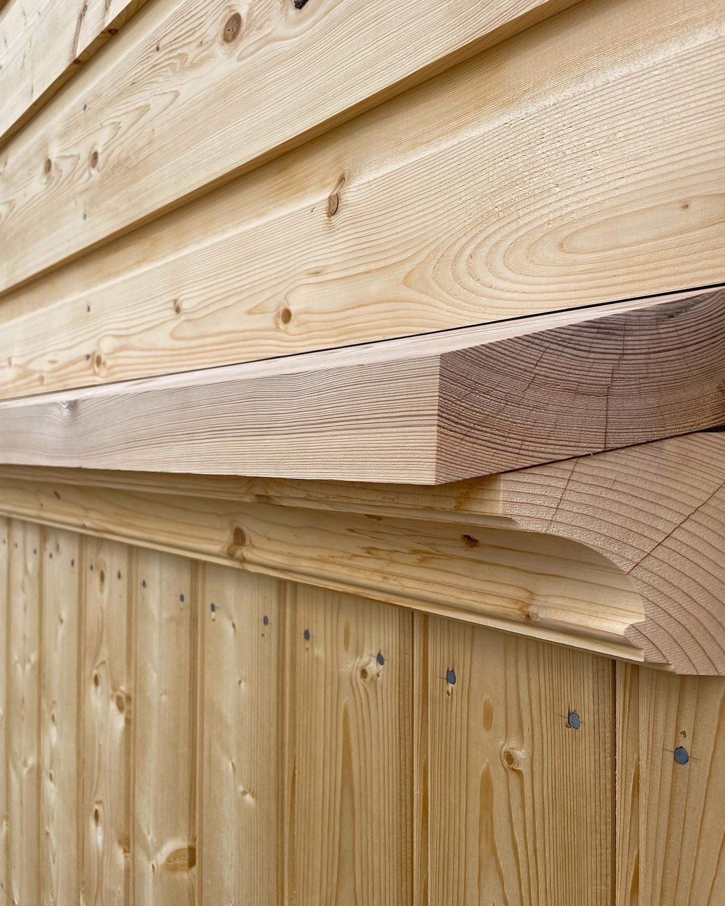
External cladding
Patches and repairs to the external cladding or partial replacement of boards must be done using a cladding board of the same dimensions and cross-sectional shape as the original. Even in a situation where the entire cladding of a building needs to be replaced, choose cladding that is in keeping with the original character of the building and matches the original. Changing the external cladding, just like changing the roofing, requires a building permit from the municipal building inspector.
Source: Puuinfo
Image: SAATSI arkkitehdit

Slide 38
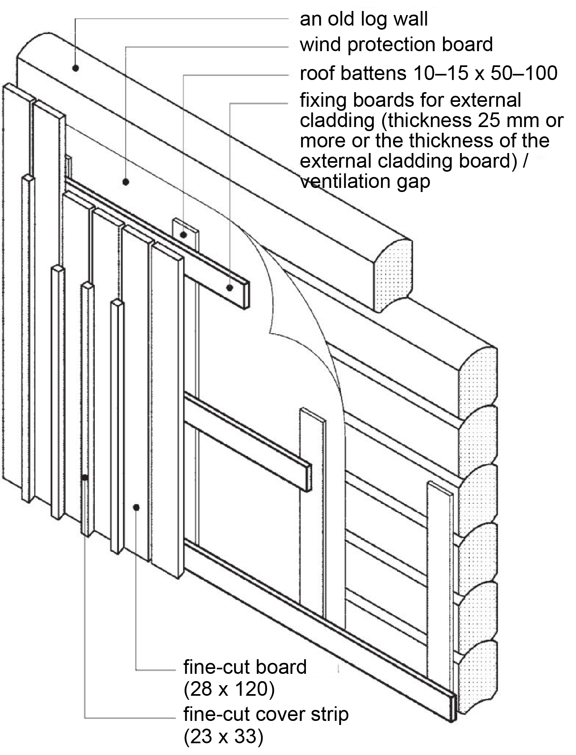
External cladding
When repairing the cladding, the condition of the wind protection on the exterior wall should also be checked. If necessary, construction paper (tar paper) or a wind protection plate (weatherproof 12 mm thick fibreboard) can be added.
Example of the external cladding of a log wall. Recommended thickness of external cladding boards is 28 mm. Tar paper can be used as wind protection. It is preferable to use weather-resistant 12 mm or 25 mm fibreboard, which also improves the thermal insulation of the wall.
Source: Puuinfo

Slide 39
Prerequisites for a functional and long-lasting external cladding:
use a sufficiently thick cladding board, recommended thickness 28 mm
avoid extensions
shape the bottom edge of the cladding into a drip moulding
a ventilation gap at least 20 mm from the bottom up behind the external cladding
the lower edge of the external cladding must not be less than 300 mm, the recommendation is that it hangs be 500 mm above the ground;
functional external sills for windows and battenings/weatherboards
functional rainwater gutters and downpipes
eaves at least 300 mm wide, preferably 600 mm wide
regular paint maintenance of the external cladding
Source: Puuinfo

Slide 40
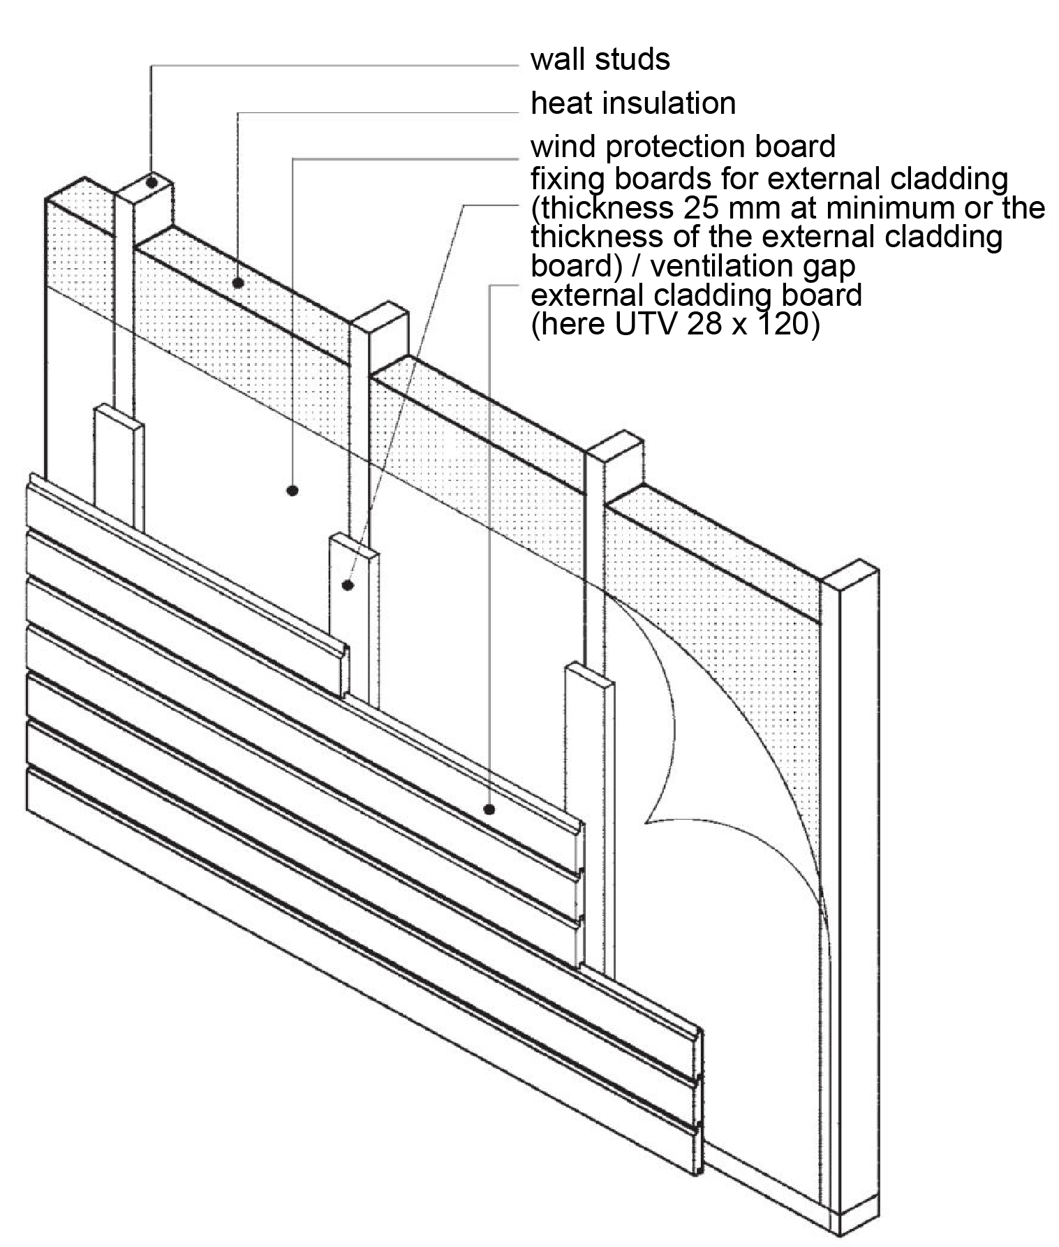
External cladding
Example of the external cladding of a framed structure wall Recommended thickness of external cladding boards is 28 mm. Tar paper can be used as a wind protection. It is better to use weather-resistant 12 mm or 25 mm fibreboard, which also improves the thermal insulation of the wall.
Source: Puuinfo

Slide 41
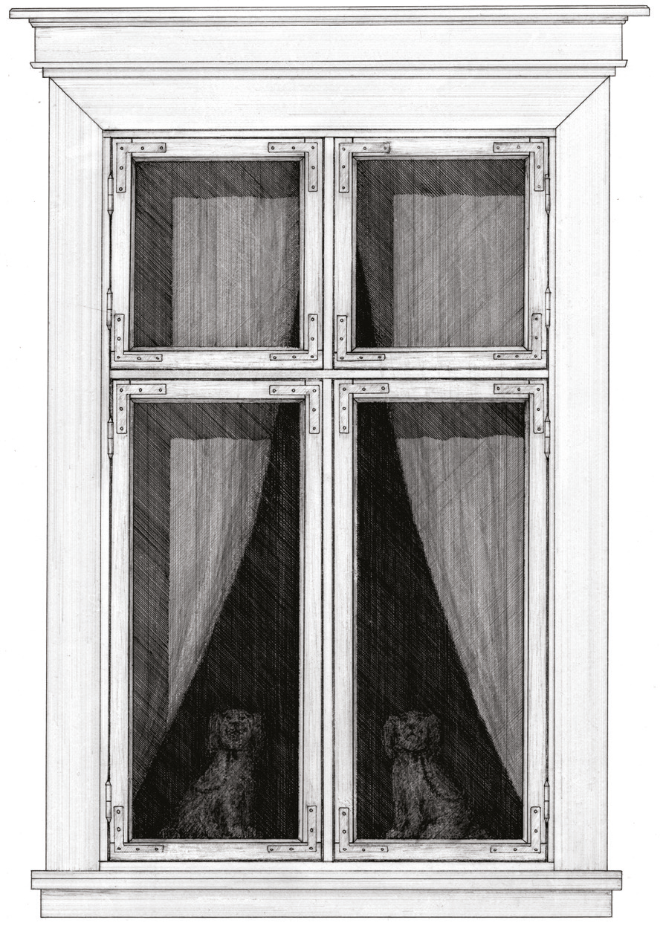
Windows
Window frames in old buildings are usually made of dense pithwood. They usually last for decades when maintained well.
The maintenance and repair of windows includes not only the jambs and the frames, but also the external weatherboards and internal mouldings.
External weatherboards, especially the water board above the window and the external sill or board below, should be kept in good condition to prevent rainwater from entering both the caulked space between the window and the wall and the wall structure itself.
The slope of the window panel must be at least 30°.
The functional sealing of the window frame and the gap between the wall and thw window significantly reduce draught and improve the thermal economy of the building.
Source: Puuinfo
Photo: Vanhrauma.fi

Slide 42
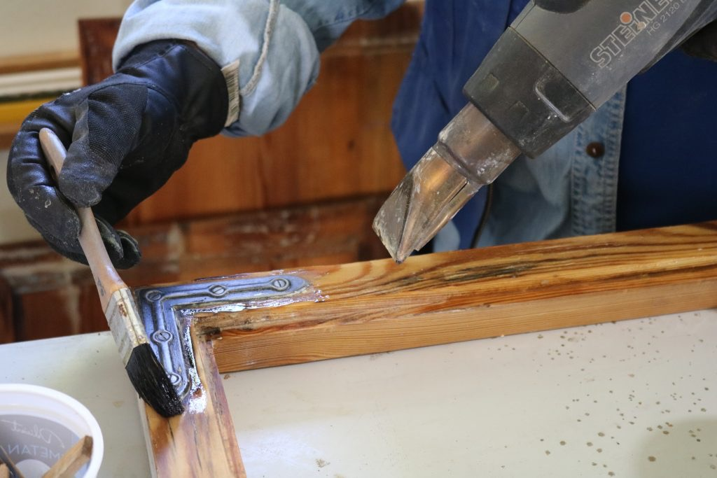
Windows
If there is damage to the window structure, find out whether the window can be renovated by repairing the damaged part. If it is necessary to replace windows in poor condition, choose new windows that are of the same size, frame and materials as the original and are appropriate to the character of the building.
Source: Puuinfo
Photo: ikkunainen.fi

Slide 43
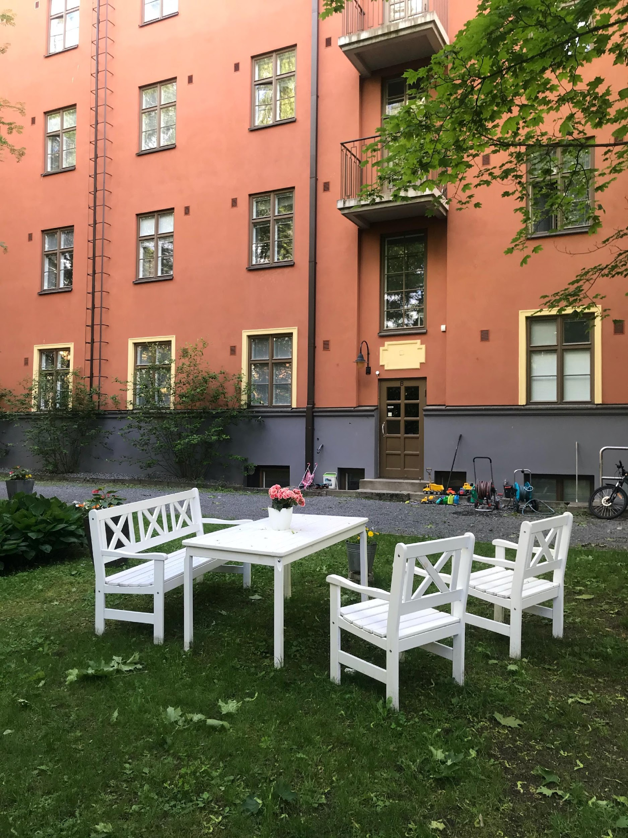
Windows
Today's industrially manufactured windows intended for new construction are not necessarily stylistically suitable for use in old buildings. For example, today's windows are invariably inward-opening (both the outer and inner sashes open inwards), whereas until the 1950s, inward-opening windows (the inner sash opens inwards and the outer sash opens outwards) were common. Even a change in the opening of the windows may disturb the overall appearance of an old building, which is created and maintained by these small details and is sensitive to changes.
The windows of this apartment building, built in 1926, originally opened completely outwards. Now it has been modernised with windows that open inwards.
Source: Puuinfo
Image: Henri Käpynen

Slide 44
Summary: Common mistakes in renovating a wooden house
There is a risk that the original values of the building will be lost and that the building will have potential mould damage. Here are a few more key points to consider when planning a renovation:
Wall structures expand outwards with additional insulation
As a result, the eaves become shorter and the original proportions are lost
Moulding and battens are added without respect for the original solutions.
New façade boards are "over planed" and the original atmosphere will be lost
The doors are ordered as ready-made catalog products and, for example, carpentry services are not used
Wood-framed windows are replaced with modern ones, like with aluminium, and in the worst case, the whole window will be replaced with a new catalogue product.
The building is painted with plastic-based paint products (e.g. latex paint)
Source: Puuinfo

