Slide 1
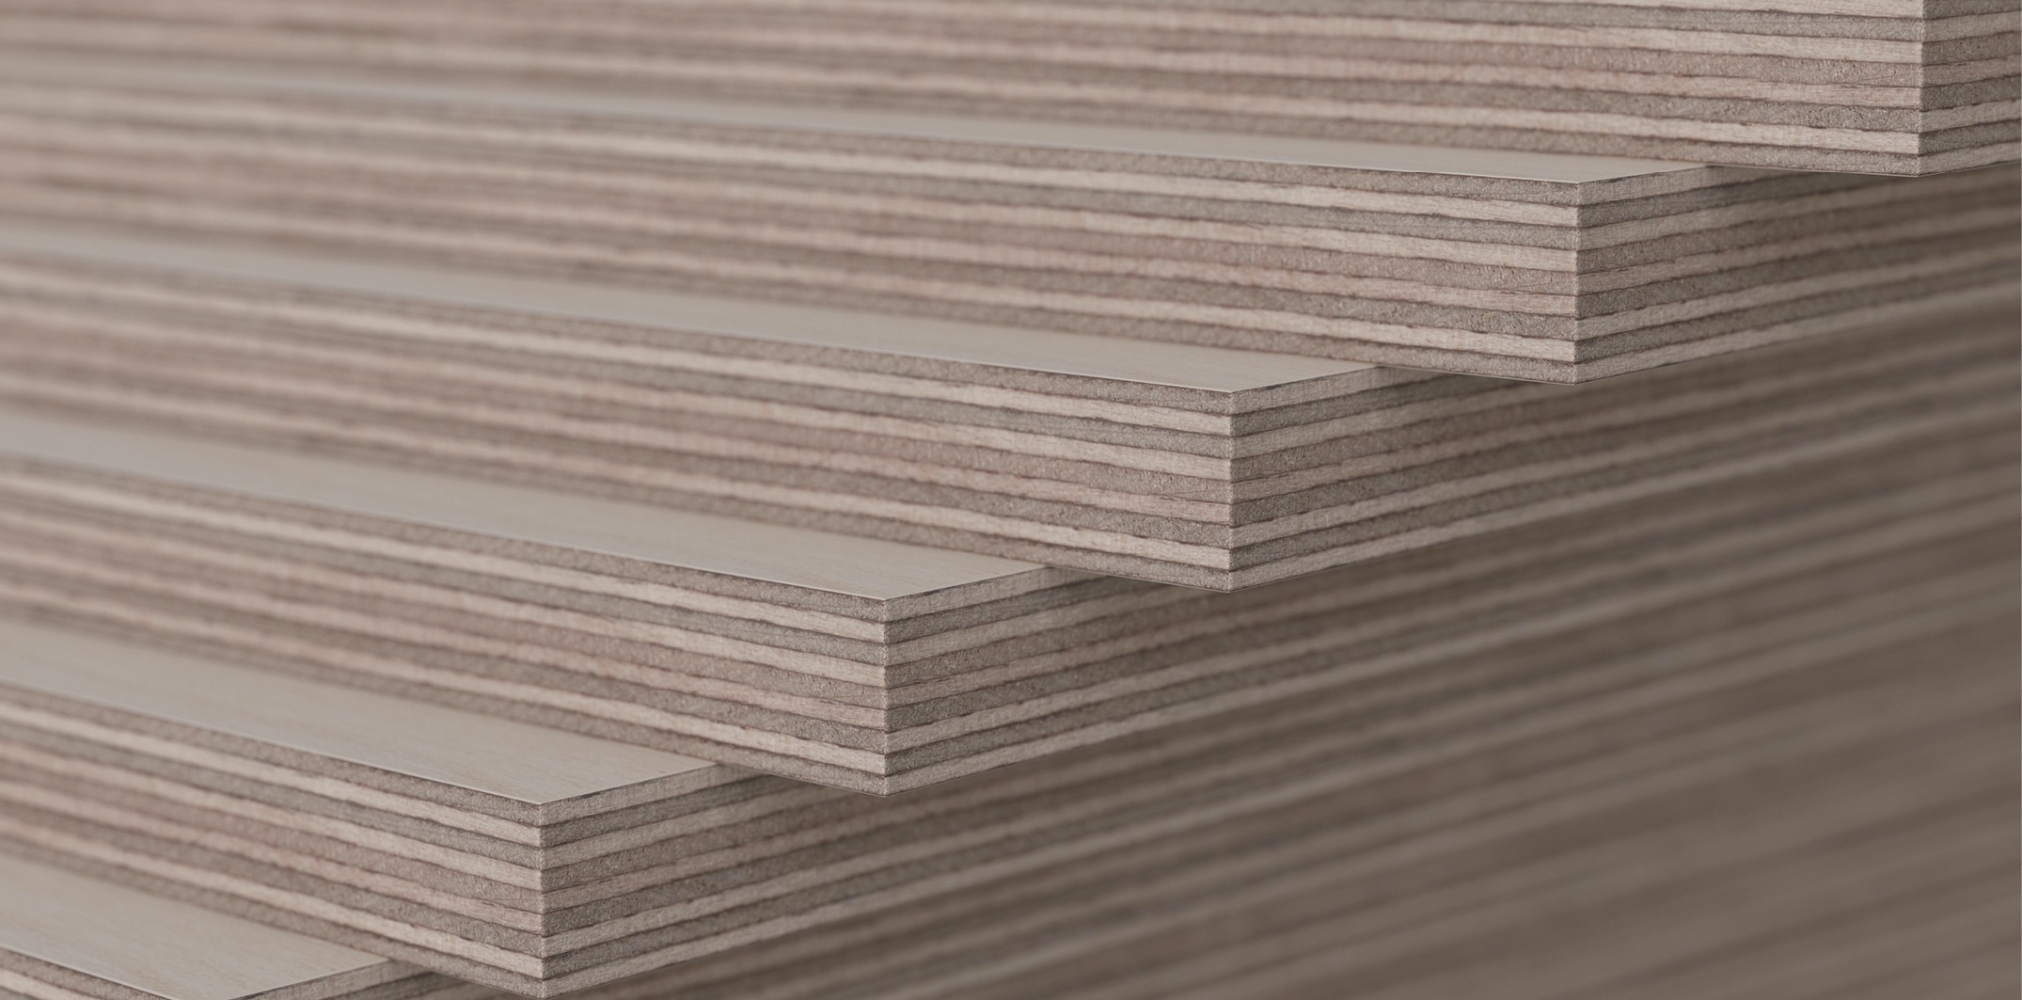


Industrial wood construction
Teaching materials for industrial wood construction education 2022

Slide 2
Origin of the materials
Use of the materials
These learning materials for industrial wood construction have been prepared in a project led by Puuinfo Oy in 2021–2022. Also involved in the project were
Lappia Vocational College,
TTS-Työtehoseura ry
South-Eastern Finland University of Applied Sciences,
Metropolia University of Applied Sciences,
Jyväskylä University of Applied Sciences,
University of Tampere, and
Federation of the Finnish Woodworking Industries Puutuoteteollisuus ry
The project was funded by the Ministry of the Environment.
The materials are intended to be used as extensively as possible in industrial wood construction education and studies.
The materials are released under the Creative Commons licence Attribution-ShareAlike (CC BY-SA), which requires that the author be properly credited when the materials are used and that derivative works may only be distributed under the same licence as the original work.
The original materials and any updates to them by Puuinfo will be published on the Library of Open Educational Resources website (aoe.fi) and the Puuinfo.fi website.

Slide 3
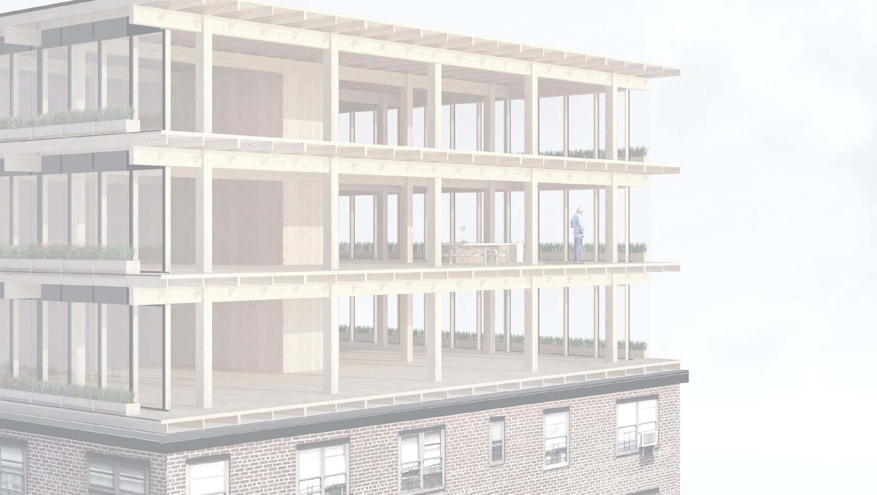
Repair construction of wooden buildings and use of wood in repair construction

Slide 4
Authors
Markku Karjalainen, Architect D.Sc. (Tech.), Professor
Henri Käpynen, Architect, Researcher
University of Tampere
Release date: 29/06/2022

Slide 5
Repairing a wooden building and use of wood in repair construction – contents
‹#›
Introduction - Repair construction
Options for using wood in energy renovation projects of suburban blocks of flats and in adding storeys to buildings
  General information on adding storeys
  Building systems for adding wooden storeys
  Architecture competitions – repair construction
  Stages of an additional storey construction project
Adding heat insulation in a wooden building and using wood in repairing a block of flats made of concrete Adding heat insulation in a wooden building and using wood in repairing a block of flats made of concrete
  Heat insulation
  Overall energy review
  Energy performance requirements
  Structural types for additional storeys
  Energy renovation of a suburban building
  Survey on the actual repair construction potential of Finnish blocks of flats 10/2015
  Student projects
Wood façade repair
  Surface treatment
  Breathable structure
  Fixing board cladding
  Principles of repair work
  Repair work step by step
Replacing the bottom logs of a log house ("shoeing")
  Replacing logs
  Examples
  Procedures
  Example sites
Wood structure repair
  Condition assessment and continuous maintenance
  Roof
  Foundations and subsurface drains
  Load-bearing structures and additional insulation
  Ground floor
  Exterior wall
  Attic floor
  External cladding
  Windows

Slide 6
Wood façade repair

Slide 7
Contents
Wood façade repair
  Surface treatment
  Breathable structure
  Fixing board cladding
  Principles of repair work
  Repair work step by step
    Condition assessment
    Removing boards
    Attachment of boards
    Patching

Slide 8
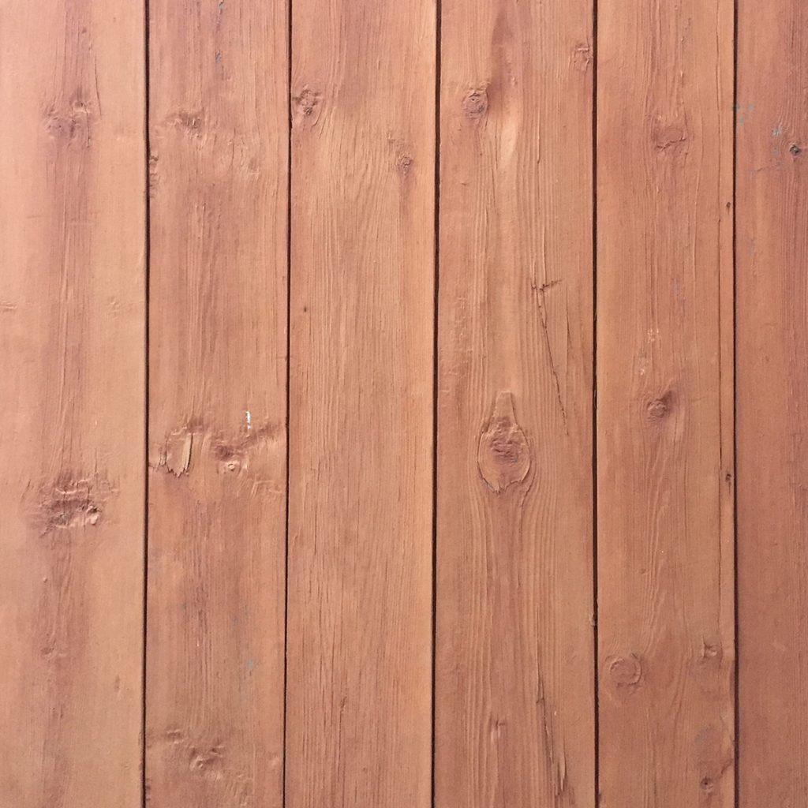
Surface treatment
Photo: saatsi.fi

Slide 9
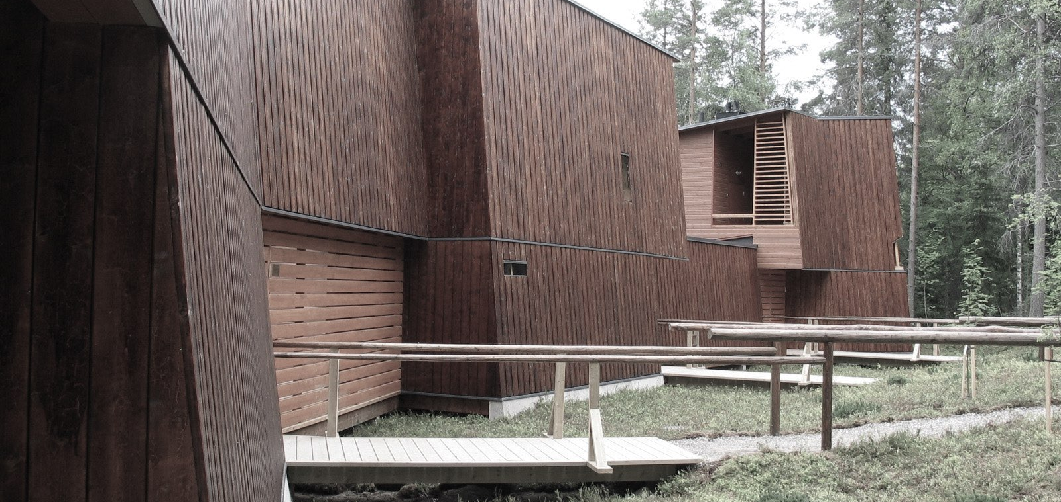
Exterior wood cladding can have a considerable service life and a maintenance paint interval of 10 to 15 years when following the relevant instructions.
Image: Jukka Koivula, Sandhouse, Sotkamo

Slide 10
Key aspects that contribute to the long-term durability of external wood cladding:
the cladding board is thick enough (> 25 mm recommended)
the quality of the wood is as good as possible (preferably spruce or pine heartwood),
the cladding board is sufficiently dry when installed and surface treated (moisture content < 18 %)
providing structural protection for the cladding, e.g. eaves and sufficient clearance from the ground for the underside of the cladding (recommended > 500 mm)
joints and unprotected board ends that are susceptible to weather are avoided as far as possible.
protect the joints and extensions of the wood, preferably also the attachment points
wood cladding is free to dry after getting wet and rainwater cannot absorb into the structure (sloping surfaces, drip edges, protective cladding)
installations, attachments and surface treatments have been carried out carefully in accordance with the relevant instructions.
the external cladding is inspected, repaired and maintained frequently enough. Correct and timely paint maintenance is an essential requirement for the long-term durability of wooden external cladding.

Slide 11
Surface treatment outdoors
Wood turns grey when exposed to the sun's ultraviolet rays outdoors. The greying can be prevented and the wood colour can be restored by surface treatment that provides UV protection.
Suitable surface treatment includes wood oils, translucent and opaque wood preservatives and protective liquids as well as paints intended for outdoor use.
Mould growth can be prevented by treating the surface with an anti-mould agent. The air, paint and the surface to be painted must be at least +5°C and the relative humidity of the air must be less than 80% during surface treatment and drying.

Slide 12
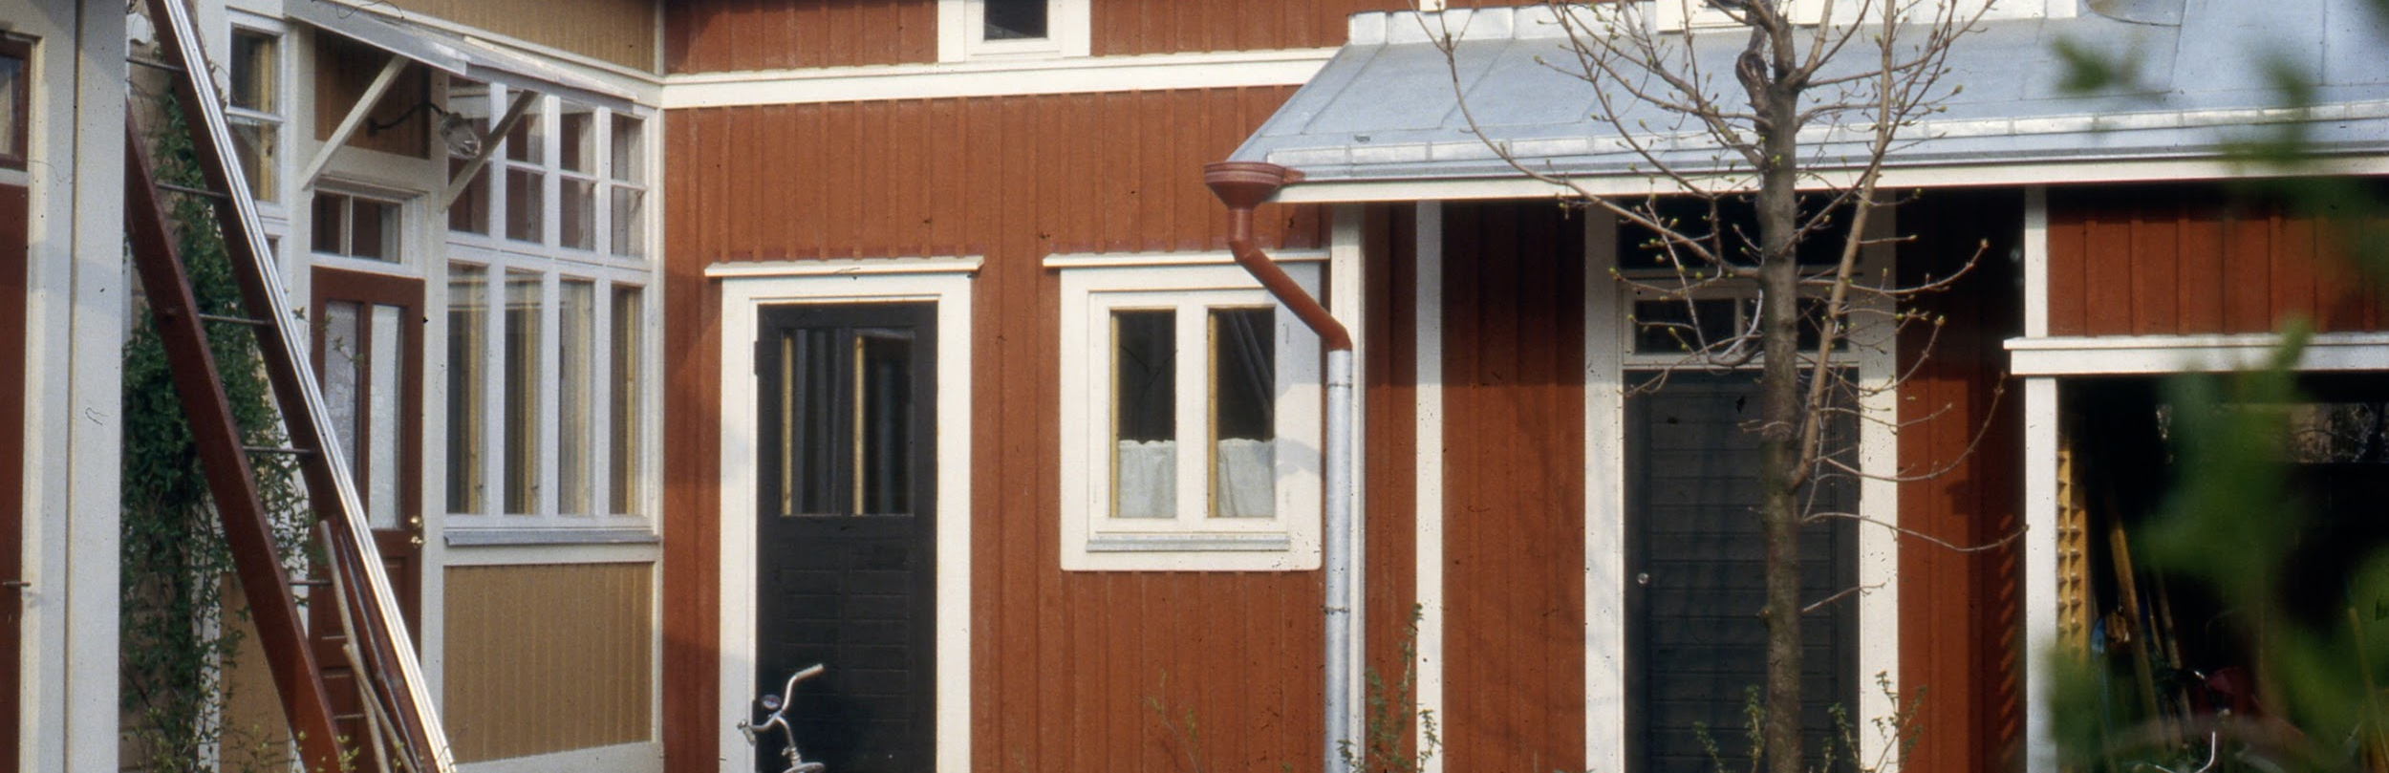
Surface treatment outdoors
Surface treatment agent should be selected according to the application. Read the surface treatment manufacturer's instructions before processing. You can get help from shops selling paints and wood preservative liquids.
Surface treatment agent must be selected according to the application. Read the surface treatment manufacturer's instructions before processing. You can get help from shops selling paints and wood preservative liquids.

Slide 13
Surface treatment outdoors
When surface-treating pressure impregnated timber, attention must be paid to ensuring that the wood is sufficiently dry. For example, a terrace built in the spring is sufficiently dry for surface treatment in late summer, if the terrace has been protected from rain during the summer. If the construction work is scheduled for summer or autumn, then the surface treatment should not be carried out until the following summer.
Heat-treated wood surfaces should be surface-treated immediately upon installation.
Special attention should be paid to the surface treatment of cut surfaces, as the wood naturally absorbs the most moisture from the longitudinal ends of the piece. If the products are treated before installation, the mounting points must be treated separately with a surface treatment agent after installation.

Slide 14
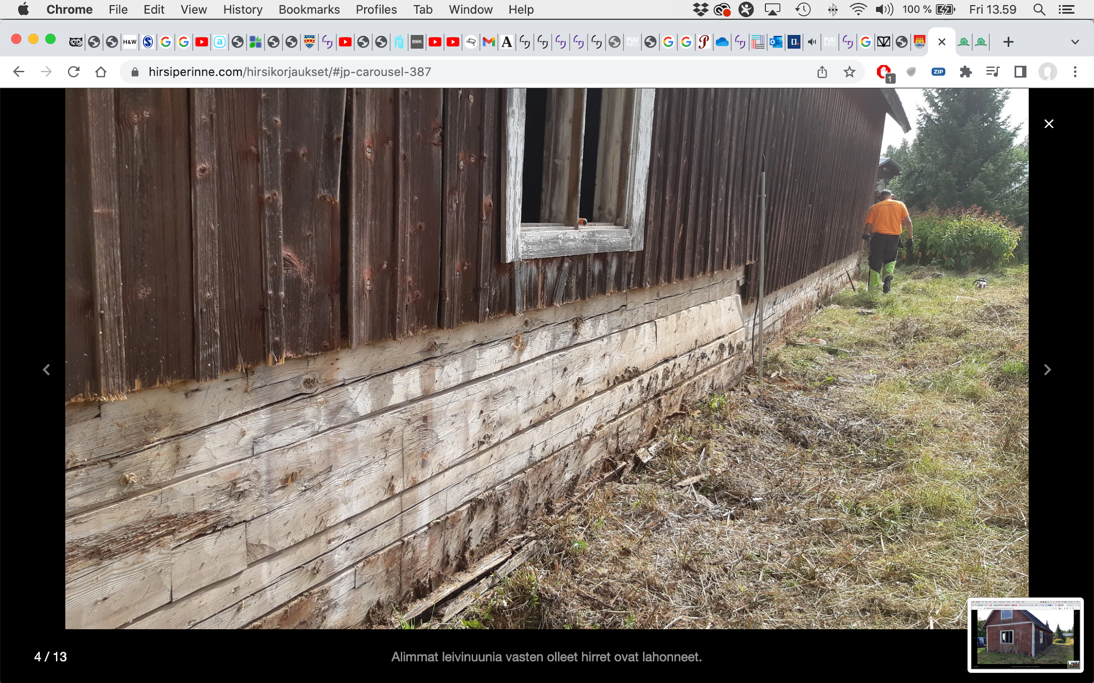
Paint maintenance of the external cladding
The paint maintenance of the wood façade becomes topical when the previous treatment is worn or damaged to the extent that it has lost its aesthetic or protective significance. Always follow the instructions of the surface treatment manufacturers.
If mould or algae are present on an intact paint surface, they can usually be removed by a simple wash. However, the result is more permanent if the washed surface is also painted. Fungal and algal growth are usually found on surfaces with lush vegetation near them.
Source: Puuinfo

Slide 15
Paint maintenance of the external cladding
The need for paint maintenance varies on different façades depending on the direction the façade is facing. The paint on the south façade has a shorter service life than the paint on the north façade. Paint maintenance can only be applied to those wall surfaces that are in immediate need of repair. Remember, however, that even if the same colour and paint type are used, the new paint surface is likely to differ noticeably from the old and mostly slightly faded paint surface.
Choose a colour for the exterior cladding that blends well with its surroundings and fits the original character of the building. A change of colour should be considered mainly when the building has at some point been painted in a different colour to the original, a colout that is not in keeping with the old character of the building. Check whether a change in the colour of the façade requires a permit from your local building inspector.
Source: Puuinfo

Slide 16
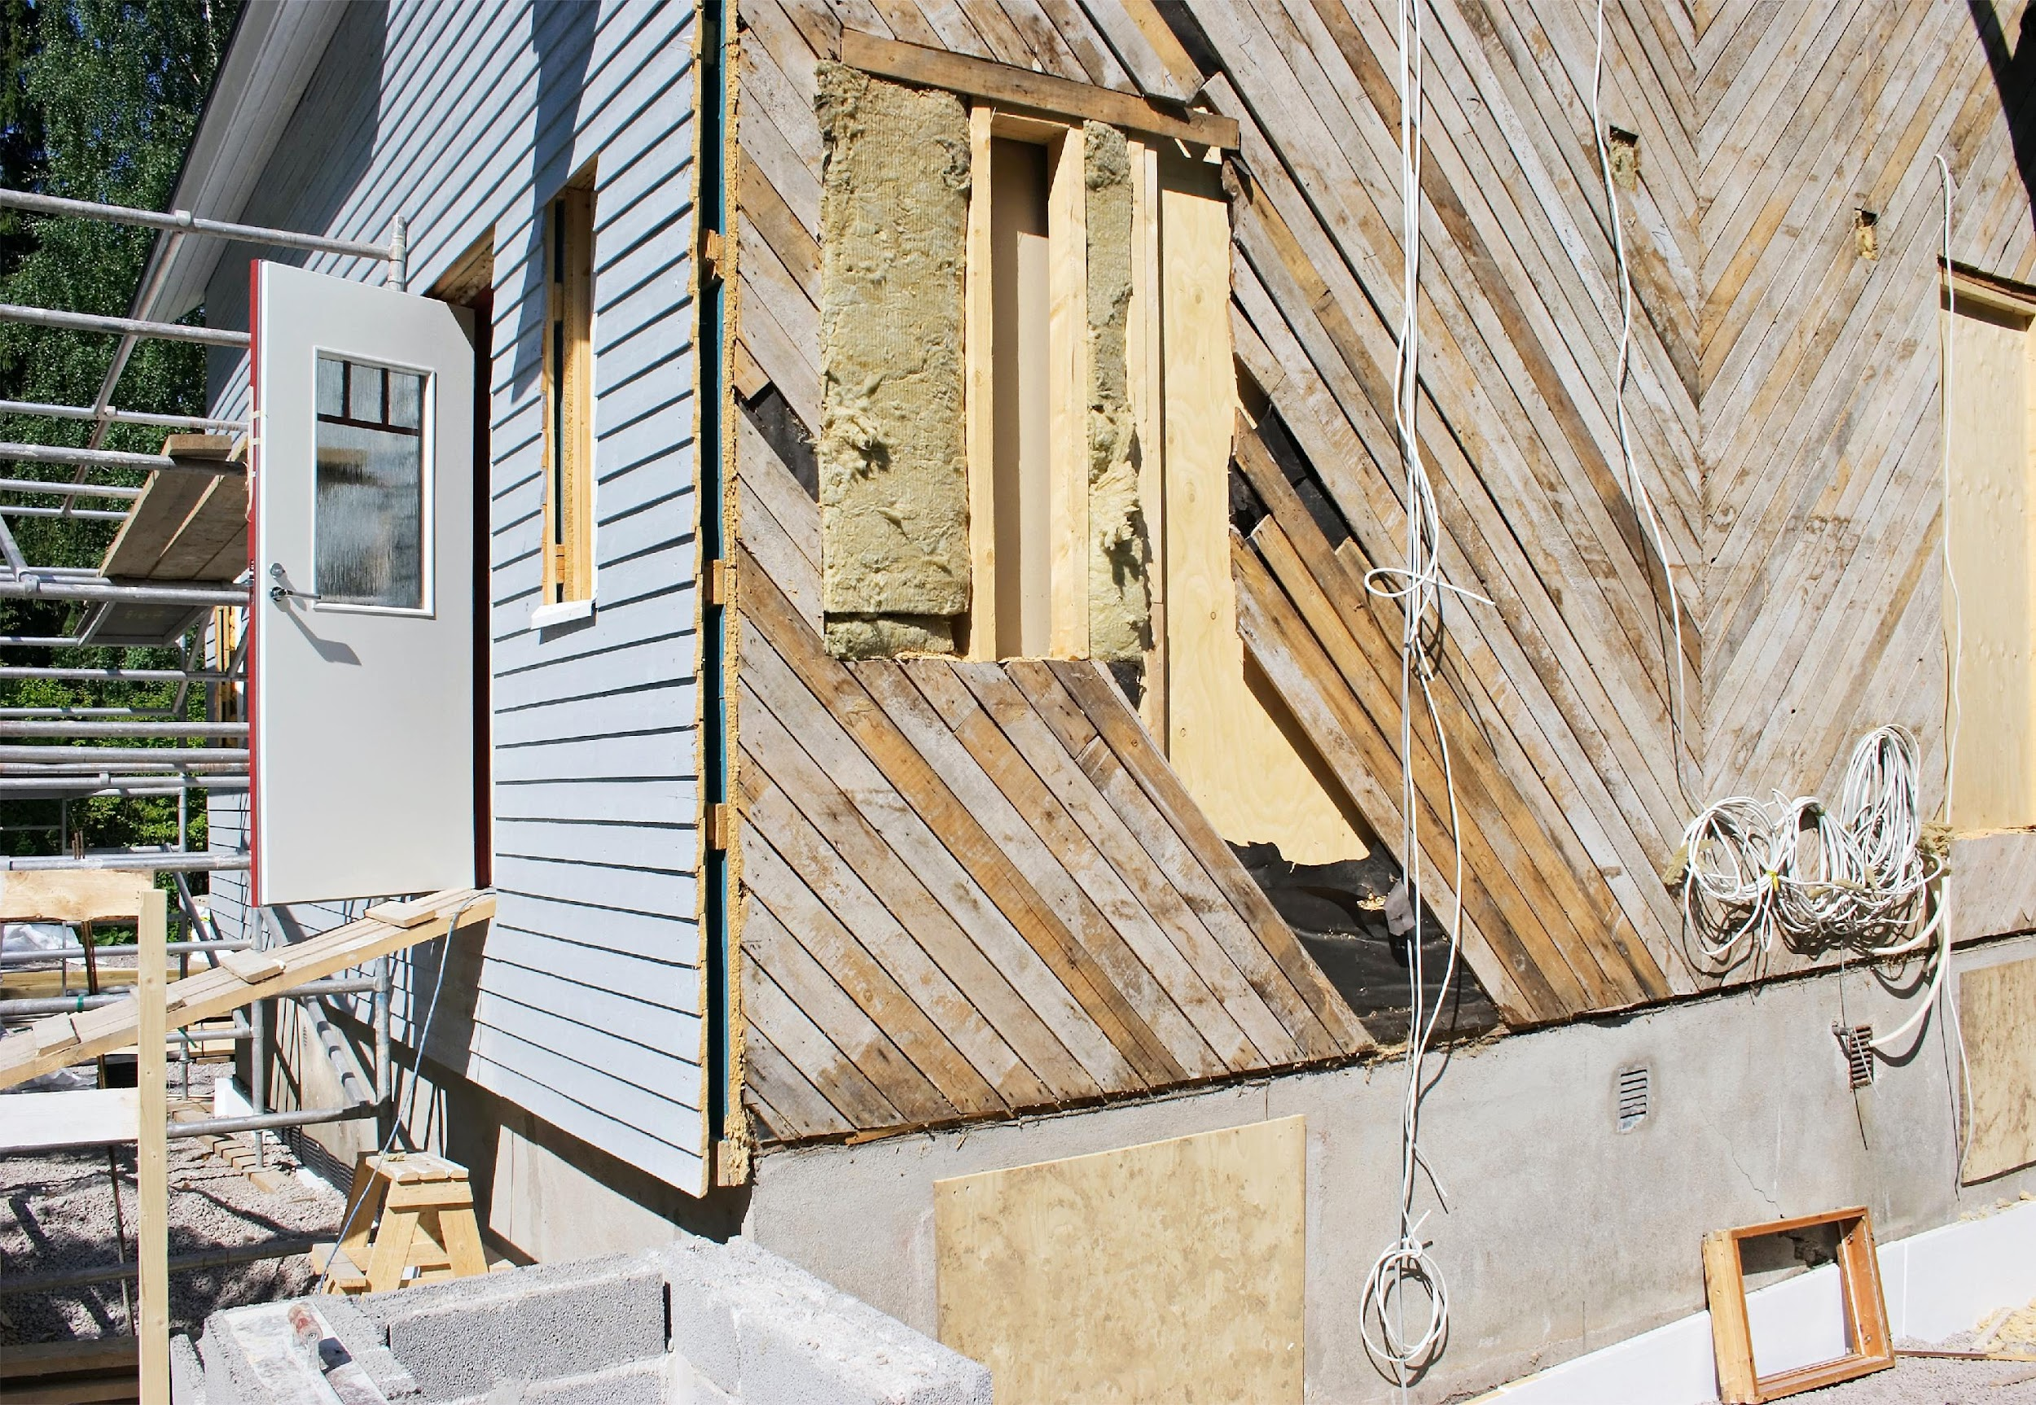
Paint maintenance of the external cladding
Maintenance intervals vary for different paint products. Environmental conditions also cause variations in the durability of the paint surface. As a general rule, finishing paints achieve a longer treatment interval than translucent wood preservatives. This is due to the better coverage and greater film thickness of the finishing paints.
The best time for paintwork is from the beginning of May to September. Direct sunshine is usually harmful because the paint dries too quickly. After rain, wood surfaces must be allowed to dry sufficiently. Paint with a brush to ensure that the paint adheres properly to the wood surface.
Source: Puuinfo

Slide 17
Paint maintenance of the external cladding
When starting paint maintenance, determine the previous treatments and paint types used. Choose the paint type that has been used before, provided that the appropriate paint type has been chosen in the first place. Otherwise, the old paint must be completely removed. At all stages, but especially with regard to pre-treatments, careful and thorough work is very important.
As it can be difficult to identify the type of paint previously used, always mark the type of paint or paint combination (and colour ) used during the painting work in an inconspicuous but easy-to-find place in the building.
Source: Puuinfo

Slide 18
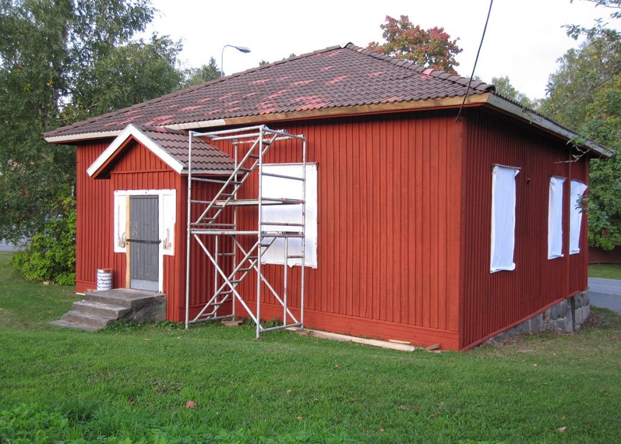
Paint maintenance of the external cladding
Pitäjäntupa in Mäntsälä was given a red wash of Italian red paint by volunteers.
Source: saatsi.fi

Slide 19
Instructions for investigating old paint treatment
An old oil paint surface is characterised by:
dim, slightly powdery surface
fine mesh cracking of the surface
An old dispersion paint surface (latex) is characterised by:
dimmed shine
surface cracking and paint film detachment
in addition, the dispersion paint softens when heated and forms a "rubbery" smell when burnt
Source: Puuinfo

Slide 20
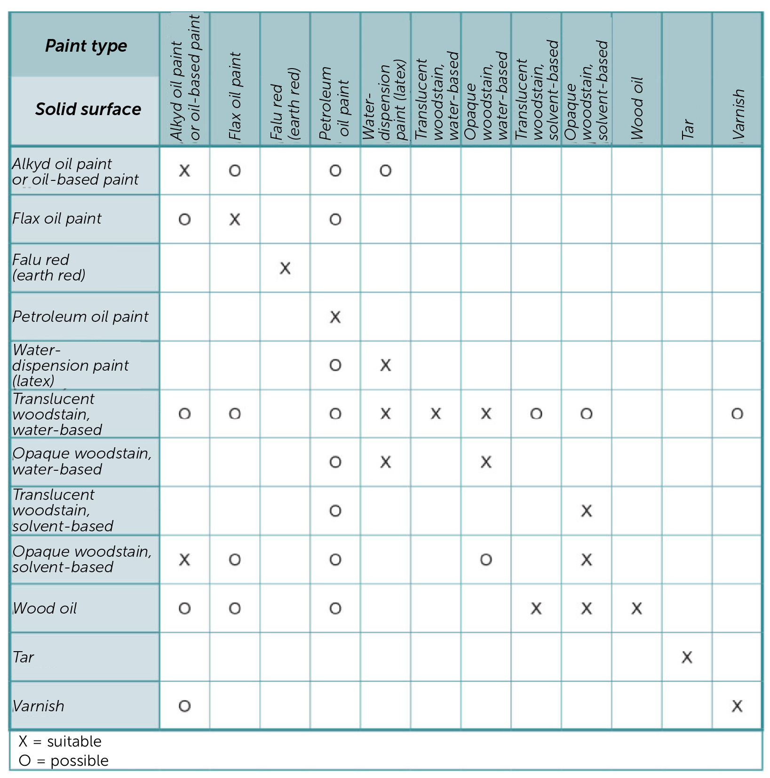
Types of paint suitable for paint maintenance based on previous treatment of the base:
Source: Puuinfo

Slide 21
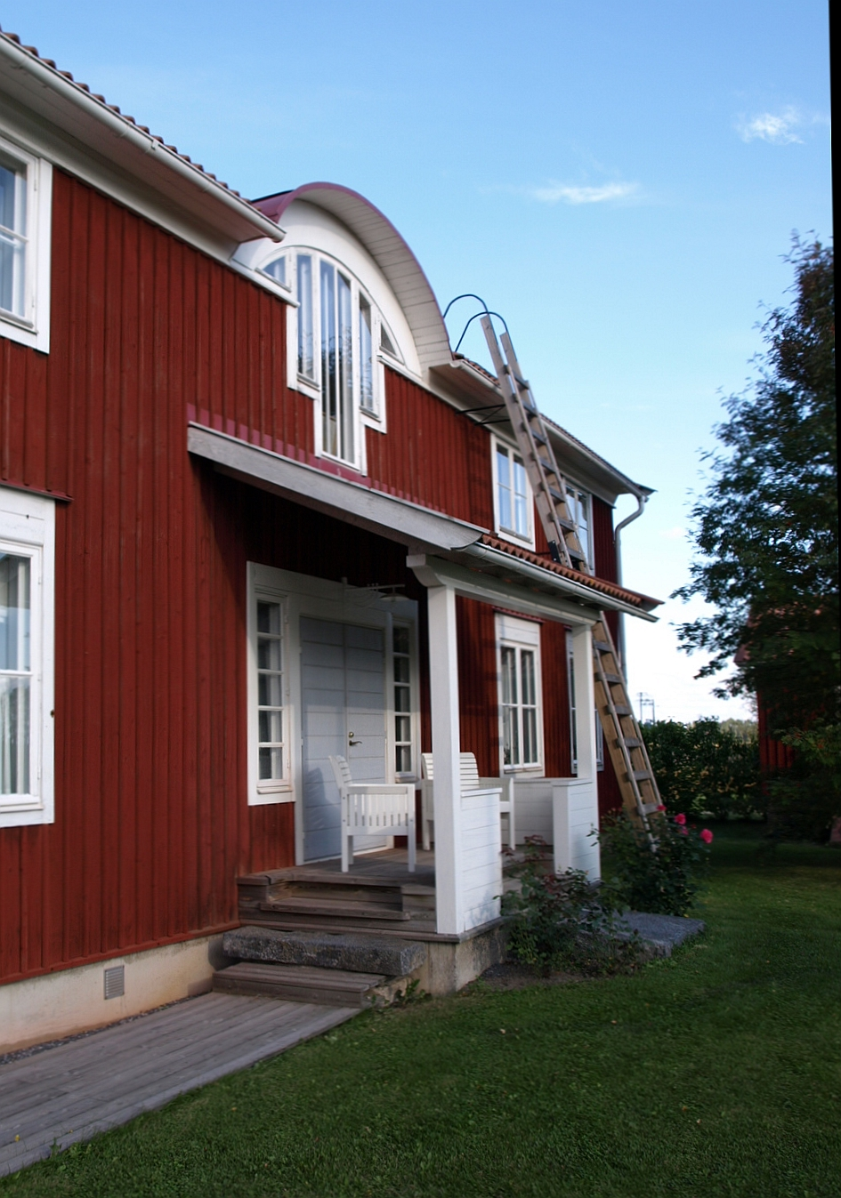
Pre-treatment
If the old paint surface is intact, it is usually sufficient to remove dust and dirt by brushing and then washing and rinsing.
Use a steel scraper to remove all flaking and chipping paint from a worn or damaged paint surface.
Remove also any intact paint film that is loosely attached to its base.
In addition, brush all over the old paint surfaces with a steel brush.
Sand window frames and similar surfaces with sandpaper.
Image: Jukka Koivula
Source: Puuinfo

Slide 22
Washing
After mechanical cleaning, wash and brush the surfaces to be painted. Washing should preferably be done by hand and the washing solution should be selected according to the paint manufacturer's instructions.
If you use a pressure washer, make sure that water does not penetrate the backing structures of the cladding. Pressure washing also requires a longer drying time than manual washing.
Source: Puuinfo

Slide 23
Priming
The primer is determined by both the base and the selected surface treatment:
wood preservatives are only suitable for priming surfaces from which the old paint has been completely removed
oil and alkyd primers are suitable for priming surfaces previously painted with the same type of paint
zinc white primer is only suitable for surfaces from which the old paint has been completely removed and which are to be painted with linseed oil paint.
Falu red (red paint) does not require priming
Source: Puuinfo

Slide 24
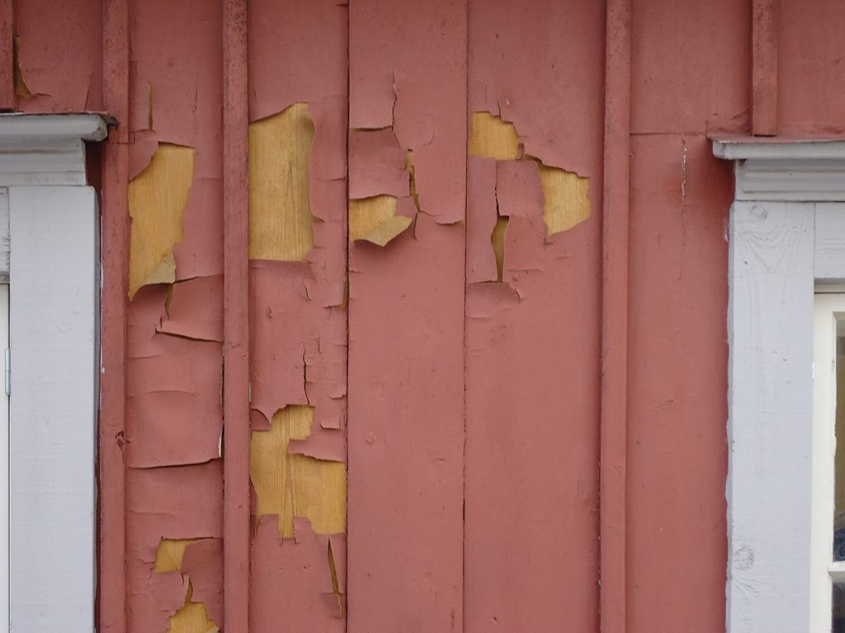
Surface painting
Oil and alkyd oil paints are best suited for wood surfaces previously treated with similar paint products. However, they may also be used on surfaces previously treated with dispersion paints (latex) or solvent-treated wood preservatives.
Linseed oil paint adheres well to a cleaned and chalked paint surface. Wear and chalking will also prevent the paint layers from becoming too thick. Linseed oil paint is recommended for use on a surface previously treated with a similar paint product.
Photo: saatsi.fi
The binder for this red paint is alkyd, i.e. it is a plastic paint.
Source: Puuinfo

Slide 25
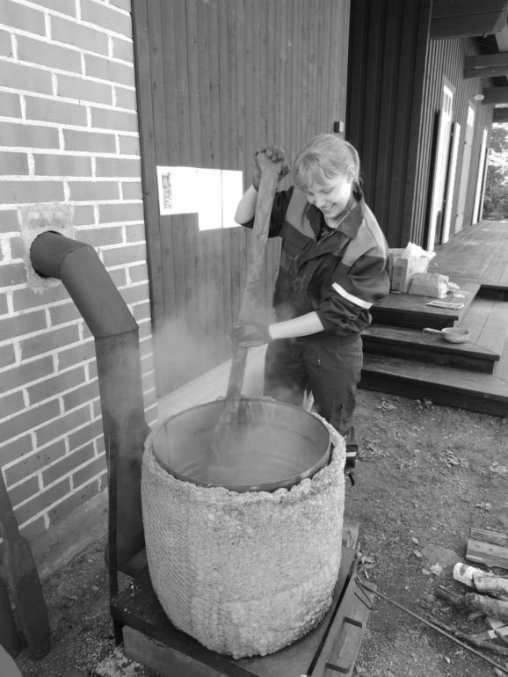
Earth red paint (Falu red)
Mud paint (e.g. earth red paint) is only suitable for wooden surfaces previously treated with mud paint. Pre-treatment involves brushing the old paint layer clean, for example with a root brush. If the old paint has not worn out very badly, one coat is enough.
Water- or solvent-based wood preservatives are suitable for use on a wood base previously treated with a similar type of wood preservative. Opaque wood preservative can also be applied to a surface previously treated with a translucent wood preservative, but not vice versa. Opaque water-based wood preservative is also suitable for use on surfaces painted with dispersion paint. Solvent wood preservatives are not recommended for previously treated surfaces covered with water-treated wood preservatives.
Photo: Vanhrauma.fi
Making of earth red paint at Renovation Centre Tammela in Rauma.
Source: Puuinfo

Slide 26
Cooking instructions for mud paint:
Cooking ingredients:
50 l water
2 kg of green vitriol (ferrous sulphate)
4.5 kg of fine rye or wheat flour
8 kg of red mud
(salt)
Cooking equipment:
Iron barrel (200 l)
Bricks or stones
Mineral wool carpet, wire yarn
Paddle made of a board
Buckets
A large iron barrel opened at the top is a suitable cooking vessel for earth red. Underneath the barrel, a fireplace approximately 20 cm high is made of bricks or stones. A mineral wool mat is wrapped around the barrel with iron wire; the top of the barrel can be left bare.
Put 40 litres of water in the pot and light the fire. Boil the water and add 2 kg of green vitriol.
In a separate bucket, gradually mix the flour with 10 litres of water.
Gradually pour the water and flour mixture into the pot of boiling water, stirring all the time.
Add 4.5 kg of fine rye flour.
Mix thoroughly (along the bottom) and boil for 2–3 hours.
Add red earth (8 kg) at low doses.
Cook and mix for ½ to 2 hours on low heat.
Leave the mixture to cool down.
The paint can be thinned with salt water. If you want to keep the paint for a few days, add half a decilitre of salt to the mixture.
Source: Renovation Centre Tammela, Rauma

Slide 27
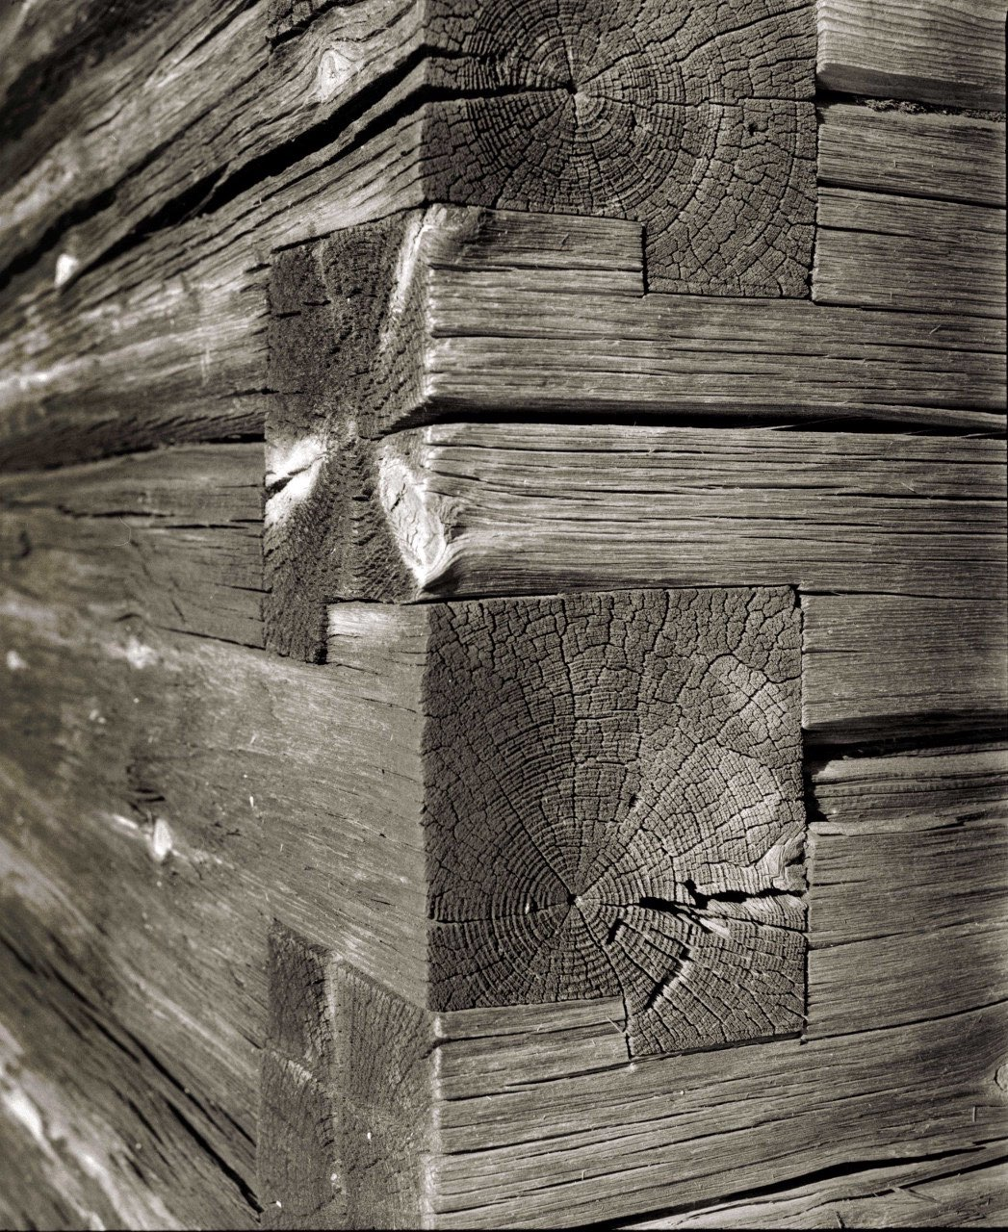
Breathable structure

Slide 28
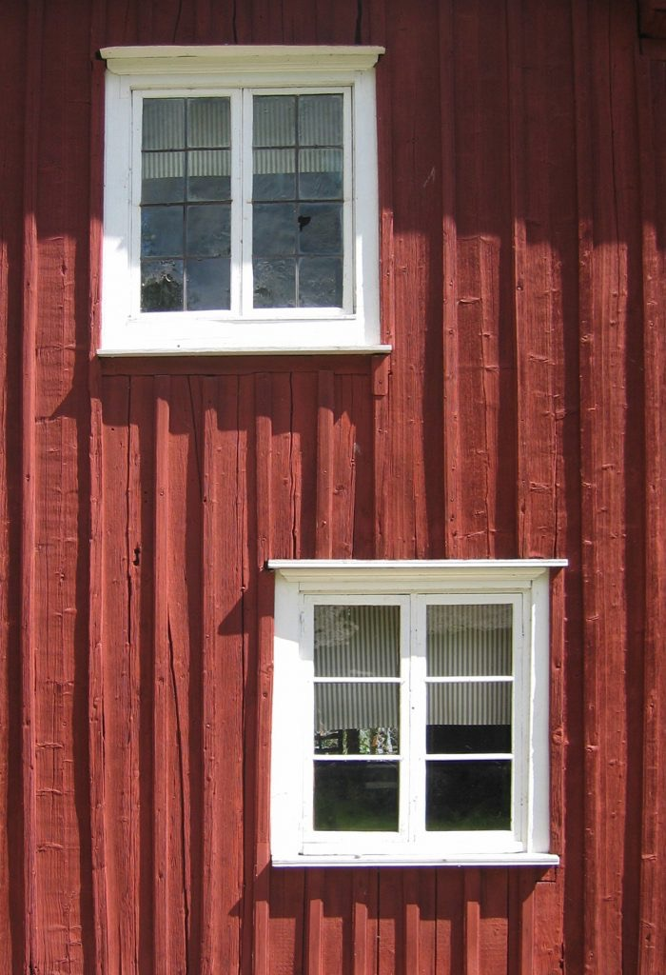
Breathability does not mean there are air leaks in the external sheathing!
Breathability means that the structures of the building can absorb and release water in both gaseous and liquid form. As a rule, breathability means that the moisture generated in the room (gaseous water molecules in the air) passes through the structures from the inside to the outside. A four-person family releases about ten litres of water into the air every day. In addition to breathing and sweating, moisture is formed by drying laundry and cooking food.
A traditional corner joint structure with an external board cladding painted with earth red is a healthy structure that binds moisture. Seurasaari, Ivars.
Source: SAATSI arkkitehdit
Source: Perinnemestari

Slide 29
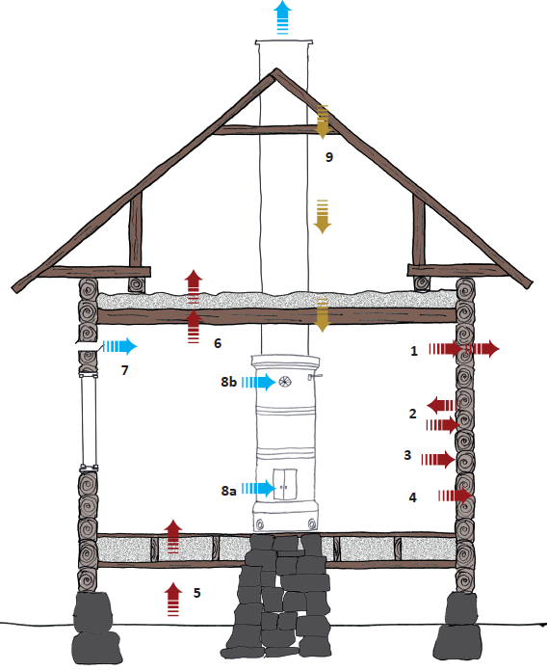
Breathable structure
Moisture transfer through structures (1, 5 and 6) is strongest in winter, while the equalisation of moisture peaks (2) occurs within a few hours.
All layers of the wall are breathable. Moisture moves freely through wallpaper, paste, porous fibreboard, logs or sawdust, tar paper, boarding and linseed oil paint to the outside air.
Moisture peaks equalise. When cooking in the kitchen, moisture is absorbed by the wall, and when the meal is over, the moisture returns to the room.
The wall is covered with plastic wallpaper and moisture does not penetrate the wall. It does not affect the house, but it does reduce the quality of indoor air.
Source: Perinnemestari

Slide 30
Breathable structure
Moisture enters the wall, but is trapped behind the plastic paint on the exterior wall, allowing microbial growth.
Moisture rises from the ground and slowly moves through the floor into the apartment. The floor will not get wet because moisture will not be trapped inside it.
The moisture generated in the apartment is also transferred to the attic. The surfaces on the room side slow down the penetration of moisture into the attic floor. In the attic, there should not be a dense layer of insulation to prevent moisture from being trapped underneath.
Source: Perinnemestari

Slide 31
Breathable structure
Breathability is not ventilation. Breathability is also not about air flowing in through the cracks. Controlled ventilation is handled with exhaust and replacement air valves (7). With ventilation, there is plenty of moisture in the apartment in the summer and hardly any in winter temperatures. During heating, air is changed and moisture is removed through the firebox (8a). When the fire is extinguished, the air is exhausted through the star valve (8b) or the ventilation valve in the chimney.
Breathable materials also serve as an insurance. If water leaks or condenses anywhere in the house, it will be exposed. For example, water from a leaking roof (9) drains through the attic floor and is visible in the ceiling. If there were plastic in between, water would accumulate for months or years.
Source: Perinnemestari

Slide 32
Fixing board cladding

Slide 33
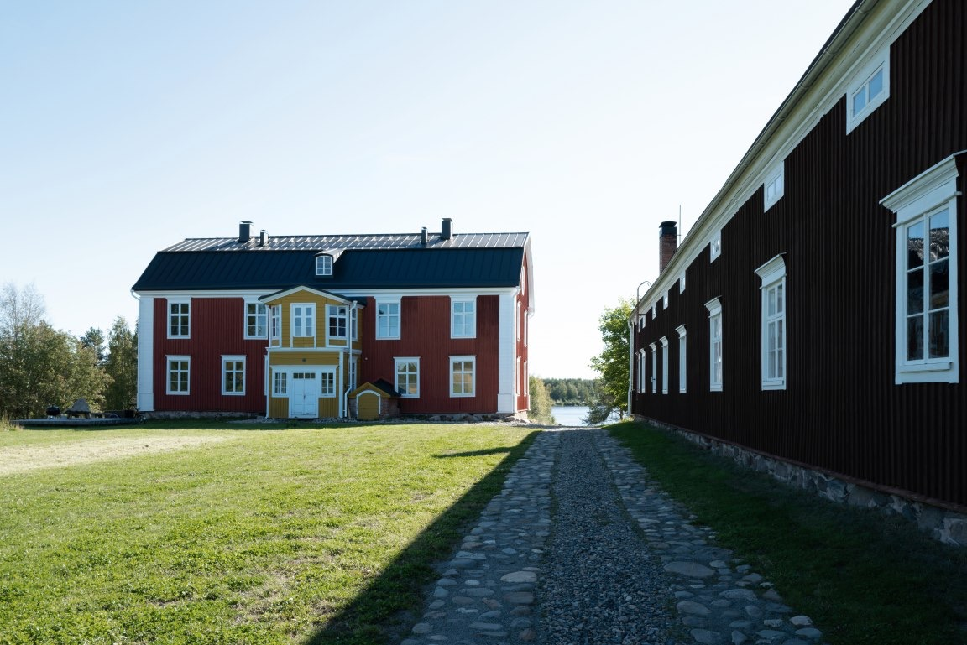
External cladding
The earliest external cladding in Finland were built on public buildings in the late 1600s. In urban residential buildings and rural manors, cladding became more common only a hundred years later. The cladding protected the logds, allowed the wall retain heat better and made the building look more beautiful and prosperous. Initially, only the most important parts of the façade were protected: the corners susceptible to rot and the sun-damaged south side. The cladding could also be used to highlight the building's façade or streetscape.
Akola Manor
JKMM Arkkitehdit
Image: Teemu Kurkela

Slide 34
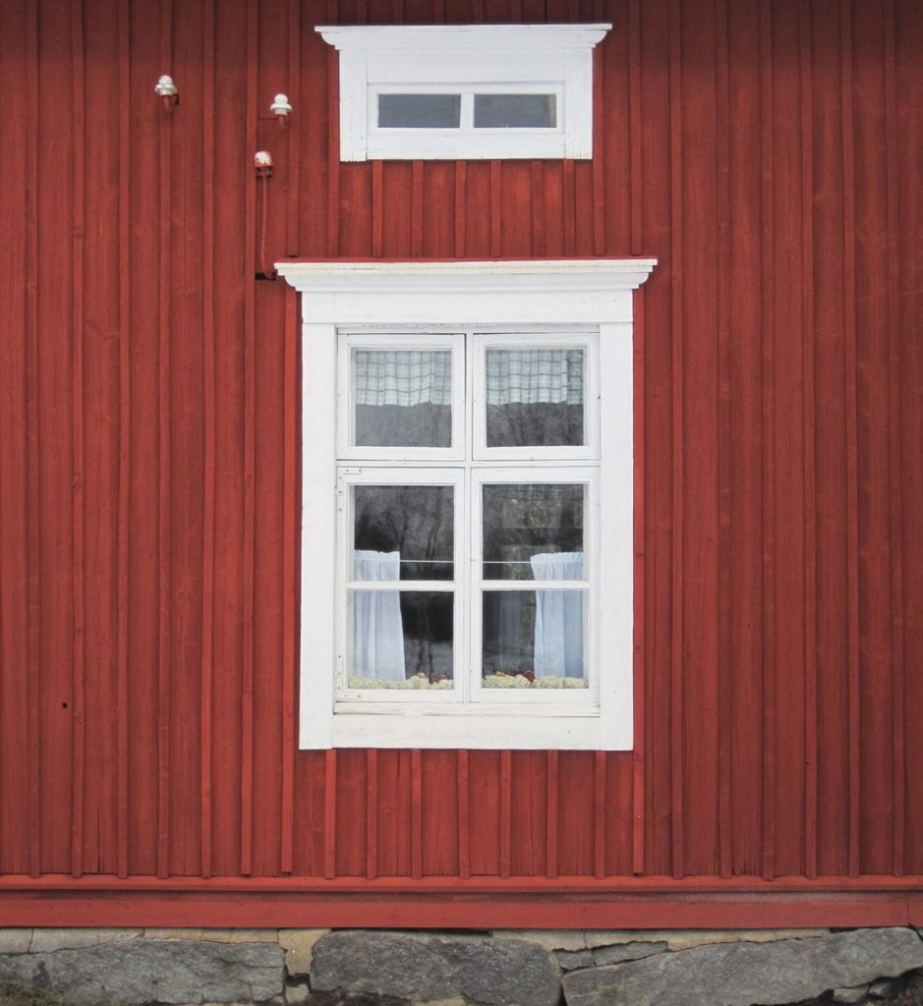
Cladding types and painting
The first type of external cladding was smooth vertical boarding. When the closed seams of the boards opened and began to collect water, the gaps were covered with thin, often profiled cover strips. The surface of the wood was protected by painting, which also strengthened the idea of a stone building.
An example of a beautifully refurbished façade with a beautifully ageing façade painted with an Italian-red mud paint and with its windows refurbished.
SAATSI arkkitehdit
The Suojanen House
Source: Finnish Heritage Agency, Repair Cards

Slide 35
Cladding types and painting
The use of planed horizontal cladding became more common in the early decades of the 19th century with the advent of Empire architecture. This new cladding type was protected by oil paint. The mouldings of windows, corners and eaves were highlighted with light colours. Towards the end of the 19th century, both vertical and horizontal boarding was combined on the same façade, usually structured with dark, strong moulding.
As industrial planing became more common, the size of the boards became narrower and profiling became more common. In this century, the horizontal narrow rebate board and the vertical board with cover strips have become the most common cladding type and the use of ornamentation has declined. A new type introduced in the 1930s was the horizontal narrow overlap siding. The colours have usually been quite light.
Source: Finnish Heritage Agency, Repair Cards

Slide 36
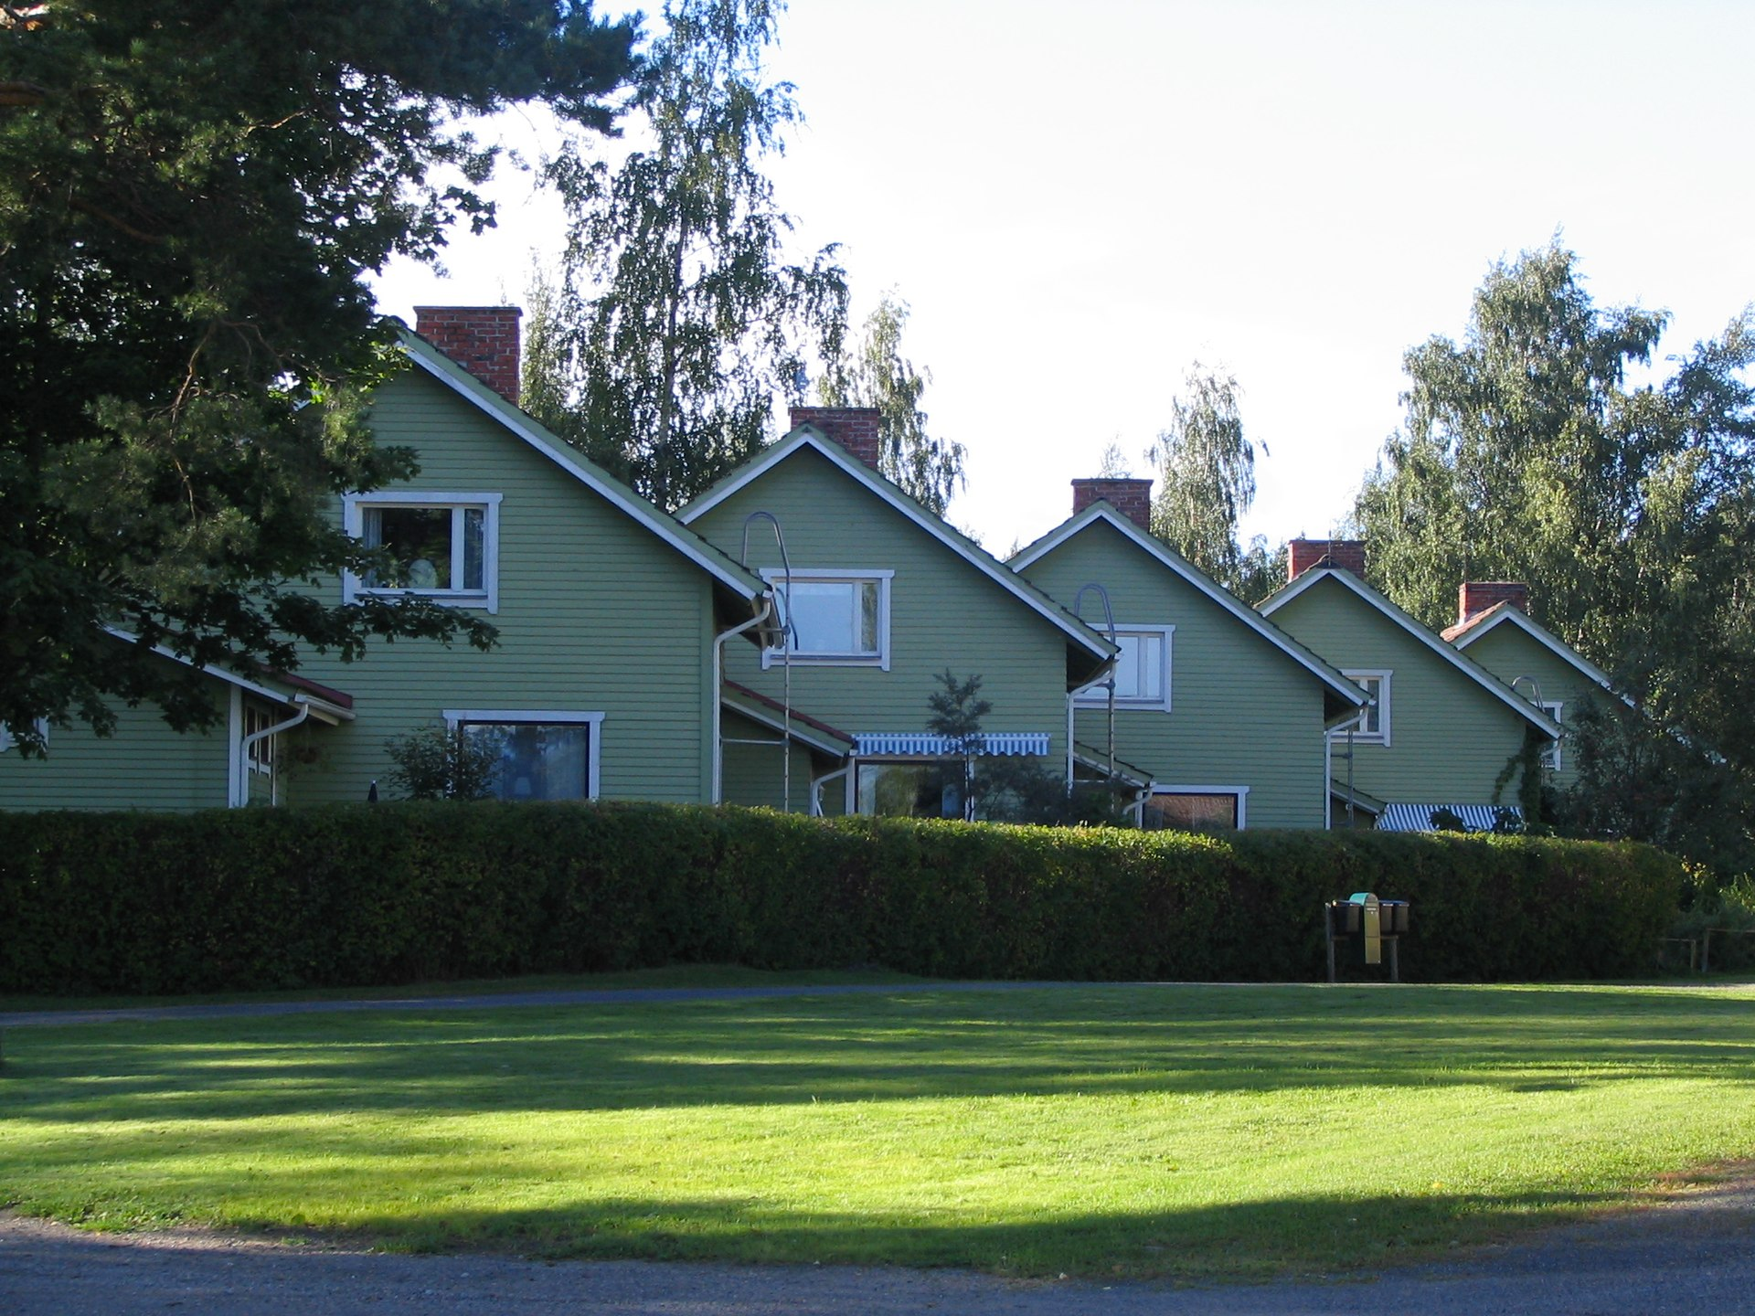
Buildings built by Enso Gutzeit Oy in Säynätsalo, Jyväskylä.
Image: wikiwand
Source: Finnish Heritage Agency, Repair Cards

Slide 37
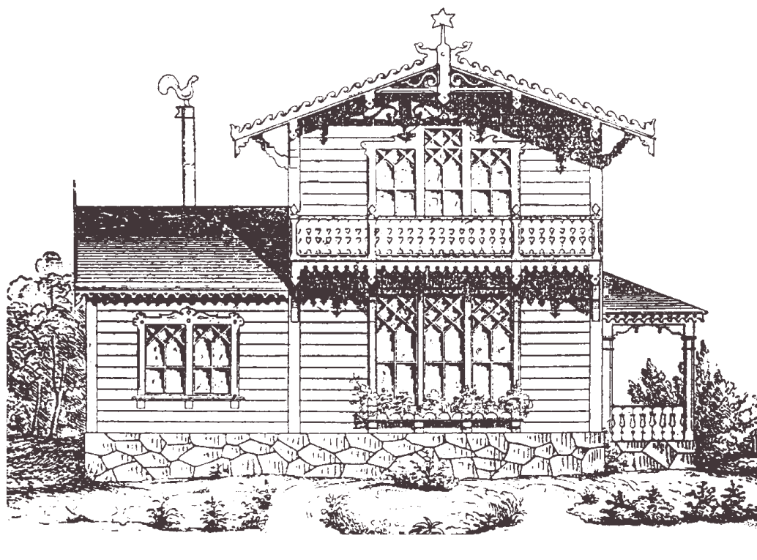
Façade decorations
The type of panelling and decorative mouldings are an essential part of the unique character of the building. The neo-renaissance, which imitated 19th-century plasterwork, favoured abundant classical decoration. In the mid-century Swiss style and later in the so-called Arts and Crafts style, wood construction was emphasised with bevelled, turned, drilled and sawn decorations.
The Swiss style, which began in the 1850s, emphasised a wooden building's own material for the first time. The difference between stone buildings was achieved with an abundance of lace-like decorations. A Swiss-style villa designed by architect G.T.P.Chiewitz in Ruissalo.
Image: Tidskrift för praktisk byggnadskonst, 1851
Source: Finnish Heritage Agency, Repair Cards

Slide 38
Breathable structure
Boarding was usually fixed directly to the log surface. Bark, rag felt or tar paper was used as wind and moisture protection under the cladding. Later building guides recommended ventilating the cladding, i.e. leaving an air gap between the tar paper and the boards. In practice, the air gap was often not implemented. Only as the use of sealed latex and alkyd paints became more common in the 1960s, it was found necessary to ventilate wood cladding. In the wood-framed and shaving-insulated houses of this century, cladding was part of the house construction from the start. The lining boards were usually attached to diagonal boarding protected by tar paper.
Source: Finnish Heritage Agency, Repair Cards

Slide 39
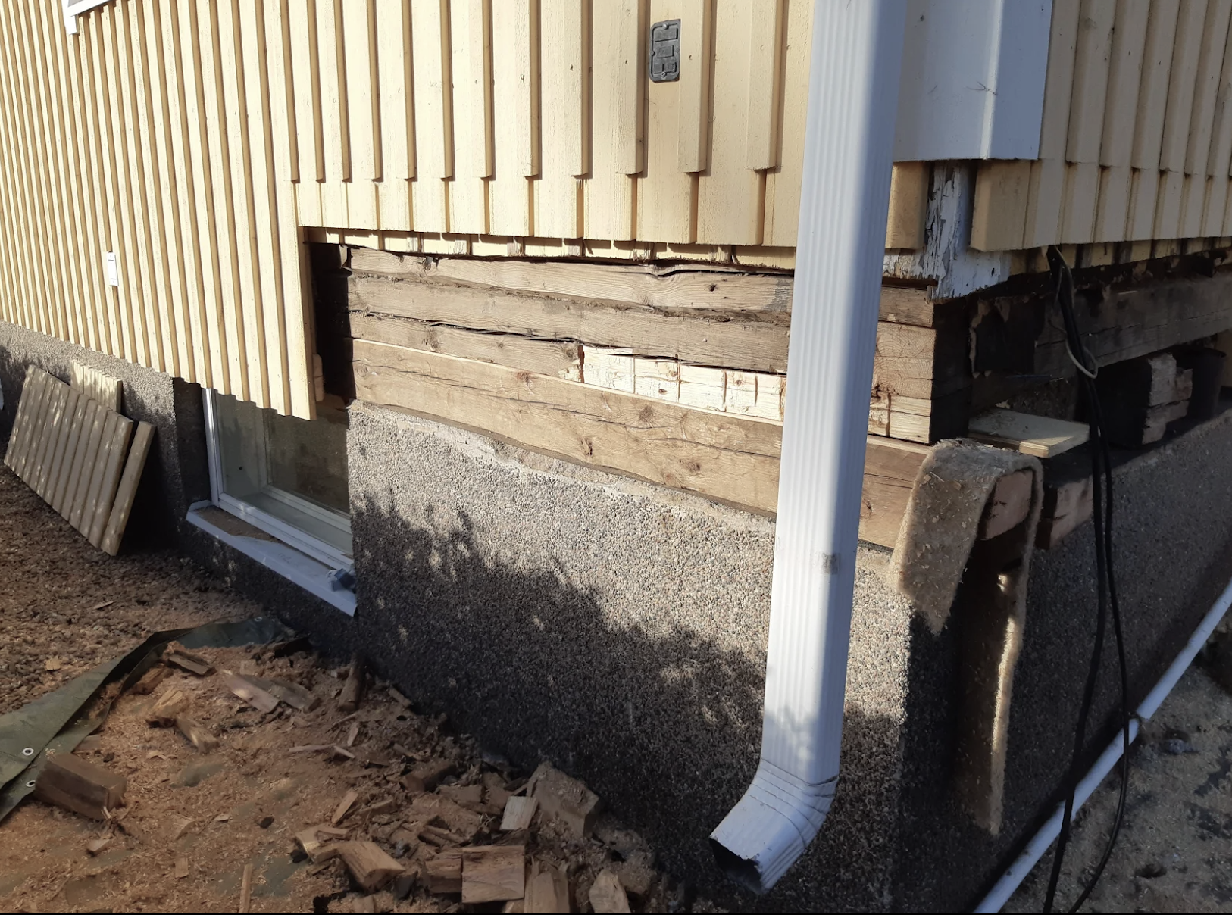
The principle of repair work

Slide 40
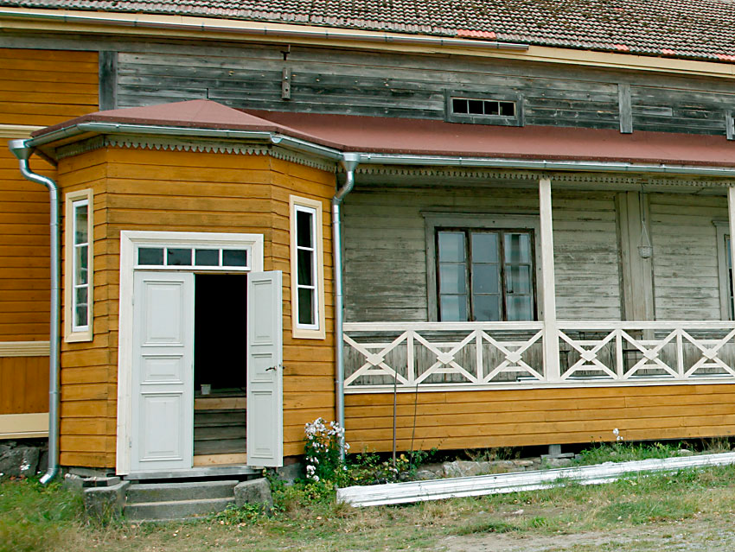
The principle of repair work
When renovating the exterior of a building of cultural and historical value, the objective is to preserve the existing boarding and mouldings with as few changes as possible. Only damaged parts of the external cladding are replaced. The entire cladding should not be replaced when only the south side or the lower part of the cladding is in need of repair. If the different façades of the building are different, there is no need to harmonise them. Nor is there any reason to make them any finer than they have been. By repairing them, the most successful outcome can be achieved: a building with genuine materials and a multifaceted look at its history.
Photo: perinnemestari.com
Source: Finnish Heritage Agency, Repair Cards

Slide 41
Changes in the external cladding
The façade of a building may have been altered over time. In general, changes should not be reinstated and façades should not be unified. The history of the house is written on the old exterior walls: the relocation of windows and doors, extensions, patching and other changes can be seen there. Above all, the ageing of the cladding indicates the time elapsed. Renewing the entire cladding would destroy these temporal deposits in the building. A new external cladding made according to the original model has no historical value.
The exception is for particularly disruptive, relatively recent changes. If the cladding is covered with asbestos cement tiles, for example, it is worth considering bringing out the wooden façade underneath. In this case, it should be remembered that when removing asbestos cement plates, you must protect yourself appropriately or turn to an asbestos renovation specialist. Usually the boarding has survived quite intact underneath the plating.
Source: Finnish Heritage Agency, Repair Cards

Slide 42
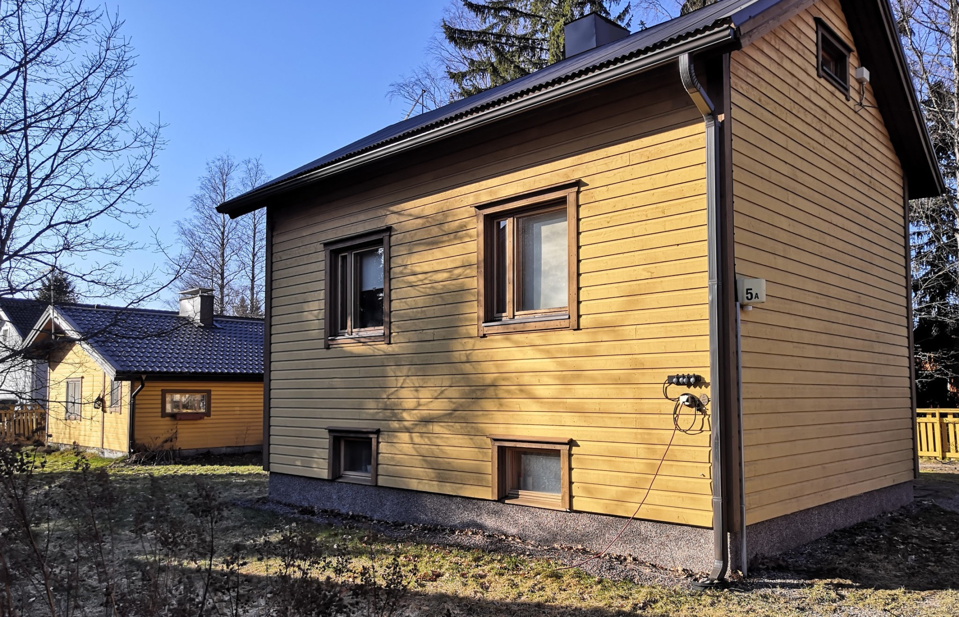
Replacement of siding
Replacing the boarding on the whole building or on one façade will only be considered in exceptional cases. Before deciding to renovate, all the historical, economic, structural and aesthetic considerations must be weighed up. When renovating one façade, carefully remove the external cladding and save those in good condition for the repairing of other walls.
Source: Finnish Heritage Agency, Repair Cards

Slide 43
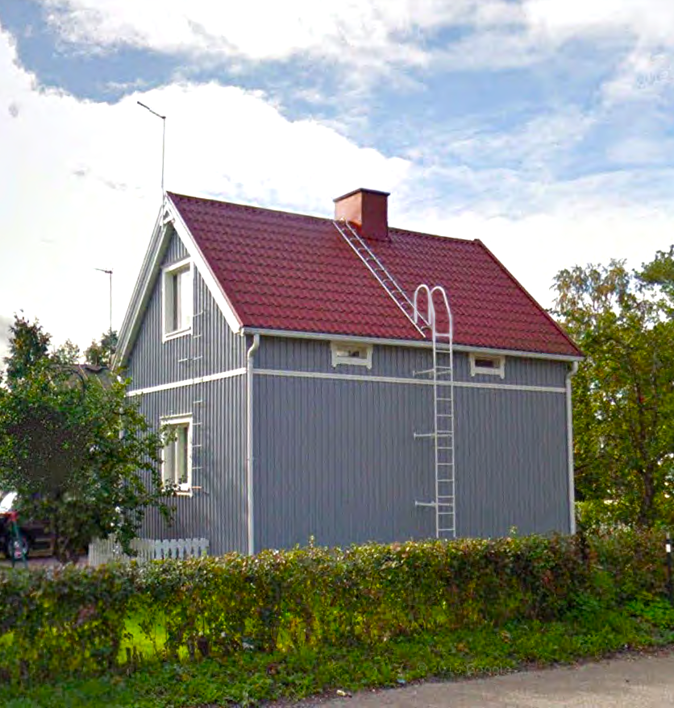
Additional thermal insulation
Additional thermal insulation is an expensive and laborious measure that should always be carefully considered. Additional external thermal insulation always changes the appearance of the building: windows remain recessed and the thickness of the walls changes. Economic savings are also questionable – the construction costs are so high that the savings in heat consumption are not recovered. It is therefore not worth undertaking a façade renovation for the sake of additional insulation. On the other hand, if the boarding has to be replaced due to its particularly poor condition, the windproofing of the house can be improved.
For these reasons, additional external thermal insulation is generally not an option when renovating buildings of cultural and historical value.
A detached house with additional thermal insulation.
Source: Finnish Heritage Agency, Repair Cards

Slide 44
Panel types
When repairing the old façade, the size, surface and profile of boards and mouldings used for patching must be accurate. Modern timber can be used in extension parts and sometimes also when renewing the whole façade.
If panels have to be commissioned, it is advisable to check if the sawmill has a suitable blade available. When planing a panel, it costs quite a lot to commission a planer blade, so the price per metre of board evens out as the quantity ordered increases. It is cheaper to commission a hand planer blade, so if you are only planing a few boards, it's worth planing them by hand.
If a façade made of timber of varying widths, unmeasured or untrimmed, has to be repaired or the boarding completely replaced, it is advisable to use timber of similar dimensions and variety. The use of regular and narrow boards will greatly change the appearance of the building.
Source: Finnish Heritage Agency, Repair Cards

Slide 45
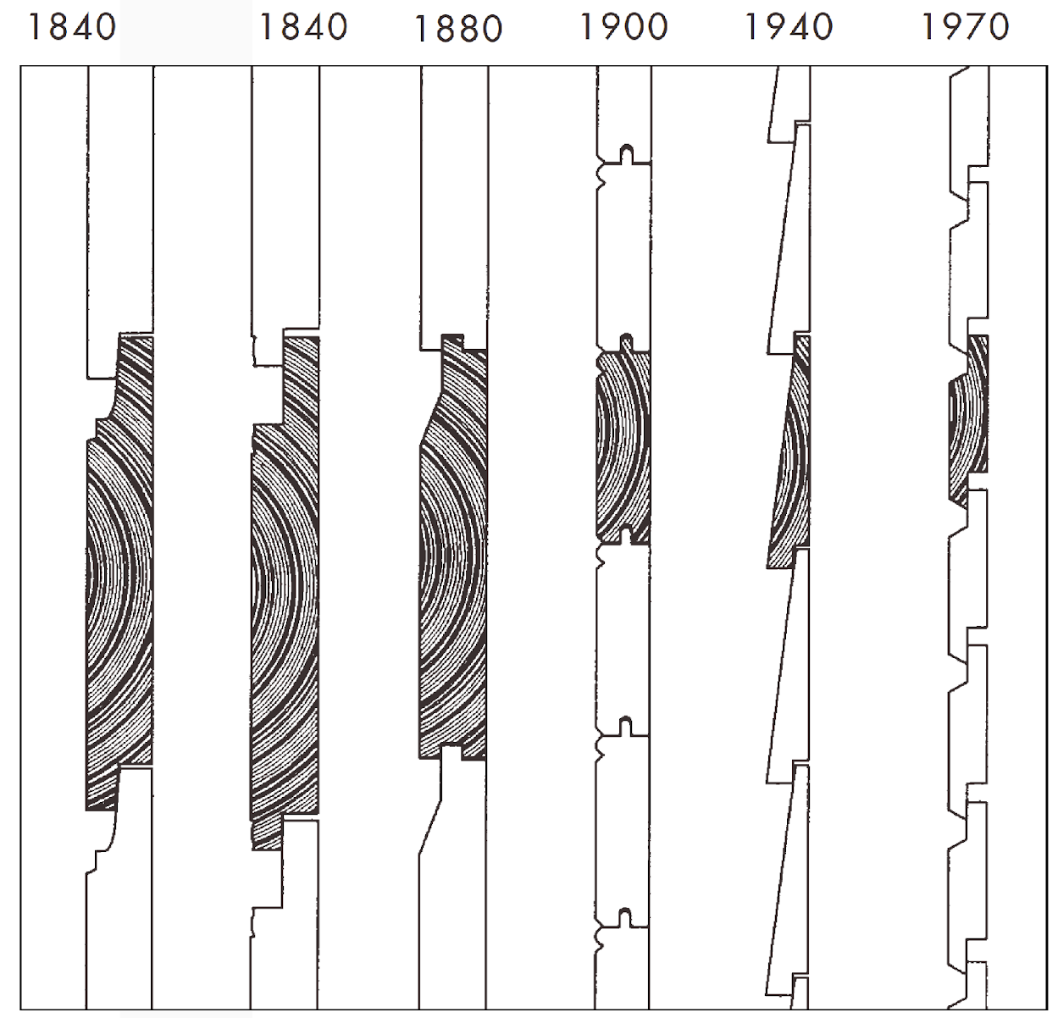
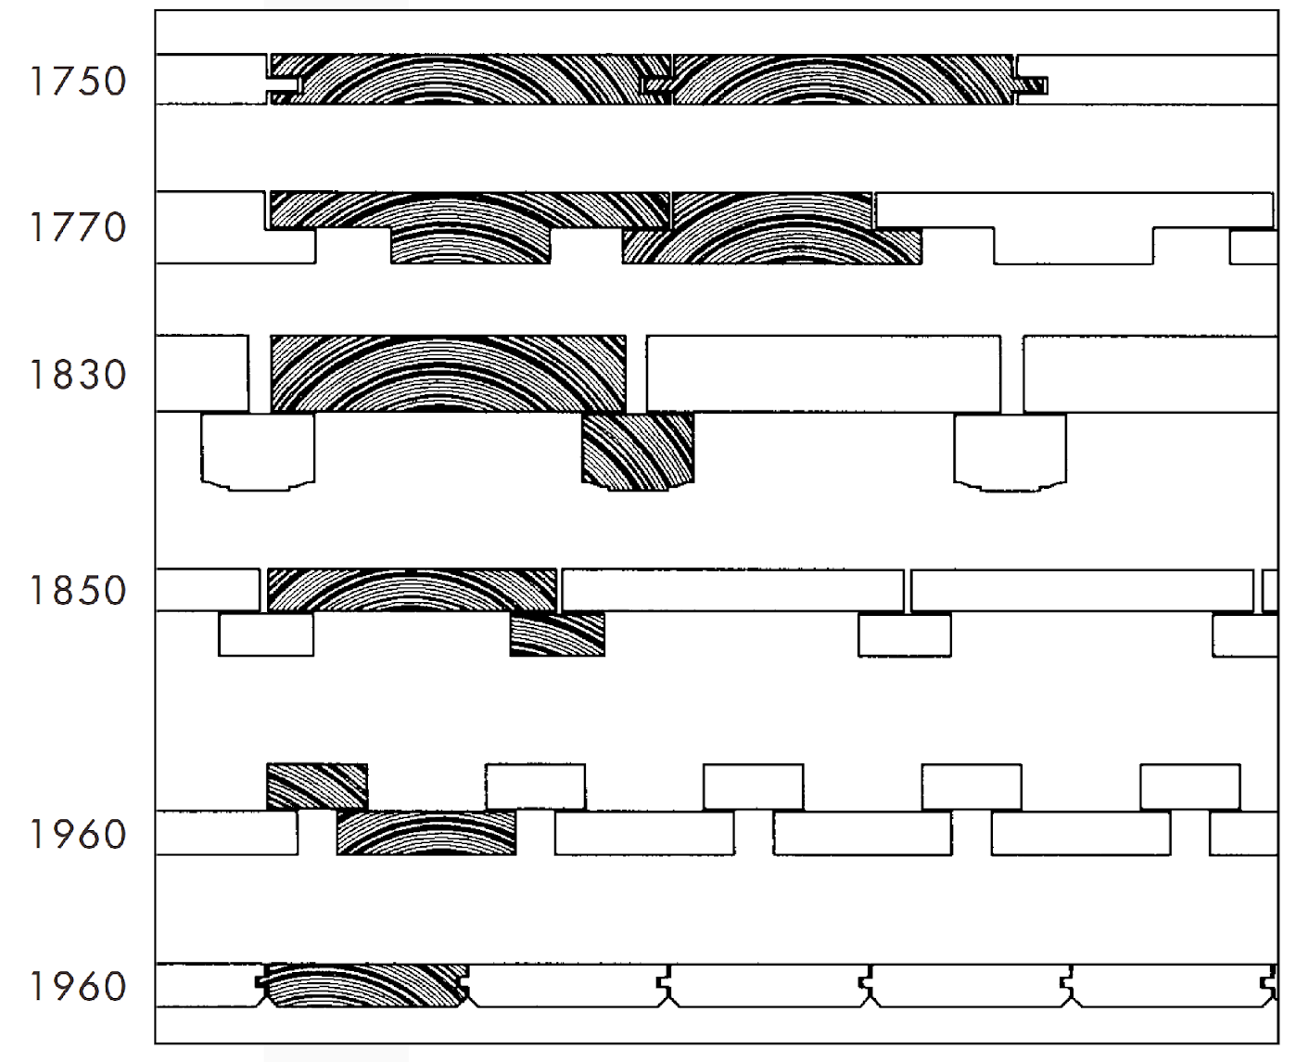
Examples of vertical and horizontal cladding board types
Source: Talo kautta aikojen,
julkisivujen historia, 1987.

Slide 46
Wood material used for renovation
Old cladding boards are often sawn from good quality timber, planed and carefully fixed. The quality of the timber, the density of the growth rings and, in the case of pine boards, especially the amount of pithwood, are still worth paying attention to when choosing timber for renovation or replacement.
The species of wood used in the external cladding should be the same as in the original cladding, which is most commonly pine or spruce in Finland. To replace the old sawn, carved or planed surface, the existing fine-sawn or rough-sawn board can be used. Planed wood is always used as the lining strips for windows and doors. The sawn surface is easily soiled and will soon look unclean.
When using new wood, the wood must be dry outside. Internally dry wood is not suitable for external cladding due to swelling, but it must also not be fresh due to shrinkage caused by drying. Preparations should be made well in advance for the repair of the external cladding by storing the boards in a warehouse, where they will be allowed to dry slowly, preferably for a few years.
Pressure-impregnated wood is not used for the external cladding of buildings. In moisture-prone areas, such as weatherboards, it is recommended to use pine pithwood.
Source: Finnish Heritage Agency, Repair Cards

Slide 47
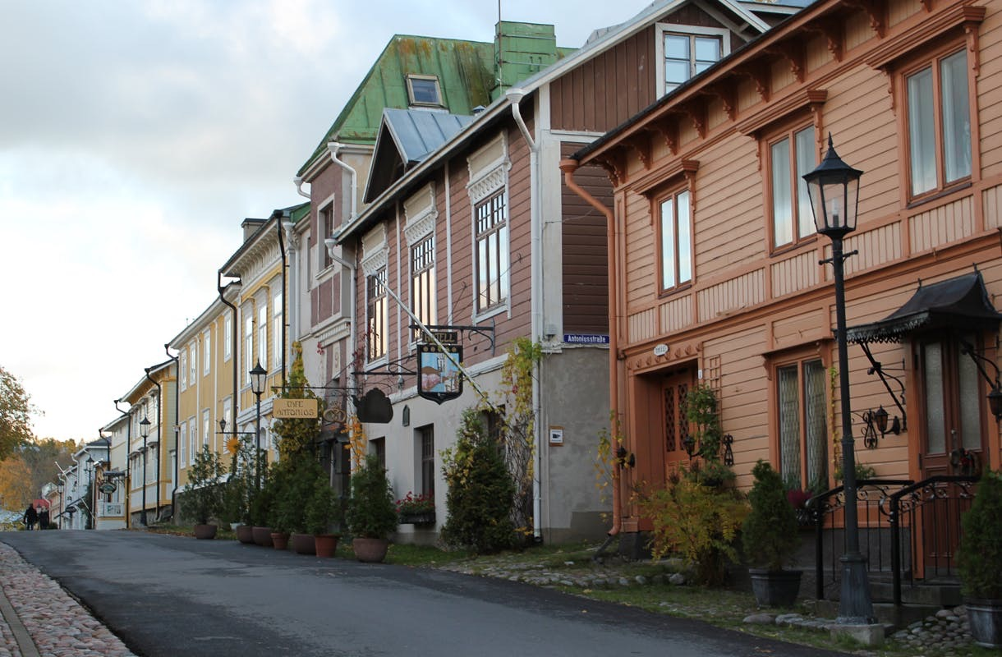
Work stages
The following chapters describe the work stages for renovating the external cladding.
Not all façades need thorough renovation; the need for renovation must be considered separately for each façade.
Image: Perinnemestari
Source: Finnish Heritage Agency, Repair Cards

Slide 48
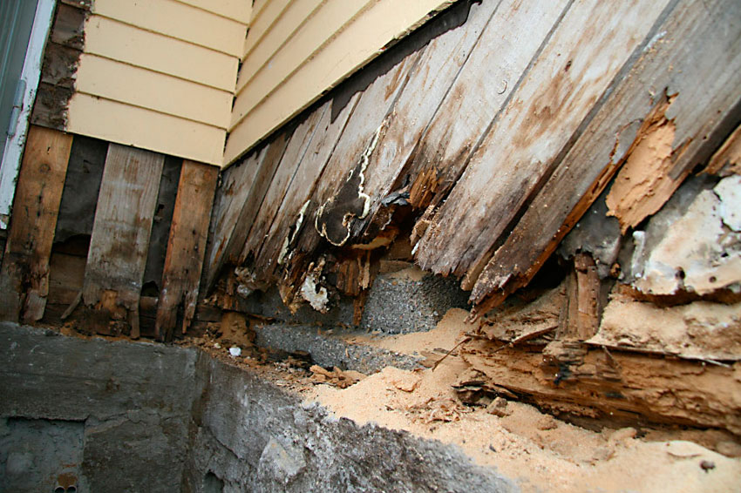
Condition assessment

Slide 49
Condition assessment
The repair work is based on a survey of the condition of the external cladding. The aim is to get the most accurate picture of the condition of different façades and thus avoid unnecessary repairs. Based on the condition assessment, a summary of the necessary repair measures and their scope is drawn up.
Each façade is studied separately. The condition of the upper and lower parts of the façade is specified. The boarding is usually in the most unfit condition in the lower part of the southern part of the house, and in the best condition in the upper part of the north façade. The boarding on the south side may have had to be replaced while the boarding on the north side may still be original.
In connection with the condition assessment, it is advisable to examine the original cladding method, possible differences in boarding in different parts of the house, additions and changes, and the original colour of the house.
Source: Finnish Heritage Agency, Repair Cards

Slide 50
Condition assessment
Damages
The cause of the damage will be identified and, where possible, the cause removed. If the damage is repaired and the cause is not removed, the repair work must be repeated in due course.
Wear
Wear is usually an acceptable ageing process that does not necessarily require action. On the other hand, a worn-out paint surface, for example, may be in need of repainting in order to protect the wood.
Additions and changes
Planned additions and changes are recorded in the condition assessment – for example, a new porch.
Source: Finnish Heritage Agency, Repair Cards

Slide 51
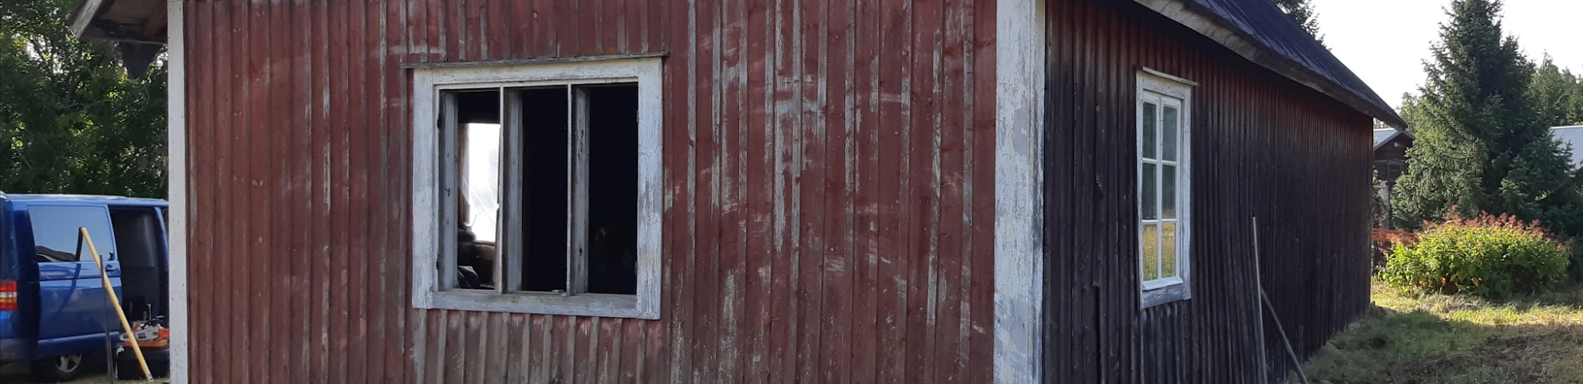
Surface wear and cracking
The surface of untreated wood left in the open air develops a greyish or brown layer full of cracks. The grey wood is soft and fuzzy. This is natural wear that should not be confused with rot damage. If the fuzzy wood is to be painted with oil paint, the surface must first be sanded to make it solid. Earth red is capable of remaining intact on a fuzzy surface.
On the south side of the building, rapid changes in humidity and temperature stress the wood, causing cracking and warping. Sun-facing façades always require more maintenance and repair than shade-facing façades. Cracking occurs when the paint has worn away; the darker and more heat-absorbent the surface, the more it will crack. In other words, a dark and translucent treatment speeds up the destruction of the wood.
Source: Finnish Heritage Agency, Repair Cards

Slide 52
Surface wear and cracking
If the wood gets wet and is not allowed to dry out, damage caused by wood-rotting fungus will gradually develop. The most common causes of rot damage on the external cladding are an overly compact paint finish, incorrect window structure, an improperly built foundation, a leaking gutter or downspout.
Other common causes of damage include the ground rising to the level of the cladding, vegetation growing too close to the wall, snow and ice, faulty construction or, for example, a flagpole or ladder attached to the wall whose brackets allow water to run down the façade. Damage to a wall can also be caused by moisture from the inside, most commonly by condensation from indoor air.
Further decay must be prevented, but there is no need to remove wood that has been only slightly damaged by decay.
Source: Finnish Heritage Agency, Repair Cards

Slide 53
Rotten skirt
The most vulnerable point in the façade is the lower part of the cladding, especially its junction with the foundation. In the worst case, the plinth made of natural stones is covered with concrete and the lowest part of the external cladding is inside it. In this case, water runs along the cladding boards down inbetween the plinth and the logs and rots not only the lower part of the cladding but also the lowest logs of the building.
Without such a false plinth, the lowest joist and the ends of the cladding boards of the vertical boarding are also susceptible to rot. The wood cells absorb water best along the length of the trunk. The lower end of the vertical board, which is often still attached to the water board, stays damp the longest after rain and allows water to penetrate it. When painting the exterior, the lower end of the board should also be painted.
Source: Finnish Heritage Agency, Repair Cards

Slide 54
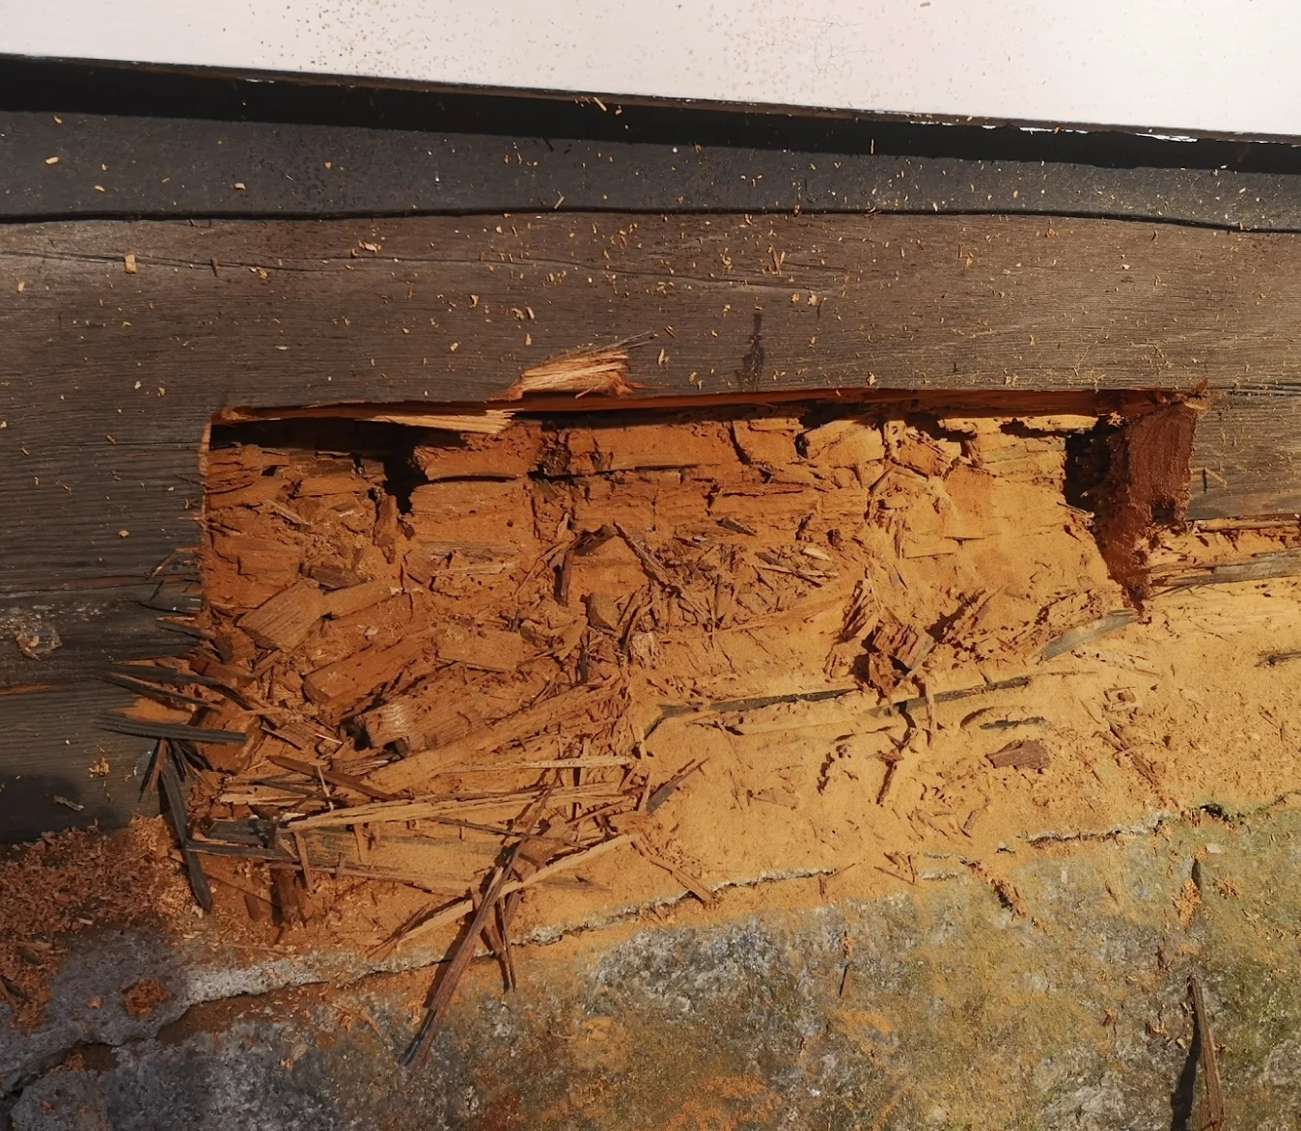
Insect damage
Insect infestation can be identified by holes on the surface of the wood and by the wood turning into a fine powder inside. Insect damage usually occurs together with wood-rotting fungi. Therefore, damage is more common in the logs than in the cladding, and if traces are visible in the boarding, the log frame itself should definitely be inspected.
The wood may have either old eating marks or ongoing insect damage. The ongoing destruction can be identified by flight holes that appear on the surface of the wood in the spring and which are pale inside. Holes can be marked in a certain area, and over the summer we will see if new ones appear.
Old insect damage does not require control; the boarding is repaired by patching if it has become too weak. Depending on the species and the situation, the ongoing destruction can be prevented. To control insects, it is often enough to simply dry the wood.
Sawdust from the nest of a black carpenter ant.
Source: Finnish Heritage Agency, Repair Cards

Slide 55
Examining rot damage
The damage is examined with a knife, screwdriver or spike. The blade is used to determine whether the wood is also soft on the inside, or whether the wood is just worn or cracked on the surface. If the external cladding is painted with a dense plastic-based paint that shows cracks, it is worth investigating whether the wood is rotting underneath the solid-looking paint.
Humidity can be measured with an electronic capacitance meter without damaging the surface. Prolonged humidity above 20% allows the growth of wood-rotting fungi in the wood.
Source: Finnish Heritage Agency, Repair Cards

Slide 56
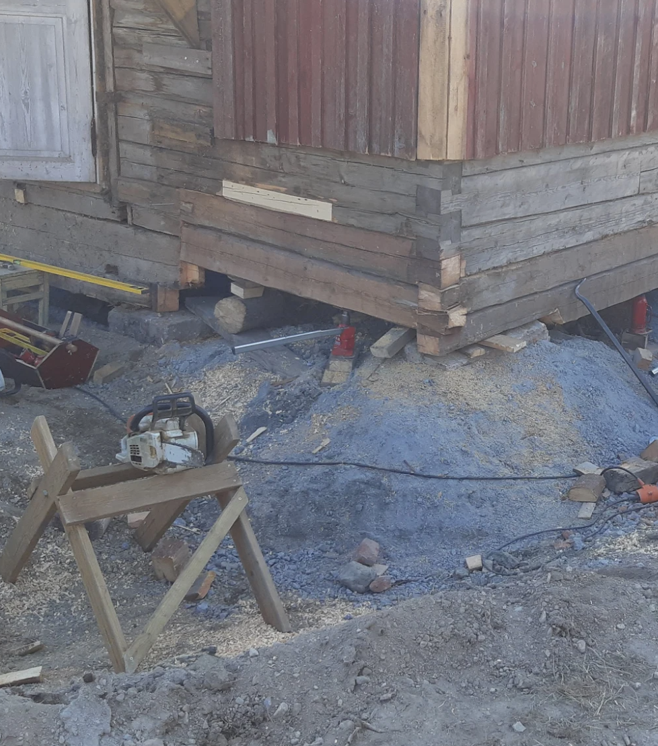
Removing boards

Slide 57
Removing boards
Exterior boarding may need to be removed for repair work, for example. Careful removal rewards the effort because of the quality of old timber; of course, the most important thing is to keep the boards because of their historical value.
If the entire façade has to be replaced, the tongued and grooved boards are removed in the opposite order to that in which they were first fixed to the wall, so from top to bottom in the case of horizontal boarding. Nails are best removed by hammering long, loose wooden wedges under the boarding next to the nails.
If the wood is hard, the nails can be gently lifted out of the board by twisting, then the board is pressed down and the nails are removed with a crowbar. The board is protected by a wooden block placed under the crowbar. If the nails are rusted, they can be sawed off from behind the board with a hacksaw. Sometimes a rusted nail can be loosened by tapping it with a hammer. If the board tears at the nail, the hole is patched or the damaged part is cut out of the board.
When removing boards that have been fastened with nails, the valuable, hand-forged nails are carefully pulled out, recovered and reused to fasten the old boards.
Source: Finnish Heritage Agency, Repair Cards

Slide 58
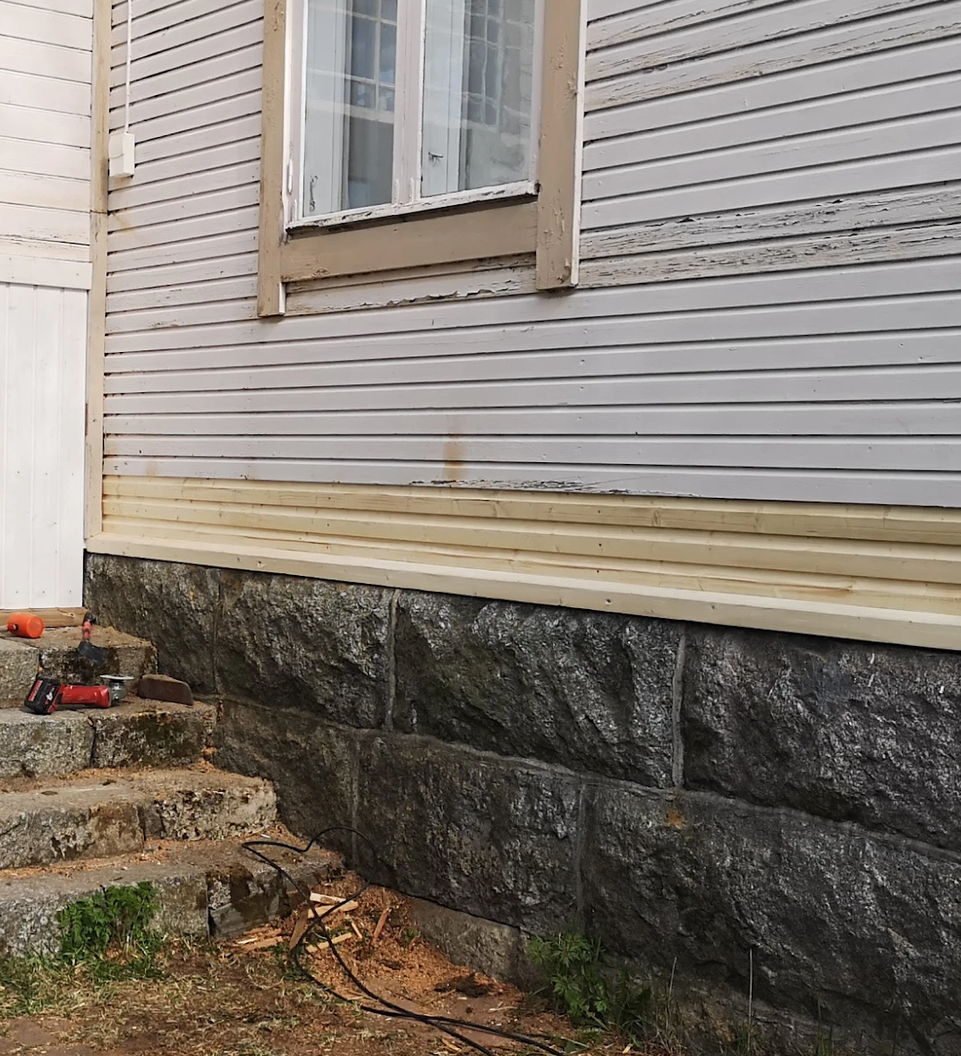
Patching

Slide 59
Cracks
Small cracks and crevices that collect water, for example on horizontal surfaces, are filled with oil putty. Puttying is always done on a primed surface, otherwise the oil putty will soak into the wood and the putty will come off the wood surface. A hard, low-oil finish putty can be painted over while still fresh. Oil paint put over the soft putty will wrinkle. The putty can be made firmer by adding chalk to it.
Gaps of more than half a centimetre are repaired with wooden strips. The gaps are first half-filled with oil putty, then a piece of wood of the appropriate size is pressed into the gap and the excess putty is scraped off. The patch is fixed in place with thin nails.
Source: Finnish Heritage Agency, Repair Cards

Slide 60
Areas
Large areas of the façade that have been damaged by decay may need to be repaired: the undersides of the windows, gutter backs, junctions between horizontal mouldings or canopies, or blocked windows or door openings. The condition of the joists underneath decayed cladding boards – usually below the mantle and window – is checked and repaired if necessary.
The timber used for patching is as similar as possible to that originally used in the wall. For example, on the one hand, timber in good condition removed from the exterior of the building or old timber purchased elsewhere. At the point to be patched, the ends of the boards are sealed with oil putty or paint.
Source: Finnish Heritage Agency, Repair Cards

Slide 61
Vertical cladding
The lower part of the cladding can be patched in several ways. It is necessary to consider the solution that best preserves the old cladding and fits the architecture of the building. A good way to do this is to replace only the decaying parts by patching them up. The decayed part is cut off at an angle, the patch is fitted in place, and the gap is covered with oil putty. After painting, the patches do not stand out too much from the overall façade. Seams can be broken up at different heights in the façade or be placed in the same straight line. These methods are most likely to produce an architecturally satisfactory result.
Another way is to saw through the vertical boarding diagonally across from the top of the rotten part. A water board is placed in the sawed area, well away from the ends of the vertical cladding, and the lower part is lined with horizontal boards, preferably wider than the vertical boards.
Source: Finnish Heritage Agency, Repair Cards

Slide 62
Horizontal cladding
It is easier to renew the horizontal cladding:
boards in poor condition are carefully removed and replaced with new ones. The horizontal boards must be mounted on the same level as the old cladding.
Source: Finnish Heritage Agency, Repair Cards

Slide 63
Damage to a tongued and grooved board
At the bottom of a smooth, tongued and grooved vertical board, the tongue will easily come off when the board cracks.
This is corrected by nailing the tongue closed or by making a narrow list to replace the lost tongue.
The horizontal boarding that has come loose from its tongues and grooves will be repaired in the same way, by using small strips of wood. Once the wall is painted, this kind of patch is almost invisible.
Source: Finnish Heritage Agency, Repair Cards

Slide 64
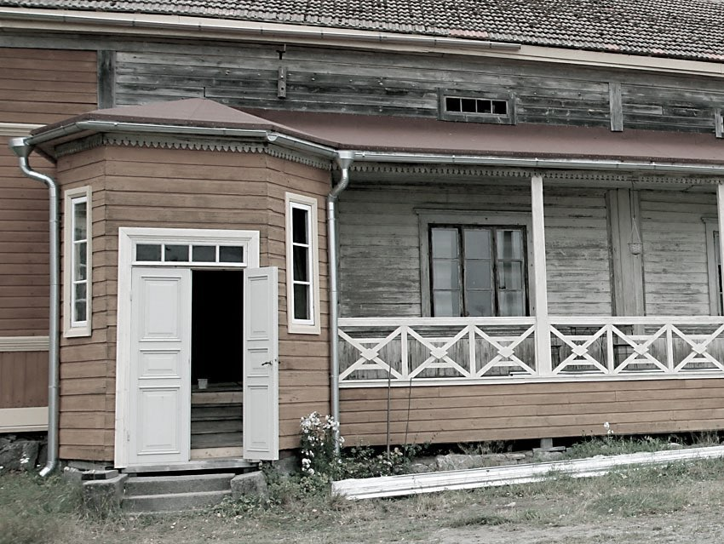
Attachment of boards

Slide 65
Attachment of boards
The board is fixed to the façade with the pith side facing outwards and the vertical board with the sawed fuzz facing downwards. This way, the most durable part of the wood is facing outwards and water runs down the board's surface.
If the base and top sides of the boards are alternated, the surface and pithside must also be alternated as an outer surface. The sawed fuzz should always be placed facing downwards.
Removed, reusable boards are nailed in the same way as before. According to the old instructions, the nail should be three times as long as the thickness of the board to be nailed.
Source: Finnish Heritage Agency, Repair Cards

