Slide 1



Industrial wood construction
Teaching materials for industrial wood construction education 2022

Slide 2
Origin of the materials
Use of the materials
These learning materials for industrial wood construction have been prepared in a project led by Puuinfo Oy in 2021–2022. Also involved in the project were
Lappia Vocational College,
TTS-Työtehoseura ry
South-Eastern Finland University of Applied Sciences,
Metropolia University of Applied Sciences,
Jyväskylä University of Applied Sciences,
University of Tampere, and
Federation of the Finnish Woodworking Industries Puutuoteteollisuus ry
The project was funded by the Ministry of the Environment.
The materials are intended to be used as extensively as possible in industrial wood construction education and studies.
The materials are released under the Creative Commons licence Attribution-ShareAlike (CC BY-SA), which requires that the author be properly credited when the materials are used and that derivative works may only be distributed under the same licence as the original work.
The original materials and any updates to them by Puuinfo will be published on the Library of Open Educational Resources website (aoe.fi) and the Puuinfo.fi website.

Slide 3
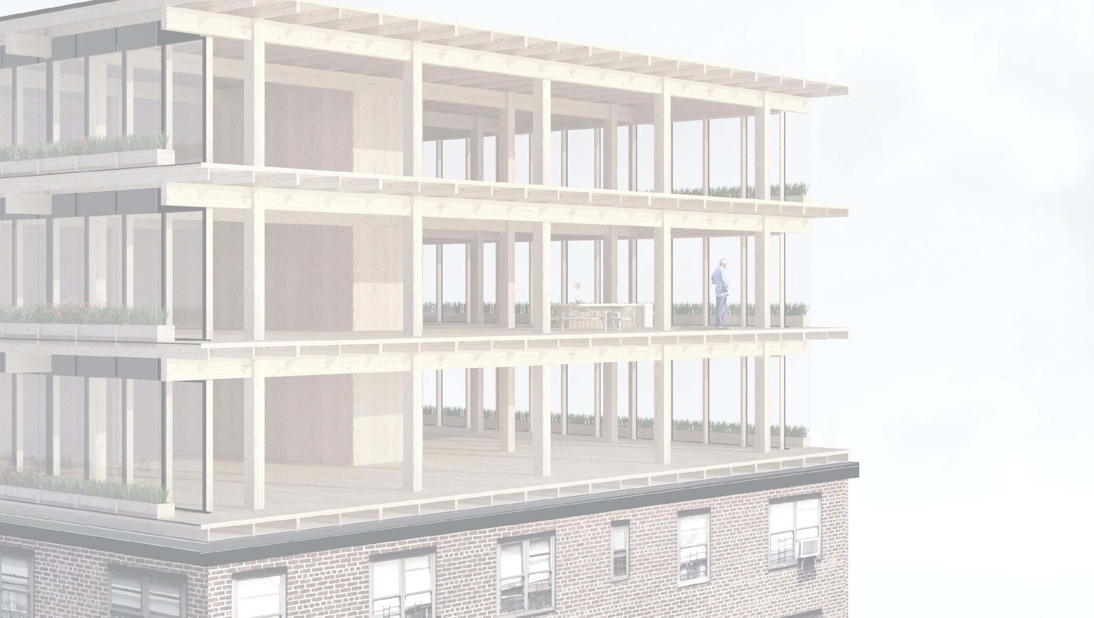
Repair construction of wooden buildings and use of wood in repair construction

Slide 4
Authors
Markku Karjalainen, Architect D.Sc. (Tech.), Professor
Henri Käpynen, Architect, Researcher
University of Tampere
Release date: 29/06/2022

Slide 5
Repairing a wooden building and use of wood in repair construction – contents
5
Introduction - Repair construction
Options for using wood in energy renovation projects of suburban blocks of flats and in adding storeys to buildings
General information on adding storeys
Building systems for adding wooden storeys
Architecture competitions – repair construction
Stages of an additional storey construction project
Adding heat insulation in a wooden building and using wood in repairing a block of flats made of concrete Adding heat insulation in a wooden building and using wood in repairing a block of flats made of concrete
Heat insulation
Overall energy review
Energy performance requirements
Structural types for additional storeys
Energy renovation of a suburban building
Survey on the actual repair construction potential of Finnish blocks of flats 10/2015
Student projects
Wood façade repair
Surface treatment
Breathable structure
Fixing board cladding
Principles of repair work
Repair work step by step
Replacing the bottom logs of a log house ("shoeing")
Replacing logs
Examples
Procedures
Example sites
Wood structure repair
Condition assessment and continuous maintenance
Roof
Foundations and subsurface drains
Load-bearing structures and additional insulation
Ground floor
Exterior wall
Attic floor
External cladding
Windows

Slide 6
Additional heat insulation of a wooden building and the use of wood in the repair of a concrete block of flats

Slide 7
Contents
Additional heat insulation of a wooden building and the use of wood in the repair of a concrete block of flats
Heat insulation
Overall energy review
Energy performance requirements
Structural types for additional storeys
Energy renovation of a suburban building
Survey on the actual repair construction potential of Finnish blocks of flats 10/2015
Student projects

Slide 8
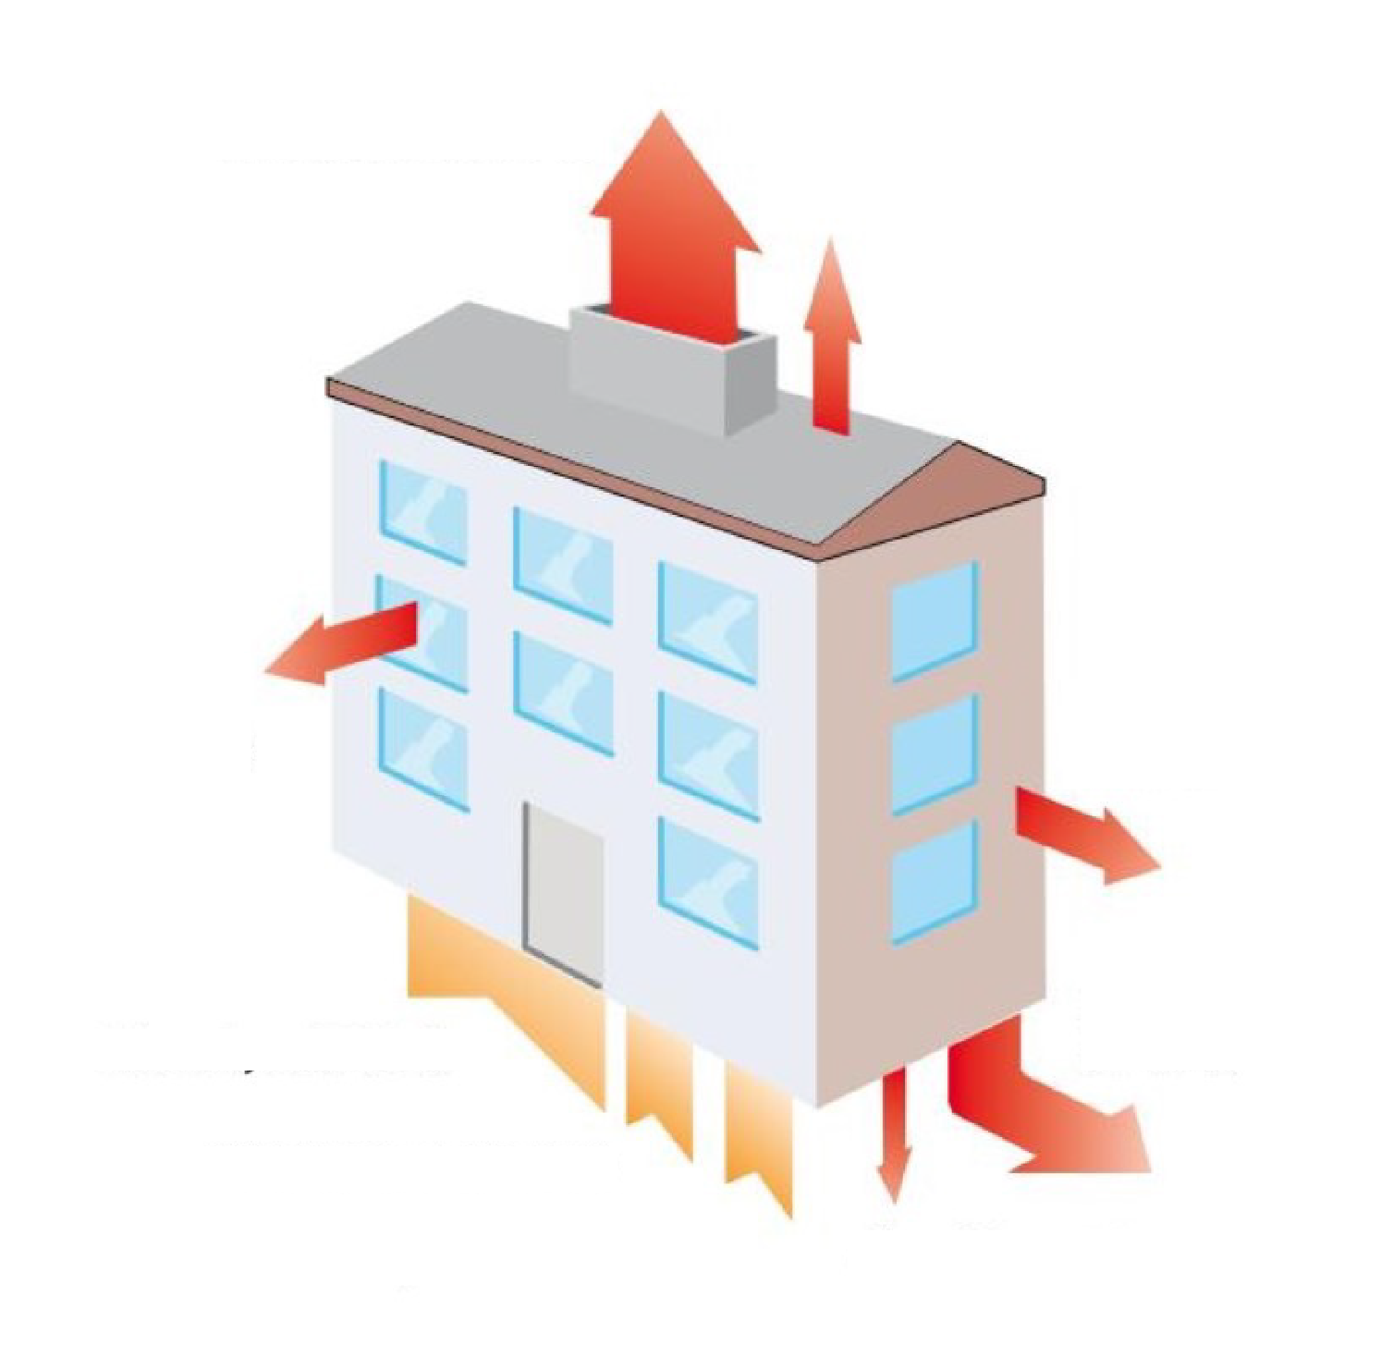
Heat insulation
Ventilation 36-37%
The greatest potential for saving energy in houses built in the 1960s and 1970s is heat recovery by ventilation.
Attic floor 4-6%
Windows 19-21%
Exterior walls 13-17%
Sewer 17-19%
Heating 66-72%
Electrical equipment 15-16%
Sun and people 15-16%
Base floor 5-6%
Image: Taloyhtiön Energiakirja, 2011.

Slide 9
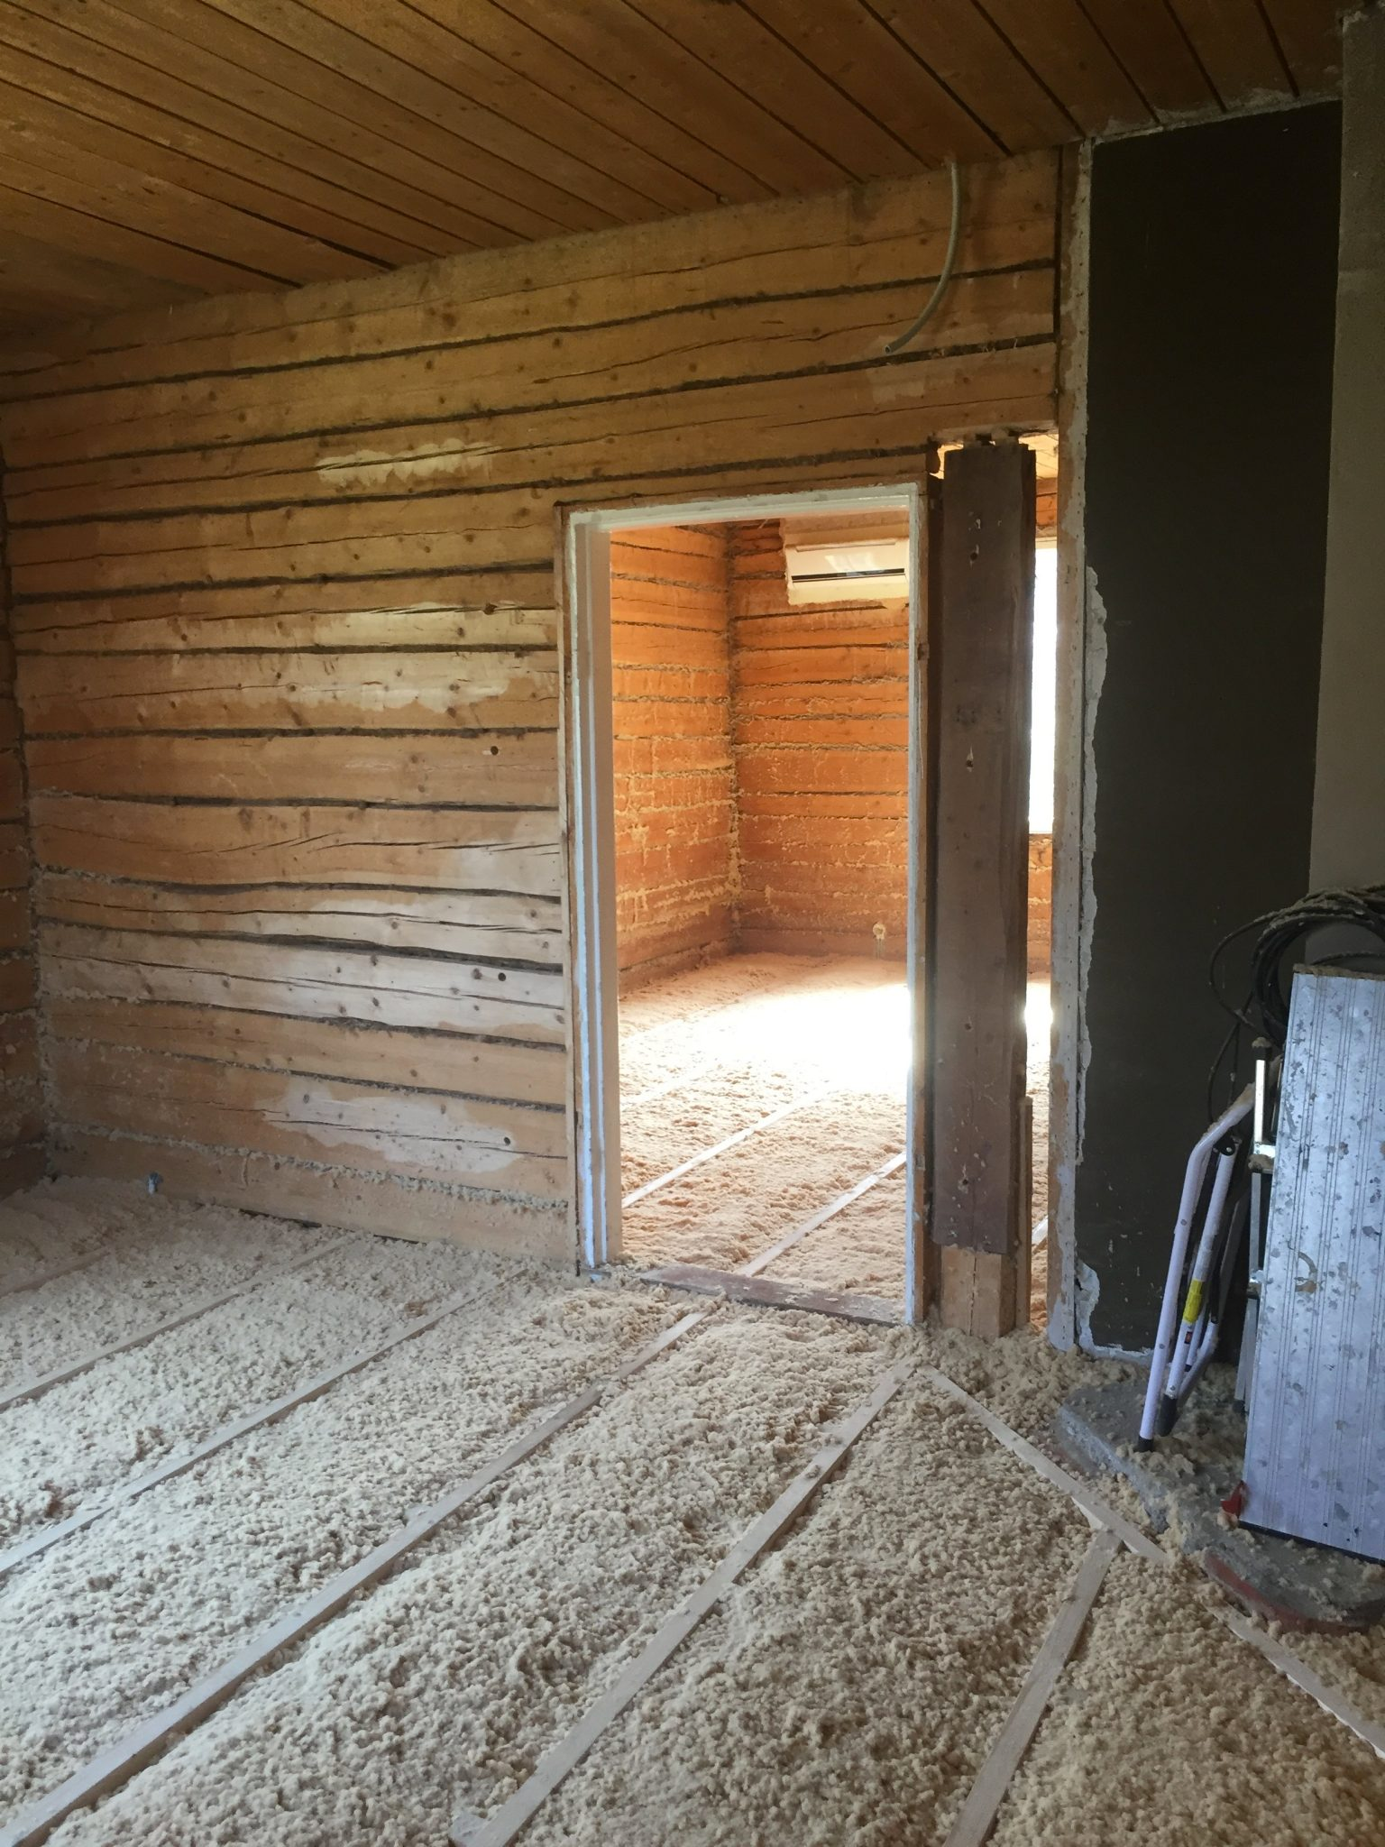
Heat insulation
U values, W/(m2K)
Exterior wall 0.17 (insulation approx. 220 - 250 mm)
Roof 0.09 (insulation approx. 400 - 450 mm)
Base floor 0.16
Windows 1.0
Doors 1.0
E-rating kWh_{E}/m² per year
Insulation of the base floor with mineral wool

Slide 10
Overall energy review
E-rating = Upper limit for the total energy consumption of a building per building type
The calculation of the E-rating takes into account the type of energy production used by the building

Slide 11
E-rating; 1 January 2018
Comparability of data has been taken into account in normal use
Energy conversion factors provide guidance in selecting the energy source for purchased energy
Firewood is renewable purchased energy
The energy conversion factors are:
Fossil fuels: 1
Electricity: 1.2
District heating: 0.5
Purchased renewable energy (wood): 0.5
Disctrict cooling 0.28

Slide 12
A building permit shall be subject to an annual E-value not exceeding kWhE/m2 per year.
Building | kWhE/m2 | Building size
Single-family house | 200 | 50–150 m²
Single-family house | 116 | 150–600m²
Single-family house | 92 | > 600 m2
Terraced house | 105
Residential block of flats | 105 | 2 floors or less
Residential apartment blocks | 90 | 2 floors or less

Slide 13
Structural types for additional storeys
Exterior wall
Attic floor

Slide 14
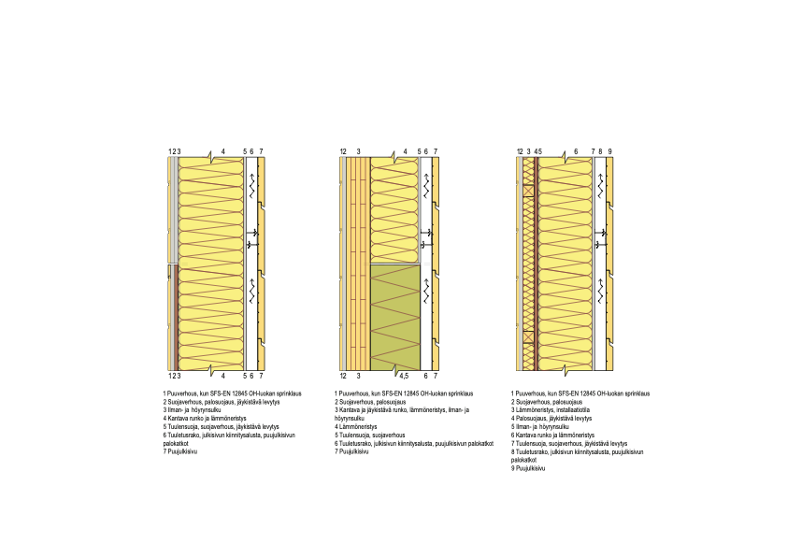
Structural types for additional storeys – Exterior walls
U value < 0.17 W/(m2K) = Thermal insulation 220 – 250 mm
Insulation fire resistance rating A2; Rock or glass wool
Framed structure
exterior wall
CLT-structured
exterior wall
A cross-framed external wall with a frame structure built in

Slide 15
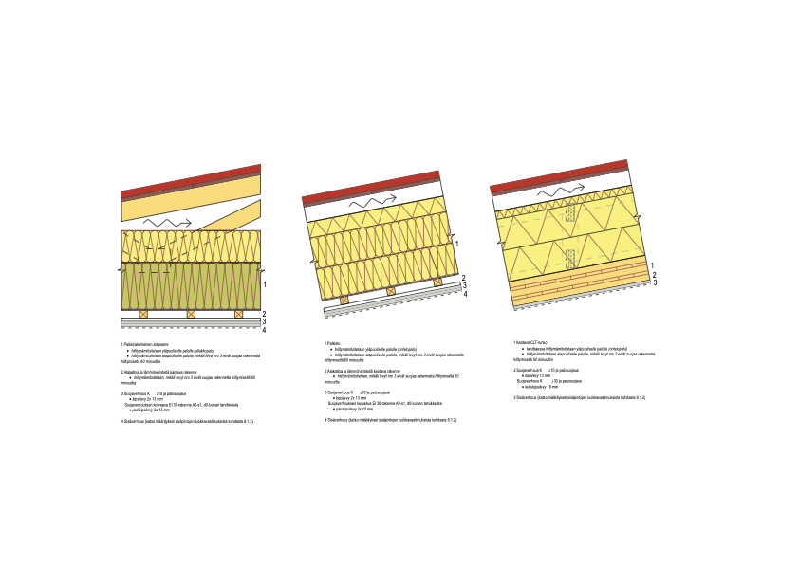
Structural types for additional storeys – Attic floor
Truss frame
Beam structure
CLT structure
U value < 0.09
(thermal insulation 400 – 450 mm)
Ventilation interval; Min. 150 mm

Slide 16
Energy renovation of a suburban building
Possibility for the installation of additional thermal insulation elements
Facade
TES elements
Case study: Riihimäki Peltosaari - Innova project
Ministry of Economic Affairs and Employment survey

Slide 17
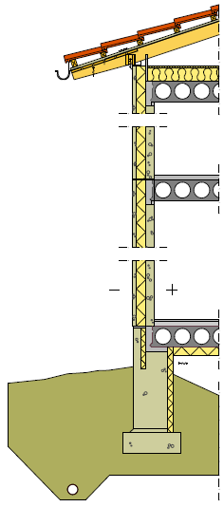
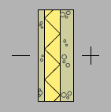
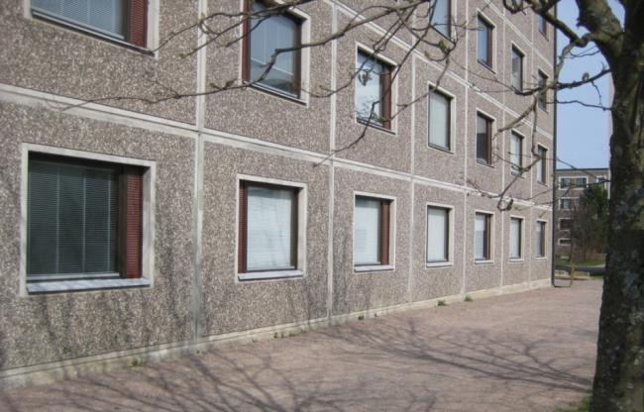
Wall structure: contract sandwich façade 1970s
SANDWICH WALL
80 mm concrete
90 mm mineral wool
40 mm concrete
U=0.53 W/m²K
Note: The U value is currently 0.17 (thermal insulation 220 – 250 mm)

Slide 18
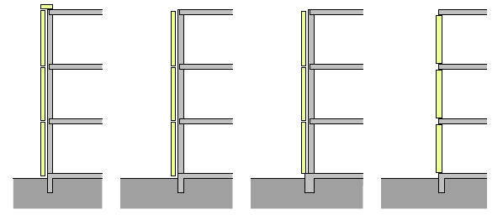
Possibility for the installation of additional thermal insulation elements
Suspended
Installed in
layers
Standing
Supported by storey

Slide 19
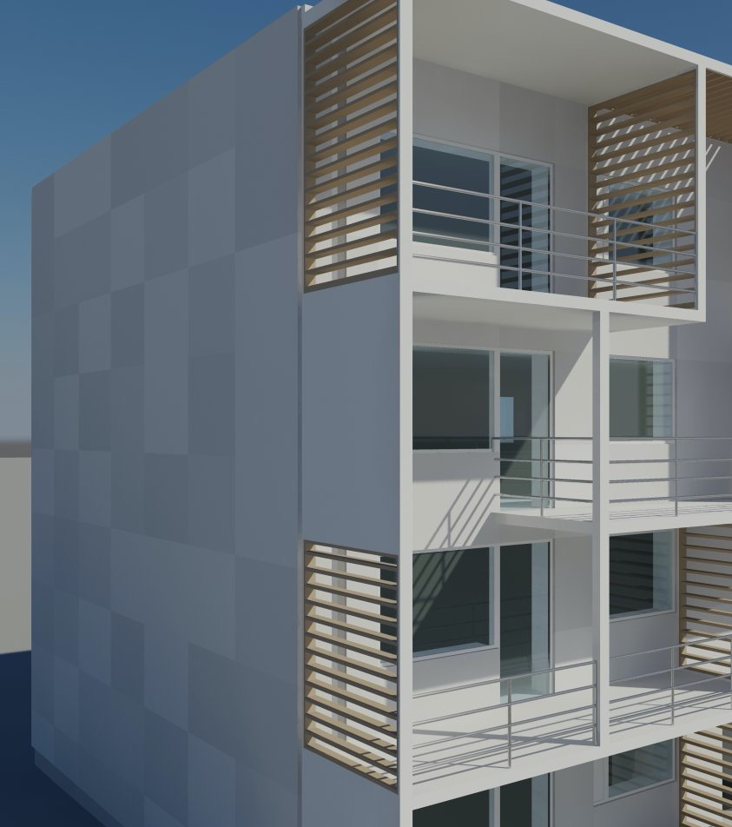
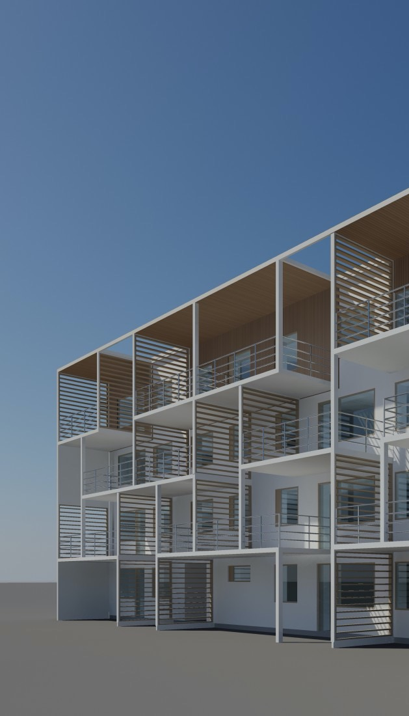

Façade material can be selected
Thin or 3-coat plaster
Ventilated structure:
Board cladding
Wood cladding
Thin brick cladding
Fibre cement siding
Metal products
See more: Ventilated façades guide

Slide 20
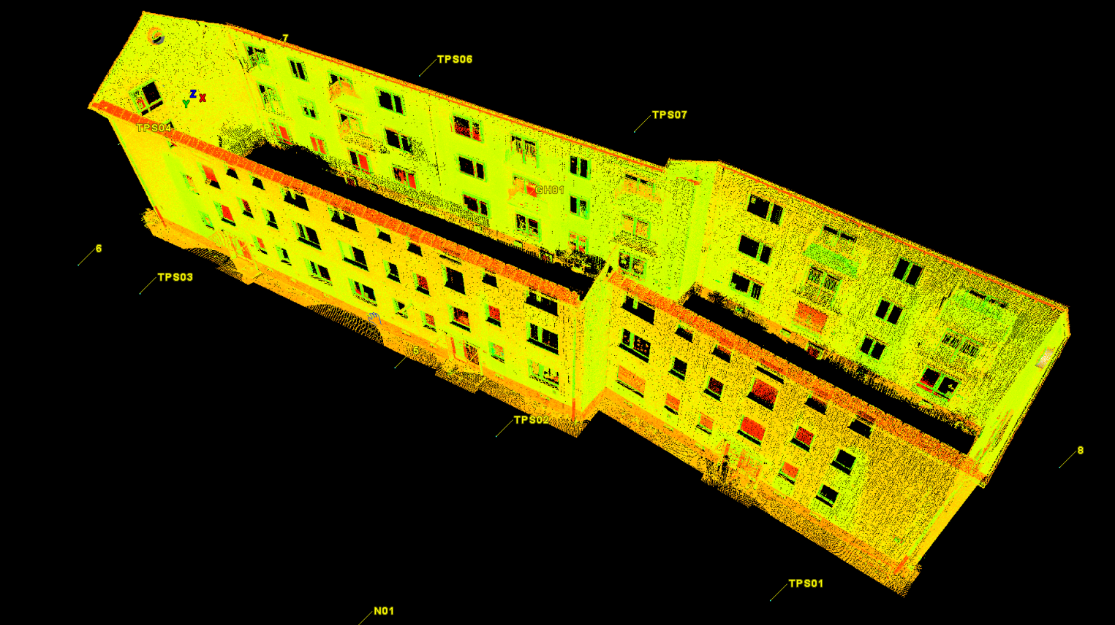
Deviations in the façade will have an effect on things such as the size of new windows

Slide 21
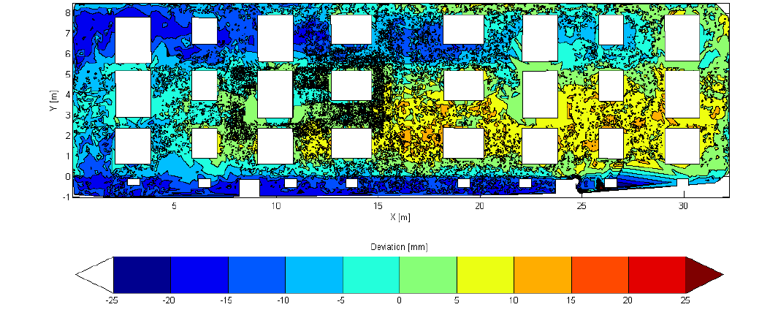
Deviations in the façade will have an effect on things such as the size of new windows
The depth of deviations in the façade of an old building can be substantial, up to 40 mm.

Slide 22
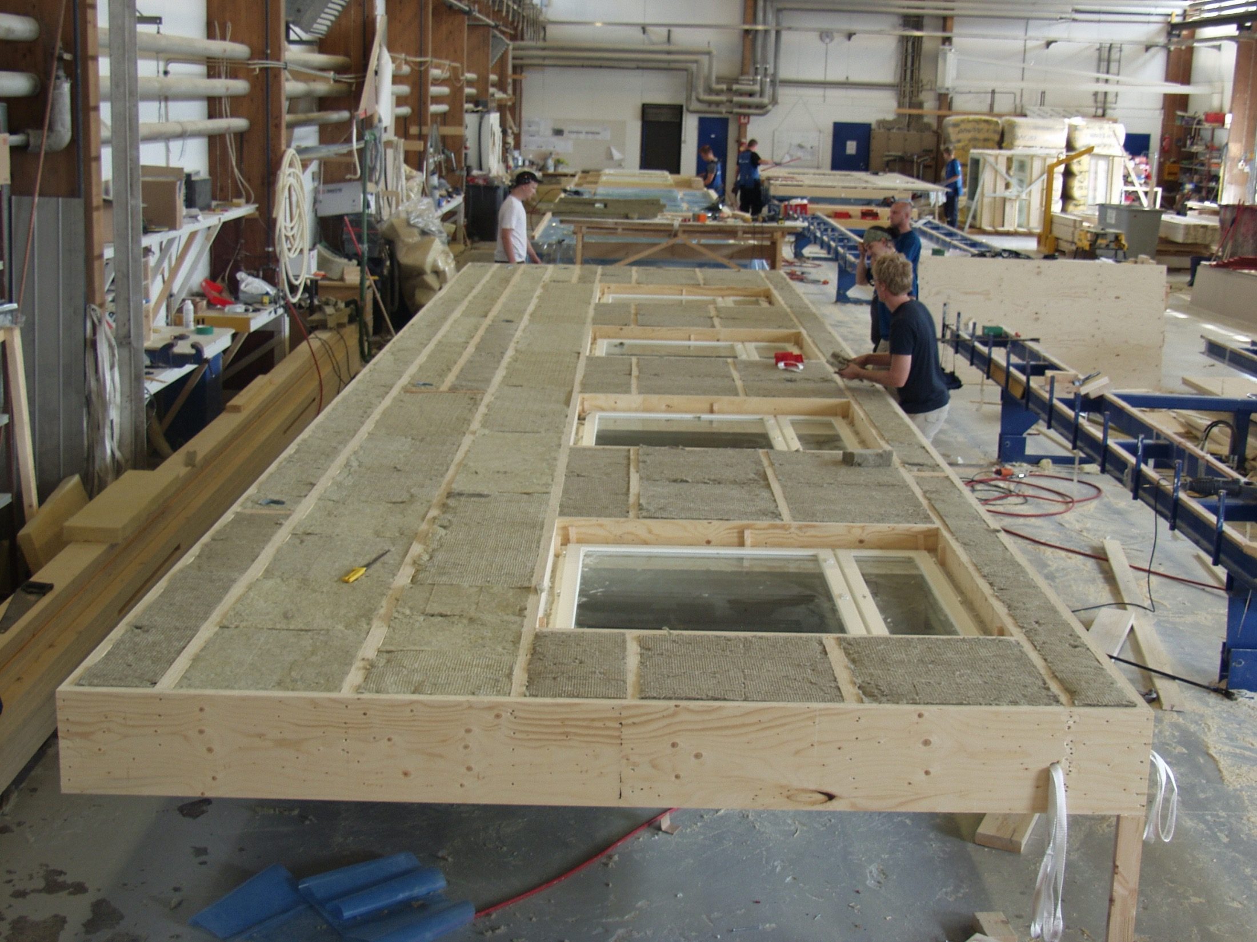
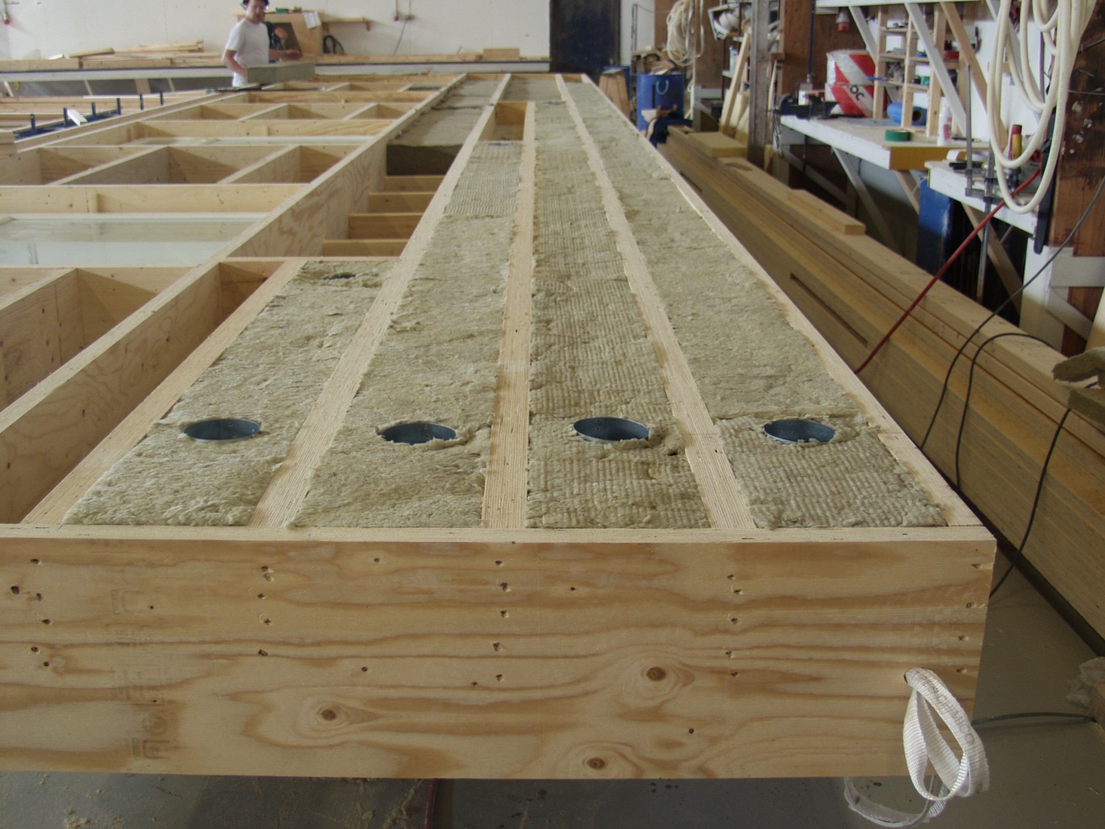
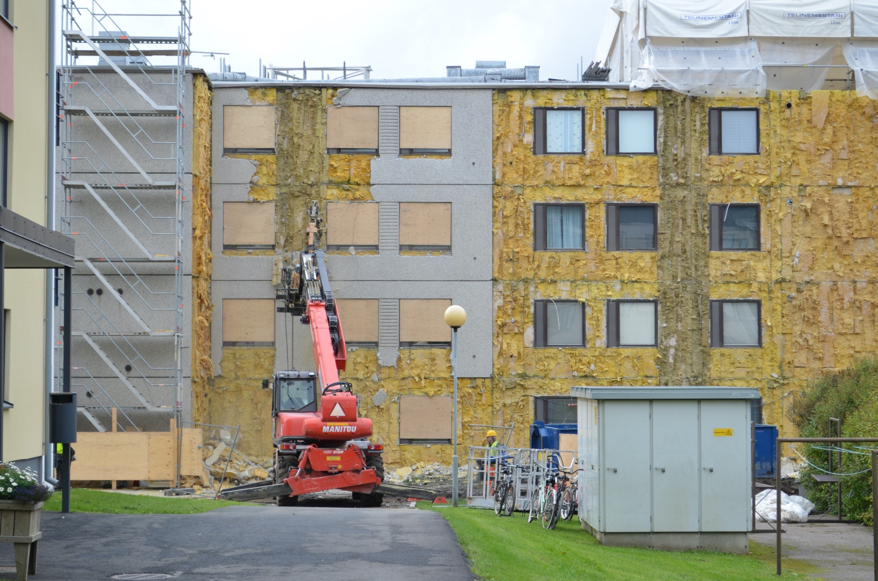
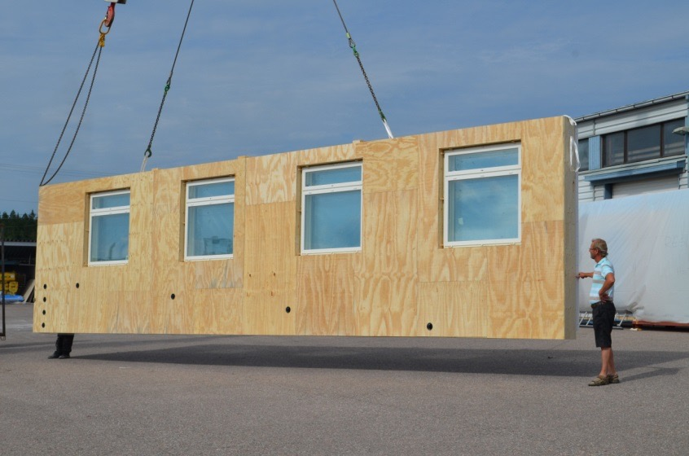
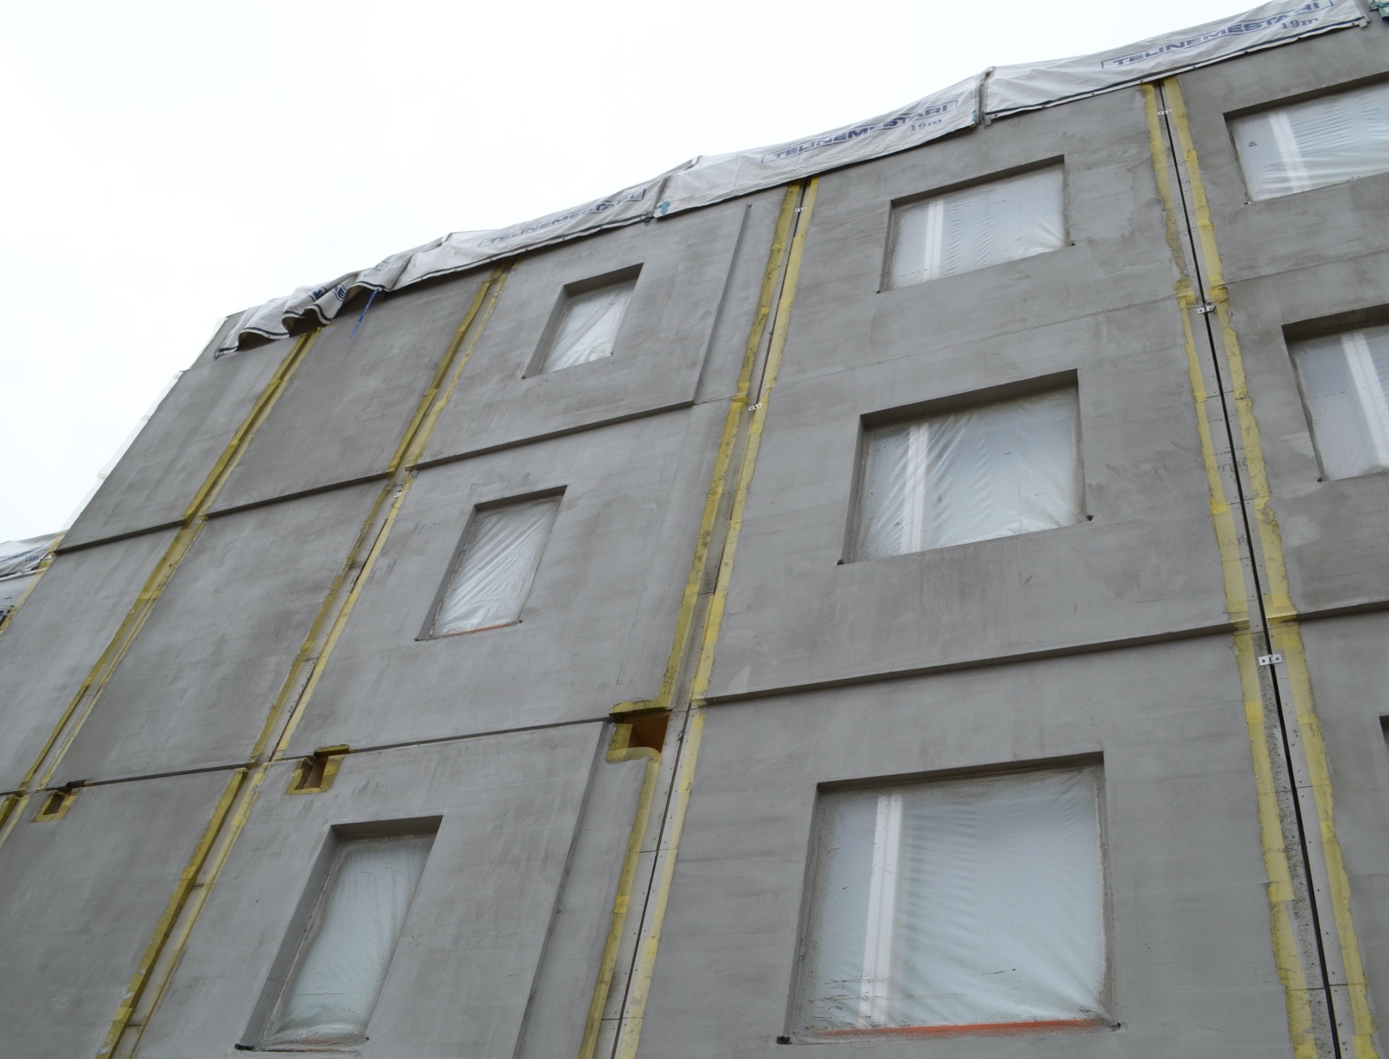
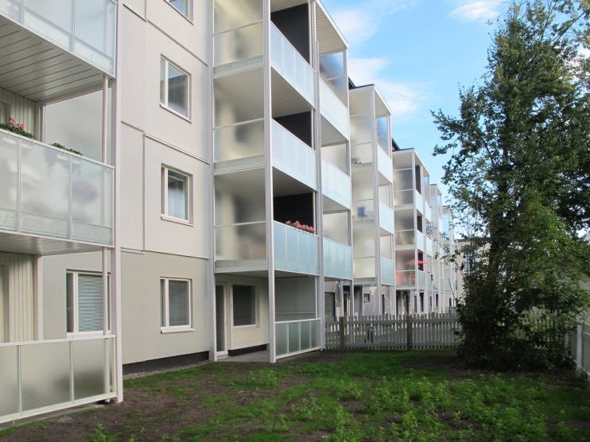
TES (Timberbased Element System) Façade repairs on suburban apartment blocks
Kimmo Lylykangas Architects Ltd
Image: Simon le Roux

Slide 23
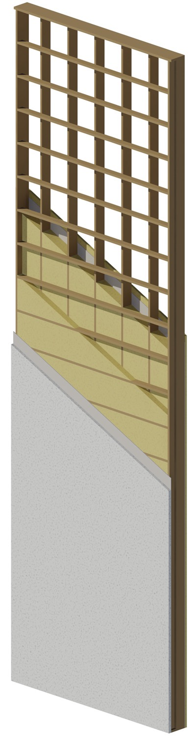
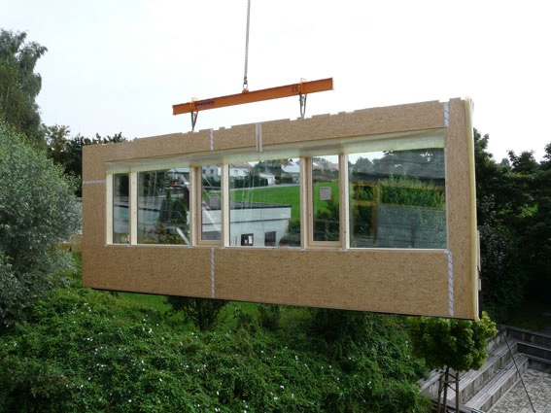
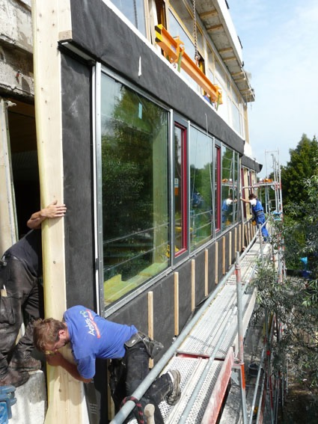
TES elements disassembling into the inner shell additional thermal insulation

Slide 24
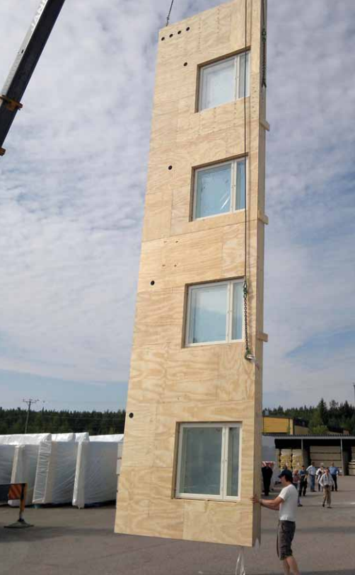
Energy renovation with wooden elements
The exterior shell of a concrete sandwich element and its insulation are dismantled - wood elements wooden elements will provide a new "tread" for the building
Fast installation phase due to element technology for minimal disruption to residents
Large uniform surfaces for better tightness
Image: Teeri-kolmio Oy, Metsätalouslehti

Slide 25
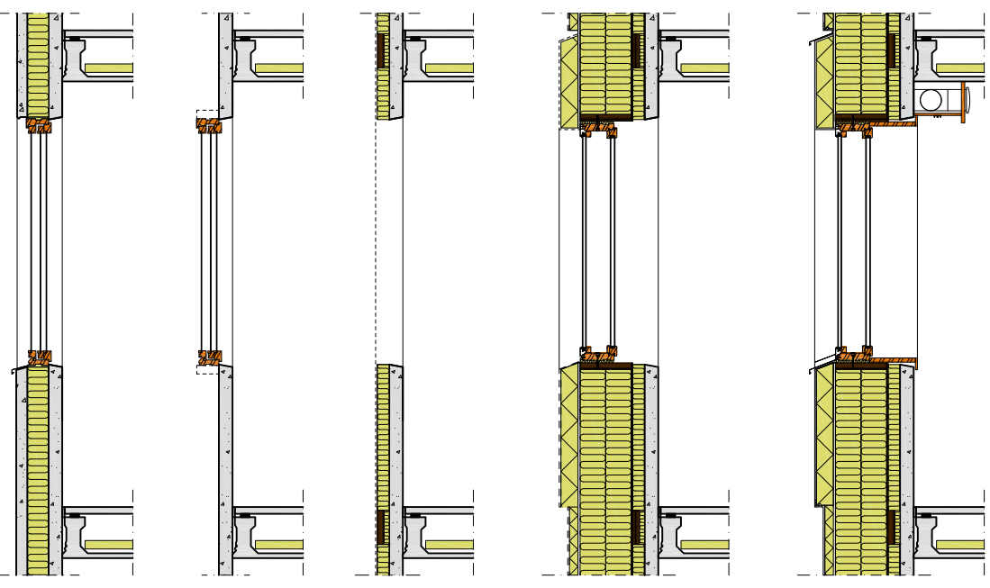
Procedures for the energy renovation of a suburban building
Starting point
Stripping
Smoothing insulation layer
Wooden frame
Finishing

Slide 26
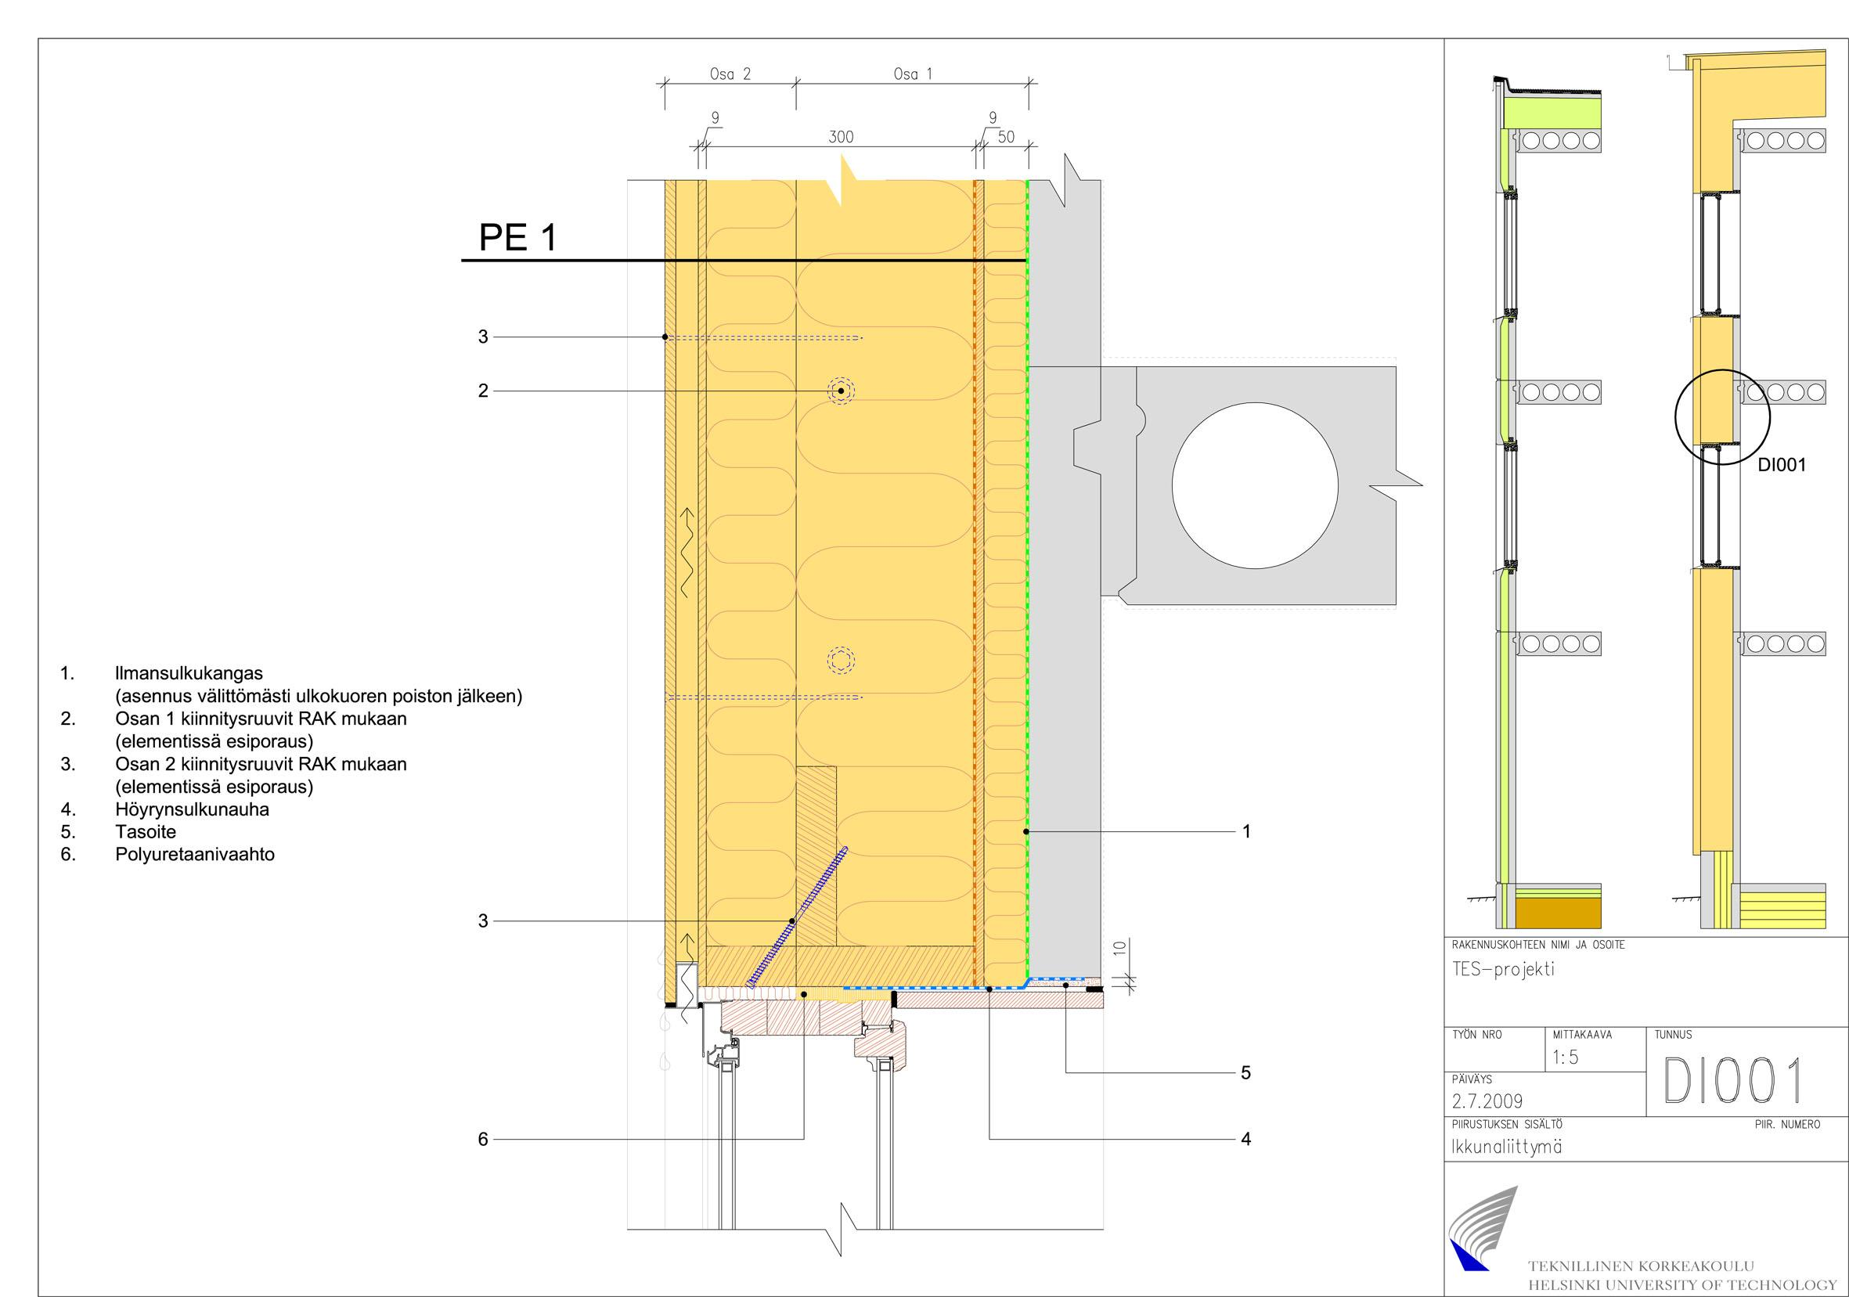
Structural detail when using wood a façade
1. Air barrier fabric
(installation immediately after the outer shell has been removed)
2. Fastening screws for part 1 according to RAK
(pre-drilling in element)
3. Fastening screws for part 2 according to RAK
(pre-drilling in element)
4. Vapour barrier
5. Filler
6. Polyurethane foam

Slide 27
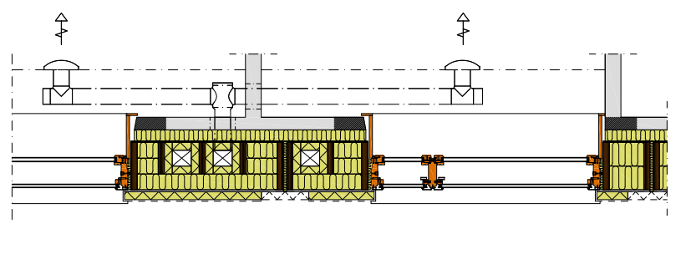
Energy consumption
Starting point: 192 kWh/m²
After the repair: 25 kWh/m²

Slide 28
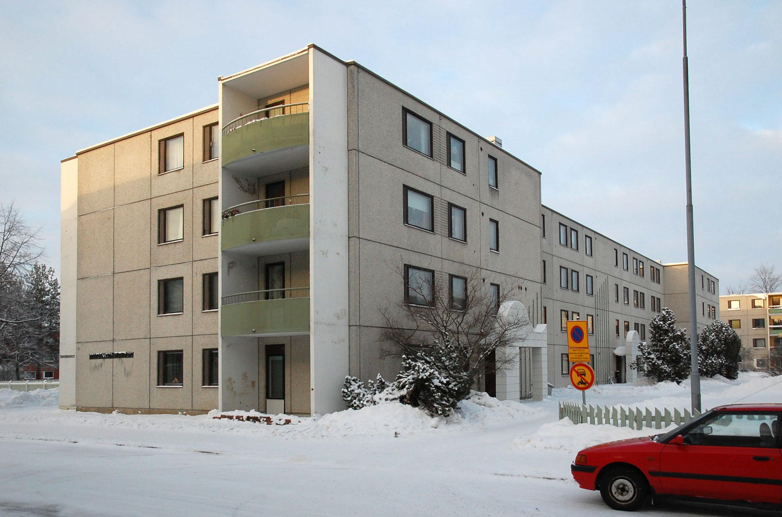
Riihimäki Peltosaari - Innova project
The Innova project showcased a completely new way of renovating a conventional 1960s or 70s concrete element building. The apartment block in Peltosaari, Riihimäki, was renovated to reduce its energy consumption to the passive house standard.
Kimmo Lylykangas Architects Ltd
Image: Simon le Roux

Slide 29
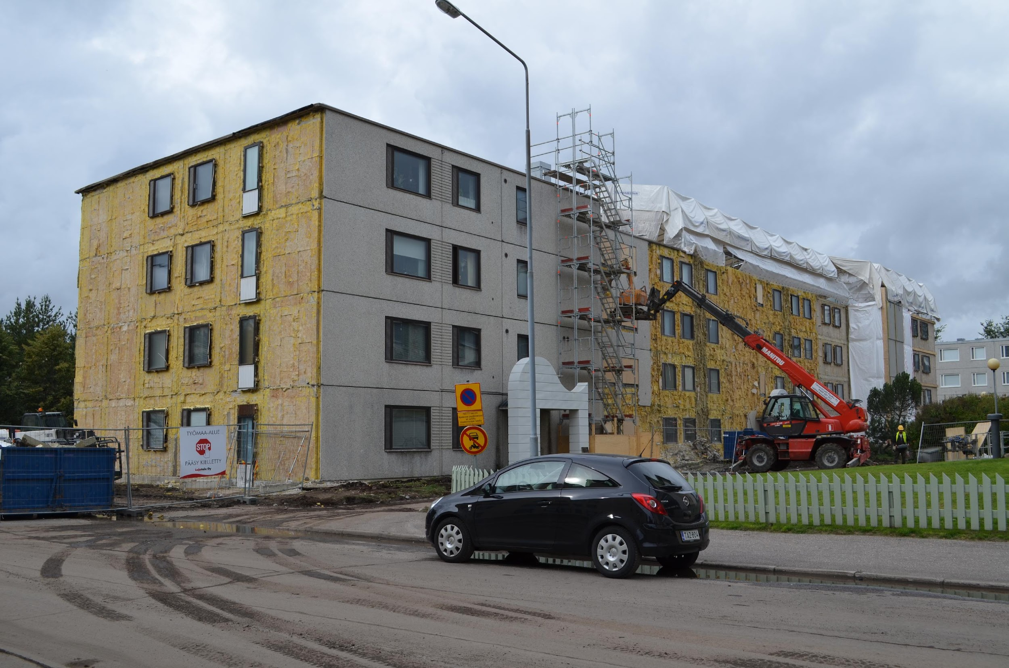
Riihimäki Peltosaari - Innova project
The repair method was completely new: vertical wooden frame elements with integrated PAROC stone wool insulation, windows and ventilation ducts. The elements were installed without scaffolding. This substantially reduced the time spent at the construction site and reduced disturbance to residents. Residents were able to live at home during the entire renovation.
Kimmo Lylykangas Architects Ltd
Image: Simon le Roux

Slide 30
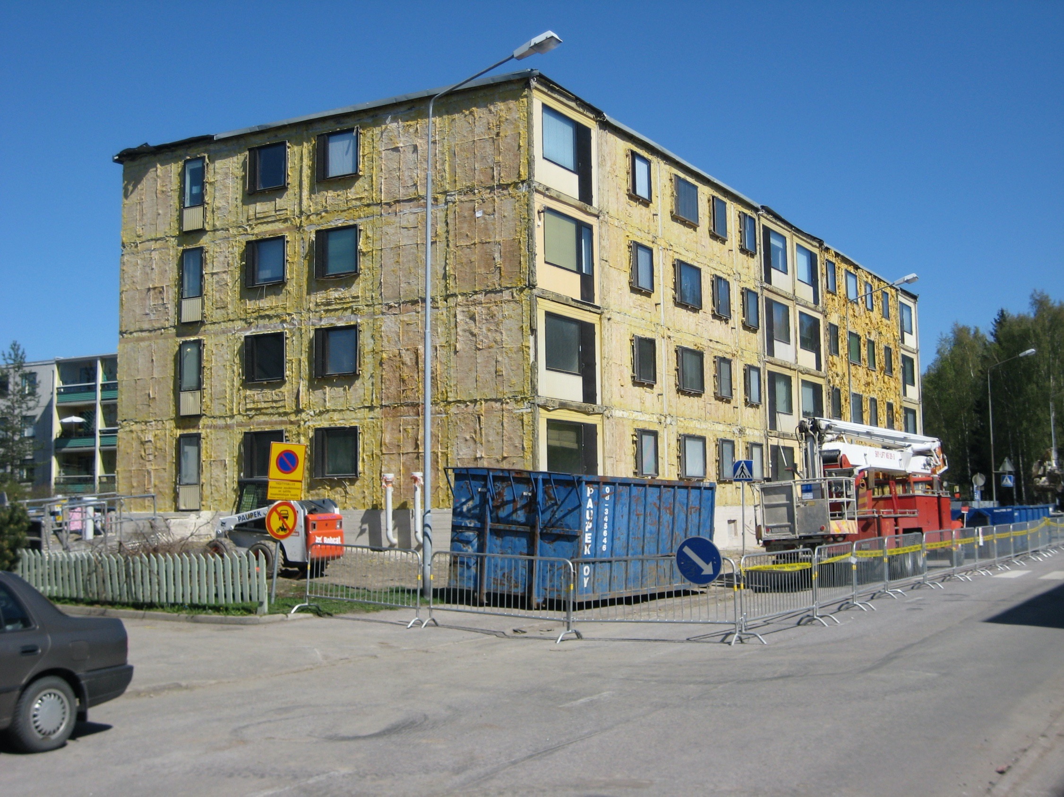
Riihimäki Peltosaari - Innova project Element stripping
Kimmo Lylykangas Architects Ltd
Image: Simon le Roux

Slide 31
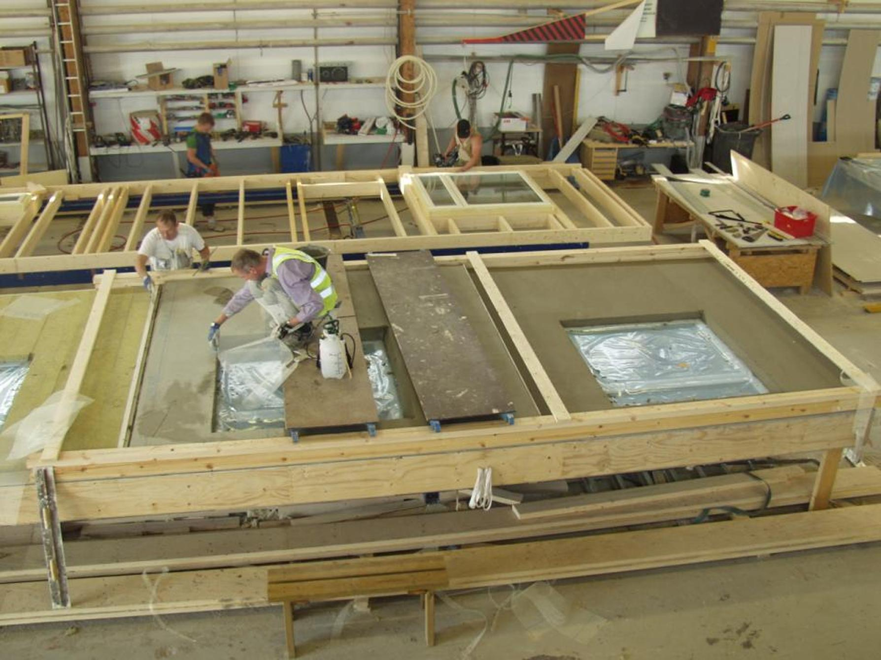
Riihimäki Peltosaari - Innova project Manufacture of additional insulation elements at the factory

Slide 32
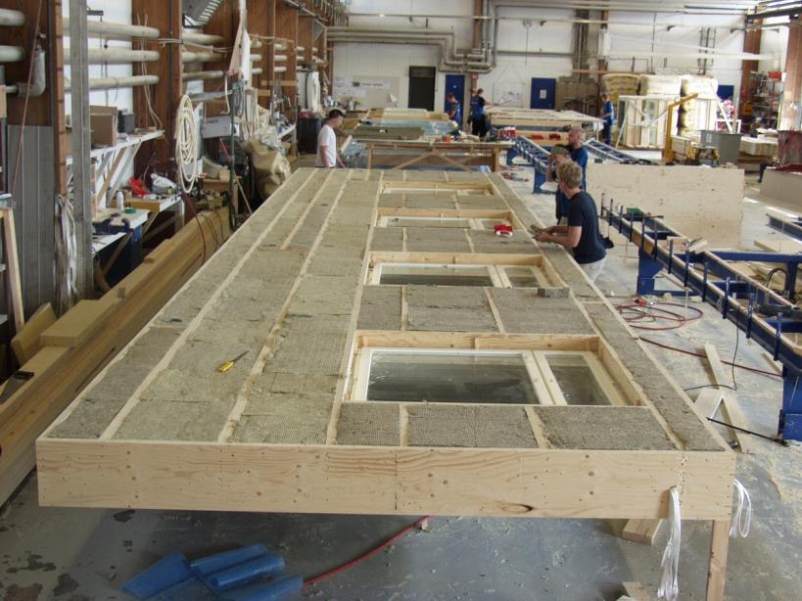
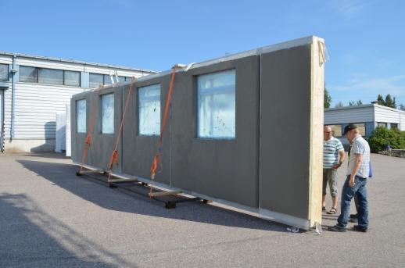
Riihimäki Peltosaari - Innova project Transfer to site
TES elements in production
INNOVA pilot Riihimäki, Finland
http://parocfi.virtual35.nebula.fi/innova/
Kimmo Lylykangas Architects Ltd
Image: Kimmo Lylykangas

Slide 33
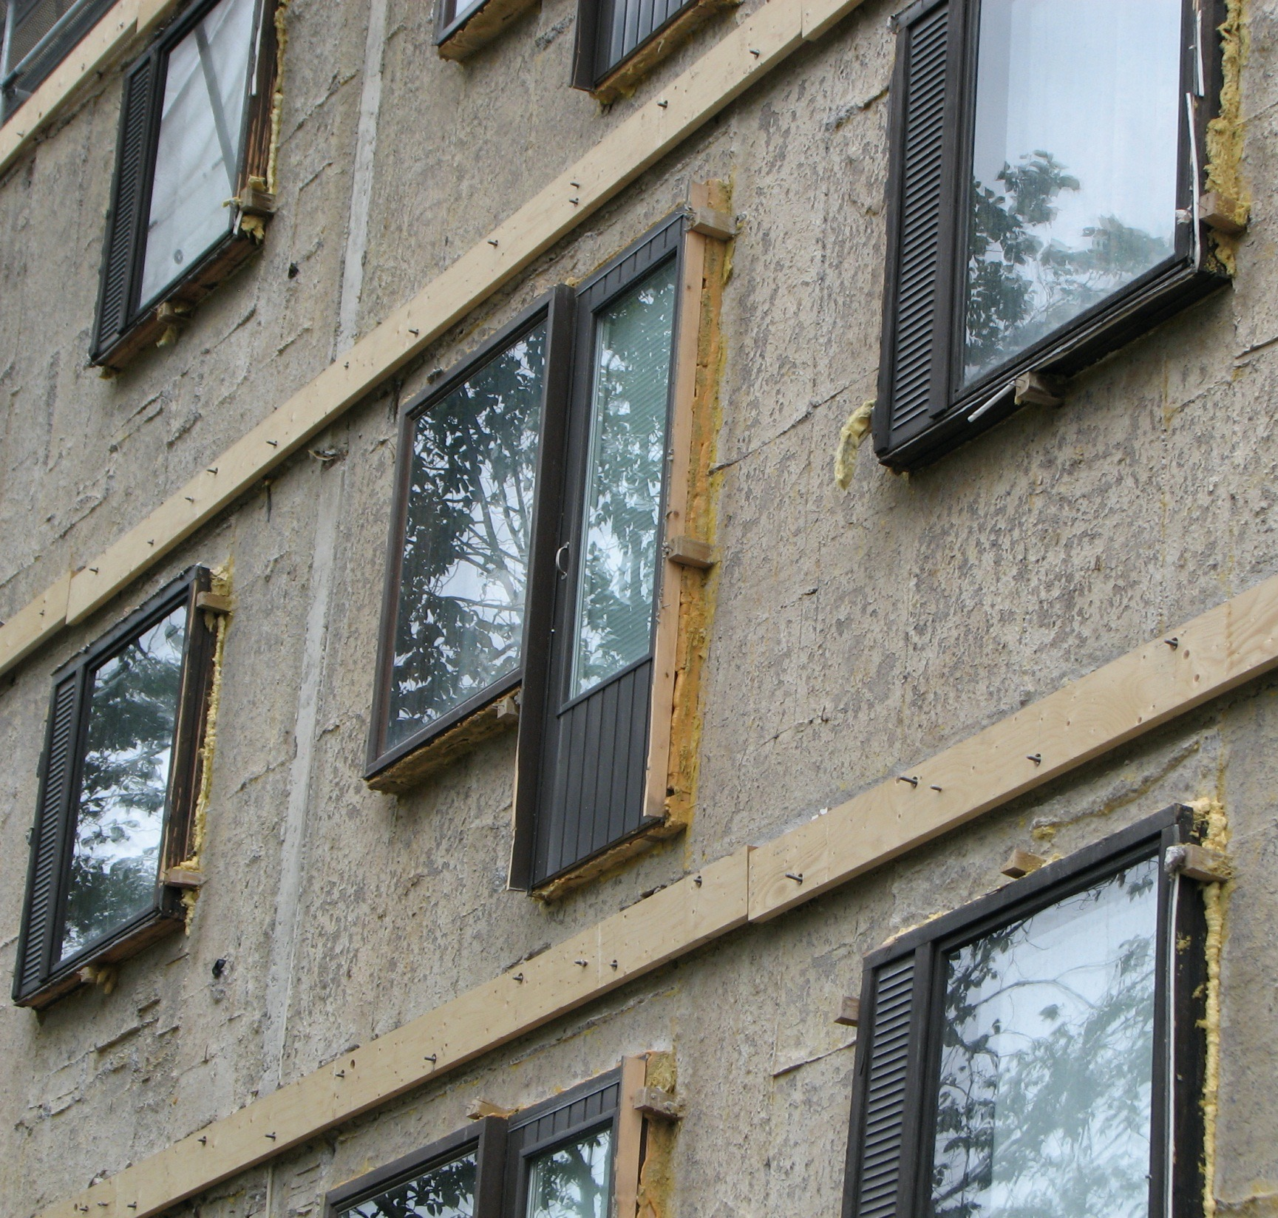
Riihimäki Peltosaari - Innova project Transfer to site
PAROC Innova project First TES repair renovation implemented in Finland
Additional information: http://parocfi.virtual35.nebula.fi/innova/
Kimmo Lylykangas Architects Ltd
Image: Kimmo Lylykangas
Text: https://www.rakennusfakta.fi/
Kimmo Lylykangas Architects Ltd
Image: Simon le Roux

Slide 34
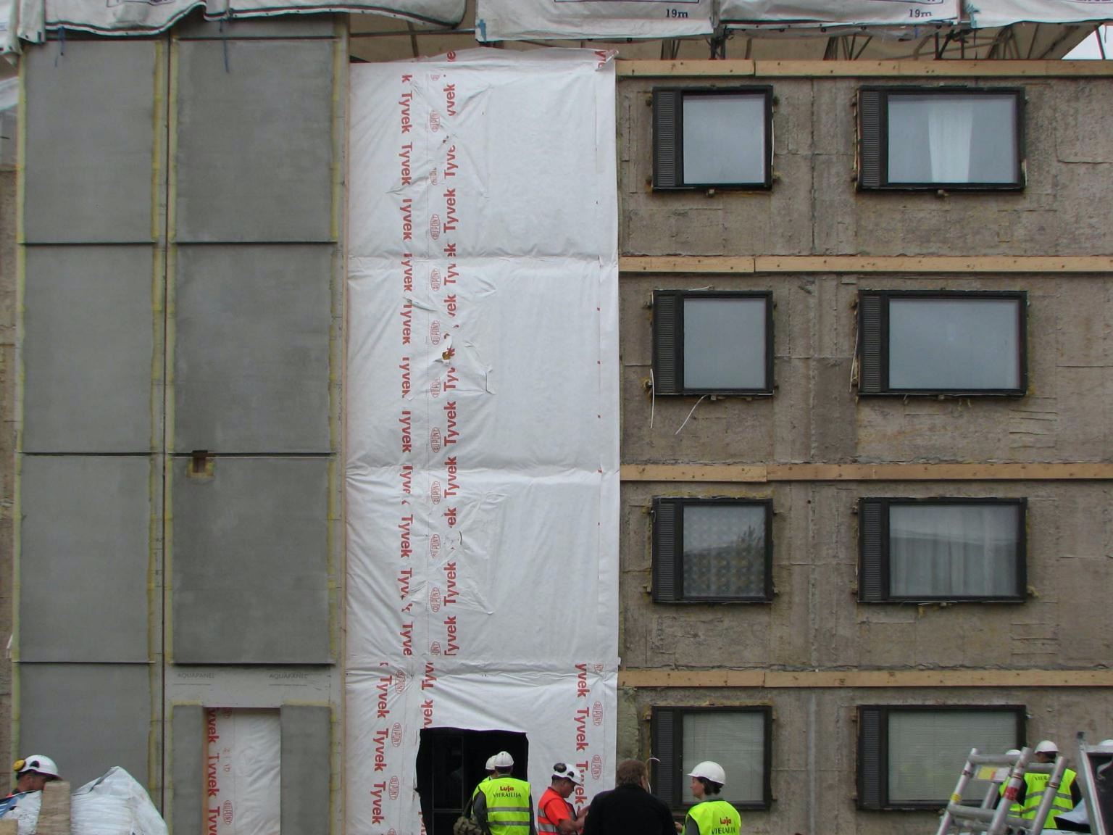
The repair method was completely new: vertical wooden frame elements with integrated PAROC stone wool insulation, windows and ventilation ducts.
Text: https://www.rakennusfakta.fi/
Kimmo Lylykangas Architects Ltd
Image: Simon le Roux

Slide 35
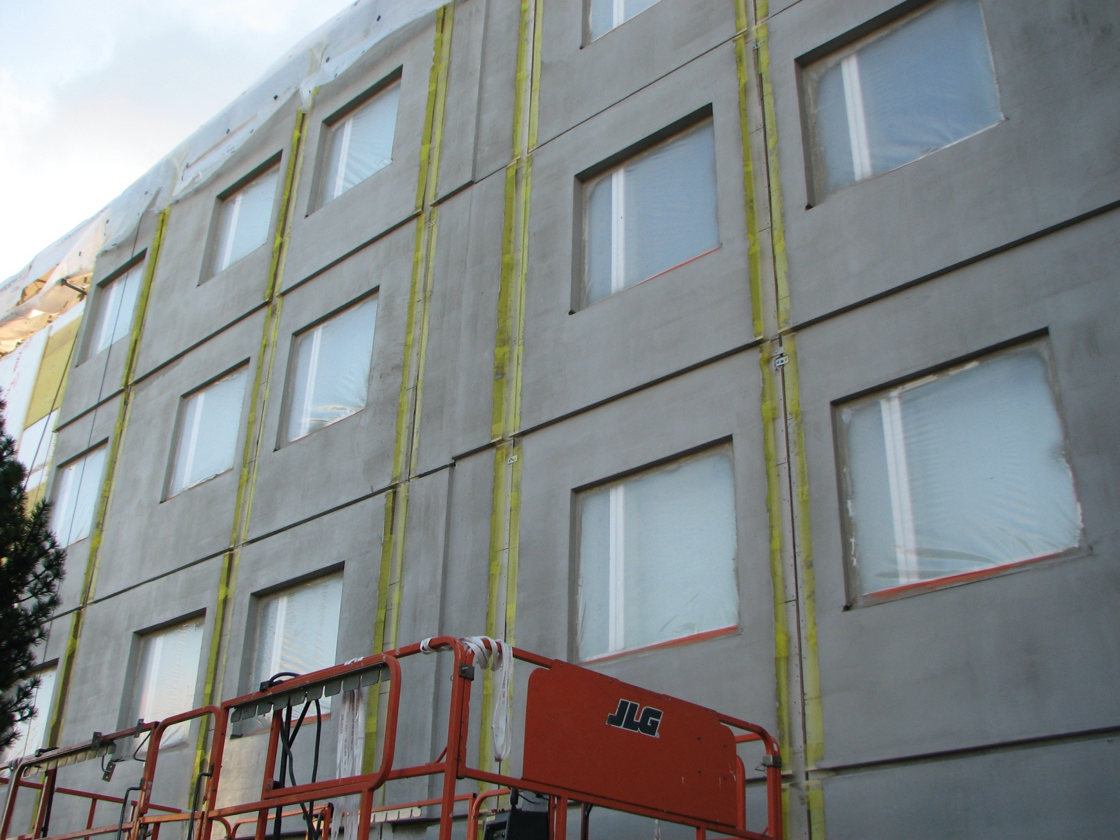
The elements were installed without scaffolding.
This substantially reduced the time spent at the construction site and reduced disturbance to residents.
Residents were able to live at home during the entire renovation.
Text: https://www.rakennusfakta.fi/
Kimmo Lylykangas Architects Ltd
Image: Simon le Roux

Slide 36
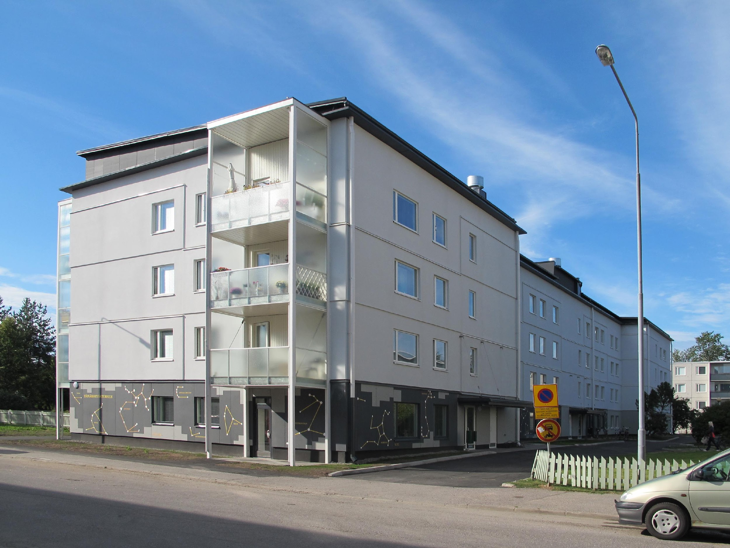
Riihimäki Peltosaari - Innova project Completed façade repair
The aim of architectural design was to renovate the appearance of an apartment block, but to retain some of the original style of the building.
Kimmo Lylykangas Architects Ltd
Image: Kimmo Lylykangas

Slide 37

Text: https://www.rakennusfakta.fi/
Kimmo Lylykangas Architects Ltd
Image: Simon le Roux

Slide 38

Survey on the actual repair construction potential of Finnish apartment blocks 10/2015
Survey commissioned by: Ministry of Economic Affairs and Employment
Survey conducted by: Valvontakonsultit Oy
The survey was carried out in summer 2015
3,376 responses were submitted

Slide 39
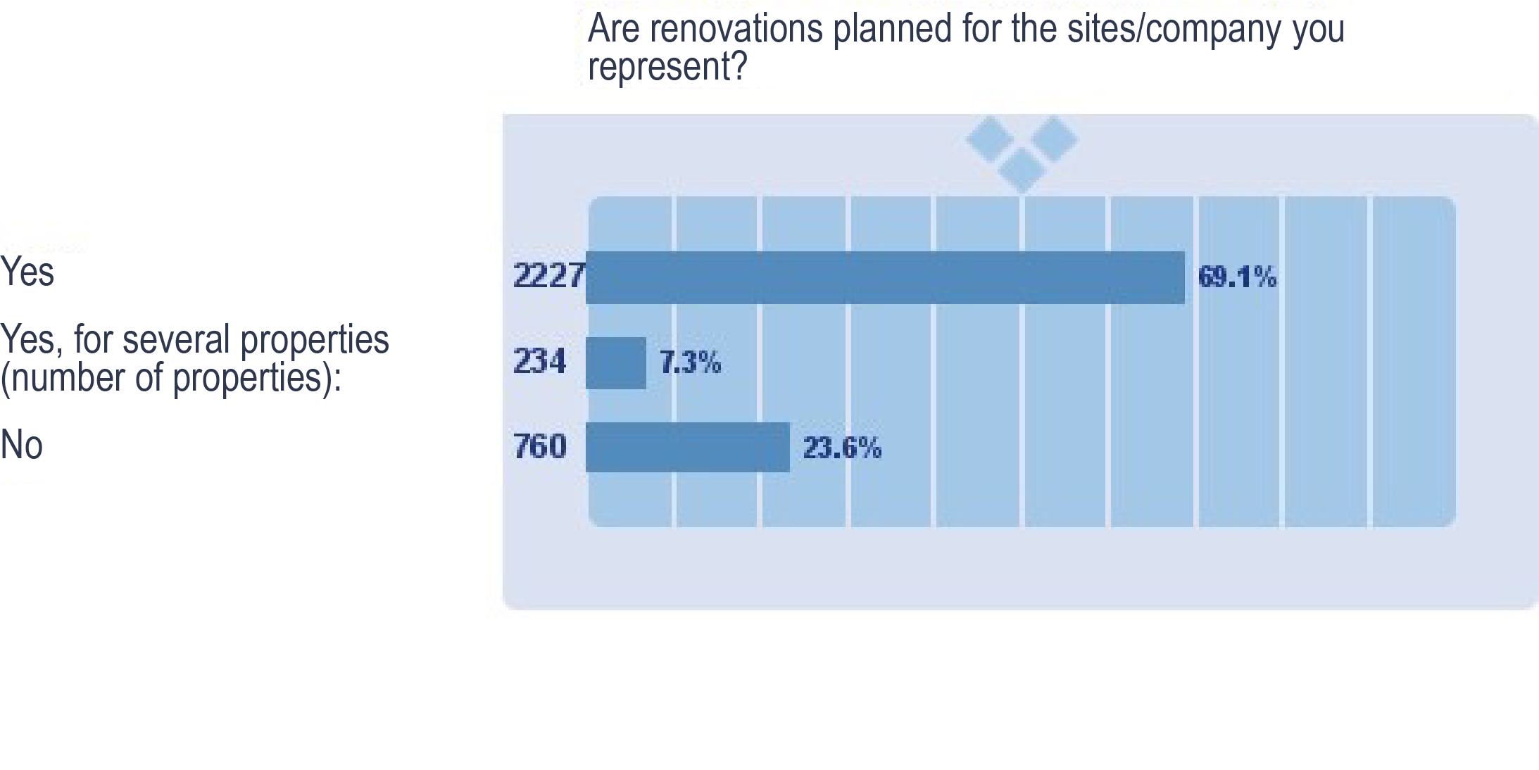
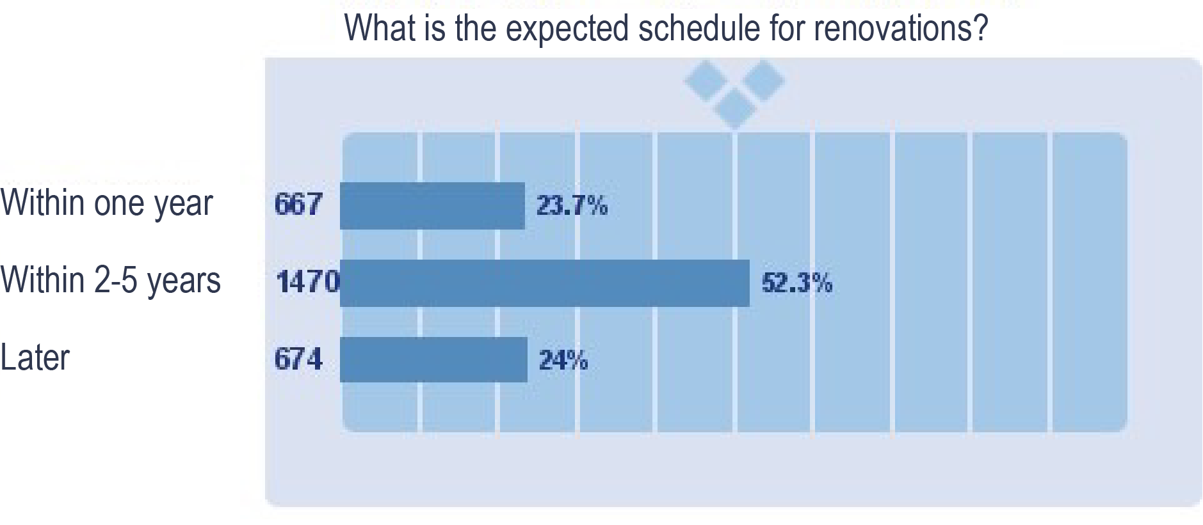
Survey results

Slide 40
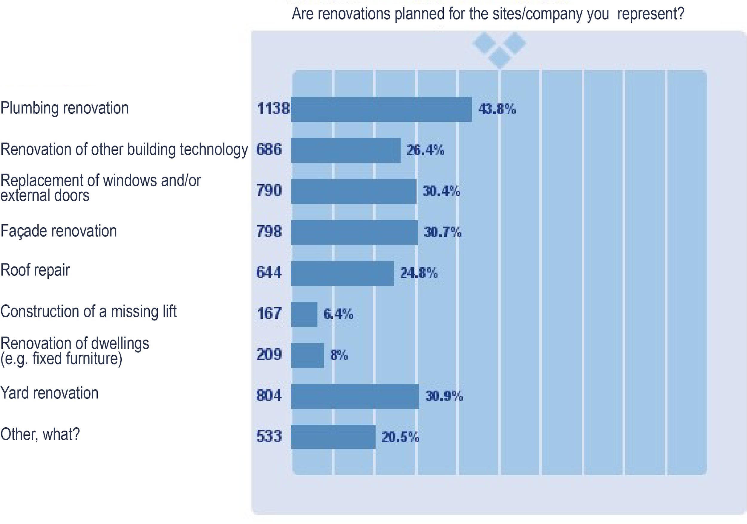
Survey results

Slide 41
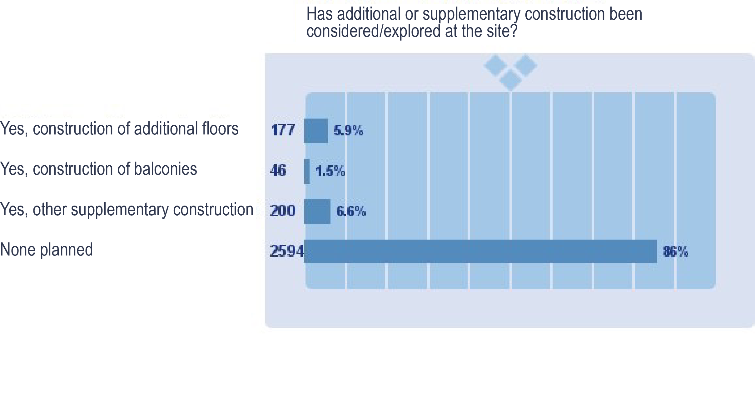
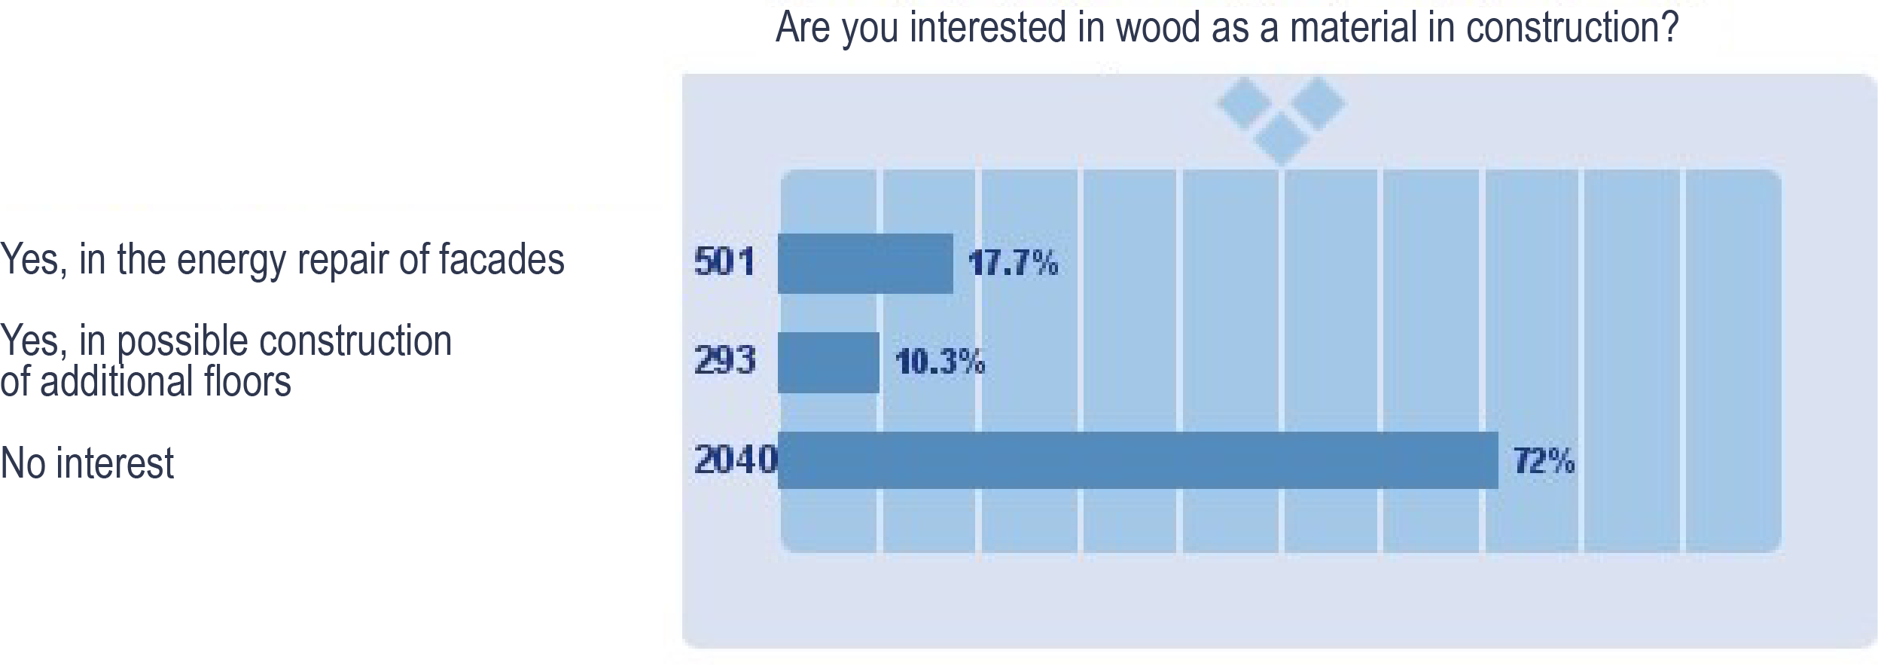
Survey results

Slide 42
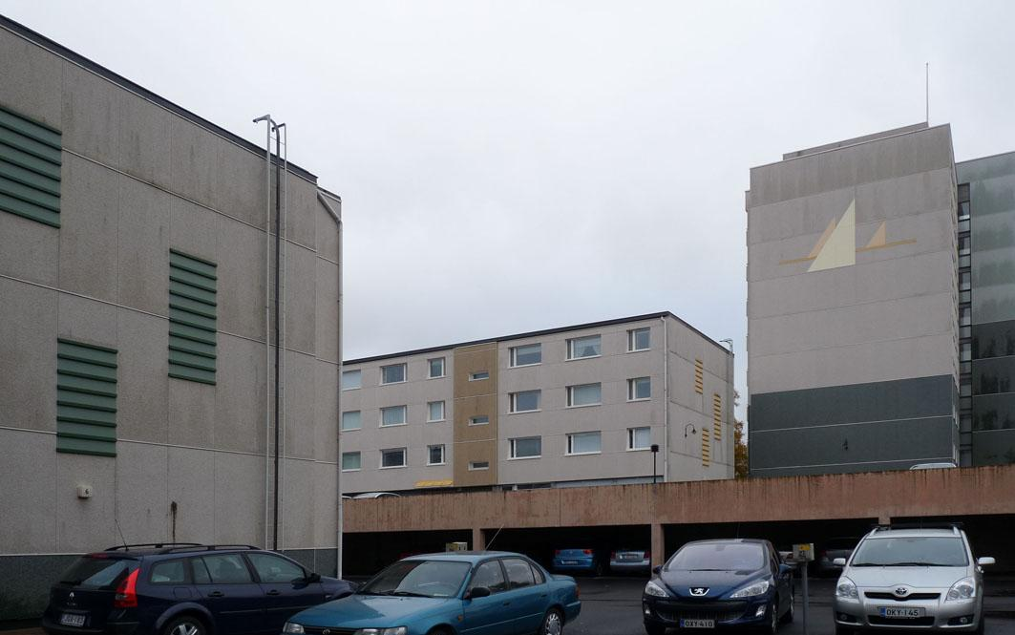
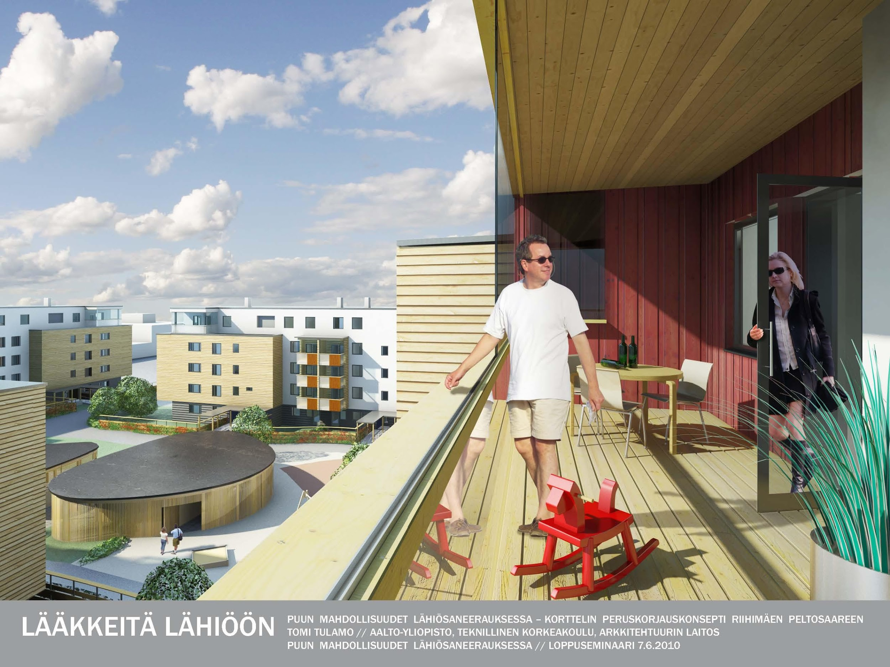
Potential benefits of suburban renovation

Slide 43
General objectives of suburban renovation
Improving the energy economy of buildings
Opportunity to build an additional floor
Renovation and/or construction of balconies
Improves the aesthetic and functional quality of the yard area, taking all age groups into account
Lift construction requirement
Find new design solutions based on existing wood products

Slide 44
Considerations for suburban renovation:
Design sites are blocks, not individual buildings - improving the neighbourhood setting
Making the urban structure more compact, supplementary construction
Improving the functionality and pleasantness of the ground floor and dwellings
Improving architecture and pleasantness
Additional thermal insulation, sun protection
Lightness, speed of wood construction
Little disturbance to residents

Slide 45
Student projects
Tampere - Lightness, speed, supplementary construction on an open block corner
Riihimäki - Speed, neatness, cost-effectiveness

Slide 46
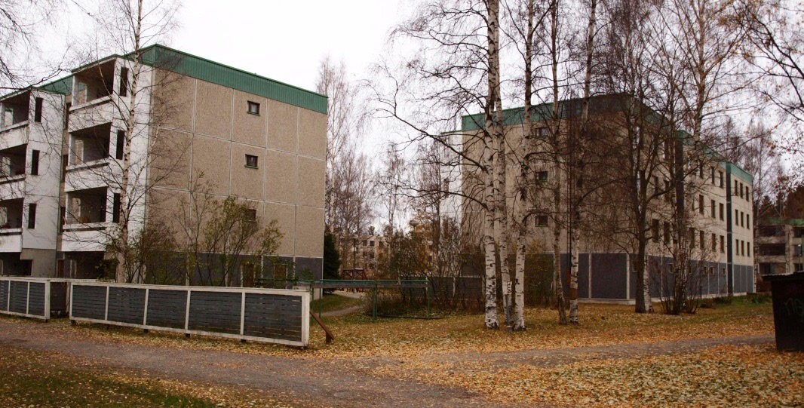
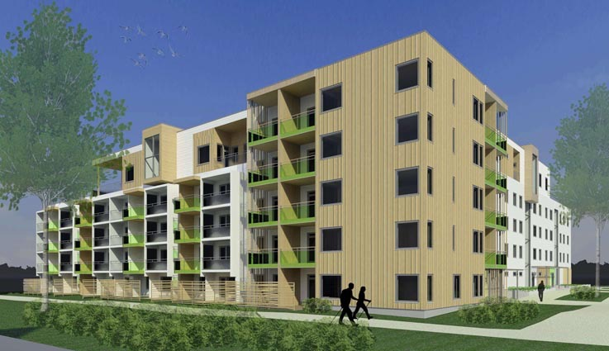
Tampere - Lightness, speed, supplementary construction on an open block corner
current status
design
Design: Architecture student Niina Murtonen

Slide 47
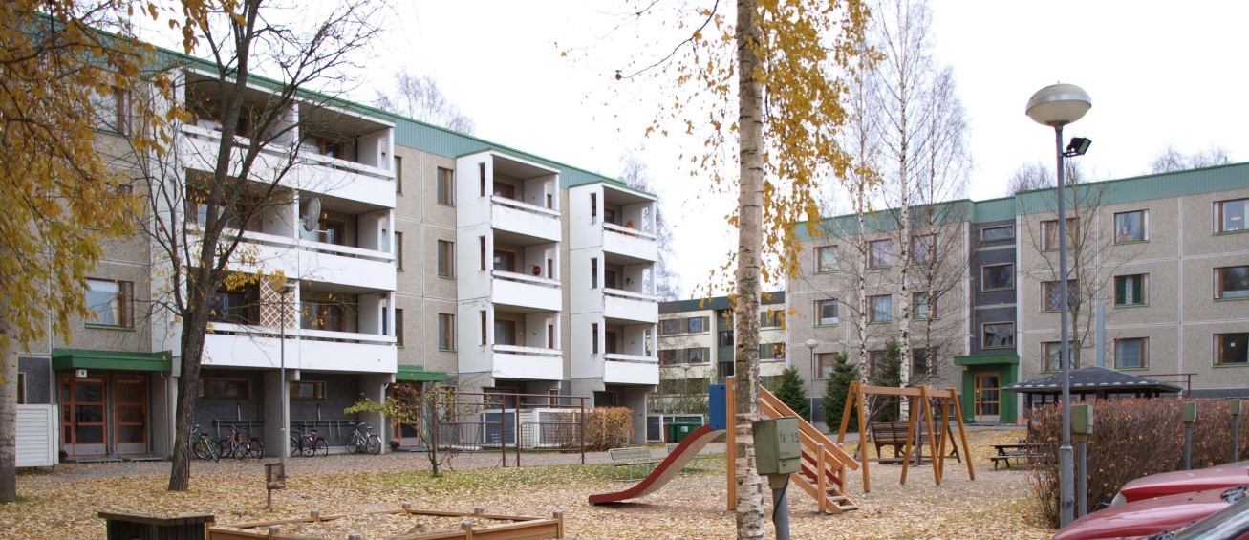
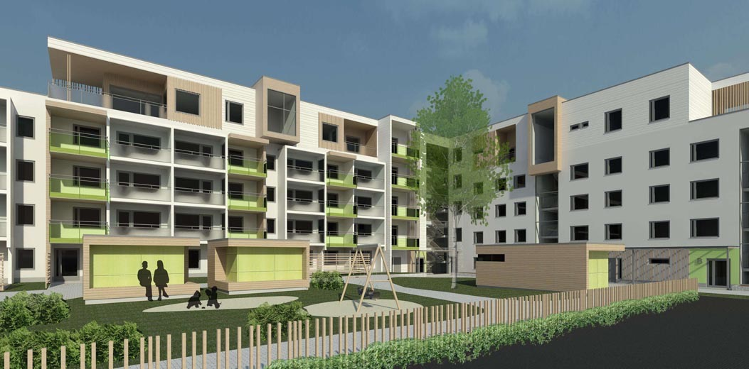
Tampere - Lightness, speed, supplementary construction on an open block corner
current status
design
Design: Architecture student Niina Murtonen

Slide 48
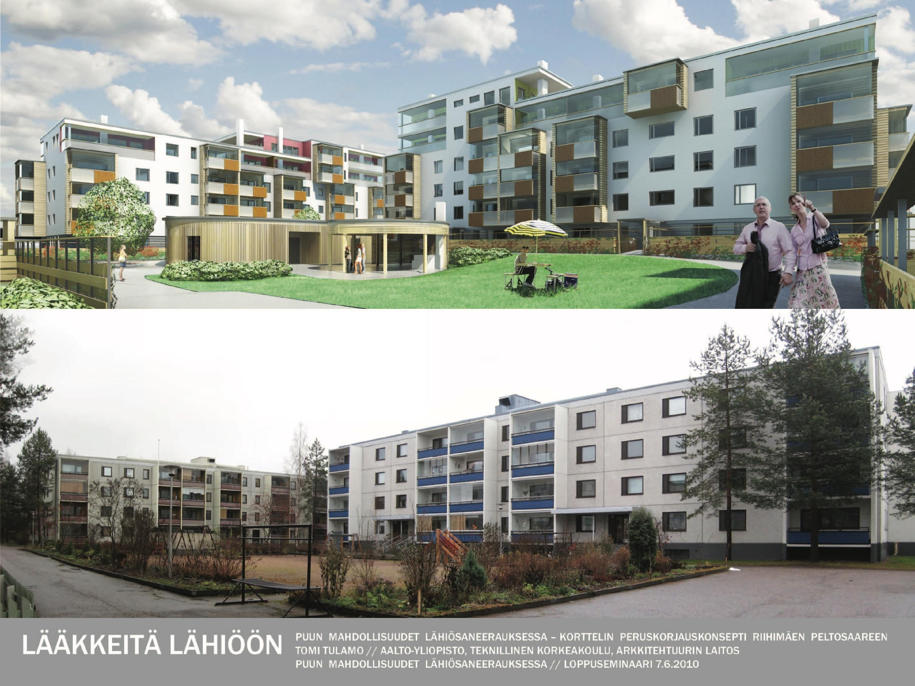
Riihimäki - Speed, neatness, cost-effectiveness
current status
design
Design: Architecture student Tomi Tulamo

Slide 49
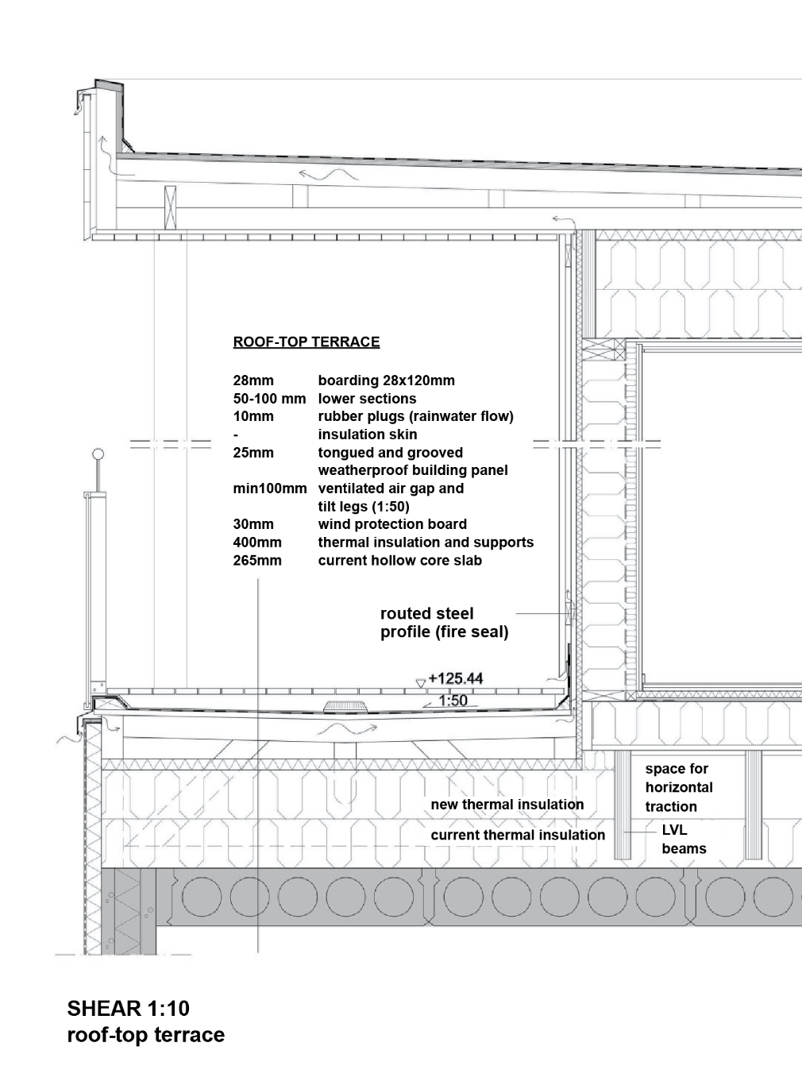
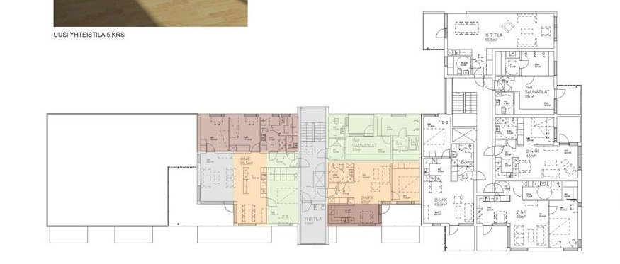
Riihimäki - Speed, neatness, cost-effectiveness
49
additional layer
new wooden apartment block
spatial element division
Design: Architecture student Tomi Tulamo

Slide 50


Riihimäki - Speed, neatness, cost-effectiveness
50
1-2 additional layers
frame made of cross-laminated wood panels (CLT)
Design: Architecture student Tomi Tulamo

Slide 51


Riihimäki - Speed, neatness, cost-effectiveness
51
Principle axonometry from balcony
Example of balcony details
Design: Architecture student Tomi Tulamo

