Slide 1



Industrial wood construction
Teaching materials for industrial wood construction education
2022

Slide 2
Origin of the materials
Use of the materials
These learning materials for industrial wood construction have been prepared in a project led by Puuinfo Oy in 2021–2022. Also involved in the project were
Lappia Vocational College,
TTS-Työtehoseura ry
South-Eastern Finland University of Applied Sciences,
Metropolia University of Applied Sciences,
Jyväskylä University of Applied Sciences,
University of Tampere, and
Federation of the Finnish Woodworking Industries Puutuoteteollisuus ry
The project was funded by the Ministry of the Environment.
The materials are intended to be used as extensively as possible in industrial wood construction education and studies.
The materials are released under the Creative Commons licence Attribution-ShareAlike (CC BY-SA), which requires that the author be properly credited when the materials are used and that derivative works may only be distributed under the same licence as the original work.
The original materials and any updates to them by Puuinfo will be published on the Library of Open Educational Resources website (aoe.fi) and the Puuinfo.fi website.

Slide 3

Wood as construction material

Slide 4
Authors
Henrik Heräjärvi, Senior Researcher
Anni Harju, Senior Researcher
Veikko Möttönen, Senior Researcher
Martti Venäläinen, Senior Researcher
Natural Resources Institute Finland (LUKE)
Release date: 13/05/2022

Slide 5
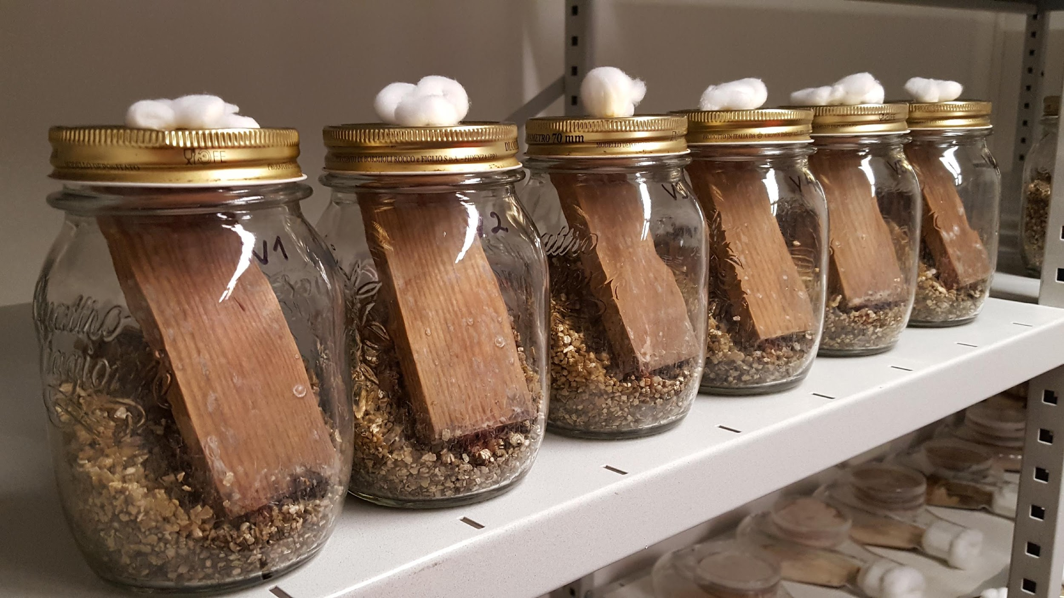
Contents
Wood material science and use of wood in construction
  Microstructure and composition
  Mechanical properties
  Moisture properties
  Long-term durability
  Impact of forest improvement and silviculture in the material properties of wood
Industrial wood products, their properties and uses
  Sawn timber, seasoning, strength classes and quality grades
  Planed and finger joint products
  Glued laminated timber, strength classes and processing
  LVL types, strength classification
  CLT, commonly used lamination configurations
  Plywood in construction: conifer, birch and mixed plywood
  Other timber-based panels in construction
  Pressure impregnation, modifications, wood-plastic composites
  Surface treatment to protect wood materials
Wood engineering
  Industrial manufacture of wood products
  Sawmilling, woodturning and other machine-tooling
  Strength grading methods for sawn timber
  Finger-joining and gluing sawn timber and laminated wood

Slide 6
Wood material science and use of wood in construction

Slide 7
Special features of wood as construction material
The only industrially exploited renewable construction material
When growing, trees bind atmospheric carbon dioxide and release oxygen into the atmosphere
Is heat-insulating and load-bearing regardless of temperature
Transparent certification of a sustainable raw material production system
Basic processes efficient and self-sufficient in terms of energy
Promotes psychophysical well-being and recovery, improves concentration
Forms a rich socio-economic impact network of regional and national economies: hundreds of businesses, more than half a million forest owners

Slide 8
What is wood?
Average elemental composition of a wood cell
  50% carbon (C)
  44% oxygen (O)
  6% hydrogen (H)
  0.2-0.3% ash (comprises numerous elements)
  <0.1% nitrogen (N)
Average basic chemical components of a wood cell
  Cellulose 35–45% The most abundant organic compound on Earth
  Lignin 20–30%
  Hemicellulose 25–35%

Slide 9
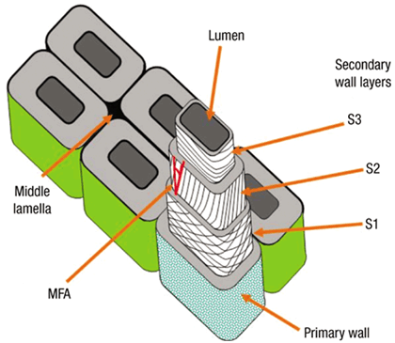
Microstructure of a wood cell (1/2)
From a functional perspective, the complex layer structure of a wood cell is ingenious
A wood cell (fibre) consists of a layered and porous cell wall, a lumen, and the middle lamella between cells
The microfibril angle (MFA) of the organised microfibrils (cellulose bundles) in the so-called S2 layer of the secondary wall relative to the cell's longitudinal axis critically affects several properties of wood
  Examples of properties affected by the microfibril angle:
    Stiffness and strength of the cell, piece of wood, or frame
    Moisture swelling and drying shrinkage (dimensional stability)
    Deformation due to moisture variation (form stability)

Slide 10
Microstructure of a wood cell (2/2)
Moisture is transferred fastest along the length of the tree, through the large open tube cells (deciduous trees) or pores at the ends of the cells
The pores on the sides of the cell wall allow fluids and gases to diffuse between cells
The porous structure plays an important role in maintaining the vital functions of the tree, the seasoning of the wood product, the moisture dynamics during use (adsorption-desorption), and impregnability (permeability)
  Deciduous trees differ from coniferous trees, and there are major anatomical differences between species within both groups as well
  Cells produced by the tree at different ages and at different stages of the growing season are also anatomically different from each other
Further information: Kärkkäinen, M. 2007. Puun rakenne ja ominaisuudet. Metsäkustannus Oy. p. 468

Slide 11
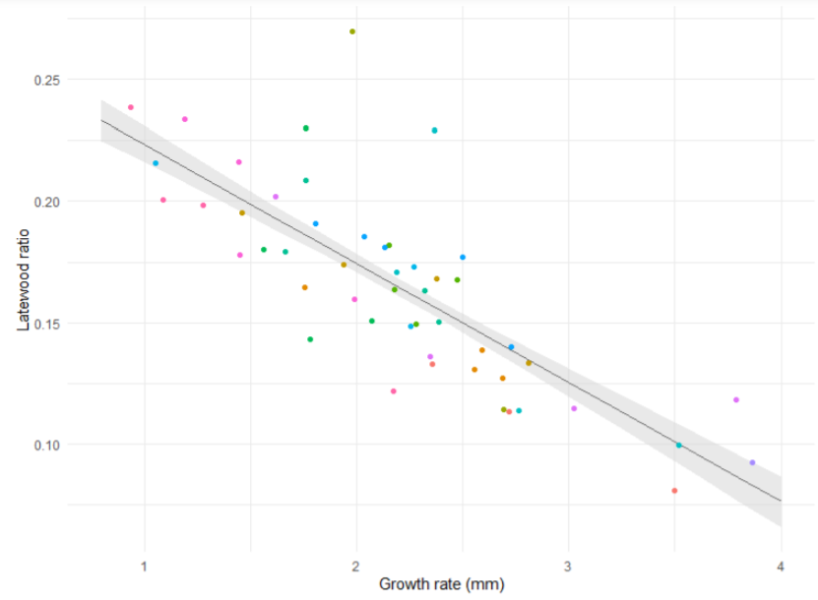
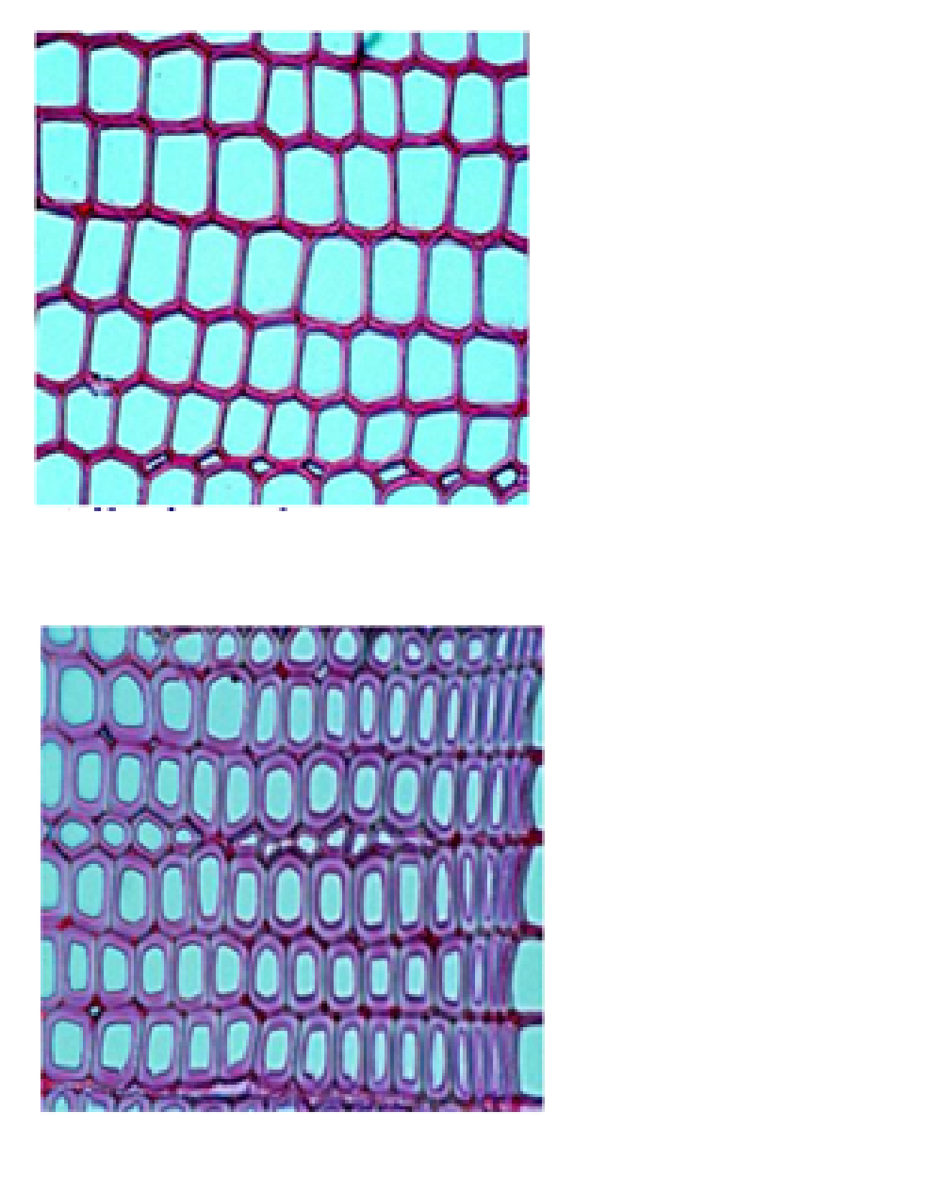
Growth rate is an important quality criterion for wood
The share of strong latewood tissue in the growth ring will decrease as the growth rate increases.
Pehkonen, M. 2021. The effect of growth rate on sawlog quality of Norway spruce. University of Eastern Finland, Faculty of Science and Forestry, School of Forest Sciences. MSc thesis in Forest Science. p. 41
Adult earlywood
Images: Pekka
Saranpää/Luke
Adult latewood

Slide 12
Mechanical properties (1/3)
The mechanical properties of wood (strength and stiffness in different load situations) are affected by:
  Load direction (radial, tangential, longitudinal)
  Load method (slow, fast; compressive, tensile, cut...)
  Cell anatomy and structure of the cell wall
    The thickness of the cell wall determines the density of the wood
    Cell wall structure, particularly the microfibril angle, cell length and shape
  Structural unconformities (e.g. branches) and defects (e.g. rot and decay)
  Moisture content (ratio of water mass to dry mass) and temperature
    The strength and stiffness of wood is approximately doubled when seasoned from wet (moisture ratio of over 30%) to its typical operating moisture content (10–15%)
    As a rule, the strength and stiffness of wood will decrease as the temperature rises, but the mechanical properties of dry and wet wood have different temperature dependencies

Slide 13
Mechanical properties (2/3)
The longitudinal elastic modulus (stiffness) of "flawless" wood (= no branches, decay, etc.) is 40 to 120 times higher (coniferous trees) or 10 to 60 times higher (deciduous trees) than its radial elastic modulus
The radial elastic modulus is 1.5 to 6 times higher than the tangential elastic modulus
Ways to influence the mechanical properties of wood:
  Regulation of ambient conditions (humidity, temperature)
  Selection and grading of raw material
  Modification of properties with heat, pressure, or chemical substances
  Cutting and re-gluing wood => Engineered Wood Products (EWP)
    Plywood, chipboard, laminated veneer lumber (LVL), glulam beams, OSB, CLT...

Slide 14
Mechanical properties (3/3)
Percentage change of certain mechanical properties of wood per percent change in moisture content, baseline moisture ratio 12% (applicable when moisture content <30%):
Property | Change in % when the moisture content of wood changes by one percent
Compressive strength parallel to grain | 5
Compressive strength perpendicular to grain | 5
Bending strength parallel to grain | 4
Shearing strength parallel to grain | 3
Tensile strength parallel to grain | 2.5
Tensile strength perpendicular to grain | 2
Elastic modulus parallel to grain | 1.5
Further information: Kärkkäinen, M. 2007. Puun rakenne ja ominaisuudet. Metsäkustannus Oy. p. 468

Slide 15
Moisture properties (1/3)
Wood is hygroscopic, i.e. its moisture content is affected by the relative humidity and temperature of the ambient air
  If the conditions remain constant, the wood will eventually stabilise at its equilibrium moisture content (EMC)
    The EMC will be lower if achieved through adsorption rather than desorption (hysteresis phenomenon)
  The relative humidity of indoor air varies between 20% and 80% by season => The moisture content of wood will vary between approx. 5% and 15% => Dries and shrinks during the heating season, gets damp and swells in late summer and autumn

Slide 16
Moisture properties (2/3)
As wood gets wet, the water molecules push the microfibrils in the cell wall further apart, causing the cell wall to swell – the opposite happens as the wood dries again
In high-quality wood, the microfibrils are almost parallel to the cell's long axis, which means that the cell will shrink/swell only slightly in the longitudinal direction. If the microfibril angle is sharper, shrinkage and swelling in the longitudinal and tangential directions will increase
Average maximum shrinkage from wet to dry
  In tangential direction 8%
  In radial direction 4%
  In longitudinal direction 0.4%

Slide 17
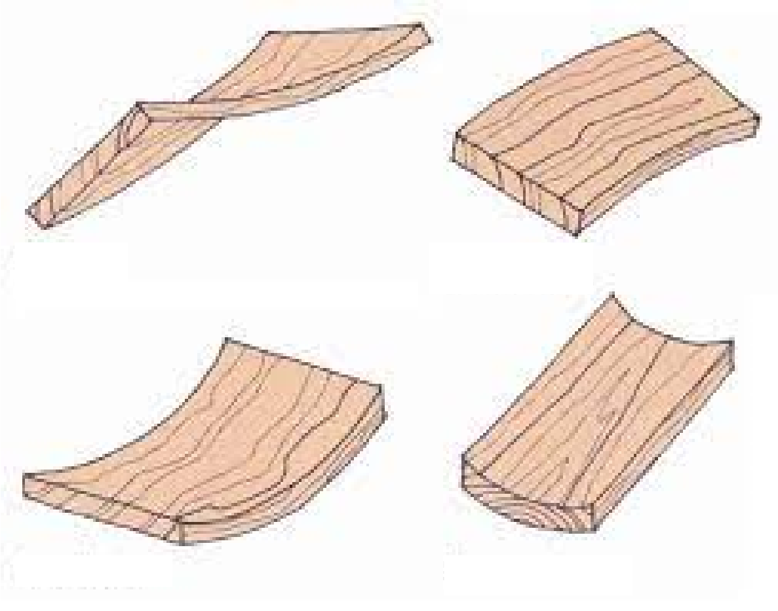
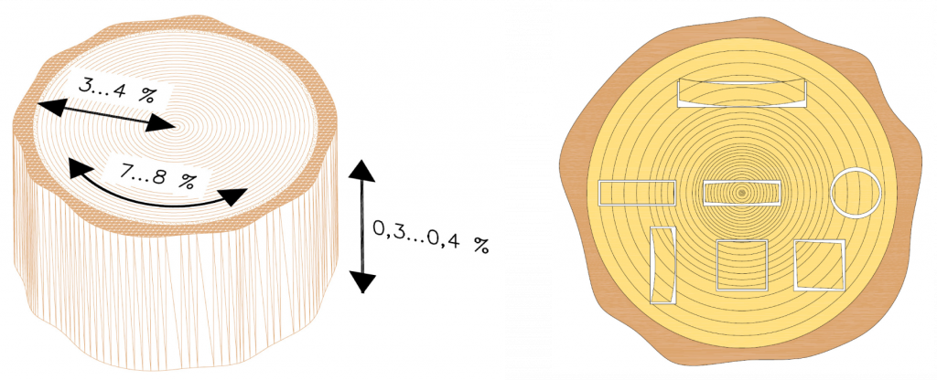
Moisture properties (3/3)
Moisture swelling and drying shrinkage of a piece of wood depend on
  a) the structure of the wood cells (see Microstructure of a wood cell)
  b) the direction (longitudinal, radial, tangential)
  c) where in the trunk cross-section the piece originates from
Twist
Crook
Bow
Cup
Image source and further information: Siikanen, U. 2008. Puurakentaminen. Rakennustieto Oy. p. 367

Slide 18
Long-term durability (1/4): weather resistance
Weather resistance refers to the resistance of wood to weathering
The main factors of weathering are:
  Energy of the UV radiation from the sun
  Temperature variations and their impact on the drying of wood
  Rain and humidity
Effects of weathering on wood
  Photodegradation of lignin and the resulting slow fibre loss (milligrams per 100 years)
  Graying and fuzzing
  Cracking, splintering and deformations
  Further information: Weathering Testing Guidebook. 2001. Atlas Electric Devices Company. https://fdocuments.in/document/weathering-testing-guidebook.html?page=1
  George, B. et al. 2005. Photodegradation and photostabilisation of wood - the state of the art. doi:10.1016/j.polymdegradstab.2004.10.018

Slide 19
Long-term durability (2/4): biological durability
Biological durability refers to the ability of timber to resist damage caused by living organisms
Organisms that decay wood or deteriorate the appearance of timber:
  Wood-rotting fungi
    Degrade the strength of wood by breaking down the cellulose and lignin
    Brown-rot fungi (e.g. dry rot) thrive in coniferous wood in particular
    Need water, oxygen, and a suitable temperature (15 to 40°C optimum) to thrive
    Mould fungi and blue-stain fungi
    Do not degrade the wood, but cause aesthetic and sometimes health-related harm and damage
  Insects
    So far, there is no major risk in Finland; further south, e.g. termites
  Bacteria and actinomycetes
    In wet wood
Further information: 1) Zabel, R. & Morrell, J. 1992. Wood Microbiology: Decay and its Prevention. 2) Timonen, S. & Valkonen, J. 2013. Sienten biologia.

Slide 20
Long-term durability (3/4)
Ways to prevent or slow down decay:
  Keeping the wood dry with structural protection
  Preventing water absorption with surface treatment
  Modifying wood for water resistance (e.g. acetylation) or reduce its equilibrium moisture content (e.g. heat treatment)
  Using heartwood rich with extractives (e.g. pine, larch, oak)
  Impregnating wood with a protective agent that prevents the vital functions of wood-rotting fungi (e.g. copper impregnation)
The service life of a wood product or structure will depend on the combined effects of the conditions of use and the durability properties of the material

Slide 21
Long-term durability (4/4)
Use classes describing the different service situations that wood and wood-based materials may be exposed to according to the EN 355:2013 standard. The use class descriptions are unofficial translations. The description of the risk of damage is provided as an informal opinion.
Durability classes describing the resistance of wood-based materials to wood-decaying fungi according to the EN 350:2016 standard.
Use class | Description of the service situation the wooden structure is exposed to | Risk of infestation by mould fungi or wood-decaying fungi
UC 1 | Interior use, no exposure to weather or wetting | No risk, except due to a random accident
UC 2 | Interior use, no exposure to weather (not even to slanted rain), but may get wet occasionally or be exposed to condensed water | Possible risk of being infested by mould fungi or wood-decaying fungi
UC 3 | Exterior structure, but not in contact with the ground; exposed to weather, particularly rain
UC 3.1 | The structure may get wet but will not stay wet for extended periods of time | Risk of being infested exists
UC 3.2 | The structure may get wet and will remain wet for extended periods of time, water may accumulate in the structure | Risk of being infested probable
UC 4 | The structure is in direct contact with the ground or fresh water | Infestation is inevitable
UC 5 | The structure is in direct contact with sea water or brackish water | Risk of being infested probable
Durability class | Durability class description | Unofficial Finnish translation
DC 1 | Very durable | Erittäin kestävä
DC 2 | Durable | Kestävä
DC 3 | Moderately durable | Kohtalaisen kestävä
DC 4 | Slightly durable | Jossain määrin kestävä
DC 5 | Not durable | Ei lahonkestävä
Further information:
EN 335: 2013. Durability of wood and wood-based products. Use classes: definitions, application to solid wood and wood-based products.
EN 350: 2016. Durability of wood and wood-based products. Testing and classification of the durability to biological agents of wood and wood-based materials.​

Slide 22
Affecting the quality of wood through forest improvement (1/3): objectives
Forest improvement objectives
Cultivation reliability
    Selection of species, climate adaptation, resistance to disease
    Information on origin important: target areas
2. Increasing volume increment
    Tree growth rate (wood yield)
Good external quality
    Properties affecting timber quality
BUT: multiple properties cannot be effectively improved at the same time!

Slide 23
Affecting the quality of wood through forest improvement (2/3): improvement cycle
Forest improvement involves selection = artificial selection
Measuring the properties of individual trees
Selecting suitable individuals based on phenotype
Forest improvement involves testing
Determining the genetic value of the selected individuals
  Progeny tests, clonal tests (in the field, at the experimental farm)
Forest improvement involves crossing
Crossing genetically superior individuals
  Influencing the amount and distribution of genetic variation in the subsequent generation
Improvement progresses in a cycle: selection – testing – crossing

Slide 24
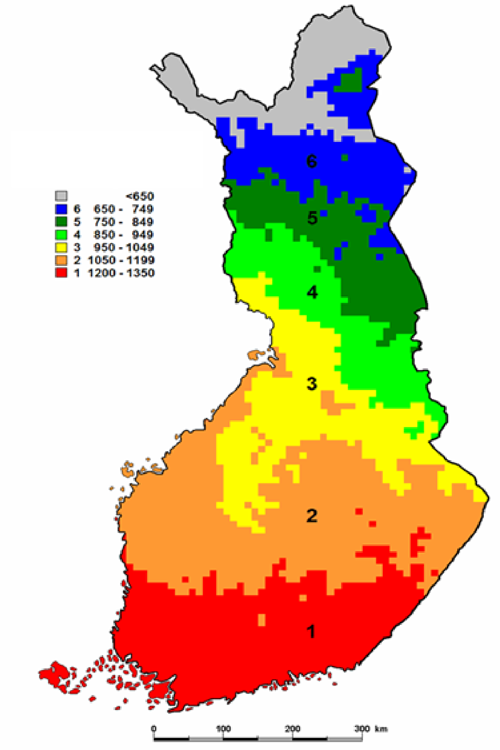
Affecting the quality of wood through forest improvement (3/3): in practice
Target areas of Finnish forest improvement
The seed produced in orchards for forest cultivation is:
Improved = of good genetic quality
Easy to collect (cutting grafts)
Large and sprouts well = good physiological quality
Forest improvement target areas (image)
Determined on the basis of annual heat summation
Production of improved forest cultivation material that has been adapted to local conditions
Further information: Haapanen, M., Mikola, J. 2008. Metsänjalostus 2050 — pitkän aikavälin metsänjalostusohjelma. Metlan työraportteja 71. p. 50 http://urn.fi/URN:ISBN:978-951-40-2084-1
Target area Heat summation d.d.
Haapanen & Mikola, 2008

Slide 25
Industrial wood products, their properties and uses

Slide 26
Industrial wood products in Finland
Wood product | Production in 2020 (1,000 m3)
Sawn timber | 11000
Veneer and veneer-based products (plywood and laminated veneer lumber LVL) | 1000
Glued laminated timber | 400
Chipboards and fibreboards | 150
Building logs | 120
Wood poles | 100
Cross-laminated timber CLT | 25

Slide 27
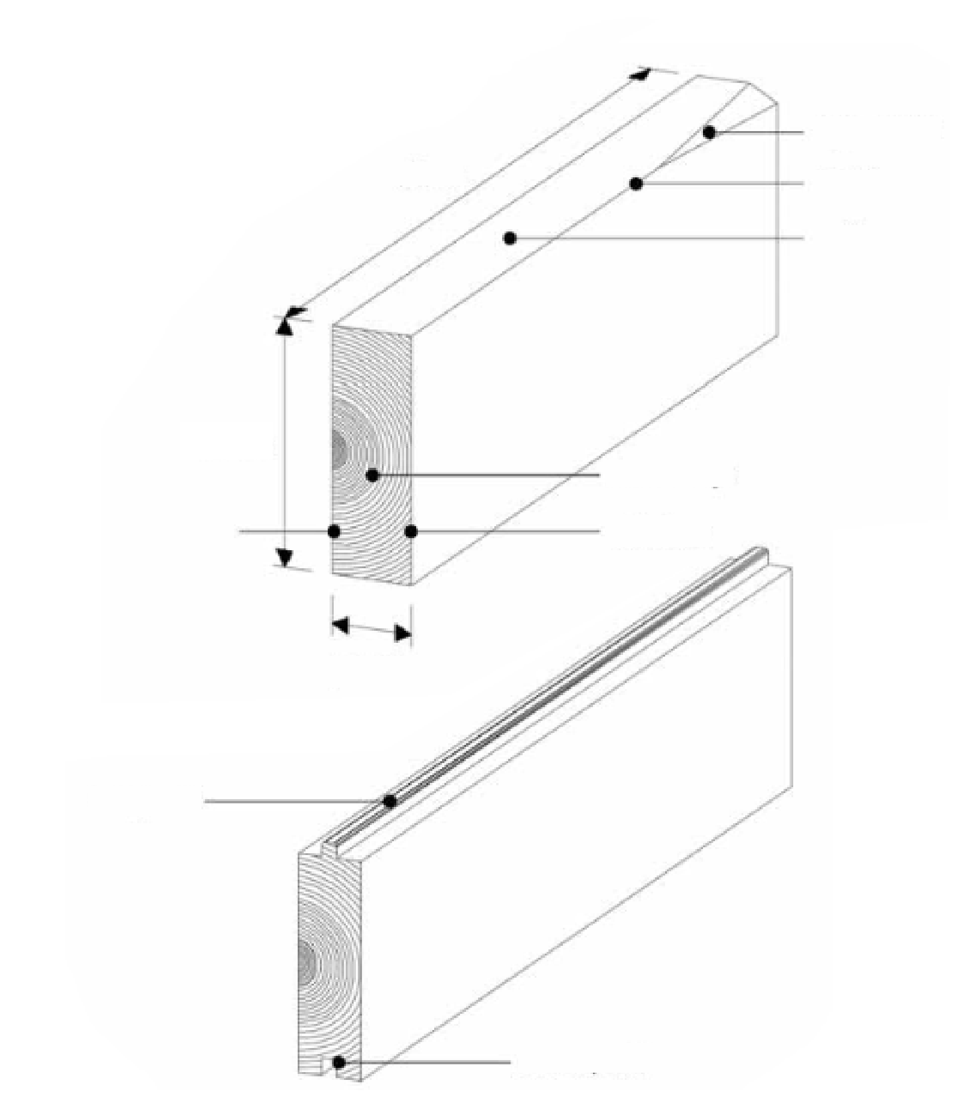
Sawn timber, seasoning, strength classification and quality grades(1/6)
wane
length
arris
edge
Sawn timber terminology
Deal/batten: a 38–50 mm thick and 75–150 mm wide piece of timber
Plank: a piece of sawn timber sturdier than a batten
Spar: ≥75 mm thick piece with four sawn sides, square or nearly square cross-section
Centre yield: piece of timber sawn from the centre part of the log, thickness ≥ 32 mm
Slab: a piece sawn from the surface of the log, with four sawn sides but a waney edge
Side yield: piece of timber sawn from the parts outside the centre of the log, either full-edged or waney-edged, four sawn sides
Beam: a sturdy piece with four sawn sides, meant for construction purposes. Difference between width and thickness > 25 mm
Batten/strip: split piece of timber, 12–38 mm thick and 25–63 mm wide
growth rings
inside face
outside face
thickness
tongue
groove

Slide 28
Sawn timber, seasoning, strength classification and quality grades(2/6)
The most common cross-sectional dimensions and maximum permitted dimensional deviations for sawn timber

Slide 29
Sawn timber, seasoning, strength classification and quality grades(2/6)
Thickness (mm) |  | Width (mm)
 |  | 50 | 75 | 100 | 125 |  | 150 | 175 | 200 | 225 | 250
19 ¹⁾
22 ²⁾ |  | JH | JH
25 ¹⁾
32
38
44 ²⁾
50 |  |  | JH
63
75 |  |  | JH
100
125
150
¹⁾ usually pine ²⁾ usually spruce JH = typically done by splitting afterwards (jälkihalkaisu), whereby the width is 2 mm less that the nominal size
 | = standard size
 | = rarely produced size
The most common cross-sectional dimensions
(table on the left) and maximum permitted
dimensional deviations (table below) for sawn timber
Dimensions | Deviation when the moisture content of the sawn timber is 20%
Thickness and width ≤ 100 mm | - 1.0 … + 3.0 mm
Thickness and width > 100 mm | - 2.0 … + 4.0 mm
Length 1,800 … 6,000 mm | - 0 … + 50 mm
Length when cut to the specified size | ± 2,0 mm

Slide 30
Sawn timber, seasoning, strength classification and quality grades(3/6)
Trees need water to flourish, but wood products need to be kept dry
Seasoning refers to decreasing the moisture content of a wood product to a level where the amount of water equals approximately 10–15% of the dry mass of the piece
  It is typically not worthwhile to season the wood more than this
Wood products are seasoned before delivery to the client because
  Transporting water, which equals more than half of the weight of fresh wood, is a waste of energy
  Dry wood does not mould or decay
  Wood installed when wet will shrink as it dries after installation => visual and technical issues
  Dry wood is stronger and stiffer than wet => Larger and easier-to-predict load-bearing capacity

Slide 31
Sawn timber, seasoning, strength classification and quality grades(4/6)
European conformity approval (CE marking) is required for all products used in load-bearing structures
The CE mark requires piece-specific information of the strength of structural sawn timber; without this information, the product may not be sold
For the strength to be measured, the piece would have to be tested=> In practice, strength is predicted based on non-destructive testing

Slide 32
Sawn timber, seasoning, strength classification and quality grades(5/6)
The strength classes (C classes) of sawn conifer timber according to the EN 338 standard are: C14, C16, C18, C20, C22, C24, C27, C30, C35, C40, C45, and C50, where the figure indicates the characteristic bending strength of the piece
  There is no strength classification standard for Finnish sawn deciduous timber, which effectively prevents the use of deciduous timber in load-bearing structures
Pieces that do not meet Class C14 requirements can still be used for non-structural purposes
In addition to the mechanical strength classification, the pan-Nordic visual classification system INSTA 142 can be used
  Focus on branches, width of the growth rings, deviations in grain direction, and other factors affecting strength
  INSTA 142 has four strength classes: T0, T1, T2 and T3, which have been agreed to correspond to C classes C14, C18, C24 and C30
SFS-EN 338: 2016. Structural timber - Strength classes. p. 16

Slide 33
Sawn timber, seasoning, strength classification and quality grades(6/6)
The main grading criteria are the maximum number of knots per worst metre, the size of face and edge knots and other knots on the outside face and edge.
Other factors affecting grading: shakes and cracks, waney edges, resin pockets, resin wood, slope of grain, top rupture, compression wood, fungus infections, warp, and discolouration
Sawn timber grades
US |  |  |  | V | VI | VII
US I | US II | US III | US IV
Old grades
A |  |  |  | B | C | D
A1 | A2 | A3 | A4
Sawn timber grades. Source: Pohjoismainen sahatavara. Mänty- ja kuusisahatavaran lajitteluohjeet (2016).
Further information: Varis, R. (toim.). 2017. Sahateollisuus. Suomen Sahateollisuusmiesten Yhdistys ry. p. 285

Slide 34
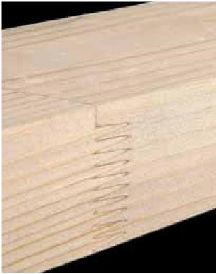
Planed and finger joint products
The purpose of planing is to improve the cut surface towards becoming the surface of the final product, ensure the strength of the glue joint, and facilitate surface treatment
Panels and skirting boards are manufactured by planing the desired profile out of a rectangular piece of sawn timber with a form tool
Finger joints can be used to extend sawn timber if a longer than standard piece is needed, or to improve the strength or dimensional stability of the piece
The furniture and window industries need heartwood timber or knotless timber, which is manufactured using finger joints
Finger-jointed sawn timber can be graded for strength, after which it can be used to make gluelam beams, for example

Slide 35
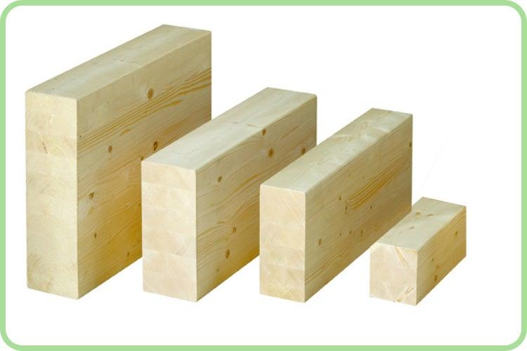
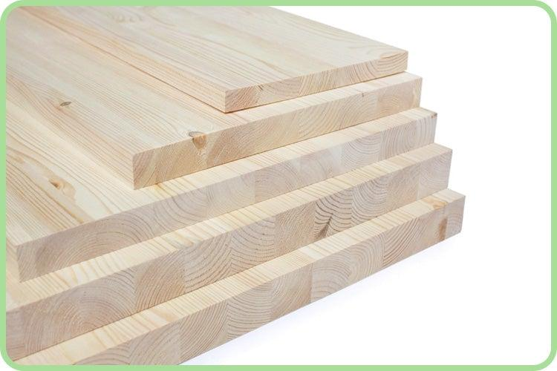
Glued laminated timber, strength classes and further processing (1/3)
Glued laminated timber refers either to structural glued laminated (glulam) beams or glued timber slabs used in, for example, table covers
Glulam beams enable the manufacture of products with dimensions deviating from timber dimensions
  Diversifying the applications of wood
  Glulam beams compete with steel and concrete beams e.g. in stadium and stand structures
  Minor strength variation, good strength/weight ratio
The typical raw material for glulam beams is spruce, but pine beams are also manufactured
Any tree species can be used to make glued timber slabs
Photos: www.hattulanpuu.fi

Slide 36
Glued laminated timber, strength classes and processed products (2/3)
Minimum requirements for glued laminated timber used in buildings and bridges are set out in product standard EN 14080
The most common strength classes for glued laminated timber are GL24c, GL30c, GL24c, GL24h
  The figure indicates the characteristic bending strength (Mpa) of the beam
  The letter 'c' means that the cross-section of the glued laminated timber consists of layers from different strength classes (combined glulam)
  The letter ‘h' indicates that all layers have the same strength class (homogeneous glulam)

Slide 37
Glued laminated timber, strength classes and processed products (3/3)
  The standard cross-sectional widths of rectangular glulam products vary between 90 mm and 290 mm in increments of 25 mm. The height of the cross-sections varies between 225 and 2,000 mm in increments of 45 mm. The length of glulam building elements is limited by transportability
  The minimum width according to the EN 14080 standard is 38 mm and the maximum width is height divided by 8. Building elements less than 90 mm wide are produced by splitting
  Glued laminated timber is profiled by planing, which means it has planed surfaces
  In addition to the standard rectangular shape, products with an I, T or L shaped or hollow cross-section can be made
Further information: Liimapuukäsikirja osat 1-3: https://puuinfo.fi/suunnittelu/ohjeet/liimapuukasikirja/

Slide 38
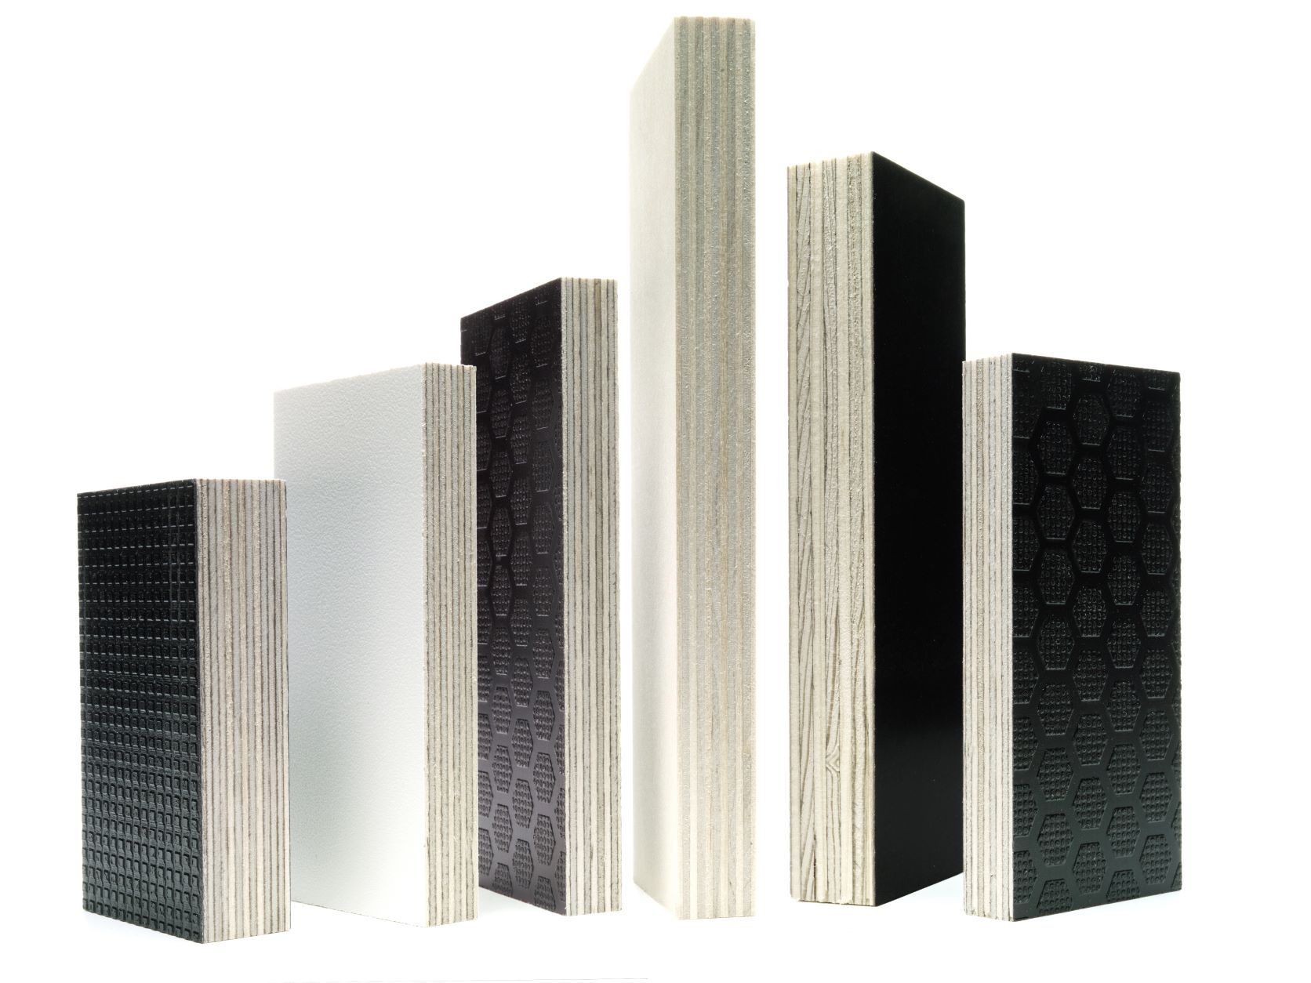
Plywood (1/2)
Plywood is manufactured by gluing cross-banding deciduous or coniferous veneers to form a panel with good strength, stiffness, and wear-resistance properties
  Glued with either outdoor or indoor adhesives, nowadays already partially bio-based
  Typically have an odd number of veneer plies: 3, 5, 7... so that the outer plies will have the same grain direction
  Plywood can be surface treated to protect against moisture, chemicals, and wear, or e.g. to improve friction properties
Image: UPM

Slide 39
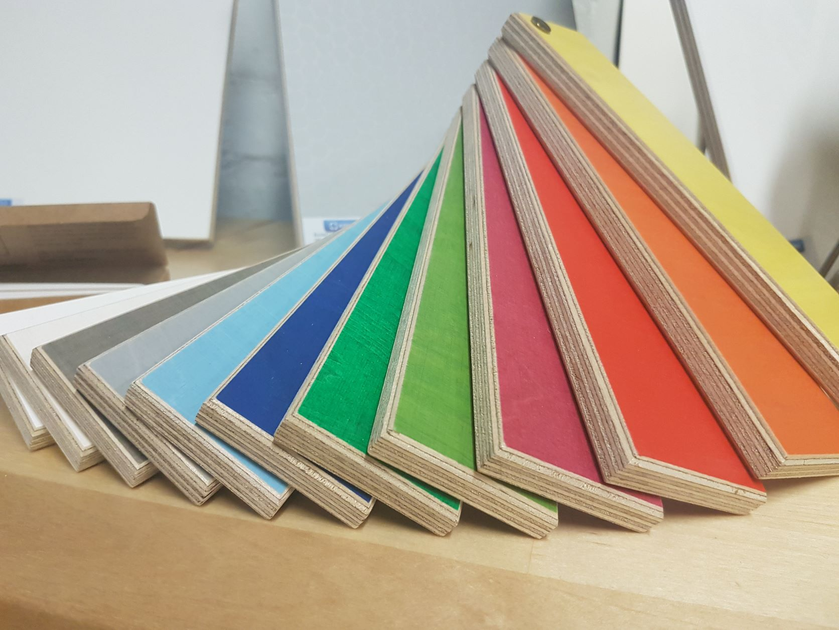

Plywood (2/2)
Applications of plywood include e.g. means of transport (trains, buses, lorries, cargo ships), substructures and stiffening structures in construction, and furniture and fixtures – it is among the most versatile wood products
The plywood manufactured in Finland is either birch or spruce plywood, or mixed plywood where the top plies are birch and inner plies spruce.
Image: Koskisen Oy
Tanks transporting liquefied natural gas are a significant user of birch plywood. Image: UPM.

Slide 40
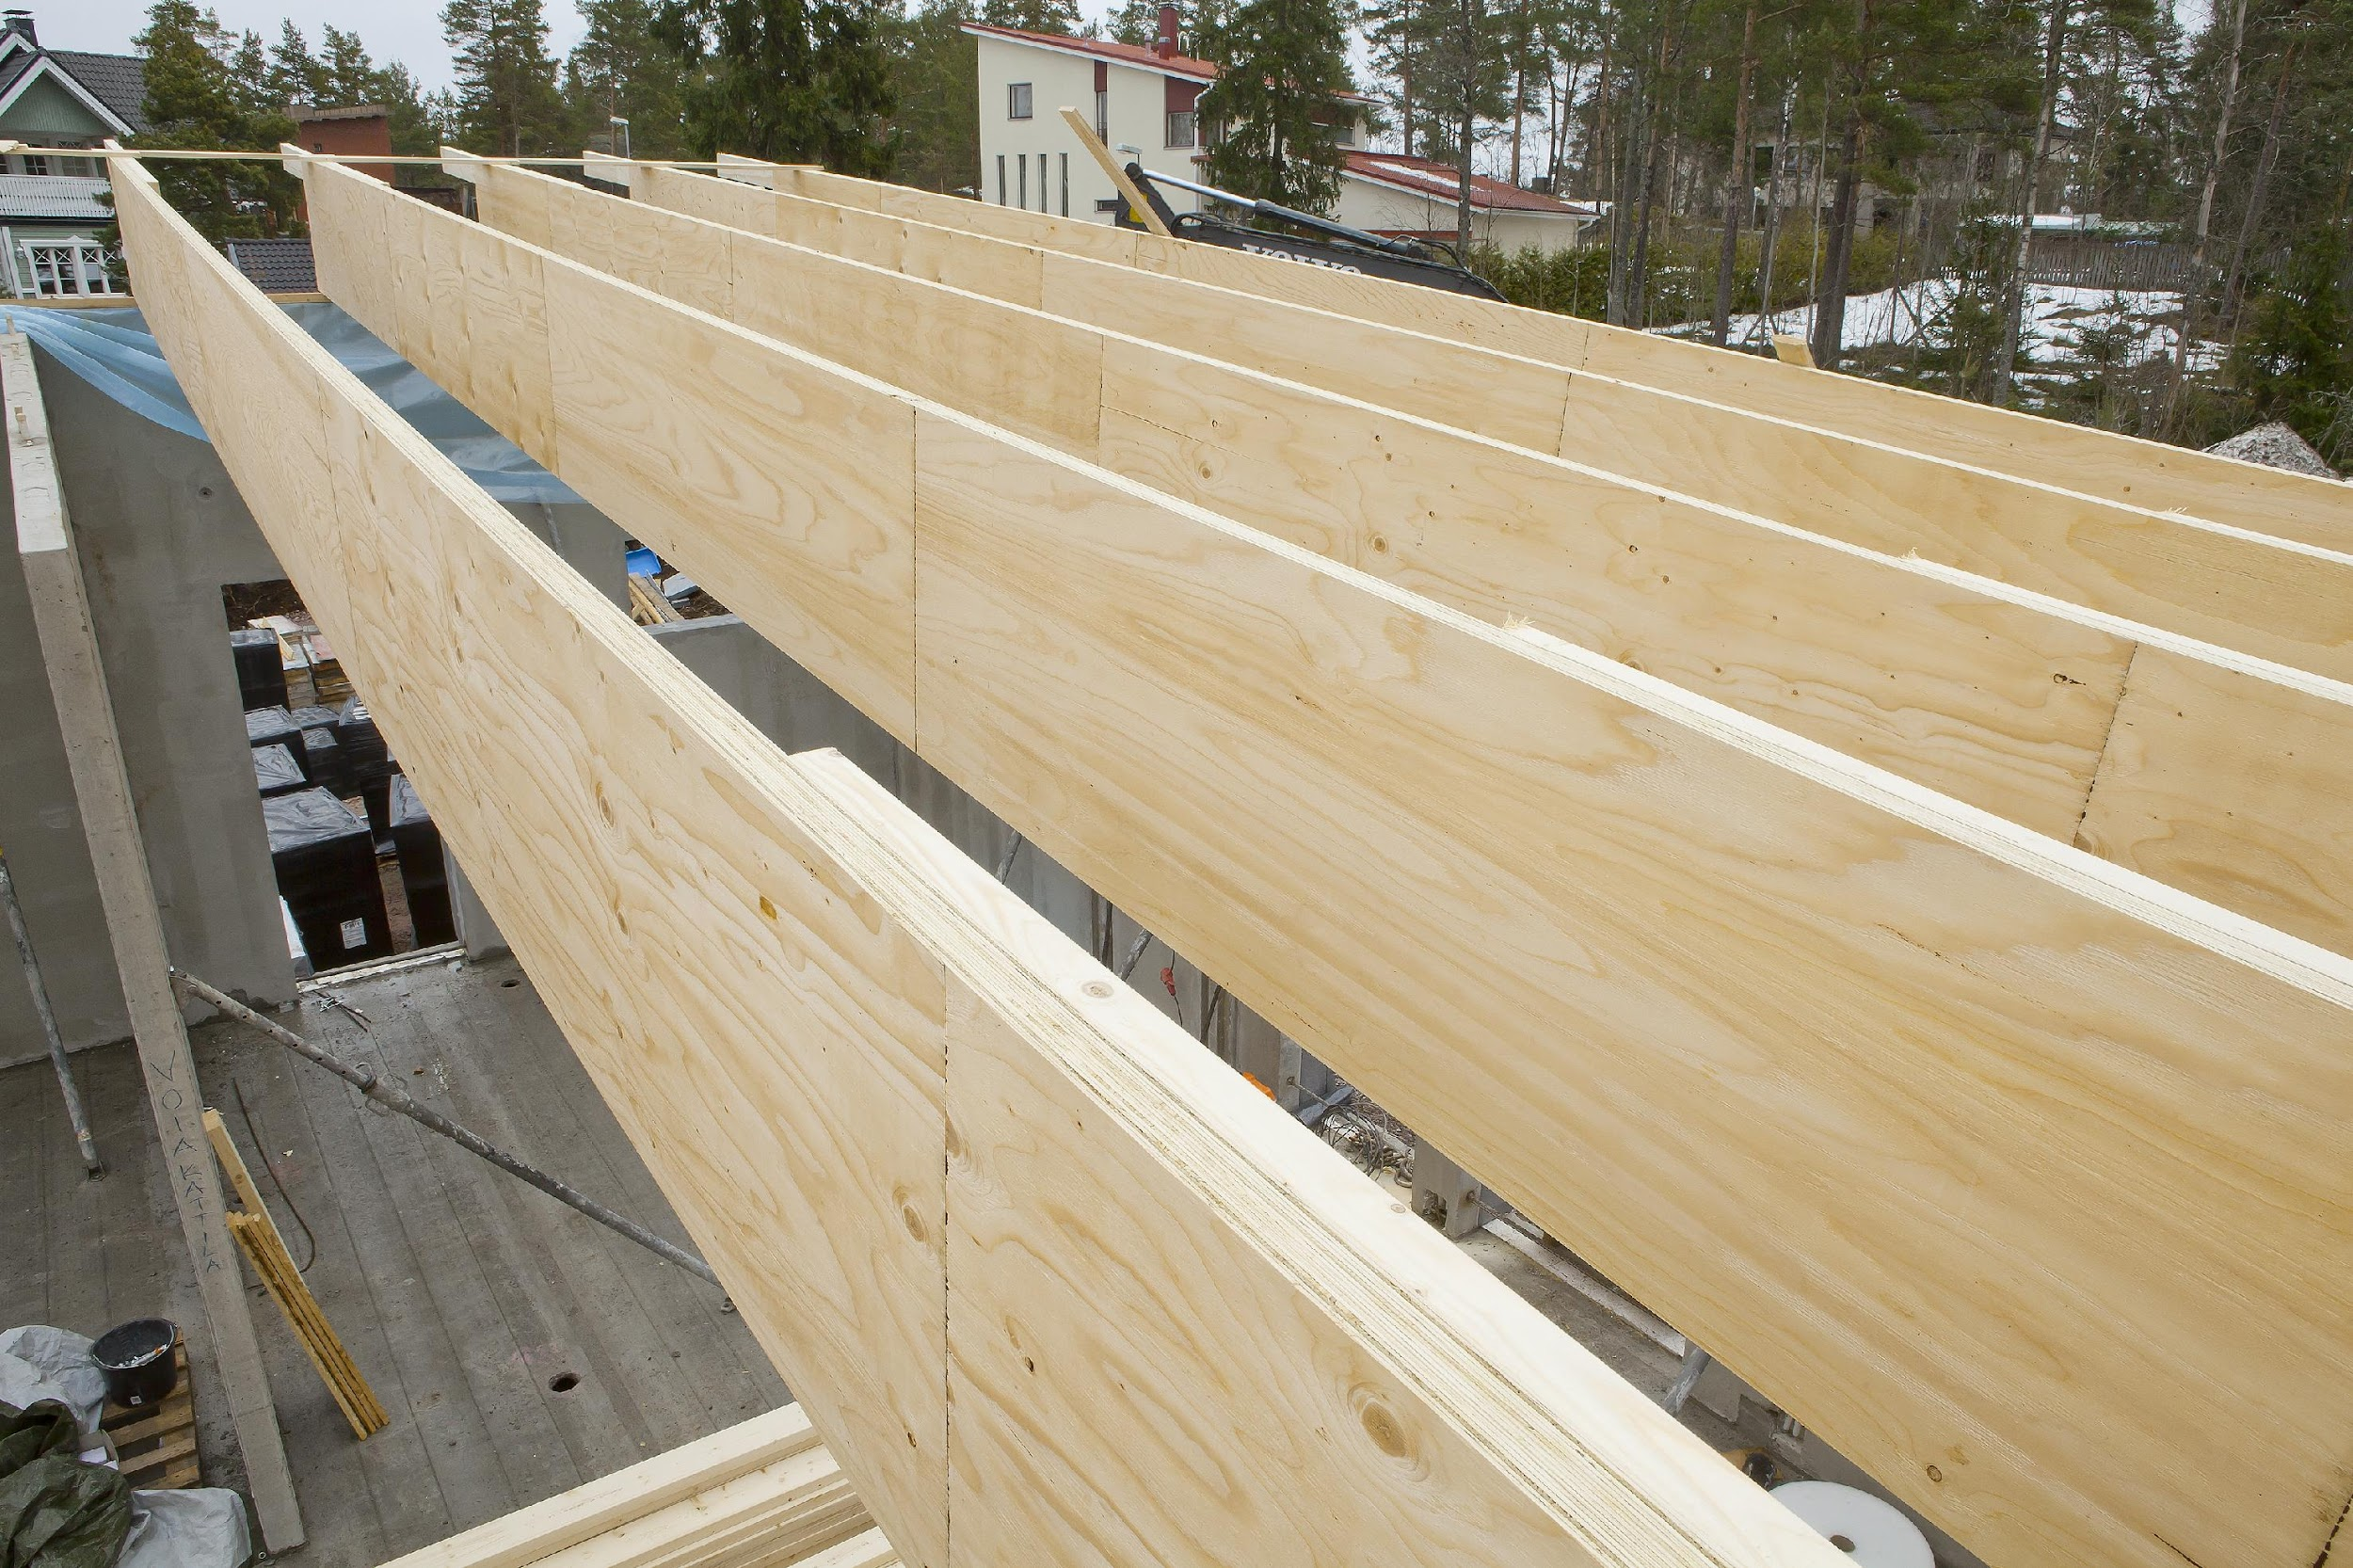
Laminated veneer lumber: types, strength classification (1/3)
The laminated veneer lumber (LVL) manufactured in Finland is typically made of spruce
In LVL, all or most of the veneers are stacked in the same direction (as compared to plywood)
LVL is used both as structural
beams, columns and as panels
Benefits compared to solid wood:
  Low variation in strength and stiffness
  => smaller safety margins in structural design
  Dimensions mainly limited by transportability
  High longitudinal (grain-direction)
  compression strength => columns can withstand
  the vertical loads of even the tallest of buildings
Image: Metsä Wood

Slide 41
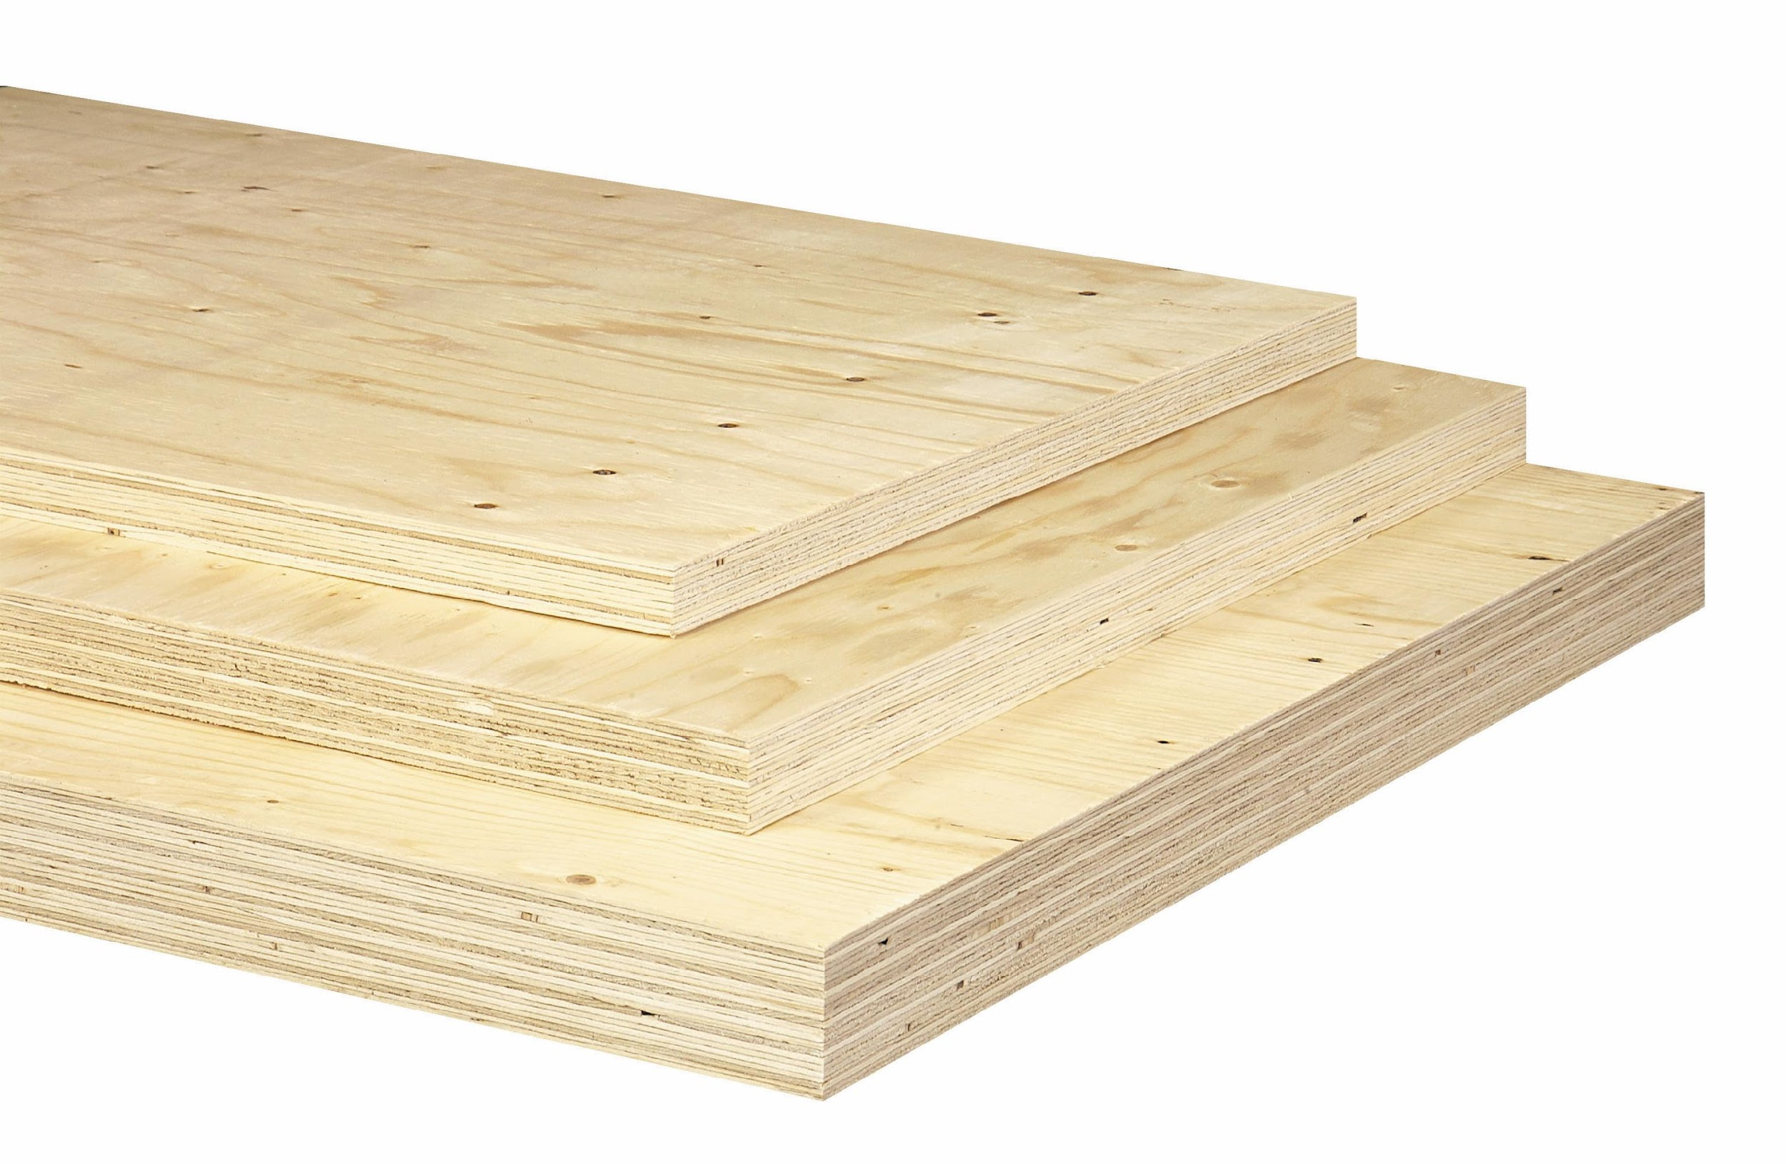
Laminated veneer lumber: types, strength classification (2/3)
LVL-P type only comprises parallel veneers, while LVL-C contains at least two crossband veneers
Product dimensions vary by manufacturer
  For LVL-P, the standard thicknesses range from 27 to 75 mm and standard heights from 200 to 600 mm
  For LVL- C, the standard thicknesses are between 21 and 75 mm and standard heights between 900 and 2,500 mm
Glued laminated LVL products GLVL-P and
GLVL-C consist of LVL-P or LVL-C products
that are stacked and glued together.
This enables the manufacture of beams or columns
with cross-sections wider than 75 mm, or
panels with a thickness exceeding 75 mm
Image: Metsä Wood

Slide 42
Laminated veneer lumber: types, strength classification (3/3)
The minimum requirements defined for LVL in structural applications are set out in the product standard EN 14374. Strength classes are also presented in the publication 'LVL bulletin' from 2019
  LVL-P panels have five strength classes (LVL 32 P, LVL 35 P, LVL 48 P, LVL 50 P, LVL 80 P) and LVL-C panels have six strength classes (LVL 22 C, LVL 25 C, LVL 32 C, LVL 36 C, LVL 70 C, LVL 75)
  Standard EN 14374 also sets out the testing and conformity assessment methods as well as information to be included in product labelling
The strength classes indicate the strength, stiffness, and density values needed in design
The classification does not apply to LVL whose biological integrity or resistance to fire has been improved by treatment
Further information: LVL Handbook. Federation of the Finnish Woodworking Industries. p. 224

Slide 43
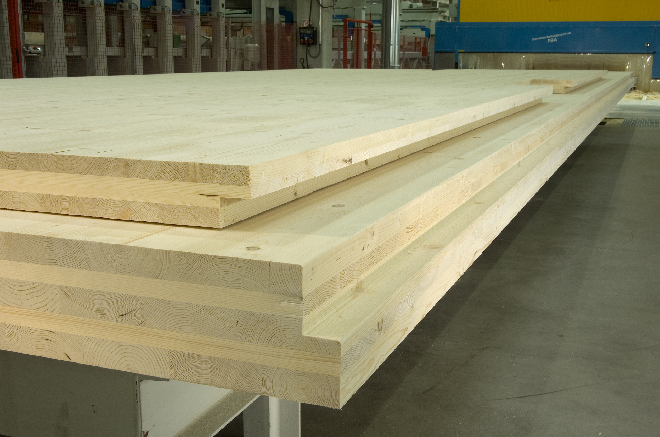
CLT, composition
Cross Laminated Timber is typically produced by gluing together three, five, or seven crossband layers of wood
The 20 to 60 mm thick boards used as raw material are typically either pine or spruce
In edge glued panels, the board layers
are glued together by the edges, and the
resulting panel is then glued on its face
and laid up in preparation for assembly pressing. Drying can cause the top boards
of edge-glued panels to crack
In panels where the edges are not glued,
only the faces of the boards are glued,
and drying variations take place at the joints of the panel
Image: Stora Enso

Slide 44
Pressure impregnation, modifications, wood-plastic composites (1/5)
In pressure impregnation, the preservative, i.e. the impregnating agent, is absorbed into the wood in an impregnation cylinder by using water or organic solvent and pressure.
There are multiple impregnation methods, salt and oil preservatives being the most common
Salt preservatives are copper-based (Type C preservatives)
Oil preservatives include e.g. crude tall oil and its products
In Finland, impregnation processes and product quality are monitored by independent auditors

Slide 45
Pressure impregnation, modifications, wood-plastic composites (2/5)
Modification of wood, i.e. non-toxic modification, improves a property either in the long term or permanently
Modification can be done chemically, biologically or physically
  Pressure, heat, chemicals absorbed into wood, and combinations thereof
Chemical modification methods include acetylation (Accoya®), furfurylation (Kebony®), and silicate impregnation (Kivipuu, Organowood®)
Physical modification methods include e.g. thermal modification (Thermowood®) and thermomechanical modification (TMTMTM)

Slide 46
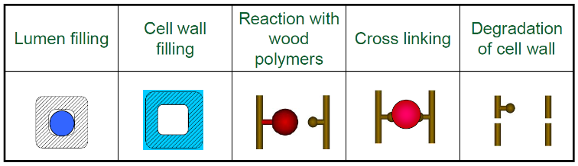
Pressure impregnation, modifications, wood-plastic composites (3/5)
The chemical fills the lumens
The chemical penetrates the cell walls
Weak bonds between wood and chemical
Covalent bonds between wood and chemical
Wood component degradation
Changes at the wood cell level caused by modification (from the left): the modification chemical fills the lumen, the modification chemical penetrates the cell wall, the modification chemical forms weak bonds with the wood components, the modification chemical forms covalent bonds with the wood components, the modification results in the degradation of the wood components
Further information: Möttönen, V., Boren, H. & Heräjärvi, H. 2018. Puun ominaisuuksien modifiointi. Menetelmät ja tutkimuksen tila. Luonnonvara- ja biotalouden tutkimus 11/2018. Luonnonvarakeskus, Helsinki. p. 57 http://urn.fi/URN:ISBN:978-952-326-546-2

Slide 47
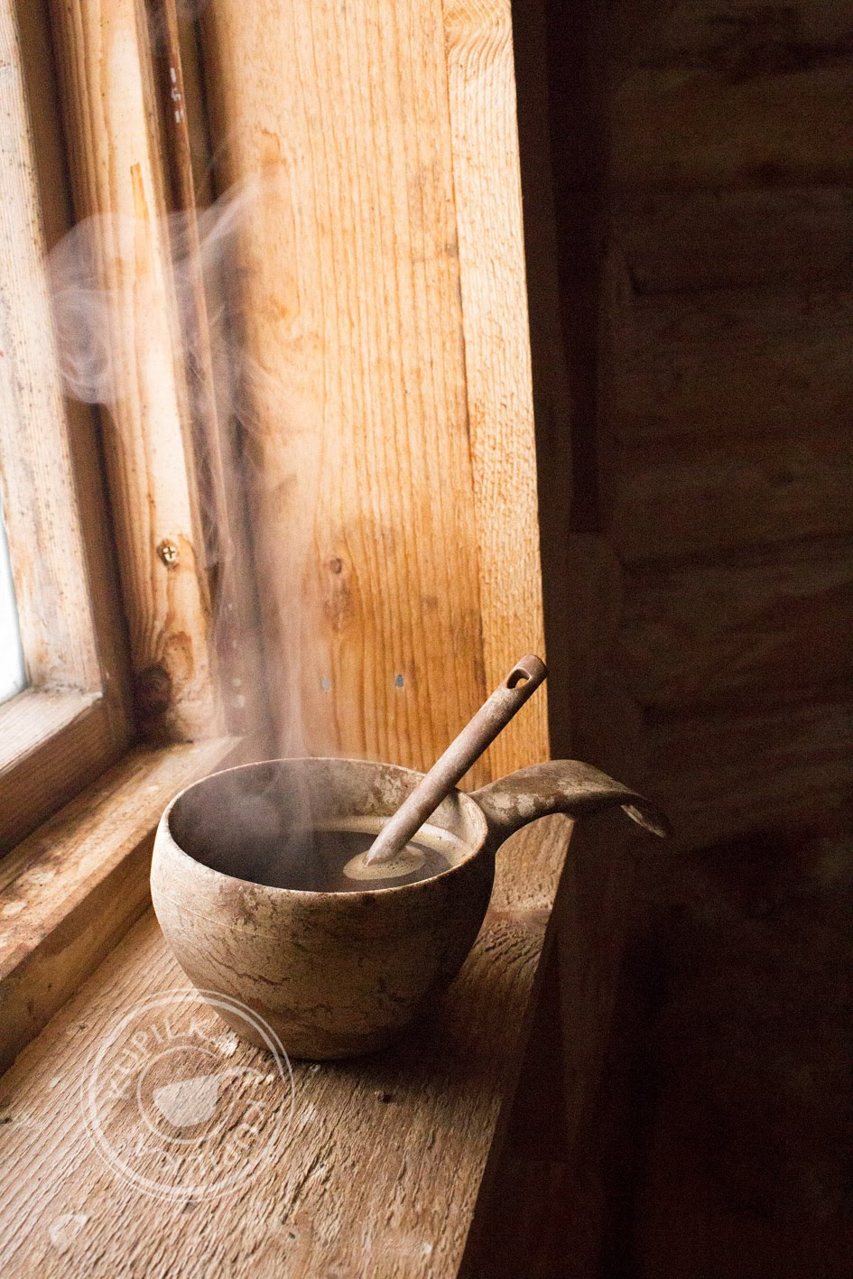
Pressure impregnation, modifications, wood-plastic composites ​(4/5)
Photo: www.kupilka.fi
Wood-plastic composites are composite materials in which the wood fibre or wood flour used as reinforcement is bound into a product by means of a filler plastic matrix.
Coupling agents can be added to improve the binding of wood and plastic, lubricants can be used to facilitate the manufacturing process, and UV preservatives and rot and flame retardants can be added.
The aim is to find a composite that combines the good properties of all its components

Slide 48
Pressure impregnation, modifications, wood-plastic composites (5/5)
In wood-plastic composites, wood is typically used in the form of sawdust, flour, chips, or pellets. Wood usually accounts for 30 to 60% of the material
Plastics are either thermoplastic polymers or thermosetting polymers, including recycled polymers
  Thermosetting polymers and infusible
  Thermoplastic polymers can be fused and reused
Wood-plastic composite products can be manufactured by extrusion or injection moulding
Applications for wood-plastic composites include e.g. non-load-bearing garden structures and the furniture and car industries

Slide 49
Surface treatment to protect wood materials
The objective of surface treatment is to:
  Change or preserve the original appearance of wood
    stains, varnishes, oils, translucent wood preservatives
  Change the properties of the wooden surface, such as cleanability or hygroscopicity (water vapour absorption)
    waxes, oils, paints, varnishes, functional coverings
  Protect the wood from wear, moisture, UV radiation, and other weathering, or combustion
    varnishes, paints, fire retardants
    opaque paints are classified by binding agent (e.g. oil, alkyd, acrylate) or solvent (e.g. water, commercial solvent)
Further information: 1) Siikanen, U. Puurakennusten suunnittelu, chapter 19 Puuverhouksen pintakäsittely. pp. 133-139. 2) Kaila, P. Talotohtori, chapter 18.01 Mitä on maali? pp. 542-545.

Slide 50
Wood engineering

Slide 51
Industrial manufacture of wood products
Industrial wood products refer to wood products manufactured on an industrial scale that are ready for use or installation without additional work phases
  Seasoned sawn timber or veneer, glued laminated timber, plywood, laminated veneer lumber, cross-laminated timber, chipboards and fibreboards, columns, industrially produced logs, pallets, roof trusses, terrace boards, floor boards, cladding boards...
Manufacture always comprises at least two stages of processing (e.g. sawmilling-seasoning), typically several (e.g. sawmilling-seasoning-strength grading-planing-gluing)

Slide 52
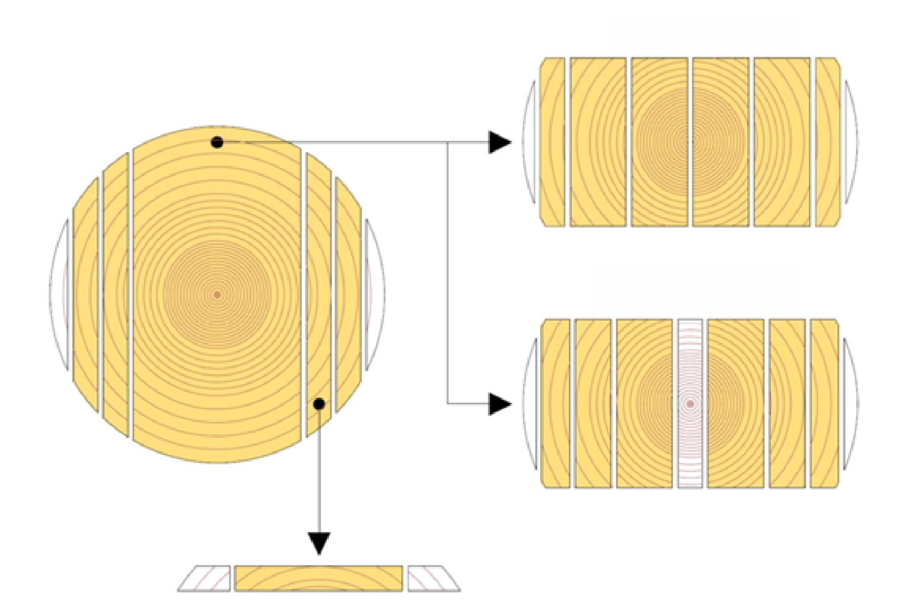
Sawmilling, woodturning and other machine-tooling
Scandinavian cut (double cut)
Includes normal and pith-free pattern cut
Achieve good dimensional stability by splitting the heart or removing the pith
Good yield, but the branchless sapwood pieces will be thin
Normal cut
Pith-free cut

Slide 53
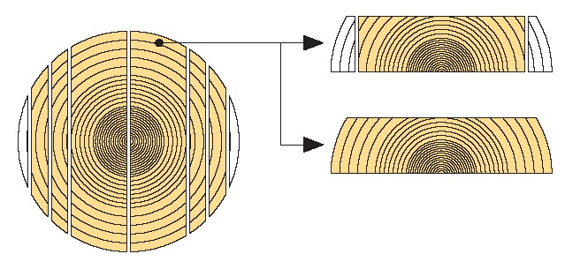
Sawmilling, woodturning and other machine-tooling
Through-sawing
Suitable for deciduous trees, or other tree species when the logs are not sufficiently robust for other methods
The cut can be made parallel to the central line or parallel to the surface
Through-sawn timber is edged either longitudinally and superficially after sawing.

Slide 54
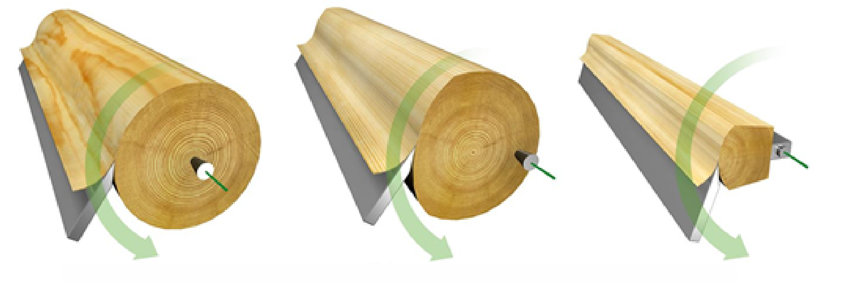
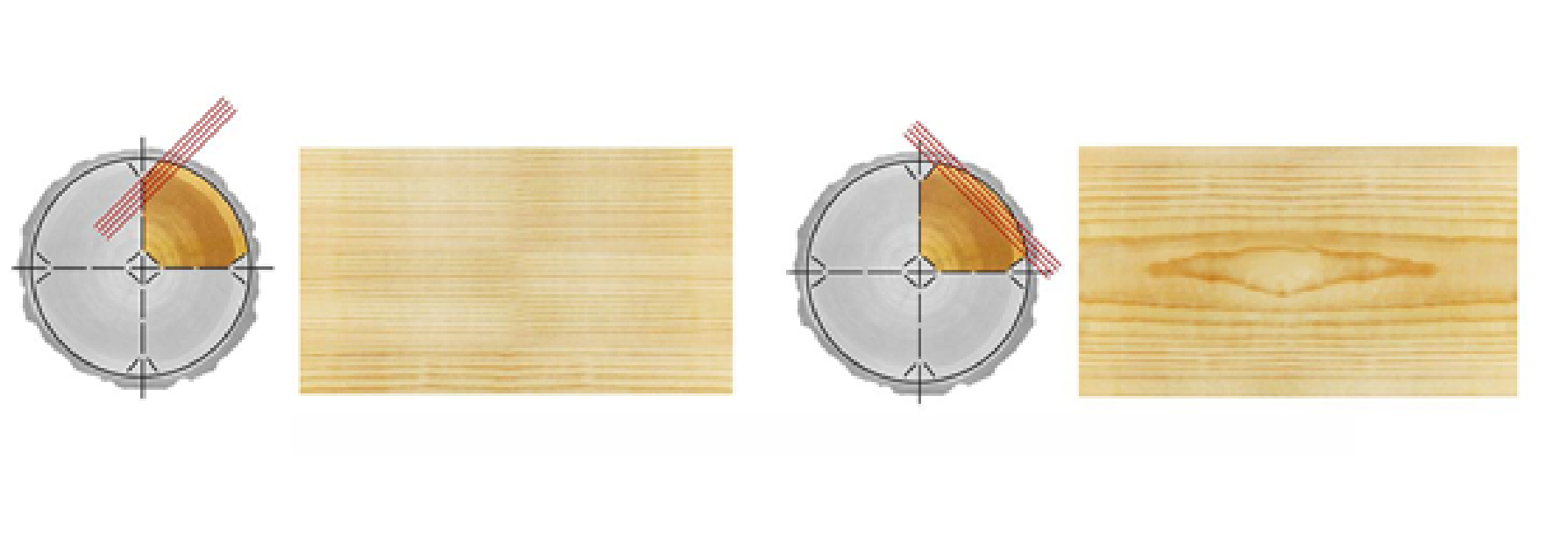
Sawmilling, woodturning and other machine-tooling
Peeled veneer
Manufactured by spinning a log in a veneer peeler while the blade peels veneer from the surface of the log
The peeled veneer straightens out, which may cause small cracks to form if the veneer is thick
Used mainly for plywood production
Cut veneer
Manufactured by planing sheets of veneer off logs
The grain pattern will have a natural appearance, similar to that of sawn wood
The cut direction can be tangential or radial
Used as surface material for furniture, doors, and interior wallboards
Veneer cutting
Eccentric cutting
Staylog cutting
Radial cut
Tangential cut

Slide 55
Strength grading methods for sawn timber
The most commonly used strength grading method today is based on the speed of sound waves travelling across a the piece of timber
  The strength of the piece is predicted based on the speed of sound and density of the wood
  The strength class is marked on each piece of structural sawn timber
Other strength grading methods
  X-ray measurement
  Bending load within the elastic load range
  Speed of ultrasound
  Visual grading (see ‘Sawn timber, seasoning, strength classification and quality grades')
  Used mainly for plywood production

Slide 56
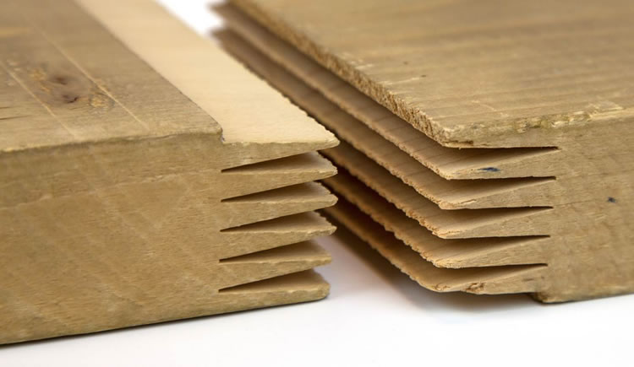
Finger-joining and gluing sawn timber and laminated wood
Defects (e.g. knots) in the wood billets are cut off before shaping "fingers" to the ends of the pieces for the finger joints
Adhesive is applied to the fingers and the ends are pressed together
The crossed fingers will multiply the surface area of the adhesive as compared to the cross-section of the piece => the strength of the glue joint will correspond to or exceed the strength of intact wood
The length and profile (and, therefore, the strength and appearance) of the fingers vary depending on whether the piece is going to be used in furniture or other visible object or in a load-bearing structure that will be hidden behind walls, etc.
Finger joints are a sign of quality, not lack thereof
Photo: www.nrcan.gc.ca

